Slide 1
Summary of Atmospheric Convection
Convection occurs due to enhanced solar heating near the surface that increases atmospheric instability (i.e., making T increases faster downward than a stable atmosphere).
It transports energy and moisture from the boundary layer to the middle and upper troposphere, where LW radiation can escape to space. This leads to a radiative-convective equilibrium in the tropics.
Convection affects the atmosphere through condensation, evaporation and vertical eddy transports of energy, moisture, and momentum.
The Q₁ (heating), Q₂ (moisture sink), and Q₃ (momentum transport) fluxes quantify the impacts of convection (sub-grid scale) on the environment (resolved scale in a GCM).
On a large scale, the stabilizing effect of convection balances the destabilizing effect of solar heating and other large-scale forcing.
The mean state of the atmosphere is close to the moist adiabat (i.e., neutral for moist convection); but locally and at times, conditional instability (i.e., positive buoyancy above LCL) exists in the tropics and warm-season mid-latitudes.
CAPE represents the potential energy available for convection between the Level of Free Convection and Level of Neutral Buoyancy.
Below LFC, there is often some negative buoyancy (convective inhibition or CIN) for a parcel to overcome (e.g., by turbulence lifting).
There are three common types of convection: shallow cumulus, shallow stratocumulus, and deep cumulonimbus convection. Shallow cumulus convection is most common over the oceans and warm-season land.

Slide 2
A ATM551, Lecture #14
Air–Sea and Land-Atmosphere Interactions

Slide 3
Outline of Today’s Lecture
Air-sea Interaction: the interaction between the atmosphere and the oceans
  Air-sea interaction processes
  Surface energy fluxes
  Surface water fluxes
  Air-sea bulk formulas
  - Air-sea feedbacks
  Air-sea momentum exchange (wind stress)
  Air-sea CO2 fluxes
  Land-Atmosphere Interaction: the interaction between land surface and the atmosphere.
  Major processes
  Major feedbacks
  Distribution of land-atmosphere coupling strength

Slide 4
Major air-sea interaction processes
Any examples?
Solar radiation (SW): absorption, reflection and scattering by ocean surfaces
Infrared radiation: emission, reflection and absorption
Turbulent heat transfer (SH)
Evaporation – Latent heat flux (LH)
Precipitation
Net freshwater flux (E-P)
Turbulent transfer of kinetic energy by tangential components (wind stress) – wind driven currents
Turbulent transfer of kinetic energy by normal components (normal pressure)
Ocean surface wave generation and decay
Mixing in the atmospheric boundary layer
Mixing (mechanical and convective) in the ocean
Gas and aerosol exchanges – CO2, O2, sea salt, etc.

Slide 5
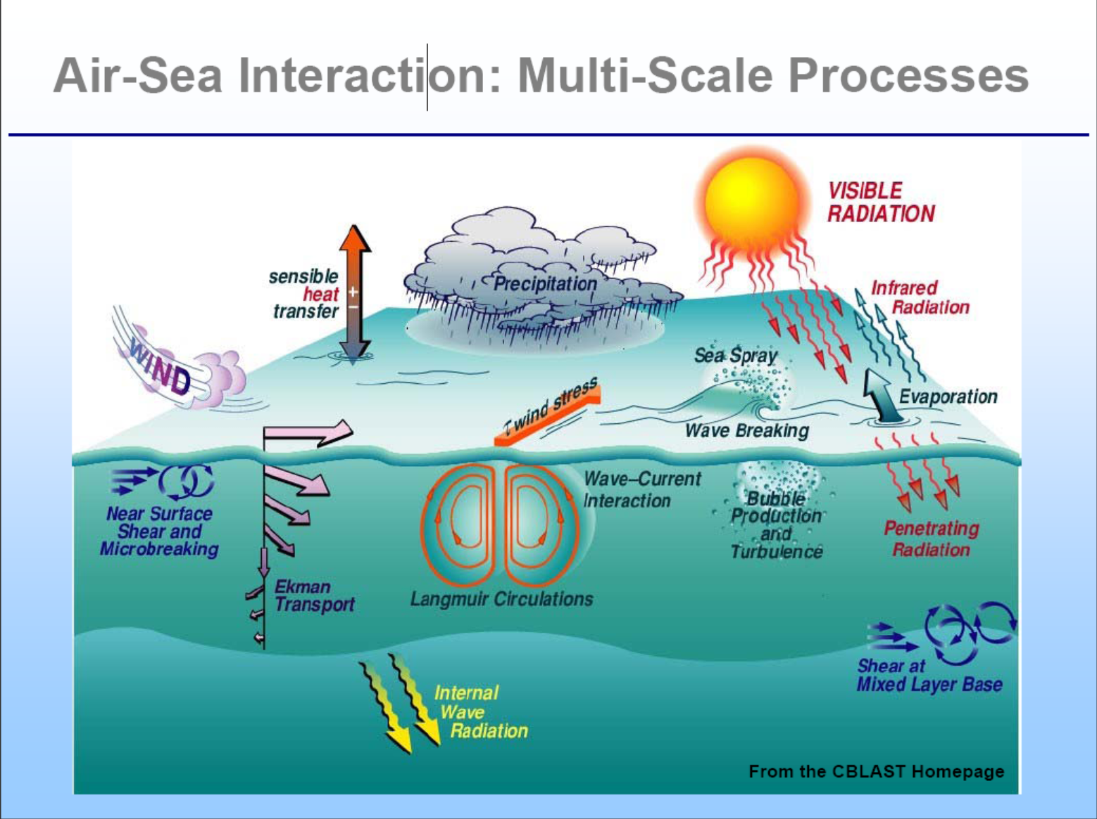

Slide 6
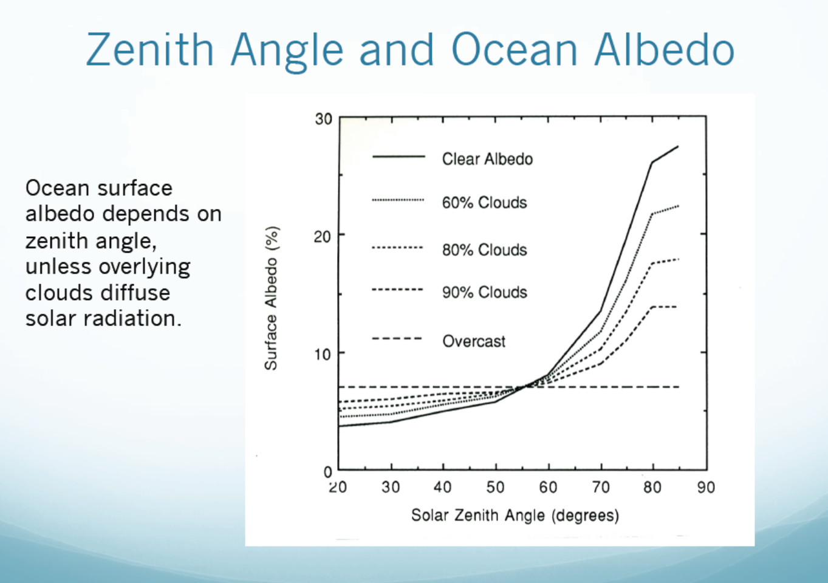
θ
Ocean surface albedo increases with solar zenith angle from ~5% to 25%

Slide 7
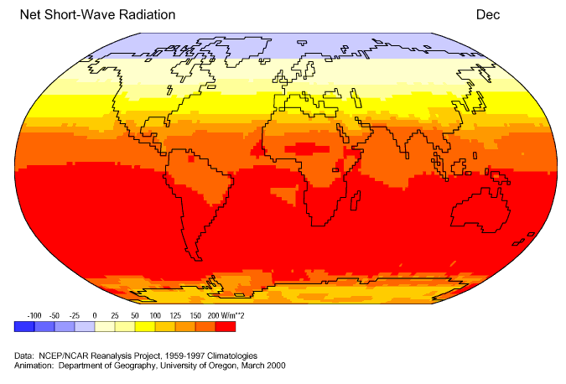
Seasonal Variations in Surface Net Solar Radiation
Depends on:
Season and latitude
Atmospheric albedo (clouds and aerosols)
Surface albedo

Slide 8
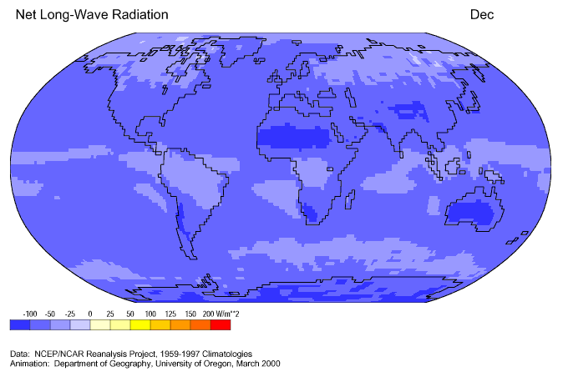
Seasonal Variations in Surface Net LW Radiation
( LW – LW ): negative = sfc.cooling
Depends on:
Surface temperature (Ts) and type
Near surface air T (Ta) and humidity
Ts − Ta difference
Cloud amount

Slide 9
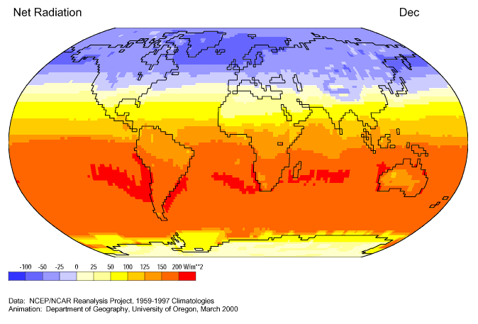
Seasonal Variations in Surface Net Radiation
positive = surface warming
Depends on:
Season and latitude
Atmospheric albedo (clouds and aerosols)
Surface albedo
Ts − Ta difference

Slide 10
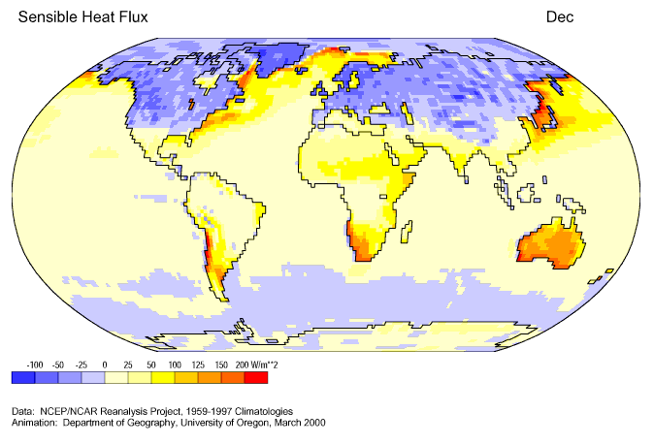
Seasonal Variations in Surface Sensible Heat Flux
positive = upward, negative=downward
Depends on:
Ts − Ta difference
Near-surface wind speed

Slide 11
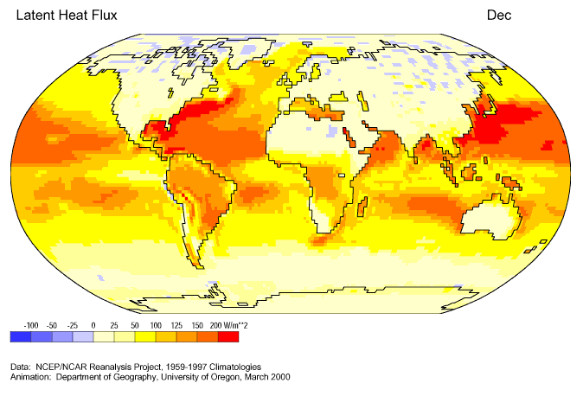
Seasonal Variations in Surface Latent Heat Flux
Depends on:
q_{s} − q_{a} difference
Near-surface wind speed

Slide 12
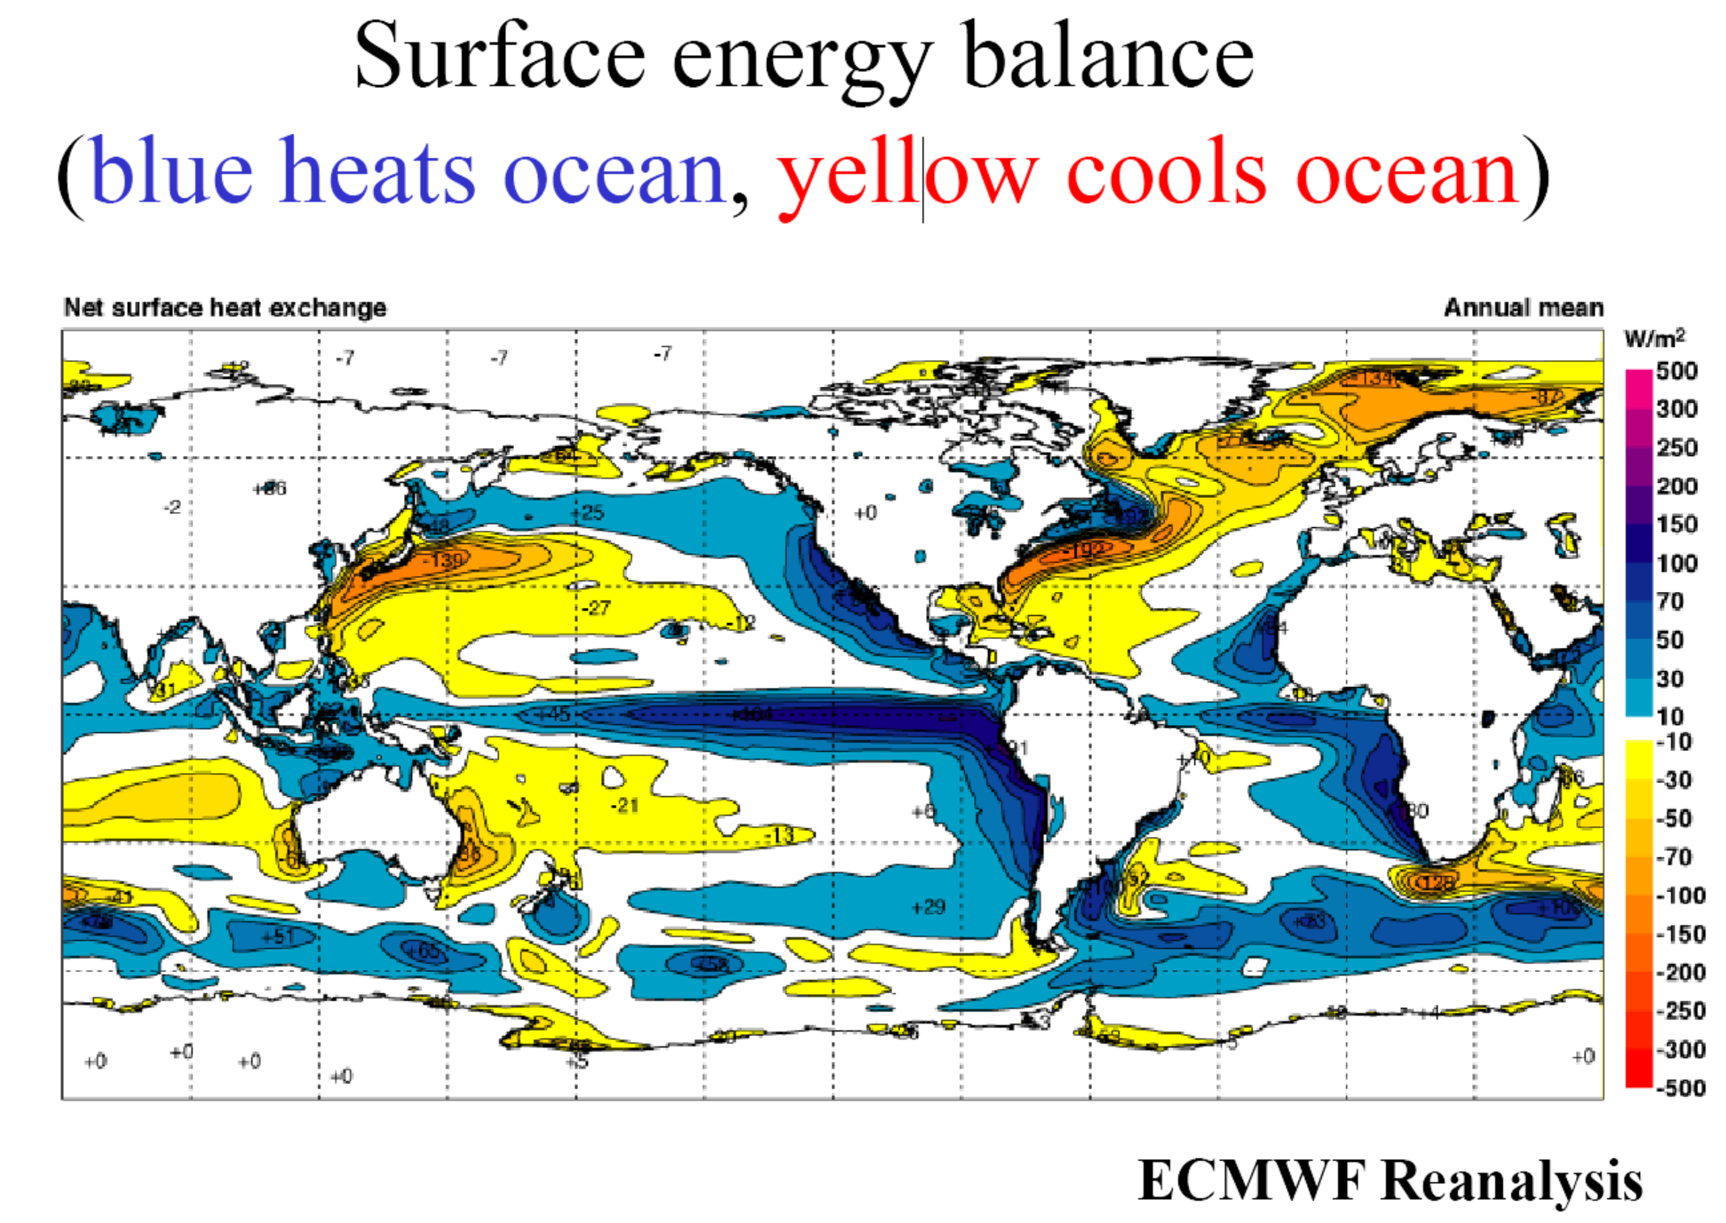
Annual

Slide 13
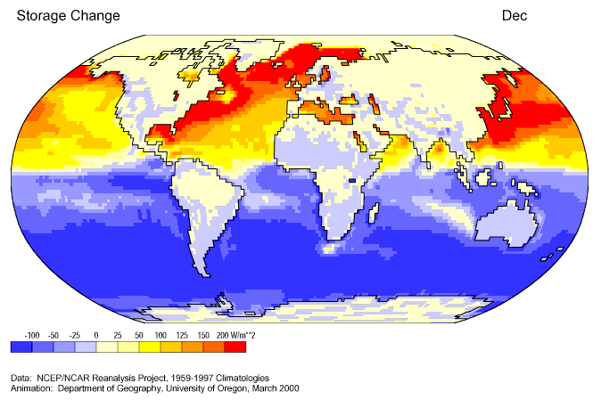
Seasonal Variations in Surface Net Energy Flux
positive = upward, negative=downward
Depends on:
Solar radiation (season and latitude)
LH flux and net LW flux

Slide 14
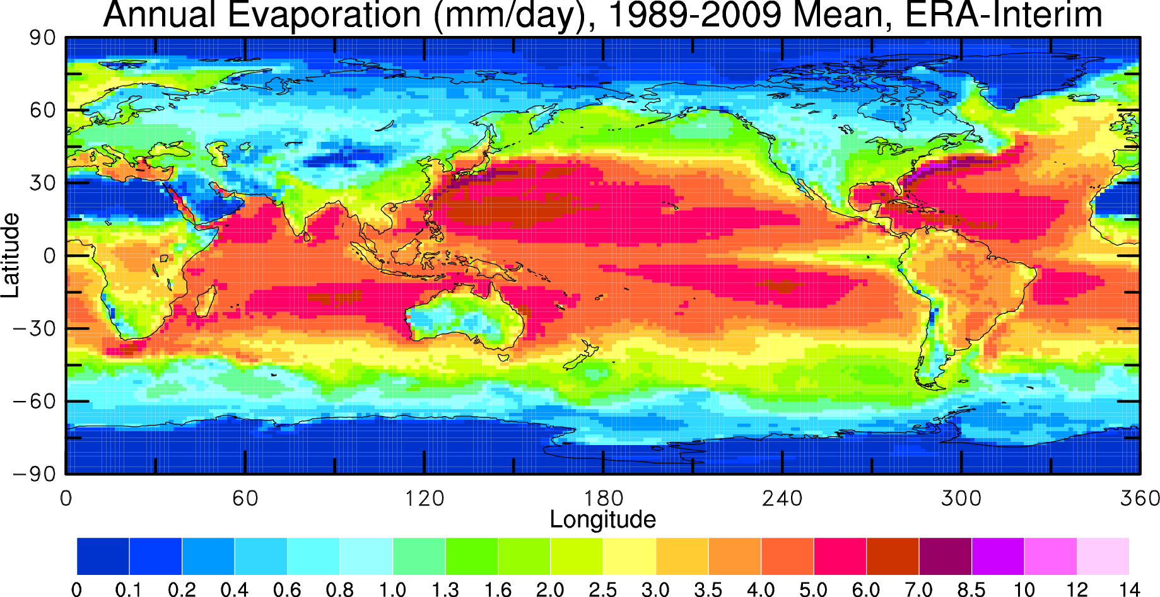
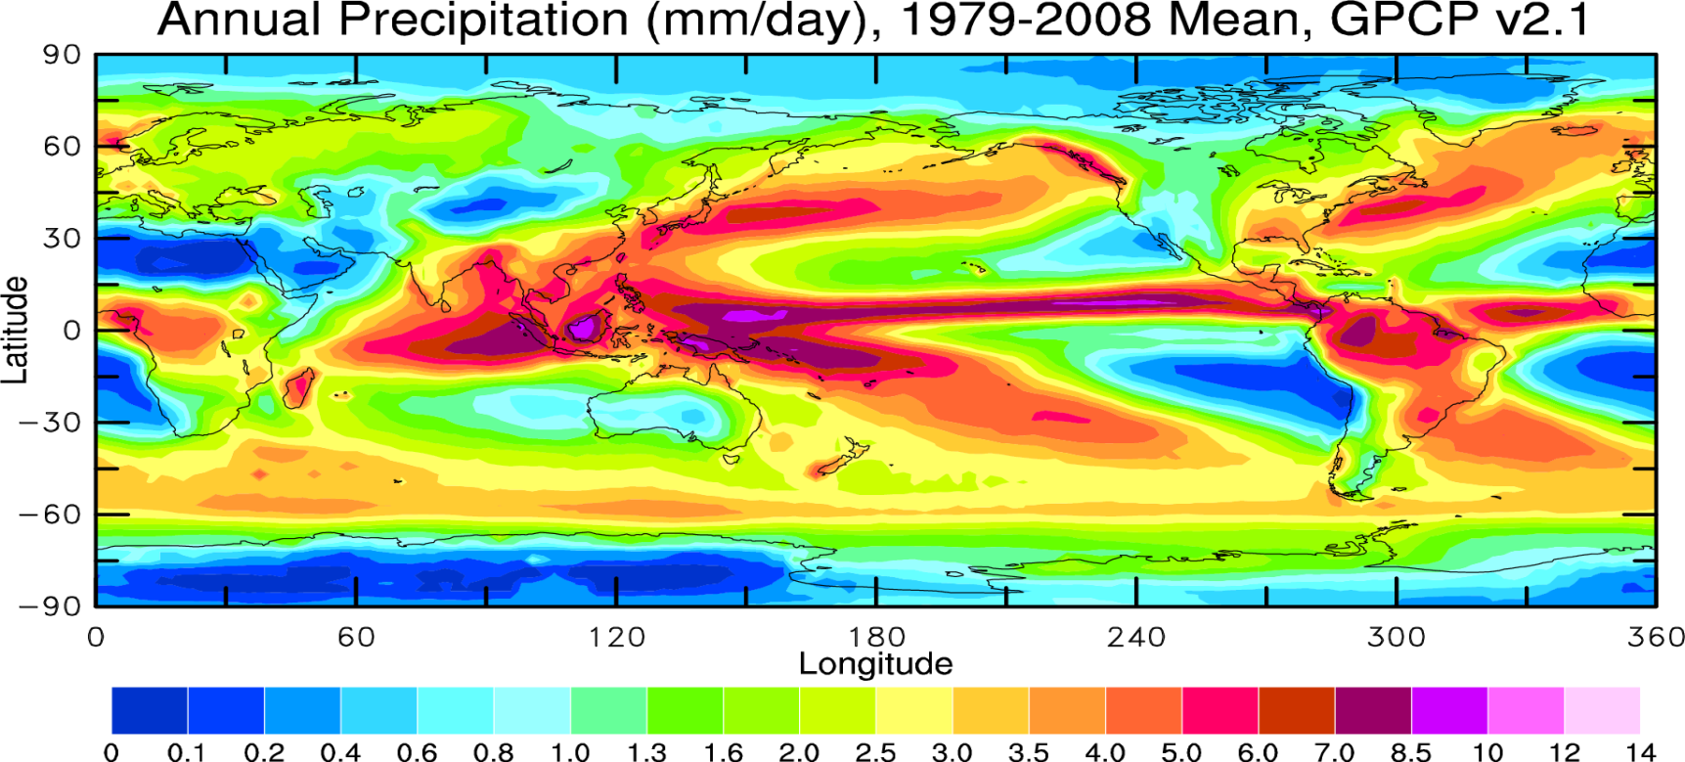
Evaporation (E) vs. Precipitation (P)

Slide 15
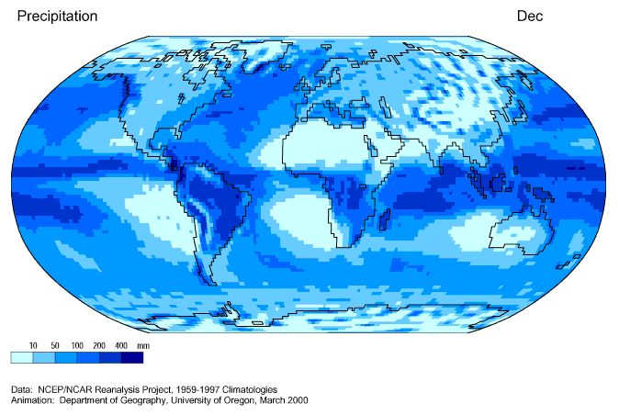
Seasonal Variations in Precipitation
Varies with:
Season and latitude
Peaks in the ITCZ
Low in the subtropics

Slide 16
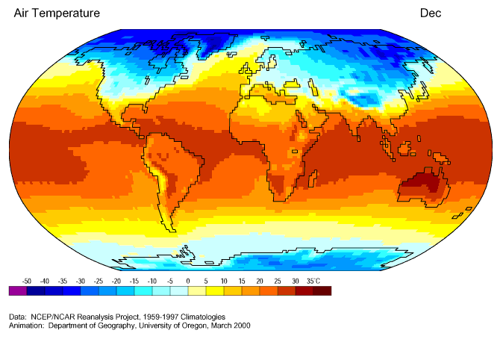
P moves with Ta

Slide 17
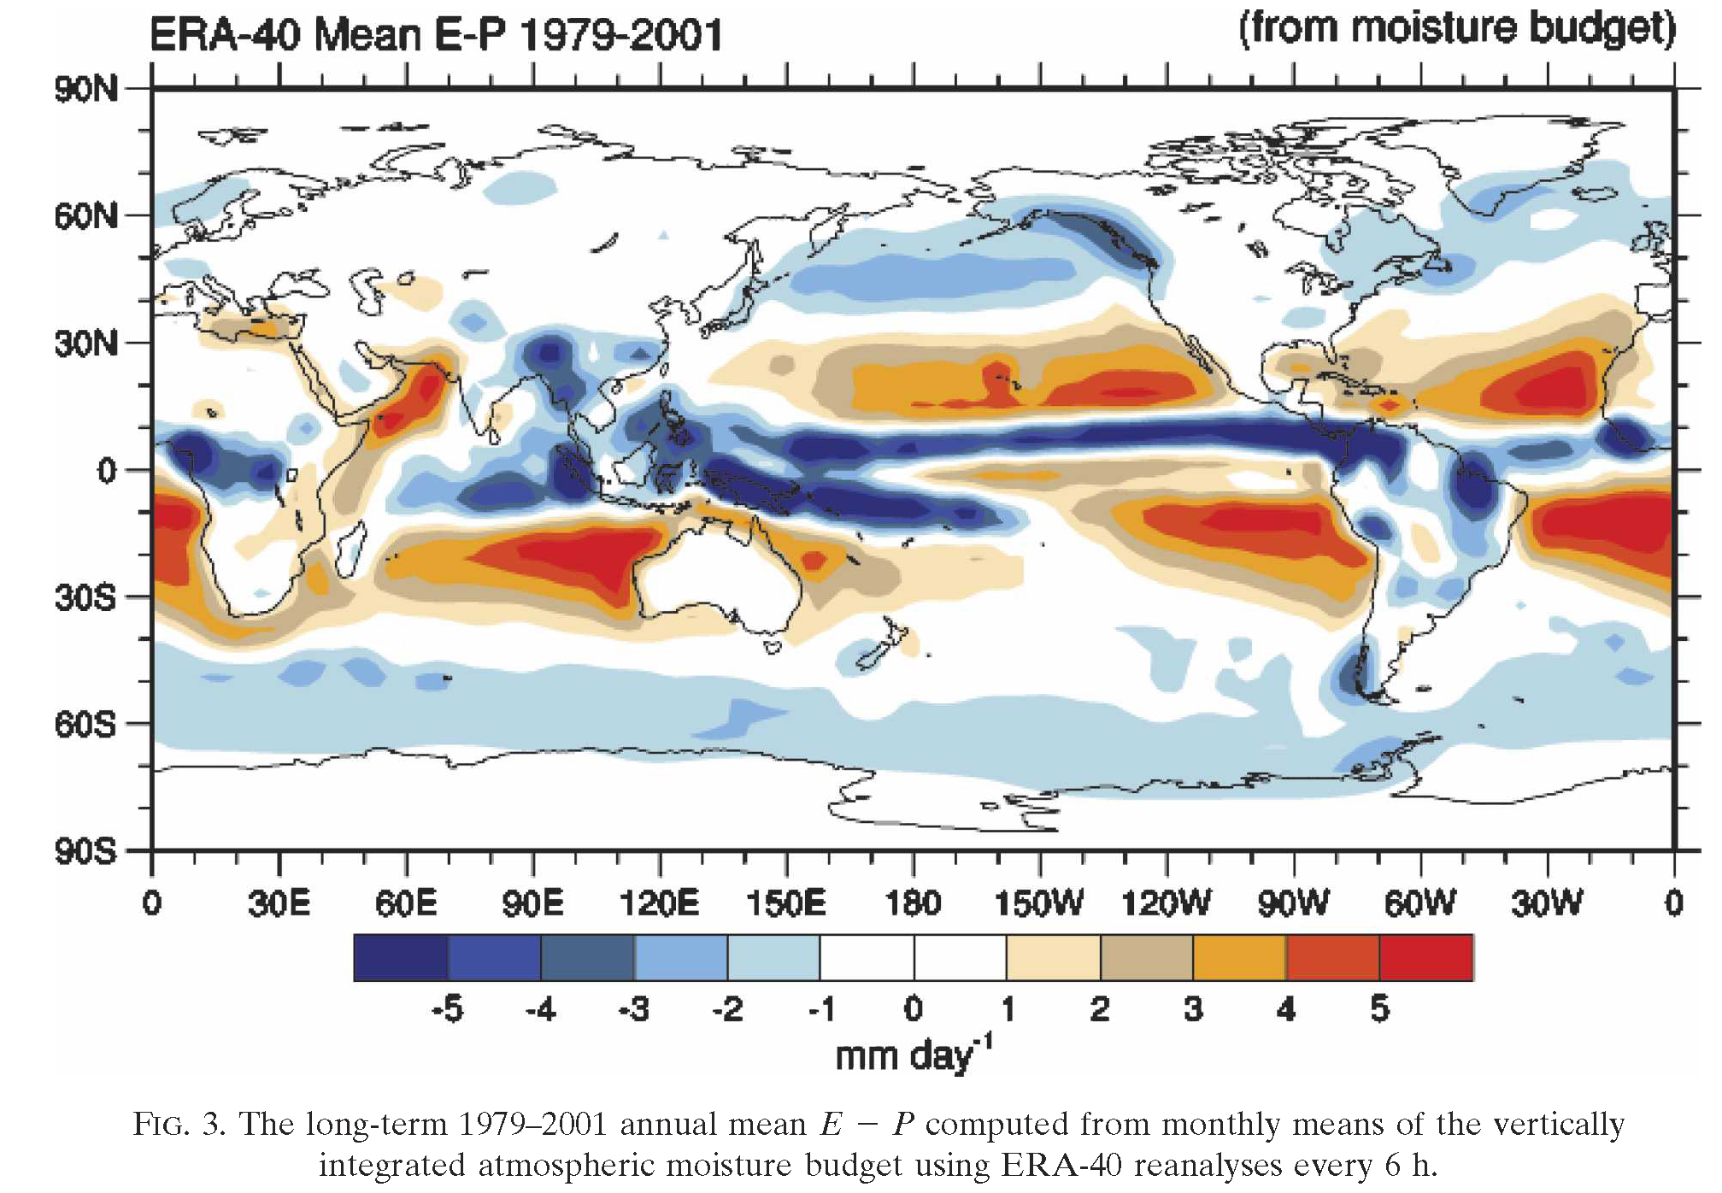
Long-term Mean E – P Difference Map
Trenberth et al. (2007, JHM)

Slide 18
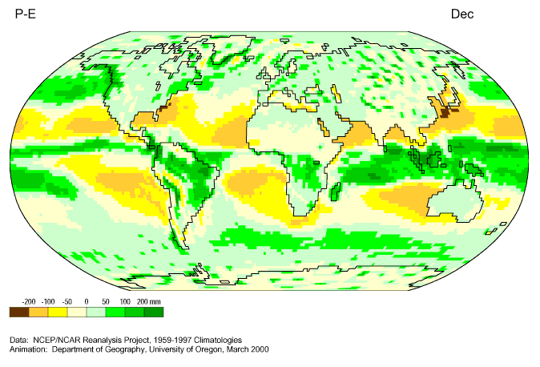
Seasonal Variations in Surface Net Water Flux (P-E)
Varies with:
The positions of the ITCZ and Subtropical High
Mainly with precipitation

Slide 19
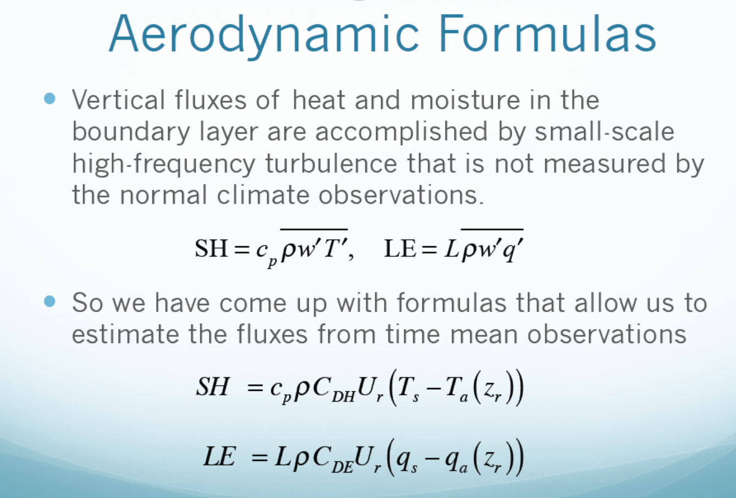
A lot of efforts were devoted to estimate the turbulence transfer coefficient C_{D} for heat, water, and momentum (wind stress). Note the influence of wind speed.

Slide 20
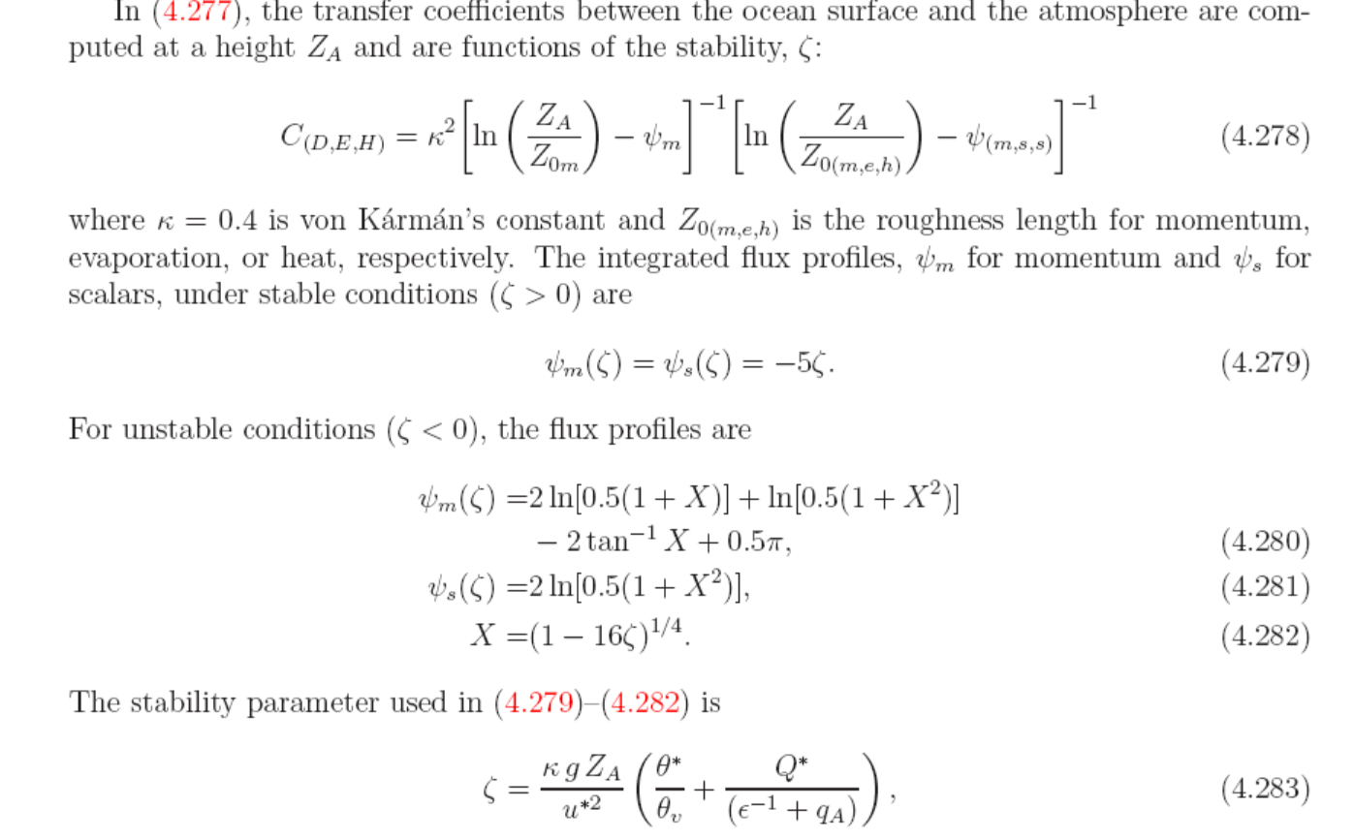
Transfer Coefficients in NCAR CAM5
CD depends on atmospheric stability and surface roughness length

Slide 21
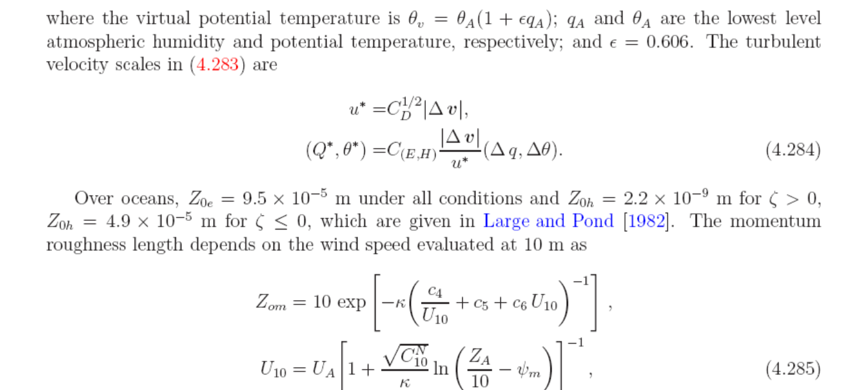

Slide 22
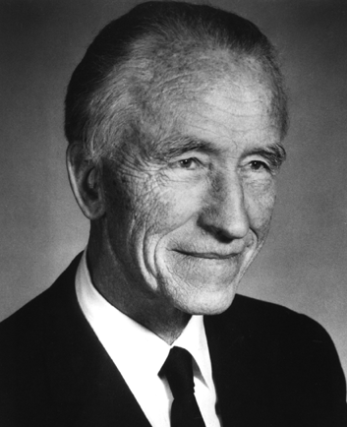
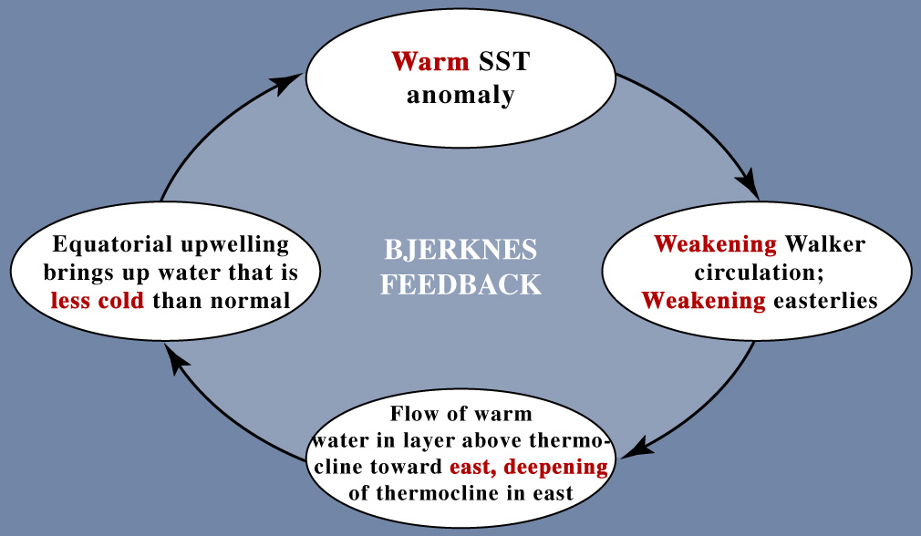
The Bjerknes feedbacks in the tropics (warm ENSO phase)
Jakob Bjerknes (1897-1975)
Air-Sea Feedbacks:
Norwegian-American meteorologist, founded UCLA Dept. of Meteorology
in the east
Positive feedback loop reinforces initial anomaly
Neelin, 2011. Climate Change and Climate Modeling, Cambridge UP

Slide 23
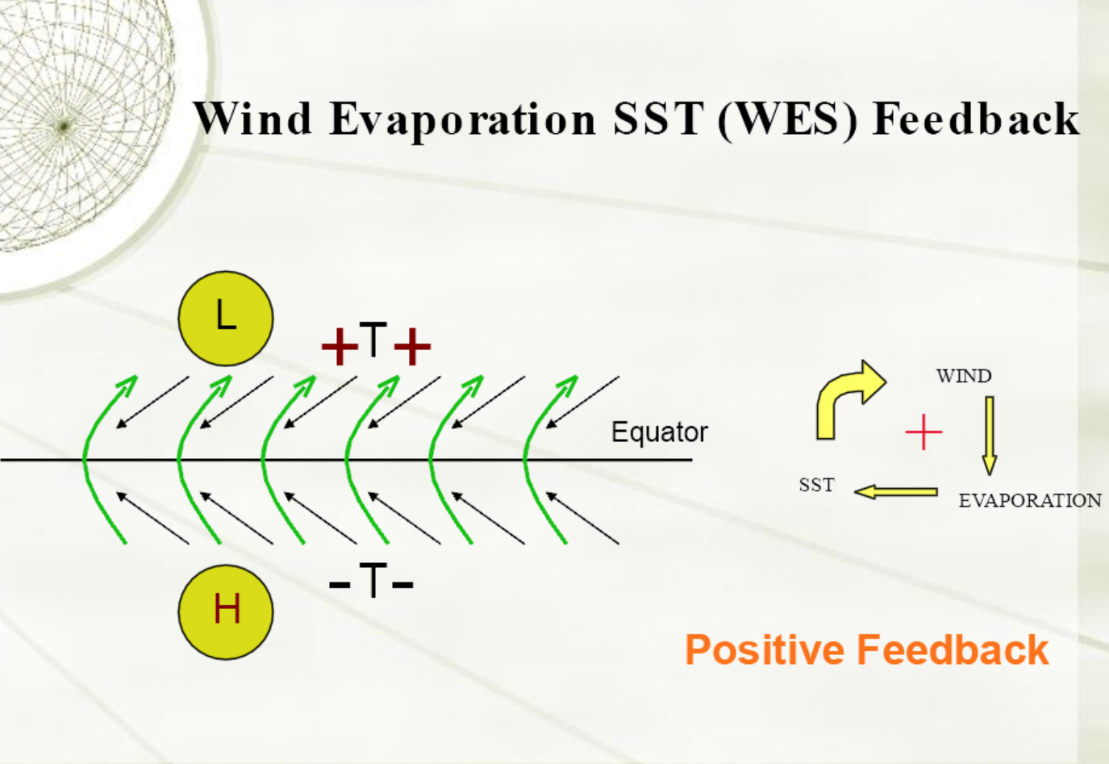
In the Tropics
Anomaly winds
Background winds
SST gradient → Pressure gradient → anomaly winds (green arrows) → decreased
(increased) winds north (south) of Equator → Reduced (enhanced) E north (south) of
Equator → SST warming (cooling) North (south) of Equator → Increased SST gradient

Slide 24
Wind Evaporation SST (WES) Feedback at Midlatitudes
(Chiang and Bitz 2005)
Sea-ice-induced cold SST front reaches
the trade winds
North-Southward Pressure Gradient
H
Cold
SST Cold Front
L
Warm
Northeasterlies South of the Front
trade winds
Anomaly winds
WES feedback usually works like this:
- A SST gradient induces a pressure gradient,
The pressure gradient induces wind anomalies
Wind anomalies either enhance or reduce E
E changes cool or warm SSTs
The SST changes modulate the SST gradient.
Increased Wind Speed South of the Front
Enhanced E Cools SST South of the Front
Cold Front Moves Southward

Slide 25
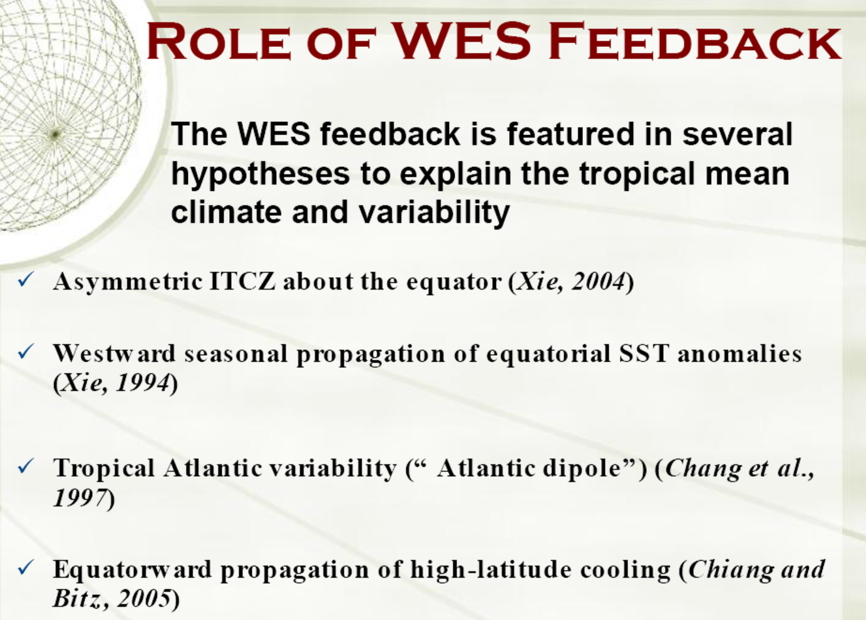

Slide 26
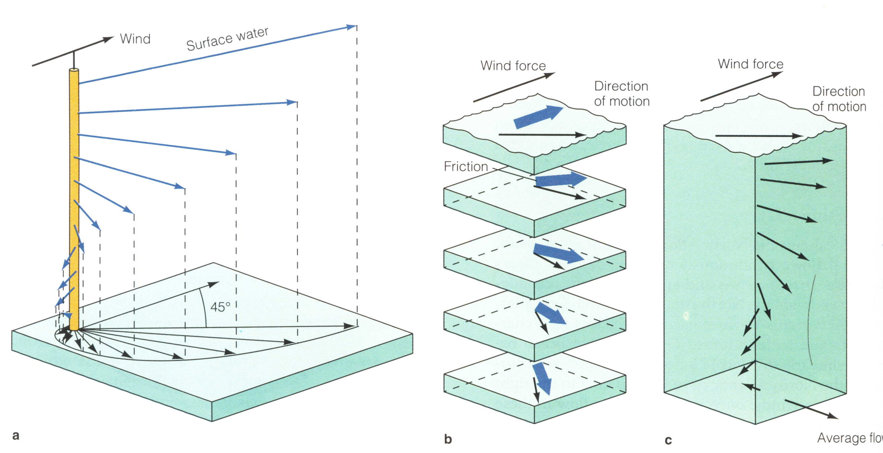
Wind Stress on Oceans
The force component parallel to the surface, per unit area, as applied by the wind on the water surface.
Ekman Spiral of Wind-driven Currents for N.H.
Average flow is 90º to the right of the wind
Wind Stress
τ
Friction
Current
Coriolis

Slide 27
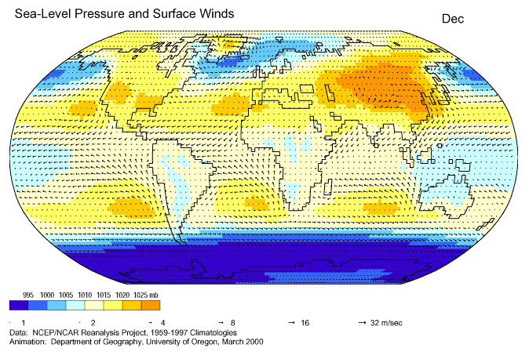
Seasonal Variations in Surface Winds and SLP
which determines surface fluxes
and upper ocean circulation

Slide 28
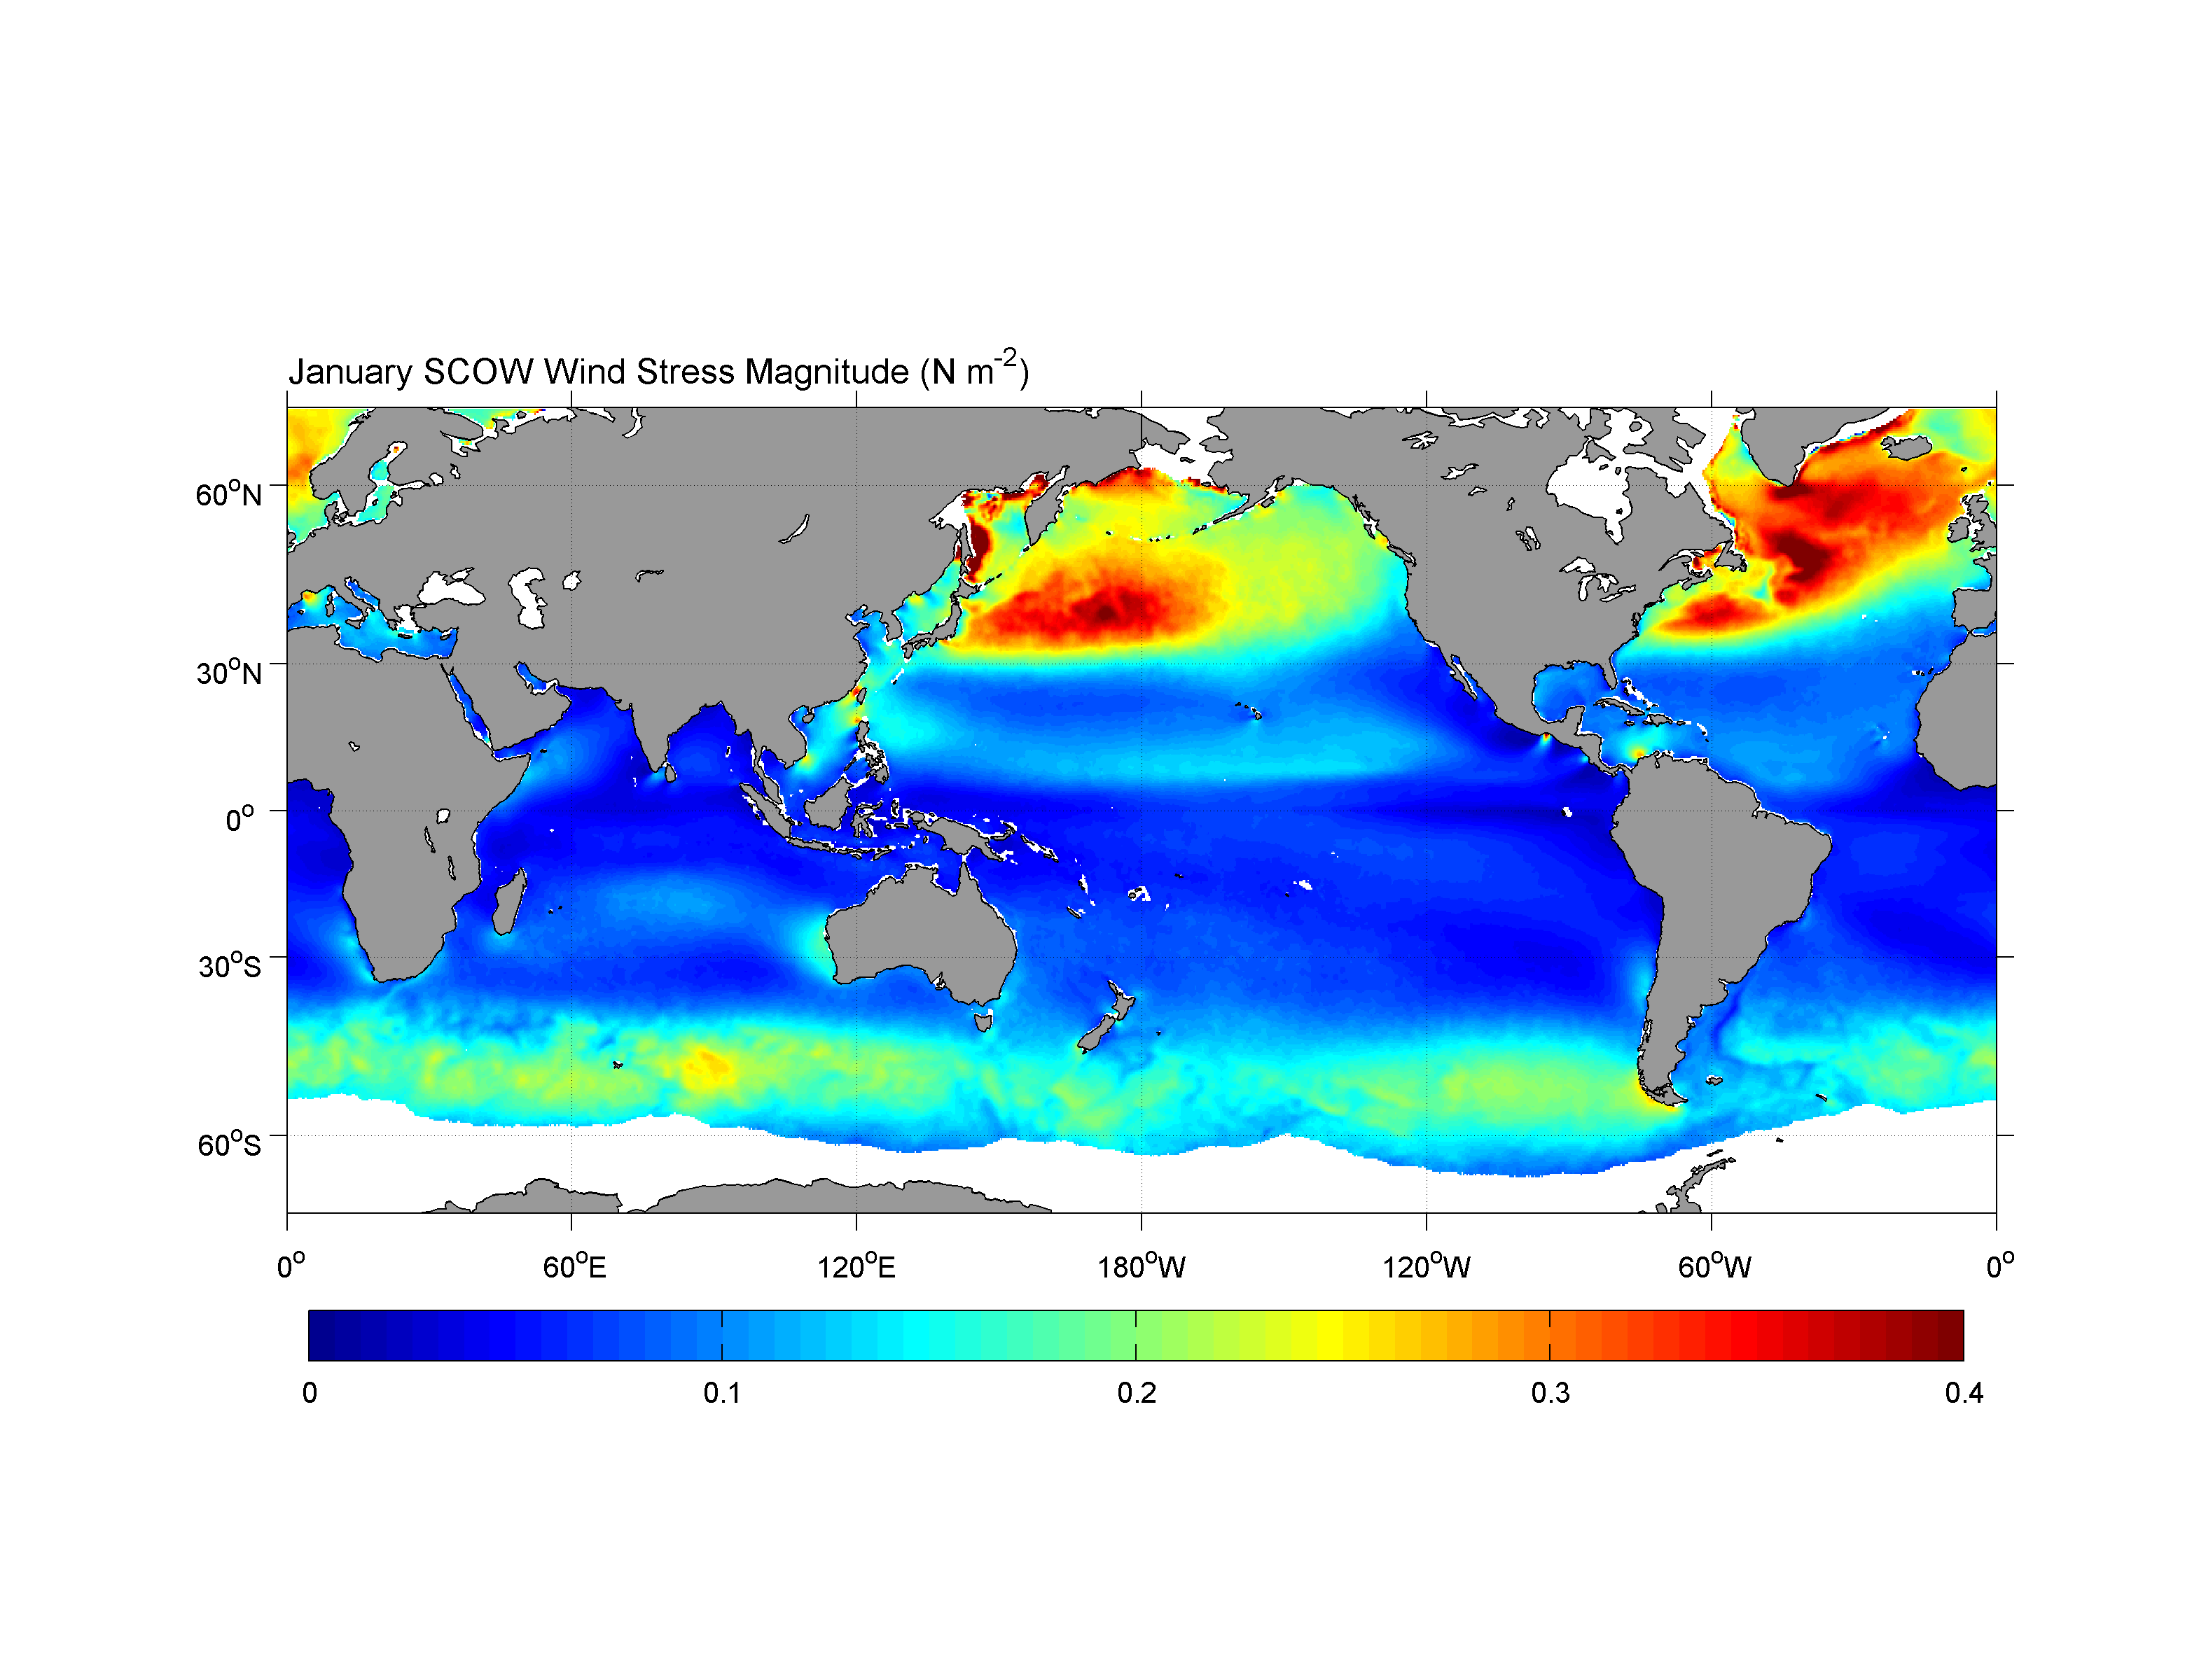
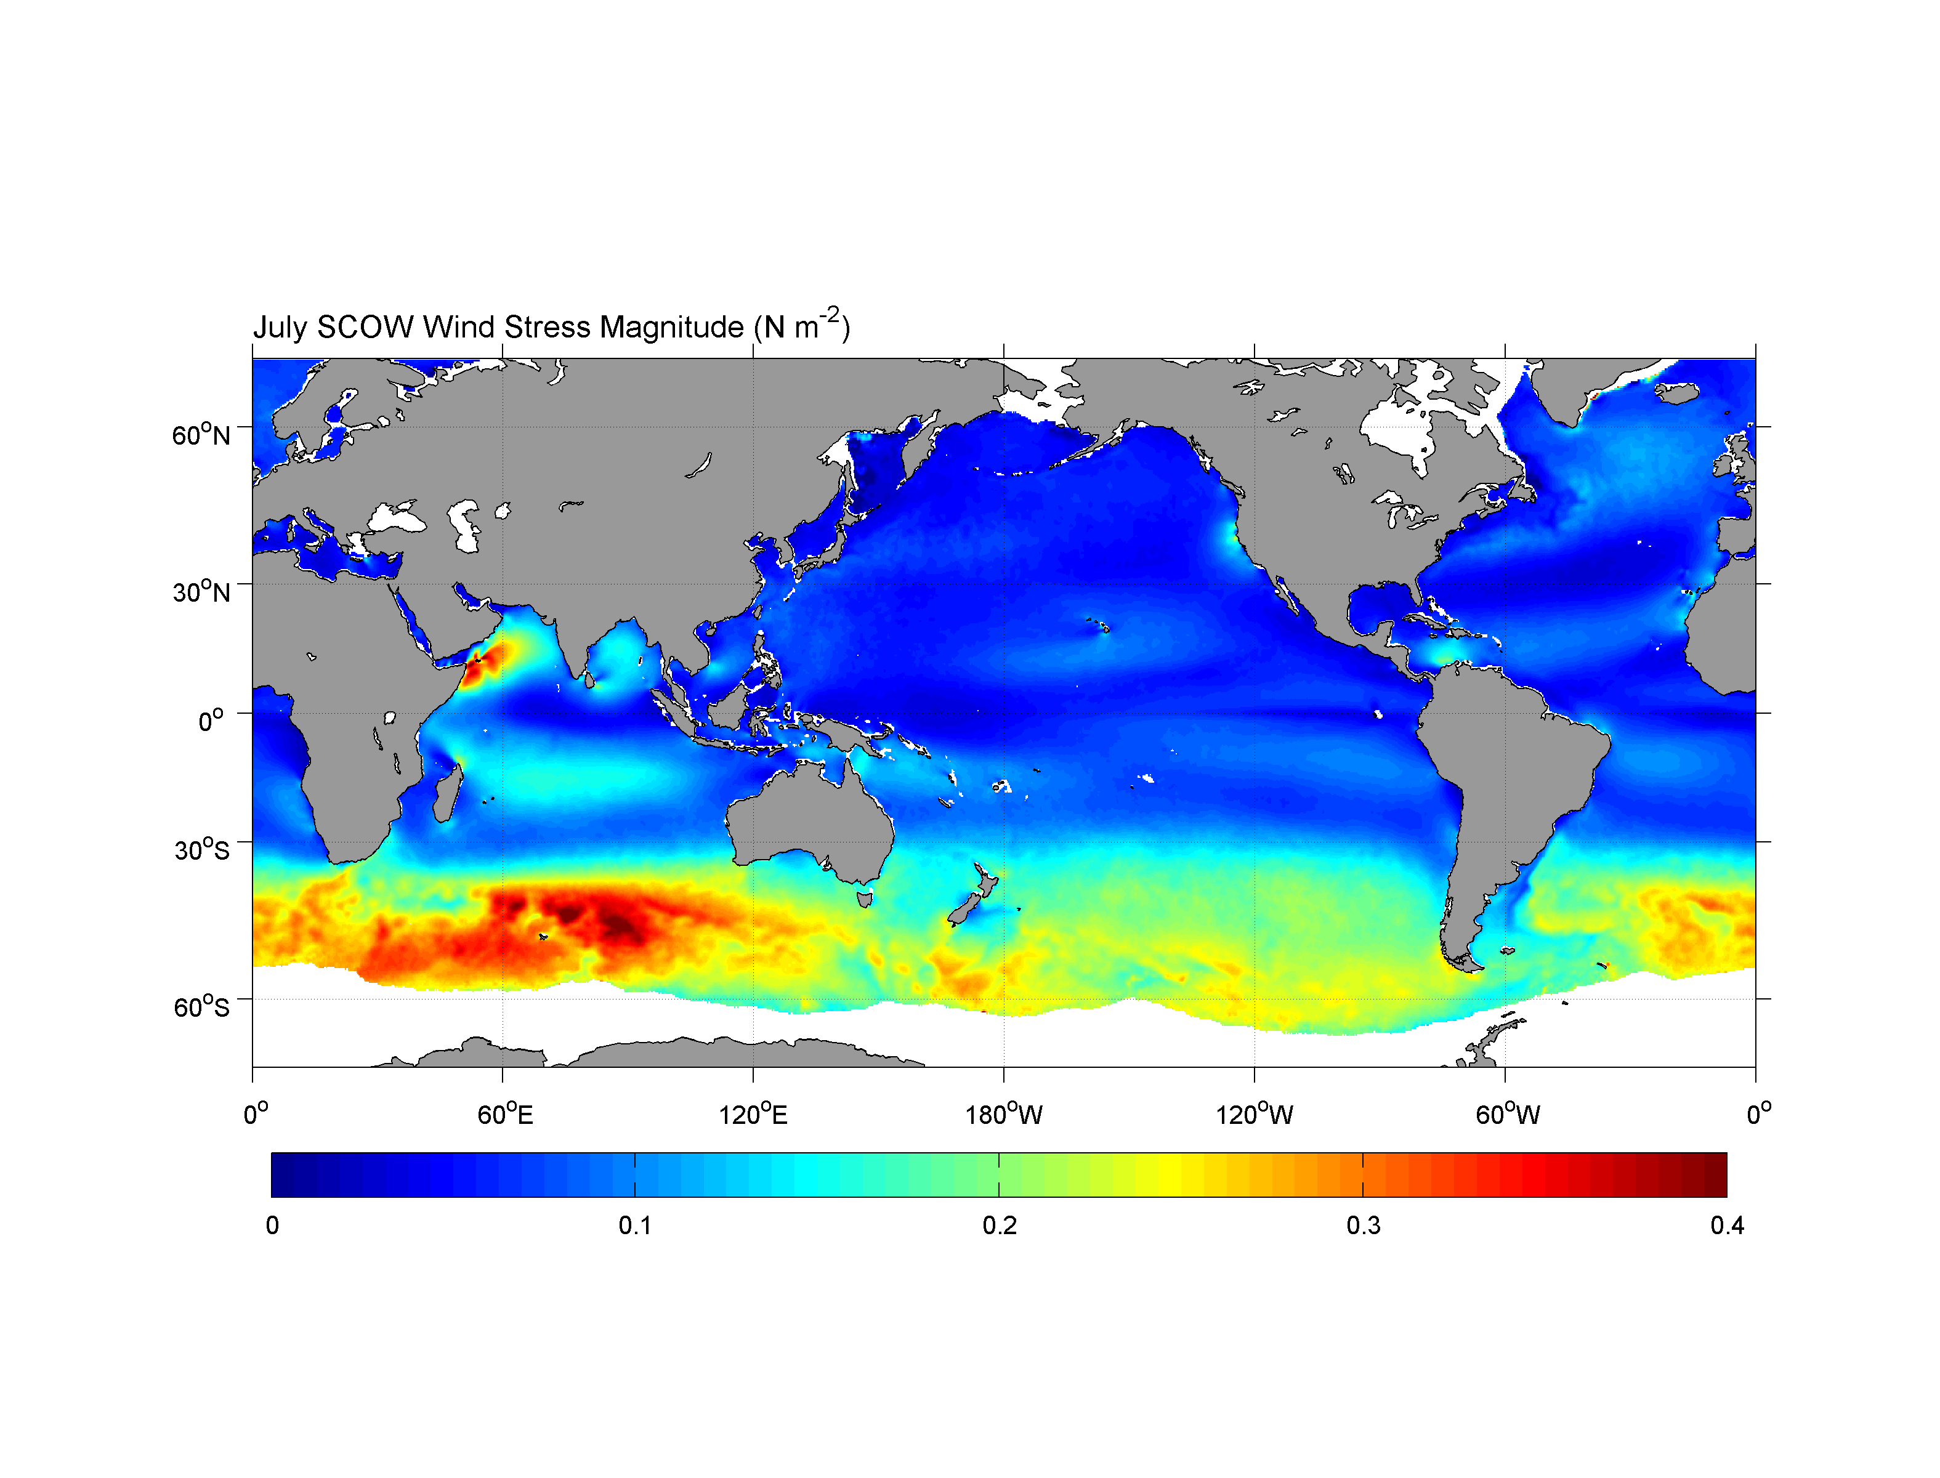
Wind Stress Magnitude, January
Wind Stress Magnitude, July

Slide 29
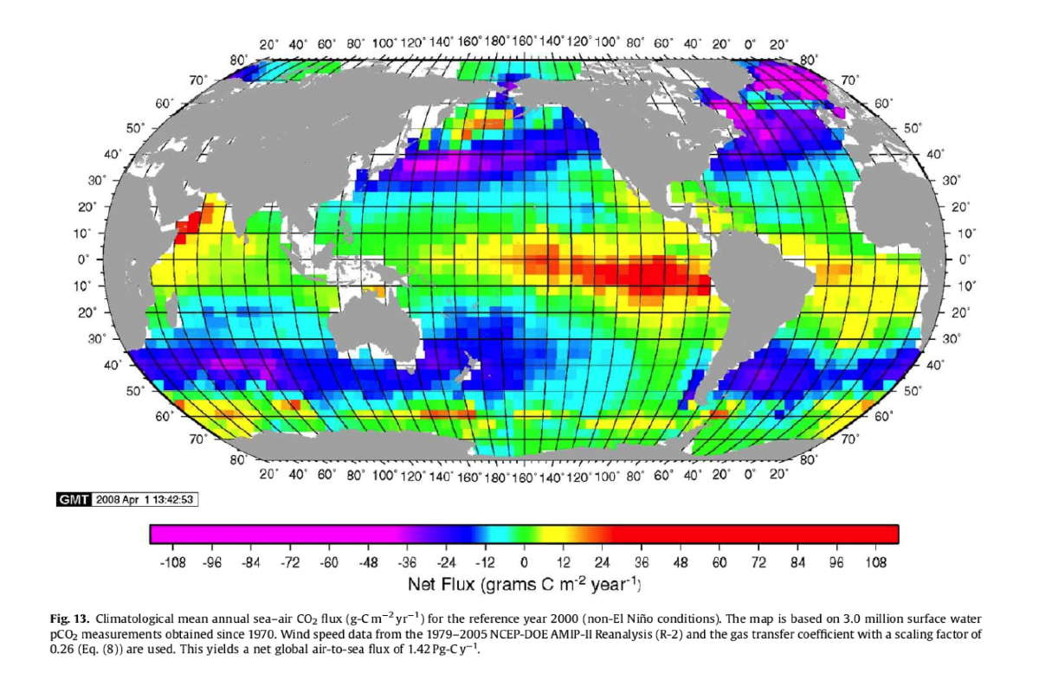
Air-Sea CO2 Flux
Cold water holds more CO2 than warm water → upwelling = out-gassing
Global Ocean Uptake = 1.42 Pg C/yr, 1Pg (Petagram)=10¹⁵ g =10⁹ Ton
1.42 Pg ≈ the weight
of 1 billion cars.
Weighs twice
as all cars in
U.S.!
F∼U ΔpCO2
Negative: into the Oceans
Positive: into the Atmosphere
Notes:
CO₂ dissolves in seawater, and then reacts with the water so that it disassociates into several ions. This disassociation means that the oceans can hold a lot of carbon – 85% of the active reservoir on Earth. Cold seawater can hold more CO₂ than warm water, so waters that are cooling (i.e. poleward-moving western boundary currents) tend to take up carbon, and waters that are upwelling and warming (i.e. coastal zones and the tropics) tend to emit carbon. This is the basic reason for the pattern of the global sea-to-air CO₂ flux as estimated by Takahashi et al. [2009] in the figure at right.

Slide 30
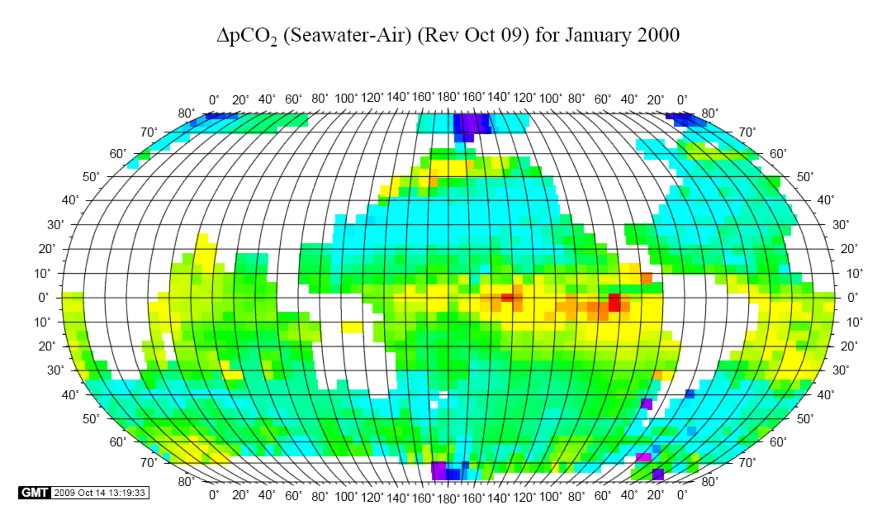
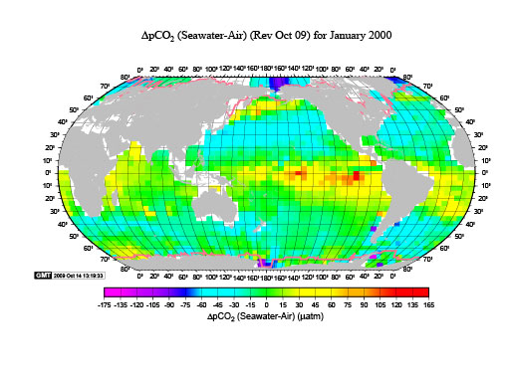

Slide 31
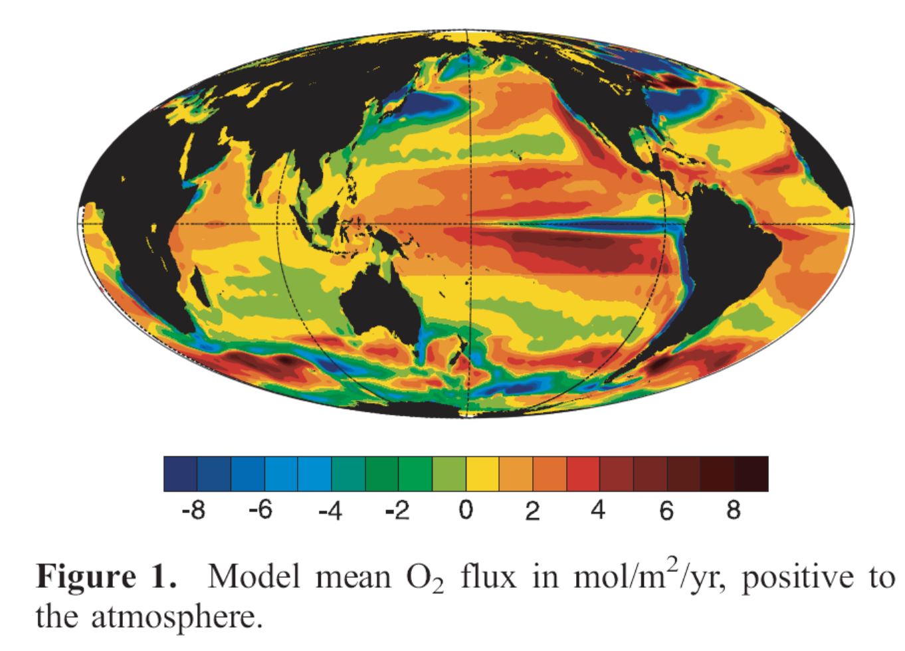
Air-Sea O2 Flux (positive to the atmosphere)
McKinley et al. (2003)

Slide 32
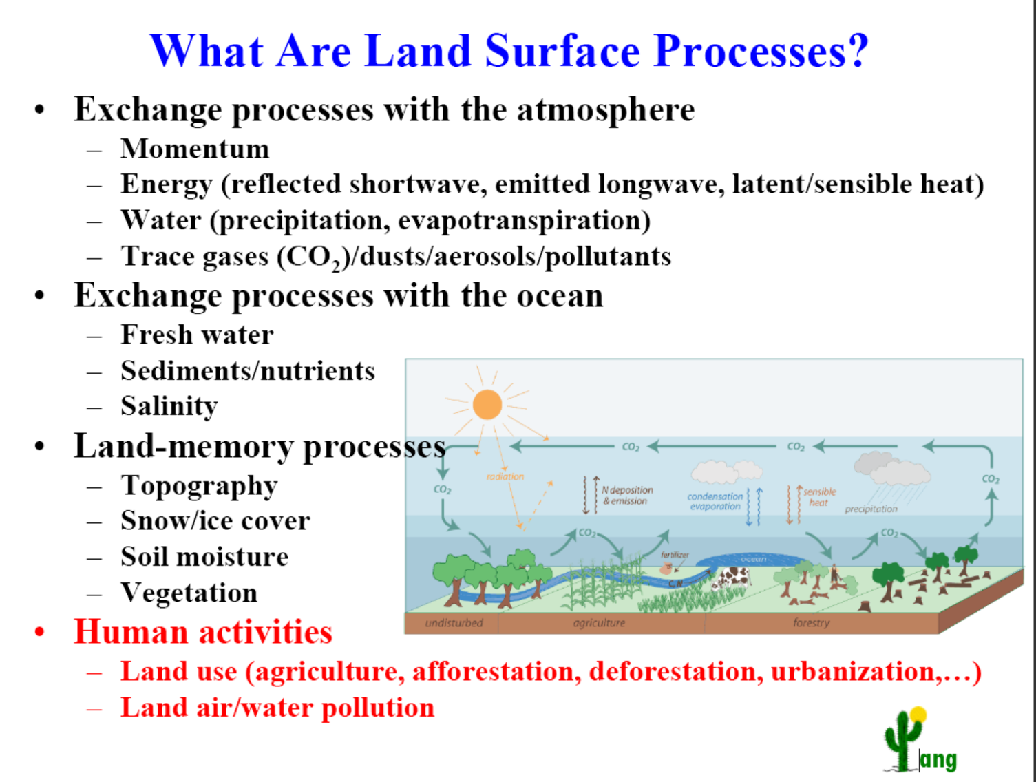

Slide 33
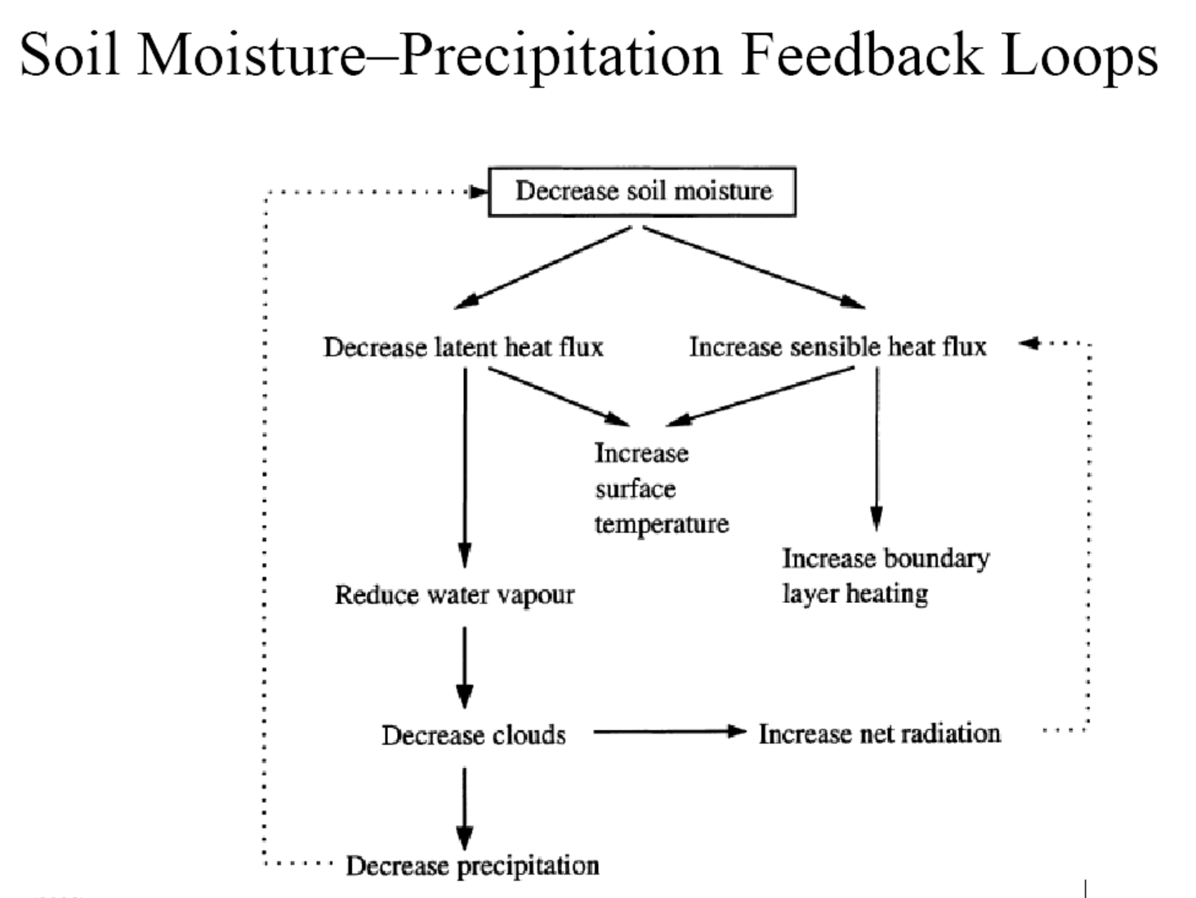
A Positive Feedback

Slide 34
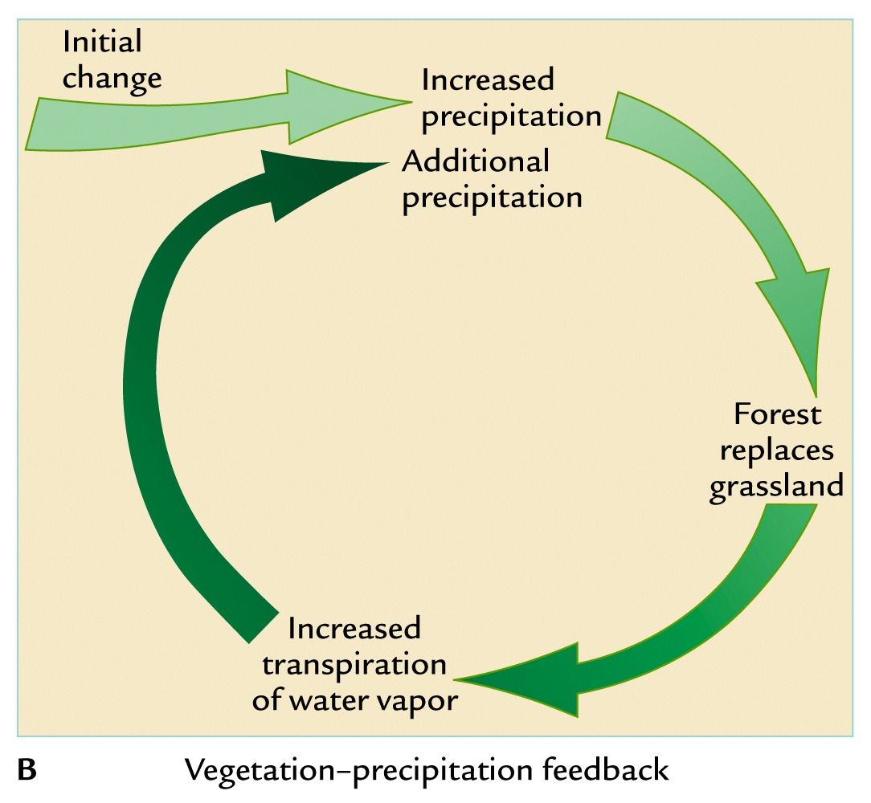
Vegetation − Precipitation Feedback
Effective in semi-arid regions (e.g. Sahel)
A Positive Feedback
+

Slide 35
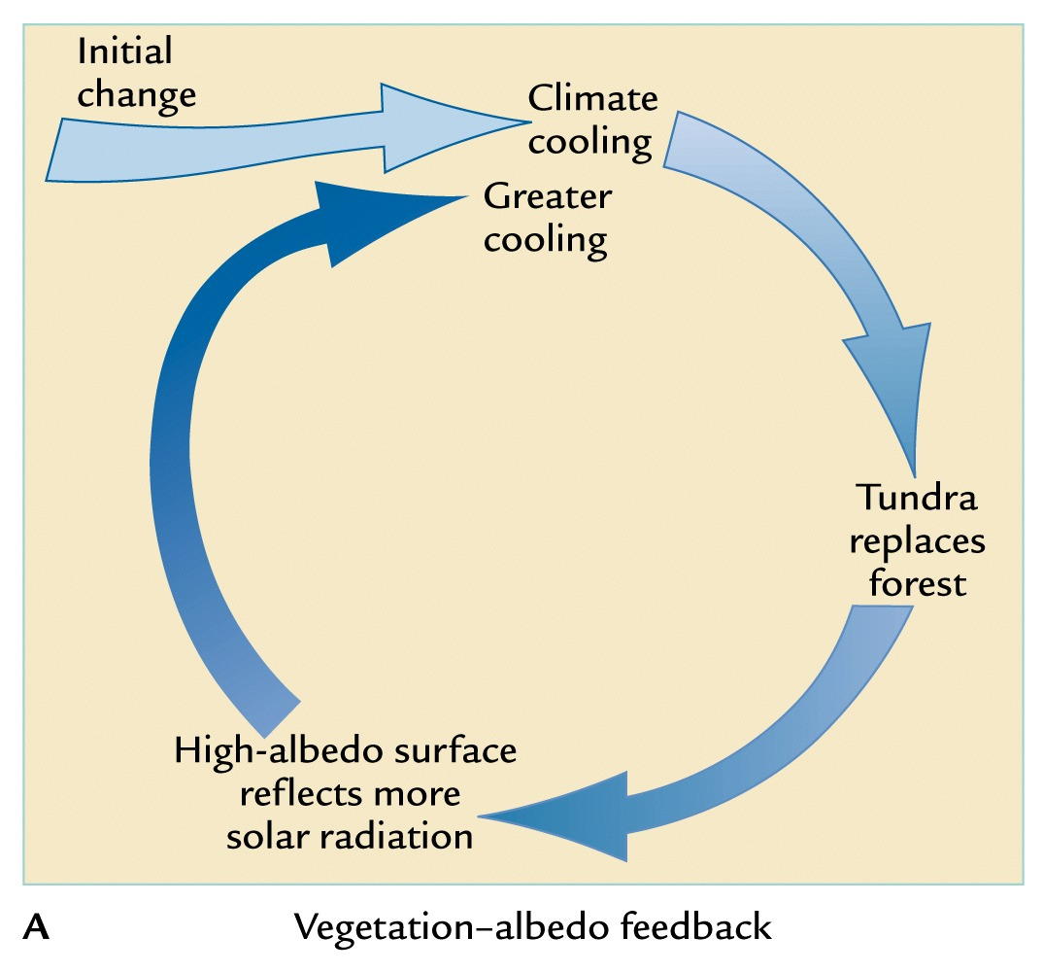
Vegetation − Albedo Feedback
Effective during Ice Ages
A Positive Feedback
+

Slide 36
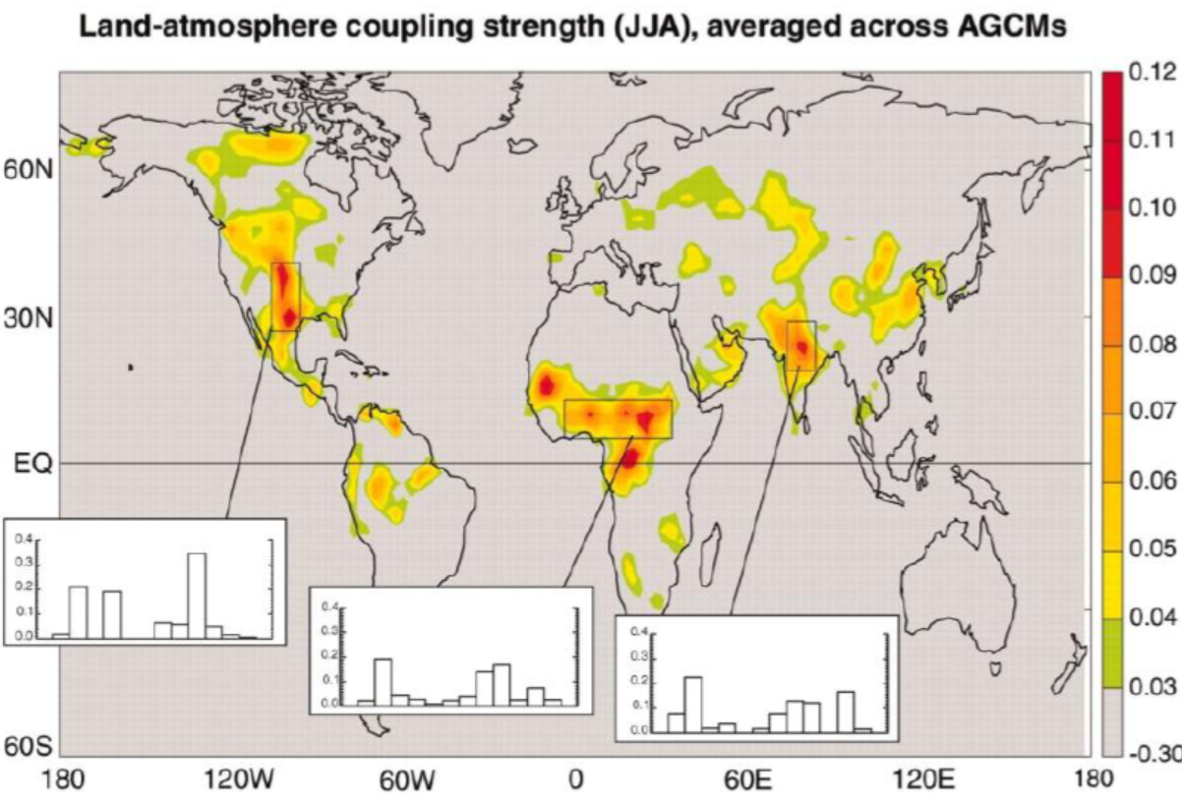
Land-Atmosphere Coupling Strength
Appears to be strongest in semi-arid areas where soil moisture is sensitive to precipitation
(Koster et al. 2004).

Slide 37
Summary
Air-sea interaction includes surface radiative fluxes, water fluxes (E and P), surface heat, momentum, and gas exchanges, and several air-sea feedbacks.
Surface winds play a crucial role in air-sea interaction: they affects upper ocean currents, air-sea SH, LH and momentum fluxes, and play a key role in air-sea feedbacks (such as the Bjerknes and WES feedbacks).
In the tropics, SST is often forced by solar radiation and oceanic processes (.e.g. upwelling) and acts as a lower-boundary forcing for the atmosphere; whereas in the mid-high latitudes, SST may also respond to atmospheric changes (e.g., winds) and thus two-way interactions are important.
The Wind-Evaporation-SST (WES) feedback works as follows: A SST gradient induces pressure gradient, which induces wind anomalies that lead to E changes which provide a feedback impact on the SST gradient (positive over the Equator).
Land-atmosphere interaction includes surface exchanges of heat, water, momentum, and gases (CO2, O2, etc.), albedo effect, modulation of atmospheric flow by mountains, soil moisture-precipitation interactions, vegetation-albedo feedback.
Land-atmosphere coupling seems to be strongest in semi-arid areas.
Initial conditions of soil moisture content are important for short-term weather forecast.

Slide 38
Next Lecture:
Sea Ice and Polar Climate

