Slide 1
Homework #4 (due in one week)
How do we measure climate variability? How and why is the variability of surface air temperature projected to change at northern high latitudes and in low latitudes? (20%)
Describe the mechanisms or physical processes behind the ENSO cycles, including the Bjerknes feedacks and the processes that end an El Niño or La Niña event and those that lead to the opposite phase in an ENSO cycle. (25%)
Describe the temporal and spatial characteristics of the IPO and AMO, their impacts on global climate, their interactions, and their likely formation mechanisms. (25%)
How do NAO and AO affect weather over North America and Europe? What are the main features for the positive and negative phases of NAO and AO? (20%)
What is the relationship among ENSO, PDO, and IPO? (10%)

Slide 2
Summary of ENSO
ENSO refers to irregular (2-7yr) oscillations in SLP, SST and winds in the tropical central-eastern Pacific. It is the largest interannual variation.
ENSO dynamics/formation: See slides 17 and 19:
El Niño formation: westerly wind anomaly→ more warm water pushed to the east → lower (higher) sea level in the west (east) and shallower (deeper) thermocline in the west (east) + Bjerknes feedback → warmer SST in the east and weaker trade winds → reduced west-east sea-level height gradient → no more transport of warm water to the east → SST and SLP in the east recover to normal → trade winds push surface water westward, subsurface cold water moves eastward → transition to the cold phase La Niña
La Niña formation: easterly wind anomaly→ more warm water pushed to the west → higher (lower) sea level in the west (east), deeper (shallower) thermocline in the west (east) + Bjerknes feedback → colder SST in the east and stronger trade winds→ increased west-east sea-level height gradient → no more transport of warm water to the west → SST and SLP in the east recover to normal → ocean pressure gradient force pushes surface warm water eastwards, subsurface warm water moves eastward → transition to El Niño.
ENSO theoretical models: simple models considering the basic ENSO processes, they can produce the oscillation of Nino4 T. The unified oscillator model can produce several other ENSO models.
ENSO can be predicted 3-6 months ahead.
ENSO Impacts: During El Niño: dry in Indonesia, eastern Australia, central America, Northwest S. America, West Africa, southern Africa and India; wet in the central-eastern equatorial Pacific, the western tropical Indian Ocean and East Africa, Southeast S. America, the southern U.S., most of the extratropical North Atlantic, central Eurasia, parts of East Asia. The impact is roughly reversed during La Niña.

Slide 3
A ATM551: Lecture #19-20
NAO, AO, Atlantic and Pacific Multidecadal Variability
Reading Materials (Available at the course website):
Luo et al. (2007, JAS) (NAO formation)
Deser (2000, GRL) (AO vs. NAO)
Liu (2012, J. Climate, pp. 1963-1995) (Decadal Modes)
Zhang et al. (2019, Rev. Geophys.) (AMO and AMOC)
Sutton et al. (2018, BAMS) (AMO)
Cai et al. (2019, Science) (inter-basin connection)
Meehl et al. (2021, Nature Geosci.) (AMV-PDV interactions)

Slide 4
Major Modes of Climate Variability
Modes of Climate Variability: recurring spatial and temporal patterns of climate variations.
Inter-annual modes:
- El Niño-Southern Oscillation (ENSO)
- North Atlantic Oscillation (NAO)
- Arctic Oscillation (AO) or Northern Annular Mode (NAM)
- Southern Annular Mode (SAM), similar to NAM but for S.H.
Decadal to multi-decadal modes (Liu 2012, JC):
- Pacific Decadal Oscillation (PDO)
- Inter-decadal Pacific Oscillation (IPO)
- Atlantic Multi-decadal Oscillation (AMO)

Slide 5
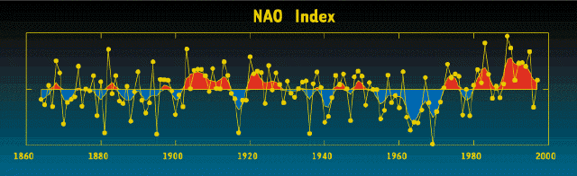
North Atlantic Oscillation (NAO)
NAO is a large-scale seesaw in atmospheric mass or pressure between the Atlantic subtropical high and subpolar low (see next slide for its pattern).
NAO is the dominant mode of winter climate variability in the North Atlantic. Individual NAO events last for ~2 weeks (similar to atmospheric blocking events), caused by synoptic eddies interacting with planetary waves (Luo et al. 2007, JAS).
NAO index varies from year to year, but also exhibits a tendency to remain in one phase for intervals lasting several years or decades.
NAO is related to storm track strength and jet stream positions over the North Atlantic.
Luo, D., A. R. Lupo, and H. Wan, 2007: Dynamics of eddy-driven low-frequency dipole modes. Part I: A simple model of North Atlantic Oscillations. J. Atmos. Sci., 64, 3–28, https://doi.org/10.1175/JAS3818.1.
Luo, D., X. Chen and S. Feldstein, 2018: Linear and nonlinear dynamics of North Atlantic Oscillations: A new thinking of symmetry breaking, J. Atmos. Sci.，75, 1955-1977, DOI: 10.1175/JAS- D-17-0274.1
Winter index of the NAO based on the difference of normalized sea level pressures (SLP) between Lisbon, Portugal and Stykkisholmur/Reykjavik, Iceland since 1864 [Lisbon SLP (south) minus Iceland (north) SLP).
Notes:
During NAO+ Phase:
The Positive NAO index phase shows a stronger than usual subtropical high pressure center and a deeper than normal Icelandic low.
The increased pressure difference results in more and stronger winter storms crossing the Atlantic Ocean on a more northerly track.
This results in warm and wet winters in Europe and in cold and dry winters in northern Canada and Greenland
The eastern US experiences mild and wet winter conditions
During NAO- phase:
The negative NAO index phase shows a weak subtropical high and a weak Icelandic low.
The reduced pressure gradient results in fewer and weaker winter storms crossing on a more west-east pathway.
They bring moist air into the Mediterranean and cold air to northern Europe
The US east coast experiences more cold air outbreaks and hence snowy weather conditions.
Greenland, however, will have milder winter temperatures

Slide 6
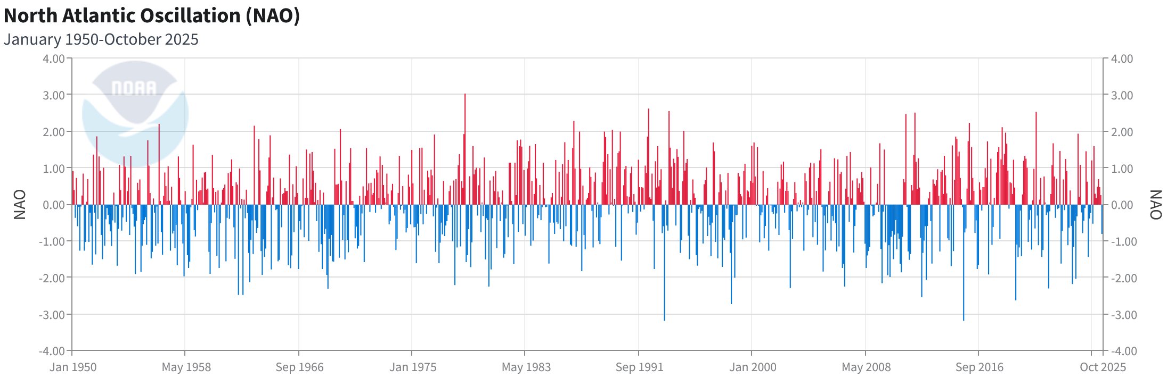
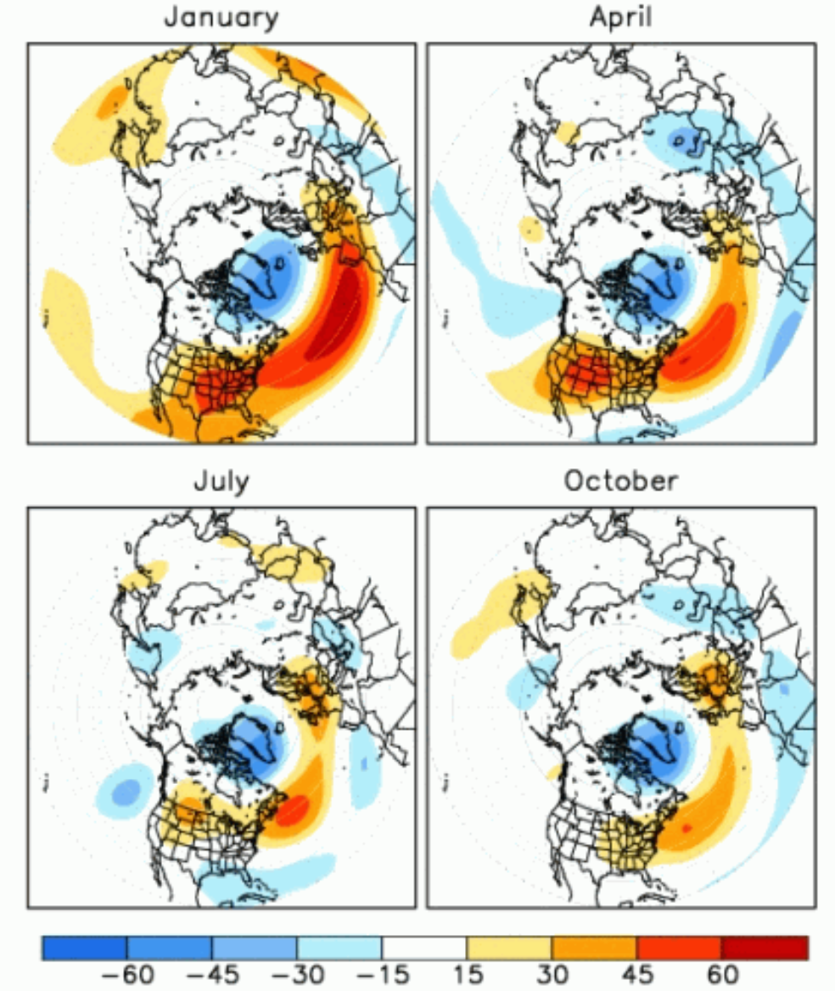
Monthly NAO Index (Azores SLP (south) minus Iceland (north) SLP)
NAO Spatial Pattern (for a positive phase):
Source: https://www.ncei.noaa.gov/access/monitoring/nao/

Slide 7
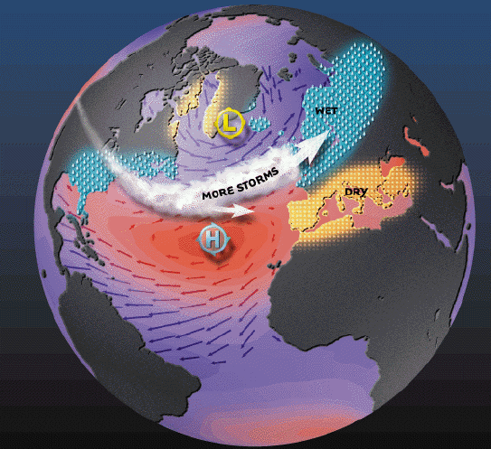
Positive NAO Phase
The positive NAO index phase shows a stronger than usual subtropical high pressure center and a deeper than normal Icelandic low.
The increased pressure gradient results in more and stronger winter storms crossing the Atlantic Ocean on a more northerly track.
This results in warm and wet winters in
most Europe and cold and dry winters
in northern Canada and Greenland.
The eastern US experiences mild
and wet winter conditions.
NAO+
x
x
Notes:
During NAO+ Phase:
The Positive NAO index phase shows a stronger than usual subtropical high pressure center and a deeper than normal Icelandic low.
The increased pressure difference results in more and stronger winter storms crossing the Atlantic Ocean on a more northerly track.
This results in warm and wet winters in Europe and in cold and dry winters in northern Canada and Greenland
The eastern US experiences mild and wet winter conditions

Slide 8
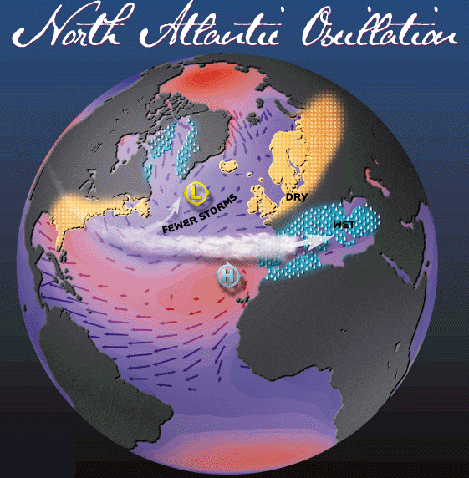
Negative NAO Phase
The negative NAO index phase shows a weak subtropical high and a weak Icelandic low.
The reduced pressure gradient results in fewer and weaker winter storms crossing on a more west-east pathway.
They bring moist air into the
Mediterranean and cold/dry air to
northern Europe.
The US east coast experiences more
cold air outbreaks and hence snowy
weather conditions.
Greenland has milder winter
temperatures
NAO−
Notes:
During NAO- phase:
The negative NAO index phase shows a weak subtropical high and a weak Icelandic low.
The reduced pressure gradient results in fewer and weaker winter storms crossing on a more west-east pathway.
They bring moist air into the Mediterranean and cold air to northern Europe
The US east coast experiences more cold air outbreaks and hence snowy weather conditions.
Greenland, however, will have milder winter temperatures

Slide 9
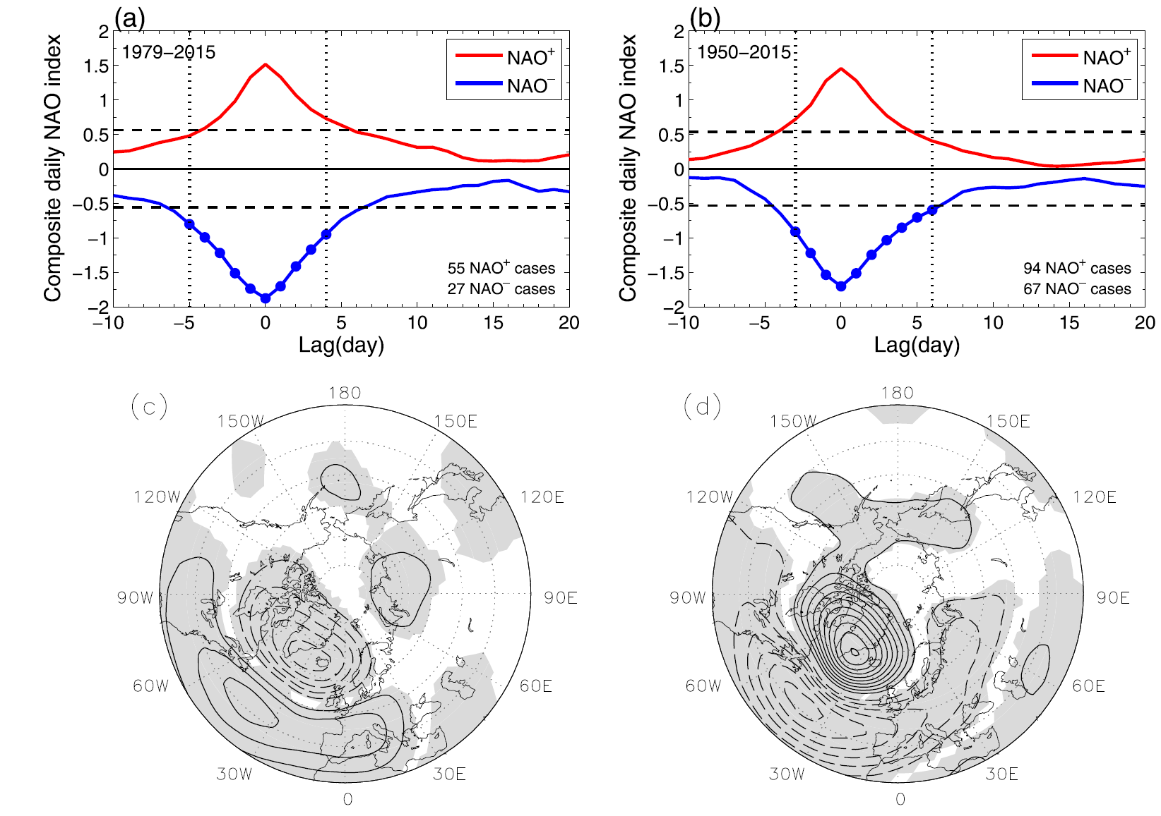
NAO Composite Temporal Evolution
NAO Composite SLP Anomly
NAO⁻
NAO⁺
Luo et al. (2018)

Slide 10
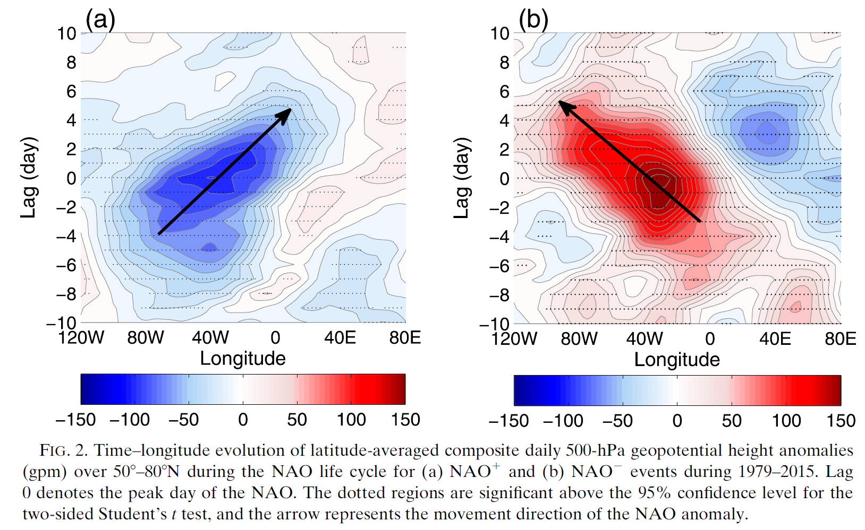
NAO Composite Z500 (of 50º-80ºN) Anomaly Evolution
NAO⁺
NAO⁻
Luo et al. (2018)

Slide 11
NAO Formation (Luo et al. 2007)
Eddy forcing arising from the preexisting synoptic-scale waves is crucial for the growth and decay of the NAO
A preexisting low-over-high (high-over-low) dipole planetary-scale wave is required to match the preexisting positive-over-negative (negative-over-positive) dipole eddy forcing over the North Atlantic, which excites a positive (negative) phase NAO event.
The positive and negative feedbacks of the preexisting dipole eddy forcing, which depend on the background westerly wind, seem to dominate the life cycle of the NAO and its duration.

Slide 12
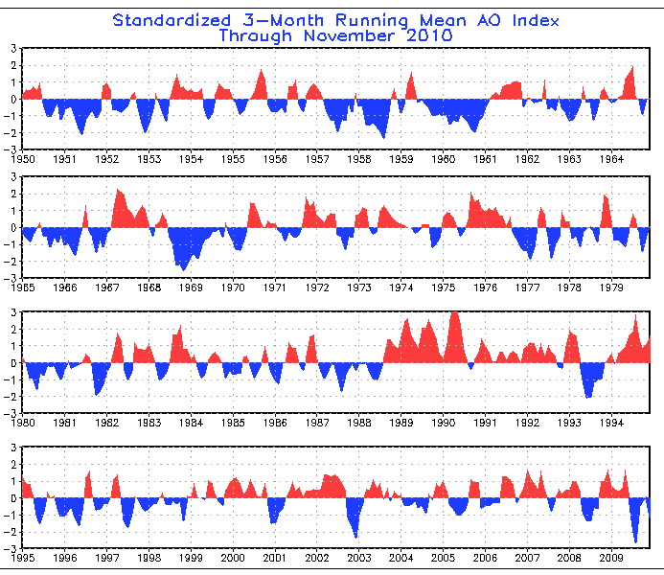
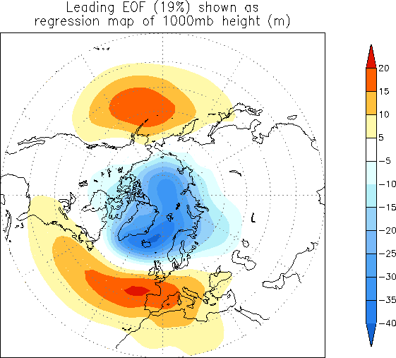
Arctic Oscillation (AO)
The AO is a large-scale seesaw pattern in atmospheric mass between the sub-polar low and the high-pressure centers in the Pacific and Atlantic around 37-45ºN, primarily in winter.
The NAO mainly reflects the Atlantic part of the AO.
Weak connection between the Atlantic and Pacific high-pressure centers; AO is dominated by the polar low-pressure center (Deser 2000)
Causes for the AO phase change are not well known.
SLP Anomaly for AO Positive Phase

Slide 13
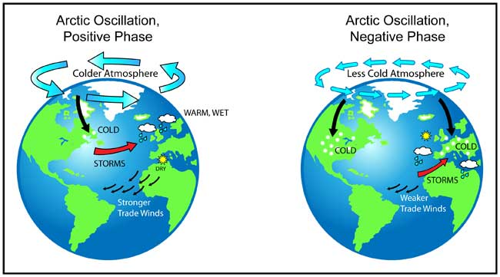
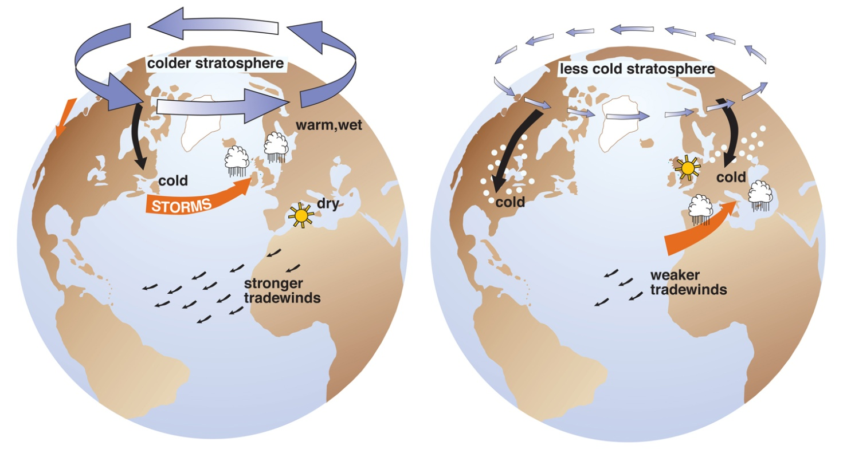
Positive AO→
Stronge SLP
gradient→
Stronge Polar
Vortex &
stronge westerlies
→Fewer cold
breaks to midlat.
Negative AO→
Weak SLP
gradient →
Weak Polar
Vortex & weak
westerlies
→ More cold
breaks to midlat.

Slide 14
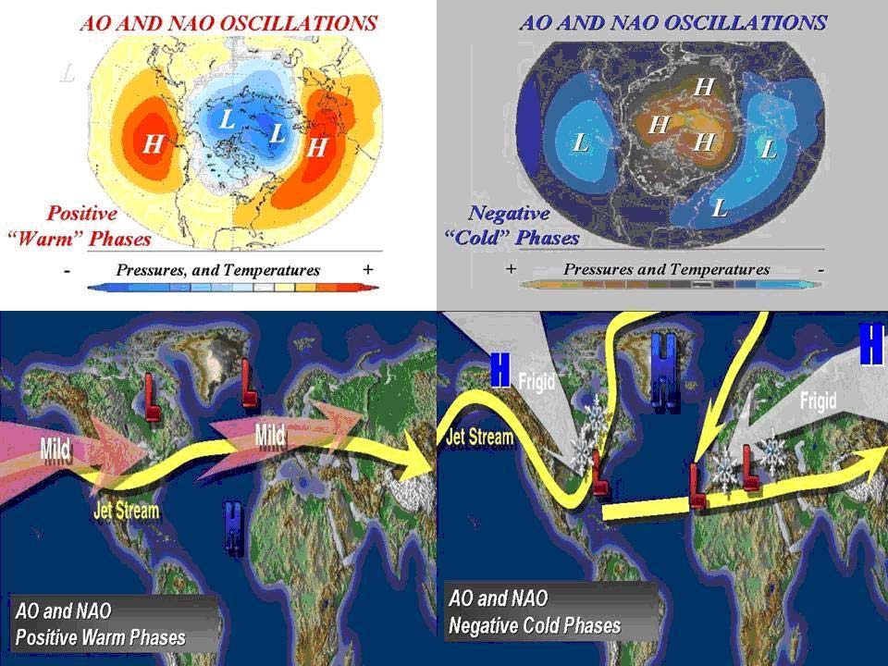

Slide 15
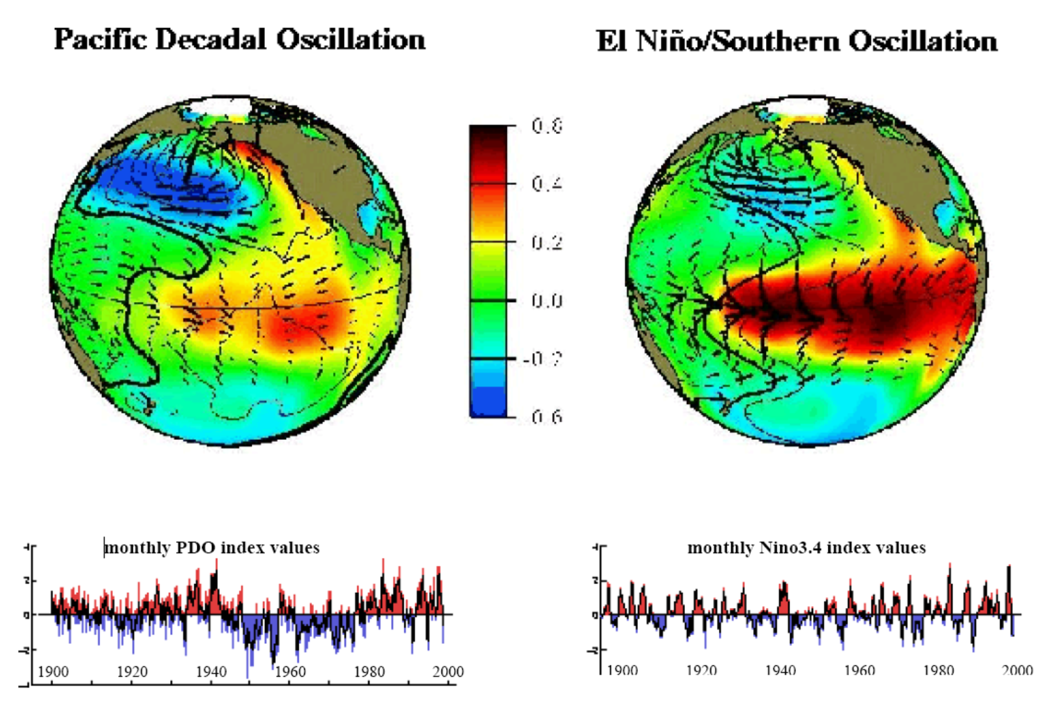
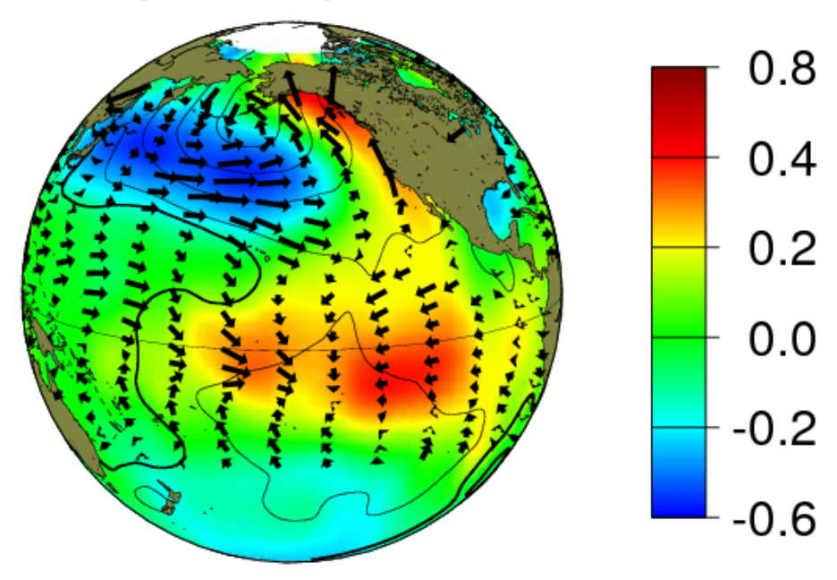
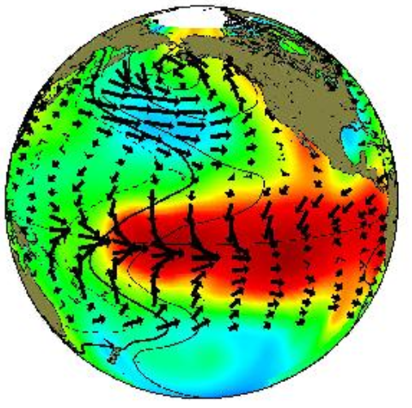
PDO and IPO vs. ENSO
The PDO is the ENSO-like multi-decadal (40-60yr) quasi-oscillations in the North Pacific Ocean
The Inter-decadal Pacific Oscillation (IPO) is the ENSO-like multi-decadal quasi-oscillations in the whole Pacific Ocean, defined in SST and SLP fields
The PDO and IPO may be considered as the decadal variability of ENSO activity
The PDO/IPO is thought to result from atmospheric random forcing with its time scale related to oceanic processes. This is still an active research area.
IPO/PDO Positive or Warm Phase
El Niño or Warm Phase ENSO
IPO: Larger anomalies
in N. Pacific, wider
tropical dSST pattern
Notes:
Causes: reddening of ENSO forced by atmospheric stochastic forcing. But the exact time scale of the IPO or PDO is thought to be determined by the transit time of ocean Rossby waves in the Pacific basin.

Slide 16
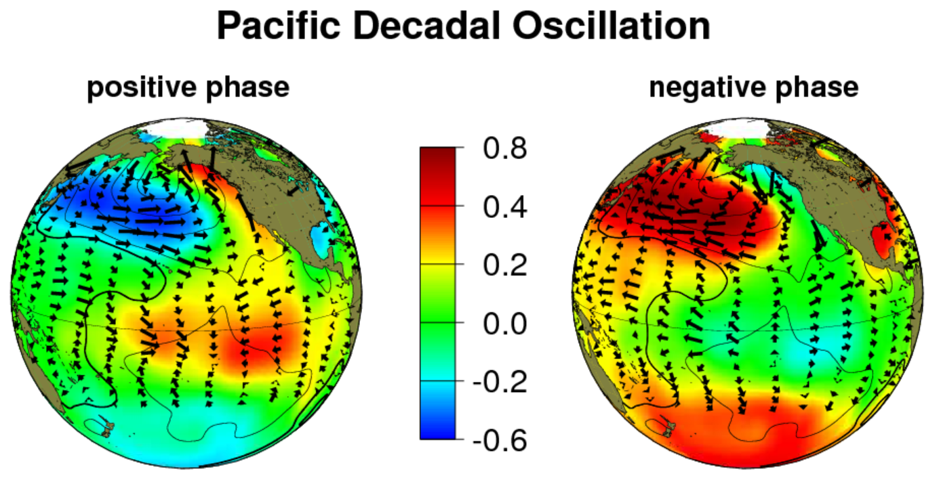

Slide 17
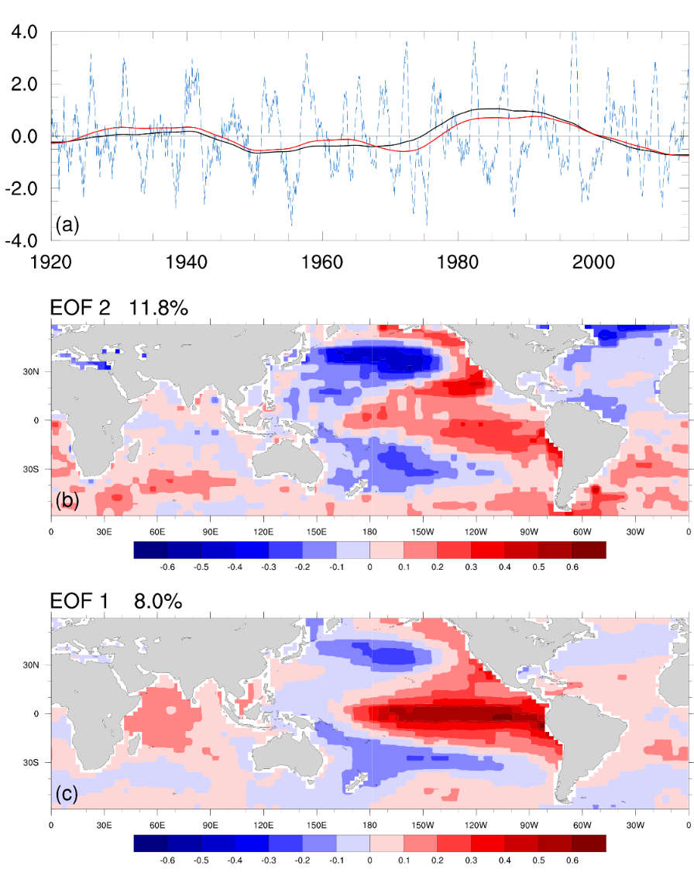
ENSO
IPO
IPO vs. ENSO
Pattern differences:
EOF 2 of 9-yr smoothed SSTs
IPO
IPO has small (large) SST
anomalies over equator (the North Pacific)
ENSO has the largest SST
anomalies on the equator.
EOF 1 of SSTs without 9-yr average
ENSO
Dong et al. (2018)

Slide 18
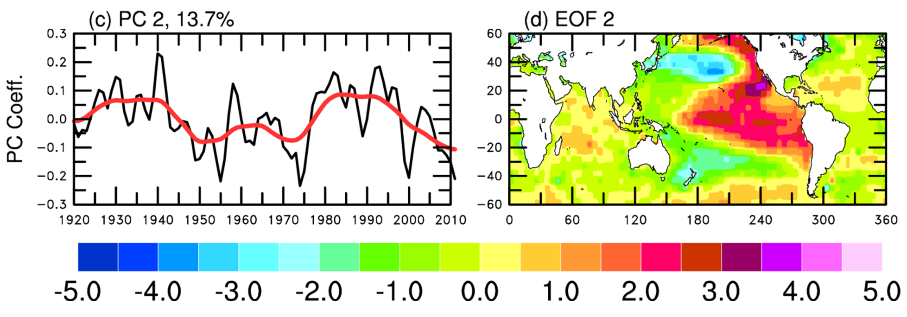
IPO Index
IPO SST Pattern

Slide 19
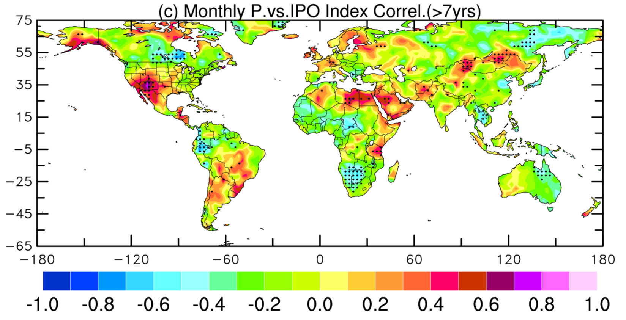
IPO’s Influence on Land Precipitaiton
Dry during
negative IPO phase
Stippling indicates significant at 5% level Dai (2013)

Slide 20
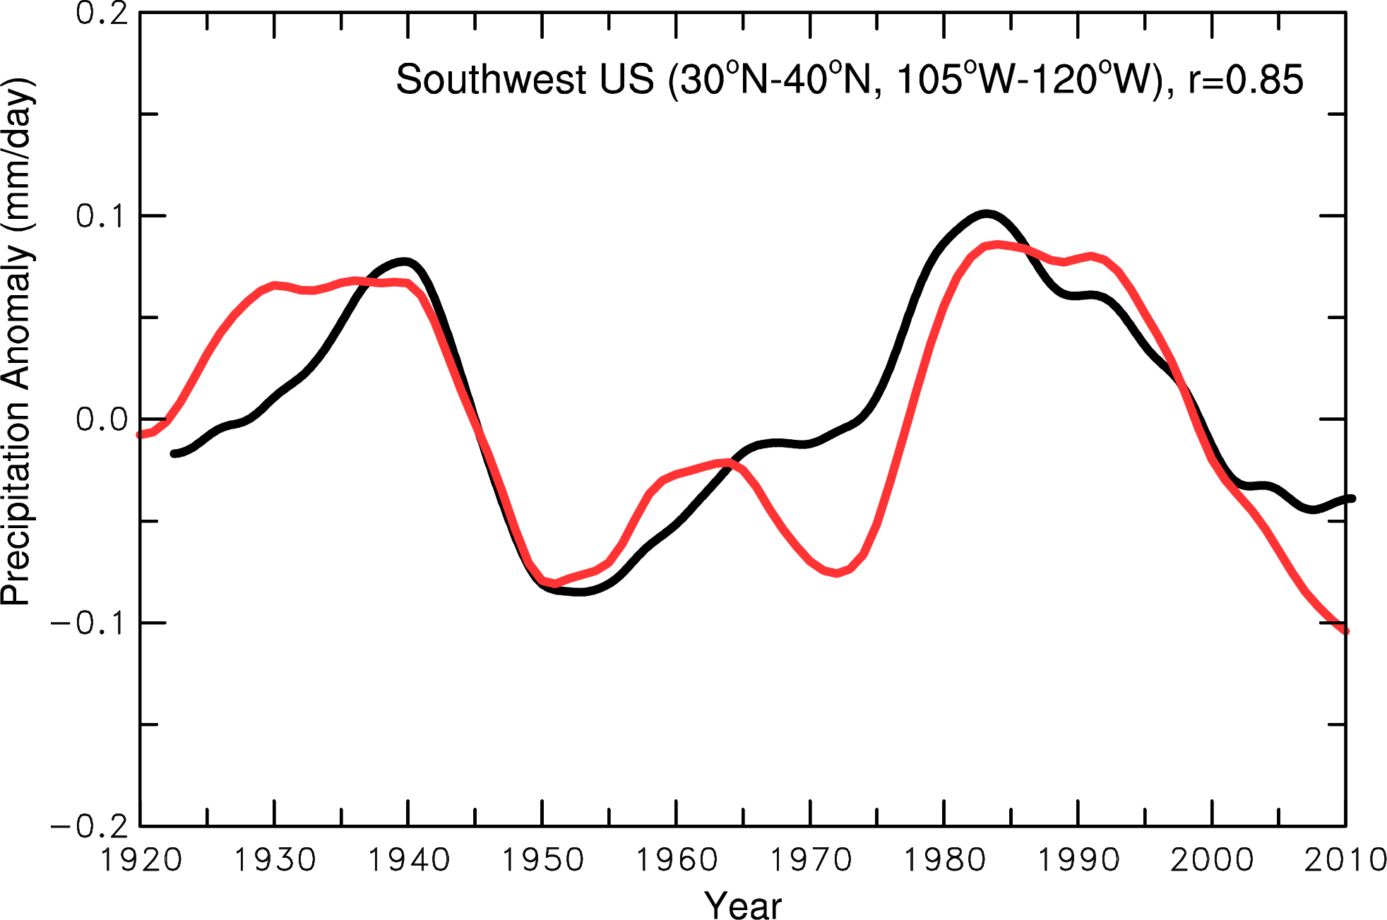
The IPO and Southwest U.S. Precip.
IPO
Precip
?
1999-2029?
31yrs
1924-1945
22yrs
1946-1976
31yrs
1977-1998
22yrs
2020
2030
- What controls the IPO phase change is not well understood
- Models still have difficulties in predicting the IPO
- If it follows previous cycles → Cold phase 1999-2029, Warm phase 2030-2051

Slide 21
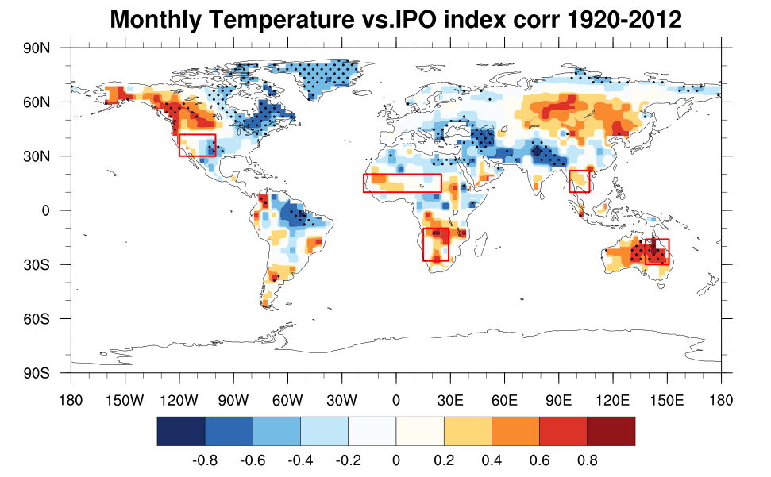
Correlation Between IPO Index and Local T Anomalies
Warm during IPO
positive phase
Dong and Dai (2015)

Slide 22
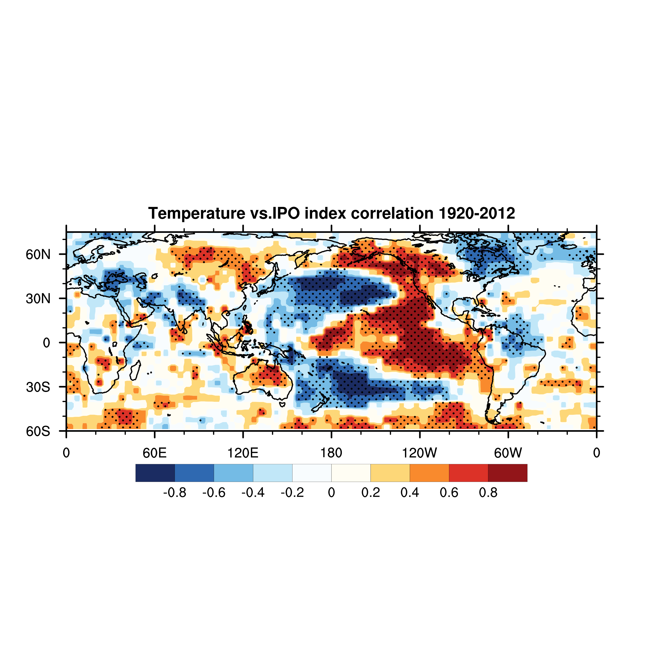
IPO’s Influence on Surface Temperature
Dong and Dai (2015)

Slide 23
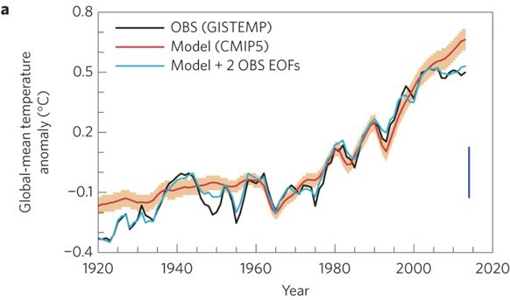
Impacts of IPO and AMO on Global-mean Temperature
(IPO+AMO)
Dai et al. (2015, NCC)

Slide 24

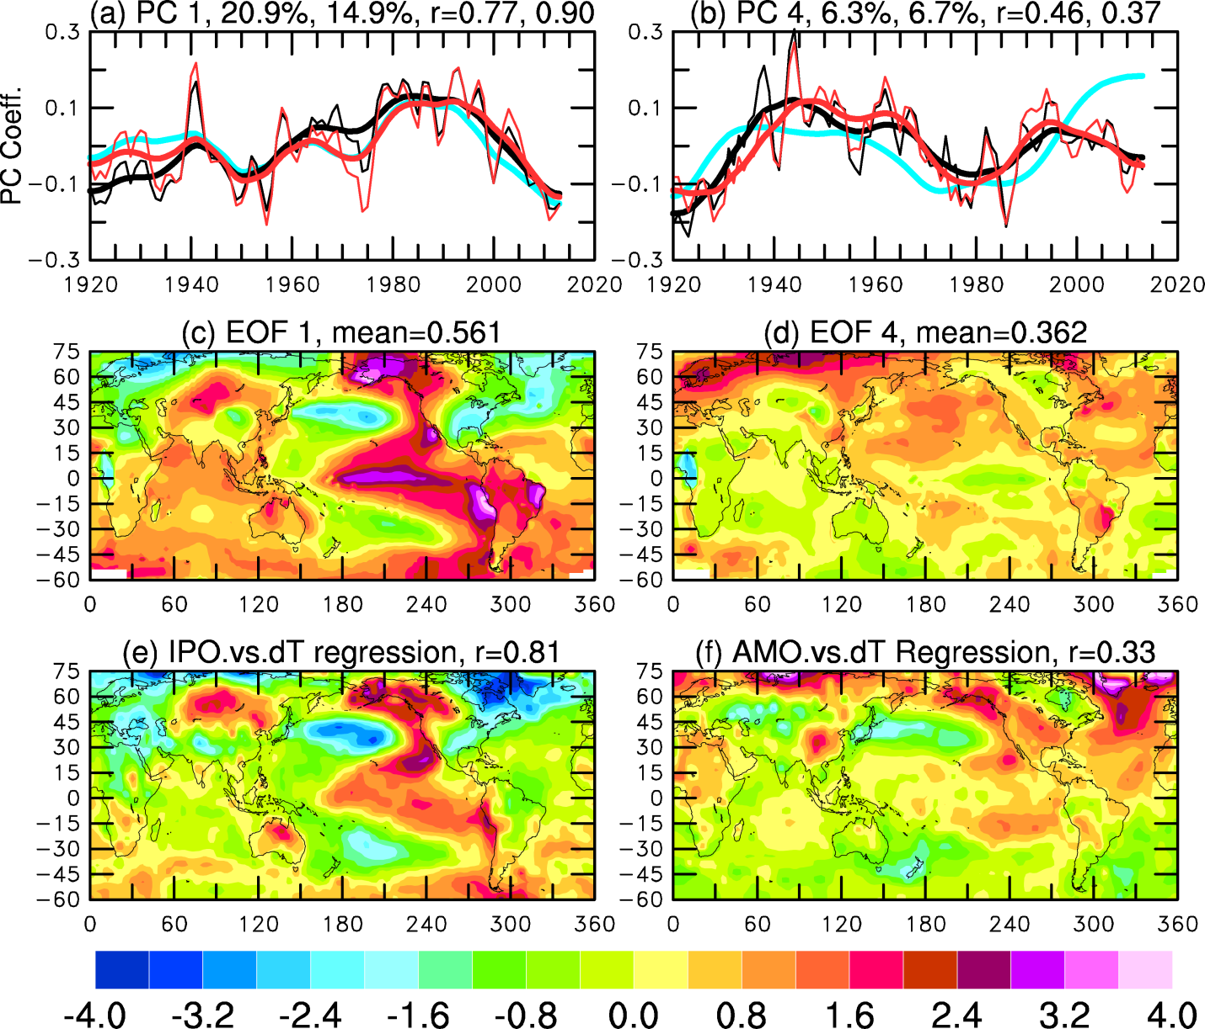
EOF1: IPO Mode EOF4: AMO-related
GISTEMP
IPO
AMO
HadCRUT4
Notes:
Red line = HadCRUT4; black line = GISTEMP; blue line = IPO index in (a) and AMO index in (b)
EOFs are based on GISTEMP
Conclusions:
EOF1 reflects IPO’s influence on T over the globe
EOF4 is related to AMO and the West Pacific Oscillation

Slide 25
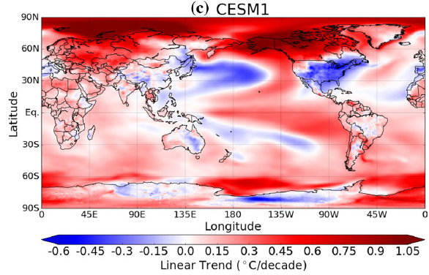
1979-2014 Trend Difference Patterns
Between the Runs with the Maximum and Minimum Global Tas Trend
IPO has a large impact on multidecadal global warming trends!
Dai and Bloecker (2019)

Slide 26
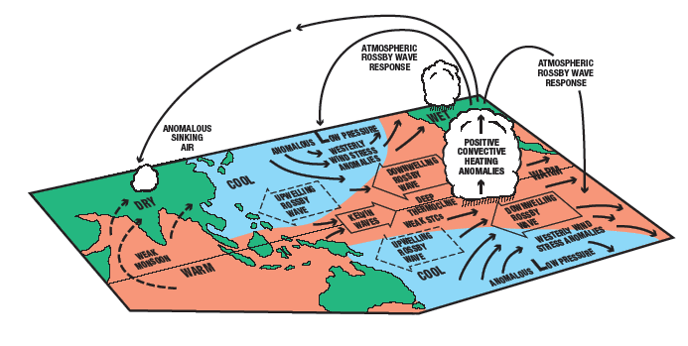
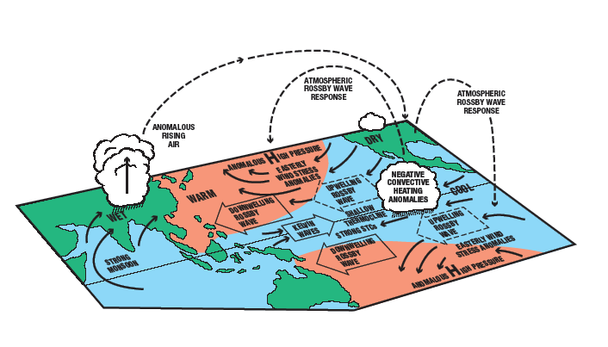
IPO Warm Phase:
IPO Cold Phase:
Meehl & Hu (2006)
Notes:
FIG. 19. Schematic diagram of the coupled atmosphere–ocean tropical–midlatitude mechanism that produces multidecadal precipitation variability over the Great Basin region in the southwestern United States and the Indian monsoon region with extremes in the multidecadal oscillation being manifested as megadroughts in those regions. (a) The phase when the IPO is positive with multidecadal drought in the Indian monsoon region and anomalously wet conditions in the Great Basin region in the southwestern United States, with relatively warm SSTs and positive convective precipitation and convective heating anomalies in the tropical Pacific, deeper low pressure centers in the midlatitude North Pacific and South
Pacific, and anomalous westerly wind stress anomalies extending down to 20°N and 25°S forcing downwelling
ocean Rossby waves that begin to travel westward. Farther west are upwelling ocean Rossby
waves forced by easterly wind stress anomalies 10–15 yr earlier reaching the western boundary where
they will make their way to the equatorial Pacific and be manifested as eastward-propagating upwelling
ocean Kelvin waves that act to shallow the thermocline. Equatorial Pacific SSTs cool, and trade winds
strengthen, spinning up the STCs, which further act to shallow the thermocline and contribute to even
cooler tropical Pacific SSTs. This leads to (b) the phase when the IPO is negative with multidecadal wet
conditions in the Indian monsoon region and drought conditions in the Great Basin region in the
southwestern United States, with relatively cool SSTs and negative precipitation and convective heating
anomalies in the tropical Pacific, shallower low pressure centers in the midlatitude North and South
Pacific, and anomalous easterly wind stress anomalies extending down to 20°N and 25°S forcing upwelling
ocean Rossby waves that begin to travel westward. Farther west are the downwelling ocean
Rossby waves that were forced by the westerly wind stress anomalies 10–15 yr earlier at top reaching the
western boundary where they will make their way to the equatorial Pacific and be manifested as
eastward-propagating downwelling ocean Kelvin waves that act to deepen the thermocline. Equatorial
Pacific SSTs warm, and trade winds weaken, spinning down the STCs, which further act to deepen the
thermocline and contribute to even warmer tropical Pacific SSTs that return the system to the state in (a).

Slide 27
Observed IPO is mainly due to internal variability, not external forcing
IPO from CMIP5 All-forcing Simulations: All Models
Ensemble-mean
Spatial pattern:
IPO in models is
similar to Obs.
Individual runs
IPO Index from
Individual runs (grey)
Ensemble mean (red)
(for all 39 models)
No forced signal!
OBS
Ensemble mean
Hua et al. (2018)

Slide 28
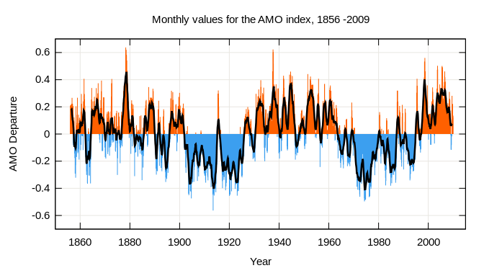
Atlantic Multidecadal Oscillation (AMO)
AMO is the multi-decadal (60-80yr) variability in North Atlantic SST and
other related fields. Also called Atlantic Multidecadal Variability (AMV)
AMO Index is the leading PC in or average of detrended N. Atlantic SST field.
AMO may result from changes in Atlantic Meridional Overturning Circulation (AMOC).
AMO warm phase leads to more drought over U.S. Midwest and Southwest, but
more rainfall over Florida, and is associated with more hurricanes.
Notes:
During NAO+ Phase:
The Positive NAO index phase shows a stronger than usual subtropical high pressure center and a deeper than normal Icelandic low.
The increased pressure difference results in more and stronger winter storms crossing the Atlantic Ocean on a more northerly track.
This results in warm and wet winters in Europe and in cold and dry winters in northern Canada and Greenland
The eastern US experiences mild and wet winter conditions
During NAO- phase:
The negative NAO index phase shows a weak subtropical high and a weak Icelandic low.
The reduced pressure gradient results in fewer and weaker winter storms crossing on a more west-east pathway.
They bring moist air into the Mediterranean and cold air to northern Europe
The US east coast experiences more cold air outbreaks and hence snowy weather conditions.
Greenland, however, will have milder winter temperatures

Slide 29
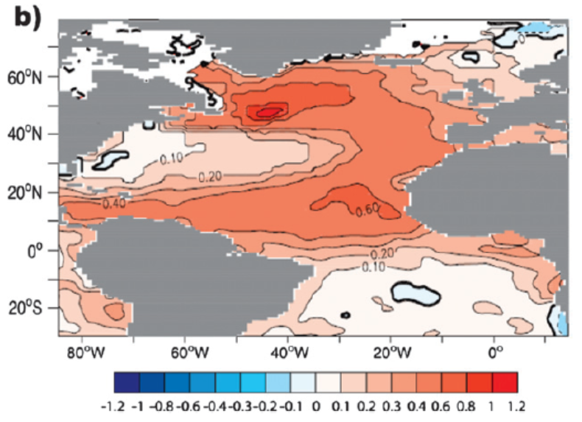
AMO SST Pattern (warm phase)

Slide 30
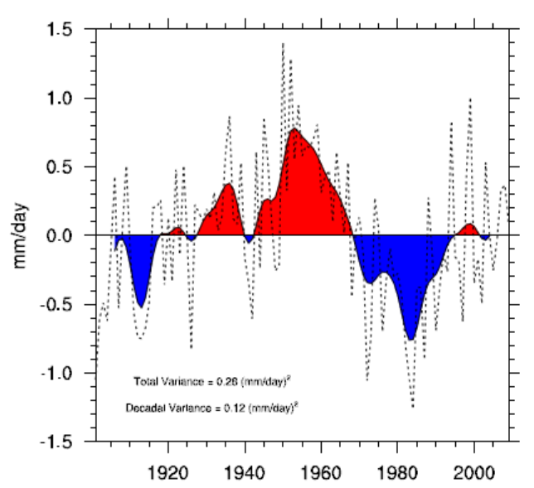
AMO Index
Sahel JJA Rainfall
Notes:
Sahel = (10N-20N, 20W-10E)

Slide 31
Connections to AMO
Sutton et al. (2018)
AMO Index
Global T
NASST

Slide 32
Observed and Simulated AMO-induced Summer P and T Anomalies
AMO Positive minus Negative Phase Difference
JJA P Anomalies
JJA T Anomalies
OBS
MODEL
Zhang et al. (2019)

Slide 33
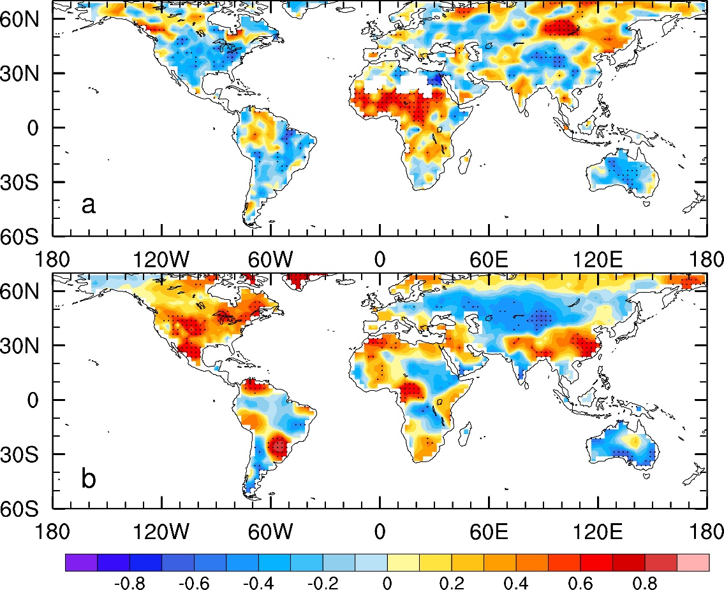
AMO’s Impact on Annual Precipitation & Temperature
1901-2018, CRU TS Data
AMO vs. Precip. Correlation
AMO vs. Temp. Correlation
Qin et al. (2022a)
Notes:
Positive correlation indicates positive T or P anomalies under warm AMO index or warm North Atlantic conditions.
The correlation patterns may change slightly depending on how one defines the AMV index and what dataset and time period are used.

Slide 34
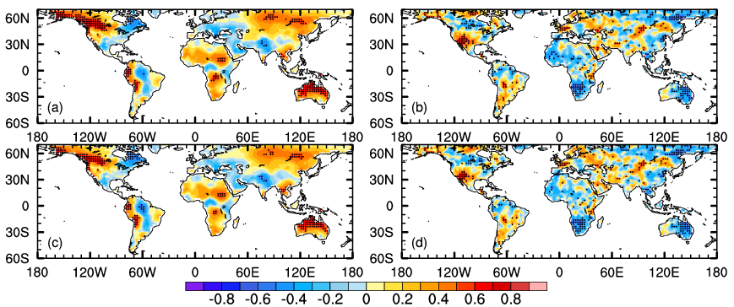
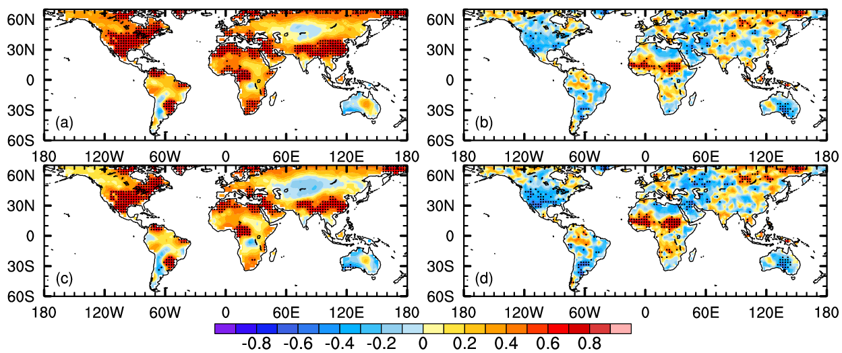
Correlation Patterns of Annual T and P with IPO and AMO Index
(1920-~2018 observational data)
IPO vs.Tas
IPO vs. Pr
AMO vs.Tas
AMO vs. Pr
A positive correlation → a positive T or P anomaly during a warming phase of IPO or AMO
Notes:
1920-2018(?) annual-mean data

Slide 35
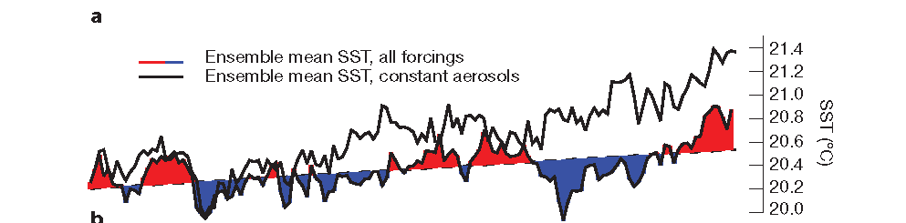

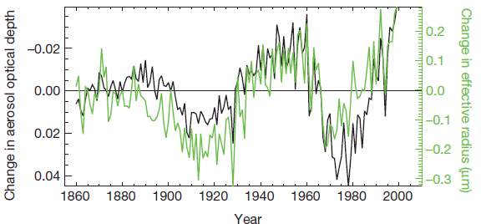
Effects of Aerosols on North Atlantic (0-60ºN) SST
Booth et al. (2012, Nature)
Detrended

Slide 36
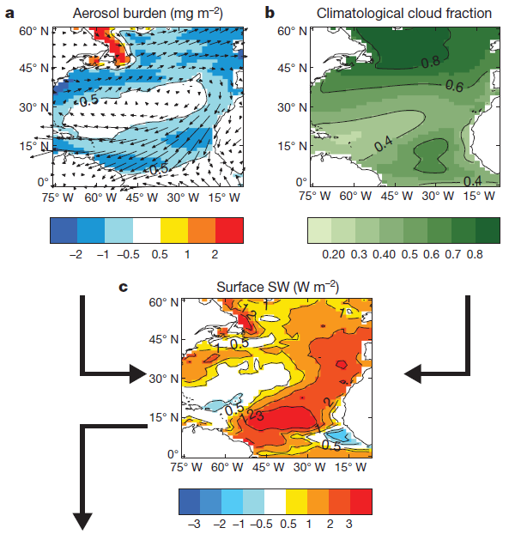
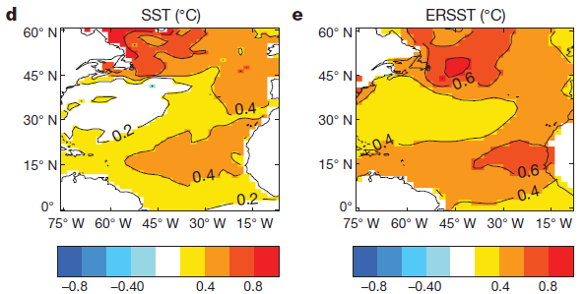
Composite Differences:
North Atlantic Warm minus Cold Phase
Booth et al. (2012, Nature)

Slide 37
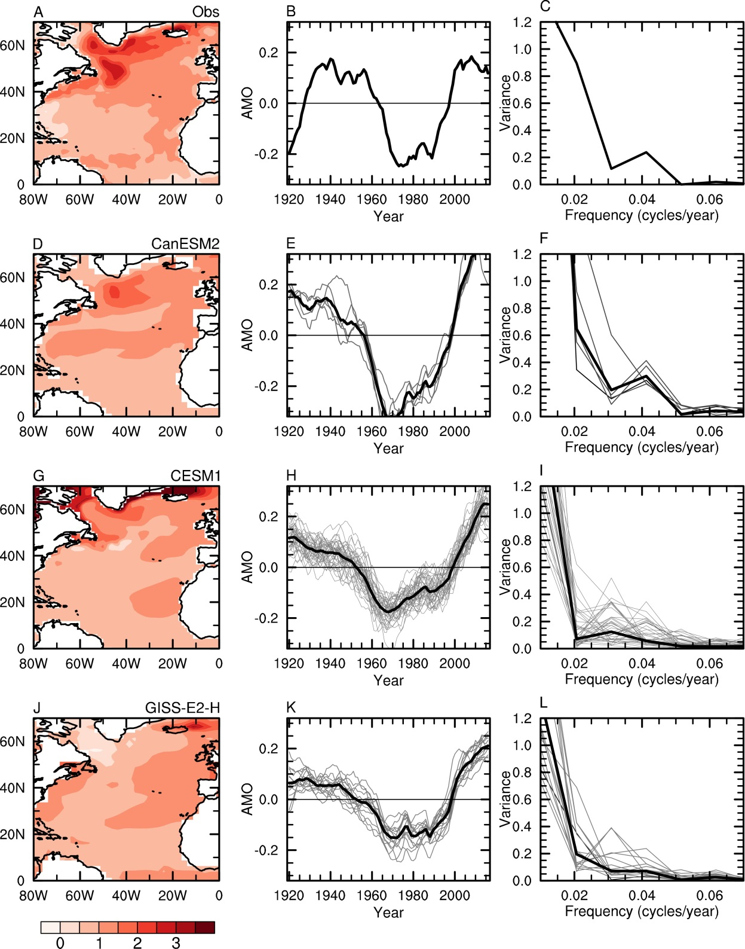
OBS (HadISST)
All-forcing Simulations:
CanESM2
CESM1
GISS-E2-H
Hua et al. (2019)
Notes:
Linear detrended, 11-yr averaged

Slide 38
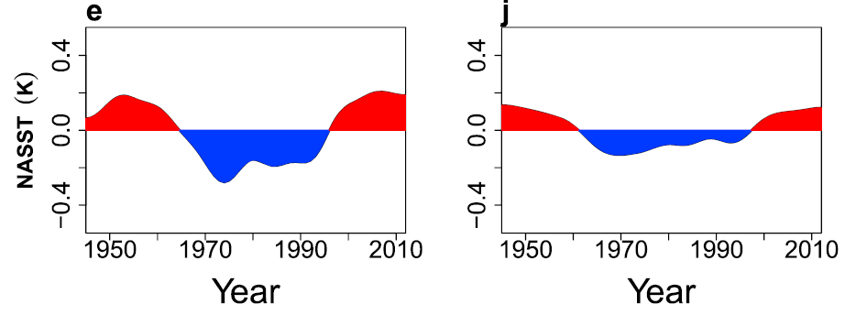
OBS (HadISST)
CMIP5 MMM
Similar multi-decadal variations in NA SST →
A significant contribution by external forcing
Yan et al. (2019, GRL)
Notes:
Linearly detrended SSTA, 10yr averaged

Slide 39
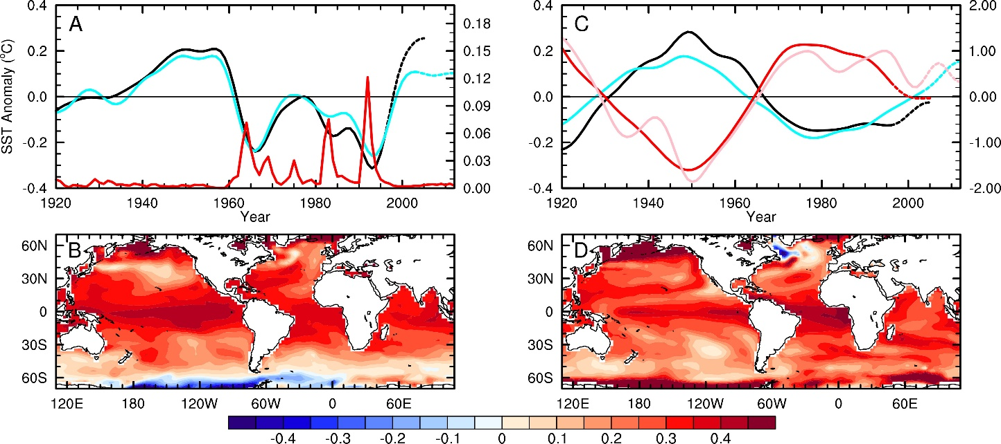
AMO-like SST Variations Caused by Volcanic and Anthropogenic Aerosols
Volcanic Aerosols
Anthoropogenic Aerosols
CMIP5, PC1
CMIP5, AOD
AOD
PC1, CMIP6
EOF1
of SST
Conclusion: Recent AMV is partly forced by aerosols
Qin et al. (2020, Sci. Adv.)

Slide 40
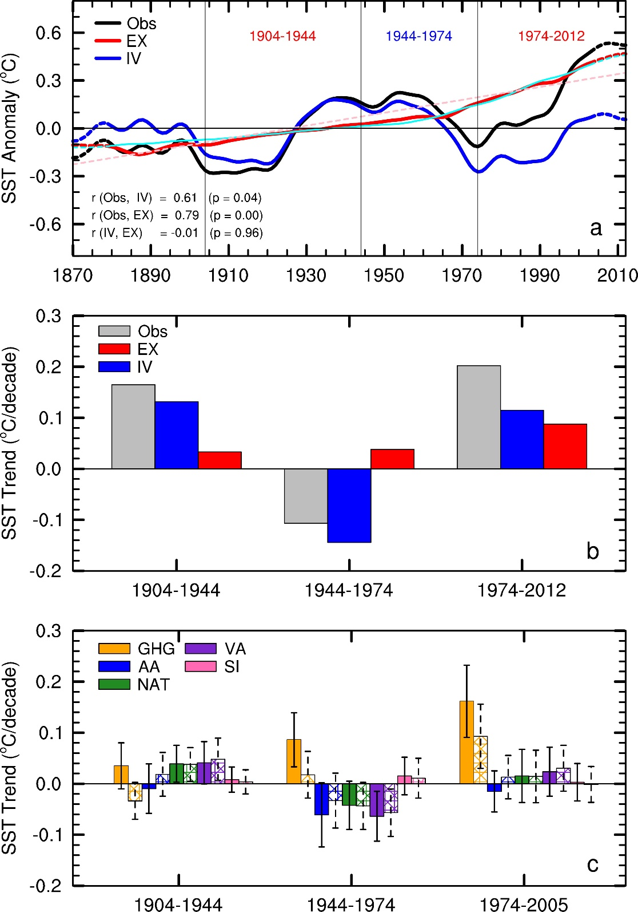
Contributions of External Forcing (EX) and Internal Variability (IV) to AMV
Qin et al. (2020, GRL.)

Slide 41
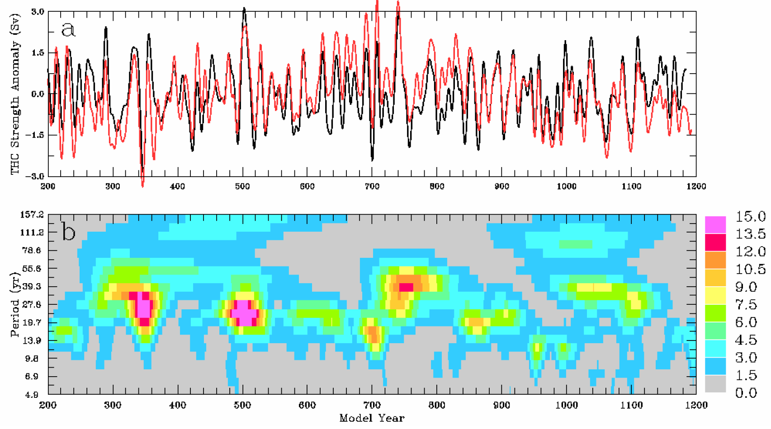
AMV Exists in Long Control Runs of Coupled Models
Conclusion: Internally-generated mode
Dai et al. (2005, J Climate)
Notes:
FIG. 5. (top) Detrended time series of the maximum THC streamfunction anomaly (Sv, black line) and volume transport within top
1-km depth at 40°N in the Atlantic Ocean (Sv, red line) with variations shorter than 10-yr time scales being removed. The curves have
a maximum correlation of 0.70 at a zero time lag. (bottom) The time-period distribution of relative power of the detrended (unsmoothed)
annual maximum THC streamfunction from a wavelet analysis.

Slide 42
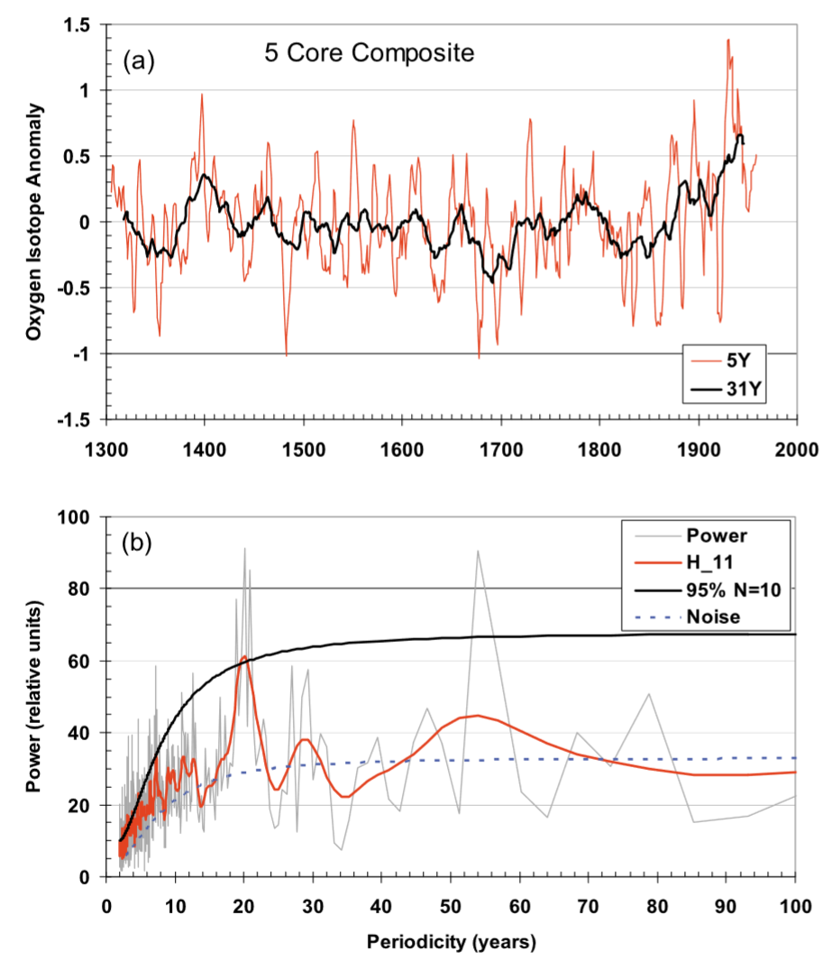
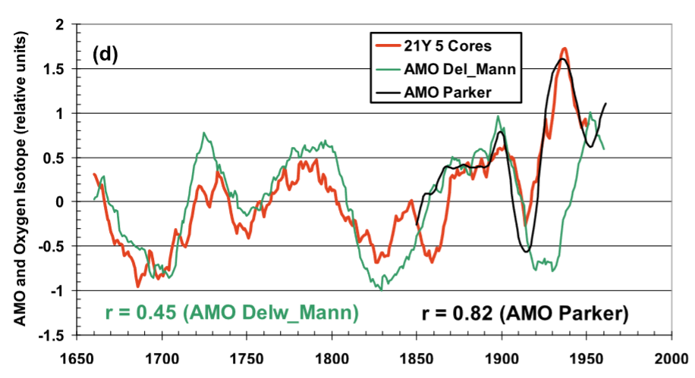
AMV Exists in Greenland Ice-core data before Instrumental Records
Chylek et al. (2011, GRL)
Conclusion: Internally-generated mode

Slide 43
Dynamics of PDO, IPO and AMO
It is still an active research area.
Modeling studies suggest that they are likely result from stochastic forcing (i.e., random weather events).
For PDO and IPO, T changes in the wind-driven upper oceans in the Pacific are important. The two are likely closely coupled.
For AMO, the Atlantic meridional overturning circulation is important, and it may be coupled with the NAO.
Their time scale is thought to be mainly determined by Rossby wave propagation in the extratropics within the Pacific and Atlantic Ocean.
See Liu (2012, J. Climate) for more discussions.

Slide 44
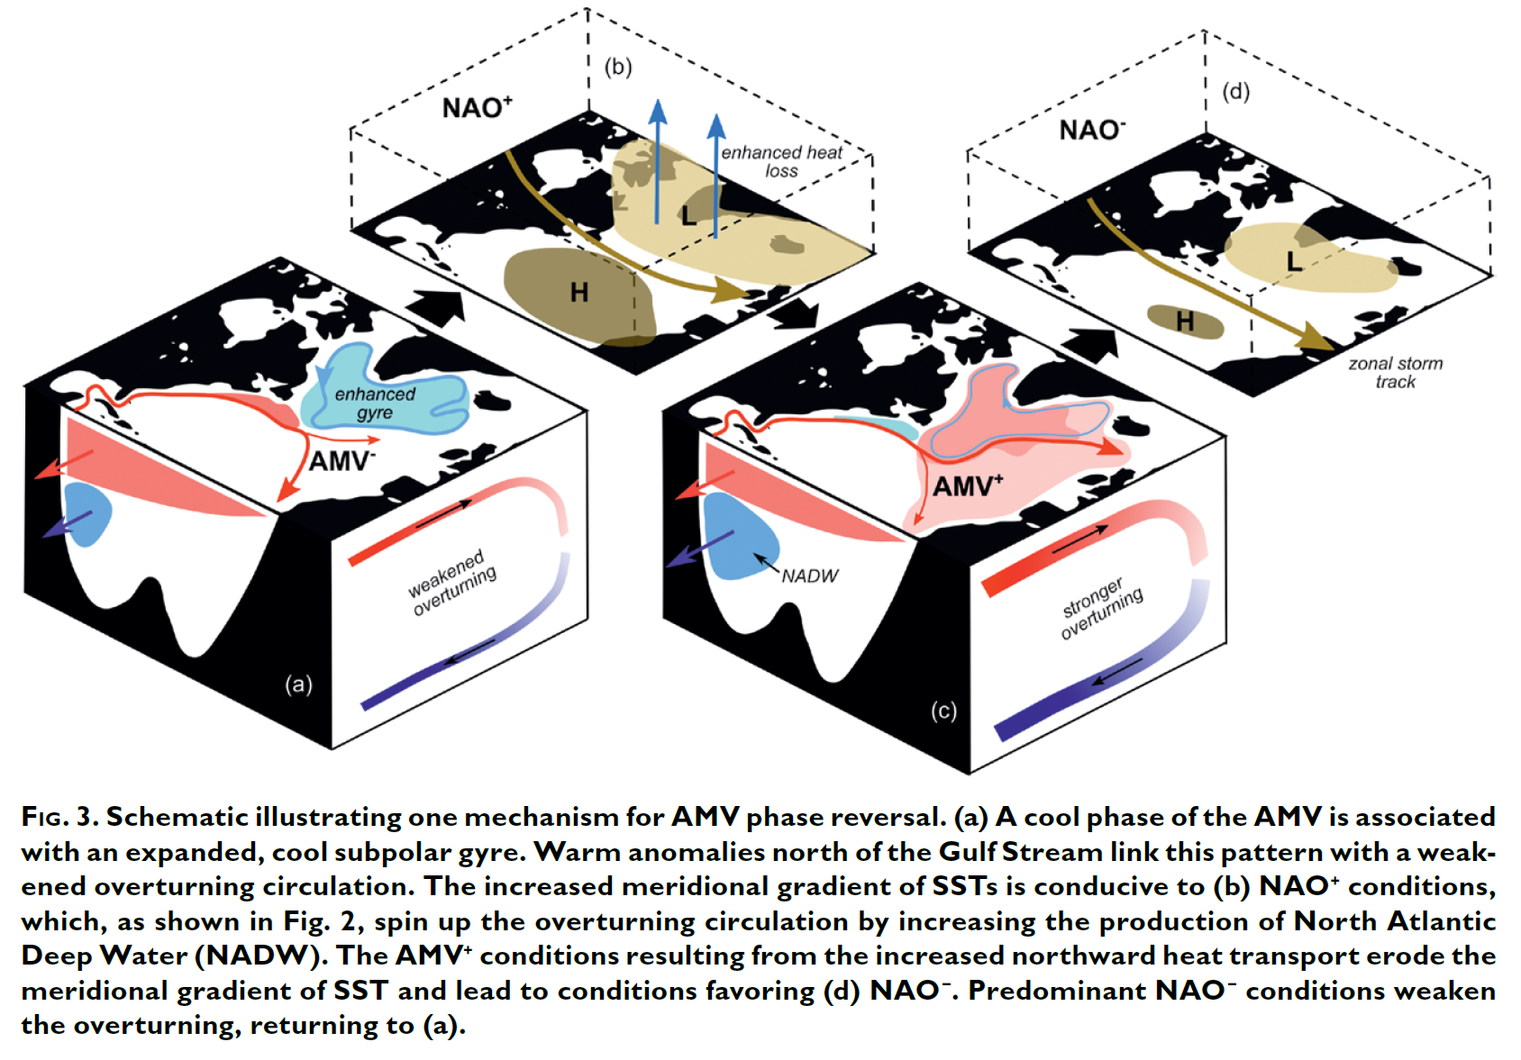
Interactions Among AMV, AMOC and NAO
Sutton et al. (2018)

Slide 45
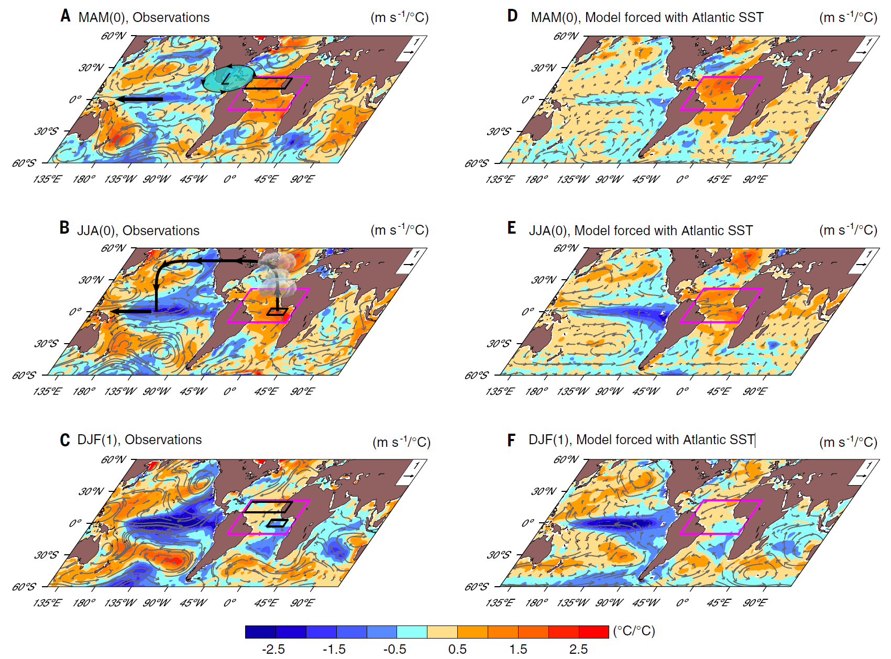
Observed and Simulated Atlantic Influence on Pacific SST & 850hPa Winds
Regression patterns with tropical Atlantic SST (1980-2005)
Cai et al. (2019)

Slide 46
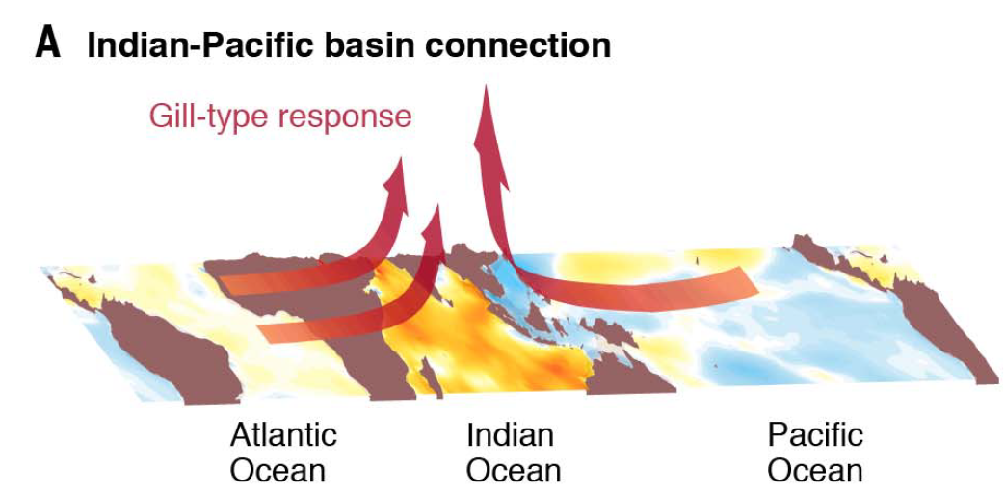
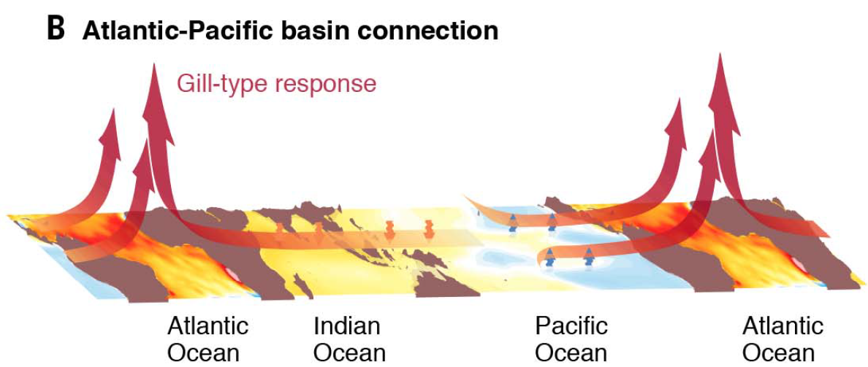
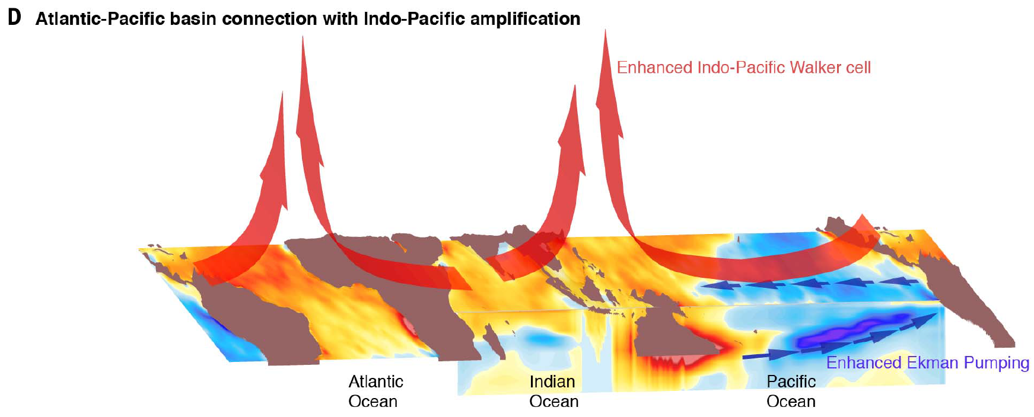
Cai et al. (2019)

Slide 47
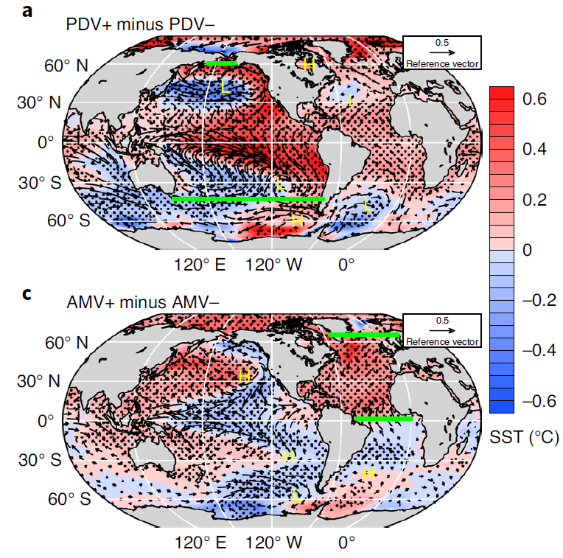
Interactions between PDV/IPO and AMV:
SST & Sfc Wind Results from Pacemaker Coupled Model Simulations
Warm tropical Pacific →
Warm tropical Atlantic
Warm tropical Atlantic →
Cold tropical Pacific
Meehl et al. (2021)
Notes:
A pacemaker simulation is a fully coupled climate model simulation except for a specified region, where SST is specified based on observations or climatology, so that the response in other ocean basins to the specified regional SST can be quantified.

Slide 48


Tropical Atmospheric Response in Pacemaker Coupled Model Simulations
Meehl et al. (2021)

Slide 49


Stronger Pacific trade winds→
Cooling in central-eastern Pacific
Processes Connecting the
Pacific and Atlantic
Surface flux changes + horizonal warm
advection → warming tropical Atlantic
Meehl et al. (2021)

Slide 50


Schematic of the Phase Delay in AMV and PDV
+
Meehl et al. (2021)

Slide 51

Observed AMV and PDV Relationship
Meehl et al. (2021)

Slide 52
Key points of Today’s Lecture
Inter-annual modes: NAO, AO (and ENSO)
NAO and AO: Positive phase→ larger meridional pressure gradients, stronger polar vortex → stronger jet and westerlies → fewer cold breaks from the Arctic to mid-latitudes, more northerly flow over the Atlantic → mild and wet winter in northern Europe and the eastern U.S., but dry Mediterranean (dT is small).
NAO results from interactions between synoptic eddies and planetary waves under certain matching conditions; it typically has a lifetime of ~2 weeks and is influenced by Atlantic westerly winds
Decadal modes: PDO/IPO, AMO/AMV: formation dynamics not well known.
PDO/IPO: the decadal to multi-decadal oscillations in ENSO activities, with periods from ∼40-60 years and spatial patterns similar to ENSO
AMO: The 60-80yr oscillation in SST in the North Atlantic.
These modes are likely generated by stochastic atmospheric forcing, with Rossby wave propagation in the extratropical Pacific and Atlantic Ocean being key to their time scales.
AMO may result from the interactions between AMV, AMOC and NAO: AMV-/AMOC- → NAO+ → AMV+AMOC+ → NAO- → AMV-/AMOC-
AMO cycles since 1920 may be partly forced by changes in aerosols
IPO and AMO affects T and P over the Americas, West Africa, Europe and Asia on decadal-multidecadal time scales. They affect global-mean T on multidecadal time scales.
Warm tropical Atlantic leads to cooing in the central-eastern tropical Pacific due to stronger trade winds
Warm tropical Pacific leads to warm tropical Atlantic due to local flux changes and horizontal warm advection.

Slide 53
Homework #4 (due in one week)
How do we measure climate variability? How and why is the variability of surface air temperature projected to change at northern high latitudes and in low latitudes? (20%)
Describe the mechanisms or physical processes behind the ENSO cycles, including the Bjerknes feedacks and the processes that end an El Niño or La Niña event and those that lead to the opposite phase in an ENSO cycle. (25%)
Describe the temporal and spatial characteristics of the IPO and AMO, their impacts on global climate, their interactions, and their likely formation mechanisms. (25%)
How do NAO and AO affect weather over North America and Europe? What are the main features for the positive and negative phases of NAO and AO? (20%)
What is the relationship among ENSO, PDO, and IPO? (10%)

Slide 54
Next Lecture:
Climate forcing, and response vs Internal variability

