Slide 1
A ATM551: #22
Climate Feedbacks
Reading Materials:
Chapter 10 of Hartmann GPC
Hansen et al. (1984, AGU Monograph)
Roe, R., 2009: Feedbacks, Timescales, and Seeing Red. Annu. Rev. Earth Planet. Sci. 37:93–115.

Slide 2
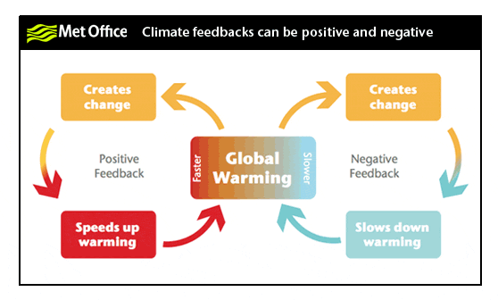
Climate Feedbacks
Refer to physical processes that either enlarge (positive) or reduce (negative) the response of the global-mean surface temperature to an initial radiative forcing.
Examples:
  Positive feedbacks: water vapor feedback, ice-albedo feedback, Arctic sea-ice feedback
  Negative feedbacks: Chemical weathering feedback, tropical SST-cloud feedback, temperature feedback (= Planck feedback + lapse rate feedback)

Slide 3
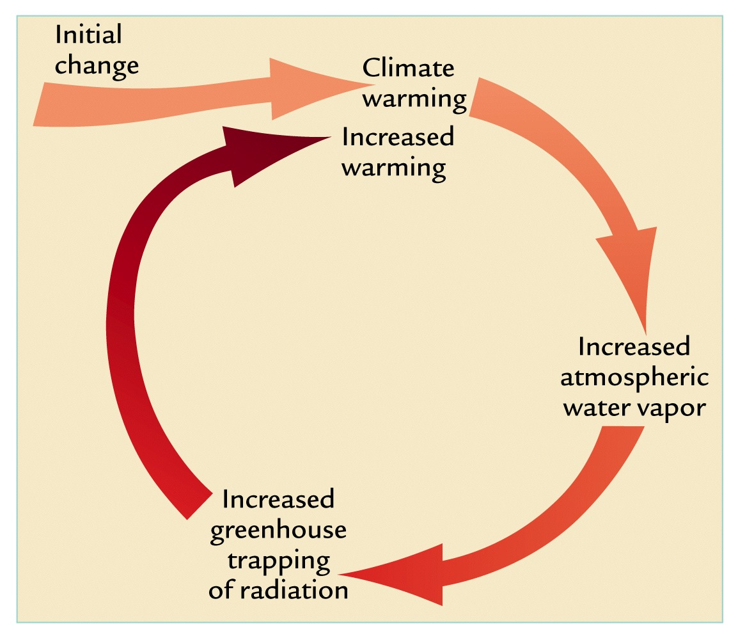

Temperature feedback (fast, negative)
Reduced
-
Increased surface
and atmospheric T
Increased radiative cooling:
LW ~ σ T⁴

Slide 4
Water vapor positive feedback (fast, positive)
+

Slide 5

Climate Sensitivity: 0-D Model Analysis
Global energy balance at TOA: Net = Net SW – OLR or N = S – F (positive downward)
At equilibrium, Net = 0 and S = F. Note: Net SW = S_{o} (1 – αp)/4
If there is a perturbation to the system (e.g., a doubling of CO2 ) that produces a TOA
net forcing of dR (positive downward, e.g., dR=4W/m² for 2xCO2), then the climate
system will try to adjust itself to reach a new equilibrium with a surface temperature
change of dTs and a new TOA balance so that dN = dS – dF = –dR (i.e., the dN is to cancel
the initial forcing dR). Then
where W, C, and A represent water vapor, clouds, and surface albedo. Ignoring all the feedbacks, assuming W, C, A and α_{p} do not change, and considering only the response of LW to Ts changes, then
Observed relationship: F ≈ 1.55Ts – 212 (North 1975), which yields λ = 0.6 K (W/m²)⁻¹. Why?
$$λ≡\frac{dT_{s}}{dR}={\left(\frac{dR}{dT_{s}}\right)}^{−1}=\frac{1}{\frac{dF}{dT_{s}}−\frac{dS}{dT_{s}}}$$
$$\frac{dF}{dT_{s}}=\frac{∂F}{∂T_{s}}+\frac{∂F}{∂W}\frac{∂W}{∂T_{s}}+\frac{∂F}{∂C}\frac{∂C}{∂T_{s}}+\frac{∂F}{∂A}\frac{∂A}{∂T_{s}}+⋯$$
$$−\frac{dS}{dT_{s}}=\frac{S_{o}}{4}\left(\frac{∂α_{p}}{∂T_{s}}+\frac{∂α_{p}}{∂W}\frac{∂W}{T_{s}}+\frac{∂α_{p}}{∂C}\frac{∂C}{∂T_{s}}+\frac{∂α_{p}}{∂A}\frac{∂A}{∂T_{s}}+⋯\right)$$
$$λ={\left(\frac{∂F}{∂T_{s}}\right)}^{−1}≈{\left(\frac{∂\left(εσ{T_{s}}^{4}\right)}{∂T_{s}}\right)}^{−1}=\frac{1}{4εσ{T_{s}}^{3}}≈0.3 K(W/m^{2})^{−1} for ε=0.612 and T_{s}=288K.$$

Slide 6
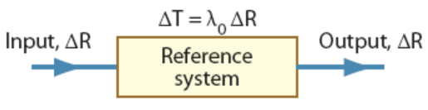
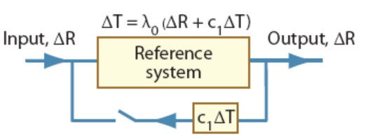
Climate Feedback Analysis
There are at least three different methods to analyze/quantify climate feedbacks:
Method 1: Using dTs ratios between the cases with and without the feedback process as the feedback factor f_{h} (Hansen et al. 1984). This method directly follows the original definition of climate feedback (modulation to the Ts change) and thus is easy to understand.
Method 2: Define the feedback factor f_{r} as the gain factor for radiative forcing (Roe 2009):
f_{r} ≡ c₁ λ_{o} and ΔT = λ_{o} (ΔR + c₁ ΔT) → λ_{o} ≡ ΔT_{o}/ ΔR
ΔT = λ_{o} ΔR/(1 – c₁λ_{o}) = ΔT_{o} / (1 – f_{r} ) →
f_{h} = 1 / (1 – f_{r} )
f_{r} is the gain factor g of Hansen et al. (1984), and
the gain factor (G) in Roe (2009) is Hansen’s
feedback factor (f_{h})!
Relationship between climate sensitivity (λ) and f_{h}:
ΔT_{s} = λ ΔR and ΔT_{s} = f_{h} ΔT_{o}= f_{h} λ_{o} ΔR → λ = f_{h} λ_{o} , where λ_{o} is the sensitivity without the
feedback.
Forcing
ΔR
Ref. System
Without feedback
Response
ΔT_{o}
Forcing
ΔR
Ref. System
With feedback
Response
ΔT_{s}
f_{h} ≡ ΔT_{s}/ ΔT_{o}
o

Slide 7
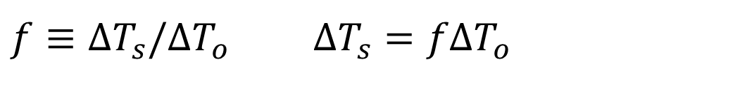
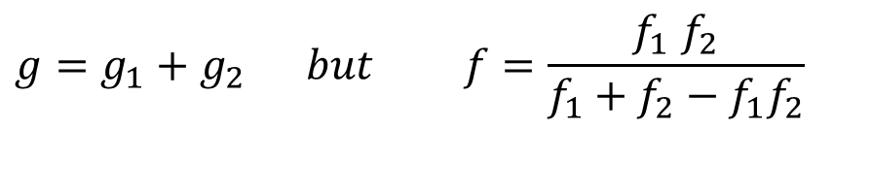
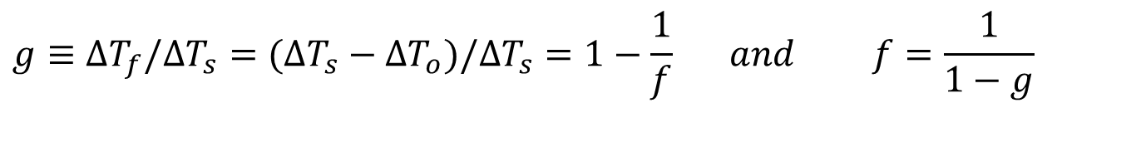
Quantification of Climate Feedback
(Hansen et al. 1984)
$$f≡ΔT_{s}/ΔT_{o} ΔT_{s}=fΔT_{o}$$
Where ΔTs is the change in global-mean surface air T at equilibrium. ΔT_{o} is the T change without the feedback. f is the feedback factor (~2 for water vapor).
Gain factor (g):
For multiple processes:
$$g≡ΔT_{f}/ΔT_{s}=(ΔT_{s}−ΔT_{o})/ΔT_{s}=1−\frac{1}{f} and f=\frac{1}{1−g}$$
$$g=g_{1}+g_{2} but f=\frac{f_{1 }f_{2}}{f_{1}+f_{2}−f_{1}f_{2}}$$
Notes:
2xCO2 forcing = 3.7W/m2

Slide 8
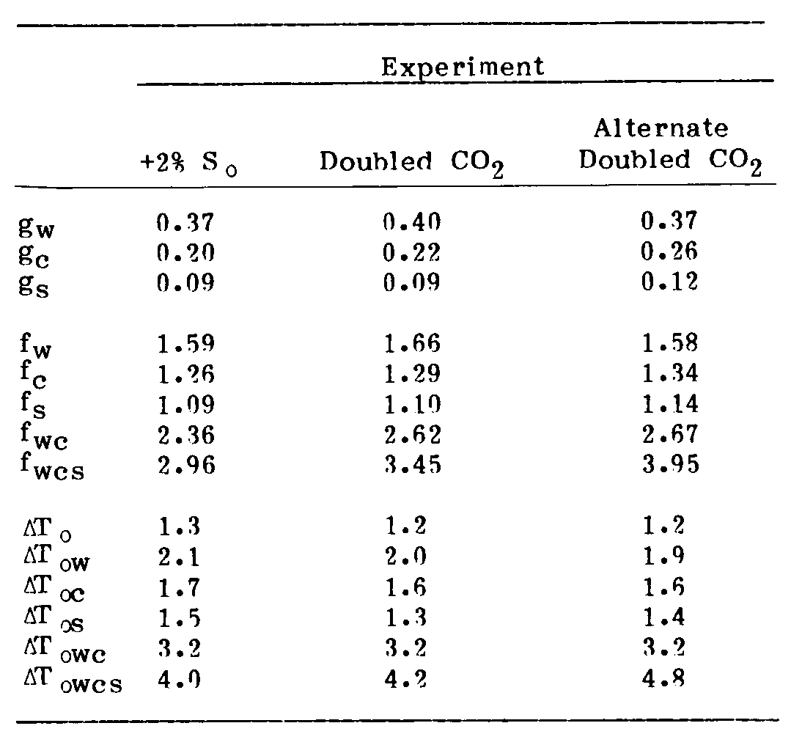
1-D Model Estimate of f and g:
Based on 1-D radiative-convective model calculations with 3-D GCM calculated global changes in the quantities.
g = f_{r}
f = f_{h}
Hansen et al. (1984) w=water vapor, c=clouds, s=snow/ice
Notes:
Based on 1-D radiative-convective model calculations with 3-D GCM calculated global changes in the quantities.

Slide 9
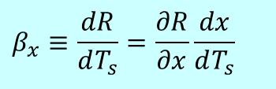
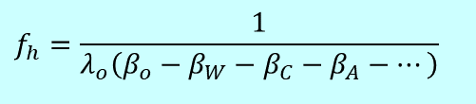
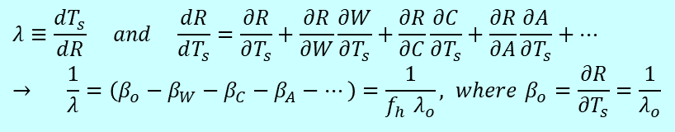
Quantifying Climate Feedback: 3rd Method
(Soden et al. 2008; Jenkins and Dai 2021, GRL)
The feedback factor is defined in terms of changes in radiative forcing
at the tropopause or top of the atmosphere (TOA):
R is the TOA net radiative flux (positive downward), x represents a feedback variable (water
vapor W, clouds C, albedo A, etc.), Ts is the global-mean surface air temperature.
β_{x} is defined as the TOA net radiative flux change due to changes in x per
unit surface warming, in W/m²/K. Often for global-mean or regional mean.
This is very different from the original definition of climate feedback and
Hansen’s f_{h}. In 0-D model analysis:
λ_{o}=0.26, β_{o}=1/λ_{o}=3.85; for β_{w}=2, f_{h}=2.1
But it is unclear how these two are related in GCMs, because the R change at TOA
is not directly related to Ts in the real world and GCMs, especially for transient
climate changes (such as the CMIP5 and CMIP6 runs).
Even more confusing, Soden and others name their feedback factor also as λ.
∂R/∂x is computed using 1-D radiative transfer model or AGCMs with the kernel
method, dx/dT_{s} is estimated from GCM output or observations.
See Jenkins & Dai (2021) for more details on the kernel method, and Dai & Jenkins (2023)
for proper interpretation of the impact on Ts of the estimated TOA flux change.
$$β_{x}≡\frac{dR}{dT_{s}}=\frac{∂R}{∂x}\frac{dx}{dT_{s}}$$
$$λ≡\frac{dT_{s}}{dR} and \frac{dR}{dT_{s}}=\frac{∂R}{∂T_{s}}+\frac{∂R}{∂W}\frac{∂W}{∂T_{s}}+\frac{∂R}{∂C}\frac{∂C}{∂T_{s}}+\frac{∂R}{∂A}\frac{∂A}{∂T_{s}}+⋯ \\ → \frac{1}{λ}=\left(β_{o}−β_{W}−β_{C}−β_{A}−⋯\right)=\frac{1}{f_{h} λ_{o}}, where β_{o}=\frac{∂R}{∂T_{s}}=\frac{1}{λ_{o}}$$
$$f_{h}=\frac{1}{λ_{o}\left(β_{o}−β_{W}−β_{C}−β_{A}−⋯\right)}$$
Notes:
2xCO2 forcing = 3.7W/m2

Slide 10
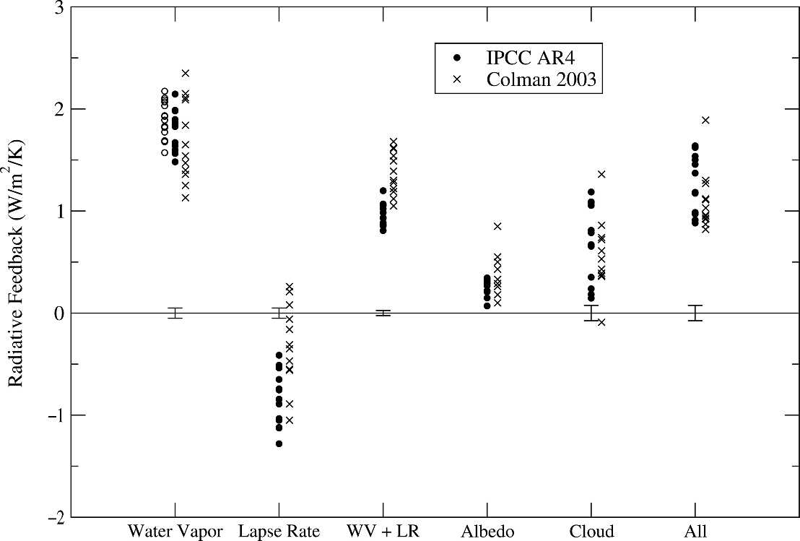
β Estimates for Climate Models
(Soden & Held 2006, J Clim)
β
For λo=0.26 and β=1.8, f_{h}≈1.9; for λo=0.3 and β=1.8, f_{h}≈2.2
Compared with Hansen’s estimate of f_{h}≈ 1.7
Notes:
Solid circles are estimates by Soden and Held (2006). The open circles are estimated with fixed RH by them.

Slide 11
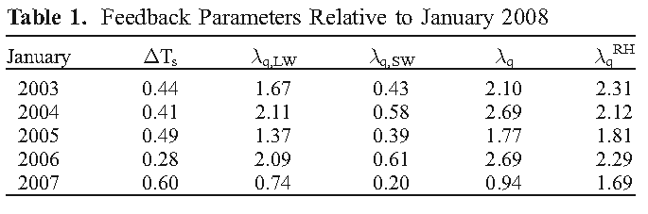
β_{w} Estimates from Satellite Observations
(Dessler et al. 2008, GRL)
(W/m²/K)
Dessler’s λ_{q} is the β_{w} here. For simple model analysis:
For λo=0.26 and β=2.0, f_{h}≈2.1; for λo=0.3 and β=2.0, f_{h}≈2.5
Compared with Hansen’s estimate of f_{h}≈ 1.7
Notes:
Based on Satellite-observed T and q changes from 2003-2008

Slide 12
Temperature feedback (fast, negative)
(also called Stefan-Boltzmann feedback)
λ_{B}=(dσT⁴/dT)⁻¹
≈0.26K/W/m²
For α=0.3, for 1W/m²
TOA forcing, it
requires 1x4/0.7=5.7W/m²
change in solar
constant So, so that
for 1K T change,
it requires 5.7/0.26=
22W/m² or 1.6%
change in So (=1366).
Other positive feedbacks
must be at work to
increase climate
sensitivity to 0.5~1.1 K/W/m² seen in CMIP5
models.
Reduced warming
Reduced Warming
-
Increased surface
and atmospheric T
Increased radiative cooling:
LW ~ σ T⁴

Slide 13
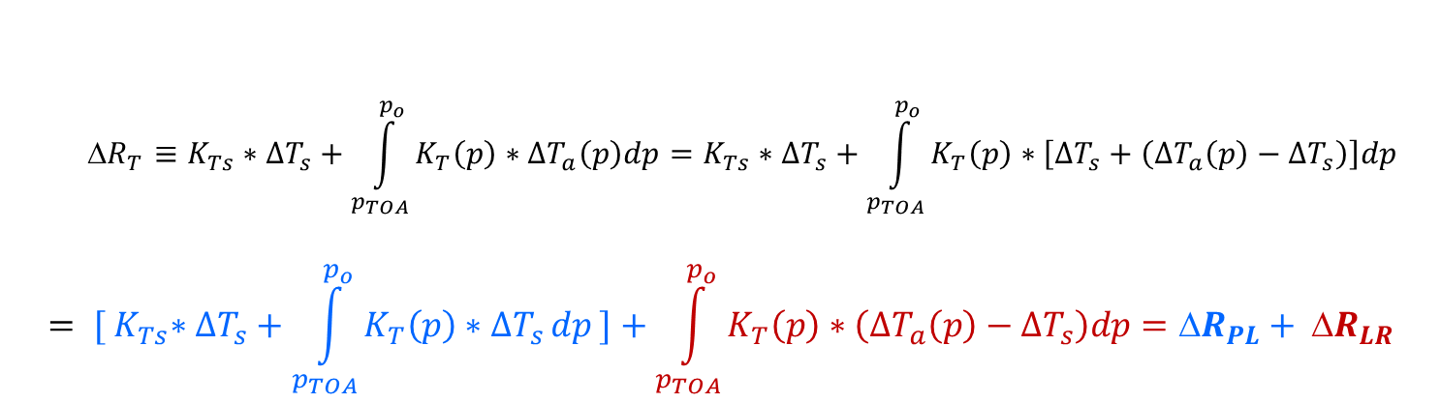
Decomposition of the Temperature Feedback into Planck Feedback and Lapse Rate Feedback
(Jenkins and Dai 2021, GRL)
$${R}_{T}≡K_{Ts}∗ΔT_{s}+\int_{p_{TOA}}^{p_{o}}{K_{T}\left(p\right)∗ΔT_{a}\left(p\right)dp}=K_{Ts}∗ΔT_{s}+\int_{p_{TOA}}^{p_{o}}{K_{T}\left(p\right)∗\left[ΔT_{s}+\left(ΔT_{a}\left(p\right)−ΔT_{s}\right)\right]dp}$$
$$= {[ K}_{Ts}∗ΔT_{s}+\int_{p_{TOA}}^{p_{o}}{K_{T}\left(p\right)∗ΔT_{s }dp ]+\int_{p_{TOA}}^{p_{o}}{K_{T}\left(p\right)∗\left(ΔT_{a}\left(p\right)−ΔT_{s}\right)dp={ΔR}_{PL}}+ {ΔR}_{LR}}$$
Notes:
dR_{T} is the TOA LW radiative flux change due to surface (dTs) and tropospheric warming (dTa). K_{T}(p) (<0) is the temperature radiative kernel at pressure level p, estimated using radiative transfer model by perturbing air temperature by 1K at pressure level p only (without other changes) and measure the TOA LW flux change (which is always upward, cooling for the Earth climate system). K_{Ts} is the surface temperature radiative kernel.

Slide 14
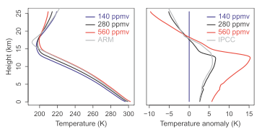
Lapse Rate Feedback
Particularly in the tropics, the vertical temperature gradient expected to decrease
  Envision a “parcel of air” rising, releasing latent heat as it condenses and warming the surrounding air. A warmer parcel contains more water vapor when it becomes saturated, so it condenses more vapor as it rises, and temperature decreases with height more slowly. That is, the moist adiabatic lapse rate, -dT/dz , decreases with warming.
  Negative in the tropics, but positive in the Arctic.
Tropical Warming Profiles
Recall greenhouse effect dependent on vertical temperature gradient. More emission aloft implies surface doesn’t need to heat up as much to get back to equilibrium
Negative Feedback that is anti-correlated (strongly) with water vapor feedback
Courtesy of Isaac Held

Slide 15
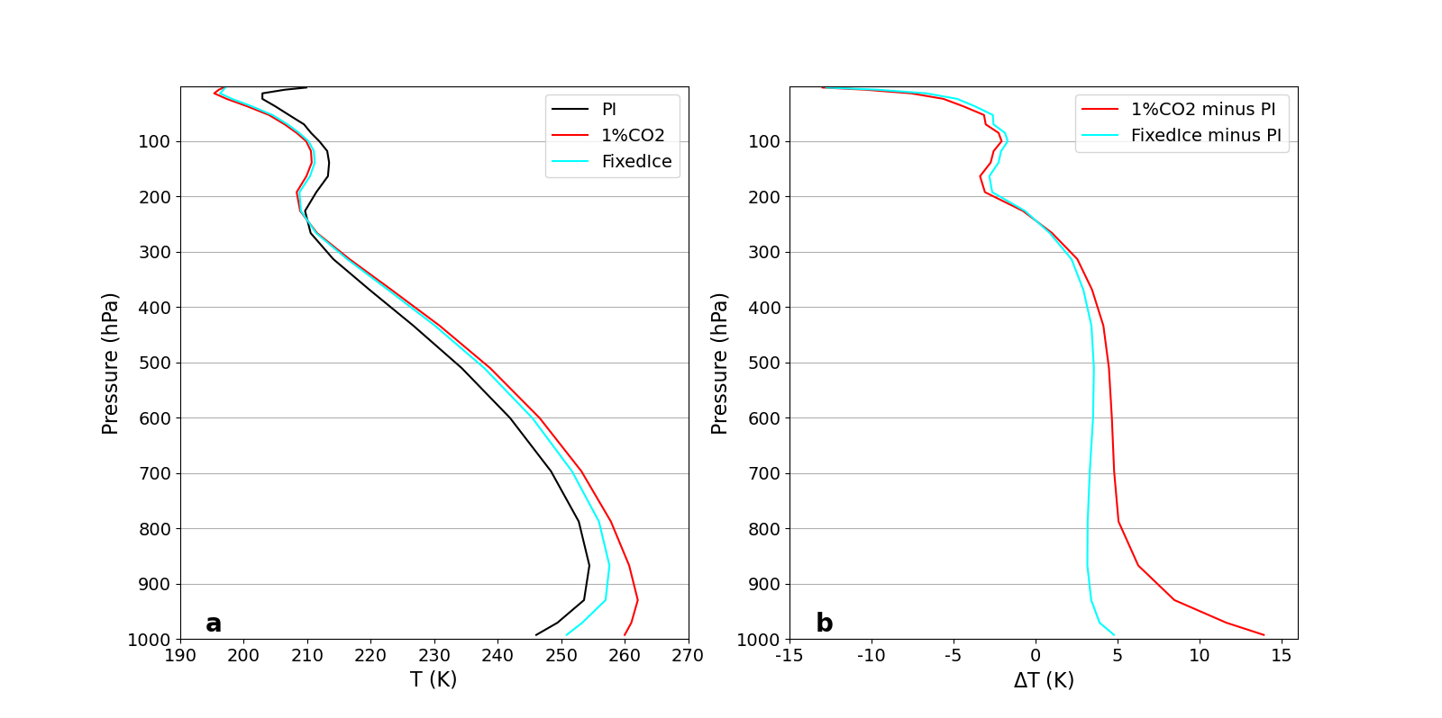
Arctic (67-90ºN) Warming Profiles
CESM1 runs with 1%/yr CO₂ increase, ANN
Positive Lapse
Rate Feedback
Jenkins and Dai (2021)

Slide 16
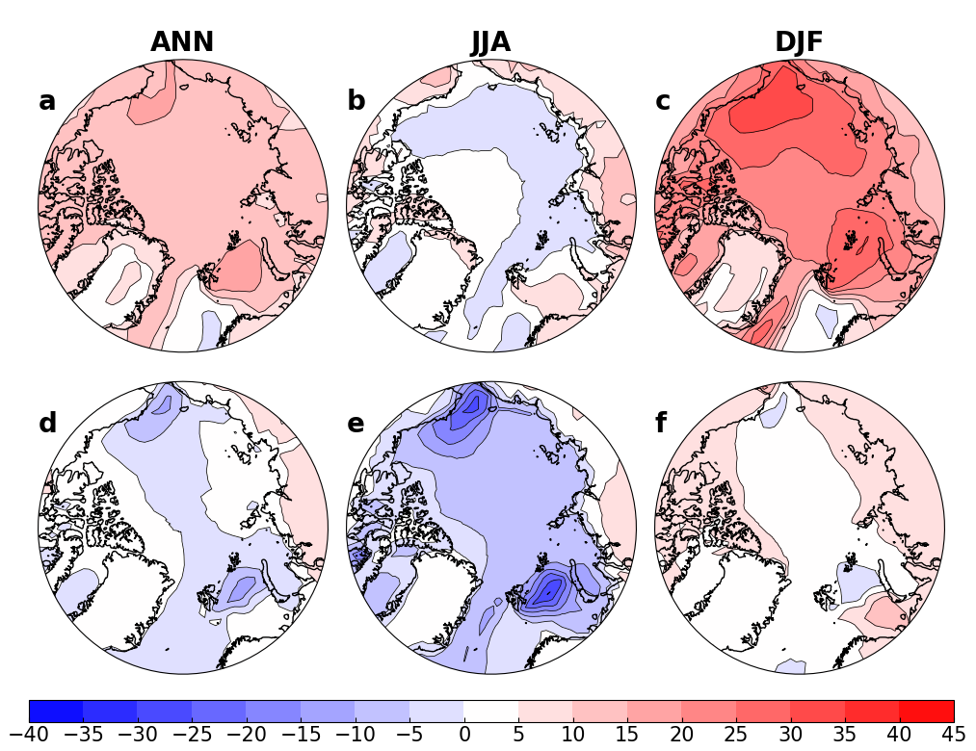
Arctic Positive Lapse Rate Feedback
CESM1 runs with 1%/yr CO₂ increase
Fully coupled:
Fixed sea ice:
TOA Flux Change (in Wm⁻²) around 4xCO₂
Jenkins and Dai (2021)

Slide 17
Arctic Permafrost and Climate Change
(~4min., made in 2013)

Slide 18
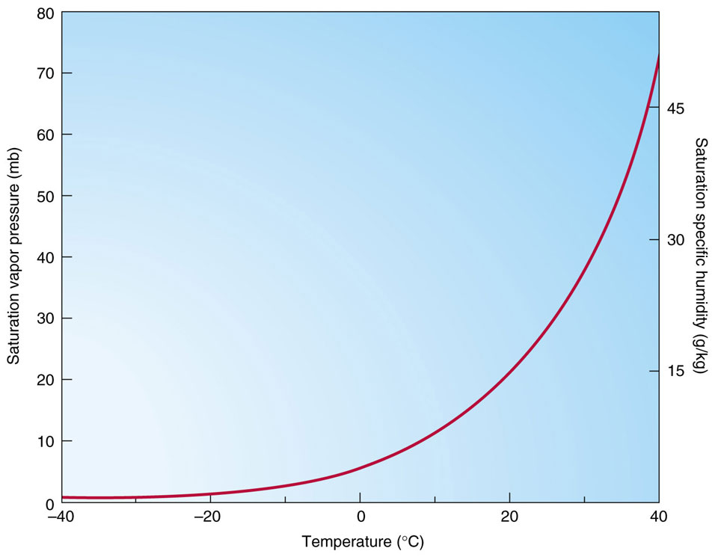

Water Vapor Feedback (fast, positive)
Water vapor feedback is a positive feedback that amplifies the
initial change in surface air temperature. It results from the
strong dependence of the atmospheric water vapor content on
air temperature: q = RH x qs(T) and RH ≈ constant.
It is important that RH
does not decrease a lot
in order for q to increase
with T.
Saturation Vapor Pressure
+

Slide 19
Water vapor positive feedback (fast)
λ_{B+FixRH} ≈0.5K/W/m²
based on 1-d radiative-
convective equilibrium
model calculations.
Adding fixed RH water
vapor feedback doubles
the climate sensitivity
with only the temperature
feedback (~0.26K/W/m²).
+

Slide 20
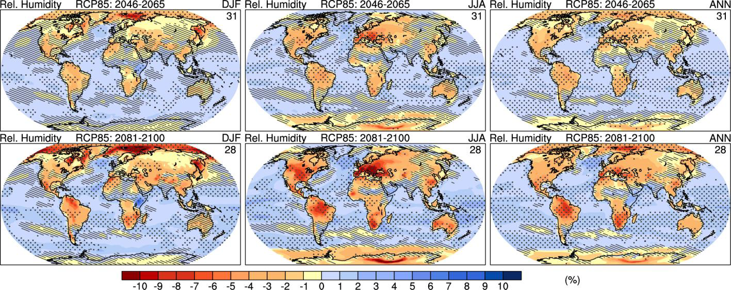
CMIP5 Model-simulated near-surface RH Change
2081-2100 minus 1986-2005 (IPCC 2013)
RH increases over oceans but decreases over land
Notes:
Hatching indicates regions where the multi model mean is less than one standard deviation of
internal variability. Stippling indicates regions where the multi model mean is greater than two standard deviations of
internal variability and where 90% of models agree on the sign of change (see Box 12.1). The number of CMIP5
models used is indicated in the upper right corner of each panel.

Slide 21
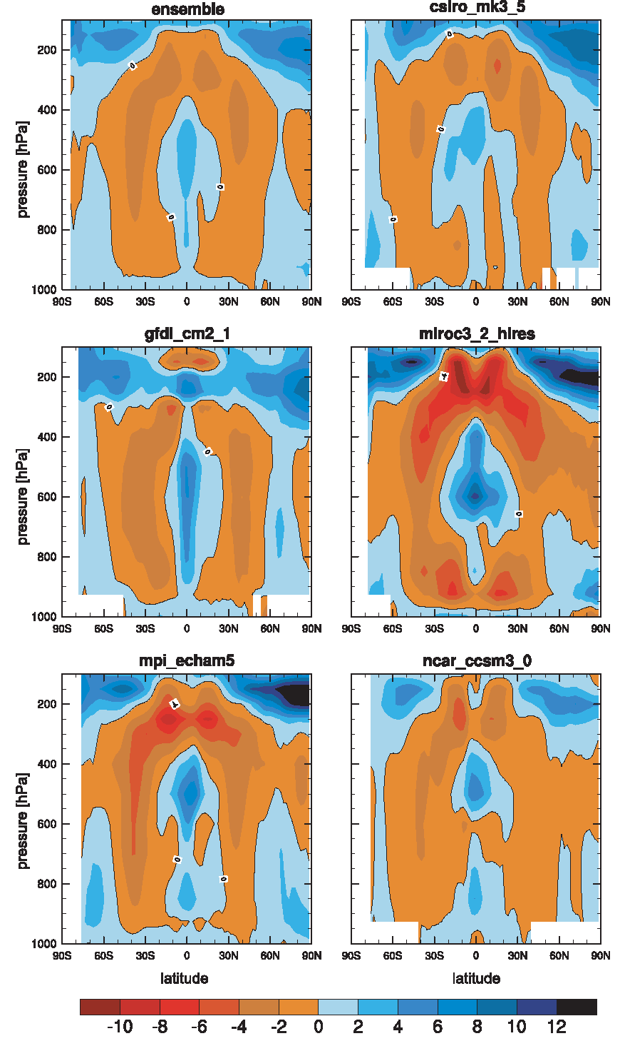
RH change (%) from 2000 to 2100
CMIP3, A1B scenario, ocean only
(Richter and Xie 2008, JGR)

Slide 22
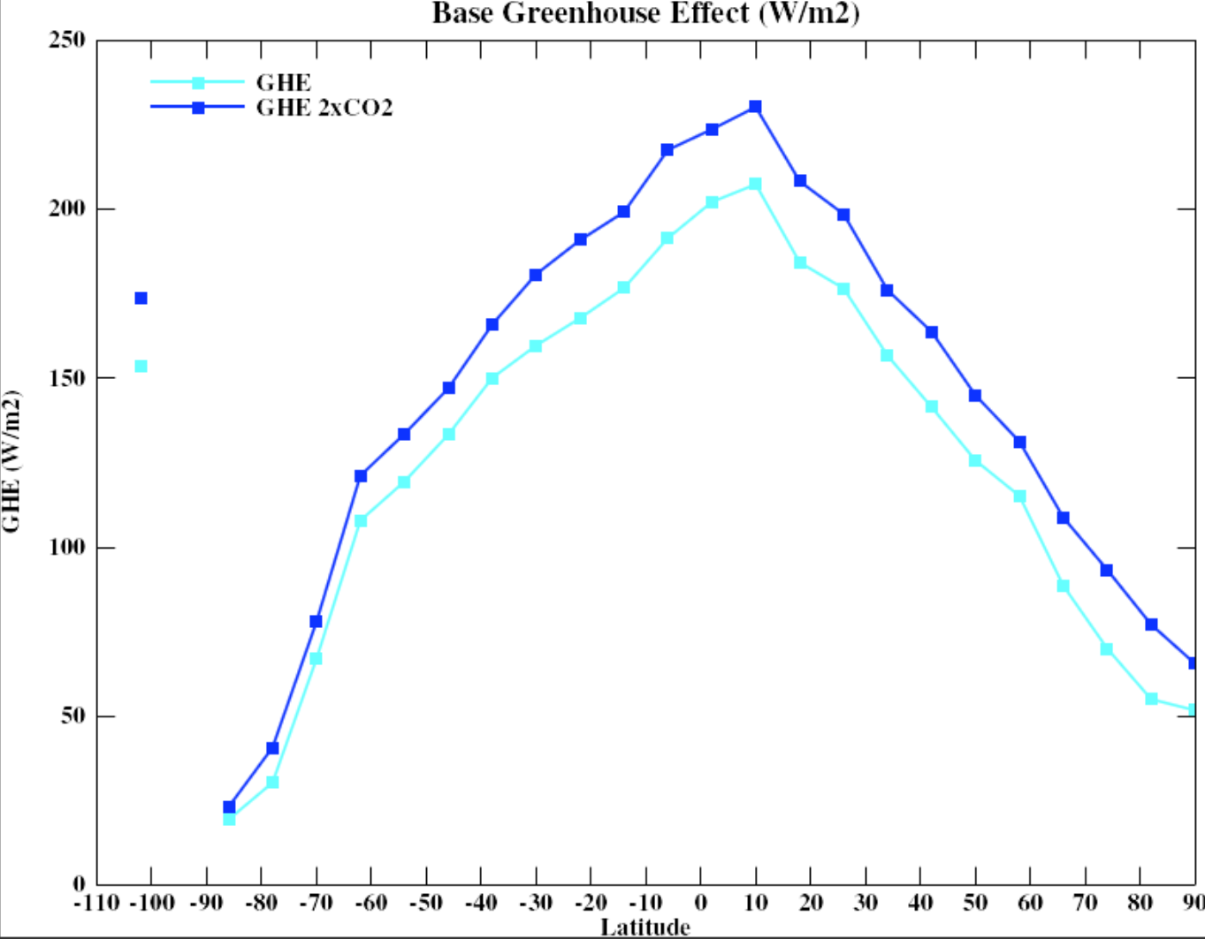
Larger at low-latitudes
Smallest at the poles
Water feedback is smaller
at high-latitudes
Why?
From Gavin Schmidt, NASA GISS Model GHE = Surface LW_up minus TOA LW Radiation

Slide 23
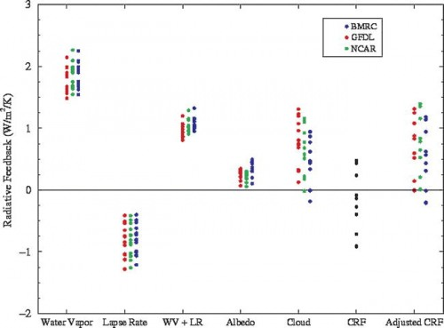
Water Vapor Feedback
The strongest positive feedback
It roughly doubles the initial warming
It is coupled to cloud, lapse rate and other feedbacks
Comes mostly from the mid-upper troposphere
Notes:
2xCO2 radiative forcing = 3.7W/m2

Slide 24
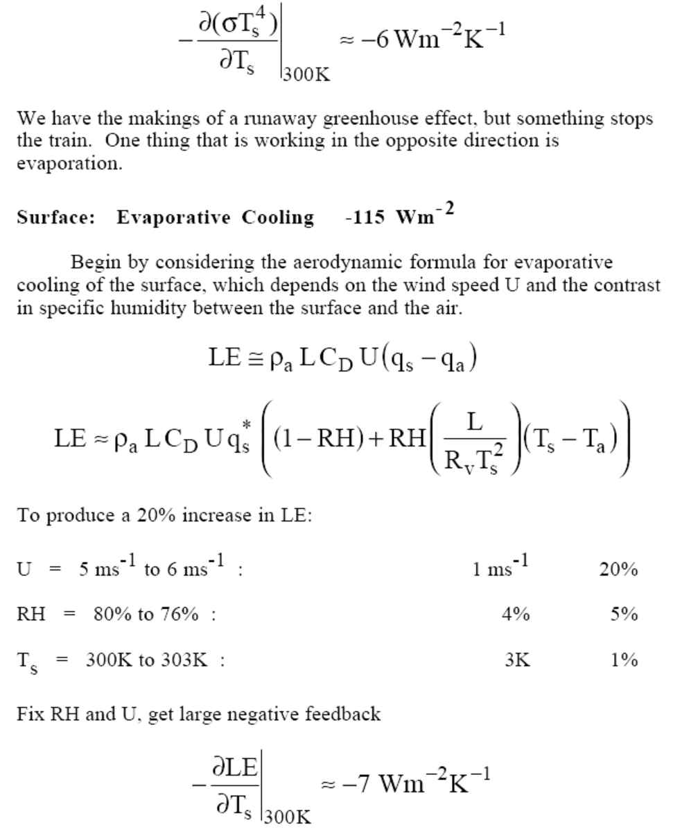
Evaporation feedback:
(negative, as surface LE
cooling increases with
increasing Ts at ∼7Wm⁻² K⁻¹
with fixed RH and Ts-Ta)
This feedback is reduced over
dry land → larger warming
over dry land.

Slide 25
Cloud Feedback
Clouds are expected to change as global-mean T changes, thus providing a feedback on global-mean temperature.
2) Not well-known how cloud distribution should change in a new climate, but most GCMs suggest some decreases in low-mid level clouds and increases in high clouds.
3) Clouds act to enhance the planetary albedo, exerting a global and annual shortwave radiative effect of −50 W m⁻². Clouds also are very good infrared trappers, exerting a mean longwave greenhouse effect of +30 W m⁻² (Loeb et al., 2009). The net global effect of −20 W m⁻² implies a net cooling effect of clouds in the modern climate
4) This doesn’t tell us anything about cloud feedback, but very difficult to figure out the changing residual between two very large and competing terms. No simple theory allows us to determine the sign or magnitude of cloud feedback
5) Cloud feedback, especially the shortwave component, is responsible for a substantial amount of spread in climate sensitivity estimates, and thus in the future response

Slide 26
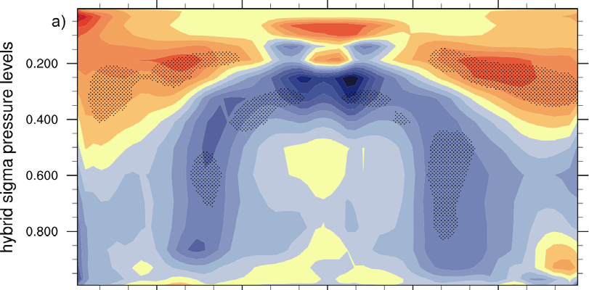
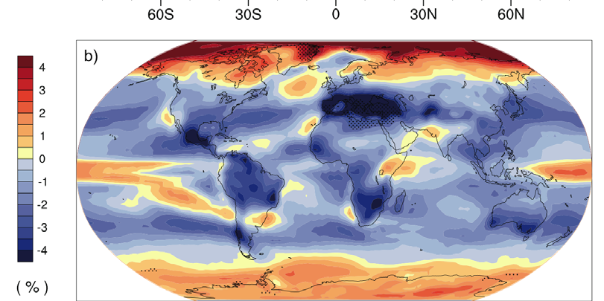
Model-simulated Cloud Amount Changes:
2080-2090 minus 1980-1990
Decreases in low and
mid-level clouds
Increases in high
clouds due to upward
shift of convection
Total cloud amount
increases at high-
latitudes, but
decreases at mid-low
latitudes
IPCC 2007
Notes:
Multi-model mean, A1B scenario, CMIP3 models, stippling indicate the changes exceed the inter-model s.d.

Slide 27
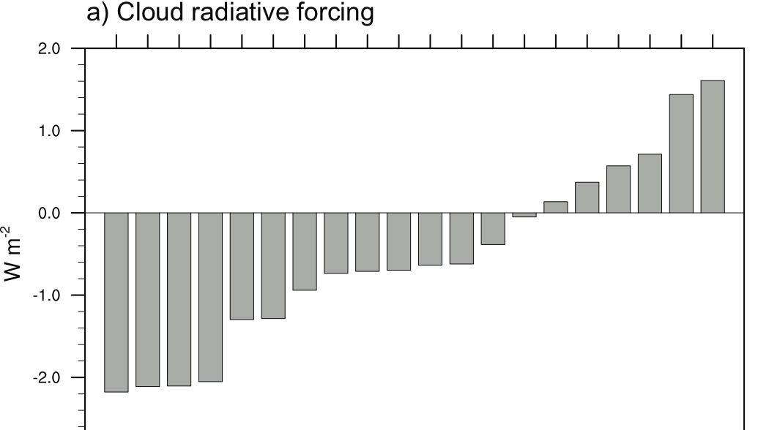
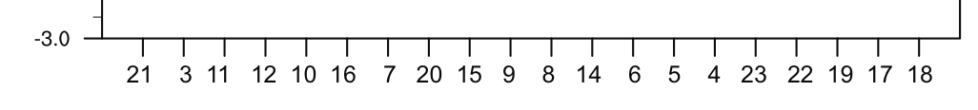
Cloud Radiative Forcing Changes
2080-2090 minus 1980-1990
Increased CRF → A negative feedback
Reduced CRF → A positive (warming) feedback
CMIP3 Model Index
Model Index
Note: Net CRF is negative (cooling) of ~20W/m²
IPCC 2007
Notes:
AR4 models, A1B scenario

Slide 28
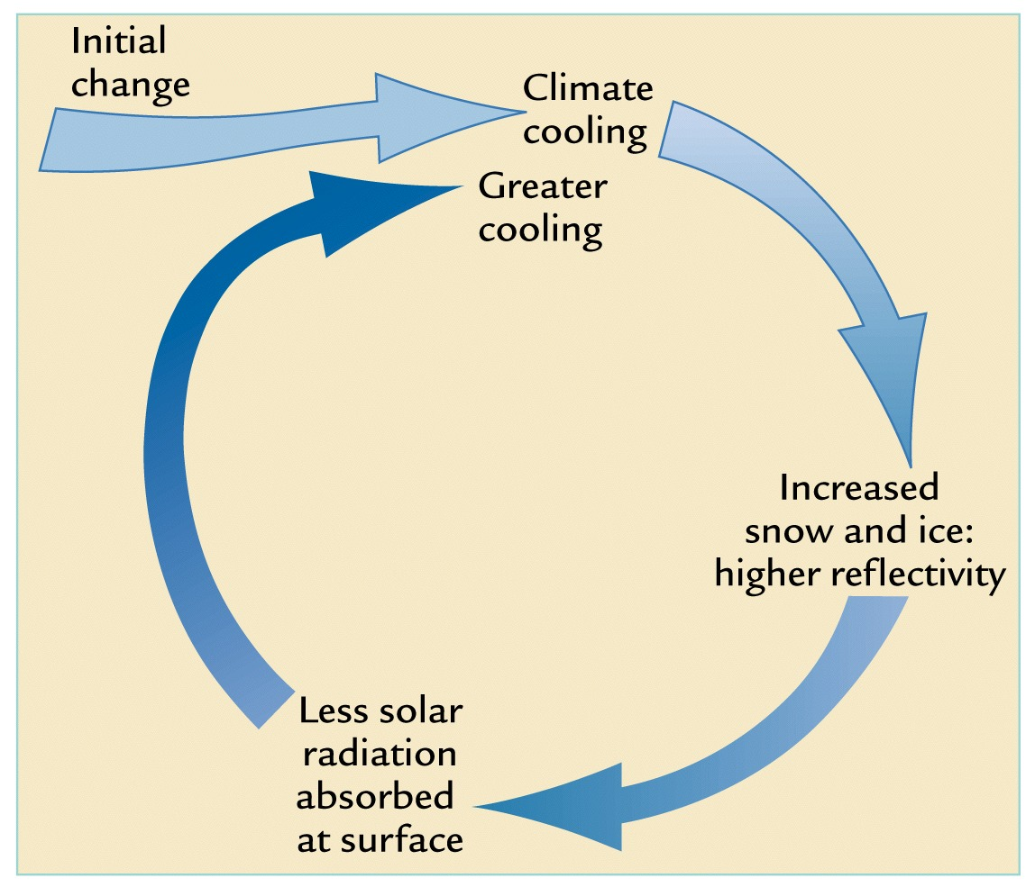
Snow-ice albedo positive feedback (fast for snow &
sea-ice, slow
for ice-sheets)
Further increase
climate sensitivity,
mostly at high-lat.
Important for
formation of
ice ages.
+

Slide 29
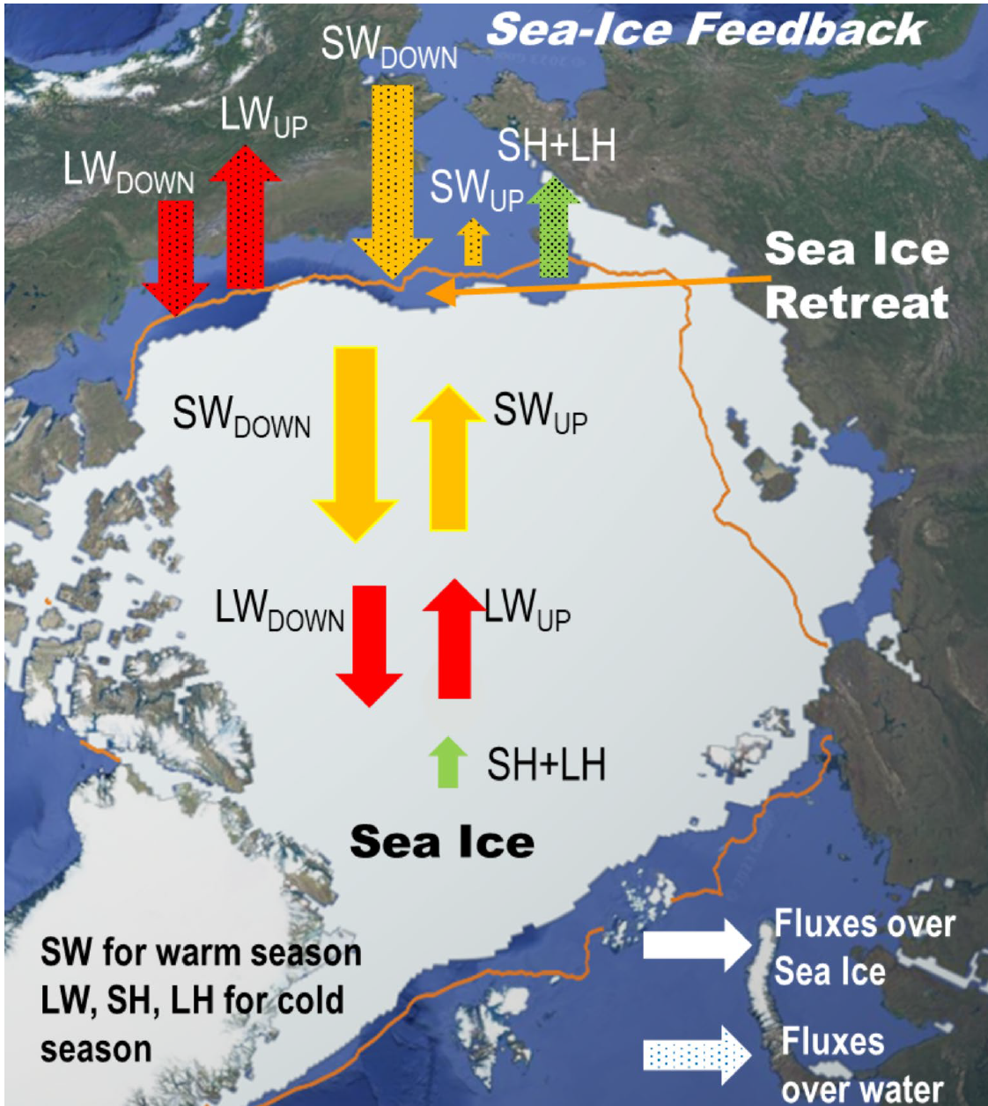
Includes
Warm-season ice-albedo feedback
Ocean heat storage
Cold-season ice insulation effect
Ocean heat release
Dai & Jenkins (2023)

Slide 30
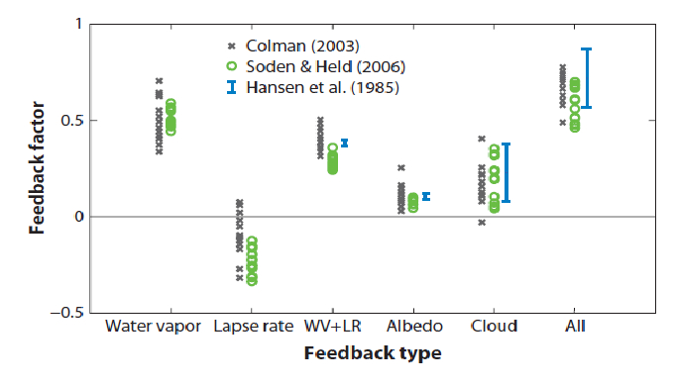
Putting it all together… for f_{r} of Roe (2009)
f_{r}
Note: f_{h} = 1/(1-f_{r}), so for f_{r}=0.5, f_{h}=2.0
Roe (2009)

Slide 31
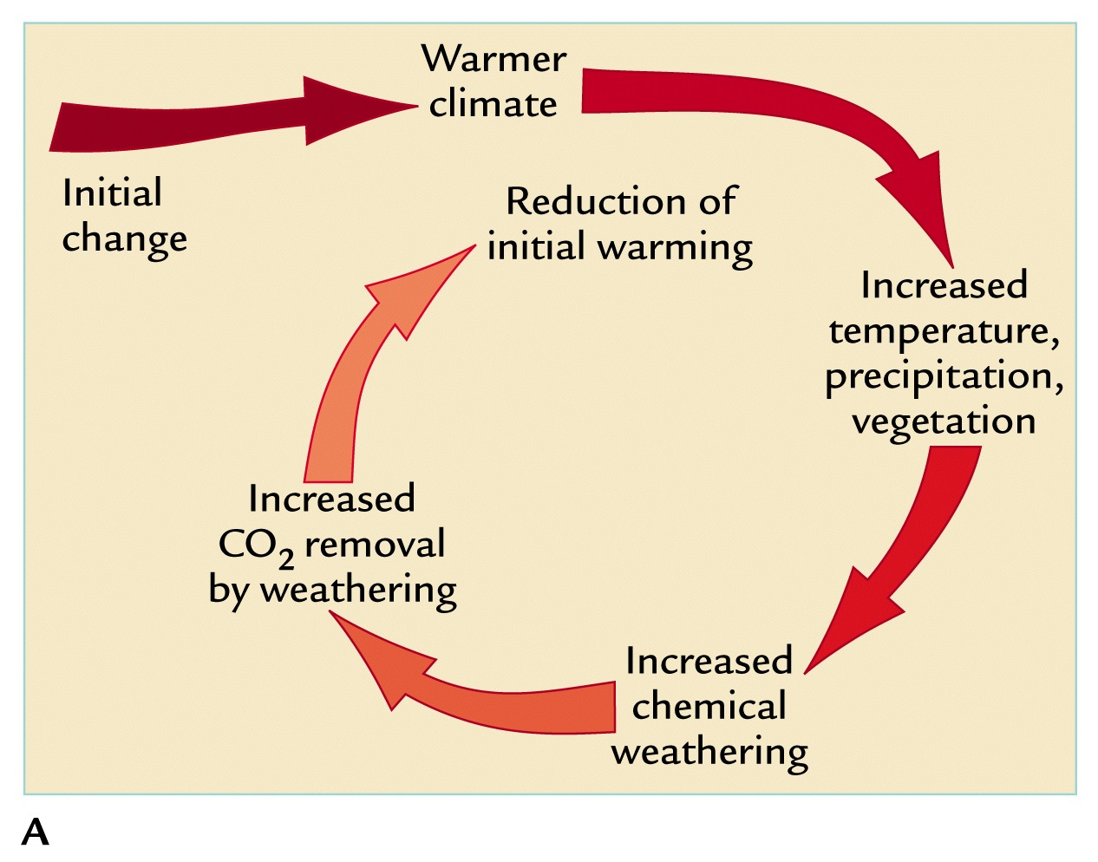
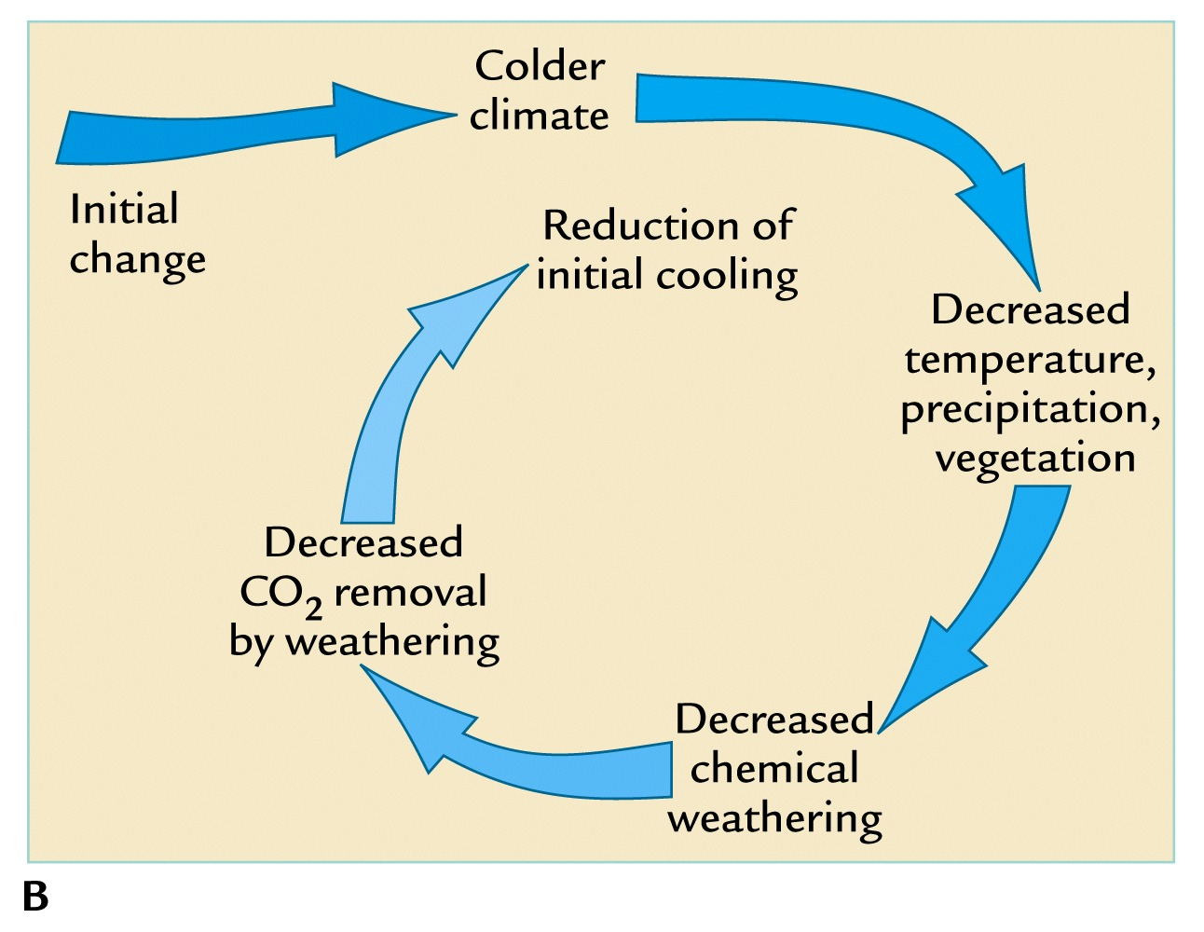
Chemical weathering
negative feedback
(very slow)
-
-

Slide 32
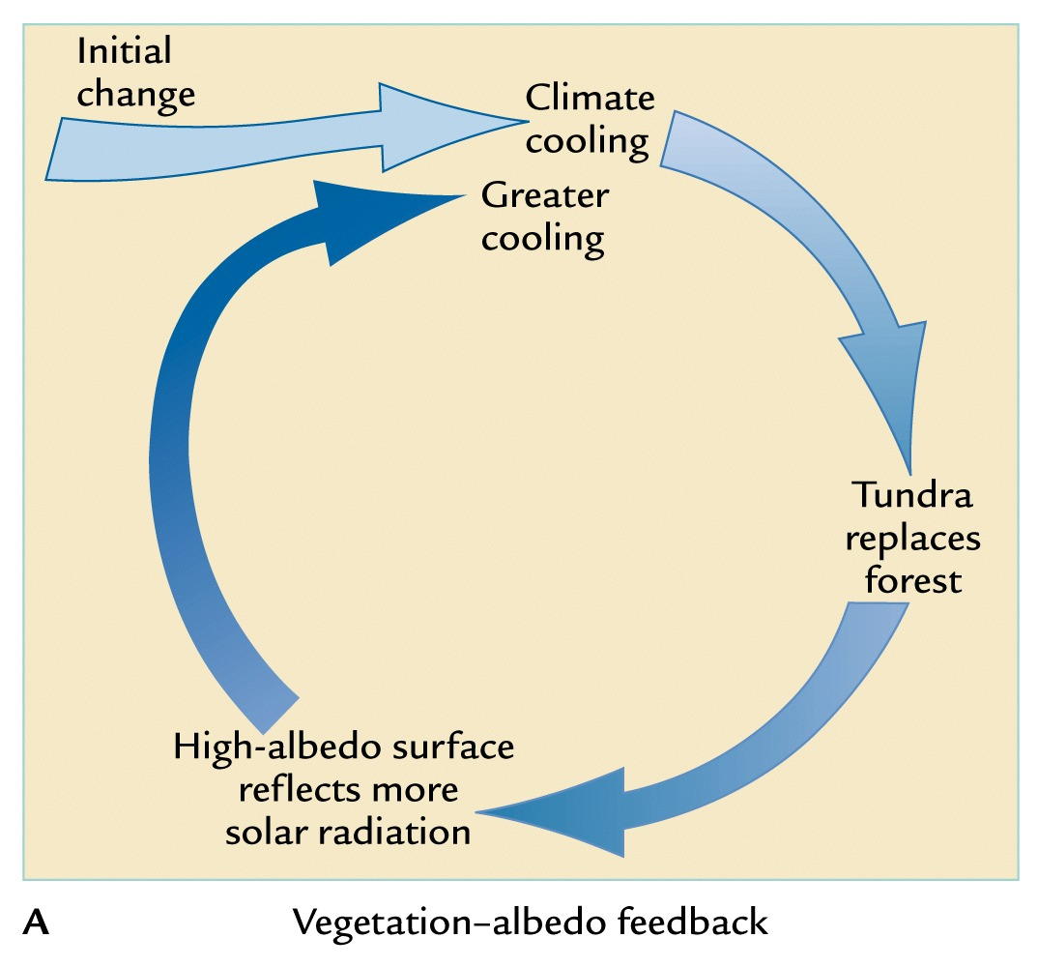
Vegetation-albedo positive feedback (slow)
Further increase
climate sensitivity,
mostly at high-lat.
Important for
ice age cycles
+

Slide 33
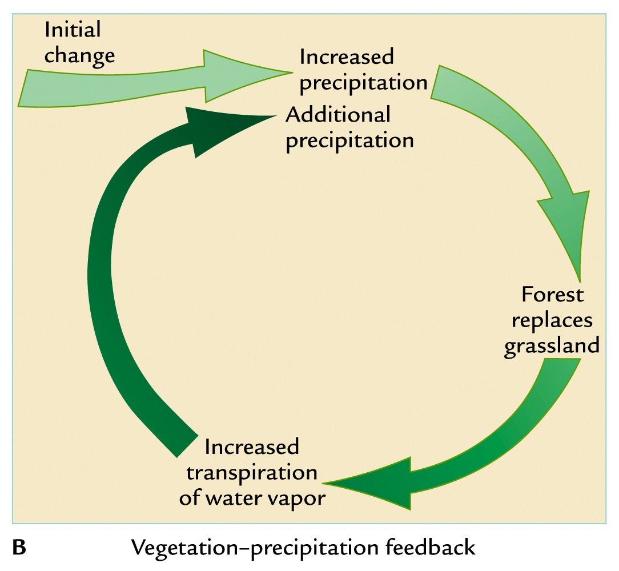
Vegetation-precipitation positive feedback (slow)
+

Slide 34
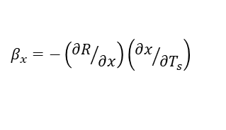
Summary for Climate Feedbacks
Climate feedbacks refer to processes that either enlarge (positive feedback) or reduce
(negative) the initial global temperature change induced by a radiative forcing.
Common climate feedbacks include: Stefan-Boltzmann or Planck (negative) feedback
(through increased LW cooling with increasing Ts), water vapor feedback (through its
strong dependence on Ts), ice-albedo feedback, lapse rate feedback (negative
globally), cloud feedback (mostly positive), chemical weathering (negative) feedback.
There are three methods to quantify climate feedbacks: Hansen’s fh = ΔTs/ ΔTo, Roe’s
fr = 1 – 1/fh, and Soden’s . They are related in simplified analysis,
but the relationship with β_{x} is unclear in GCMs and the real world.
Water vapor feedback roughly doubles the CO2-induced initial warming.
Cloud feedback is quite uncertain, but generally positive in models.
Lapse rate feedback is negative in the tropics and globally but positive in the Arctic
due to top-heavy (bottom-heavy) warming profiles in the tropics (Arctic).
$$β_{x}=−\left({∂R}/{∂x}\right)\left({∂x}/{∂T_{s}}\right)$$

