Slide 1
A ATM551, Lecture #26
Final-exam Review
Study all the slides, including the hidden ones that are not discussed in class. Also study homework questions for HW#3 and #4!
Final Exam: 5/03, 3:30-5:30pm, ETEC 482
The exam will include P1: Multiple choice questions and P2: short-answer questions (similar to homework questions).

Slide 2
Topics of the Second Half
Part 3 – Climate Variability and Modes (3 lectures)
Lecture 16: Climate Internal Variability and Extremes (3/26)
Lecture 17-18: ENSO and its impacts (3/28, 4/02)
Lecture 19-20: Atlantic and Pacific Multidecadal Variability (4/04, 4/09)
Part 4 – Climate Change and Modeling (5 lectures)
Lecture 21: Climate Forcing, Response and Sensitivity (4/11)
Lecture 22: Climate Feedbacks (4/16)
Lecture 23: Introduction to Climate Modeling (4/18)
Lecture 24: Common Climate Simulations & Projections (4/23)
Lecture 25: Projected future climate changes (4/25)
Final Exam Review Lecture: April 30
Final Exam: Friday, 5/03, 3:30-5:30pm, ETEC 482

Slide 3
Climate vs. Climate Variability
Climate refers to:
- Long-term (e.g., 30yr) mean states near the surface and in the atmosphere and oceans.
- Examples: 30yr averaged daily or monthly or annual T and P may be considered as part of the climate at a given location.
- But the mean T and P for the last winter or last year may not be representative of the (mean) climate.
Climate Variability (or Variation) refers to:
- Variations of any climate variable (e.g., T, P, or winds) over many years. The variations can be from season to season (annual cycle), year-to-year (inter-annual), decade-to-decade (inter-decadal).
- A monthly or annual mean for a given year represents one realization (a special case) of the mean climate for that particular month or year.
- Monthly anomalies (relative to long-term mean annual cycle) are often used to quantify climate variability and change over a given period.
Climate fluctuates naturally from year to year or decade to decade due to internal dynamics!

Slide 4
Major Modes of Climate Variability
Modes of Climate Variability: recurring spatial and temporal patterns of climate variations. Major focus of climate anlaysis
Inter-annual modes:
- El Niño-Southern Oscillation (ENSO)
- North Atlantic Oscillation (NAO)
- Arctic Oscillation (AO) or Northern Annular Mode (NAM)
- Southern Annular Mode (SAM), similar to NAM but for S.H.
Decadal to multi-decadal modes (Liu 2012, JC):
- Pacific Decadal Oscillation (PDO)
- Inter-decadal Pacific Oscillation (IPO)
- Atlantic Multi-decadal Oscillation (AMO)

Slide 5
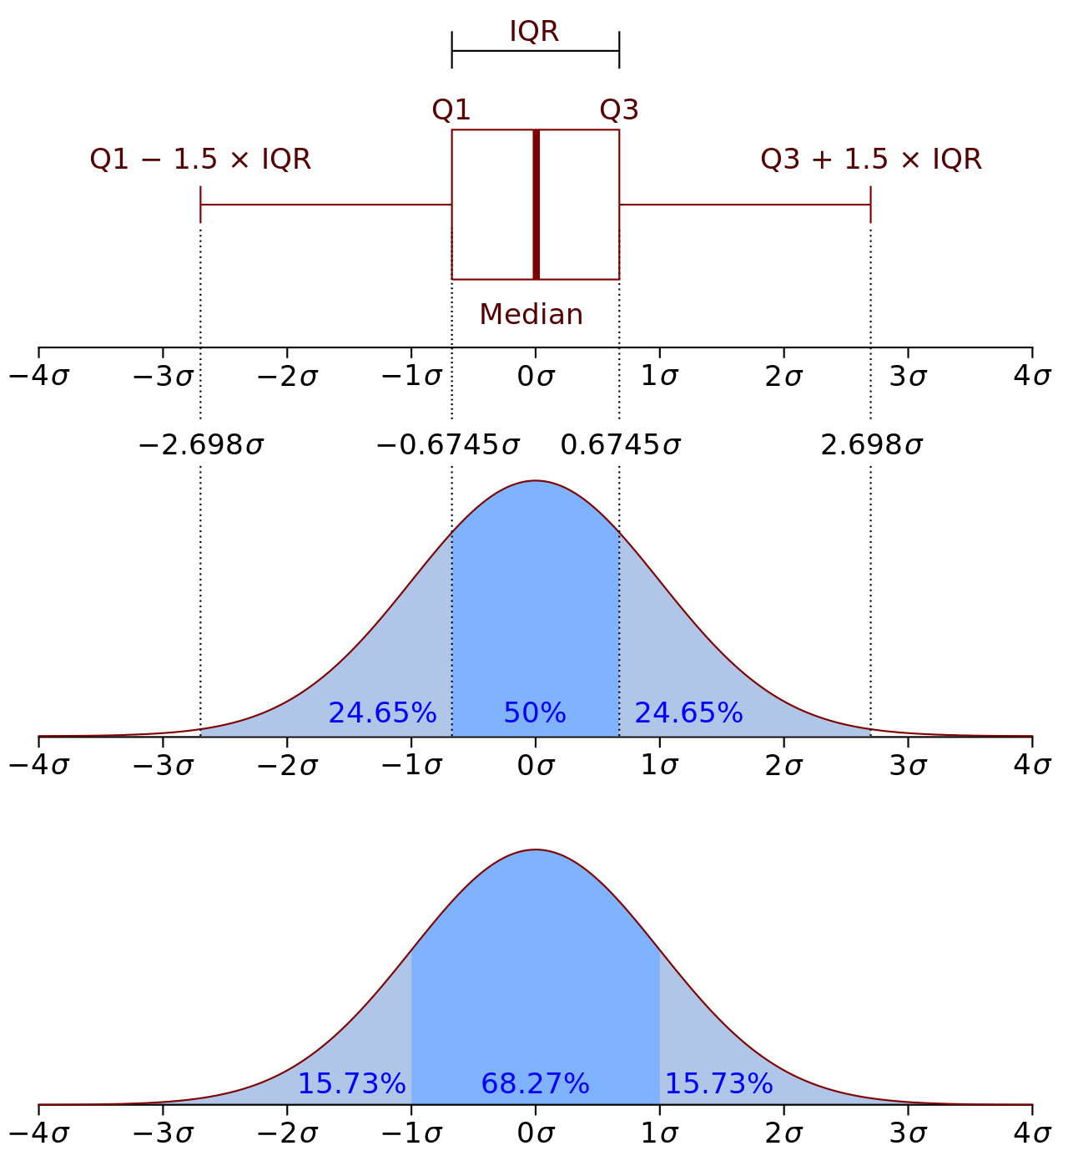
One way to quantify the variability is to use S.D. (σ)
Many (averaged) variables (e.g., T, q) have a normal distribution
SD is sufficient to define its variability or spread for normal distributions.
From Wikipedia

Slide 6
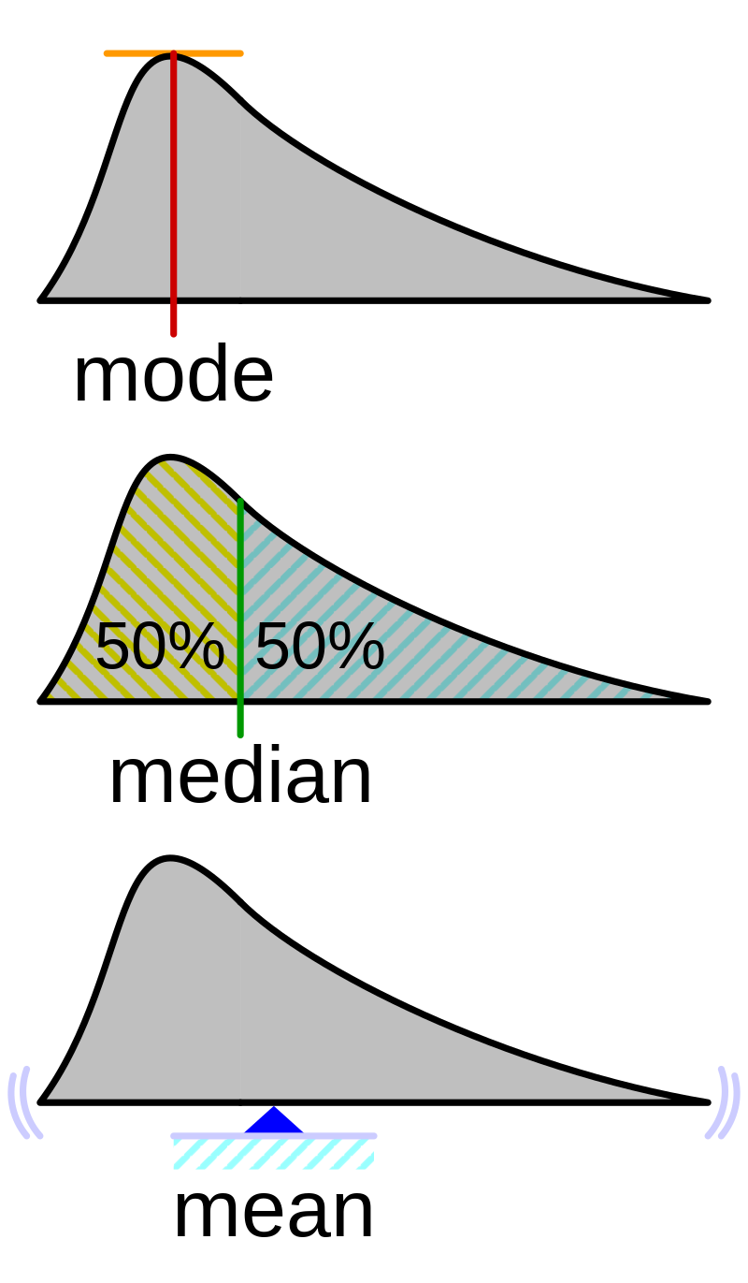
One way to quantify the variability is to use S.D. (σ)
Some (unaveraged) variables (e.g., precip.) have a non-Gaussian distribution
SD is insufficient to describe its distribution, but is still a useful measure of variability
From Wikipedia

Slide 7
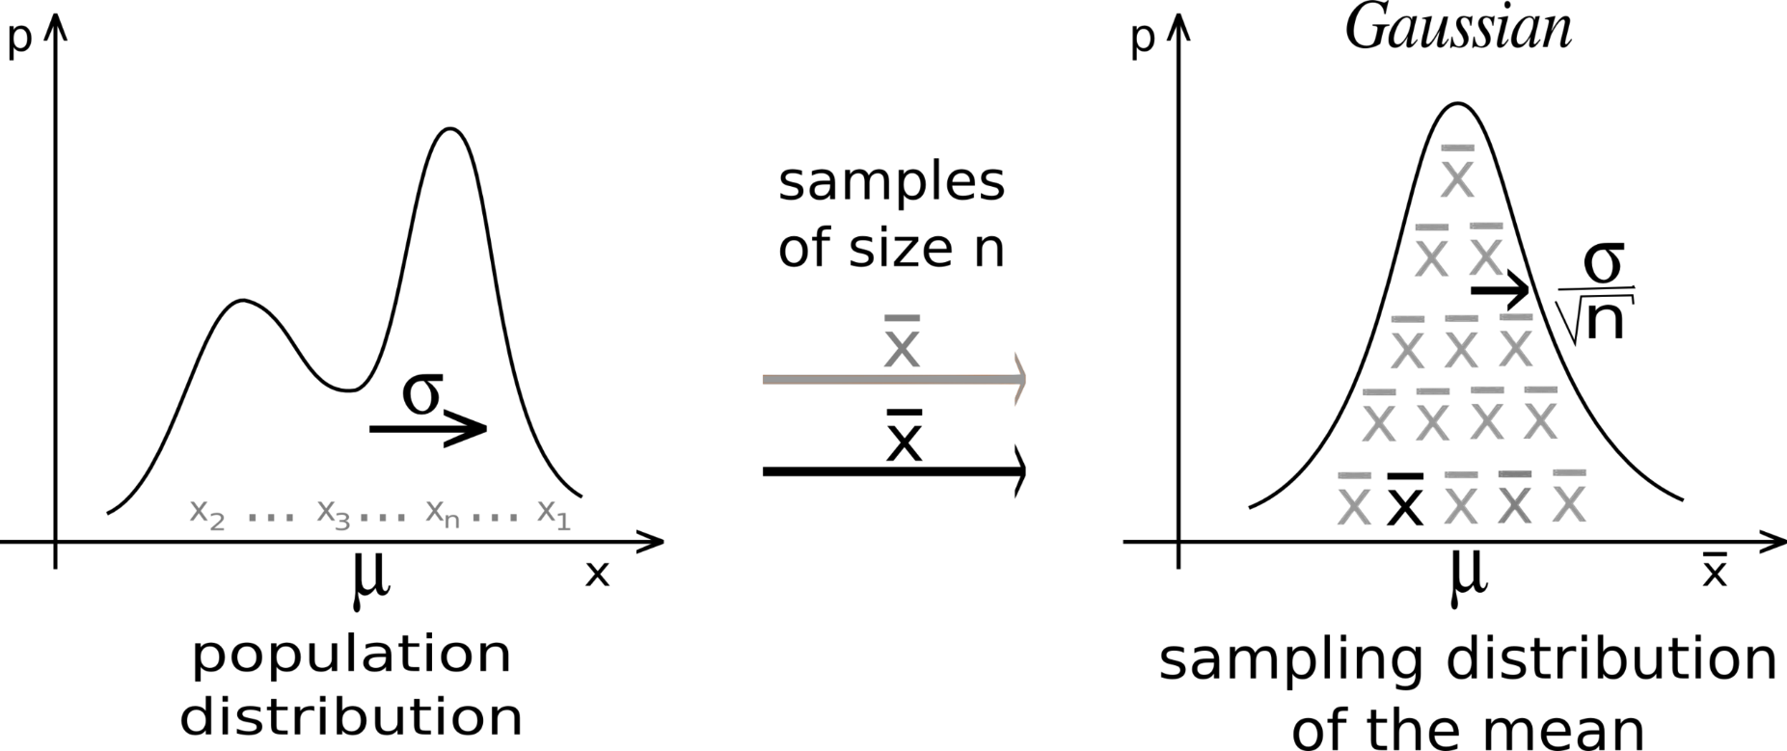
The central limit theorem (CLT) establishes that, in many situations, when independent random variables are summed up, their properly normalized sum tends toward a normal distribution even if the original variables themselves are not normally distributed.
p
p
p
Hourly Precipitation
Daily Precip Anomaly
Monthly Precip Anomaly

Slide 8
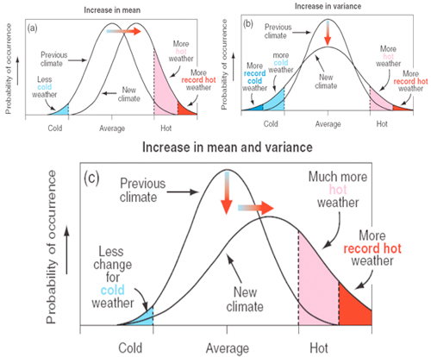
Changes in the Mean and Variability
- GHG forcing can cause changes in both the mean and variance!
- A 2ºC warming is a change in the mean.
- The increase in heatwaves is a change in the extreme.
- The frequency of the hot temperatures could increase faster than the mean.

Slide 9
CMIP5 model-projected Percentage Change for Annual Tas
Seasonal Amplitude
Standard Deviation (SD)
Chen et al. (2019)
Notes:
FIG. 5. The 25 CMIP5 model-averaged percentage change (in % of the 1950–79) in (a) the amplitude of the mean
seasonal cycle of daily surface air temperature (Tas) and (b) the standard deviation (SD) of Tas anomalies (i.e., with
the 30-yr-mean seasonal cycle of each period removed from the daily Tas before calculating the SD, with all days
included) from 1950–79 to 2010–39 under the RCP8.5 scenario. (c),(d) As in (a),(b), but for changes from 1950–79
to 2070–99. Stippling indicates at least 80% of the models agree on the sign of change.

Slide 10
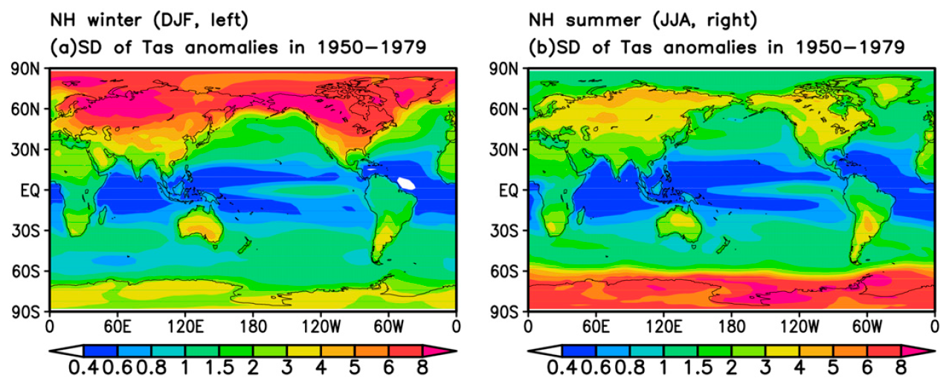
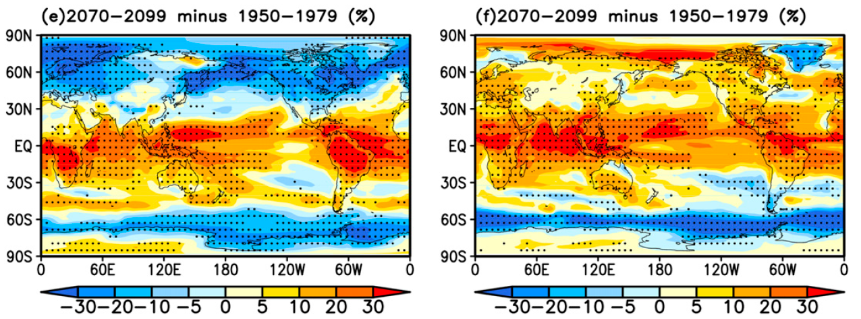
CMIP5 model-projected Percentage Change for
SD of Daily Tas for DJF and JJA
Chen et al. (2019)

Slide 11
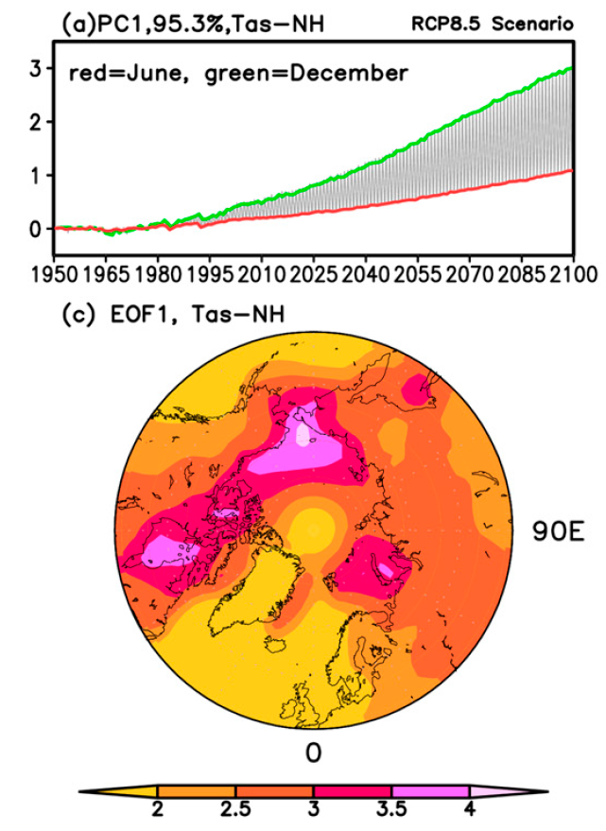
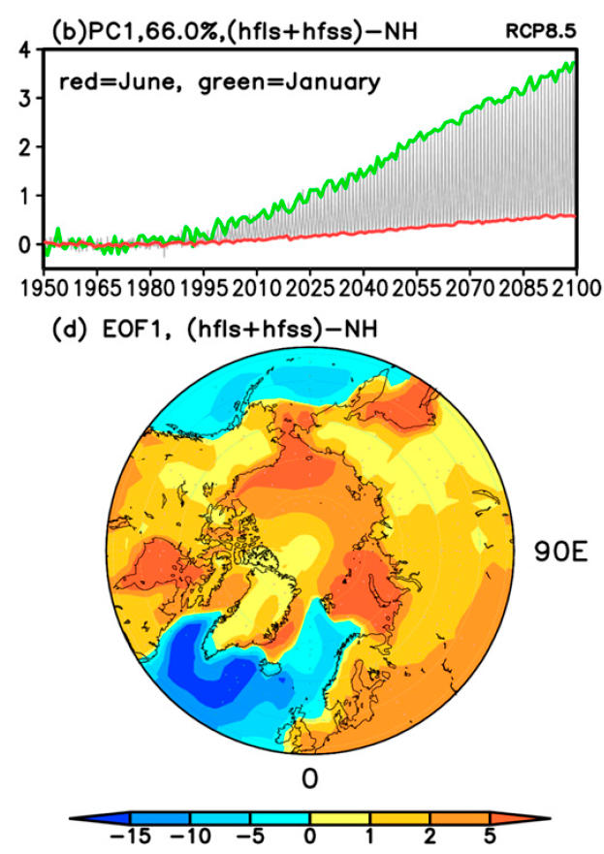
Sea ice-indued larger winter warming → reduced seasonal amplitude at high latitudes
Chen et al. (2019)
Notes:
FIG. 11. The (a),(b),(e),(f) time series and (c),(d),(g),(h) spatial patterns of the first leading EOF mode of
monthly anomalies (relative to the 1950–80 mean, with all months concatenated) of (left) surface air temperature
(averaged over 72 model runs) and (right) sea ice concentration (averaged over 38 model runs) from the ensemble
mean of the historical (for 1950–2005) and RCP8.5 (for 2006–2100) simulations by 38 CMIP5 models for the (a)–(d)
northern (508–908N) and (e)–(h) southern (508–908S) latitudes. Areas with less than 5% sea ice concentrations of
the current (1950–79) mean were masked out in the sea ice analyses. In the time series plots, the two-colored lines
connect the temporal coefficients corresponding to each of the two specific months while the coefficients for all the
other months fall between them.

Slide 12
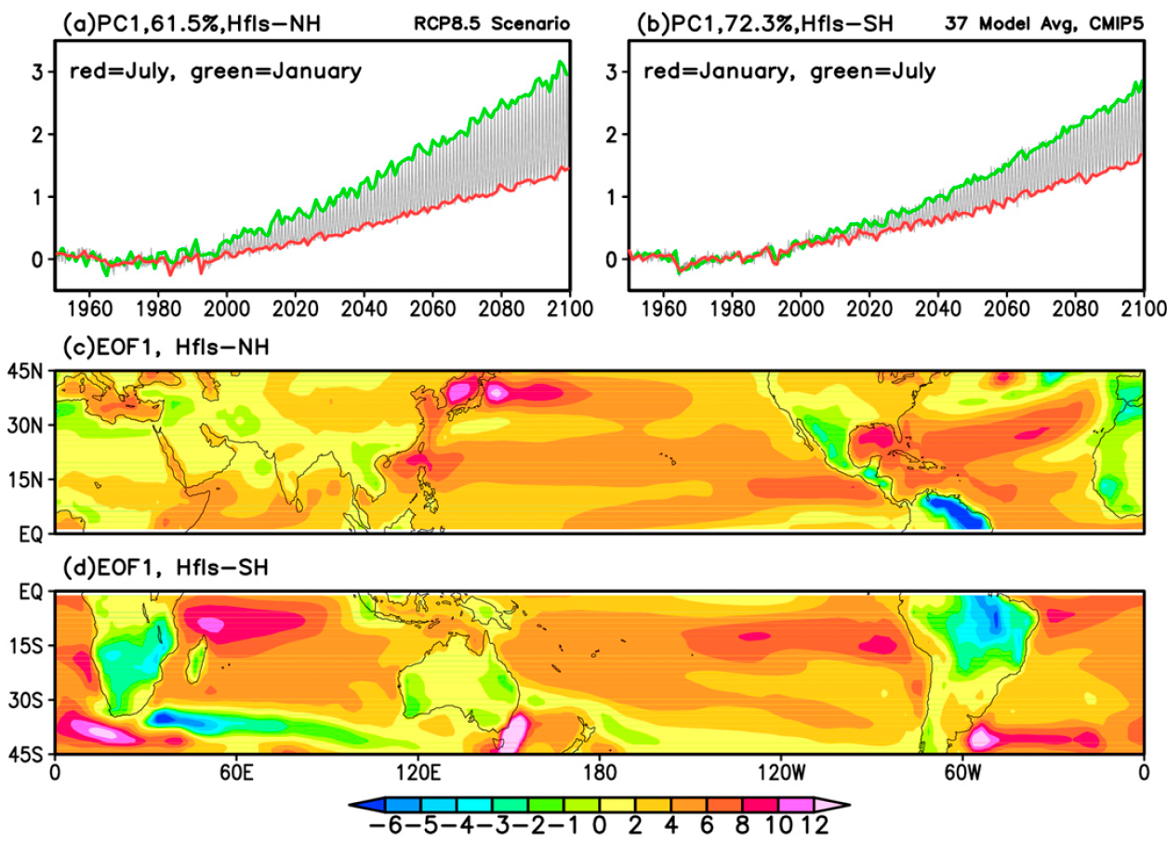
Larger winter LH increase→ reduced winter warming →
Increased seasonal amplitude at low latitudes

Slide 13
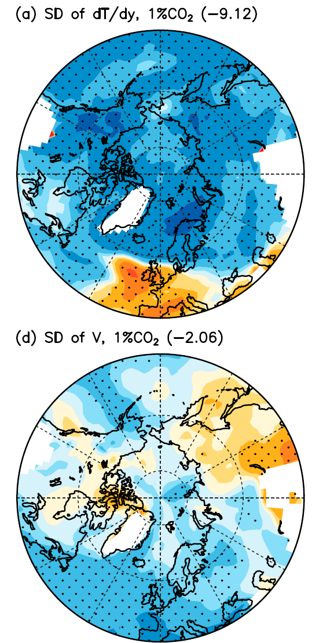
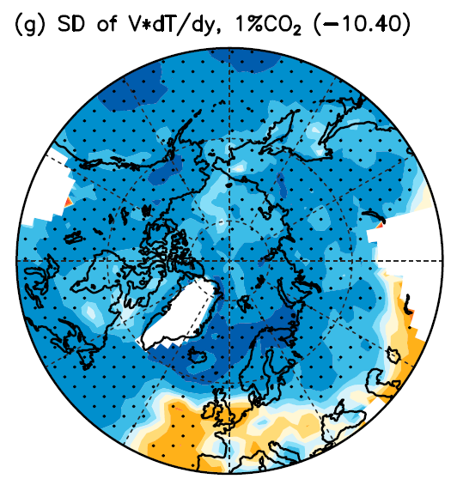
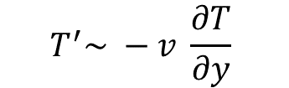
$$T^{′}\sim −v \frac{∂T}{∂y}$$
Decreased variability in meridional
thermal advection →
decreased T variability
Dai and Deng (2021)

Slide 14
Summary of Climate Change vs. Variation
Large variations in local and regional climate data resulting from internal dynamics:
They often dominate over the forced response to long-term GHG forcing, making it difficult to quantify the forced response in observations. This is especially true for precipitation.
Averaging over large regions and the globe enhances the forced signal:
However, even global-mean T still contains substantial natural variations not related to GHG forcing. For P, natural variations dominate even in the global-mean, making it hard to quantify precipitation response to GHG-induced global warming.
Trends vs. multi-decadal variations:
Regional climate often shows multi-decadal oscillations that are not related to GHG forcing, and these slow variations result in apparent trends over a period up to several decades. These trends can be mistaken as a forced response to GHG-induced global warming.
Future changes in variability:
Tas variability and seasonal amplitudes are projected to decrease (due to reduced variability in thermal advection and larger winter warming) in high latitudes but increases in low-latitudes. Larger seasonal amplitudes in soil moisture and runoff flatten their PDFs. P variability may increase slightly under GHG-induced global warming as its mean increases.

Slide 15
Summary of Extreme Events & Climate Change
Extreme weather events (tornados, hurricanes, snowstorms, etc.) and extreme climate events (droughts and floods, heat waves, cold winters, etc.) occur naturally mainly due to unforced weather and climate variations.
Global warming and climate change usually are not the direct cause of individual extreme events.
However, climate change may alter the frequency of occurrence of these extreme events as the mean climate changes. It can also directly enhance heat waves as the mean T increases.
Thus, while we can’t attribute any particular event (such as superstorm Sandy) directly to climate change, it is expected that many extreme events such as heat waves, droughts and floods will become more frequent and more severe as global warming continues.
Changes in the frequency of extreme events can be large for a small change in the mean.

Slide 16
A ATM551, Lecture #18
ENSO
ENSO definition and indices
ENSO characteristics & formation (slides from Neelin (2011)
ENSO theory and models (slides from C. Wang)
ENSO forecast
ENSO impacts
Reading Assignments (under OtherReadingMaterials\):
Chapter 4 (El Nino) of the Neelin (2011) textbook
Wang et al. (2016), Wang (2018)

Slide 17
What is ENSO?
ENSO is the acronym for El Niño-Southern Oscillation
ENSO refers to the irregular periodic (2-7yr) variation in SLP, SST and winds over the tropical eastern and central Pacific that affects the climate over much of the globe.
ENSO is the strongest interannual (year-to-year) climate variation.
ENSO results purely from unforced, internal dynamic processes, especially the air-sea interactions over the tropical Pacific.
ENSO is the most studied and best understood mode of climate variability.

Slide 18
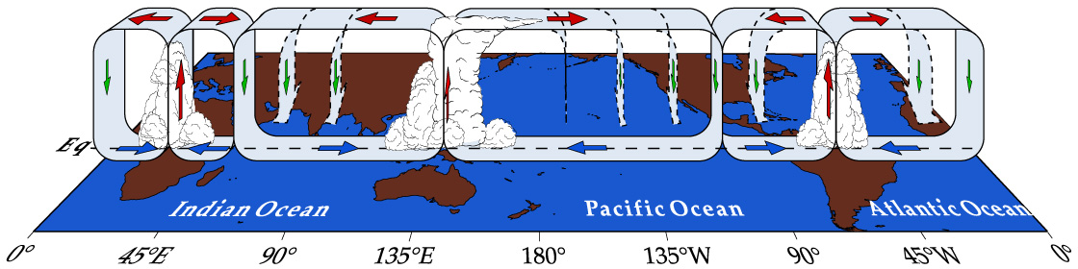
Equatorial Walker Circulation
Both the Walker and Hadley Circulation induce easterly winds over the equatorial Pacific Ocean.

Slide 19
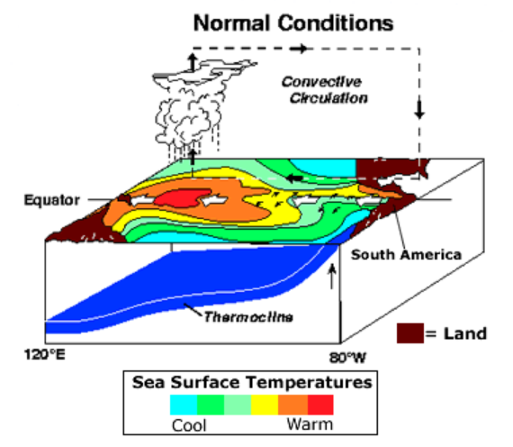
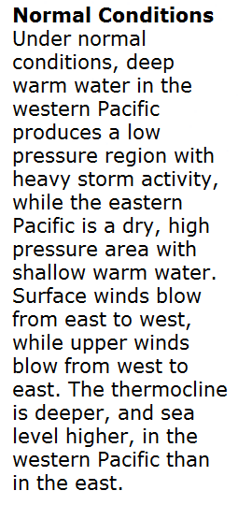
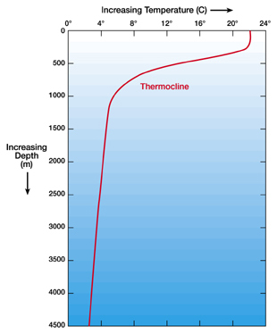
Mixed Layer
Neelin (2011)

Slide 20
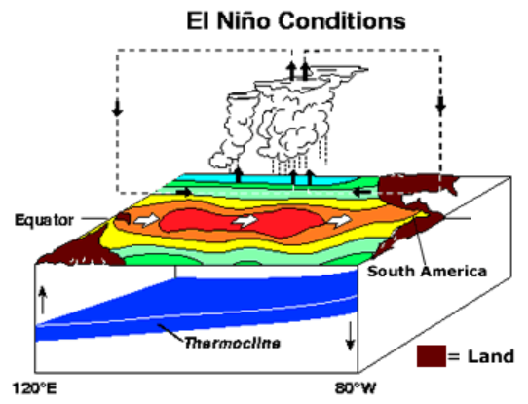
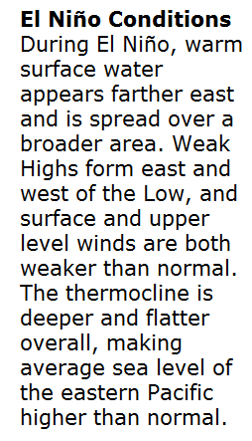
Neelin (2011)

Slide 21
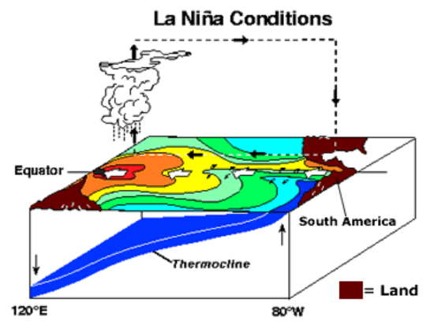
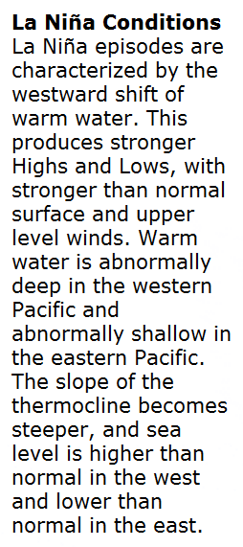
Neelin (2011)

Slide 22
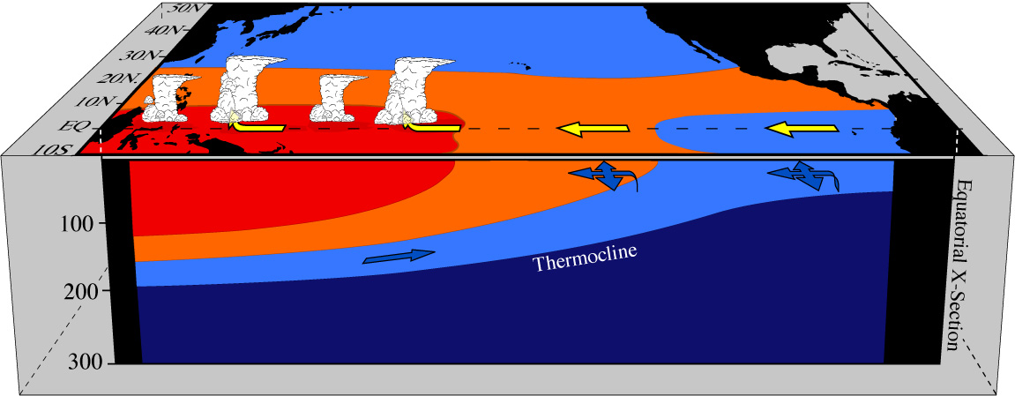
Pacific in three-dimensions under "Normal" conditions
10 km
15000 km
Depth (m)
~28 C
~24 C
~20 C
15 C or colder
Atmosphere:
Trade winds blow across Pacific air rises in convergence zone over the warm SSTs in the west.
Ocean:
Thermocline ~100m deeper in west (sea level 40cm higher)
Pressure gradient in ocean (eastward) balances wind stress in vertical average
Surface current moves westward following surface winds → higher sea level in west
Undercurrent moves eastward → returns the water to the east
Neelin, 2011. Climate Change and Climate Modeling, Cambridge UP
Notes:
norm.pacific_x.sec3.jpg

Slide 23
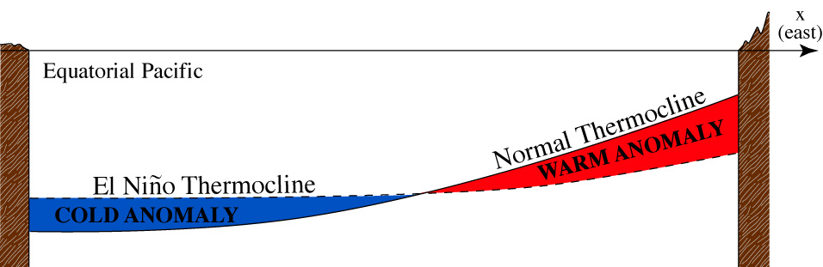
Two positions of the thermocline, indicating region of thermocline anomalies
Shallower thermocline → Cold T anomalies at the same depth
Deeper thermocline → Warm T anomalies at the same depth
Mixed Layer
Thermocline = the layer with large vertical T gradient
Neelin, 2011. Climate Change and Climate Modeling, Cambridge UP
Notes:
thermocline.anom.clr.eps

Slide 24
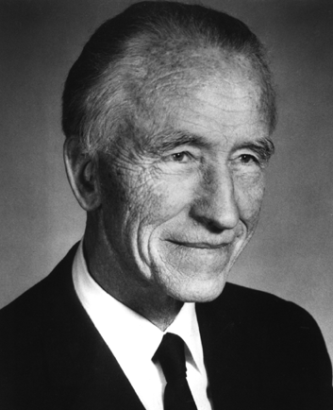
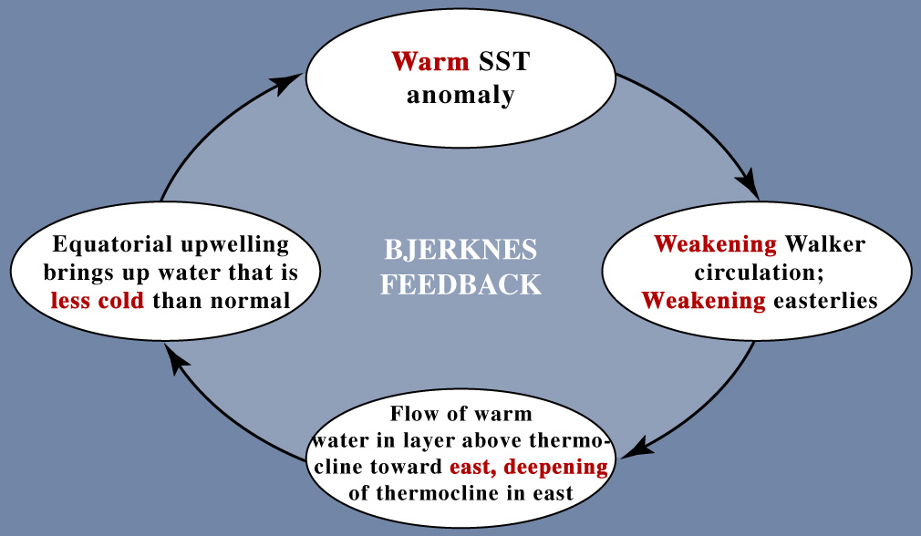
The Bjerknes feedbacks (warm phase)
Jakob Bjerknes (1897-1975)
Norwegian-American meteorologist, founded UCLA Dept. of Meteorology
Weakening
SLP gradient
in the east
Positive feedback loop reinforces initial anomaly
Neelin, 2011. Climate Change and Climate Modeling, Cambridge UP

Slide 25
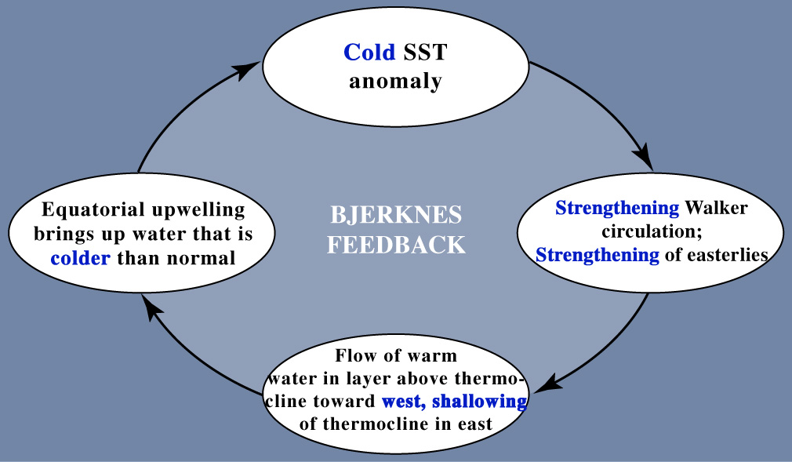
The Bjerknes feedbacks (cold phase)
Enhanced
SLP gradient
in the east
Positive feedback loop reinforces initial anomaly
Neelin, 2011. Climate Change and Climate Modeling, Cambridge UP
Notes:
Bjerknes_hypoth_nina.jpg

Slide 26
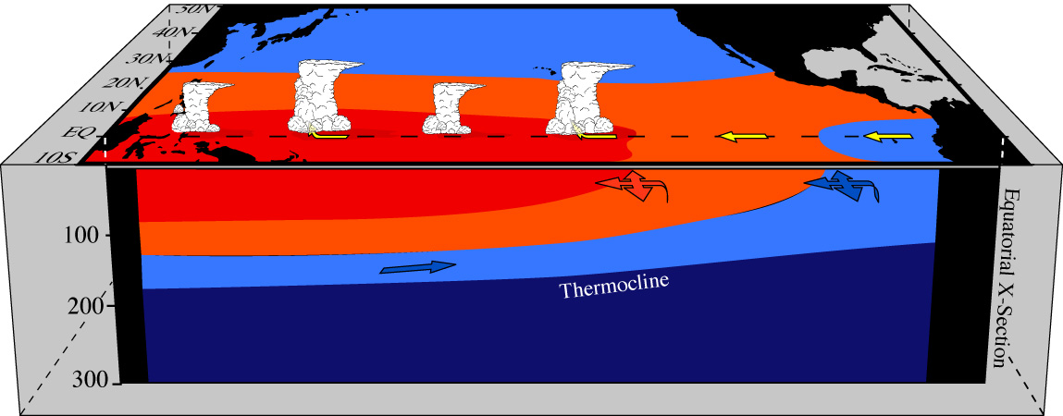
Pacific basin under El Niño (warm) conditions
Warmer SST in the east; rainfall tends to spread eastward
Trade winds weaken due to reduced SST and SLP west-east gradient
Unbalanced eastward PGF in ocean → anomalous eastward surface currents → thermocline
deepens in the east but shallows in the west → subsurface cold anomalies appear in the west
Upwelling brings up water less cold than normal in the east→ further increases SST in the east (Bjerknes feedbacks)
As more warm surface water is moved to east, the shallowed thermocline reaches the western boundary and it runs out of warm water → west sea level decreases, PGF decreases to balance the weakened wind force, eastward transport of warm water weakens, thermocline and SST anomalies are reduced in east→ SST and wind anomalies disappear, El Niño ends → without the anomalous winds, wind force exceeds PGF, surface warm water moves westward, the shallow thermocline anomalies or cold subsurface water moves eastward → start of the next La Niña.
However, this cycle may be delayed if surface wind anomalies can be sustained (e.g. by MJO or other perturbations), or the SST in the east does not return to normal after the eastward transport of surface water stops (e.g., due to reduced upwelling of cold waters). This may lead to some El Nino events lasting for 2-4 years, instead of one season.
Notes:
nino.pacific_x.sec3.jpg (From el-la.pacific_x.sec3.eps)

Slide 27
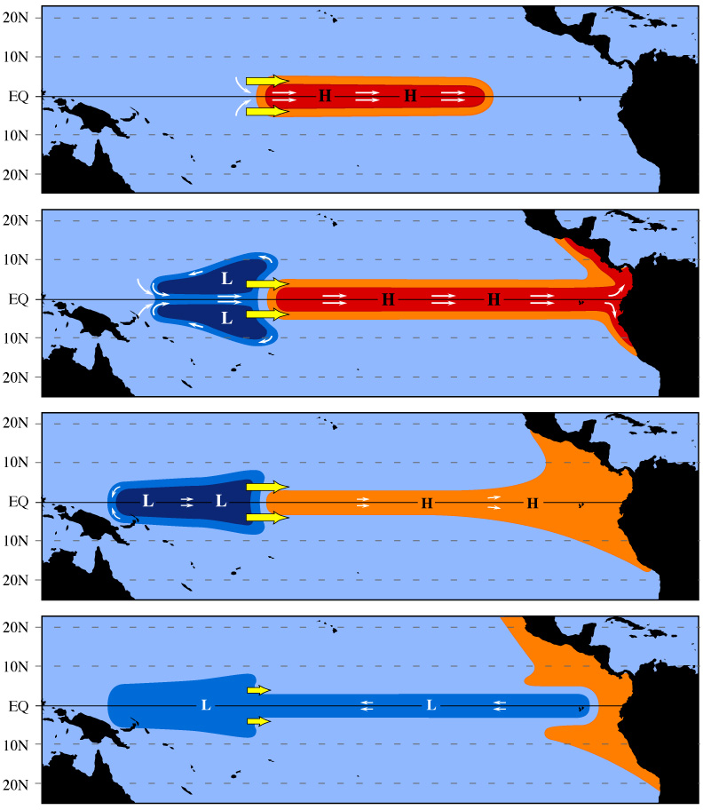
Response of the ocean to a westerly wind anomaly
Re: Onset and demise of El Niño warm phase
Figure 4.13
To east of the wind anomalies, equatorial jet (Kelvin wave) extends east, deepening thermocline (H) and increases SST in east
To west, inflow of water to jet (in ocn. upper layer) comes from off the equator (but little effect on SST)
Shallow thermocline in west extends westward (Rossby wave), as mass transferred to east by jet
When it reaches western boundary, it can no longer supply mass by extending the shallow region. Oceanic PGF weakens to
balance the wind force.
Weakening of jet extends eastward, ending warm phase
As wind anomalies weaken, shallow thermocline extends eastward: transition to cold phase
Wind anoms currents
Deep Thermocline anoms
Neelin, 2011. Climate Change and Climate Modeling, Cambridge UP
Notes:
ENSO_stages.gif

Slide 28
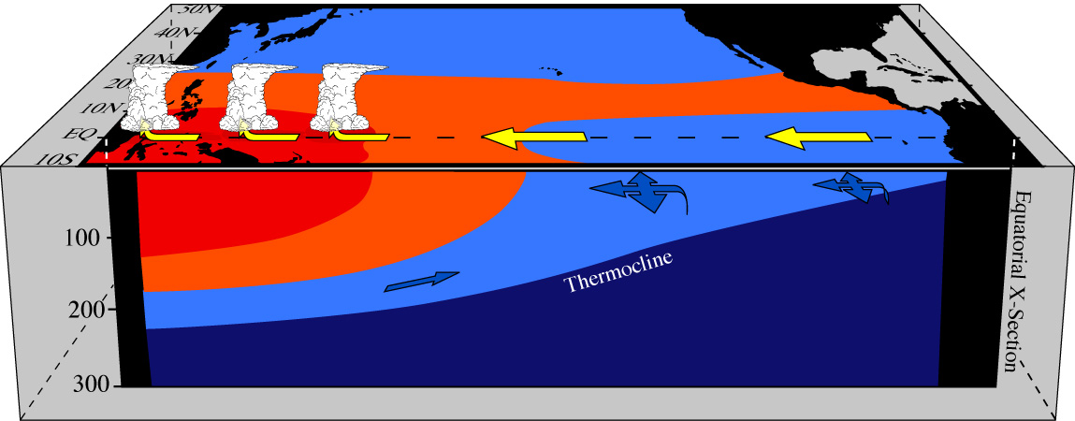
Pacific basin under La Niña (cold) conditions
Cooler SST in east; rainfall concentrated in west
Trade winds strengthen due to increased SST and SLP gradient along the equator
Westward wind stress exceeds eastward PGF in ocean → anomalous westward surface currents
along Eq. → thermocline shallows in the east but deepens in the west → subsurface warm anomalies
appear in the west
Upwelling brings up water colder than normal in the east, further reducing SST in the east
As more warm surface water is moved to west, the deepened thermocline reaches the western boundary and it runs out of room to receive more warm water from the east → PGF increases to balance wind force, westward transport of warm water stops, thermocline & SST return to normal in the east, wind anomalies disappear, La Niña ends → without the anomalous winds, PGF exceeds wind force, surface warm water moves eastward, the deepened thermocline anomalies or warm subsurface water also moves eastward → start of the next El Niño.
However, this cycle may be delayed if surface wind anomalies can be sustained (e.g. by MJO or other perturbations), or the SST in the east does not return to normal after the westward transport of surface water stops (e.g., due to continued upwelling of cold waters). This may lead to some La Nina events lasting for 2-4 years, instead of one season.

Slide 29
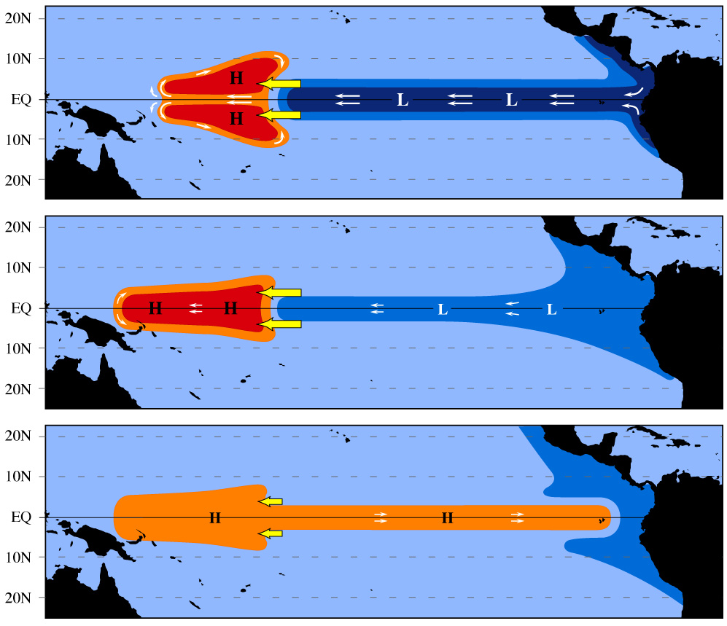
Response of the ocean to a easterly wind anomaly
Re: Onset and demise of La Niña cold phase
Same as Figure 4.13 but anomalies of opposite sign
Enhanced easterly winds
move more warm surface
water to the west. This deepens
the thermocline in the west,
especially off the Equator.
The deepened thermocline
extends westward and reaches
the western boundary. Then the
west runs out of room to hold
more warm water from the east.
PGF builds up and balances the
wind force.
Warm water stops moving
westward, SST in east returns
to normal, wind anomalies
disappear →warm water moves
eastward → start of next El Niño
Neelin, 2011. Climate Change and Climate Modeling, Cambridge UP
Notes:
ENSO_stages_rev.gif

Slide 30
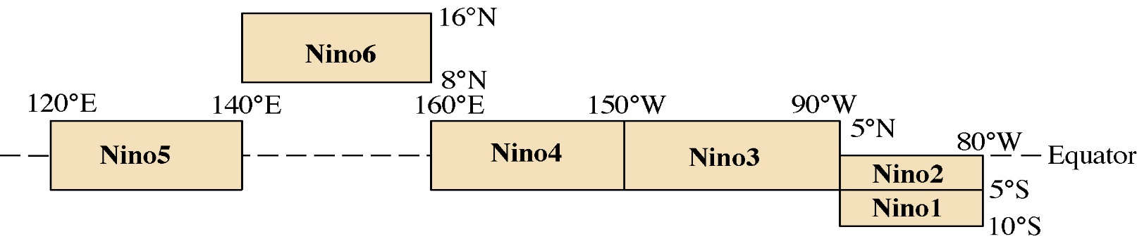
Unified oscillator model for ENSO
Based on the Cane-Zebiak’s coupled model, the unified oscillator model is derived and formulated (Wang 2001, JC) as:
T is Nino3 SST anomaly; h is Nino6 thermocline depth anomaly;
τ₁ is Nino4 zonal wind stress anomaly; τ₂ is Nino5 zonal wind stress anomaly.
h
τ₂
τ₁
T

Slide 31
Take-home message of simple ENSO models
All oscillator mechanisms work together, and their relative importance may be time-dependent.
Conceptual models are just heuristic, and cannot perfectly simulate all features of ENSO events.
Parameters of conceptual oscillator models are NOT constant; and conceptual models can be forced by high frequency such as random (stochastic) forcing.
Processes outside the tropical Pacific can account for ENSO diversity.
Conceptual models need to consider external influences outside the tropical Pacific, such as inter-basin interactions.

Slide 32
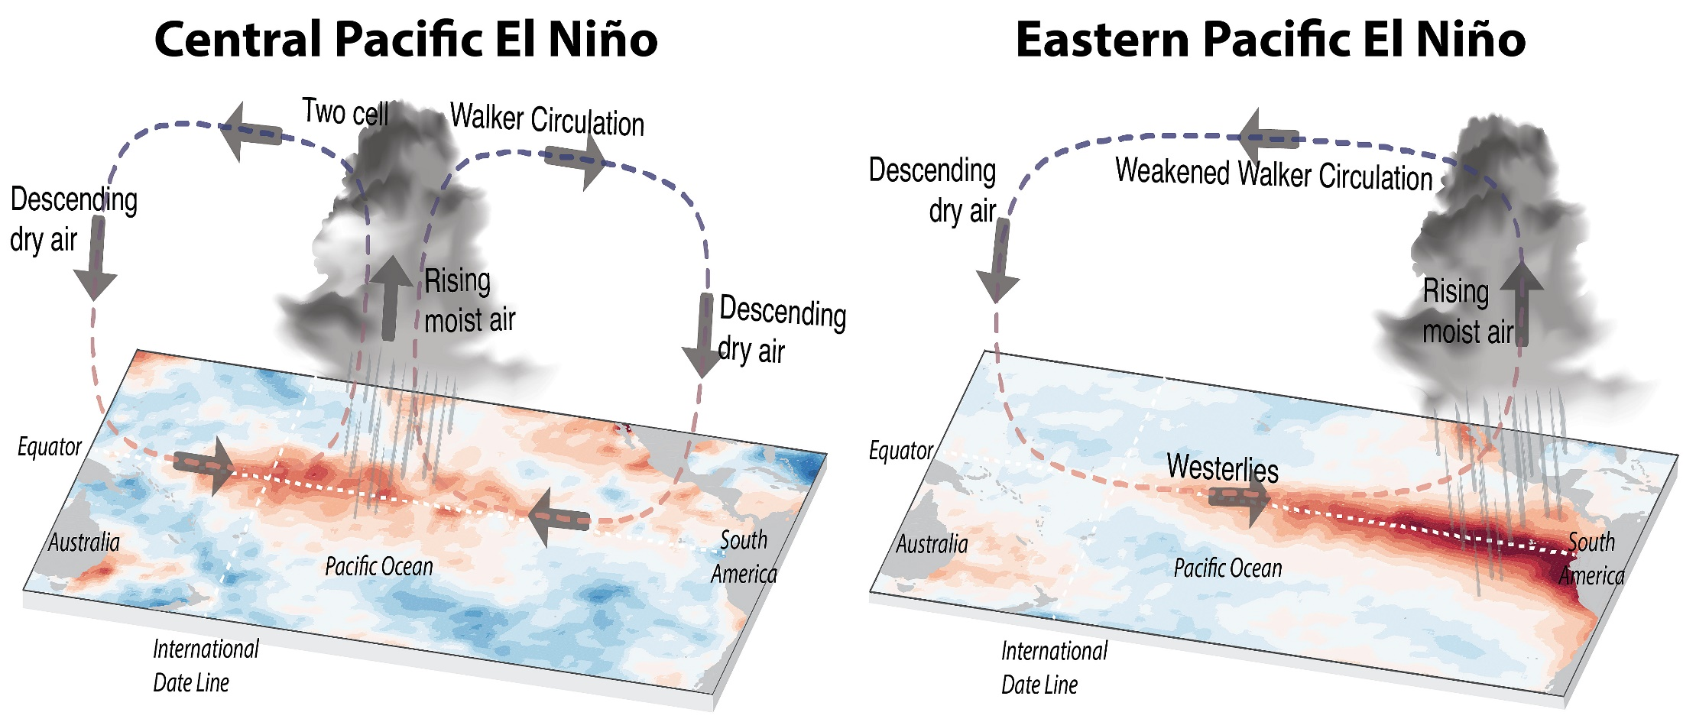
Anomaly Fields for Central Pacific vs. traditional Eastern Pacific El Nino
Some El Niños occur mainly in the Central Pacific in Recent Decades.
Source: https://ecoevocommunity.nature.com/posts/48594-unraveling-the-history-of-el-nino-flavours

Slide 33
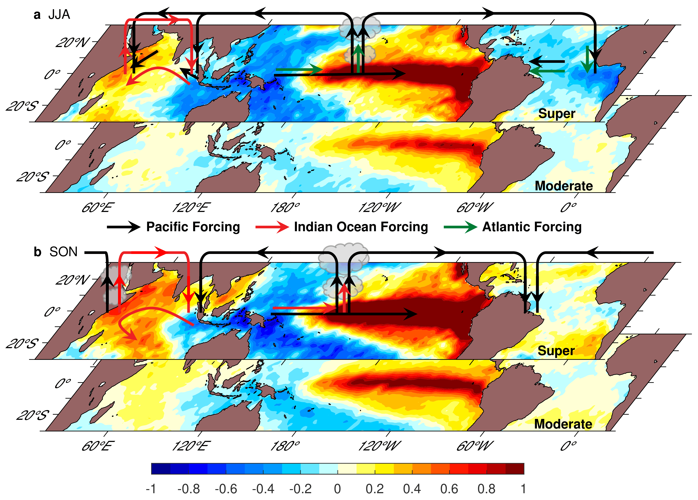
Contributions of Indian & Atlantic Oceans to El Niño
Summer:
Atlantic Niña
Atlantic Niña induces westerlies
IOD induces westerlies
Fall:
Indian Ocean dipole
The successive occurrence of Atlantic Niña and positive IOD is called the Indo-Atlantic booster (IAB) (Wang and Wang 2021, JC).
IAB helps produce super El Niño via three-ocean interactions coupled with seasonal cycle.

Slide 34
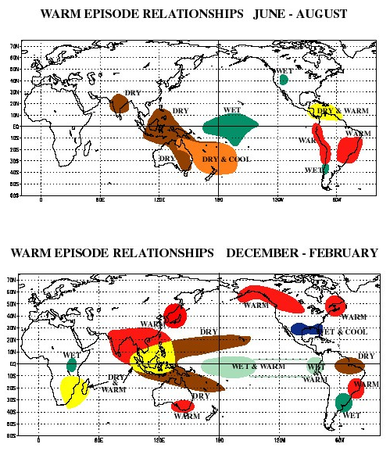
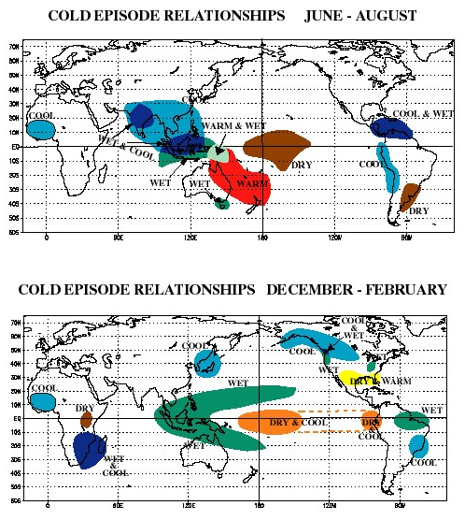
Climate Impacts of El Niño and La Niña
El Niño
La Niña
With the Nino SST forecast 3-6 months ahead, we can predict the T and P anomalies over these regions with the same lead time.

Slide 35
Precip. vs. Nino3.4 SST Correlation: 1920–2010 (1979–2010 over oceans)
ENSO
IPO
Stippling indicates significant at 5% level Dai (2013)

Slide 36
Summary of ENSO
ENSO refers to irregular (2-7yr) oscillations in SLP, SST and winds in the tropical central-eastern Pacific. It is the largest interannual variation.
ENSO dynamics/formation: See slides 17 and 19:
El Niño formation: westerly wind anomaly→ more warm water pushed to the east → lower (higher) sea level in the west (east) and shallower (deeper) thermocline in the west (east) + Bjerknes feedback → warmer SST in the east and weaker trade winds → reduced west-east sea-level height gradient → no more transport of warm water to the east → SST and SLP in the east recover to normal → trade winds push surface water westward, subsurface cold water moves eastward → transition to the cold phase La Niña
La Niña formation: easterly wind anomaly→ more warm water pushed to the west → higher (lower) sea level in the west (east), deeper (shallower) thermocline in the west (east) + Bjerknes feedback → colder SST in the east and stronger trade winds→ increased west-east sea-level height gradient → no more transport of warm water to the west → SST and SLP in the east recover to normal → ocean pressure gradient force pushes surface warm water eastwards, subsurface warm water moves eastward → transition to El Niño.
ENSO theoretical models: simple models considering the basic ENSO processes, they can produce the oscillation of Nino4 T. The unified oscillator model can produce several other ENSO models.
ENSO can be predicted 3-6 months ahead.
ENSO Impacts: During El Niño: dry in Indonesia, eastern Australia, Central America, Northwest S. America, West Africa, southern Africa and India; wet in the central-eastern equatorial Pacific, the western tropical Indian Ocean and East Africa, Southeast S. America, the southern U.S., most of the extratropical North Atlantic, central Eurasia, parts of East Asia. The impact is roughly reversed during La Niña.

Slide 37
A ATM551: Lecture #19
NAO, AO, Atlantic and Pacific Multidecadal Variability
Reading Materials:
Luo et al. (2007, JAS) (NAO formation)
Deser (2000, GRL) (AO vs. NAO)
Liu (2012, J. Climate, pp. 1963-1995) (Decadal Modes)
Zhang et al. (2019, Rev. Geophys.) (AMO and AMOC)
Sutton et al. (2018, BAMS) (AMO)
Cai et al. (2019, Science) (inter-basin connection)
Meehl et al. (2021, Nature Geosci.) (AMV-PDV interactions)

Slide 38
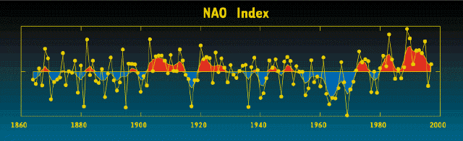
North Atlantic Oscillation (NAO)
NAO is a large-scale seesaw in atmospheric mass or pressure between the Atlantic subtropical high and subpolar low.
NAO is the dominant mode of winter climate variability in the North Atlantic. Individual NAO events last for ~2 weeks (similar to atmospheric blocking events), caused by synoptic eddies interacting with planetary waves (Luo et al. 2007, JAS).
NAO index varies from year to year, but also exhibits a tendency to remain in one phase for intervals lasting several years or decades.
NAO is related to storm track strength and jet stream positions over the North Atlantic.
Luo, D., A. R. Lupo, and H. Wan, 2007: Dynamics of eddy-driven low-frequency dipole modes. Part I: A simple model of North Atlantic Oscillations. J. Atmos. Sci., 64, 3–28, https://doi.org/10.1175/JAS3818.1.
Luo, D., X. Chen and S. Feldstein, 2018: Linear and nonlinear dynamics of North Atlantic Oscillations: A new thinking of symmetry breaking, J. Atmos. Sci.，75, 1955-1977, DOI: 10.1175/JAS- D-17-0274.1
Winter index of the NAO based on the difference of normalized sea level pressures (SLP) between Lisbon, Portugal and Stykkisholmur/Reykjavik, Iceland since 1864 [Lisbon SLP (south) minus Iceland (north) SLP).
Notes:
During NAO+ Phase:
The Positive NAO index phase shows a stronger than usual subtropical high pressure center and a deeper than normal Icelandic low.
The increased pressure difference results in more and stronger winter storms crossing the Atlantic Ocean on a more northerly track.
This results in warm and wet winters in Europe and in cold and dry winters in northern Canada and Greenland
The eastern US experiences mild and wet winter conditions
During NAO- phase:
The negative NAO index phase shows a weak subtropical high and a weak Icelandic low.
The reduced pressure gradient results in fewer and weaker winter storms crossing on a more west-east pathway.
They bring moist air into the Mediterranean and cold air to northern Europe
The US east coast experiences more cold air outbreaks and hence snowy weather conditions.
Greenland, however, will have milder winter temperatures

Slide 39
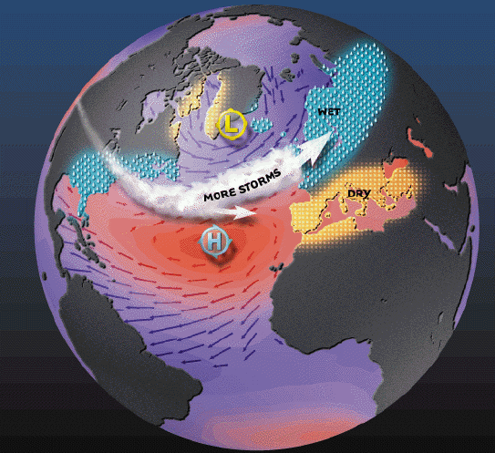
Positive NAO Phase
The positive NAO index phase shows a stronger than usual subtropical high pressure center and a deeper than normal Icelandic low.
The increased pressure gradient results in more and stronger winter storms crossing the Atlantic Ocean on a more northerly track.
This results in warm and wet winters in
most Europe and cold and dry winters
in northern Canada and Greenland.
The eastern US experiences mild
and wet winter conditions.
NAO+
Notes:
During NAO+ Phase:
The Positive NAO index phase shows a stronger than usual subtropical high pressure center and a deeper than normal Icelandic low.
The increased pressure difference results in more and stronger winter storms crossing the Atlantic Ocean on a more northerly track.
This results in warm and wet winters in Europe and in cold and dry winters in northern Canada and Greenland
The eastern US experiences mild and wet winter conditions

Slide 40
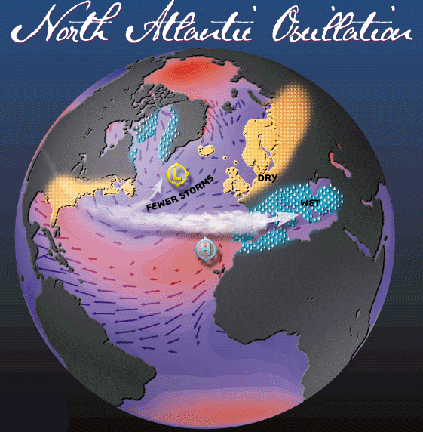
Negative NAO Phase
The negative NAO index phase shows a weak subtropical high and a weak Icelandic low.
The reduced pressure gradient results in fewer and weaker winter storms crossing on a more west-east pathway.
They bring moist air into the
Mediterranean and cold/dry air to
northern Europe.
The US east coast experiences more
cold air outbreaks and hence snowy
weather conditions.
Greenland has milder winter
temperatures
NAO−
Notes:
During NAO- phase:
The negative NAO index phase shows a weak subtropical high and a weak Icelandic low.
The reduced pressure gradient results in fewer and weaker winter storms crossing on a more west-east pathway.
They bring moist air into the Mediterranean and cold air to northern Europe
The US east coast experiences more cold air outbreaks and hence snowy weather conditions.
Greenland, however, will have milder winter temperatures

Slide 41
NAO Formation (Luo et al. 2007)
Eddy forcing arising from the preexisting synoptic-scale waves is crucial for the growth and decay of the NAO
A preexisting low-over-high (high-over-low) dipole planetary-scale wave is required to match the preexisting positive-over-negative (negative-over-positive) dipole eddy forcing over the North Atlantic, which excites a positive (negative) phase NAO event.
The positive and negative feedbacks of the preexisting dipole eddy forcing, which depend on the background westerly wind, seem to dominate the life cycle of the NAO and its duration.

Slide 42
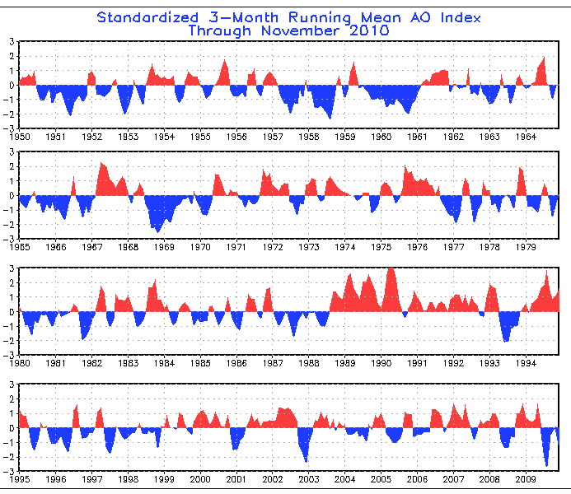
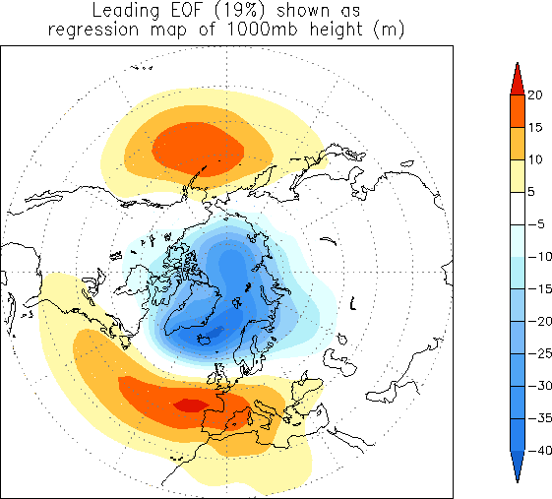
Arctic Oscillation (AO)
The AO is a large-scale seesaw pattern in atmospheric mass between the sub-polar low and the high-pressure centers in the Pacific and Atlantic around 37-45ºN.
The NAO mainly reflects the Atlantic part of the AO.
Weak connection between the Atlantic and Pacific high-pressure centers; AO is dominated by the polar low-pressure center (Deser 2000)
Causes for the AO phase change are not well known.

Slide 43
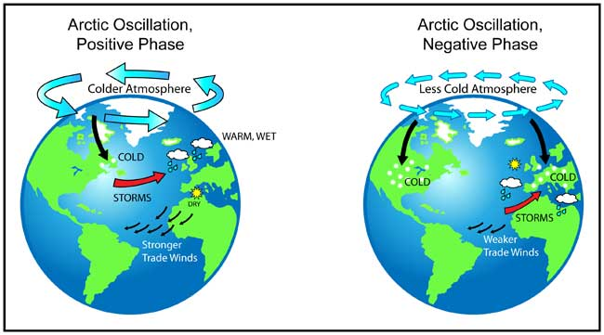
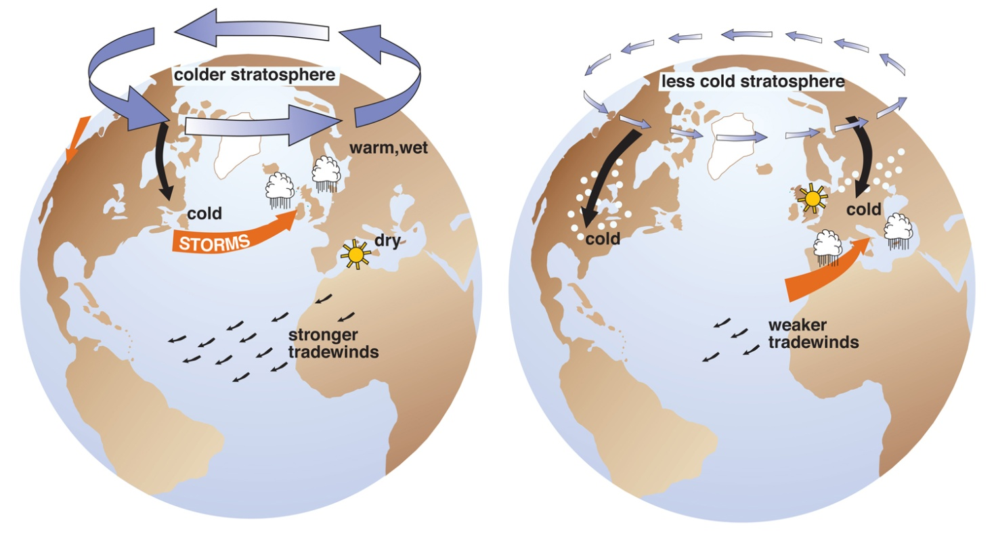
Positive AO→
Stronge SLP
gradient→
Stronge Polar
Vortex &
stronge westerlies
→Fewer cold
breaks to midlat.
Negative AO→
Weak SLP
gradient →
Weak Polar
Vortex & weak
westerlies
→ More cold
breaks to midlat.

Slide 44
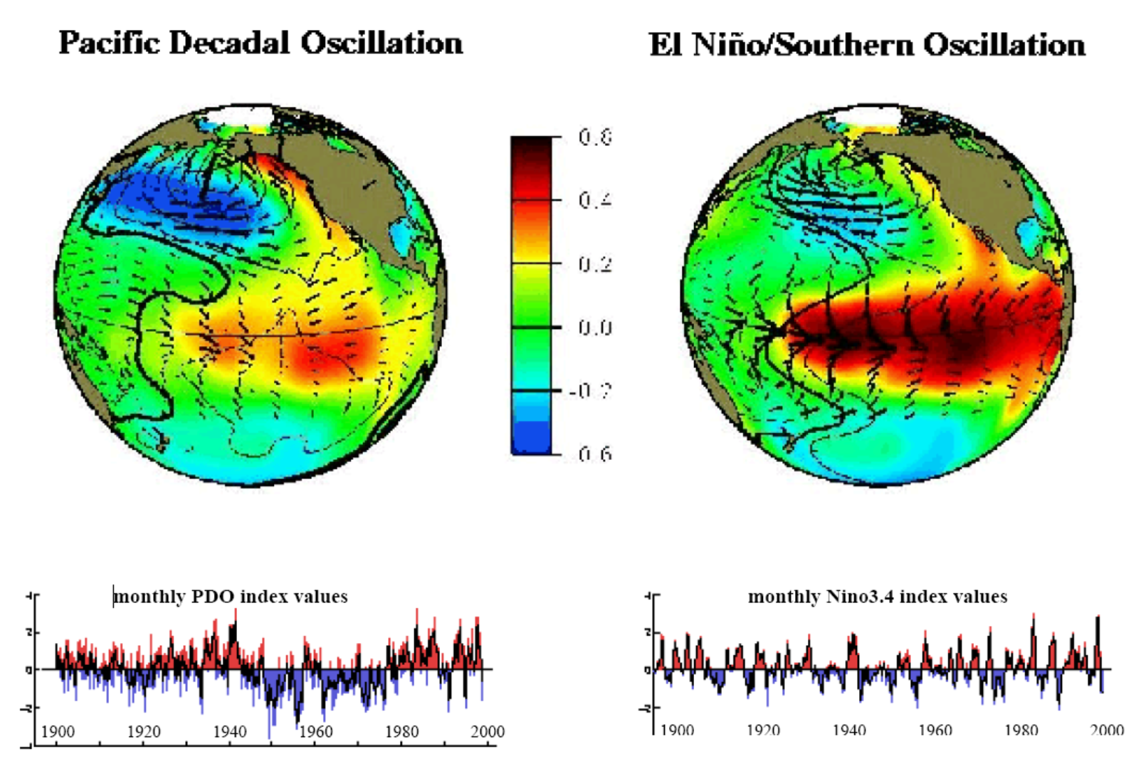
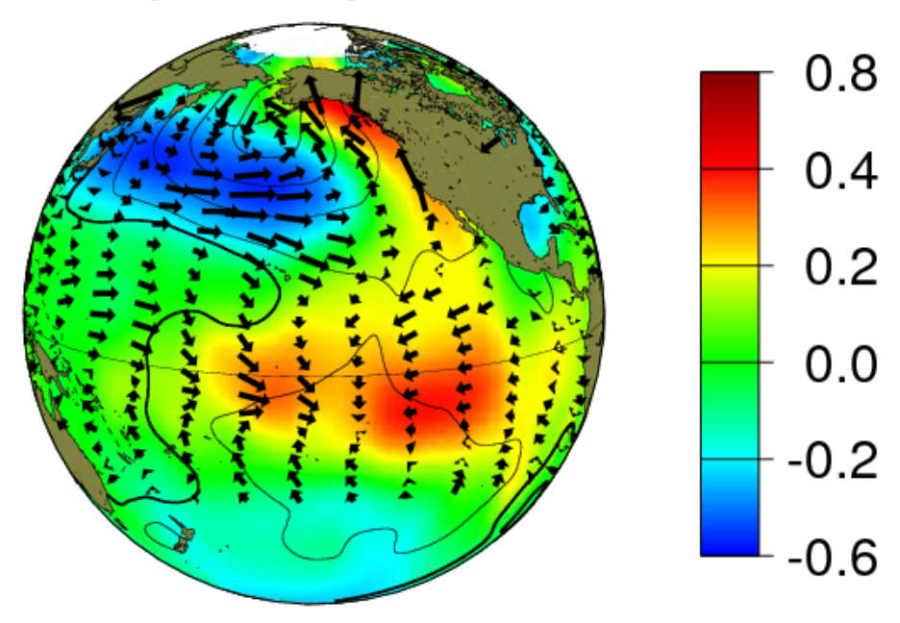
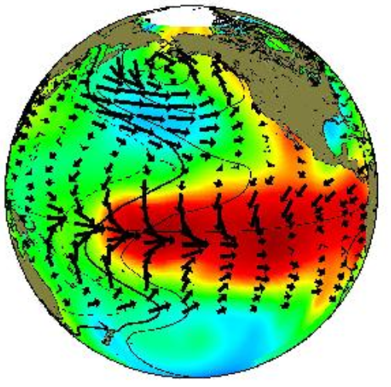
PDO and IPO vs. ENSO
The PDO is the ENSO-like multi-decadal (40-60yr) quasi-oscillations in the North Pacific Ocean
The Inter-decadal Pacific Oscillation (IPO) is the ENSO-like multi-decadal quasi-oscillations in the whole Pacific Ocean, defined in SST and SLP fields
The PDO and IPO may be considered as the decadal variability of ENSO activity
The PDO/IPO is thought to result from atmospheric random forcing with its time scale related to oceanic processes. This is still an active research area.
IPO/PDO Positive or Warm Phase
IPO: Larger anomalies
in N. Pacific, wider
tropical dSST pattern
Notes:
Causes: reddening of ENSO forced by atmospheric stochastic forcing. But the exact time scale of the IPO or PDO is thought to be determined by the transit time of ocean Rossby waves in the Pacific basin.

Slide 45
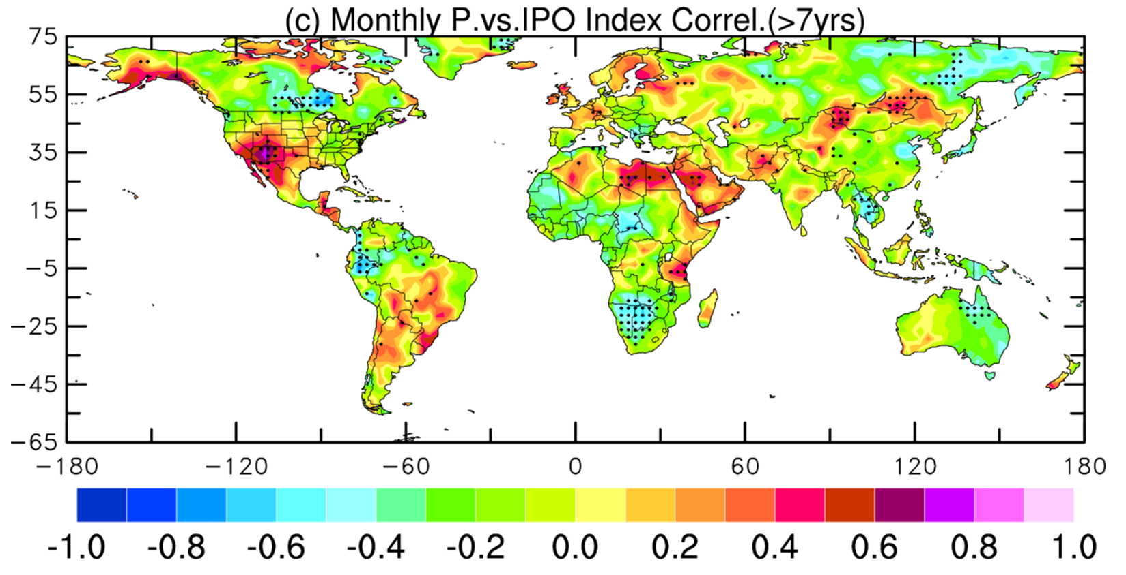
Dry during
negative IPO phase
Stippling indicates significant at 5% level Dai (2013)

Slide 46
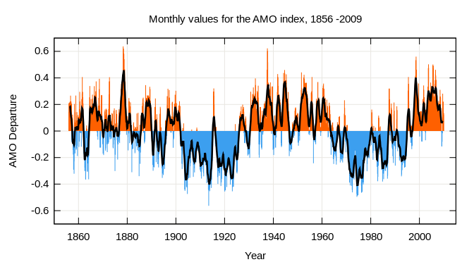
Atlantic Multidecadal Oscillation (AMO)
AMO is the multi-decadal (60-80yr) variability in North Atlantic SST and
other related fields. Also called Atlantic Multidecadal Variability (AMV)
AMO Index is the leading PC in or average of detrended N. Atlantic SST field.
AMO may result from changes in Atlantic Meridional Overturning Circulation (AMOC).
AMO warm phase leads to more drought over U.S. Midwest and Southwest, but
more rainfall over Florida, and is associated with more hurricanes.
Notes:
During NAO+ Phase:
The Positive NAO index phase shows a stronger than usual subtropical high pressure center and a deeper than normal Icelandic low.
The increased pressure difference results in more and stronger winter storms crossing the Atlantic Ocean on a more northerly track.
This results in warm and wet winters in Europe and in cold and dry winters in northern Canada and Greenland
The eastern US experiences mild and wet winter conditions
During NAO- phase:
The negative NAO index phase shows a weak subtropical high and a weak Icelandic low.
The reduced pressure gradient results in fewer and weaker winter storms crossing on a more west-east pathway.
They bring moist air into the Mediterranean and cold air to northern Europe
The US east coast experiences more cold air outbreaks and hence snowy weather conditions.
Greenland, however, will have milder winter temperatures

Slide 47
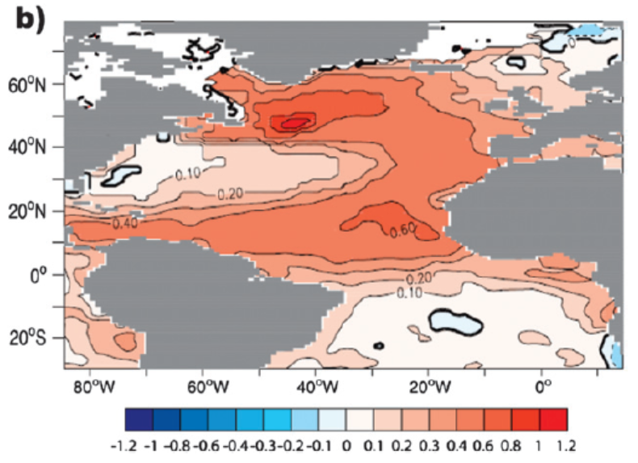
AMO SST Pattern (warm phase)

Slide 48
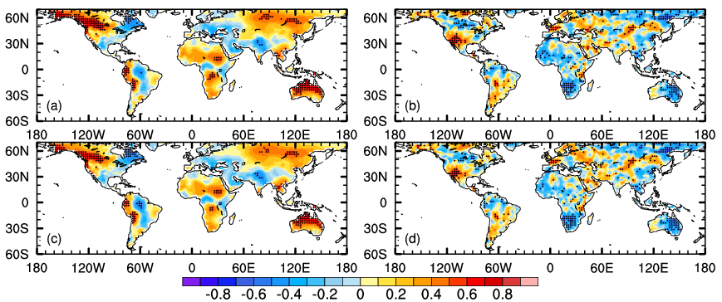
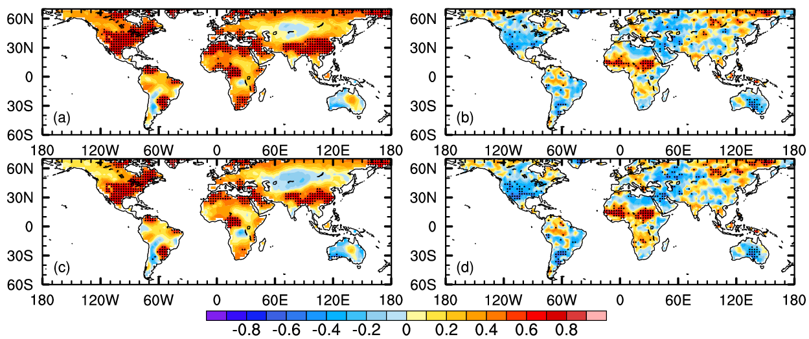
Correlation Patterns of Annual T and P with IPO and AMO Index
(1920-~2018 observational data)
IPO vs.Tas
IPO vs. Pr
AMO vs.Tas
AMO vs. Pr
A positive correlation → a positive T or P anomaly during a warming phase of IPO or AMO
Notes:
1920-2018(?) annual-mean data

Slide 49
Dynamics of PDO, IPO and AMO
It is still an active research area.
Modeling studies suggest that they are likely result from stochastic forcing (i.e., random weather events).
For PDO and IPO, T changes in the wind-driven upper oceans in the Pacific are important. The two are likely closely coupled.
For AMO, the Atlantic meridional overturning circulation is important, and it may be coupled with the NAO.
Their time scale is thought to be mainly determined by Rossby wave propagation in the extratropics within the Pacific and Atlantic Ocean.
See Liu (2012, J. Climate) for more discussions.

Slide 50
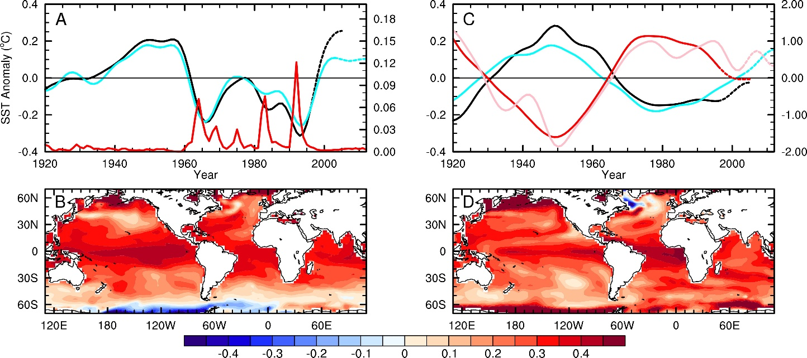
AMO-like SST Variations Caused by Volcanic and Anthropogenic Aerosols
Volcanic Aerosols
Anthoropogenic Aerosols
CMIP5, PC1
CMIP5, AOD
AOD
PC1, CMIP6
EOF1
of SST
Conclusion: Recent AMV is partly forced by aerosols
Qin et al. (2020, Sci. Adv.)

Slide 51

Interactions Among AMV, AMOC and NAO
Sutton et al. (2018)

Slide 52

Observed and Simulated Atlantic Influence on Pacific SST & 850hPa Winds
Regression patterns with tropical Atlantic SST (1980-2005)
Cai et al. (2019)

Slide 53

SST & Sfc Wind Results from Pacemaker Coupled Model Simulations
Warm tropical Pacific →
Warm tropical Atlantic
Warm tropical Atlantic →
Cold tropical Pacific
Meehl et al. (2021)
Notes:
A pacemaker simulation is a fully coupled climate model simulation except for a specified region, where SST is specified based on observations or climatology, so that the response in other ocean basins to the specified regional SST can be quantified.

Slide 54


Stronger Pacific trade winds→
Cooling in central-eastern Pacific
Processes Connecting the
Pacific and Atlantic
Surface flux changes + horizonal warm
advection → warming tropical Atlantic
Meehl et al. (2021)

Slide 55
Key points of Lecture 19
Inter-annual modes: NAO, AO (and ENSO)
NAO and AO: Positive phase→ larger meridional pressure gradients, stronger polar vortex → stronger jet and westerlies → fewer cold breaks from the Arctic to mid-latitudes, more northerly flow over the Atlantic → mild and wet winter in northern Europe and the eastern U.S., but dry Mediterranean (dT is small).
NAO results from interactions between synoptic eddies and planetary waves under certain matching conditions; it typically has a lifetime of ~2 weeks and is influenced by Atlantic westerly winds
Decadal modes: PDO/IPO, AMO/AMV: formation dynamics not well known.
PDO/IPO: the decadal to multi-decadal oscillations in ENSO activities, with periods from ∼40-60 years and spatial patterns similar to ENSO
AMO: The 60-80yr oscillation in SST in the North Atlantic.
These modes are likely generated by stochastic atmospheric forcing, with Rossby wave propagation in the extratropical Pacific and Atlantic Ocean being key to their time scales.
AMO may result from the interactions between AMV, AMOC and NAO: AMV-/AMOC- → NAO+ → AMV+AMOC+ → NAO- → AMV-/AMOC-
AMO cycles since 1920 may be partly forced by changes in aerosols
IPO and AMO affects T and P over the Americas, West Africa, Europe and Asia on decadal-multidecadal time scales.
Warm tropical Atlantic leads to cooing in the central-eastern tropical Pacific due to stronger trade winds
Warm tropical Pacific leads to warm tropical Atlantic due to local flux changes and horizontal warm advection.

Slide 56
Homework #4 (due in one week)
How do we measure climate variability? How and why is the variability of surface air temperature projected to change at northern high latitudes and in low latitudes? (20%)
Describe the mechanisms or physical processes behind the ENSO cycles, including the Bjerknes feedacks and the processes that end an El Niño or La Niña event and those that lead to the opposite phase in an ENSO cycle. (25%)
Describe the temporal and spatial characteristics of the IPO and AMO, their impacts on global climate, their interactions, and their likely formation mechanisms. (25%)
How do NAO and AO affect weather over North America and Europe? What are the main features for the positive and negative phases of NAO and AO? (20%)
What is the relationship among ENSO, PDO, and IPO? (10%)

Slide 57
A ATM551: Lectures #21
Climate Forcing, Response, and Sensitivity
Reading Materials:
Chapter 10 of Hartmann GPC
Gregory et al. (2004, GRL)
Dai et al. (2020, CD)

Slide 58
Climate Forcing and Response
Climate Forcing refers to a change in atmospheric GHG levels, solar insolation, volcanic eruptions, land surface conditions, etc. that can lead to global or regional climate changes. It can be human-induced (e..g, through fossil fuel burning or converting forests to crop land) or natural (e.g., large volcanic eruptions or solar cycles).
Climate forcing is often measured using the TOA net radiative flux change (from zero) induced right after the change. Note that TOA net radiation will restore to zero again after a new equilibrium is reached. Thus, climate radiative forcing (at TOA) is often used.
Climate Response refers to the change of the climate in response to a given climate forcing, such as increases in atmospheric CO2 levels.
Climate response may be masked by large natural variations, making it difficult to quantify it.
Climate forcing
The Climate System
Climate Response
Climate Variations
Notes:
TOA = Top-of-atmosphere

Slide 59

Radiative Forcing
Radiative forcing (RF) is the change in the net radiative flux at the top of the atmosphere (TOA) caused by a climate forcing, such as a change in GHGs, solar radiation, or volcanic aerosols, immediately following such a change. Note the net radiative flux at TOA will become zero again after a new equilibrium is reached.
In some analyses, the change in the net radiative flux at the tropopause may be used as the radiative forcing, since the atmosphere above the tropopause is allowed to reach radiative equilibrium (thus no contribution to TOA imbalance) in estimating the radiative forcing.
Radiative forcing due to a doubling of atmospheric CO2 is around 4 W/m².
Radiative forcing after an instantaneous doubling of CO2 in EdGCM
RF≈3.8W/m²

Slide 60

Estimates of Radiative Forcing due to GHGs
IPCC (2001)
RF increases with CO2, CH4, and N2O nonlinearly, with a logarithmic
relationship.

Slide 61

RF = 5.35 ln(C/Co)
CO2 RF (W/m²)
2xCO2 3.7
3xCO2 5.9
4xCO2 7.4
5xCO2 8.6
8xCO2 11.1

Slide 62

Historical Radiative Forcing: Temporal Evolution (IPCC AR5)

Slide 63

Historical and Future CO2 Forcing

Slide 64

Equilibrium Climate Sensitivity (ECS)
Climate sensitivity (λ) is the equilibrium response of the global-mean surface temperature (T) to a given (initial) TOA radiative forcing (R), expressed in ºC per W/m²: λ=dT/dR. It depends on the initial state of the climate system as well as the nature of the forcing (e.g., changes in GHGs, solar radiation, or volcanic aerosols, etc.)
The global-mean T change due to a doubling of CO2 is also used as a measure of climate sensitivity for climate models. The EdGCM has a sensitivity of ~4.2ºC for 2xCO2.
The IPCC AR5 says that climate sensitivity for a 2xCO2 is likely within 2.0-4.5ºC, with
a λ of 0.5 ~ 1.1 K per W/m², assuming a dR of 4 W/m² for 2xCO2.
4.2ºC

Slide 65
Methods of Determining Climate Sensitivity
Paleoclimate Evidence. 3 primary methods:
  Take two different climate periods (e.g., the Last Glacial Maximum and Pre-Industrial) and divide the temperature change by the radiative Forcing
  Ensemble of LGM simulations is carried out using a single climate model in which each ensemble member typically differs in model parameters and the ensemble covers a range of climate sensitivity. Model parameters are then constrained by reconstructed LGM climate, and probability distribution of climate sensitivity is generated
  Multiple GCM simulations are compared to proxy data (Otto-Bliesner et al., 2009), and performance of the models (and indirectly their climate sensitivity) are assessed
2) Using the observed record.
  Satellite measurements of TOA radiative response to SST anomalies
  Response to Pinatubo
  20th century trend
3) In CMIP5 models, climate sensitivity obtained directly from the AOGCMs from a linear fit of the model output to the global energy balance relationship
4) Run an AGCM with a slab ocean model to an equilibrium

Slide 66

Equilibrium Climate Sensitivity Estimate
Linear fitting method of Gregory et al. (2004)
ΔN = F - b ΔT
ECS = 0.5 F/ b
F is the intercept
for 4×CO₂
b = −dN/ dT for the green line
Dai et al. (2020)

Slide 67

An Improved Method for Estimating ECS
(Dai et al. 2020, Clim. Dyn.)
ECS = θ × (ΔT_{mean} + ΔN_{mean}/b) based on 4xCO2 run
Δt_{mean} = realized warming near the end of simulation
ΔN_{mean}/b = unrealized warming by the simulation
ΔN_{mean}= TOA net flux near the end of the simulation
b = -dN/dT near the end of the simulation
θ = 0.485 or 0.4759

Slide 68

Comparison of the Estimated ECS
Gregory method
Improved method
True ECS
Dai et al. (2020)

Slide 69
Transient Climate Sensitivity
An equilibrium takes many centuries to reach in fully coupled OAGCMs.
Transient climate sensitivity (or response) is the global-mean surface temperature change averaged over a 20yr period around the time of a doubling of atmospheric CO2 (i.e., yr 60-79) in a transient simulation with 1%/yr increase in CO2.
The transient climate sensitivity is lower than the (equilibrium) climate sensitivity as the deep oceans take longer than 70yrs to respond to CO2 increases, that is, the surface temperature will continue to increase even if CO2 stabilizes after year 70.
Transient Run
2XCO2 Run

Slide 70

TCR and ECS in CMIP5 Models
λ=b=-dN/dT
Dai et al. (2020)

Slide 71

TCR and ECS in CMIP6 Models
Dai et al. (2020)

Slide 72

Comparison of TCR vs. ECS
CMIP5
CMIP5
Dai et al. (2020)
CMIP6
CMIP6

Slide 73
Summary for Climate Forcing, Response, & Sensitivity
Climate forcing refers to a change in GHGs, aerosols, solar insolation, etc. It is
often quantified by the net TOA flux change – radiative forcing.
Climate sensitivity (λ=dT/dR) refers to the equilibrium response of the global-
mean surface temperature to a given (radiative) forcing at TOA caused by a
sudden change in GHGs, aerosols, solar insolation, or other changes.
Equilibrium climate sensitivity (ECS) refers to the equilibrium warming of the
global-mean surface temperature in response to a doubling of CO2.
Transient climate sensitivity (or response) refers to global-mean T change at
the time of CO2 doubling (~year 70) in a transient run with 1%/yr CO2 increase.
Estimating ECS is challenging as it takes thousands of years for the climate
system to reach a new equilibrium.
Various empirical and modeling methods are used to estimate ECS
A common method is to fit the global-mean TOA flux with surface T change to
estimate ECS, but the dN/dT slope changes over time.
Most GCMs show a warming of 2-4.5ºC for 2xCO2 (with a radiative forcing of
~4W/m²), or a climate sensitivity of 0.5-1.1K per W/m².
The new CMIP6 models show a mean ECS of 3.4ºC, similar to that of CMIP5
models but with a larger upper limit (5.9 vs. 5.4ºC).

Slide 74
A ATM551: #22
Climate Feedbacks
Reading Materials:
Chapter 10 of Hartmann GPC
Hansen et al. (1984, AGU Monograph)
Roe, R., 2009: Feedbacks, Timescales, and Seeing Red. Annu. Rev. Earth Planet. Sci. 37:93–115.

Slide 75

Climate Feedbacks
Refer to physical processes that either enlarge (positive) or reduce (negative) the response of the global-mean surface temperature to an initial radiative forcing.
Examples:
  Positive feedbacks: water vapor feedback, ice-albedo feedback
  Negative feedbacks: Chemical weathering feedback, tropical SST-cloud feedback, tropical lapse-rate feedback, Planck LW radiative feedback

Slide 76


Climate Feedback Analysis
There are at least three different methods to analyze/quantify climate feedbacks:
Method 1: Using dTs ratios between the cases with and without the feedback process as the feedback factor f_{h} (Hansen et al. 1984). This method directly follows the original definition of climate feedback (modulation to the Ts change) and thus is easy to understand.
Method 2: Define the feedback factor f_{r} as the gain factor for radiative forcing (Roe 2009):
f_{r} ≡ c₁ λ_{o} and ΔT = λ_{o} (ΔR + c₁ ΔT) → λ_{o} ≡ ΔT_{o}/ ΔR
ΔT = λ_{o} ΔR/(1 – c₁λ_{o}) = ΔT_{o} / (1 – f_{r} ) →
f_{h} = 1 / (1 – f_{r} )
f_{r} is the gain factor g of Hansen et al. (1984), and
the gain factor (G) in Roe (2009) is Hansen’s
feedback factor (f_{h})!
Relationship between climate sensitivity (λ) and f_{h}:
ΔT_{s} = λ ΔR and ΔT_{s} = f_{h} ΔT_{o}= f_{h} λ_{o} ΔR → λ = f_{h} λ_{o} , where λ_{o} is the sensitivity without the
feedback.
Forcing
ΔR
Ref. System
Without feedback
Response
ΔT_{o}
Forcing
ΔR
Ref. System
With feedback
Response
ΔT_{s}
f_{h} ≡ ΔT_{s}/ ΔT_{o}
o

Slide 77
Quantifying Climate Feedback: 3rd Method
(Soden et al. 2008)
The feedback factor is defined in terms of changes in radiative forcing
at the tropopause or top of the atmosphere (TOA):
where R is the TOA global-mean net radiative flux, x represents a feedback variable (water
vapor W, clouds C, albedo A, etc.), Ts is the global-mean surface air temperature.
β_{x} is defined as the global-mean TOA net radiative flux change due to changes in x per
unit surface warming, in W/m²/K.
This is very different from the original definition of climate feedback and
Hansen’s f_{h}. In 0-D model analysis:
λ_{o}=0.26, β_{o}=1/λ_{o}=3.85; for β_{w}=2, f_{h}=2.1
But it is unclear how these two are related in GCMs, because the R change at TOA
is not directly related to Ts in the real world and GCMs, especially for transient
climate changes (such as the CMIP3 and CMIP5 runs).
∂R/∂x is computed using 1-D radiative transfer model or AGCMs with the kernel
method, dx/dT_{s} is estimated from GCM output or observations.
Even more confusing, Soden and others name their feedback factor also as λ.
Notes:
2xCO2 forcing = 3.7W/m2

Slide 78

β Estimates for Climate Models
(Soden & Held 2006, J Clim)
β
For λo=0.26 and β=1.8, f_{h}≈1.9; for λo=0.3 and β=1.8, f_{h}≈2.2
Compared with Hansen’s estimate of f_{h}≈ 1.7
Notes:
Solid circles are estimates by Soden and Held (2006). The open circles are estimated with fixed RH by them.

Slide 79

Stefan-Boltzmann negative feedback (fast)
λ_{B}=(dσT⁴/dT)⁻¹
≈0.26K/W/m²
For α=0.3, for 1W/m²
TOA forcing, it
requires 1x4/0.7=5.7W/m²
change in solar
constant So, so that
for 1K T change,
it requires 5.7/0.26=
22W/m² or 1.6%
change in So (=1366).
Other positive feedbacks
must be at work to
increase climate
sensitivity to 0.5~1.1 K/W/m² seen in CMIP5
models.
Reduced warming
Reduced Warming
-
Increased surface
and atmospheric T
Increased radiative cooling:
LW ~ σ T⁴

Slide 80


Water Vapor Feedback
Water vapor feedback is a positive feedback that amplifies the
initial change in surface air temperature. It results from the
strong dependence of the atmospheric water vapor content on
air temperature: q = RH x qs(T) and RH ≈ constant.
It is important that RH
does not decrease a lot
in order for q to increase
with T.
Saturation Vapor Pressure
+

Slide 81
Water vapor positive feedback (fast)
λ_{B+FixRH} ≈0.5K/W/m²
based on 1-d radiative-
convective equilibrium
model calculations.
Adding fixed RH water
vapor feedback doubles
the climate sensitivity
with only the Stefan-
Boltzmann feedback
(~0.26K/W/m²).
+

Slide 82

Snow-ice albedo positive feedback (fast for snow &
sea-ice, slow
for ice-sheets)
Further increase
climate sensitivity,
mostly at high-lat.
Important for
formation of
ice ages.
+

Slide 83

Lapse Rate (negative) Feedback
Particularly in the tropics, the vertical temperature gradient expected to decrease
  Envision a “parcel of air” rising, releasing latent heat as it condenses and warming the surrounding air. A warmer parcel contains more water vapor when it becomes saturated, so it condenses more vapor as it rises, and temperature decreases with height more slowly. That is, the moist adiabatic lapse rate, -dT/dz , decreases with warming.
Recall greenhouse effect dependent on vertical temperature gradient. More emission aloft implies surface doesn’t need to heat up as much to get back to equilibrium
Negative Feedback that is anti-correlated (strongly) with water vapor feedback
Courtesy of Isaac Held

Slide 84

Arctic (67-90ºN) Warming Profiles
CESM1 runs with 1%/yr CO₂ increase, ANN
Positive Lapse
Rate Feedback
Jenkins and Dai (2021)

Slide 85

Evaporation feedback:
(negative, as surface LE
cooling increases with
increasing Ts at ∼7Wm⁻² K⁻¹
with fixed RH and Ts-Ta)
This feedback is reduced over
dry land → larger warming
over dry land.

Slide 86
Cloud Feedback
Clouds are expected to change as global-mean T changes, thus providing a feedback on global-mean temperature.
2) Not well-known how cloud distribution should change in a new climate, but most GCMs suggest some decreases in low-mid level clouds and increases in high clouds.
3) Clouds act to enhance the planetary albedo, exerting a global and annual shortwave radiative effect of −50 W m⁻². Clouds also are very good infrared trappers, exerting a mean longwave greenhouse effect of +30 W m⁻² (Loeb et al., 2009). The net global effect of −20 W m⁻² implies a net cooling effect of clouds in the modern climate
4) This doesn’t tell us anything about cloud feedback, but very difficult to figure out the changing residual between two very large and competing terms. No simple theory allows us to determine the sign or magnitude of cloud feedback
5) Cloud feedback, especially the shortwave component, is responsible for a substantial amount of spread in climate sensitivity estimates, and thus in the future response

Slide 87


Model-simulated Cloud Amount Changes:
2080-2090 minus 1980-1990
Decreases in low and
mid-level clouds
Increases in high
clouds due to upward
shift of convection
Total cloud amount
increases at high-
latitudes, but
decreases at mid-low
latitudes
IPCC 2007
Notes:
Multi-model mean, A1B scenario, CMIP3 models, stippling indicate the changes exceed the inter-model s.d.

Slide 88


Cloud Radiative Forcing Changes
2080-2090 minus 1980-1990
Increased CRF → A negative feedback
Reduced CRF → A positive (warming) feedback
CMIP3 Model Index
Model Index
Note: Net CRF is negative (cooling) of ~20W/m²
IPCC 2007
Notes:
AR4 models, A1B scenario

Slide 89

Putting it all together… for f_{r} of Roe (2009)
f_{r}
Note: f_{h} = 1/(1-f_{r}), so for f_{r}=0.5, f_{h}=2.0
Roe (2009)

Slide 90


Chemical weathering
negative feedback
(very slow)
-
-

Slide 91

Vegetation-albedo positive feedback (slow)
Further increase
climate sensitivity,
mostly at high-lat.
Important for
ice age cycles
+

Slide 92

Vegetation-precipitation positive feedback (slow)
+

Slide 93
Summary for Climate Feedbacks
Climate feedbacks refer to processes that either enlarge (positive feedback) or reduce
(negative) the initial global temperature change induced by a radiative forcing.
Common climate feedbacks include: Stefan-Boltzmann or Planck (negative) feedback
(through increased LW cooling with increasing Ts), water vapor feedback (through its
strong dependence on Ts), ice-albedo feedback, lapse rate feedback (negative
globally), cloud feedback (mostly positive), chemical weathering (negative) feedback.
There are three methods to quantify climate feedbacks: Hansen’s fh = ΔTs/ ΔTo, Roe’s
fr = 1 – 1/fh, and Soden’s . They are related in simplified analysis,
but the relationship with β_{x} is unclear in GCMs and the real world.
Water vapor feedback roughly doubles the CO2-induced initial warming.
Cloud feedback is quite uncertain, but generally positive in models.
Lapse rate feedback is negative in the tropics and globally but positive in the Arctic
due to top-heavy (bottom-heavy) warming profiles in the tropics (Arctic).

Slide 94

A ATM551, Lecture #23
Introduction to Climate Modeling
Reading Assignment:
Chapter 3 of the UCL online textbook.
Chapter 5 of the Neelin textbook.
Educational GCM:
http://edgcm.columbia.edu/download-edgcm/software-updates/

Slide 95

What is a Climate Model?
A climate model is a mathematical
representation of the various
processes that control the climate.
It’s a quantitative but often simplified
representation of the real climate system.
It requires
- Knowledge of the physical laws that govern the climate;
- Mathematic representation of the physical laws;
- Numerical methods to solve the mathematic equations on
computers if they can’t be solved analytically; and
- Adequate computing power to carry out the numerical
calculations.

Slide 96
Why Do We Need Climate Models?
We need models to help us understand many physical processes:
- We can’t control the real climate system, but we can control the models of the climate system to study (how?) the impacts of various physical processes, such as the impact of clouds, land cover, or GHGs, etc.
- Observational data are often incomplete. Model data can help us study the climate.
We need models to simulate and reproduce paleoclimates, for which there are only very limited proxy data.
We need models to predict future climate changes:
The global climate models represent our best understanding of the climate system, thus they are our best tool (albeit imperfect) for predicting future climate changes.
We need models to perform many hypothetic experiments:
These experiments are of interest scientifically (e.g., what would happen to our weather and climate if the Rocky Mountain Range were removed?), but can’t be done in the real world.
Climate modeling has become one of the most important approaches in climate research!
Can you think of any reasons?

Slide 97
Can We Trust the Models?
Climate models vary in complexity. A model is a simplified version of the real world. It may be useful for certain purpose, but may not be suitable for other applications.
In general, the global climate models simulate the large-scale processes relatively well, such as atmospheric circulation, temperature and humidity fields.
But they tend to have difficulties in simulating the small-scale processes, such as the formation of clouds, convective precipitation, thunderstorms, and other severe weather events.
One needs to know the strength and weakness of a model in order to properly use it.

Slide 98



Timeline of Numerical Weather & Climate Modeling
1904: Norwegian meteorologist Vilhelm Bjerknes stated the
weather forecasting problem as
1. A sufficiently accurate knowledge of the state of the atmosphere
at the initial time; and
2. A sufficiently accurate knowledge of the laws according to which
one state of the atmosphere develops from another.
These are still valid today, but a third condition is that there is sufficient
computing power to carry out the calculations in a timely fashion.
During World War I, English scientist Lewis. F. Richardson attempted to
forecast the weather by solving the basic equations of atmospheric
motions using a mechanical calculator, when people realized that the
equations can be solved only through numerical approximations.
Late 1940s to early 1950s:
American meteorologist Jule G. Charney led a team of scientists to
perform the first numerical weather forecast on an electronic computer
built at Princeton University’s Institute for Advanced Studies.
Late 1950s: Formation of the group led to the now Geophysical Fluid
Dynamics Laboratory (GFDL). Thereafter, weather and climate modeling
became popular throughout the world.
Vilhelm Bjerknes
(1862-1951)
Lewis Fry Richardson
(1882-1953)
Jule Charney
(1917-1971)

Slide 99





Timeline of Climate Modeling
1960s – 1970s:
Syukuro (“Suki”) Manabe and Kirk Bryan at GFDL developed
the first atmospheric and oceanic GCM and the first coupled GCM.
Warren M. Washington et al. at NCAR also developed AGCMs.
GFDL and NCAR have remained as the leading climate modeling
groups in the world.
1980s:
AGCMs became widely used for 2xCO₂ sensitivity experiments.
James E. Hansen at NASA Goddard Institute for Space Studies (GISS) in
NYC developed AGCMs to study GHG impacts on climate
John F. Mitchell at U.K. Met Office developed one of the leading AGCMs in
the world. The Met Office GCM remains one of the better models today.
1990s:
The coupling between most AGCMs and OGCMs requires surface flux
correction. GFDL, NCAR, and U.K. Met Office were the leading centers.
2000s:
Fully coupled climate models without flux correction became popular.
Motivated by the IPCC Assessment Reports and the CMIP projects, many new groups
started to develop/improve climate models and make future climate projections.
Today, there are over 20 different climate modeling groups that develop GCMs in a
number of countries, including U.S., U.K., Germany, France, Canada, Japan, Australia,
China, & Russia
Suki Manabe
(1931- )
Kirk Bryan
(1928- )
James E. Hansen
(1941-)
Warren Washington
(1936-)
John F. Mitchell
U.K. Met Office

Slide 100

Timeline of Climate Model Development
Near-future
Notes:
100

Slide 101

Evolution of Climate Model Resolution
1990
2001
1995
2007

Slide 102
Types of Climate Models (cont’d)
General Circulation Models (GCMs):
These are 3-dimensional models that are built upon the basic equations that govern the air flows in the atmosphere and water currents in the oceans. They treat most of the physical processes (e.g., radiative transfer) important for the climate in a complex way using our best knowledge.
There are GCMs for the Atmosphere and the Oceans. A 3-d land surface model is also a major component of a coupled climate model.
Atmospheric GCMs (AGCMs) were first developed in the 1950s for short-term (<7days) weather forecast.
In the 1960s, AGCMs and ocean GCMs (OGCMs) were developed to simulate long-term climate, with a grid size of 500-800km, pioneered by S. Manabe, W. Washington, et al.
Before around 2000, the coupling of an AGCM and OGCM requires an artificial flux correction at the air-sea interface, referred to as “flux correction”, in order to produce a stable climate in a control run, in which there is no external forcing.
Today’s fully coupled models do not need such flux correction, with a grid size of 50-300km. Global carbon, sulfur and nitrogen cycles are being added to these models, which are often referred to as the Earth System Models (ESMs).

Slide 103

Climate System Models

Slide 104

Climate Model Development

Slide 105

Discretization Using Finite Differences
Where Δt is the model time step, n is the time index. Δt = 10-30min. and Δx = 100-300km in most AGCMs.
Higher resolution means smaller Δt and Δx, which takes more computing power but represents the real world more realistically .
Computing Time
Resolution

Slide 106

Terrain and Model Resolution
T42 ~ 280km, T85 ~ 140 km, …
Notes:
T42 ~ 280km, T85 _ 140 km, …

Slide 107
Weather Forecast Models vs. Climate Models
A weather forecast model is an AGCM initialized with observed conditions in the atmosphere and forced by observed SST boundary conditions only.
A coupled climate model includes an AGCM, an OGCM, a detailed land surface model, a sea-ice model, and a coupler connecting these component models.
Initial conditions are critical for weather forecast models, but not important for long-term climate simulations. Why?
Changes in GHGs, aerosols, solar radiation and volcanic activities are important for climate models, but not for short-term weather forecast. Why?
Detailed simulations of the oceans, land processes, sea-ice, and mass and energy conservations are important for climate models, but not in weather forecast models.
Weather forecast models are usually run at 5-10 times higher resolution than climate models because they are integrated over only a few days to 2 weeks into the future, instead of many years to centuries for climate models.
Climate models aim to predict the mean climate state, not the day-to-day weather variations; thus they can provide useful information well beyond a few weeks, beyond which weather forecast is unreliable.

Slide 108
Weather Forecast Models vs. Climate Models
Weather Model
Coupled Climate Model
Initial Conditions
AGCM
AGCM
External Forcing
Coupler
Simple Land Model
Observed SSTs
Sea-ice Model
OGCM
Land Model

Slide 109
Regional Climate Models (RCMs)
Global climate models typically have a grid size of 100-300km, which is insufficient to provide detailed information for local and regional climate changes.
Regional climate models were developed to run over a limited domain (e.g., over the West U.S.) at 5-10 times higher resolutions (4-50km) than global models.
A regional model is like a GCM but it runs only over a region, with the lateral and surface boundary conditions provided by a global model or observations.
The most common regional model is for the atmosphere, such as the widely used NCAR Weather Research and Forecasting (WRF) model.
WRF can be used as a regional model for studying the weather or as a regional climate model for regional climate simulations.
Like NCAR’s global model CESM, WRF is freely available and thus has been widely used in weather and climate research in the world.

Slide 110

Global vs. Regional Climate Models
RCMs can resolve more local features but they need GCMs to provide boundary conditions, which can affect interior climate simulated by the RCMs. The GCM forcing may include realization-dependent unforced changes, which complicate the interpretation of the RCM-simulated changes.

Slide 111
Common Climate Model Simulations
Control run: a baseline run without any GHG or other changes. The climate from a control run should be stable and can be used as a reference for other perturbed runs. Also used for quantifying the natural climate variability in a model.
Perturbed or forced runs: these are model simulations in which some changes are made relative to the control run, e.g., GHGs may allowed to increase, solar constant may be changed, or some new model physics are added. By comparing with the control run, one can estimate the impact of these changes.
Historical climate simulations: these are simulations of the historical climate from the mid-19th century to present using fully coupled models forced with observed changes in GHGs, aerosols, solar radiation, and volcanic eruptions. They are designed to reproduce the observed climate changes, but many natural variations (e.g., El Niño) depend on the starting condition (which differs from the real world) and thus cannot be reproduced exactly as in observations.
Future climate simulations: fully coupled model runs forced with projected future GHG emissions or concentrations. Used for climate projections.
2XCO2 experiments: an AGCM coupled with a slab (or shallow) ocean model run with a doubled CO2 content. Used to examine the model’s climate sensitivity to a doubling of CO2.
AMIP experiments: an AGCM forced with observed SST. Used to study atmospheric and land climate response to changes in ocean conditions.

Slide 112
Key points of Climate Modeling
What is a climate model?
- a simplified, mathematic representation of the climate system.
Types of climate models:
- EBMs, RCMs, EMiCs, GCMs, ESMs.
Components in an ESM:
- AGCM, OGCM, LSM, Sea-ice model.
How to build a GCM:
- Primitive equations, discretization, parameterizations, resolution
Common climate simulations (or runs):
- Control run, perturbed/forced runs, historical runs, future simulations, 2xCO2 runs, AMIP runs
Differences between weather and climate models:
- initial conditions, forcing, simulation length, components, purpose
Regional climate modeling: more details, needs boundary forcing

Slide 113
A ATM551, Lectures #24
Climate Simulations and Projections:
Introduction and Common Simulations

Slide 114
Climate Simulations/Experiments
A Climate Simulation or Experiment refers to any numerical simulation of the climate. It can be a numerical prediction of the mean state for the up-coming summer, a climate projection for the next few decades to few centuries, or for the past climate in the 20th century or during the last glacial maximum. It can also be a numerical simulation under hypothetic conditions (e.g., for an aqua-planet without land), or any sensitivity experiments.
AGCM
Climate scientists do numerical
experiments on computers, instead
of doing experiments in the real
world or in a laboratory!
Climate simulations have become
one of the most important
approaches in climate research.
External Forcing
Coupler
Sea-ice Model
OGCM
Land Model
Initial Conditions

Slide 115
Some Climate Modeling Phrases
An Ensemble Simulation refers to a set of climate simulations with identical model setup and forcing except that each individual simulation (or run) starts from slightly different initial conditions (e.g., from a different decade in a control run). An ensemble simulation may also consist of individual runs (called ensemble members) with varying parameters for some physical schemes.
An Ensemble Mean is the simple average of all the ensemble members. It usually represents the best estimate of the forced response to the given forcing.
An Ensemble Range refers to the range of an ensemble simulation, often used to represent the uncertainties associated with natural variations or uncertainties in the model parameters.
A Multi-model Ensemble refers to a set of identical climate simulations performed by different climate models. The range from such an ensemble is often used to represent the uncertainties associated with model physics and natural climate variability.
A Climate Scenario often refers to a future path for GHG emissions modeled based on assumptions regarding future population and economic growth and energy consumptions. A range of climate scenarios are often used to quantify the uncertainties associated with these assumptions.
Uncertainties of a climate projection consist of three sources: 1) uncertainty in future emissions (increases with time), 2) errors in model physics, and 3) natural climate variations (important for near-future climate).

Slide 116

Ensemble Range, Emissions Scenarios

Slide 117

Climate Projection vs. Prediction
A climate projection is a statement about possible climate changes decades to centuries in the future under certain assumptions, such as those regarding
GHG emissions. It is usually made using climate
system models forced with projected future GHG emissions.
A climate prediction is a statement about the
climate in the near future (months to years
ahead), usually starting from the current
conditions and integrating forward using
a climate model.
Climate projections focus on the forced
climate response to future GHG increases.
The forcing estimates are very important.
Climate predictions tend to focus on the
natural climate variations, thus the starting
conditions are very important.

Slide 118
Common Types of Climate Simulations
A Control Run is a standard simulation with constant GHG and other forcing. Often serves as a baseline for comparison with observations and other perturbed simulations.
A Sensitivity Experiment is a climate simulation in which some modifications are made to the standard version of the model used in the control run. The difference from the control run is often used to quantify the sensitivity of the climate to these changes. Examples: 2xCO2 runs, runs with different convection schemes, or boundary conditions, or modifications to a particular physical process in the model. Useful for studying the climatic impact of a specific forcing or physical process. Widely used in climate research.
A Climate Change Simulation is a climate simulation in which a coupled climate model is used to simulate the evolution of the climate over some time period under certain scenario, such as under the historical GHG and other forcing (historical climate simulation), or the future GHG emissions scenarios in the 21st century (21st century climate simulation). The initial conditions in these simulations are not the same as in the real world, thus the phasing of all natural climate modes (ENSO, PDO, AMO, etc.) in these simulations are not the same as in observations. This could complicate the comparison between historical climate simulations and observations.
An Equilibrium 2xCO2 run: Double CO2 instantaneously, and run the model to equilibrium (i.e., with a stable global-mean temperature). Often run with a slab ocean for estimating the climate sensitivity of a model to doubling of atmospheric CO2.
Transient Climate Change Experiments are climate change simulations with gradual increases of GHG concentrations. A fully coupled ocean-atmosphere model is often used.

Slide 119
SST-forced AGCM Runs – AMIP Runs
Running a fully coupled ocean-atmosphere GCM is expensive. For some applications, a dynamic OGCM may not be necessary.
An AGCM may be run with specified ocean boundary conditions (mainly SSTs). This allows one to study atmospheric response to changes in SSTs (e.g., associated with ENSO).
Observed SSTs are often used to force AGCMs. These AGCM runs are referred to as the AMIP runs, following the first use of this type of runs in the Atmospheric Model Inter-comparison Project (AMIP) in the early 1990s.
In the AMIP simulations, the atmosphere is being forced by the oceans. This is largely true for the tropics, but may be unrealistic in the extra-tropics where the atmosphere can significantly affect SST. Thus AMIP simulations are most useful for simulating atmospheric response to tropical SST changes.
Example: Pacific vs. Atlantic influences on North American precipitation.

Slide 120
Climate Change Simulations
Refer to numerical experiments in which some changes are made to the external forcing (e.g., GHGs or solar radiation or volcanic aerosols), or boundary conditions (e.g., land cover, or SSTs for AMIP runs) relative to a control run. The model may restart from a state of the control run and integrate forward with the changes.
Common climate change simulations:
- 2xCO2 experiments (change to CO2 level), often with a slab ocean model.
- Ice age experiments (changes in CO2 and land boundary conditions)
- 20th century historical climate simulations (observed GHG+solar rad. changes)
- Future climate simulations (GHG changes under certain emissions scenarios).
- Historical AMIP simulations (an AGCM forced with observed monthly series of
SST and sea-ice extent).
- Historical climate simulations with individual forcing changes (e.g., solar, GHG,
aerosol, volcanic forcing , or land cover change only)
Other climate simulations:
- Climate sensitivity experiments: model runs to test the sensitivity of the model
climate to certain changes to model physics or boundary conditions (e.g.,
topography). Often used in model development.

Slide 121
Initial Conditions
The initial state of the climate system is important for natural climate variations:
- Each coupled model run is one realization of the climate system, and the real world is just one such realization.
- The phase or time sequence of all climate variations are realization-dependent (i.e., varies with the initial condition), and thus is incomparable between two model runs or between the observation and a model run. We can only compare their statistical properties (e.g., mean spatial patterns or spectrum of the time scales of ENSO, but not the actual ENSO cycles).
Initial atmospheric conditions are important only for the first ~2 weeks due to the short memory of the atmosphere. After that, atmospheric initial conditions have little impact.
Initial ocean conditions can influence the evolution of decadal to multi-decadal modes for a number of decades due to oceans’ long memory.
Initial land conditions may have an influence lasting for a few months, mostly for seasonal variations.
Starting coupled model runs from states at different times (often decades apart, why?) in a control run is often used to generate ensemble runs with different initial conditions.
ENSO
Run 2
Run 1
Obs
time

Slide 122
Forced Response vs. Natural Variations
Ensemble-mean is often used to represent the forced climate change,
which is the focus of most climate projections.
Ensemble range is often used to represent the uncertainty associated
with (unpredictable) natural variability.
These two are often mixed up and hard to separate in observations
and individual model runs!
Changes due to natural
variability are often mistaken
as a response to external
forcing!

Slide 123
Regional Climate Downscaling
Motivation:
- Outputs from global models are too coarse for studying regional climate changes, especially for extreme weather such as intense storms and flash floods.
- High resolution climate data are needed for studying the impacts of climate change on crops, water resources and natural ecosystems through high-resolution modeling.
The coarse global model outputs need to be “downscaled” onto finer grids for these purposes through a process called regional climate downscaling.
There have been two approaches for climate downscaling:
- Statistical downscaling: Based on current statistical relationships
- Dynamic downscaling: Based on regional climate modeling

Slide 124
Regional Climate Downscaling
Statistical downscaling: use the relationship between the local climate (T, P and
other variables) and large-scale (i.e., GCM-resolved) atmospheric fields (e.g., 500mb
height, etc.) found in current climate to estimate future changes in the local climate
variables using global-model predicted large-scale atmospheric changes:
where ylocal is the local climate variable (e.g., T in Albany), and X1, X2, X3, … are GCM-
predicted fields near the location. f is an empirical function based on current climate.
Advantages: simple and fast.
Caveats: the relationship may be weak and it may change in future climate!
Dynamic downscaling: force a regional climate model with outputs from a global
model to simulate the climate changes at finer resolutions (dx=4-50km).
Advantages: represents local topography, T and P patterns better than GCMs.
Disadvantages: Not a trivial task, the regional model may introduce additional biases, no two-way interactions, the circulation fields from the global and regional models may be inconsistent with each other (spectral
nudging may minimize this).

Slide 125
Steps for a Modeling Study
Step 1: Form your scientific ideas/questions for your investigation based on your
reading of the literature on certain topic. For example, you may ask how the atmospheric circulation and climate would change over Asia if the Himalayas and Tibetan Plateau were removed (which was the case many million years ago). You then want to find out what research has been done on this topic (e.g., using Google Scholar search for “Climate impacts of Tibetan”), and
whether there are still un-resolved issues you can investigate using your model. Or you can study the impacts of Andes or the Rockies.
Step 2: Evaluate whether your model is capable of studying your problems by comparing the model-simulated fields (e.g., circulation over Asia) for the current climate with observations. The10x8deg. EdGCM may be a bit too coarse to address the above question.
Step 3: Design your experiments; e.g., you may make a control run with current topography and an experiment with reduced terrain over Asia, and use their
  difference to quantify the impacts of the Tibetan Plateau.
Step 4: Analyze your simulations to see if there are any interesting results that would
  support some new arguments; in this case about the role of Tibetan Plateau in atmospheric circulation and climate. You’re unlikely to find a topic that no one has studied before, but there are always some aspects may need further investigations.

Slide 126
A ATM551, Lectures #25
21st Century Climate Projection and CMIP Model Simulations
Many of the slides are from IPCC AR5 and AR6 Reports

Slide 127
How Do We Make Climate Projections?
Projections of future population growth, economy, energy sources, etc.
Earth System Models
Model projections of future GHG emissions scenarios
Global climate projections from multiple models & multiple runs
Model Projections of future
GHG concentrations
Regional climate model downscaling
Assessment of climate change impacts
Regional & local climate changes

Slide 128
Uncertainties in Climate Projections
Main sources of uncertainty:
- Future GHG emissions scenarios: need to make various assumptions, increasing uncertainty with time
- Model errors: models are imperfect. Using multiple models may help quantify the model error range.
- Natural variations: vary with individual model runs, important for near-future projections, some of them might be predictable (e.g., AMO,IPO)
Uncertain GHG forcing
Imperfect Models
Natural Climate Variations
Total uncertainties of a climate projection
Notes:
Forcing uncertainty increases with time, while the impact of the noise from natural variations decreases with time. Model errors decreases as models are improved over time.

Slide 129
Methods to Reduce the Uncertainties
GHG forcing uncertainty:
To cover all the possibilities, one can consider a range of possible scenarios.
Model response uncertainty:
Different models may produce different response for a given GHG forcing. To reduce this uncertainty, one can average the projections over multiple models – ensemble averaging over different models.
Natural variation uncertainty: important for near-future climate.
Future, unforced natural climate variations (such as El Niño) vary with model’s starting condition (i.e., initial condition), which differs among different model runs. To reduce the impact of this natural noise, one can average over many model runs from one or multiple models – ensemble averaging over multiple model runs. The impact of the natural climate variations also decreases with averaging over time and space. For example, its impact is relatively small in global-mean T time series, but large over a small region (e.g., New York State). As models and obs. improve, some of the natural variations may be predictable (e.g., those associated with AMO and IPO/PDO).
Notes:
Forcing uncertainty increases with time, while the impact of the noise from natural variations decreases with time. Model errors decreases as models are improved over time.

Slide 130



IPCC AR6 (2021)
CO2 Emission Scenarios = 3.664 Carbon Emissons

Slide 131



Slide 132

CMIP6

Slide 133

CMIP6 Projected Global Surface Temp.
1ºC = 1.8ºF

Slide 134

Global d(lnP)/dT Ratio, CMIP5
Notes:
Figure 12.7: Percentage changes in global, land and ocean precipitation per °C of global warming for CMIP5 model
projections for the four RCPs, over the period 2006–2100. Changes are calculated relative to the mean precipitation and
temperature for 1986–2005 and the gradient of a least-squares fit through annual mean data for each model ensemble
mean is computed. Land and ocean values use global mean temperature in the denominator. Each coloured symbol
represents the ensemble mean for a single model, and black squares are multi-model means. Also shown are
corresponding results for ENSEMBLES model projections for the E1 and A1B scenarios (Johns et al., 2011), in this
case using a least-squares fit calculated over the period 2000–2099 and for percentage change relative to the period
1980–1999. The change of precipitation over land and ocean are discussed in Section 12.4.5.2.

Slide 135

CMIP5 T and P Change Patterns
2081-2100 minus 1986-2005
Notes:
Relative to 1986-2005: Top for CMIP3 models, bottom for CMIP5 models. Stippling = significant. Ensemble average. Normalized by global dT.

Slide 136

CMIP6 Projected Surface Warming Pattern
IPCC (2021)

Slide 137

CMIP6 Projected Precip and S.M. Change Patterns
IPCC (2021)

Slide 138





CMIP6: Changes in the Mean of Hydroclimate Variables
2070-2099 minus 1970-1999, SSP2-4.5
Precipitation
Sfc. Soil Moisture
%
Evaporation
Total runoff
25 CMIP6 Projected Mean Changes in the 21st Century under SSP2-4.5
Zhao & Dai (2022)

Slide 139

CMIP5 Surface Relative Humidity Changes
RH change relative to 1986-2005
Dec.-Feb.
June-Aug.
Annual Mean
2046-2065
2081-2100
Drier Air
Moist Air
Notes:
Figure 12.21: Projected changes in near-surface relative humidity from the CMIP5 models under RCP8.5 for the DJF
(left), JJA (middle) and annual mean (left) averages relative to 1986–2005 for the periods 2046–2065 (top row), 2081–
2100 (bottom row). Hatching indicates regions where the multi model mean is less than one standard deviation of
internal variability. Stippling indicates regions where the multi model mean is greater than two standard deviations of
internal variability and where 90% of models agree on the sign of change (see Box 12.1). The number of CMIP5
models used is indicated in the upper right corner of each panel.

Slide 140

Notes:
Relative to 1986-2005.

Slide 141


Slide 142

Winter Storm
Track Changes
2081-2100 minus
1986-2005
Blue areas = Weakening
Notes:
Figure 12:20: Change in winter, extratropical storm track density (2081–2100) – (1986–2005) in CMIP5 multi-model
ensembles: (a) RCP4.5 Northern Hemisphere DJF and (b) RCP8.5 Northern Hemisphere DJF (c) RCP4.5 Southern
Hemisphere JJA and (d) RCP8.5 Southern Hemisphere JJA. Storm-track computation uses the method of Bengtsson et
al. (2006, their Figure 13a) applied to six-hourly 850 hPa vorticity computed from horizontal winds in the CMIP5
archive. The number of models used appears in the upper right of each panel. DJF panels include data for December
1985 and 2080 and exclude December 2005 and December 2100 for in-season continuity. Stippling marks
locations where at least 90% of the models agree on the sign of the change; note that this criterion differs from that used
for many other figures in this chapter, due to the small number of models providing sufficient data to estimate internal
variability of twenty-year means of storm-track statistics. Densities have units (number density/month/unit area), where
the unit area is equivalent to a 5° spherical cap (~106 km2). Locations where the scenario or contemporary-climate
ensemble average is below 0.5 density units are left white.

Slide 143

CMIP6 Projected Arctic Sept Sea Ice Change
IPCC (2021)

Slide 144

CMIP6 Projected Ocean pH Change
IPCC (2021)

Slide 145


CMIP6 Projected Sea Level Change
IPCC (2021)

Slide 146

Projected Sea-level Rise Components

Slide 147
Key points of Climate Projection
What is a climate projection?
- Statement about future climate changes made using climate models based on certain assumptions about future GHG emissions.
How to make a climate projection:
- GHG emissions scenario, Earth System Models, Global and Regional climate projections.
Main sources of uncertainty in climate projection:
- Uncertainties in future GHG emissions, model response to a given GHG forcing, and noise from natural climate variations.
Methods to reduce the uncertainties:
- Use of a range of scenarios, ensemble averaging over multiple models and multiple runs
Main factors controlling future GHG emissions:
- Population and economic growth, energy structure, pollution control
Projected future climate changes:
- Global dT as a function of the RCP scenarios, dP/dT ratio, T and P change patterns, other changes.

Slide 148
Questions for Part 4: Climate Change & Modeling
What is a climate forcing? Can you list some examples?
What is climate sensitivity?
What is the equilibrium climate sensitivity (ECS) and transient climate sensitivity? What is the typical ECS range?
What is a climate feedback? What are the common positive and negative climate feedbacks?
How do we quantify climate feedbacks?
What is climate modeling? What are the major components of Earth system model?
What are the common applications of climate models?
What are the common climate simulations?
What is a climate projection, and how to make a climate projection?
What are the main sources of uncertainty in climate projection?
What are the methods to reduce or quantify the uncertainties of climate projections?
What are the main factors controlling future GHG emissions?
What is CMIP5 or CMIP6?
How are temperature, precipitation, sea level and Arctic sea ice projected to change in the 21st century?

