Slide 1
A ATM551, Lectures #7-8
Atmospheric Circulation and Climate
Note: some slides were hidden/skipped in slide show mode. You should study those slides as well.
Reading Assignment:
Chapter 6 of Hartmann GPC
Hartmann, D. 2007: The atmospheric general circulation and its variability. J. Met. Soc. Japan. 85B: 123-143
Liu, Z., and M. Alexander (2007), Atmospheric bridge, oceanic tunnel, and global climatic
teleconnections, Rev. Geophys.,45, RG2005, doi:10.1029/2005RG000172

Slide 2
Key points of Last Lecture
The Global Water Cycle:
- Main reservoirs and residence times:
Oceans (1000yrs), atmospheric water vapor (10days), soil moisture and groundwater (days-decades), the cryosphere (snowpack, ice-cap, glaciers: seasons-1000yrs)
- Main fluxes:
Evaporation, precipitation (975mm/yr), continental discharge (40,000km³/yr),
ocean-land moisture transport (≈35% of land precipitation)
- Main physical processes: (Each is a research field!)
Evaporation, precipitation, runoff
  - Water balance equations:
  At the surface: dW/dt = P – E – R; R=0 for global-mean, dW/dt=0 for long-term mean
  For an atmospheric column: dW/dt = P – E – Div; Div=0 for global-mean and dW/dt≈0 for annual mean, so P=E in this case. Div is water vapor divergence.
  - Atmospheric energy constraint on global-mean P rate:
  Latent heating is balanced by LW cooling (minus SH). Atmospheric LW cooling increases with both Ts and water vapor, at a faster rate than surface upward LW flux, allowing increased (LH+SH) fluxes and therefore increased precipitation.

Slide 3
Outline of Today’s Lecture
Some basics of atmospheric circulation:
Geostropic flow, Thermal Wind, Barotropic vs.Baroclinic fields, Temperature vs. Pressure levels, Surface vs. Upper-level flows
Conservation of Angular Momentum
Overview of the mean circulation
Zonal average and mid-latitude eddies
Meridional transport of energy, moisture
  and momentum
  Circulation and regional climate

Slide 4
Key Roles of Atmospheric Circulation
- Transport of energy and moisture, e.g., from the tropics to
the polar regions, thereby affecting T and q distributions;
- Large impacts on precipitation and cloud formation (e.g.,
in the ITCZ and subtropics), thereby affecting latent heating and
solar radiation;
- Surface winds provide wind stress that drives upper ocean
circulation; and
- Surface winds affect surface SH and LH fluxes.
- Winds result from T and pressure gradients due to differential heating. Atmospheric circulation acts to remove these gradients while the differential heating enhances them.
- The mean circulation balances the mean T and pressure gradients. Thus, atmospheric circulation is an integral part of the climate.

Slide 5
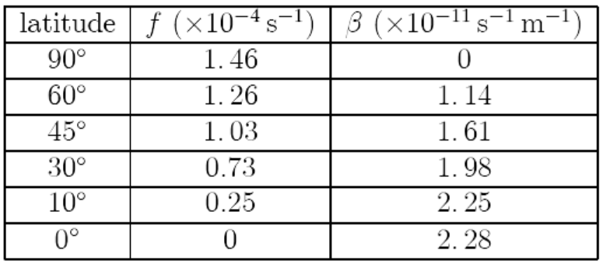
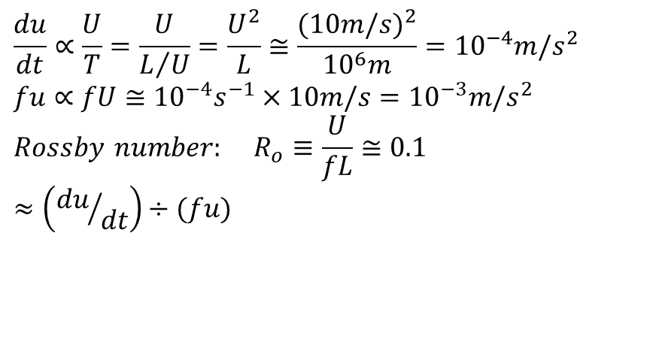


Basic Equations of Atmospheric Motion
On a local Cartesian Coordinate:
Colioris force
$$\frac{du}{dt}−fv=−\frac{1}{ρ}\frac{∂p}{∂x} + F_{x} \\ \frac{dv}{dt}+fu=−\frac{1}{ρ}\frac{∂p}{∂y} + F_{y} \\ g=−\frac{1}{ρ}\frac{∂p}{∂z} , p=ρRT$$
Friction is
important
only in PBL
$$f=2Ω\sin{φ} , Ω=7.292×10^{−5}s^{−1} , β≡\frac{df}{dy}$$
Hydrostatic balance: gravitational force = vert. PGF
Scale Analysis:
$$\frac{du}{dt}∝\frac{U}{T}=\frac{U}{L/U}=\frac{U^{2}}{L}≅\frac{(10m/s)^{2}}{10^{6}m}=10^{−4}m/s^{2} \\ fu∝fU≅10^{−4}s^{−1}×10m/s=10^{−3}m/s^{2} \\ Rossby number: R_{o}≡\frac{U}{fL}≅0.1 ≈\left({du}/{dt}\right)÷(fu)$$

Slide 6
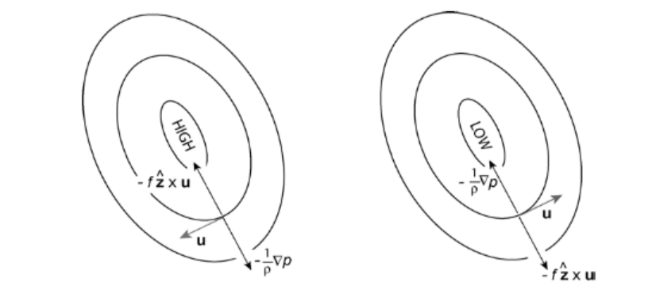
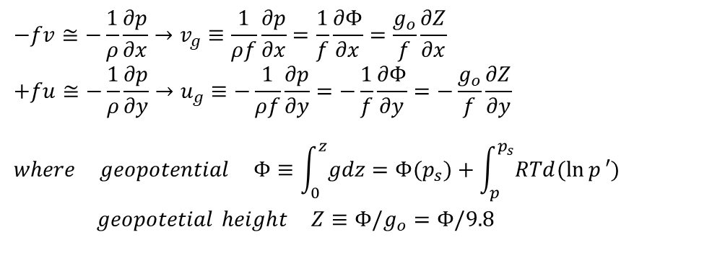
Geostrophic Flow
Since Ro ≈ 0.1
outside the tropics
and above PBL:
$$−fv≅−\frac{1}{ρ}\frac{∂p}{∂x}→v_{g}≡\frac{1}{ρf}\frac{∂p}{∂x}=\frac{1}{f}\frac{∂Φ}{∂x}=\frac{g_{o}}{f}\frac{∂Z}{∂x} \\ +fu≅−\frac{1}{ρ}\frac{∂p}{∂y}→u_{g}≡−\frac{1}{ρf}\frac{∂p}{∂y}=−\frac{1}{f}\frac{∂Φ}{∂y}=−\frac{g_{o}}{f}\frac{∂Z}{∂y}$$
$$where geopotential Φ≡\int_{0}^{z}{gdz}=Φ(p_{s})+\int_{p}^{p_{s}}{RTd(\ln{p}′)} \\ geopotetial height Z≡Φ/g_{o}=Φ/9.8$$
Warmer air→
Higher Z for same p
For the Northern Hemisphere
(opposite in the S.H.)
Above PBL
With friction
Fr
Anti-cyclonic:
Cyclonic:

Slide 7
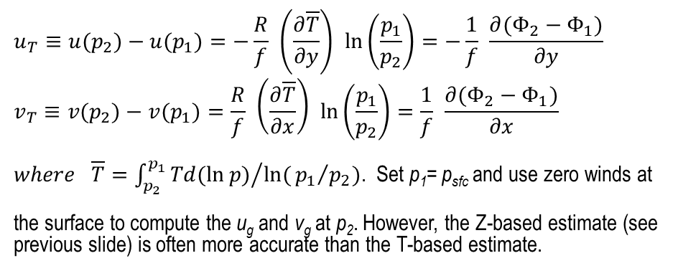
Thermal Wind
The geostrophic wind must have vertical shear if horizontal T gradient (or baroclinity) exists:
$$u_{T}≡u(p_{2})−u(p_{1})=−\frac{R}{f} \left(\frac{∂\overline{T}}{∂y}\right) \ln\left(\frac{p_{1}}{p_{2}}\right)=−\frac{1}{f} \frac{∂(Φ_{2}−Φ_{1})}{∂y} \\ v_{T}≡v(p_{2})−v(p_{1})=\frac{R}{f} \left(\frac{∂\overline{T}}{∂x}\right) \ln\left(\frac{p_{1}}{p_{2}}\right)=\frac{1}{f} \frac{∂(Φ_{2}−Φ_{1})}{∂x}$$
$where \overline{T}={\int_{p_{2}}^{p_{1}}{Td(\ln{p})}}/{\ln{(}{p_{1}}/{p_{2}}})$. Set p₁= p_{sfc} and use zero winds at
the surface to compute the u_{g} and v_{g} at p₂. However, the Z-based estimate (see previous slide) is often more accurate than the T-based estimate.
Summer Asia
Dai et al. (2013)

Slide 8
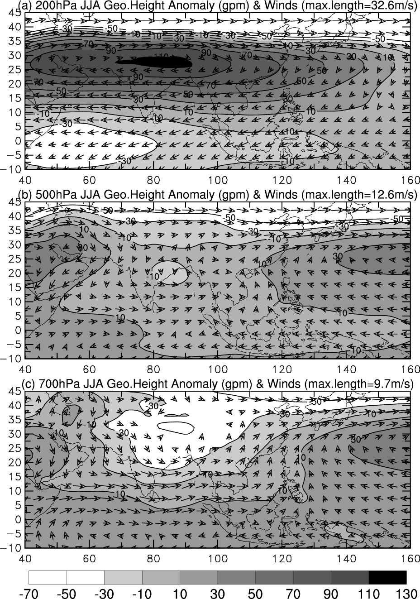
The Z and u wind shear over
South Asia follow the thermal
wind relation, with strong
westerly u wind at 700mb,
weaker westerlies at 500mb
and strong easterlies at 200mb.
The Z and v shear over East
Asia also follow the
thermal wind relation:
Relatively strong southerly
winds at 700mb, weaker
southerlies at 500mb, and
northerly winds at 200mb.
ERA-40, 1971-2000 data
Z anomaly = local Z − domain mean Z
Dai et al. (2013)

Slide 9
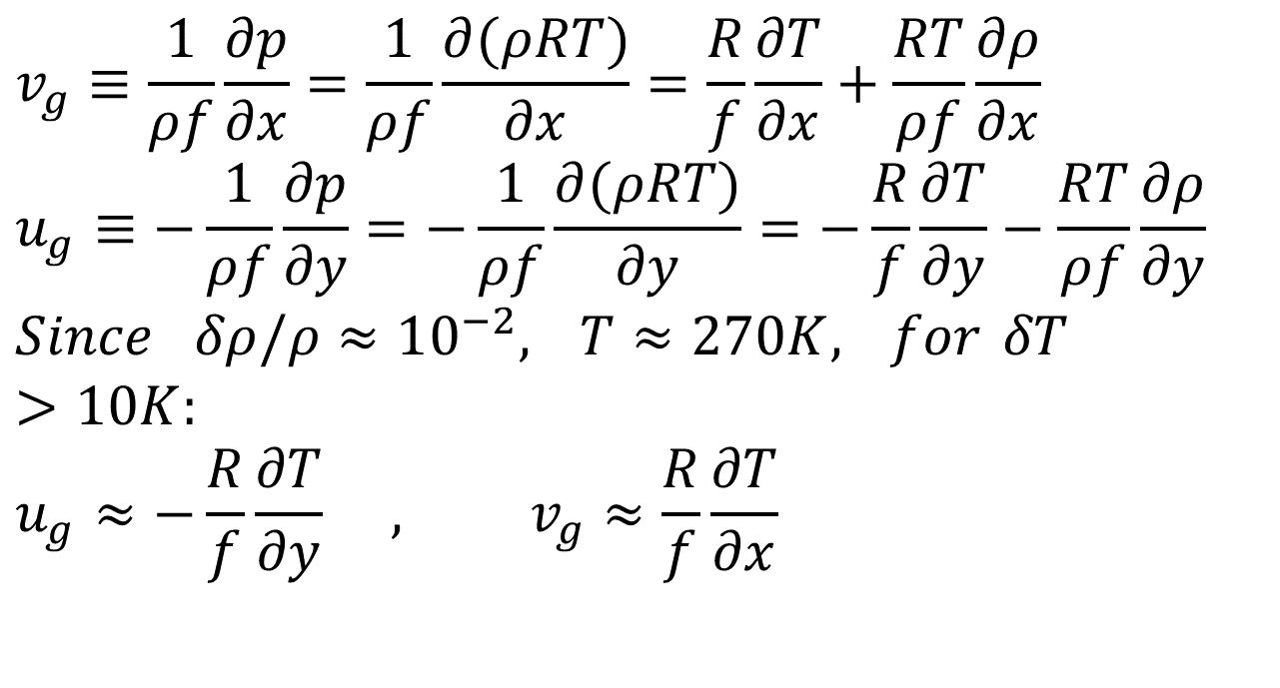
Impact of Temperature Gradients
$$v_{g}≡\frac{1}{ρf}\frac{∂p}{∂x}=\frac{1}{ρf}\frac{∂(ρRT)}{∂x}=\frac{R}{f}\frac{∂T}{∂x}+\frac{RT}{ρf}\frac{∂ρ}{∂x} \\ u_{g}≡−\frac{1}{ρf}\frac{∂p}{∂y}=−\frac{1}{ρf}\frac{∂(ρRT)}{∂y}=−\frac{R}{f}\frac{∂T}{∂y}−\frac{RT}{ρf}\frac{∂ρ}{∂y} \\ Since δρ/ρ≈10^{−2}, T≈270K, for δT>10K: \\ u_{g}≈−\frac{R}{f}\frac{∂T}{∂y} , v_{g}≈\frac{R}{f}\frac{∂T}{∂x}$$
So large temperature gradients roughly determine the pressure gradient and thus the geostrophic winds.

Slide 10
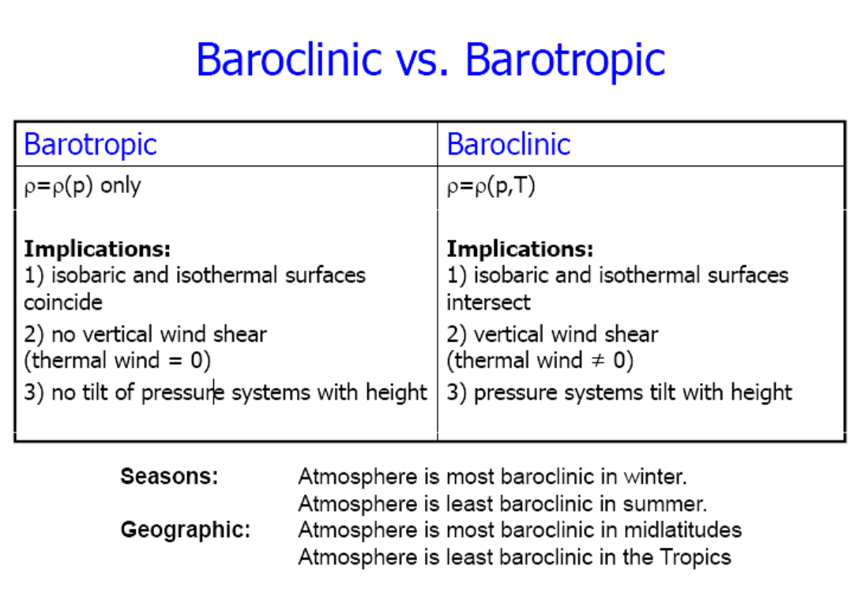
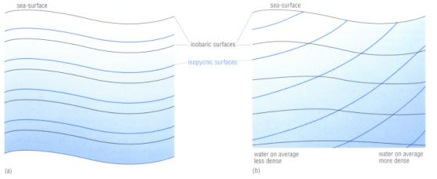

Slide 11
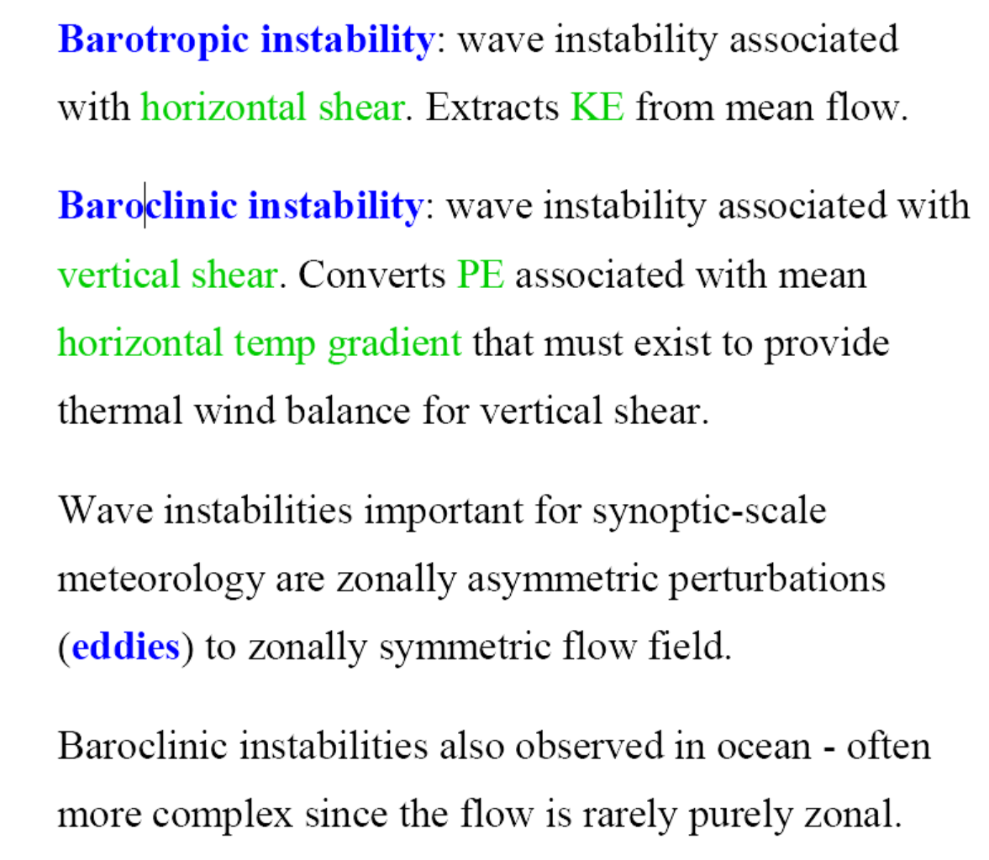

Slide 12
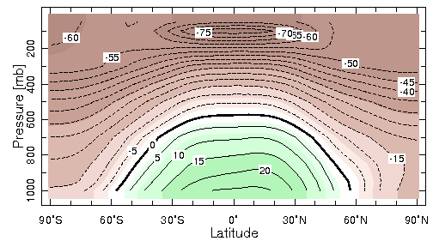
Annual-mean Atmospheric Temp (ºC)
Typical Equator-Pole dT =40ºC in the Troposphere
Baroclinic
u_{T}≠0
Barotropic
u_{T}=0
Baroclinic
u_{T}≠0

Slide 13
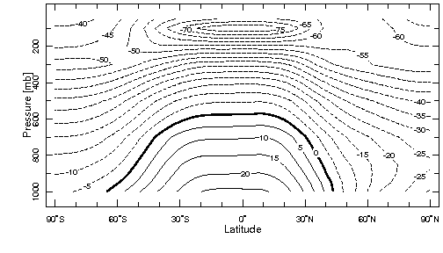
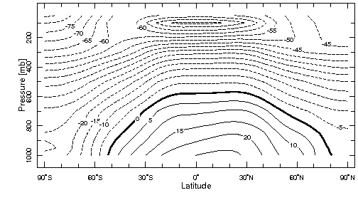
Seasonal-mean Atmospheric Temp (ºC)
DJF
JJA

Slide 14
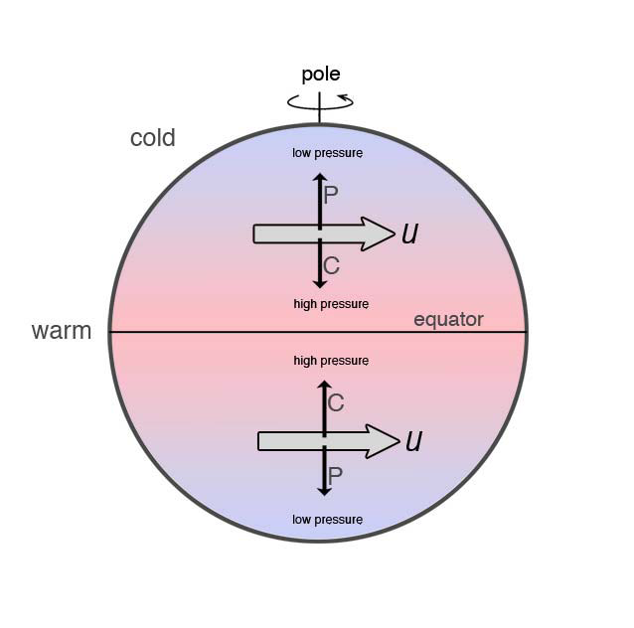
Temperature .vs. Pressure Surface

Slide 15
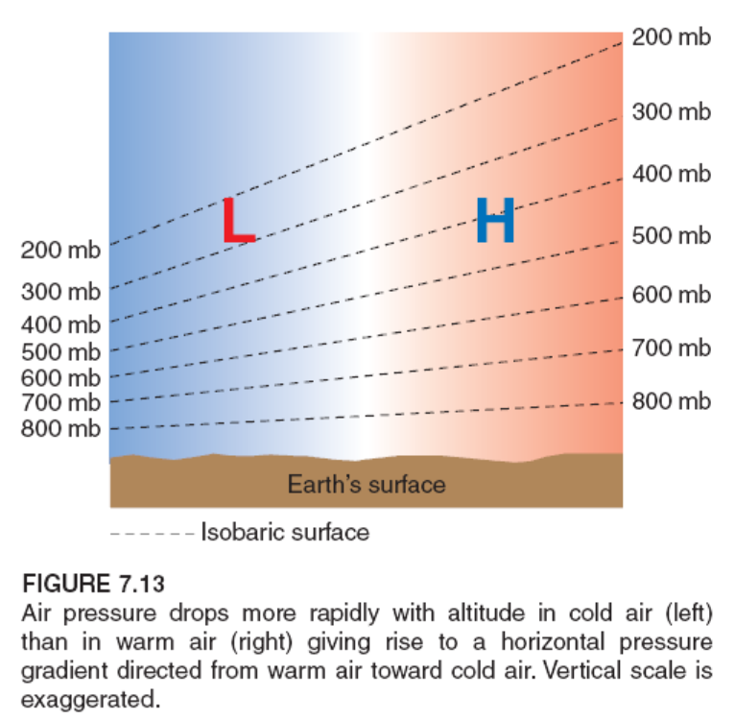

Temperature .vs. Pressure Surface
Warm air expands
Higher pressure surfaces
in the atmosphere
Cold air contracts
Lower pressure surfaces
in the atmosphere
L
H
Higher p surface
Higher Geopotential
Height (Z) for a given p
Higher Z (for a given p)
Higher p (for a given
altitude).
H
L
$$dp=−ρg dz , p=ρR T \\ ⇒ dz=−\frac{RT}{pg}dp$$
Pole
Equator
Notes:
At the surface, warm (cold) air column often is associated with Low (High) pressure center, as warm (cold) air expands (contracts) so that the column can hold less (more) air mass above the surface. The pressure centers reverse sign in the mid-upper troposphere as the pressure surface increases with altitude faster in warm air than in cold air.

Slide 16
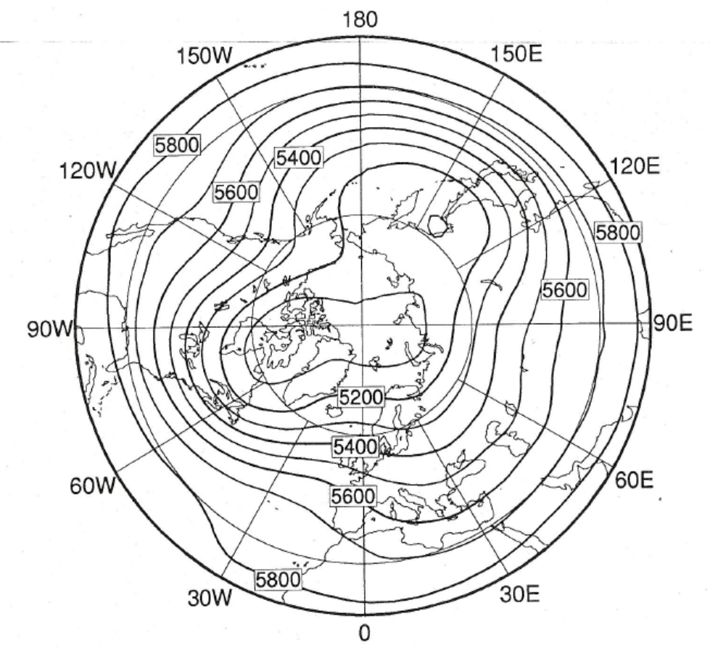
Long-term mean January
500hPa Height (m):
The low-latitudes (5.8km)
have a higher surface
than the polar region (5.1km).
N. Pacific
N. A.
NP
Eurasia
N. Atlantic

Slide 17
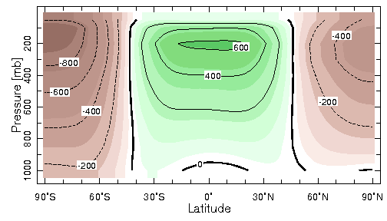
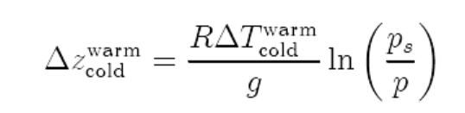
Annual-mean Z Anomaly (m)
(mean Z for each p level removed)
Z
Small gradients
For ΔT=40ºC (Pole-Equator) and p=500mb, ΔZ=811m

Slide 18
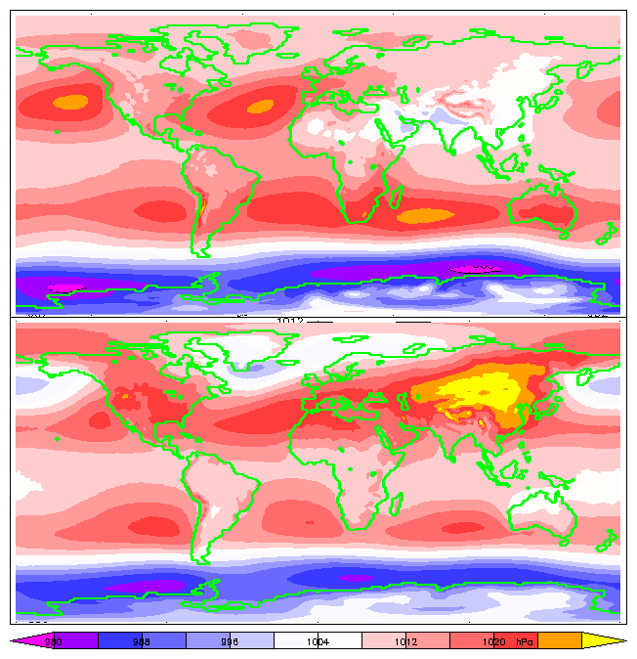
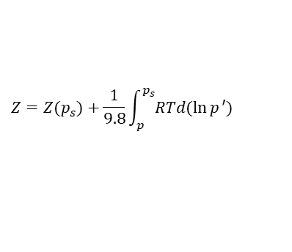
JJA
Mean SLP
Ps=g × column airmass
Warm columns expand
Less airmass
Low Ps
Cold columns contract
More airmass
High Ps
This is different from upper-
level pressure or Z field, where
warm T raises Z (& p surface):
Ts and SLP anomaly relation-
ship may be different at mid-
latitudes.
H
L
L
H
H
L
L
L
L
H
H
H
L
L
DJF
L
L
H
L
H
H
$$Z=Z(p_{s})+\frac{1}{9.8}\int_{p}^{p_{s}}{RTd(\ln{p}′)}$$
L
L
L
L
H
H
H
L
L
L

Slide 19
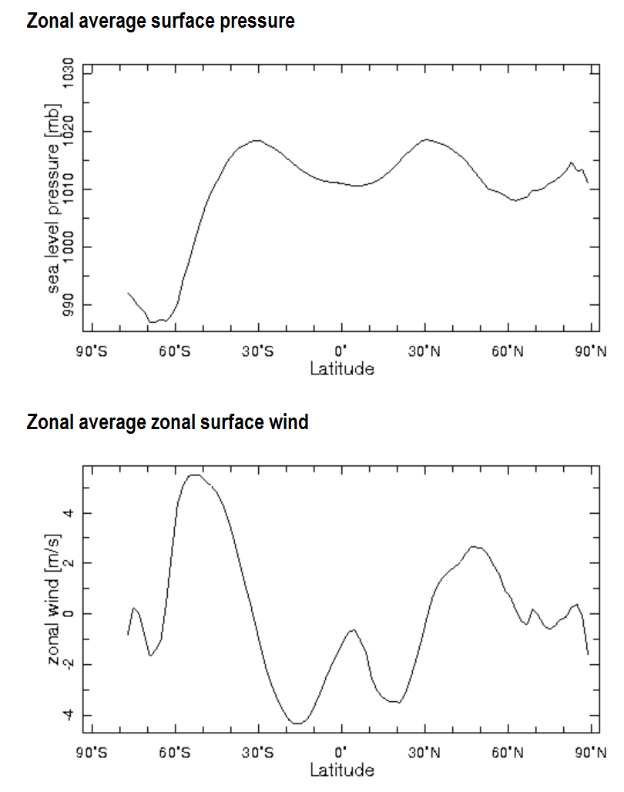
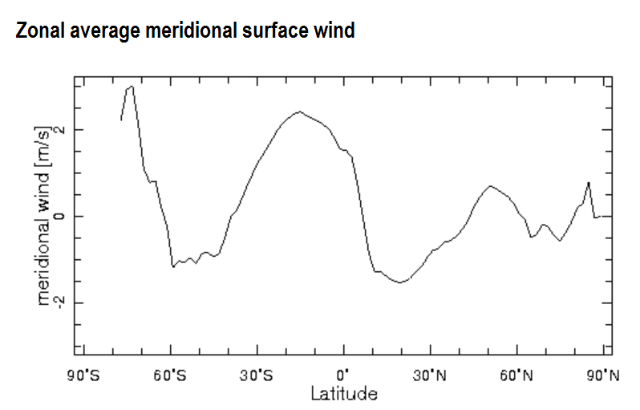
Annual-mean, Zonal-mean
SLP and Surface Winds
SLP
H
L
H
L
L
u
v
W
W
L
H
L
L
H
E
E

Slide 20
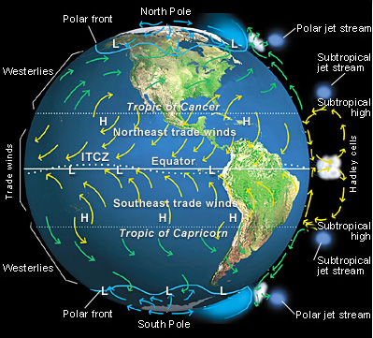
Surface Winds, Surface Pressure Lows and Highs
Zonal-mean Circulation

Slide 21
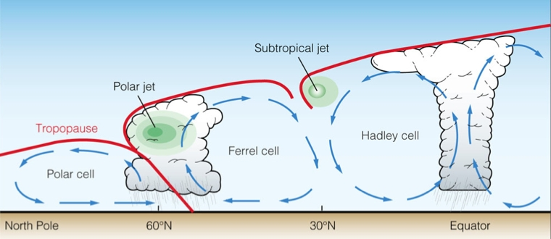
Zonal-mean Atmospheric Circulation
18km
15km
10km
Deserts

Slide 22
Surface Pressure Lows and Highs
The Equatorial Low Pressure Trough: This area is in the Earth's equatorial region (0°-10° North and South) and is composed of warm, light, ascending and converging air. Because the converging air is wet and full of excess energy it expands and cools as it rises, creating the clouds and heavy rainfall that are prominent throughout the area. This low pressure zone trough also forms the ITCZ and trade winds.
Subtropical High-Pressure Cells: Located between 20° N/S and 35°N/S this is a zone of hot, dry air that forms as the warm air descending from the tropics becomes hotter. Because hot air can hold more water vapor, it is relatively dry. The heavy rain along the equator also removes most of the excess moisture. The dominant winds in the Subtropical high are called westerlies.
Subpolar Low-Pressure Cells: This area is at 60° N/S latitude and features cool, wet weather. The Subpolar low is caused by the meeting of cold air masses from higher latitudes and warmer air masses from lower latitudes. In the northern hemisphere, their meeting forms the polar front which produces the low pressure cyclonic storms responsible for precipitation in the Pacific Northwest and Europe. In the southern hemisphere, severe storms develop along these fronts and cause high winds and snowfall in Antarctica.
Polar High-Pressure Cells: These are located at 90° N/S and are extremely cold and dry. With these systems, winds move away from the poles in an anticyclone which descends and diverges to form the polar easterlies. They are weak however because there is little energy available in the poles to make the systems strong. The Antarctic high is stronger though because it is able to form over the cold landmass instead of the warmer sea.

Slide 23
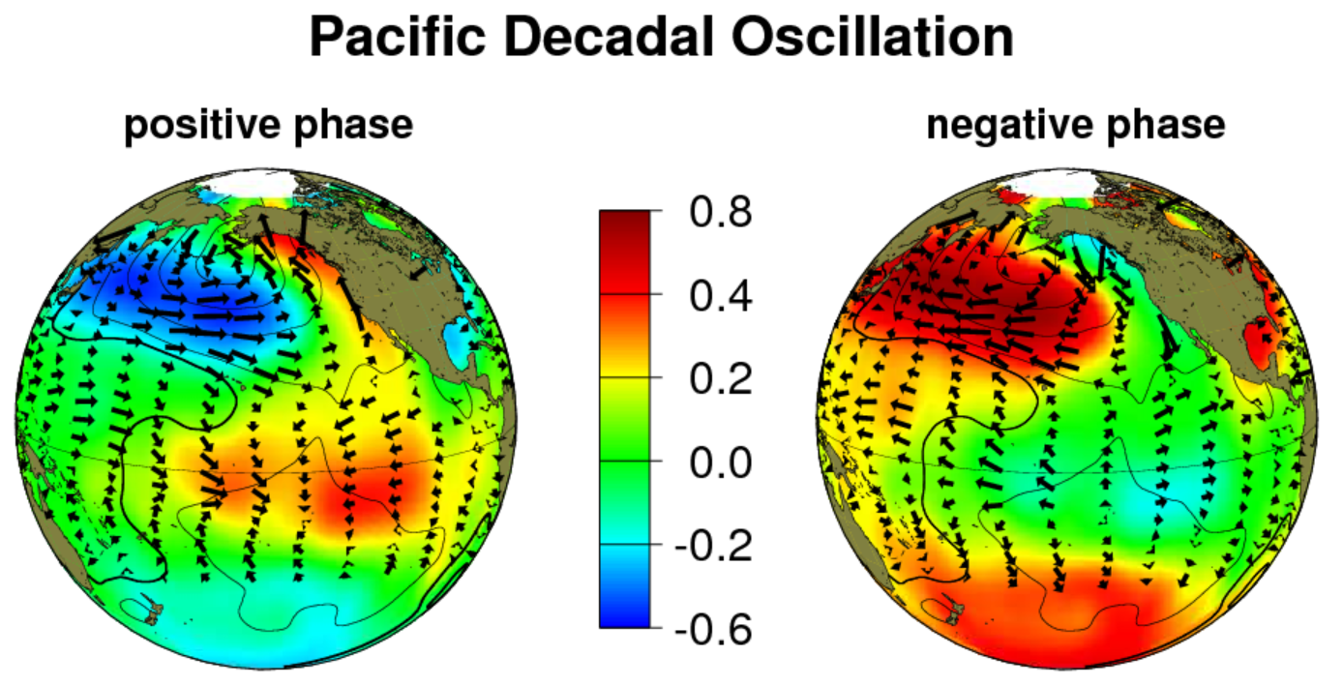
Pressure vs. Temeprature Relationship
DJF Anomaly SST (color) vs. low-level winds (arrows)
SST forced by Atmosphere (winds, clouds)
L
H
L
H
Atmosphere forced by SST
In the Tropics: Warm SST → Low sfc. Pressure → Sfc. Convergence
Cold SST → High sfc. Pressure → Sfc. Divergence
At Mid-latitudes: The above applies to the seasonal mean climate at midlatitudes:
Cold Ocean → High Ps, warm land → low Ps
But the SST and SLP anomaly relationship may be different from the above
due to response to tropical latent heating and other surface processes.
The SST anomalies in N. Pacific result from LH, SH and SW flux changes. How?

Slide 24
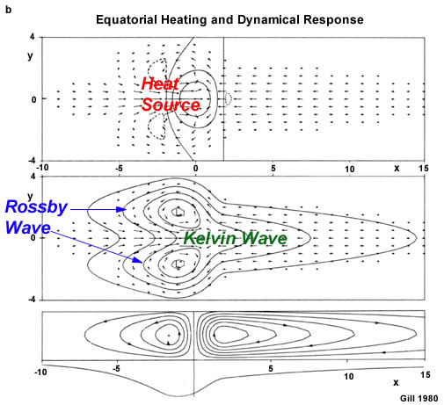
in the tropical atmos.
Low-level winds & w (contours)
Low-level winds & p (contours, all negative)
L
L
z
p
Zonal-mean stream-function & p

Slide 25
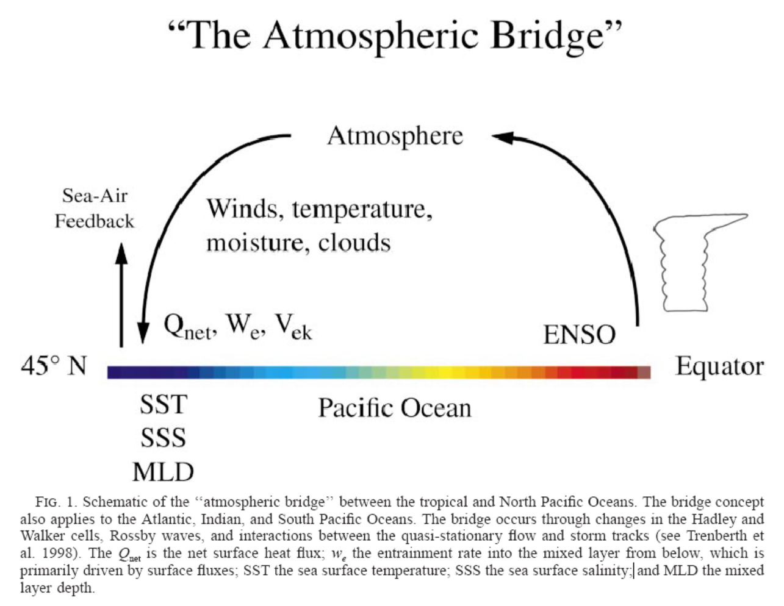

Slide 26
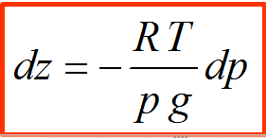

Local T vs. Z Vertical Structures – Warm Surface Case
In the tropics (e.g. W. Pacific): Atmospheric barotropic response to SST forcing
H
In the upper troposphere
High Z → High Pressure
→Divergence
200mb
T
Pressures Levels
In the mid-lower troposphere,
warmer T gradually raises Z:
Cold
Warm
Cold
$$Z=Z(p_{s})+\frac{1}{9.8}\int_{p}^{p_{s}}{RTd(\ln{p}′)}$$
Warm air rises
Z
L
Warm
Ps=g x Column airmass
Warm column → Expansion
Less air mass
Low Ps and Low Z
→ Convergence
Equator
Surface
Longitude

Slide 27

Local T vs. Z Vertical Structures – Cold Surface Case
In the Tropics (e.g., the Eastern Pacific), barotropic
L
In the upper troposphere
Low Z → Low Pressure
→Convergence,
200mb
T
Pressures Levels
In the mid-lower troposphere,
colder T depresses Z:
Warm
Cold
Warm
$$Z=Z(p_{s})+\frac{1}{9.8}\int_{p}^{p_{s}}{RTd(\ln{p}′)}$$
Cold air sinks
Z
H
Cold column → contraction
More airmass in column
High Ps and high Z
Divergence
Cold
Equator
Surface
Longitude

Slide 28
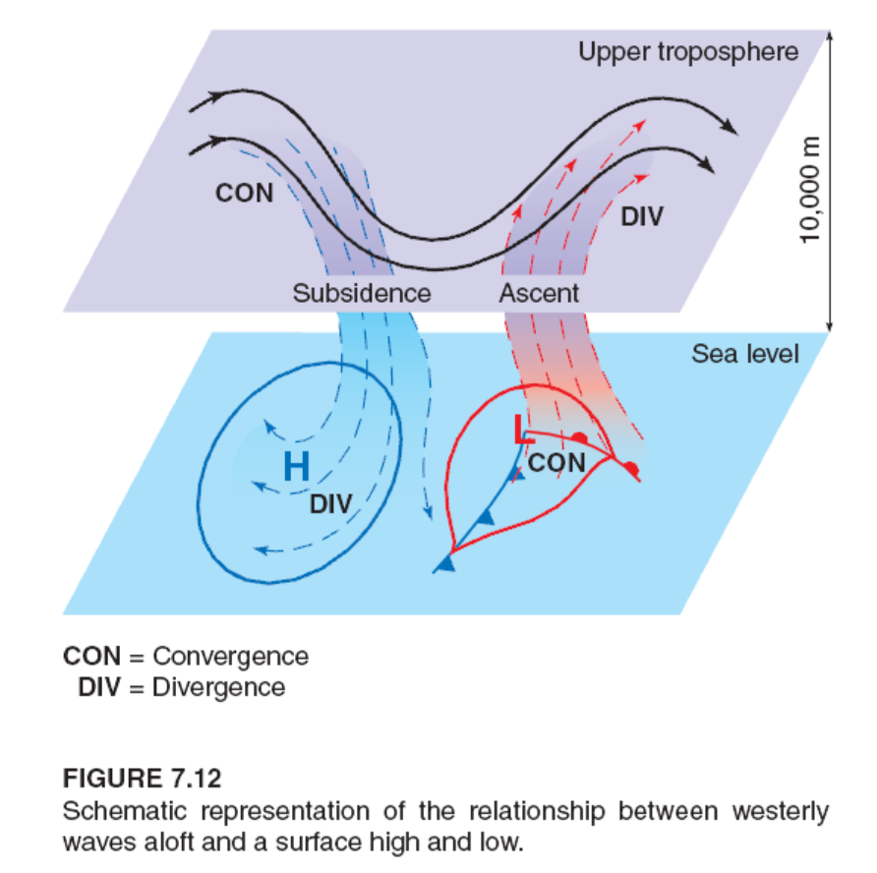
T vs. Z Vertical Structures – Midlatitudes: Baroclinic
slowdown
speed-up
At the surface:
Cold air contracts→ High p
Warm air expands → Low p
Upper-level p is different from Tropics
Notes:
Conservation of angular momentum slows down the air parcel as it moves southward but speeds up as it moves northward, creating convergence and divergence, respectively.

Slide 29
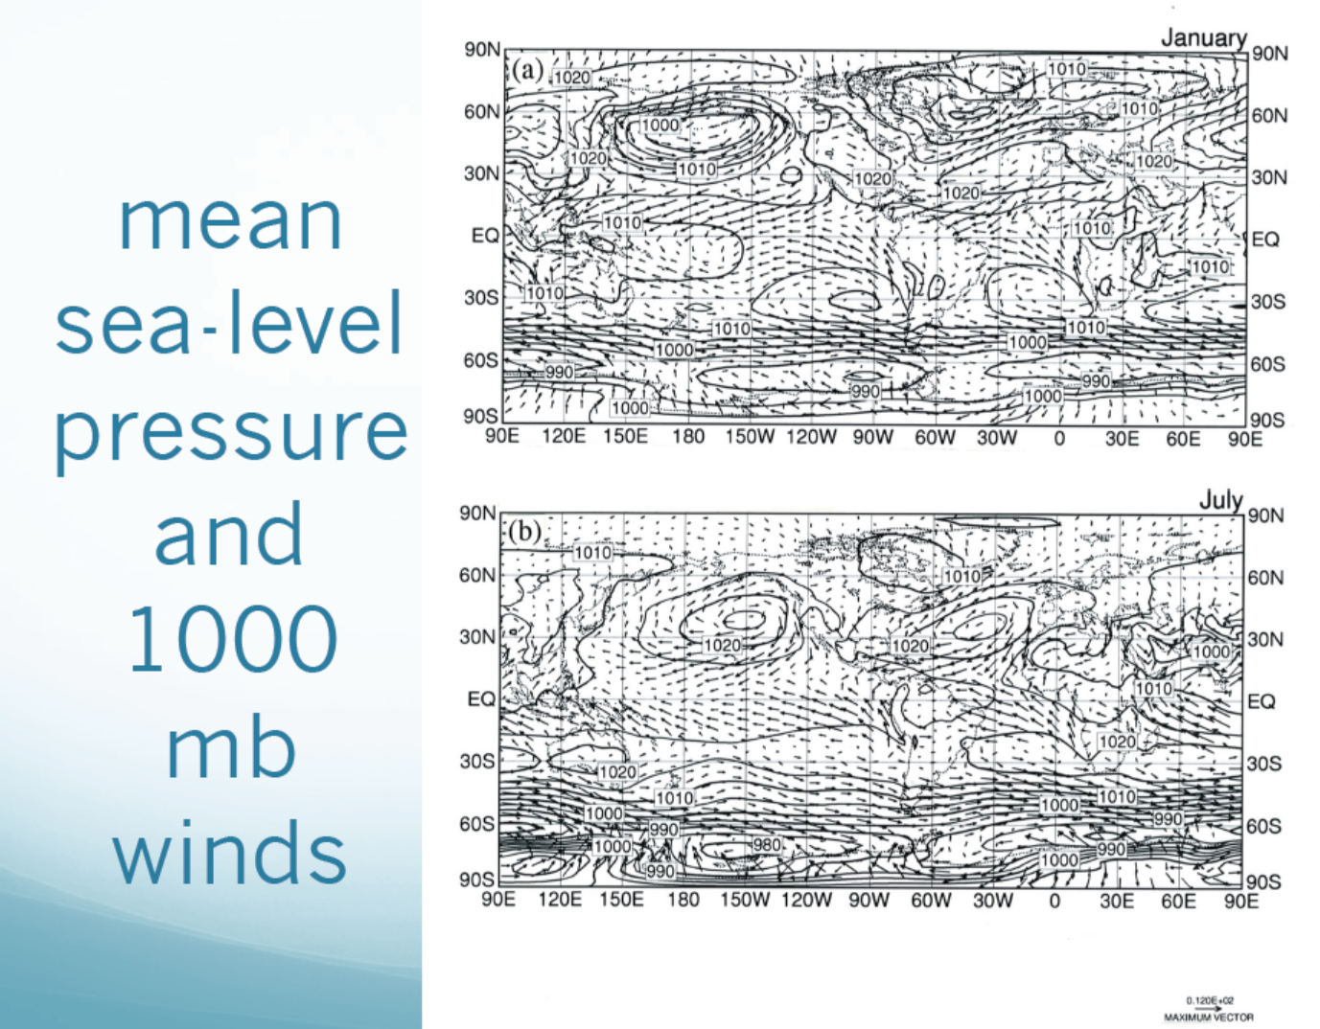
L
L
H
H
H
H
H
L
L
L
H
L
H

Slide 30
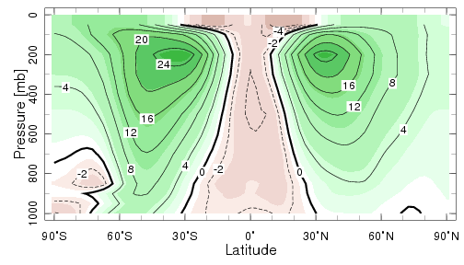
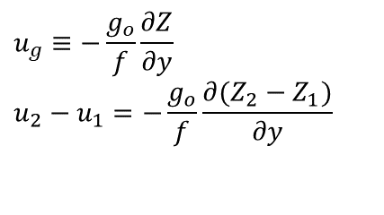
Annual-mean
Subtropical jets at 30-40º lat. & 200mb
~60mph
u(m/s)
Westerlies
Jets at 50-60º lat.
in lower troposphere
Westerlies
Easterlies
ΔZ(m)
Z
$$u_{g}≡−\frac{g_{o}}{f}\frac{∂Z}{∂y} \\ u_{2}−u_{1}=−\frac{g_{o}}{f}\frac{∂(Z_{2}−Z_{1})}{∂y}$$
Z

Slide 31
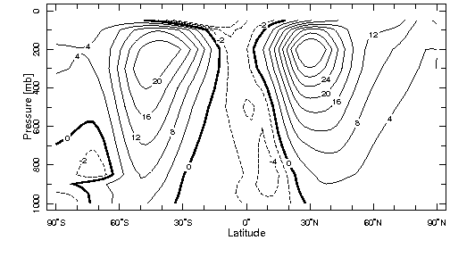
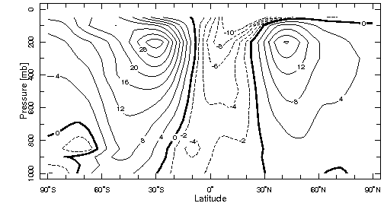
DJF
u(m/s)
JJA

Slide 32
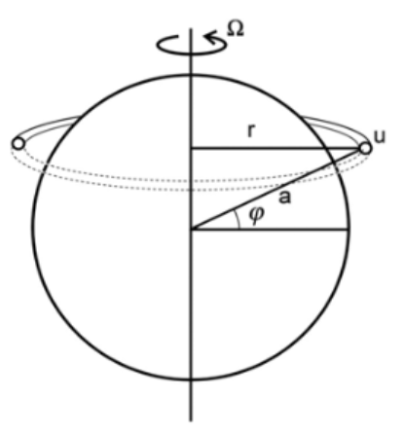

Angular Momentum
Angular momentum is defined as the product of
air parcel mass × distance from rotating axis × the rotation velocity.
The absolute angular momentum of an air parcel with
1 unit of mass:
Earth’s rotation: from west to east
$$A=Ωr^{2}+ur=Ωa^{2}\cos^{2}{φ}+ua \cos{φ}$$
From rotation
From zonal wind (u)
relative to Earth’s surface

Slide 33
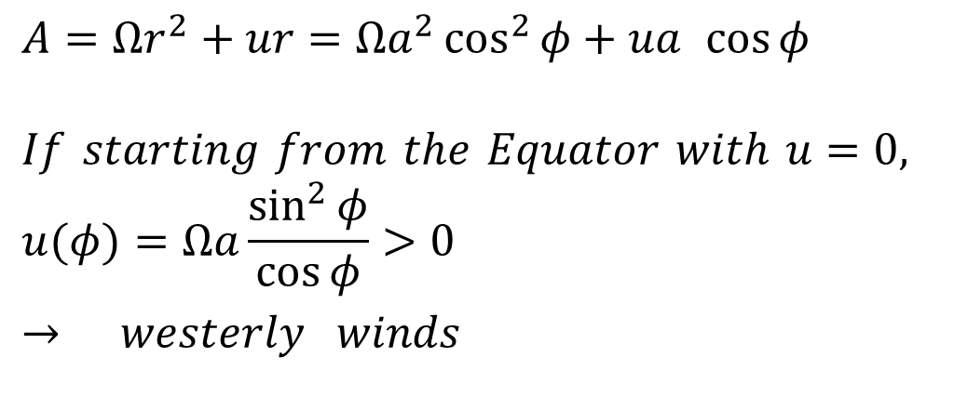
Conservation of Angular Momentum
Absolute angular momentum is conserved above
the PBL:
$$A=Ωr^{2}+ur=Ωa^{2}\cos^{2}{φ}+ua \cos{φ}$$
$$If starting from the Equator with u=0, \\ u(φ)=Ωa\frac{\sin^{2}{φ}}{\cos{φ}}>0 → westerly winds$$
r decreases with lat. → u increases with lat.
u increases with latitude as it moves poleward.
Since u becomes infinity as ϕ approaches 90º, it implies that
the Hadley Cell can not extend to the poles.
The exact location Hadley Cell ends depends on Ω and other factors.
The slower the Earth rotates, the farther it extends poleward. Why?
Notes:
Since u increases with omega, so for a given u (determined by dT/dy), the lat in the above equation decreases with omega.

Slide 34
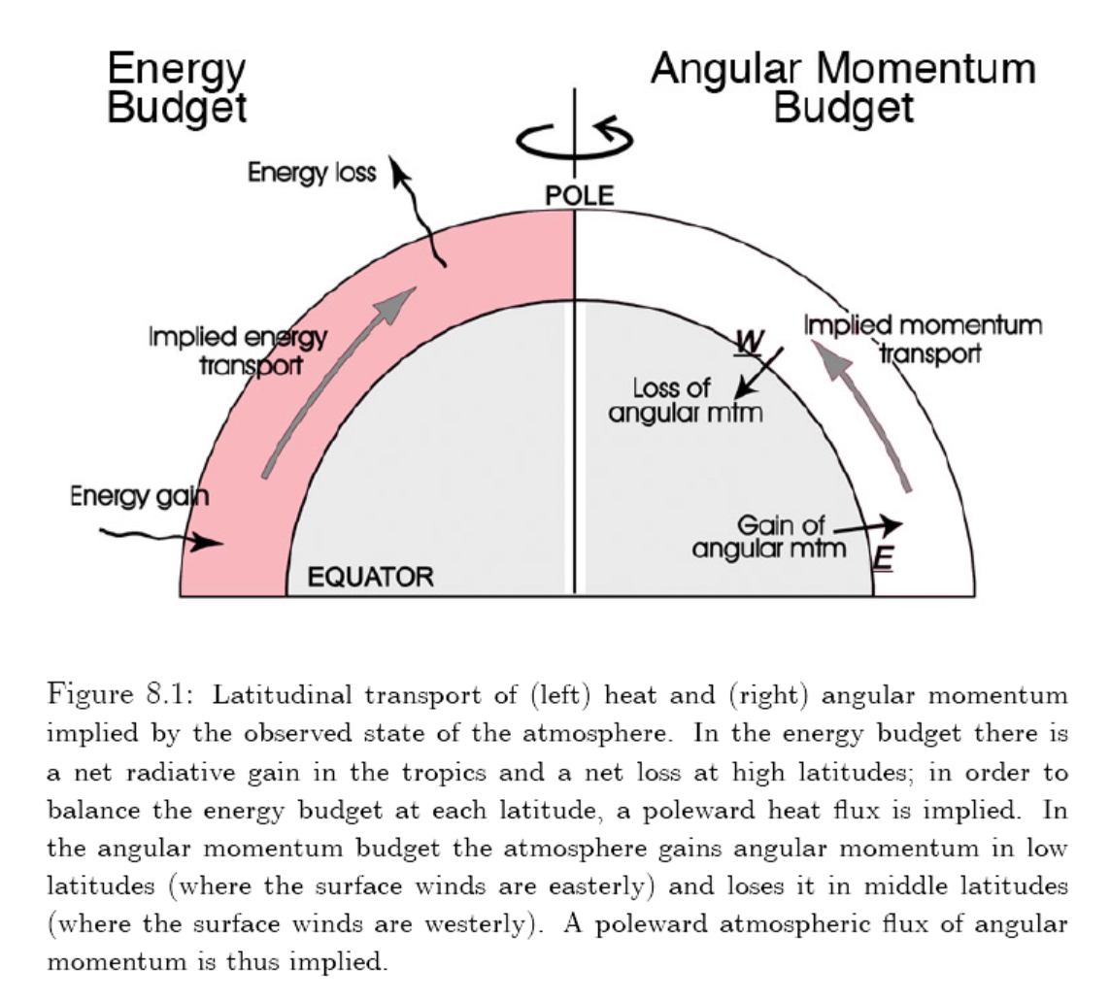
Notes:
Westerly surface winds at midlat means that the surface friction slows down the westerly winds and thus the atmosphere loses westerly angular momentum. In the tropics, the surface drags the air eastwrard, thus slowing down the (negative) westward angular momentum or the atmosphere gains westerly angular momentum.

Slide 35
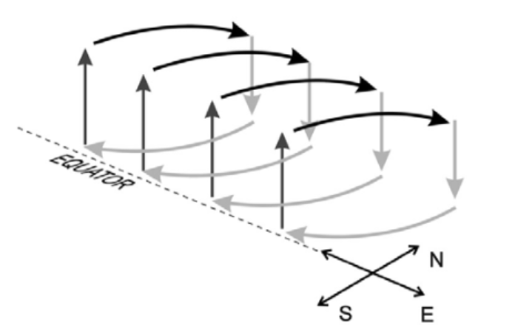
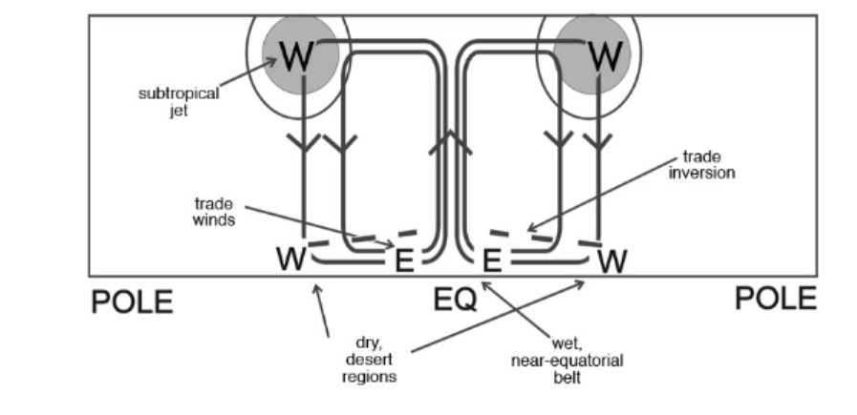
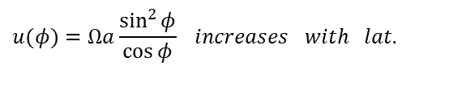
Conservation of angular momentum → largest u wind at the highest lat. of the Hardley Cell → subtropical jets, whose existence is also consistent with the T and Z fields.
$$u(φ)=Ωa\frac{\sin^{2}{φ}}{\cos{φ}} increases with lat.$$
See chapter 10 of Holton’s Dynamic Meteorology for energy and dynamic constraints on the Hadley Cell

Slide 36
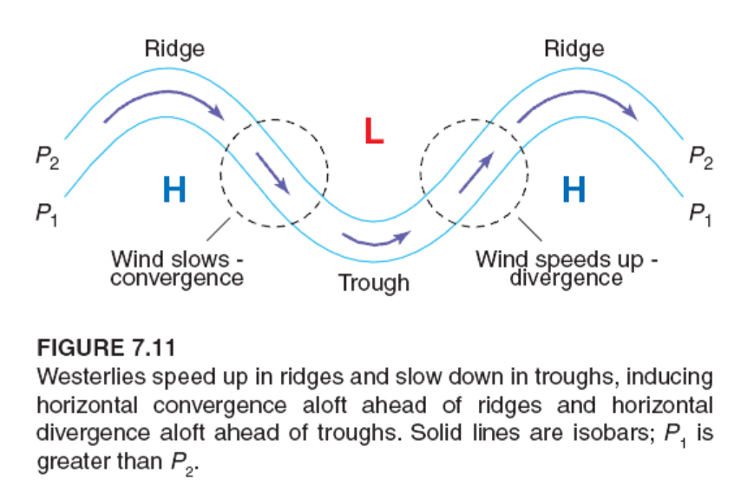

Conservation of Angular Momentum
Leads to CON and DIV in upper levels
Poleward
$$A=Ωr^{2}+ur=const$$
Equatorward

Slide 37
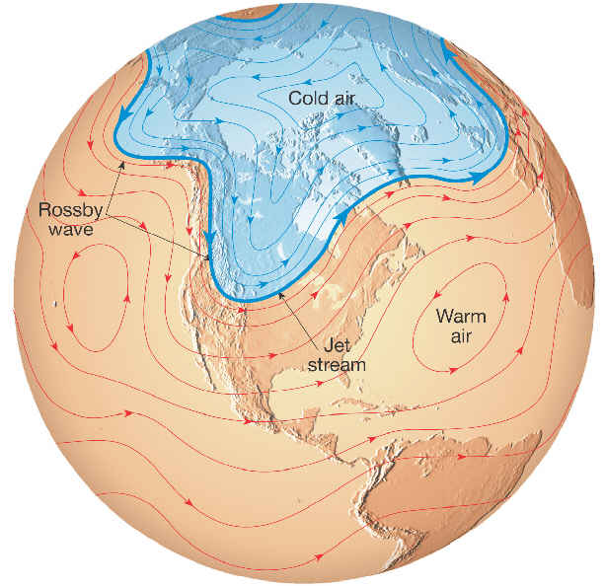
H
Ridge
L
Trough

Slide 38
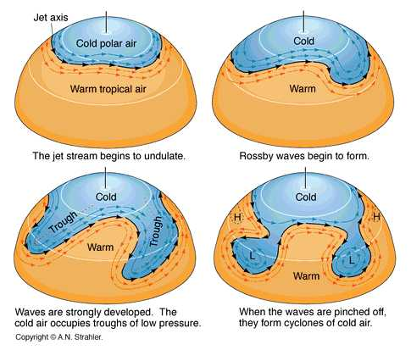
Mid-latitude Eddies, Fronts and Cyclones
The Jet is unstable
due to wind shear
(baroclinic instability),
which is caused by
T gradients resulting
from differential
heating.
The disturbance
draws energy from
the Jet, and develops
into synoptic systems
in midlatitudes.
Cyclones (Lows) and
Blocking (Highs) may
form.
Ridge
The Jet in the lower troposphere can be at mid-latitudes.
Notes:
Again, the surface T and pressure anomaly relationship (cold T with low pressure) is different from the mean T and pressure relationship (cold land with high pressure and warm ocean with low pressure on slide #18).

Slide 39
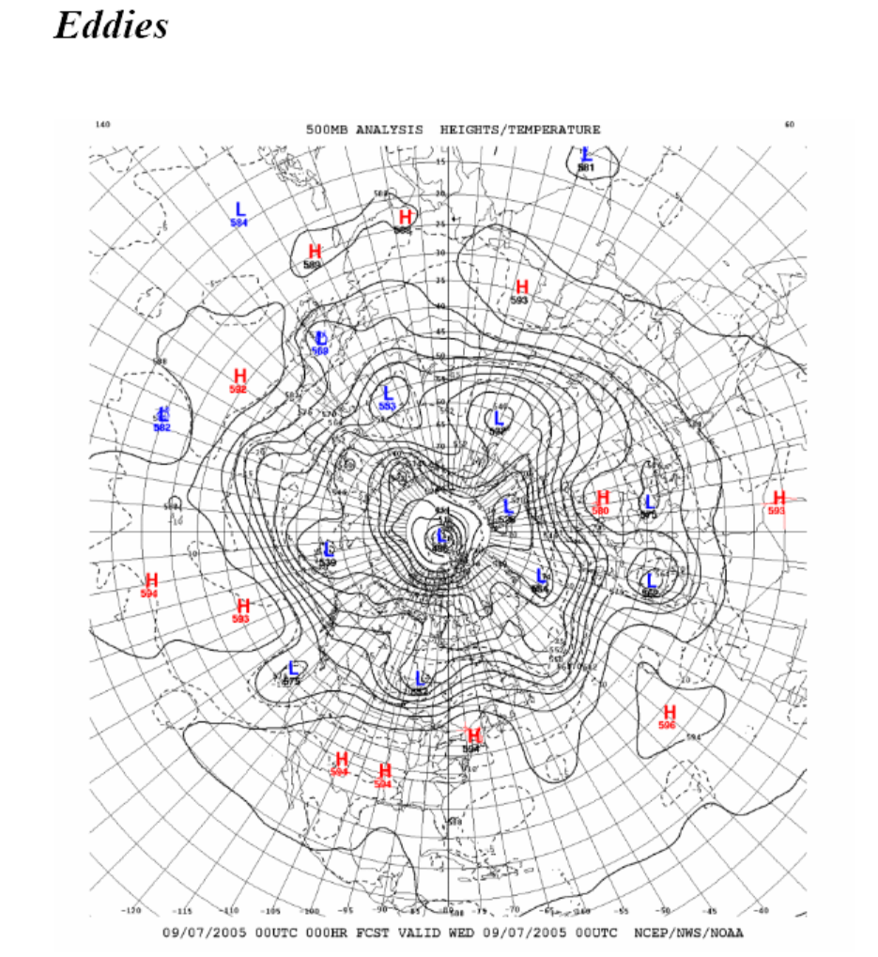
on 500mb Height Field

Slide 40
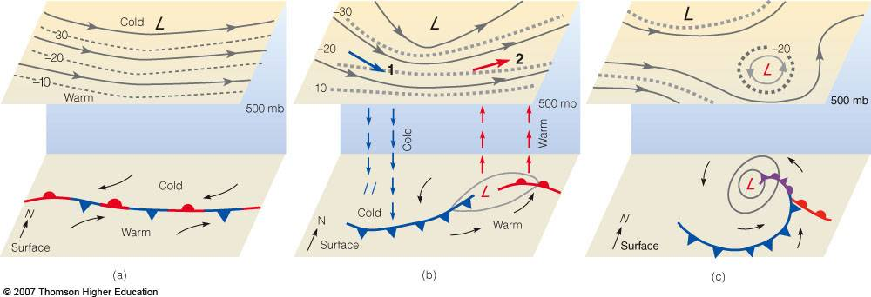
Surface Frontal Movements
Cold fronts move equator-ward, warm fronts move pole-ward (and upward).
At Surface: Low (High) Pressure is associated with warm (cold) air.
At 500mb: Trough (Ridge) is associated with Cold (Warm) air; but for mature systems,
warm Low Pressure (and cold High Pressure) exist at both the surface
and 500mb.

Slide 41
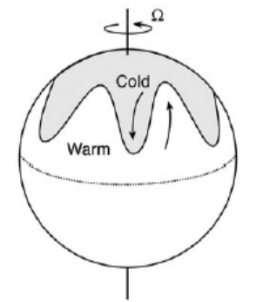
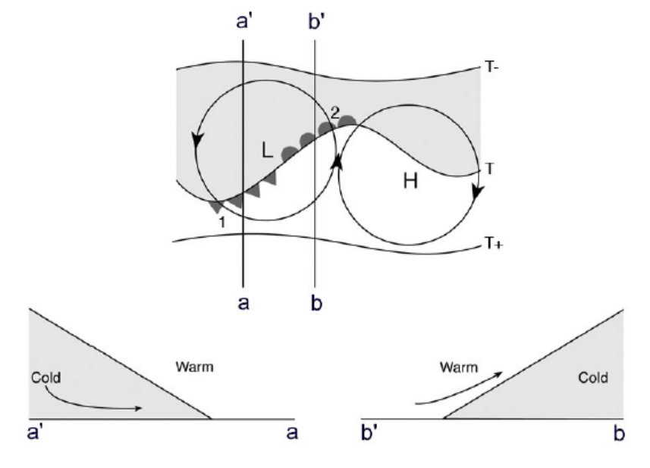
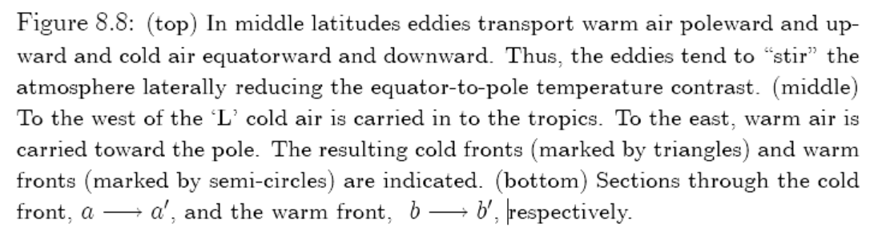
Mid-latitude Eddies/Fronts
b
b’

Slide 42

(K)
(m/s)
(m/s)

Slide 43


eddy
Total value:
$$x=[\bar{x}]+{\bar{x}}^{∗}+x′$$

Slide 44

(zonal and time mean):
Notes:
Large v* and T* over the N. Hemisphere due to the large land-sea contrast in N.H.

Slide 45

v* T*>0 → Northward flux
T

Slide 46

K m/s

Slide 47

g/kg m/s

Slide 48

Moist static energy = c_{p}T + gz + Lq = Sensible + potential + Latent energy
Notes:
Cp=1004 J/k/kg, Cv=717 J/k/kg

Slide 49

Unit: 10¹⁹ Calories/day
Southward fluxes
are shaded
Large cancellation
between PE and
SH+LH fluxes for
the mean circulation
Why?

Slide 50

PW (petawatt) = 10¹⁵ W MMC=Mean Meridional Circulation

Slide 51


Slide 52

Easterly winds gain westerly angular momentum
Westerly winds lose westerly angular momentum. Why?
Notes:
Surface drag by solid earth pulls the easterlies toward the east, slowing down the easterly winds and gain westerly momentum. In midlatitude, the westerlies move fast than the rotating earth surface (also moving from west to east), thus the surface drag is to slow down the westerly winds and causing it to lose westerly momentum.

Slide 53


Slide 54


Slide 55

In regions of westerlies, the drag slows down the winds and
westerly momentum is transferred from the air to the solid earth.

Slide 56

to the
in regions of westerlies in mid-lat.

Slide 57

500mb, DJF
(m/s)
850mb, DJF
(m/s K)
Both subtropical jets and
storm tracks are centered over
the western N. Pacific and western
N. Atlantic Ocean in N.H. due to
zonal land-sea contrast (why?).
Notes:
Atmospheric circulation is not zonally uniform, partly due to land-sea contrast at each latitude. This helps create regional climate.

Slide 58
Impact of Temperature Gradients
$$v_{g}≡\frac{1}{ρf}\frac{∂p}{∂x}=\frac{1}{ρf}\frac{∂(ρRT)}{∂x}=\frac{R}{f}\frac{∂T}{∂x}+\frac{RT}{ρf}\frac{∂ρ}{∂x} \\ u_{g}≡−\frac{1}{ρf}\frac{∂p}{∂y}=−\frac{1}{ρf}\frac{∂(ρRT)}{∂y}=−\frac{R}{f}\frac{∂T}{∂y}−\frac{RT}{ρf}\frac{∂ρ}{∂y} \\ Since δρ/ρ≈10^{−2}, T≈270K, for δT>10K: \\ u_{g}≈−\frac{R}{f}\frac{∂T}{∂y} , v_{g}≈\frac{R}{f}\frac{∂T}{∂x}$$
Larger positive dT/dx and stronger negative dT/dy around the western boundary of the Pacific and Atlantic lead to stronger V and U winds.

Slide 59

Monsoon Rainfall
Central & South American
Monsoon: seasonal reversal in atmospheric circulation and rainfall due to differential heating over land and ocean.

Slide 60

Monsoon Circulation
Result from thermal contrast
over land and ocean (why?)
Enhanced by latent heating
from monsoon rainfall
The land-sea thermal gradient
exists in the whole troposphere

Slide 61

Reversal of Monsoon Winds
Wind convergence zone

Slide 62

East Asia

Slide 63

East Asia
A=Anti-cyclonic or High Pressure C=Cyclonic or Low Pressure

Slide 64

East Asia

Slide 65

January
SLP and 1000mb Winds
July

Slide 66

(mm/month)
Notes:
Contour interval=10mm for Jan and 100mb for July

Slide 67

January
ITCZ
July
ITCZ

Slide 68

(approx. 10–20 °N and 18 °W–20 °E)
Notes:
Contours are annual precipitation in mm/yr.

Slide 69

Deserts form where annual P is much less than PET
Deserts have large T diurnal cycle
and often have net radiation loss.
Precip. is suppressed by subsidence associated with the Hadley Cell or mountain ranges (e.g., in N. and S. America), or due to deletion of moisture after crossing a mountain range.

Slide 70
Key points of Today’s Lecture
Atmospheric Circulation and Climate:
- Some basic:
Rossby number [= (du/dt)/fv] ≈0.1 → Geostrophic flow
Midlat.: Horizontal T gradient → baroclinity → thermal wind/vertical shear → baroclinic instability → synoptic systems
Tropics: Warm tropics → higher pressure surface. Small T gradients→ barotropic.
Summer cool ocean → surface Subtropical High over the N. Pacific and Atlantic and surface Low Pressure over Eurasia and N. America; opposite in Winter.
- Mean Circulation: (determined by T and Z gradients)
Easterlies in the tropics (partly associated with the return flow of the Hadley Cell)
Westerlies in the midlatitudes (associated with the outflow of the Hadley Cell)
Weak easterlies in polar region in the lower troposphere.
- Transport of Energy and Moisture:
Acts to mention a balance between the circulation and T gradients
Mean meridional transport is important only in the tropics
Eddy transport dominates in the midlatitudes
Angular Momentum is transferred from tropical (& polar) easterlies to midlatitude westerlies
Seasonal reversal in surface winds leads to regional monsoon climate
Subtropical subsidence from the Hadley Circulation causes deserts.

Slide 71
Homework Assignments:
- Reading Assignments:
Chapter 6 of Hartmann GPC
Hartmann, D. 2007: The atmospheric general circulation and its variability. J. Met. Soc. Japan. 85B:123-143.
Liu, Z., and M. Alexander (2007), Atmospheric bridge, oceanic tunnel, and global climatic teleconnections, Rev. Geophys.,45, RG2005, doi:10.1029/2005RG000172
- Answer following questions using concise text (HW #2, due in one week):
Describe the global energy balance, including its major shortwave and longwave fluxes at TOA, in the atmosphere, and at the surface. Also mention the key factors that control these fluxes. (20%)
What are the bulk formulas or aerodynamic formulas for estimating surface sensible and latent heat fluxes? Describe the symbols in the formulas (10%)
Describe the key processes involved in the formation of precipitation and the key processes of evaporation and transpiration. What is the main difference and similarity between evaporation over a water surface and transpiration by plants? (20%)
Explain why the net energy transport of the Hadley circulation is much less than its poleward transport of potential energy. In what ways are the Hadley circulation and its energy and moisture transports related to the climate of the tropics and subtropics? (20%)
Calculate the zonal velocity (u) of an air parcel at 27ºN, if it has conserved angular momentum while moving to 27ºN from 7ºN, where it was initially at rest relative to the surface. (10%)
The tropical easterlies and midlatitude westerlies occupy about the same surface area of the Earth. Would you expect the surface easterly winds to be stronger, weaker, or about the same as the surface westerlies? Explain why. You may ignore the small impact of the polar regions. Compare your answer with the zonal u wind shown in slide #19. (20%)

Slide 72

Next Lecture:
Ocean Circulation and Climate

