Slide 1
Key points of Last Lecture
Atmospheric Circulation and Climate:
- Some basic:
Rossby number ≈0.1 → Geostrophic flow
Midlat.: Horizontal T gradient → baroclinity → thermal wind/vertical shear → baroclinic instability → synoptic systems
Tropics: Warm tropics → higher tropospheric pressure surface. Small T gradients→ barotropic.
Summer: cool ocean/warm land → surface Subtropical High over the N. Pacific and Atlantic and surface Low Pressure over Eurasia and N. America, opposite in Winter.
- Mean Circulation: (driven by T and Z gradients)
Easterlies in the tropics (partly associated with the return flow of the Hadley Cell)
Westerlies in the midlatitudes (associated with dT/dy, and the outflow of the Hadley Cell)
Weak easterlies in polar region in the lower troposphere.
- Transport of Energy and Moisture:
Acts to mention a balance between the circulation and T gradients
Mean meridional transport is important only in the tropics
Eddy transport dominates in the midlatitudes
Angular Momentum is transferred from tropical (& polar) easterlies to midlat. Westerlies, which return it to the solid Earth. Zonal wind increases with latitude.
Seasonal reversal in surface winds leads to regional monsoon climate
Subtropical subsidence from the Hadley Circulation causes deserts.

Slide 2
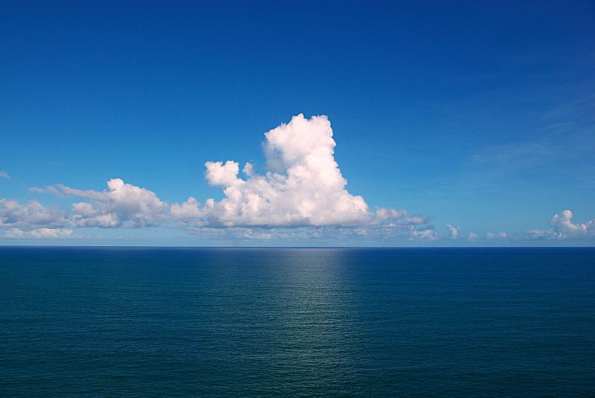
A ATM551: Lectures #9-10
Ocean Circulation and Climate
Reading Assignment:
Chapter 7 of Hartmann GPC

Slide 3
Outline of Today’s Lecture
Properties of seawater: T, S, density distributions
Ocean mixed layer: processes and depth distribution
Wind-driven circulation: surface currents, boundary currents, Ekman layer theory, upwelling
Deep ocean circulation: thermohaline circulation, deep water formation, different types of water masses
  Oceanic transport of heat and freshwater: self study

Slide 4
Key Roles of the Oceans
- Key ocean properties: wet, low albedo, high heat capacity/long memory, fluid
- Wet surface: Oceans provide 85% of global evaporation, thus a major source of atmospheric water vapor and latent heat
- High heat capacity/long memory: Oceans account for most of climate variations on time scales from seasons to decades and longer.
- Fluid: Ocean currents can help re-distribute heat, salt, and other minerals.
- Air-sea interaction plays a key role for the climate, especially in the tropics.
- Other roles: oceans play a big role in C, N, S and other biogeochemical cycles. For example, CO2 is dissolved into seawater, where it is converted into shells and other organic matter and becomes sediments.

Slide 5
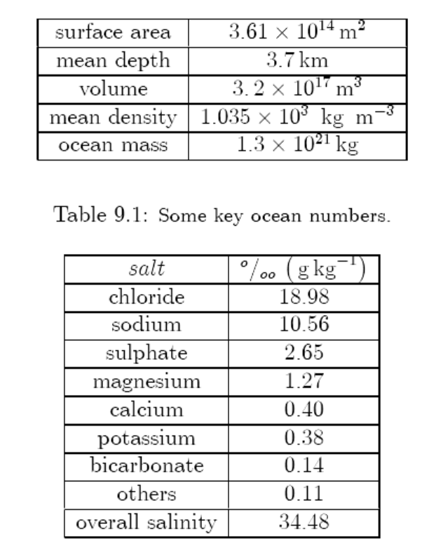
Some Basic Ocean Numbers
~72% Earth’s surface
~3.5% higher than freshwater
Why?
Only ~5% of the oceans have
been explored by humans!
Water density=1.0g/cm³
Salt density =2.16g/cm³
Notes:
Density of sailt = 2.16 g/cm3. density of freshwater = 1.0 g/cm3
Ocean salinity is generally defined as the salt concentration (e.g., Sodium and Chlorure) in sea water. It is measured in unit of PSU (Practical Salinity Unit), which is a unit based on the properties of sea water conductivity. It is equivalent to per thousand or (o/00) or to g/kg.

Slide 6
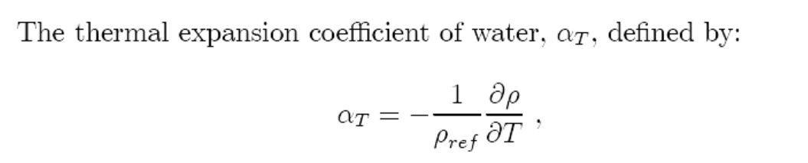
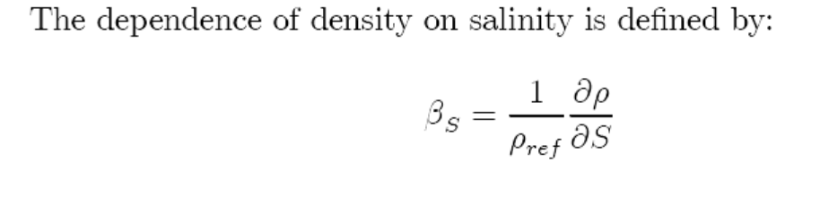

Properties of Seawater– Equation of State
Seawater typically contains ~3.45% of salt, or a salinity (S) of 34.5psu.
Surface ocean T ranges from about −2 (freezing point) to about 30ºC.
Density of seawater depends on T, S, and pressure (p):
Notes:
Sigma_o is the anomaly density for (To, So). S in unit of psu is close to S in part per thousand (per mil %_{o})
The Practical Salinity Scale defines salinity in terms of the conductivity ratio of a sample to that of a solution of 32.4356 g of KCl at 15°C in a 1 kg solution. A sample of seawater at 15°C with a conductivity equal to this KCl solution has a salinity of exactly 35 practical salinity units (psu).
In practice, salinity is determined from empirical relationships between temperature and the conductivity ratio of a sample to International Association for the Physical Sciences of the Ocean (IAPSO) Standard Seawater. Comparison of results with other laboratories requires all researchers to use the IAPSO Standard Seawater for calibration.

Slide 7
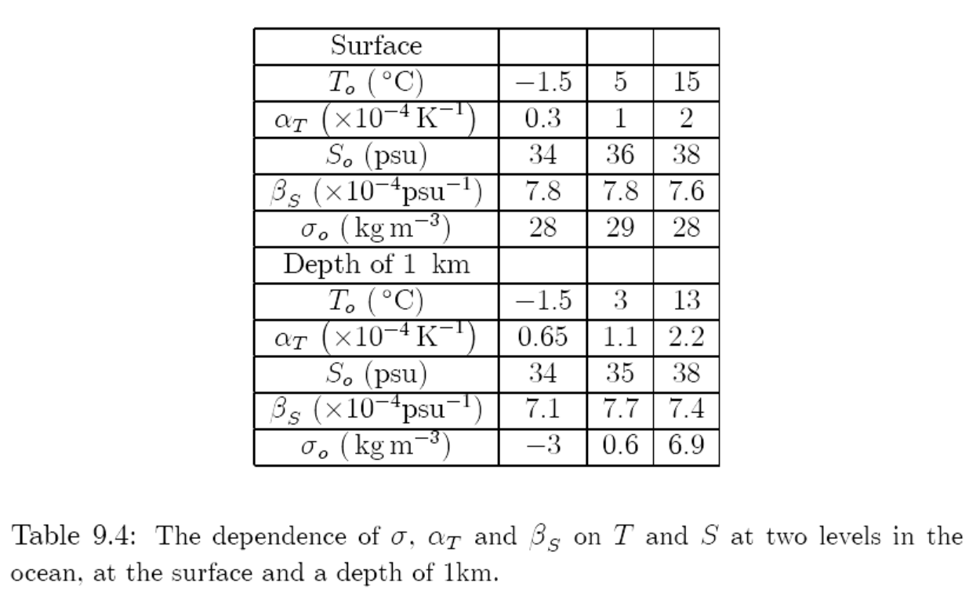
T’s impact is larger
in warm waters!
S’s impact is similar
at all temperatures.
Impact on density:
1 psu S increase ≈
8ºC T decrease for T < 5ºC
4ºC T decreases for T ~15ºC

Slide 8
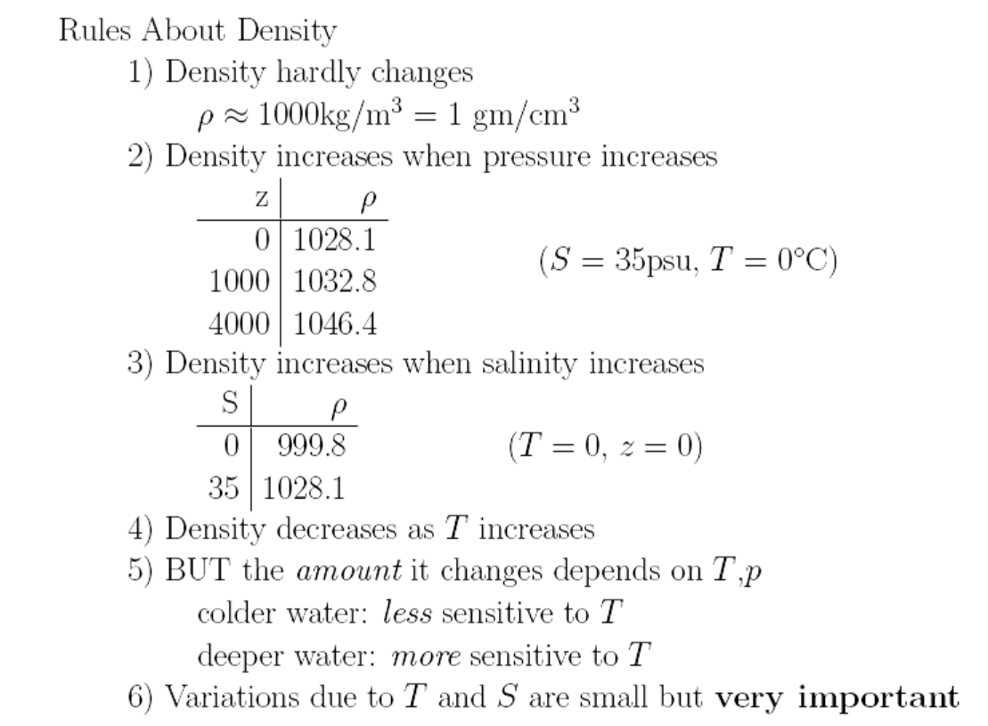
of seawater

Slide 9
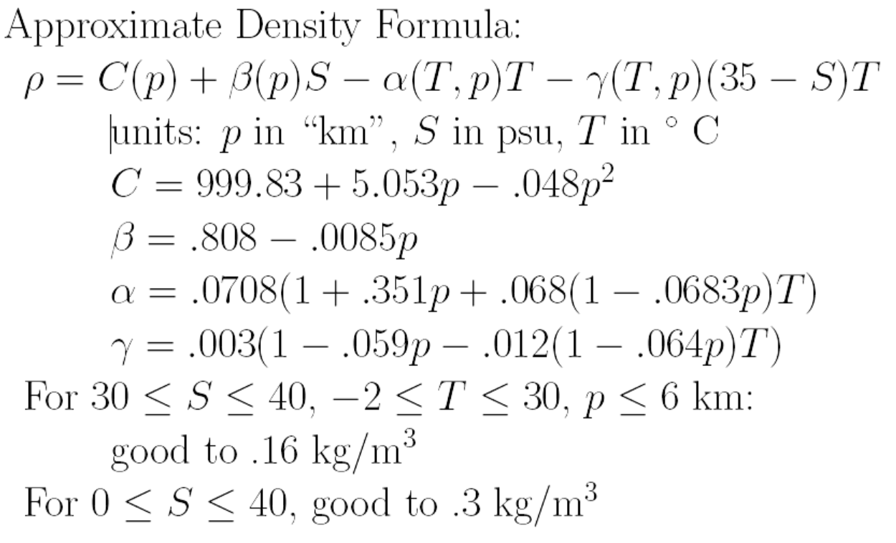

Slide 10
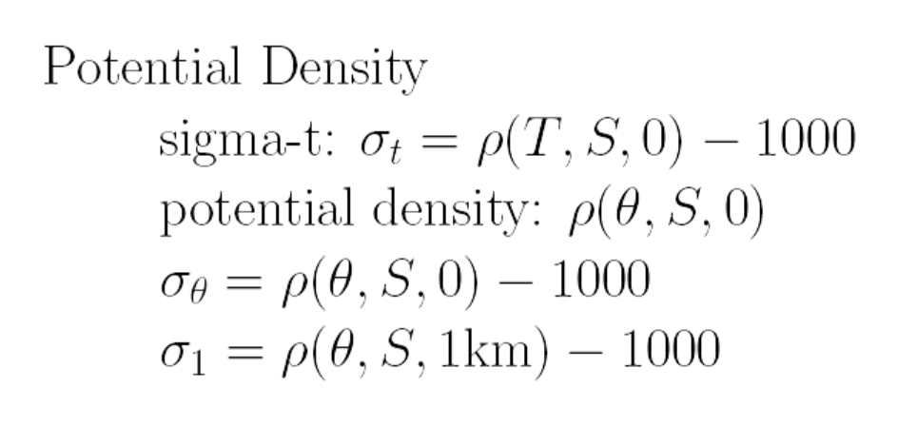
The potential density of a fluid parcel at pressure p is the density that the parcel would acquire if adiabatically brought to a reference pressure p_{o}, often at 1000hPa (surface ocean),
= function of θ, S, and ref. height
Anomaly density:
The potential temperature (θ) of a parcel of fluid at pressure p is the temperature that the parcel would acquire if adiabatically brought to a standard reference pressure p_{o}, usually1000 hPa.
Notes:
Theta = potential temperature. Sigma-t is the anomaly density in kg/m3 of a sample of seawater with in-situ temperature T and salinity S but at standard atmospheric pressure (not in-situ pressure). Sigma-theta is the anomaly density in kg/m3 of a sample of seawater with salinity S and potential temperature Theta when brought to surface ocean. Sgima-1 is the anomaly density in kg/m3 of a sample seawater with salinity S and a potential temperature Theta when brought to 1km depth.

Slide 11
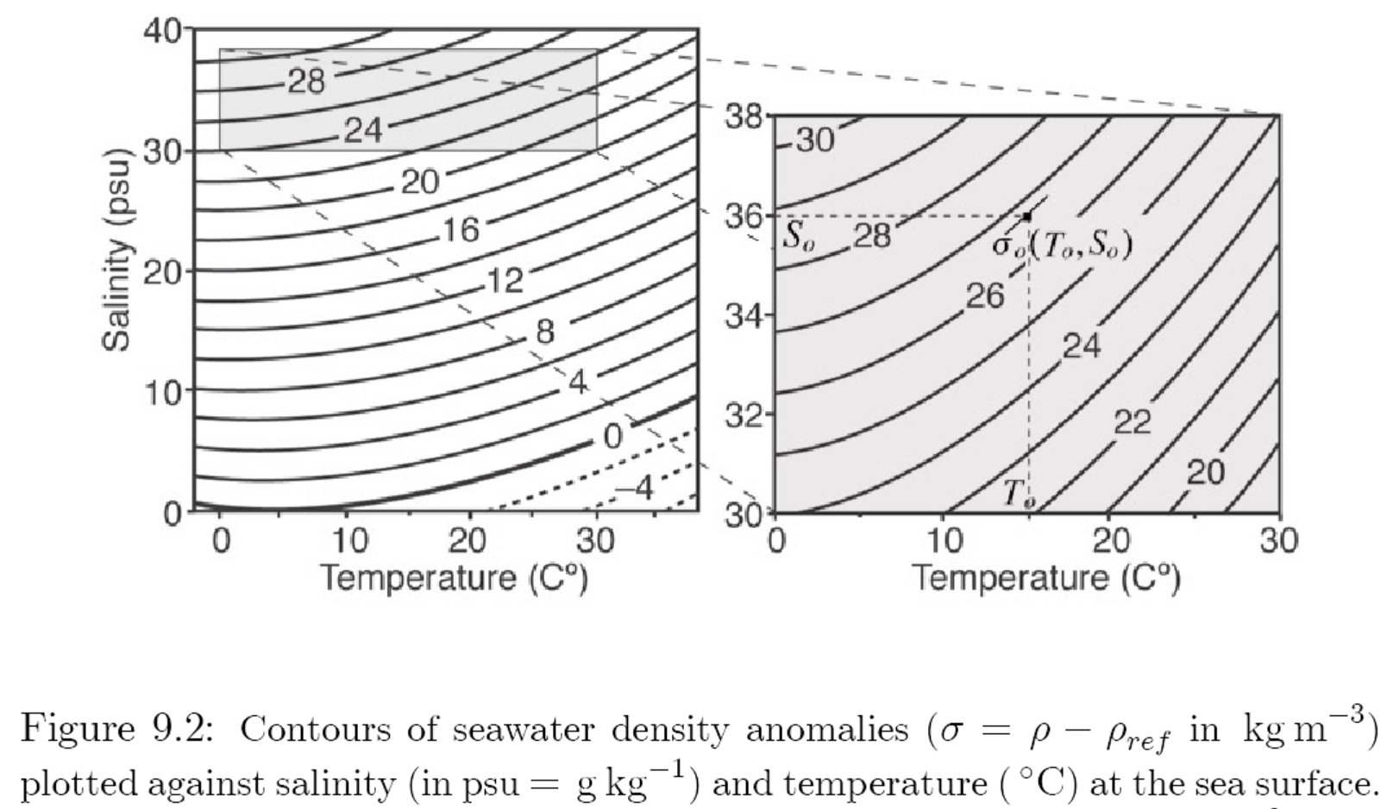
T − S Plot of Ocean Density (σ_{t})
Open Ocean Conditions
Freshwater is heaviest at 4ºC, so ice can stay near the surface in lakes!
What about sea ice? Why would sea ice stay at the surface?
Density increases with S but decreases with T, with larger impact of T at warmer temperatures!

Slide 12
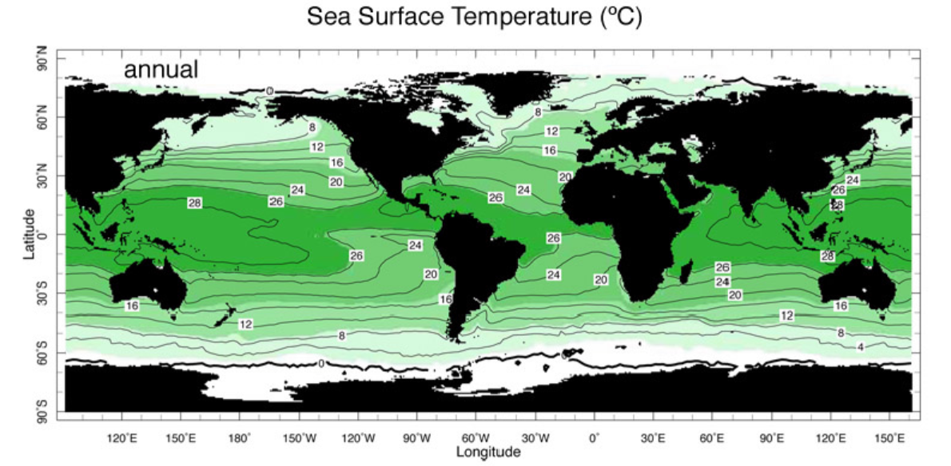
Annual-mean
Surface T decreases a lot (by 25-30ºC) from the tropics to the poles.
Why are the warmest SSTs located in the western Pacific?

Slide 13
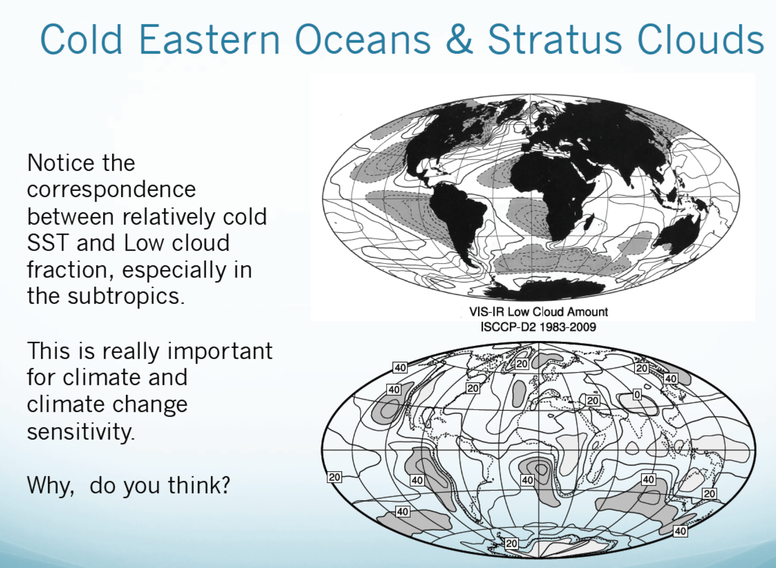
SST deviation from zonal mean
Low Cloud Amount

Slide 14
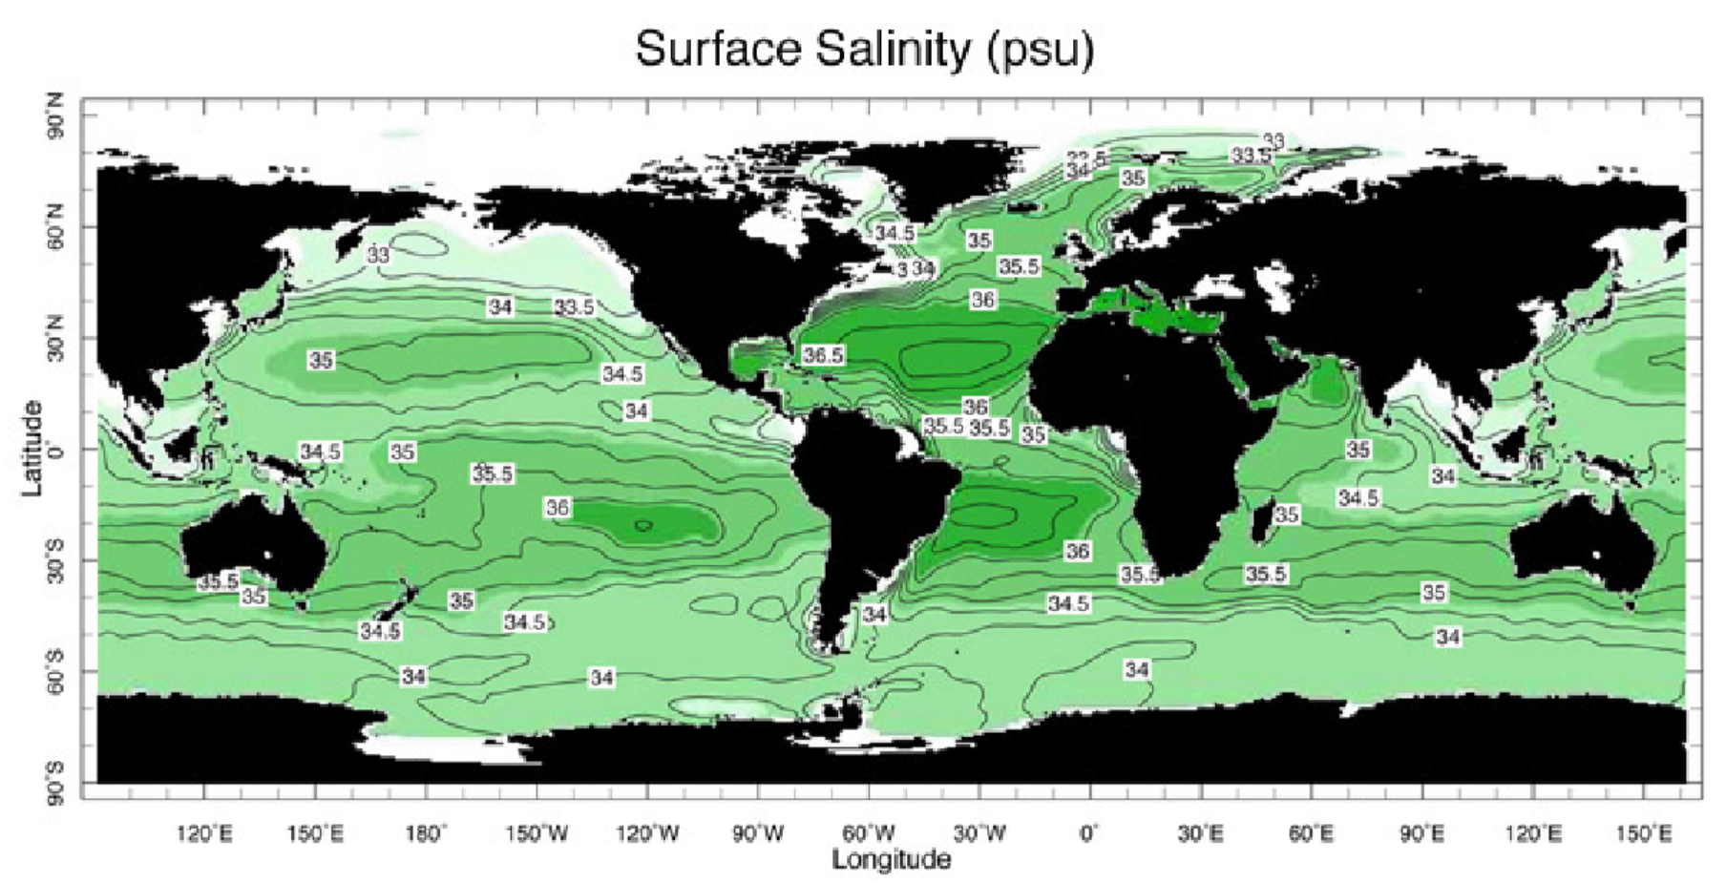
Annual-mean
35
37
S decreases slightly (by a few psu) from the subtropics to the poles.

Slide 15
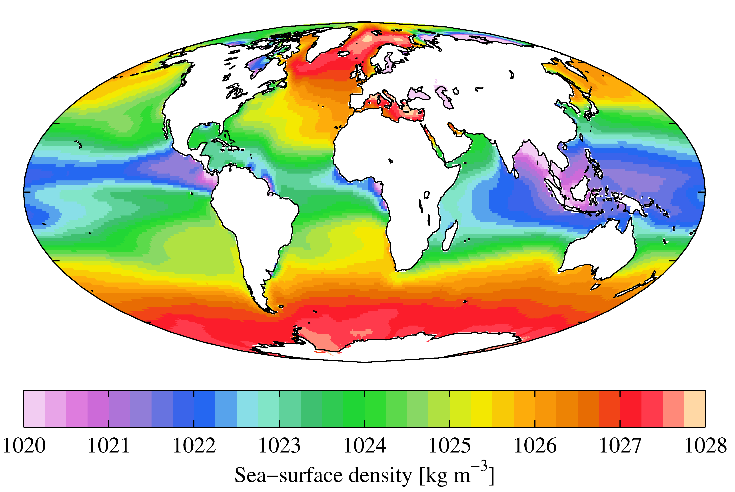
Surface Seawater Density
Light in the tropics, and heavy at high latitudes. Why?

Slide 16
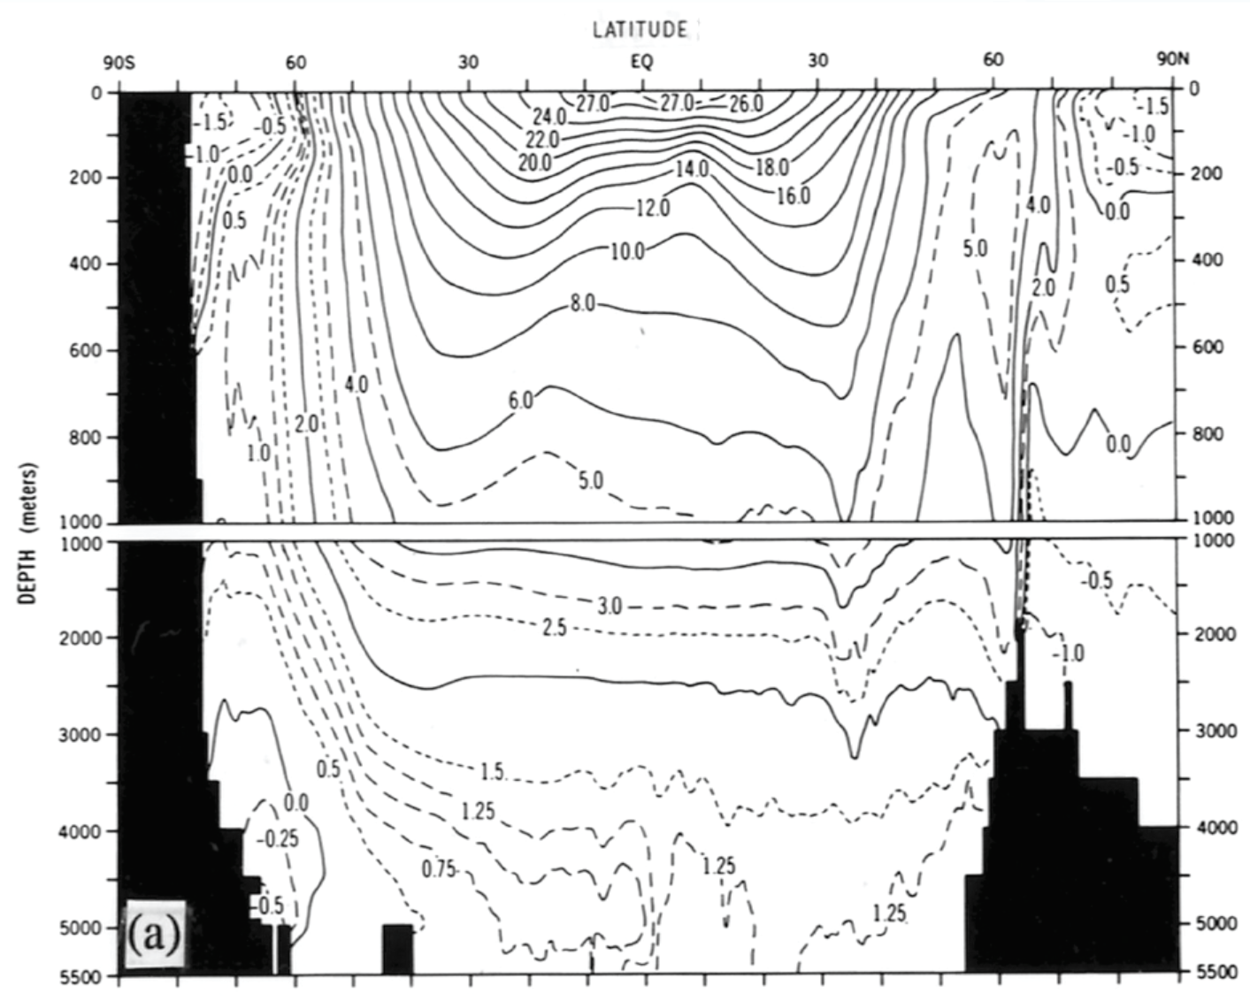
Annual-mean, Zonal-mean Potential Temperature (ºC, ref.=ocean sfc)
Notes:
For all oceans

Slide 17
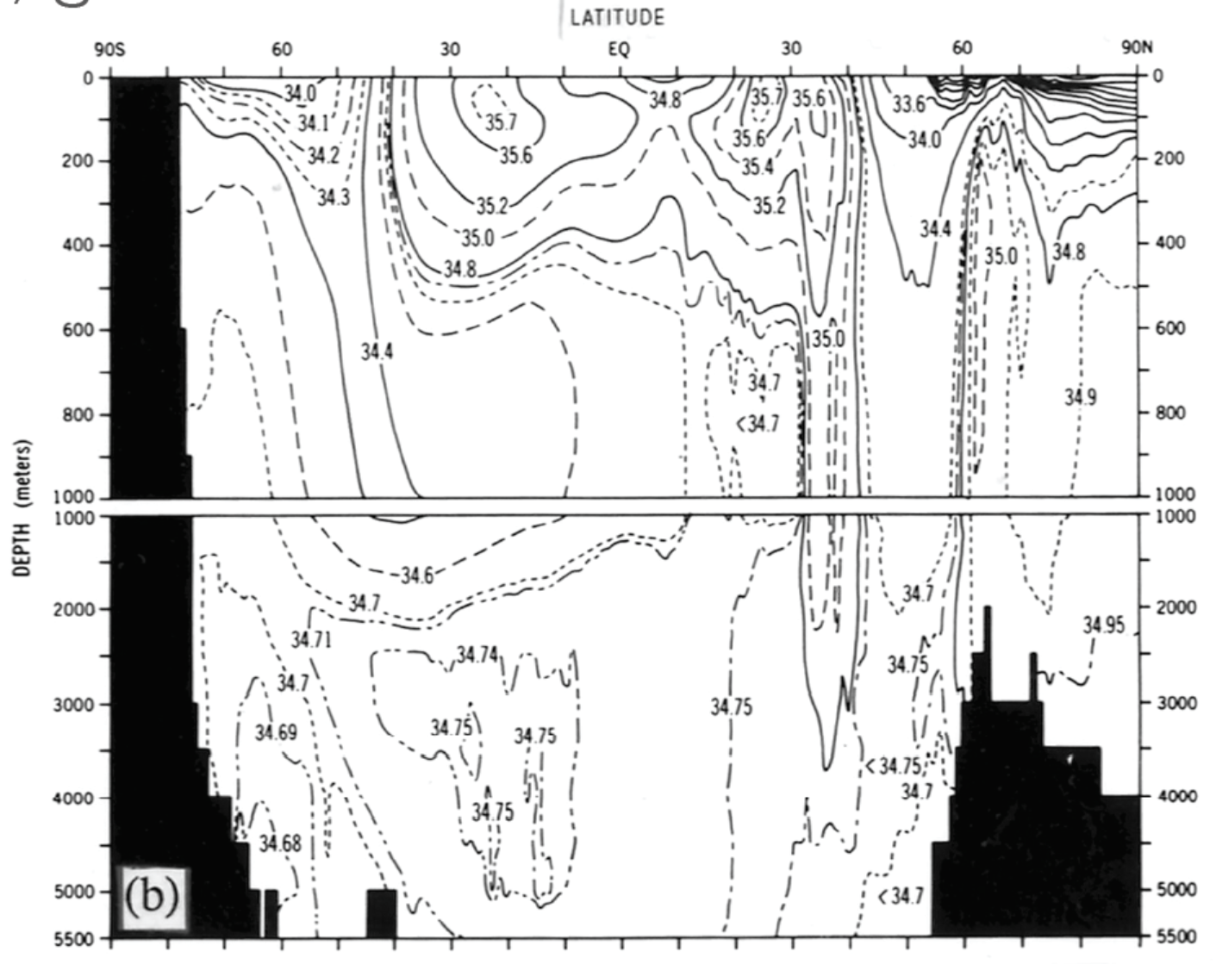
Annual-mean, Zonal-mean Salinity (%o, parts per thousand, similar to psu)

Slide 18
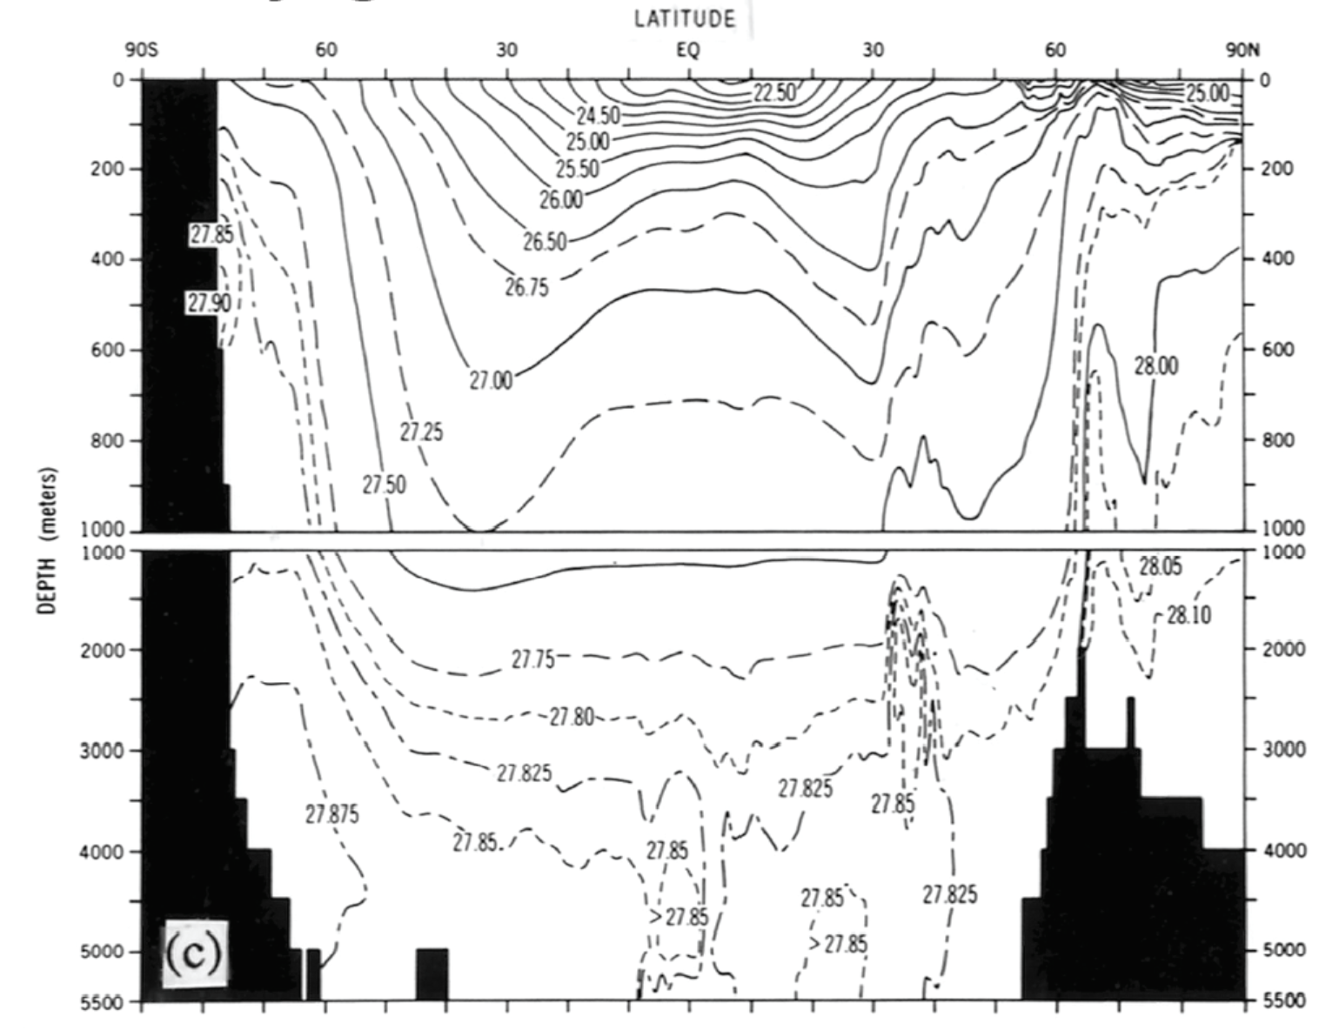
Annual-mean, Zonal-mean Potential Density (σ_{θ} kg/m³, ref=surface)
Mostly follows Potential Temp. Range: 22~28 kg/m³)

Slide 19
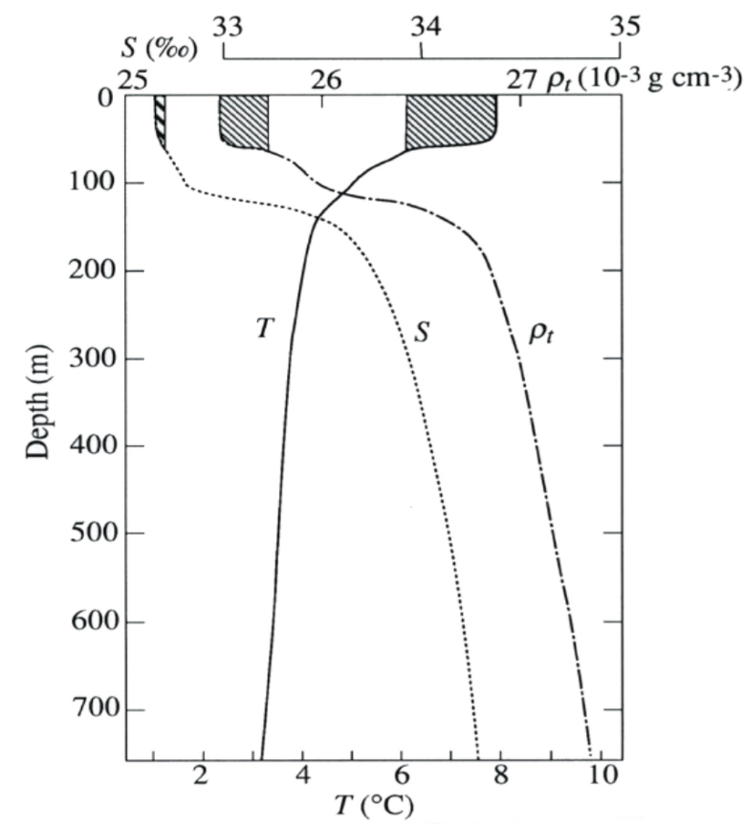
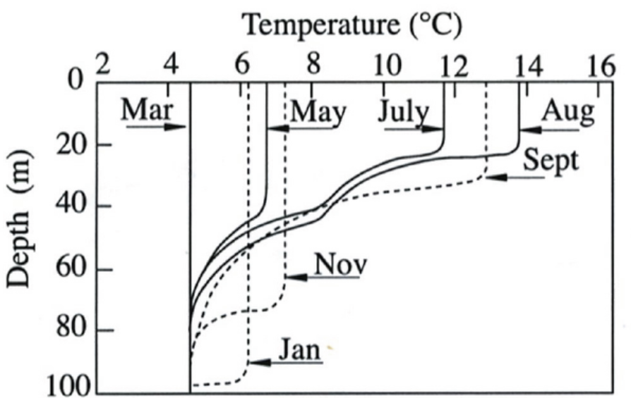
Ocean Mixed Layer: The top ocean layer (50-200m) that has well mixed T, S, and density. It responds to the seasonal cycle quite rapidly. Its depth increases with stormy weather in winter/spring and gets shallower in summer.
North Pacific (50ºN, 145ºW)

Slide 20
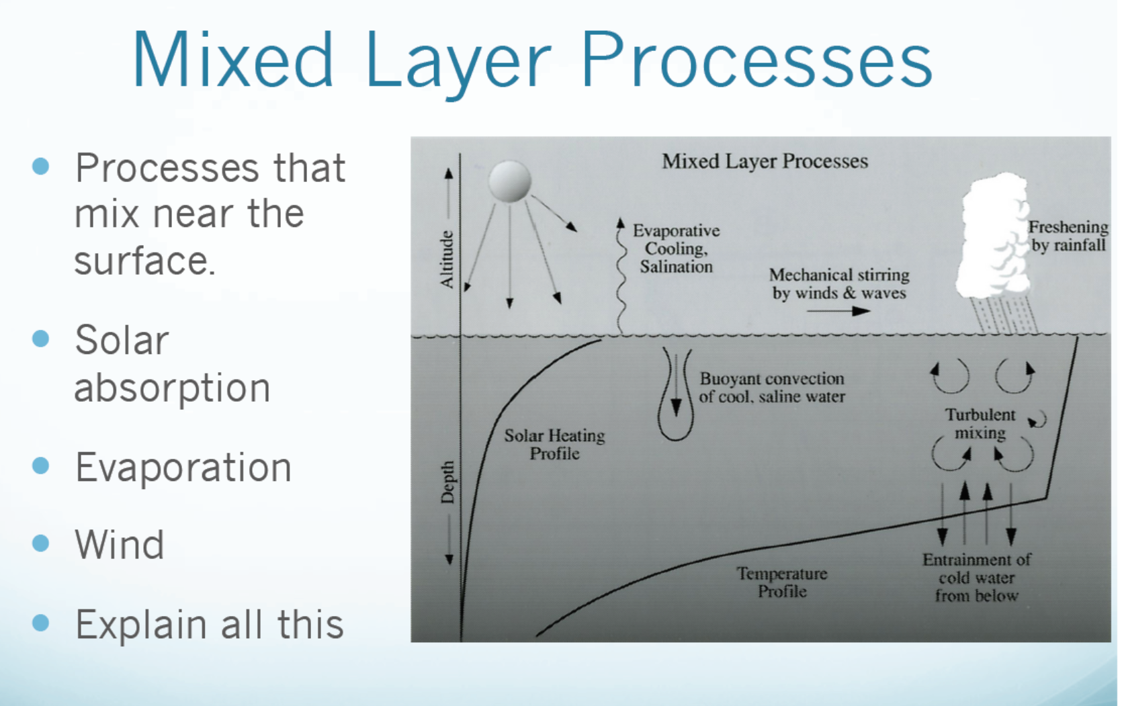
in top 100m
LW within top 1cm
Energy must be transported from subsurface to the surface by turbulent
mixing (aided by winds), convection (usually at night, why?), upwelling/downwelling.

Slide 21
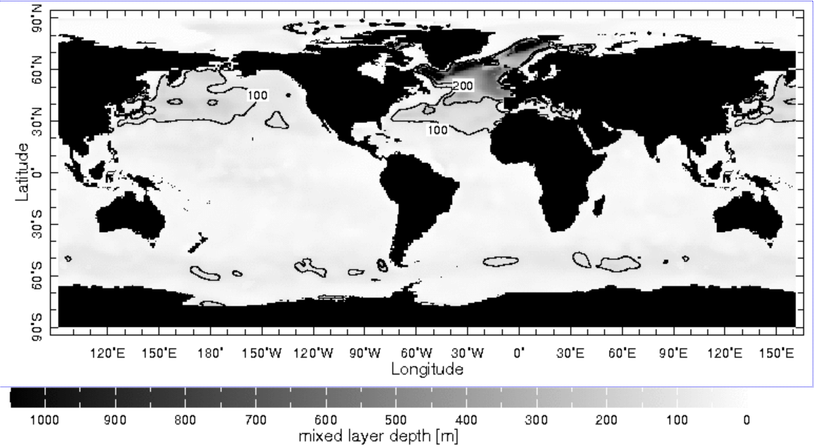
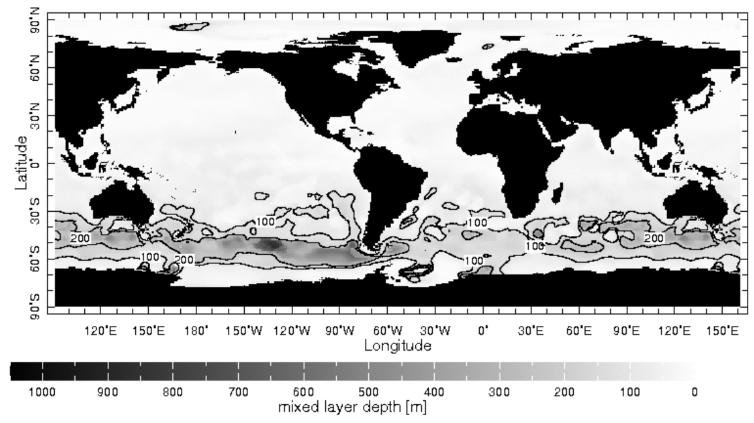
Distribution of Mixed Layer Depth
JFM
JJA

Slide 22
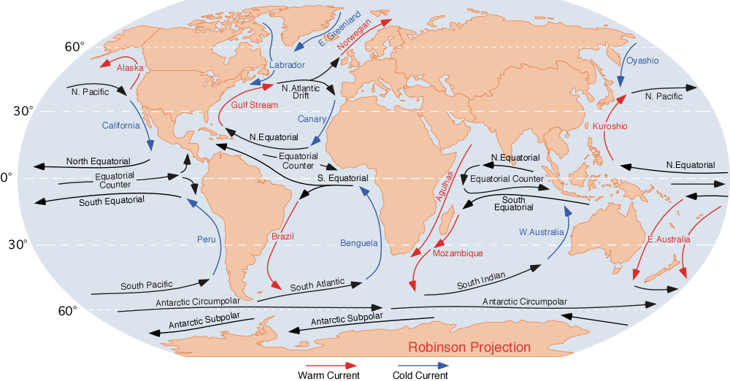
Surface Ocean Currents
Notes:
Equatorial countercurrent, current phenomenon noted near the equator, an eastward flow of oceanic water in opposition to and flanked by the westward equatorial currents of the Atlantic, Pacific, and Indian oceans. Lying primarily between latitude 3° and 10° N, the countercurrents shift south during the northern winter and north during the summer. To either side the trade winds blow constantly and push great volumes of water westward in the equatorial currents, raising the sea level in the west. Within the doldrums, where strong constant winds are absent, the higher western sea levels flow downslope to the east. The Pacific Equatorial Countercurrent is very strong and is definable year-round. The Atlantic Equatorial Countercurrent is strongest off the coast of Ghana (Africa), where it is known as the Guinea Current. The countercurrent of the Indian Ocean flows only during the northern winter and only south of the equator. (from https://www.britannica.com/science/equatorial-countercurrent )

Slide 23
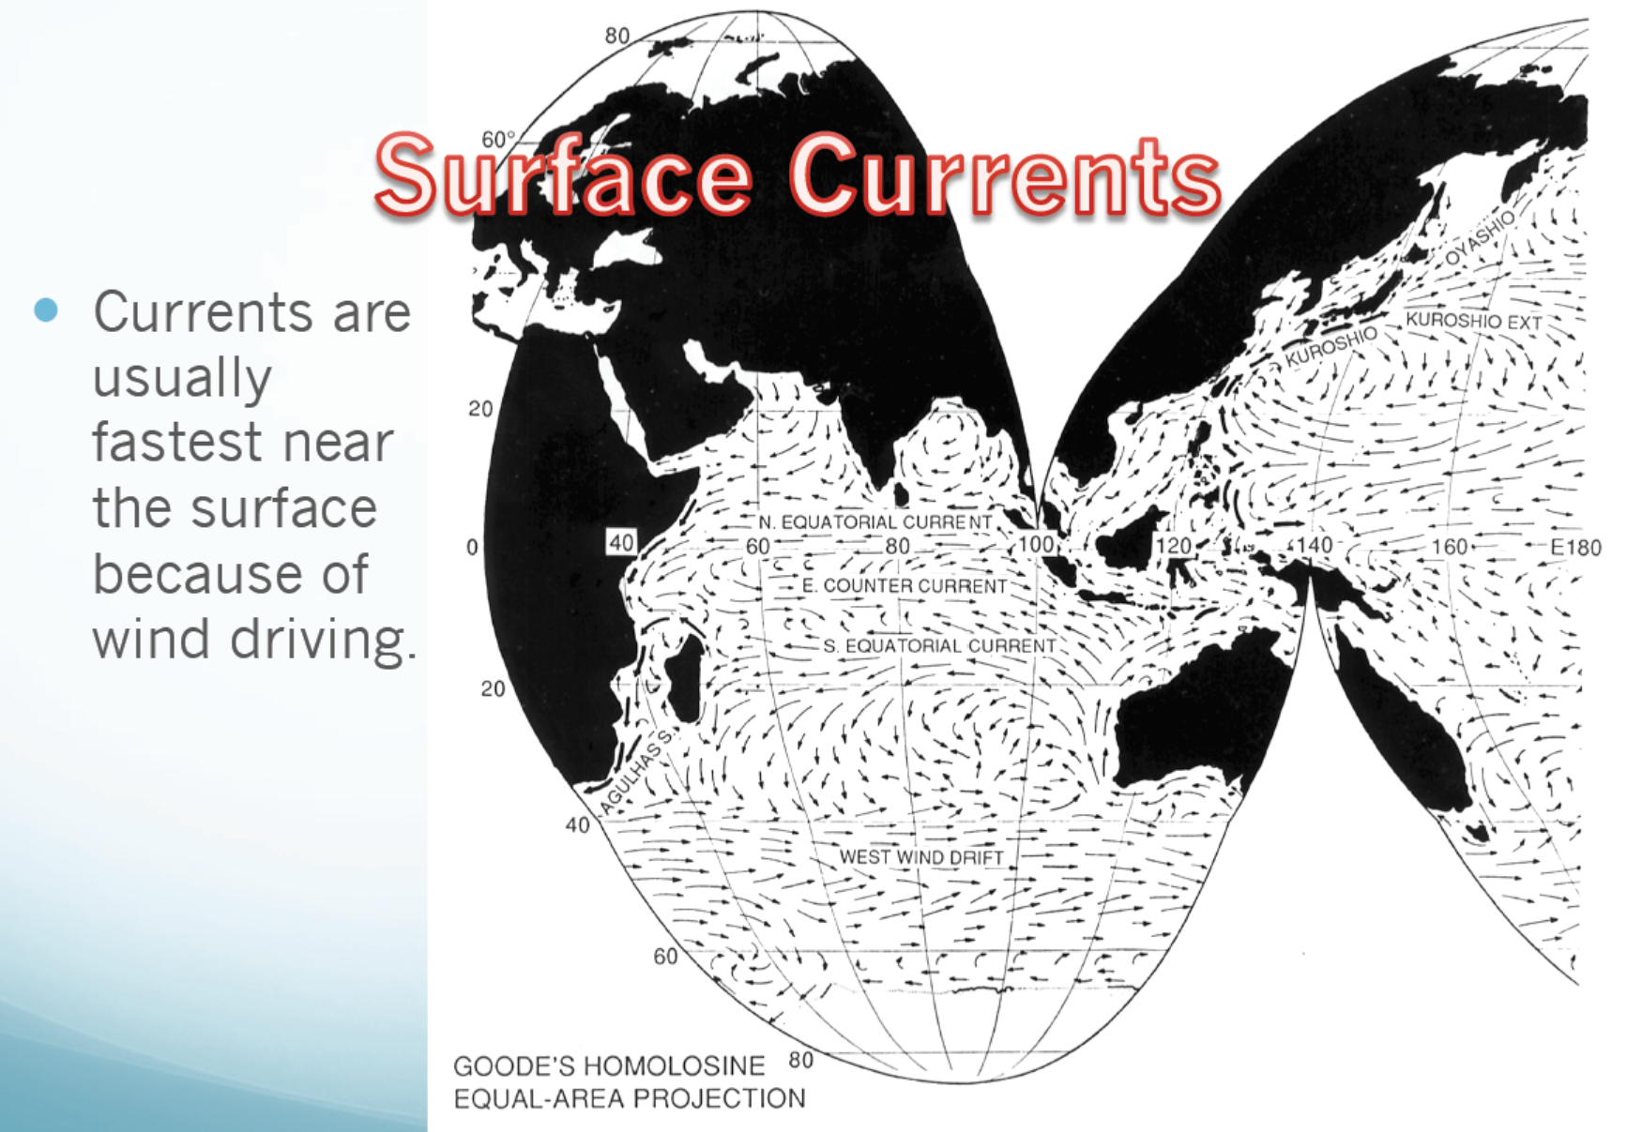
Gyre
Gyre
Speed ∼ 10 cm/s

Slide 24
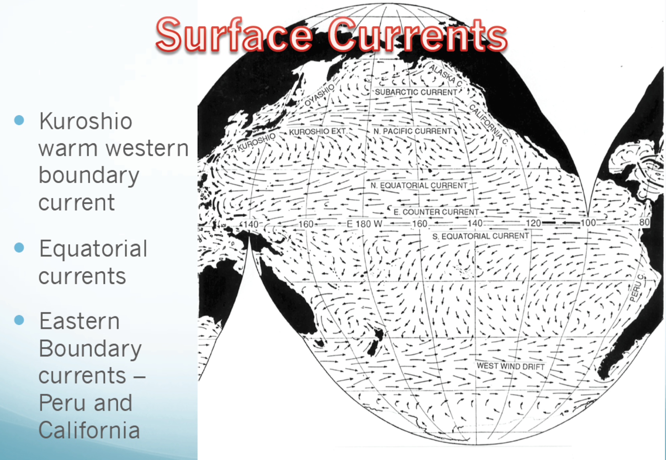
Western Boundary Current

Slide 25
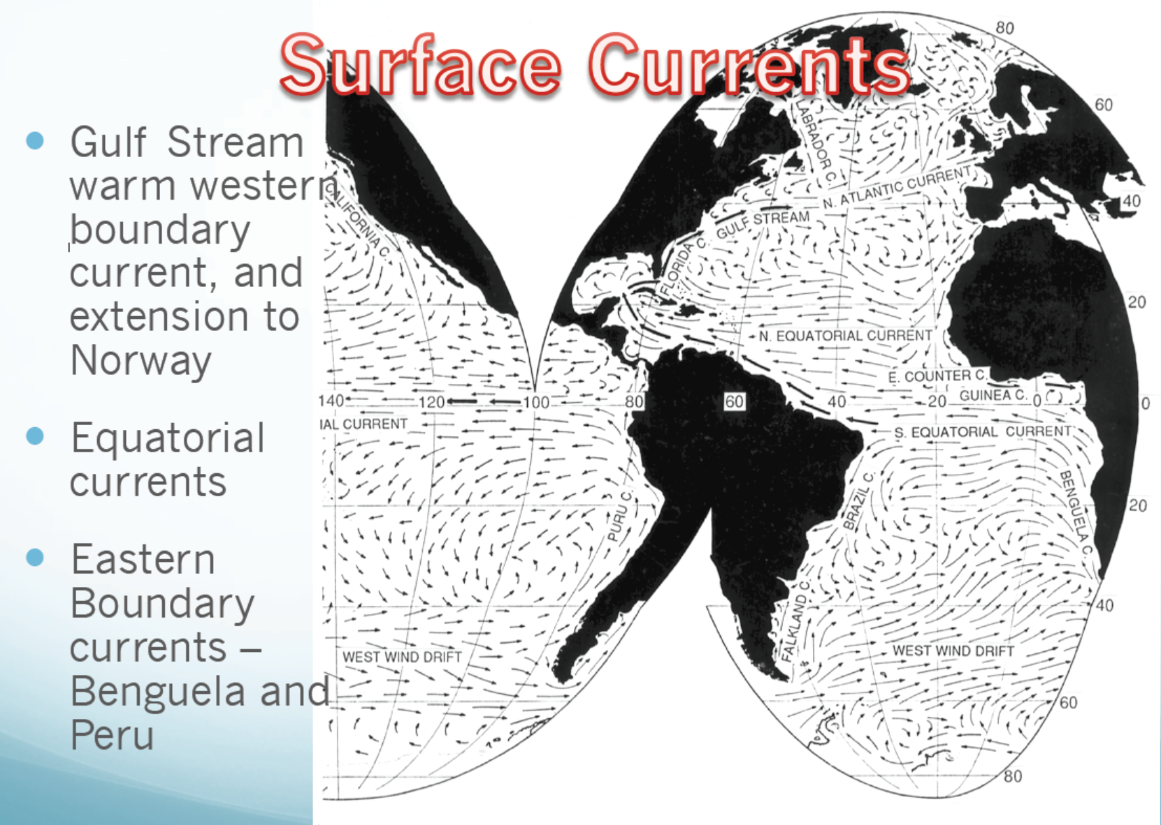
Western Boundary Current
Eastern Boundary Current

Slide 26
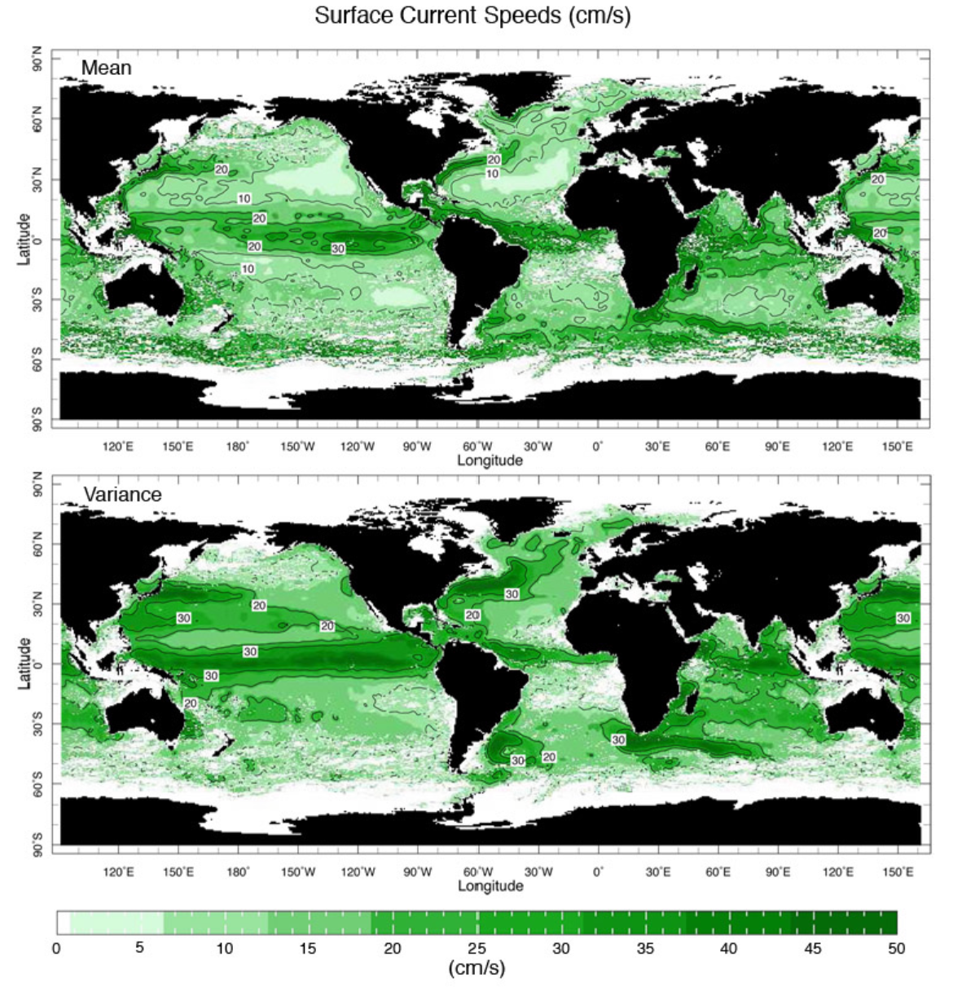
Eddies

Slide 27
NASA Video:
The Oceans (~5min.)
Notes:
Westerly surface winds at midlat means that the surface friction slows down the westerly winds and thus the atmosphere loses westerly angular momentum. In the tropics, the surface drags the air eastwrard, thus slowing down the (negative) westward angular momentum or the atmosphere gains westerly angular momentum.

Slide 28
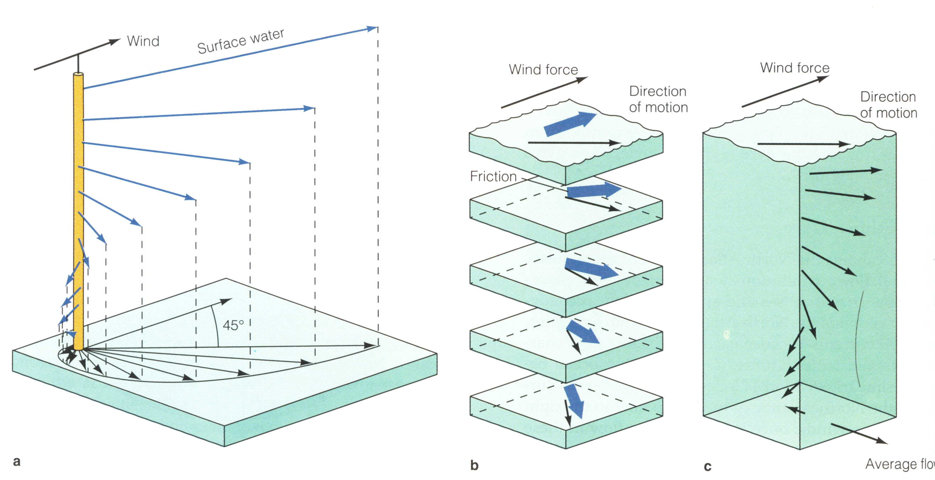
Wind-driven Upper Ocean Circulation
Ekman Spiral of Wind-driven Currents for N.H.
Average flow is 90º to the right of the wind
Wind Stress
τ
45º
Friction
Current
Coriolis
Notes:
The balance among wind stress, friction and Coriolis forces leads to 45deg between the surface ocean current and wind stress. See
https://en.wikipedia.org/wiki/Ekman_transport#cite_note-7 for mathematical derivation of this angle.

Slide 29
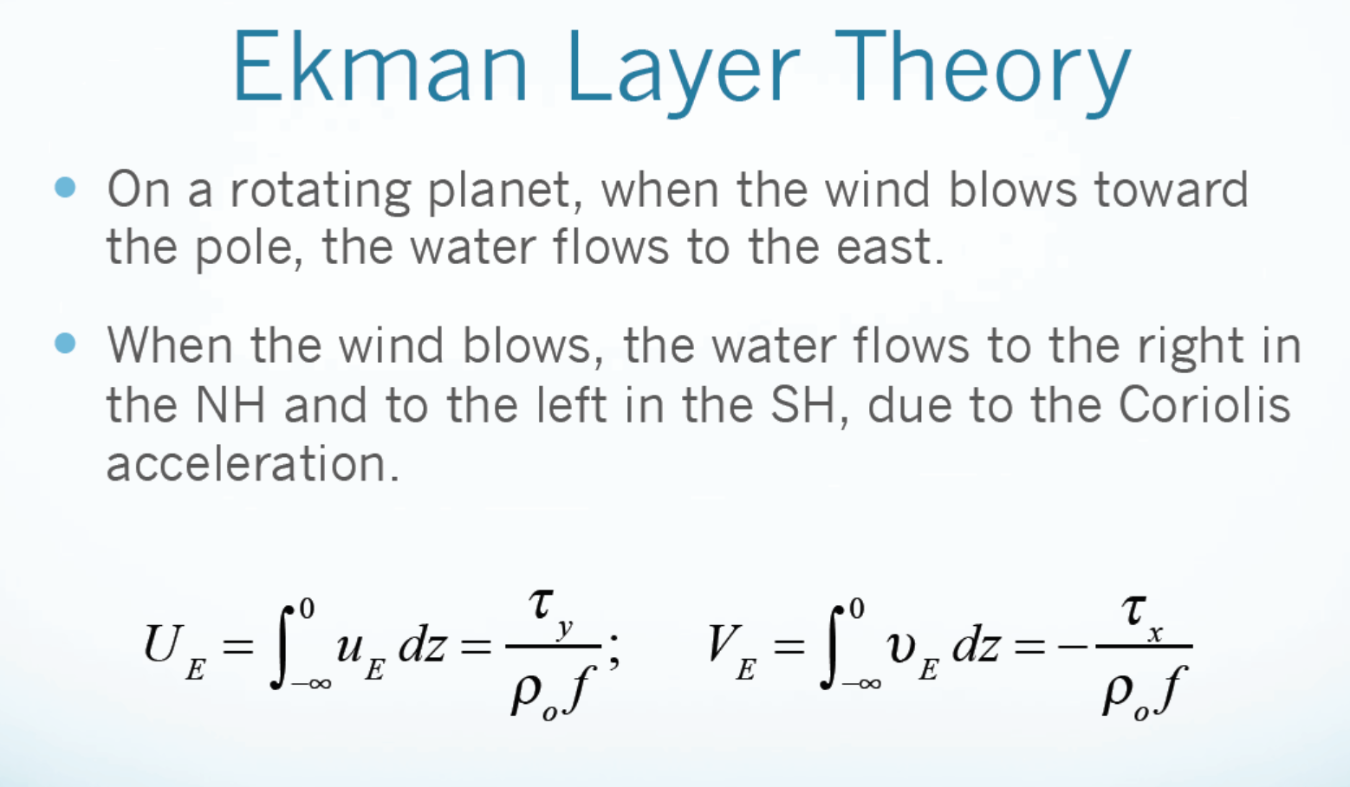
on the N.H.
For layer-averaged mean flow (Ekman transport):
Typical Ekman Layer depth is ~800 to 1000 m.
Wind stress (horizontal force exerted by the wind on sea surface):

Slide 30
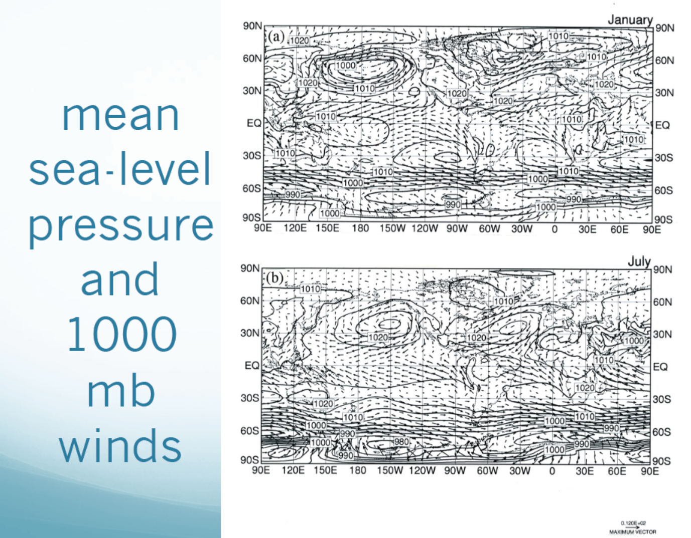
L
L
H
H
H
L
H
H
L
L
L
H
L
H
L
Along-coast winds are strong on the eastern boundary

Slide 31
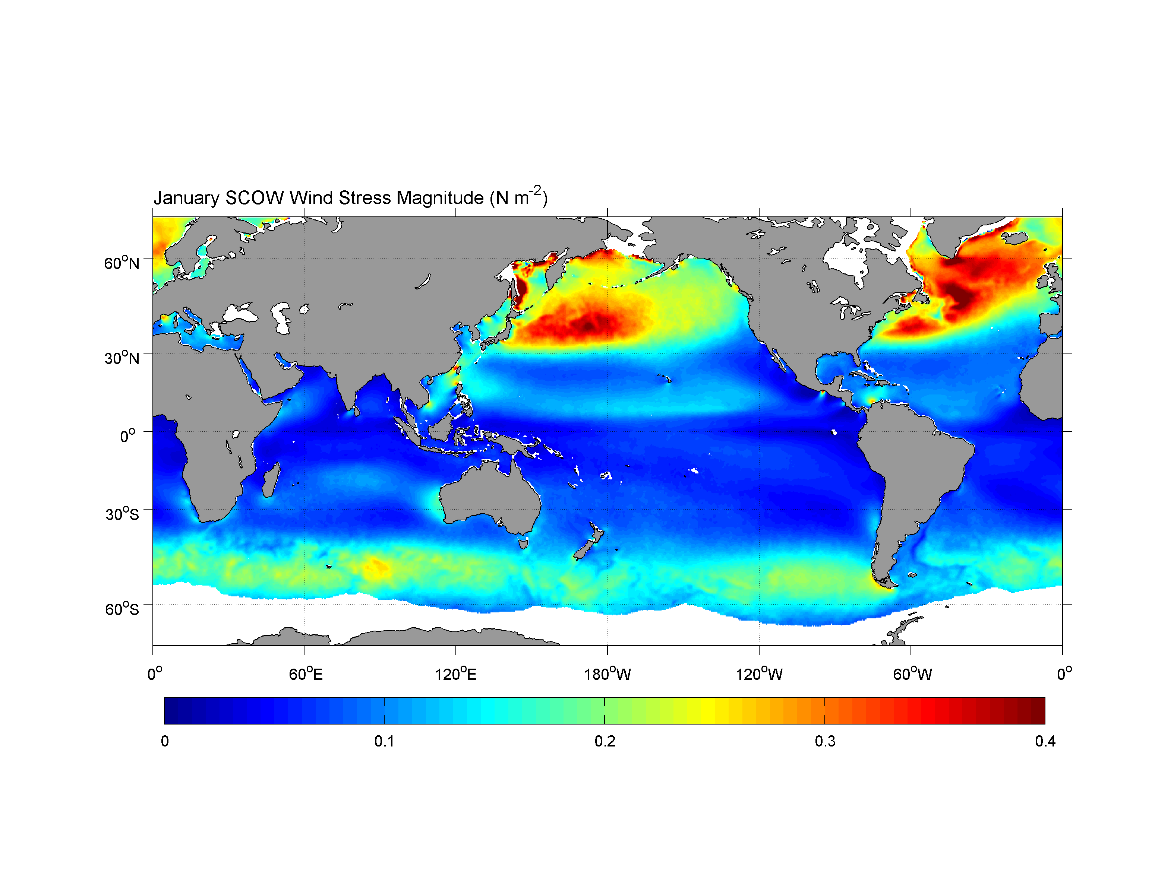
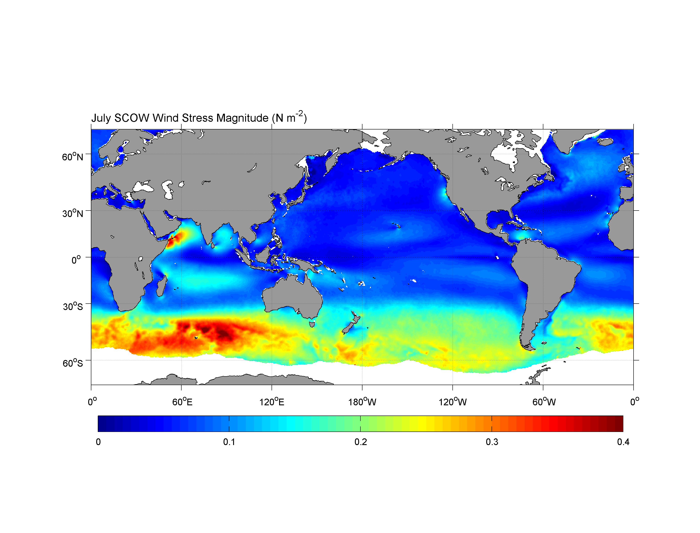
Wind Stress Magnitude, January
Wind Stress Magnitude, July

Slide 32
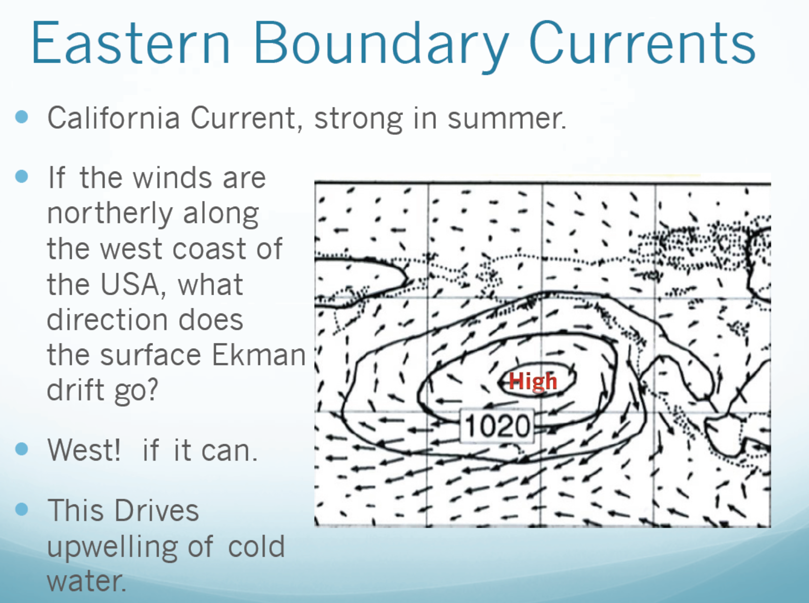

Slide 33
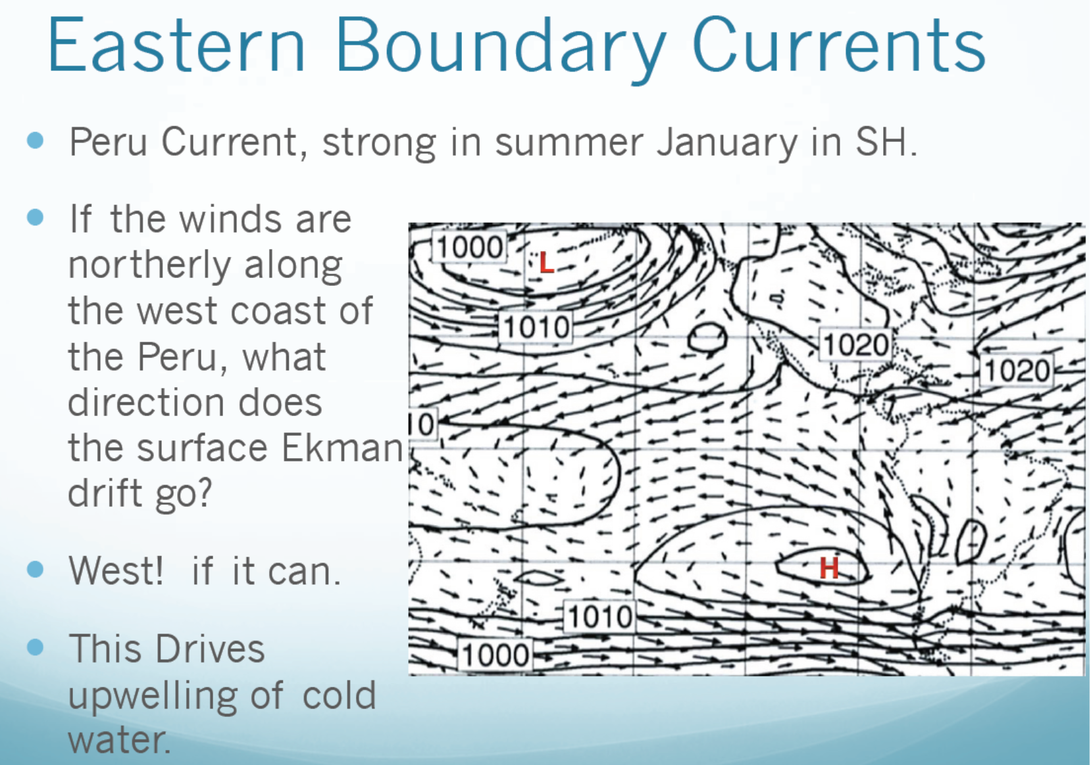
southerly

Slide 34
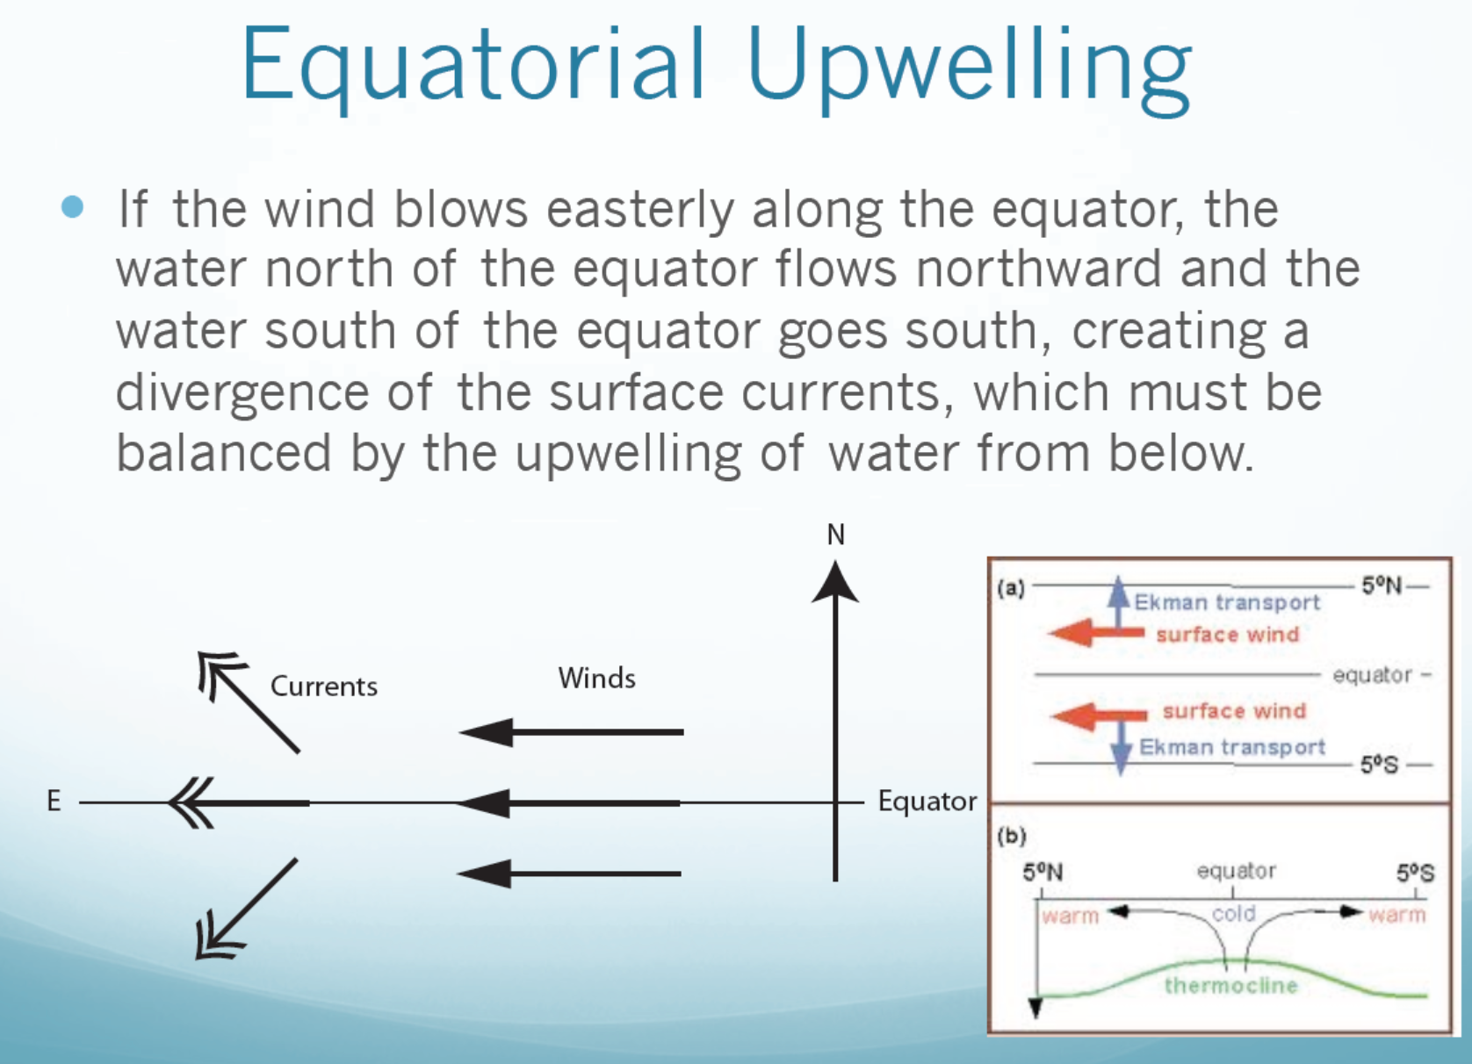

Slide 35
Deep Ocean Circulation
Below the thermocline, ocean currents are slow and driven mainly by density gradients, which in turn are driven by T and S differences.
Thus, this density driven circulation is often called thermohaline circulation.
Direct measurements of the deep currents are difficult due to their slow motion.
Deep water flows along density surfaces with little mixing across these surfaces. Thus, T, S, O2 and trace gas contents can be used to trace the origin of the water mass, thereby inferring its motion.
Time scales are long, from 500-3500 years
heat
salt

Slide 36
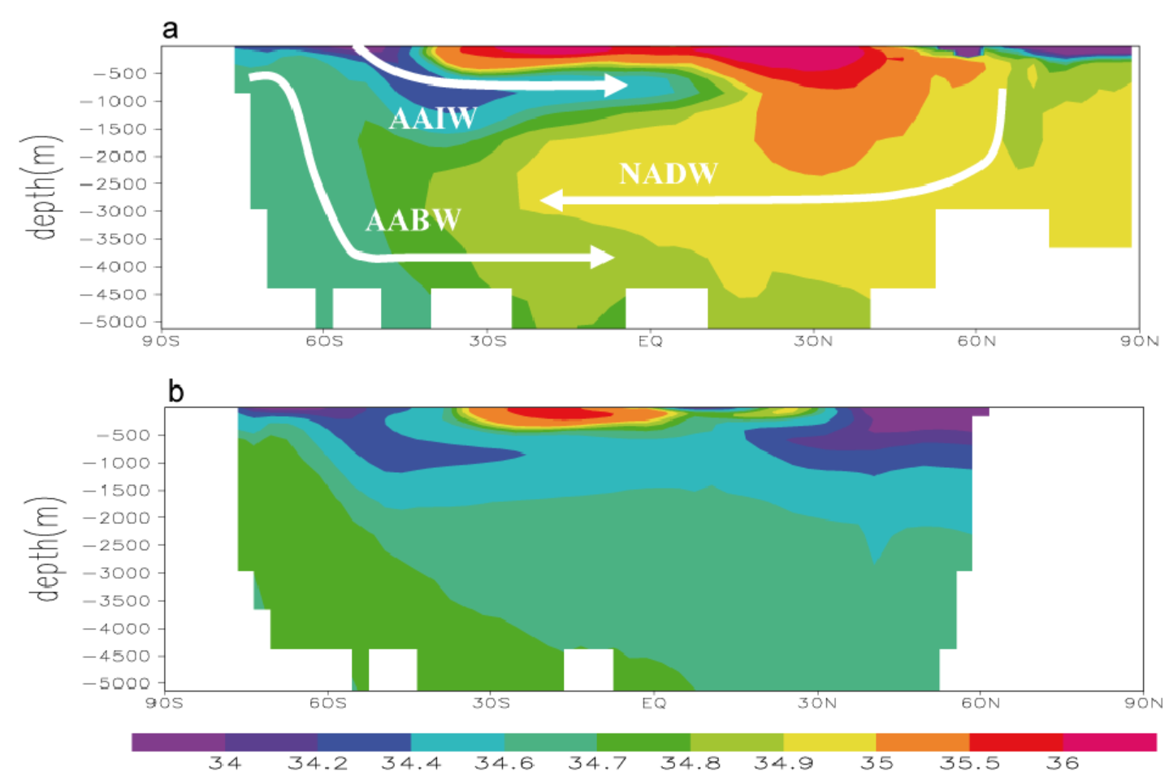
Zonal-mean Ocean Salinity
Atlantic
AABW = Antarctic Bottom Water AAIW=Antarctic Intermediate Water NADW = North Atlantic Deep Water
Pacific
^{PSU}

Slide 37
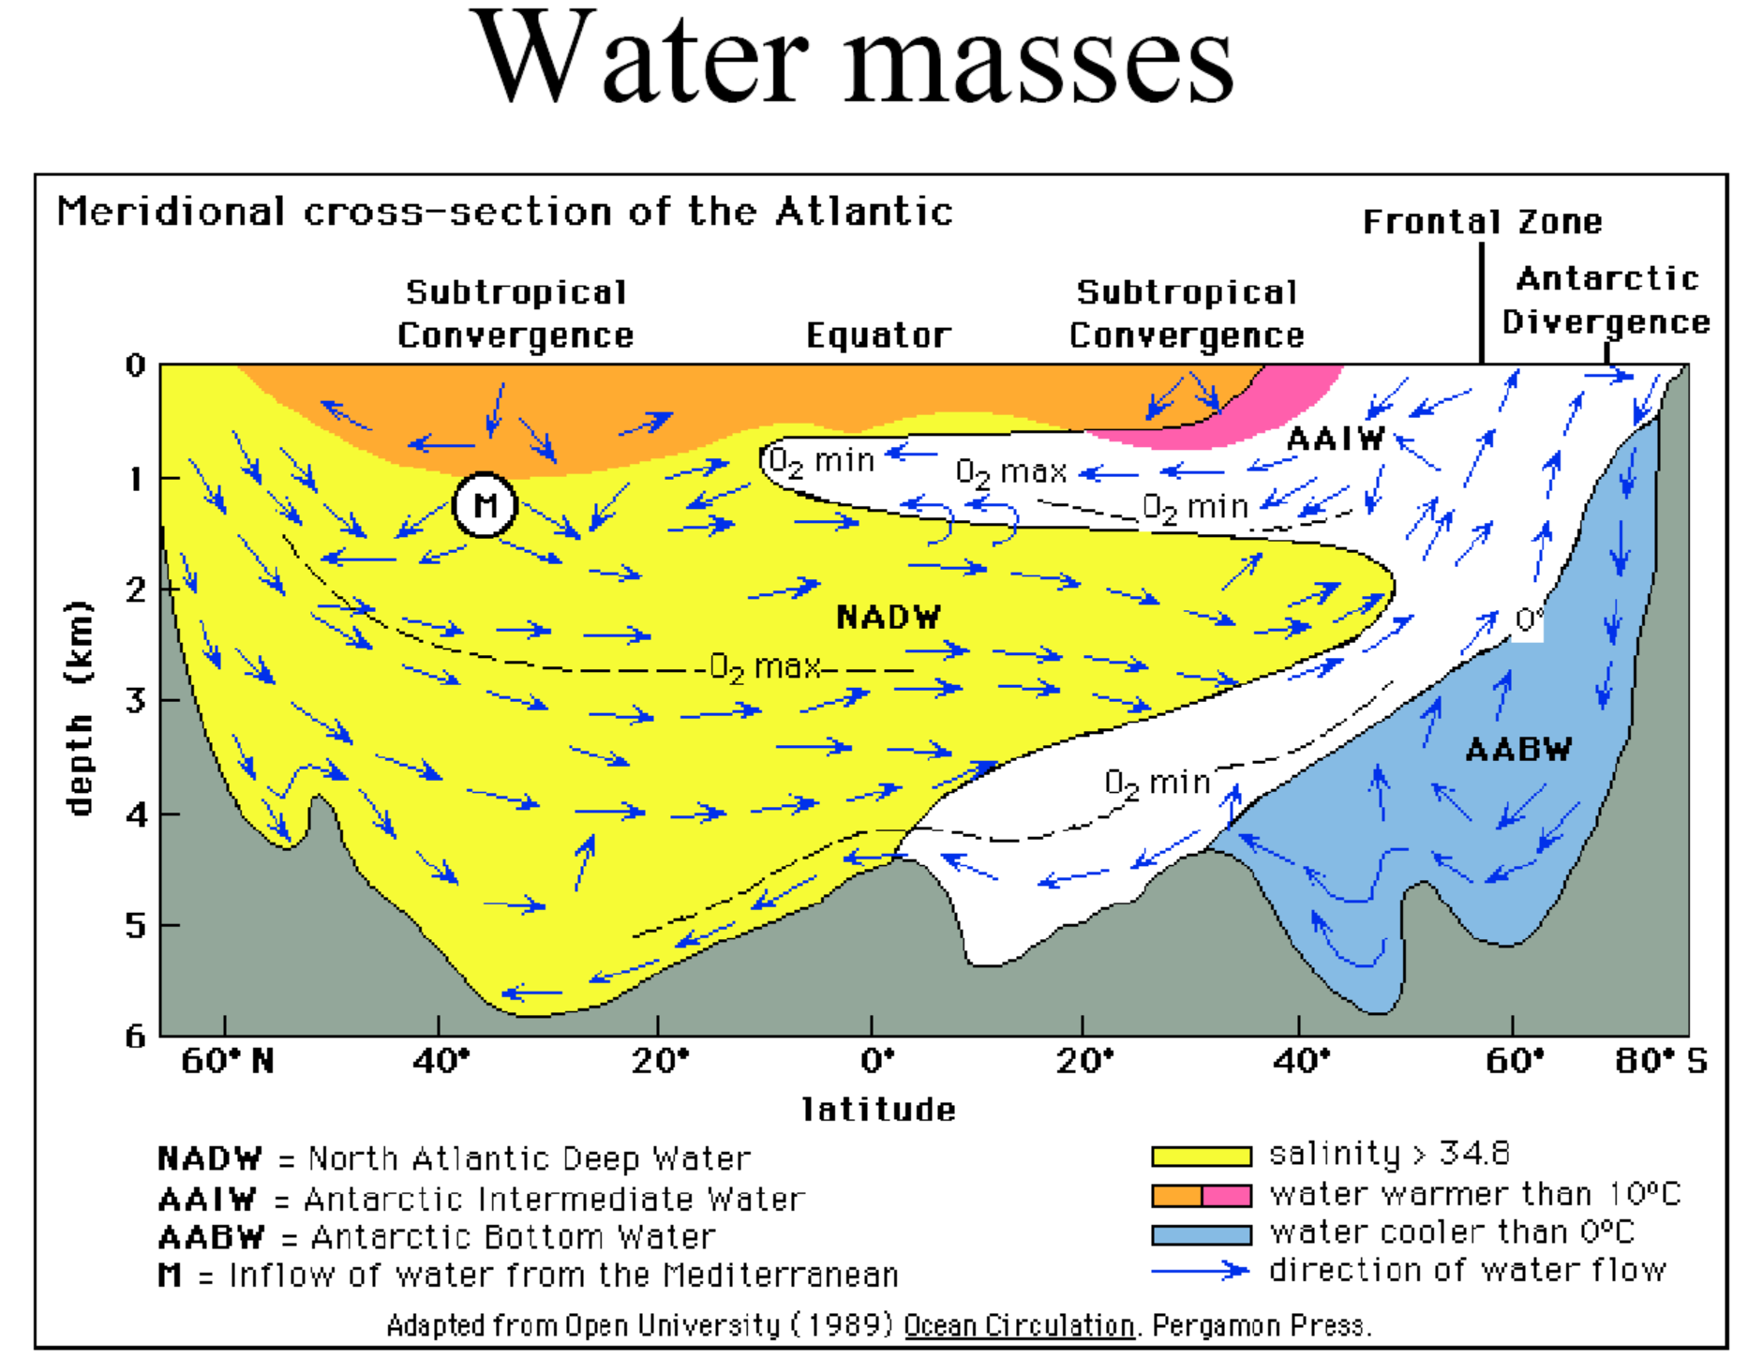

Slide 38
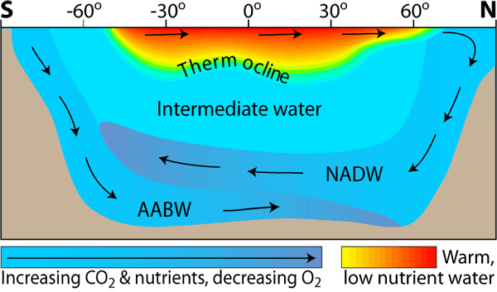
Zonal-mean Circulation in the Atlantic
AABW = Antarctic Bottom Water NADW = North Atlantic Deep Water

Slide 39
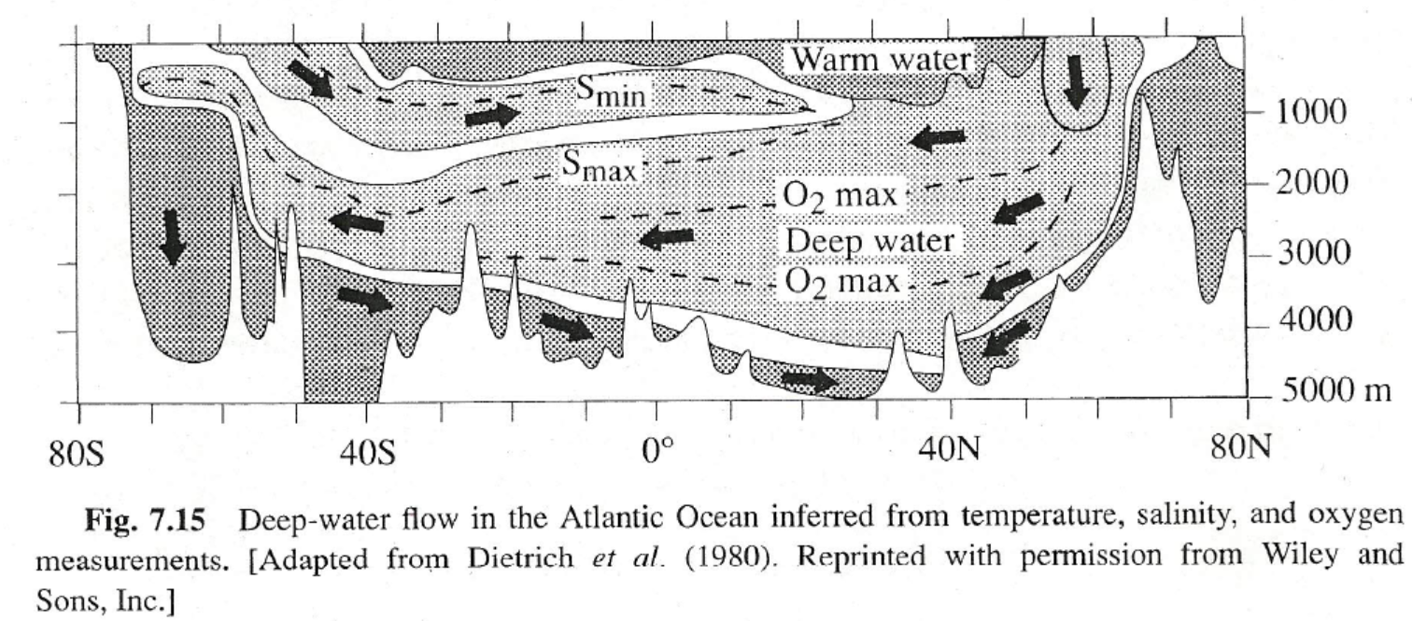

Slide 40
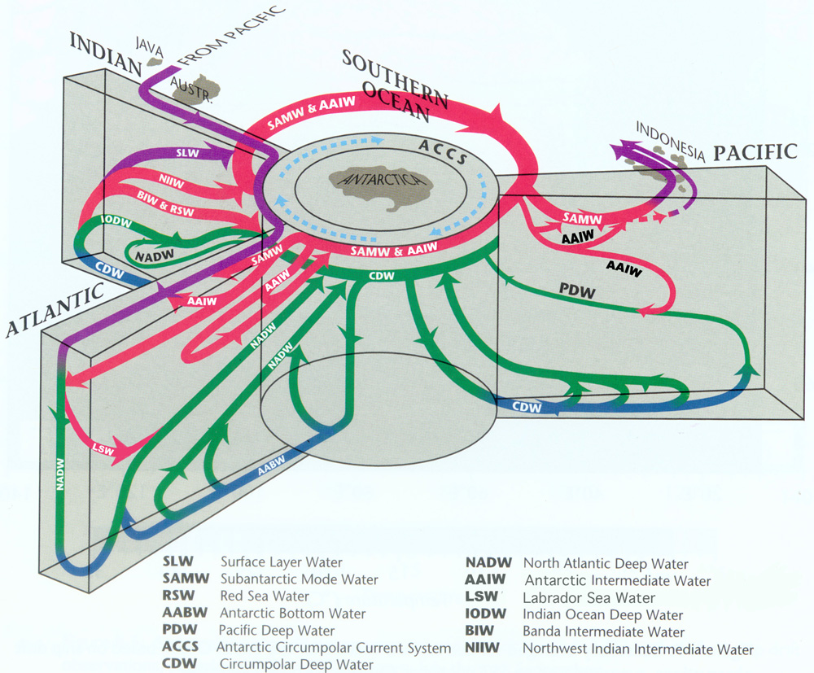

Slide 41
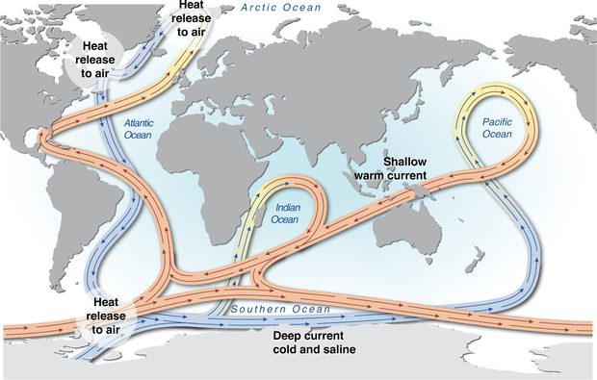
Ocean Overturning Circulation

Slide 42
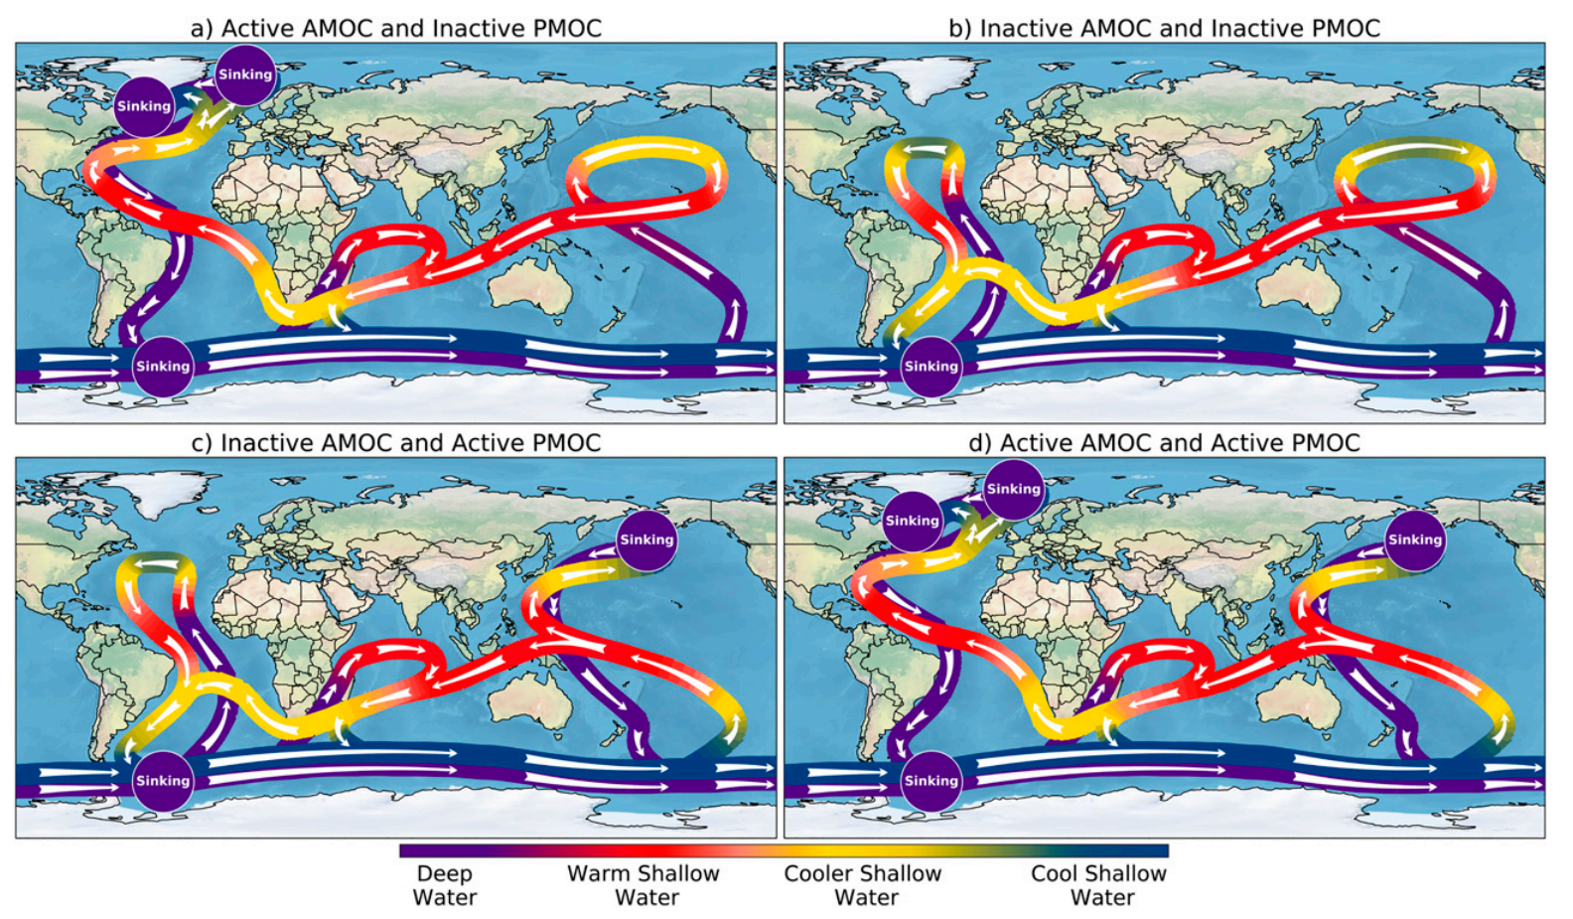
Hu et al. (2021, JClim)

Slide 43
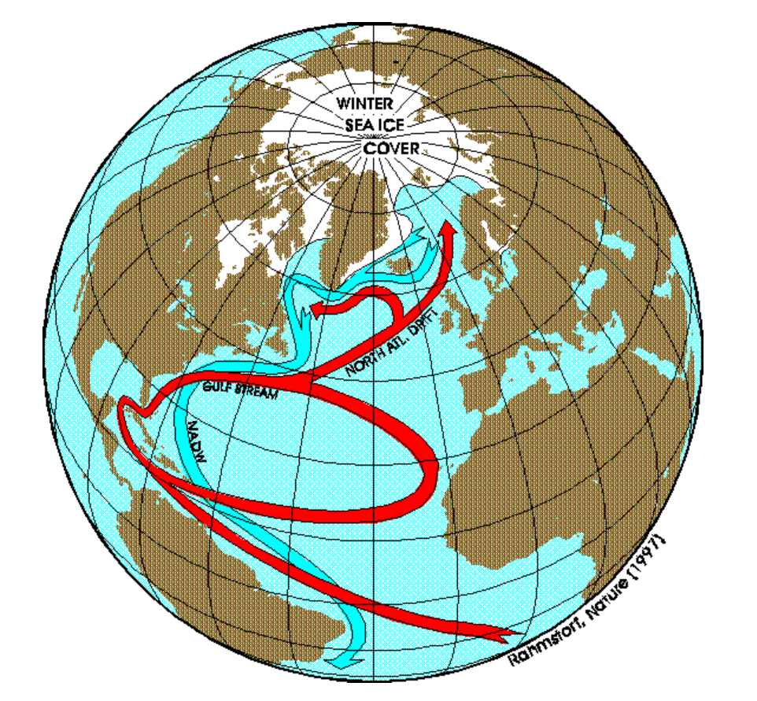
NADW Formation

Slide 44
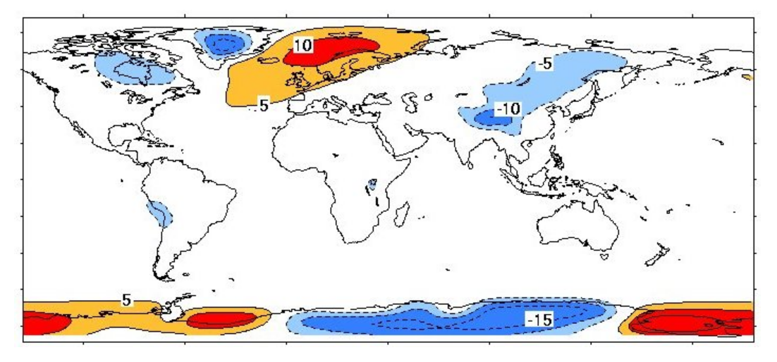
Surface T Deviation (ºC) from Zonal Mean

Slide 45
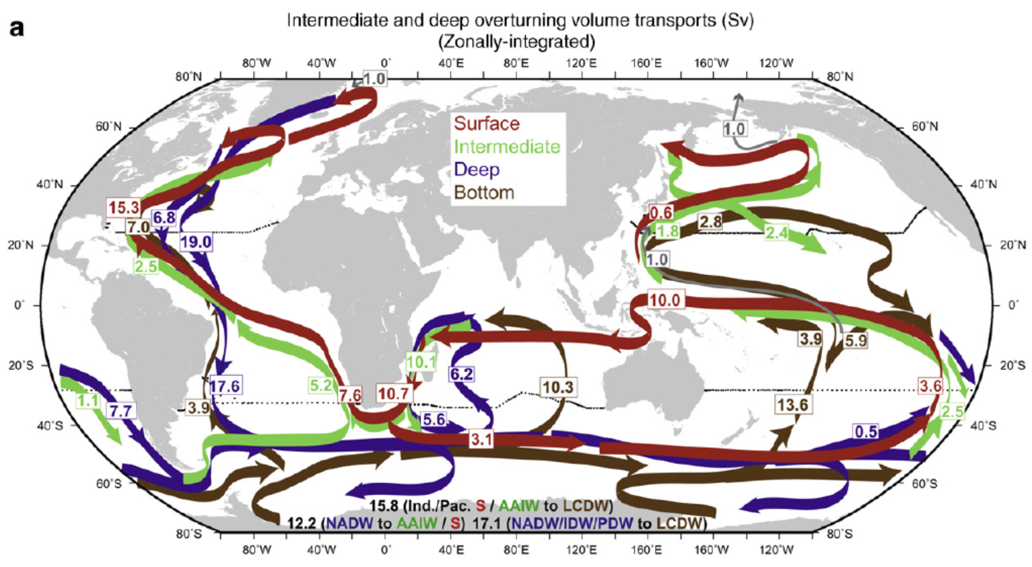
Ocean Volume Transport at Different Levels
1Sv=10⁶ m³/s
Equatorward Transport of Freshwater in the Oceans:
N. Hemisphere: Mostly through N. Atlantic Overturning Circulation
S. Hemisphere: Mostly through upper oceans
Talley 2008

Slide 46
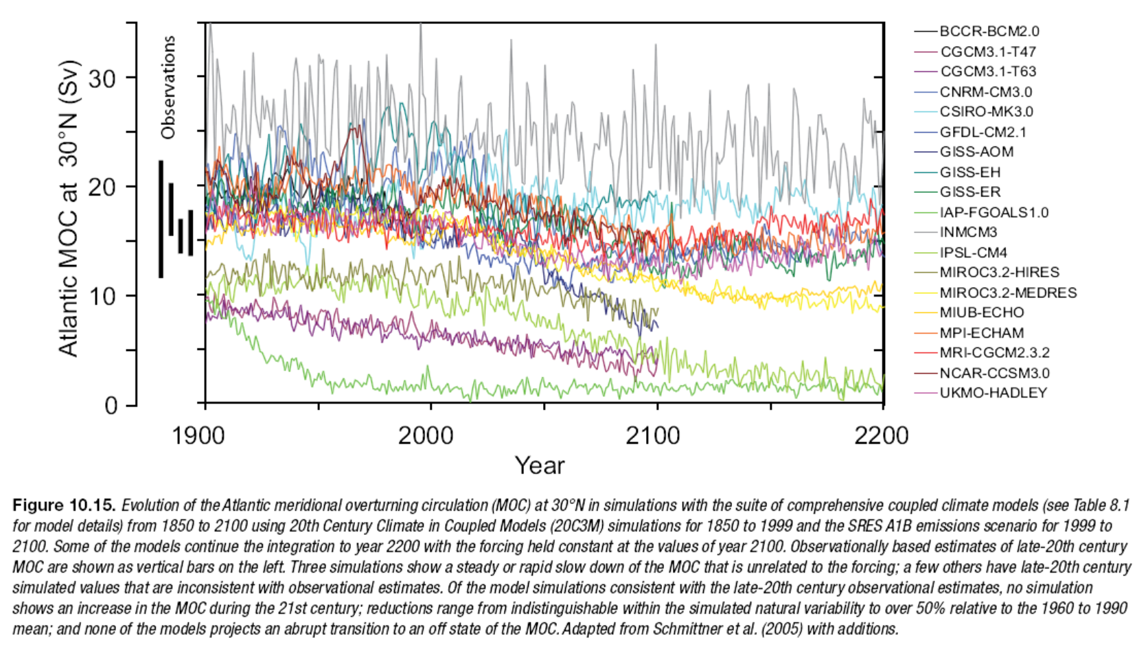
Weakening of the Atlantic THC Under GHG Forcing
Models
IPCC 2007

Slide 47
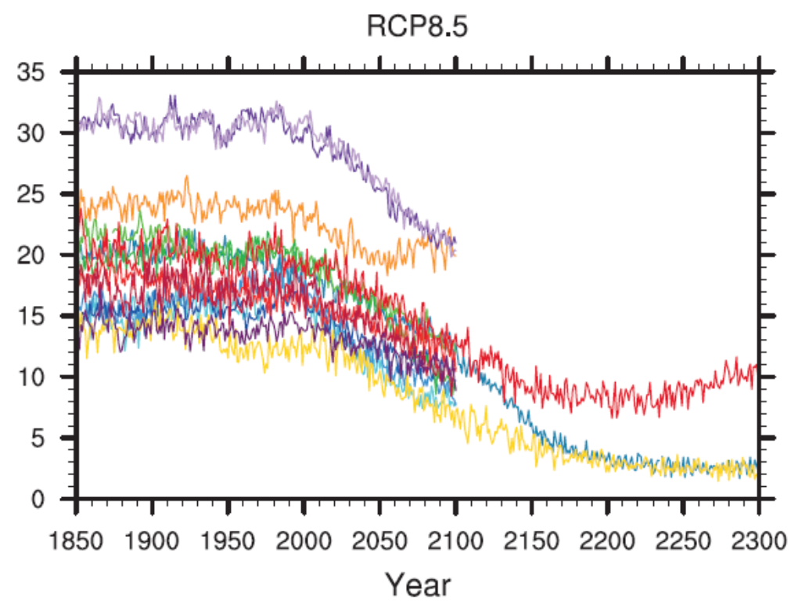
Weakening of the Atlantic THC Under GHG Forcing
Atlantic Meridional Overturning Circulation (AMOC) strength at 30°N (Sv)
IPCC 2013
Notes:
1Sv = 10⁶ m/s

Slide 48
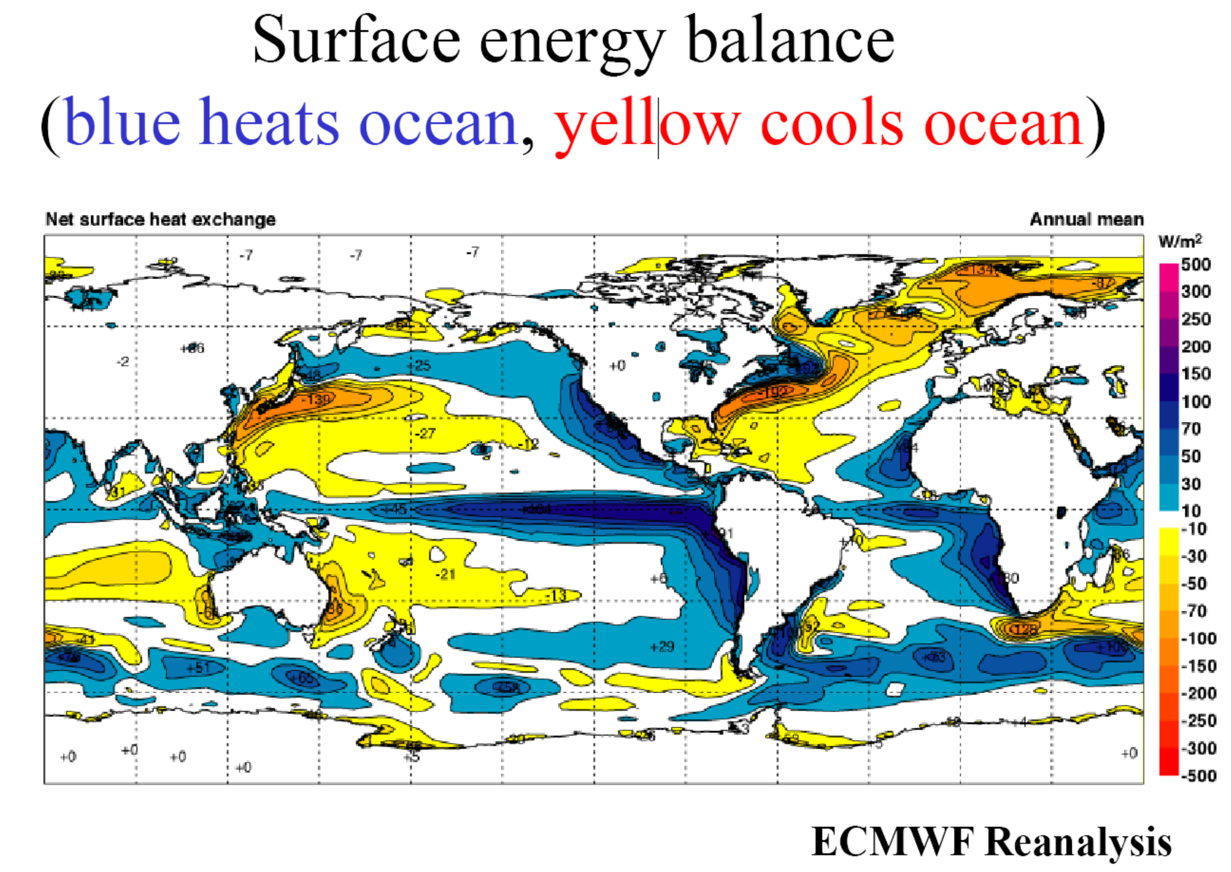
Cold colors: the ocean absorbs net energy, mostly from solar radiation
Warm colors: the ocean heats the atmosphere

Slide 49
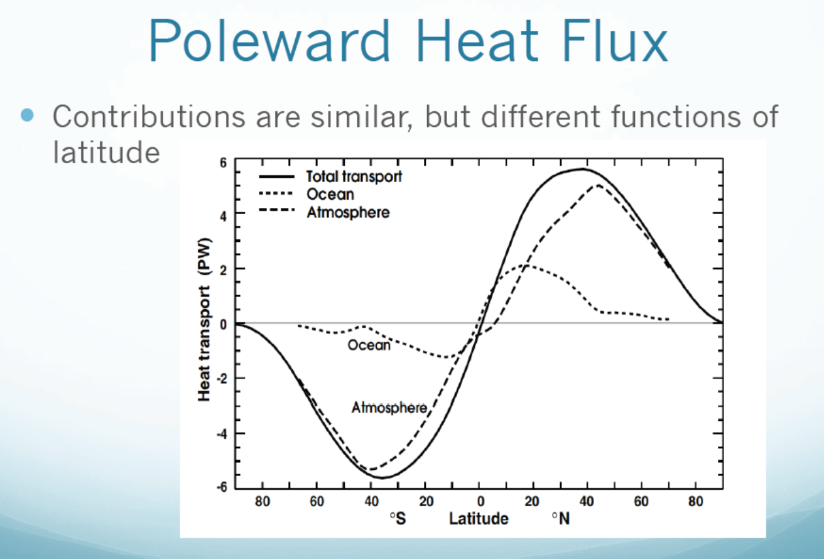
positive=northward
negative=southward
Ocean transport important
mainly at low latitudes
PW (petawatt) = 10¹⁵ W Fasullo and Trenberth (2008)
Notes:
MW (megawatt) = 10⁶ W; GW (Gigawatt)= 10⁹W; PW (petawatt) = 10¹⁵ W

Slide 50
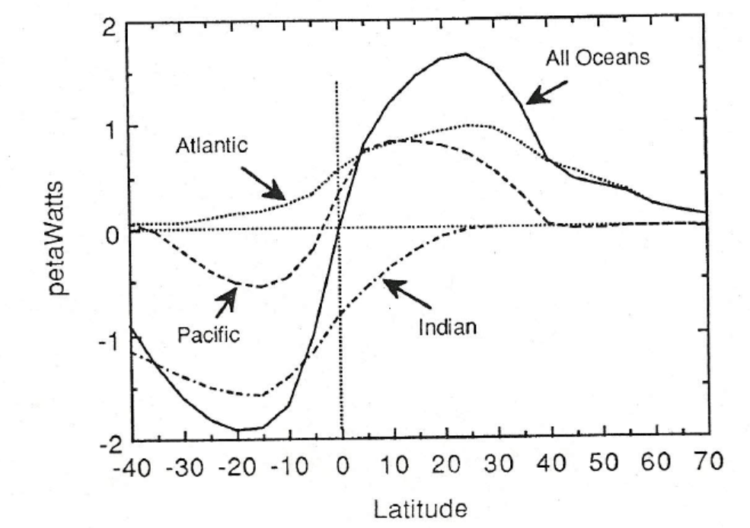
Heat Transport by Individual Oceans:
Northward
Southward
South
North

Slide 51
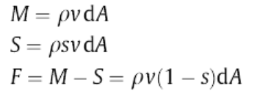
E
Oceanic Freshwater Balance:
P
P - E + R = F_{out} - F_{in}
V, F_{out}
R
Mass flux
R
Salt flux
Freshwater flux F ≈ M,
Since salinity s = 0.030-0.038
dA
V, F_{in}
Need to know P, E, and R (freshwater forcing for the oceans)
For some sections, there are measurements of v

Slide 52
Global-mean Oceanic Freshwater Fluxes
(Schanze et al. 2010)
Data Period: 1987–2006.
P = 12.2 ± 1.2 Sv (1 Sv = 10⁶ m³/s)
E = 13.0 ± 1.3 Sv
R = 1.25 ± 0.1 Sv (~10% of P)
Global imbalance: 0.5 ± 1.8 Sv (contributes to sea-level rise)

Slide 53
Impact of Freshwater Fluxes
E-P largely determines surface salinity (i.e., salt concentration).
Salinity affects sea-water density, which affects ocean circulations.
Ocean currents, determined by wind stress and density gradients, act to remove the salinity (and temperature) gradients within the oceans.
In doing so, freshwater is also transported to balance the mis-match between E and P over different regions, e.g., from the high-latitude to the evaporative subtropics, thus maintaining the T, S, and density gradients that are consistent with the ocean circulation.

Slide 54

Link to Salinity Gradients
Net F_{ocean}≈V_{northward}*(S_{north}- S_{south})
P > E
E > P
Horizontal transport
Net F_{ocean}≈V_{n}*(S_{upper}- S_{lower})
Vertical transport
Talley 2008

Slide 55

E – P Based on Surface E and P Estimates
Schanze et al. (2010) based on GPCP P and OAFlux E

Slide 56

Annual Continental Freshwater Discharge (10³ m³/s)
Dai and Trenberth (2002)

Slide 57

Oceanic Northward Freshwater Transport
Dai & Trenberth (2003)
Notes:
Must be balanced by opposite atmospheric vapor transport.

Slide 58


Oceanic Freshwater Flux (Sv)
in Sv
Schanze et al. 2010
in 0.1Sv

Slide 59

Temporal Variations in Global Oceanic P, E, R
Schanze et al. 2010

Slide 60
Key points of Today’s Lecture
Ocean Circulation and Climate:
⁻ Seawater properties:
Temperature ≈-2 to 30ºC, salinity ≈30 to 38psu, mean density ≈1035kg/m³, density increases with depth and latitude as T decreases; potential density anomaly (σ_{t}, σ_{θ}, σ₁) is often used.
- Upper (<1 km) Ocean Circulation:
Mainly driven by winds, surface current is 45º to the right (left) when your back is against the wind on the N.H. (S.H.). The Ekman layer (∼800m) -averaged flow (called Ekman transport) is 90º to the right (left) of the wind direction on the N.H. (S.H.).
Surface currents have a speed ranging from ∼0.4-0.5 m/s for the equatorial and western boundary currents to less than 5 cm/s in subtropical oceans.
Major surface currents include: equatorial currents and counter currents, western and eastern boundary currents, subtropical gyres, and the Antarctic Circumpolar Current (AACC)
- Deep Ocean Circulation:
Driven by density gradients caused by T & S gradients, called thermohaline circulation (THC)
Dominated by the flow of the major water masses, such as NADW, AABW, AAIW.
Currents below ∼100m depth move very slowly, have a time scale of 500-3500yrs.
Atlantic THC transports heat from the low latitudes to the mid-high latitudes, leading to a mild climate in Europe.
Models suggest that the THC may weaken as CO2 increases, which could affect global climate.
Oceanic transport of heat is important mainly in the low-latitudes (35ºS-40ºN), except in the
Atlantic Ocean.
Freshwater is transported into the subtropics from both low and high latitudes to maintain the high E rate there.

Slide 61
After class work:
- Reading Assignments: Chapter 7 of Hartmann GPC
- Review my ppt slides
- Think of following questions: (NOT a homework assignment).
Answer question #1 on p. 202 of GPC, explain how you derive your answer. (20%)
Briefly describe the major surface currents in world’s oceans (see slides 23-26). (30%)
In order for sea-ice to flow southwest-ward along the eastern coast of Greenland, what kind of wind (i.e., from which direction) is needed? Explain why. (hint: sea-ice follows surface currents) (20%)
Briefly describe the major water masses and their associated movements within the Atlantic Ocean (see slides 39-40, and 43). (30%)

Slide 62
Next Lecture:
Water Vapor, Clouds and Aerosols

