Slide 1
Key points of Last Lecture
Ocean Circulation and Climate:
⁻ Seawater properties:
Temperature ≈-2 to 30ºC, salinity ≈30 to 38psu, mean density ≈1035kg/m³, density increases with depth and latitude as T decreases, anomaly density (σ_{t}) and potential anomaly density (σ_{θ}, σ₁) are often used.
- Upper Ocean Circulation (depth<1 km) :
Mainly driven by winds, surface current is 45º to the right (left) when your back is against the wind on the N.H. (S.H.). The Ekman layer (∼800m)-averaged flow (called Ekman transport) is 90º to the right (left) of the wind direction on the N.H. (S.H.).
Surface currents have a speed ranging from ∼0.4-0.5 m/s for the equatorial and western boundary currents to less 5 cm/s in subtropical oceans.
Major surface currents include: equatorial currents and counter currents, western and eastern boundary currents, subtropical gyres, and the Antarctic Circumpolar Current (AACC)
- Deep Ocean Circulation:
Driven by density gradients caused by T & S gradients, called thermohaline circulation (THC)
Dominated by the flow of the major water masses, such as NADW, AABW, AAIW.
Currents below ∼100m depth move very slowly, have a time scale of 500-3500yrs.
Atlantic THC transports heat from the low latitudes to the mid-high latitudes, leading to a mild climate in Europe.
Models suggest that the THC may weaken as CO2 increases, which could affect global climate.
Oceanic transport of heat is important mainly in the low-latitudes (35ºS-40ºN), except in the
Atlantic Ocean.
Freshwater is transported into the subtropics from both low and high latitudes to maintain the high E rate there.

Slide 2
A ATM551, Lecture #11
Water Vapor, Clouds, and Aerosols
Reading Assignment:
Chapter 10 of Hartmann GPC
And
Held, I. and B. Soden, 2000: Water vapor feedback and global warming. Annu. Rev. Energy Environ. 25:441–75.
Wang, J. A. Dai, C. Mears, and L. Zhang, 2016: Global water vapor trend from 1988-2011 and its diurnal asymmetry based on GPS, radiosonde, and microwave satellite measurements. J. Climate, 29, 5205-5222. DOI: http://dx.doi.org/10.1175/JCLI-D-15-0485.1.

Slide 3
Outline of Today’s Lecture
Water Vapor:
  Basic humidity variables,
  Water vapor measurements,
  q and RH distributions
  Water vapor feedback
  Water Vapor changes
Clouds:
  Cloud classification/types
  Cloud distribution
  Cloud radiative forcing
  Cloud response to GHG forcing
Aerosols: May not have time to cover all
  Aerosols’ effects on clouds and climate
  Aerosol production rates
  20th century aerosol forcing

Slide 4
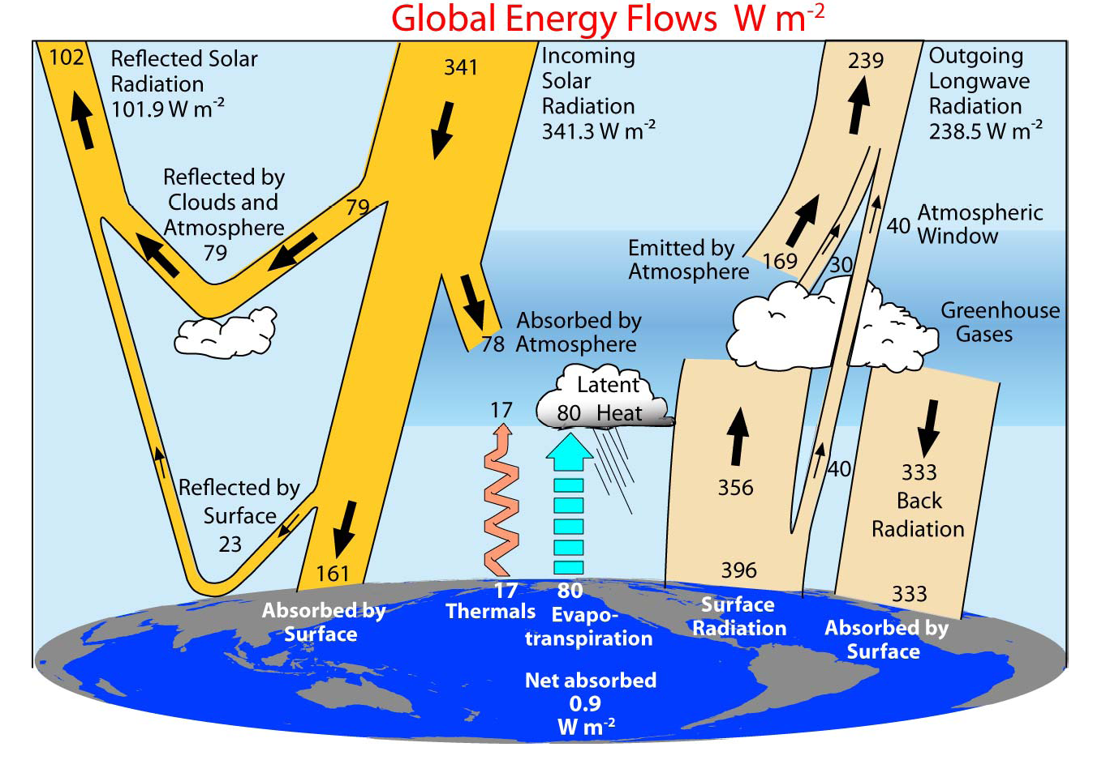
Trenberth et al. (2009, BAMS)
Water vapor & clouds strongly affects LW radiation
Clouds and aerosols also affect SW radiation.

Slide 5
Role of Water Vapor
Allows evapotranspiration to cool the surface and add water and (latent) energy into the atmosphere at the same time
Allows water and latent energy to be moved around within the atmosphere by winds, contributing to spatial and temporal variations in clouds and precipitation
Strongly absorbs and emits infrared (IR) or longwave radiation, resulting in the largest greenhouse warming of the atmosphere among all the GHGs
Provides the water source for forming clouds and precipitation
Provides the largest positive feedback under GHG-induced global warming, as water vapor content increases with air temperature
Plays an important role in atmospheric chemistry, including that in the ozone (O₃) layer

Slide 6
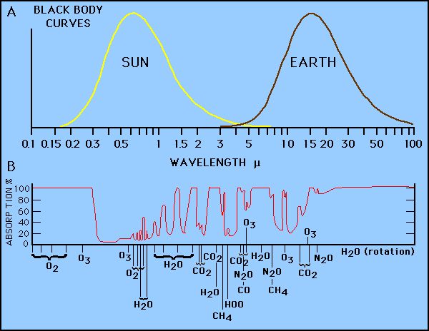
Atmospheric Radiative Absorption Bands
(10⁻⁶m)
Notes:
Mu = micrometer = E-6m nanometer (nm)=E-9m

Slide 7
Water Vapor Variables
Water vapor mixing ratio r = water vapor mass/ dry air mass
Saturated vapor pressure (e_{s}): equilibrium vapor pressure over a water surface. e_{s} = 6.112 mb at ºC. e_{s} increases exponentially with air temperature T (ºC): e_{s} (mb) = 6.112 exp [17.67T/(T + 243.5)] (Bolton 1980)
Vapor pressure (e) is the partial pressure exerted by water vapor in the air. It is a function of e_{s} and RH: e = e_{s} RH/100 = r P/(0.622+r).
Relative humidity RH(%)=100*e/e_{s}=100*r/r_{s} : represents the level of water vapor saturation in the air
Specific humidity q = water vapor mass (g) / total air mass (kg) in a given volume; q=r/(1+r), r=q/(1-q)=0.622e/(P-e), q=0.622e/(P-0.378e),
where P=air pressure
Absolute humidity AH = water mass per unit air (g/m³): 0-30g/m³
Precipitable water (PW) is the column-integrated total water vapor content, often expressed in mm depth over a unit surface
Dew point depression (DPD) is the temperature difference between air temperature and the dew point temperature
RH, q, and PW are the most commonly used variables.

Slide 8
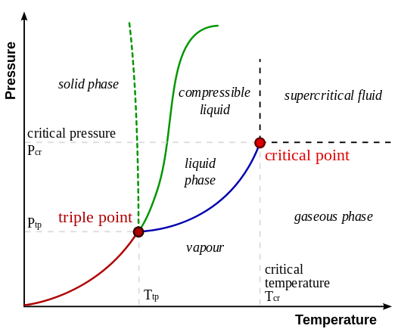

The Clausius-Clapeyron Relation
The Clausius–Clapeyron relation, named after Rudolf Clausius and Benoît Paul Émile Clapeyron, is a way of characterizing a discontinuous phase transition between two phases of matter of a single constituent. On a pressure–temperature (P–T) diagram, the line separating the two phases is known as the coexistence curve. The Clausius–Clapeyron relation gives the slope of the tangents to this curve. The exact equation for e_{s}(T) is determined in labs and may vary slightly.
The C-C Eq. for water vapor:
e_{s} (hPa) = 6.112 exp [ 17.67T/(T + 243.5)]
T is in ºC. (Bolton 1980).

Slide 9
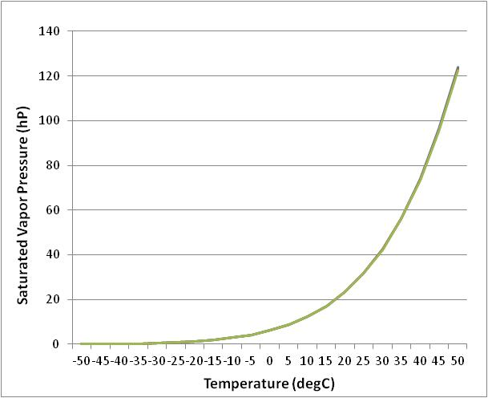
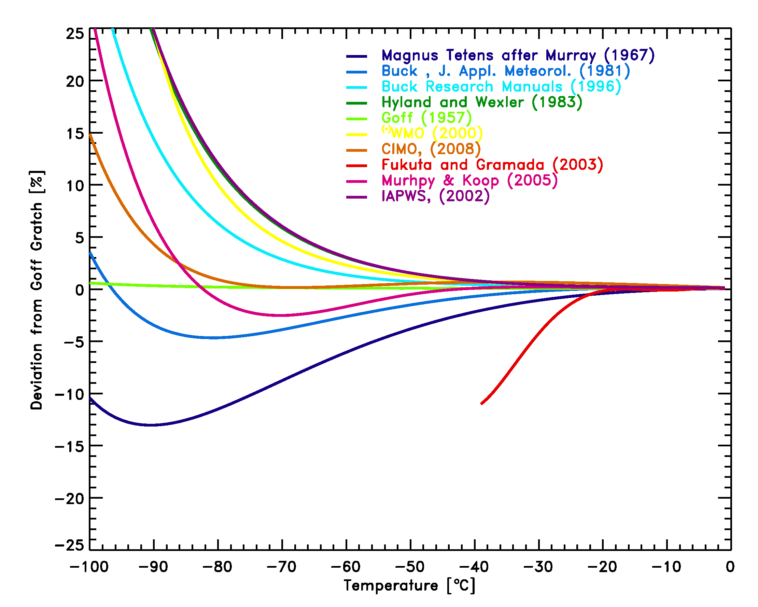
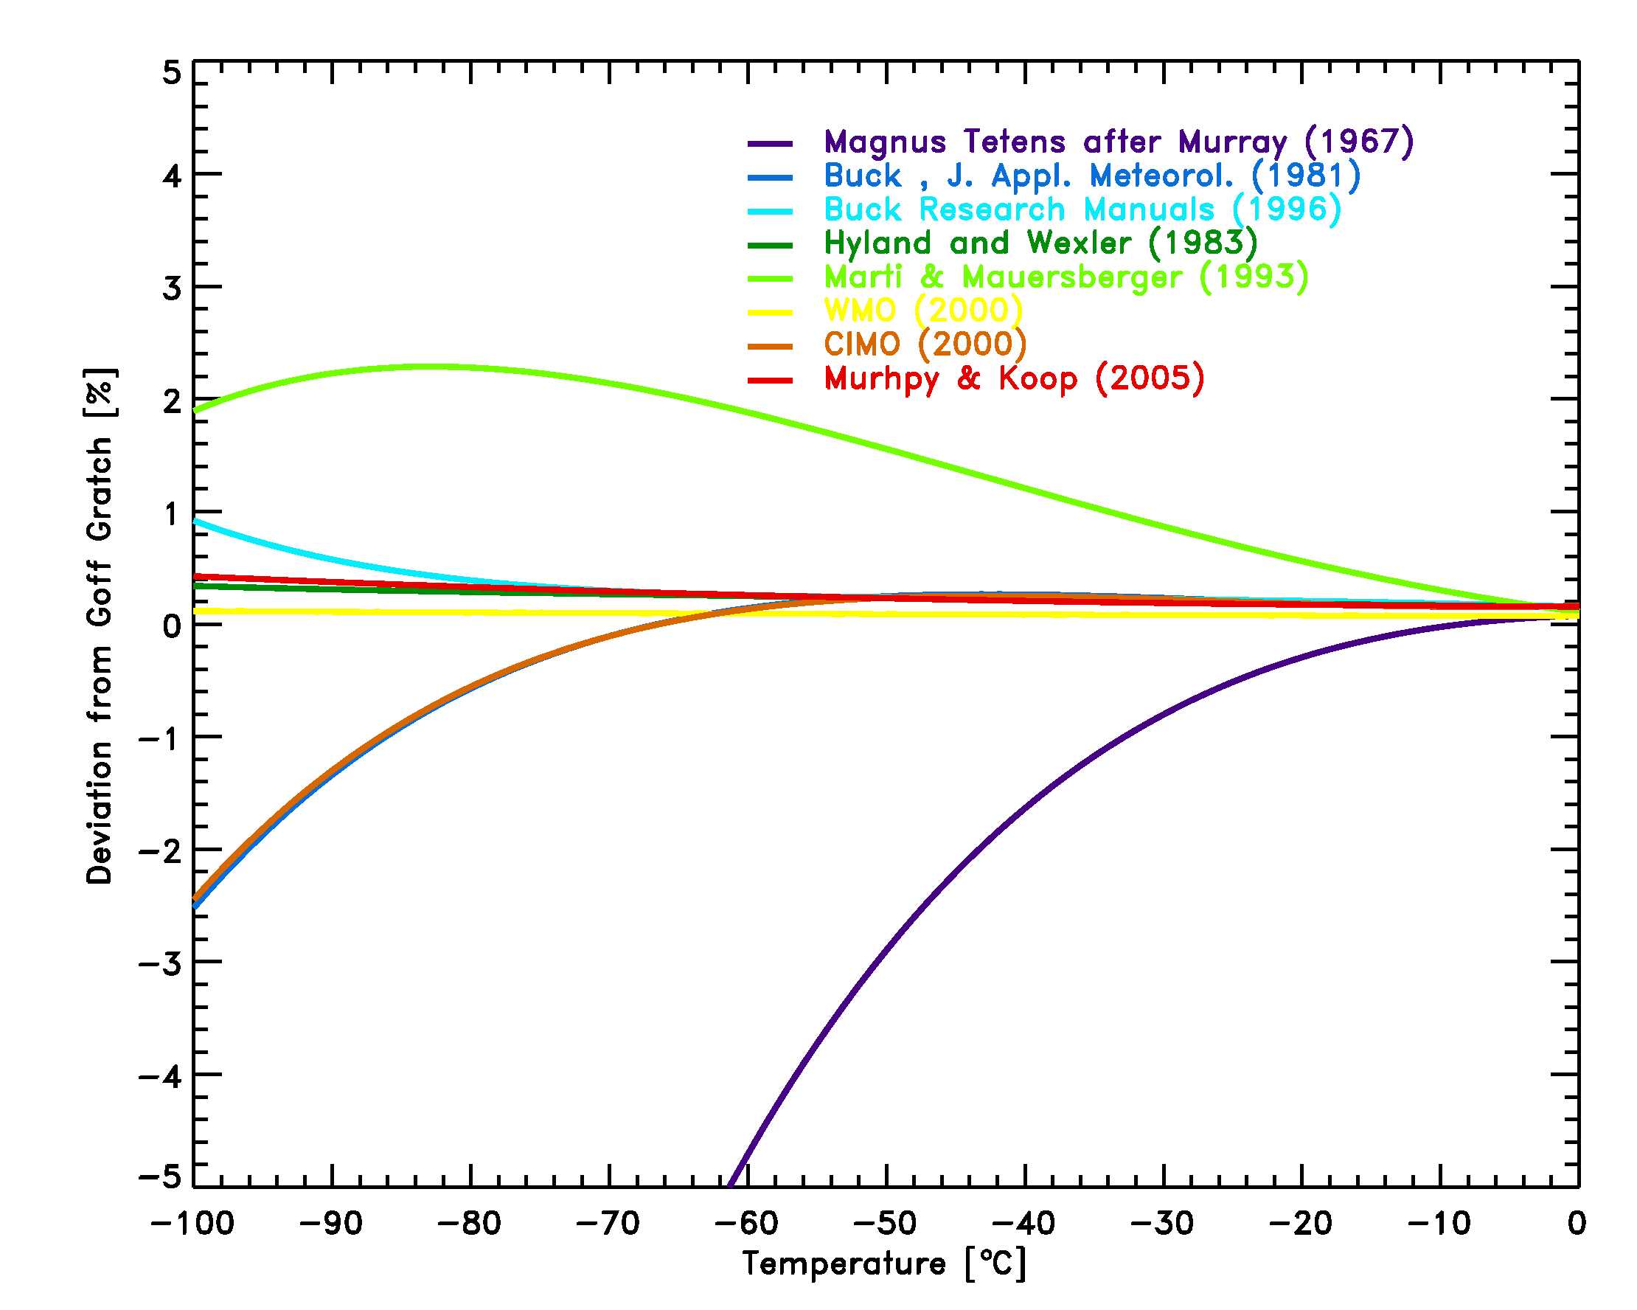
Saturation Vapor Pressure Equations:
There are many similar equations for estimating e_{s} over water and over ice:
Suggest to use WMO (2008) recommended Equations (t in ºC and e in hPa):
e_{w} = 6.112 e^{(17.62 t/(243.12 + t))} saturation vapor pressure over liquid water
e_{i} = 6.112 e(22.46 t/(272.62 + t)) saturation vapor pressure over solid ice
See http://faculty.eas.ualberta.ca/jdwilson/EAS372_13/Vomel_CIRES_satvpformulae.html
e_{w} increases with T
Differences for e_{w} Eqs.
Differences for e_{i} Eqs.

Slide 10
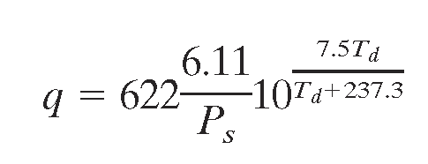
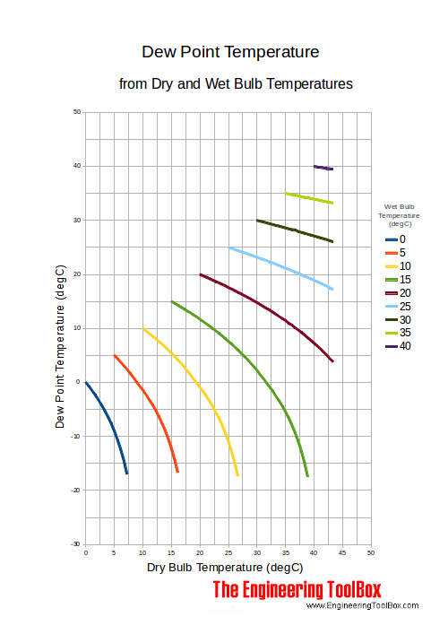
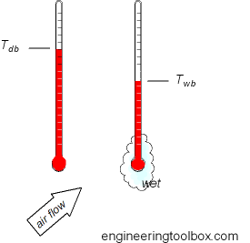
Water Vapor Measurements
Measurements of near-surface humidity at weather stations: Dry and wet bulb temperatures are measured and used to derive the dew point temperature Td (T at which the air becomes saturated).
q: g/kg
Ps: mb
Td: ºC

Slide 11
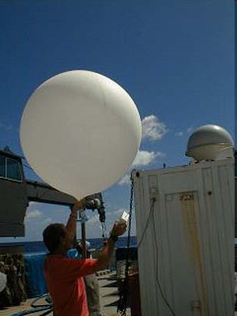
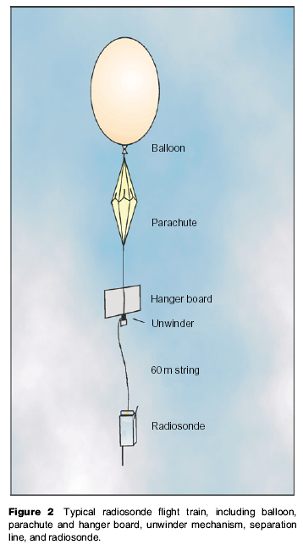
Measurements of upper-air humidity by radiosondes: various types of hygrometers were used to measure RH, from which DPD was derived and archived. Less reliable above ∼200mb, large biases and discontinuities
Notes:
The title of my talk is diurnal cycle in observed and model simulated precipitation.

Slide 12
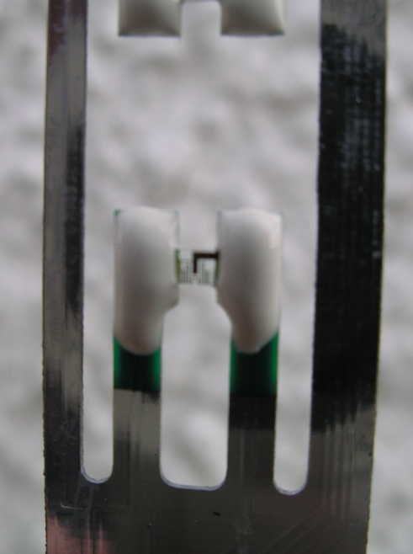
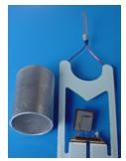
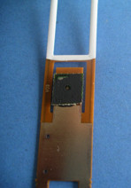
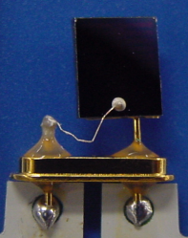
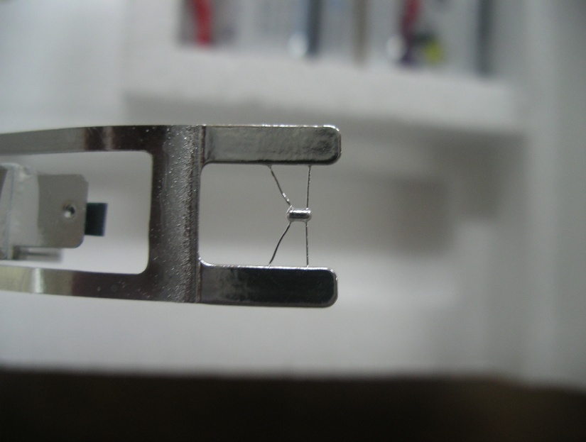
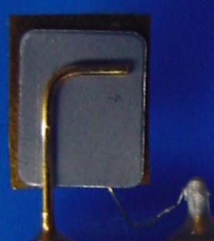
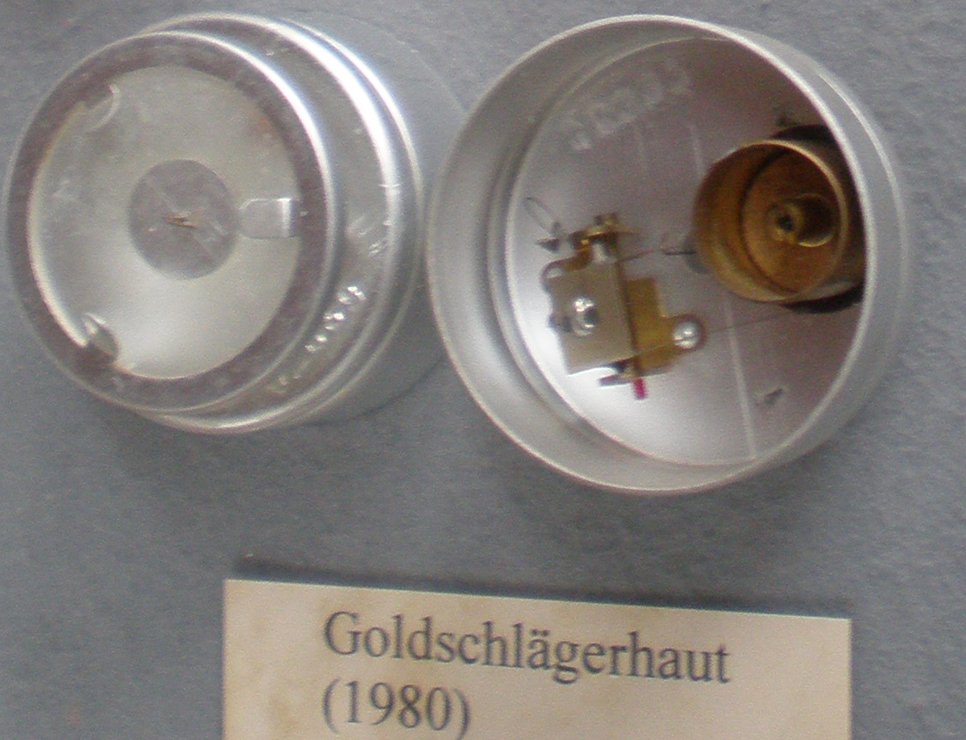
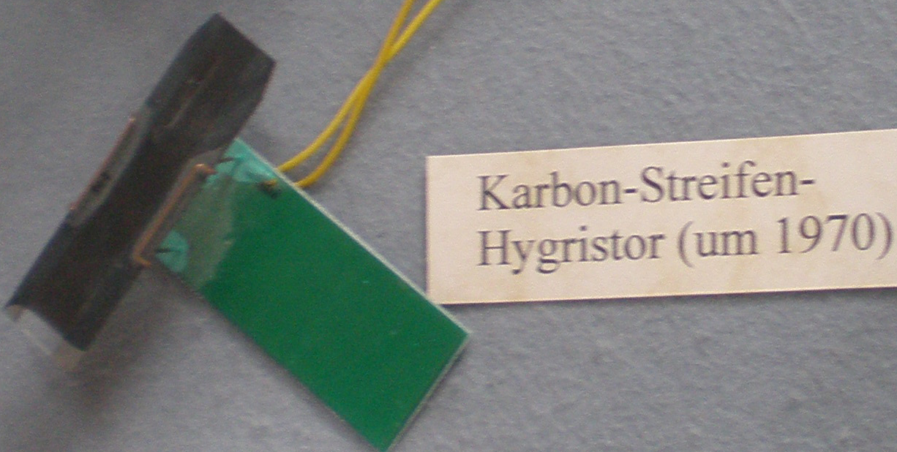
body of the radiosondes.
Humidity sensors:
Thin-film capacitor
Carbon hygristor
Goldbeater’s skin
Dew/frost-point hygrometer
Tunable diode laser (TDL)
Carbon hygristor
Vaisala Humicap
Goldbeater’s skin
Modem capacitive
Meisei capacitive
Graw capacitive
(4) Modem (5) Graw
Notes:
Thin-film: the variation of the dielectric constant of a polymer film with ambient water vapor pressure
CH: made by suspending finely divided carbon particles in a hygroscopic film. RH changes lead to the dimension change of the film (resistance).
Golderbeater’s skin: the length of the Goldbeater’s skin (beef peritoneum) changes with RH.

Slide 13
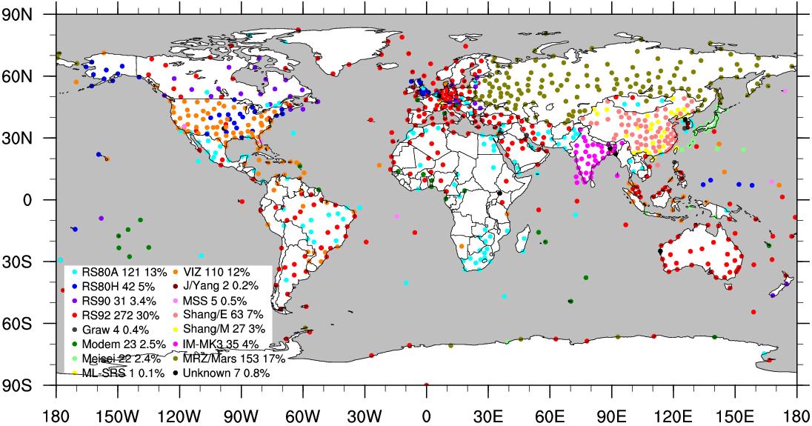
Global radiosonde network
(WMO report, July 2007)
Vaisala: 51% (35% in 1993)
VIZ (Sippican): 9%
~917 stations
~15 types
00 and 12 UTC at 2/3 stations
Notes:
Next let’s look at global radiosonde network.
Here is a map of global radiosonde stations colored by radiosonde types. Total ~900 stations …
The points I want to make here are that globally 51% of stations use Vaisala radiosondes which carry Humicap humidity sensor; and about 14% stations use radiosondes with the CH or similar humidity sensor.

Slide 14
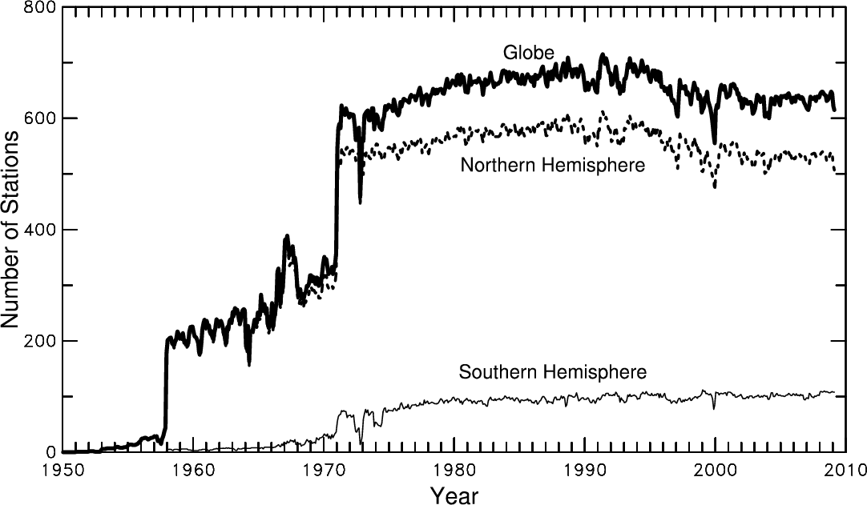
Number of Radiosonde Stations
Notes:
Based on IGRA data set

Slide 15
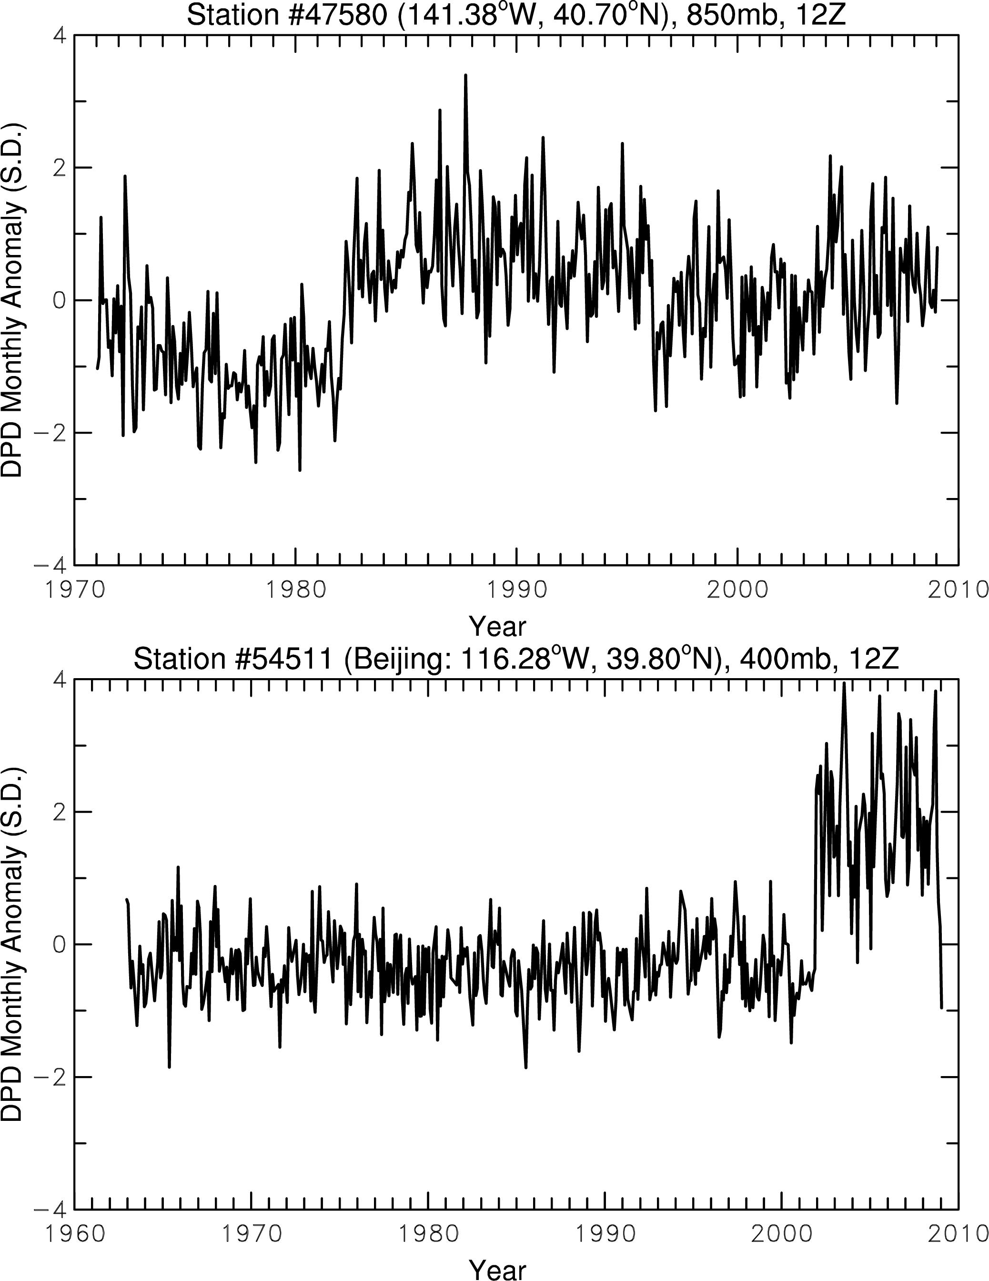
Examples of discontinuities in DPD time series
850mb DPD at a Japanese station
DPD = Dew Point Depression
RSII-56
RSII-80
MEIR91
These radiosonde data
have been used in NCEP,
ERA and other
reanalyses and climate
change studies without
adjustments!
400mb DPD, Beijing
Goldbeater Skin
Carbon
Hygristor

Slide 16
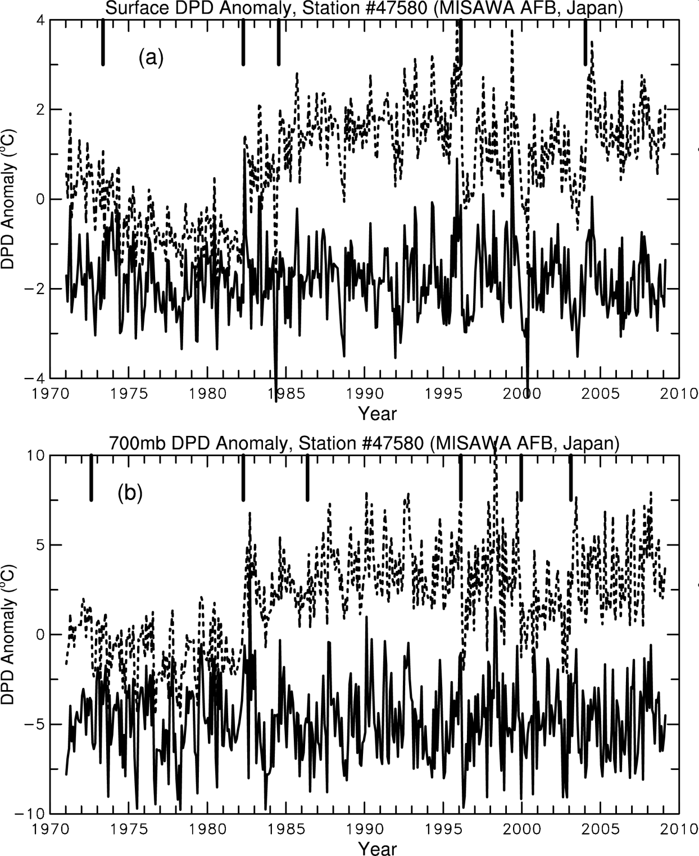
Monthly DPD Anomaly Series
Surface
Raw data
Homogenized
700mb
Raw data
Homogenized
Dai et al. (2011, J. Climate)

Slide 17
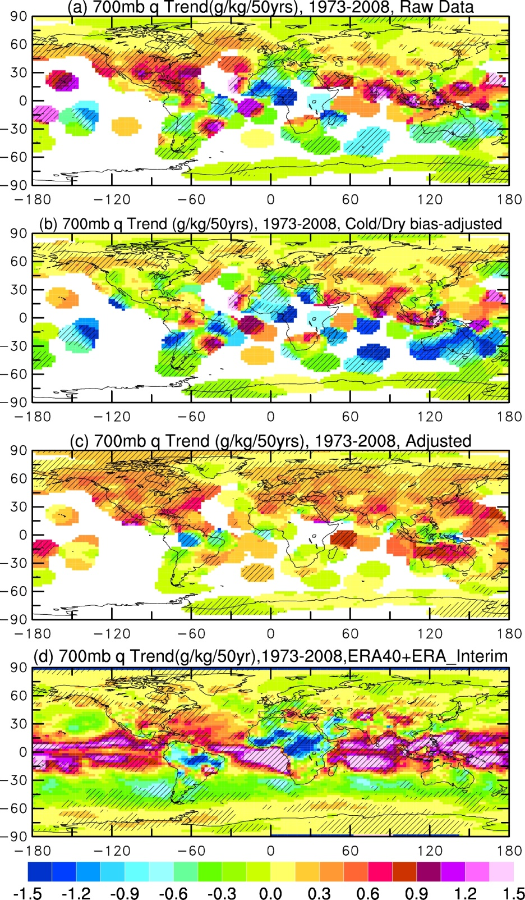
700mb q Trend
1973-2008
Raw data
Sampling
corrected
Homogenized
ERA40+Interim
Dai et al. (2011, J. Climate)

Slide 18
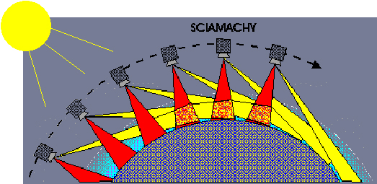
Other Types of Measurements
Satellite remote sensing: a spectrometer onboard a satellite can measure the amount of radiation from the atmosphere absorbed by H₂O, from which the water vapor content can be derived. Started from the 1980s. Most reliable since ~2000.
Advantages: near-global coverage
Disadvantages: poor vertical resolution, coarse horizontal resolution, contamination by clouds, etc.

Slide 19
Other Types of Measurements
GPS measurements: radio signals from GPS and other navigational satellites are delayed by atmospheric water vapor. This time delay is a function of PW and is used to derive PW. Only available since ∼1997 at a few hundred sites.
Wang et al. 2007, JGR

Slide 20
Surface Specific Humidity Distribution
Decreases with lat.
Zonal variations too
Controls:
Surface Tair
Surface RH
Unit: g/kg
From surface obs.
Dai 2006, JClim

Slide 21
Surface Relative Humidity Distribution
Fairly constant over
oceans (78-82%)
Lower over deserts
(30-50%)
Controls:
Not well-understood
Local E
Vertical mixing
Wind direction
Why 80%, not 60 or
90% over oceans?
Dai 2006, JClim

Slide 22
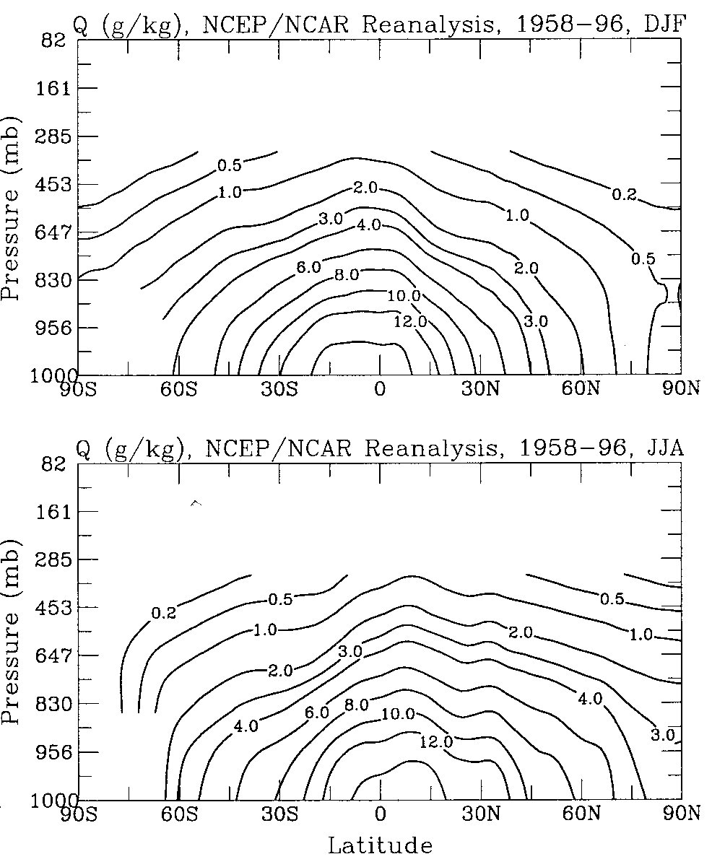
Atmospheric Specific Humidity Distribution
q decreases with height as T
and RH decreases with height
q decreases with latitude
q is conserved in air mass
without precipitation, so q is
the same during subsidence
in the subtropics .
Thus, upper tropospheric
and stratrospheric q
is controlled by the q at
the last saturation.
Dai 2001, JClim

Slide 23
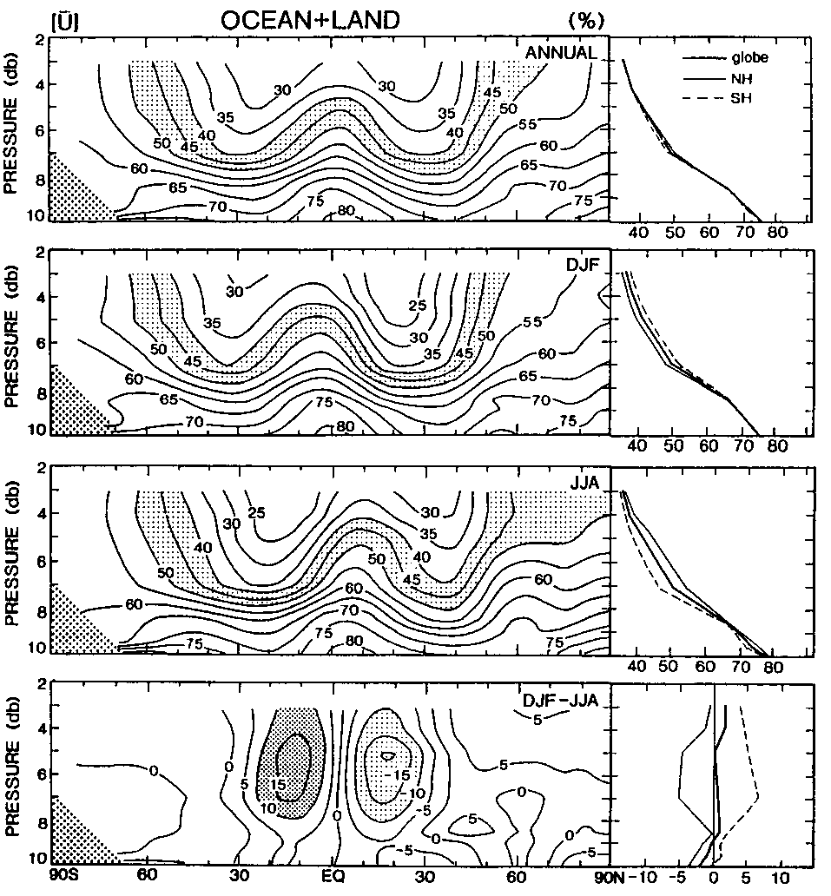
Atmospheric Relative Humidity Distribution
RH decreases with height
(why?) from ~76% at sfc
to 30-50% at 500mb.
RH is lower in the subtropics
but higher in the tropics
(why?)
RH is well-below saturation in
the upper troposphere
Tropical deep convection
transports surface moisture
to the upper levels
Upper-level q (and RH) is
critical for greenhouse effect
but the controls of this RH
are not well understood
Peixoto and Oort (1996)

Slide 24
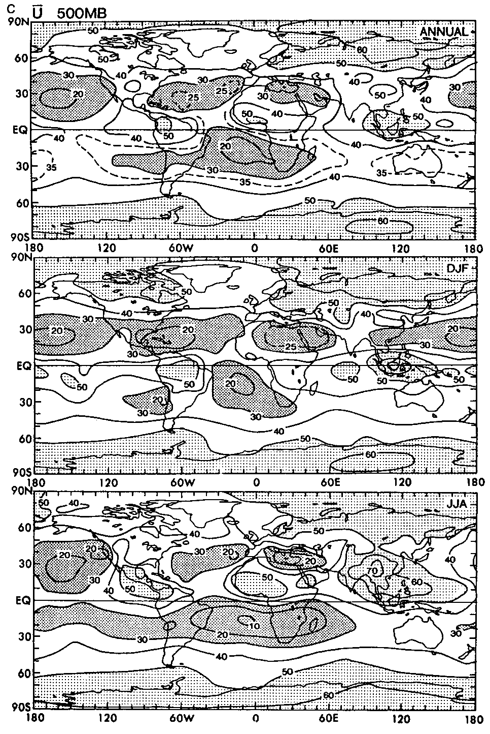
500mb Relative Humidity Distribution
ANN
Low RH over the
subtropics and
high RH at high-lat.
DJF
JJA
Peixoto and Oort (1996)

Slide 25
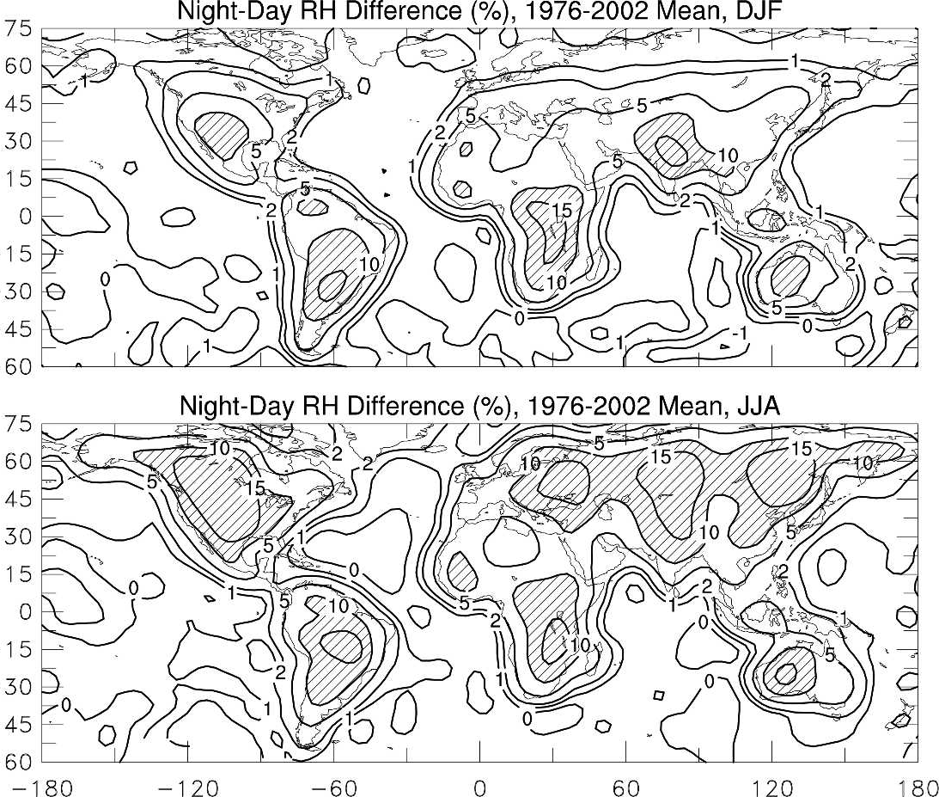
Night─Day Near-surface RH Difference (why?)
DJF
JJA
Dai 2006
Notes:
Mainly due T diurnal changes

Slide 26
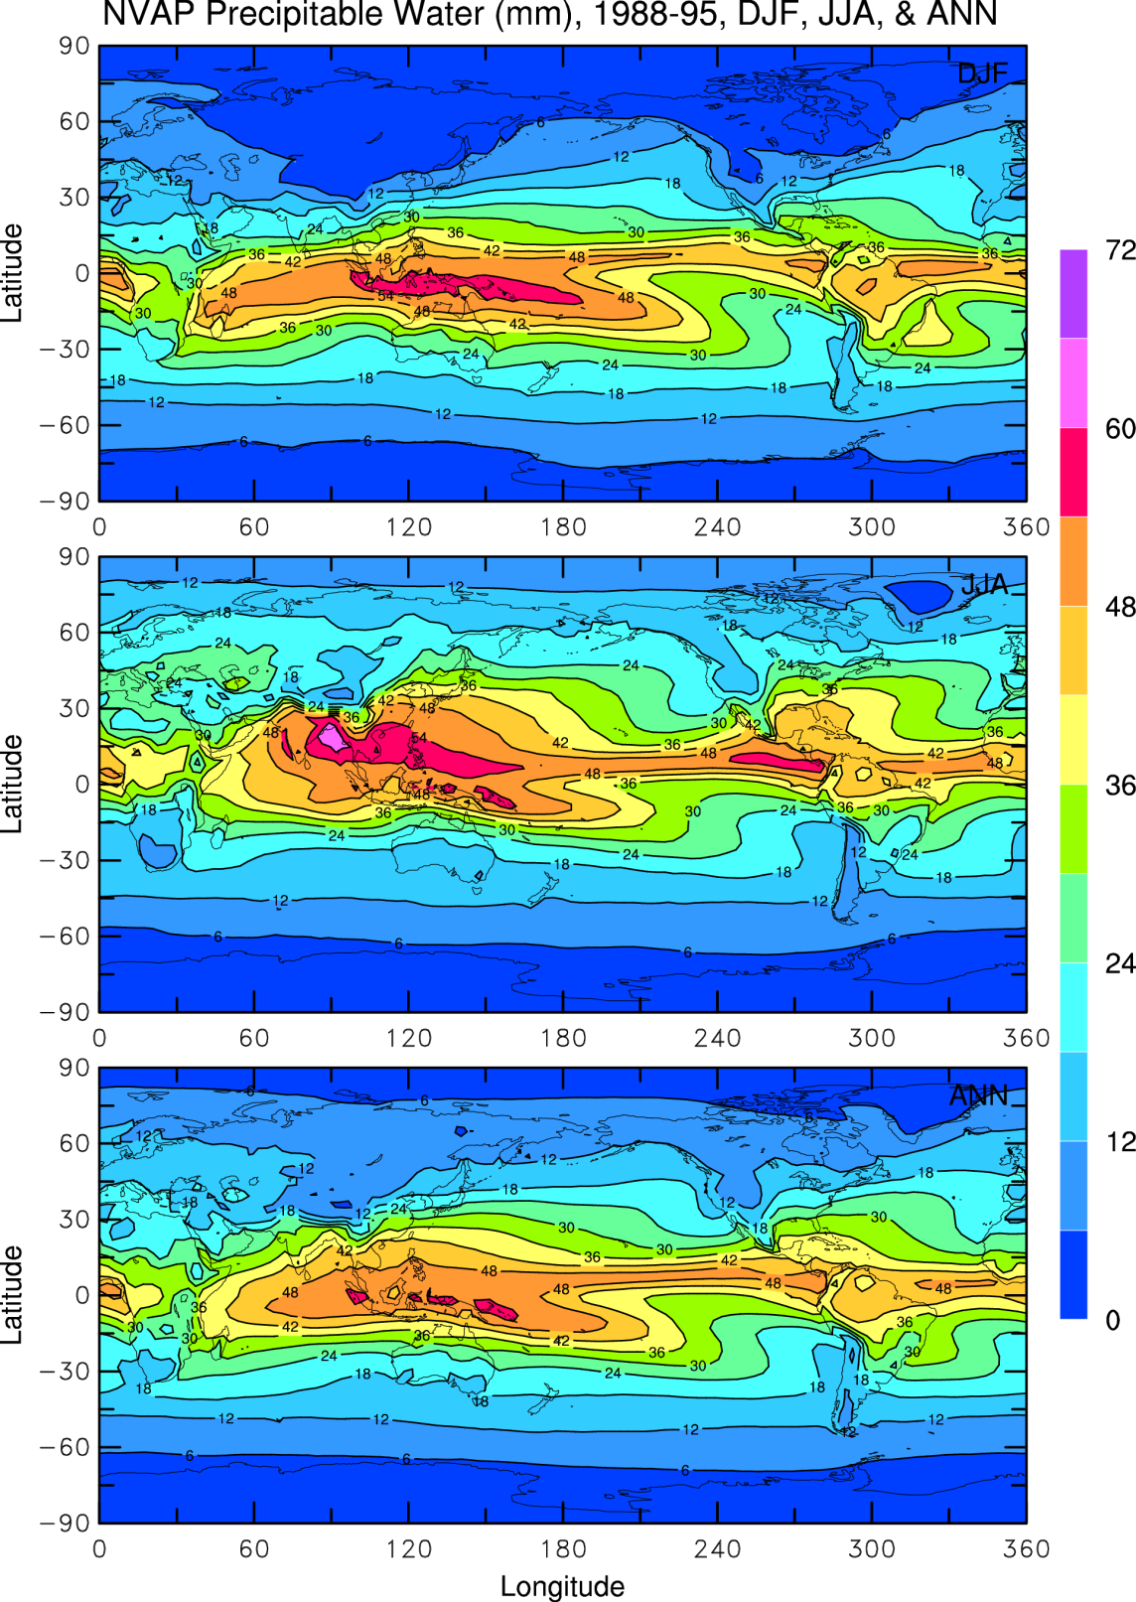
Precipitable Water:
total water vapor in a column.
Follows surface T patterns
Maximum PW ~60mm
DJF
JJA
ANN
Notes:
NVAP=NASA Water Vapor Project (http://eosweb.larc.nasa.gov/GUIDE/campaign_documents/nvap_project.html)

Slide 27
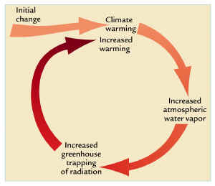
Water Vapor Feedback
Water vapor feedback is a positive feedback that amplifies the
initial change in surface air temperature. It results from the
strong dependence of the atmospheric water vapor content on
air temperature.
+

Slide 28
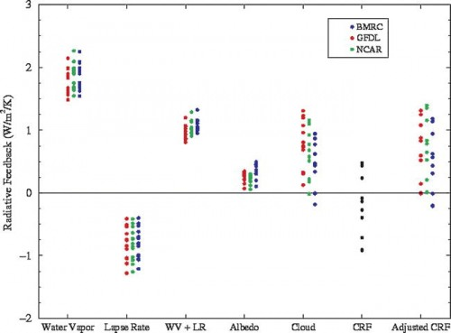
Water Vapor Feedback
The strongest positive feedback
It roughly doubles the initial warming
It is coupled to cloud, lapse rate and other feedbacks
Comes mostly from the mid-upper troposphere as the LW absorption
in the lower troposphere is near saturation
It results mainly from the increase of water vapor with air temperature
Notes:
2xCO2 radiative forcing = 3.7W/m2

Slide 29
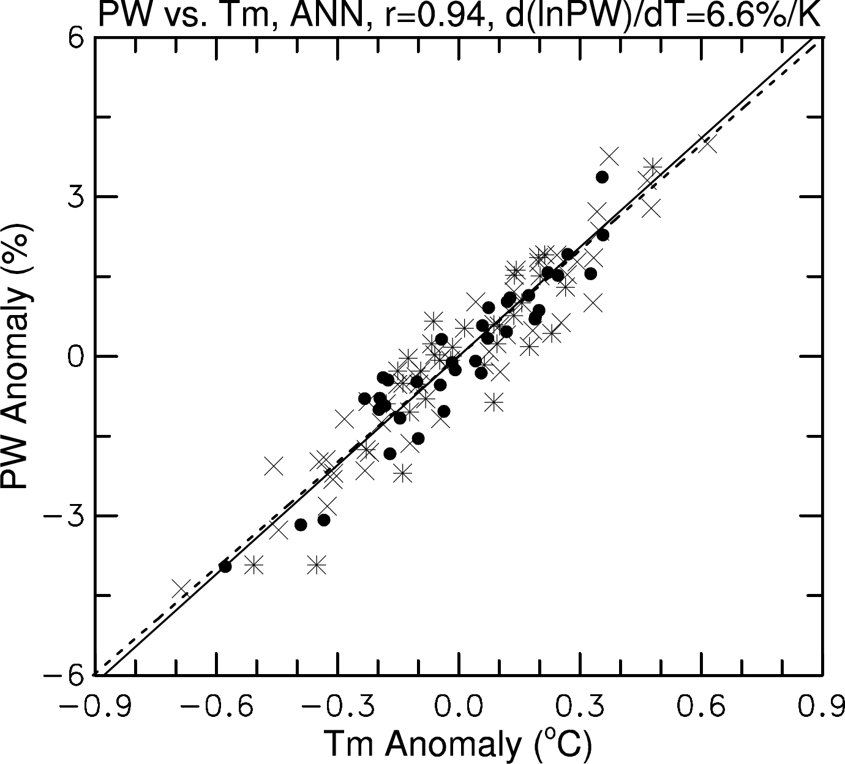
Atmospheric dPW vs dT over the Globe: 1973-2008, based on radiosonde data
Notes:
Dashed line = CC relationship. Radiosonde based estimates. Tm=water-vapor weighted tropospheric T.

Slide 30
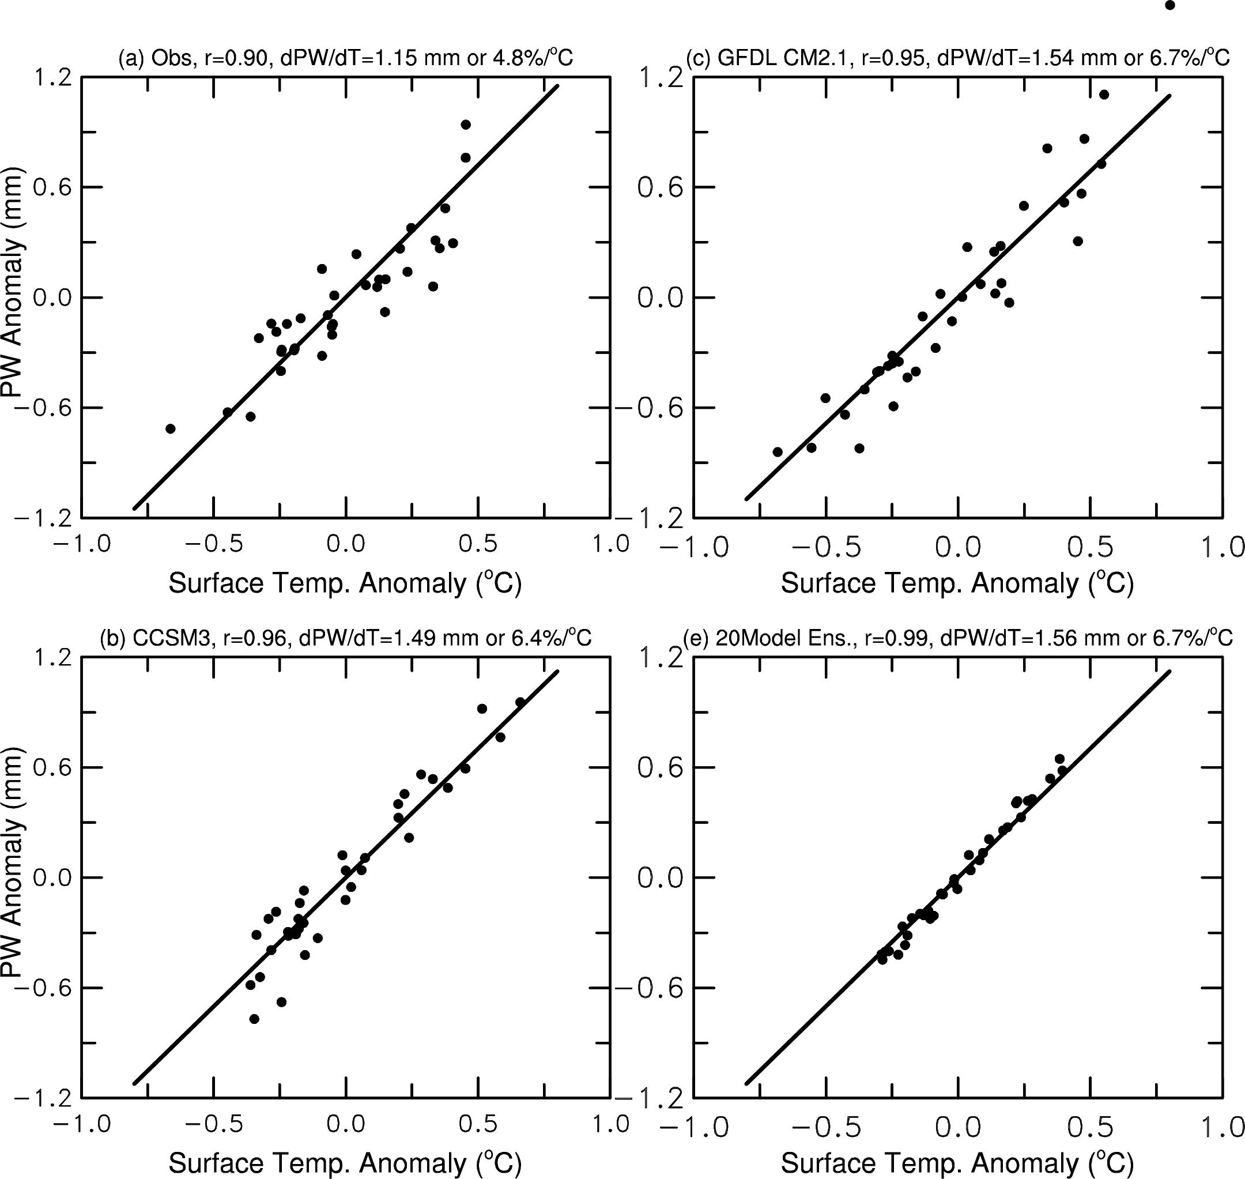

Global-mean PW vs. Tas
OBS
r=0.90
b=4.8%/ ºC
GFDL CM2.1
r=0.95
b=6.7%/ ºC
6.0%/ ºC
NCAR CCSM3
r=0.96
b=6.4%/ ºC
20-model Ens.
r=0.99
b=6.7%/ ºC
Notes:
Solid line represents 6% PW change per deg.C

Slide 31
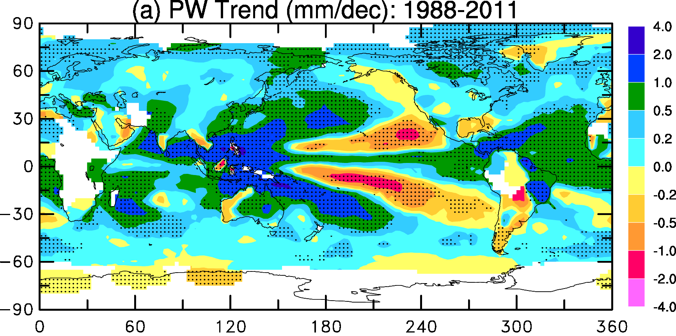
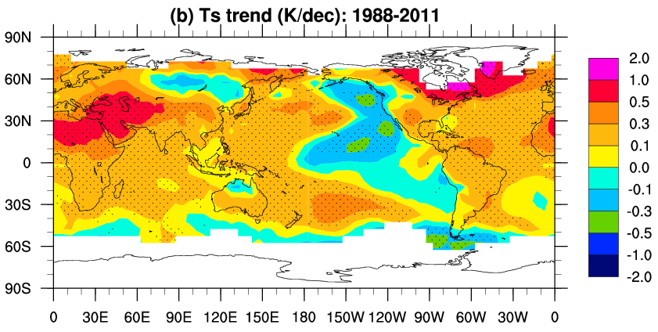
Global maps of PW trends from1988-2011 estimated from radiosonde observations over land and MWR satellite data over oceans. (Wang et al. 2016)

Slide 32
IPCC AR4 Model Predicted Changes: 2080-99 minus 1980-99
Precipitable Water
30
9% K⁻¹
Global Change (%)
20
10
2
3
4
Global Temp. Change (K)
Sun et al. (2007, J. Climate)
Notes:
Each letter (a total of 17) represents a AR4 model, and blue for SERES B1 and red for SERES A2 scenarios.

Slide 33
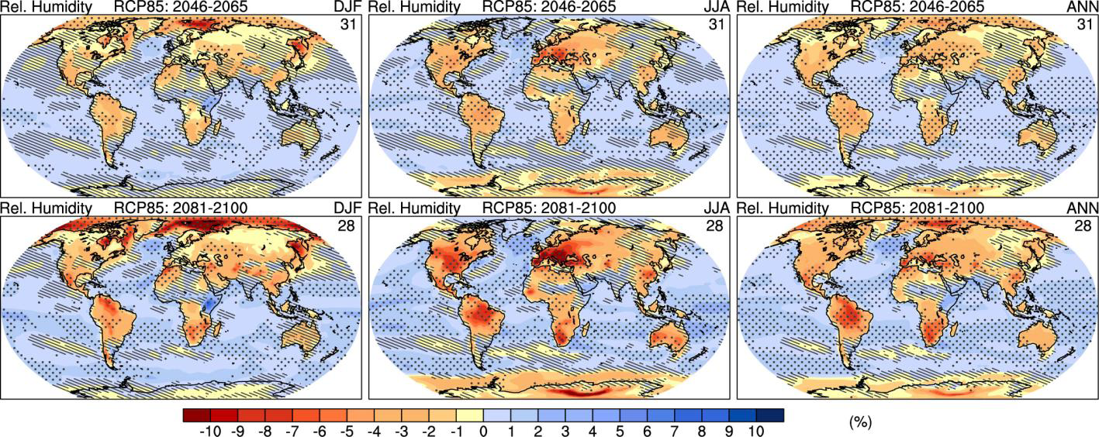
CMIP5 Model-simulated near-surface RH Change
2081-2100 minus 1986-2005
RH increases over oceans but decreases over land
Notes:
Hatching indicates regions where the multi model mean is less than one standard deviation of
internal variability. Stippling indicates regions where the multi model mean is greater than two standard deviations of
internal variability and where 90% of models agree on the sign of change (see Box 12.1). The number of CMIP5
models used is indicated in the upper right corner of each panel.

Slide 34
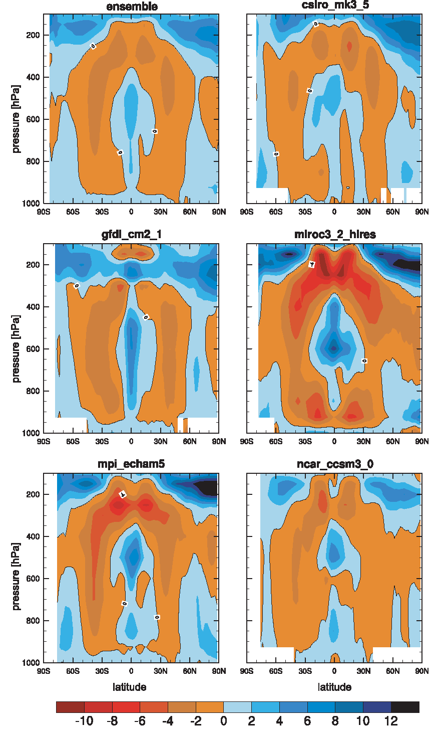
RH change (%) from 2000 to 2100
CMIP3, A1B scenario, ocean only
(Richter and Xie 2008, JGR)
Near-surface RH increases by 1-2%
Subtropical RH decreases due to
enhanced subsidence
RH decreases in the upper tropical
troposphere due to upward shift
of tropical convection.

Slide 35
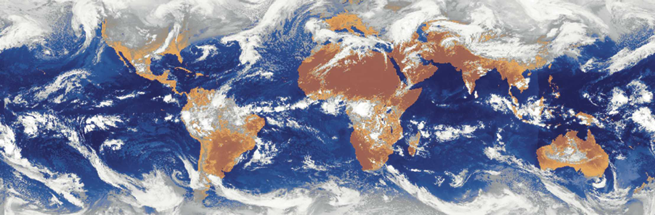
Clouds and Climate
Notes:
Composite of instantaneous infrared imagery from geostationary satellites at 1200 UTC 29 Mar 2004

Slide 36
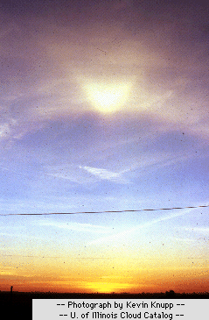

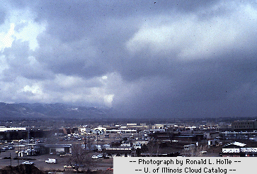
Mid-level clouds: Altocumulus
Base between 2-6km
High clouds: Cirrus
Base above 6km
Low clouds: Nimbostratus
Cloud base below 2km

Slide 37
YouTube Video
Cloud Types

Slide 38
Role of Clouds
Any Examples?
Reflect sunlight → cool the Earth by 50W m⁻² globally
Block out-going longwave radiation → warm the Earth by about 30 W m⁻² globally
Net effect:
High clouds → warming (LW dominates over SW, why?)
Low clouds → cooling (SW dominates over LW, why?)
Global-mean→ cooling by 20W m⁻² (SW dominates)
Cloud amount and its radiative effect vary with surface temperature → cloud feedback
Cloud feedback helps regulate global-mean temperature

Slide 39
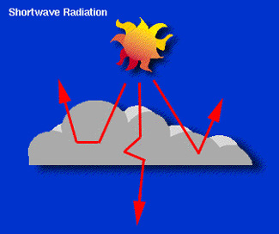
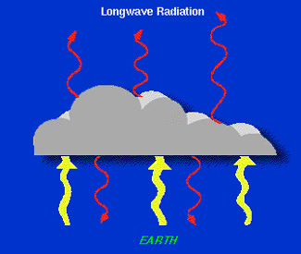
Radiative Effects of Clouds
Albedo depends on cloud thickness:
- Low clouds are optically thick →
strong reflector
High clouds are optically thin →
weak reflector
- Some absorption also occurs
- Cooling effect for SW
Net LW effect depends on cloud top height:
Low clouds have low top → T similar to Ts → small warming effect
High clouds have high top → T lower than Ts → large warming effect
Net effect: Low clouds→ cooling, high clouds→ warming

Slide 40
Cloud Types
Latin Root |  | Translation |  | Example
cumulus stratus cirrus nimbus |  | heap layer curl of hair rain |  | fair weather cumulus altostratus cirrus cumulonimbus
Convective Clouds: formed during convection: Cu, Cb
Stratiform Clouds: formed by large-scale systems, such
fronts: As, Ci

Slide 41
Cloud Types
High-Level Clouds : base above 6km, thin bright, ice crystals
Cloud types include: cirrus and cirrostratus.
Mid-Level Clouds: base at 2-6km, mostly water droplets
Cloud types include: altocumulus, altostratus.
Low-Level Clouds: base below 2km, mostly water droplets
Cloud types include: nimbostratus and stratocumulus.
Clouds with Vertical Development : as tall as 12km, through convection and frontal lifting
Cloud types include: fair weather cumulus & cumulonimbus.
Other Cloud Types
Cloud types include: contrails, billow clouds, mammatus, orographic and pileus clouds.

Slide 42
Cloud Observations:
At weather stations by trained observers:
total and low cloud amount in octas (1/8) and cloud base height
Such records exist for nearly 100 yrs at many stations, but discontinued at many automated stations since the late 1990s.
Since ∼1983, satellite IR and VIS images have been used to identify clouds. The ISCCP produces widely used cloud products from satellite observations
Surface Obs: most reliable for low clouds
Satellite Obs.: most reliable for high clouds
ISCCP=International Satellite Cloud Climatology Project
Notes:
ISCCP: http://isccp.giss.nasa.gov/overStatPg.html

Slide 43
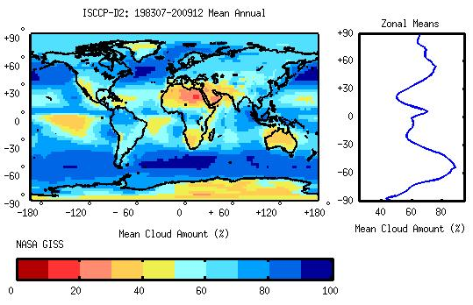
Cloud Amount Distributions

Slide 44
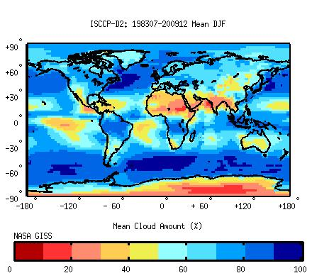
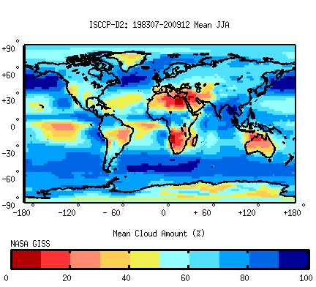
Cloud Amount: Seasonal Variations

Slide 45
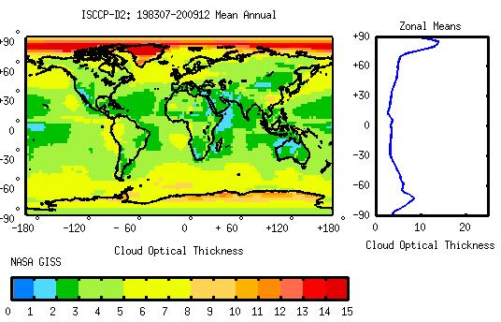
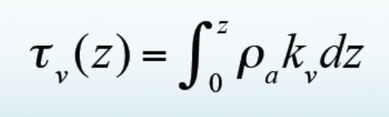
Cloud Optical Thickness
Cloud optical thickness (τ) is a measure of attenuation of the light passing through the cloud due to the scattering and absorption by cloud droplets.

Slide 46
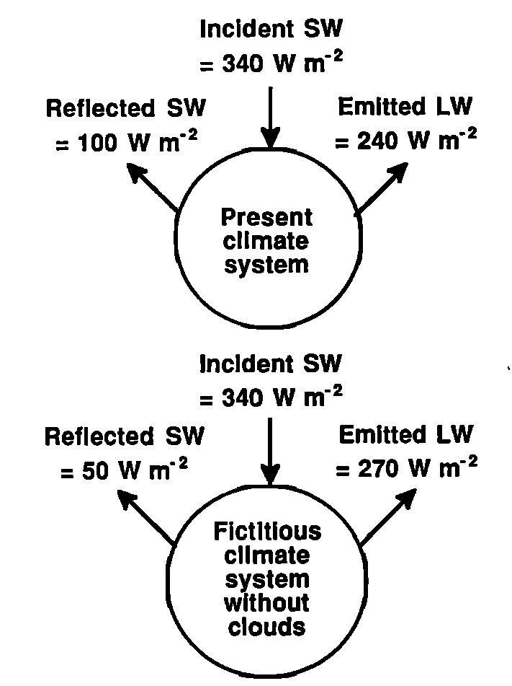
Cloud Radiative Forcing (CRF)
CRF = TOA Radiative Flux over
a domain with clouds
minus
TOA Radiative
Flux averaged over the
clear-sky regions within
the same domain.
Flux positive downward
Cess et al. 1996

Slide 47
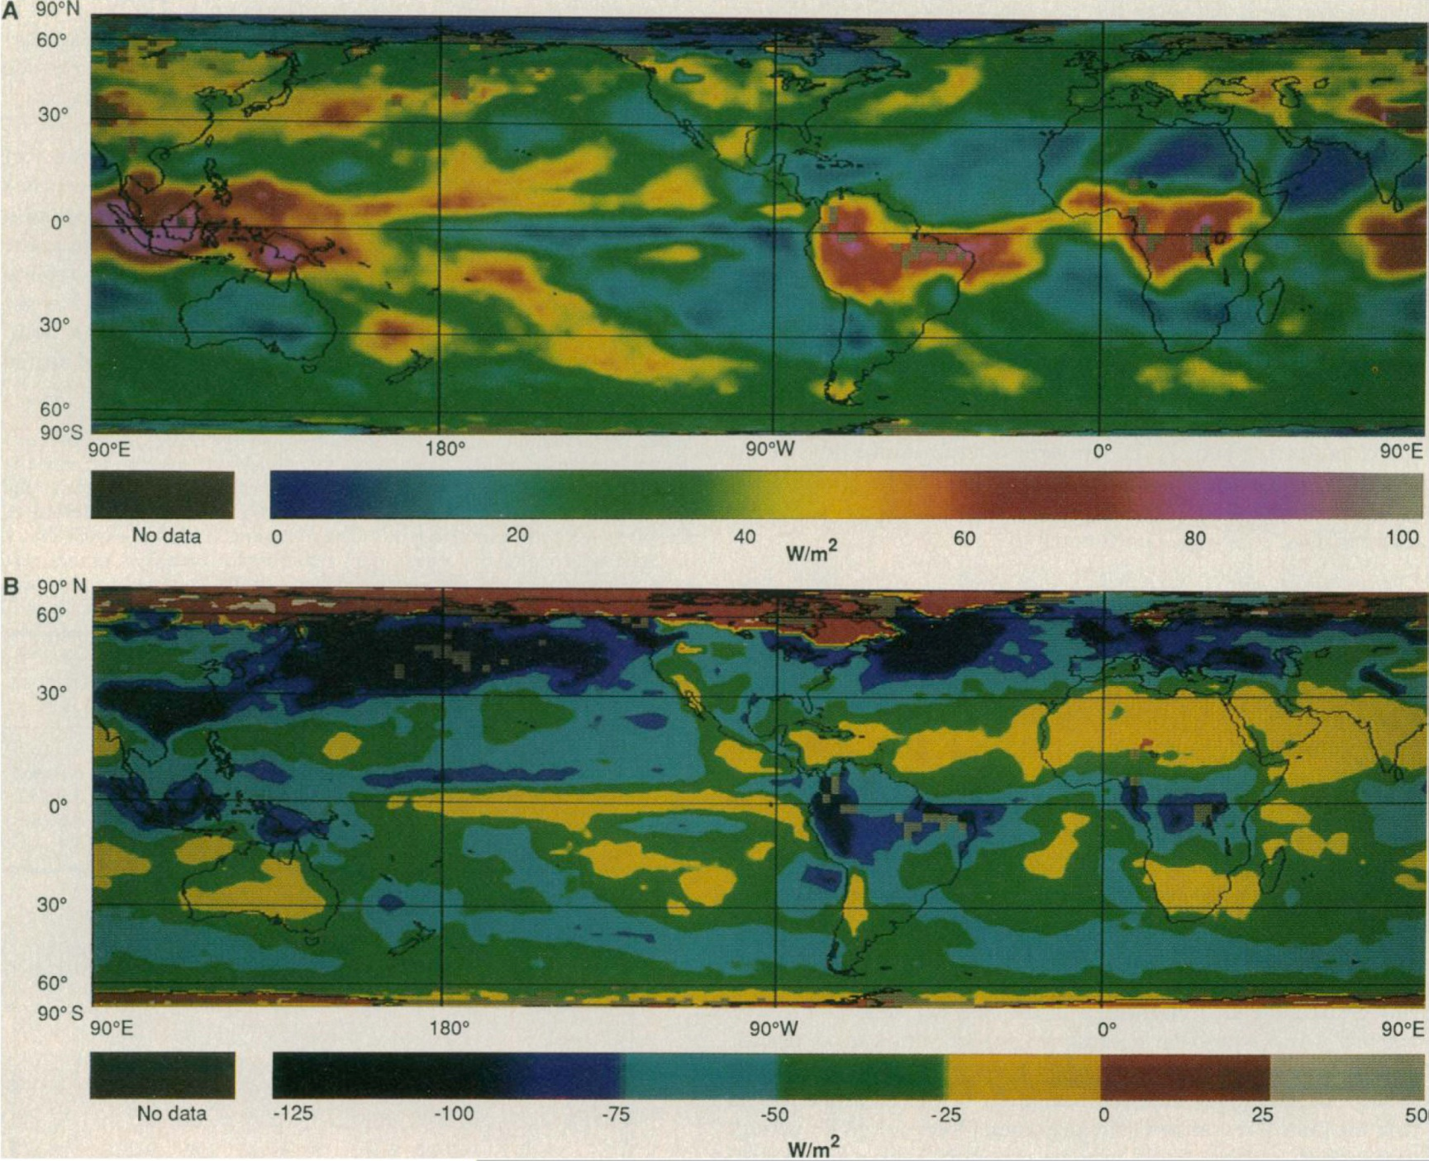
For April 1985, ERBE Satellite Data
LW CRF
Global-mean
31 W/m²
^{(warming)}
SW CRF
Global-mean
-45 W/m²
^{(Cooling)}
Ramanathan et al. 1989
Notes:
ERBE data, April 1985

Slide 48

For April 1985, ERBE Satellite Data
Net CRF
-14 W/m²
Annual mean:
−20W/m²
Ramanathan et al. 1989
Notes:
ERBE data, April 1985

Slide 49


Model-simulated Cloud Amount Changes:
2080-2090 minus 1980-1990
Decreases in low and
mid-level clouds
Increases in high
clouds due to upward
shift of convection
Total cloud amount
increases at high-
latitudes, but
decreases at mid-low
latitudes
IPCC 2007
Notes:
Multi-model mean, A1B scenario, CMIP3 models, stippling indicate the changes exceed the inter-model s.d.

Slide 50
RH change (%) from 2000 to 2100
CMIP3, A1B scenario, ocean only
(Richter and Xie 2008, JGR)
Related to cloud decreases
Due to enhanced subsidence

Slide 51


Cloud Radiative Forcing Changes
2080-2090 minus 1980-1990
Increased CRF → A positive (warming) feedback
More negative CRF → A negative (cooling) feedback
CMIP3 Model Index
IPCC 2007
Notes:
AR4 models, A1B scenario

Slide 52

Aerosols’ Impacts on Clouds & Climate

Slide 53
Aerosols’ Impacts on Clouds & Climate
Direct/Radiative Effect:
- Reflect sunlight → cool the surface → less evaporation
→ less water vapor → fewer clouds & less precipitation
- Absorb sunlight → warm the lower troposphere
- Both lead to a stable atmosphere → less
convection, fewer clouds, and less precipitation
Indirect/Microphysical Effect:
- More aerosols → more cloud condensation nuclei (CCN)
→ brighter clouds → more reflection of sunlight
- More CCN → smaller cloud droplets → longer cloud
lifetime and less precipitation
A major source of uncertainty in 20th and 21st century
climate simulations

Slide 54


Aerosols Production Rates
IPCC 2005

Slide 55

Aerosols Production Rates

Slide 56

Cloud-Aerosol Interactions
Aerosol Optical Thickness
Cloud condensation nuclei increase with aerosol concentration.
Rosenfeld et al. 2008

Slide 57

Rosenfeld et al. 2008
Clean Air
Polluted Air
Brighter clouds, longer lifetime

Slide 58

Historical Radiative Forcing:
1750-2005
IPCC 2007
Notes:
2xCO2 forcing = 3.7W/m2

Slide 59


Effects of Aerosols on North Atlantic (0-60ºN) SST
Booth et al. 2012, Nature

Slide 60
Summary for Water Vapor
Water vapor is the single largest greenhouse gas;
RH, q, and PW are often used to quantify atmospheric humidity and water vapor content;
Surface RH varies little over the oceans (~78-82%), ranges from >82% over the Amazon to <30% over deserts. The factors that control RH are not well understood, although large-scale subsidence seems to have a major impact on upper tropospheric RH;
Water vapor feedback is a strong positive feedback that amplifies the radiative forcing by a factor of ~2;
Limited data suggest that atmospheric water vapor content increases with T, approximately following the Clausius-Clapeyron relation, which implies small changes in RH;
Models suggest global PW increases by ~9%/K, slightly above the C-C rate but consistent with the SSMI satellite data (8.9%/K);
Models suggest a slight increase (~1%) in near-surface RH and a small RH decrease (1-4%) in the sub-tropical subsidence region and 1-4% increases over the equator and mid-high latitude troposphere during the 21st century;

Slide 61
Summary of Clouds and Aerosols
Clouds are classified by shapes (cumulus, stratus, cirrus, and nimbus), formation (convective and stratiform), or height (high, middle and low clouds).
Generally, there are more clouds over oceans than over land, more clouds over the high-latitudes than the low-latitudes.
Clouds reflect and absorb sunlight (cooling effect on surface) and block out-going longwave radiation (warming effect);
SW cooling dominates over LW warming effect for low clouds, but the opposite is true for high clouds. Why?
Globally, the SW cooling effect is about 50W m⁻² and LW warming effect is about 30W m⁻², resulting in a net cooling of ∼20 W m⁻², predominately over the northern mid-latitudes.
Under GHG-induced global warming, most models suggest a decrease in low and mid-level clouds, especially over the mid-latitudes and subtropics and an increase in high clouds due to enhanced tropical convection.
CMIP3 models show a CRF change from -2.2 to 1.6 W m⁻² in the 21st century, a major source of uncertainty for the future climate.
Aerosols affect climate directly through their radiative effects and indirectly through their impact on clouds albedo and lifetime.
How aerosols have contributed to the 20th century climate is still a very active research area.

Slide 62
Assignments:
- Reading Assignments: Chapter 9 of Hartmann GPC
Held, I. and B. Soden, 2000: Water vapor feedback and global warming. Annu. Rev. Energy Environ. 25:441–75.
- Review my ppt slides
- Try to answer following questions (not a homework assignment):
Briefly describe what the water vapor feedback is, its magnitude and how it comes to exist.
Briefly describe what the cloud radiative forcing is, how it varies with short and long wave radiation, and how it depends on cloud types (e.g., low vs. high clouds).
Describe the main physical processes through which aerosols affect the climate.
Briefly summarize how atmospheric specific (q) and relative (RH) humidity and cloud amount would respond to CO₂ and other GHG forcing based on recent model-simulated changes.

Slide 63
Next Lecture:
Atmospheric Convection

