Slide 1
Summary of Air-Sea and Land-Atmosphere Interactions
Air-sea interaction includes surface radiative fluxes, water fluxes (E and P), surface heat, momentum, and gas exchanges, and several air-sea feedbacks.
Surface winds play a crucial role in air-sea interaction: they affects upper ocean currents, air-sea SH, LH and momentum fluxes, and play a key role in air-sea feedbacks (such as the Bjerknes and WES feedbacks).
In the tropics, SST is often forced by solar radiation and oceanic processes (.e.g. upwelling) and acts as a lower-boundary forcing for the atmosphere; whereas in the mid-high latitudes, SST may also respond to atmospheric changes (e.g., winds) and thus two-way interactions are important.
The Wind-Evaporation-SST (WES) feedback works as follows: A SST gradient induces pressure gradient, which induces wind anomalies that lead to E changes which provide a feedback impact on the SST gradient (positive over the Equator).
Land-atmosphere interaction includes surface exchanges of heat, water, momentum, and gases (CO2, O2, etc.), albedo effect, modulation of atmospheric flow by mountains, soil moisture-precipitation interactions, vegetation-albedo feedback.
Land-atmosphere coupling seems to be strongest in semi-arid areas.
Initial conditions of soil moisture content are important for short-term weather forecast.

Slide 2
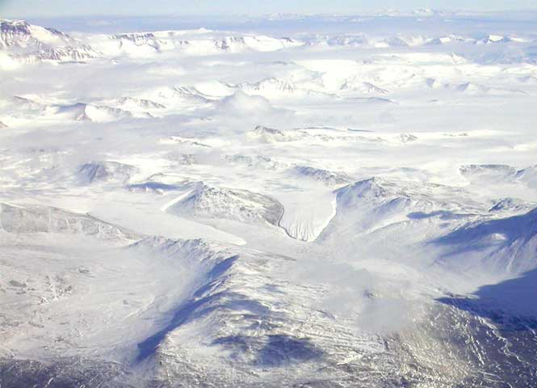
ATM 551: lecture 15
Sea Ice and Polar Climate
Polar geography
Sea-ice processes
Sea-ice seasonal variations
Polar climate vs. sea ice
Sea ice trends
Impact of Sea-ice loss
Arctic amplification: Causes and impacts

Slide 3
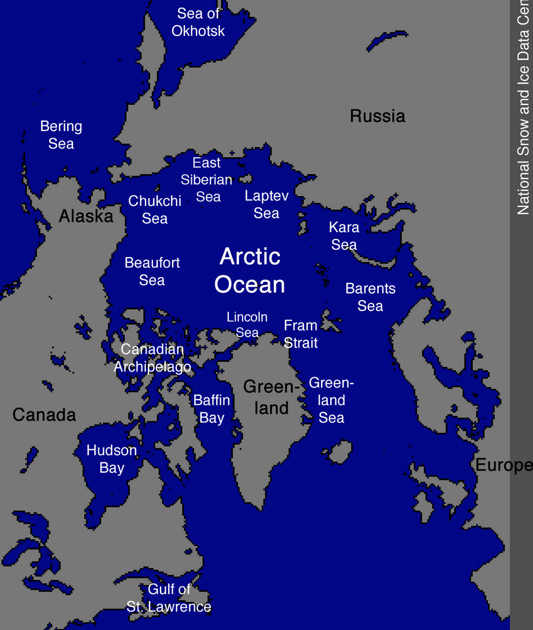
Norwegian Sea
Iceland
Labrador Sea
North Atlantic Ocean

Slide 4
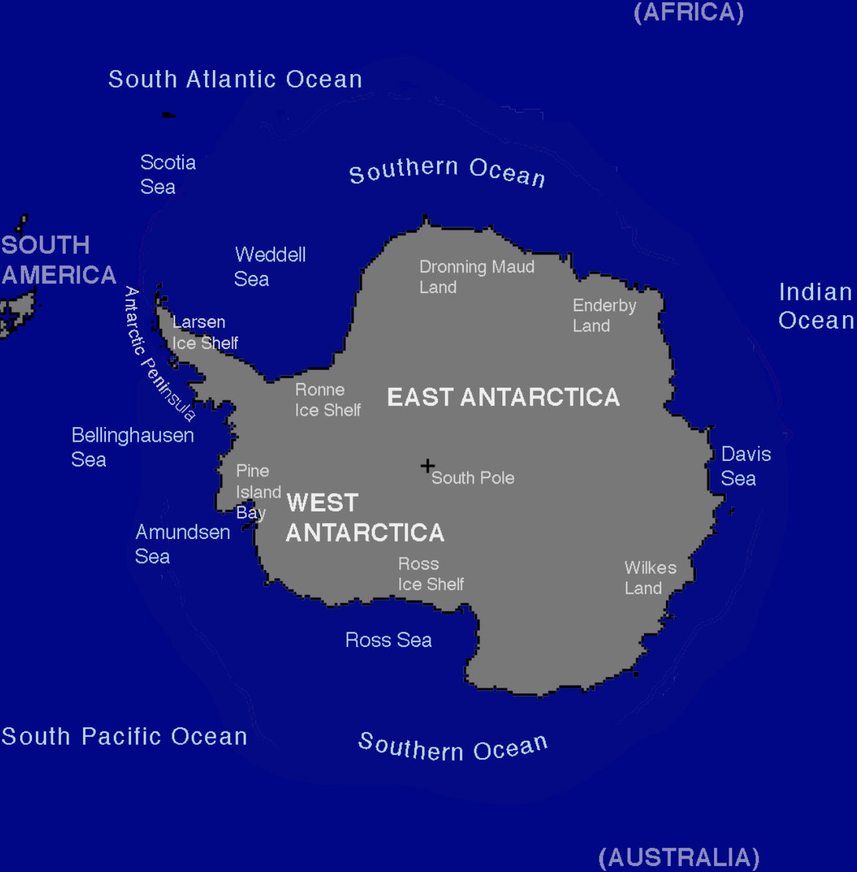
0º
Map of Antarctica
Drake
Passage
180º

Slide 5
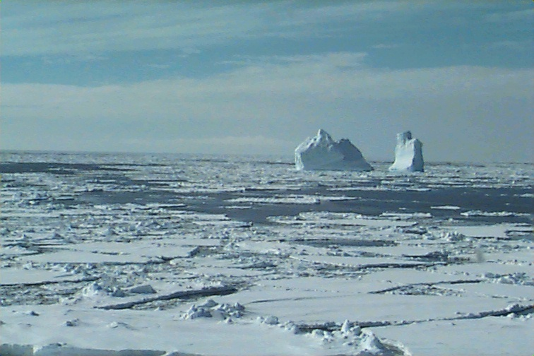
Sea Ice
Sea ice covers ∼12% (1/8) of the world’s oceans, primarily in the polar regions
It varies seasonally:
S.H.: A minimum of 3-4 million km² in February to a maximum of 17-20 million km² in September, 1-2 m thick
N.H.: A minimum of 7-9 million km² in September to a maximum of 14-16 million km² in March. 2-4 m thick
Why is the seasonal variation larger in the S.H. than in the N.H.?
Satellite passive microwave obs. began in the late 1970s.
Main data source: National Snow and Ice Data Center (NSIDC) in Boulder, CO
(http://nsidc.org/cryosphere/sotc/sea_ice.html)

Slide 6
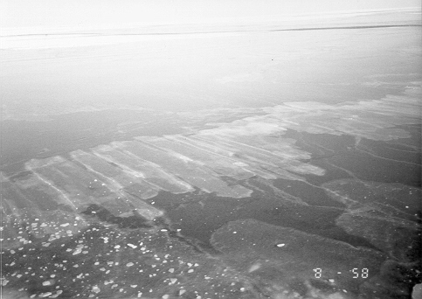
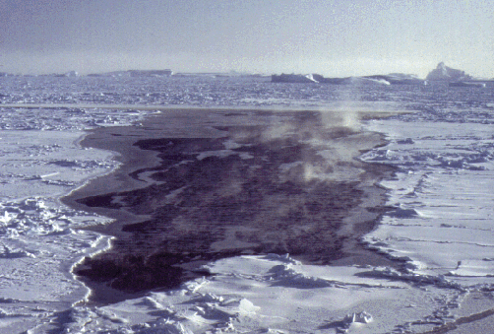
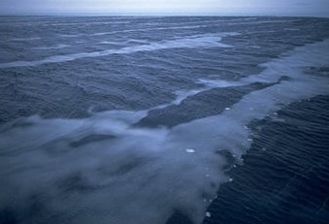
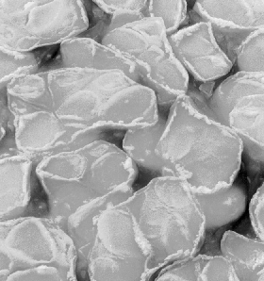
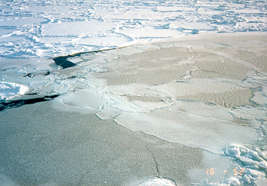
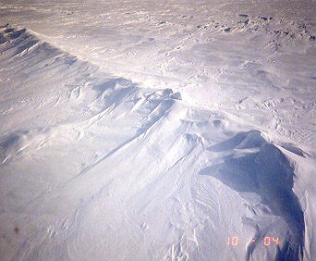
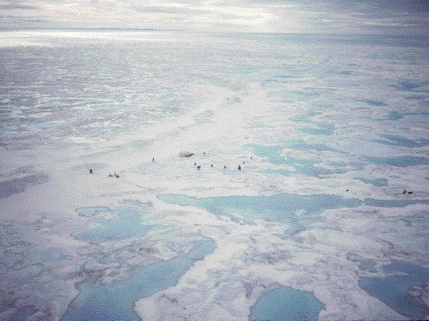

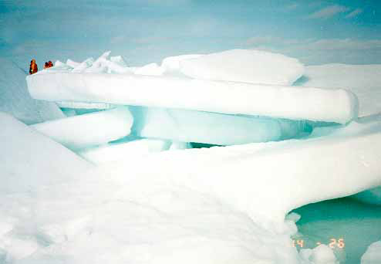
Sea Ice
Sea ice is a highly variable feature of the earth’s surface.
Greece Ice
Pancake Ice
Nilas & Leads
First-Year Ice
Multi-Year Ice
Melt Pond
Snow-Ice
Rafting

Slide 7
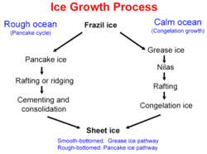
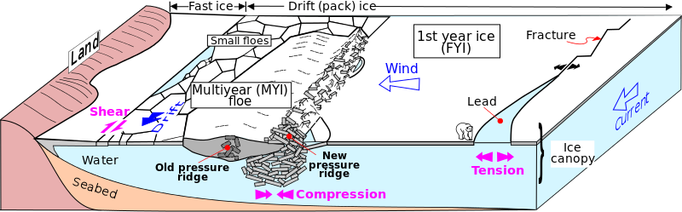
Major Sea Ice Features
Sunlight
SH & LH
Salt
Sea-ice ejects about 2/3 of the salt into the open water (why?)
Notes:
When ice crystals form, salt accumulates into small droplets called brine, which are in liquid form (due to salt’s lower freezing point) and are expelled into the sea water through various ways.

Slide 8
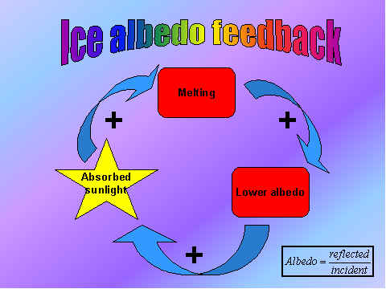
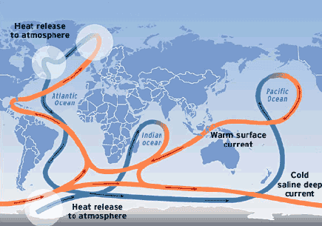
1. Albedo
2. Insulating
3. Density
High Cloud
Middle Cloud
Low Cloud
SW Flux
Ice Crystals
* *
* * * *
* *
LW Flux
P-E
Sensible Heat
Latent Heat
Run Off
Snow
Melt Ponds
Ridged Ice
Sea Ice
Lead
Air Bubbles
Ice Export
Brine Pockets
Melt/Freeze
Lateral Heat Flux
Basal Heat Flux
Fresh Water Inflow
Diffusion
Ocean Mixed Layer
Entrainment
Pycnocline

Slide 9
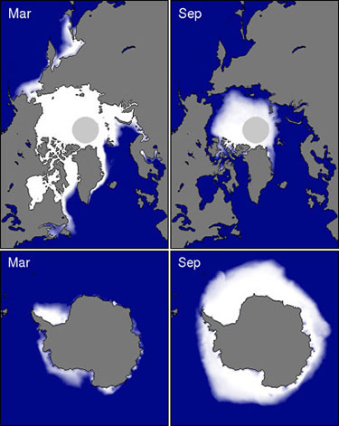
Seasonal Sea Ice Extent

Slide 10
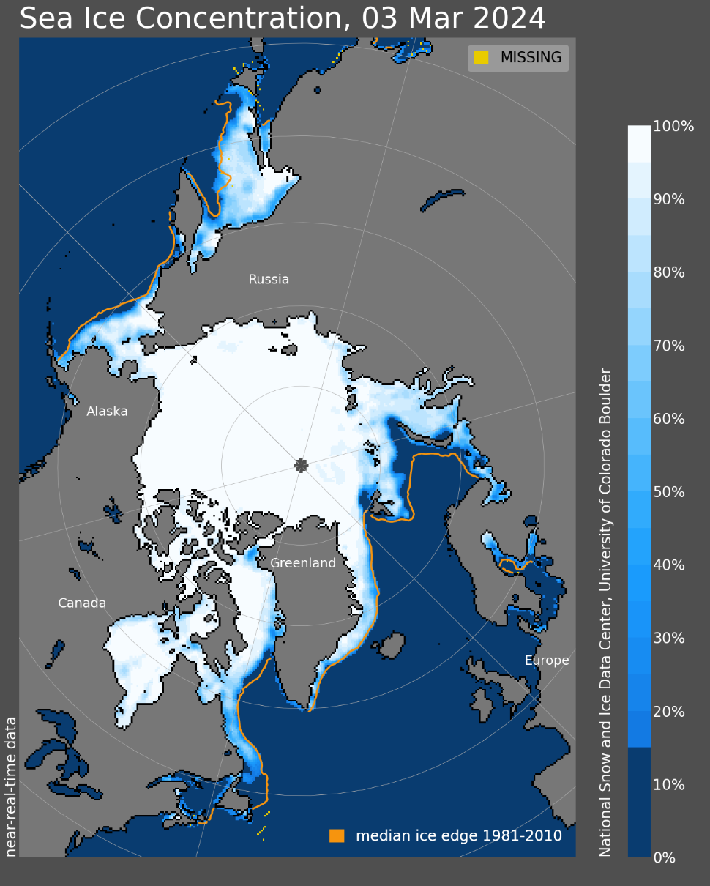
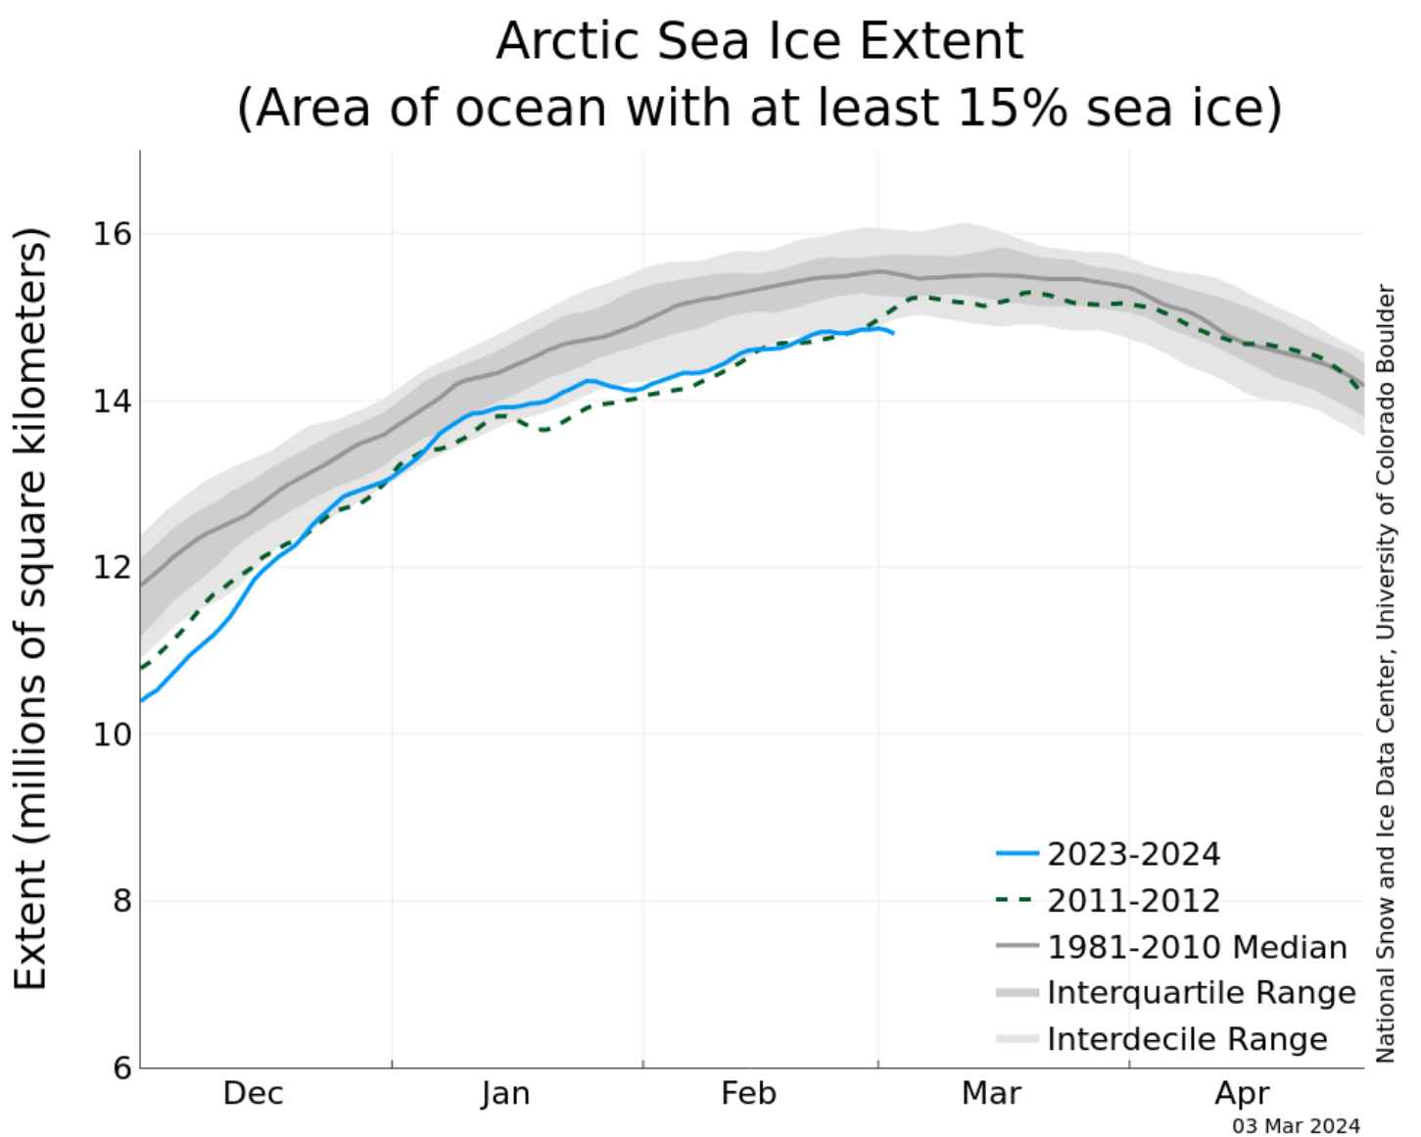
https://nsidc.org/arcticseaicenews/

Slide 11
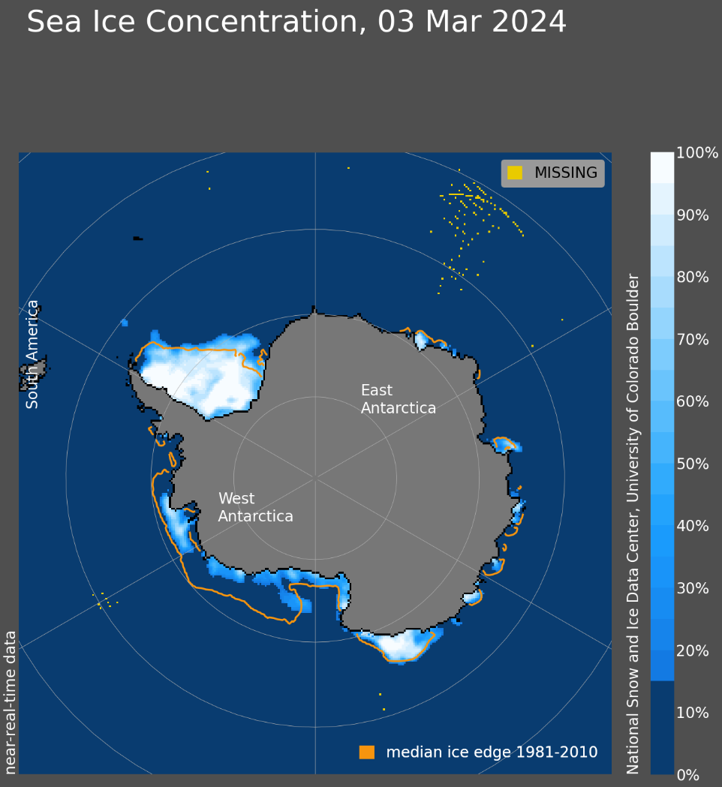
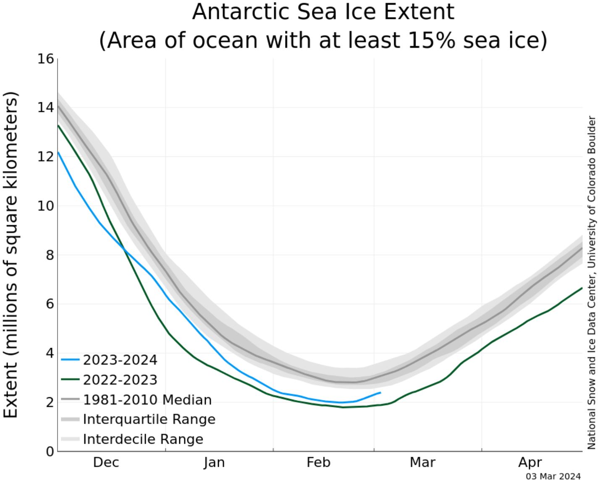
Source: https://nsidc.org/arcticseaicenews/charctic-interactive-sea-ice-graph/

Slide 12
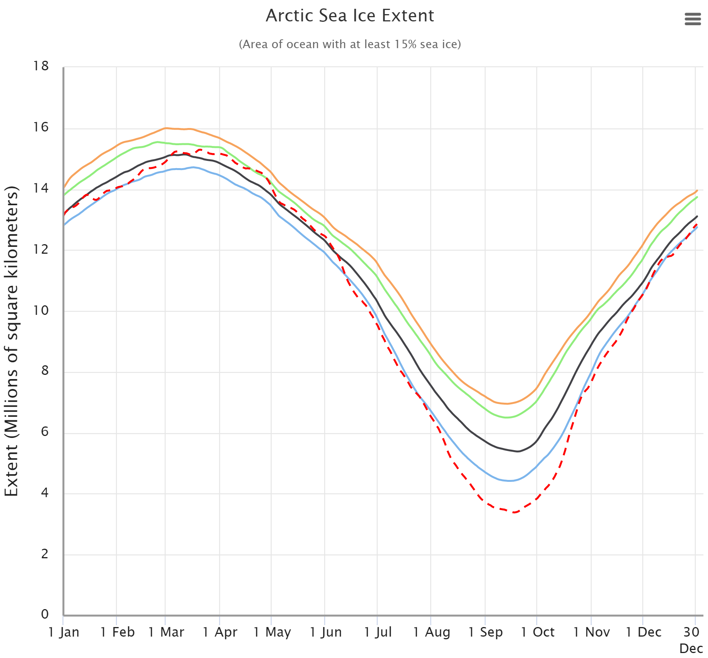

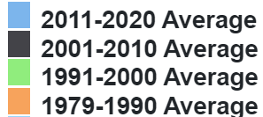
Source: https://nsidc.org/arcticseaicenews/charctic-interactive-sea-ice-graph/

Slide 13
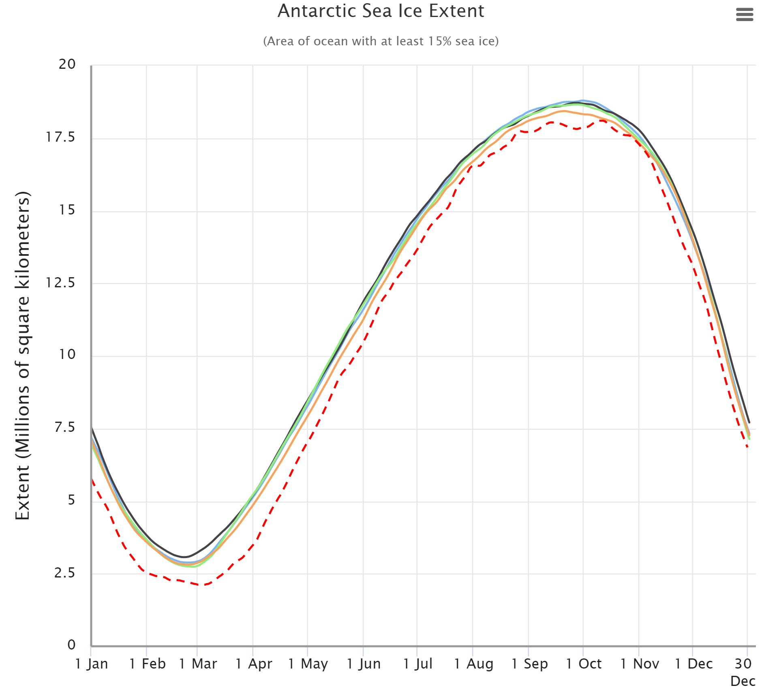

Source: https://nsidc.org/arcticseaicenews/charctic-interactive-sea-ice-graph/

Slide 14
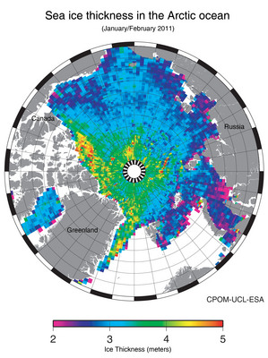
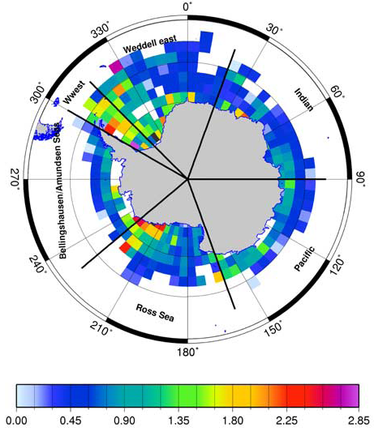
Sea-ice Thickness
Worby et al. 2008
Jan-Feb 2011
Antarctic Sea-ice annual-mean thickness (m)
m
http://www.esa.int/esaCP/SEMAAW0T1PG_index_0.html

Slide 15
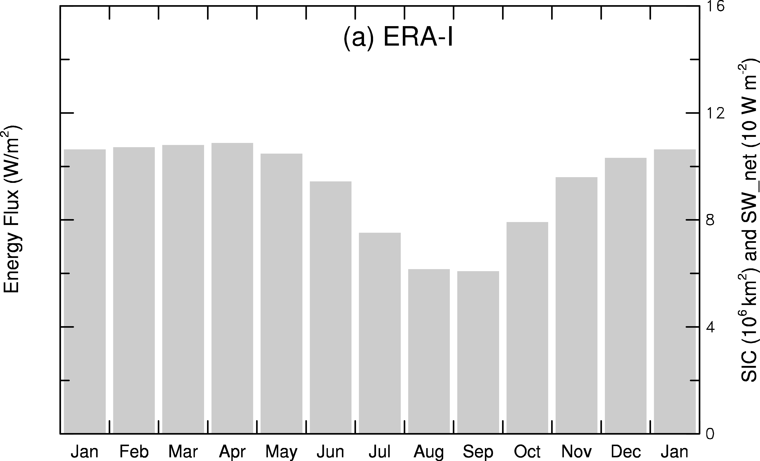
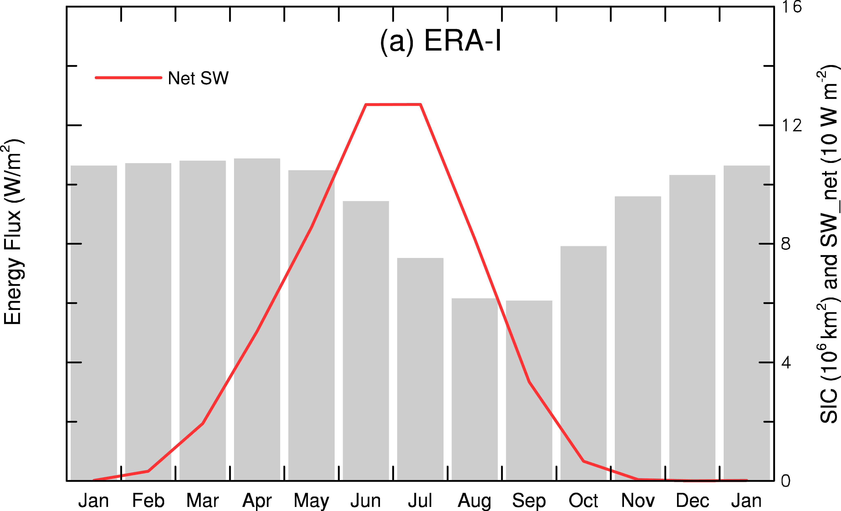
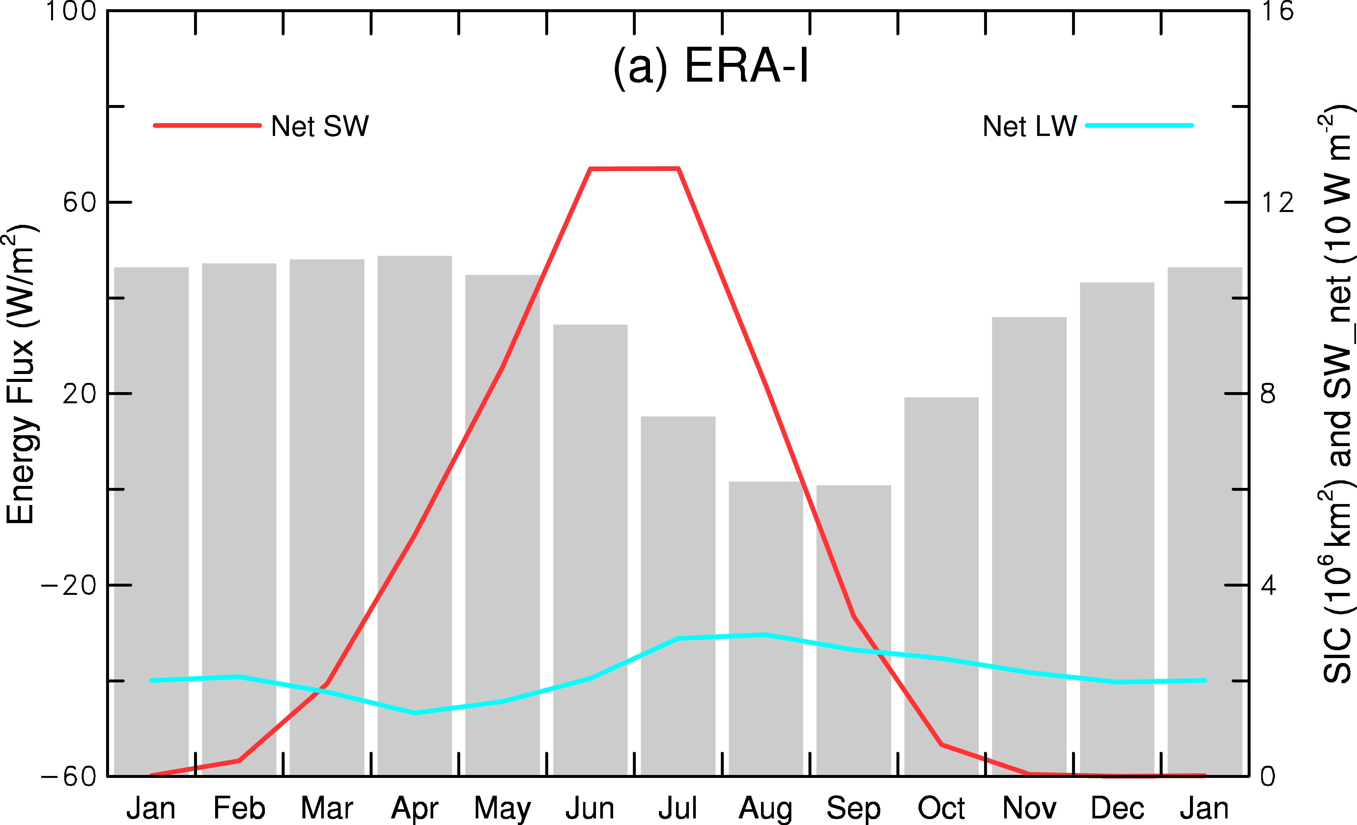
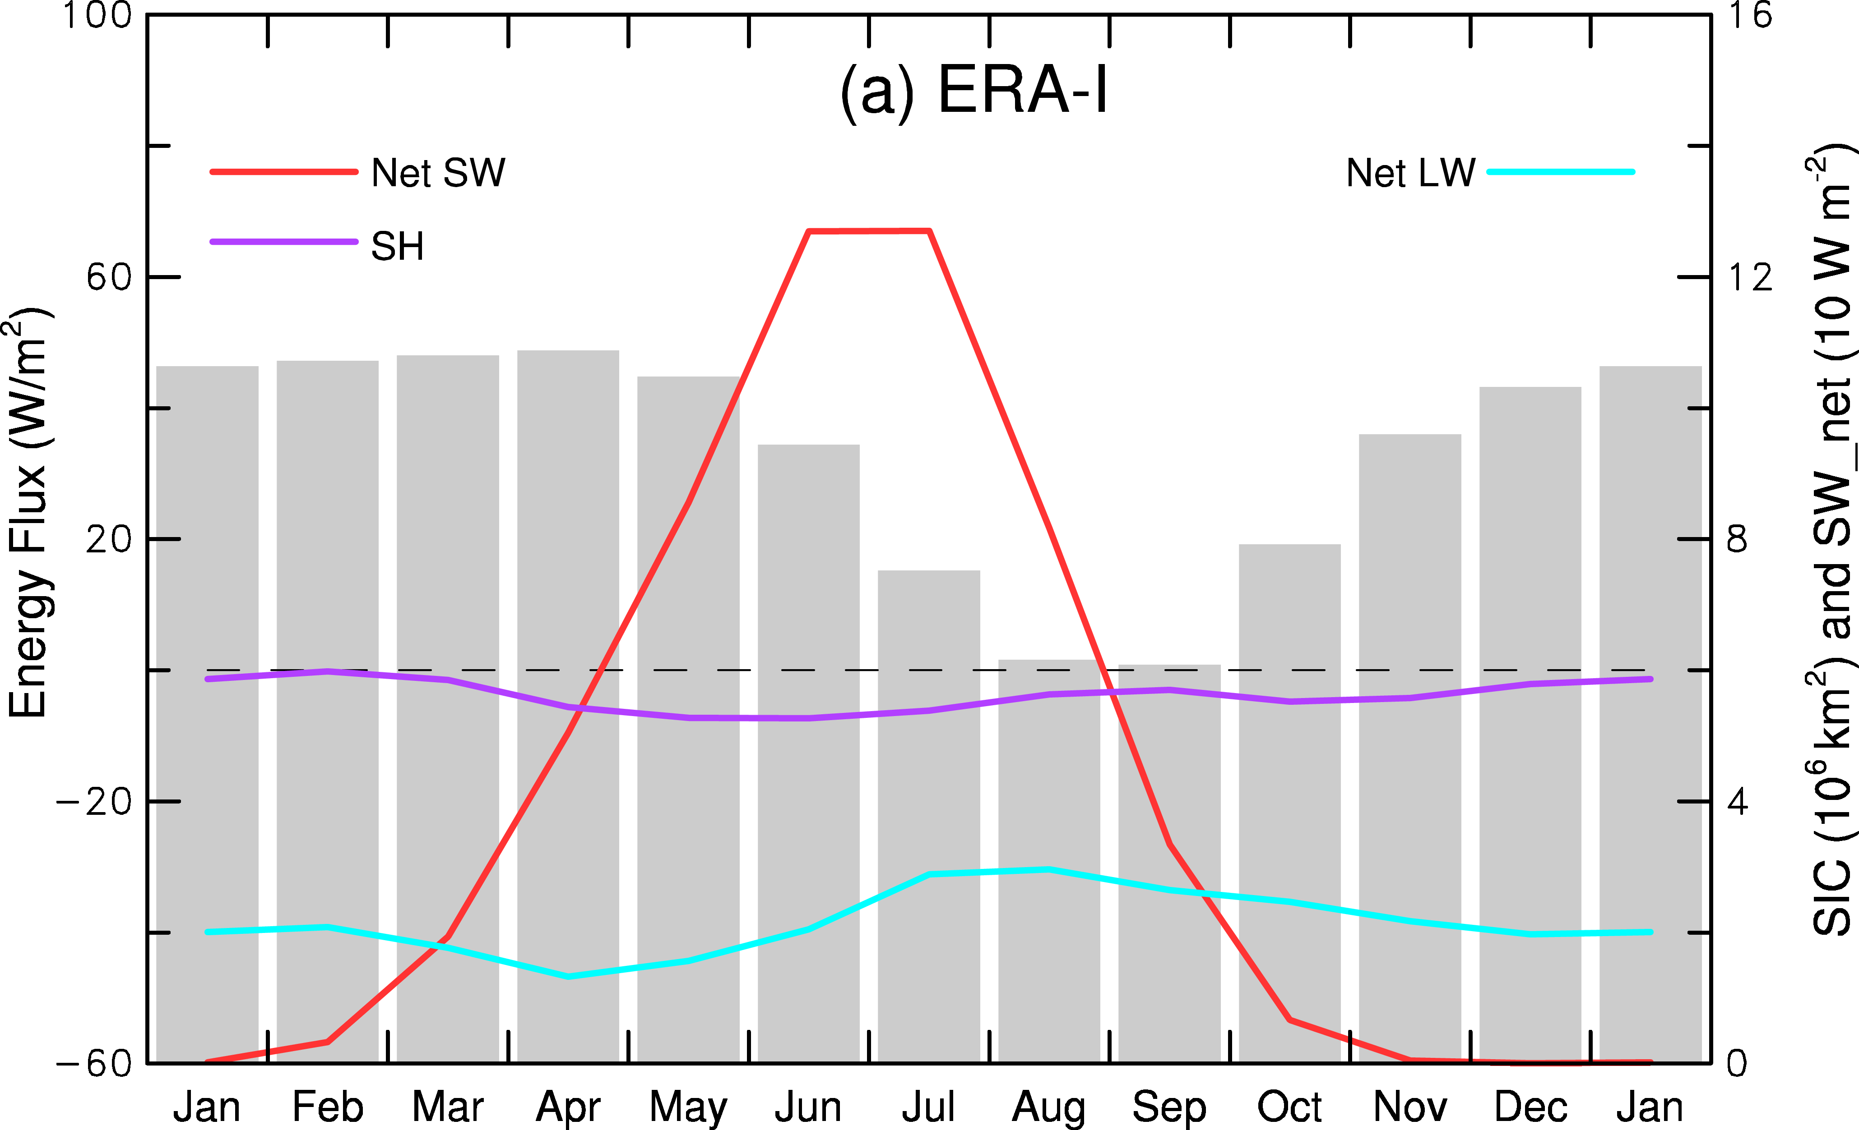
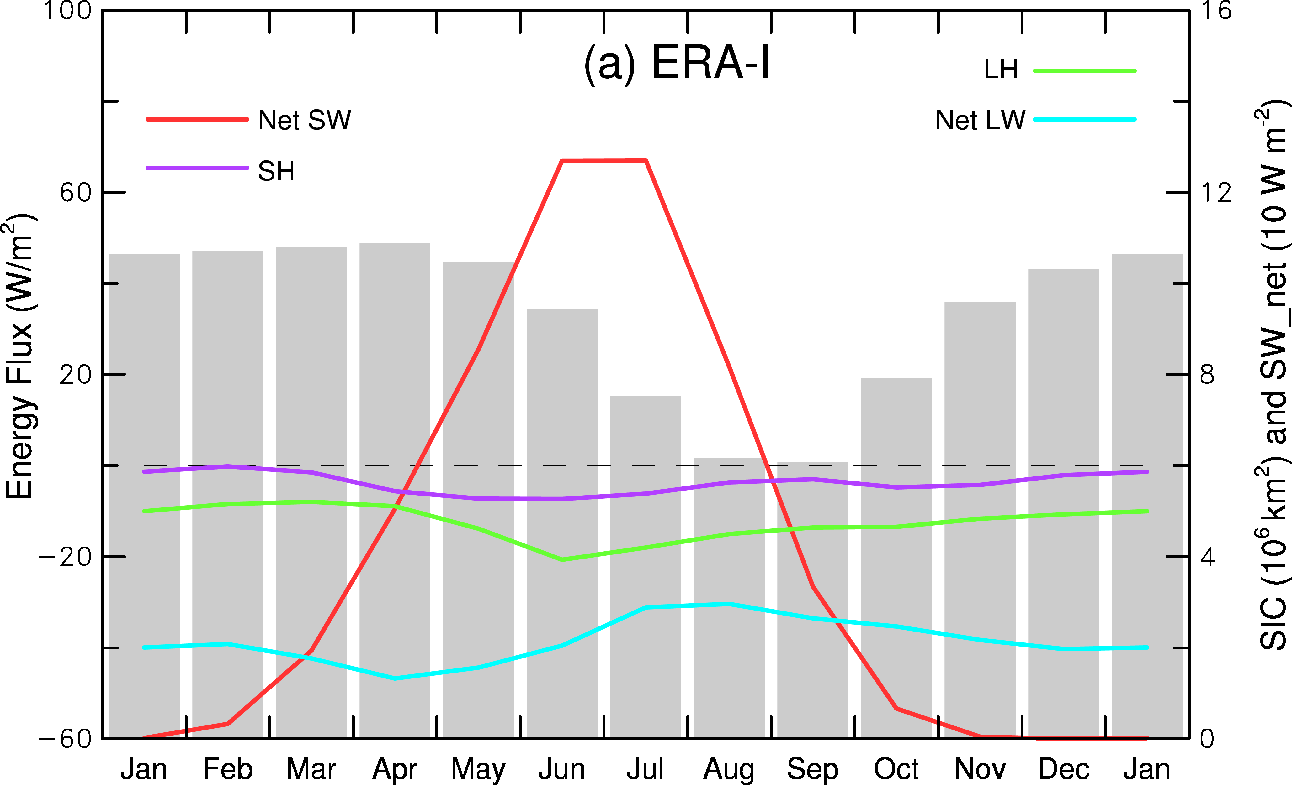
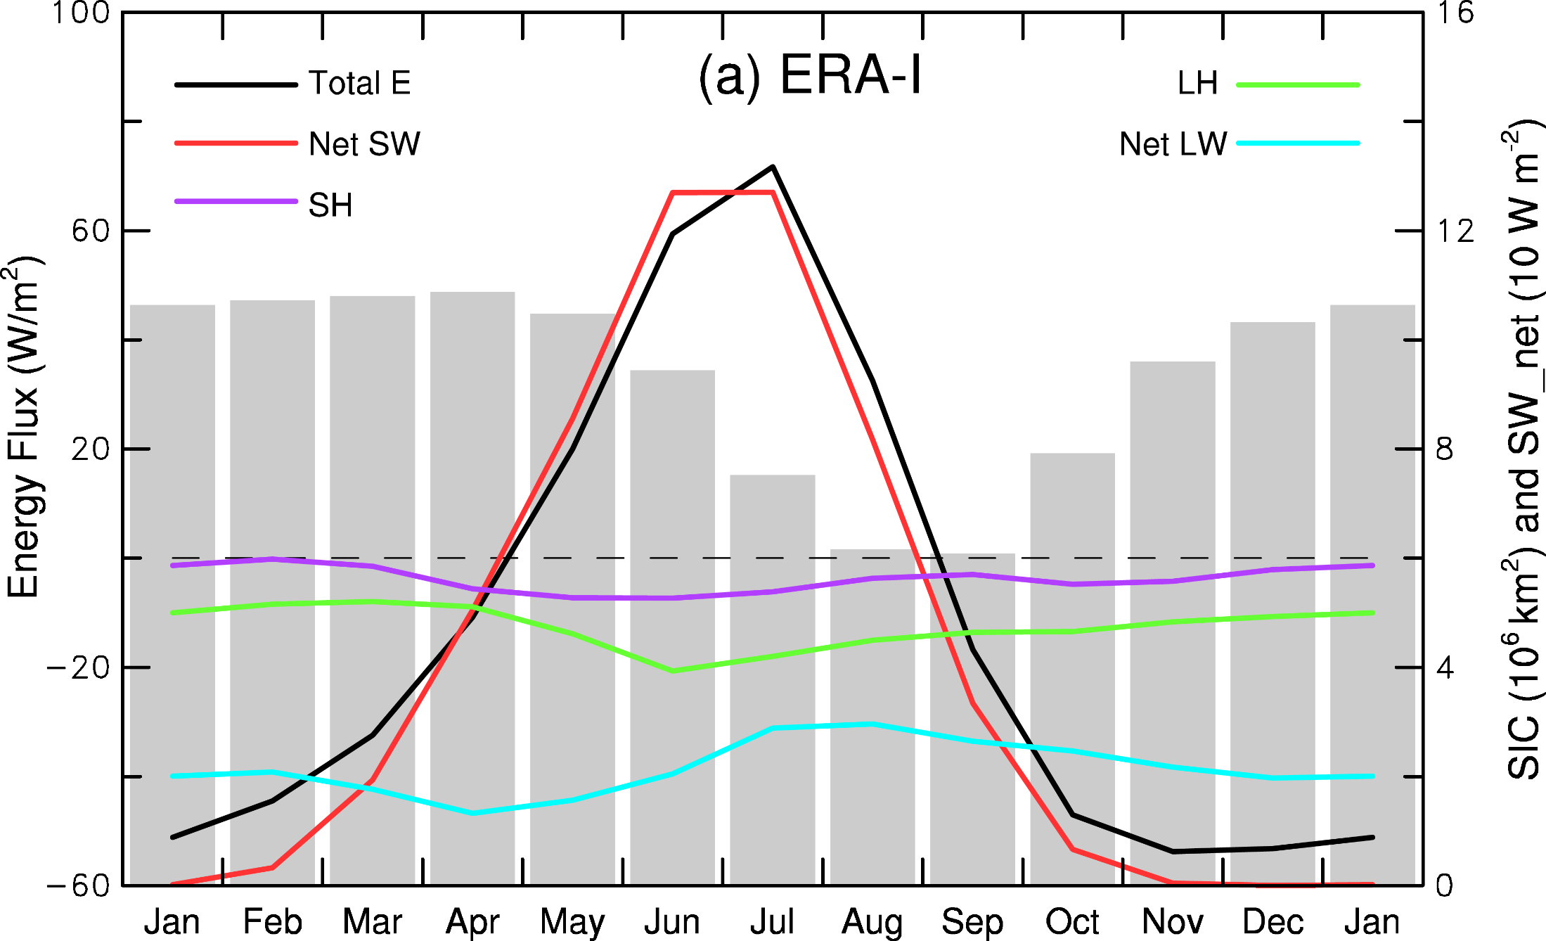
Mean Annual Cycle of Arctic SIC and Surface Fluxes (positive downward)
Arctic Ocean heats the atmosphere
from October-March!
Dai et al. (2019)
Notes:
1979-1988 mean annual cycle. Fluxes positive downward

Slide 16
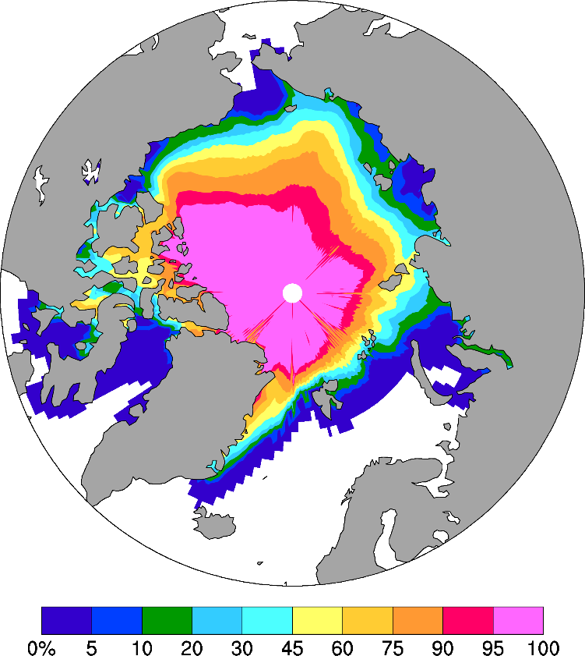
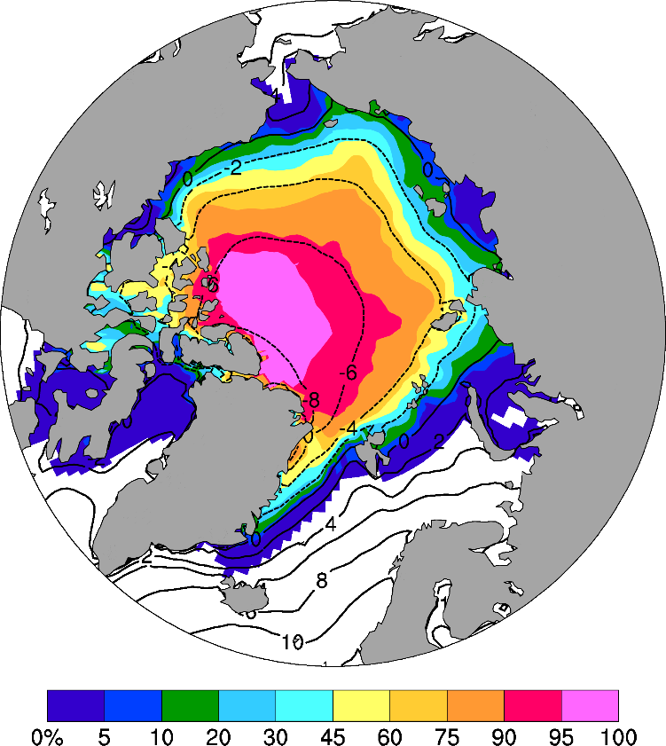
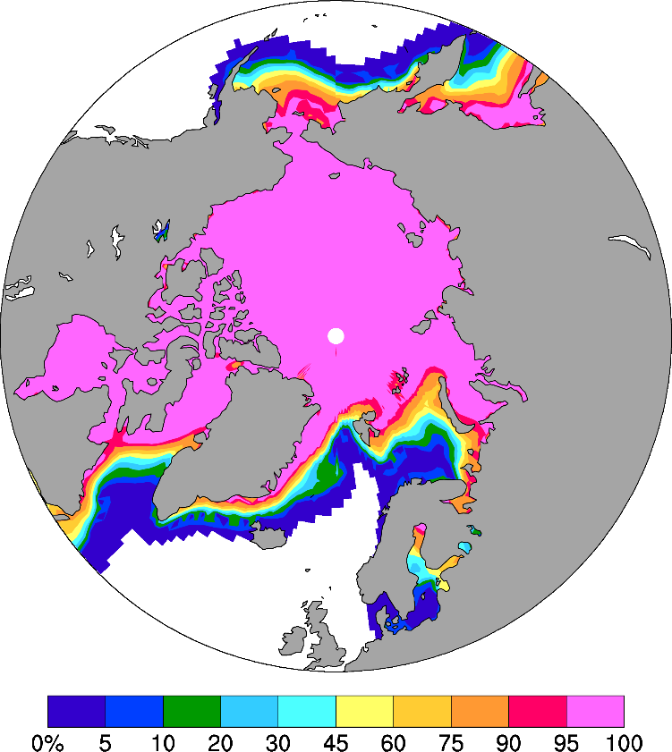
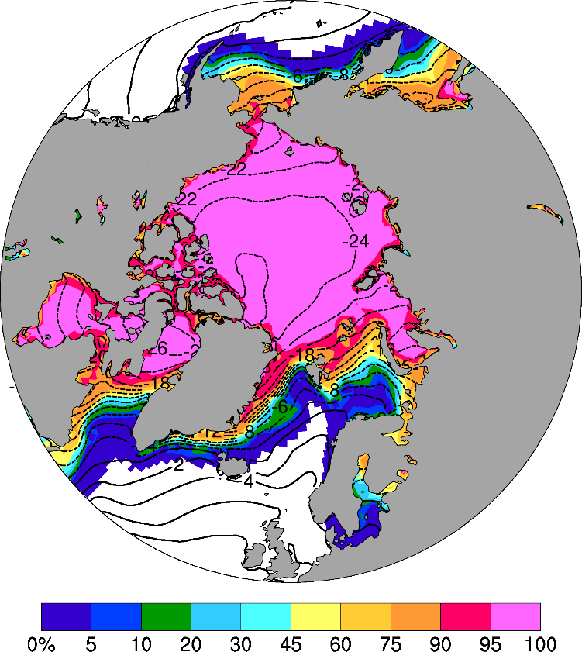
Satellite Obs
ERA5
a
1979-2015 Mean
b
September
Contour=2m air temperature
Reanalysis data have been
used to study polar climate.
Color=Sea-ice Concentration
c
d
March
Notes:
1979-2015 mean SIC (%) for (a-b) September and (c-d) March from (a, c) NOAA satellite observations and (b, d) ERA5. Also shown in (b,d) are the ERA5 1970-2015 mean 2m air temperature (ºC) for (b) September and (d) March. Note the large temperature gradients and the zero temperature line along the ice margins.

Slide 17
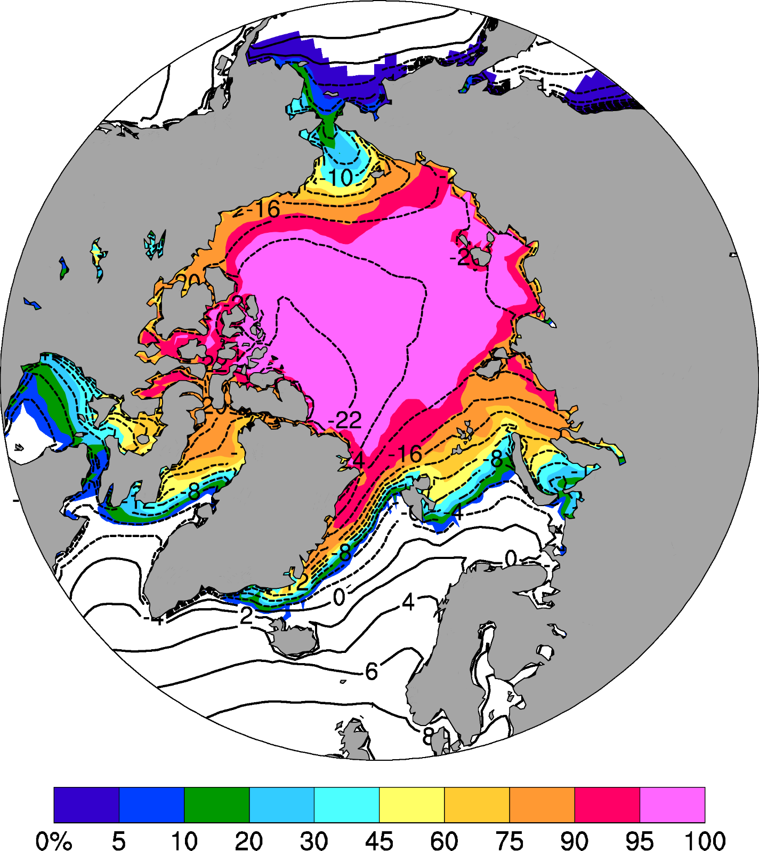
ERA5 1979-2020 mean November sea ice cover (shading, in %) and 2m air temperature (contours, in ºC).
Notes:
ERA5 1979-2020 mean November sea ice cover (shading, in %) and 2m air temperature (contours, in degC). Note the large temperature gradients along the ice margins. T2m is slightly below the freezing point at the ice margins.

Slide 18
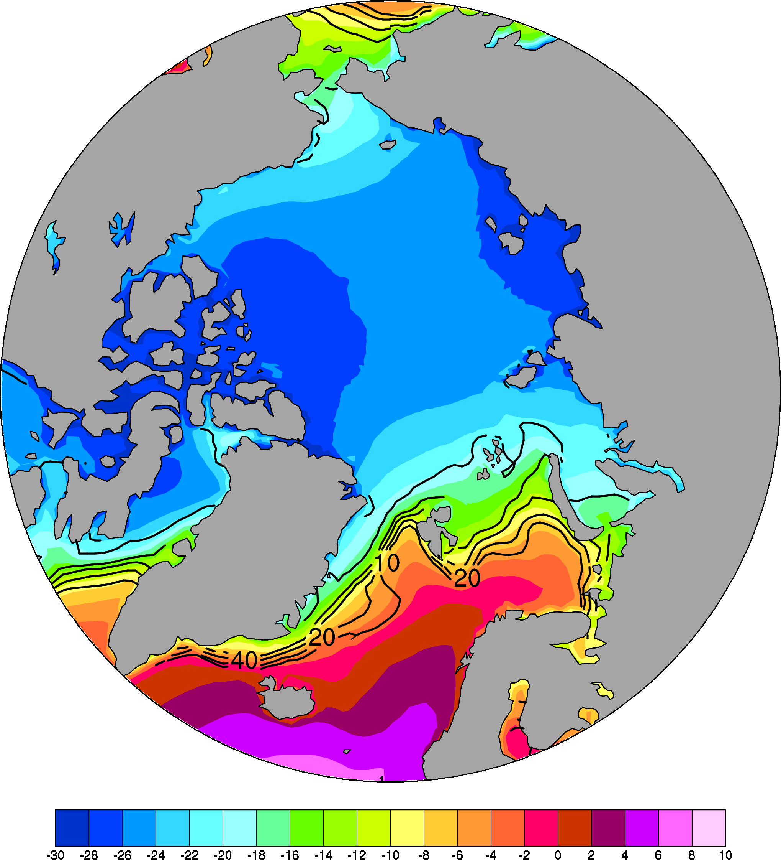
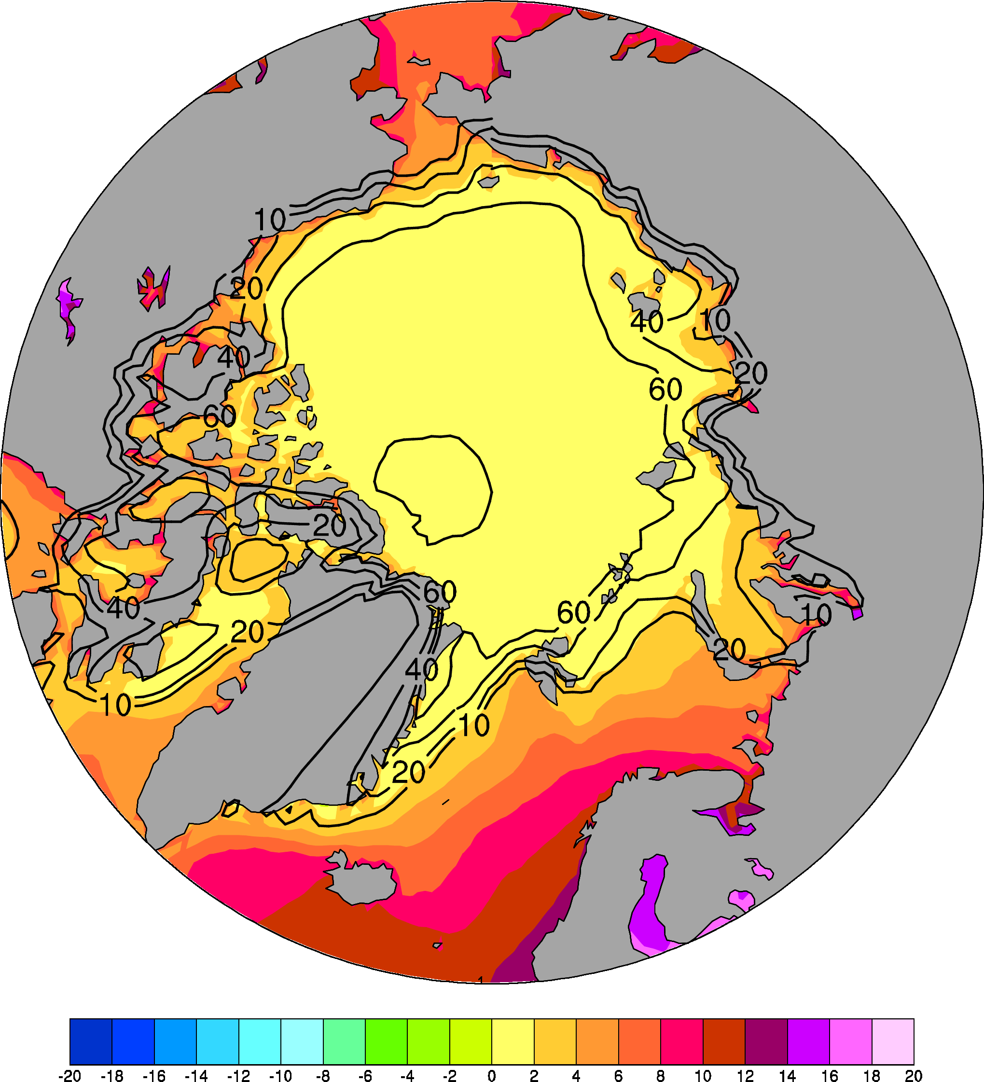
ERA5 2m Temperature, 1979-2020 mean
January
July
degC
Contour = Sea-ice Concentration (%)
Notes:
ERA5 1979-2020 mean surface air temp (degC, color) and SIC (contours in 90, 60, 40, 20, and 10%) for (left) January and (right) July

Slide 19
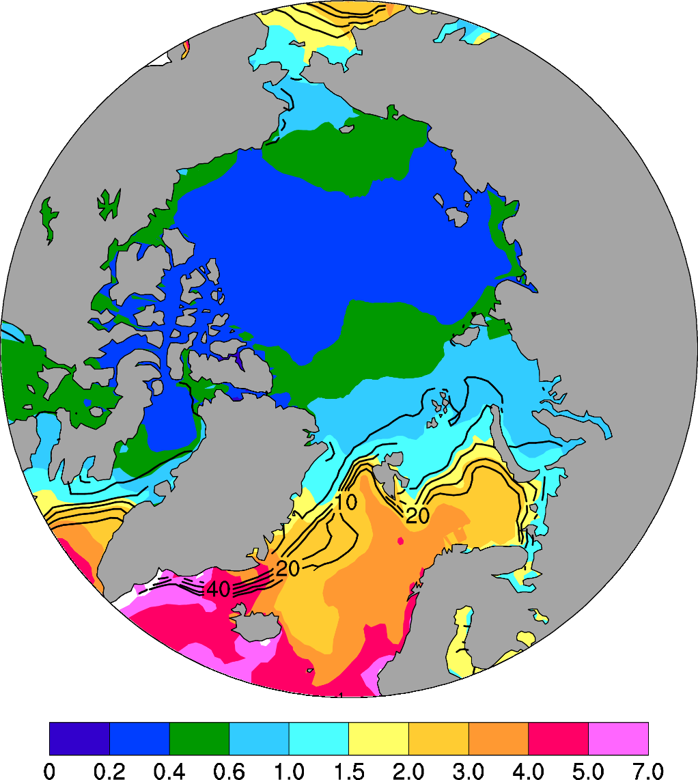
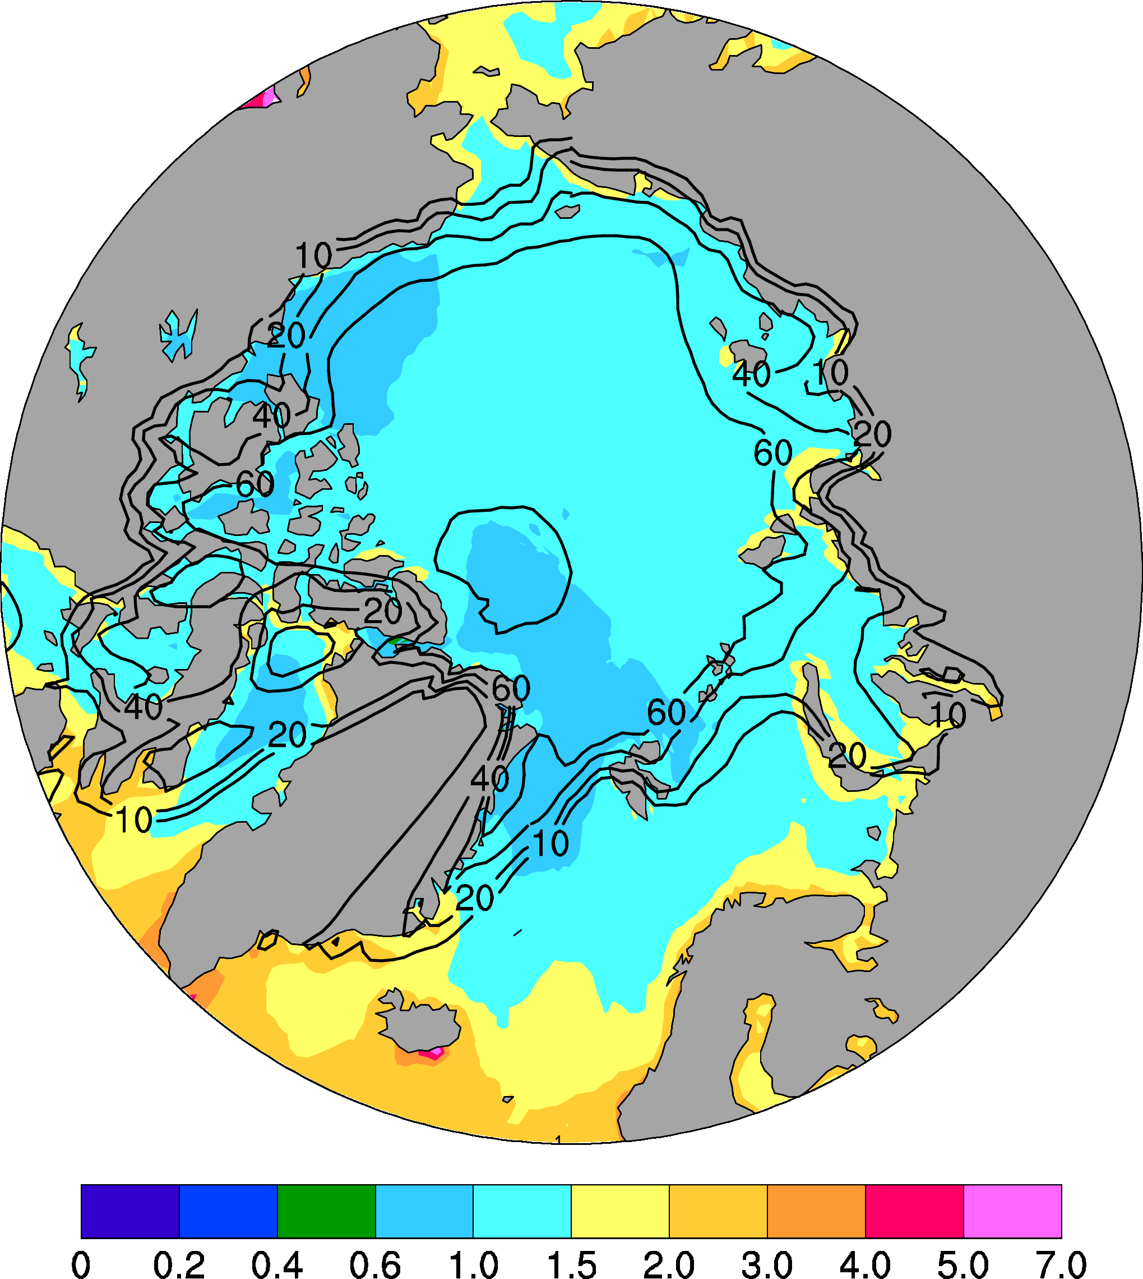
ERA5 Precipitation, 1979-2020 mean
January
July
mm/day
Contour = Sea-ice Concentration (%)
Notes:
ERA5 1979-2020 mean precip (mm/day, color) and SIC (contours in 90, 60, 40, 20, and 10%) for (left) Janunary and (right) July

Slide 20
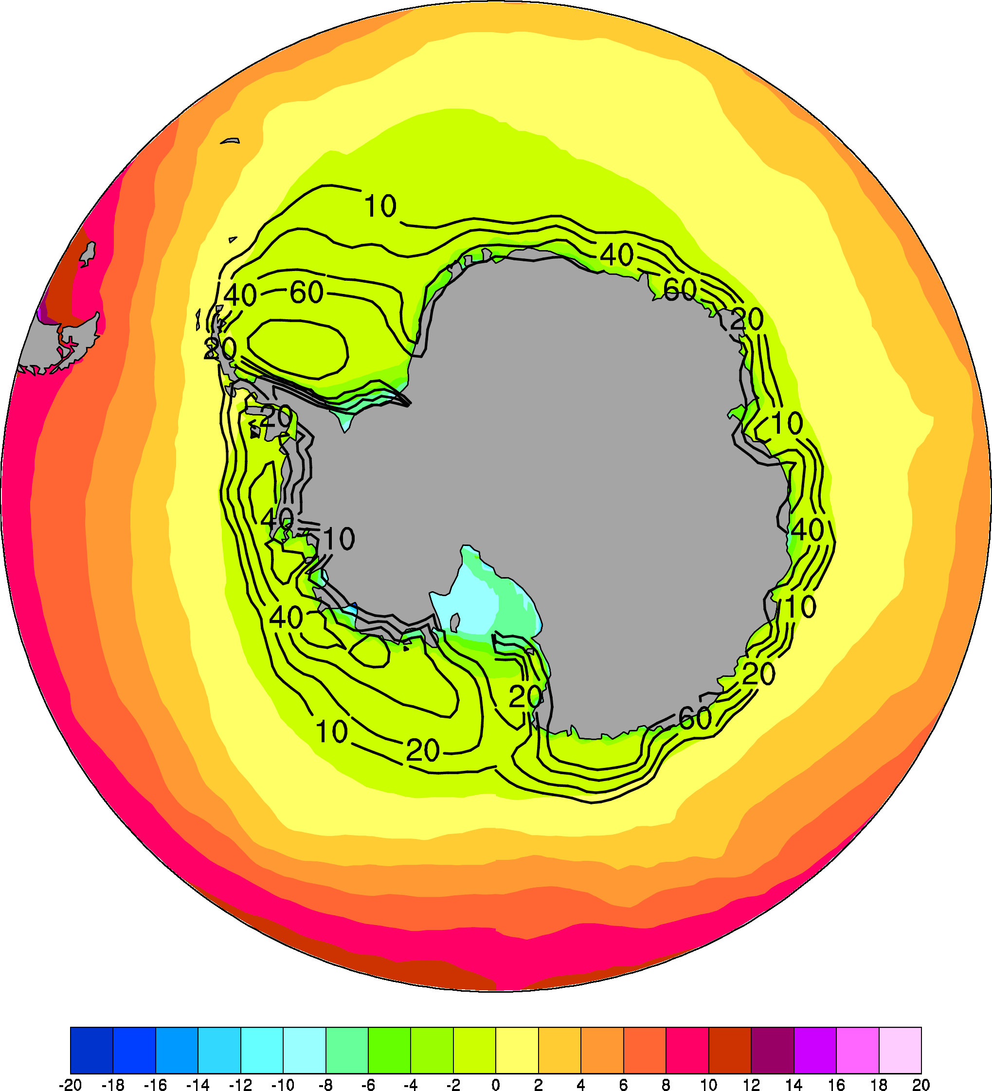
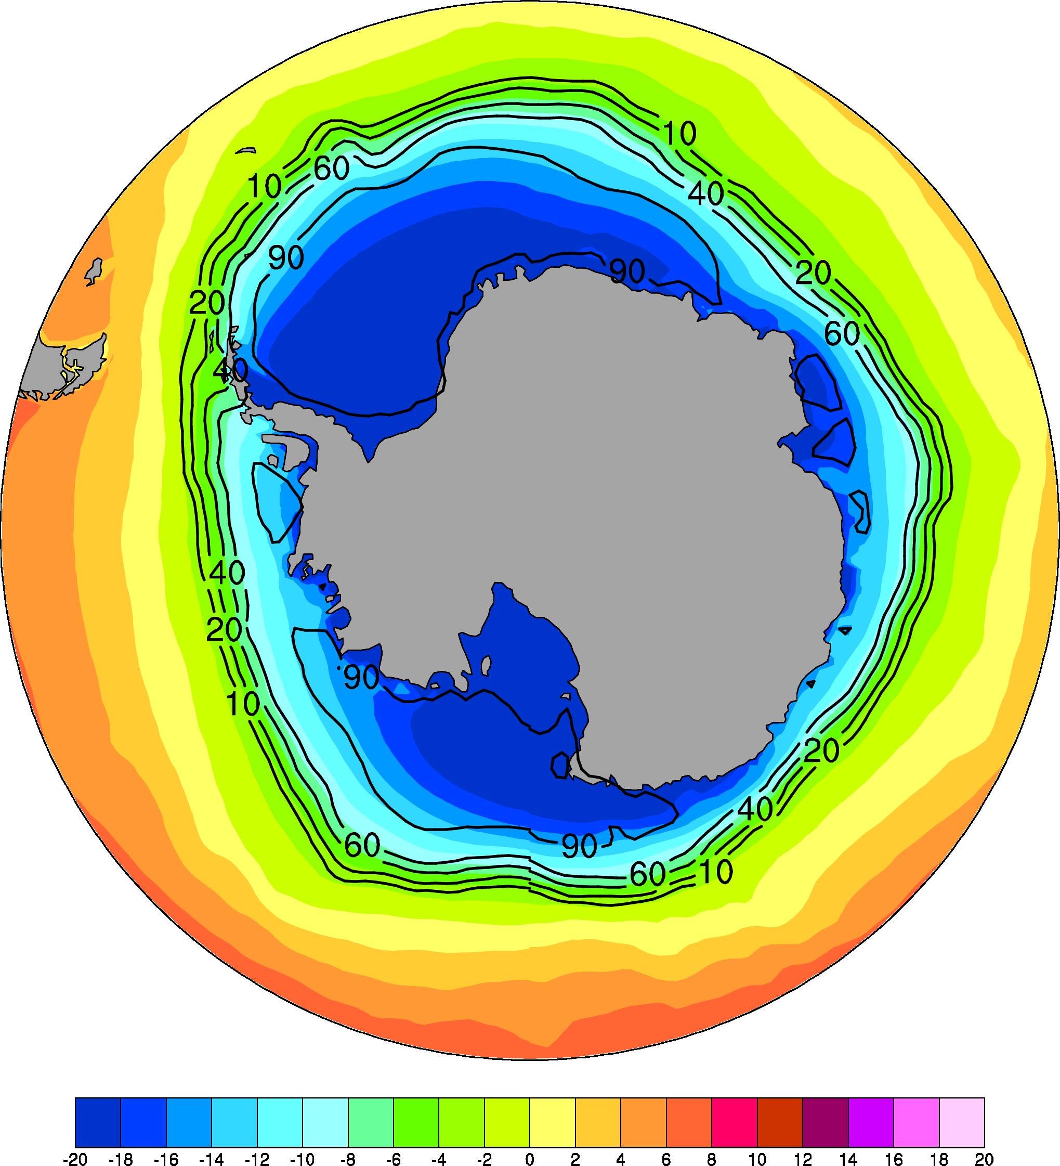
ERA5 2m Temperature, 1979-2020 mean
January
July
degC
Contour = Sea-ice Concentration (%)
Notes:
ERA5 1979-2020 mean surface air temp (degC, color) and SIC (contours in 90, 60, 40, 20, and 10%) for (left) January and (right) July

Slide 21
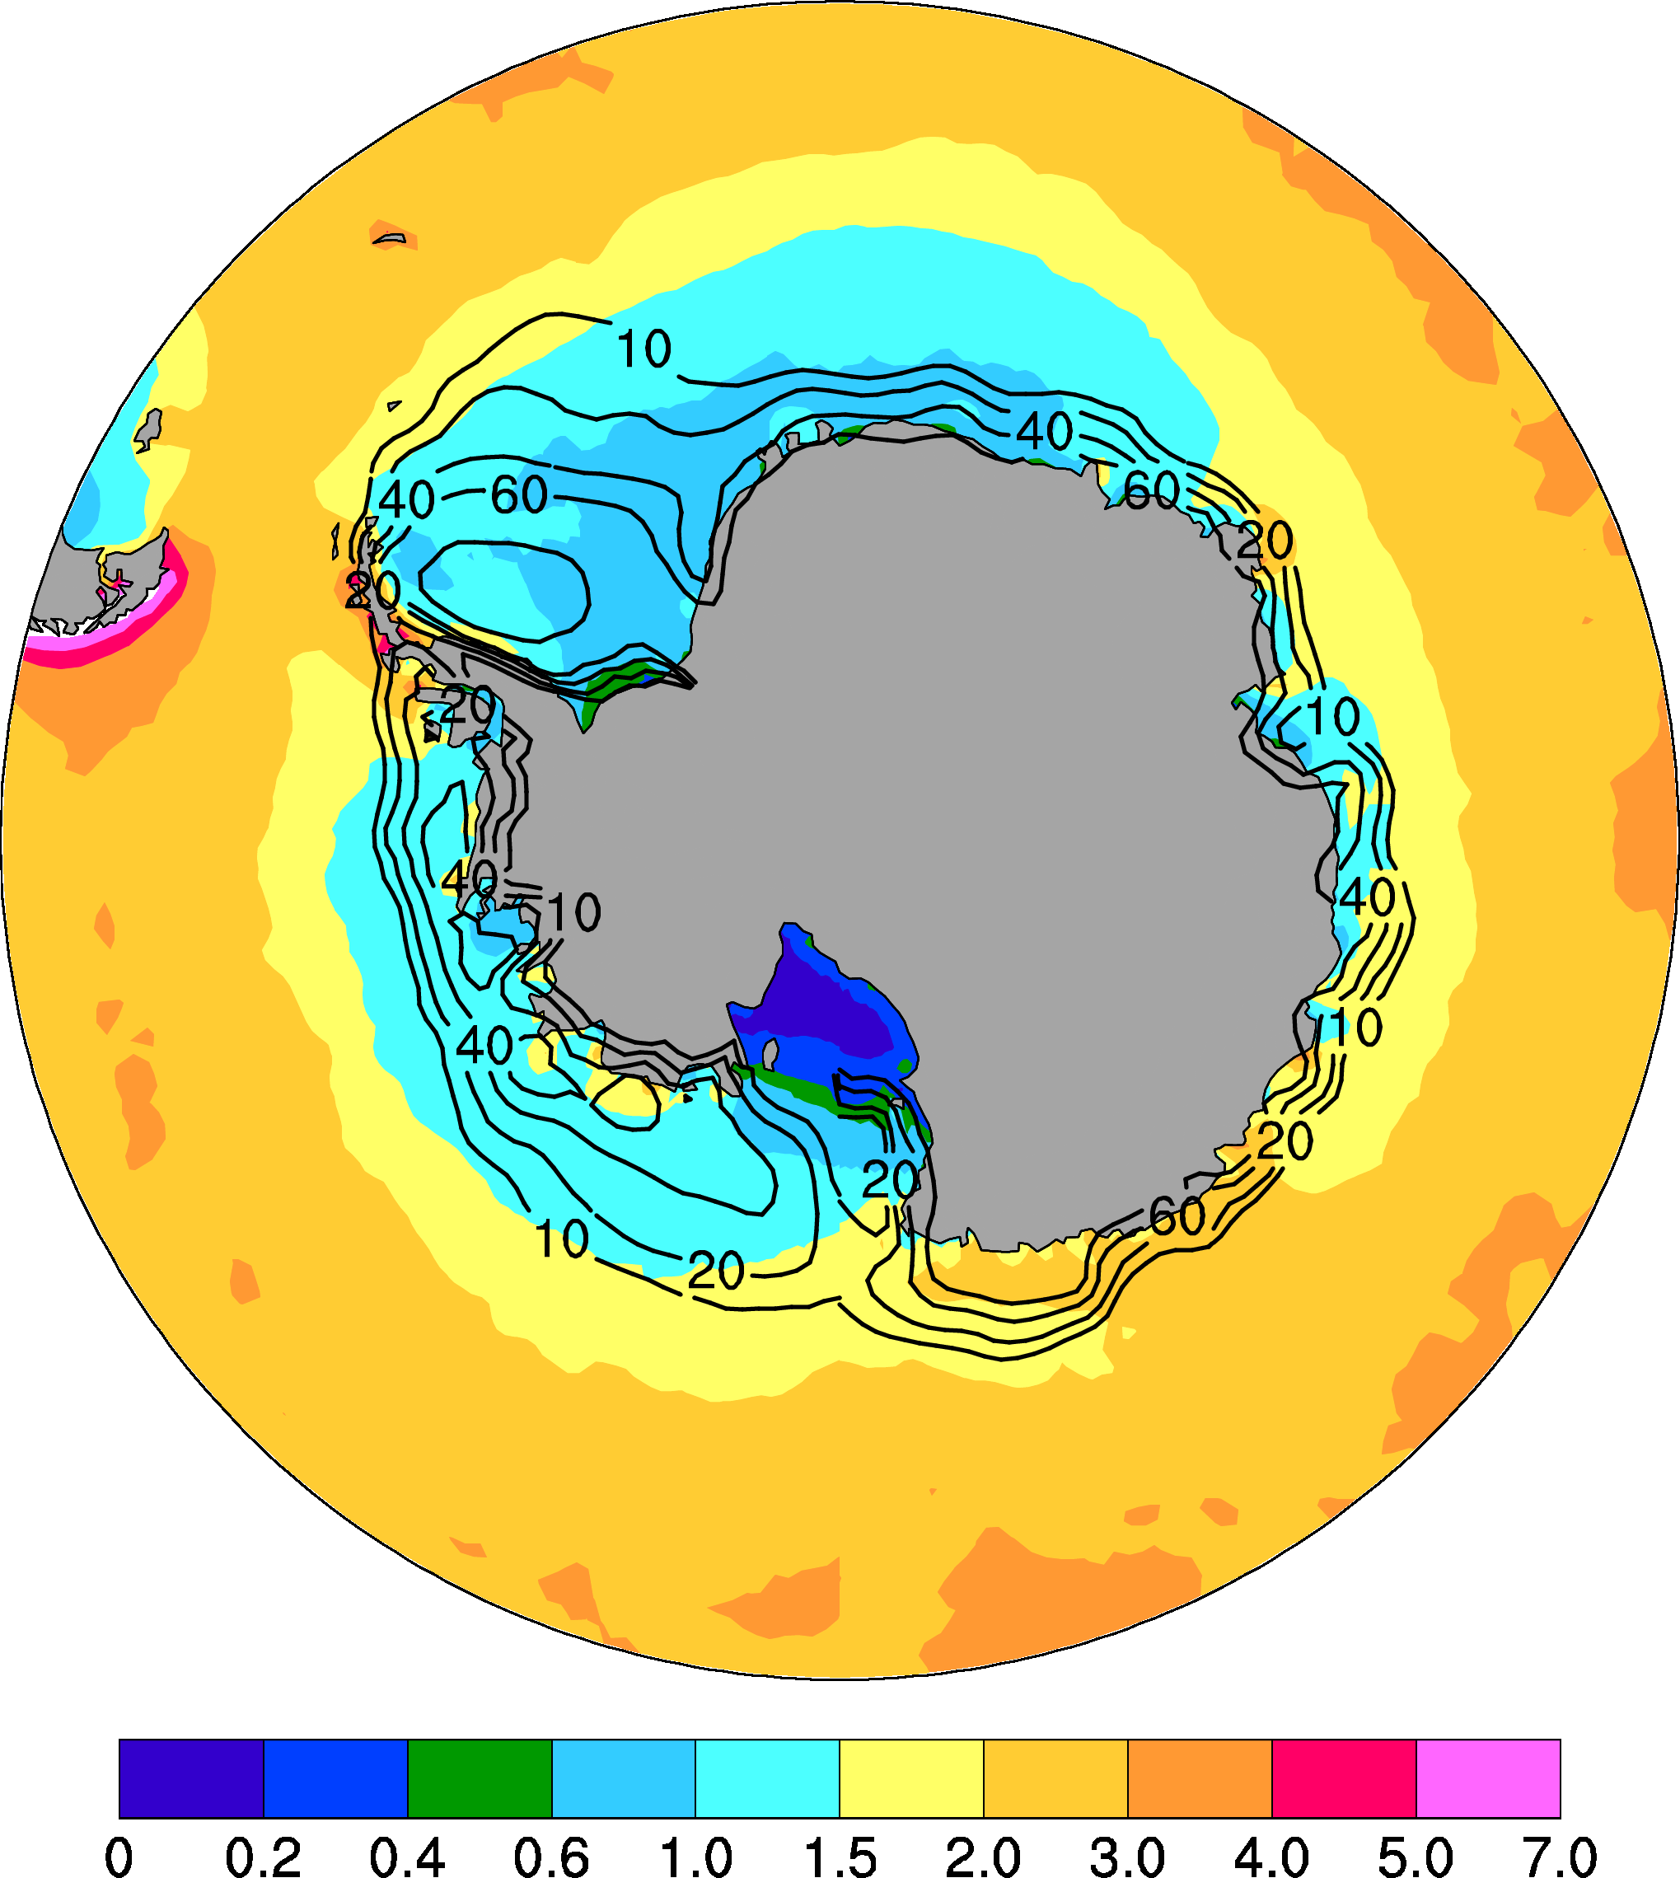
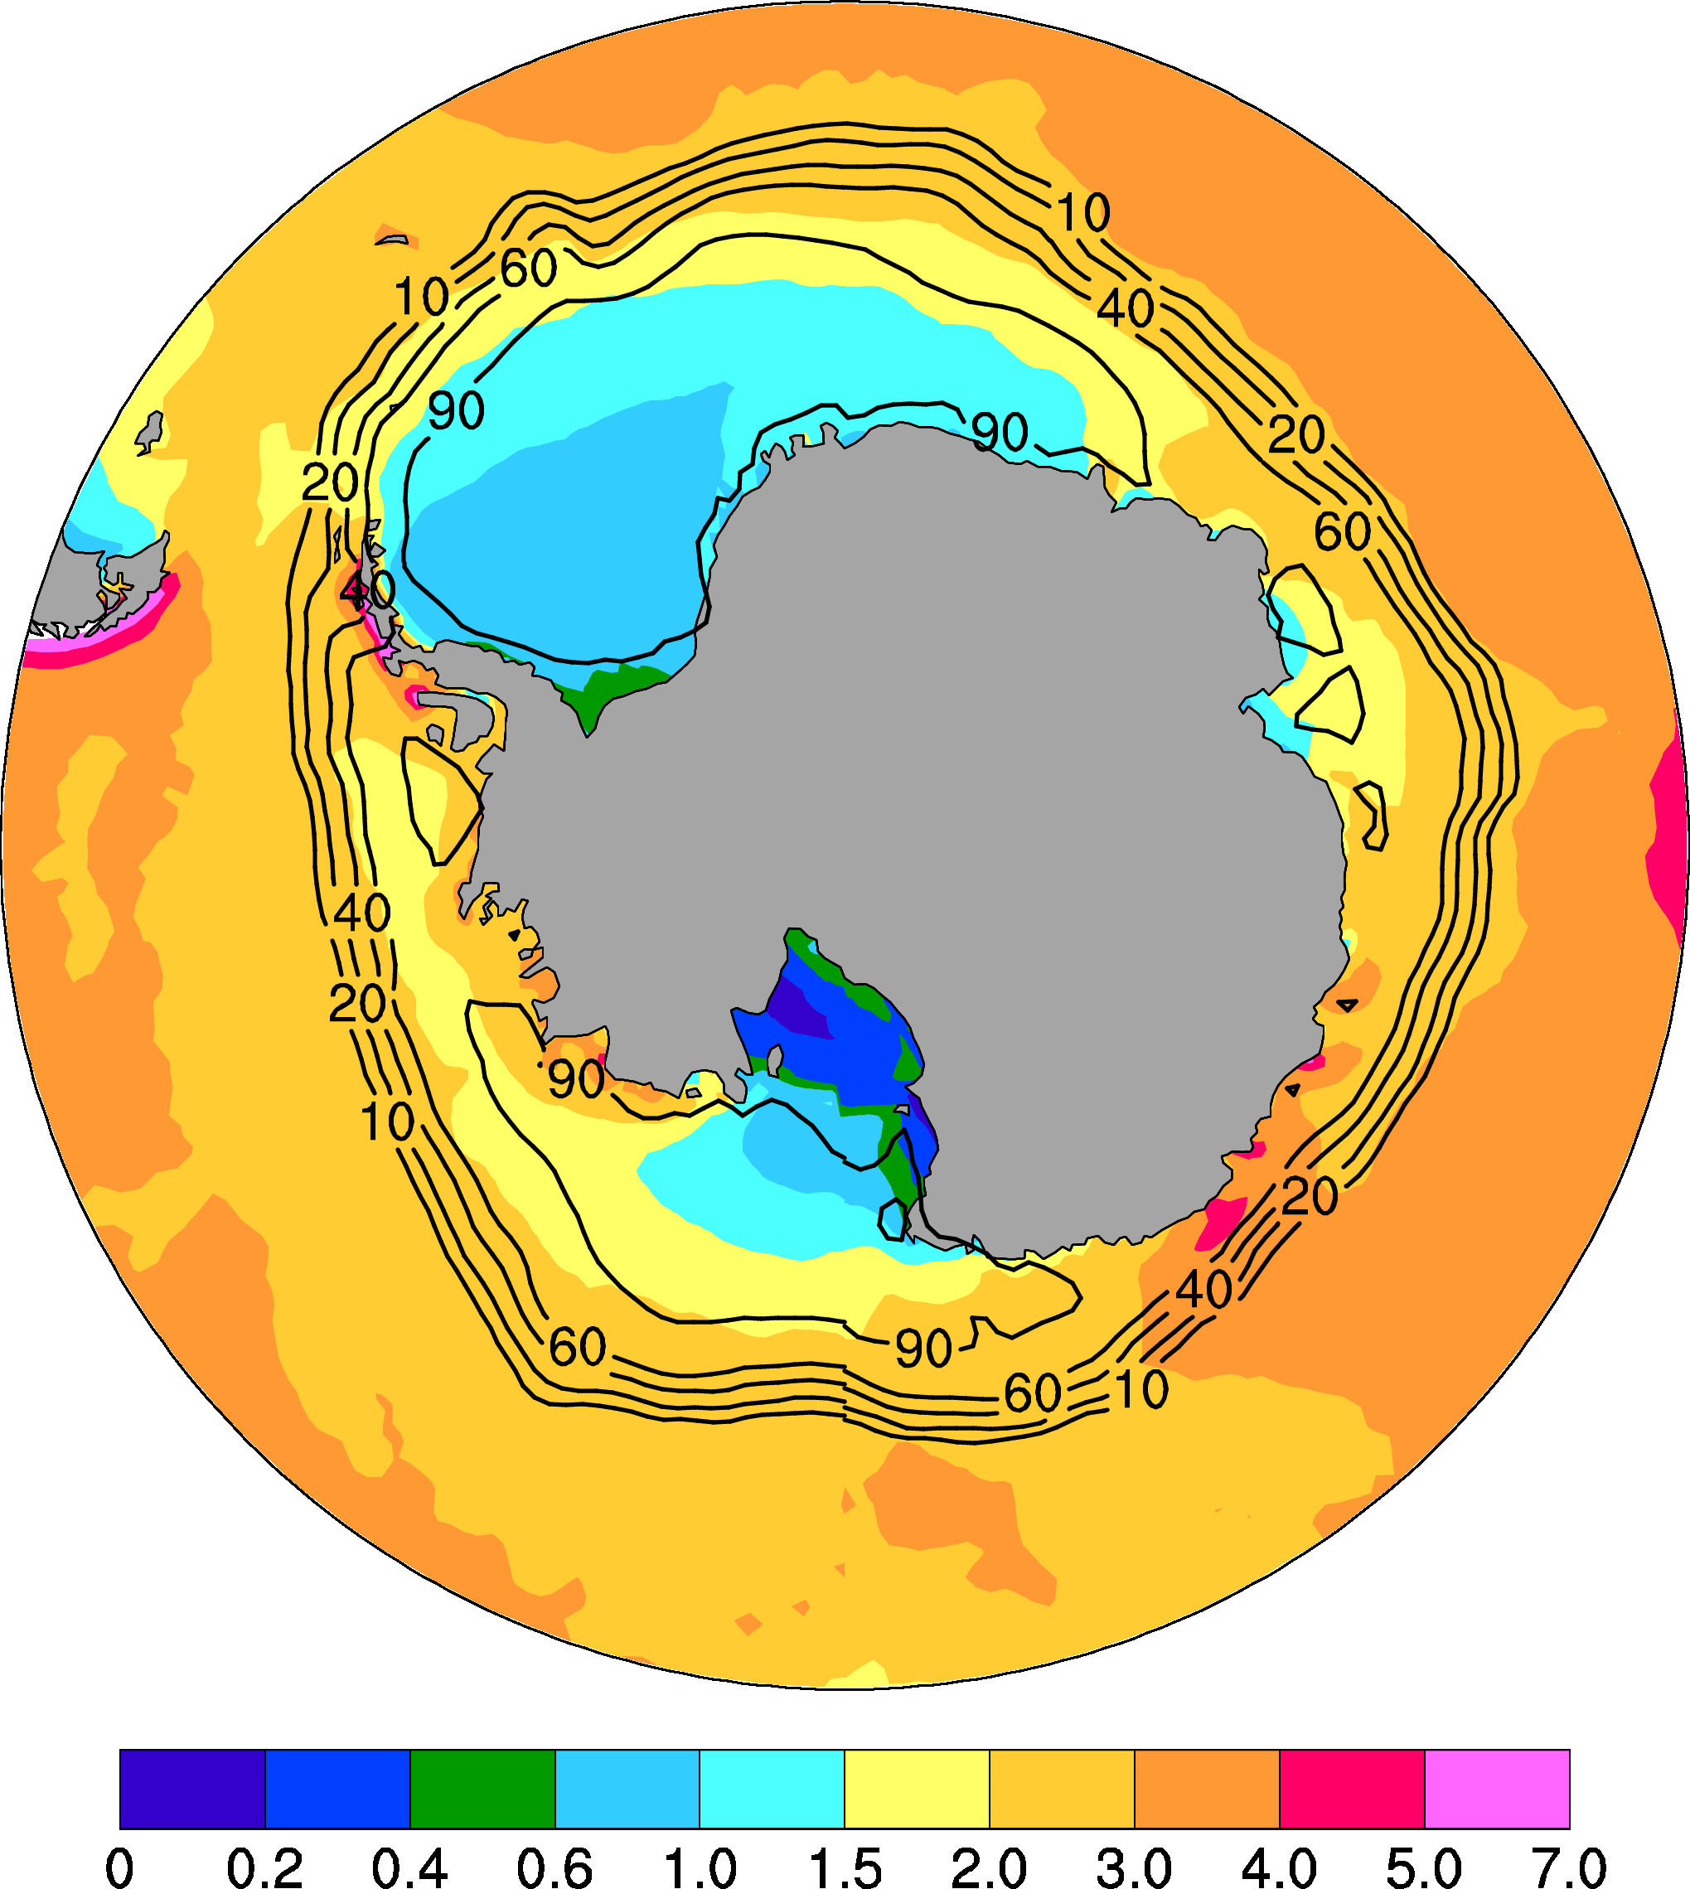
ERA5 Precipitation, 1979-2020 mean
January
July
mm/day
Contour = Sea-ice Concentration (%)
Notes:
ERA5 1979-2020 mean precip (mm/day, color) and SIC (contours in 90, 60, 40, 20, and 10%) for (left) Janunary and (right) July

Slide 22
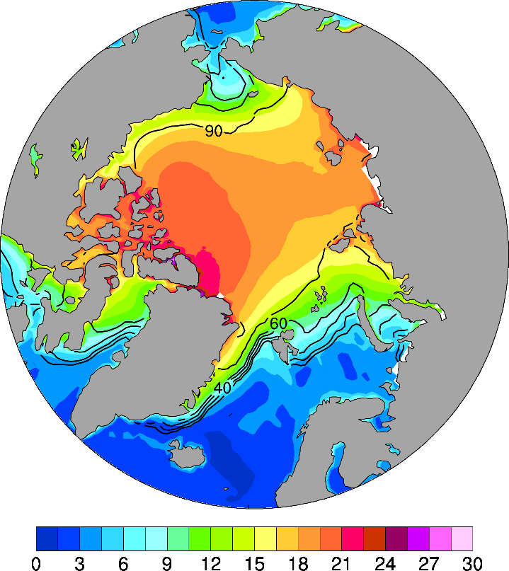
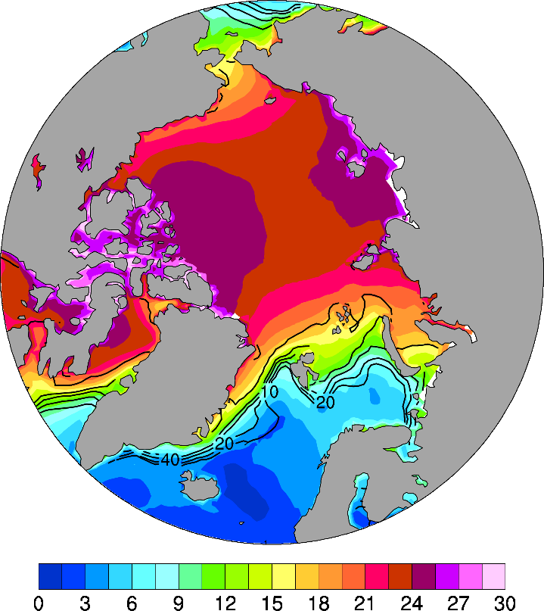
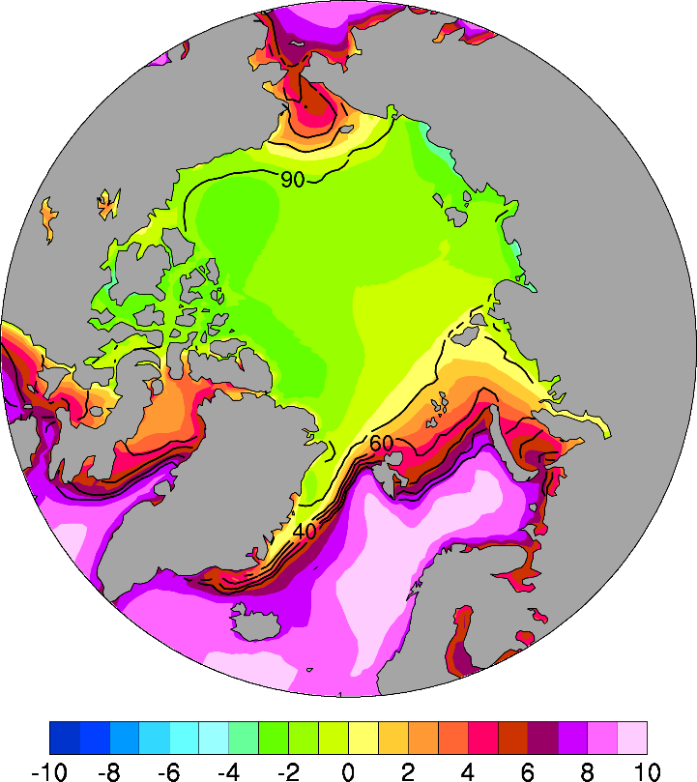
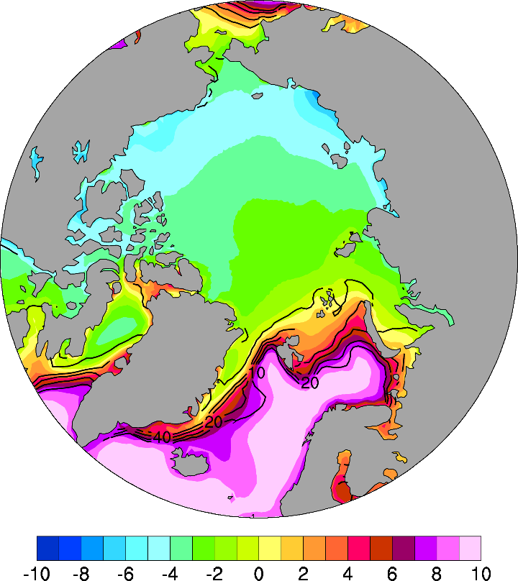
November
ERA5 1979-2015 Mean
January
a
b
SST-T2m
Color = T difference
Contour = sea-ice concentration
c
d
1000hPa – 850hPa
T difference
Notes:
ERA5 1979-2020 mean SST-T2m difference (shading, in K) for (a) November and (b) January, and ERA5 1979-2020 mean 1000hPa minus 850hPa temperature difference (shading, K) for (c) November and (d) January. Also shown is 1979-2020 mean sea-ice concentration for the same month (contours, in %, contour levels are 90, 60, 40, 20, and 10%) over 60N-90N. Note the sharp gradients along the ice margins.

Slide 23
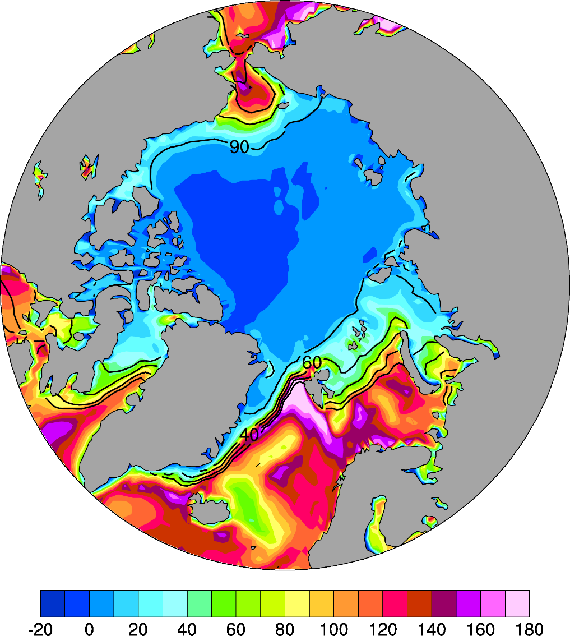

ERA5, 1979-2020 mean, November
SH + LH fluxes
Upward LW Radiation
a
b
W m⁻²
Contour = Sea-ice Concentration (%)
Notes:
ERA5 1979-2020 mean November (a) SH + LH fluxes and (b) upward LW radiation (positive upward, shading, in W/m2). Also shown is 1979-2020 mean November sea-ice concentration (contours, in %, contour levels are 90, 60, 40, 20, and 10%) over 60N-90N. Note the sharp flux gradients along the ice margins.

Slide 24


ERA5, 1979-2020 mean, November
Low Cloud Cover
High Cloud Cover
a
b
%
Contour = Sea-ice Concentration (%)
Notes:
ERA5 1979-2020 mean November (a) low and (b) high cloud cover (shading, in % of the sky). Also shown is 1979-2020 mean November sea-ice concentration (contours, in %, contour levels are 90, 60, 40, 20, and 10%) over 60N-90N. Note the sharp gradients along the ice margins.

Slide 25

Arctic September Sea-ice Extent
1979-2019

Slide 26


September Arctic Sea Ice Change 1979-2023
February Arctic Sea Ice 1979-2024
Source: http://nsidc.org/arcticseaicenews/sea-ice-analysis-tool/

Slide 27


September Sea Ice Trend
1979-2021
February Sea Ice Trend
1979-2022
Source: http://nsidc.org/arcticseaicenews/sea-ice-analysis-tool/

Slide 28



Arctic Sea-ice Loss
Sept Area Coverage
Magenta line = 1979-2000 mean of 8.7 million km²
Source: NSIDC
2012
2016
Notes:
Magenta line indicates the 1979-2000 mean coverage

Slide 29

Lowest on Record: 3.41 million km²

Slide 30




Slide 31
September Arctic Sea-ice Extent 1979-present

Slide 32

Arctic Late-summer Sea-ice Extent: Historical Perspective
Kinnard et. al 2011,Nature: based on proxy data from ice-cores, tree-ring, lake sediments, documentary, ocean cores around the Arctic.

Slide 33

Antarctic vs. Arctic Sea-ice Extent Trends
Source: NSIDC based on satellite microwave obs.
Notes:
Thick line=12month running mean, thin line = monthly anomaly

Slide 34


September Antarctic Sea Ice Change
February Antarctic Sea Ice Change
Source: http://nsidc.org/arcticseaicenews/sea-ice-analysis-tool/

Slide 35


September Sea Ice Trend
1979-2021
February Sea Ice Trend
1979-2022
Source: http://nsidc.org/arcticseaicenews/sea-ice-analysis-tool/

Slide 36

Antarctic Ice Shelves
0º
South Atlantic Ocean
Weddell Sea
South Indian Ocean
Antarctic Peninsula
Bellingshausen Sea
West Antarctica
East Antarctica
90ºW
90ºE
Amundsen Sea
Ross Sea
South Pacific Ocean
180º
Notes:
Ice shelves are permanent floating sheets of ice that connect to a landmass, mostly seen in Antarctica.

Slide 37

Recent Antarctic Mass Changes

Slide 38
Causes of Arctic Sea-ice Variations
Studies suggest that winter Arctic ice variations are largely caused
by changes in surface heat flux (thermodynamic) and wind stress
(dynamic) induced by atmospheric circulation changes (Alexander et al.
2004).
NAO’s trend toward a positive phase is associated with an
intensification of the Icelandic low and advection of anomalously
warm (cold) air to the east (west) of Greenland, which results in
ice extent increases in the Labrador Sea and decreases in the
Greenland–Iceland–Norwegian (GIN) Seas (Deser et al. 2000).
The recent rapid decline seems to be related to high pressure over
Greenland that may result from atmospheric blocking (a stationary pressure
system) associated with midlatitude circulation (Overland et al. 2012)
The blocking led to decreases in East – West Arctic SLP gradient since ∼2002,
which led to increased pressure gradient across the Fram Strait and thus
increased export of sea-ice into the N. Atlantic.

Slide 39

Arctic Sea-ice Circulation
Greenland
Kwok & Untersteiner 2011

Slide 40


Slide 41

925mb JJAS Anomaly Winds
2007-2011 minus 1979-2006
Ogi & Wallace (2012)

Slide 42

June 700hPa Geopotential Height
2007-2012 minus 1971-2000
1981-2010 Mean
2007-2012 Mean
H
Atmospheric blocking over Greenland may be responsible for the
height and pressure anomalies, which lead to stronger winds and
sea-ice export along the Fram Strait
Overland et al. (2012)

Slide 43


Causes of Recent Sea-ice Reduction
East
West
East – West Arctic SLP
gradient is decreasing!
Overland et al. (2012)

Slide 44
Impacts of Arctic Sea-ice Loss
Enhanced warming over the Arctic Ocean and nearby land areas
(Kumar et al. 2010)
Increased winter snowfall over Eurasia and N.A. (Liu et al. 2012)
Potential slow down of midlatitude Rossby waves (Francis et al. 2012)
Other significant impacts on precipitation and atmospheric
circulation (Alexander et al. 2004; Singaryar et al. 2006).

Slide 45

Zonal-mean T Trend from 1989-2008, ERA-I Data
Screen & Simmonds (2010, Nature)
AA = Arctic enhanced warming related to the global-mean under increasing GHGs
DJF
MAM
Strongest in DJF
Strongest at Sfc.
AA = Arctic dTas /
Global dTas
JJA
SON
Weakest in JJA
No AA at Sfc.
Notes:
Screen and Simmonds (2010) concluded that sea-ice loss is central to AA, mainly based on regression analysis, which showed that most of the observed Arctic warming can be explained statistically by sea-ice loss.

Slide 46

Impact of Winter
No sea-ice loss
With sea-ice loss
Serreze & Barry (2011)
Notes:
Fig. 2. Schematics of the surface energy budget of the Arctic Ocean, contrasting the situation during the low-sun period for (left) an unperturbed Arctic and (right) in response to a positive (warming) climate forcing that results in decreased ice concentration and thickness. The dotted line is an arbitrary isotherm in the lower troposphere; warming over the Arctic Ocean bows the isotherm upward. SW = shortwave radiation flux, LW = longwave radiation flux, Sens. Heat = sensible heat flux, Lat. Heat = latent heat flux. (From Serreze and Barry 2011).

Slide 47



1979−2016 Trend
Dai et al. (2019)

Slide 48



Nov-Dec
1979-2016 Trend:
SIC trend: Color shading
ERA-I Data for Dec-Nov
(NOAA Satellite SIC data show similar trends)
Largest warming
over areas with
sea-ice loss (as shown later, the dTas is not the main cause of the SIC pattern!)
SH+LH fluxes contributes
to the warming
Tas Trend
Tas Trend (K/decade)
SH+LH Trend (W m⁻²/decade)
%/decade
Dai et al. (2019)

Slide 49

Potential Impacts of Arctic Amplification
Arctic Amplification (AA=2~3)
Jet stream may become less zonal
Walsh (2014), Francis & Vavrus (2015), Francis et al. (2017)
Thermal Winds:

Slide 50

Arctic Warming and Eurasian Cooling
Cohen et al. (2014)

Slide 51

SAT (color) and 500hPa Z (contours) regressed on Arctic SIC (1979-2015)
Many studies have concluded that Arctic sea-ice loss and the accompanying AA have contributed to the recent cold and snowy winters over Eurasia and N.A., often based on regression analyses (Liu et al. 2012; Mori et al. 2014, 2019; Yao et al. 2017; etc.).
Yao et al. (2017)
Notes:
Linear regressionmap (north of 308N) of DJF-mean 500-hPa height [contours;
interval 5 15 gpm(std dev)21] and SAT [color shading; K(std dev)21] anomaly fields projected onto the Arctic SIE
time series [blue line in (a),multiplied by-1] with all the data being detrended prior to the regression. The green line
encircles the area over which the regression coefficients are above the 95% confidence level based on the two-sided
Student’s t test. 1979-2015 NCEP-NCAR data for Z and SAT daily data (detrended).

Slide 52
Greenland Ice Sheet: 4min
Arctic Sea-Ice Loss Video: 6min

Slide 53

CMIP5 Model-simulated Arctic Sept Sea-ice Extent
nearly sea ice free by the 2030s
Wang & Overland 2012, GRL
1900
2000
2100
Notes:
nearly sea ice free by the 2030s

Slide 54

CMIP5 Model Projected Sea-ice Changes
Sea-ice concentration (%)

Slide 55
Summary for Sea-ice and polar climate
Polar sea-ice covers about 7% of the Earth surface or 12% of global oceans. It varies seasonally with a max. in March and min. in Sept in the Arctic. Opposite for Antarctic sea ice.
There are many complex processes within sea ice, including thermodynamic and dynamic processes.
Sea-ice increases surface albedo and atmospheric stability, but cuts off air-sea exchanges of heat and moisture, thus affecting the climate.
The Arctic Ocean is a net energy sink during the warm season but a heat source to the air during the cold season (Oct-Mar).
Arctic sea-ice extent in summer and fall has been decreasing rapidly since 1979, and it is likely related to polar warming and atmospheric circulation changes.
Arctic and Antarctic climate has a very large seasonal cycle with little precipitation in winter Arctic.
Sea-ice loss can lead to large oceanic heating of the air in winter, leading to amplified Arctic warming.
Arctic amplification reduces │dT/dy │, which may lead to weaker U and other changes in midlatitudes.
The Arctic is projected to be almost ice free in September by the 2030s.

Slide 56
Next Lecture
The Global Carbon Cycle

