Slide 1
Key points of last lecture
The Global Carbon Cycle:
- Terrestrial organic carbon cycle: Plant’s photosynthesis & soil respiration,
CO₂ fertilization
- Marine organic carbon cycle: Phytoplankton’s photosynthesis,
zooplankton’s removal of organic materials, deposit to sea floor ->
biological pump – important on geological time scales (millions of years)
- Inorganic carbon cycle: Silicate-carbonate cycle, weathering and rock
metamorphism, important on geological time scales
- Ocean acidification: Increased CO2 → lower PH in seawater → major
impacts on marine organisms
Anthropogenic Carbon Emissions:
- Atmospheric CO₂ has been rising rapidly since the 19th century to ~420ppm today.
- CO₂ emissions from fossil fuel burning and deforestation (~9.5GtC/yr) have greatly altered the global carbon cycle, causing rapid CO₂ rise.

Slide 2
A ATM551: Lecture #16
Climate Variability & Extremes

Slide 3
Design of the Course (2/3)
Part 2 – Basic Controls of Earth’s Climate (cont’d)
Lecture 11: Water Vapor, Clouds, and Aerosols (2/22)
Lecture 12: Atmospheric Convection & Tropical Climate (2/27)
Lecture 13: Air-Sea & Land-Atmosphere Interactions (2/29)
Lecture 14: Sea Ice and Polar Climate (3/05)
Lecture 15: The Global Carbon Cycle and Climate (3/07)
Mid-term review: 3/12
Mid-term Exam: March 14
Spring Break: March 16-22
Part 3 – Climate Variability and Climate Modes (5 lectures)
Lecture 16: Climate Internal Variability and Extremes (3/26)
Lecture 17-18: ENSO and its impacts (3/28, 4/02)
Lecture 19-20: Atlantic and Pacific Multidecadal Variability (4/04, 4/09)

Slide 4
Climate vs. Climate Variability
Climate refers to:
- Long-term (e.g., 30yr) mean states near the surface and in the atmosphere and oceans.
- Examples: 30yr averaged daily or monthly or annual-mean T and P may be considered as part of the climate at a given location.
- But the mean T and P for the last winter or last year may not be representative of the (mean) climate.
Climate Variability (or Variation) refers to:
- Variations of any climate variable (e.g., T, P, or winds) over many years. The variations can be from season to season (annual cycle), year-to-year (inter-annual), decade-to-decade (inter-decadal).
- A monthly or annual mean for a given year represents one realization (a happened case) of the mean climate for that particular month or year.
- Monthly anomalies (relative to long-term mean annual cycle) are often used to quantify climate variability and change over a given period.
Climate fluctuates naturally from year to year or decade to decade due to internal dynamics!

Slide 5
Major Modes of Climate Variability
Modes of Climate Variability: recurring spatial and temporal patterns of climate variations. Major focus of climate analysis
Inter-annual modes:
- El Niño-Southern Oscillation (ENSO)
- North Atlantic Oscillation (NAO)
- Arctic Oscillation (AO) or Northern Annular Mode (NAM)
- Southern Annular Mode (SAM), similar to NAM but for S.H.
Decadal to multi-decadal modes (Liu 2012, JC):
- Pacific Decadal Oscillation (PDO)
- Inter-decadal Pacific Oscillation (IPO)
- Atlantic Multi-decadal Oscillation (AMO)

Slide 6
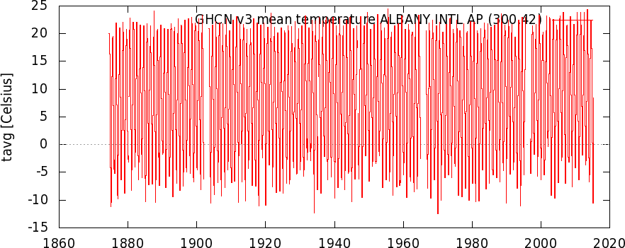

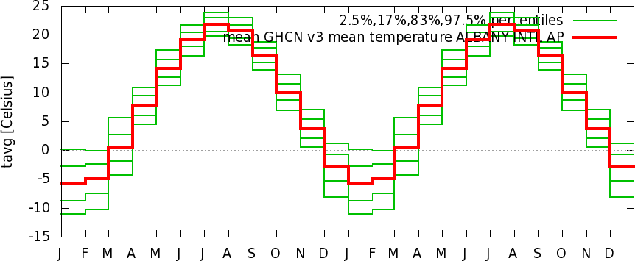
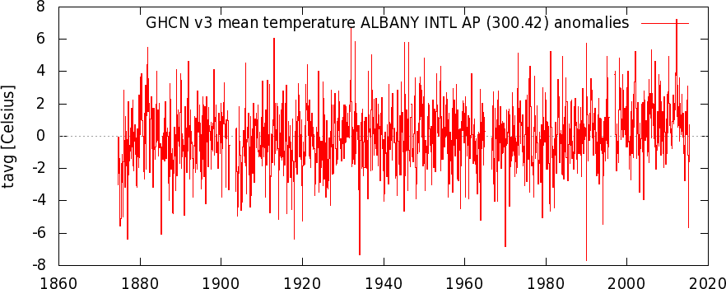
Forced Changes vs. Internal Variations
Monthly mean Temperature at Albany, NY: 1874-2015
Total variations
and changes
dT = dT_{forced} +
dT_{unforced}
Sun-forced
seasonal cycle
Residual: mostly
unforced internal
variations, but may
still contain GHG-
forced changes.

Slide 7
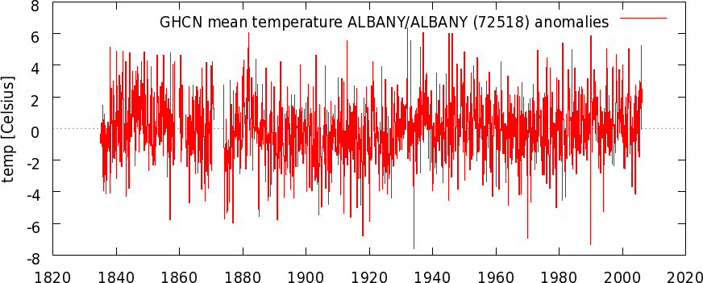
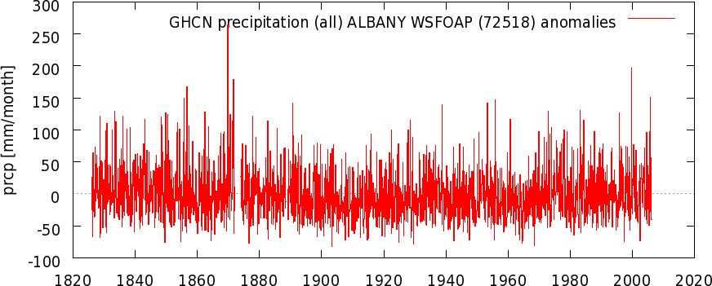
Albany T & P Monthly Anomalies since the 1830s
- Data from a single location can be noisy.
Long-term change signal is often weak compared with natural
variations.
- This presents a challenge for quantifying long-term changes.
Notes:
Monthly anomaly (with the mean annual cycle removed)

Slide 8
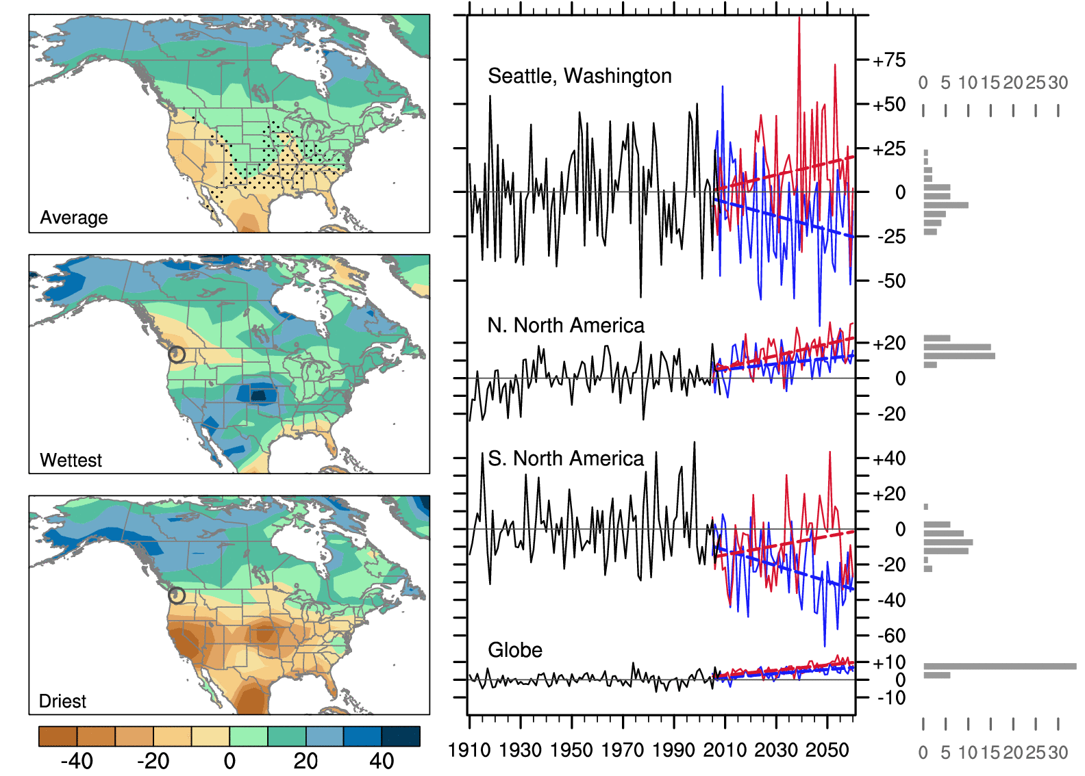
Different Trends due to Internal Variability
CCSM3 Ensemble Runs (What’s the implication for obs?)
P change (%)
Deser et al. (2012, NCC) 40-member ensemble, 2000-2060, A1B scenario
Notes:
40 CCSM3 ensemble runs with AGCM starting from different days in December and January 2000 and continue to 2060 under IPCC A1B scenario. Stippling indicates insignificant trends. Same GHG forcing in these runs.

Slide 9
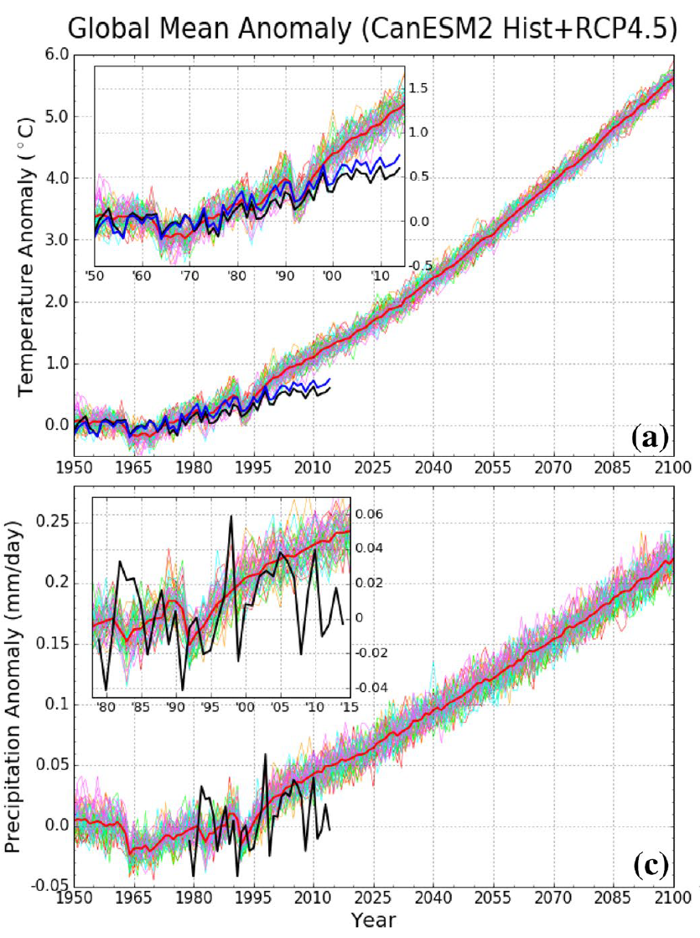
Internal variations in
Global-mean T and P:
Each line is one ensemble
model simulation. The difference
among them is due to internal variability.
The observation represents one of the
model runs.
Dai and Bloecker (2019)

Slide 10
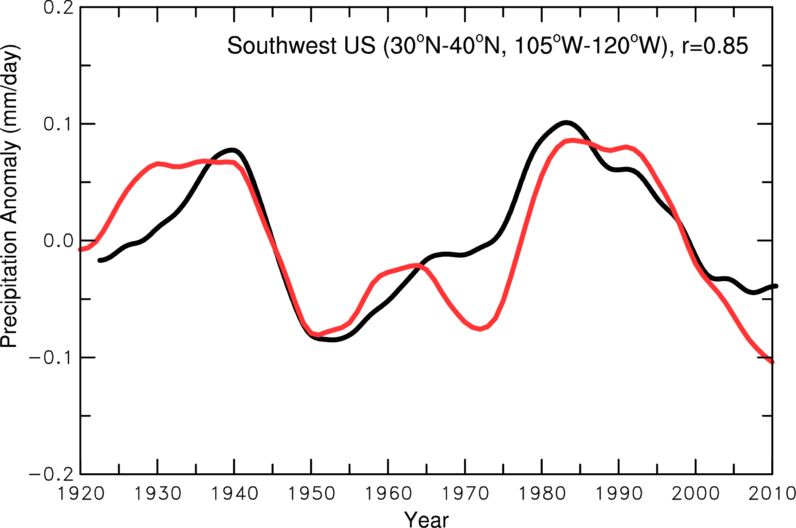
Natural Cycles or Trends?
P
IPO

Slide 11
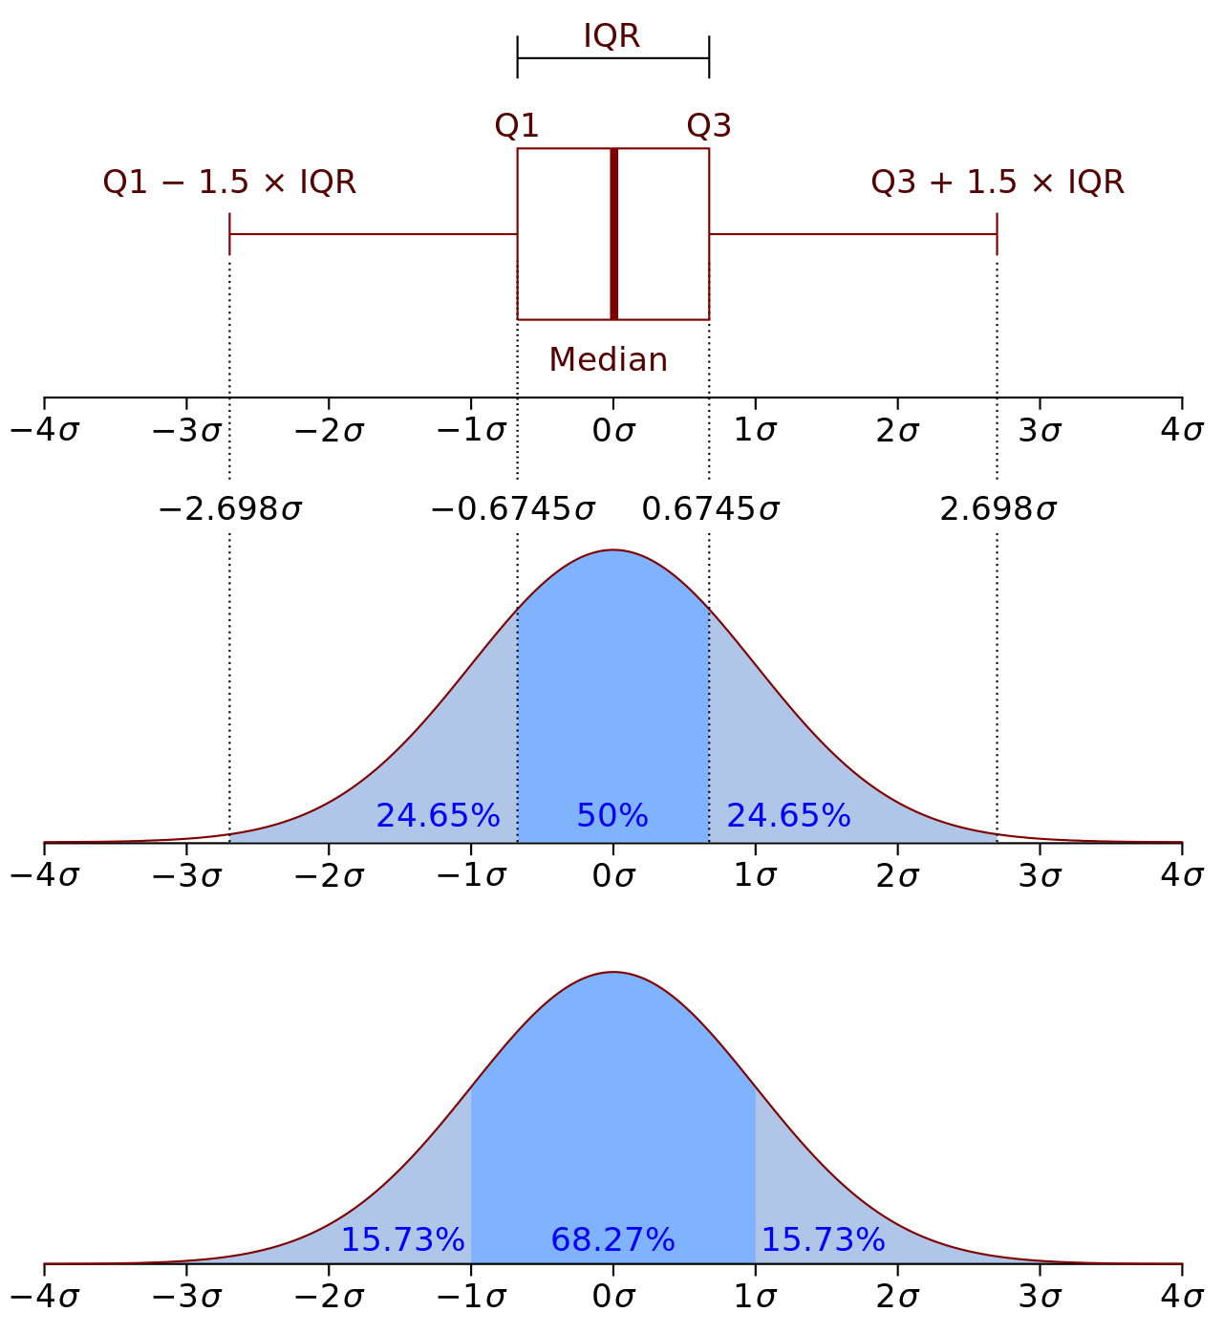
One way to quantify the variability is to use S.D. (σ)
Many (averaged) variables (e.g., T, q) have a normal distribution
SD is sufficient to define its variability or spread for normal distributions.
From Wikipedia

Slide 12
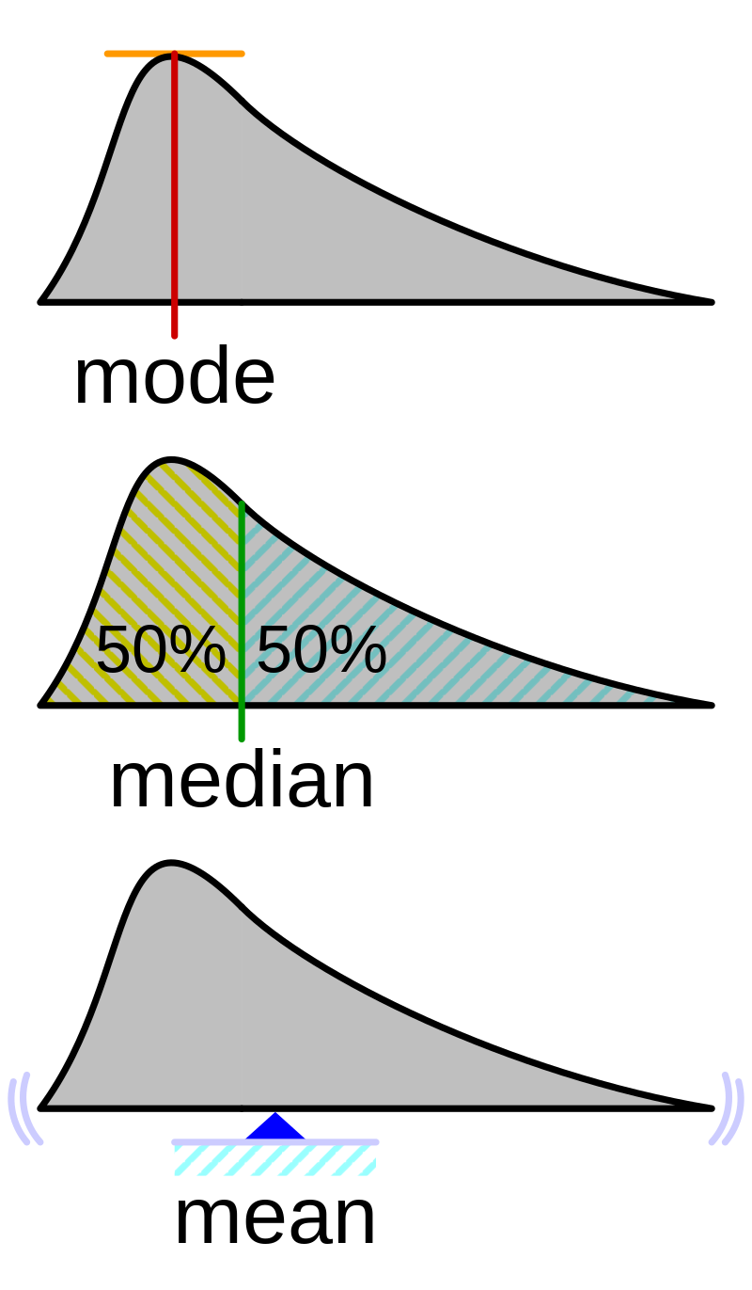
One way to quantify the variability is to use S.D. (σ)
Some (unaveraged) variables (e.g., precip.) have a non-Gaussian distribution
SD is insufficient to describe its distribution, but is still a useful measure of variability
From Wikipedia

Slide 13
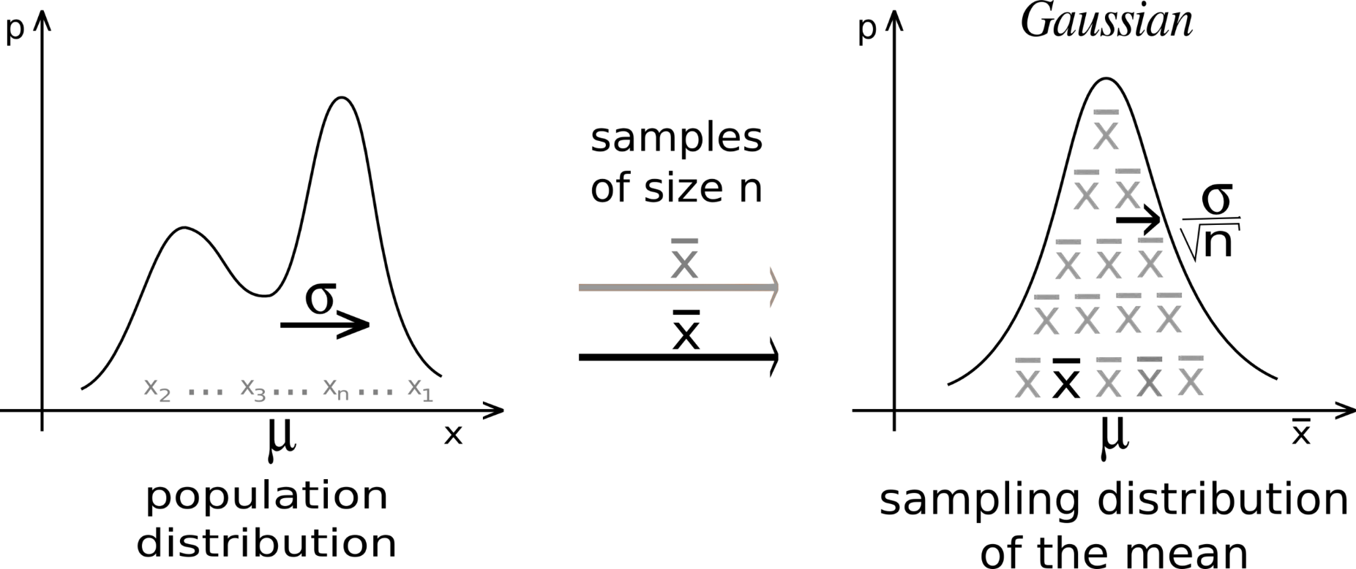
The central limit theorem (CLT) establishes that, in many situations, when independent random variables are summed up, their properly normalized sum tends toward a normal distribution even if the original variables themselves are not normally distributed.
p
p
p
Hourly Precipitation
Daily Precip Anomaly
Monthly Precip Anomaly

Slide 14
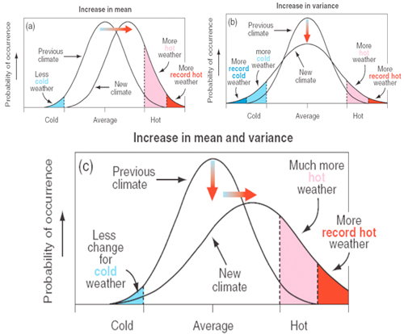
Changes in the Mean and Variability
From IPCC 2001, Fig. 2.32
GHG forcing can cause changes in both the mean and variance!
A 2ºC warming is a mean change.
The frequency of the hot temperatures could increase rapidly.

Slide 15
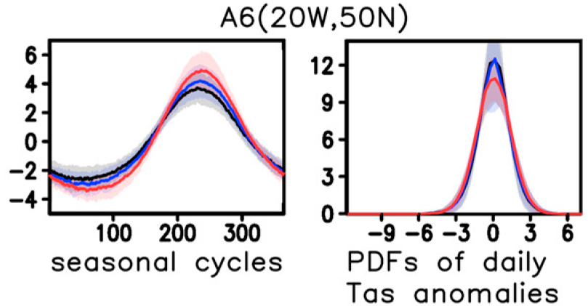
2m Daily Air Temperature from One Location in CMIP5
Chen et al. (2019)

Slide 16
2m T Seasonal Amplitude & SD
Chen et al. (2019)
Notes:
FIG. 2. (left) Distributions of the (a) amplitude (unit: 8C) of the 1979–98 mean seasonal cycle of daily surface air
temperature (Tas) and (c) the standard deviation (SD) of daily Tas anomalies (i.e., with the 20-yr-mean seasonal
cycle removed before calculating the SD) during 1979–98 from ERA-interim reanalysis. (right) (b),(d) As in (a),(c),
but for the mean results of the historical simulations averaged over the 25 CMIP5 models listed in Table 1. Stippling
in (a),(c) indicates the areas where the ERA-interim values are outside the 5%–95% range of the model results.

Slide 17
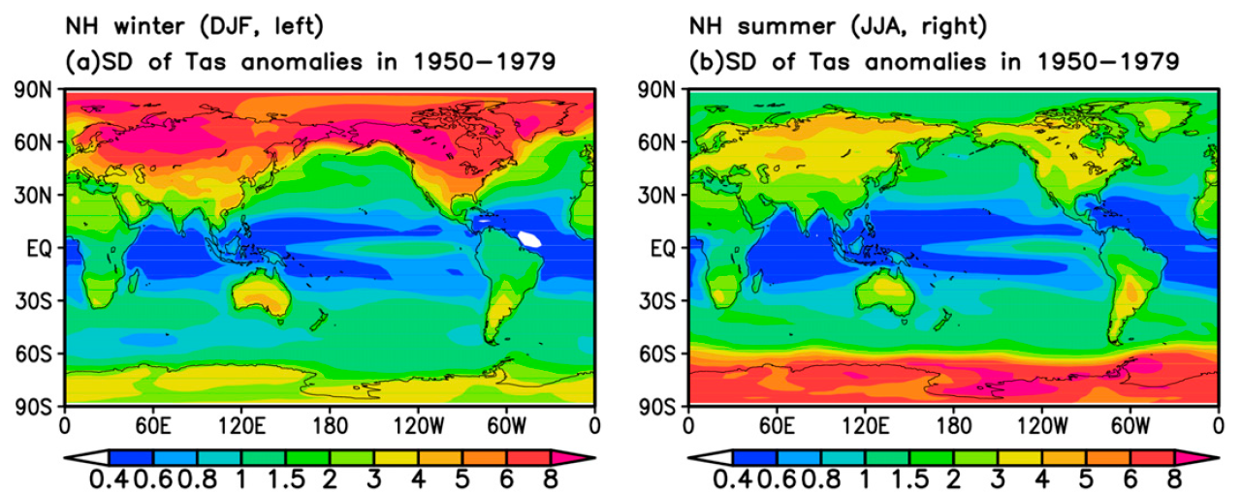
Seasonal SD of 2m Daily Tas, CMIP5 Models
Why is the winter Tas more variable?

Slide 18
CMIP5 model-projected Percentage Change for Annual Tas
Seasonal Amplitude
Standard Deviation (SD)
Chen et al. (2019)
Notes:
FIG. 5. The 25 CMIP5 model-averaged percentage change (in % of the 1950–79) in (a) the amplitude of the mean
seasonal cycle of daily surface air temperature (Tas) and (b) the standard deviation (SD) of Tas anomalies (i.e., with
the 30-yr-mean seasonal cycle of each period removed from the daily Tas before calculating the SD, with all days
included) from 1950–79 to 2010–39 under the RCP8.5 scenario. (c),(d) As in (a),(b), but for changes from 1950–79
to 2070–99. Stippling indicates at least 80% of the models agree on the sign of change.

Slide 19
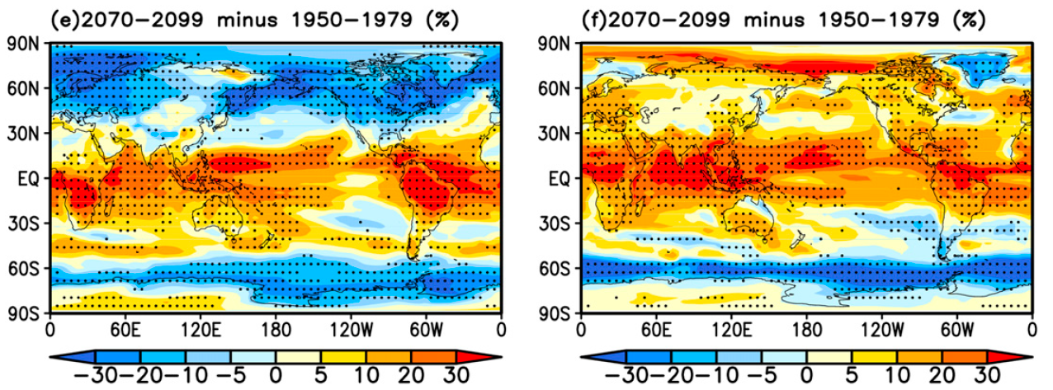
CMIP5 model-projected Percentage Change for
SD of Daily Tas for DJF and JJA
Chen et al. (2019)

Slide 20
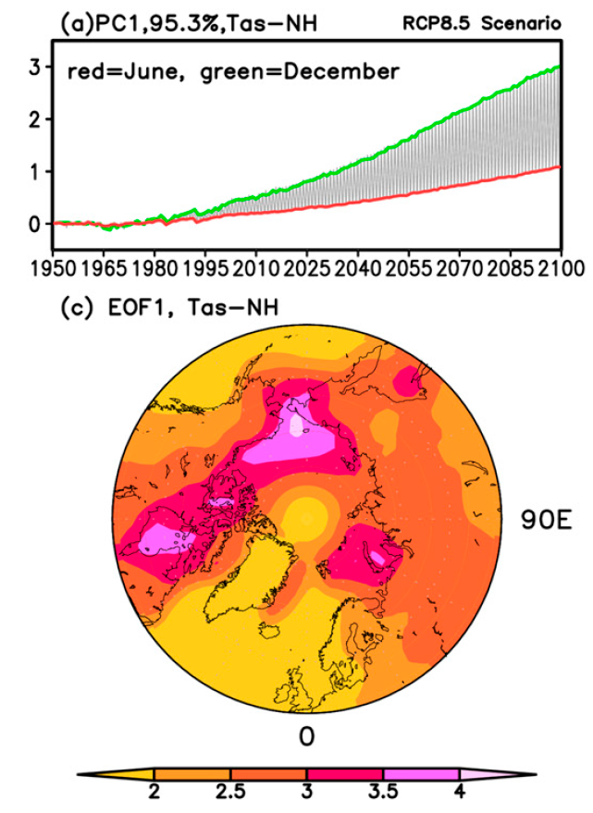
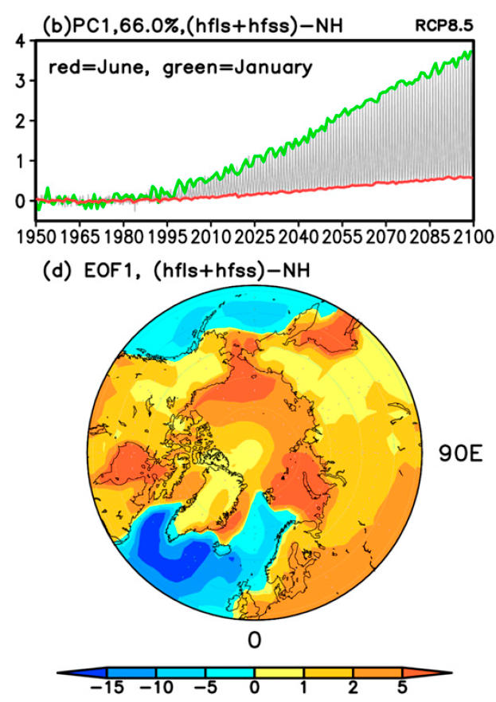
Sea ice-indued larger winter warming → reduced seasonal amplitude at high latitudes
Chen et al. (2019)
Notes:
FIG. 11. The (a),(b),(e),(f) time series and (c),(d),(g),(h) spatial patterns of the first leading EOF mode of
monthly anomalies (relative to the 1950–80 mean, with all months concatenated) of (left) surface air temperature
(averaged over 72 model runs) and (right) sea ice concentration (averaged over 38 model runs) from the ensemble
mean of the historical (for 1950–2005) and RCP8.5 (for 2006–2100) simulations by 38 CMIP5 models for the (a)–(d)
northern (508–908N) and (e)–(h) southern (508–908S) latitudes. Areas with less than 5% sea ice concentrations of
the current (1950–79) mean were masked out in the sea ice analyses. In the time series plots, the two-colored lines
connect the temporal coefficients corresponding to each of the two specific months while the coefficients for all the
other months fall between them.

Slide 21
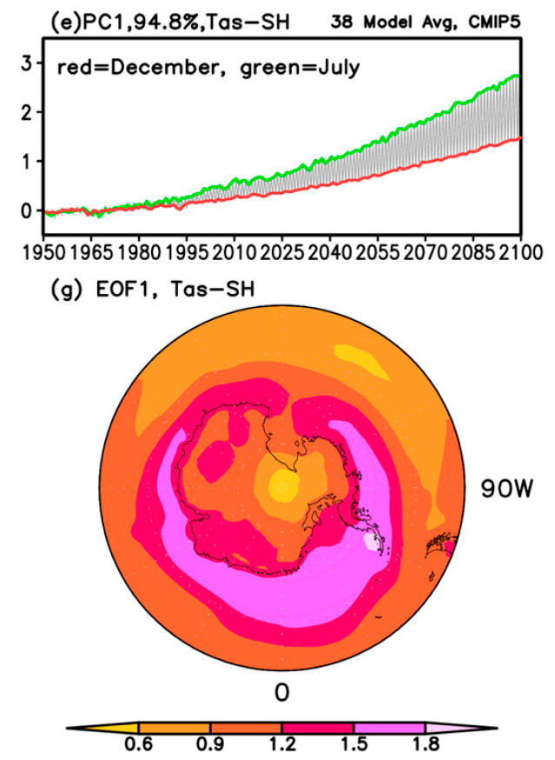
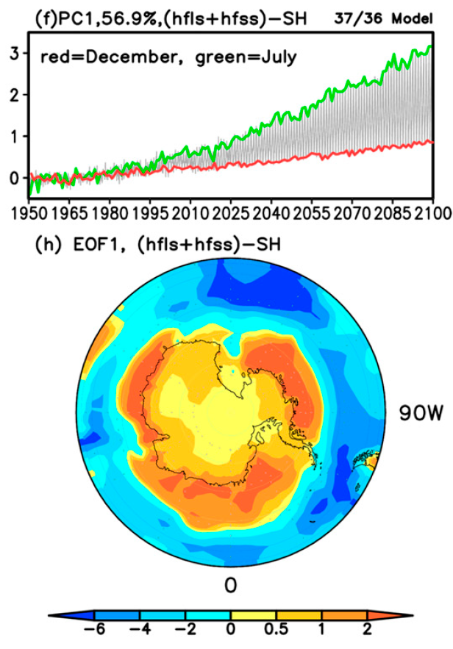
Sea ice-indued larger winter warming → reduced seasonal amplitude at high latitudes
Chen et al. (2019)
Notes:
FIG. 11. The (a),(b),(e),(f) time series and (c),(d),(g),(h) spatial patterns of the first leading EOF mode of
monthly anomalies (relative to the 1950–80 mean, with all months concatenated) of (left) surface air temperature
(averaged over 72 model runs) and (right) sea ice concentration (averaged over 38 model runs) from the ensemble
mean of the historical (for 1950–2005) and RCP8.5 (for 2006–2100) simulations by 38 CMIP5 models for the (a)–(d)
northern (508–908N) and (e)–(h) southern (508–908S) latitudes. Areas with less than 5% sea ice concentrations of
the current (1950–79) mean were masked out in the sea ice analyses. In the time series plots, the two-colored lines
connect the temporal coefficients corresponding to each of the two specific months while the coefficients for all the
other months fall between them.

Slide 22
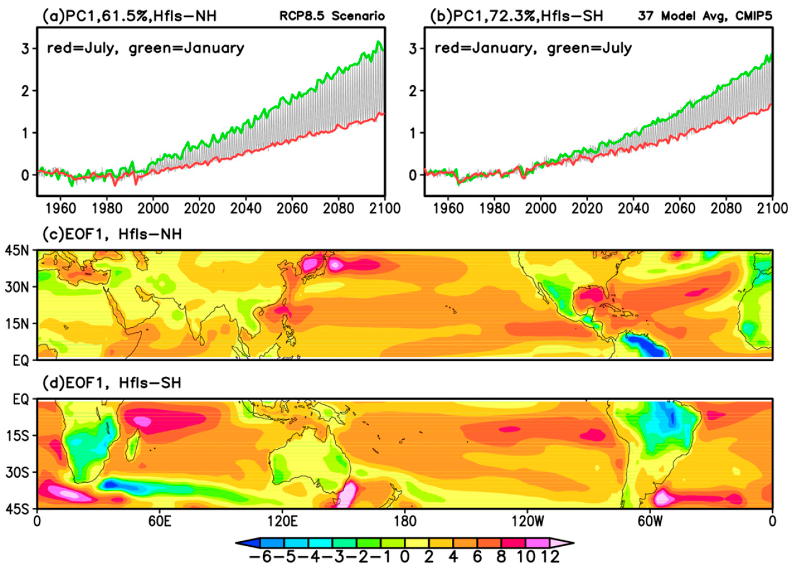
Larger winter LH increase→ reduced winter warming →
Increased seasonal amplitude at low latitudes

Slide 23
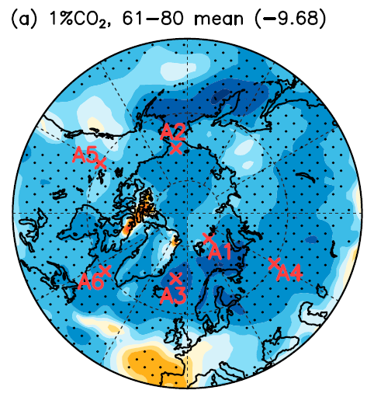
Percentage Change in SD of Oct-March Daily Tas at 2xCO₂ in CESM1
Dai and Deng (2021)

Slide 24
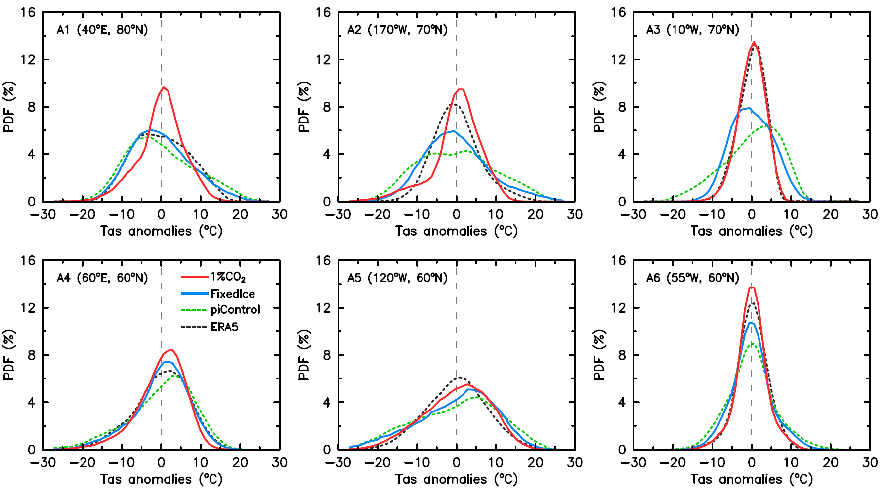
PDFs of Oct-March Daily Tas in CESM1 at High-lat. Locations
Red line = PDF at 4xCO₂
Dai and Deng (2021)

Slide 25
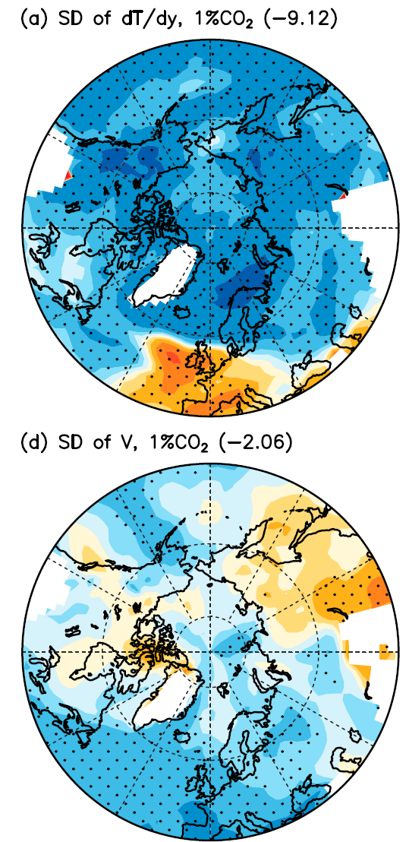
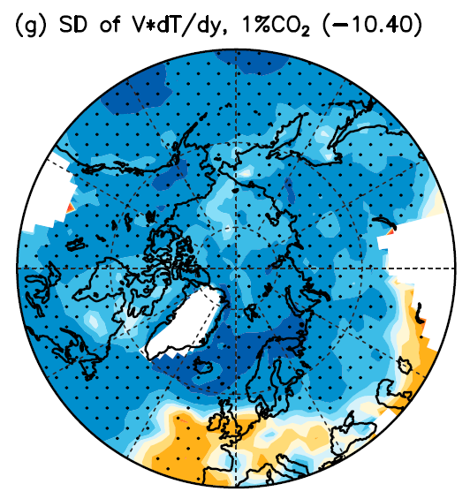
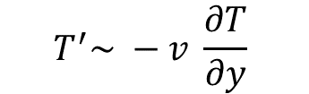
$$T^{′}\sim −v \frac{∂T}{∂y}$$
Decreased variability in meridional
thermal advection →
decreased T variability
Dai and Deng (2021)

Slide 26
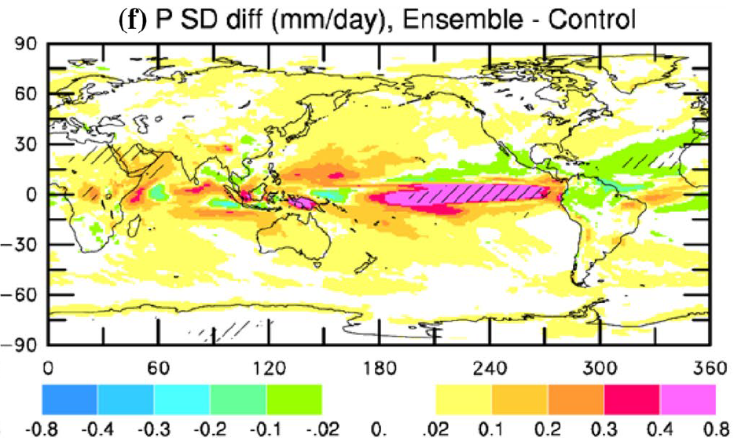
CESM1-simulated S.D. Change (relative to Control Run)
in Annual Precip. (with forced change removed) by 2100
P variability increases slightly as its mean increases
Dai and Bloecker (2019)

Slide 27
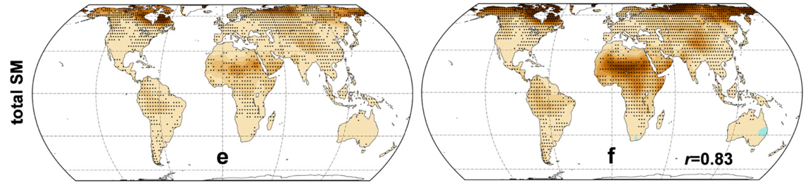
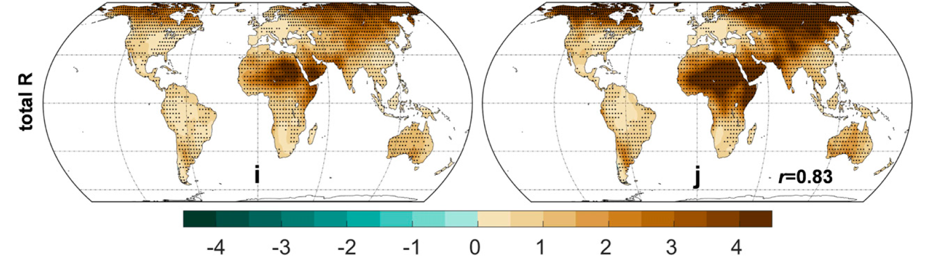
CMIP6 Model-projected S.D. Change in Total S.M. and Runoff
In units of S.D. for 1970-1999
The PDF flattening is mainly due to increased seasonal amplitude.
Zhao and Dai (2022)

Slide 28
Summary of Climate Change vs. Variation
Large variations in local and regional climate data resulting from internal dynamics:
They often dominate over the forced response to long-term GHG forcing, making it difficult to quantify the forced response in observations. This is especially true for precipitation.
Averaging over large regions and the globe enhances the forced signal:
However, even global-mean T still contains substantial natural variations not related to GHG forcing. For P, natural variations dominate even in the global-mean, making it hard to quantify precipitation response to GHG-induced global warming.
Trends vs. multi-decadal variations:
Regional climate often shows multi-decadal oscillations that are not related to GHG forcing, and these slow variations result in apparent trends over a period up to several decades. These trends can be mistaken as a forced response to GHG-induced global warming.
Future changes in variability:
Tas variability and seasonal amplitudes are projected to decrease (due to reduced variability in thermal advection and larger winter warming) in high latitudes but increases in low-latitudes. Larger seasonal amplitudes in soil moisture and runoff flatten their PDFs. P variability may increase slightly under GHG-induced global warming as its mean increases.

Slide 29
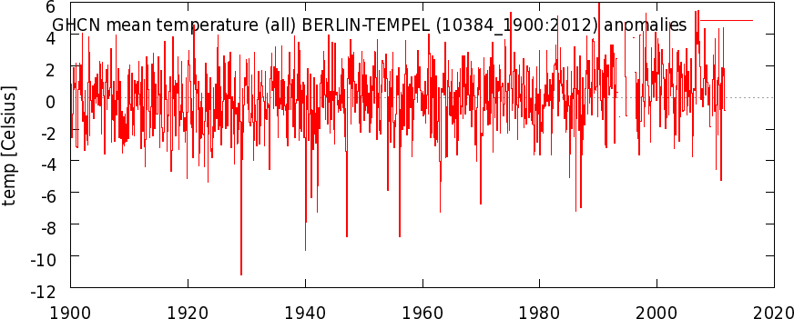
Extreme Weather Events and Climate Change
Long-term climate change provides a background that could make extreme events more or less frequent. However, individual events result largely from natural variations; only their expected frequency of occurrence may be significantly affected by long-term climate change.
Notes:
Whether a particular weather or climate event is caused by climate change has become a popular topic in the media.

Slide 30
Changes in the Mean and Extremes
% change in the extremes can be large for a small mean change!

Slide 31
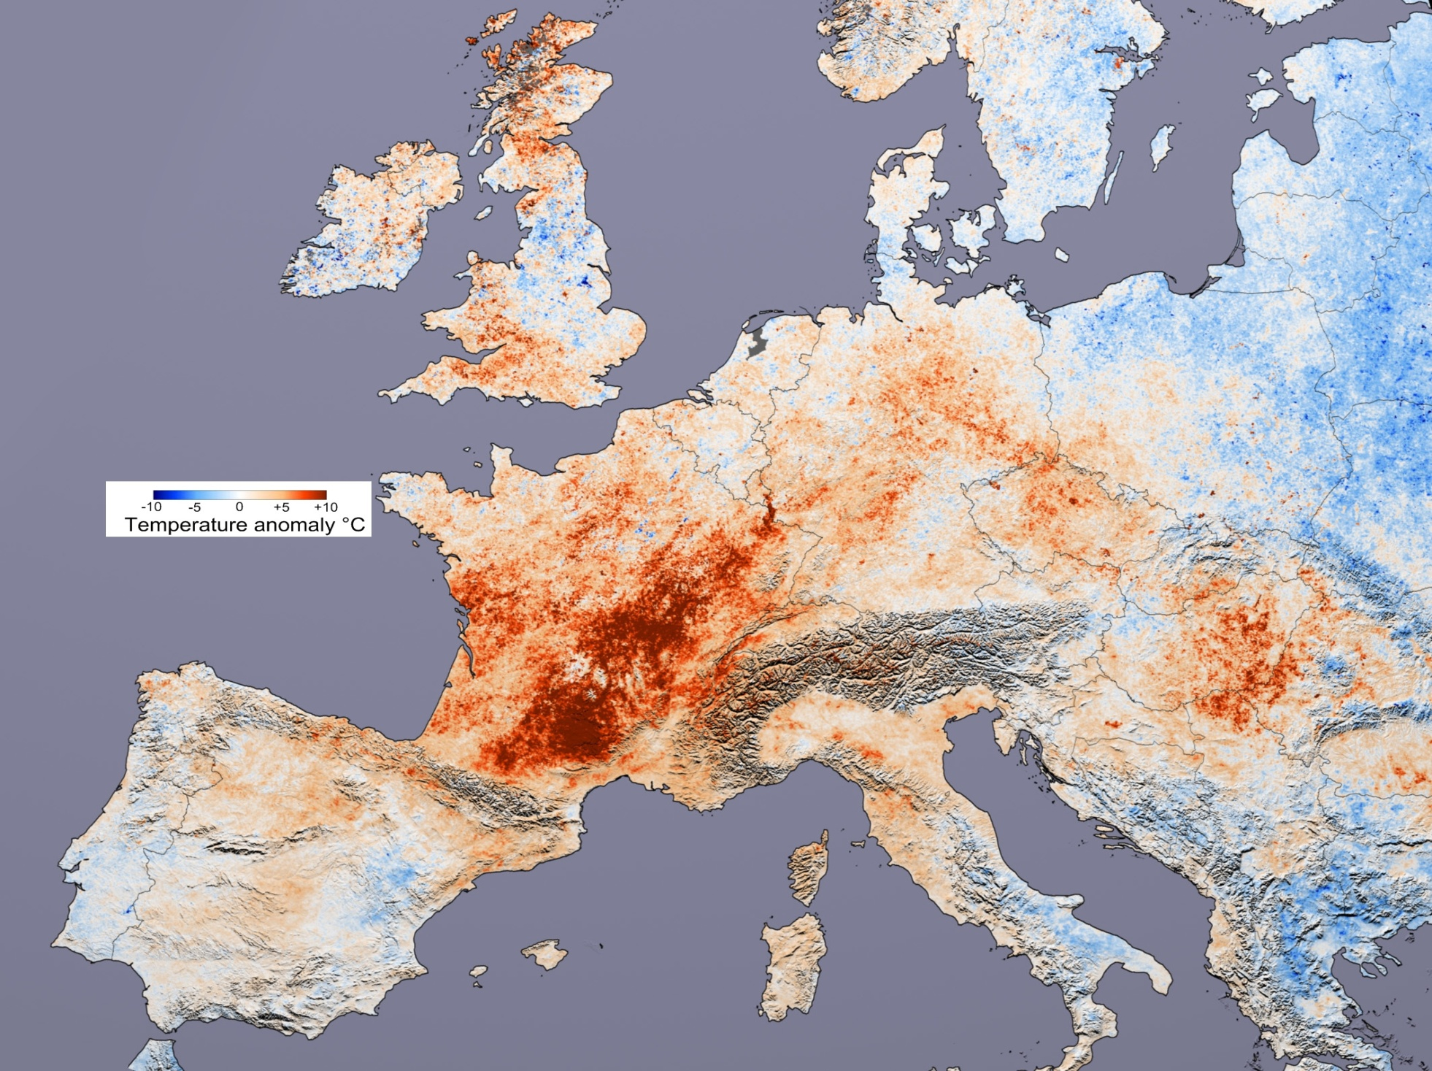
2003 European Heat Wave
Hottest summer since 1540
Death toll: 70,000

Slide 32
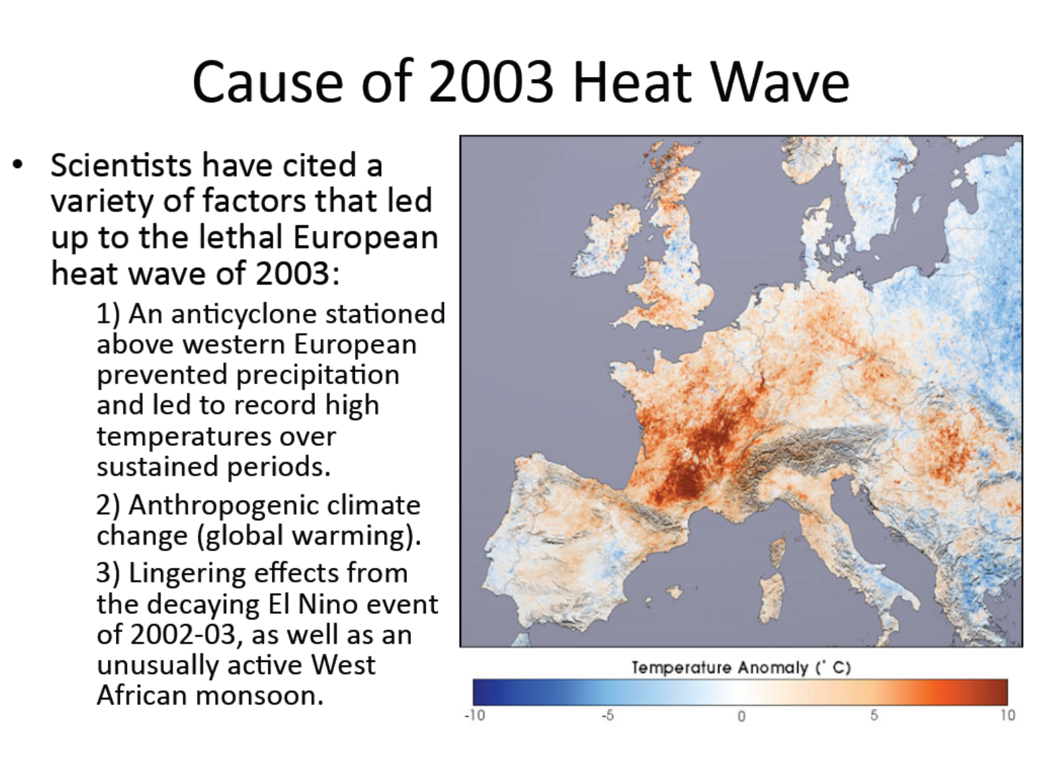

Slide 33
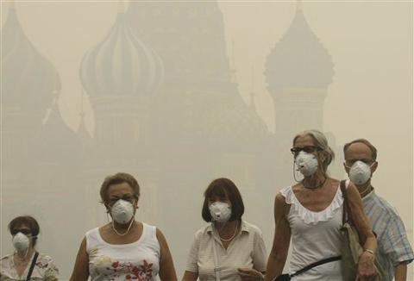
2010 Russian Heat Wave & Wildfires
Death toll: 11,000 in Moscow alone

Slide 34
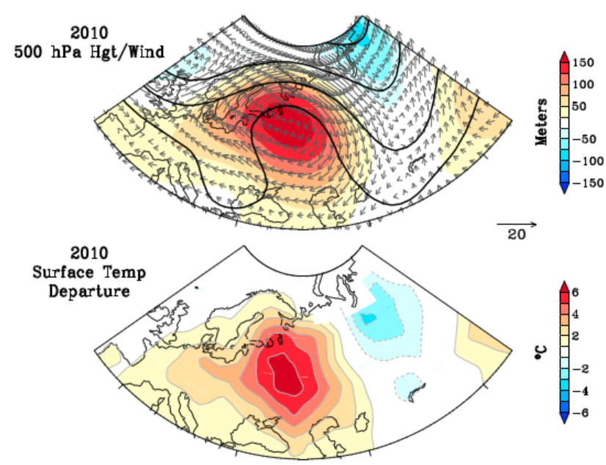
Cause of the 2010 Russian Heat Wave:
An atmospheric blocking or wave breaking led to a long-lasting anti-cyclonic system over western Russia that caused the high temperatures, drought and wild fires .
Role of Climate Change: Climate change may have increased the chance of such intense heat waves.
Dole et al. 2011

Slide 35

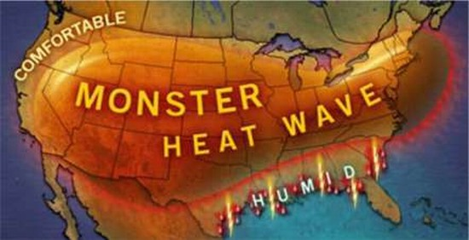

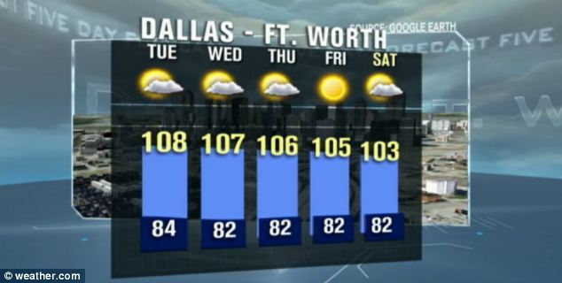
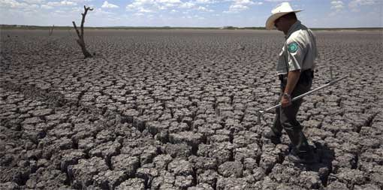
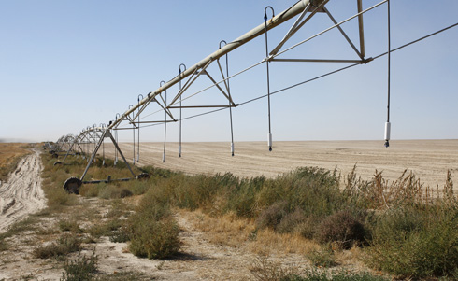
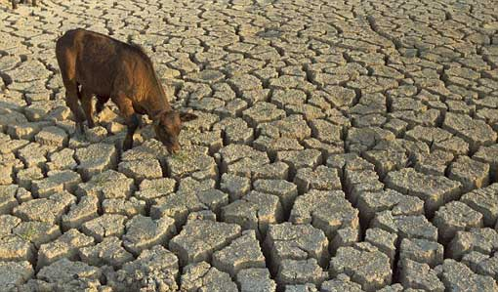
Texas
JJA 2011
Hottest on record
>$5 billion damage
65 days >100
Some towns in western Texas had more than 60 straight days over 100ºF

Slide 36
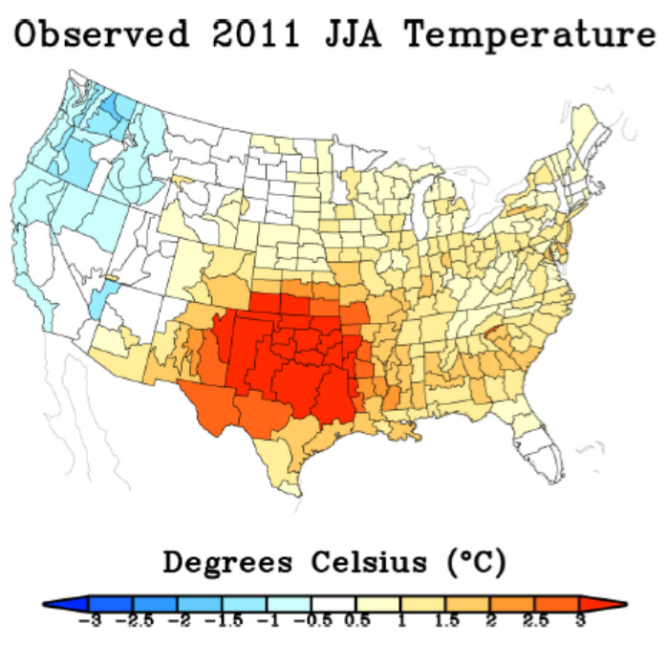
Cause of the 2011 Texas Drought & Heat Wave
The high temperature (~3.0ºC above normal) is mainly due to a lack of precipitation and partly due to global warming.
The lack of precipitation is linked to cold SST conditions in the central and eastern tropical Pacific Ocean.
Hoerling et al. 2012

Slide 37
Summary of Extreme Events & Climate Change
Extreme weather events (tornados, hurricanes, snowstorms, etc.) and extreme climate events (droughts and floods, heat waves, cold winters, etc.) occur naturally mainly due to unforced weather and climate variations.
Global warming and climate change usually are not the direct cause of individual extreme events.
However, climate change may alter the frequency of occurrence of these extreme events as the mean climate changes. It can also directly enhance heat waves as the mean T increases.
Thus, while we can’t attribute any particular event (such as superstorm Sandy) directly to climate change, it is expected that many extreme events such as heat waves, droughts and floods will become more frequent and more severe as global warming continues.
Changes in the frequency of extreme events can be large for a small change in the mean.

Slide 38
Next Lecture:
ENSO & its Impacts

