Slide 1
A ATM551, Lecture #17-18
ENSO
ENSO definition and indices
ENSO characteristics & formation (slides from Neelin 2011)
ENSO theory and models (slides from C. Wang)
ENSO forecast
ENSO impacts
Reading Assignments (under OtherReadingMaterials\):
Chapter 4 (El Nino) of the Neelin (2011) textbook
Wang et al. (2016), Wang (2018)

Slide 2
Major Modes of Climate Variability
Modes of Climate Variability: recurring spatial and temporal patterns of climate variations.
Inter-annual modes:
- El Niño-Southern Oscillation (ENSO)
- North Atlantic Oscillation (NAO)
- Arctic Oscillation (AO) or Northern Annular Mode (NAM)
- Southern Annular Mode (SAM), similar to NAM but for S.H.
Decadal to multi-decadal modes (Liu 2012, JC):
- Pacific Decadal Oscillation (PDO)
- Inter-decadal Pacific Oscillation (IPO)
- Atlantic Multi-decadal Oscillation (AMO)

Slide 3
What is ENSO?
ENSO is the acronym for El Niño-Southern Oscillation
ENSO refers to the irregular periodic (2-7yr) variation in SLP, SST and winds over the tropical eastern and central Pacific that affects the climate over much of the globe.
ENSO is the strongest interannual (year-to-year) climate variation.
ENSO results purely from unforced, internal dynamic processes, especially the air-sea interactions over the tropical Pacific.
ENSO is the most studied and best understood mode of climate variability.

Slide 4
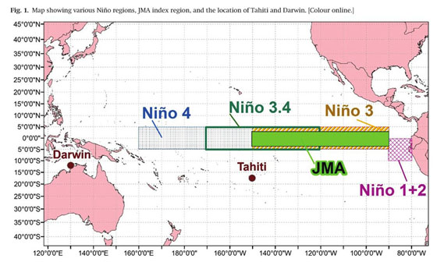
ENSO Indices
Southern Oscillation Index (SOI): Standardized anomaly of the mean sea level pressure difference between Tahiti and Darwin, a traditional ENSO index, correlates strongly with SST anomaly indices.
NOAA Oceanic Niño Index (ONI): Sea surface temperature anomaly index for Niño3.4 (5°N- 5°S, 170°W-120°W), onset of El Niño declared when Niño3.4 anomaly exceeds +0.5°C for a 3-month period. To be "full-fledged" El Niño (or La Niña), onset conditions must be met for 5 consecutive 3-month periods. Most commonly used ENSO index.
Japanese Meteorological Agency ENSO Index (JMA): Sea surface temperature anomaly index roughly for Niño3 (4°N-4°S, 150°W-90°W), less noisy than traditional SOI and more vigorous than NOAA ONI, anomalies must exceed 0.5°C for 6 consecutive 5-month periods.
Multivariate ENSO Index (MEI): Weighted anomaly
average of 6 meteorological variables in the
tropical Pacific: sea surface temperature, sea level
pressure, surface air temperature, zonal and
meridional components of surface wind, and
total cloudiness fraction of the sky.
https://climatedataguide.ucar.edu/climate-data/nino-sst-indices-nino-12-3-34-4-oni-and-tni
Source: https://www.weather.gov/fwd/indices

Slide 5
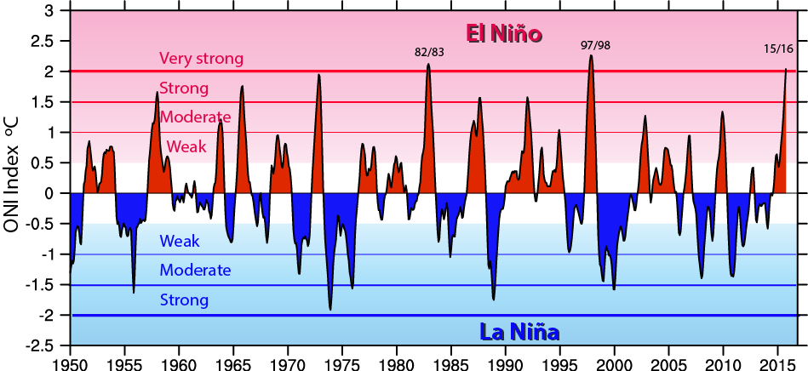
NOAA Nino3.4 Index
https://climatedataguide.ucar.edu/climate-data/nino-sst-indices-nino-12-3-34-4-oni-and-tni
https://psl.noaa.gov/gcos_wgsp/Timeseries/Data/nino34.long.data
https://psl.noaa.gov/data/correlation/nina34.data

Slide 6
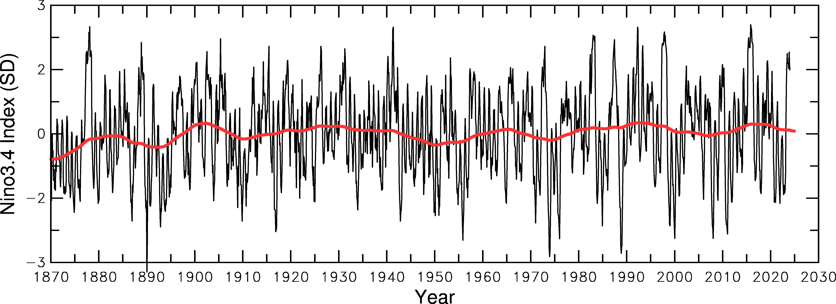
NOAA Nino3.4 Index based on HadISST
https://psl.noaa.gov/gcos_wgsp/Timeseries/Data/nino34.long.data

Slide 7
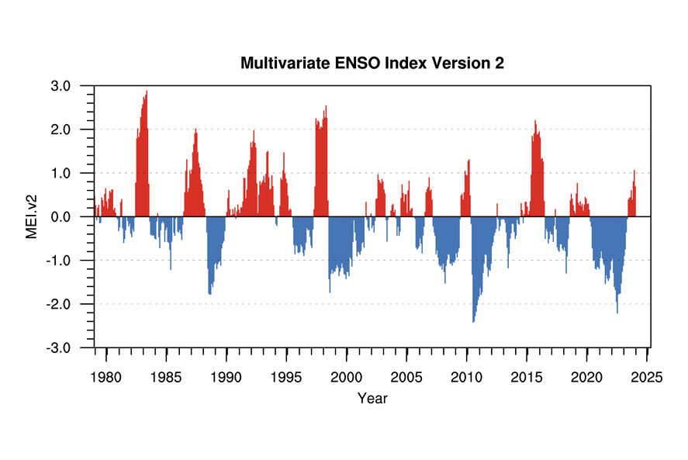
https://psl.noaa.gov/enso/mei/

Slide 8
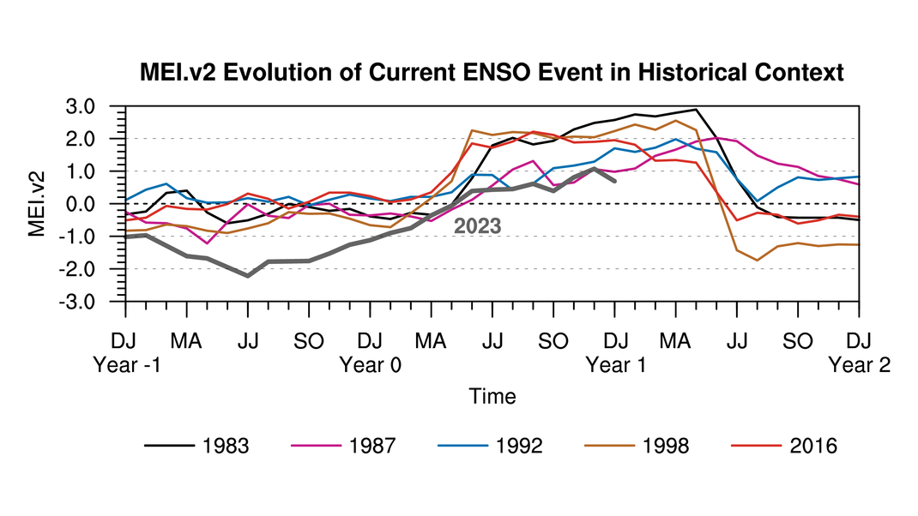
https://psl.noaa.gov/enso/mei/

Slide 9
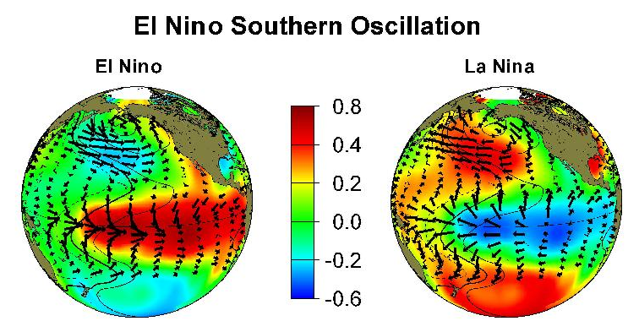
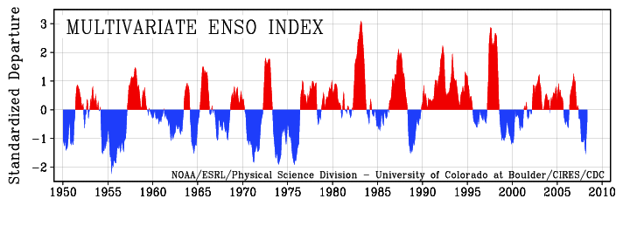
ΔSST
El Niño and La Niña events ocur once every 2-7 years,
mainly from September – February.
Notes:
El Nino and La Nina events occur irregularly once every 2-7 years. They are the most predominant climate variations in the low-latitudes. ENSO
results from air-sea interactions in tropical Pacific, including the effects of easterly wind stress on equatorial ocean currents and sub-surface ocean Kelvin wave propagation.

Slide 10
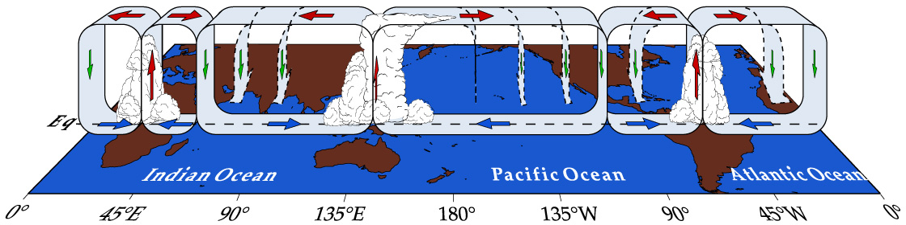
Equatorial Walker Circulation
(normal condition)
Both the Walker and Hadley Circulation induce easterly winds over the equatorial Pacific Ocean.
Note the three convection centers

Slide 11
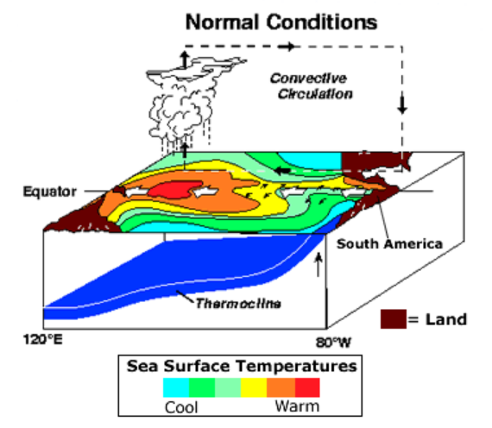
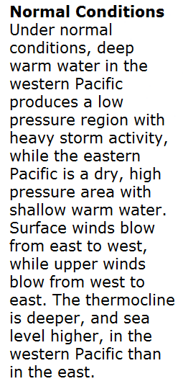
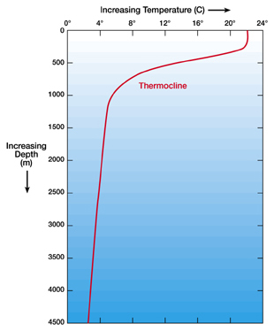
Mixed Layer
Neelin (2011)

Slide 12
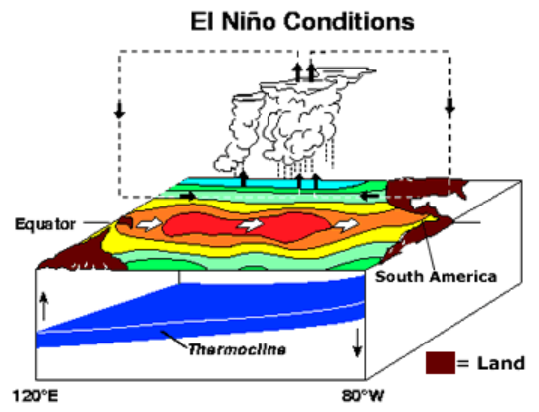
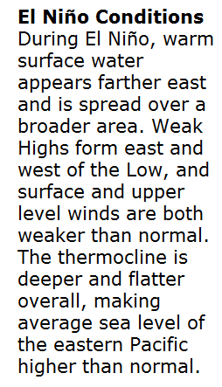
Neelin (2011)

Slide 13
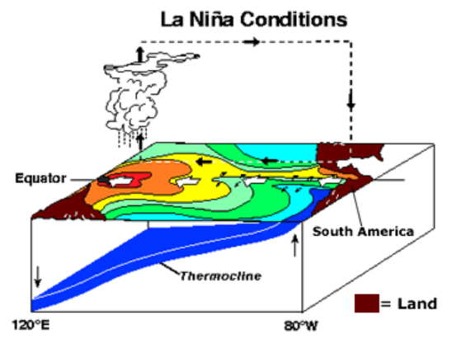
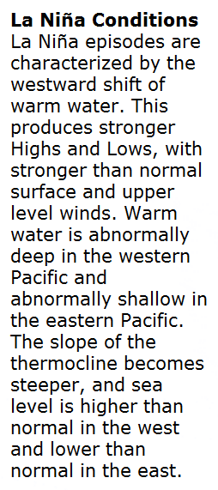
Neelin (2011)

Slide 14
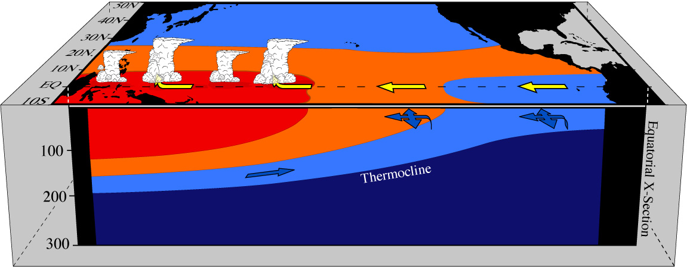
Pacific in three-dimensions under "Normal" conditions
10 km
15000 km
Depth (m)
~28 C
~24 C
~20 C
15 C or colder
Atmosphere:
Trade winds blow across Pacific air rises in convergence zone over the warm SSTs in the west.
Ocean:
Thermocline ~100m deeper in west (sea level 40cm higher)
Pressure gradient in ocean (eastward) balances wind stress in vertical average
Surface current moves westward following surface winds → higher sea level in west
Undercurrent moves eastward → returns the water to the east
Neelin, 2011. Climate Change and Climate Modeling, Cambridge UP
Notes:
norm.pacific_x.sec3.jpg

Slide 15
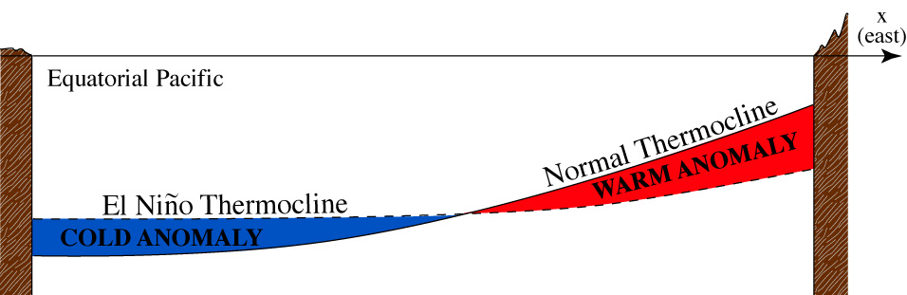
Two positions of the thermocline, indicating region of thermocline anomalies
Shallower thermocline → Cold T anomalies at the same depth
Deeper thermocline → Warm T anomalies at the same depth
Mixed Layer
Thermocline = the layer with large vertical T gradient
Neelin, 2011. Climate Change and Climate Modeling, Cambridge UP
Notes:
thermocline.anom.clr.eps

Slide 16
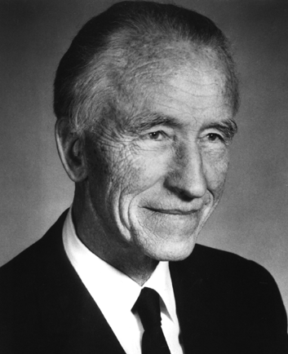
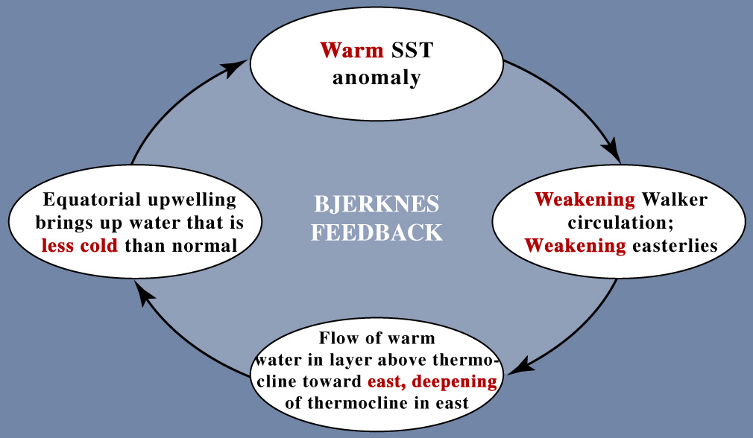
The Bjerknes feedbacks (warm phase)
Jakob Bjerknes (1897-1975)
Norwegian-American meteorologist, founded UCLA Dept. of Meteorology
Weakening
SLP gradient
in the east
Positive feedback loop reinforces initial anomaly
Neelin, 2011. Climate Change and Climate Modeling, Cambridge UP

Slide 17
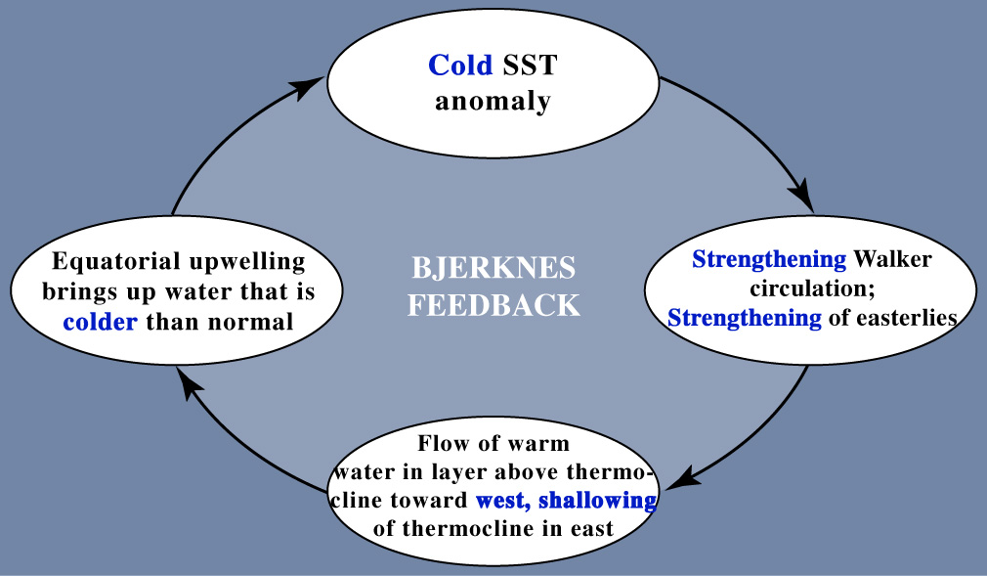
The Bjerknes feedbacks (cold phase)
Enhanced
SLP gradient
in the east
Positive feedback loop reinforces initial anomaly
Neelin, 2011. Climate Change and Climate Modeling, Cambridge UP
Notes:
Bjerknes_hypoth_nina.jpg

Slide 18
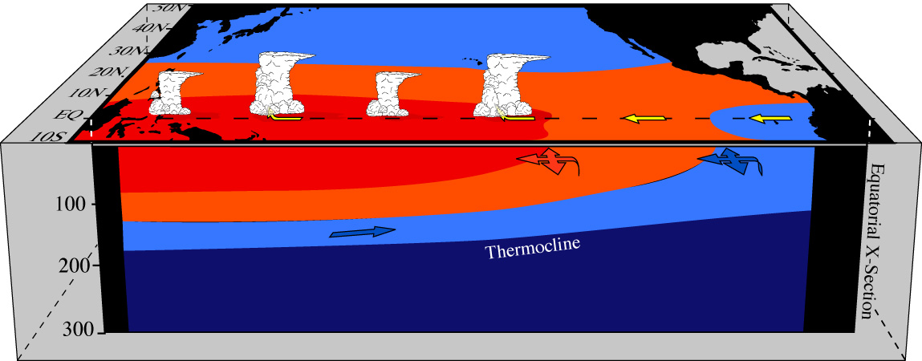
Pacific basin under El Niño (warm) conditions
Warmer SST in the east; rainfall tends to spread eastward
Trade winds weaken due to reduced SST and SLP west-east gradient
Unbalanced eastward PGF in ocean → anomalous eastward surface currents → thermocline
deepens in the east but shallows in the west → subsurface cold anomalies appear in the west
Upwelling brings up water less cold than normal in the east→ further increases SST in the east (Bjerknes feedbacks)
As more warm surface water is moved to east, the shallowed thermocline reaches the western boundary and it runs out of warm water → west sea level decreases, PGF decreases to balance the weakened wind force, eastward transport of warm water weakens, thermocline and SST anomalies are reduced in east→ SST and wind anomalies disappear, El Niño ends → without the anomalous winds, wind force exceeds PGF, surface warm water moves westward, the shallow thermocline anomalies or cold subsurface water moves eastward → start of the next La Niña.
However, this cycle may be delayed if surface wind anomalies can be sustained (e.g. by MJO or other perturbations), or the SST in the east does not return to normal after the eastward transport of surface water stops (e.g., due to reduced upwelling of cold waters). This may lead to some El Nino events lasting for 2-4 years, instead of one season.
Notes:
nino.pacific_x.sec3.jpg (From el-la.pacific_x.sec3.eps)

Slide 19
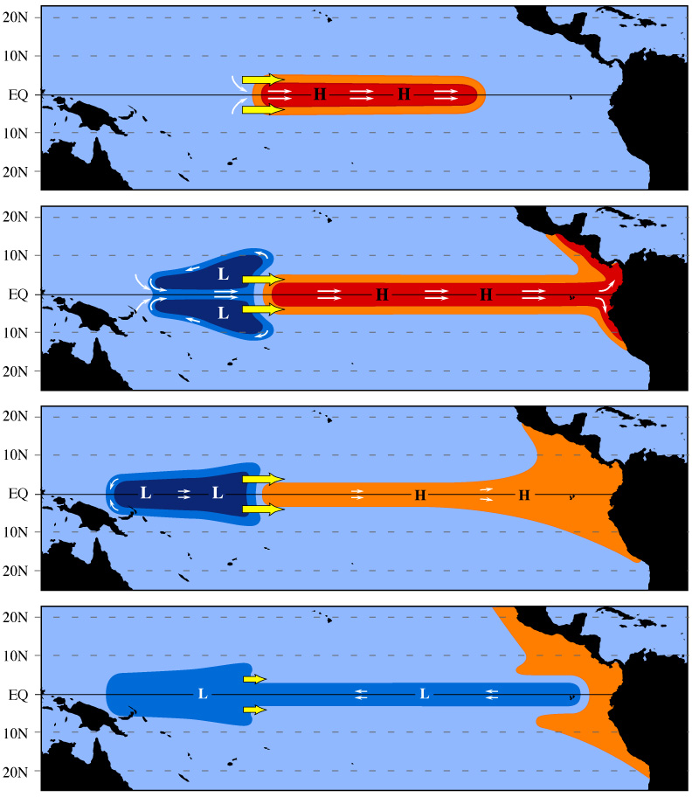
Response of the ocean to a westerly wind anomaly
Re: Onset and demise of El Niño warm phase
Figure 4.13
To east of the wind anomalies, equatorial jet (Kelvin wave) extends east, deepening thermocline (H) and increases SST in east
To west, inflow of water to jet (in ocn. upper layer) comes from off the equator (but little effect on SST)
Shallow thermocline in west extends westward (Rossby wave), as mass transferred to east by jet
When it reaches western boundary, it can no longer supply mass by extending the shallow region. Sea level drops in the west, oceanic PGF weakens to balance the wind force.
Weakening of jet extends eastward, ending warm phase
As wind anomalies weaken, shallow thermocline extends eastward: transition to cold phase
Wind anoms currents
Deep Thermocline anoms
Neelin, 2011. Climate Change and Climate Modeling, Cambridge UP
Notes:
ENSO_stages.gif

Slide 20
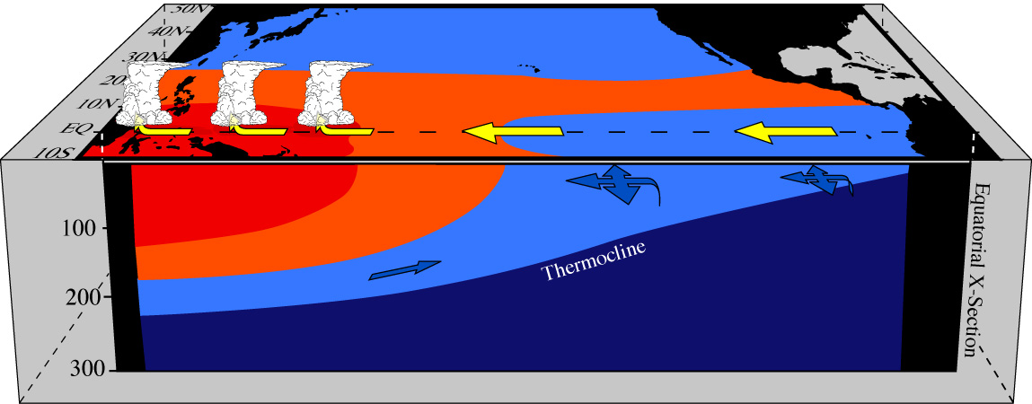
Pacific basin under La Niña (cold) conditions
Cooler SST in east; rainfall concentrated in west
Trade winds strengthen due to increased SST and SLP gradient along the equator
Westward wind stress exceeds eastward PGF in ocean → anomalous westward surface currents
along Eq. → thermocline shallows in the east but deepens in the west → subsurface warm anomalies
appear in the west
Upwelling brings up water colder than normal in the east, further reducing SST in the east (Bjerknes feedback)
As more warm surface water is moved to west, the deepened thermocline reaches the western boundary and it runs out of room to receive more warm water from the east → PGF increases to balance wind force, westward transport of warm water stops, thermocline & SST return to normal in the east, wind anomalies disappear, La Niña ends → without the anomalous winds, PGF exceeds wind force, surface warm water moves eastward, the deepened thermocline anomalies or warm subsurface water also moves eastward → start of the next El Niño.
However, this cycle may be delayed if surface wind anomalies can be sustained (e.g. by MJO or other perturbations), or the SST in the east does not return to normal after the westward transport of surface water stops (e.g., due to continued upwelling of cold waters). This may lead to some La Nina events lasting for 2-4 years, instead of one season.

Slide 21
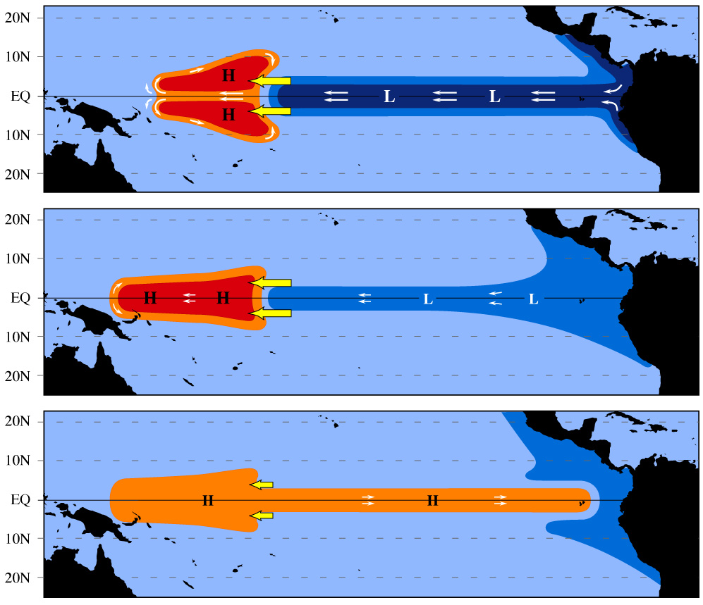
Response of the ocean to a easterly wind anomaly
Re: Onset and demise of La Niña cold phase
Same as Figure 4.13 but anomalies of opposite sign
Enhanced easterly winds
move more warm surface
water to the west. This deepens
the thermocline in the west,
especially off the Equator.
The deepened thermocline
extends westward and reaches
the western boundary. Then the
west runs out of room to hold
more warm water from the east.
Sea level increases in the west,
PGF builds up and balances the
wind force.
Warm water stops moving
westward, SST in east returns
to normal, wind anomalies
disappear →warm water moves
eastward → start of next El Niño
Neelin, 2011. Climate Change and Climate Modeling, Cambridge UP
Notes:
ENSO_stages_rev.gif

Slide 22
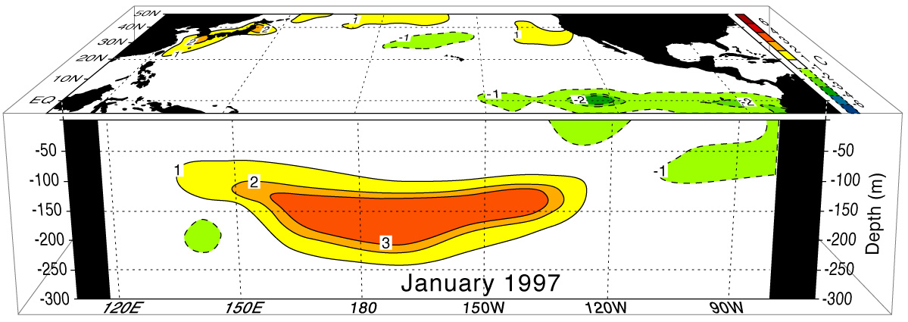
The transition into the 1997-98 El Niño warm phase (Jan. 1997)
Figure 4.8
After figures courtesy of David Pierce, Scripps Institute of Oceanography.
Warm subsurface water appears in west and central Pacific
It moves to the east and upward with the undercurrent
Neelin, 2011. Climate Change and Climate Modeling, Cambridge UP
Notes:
fig4.8a_3Dnino_jan97_c_alt.jpg

Slide 23
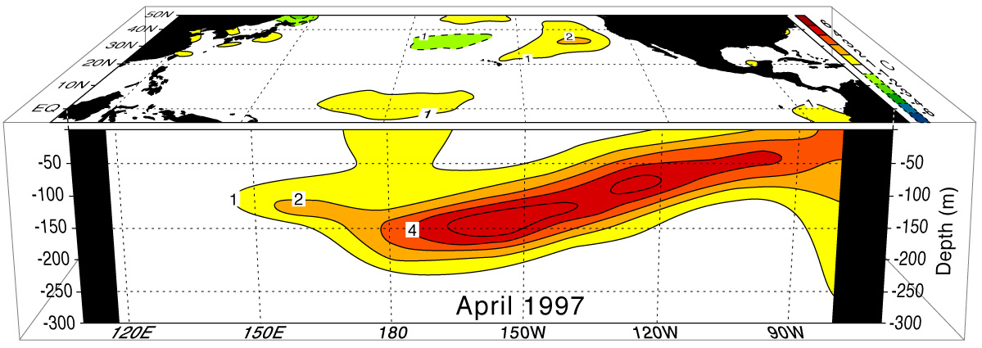
The transition into the 1997-98 El Niño warm phase (Apr. 1997)
Figure 4.8 cont.
After figures courtesy of David Pierce, Scripps Institute of Oceanography.
Warm water reaches the subsurface of the eastern Pacific
SSTs close to normal
Neelin, 2011. Climate Change and Climate Modeling, Cambridge UP
Notes:
fig4.8b_3Dnino_apr97_c_alt.jpg

Slide 24
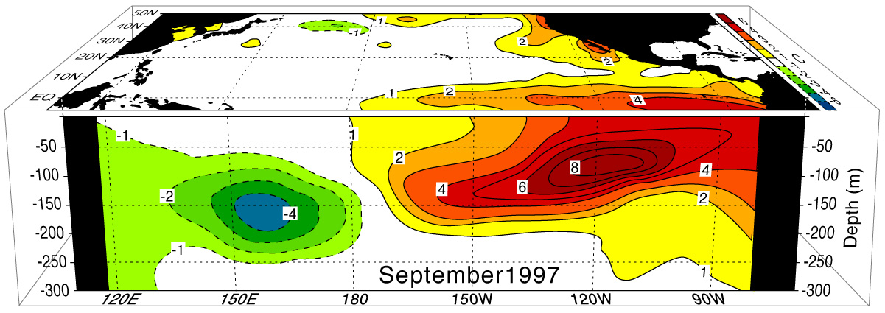
The transition into the 1997-98 El Niño warm phase (Sep. 1997)
Figure 4.8 cont.
After figures courtesy of David Pierce, Scripps Institute of Oceanography.
Warm water emerges to the surface in the eastern Pacific through upwelling
The Bjerknes positive feebacks start → SST gradient decreases, easterly
winds weaken → warm water continue to move to the east → SSTs in
the east further increase, but thermocline shallows in the central-west Pacific,
which leads to cold subsurface anomalies
Neelin, 2011. Climate Change and Climate Modeling, Cambridge UP
Notes:
fig4.8c_3Dnino_sep97_c_alt.jpg

Slide 25
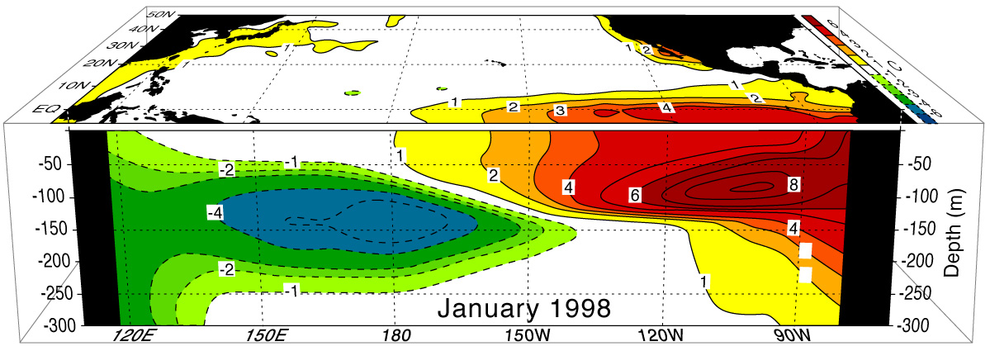
The transition into the 1997-98 El Niño warm phase (Jan. 1998)
Figure 4.8 cont.
After figures courtesy of David Pierce, Scripps Institute of Oceanography.
Warm water continues to move east- and up-ward to maintain the positive
SST anomalies in the east
As more warm water is moved to east, the shallowed thermocline expands
further to the western boundary of the Pacific and moves also eastward
Neelin, 2011. Climate Change and Climate Modeling, Cambridge UP
Notes:
fig4.8d_3Dnino_jan98_c_alt.jpg

Slide 26
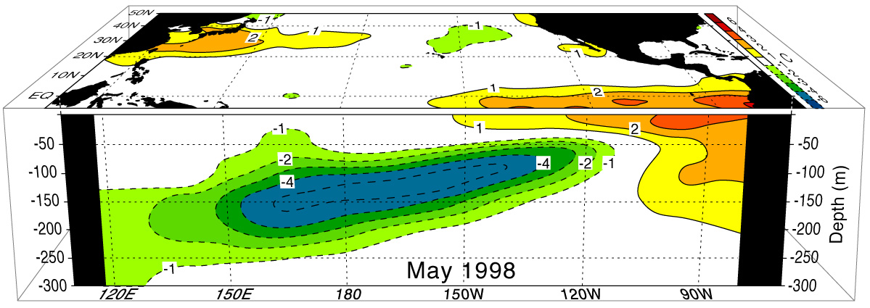
The transition into the 1998-98 La Niña cold phase (May 1998)
Figure 4.9
After figures courtesy of David Pierce, Scripps Institute of Oceanography.
The cold subsurface water continue to move eastward, eroding the warm
water in the east → reduced SST anomalies in the east
Neelin, 2011. Climate Change and Climate Modeling, Cambridge UP
Notes:
fig4.9a_3Dnino_may98_c_alt.jpg

Slide 27
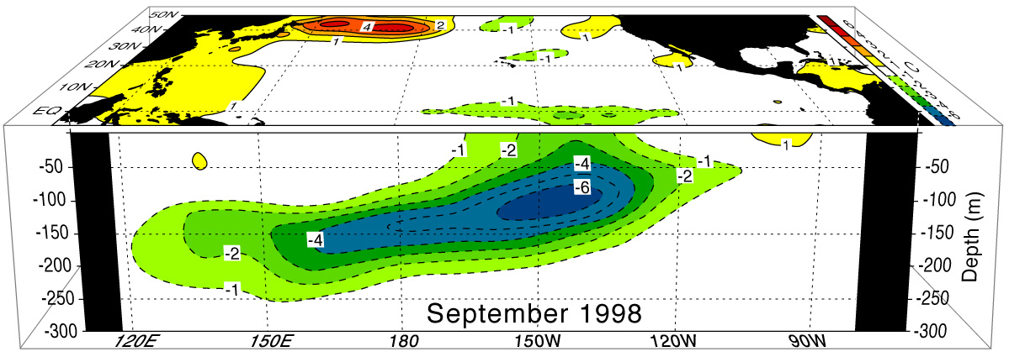
The transition into the 1998-98 La Niña warm phase (Sep. 1998)
Figure 4.9 cont.
After figures courtesy of David Pierce, Scripps Institute of Oceanography.
Cold water emerges in the central Pacific, SSTs in east return to normal
The Bjerknes feedbacks start → increased SST gradients along Eq. →
stronger easterly winds → thermocline shallows in the central and east
but deepens in the west
Neelin, 2011. Climate Change and Climate Modeling, Cambridge UP
Notes:
fig4.9b_3Dnino_sep98_c_alt.jpg

Slide 28
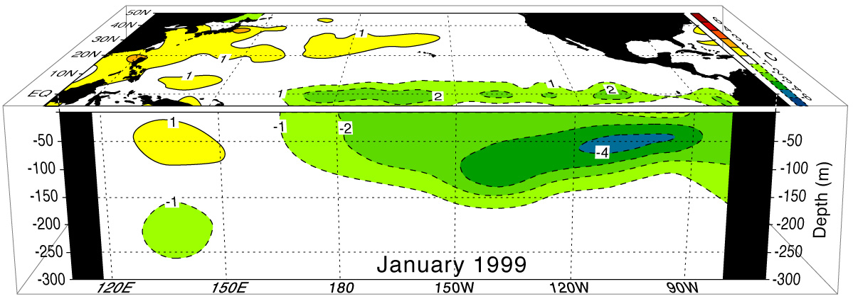
The transition into the 1998-98 La Niña phase (Jan. 1999)
Figure 4.9 cont.
After figures courtesy of David Pierce, Scripps Institute of Oceanography.
Cold water spreads to the central and eastern Pacific (La Niña)
Thermocline deepens in the west → warm subsurface anomalies appear.
Neelin, 2011. Climate Change and Climate Modeling, Cambridge UP
Notes:
fig4.9c_3Dnino_jan99_c_alt.jpg

Slide 29
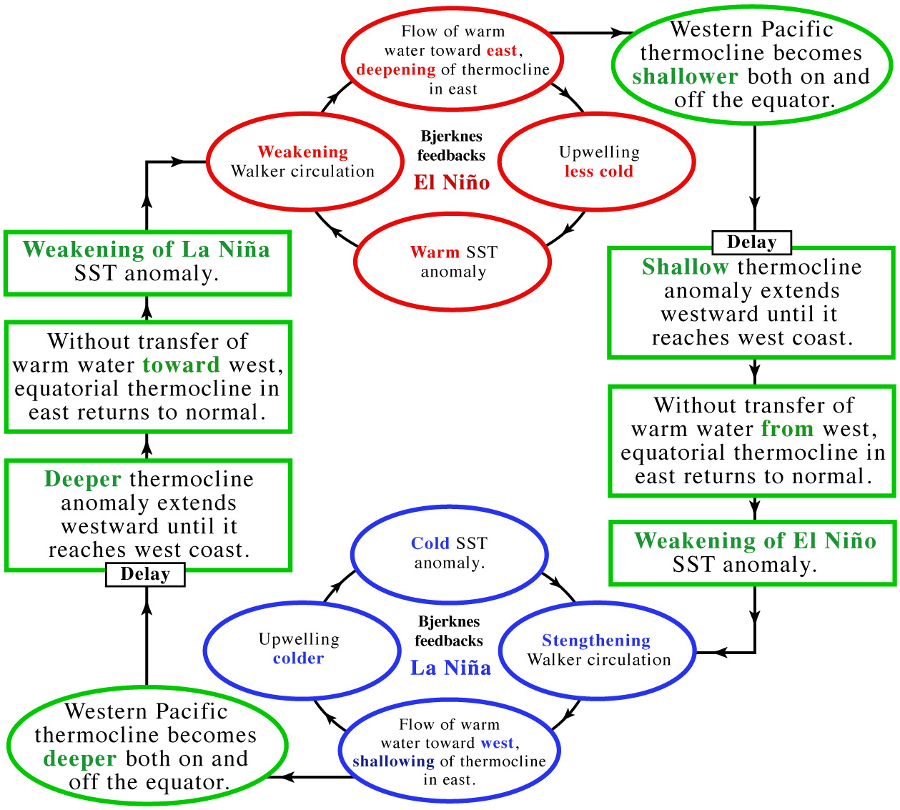
ENSO transitions
Meantime, in the West Pacific (subsurface)
Recall: feedbacks that strengthen El Niño
Delay: no surface effect until…
And vice versa…
Onset of La Niña cold phase
Figure 4.14
Neelin, 2011. Climate Change and Climate Modeling, Cambridge UP
Notes:
ENSO_transitions.c.eps

Slide 30
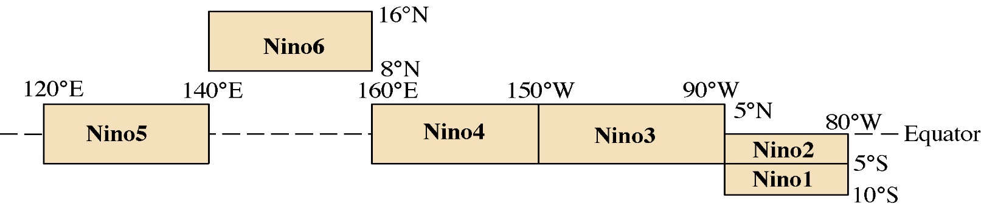
Unified oscillator model for ENSO
Based on the Cane-Zebiak’s coupled model, the unified oscillator model is derived and formulated (Wang 2001, JC) as:
T is Nino3 SST anomaly; h is Nino6 thermocline depth anomaly;
τ₁ is Nino4 zonal wind stress anomaly; τ₂ is Nino5 zonal wind stress anomaly.
h
τ₂
τ₁
T

Slide 31
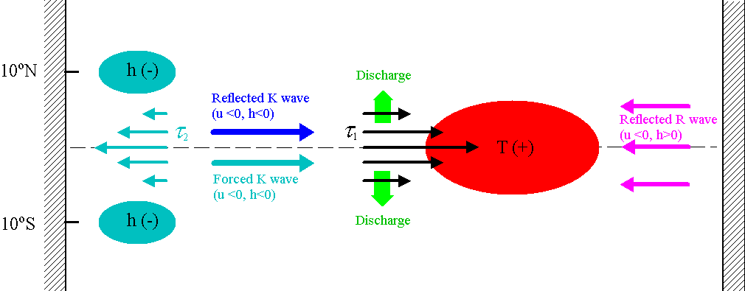
Physics of the unified oscillator model
The Bjerknes’ (1969) positive feedback causes the growth of El Niño. Four negative feedbacks for El Niño’s decaying are:
Reflected Kelvin wave at the ocean western boundary;
Discharge process due to Sverdrup transport;
Western Pacific wind-forced Kelvin wave;
Reflected Rossby wave at the ocean eastern boundary.

Slide 32
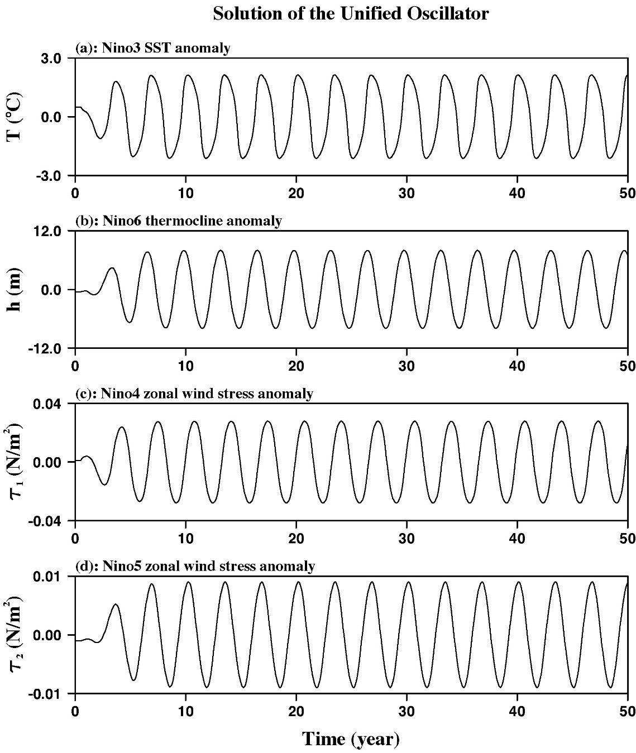
Solution of the unified oscillator model
Model Solution
Given a certain range of model parameters, the unified oscillator model oscillates on interannual time scales (Wang 2001, JC).

Slide 33
A special case: The delayed oscillator
The delayed oscillator does not consider the coupled role of the western Pacific in ENSO and wave reflection at the eastern boundary. By setting b₂=0 and b₃=0, the unified oscillator model is reduced to:
(2)
Equation (2) is the delayed oscillator model of Suarez and Schopf (1988) and Battisti and Hirst (1989).

Slide 34
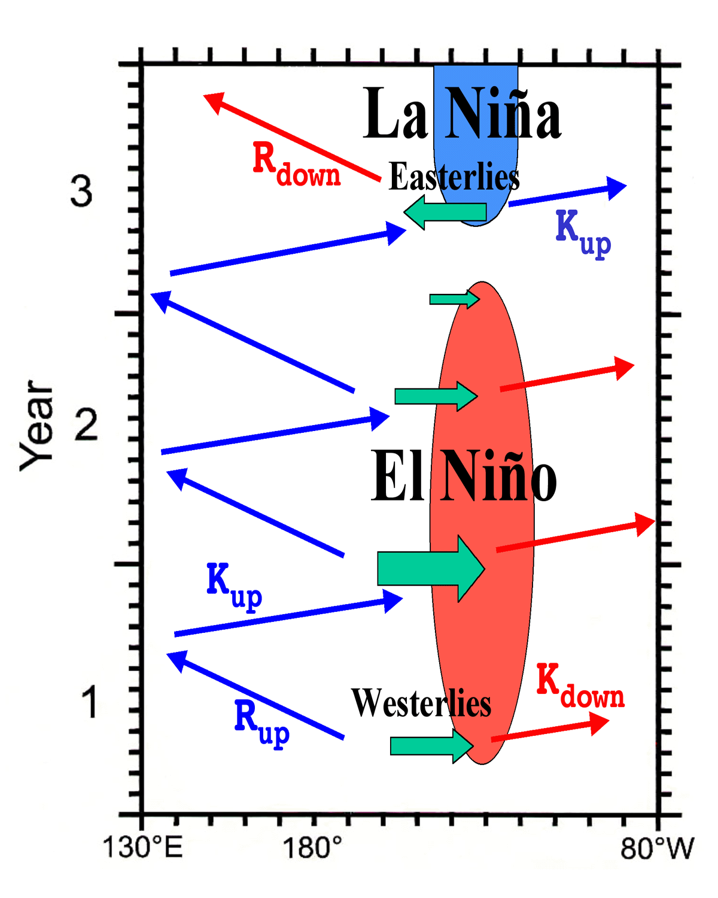
Physics and hypotheses of the delayed oscillator
It considers wave reflection at western boundary with a delayed time.
It does not consider the coupled role of the western Pacific in ENSO and eastern boundary wave reflection.

Slide 35
A special case: The recharge oscillator
As argued by Jin (1997), equatorial wave dynamics are important in the adjustment of equatorial ocean, but wave propagations are not explicit in the recharge model. If the time derivatives in Eqs. (1c) and (1d) are dropped and all delay parameters are set to zero, the unified oscillator is reduced to:
(3a)
(3b)
The mathematical form of equation (3) is the same as the recharge oscillator model of Jin (1997).

Slide 36
Physics and hypotheses of the recharge oscillator
Wyrtki’s (1975) “buildup” mechanism
Strong trade wind
West
East
Normal sea level
Sea level with
strong trade wind
Strong easterly wind before El Niño.
High sea level in the western Pacific before El Niño.
A “trigger” is a rapid collapse of easterly wind.
Warming off the west coast of South America before El Niño.
He recognized that coastal warming is not a local phenomenon.

Slide 37
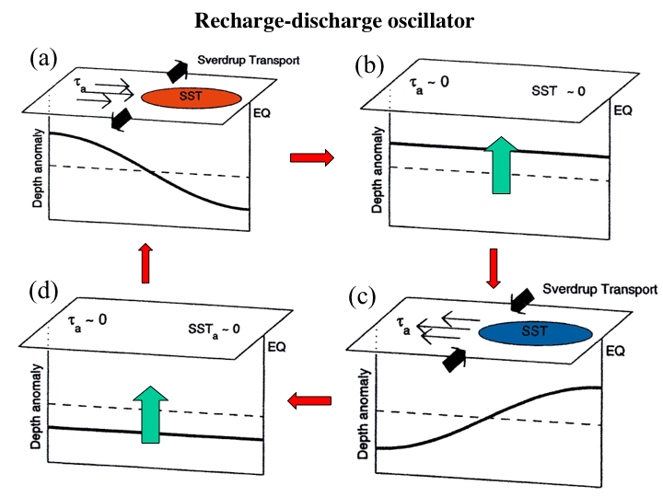
Physics and hypotheses of the recharge oscillator
W phase I: Bjerknes’ positive feedback; Discharge of equatorial heat content.
W to C transition phase II: Anomalous shallow thermocline due to discharge.
C phase III: Pump cold water to the surface by climatological upwelling;
Recharge of equatorial heat content.
C to W transition phase IV: Thick thermocline due to recharge process.
Pump relatively warm water to the surface.
I
II
IV
III

Slide 38
A special case: The western Pacific oscillator
The western Pacific oscillator model does not necessarily require wave reflections at the western and eastern boundaries. By setting b₁=0 and b₃=0, the unified oscillator is reduced to:
(4a)
(4b)
(4c)
(4d)
Equation (4) is the western Pacific oscillator model of Weisberg and Wang (1997) and Wang et al. (1999).

Slide 39
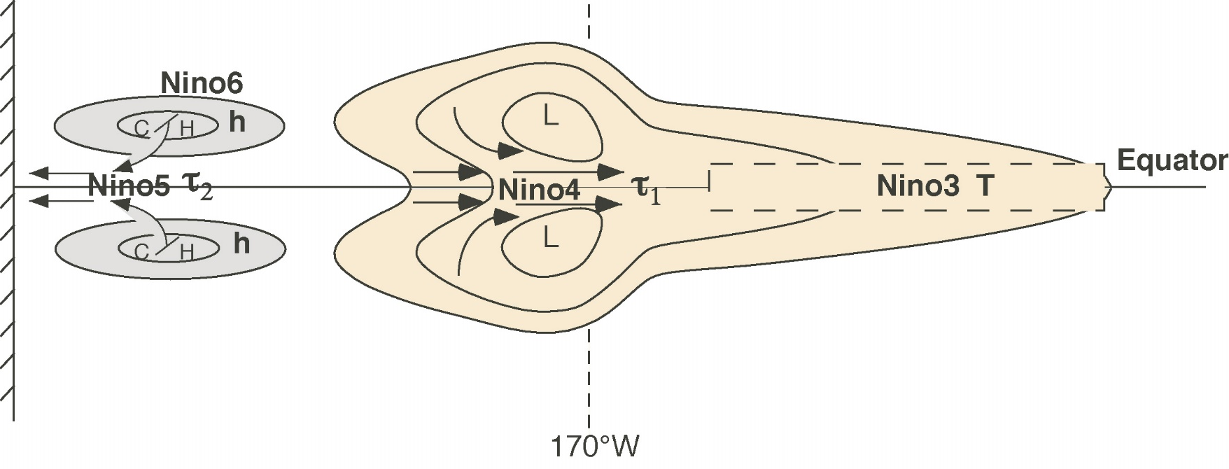
Physics and hypotheses of the western Pacific oscillator
Induce Westerly Wind
in the Nino4 Region
Increase SST
in Nino3 Region
Heating in
Nino4 region
Off-Equator
Cyclonic Pair
Raise h
in Nino6 Region
C SST/H SLP
in Nino6 Region
Easterly Wind
in Nino5 region

Slide 40
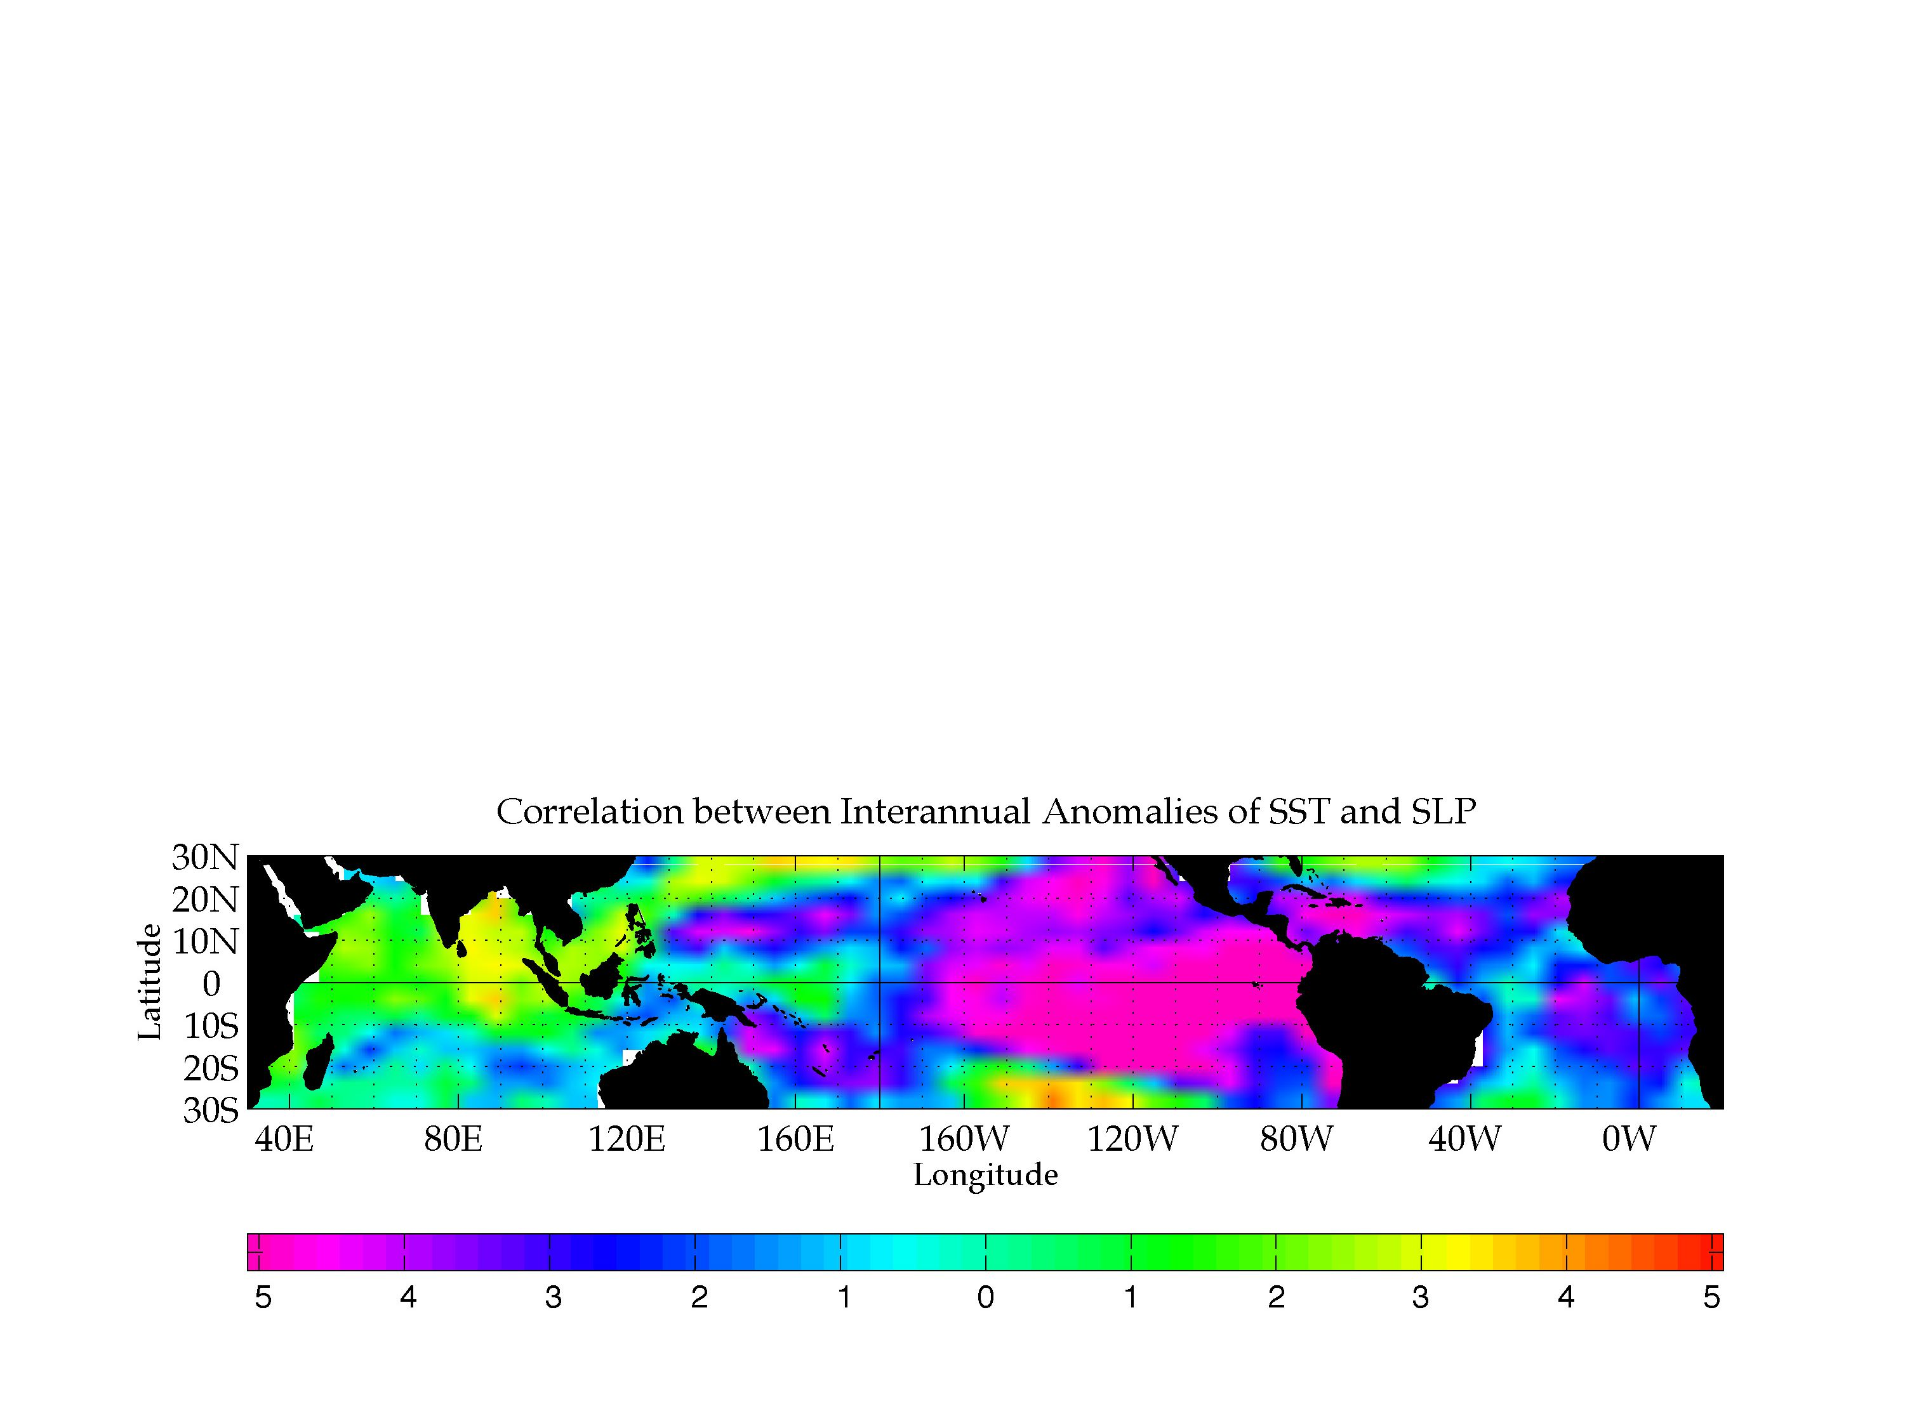
Physics and hypotheses of the western Pacific oscillator
-
-
-
-
-
Wang et al. (1999, JGR)
Significant negative correlation is in the tropical eastern Pacific.
Significant negative correlation is also located in the off-equatorial western Pacific.

Slide 41
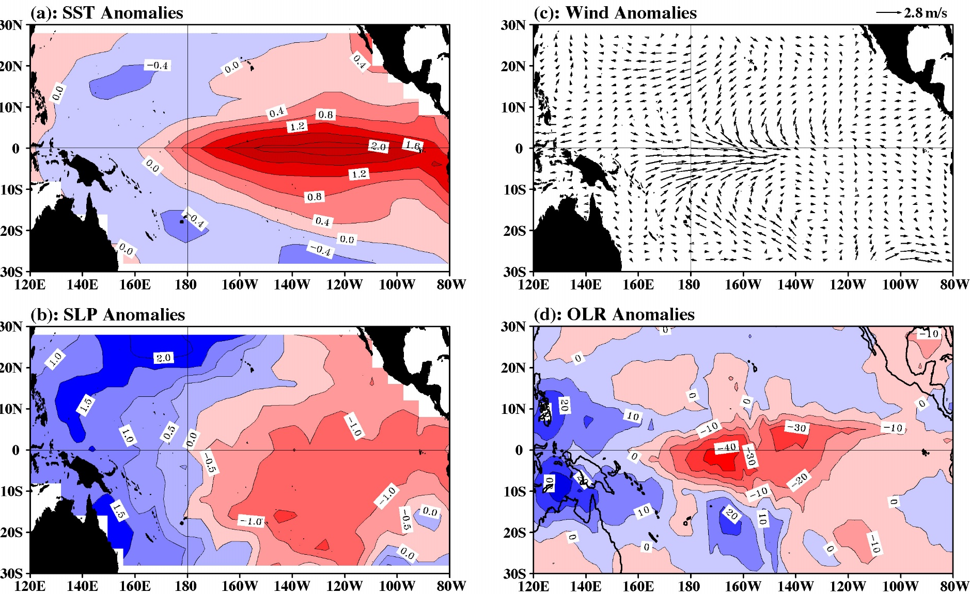
Physics and hypotheses of the western Pacific oscillator
ENSO composites show both eastern and western Pacific anomaly patterns. The western Pacific oscillator emphasizes the coupled role of the western Pacific pattern in ENSO that is overlooked in other ENSO oscillators.

Slide 42
A special case: The advective-reflective oscillator
By setting b₂=0 (without western Pacific wind-forced wave effect), the unified oscillator is reduced to:
(5a)
(5b)
Equation (5) represents the advective-reflective oscillator of Picaut et al. (1997). Notice that Picaut et al. (1997) did not provide a set of heuristic equations.

Slide 43
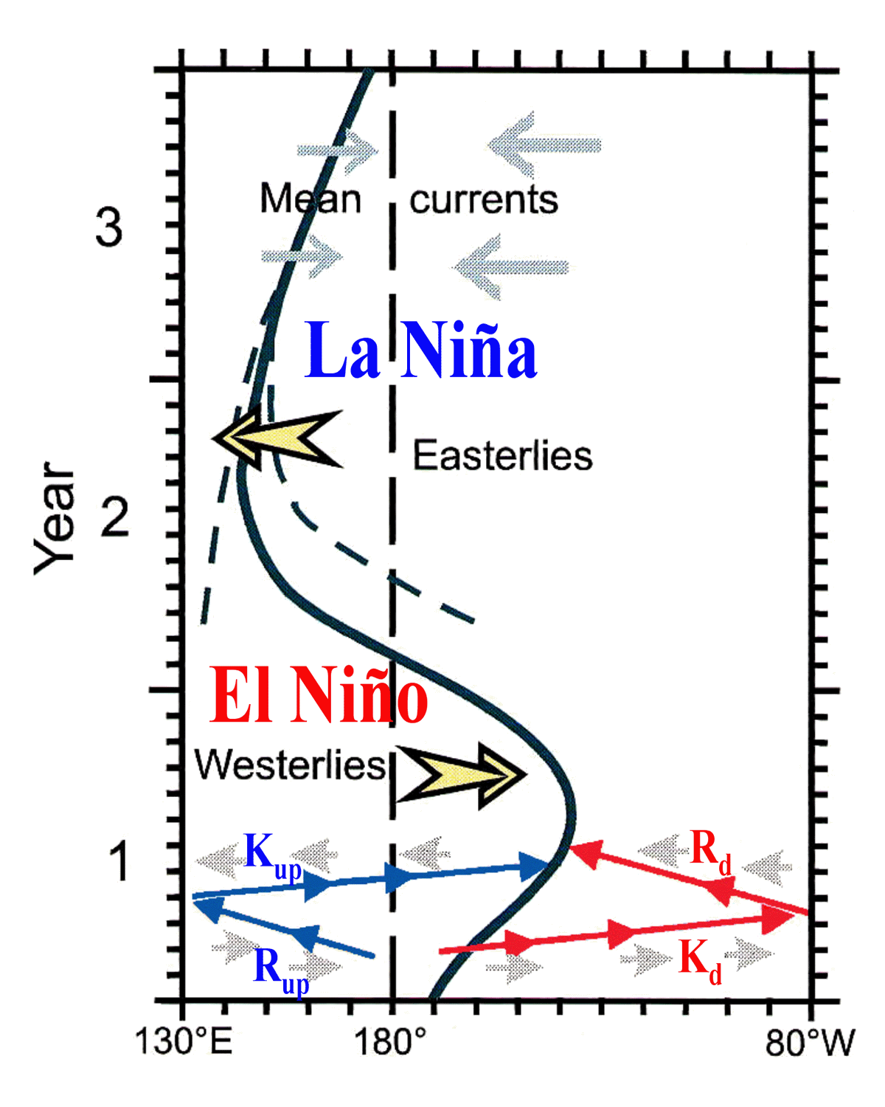
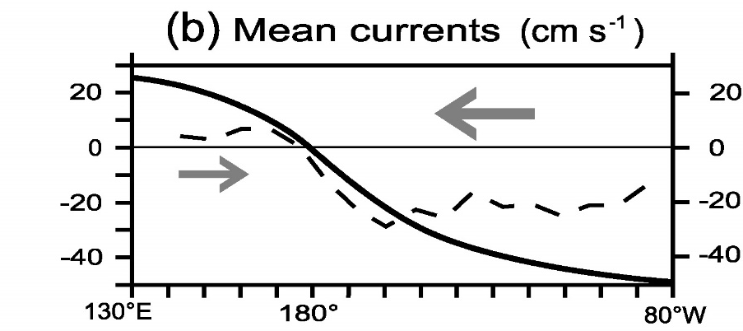
Physics and hypotheses of the advective-reflective oscillator
It emphasizes zonal advection associated with wave reflection at W&E boundaries.
Three negative feedbacks:
Anom. current of upwelling Kelvin wave.
Anom. current of downwelling Rossby wave.
Mean zonal current.
Eastern edge of the warm pool
Downwelling Rossby wave (u<0, h>0)
Upwelling Kelvin wave (u<0, h<0)

Slide 44
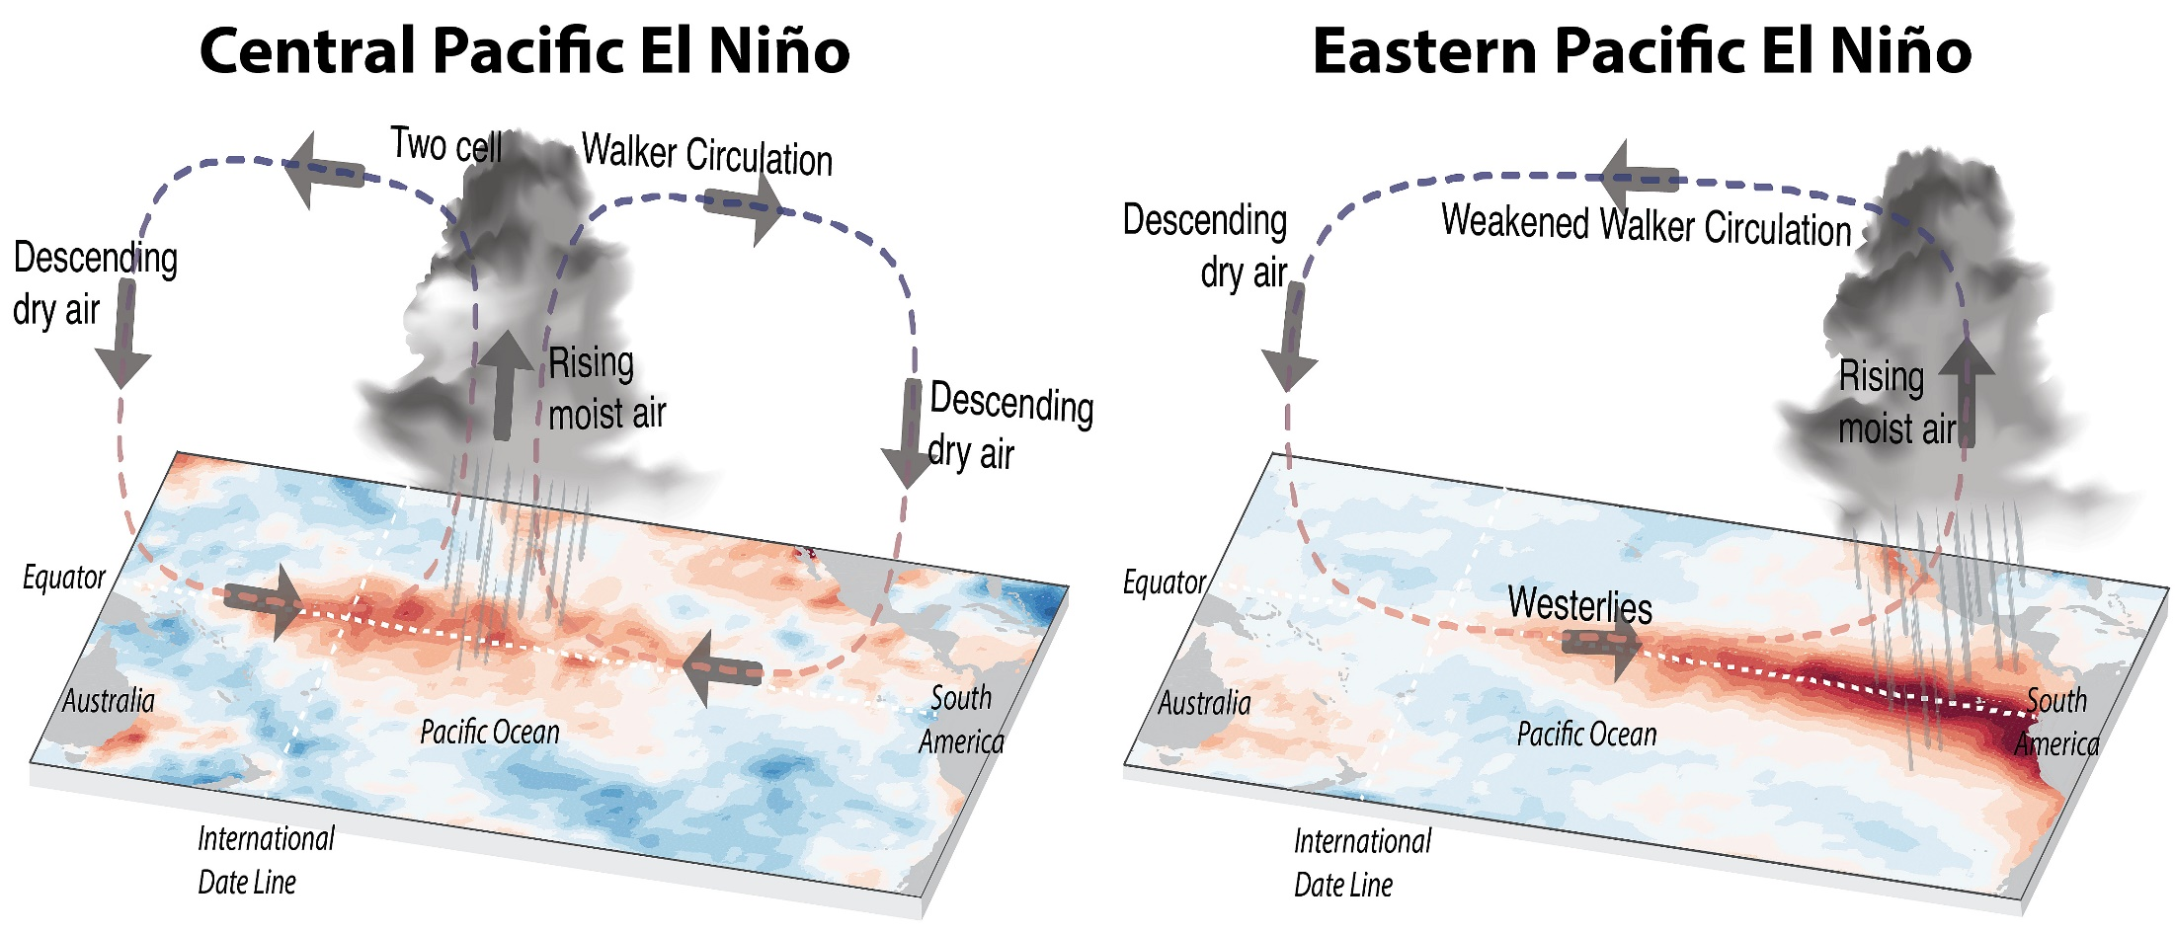
Central Pacific vs. traditional Eastern Pacific El Nino
Some El Niños occur mainly in the Central Pacific in Recent Decades.
Source: https://ecoevocommunity.nature.com/posts/48594-unraveling-the-history-of-el-nino-flavours

Slide 45
Possible mechanisms of the CP El Niño
All oscillator models may work on the CP El Niño.
The CP El Niño may involve the ocean zonal advection feedback more than the thermocline feedback.
The CP El Niño will occur if WWBs are relatively weak and are confined to the equatorial western Pacific.
The CP El Niño may originate outside the tropical Pacific (the extratropical Pacific and other ocean basins).
Three-box conceptual models for the CP El Niño.
…
Notes:
WWBs = westerly wind bursts

Slide 46
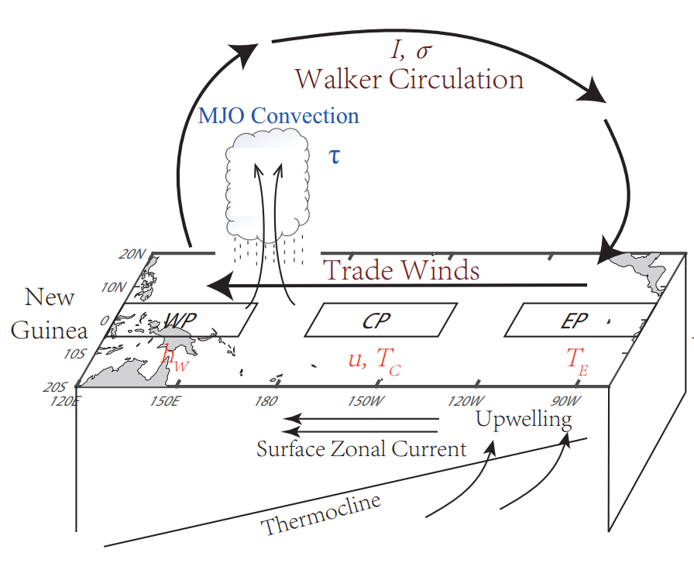
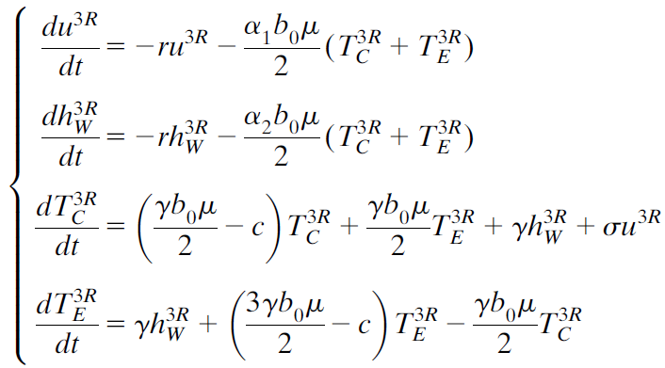
Three-box model of the CP El Niño
Fang and Mu (2018, JC)
Depict different variations between CP and EP El Niño events.
Show the dominant role played by zonal advective feedback in the development of the CP El Niño.

Slide 47
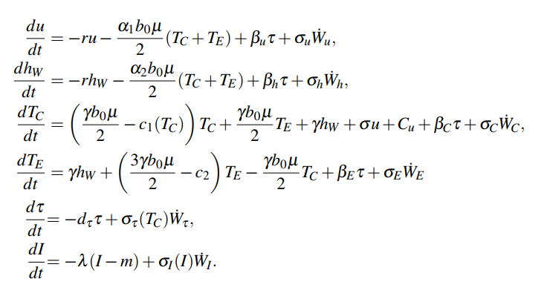
Multiscale Stochastic conceptual Model (MSM)
Three-box model with intra-seasonal and decadal processes:
Chen et al. (2021, NG, under review)
Includes intra-seasonal (τ) and decadal (I) processes.
Reproduce not only general properties of ENSO, but also complexity in patterns (e.g., CP vs EP events), intensity (e.g., 10-20 year reoccurrence of extreme El Niño), and temporal evolution (e.g., more multi-year La Niña than multi-year El Niño).

Slide 48
Missing ingredients to conceptual models
All oscillator mechanisms appear in nature, and their relative importance may be time-dependent.
Conceptual models are just heuristic, and cannot perfectly simulate all features of ENSO events.
Model parameters should not be constant; as an example, seasonal cycle may be included in the model parameters.
Conceptual models can be forced by high frequency such as random (stochastic) forcing.
Conceptual models do not consider inter-basin interactions which are recently found to be able to initiate or modulate ENSO events.
Jansen et al.’s (2009) model showed that the Indian and Atlantic Oceans provide negative feedbacks to ENSO which are inconsistent with the initiation of ENSO by other oceans.

Slide 49

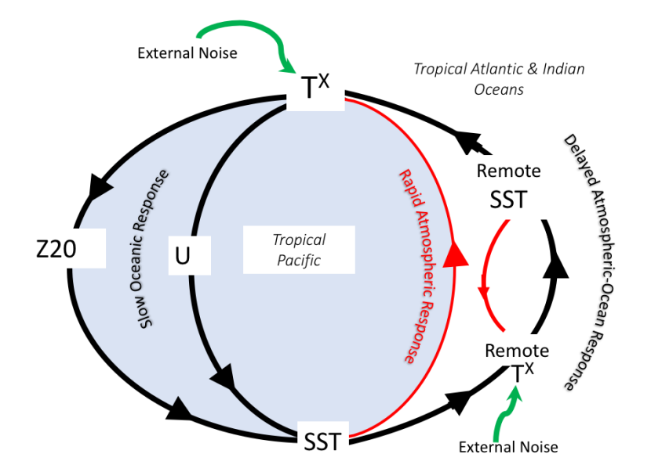
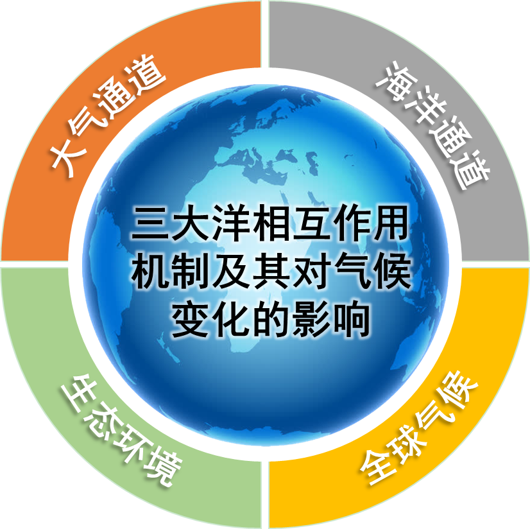
Frontier scientific issues: Three-ocean interactions
CLIVAR/Tropical Basin Interaction (CLIVAR/TBI) Research Focus
WCRP-CLIVAR was/is frequently organizing inter-basin interaction workshops or special sessions
Recent progress of TBI
National Key R&D Program of China
Cai et al. (2019), Wang (2019), and Mechoso (2020)

Slide 50
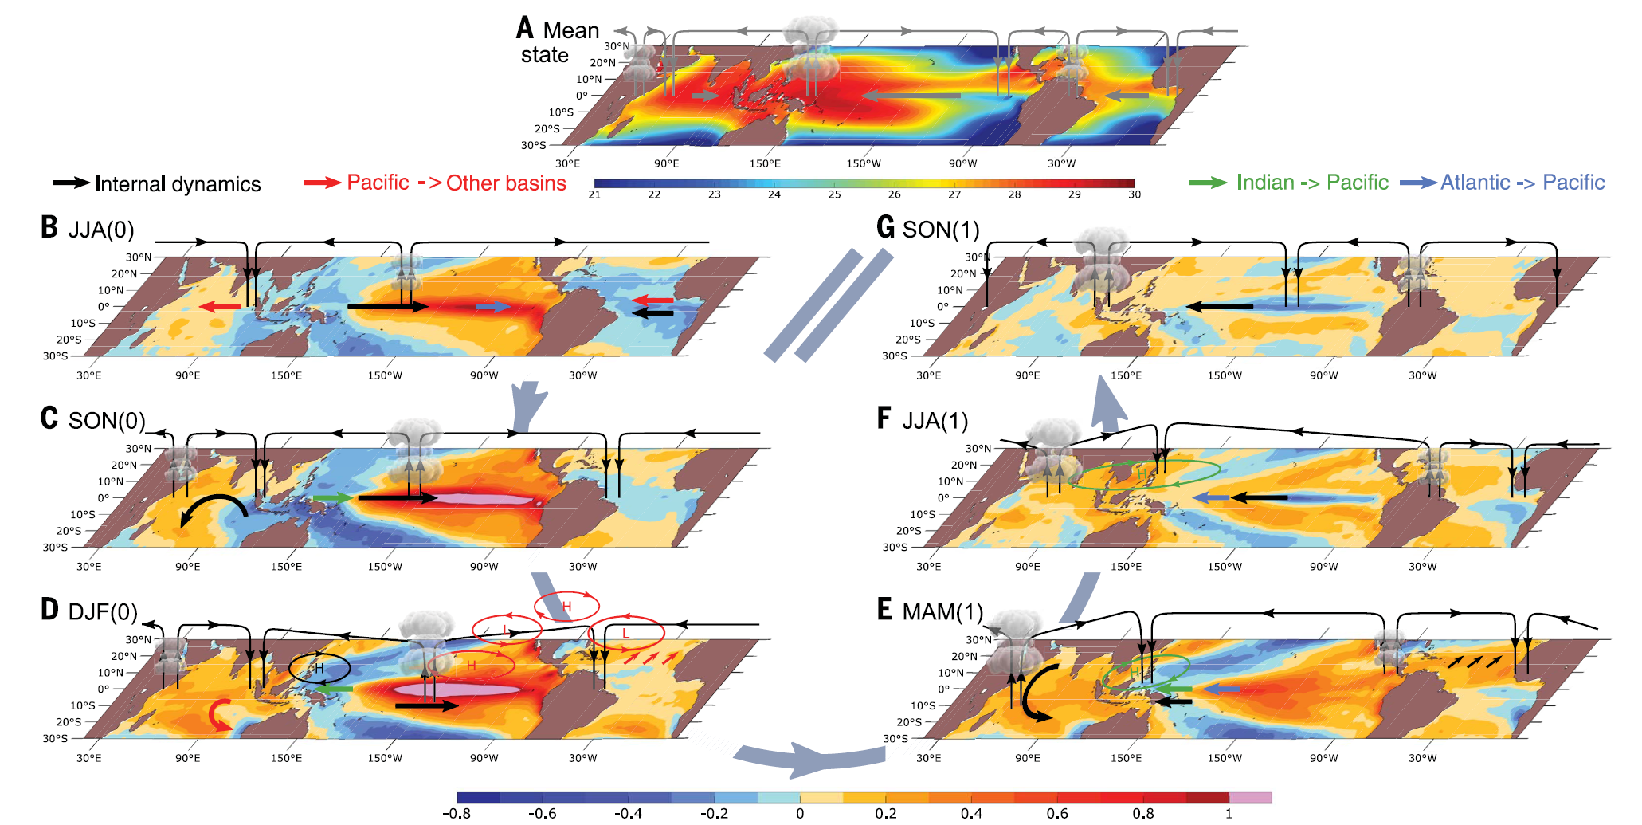
Evolution of tropical inter-basin interactions during a typical El Niño
Cai et al. (2019)

Slide 51
Indian & Atlantic Oceans can initiate/induce El Niño
Atlantic Niño/Niña can initiate/induce EP ENSO events;
TNA/AWP can initiate/induce CP ENSO events;
Indian Ocean influences the WP and then ENSO events;
Presently, conceptual models do not address inter-basin interactions.
Wang (2019, Clim. Dyn.)

Slide 52
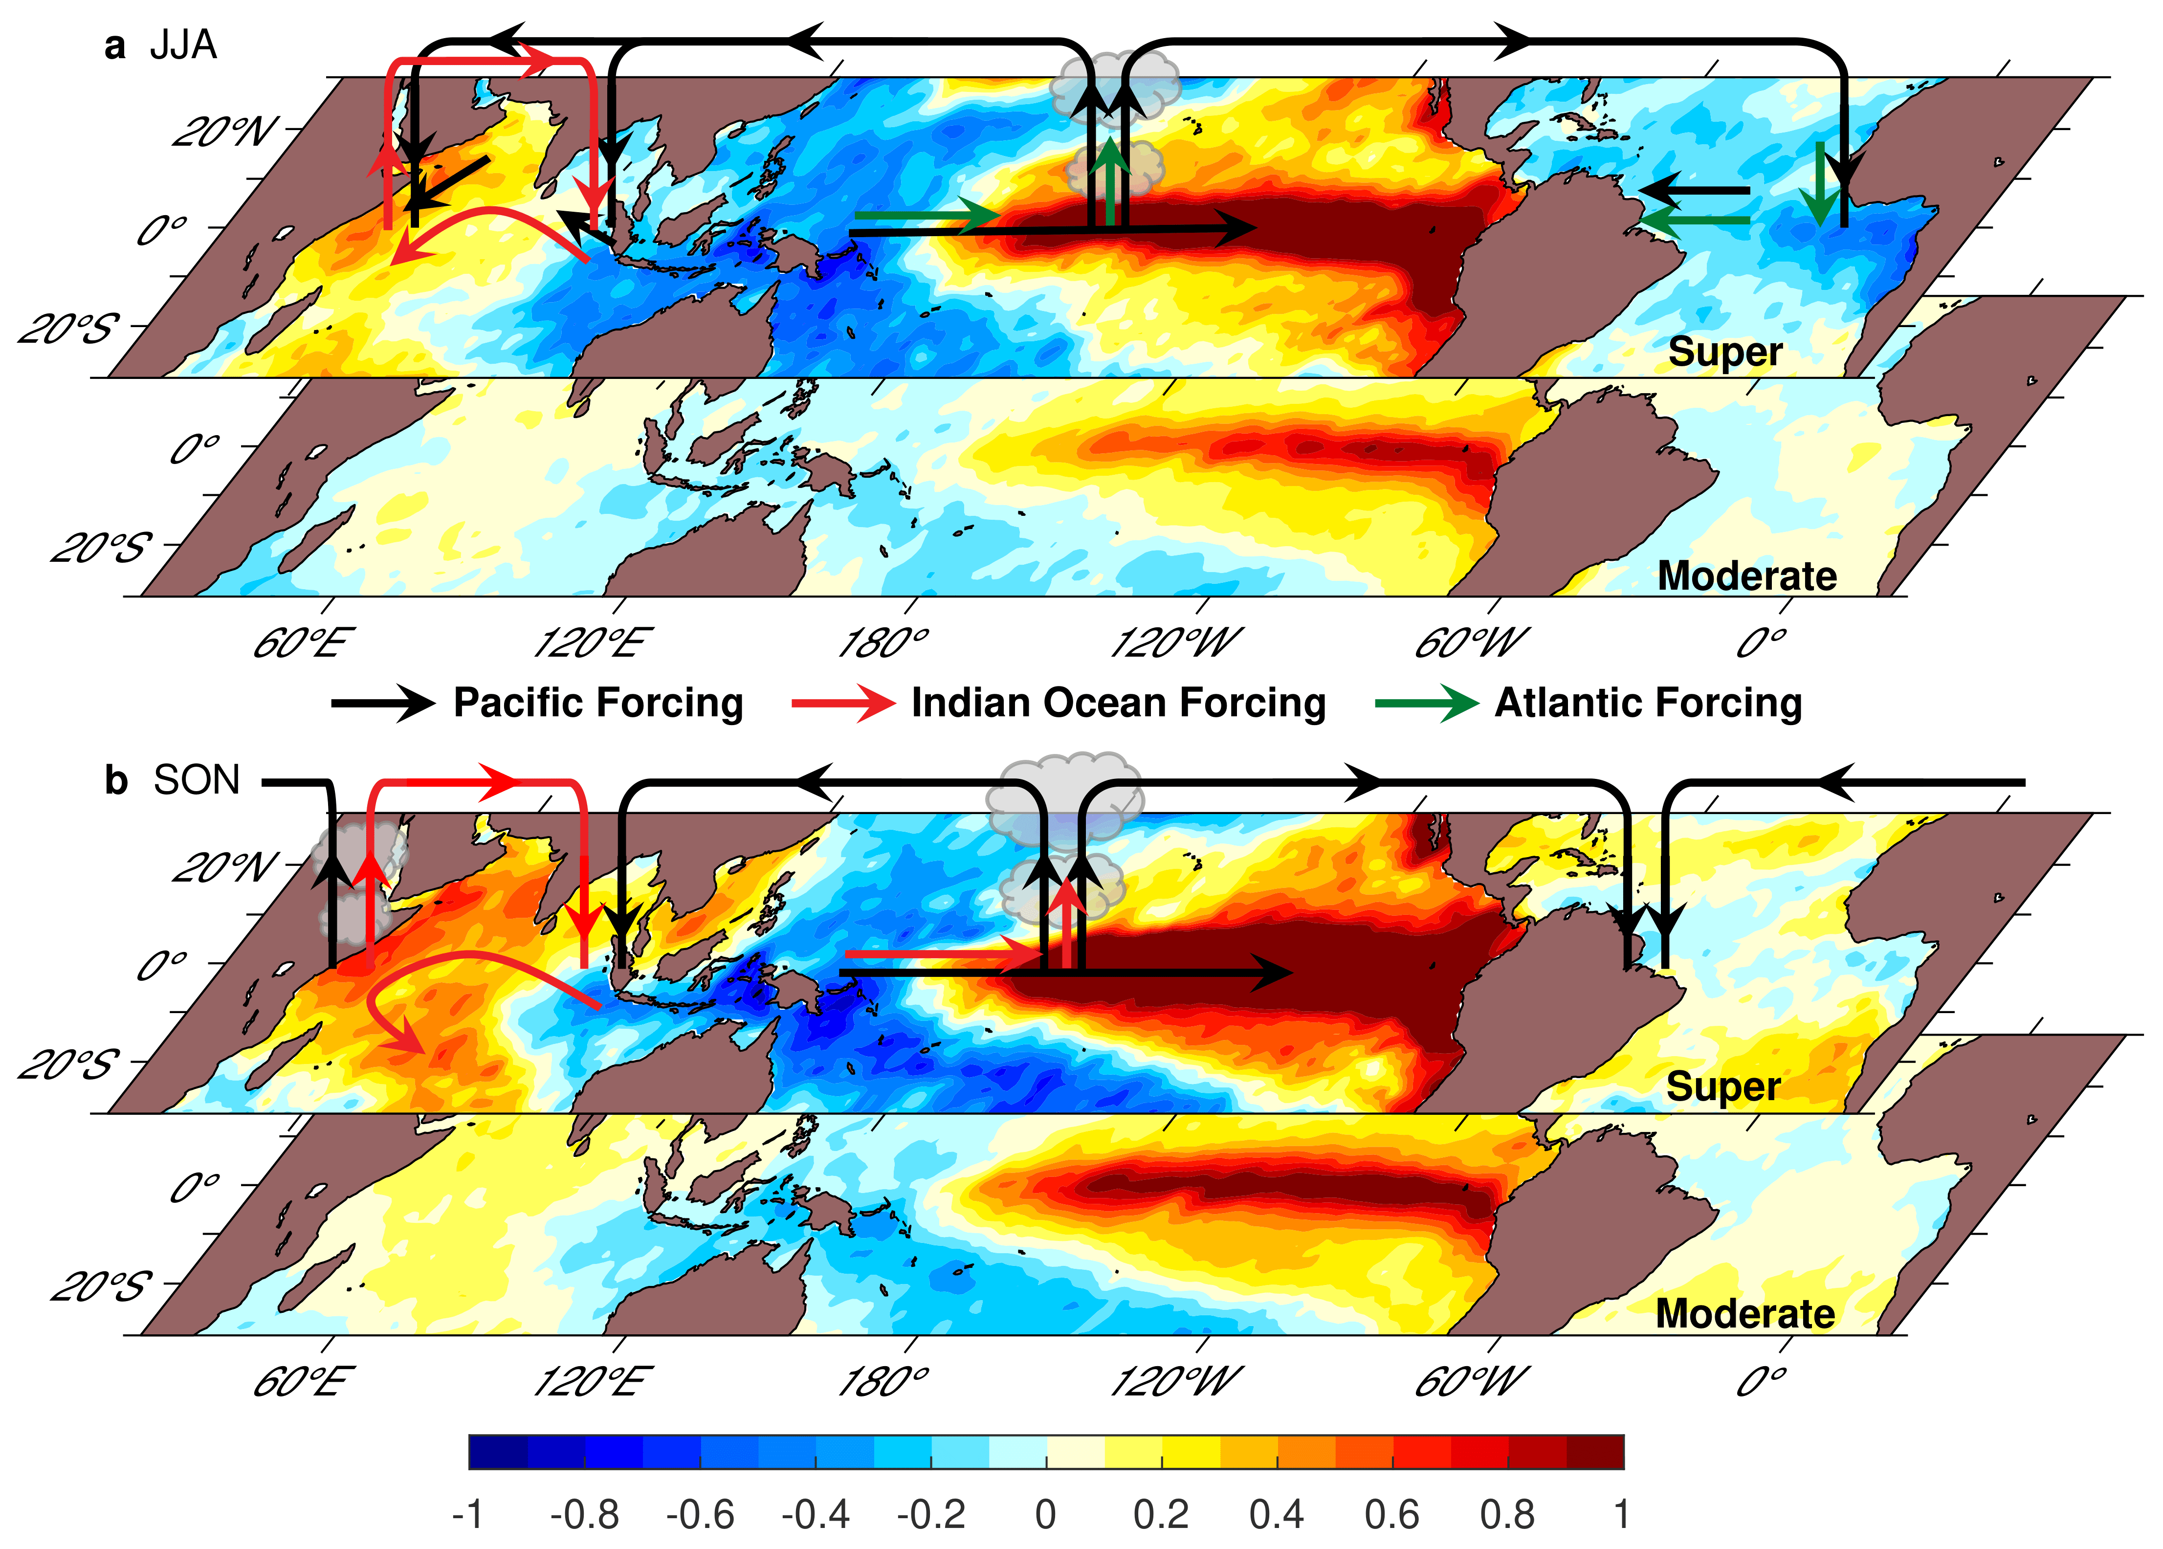
Contributions of Indian & Atlantic Oceans to El Niño
Summer:
Atlantic Niña
Atlantic Niña induces westerlies
IOD induces westerlies
Fall:
Indian Ocean dipole
The successive occurrence of Atlantic Niña and positive IOD is called the Indo-Atlantic booster (IAB) (Wang and Wang 2021, JC).
IAB helps produce super El Niño via three-ocean interactions coupled with seasonal cycle.

Slide 53


Feedback of Atlantic Niña to El Niño in summer
Partial regressions of SST and wind anomalies (Summer)
Growing up of
El Niño
Starting of
IOD
Feedbacking of
Atlantic Niña
Wang and Wang (2021, JC)
El Niño induces Atlantic Niña in summer which in turn produces westerly wind anomalies in the WP.

Slide 54


Feedback of IOD to El Niño in fall
Partial regressions of SST and wind anomalies (Fall)
Growing up of
El Niño
Feedbacking of
IOD
Decaying of
Atlantic Niña
Wang and Wang (2021, JC)
El Niño induces IOD in fall which in turn produces westerly wind anomalies in the CP.

Slide 55

Contributions of IAB to super El Niño
Summer
Fall
Wang and Wang (2021, JC)
Atlantic Niña contributes about 1 m/s westerly wind anomaly in summer.
IOD contributes about 1-2.5 m/s westerly wind anomaly in fall.
IAB, as a self-excited mechanism, produces additional Bjerknes feedbacks for super El Niño.

Slide 56
A paradox about impacts of Indian/Atlantic Oceans on ENSO
Decoupled IO
With IO
Decoupled experiments show that Indian & Atlantic Oceans have a damping effect and shorter cycle for ENSO (Dommenget et al. 2006; Frauen and Dommenget 2012; Terray et al. 2016; Kajtar et al. 2017);
This is because they focused on the decaying of El Niño instead of the growth;
IO and AO do help the growth of El Niño in these decoupled experiments;
Fast decaying may be due to impacts of IOB and TNA modes in spring.
Growth phase
Decaying phase
Notes:
El Niño attenuates at the end of the year owing to its intrinsic dynamics (all lines); that is, even if there were no the Indian Ocean, El Niño would still stop growing in winter (the blue line). The “death” of IOD and ensuing IOB, hence, do not hinder El Niño growth but lead to a faster decay.
The ENSO intensity is measured by the standard deviation of Niño3.4 index.
The calculation use all data, without separating the year(0) or year(1).
For example, the Apr(0) of a well-coupled case is larger than the Apr(0) of a decoupled case. However, the Apr(1) of a well-coupled case is much smaller than the Apr(1) of a decoupled case. Thus, the overall effects of the Indian Ocean seems to be damping.
IOB & TNA modes facilitate La Nina

Slide 57
Take-home message of simple ENSO models
All oscillator mechanisms work together, and their relative importance may be time-dependent.
Conceptual models are just heuristic, and cannot perfectly simulate all features of ENSO events.
Parameters of conceptual oscillator models are NOT constant; and conceptual models can be forced by high frequency such as random (stochastic) forcing.
Processes outside the tropical Pacific can account for ENSO diversity.
Conceptual models need to consider external influences outside the tropical Pacific, such as inter-basin interactions.

Slide 58

An ensemble of forecasts during the onset of the 1998-99 La Niña
Figure 4.18
Start coupled model from different ocean initial conditions (leading also to changes in atm. )
Initial differences grow ⇒ ensemble of prediction runs
Ensemble spread gives estimate of uncertainty
Spread tends to grow with time (due to weather noise & coupled feedbacks)
Ensemble mean gives best estimate
The eastward movement of
anomalous subsurface water
is the key to the forecast!
Courtesy of the European Centre for Medium-range Weather Forecasting.
Neelin, 2011. Climate Change and Climate Modeling, Cambridge UP
Notes:
ecmwf_forecast.1098.clr.eps

Slide 59


Climate Impacts of El Niño and La Niña
El Niño
La Niña
With the Nino SST forecast 3-6 months ahead, we can predict the T and P anomalies over these regions with the same lead time.

Slide 60
Precip. vs. Nino3.4 SST Correlation: 1920–2010 (1979–2010 over oceans)
ENSO
IPO
Stippling indicates significant at 5% level Dai (2013)

Slide 61
Summary of ENSO
ENSO refers to irregular (2-7yr) oscillations in SLP, SST and winds in the tropical central-eastern Pacific. It is the largest interannual variation.
ENSO dynamics/formation: See slides 17 and 19:
El Niño formation: westerly wind anomaly→ more warm water pushed to the east → lower (higher) sea level in the west (east) and shallower (deeper) thermocline in the west (east) + Bjerknes feedback → warmer SST in the east and weaker trade winds → reduced west-east sea-level height gradient → no more transport of warm water to the east → SST and SLP in the east recover to normal → trade winds push surface water westward, subsurface cold water moves eastward → transition to the cold phase La Niña
La Niña formation: easterly wind anomaly→ more warm water pushed to the west → higher (lower) sea level in the west (east), deeper (shallower) thermocline in the west (east) + Bjerknes feedback → colder SST in the east and stronger trade winds→ increased west-east sea-level height gradient → no more transport of warm water to the west → SST and SLP in the east recover to normal → ocean pressure gradient force pushes surface warm water eastwards, subsurface warm water moves eastward → transition to El Niño.
ENSO theoretical models: simple models considering the basic ENSO processes, they can produce the oscillation of Nino4 T. The unified oscillator model can produce several other ENSO models.
ENSO can be predicted 3-6 months ahead.
ENSO Impacts: During El Niño: dry in Indonesia, eastern Australia, Central America, Northwest S. America, West Africa, southern Africa and India; wet in the central-eastern equatorial Pacific, the western tropical Indian Ocean and East Africa, Southeast S. America, the southern U.S., most of the extratropical North Atlantic, central Eurasia, parts of East Asia. The impact is roughly reversed during La Niña.

Slide 62
Next Lecture:
NAO, AO, Atlantic and Pacific Multidecadal Variability

