Slide 1
Key points of last lecture on NAO, PDO/IPO, & AMO
Inter-annual modes: NAO, AO (and ENSO)
NAO and AO: Positive phase→ larger meridional pressure gradients, stronger polar vortex → stronger jet and westerlies → fewer cold breaks from the Arctic to mid-latitudes, more northerly flow over the Atlantic → mild and wet winter in northern Europe and the eastern U.S., but dry Mediterranean (dT is small).
NAO results from interactions between synoptic eddies and planetary waves under certain matching conditions; it typically has a lifetime of ~2 weeks and is influenced by Atlantic westerly winds
Decadal modes: PDO/IPO, AMO/AMV: formation dynamics not well known.
PDO/IPO: the decadal to multi-decadal oscillations in ENSO activities, with periods from ∼40-60 years and spatial patterns similar to ENSO
AMO: The 60-80yr oscillation in SST in the North Atlantic.
These modes are likely generated by stochastic atmospheric forcing, with Rossby wave propagation in the extratropical Pacific and Atlantic Ocean being key to their time scales.
AMO may result from the interactions between AMV, AMOC and NAO: AMV-/AMOC- → NAO+ → AMV+AMOC+ → NAO- → AMV-/AMOC-
AMO cycles since 1920 may be partly forced by changes in aerosols
IPO and AMO affects T and P over the Americas, West Africa, Europe and Asia on decadal-multidecadal time scales.
Warm tropical Atlantic leads to cooing in the central-eastern tropical Pacific due to stronger trade winds
Warm tropical Pacific leads to warm tropical Atlantic due to local flux changes and horizontal warm advection.

Slide 2
A ATM551: Lectures #21
Climate Forcing, Response, and Sensitivity
Reading Materials:
Chapter 10 of Hartmann GPC
Gregory et al. (2004, GRL)
Dai et al. (2020, CD)

Slide 3
Design of the Course (3/3)
Part 4 – Climate Change and Modeling (5 lectures)
Lecture 21: Climate Forcing, Response and Sensitivity (4/11)
Lecture 22: Climate Feedbacks (4/16)
Lecture 23: Introduction to Climate Modeling (4/18)
Lecture 24: Common Climate Simulations & Projections (4/23)
Lecture 25: Projected future climate changes (4/25)
Final Exam Review Lecture: April 30
Final Exam: Friday, 5/03, 3:30-5:30pm, ETEC 482

Slide 4
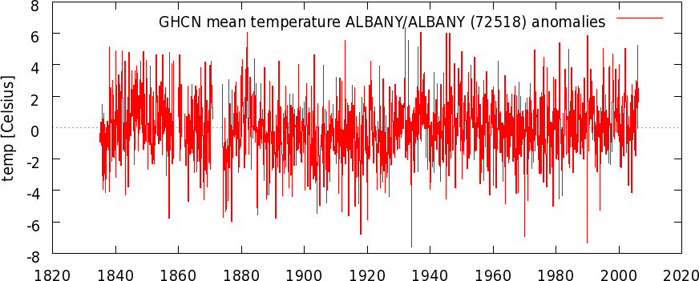
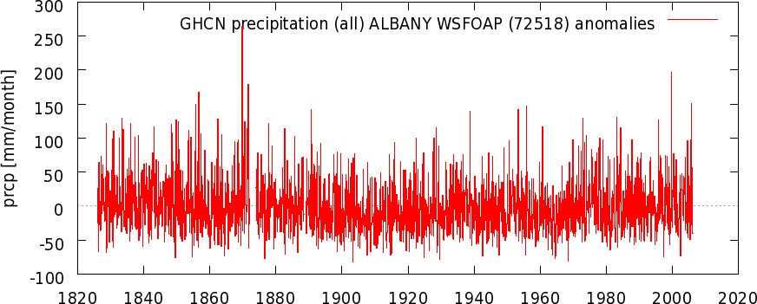
Albany T & P Monthly Anomalies since the 1830s
- Data from a single location can be noisy.
- Forced long-term change signal is often weak compared with
natural variations.
- This presents a challenge for quantifying forced long-term
changes.
Notes:
Monthly anomaly (with the mean annual cycle removed)

Slide 5
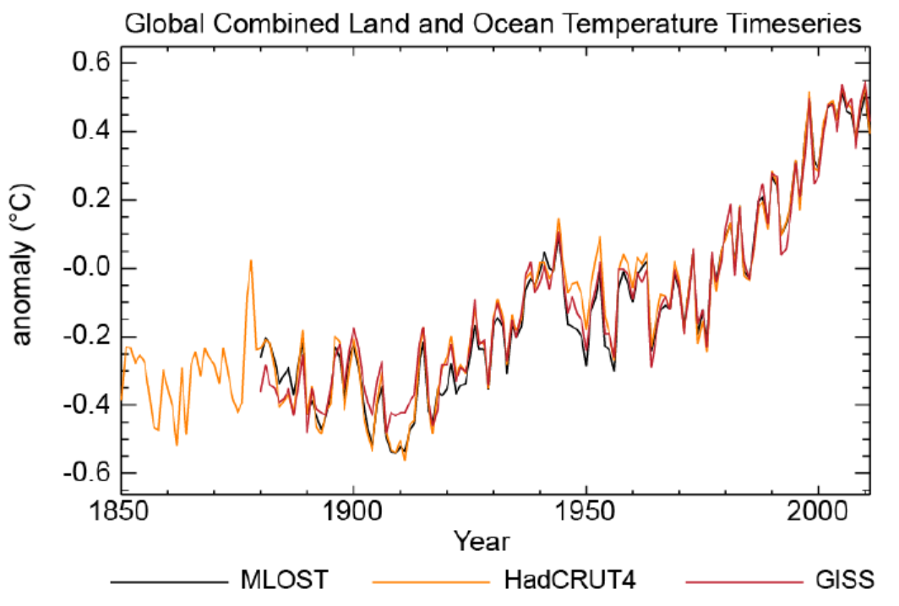
Observed Global Temperature Series
From Three Datasets, 1850−2011
Spatial averaging reduces the natural variations and
enhances the long-term change signal. Why?

Slide 6
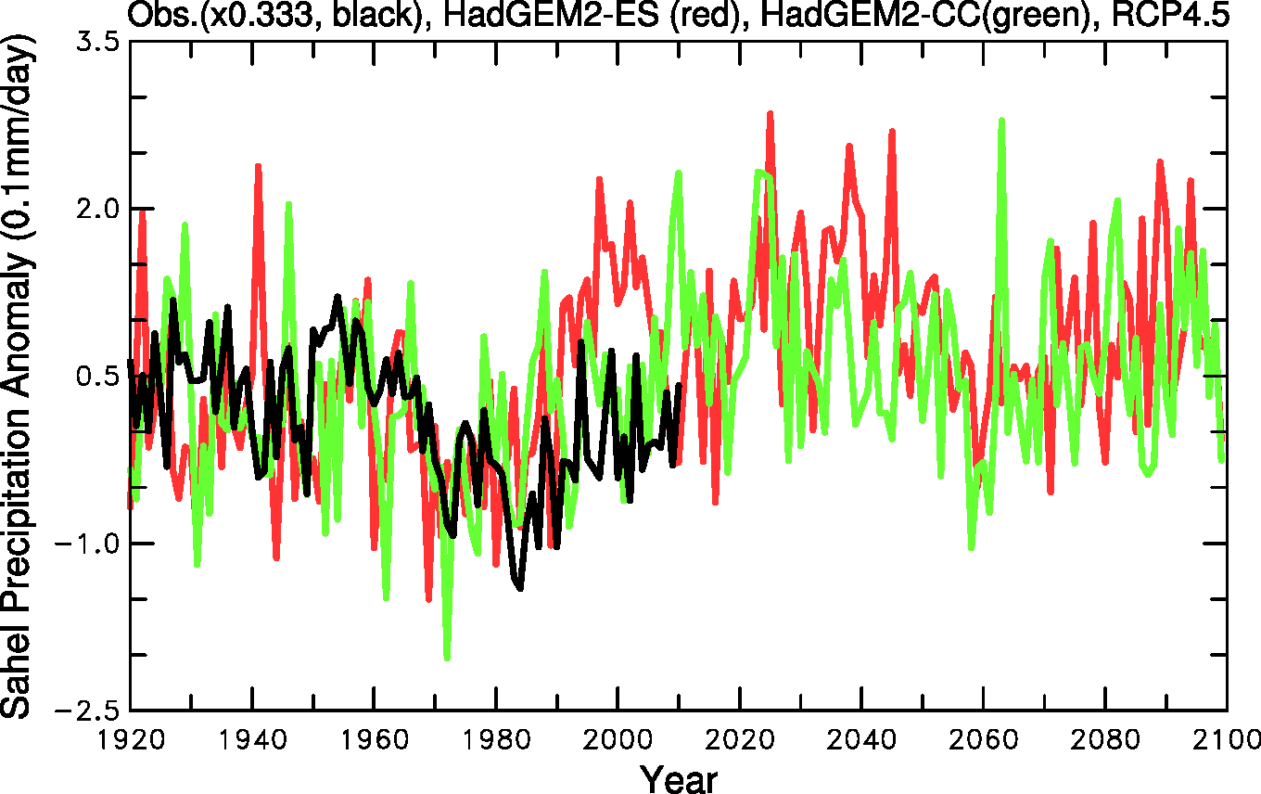
Sahel Rainfall
Obs vs. HadGEM2-ES + HadGEM2-CC
Unforced natural variations are large and vary among model runs (why?)

Slide 7
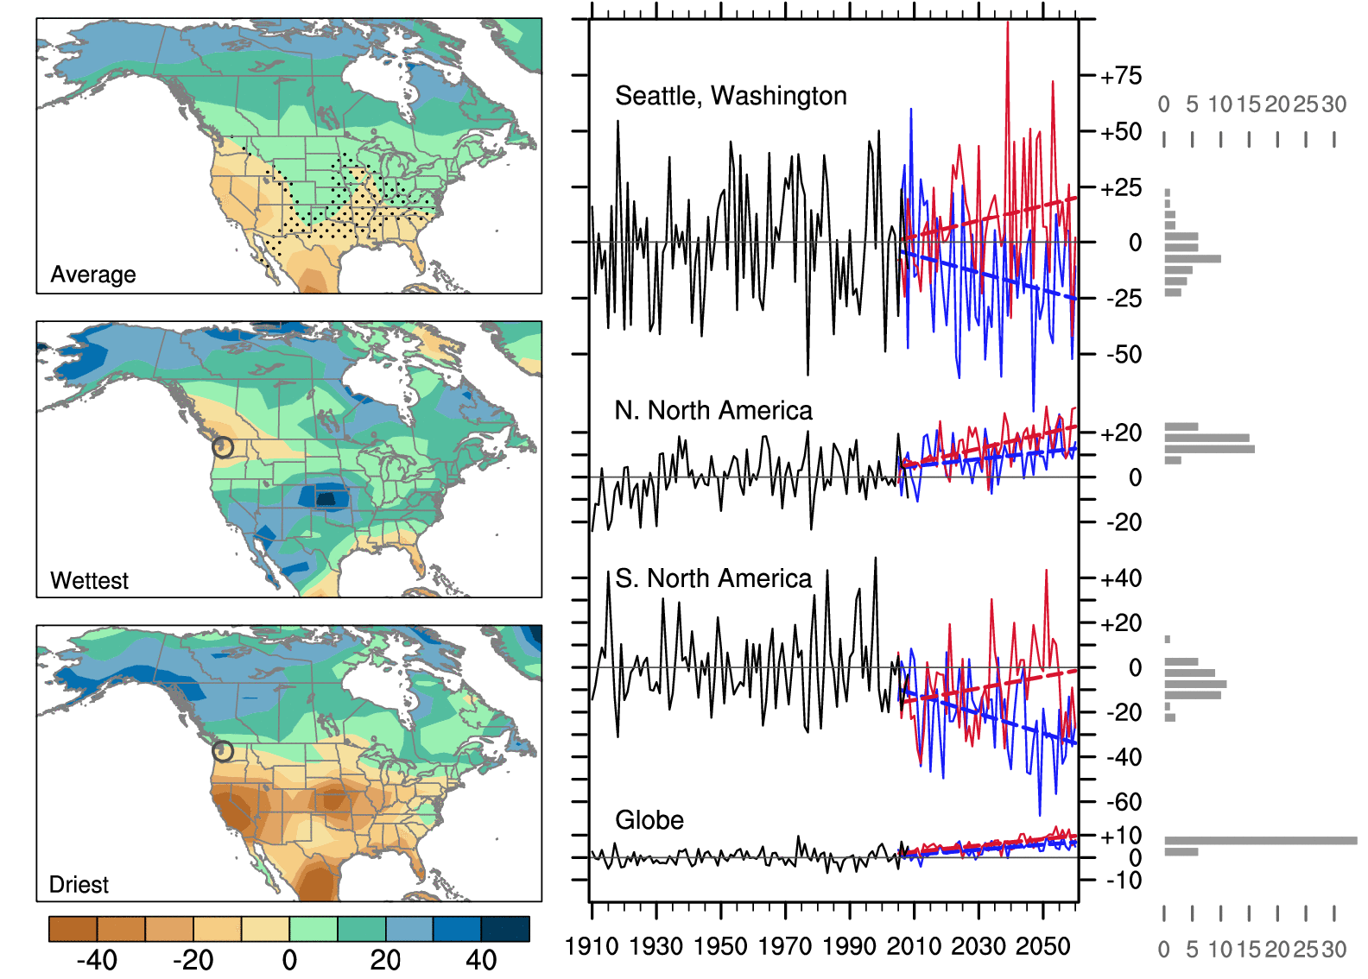
Wettest vs. Driest CCSM3 Ensemble Runs
P change (%)
Deser et al. 2012, NCC 40-member ensemble, 2000-2060, A1B scenario
Notes:
40 CCSM3 ensemble runs with AGCM starting from different days in December and January 2000 and continue to 2060 under IPCC A1B scenario. Stippling indicates insignificant trends. Same GHG forcing in these runs.

Slide 8
Climate Forcing and Response
Climate Forcing refers to a change in atmospheric GHG levels, solar insolation, volcanic eruptions, land surface conditions, etc. that can lead to global or regional climate changes. It can be human-induced (e..g, through fossil fuel burning or converting forests to crop land) or natural (e.g., large volcanic eruptions or solar cycles).
Climate forcing is often measured using the TOA net radiative flux change (from zero) induced right after the change. Note that TOA net radiation will restore to zero again after a new equilibrium is reached. Thus, climate radiative forcing (at TOA) is often used.
Climate Response refers to the change of the climate in response to a given climate forcing, such as increases in atmospheric CO2 levels.
Climate response may be masked by large natural variations, making it difficult to quantify it.
Climate forcing
The Climate System
Climate Response
Climate Variations
Notes:
TOA = Top-of-atmosphere

Slide 9
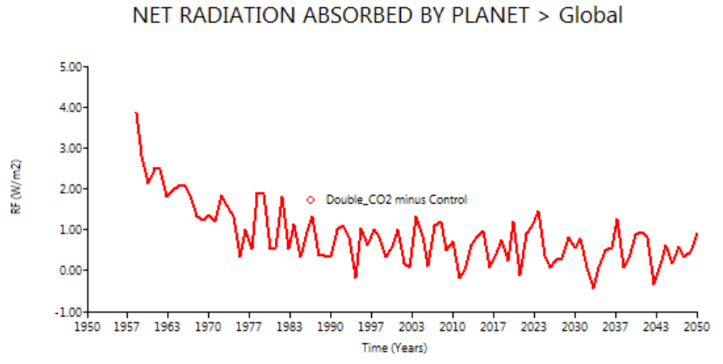
Radiative Forcing
Radiative forcing (RF) is the change in the net radiative flux at the top of the atmosphere (TOA) caused by a climate forcing, such as a change in GHGs, solar radiation, or volcanic aerosols, immediately following such a change. Note the net radiative flux at TOA will become zero again after a new equilibrium is reached.
In some analyses, the change in the net radiative flux at the tropopause may be used as the radiative forcing, since the atmosphere above the tropopause is allowed to reach radiative equilibrium (thus no contribution to TOA imbalance) in estimating the radiative forcing.
Radiative forcing due to a doubling of atmospheric CO2 is around 4 W/m².
Radiative forcing after an instantaneous doubling of CO2 in EdGCM
RF≈3.8W/m²

Slide 10
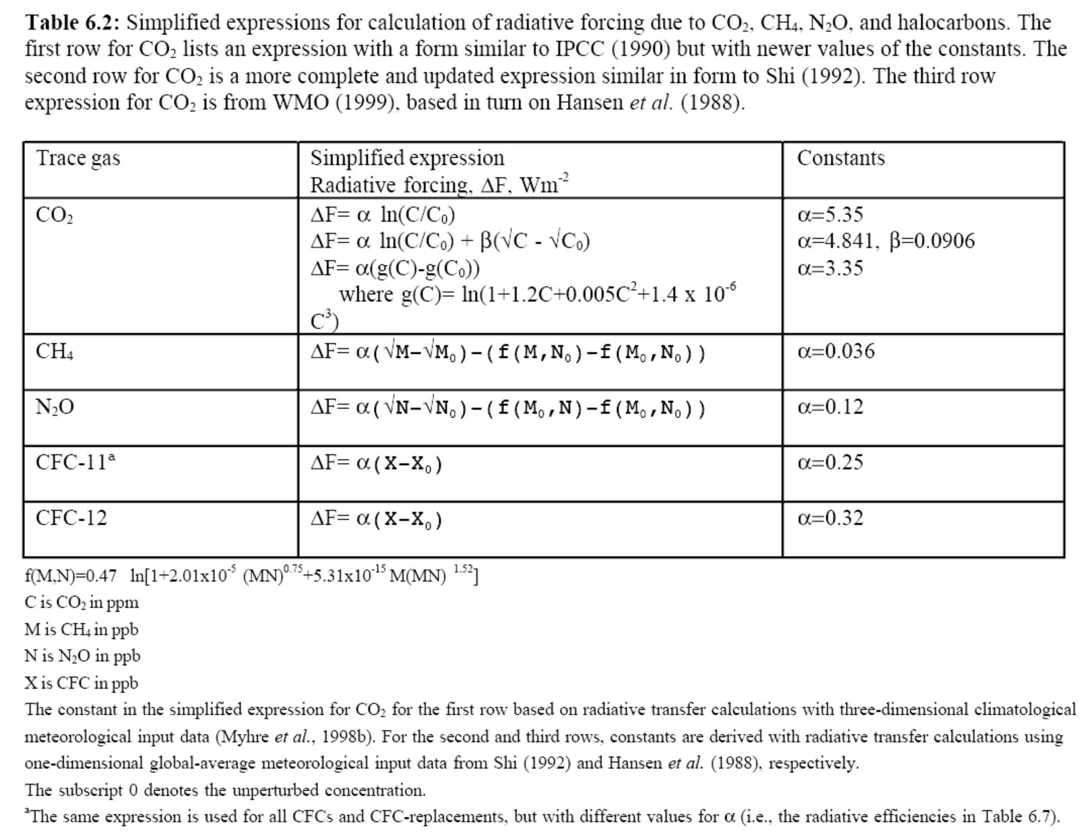
Estimates of Radiative Forcing due to GHG Changes
IPCC (2001)
RF increases with CO2, CH4, and N2O nonlinearly, with a logarithmic
relationship.

Slide 11
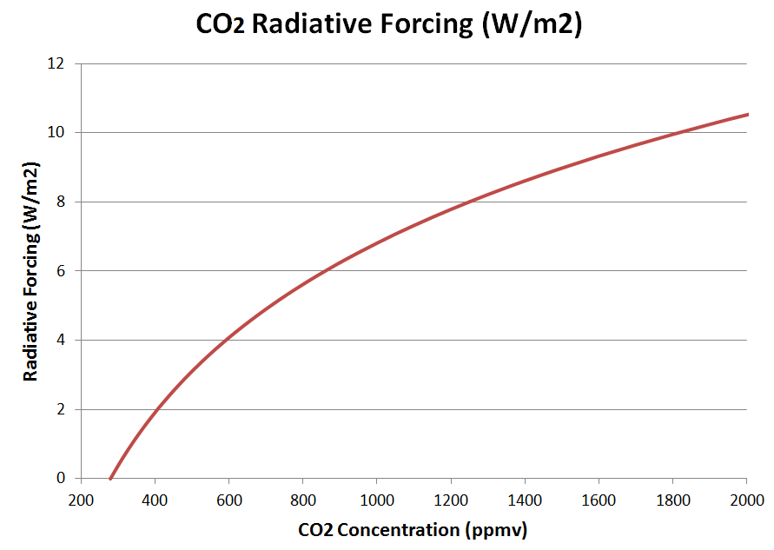
RF = 5.35 ln(C/Co)
CO2 RF (W/m²)
2xCO2 3.7
3xCO2 5.9
4xCO2 7.4
5xCO2 8.6
8xCO2 11.1

Slide 12
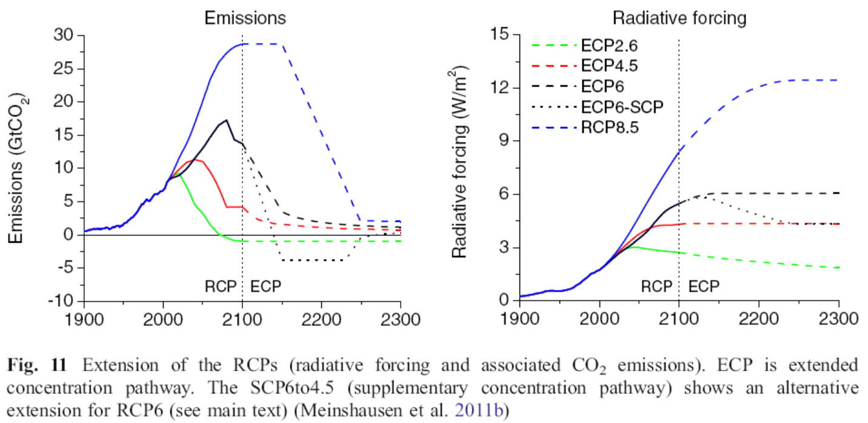
Historical and Future CO2 Forcing

Slide 13
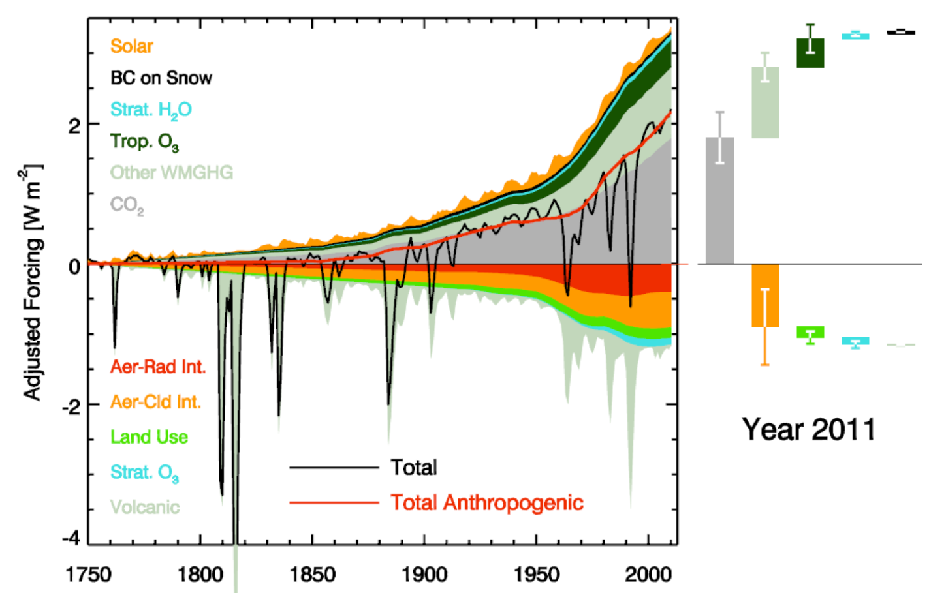
Historical Radiative Forcing: Temporal Evolution (IPCC AR5)

Slide 14
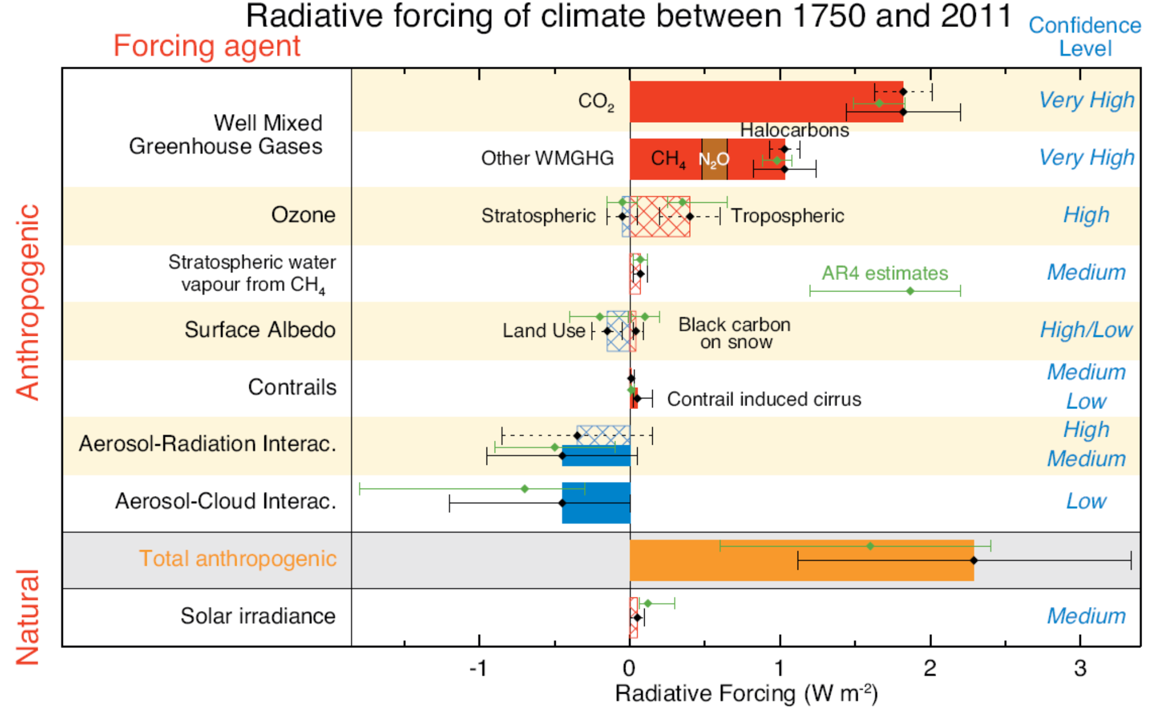
Historical Radiative Forcing: 1750-2011 (IPCC AR5)
CO2 ≈ 1.8, CH4 ≈ 0.5, CFCs ≈ 0.4, N2O ≈0.2, tropospheric O3 ≈ 0.4, aerosols ≈ –0.7, total ≈2.4 W/m2
Notes:
RF= Change in net irradiance at the tropopause after allowing for stratospheric temperatures to readjust to radiative
equilibrium, while holding surface and tropospheric temperatures and state variables fixed at the unperturbed values.
AF = Change in net irradiance at the TOA after allowing for atmospheric temperatures, water vapour, clouds and land
albedo to adjust, but with all or a portion of surface conditions unchanged. Nitrous oxide (N2O)

Slide 15
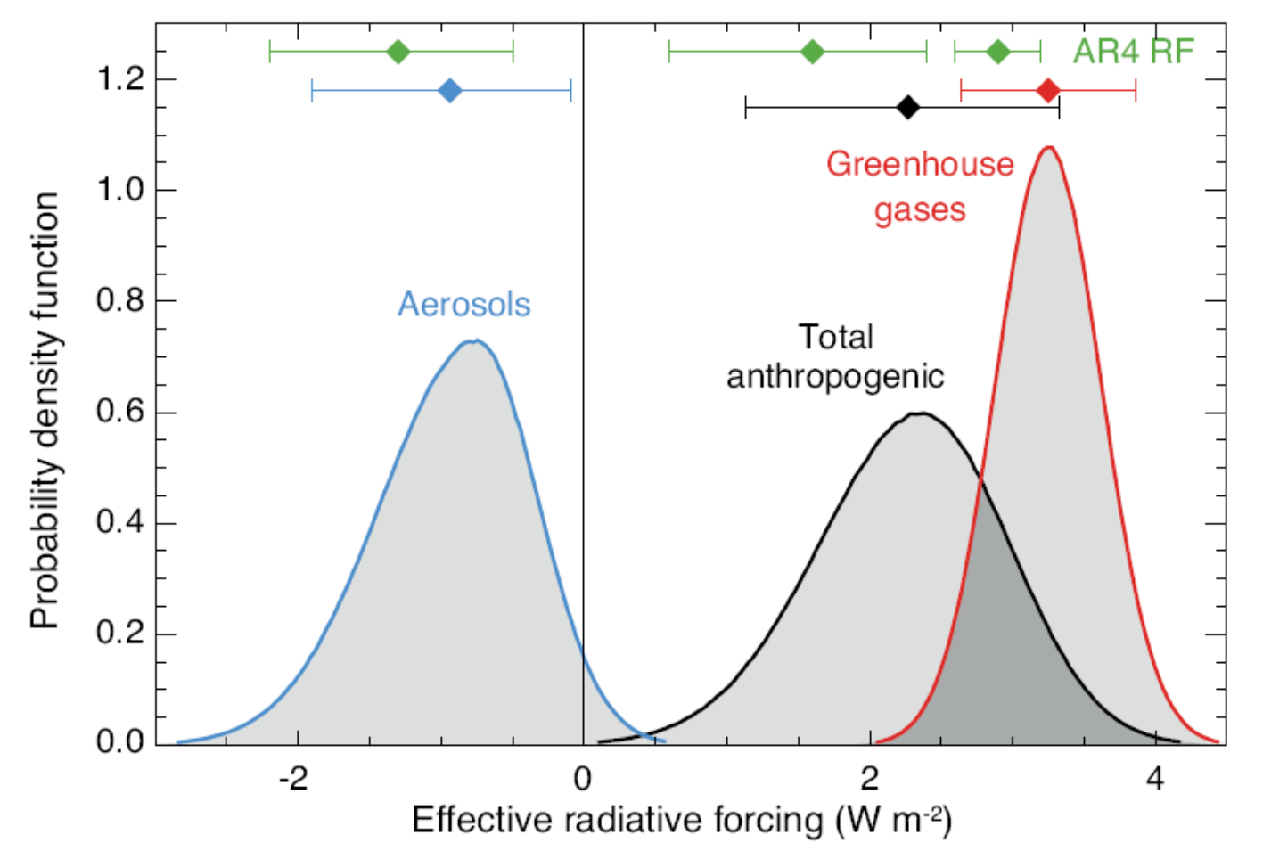
Historical Radiative Forcing: 1750-2011 (IPCC AR5)
Global-mean forcing

Slide 16
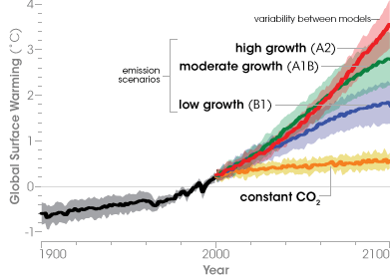
Quantifying Response and Variations
An ensemble of simulations consisting of multiple runs starting from different initial conditions but with identical forcing and model physics is often used to quantify the mean climate response to a given forcing by averaging all the ensemble members(why?)
Single model vs. multi-model ensemble simulations: Different model physics in latter.
The spread (shading on Figure) from such an ensemble is considered as the uncertainties associated with the natural climate variability.

Slide 17
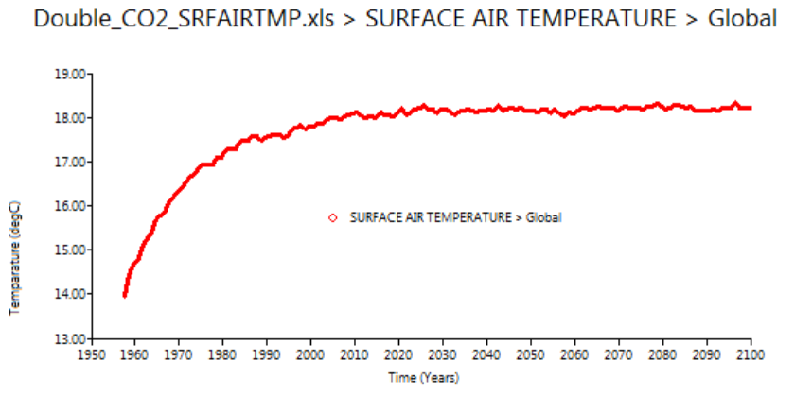
Equilibrium Climate Sensitivity (ECS)
Climate sensitivity (λ) is the equilibrium response of the global-mean surface temperature (T) to a given (initial) TOA radiative forcing (R), expressed in ºC per W/m²: λ=dT/dR. It depends on the initial state of the climate system as well as the nature of the forcing (e.g., changes in GHGs, solar radiation, or volcanic aerosols, etc.)
The global-mean T change due to a doubling of CO2 is also used as a measure of climate sensitivity for climate models. The EdGCM has a sensitivity of ~4.2ºC for 2xCO2.
The IPCC AR5 says that climate sensitivity for a 2xCO2 is likely within 2.0-4.5ºC, with
a λ of 0.5 ~ 1.1 K per W/m², assuming a dR of 4 W/m² for 2xCO2.
4.2ºC

Slide 18
Methods of Determining Climate Sensitivity
Paleoclimate Evidence. 3 primary methods:
  Take two different climate periods (e.g., the Last Glacial Maximum and Pre-Industrial) and divide the temperature change by the radiative Forcing
  Ensemble of LGM simulations is carried out using a single climate model in which each ensemble member typically differs in model parameters and the ensemble covers a range of climate sensitivity. Model parameters are then constrained by reconstructed LGM climate, and probability distribution of climate sensitivity is generated
  Multiple GCM simulations are compared to proxy data (Otto-Bliesner et al., 2009), and performance of the models (and indirectly their climate sensitivity) are assessed
2) Using the observed record.
  Satellite measurements of TOA radiative response to SST anomalies
  Response to Pinatubo
  20th century trend
3) In CMIP5 models, climate sensitivity obtained directly from the AOGCMs from a linear fit of the model output to the global energy balance relationship
4) Run an AGCM with a slab ocean model to an equilibrium

Slide 19
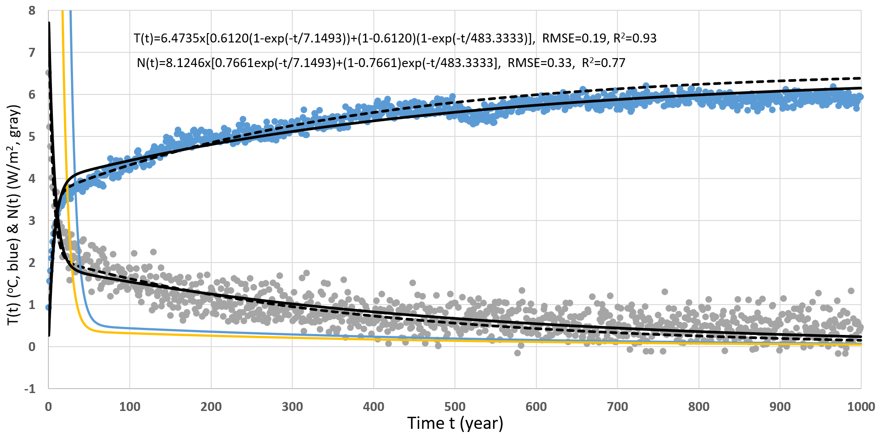
Equilibrium Climate Sensitivity Estimate
CESM1-simulated global T and TOA flux change from a 4xCO2 run
Dai et al. (2020)
Notes:
The black lines are the two-layer model fitted curves (dashed for fitting to the first 500 yrs and solid for fitting to the whole 1000 yrs).
The blue (orange) line is the slope dT(t)/dt (-dN(t)/dt) of the solid fitted lines in units of K/100yr (W/m2/100yr).

Slide 20
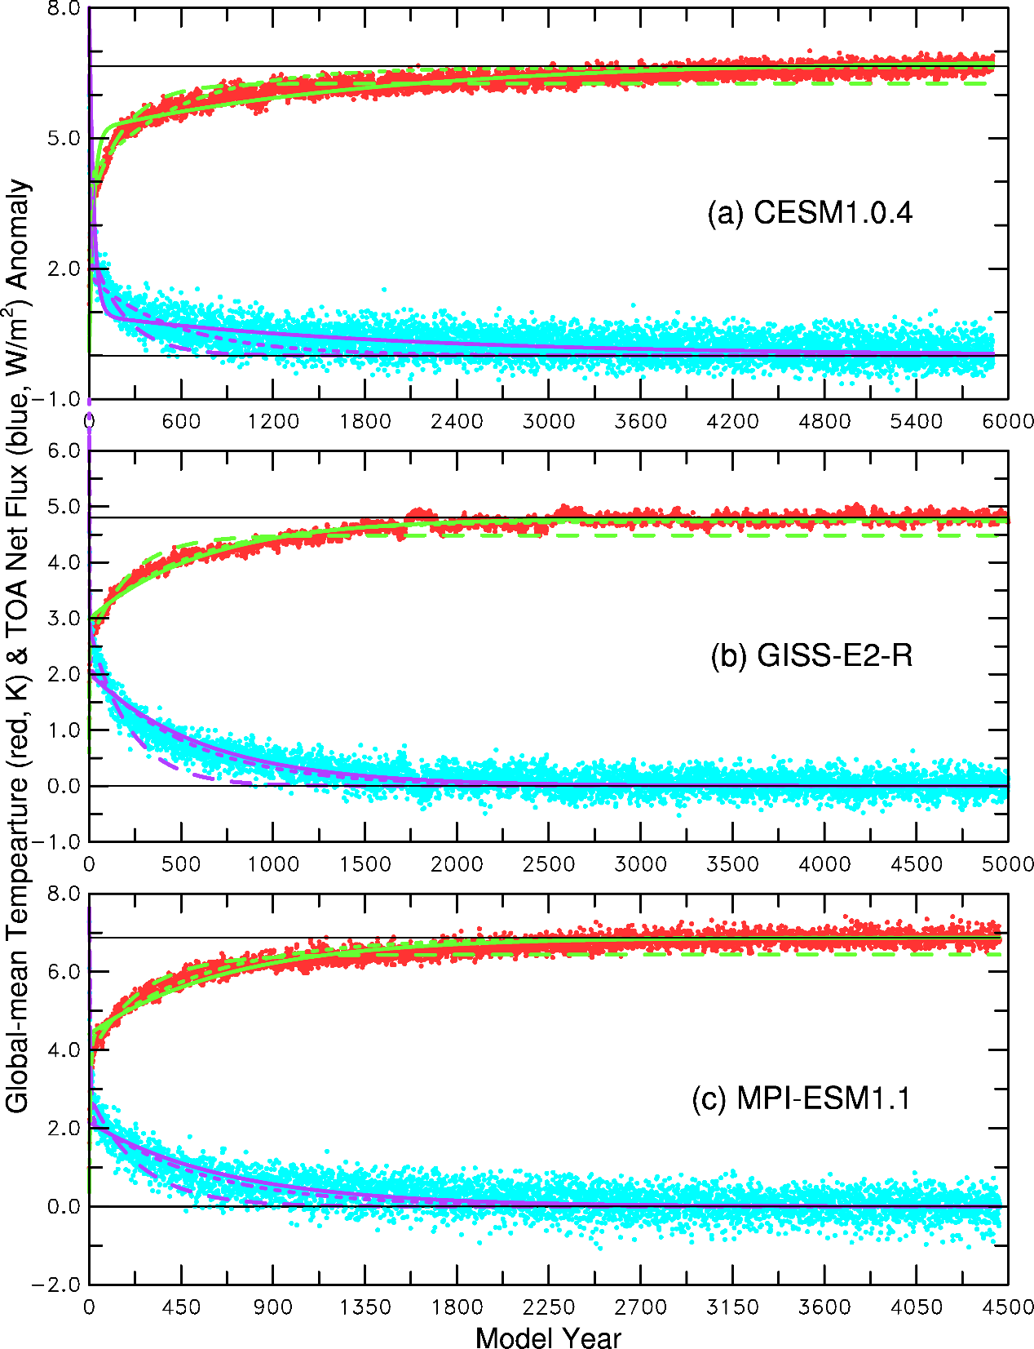
Global T and TOA flux change
from abrupt 4xCO2 runs
Dai et al. (2020)

Slide 21
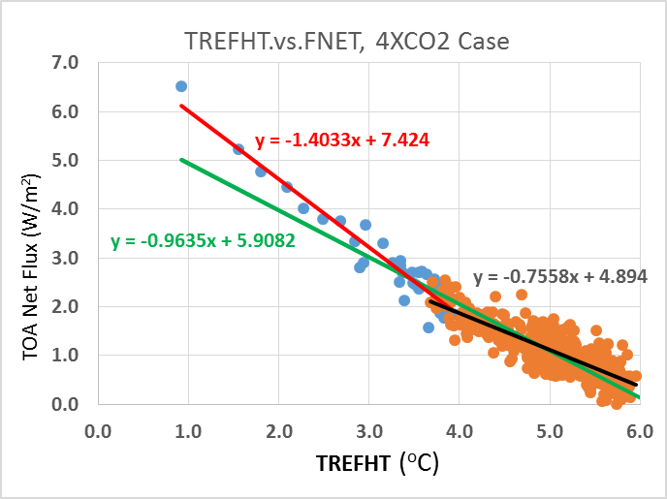
Equilibrium Climate Sensitivity Estimate
Linear fitting method of Gregory et al. (2004)
ΔN = F - b ΔT
ECS = 0.5 F/ b
F is the intercept
for 4×CO₂
b = −dN/ dT for the green line
Dai et al. (2020)

Slide 22
An Improved Method for Estimating ECS
(Dai et al. 2020, Clim. Dyn.)
ECS = θ × (ΔT_{mean} + ΔN_{mean}/b) based on 4xCO2 run
Δt_{mean} = realized warming near the end of simulation
ΔN_{mean}/b = unrealized warming by the simulation
ΔN_{mean}= TOA net flux near the end of the simulation
b = -dN/dT near the end of the simulation
θ = 0.485 or 0.4759

Slide 23
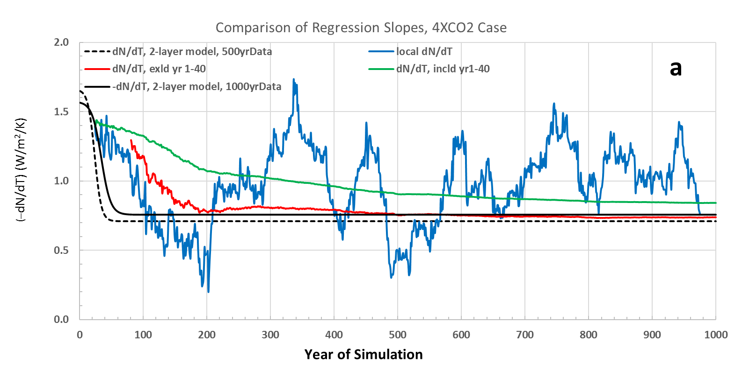
Variations in the Estimated Slope (b=−dN/dT)
Dai et al. (2020)

Slide 24
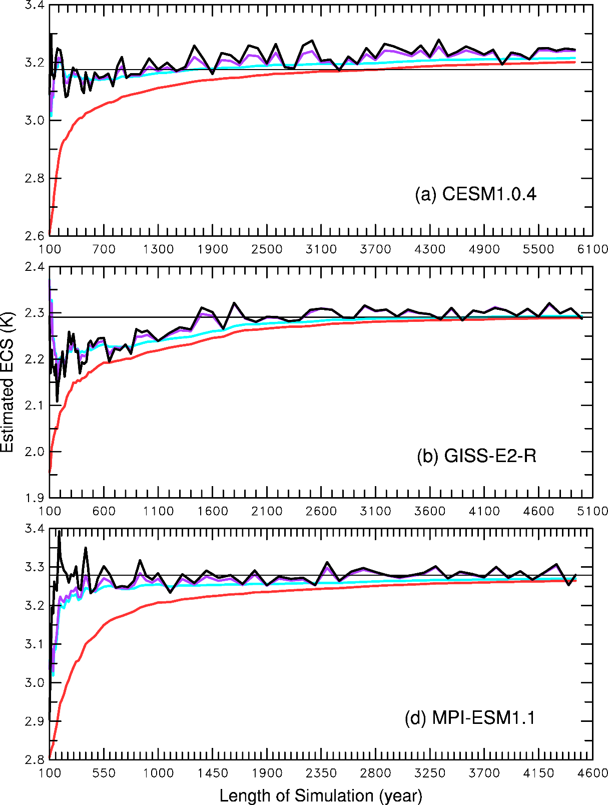
Comparison of the Estimated ECS
Gregory method
Improved method
True ECS
Dai et al. (2020)

Slide 25
Transient Climate Sensitivity
An equilibrium takes many centuries to reach in fully coupled OAGCMs.
Transient climate sensitivity (or response) is the global-mean surface temperature change averaged over a 20yr period around the time of a doubling of atmospheric CO2 (i.e., yr 60-79) in a transient simulation with 1%/yr increase in CO2.
The transient climate sensitivity is lower than the (equilibrium) climate sensitivity as the deep oceans take longer than 70yrs to respond to CO2 increases, that is, the surface temperature will continue to increase even if CO2 stabilizes after year 70.
Transient Run
2XCO2 Run

Slide 26
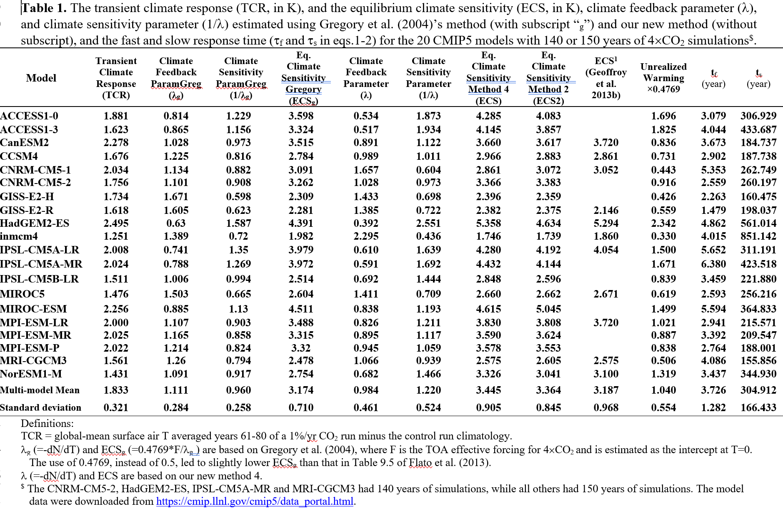
TCR and ECS in CMIP5 Models
λ=b=-dN/dT
Dai et al. (2020)

Slide 27
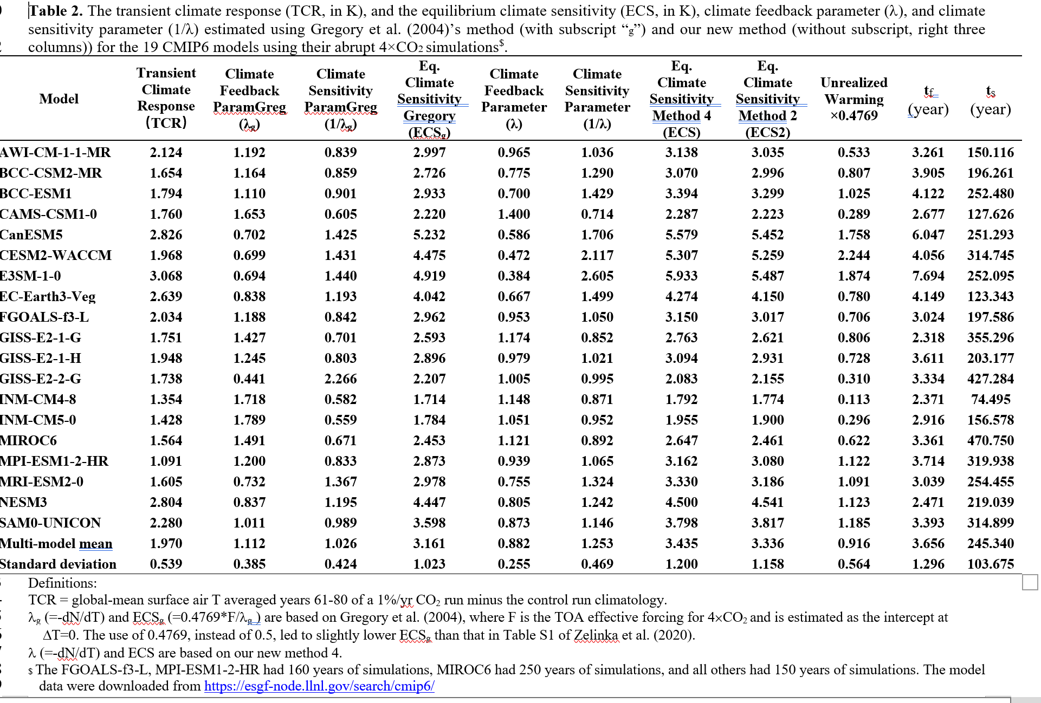
TCR and ECS in CMIP6 Models
Dai et al. (2020)

Slide 28
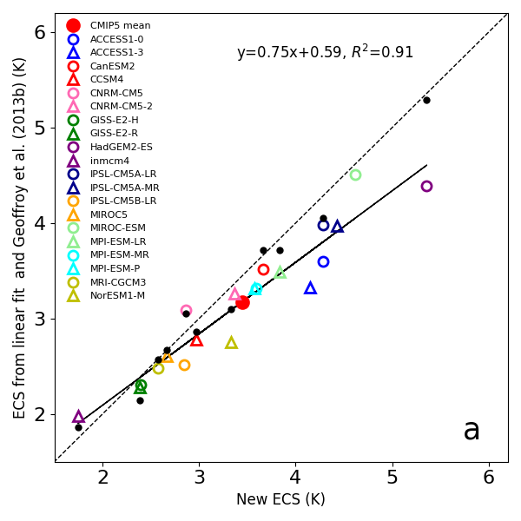
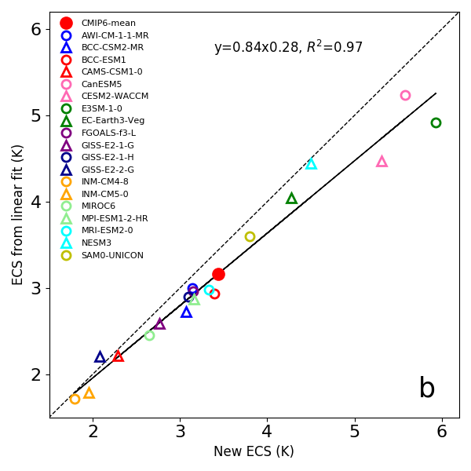
Comparison of the ECS Estimates
CMIP5 Models
CMIP6 Models
from Dai et al.
from Dai et al.
Dai et al. (2020)

Slide 29
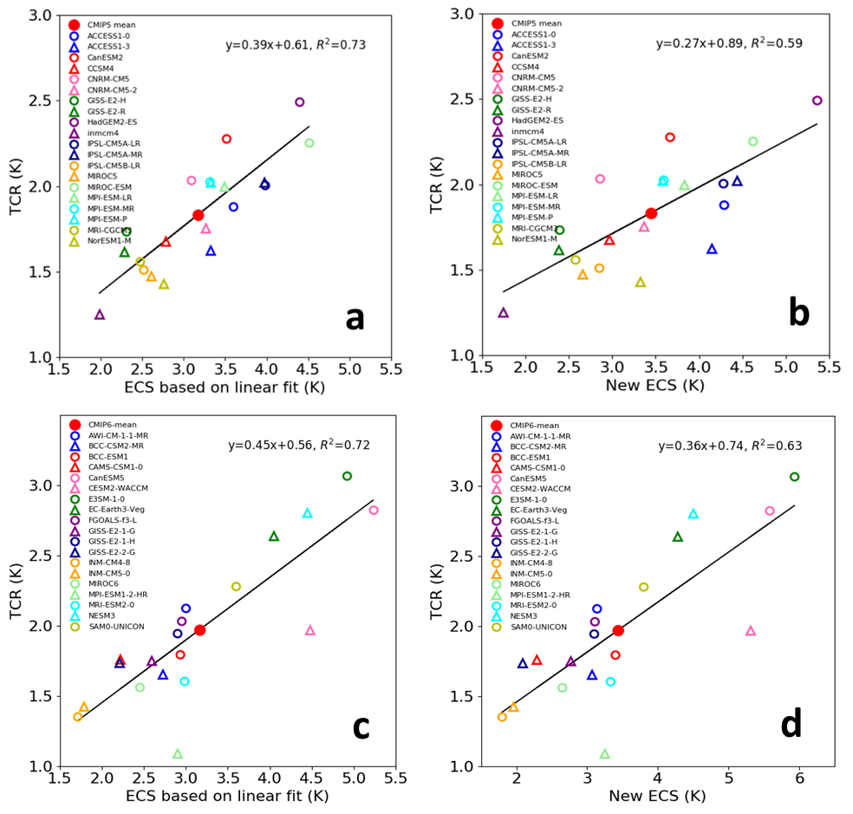
Comparison of TCR vs. ECS
CMIP5
CMIP5
Dai et al. (2020)
CMIP6
CMIP6

Slide 30
Summary for Climate Forcing, Response, & Sensitivity
Climate forcing refers to a change in GHGs, aerosols, solar insolation, etc. It is
often quantified by the net TOA flux change – radiative forcing.
Climate sensitivity (λ=dT/dR) refers to the equilibrium response of the global-
mean surface temperature to a given (radiative) forcing at TOA caused by a
sudden change in GHGs, aerosols, solar insolation, or other changes.
Equilibrium climate sensitivity (ECS) refers to the equilibrium warming of the
global-mean surface temperature in response to a doubling of CO2.
Transient climate sensitivity (or response) refers to global-mean T change at
the time of CO2 doubling (~year 70) in a transient run with 1%/yr CO2 increase.
Estimating ECS is challenging as it takes thousands of years for the climate
system to reach a new equilibrium.
Various empirical and modeling methods are used to estimate ECS
A common method is to fit the global-mean TOA flux with surface T change to
estimate ECS, but the dN/dT slope changes over time.
Most GCMs show a warming of 2-4.5ºC for 2xCO2 (with a radiative forcing of
~4W/m²), or a climate sensitivity of 0.5-1.1K per W/m².
The new CMIP6 models show a mean ECS of 3.4ºC, similar to that of CMIP5
models but with a larger upper limit (5.9 vs. 5.4ºC).

