Slide 1
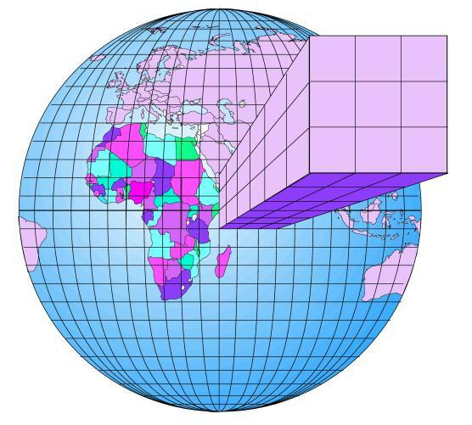
A ATM551, Lecture #23 by Aiguo Dai at UAlbany
Introduction to Climate Modeling
Reading Assignment:
Chapter 3 of the UCL online textbook.
Chapter 5 of the Neelin textbook.
Educational GCM:
http://edgcm.columbia.edu/download-edgcm/software-updates/

Slide 2
Outline of Today’s Lecture
What is a climate model?
Why do we need climate models?
A brief history of climate modeling.
Types of climate models
Weather forecast vs. climate modeling
Regional vs. global climate models

Slide 3
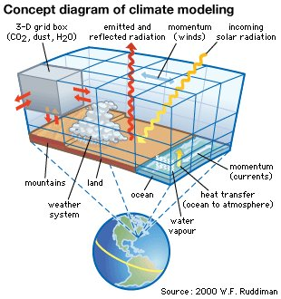
What is a Climate Model?
A climate model is a mathematical
representation of the various
processes that control the climate.
It’s a quantitative but often simplified
representation of the real climate system.
It requires
- Knowledge of the physical laws that govern the climate;
- Mathematic representation of the physical laws;
- Numerical methods to solve the mathematic equations on
computers if they can’t be solved analytically; and
- Adequate computing power to carry out the numerical
calculations.

Slide 4
Why Do We Need Climate Models?
We need models to help us understand many physical processes:
- We can’t control the real climate system, but we can control the models of the climate system to study (how?) the impacts of various physical processes, such as the impact of clouds, land cover, or GHGs, etc.
- Observational data are often incomplete. Model data can help us study the climate.
We need models to simulate and reproduce paleoclimates, for which there are only very limited proxy data.
We need models to predict future climate changes:
The global climate models represent our best understanding of the climate system, thus they are our best tool (albeit imperfect) for predicting future climate changes.
We need models to perform many hypothetic experiments:
These experiments are of interest scientifically (e.g., what would happen to our weather and climate if the Rocky Mountain Range were removed?), but can’t be done in the real world.
Climate modeling has become one of the most important approaches in climate research!
Can you think of any reasons?

Slide 5
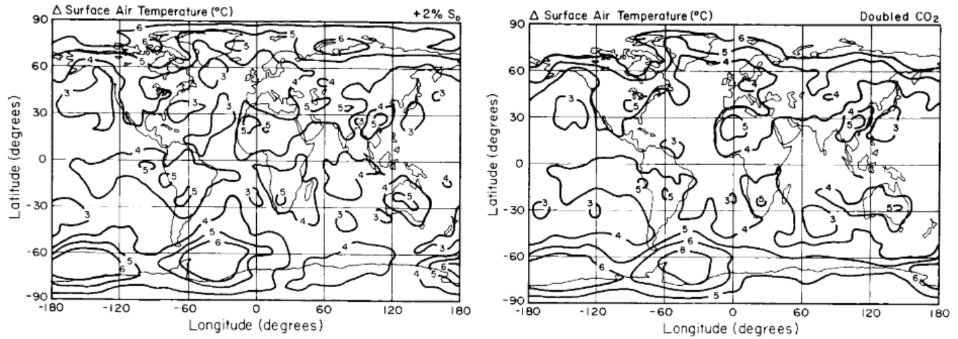
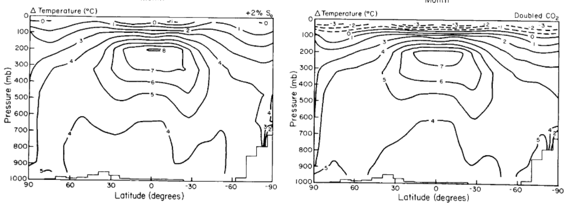
Examples of Climate Modeling
2xCO2 experiments: Double CO2 level in an AGCM, run the model with a slab ocean model for 60-80 years, examine the last 20-30yr mean T, precip, and other changes from a control run with 1xCO2. You’ll do this simulation using the EdGCM!
Hansen et al.1984

Slide 6
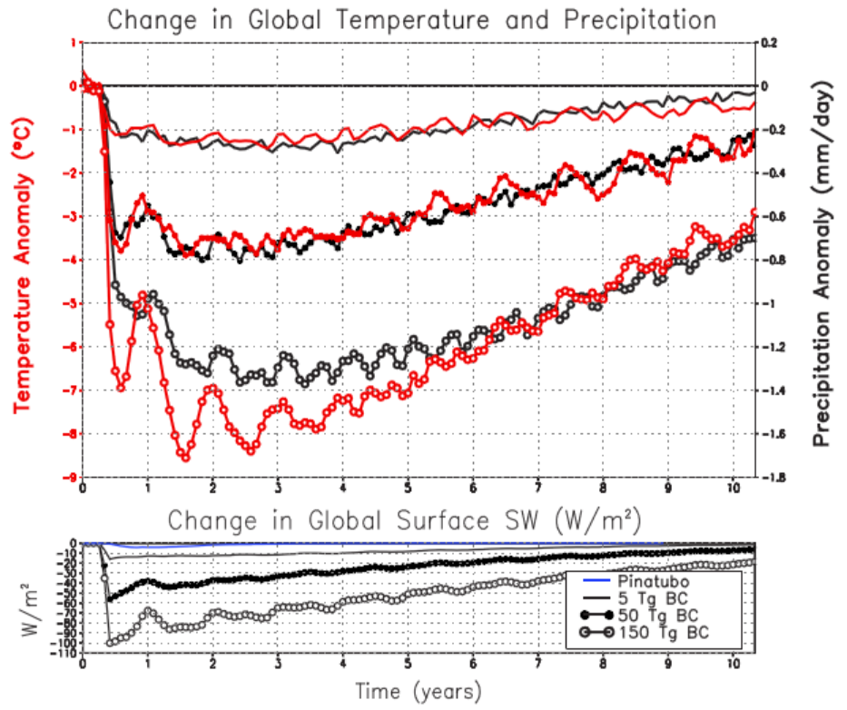
Examples of Climate Modeling
Nuclear winter experiments: A nuclear war or impacts of comets or asteroids can inject large amounts of smoke and soot into the stratosphere, causing large global cooling – referred to as “nuclear winter”.
Robock et al. 2007

Slide 7
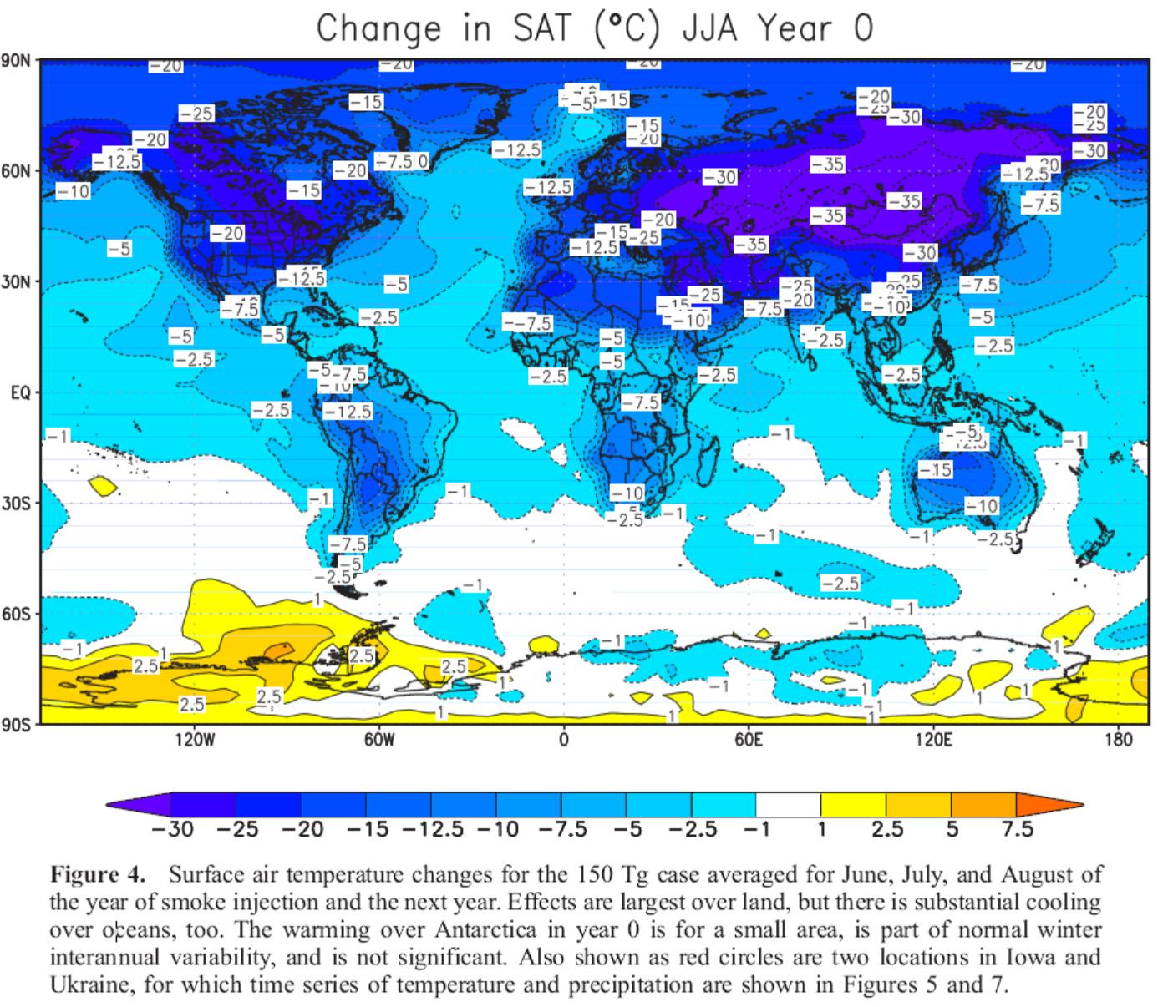
Nuclear Winter Experiments
Robock et al. 2007
Notes:
Nuclear winter GCM experiments with inject of 150Tg (10¹² g) of smoke.

Slide 8
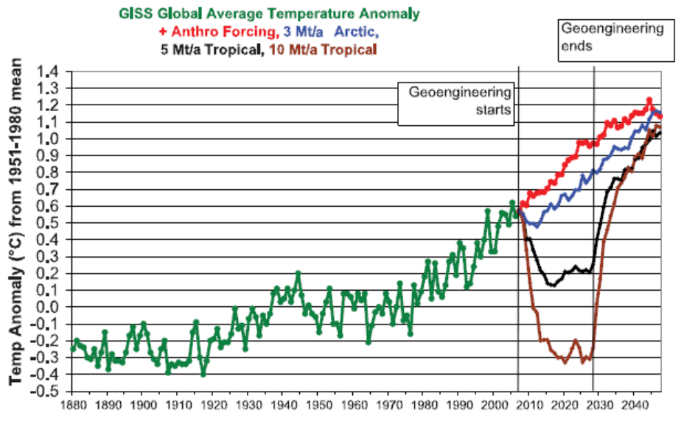
Examples of Climate Modeling
Geoengineering experiments: Artificially put large amounts of sulfate aerosols into the stratosphere (emulating volcanic eruptions), and see how the climate responds.
Robock et al. 2008

Slide 9
Can We Trust the Models?
Climate models vary in complexity. A model is a simplified version of the real world. It may be useful for certain purpose, but may not be suitable for other applications.
In general, the global climate models simulate the large-scale processes relatively well, such as atmospheric circulation, temperature and humidity fields.
But they tend to have difficulties in simulating the small-scale processes, such as the formation of clouds, convective precipitation, thunderstorms, and other severe weather events.
One needs to know the strength and weakness of a model in order to properly use it.

Slide 10
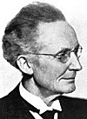
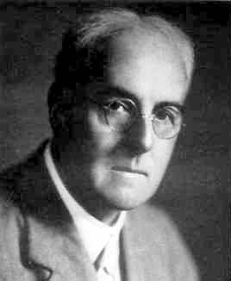

Timeline of Numerical Weather & Climate Modeling
1904: Norwegian meteorologist Vilhelm Bjerknes stated the
weather forecasting problem as
1. A sufficiently accurate knowledge of the state of the atmosphere
at the initial time; and
2. A sufficiently accurate knowledge of the laws according to which
one state of the atmosphere develops from another.
These are still valid today, but a third condition is that there is sufficient
computing power to carry out the calculations in a timely fashion.
During World War I, English scientist Lewis. F. Richardson attempted to
forecast the weather by solving the basic equations of atmospheric
motions using a mechanical calculator, when people realized that the
equations can be solved only through numerical approximations.
Late 1940s to early 1950s:
American meteorologist Jule G. Charney led a team of scientists to
perform the first numerical weather forecast on an electronic computer
built at Princeton University’s Institute for Advanced Studies.
Late 1950s: Formation of the group led to the now Geophysical Fluid
Dynamics Laboratory (GFDL). Thereafter, weather and climate modeling
became popular throughout the world.
Vilhelm Bjerknes
(1862-1951)
Lewis Fry Richardson
(1882-1953)
Jule Charney
(1917-1971)

Slide 11

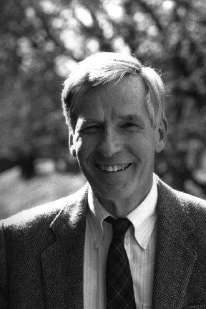
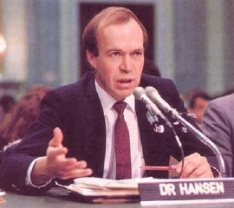
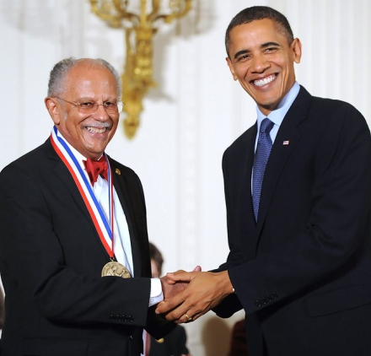

Timeline of Climate Modeling
1960s – 1970s:
Syukuro (“Suki”) Manabe and Kirk Bryan at GFDL developed
the first atmospheric and oceanic GCM and the first coupled GCM.
Warren M. Washington et al. at NCAR also developed AGCMs.
GFDL and NCAR have remained as the leading climate modeling
groups in the world.
1980s:
AGCMs became widely used for 2xCO₂ sensitivity experiments.
James E. Hansen at NASA Goddard Institute for Space Studies (GISS) in
NYC developed AGCMs to study GHG impacts on climate
John F. Mitchell at U.K. Met Office developed one of the leading AGCMs in
the world. The Met Office GCM remains one of the better models today.
1990s:
The coupling between most AGCMs and OGCMs requires surface flux
correction. GFDL, NCAR, and U.K. Met Office were the leading centers.
2000s:
Fully coupled climate models without flux correction became popular.
Motivated by the IPCC Assessment Reports and the CMIP projects, many new groups
started to develop/improve climate models and make future climate projections.
Today, there are over 20 different climate modeling groups that develop GCMs in a
number of countries, including U.S., U.K., Germany, France, Canada, Japan, Australia,
China, & Russia
Suki Manabe
(1931- )
Kirk Bryan
(1928- )
James E. Hansen
(1941-)
Warren Washington
(1936-)
John F. Mitchell
U.K. Met Office

Slide 12
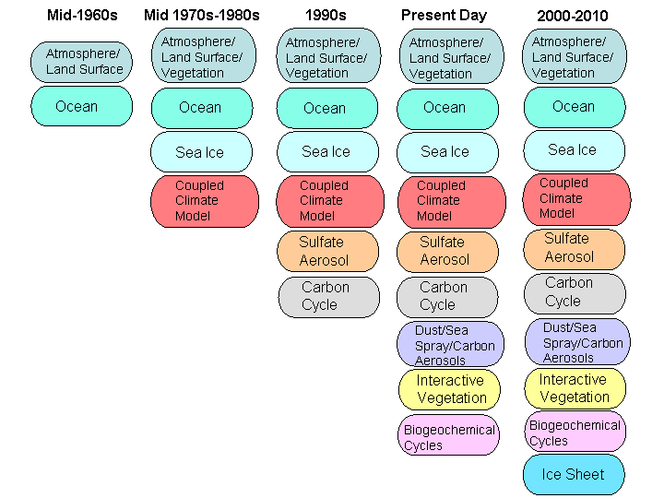
Timeline of Climate Model Development
Near-future
Notes:
12

Slide 13
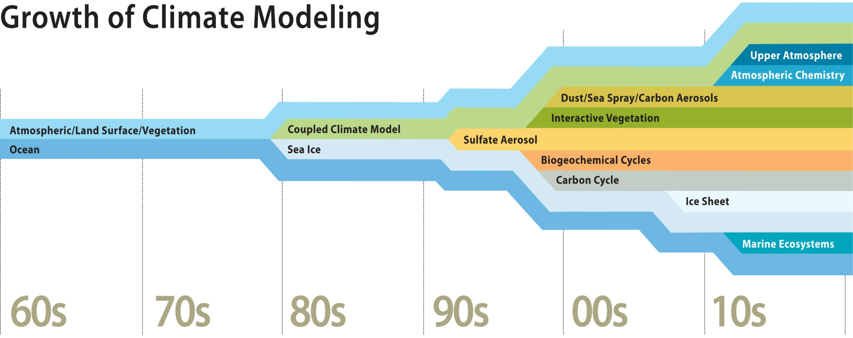

Slide 14
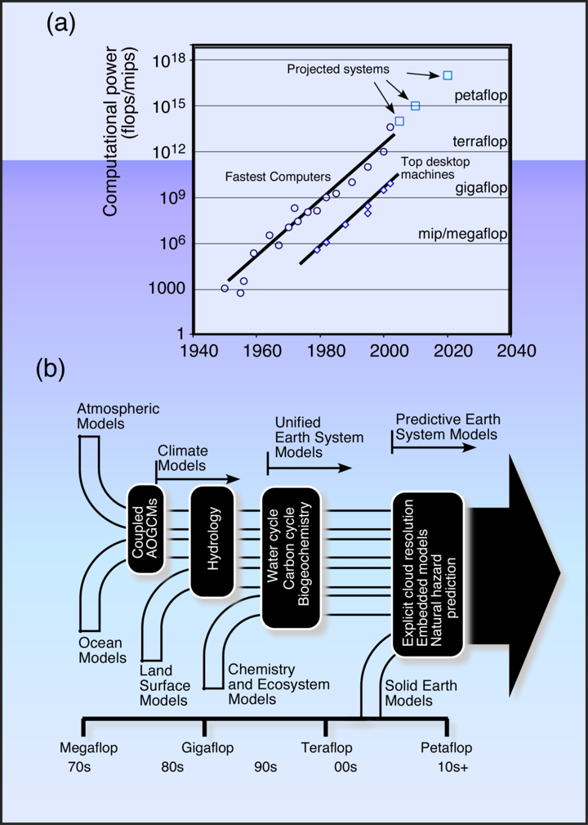
Climate Computing
Climate modelling requires the use of the most powerful supercomputers on Earth, and even with those we have to simplify the models.
Climate modelling is therefore constrained by the computer capabilities and will be for the foreseeable future.
McGuffie and Henderson-Sellers, 2005

Slide 15
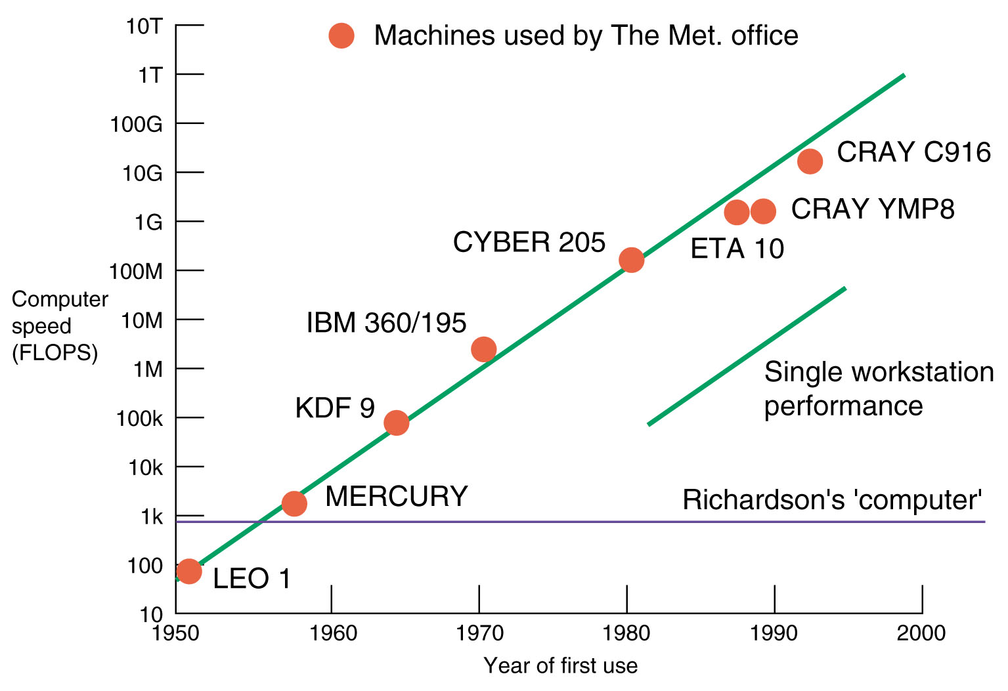
FLOPS=FLoating-point Operations Per Second
gigaFLOPS: 10⁹
teraFLOPS: 10¹²
petaFLOPS: 10¹⁵ NCAR Yellowstone: 1.5 petaFLOPS
exaFLOPS: 10¹⁸

Slide 16
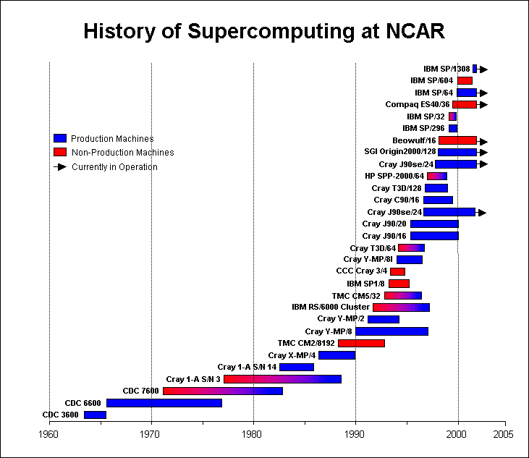
Yellowstone x

Slide 17
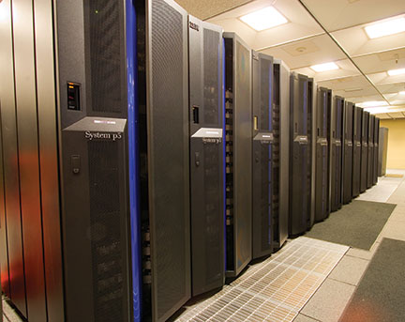
NCAR Blue-ice Super Computer
Installed in 2006, de-comissioned in 2013

Slide 18
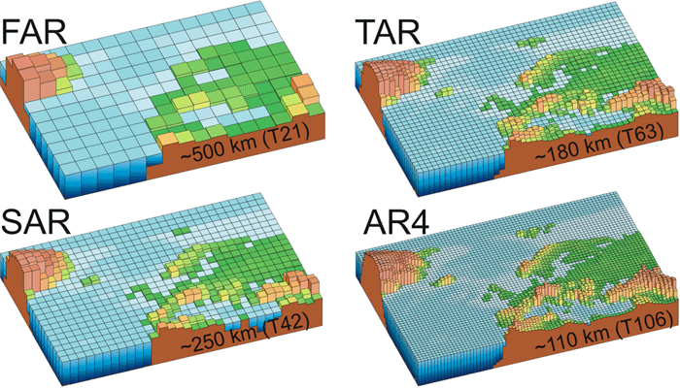
Evolution of Climate Model Resolution
1990
2001
1995
2007

Slide 19
YouTube Video:
NCAR Yellowstone Supercomputer (4min.)
Climate Modeling 101 (from GFDL)
(Impact of Resolution, ~9min.)

Slide 20
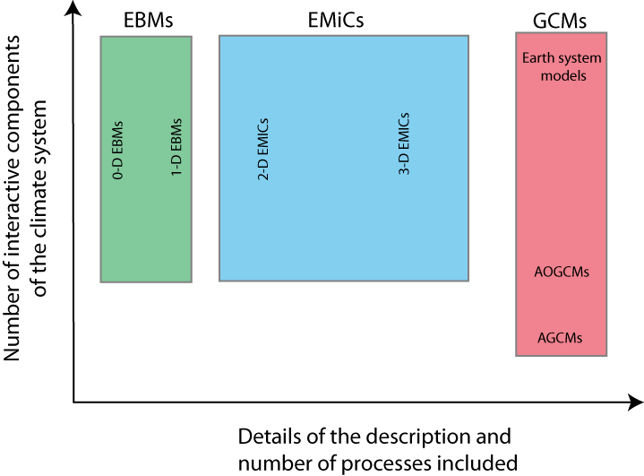
Types of Climate Models
most commonly used today
EMiCs = Earth Models of Intermediate Complexity

Slide 21
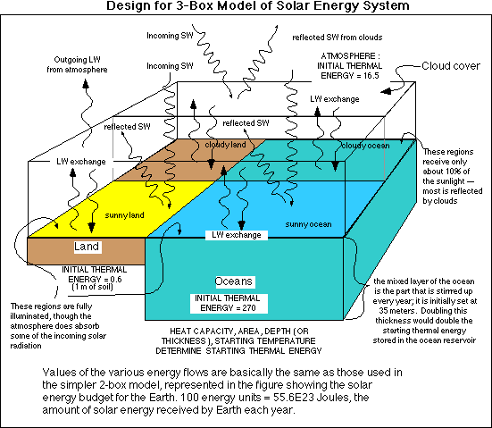
Types of Climate Models (cont’d)
Simple models:
- 0-dimensional, global energy balance models (EBMs):
Box models:
The climate system is represented by
boxes with fluxes linking the boxes.
Properties within each box are assumed
to be homogeneous.
Useful for certain applications.

Slide 22
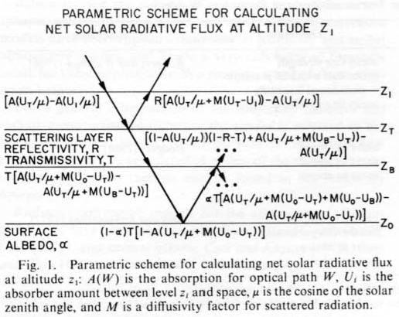
Types of Climate Models (cont’d)
Simple models:
- 1-dimensional, radiative-convective models (RCMs):
RCMs divide the atmosphere into multiple layers and then consider:
1) upwelling and downwelling radiative transfer
through the layers that both absorb and emit infrared radiation; and
2) upward transport of heat by convection.
RCMs can be used to study the effect of GHGs on Earth’s effective emissivity and thus the surface temperature.
RCMs were used extensively in the 1970s and 1980s when 3-d models were difficult to run on computers.
Ramanathan & Coakley (1978)

Slide 23
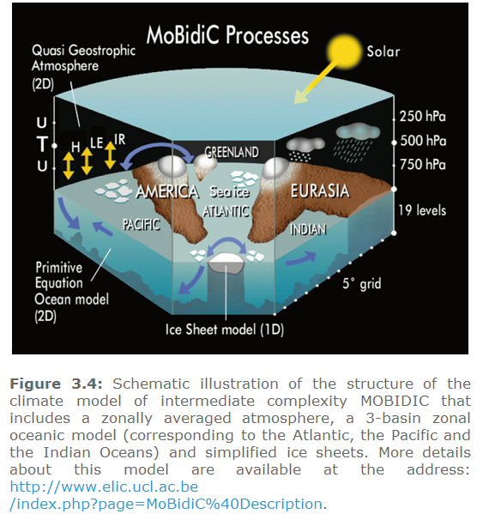
Types of Climate Models (cont’d)
Intermediate Complexity Models:
These models are between the simple models and the 3-d fully coupled climate models, usually with 2-dimensions with zonally averaged fields (i.e., no variations in the east-west direction).
These models are useful for long-term (10,000yr) simulations of paleoclimates.
They were popular in the 1990s when computers were not fast enough to make long simulations using fully coupled 3-d models.

Slide 24
Types of Climate Models (cont’d)
General Circulation Models (GCMs):
These are 3-dimensional models that are built upon the basic equations that govern the air flows in the atmosphere and water currents in the oceans. They treat most of the physical processes (e.g., radiative transfer) important for the climate in a complex way using our best knowledge.
There are GCMs for the Atmosphere and the Oceans. A 3-d land surface model is also a major component of a coupled climate model.
Atmospheric GCMs (AGCMs) were first developed in the 1950s for short-term (<7days) weather forecast.
In the 1960s, AGCMs and ocean GCMs (OGCMs) were developed to simulate long-term climate, with a grid size of 500-800km, pioneered by S. Manabe, W. Washington, et al.
Before around 2000, the coupling of an AGCM and OGCM requires an artificial flux correction at the air-sea interface, referred to as “flux correction”, in order to produce a stable climate in a control run, in which there is no external forcing.
Today’s fully coupled models do not need such flux correction, with a grid size of 50-300km. Global carbon, sulfur and nitrogen cycles are being added to these models, which are often referred to as the Earth System Models (ESMs).

Slide 25
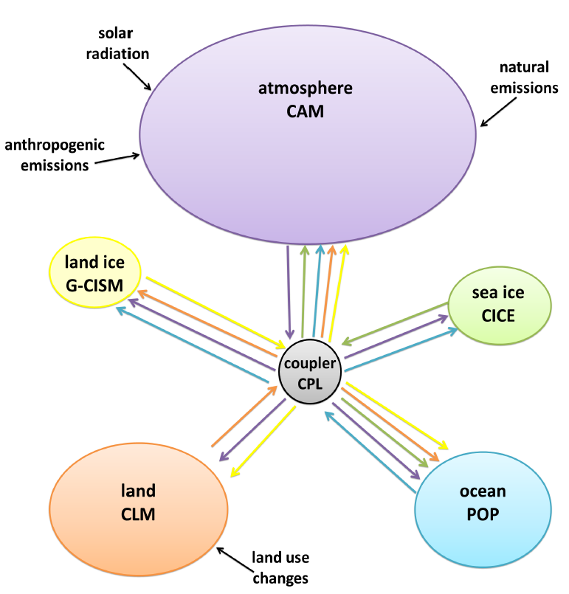
Climate System Models

Slide 26
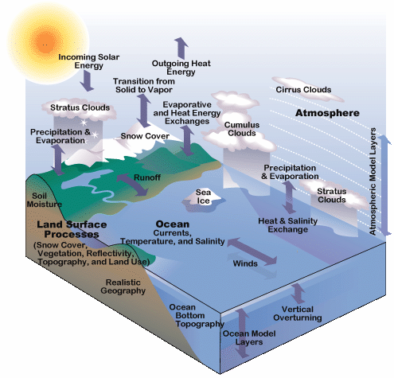
Processes to include
General circulation models

Slide 27
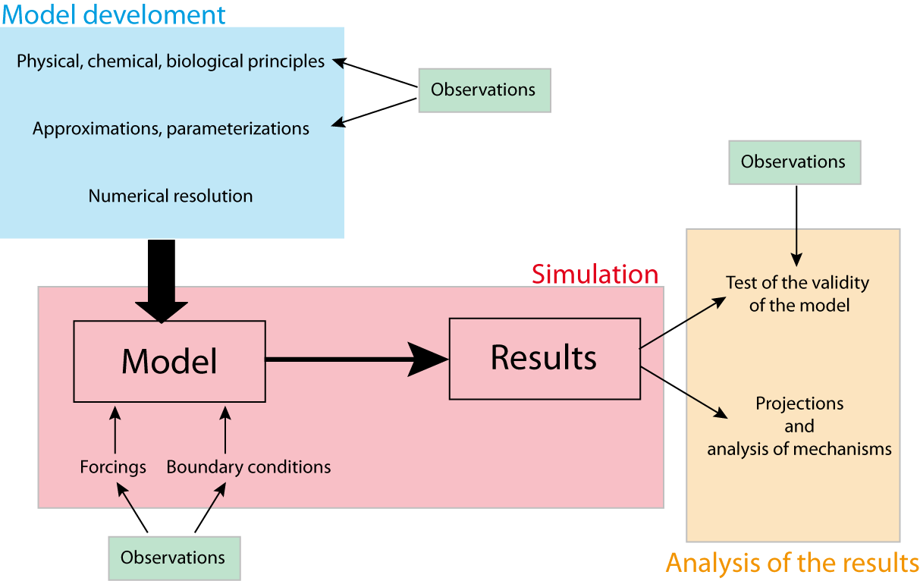
Climate Model Development

Slide 28
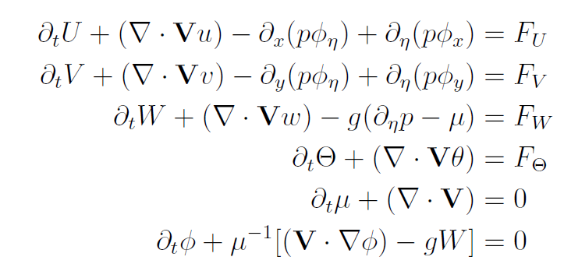
Starting from the Governing Equations for the Atmosphere (used in WRF)
Nonlinear partial differential equations can be solved only numerically on computers → numerical weather and climate models.

Slide 29
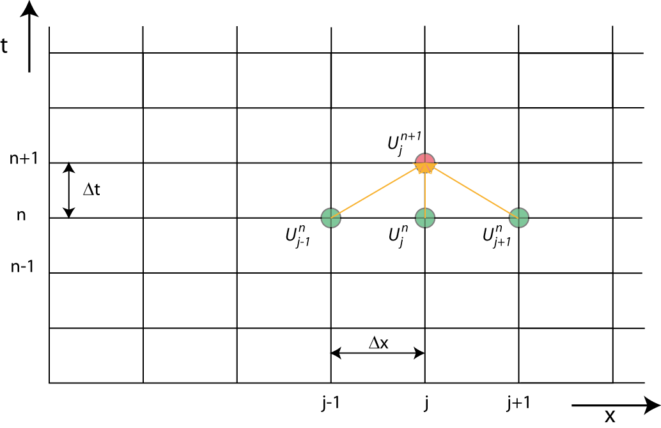
Discretization Using Finite Differences
Where Δt is the model time step, n is the time index. Δt = 10-30min. and Δx = 100-300km in most AGCMs.
Higher resolution means smaller Δt and Δx, which takes more computing power but represents the real world more realistically .
Computing Time
Resolution

Slide 30
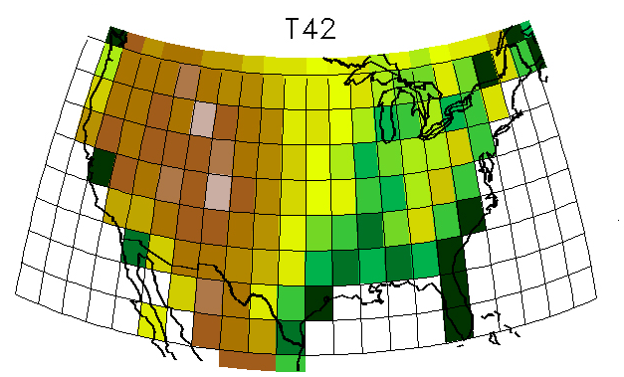
Terrain and Model Resolution
T42 ~ 280km, T85 ~ 140 km, …
Notes:
T42 ~ 280km, T85 _ 140 km, …

Slide 31
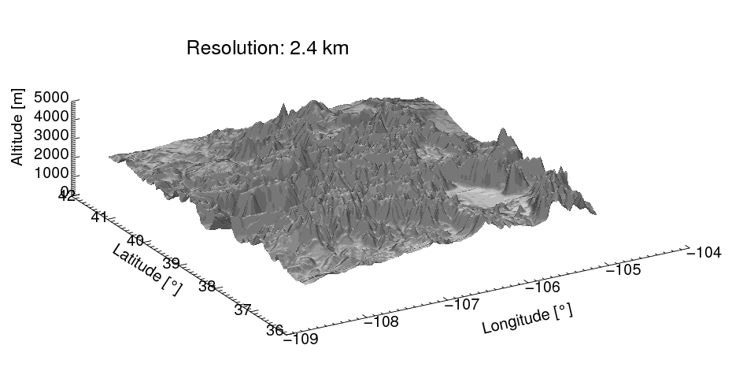
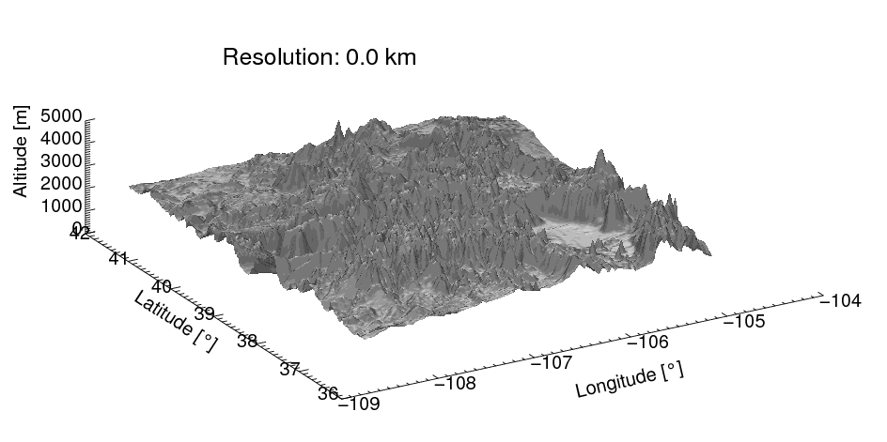
Rocky Mountain Terrain vs. Model Resolution
Resolution : 2.4 km
Courtesy Andy Prein
Notes:
Why do we use high-res. regional model?
Added value of simulation performed with high-res. regional model can be illustrated in this animation.
This animation shows how model terrain gets smoothed out with increasing grid spacing.
Running high resolution model over complex terrain is very important because:
It can resolve vertical motions tied to complex terrain and thus able to produce “close to observed” precipitation pattern.
Having accurate spatial distribution of precipitation is important for properly representing hydrologic balance.

Slide 32
Weather Forecast Models vs. Climate Models
A weather forecast model is an AGCM initialized with observed conditions in the atmosphere and forced by observed SST boundary conditions only.
A coupled climate model includes an AGCM, an OGCM, a detailed land surface model, a sea-ice model, and a coupler connecting these component models.
Initial conditions are critical for weather forecast models, but not important for long-term climate simulations. Why?
Changes in GHGs, aerosols, solar radiation and volcanic activities are important for climate models, but not for short-term weather forecast. Why?
Detailed simulations of the oceans, land processes, sea-ice, and mass and energy conservations are important for climate models, but not in weather forecast models.
Weather forecast models are usually run at 5-10 times higher resolution than climate models because they are integrated over only a few days to 2 weeks into the future, instead of many years to centuries for climate models.
Climate models aim to predict the mean climate state, not the day-to-day weather variations; thus they can provide useful information well beyond a few weeks, beyond which weather forecast is unreliable.

Slide 33
Weather Forecast Models vs. Climate Models
Weather Model
Coupled Climate Model
Initial Conditions
AGCM
AGCM
External Forcing
Coupler
Simple Land Model
Observed SSTs
Sea-ice Model
OGCM
Land Model

Slide 34
Popular Coupled Climate Models
There are 20-40 different global climate models in the world today. In the 1960s, only few groups (GFDL and NCAR) built such models.
The most widely used climate models include:
  NCAR Community Earth System Model (CESM)
  GFDL Earth System Model (GFDL-ESM)
  U.K. Met Office Hadley Centre Model (HadGEM)
  German Max-Plank Institute of Meteorology Model (MPI-ESM)
  NASA-GISS Climate Model (GISS-E)
The NCAR CESM is the one of the few climate models freely available to anyone, many groups have used it as a starting point to build their own climate models.
Development of a global climate model is a major effort, requiring many people working together.
Climate models often reflect the level of climate research in a country.
The Climate Model Inter-comparison Project (CMIP) is an international modeling project, in which all of world’s major modeling groups participate by providing simulations with common setups.
IPCC reports heavily use CMIP model projections for future climates.

Slide 35
Regional Climate Models (RCMs)
Global climate models typically have a grid size of 100-300km, which is insufficient to provide detailed information for local and regional climate changes.
Regional climate models were developed to run over a limited domain (e.g., over the West U.S.) at 5-10 times higher resolutions (4-50km) than global models.
A regional model is like a GCM but it runs only over a region, with the lateral and surface boundary conditions provided by a global model or observations.
The most common regional model is for the atmosphere, such as the widely used NCAR Weather Research and Forecasting (WRF) model.
WRF can be used as a regional model for studying the weather or as a regional climate model for regional climate simulations.
Like NCAR’s global model CESM, WRF is freely available and thus has been widely used in weather and climate research in the world.

Slide 36
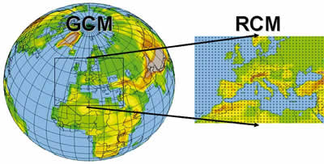
Global vs. Regional Climate Models
RCMs can resolve more local features but they need GCMs to provide boundary conditions, which can affect interior climate simulated by the RCMs. The GCM forcing may include realization-dependent unforced changes, which complicate the interpretation of the RCM-simulated changes.

Slide 37
Common Climate Model Simulations
Control run: a baseline run without any GHG or other changes. The climate from a control run should be stable and can be used as a reference for other perturbed runs. Also used for quantifying the natural climate variability in a model.
Perturbed or forced runs: these are model simulations in which some changes are made relative to the control run, e.g., GHGs may allowed to increase, solar constant may be changed, or some new model physics are added. By comparing with the control run, one can estimate the impact of these changes.
Historical climate simulations: these are simulations of the historical climate from the mid-19th century to present using fully coupled models forced with observed changes in GHGs, aerosols, solar radiation, and volcanic eruptions. They are designed to reproduce the observed climate changes, but many natural variations (e.g., El Niño) depend on the starting condition (which differs from the real world) and thus cannot be reproduced exactly as in observations.
Future climate simulations: fully coupled model runs forced with projected future GHG emissions or concentrations. Used for climate projections.
2XCO2 experiments: an AGCM coupled with a slab (or shallow) ocean model run with a doubled CO2 content. Used to examine the model’s climate sensitivity to a doubling of CO2.
AMIP experiments: an AGCM forced with observed SST. Used to study atmospheric and land climate response to changes in ocean conditions.

Slide 38
Key points of Today’s Lecture
What is a climate model?
- a simplified, mathematic representation of the climate system.
Types of climate models:
- EBMs, RCMs, EMiCs, GCMs, ESMs.
Components in an ESM:
- AGCM, OGCM, LSM, Sea-ice model.
How to build a GCM:
- Primitive equations, discretization, parameterizations, resolution
Common climate simulations (or runs):
- Control run, perturbed/forced runs, historical runs, future simulations, 2xCO2 runs, AMIP runs
Differences between weather and climate models:
- initial conditions, forcing, simulation length, components, purpose
Regional climate modeling: more details, needs boundary forcing

Slide 39
Next Lecture:
Common Climate Simulations and Projections

