Slide 1
A ATM551, Lecture #24
Climate Simulations and Projections:
Introduction and Common Simulations

Slide 2
Outline of Today’s Lecture
Climate simulation, climate prediction vs. projection
What are the common climate simulations?
Initial conditions and model spin-up
Control run and climate drift
Climate change simulations
Regional climate simulations and downscaling
Steps to carry out a climate simulation

Slide 3
Climate Simulations/Experiments
A Climate Simulation or Experiment refers to any numerical simulation of the climate. It can be a numerical prediction of the mean state for the up-coming summer, a climate projection for the next few decades to few centuries, or for the past climate in the 20th century or during the last glacial maximum. It can also be a numerical simulation under hypothetic conditions (e.g., for an aqua-planet without land), or any sensitivity experiments.
AGCM
Climate scientists do numerical
experiments on computers, instead
of doing experiments in the real
world or in a laboratory!
Climate simulations have become
one of the most important
approaches in climate research.
External Forcing
Coupler
Sea-ice Model
OGCM
Land Model
Initial Conditions

Slide 4
Some Climate Modeling Phrases
An Ensemble Simulation refers to a set of climate simulations with identical model setup and forcing except that each individual simulation (or run) starts from slightly different initial conditions (e.g., from a different decade in a control run). An ensemble simulation may also consist of individual runs (called ensemble members) with varying parameters for some physical schemes.
An Ensemble Mean is the simple average of all the ensemble members. It usually represents the best estimate of the forced response to the given forcing.
An Ensemble Range refers to the range of an ensemble simulation, often used to represent the uncertainties associated with natural variations or uncertainties in the model parameters.
A Multi-model Ensemble refers to a set of identical climate simulations performed by different climate models. The range from such an ensemble is often used to represent the uncertainties associated with model physics and natural climate variability.
A Climate Scenario often refers to a future path for GHG emissions modeled based on assumptions regarding future population and economic growth and energy consumptions. A range of climate scenarios are often used to quantify the uncertainties associated with these assumptions.
Uncertainties of a climate projection consist of three sources: 1) uncertainty in future emissions (increases with time), 2) errors in model physics, and 3) natural climate variations (important for near-future climate).

Slide 5
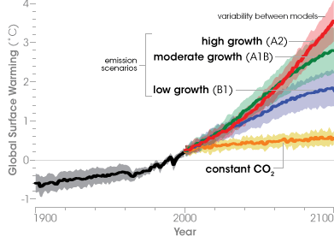
Ensemble Range, Emissions Scenarios

Slide 6
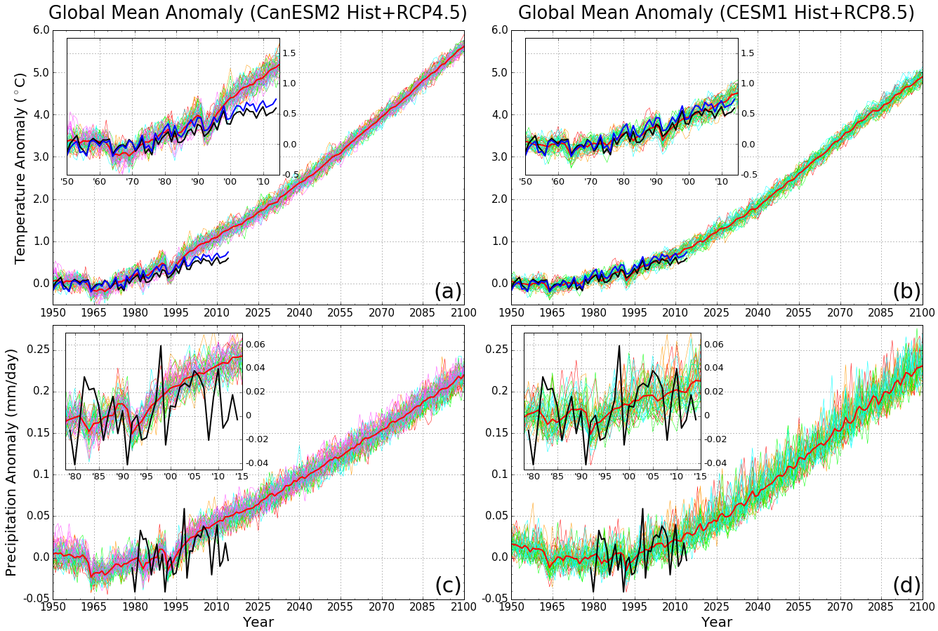
Large ensembles of
simulations are
increasingly used
to quantify
natural variations.
Dai and Bloecker (2017, CD)

Slide 7
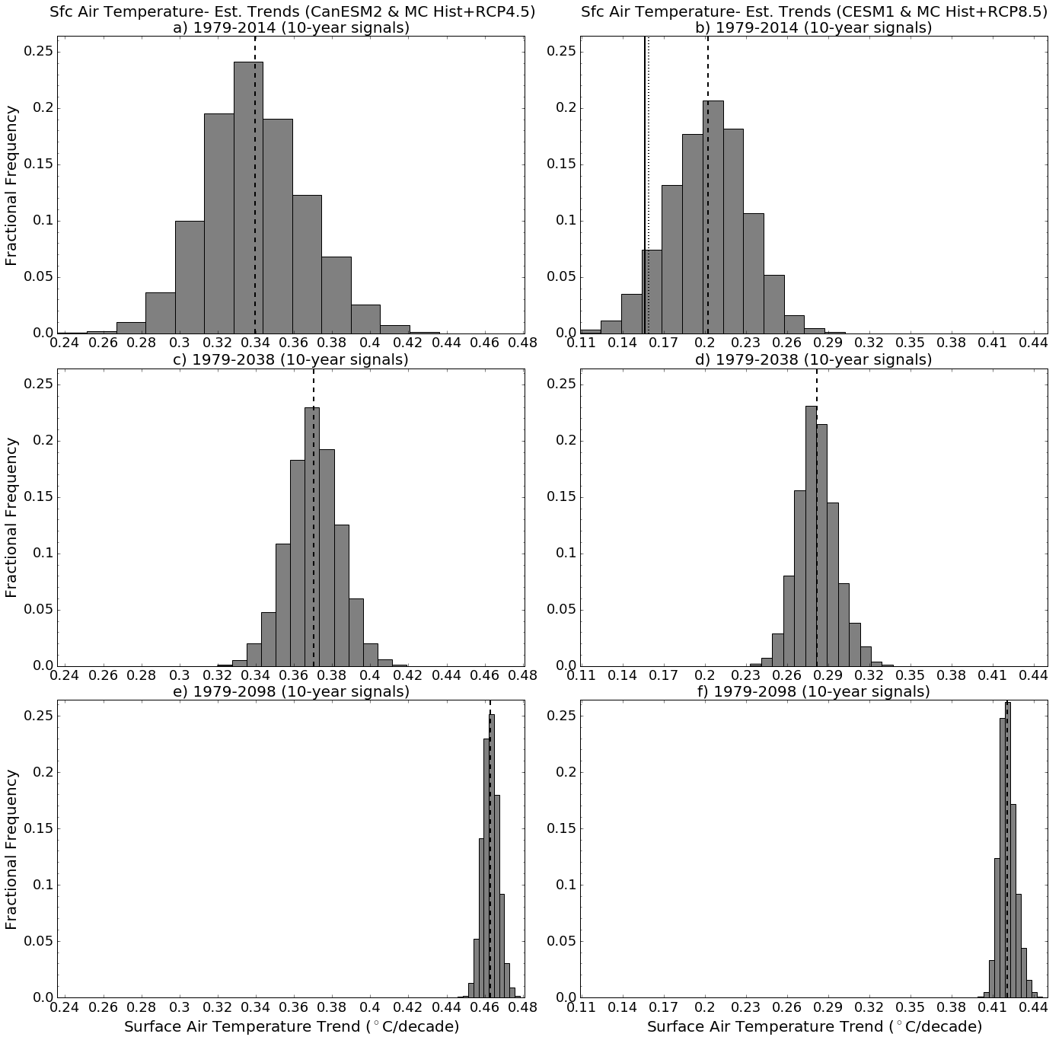
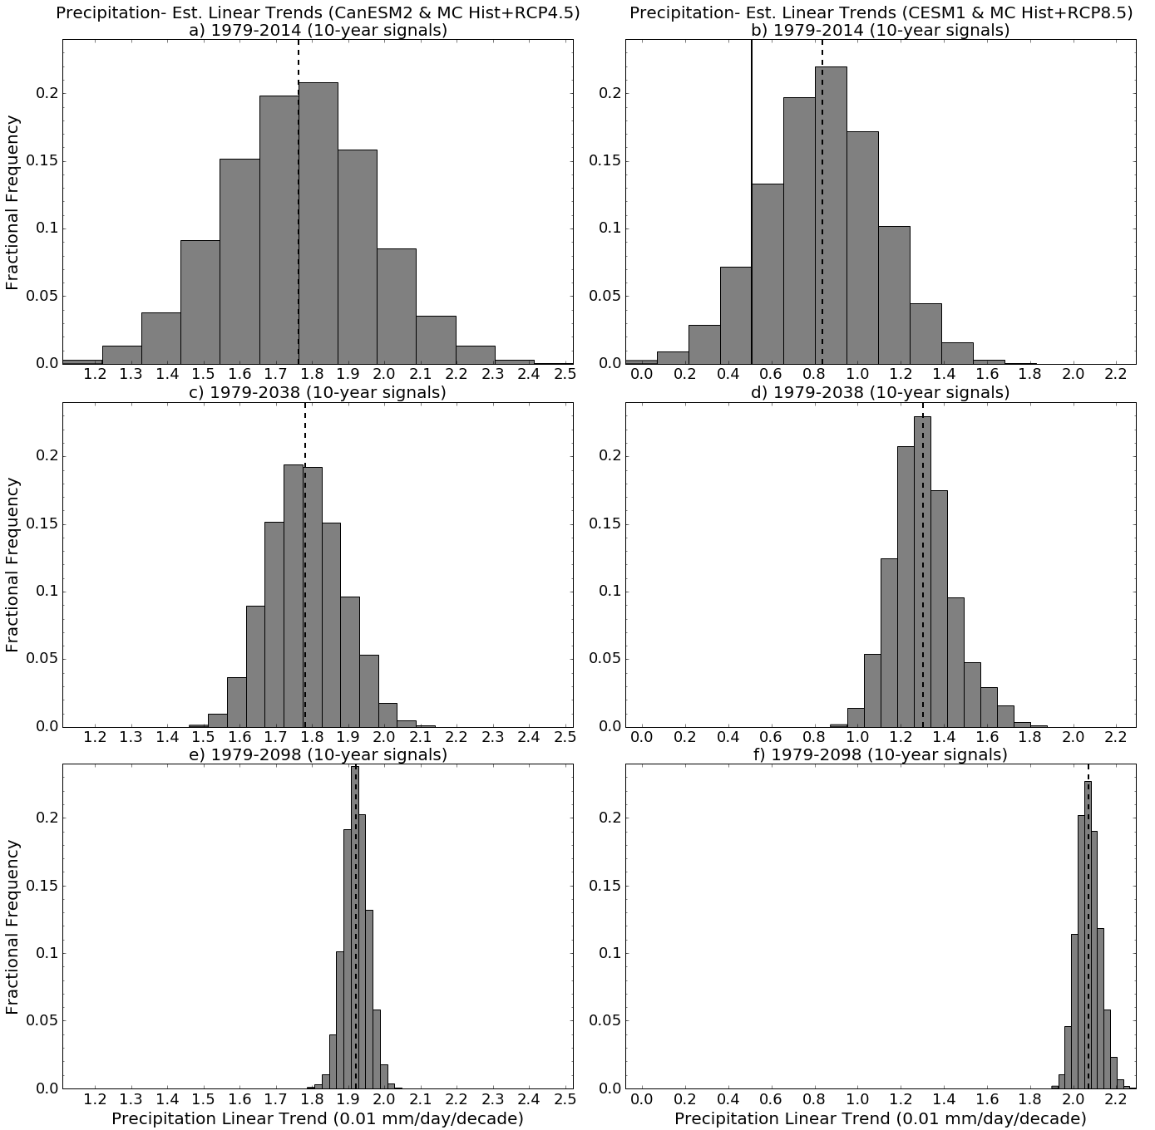
T trend
P trend
Trend Histograms
of global T and P
Dai & Bloecker (2017, CD)

Slide 8
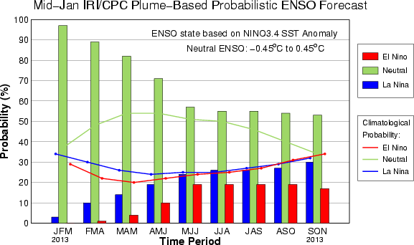
Climate Projection vs. Prediction
A climate projection is a statement about possible climate changes decades to centuries in the future under certain assumptions, such as those regarding
GHG emissions. It is usually made using climate
system models forced with projected future GHG emissions.
A climate prediction is a statement about the
climate in the near future (months to years
ahead), usually starting from the current
conditions and integrating forward using
a climate model.
Climate projections focus on the forced
climate response to future GHG increases.
The forcing estimates are very important.
Climate predictions tend to focus on the
natural climate variations, thus the starting
conditions are very important.

Slide 9
Major Applications of Climate Modeling
We need models to help us understand many physical processes:
- We can’t control the real climate system, but we can control the models of the climate system to study (how?) the impacts of various physical processes, such as the impact of clouds, land cover, or GHGs, etc.
- Observational data are often incomplete. Model data can help us study the climate.
We need models to simulate and reproduce paleoclimates, for which there are only very limited proxy data.
We need models to predict future climate changes:
The global climate models represent our best understanding of the climate system, thus they are our best tool (albeit imperfect) for predicting future climate changes.
We need models to perform many hypothetic experiments:
These experiments are of interest scientifically (e.g., what would happen to our weather and climate if the Rocky Mountain Range were removed?), but can’t be done in the real world.
Climate modeling has become one of the most important approaches in climate research!
Can you think of any examples?

Slide 10
Common Types of Climate Simulations
A Control Run is a standard simulation with constant GHG and other forcing. Often serves as a baseline for comparison with observations and other perturbed simulations.
A Sensitivity Experiment is a climate simulation in which some modifications are made to the standard version of the model used in the control run. The difference from the control run is often used to quantify the sensitivity of the climate to these changes. Examples: 2xCO2 runs, runs with different convection schemes, or boundary conditions, or modifications to a particular physical process in the model. Useful for studying the climatic impact of a specific forcing or physical process. Widely used in climate research.
A Climate Change Simulation is a climate simulation in which a coupled climate model is used to simulate the evolution of the climate over some time period under certain scenario, such as under the historical GHG and other forcing (historical climate simulation), or the future GHG emissions scenarios in the 21st century (21st century climate simulation). The initial conditions in these simulations are not the same as in the real world, thus the phasing of all natural climate modes (ENSO, PDO, AMO, etc.) in these simulations are not the same as in observations. This could complicate the comparison between historical climate simulations and observations.
An Equilibrium 2xCO2 run: Double CO2 instantaneously, and run the model to equilibrium (i.e., with a stable global-mean temperature). Often run with a slab ocean for estimating the climate sensitivity of a model to doubling of atmospheric CO2.
Transient Climate Change Experiments are climate change simulations with gradual increases of GHG concentrations. A fully coupled ocean-atmosphere model is often used.

Slide 11
SST-forced AGCM Runs – AMIP Runs
Running a fully coupled ocean-atmosphere GCM is expensive. For some applications, a dynamic OGCM may not be necessary.
An AGCM may be run with specified ocean boundary conditions (mainly SSTs). This allows one to study atmospheric response to changes in SSTs (e.g., associated with ENSO).
Observed SSTs are often used to force AGCMs. These AGCM runs are referred to as the AMIP runs, following the first use of this type of runs in the Atmospheric Model Inter-comparison Project (AMIP) in the early 1990s.
In the AMIP simulations, the atmosphere is being forced by the oceans. This is largely true for the tropics, but may be unrealistic in the extra-tropics where the atmosphere can significantly affect SST. Thus AMIP simulations are most useful for simulating atmospheric response to tropical SST changes.
Example: Pacific vs. Atlantic influences on North American precipitation.

Slide 12
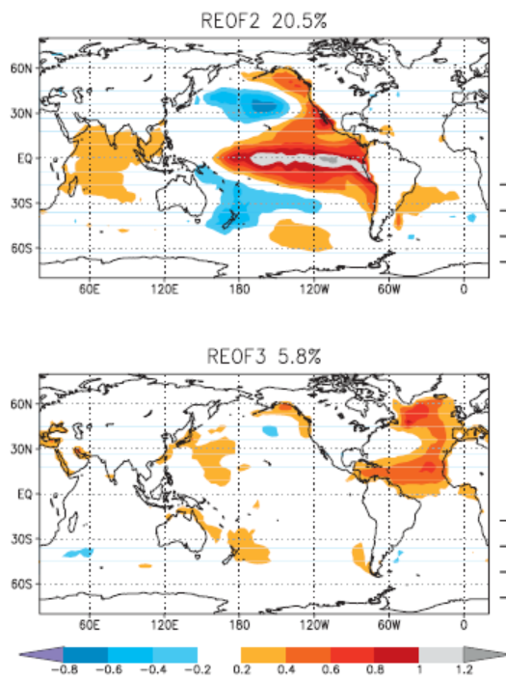
Pacific Warming
Force an AGCM with the SST anomaly
Patterns added to SST climatology, then
Examine the simulated differences from
A control run forced with the SST
climatology.
Atlantic Warming
Schubert et al. (2009)

Slide 13
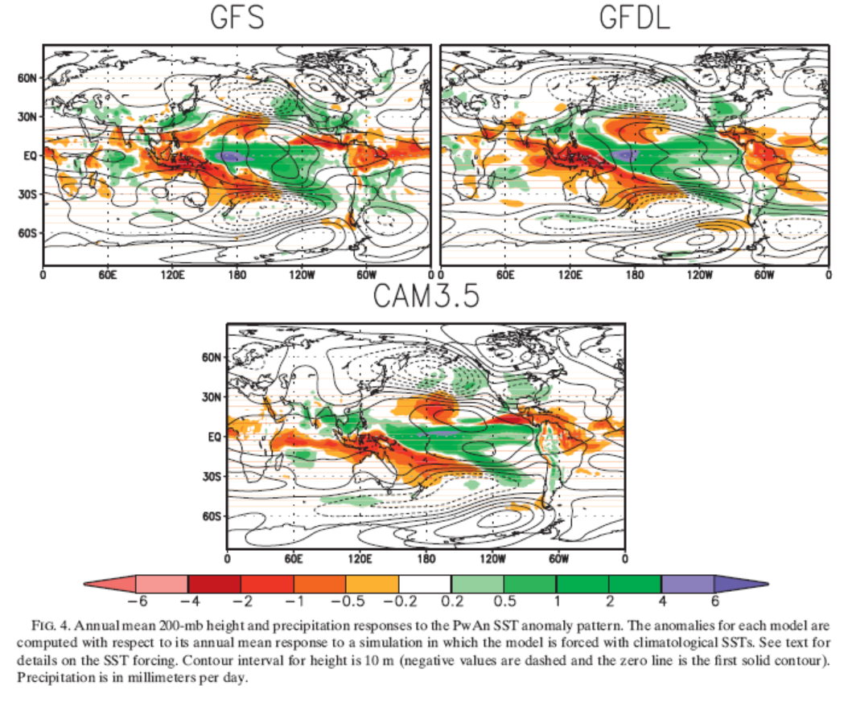
Annual Precipitation (color, mm/day) and 200mb Height Response
To Warm Pacific and Neutral Atlantic SSTs
Schubert et al. (2009)

Slide 14
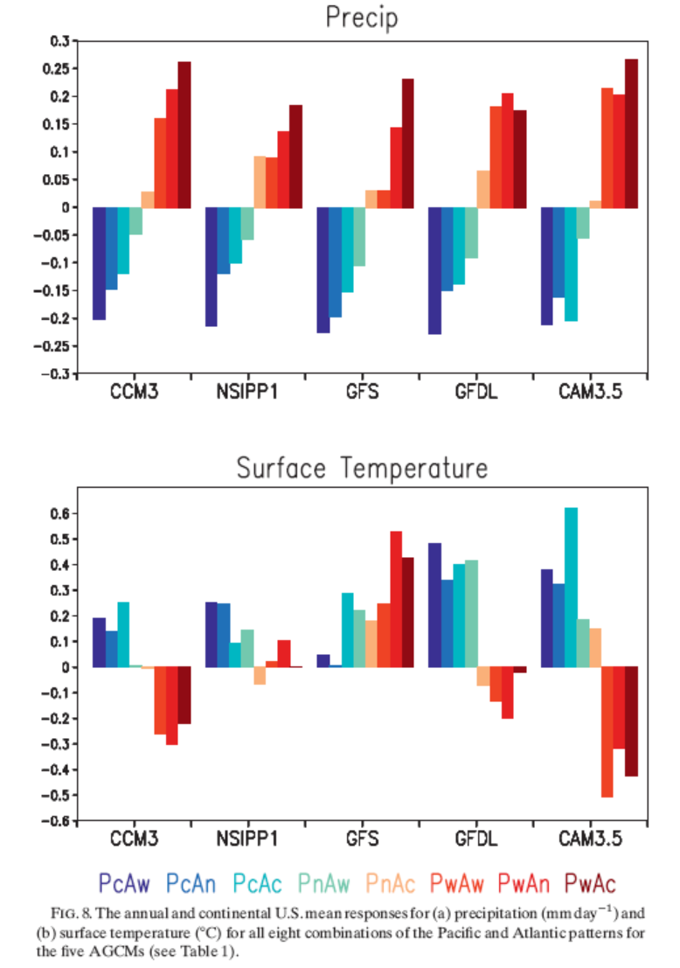
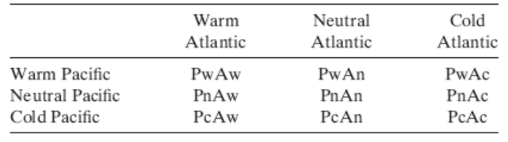
U.S. Annual
U.S. Annual P and T
Response to various
Combinations of Pacific
and Atlantic SST forcing
Note how many model runs they have
to make to study the sensitivities!
Schubert et al. (2009)

Slide 15
Initial Conditions
The initial state of the climate system is important for natural climate variations:
- Each coupled model run is one realization of the climate system, and the real world is just one such realization.
- The phase or time sequence of all climate variations are realization-dependent (i.e., varies with the initial condition), and thus is incomparable between two model runs or between the observation and a model run. We can only compare their statistical properties (e.g., mean spatial patterns or power spectrum of the ENSO index, but not the actual ENSO cycles).
Initial atmospheric conditions are important only for the first ~2 weeks due to the short memory of the atmosphere. After that, atmospheric initial conditions have little impact.
Initial ocean conditions can influence the evolution of decadal to multi-decadal modes for a number of decades due to oceans’ long memory.
Initial land conditions may have an influence lasting for a few months, mostly for seasonal variations.
Starting coupled model runs from states at different times (often decades apart, why?) in a control run is often used to generate ensemble runs with different initial conditions.
ENSO
Run 2
Run 1
Obs
time

Slide 16
Spin-up Process
The initial conditions for the land and ocean models may be unrealistic. In this case, the coupled model needs to be spun up to an internally matched steady states among the component models. This spin-up process could take many decades for deep soil layers and even longer for deep oceans.
For AGCM runs forced with specified SSTs, the first few months of simulations may be considered as the spin-up if the land conditions are not initialized realistically to match the atmospheric initial conditions. The output data from the spin-up stage are usually not used.
AGCM
Start of
integration
Coupling
Coupling
Spin-up the ocean
with observed
atmospheric forcing
Spin-up
OGCM

Slide 17
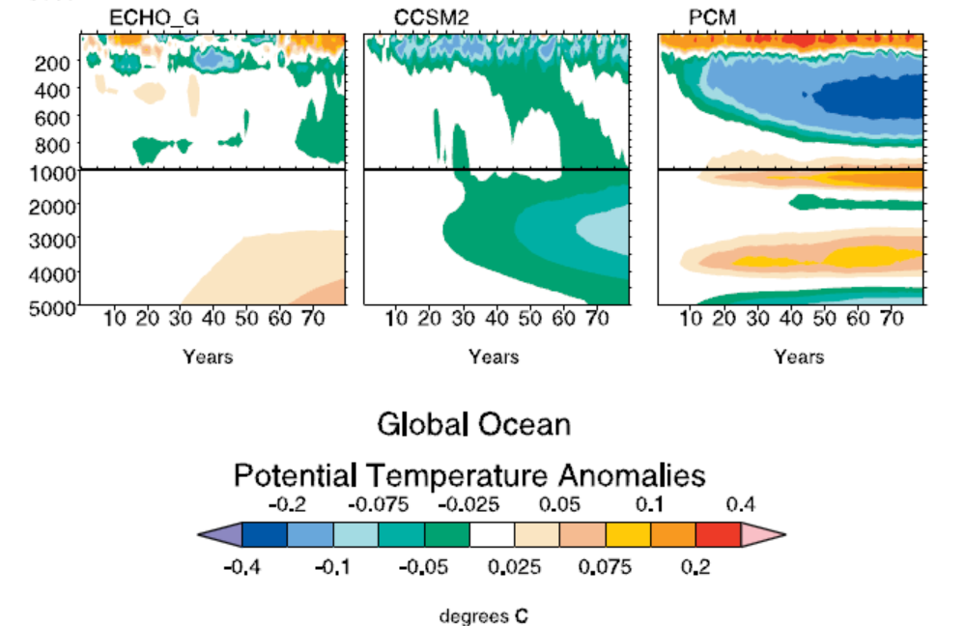
Control Run and Climate Drift
After the coupled model being spun up, a long control run of many centuries is often performed before making any climate change simulations.
The stability of the global-mean climate in such a control run without any forcing changes is assessed. Some models may show small trends in deep ocean temperature and salinity (climate drift) due to various reasons (e.g., not fully spun-up deep ocean, or small errors in energy conservation in the model, etc.).
Accurate energy balance at the TOA and surface is critical for such a long-term integration in order to avoid climate drift.
The EdGCM may have a drift if it
starts from different date other than
1958, as the initial conditions may
not fit with your GHG or boundary
conditions.
Please make sure your simulated
changes do not include this climate
drift.
Covey et al. 2006

Slide 18
Climate Change Simulations
Refer to numerical experiments in which some changes are made to the external forcing (e.g., GHGs or solar radiation or volcanic aerosols), or boundary conditions (e.g., land cover, or SSTs for AMIP runs) relative to a control run. The model may restart from a state of the control run and integrate forward with the changes.
Common climate change simulations:
- 2xCO2 experiments (change to CO2 level), often with a slab ocean model.
- Ice age experiments (changes in CO2 and land boundary conditions)
- 20th century historical climate simulations (observed GHG+solar rad. changes)
- Future climate simulations (GHG changes under certain emissions scenarios).
- Historical AMIP simulations (an AGCM forced with observed monthly series of
SST and sea-ice extent).
- Historical climate simulations with individual forcing changes (e.g., solar, GHG,
aerosol, volcanic forcing , or land cover change only)
Other climate simulations:
- Climate sensitivity experiments: model runs to test the sensitivity of the model
climate to certain changes to model physics or boundary conditions (e.g.,
topography). Often used in model development.

Slide 19
How Do We Make Climate Projections?
Projections of future population growth, economy, energy sources, etc.
Earth System Models
Model projections of future GHG emissions scenarios
Global climate projections from multiple models & multiple runs
Model Projections of future
GHG concentrations
Regional climate model downscaling
Assessment of climate change impacts
Regional & local climate changes

Slide 20
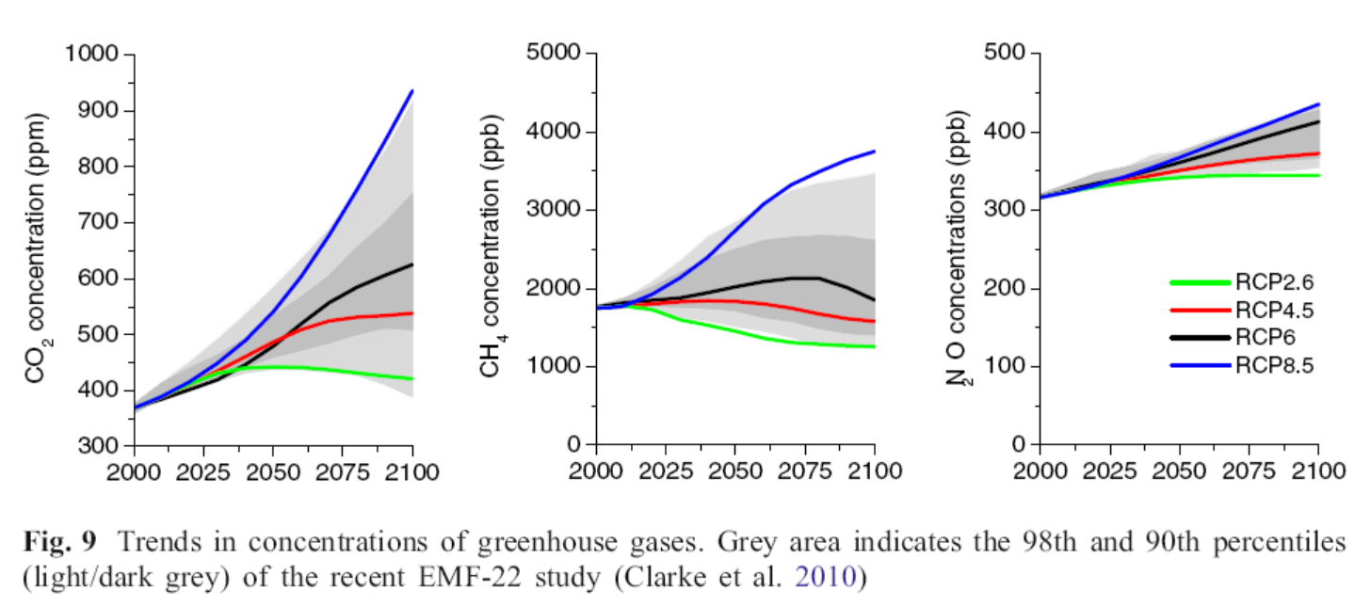
Projections of CO2, CH4 & N2O Concentrations
No feedback of future climate change on CO₂ is included!
Purely based on anthropogenic emissions increases.

Slide 21
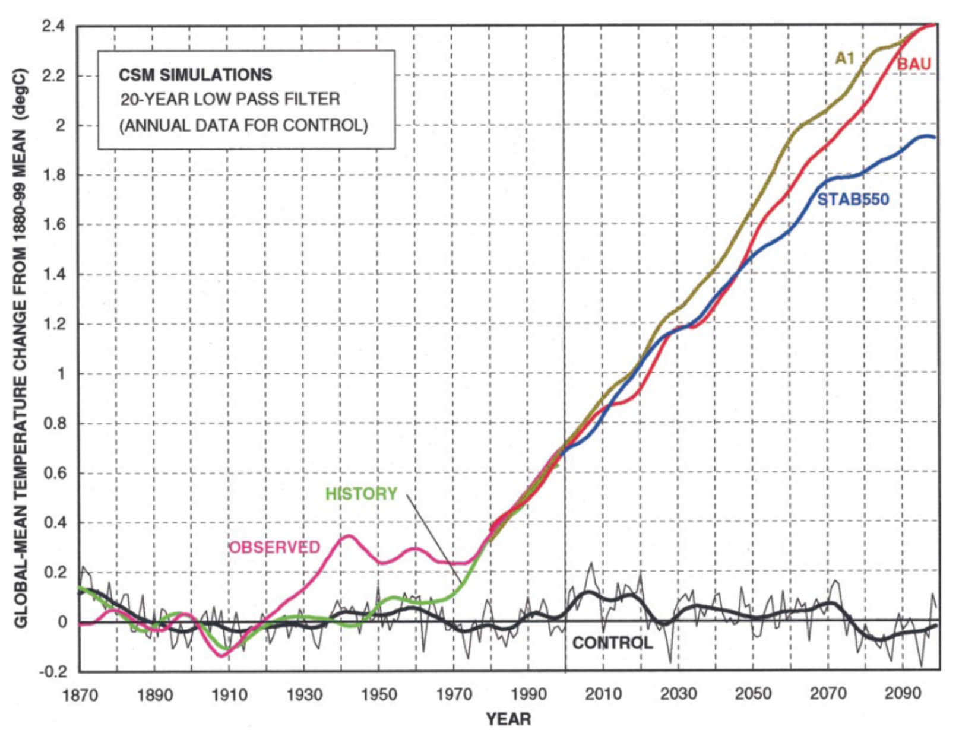
Climate Change Simulations
Control run provides the natural variability or noise for comparison
Dai et al. 2001

Slide 22
Uncertainties in Climate Projections
Main sources of uncertainty:
- Future GHG emissions scenarios: need to make various assumptions, increasing uncertainty with time
- Model errors: models are imperfect. Using multiple models may help quantify the model error range.
- Natural variations: vary with individual model runs, important for near-future projections, some of them might be predictable (e.g., AMO,IPO)
Uncertain GHG forcing
Imperfect Models
Natural Climate Variations
Total uncertainties of a climate projection
Notes:
Forcing uncertainty increases with time, while the impact of the noise from natural variations decreases with time. Model errors decreases as models are improved over time.

Slide 23
Forced Response vs. Natural Variations
Ensemble-mean is often used to represent the forced climate change,
which is the focus of most climate projections.
Ensemble range is often used to represent the uncertainty associated
with (unpredictable) natural variability.
These two are often mixed up and hard to separate in observations
and individual model runs!
Changes due to natural
variability are often mistaken
as a response to external
forcing!

Slide 24
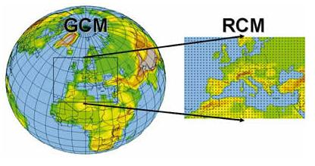
Regional Climate Simulations
Refer to climate simulations using a regional climate model (RCM, e.g., WRF) over a
limited domain (e.g., Europe).
They require lateral boundary forcing from a global model or reanalysis.
Usually a land surface model is coupled to the regional atmospheric model, but the
ocean surface is often specified (mainly SSTs). Coupled ocean-atmosphere regional
models are rare.

Slide 25
Regional Climate Downscaling
Motivation:
- Outputs from global models are too coarse for studying regional climate changes, especially for extreme weather such as intense storms and flash floods.
- High resolution climate data are needed for studying the impacts of climate change on crops, water resources and natural ecosystems through high-resolution modeling.
The coarse global model outputs need to be “downscaled” onto finer grids for these purposes through a process called regional climate downscaling.
There have been two approaches for climate downscaling:
- Statistical downscaling: Based on current statistical relationships
- Dynamic downscaling: Based on regional climate modeling

Slide 26
Regional Climate Downscaling
Statistical downscaling: use the relationship between the local climate (T, P and
other variables) and large-scale (i.e., GCM-resolved) atmospheric fields (e.g., 500mb
height, etc.) found in current climate to estimate future changes in the local climate
variables using global-model predicted large-scale atmospheric changes:
where ylocal is the local climate variable (e.g., T in Albany), and X1, X2, X3, … are GCM-
predicted fields near the location. f is an empirical function based on current climate.
Advantages: simple and fast.
Caveats: the relationship may be weak and it may change in future climate!
Dynamic downscaling: force a regional climate model with outputs from a global
model to simulate the climate changes at finer resolutions (dx=4-50km).
Advantages: represents local topography, T and P patterns better than GCMs.
Disadvantages: Not a trivial task, the regional model may introduce additional biases, no two-way interactions, the circulation fields from the global and regional models may be inconsistent with each other (spectral
nudging may minimize this).

Slide 27
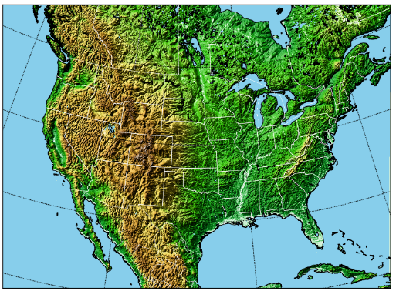
Pseudo-Global Warming (PGW) Approach
Compute 30-year CMIP5 19 model ensemble monthly mean
  Historical period : 1976-2005 Future period (RCP8.5): 2071-2100
Compute perturbation – difference between the two climates
Add perturbation to the 6-hrly ERA-I data for driving the WRF
No change in storm tracks.
Same transient spectra.
Monthly mean of historical condition
CMIP5 1976-2005
WRF Inputs for Future Climate Simulation
Monthly perturbation of CMIP5 ensemble mean
6 hourly ERA-I data
Monthly mean of future condition
CMIP5 2071-2100
WRF MODEL

Slide 28
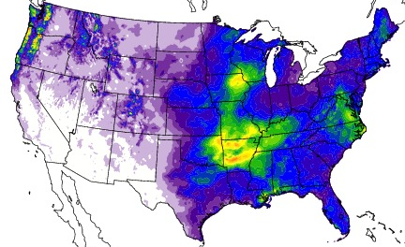
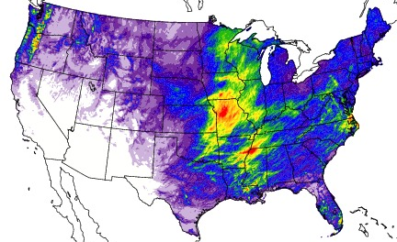
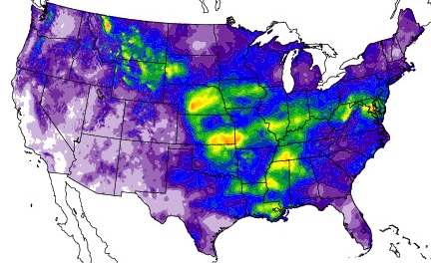
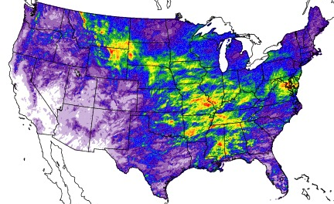
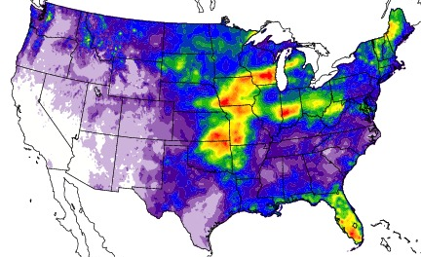
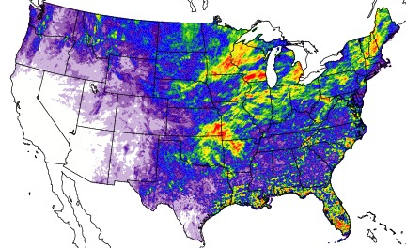
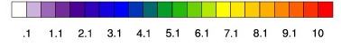
2008
PRISM
Liu et al. 2017, CD
WRF
April
May
June
(mm/day)
Precipitaiton from convection-permitting simulations (ΔX=4km)

Slide 29
Steps for a Modeling Study
Step 1: Form your scientific ideas/questions for your investigation based on your
reading of the literature on certain topic. For example, you may ask how the atmospheric circulation and climate would change over Asia if the Himalayas and Tibetan Plateau were removed (which was the case many million years ago). You then want to find out what research has been done on this topic (e.g., using Google Scholar search for “Climate impacts of Tibetan”), and
whether there are still un-resolved issues you can investigate using your model. Or you can study the impacts of Andes or the Rockies.
Step 2: Evaluate whether your model is capable of studying your problems by comparing the model-simulated fields (e.g., circulation over Asia) for the current climate with observations. The10x8deg. EdGCM may be a bit too coarse to address the above question.
Step 3: Design your experiments; e.g., you may make a control run with current topography and an experiment with reduced terrain over Asia, and use their
  difference to quantify the impacts of the Tibetan Plateau.
Step 4: Analyze your simulations to see if there are any interesting results that would
  support some new arguments; in this case about the role of Tibetan Plateau in atmospheric circulation and climate. You’re unlikely to find a topic that no one has studied before, but there are always some aspects may need further investigations.

Slide 30
Modeling Climate (~6min.)

