Slide 1
A ATM551, Lecture #25
21st Century Climate Projection and CMIP Model Simulations
Many of the slides are from IPCC AR5 and AR6 Reports

Slide 2
Outline of today’s lecture
How are climate projections carried out?
What are the uncertainties in climate projections?
How are the future GHG emissions estimated?
What are the CMIP model simulations?
What are the projected climate changes by 2100?

Slide 3
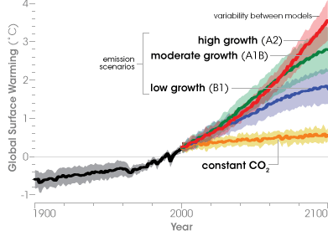
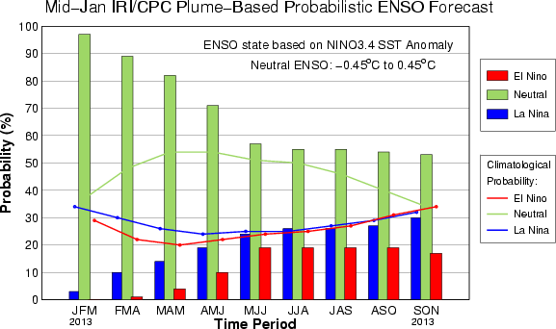
What is a Climate Projection?
A climate projection is a statement about possible climate changes decades to centuries in the future under certain assumptions, such as those regarding
GHG emissions. It is usually made using climate
system models forced with projected future GHG emissions.
Climate projections focus on the forced
climate response to future GHG increases.
The forcing estimates are very important.
In contrast, Climate Prediction tends to
focus on the natural climate variations,
thus the starting conditions are very
important.

Slide 4
Why Do We Need Climate Projections?
Climate change can greatly impact our daily life, the economy and the environment.
Information about future climate change can help us:
- Evaluate its potential impacts and consequences.
- Mitigate future climate changes by reducing GHG emissions.
- Prepare for and adapt to future climates.
- New infrastructures need to be
designed for future climate
conditions.

Slide 5
How Do We Make Climate Projections?
Projections of future population growth, economy, energy sources, etc.
Earth System Models
Model projections of future GHG emissions scenarios
Global climate projections from multiple models & multiple runs
Model Projections of future
GHG concentrations
Regional climate model downscaling
Assessment of climate change impacts
Regional & local climate changes

Slide 6
Uncertainties in Climate Projections
Main sources of uncertainty:
- Future GHG emissions scenarios: need to make various assumptions, increasing uncertainty with time
- Model errors: models are imperfect. Using multiple models may help quantify the model error range.
- Natural variations: vary with individual model runs, important for near-future projections, some of them might be predictable (e.g., AMO,IPO)
Uncertain GHG forcing
Imperfect Models
Natural Climate Variations
Total uncertainties of a climate projection
Notes:
Forcing uncertainty increases with time, while the impact of the noise from natural variations decreases with time. Model errors decreases as models are improved over time.

Slide 7
Methods to Reduce the Uncertainties
GHG forcing uncertainty:
To cover all the possibilities, one can consider a range of possible scenarios.
Model response uncertainty:
Different models may produce different response for a given GHG forcing. To reduce this uncertainty, one can average the projections over multiple models – ensemble averaging over different models.
Natural variation uncertainty: important for near-future climate.
Future, unforced natural climate variations (such as El Niño) vary with model’s starting condition (i.e., initial condition), which differs among different model runs. To reduce the impact of this natural noise, one can average over many model runs from one or multiple models – ensemble averaging over multiple model runs. The impact of the natural climate variations also decreases with averaging over time and space. For example, its impact is relatively small in global-mean T time series, but large over a small region (e.g., New York State). As models and obs. improve, some of the natural variations may be predictable (e.g., those associated with AMO and IPO/PDO).
Notes:
Forcing uncertainty increases with time, while the impact of the noise from natural variations decreases with time. Model errors decreases as models are improved over time.

Slide 8
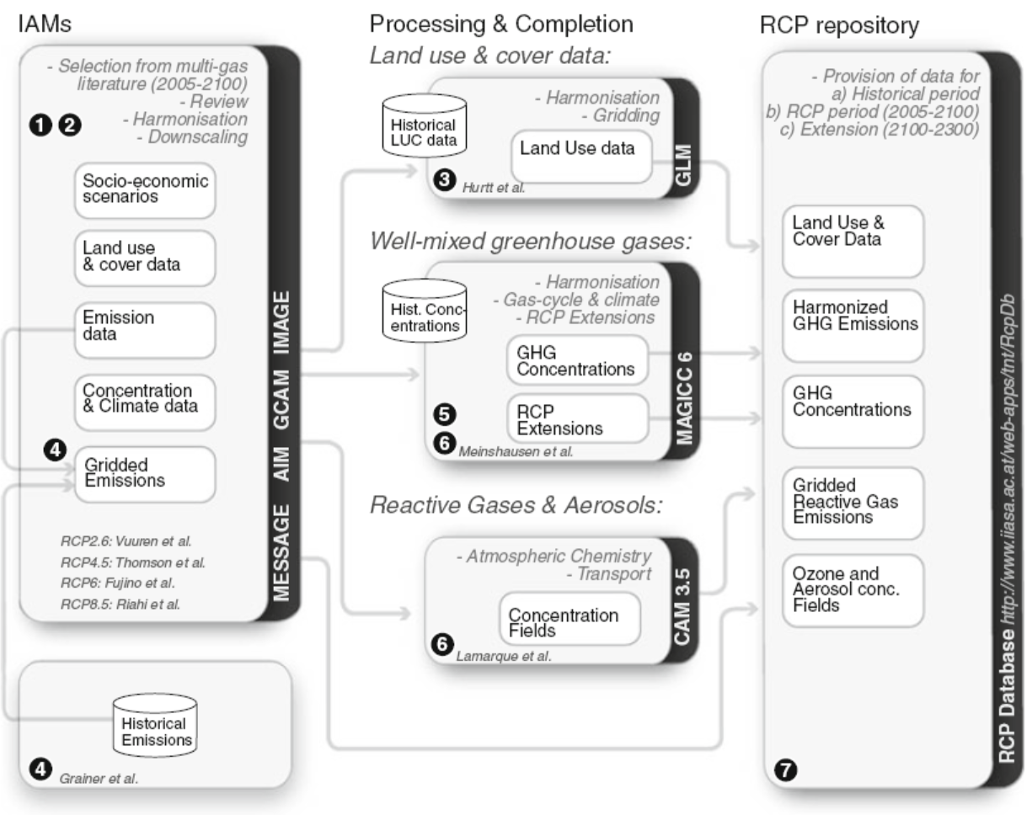
Processes for Building Future GHG Emissions Scenarios
van Vuuren et al. 2011

Slide 9
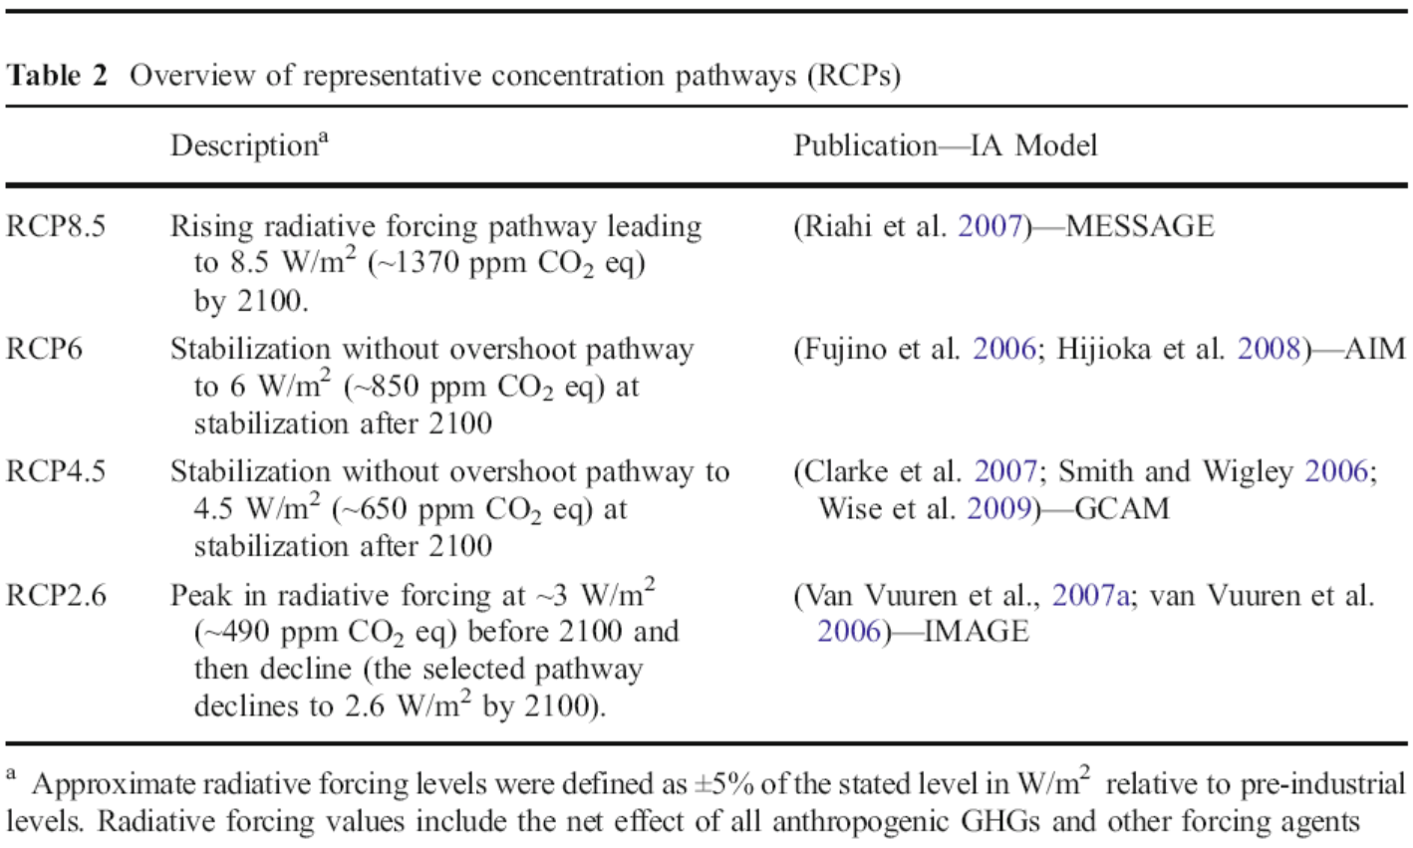
Overview of CMIP5 GHG Emissions Scenarios
Forcing at 2100 is relative to pre-industrial CO2 level: F≈5.35 ln(C/280ppm).
Notes:
Forcing at 2100 is relative to pre-industrial CO2 level: F=5.35 Ln (C/280ppm).

Slide 10
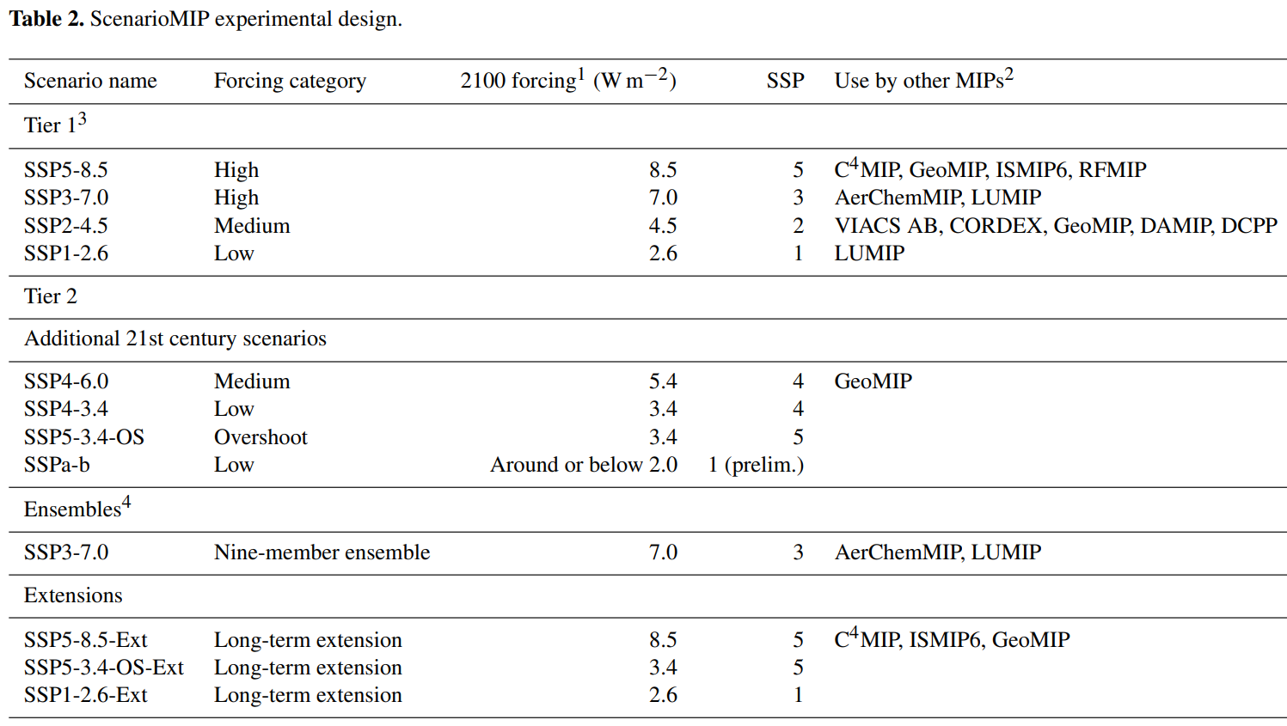
Overview of CMIP6 GHG Emissions Scenarios
SSP = Shared Socioeconomic Pathway

Slide 11
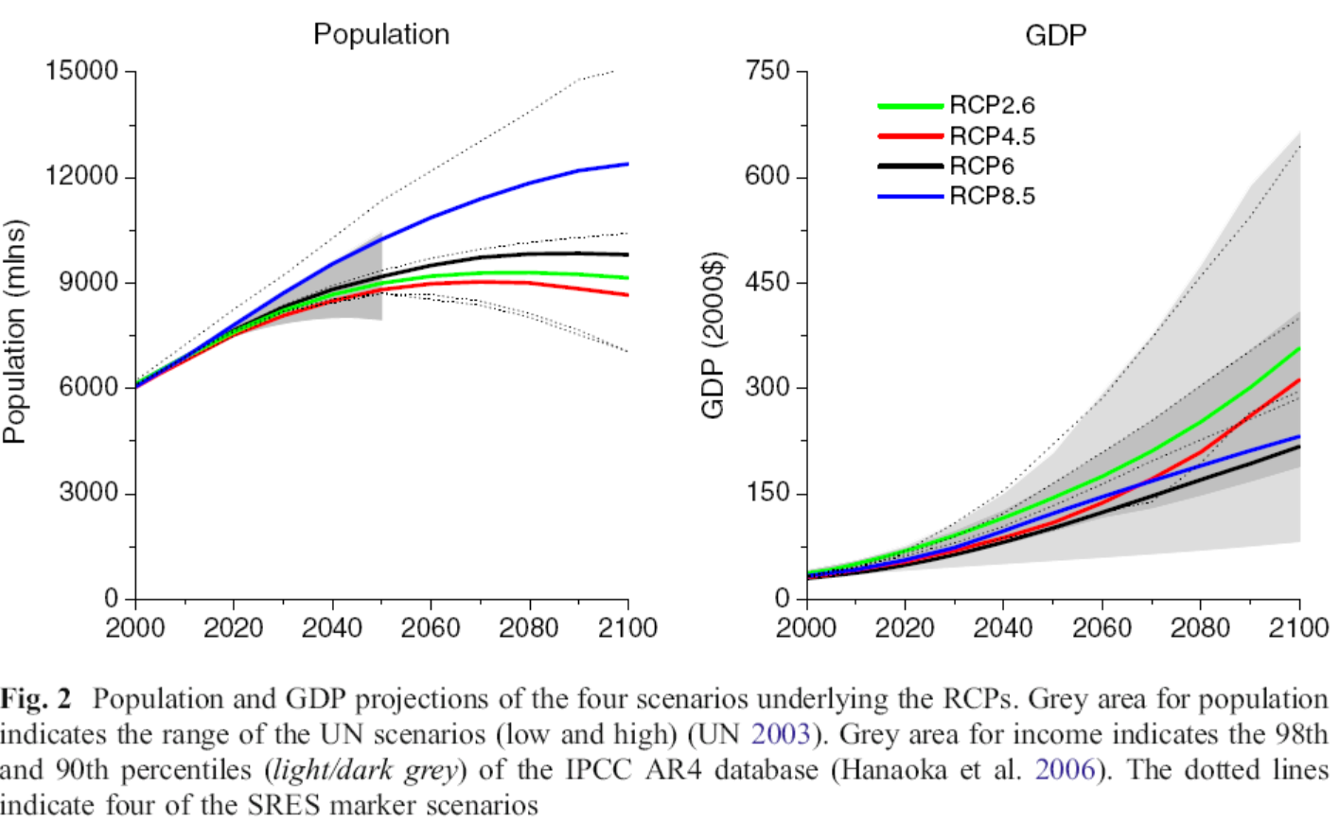
Projections of Future Population and GDP

Slide 12
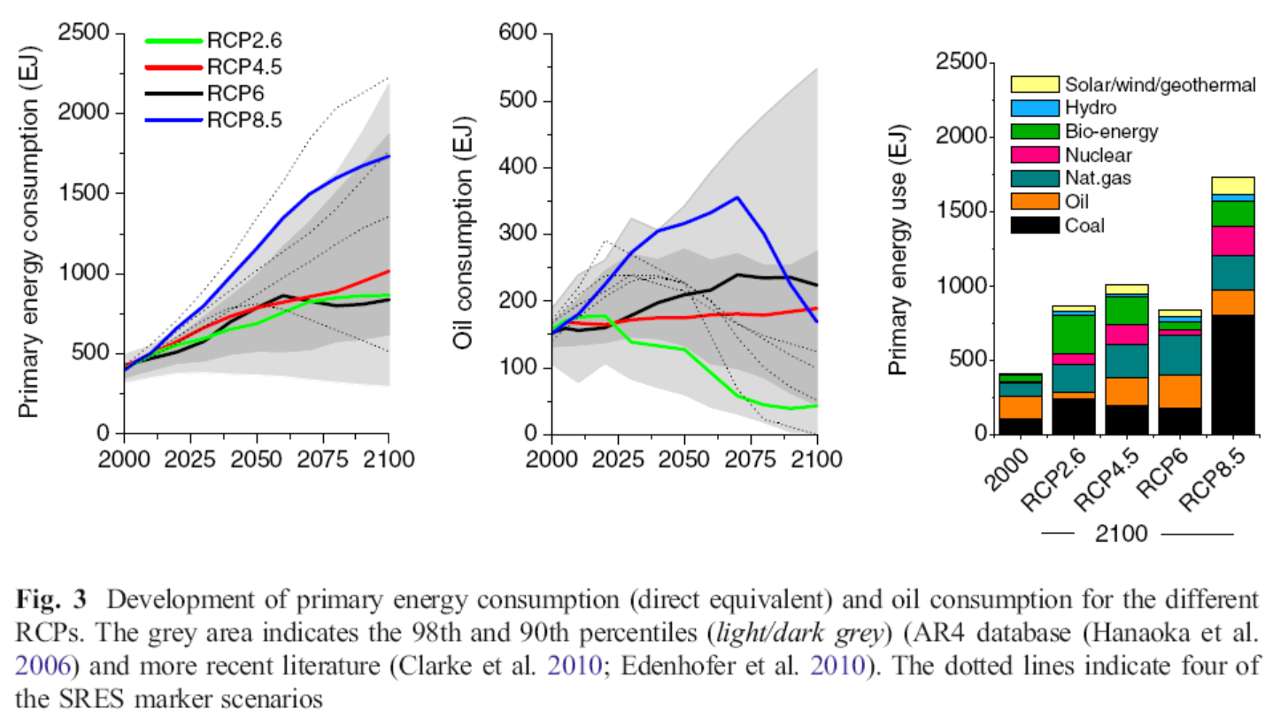
Projections of Future Energy Consumption

Slide 13
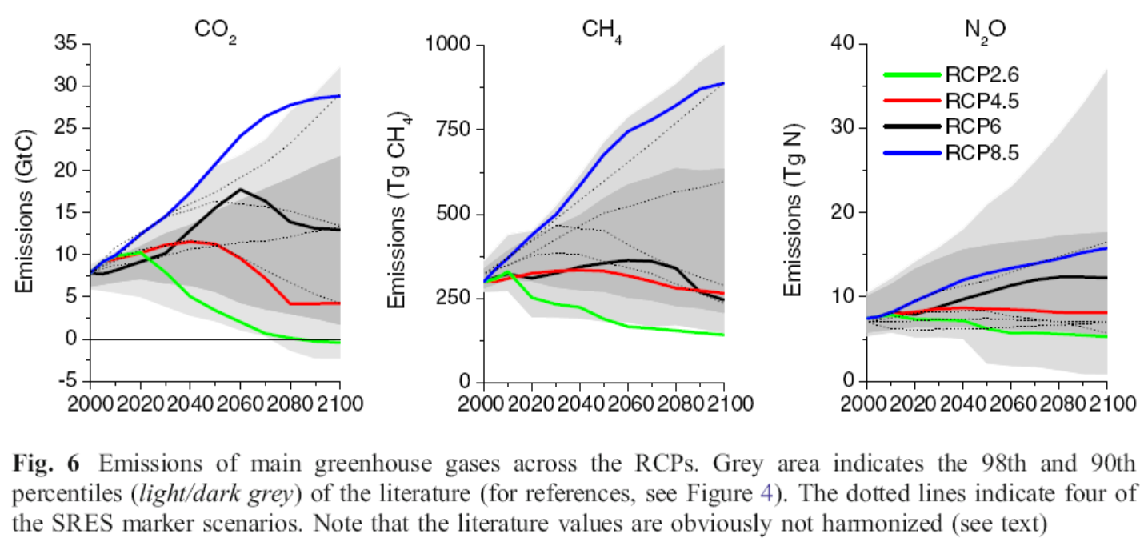
Estimated Future CO2, CH4 and N2O Emissions
1Gt = 1 Billion tons ≈ the total weight of 500 million pickup trucks! That is, if you were to give two pickup trucks to every family in the US, you would give out about 1Gt of trucks for all US families. Multiply that by 9, you get the total weight of carbon we’re emitting annually today!
Notes:
1 giga ton (Gt) = 10^9 metric ton = 1 billion tone: equivalent to the total weight of 500million pick-up trucks.

Slide 14
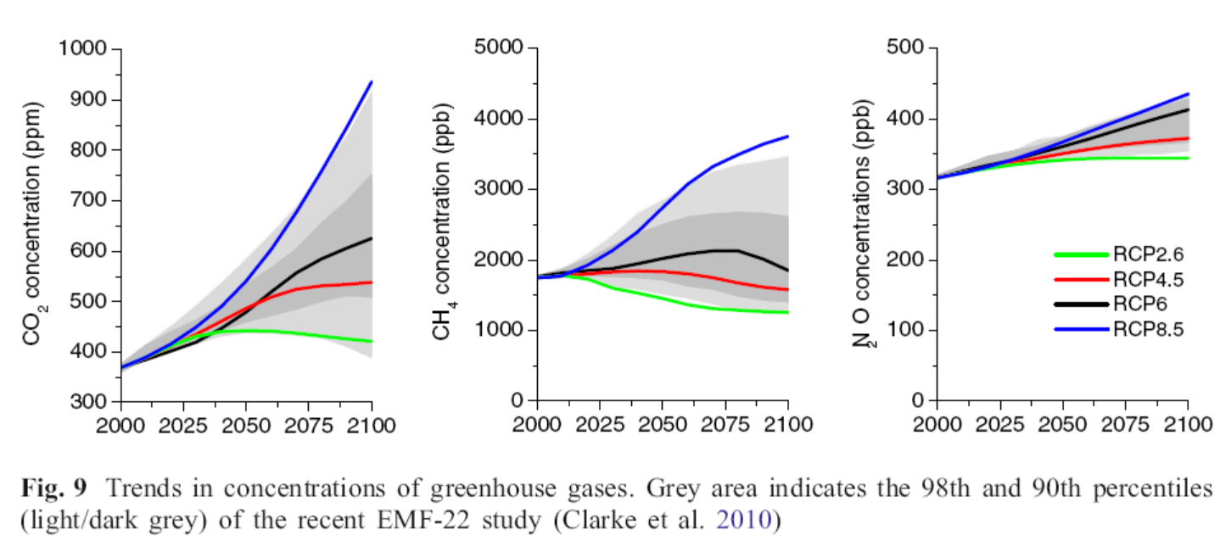
Projections of CO2, CH4 & N2O Concentrations
No feedback of future climate change on CO₂ is included!
Purely based on anthropogenic emissions increases.

Slide 15
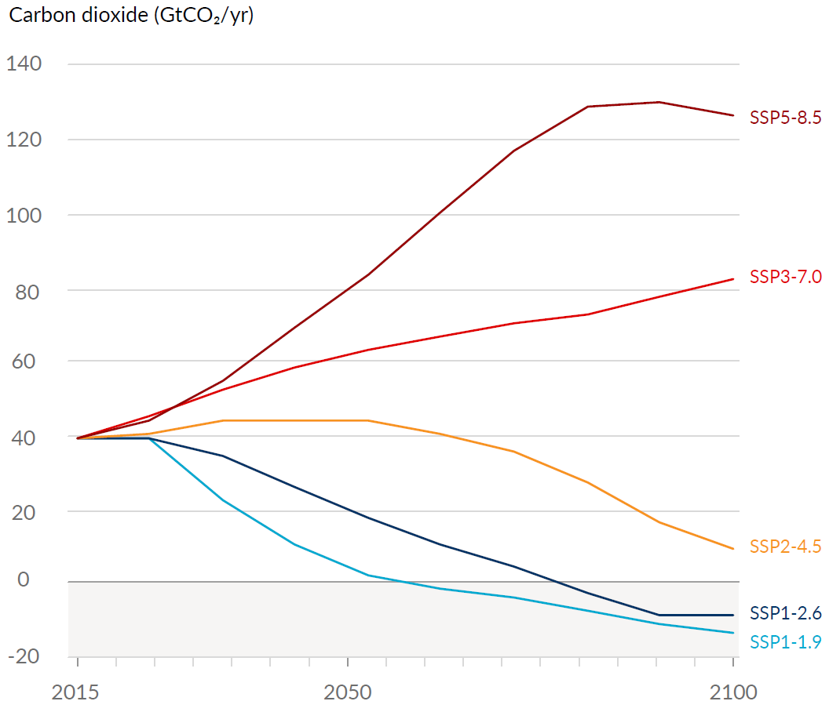
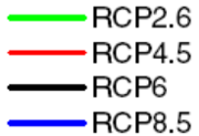
CO2 Emission Scenarios
CMIP5 vs. CMIP6
CO2 Emission Scenarios = 3.664 Carbon Emissons
IPCC AR6 (2021)

Slide 16
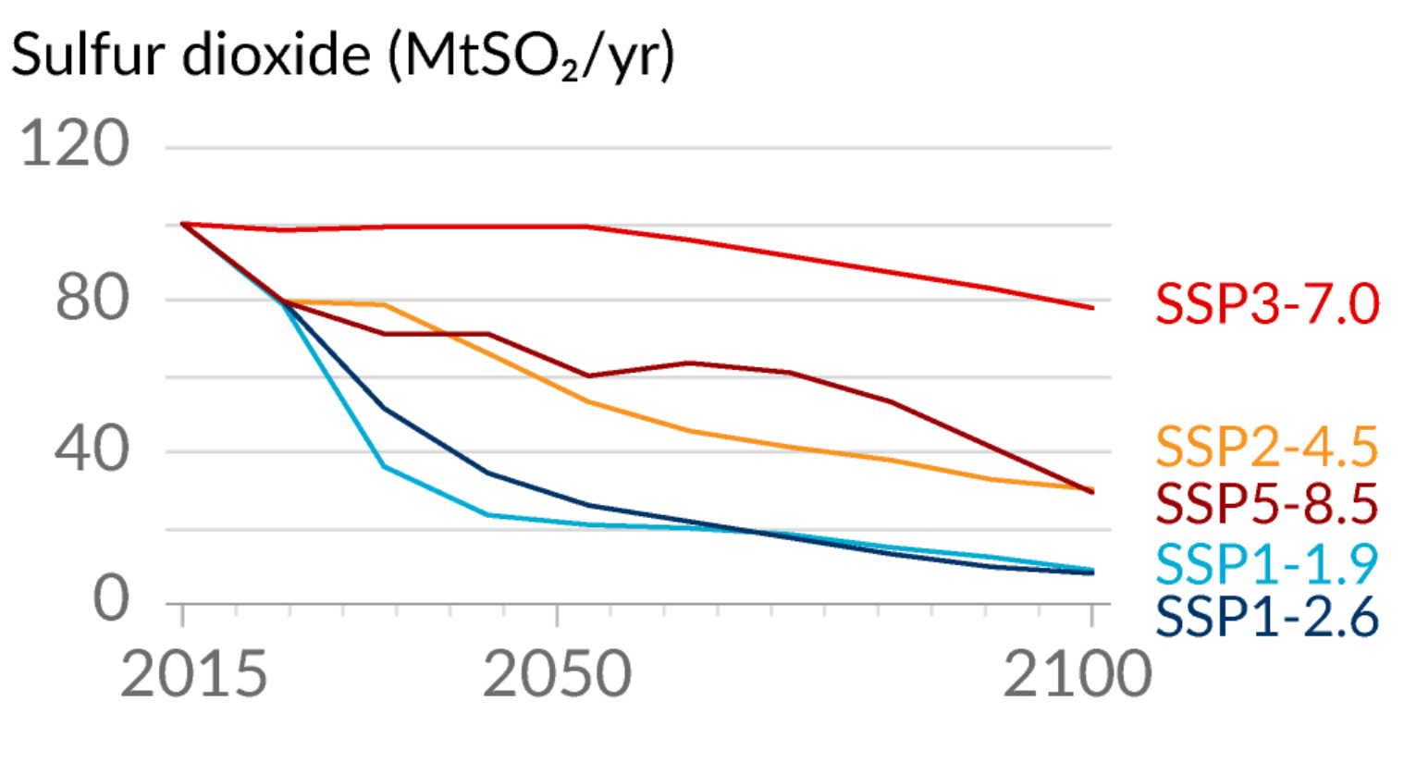
IPCC AR6 (2021)

Slide 17
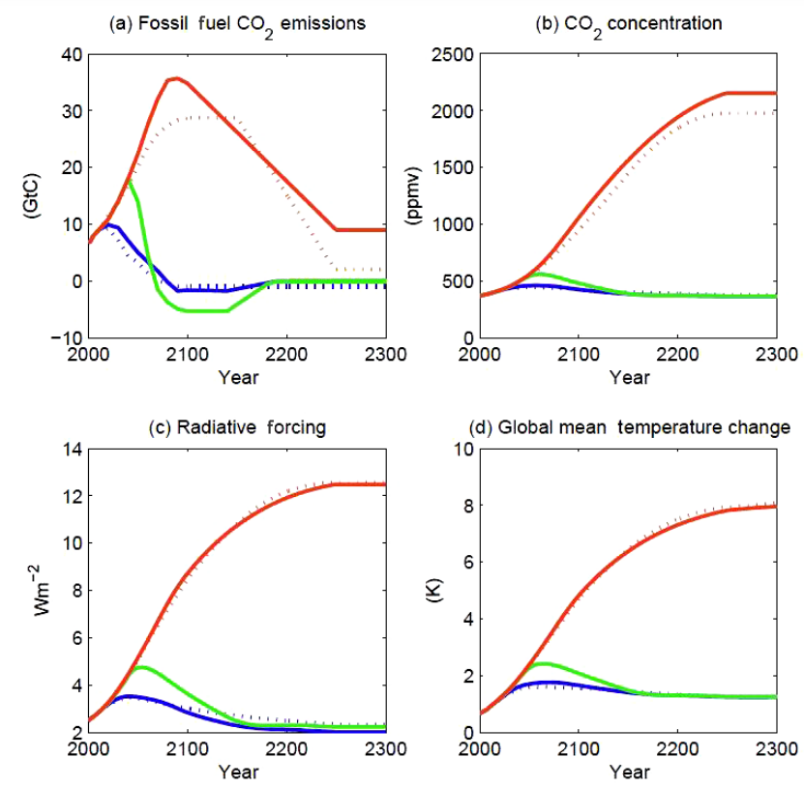
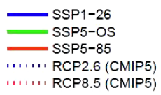

Slide 18
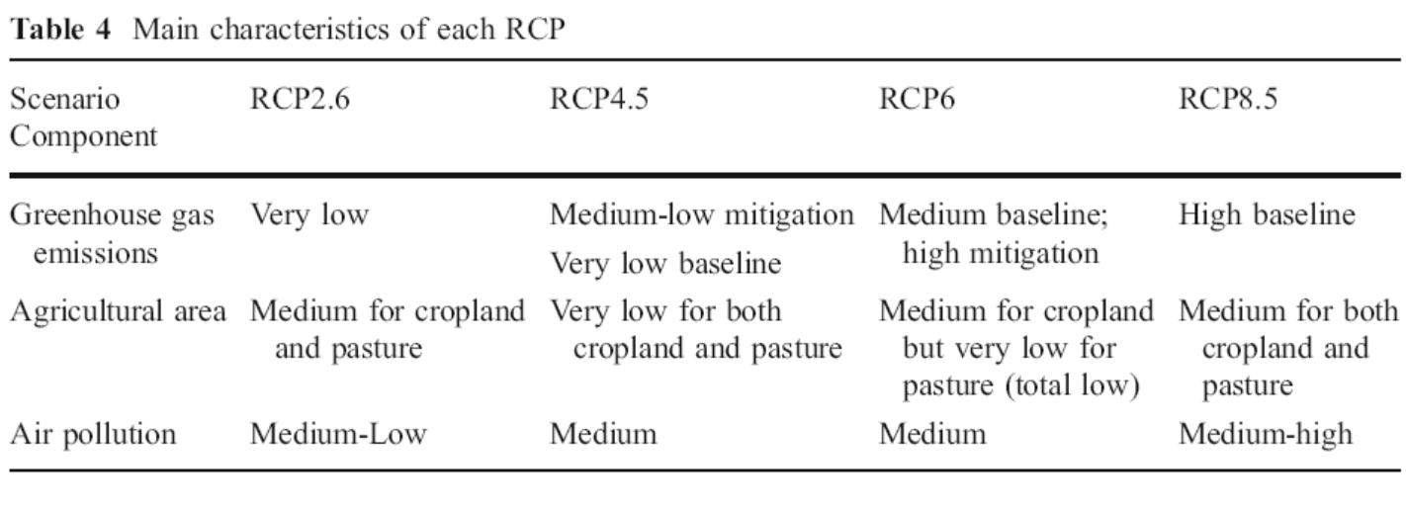
Main Characteristics of the RCPs

Slide 19
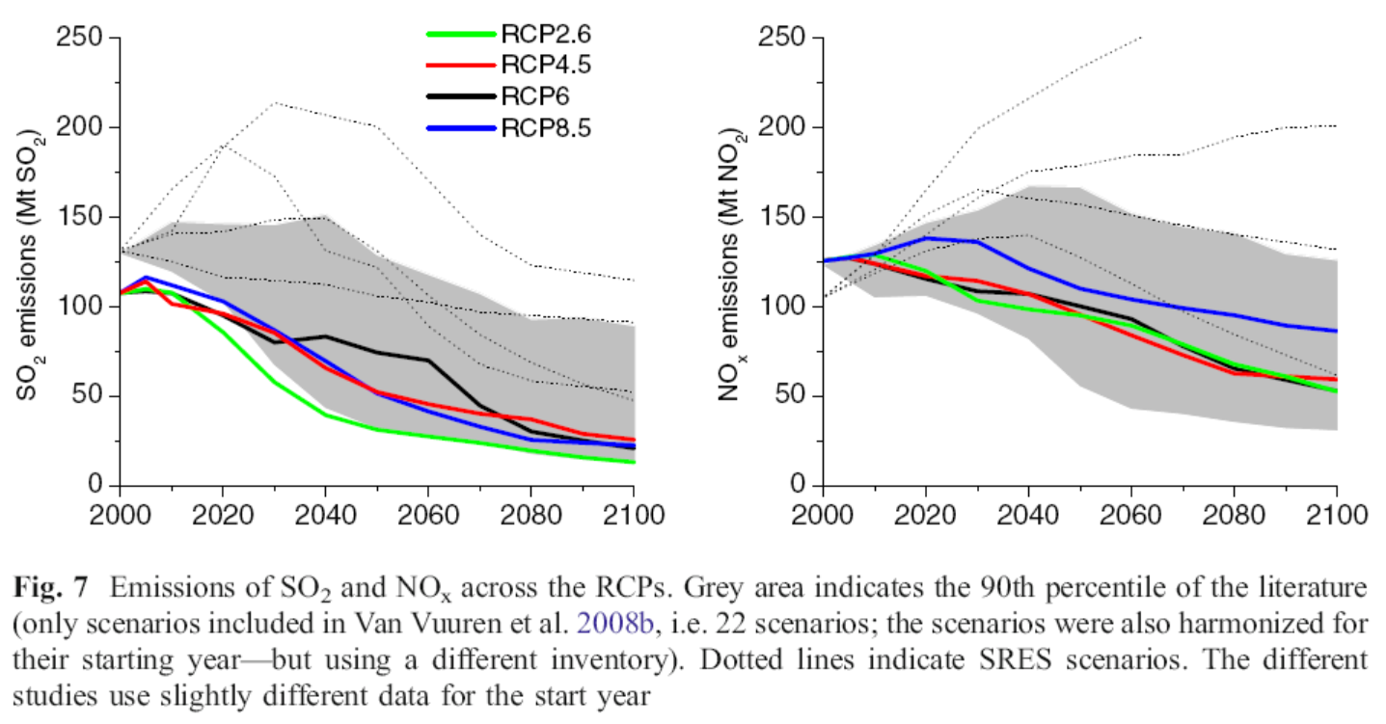
Estimated Future SO2 and NOx Emissions
The decline is due to the expected air pollution control.

Slide 20
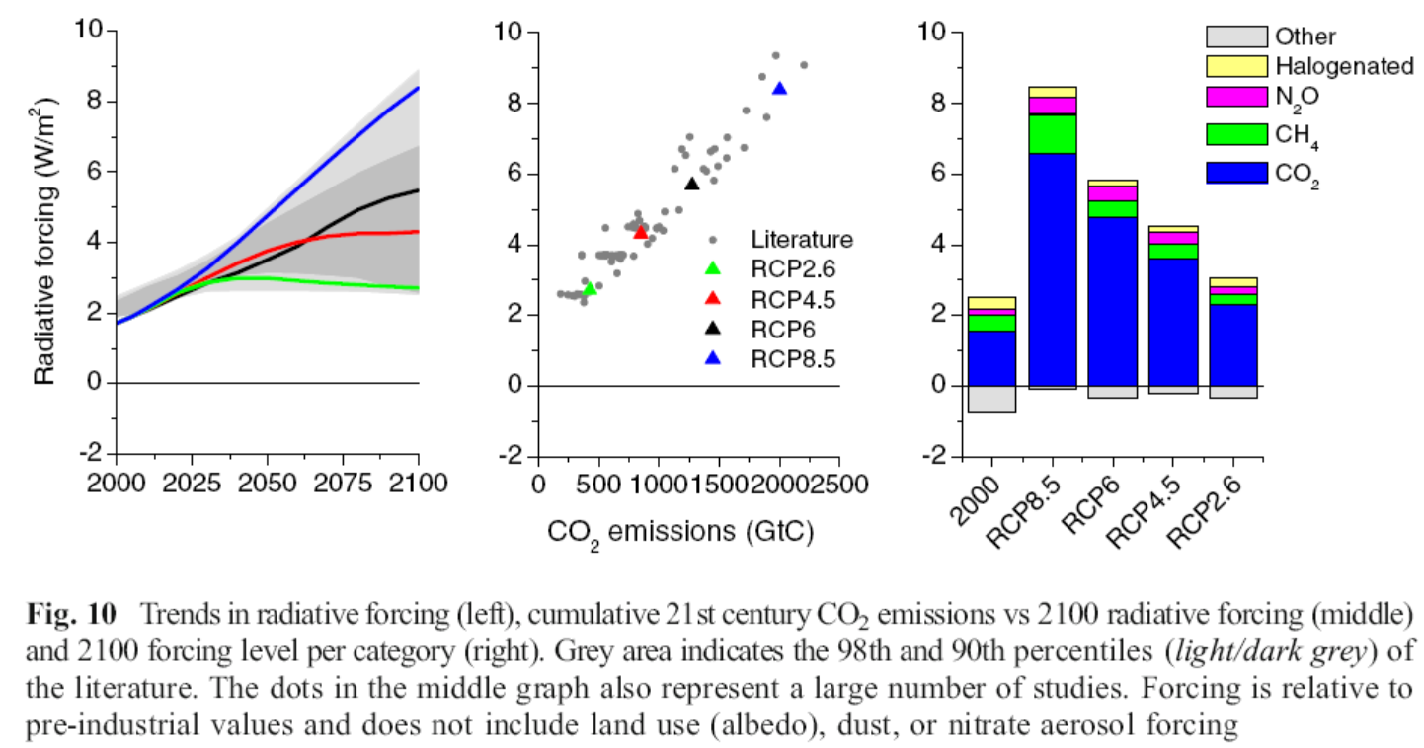
Projected Radiative Forcing in 21st Century

Slide 21
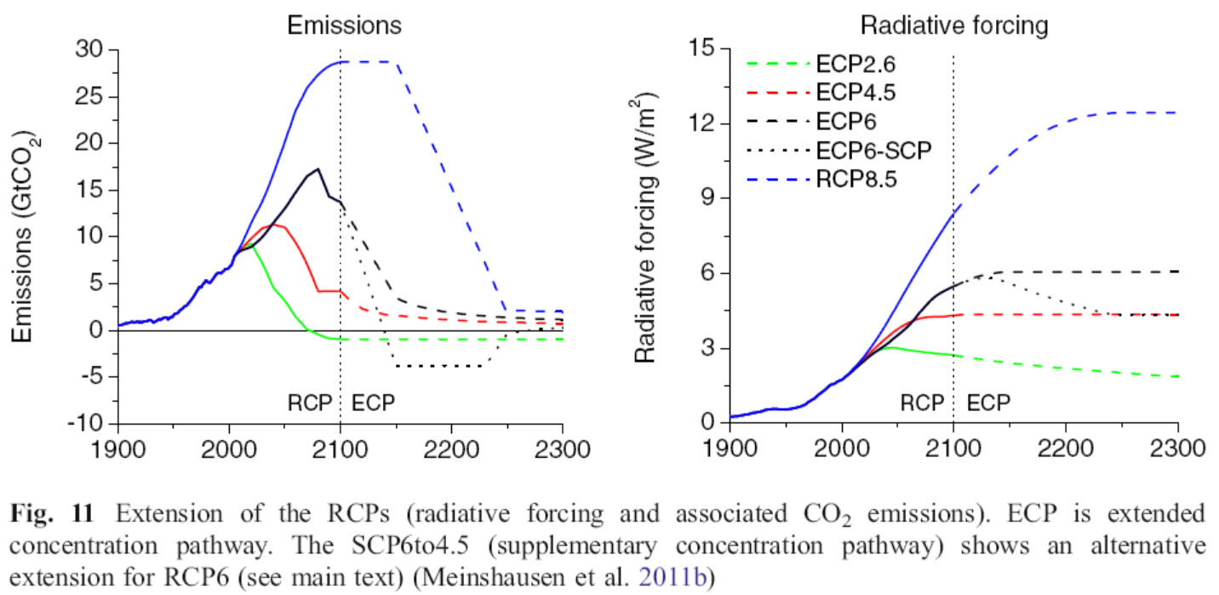
Emissions Projections Beyond 2100

Slide 22
Uncertainties in Projecting Future Climate Change
with Steve Schneider, ~8 minutes
Confronting with Climate Change
With Al Gore, ~6 minutes

Slide 23
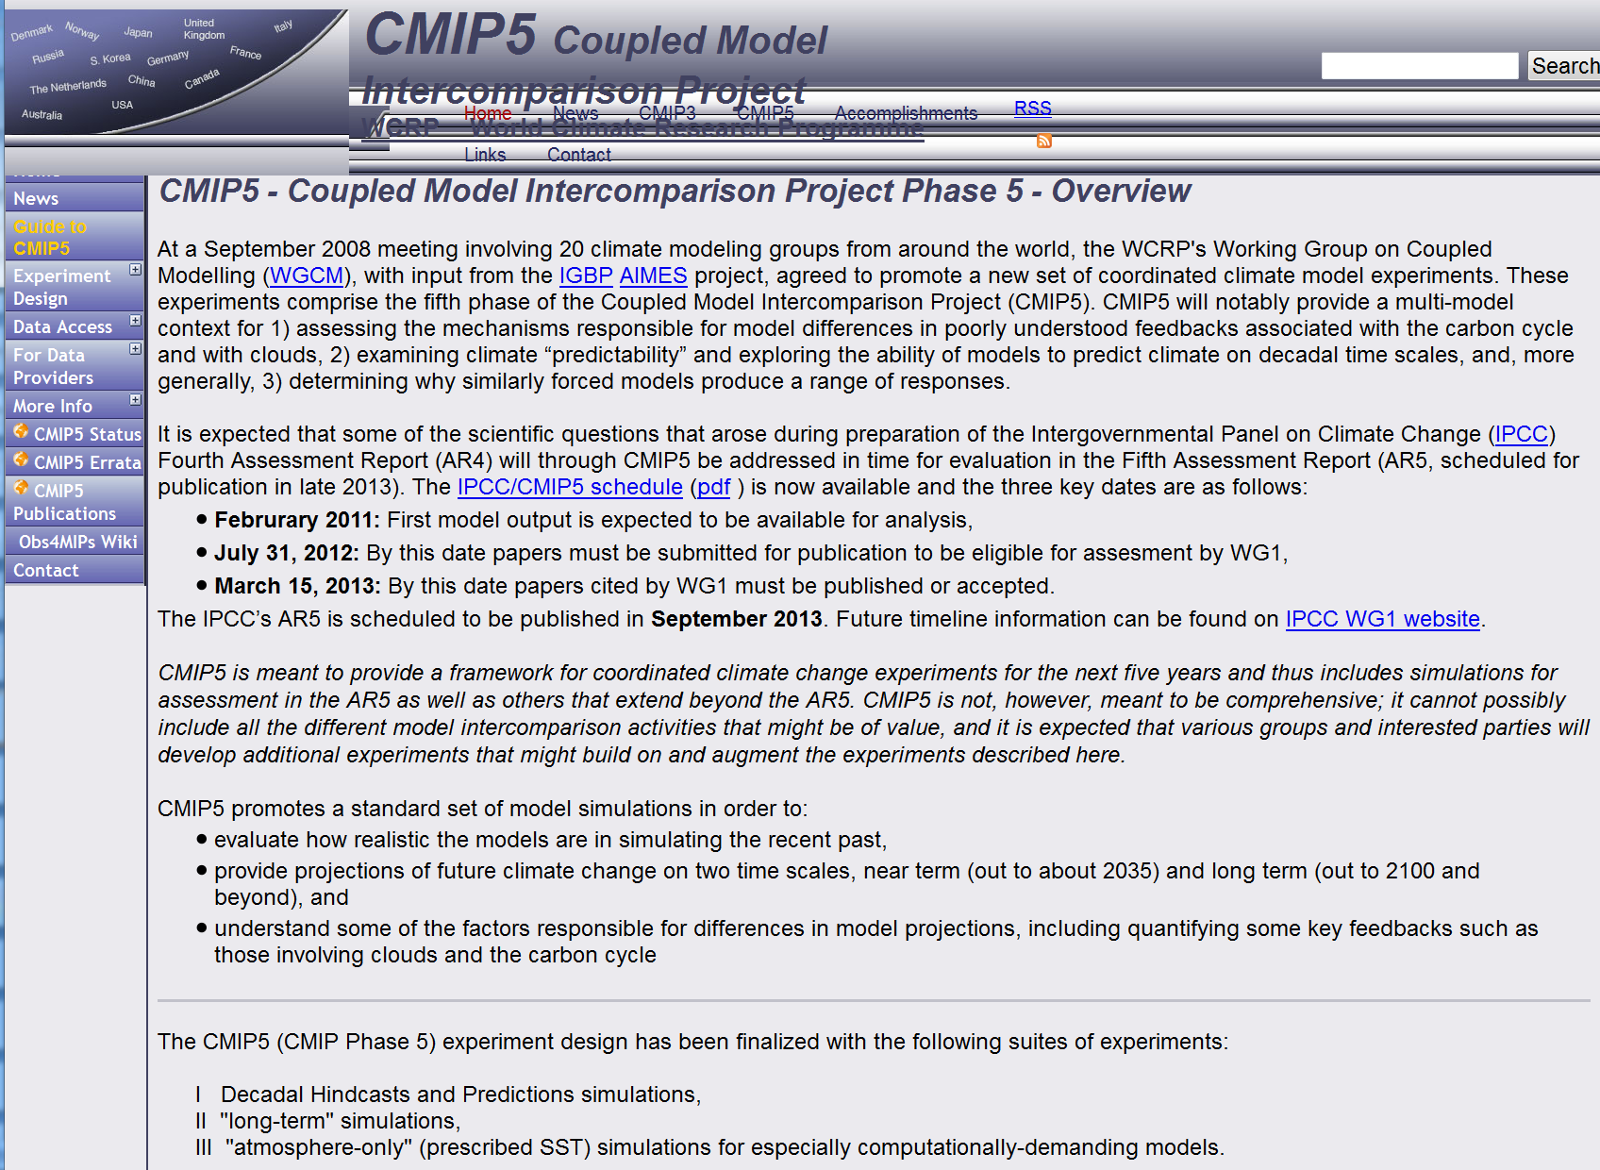
http://cmip-pcmdi.llnl.gov/cmip5/index.html
Notes:
http://cmip-pcmdi.llnl.gov/cmip5/index.html

Slide 24
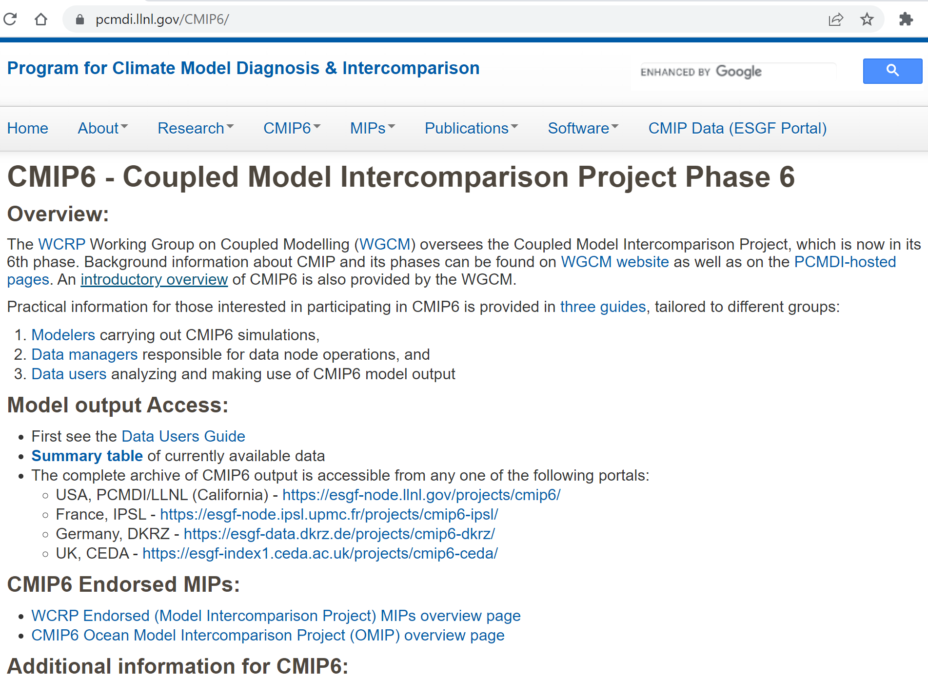
CMIP6

Slide 25
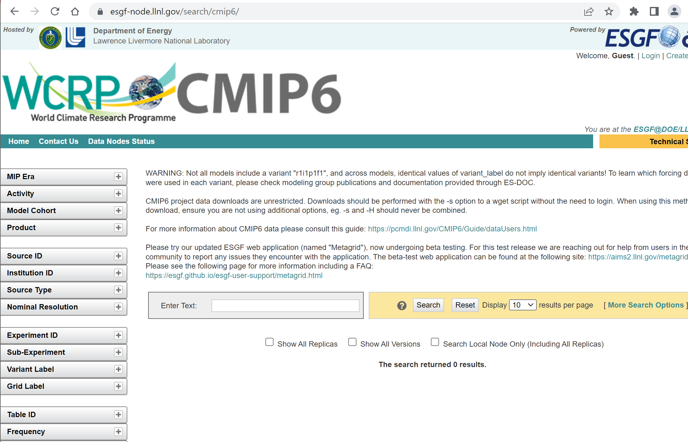

Slide 26
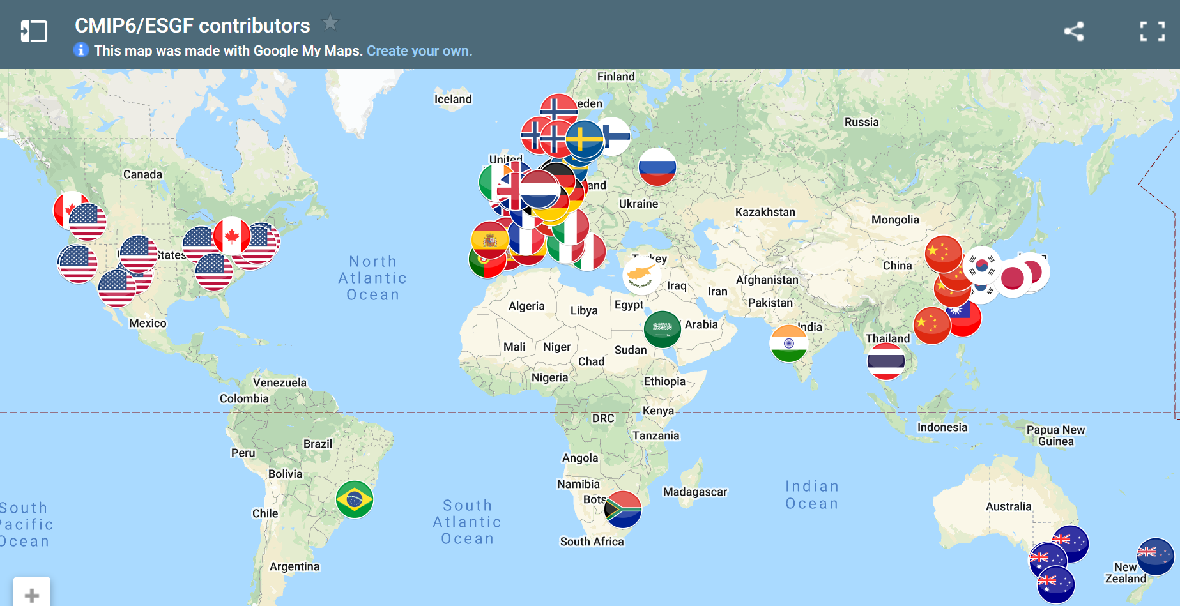
https://pcmdi.llnl.gov/CMIP6/

Slide 27
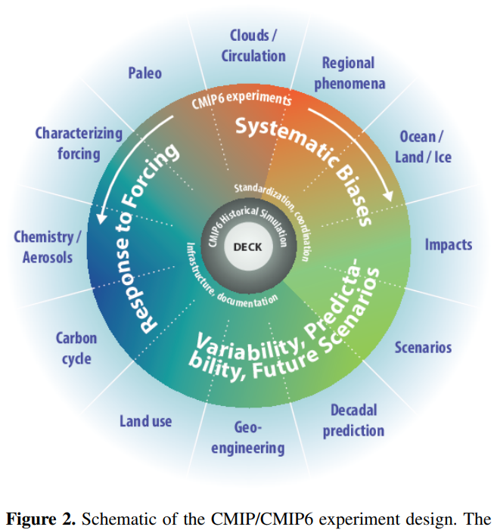
CMIP6
Eyring et al. (2016)
Geosci. Model Dev., 9, 1937–1958, 2016 www.geosci-model-dev.net/9/1937/2016/
DECK = Diagnostic, Evaluation and Characterization of Klima experiments (klima is Greek for “climate”)

Slide 28
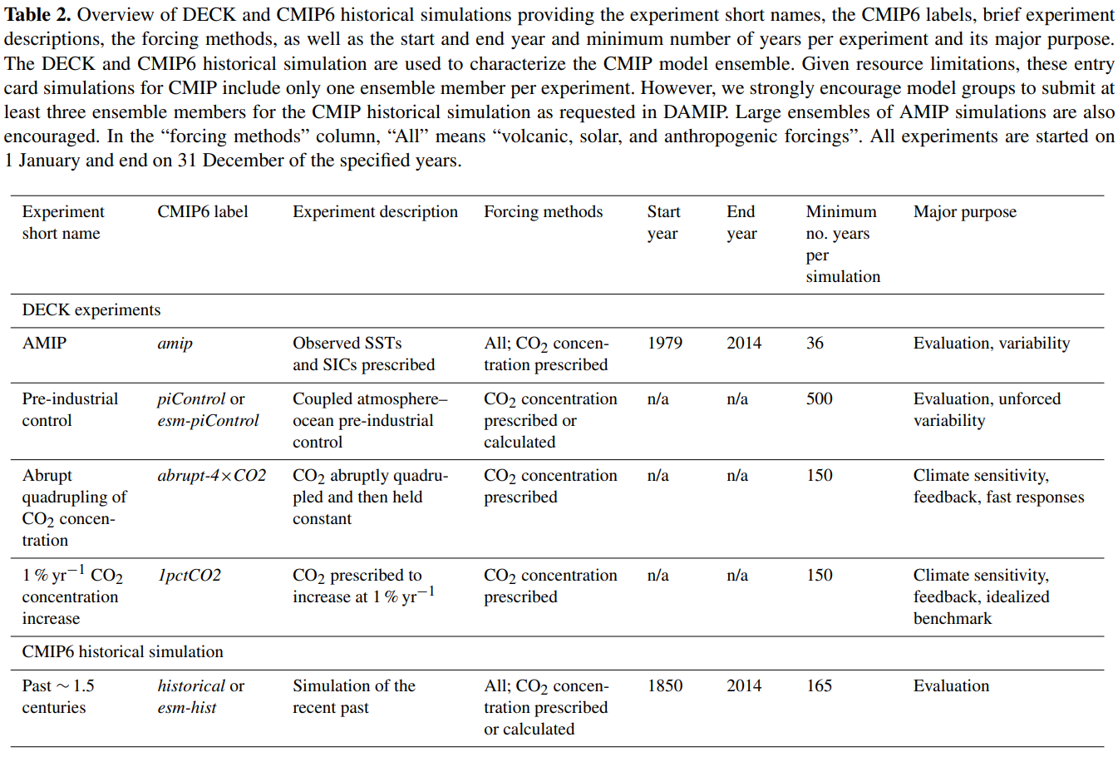
CMIP6 DECK & Historical Simulations
Eyring et al. (2016)

Slide 29
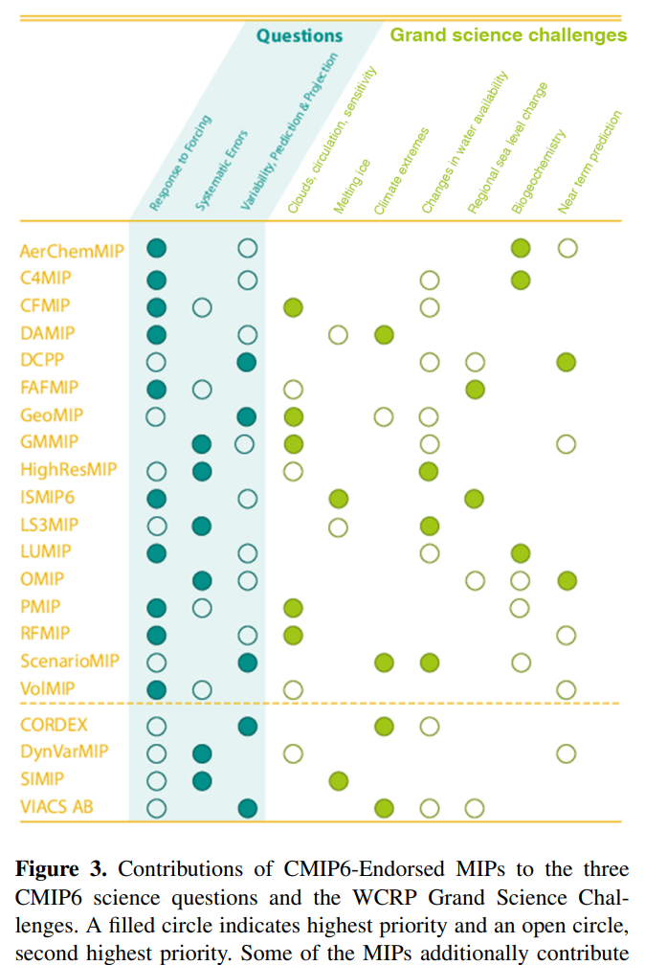

Slide 30
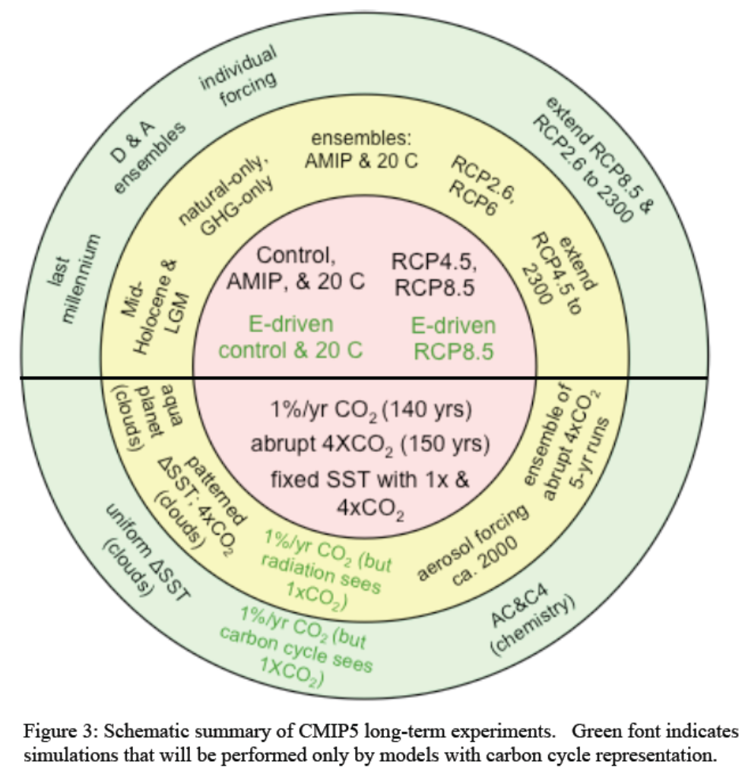

Slide 31
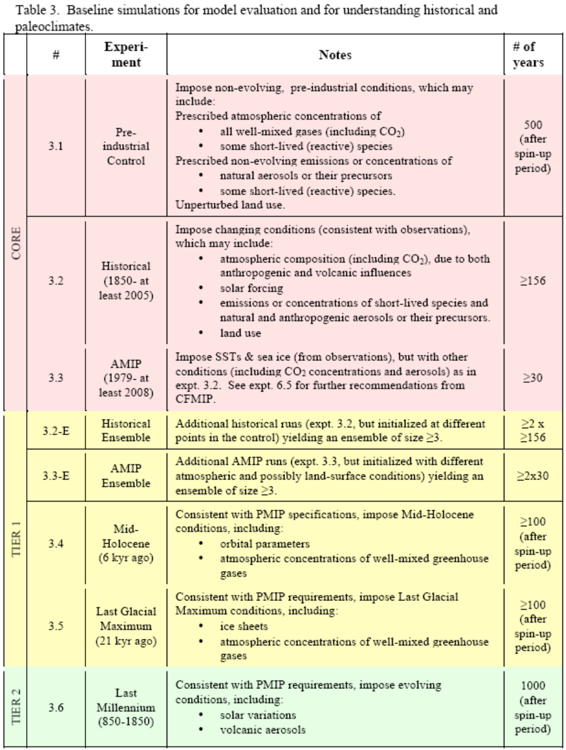
Simulations of Past Climates:
Pre-industrial control run
Historical run (1850-2005)
AMIP run: 1979-2008
Mid-Holocene run (6ka ago)
Last Glacial Maximum run (21ka ago)
Last Millennium run (850-1850).

Slide 32
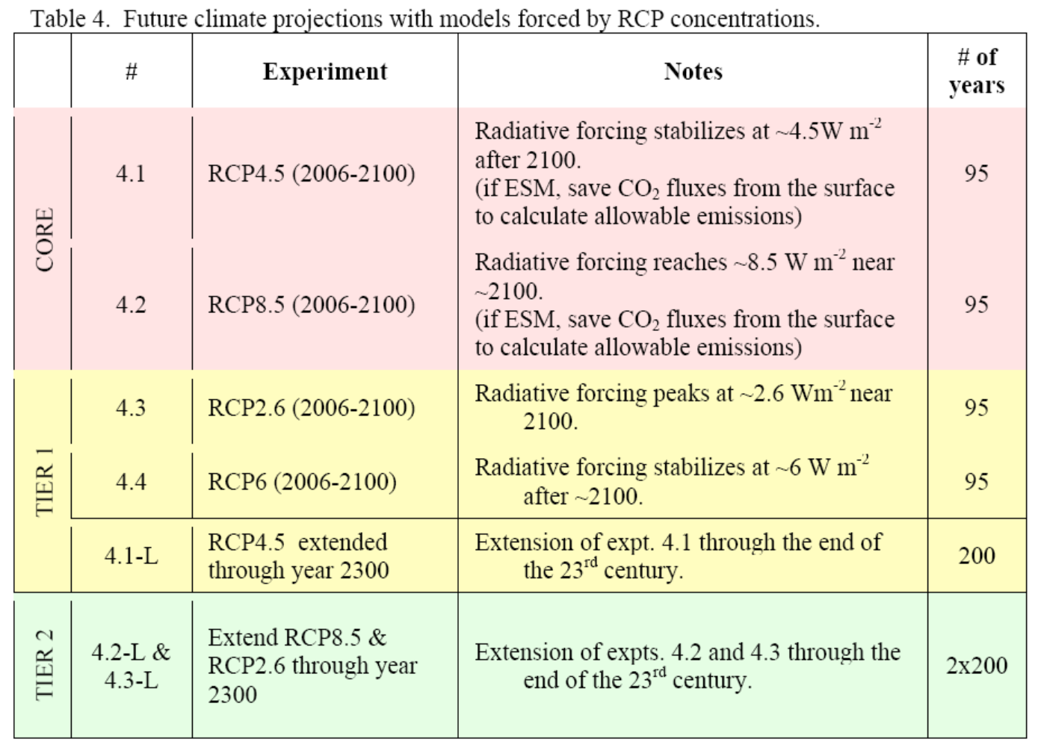
Future Climate Simulations

Slide 33
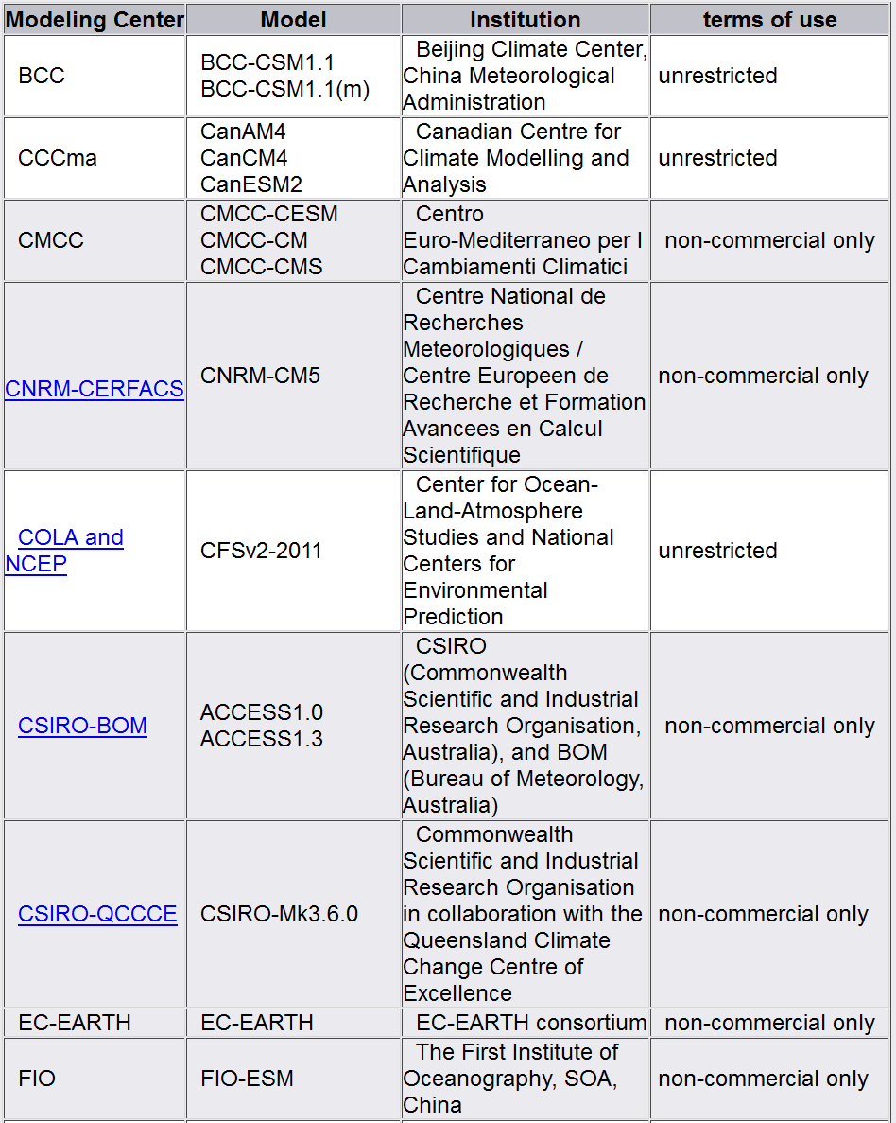
Modeling Centers and Climate Models:
There are 27 modeling groups, with 40+ models.
Main modeling groups:
NCAR, Hadley Centre,
GFDL, NASA GISS,
CCC, MPI-M, CSIRO, IPSL.

Slide 34
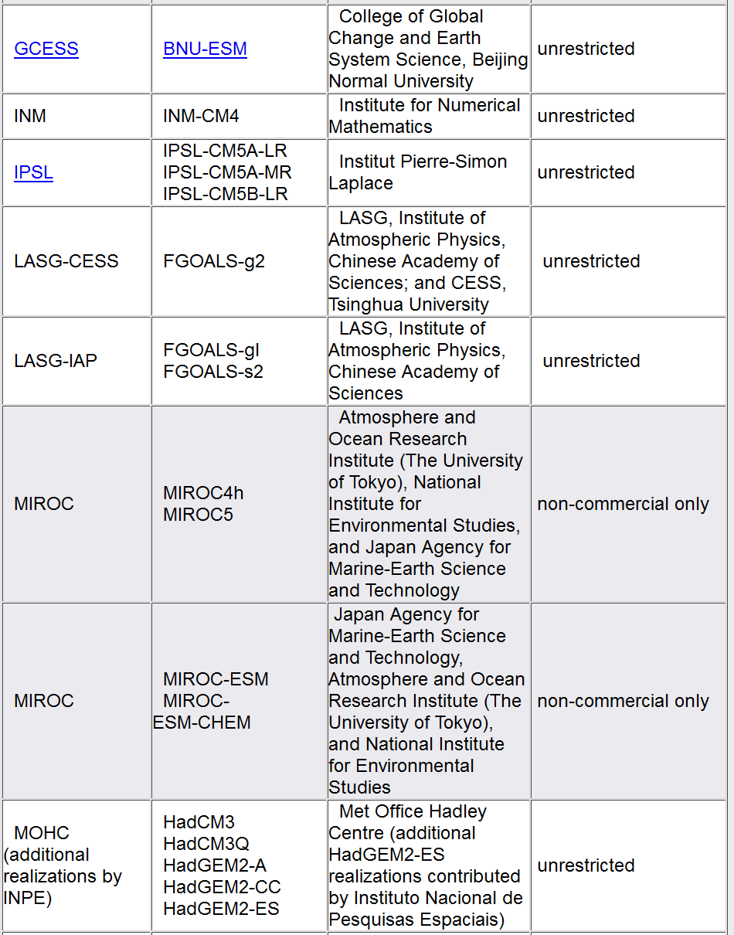

Slide 35
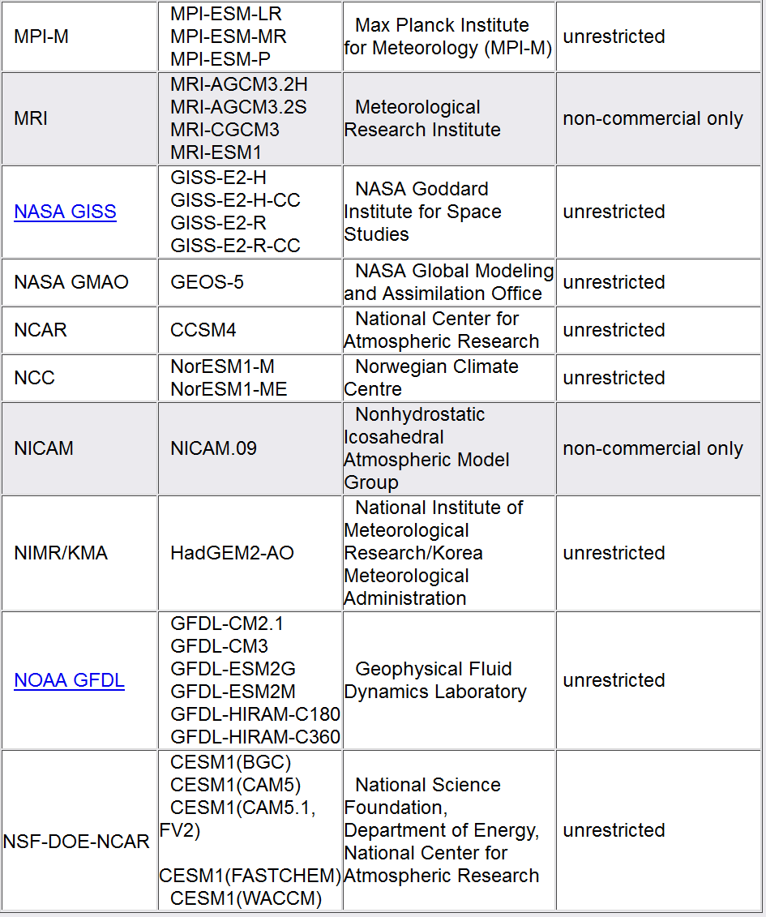

Slide 36
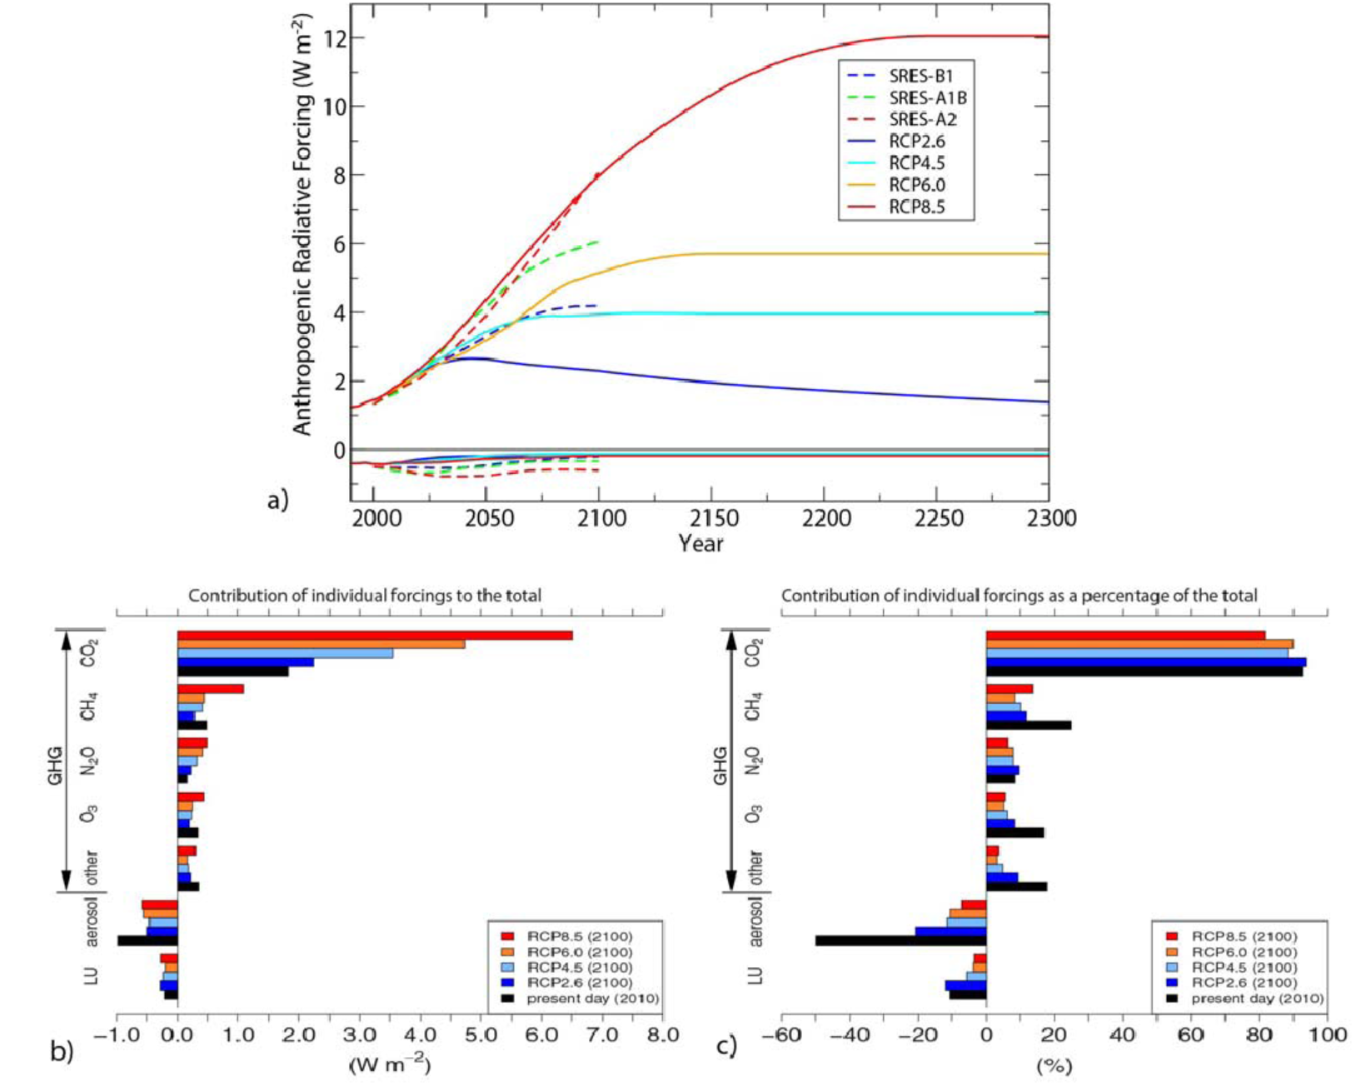

Slide 37
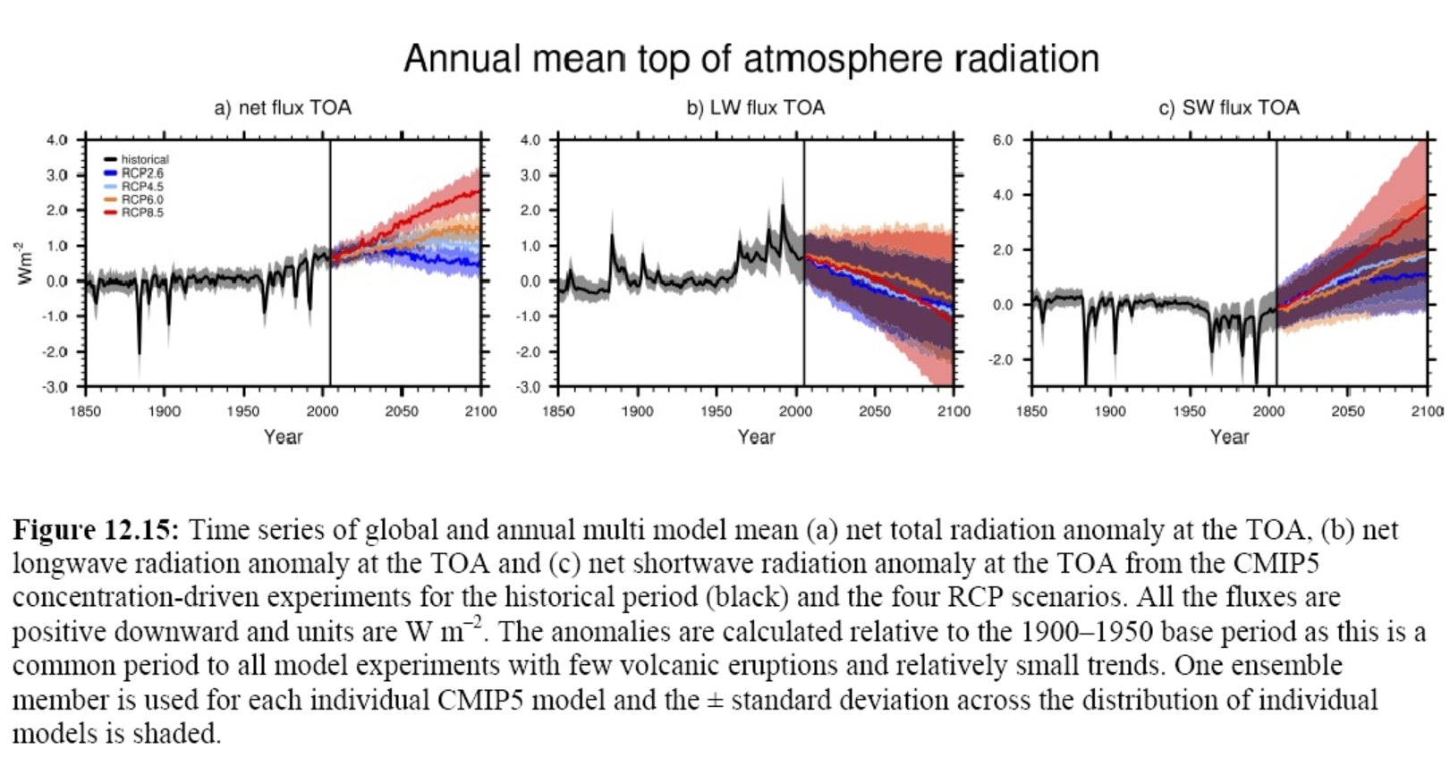
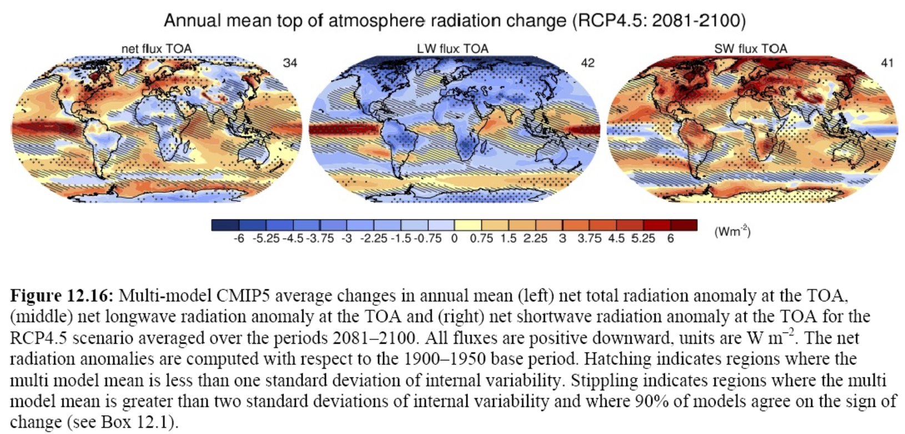
TOA net flux < the initial perturbation forcing indicated by the scenario
SW flux is larger than the LW flux, suggesting albedo effect is important.

Slide 38
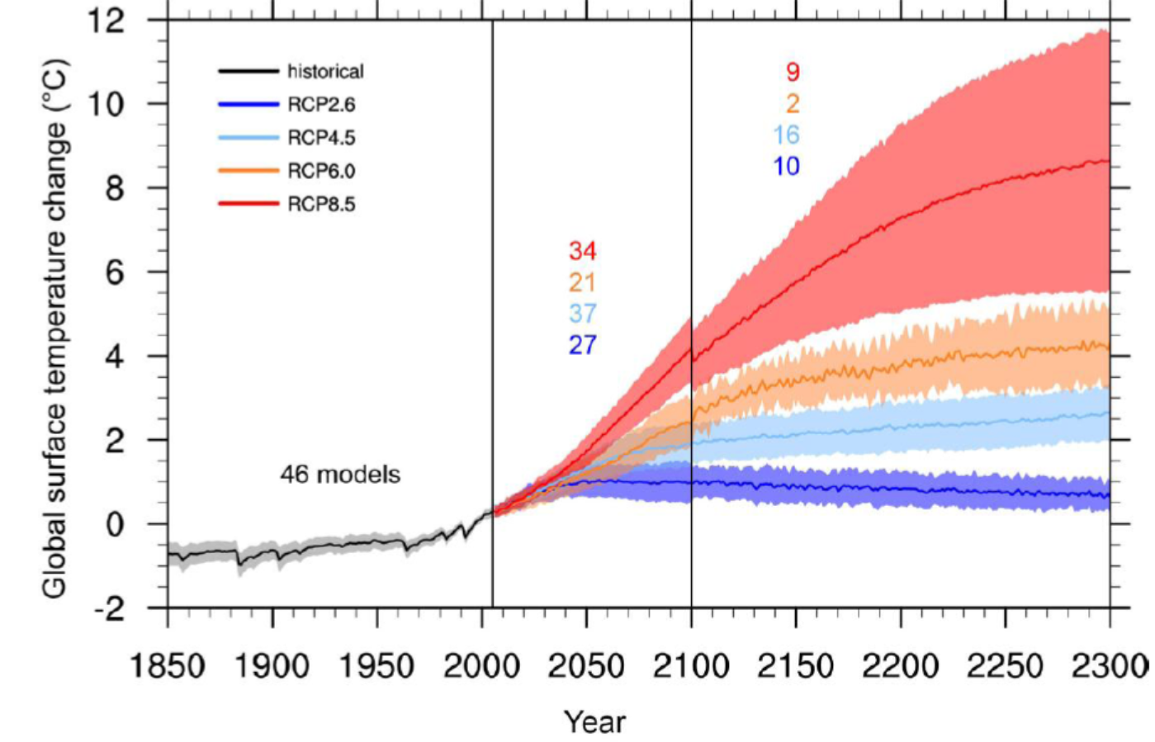
CMIP5 Projected Global Surface Temp.
1ºC = 1.8ºF

Slide 39
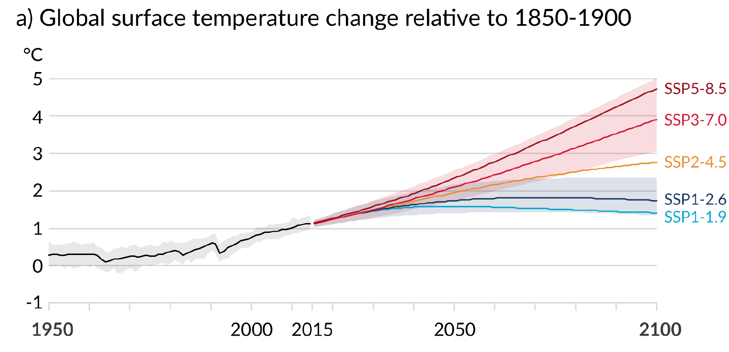
CMIP6 Projected Global Surface Temp.
1ºC = 1.8ºF

Slide 40
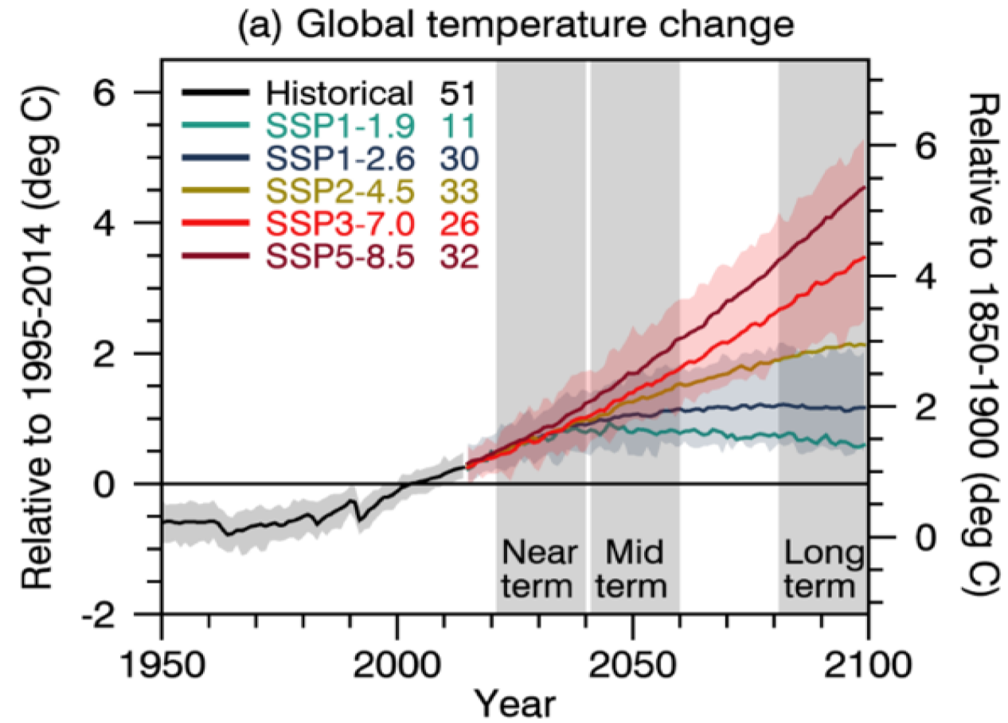
CMIP6 Model-projected Global T Change
IPCC (2021)

Slide 41
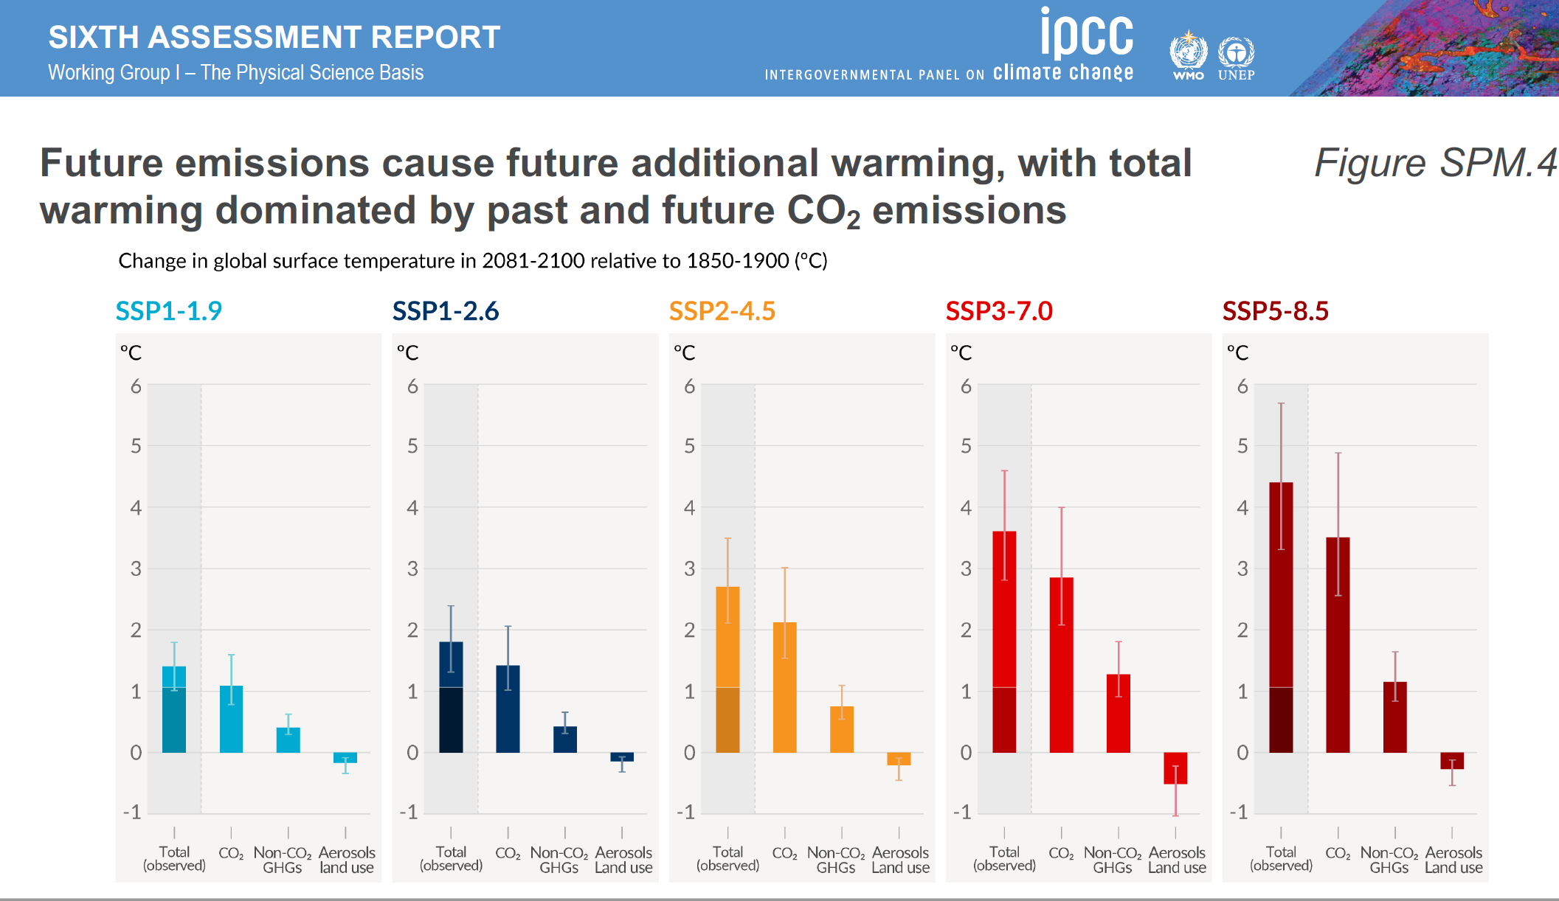
IPCC (2021)

Slide 42
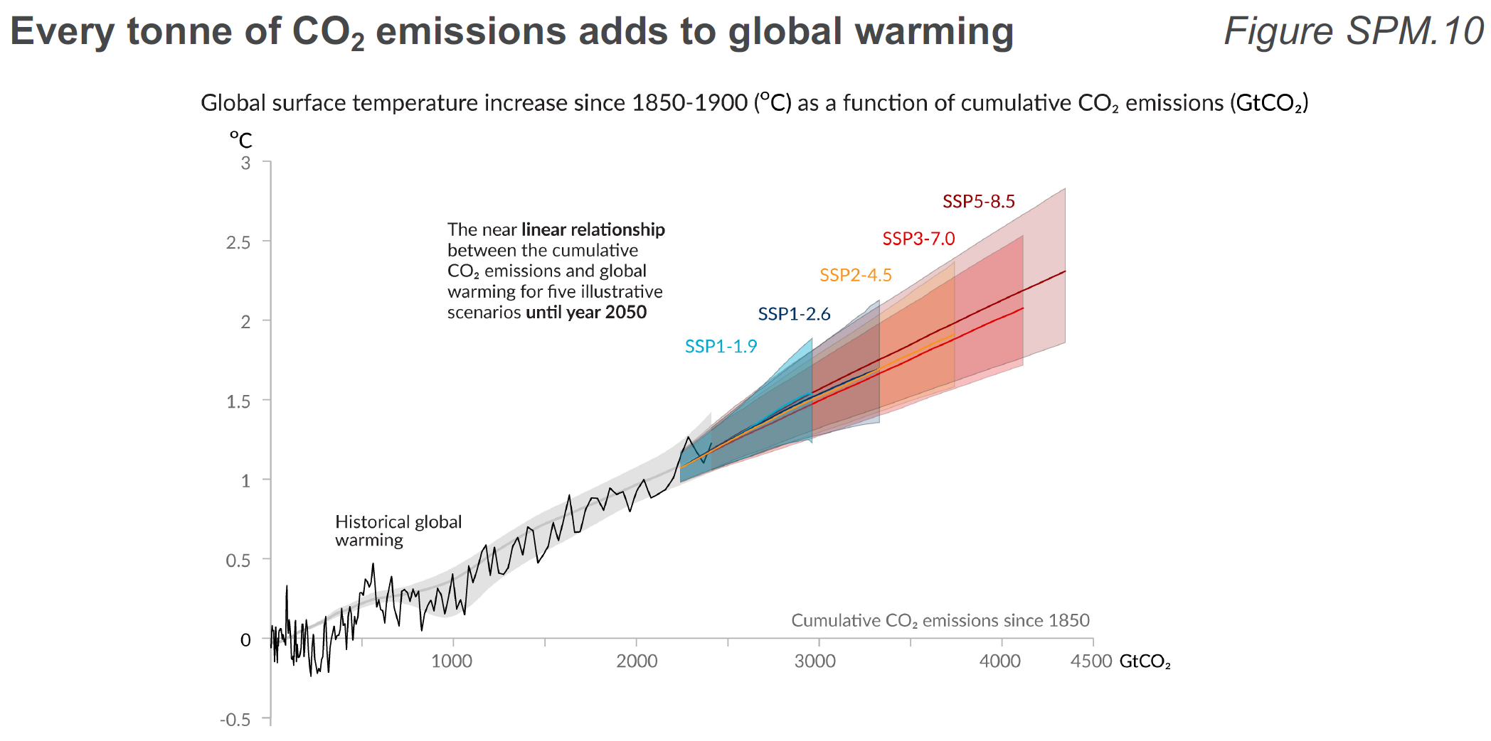
CMIP6 Model-projected Global T Change
IPCC (2021)

Slide 43
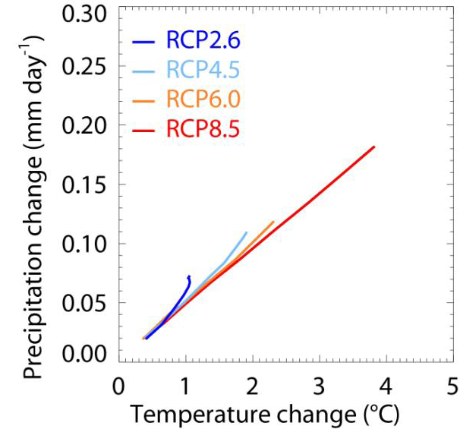
Global P Change vs. T Change

Slide 44
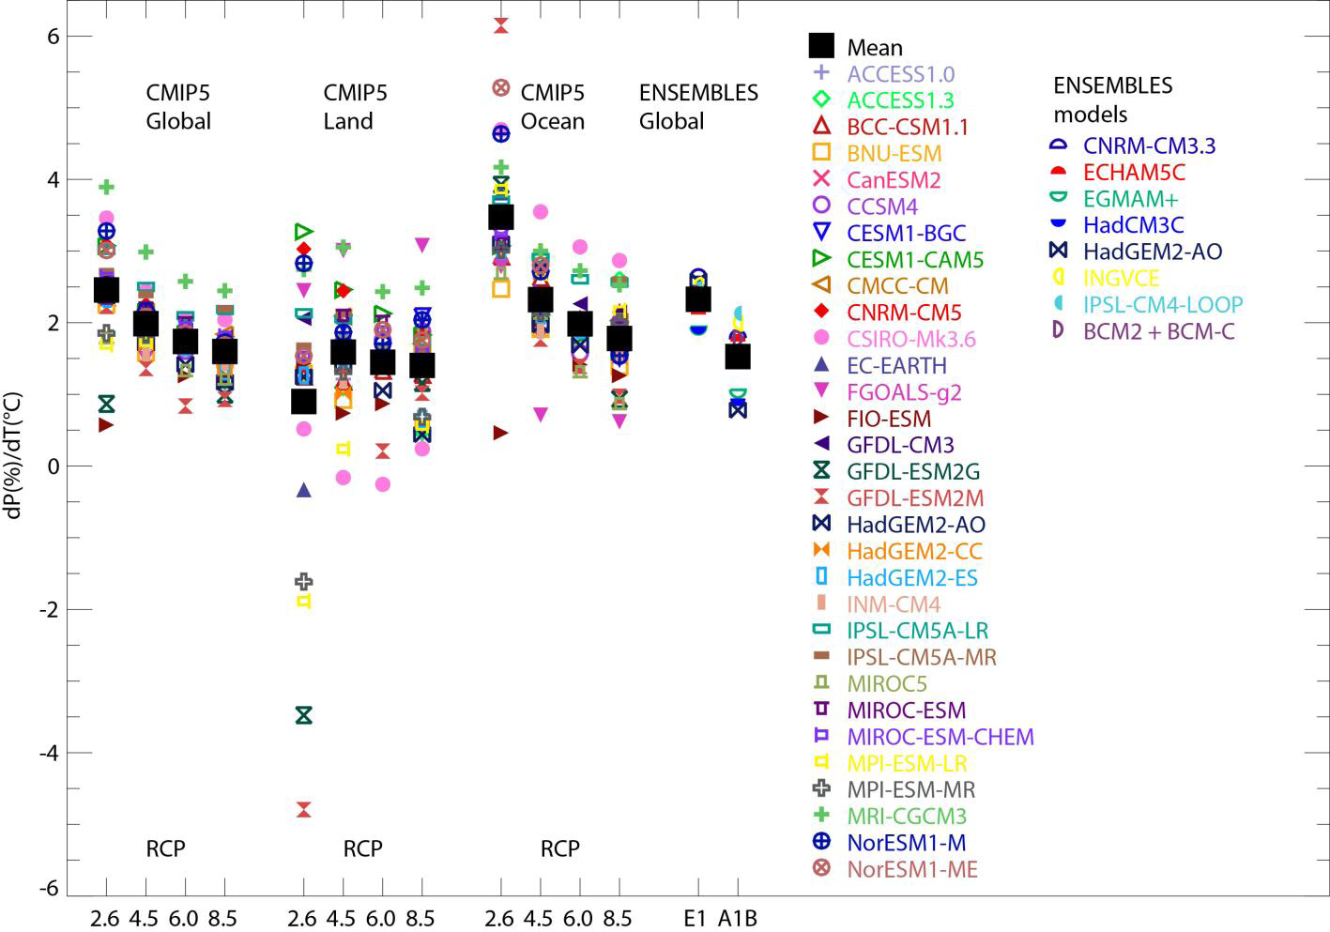
Global d(lnP)/dT Ratio, CMIP5
Notes:
Figure 12.7: Percentage changes in global, land and ocean precipitation per °C of global warming for CMIP5 model
projections for the four RCPs, over the period 2006–2100. Changes are calculated relative to the mean precipitation and
temperature for 1986–2005 and the gradient of a least-squares fit through annual mean data for each model ensemble
mean is computed. Land and ocean values use global mean temperature in the denominator. Each coloured symbol
represents the ensemble mean for a single model, and black squares are multi-model means. Also shown are
corresponding results for ENSEMBLES model projections for the E1 and A1B scenarios (Johns et al., 2011), in this
case using a least-squares fit calculated over the period 2000–2099 and for percentage change relative to the period
1980–1999. The change of precipitation over land and ocean are discussed in Section 12.4.5.2.

Slide 45
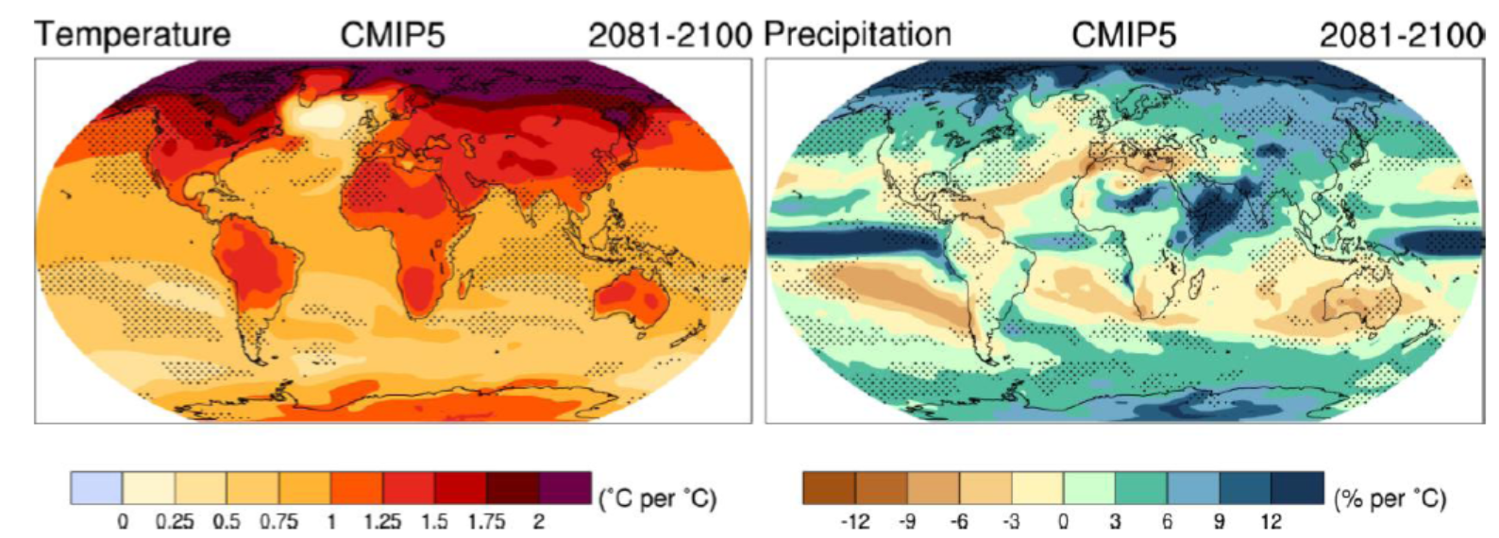
CMIP5 T and P Change Patterns
2081-2100 minus 1986-2005
Notes:
Relative to 1986-2005: Top for CMIP3 models, bottom for CMIP5 models. Stippling = significant. Ensemble average. Normalized by global dT.

Slide 46
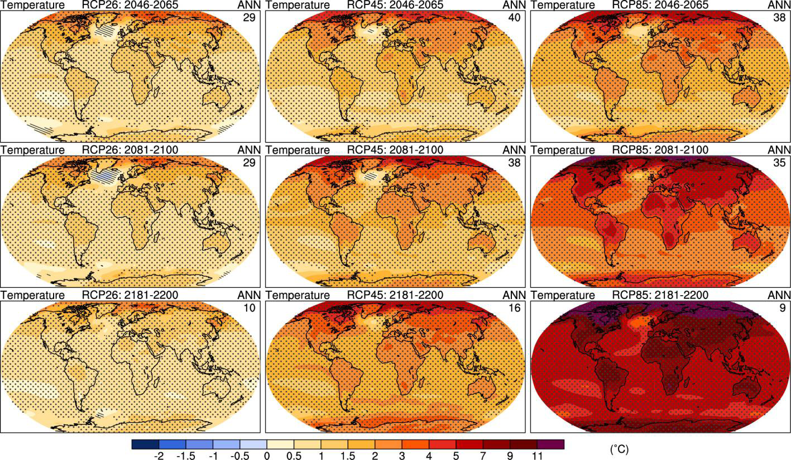
CMIP5 Projected Surface Warming
RCP2.6
RCP4.5
RCP8.5
2046-2065
2081-2100
2181-2200
Notes:
Relative to 1986-2005

Slide 47
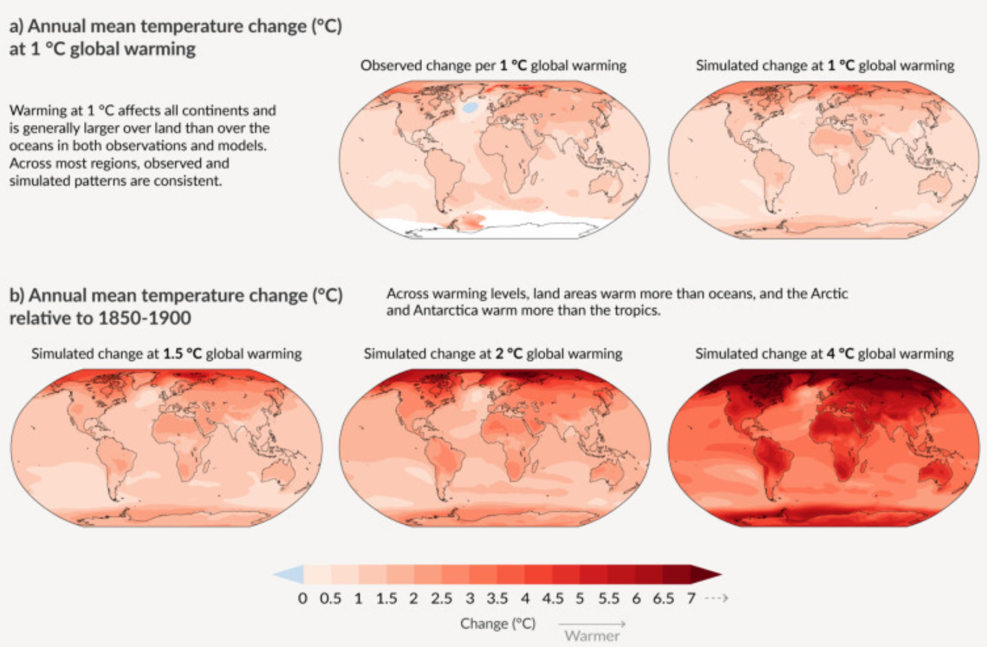
CMIP6 Projected Surface Warming Pattern
IPCC (2021)

Slide 48
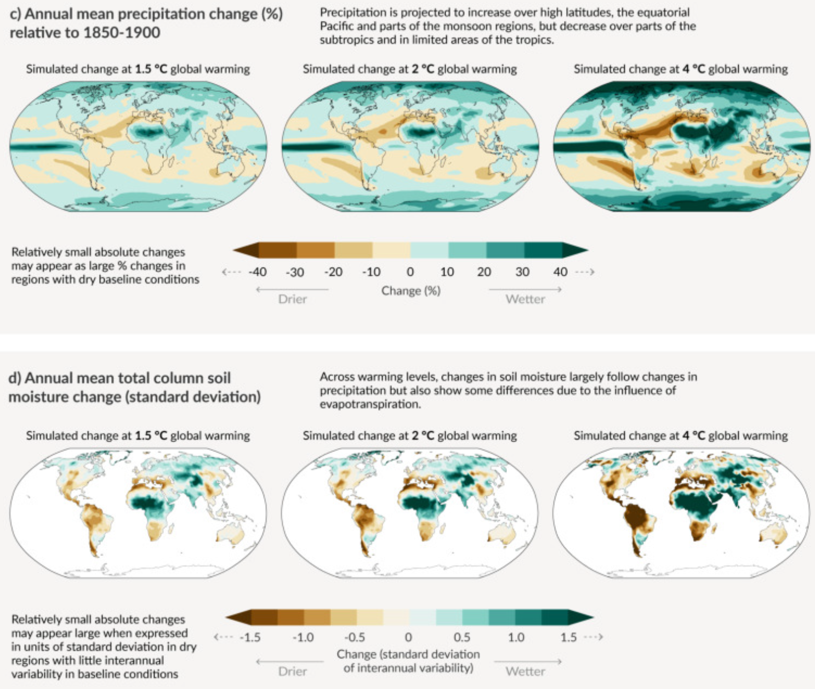
CMIP6 Projected Precip and S.M. Change Patterns
IPCC (2021)

Slide 49
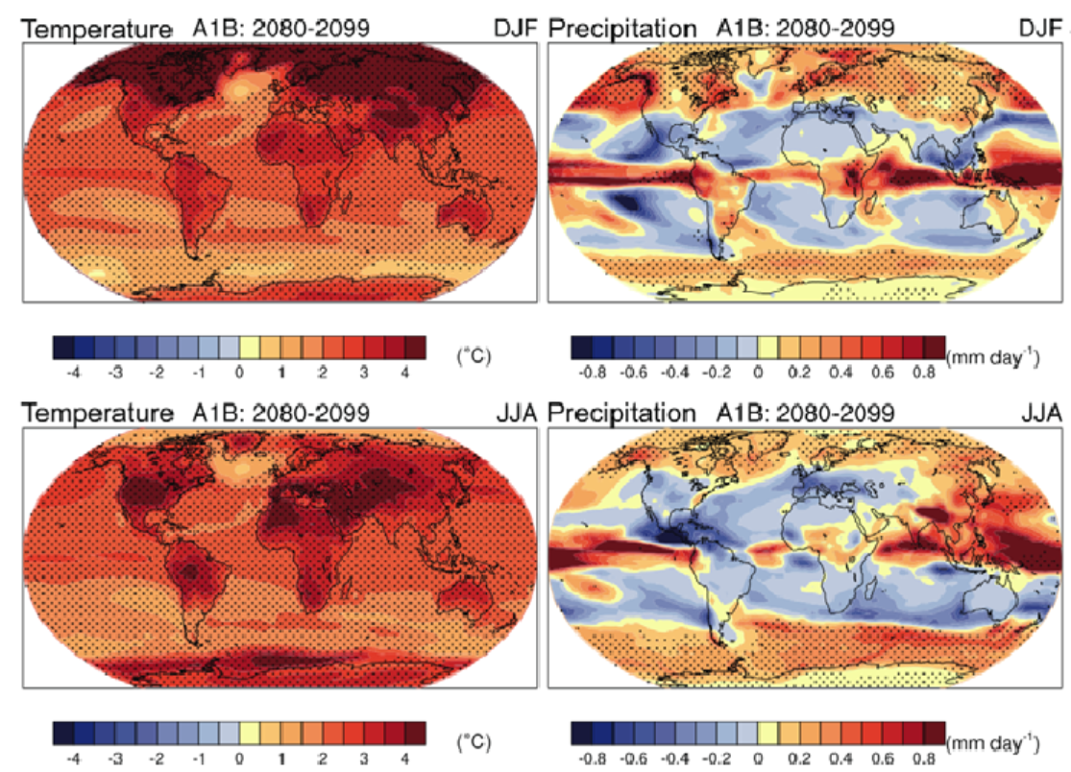
Notes:
Figure 10.3.6. Multi-model mean changes of surface air temperature (°C, left), precipitation (mm/day, middle), and sea level pressure (hPa, right) for boreal winter (DJF, top) and summer (JJA, bottom). Changes are given for the scenarios SRES A1B, for the period 2080–2099 relative to 1980–1999. Stippling denotes areas where the magnitude of the multi-model ensemble mean exceeds the inter-model standard deviation. Results for individual models can be seen in supplementary material for this chapter.

Slide 50
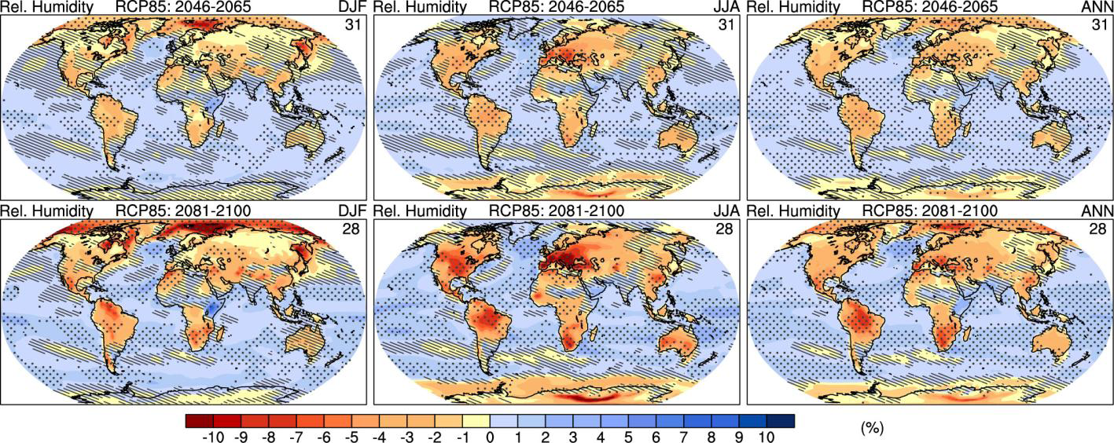
CMIP5 Surface Relative Humidity Changes
RH change relative to 1986-2005
Dec.-Feb.
June-Aug.
Annual Mean
2046-2065
2081-2100
Drier Air
Moist Air
Notes:
Figure 12.21: Projected changes in near-surface relative humidity from the CMIP5 models under RCP8.5 for the DJF
(left), JJA (middle) and annual mean (left) averages relative to 1986–2005 for the periods 2046–2065 (top row), 2081–
2100 (bottom row). Hatching indicates regions where the multi model mean is less than one standard deviation of
internal variability. Stippling indicates regions where the multi model mean is greater than two standard deviations of
internal variability and where 90% of models agree on the sign of change (see Box 12.1). The number of CMIP5
models used is indicated in the upper right corner of each panel.

Slide 51
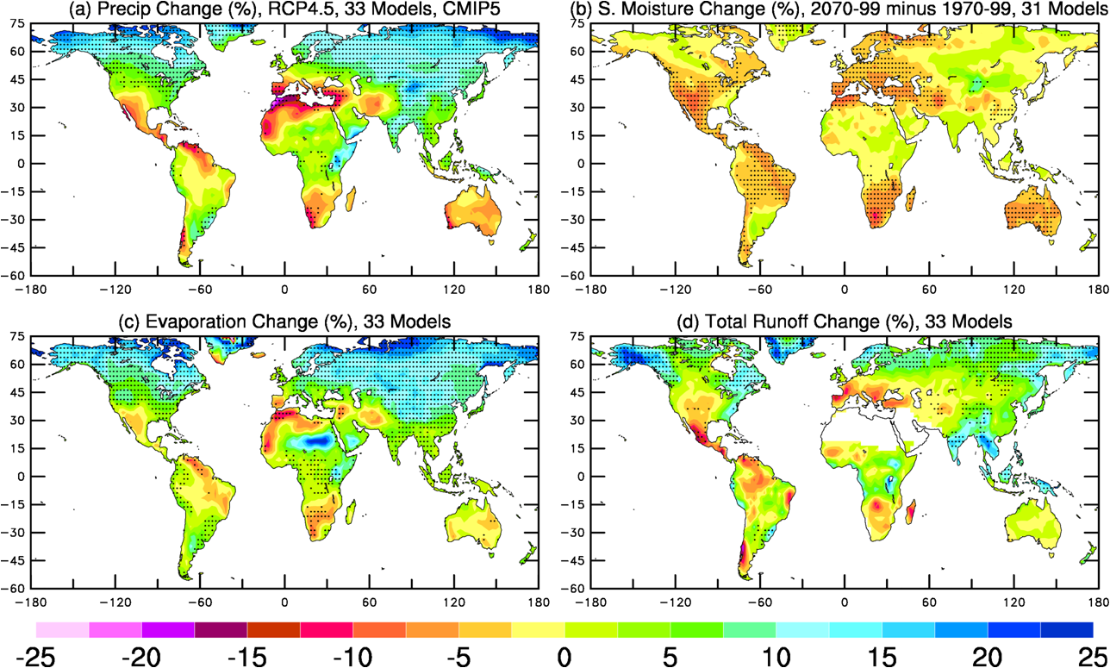
CMIP5: Changes in the Mean of Hydroclimate Variables
CMIP5 Projected Mean Changes in the 21st Century under RCP4.5
Zhao & Dai (2015)
Notes:
Stippling indicates 80% of the models agree on the sign of change.

Slide 52

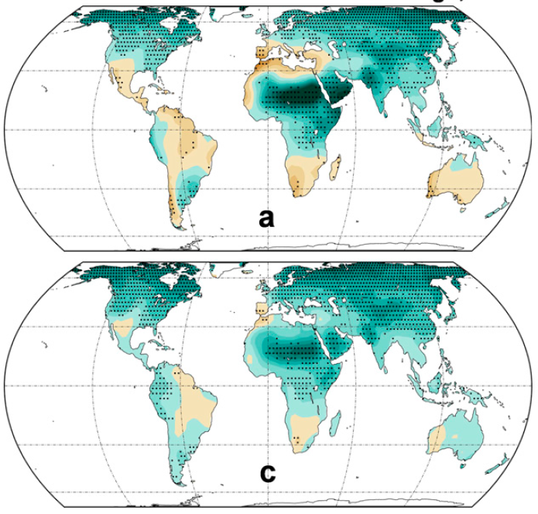
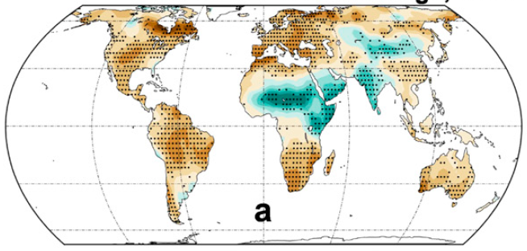


CMIP6: Changes in the Mean of Hydroclimate Variables
2070-2099 minus 1970-1999, SSP2-4.5
Precipitation
Sfc. Soil Moisture
%
Evaporation
Total runoff
25 CMIP6 Projected Mean Changes in the 21st Century under SSP2-4.5
Zhao & Dai (2022)

Slide 53

CMIP5 Soil Moisture Changes
Change relative to 1986-2005
RCP2.6
RCP4.5
RCP6.0
RCP8.5
Drier Soils
Wetter Soils
Notes:
Figure 12.23: Change in annual mean soil moisture (mass of water in all phases in the uppermost 10 cm of the soil)
(mm) relative to the reference period 1985–2005 projected for 2081–2100 from the CMIP5 ensemble for (a) RCP2.6,
(b) RCP4.5, (c) RCP6.0 and (d) RCP8.5. Hatching indicates regions where the multi model mean is less than one
standard deviation of internal variability. Stippling indicates regions where the multi model mean is greater than two
standard deviations of internal variability and where 90% of models agree on the sign of change (see Box 12.1). The
number of CMIP5 models used is indicated in the upper right corner of each panel.

Slide 54

Runoff Changes
Change relative to 1986-2005
RCP2.6
RCP4.5
RCP6.0
RCP8.5
Decreases
Increases
Notes:
Figure 12.24: Change in annual mean runoff (mm) relative to the reference period 1985–2005 projected for 2081–2100
from the CMIP5 ensemble for (a) RCP2.6, (b) RCP4.5, and (c) RCP6.0 and (d) RCP8.5. Hatching indicates regions
where the multi model mean is less than one standard deviation of internal variability. Stippling indicates regions where
the multi model mean is greater than two standard deviations of internal variability and where 90% of models agree on
the sign of change (see Box 12.1). The number of CMIP5 models used is indicated in the upper right corner of each
panel.

Slide 55

Evaporation Changes
Change relative to 1986-2005
RCP2.6
RCP4.5
RCP6.0
RCP8.5
Decreases
Increases
Notes:
Figure 12.25: Change in annual mean evaporation (mm) relative to the reference period 1985–2005 projected for
2081–2100 from the CMIP5 ensemble for (a) RCP2.6, (b) RCP4.5, and (c) RCP6.0 and (d) RCP8.5. Hatching indicates
regions where the multi model mean is less than one standard deviation of internal variability. Stippling indicates
regions where the multi model mean is greater than two standard deviations of internal variability and where 90% of
models agree on the sign of change (see Box 12.1). The number of CMIP5 models used is indicated in the upper right
corner of each panel.

Slide 56

Summary of Projected Changes to the Water Cycle
Change relative to 1986-2005
Notes:
FAQ 12.2, Figure 1: Schematic diagram of projected changes in major components of the water cycle. The blue arrows
indicate major types of water movement changes through the Earth’s climate system: poleward water transport by
extratropical winds, evaporation from the surface and runoff from the land to the oceans. The shaded regions denote
areas more likely to become drier or wetter. Yellow arrows indicate an important atmospheric circulation change by the
Hadley circulation, whose upward motion promotes tropical rainfall, while suppressing subtropical rainfall. Model
projections indicate that the Hadley circulation will shift its downward branch poleward in both the Northern and
Southern Hemispheres, with associated drying. Wetter conditions are projected at high latitudes, because a warmer
atmosphere will allow greater precipitation, with greater movement of water into these regions.

Slide 57

Notes:
Relative to 1986-2005.

Slide 58


Slide 59


Slide 60


Slide 61

Winter Storm
Track Changes
2081-2100 minus
1986-2005
Blue areas = Weakening
Notes:
Figure 12:20: Change in winter, extratropical storm track density (2081–2100) – (1986–2005) in CMIP5 multi-model
ensembles: (a) RCP4.5 Northern Hemisphere DJF and (b) RCP8.5 Northern Hemisphere DJF (c) RCP4.5 Southern
Hemisphere JJA and (d) RCP8.5 Southern Hemisphere JJA. Storm-track computation uses the method of Bengtsson et
al. (2006, their Figure 13a) applied to six-hourly 850 hPa vorticity computed from horizontal winds in the CMIP5
archive. The number of models used appears in the upper right of each panel. DJF panels include data for December
1985 and 2080 and exclude December 2005 and December 2100 for in-season continuity. Stippling marks
locations where at least 90% of the models agree on the sign of the change; note that this criterion differs from that used
for many other figures in this chapter, due to the small number of models providing sufficient data to estimate internal
variability of twenty-year means of storm-track statistics. Densities have units (number density/month/unit area), where
the unit area is equivalent to a 5° spherical cap (~106 km2). Locations where the scenario or contemporary-climate
ensemble average is below 0.5 density units are left white.

Slide 62

CMIP6 Projected Arctic Sept Sea Ice Change
IPCC (2021)

Slide 63

Sea-ice Changes
Notes:
Figure 12.28: Changes in sea ice extent as simulated by CMIP5 models over the second half of the 20th century and the
whole 21st century under RCP2.6, RCP4.5, RCP6.0 and RCP8.5 for (a) Northern Hemisphere February, (b) Northern
Hemisphere September, (c) Southern Hemisphere February and (d) Southern Hemisphere September. The solid curves
show the multi-model means and the shading denotes the 5–95% range of the ensemble. The vertical line marks the end
of CMIP5 historical climate change simulations. One ensemble member per model is taken into account in the analysis.
Sea ice extent is defined as the total ocean area where sea ice concentration exceeds 15% and is calculated on the
original model grids. Changes are relative to the reference period 1986–2005. The number of models available for each
RCP is given in the legend. Also plotted (solid green curves) are the satellite data of Comiso and Nishio (2008, updated
2012) over 1979–2012.

Slide 64

Sea-ice Coverage

Slide 65


Slide 66


Slide 67

CMIP6 Projected Ocean pH Change
IPCC (2021)

Slide 68


Slide 69

Historical and Future Sea-level Rise
Red = RCP8.5
Blue=RCP2.6

Slide 70


CMIP6 Projected Sea Level Change
IPCC (2021)

Slide 71

Projected Sea-level Rise Components

Slide 72

CMIP5 Model Projected MSL Rise
2081-2100 minus 1986-2005, RCP4.5

Slide 73

Increases in Flooding Freq. for 0.5m Sea-level Rise

Slide 74
Key points of Today’s Lecture
What is a climate projection?
- Statement about future climate changes made using climate models based on certain assumptions about future GHG emissions.
How to make a climate projection:
- GHG emissions scenario, Earth System Models, Global and Regional climate projections.
Main sources of uncertainty in climate projection:
- Uncertainties in future GHG emissions, model response to a given GHG forcing, and noise from natural climate variations.
Methods to reduce the uncertainties:
- Use of a range of scenarios, ensemble averaging over multiple models and multiple runs
Main factors controlling future GHG emissions:
- Population and economic growth, energy structure, pollution control
Projected future climate changes:
- Global dT as a function of the RCP scenarios, dP/dT ratio, T and P change patterns, other changes.

Slide 75
Questions for Part 4: Climate Change & Modeling (not a HW)
What is a climate forcing? Can you list some examples?
What is climate sensitivity?
What is the equilibrium climate sensitivity (ECS) and transient climate sensitivity? What is the typical ECS range?
What is a climate feedback? What are the common positive and negative climate feedbacks?
How do we quantify climate feedbacks?
What is climate modeling? What are the major components of Earth system model?
What are the common applications of climate models?
What are the common climate simulations?
What is a climate projection, and how to make a climate projection?
What are the main sources of uncertainty in climate projection?
What are the methods to reduce or quantify the uncertainties of climate projections?
What are the main factors controlling future GHG emissions?
What is CMIP5 or CMIP6?
How are temperature, precipitation, sea level and Arctic sea ice projected to change in the 21st century?

Slide 76
Projected Climate Changes
YouTube Video
Temperature Changes (Hadley Model)
YouTube Video
Sea-ice Changes (Hadley Model)
YouTube Video
Precipitation Changes (Hadley Model)

Slide 77
Impacts of Climate Change
Explained by former UN General-Secretary Kofi Annan
~14 minutes
Confronting Climate Change
With Al Gore, ~6 minutes

