Slide 1
A ATM551, Lecture #25
Mid-term Exam Review
Study all the slides, including the hidden ones that are not discussed in class.
Mid-term Exam: March 14, 3:00-4:20pm, ETEC 482

Slide 2
Topics Covered So Far:
First Half (15 lectures): Climate Dynamics
Part 1 – Overview of Earth’s Climate (3 lectures)
Lecture 1: The Earth Climate System
Lecture 2: Characteristics of Earth’s Current Climate
Lecture 3: Evolution of Earth’s Climate over its History
Part 2 - Processes Controlling the Climate
Lecture 4: The Global Energy Balance and Greenhouse Effect
Lecture 5: Surface and Atmospheric Energy Balances
Lecture 6: The Hydrologic Cycle and Climate
Lecture 7-8: Atmospheric General Circulation &Transport of Energy and Moisture
Lecture :9 Ocean General Circulation and Climate
Lecture 10-11: Water Vapor, Clouds, and Aerosols
Lecture 12: Atmospheric Convection
Lecture 13: Air-sea and Land-Atmosphere Interactions
Lecture 14: Sea Ice and Polar Climate
Lecture 15: The Global Carbon Cycle and Climate

Slide 3
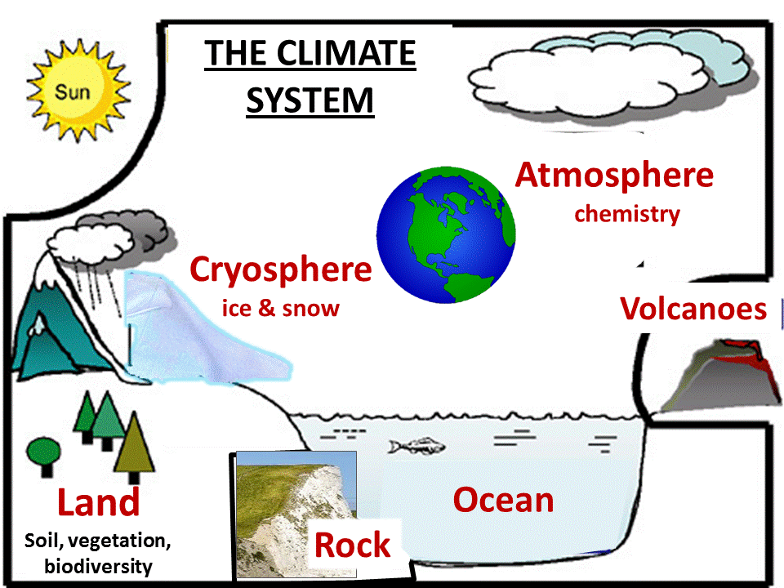
1. The Earth Climate System
The Sun, volcanoes, and human activities are considered external to the Climate System.
The Earth System is not the same as the Earth Climate System.

Slide 4
The Earth Climate System
Major Components:
- The Atmosphere (the troposphere, h<∼12km and the stratosphere, h= ∼12- 50km), time
scales ∼ hours to 10 days
- The Oceans: depth up to 4000-5000m. Time scales∼ seasons to 1000 yrs.
- Land: terrestrial biosphere, soils. Time scales: hours to decades
- The cryosphere: polar ice sheets, mountain glaciers, snowpack, sea-ice. Time scales
∼seasons to 1000 yrs.
The lithosphere is part the Earth System, but most of it is not considered part of the Earth Climate System. Volcanoes, human activities, and the Sun are considered external forcing to the Earth Climate System.
Major Interactions:
- Air – sea interaction (e.g., El Niño, air-sea energy and water fluxes)
- Land-atmosphere interaction (e.g., water and energy fluxes over land, ice-albedo feedback )
Major Cycles:
- The water cycle
- The energy cycle
- The carbon cycle and other biogeochemical cycles (e.g., Sulfur, Nitrogen cycles)
Natural and Anthropogenic Forcing:
- Changes in solar irradiance, volcanic eruptions, CO2 changes on geological times
- CO2 emissions from fossil-fuel burning, human-induced land cover changes, etc.

Slide 5
Weather vs. Climate
1. Weather refers to
- The state of the atmosphere (mainly the troposphere) at a given time.
- Short-term (hourly to weekly) variations in temperature, precipitation, circulation and other atmospheric fields.
2. Climate refers to
- The mean state near the surface and in the atmosphere averaged over several decadal or longer
(typically 30years)
- Often characterized by mean T, P, sunshine and other near-surface fields
- Global climate change can affect local mean climate including extreme weather, but individual events
(such as a cold spell or a heat wave) result mostly from random weather variations.
- Climate variability refers the variations of the climate system from monthly to decadal and longer time scales. Thus, a monthly or annual mean T represents a realization of the (mean) climate for that particular month or year, and the variations in this realization is climate variability.
3. Predictability of Weather and Climate:
- Weather becomes unpredictable after ∼2 weeks due to the chaotic nature of atmospheric circulation and sensitivity to errors in initial conditions.
- Monthly-seasonal mean states (e.g., associated with ENSO) may be predicted several months ahead
- Some decadal climate variations may be predicted many years ahead
- Greenhouse-gas forced climate changes can be predicted decades into the future given GHG emissions scenarios.
- Why is there the difference between weather and climate predictability?

Slide 6
2. Current Climate
Key Controls on Earth’s Mean Temperature
Surface Temp & Precip: Spatial and Seasonal Variations
Other Key Climate Fields: Cloud cover, water vapor & humidity
Climate Classification: Köppen–Geiger climate classification system

Slide 7
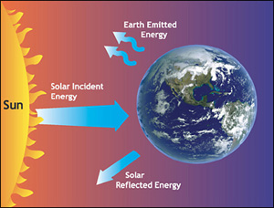
Controls on Global-mean Temperature
Absorbed solar radiation is balanced by out-going longwave
radiation:
Where
S = the solar constant = 1366 W/m²
α = Earth’s planetary albedo (≈0.3)
r = Earth’s radius (≈6.371 x10⁶m)
ε = Earth’s effective emissivity (≈0.612)
σ = the Stefan-Boltzmann constant—approximately 5.67×10⁻⁸ J·K⁻⁴·m⁻²·s⁻¹
These yield an effective average Earth temperature T = 288K (15ºC or 59ºF)
The global-mean T increases with S, but decreases with α, and ε.

Slide 8
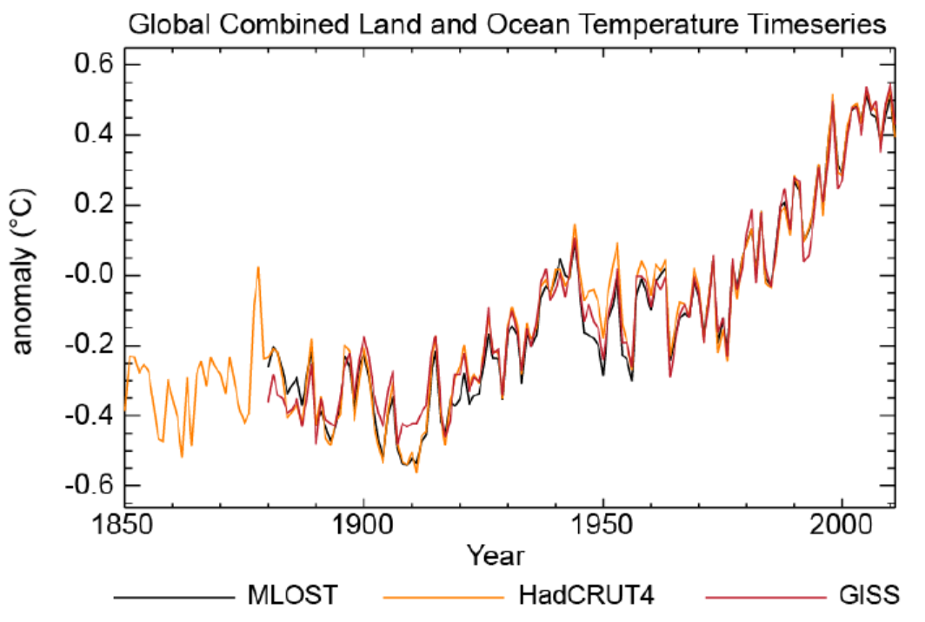
Global-mean Temperature is Rising
1961-1990 global-mean ≈ 15ºC or 59ºF
which makes it difficult to define a mean climate

Slide 9
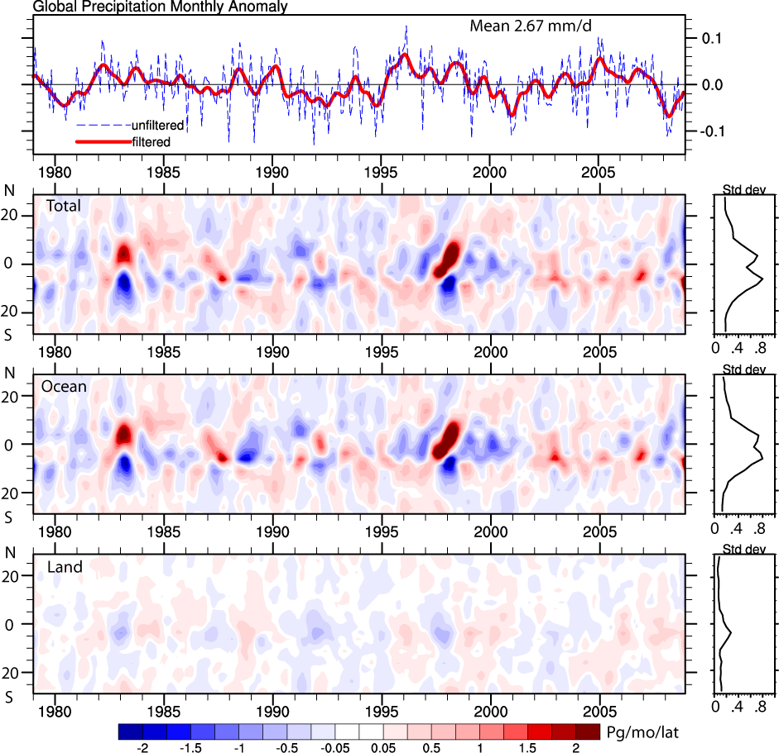
Global-mean Precipitation Anomaly from GPCP
1979-2008
(Trenberth 2010)
Precipitation Anomaly (mm/day)
0.1
3.7%
0.0
0.0
-0.1
-3.7%
No observations for precipitation over oceans before 1979
Global-mean P ≈ 975 mm/yr, P variations within ±4%
GPCP = Global Precipitation Climatology Project

Slide 10
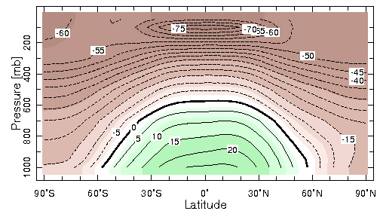
Annual-mean Atmospheric Temp (ºC)
Typical Equator-Pole dT =40ºC in the Troposphere
Baroclinic
u_{T}≠0
Barotropic
u_{T}=0
Baroclinic
u_{T}≠0

Slide 11
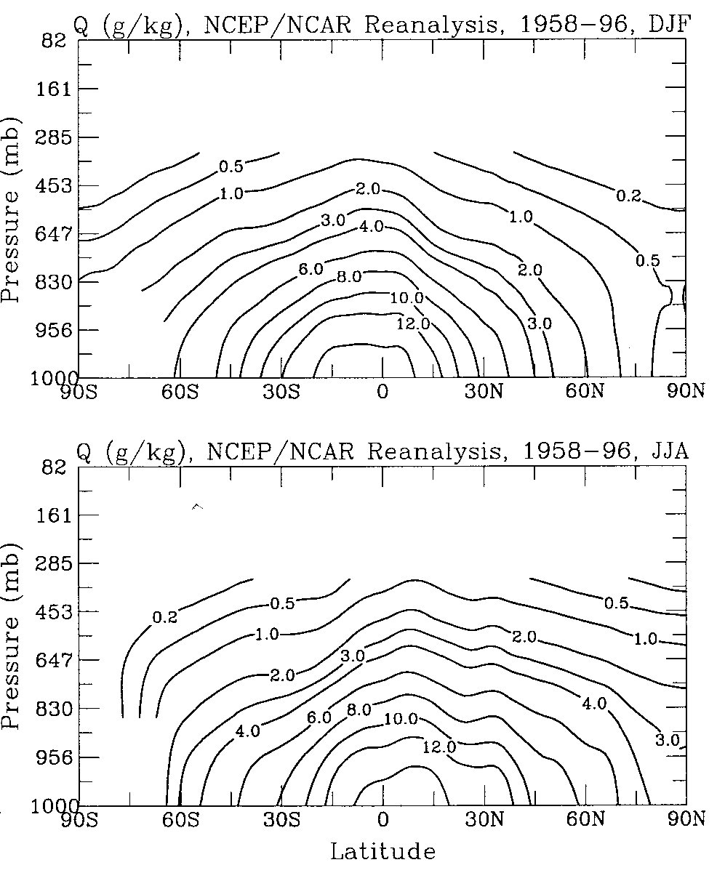
Atmospheric Specific Humidity Distribution
q decreases with height as T
and RH decreases with height
q decreases with latitude
q is conserved in air mass
without precipitation, so q is
the same during subsidence
in the subtropics .
Thus upper tropospheric
and stratrospheric q
is controlled by the q at
the last saturation.
Upper-level q is critical for
GHG effect.
Dai 2001, JClim

Slide 12
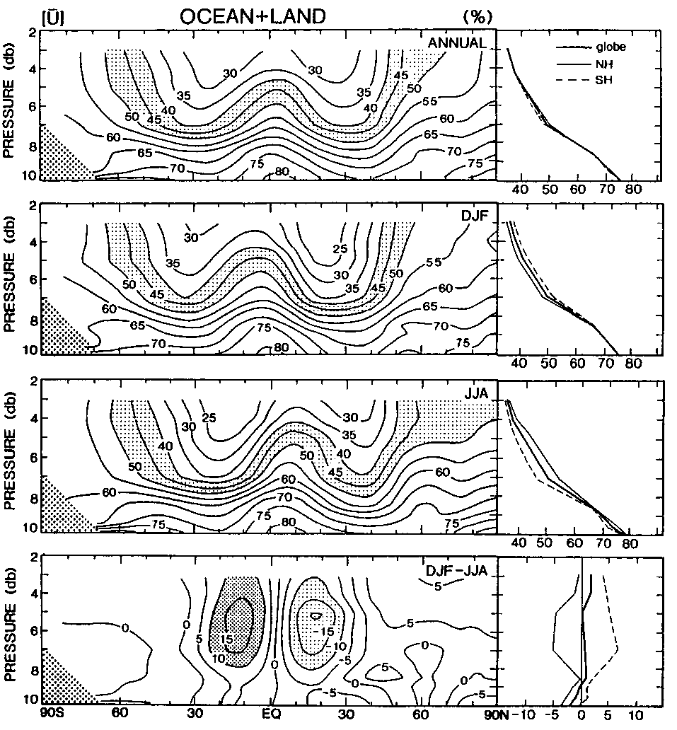
Atmospheric Relative Humidity Distribution
RH decreases with height
(why?) from ~76% at sfc
to 30-50% at 500mb.
RH is lower in the subtropics
but higher in the tropics
(why?)
RH is well-below saturation in
the upper troposphere
Tropical deep convection
transports surface moisture
to the upper levels
Upper-level q (and RH) is
critical for greenhouse effect
but the controls of this RH
are not well understood
Peixoto and Oort 1996

Slide 13
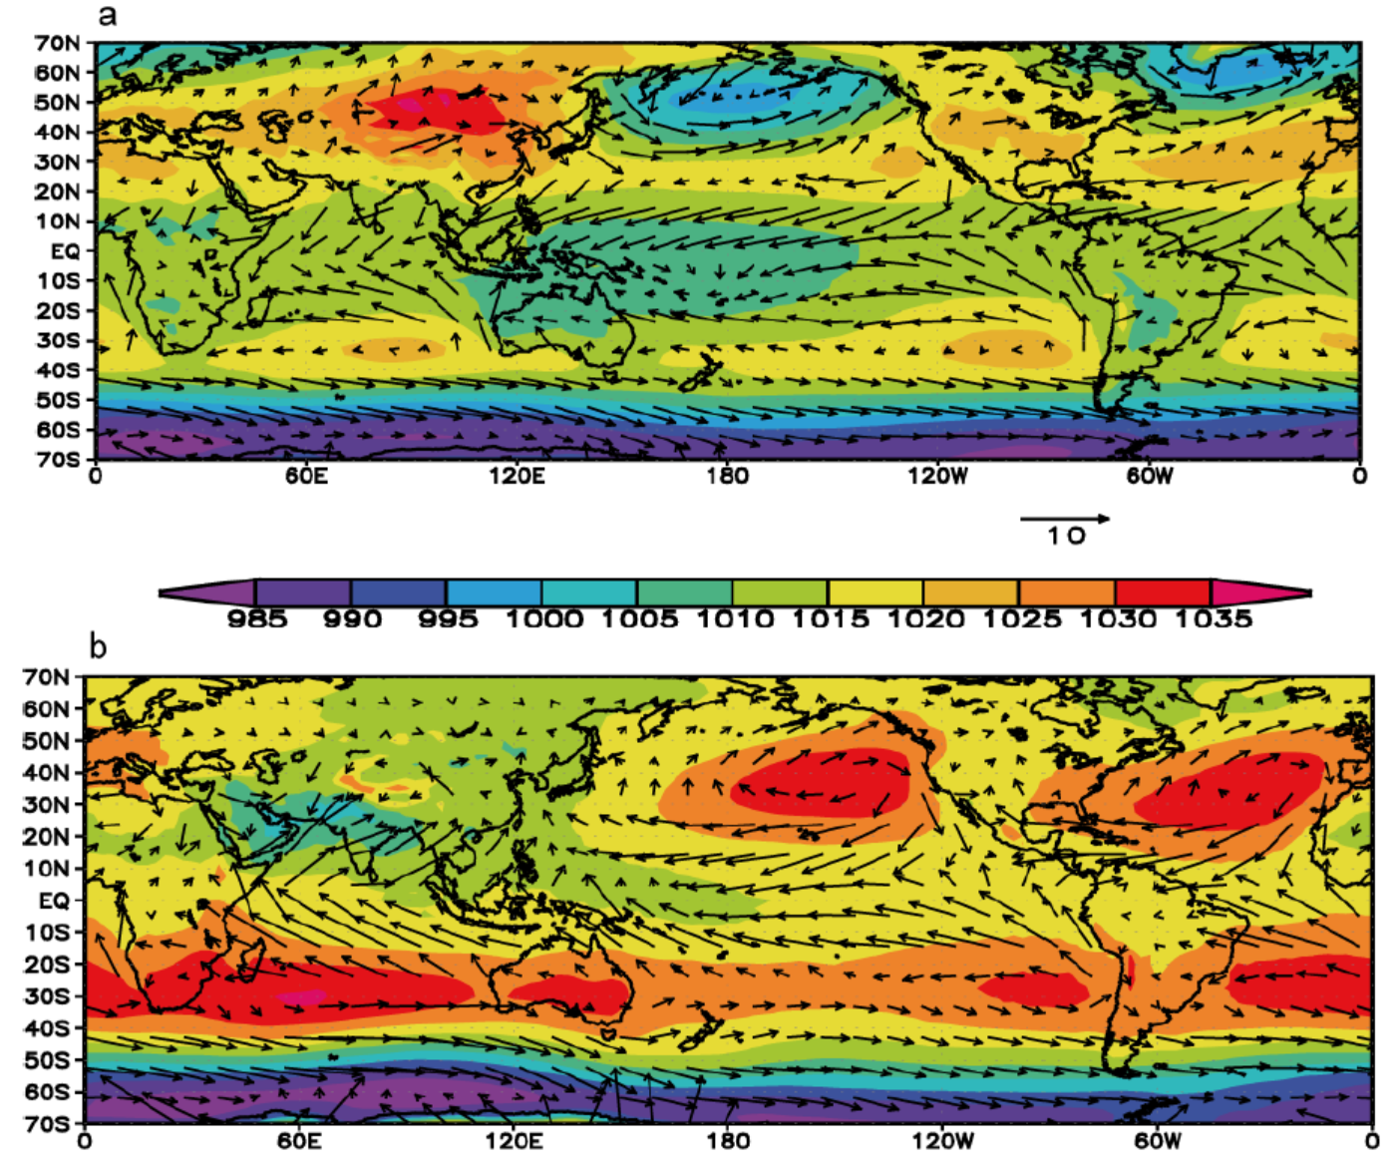
SLP and Surface Winds
DJF
H
L
L
m/s
JJA
hPa
L
H
H
H

Slide 14
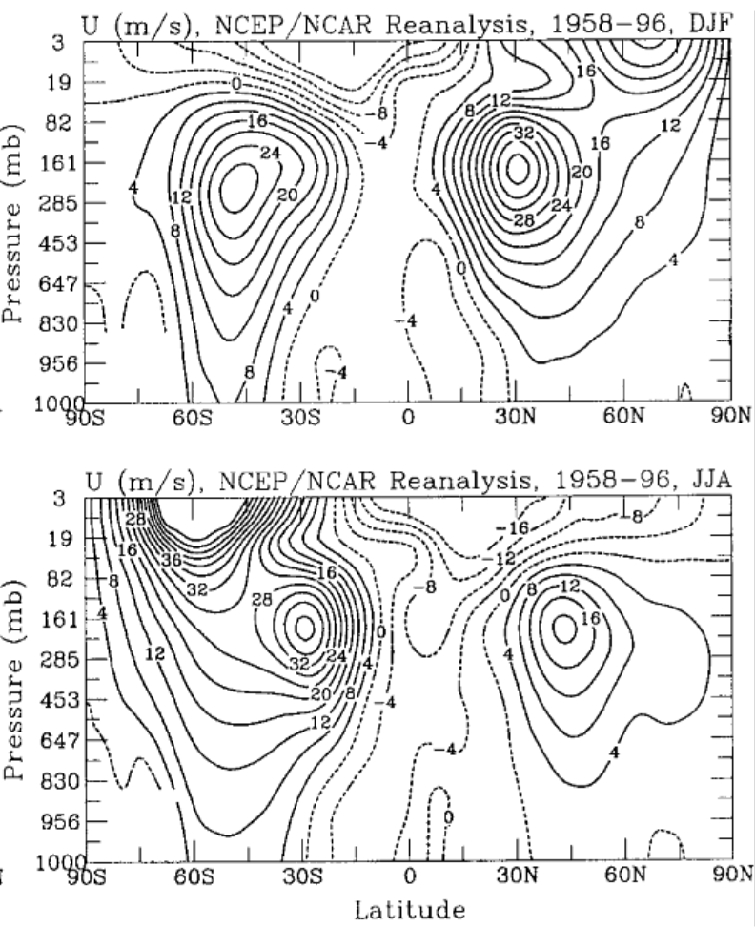
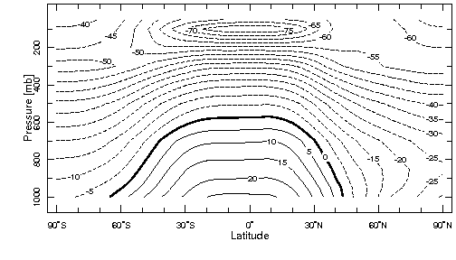
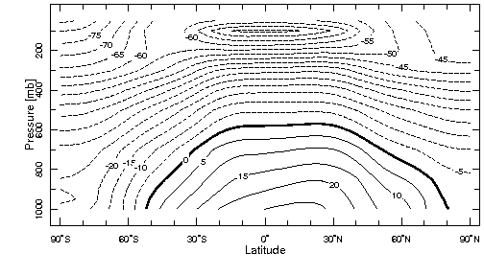
Seasonal Zonal Wind (m/s) and Temperature (ºC)
Zonal Wind (U)
Temperature
DJF
40 m/s or 90 miles/hr
JJA
Subtropical Jet is strongest in winter Hemisphere where T gradient is largest.

Slide 15
3. History of Earth’s Climate
History of Earth’s Temperature and CO2 Levels
Controls on Atmospheric CO2 levels on geological time scales
Ice Ages and the Milankovitch Theory
Earth’s Orbital Movements
The Last Glacial Maximum
The Holocene Climate

Slide 16
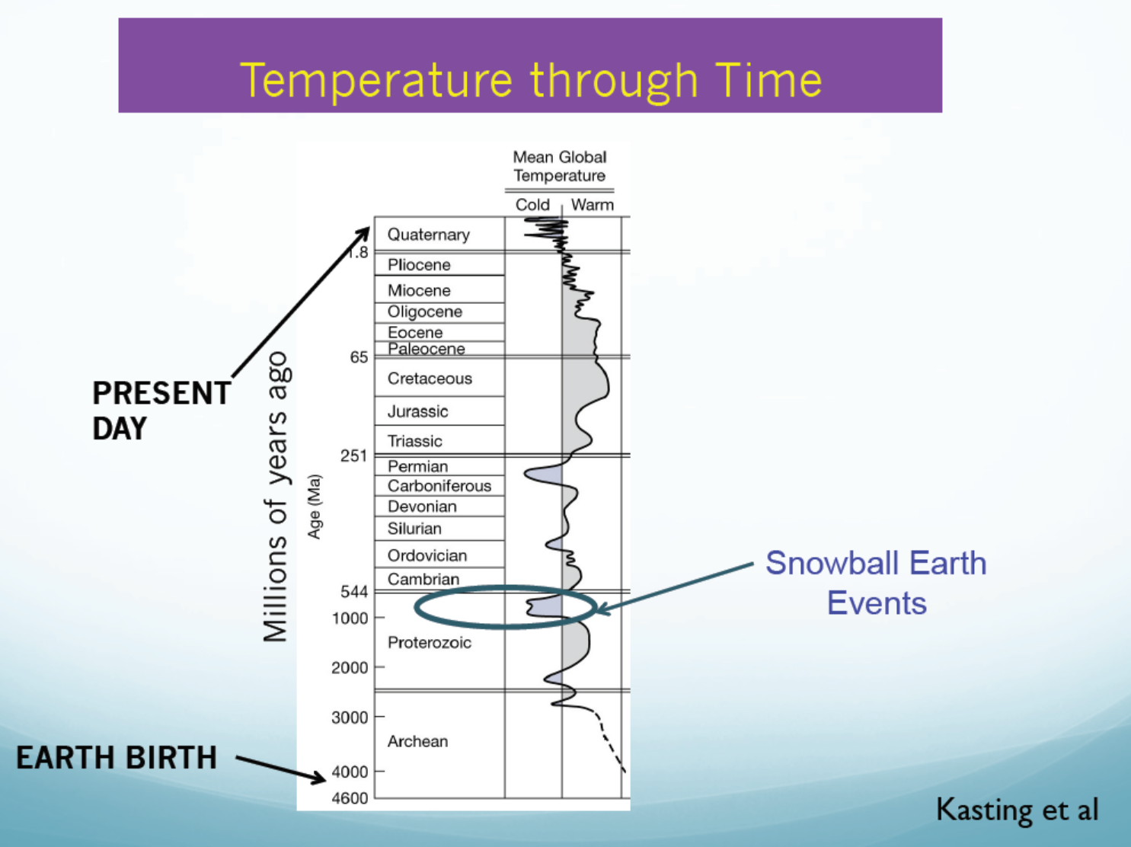
Earth’s T (and CO2) has fluctuated
greatly over its 4.6B yr history.

Slide 17
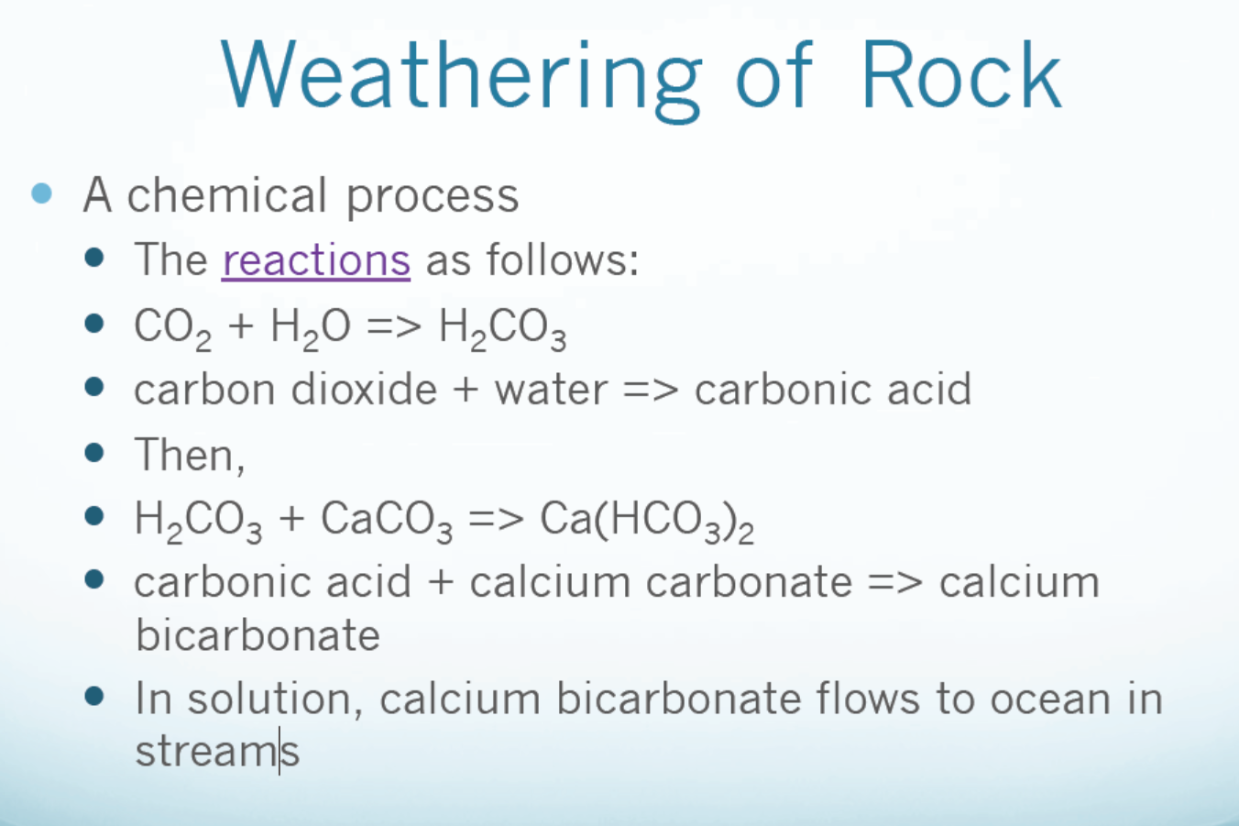
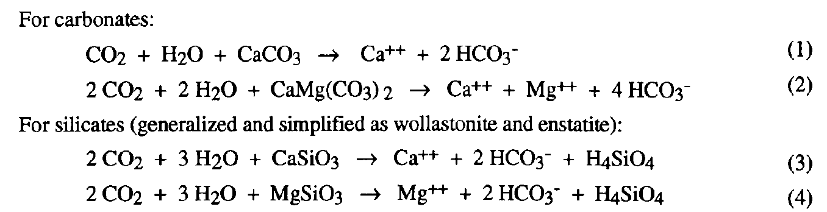
Reversed in ocean. No CO₂ removal
Berner (1995)
1 CO₂ removed in ocean

Slide 18
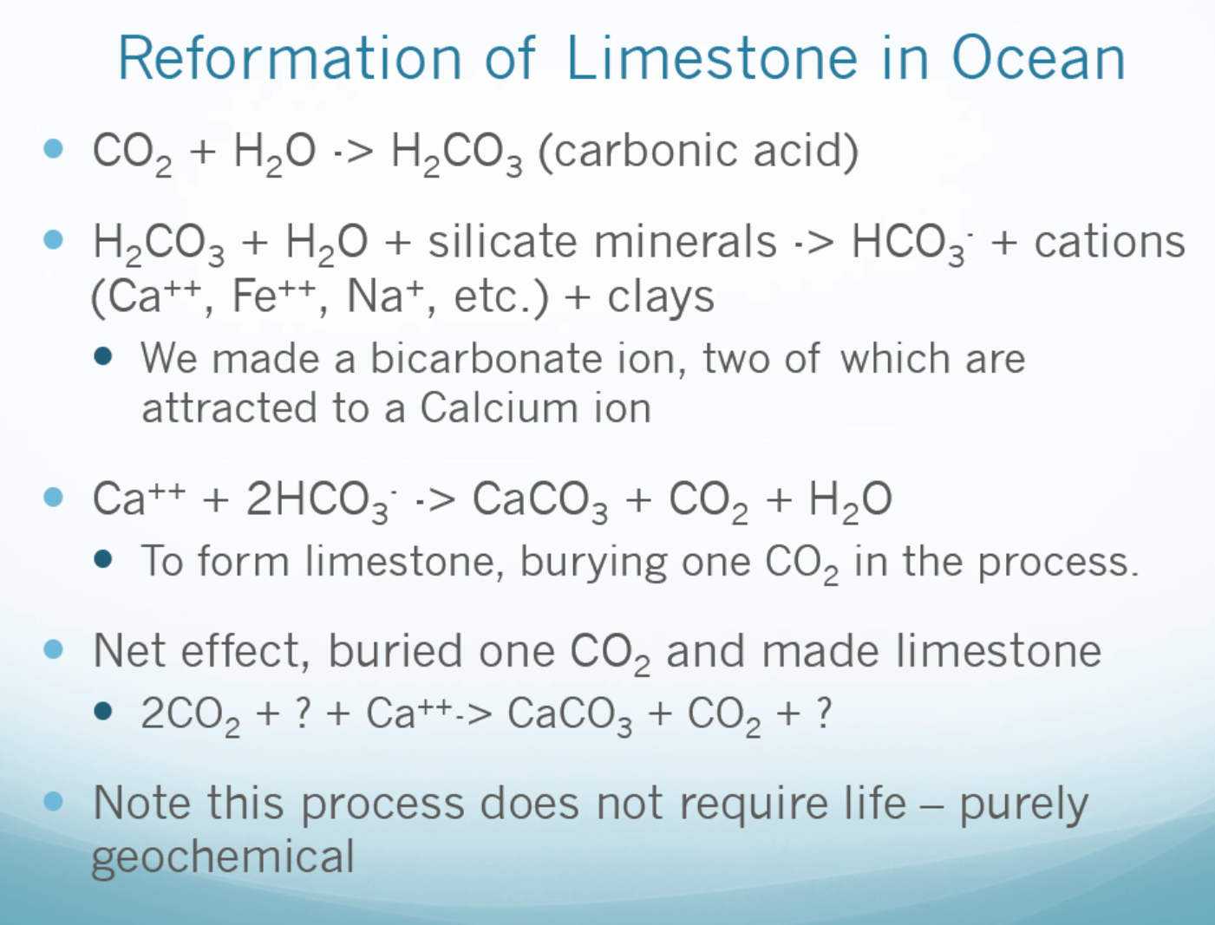
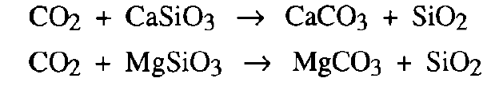
Removes 2CO₂ through silicate weathering on land
(from silicate weathering)
Net Effect from Silicate Weathering:
Land
Ocean

Slide 19
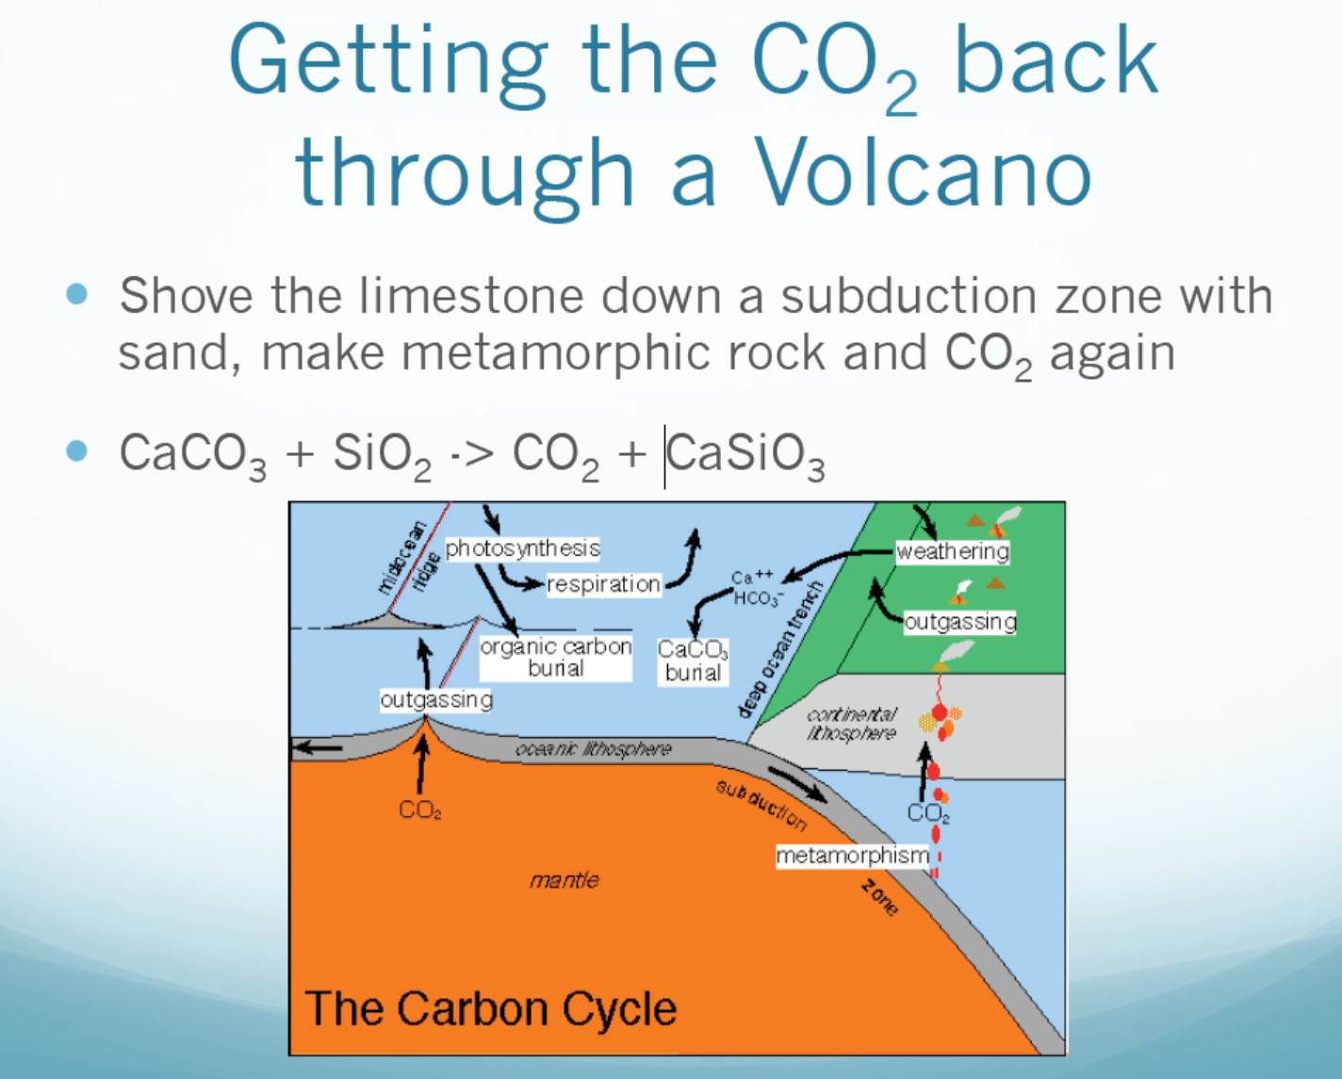

Slide 20
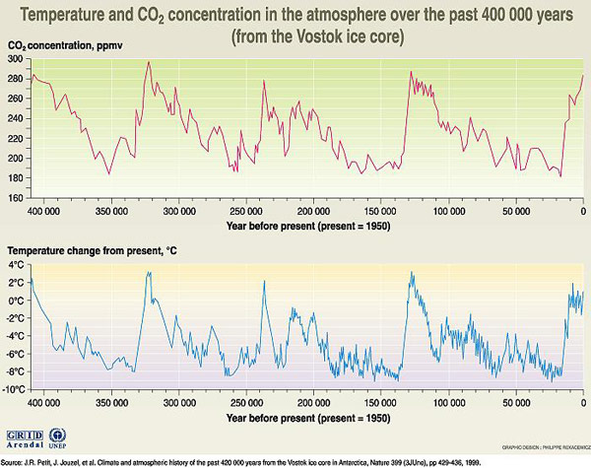
Preindustrial Level
T and CO₂ Levels are correlated, but it’s unclear which is the cause and effect.
Today’s Level
100kyr

Slide 21
Ice Age
An ice age is a period of long-term reduction in the temperature of the Earth's surface and atmosphere, resulting in the presence or expansion of continental ice sheets, polar ice sheets and alpine glaciers.
Within a long-term ice age, individual pulses of cold climate are termed "glacial periods" (or alternatively "glacials" or "glaciations" or colloquially as "ice age"), and intermittent warm periods are called "interglacials".
Cooling is gradual while warming is abrupt.
Glaical-interglaical cycles
ice age
100kyr

Slide 22
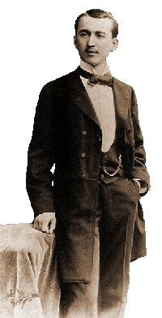
Milankovitch Theory
Milankovitch Theory describes the collective effects of changes in the Earth’s orbital movements upon its climate, named after Serbian geophysicist and astronomer Milutin Milanković, who worked on it during First World War internment. Milanković mathematically theorized that variations in eccentricity, axial tilt, and precession of the Earth's orbit determined climatic patterns on Earth through orbital forcing.
Milutin Milanković (1879-1958)
According to Milankovitch Theory, the precession of the equinoxes, variations in the tilt of the Earth's axis (obliquity) and changes in the eccentricity of the Earth's orbit are responsible for causing the observed 100 kyr cycle in ice ages by varying the amount of sunlight received by the Earth at different times and locations, particularly high northern latitude summer. These changes in the Earth's orbit are the predictable consequence of interactions between the Earth, its moon, and the other planets.
Notes:
Born in 1879 in the rural village of Dalj (then part of the Austro-Hungarian Empire, today located in Croatia), Milankovitch attended the Vienna Institute of Technology and graduated in 1904 with a doctorate in technical sciences. After a brief stint as the chief engineer for a construction company, he accepted a faculty position in applied mathematics at the University of Belgrade in 1909—a position he held for the remainder of his life. Milankovitch dedicated his career to developing a mathematical theory of climate based on the seasonal and latitudinal variations of solar radiation received by the Earth. Now known as the Milankovitch Theory, it states that as the Earth travels through space around the sun, cyclical variations in three elements of Earth-sun geometry combine to produce variations in the amount of solar energy that reaches Earth:
Variations in the Earth's orbital eccentricity—the shape of the orbit around the sun.
Changes in obliquity—changes in the angle that Earth's axis makes with the plane of Earth's orbit.
Precession—the change in the direction of the Earth's axis of rotation, i.e., the axis of rotation behaves like the spin axis of a top that is winding down; hence it traces a circle on the celestial sphere over a period of time.
Together, the periods of these orbital motions have become known as Milankovitch cycles.

Slide 23
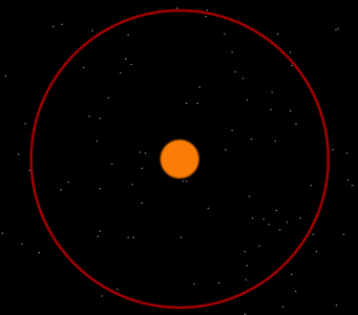
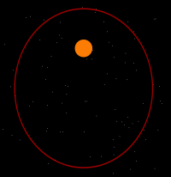
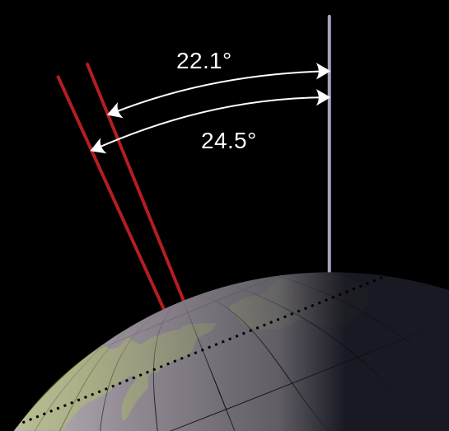
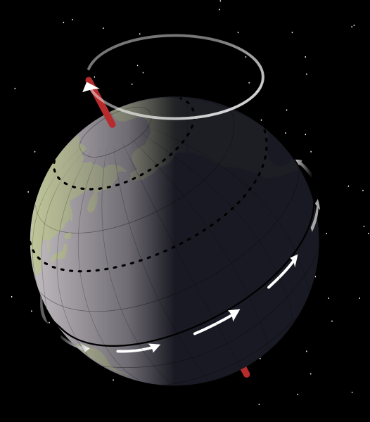
Earth’s Movements
Orbital shape (eccentricity): it varies from nearly
circular to mildly elliptical (e=0 ∼0.06, currently at 0.01) with
time due to gravitational influence from Jupiter and Saturn.
It shows a ∼100,000 yr cycle. This changes the length of
the seasons, with a 23% change in solar irradiance at
perihelion (closest point) and aphelion (farthest point).
Axial tilt (obliquity): the angle of the Earth's axial tilt (relative to the orbital plane) varies slowly between 22.1° and 24.5º with a ∼41,000 year cycle. When the obliquity decreases, the seasonal amplitude in insolation decreases, with summers in both hemispheres receiving less solar radiation, and winters more. Cooler summers are necessary for onset of ice age by melting less of previous winter’s snow on land. It can produce ∼10% changes in summer insolation at high latitudes.
Axial Precession refers to the trend in the direction of the Earth's axis of rotation relative to the fixed stars (note: precession does not change the obliquity), with a period of ∼26,000 years. This gyroscopic motion results from the tidal forces from the Sun and the Moon. The hemisphere that is in summer at perihelion receives much of the corresponding increase in solar radiation, but the same hemisphere has a colder winter. The combination of eccentricity and precession can produce ∼15% changes in high-lat summer insolation.
Together, the three factors can cause up to ∼30% changes in high-lat. summer insolation.
Ideal combination for glacial development:
a) circular orbits, which prevent close summer passes
b) small tilts (close to 21.1º) → less summer solar heating
c) N.H. summer is farthest from the Sun, which needs a
proper combination of the eccentricity and precession.
Axial Precession

Slide 24
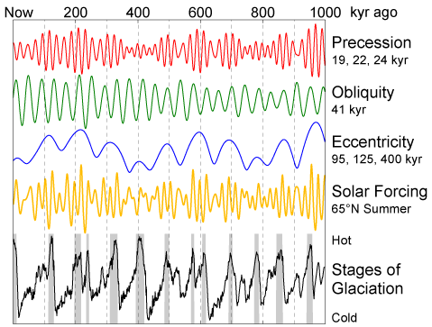
Orbital Forcing and Milankovitch Cycles
Time
_
Warming occurs when
Obliquity is large
Precession at positive phase
Peak eccentricity
Cooling occurs when
Obliquity is small
Precession is first
negative and then
positive.
-Declining e
+
Notes:
According to Milankovitch Theory, the precession of the equinoxes, variations in the tilt of the Earth's axis (obliquity) and changes in the eccentricity of the Earth's orbit are responsible for causing the observed 100 kyr cycle in ice ages by varying the amount of sunlight received by the Earth at different times and locations, particularly high northern latitude summer. These changes in the Earth's orbit are the predictable consequence of interactions between the Earth, its moon, and the other planets.

Slide 25
4. Global Energy Balance
Solar Radiation: solar zenith angle, insolation at TOA
Terrestrial Radiation: Earth’s emission temperature and effective emission altitude, emissivity, atmospheric absorption
Greenhouse Effect: Natural vs. Anthropogenic, magnitudes
Global Energy Fluxes: at TOA, surface and for the Atmosphere
Poleward Energy Transport: by the atmosphere and oceans
Atmospheric Energy Balance: latent heating, radiative transfer

Slide 26
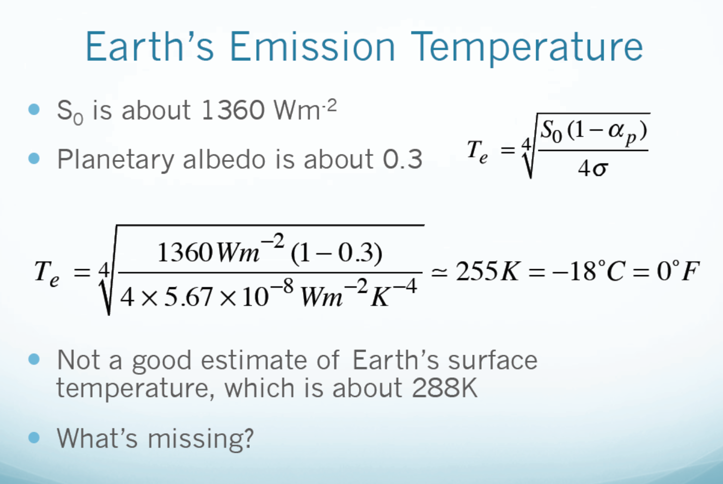
(T needed to balance net incoming solar radiation as a blackbody)
Effective Emission Height ≈ 5km

Slide 27
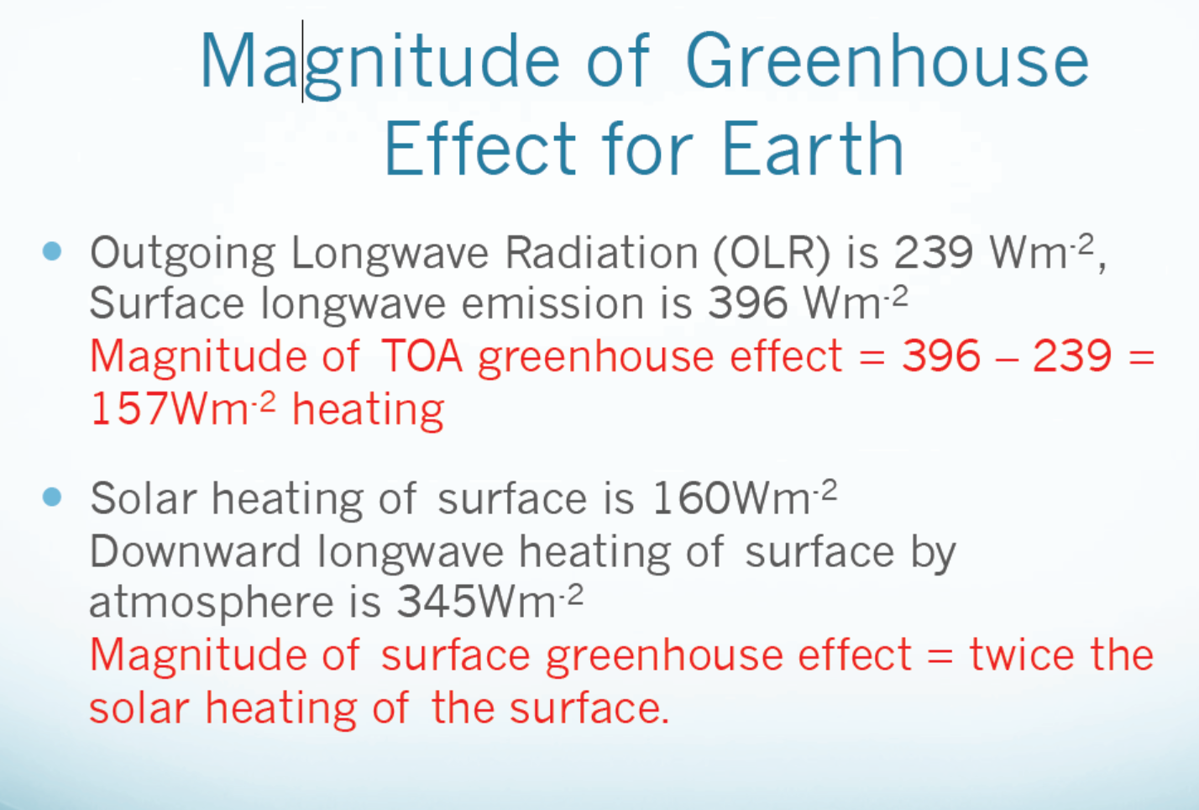

Slide 28
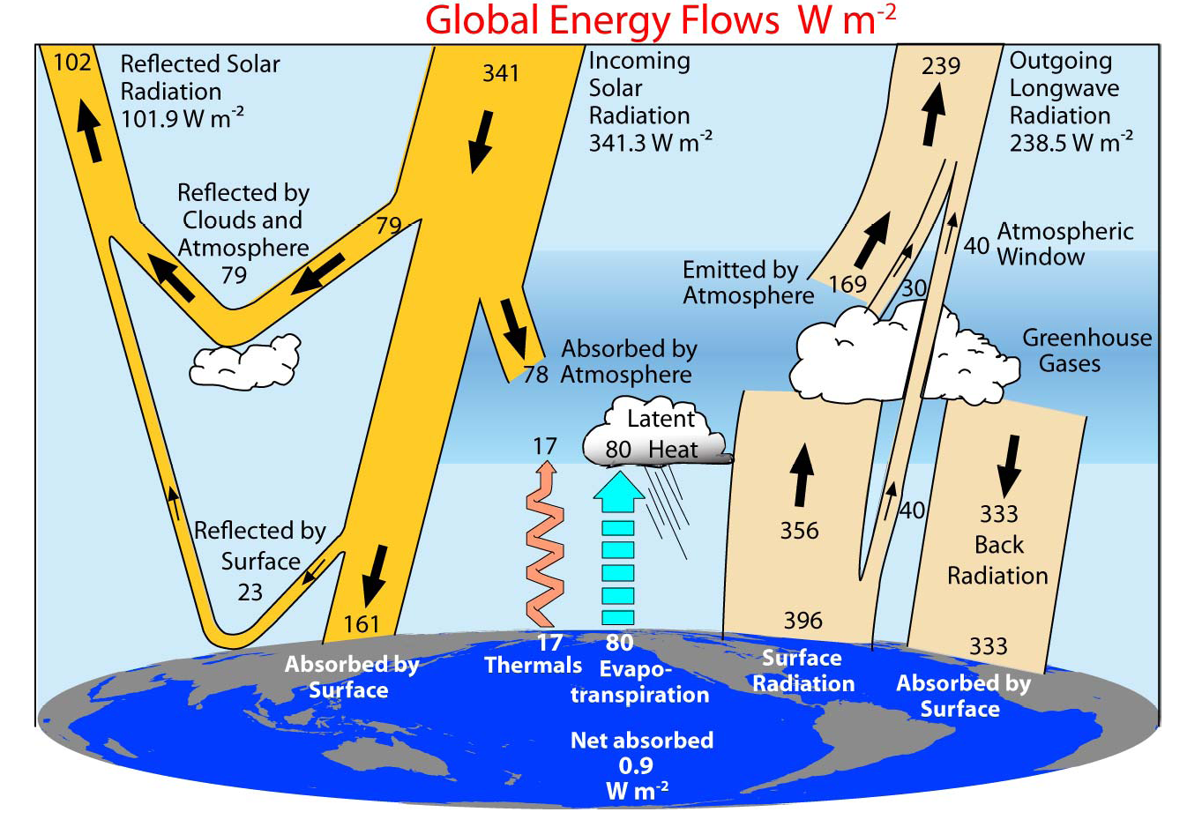
So=?
Trenberth et al. (2009, BAMS)
Notes:
Data used: TOA fluxes: satellite obs. Other fluxes: atmospheric reanalyses. LH: adjusted GPCP

Slide 29
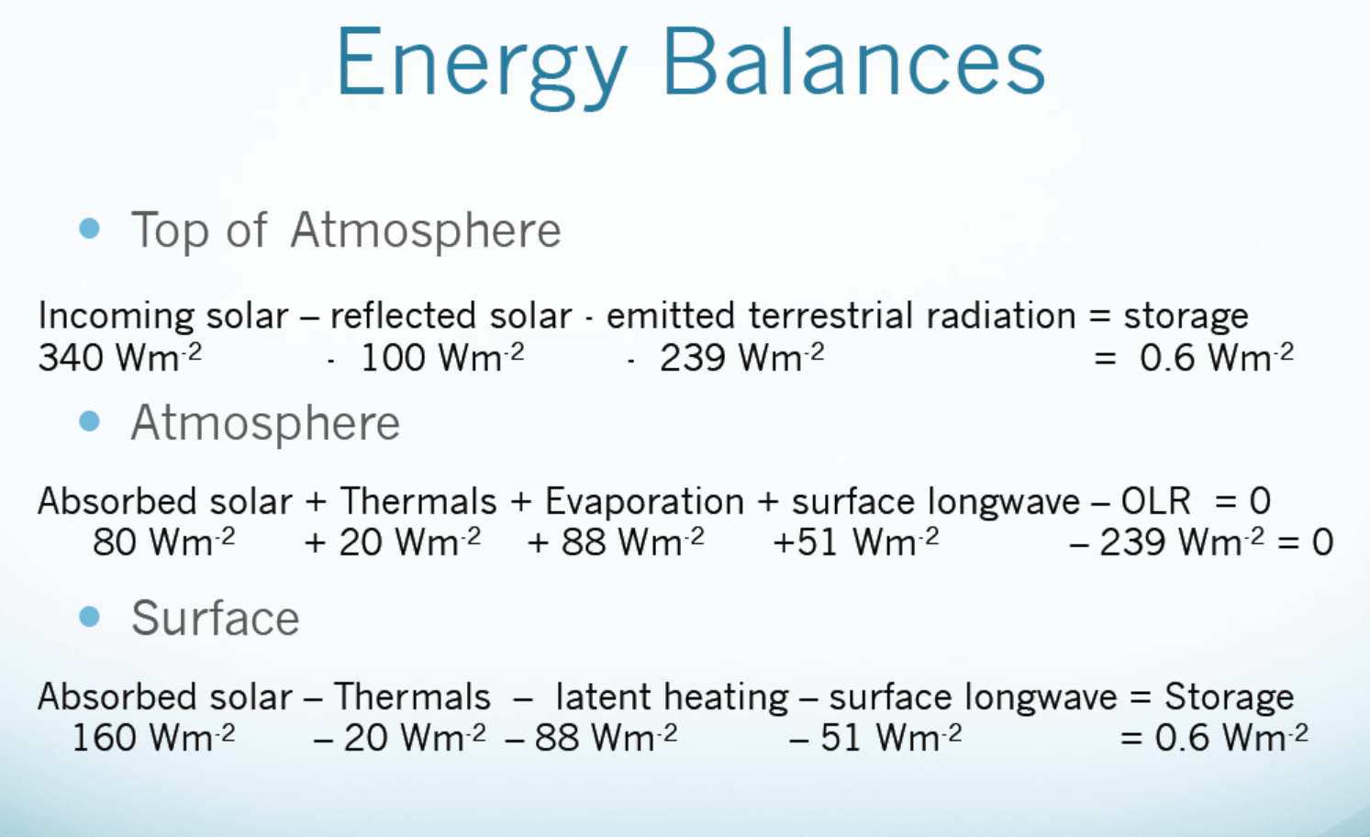
Changes in atmospheric energy storage is small (≈0) →
The TOA imbalance = Surface imbalance!
Atmospheric and surface balances are coupled!

Slide 30
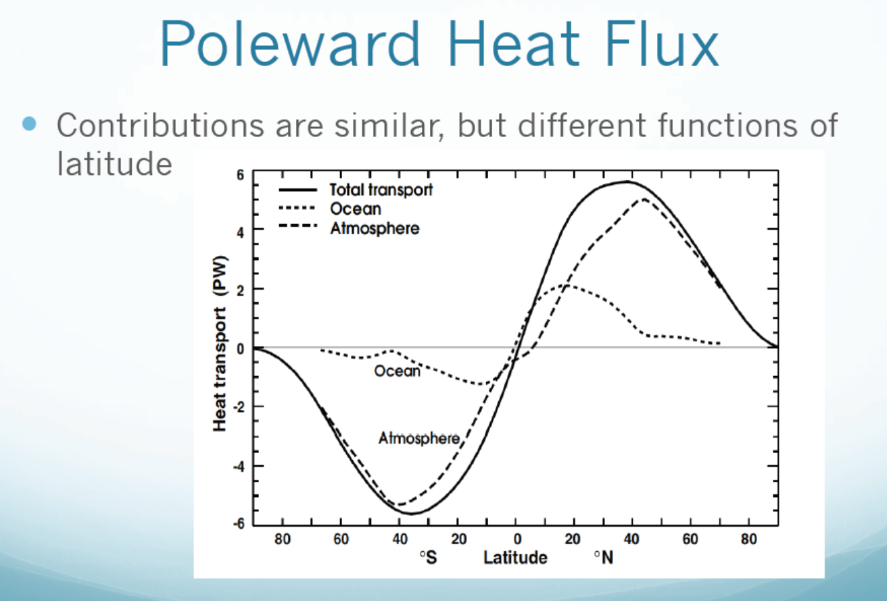
positive=northward
negative=southward
Atmospheric transport dominates
Peaks at 30-40ºN and S
PW (petawatt) = 10¹⁵ W Fasullo and Trenberth (2008)
Notes:
MW (megawatt) = 10⁶ W; GW (Gigawatt)= 10⁹W; PW (petawatt) = 10¹⁵ W

Slide 31
5. Surface Energy Balance
Surface Energy Fluxes
Heat Capacity: for the Atmosphere, Oceans, and Land
Heat transport in soils
Surface solar radiation
Surface LW radiation
Surface SH and LH fluxes: Bowen Ratio
Spatial distributions of the surface energy fluxes

Slide 32
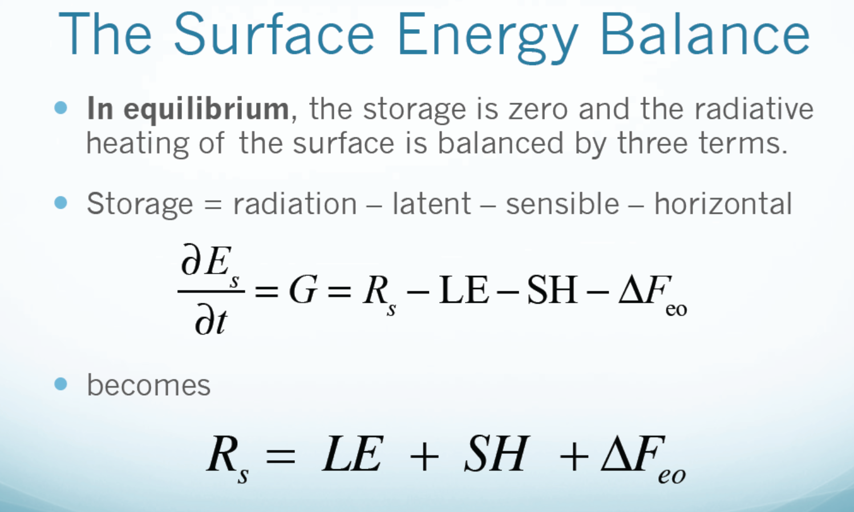
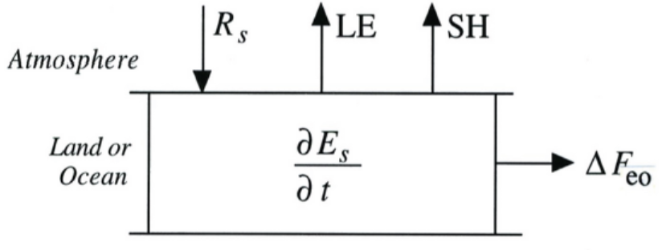
change
change

Slide 33
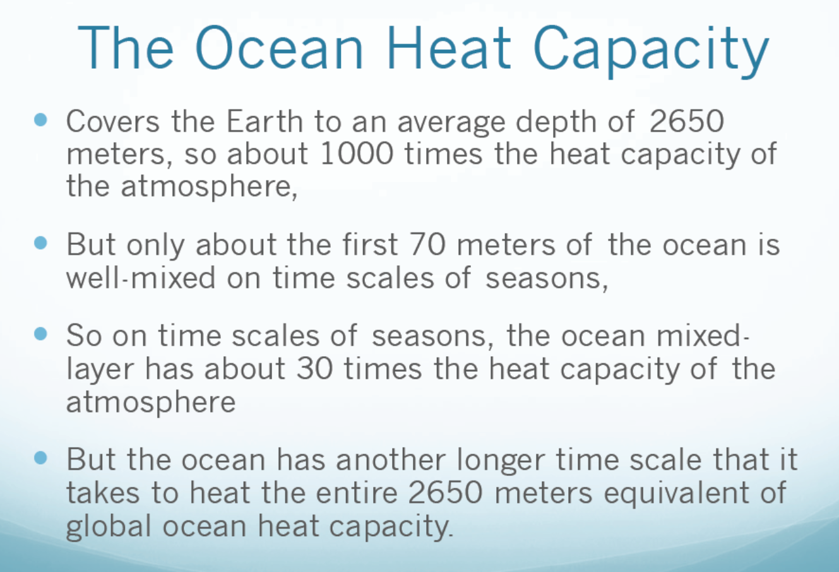

Slide 34
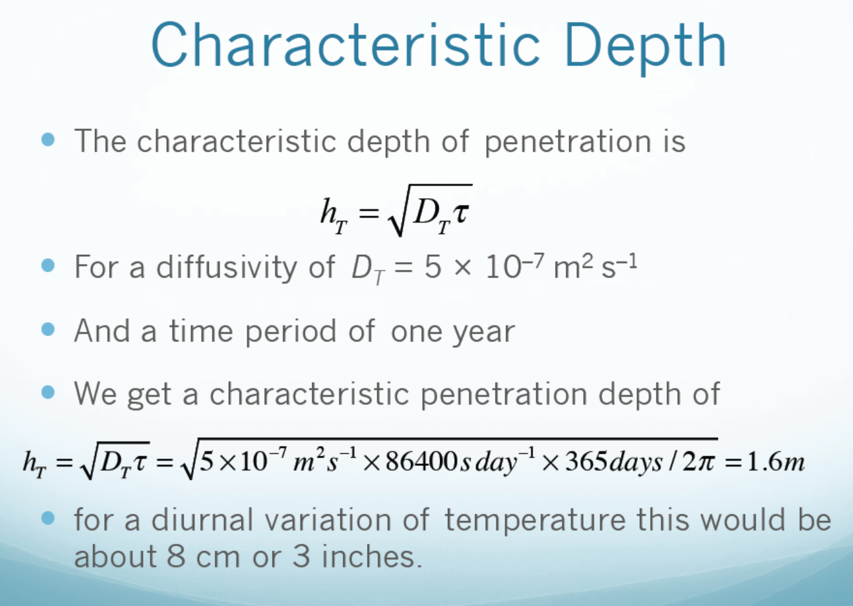

Slide 35
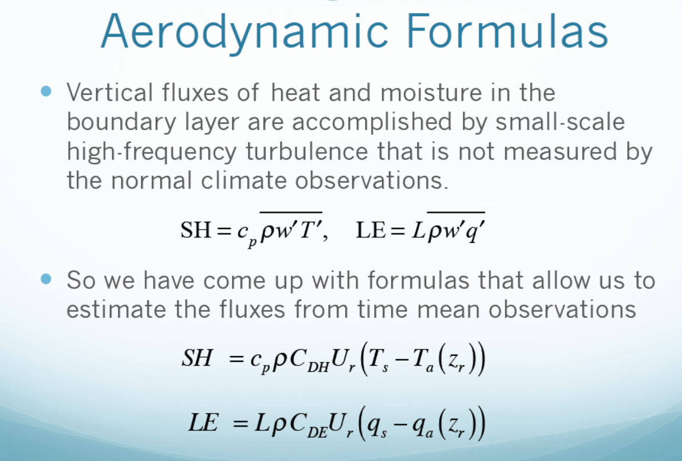
Reference height is often 10m for U (wind speed) and 2m for T_{a} and qa. These bulk formulas are used in climate and weather models. q=specific humidity

Slide 36
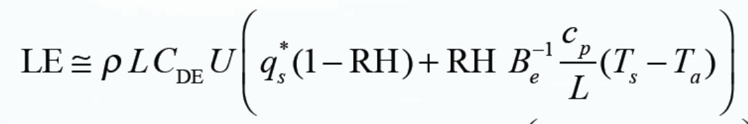
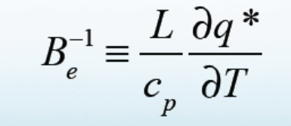
The Bowen Ratio
The Bowen Ratio is the ratio of surface sensible heat flux to the latent heat flux:
Since
Thus
where
q*_{s} is the saturation specific humidity.
Be is the Equilibrium Bowen Ratio (for wet surface with RH=100%)

Slide 37
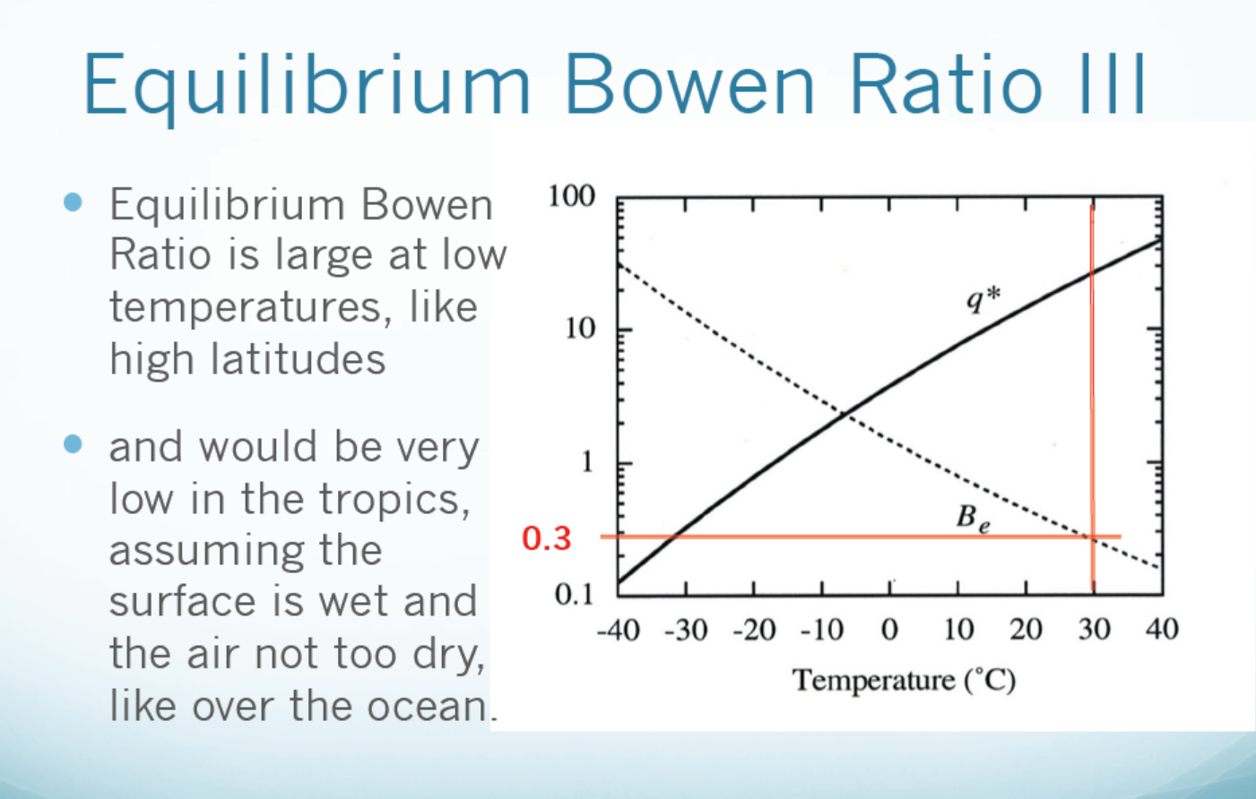
Over Wet Surface Only (g/kg for q*)
SH dominates
LH dominates

Slide 38
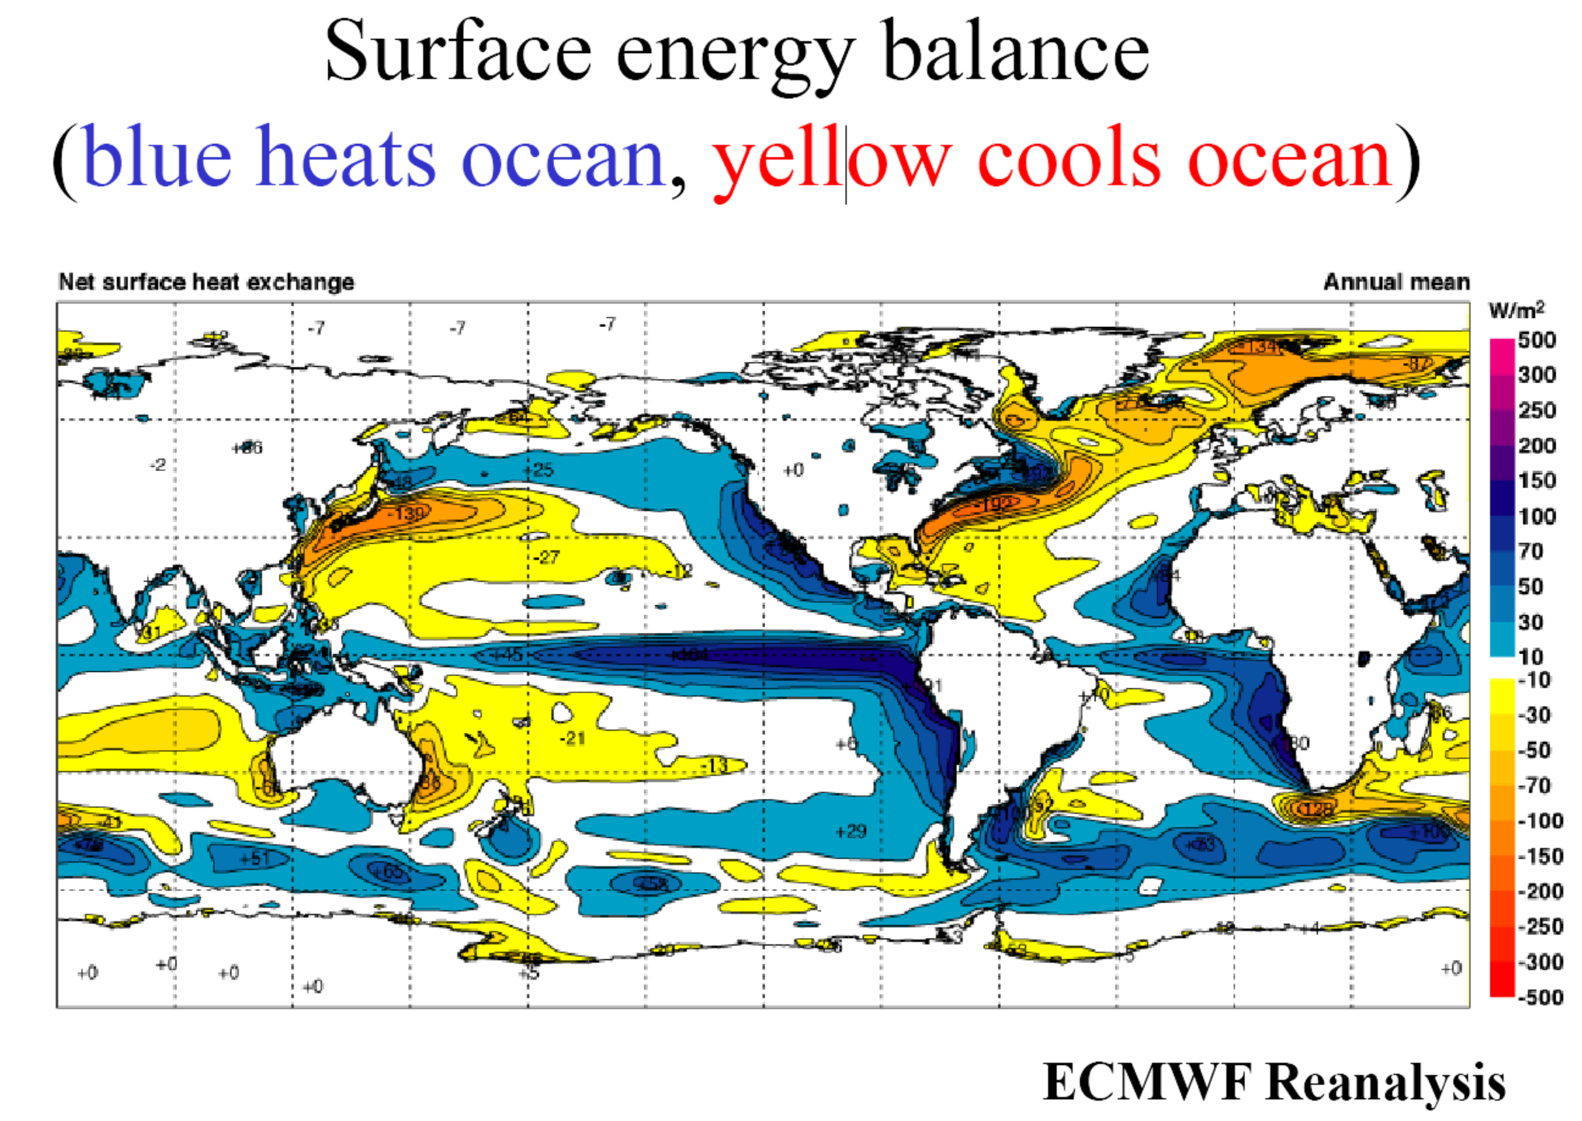

Slide 39
6. The Global Hydrologic Cycle
Definition:
It refers to the movement of water on, above or below the surface of the Earth. Also known as the hydrological cycle. It helps re-distribute water and energy on Earth, greatly affects surface temperature, forms clouds and precipitation, thus playing a critical role for the weather, climate and biosphere on Earth.
Main Reservoirs:
- Oceans (96%, t∼10³yrs), freshwater on land (2.5%, t=weeks to years ), the atmosphere (<0.01%, t =10days ), the biosphere (<0.01%, t=1week)
- Freshwater: 68.6% in glaciers and ice caps, 30% in groundwater, 2.5%in surface water (ice and snow, lakes, soil moisture, etc.)
Main Fluxes:
- Surface to the atmosphere: evaporation (Ocean: 1176mm/yr; land: 480mm/yr)
- The atmosphere to the surface: precipitation (Ocean: 1066mm/yr; land: 748mm/yr)
- Atmospheric transport: Ocean to land (40,000km³/yr)
- Land to ocean runoff: 40,000km³/yr or ∼35% of land precipitation (runoff ratio=0.35).
Main Physical Processes:
- Evaporation (absorbs heat, cools the surface)
- Condensation/precipitation (releases heat, heats the air)
- Infiltration : flow of water from the surface into the ground (soils).
- Runoff : lateral movements of water on land
Linked to the global energy cycle: evaporation brings about 80W/m² of latent heat into the atmosphere. Water vapor and clouds affect atmospheric energy budgets.

Slide 40
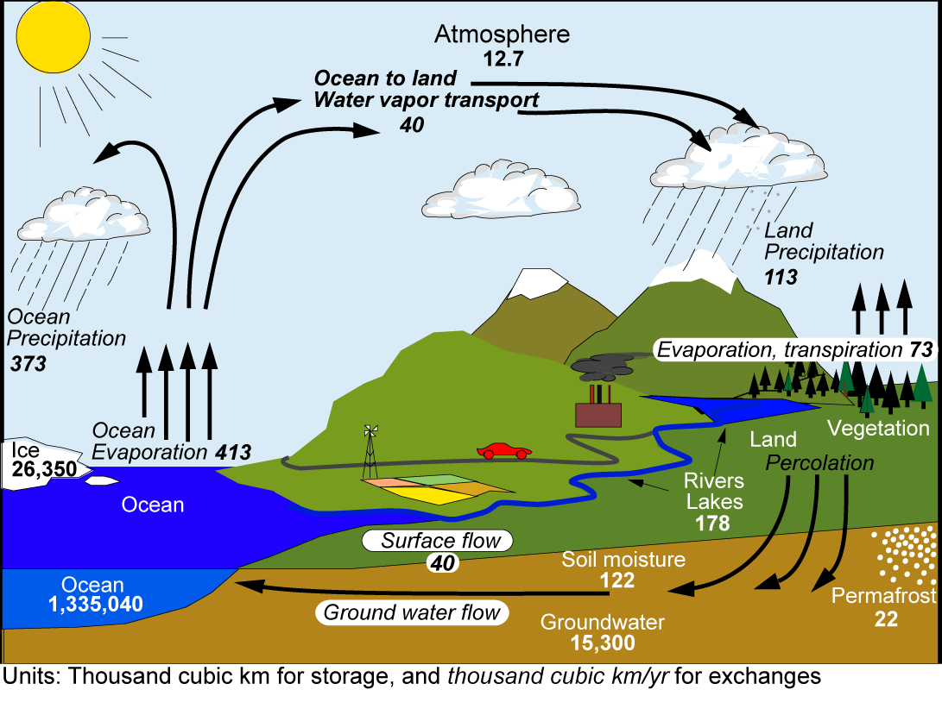
The Global Hydrologic Cycle
T=9days
35% land P comes oceanic E.
This amount runs off into ocean.
Runoff ratio=0.35
P balances 90% oceanic E.
10% of the E transported to
land and returned by
continental runoff
T ≈ 3200yrs
(From Trenberth et al., J. Hydrometeorol., 2007)

Slide 41
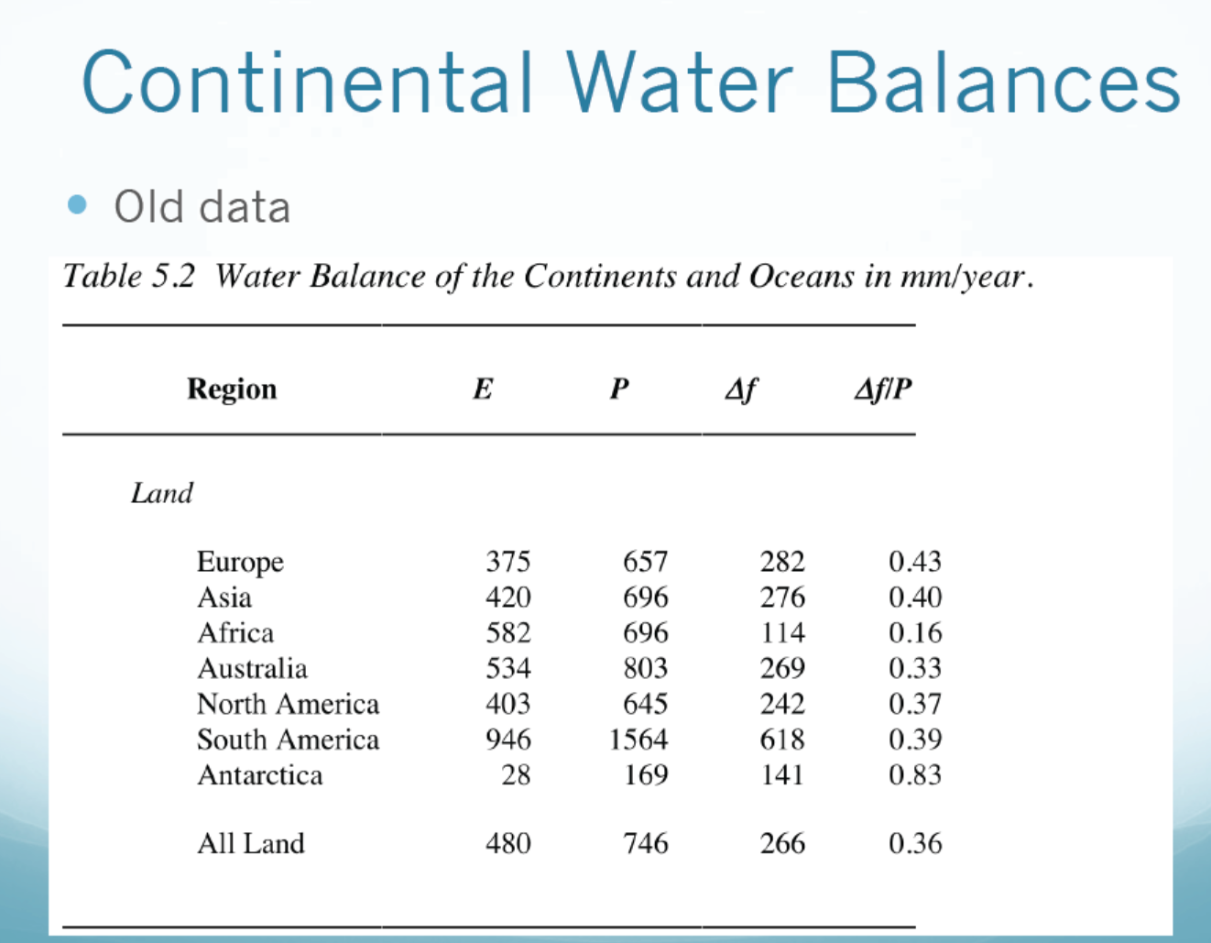
P-E
(runoff ratio)

Slide 42
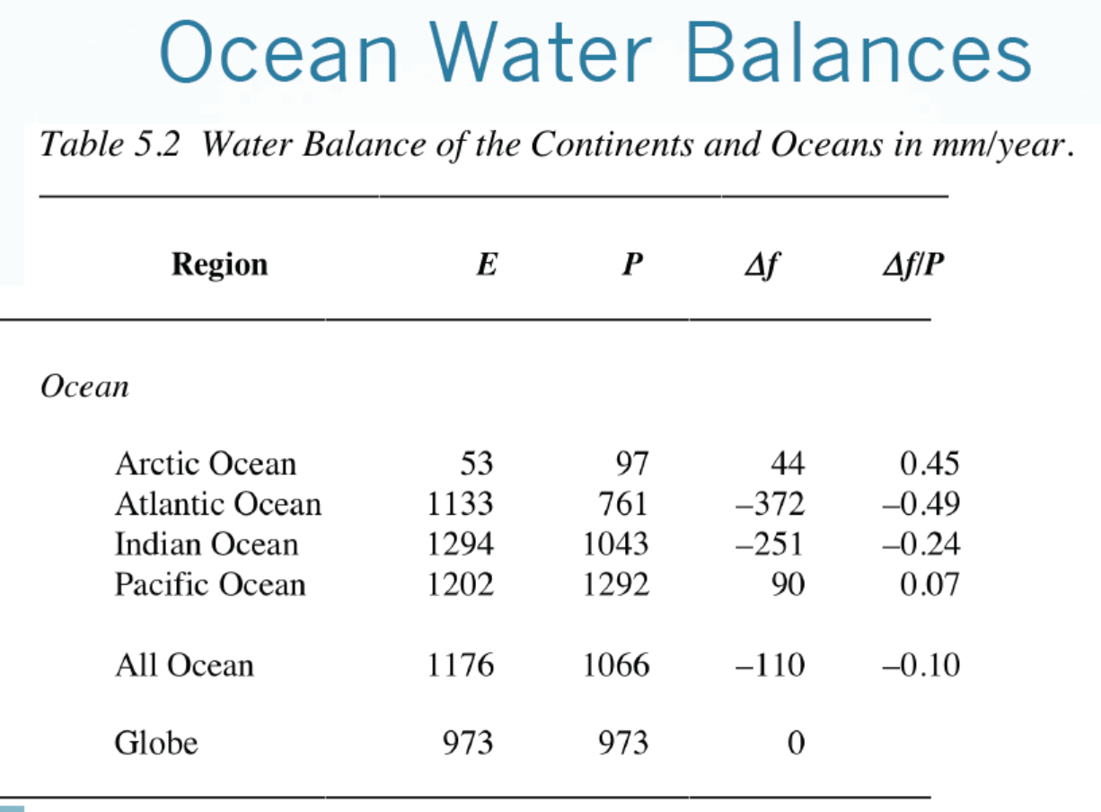
P-E

Slide 43
Atmospheric Water Balance
This applies to local, regional and global scales
Global-mean Div=0 and dW/dt≈0, so P=E globally. Also, R=-Div for steady states.
Globally, how much water goes up into the air has to come down to the surface on an annual basis.
W
Water Storage
dW/dt = E- P - Div
Div
Div
P
E

Slide 44
Controls of E
Vegetation plays a key role by drawing water from deep soils.
Energy availability: E is large in daytime and warm seasons
Soil water availability: Dry soils reduce E
Wind speed: Strong winds increase mixing, leading to higher E
Air Temperature: higher T is associated with higher Rn and larger stomal openings in leaves, leading to higher E.
Relative humidity: E decreases as RH increases.

Slide 45
Theoretical Estimates of E
Monin-Obukhov Similarity Theory (MOST): Assumes a constant flux within a layer (of ~100m) above a homogeneous surface. It relates the flux to T and q vertical gradients through its universal stability function. The MOST has an error of 10-20% under ideal conditions.
The Penman-Monteith Equation: uses surface radiation, temperature, and humidity data to estimate E (see pp.125-126 of GPC for its derivation):
where λ=latent heat of vaporization, Δ=de_{s}/dT, R_{n} is net surface radiation, G is the heat flux into the ground, r_{c} and r_{h} are the canopy and aerodynamic resistance (see Wang and Dickinson 2012 for details)
The P-M Eq. is often used to estimate the E from wet surfaces (referred to as the Potential E, as the resistance from a water-stressed surface is hard to estimate. Cp = specific heat
Net heating
Dryness of air

Slide 46
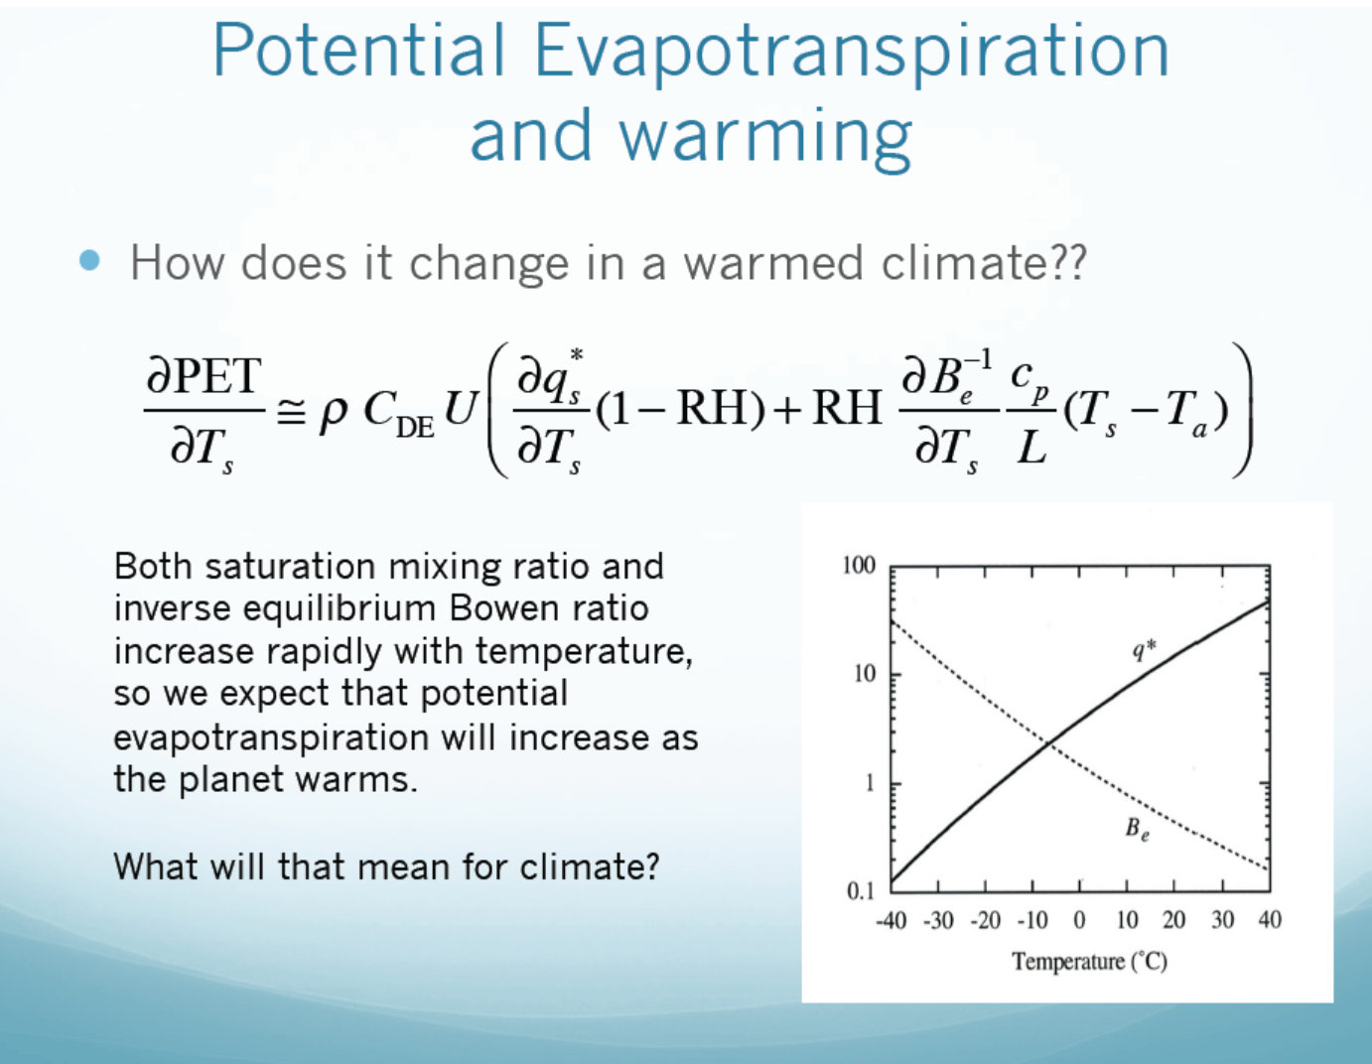
(for U and RH = constant case)
Increased atmospheric demand for
moisture → potential drying and drought

Slide 47
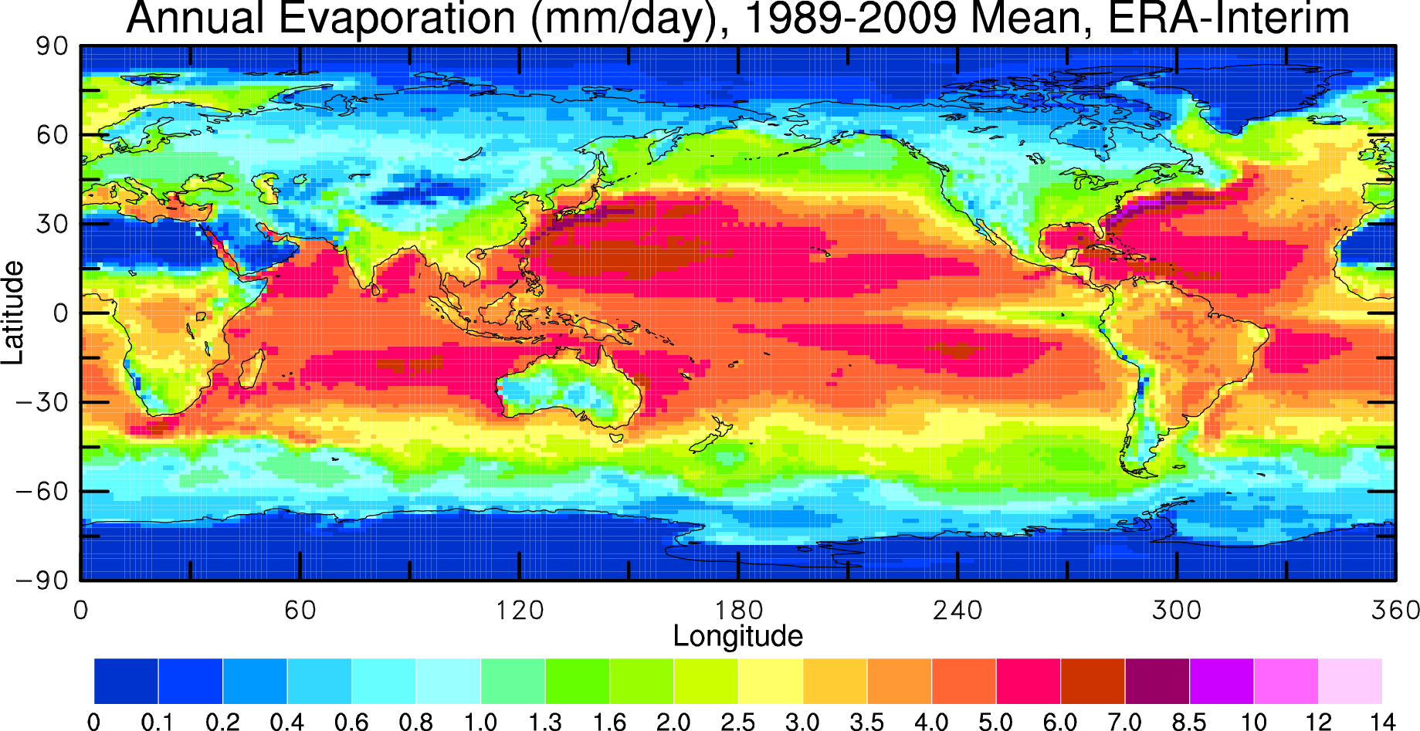
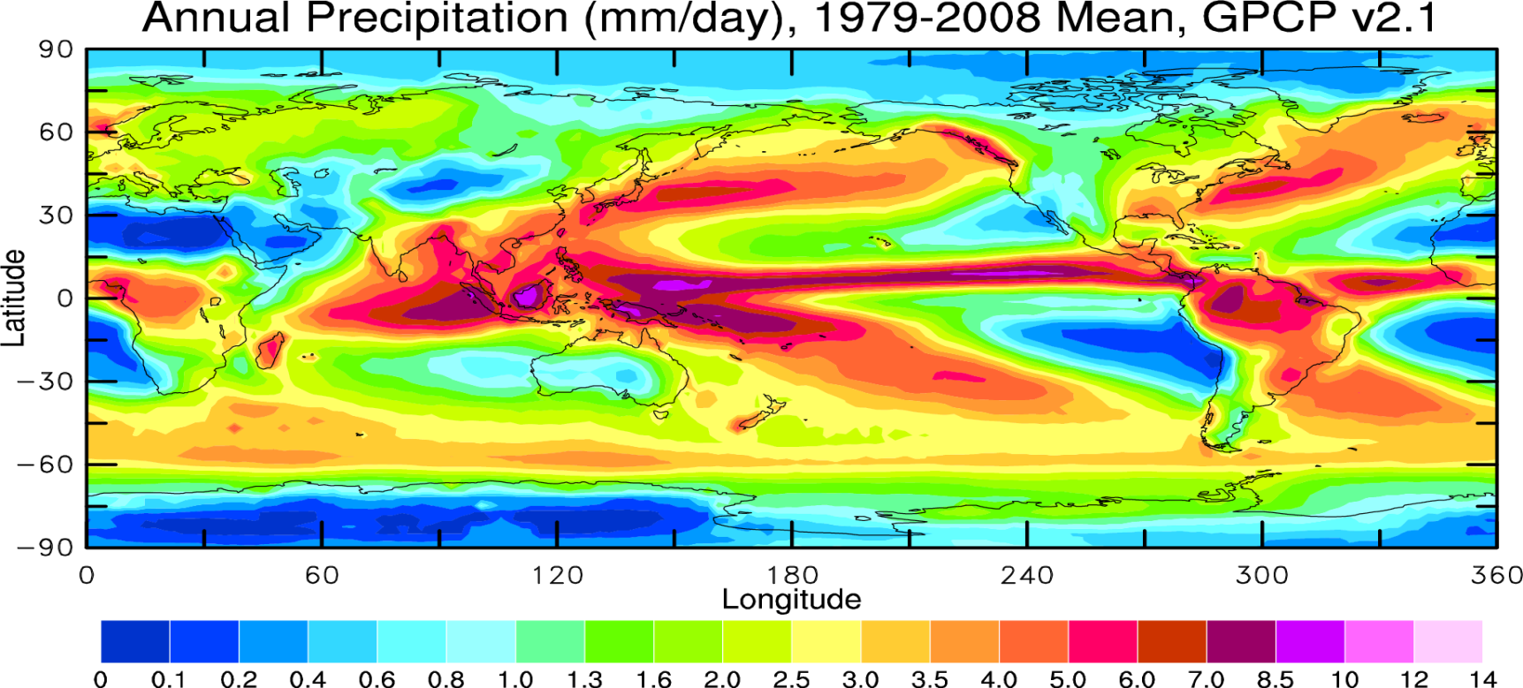
Evaporation (E) vs. Precipitation (P)

Slide 48
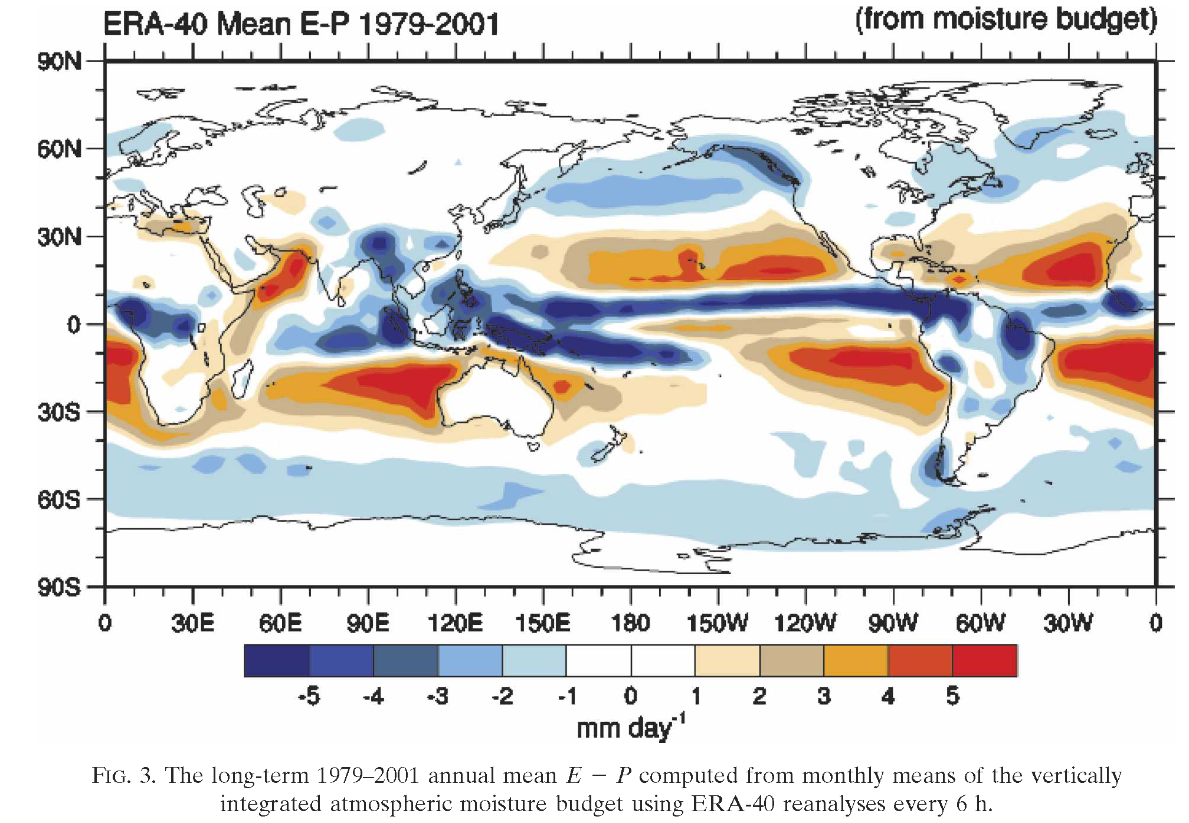
Long-term Mean E – P Difference Map
Trenberth et al. (2007, JHM)

Slide 49
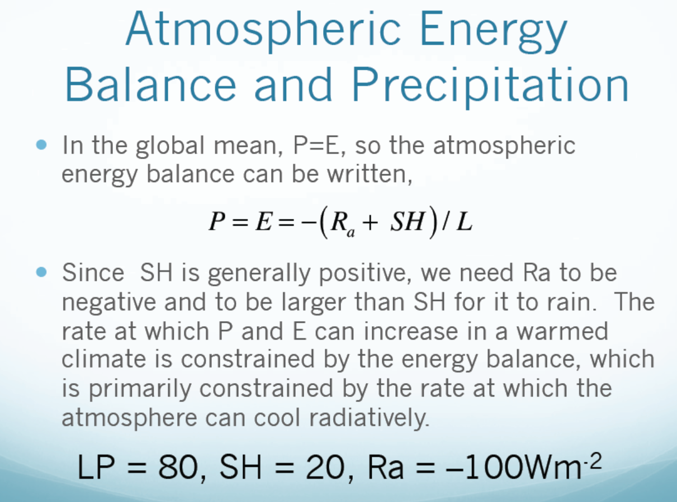

Slide 50
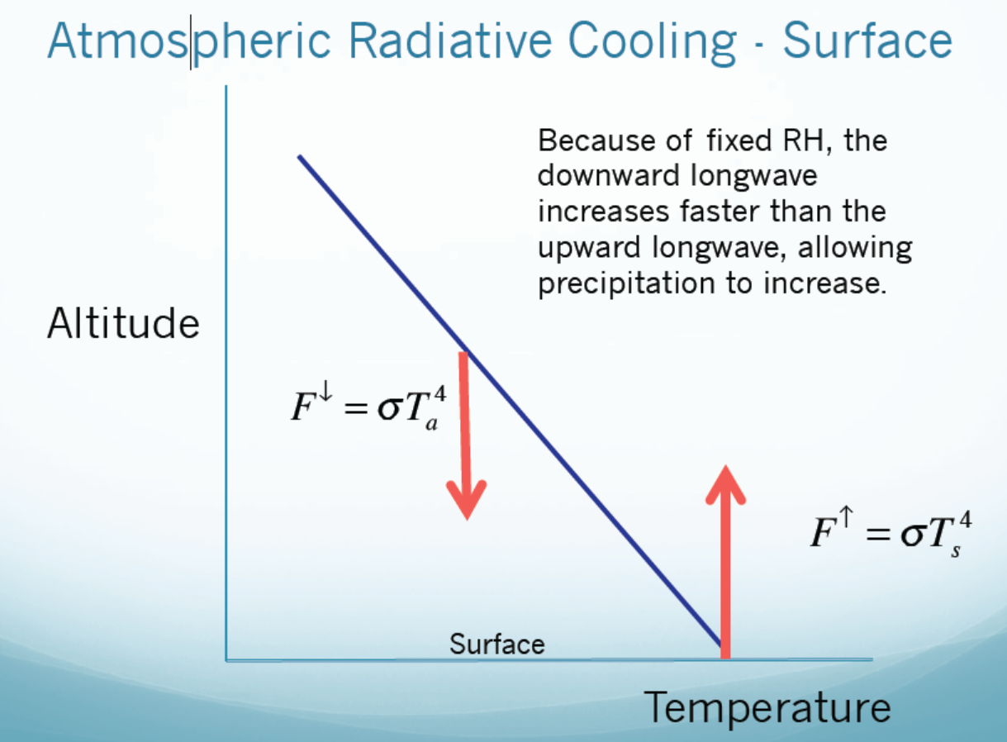
vs. Precipitation
ε
Ta increases with Ts, but H₂O
and thus ε also increases with Ts,
leading to faster increases in F↓ than F↑,
which allows atmospheric latent
heating or precip. to increase with Ts.

Slide 51
7. Atmospheric Circulation
Some basics of atmospheric circulation:
Geostropic flow, Thermal Wind, Barotropic vs.Baroclinic fields, Temperature vs. Pressure levels, Surface vs. Upper-level flows
Conservation of Angular Momentum
Overview of the mean circulation
Zonal average and mid-latitude eddies
Meridional transport of energy, moisture
  and momentum
  Circulation and regional climate

Slide 52
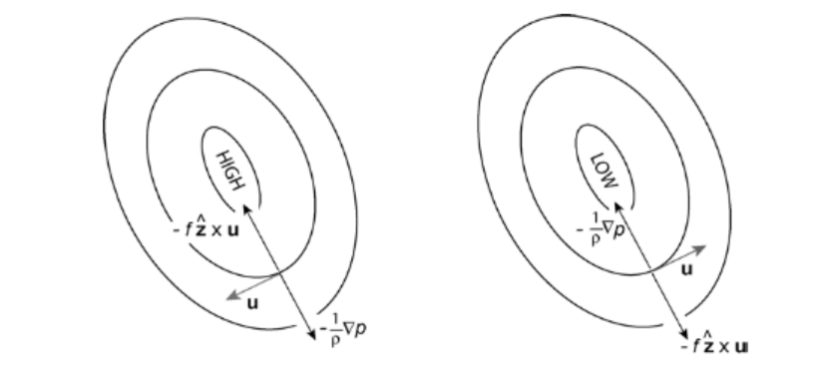
Geostrophic Flow
Since Ro ≈ 0.1
outside the tropic:
Warmer air→
Higher Z for same p
For the Northern Hemisphere
(opposite in the S.H.)
Above PBL
With friction
Fr
Anti-cyclonic:
Cyclonic:

Slide 53
Thermal Wind
The geostrophic wind must have vertical shear if horizontal T gradient (or baroclinity) exists:
Summer Asia

Slide 54
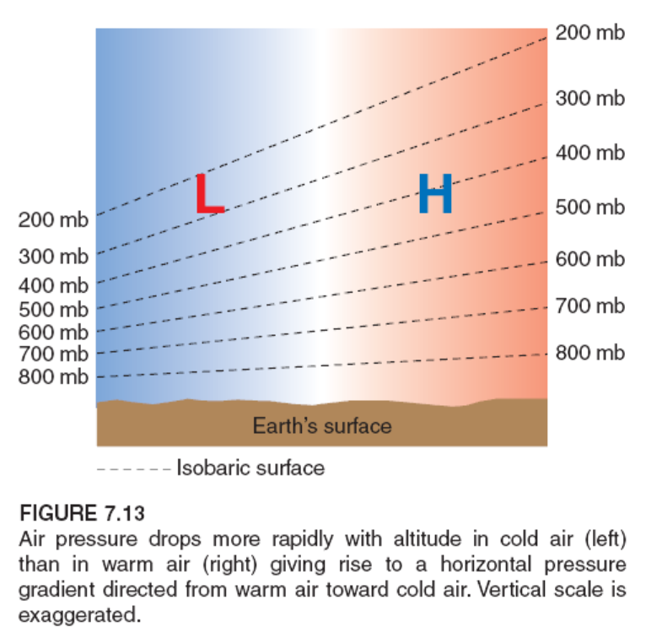
Temperature .vs. Pressure Surface
Warm air expands
Higher pressure surfaces
in the atmosphere
Cold air contracts
Lower pressure surfaces
in the atmosphere
L
H
Higher p surface
Higher Geopotential
Height (Z) for a given p
Higher Z (for a given p)
Higher p (for a given
altitude).
H
L
Pole
Equator
There are cases where surface T (e.g., SST) anomaly is decoupled with tropospheric dT, which allows low surface pressure anomaly to exist with cold SST anomaly (e.g., in the North Pacific during El Niño due to dynamic response to tropical atmospheric heating).

Slide 55
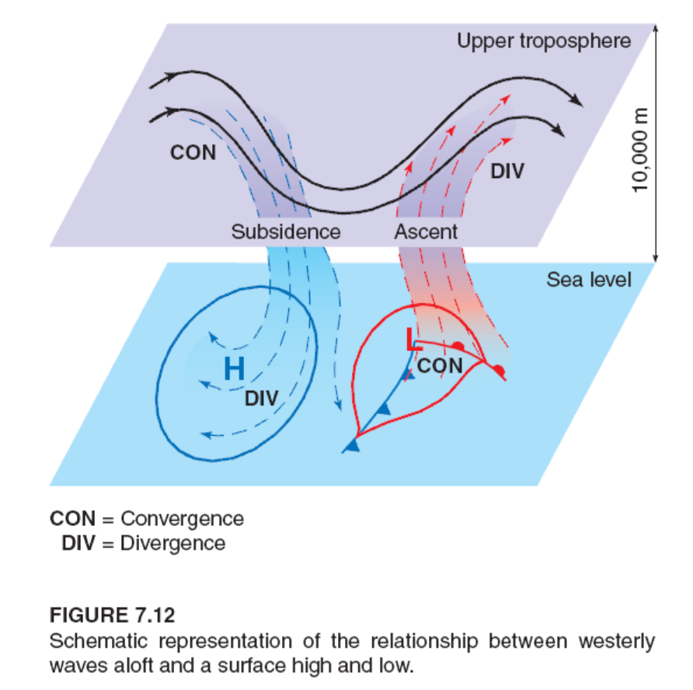
T vs. Z Vertical Structures – Midlatitudes
slowdown
speed-up
Cold air contracts→ High surface p
Warm air expands → Low surface p
Upper-level p is different from Tropics

Slide 56

Conservation of Angular Momentum
Leads to CON and DIV in upper levels

Slide 57

Surface Winds, Surface Pressure Lows and Highs
Zonal-mean Circulation

Slide 58


Annual-mean
Subtropical jets at 30-40º lat. & 200mb
u(m/s)
Westerlies
Jet at 50-60º lat.
in lower troposphere
Westerlies
Easterlies
ΔZ(m)
Z
Z

Slide 59

PW (petawatt) = 10¹⁵ W

Slide 60

Easterly winds gain westerly angular momentum
Westerly winds lose westerly angular momentum.

Slide 61


Slide 62

Zonal-mean Atmospheric Circulation
18km
15km
10km
Deserts
Mean Transport by Polar Cell
Transport by the Mean and Eddies

Slide 63

v* u*>0 → Northward momentum flux
Speed-up → u*>0
T
Slow-down → u*<0

Slide 64

Monsoon Climate
Central & South American
Monsoon: seasonal reversal in atmospheric circulation and rainfall due to differential heating over land and ocean.

Slide 65

Monsoon Circulation
Result from thermal contrast
over land and ocean (why?)
Enhanced by latent heating
from monsoon rainfall
The land-sea thermal gradient
exists in the whole troposphere

Slide 66
8. Ocean and Climate
Properties of seawater: T, S, density distributions
Ocean mixed layer: processes and depth distribution
Wind-driven circulation: surface currents, boundary currents, Ekman layer theory, upwelling
Deep ocean circulation: thermohaline circulation, deep water formation, different types of water masses
  Oceanic transport of heat and freshwater

Slide 67



Properties of Seawater– Equation of State
Seawater typically contains ~3.45% of salt, or a salinity (S) of 34.5psu.
Surface ocean T ranges from about −2 (freezing point) to about 30ºC.
Density of seawater depends on T, S, and pressure (p):
Notes:
Sigma_o is the anomaly density for (To, So). S in unit of psu is close to S in part per thousand (per mil %_{o})

Slide 68

T − S Plot of Ocean Density (σ_{t})
Open Ocean Conditions
Freshwater is heaviest at 4ºC, so ice can stay near the surface in lakes!
Density increases with S but decreases with T, with larger impact of T at warmer temperatures.

Slide 69

Annual-mean, Zonal-mean Potential Temperature (ºC, ref.=ocean sfc)
Notes:
All oceans

Slide 70

Annual-mean, Zonal-mean Potential Density (σ_{t} kg/m³, ref=surface)
Mostly follows Potential Temp.

Slide 71


Ocean Mixed Layer: The top ocean layer (50-200m) that has well mixed T, S, and density. It responds to the seasonal cycle quite rapidly. Its depth increases with stormy weather in winter/spring and gets shallower in summer.
North Pacific (50ºN, 145ºW)

Slide 72

in top 100m
LW within top 1cm
Energy must be transported from subsurface to the surface by turbulent
mixing (aided by winds), convection (usually at night, why?), upwelling/downwelling.

Slide 73

Surface Ocean Currents (~10cm/s)

Slide 74

Wind-driven Upper Ocean Circulation
Ekman Spiral of Wind-driven Currents for N.H.
Average flow is 90º to the right of the wind
Wind Stress
τ
Friction
Current
Coriolis

Slide 75


Slide 76


Slide 77

Zonal-mean Circulation in the Atlantic
AABW = Antarctic Bottom Water NADW = North Atlantic Deep Water

Slide 78

Ocean Overturning Circulation

Slide 79
9. Water Vapor, Clouds and Aerosols
Water Vapor:
  Basic humidity variables,
  Water vapor measurements,
  q and RH distributions
  Water vapor feedback
  Water Vapor changes
Clouds:
  Cloud classification/types
  Cloud distribution
  Cloud radiative forcing
  Cloud response to GHG forcing
Aerosols:
  Aerosols’ effects on clouds and climate
  Aerosol production rates
  20th century aerosol forcing

Slide 80

Water Vapor Feedback
Water vapor feedback is a positive feedback that amplifies the
initial change in surface air temperature. It results from the
strong dependence of the atmospheric water vapor content on
air temperature.
A Positive Feedback

Slide 81
IPCC AR4 Model Predicted Changes: 2080-99 minus 1980-99
Precipitable Water
30
9% K⁻¹
Global Change (%)
20
10
2
3
4
Global Temp. Change (K)
Sun et al.’07
Notes:
Each letter (a total of 17) represents a AR4 model, and blue for SERES B1 and red for SERES A2 scenarios. A study we did with a NRC postdoc and Susan Soloman

Slide 82

RH change (%) from 2000 to 2100
CMIP3, A1B scenario, ocean only
(Richter and Xie 2008, JGR)
Near-surface RH increases by 1-2%
Subtropical RH decreases due to
enhanced subsidence
RH decreases in the upper tropical
troposphere due to upward shift
of tropical convection.

Slide 83


Radiative Effects of Clouds
Albedo depends on cloud thickness:
- Low clouds are optically thick →
strong reflector
High clouds are optically thin →
weak reflector
Net LW effect depends on cloud top height:
Low clouds have low top → T similar to Ts → small warming effect
High clouds have high top → T lower than Ts → large warming effect
Net Effect: Low clouds → cooling, High clouds → warming
Global Effect: SW cooling ≈ 50 W/m², LW warming = 30 W/m², Net = 20 W/m² cooling
Cloud feedback = clouds change with Ts, a positive feedback in most models.

Slide 84
Aerosols’ Impacts on Clouds & Climate
Direct/Radiative Effect:
- Reflect sunlight → cool the surface → less evaporation
→ less water vapor → fewer clouds & less precipitation
- Absorb sunlight → warm the lower troposphere
- Both lead to a stable atmosphere → less
convection, fewer clouds, and less precipitation
Indirect/Microphysical Effect:
- More aerosols → more cloud condensation nuclei (CCN)
→ brighter clouds → more reflection of sunlight
- More CCN → smaller cloud droplets → longer cloud
lifetime and less precipitation
A major source of uncertainty in 20th and 21st century
climate simulations

Slide 85
10. Atmospheric Convection
Atmospheric Convection:
  Definition
  Roles – Radiative-convection equilibrium
  Types
  Distributions
  Diurnal cycle
  Quantifying Convection:
  Lapse rates
  Instability
  Buoyancy
  CAPE and CIN
  Lateral mixing -- entrainment and detrainment
  Heating rate Q1 and Q2

Slide 86

Atmospheric Radiative-Convective Equilibrium
The tropical T profile is in radiative-convective equilibrium as the observed T profile is close to neutral for moist convection. Convection transports energy from the surface to the troposphere, changing the radiative T profile to the moist adiabat.

Slide 87


Slide 88

Shallow v.s. Deep Convection
Deep cumulonimbus convection
anvil
Shallow cumulus convection
1-2 km tall, T’ ~0.1K, w’~2m/s
Heat flux ~200W/s
Top reaches tropopause,
~18km in Tropics
T’ ~ 1K
w’ ~ 10m/s
Heat flux ~ 1-10 kW/s
With anvil clouds made of ice crystals

Slide 89

Major Processes in Deep Convection
Low-level convergence → warm updraft→ condensation; cold downdraft → precipitation; lateral mixing; outflow at cloud top → anvil clouds and subsidence outside the cloudy area.
Entrainment
Detrainment

Slide 90




Quantifying Convection – Dry Convection
Energy change to a displaced air parcel:
For dry adiabatic convection, no latent heating and δQ=0 →
Γ_{d} is the dry adiabatic lapse rate.
stable
unstable
TE
Unstable T → convection
Stable T → oscillations →
gravity waves
Unstable if T decreases faster
than the dry adiabat

Slide 91


Moist Convection
Conditional instability: unstable after air parcel reaches (e.g., due to turbulence lifting) saturation level but stable for dry convection:
- Typical atmospheric T profile:
Tropical atmosphere is close
neutral for moist convection,
i.e., dT/dz ≈ - Γs
Equivalent Potential Temp:
θe is conserved following both dry and moist adiabat.
Typical wet adiabat
Typical T profile
Dry adiabat

Slide 92

Buoyancy of A Lifted Parcel (4)
T’ and q’ can be considered as the difference between the environ. and the parcel,
q_{l} is the liquid water content in the parcel.

Slide 93

Convective Available Potential Energy (CAPE)
in m²/s²
For most applications:
R=287 J K⁻¹ kg⁻¹, Tvp and Tve are virtual Temp(=T+0.61q) for the parcel and environ.
Notes:
Tv=T(1+0.61q)

Slide 94

Buoyancy of A Lifted Parcel (5)
Equilibrium Level
CAPE
Level of Free Convection (LFC)
CIN
Lifting condensation level (LCL)

Slide 95

due to low-level convergence

Slide 96
Major air-sea interaction processes
Solar radiation (SW): absorption, reflection and scattering by ocean surfaces
Infrared radiation: emission, reflection and absorption
Turbulent heat transfer (SH)
Evaporation – Latent heat flux (LH)
Precipitation
Net freshwater flux (E-P)
Turbulent transfer of kinetic energy by tangential components (wind stress) – wind driven currents
Turbulent transfer of kinetic energy by normal components (normal pressure)
Ocean surface wave generation and decay
Mixing in the atmospheric boundary layer
Mixing (mechanical and convective) in the ocean
Gas and aerosol exchanges – CO2, O2, sea salt, etc.

Slide 97


Slide 98
A lot of efforts were devoted to estimate the turbulence transfer coefficient C_{D} for heat, water, and momentum (wind stress). Note the influence of wind speed.

Slide 99


The Bjerknes feedbacks (warm ENSO phase)
Jakob Bjerknes (1897-1975)
Air-Sea Feedbacks:
Norwegian-American meteorologist, founded UCLA Dept. of Meteorology
in the east
Positive feedback loop reinforces initial anomaly
Neelin, 2011. Climate Change and Climate Modeling, Cambridge UP

Slide 100

In the Tropics
Anomaly winds
Background winds
SST gradient → Pressure gradient → anomaly winds (green arrows) → decreased
(increased) winds north (south) of Equator → Reduced (enhanced) E north (south) of
Equator → SST warming (cooling) North (south) of Equator → Increased SST gradient

Slide 101
Wind Stress on Oceans
The force component parallel to the surface, per unit area, as applied by the wind on the water surface.
Ekman Spiral of Wind-driven Currents for N.H.
Average flow is 90º to the right of the wind
Wind Stress
τ
Friction
Current
Coriolis

Slide 102

Air-Sea CO2 Flux
Cold water holds more CO2 than warm water → upwelling = out-gassing
Global Ocean Uptake = 1.42 Pg C/yr, 1Pg (Petagram)=10¹⁵ g =10⁹ Ton
1.42 Pg ≈ the weight
of 1 billion cars.
Weighs twice
as all cars in
U.S.!
F∼U ΔpCO2
Negative: into the Oceans
Positive: into the Atmosphere
Notes:
CO₂ dissolves in seawater, and then reacts with the water so that it disassociates into several ions. This disassociation means that the oceans can hold a lot of carbon – 85% of the active reservoir on Earth. Cold seawater can hold more CO₂ than warm water, so waters that are cooling (i.e. poleward-moving western boundary currents) tend to take up carbon, and waters that are upwelling and warming (i.e. coastal zones and the tropics) tend to emit carbon. This is the basic reason for the pattern of the global sea-to-air CO₂ flux as estimated by Takahashi et al. [2009] in the figure at right.

Slide 103

A Positive Feedback

Slide 104

Vegetation − Precipitation Feedback
Effective in semi-arid regions (e.g. Sahel)
A Positive Feedback
+

Slide 105

Vegetation − Albedo Feedback
Effective during Ice Ages
A Positive Feedback
+

Slide 106
Summary of Air-Sea and Land-Atmosphere Interactions
Air-sea interaction includes surface radiative fluxes, water fluxes (E and P), surface heat, momentum, and gas exchanges, and several air-sea feedbacks.
Surface winds play a crucial role in air-sea interaction: they affects upper ocean currents, air-sea SH, LH and momentum fluxes, and play a key role in air-sea feedbacks (such as the Bjerknes and WES feedbacks).
In the tropics, SST is often forced by solar radiation and oceanic processes (.e.g. upwelling) and acts as a lower-boundary forcing for the atmosphere; whereas in the mid-high latitudes, SST may also respond to atmospheric changes (e.g., winds) and thus two-way interactions are important.
The Wind-Evaporation-SST (WES) feedback works as follows: A SST gradient induces pressure gradient, which induces wind anomalies that lead to E changes which provide a feedback impact on the SST gradient (positive over the Equator).
Land-atmosphere interaction includes surface exchanges of heat, water, momentum, and gases (CO2, O2, etc.), albedo effect, modulation of atmospheric flow by mountains, soil moisture-precipitation interactions, vegetation-albedo feedback.
Land-atmosphere coupling seems to be strongest in semi-arid areas.
Initial conditions of soil moisture content are important for short-term weather forecast.

Slide 107

Sea Ice
Sea ice covers ∼12% (1/8) of the world’s oceans, primarily in the polar regions
It varies seasonally:
S.H.: A minimum of 3-4 million km² in February to a maximum of 17-20 million km² in September, 1-2 m thick
N.H.: A minimum of 7-9 million km² in September to a maximum of 14-16 million km² in March. 2-4 m thick
Why is the seasonal variation larger in the S.H. than in the N.H.?
Satellite passive microwave obs. began in the late 1970s.
Main data source: National Snow and Ice Data Center (NSIDC) in Boulder, CO
(http://nsidc.org/cryosphere/sotc/sea_ice.html)

Slide 108


Major Sea Ice Features
Sunlight
SH & LH
Salt
Sea-ice ejects about 2/3 of the salt into the open water (why?)
Notes:
When ice crystals form, salt accumulates into small droplets called brine, which are in liquid form (due to salt’s lower freezing point) and are expelled into the sea water through various ways.

Slide 109


1. Albedo
2. Insulating
3. Density
High Cloud
Middle Cloud
Low Cloud
SW Flux
Ice Crystals
* *
* * * *
* *
LW Flux
P-E
Sensible Heat
Latent Heat
Run Off
Snow
Melt Ponds
Ridged Ice
Sea Ice
Lead
Air Bubbles
Ice Export
Brine Pockets
Melt/Freeze
Lateral Heat Flux
Basal Heat Flux
Fresh Water Inflow
Diffusion
Ocean Mixed Layer
Entrainment
Pycnocline

Slide 110


Sea-ice Thickness
Worby et al. 2008
Jan-Feb 2011
Antarctic Sea-ice annual-mean thickness (m)
m
http://www.esa.int/esaCP/SEMAAW0T1PG_index_0.html

Slide 111






Mean Annual Cycle of Arctic SIC and Surface Fluxes (positive downward)
Arctic Ocean heats the atmosphere
from October-March!
Dai et al. (2019)
Notes:
1979-1988 mean annual cycle. Fluxes positive downward

Slide 112


September Arctic Sea Ice Change 1979-2023
February Arctic Sea Ice 1979-2024
Source: http://nsidc.org/arcticseaicenews/sea-ice-analysis-tool/

Slide 113


September Sea Ice Trend
1979-2021
February Sea Ice Trend
1979-2022
Source: http://nsidc.org/arcticseaicenews/sea-ice-analysis-tool/

Slide 114


September Antarctic Sea Ice Change
February Antarctic Sea Ice Change
Source: http://nsidc.org/arcticseaicenews/sea-ice-analysis-tool/

Slide 115


September Sea Ice Trend
1979-2021
February Sea Ice Trend
1979-2022
Source: http://nsidc.org/arcticseaicenews/sea-ice-analysis-tool/

Slide 116
Causes of Arctic Sea-ice Variations
Studies suggest that winter Arctic ice variations are largely caused
by changes in surface heat flux (thermodynamic) and wind stress
(dynamic) induced by atmospheric circulation changes (Alexander et al.
2004).
NAO’s trend toward a positive phase is associated with an
intensification of the Icelandic low and advection of anomalously
warm (cold) air to the east (west) of Greenland, which results in
ice extent increases in the Labrador Sea and decreases in the
Greenland–Iceland–Norwegian (GIN) Seas (Deser et al. 2000).
The recent rapid decline seems to be related to high pressure over
Greenland that may result from atmospheric blocking (a stationary pressure
system) associated with midlatitude circulation (Overland et al. 2012)
The blocking led to decreases in East – West Arctic SLP gradient since ∼2002,
which led to increased pressure gradient across the Fram Strait and thus
increased export of sea-ice into the N. Atlantic.

Slide 117
Impacts of Arctic Sea-ice Loss
Enhanced warming over the Arctic Ocean and nearby land areas
(Kumar et al. 2010)
Increased winter snowfall over Eurasia and N.A. (Liu et al. 2012)
Potential slow down of midlatitude Rossby waves (Francis et al. 2012)
Other significant impacts on precipitation and atmospheric
circulation (Alexander et al. 2004; Singaryar et al. 2006).

Slide 118

Impact of Winter
No sea-ice loss
With sea-ice loss
Serreze & Barry (2011)
Notes:
Fig. 2. Schematics of the surface energy budget of the Arctic Ocean, contrasting the situation during the low-sun period for (left) an unperturbed Arctic and (right) in response to a positive (warming) climate forcing that results in decreased ice concentration and thickness. The dotted line is an arbitrary isotherm in the lower troposphere; warming over the Arctic Ocean bows the isotherm upward. SW = shortwave radiation flux, LW = longwave radiation flux, Sens. Heat = sensible heat flux, Lat. Heat = latent heat flux. (From Serreze and Barry 2011).

Slide 119

Potential Impacts of Arctic Amplification
Arctic Amplification (AA=2~3)
Jet stream may become less zonal
Walsh (2014), Francis & Vavrus (2015), Francis et al. (2017)
Thermal Winds:

Slide 120

CMIP5 Model-simulated Arctic Sept Sea-ice Extent
nearly sea ice free by the 2030s
Wang & Overland 2012, GRL
1900
2000
2100
Notes:
nearly sea ice free by the 2030s

Slide 121
Summary for Sea-ice and polar climate
Polar sea-ice covers about 7% of the Earth surface or 12% of global oceans. It varies seasonally with a max. in March and min. in Sept in the Arctic. Opposite for Antarctic sea ice.
There are many complex processes within sea ice, including thermodynamic and dynamic processes.
Sea-ice increases surface albedo and atmospheric stability, but cuts off air-sea exchanges of heat and moisture, thus affecting the climate.
The Arctic Ocean is a net energy sink during the warm season but a heat source to the air during the cold season (Oct-Mar).
Arctic sea-ice extent in summer and fall has been decreasing rapidly since 1979, and it is likely related to polar warming and atmospheric circulation changes.
Arctic and Antarctic climate has a very large seasonal cycle with little precipitation in winter Arctic.
Sea-ice loss can lead to large oceanic heating of the air in winter, leading to amplified Arctic warming.
Arctic amplification reduces │dT/dy │, which may lead to weaker U and other changes in midlatitudes.
The Arctic is projected to be almost ice free in September by the 2030s.

Slide 122
ATM551: Lecture 16
The Global Carbon Cycle and Climate
The global carbon cycle & its coupling to climate
Organic carbon cycle
Inorganic carbon cycle
Ocean acidification
Recent increases in CO₂
Anthropogenic carbon emissions
Reading materials: IPCC AR5 (2013), Chapter 6

Slide 123

The Global Carbon Cycle (2000-2005)
(Source: IPCC AR4)
black = natural
red = anthropogenic
1GtC = 10¹⁵ gC
GPP = Gross Primary Production. NPP = net primary productivity = GPP – plant’s respiration = ~60 GtC/yr for terrestrial plants.
Notes:
GPP = Gross Primary Production. NPP = net primary productivity = GPP – plant’s respiration = ~60 GtC/yr for terrestrial plants.

Slide 124
Coupling of the Carbon Cycle to Climate
Atmospheric CO2 affects global temperature and other climate fields.
Climate variations and long-term changes (e.g., in T and P) over land can either enhance or reduce photosynthesis and soil respiration, e.g., during a drought or wet growing season, leading to changes in atmospheric CO2.
Changes in ocean upwelling (e.g., during ENSO events) can affect air-sea carbon fluxes, leading to changes in atmospheric CO2.
Increased atmospheric CO2 level can allow plants to partially close stomata, reducing transpiration rates and land evapotranspiration.
Removal of atmospheric CO2 by weathering increases with temperature, thereby providing a negative feedback on global climate on geological time scales.
Notes:
Each N2O molecule is ~210 times more effective in absorbing IR radiation than a CO2 molecule.

Slide 125



Slide 126

Plant growth is also limited by availability of nutrients and other factors.
Increased CO₂ allows stomata to open less, thus reducing water loss.

Slide 127

(silicon dioxide)
(calcium carbonate)

Slide 128


Slide 129


Slide 130


Slide 131


Slide 132

CaCO₃ = Calcium carbonate

Slide 133


Slide 134

Ocean Acidification
When carbon dioxide (CO₂) is absorbed by seawater, chemical reactions occur that reduce seawater pH, carbonate ion concentration, and saturation states of biologically important calcium carbonate minerals. These chemical reactions are termed "ocean acidification". Calcium carbonate minerals are the building blocks for the skeletons and shells of many marine organisms.
Source: https://www.pmel.noaa.gov/co2/story/What+is+Ocean+Acidification%3F

Slide 135


Slide 136


The Keeling Curve
https://gml.noaa.gov/ccgg/trends/

Slide 137


Slide 138


Slide 139

CO2 Emissions from Fossil Fuel
Notes:
Automobiles only account for ~16% global CO2 emissions.

Slide 140

The Methane Cycle
Notes:
Main methane sink: Methane in the troposphere reacts with hydroxyl (OH) radicals, forming mainly water and carbon dioxide:
CH4 + -OH → -CH3 + H2O and –CH3 is further converted into CO2.

Slide 141


Slide 142
Key points of the global carbon cycle
The Global Carbon Cycle:
- Terrestrial organic carbon cycle: Plant’s photosynthesis & soil respiration,
CO₂ fertilization
- Marine organic carbon cycle: Phytoplankton’s photosynthesis,
zooplankton’s removal of organic materials, deposit to sea floor ->
biological pump – important on geological time scales (millions of years)
- Inorganic carbon cycle: Silicate-carbonate cycle, weathering and rock
metamorphism, important on geological time scales
- Ocean acidification: Increased CO2 → lower pH and calcium carbonate minerals in seawater → more difficult for marine organisms grow shells
Anthropogenic Carbon Emissions:
- Atmospheric CO₂ has been rising rapidly since the 19th century to ~420ppmb today.
- CO₂ emissions from fossil fuel burning and deforestation (~9.5GtC/yr) have greatly altered the global carbon cycle, causing rapid CO₂ rise.

Slide 143
Mid-term Exam:
Thursday, March 14, 3:00-4:20pm
ETEC 482
28 Multiple choice questions
6 Individual questions, mostly descriptive ones.

