Slide 1
Potential Vorticity:
= 0 for isentropic motions
Vorticity:

Slide 2
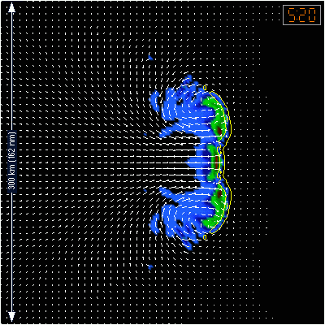
No Coriolis

Slide 3
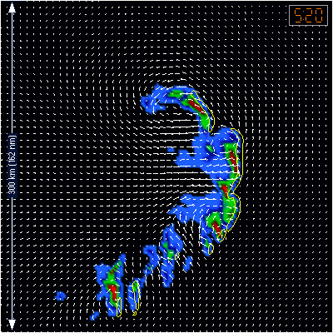
Coriolis

Slide 5
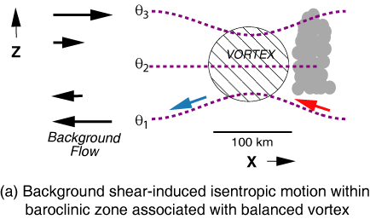
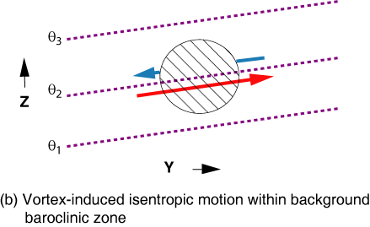
Raymond and Jiang (JAS 1990) Conceptual Model of Isentropic
Lifting within a Steady Balanced Vortex (e.g., MCV)

Slide 6
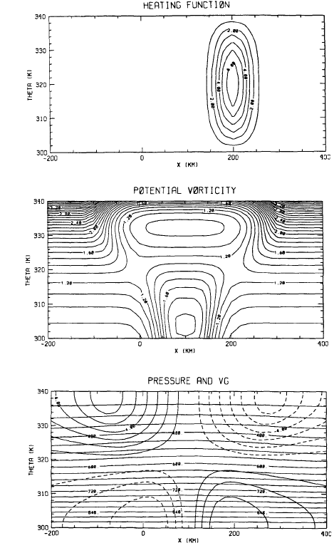
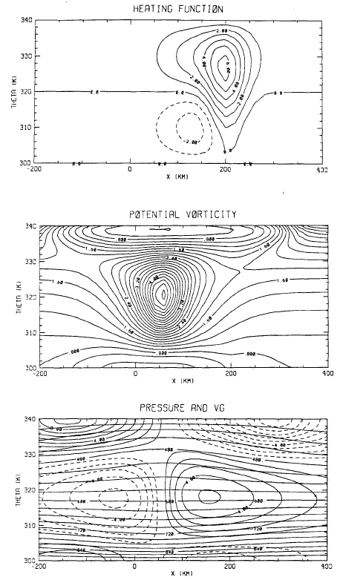
dq/dt ≈ ηH_{z}/ρ, H=heating
+
+
H_{z}>0
-
H_{z}>0
Hertenstein and Schubert 1991, MWR

Slide 7
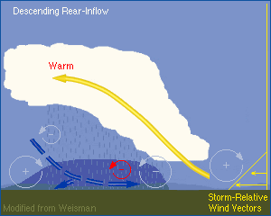
Long-time Behavior of MCSs
Cool
H
Warm
L
H
Cool
(twice)

Slide 9
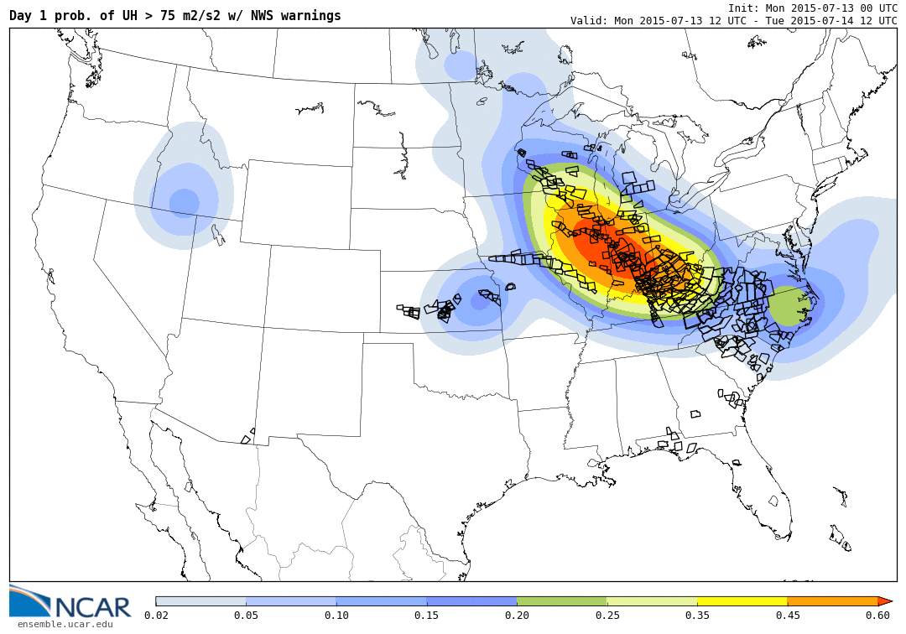
07/13/15

Slide 10
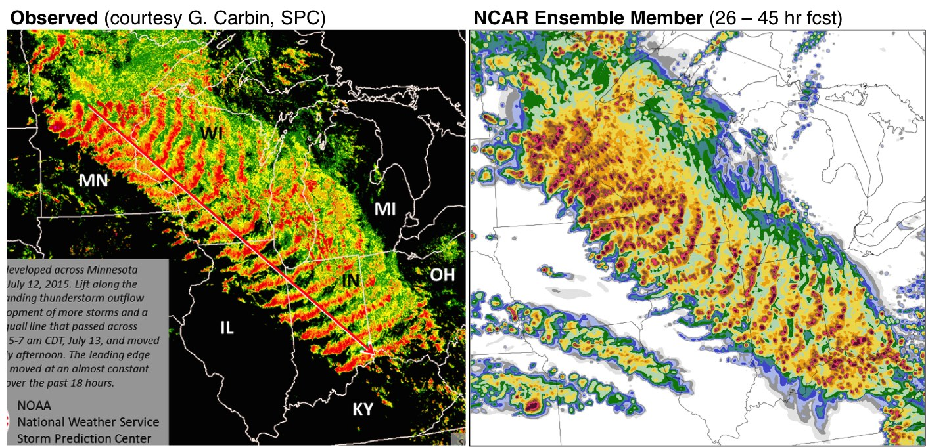
07/13/15

Slide 11
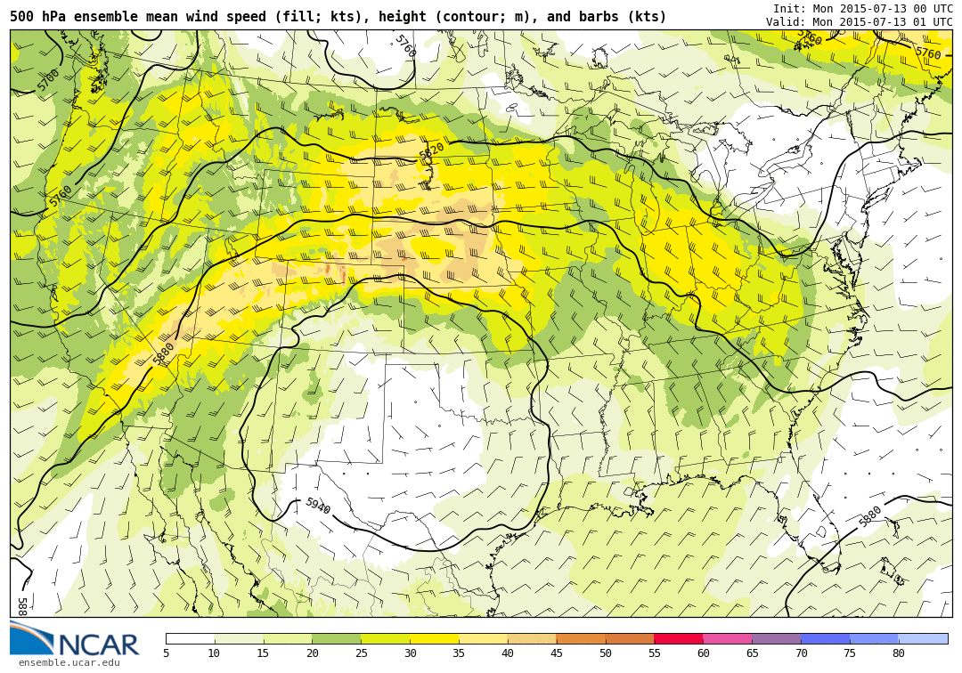
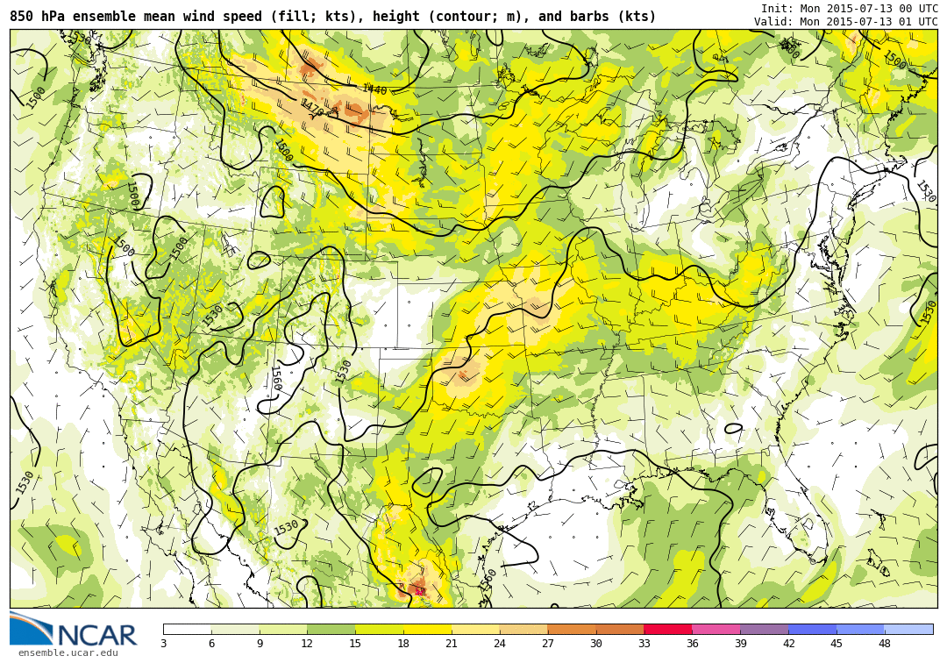
07/13/15
00 UTC
500 hPa
850 hPa

Slide 12
07/13/15

Slide 13
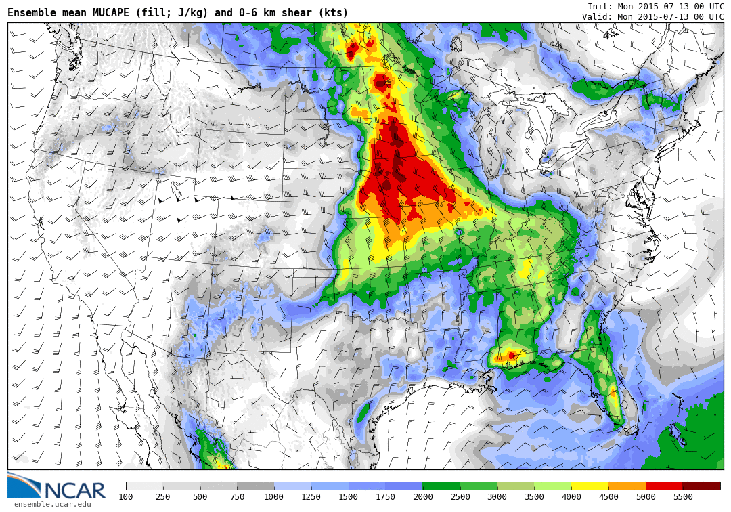
07/13/15
Ensemble Mean MUCAPE and 6 km shear
00 UTC

Slide 14
MPX 00 UTC

Slide 15
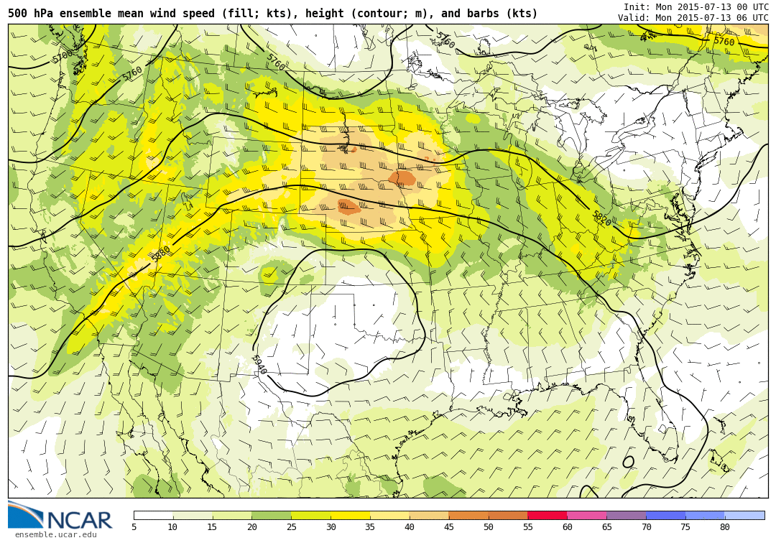
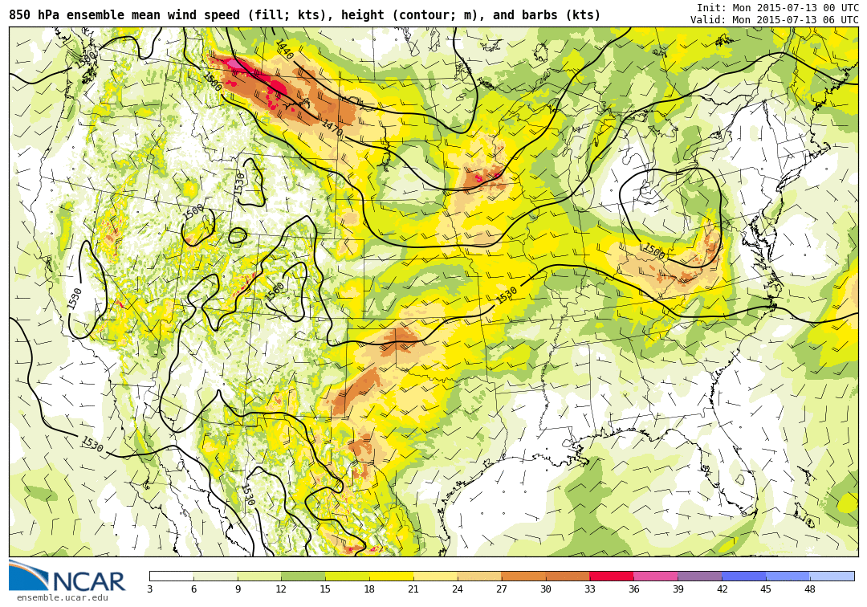
07/13/15
06 UTC
500 hPa
850 hPa

Slide 16
07/13/15

Slide 17
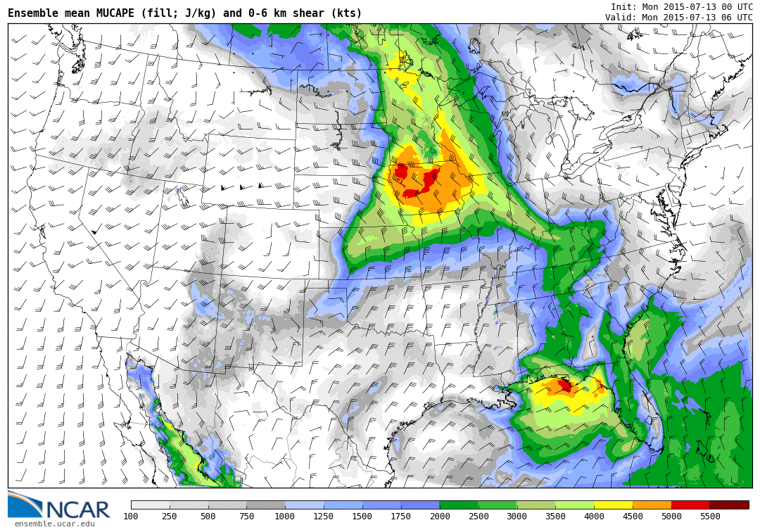
07/13/15
Ensemble Mean MUCAPE and 6 km shear
06 UTC

Slide 18
MPX 06 UTC

Slide 19
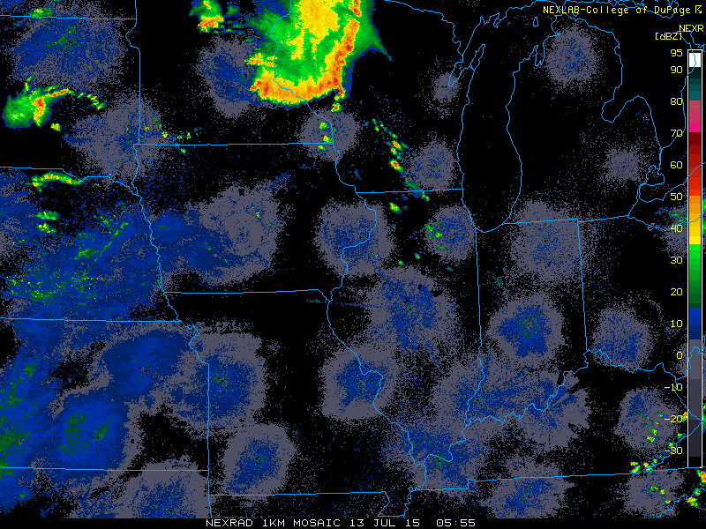
13 July 2015
Radar
Model Reflectivity 06h
06:00 UTC

Slide 20
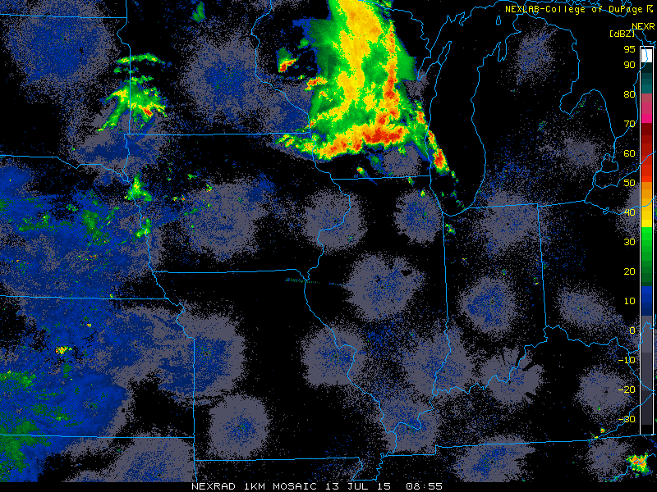
13 July 2015
Radar
Model Reflectivity 09h
09:00 UTC

Slide 21
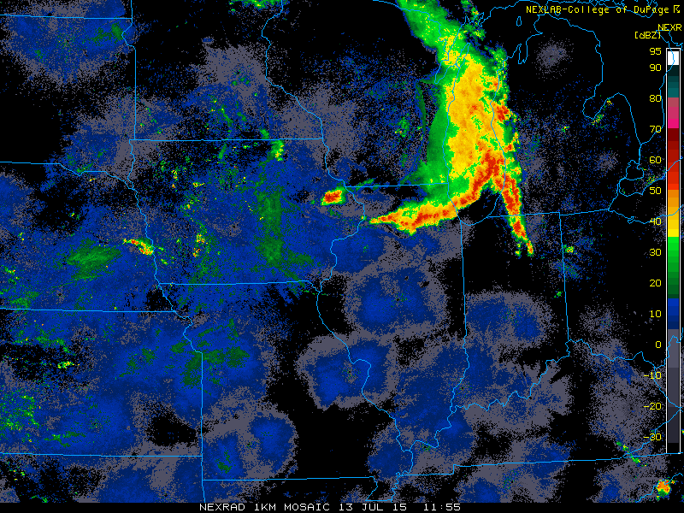
13 July 2015
Radar
Model Reflectivity 12h
12:00 UTC

Slide 22
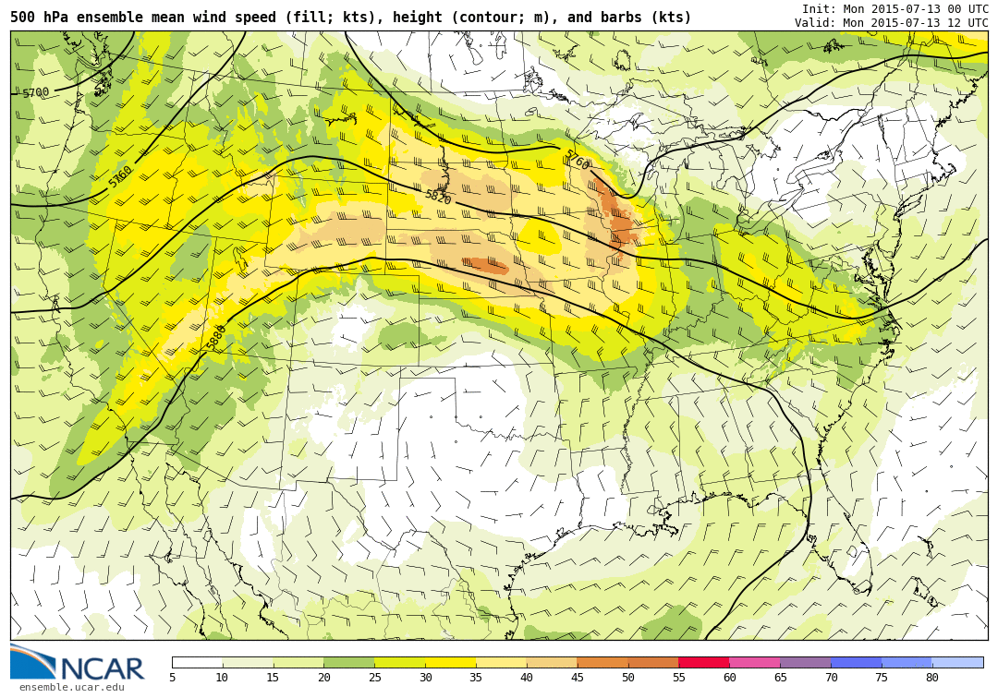
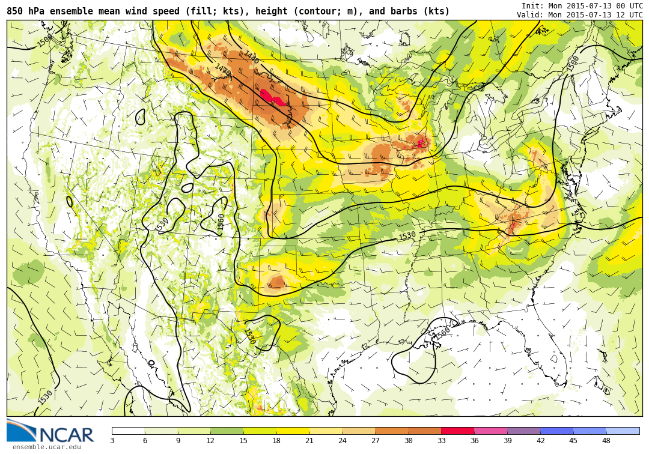
07/13/15
12 UTC
500 hPa
850 hPa

Slide 23
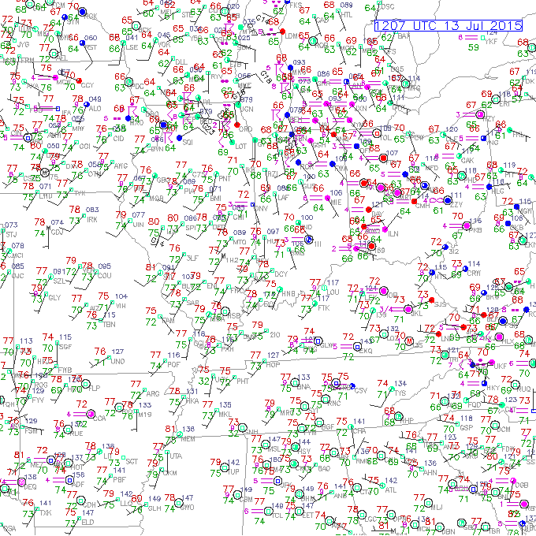
07/13/15

Slide 24
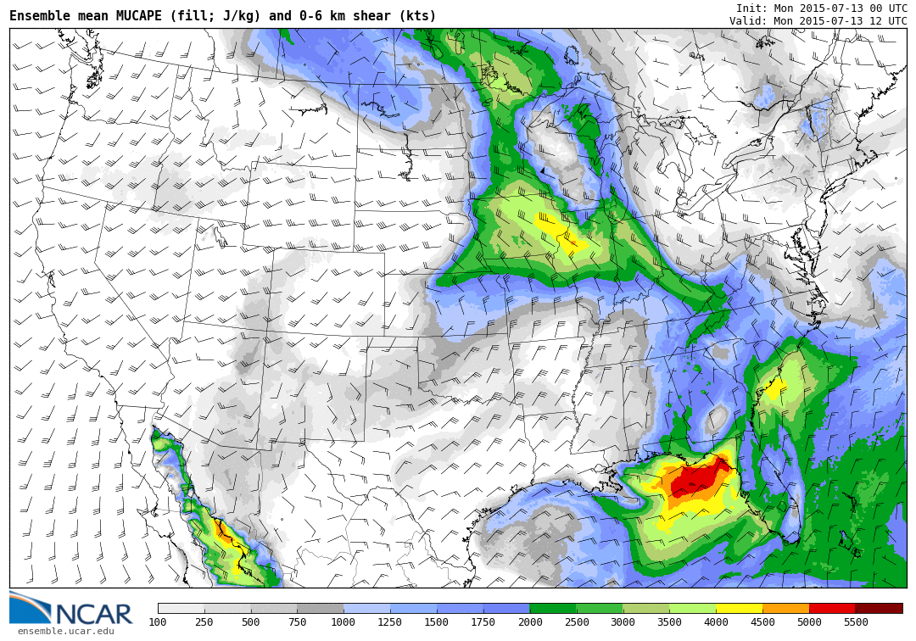
07/13/15
Ensemble Mean MUCAPE and 6 km shear
12 UTC

Slide 25
ILX 12 UTC

Slide 26
ILN 12 UTC

Slide 27
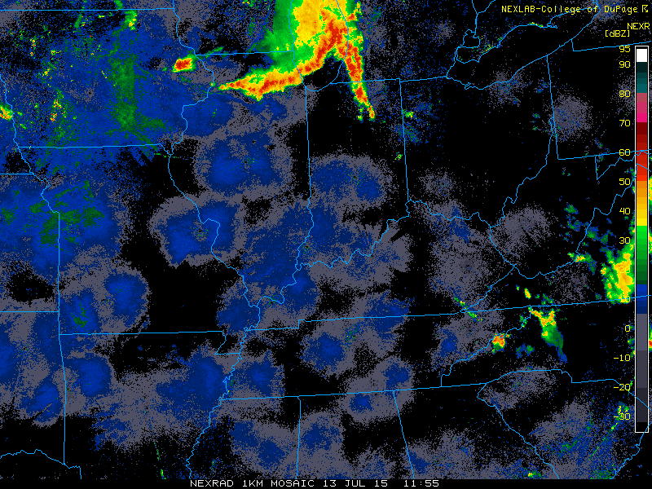
13 July 2015
Radar
Model Reflectivity 12h
12:00 UTC

Slide 28
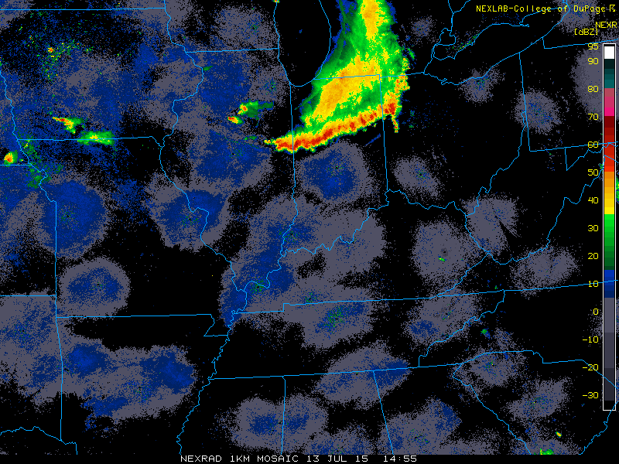
13 July 2015
Radar
Model Reflectivity 15h
15:00 UTC

Slide 29
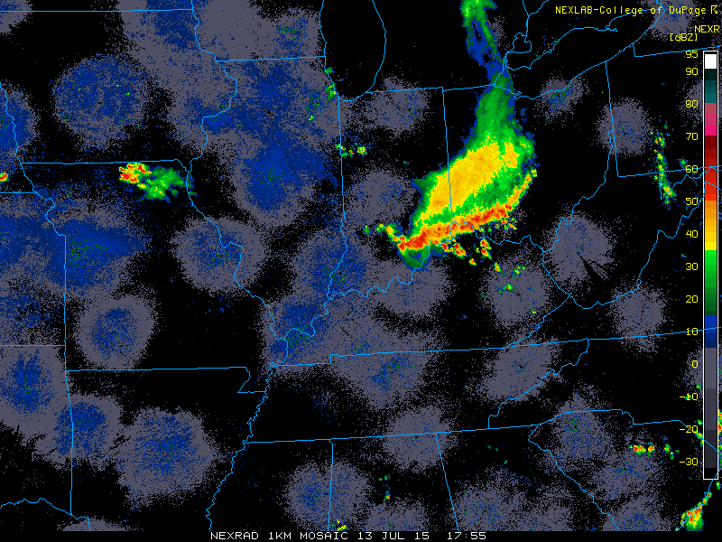
13 July 2015
Radar
Model Reflectivity 18h
18:00 UTC

Slide 30
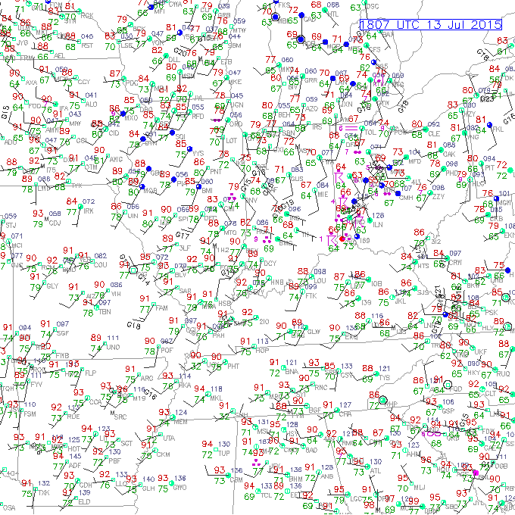
07/13/15

Slide 31
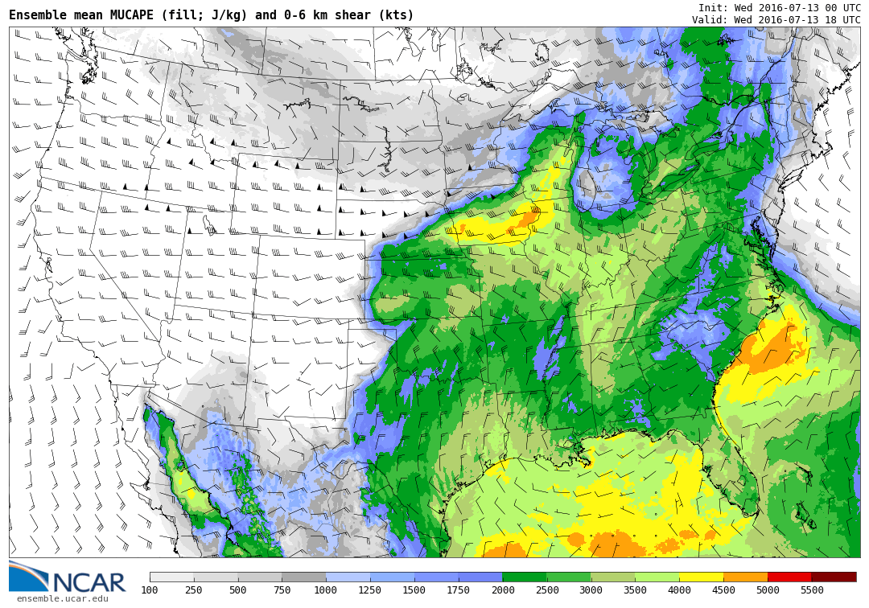
07/13/15
Ensemble Mean MUCAPE and 6 km shear
18 UTC

Slide 32
ILX 18 UTC

Slide 33
ILN 18 UTC

Slide 34
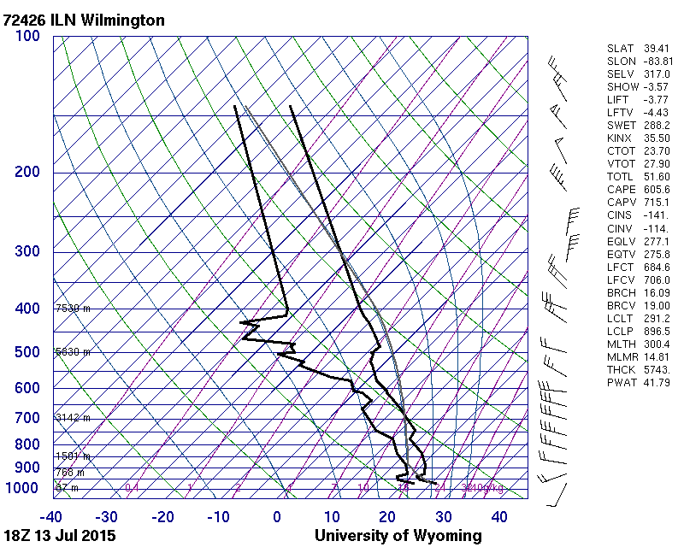

Slide 35
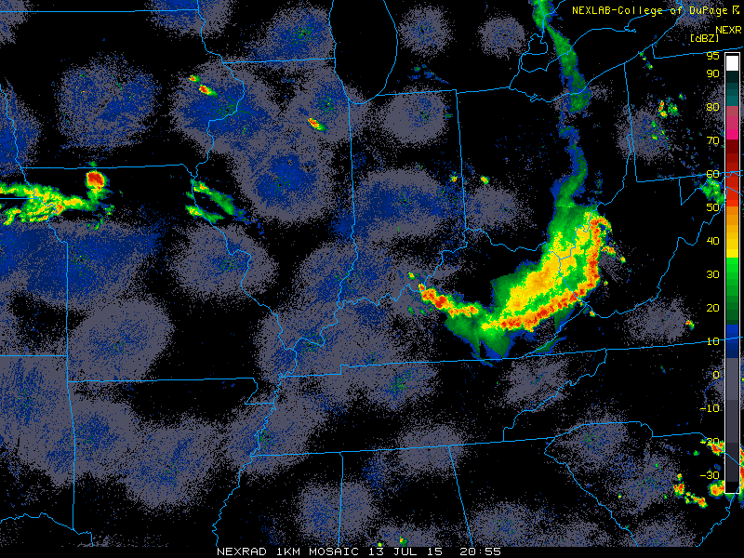
13 July 2015
Radar
Model Reflectivity 21h
21:00 UTC

Slide 36
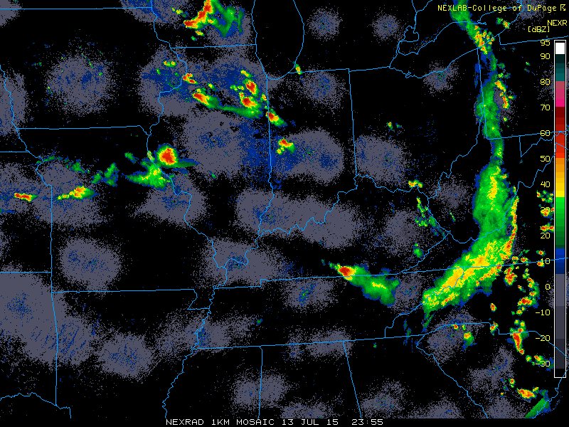
13 July 2015
Radar
Model Reflectivity 24h
00:00 UTC

Slide 37
13 July 2015
06 h forecast 6 Ensemble Members

Slide 38
13 July 2015
12 h forecast 6 Ensemble Members

Slide 39
13 July 2015
18 h forecast 6 Ensemble Members

Slide 40
13 July 2015
24 h forecast 6 Ensemble Members

Slide 41
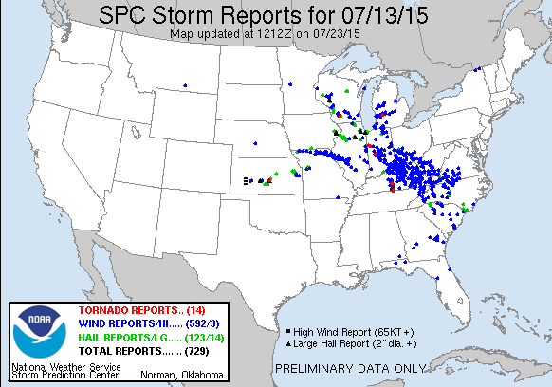
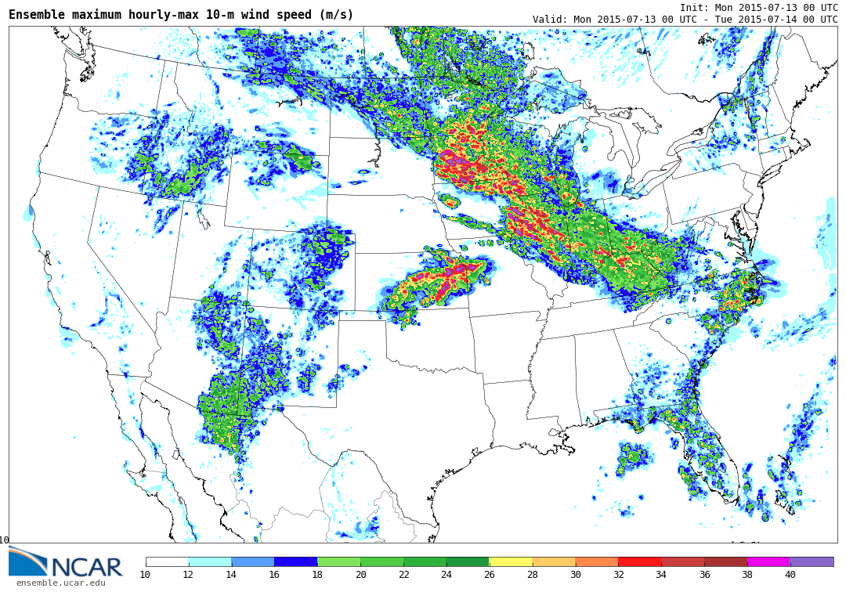
Ensemble Maximum Surface Winds:

Slide 42
13 July 2015
18 h forecast Surface T 6 Ensemble Members

Slide 43
13 July 2015 18 UTC
~ 15-20 F Cold Pool

Slide 44
07/13/15

Slide 45
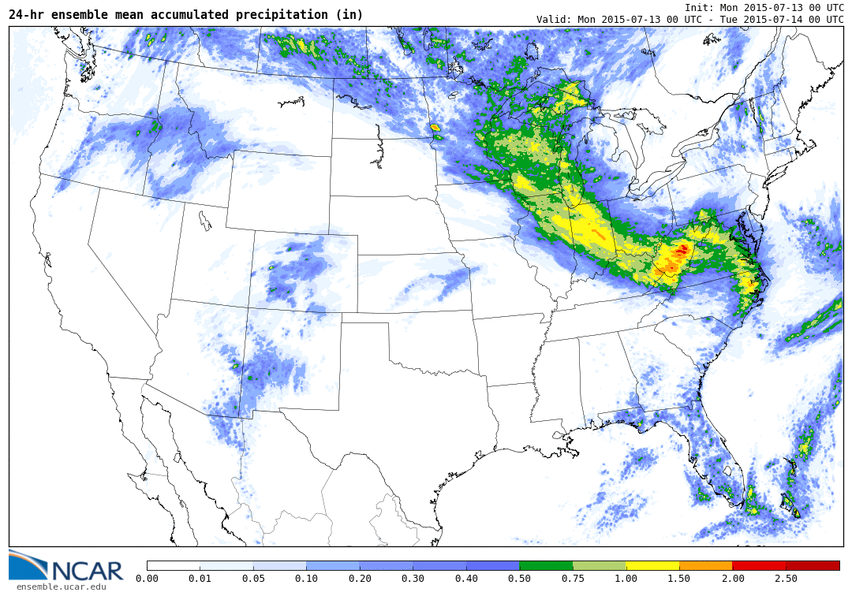
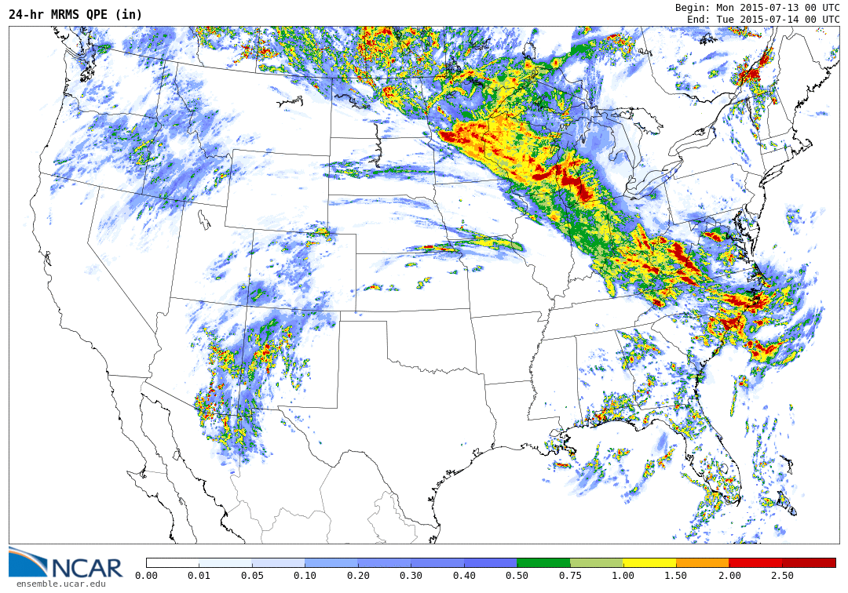
13 July 2015

Slide 47
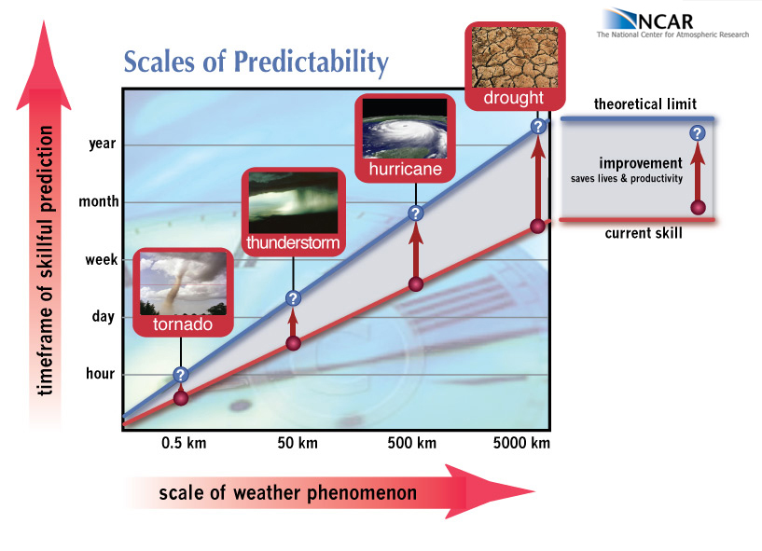
Predictability:
What can we hope to do?

Slide 48
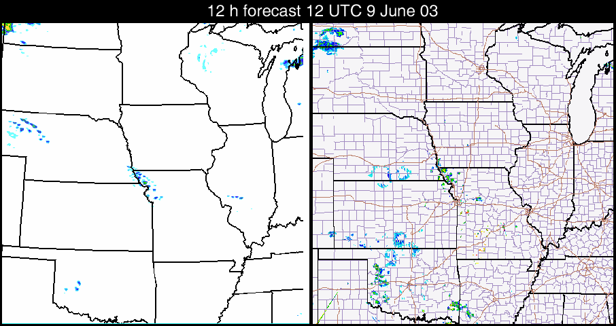
BAMEX 09 June 2003 4 km WRF

Slide 49
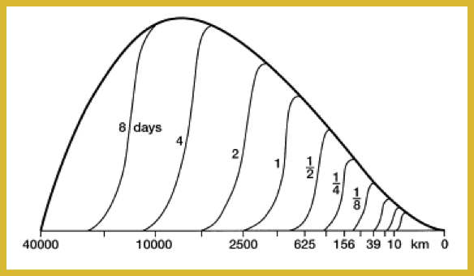
Theoretical Predictability Limits??
Atmos. Energy Spectrum
Lorenz, 1969
Predictability Limit for given scale
Error spectrum at given time
Scale (km)
Subsynoptic waves (~1200 km): ~1.5 days
Convective Systems (~300 km): ~12 h
Thunderstorms (~10 km): ~ 1h

Slide 50
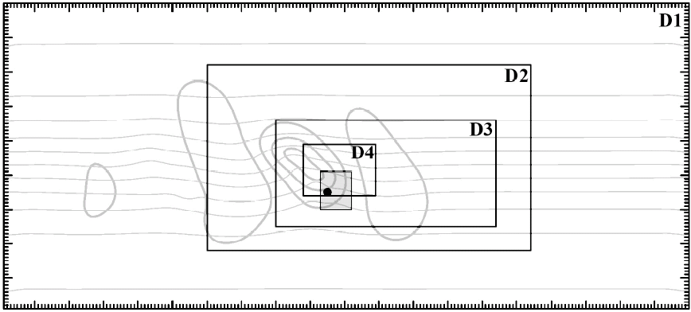
Baroclinic Waves / Moist Convection
white noise added to D2 at t = 36h
Zhang et al. (2006)
Notes:
More systematic approach considers a growing baroclinic wave in a channel / moist instability.

Slide 51
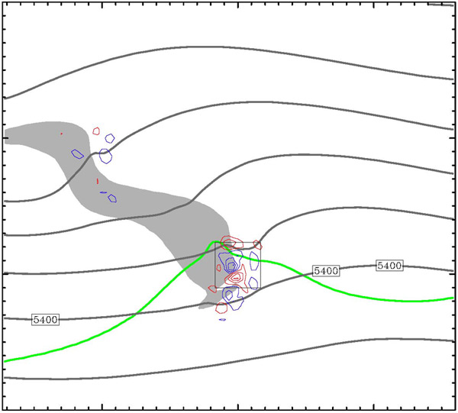
Evolution of Difference Field
500 hPa height (solid), v’ (color, c.i.=2m/s), 3h precip (shaded > 3mm)
CAPE > 50J/Kg
Zhang et al. (2006)

Slide 52
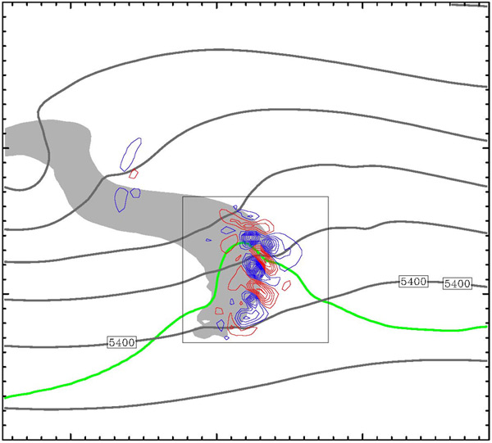
Evolution of Difference Field
500 hPa height (solid), v’ (color, c.i.=2m/s), 3h precip (shaded > 3mm)
CAPE > 50J/Kg
Zhang et al. (2006)

Slide 53
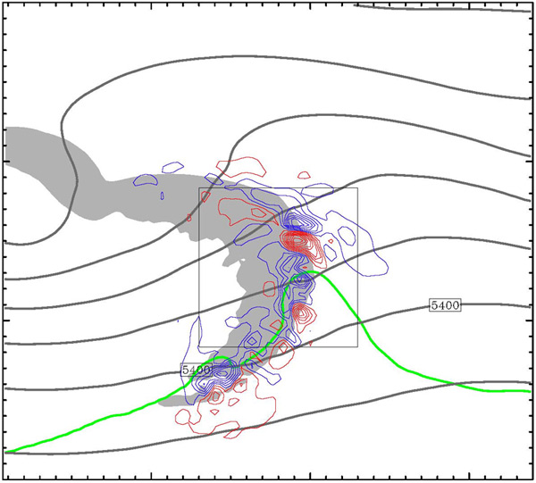
Evolution of Difference Field
500 hPa height (solid), v’ (color, c.i.=2m/s), 3h precip (shaded > 3mm)
CAPE > 50J/Kg
Zhang et al. (2006)

Slide 54
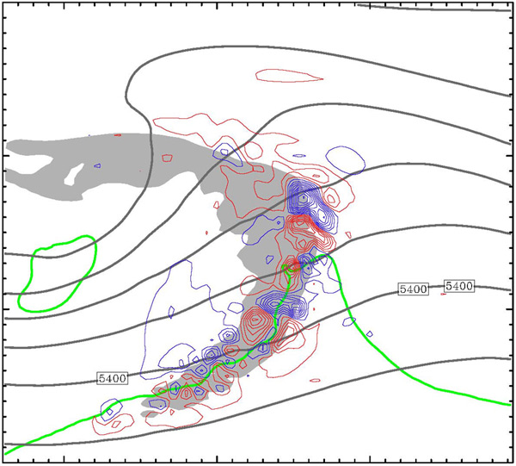
Evolution of Difference Field
500 hPa height (solid), v’ (color, c.i.=2m/s), 3h precip (shaded > 3mm)
CAPE > 50J/Kg
Zhang et al. (2006)

Slide 55
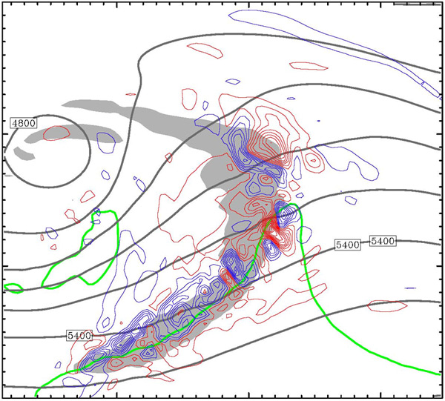
Evolution of Difference Field
500 hPa height (solid), v’ (color, c.i.=2m/s), 3h precip (shaded > 3mm)
CAPE > 50J/Kg
Zhang et al. (2006)

Slide 56
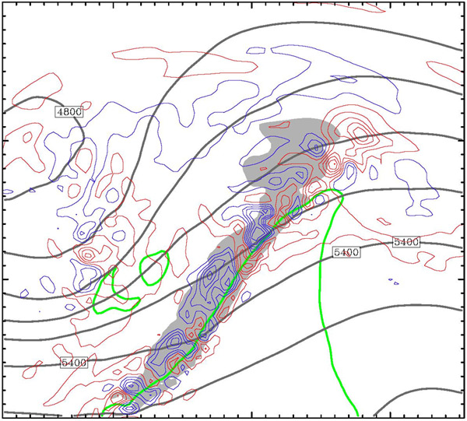
Evolution of Difference Field
500 hPa height (solid), v’ (color, c.i.=2m/s), 3h precip (shaded > 3mm)
CAPE > 50J/Kg
Zhang et al. (2006)

Slide 57
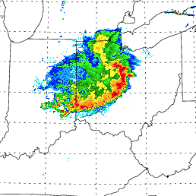
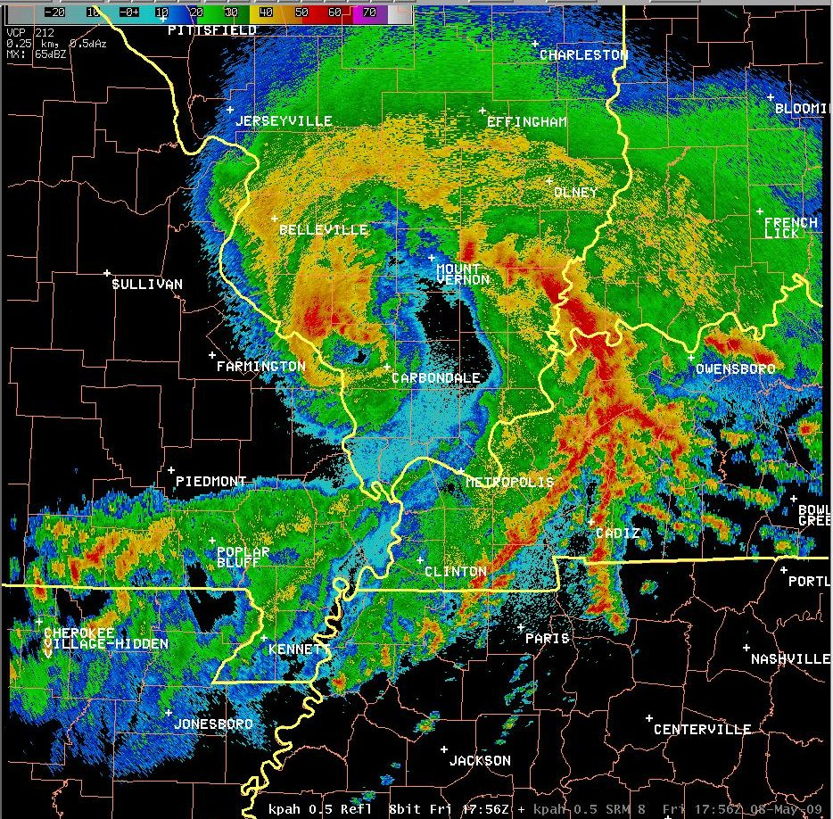
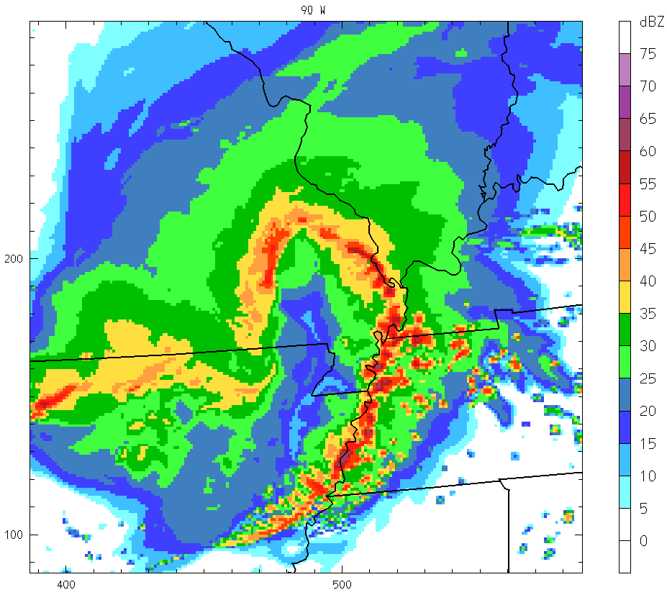
So, really, how predictable were these events??
Radar Reflectivity
Model Forecast Reflectivity
29 June 2012
08 May 2009

Slide 58
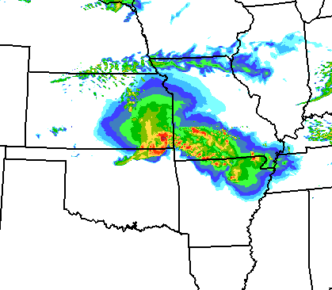
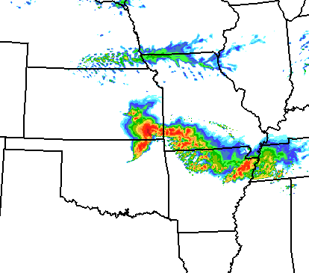
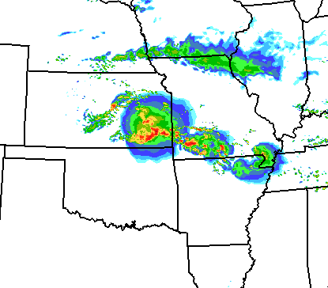






8 May 2009 Super-derecho 24 h Forecasts
Thompson / MYJ
WSM6 / MYJ
Thompson / YSU
Initial conditions:
NAM
RUC-DFI
GFS

Slide 59



Convectively explicit (3 km) forecasts can be quite “good”
e.g. 29 June 2012 Derecho:
18 UTC (6 h)
21 UTC (9 h)
00 UTC (12 h)
03 UTC (15 h)
3 km WRF-ARW Forecast: DART Analysis, MYJ, Morrison
18 UTC
21 UTC
00 UTC
03 UTC
Composite Radar

Slide 60


…but are especially sensitive to the initial analysis!!
29 June 2012 Derecho
DART-Morrison-MYJ
DART-Morrison-YSU
DART-Thompson-MYJ
GFS
NAM
RUC

Slide 61
12 UTC Analysis Differences:
500 hPa Theta
**2K / 5 ms-1 Differences**
DART - GFS
DART - NAM

Slide 62
12 UTC Analysis Differences:
850 hPa Theta-E
**20 K Differences**
***low-mid tropospheric moisture!!!
DART - GFS
DART - NAM

Slide 63


Another Example:
On this day, GFS produces best forecast…
Analysis differences are often at scales not sufficiently represented by the operational network….
Wind, Theta-e, Height differences

Slide 64



Mesoscale Predictability Experiment (MPEX)
15 May – 15 June 2013
Early Morning GV Flights:
NCAR GPS Dropsondes
( MIST, Mini, AVAPS II/Vaisala RD-94 )
Sample morning deployment
Dropsonde observations to better characterize the upstream sub-synoptic and mesoscale structure of the troposphere…
**Overall Goal: improve 6–24 h downstream convective forecasts

Slide 65






MPEX Sample Dropsonde Missions:
17 combined dropsonde/upsonde IOPs

Slide 66
MPEX Case Example: 19 May 2013 12 UTC
Water Vapor and 500 hPa dropsonde winds
500 hPa and Surface Composite

Slide 67


Day 2 Ensemble sensitivity analysis (ESA)
ESA method used in operations to help identify potential observing targets
Linear regression of forecast outcome to prior state (when aircraft is
expected to be sampling) estimated sensitive region of a future forecast
500 mb dropsonde wind observation
Notes:
The real-time guidance from the ensemble sensitivity analysis for this case provided products like those shown here, such as sensitivity to a isentropic potential vorticity. Here, and IPV anomaly from the Pacific Northwest to the central great plains. Along the PV gradient in northern AZ into NM, an increase in the potential vorticity, akin to a southward shift in the anomaly, is associated with increased precipitation within the eastern Kansas region. Another approach used to identify favorable locations for dropsondes is shown in the product on the right, which shows the hypothetical reduction in analysis variance given an observation. Warm colors indicate the most favorable locations to sample.

Slide 68
12 h Dart Ensemble Forecasts: Valid 00 UTC 20 May 2013

Slide 69




Dropsonde Assimilation Impact on Analysis:
300 mb
MAX
0.88
MIN
-0.92
500 mb
MAX
0.79
MIN
-0.95
Fill contours:
Difference in ensemble
mean temperature
analysis at 15 UTC
on 2013-05-19
Weather symbols:
Wind barbs:
Increment in wind for assimilated drops
Color dots:
Increment in temperature for assimilated drops
Prior forecast agrees well with drops
Analysis
temperature
difference
700 mb
MAX
3.45
MIN
-1.27
850 mb
MAX
4.15
MIN
-3.68
Dropsonde temperature increment
Notes:
Let’s now consider the potential impact on the analysis from assimilating the information provided by dropsonde observations. In these plots, the fill contours are the difference in analyses with and without dropsondes at different pressure levels from 300 mb down to 850 mb at 15 UTC, which represents the collective difference from assimilating all of the dropsonde observations. Overlain in the station models is the analysis increment associated with each assimilated dropsonde, showing the wind increment as a vector and the temperature increment as a colored dot. Largely, the dropsondes looked similar to the background environment, with some added noise.

Slide 70





Difference in Ensemble Mean Forecast:
a)
MAX
0.65
MIN
-0.92
b)
MAX
0.88
MIN
-1.25
2013/05/19
15 UTC
forecasts
(Drop-CNTL)
500 mb
Temperature
difference
Ensemble mean 500 mb diff in temperature
(Drop – Control)
Forecasts diverge on the mesoscale with increasing lead time
Fhr = 0
Fhr = 3
c)
MAX
2.21
MIN
-2.10
d)
MAX
2.59
MIN
-2.11
Fhr = 6
Fhr = 9
Notes:
Shown in fill is the temperature difference between the dropsonde and control forecasts every three hours from analysis to the peak convective activity. Starting from this initially modest difference, as we integrate the ensembles we see growing differences with time in the mid-tropospheric temperatures, and accompanying patterns in winds, between the runs that did and did not assimilate dropsondes.

Slide 71


Ensemble Forecasts of Reflectivity:
20 May 2013 00 UTC
Control
Drops
1
2
3
4
5
6
7
8
9
10
OBS
Fill contours where observed (black) and model forecast (solid fill color)
reflectivity > 45 dbz
Paintballs from first 10 (of 30) ensemble members
Notes:
By 00 UTC, we see some indication that the control forecast is lagging too far west in eastern KS, although the differences are fairly subtle.

Slide 72

Dropsonde Assimilation Impact on Forecasts:
Improvement in skill by assimilating
drops not related to how good the
control forecast was, something
else is dominating forecast error
19 May 2013
Mean FSS difference
Case specific forecast impact areas
Control mean FSS
Mission ‘dots’ on the right have more skillful
control, ‘dots’ above zero improved skill
from assimilating dropsondes
Notes:
Let’s see how this impact fits in with the impact from dropsondes in all of the IOPs. On the left, The scatter plot shows the forecast skill from the hourly cycled control forecasts, along the x-axis, and the difference in forecast skill for forecasts from analyses that included dropsonde observations. As you move toward the right, those are control forecasts that were more skillful, and those above the zero line on the y axis improved after assimilating drops. As you can see from the trend line, on average forecasts were improved with dropsondes, but the amount of improvement is not related to how skillful the control forecast was. Further, the amount of improvement is considerably smaller than the range of skills among forecasts, suggesting the changes in IC are a smaller driver in forecast differences than other factors. Those might include model error, or errors in the initial state not improved with dropsondes. Note that these impacts from dropsondes were determined by centering a 900x900 km box over the area showing the largest differences in precipitation forecasts with or without drops. The example I previously showed was from IOP4, which you can see was among the larger positive impacts, and among the more skillful controls. Let’s take a quick look at a few of the other IOPs to get a sense for the range of responses. We will first look at IOP1 which was slightly worse, and then IOP6, which was both unskillful in the control and markedly worse with dropsondes.

Slide 73
Summary and Future Plans:
Atmospheric predictability was high during Spring 2013,
indicated by particularly skillful control forecasts
- many strongly forced convective events
Impact on forecasts from assimilating dropsonde observations
was positive but modest overall, in line with prior studies
- 8 improved, 5 about the same, 2 less skillful forecasts
Investigation of the effectiveness of our real-time targeting
approach is still underway (e.g., Torn and Romine, MWR 2015)

Slide 74
Predictability:
What can we hope to do?

Slide 76

GFSANL and Dropsonde θ_{e} at 1200 UTC
650 hPa θ_{e}, θ_{e} error, wind, and WV
at 1200 UTC for IOP4 (20130519)
0
2
2
0
0
2
0
−2
0
2
0

Slide 77

Impacts of dropsondes on 500 hPa analysis and forecasts:
Tune-in Next Week!

Slide 78
Model Physics in High Resolution NWP
Physics
“No Man’s Land”
1 10 100 km
Resolved Convection
Cumulus Parameterization
3-D Radiation
Two Stream Radiation
LES
PBL Parameterization

