Slide 1
So, where does the buoyancy term come from?
…linearize about a hydrostatic base state:
…final form
-precip loading
…or
-precip loading

Slide 2
Vertical Momentum Eq. (rewritten)
(dynamic) + (buoyancy)
**Impact of buoyancy is scale dependent!

Slide 3
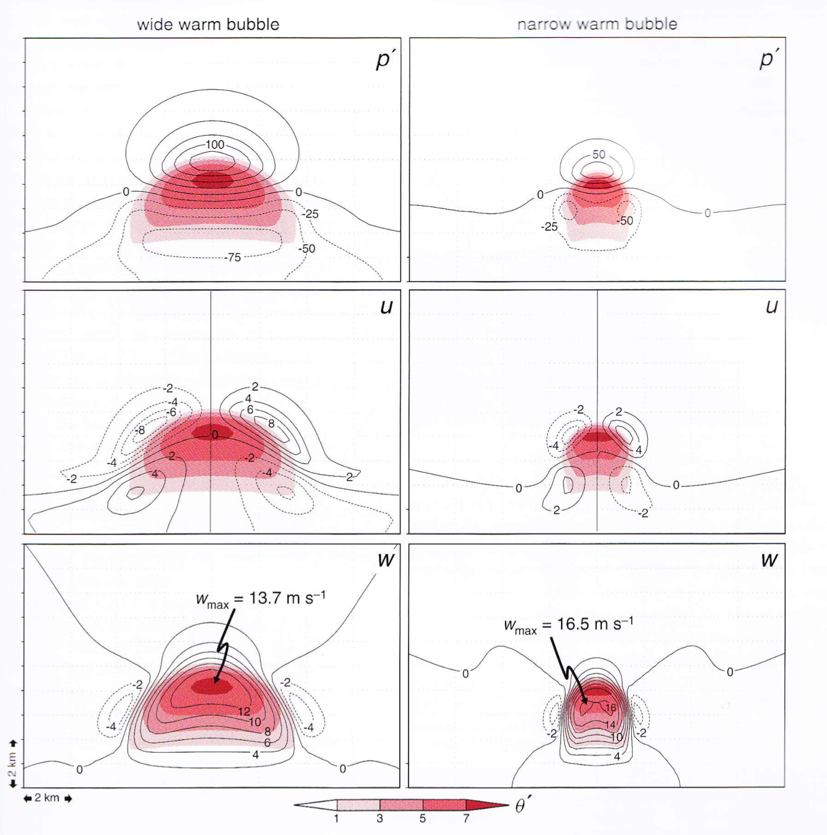
The basic response of the pressure field to a warm bubble is to generate high pressure above the bubble and low pressure beneath
Buoyancy is Scale-Dependent!!!

Slide 4
Or, more simply, consider the 2D horizontal vorticity equation:
where

Slide 5
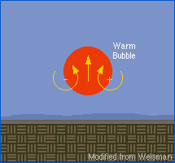

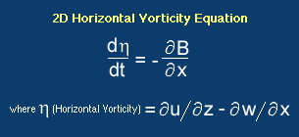
Buoyant Processes:
Buoyancy is Scale-Dependent!!!

Slide 6
CAPE:
Parcel Theory:
CAPE =
…following a parcel, ignoring p’
.5
Wmax = (2CAPE)

Slide 7
DCAPE
DCAPE =
…following a parcel downward
Wmin = (2DCAPE)

Slide 8
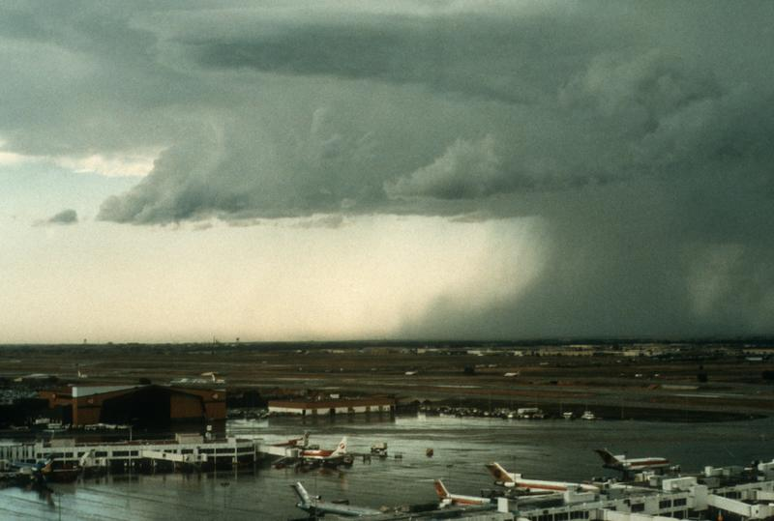
Cold Pools: Density Currents

Slide 9
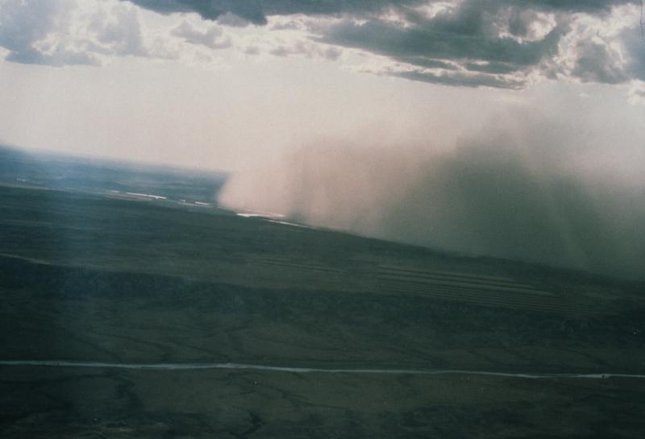

Slide 10
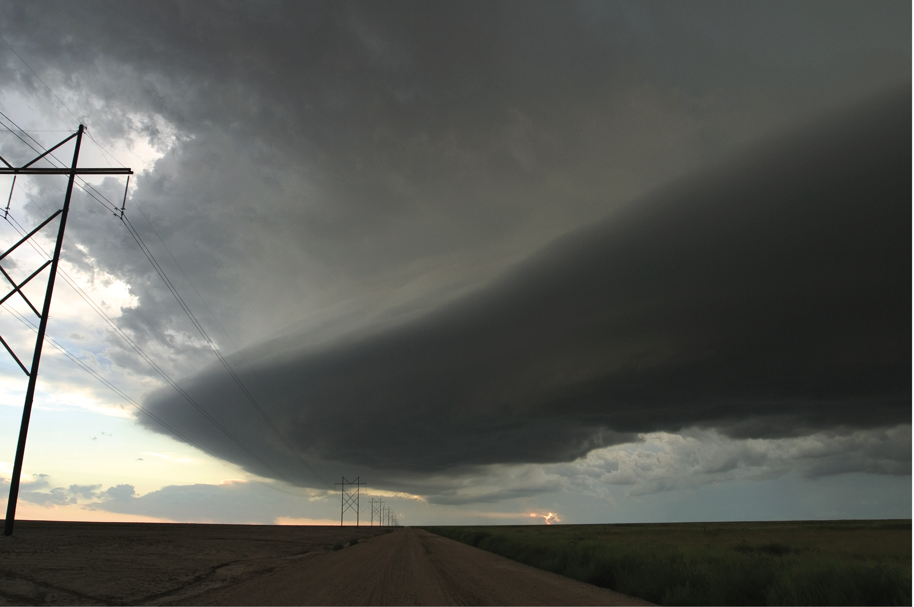

Slide 11
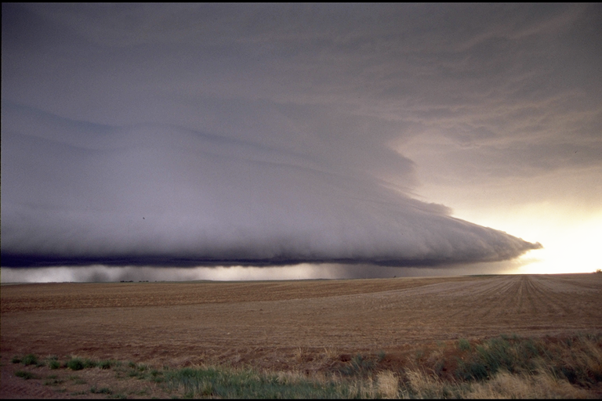

Slide 13
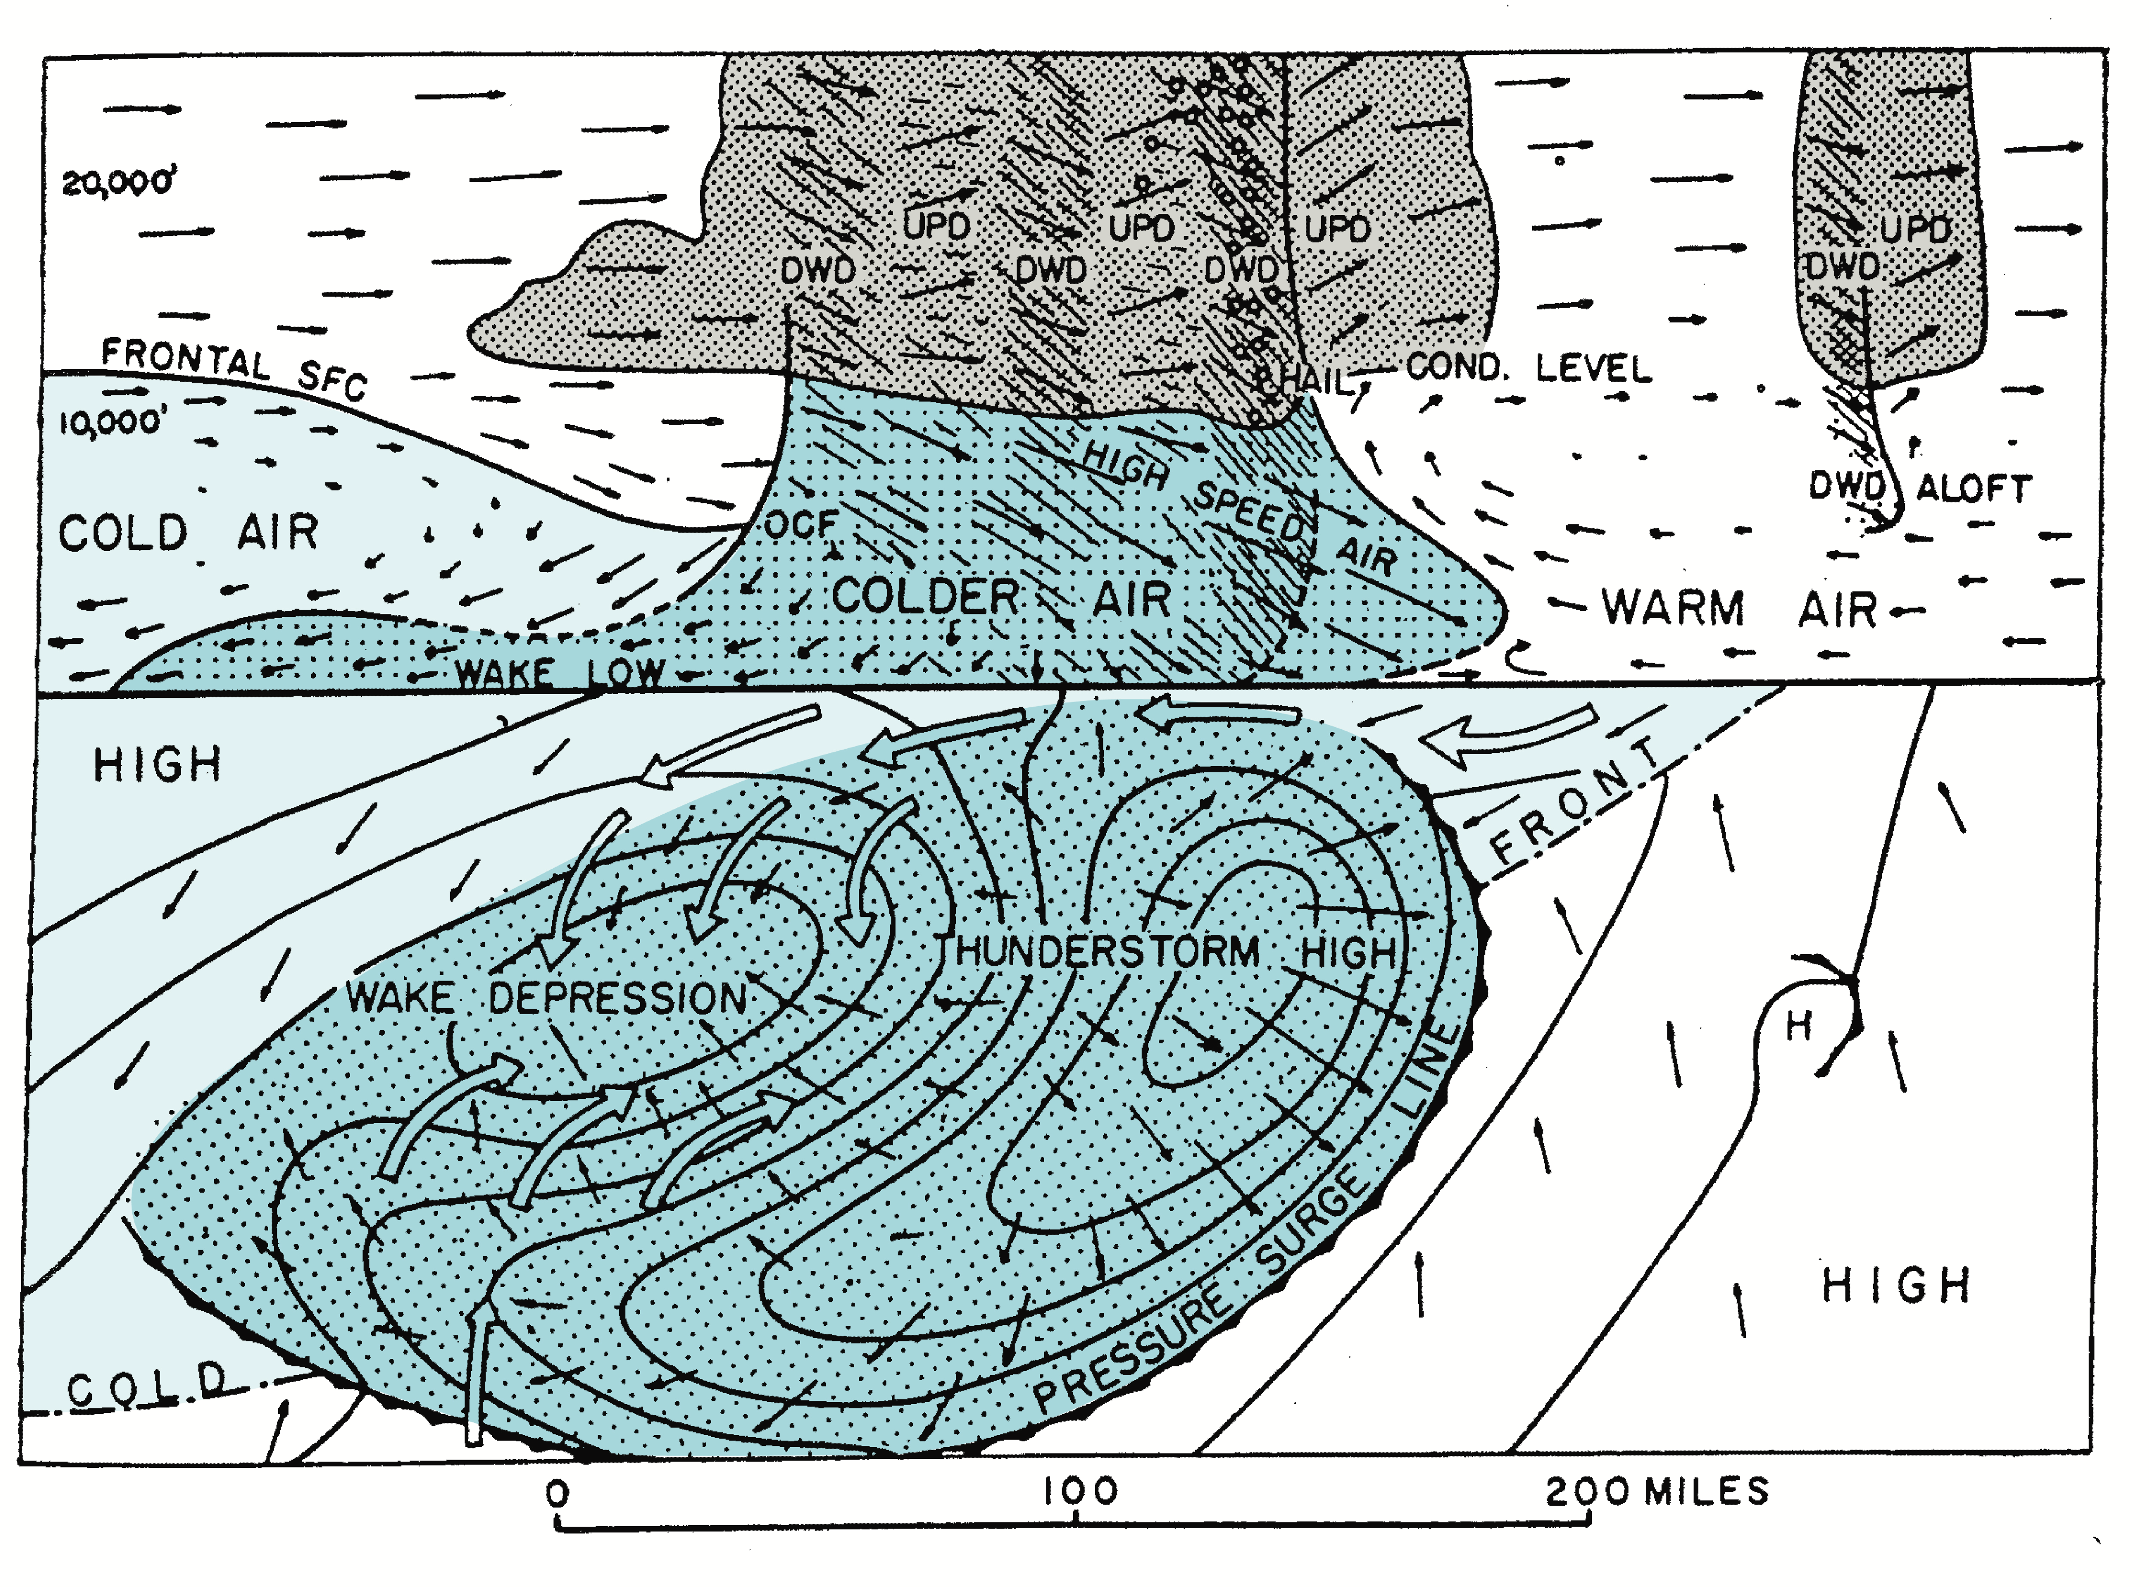
vertical
cross
section:
surface:
Fujita (1955)

Slide 16
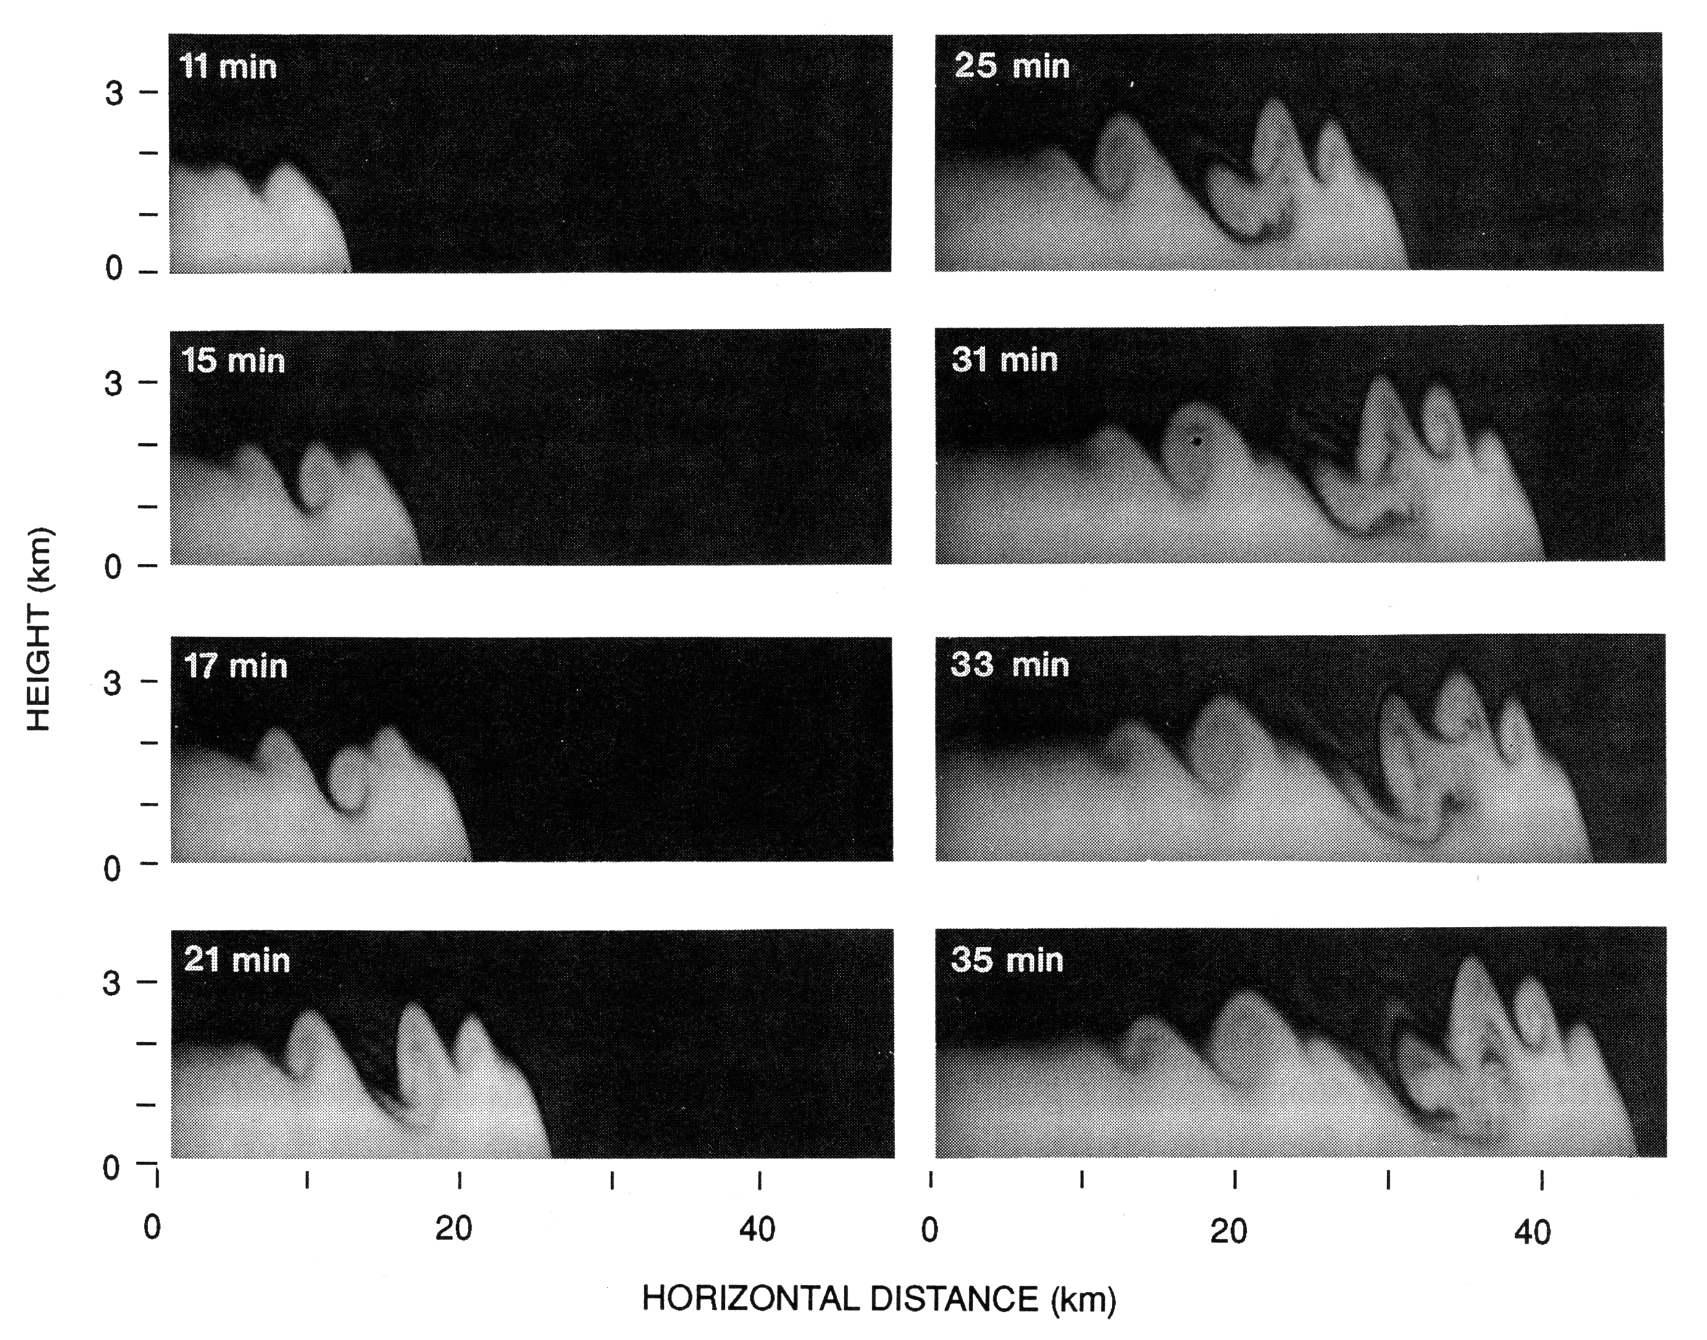
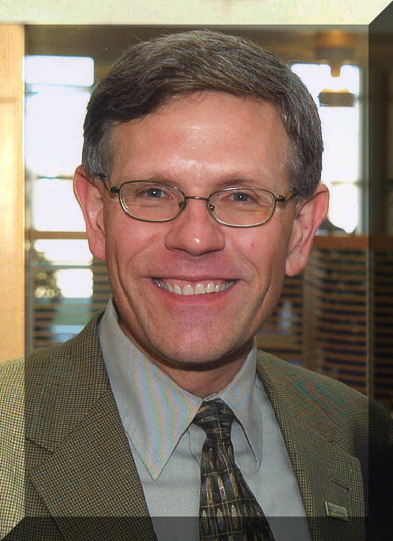
Droegemeier and Wilhelmson, JAS, 1987
…2D
…30 – 40 km
…100 – 200 m
You’ve all heard of “Kelvin” Helmholtz instability…????

Slide 17
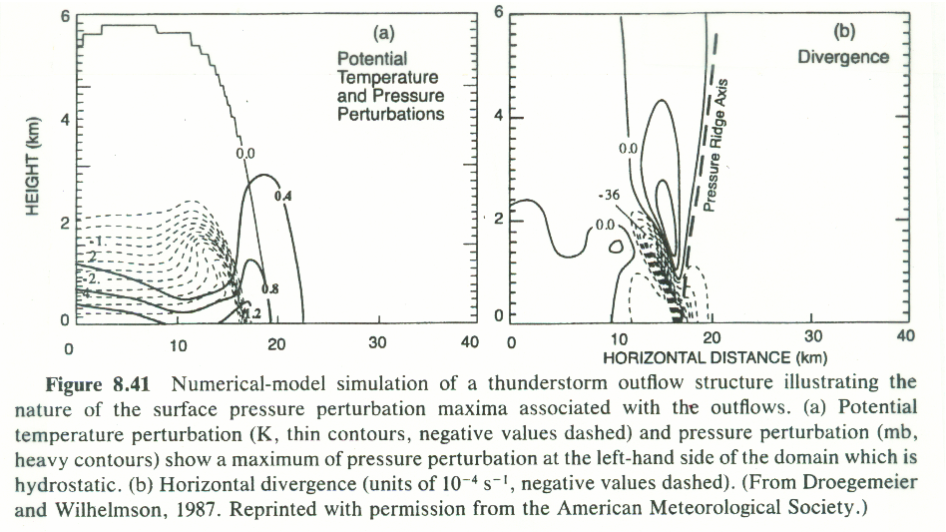

Slide 18
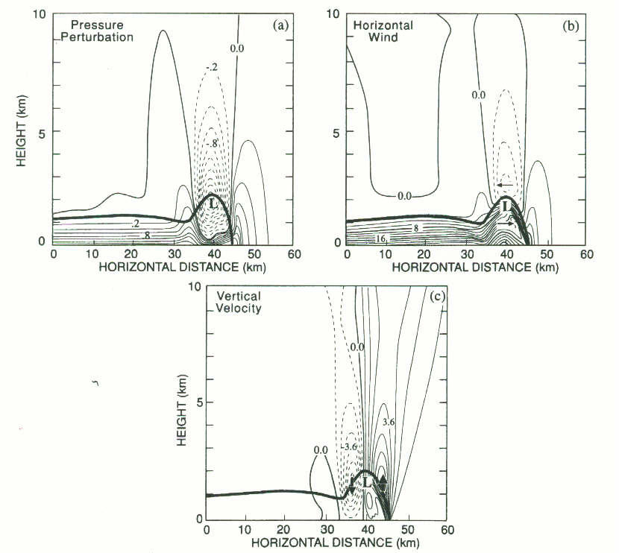

Slide 19
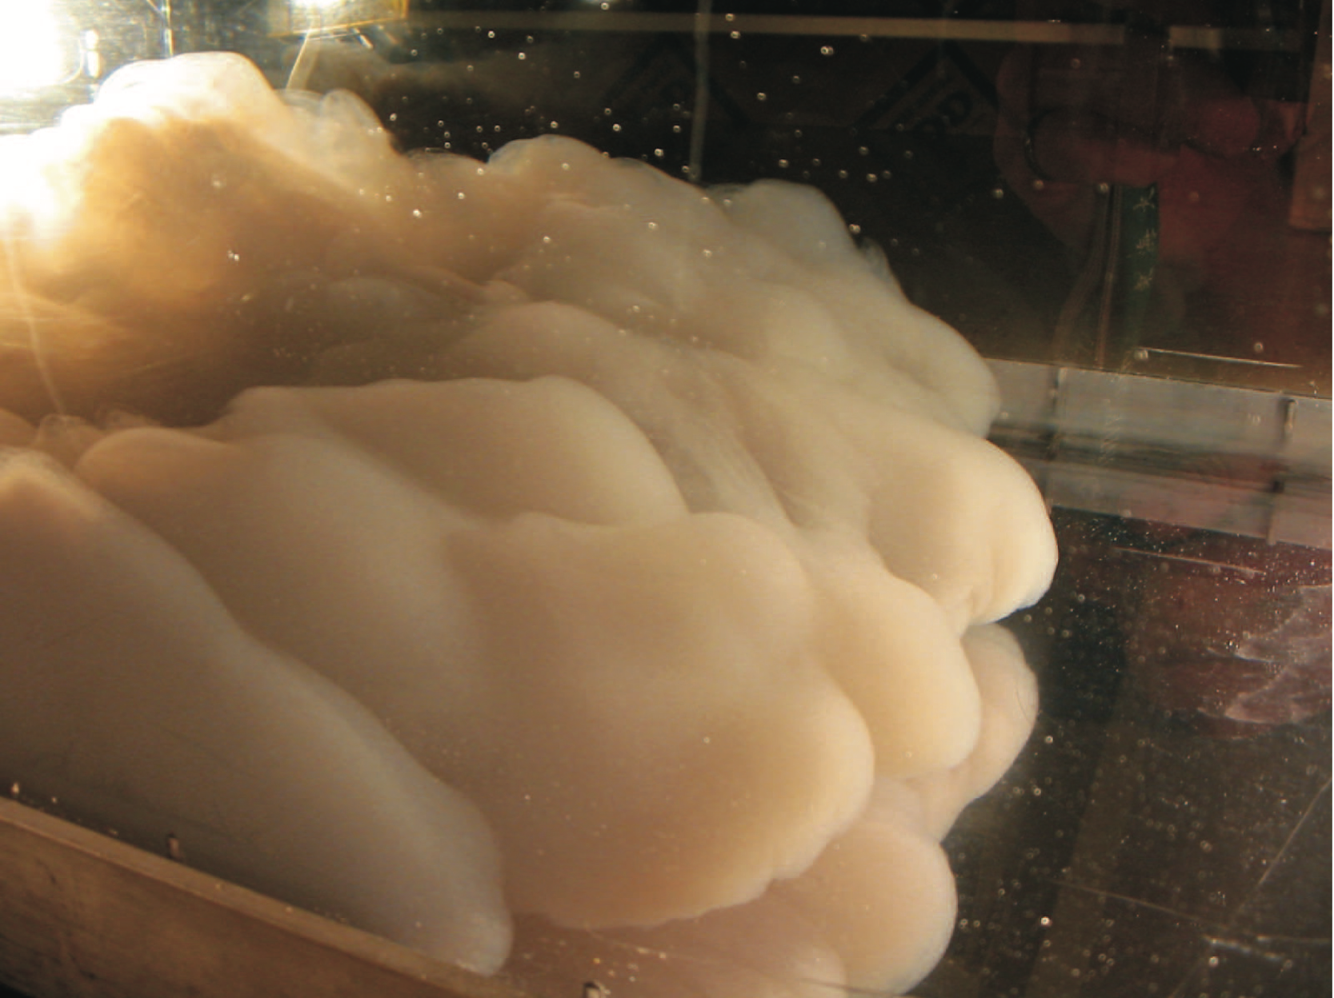
Density currents in the laboratory:

Slide 21
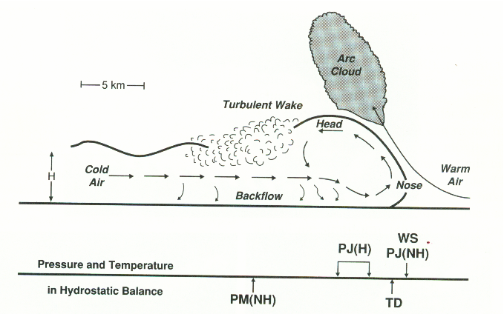
Density Currents…Gravity Currents…Cold Pools

Slide 22
Momentum Eq.
Assume steady state, follow along streamline:
Bernoulli Equation:

Slide 23
Density Currents
Bernoulli Equation:
(along a steady-state streamline)
Theoretical speed of propagation:

Slide 24
J. Fluid Mech. (1994)
“On the dynamics of gravity currents in a channel”
von Karman (1940)
Benjamin (1968)
von Karman:
Benjamin:

Slide 25
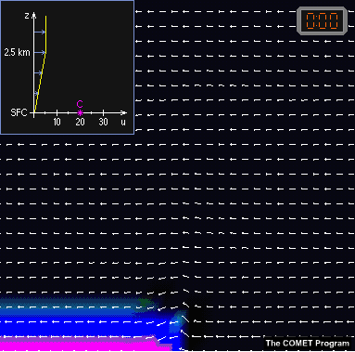

Slide 26
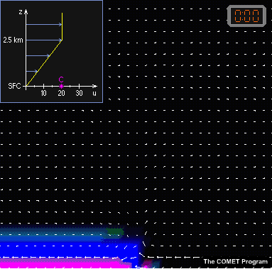

Slide 27
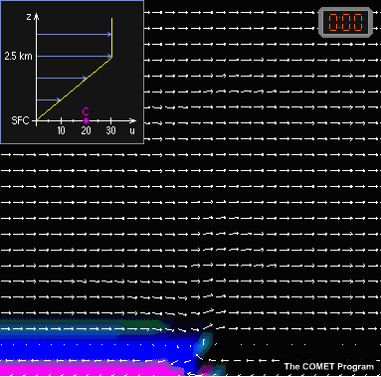

Slide 28
Horizontal Vorticity:
(in flux form)

Slide 29
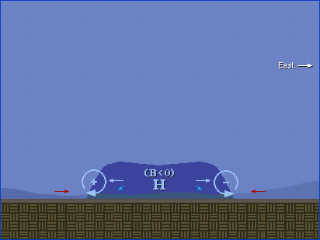
Density Current:

Slide 30
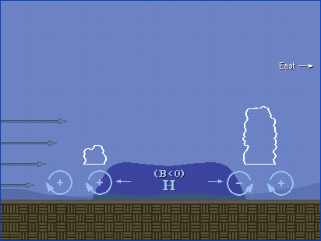

Slide 31
W=0
No vertical wind shear
⬅⬅⬅⬅
⬅⬅⬅⬅
⬅⬅⬅⬅⬅⬅⬅⬅⬅
⬆⬆⬆
⬅⬅⬅⬅⬅
Horizontal Vorticity:
(in flux form)
Over control volume

Slide 32
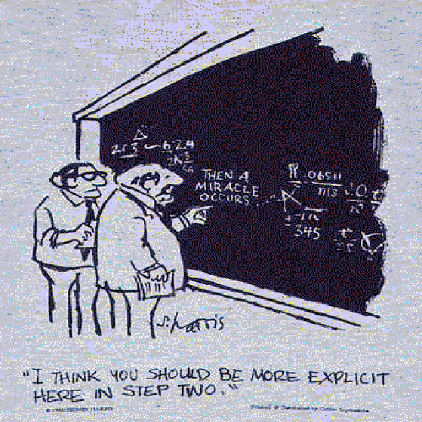

Slide 33
W=0
⬅⬅⬅⬅
⬅⬅⬅⬅
⬅⬅⬅⬅⬅⬅⬅
⬆⬆
⬅⬅⬅⬅
Assume steady state, Br=0, W=0 Use

Slide 34
W=0
⬅⬅⬅⬅
No vertical wind shear
⬅⬅⬅⬅
⬅⬅⬅⬅⬅⬅⬅
⬆⬆
⬅⬅⬅⬅
Assume no shear, no flow in cold pool….

Slide 35
⬆⬆⬆⬆⬆⬆⬆⬆⬆
With “optimal” vertical wind shear
⬅⬅⬅⬅
Now assume UL=0, Urd=0, symmetric updraft…
RKW “optimal” state:

Slide 36
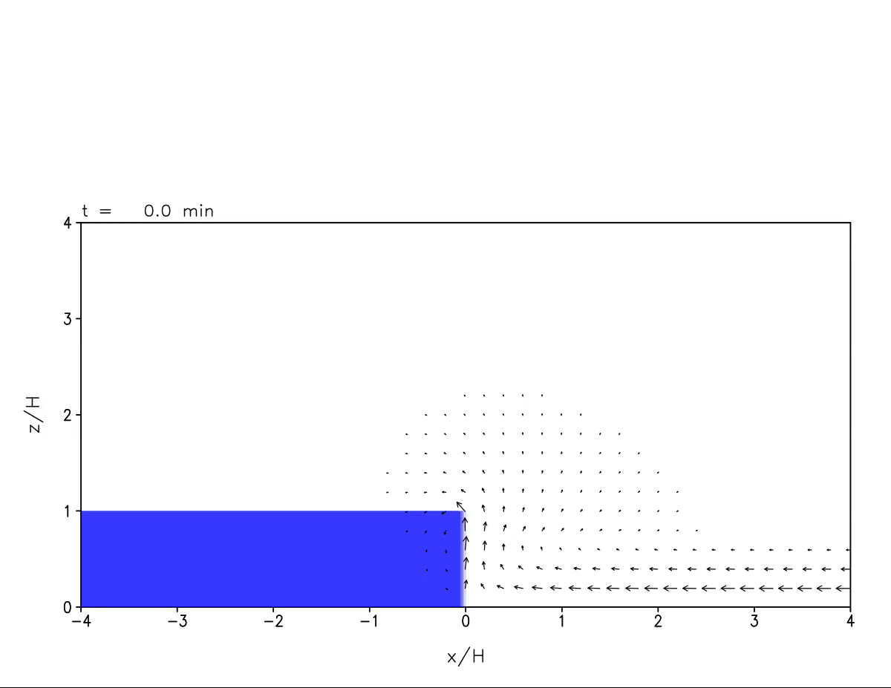
George Bryan: 31 m resolution using CM1
Simulation with necessary conditions for vertically oriented jet
z/H
x/H

Slide 37
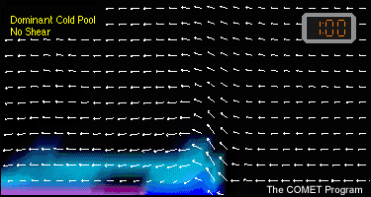
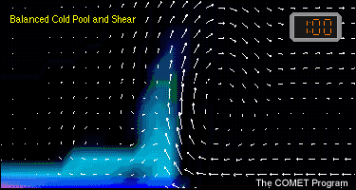
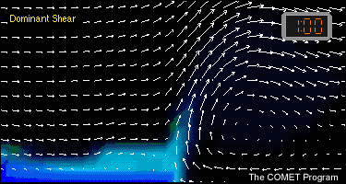
RKW Theory
Rotunno et al. (JAS, 1988)
C/∆u > 1
“Optimal” condition for cold pool lifting
C/∆u = 1
C/∆u < 1

Slide 38
Two Approaches to Environmental Shear
Vertically confined flow
Vertically unconfined flow
Originated with Benjamin (1968) (without shear)
Xu (1992), Xu et al. (1996), Xue (2000), etc, added shear
Originated with Rotunno, Klemp, and Weisman (1988)
First to include shear analytically
Xu (1992)
Rotunno et al. (1988)

Slide 39
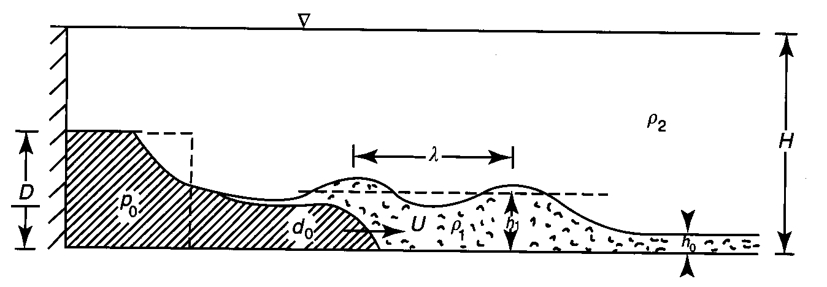
Shallow (Trapped) Wave-Like Disturbances
Density Current
Internal Bore of
Wavelength
Gravity-wave related phenomena can be excited by antecedent convection
Statically stable nocturnal PBL provides an environment where such
disturbances can maintain coherence
From Simpson (1997), An Introduction to Atmospheric Density Currents

Slide 40
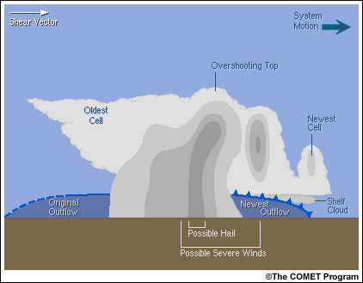
Multicell:

