Slide 1
Density Currents
Bernoulli Equation:
(along a steady-state streamline)
Theoretical speed of propagation:

Slide 2
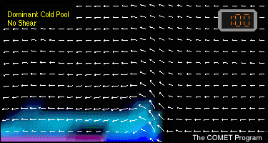
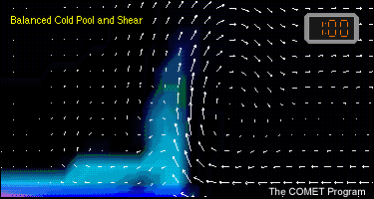
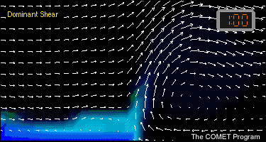
RKW Theory
Rotunno et al. (JAS, 1988)
Weak low-level shear
“Optimal” condition for cold pool lifting
Moderate low-level shear
Strong low-level shear

Slide 3
W=0
No vertical wind shear
⬅⬅⬅⬅
⬅⬅⬅⬅
⬅⬅⬅⬅⬅⬅⬅⬅⬅
⬆⬆⬆
⬅⬅⬅⬅⬅
Horizontal Vorticity:
(in flux form)
Over control volume

Slide 4
W=0
⬅⬅⬅⬅
⬅⬅⬅⬅
⬅⬅⬅⬅⬅⬅⬅
⬆⬆
⬅⬅⬅⬅
Assume steady state, Br=0, W=0 Use

Slide 5
W=0
⬅⬅⬅⬅
No vertical wind shear
⬅⬅⬅⬅
⬅⬅⬅⬅⬅⬅⬅
⬆⬆
⬅⬅⬅⬅
Assume no shear, no flow in cold pool….

Slide 6
⬆⬆⬆⬆⬆⬆⬆⬆⬆
With “optimal” vertical wind shear
⬅⬅⬅⬅
Now assume UL=0, Urd=0, symmetric updraft…
RKW “optimal” state:

Slide 7
RKW Theory
Rotunno et al. (JAS, 1988)
C/∆u > 1
“Optimal” condition for cold pool lifting
C/∆u = 1
C/∆u < 1

Slide 8
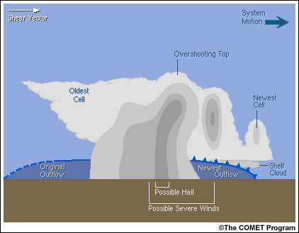
Multicell:

Slide 9
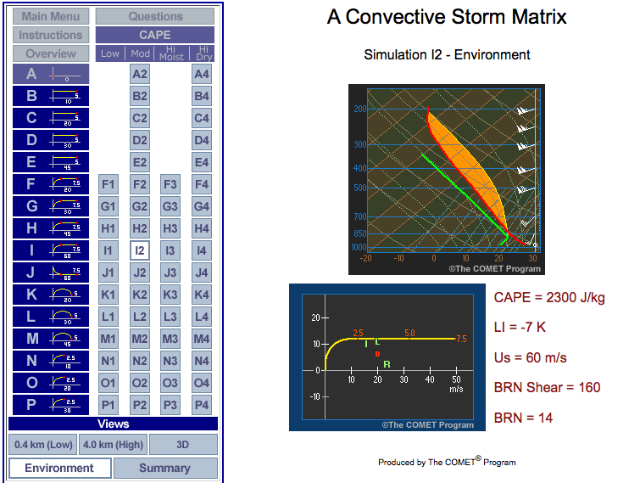
http://www.meted.ucar.edu/convectn/csmatrix/

Slide 10
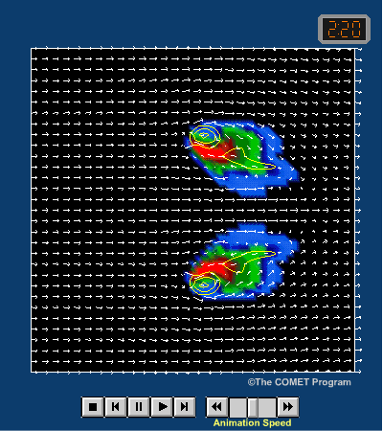
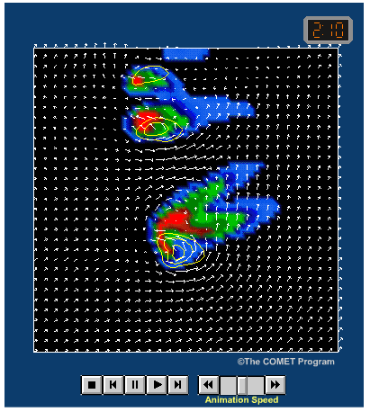
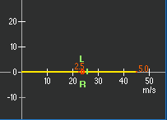
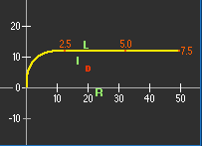
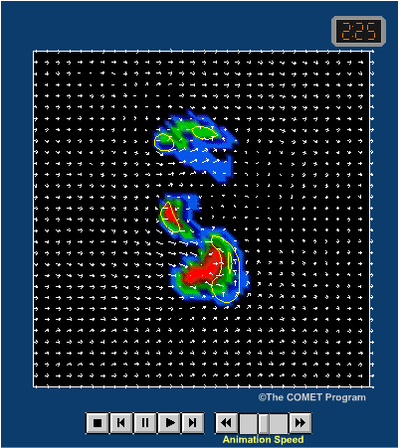
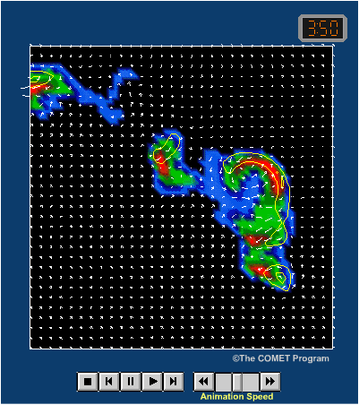
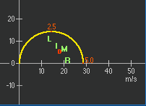
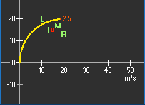
Splitting Supercells
Right-moving Supercell
High-Prec. Supercell
Bow-Echo

Slide 11
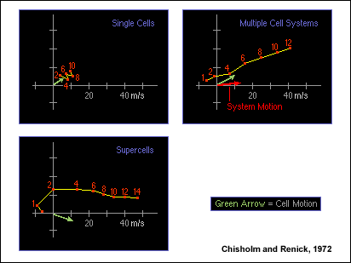

Slide 12
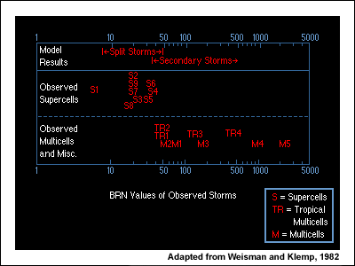

Slide 15
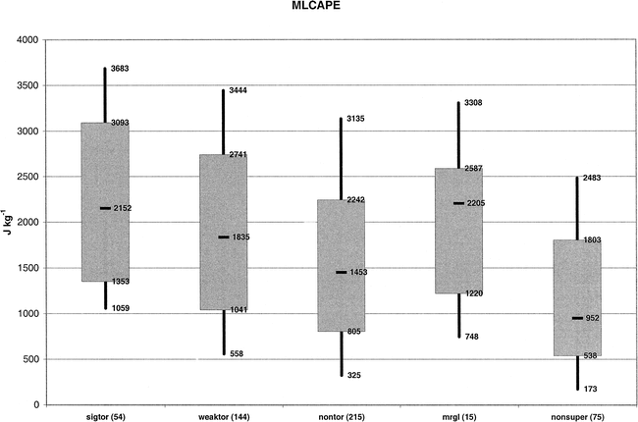
Thompson et al. WAF 2003

Slide 16
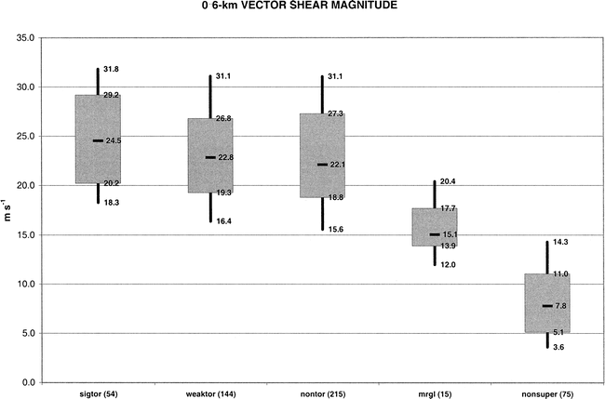
Thompson et al. WAF 2003

Slide 17
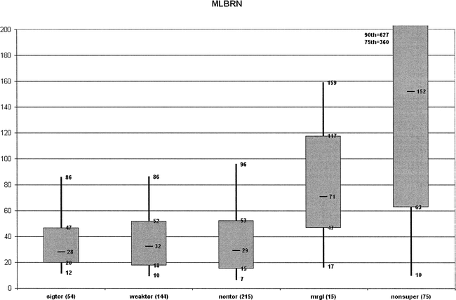
Thompson et al. WAF 2003

Slide 18
Bunkers et al. WAF 2006: Long-lived Supercells

Slide 19
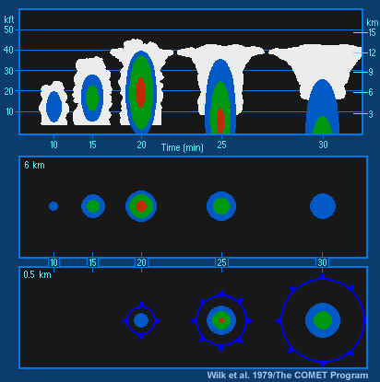
Ordinary Cell:
Buoyancy processes dominate

Slide 20
Multicell:
Cold pool / vertical shear processes contribute to cell regeneration

Slide 21
Supercells

Slide 22
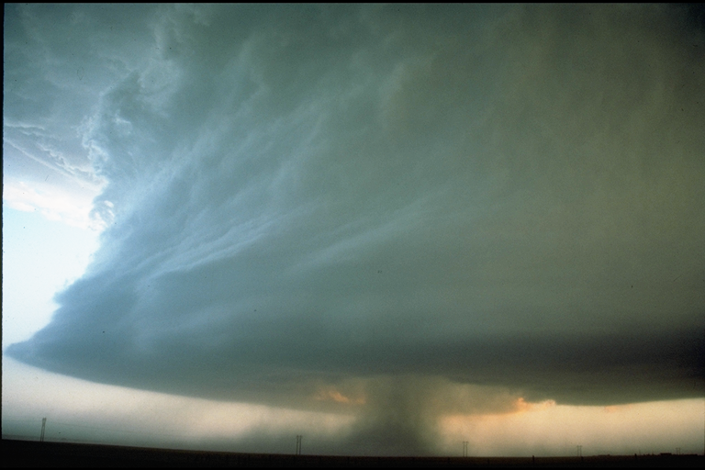

Slide 23
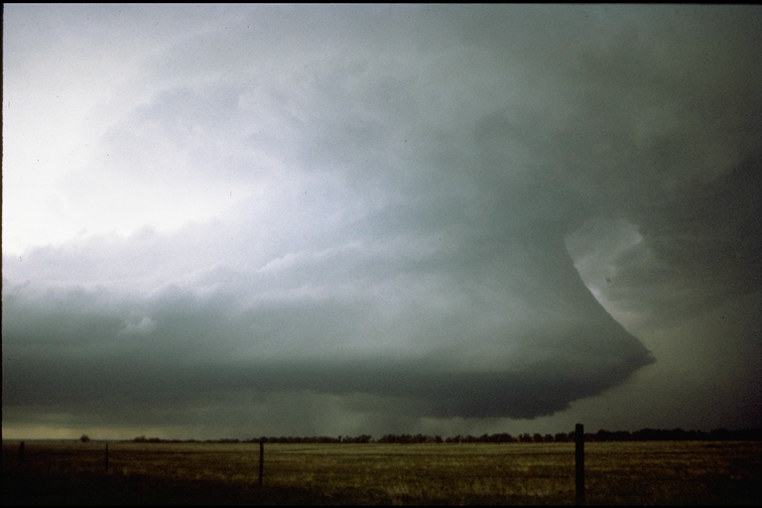

Slide 24
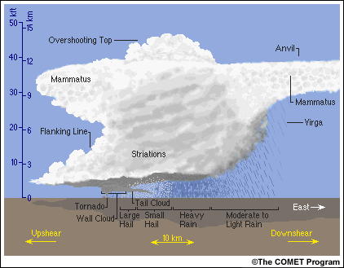
Supercell:

Slide 25
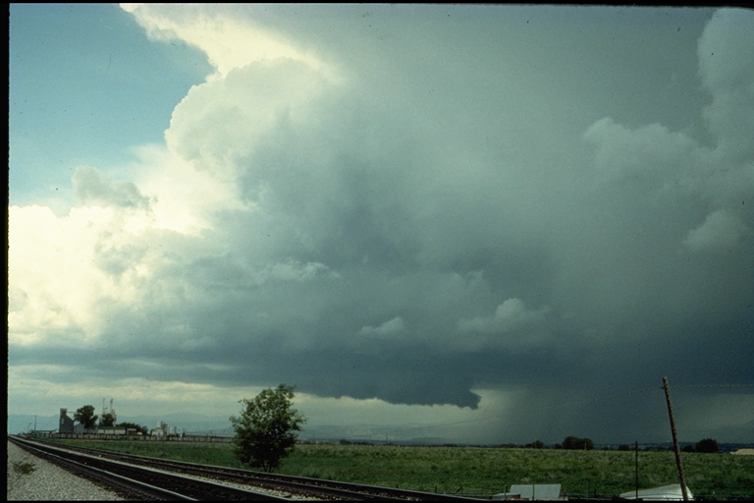

Slide 26
Browning 1964

Slide 29
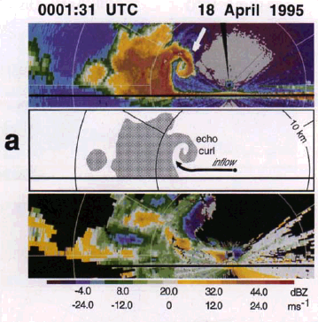
from: Wakimoto et al. (1996)

Slide 30
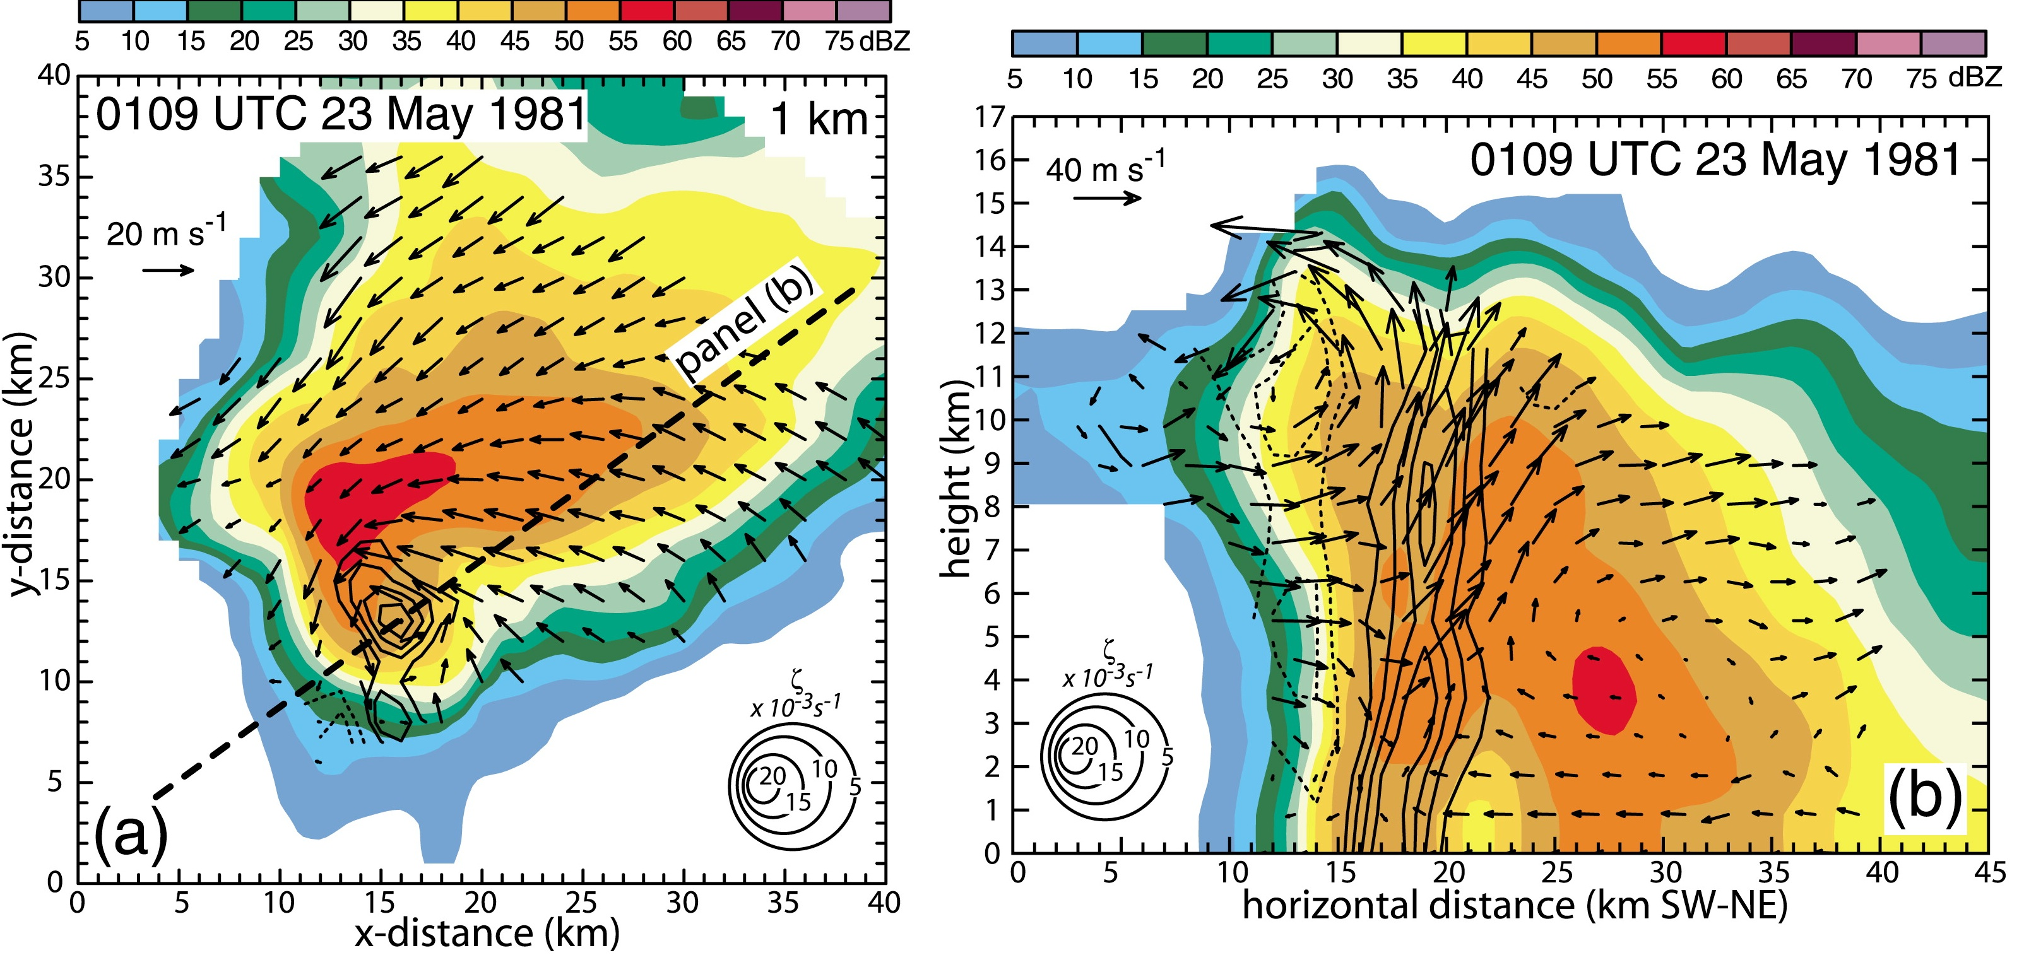

Slide 31
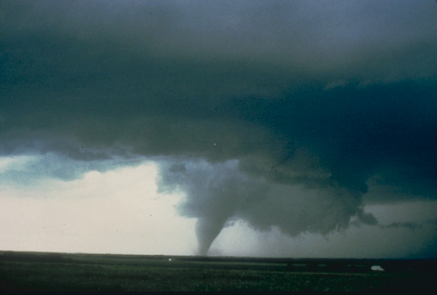
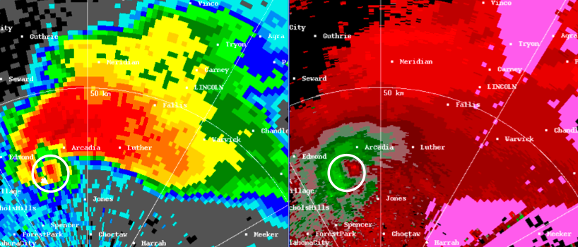
Supercell Surface Features
velocity couplet associated with mesocyclone
hook echo

Slide 33
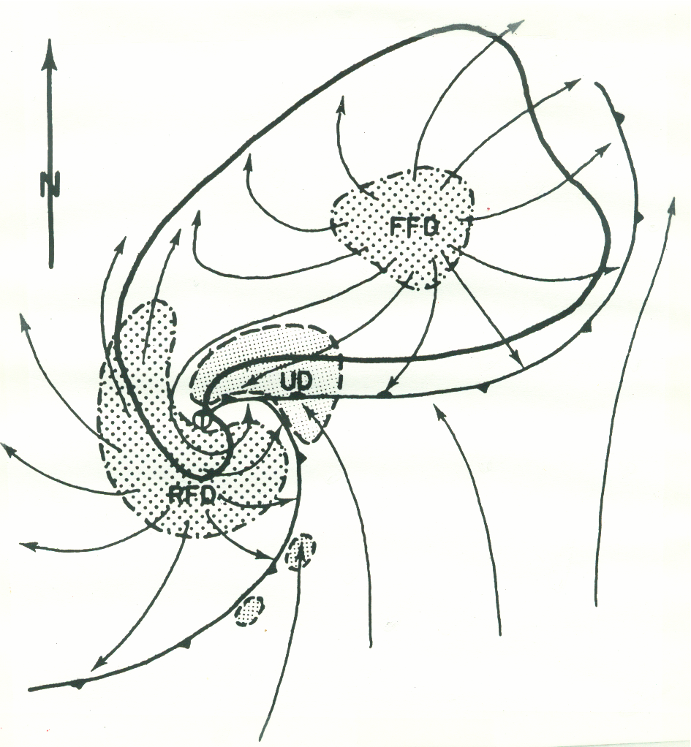

Slide 35
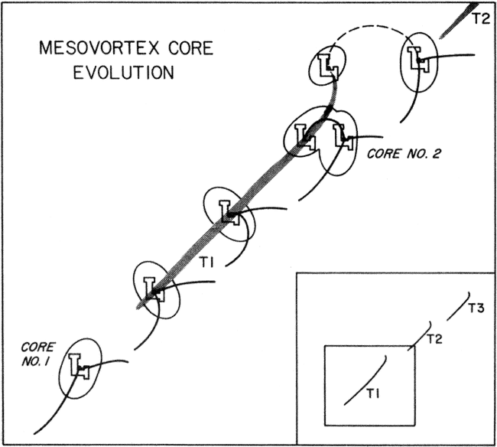

Slide 36
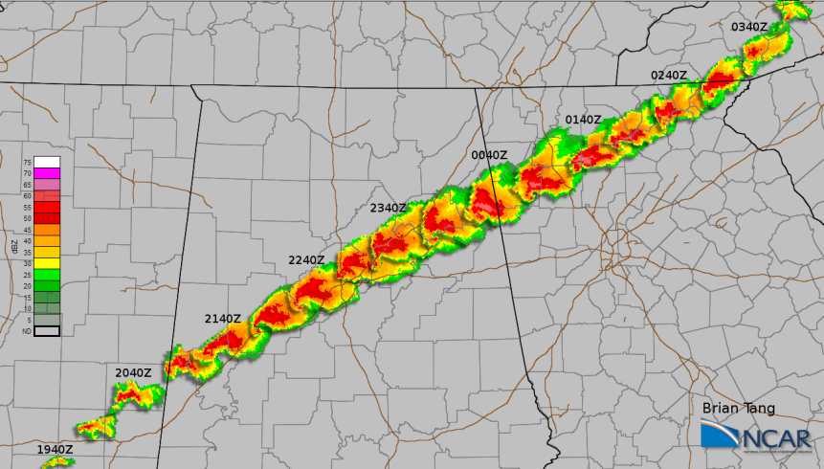
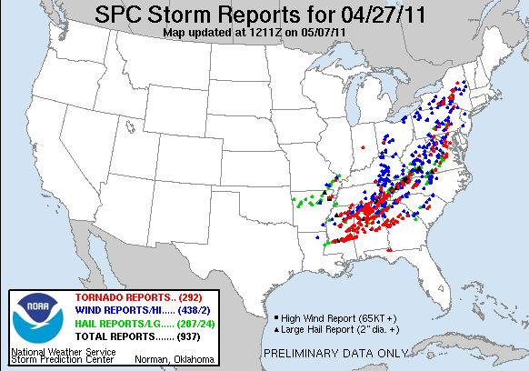
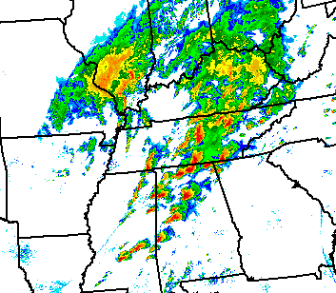
27 April 2011 Tornado Outbreak
Tuscaloosa-Birmingham Storm (Radar Observations)
Storm Longevity!!
Radar Observations (22 UTC)

Slide 37
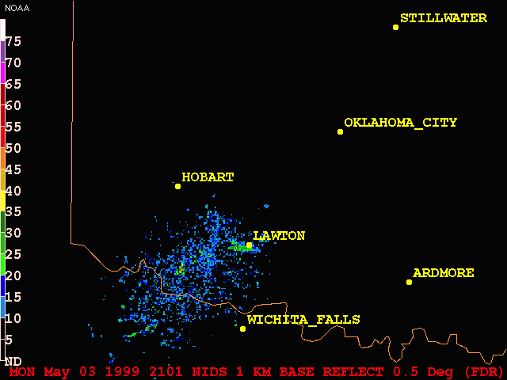
Splitting Supercells, 3 May 1999

Slide 38
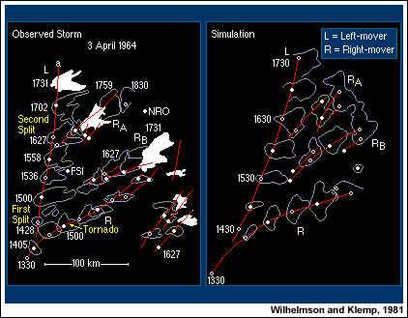

Slide 42
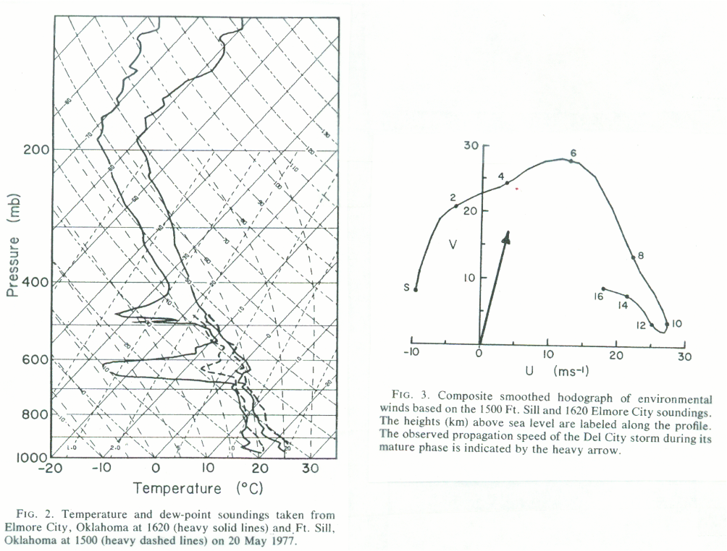
Klemp et al., JAS 1981 “Del City storm”

Slide 43
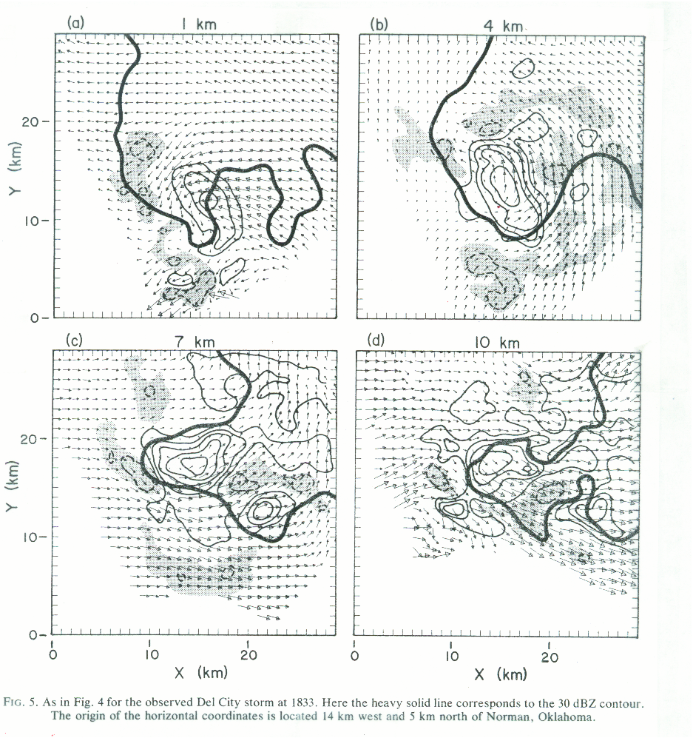

Slide 44
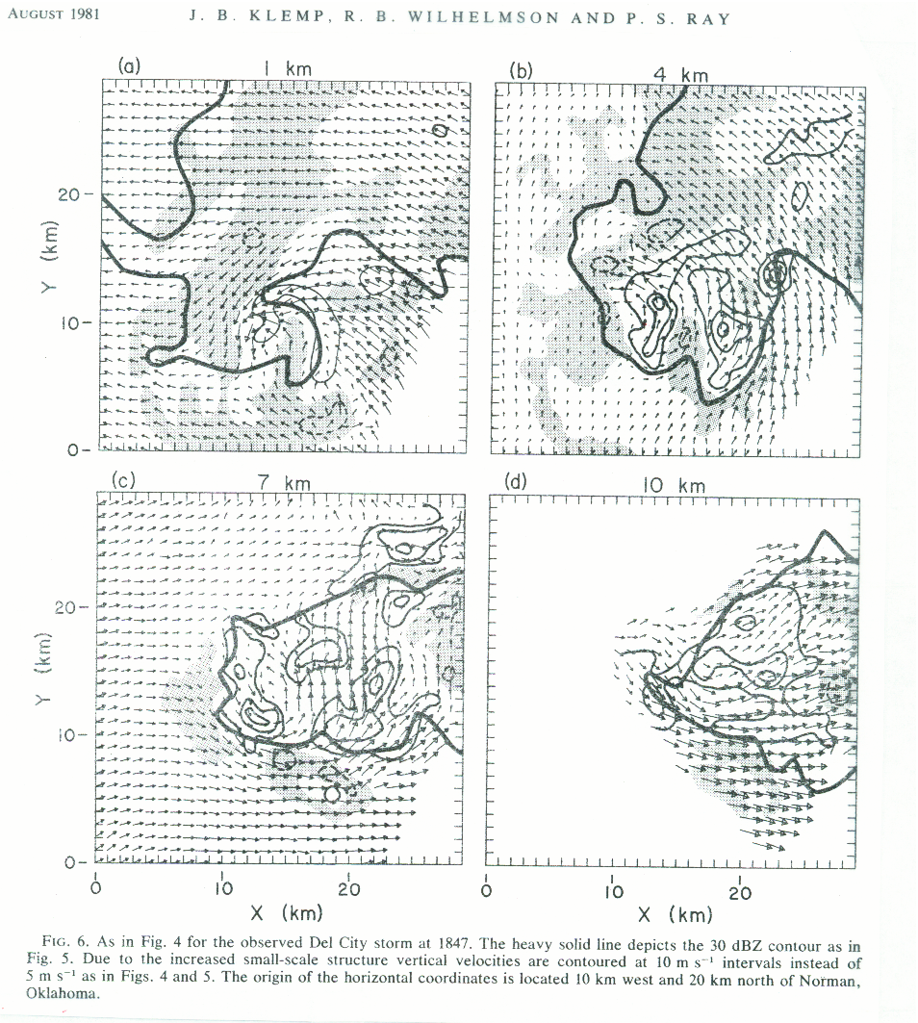

Slide 45
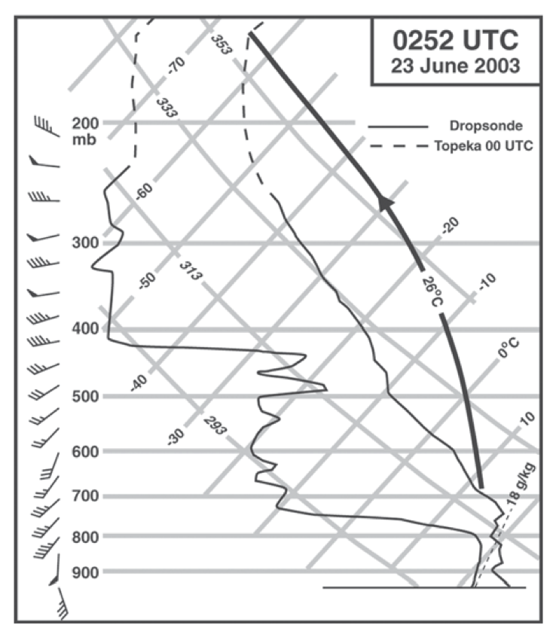
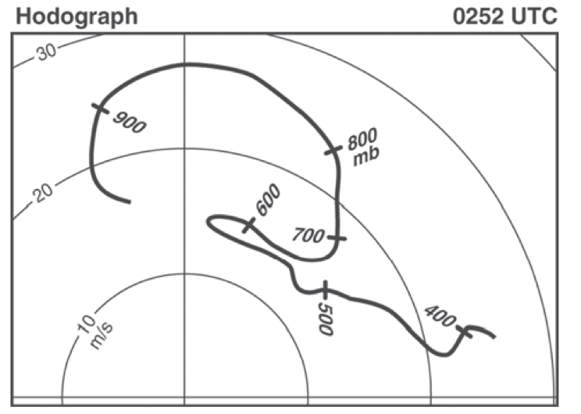

Slide 46
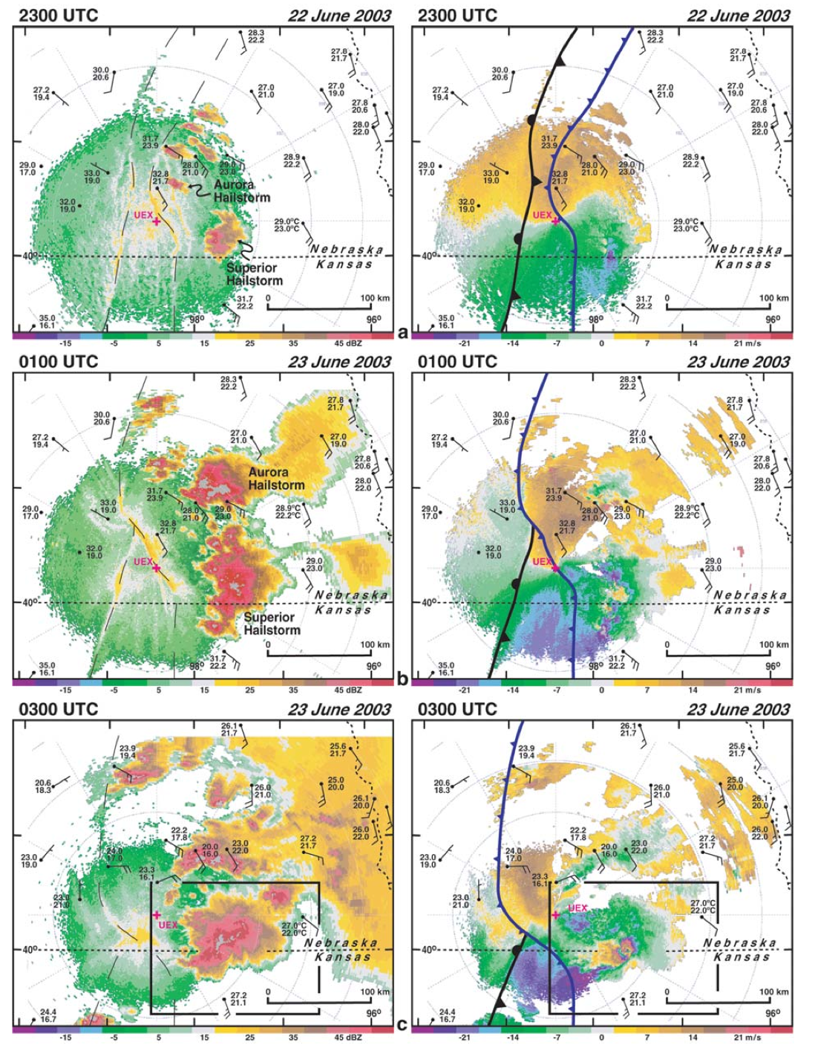

Slide 47
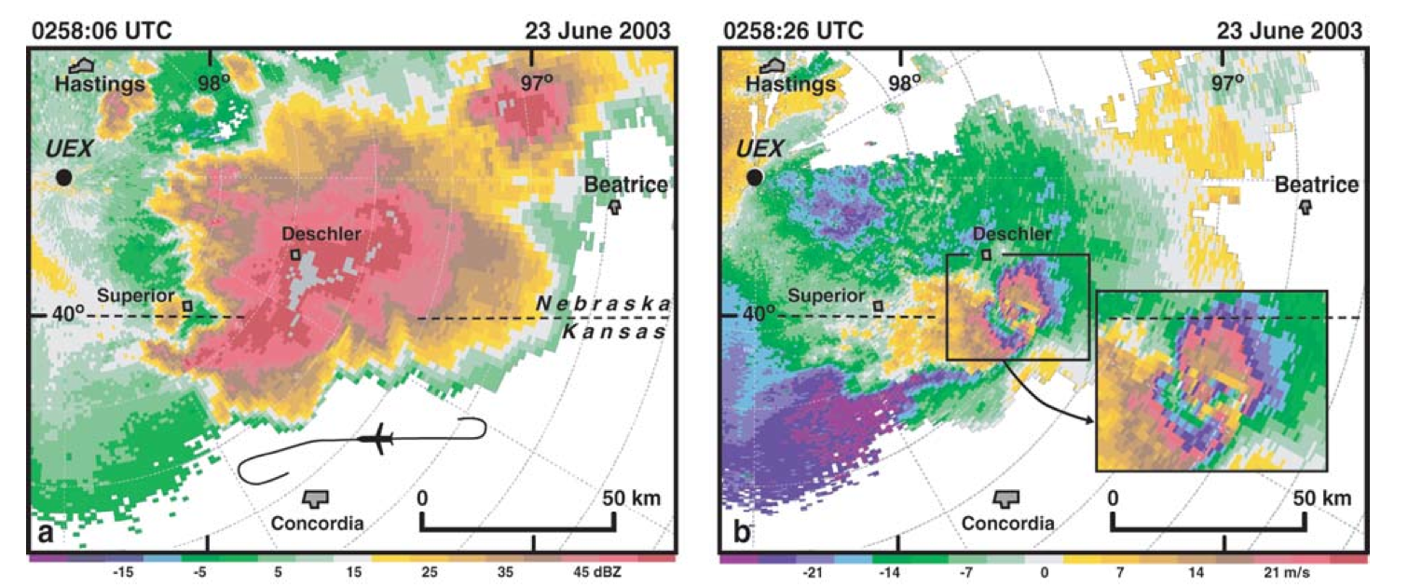

Slide 48
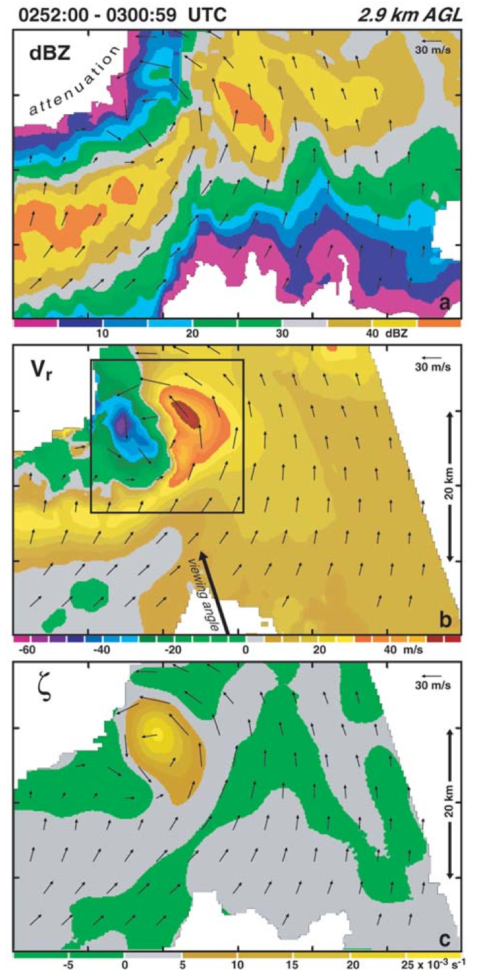

Slide 49
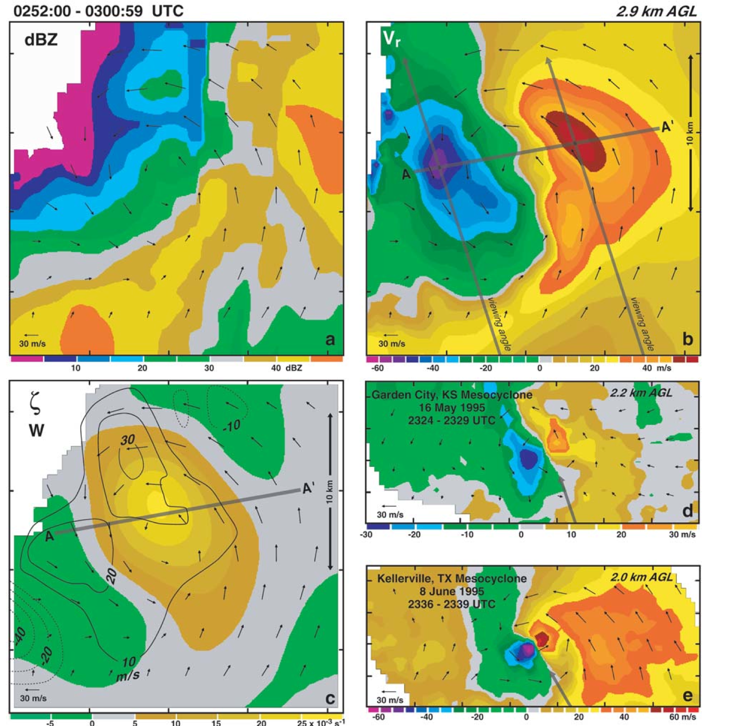

Slide 50
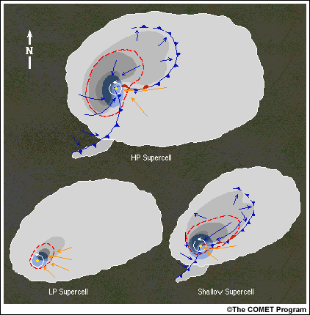

Slide 51
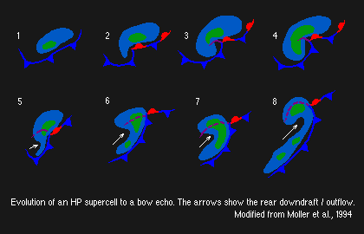

Slide 52
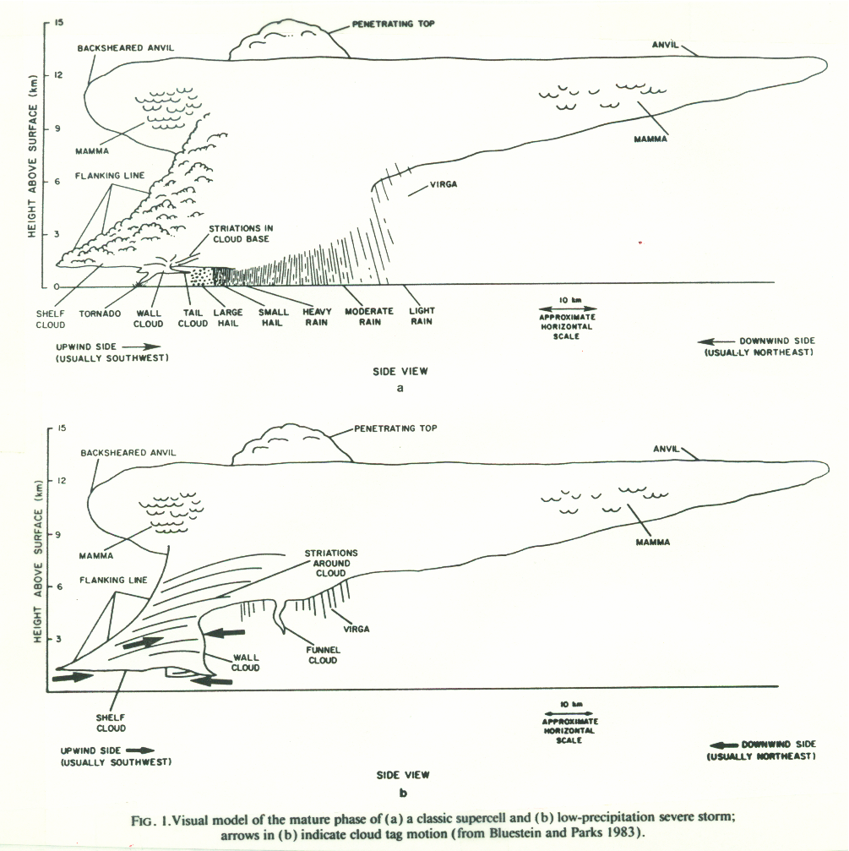

Slide 53
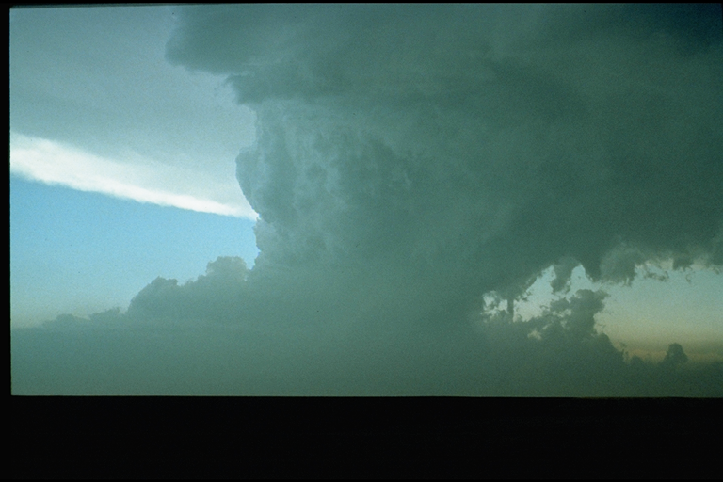

Slide 54
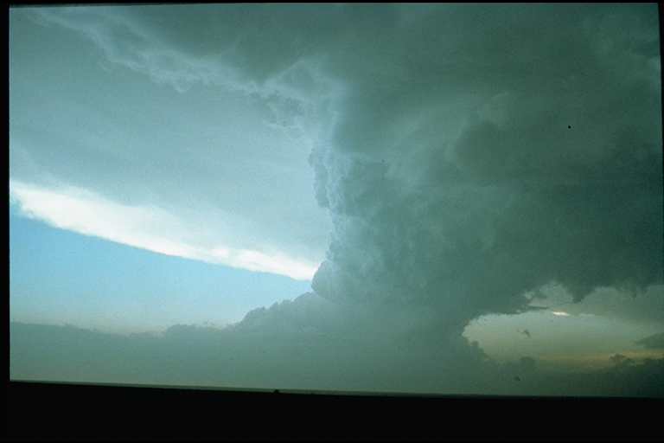

Slide 55
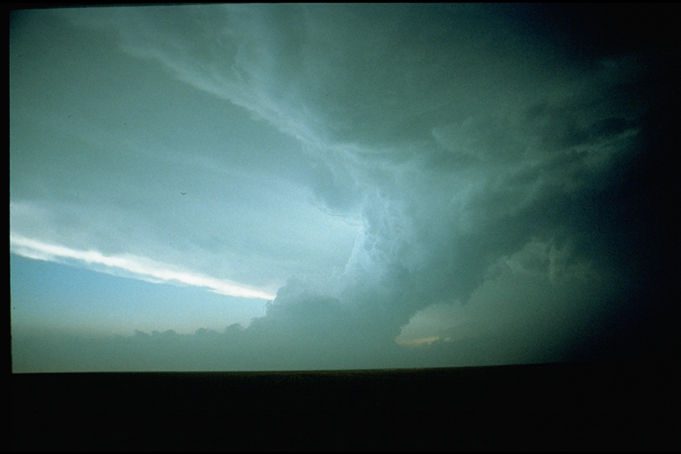

Slide 56
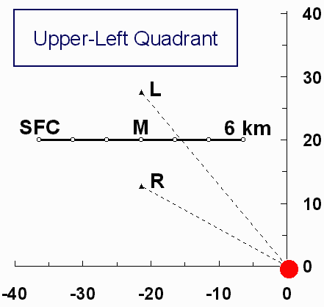


Supercell Hodographs:
Storm Motion:
Mean + Propagation

Slide 57

Bunkers et al. WAF 2000

