Slide 1
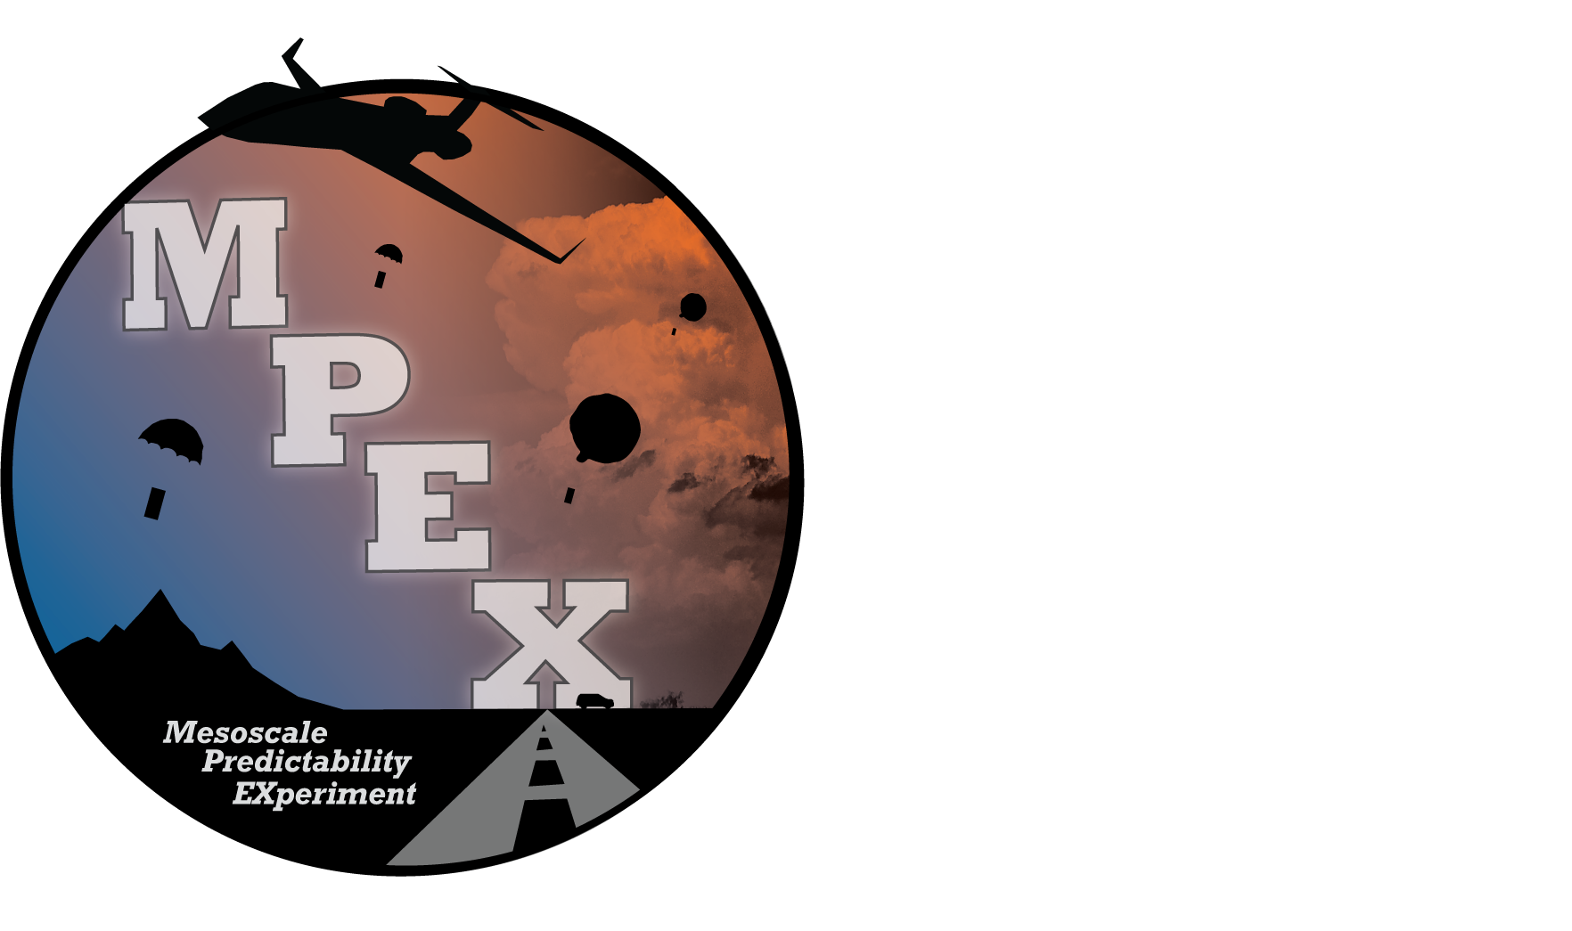


“The Mesoscale Predictability Experiment:
Overview and Results from a Realtime
Ensemble-based Forecast System”
Morris Weisman, NCAR/MMM
NCAR
NOAA-GSD-NSSL
SUNY Albany
Purdue
Univ. Wisconsin-Milwaukee
Colorado State University
MMM Lab Seminar 01/22/15

Slide 2
MPEX PIs:
NCAR/MMM:
Morris Weisman, Chris Davis, Glen Romine, Craig Schwartz,
Tom Galarneau, Stan Trier, Wei Wang , Kevin Manning,
Dave Ahijevych, Kate Fossel, Ryan Sobash
Purdue:
Jeff Trapp, Mike Baldwin
SUNY Albany:
Ryan Torn, Lance Bosart
CSU:
Russ Schumacher
Univ. Wisconsin/Milwaukee:
Clark Evans, Paul Roebber
NOAA/NSSL:
Dave Stensrud, Jack Kain, Mike Coniglio
NOAA/GSD:
John Brown and David Dowell

Slide 3
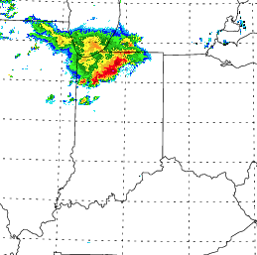
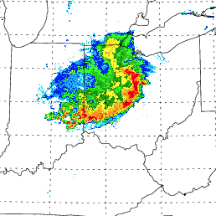
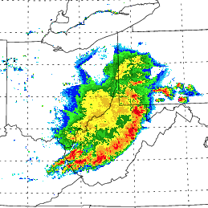
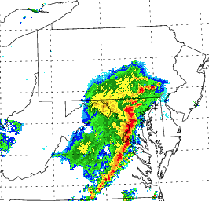
Convectively explicit (3 km) forecasts can be quite “good”
e.g. 29 June 2012 Derecho:
18 UTC (6 h)
21 UTC (9 h)
00 UTC (12 h)
03 UTC (15 h)
3 km WRF-ARW Forecast: DART Analysis, MYJ, Morrison
18 UTC
21 UTC
00 UTC
03 UTC
Composite Radar

Slide 4
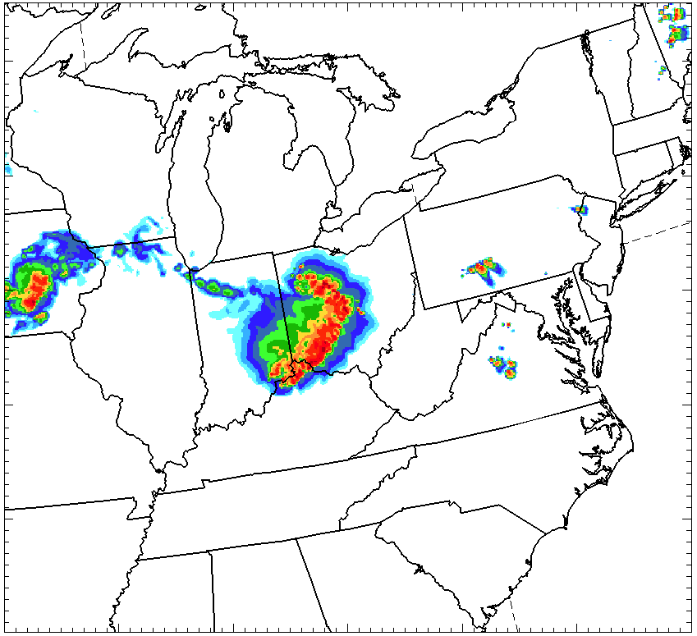
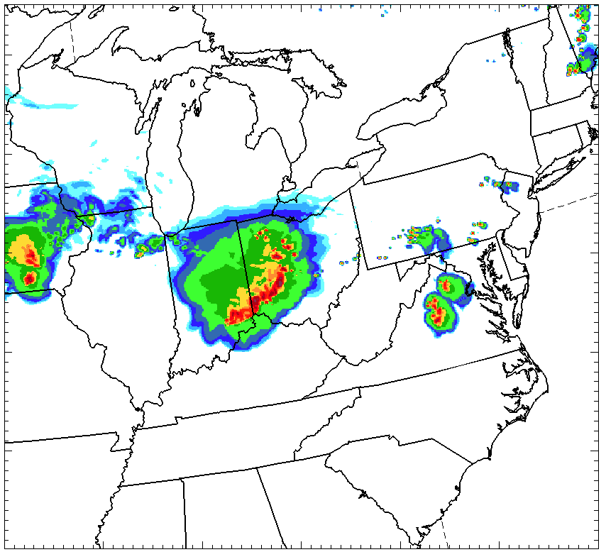
…but are especially sensitive to the initial analysis!!
29 June 2012 Derecho
DART-Morrison-MYJ
DART-Morrison-YSU
DART-Thompson-MYJ
GFS
NAM
RUC

Slide 5
Key MPEX Question:
Can the predictability of significant convective events be improved by reducing analysis uncertainty at the synoptic and sub-synoptic scales?
Enhanced observational periods:
…Morning dropsonde and MTP observations over the Rocky Mountain states, upstream of anticipated convective outbreaks over the High Plains
…Afternoon mobile sounding observations to validate morning model forecasts and to measure the impact of convection on its local environment

Slide 6
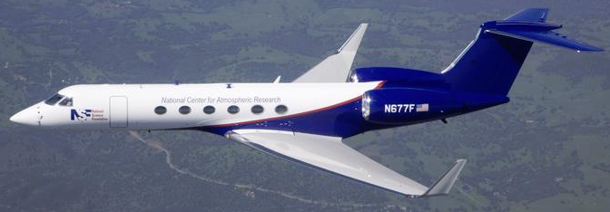
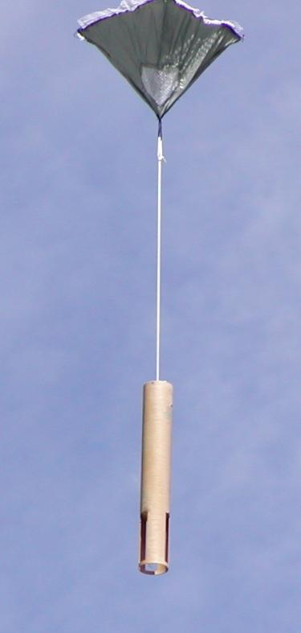
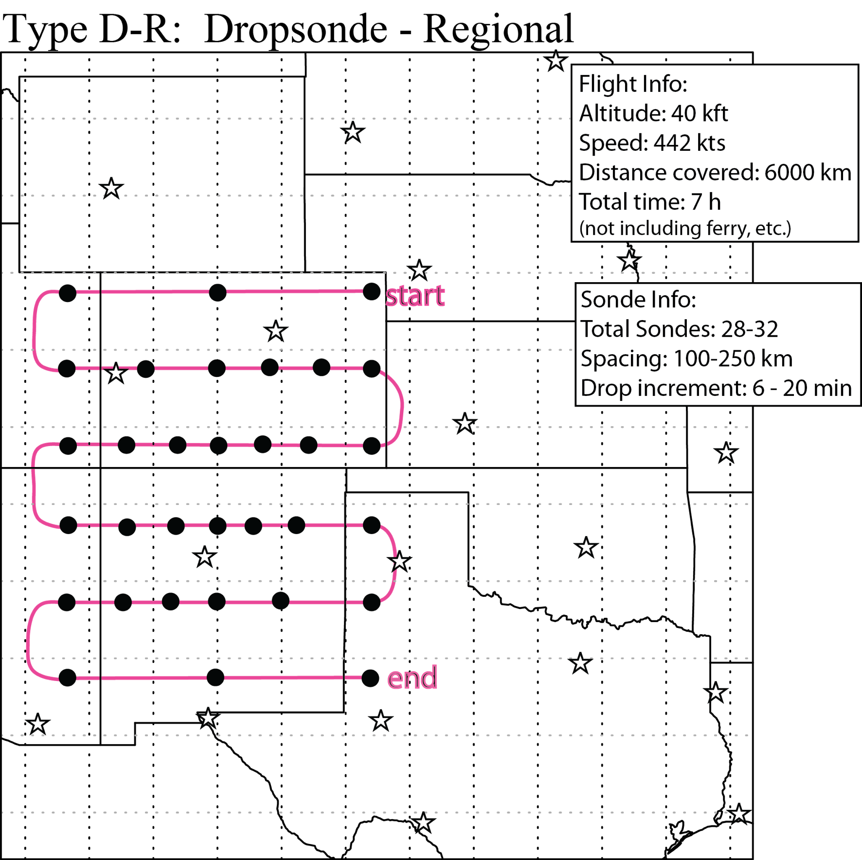
Morning Dropsonde Observations:
15 May – 15 June 2013
Early Morning GV Flights:
NCAR GPS Dropsondes
( MIST, Mini, AVAPS II/Vaisala RD-94 )
Sample morning deployment
Dropsonde observations to better characterize the upstream sub-synoptic and mesoscale structure of the troposphere…
**Overall Goal: improve 6–24 h downstream convective forecasts

Slide 7
31 May 2013 “El Reno Tornado”
Aircraft observations taken early in the morning, upstream from expected severe storms
12:00 UTC ~200 hPa winds
Severe storms develop over central Oklahoma later that afternoon
23:00 UTC

Slide 8
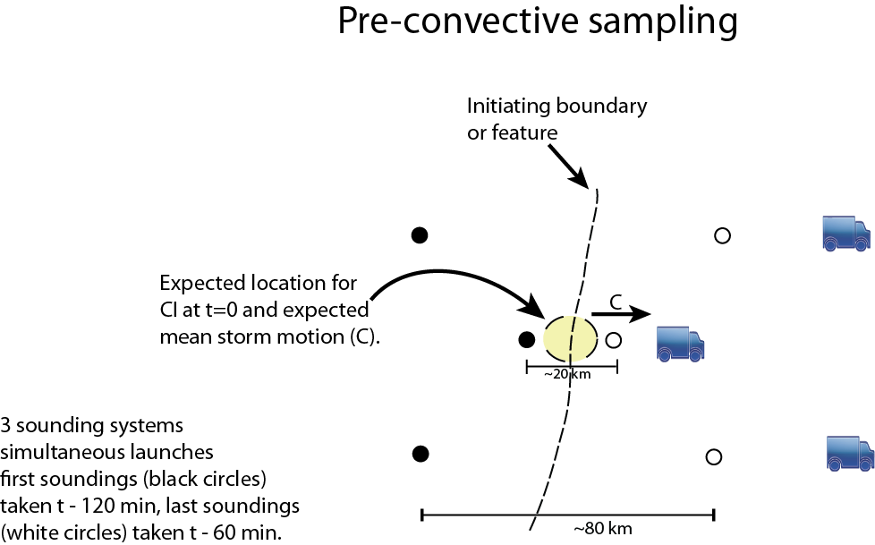
Afternoon Mobile Sounding Launches:
(Jeff Trapp, Mike Coniglio, Russ Schumacher, Dave Stensrud)

Slide 9
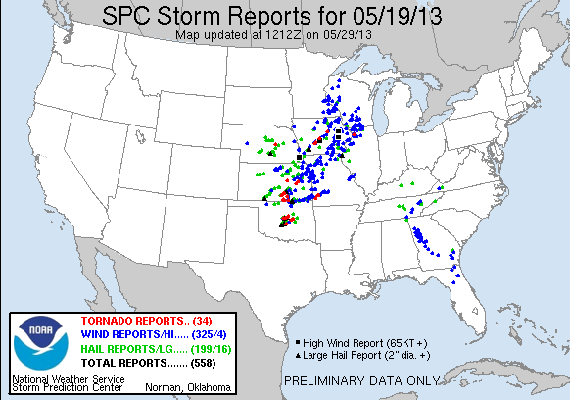
05/19/13

Slide 10
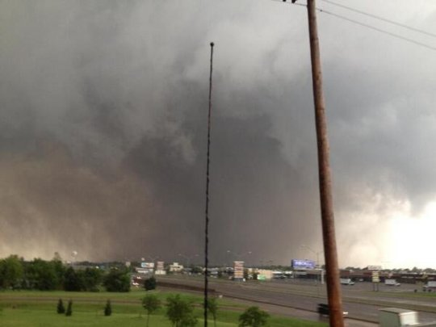
Moore, Oklahoma May 20, 2013

Slide 11
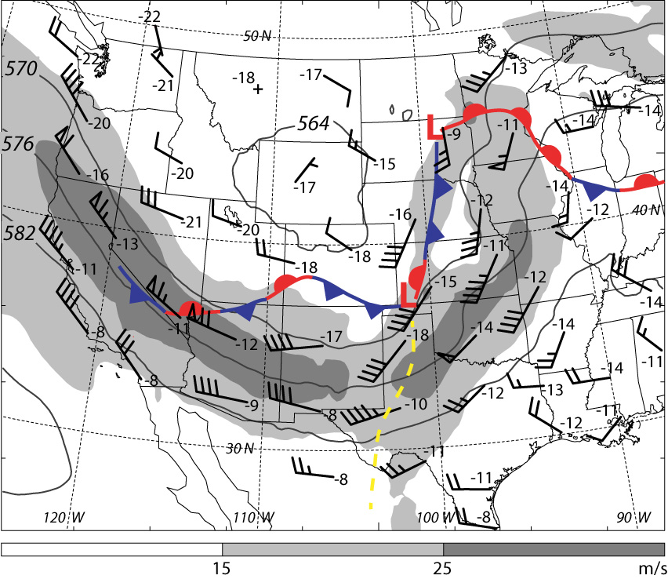
MPEX Case Example: 19 May 2013 12 UTC
500 hPa winds, height, temperature and composite surface features:

Slide 12
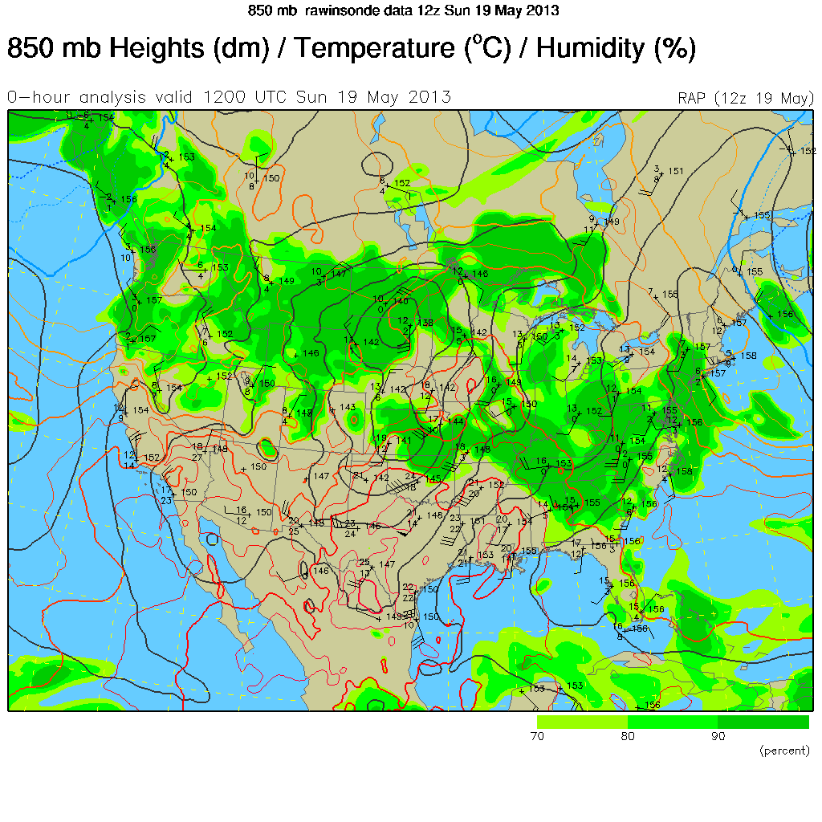

Slide 14
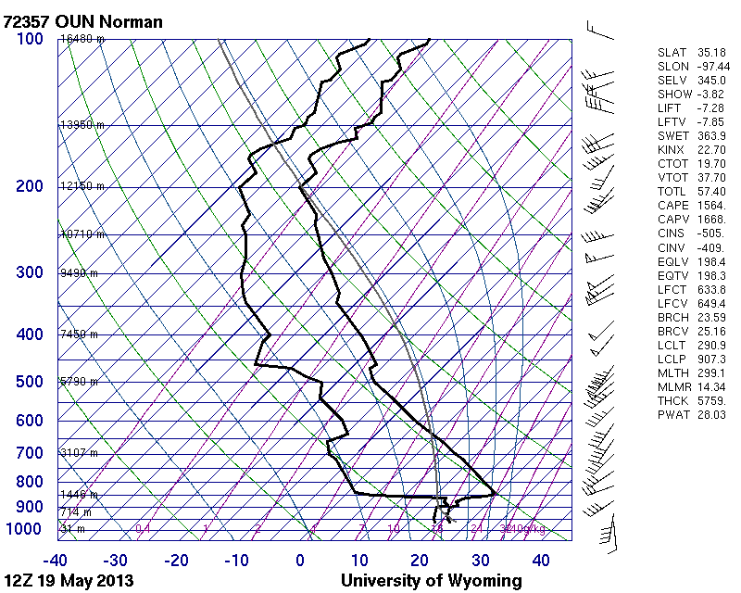

Slide 15
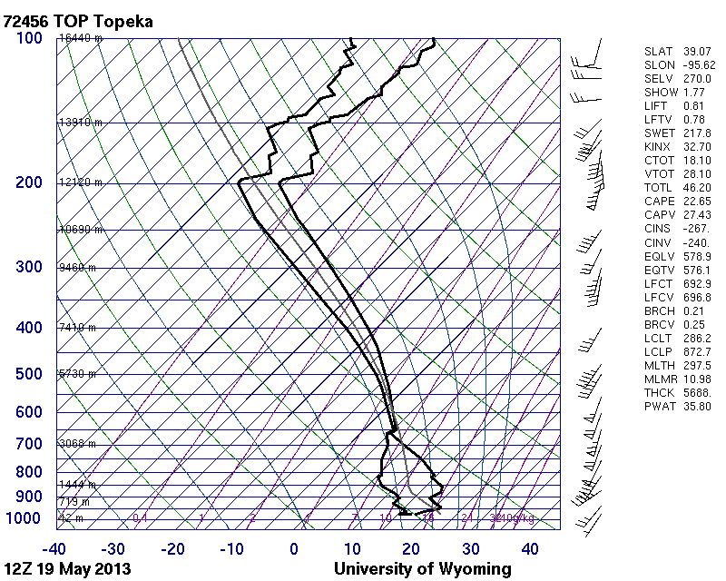

Slide 16
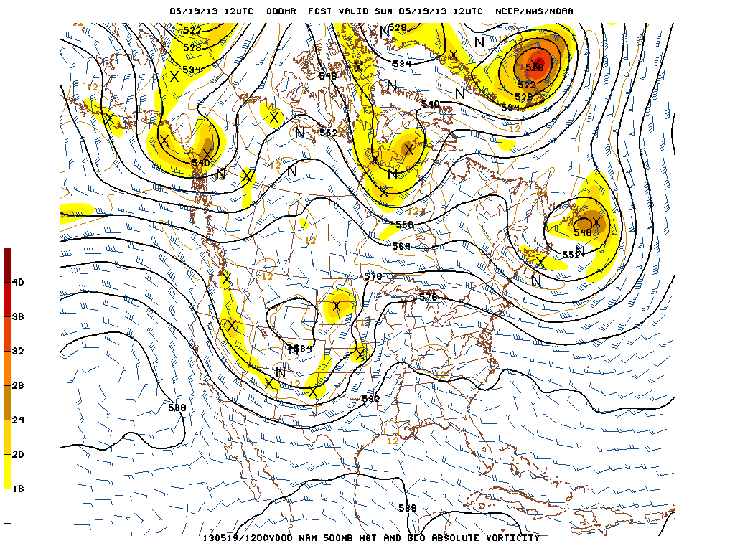

Slide 17
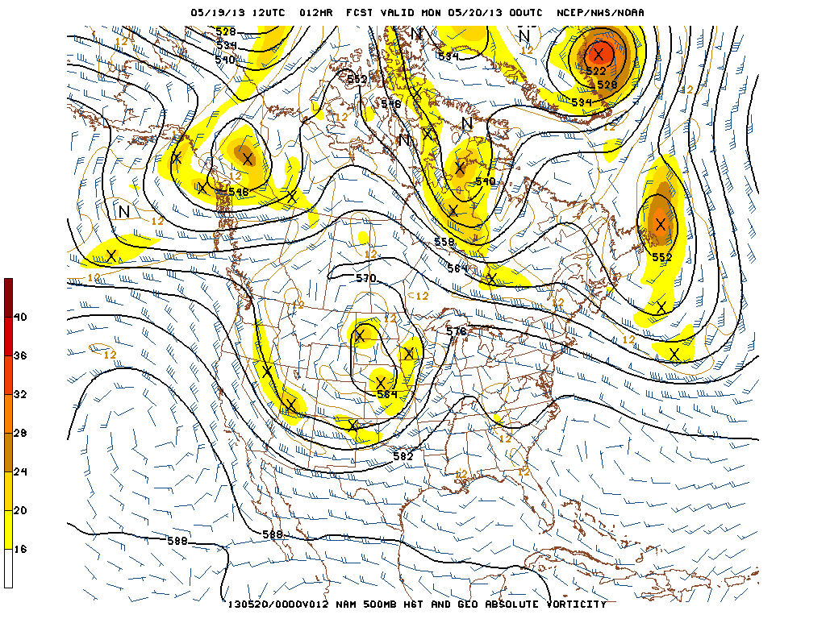

Slide 18
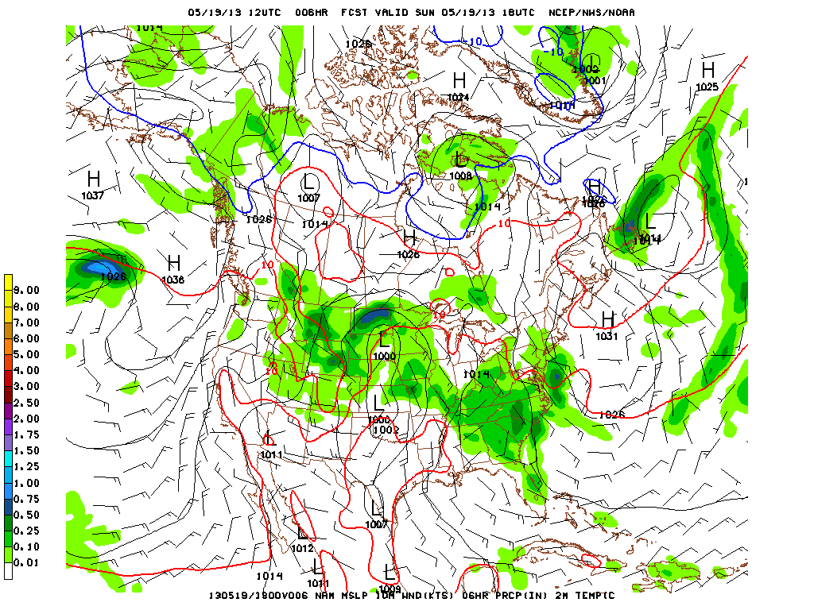

Slide 19
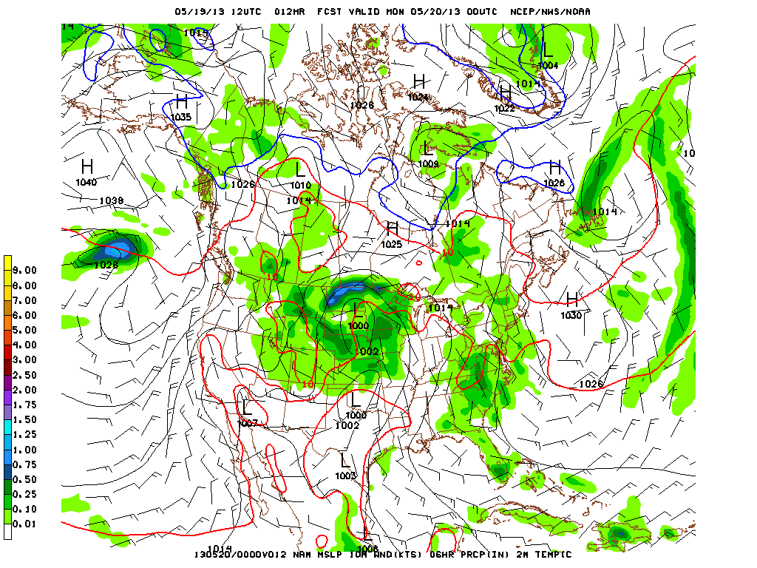

Slide 20
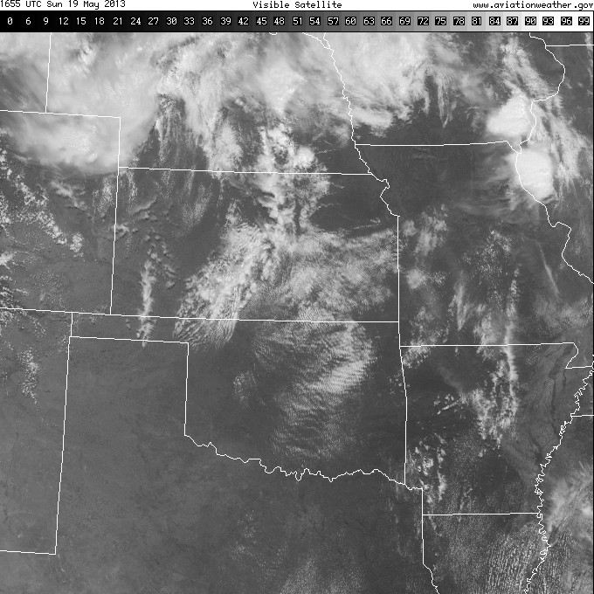

Slide 21
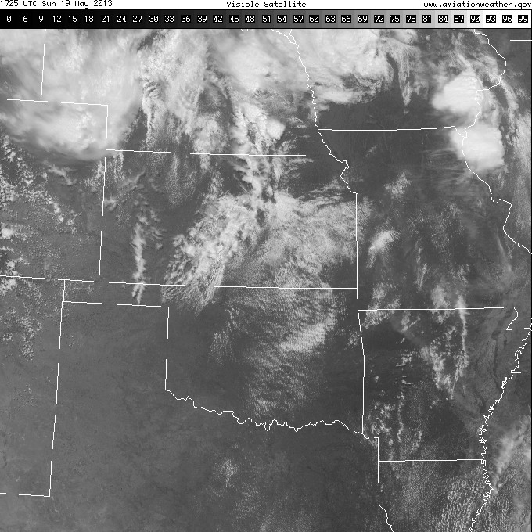

Slide 22
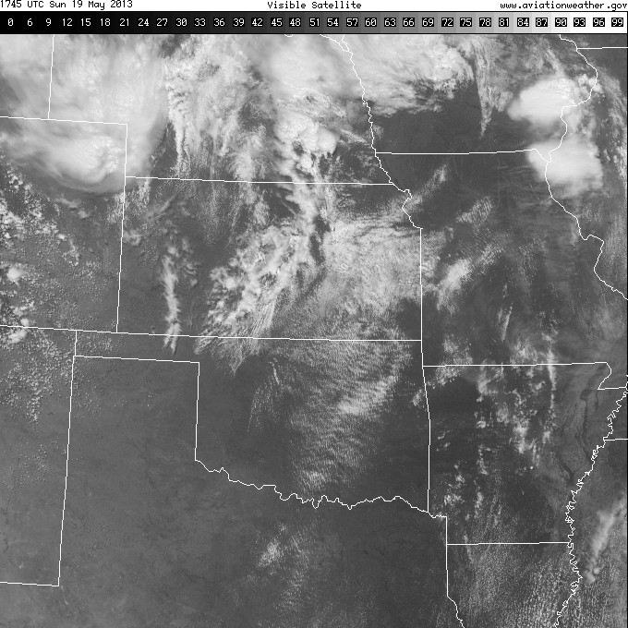

Slide 23
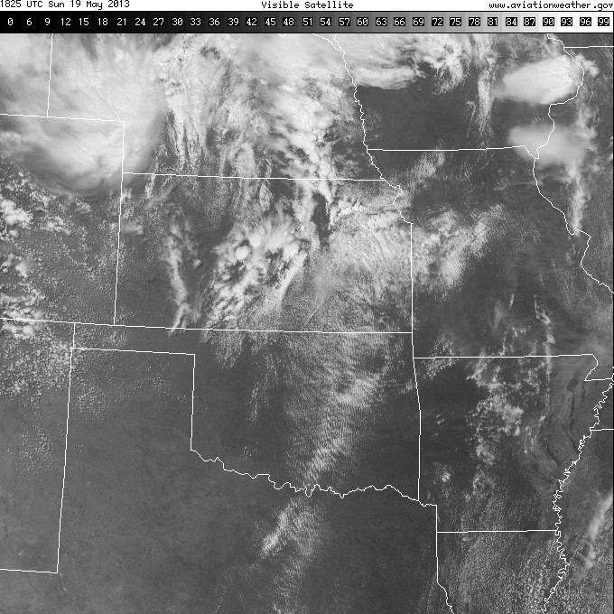

Slide 24
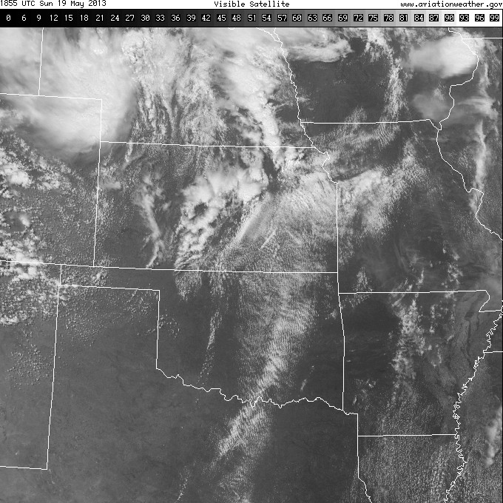

Slide 25
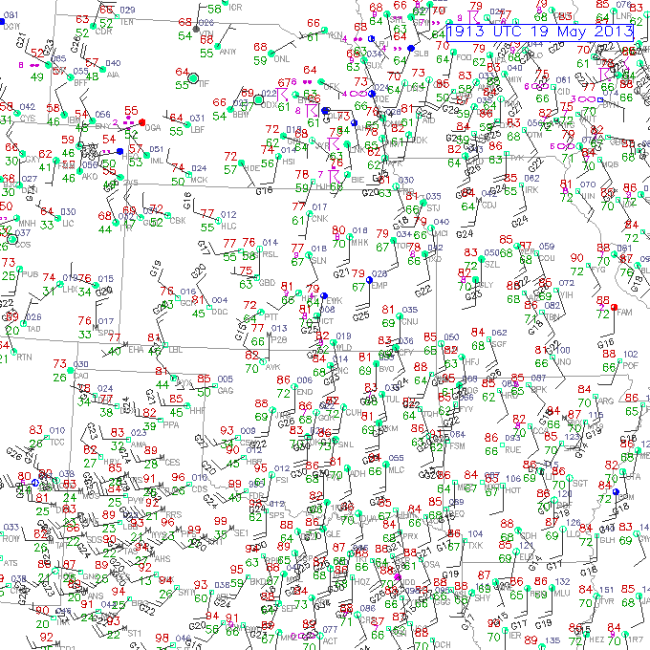

Slide 26
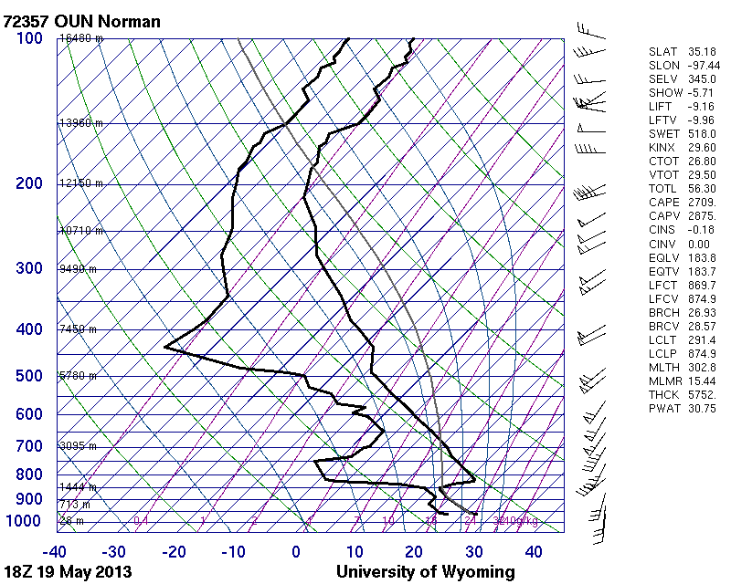

Slide 27
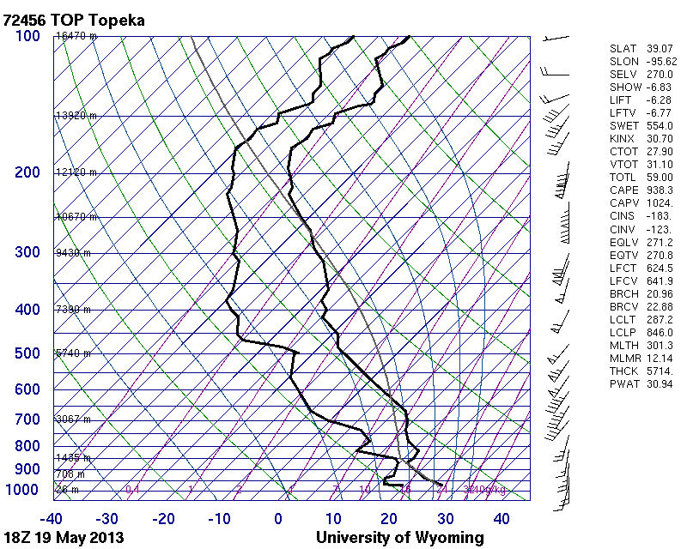

Slide 28
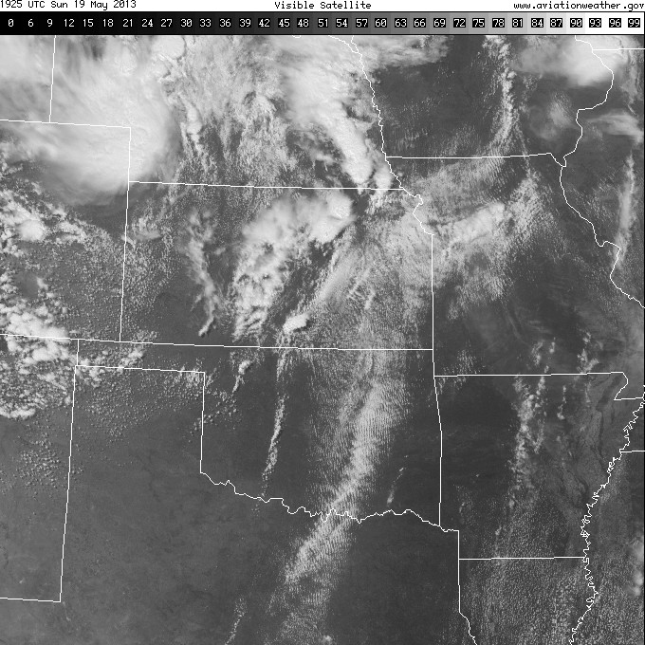

Slide 29
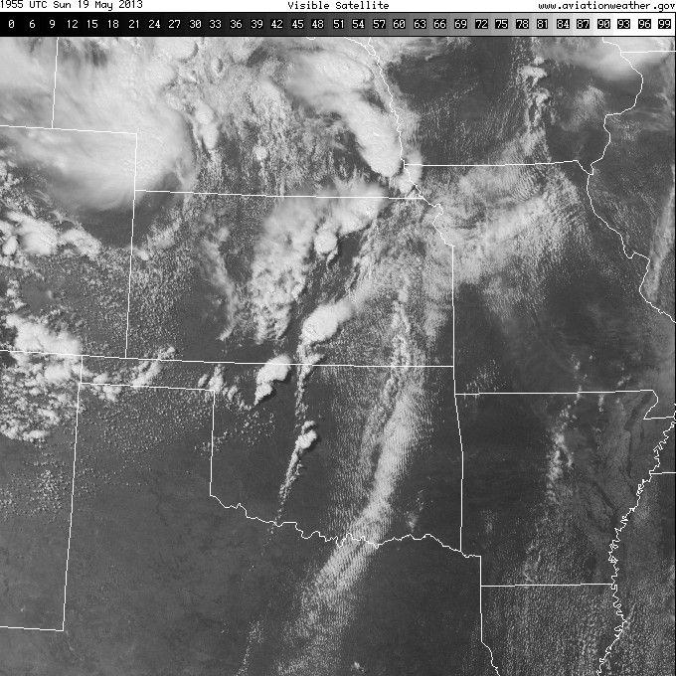

Slide 30
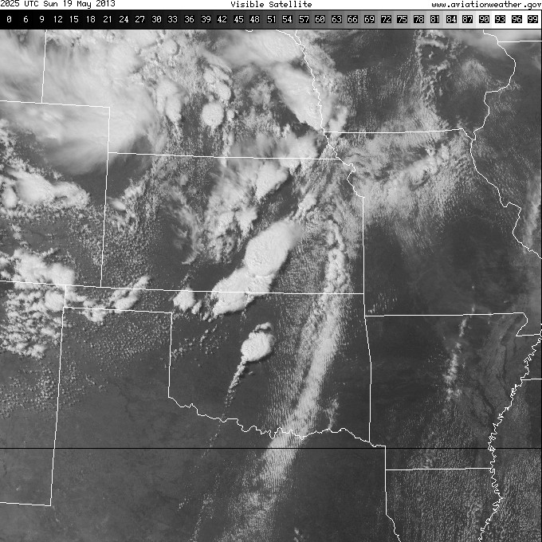

Slide 31
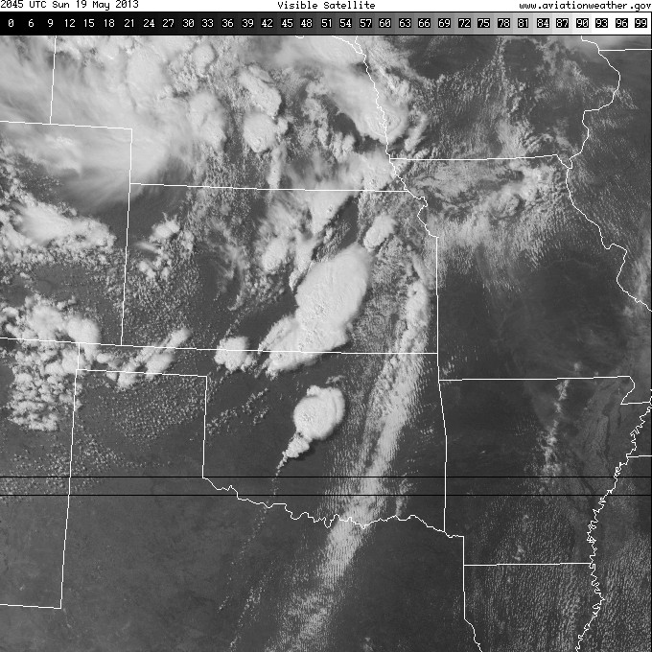

Slide 32
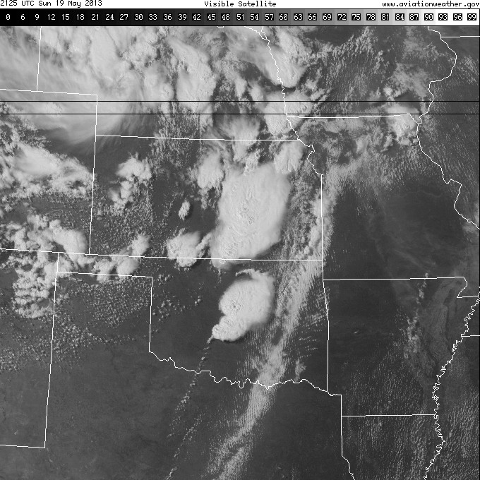

Slide 33
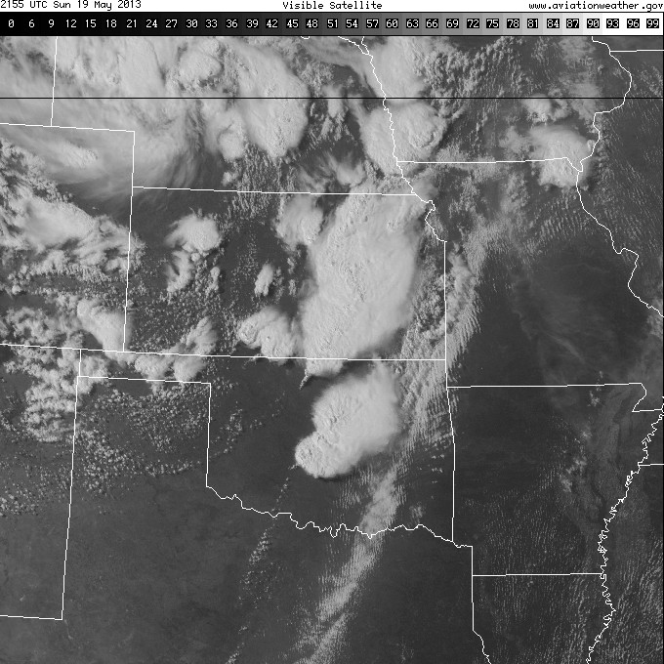

Slide 34
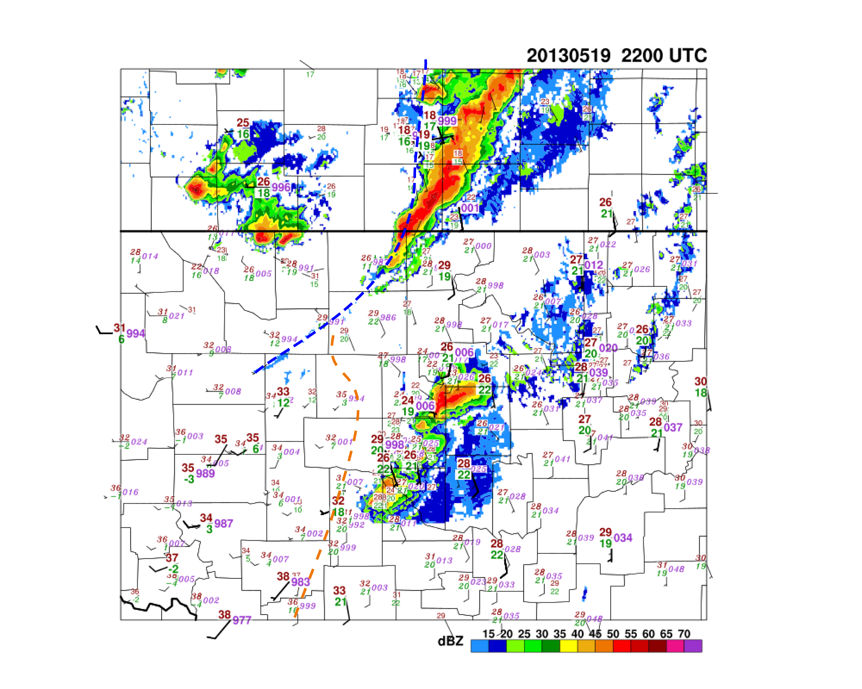
19 May 2013 22:00 UTC Surface

Slide 35
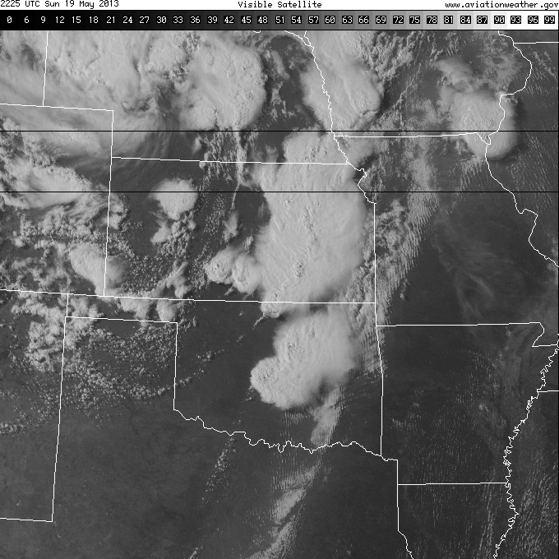

Slide 36
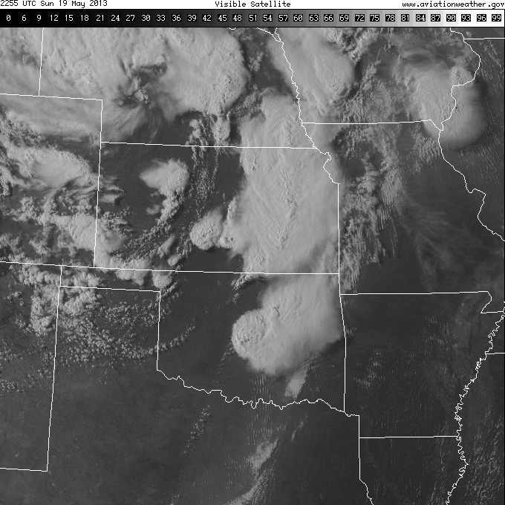

Slide 37
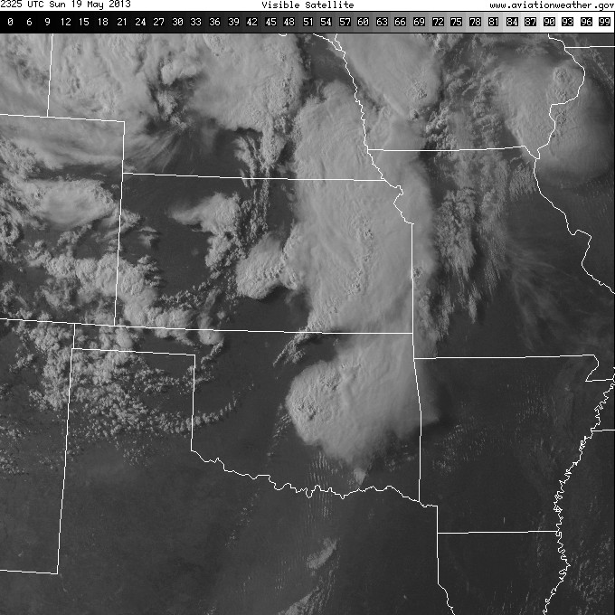

Slide 38
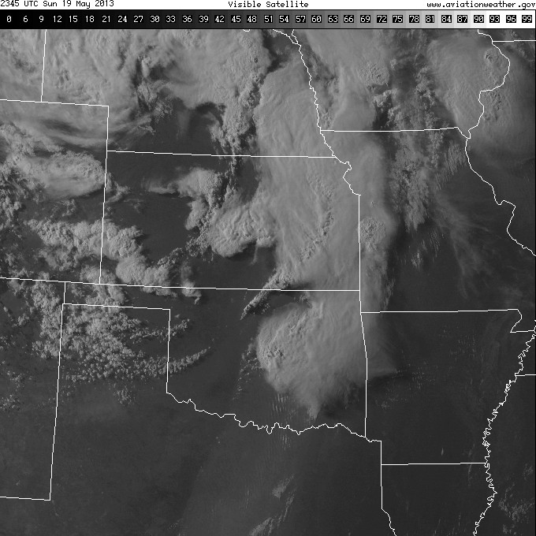

Slide 39
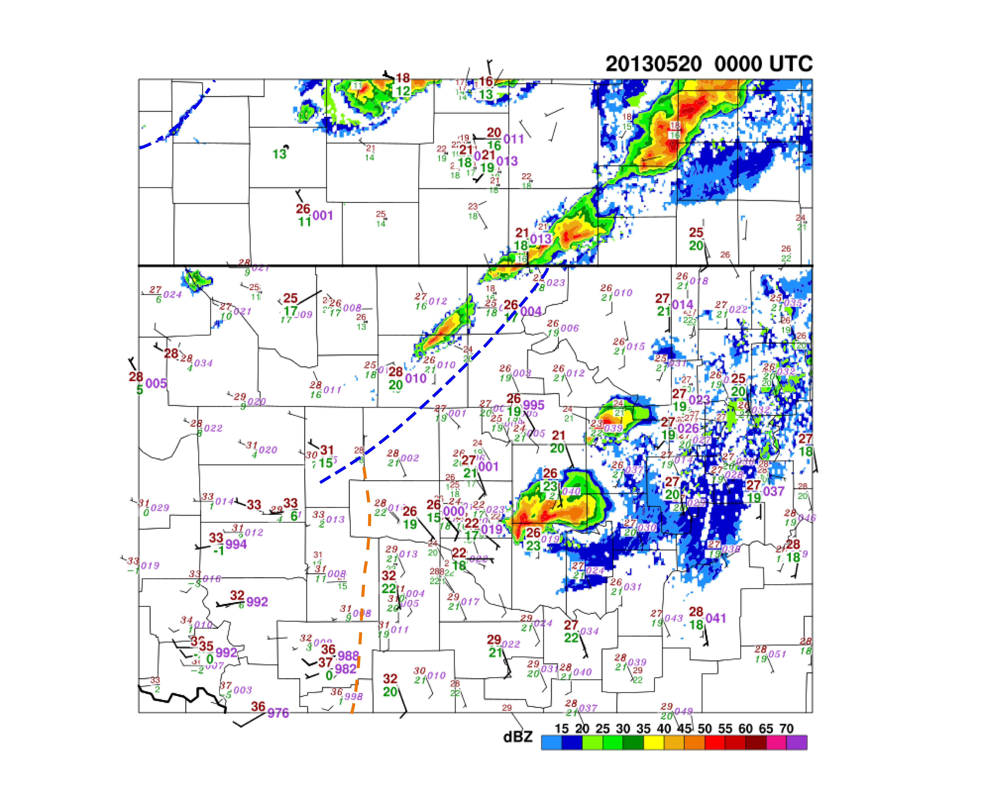
20 May 2013 00:00 UTC Surface

Slide 40
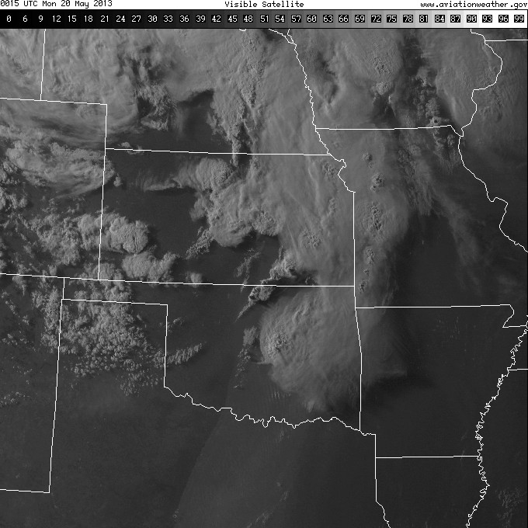

Slide 41
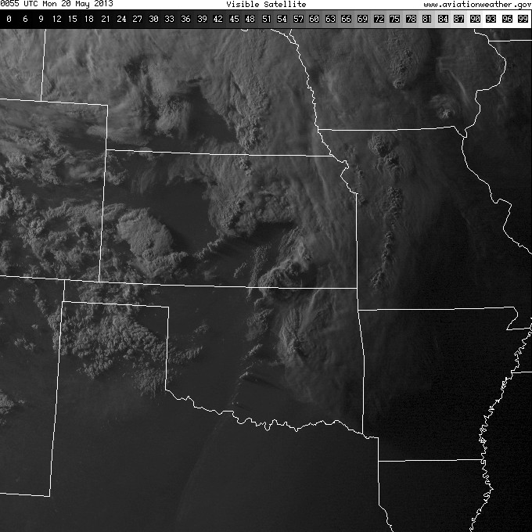

Slide 42
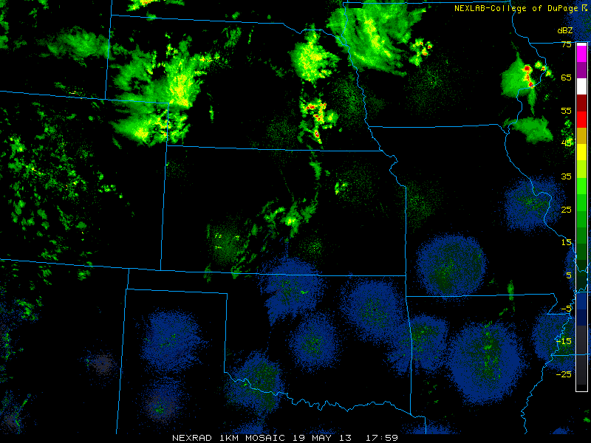

Slide 43
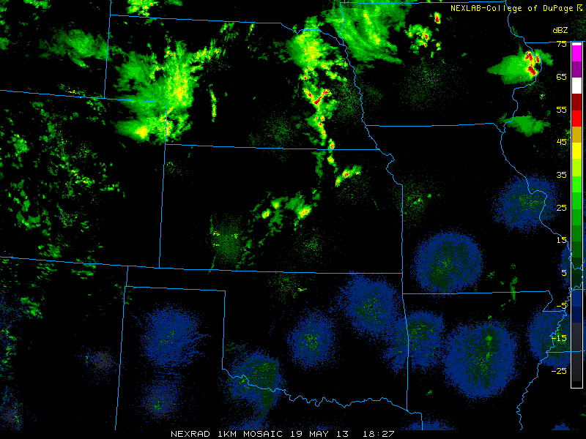

Slide 44
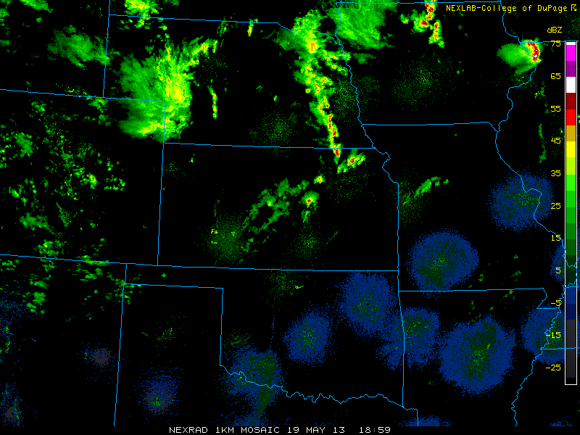

Slide 45
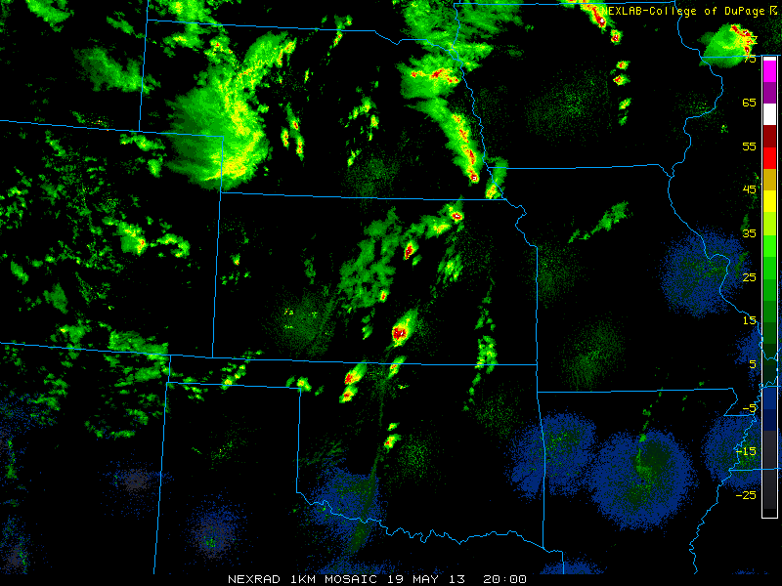

Slide 46
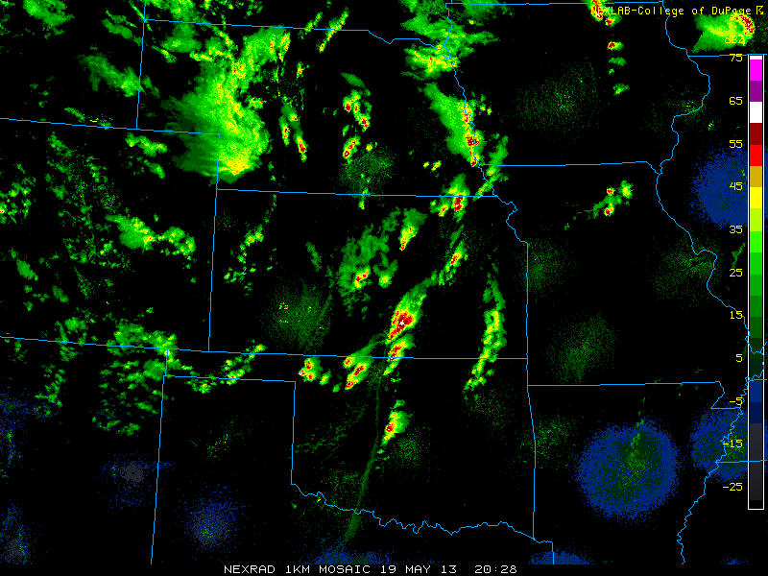

Slide 47
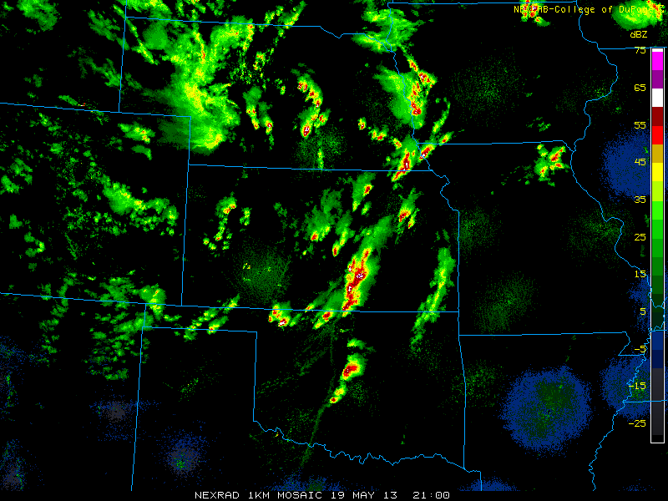

Slide 48
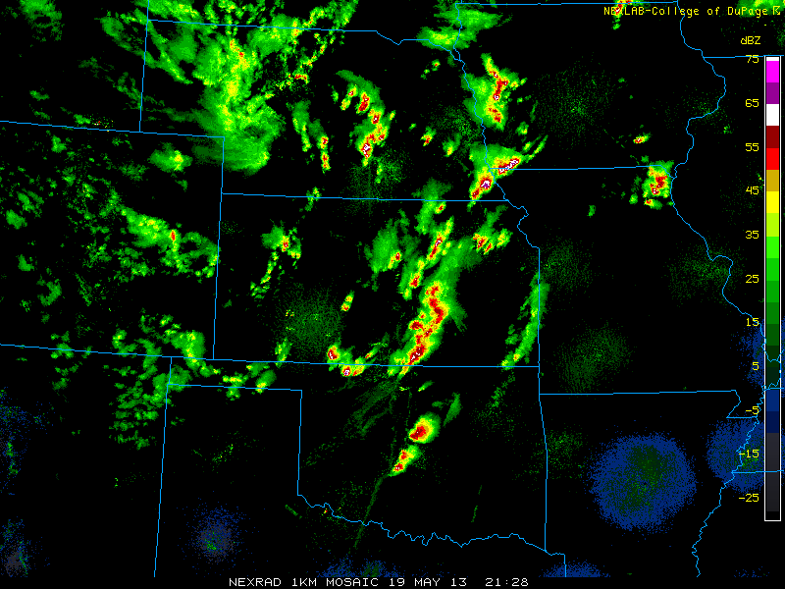

Slide 49


Slide 50


Slide 51


Slide 52


Slide 53


Slide 54


Slide 55


Slide 56


Slide 57


Slide 58


Slide 59


Slide 60
5/19; two tornadic supercells; pre-CI, upstream/downstream sampling, and surround sampling

Slide 61


Slide 62


Slide 63


Slide 64


Slide 65


Slide 66
05/19/13
WRF CAPE/Shear: 21 UTC

Slide 67
05/19/13
Radar 00:00 UTC
WRF-DART 12 h Forecast

Slide 68
36 h Dart Ensemble Forecasts: Valid 00 UTC 20 May 2013

Slide 69
12 h Dart Ensemble Forecasts: Valid 00 UTC 20 May 2013

Slide 70

36 h Dart Ensemble Forecasts: Valid 00 UTC 20 May 2013
Updraft Helicity (UH)
> ~75: Severe
> ~150: Sign. Severe
Probability of Accum. 00-03 UTC

Slide 71


Slide 72

05/19/13
Radar 00:00 UTC

Slide 73

05/19/13
Radar 00:00 UTC

Slide 74
MPEX Mobile Soundings 19 May 2013
CSU 19 UTC
CSU 21 UTC
CSU 23 UTC
WRF OUN 19 UTC
WRF OUN 23 UTC
WRF OUN 00 UTC

Slide 75
MWR 2015

Slide 76
MPEX Case Example: 19 May 2013 12 UTC
Water Vapor and 500 hPa dropsonde winds
500 hPa and Surface Composite

Slide 78


Slide 79


Slide 80


Slide 81


Slide 82


Slide 83


Slide 84


Slide 85


