Slide 1
Supercells

Slide 2
Vertical Momentum Eq. (rewritten)
(dynamic) + (buoyancy)

Slide 3
Vorticity Equation:
Vertical Vorticity:
tilting
stretching

Slide 4
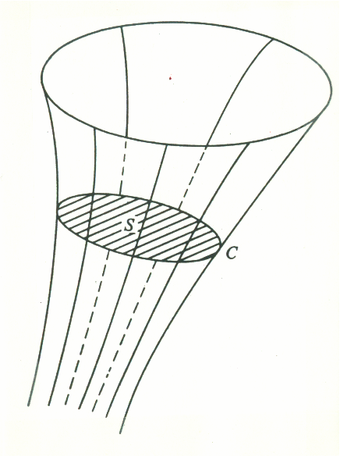
Vortex Tube
Circulation:

Slide 5
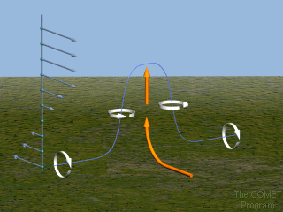

Slide 6
(H = horizontal shearing deformation)
So, for a wind profile in pure rotation:
So, again, since

Slide 7
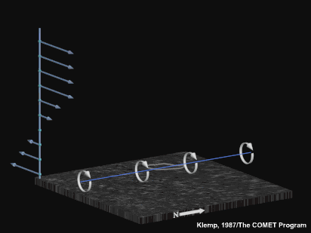

Slide 9
Linearise pressure eq. about U(z), V(z) (environmental vertical wind shear)
So, since

Slide 10
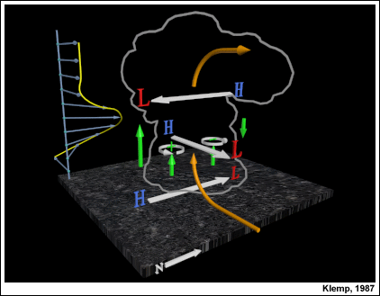
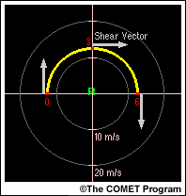

Slide 11
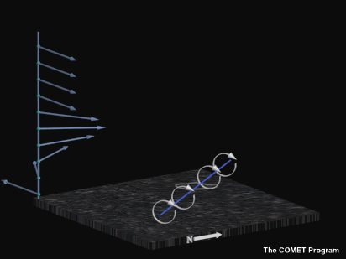

Slide 12
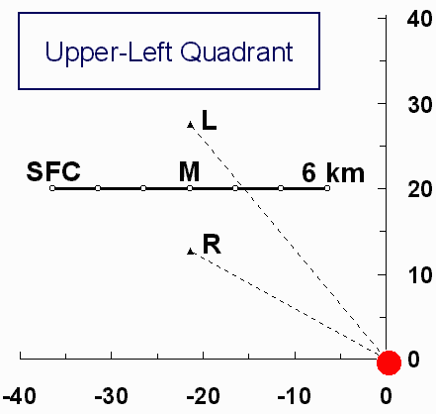
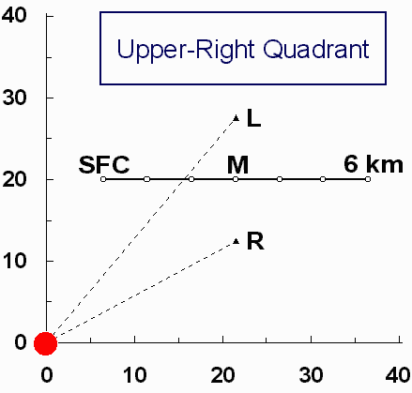
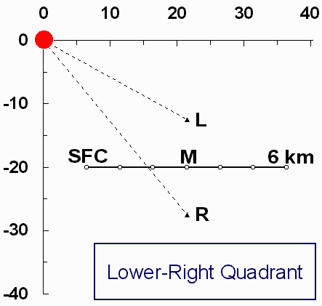
Supercell Hodographs:
Supercell processes are Galilean invariant!!!

Slide 13
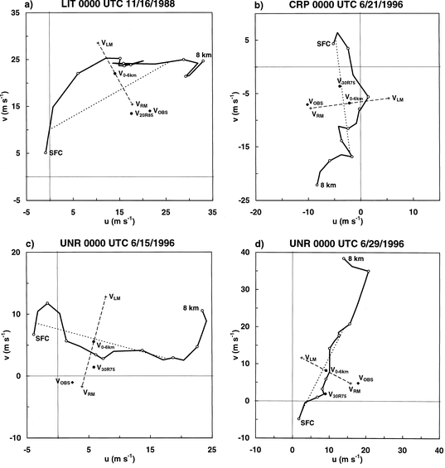
Bunkers et al. WAF 2000

Slide 15
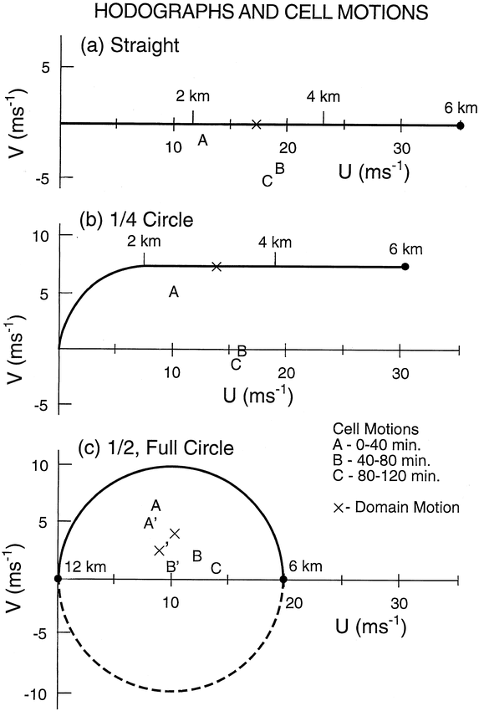
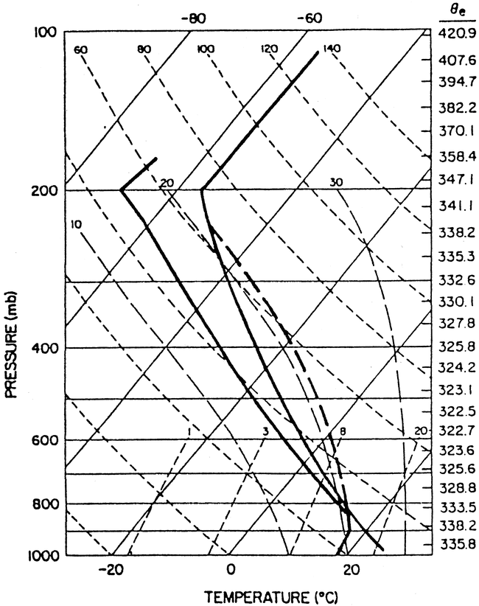
Weisman and Rotunno, Jas 2000
straight
¼ circle
½ circle
full circle

Slide 16
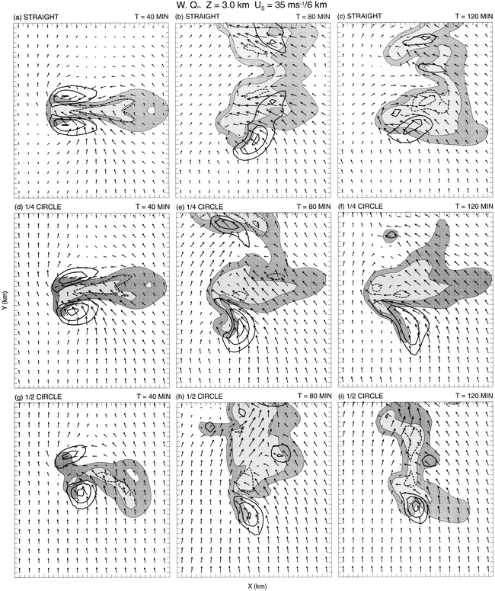
Hodographs:
straight
¼ circle
½ circle

Slide 17
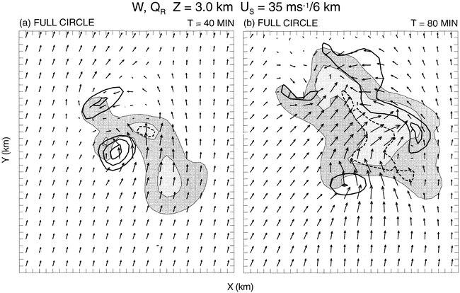
full circle

Slide 18
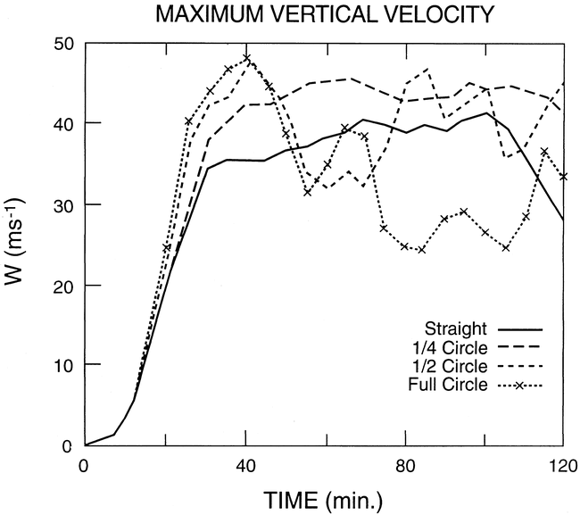

Slide 19
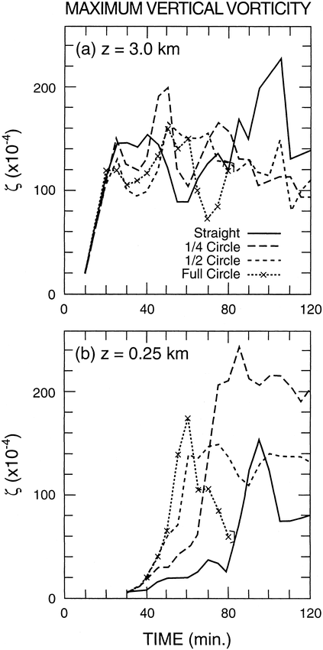

Slide 20
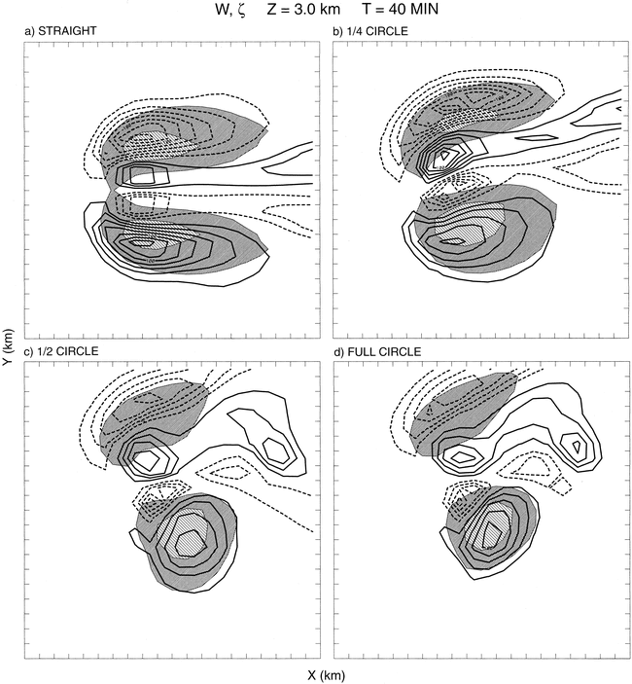
straight
¼ circle
½ circle
full circle

Slide 21
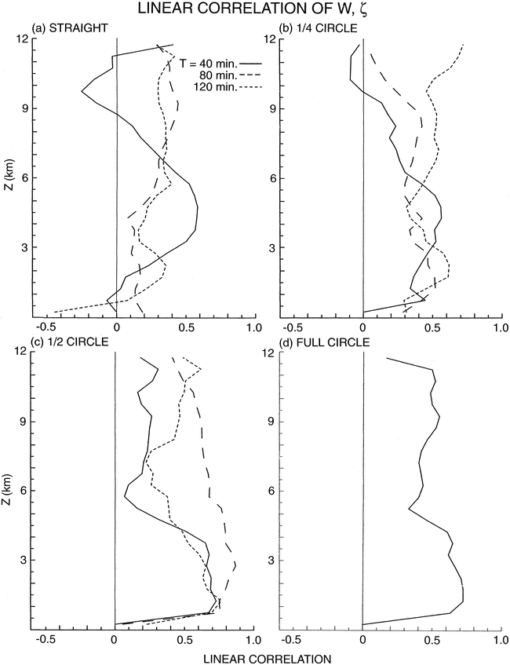
straight
¼ circle
½ circle
full circle

Slide 22
Linear:
Non-Linear:

Slide 23
Non-linear forcing:

Slide 24
Linear forcing:

Slide 25
…integrate along parcel path

Slide 26
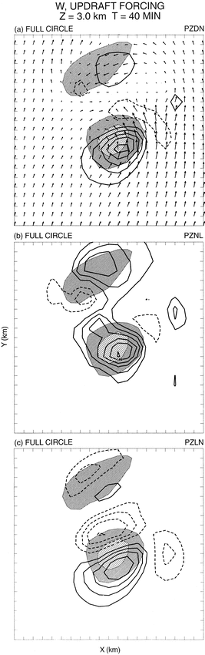
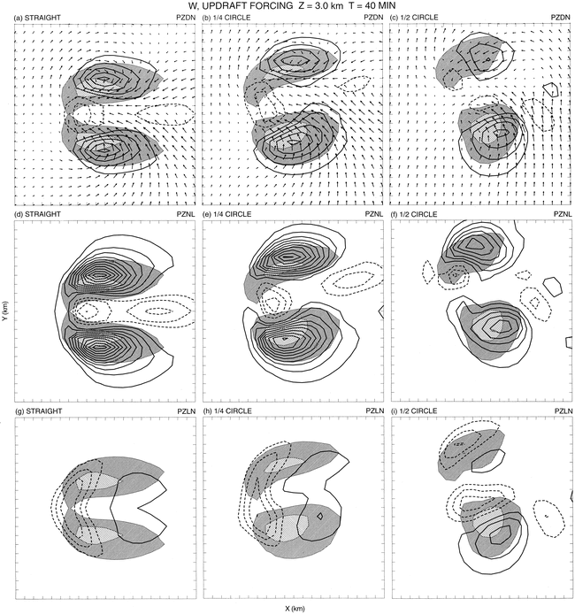
Updraft Forcing:
40 min
Total:
Non-Linear
Linear:
straight
¼ circle
½ circle
full circle

Slide 27
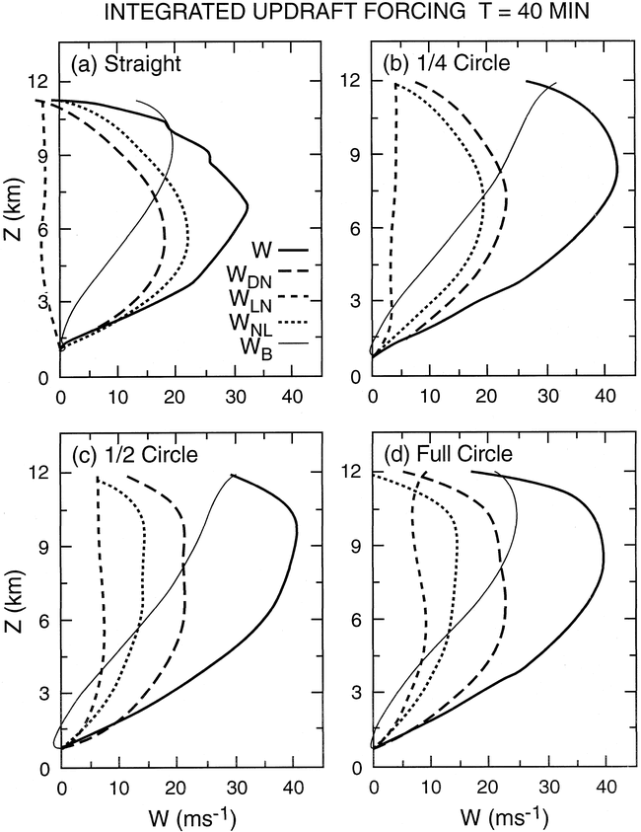
40 min
straight
¼ circle
½ circle
full circle

Slide 28
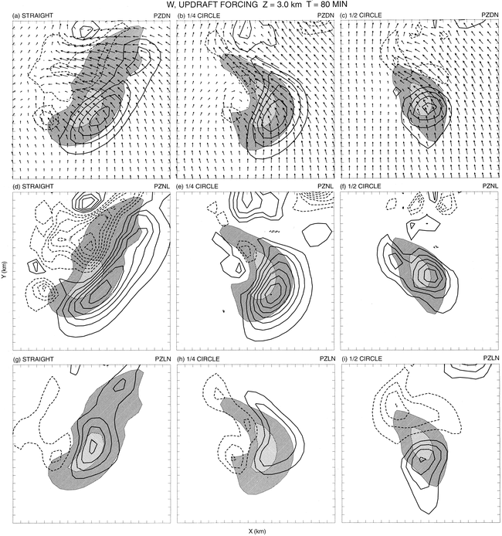
Updraft Forcing:
80 min
Total:
Non-Linear
Linear:
straight
¼ circle
½ circle

Slide 29
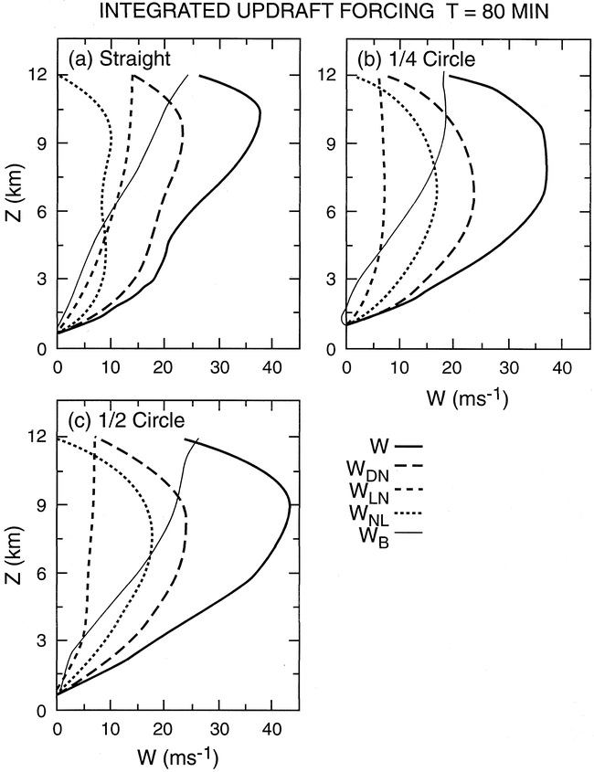
80 min
straight
¼ circle
½ circle

Slide 32
(stagnation pressures near saddle pts. in streamline pattern)
Splat:
Spin:
(eddy rotation)
For flow in solid body rotation:

Slide 33
Helicity: (Lilly, 1986)
…a quasi-conserved property of the flow
*for purely helical flow:
=0
⁄
…reduces non-linear interactions between scales, thereby reducing dissipating effects of turbulence on rotating storms and possibly increasing their predictability

Slide 34
Davies-Jones, 1984
…from linear theory of circular, convective cells in a sheared environment, covariance of vertical velocity and vertical vorticity is proportional to the storm-relative environmental helicity
*assumes steady-state, propagating storm

Slide 36
Potential Vorticity:
= 0 for isentropic motions
Equivalent Potential Vorticity:

Slide 38
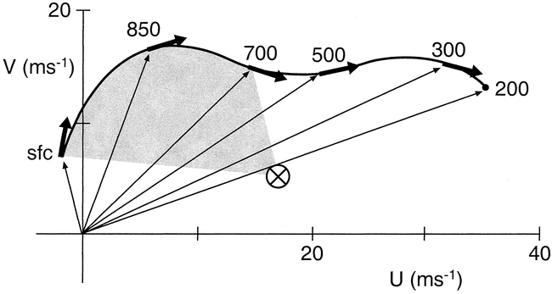
Storm-relative Environmental Helicity (SREH)
(actually, streamwise vorticity)

Slide 39
Unidirectional shear (straight hodograph): mean motion on hodograph implies no SREH…..need to develop off-hodograph propagation to develop storm updraft rotation
Directionally varying shear vector(curved hodograph): mean motion off hodograph implies rotating storm updraft from get-go

Slide 40
Supercell Perspectives:
Vertical wind shear: updraft rotation develops as result of tilting and subsequent stretching of environmental horizontal vorticity, producing dynamic PGFs that promotes the maintenance and propagation of the rotating storm (Gallilean invariant)
SREH: assumes steady, propagating updraft and deduces updraft rotational characeristics based on storm motion (not Gallilean invariant)

Slide 42
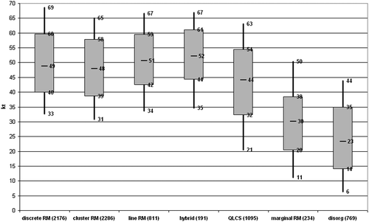
Thompson et al., WAF 2012
EBWD
Convective Modes
EBWD: Effective Bulk Wind Difference (half storm depth)

Slide 43
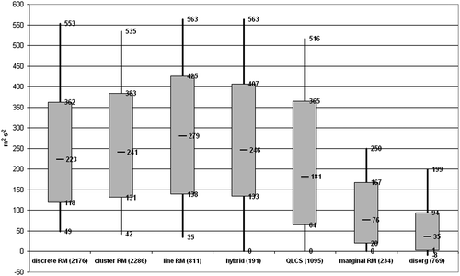
Thompson et al., WAF 2012
ESRH
Convective Modes
ESRH: Effective Storm-Relative Helicity (effective inflow layer)

Slide 44
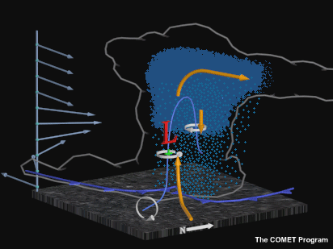

Slide 45
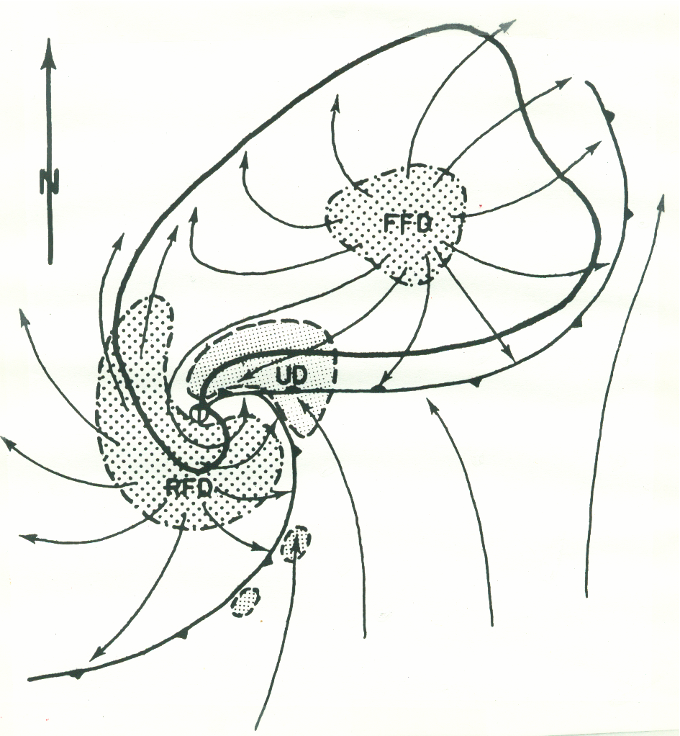

Slide 47
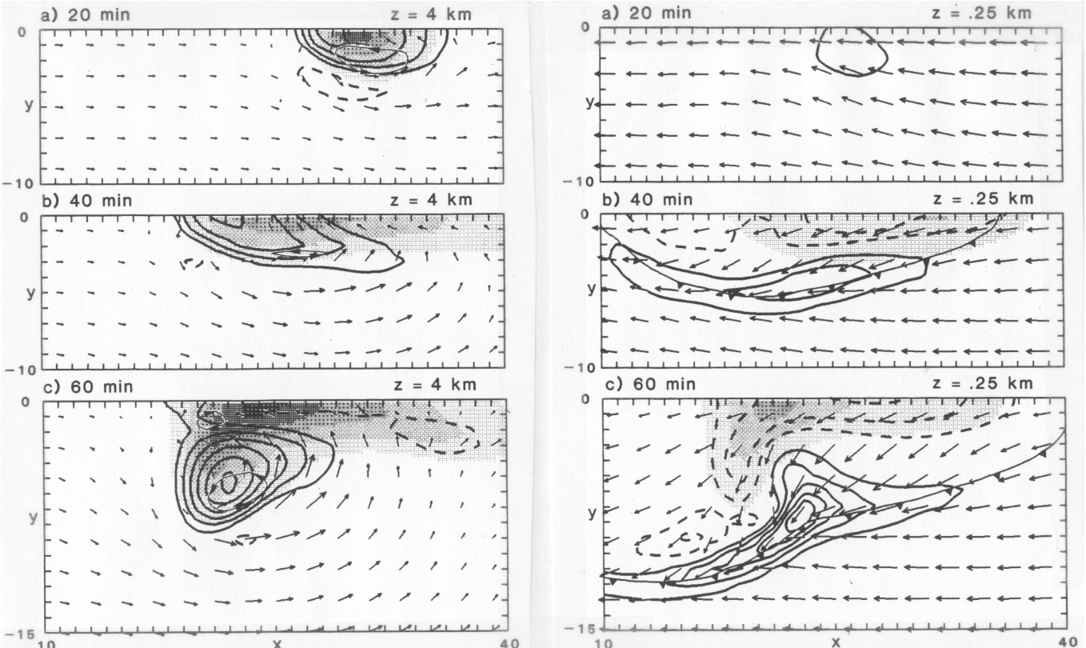
“On the rotation and propagation of simulated supercell thunderstorms” Rotunno and Klemp, JAS, 1985
…… used unidirectional shear

Slide 48
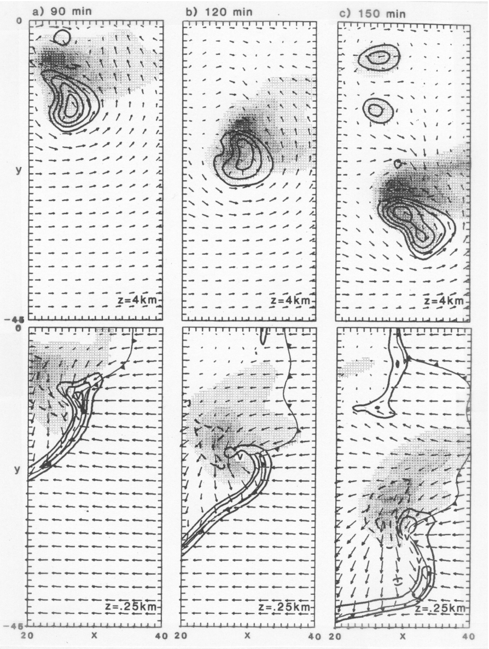
W, Qr
Z = 4 km
Z = .25 km

Slide 49
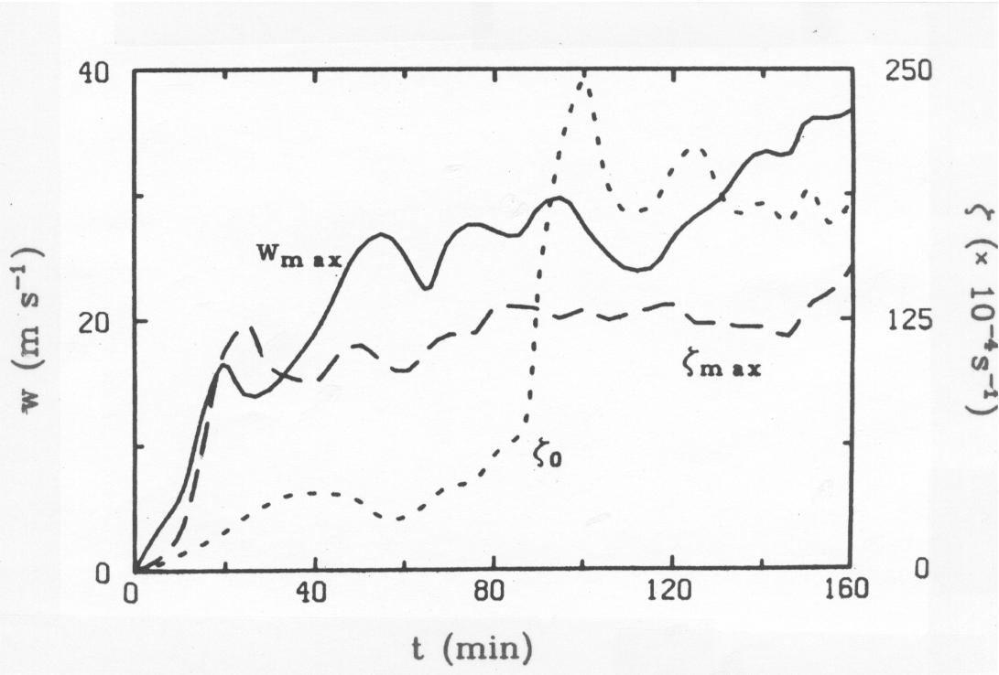

Slide 50
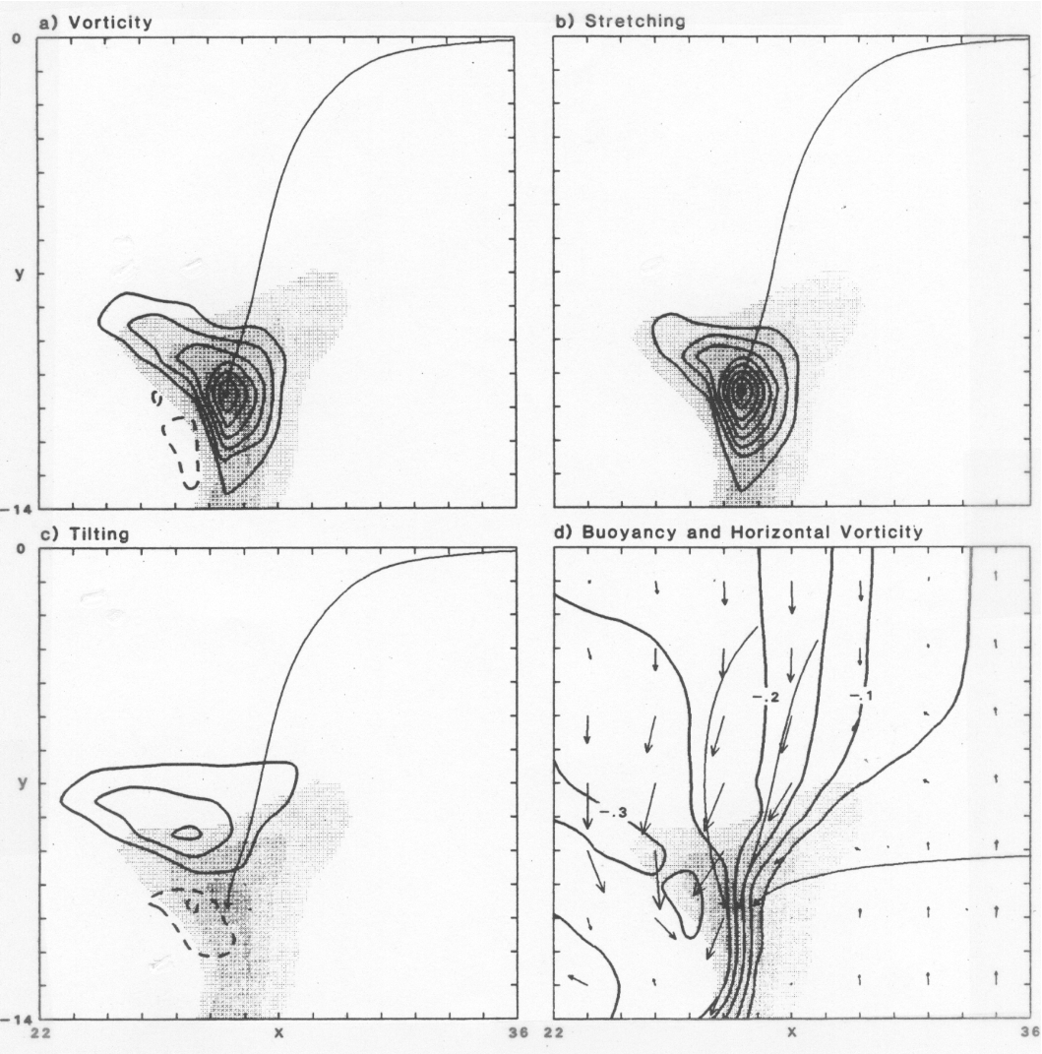

Slide 51
Vortex Tube
Circulation:

Slide 52
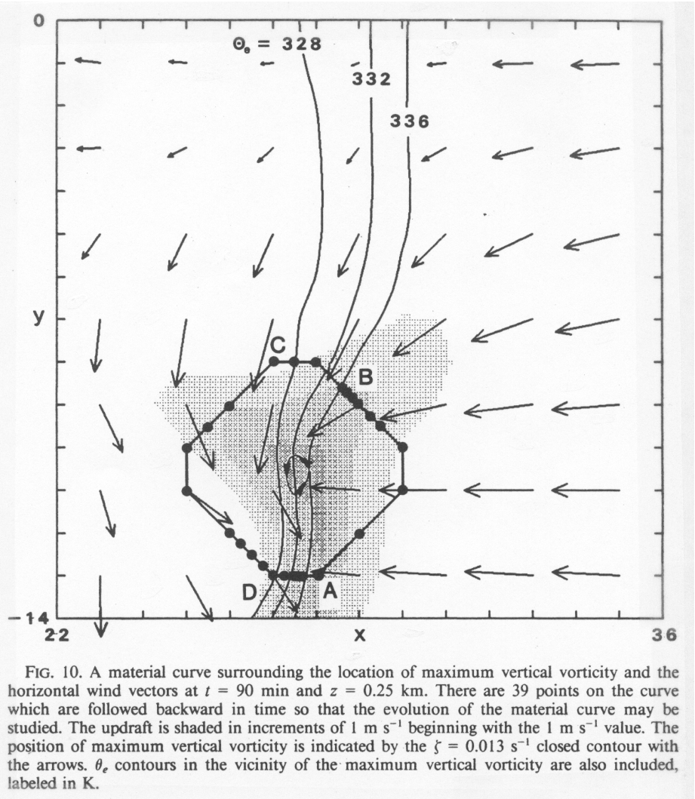

Slide 53
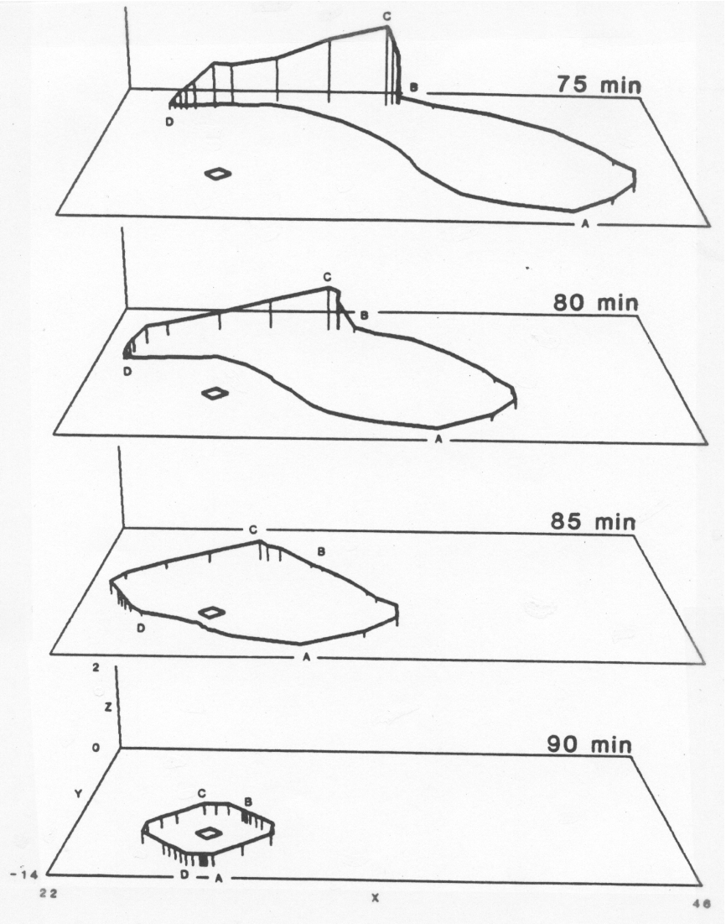

Slide 54
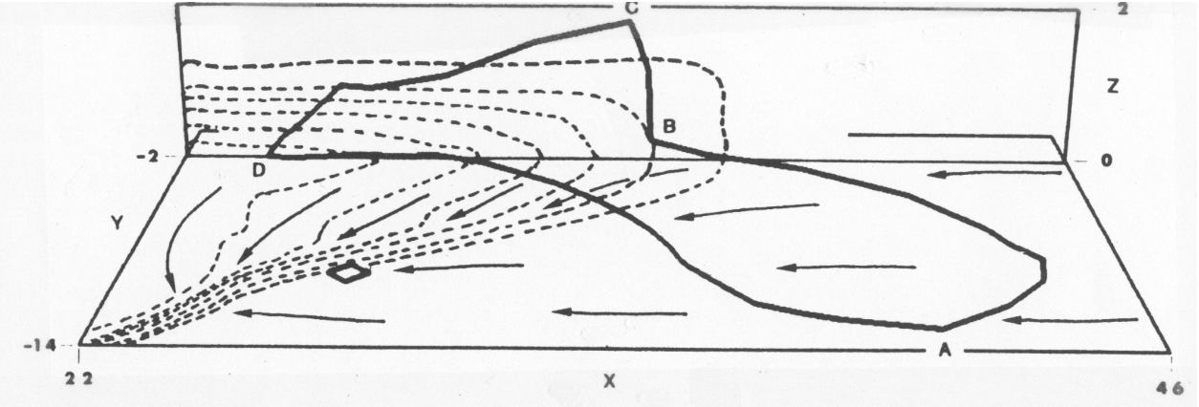

Slide 55
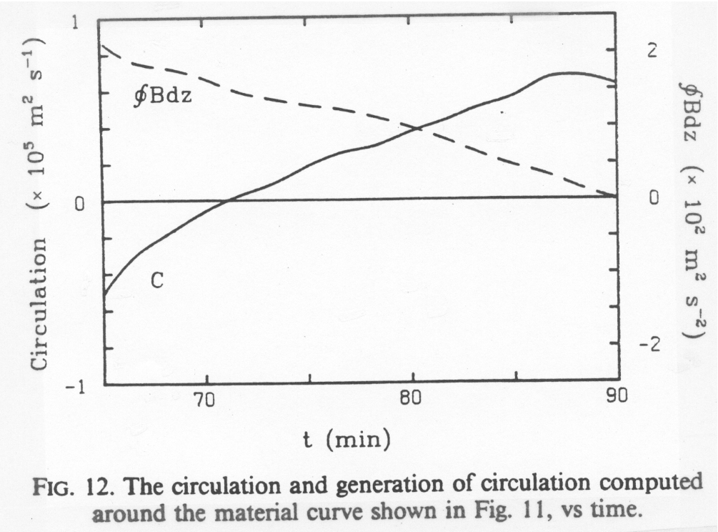

Slide 56
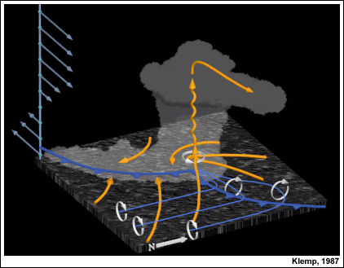

Slide 57
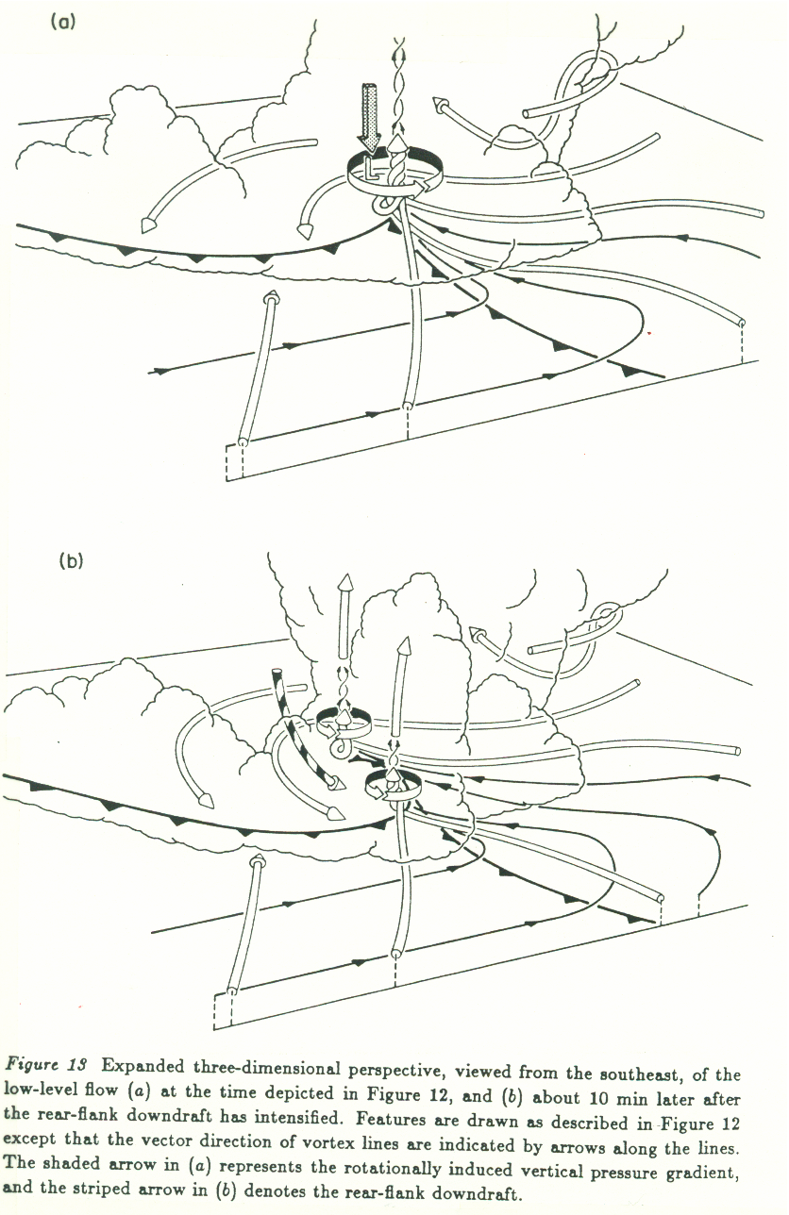

Slide 58
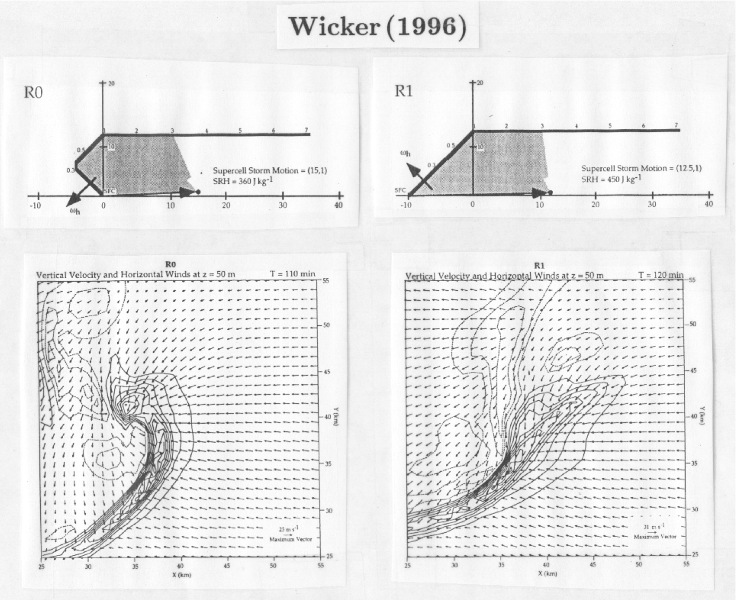

Slide 59
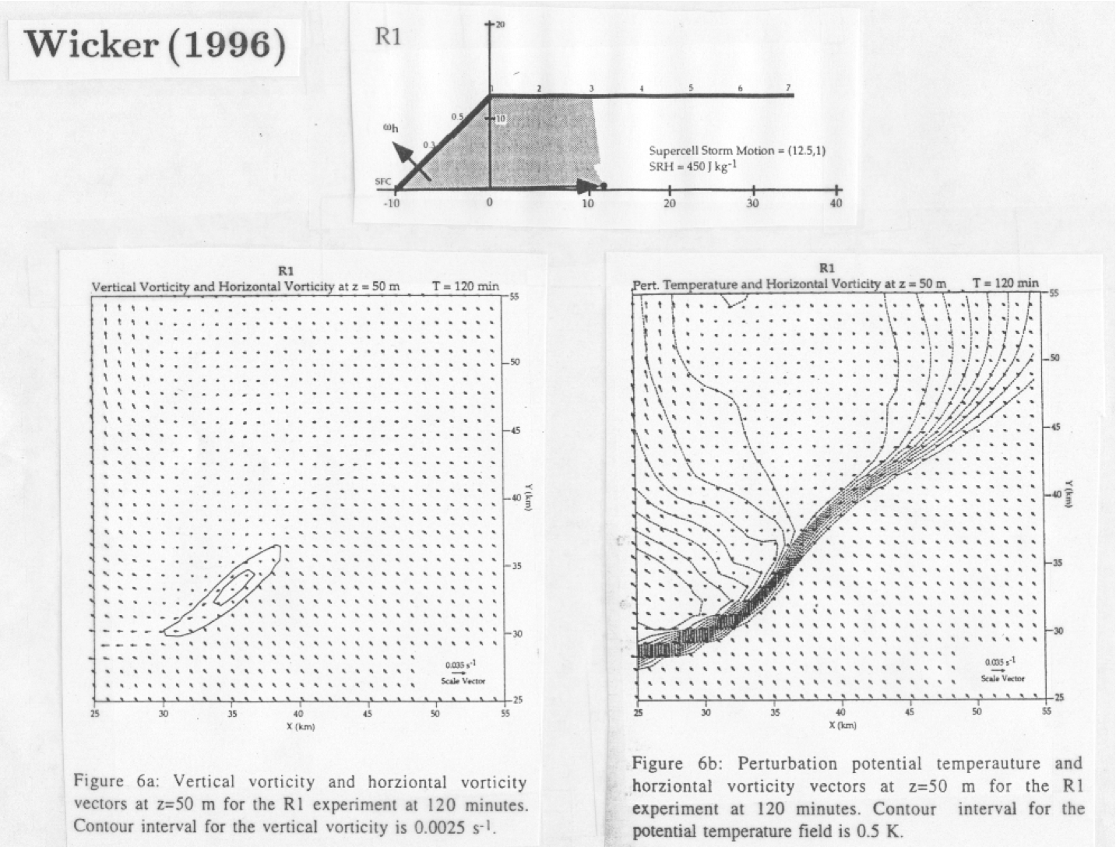

Slide 60
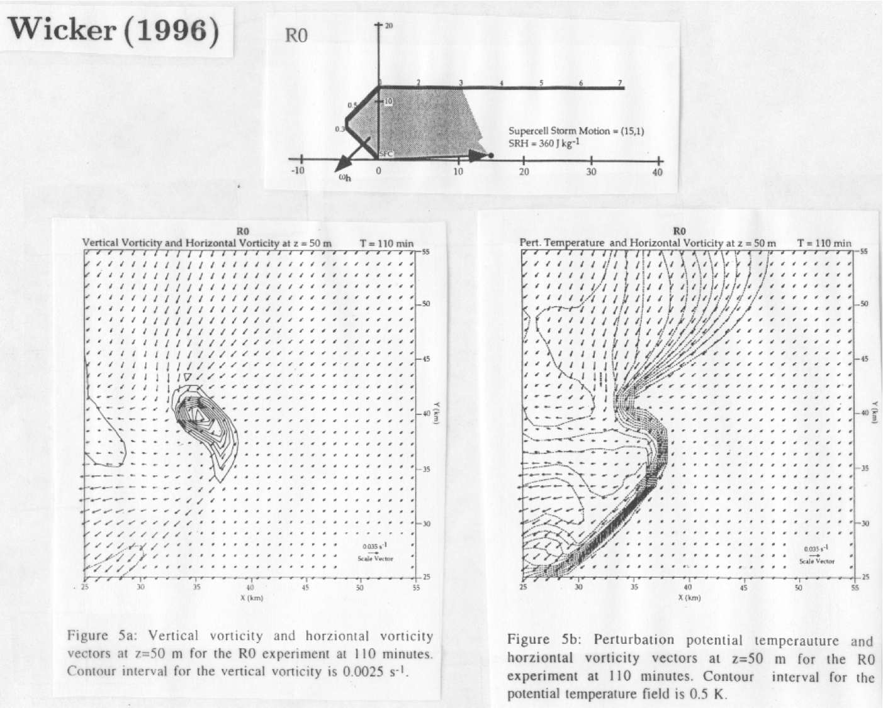

Slide 61
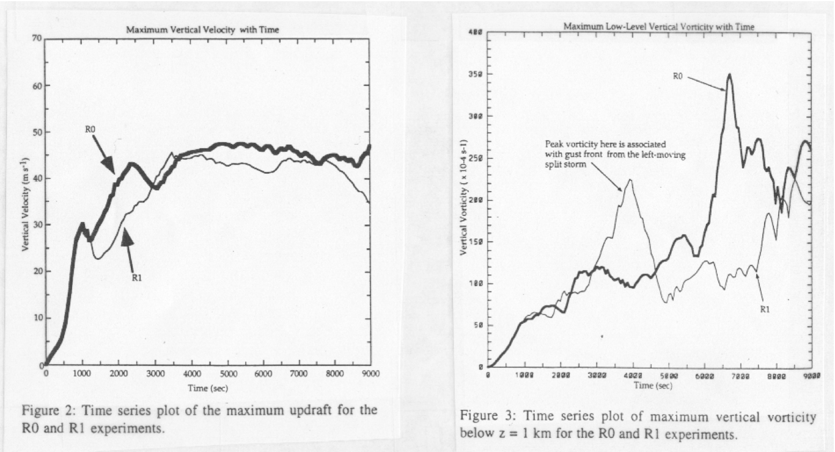

Slide 62
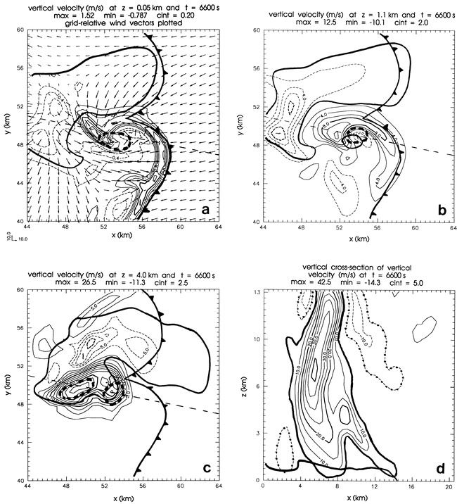
Adlerman and Droegemeier JAS 1999
“Cyclic- Mesocyclogenesis”
Back to Del City…. 20 May, 1977
100 km x 100 km,
500 m grid

Slide 63
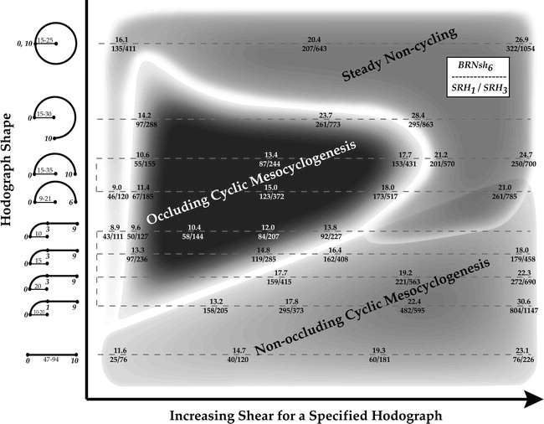
Adlerman and Droegemeier, MWR, 2005

