Slide 1
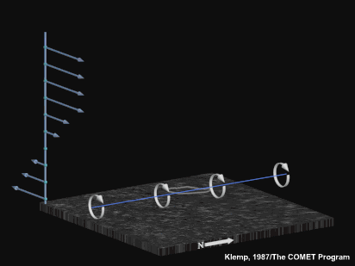
Non-linear forcing:

Slide 2
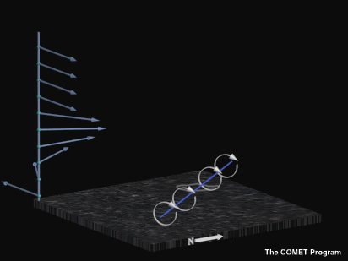
Linear forcing:

Slide 3
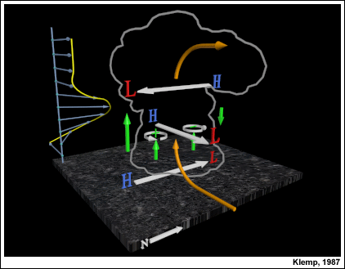
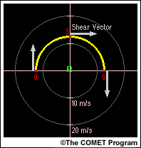

Slide 4
Potential Vorticity:
= 0 for isentropic motions
Equivalent Potential Vorticity:

Slide 5
Equivalent Potential Vorticity:
For a horizontally homogeneous atmosphere with vertical wind shear, vortex lines and Theta-E surfaces are initially horizontal (EPV=0). Since EPV is conserved, vortex lines remain on the original theta-E surfaces if they are subsequently tilted up or down…. Thus, vertical vorticity generated via tilting must be colocated within a horizontal gradient of theat-E!

Slide 6
Davies-Jones, 1984
…from linear theory of circular, convective cells in a sheared environment, covariance of vertical velocity and vertical vorticity is proportional to the storm-relative environmental helicity
*assumes steady-state, propagating storm

Slide 7
Supercell Perspectives:
Vertical wind shear: updraft rotation develops as result of tilting and subsequent stretching of environmental horizontal vorticity, producing dynamic PGFs that promotes the maintenance and propagation of the rotating storm (Galilean invariant)
SREH: assumes steady, propagating updraft and deduces updraft rotational characeristics based on storm motion (not Galilean invariant)

Slide 8
Unidirectional shear (straight hodograph): mean motion on hodograph implies no SREH…..need to develop off-hodograph propagation to develop storm updraft rotation
Directionally varying shear vector(curved hodograph): mean motion off hodograph implies rotating storm updraft from get-go

Slide 9
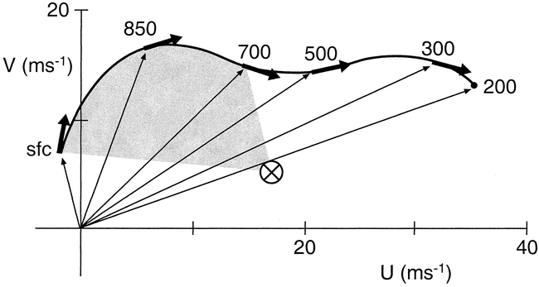
Storm-relative Environmental Helicity (SREH)
(actually, streamwise vorticity)

Slide 10
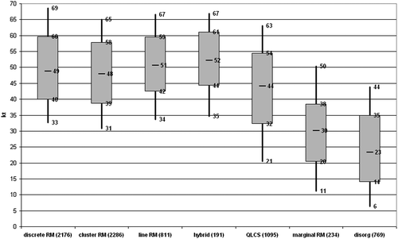
Thompson et al., WAF 2012
EBWD
Convective Modes
EBWD: Effective Bulk Wind Difference (half storm depth)

Slide 11
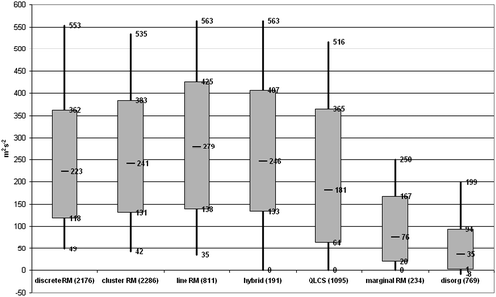
Thompson et al., WAF 2012
ESRH
Convective Modes
ESRH: Effective Storm-Relative Helicity (effective inflow layer)

Slide 12
Supercells

Slide 13
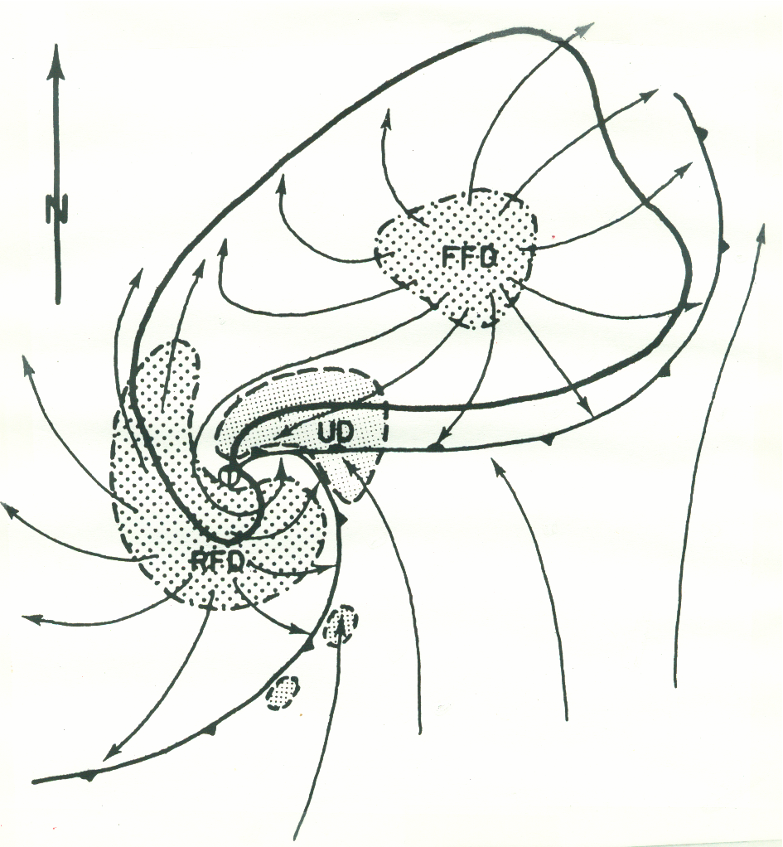

Slide 15
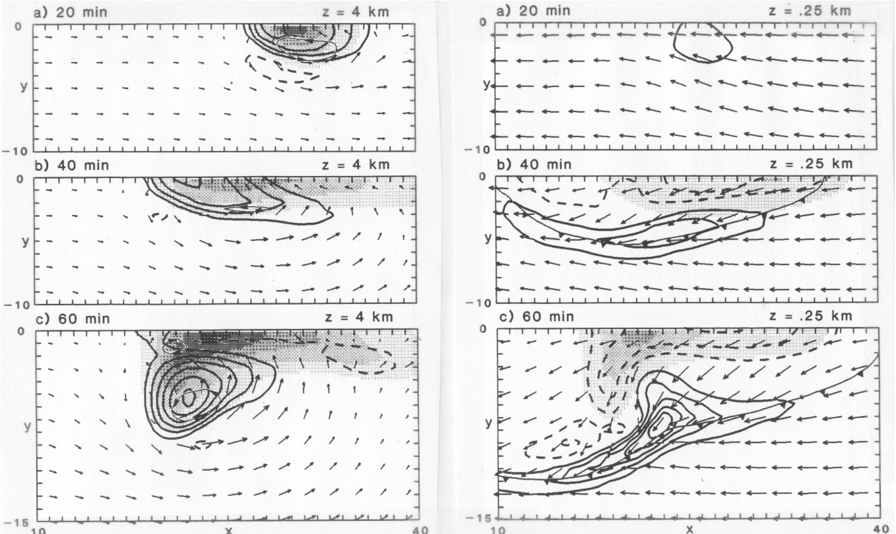
“On the rotation and propagation of simulated supercell thunderstorms” Rotunno and Klemp, JAS, 1985
…… used unidirectional shear

Slide 16
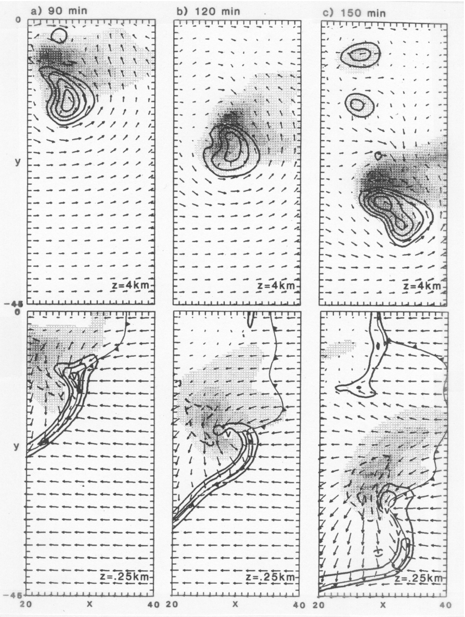
W, Qr
Z = 4 km
Z = .25 km

Slide 17
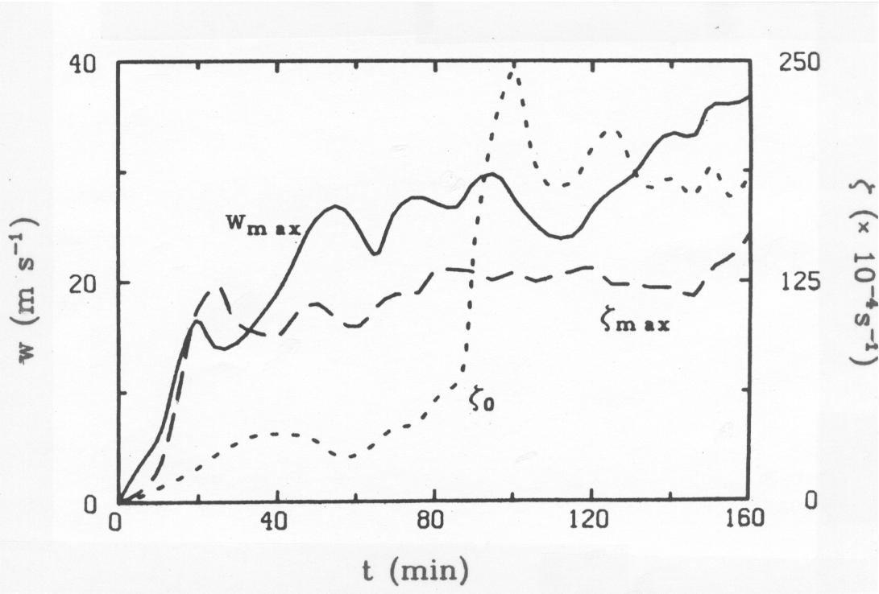

Slide 18
Vorticity Equation:
Vertical Vorticity:
tilting
stretching
2D Horizontal Vorticity:

Slide 19
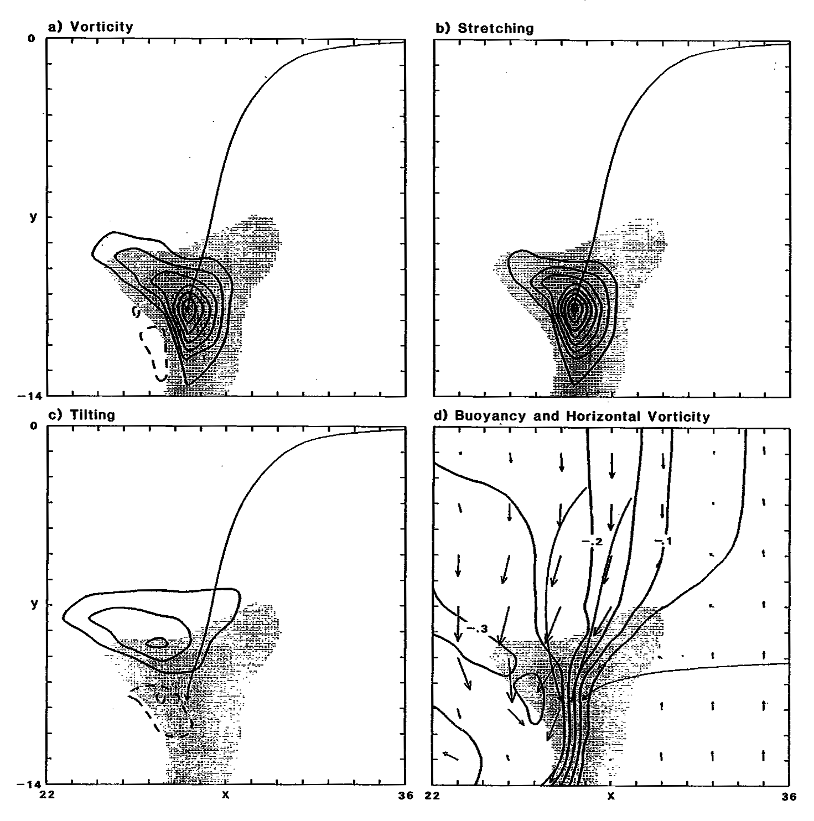

Slide 20
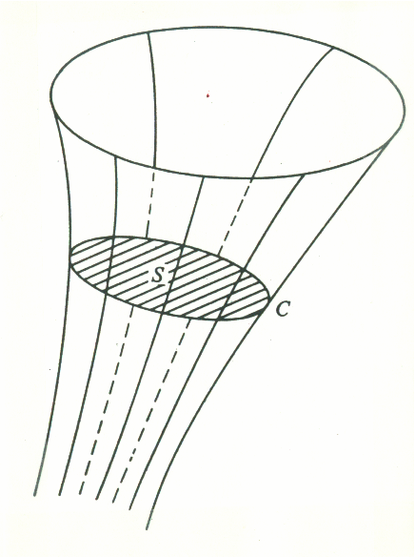
Vortex Tube
Circulation:

Slide 21
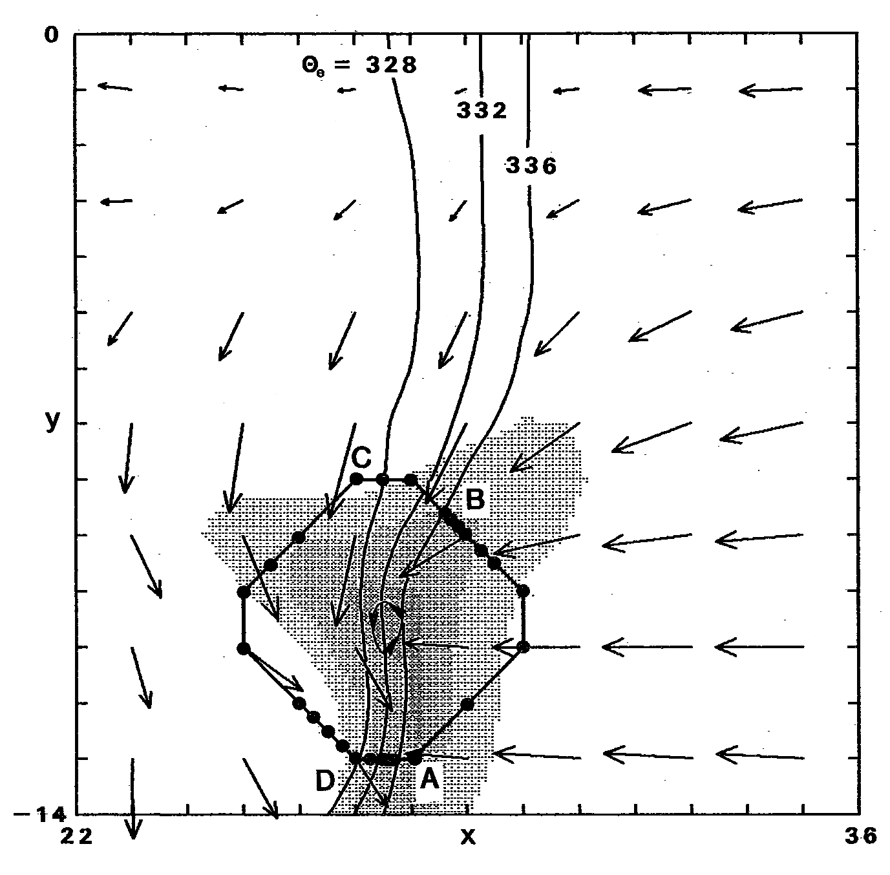

Slide 22
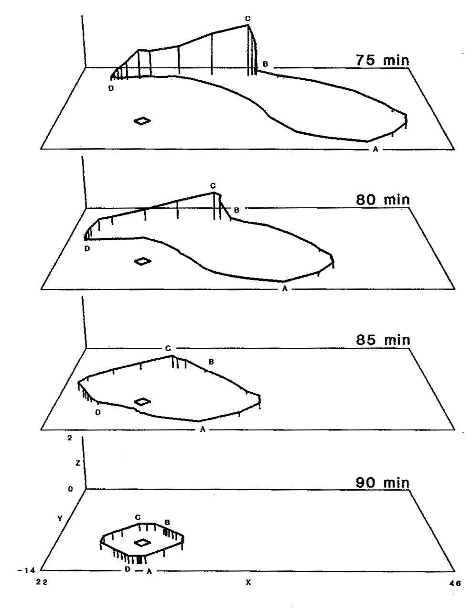

Slide 23
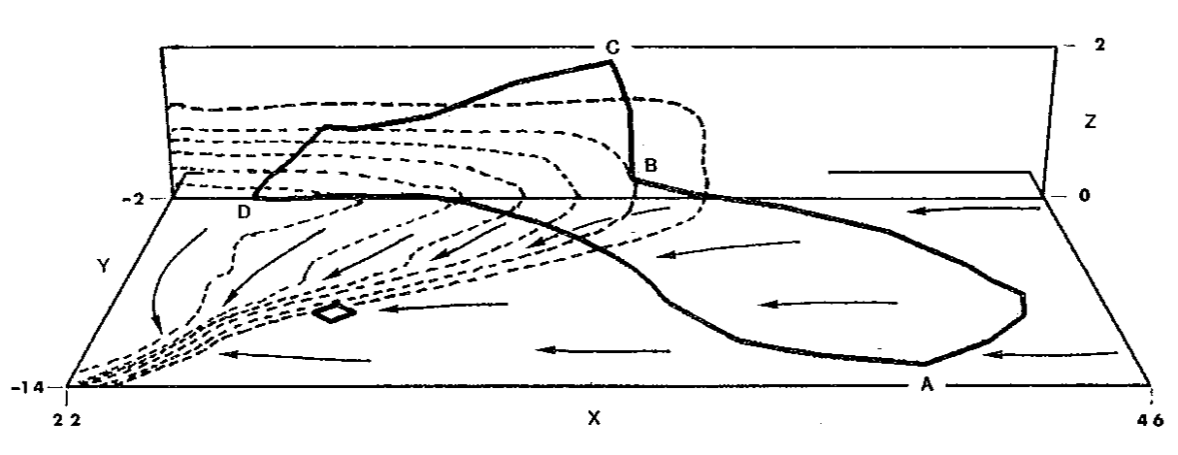

Slide 24
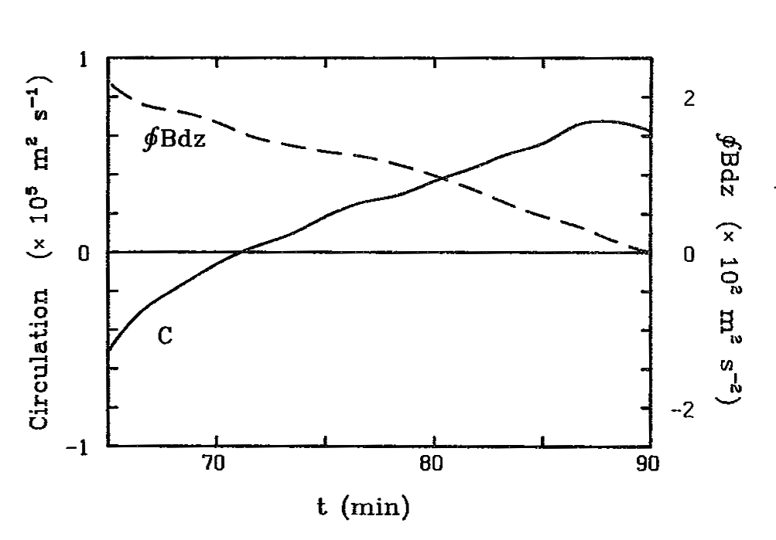

Slide 25
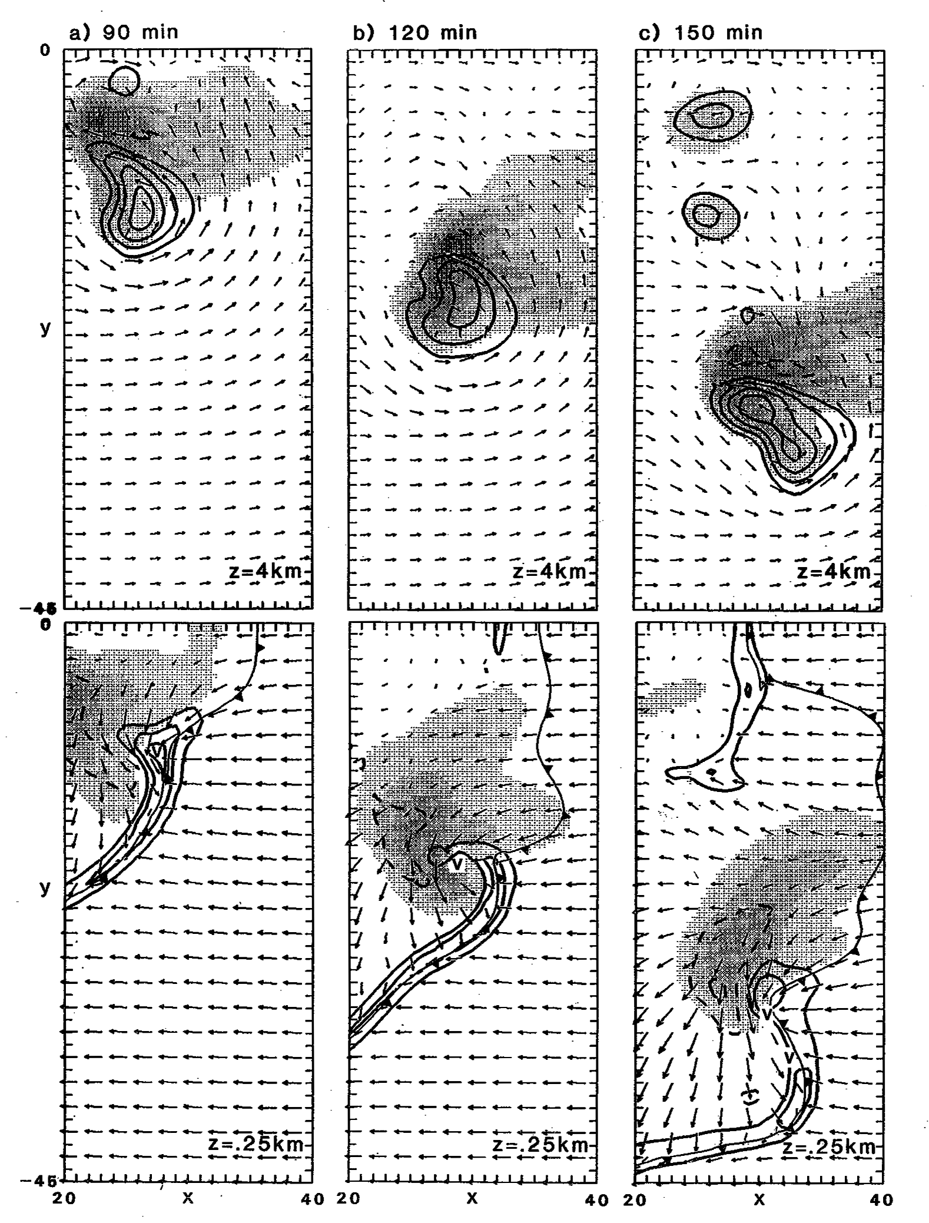
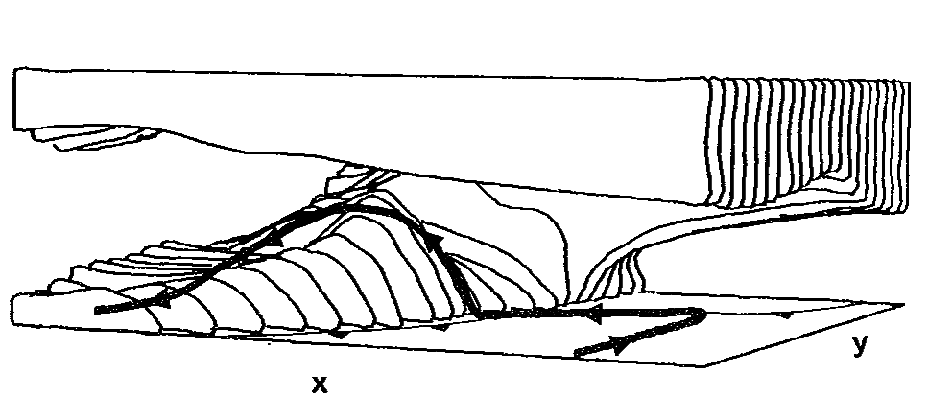
Rotunno and Klemp, JAS, 1985
…surface mesocyclone formed from tilting of horizontal vorticity generated in storm’s forward flank region
Unidirectonal shear, Warm rain

Slide 26
Supercells

Slide 27
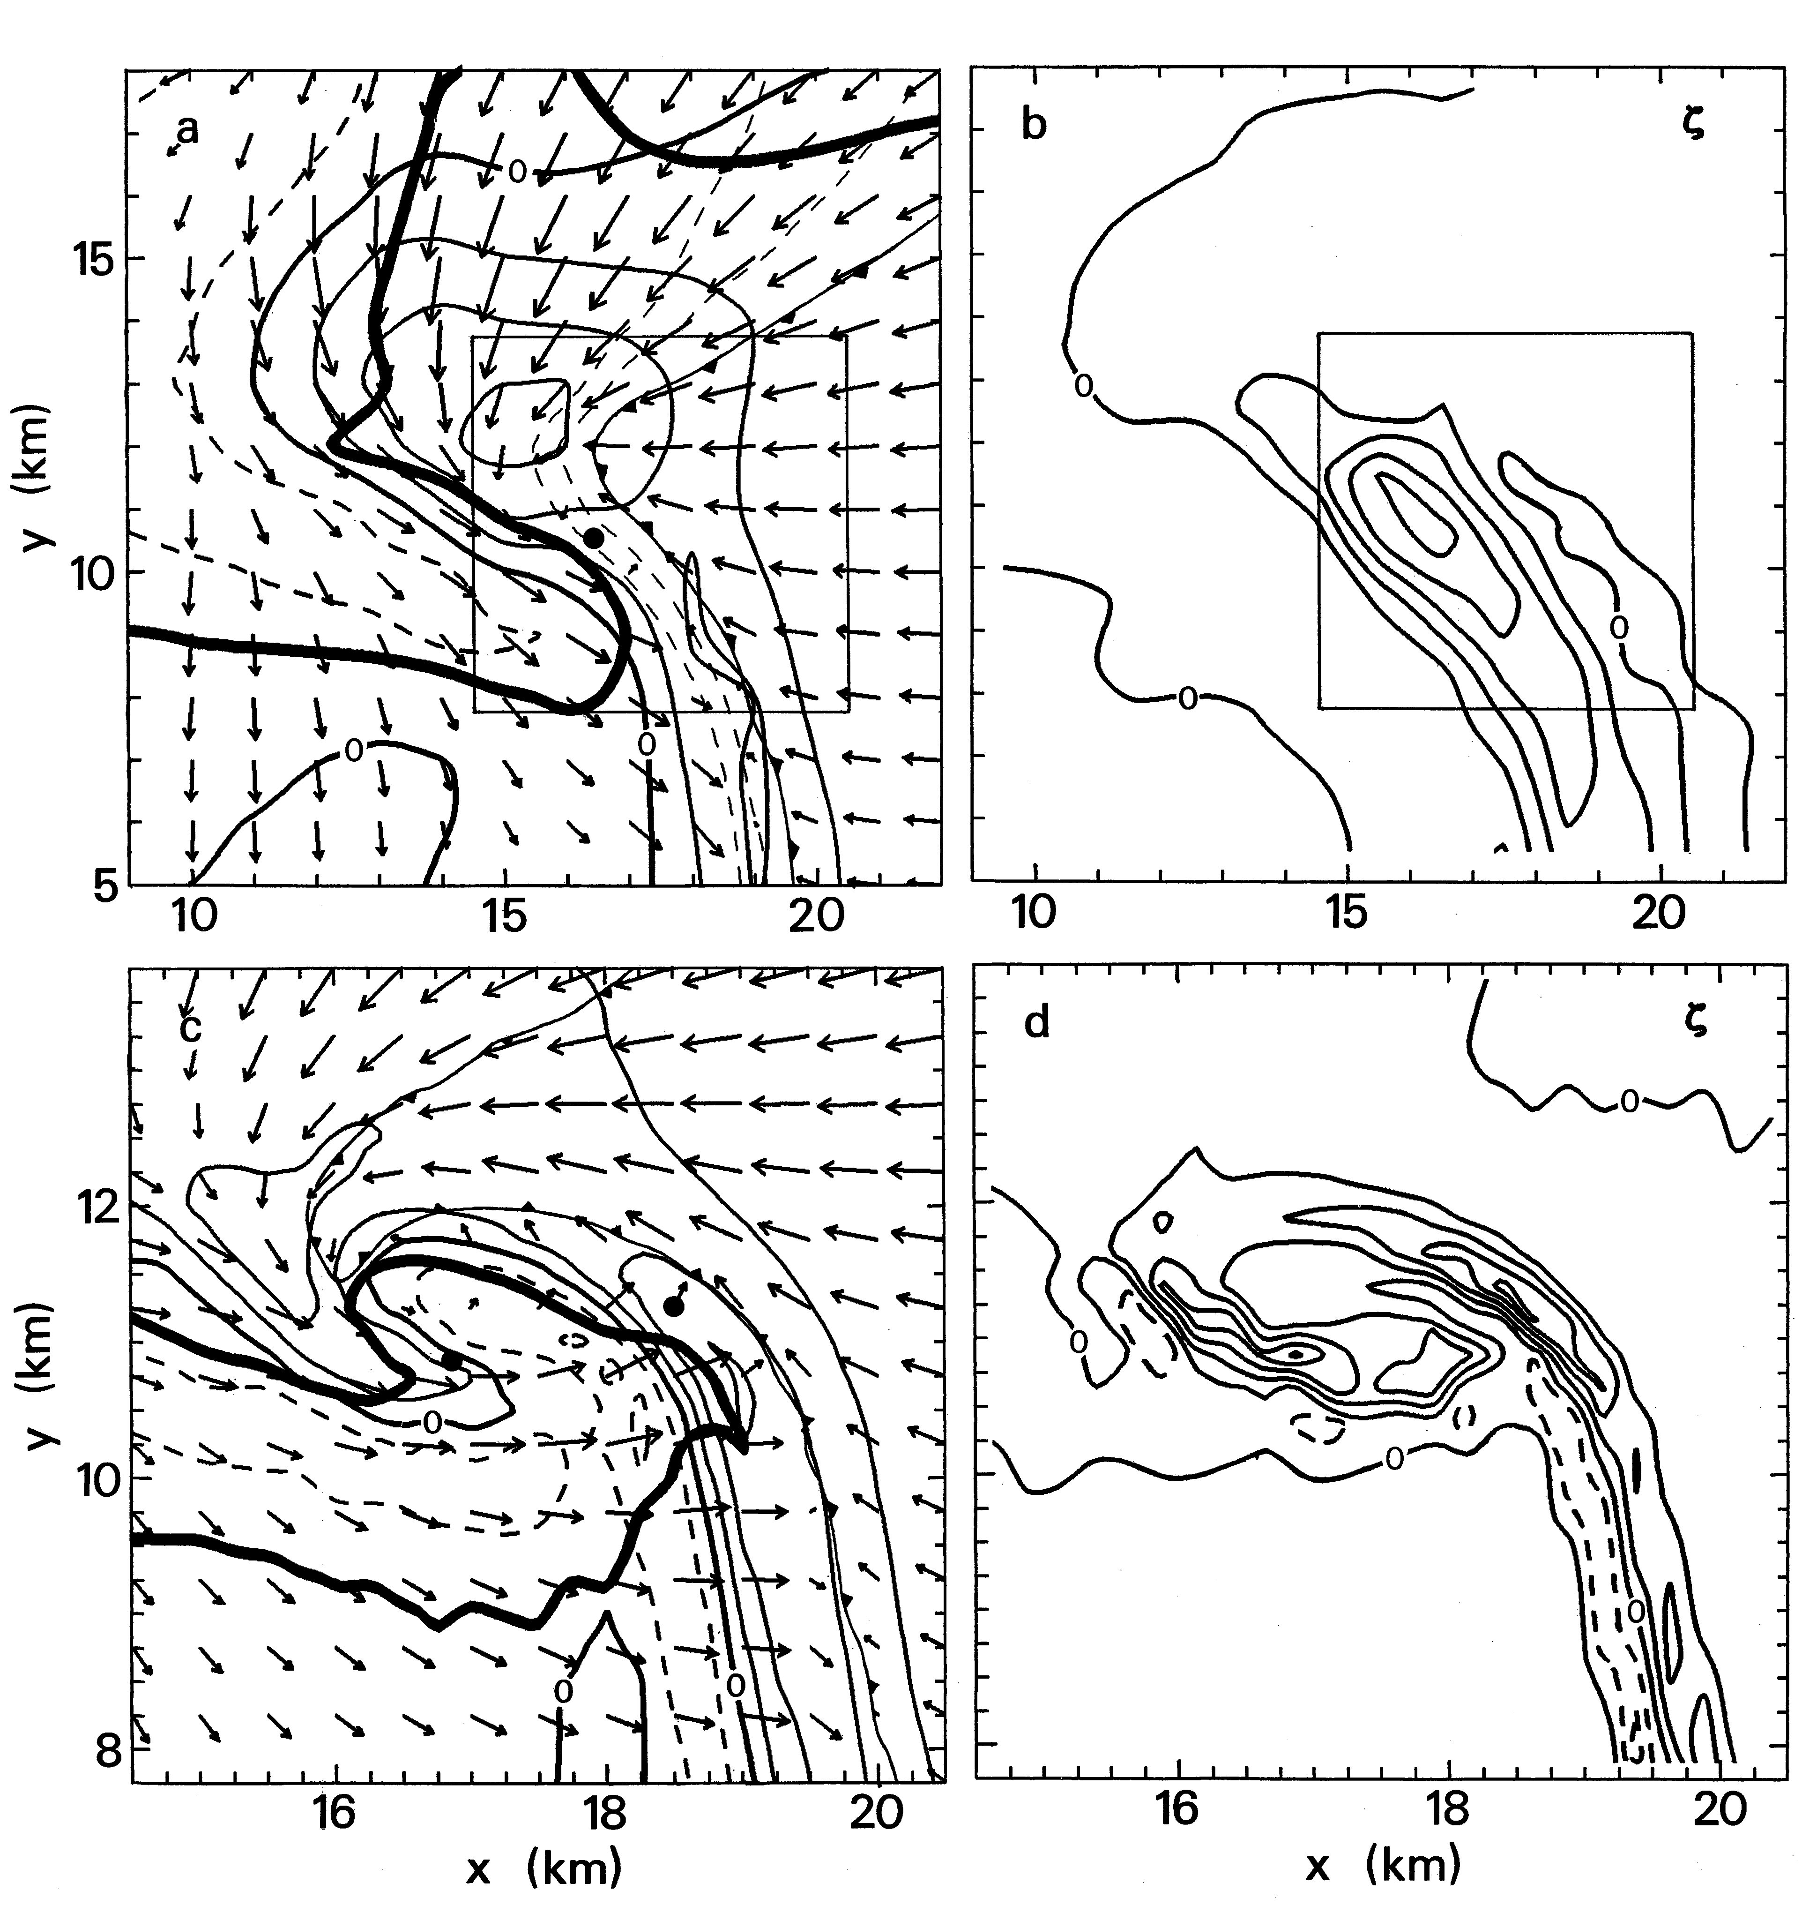
Klemp and Rotunno, JAS, 1983
1 way nest, adjustment from 1km to 250m, 6 min simulation….

Slide 28
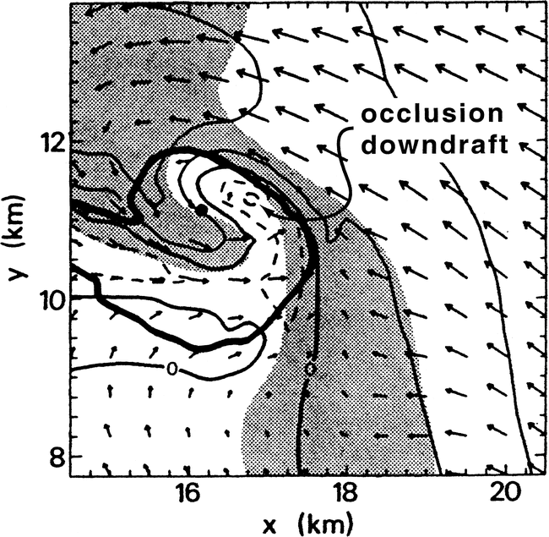

Slide 29
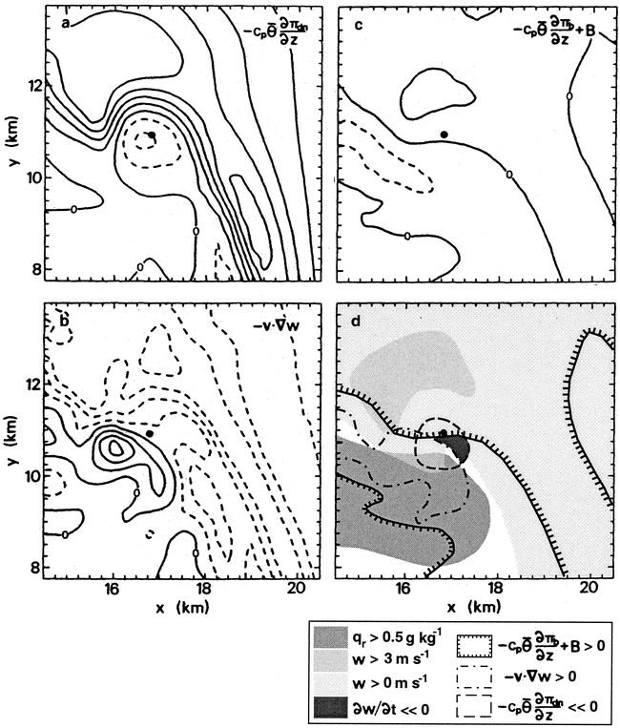

Slide 30
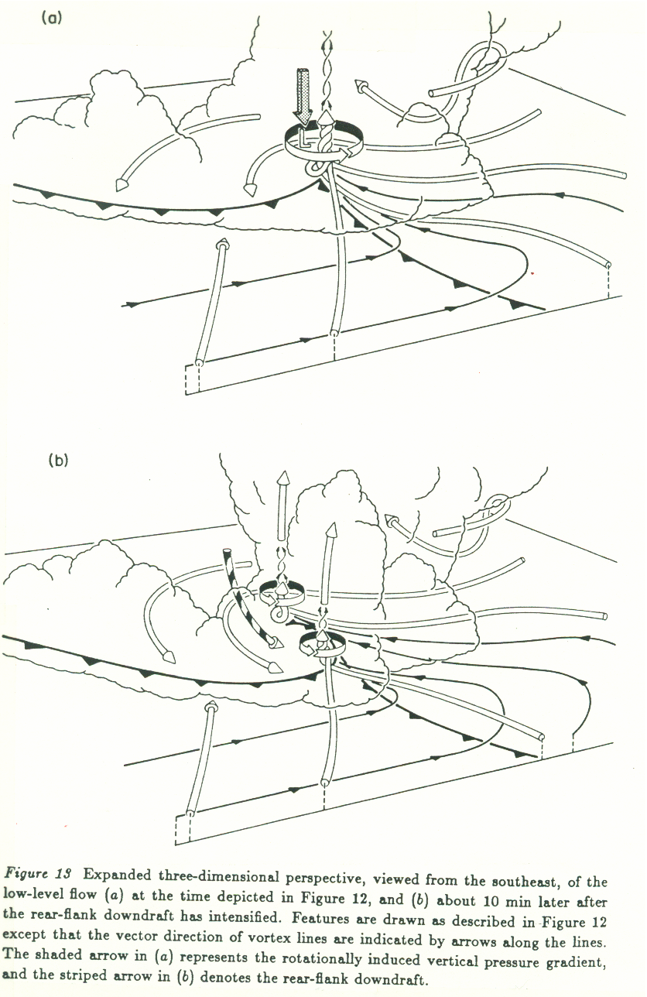

Slide 31
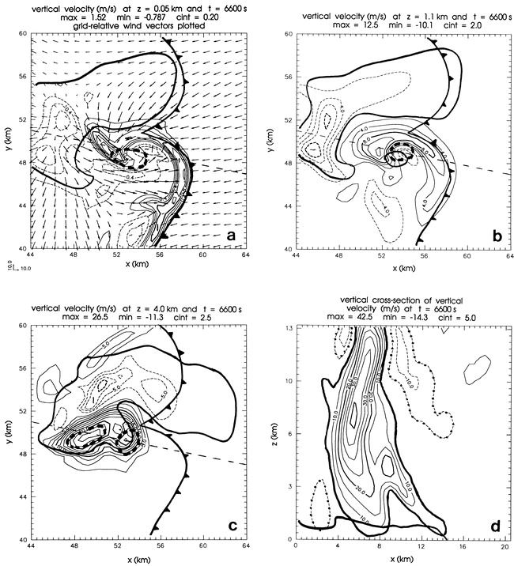
Adlerman and Droegemeier JAS 1999
“Cyclic- Mesocyclogenesis”
Back to Del City…. 20 May, 1977
100 km x 100 km,
500 m grid

Slide 32
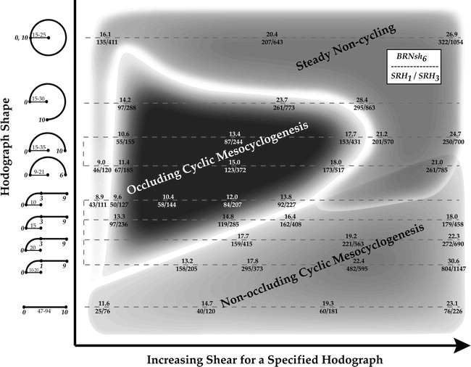
Adlerman and Droegemeier, MWR, 2005

Slide 33
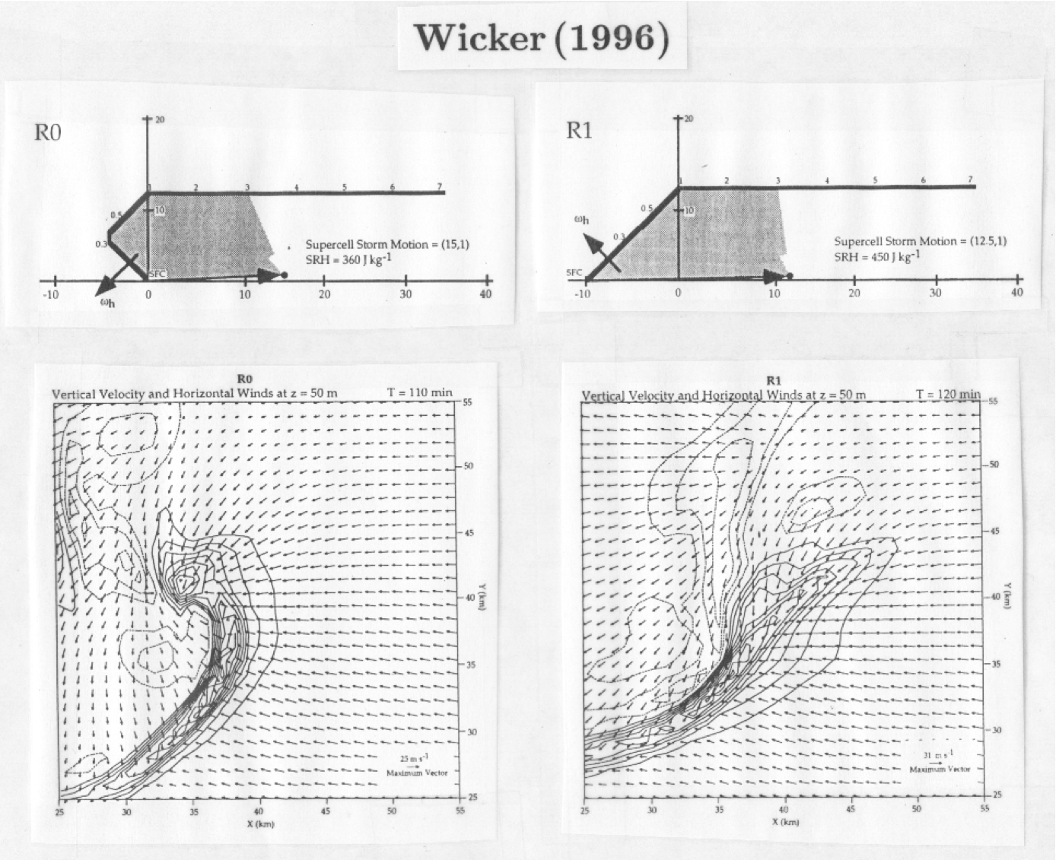

Slide 34
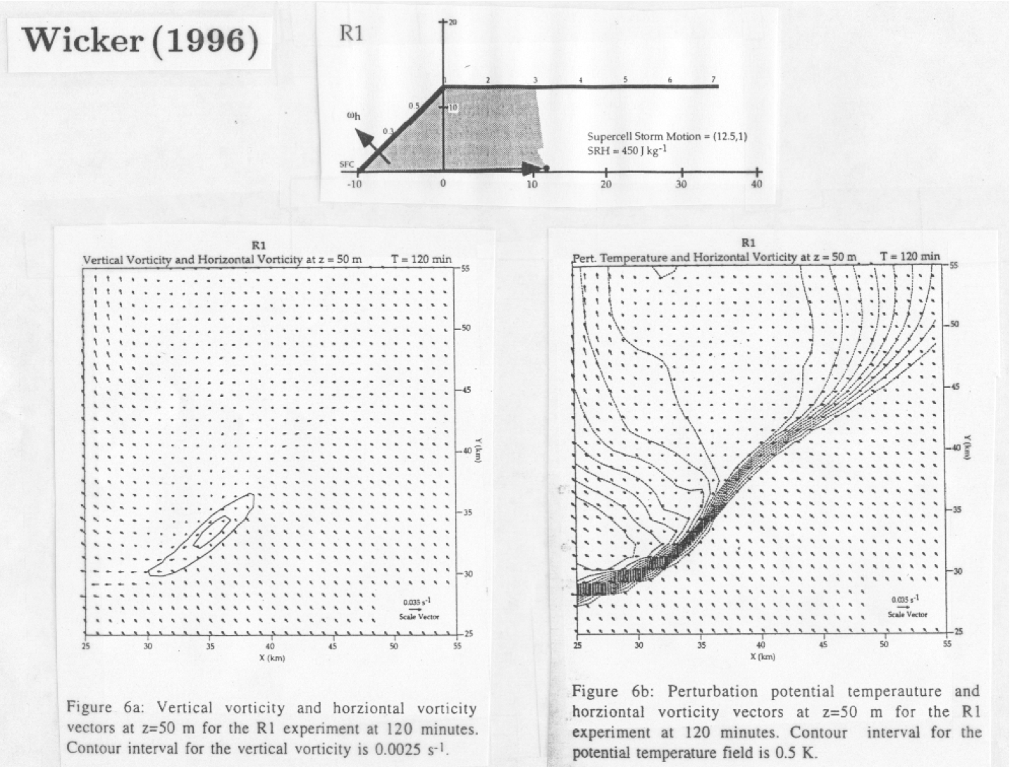

Slide 35
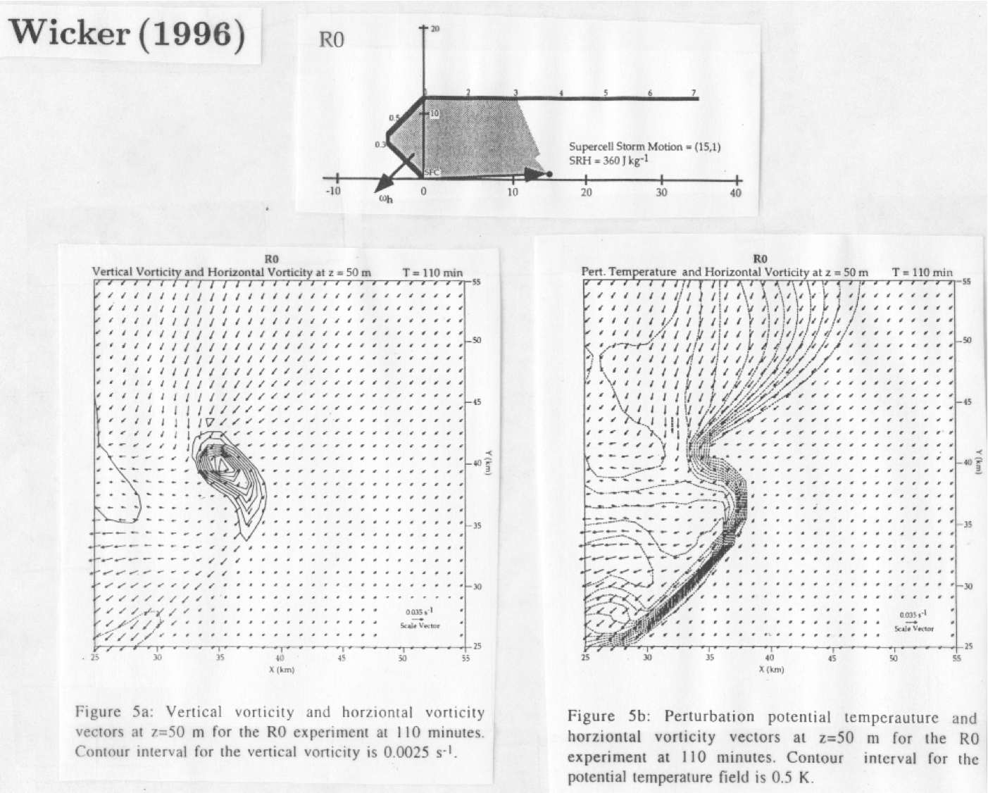

Slide 36
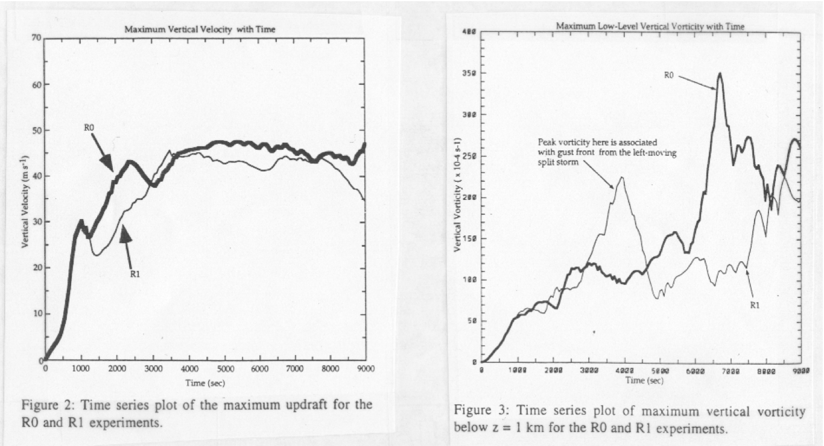

Slide 37
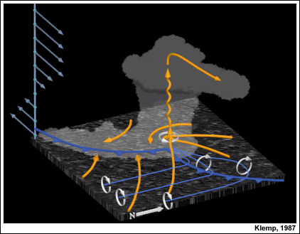

Slide 38
Vertical wind shear vs. Helicity:
VWS:
…Rotation generates updraft maintenance and propagation… (Galiean invariant)
…Forcing primarily non-linear
...considers straight and curved hodographs alike
Helicity:
…A steady, propagating storm is assumed…(not Galilean invariant)
…Propagation generates rotation
...Forcing primarily linear
...curved hodographs favored, straight hodographs problematic

