Slide 1
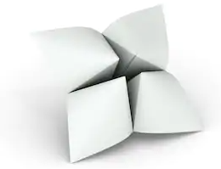

Rotate text/images this way
2
8
Rotate text/images this way
3
1
7
4
Rotate text/images this way
Rotate text/images this way
5
6
Directions:
1
2
3
4
While face down, fold corners to middle
Make a super awesome study game!
5. While face down, fold the corners to the middle
6. Fold along center lines into a square, then pop out each flap to create the pockets for your fingers

Slide 2
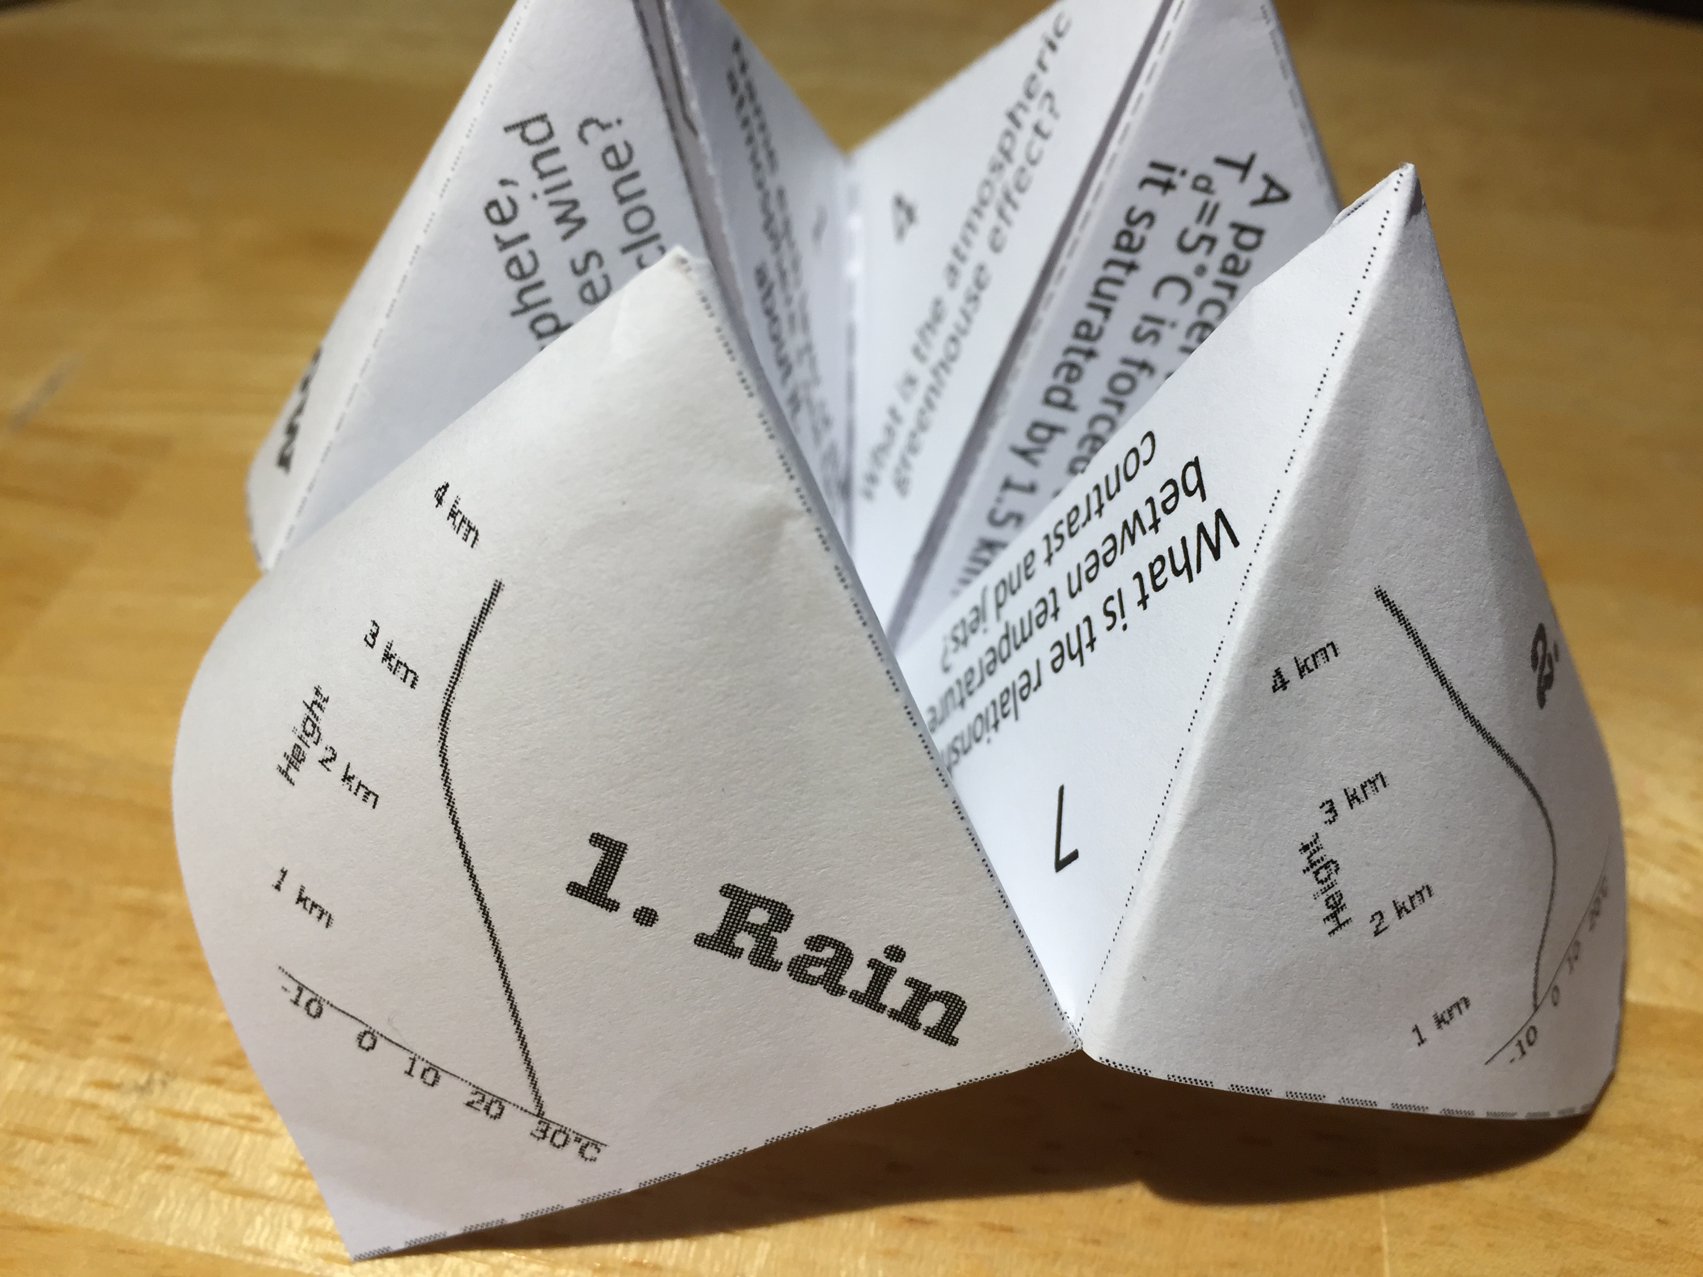
Tips on using this template:
The four outer boxes will be the outside face of your final product. Be sure to rotate your text/images so that the tops point to the middle of the template
The small triangles with numbers will be the inside (see picture below), you can add questions here
The large triangles in the middle will be what you lift the flap to see, this could be your answer or a hint for your answer.
Have fun!
I hope this is helpful! I’d love to see how you use it!
Andrea Lopez Lang
alang@albany.edu
Twitter: @alopezlang

