Slide 1





NCAR
UCAR
air • planet • people
SOARS Center for Undergraduate Research
The gap between graduates’ skills
and employers’ expectations
Val Sloan, Ph.D.

Slide 2
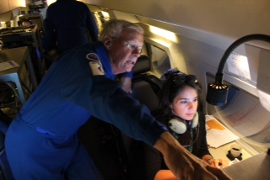
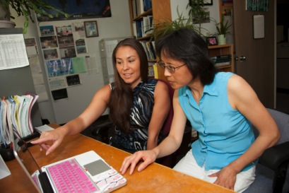
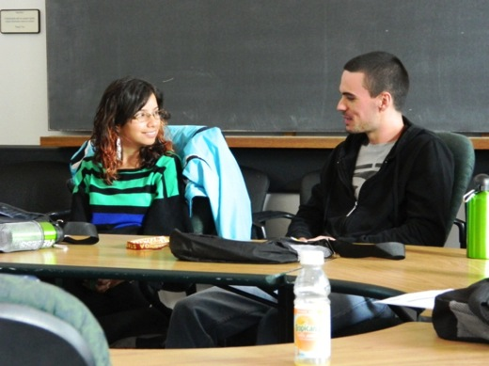
The job forecast in the atmospheric geosciences is small, but indicates positive growth
Occupation Title | Year 2012 | Year 2022 | Employ- ment change 2012 - 2022 | Employment change 2012- 2022 | Job openings due to growth and replacement 2012-2022 | Education
Atmospheric and space scientists | 11,100 | 12,200 | 1,100 | 10.0% | 3,800 | B.S.
Atmospheric, Earth, marine, and space teachers, faculty | 13,200 | 14,700 | 1,500 | 11.4% | 3,500 | Ph.D. or professional degree
U.S. Bureau of Labor Statistics: http://data.bls.gov/projections/occupationProj
NCAR
UCAR
air • planet • people
UCAR Center for Science Education
Notes:
The job forecast in the atmospheric geosciences is small, but indicates positive growth

Slide 3
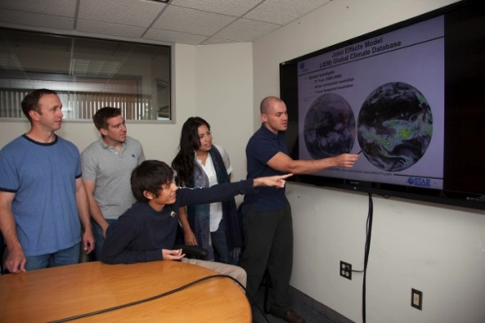
What does the gap in skills look like?
Technical Skills
Computer programming
Math
Communication Skills
Writing – papers, proposals
Oral – presentations
Email – professional & clear
Meetings – purposeful, respectful, being prepared
Leadership skills
Taking initiative
Supporting team
Mentoring others
Project management
NCAR
UCAR
air • planet • people
UCAR Center for Science Education
Notes:
What does the gap in skills look like?
Technical Skills
Computer programming
Math
Communication Skills
Writing – papers, proposals
Oral – presentations
Email – professional & clear
Meetings – purposeful, respectful, being prepared
Leadership skills
Taking initiative
Supporting team
Mentoring others
Project management

Slide 4
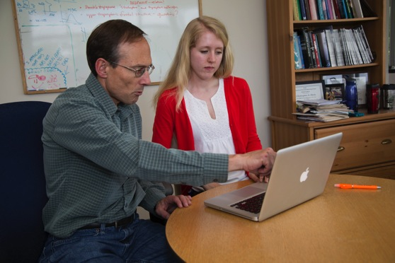
What do employers and potential graduate advisors look for?
To find out, we plan to:
Survey graduate schools & employers on skills sought - and perceived as lacking - in graduates and postgrads
Identify creative solutions
Provide UCAR members with survey results & suggestions
NCAR
UCAR
air • planet • people
UCAR Center for Science Education
Notes:
What do employers and potential graduate advisors look for?
To find out, we plan to:
Survey graduate schools & employers on skills sought - and perceived as lacking - in graduates and postgrads
Identify creative solutions
Provide UCAR members with survey results & recommendations.

Slide 5
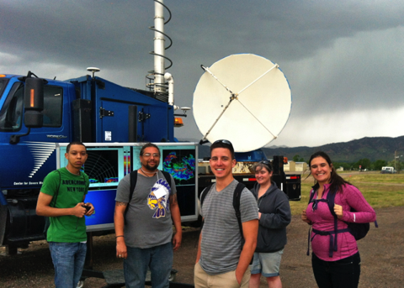
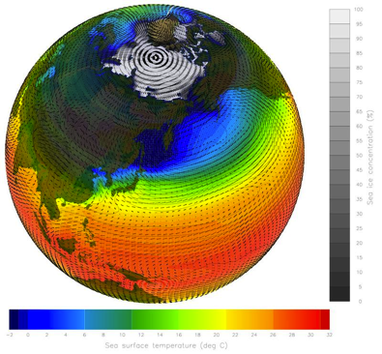
What are some innovative ways to close the skills gap and improve access?
Update departmental degree requirements
Incorporate real research into courses
Permit students to develop skills online for credit
Transcend bricks and mortar → students without borders
Encourage internships & work opportunities
NCAR
UCAR
air • planet • people
UCAR Center for Science Education
Notes:
What are some innovative ways to close the skills gap and improve access?
Update departmental degree requirements
Incorporate real research into courses
Permit students to develop skills online for credit
Transcend bricks and mortar → students without borders
Encourage internships & work opportunities

