Slide 1
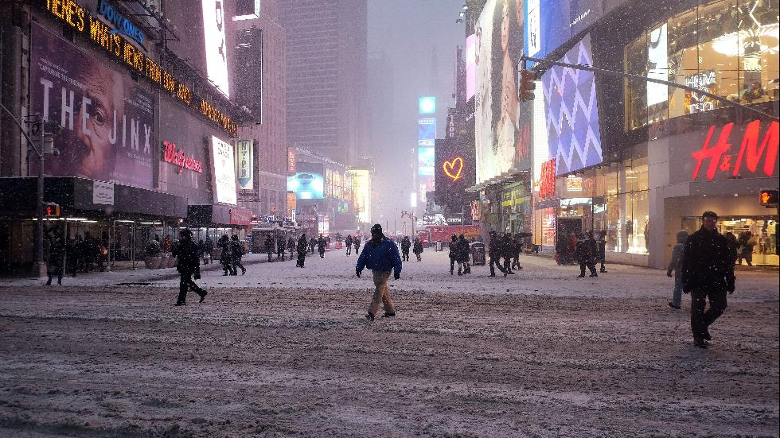
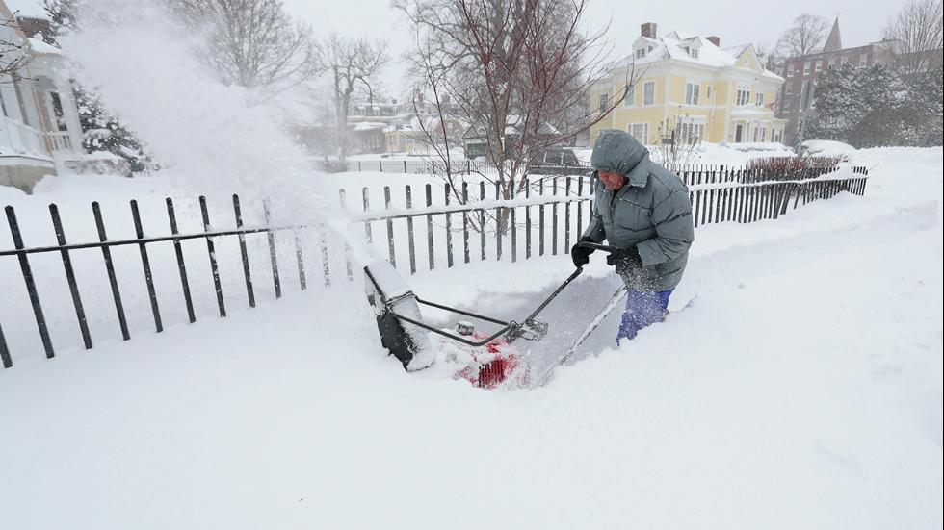
Event Statistics
Two sequential cyclogenesis events impacted East Coast in January 2015.
Snowfall totals for the second storm were >1 m (3 ft) in some locations.
Considerable coastal flooding reported in MA with wind gusts >60 kts.
Worcester, MA, tallied 87 cm (34.5 in.) (all-time record).
Delta pre-emptively canceled 600 flights on 26 Jan.
The second storm was characterized by considerable forecast uncertainty.
Times Square
Boston
AP Photos

Slide 2

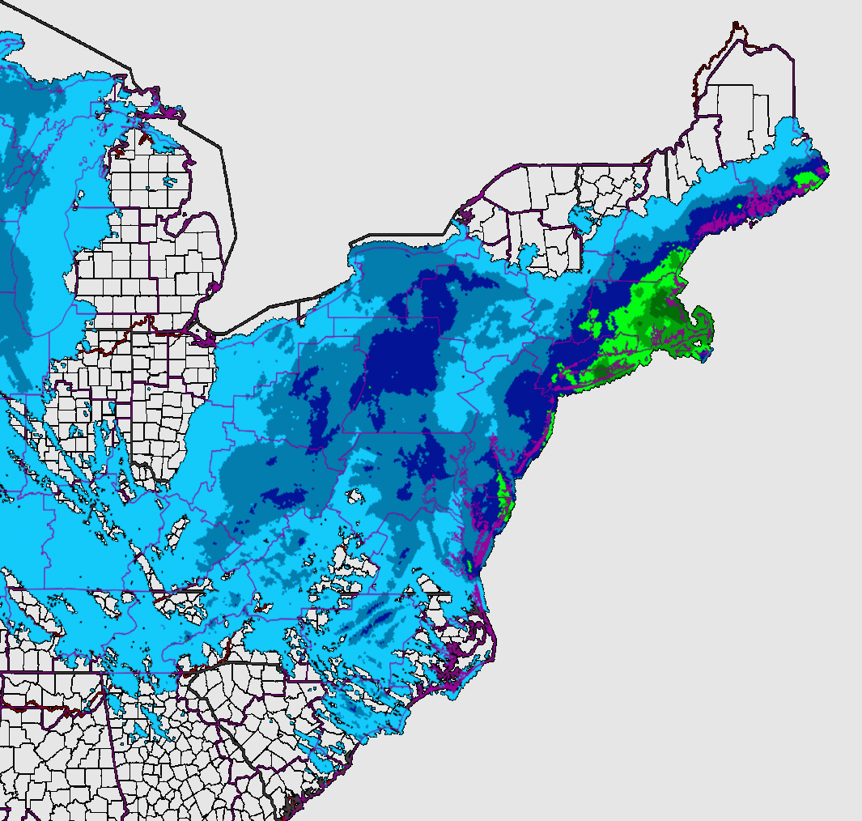
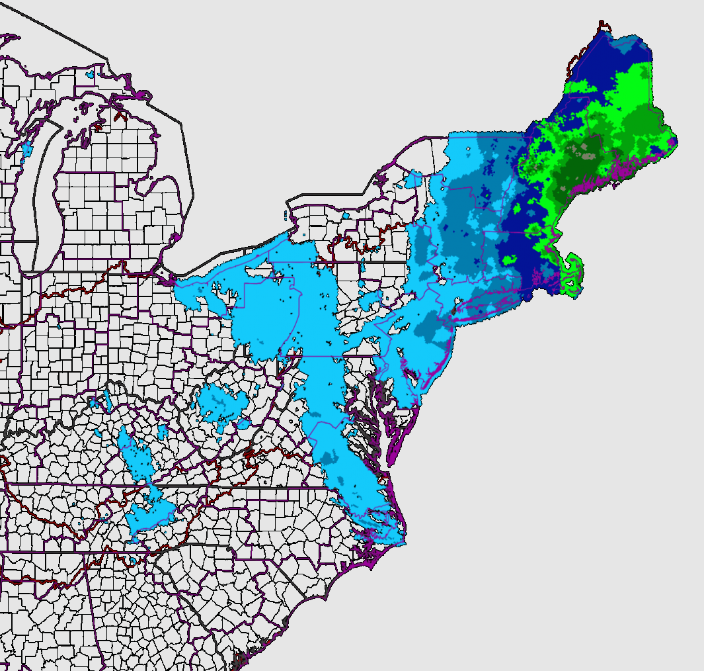
NOAA 24-h Quantitative Precipitation Estimates
Ending: 1200 UTC 27 Jan. 2015
Ending: 1200 UTC 28 Jan. 2015

Slide 3
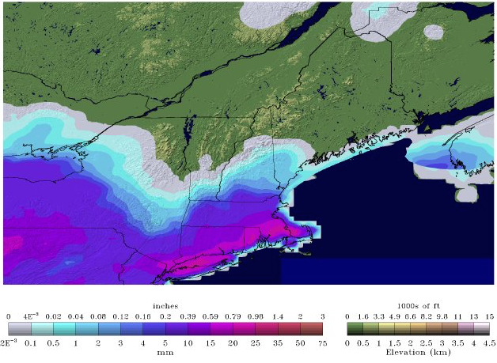
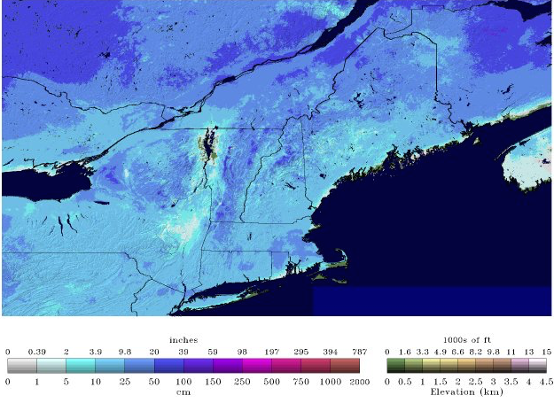
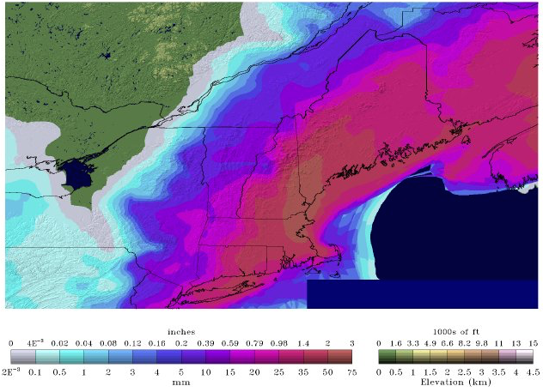
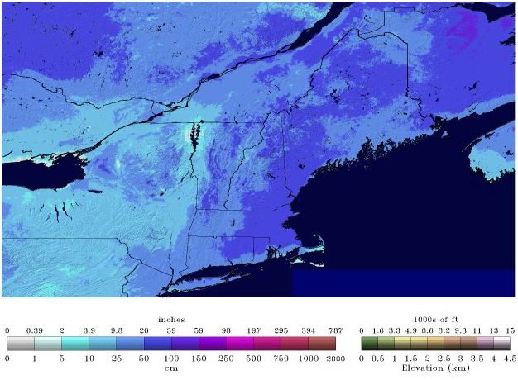


NOAA National Snow Analysis Statistics
Snow Precipitation
Snow Depth
0600 UTC 27 Jan. 2015
0600 UTC 28 Jan. 2015
0.1
1
3
5
15
25
50
1
10
50
150
500
1000
cm
cm

Slide 4
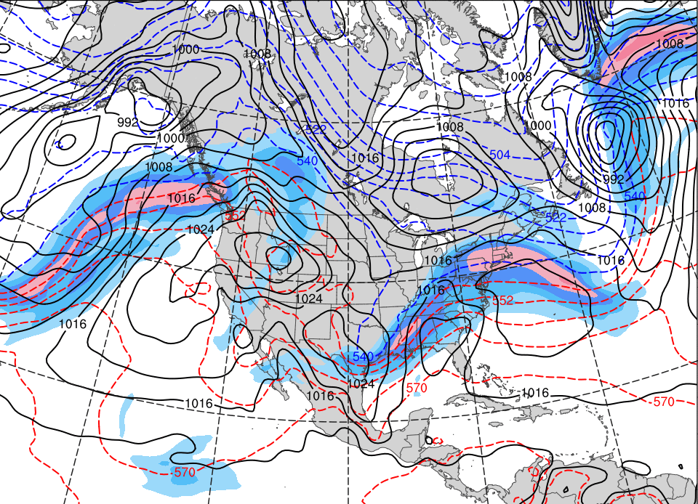
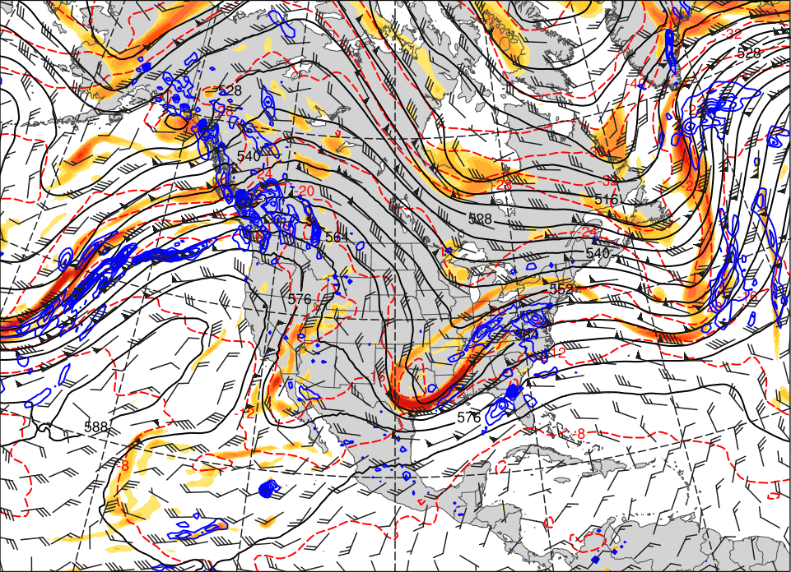
Synoptic Evolution – Late-January 2015
0000 UTC 24 Jan. 2015
500 hPa Heights (dam; black)
500 hPa Winds (kts; barbs)
500 hPa Rel. Vor. (10^{–5} s^{–1} fill pattern)
500 hPa Temp. (ºC; dashed red)
500 hPa Ascent (dPa s^{–1}; blue)
SLP (hPa; black)
1000–500 hPa Thickness (dam; dashed)
250 hPa Jet (ms^{–1}; fill pattern)

Slide 5
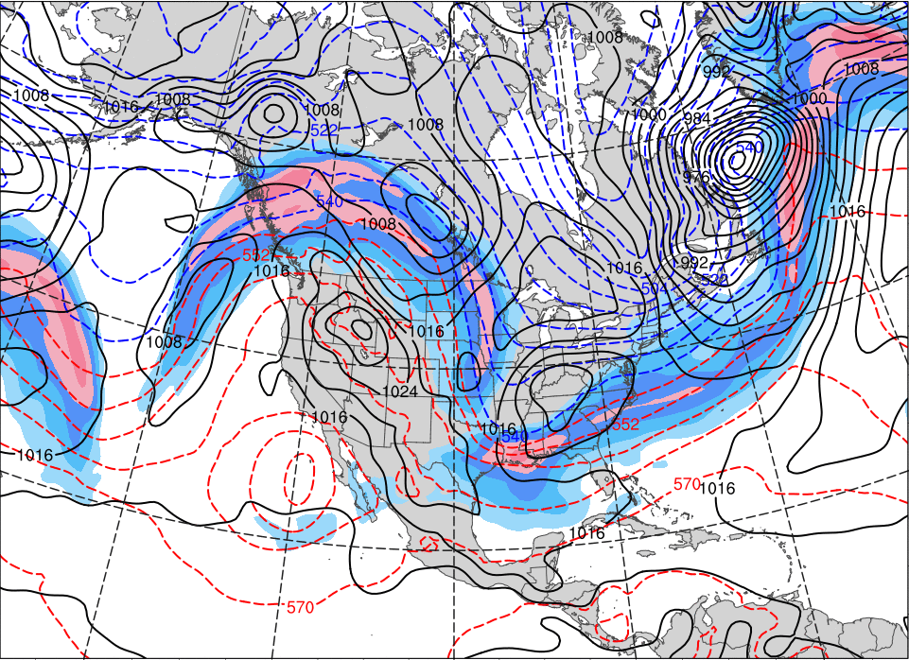
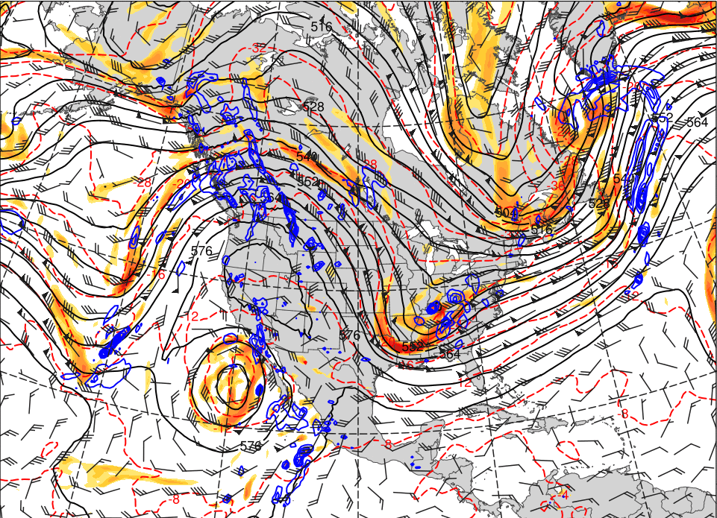
Synoptic Evolution – Late-January 2015
0000 UTC 26 Jan. 2015
500 hPa Heights (dam; black)
500 hPa Winds (kts; barbs)
500 hPa Rel. Vor. (10^{–5} s^{–1} fill pattern)
500 hPa Temp. (ºC; dashed red)
500 hPa Ascent (dPa s^{–1}; blue)
SLP (hPa; black)
1000–500 hPa Thickness (dam; dashed)
250 hPa Jet (ms^{–1}; fill pattern)

Slide 6
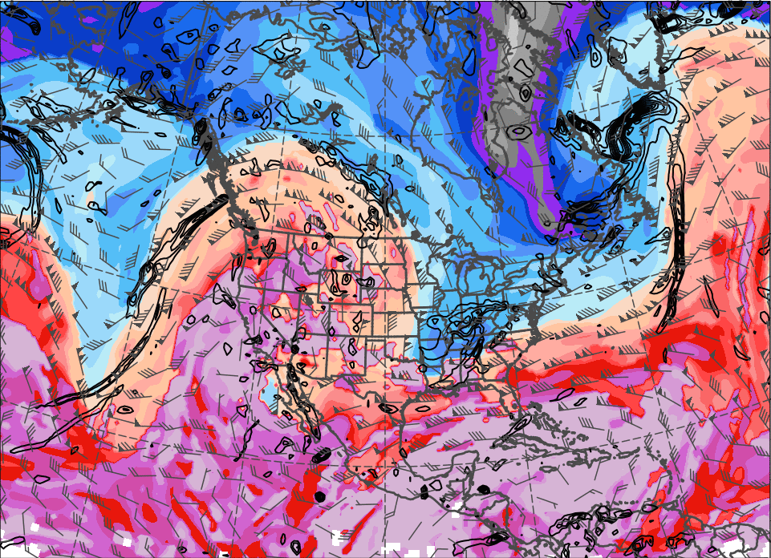
0000 UTC 26 Jan. 2015
Top Left: SLP, 1000–500 hPa Thickness, and the 250-hPa Jet
Top Right: 500 hPa Rel. Vor., Heights, Winds, Temperature, and Ascent
Bottom Left: DT Theta (K; fill), Winds (kts; barbs), 925–850 hPa Rel. Vor. (10^{–5} s^{–1};black)

Slide 7
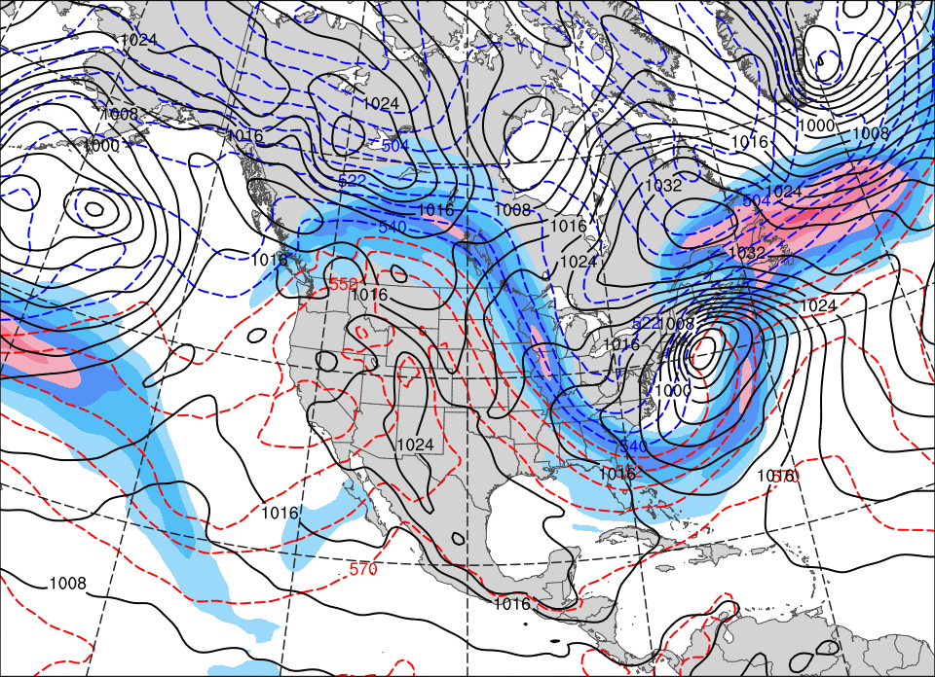
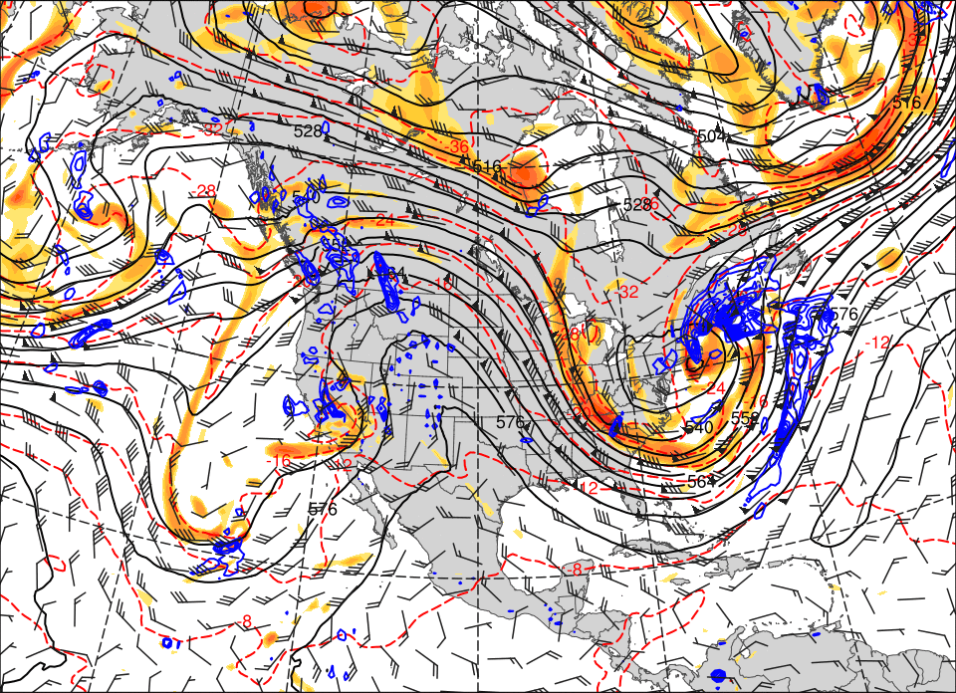
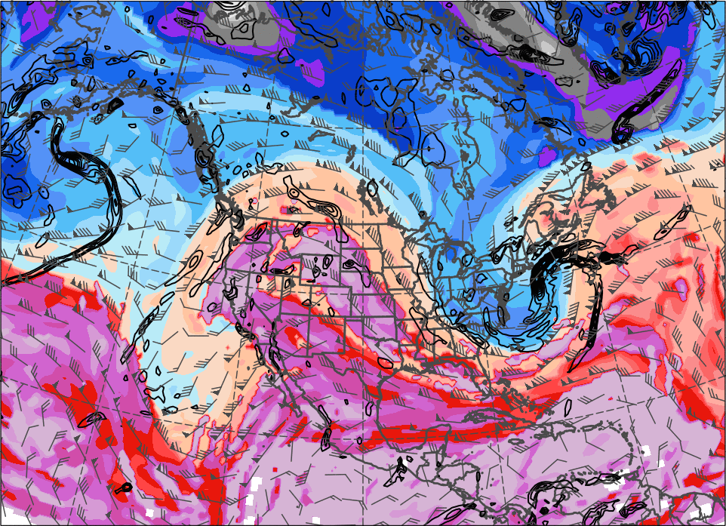
0000 UTC 27 Jan. 2015
Top Left: SLP, 1000–500 hPa Thickness, and the 250-hPa Jet
Top Right: 500 hPa Rel. Vor., Heights, Winds, Temperature, and Ascent
Bottom Left: DT Theta (K; fill), Winds (kts; barbs), 925–850 hPa Rel. Vor. (10^{–5} s^{–1};black)

Slide 8
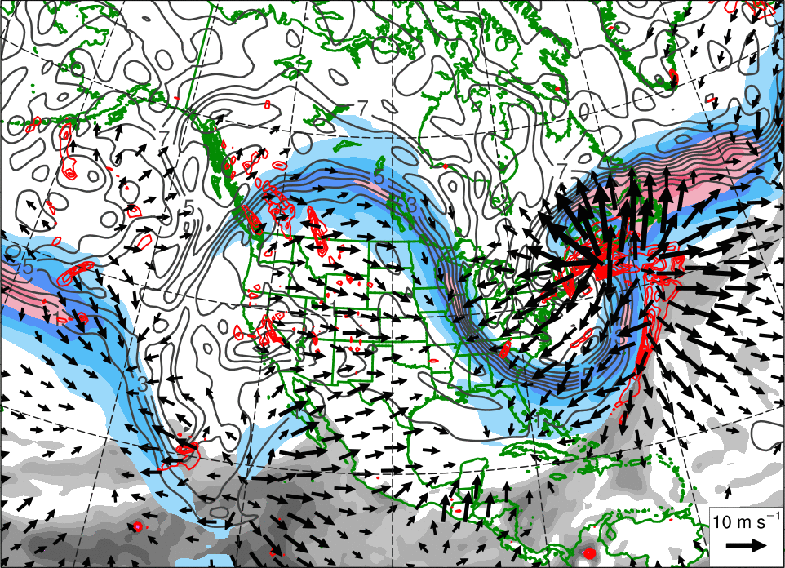
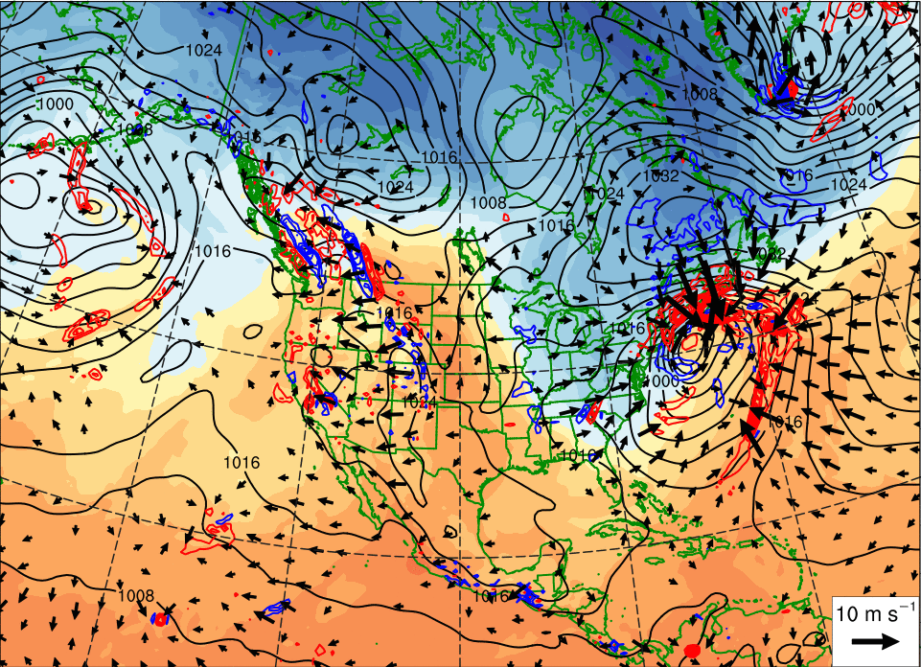

Synoptic Evolution – January 2015
1200 UTC 27 Jan. 2015
250 hPa Jet (ms^{–1}; blue fill)
600–400 hPa Ascent (dPa s^{–1}; red)
300–200 hPa PV/Irr. Wind (gray/vectors)
PW (mm; gray fill)
SLP (hPa; black)
700–500 hPa Ascent (dPa s^{–1}; red)
900–800 hPa Irr. Wind (vectors)
850 hPa Theta (K; fill)

Slide 9
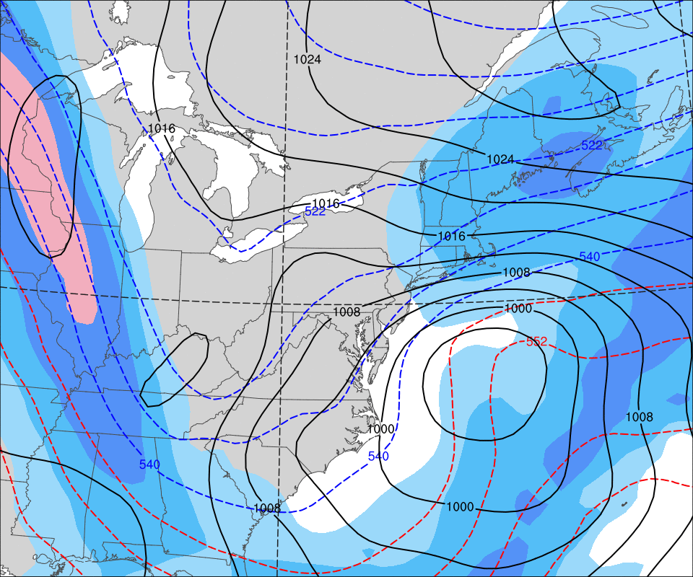
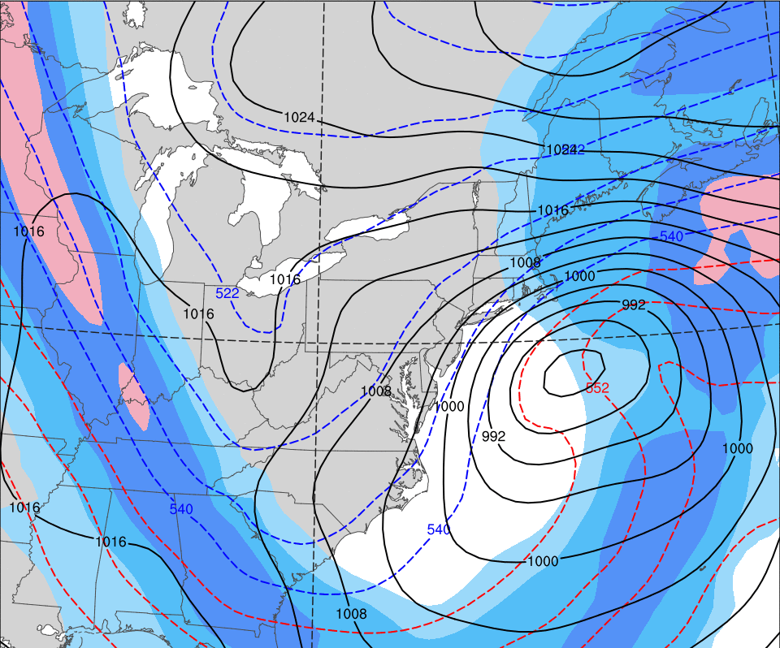
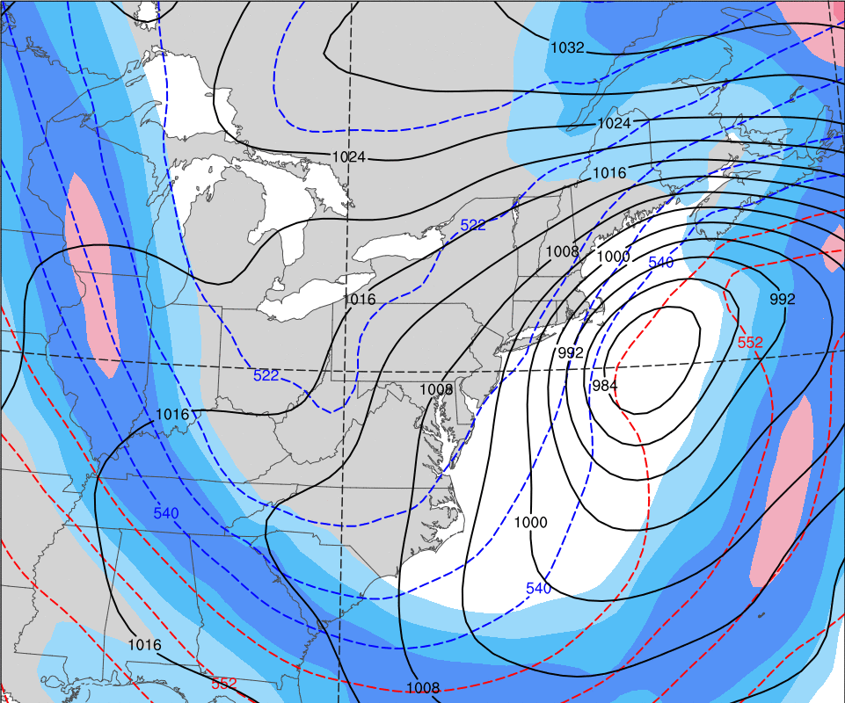
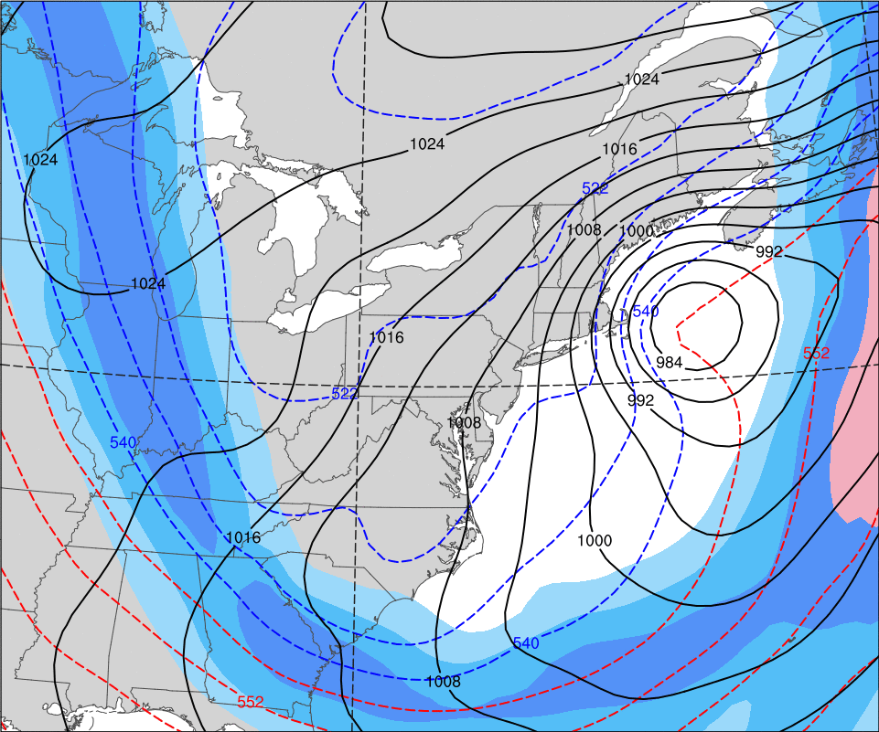
Sub-Synoptic Scale Evolution – 27 Jan 2015
0000 UTC 27 Jan. 2015
0600 UTC 27 Jan. 2015
L₉₈₄
250 hPa Jet
(ms^{–1}; fill)
1000–500 hPa Thickness (dam; dashed)
SLP (hPa; black)
L₉₉₆
1200 UTC 27 Jan. 2015
1800 UTC 27 Jan. 2015
L₉₈₂
L₉₈₂

Slide 10
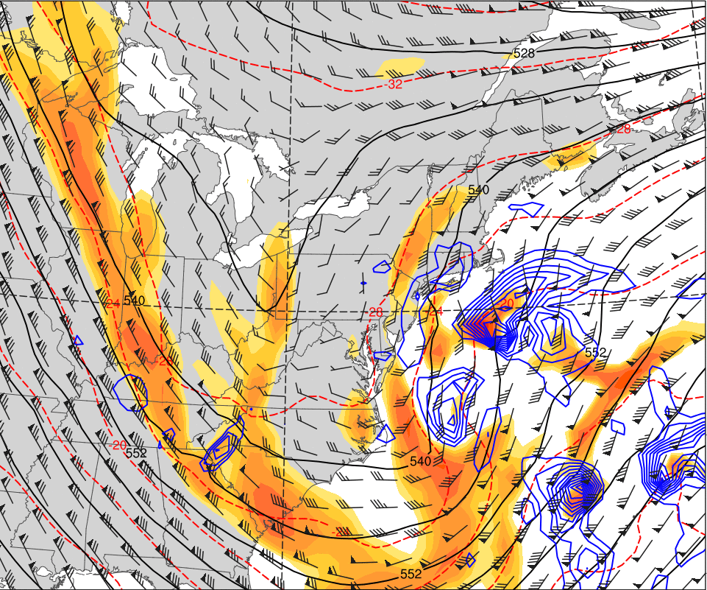
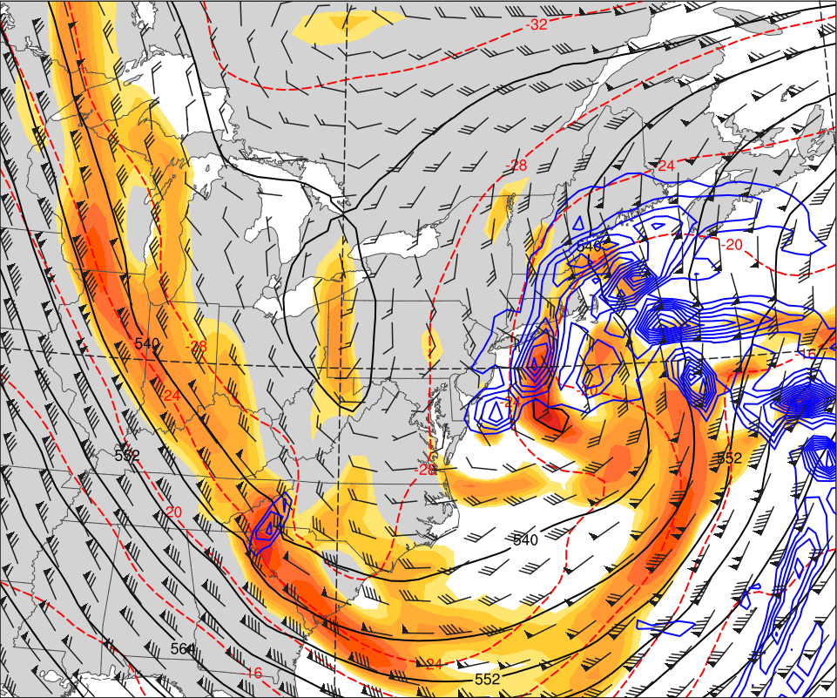
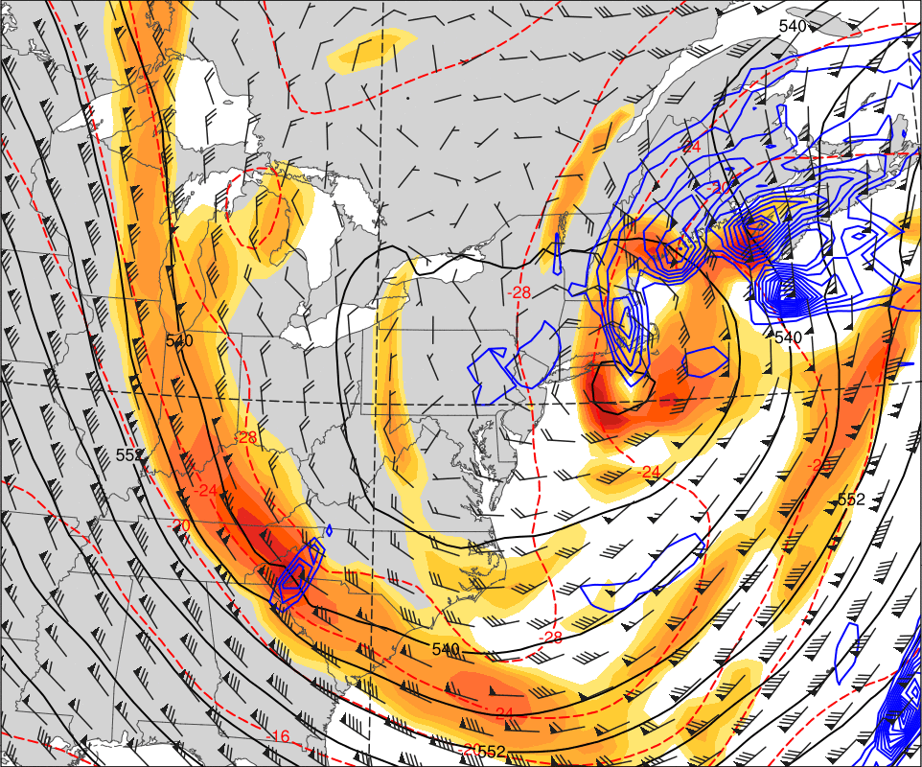
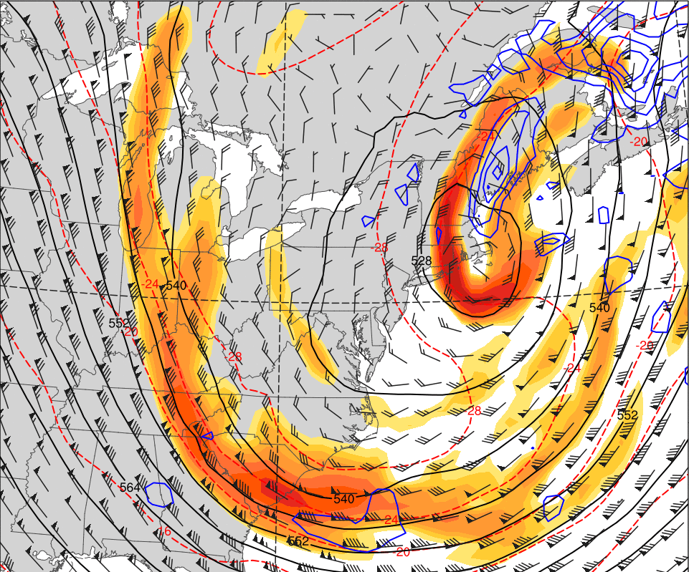
Sub-Synoptic Scale Evolution – 27 Jan 2015
0000 UTC 27 Jan. 2015
0600 UTC 27 Jan. 2015
500 hPa Rel. Vor. (10^{–5} s^{–1}; fill)
500 hPa Temp.
(K; red dashed)
500 hPa Heights (dam; black)
500 hPa Winds (kts; barbs)
500 hPa Ascent (dPa s^{–1}; blue)
1200 UTC 27 Jan. 2015
1800 UTC 27 Jan. 2015

Slide 11
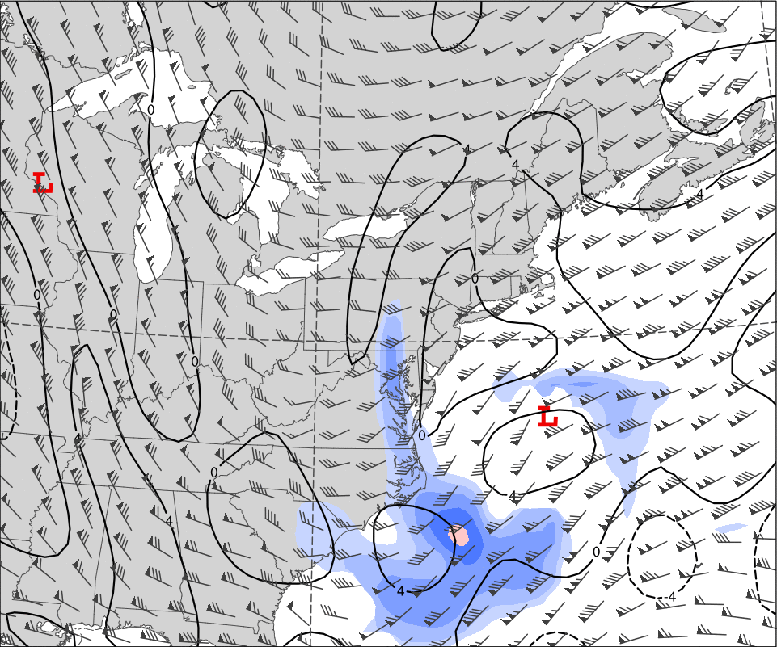
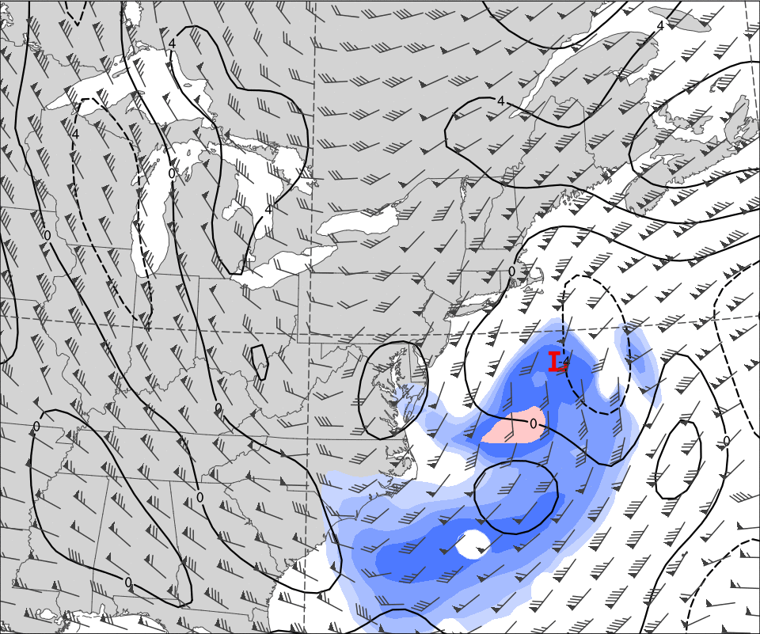
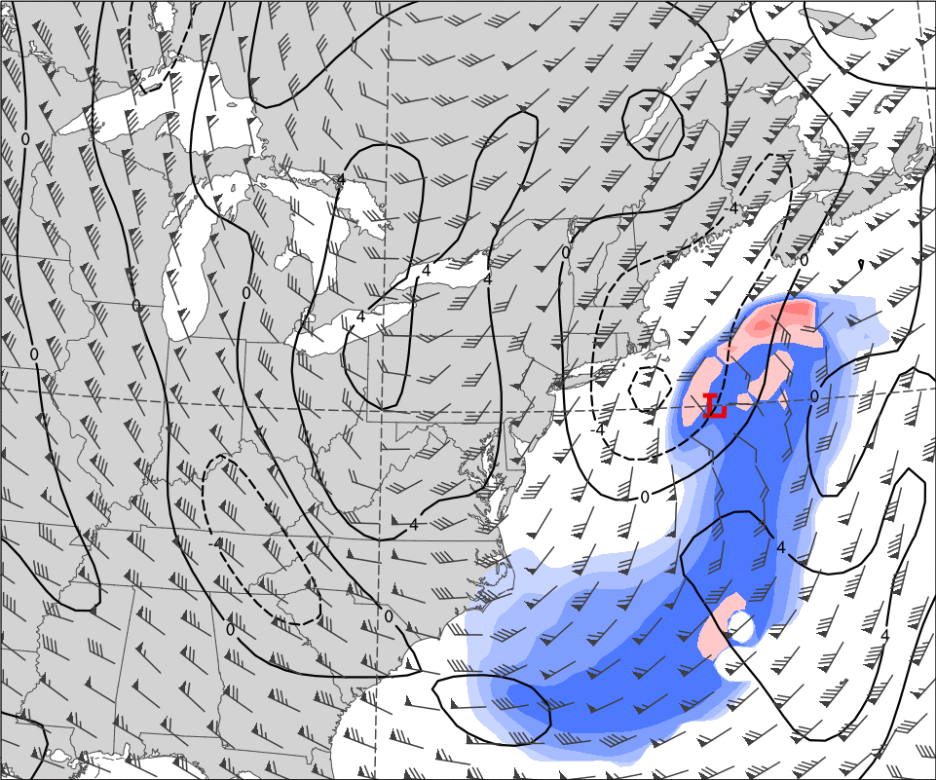
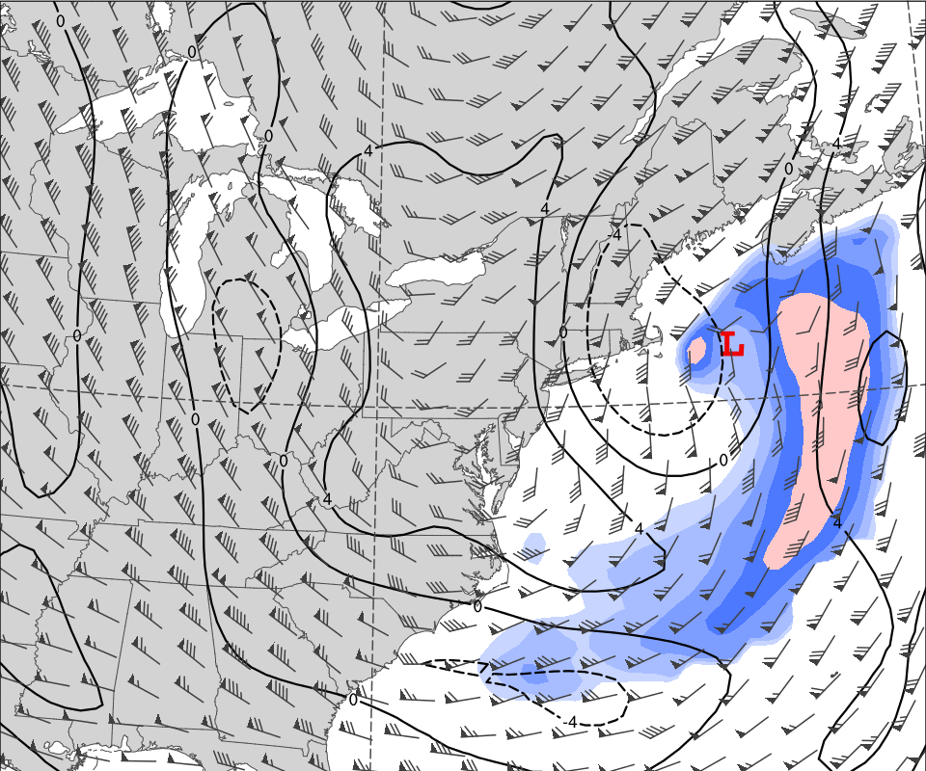
Sub-Synoptic Scale Evolution – 27 Jan 2015
0000 UTC 27 Jan. 2015
0600 UTC 27 Jan. 2015
Coupling Index (K; black)
500–200 hPa Thermal Vort. (10^{–5} s^{–1}; fill)
850–200 hPa Wind Shear (kts; barbs)
Surface Low (“L”)
1200 UTC 27 Jan. 2015
1800 UTC 27 Jan. 2015
CI_{min}=–8K

Slide 12
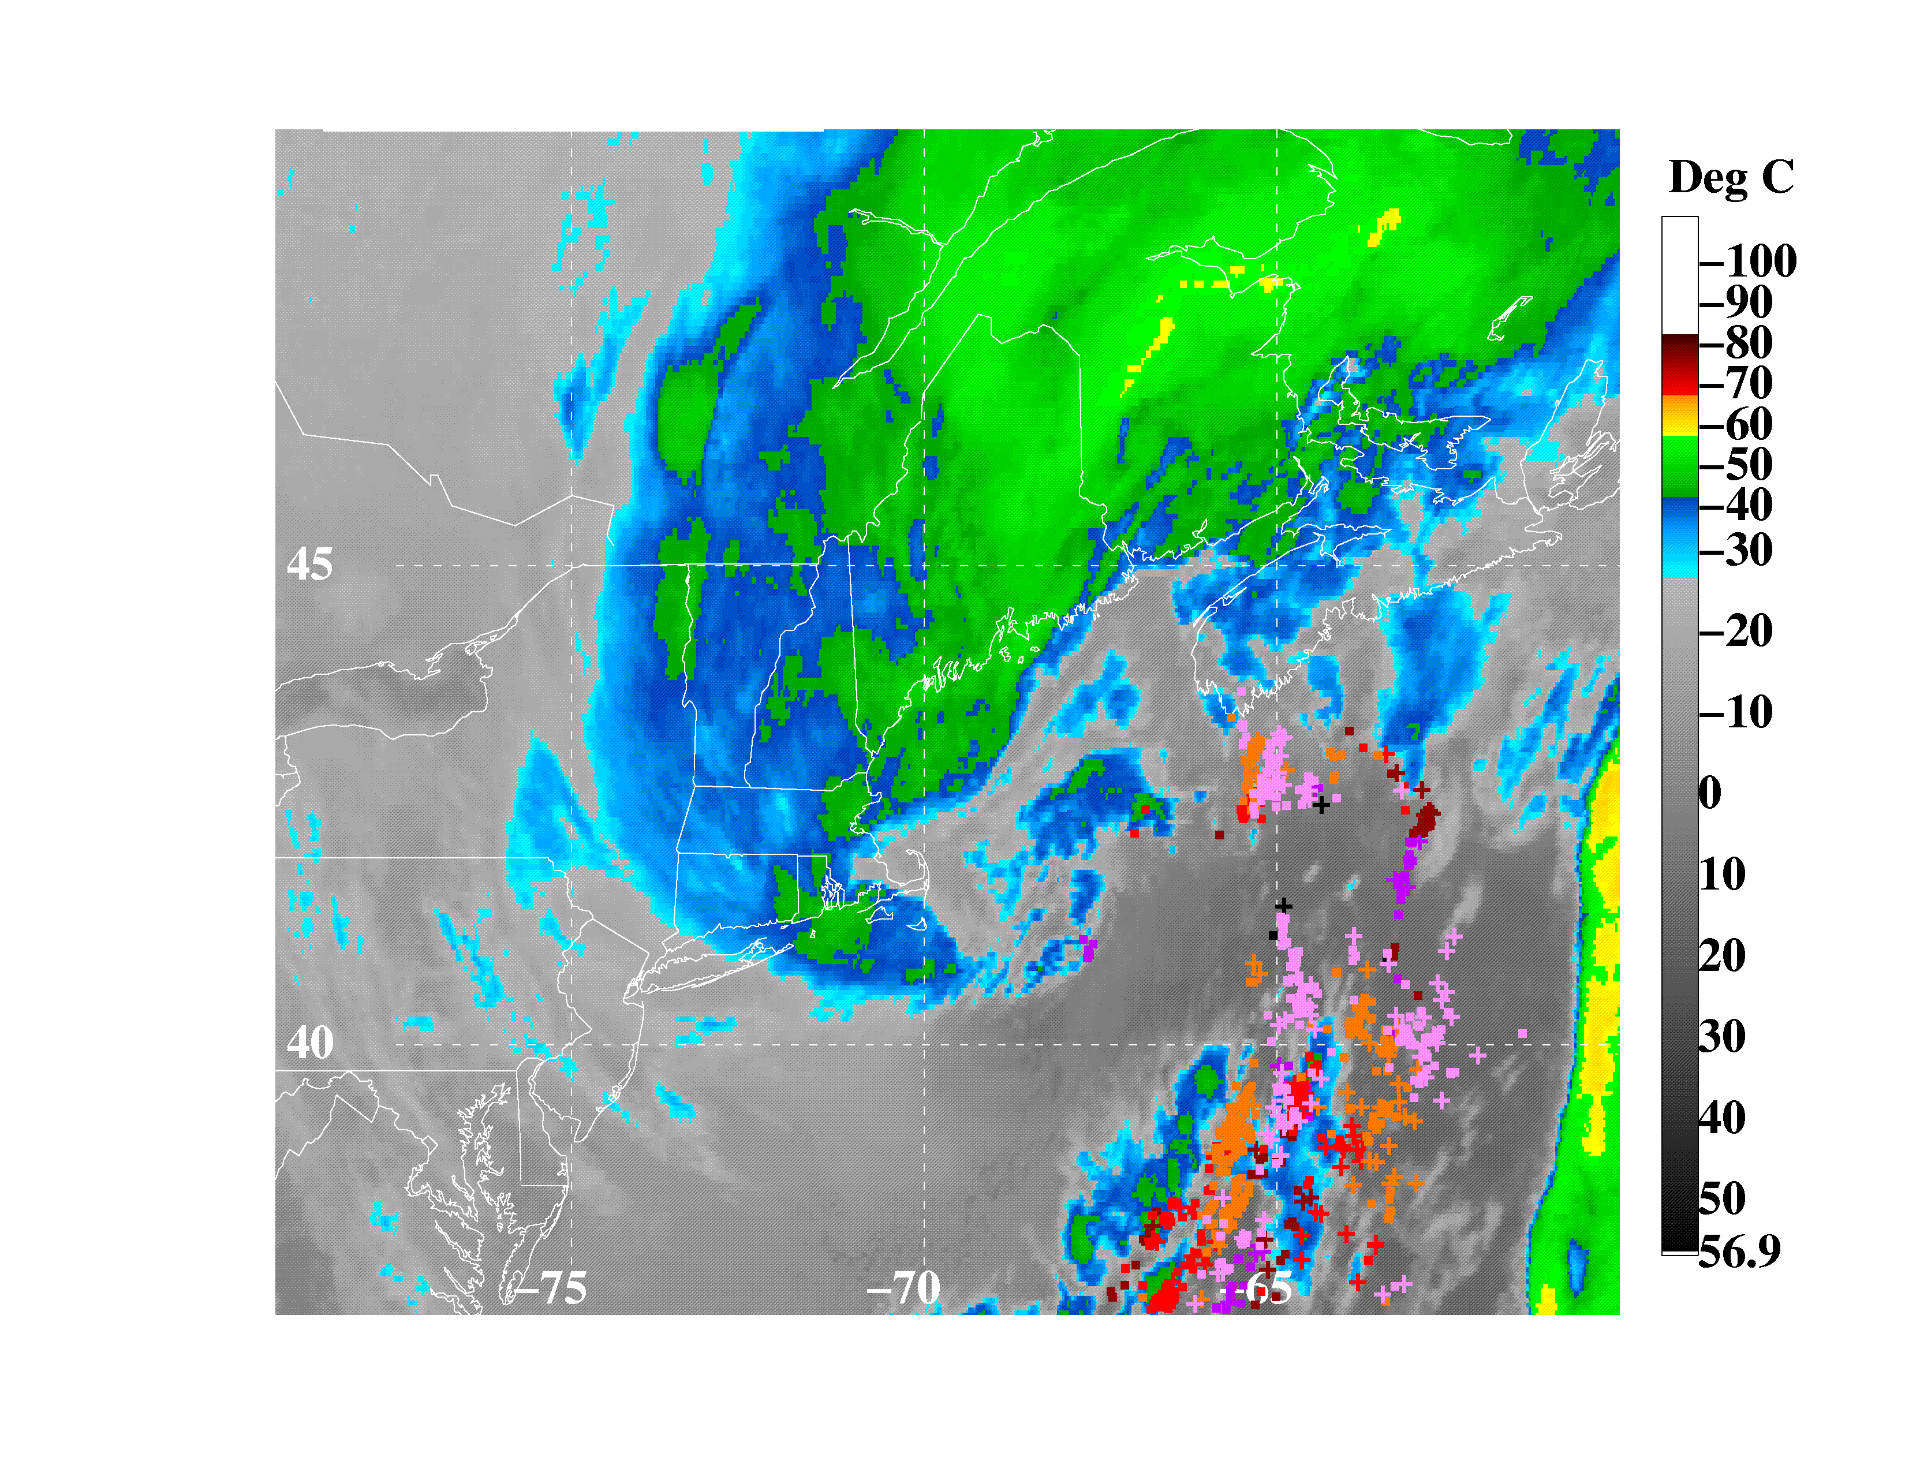
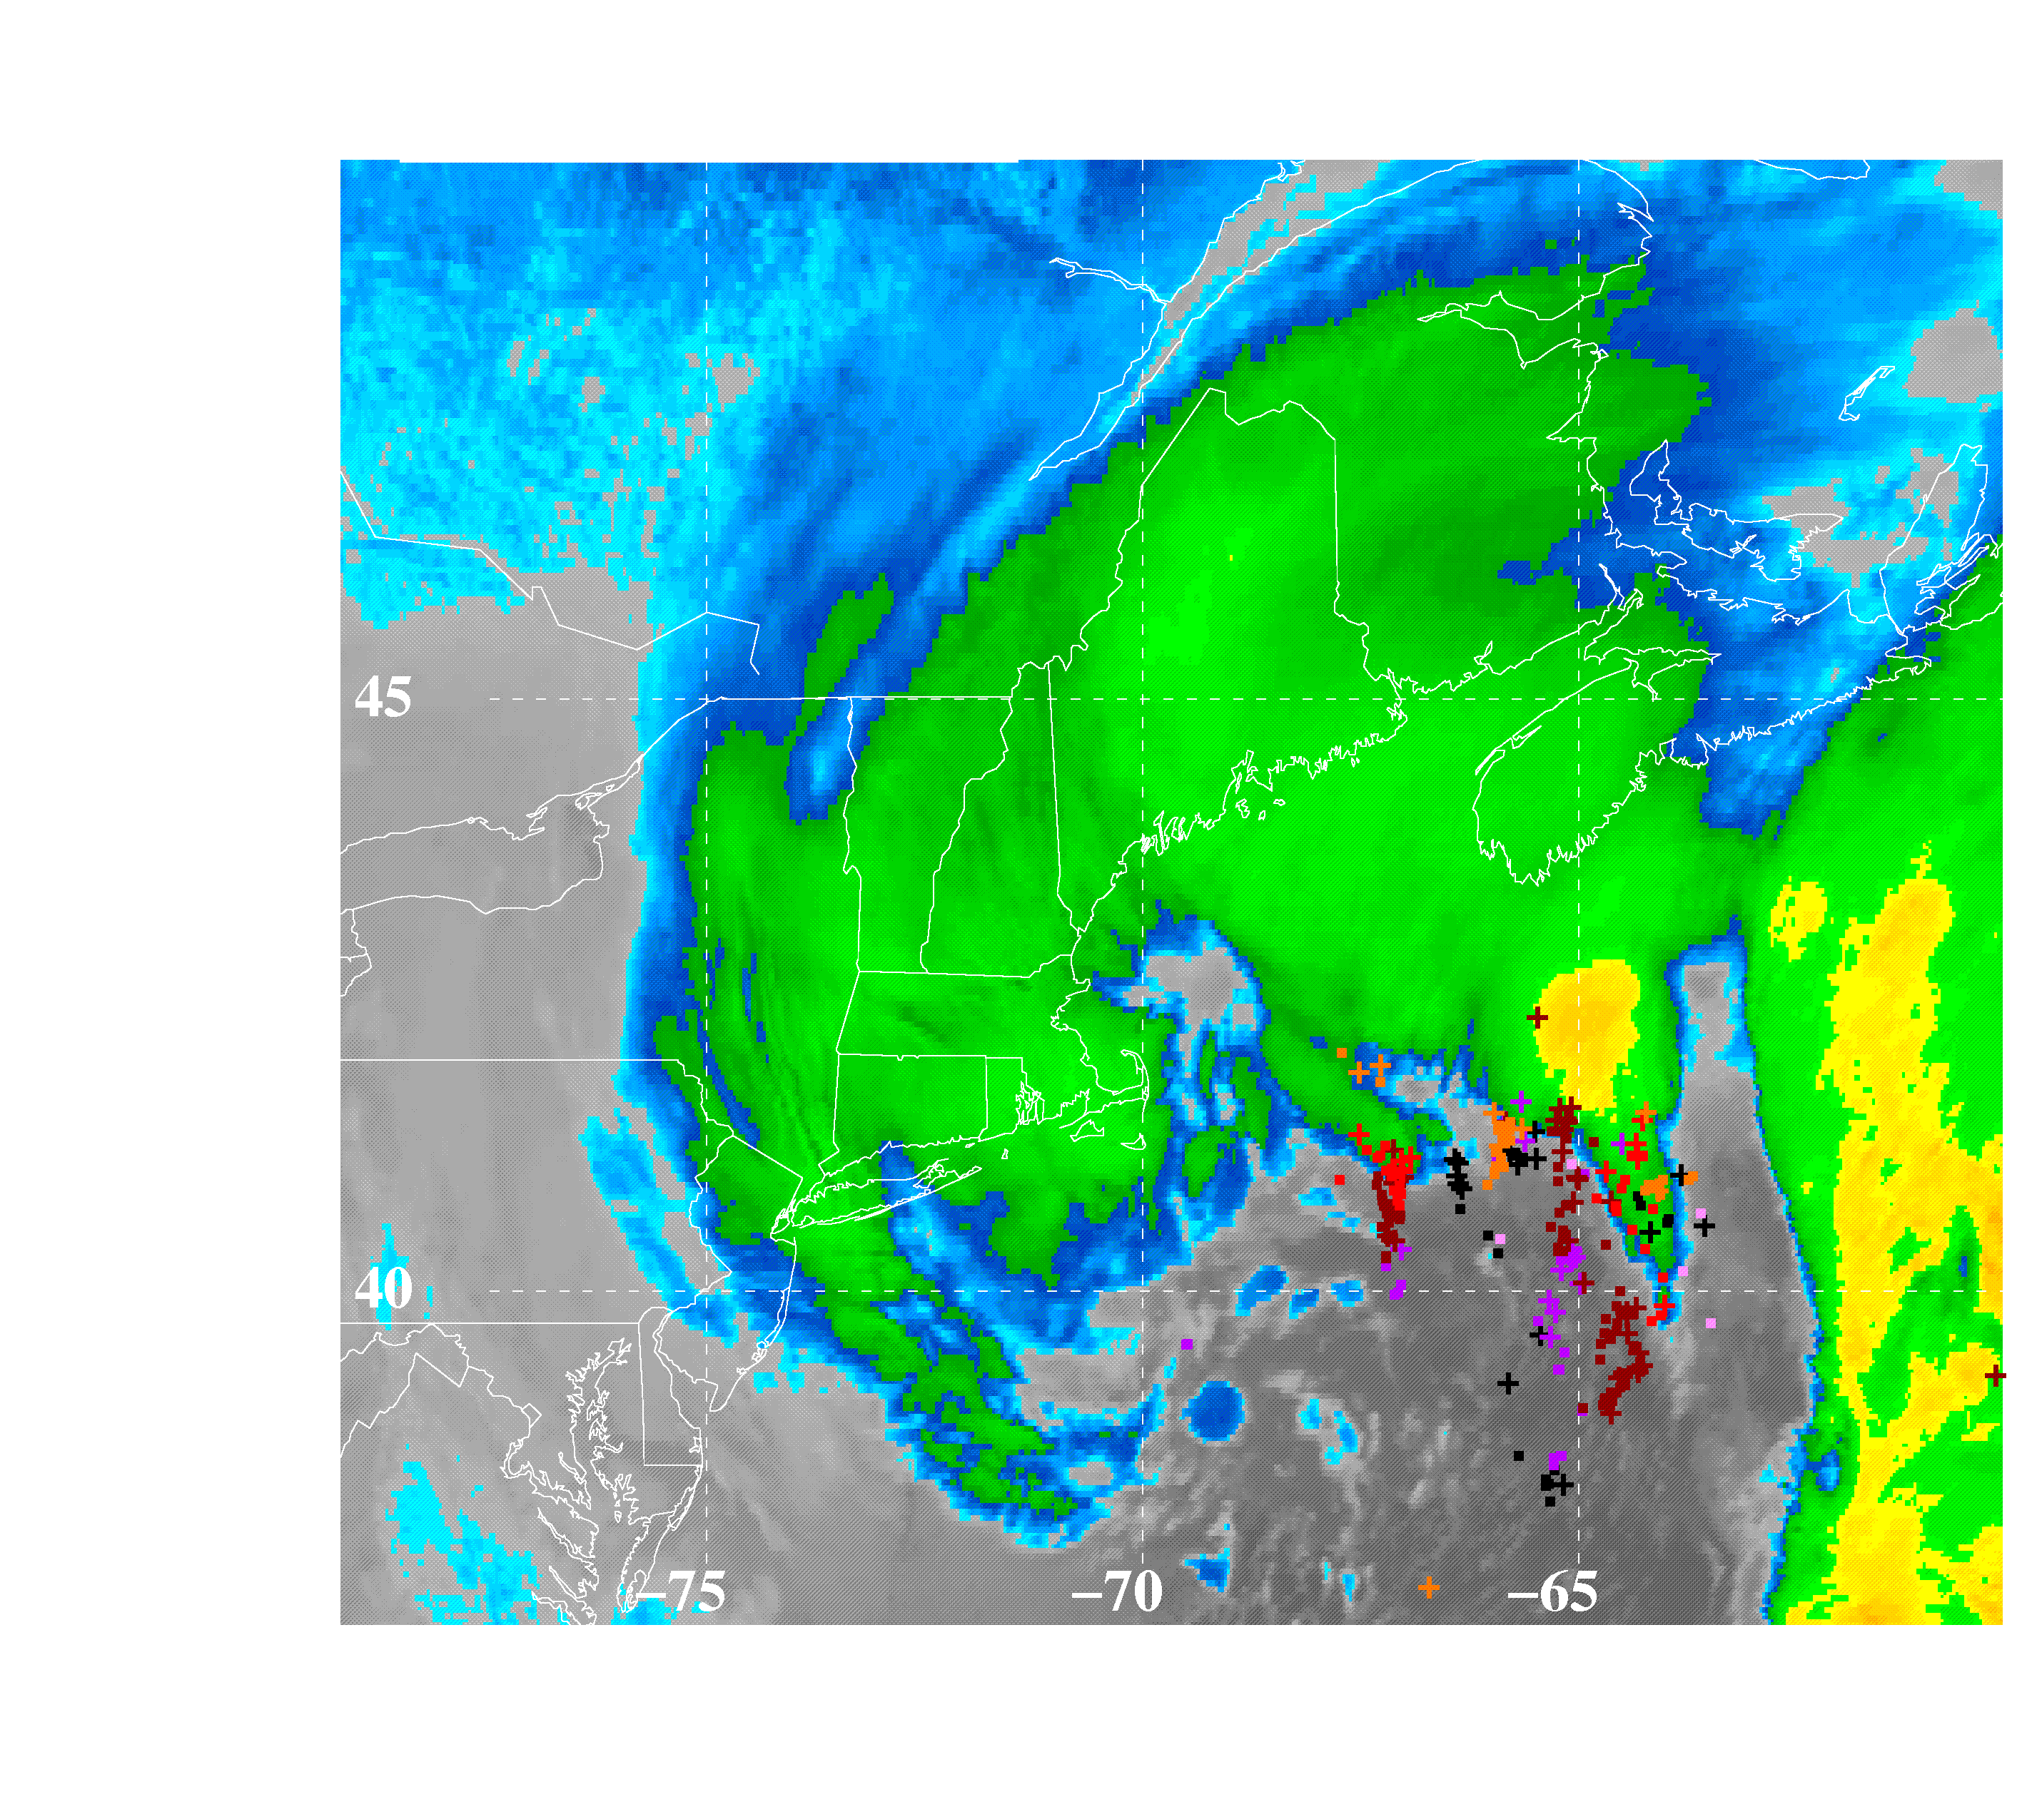
Sub-Synoptic Scale Evolution – 27 Jan 2015
Lightning Strikes and IR Brightness Temperature
0600–1200 UTC 27 Jan. 2015
1200–1800 UTC 27 Jan. 2015
Coupling Index (K; black)
500–200 hPa Thermal Vort. (10^{–5} s^{–1}; fill)
850–200 hPa Wind Shear (kts; barbs)
Surface Low (“L”)
Courtesy of Dave Vollaro
Age of Strikes
h
6
5
4
3
2
1
0

Slide 13
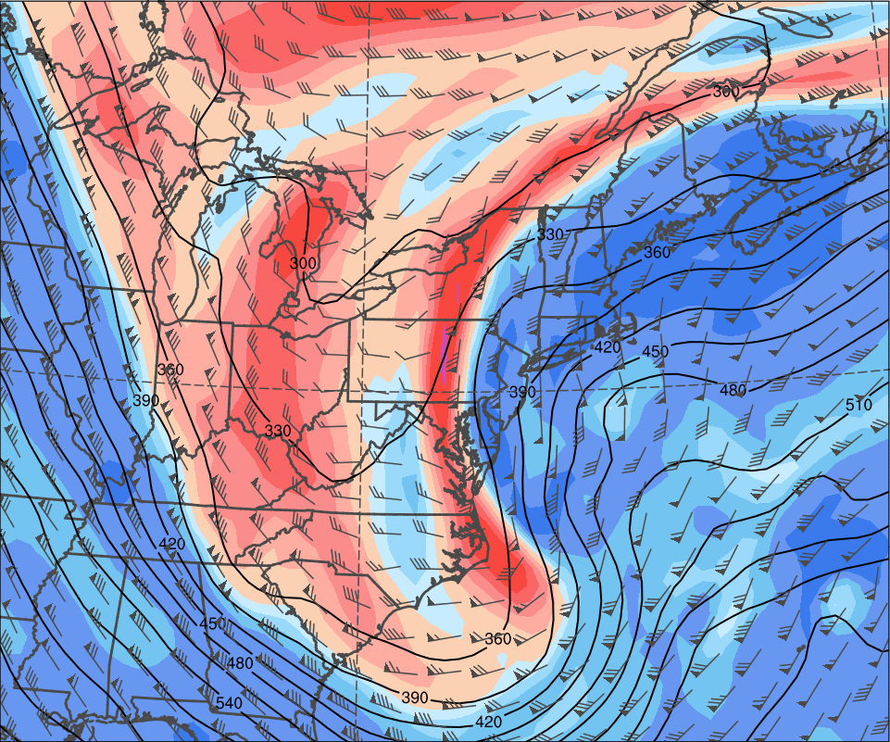
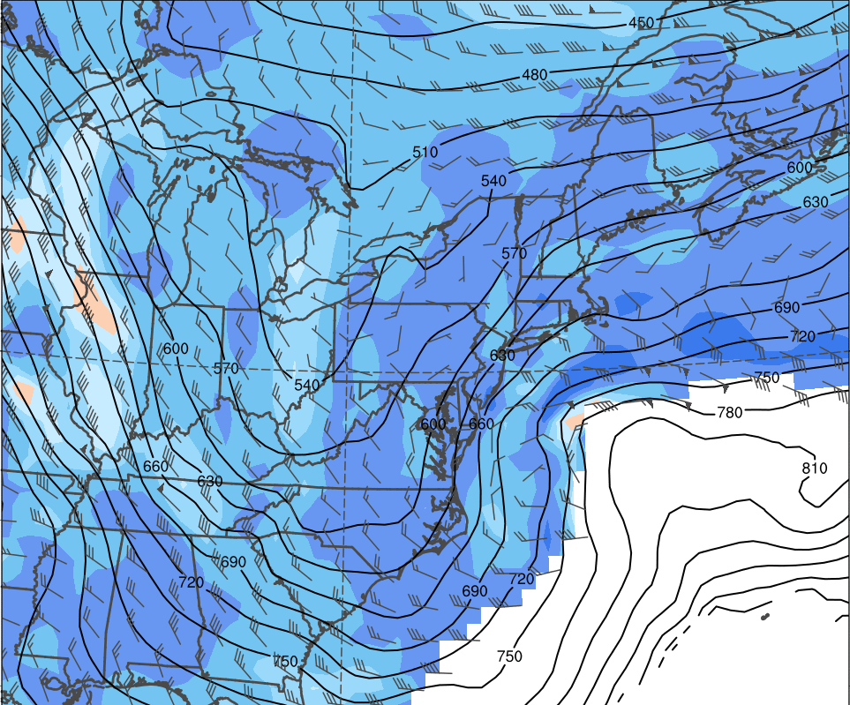
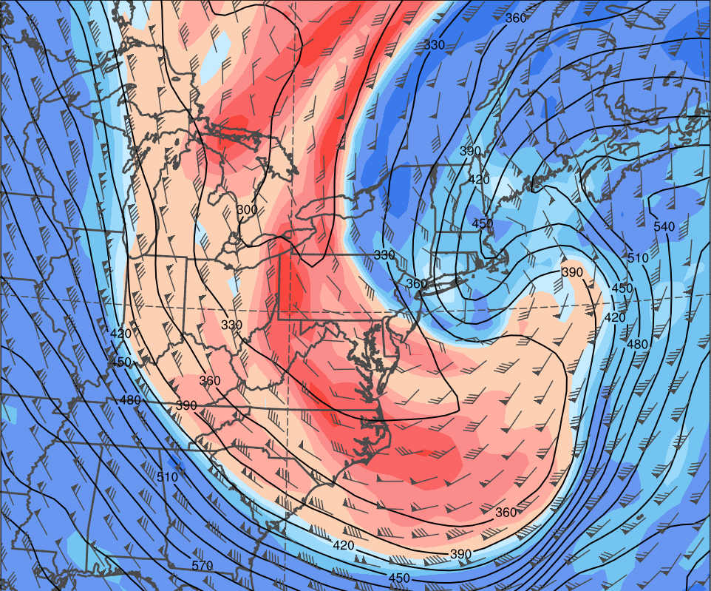
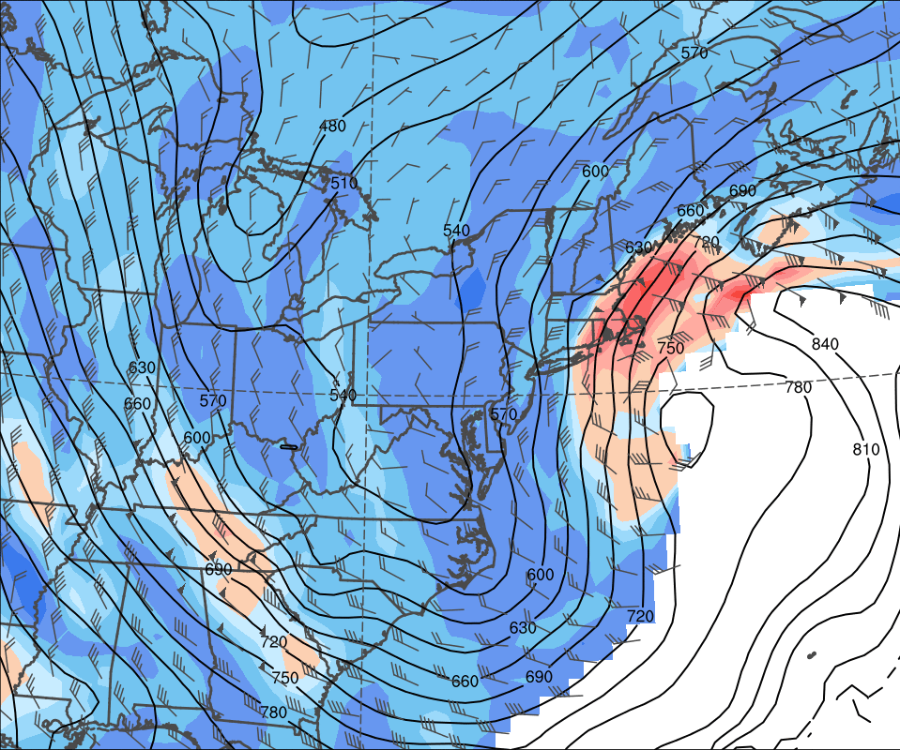
Sub-Synoptic Scale Evolution – 27 Jan 2015
310-K: 0000 UTC 27 Jan. 2015
295-K: 0000 UTC 27 Jan. 2015
Pressure (hPa; black)
PV (fill)
Winds (kts; barbs)
310-K: 1200 UTC 27 Jan. 2015
295-K: 1200 UTC 27 Jan. 2015

Slide 14
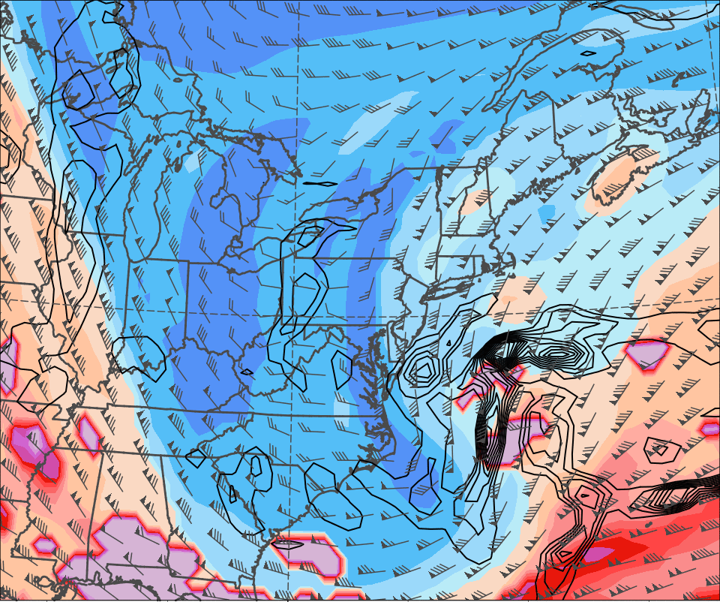
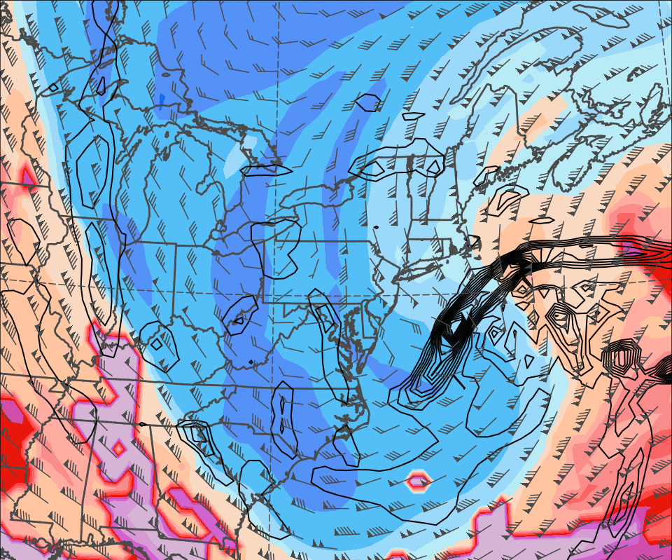
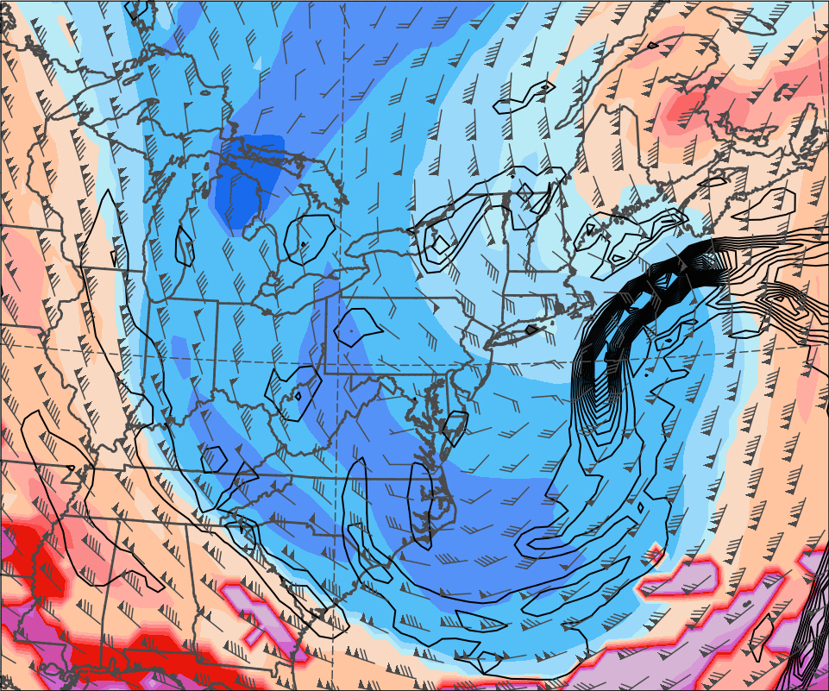
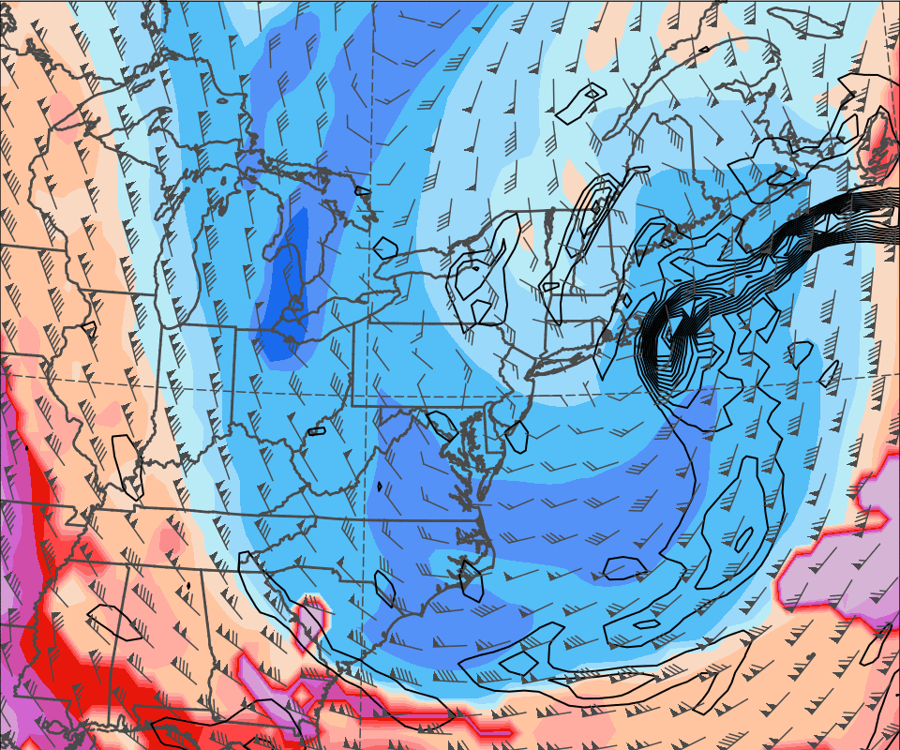
Sub-Synoptic Scale Evolution – 27 Jan 2015
0000 UTC 27 Jan. 2015
0600 UTC 27 Jan. 2015
DT Theta (K; fill)
DT Winds (kts; barbs)
925–850 hPa Rel. Vor.
(10^{–5} s^{–1}; black)
1200 UTC 27 Jan. 2015
1800 UTC 27 Jan. 2015

Slide 15
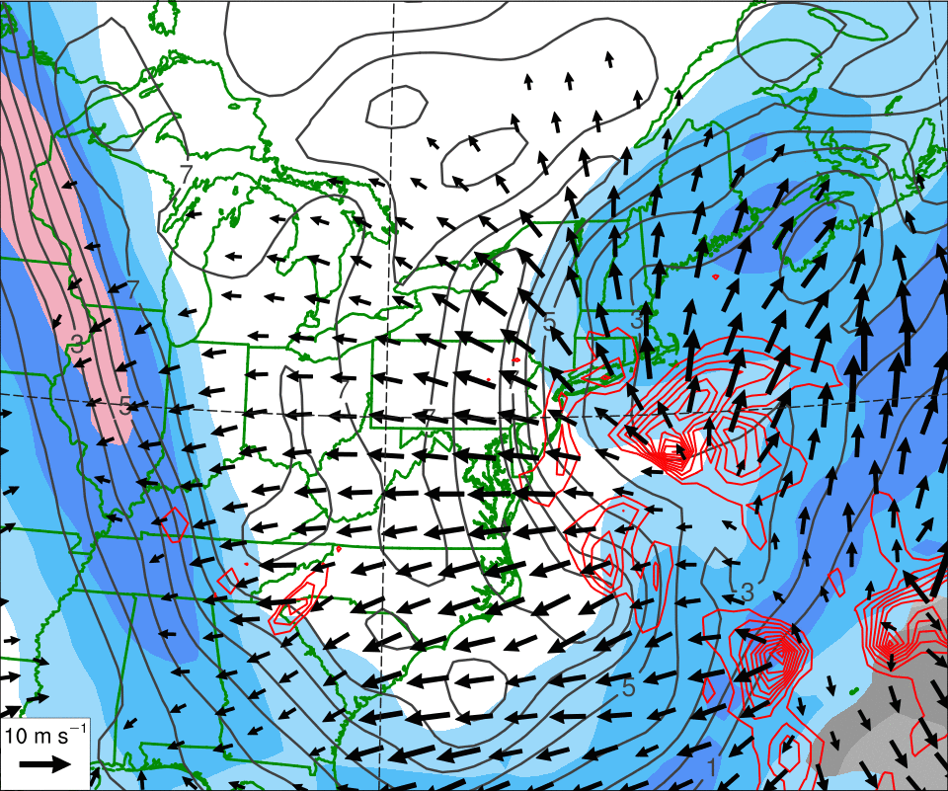
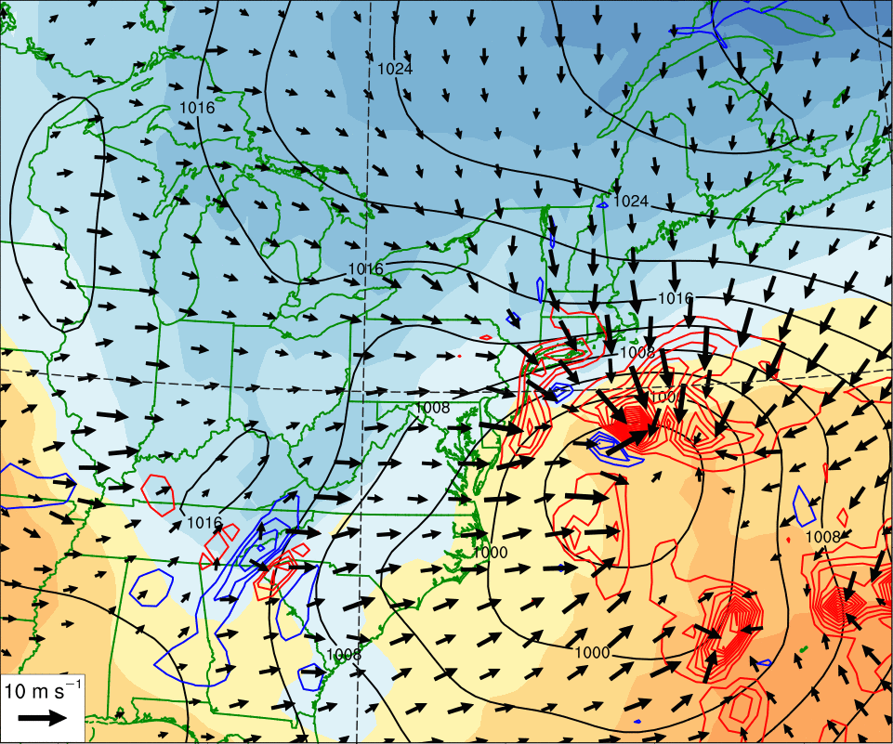
Sub-Synoptic Scale Evolution – 27 Jan 2015
0000 UTC 27 Jan. 2015
250 hPa Jet (ms^{–1}; fill pattern)
600–400 hPa Ascent (dPa s^{–1}; red)
300–200 hPa PV (gray)
300–200 hPa Irr. Wind (vectors)
PW (mm; gray fill)
SLP (hPa; black)
850 hPa Theta (K; fill pattern)
900–800 hPa irr. wind (vectors)
700–500 hPa Ascent (dPa s^{–1}; red)

Slide 16
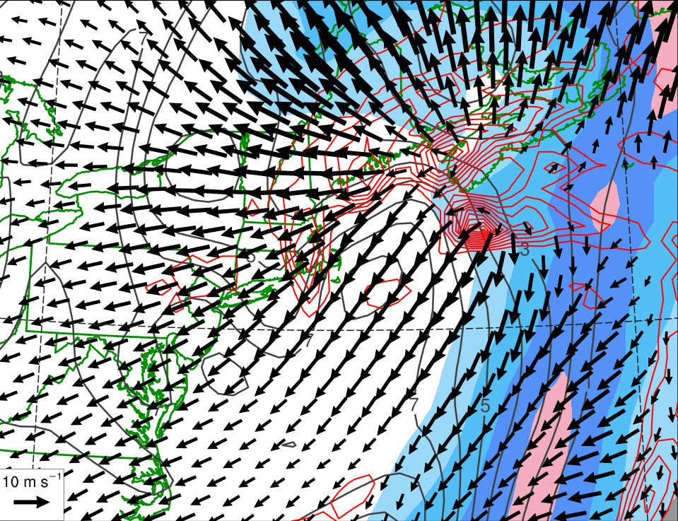
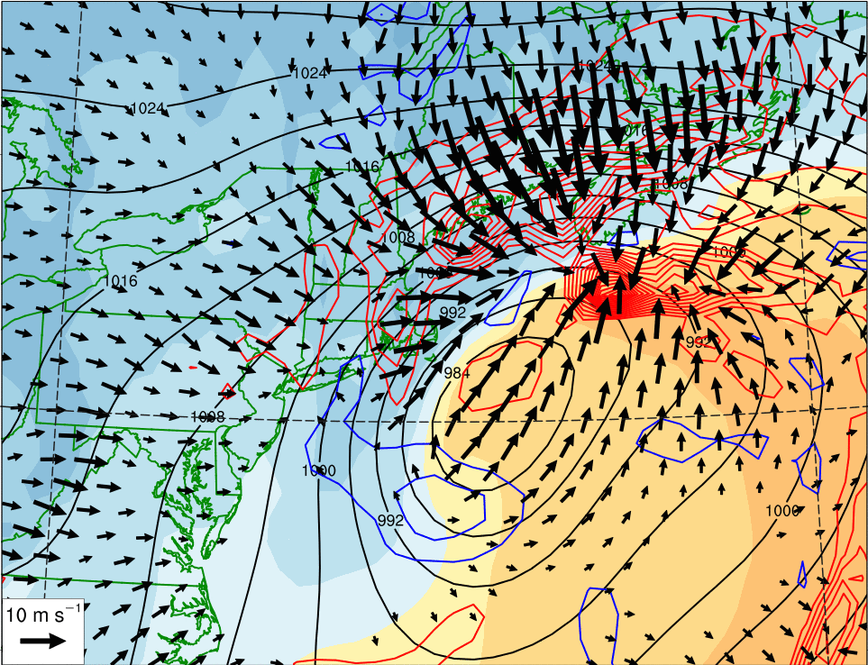
Sub-Synoptic Scale Evolution – 27 Jan 2015
1200 UTC 27 Jan. 2015
250 hPa Jet (ms^{–1}; fill pattern)
600–400 hPa Ascent (dPa s^{–1}; red)
300–200 hPa PV (gray)
300–200 hPa Irr. Wind (vectors)
PW (mm; gray fill)
SLP (hPa; black)
850 hPa Theta (K; fill pattern)
900–800 hPa irr. wind (vectors)
700–500 hPa Ascent (dPa s^{–1}; red)

Slide 17
RMSE of Geopotential Heights (m) Verifying
1800 UTC 27 January 2015
250
500 hPa
1000 hPa
200
150
100
50
0
222
01/18
168
01/20
120
01/22
72
01/24
24
01/26
222
01/18
168
01/20
120
01/22
72
01/24
24
01/26
Forecast Hour (h)
96-h: GEFS Forecasts improve after ridge amplification begins in the eastern N. Pacific (1800 UTC 23 Jan.)

Slide 18
GFS DeterministicForecasts Verifying 1800 UTC 27 January 2015

Slide 19
GFS DeterministicForecasts Verifying 1800 UTC 27 January 2015

Slide 20
GFS DeterministicForecasts Verifying 1800 UTC 27 January 2015

Slide 21
GFS DeterministicForecasts Verifying 1800 UTC 27 January 2015

Slide 22
GFS DeterministicForecasts Verifying 1800 UTC 27 January 2015

Slide 23
GFS DeterministicForecasts Verifying 1800 UTC 27 January 2015

Slide 24
GFS DeterministicForecasts Verifying 1800 UTC 27 January 2015

Slide 25
GFS DeterministicForecasts Verifying 1800 UTC 27 January 2015

Slide 26
GFS DeterministicForecasts Verifying 1800 UTC 27 January 2015

Slide 27
GFS DeterministicForecasts Verifying 1800 UTC 27 January 2015

Slide 28
GFS DeterministicForecasts Verifying 1800 UTC 27 January 2015

Slide 29
GEFS Ensemble Spread of Geo. Heights (m) Verifying 1800 UTC 27 January 2015
240-h Forecast
1000 hPa
500 hPa
Ens. Spread:
Ens. Mean Geo. Heights
Observed Geo. Heights

Slide 30
GEFS Ensemble Spread of Geo. Heights (m) Verifying 1800 UTC 27 January 2015
222-h Forecast
1000 hPa
500 hPa
Ens. Spread:
Ens. Mean Geo. Heights
Observed Geo. Heights

Slide 31
GEFS Ensemble Spread of Geo. Heights (m) Verifying 1800 UTC 27 January 2015
192-h Forecast
1000 hPa
500 hPa
Ens. Spread:
Ens. Mean Geo. Heights
Observed Geo. Heights

Slide 32
GEFS Ensemble Spread of Geo. Heights (m) Verifying 1800 UTC 27 January 2015
168-h Forecast
1000 hPa
500 hPa
Ens. Spread:
Ens. Mean Geo. Heights
Observed Geo. Heights

Slide 33
GEFS Ensemble Spread of Geo. Heights (m) Verifying 1800 UTC 27 January 2015
144-h Forecast
1000 hPa
500 hPa
Ens. Spread:
Ens. Mean Geo. Heights
Observed Geo. Heights

Slide 34
GEFS Ensemble Spread of Geo. Heights (m) Verifying 1800 UTC 27 January 2015
120-h Forecast
1000 hPa
500 hPa
Ens. Spread:
Ens. Mean Geo. Heights
Observed Geo. Heights

Slide 35
GEFS Ensemble Spread of Geo. Heights (m) Verifying 1800 UTC 27 January 2015
96-h Forecast
1000 hPa
500 hPa
Ens. Spread:
Ens. Mean Geo. Heights
Observed Geo. Heights

Slide 36
GEFS Ensemble Spread of Geo. Heights (m) Verifying 1800 UTC 27 January 2015
72-h Forecast
1000 hPa
500 hPa
Ens. Spread:
Ens. Mean Geo. Heights
Observed Geo. Heights

Slide 37
GEFS Ensemble Spread of Geo. Heights (m) Verifying 1800 UTC 27 January 2015
48-h Forecast
1000 hPa
500 hPa
Ens. Spread:
Ens. Mean Geo. Heights
Observed Geo. Heights

Slide 38
GEFS Ensemble Spread of Geo. Heights (m) Verifying 1800 UTC 27 January 2015
24-h Forecast
1000 hPa
500 hPa
Ens. Spread:
Ens. Mean Geo. Heights
Observed Geo. Heights

Slide 39
GEFS Ensemble Spread of Geo. Heights (m) Verifying 1800 UTC 27 January 2015
00-h Forecast
1000 hPa
500 hPa
Ens. Spread:
Ens. Mean Geo. Heights
Observed Geo. Heights

Slide 40
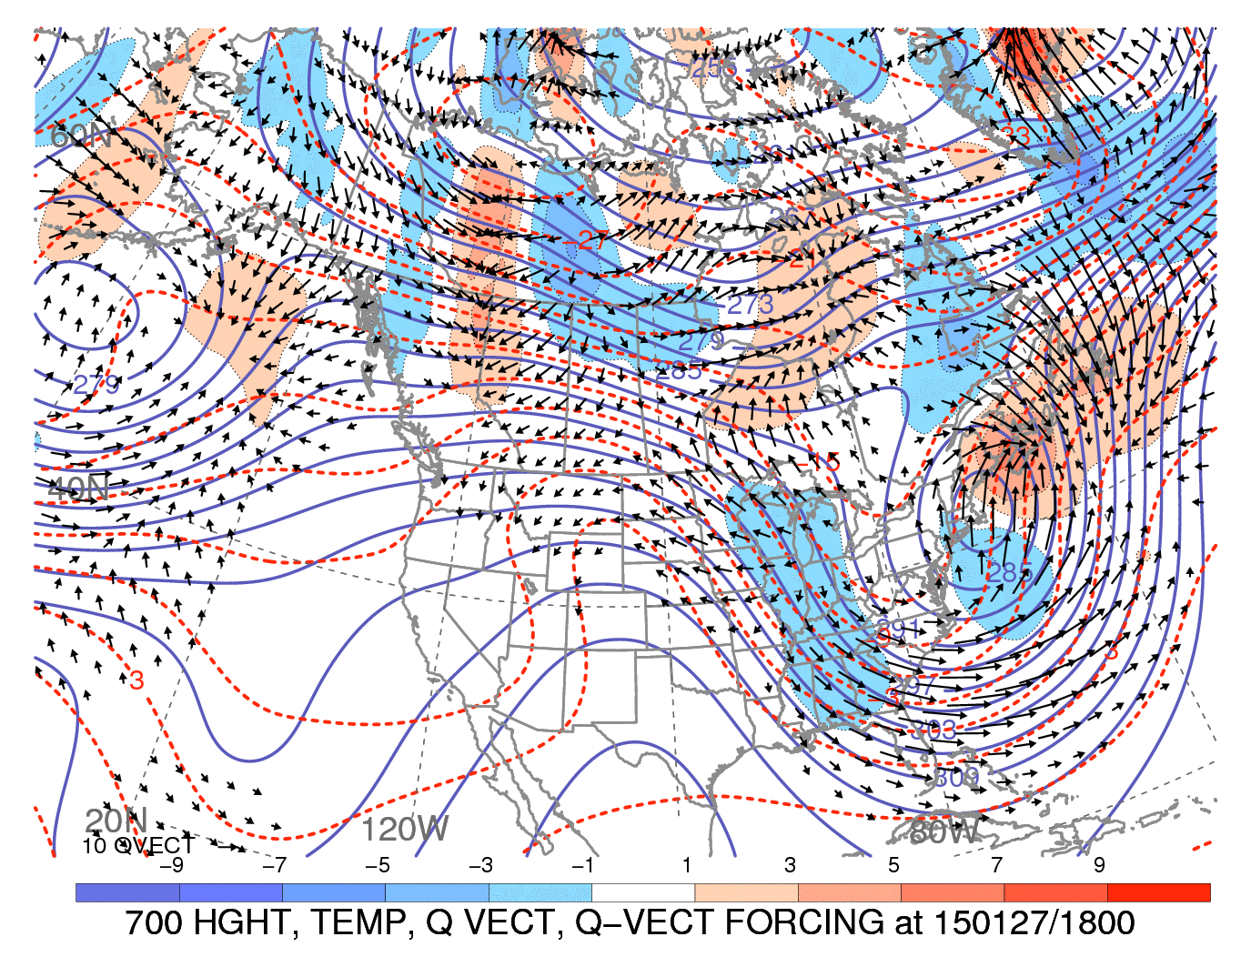
Supplementary Slides
Martin 2006
Notes:
Justifying the choice of frontogenesis as a fourth panel. Notice most Q-vectors are of the Qn variety.

Slide 41
GFS DeterministicForecasts Verifying 1200 UTC 27 January 2015

Slide 42
GFS DeterministicForecasts Verifying 1200 UTC 27 January 2015

Slide 43
GFS DeterministicForecasts Verifying 1200 UTC 27 January 2015
216-h

Slide 44
GFS DeterministicForecasts Verifying 1200 UTC 27 January 2015
216-h

Slide 45
GFS DeterministicForecasts Verifying 1200 UTC 27 January 2015
216-h

Slide 46
GFS DeterministicForecasts Verifying 1200 UTC 27 January 2015
216-h
150-h

Slide 47
GFS DeterministicForecasts Verifying 1200 UTC 27 January 2015
216-h
150-h
126-h

Slide 48
GFS DeterministicForecasts Verifying 1200 UTC 27 January 2015
216-h
150-h
126-h

Slide 49
GFS DeterministicForecasts Verifying 1200 UTC 27 January 2015
216-h
150-h
126-h

Slide 50
GFS DeterministicForecasts Verifying 1200 UTC 27 January 2015
216-h
150-h
126-h

Slide 51
GFS DeterministicForecasts Verifying 1200 UTC 27 January 2015
216-h
150-h
126-h

Slide 52
RMSE of Geopotential Heights (m) Verifying
1200 UTC 27 January 2015
250
500 hPa
1000 hPa
200
150
100
50
0
222
01/18
168
01/20
120
01/22
72
01/24
24
01/26
222
01/18
168
01/20
120
01/22
72
01/24
24
01/26
Forecast Hour (h)
96-h: GEFS Forecasts improve after ridge amplification begins in the eastern N. Pacific (1800 UTC 23 Jan.)

