Slide 1

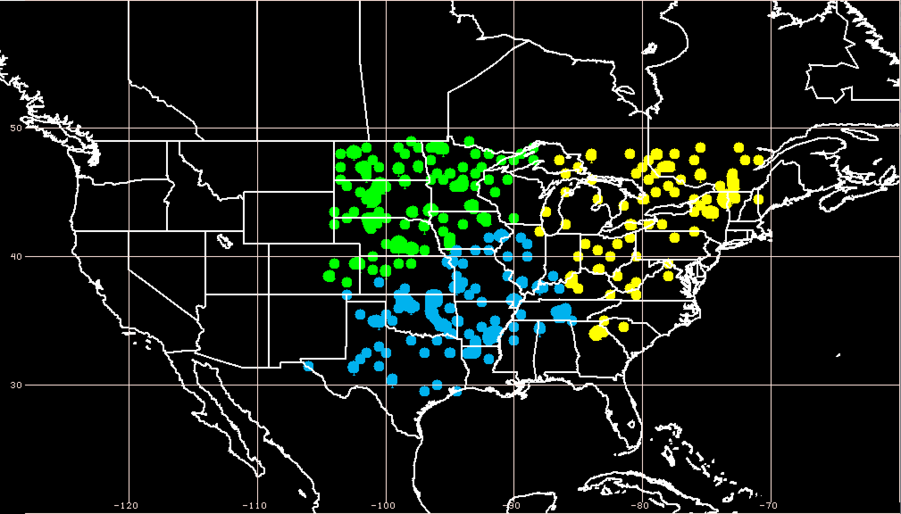
Title of Project: An Investigation of the Skill of Week Two Extreme Temperature and Precipitation Forecasts at the NCEP-WPC
PIs: Lance F. Bosart and Daniel Keyser
(a) Extreme Warm Events (304)
Northern Plains | 116
S. Plains/SE US | 102
Eastern US | 86
(b)
Key scientific accomplishments
to date:
Developed methodology to identify extreme temperature and precipitation events and to cluster them by geographic region (Figs. 1a,b).
Employed the two leading modes of 250-hPa zonal wind variability to develop a N. Pacific Jet phase diagram and to identify antecedent environments conducive to the production of extreme events (Figs. 1c,d,e).
Initiated efforts with WPC personnel to transition the N. Pacific Jet phase diagram into operations as a tool to characterize the upper-tropospheric flow pattern in the N. Pacific (Fig. 1f)
(a)
(c)
EOF 1: Jet Extension/Retraction
(d)
EOF 2: Poleward/Equatorward Shift
(e)
Poleward Shift
(f)
Poleward Shift
Retraction
Extension
Retraction
Extension
Significance:
Provide forecasters with a “first alert” to the possibility of the occurrence of extreme events during week two on the basis of current conditions and model forecasts.
Equatorward Shift
Equatorward Shift
Figure 1: (a) Number of extreme warm events east of the Rockies binned by geographic region. (b) Event centroids for extreme warm events colored by geographic region. (c) First and (d) second EOFs of 250-hPa zonal wind in the N. Pacific during Sept.–May (shading) and the Sept.–May mean 250-hPa zonal wind (m s^{–1}; black contours). (e) N. Pacific Jet phase diagram with S. Plains/SE US extreme warm events (x’s) projected onto the EOFs in (c) and (d). (f) 9-day probabilistic forecast trajectory within the N. Pacific Jet phase diagram employing GEFS forecasts initialized at 0000 UTC 24 May 2016; probability is shaded and the ensemble mean is denoted by the dotted black and white line.
Notes:
Top priorities/activities for FY 16:
Conduct composite analyses of extreme temperature and precipitation events based upon the projection of antecedent environments onto the North Pacific Jet phase diagram.
Perform an evaluation of operational NCEP GFS/GEFS week two forecast skill for the extreme events with an emphasis on the 8–10 day time range.
Continue work on transitioning the North Pacific Jet phase diagram into operations and begin development of other potential forecast products.
Most significant issue or coordination need:
Technical discussions with personnel at NCEP-WPC that will permit a seamless transition of potential products into the operational and computational infrastructure at NCEP-WPC.

