Slide 1
An Investigation of the Skill of Week Two
Extreme Temperature and Precipitation
Forecasts at the NCEP-WPC
Lance F. Bosart, Daniel Keyser, and Andrew C. Winters
Department of Atmospheric and Environmental Sciences
University at Albany, State University of New York, Albany, NY 12222
NCEP-WPC Collaborative Visit
College Park, MD
13–14 July 2016

Slide 2
Project Motivation
One or several extreme weather events (EWEs) during a single season can contribute disproportionately to temperature and precipitation anomaly statistics for a particular season.
The disproportionate contribution of EWEs to seasonal temperature and precipitation anomaly statistics suggests that EWEs need to be considered in understanding the dynamical and thermodynamic processes that operate at the weather–climate intersection.
Consideration of EWEs may result in improved operational probabilistic temperature and precipitation forecasts in the 8–10 day time range.

Slide 3
Project Summary (1)
Improve temperature and precipitation forecasts on the 8–10 day time range at the WPC in collaboration with WPC personnel.
Perform illustrative case studies of individual extreme temperature and precipitation events and conduct verification studies of GFS model and associated human forecasts for the illustrative case studies.

Slide 4
Project Summary (2)
  The forecasts for the following events were strongly influenced by precursor events that perturbed the North Pacific waveguide and contributed to an amplification of the upper-tropospheric flow pattern:
    22–23 Dec 2013 Northeast ice storm
    Nov 2014 record US cold that followed the ET of STY Nuri in the western N. Pacific
    25–27 January 2015 East Coast blizzard
    22–24 January 2016 mid-Atlantic blizzard
  Presentations accessible via: http://www.atmos.albany.edu/facstaff/awinters/mayreport

Slide 5
Project Summary (3)
  Identified “events of opportunity” during the tenure of the project:
  Mid-February 2016 sequential mid-Atlantic cyclones
  20–21 March 2016 potential for a Nor’easter
  23–24 March 2016 Colorado Front Range snowstorm
  3–4 April 2016 extreme cold in the Northeast US
  16 April 2016 High Plains extreme precipitation event
  26 April 2016 Central Plains severe weather outbreak
  June 2016 extreme heat in the Southwest US

Slide 6
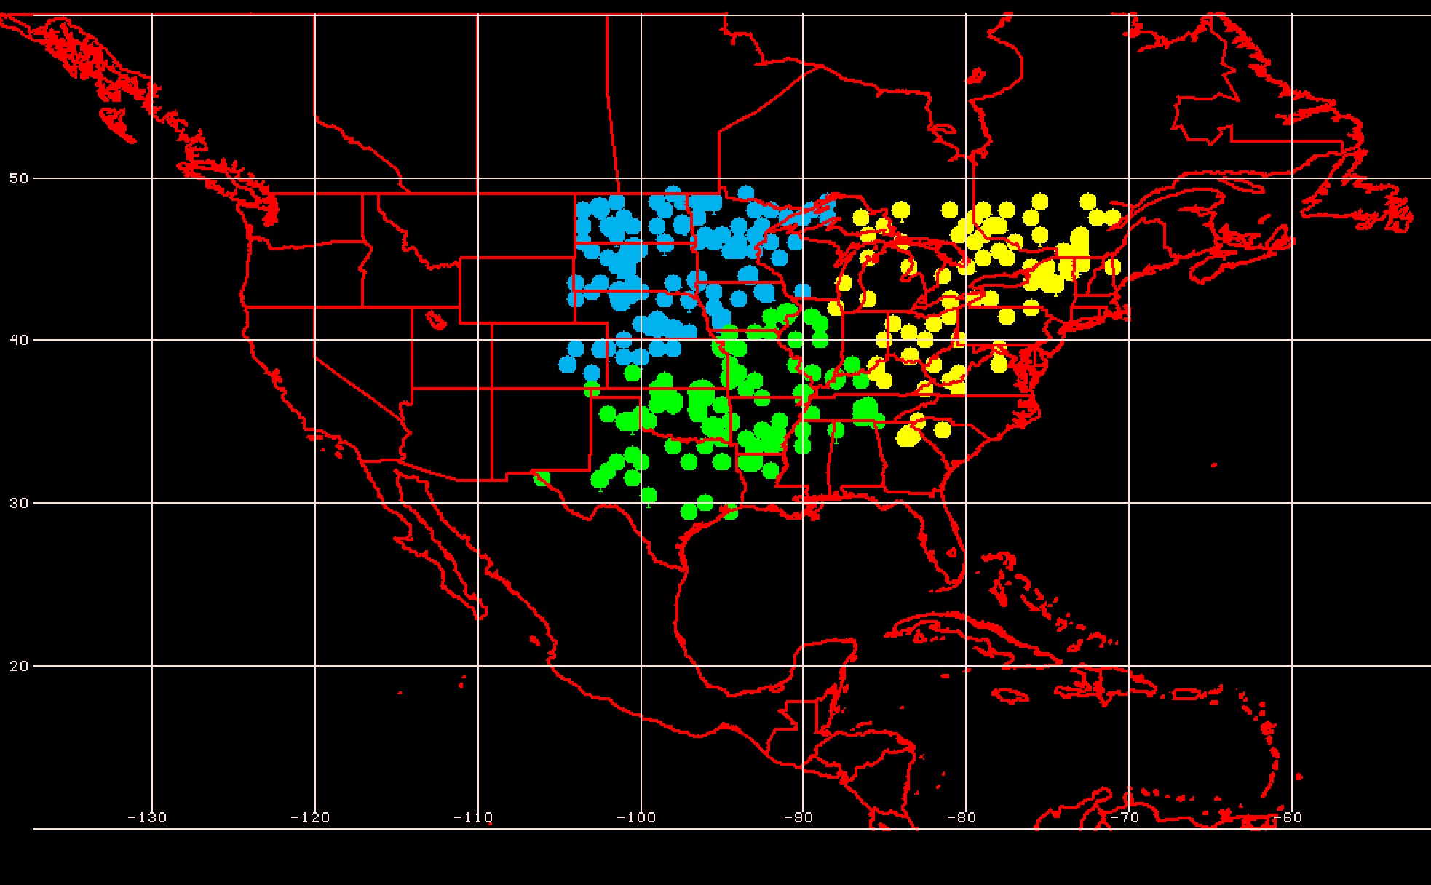
Project Summary (4)
Develop a methodology for identifying extreme temperature and precipitation events over the CONUS for all seasons during 1979–present.
Perform composite analyses of characteristic event types in order to determine the multiscale evolution of the governing atmospheric flow patterns that culminate in these event types.
3 Geographic Clusters
Objectively identified extreme warm event centroids east of the Rockies (304 events)
Considerable variability characterizes the antecedent environments associated with extreme events

Slide 7
250-hPa N. Pacific Zonal Wind EOF Patterns
EOF1 – Jet Extension/Retraction
Mean 250-hPa Zonal Wind: black contours
+ EOF1: Jet Extension
– EOF1: Jet Retraction

Slide 8
250-hPa N. Pacific Zonal Wind EOF Patterns
EOF2 – Poleward/Equatorward Shift
Mean 250-hPa Zonal Wind: black contours
+ EOF2: Poleward Shift
– EOF2: Equatorward Shift

Slide 9
250-hPa N. Pacific Zonal Wind EOF Patterns
0000 UTC 8 November 2014
250-hPa Wind Speed: shaded

Slide 10
Extreme Warm Events
Extreme Warm Event Centroids East of the Rockies (304 events)
3 Geographic Clusters
The North Pacific jet phase diagram can be used to identify the antecedent flow patterns most conducive to the production of extreme warm events

Slide 11
E. Rockies – S. Plains Cluster
3 Geographic Clusters
WARM EVENTS
Poleward Shift
18
Events during
Sept. – May projected onto phase diagram
PC 2
35
15
Retraction
Extension
Each point is an average of the PCs for
3–7 days prior to the event
16
Equatorward Shift
84 events
PC 1

Slide 12
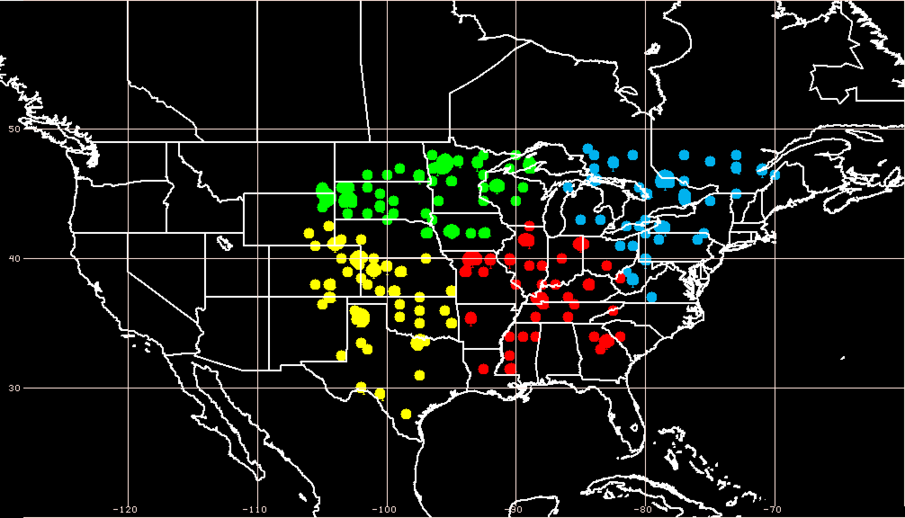
E. Rockies – S. Plains Cluster
4 Geographic Clusters
COLD EVENTS
Poleward Shift
4
Events during
Sept. – May projected onto phase diagram
PC 2
4
14
Retraction
Extension
Each point is an average of the PCs for
3–7 days prior to the event
26
Equatorward Shift
48 events
PC 1

Slide 13
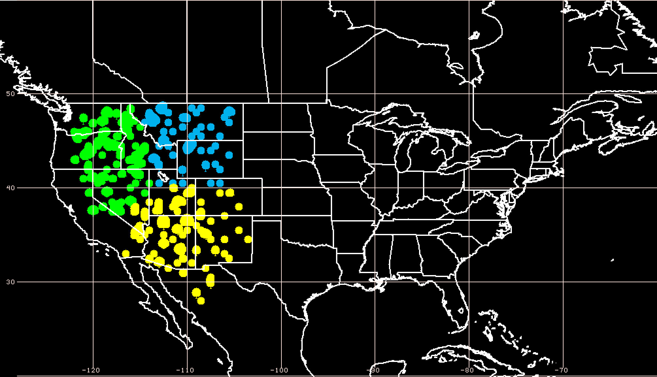
W. Rockies – Pac. NW Cluster
3 Geographic Clusters
WARM EVENTS
Poleward Shift
22
Events during
Sept. – May projected onto phase diagram
PC 2
13
27
Retraction
Extension
Each point is an average of the PCs for
3–7 days prior to the event
27
Equatorward Shift
89 events
PC 1

Slide 14
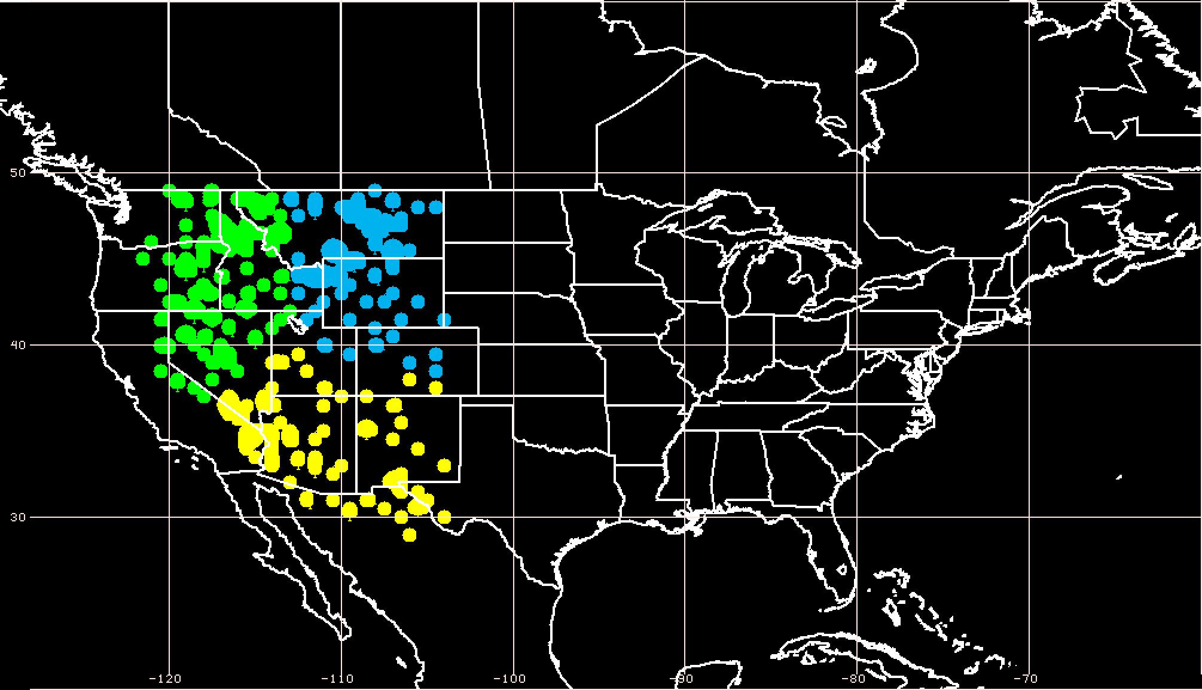
W. Rockies – Pac. NW Cluster
3 Geographic Clusters
COLD EVENTS
Poleward Shift
18
Events during
Sept. – May projected onto phase diagram
PC 2
31
9
Retraction
Extension
Each point is an average of the PCs for
3–7 days prior to the event
20
Equatorward Shift
78 events
PC 1

Slide 15
Project Summary (5)
Perform an evaluation of operational NCEP GFS week two forecast skill for the identified extreme temperature and precipitation events over the CONUS during 1979–present for the 8–10 day time range.
  To be investigated during Fall 2016
Test methodology and new forecast formats under development at WPC and incorporate them into forecast operations.
  Regular teleconferences with WPC personnel
  Site visits to NCEP-WPC
  Development of North Pacific jet phase diagram

Slide 16
Real-Time NPJ Phase Diagram
0000 UTC 8 November 2014
250-hPa Wind Speed: shaded

Slide 17
Real-Time NPJ Phase Diagram
0000 UTC 10 November 2014
250-hPa Wind Speed: shaded

Slide 18
Real-Time NPJ Phase Diagram
0000 UTC 12 November 2014
250-hPa Wind Speed: shaded

Slide 19
Real-Time NPJ Phase Diagram
0000 UTC 14 November 2014
250-hPa Wind Speed: shaded

Slide 20
Real-Time NPJ Phase Diagram
0000 UTC 16 November 2014
250-hPa Wind Speed: shaded

Slide 21
Real-Time NPJ Phase Diagram
0000 UTC 18 November 2014
250-hPa Wind Speed: shaded

Slide 22
Real-Time NPJ Phase Diagram
GEFS Ensemble Trajectories Initialized at 0000 UTC 24 May 2016
Poleward Shift
9-day forecast
0000 UTC 24 May
(initialization)
0000 UTC 2 Jun (verification)
Retraction
Extension
Ensemble mean
Equatorward Shift
Probability

Slide 23
Project Outcomes
Provide forecasters with a “first alert” to the possibility of the occurrence of extreme temperature and precipitation events during week two on the basis of current conditions and model forecasts.
Provide forecasters with an indication of the character and flavor of possible extreme events as inferred from where the events lie in the frequency distributions of the anticipated event types.
Provide forecasters with knowledge that allows them to make science-based adjustments to model guidance and add value to week two forecasts of temperature and precipitation.

