Slide 1
Antecedent Environments Conducive to the Production of Extreme Temperature and Precipitation Events in the United States
Andrew C. Winters, Daniel Keyser, and Lance F. Bosart
Department of Atmospheric and Environmental Sciences
University at Albany, State University of New York, Albany, NY 12222
NCEP-WPC Collaborative Visit
College Park, MD
13–14 July 2016

Slide 2
Motivation
One or several extreme weather events (EWEs) during a single season can contribute disproportionately to temperature and precipitation anomaly statistics for a particular season.
The disproportionate contribution of EWEs to seasonal temperature and precipitation anomaly statistics suggests that EWEs need to be considered in understanding the dynamical and thermodynamic processes that operate at the weather–climate intersection.
Consideration of EWEs may result in improved operational probabilistic temperature and precipitation forecasts in the 8–10 day time range.

Slide 3
Outline
1) Examine extreme warm events in the context of North Pacific Jet (NPJ) variability
2) Update the development of a real-time NPJ phase diagram

Slide 4
Extreme Warm Event Identification
Temperature:
Employed 1-h forecast of 2-m temperature (1979–2014) from the CFSR (0.5°× 0.5°) at 6-h intervals
Compiled data within 21-day windows centered on each time for all 36 years
  Each grid point has 756 data points for a given time
Determined the temperature value that corresponds to the 99th percentile for each grid point at a given time

Slide 5
Example: 1900 UTC 30 May
1) For each year during 1979–2014 compile the 1-h forecast of 2-m air temperature valid at 1900 UTC within a 21-day window centered on 1900 UTC 30 May in the CFSR.
Days
Days
–10
–9
–8
–7
–6
–5
–4
–3
–2
–1
+1
+2
+3
+4
+5
+6
+7
+8
+9
+10
1900 UTC 30 May
2) Calculate the 2-m air temperature that corresponds to the 99th percentile at that date and time for each grid point in the CFSR.

Slide 6
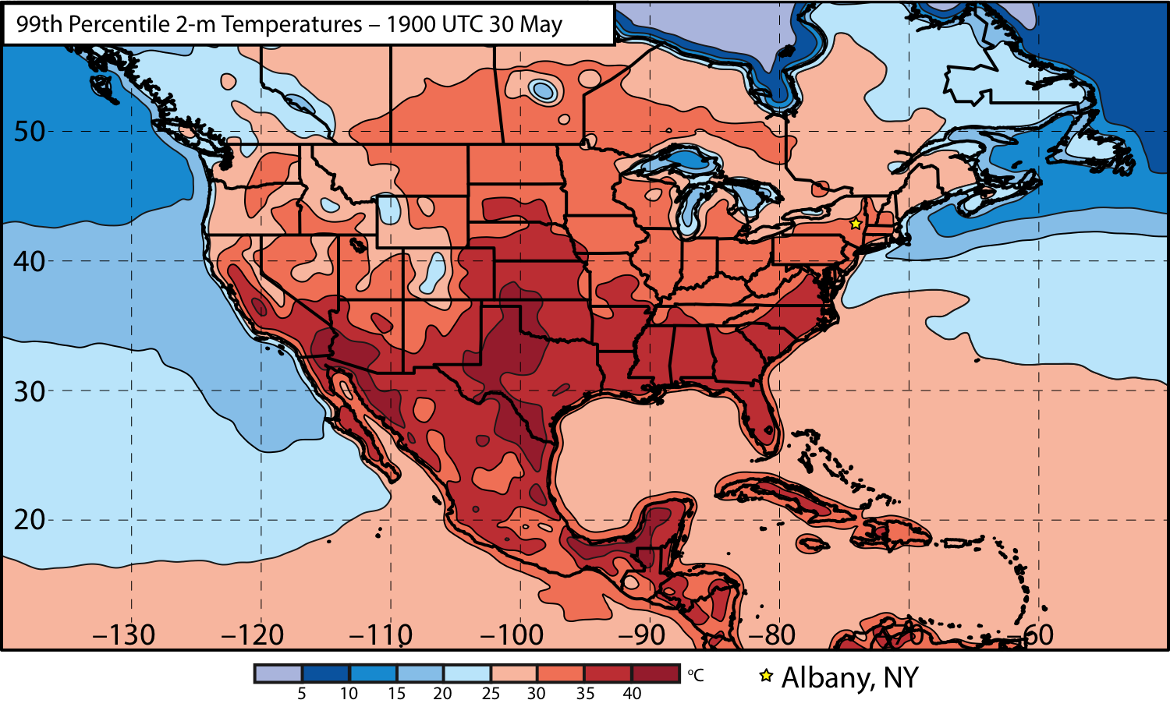
Extreme Warm Event Identification

Slide 7
Extreme Warm Event Identification
Western US
Eastern US

Slide 8
Extreme Warm Event Identification
Temperature:
To identify extreme warm events, catalog the times during which at least one grid point was characterized by a temperature > 99th percentile.
Times were subsequently ranked within each domain by the number of grid points > 99th percentile.
Times that rank in the top 5% in terms of the number of grid points > 99th percentile within each domain were identified as extreme warm events.

Slide 9
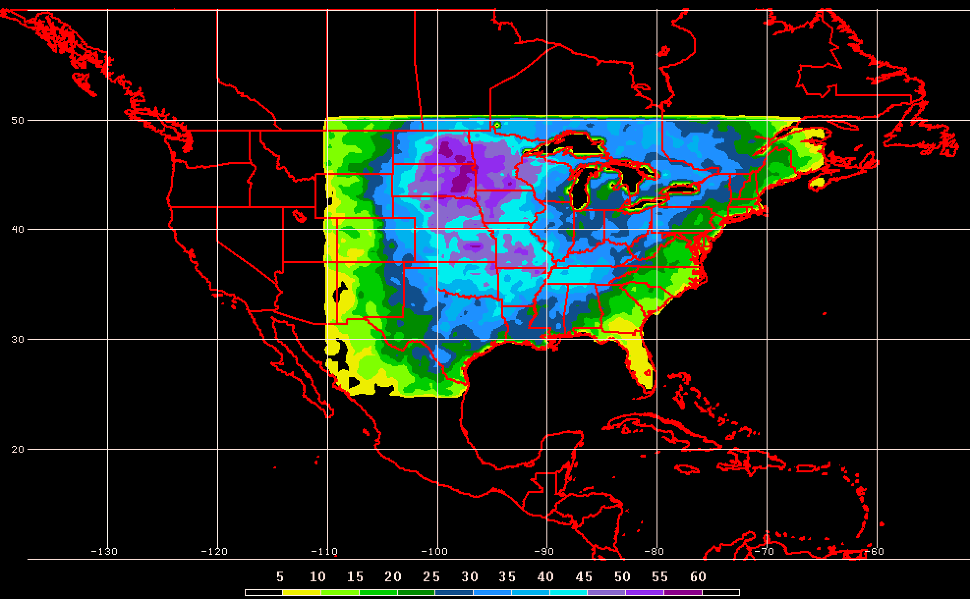
Extreme Warm Event Identification
Extreme Warm Event Frequency East of the Rockies (304 events)

Slide 10
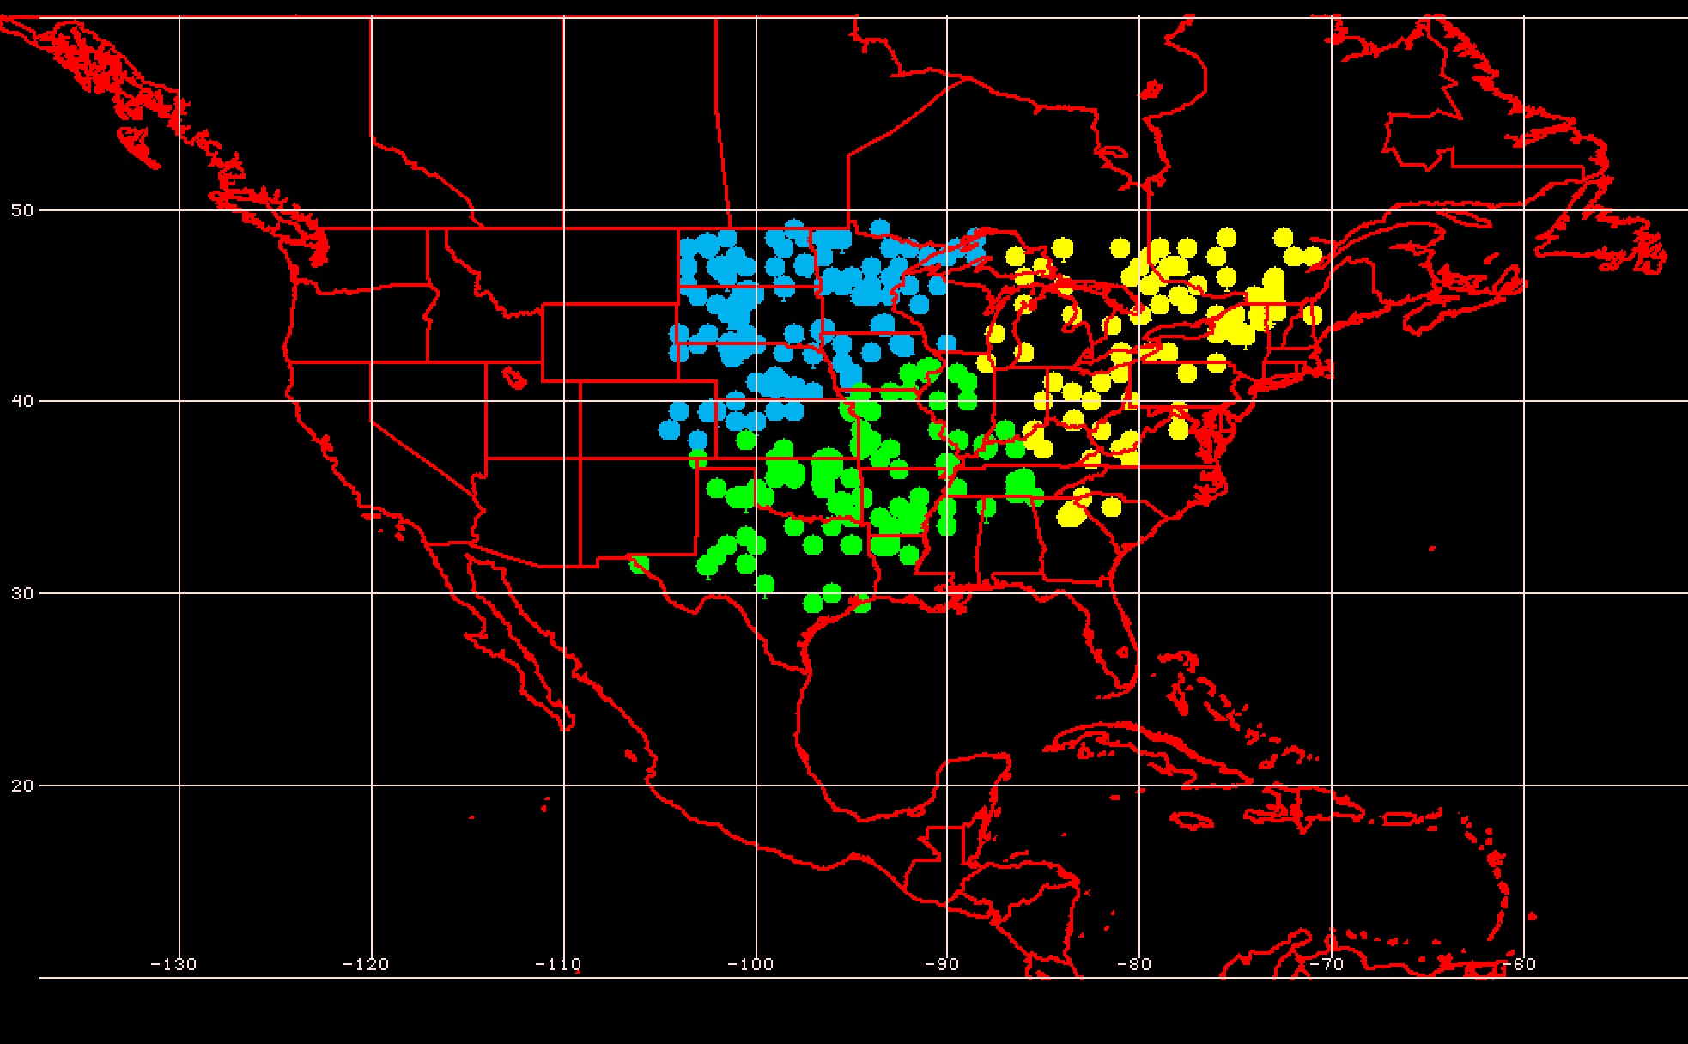
Extreme Warm Event Identification
Extreme Warm Event Centroids East of the Rockies (304 events)
3 Geographic Clusters
Considerable variability characterizes the antecedent environments associated with extreme warm events

Slide 11
250-hPa N. Pacific Zonal Wind EOF Patterns
EOF1 – Jet Extension/Retraction
Mean 250-hPa Zonal Wind: black contours
+ EOF1: Jet Extension
– EOF1: Jet Retraction

Slide 12
250-hPa N. Pacific Zonal Wind EOF Patterns
EOF2 – Poleward/Equatorward Shift
Mean 250-hPa Zonal Wind: black contours
+ EOF2: Poleward Shift
– EOF2: Equatorward Shift

Slide 13
250-hPa N. Pacific Zonal Wind EOF Patterns
0000 UTC 8 November 2014
250-hPa Wind Speed: shaded

Slide 14
Extreme Warm Event Identification
Extreme Warm Event Centroids East of the Rockies (304 events)
3 Geographic Clusters
The North Pacific jet phase diagram can be used to identify the antecedent flow patterns most conducive to the production of extreme warm events

Slide 15
E. Rockies – S. Plains Cluster
3 Geographic Clusters
WARM EVENTS
Poleward Shift
18
Events during
Sept. – May projected onto phase diagram
PC 2
35
15
Retraction
Extension
Each point is an average of the PCs for
3–7 days prior to the event
16
Equatorward Shift
84 events
PC 1

Slide 16
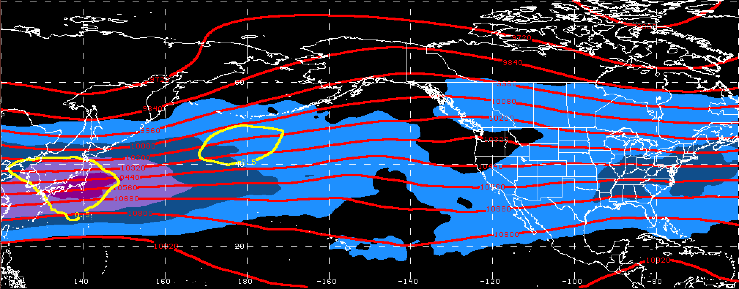
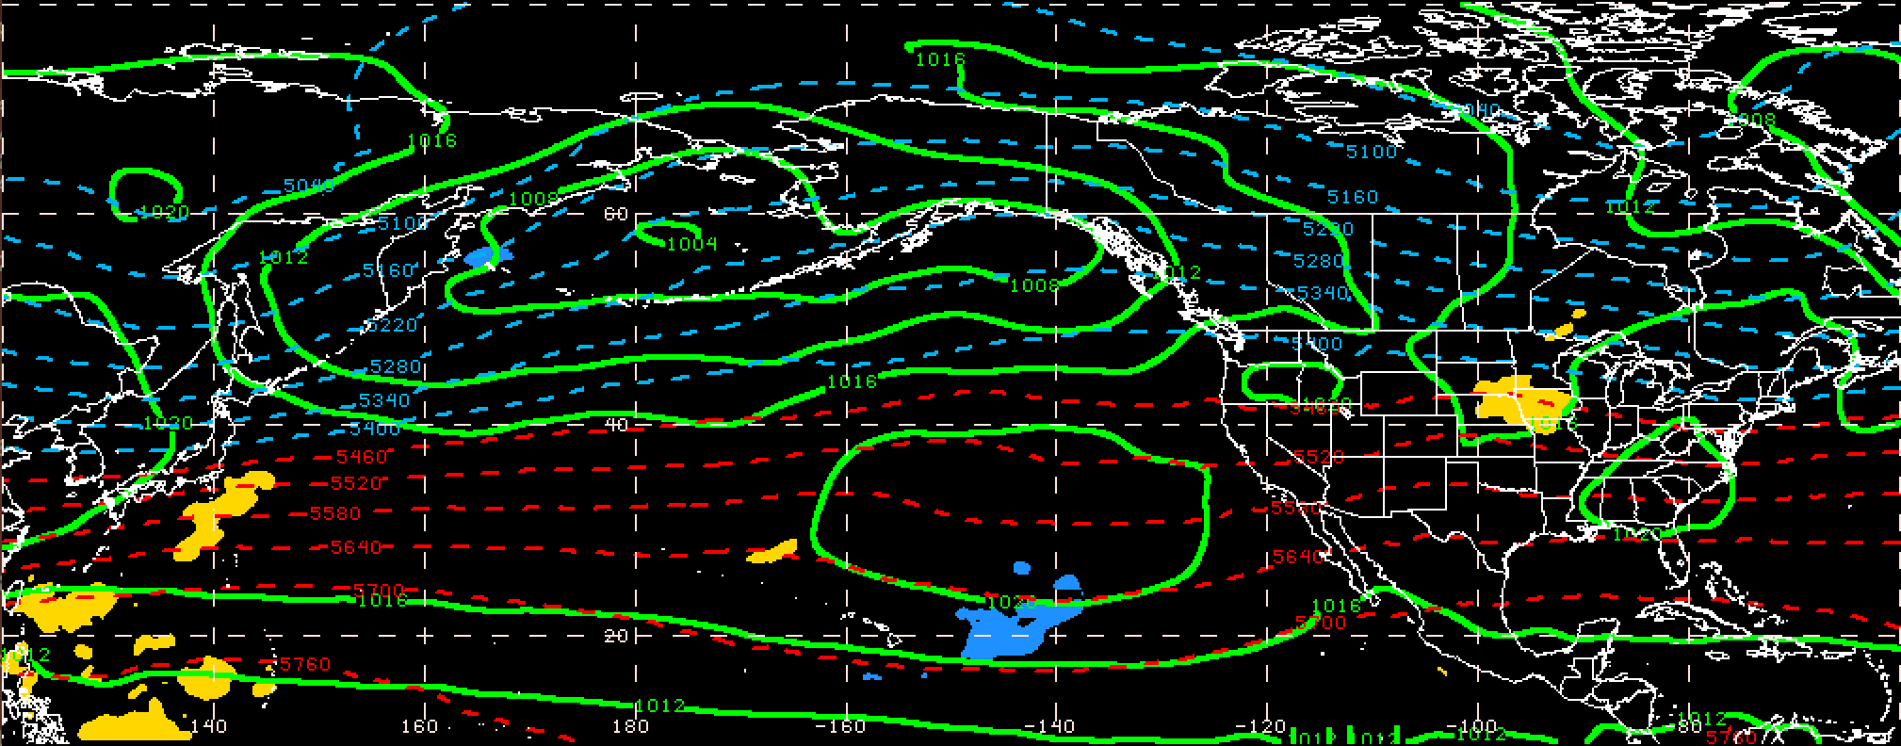
250-hPa Wind Speed, Geo. Heights, Std. Height Anomalies: Day −10
S. Plains Warm Event – Jet Retraction
m s^{–1}
Mean Sea-Level Pressure, 1000–500-hPa Thickness, 950-hPa Std. Temp. Anomalies: Day −10
L
H
H
σ

Slide 17
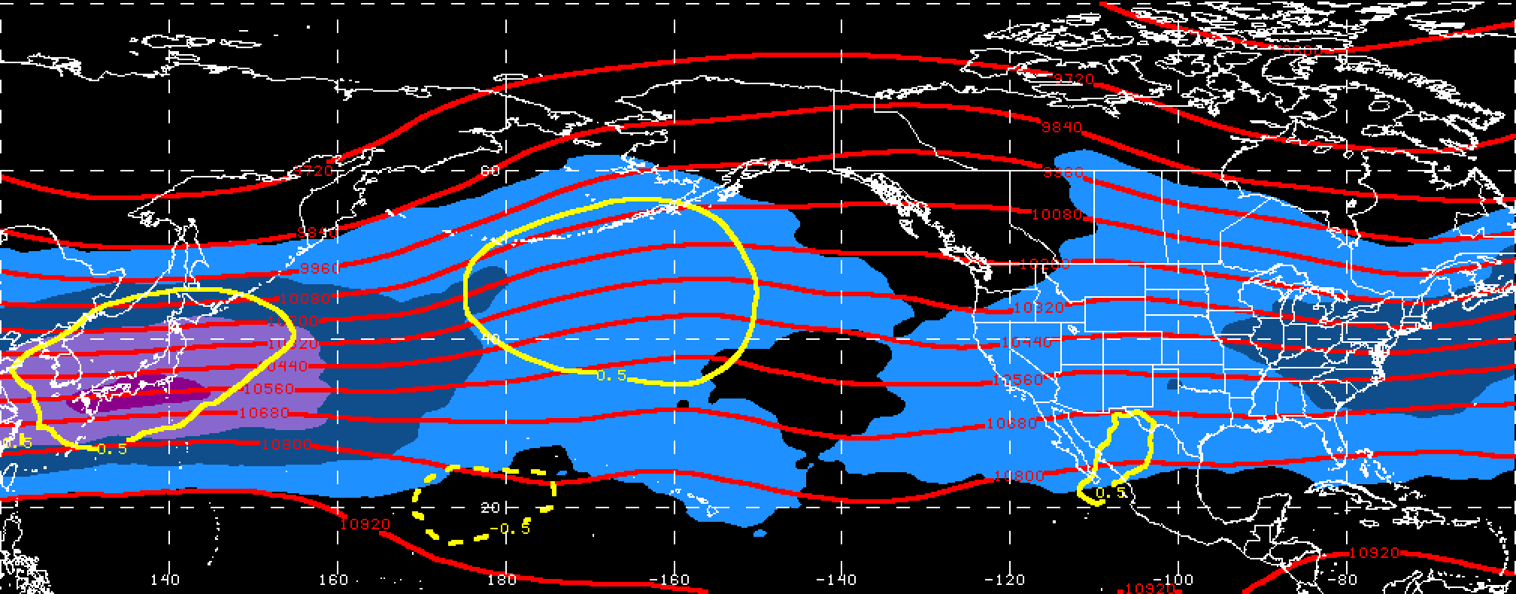
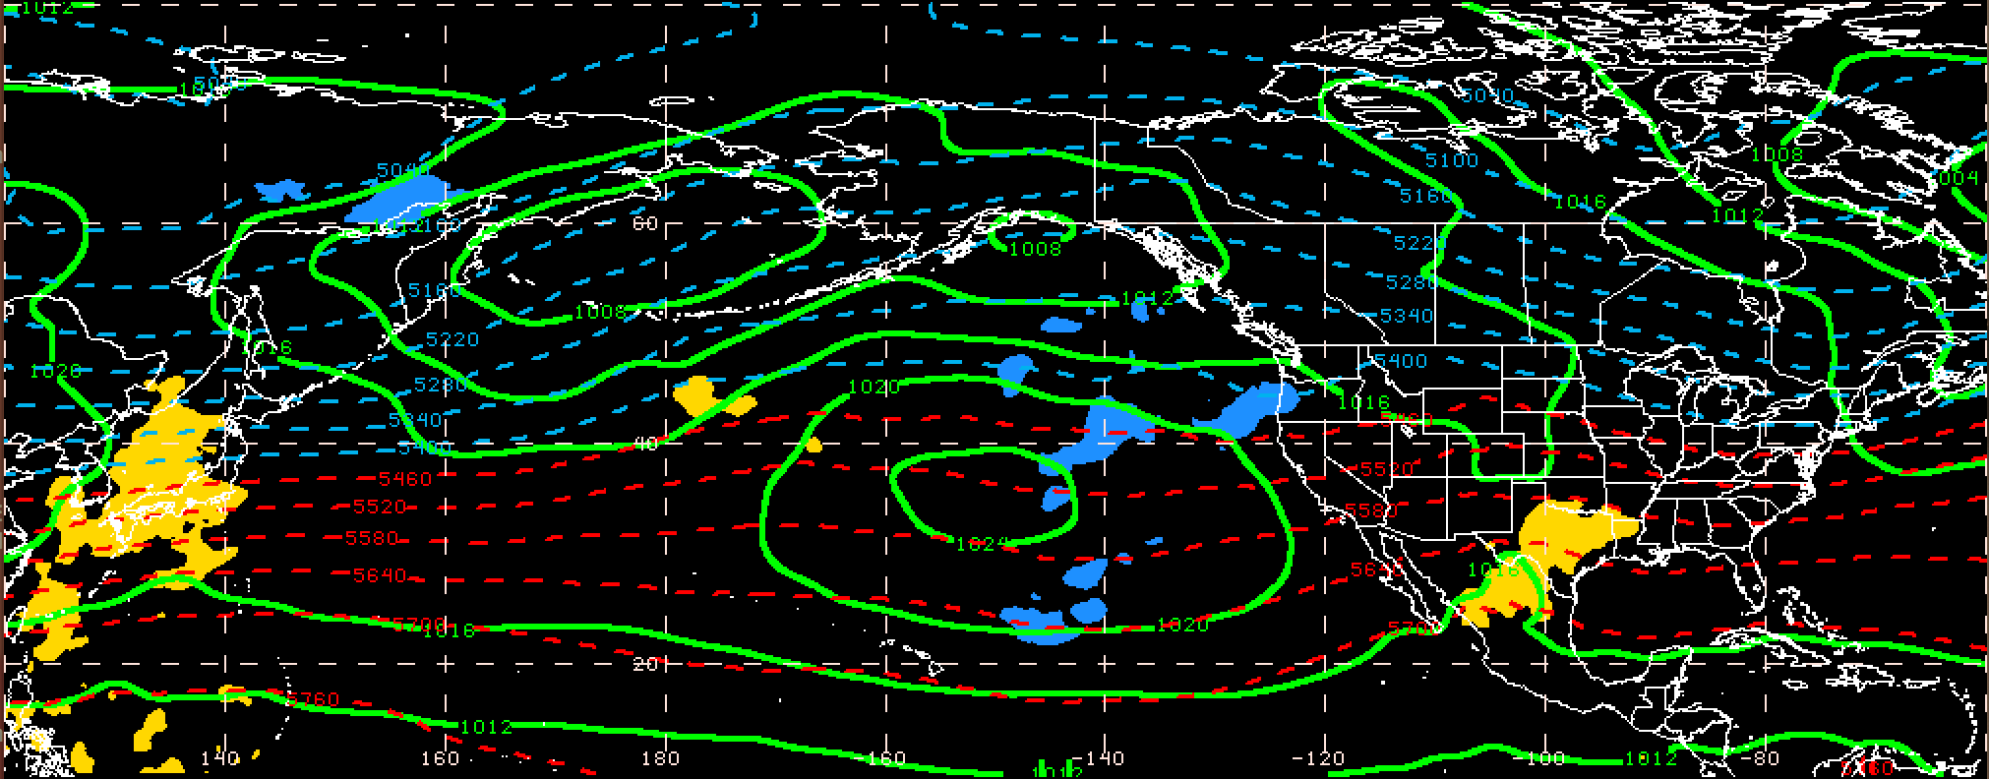
250-hPa Wind Speed, Geo. Heights, Std. Height Anomalies: Day −8
S. Plains Warm Event – Jet Retraction
m s^{–1}
Mean Sea-Level Pressure, 1000–500-hPa Thickness, 950-hPa Std. Temp. Anomalies: Day −8
L
L
H
σ

Slide 18
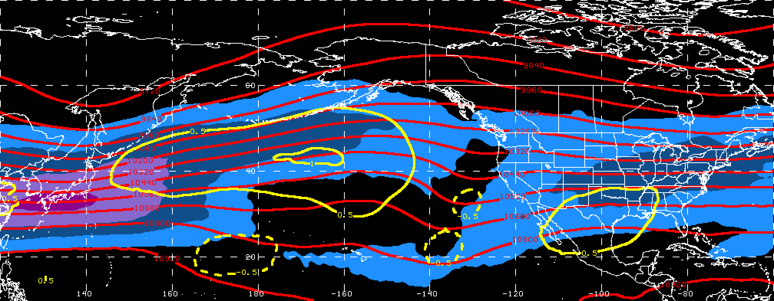
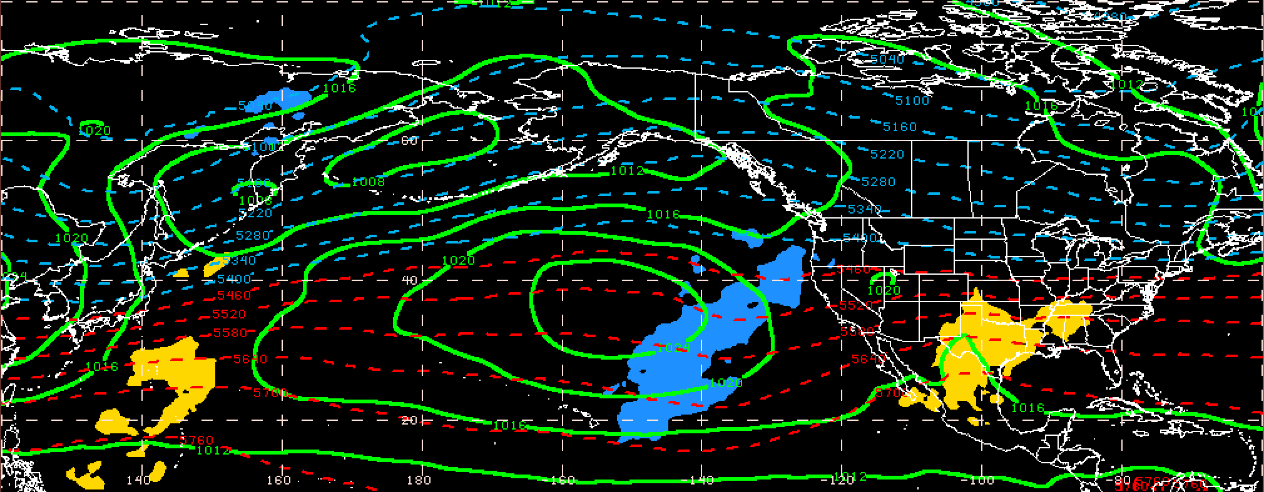
250-hPa Wind Speed, Geo. Heights, Std. Height Anomalies: Day −6
S. Plains Warm Event – Jet Retraction
m s^{–1}
Mean Sea-Level Pressure, 1000–500-hPa Thickness, 950-hPa Std. Temp. Anomalies: Day −6
L
H
σ

Slide 19
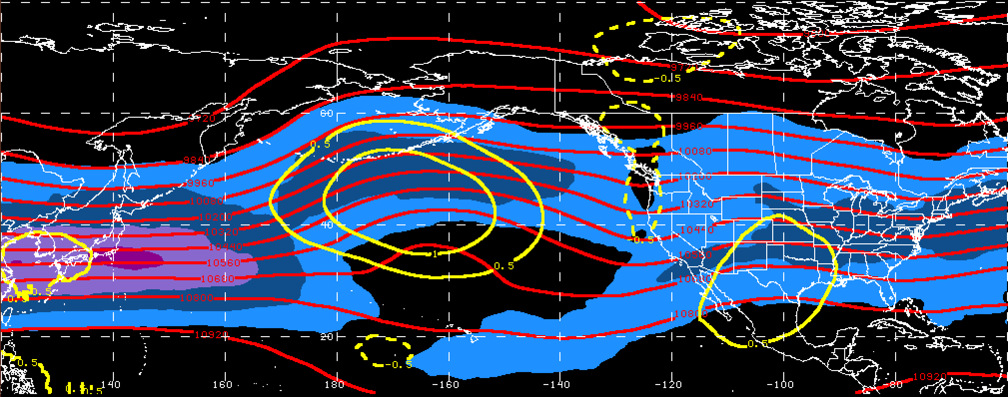
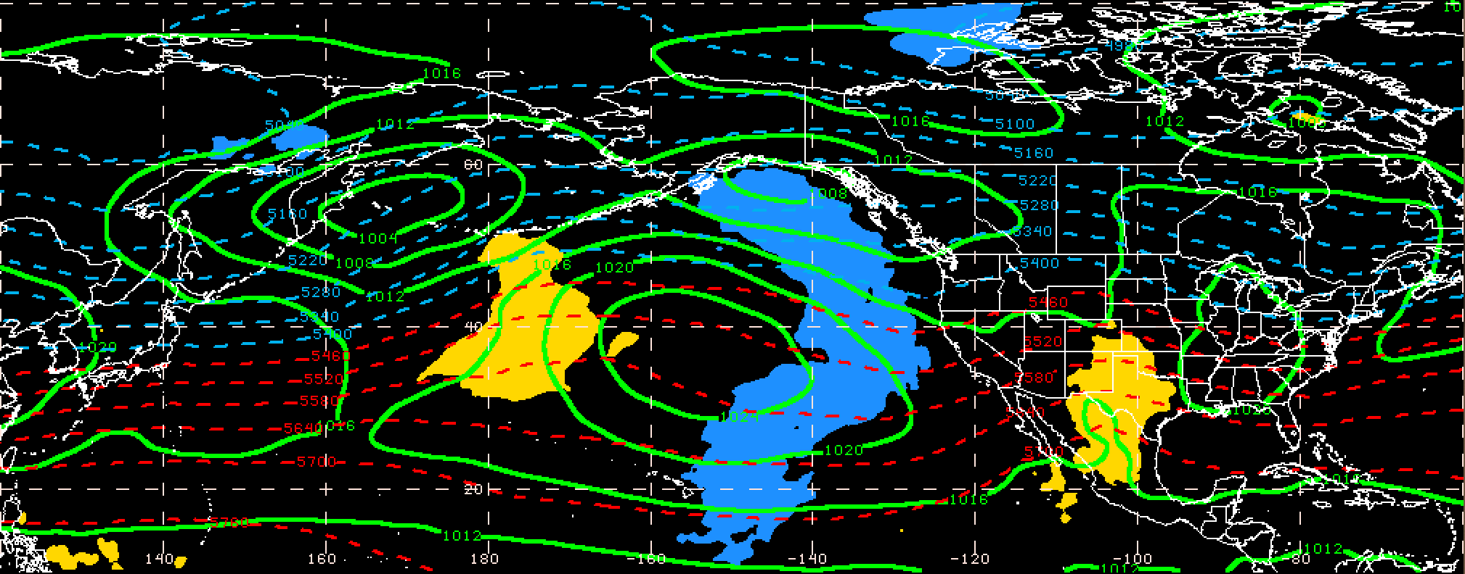
250-hPa Wind Speed, Geo. Heights, Std. Height Anomalies: Day −4
S. Plains Warm Event – Jet Retraction
m s^{–1}
Mean Sea-Level Pressure, 1000–500-hPa Thickness, 950-hPa Std. Temp. Anomalies: Day −4
L
L
H
H
σ

Slide 20
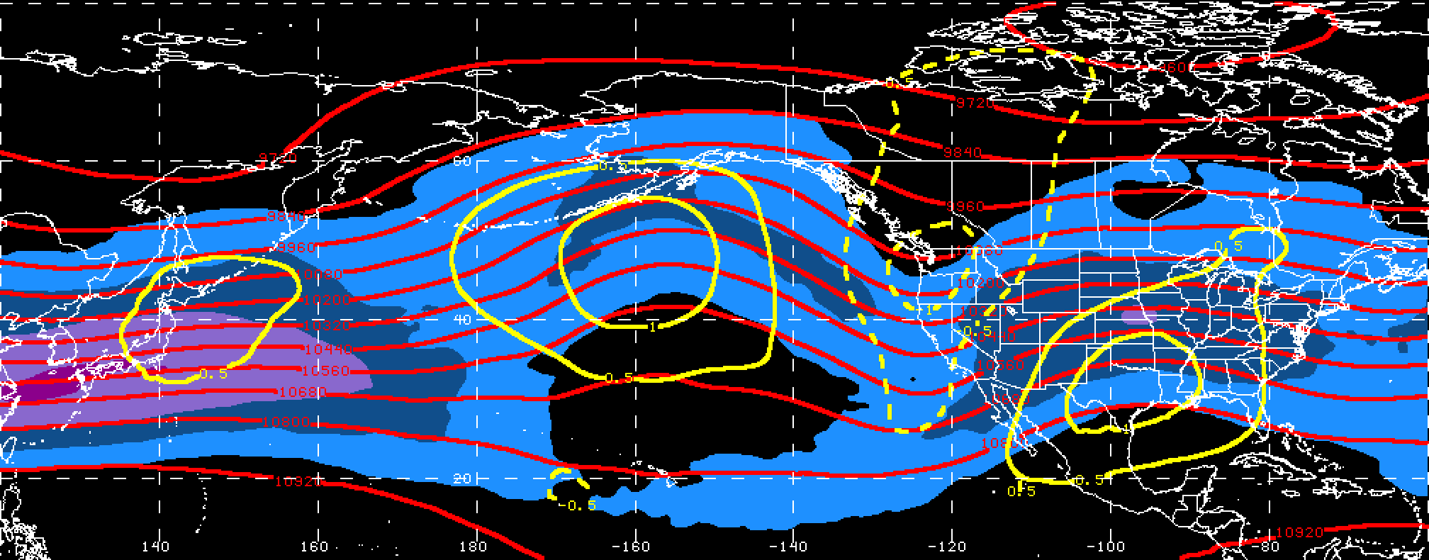
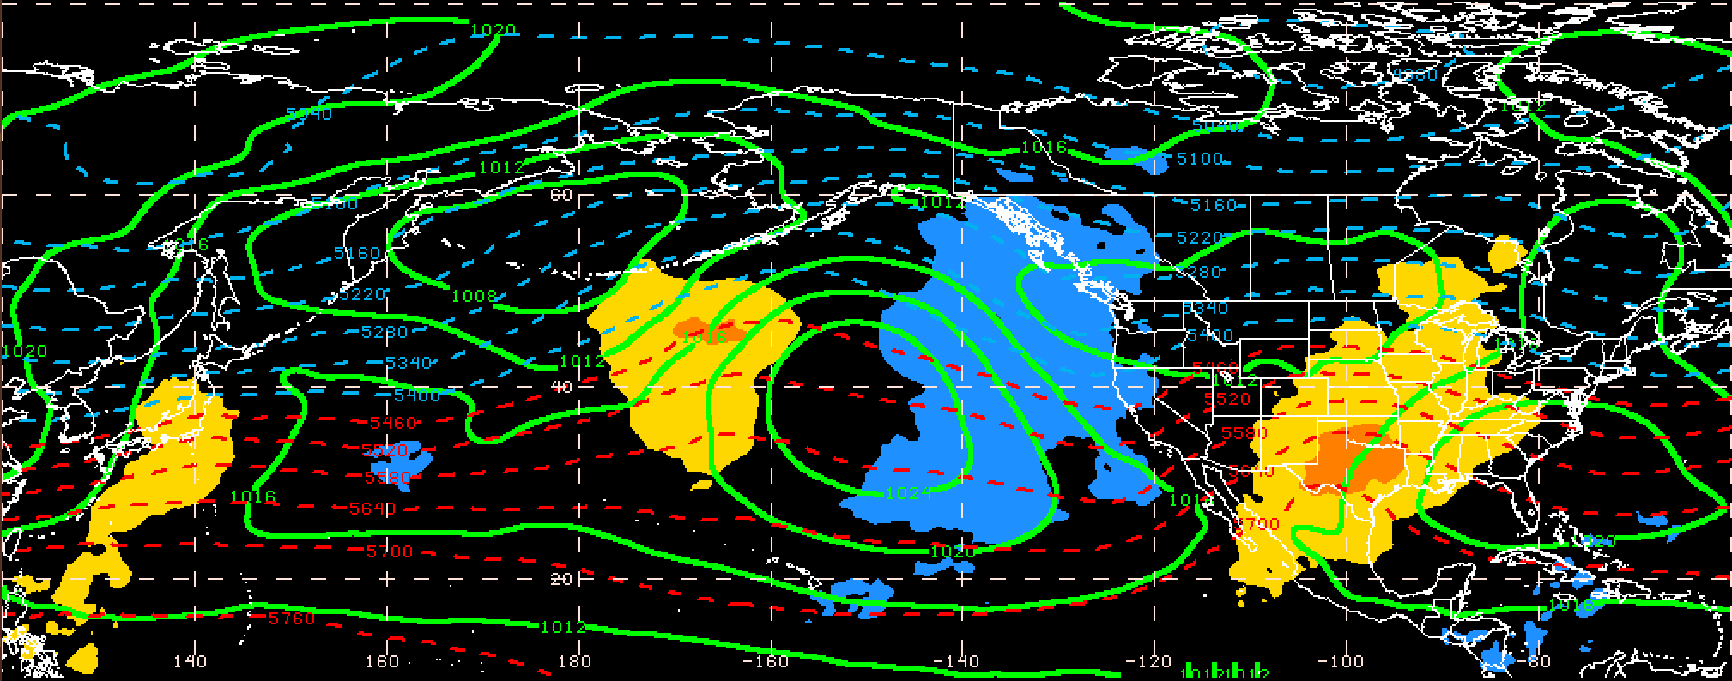
250-hPa Wind Speed, Geo. Heights, Std. Height Anomalies: Day −2
S. Plains Warm Event – Jet Retraction
m s^{–1}
Mean Sea-Level Pressure, 1000–500-hPa Thickness, 950-hPa Std. Temp. Anomalies: Day −2
L
L
H
H
σ

Slide 21
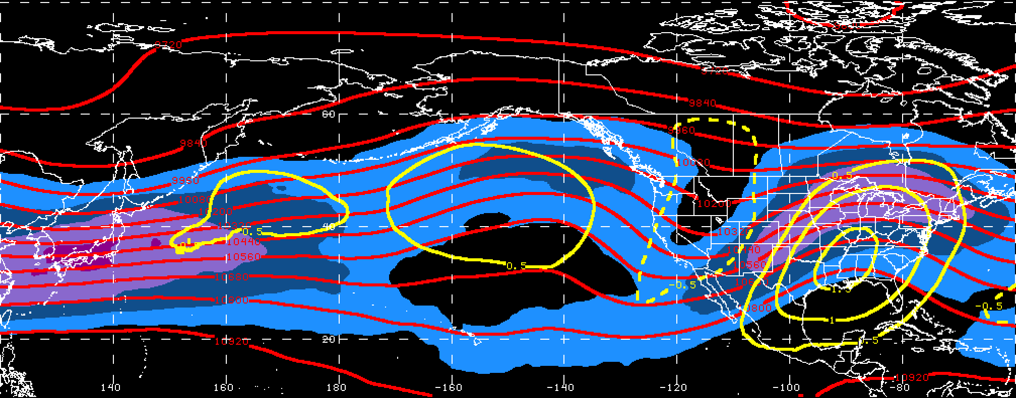
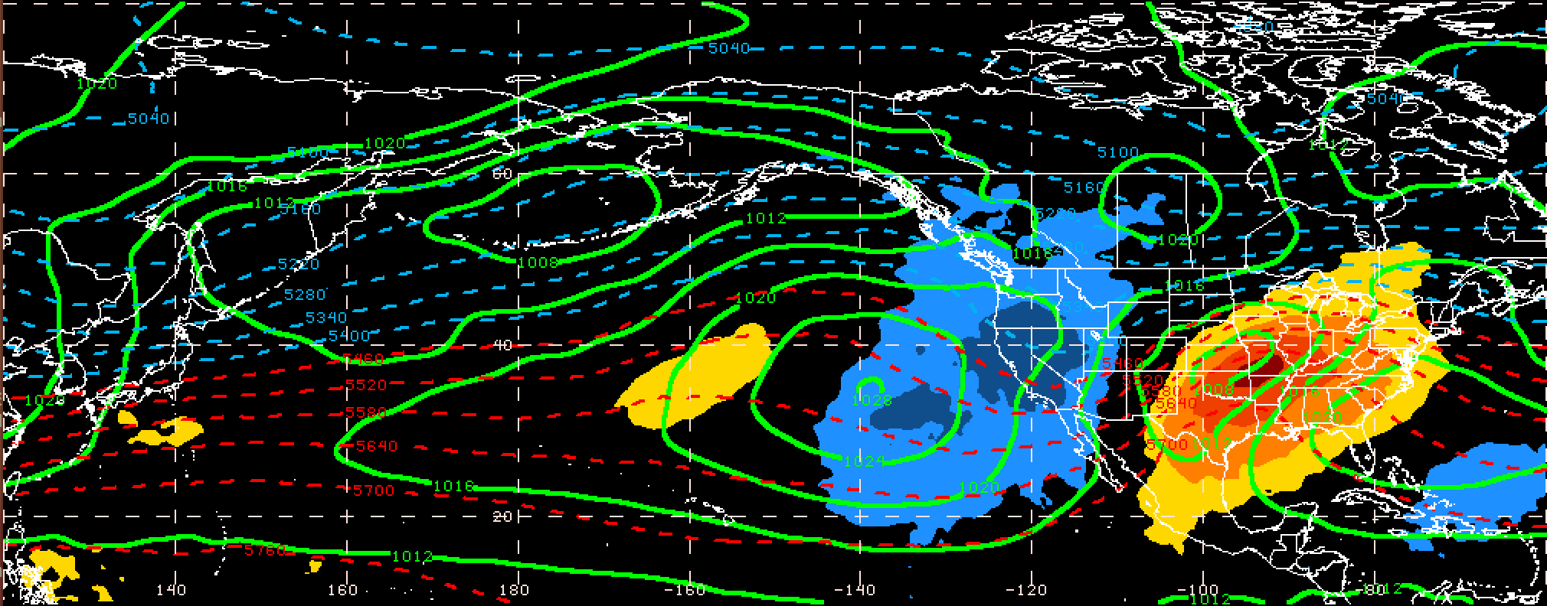
250-hPa Wind Speed, Geo. Heights, Std. Height Anomalies: Day 0
S. Plains Warm Event – Jet Retraction
m s^{–1}
Mean Sea-Level Pressure, 1000–500-hPa Thickness, 950-hPa Std. Temp. Anomalies: Day 0
L
H
H
L
H
σ

Slide 22
E. Rockies – S. Plains Cluster
3 Geographic Clusters
WARM EVENTS
Poleward Shift
18
Events during
Sept. – May projected onto phase diagram
PC 2
35
15
Retraction
Extension
Each point is an average of the PCs for
3–7 days prior to the event
16
Equatorward Shift
84 events
PC 1

Slide 23
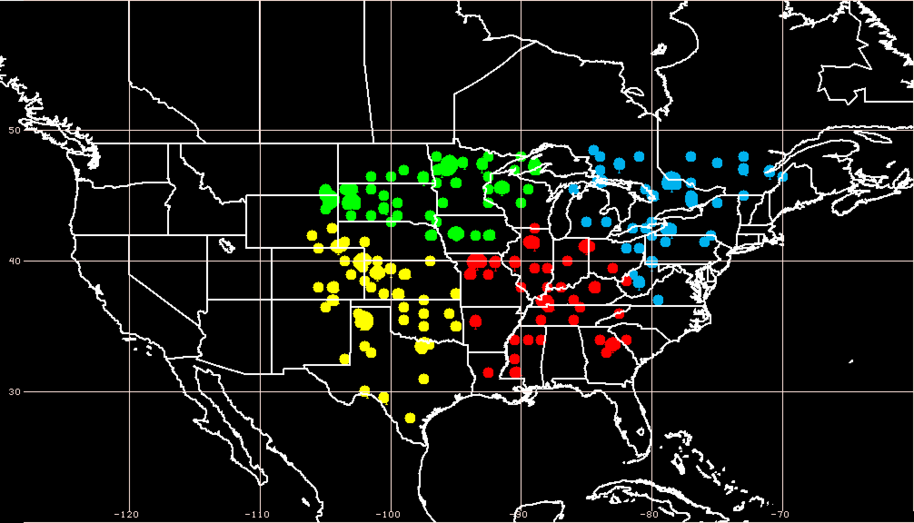
E. Rockies – S. Plains Cluster
4 Geographic Clusters
COLD EVENTS
Poleward Shift
4
Events during
Sept. – May projected onto phase diagram
PC 2
4
14
Retraction
Extension
Each point is an average of the PCs for
3–7 days prior to the event
26
Equatorward Shift
48 events
PC 1

Slide 24
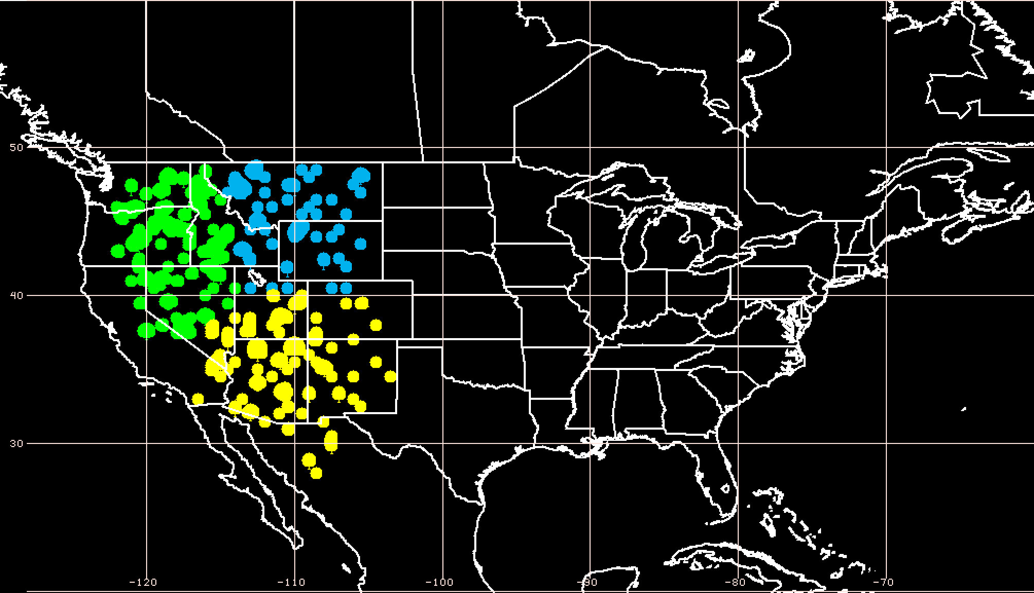
W. Rockies – Pac. NW Cluster
3 Geographic Clusters
WARM EVENTS
Poleward Shift
22
Events during
Sept. – May projected onto phase diagram
PC 2
13
27
Retraction
Extension
Each point is an average of the PCs for
3–7 days prior to the event
27
Equatorward Shift
89 events
PC 1

Slide 25
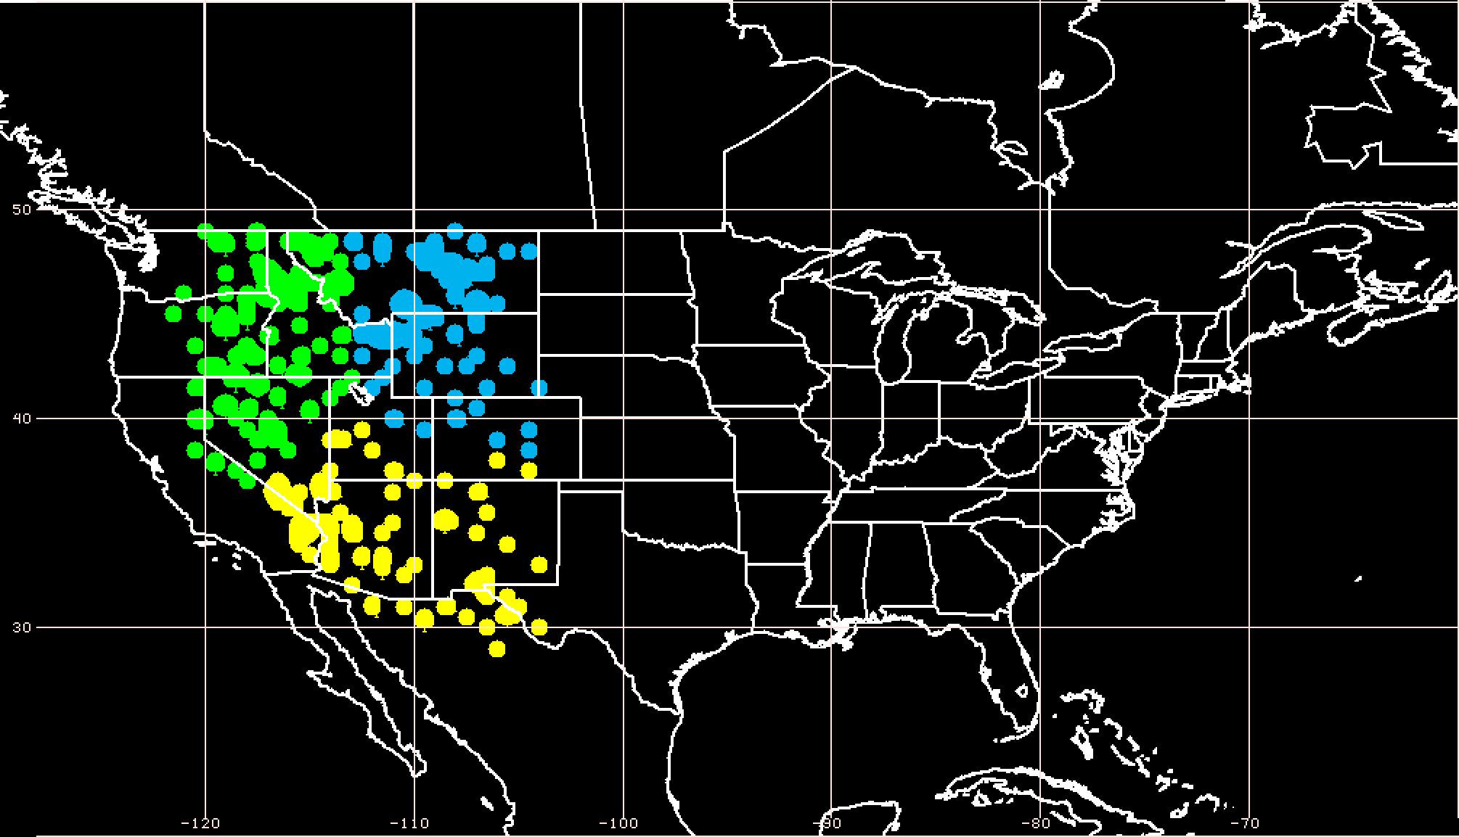
W. Rockies – Pac. NW Cluster
3 Geographic Clusters
COLD EVENTS
Poleward Shift
18
Events during
Sept. – May projected onto phase diagram
PC 2
31
9
Retraction
Extension
Each point is an average of the PCs for
3–7 days prior to the event
20
Equatorward Shift
78 events
PC 1

Slide 26
Real-Time North Pacific Jet Phase Diagram

Slide 27
November 2014: Record US Cold
0000 UTC 8 November 2014
250-hPa Wind Speed: shaded

Slide 28
November 2014: Record US Cold
0000 UTC 10 November 2014
250-hPa Wind Speed: shaded

Slide 29
November 2014: Record US Cold
0000 UTC 12 November 2014
250-hPa Wind Speed: shaded

Slide 30
November 2014: Record US Cold
0000 UTC 14 November 2014
250-hPa Wind Speed: shaded

Slide 31
November 2014: Record US Cold
0000 UTC 16 November 2014
250-hPa Wind Speed: shaded

Slide 32
November 2014: Record US Cold
0000 UTC 18 November 2014
250-hPa Wind Speed: shaded

Slide 33
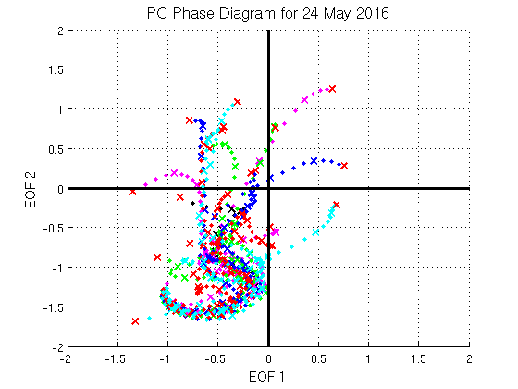
Real-Time NPJ Phase Diagram
GEFS Ensemble Trajectories Initialized at 0000 UTC 24 May 2016
Poleward Shift
9-day forecast
0000 UTC 24 May
(initialization)
PC 2
Extension
Retraction
Equatorward Shift
PC 1

Slide 34
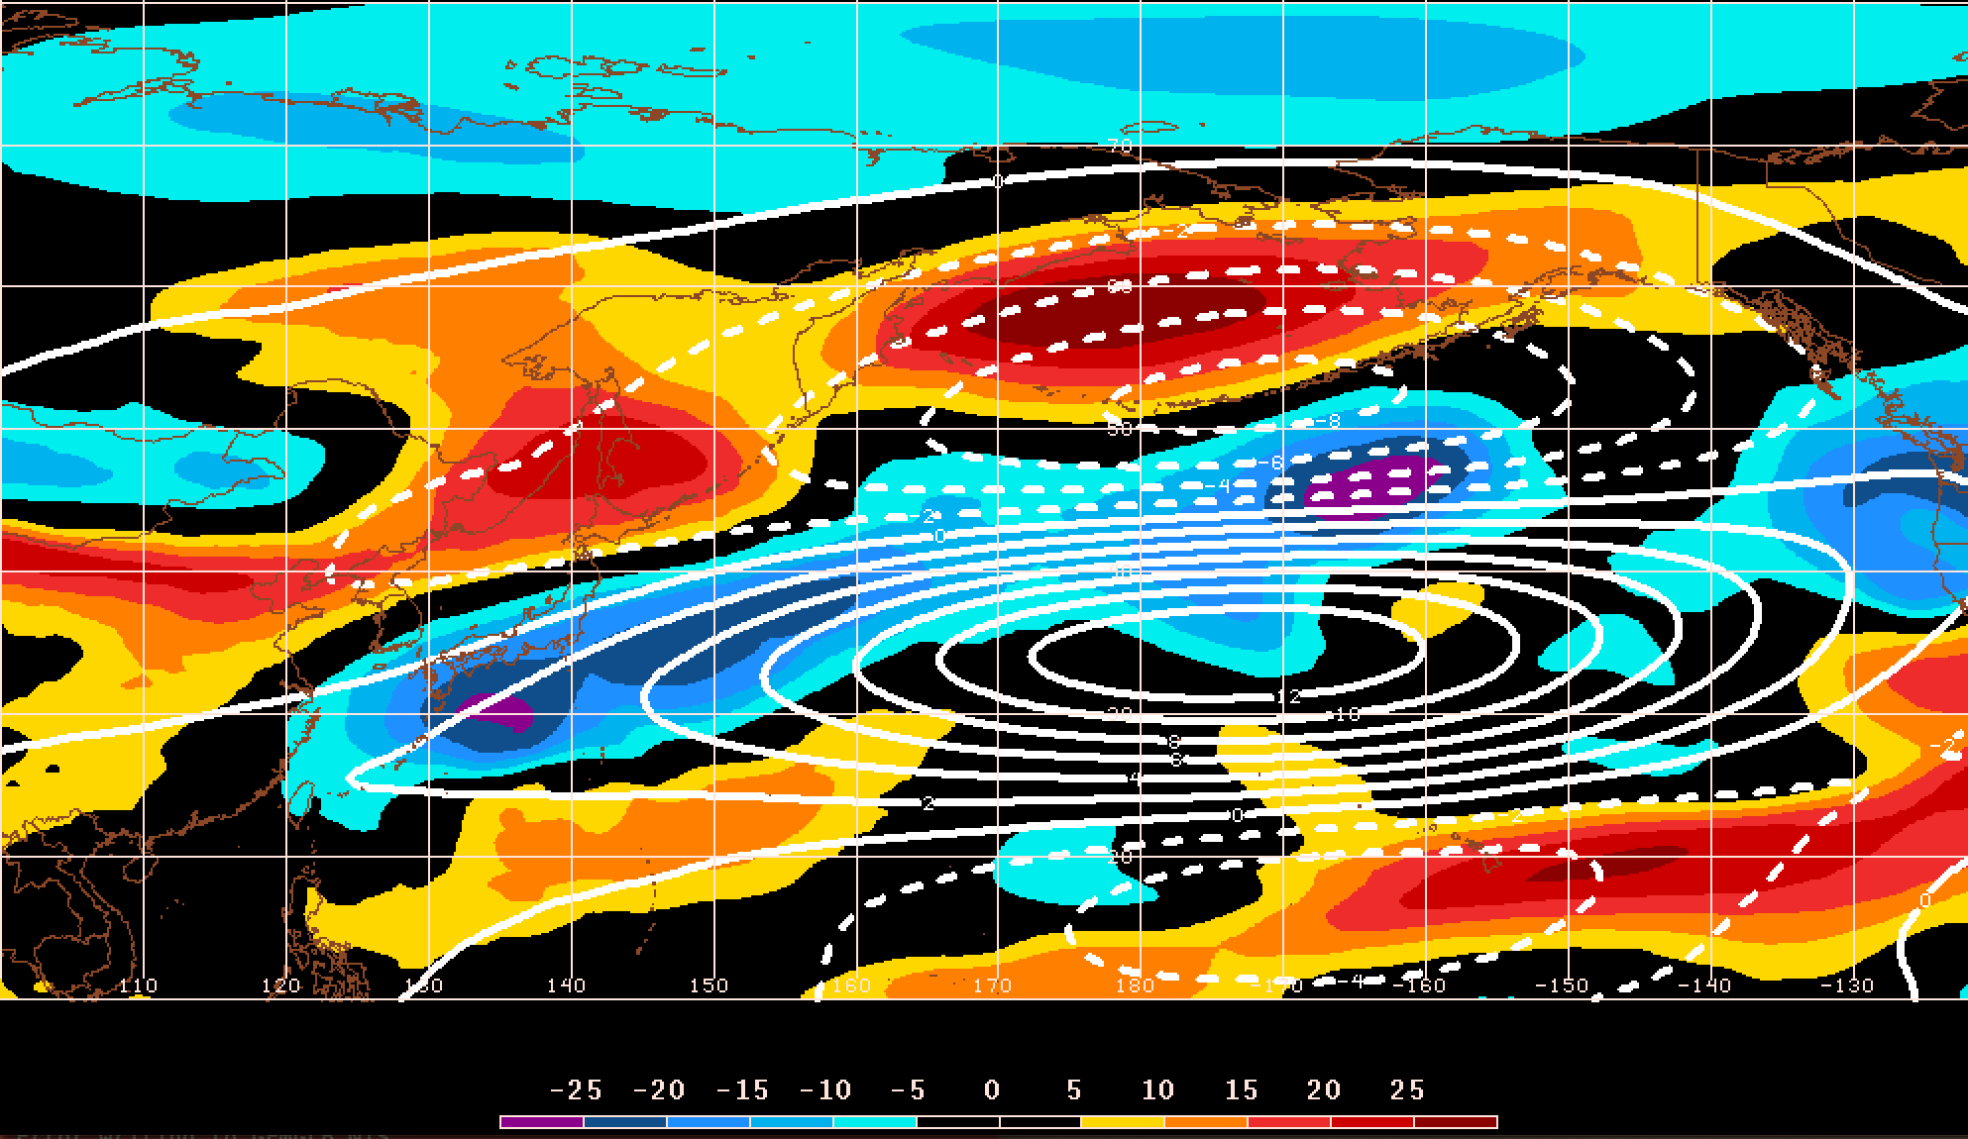
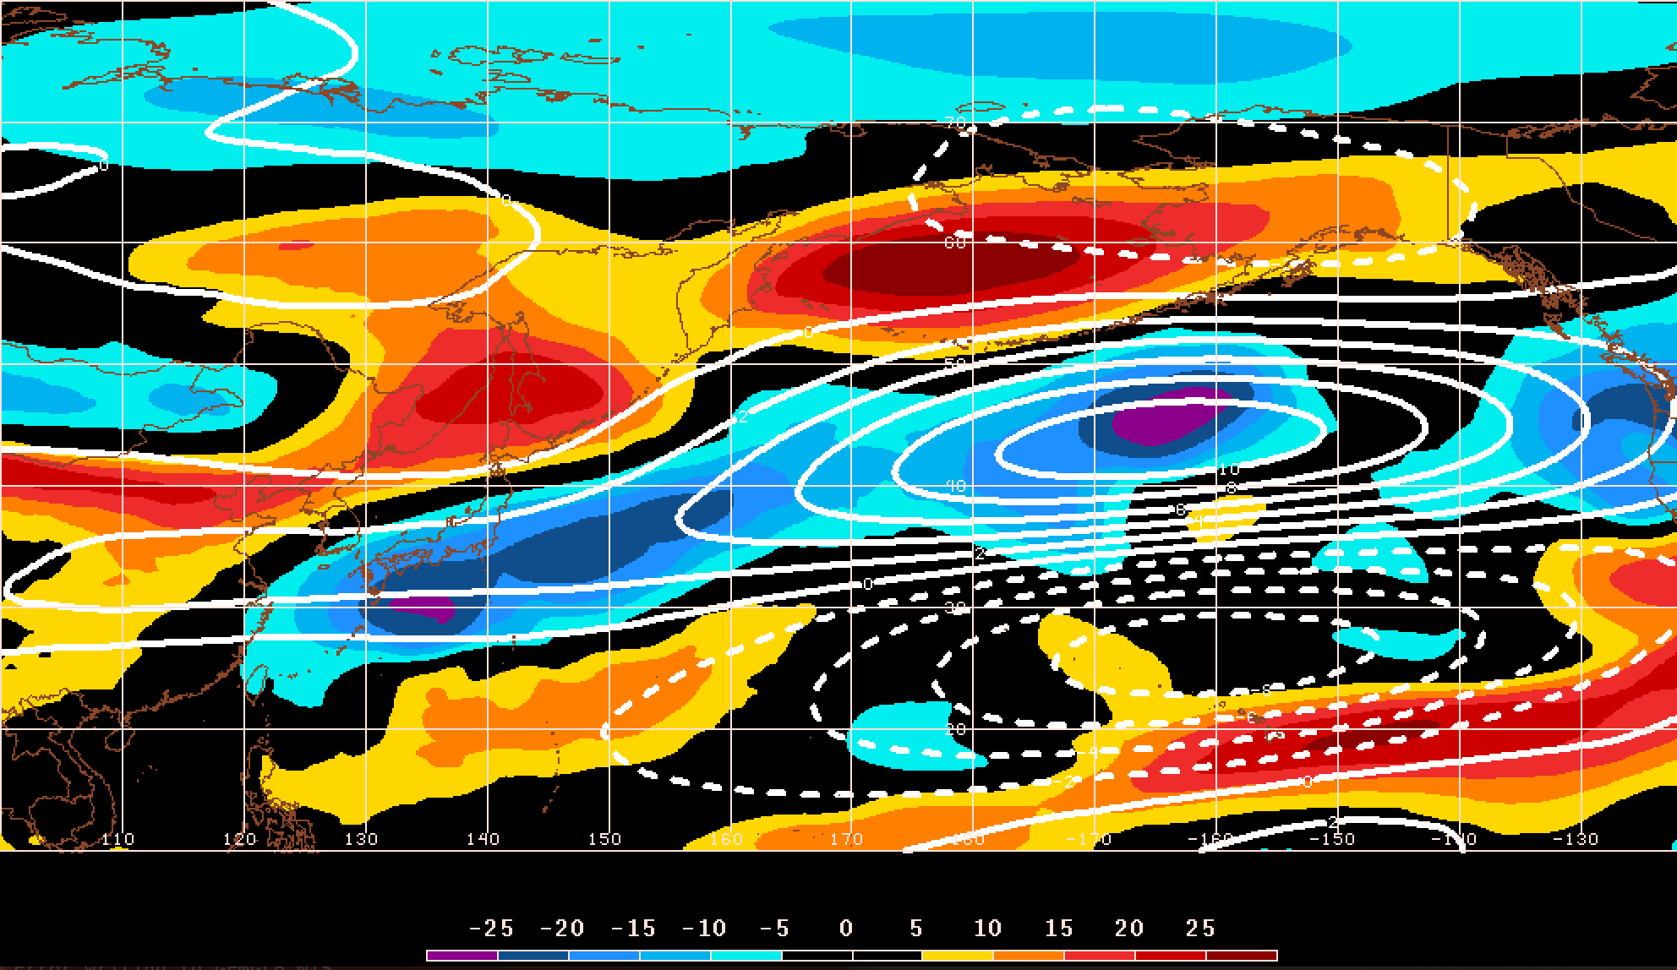
GEFS Ensemble Trajectories Initialized at 0000 UTC 24 May 2016
Poleward Shift
250-hPa Zonal Wind Anomalies and EOF1: 0000 UTC 24 May
Retraction
Extension
PC 2
Equatorward Shift
PC 1
0000 UTC 24 May
(initialization)
m s^{–1}
250-hPa Zonal Wind Anomalies and EOF2: 0000 UTC 24 May
250-hPa zonal wind anomalies at 0000 UTC 24 May project strongly onto
EOF1 < 0 and EOF2 < 0
250-hPa zonal wind anomalies: shading
EOF patterns: white contours
m s^{–1}

Slide 35
Real-Time NPJ Phase Diagram
GEFS Ensemble Trajectories Initialized at 0000 UTC 24 May 2016
Poleward Shift
9-day forecast
0000 UTC 24 May
(initialization)
0000 UTC 2 Jun (verification)
PC 2
Extension
Retraction
Equatorward Shift
PC 1

Slide 36
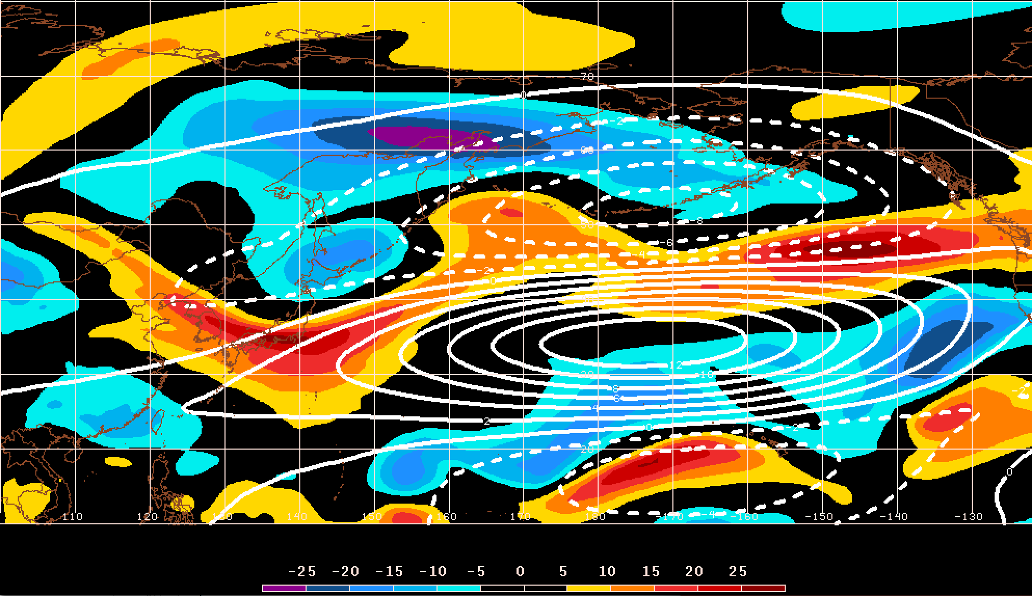
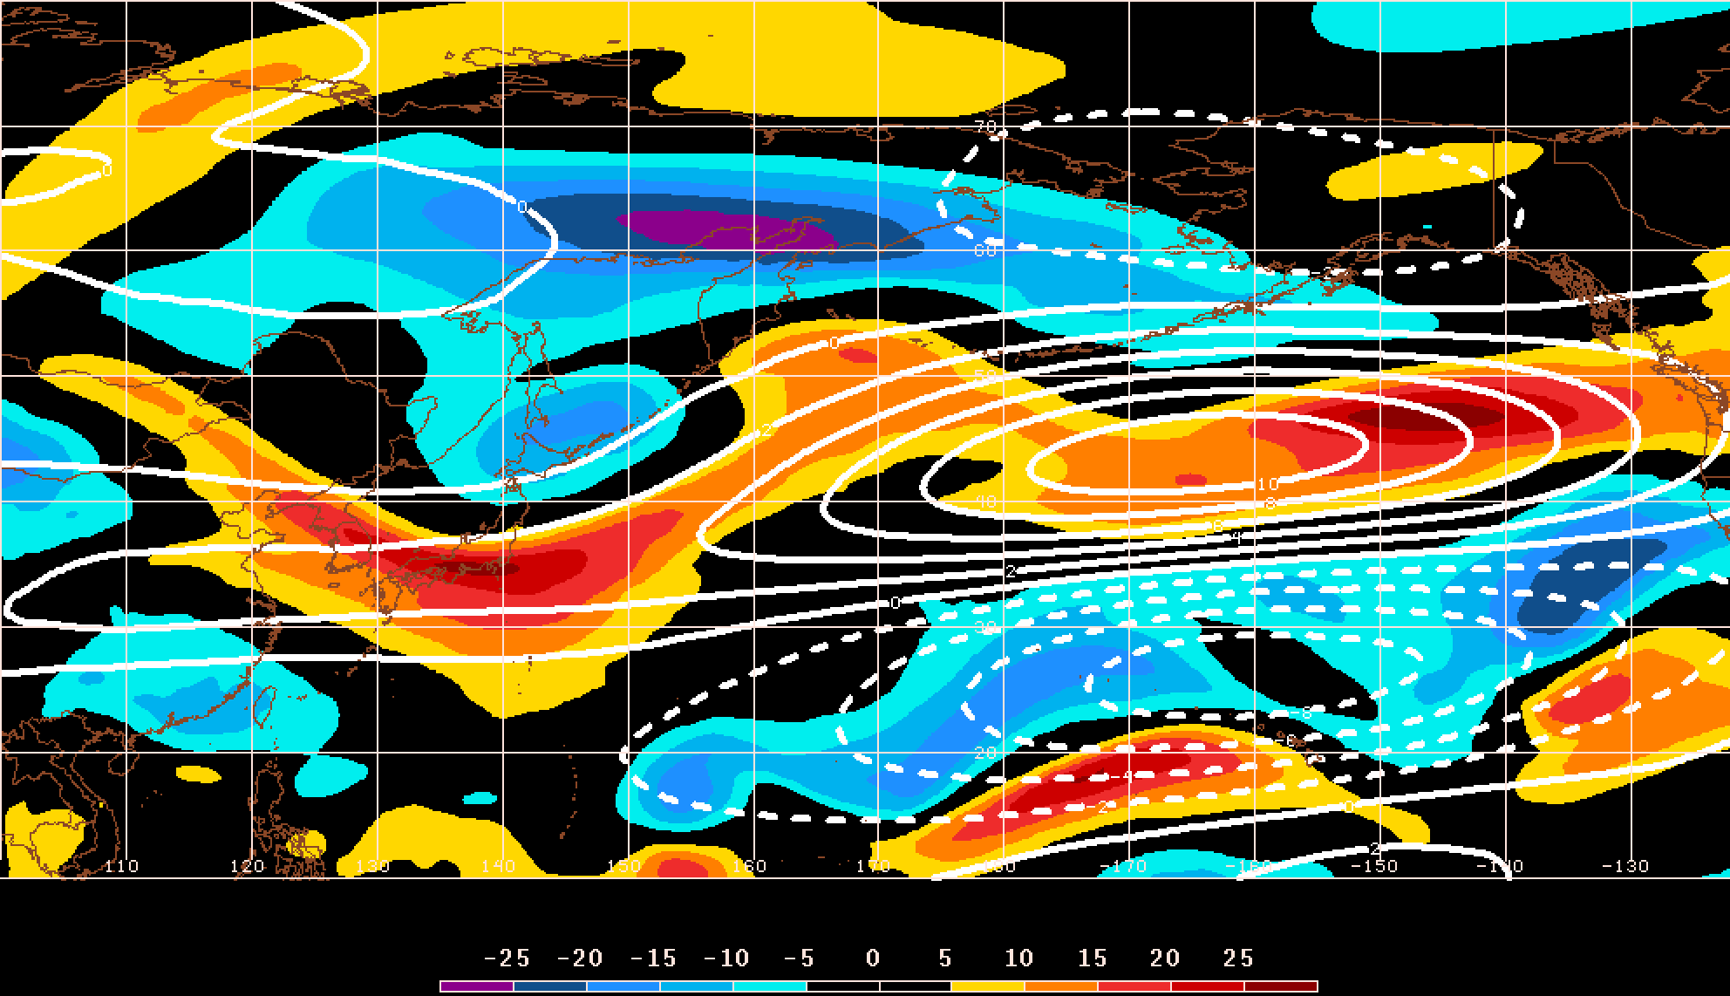
GEFS Ensemble Trajectories Initialized at 0000 UTC 24 May 2016
Poleward Shift
250-hPa Zonal Wind Anomalies and EOF1: 0000 UTC 2 Jun
Retraction
Extension
PC 2
Equatorward Shift
PC 1
0000 UTC 2 Jun
(verification)
m s^{–1}
250-hPa Zonal Wind Anomalies and EOF2: 0000 UTC 2 Jun
250-hPa zonal wind anomalies at 0000 UTC 2 Jun project strongly onto
EOF2 > 0
250-hPa zonal wind anomalies: shading
EOF patterns: white contours
m s^{–1}

Slide 37
Real-Time NPJ Phase Diagram
GEFS Ensemble Trajectories Initialized at 0000 UTC 24 May 2016
Poleward Shift
9-day forecast
0000 UTC 24 May
(initialization)
0000 UTC 2 Jun (verification)
Retraction
Extension
Ensemble mean
Equatorward Shift
Probability

Slide 38
Supplementary Slides

Slide 39
Event Precip. Event Identification
Precipitation:
Employed CPC Unified Gauge-Based Analysis of Daily Precipitation over CONUS (0.25°× 0.25°)
Compiled data within 21-day windows centered on each time for all 36 years
  Each grid point has 756 data points for a given time
Determined the precipitation values that correspond to the 99th percentile for each grid point at a given time (only for days precipitation was observed)

Slide 40
Event Identification
Temperature
Eastern US (1st % Cold):
- Threshold: 221 grid points
~7.0°×7.0° box
- After QC: 226 events
Eastern US (99th % Warm):
- Threshold: 224 grid points
~7.0°×7.0° box
- After QC: 304 events
Western US (1st % Cold):
- Threshold: 125 grid points
~5.0°×5.0° box
- After QC: 271 events
Western US (99th % Warm):
- Threshold: 144 grid points
~5.5°×5.5° box
- After QC: 264 events
Precipitation
Eastern US (99th %):
- Threshold: 211 grid points ~3.5°×3.5° box
- After QC: 351 events
Western US (99th %):
- Threshold: 141 grid points
~2.75°×2.75° box
- After QC: 333 events

Slide 41
EOF Calculations
Removed the mean and the annual and diurnal cycles from 6-hourly 250-hPa zonal wind data from the CFSR (1979–2014)
Isolated data for September – May
Calculated EOF patterns within the domain, 10–80°N ; 100°E–120°W

Slide 42
Notes on Phase Space Diagram
Each point on the phase space is a weighted average of the principal components within +/− 1 day of the time under consideration
Example: 0000 UTC 15 November 2014
Weight
5
4
3
2
1
Date
0000 UTC 14 Nov.
1200 UTC 14 Nov.
0000 UTC 15 Nov.
1200 UTC 15 Nov.
0000 UTC 16 Nov.

Slide 43
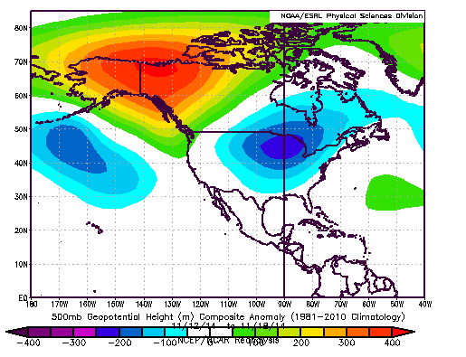
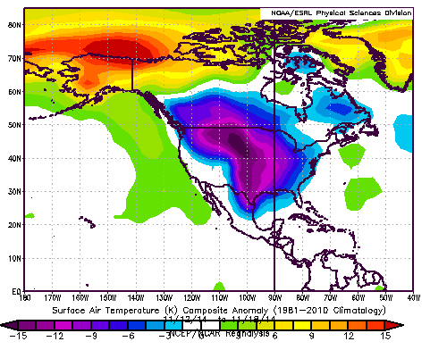
November 2014: Record US Cold
13–18 November 2014 Composite Anomalies
500-hPa Geo. Height (m)
Surface Temperature (°C)

Slide 44
E. Rockies – S. Plains Cluster
4 Geographic Clusters
COLD EVENTS
Poleward Shift
4
Events during
Sept. – May projected onto phase diagram
PC 2
4
14
Retraction
Extension
Each point is an average of the PCs for
3–7 days prior to the event
16–19 Nov. 2014
26
Equatorward Shift
48 events
PC 1

Slide 45
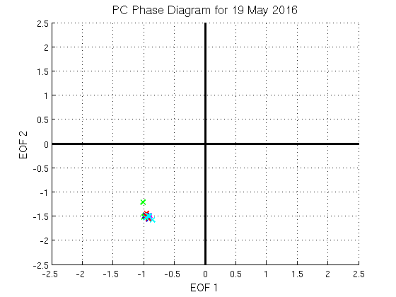
Real-Time NPJ Phase Diagram
GEFS Ensemble Trajectories Initialized at 0000 UTC 24 May 2016
Poleward Shift
1-day forecast
0000 UTC 24 May
(initialization)
PC 2
Extension
Retraction
Equatorward Shift
PC 1

Slide 46
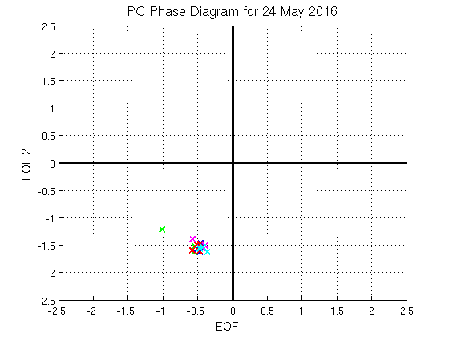
Real-Time NPJ Phase Diagram
GEFS Ensemble Trajectories Initialized at 0000 UTC 24 May 2016
Poleward Shift
2-day forecast
0000 UTC 24 May
(initialization)
PC 2
Extension
Retraction
Equatorward Shift
PC 1

Slide 47
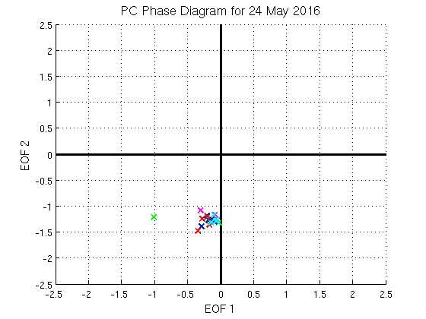
Real-Time NPJ Phase Diagram
GEFS Ensemble Trajectories Initialized at 0000 UTC 24 May 2016
Poleward Shift
3-day forecast
0000 UTC 24 May
(initialization)
PC 2
Extension
Retraction
Equatorward Shift
PC 1

Slide 48
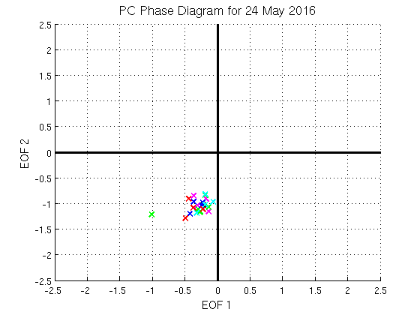
Real-Time NPJ Phase Diagram
GEFS Ensemble Trajectories Initialized at 0000 UTC 24 May 2016
Poleward Shift
4-day forecast
0000 UTC 24 May
(initialization)
PC 2
Extension
Retraction
Equatorward Shift
PC 1

Slide 49
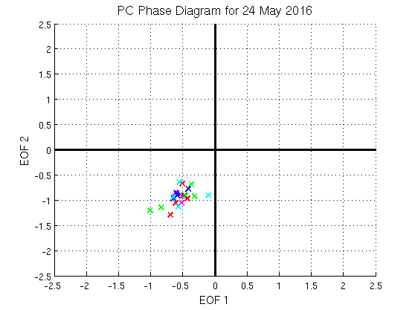
Real-Time NPJ Phase Diagram
GEFS Ensemble Trajectories Initialized at 0000 UTC 24 May 2016
Poleward Shift
5-day forecast
0000 UTC 24 May
(initialization)
PC 2
Extension
Retraction
Equatorward Shift
PC 1

Slide 50
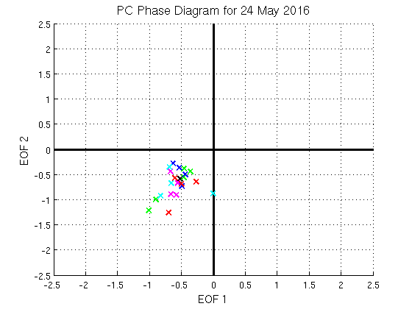
Real-Time NPJ Phase Diagram
GEFS Ensemble Trajectories Initialized at 0000 UTC 24 May 2016
Poleward Shift
6-day forecast
0000 UTC 24 May
(initialization)
PC 2
Extension
Retraction
Equatorward Shift
PC 1

Slide 51
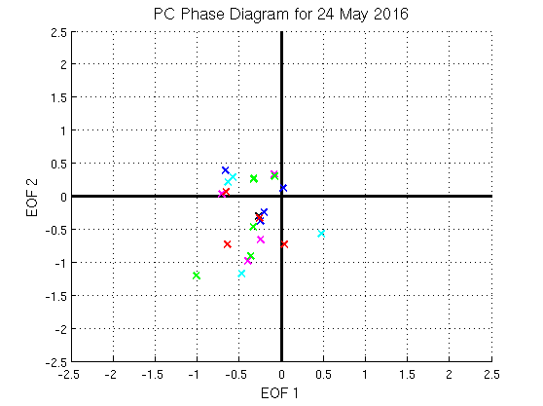
Real-Time NPJ Phase Diagram
GEFS Ensemble Trajectories Initialized at 0000 UTC 24 May 2016
Poleward Shift
7-day forecast
0000 UTC 24 May
(initialization)
PC 2
Extension
Retraction
Equatorward Shift
PC 1

Slide 52
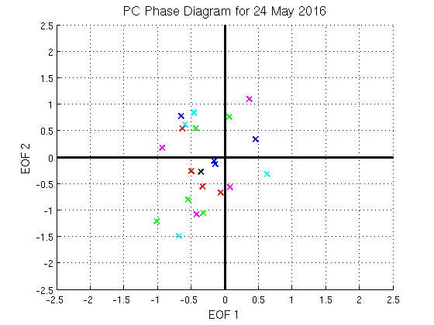
Real-Time NPJ Phase Diagram
GEFS Ensemble Trajectories Initialized at 0000 UTC 24 May 2016
Poleward Shift
8-day forecast
0000 UTC 24 May
(initialization)
PC 2
Extension
Retraction
Equatorward Shift
PC 1

Slide 53
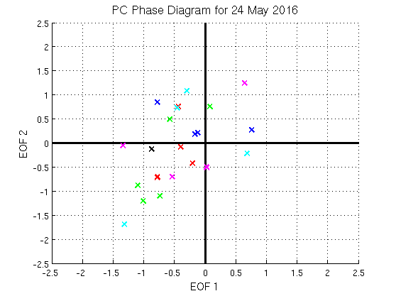
Real-Time NPJ Phase Diagram
GEFS Ensemble Trajectories Initialized at 0000 UTC 24 May 2016
Poleward Shift
9-day forecast
0000 UTC 24 May
(initialization)
0000 UTC 2 Jun (verification)
PC 2
Extension
Retraction
Equatorward Shift
PC 1

