Slide 1
Weather Regime-Dependent Predictability: Antecedent Environments Conducive to the Production of Extreme Temperature Events over the United States
Andrew C. Winters
Department of Atmospheric and Environmental Sciences
University at Albany, State University of New York, Albany, NY 12222
University of Washington
Department of Atmospheric Sciences
Seattle, WA
7 April 2017
This work is supported by NOAA Grant NA15NWS4680006

Slide 2
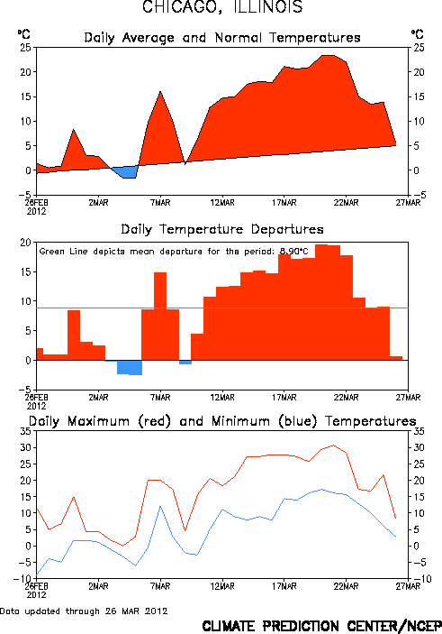
March 2012 Heat Wave
Extreme and persistent warmth prevailed east of the Rocky Mountains during 13–24 March 2012.
Over 15,000 combined maximum and high minimum temperature records were broken during March 2012.
March 2012 was the warmest March on record for 25 different states.
ESRL /

Slide 3
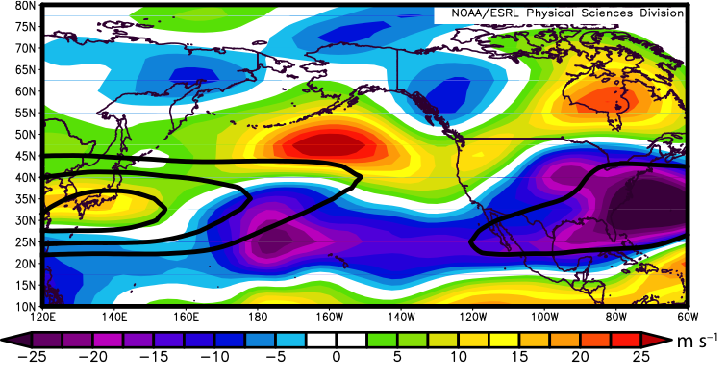
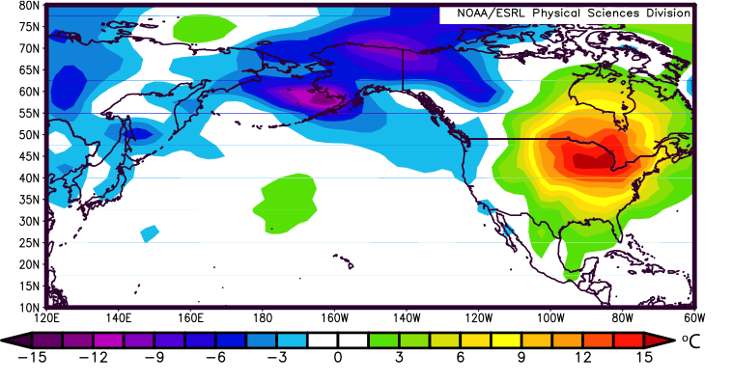
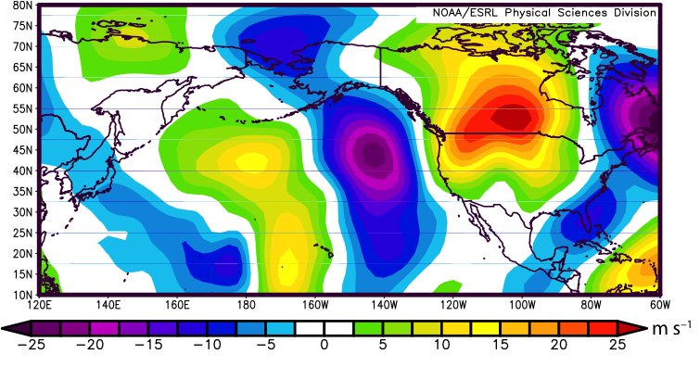
March 2012 Heat Wave
250-hPa U-Wind Anomalies (13–24 March 2012)
Surface Temp. Anomalies (13–24 March 2012)
250-hPa V-Wind Anomalies (13–24 March 2012)
Surface temperature anomalies exceeded 15ºC in the Upper-Midwest.
The North Pacific Jet was shifted poleward and characterized by an amplified flow pattern.

Slide 4
March 2012 Heat Wave
250-hPa U-Wind Anomalies (13–24 March 2012)
Surface Temp. Anomalies (13–24 March 2012)
250-hPa V-Wind Anomalies (13–24 March 2012)
Dole et al. (2014) demonstrated that this extreme warm event developed due to the favorable superposition of a number of inter and intraannual teleconnection patterns.

Slide 5
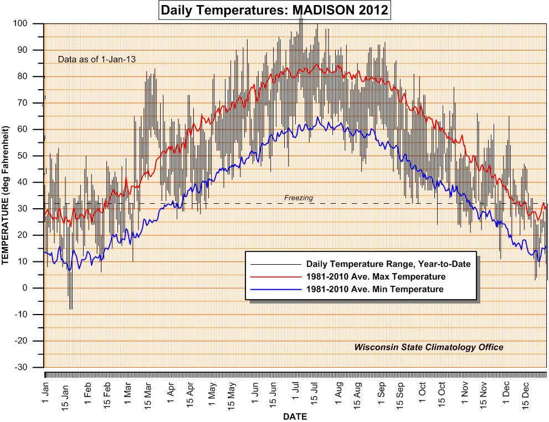
March 2012 Heat Wave
A return to near-normal temperatures during April 2012 posed problems for fruit crops in the Upper Midwest.
Apple orchards in Iowa, Minnesota, and Wisconsin lost 20–100% of their crop.
Mar
Apr
Temperature (ºF)
Freezing
Wisconsin State Climatology Office
Pear, plum, cherry, and strawberry crops in southwestern Wisconsin were also severely damaged.
Storm Data

Slide 6
Project Motivation
One or several extreme temperature events (ETEs) during a single season can contribute disproportionately to temperature anomaly statistics for a particular season.

Slide 7
Project Motivation
One or several extreme temperature events (ETEs) during a single season can contribute disproportionately to temperature anomaly statistics for a particular season.
The disproportionate contribution of ETEs to seasonal temperature anomaly statistics suggests that ETEs need to be considered in understanding the dynamical and thermodynamic processes that operate at the weather–climate intersection.

Slide 8
Project Motivation
One or several extreme temperature events (ETEs) during a single season can contribute disproportionately to temperature anomaly statistics for a particular season.
The disproportionate contribution of ETEs to seasonal temperature anomaly statistics suggests that ETEs need to be considered in understanding the dynamical and thermodynamic processes that operate at the weather–climate intersection.
Consideration of ETEs may improve operational probabilistic temperature forecasts in the 8–10 day time range.

Slide 9
Extreme Event Identification
Extreme Warm Events:
Employed 1-h forecasts of 2-m temperature from the CFSR (0.5°× 0.5°) at 6-h intervals (Saha et al. 2014)
Compiled data for each grid point within 21-day windows centered on each analysis time for 36 years, 1979–2014
  Each grid point has 756 (21 × 36) data points for each analysis time
Frequency distribution of 2-m temperature at
1900 UTC 30 May for a grid point near Albany, NY

Slide 10
Extreme Event Identification
Extreme Warm Events:
Employed 1-h forecasts of 2-m temperature from the CFSR (0.5°× 0.5°) at 6-h intervals (Saha et al. 2014)
Compiled data for each grid point within 21-day windows centered on each analysis time for 36 years, 1979–2014
  Each grid point has 756 (21 × 36) data points for each analysis time
Determined the temperature that corresponds to the 99th percentile for each grid point at a given analysis time
Frequency distribution of 2-m temperature at
1900 UTC 30 May for a grid point near Albany, NY

Slide 11
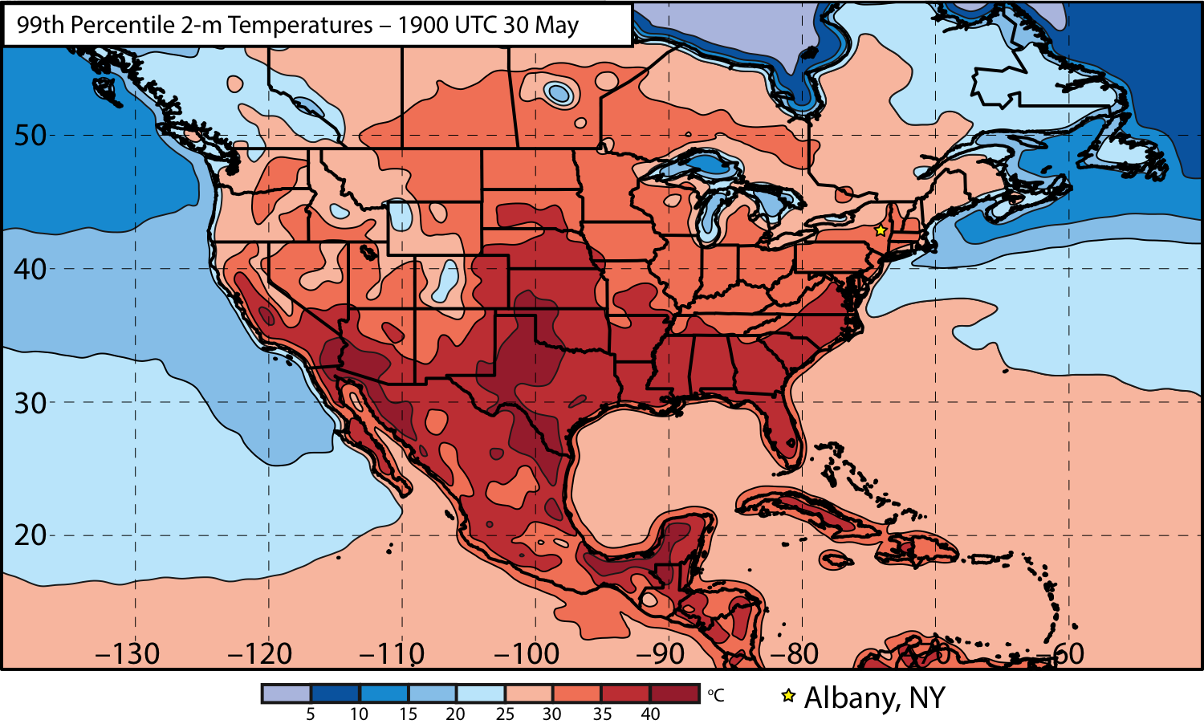
Extreme Event Identification

Slide 12
Extreme Event Identification
Western U.S.
Eastern U.S.

Slide 13
Extreme Event Identification
Extreme Warm Events:
Cataloged times during which at least one grid point was characterized by a temperature > 99th percentile
Ranked times within each domain by the number of grid points > 99th percentile
Frequency distribution of times exhibiting at least one grid point > 99th percentile

Slide 14
Extreme Event Identification
Extreme Warm Events:
Cataloged times during which at least one grid point was characterized by a temperature > 99th percentile
Ranked times within each domain by the number of grid points > 99th percentile
Identified times that rank in the top 5% in terms of the number of grid points > 99th percentile within each domain as extreme warm events
Frequency distribution of times exhibiting at least one grid point > 99th percentile

Slide 15
Extreme Event Identification
Eastern U.S. Domain
Extreme Warm Events:
304 Events
Areal Coverage Threshold:
224 grid points
(~7.0°×7.0° box)

Slide 16
Extreme Event Identification
Eastern U.S. Domain
Extreme Warm Events:
304 Events
Areal Coverage Threshold:
224 grid points
(~7.0°×7.0° box)
Extreme Cold Events:
225 Events
Areal Coverage Threshold:
221 grid points
(~7.0°×7.0° box)

Slide 17
Extreme Event Identification
Eastern U.S. Domain
Extreme Warm Events:
304 Events
Areal Coverage Threshold:
224 grid points
(~7.0°×7.0° box)
Extreme Cold Events:
225 Events
Areal Coverage Threshold:
221 grid points
(~7.0°×7.0° box)
Western U.S. Domain
Extreme Warm Events:
264 Events
Areal Coverage Threshold:
144 grid points
(~5.5°×5.5° box)
Extreme Cold Events:
269 Events
Areal Coverage Threshold:
125 grid points
(~5.0°×5.0° box)

Slide 18
Extreme Event Identification
Eastern U.S. Domain
Extreme Warm Events:
304 Events
Areal Coverage Threshold:
224 grid points
(~7.0°×7.0° box)
Extreme Cold Events:
225 Events
Areal Coverage Threshold:
221 grid points
(~7.0°×7.0° box)
Western U.S. Domain
Extreme Warm Events:
264 Events
Areal Coverage Threshold:
144 grid points
(~5.5°×5.5° box)
Extreme Cold Events:
269 Events
Areal Coverage Threshold:
125 grid points
(~5.0°×5.0° box)

Slide 19
Extreme Event Identification
Extreme Warm Event Frequency: Eastern U.S. Domain (N = 304)

Slide 20
Extreme Event Identification
Extreme Warm Event Centroids: Eastern U.S. Domain (N = 304)

Slide 21
Extreme Event Identification
Extreme Warm Event Centroids: Eastern U.S. Domain (N = 304)
Northern Plains Cluster (N=116)
Southern Plains Cluster (N=102)
Eastern U.S. Cluster (N=86)
3 geographic clusters objectively identified using a k-means clustering algorithm

Slide 22
Extreme Event Identification
Extreme Warm Event Centroids: Eastern U.S. Domain (N = 304)
Northern Plains Cluster (N=116)
Southern Plains Cluster (N=102)
Eastern U.S. Cluster (N=86)
Considerable North Pacific Jet variability characterizes the antecedent environments associated with events in each geographic cluster

Slide 23
Antecedent Environments Associated with Cool-Season (Sept.–May) ETEs in the Context of North Pacific Jet Variability

Slide 24
250-hPa North Pacific Zonal Wind Variability
Removed the mean and the annual and diurnal cycles from 6-hourly, 250-hPa zonal wind data from the CFSR (1979–2014)
Restricted data to the cool season (Sept.–May)
Performed an EOF analysis on the zonal wind anomalies within the domain: 10–80°N ; 100°E–120°W
Analysis techniques and resultant EOF patterns are consistent with related work on the North Pacific Jet:
Athanasiadis et al. (2010)
Jaffe et al. (2011)
Griffin and Martin (2016)

Slide 25
250-hPa North Pacific Zonal Wind Variability
EOF 1 – Jet Extension/Retraction
Sept.–May mean 250-hPa zonal wind: black contours
Sept.–May 250-hPa zonal wind EOF 1 pattern: shading
+ EOF 1: Jet Extension
– EOF 1: Jet Retraction

Slide 26
250-hPa North Pacific Zonal Wind Variability
EOF 1 – Jet Extension/Retraction
Hypothetical Zonal Wind
Sept.–May mean 250-hPa zonal wind: black contours
Sept.–May 250-hPa zonal wind EOF 1 pattern: shading
+ EOF 1: Jet Extension
– EOF 1: Jet Retraction
Notes:
The outermost green contour is 20 m/s and contour interval for green contours is every 10 m/s. The green contours are calculated by adding the EOF patterns to the mean zonal wind. The resultant wind distribution would project onto the point (1,0) on the N. Pacific Jet phase diagram.

Slide 27
250-hPa North Pacific Zonal Wind Variability
EOF 1 – Jet Extension/Retraction
Hypothetical Zonal Wind
Sept.–May mean 250-hPa zonal wind: black contours
Sept.–May 250-hPa zonal wind EOF 1 pattern: shading
+ EOF 1: Jet Extension
– EOF 1: Jet Retraction
Notes:
The distribution of zonal wind in this slide would project onto the point (-1,0) on the N. Pacific Jet phase diagram.

Slide 28
250-hPa North Pacific Zonal Wind Variability
EOF 2 – Poleward/Equatorward Shift
Sept.–May mean 250-hPa zonal wind: black contours
Sept.–May 250-hPa zonal wind EOF 2 pattern: shading
+ EOF 2: Poleward Shift
– EOF 2: Equatorward Shift

Slide 29
250-hPa North Pacific Zonal Wind Variability
EOF 2 – Poleward/Equatorward Shift
Hypothetical Zonal Wind
Sept.–May mean 250-hPa zonal wind: black contours
Sept.–May 250-hPa zonal wind EOF 2 pattern: shading
+ EOF 2: Poleward Shift
– EOF 2: Equatorward Shift
Notes:
The zonal wind pattern in green would project onto the point (0,1) on the N. Pacific Jet phase diagram.

Slide 30
250-hPa North Pacific Zonal Wind Variability
EOF 2 – Poleward/Equatorward Shift
Hypothetical Zonal Wind
Sept.–May mean 250-hPa zonal wind: black contours
Sept.–May 250-hPa zonal wind EOF 2 pattern: shading
+ EOF 2: Poleward Shift
– EOF 2: Equatorward Shift
Notes:
The zonal wind pattern in green would project onto the point (0,-1) on the N. Pacific Jet phase diagram.

Slide 31
250-hPa North Pacific Zonal Wind Variability
0000 UTC 8 November 2014
250-hPa wind speed: shaded
Instantaneous 250-hPa zonal wind anomalies can be projected onto EOF 1 and EOF 2, resulting in a point on a North Pacific Jet phase diagram

Slide 32
250-hPa North Pacific Zonal Wind Variability
Extreme Warm Event Centroids: Eastern U.S. Domain (N = 304)
Northern Plains Cluster (N=116)
Southern Plains Cluster (N=102)
Eastern U.S. Cluster (N=86)
Projecting antecedent environments associated with extreme warm events onto the North Pacific Jet phase diagram can identify flow patterns conducive to the development of these events

Slide 33
Eastern U.S. – S. Plains Cluster
Extreme Warm Event Centroids
WARM EVENTS (N = 84)
Poleward Shift
18
Events during
Sept. – May projected onto phase diagram
35
Jet Retraction
15
Jet Extension
Each point is an average of the PCs
3–7 days prior to an event
16
Equatorward Shift
–4

Slide 34
Eastern U.S. – S. Plains Cluster
Extreme Warm Event Centroids
WARM EVENTS (N = 84)
Poleward Shift
18
Events during
Sept. – May projected onto phase diagram
35
Jet Retraction
15
Jet Extension
Each point is an average of the PCs
3–7 days prior to an event
16
Equatorward Shift
–4

Slide 35
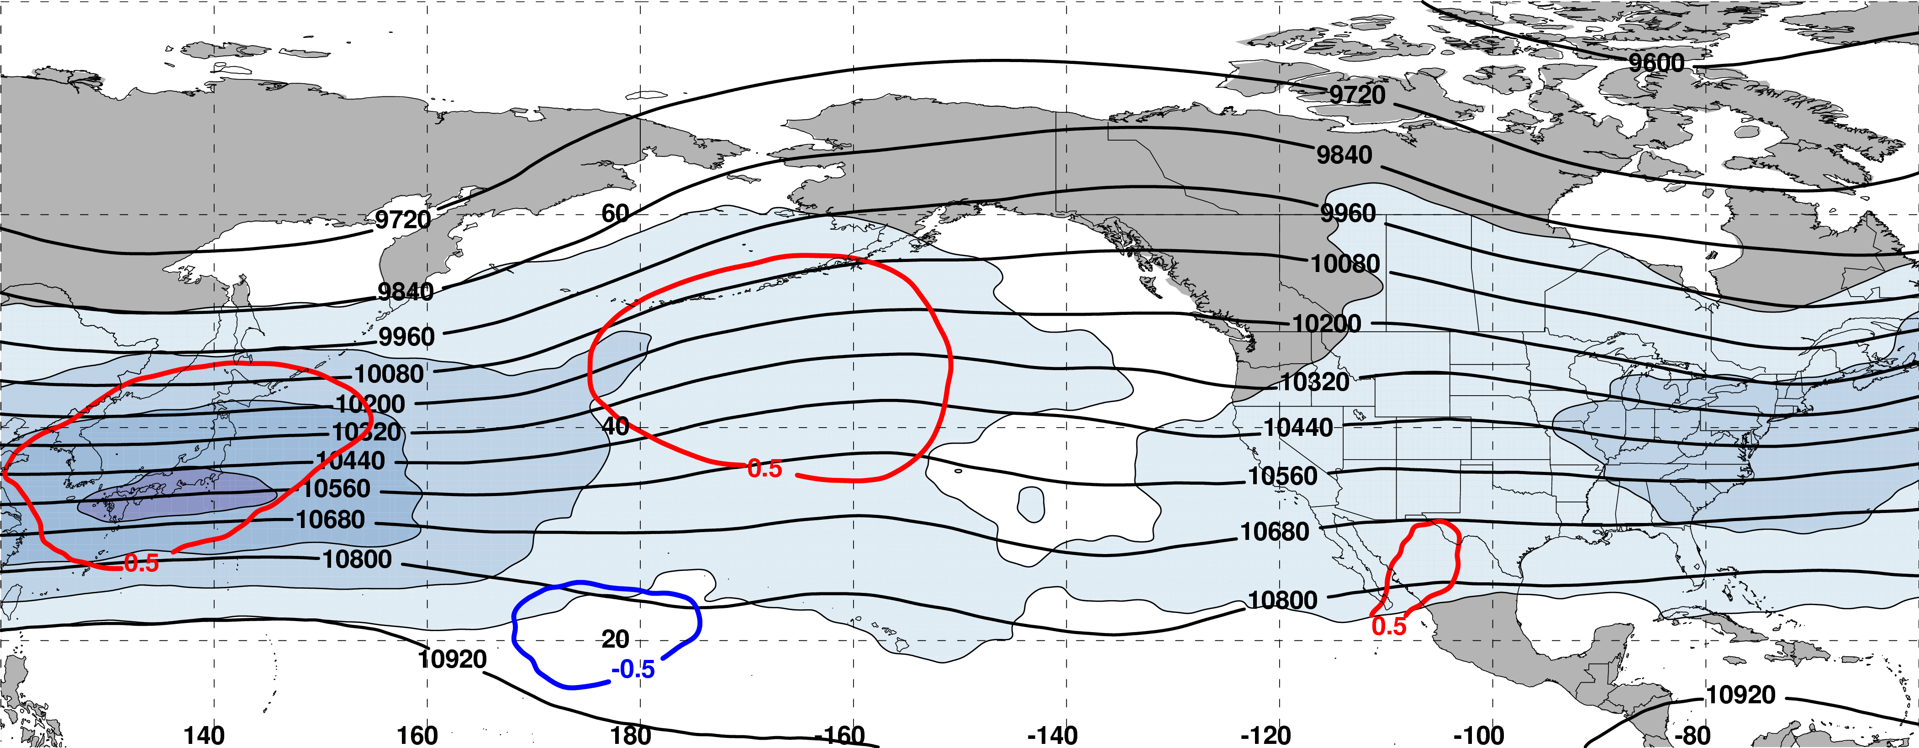
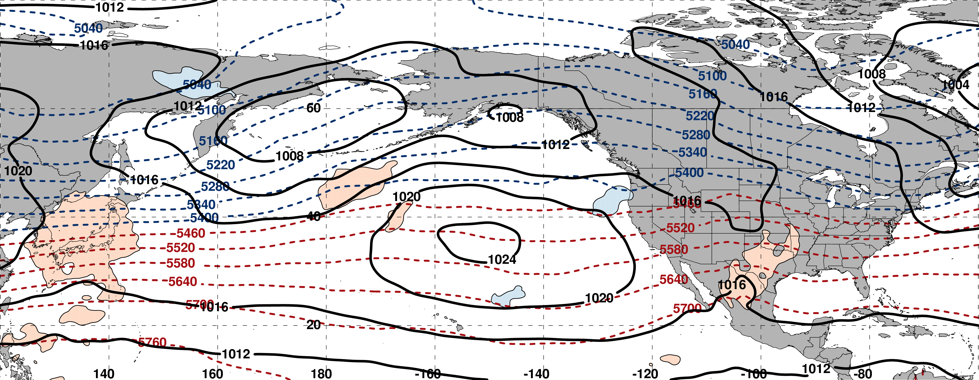
250-hPa Wind Speed, Geo. Heights, Std. Height Anomalies: Day −8
m s^{–1}
m s^{–1}
Mean Sea-Level Pressure, 1000–500-hPa Thickness, 850-hPa Std. Temp. Anomalies: Day −8
L
H
σ

Slide 36
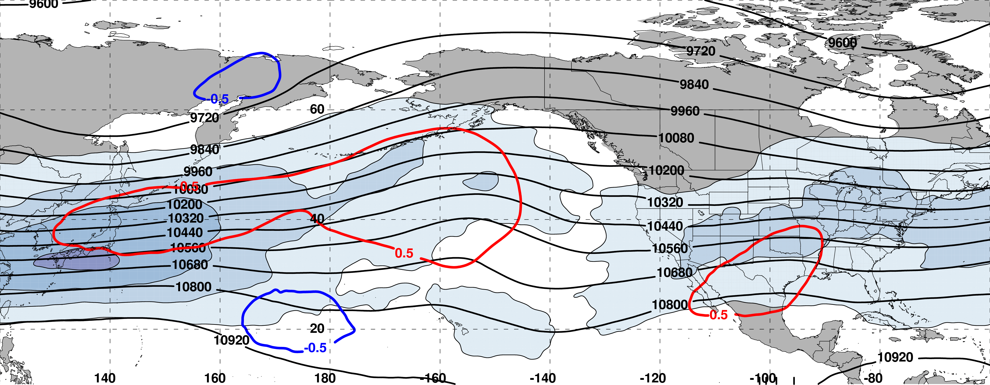
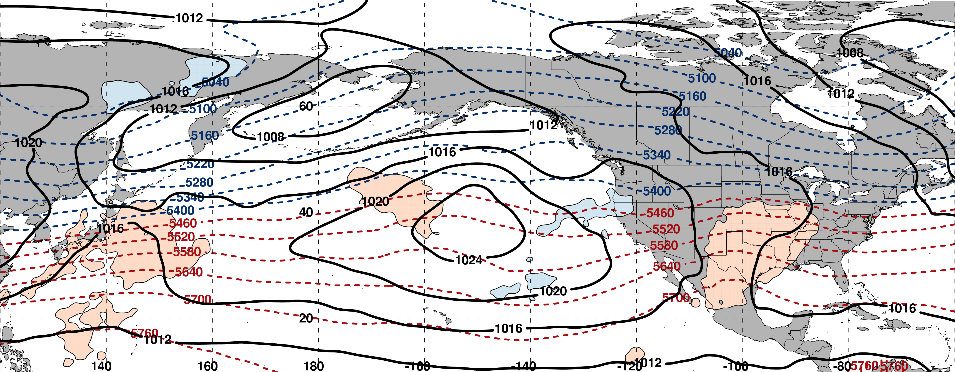
250-hPa Wind Speed, Geo. Heights, Std. Height Anomalies: Day −7
m s^{–1}
m s^{–1}
Mean Sea-Level Pressure, 1000–500-hPa Thickness, 850-hPa Std. Temp. Anomalies: Day −7
L
H
σ

Slide 37
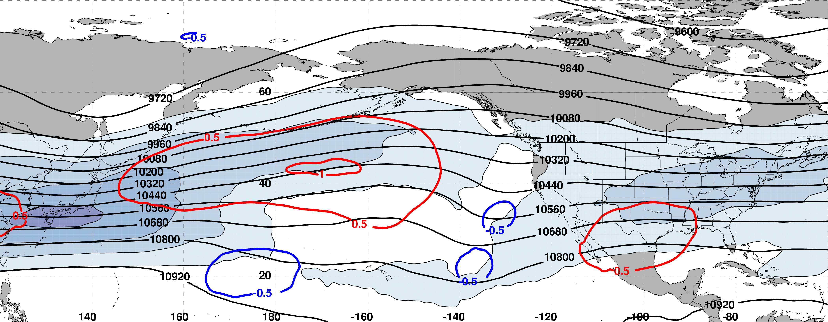
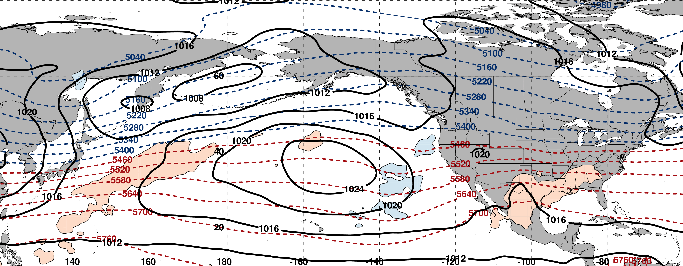
250-hPa Wind Speed, Geo. Heights, Std. Height Anomalies: Day −6
m s^{–1}
m s^{–1}
Mean Sea-Level Pressure, 1000–500-hPa Thickness, 850-hPa Std. Temp. Anomalies: Day −6
L
H
σ

Slide 38
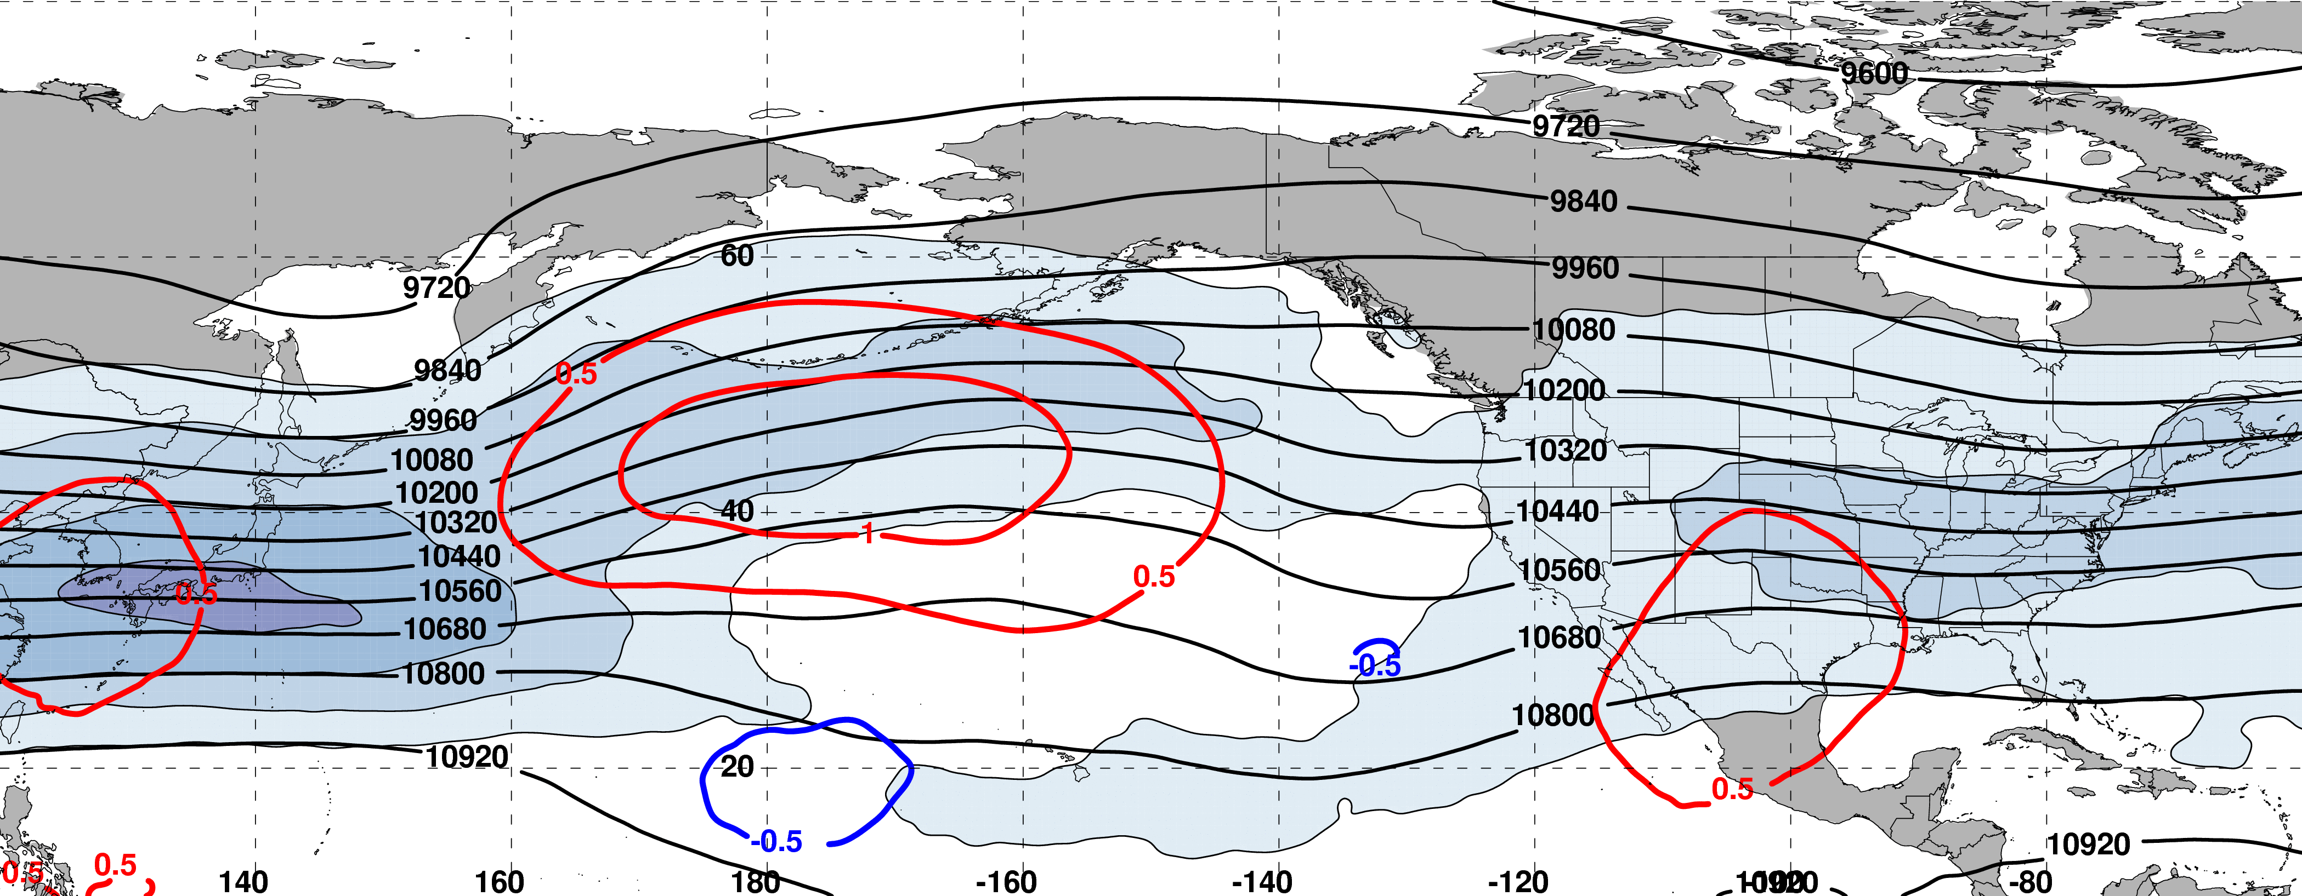
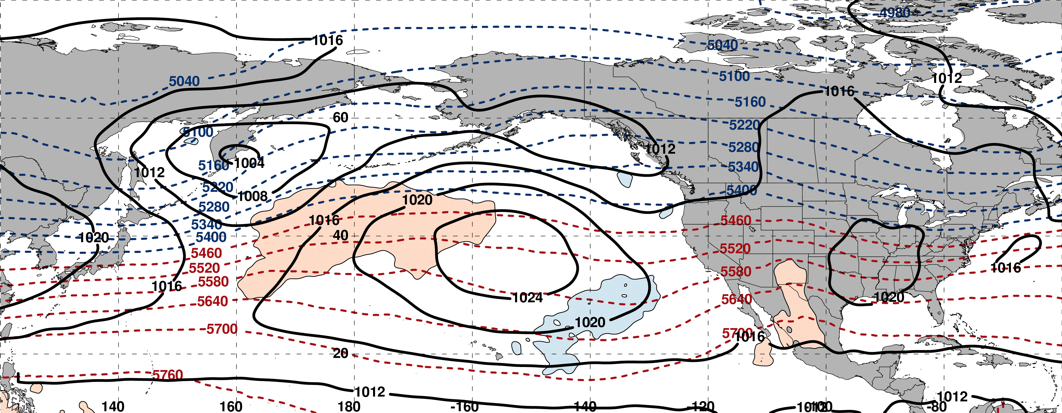
250-hPa Wind Speed, Geo. Heights, Std. Height Anomalies: Day −5
m s^{–1}
m s^{–1}
Mean Sea-Level Pressure, 1000–500-hPa Thickness, 850-hPa Std. Temp. Anomalies: Day −5
L
L
H
H
σ

Slide 39
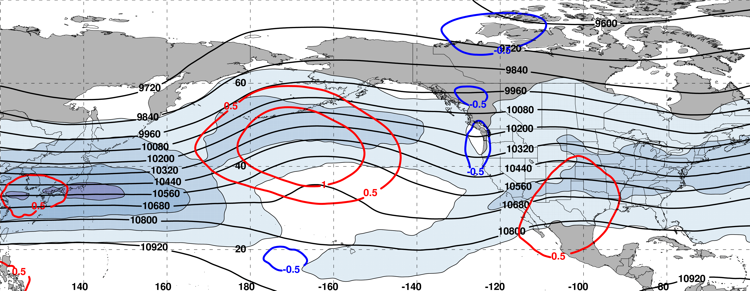
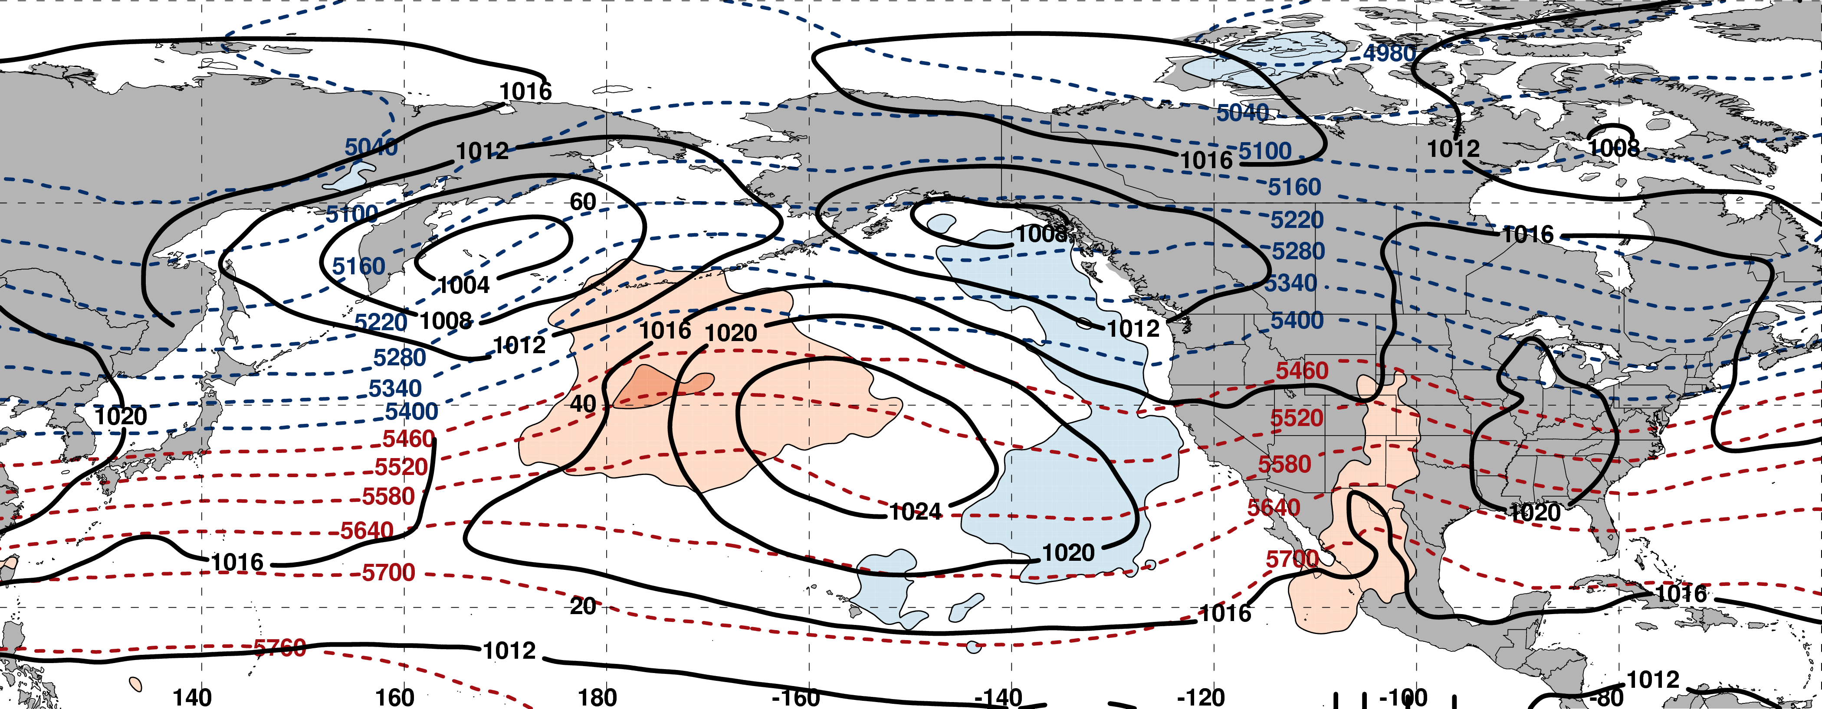
250-hPa Wind Speed, Geo. Heights, Std. Height Anomalies: Day −4
m s^{–1}
m s^{–1}
Mean Sea-Level Pressure, 1000–500-hPa Thickness, 850-hPa Std. Temp. Anomalies: Day −4
L
L
H
H
σ

Slide 40
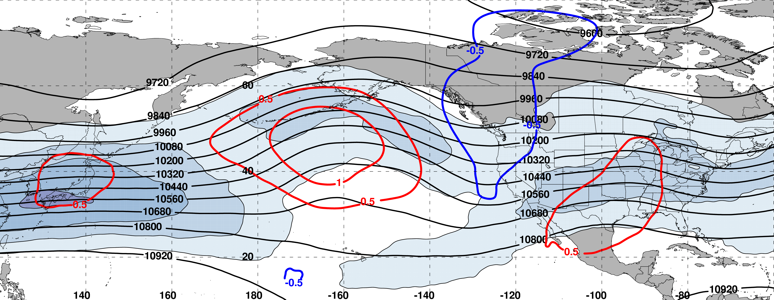
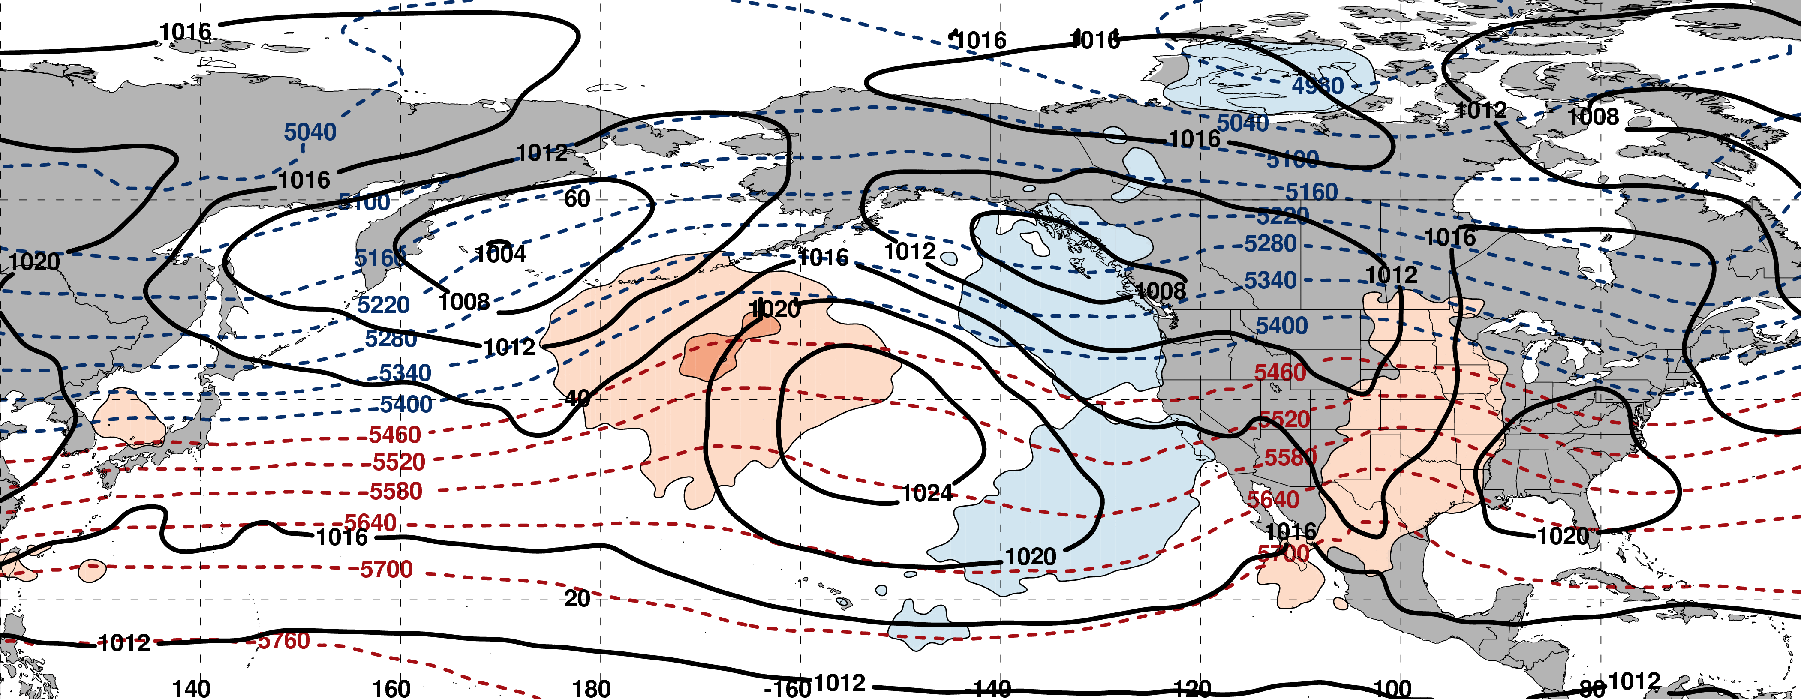
250-hPa Wind Speed, Geo. Heights, Std. Height Anomalies: Day −3
m s^{–1}
m s^{–1}
Mean Sea-Level Pressure, 1000–500-hPa Thickness, 850-hPa Std. Temp. Anomalies: Day −3
L
L
H
H
σ

Slide 41
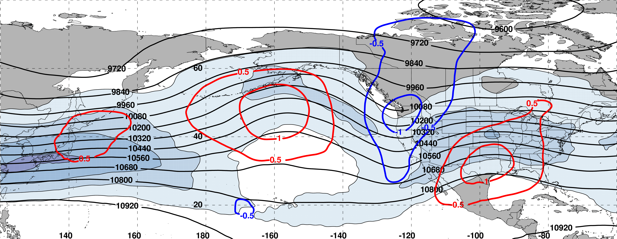
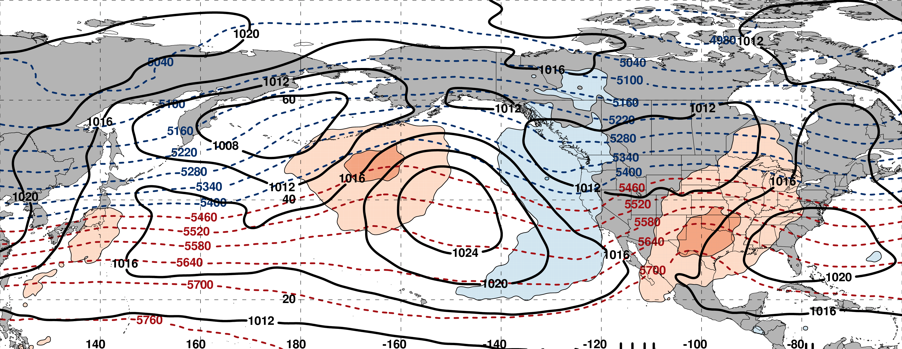
250-hPa Wind Speed, Geo. Heights, Std. Height Anomalies: Day −2
m s^{–1}
m s^{–1}
Mean Sea-Level Pressure, 1000–500-hPa Thickness, 850-hPa Std. Temp. Anomalies: Day −2
L
L
H
H
σ

Slide 42
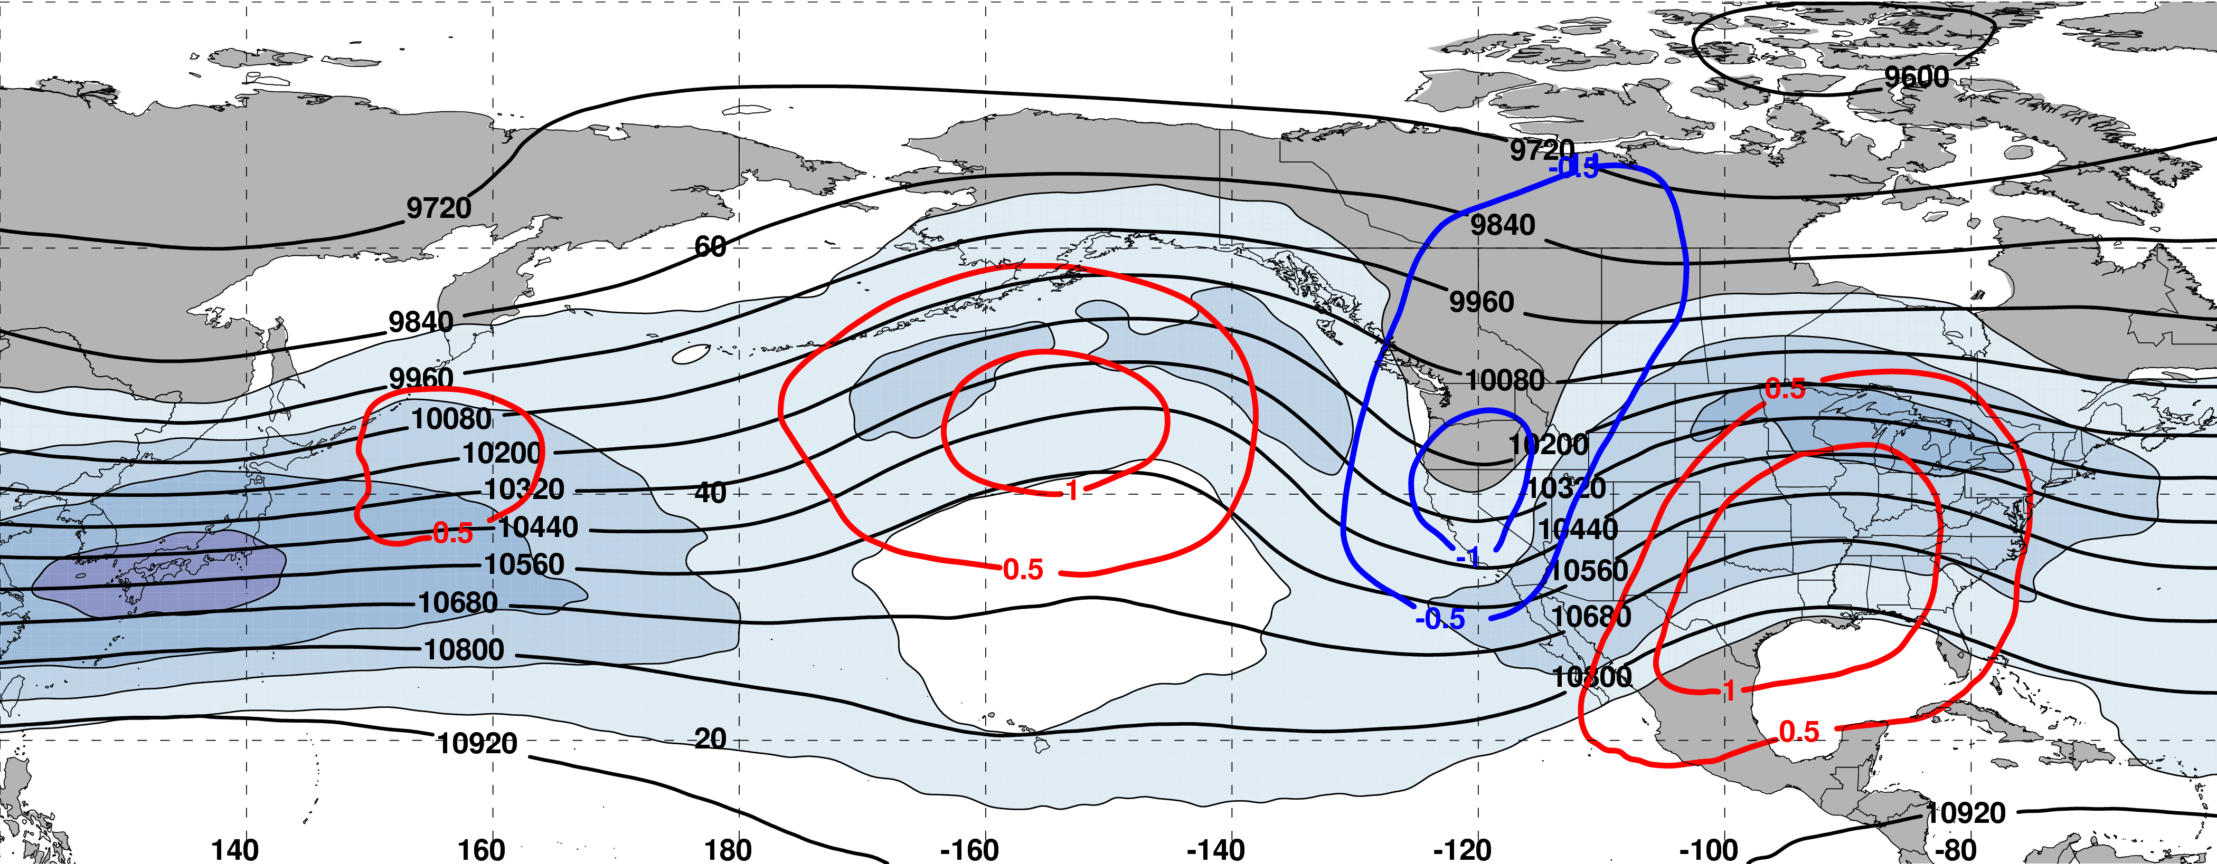
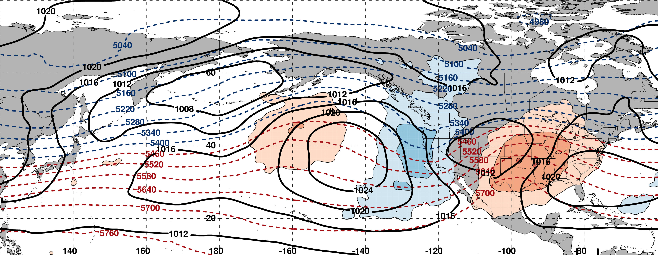
250-hPa Wind Speed, Geo. Heights, Std. Height Anomalies: Day −1
m s^{–1}
m s^{–1}
Mean Sea-Level Pressure, 1000–500-hPa Thickness, 850-hPa Std. Temp. Anomalies: Day −1
H
L
H
L
H
σ

Slide 43
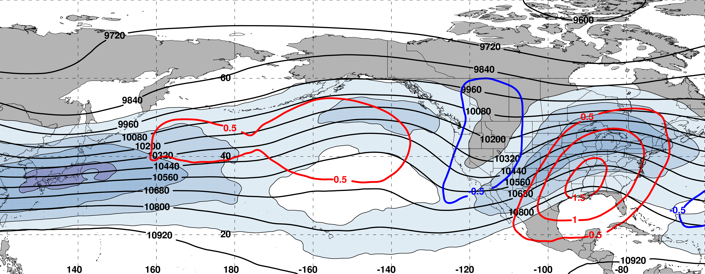
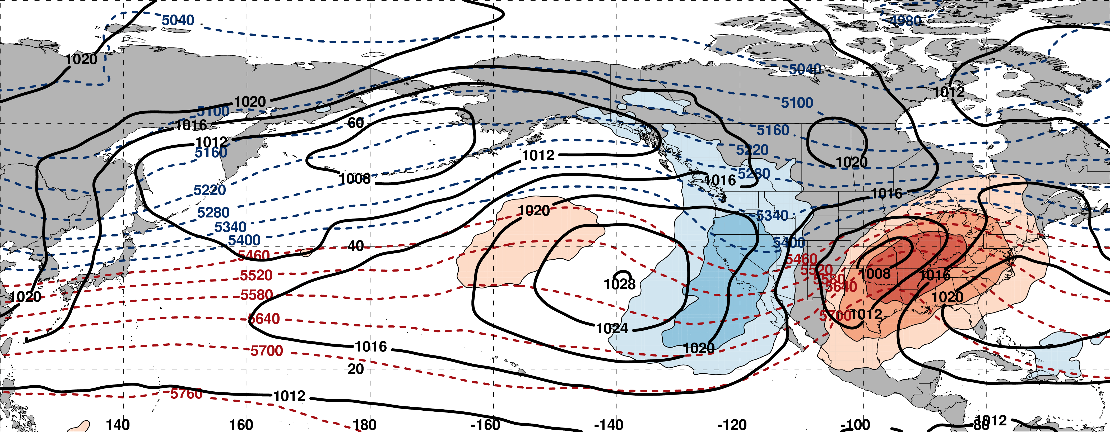
250-hPa Wind Speed, Geo. Heights, Std. Height Anomalies: Day 0
m s^{–1}
m s^{–1}
Mean Sea-Level Pressure, 1000–500-hPa Thickness, 850-hPa Std. Temp. Anomalies: Day 0
L
H
L
H
H
σ

Slide 44
Eastern U.S. – S. Plains Cluster
Extreme Warm Event Centroids
WARM EVENTS (N = 84)
Poleward Shift
18
Events during
Sept. – May projected onto phase diagram
35
Jet Retraction
15
Jet Extension
Each point is an average of the PCs
3–7 days prior to an event
16
Equatorward Shift
–4

Slide 45
Extreme Event Identification
Eastern U.S. Domain
Extreme Warm Events:
304 Events
Areal Coverage Threshold:
224 grid points
(~7.0°×7.0° box)
Extreme Cold Events:
225 Events
Areal Coverage Threshold:
221 grid points
(~7.0°×7.0° box)
Western U.S. Domain
Extreme Warm Events:
264 Events
Areal Coverage Threshold:
144 grid points
(~5.5°×5.5° box)
Extreme Cold Events:
271 Events
Areal Coverage Threshold:
125 grid points
(~5.0°×5.0° box)

Slide 46
Extreme Event Identification
Eastern U.S. Domain
Extreme Warm Events:
304 Events
Areal Coverage Threshold:
224 grid points
(~7.0°×7.0° box)
Extreme Cold Events:
225 Events
Areal Coverage Threshold:
221 grid points
(~7.0°×7.0° box)
Western U.S. Domain
Extreme Warm Events:
264 Events
Areal Coverage Threshold:
144 grid points
(~5.5°×5.5° box)
Extreme Cold Events:
271 Events
Areal Coverage Threshold:
125 grid points
(~5.0°×5.0° box)

Slide 47
250-hPa North Pacific Zonal Wind Variability
Extreme Cold Event Centroids: Eastern U.S. Domain (N = 225)

Slide 48
250-hPa North Pacific Zonal Wind Variability
Extreme Cold Event Centroids: Eastern U.S. Domain (N = 225)
Northern Plains Cluster (N=65)
Southern Plains Cluster (N=58)
Southeast Cluster (N=50)
Northeast Cluster (N=52)
4 geographic clusters objectively identified using a k-means clustering algorithm

Slide 49
250-hPa North Pacific Zonal Wind Variability
Extreme Cold Event Centroids: Eastern U.S. Domain (N = 225)
Northern Plains Cluster (N=65)
Southern Plains Cluster (N=58)
Southeast Cluster (N=50)
Northeast Cluster (N=52)
Projecting antecedent environments associated with extreme cold events onto the North Pacific Jet phase diagram can identify flow patterns conducive to the development of these events

Slide 50
Eastern U.S. – S. Plains Cluster
Extreme Cold Event Centroids
COLD EVENTS (N = 48)
Poleward Shift
4
Events during
Sept. – May projected onto phase diagram
4
Jet Retraction
14
Jet Extension
Each point is an average of the PCs
3–7 days prior to an event
26
Equatorward Shift
–4

Slide 51
Eastern U.S. – S. Plains Cluster
Extreme Cold Event Centroids
COLD EVENTS (N = 48)
Poleward Shift
4
Events during
Sept. – May projected onto phase diagram
4
Jet Retraction
14
Jet Extension
Each point is an average of the PCs
3–7 days prior to an event
26
Equatorward Shift
–4

Slide 52
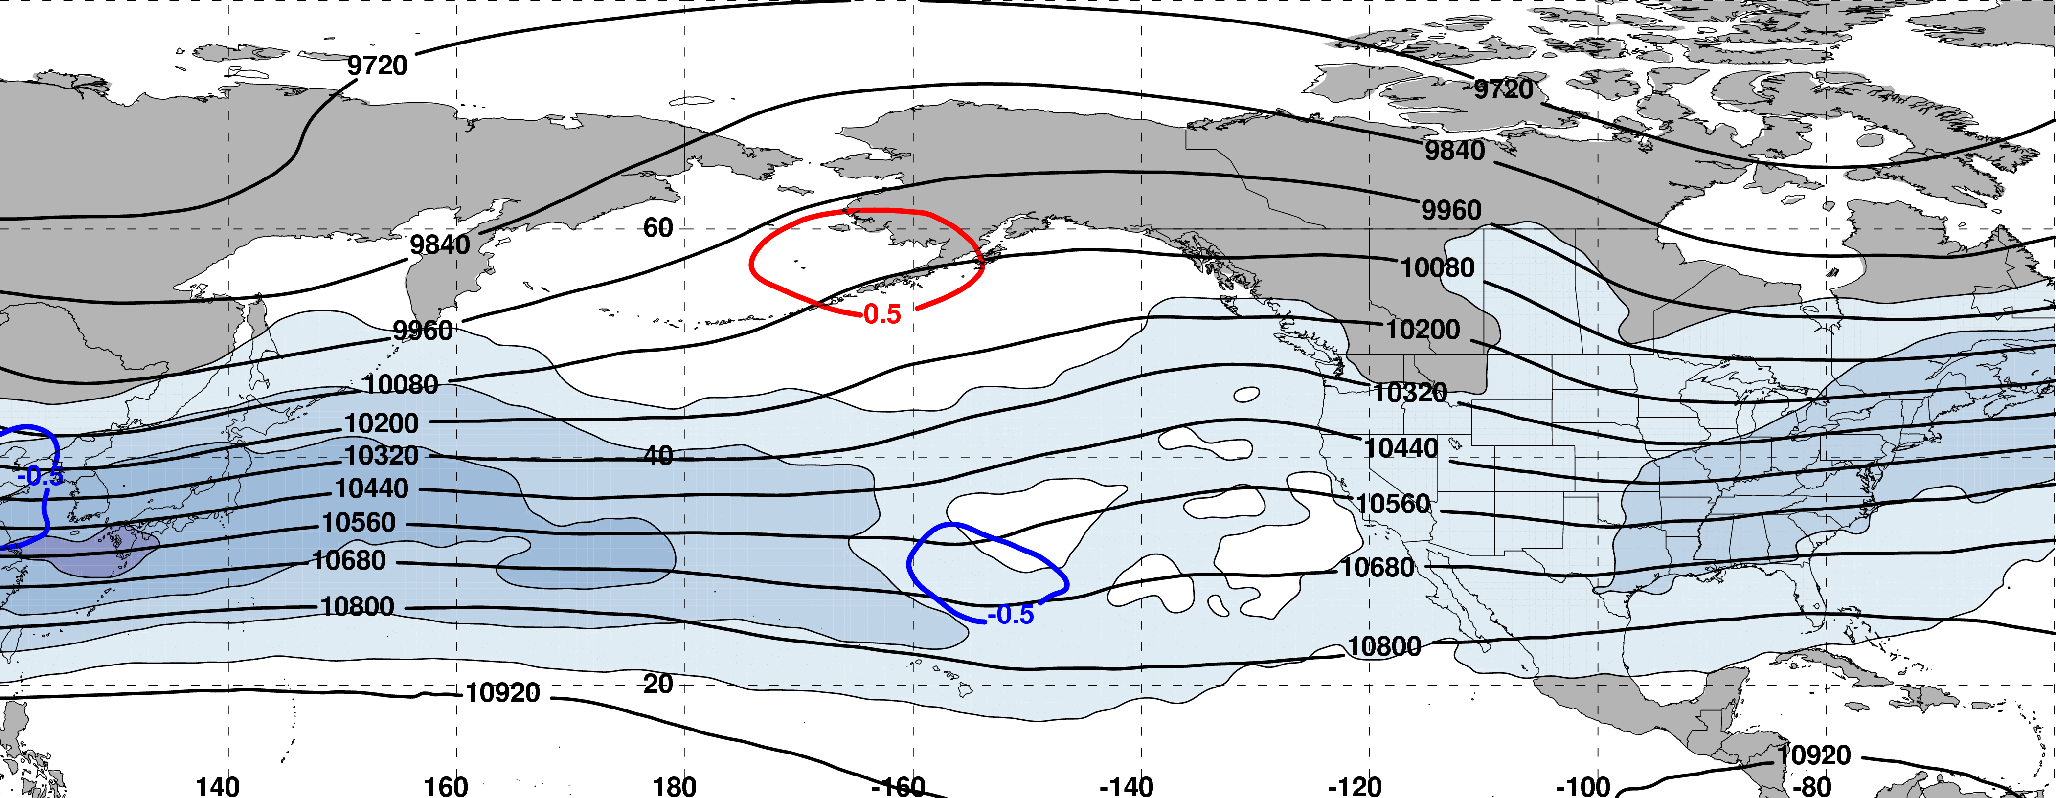
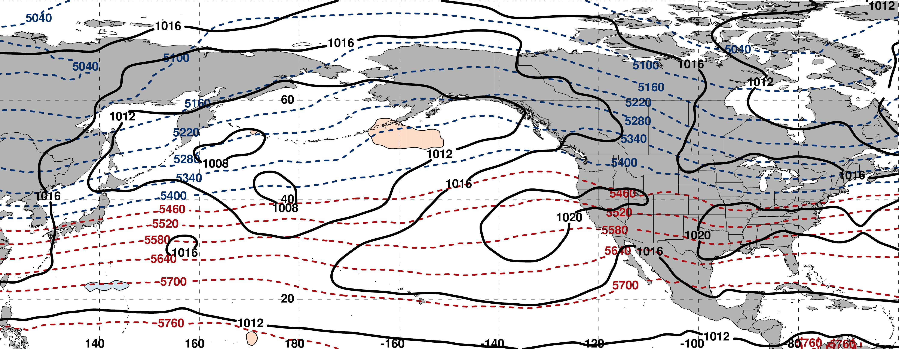
250-hPa Wind Speed, Geo. Heights, Std. Height Anomalies: Day −8
m s^{–1}
m s^{–1}
Mean Sea-Level Pressure, 1000–500-hPa Thickness, 850-hPa Std. Temp. Anomalies: Day −8
L
H
H
σ

Slide 53
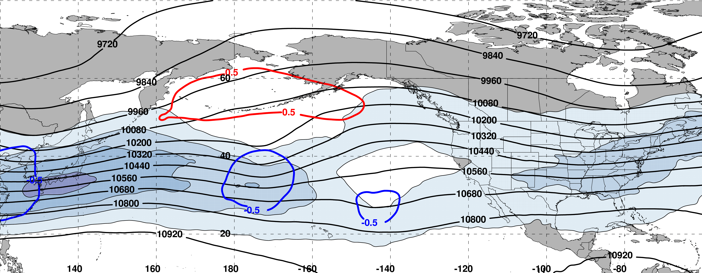
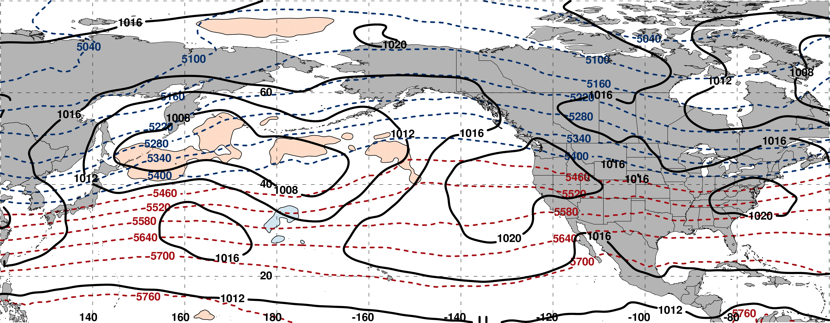
250-hPa Wind Speed, Geo. Heights, Std. Height Anomalies: Day −7
m s^{–1}
m s^{–1}
Mean Sea-Level Pressure, 1000–500-hPa Thickness, 850-hPa Std. Temp. Anomalies: Day −7
L
H
H
σ

Slide 54
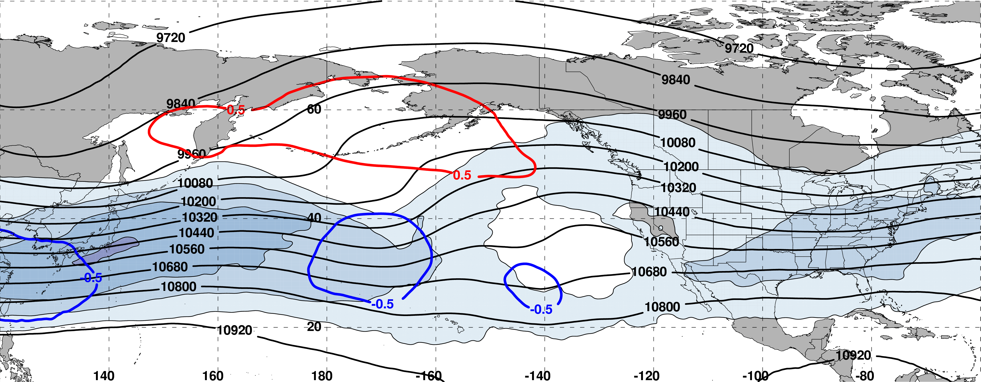
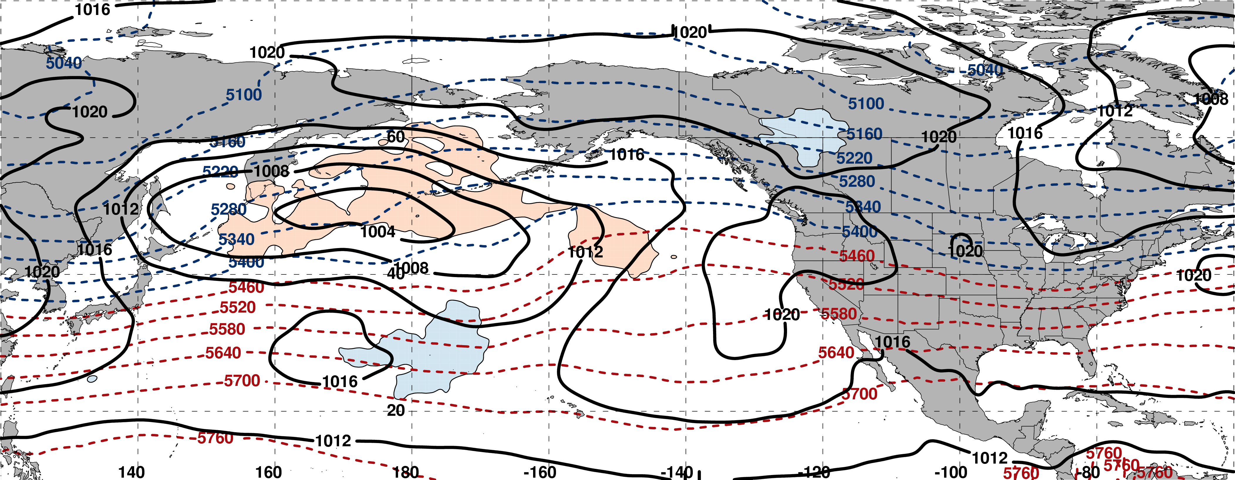
250-hPa Wind Speed, Geo. Heights, Std. Height Anomalies: Day −6
m s^{–1}
m s^{–1}
Mean Sea-Level Pressure, 1000–500-hPa Thickness, 850-hPa Std. Temp. Anomalies: Day −6
H
L
H
H
σ

Slide 55
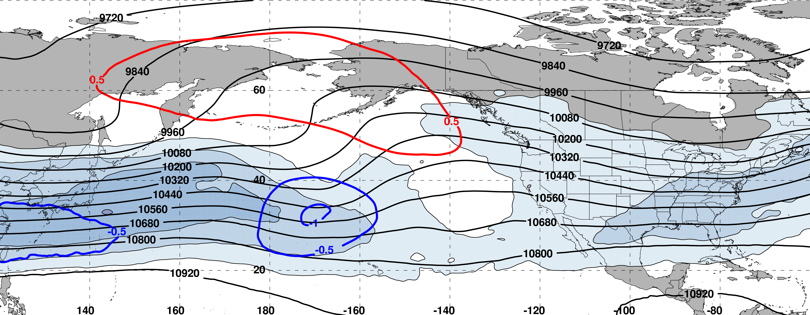
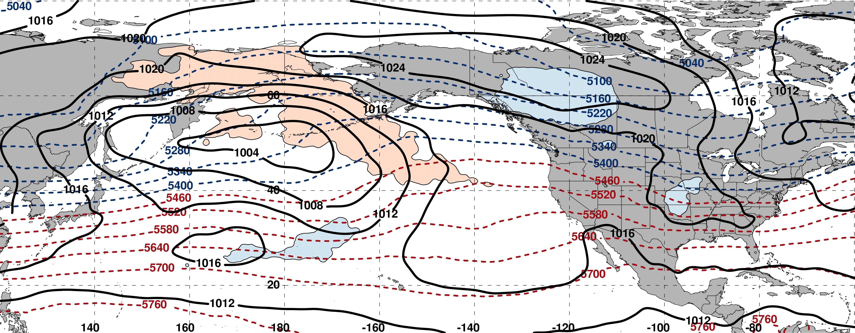
250-hPa Wind Speed, Geo. Heights, Std. Height Anomalies: Day −5
m s^{–1}
m s^{–1}
Mean Sea-Level Pressure, 1000–500-hPa Thickness, 850-hPa Std. Temp. Anomalies: Day −5
H
L
H
σ

Slide 56
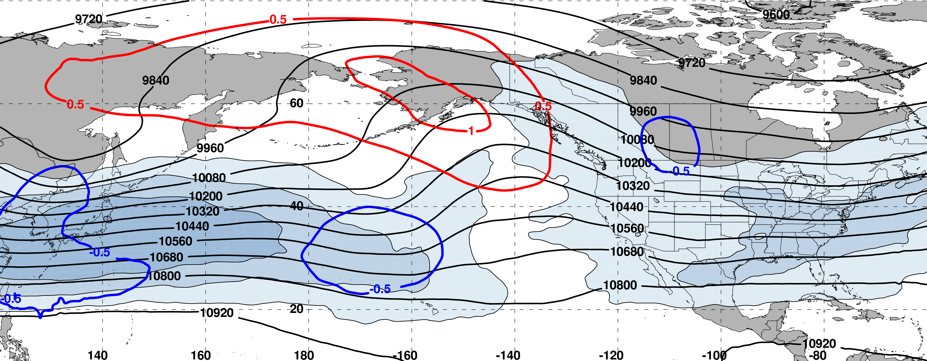
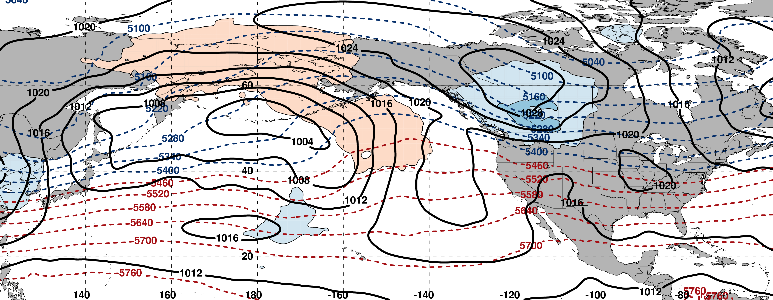
250-hPa Wind Speed, Geo. Heights, Std. Height Anomalies: Day −4
m s^{–1}
m s^{–1}
Mean Sea-Level Pressure, 1000–500-hPa Thickness, 850-hPa Std. Temp. Anomalies: Day −4
H
L
H
σ

Slide 57
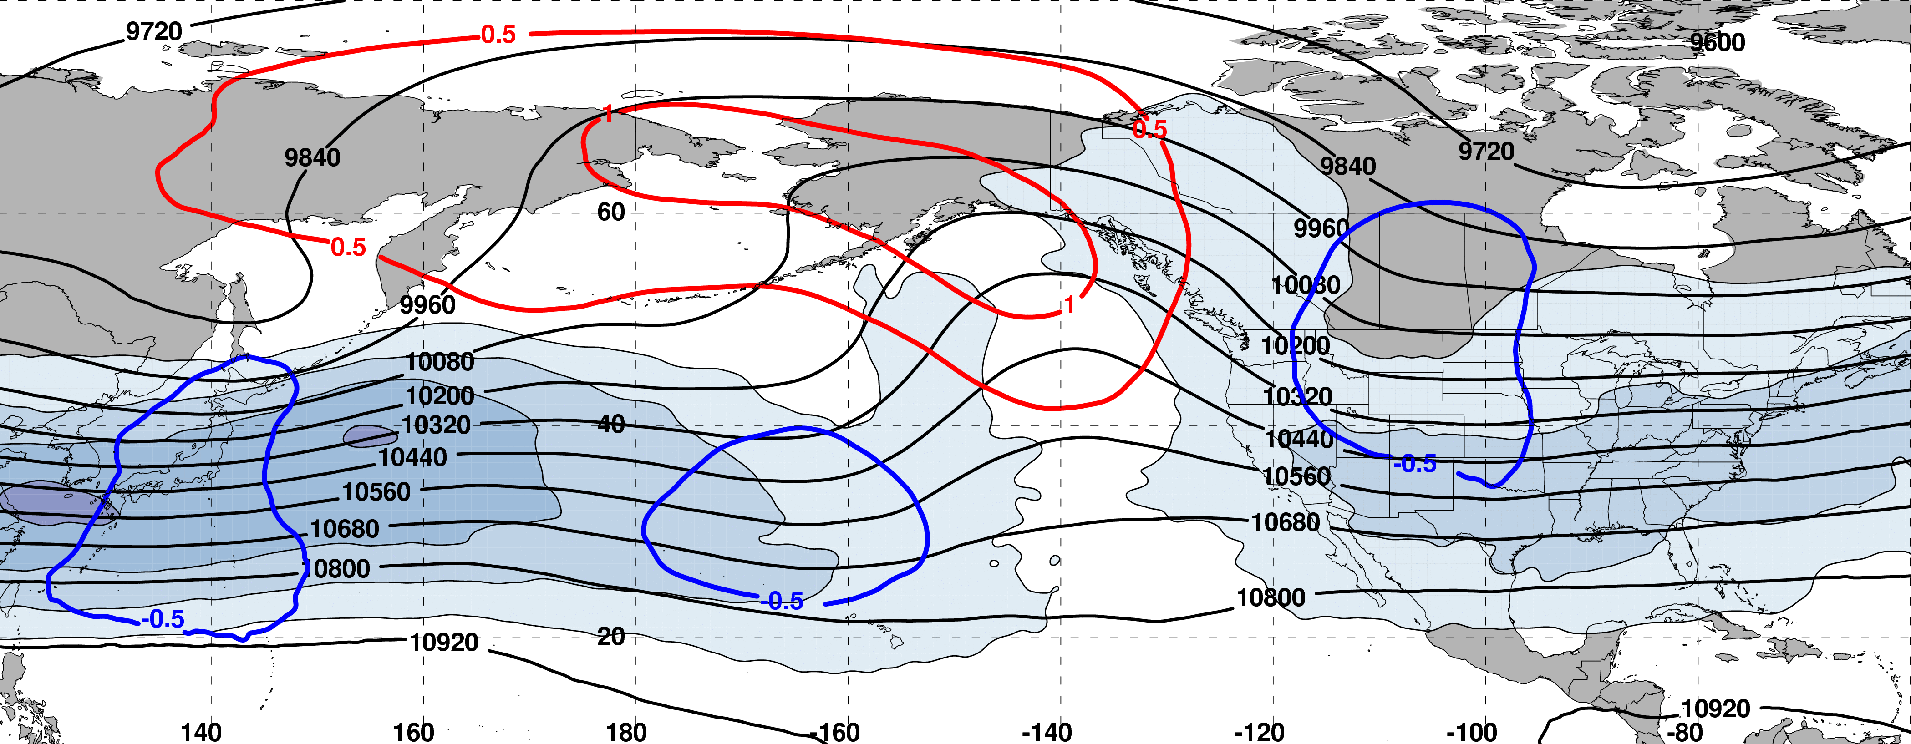
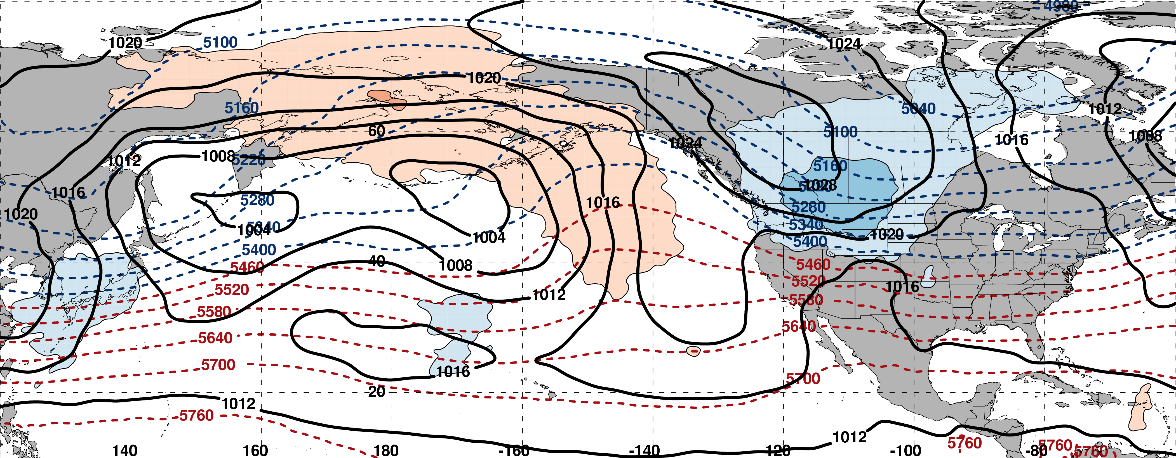
250-hPa Wind Speed, Geo. Heights, Std. Height Anomalies: Day −3
m s^{–1}
m s^{–1}
Mean Sea-Level Pressure, 1000–500-hPa Thickness, 850-hPa Std. Temp. Anomalies: Day −3
H
L
L
σ

Slide 58
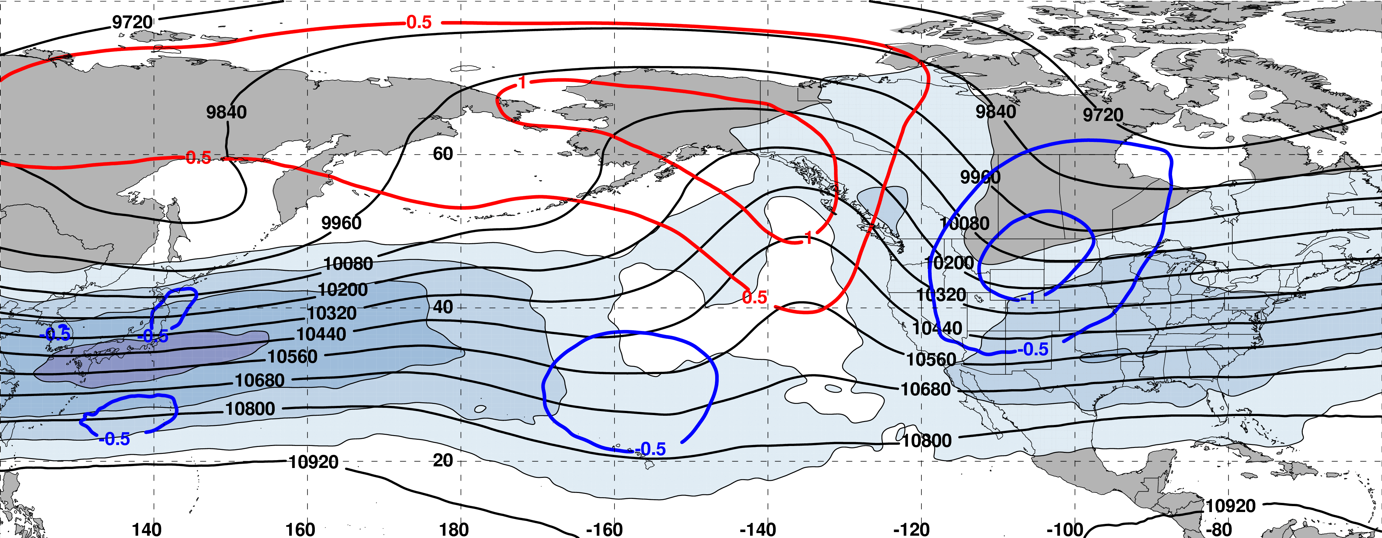
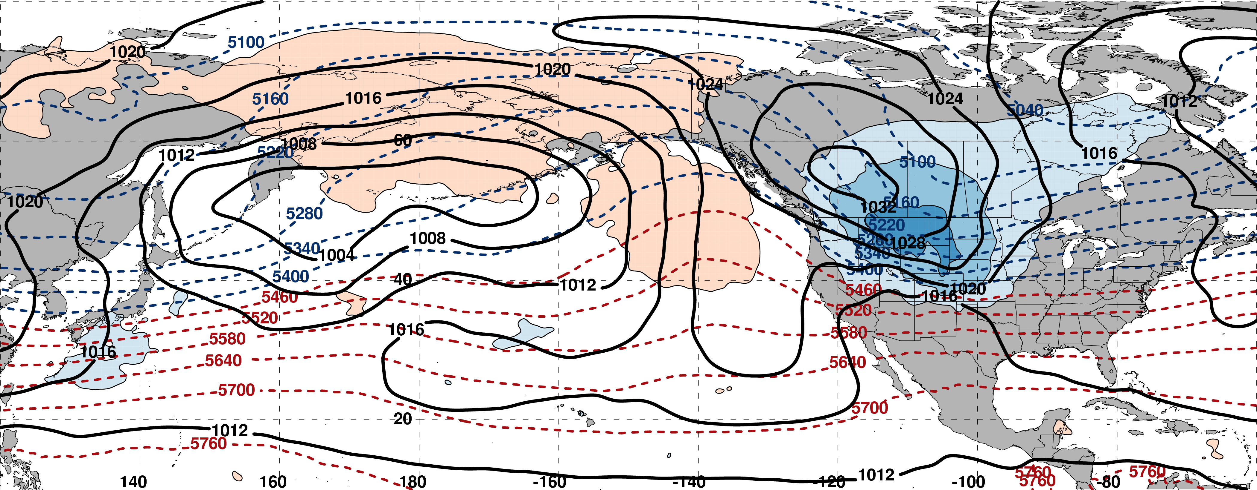
250-hPa Wind Speed, Geo. Heights, Std. Height Anomalies: Day −2
m s^{–1}
m s^{–1}
Mean Sea-Level Pressure, 1000–500-hPa Thickness, 850-hPa Std. Temp. Anomalies: Day −2
L
H
L
σ

Slide 59
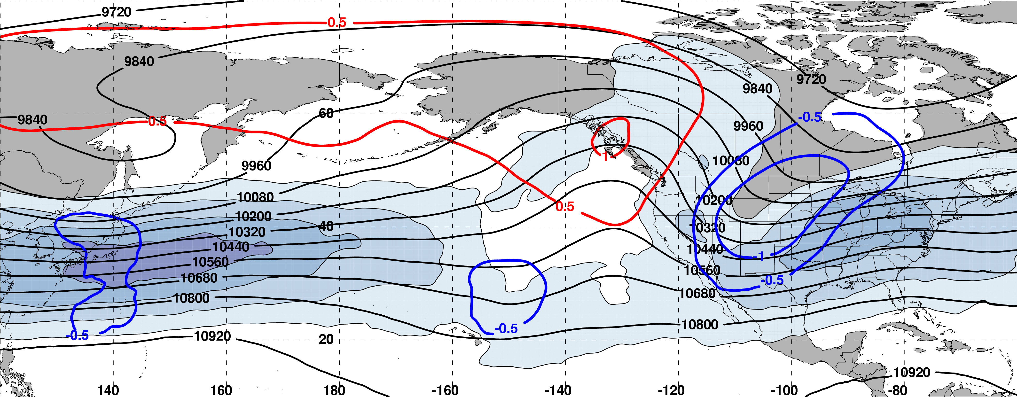
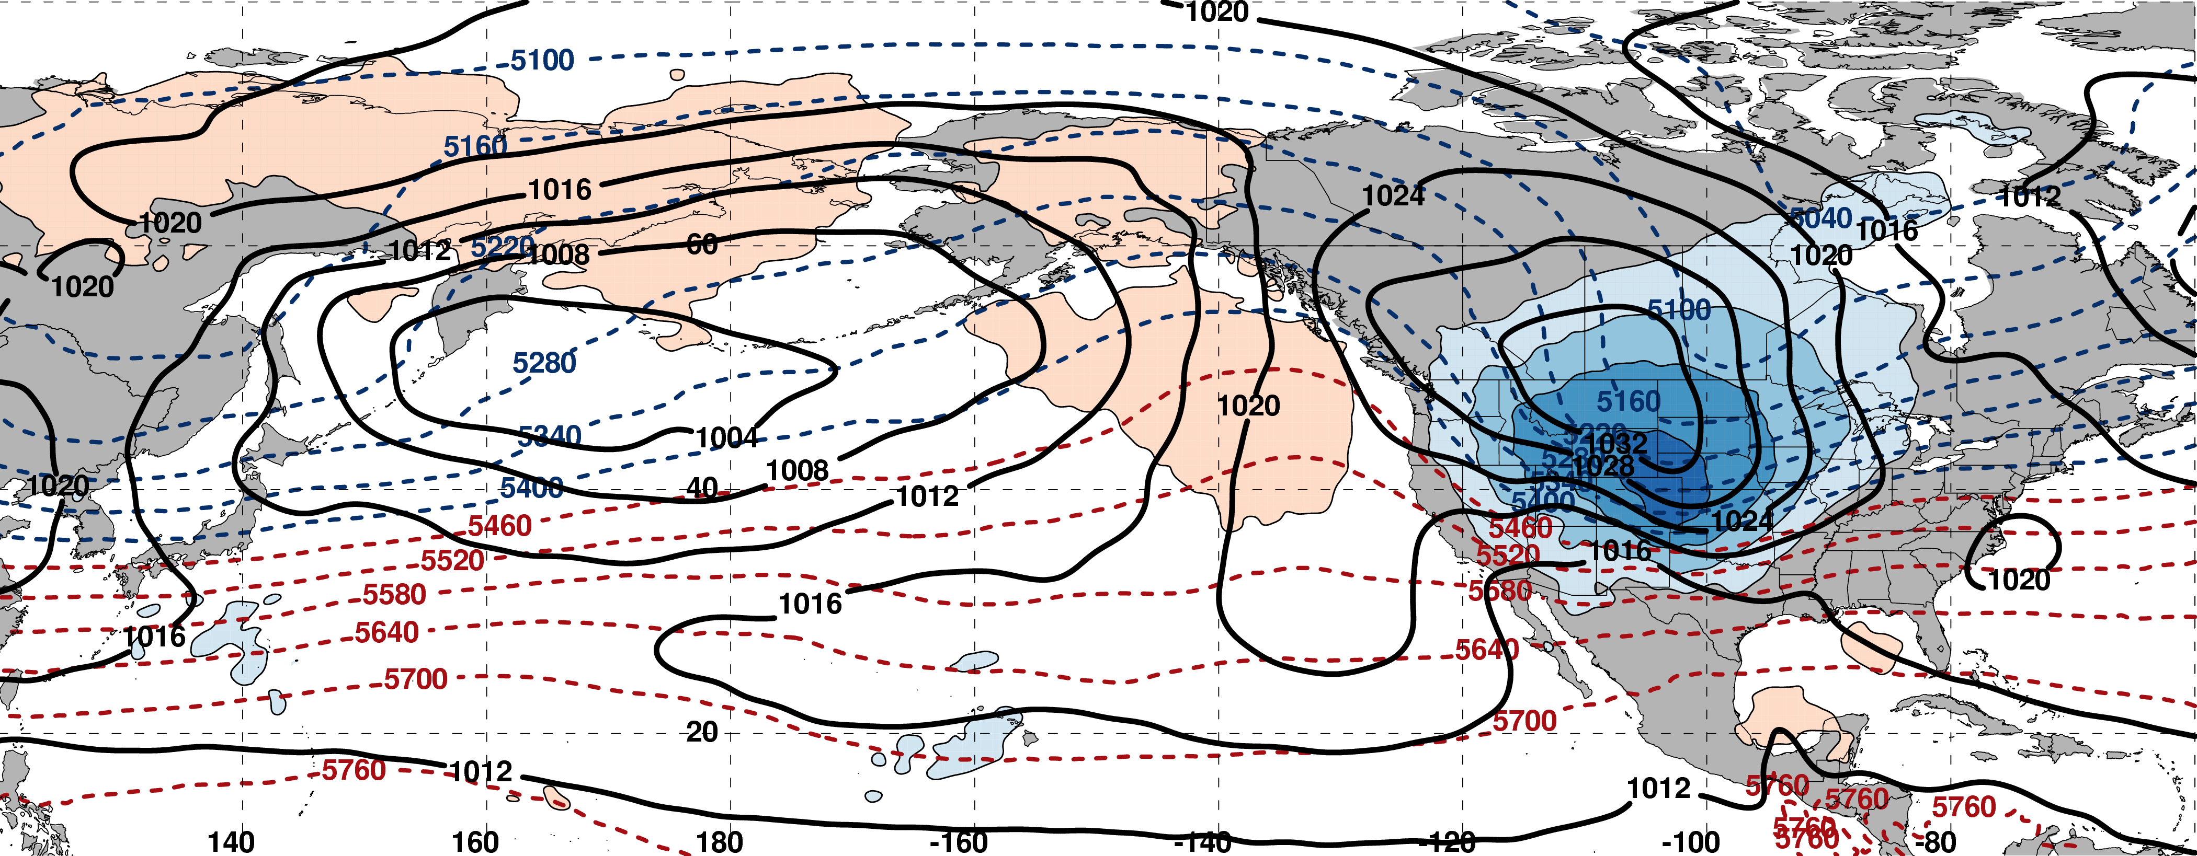
250-hPa Wind Speed, Geo. Heights, Std. Height Anomalies: Day −1
m s^{–1}
m s^{–1}
Mean Sea-Level Pressure, 1000–500-hPa Thickness, 850-hPa Std. Temp. Anomalies: Day −1
L
H
σ

Slide 60
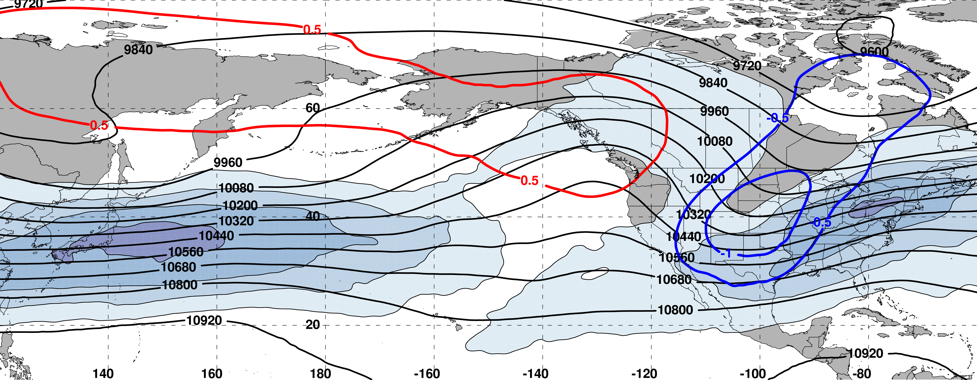
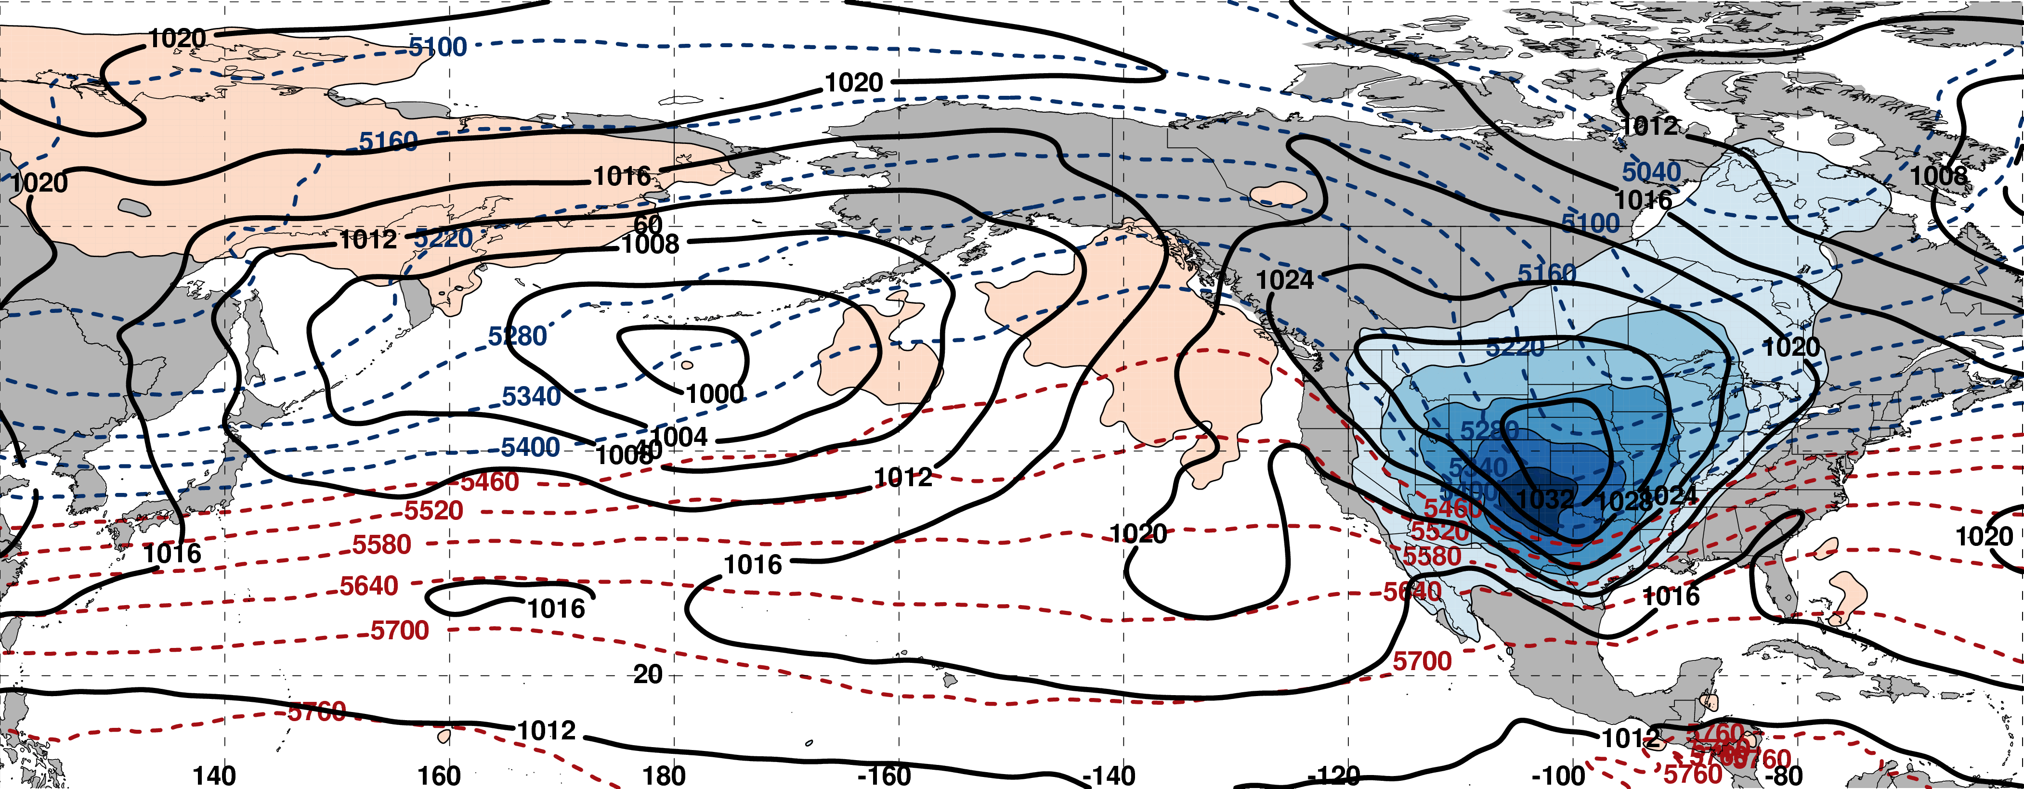
250-hPa Wind Speed, Geo. Heights, Std. Height Anomalies: Day 0
m s^{–1}
m s^{–1}
Mean Sea-Level Pressure, 1000–500-hPa Thickness, 850-hPa Std. Temp. Anomalies: Day 0
L
H
L
σ

Slide 61
Eastern U.S. – S. Plains Cluster
Extreme Cold Event Centroids
COLD EVENTS (N = 48)
Poleward Shift
4
Events during
Sept. – May projected onto phase diagram
4
Jet Retraction
14
Jet Extension
Each point is an average of the PCs
3–7 days prior to an event
26
Equatorward Shift
–4

Slide 62
Eastern U.S. – S. Plains Cluster
Extreme Cold Event Centroids
COLD EVENTS (N = 48)
Poleward Shift
4
Events during
Sept. – May projected onto phase diagram
4
Jet Retraction
14
Jet Extension
Each point is an average of the PCs
3–7 days prior to an event
26
Equatorward Shift
–4
Mean Projection

Slide 63
Eastern U.S. – S. Plains Cluster
Extreme Warm Event Centroids
WARM EVENTS (N = 84)
Poleward Shift
18
Events during
Sept. – May projected onto phase diagram
35
Jet Retraction
15
Jet Extension
Each point is an average of the PCs
3–7 days prior to an event
16
Equatorward Shift
–4
Mean Projection

Slide 64
Eastern U.S. – All Events
Extreme Cold Event Centroids
COLD EVENTS (N = 173)
Poleward Shift
23
Events during
Sept. – May projected onto phase diagram
30
Jet Retraction
47
Jet Extension
Each point is an average of the PCs
3–7 days prior to an event
73
Equatorward Shift
Mean Projection

Slide 65
Eastern U.S. – All Events
Extreme Warm Event Centroids
WARM EVENTS (N = 239)
Poleward Shift
66
Events during
Sept. – May projected onto phase diagram
69
Jet Retraction
47
Jet Extension
Each point is an average of the PCs
3–7 days prior to an event
57
Equatorward Shift
Mean Projection

Slide 66
Eastern U.S. – All Events
Extreme Warm Event Centroids
WARM EVENTS (N = 239)
Poleward Shift
13–24 March 2012 Heat Wave
66
Events during
Sept. – May projected onto phase diagram
69
Jet Retraction
47
Jet Extension
Each point is an average of the PCs
3–7 days prior to an event
57
Equatorward Shift
Mean Projection

Slide 67
March 2012 Heat Wave
250-hPa U-Wind Anomalies (13–24 March 2012)
Surface Temp. Anomalies (13–24 March 2012)
250-hPa V-Wind Anomalies (13–24 March 2012)
Surface temperature anomalies exceeded 15ºC in the Upper-Midwest.
The North Pacific Jet was shifted poleward and characterized by an amplified flow pattern.

Slide 68
Western U.S. – Pac. NW Cluster
Extreme Cold Event Centroids
COLD EVENTS (N = 78)
Poleward Shift
18
Events during
Sept. – May projected onto phase diagram
31
Jet Retraction
9
Jet Extension
Each point is an average of the PCs
3–7 days prior to an event
20
Equatorward Shift
–4
Mean Projection

Slide 69
Western U.S. – Pac. NW Cluster
Extreme Warm Event Centroids
WARM EVENTS (N = 89)
Poleward Shift
22
Events during
Sept. – May projected onto phase diagram
13
Jet Retraction
27
Jet Extension
Each point is an average of the PCs
3–7 days prior to an event
27
Equatorward Shift
–4
Mean Projection

Slide 70
Forecast Skill of Extreme Temperature Events

Slide 71
Forecast Skill of Extreme Temperature Events
GEFS Reforecasts (Hamill et al. 2013) of extreme cold and warm events at each forecast lead time were binned based on whether they exhibited a standardized root-mean-square error (RMSE) or standardized anomaly correlation coefficient (ACC) of 500-hPa geopotential height over the CONUS (25–55°N; 140–60°W) that was:
  Above-normal (x > 0.5σ)
  Below-normal (x < –0.5σ)
  Near-normal (–0.5σ < x < 0.5σ)
Notes:
Additional bullet for transformation of rmse and acc into sigma units?

Slide 72
Forecast Skill of Extreme Temperature Events
GEFS Reforecasts (Hamill et al. 2013) of extreme cold and warm events at each forecast lead time were binned based on whether they exhibited a standardized root-mean-square error (RMSE) or standardized anomaly correlation coefficient (ACC) of 500-hPa geopotential height over the CONUS (25–55°N; 140–60°W) that was:
  Above-normal (x > 0.5σ)
  Below-normal (x < –0.5σ)
  Near-normal (–0.5σ < x < 0.5σ)
The percent difference between the frequency of events with below-normal and above-normal RMSE or ACC offers information regarding the forecast skill of extreme events.

Slide 73
Forecast Skill of Extreme Temperature Events
Percent Difference Between the Frequency of Forecasts with Below-Normal and Above-Normal ACC
Higher frequency of forecasts with below-normal ACC
(i.e., more bad forecasts)
Higher frequency of forecasts with above-normal ACC
(i.e., more good forecasts)
Notes:
Good go with bad. Quote good and bad.

Slide 74
Forecast Skill of Extreme Temperature Events
Percent Difference Between the Frequency of Forecasts with Below-Normal and Above-Normal ACC
Higher frequency of forecasts with below-normal ACC
(i.e., more bad forecasts)
Higher frequency of forecasts with above-normal ACC
(i.e., more good forecasts)

Slide 75
Forecast Skill of Extreme Temperature Events
Percent Difference Between the Frequency of Forecasts with Below-Normal and Above-Normal RMSE
Higher frequency of forecasts with below-normal RMSE
(i.e., more good forecasts)
Higher frequency of forecasts with above-normal RMSE
(i.e., more bad forecasts)

Slide 76
Forecast Skill of Extreme Temperature Events
Percent Difference Between the Frequency of Forecasts with Below-Normal and Above-Normal RMSE
Higher frequency of forecasts with below-normal RMSE
(i.e., more good forecasts)
Higher frequency of forecasts with above-normal RMSE
(i.e., more bad forecasts)

Slide 77
Discussion
The North Pacific Jet phase diagram is a tool that objectively characterizes the upper-tropospheric flow pattern over the North Pacific.
The North Pacific Jet phase diagram can be used to identify antecedent environments that are favorable for the production of extreme temperature events over the U.S.
Notes:
Remove ½ , etc. Revise third bullet so it is parallel to fourth.

Slide 78
Discussion
The North Pacific Jet phase diagram is a tool that objectively characterizes the upper-tropospheric flow pattern over the North Pacific.
The North Pacific Jet phase diagram can be used to identify antecedent environments that are favorable for the production of extreme temperature events over the U.S.
Extreme warm and extreme cold events are both characterized by a higher frequency of forecasts with above-normal ACC scores than below-normal ACC scores.
Notes:
Remove ½ , etc. Revise third bullet so it is parallel to fourth.

Slide 79
Discussion
The North Pacific Jet phase diagram is a tool that objectively characterizes the upper-tropospheric flow pattern over the North Pacific.
The North Pacific Jet phase diagram can be used to identify antecedent environments that are favorable for the production of extreme temperature events over the U.S.
Extreme warm and extreme cold events are both characterized by a higher frequency of forecasts with above-normal ACC scores than below-normal ACC scores.
Extreme warm events are characterized by a higher frequency of forecasts with below-normal RMSE, whereas extreme cold events are characterized by a higher frequency of forecasts with above-normal RMSE.
Notes:
Remove ½ , etc. Revise third bullet so it is parallel to fourth.

Slide 80
Discussion
The North Pacific Jet phase diagram is a tool that objectively characterizes the upper-tropospheric flow pattern over the North Pacific.
The North Pacific Jet phase diagram can be used to identify antecedent environments that are favorable for the production of extreme temperature events over the U.S.
Extreme warm and extreme cold events are both characterized by a higher frequency of forecasts with above-normal ACC scores than below-normal ACC scores.
Extreme warm events are characterized by a higher frequency of forecasts with below-normal RMSE, whereas extreme cold events are characterized by a higher frequency of forecasts with above-normal RMSE.
Notes:
Remove ½ , etc. Revise third bullet so it is parallel to fourth.

Slide 81
Additional Applications of the North Pacific Jet Phase Diagram

Slide 82
Jet Regime Definitions
Determined the position within the phase diagram at all analysis times in the CFSR at 6-h intervals between Sept.–May 1979–2014

Slide 83
Jet Regime Definitions
Isolated the analysis times during which there was a strong projection onto one of the four jet regimes

Slide 84
Jet Regime Frequency by Month
Poleward and Equatorward Shifts are favored during September
Jet regime frequencies are nearly equivalent during all other months

Slide 85
Jet Regime Frequency and ENSO
El Niño
La Niña
Composite 250-hPa Zonal Wind Anomalies (m s^{–1})
Composite 250-hPa Zonal Wind Anomalies (m s^{–1})
El Niño favors anomalously strong zonal wind speeds east of the dateline over the North Pacific
La Niña favors anomalously weak zonal wind speeds east of the dateline over the North Pacific
NOAA/ESRL

Slide 86
Jet Regime Frequency and ENSO
Jet Extensions and Equatorward Shifts are favored during an El Niño
Jet Retractions and Poleward Shifts are favored during a La Niña

Slide 87
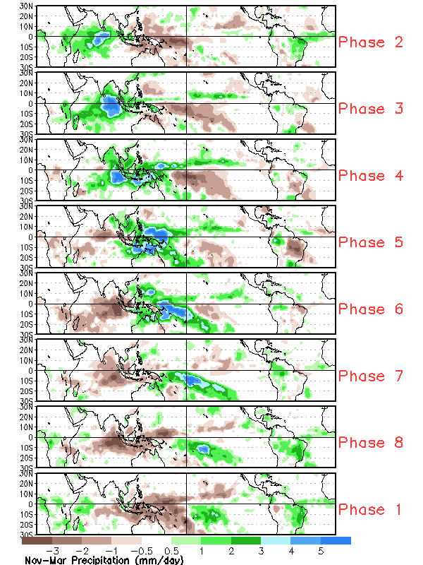
Jet Regime Frequency and the MJO
The Madden–Julian Oscillation (MJO) is a leading mode of intraannual variability in the tropics with a period of 30–60 days.
Climate Prediction Center
Nov–Mar Composite Daily Precipitation (mm)

Slide 88
Jet Regime Frequency and the MJO
The Madden–Julian Oscillation (MJO) is a leading mode of intraannual variability in the tropics with a period of 30–60 days.
The MJO is characterized by an eastward propagating region of enhanced convection in the equatorial Indian and Pacific Oceans.
Climate Prediction Center
Nov–Mar Composite Daily Precipitation (mm)

Slide 89
Jet Regime Frequency and the MJO
The Madden–Julian Oscillation (MJO) is a leading mode of intraannual variability in the tropics with a period of 30–60 days.
The MJO is characterized by an eastward propagating region of enhanced convection in the equatorial Indian and Pacific Oceans.
The location of convection can strongly modulate the midlatitude circulation.
Climate Prediction Center
Nov–Mar Composite Daily Precipitation (mm)

Slide 90
Jet Regime Frequency and the MJO
Jet Retractions are favored during Phases 2, 3, and 4
Poleward Shifts are favored during Phases 5 and 6
Jet Extensions are favored during Phases 7, 8, and 1

Slide 91
Jet Regime Frequency and the PNA
Composite 250-hPa Zonal Wind Anomalies (m s^{–1})
+PNA
A positive PNA pattern is characterized by above normal 250-hPa zonal wind speeds in the exit region of the North Pacific Jet
A negative PNA pattern is characterized by below normal 250-hPa zonal wind speeds in the exit region of the North Pacific Jet
–PNA
NOAA/ESRL

Slide 92
Jet Regime Frequency and the PNA
Jet Extensions and Poleward Shifts are favored during a positive PNA
Jet Retractions and Equatorward Shifts are favored during a negative PNA

Slide 93
Summary
The North Pacific Jet phase diagram serves as an objective tool to describe the relationship between the upper-tropospheric flow pattern and some of the leading modes of tropical and midlatitude variability.

Slide 94
Summary
The North Pacific Jet phase diagram serves as an objective tool to describe the relationship between the upper-tropospheric flow pattern and some of the leading modes of tropical and midlatitude variability.
However, the relationship between the upper-tropospheric flow pattern and these leading modes of tropical and midlatitude variability can be highly variable.

Slide 95
Summary
The North Pacific Jet phase diagram serves as an objective tool to describe the relationship between the upper-tropospheric flow pattern and some of the leading modes of tropical and midlatitude variability.
However, the relationship between the upper-tropospheric flow pattern and these leading modes of tropical and midlatitude variability can be highly variable.
Knowledge of the frequency of jet regimes during certain atmospheric teleconnection regimes may better inform the likelihood of extreme temperature events over the CONUS.

Slide 96
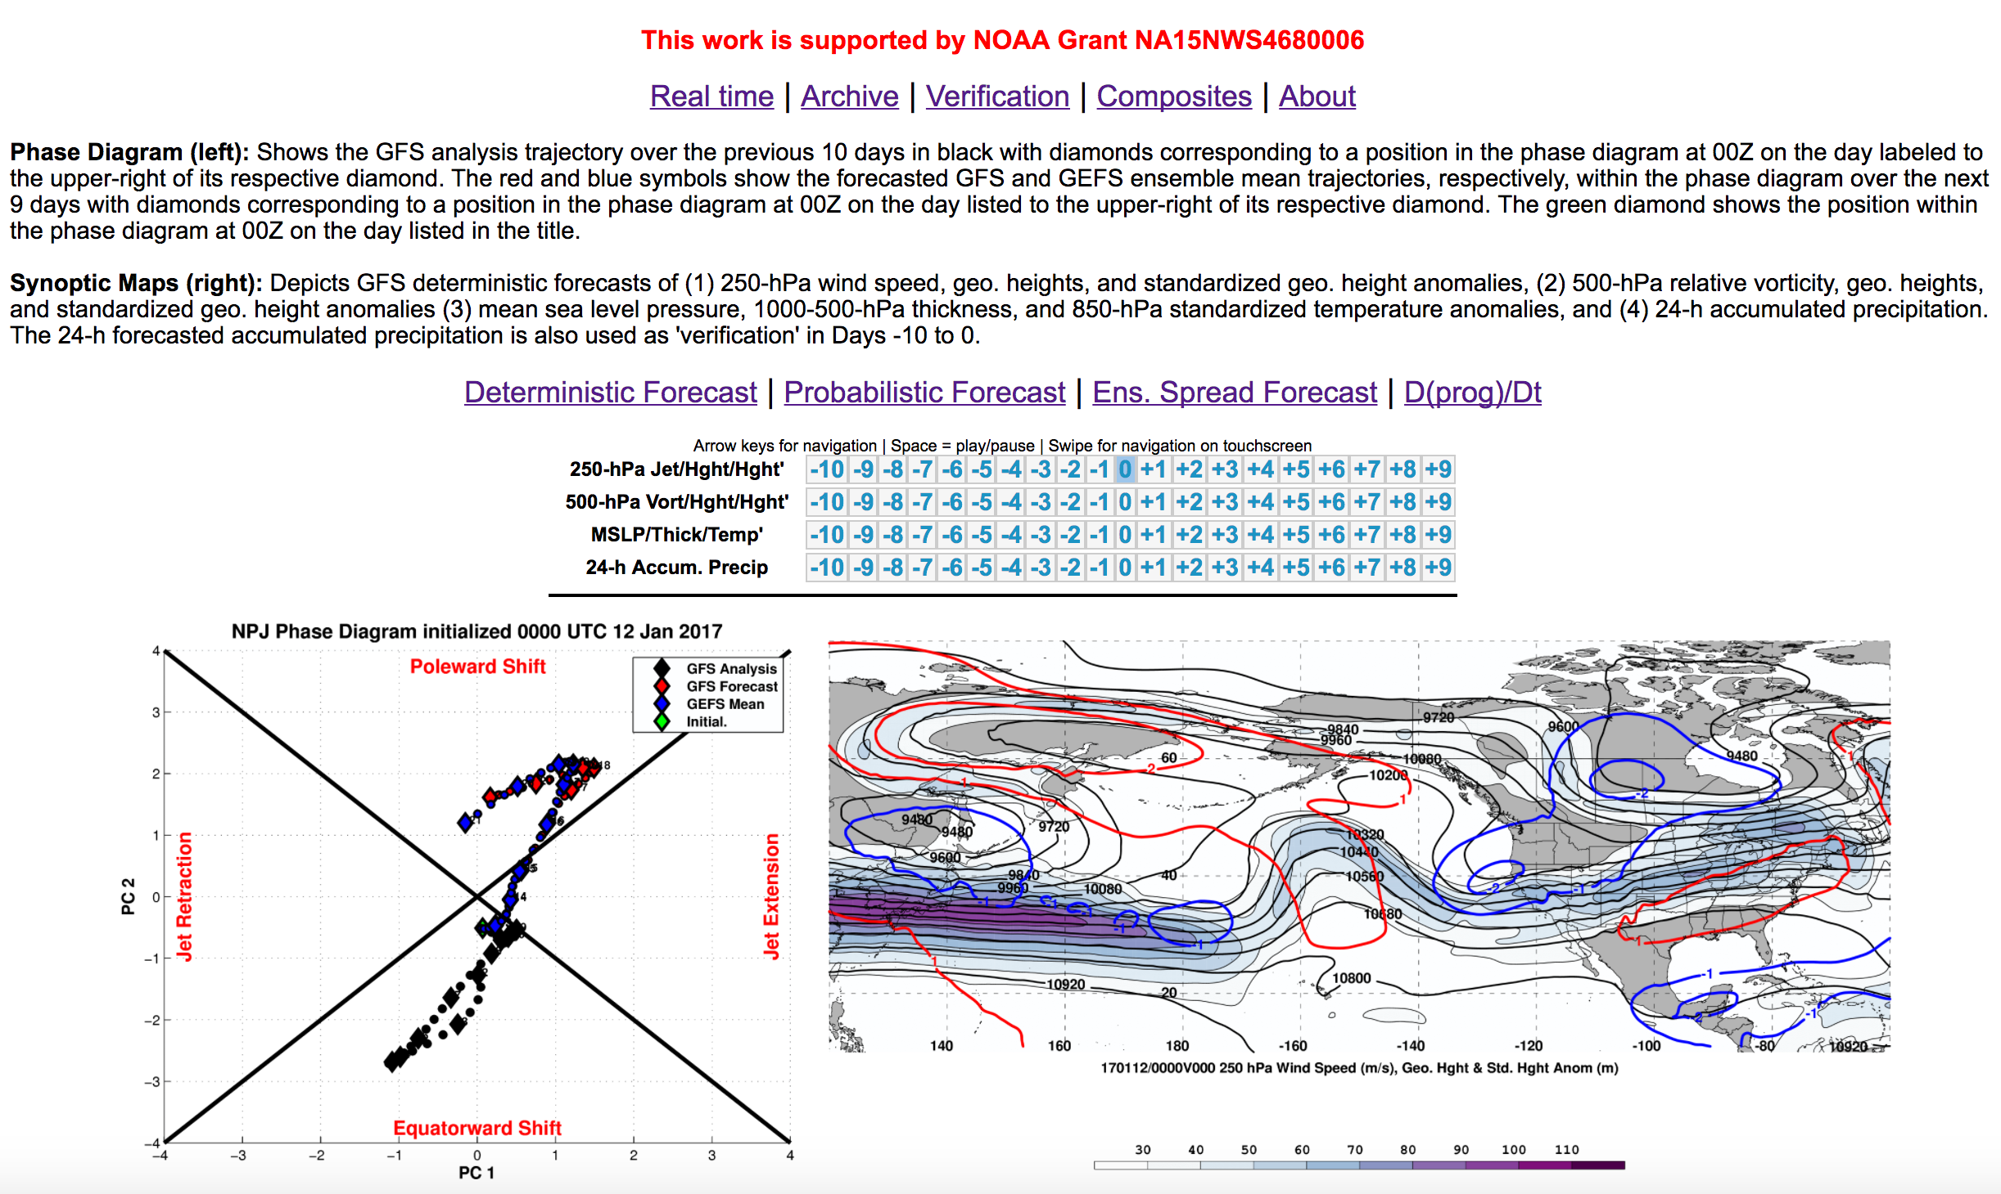
Phase Diagram Web Interface

Slide 97
Phase Diagram Web Interface

Slide 98
Phase Diagram Web Interface

Slide 99
Phase Diagram Web Interface

Slide 100
Phase Diagram Web Interface
A web interface has been developed that offers real time North Pacific Jet phase diagram forecasts and extreme event composites.
http://www.atmos.albany.edu/facstaff/awinters/realtime/About_EOFs.php
Contact: acwinters@albany.edu
Collaborators: Lance F. Bosart (SUNY), Daniel Keyser (SUNY), Mike Bodner (WPC), Arlene Laing (NOAA),
and Dan Halperin (WPC)

Slide 101
References
Athanasiadis, P. J., J. M. Wallace, and J. J. Wettstein, 2010: Patterns of wintertime jet stream variability and their relation to the storm tracks. J. Atmos. Sci., 67, 1361–1381.
Dole, R., M. Hoerling, A. Kumar, J. Eischeid, J. Perlwitz, X. Quan, G. Kiladis, R. Webb, D. Murray, M. Chen, K. Wolter, and T. Zhang, 2014: The making of an extreme event: Putting the pieces together. Bull. Amer. Meteor. Soc., 95, 427–440.
Griffin, K. S., and J. E. Martin, 2016: Synoptic features associated with temporally coherent modes of variability of the North Pacific jet stream. J. Climate, 29, in press.
Hamill, T. M., G. T. Bates, J. S. Whitaker, D. R. Murray, M. Fiorino, T. J. Galarneau, Y. Zhu, and W. Lapenta, 2013: NOAA’s Second-Generation Global Medium-Range Ensemble Forecast Dataset. Bull. Amer. Meteor. Soc., 94, 1553–1565.
Jaffe, S. C., J. E. Martin, D. J. Vimont, and D. L. Lorenz, 2011: A synoptic climatology of episodic, subseasonal retractions of the Pacific jet. J. Climate, 24, 2846–2860.
Saha, S., and Coauthors, 2014: The NCEP Climate Forecast System Version 2. J. Climate, 27, 2185–2208.

Slide 102
Supplementary Slides

Slide 103
Project Outcomes
Provide forecasters with a “first alert” to the possibility of the occurrence of extreme temperature and precipitation events during week two on the basis of current conditions and model forecasts.
Provide forecasters with an indication of the character and flavor of possible extreme events as inferred from where the events lie in the frequency distributions of the anticipated event types.
Provide forecasters with knowledge that allows them to make science-based adjustments to model guidance and add value to week two forecasts of temperature and precipitation.

Slide 104
Jet Regime-Dependent Forecast Skill
GEFS Reforecasts (Hamill et al. 2013) initialized during the same jet regime were binned at all forecast hours based on whether they exhibited a standardized root-mean-square error (RMSE) of 500-hPa geopotential height over the CONUS (25–55°N; 140–60°W) that was:
  Above-normal (x > 0.5σ)
  Below-normal (x < –0.5σ)
  Near-normal (–0.5σ < x < 0.5σ)

Slide 105
Jet Regime-Dependent Forecast Skill
GEFS Reforecasts (Hamill et al. 2013) initialized during the same jet regime were binned at all forecast hours based on whether they exhibited a standardized root-mean-square error (RMSE) of 500-hPa geopotential height over the CONUS (25–55°N; 140–60°W) that was:
  Above-normal (x > 0.5σ)
  Below-normal (x < –0.5σ)
  Near-normal (–0.5σ < x < 0.5σ)
The percent difference between the frequency of forecasts initialized during the same jet regime with below-normal and above-normal RMSE or ACC offers information on the forecast skill during that jet regime.

Slide 106
Jet Regime-Dependent Forecast Skill
Percent Difference Between the Frequency of Forecasts with Below-Normal and Above-Normal RMSE
Higher frequency of forecasts with
below-normal RMSE
(i.e., more good forecasts)
Higher frequency of forecasts with
above-normal RMSE
(i.e., more bad forecasts)

Slide 107
Jet Regime-Dependent Forecast Skill
Percent Difference Between the Frequency of Forecasts with Below-Normal and Above-Normal RMSE
Higher frequency of forecasts with
below-normal RMSE
(i.e., more good forecasts)
Higher frequency of forecasts with
above-normal RMSE
(i.e., more bad forecasts)

Slide 108
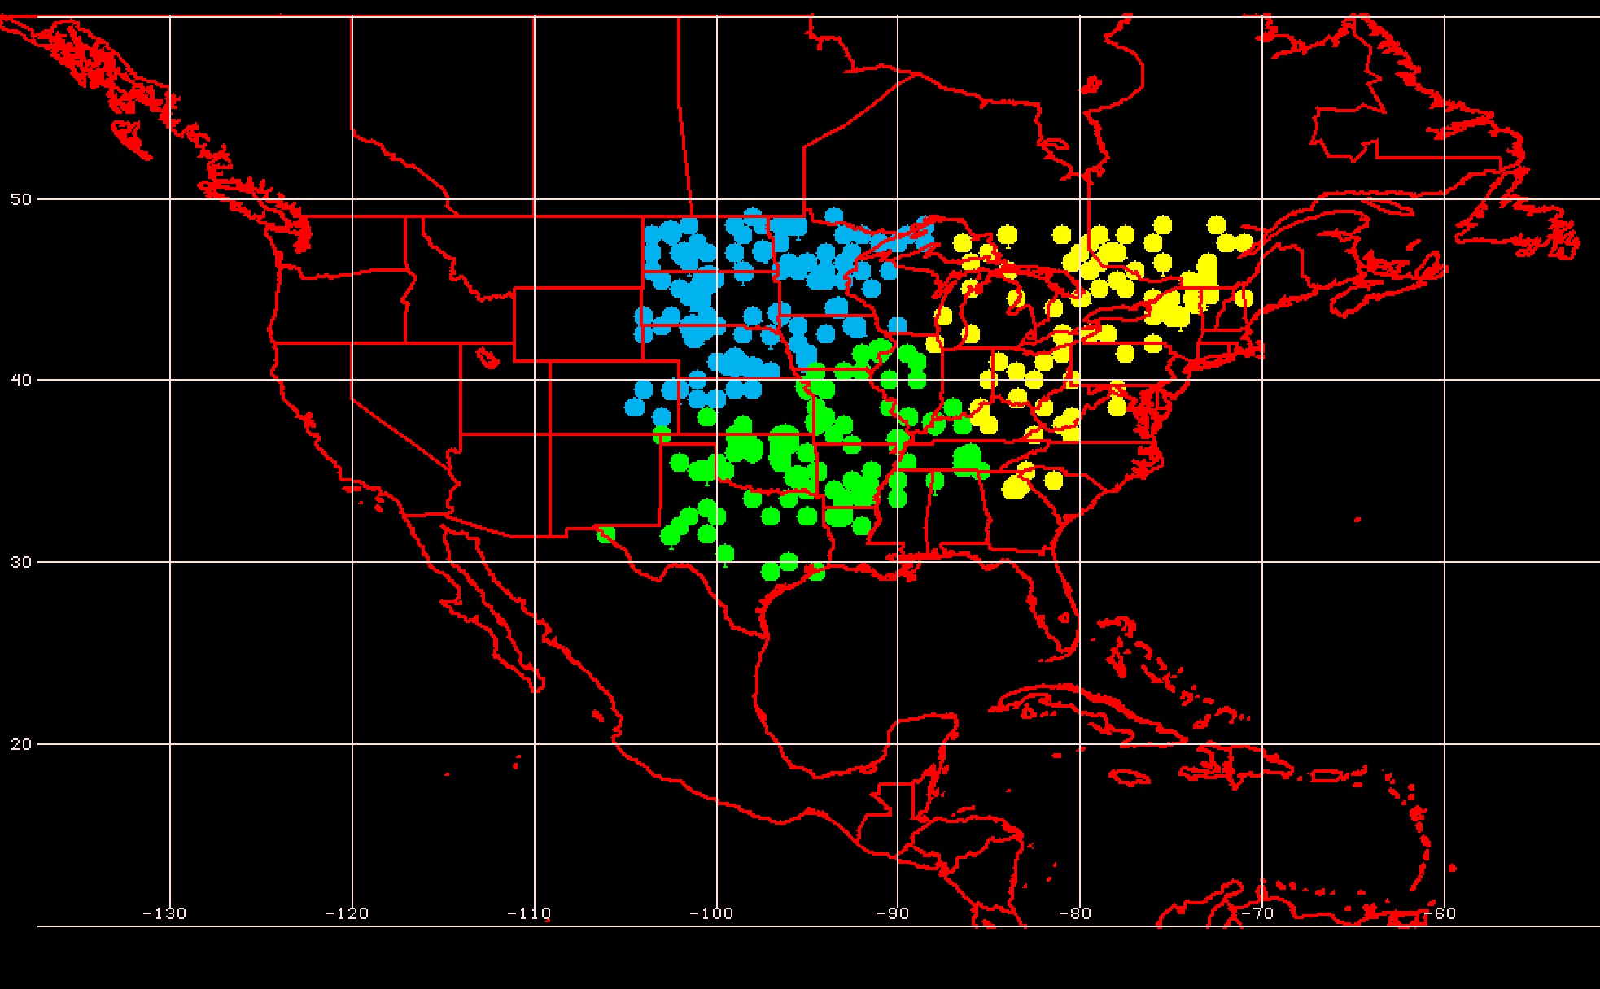
Geographic Event Clusters
Extreme Warm Event Centroids East of the Rockies

Slide 109
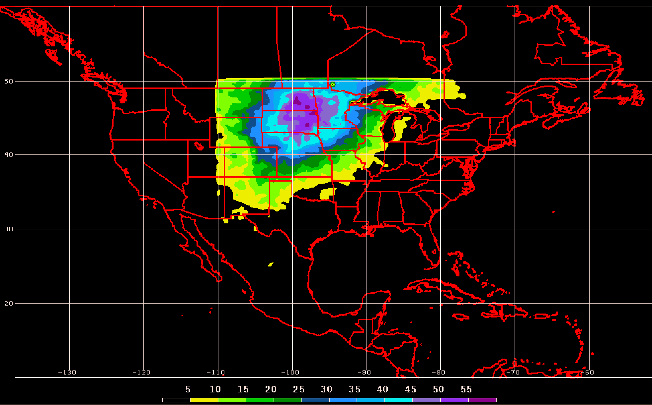
Geographic Event Clusters
Extreme Warm Event Frequency for Northern Plains

Slide 110
Real Time North Pacific Jet Phase Diagram
0000 UTC 8 November 2014
250-hPa wind speed: shaded
Instantaneous 250-hPa zonal wind anomalies can be projected onto EOF 1 and EOF 2, resulting in a point on a North Pacific Jet phase diagram

Slide 111
Real Time North Pacific Jet Phase Diagram
Each point on the phase diagram is a weighted average of the principal components within +/− 1 day of the time under consideration
Example: 0000 UTC 8 November 2014
Weight
5
4
3
2
1
Date
0000 UTC 7 Nov.
1200 UTC 7 Nov.
0000 UTC 8 Nov.
1200 UTC 8 Nov.
0000 UTC 9 Nov.

Slide 112
Real Time North Pacific Jet Phase Diagram
Characterizes the past evolution and present state of the upper-tropospheric flow pattern over the North Pacific.
  Captures regime transitions
  Identifies flow patterns conducive to the development of extreme weather events
Characterizes the forecasted evolution of the upper-tropospheric flow pattern over the North Pacific.

Slide 113
Real Time North Pacific Jet Phase Diagram
0000 UTC 8 November 2014
250-hPa wind speed: shaded

Slide 114
Real Time North Pacific Jet Phase Diagram
0000 UTC 10 November 2014
250-hPa wind speed: shaded

Slide 115
Real Time North Pacific Jet Phase Diagram
0000 UTC 12 November 2014
250-hPa wind speed: shaded

Slide 116
Real Time North Pacific Jet Phase Diagram
0000 UTC 14 November 2014
250-hPa wind speed: shaded

Slide 117
Real Time North Pacific Jet Phase Diagram
0000 UTC 16 November 2014
250-hPa wind speed: shaded

Slide 118
Real Time North Pacific Jet Phase Diagram
0000 UTC 18 November 2014
250-hPa wind speed: shaded

Slide 119
Real Time North Pacific Jet Phase Diagram
16–19 November 2014 Composite Anomalies
500-hPa Geo. Height (m)
Surface Temperature (°C)

Slide 120
E. Rockies – S. Plains Cluster
Extreme Cold Event Centroids
COLD EVENTS (n = 48)
Poleward Shift
4
Events during
Sept. – May projected onto phase diagram
4
Jet Retraction
14
Jet Extension
Each point is an average of the PCs
3–7 days prior to the event
16–19 Nov. 2014
26
Equatorward Shift

Slide 121
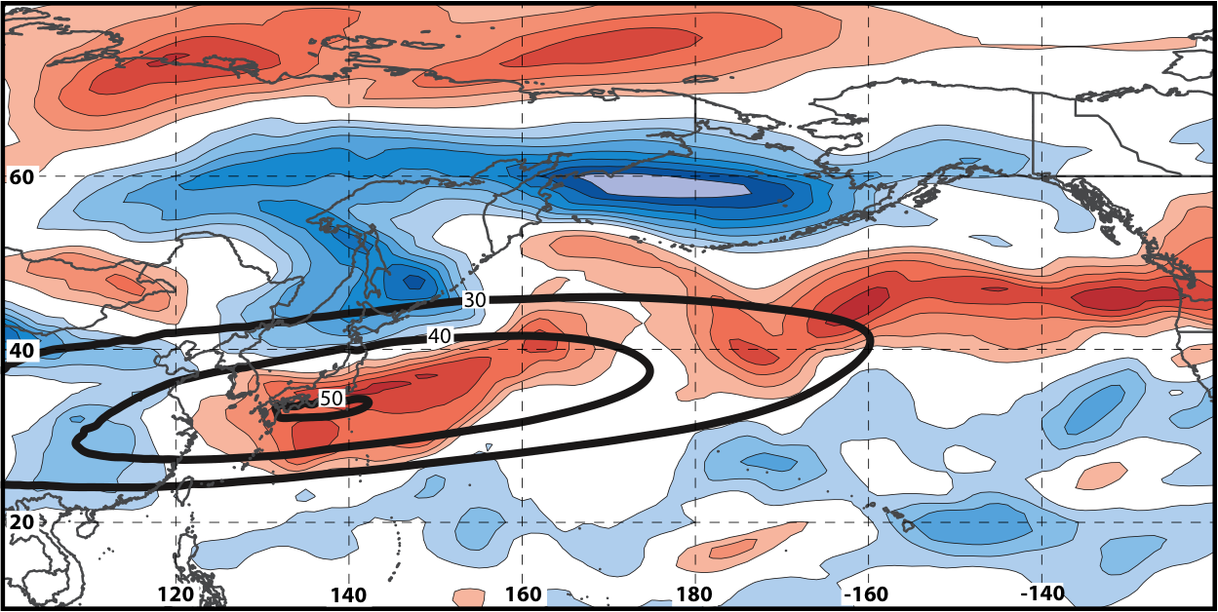
Real Time North Pacific Jet Phase Diagram
250-hPa zonal wind at 0000 UTC 2 Jun minus 250-hPa zonal wind at 0000 UTC 24 May (shading) in the GFS analyses shows the transition to a poleward-shifted jet regime
0000 UTC 24 May
(0-h forecast)
0000 UTC 2 Jun (verification)
Ensemble mean
Sept.–May mean 250-hPa zonal wind: black contours
Notes:
Note that the positive changes in zonal wind correspond exactly to where the positive anomalies are located in the EOF2 pattern – See slide 14.

Slide 122
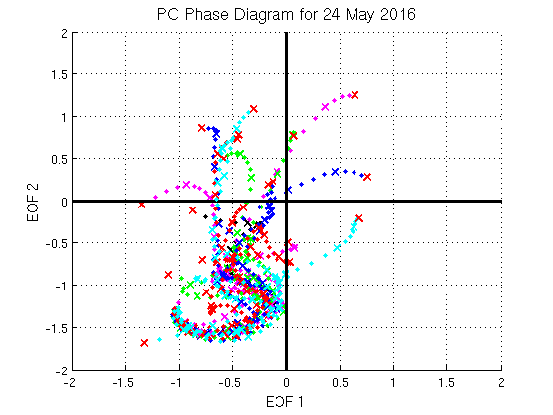
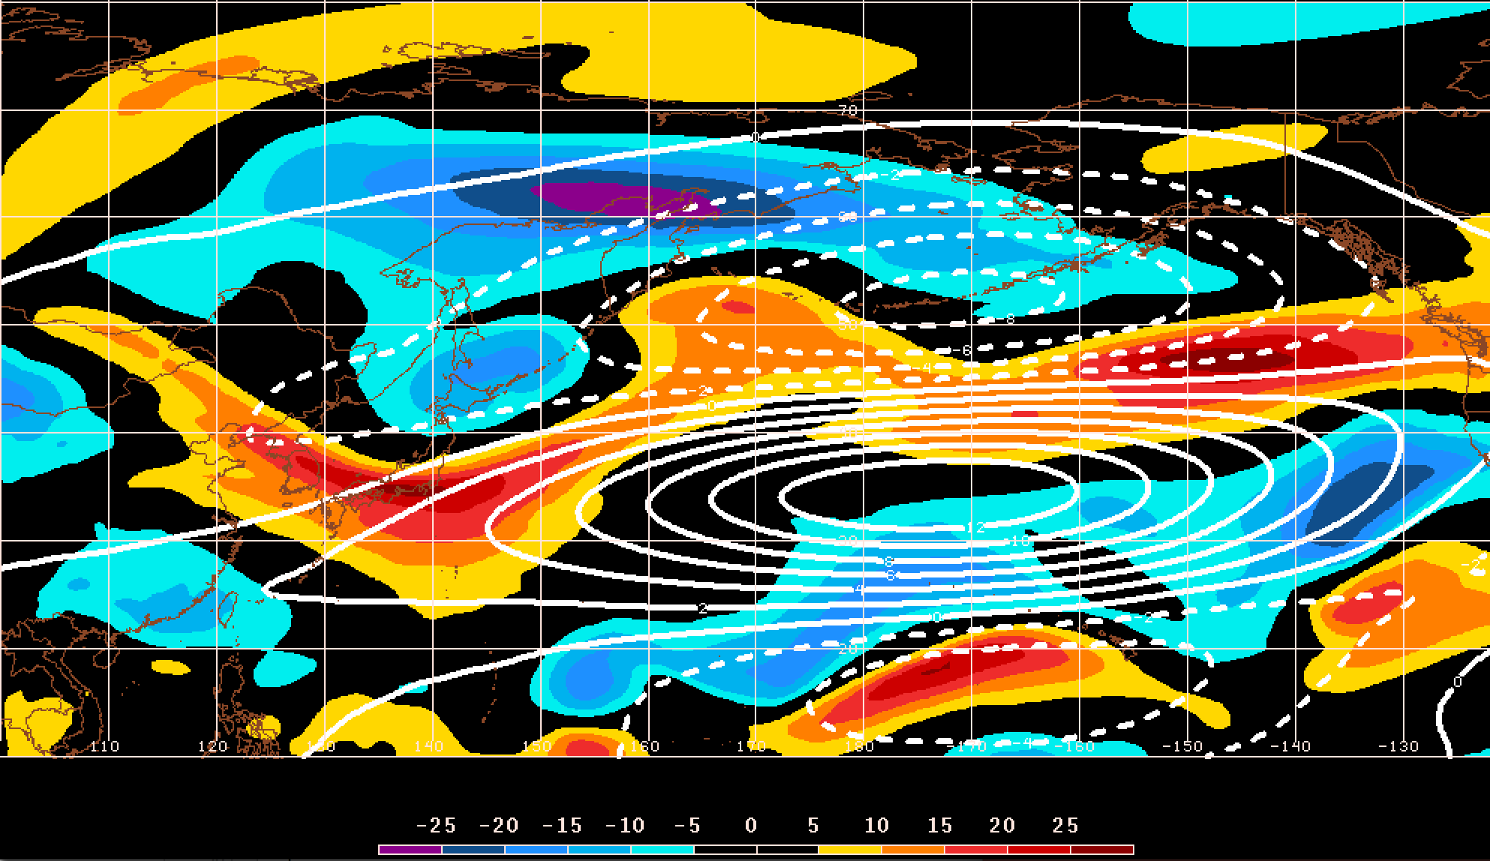
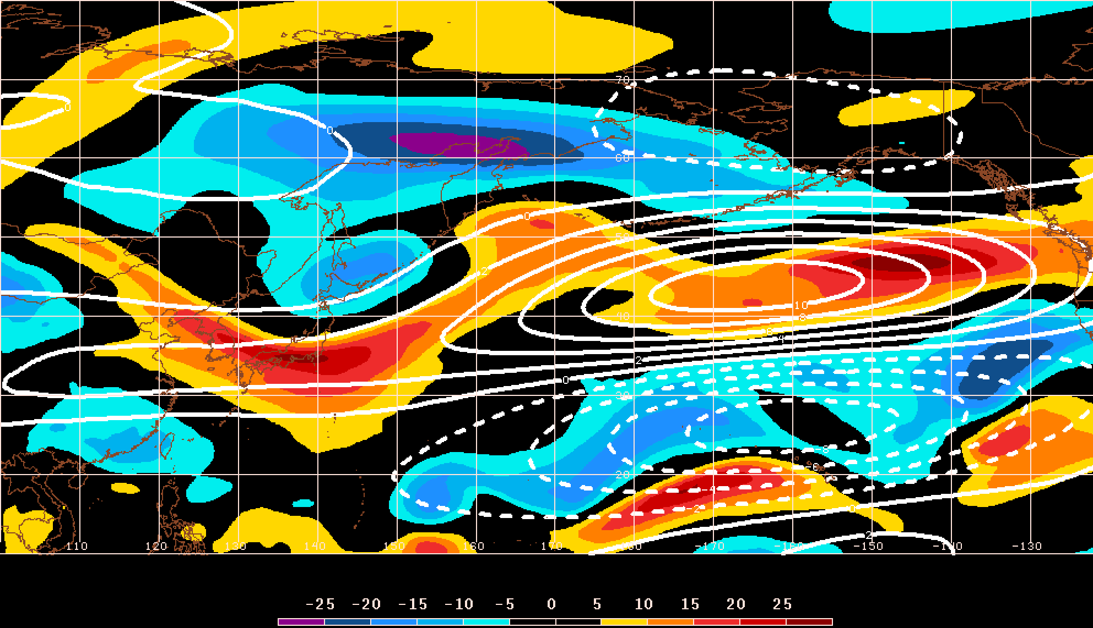
GEFS Ensemble Trajectories Initialized 0000 UTC 24 May 2016
250-hPa Zonal Wind Anomalies and EOF1: 0000 UTC 2 Jun
0000 UTC 2 Jun (verification)
m s^{–1}
250-hPa Zonal Wind Anomalies and EOF2: 0000 UTC 2 Jun
250-hPa zonal wind anomalies at 0000 UTC 2 Jun project strongly onto
EOF2 > 0
m s^{–1}

