Slide 1
Large-Scale Antecedent Conditions Associated with 2014–2015 Winter Onset over North America and mid-Winter Storminess Along the North Atlantic Coast
Lance F. Bosart, Alicia M. Bentley, Philippe P. Papin,
Benjamin J. Moore, and Andrew C. Winters
Department of Atmospheric and Environmental Sciences
University at Albany/State University of New York at Albany, Albany, NY 12222
American Geophysical Union Fall Meeting
Session A43K-06
San Francisco, California 94103
17 December 2015
Edited: 27 May 2016
Support Provided by NSF Grant AGS-1355960
and NOAA Grant NA15NWS4680006

Slide 2
Motivation
Winter 2014–2015: Part I featured unexpected record CONUS November cold and early season snow. Part II featured sequential epic Northeast snowstorms between 24 Jan – 16 Feb 2015
Part I: The STY Nuri ET/EC disrupted the NH flow, caused omega block formation downstream, opened the arctic air floodgates into the CONUS, and wrecked the CPC Nov temperature forecast
Part II: Persistent West Coast ridging favored record-breaking clustered Northeast snowstorms (depths not seen since 1717) and resulted in important predictability challenges

Slide 3
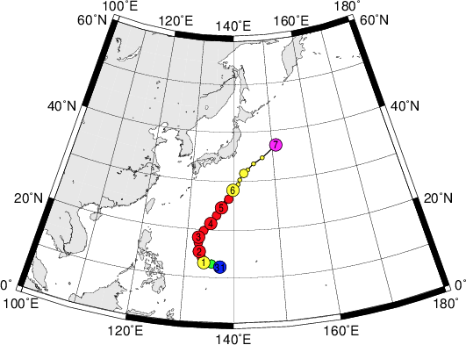
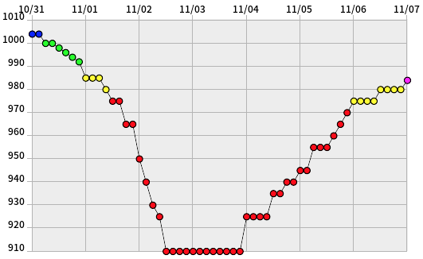
Super Typhoon Nuri: 31 Oct – 7 Nov 2014
JMA: Best Track
JMA: Minimum SLP (hPa)
Digital Typhoon (http://agora.ex.nii.ac.jp/digital-typhoon/index.html.en)

Slide 4
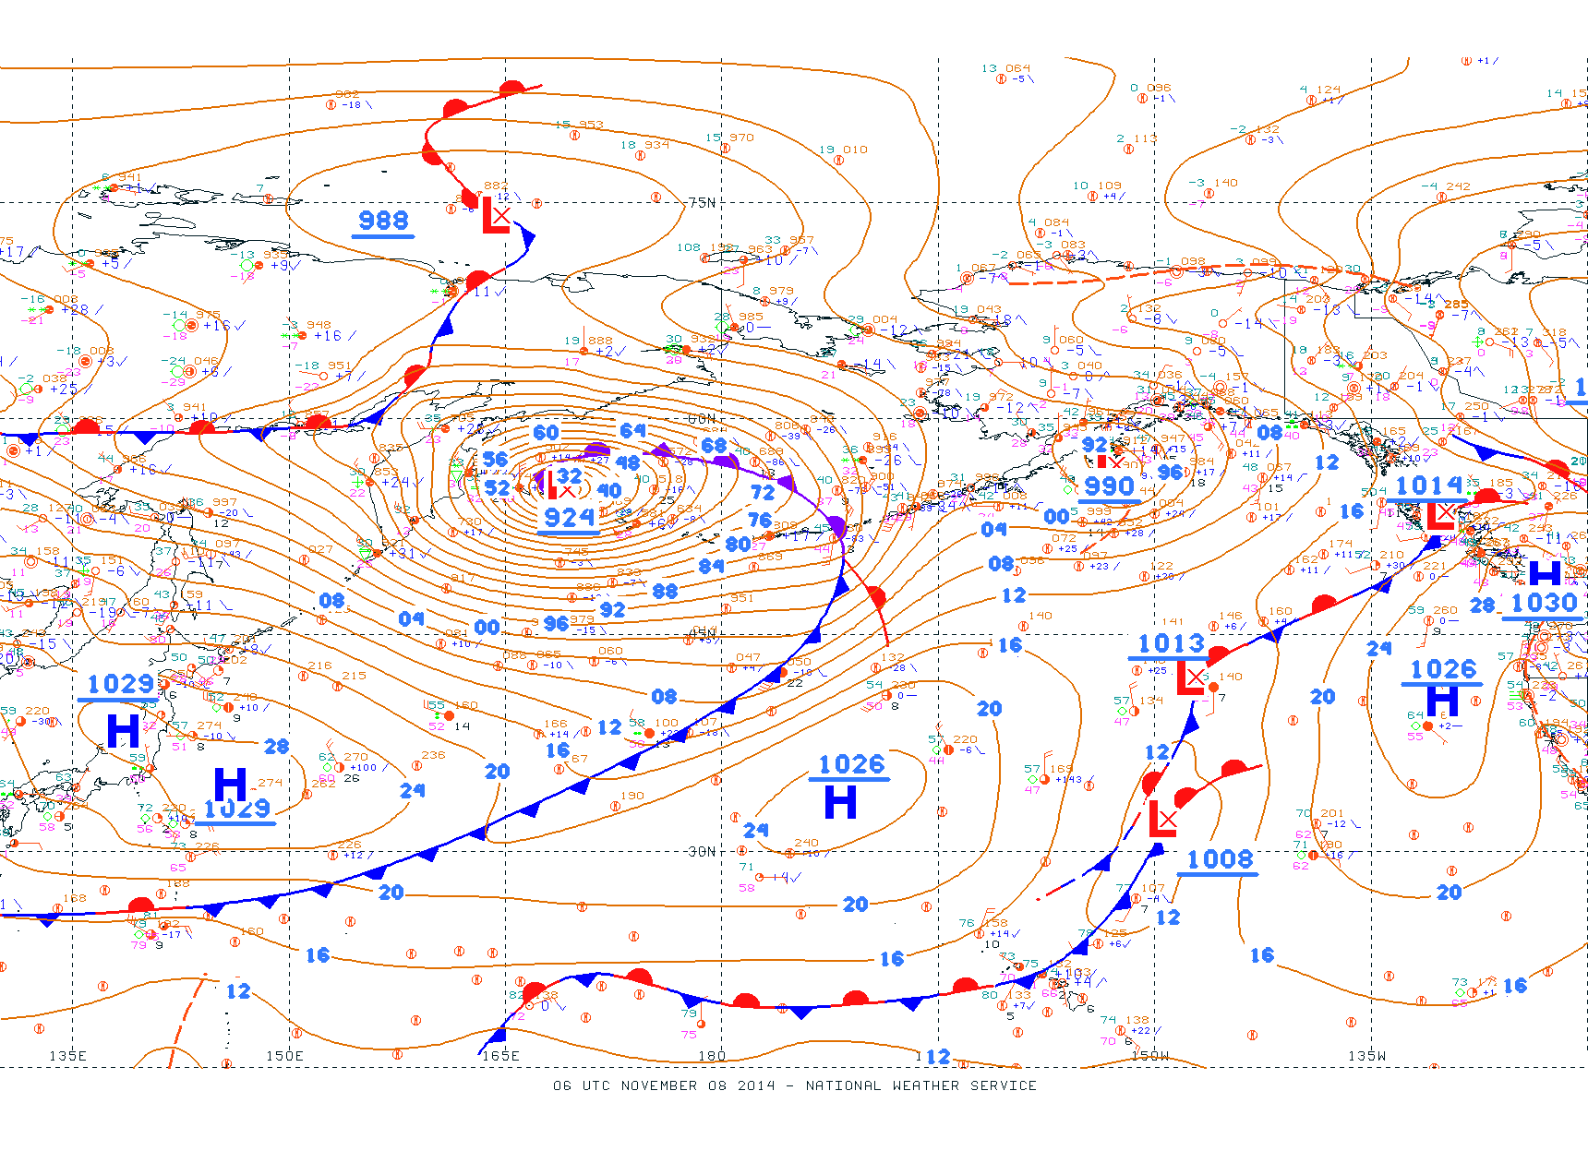
NCEP-OPC Surface Analysis: 0600 UTC 8 November 2014

Slide 5
Outline
Winter 2014–2015: Part I
Supertyphoon Nuri (2014) induces NH circulation changes
Trough north of Hawaii favors poleward Omega block formation
Multiple arctic surges into the CONUS occur east of the Omega block
Winter 2014–2015: Part II
Gulf of Alaska and Siberia act as a PV disturbance source
West Coast ridge enables PV disturbances to reach the eastern CONUS
Migratory PV disturbances trigger sequential Northeast cyclones

Slide 6
Data and Methodology
CFSR 0.5° gridded datasets are used
A multiscale analysis perspective is adopted
Forecast sensitivity is addressed

Slide 7
How can a reconfiguration of the downstream NH flow induced by a recurving Western Pacific STY trigger CONUS extreme weather events (EWEs)?
Science Question:

Slide 8
A Schematic Perspective on STY Nuri-Induced North Pacific Flow Evolution

Slide 9
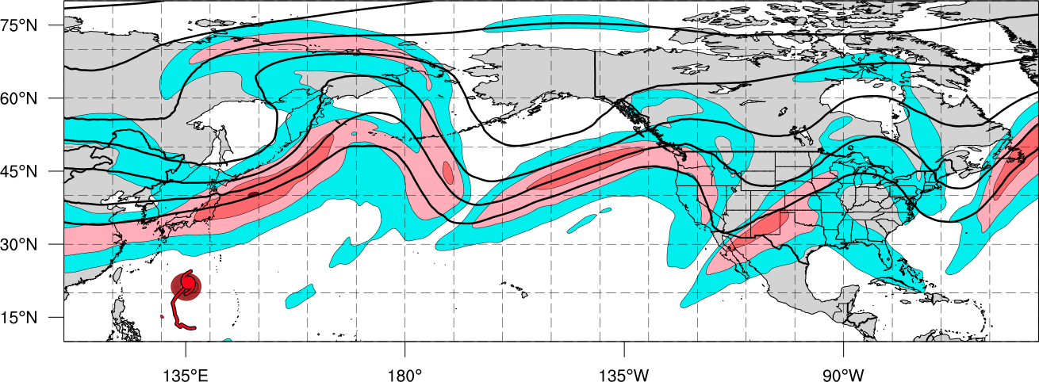
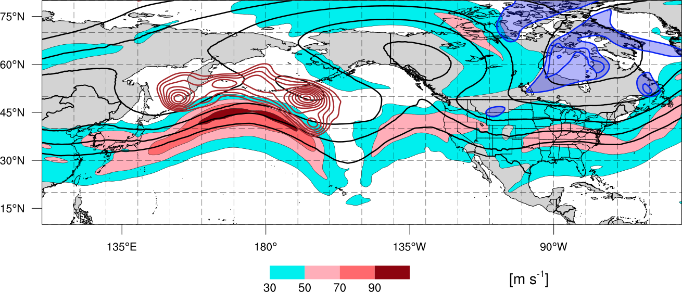
Schematic – Synoptic Evolution November 2014
0000 UTC 4 November 2014
Polar Cold Outbreak
Polar Jet
TC Outflow
STY Nuri
Legend
L
Extratropical low pressure center
H₁
High pressure center
Sea level pressure < 1000-hPa
Cold front
Arctic air
200-hPa geopotential heights
Tropical Cyclone
200-hPa Isotachs

Slide 10
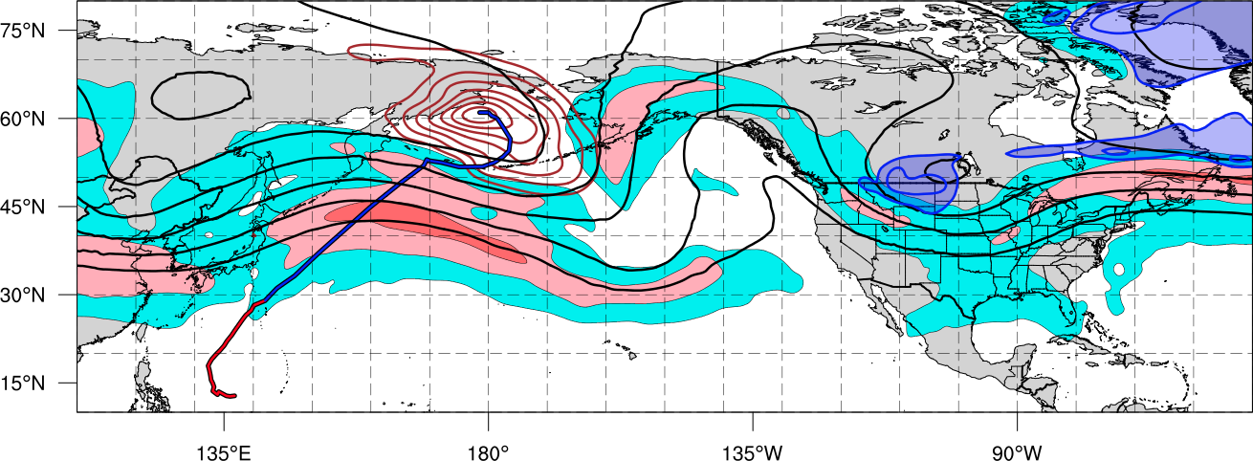
Schematic – Synoptic Evolution November 2014
1200 UTC 11 November 2014
Ex Nuri
L
H₁
Building Omega Block
1st Cold Surge
Polar Jet
Tropical Moisture
Legend
L
Extratropical low pressure center
H₁
High pressure center
Sea level pressure < 1000-hPa
Cold front
Arctic air
200-hPa geopotential heights
Tropical Cyclone
200-hPa Isotachs

Slide 11
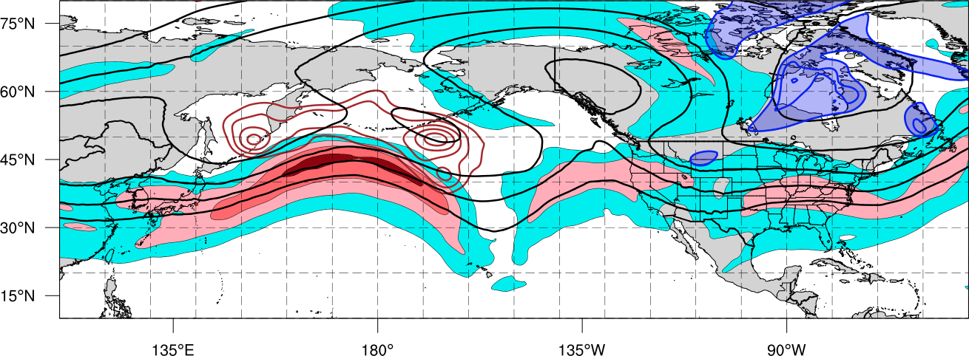
Schematic – Synoptic Evolution November 2014
1200 UTC 15 November 2014
H₃
Omega Block
Ex Nuri
2nd Cold Surge
L
H₂
Polar Jet
H₁
Legend
L
Extratropical low pressure center
H₁
High pressure center
Sea level pressure < 1000-hPa
Cold front
Arctic air
200-hPa geopotential heights
Tropical Cyclone
200-hPa Isotachs

Slide 12
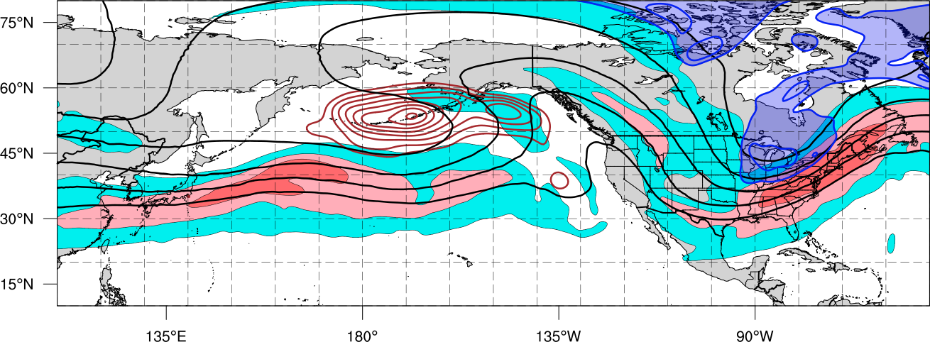
Schematic – Synoptic Evolution November 2014
1200 UTC 18 November 2014
Blocking Ridge
L
Ex Nuri
3rd Cold Surge
L
Polar Jet
H₂
H₂
H₃
H₁
Legend
L
Extratropical low pressure center
H₁
High pressure center
Sea level pressure < 1000-hPa
Cold front
Arctic air
200-hPa geopotential heights
Tropical Cyclone
200-hPa Isotachs

Slide 13
Impacts: CONUS Cold

Slide 14
Minimum Temperature Records Broken: 16–22 November 2014 (N = 2677)
Source: NCDC

Slide 15
CPC November 2014 CONUS Temperature Forecast is Derailed

Slide 16
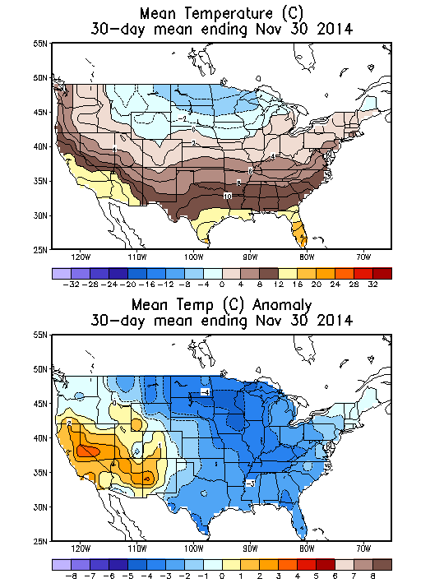
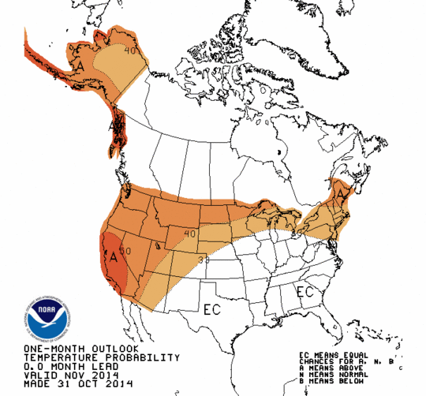
November 2014 CPC Forecast Temperature Anomaly Probability (Left); Mean and Observed Temperature Anomaly °C (right)

Slide 17
NH Flow Reconfiguration:
Predictability Issues

Slide 18
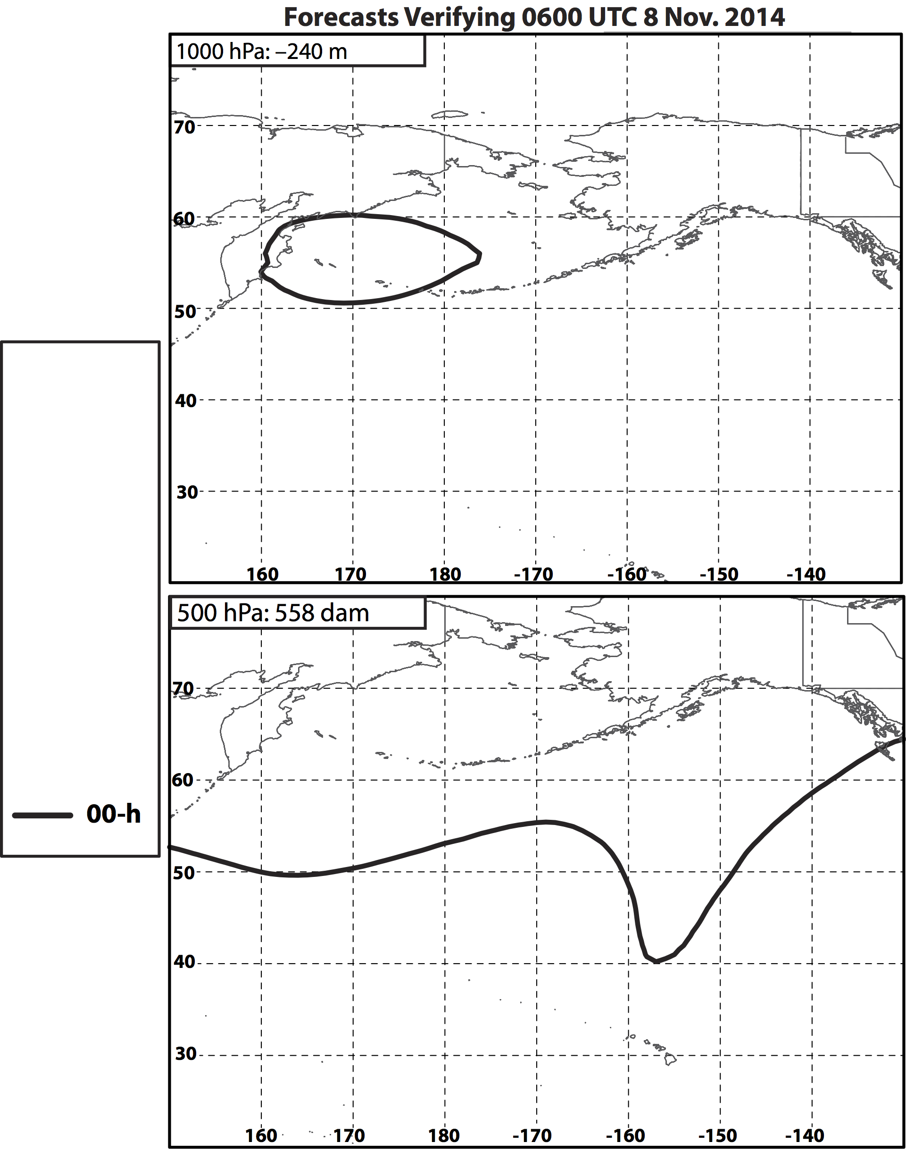
Nuri’s ET – 8 Nov.

Slide 19
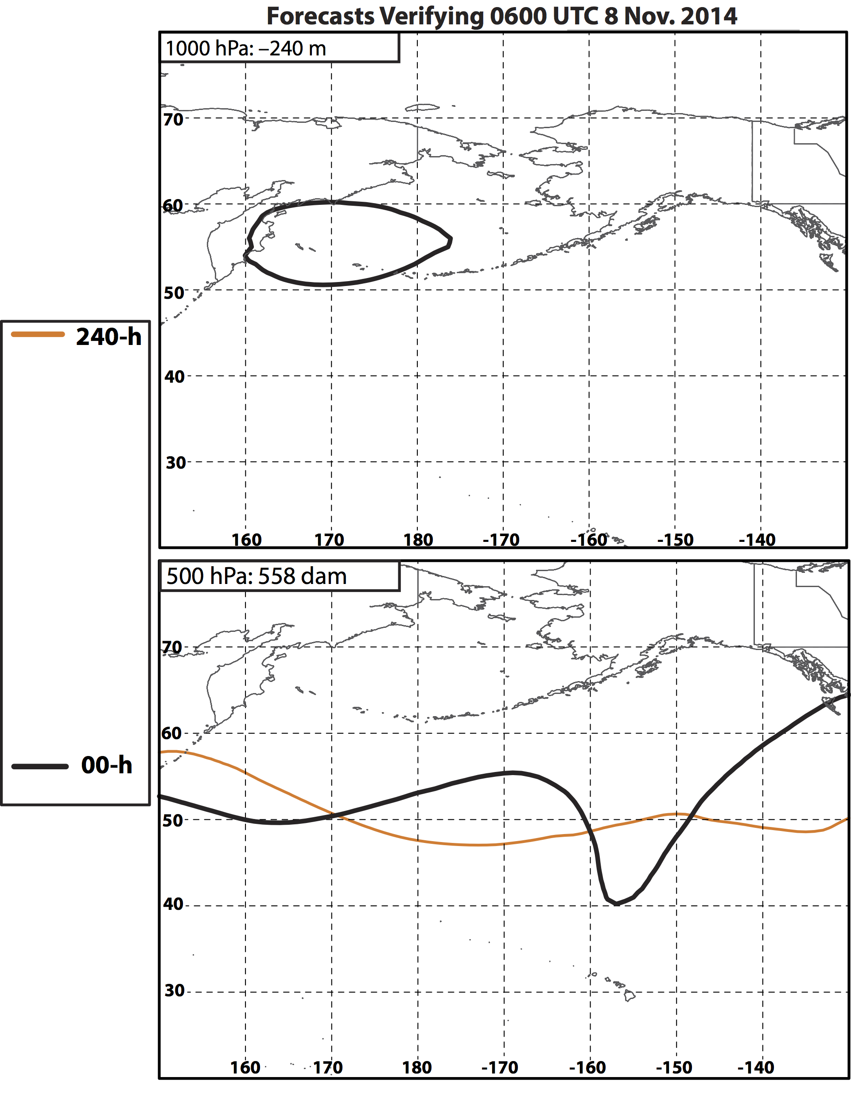
Nuri’s ET – 8 Nov.

Slide 20
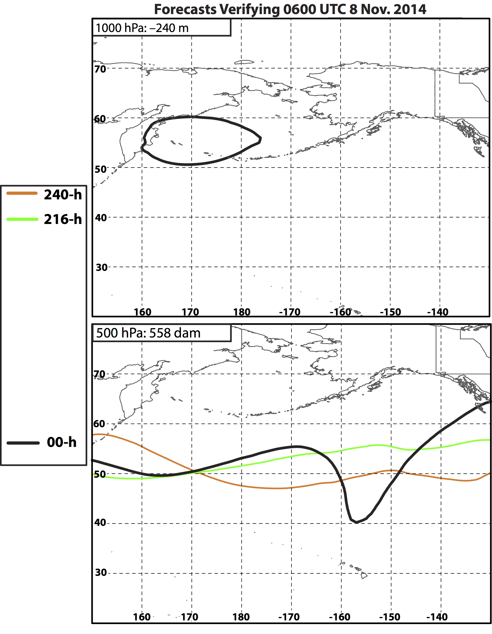
Nuri’s ET – 8 Nov.

Slide 21
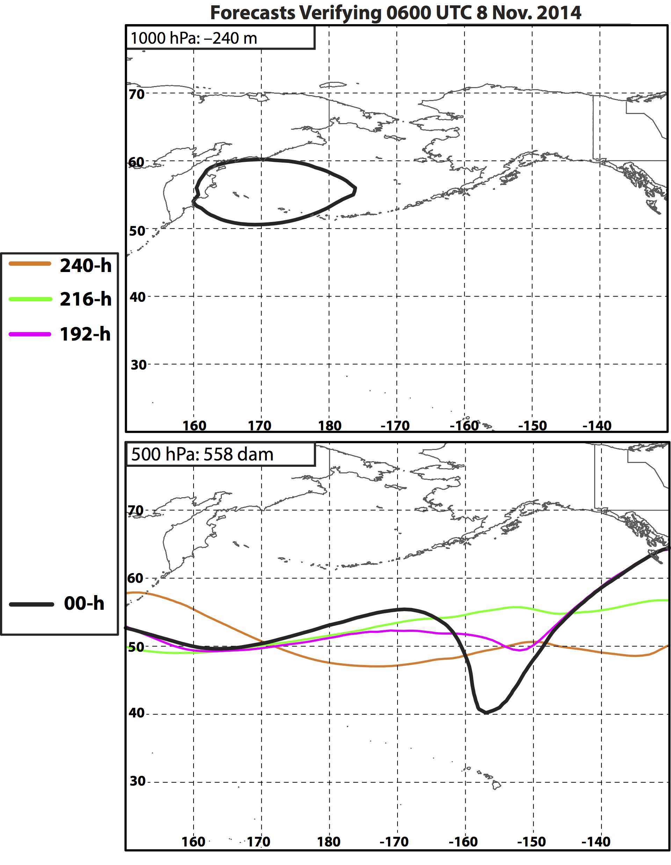
Nuri’s ET – 8 Nov.

Slide 22
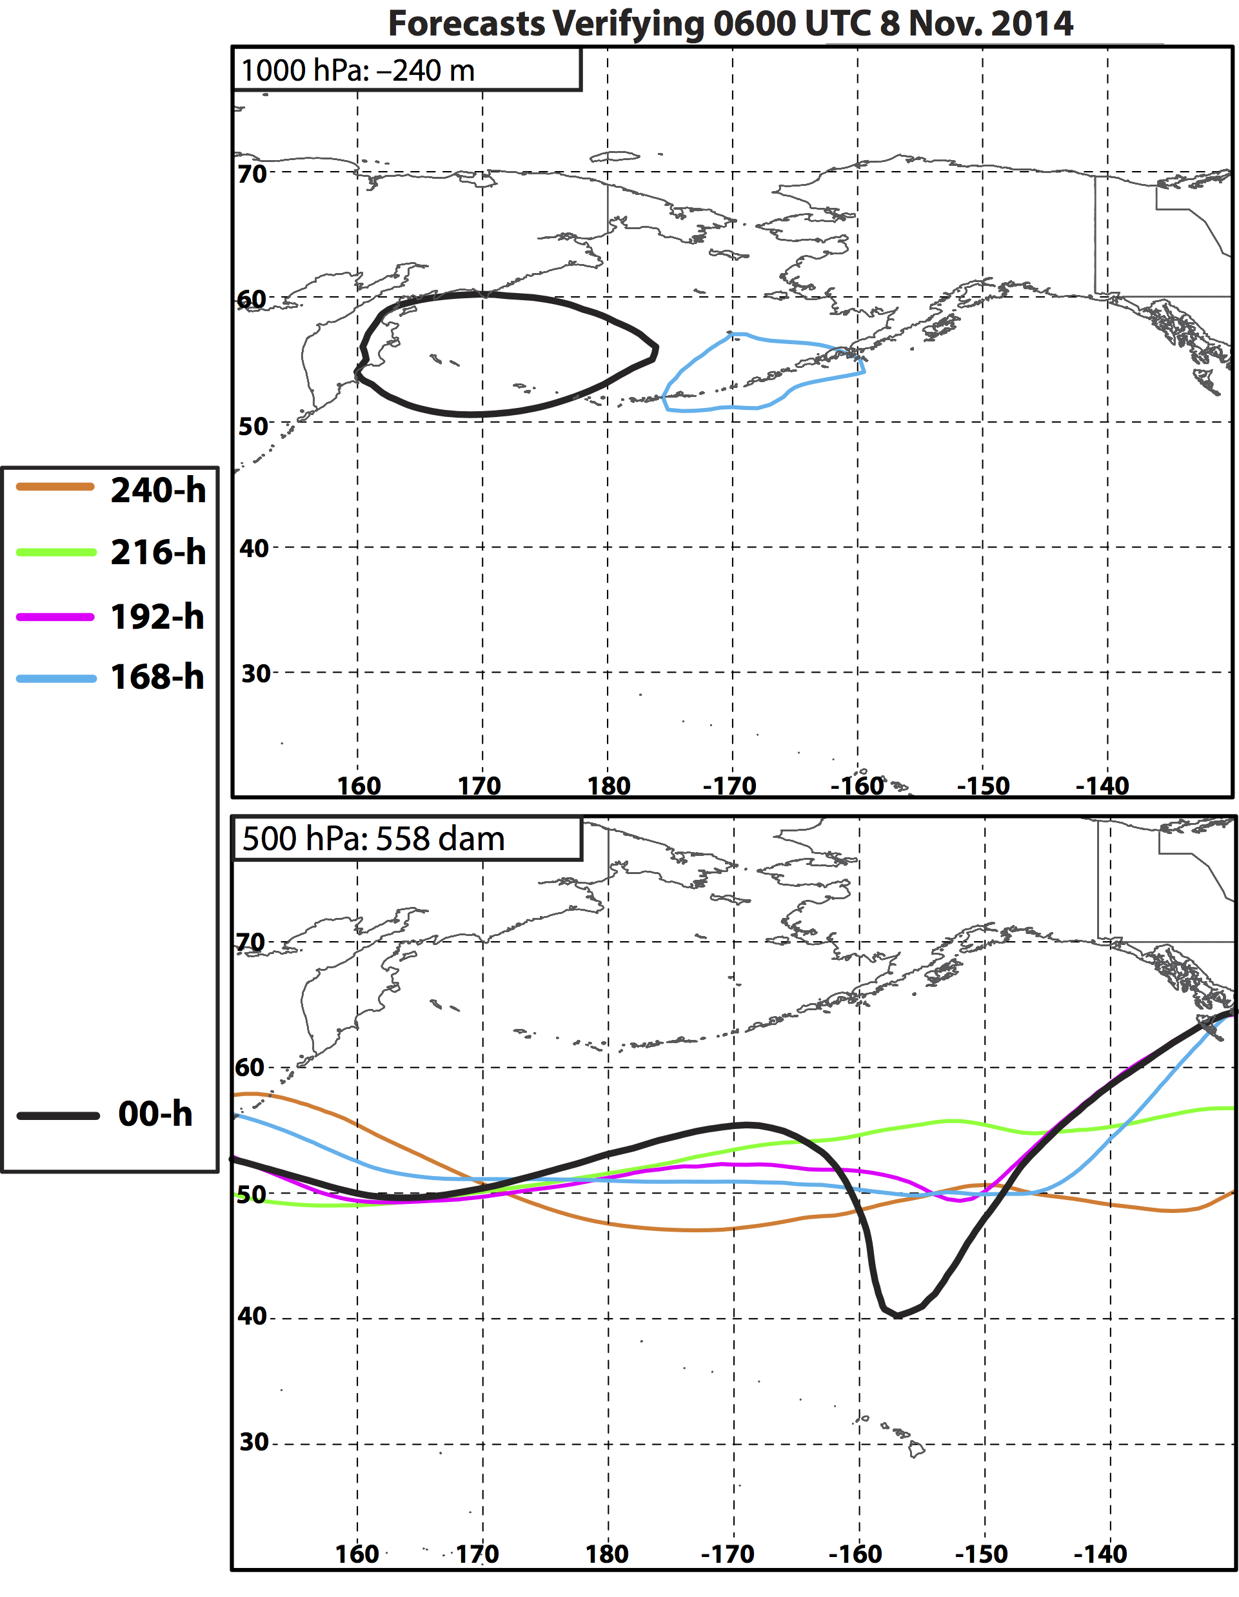
Nuri’s ET – 8 Nov.

Slide 23
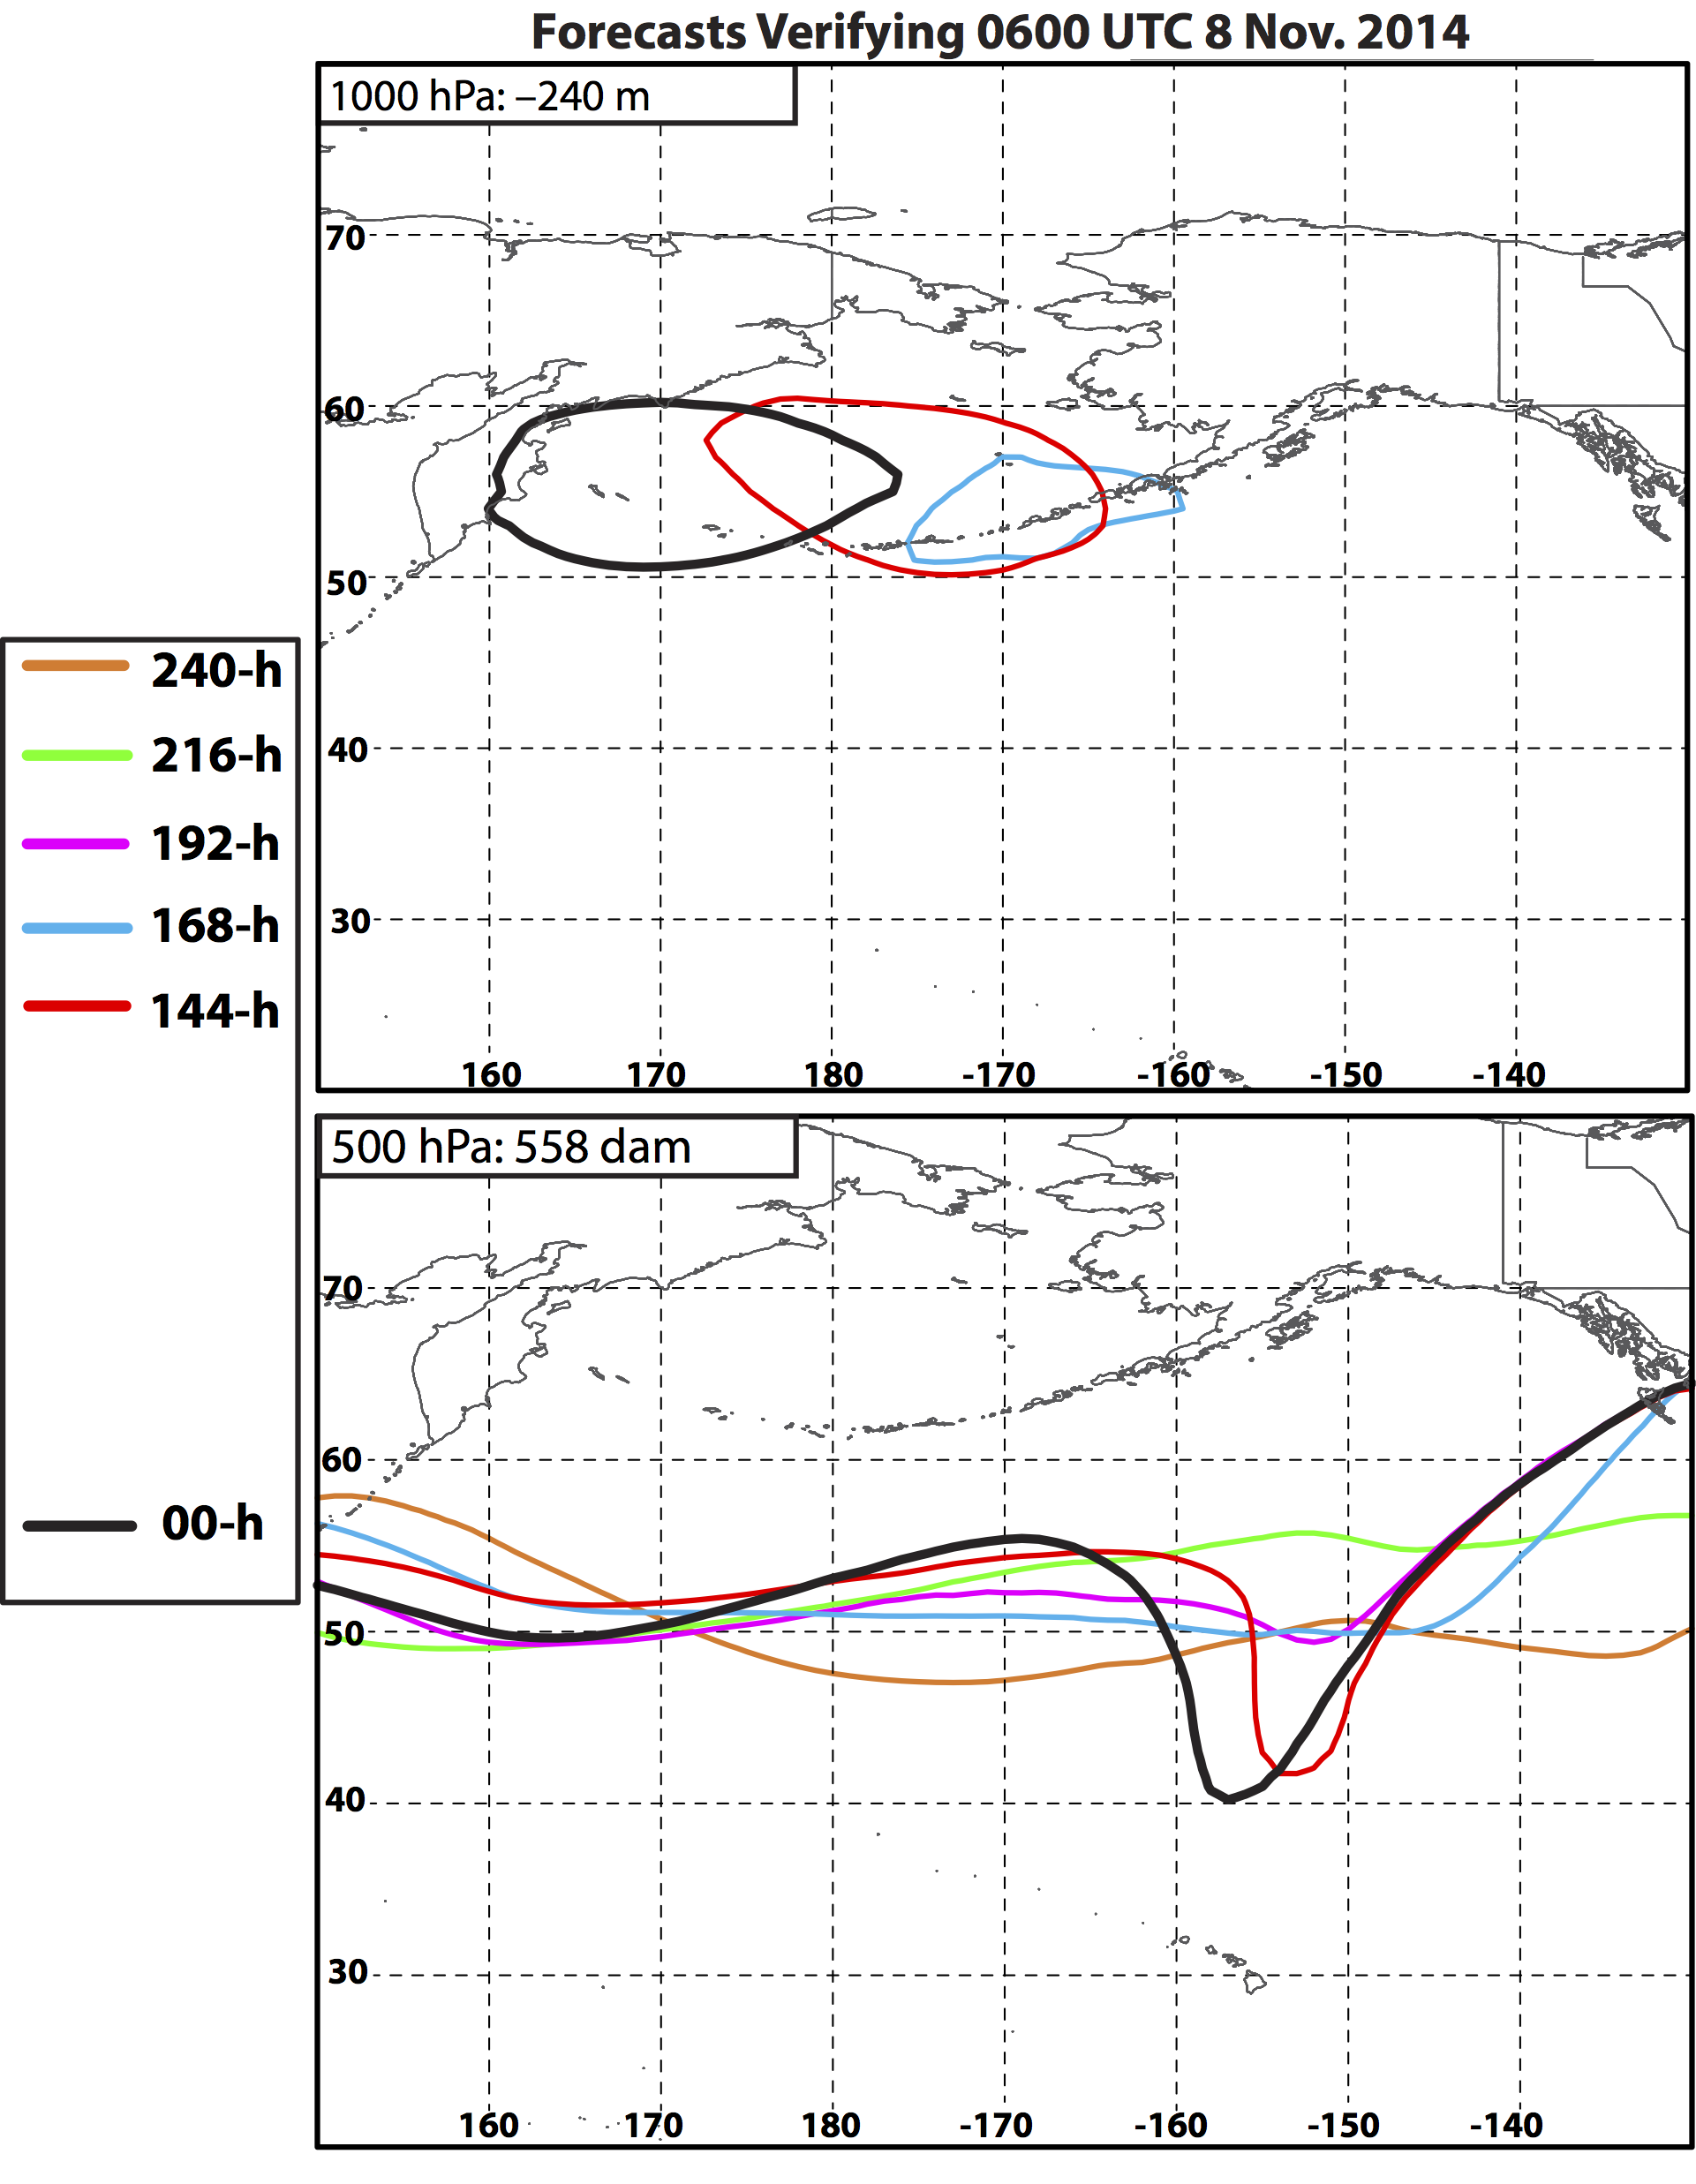
Nuri’s ET – 8 Nov.
144-h forecast:
First forecast to show Nuri intensifying to levels that match observations.
Coincident with an indication of trough development poleward of Hawaii.

Slide 24
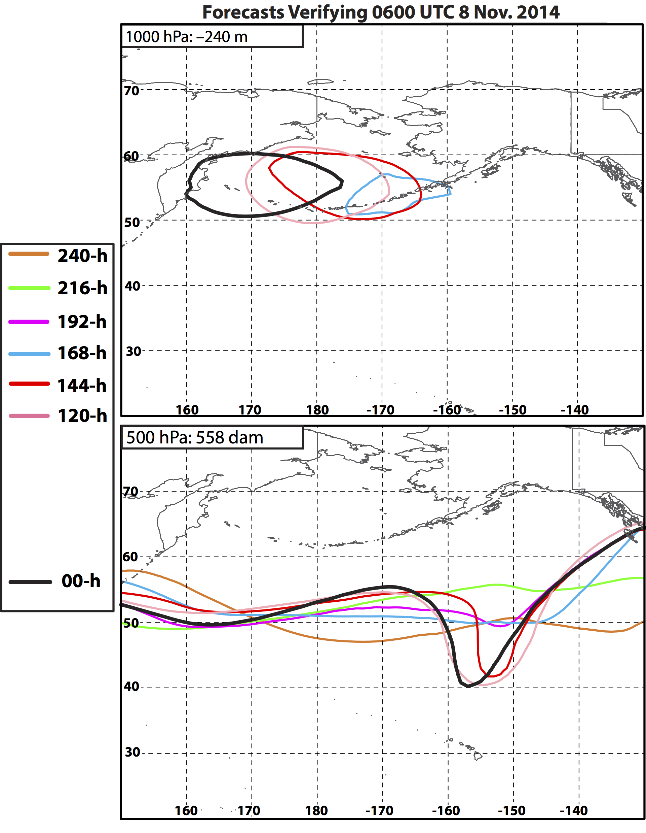
Nuri’s ET – 8 Nov.
144-h forecast:
First forecast to show Nuri intensifying to levels that match observations.
Coincident with an indication of trough development poleward of Hawaii.
Notes:
The forecast initialized 6-days prior to

Slide 25
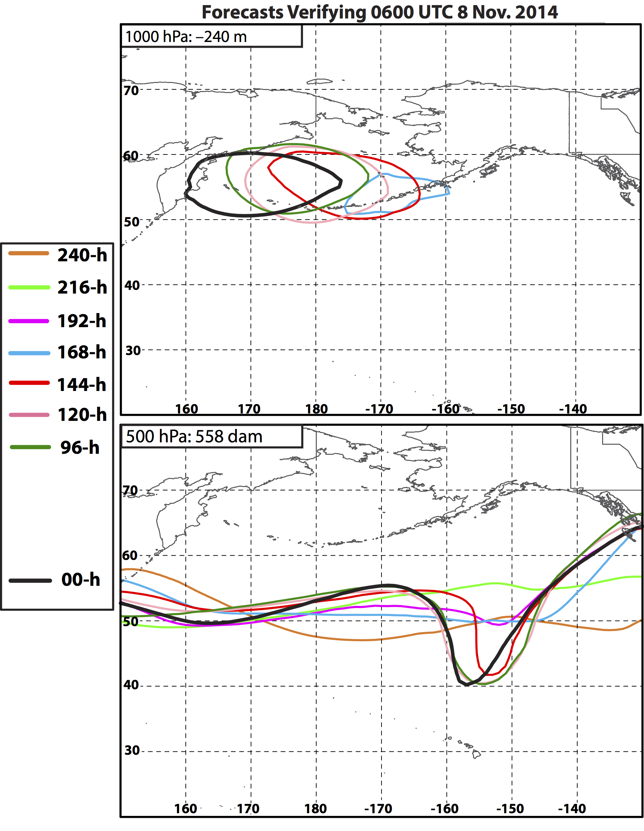
Nuri’s ET – 8 Nov.
144-h forecast:
First forecast to show Nuri intensifying to levels that match observations.
Coincident with an indication of trough development poleward of Hawaii.

Slide 26
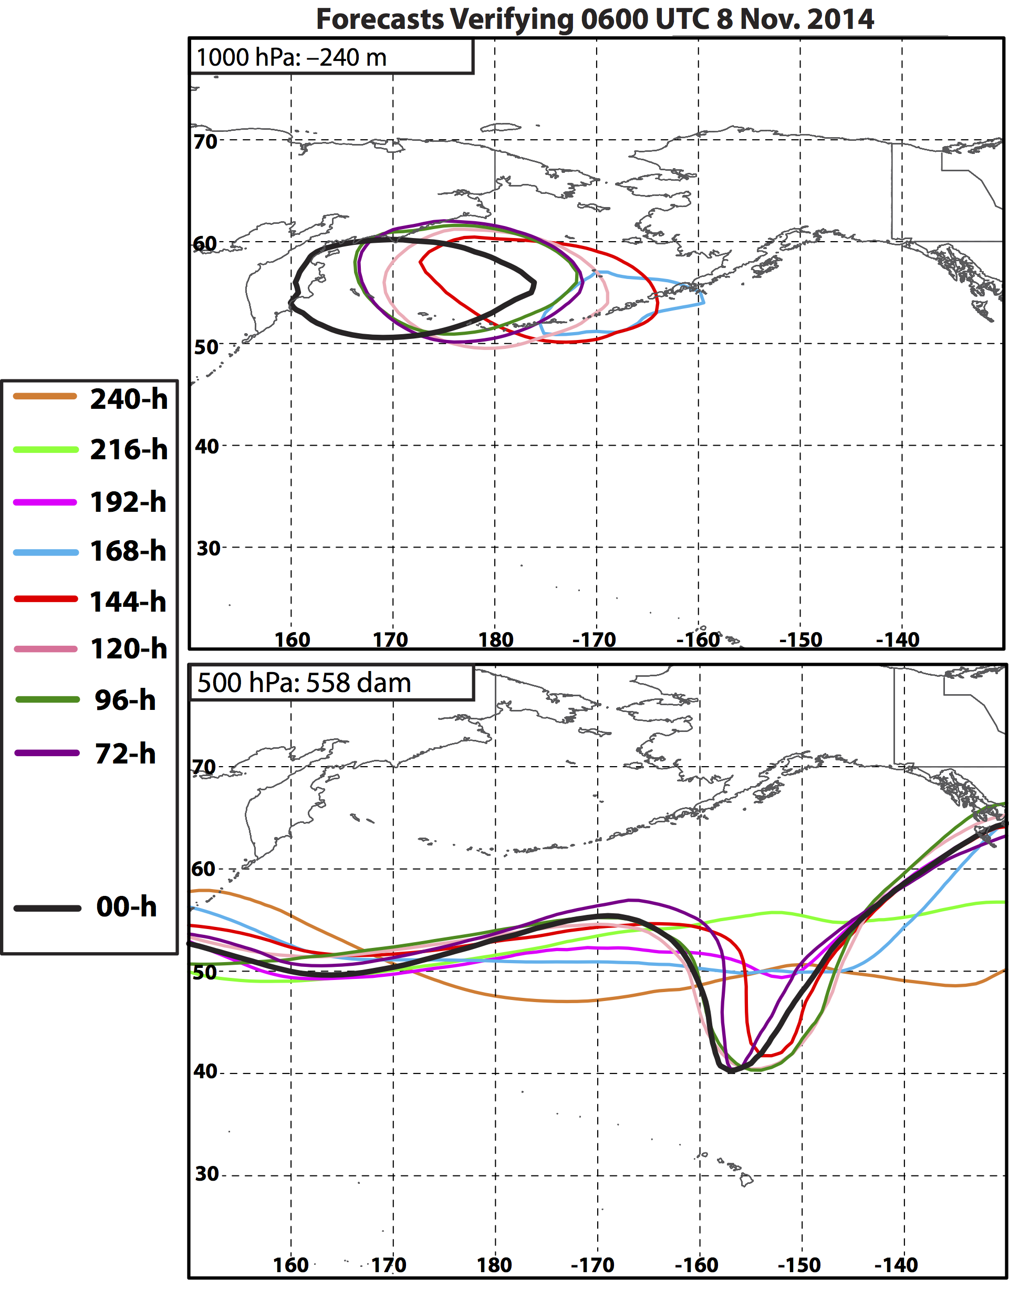
Nuri’s ET – 8 Nov.
144-h forecast:
First forecast to show Nuri intensifying to levels that match observations.
Coincident with an indication of trough development poleward of Hawaii.

Slide 27
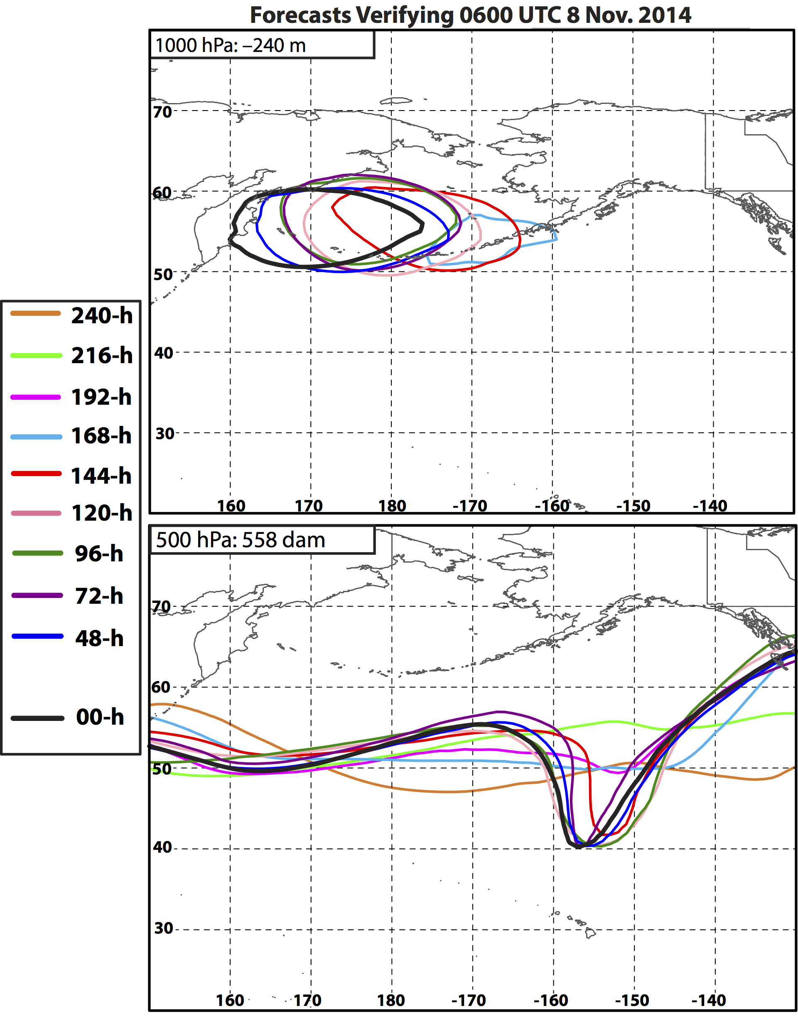
Nuri’s ET – 8 Nov.
144-h forecast:
First forecast to show Nuri intensifying to levels that match observations.
Coincident with an indication of trough development poleward of Hawaii.

Slide 28
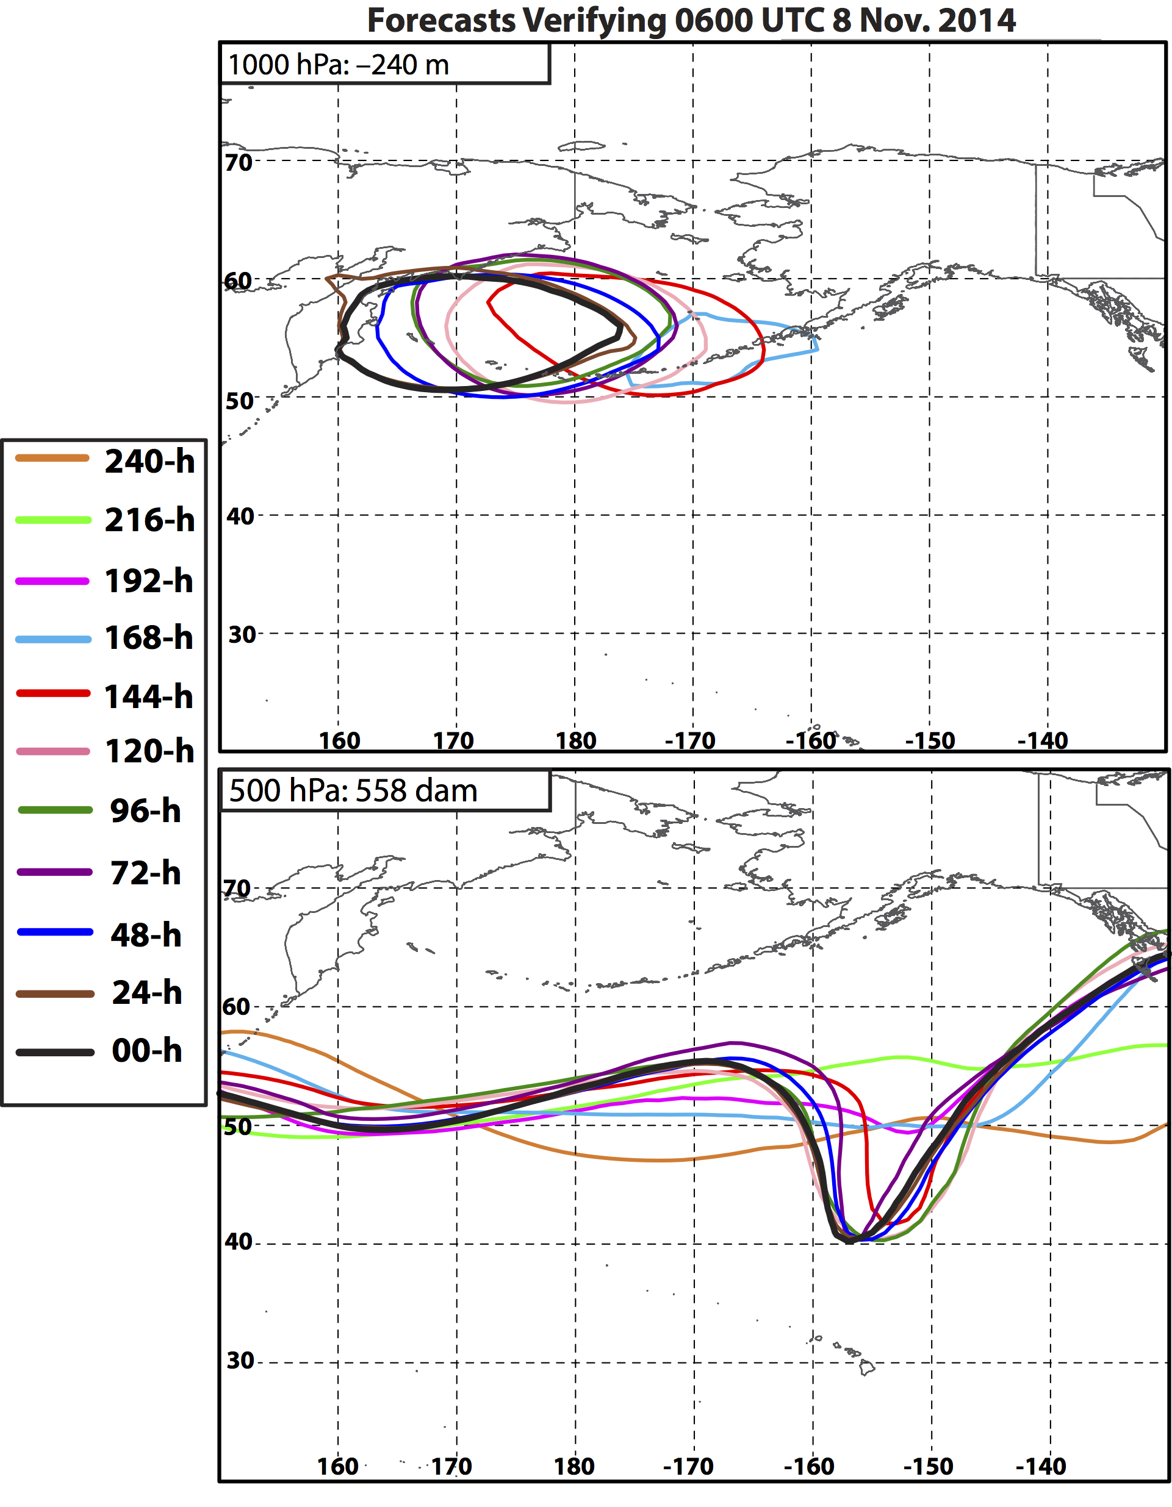
Nuri’s ET – 8 Nov.
144-h forecast:
First forecast to show Nuri intensifying to levels that match observations.
Coincident with an indication of trough development poleward of Hawaii.
144-to-00-h forecast: Westward shift in the location of post-ET Nuri in each subsequent forecast.

Slide 29
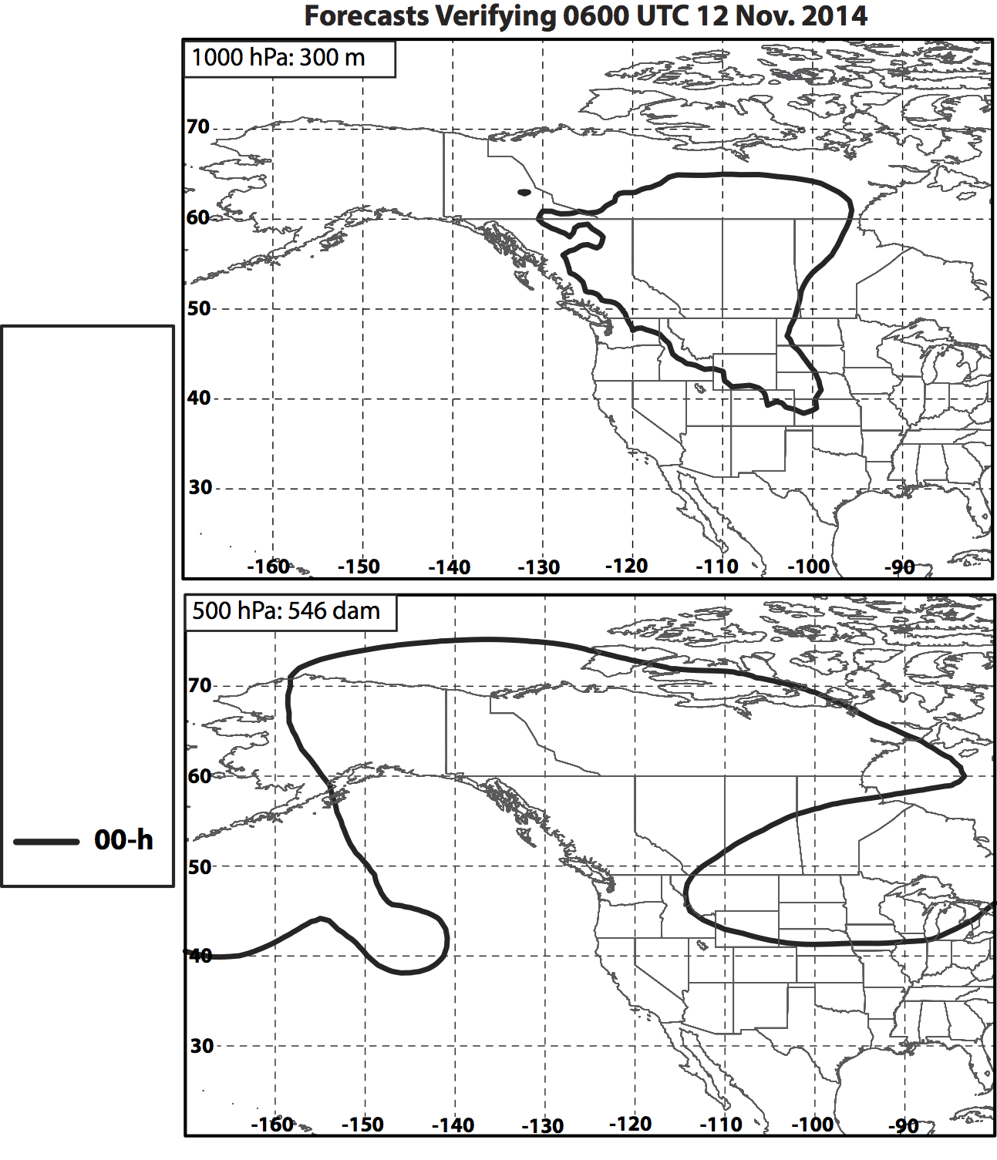
Eastern N. Pacific Ridge – 12 Nov.

Slide 30
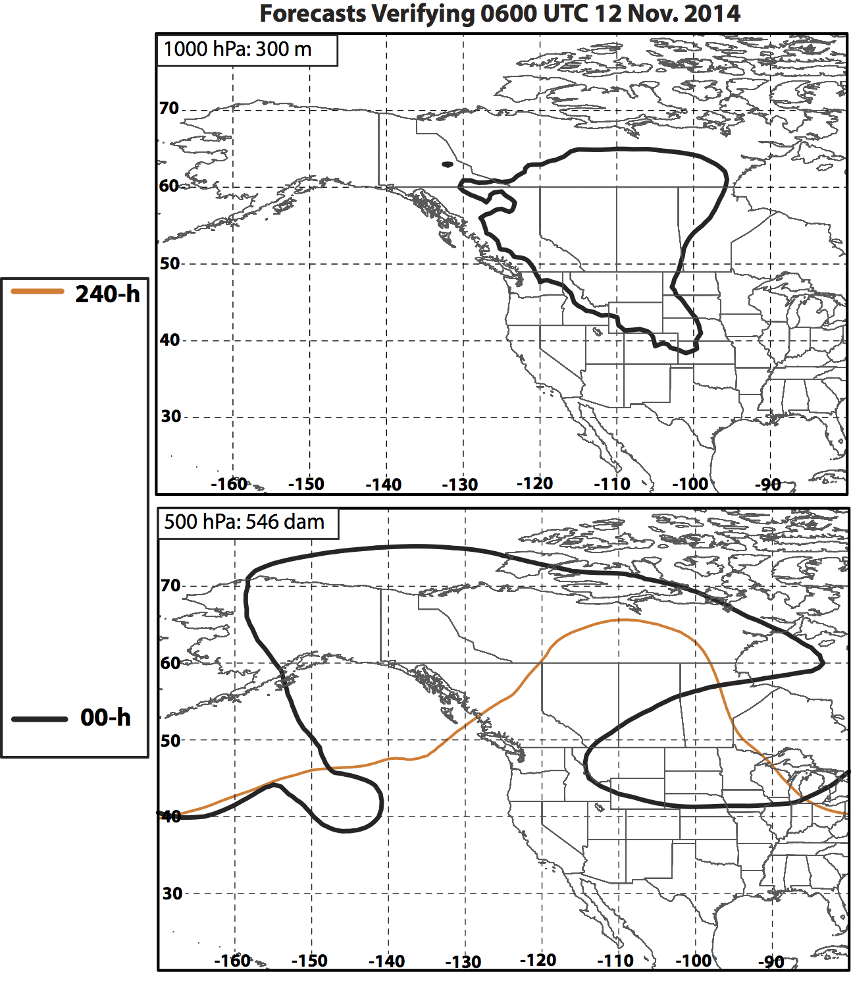
Eastern N. Pacific Ridge – 12 Nov.

Slide 31
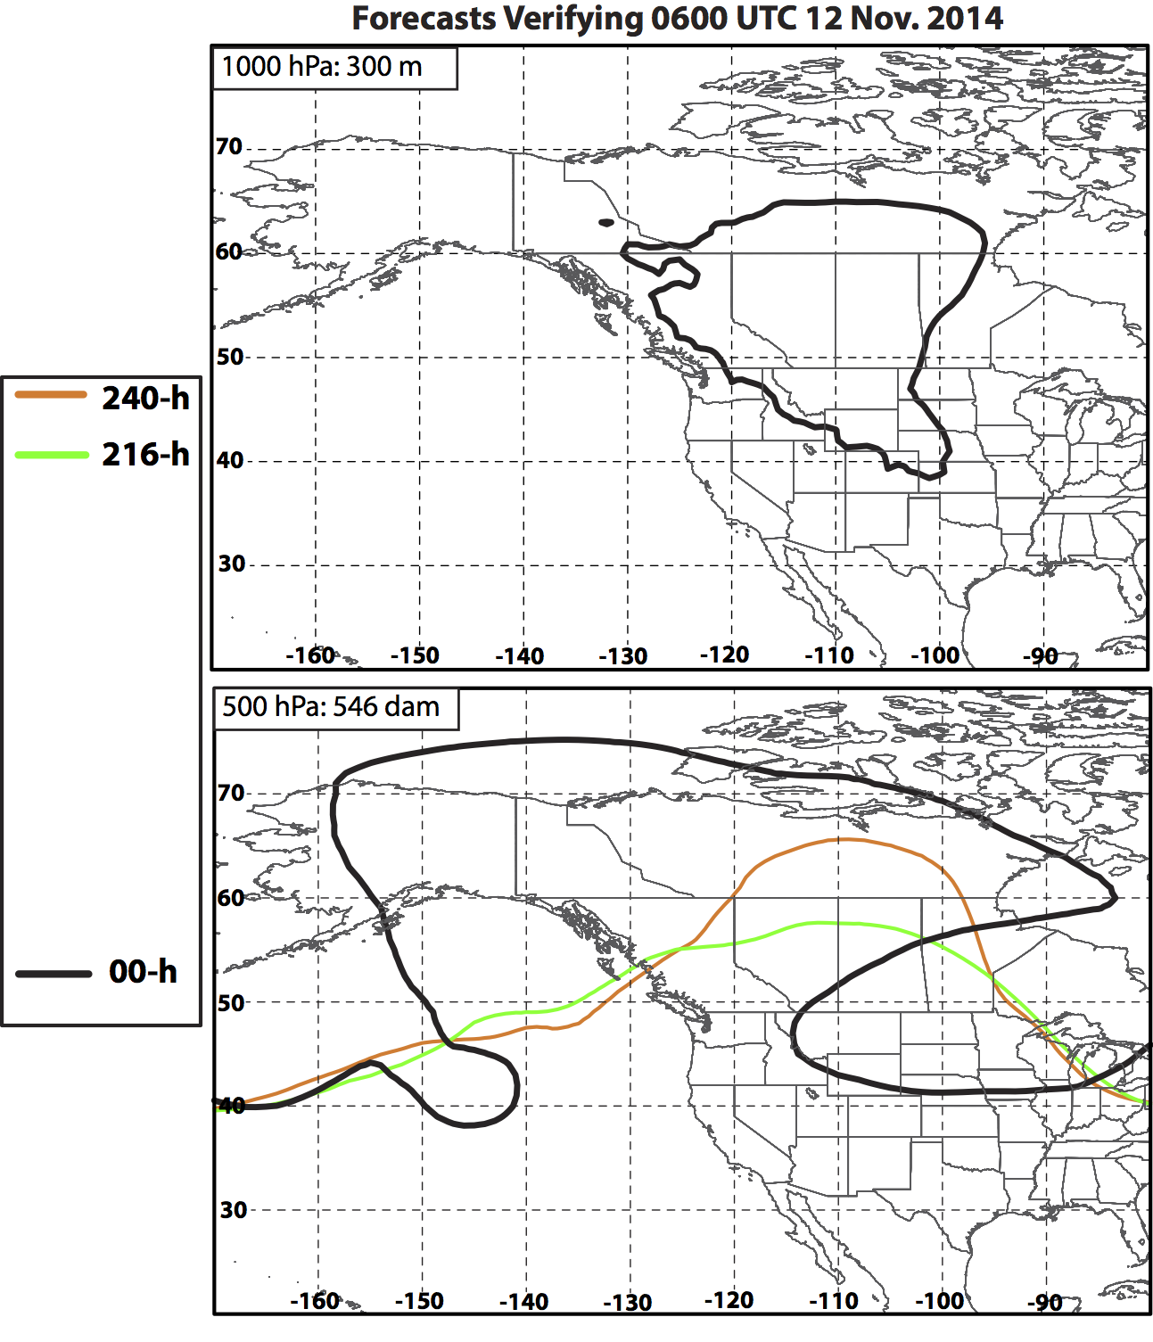
Eastern N. Pacific Ridge – 12 Nov.

Slide 32
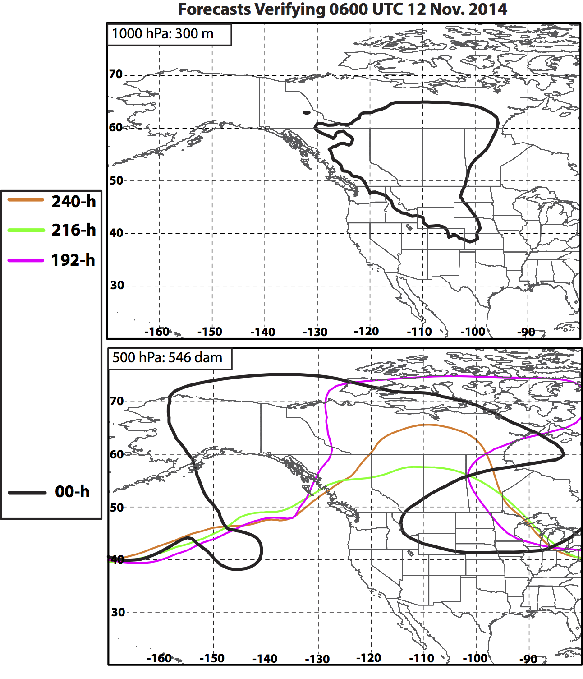
Eastern N. Pacific Ridge – 12 Nov.

Slide 33
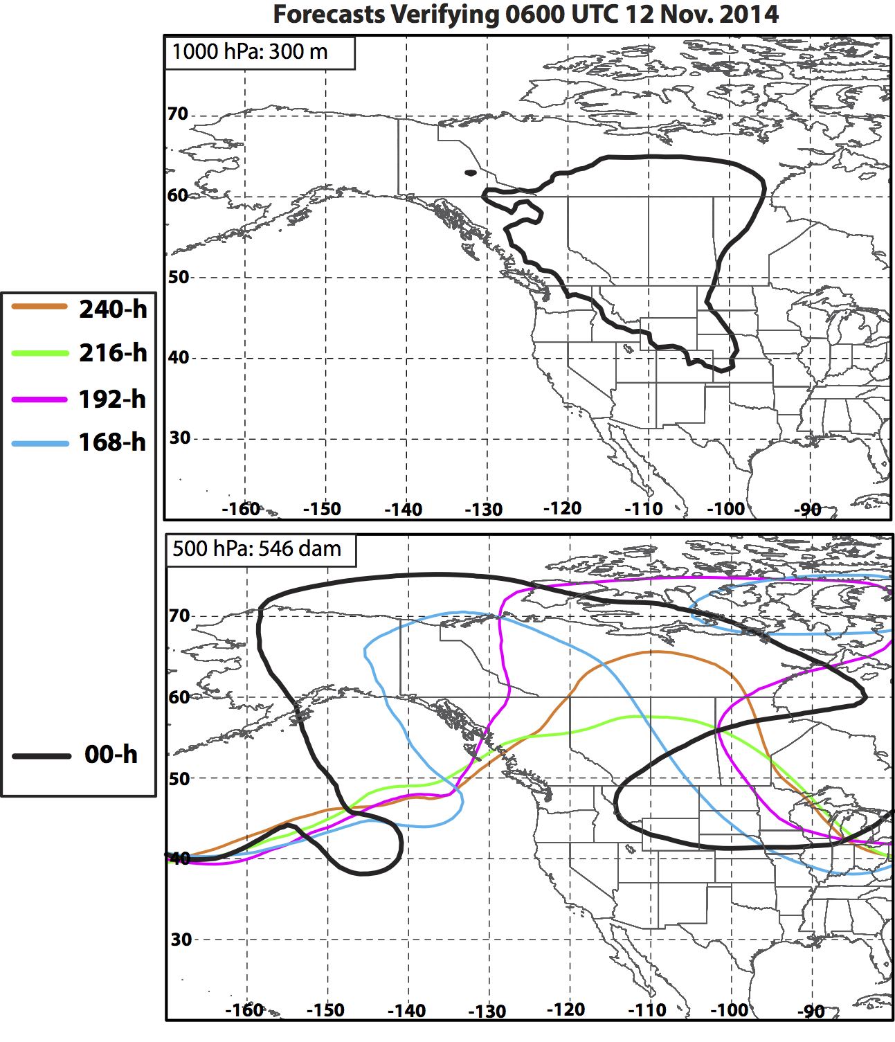
Eastern N. Pacific Ridge – 12 Nov.
168-h forecast:
First indication of negatively-tilted trough west of British Columbia.

Slide 34
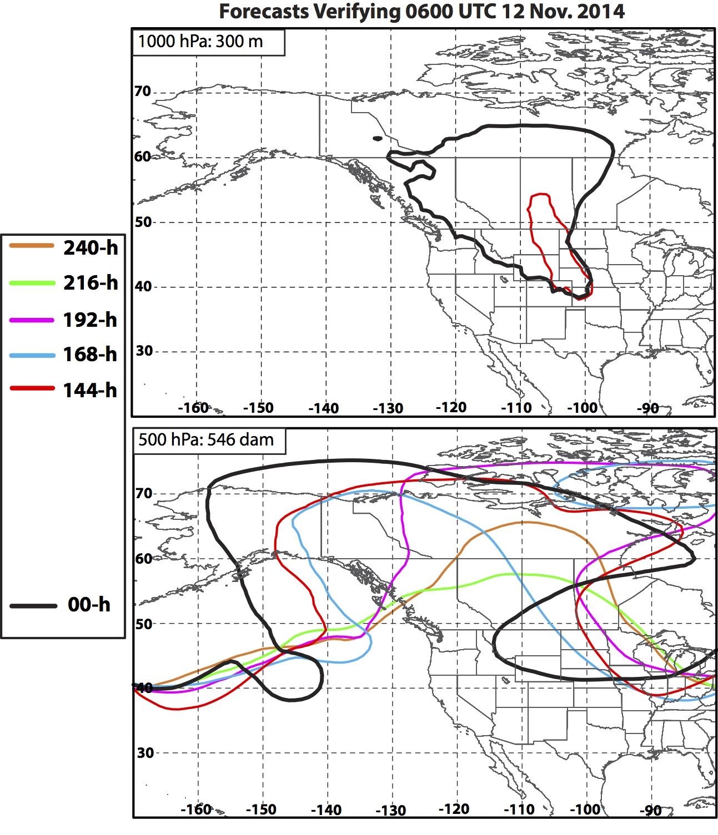
Eastern N. Pacific Ridge – 12 Nov.
168-h forecast:
First indication of negatively-tilted trough west of British Columbia.
144-h forecast:
First indication of strong anticyclone (>300 m) east of the Rockies.
Coincides with better resolution of the eastern side of the omega block.

Slide 35
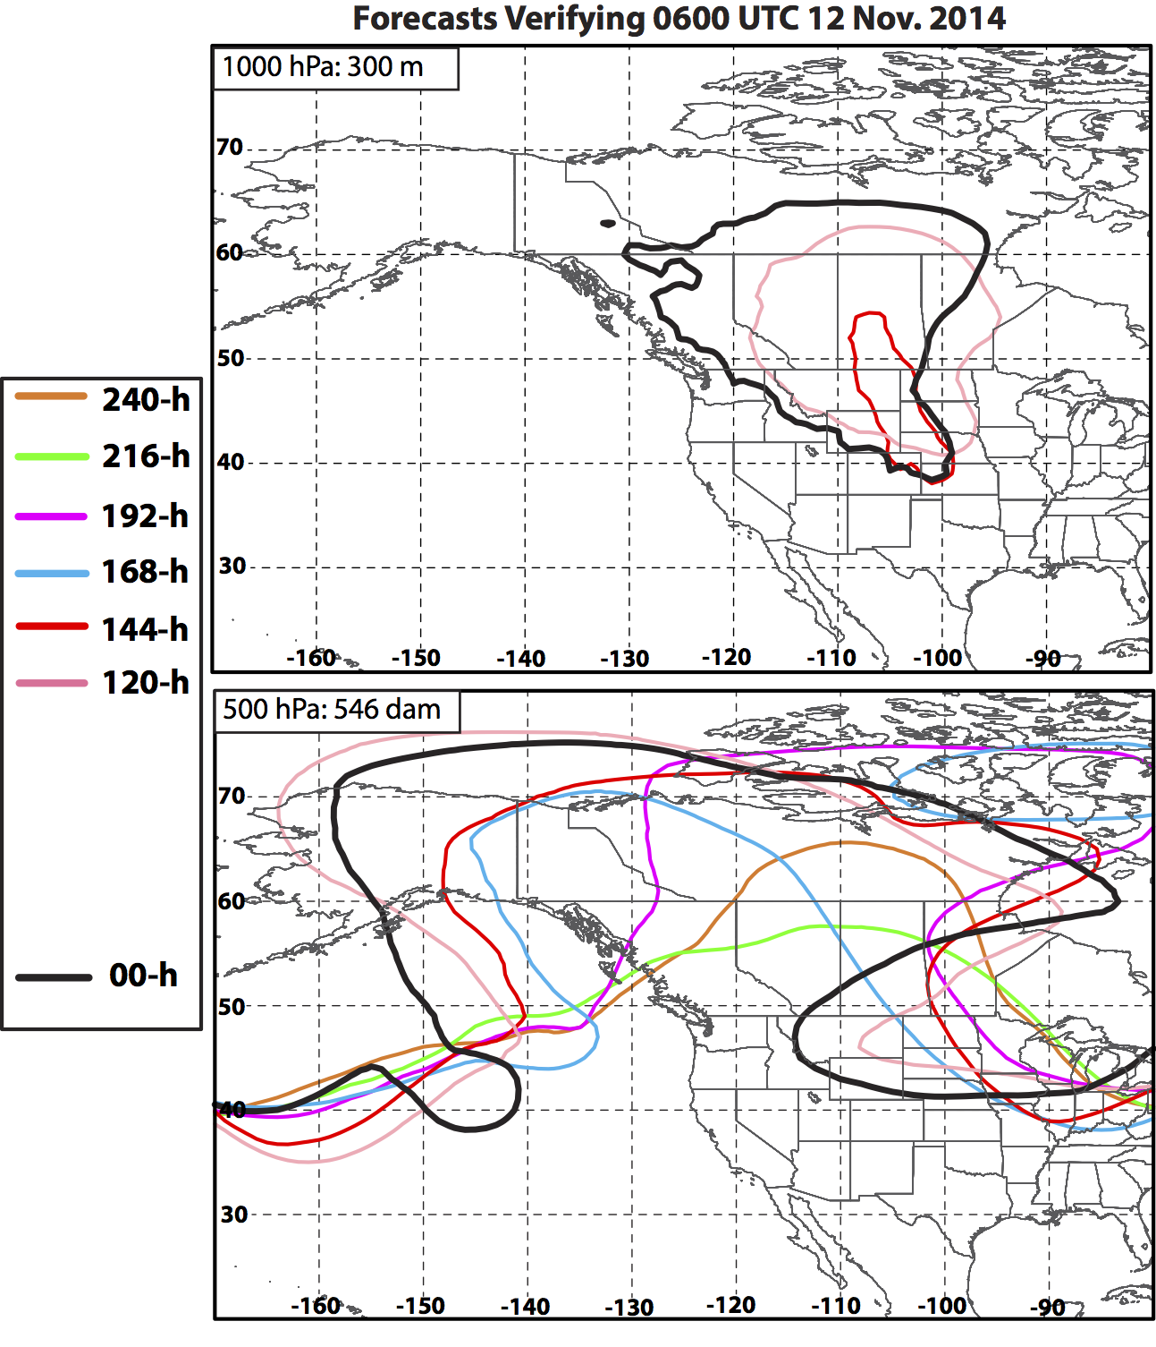
Eastern N. Pacific Ridge – 12 Nov.
168-h forecast:
First indication of negatively-tilted trough west of British Columbia.
144-h forecast:
First indication of strong anticyclone (>300 m) east of the Rockies.
Coincides with better resolution of the eastern side of the omega block.
Forecasts improve once Nuri’s ET occurs

Slide 36
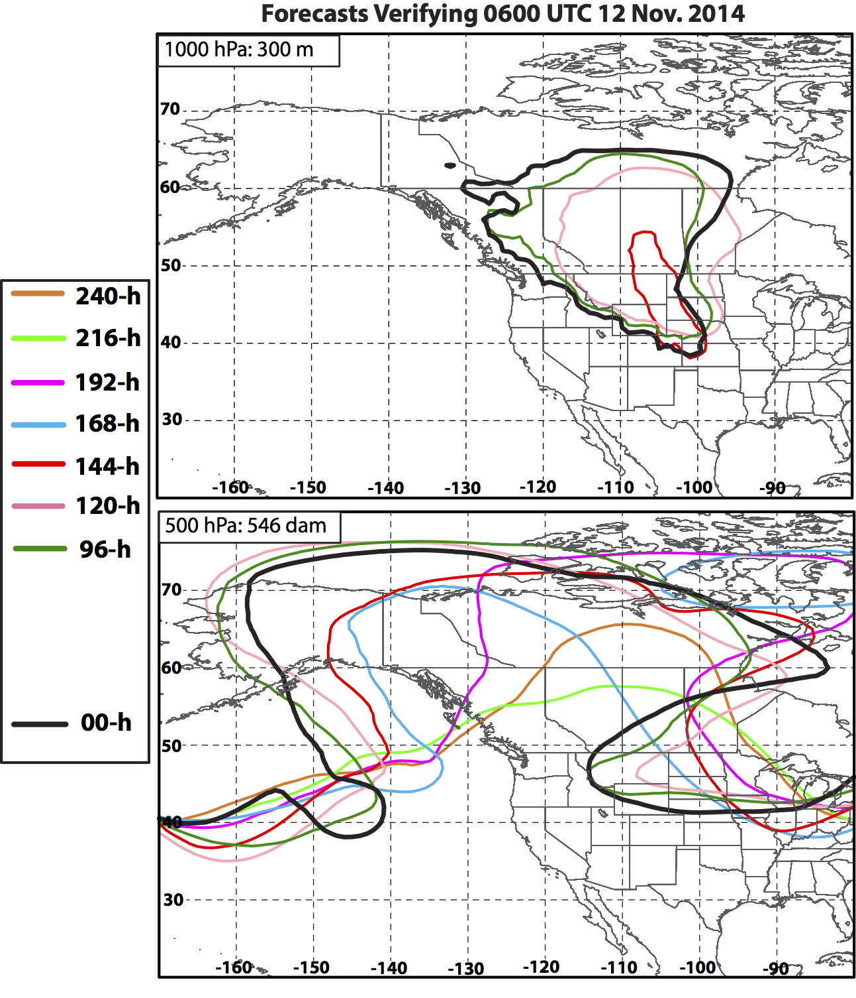
Eastern N. Pacific Ridge – 12 Nov.
168-h forecast:
First indication of negatively-tilted trough west of British Columbia.
144-h forecast:
First indication of strong anticyclone (>300 m) east of the Rockies.
Coincides with better resolution of the eastern side of the omega block.
Forecasts improve once Nuri’s ET occurs

Slide 37
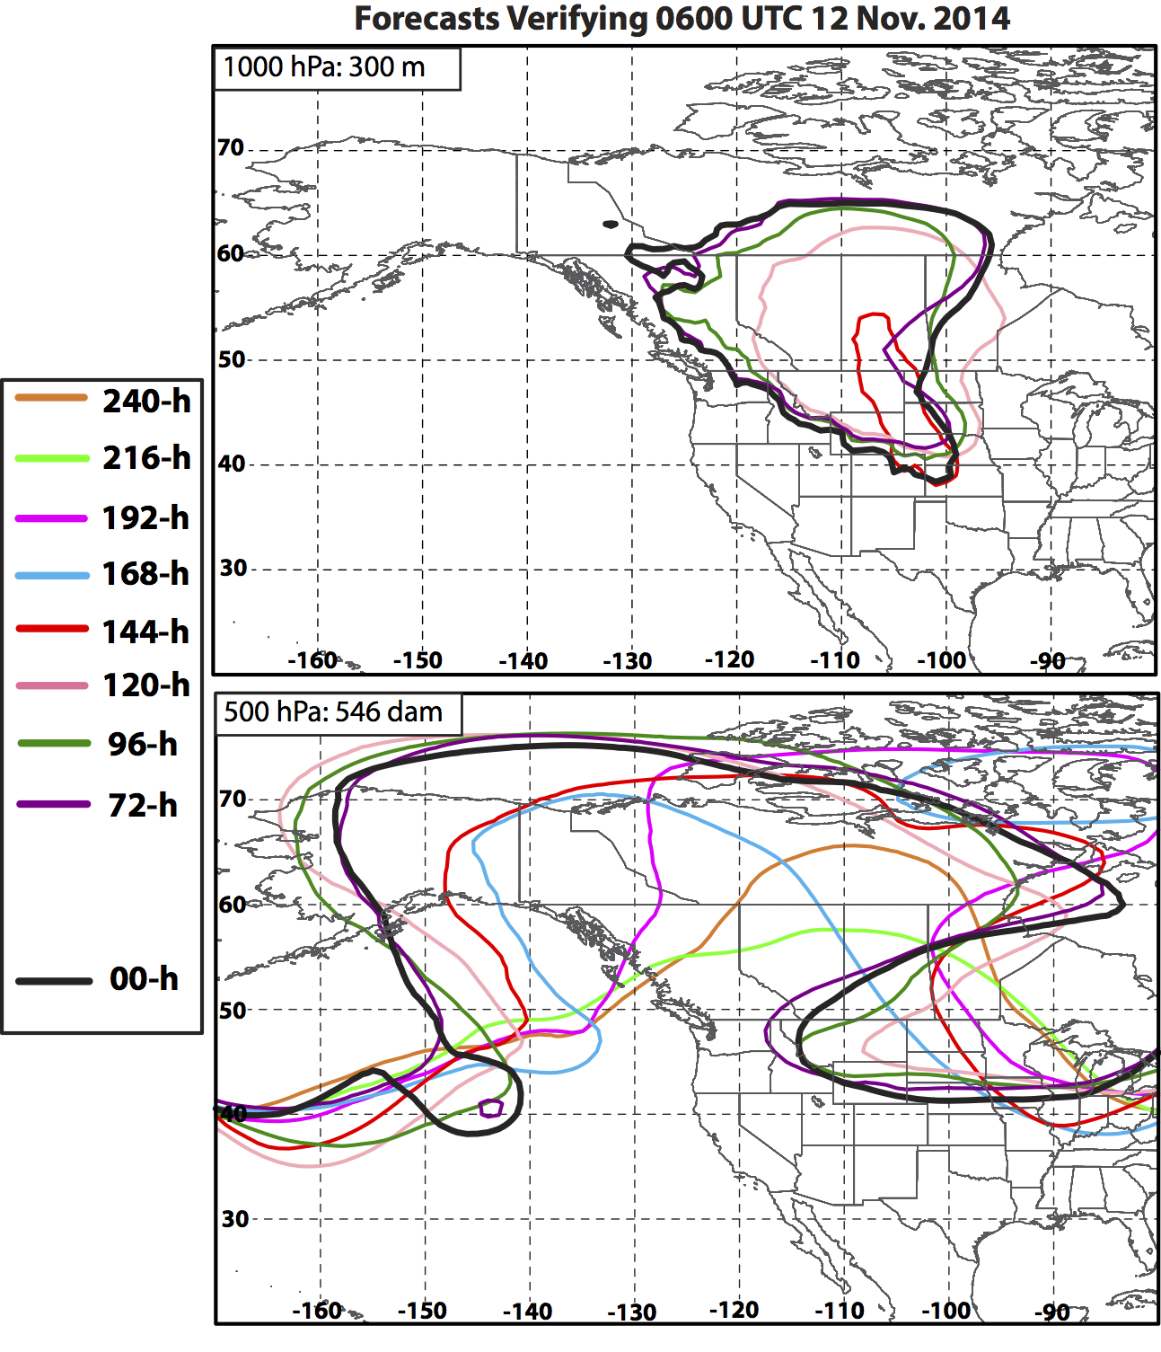
Eastern N. Pacific Ridge – 12 Nov.
168-h forecast:
First indication of negatively-tilted trough west of British Columbia.
144-h forecast:
First indication of strong anticyclone (>300 m) east of the Rockies.
Coincides with better resolution of the eastern side of the omega block.
Forecasts improve once Nuri’s ET occurs

Slide 38
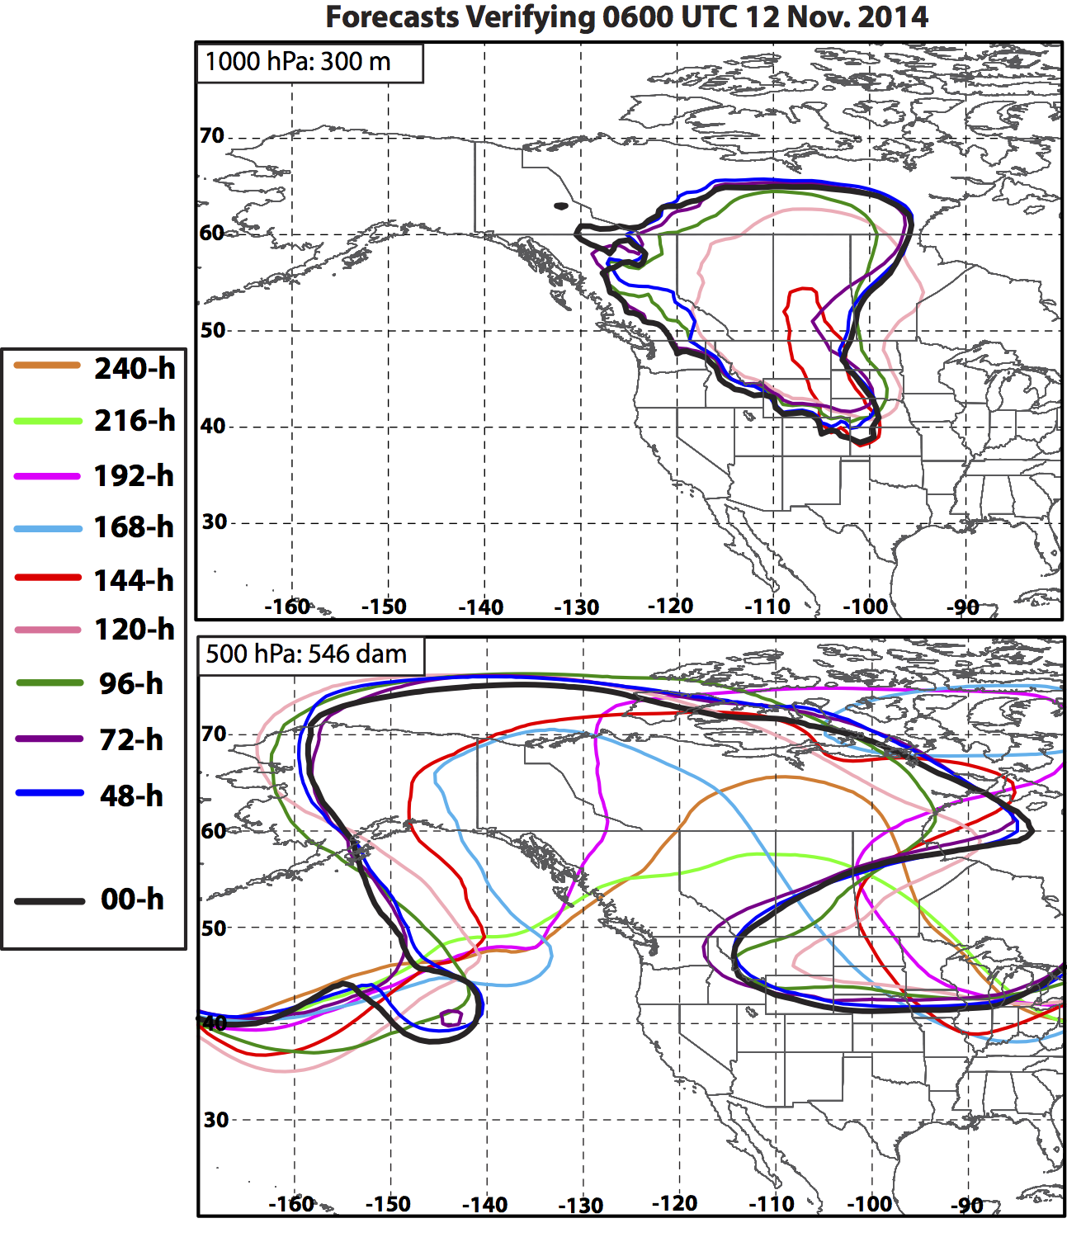
Eastern N. Pacific Ridge – 12 Nov.
168-h forecast:
First indication of negatively-tilted trough west of British Columbia.
144-h forecast:
First indication of strong anticyclone (>300 m) east of the Rockies.
Coincides with better resolution of the eastern side of the omega block.
Forecasts improve once Nuri’s ET occurs

Slide 39
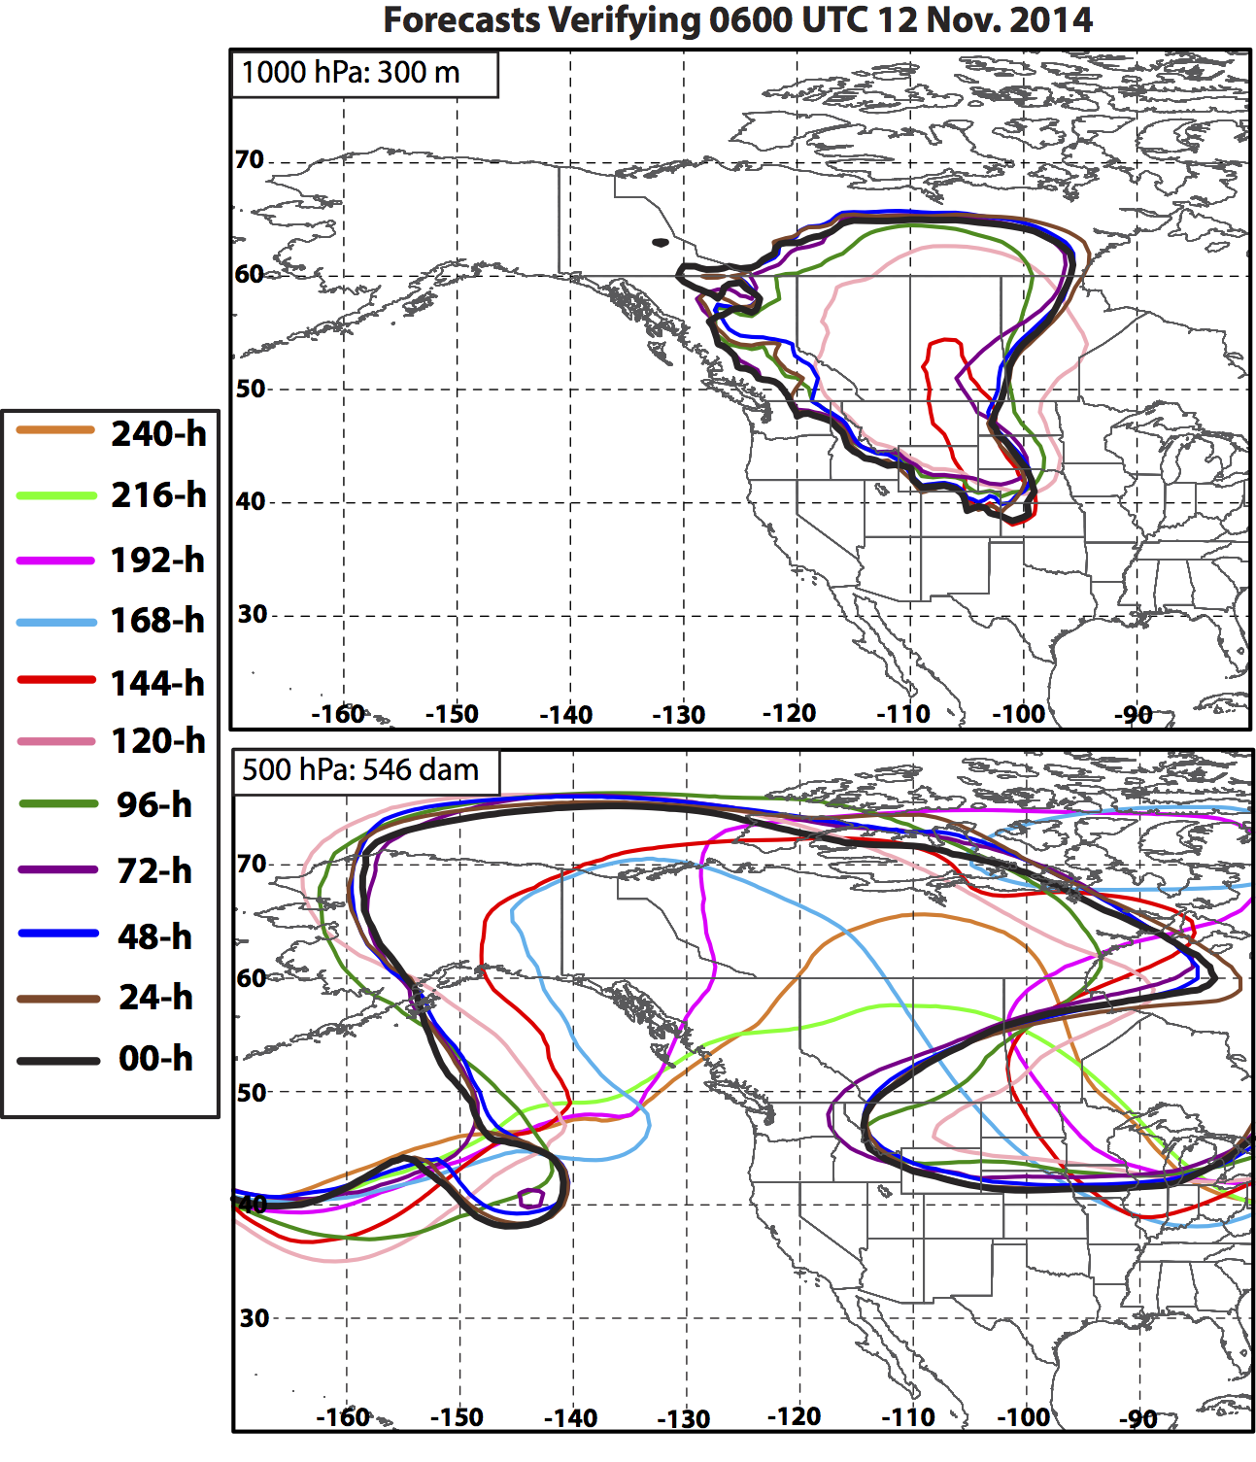
Eastern N. Pacific Ridge – 12 Nov.
168-h forecast:
First indication of negatively-tilted trough west of British Columbia.
144-h forecast:
First indication of strong anticyclone (>300 m) east of the Rockies.
Coincides with better resolution of the eastern side of the omega block.
Forecasts improve once Nuri’s ET occurs

Slide 40
“Apocalyptic” Snows in the Northeast: 24 January – 16 February 2015

Slide 41
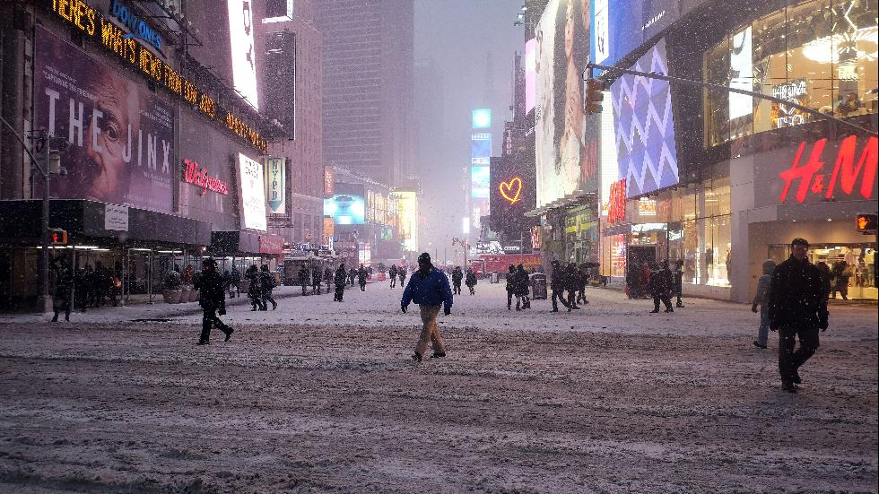
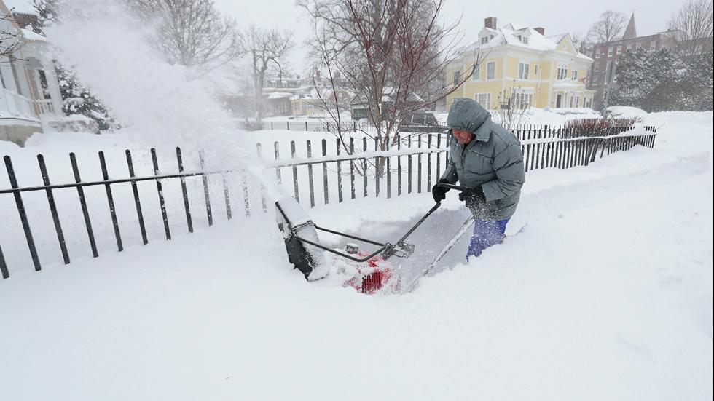
Event Statistics: NYC Brushed and Boston Buried
Two sequential cyclogenesis events impacted East Coast in January 2015.
Snowfall totals for the second storm were >1 m (3 ft) in some locations.
Considerable coastal flooding reported in MA with wind gusts >60 kts.
Worcester, MA, tallied 87 cm (34.5 in.) (all-time record).
Delta pre-emptively canceled 600 flights on 26 Jan.
The second storm was characterized by considerable forecast uncertainty.
Times Square
Boston
AP Photos

Slide 42
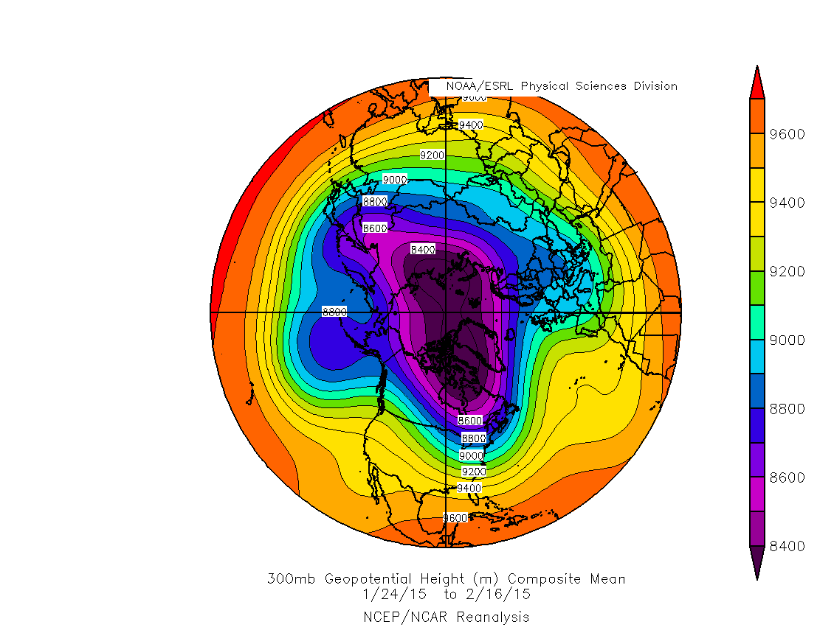
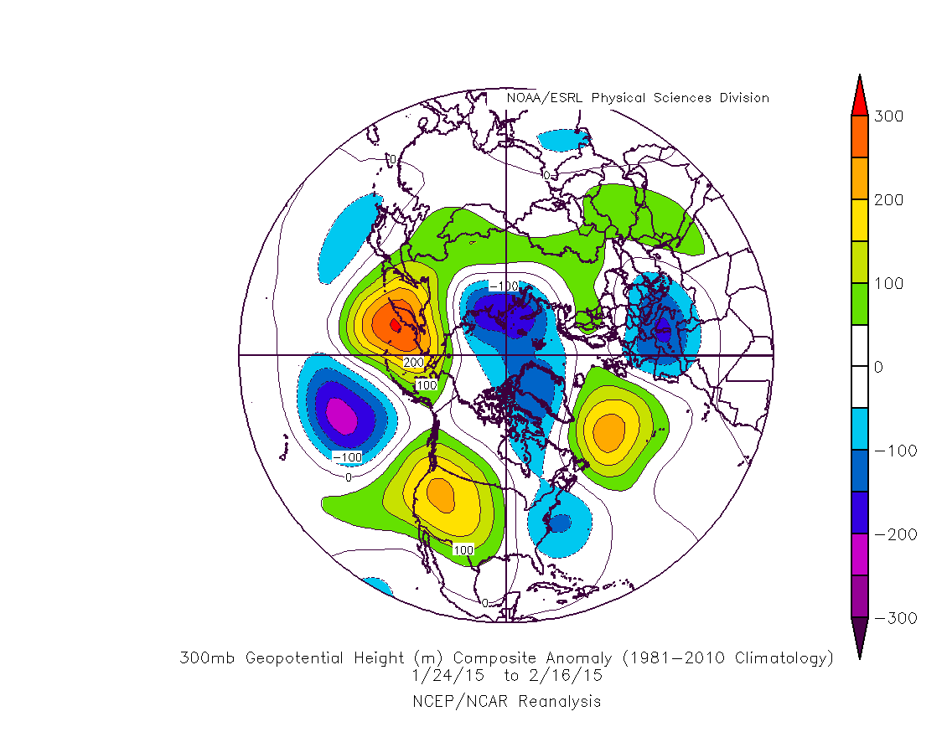
300-hPa Mean (left) and Anomaly (right) Geopotential Height (m, shaded)
24 Jan – 16 Feb 2015
Source: NOAA/ESRL/PSD

Slide 43
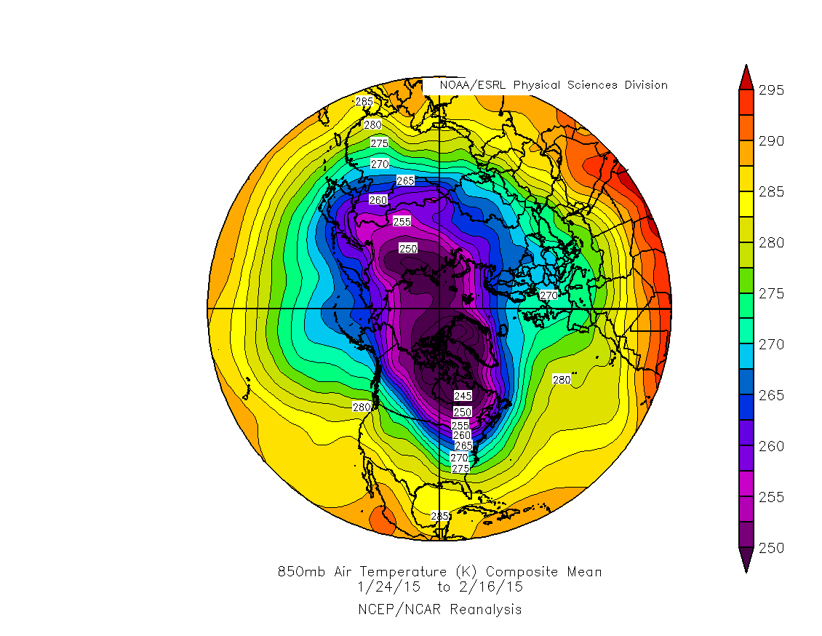
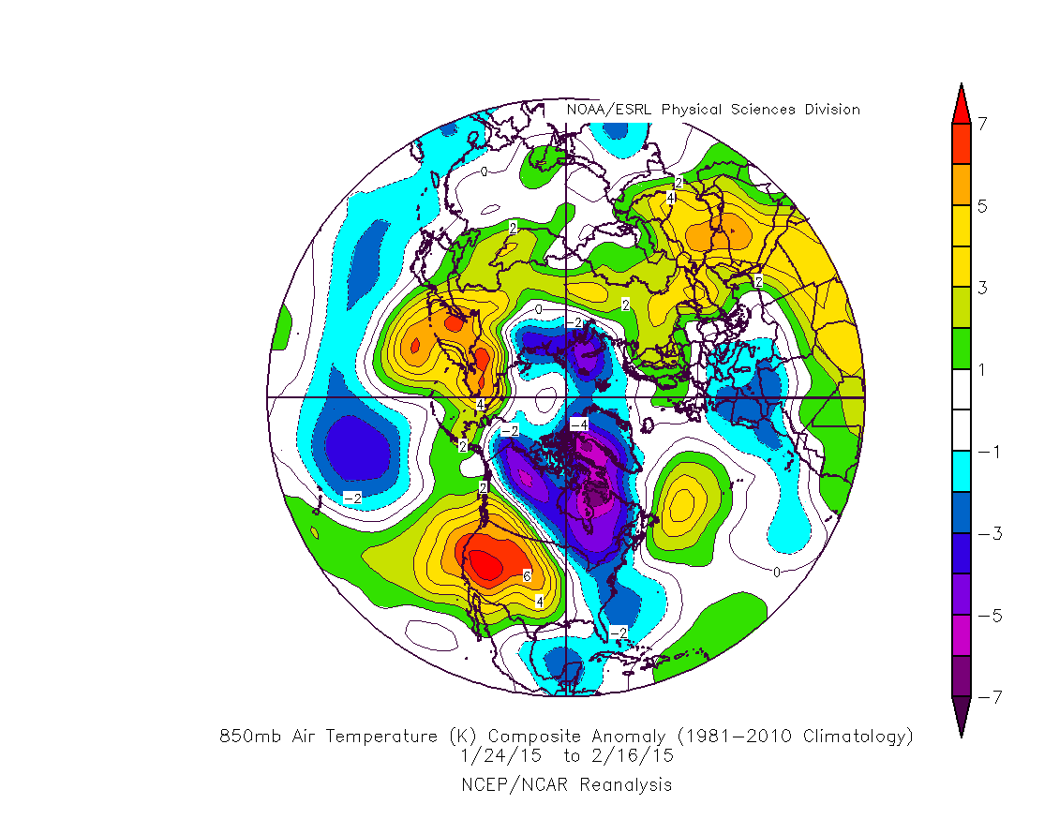
850-hPa Mean (left) and Anomaly (right) Temperature (K, shaded)
24 Jan – 16 Feb 2015
Source: NOAA/ESRL/PSD

Slide 44
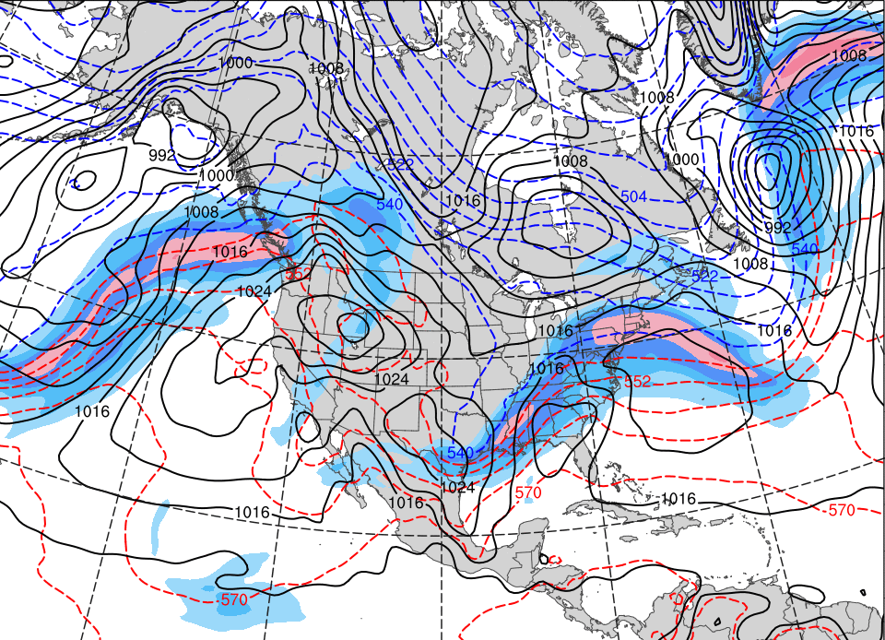
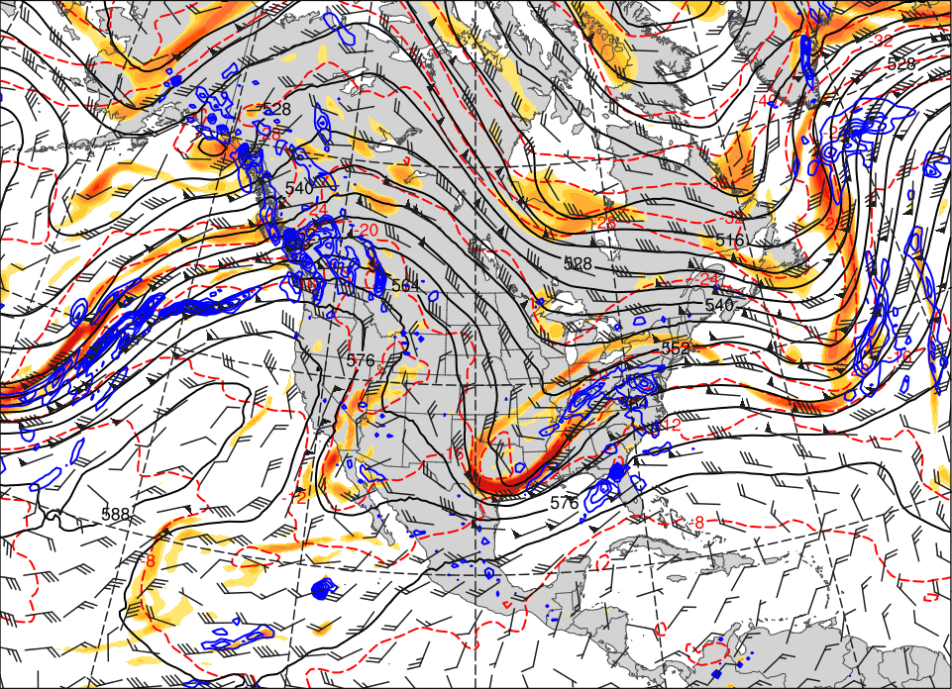
Synoptic Evolution – Late-January 2015
0000 UTC 24 Jan. 2015
500 hPa Heights (dam; black)
500 hPa Winds (kts; barbs)
500 hPa Rel. Vor. (10^{–5} s^{–1} fill pattern)
500 hPa Temp. (ºC; dashed red)
500 hPa Ascent (dPa s^{–1}; blue)
SLP (hPa; black)
1000–500 hPa Thickness (dam; dashed)
250 hPa Jet (ms^{–1}; fill pattern)

Slide 45
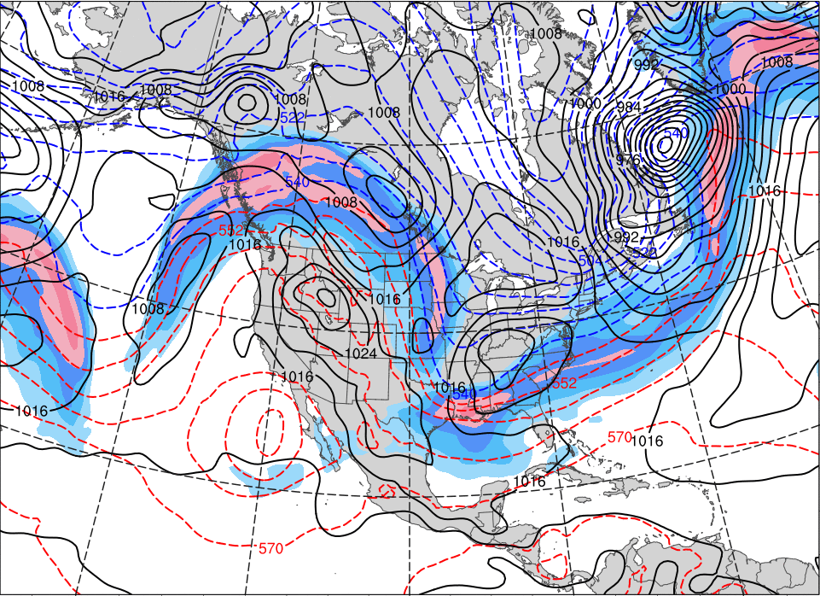
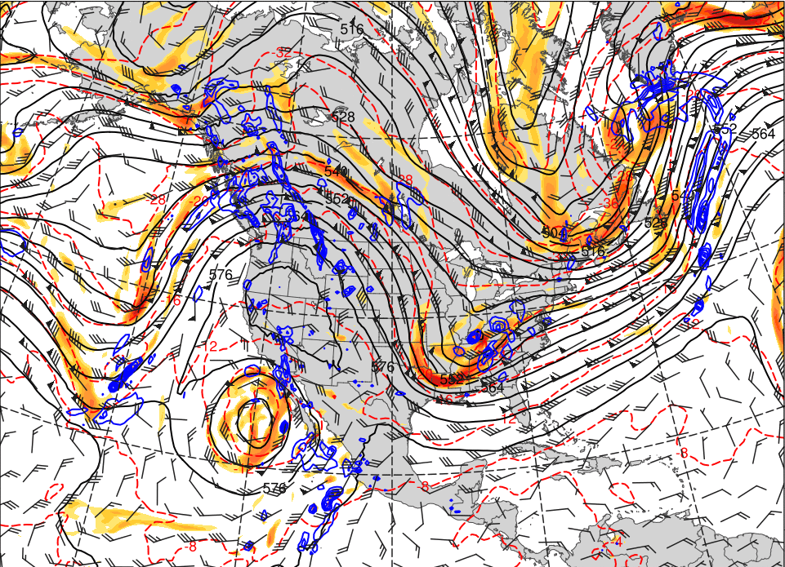
Synoptic Evolution – Late-January 2015
0000 UTC 26 Jan. 2015
500 hPa Heights (dam; black)
500 hPa Winds (kts; barbs)
500 hPa Rel. Vor. (10^{–5} s^{–1} fill pattern)
500 hPa Temp. (ºC; dashed red)
500 hPa Ascent (dPa s^{–1}; blue)
SLP (hPa; black)
1000–500 hPa Thickness (dam; dashed)
250 hPa Jet (ms^{–1}; fill pattern)

Slide 46
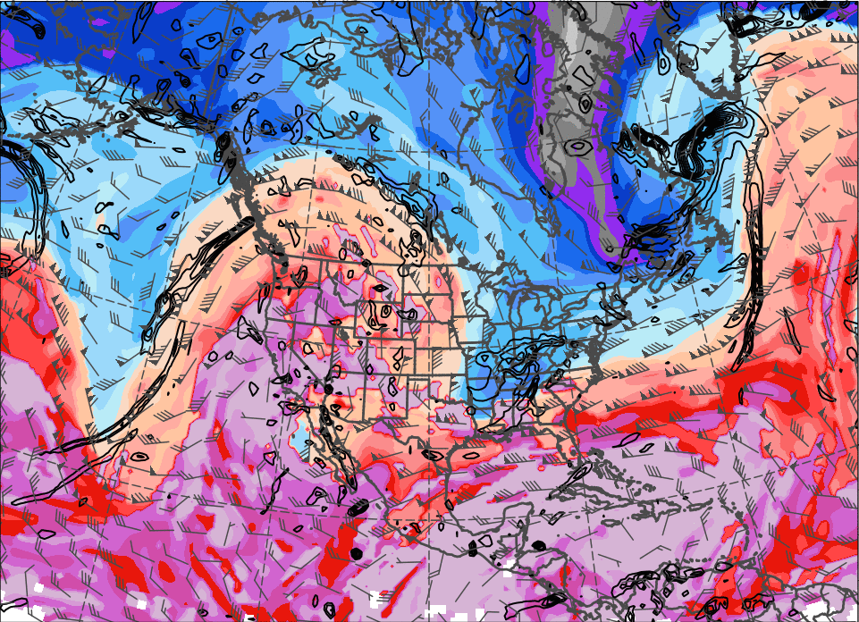
0000 UTC 26 Jan. 2015
Top Left: SLP, 1000–500 hPa Thickness, and the 250-hPa Jet
Top Right: 500 hPa Rel. Vor., Heights, Winds, Temperature, and Ascent
Bottom Left: DT Theta (K; fill), Winds (kts; barbs), 925–850 hPa Rel. Vor. (10^{–5} s^{–1};black)

Slide 47
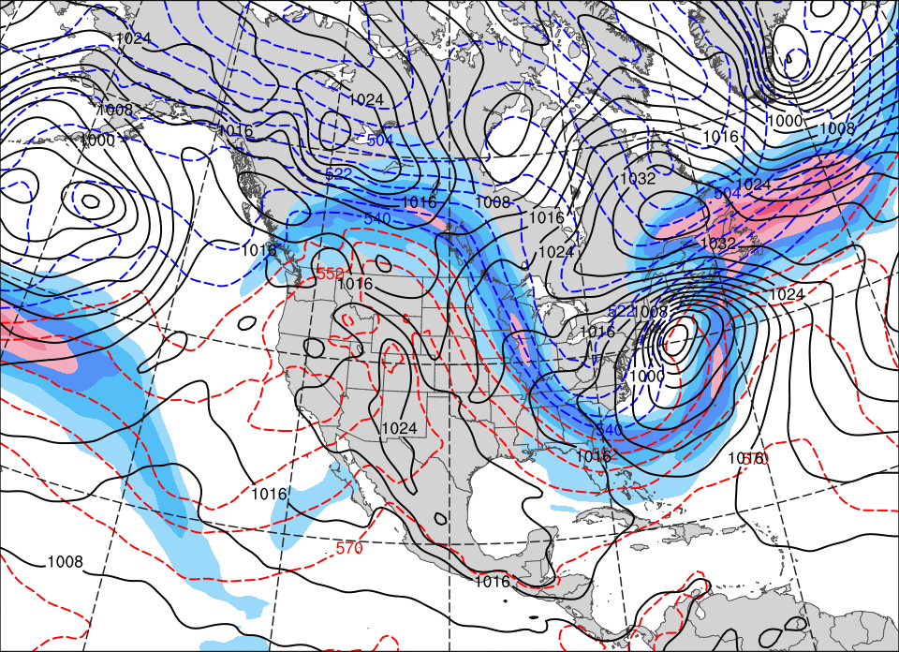
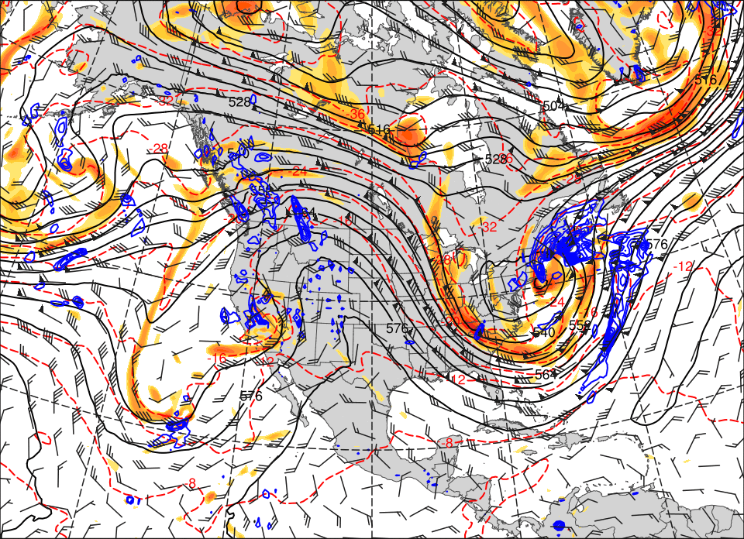
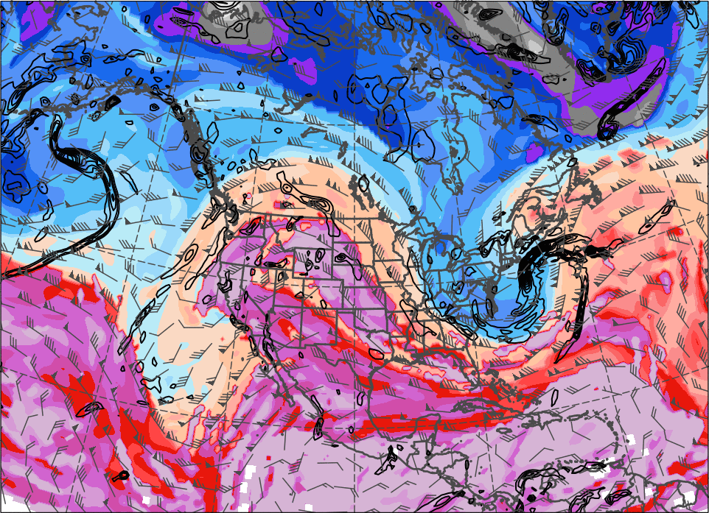
0000 UTC 27 Jan. 2015
Top Left: SLP, 1000–500 hPa Thickness, and the 250-hPa Jet
Top Right: 500 hPa Rel. Vor., Heights, Winds, Temperature, and Ascent
Bottom Left: DT Theta (K; fill), Winds (kts; barbs), 925–850 hPa Rel. Vor. (10^{–5} s^{–1};black)

Slide 48
RMSE of Geopotential Heights (m) Verifying
1800 UTC 27 January 2015
250
500 hPa
1000 hPa
200
150
100
50
0
222
01/18
168
01/20
120
01/22
72
01/24
24
01/26
222
01/18
168
01/20
120
01/22
72
01/24
24
01/26
Forecast Hour (h)
96-h: GEFS Forecasts improve after ridge amplification begins in the eastern N. Pacific (1800 UTC 23 Jan.)

Slide 49
GEFS Ensemble Spread of Geo. Heights (m) Verifying 1800 UTC 27 January 2015
240-h Forecast
1000 hPa
500 hPa
Ens. Spread:
Ens. Mean Geo. Heights
Observed Geo. Heights

Slide 50
GEFS Ensemble Spread of Geo. Heights (m) Verifying 1800 UTC 27 January 2015
120-h Forecast
1000 hPa
500 hPa
Ens. Spread:
Ens. Mean Geo. Heights
Observed Geo. Heights

Slide 51
GEFS Ensemble Spread of Geo. Heights (m) Verifying 1800 UTC 27 January 2015
72-h Forecast
1000 hPa
500 hPa
Ens. Spread:
Ens. Mean Geo. Heights
Observed Geo. Heights

Slide 52
Science and Forecast Implications
Extreme weather events (EWEs) during a single season can contribute disproportionately to temperature and precipitation anomaly statistics for a given month or season
EWEs need to be considered in documenting and understanding the dynamical and thermodynamical processes that operate at the weather-climate intersection
The skill of operational probabilistic temperature and precipitation forecasts during the week two (8–14 day) period will likely be very sensitive to whether or not EWEs occur

Slide 53
Conclusions
The ET/EC of STY Nuri in Nov 2014 reconfigured the downstream flow, enabled Omega block formation, and allowed artic air to reach the CONUS
Week two predictability was relatively low before STY Nuri’s ET/EC and relatively high subsequent to downstream Omega block formation
PV disturbances from the North Pacific and Siberia triggered the Northeast snowstorm of 27–28 Jan 2015 that was in turn set up by an earlier storm
Snow amount and location predictability was relatively low until 72–96 h before the heaviest snow fell.

