Slide 1
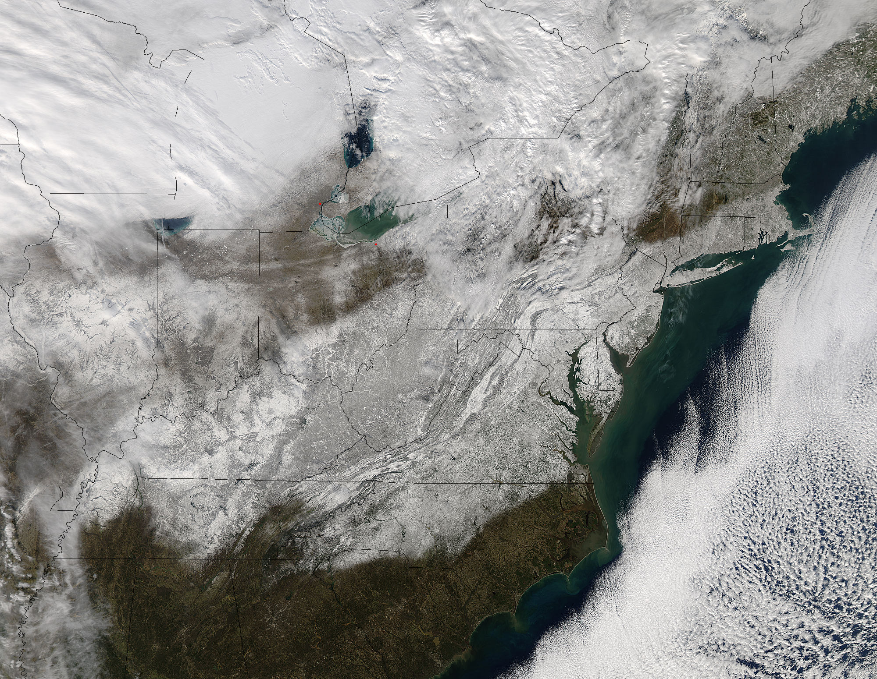


An Investigation of the Skill of GFS/GEFS Forecasts for Two Recent Extreme Weather Events
Andrew C. Winters,
Lance F. Bosart, and Daniel Keyser
EMC Global Modeling Branch
18 February 2016

Slide 2

Motivation
One or several extreme weather events (EWEs) can have a substantial impact on seasonal temperature and precipitation statistics.
Jamie Henn - Twitter

Slide 3
Motivation
One or several extreme weather events (EWEs) can have a substantial impact on seasonal temperature and precipitation statistics.
EWEs need to be considered in describing and understanding the processes that operate at the
weather–climate intersection.
Jamie Henn - Twitter

Slide 4
Motivation
One or several extreme weather events (EWEs) can have a substantial impact on seasonal temperature and precipitation statistics.
EWEs need to be considered in describing and understanding the processes that operate at the
weather–climate intersection.
An increased understanding of EWEs has the potential to improve temperature and precipitation forecasts for the 8–10 day period.
Jamie Henn - Twitter

Slide 5
Objectives
1) To identify the governing atmospheric flow patterns essential to the evolution of two recent EWEs:
22–24 January 2016 Blizzard
22–23 December 2013 Ice Storm

Slide 6
Objectives
1) To identify the governing atmospheric flow patterns essential to the evolution of two recent EWEs:
22–24 January 2016 Blizzard
22–23 December 2013 Ice Storm
2) To evaluate the skill of operational GFS and GEFS forecasts for these events.

Slide 7
Objectives
1) To identify the governing atmospheric flow patterns essential to the evolution of two recent EWEs:
22–24 January 2016 Blizzard
22–23 December 2013 Ice Storm
2) To evaluate the skill of operational GFS and GEFS forecasts for these events.
3) To outline a research plan that desires to systematically identify, classify, and evaluate EWEs.

Slide 8
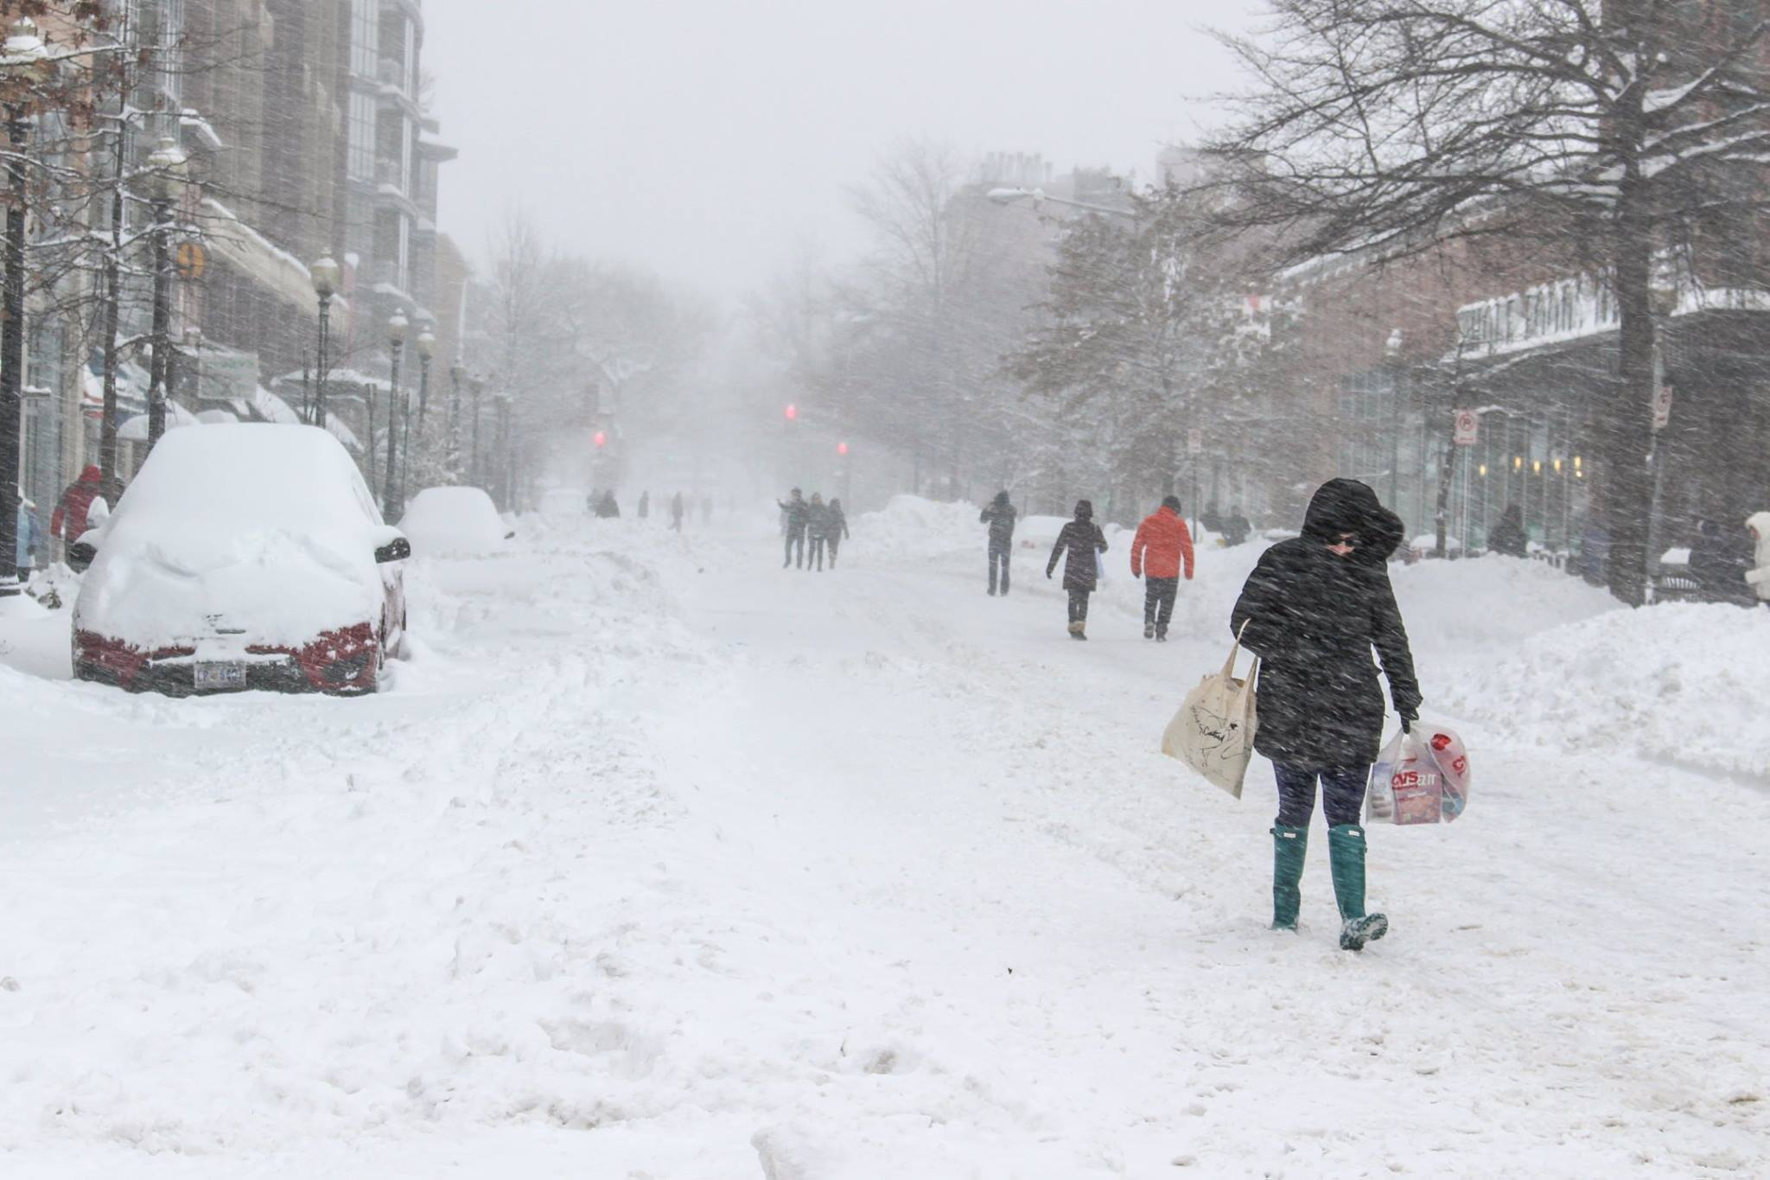
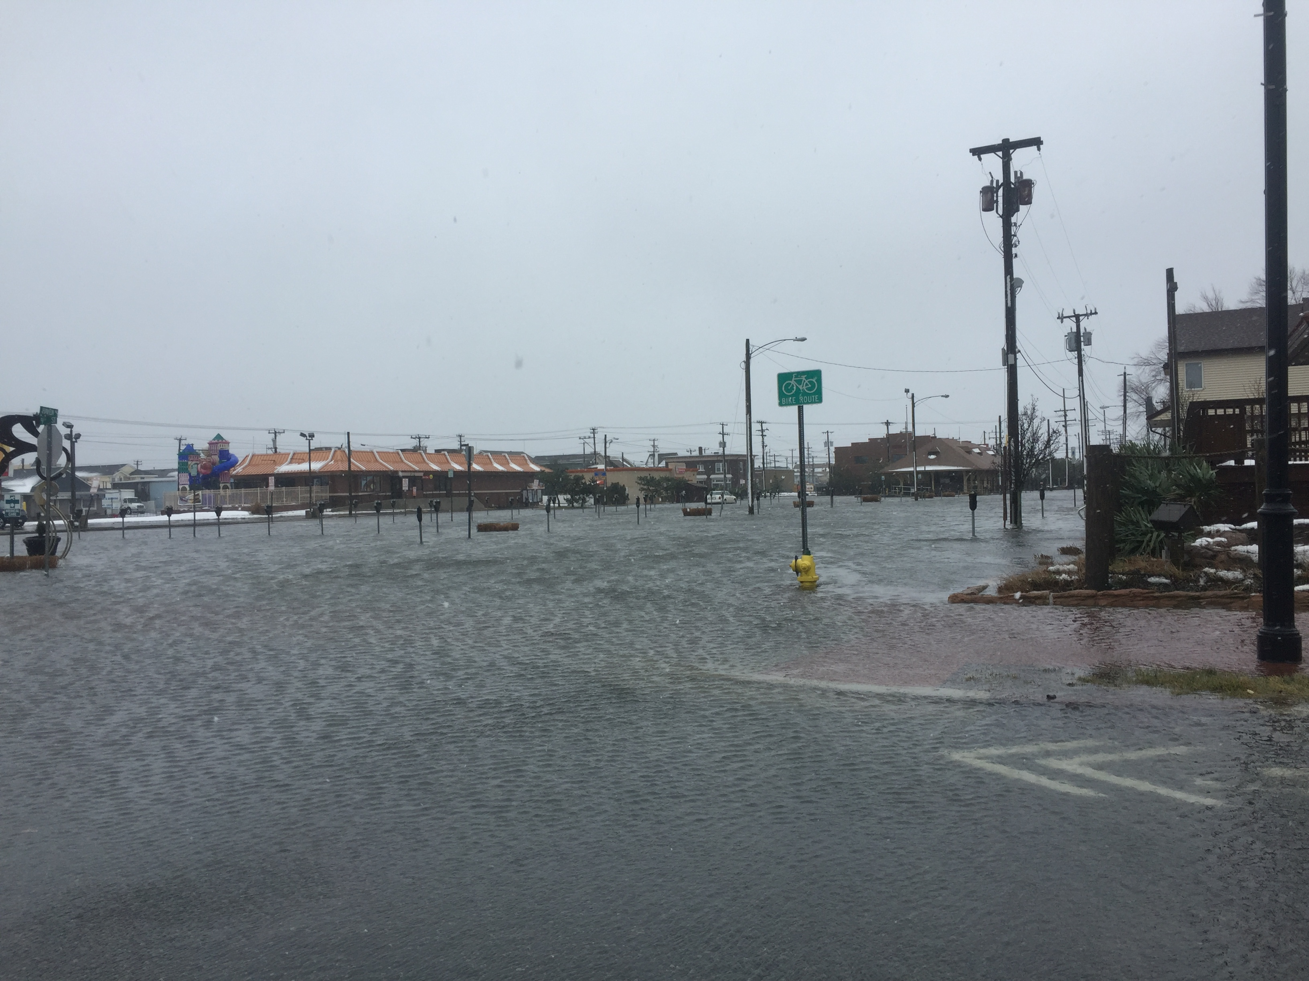
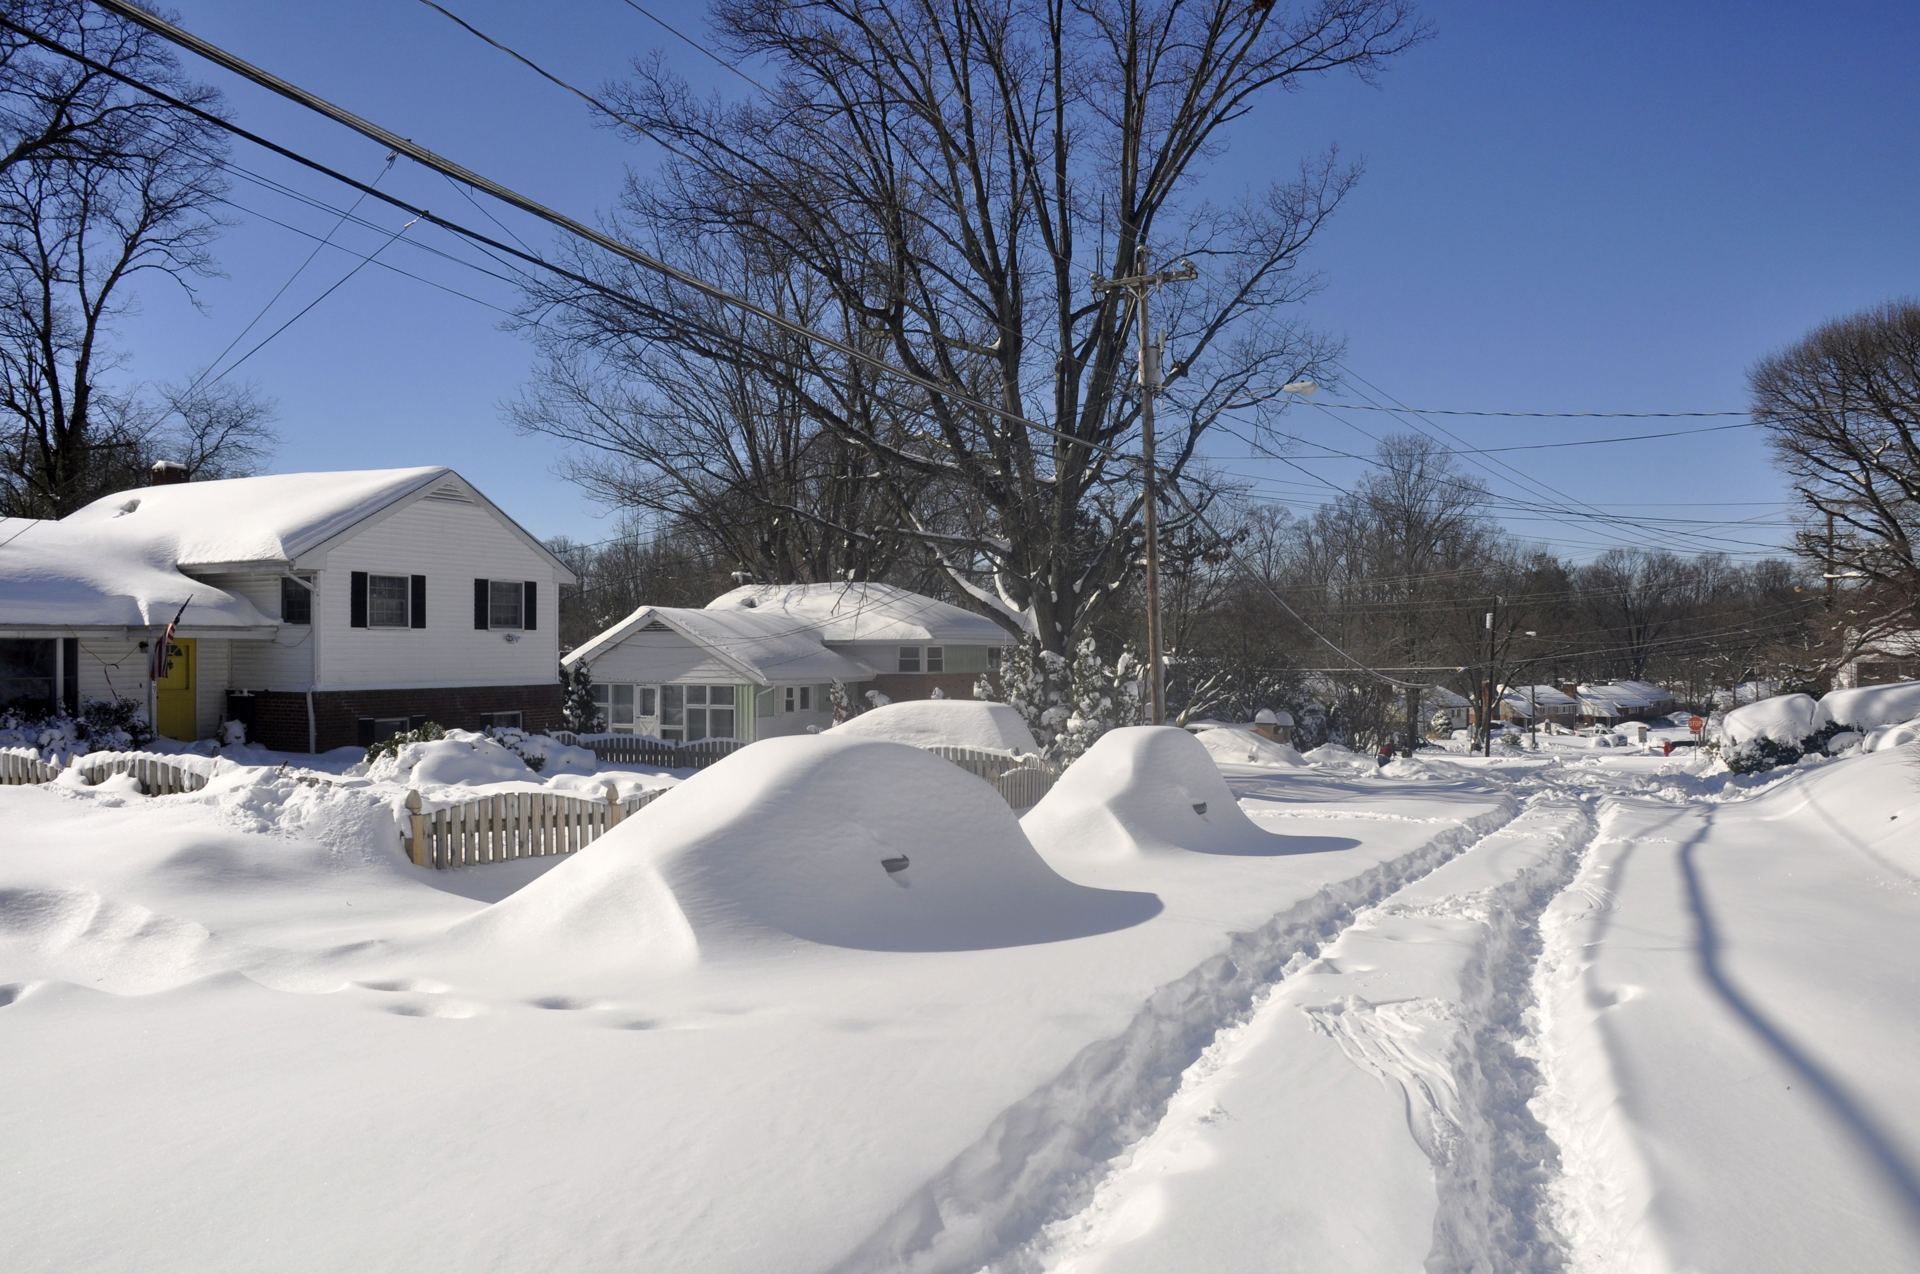
22–24 January 2016 Blizzard
~1,125,000 km² affected.
24 million people resided in locations with >50 cm of snow.
~500,000 lost power along the East Coast.
55 fatalities attributed to the storm.
NOAA
Jarekt
A. Hink

Slide 9
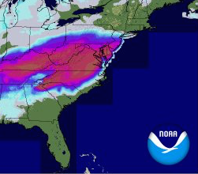
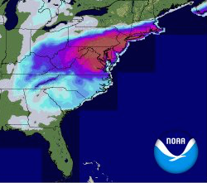

22–24 January 2016 Blizzard
24-h Snow Accumulation
Ending: 0600 UTC 23 January 2016
Ending: 0600 UTC 24 January 2016
0.1
1
3
5
15
25
50
NOHRSC
cm

Slide 10
22–24 January 2016 Blizzard
1800 UTC 20 January
L
PT
PT
= Polar Trough
250 hPa Wind Speed (m s^{–1}; fill) 1000–500 hPa Thickness (dam; dashed)
Mean SLP (hPa; green)

Slide 11
22–24 January 2016 Blizzard
1800 UTC 21 January
L
H
H
PT
L
PT
= Polar Trough
250 hPa Wind Speed (m s^{–1}; fill) 1000–500 hPa Thickness (dam; dashed)
Mean SLP (hPa; green)

Slide 12
22–24 January 2016 Blizzard
1800 UTC 22 January
H
PT
L
PT
= Polar Trough
250 hPa Wind Speed (m s^{–1}; fill) 1000–500 hPa Thickness (dam; dashed)
Mean SLP (hPa; green)

Slide 13
22–24 January 2016 Blizzard
1800 UTC 23 January
H
L
PT
PT
= Polar Trough
250 hPa Wind Speed (m s^{–1}; fill) 1000–500 hPa Thickness (dam; dashed)
Mean SLP (hPa; green)

Slide 14
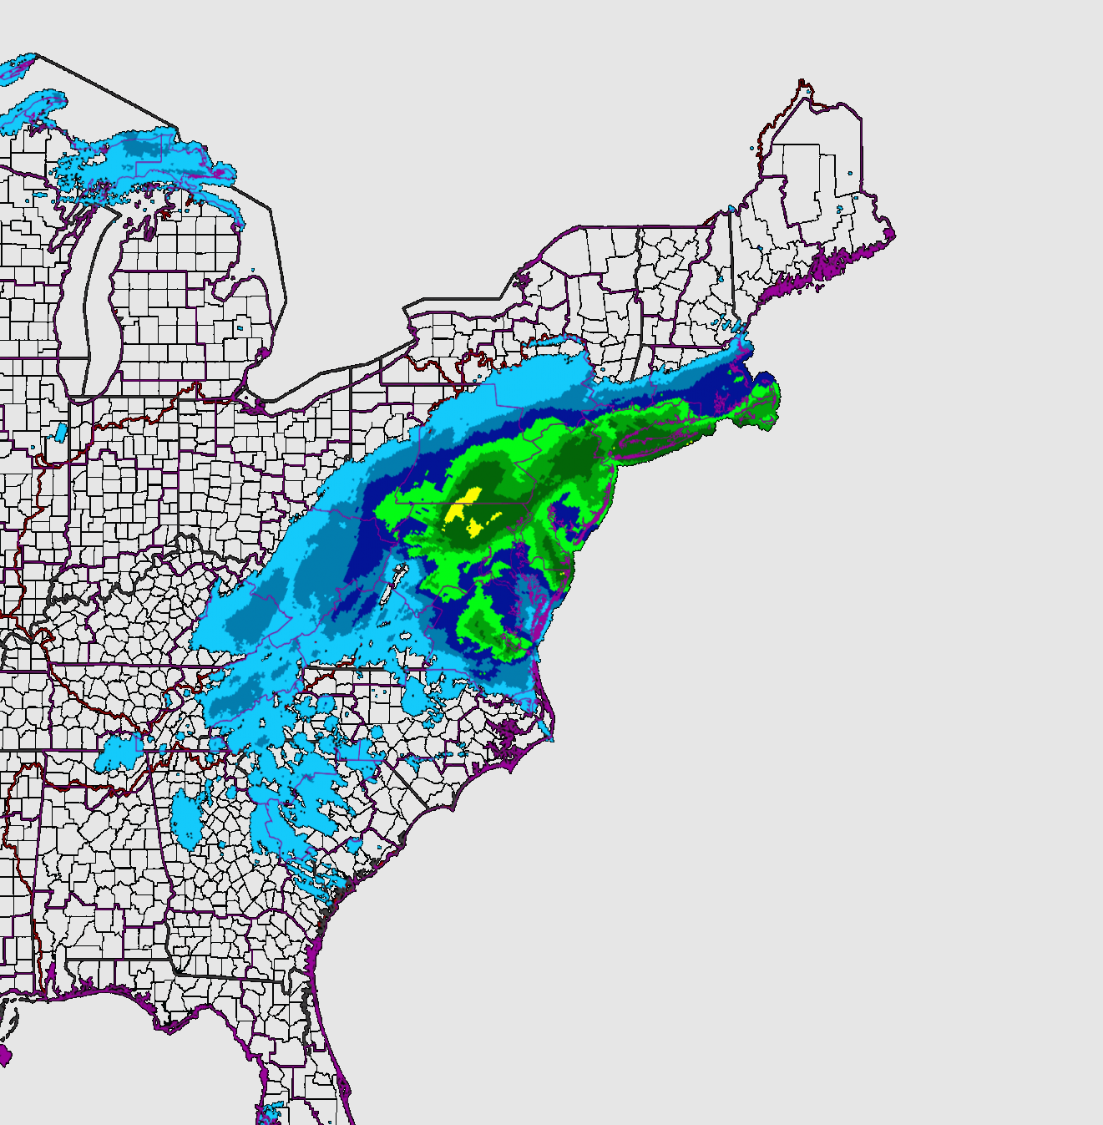

GFS Forecasts Verifying 1800 UTC
23 Jan 2016
24-h Precip. ending 0600 UTC 24 Jan 2015

Slide 15
GFS Forecasts Verifying 1800 UTC
23 Jan 2016

Slide 16
GFS Forecasts Verifying 1800 UTC
23 Jan 2016
216-h

Slide 17
GFS Forecasts Verifying 1800 UTC
23 Jan 2016
216-h

Slide 18
GFS Forecasts Verifying 1800 UTC
23 Jan 2016
216-h

Slide 19
GFS Forecasts Verifying 1800 UTC
23 Jan 2016
216-h

Slide 20
GFS Forecasts Verifying 1800 UTC
23 Jan 2016
216-h

Slide 21
GFS Forecasts Verifying 1800 UTC
23 Jan 2016
216-h

Slide 22
GFS Forecasts Verifying 1800 UTC
23 Jan 2016
216-h

Slide 23
GFS Forecasts Verifying 1800 UTC
23 Jan 2016
216-h

Slide 24
GFS Forecasts Verifying 1800 UTC
23 Jan 2016
216-h

Slide 25
GEFS Forecasts Verifying 1800 UTC 23 Jan 2016
925 hPa Pot. Temp; Every 5 K
120-h Forecast
6-h Accumulated Precipitation; Every 10 mm
925 hPa Fronto-genesis;
Every 0.5 K (100 km)^{–1} (3 h)^{–1}
Ens. Mean
Analysis

Slide 26
GEFS Forecasts Verifying 1800 UTC 23 Jan 2016
925 hPa Pot. Temp; Every 5 K
96-h Forecast
6-h Accumulated Precipitation; Every 10 mm
925 hPa Fronto-genesis;
Every 0.5 K (100 km)^{–1} (3 h)^{–1}
Ens. Mean
Analysis

Slide 27
GEFS Forecasts Verifying 1800 UTC 23 Jan 2016
925 hPa Pot. Temp; Every 5 K
72-h Forecast
6-h Accumulated Precipitation; Every 10 mm
925 hPa Fronto-genesis;
Every 0.5 K (100 km)^{–1} (3 h)^{–1}
Ens. Mean
Analysis

Slide 28
GEFS Forecasts Verifying 1800 UTC 23 Jan 2016
925 hPa Pot. Temp; Every 5 K
48-h Forecast
6-h Accumulated Precipitation; Every 10 mm
925 hPa Fronto-genesis;
Every 0.5 K (100 km)^{–1} (3 h)^{–1}
Ens. Mean
Analysis

Slide 29
GEFS Forecasts Verifying 1800 UTC 23 Jan 2016
925 hPa Pot. Temp; Every 5 K
24-h Forecast
6-h Accumulated Precipitation; Every 10 mm
925 hPa Fronto-genesis;
Every 0.5 K (100 km)^{–1} (3 h)^{–1}
Ens. Mean
Analysis

Slide 30
GEFS Forecasts Verifying 1800 UTC 23 Jan 2016
925 hPa Pot. Temp; Every 5 K
00-h Forecast
6-h Accumulated Precipitation; Every 10 mm
925 hPa Fronto-genesis;
Every 0.5 K (100 km)^{–1} (3 h)^{–1}
Ens. Mean
Analysis

Slide 31
GEFS Forecasts Verifying 1800 UTC 23 Jan 2016
120-h Forecast
925 hPa Frontogenesis;
Every 0.5 K (100 km)^{–1} (3 h)^{–1}
Angle Betw. Isentropes and Axis of Dilatation
Ens. Mean
Analysis

Slide 32
GEFS Forecasts Verifying 1800 UTC 23 Jan 2016
925 hPa Convergence; Every
2x10^{–5} s^{–1}
120-h Forecast
925 hPa Frontogenesis;
Every 0.5 K (100 km)^{–1} (3 h)^{–1}
925 hPa Deformation; Every
2x10^{–5} s^{–1}
Ens. Mean
Analysis

Slide 33
GEFS Forecasts Verifying 1800 UTC 23 Jan 2016
925 hPa Convergence; Every
2x10^{–5} s^{–1}
96-h Forecast
925 hPa Frontogenesis;
Every 0.5 K (100 km)^{–1} (3 h)^{–1}
925 hPa Deformation; Every
2x10^{–5} s^{–1}
Ens. Mean
Analysis

Slide 34
GEFS Forecasts Verifying 1800 UTC 23 Jan 2016
925 hPa Convergence; Every
2x10^{–5} s^{–1}
72-h Forecast
925 hPa Frontogenesis;
Every 0.5 K (100 km)^{–1} (3 h)^{–1}
925 hPa Deformation; Every
2x10^{–5} s^{–1}
Ens. Mean
Analysis

Slide 35
GEFS Forecasts Verifying 1800 UTC 23 Jan 2016
925 hPa Convergence; Every
2x10^{–5} s^{–1}
48-h Forecast
925 hPa Frontogenesis;
Every 0.5 K (100 km)^{–1} (3 h)^{–1}
925 hPa Deformation; Every
2x10^{–5} s^{–1}
Ens. Mean
Analysis

Slide 36
GEFS Forecasts Verifying 1800 UTC 23 Jan 2016
925 hPa Convergence; Every
2x10^{–5} s^{–1}
24-h Forecast
925 hPa Frontogenesis;
Every 0.5 K (100 km)^{–1} (3 h)^{–1}
925 hPa Deformation; Every
2x10^{–5} s^{–1}
Ens. Mean
Analysis

Slide 37
GEFS Forecasts Verifying 1800 UTC 23 Jan 2016
925 hPa Convergence; Every
2x10^{–5} s^{–1}
00-h Forecast
925 hPa Frontogenesis;
Every 0.5 K (100 km)^{–1} (3 h)^{–1}
925 hPa Deformation; Every
2x10^{–5} s^{–1}
Ens. Mean
Analysis

Slide 38
Case Summary
The event was well-forecasted by the operational GFS as many as 9 days prior to the event.
Considerable uncertainty with respect to the amount and location of precipitation along the bent-back warm front lingered prior to the event.
The spread in several diagnostics for vertical motion reflected the uncertainty in accurately forecasting total snow accumulations.

Slide 39
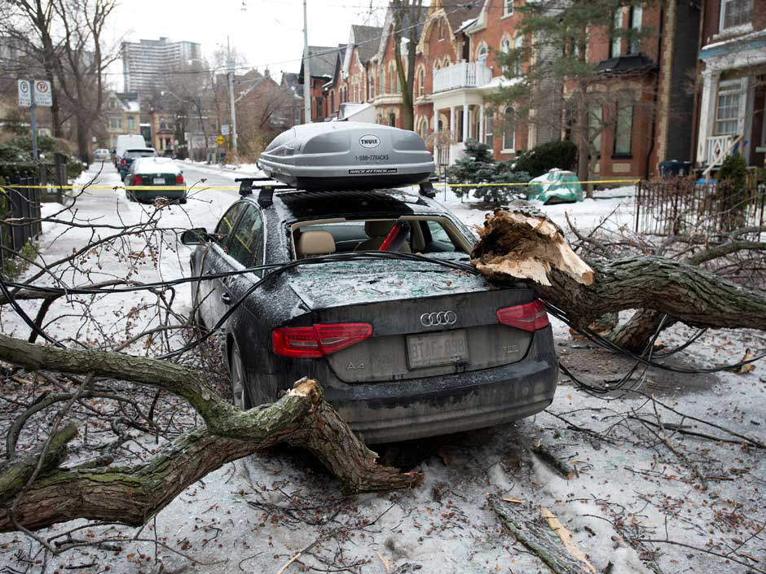
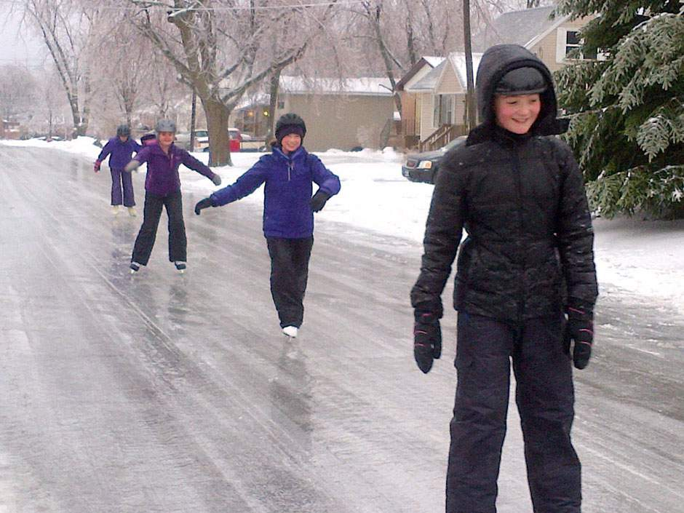
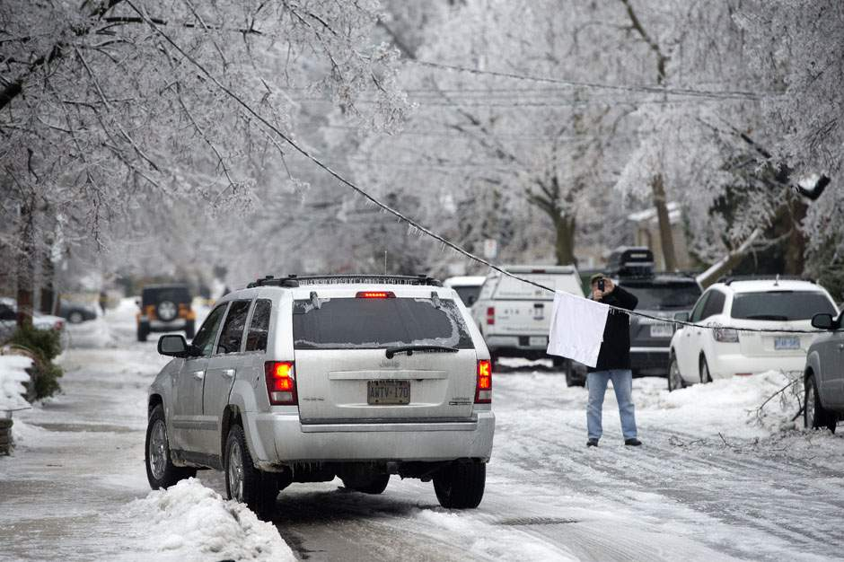
22–23 December 2013 Ice Storm
> 30 mm of ice in some locations.
> 400,000 lost power in Ontario, Quebec, and in the Canadian Maritimes.
Gusty winds in excess of 15 m s^{–1}.
The Canadian Press

Slide 40
22–23 December 2013 Ice Storm
1200 UTC 19 December
250 hPa Wind Speed (m s^{–1}; fill)
1000–500 hPa Thickness (dam; dashed)
Mean SLP (hPa; green)
AWB
H
L
Trough Axis

Slide 41
22–23 December 2013 Ice Storm
1200 UTC 20 December
H
250 hPa Wind Speed (m s^{–1}; fill)
1000–500 hPa Thickness (dam; dashed)
Mean SLP (hPa; green)
H
L
Trough Axis

Slide 42
22–23 December 2013 Ice Storm
1200 UTC 21 December
250 hPa Wind Speed (m s^{–1}; fill)
1000–500 hPa Thickness (dam; dashed)
Mean SLP (hPa; green)
H
L
Trough Axis

Slide 43
22–23 December 2013 Ice Storm
1200 UTC 22 December
250 hPa Wind Speed (m s^{–1}; fill)
1000–500 hPa Thickness (dam; dashed)
Mean SLP (hPa; green)
H
H
L
Trough Axis

Slide 44
22–23 December 2013 Ice Storm
240-h Forecast
1000 hPa Geo. Height (m)
Verifying
1200 UTC
22 December
GEFS Ens. Mean
Analysis

Slide 45
22–23 December 2013 Ice Storm
216-h Forecast
1000 hPa Geo. Height (m)
Verifying
1200 UTC
22 December
GEFS Ens. Mean
Analysis

Slide 46
22–23 December 2013 Ice Storm
192-h Forecast
1000 hPa Geo. Height (m)
Verifying
1200 UTC
22 December
GEFS Ens. Mean
Analysis

Slide 47
22–23 December 2013 Ice Storm
168-h Forecast
1000 hPa Geo. Height (m)
Verifying
1200 UTC
22 December
GEFS Ens. Mean
Analysis

Slide 48
22–23 December 2013 Ice Storm
144-h Forecast
1000 hPa Geo. Height (m)
Verifying
1200 UTC
22 December
GEFS Ens. Mean
Analysis

Slide 49
22–23 December 2013 Ice Storm
120-h Forecast
1000 hPa Geo. Height (m)
Verifying
1200 UTC
22 December
GEFS Ens. Mean
Analysis

Slide 50
22–23 December 2013 Ice Storm
96-h Forecast
1000 hPa Geo. Height (m)
Verifying
1200 UTC
22 December
GEFS Ens. Mean
Analysis

Slide 51
22–23 December 2013 Ice Storm
72-h Forecast
1000 hPa Geo. Height (m)
Verifying
1200 UTC
22 December
GEFS Ens. Mean
Analysis

Slide 52
22–23 December 2013 Ice Storm
48-h Forecast
1000 hPa Geo. Height (m)
Verifying
1200 UTC
22 December
GEFS Ens. Mean
Analysis

Slide 53
22–23 December 2013 Ice Storm
24-h Forecast
1000 hPa Geo. Height (m)
Verifying
1200 UTC
22 December
GEFS Ens. Mean
Analysis

Slide 54
22–23 December 2013 Ice Storm
00-h Forecast
1000 hPa Geo. Height (m)
Verifying
1200 UTC
22 December
GEFS Ens. Mean
Analysis

Slide 55
22–23 December 2013 Ice Storm
14 December – 192 h
1000 hPa Geo. Height (m; black)
500 hPa Geo. Height (dam; red)
850 hPa Geo. Height (m; black)
850 hPa Pot. Temp. (K; red)

Slide 56
22–23 December 2013 Ice Storm
16 December – 144 h
1000 hPa Geo. Height (m; black)
500 hPa Geo. Height (dam; red)
Difference in 500 hPa Geo. Height from forecast initialized 48-h earlier (m; shaded)
850 hPa Geo. Height (m; black)
850 hPa Pot. Temp. (K; red)
Difference in 850 hPa Pot. Temp. from forecast initialized 48-h earlier (K; shaded)

Slide 57
22–23 December 2013 Ice Storm
18 December – 96 h
1000 hPa Geo. Height (m; black)
500 hPa Geo. Height (dam; red)
Difference in 500 hPa Geo. Height from forecast initialized 48-h earlier (m; shaded)
850 hPa Geo. Height (m; black)
850 hPa Pot. Temp. (K; red)
Difference in 850 hPa Pot. Temp. from forecast initialized 48-h earlier (K; shaded)

Slide 58
22–23 December 2013 Ice Storm
20 December – 48 h
1000 hPa Geo. Height (m; black)
500 hPa Geo. Height (dam; red)
Difference in 500 hPa Geo. Height from forecast initialized 48-h earlier (m; shaded)
850 hPa Geo. Height (m; black)
850 hPa Pot. Temp. (K; red)
Difference in 850 hPa Pot. Temp. from forecast initialized 48-h earlier (K; shaded)

Slide 59
22–23 December 2013 Ice Storm
22 December – 00 h
1000 hPa Geo. Height (m; black)
500 hPa Geo. Height (dam; red)
Difference in 500 hPa Geo. Height from forecast initialized 48-h earlier (m; shaded)
850 hPa Geo. Height (m; black)
850 hPa Pot. Temp. (K; red)
Difference in 850 hPa Pot. Temp. from forecast initialized 48-h earlier (K; shaded)

Slide 60
Case Summary
Forecast spread decreased sharply 96-h prior to the event throughout the eastern United States.
Forecasts with a lead time greater than 96-h exhibited considerable uncertainty in the location and strength of the surface cyclone.
Forecasts exhibited uncertainty with respect to the location, strength, and magnitude of frontogenesis along the baroclinic zone as little as 48-h prior to the event.

Slide 61
Anticipated Research Efforts
Identify extreme temperature, precipitation events.

Slide 62
Anticipated Research Efforts
Identify extreme temperature, precipitation events.
Perform a composite analysis on each event type to determine the antecedent environments that favor the development of an EWE.

Slide 63
Anticipated Research Efforts
Identify extreme temperature, precipitation events.
Perform a composite analysis on each event type to determine the antecedent environments that favor the development of an EWE.
Examine 8–10 day forecast skill for EWEs that fall into each event type.

Slide 64
Anticipated Research Efforts
Identify extreme temperature, precipitation events.
Develop products that have the potential to provide a “first-alert” to the potential for EWEs.
Perform a composite analysis on each event type to determine the antecedent environments that favor the development of an EWE.
Examine 8–10 day forecast skill for EWEs that fall into each event type.

Slide 65
GFS Analysis
1800 UTC 23 Jan 2016
700 hPa Q_{s} Convergence, Q_{s} vectors, and Pot. Temp.
700 hPa Q-vector Convergence,
Q-vectors, and Pot. Temp.
700 hPa Q_{n} Convergence, Q_{n} vectors, and Pot. Temp.

