Slide 1
Regime-Dependent Predictability of Extreme Weather Events: Representative Cases
Lance F. Bosart, Andrew C. Winters, and Daniel Keyser
Department of Atmospheric and Environmental Sciences
University at Albany, State University of New York, Albany, NY 12222
41st NWA Annual Meeting
Norfolk, VA
12–15 September 2016

Slide 2
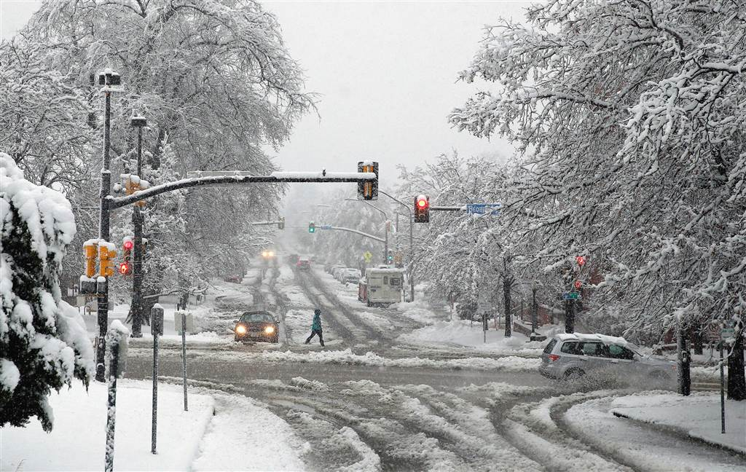
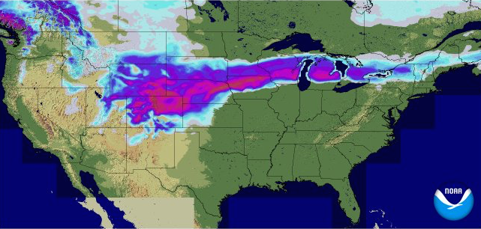

A particularly active weather pattern characterized the CONUS during 21 March – 4 April 2016
23–24 March 2016 Colorado Snowstorm
> 30 cm (1 ft) of snow in many locations along the front range
Hundreds of flights cancelled at DIA
Temperatures exceeded 20ºC the day prior to the snowstorm
Notable forecast uncertainty characterized the event
AP
24-h accumulated snow ending 0600 UTC 24 March 2016
0.1
1
3
5
15
25
50
cm

Slide 3
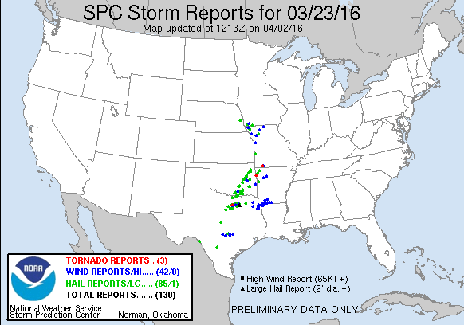
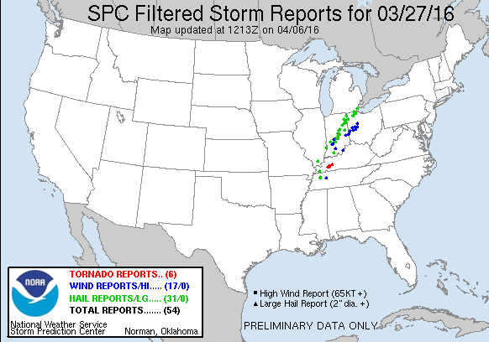
A particularly active weather pattern characterized the CONUS during 21 March – 4 April 2016
23 March and 27 March 2016 Severe Weather
184 combined severe weather reports to SPC on the two days
2 in. diameter hail reported near Dallas, TX, on 23 March
EF-2 tornado confirmed near Crofton, KY, on 27 March
A progressive synoptic flow pattern characterized both days

Slide 4
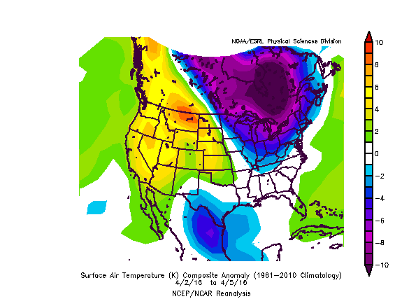
A particularly active weather pattern characterized the CONUS during 21 March – 4 April 2016
Late-March Omega Block and Early-April Northeast Cold
Omega block developed off the west coast during late March
Omega block facilitated the transport of well-below normal temperatures into the Northeast
6.4 in. of snow on 3–4 April accounted for 38% of the winter 2015–2016 snowfall (16.9 in.) in Albany, NY
500 hPa: 0000 UTC 30 March 2016
2–5 April 2016 Surface Temp. (ºC) Anomalies

Slide 5
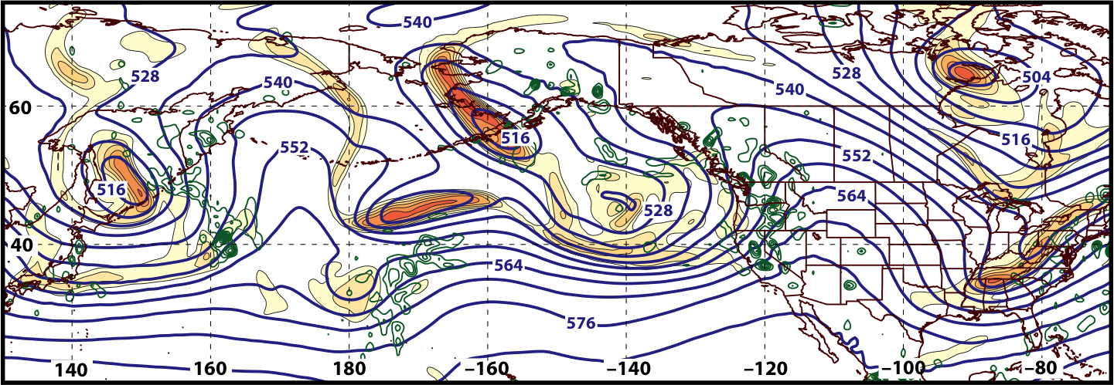
Synoptic Evolution: 21 March – 4 April 2016
0000 UTC 21 March 2016
500 hPa Heights (dam; blue)
500 hPa Rel. Vor. (10^{–5} s^{–1} fill pattern)
500 hPa Ascent (dPa s^{–1}; green)

Slide 6
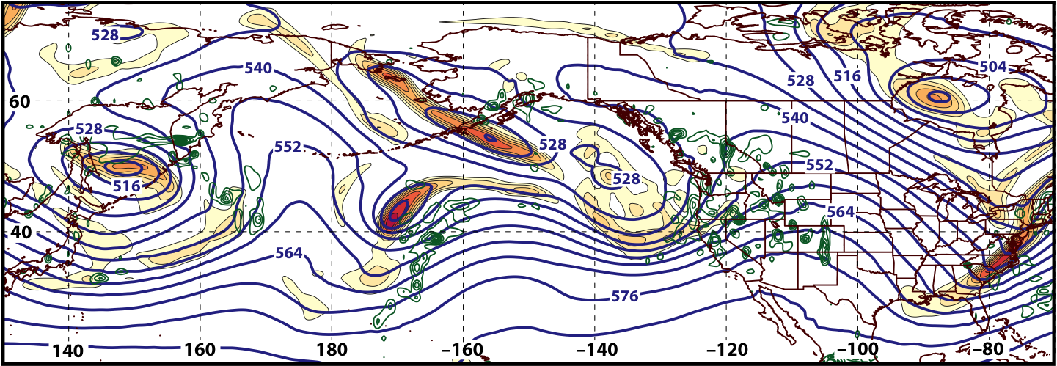
Synoptic Evolution: 21 March – 4 April 2016
1200 UTC 21 March 2016
500 hPa Heights (dam; blue)
500 hPa Rel. Vor. (10^{–5} s^{–1} fill pattern)
500 hPa Ascent (dPa s^{–1}; green)

Slide 7
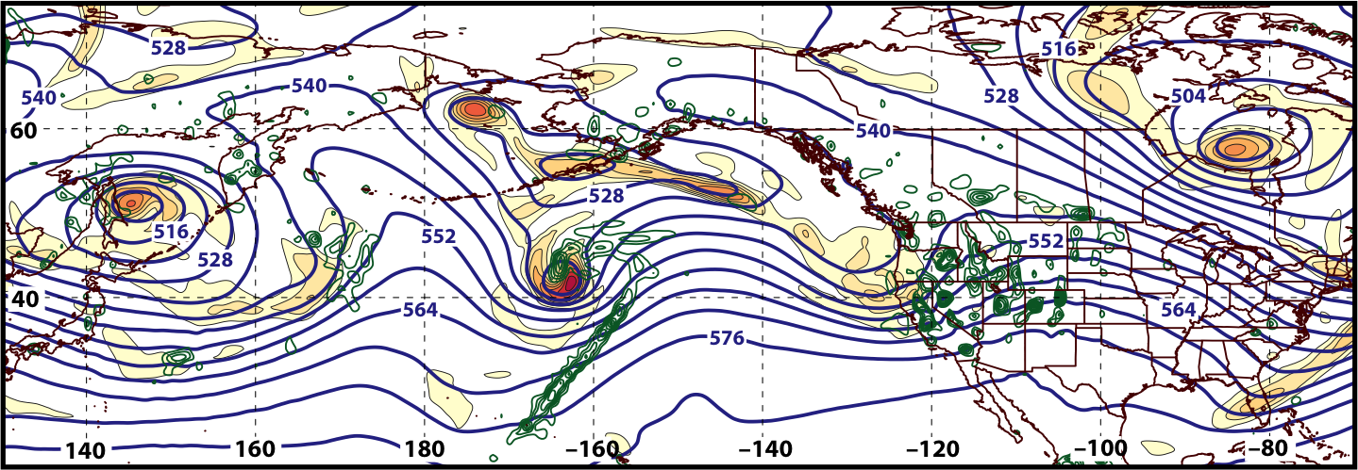
Synoptic Evolution: 21 March – 4 April 2016
0000 UTC 22 March 2016
500 hPa Heights (dam; blue)
500 hPa Rel. Vor. (10^{–5} s^{–1} fill pattern)
500 hPa Ascent (dPa s^{–1}; green)

Slide 8
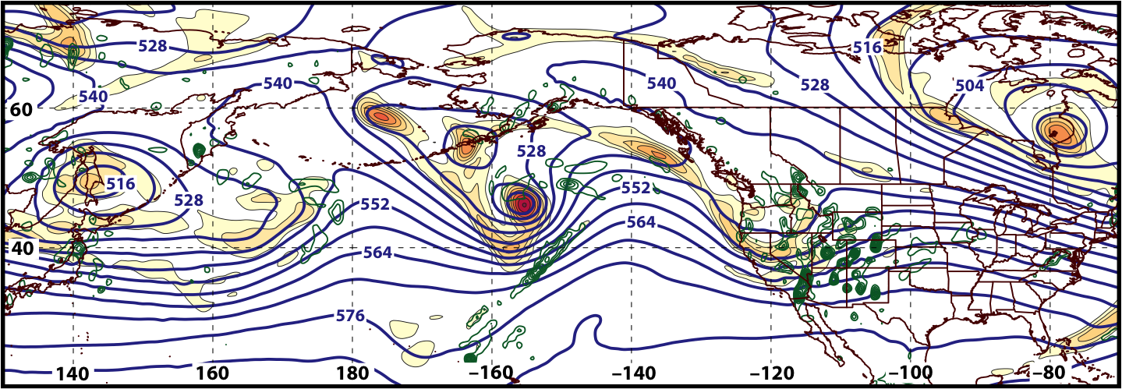
Synoptic Evolution: 21 March – 4 April 2016
1200 UTC 22 March 2016
500 hPa Heights (dam; blue)
500 hPa Rel. Vor. (10^{–5} s^{–1} fill pattern)
500 hPa Ascent (dPa s^{–1}; green)

Slide 9
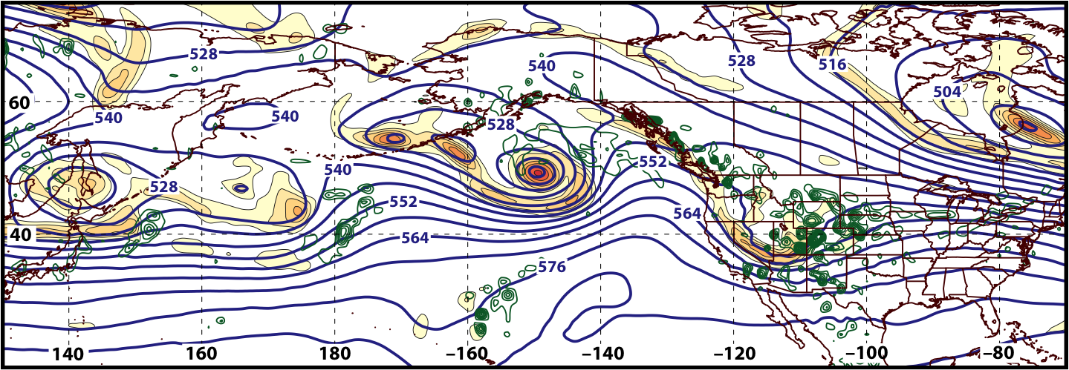
Synoptic Evolution: 21 March – 4 April 2016
0000 UTC 23 March 2016
500 hPa Heights (dam; blue)
500 hPa Rel. Vor. (10^{–5} s^{–1} fill pattern)
500 hPa Ascent (dPa s^{–1}; green)

Slide 10
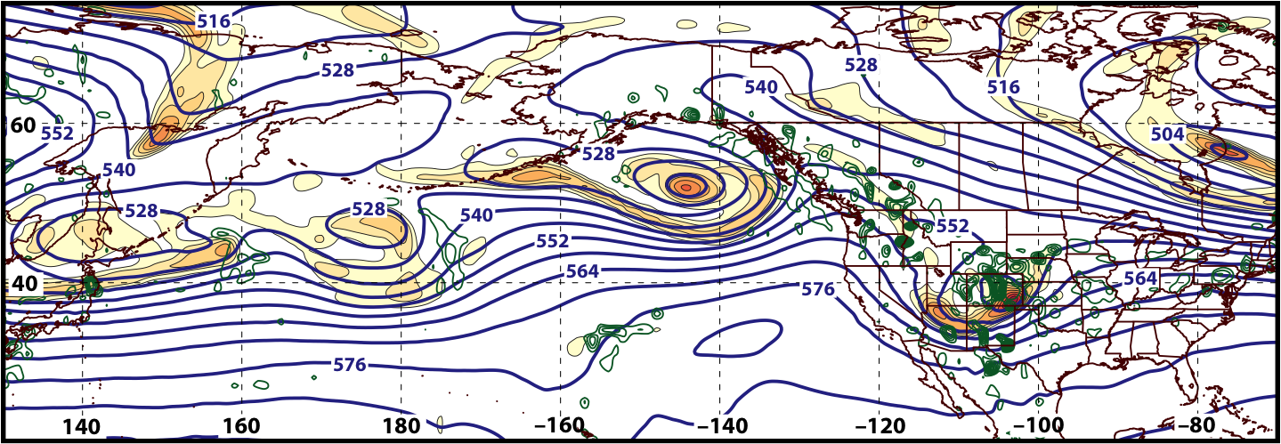
Synoptic Evolution: 21 March – 4 April 2016
1200 UTC 23 March 2016
500 hPa Heights (dam; blue)
500 hPa Rel. Vor. (10^{–5} s^{–1} fill pattern)
500 hPa Ascent (dPa s^{–1}; green)

Slide 11
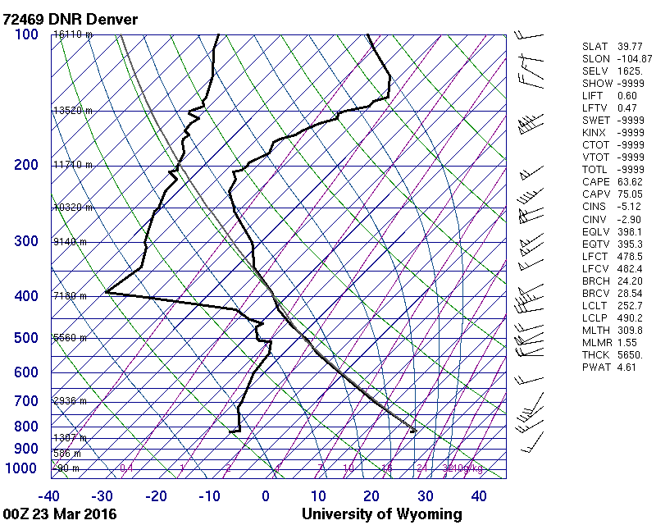
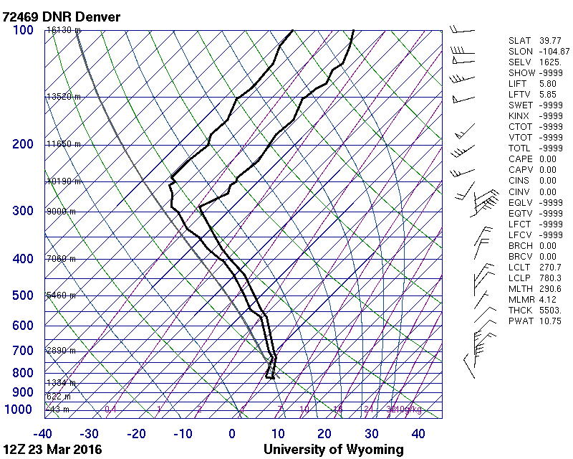
23–24 March 2016 Colorado Snowstorm
0000 UTC 23 March 2016
1200 UTC 23 March 2016

Slide 12
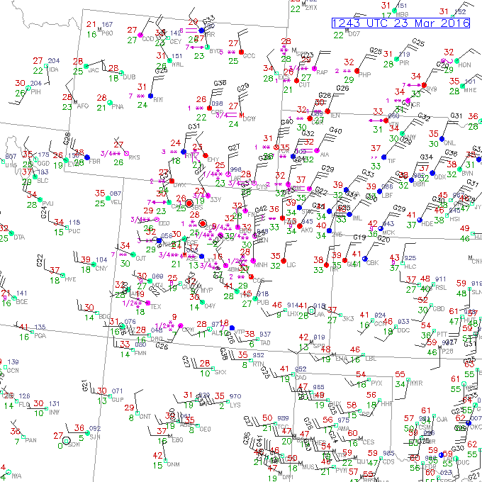
23–24 March 2016 Colorado Snowstorm
Surface
Observations:
1243 UTC
23 March 2016

Slide 13
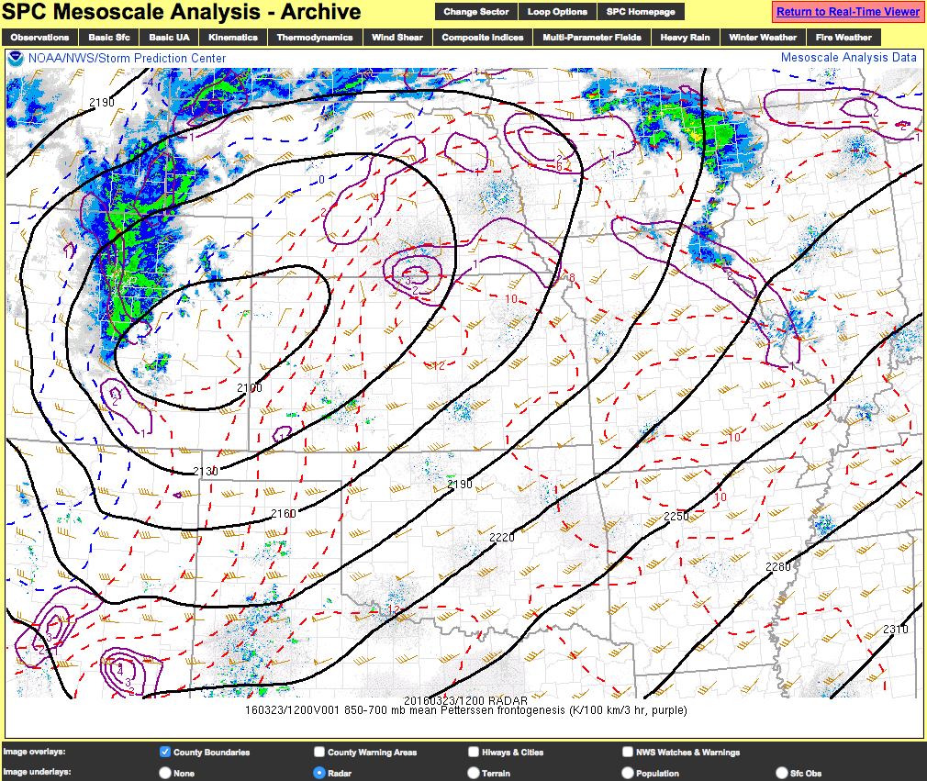
23–24 March 2016 Colorado Snowstorm
SPC Mesoanalysis:
1200 UTC
23 March 2016

Slide 14
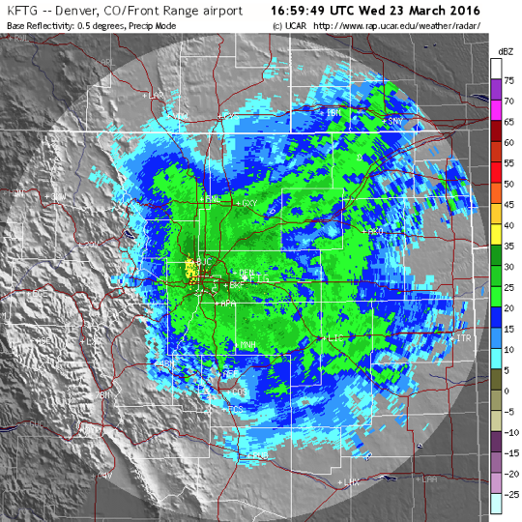
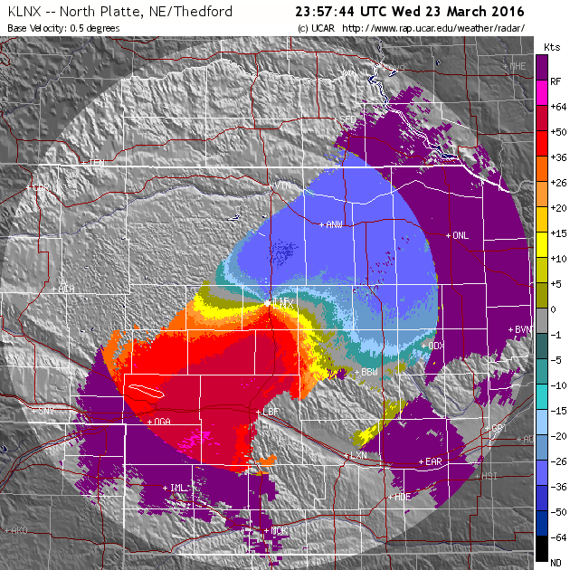
23–24 March 2016 Colorado Snowstorm
1700 UTC 23 March 2016
2357 UTC 23 March 2016
Base Reflectivity (KFTG)
Base Velocity (KLNX)

Slide 15
GFS DeterministicForecasts Verifying 1200 UTC 23 March 2016
500 hPa: = 552 dam
850 hPa: = 132 dam
850 hPa: = 25 m (100 km)^{–1}
500 hPa: = –1 Pa s^{–1}

Slide 16
GFS DeterministicForecasts Verifying 1200 UTC 23 March 2016
500 hPa: = 552 dam
850 hPa: = 132 dam
850 hPa: = 25 m (100 km)^{–1}
500 hPa: = –1 Pa s^{–1}

Slide 17
GFS DeterministicForecasts Verifying 1200 UTC 23 March 2016
500 hPa: = 552 dam
850 hPa: = 132 dam
850 hPa: = 25 m (100 km)^{–1}
500 hPa: = –1 Pa s^{–1}

Slide 18
GFS DeterministicForecasts Verifying 1200 UTC 23 March 2016
500 hPa: = 552 dam
850 hPa: = 132 dam
850 hPa: = 25 m (100 km)^{–1}
500 hPa: = –1 Pa s^{–1}

Slide 19
GFS DeterministicForecasts Verifying 1200 UTC 23 March 2016
500 hPa: = 552 dam
850 hPa: = 132 dam
850 hPa: = 25 m (100 km)^{–1}
500 hPa: = –1 Pa s^{–1}

Slide 20
GFS DeterministicForecasts Verifying 1200 UTC 23 March 2016
500 hPa: = 552 dam
850 hPa: = 132 dam
850 hPa: = 25 m (100 km)^{–1}
500 hPa: = –1 Pa s^{–1}

Slide 21
GFS DeterministicForecasts Verifying 1200 UTC 23 March 2016
500 hPa: = 552 dam
850 hPa: = 132 dam
850 hPa: = 25 m (100 km)^{–1}
500 hPa: = –1 Pa s^{–1}

Slide 22
GFS DeterministicForecasts Verifying 1200 UTC 23 March 2016
500 hPa: = 552 dam
850 hPa: = 132 dam
850 hPa: = 25 m (100 km)^{–1}
500 hPa: = –1 Pa s^{–1}

Slide 23
GFS DeterministicForecasts Verifying 1200 UTC 23 March 2016
500 hPa: = 552 dam
850 hPa: = 132 dam
850 hPa: = 25 m (100 km)^{–1}
500 hPa: = –1 Pa s^{–1}

Slide 24
GFS DeterministicForecasts Verifying 1200 UTC 23 March 2016
500 hPa: = 552 dam
850 hPa: = 132 dam
850 hPa: = 25 m (100 km)^{–1}
500 hPa: = –1 Pa s^{–1}

Slide 25
GFS DeterministicForecasts Verifying 1200 UTC 23 March 2016
500 hPa: = 552 dam
850 hPa: = 132 dam
850 hPa: = 25 m (100 km)^{–1}
500 hPa: = –1 Pa s^{–1}

Slide 26
Synoptic Evolution: 21 March – 4 April 2016
1200 UTC 23 March 2016
500 hPa Heights (dam; blue)
500 hPa Rel. Vor. (10^{–5} s^{–1} fill pattern)
500 hPa Ascent (dPa s^{–1}; green)

Slide 27
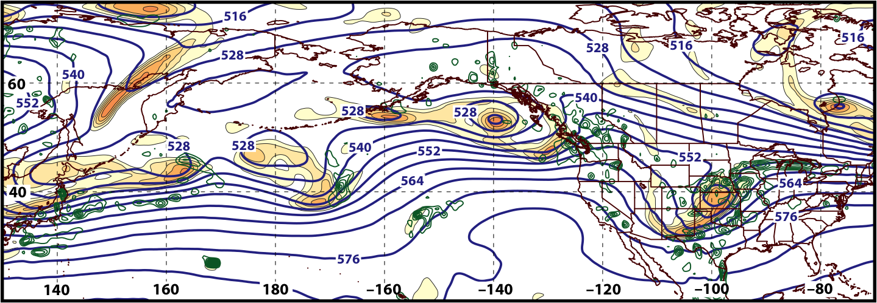
Synoptic Evolution: 21 March – 4 April 2016
0000 UTC 24 March 2016
500 hPa Heights (dam; blue)
500 hPa Rel. Vor. (10^{–5} s^{–1} fill pattern)
500 hPa Ascent (dPa s^{–1}; green)

Slide 28
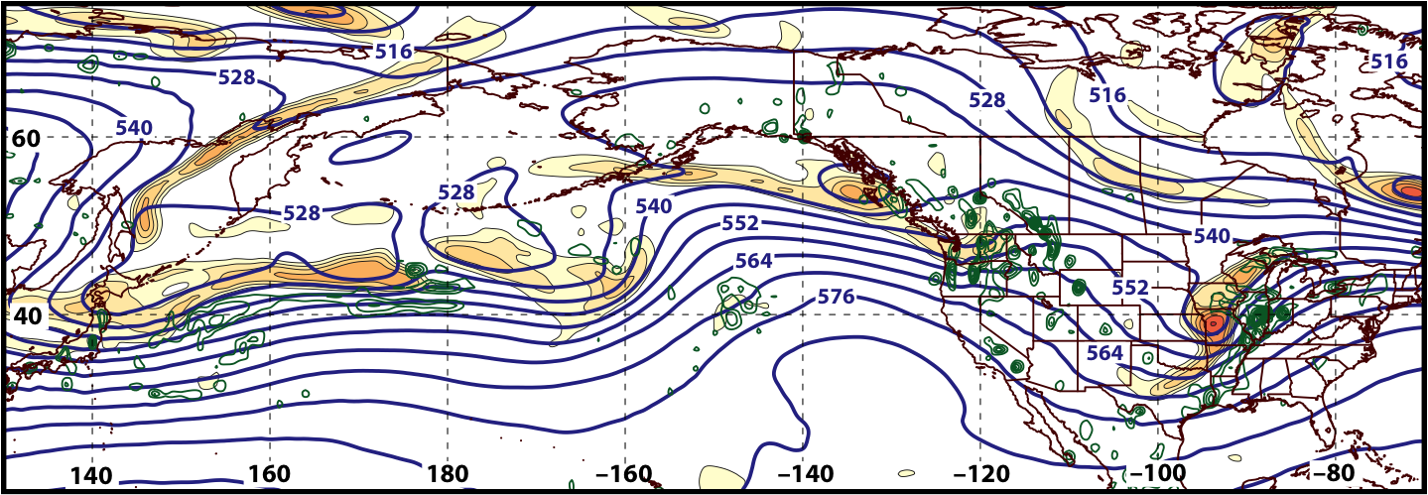
Synoptic Evolution: 21 March – 4 April 2016
1200 UTC 24 March 2016
500 hPa Heights (dam; blue)
500 hPa Rel. Vor. (10^{–5} s^{–1} fill pattern)
500 hPa Ascent (dPa s^{–1}; green)

Slide 29
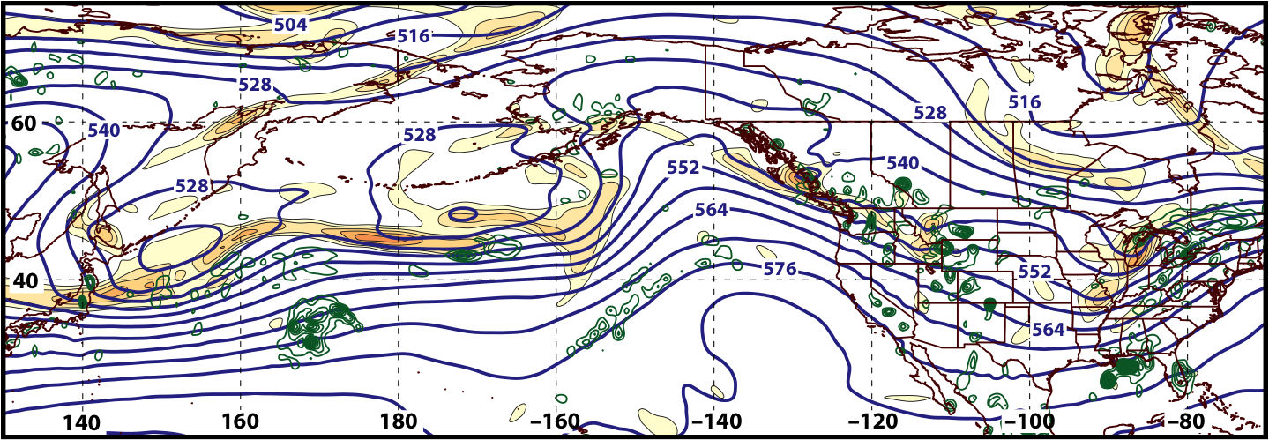
Synoptic Evolution: 21 March – 4 April 2016
0000 UTC 25 March 2016
500 hPa Heights (dam; blue)
500 hPa Rel. Vor. (10^{–5} s^{–1} fill pattern)
500 hPa Ascent (dPa s^{–1}; green)

Slide 30
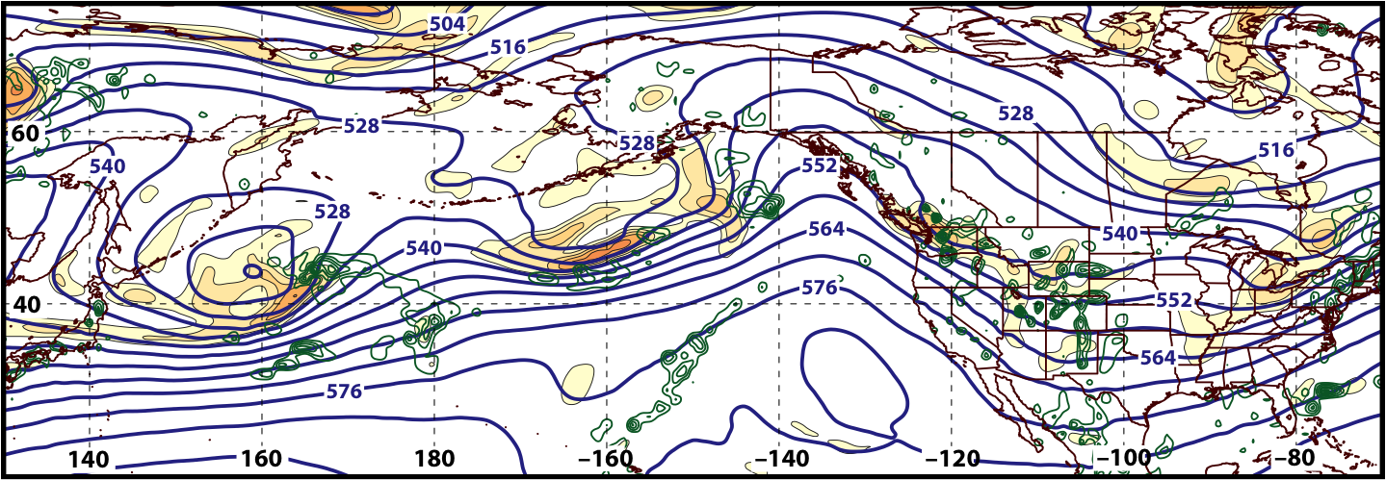
Synoptic Evolution: 21 March – 4 April 2016
1200 UTC 25 March 2016
500 hPa Heights (dam; blue)
500 hPa Rel. Vor. (10^{–5} s^{–1} fill pattern)
500 hPa Ascent (dPa s^{–1}; green)

Slide 31
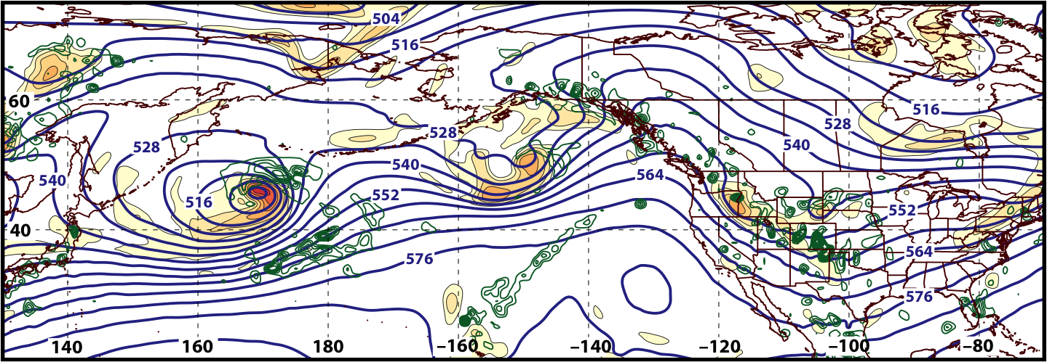
Synoptic Evolution: 21 March – 4 April 2016
0000 UTC 26 March 2016
500 hPa Heights (dam; blue)
500 hPa Rel. Vor. (10^{–5} s^{–1} fill pattern)
500 hPa Ascent (dPa s^{–1}; green)

Slide 32
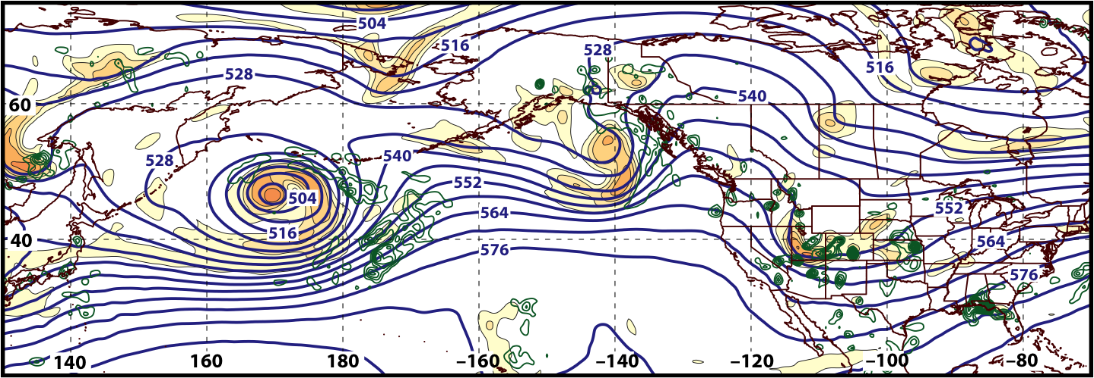
Synoptic Evolution: 21 March – 4 April 2016
1200 UTC 26 March 2016
500 hPa Heights (dam; blue)
500 hPa Rel. Vor. (10^{–5} s^{–1} fill pattern)
500 hPa Ascent (dPa s^{–1}; green)

Slide 33
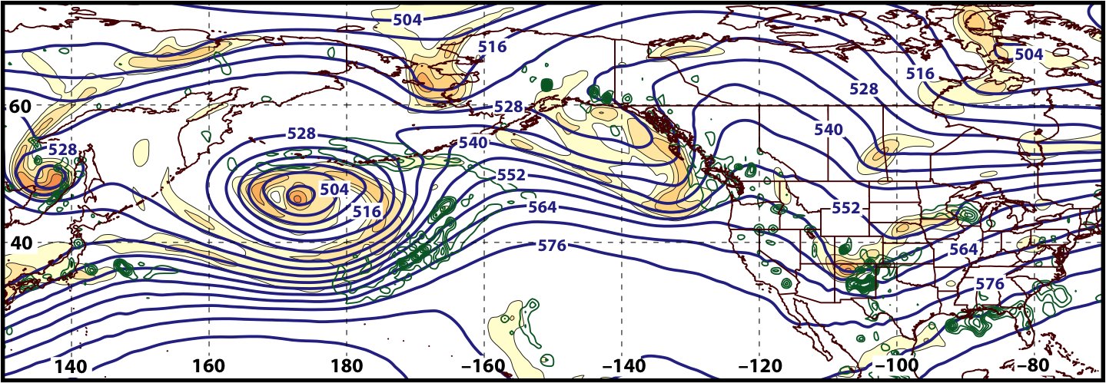
Synoptic Evolution: 21 March – 4 April 2016
0000 UTC 27 March 2016
500 hPa Heights (dam; blue)
500 hPa Rel. Vor. (10^{–5} s^{–1} fill pattern)
500 hPa Ascent (dPa s^{–1}; green)

Slide 34
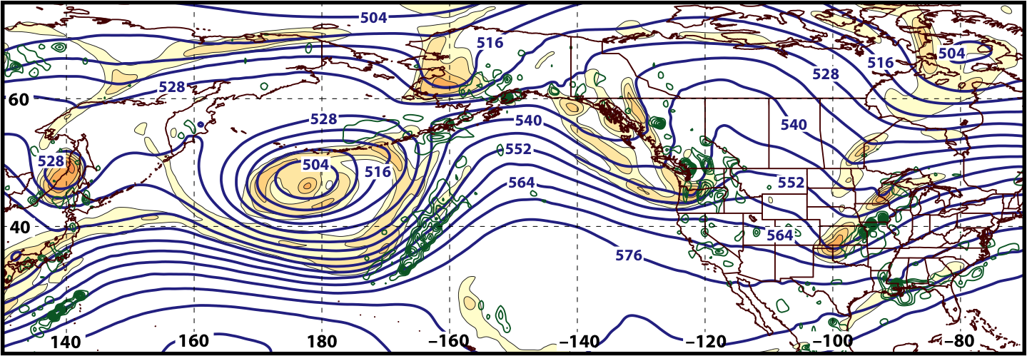
Synoptic Evolution: 21 March – 4 April 2016
1200 UTC 27 March 2016
500 hPa Heights (dam; blue)
500 hPa Rel. Vor. (10^{–5} s^{–1} fill pattern)
500 hPa Ascent (dPa s^{–1}; green)

Slide 35
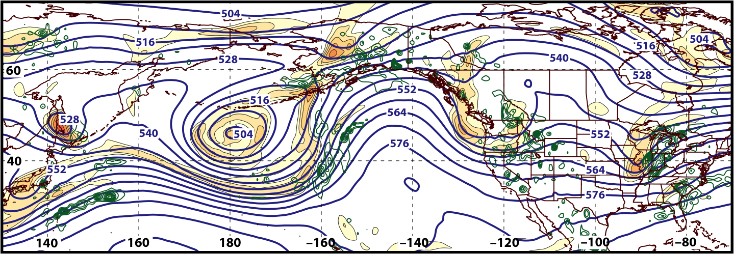
Synoptic Evolution: 21 March – 4 April 2016
0000 UTC 28 March 2016
500 hPa Heights (dam; blue)
500 hPa Rel. Vor. (10^{–5} s^{–1} fill pattern)
500 hPa Ascent (dPa s^{–1}; green)

Slide 36
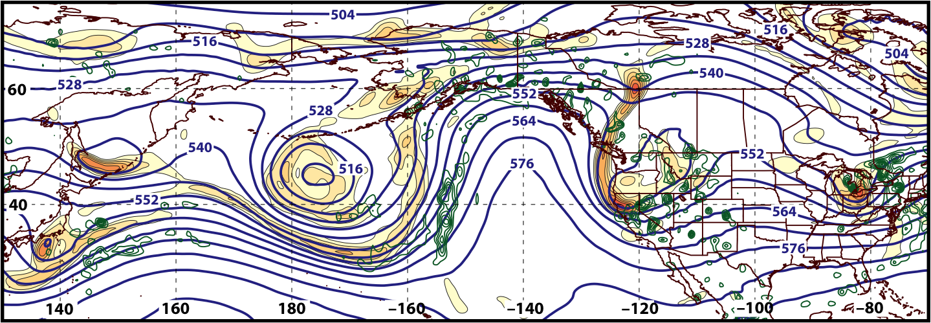
Synoptic Evolution: 21 March – 4 April 2016
1200 UTC 28 March 2016
500 hPa Heights (dam; blue)
500 hPa Rel. Vor. (10^{–5} s^{–1} fill pattern)
500 hPa Ascent (dPa s^{–1}; green)

Slide 37
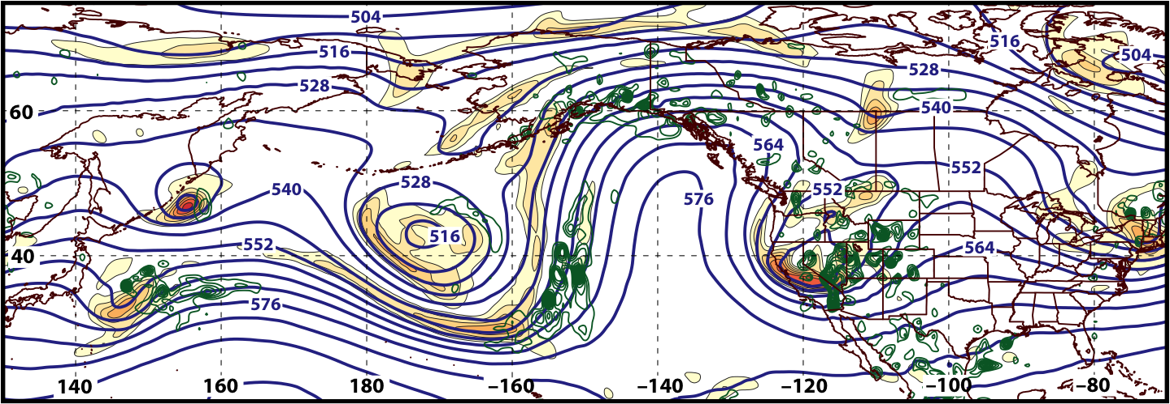
Synoptic Evolution: 21 March – 4 April 2016
0000 UTC 29 March 2016
500 hPa Heights (dam; blue)
500 hPa Rel. Vor. (10^{–5} s^{–1} fill pattern)
500 hPa Ascent (dPa s^{–1}; green)

Slide 38
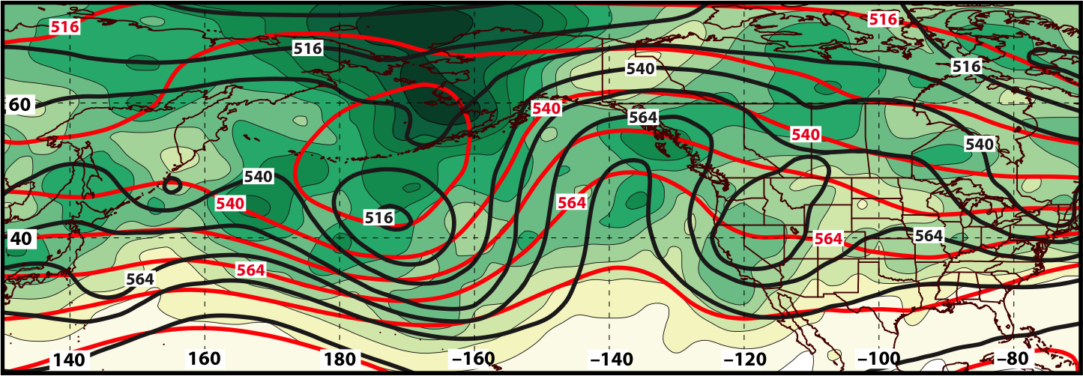
GEFS Ensemble Spread of Geo. Heights (m) Verifying 0000 UTC 29 March 2016
240-h Forecast
500 hPa
Ens. Spread:
Ens. Mean Geo. Heights
Observed Geo. Heights

Slide 39
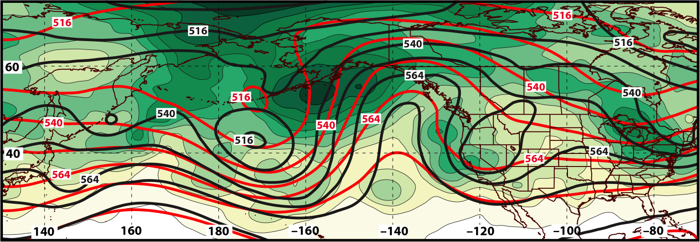
GEFS Ensemble Spread of Geo. Heights (m) Verifying 0000 UTC 29 March 2016
216-h Forecast
500 hPa
Ens. Spread:
Ens. Mean Geo. Heights
Observed Geo. Heights

Slide 40
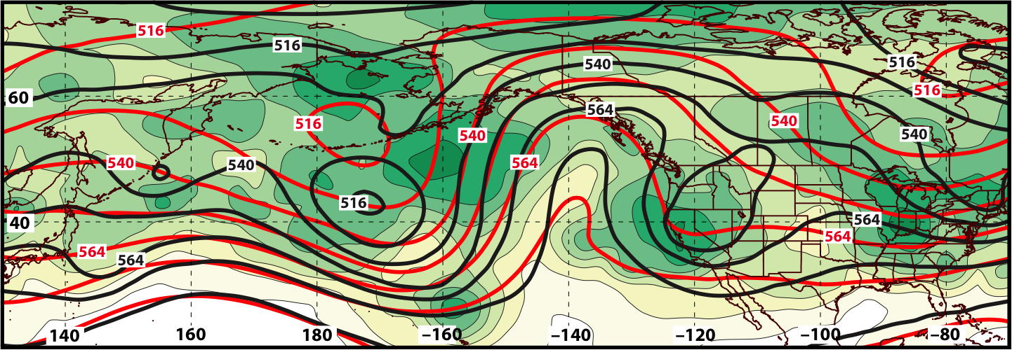
GEFS Ensemble Spread of Geo. Heights (m) Verifying 0000 UTC 29 March 2016
192-h Forecast
500 hPa
Ens. Spread:
Ens. Mean Geo. Heights
Observed Geo. Heights

Slide 41
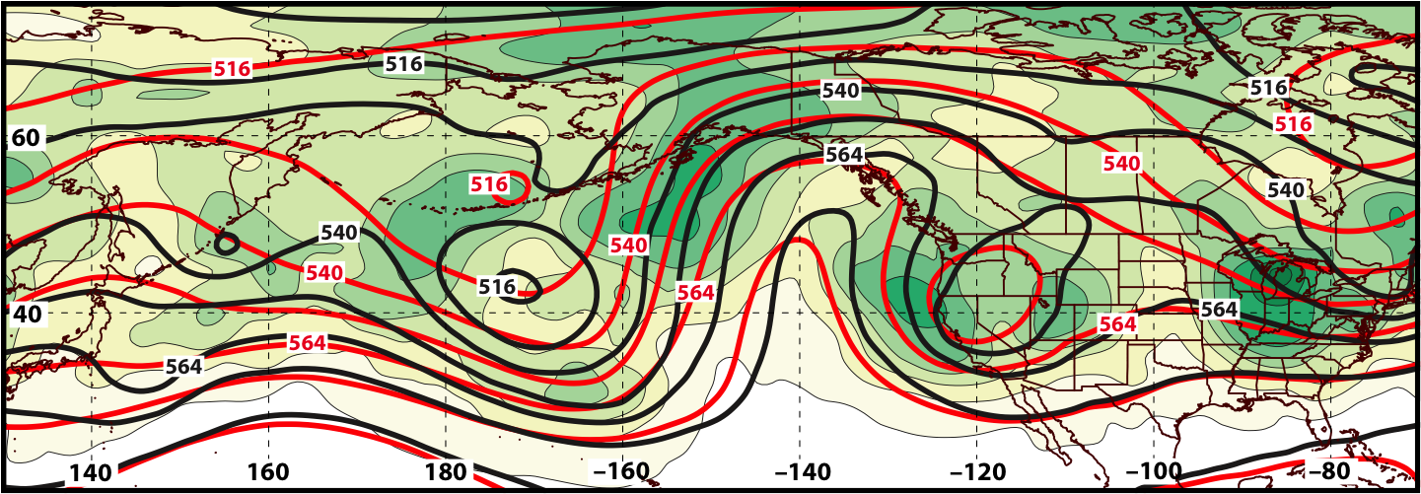
GEFS Ensemble Spread of Geo. Heights (m) Verifying 0000 UTC 29 March 2016
168-h Forecast
500 hPa
Ens. Spread:
Ens. Mean Geo. Heights
Observed Geo. Heights

Slide 42
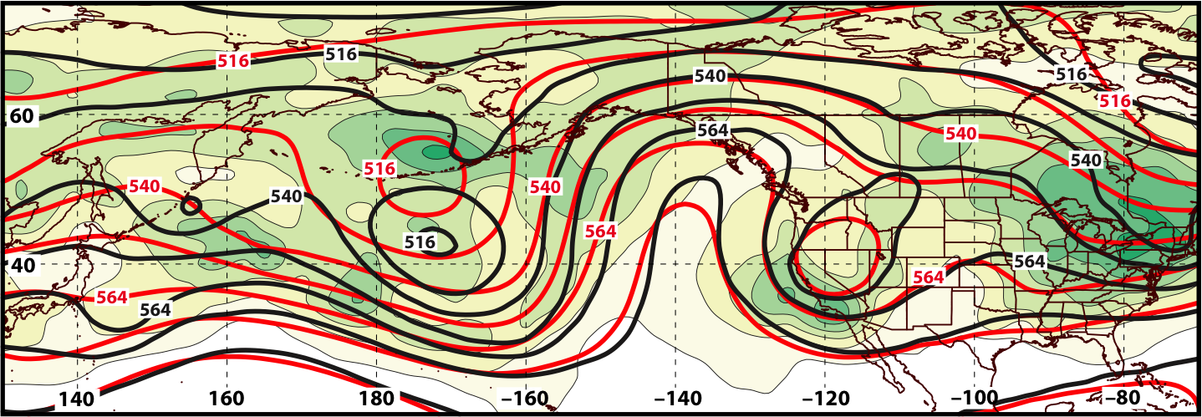
GEFS Ensemble Spread of Geo. Heights (m) Verifying 0000 UTC 29 March 2016
144-h Forecast
500 hPa
Ens. Spread:
Ens. Mean Geo. Heights
Observed Geo. Heights

Slide 43
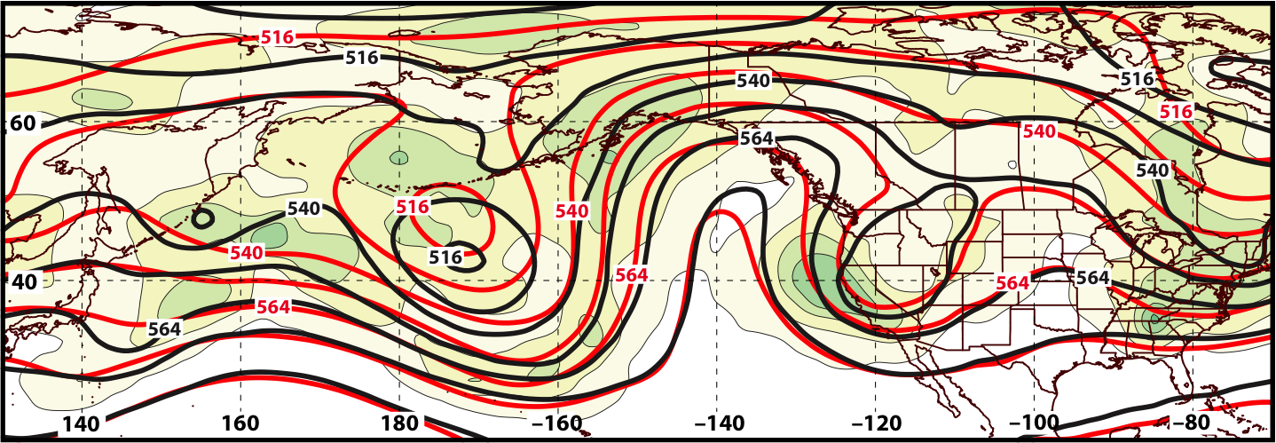
GEFS Ensemble Spread of Geo. Heights (m) Verifying 0000 UTC 29 March 2016
120-h Forecast
500 hPa
Ens. Spread:
Ens. Mean Geo. Heights
Observed Geo. Heights

Slide 44
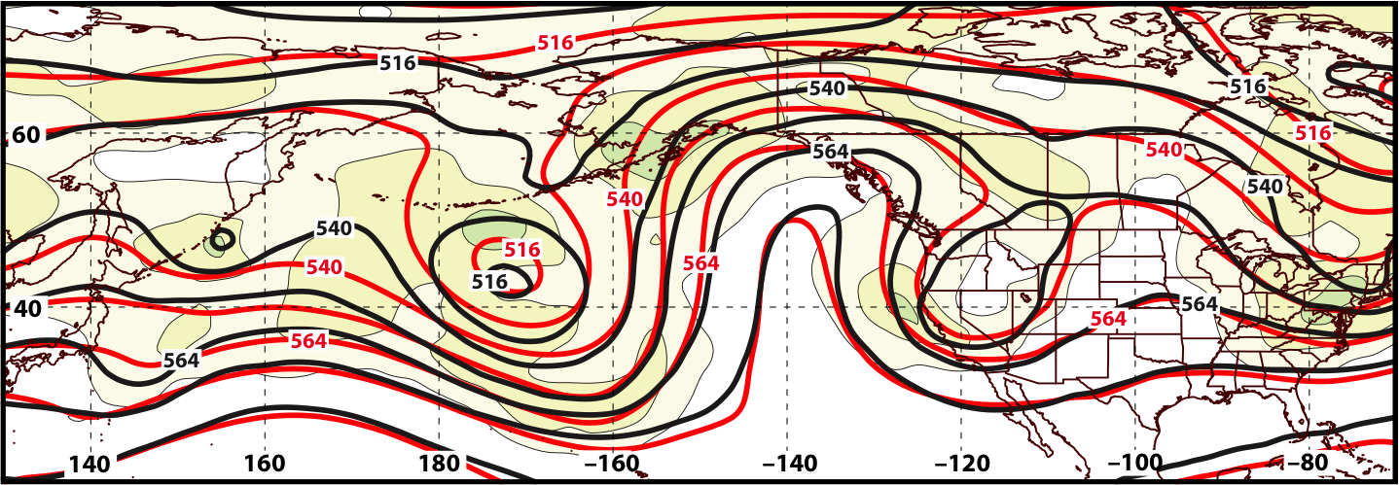
GEFS Ensemble Spread of Geo. Heights (m) Verifying 0000 UTC 29 March 2016
96-h Forecast
500 hPa
Ens. Spread:
Ens. Mean Geo. Heights
Observed Geo. Heights

Slide 45
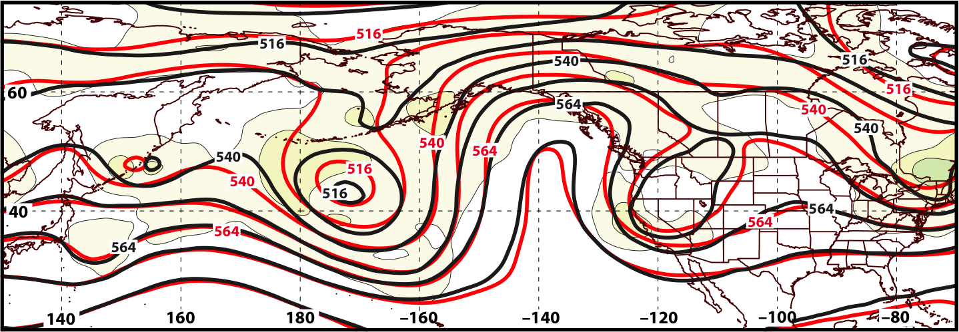
GEFS Ensemble Spread of Geo. Heights (m) Verifying 0000 UTC 29 March 2016
72-h Forecast
500 hPa
Ens. Spread:
Ens. Mean Geo. Heights
Observed Geo. Heights

Slide 46
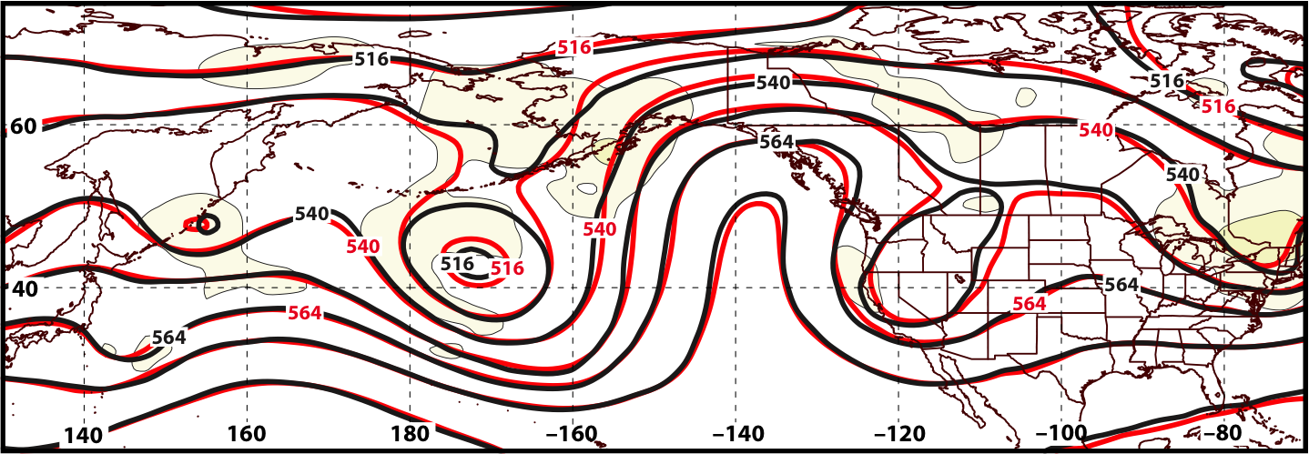
GEFS Ensemble Spread of Geo. Heights (m) Verifying 0000 UTC 29 March 2016
48-h Forecast
500 hPa
Ens. Spread:
Ens. Mean Geo. Heights
Observed Geo. Heights

Slide 47
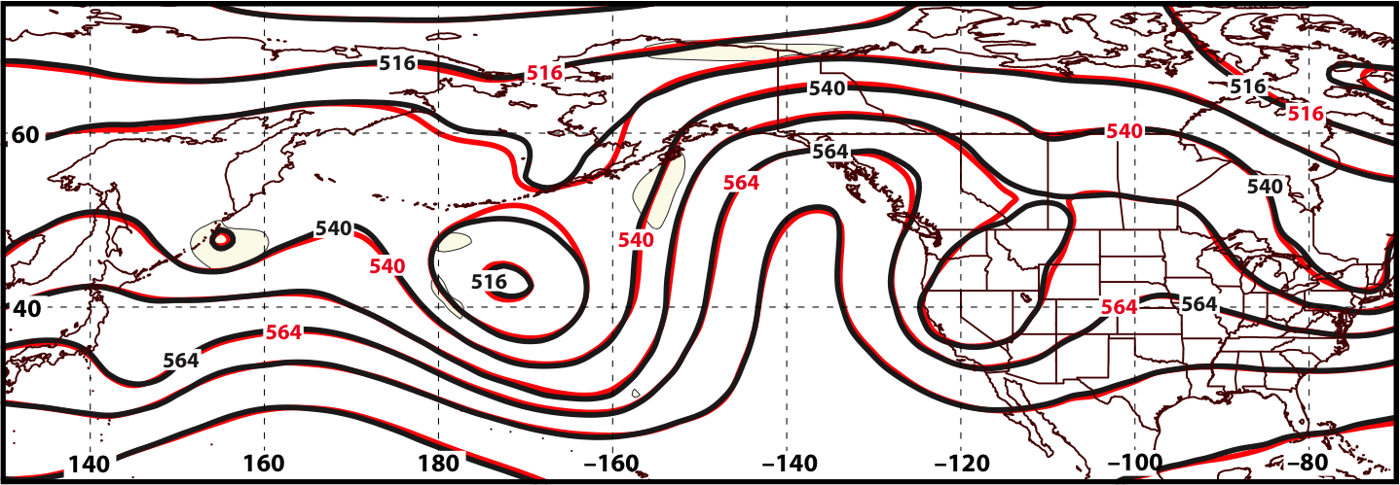
GEFS Ensemble Spread of Geo. Heights (m) Verifying 0000 UTC 29 March 2016
24-h Forecast
500 hPa
Ens. Spread:
Ens. Mean Geo. Heights
Observed Geo. Heights

Slide 48
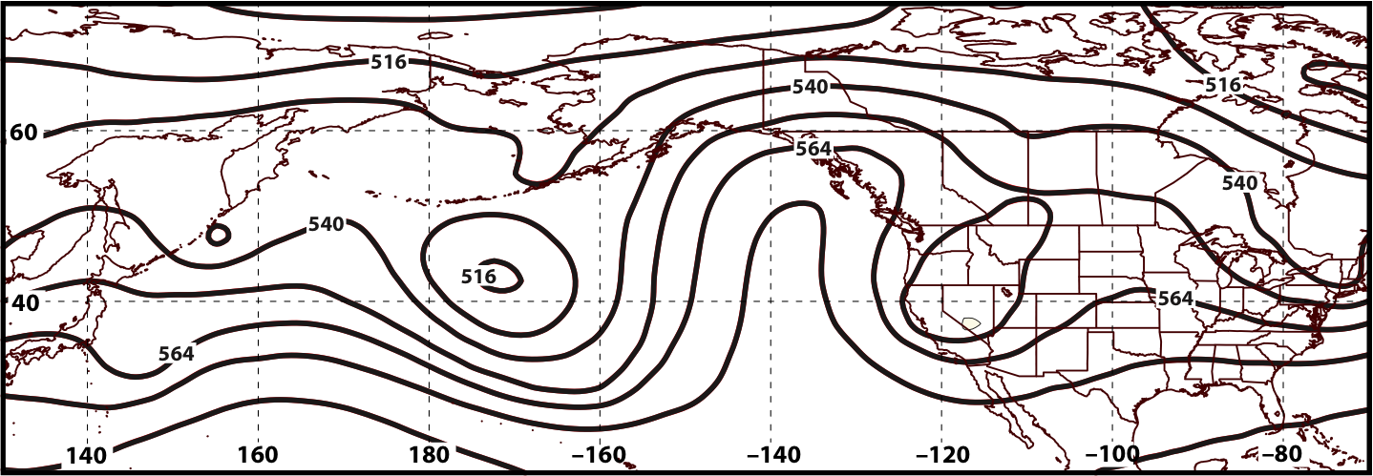
GEFS Ensemble Spread of Geo. Heights (m) Verifying 0000 UTC 29 March 2016
00-h Forecast
500 hPa
Ens. Spread:
Ens. Mean Geo. Heights
Observed Geo. Heights

Slide 49
GFS Deterministic Forecasts Verifying
0000 UTC 29 March 2016
500 hPa: = 552 dam

Slide 50
GFS Deterministic Forecasts Verifying
0000 UTC 29 March 2016
500 hPa: = 552 dam

Slide 51
GFS Deterministic Forecasts Verifying
0000 UTC 29 March 2016
500 hPa: = 552 dam

Slide 52
GFS Deterministic Forecasts Verifying
0000 UTC 29 March 2016
500 hPa: = 552 dam

Slide 53
GFS Deterministic Forecasts Verifying
0000 UTC 29 March 2016
500 hPa: = 552 dam

Slide 54
GFS Deterministic Forecasts Verifying
0000 UTC 29 March 2016
500 hPa: = 552 dam

Slide 55
GFS Deterministic Forecasts Verifying
0000 UTC 29 March 2016
500 hPa: = 552 dam

Slide 56
GFS Deterministic Forecasts Verifying
0000 UTC 29 March 2016
500 hPa: = 552 dam

Slide 57
GFS Deterministic Forecasts Verifying
0000 UTC 29 March 2016
500 hPa: = 552 dam

Slide 58
GFS Deterministic Forecasts Verifying
0000 UTC 29 March 2016
500 hPa: = 552 dam

Slide 59
GFS Deterministic Forecasts Verifying
0000 UTC 29 March 2016
500 hPa: = 552 dam

Slide 60
Synoptic Evolution: 21 March – 4 April 2016
0000 UTC 29 March 2016
500 hPa Heights (dam; blue)
500 hPa Rel. Vor. (10^{–5} s^{–1} fill pattern)
500 hPa Ascent (dPa s^{–1}; green)

Slide 61
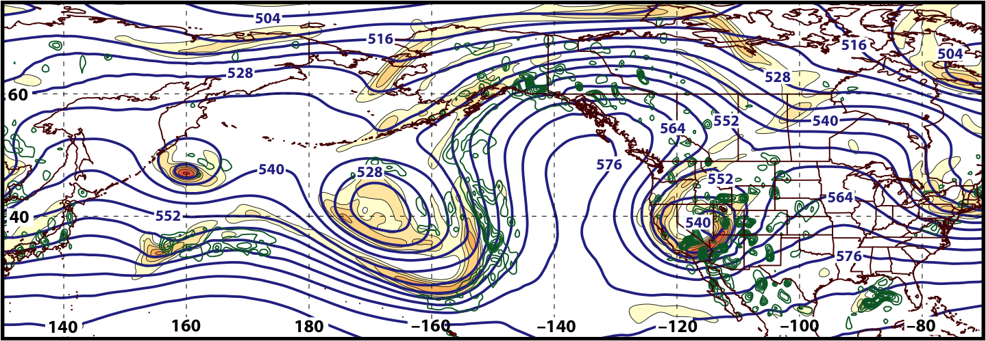
Synoptic Evolution: 21 March – 4 April 2016
1200 UTC 29 March 2016
500 hPa Heights (dam; blue)
500 hPa Rel. Vor. (10^{–5} s^{–1} fill pattern)
500 hPa Ascent (dPa s^{–1}; green)

Slide 62
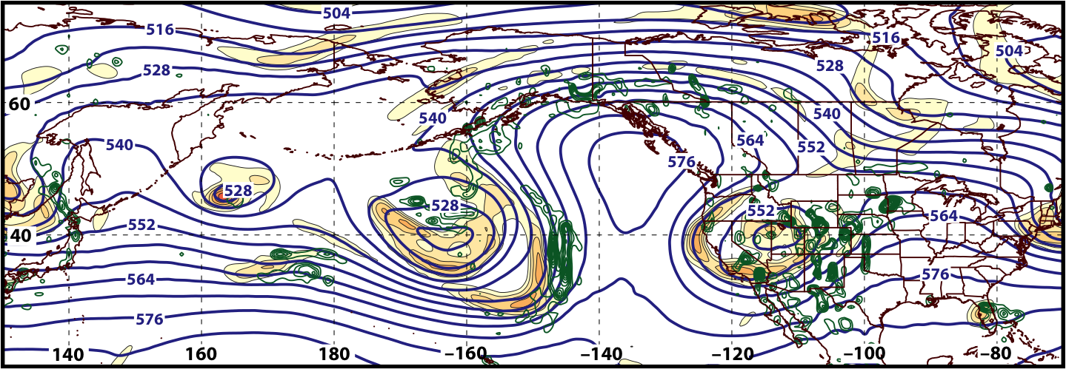
Synoptic Evolution: 21 March – 4 April 2016
0000 UTC 30 March 2016
500 hPa Heights (dam; blue)
500 hPa Rel. Vor. (10^{–5} s^{–1} fill pattern)
500 hPa Ascent (dPa s^{–1}; green)

Slide 63
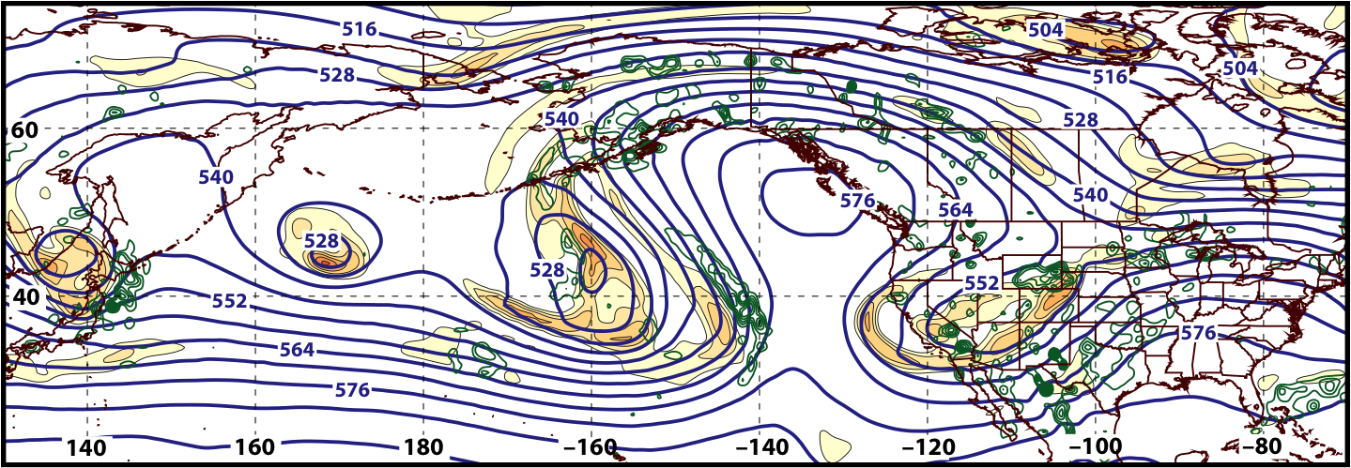
Synoptic Evolution: 21 March – 4 April 2016
1200 UTC 30 March 2016
500 hPa Heights (dam; blue)
500 hPa Rel. Vor. (10^{–5} s^{–1} fill pattern)
500 hPa Ascent (dPa s^{–1}; green)

Slide 64
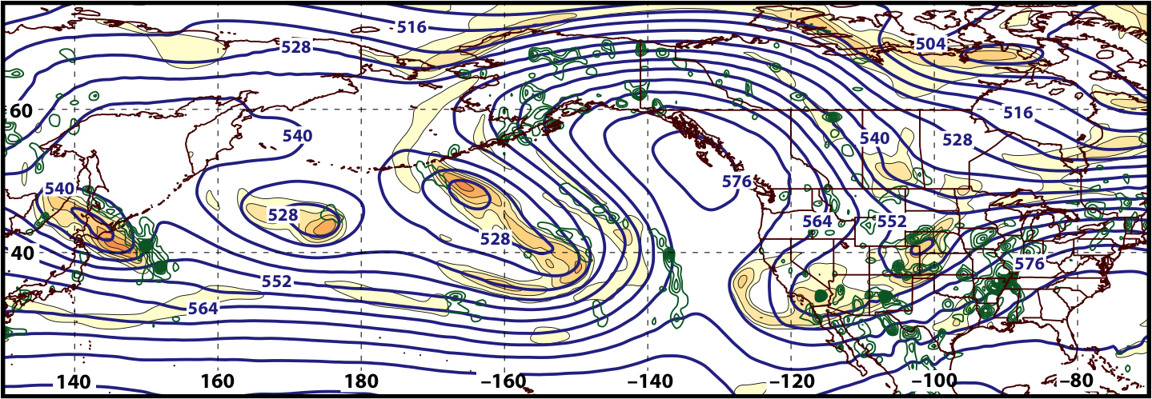
Synoptic Evolution: 21 March – 4 April 2016
0000 UTC 31 March 2016
500 hPa Heights (dam; blue)
500 hPa Rel. Vor. (10^{–5} s^{–1} fill pattern)
500 hPa Ascent (dPa s^{–1}; green)

Slide 65
E. Rockies – All Events
COLD EVENTS (n = 173)
Poleward Shift
23
Events during
Sept. – May projected onto phase diagram
30
Jet Retraction
47
Jet Extension
Each point is an average of the PCs for
3–7 days prior to an event
73
Equatorward Shift

Slide 66
Synoptic Evolution: 21 March – 4 April 2016
0000 UTC 31 March 2016
500 hPa Heights (dam; blue)
500 hPa Rel. Vor. (10^{–5} s^{–1} fill pattern)
500 hPa Ascent (dPa s^{–1}; green)

Slide 67
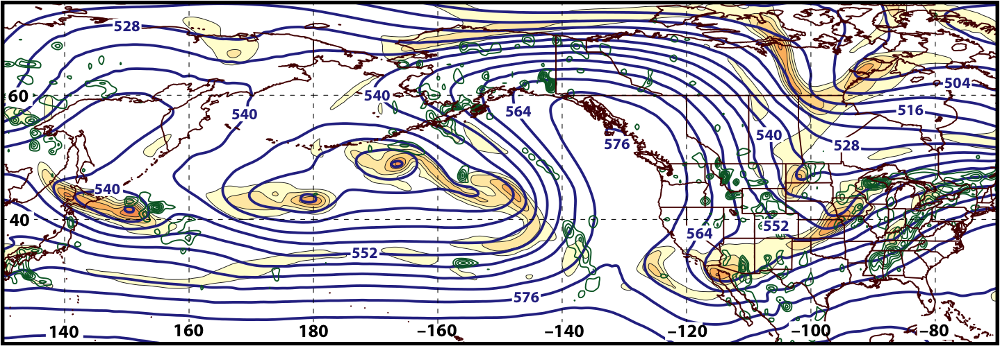
Synoptic Evolution: 21 March – 4 April 2016
1200 UTC 31 March 2016
500 hPa Heights (dam; blue)
500 hPa Rel. Vor. (10^{–5} s^{–1} fill pattern)
500 hPa Ascent (dPa s^{–1}; green)

Slide 68
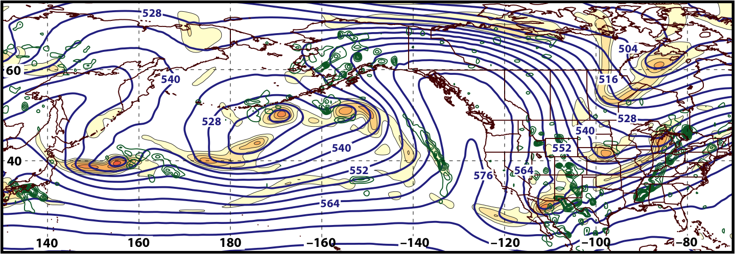
Synoptic Evolution: 21 March – 4 April 2016
0000 UTC 1 April 2016
500 hPa Heights (dam; blue)
500 hPa Rel. Vor. (10^{–5} s^{–1} fill pattern)
500 hPa Ascent (dPa s^{–1}; green)

Slide 69
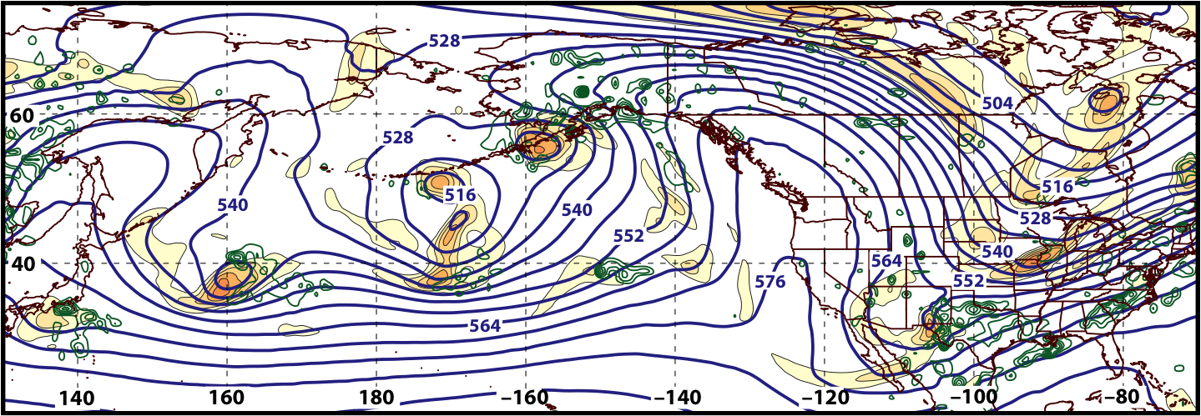
Synoptic Evolution: 21 March – 4 April 2016
1200 UTC 1 April 2016
500 hPa Heights (dam; blue)
500 hPa Rel. Vor. (10^{–5} s^{–1} fill pattern)
500 hPa Ascent (dPa s^{–1}; green)

Slide 70
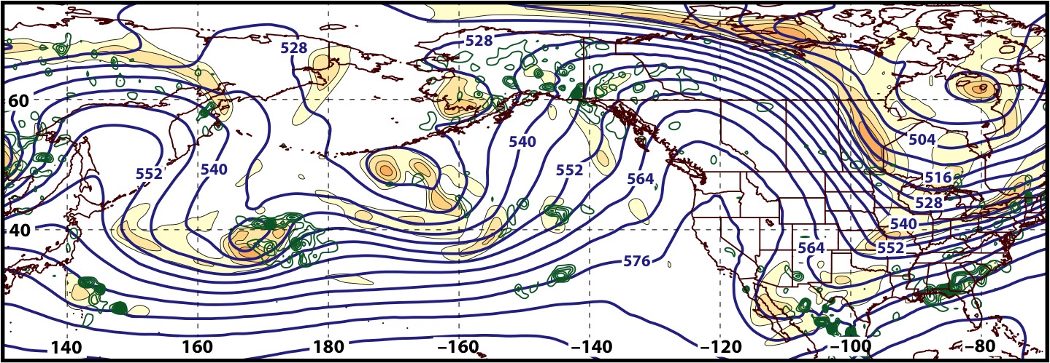
Synoptic Evolution: 21 March – 4 April 2016
0000 UTC 2 April 2016
500 hPa Heights (dam; blue)
500 hPa Rel. Vor. (10^{–5} s^{–1} fill pattern)
500 hPa Ascent (dPa s^{–1}; green)

Slide 71
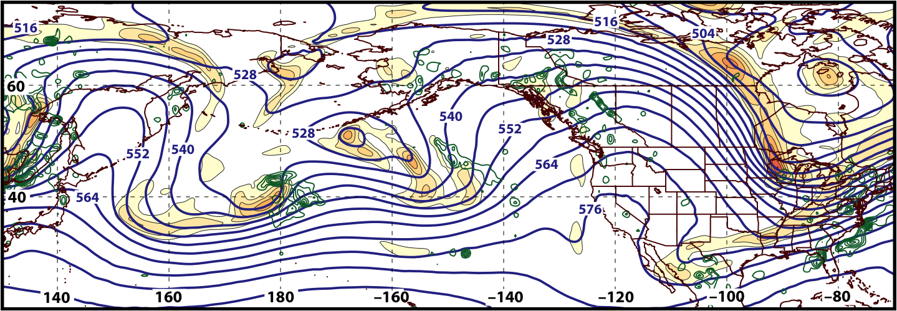
Synoptic Evolution: 21 March – 4 April 2016
1200 UTC 2 April 2016
500 hPa Heights (dam; blue)
500 hPa Rel. Vor. (10^{–5} s^{–1} fill pattern)
500 hPa Ascent (dPa s^{–1}; green)

Slide 72
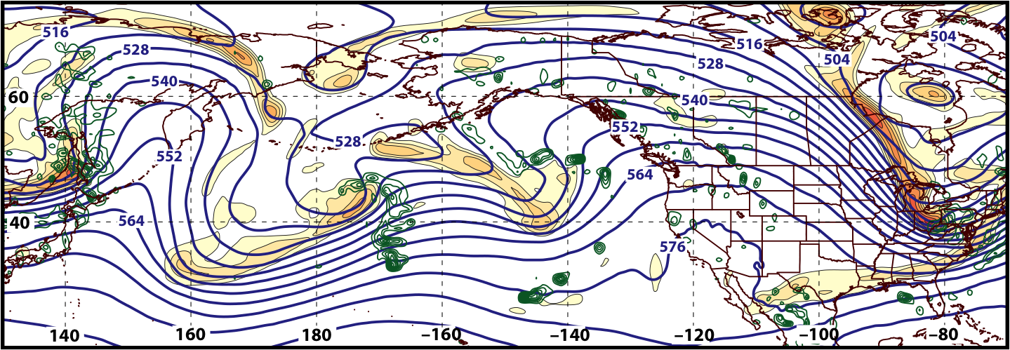
Synoptic Evolution: 21 March – 4 April 2016
0000 UTC 3 April 2016
500 hPa Heights (dam; blue)
500 hPa Rel. Vor. (10^{–5} s^{–1} fill pattern)
500 hPa Ascent (dPa s^{–1}; green)

Slide 73
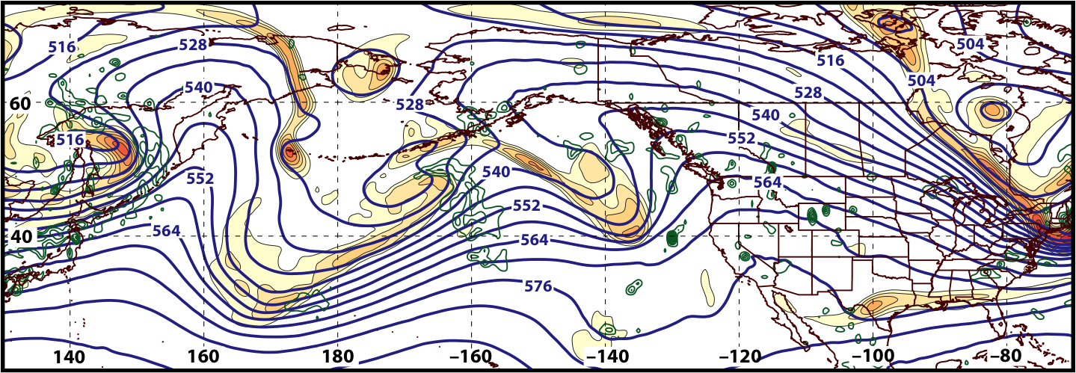
Synoptic Evolution: 21 March – 4 April 2016
1200 UTC 3 April 2016
500 hPa Heights (dam; blue)
500 hPa Rel. Vor. (10^{–5} s^{–1} fill pattern)
500 hPa Ascent (dPa s^{–1}; green)

Slide 74

Synoptic Evolution: 21 March – 4 April 2016
0000 UTC 4 April 2016
500 hPa Heights (dam; blue)
500 hPa Rel. Vor. (10^{–5} s^{–1} fill pattern)
500 hPa Ascent (dPa s^{–1}; green)

Slide 75
Summary
Considerable predictability challenges characterized the development of the 23–24 March 2016 Colorado snowstorm during the hours immediately preceding the event.
The development of an omega block over the eastern North Pacific on 0000 UTC 29 March 2016 was relatively well predicted, although the geometry of the block was uncertain until 120 h prior to block development.
The evolution of the flow pattern prior to the onset of cold over the Northeast in early April is consistent with an antecedent environment conducive to extreme cold east of the Rocky Mountains.

