Slide 1
A North Pacific Jet Phase Diagram Perspective on Extreme Weather Events during 2016–2017: Illustrative Examples
Lance F. Bosart, Andrew C. Winters, and Daniel Keyser
Department of Atmospheric and Environmental Sciences
University at Albany, State University of New York, Albany, NY 12222
NWA 42nd Annual Meeting
Garden Grove, CA
20 September 2017
This work is supported by NOAA Grant NA15NWS4680006

Slide 2
Motivation
Previous work highlighted the considerable North Pacific Jet (NPJ) variability during the medium-range period that characterizes the antecedent environments associated with continental U.S. extreme temperature events.

Slide 3
Motivation
Previous work highlighted the considerable North Pacific Jet (NPJ) variability during the medium-range period that characterizes the antecedent environments associated with continental U.S. extreme temperature events.
This NPJ variability motivated the development of the NPJ phase diagram as an objective tool to characterize the instantaneous state of the upper-tropospheric flow pattern over the North Pacific.

Slide 4
Motivation
Previous work highlighted the considerable North Pacific Jet (NPJ) variability during the medium-range period that characterizes the antecedent environments associated with continental U.S. extreme temperature events.
This NPJ variability motivated the development of the NPJ phase diagram as an objective tool to characterize the instantaneous state of the upper-tropospheric flow pattern over the North Pacific.
Consideration of the NPJ phase diagram offers the potential to increase confidence in operational probabilistic temperature and precipitation forecasts during the medium-range period.

Slide 5
The Development of the
NPJ Phase Diagram

Slide 6
The NPJ Phase Diagram
Removed the mean and the annual and diurnal cycles from 6-hourly, 250-hPa zonal wind data from the CFSR (1979–2014) (Saha et al. 2014)
Restricted data to the cool season (September–May)
Performed an EOF analysis on the zonal wind anomalies within the domain: 10–80°N ; 100°E–120°W
Analysis techniques and resultant EOF patterns are consistent with related work on the North Pacific Jet:
Athanasiadis et al. (2010)
Jaffe et al. (2011)
Griffin and Martin (2017)

Slide 7
The NPJ Phase Diagram
EOF 1 – Jet Extension/Retraction
Sept.–May mean 250-hPa zonal wind: black contours
Sept.–May 250-hPa zonal wind EOF 1 pattern: shading
+ EOF 1: Jet Extension
– EOF 1: Jet Retraction

Slide 8
The NPJ Phase Diagram
EOF 1 – Jet Extension/Retraction
Hypothetical Zonal Wind
Sept.–May mean 250-hPa zonal wind: black contours
Sept.–May 250-hPa zonal wind EOF 1 pattern: shading
+ EOF 1: Jet Extension
– EOF 1: Jet Retraction
Notes:
The outermost green contour is 20 m/s and contour interval for green contours is every 10 m/s. The green contours are calculated by adding the EOF patterns to the mean zonal wind. The resultant wind distribution would project onto the point (1,0) on the N. Pacific Jet phase diagram.

Slide 9
The NPJ Phase Diagram
EOF 1 – Jet Extension/Retraction
Hypothetical Zonal Wind
Sept.–May mean 250-hPa zonal wind: black contours
Sept.–May 250-hPa zonal wind EOF 1 pattern: shading
+ EOF 1: Jet Extension
– EOF 1: Jet Retraction
Notes:
The distribution of zonal wind in this slide would project onto the point (-1,0) on the N. Pacific Jet phase diagram.

Slide 10
The NPJ Phase Diagram
EOF 2 – Poleward/Equatorward Shift
Sept.–May mean 250-hPa zonal wind: black contours
Sept.–May 250-hPa zonal wind EOF 2 pattern: shading
+ EOF 2: Poleward Shift
– EOF 2: Equatorward Shift

Slide 11
The NPJ Phase Diagram
EOF 2 – Poleward/Equatorward Shift
Hypothetical Zonal Wind
Sept.–May mean 250-hPa zonal wind: black contours
Sept.–May 250-hPa zonal wind EOF 2 pattern: shading
+ EOF 2: Poleward Shift
– EOF 2: Equatorward Shift
Notes:
The zonal wind pattern in green would project onto the point (0,1) on the N. Pacific Jet phase diagram.

Slide 12
The NPJ Phase Diagram
EOF 2 – Poleward/Equatorward Shift
Hypothetical Zonal Wind
Sept.–May mean 250-hPa zonal wind: black contours
Sept.–May 250-hPa zonal wind EOF 2 pattern: shading
+ EOF 2: Poleward Shift
– EOF 2: Equatorward Shift
Notes:
The zonal wind pattern in green would project onto the point (0,-1) on the N. Pacific Jet phase diagram.

Slide 13
The NPJ Phase Diagram
0000 UTC 8 November 2014
250-hPa wind speed: shaded
Instantaneous 250-hPa zonal wind anomalies can be projected onto EOF 1 and EOF 2, resulting in a point on a North Pacific Jet phase diagram

Slide 14
The NPJ Phase Diagram
0000 UTC 8 November 2014
250-hPa wind speed: shaded
Forecast 250-hPa zonal wind anomalies can be projected onto EOF1 and EOF2 to describe the subsequent evolution of the NPJ

Slide 15
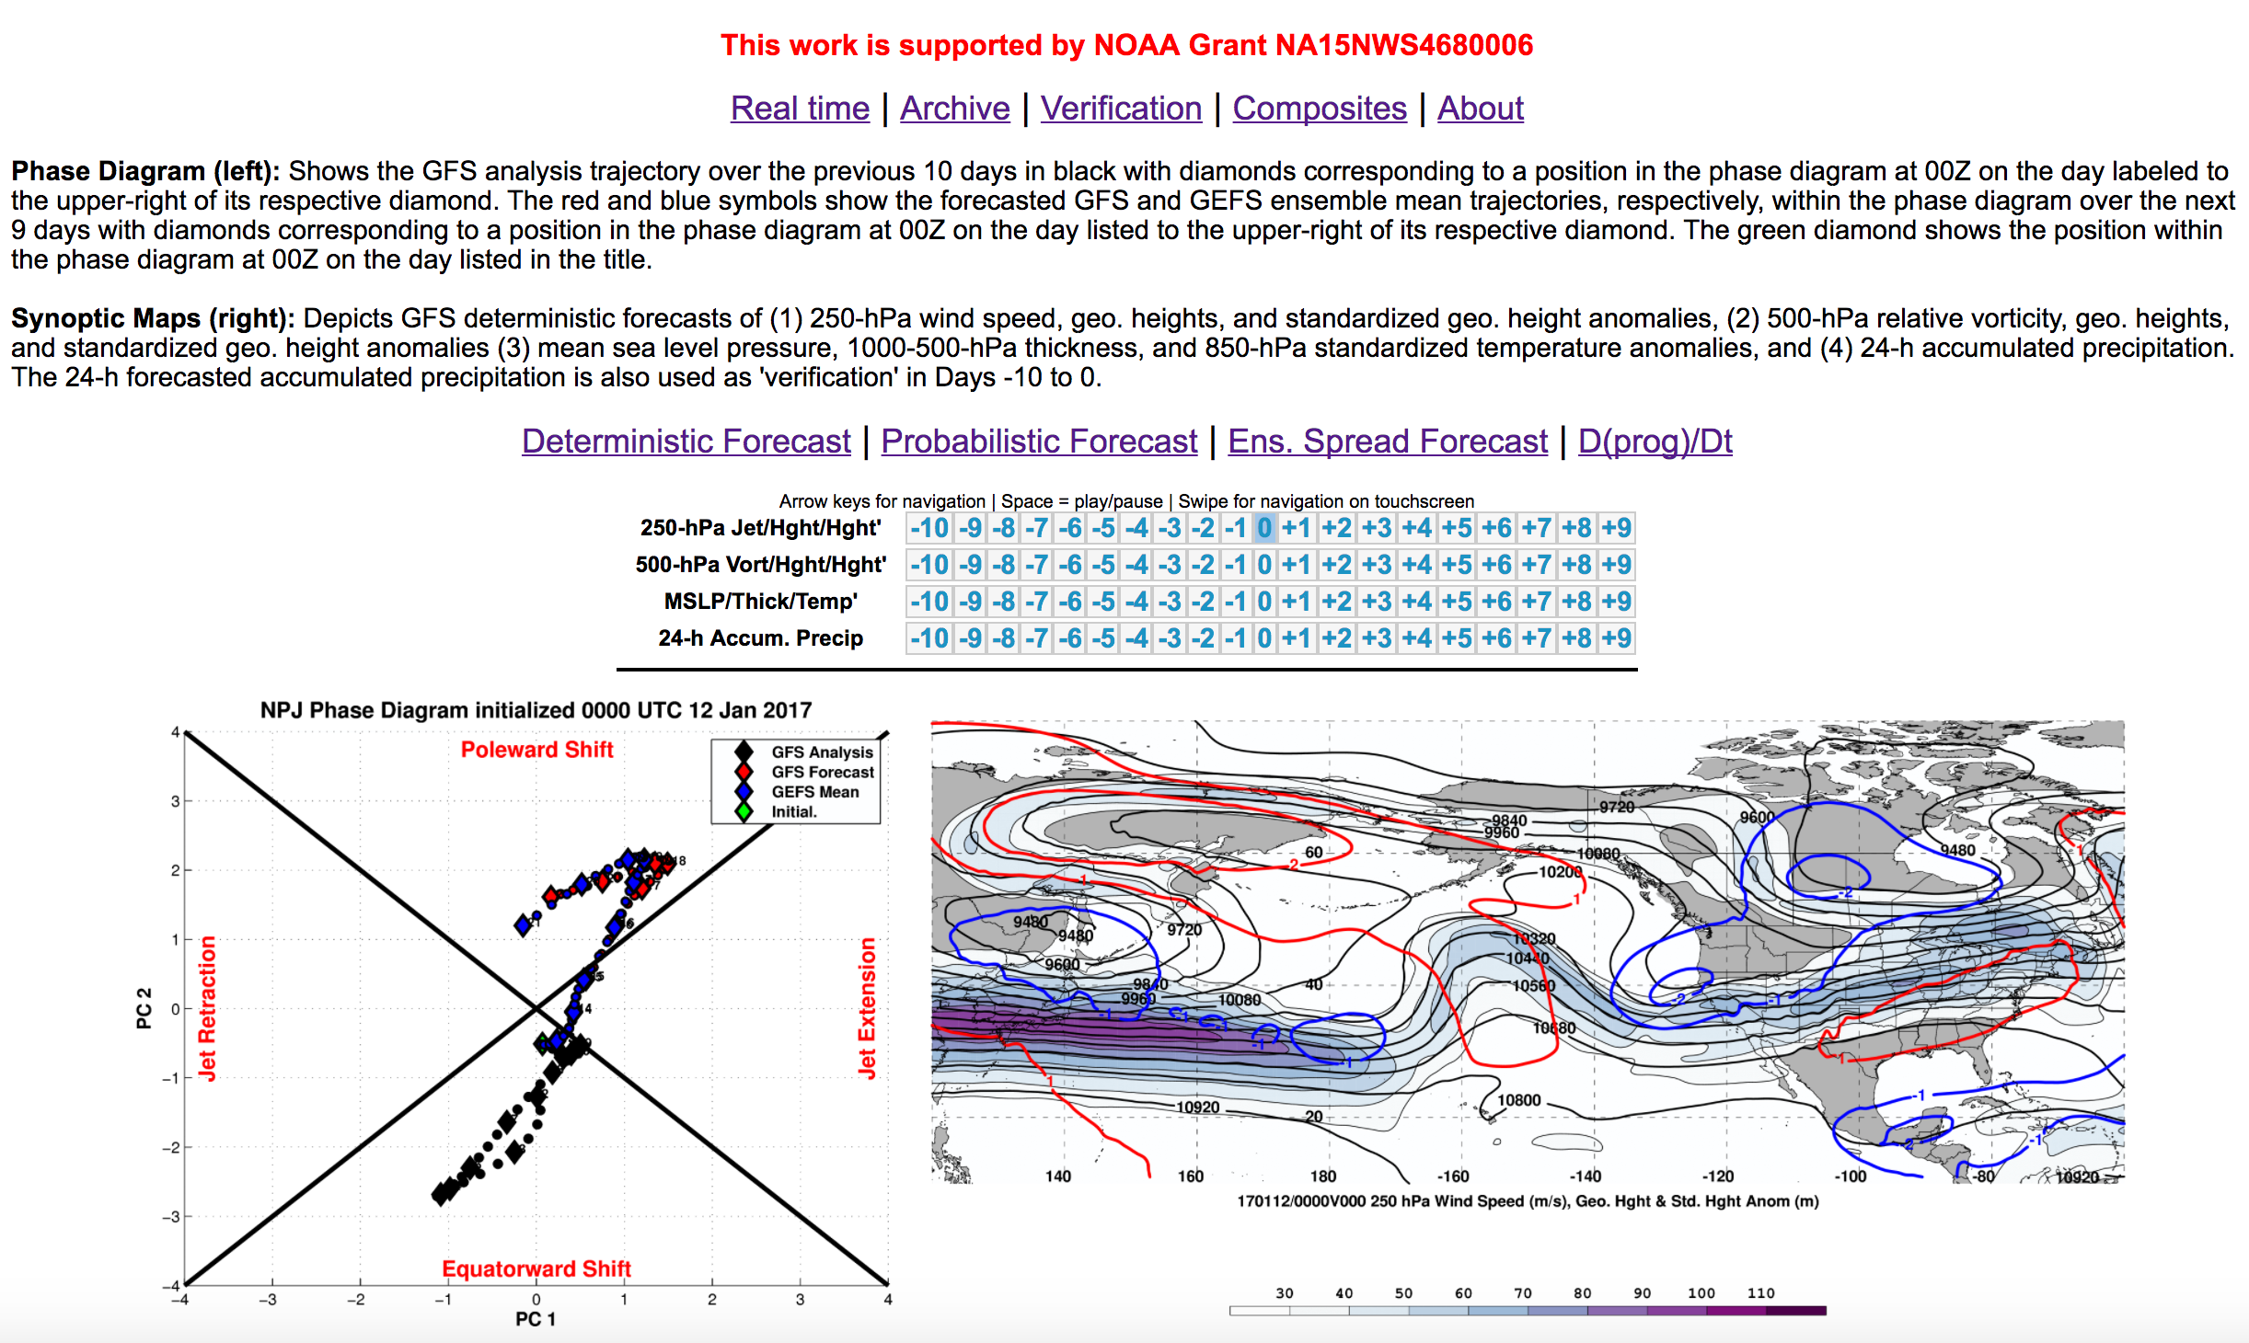
Real Time NPJ Phase Diagram Forecasts

Slide 16
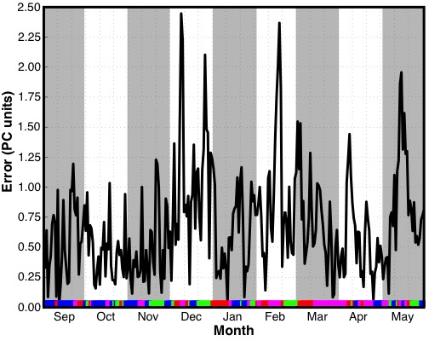
GEFS Ensemble Mean Error: 2016–2017
Time series of GEFS ensemble mean
9-day forecast error by initialization date
Jet Extension (N = 75)
Poleward Shift (N = 83)
Jet Retraction (N = 57)
Equatorward Shift (N = 56)

Slide 17
GEFS Ensemble Mean Error: 2016–2017
Time series of GEFS ensemble mean
9-day forecast error by initialization date
9-day forecasts initialized during December, February, and early-March were characterized by substantial GEFS ensemble mean errors
Jet Extension (N = 75)
Poleward Shift (N = 83)
Jet Retraction (N = 57)
Equatorward Shift (N = 56)

Slide 18
GEFS Ensemble Mean Error: 2016–2017
Time series of GEFS ensemble mean
9-day forecast error by initialization date
9-day forecasts initialized during December, February, and early-March were characterized by substantial GEFS ensemble mean errors
Jet Extension (N = 75)
Poleward Shift (N = 83)
Jet Retraction (N = 57)
Equatorward Shift (N = 56)

Slide 19
Case Study:
February 2017
NPJ Regime Change

Slide 20
Case Study: February 2017 NPJ Regime Change
Winter 2016/2017 was characterized by record setting precipitation in many parts of the Western U.S.
CDEC

Slide 21
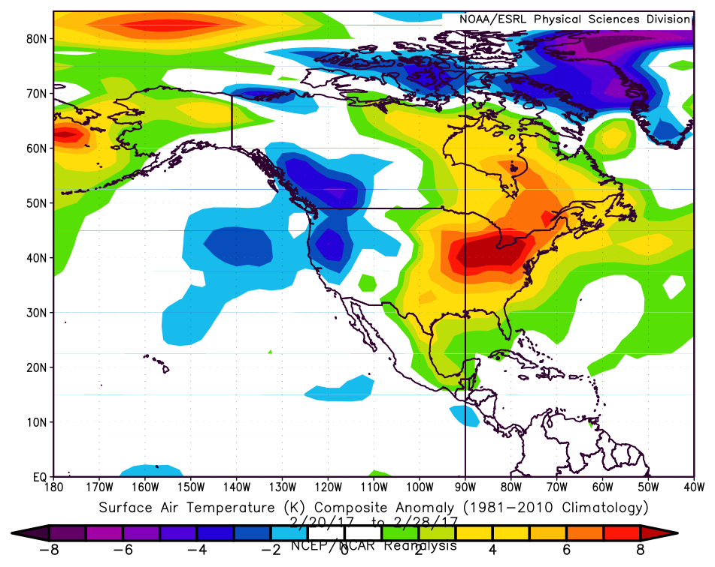
Case Study: February 2017 NPJ Regime Change
Winter 2016/2017 was characterized by record setting precipitation in many parts of the Western U.S.
A NPJ regime change in late-February ushered anomalously warm/cold temperatures into the Eastern/Western U.S.
Composite Temperature Anomalies 20–28 Feb
ESRL

Slide 22
Case Study:
February 2017
NPJ Regime Change
I: Western U.S. Mid-February Rain

Slide 23
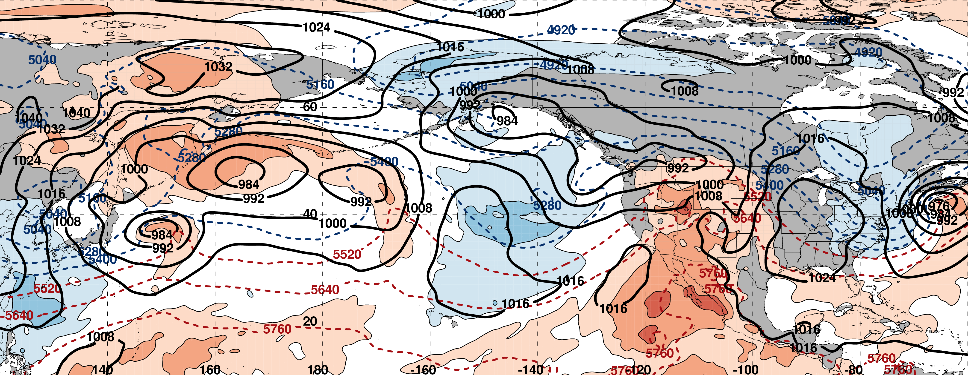
250-hPa Geopotential Height (black contours)
250-hPa Standardized Geopotential Height Anomalies (red contours: positive / blue contours: negative)
250-hPa Wind Speed (purple fill)
Standardized Precipitable Water Anomalies (green fill)
Mean Sea Level Pressure (black contours)
850-hPa Standardized Temperature Anomalies (red fill: positive / blue fill: negative)
1000–500-hPa Thickness (dashed red/blue contours)

Slide 24
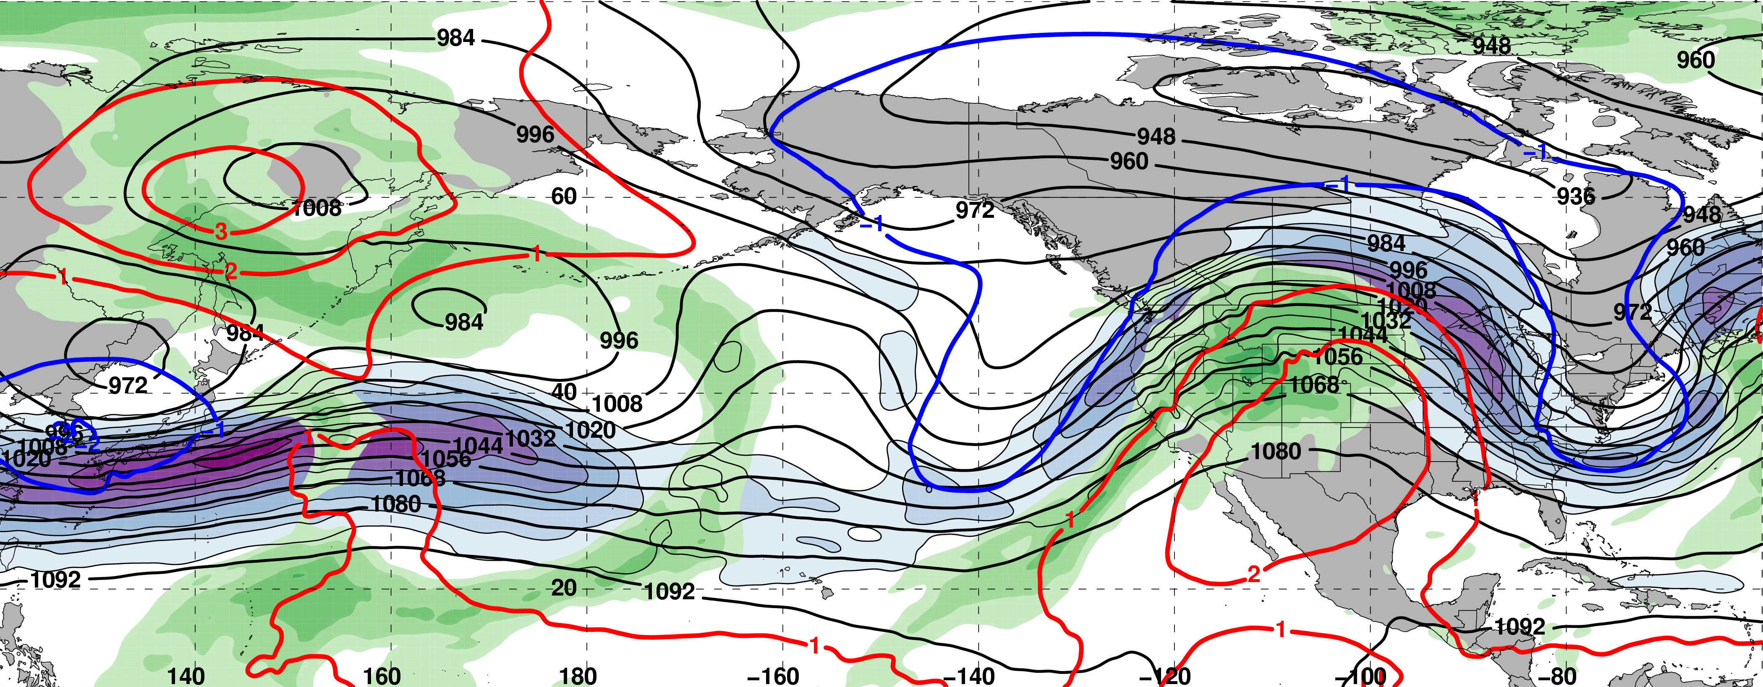
0000 UTC 10 February: 250-hPa Jet and Precipitable Water Anomalies
m s^{–1}
σ
0000 UTC 10 February: MSLP, Thickness, 850-hPa Temp. Anomalies
E. Asian
cold surge
σ

Slide 25
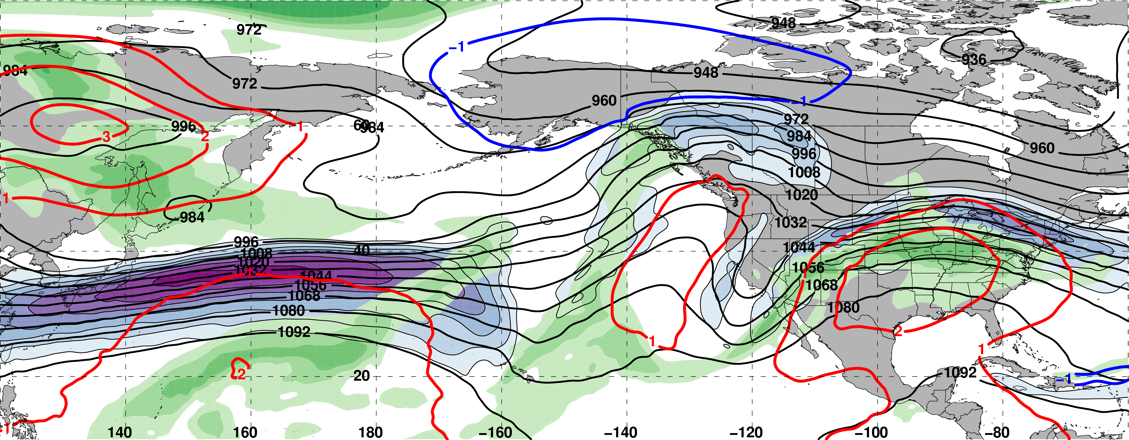
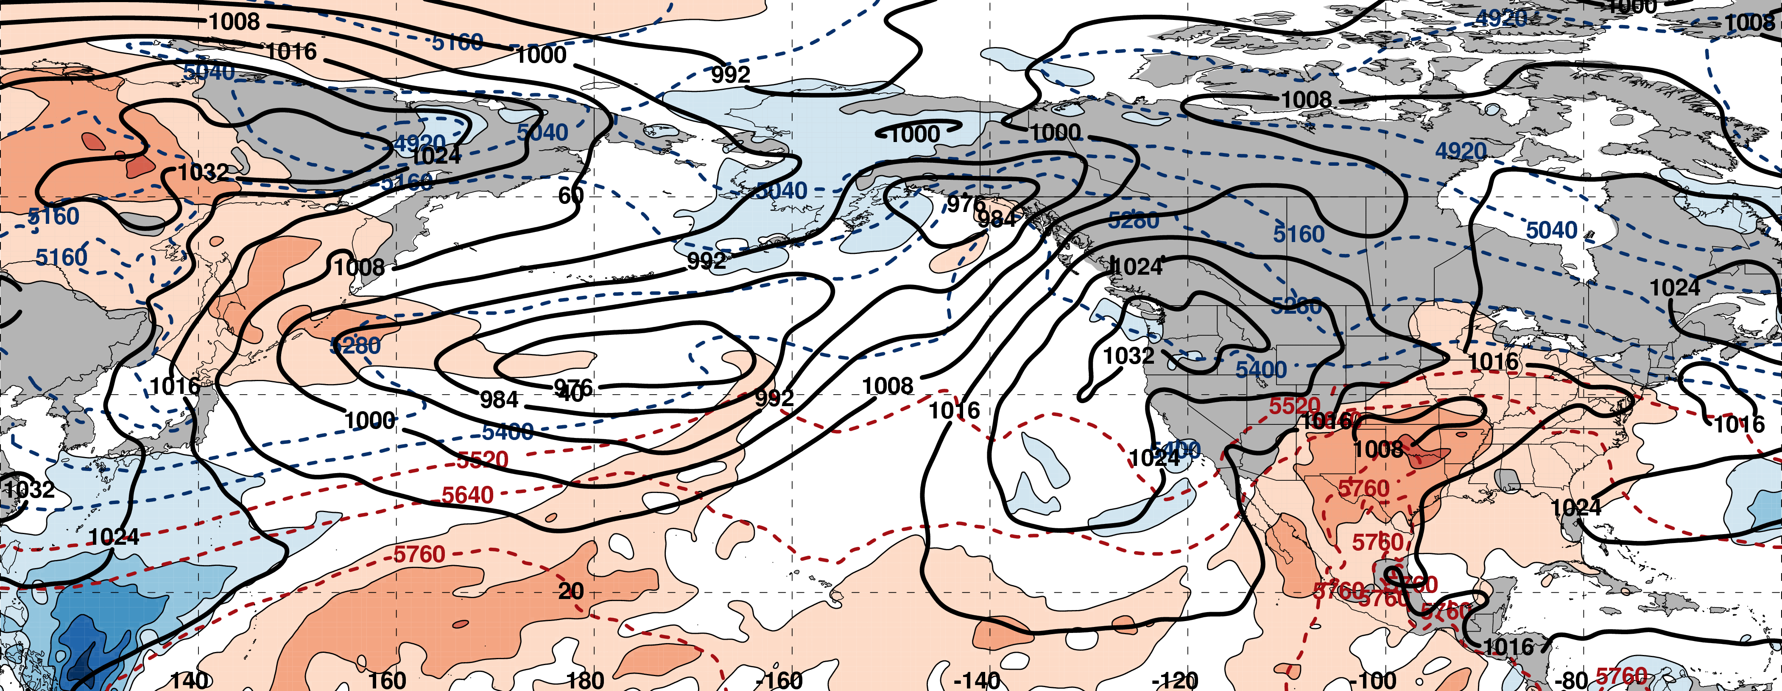
0000 UTC 12 February: 250-hPa Jet and Precipitable Water Anomalies
m s^{–1}
σ
0000 UTC 12 February: MSLP, Thickness, 850-hPa Temp. Anomalies
L
σ

Slide 26
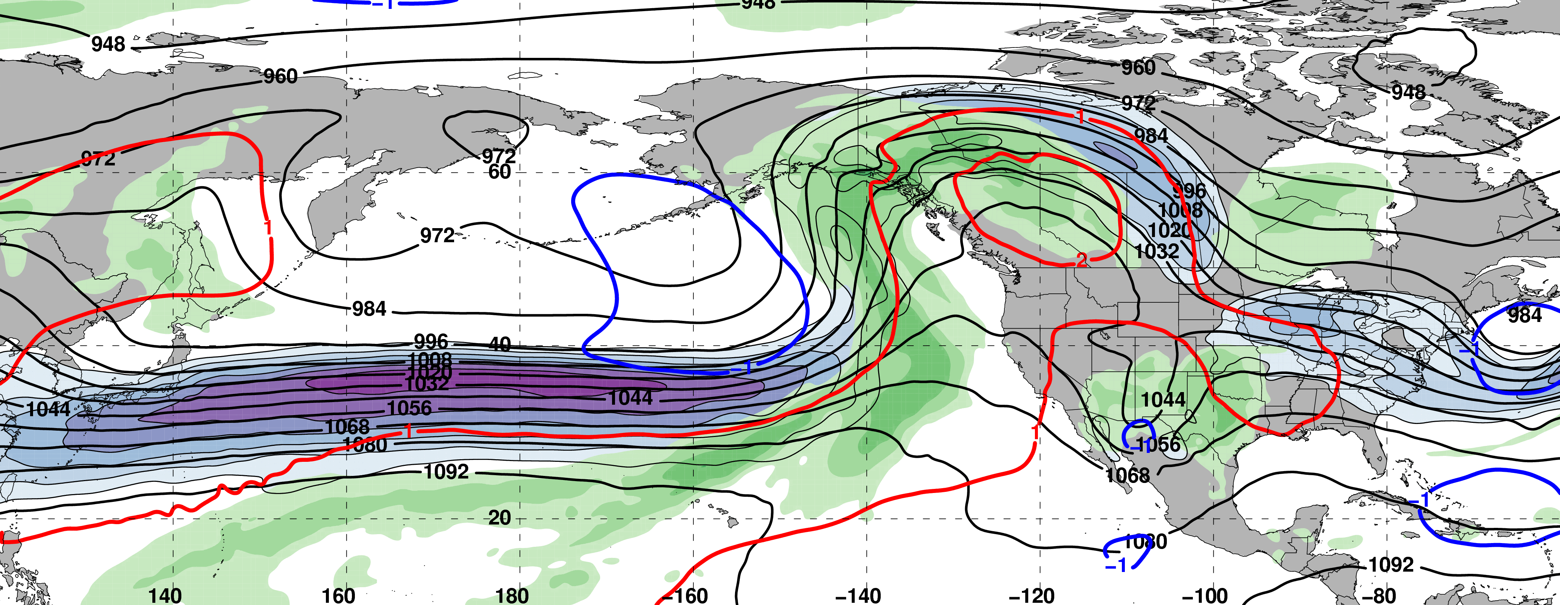
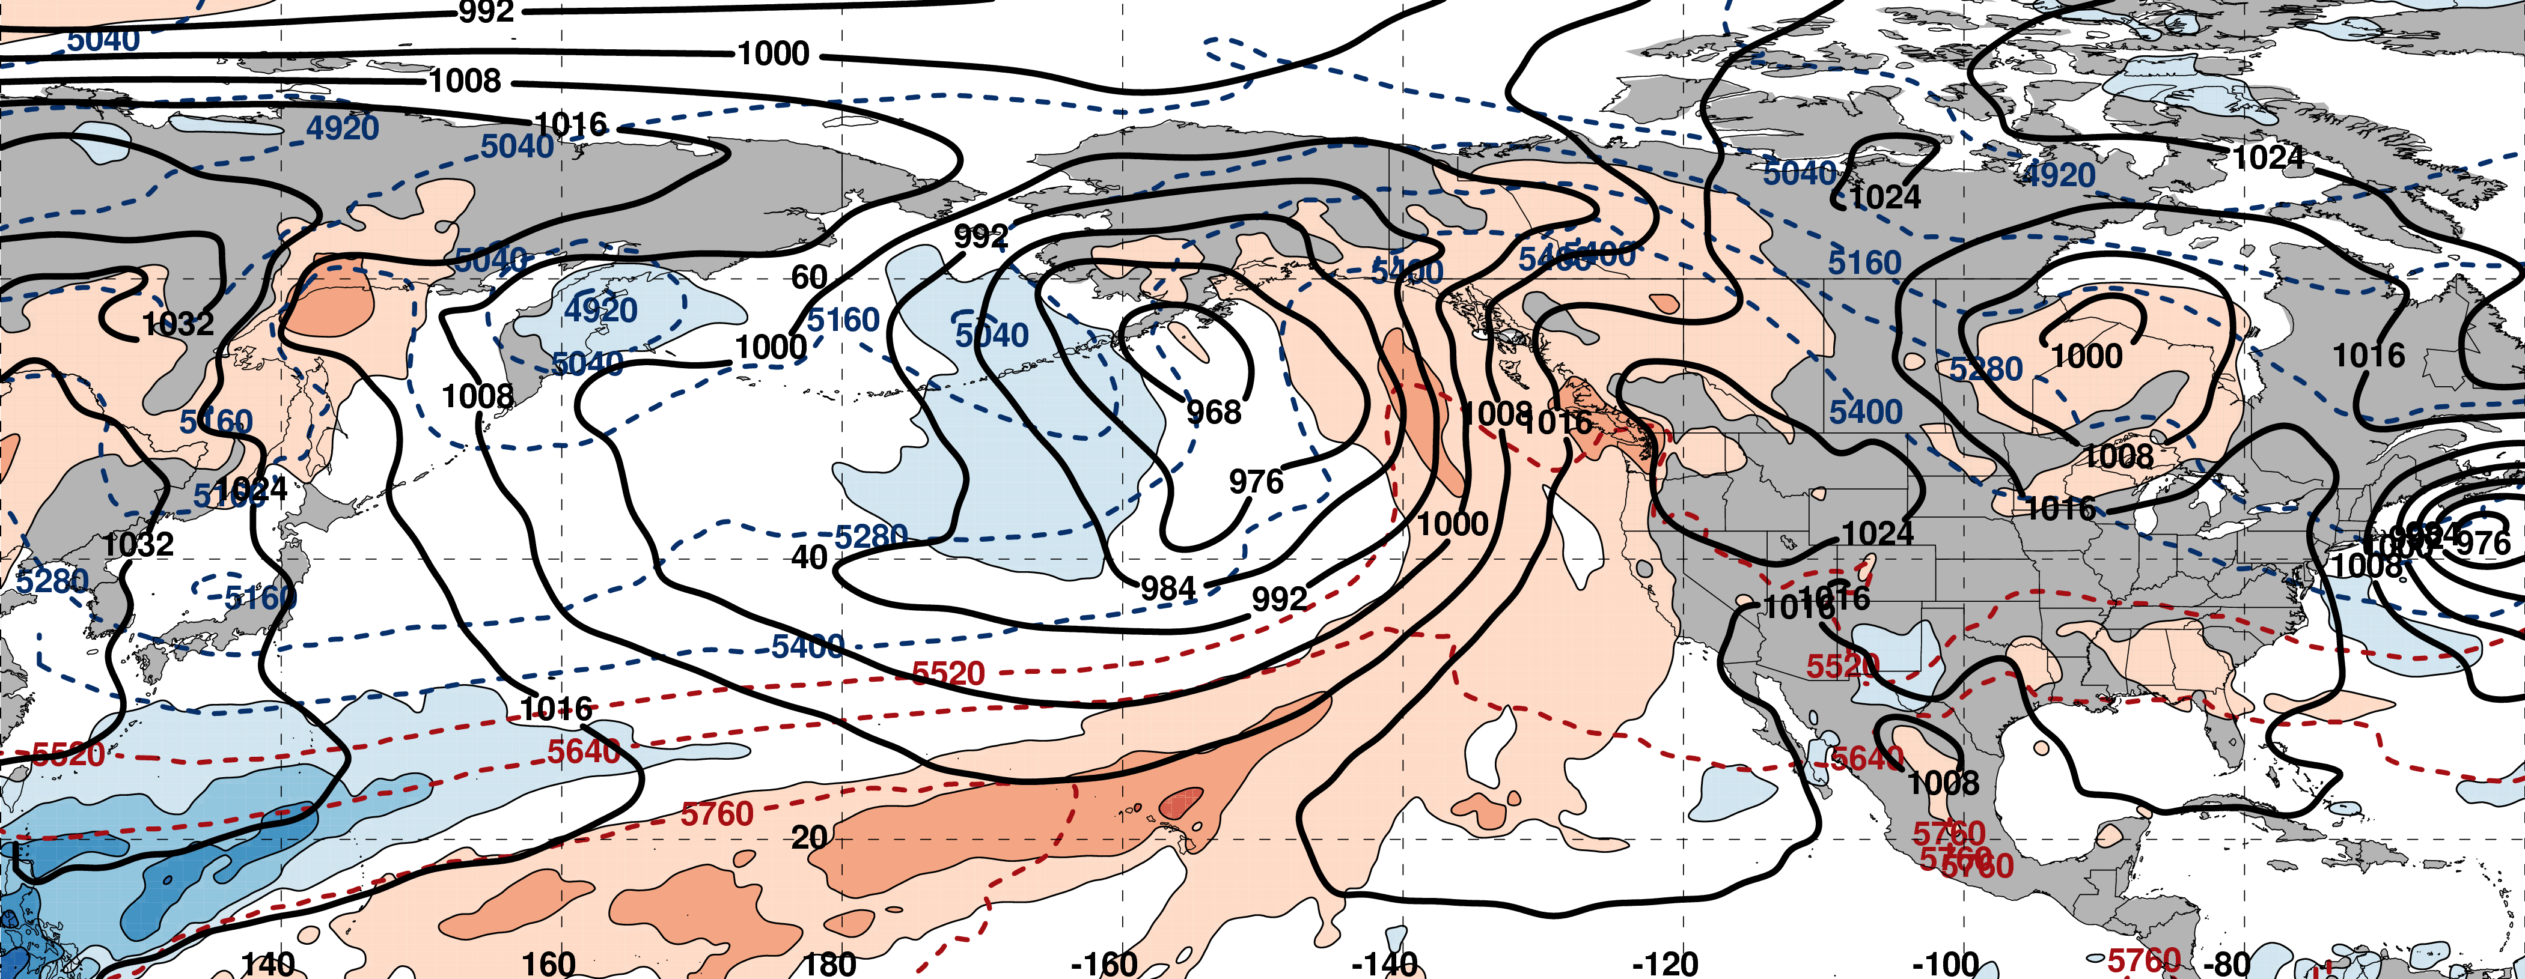
0000 UTC 14 February: 250-hPa Jet and Precipitable Water Anomalies
m s^{–1}
σ
0000 UTC 14 February: MSLP, Thickness, 850-hPa Temp. Anomalies
L
σ

Slide 27
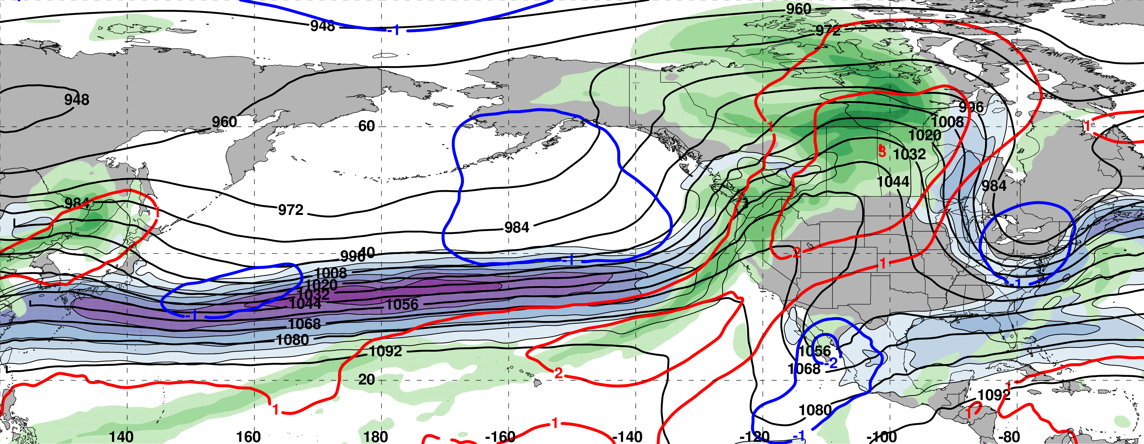
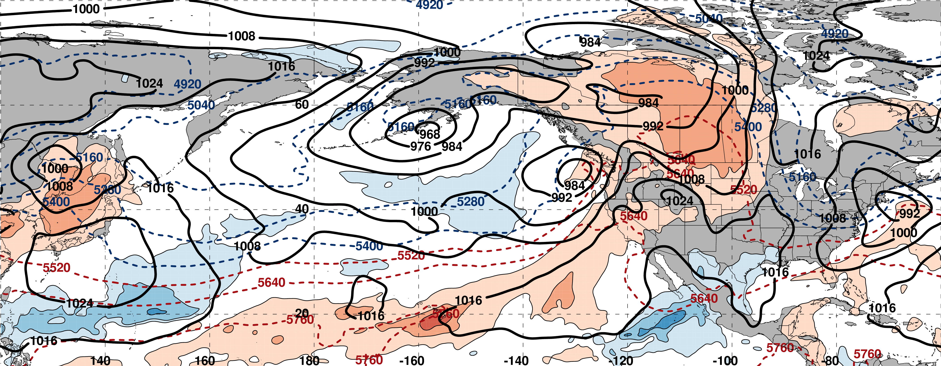
0000 UTC 16 February: 250-hPa Jet and Precipitable Water Anomalies
m s^{–1}
σ
0000 UTC 16 February: MSLP, Thickness, 850-hPa Temp. Anomalies
L
L
σ

Slide 28
0000 UTC 16 February: 250-hPa Jet and Precipitable Water Anomalies
SeaTac 15 Feb Precip : 41 mm (1.63”)
SeaTac Tot. Feb Precip: 225 mm (8.85”)
m s^{–1}
σ
0000 UTC 16 February: MSLP, Thickness, 850-hPa Temp. Anomalies
L
L
σ

Slide 29
West Coast Extreme Precipitation Events
Events during
Sep – May
1979–2014 projected onto the NPJ phase diagram (N=154)
Each point is an average of the PCs
3–7 days prior to an event
West Coast Extreme Precipitation Events are most often preceded by Jet Extensions
9–13 Feb. 2017

Slide 30
Case Study:
February 2017
NPJ Regime Change
II: NPJ Regime Change

Slide 31
0000 UTC 16 February: 250-hPa Jet and Precipitable Water Anomalies
m s^{–1}
σ
0000 UTC 16 February: MSLP, Thickness, 850-hPa Temp. Anomalies
σ

Slide 32
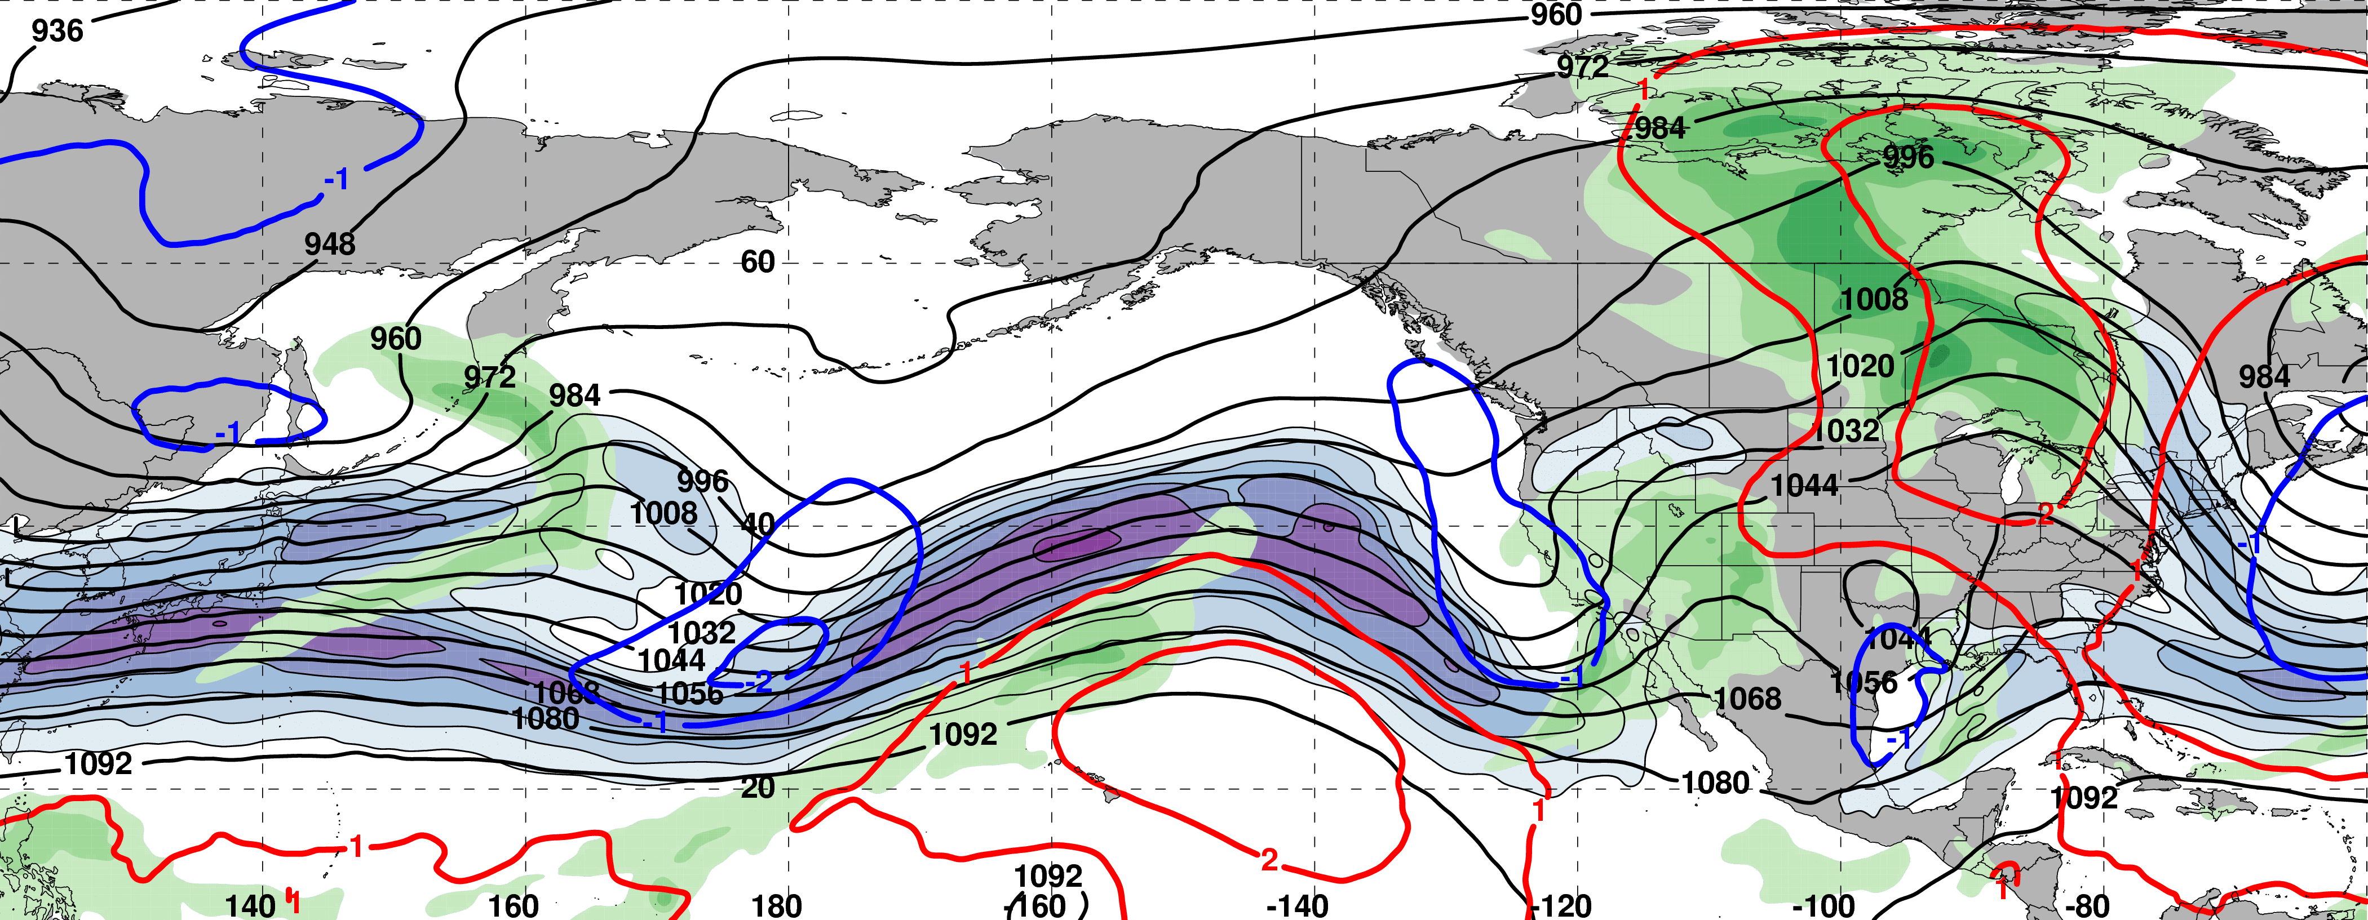
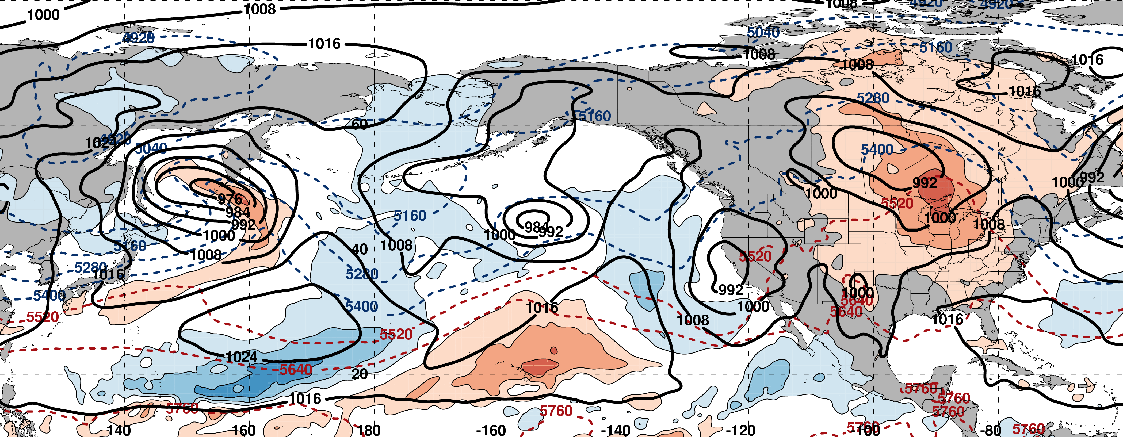
0000 UTC 18 February: 250-hPa Jet and Precipitable Water Anomalies
m s^{–1}
σ
0000 UTC 18 February: MSLP, Thickness, 850-hPa Temp. Anomalies
σ

Slide 33
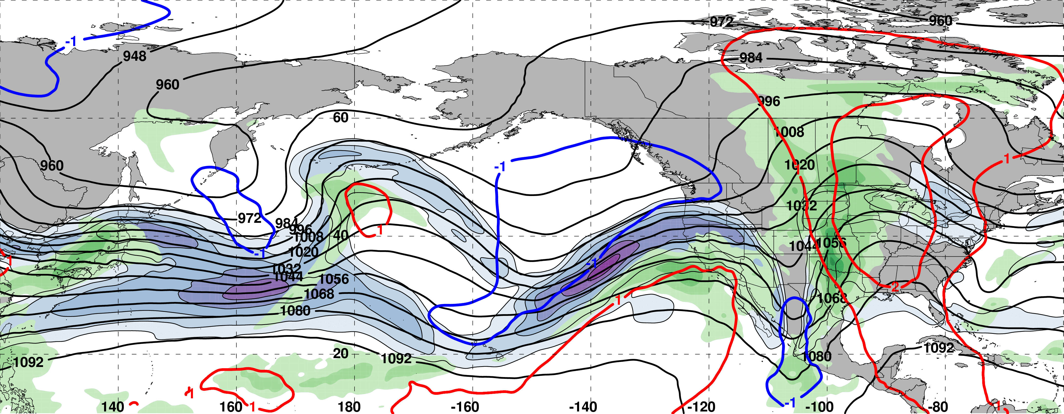
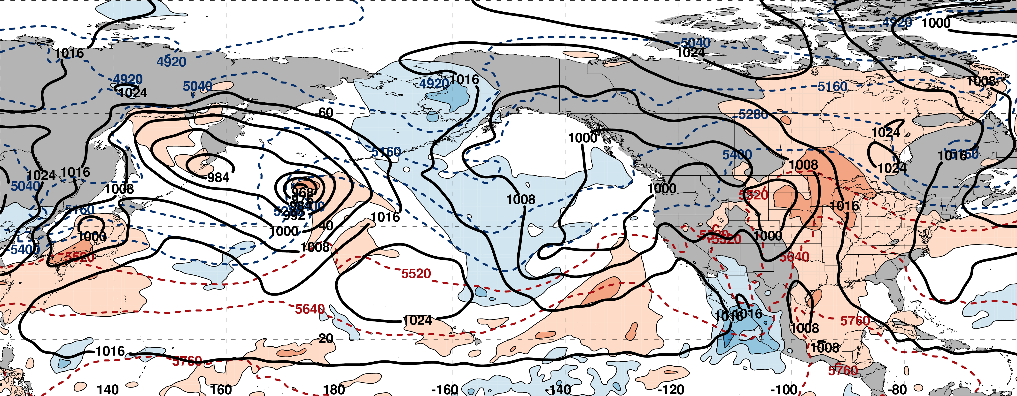
0000 UTC 20 February: 250-hPa Jet and Precipitable Water Anomalies
m s^{–1}
σ
0000 UTC 20 February: MSLP, Thickness, 850-hPa Temp. Anomalies
L
σ

Slide 34
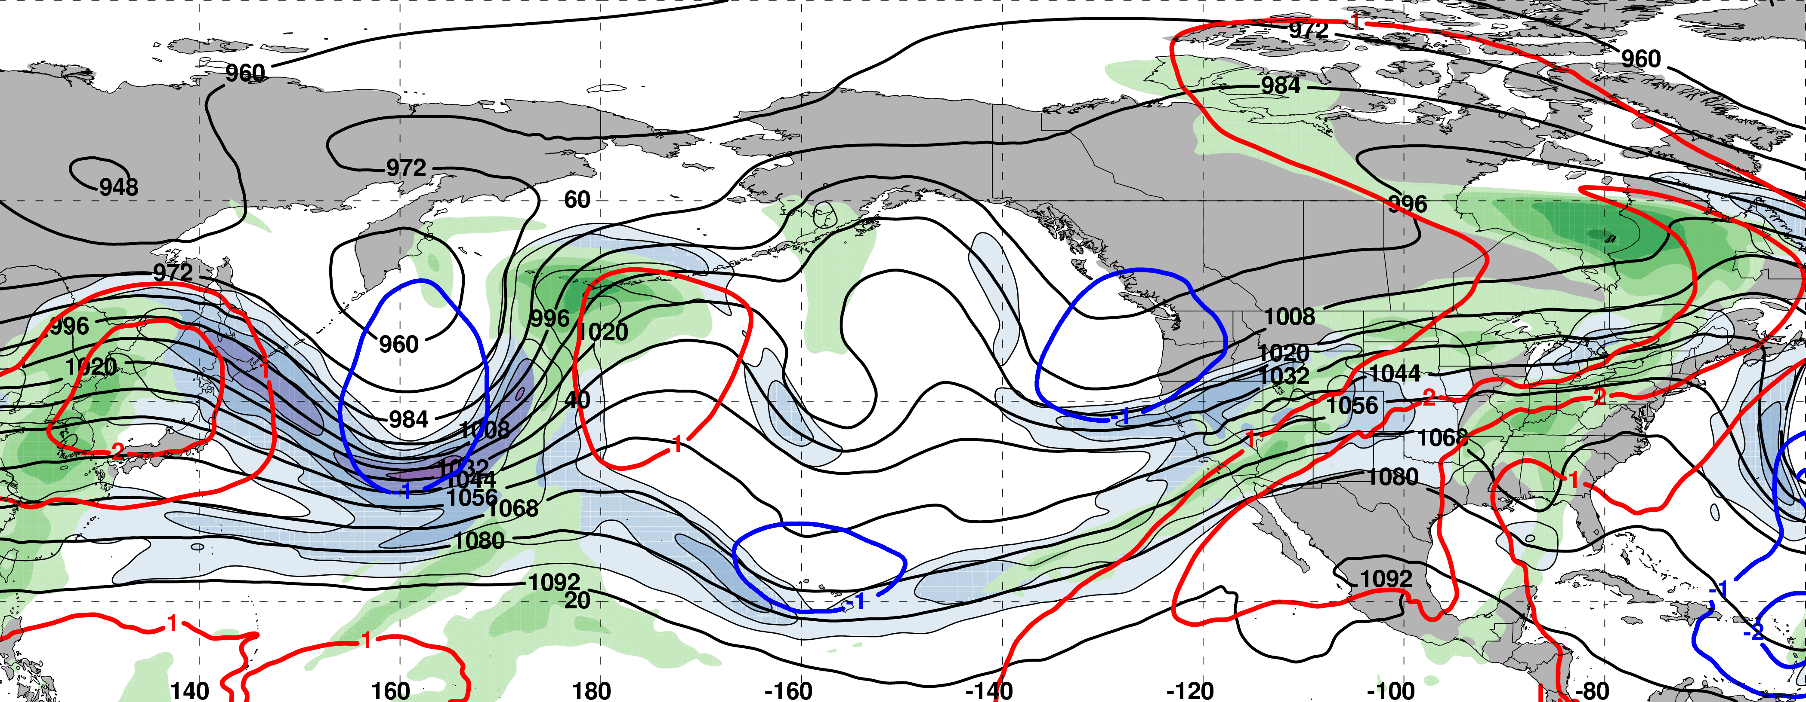
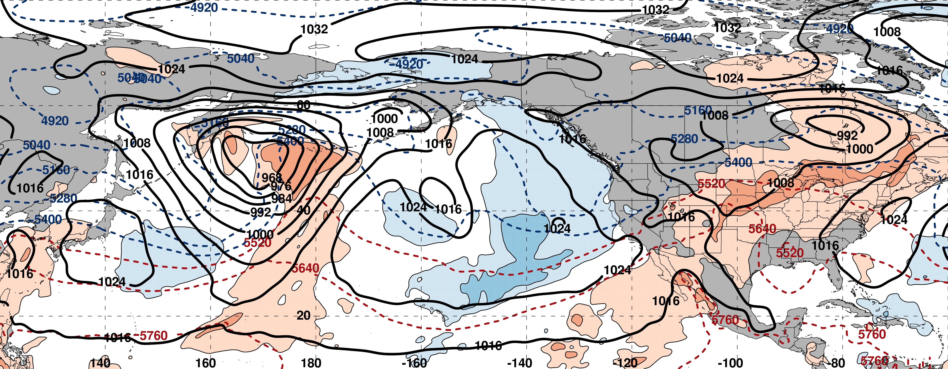
0000 UTC 22 February: 250-hPa Jet and Precipitable Water Anomalies
m s^{–1}
σ
0000 UTC 22 February: MSLP, Thickness, 850-hPa Temp. Anomalies
L
σ

Slide 35
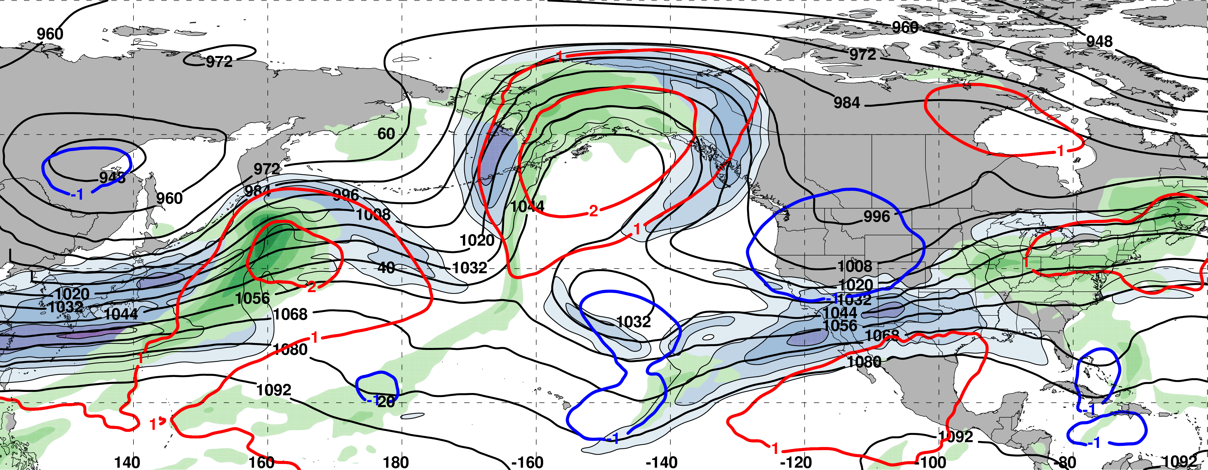
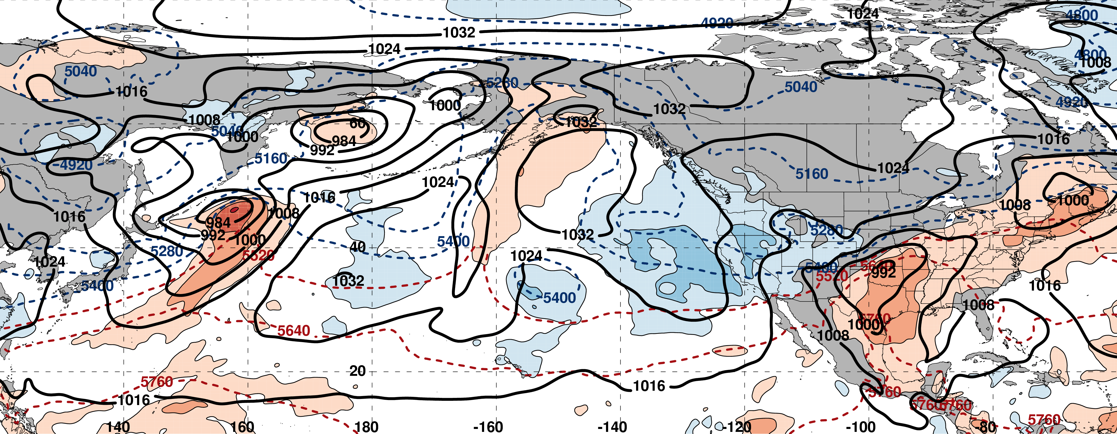
0000 UTC 24 February: 250-hPa Jet and Precipitable Water Anomalies
m s^{–1}
σ
0000 UTC 24 February: MSLP, Thickness, 850-hPa Temp. Anomalies
L
σ

Slide 36
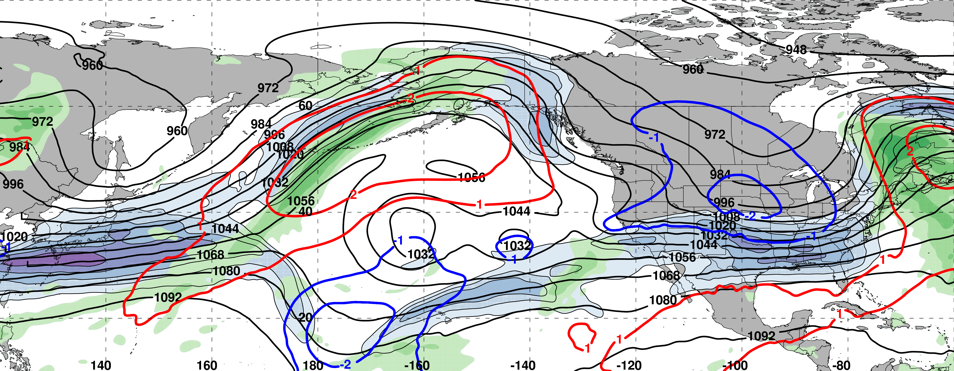
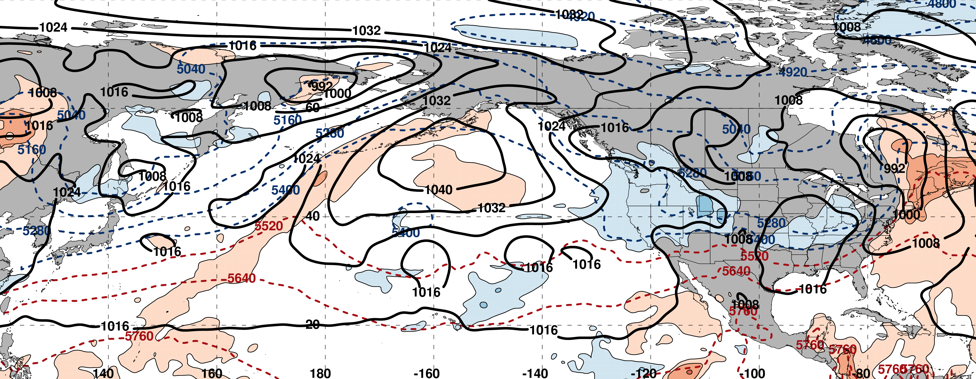
0000 UTC 26 February: 250-hPa Jet and Precipitable Water Anomalies
m s^{–1}
σ
0000 UTC 26 February: MSLP, Thickness, 850-hPa Temp. Anomalies
L
σ

Slide 37
0000 UTC 26 February: 250-hPa Jet and Precipitable Water Anomalies
m s^{–1}
σ
0000 UTC 26 February: MSLP, Thickness, 850-hPa Temp. Anomalies
Substantial Jet Retraction
σ

Slide 38
NPJ Regime Change
9-day Probabilistic Forecast Trajectory Initialized at 0000 UTC 17 February 2017
The GEFS ensemble forecast indicated the NPJ regime transition was likely

Slide 39
NPJ Regime Change
9-day Probabilistic Forecast Trajectory Initialized at 0000 UTC 17 February 2017
The GEFS ensemble forecast indicated the NPJ regime transition was likely
The GEFS ensemble did not capture an equatorward shift of the NPJ axis
This 9-day forecast ranked 2nd worst during the 2016–2017 cool season

Slide 40
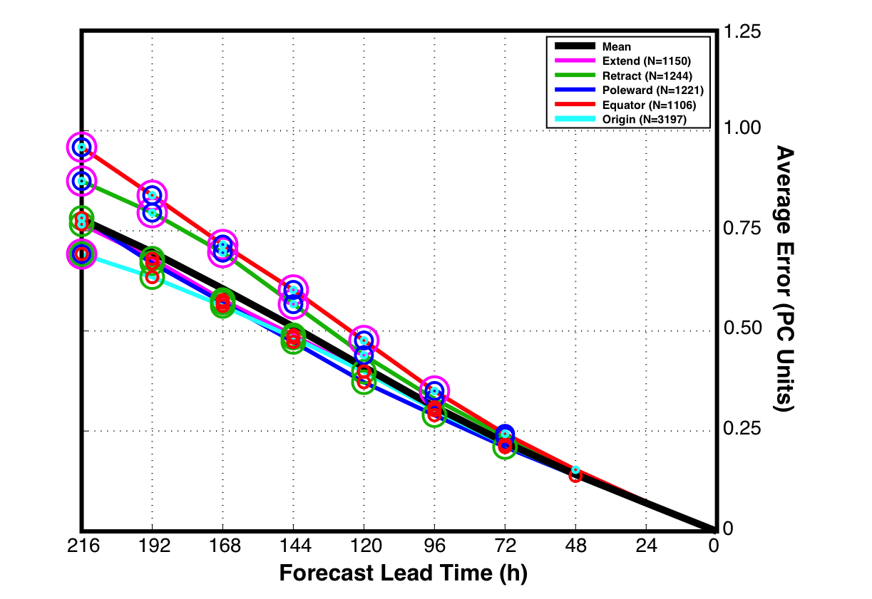
GEFS Ensemble Mean Error by NPJ Regime
GEFS Reforecasts verifying within a particular NPJ regime
Circles on a particular line indicate statistically significant differences at the 99% confidence level with respect to another NPJ regime

Slide 41
GEFS Ensemble Mean Error by NPJ Regime
GEFS Reforecasts verifying within a particular NPJ regime
Circles on a particular line indicate statistically significant differences at the 99% confidence level with respect to another NPJ regime
Forecasts verifying during equatorward shifts and jet retractions exhibit significantly larger errors than jet extensions and poleward shifts in the 96–216-h forecast period

Slide 42
GEFS Ensemble Mean Error by NPJ Regime
GEFS Reforecasts verifying within a particular NPJ regime
Circles on a particular line indicate statistically significant differences at the 99% confidence level with respect to another NPJ regime
See Winters et al. poster at 10am Thursday
Forecasts verifying during equatorward shifts and jet retractions exhibit significantly larger errors than jet extensions and poleward shifts in the 96–216-h forecast period

Slide 43
Summary
The NPJ phase diagram serves as an objective tool to characterize the instantaneous state and evolution of the upper-tropospheric flow pattern over the North Pacific.
Anomalous precipitation along the West Coast in mid-February 2017 was preceded by an NPJ that was both extended and shifted poleward.
The NPJ regime transition from a jet extension to a jet retraction during late-February 2017 was characterized by large medium-range forecast errors in the context of the NPJ phase diagram.

Slide 44
NPJ Phase Diagram Web Interface
A web interface has been developed and implemented at WPC that offers real time NPJ phase diagram forecasts and NPJ regime composites.
http://www.atmos.albany.edu/facstaff/awinters/realtime/About_EOFs.php
Contact: acwinters@albany.edu
Collaborators: Mike Bodner (WPC), Arlene Laing (NOAA), Dan Halperin (WPC), Bill Lamberson (WPC), Josh Kastman (WPC), and Sara Ganetis (WPC)

Slide 45
References
Athanasiadis, P. J., J. M. Wallace, and J. J. Wettstein, 2010: Patterns of wintertime jet stream variability and their relation to the storm tracks. J. Atmos. Sci., 67, 1361–1381.
Griffin, K. S., and J. E. Martin, 2017: Synoptic features associated with temporally coherent modes of variability of the North Pacific jet stream. J. Climate, 29, in press.
Jaffe, S. C., J. E. Martin, D. J. Vimont, and D. L. Lorenz, 2011: A synoptic climatology of episodic, subseasonal retractions of the Pacific jet. J. Climate, 24, 2846–2860.
Saha, S., and Coauthors, 2014: The NCEP Climate Forecast System Version 2. J. Climate, 27, 2185–2208.

Slide 46
Supplementary Slides

Slide 47
NPJ Regime Composite Patterns

Slide 48
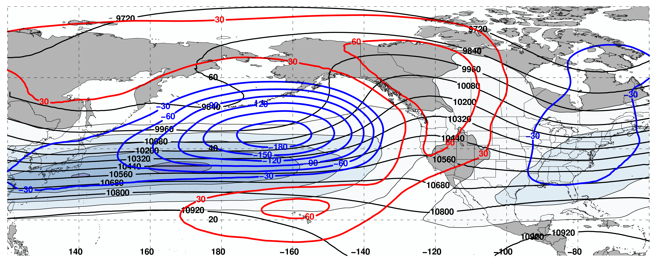
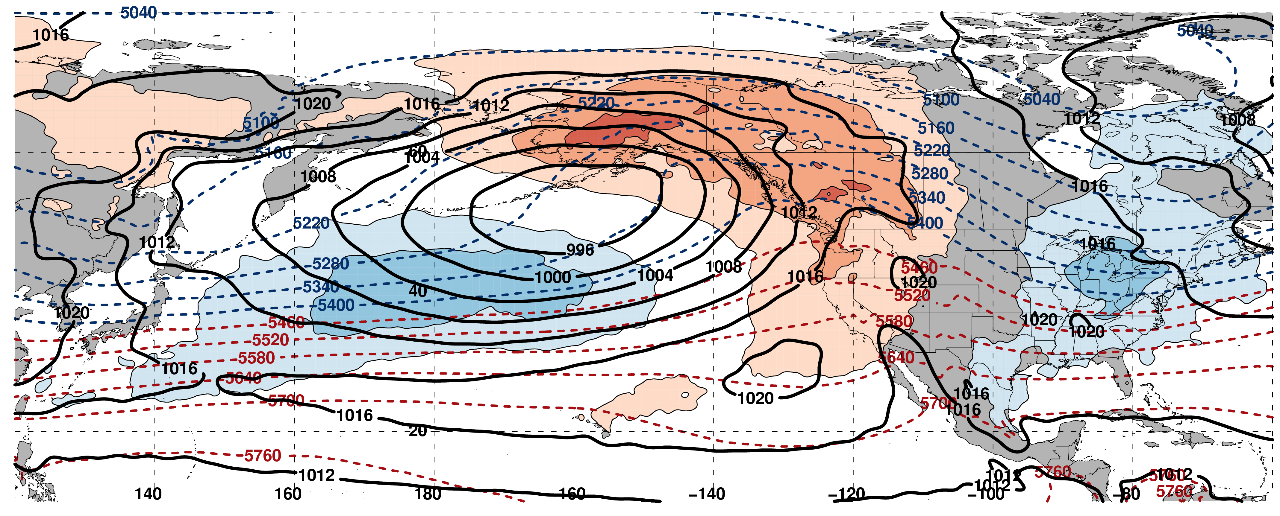
250-hPa Wind Speed, Geo. Heights, Geo. Height Anomalies: Jet Extension
m s^{–1}
Mean Sea-Level Pressure, 1000–500-hPa Thickness, 850-hPa Temp. Anomalies: Jet Extension
K

Slide 49
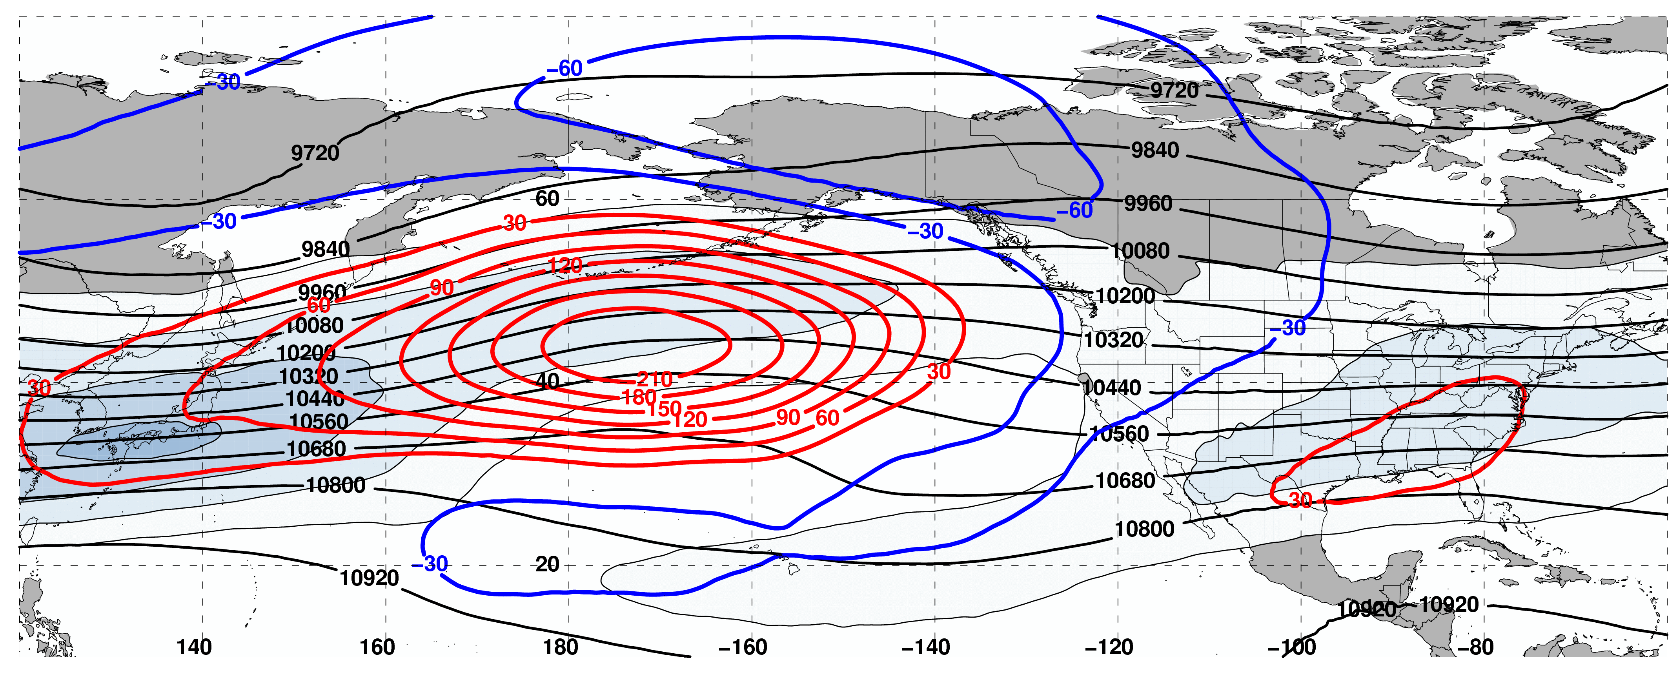
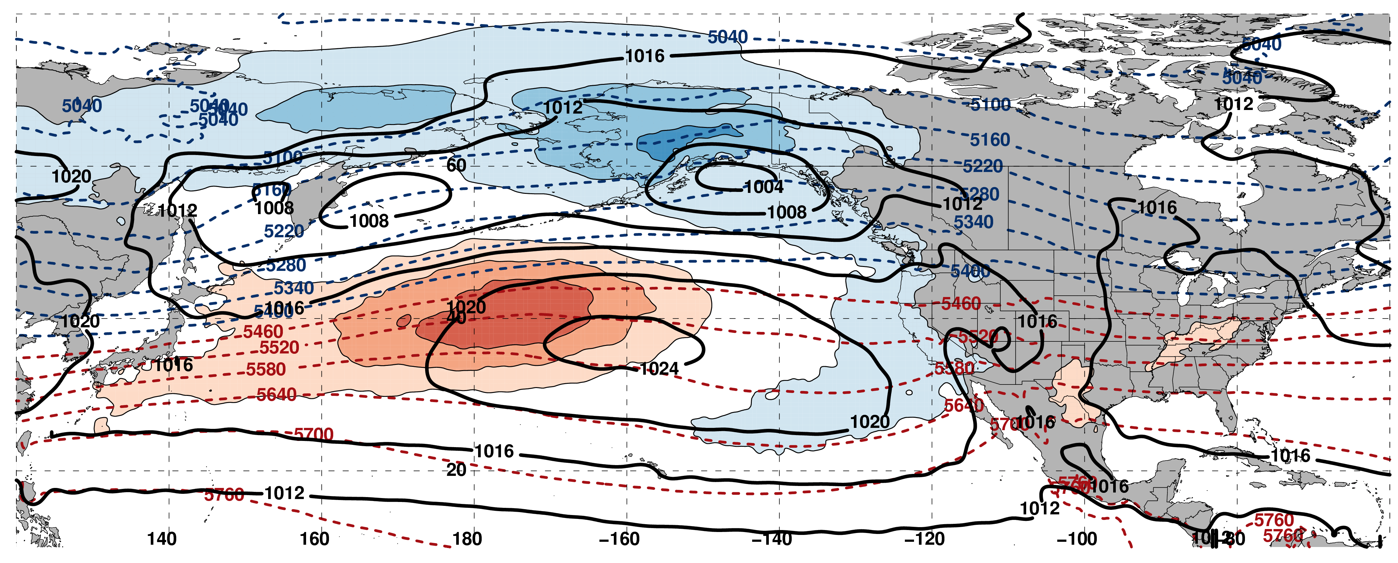
250-hPa Wind Speed, Geo. Heights, Geo. Height Anomalies: Jet Retraction
m s^{–1}
Mean Sea-Level Pressure, 1000–500-hPa Thickness, 850-hPa Temp. Anomalies: Jet Retraction
K

Slide 50
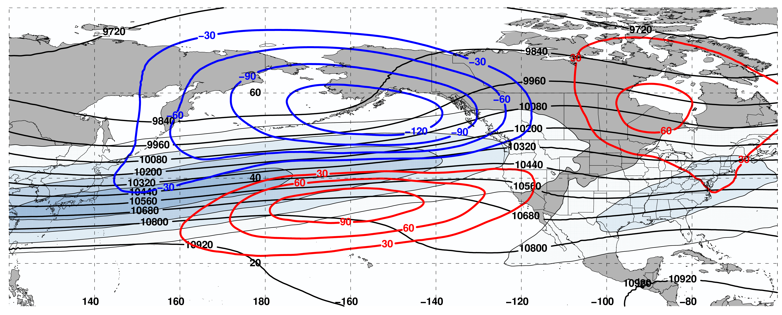
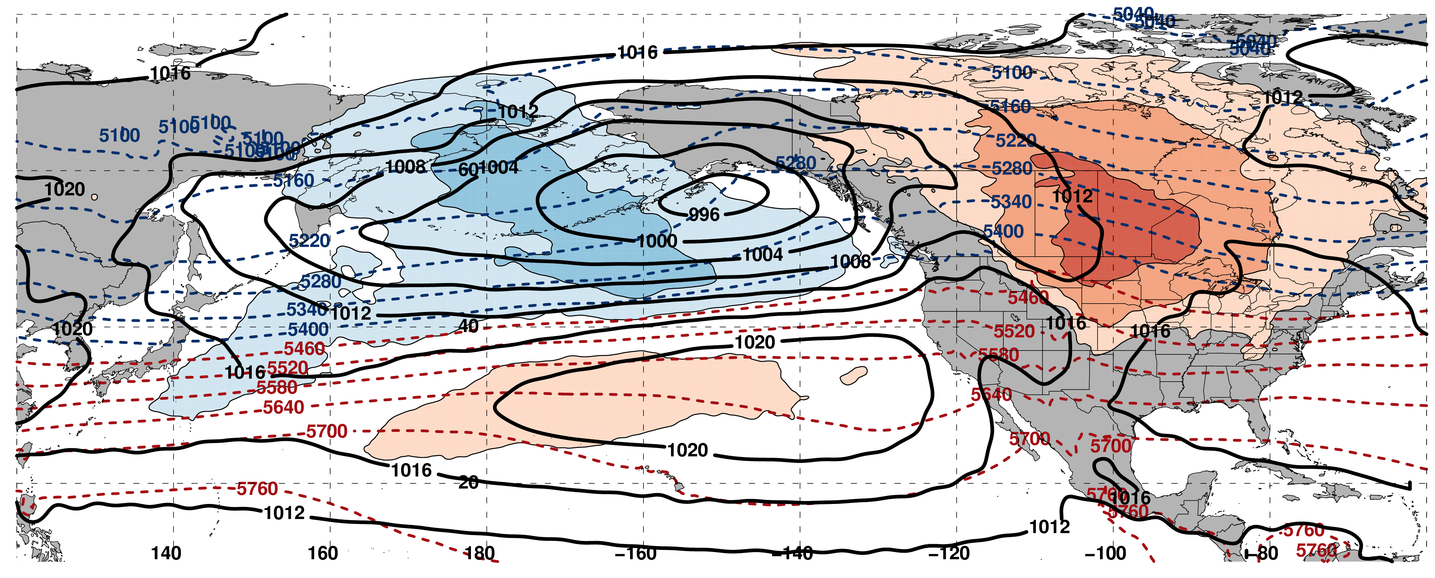
250-hPa Wind Speed, Geo. Heights, Geo. Height Anomalies: Poleward Shift
m s^{–1}
Mean Sea-Level Pressure, 1000–500-hPa Thickness, 850-hPa Temp. Anomalies: Poleward Shift
K

Slide 51
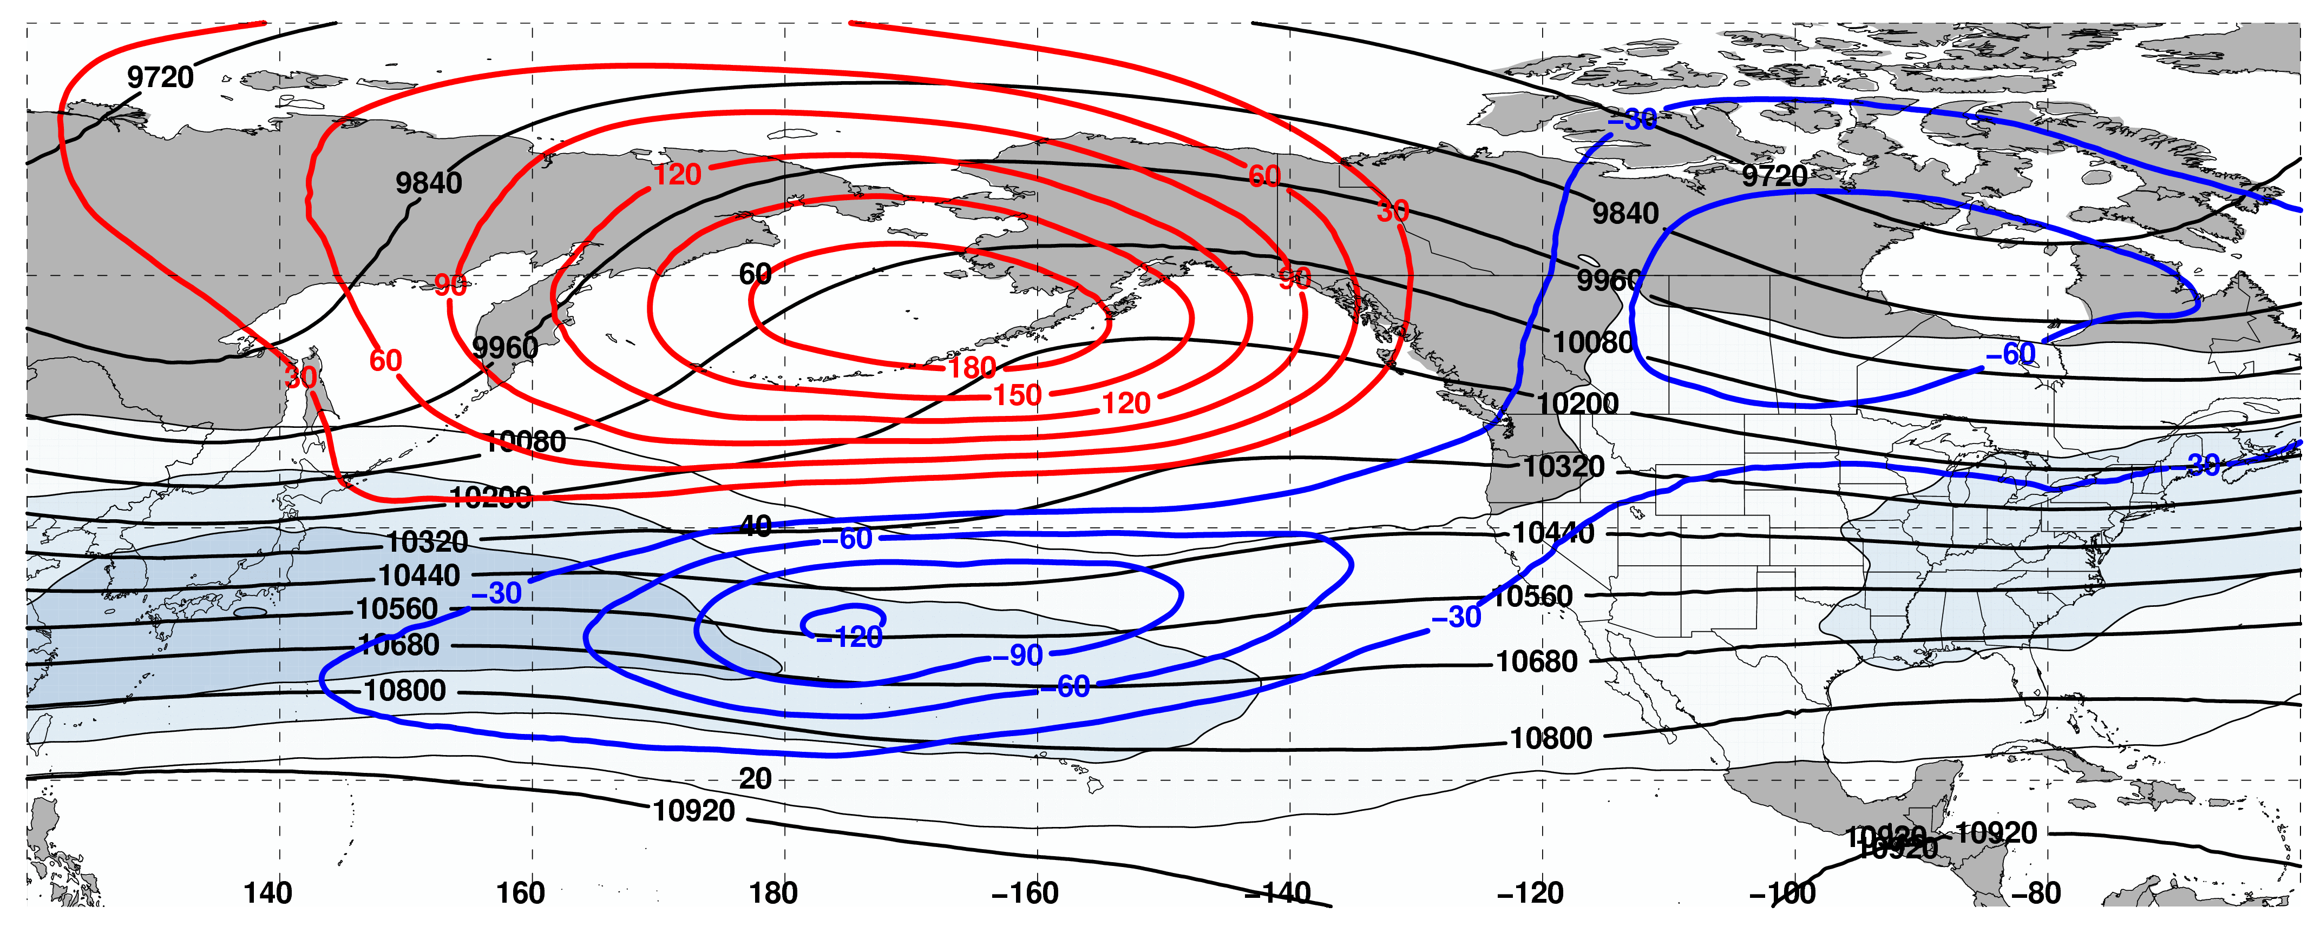
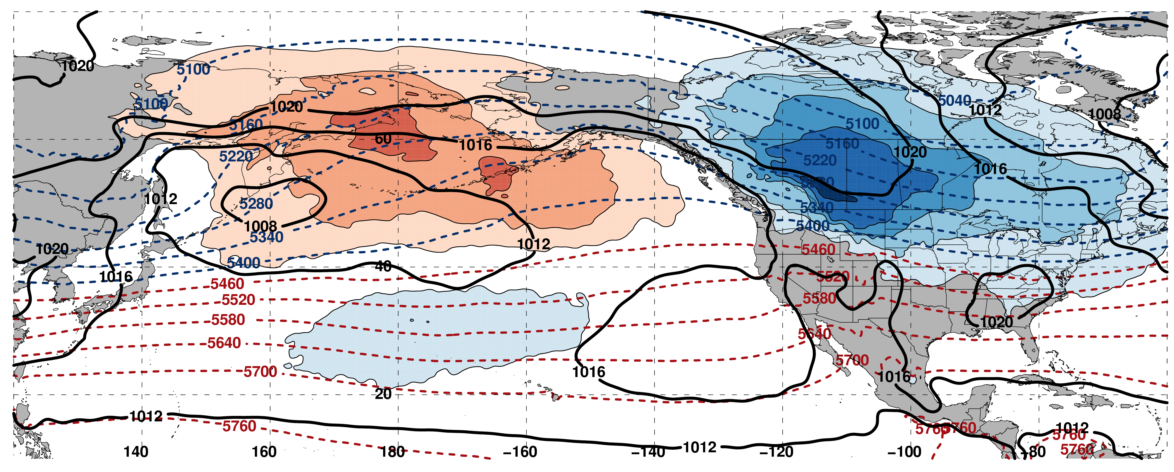
250-hPa Wind Speed, Geo. Heights, Geo. Height Anomalies: Equator. Shift
m s^{–1}
Mean Sea-Level Pressure, 1000–500-hPa Thickness, 850-hPa Temp. Anomalies: Equator. Shift
K

Slide 52
Pacific Northwest Extreme Precipitation Events
Composite NPJ Trajectory during the 10 days prior to a Pac. NW Extreme Precip. Event (N=85)
Start
End
All event trajectories comprising the composite are repositioned to begin at the origin

Slide 53
NPJ Regime Frequency by Month
Poleward and Equatorward Shifts are favored during September
NPJ regime frequencies are nearly equivalent during all other months

Slide 54
NPJ Regime Frequency and ENSO
Jet Extensions and Equatorward Shifts are favored during an El Niño
Jet Retractions and Poleward Shifts are favored during a La Niña

Slide 55
NPJ Regime Frequency and the MJO
Jet Retractions are favored during Phases 2, 3, and 4
Poleward Shifts are favored during Phases 5 and 6
Jet Extensions are favored during Phases 7, 8, and 1

Slide 56
NPJ Regime Frequency and the PNA
Jet Extensions and Poleward Shifts are favored during a positive PNA
Jet Retractions and Equatorward Shifts are favored during a negative PNA

Slide 57
Case Study:
Feb/Mar 2017
NPJ Regime Changes
III: Second NPJ Regime Change and the “Pi Day Snowstorm”

Slide 58
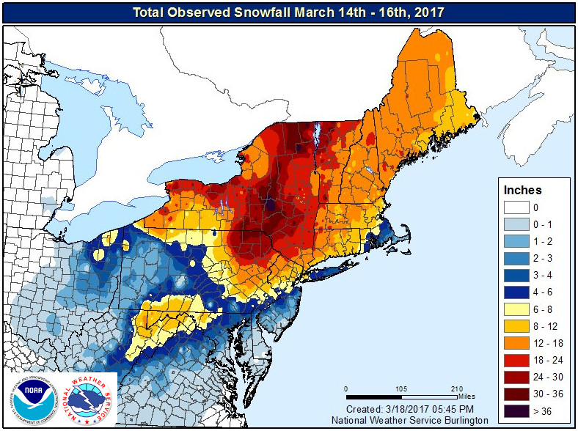
Case Study: Feb/Mar 2017 NPJ Regime Changes
Winter 2016/2017 was characterized by record setting precipitation in many parts of the Western U.S.
A NPJ regime change in late-February ushered anomalously warm/cold temperatures into the Eastern/Western U.S.
A second NPJ regime change in early-March facilitated the development of the “Pi Day Snowstorm” in the Northeast U.S.
NWS Burlington

Slide 59
0000 UTC 26 February: 250-hPa Jet and Precipitable Water Anomalies
m s^{–1}
σ
0000 UTC 26 February: MSLP, Thickness, 850-hPa Temp. Anomalies
L
σ

Slide 60
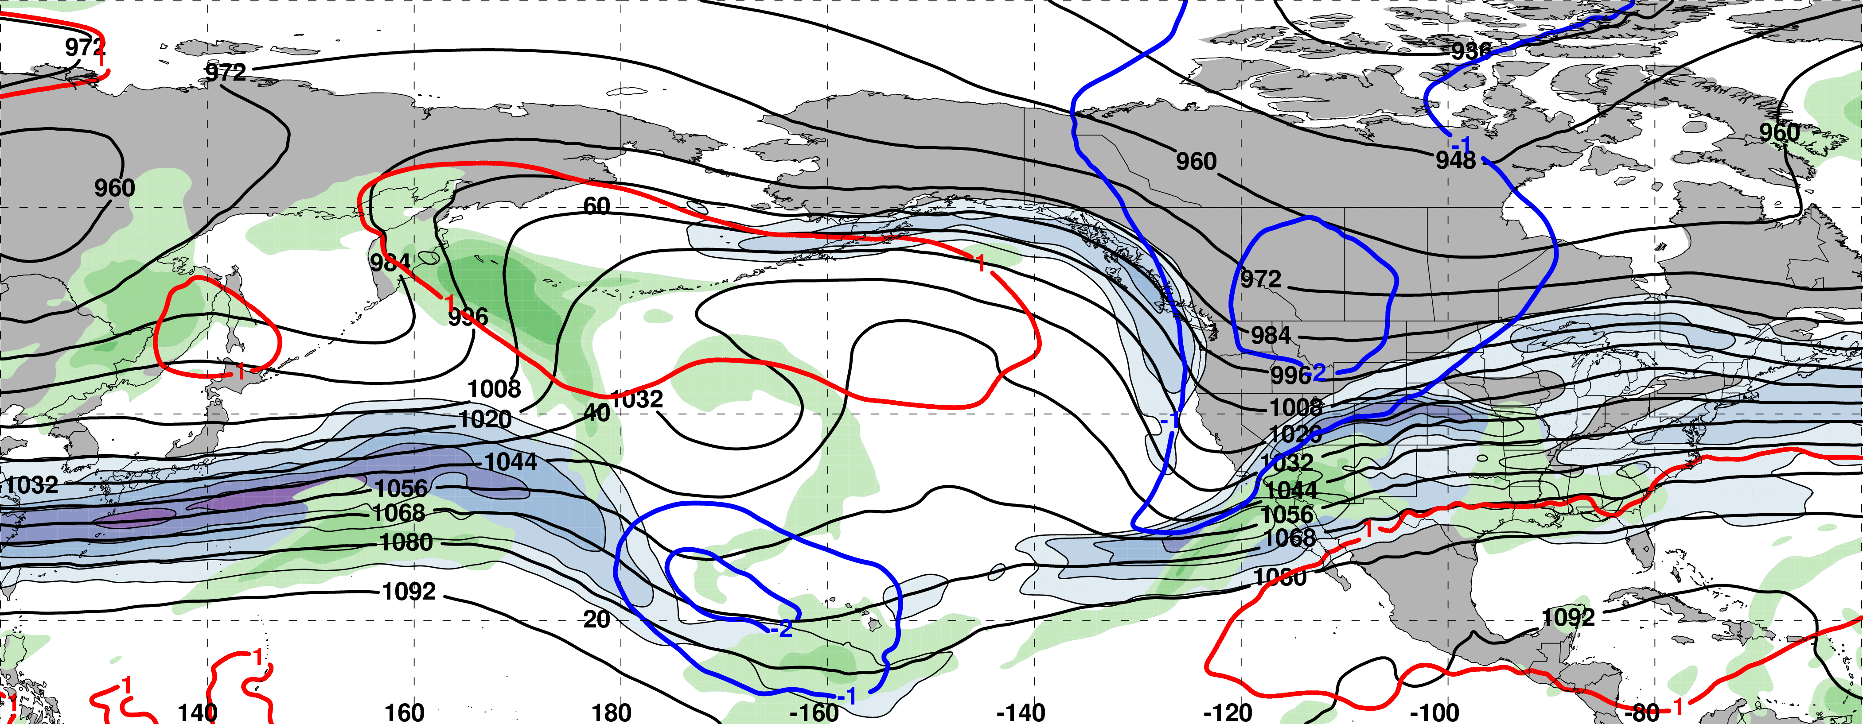
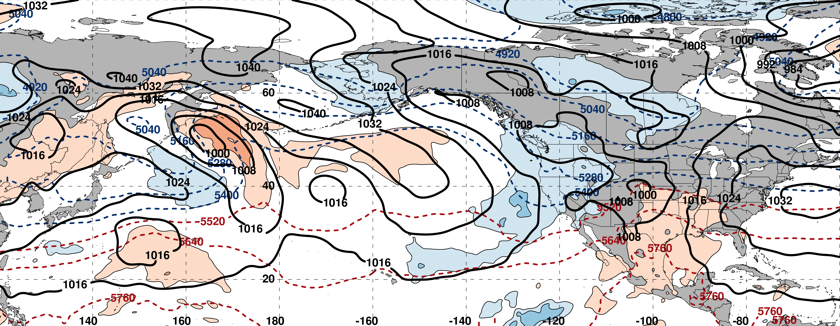
0000 UTC 28 February: 250-hPa Jet and Precipitable Water Anomalies
North Pacific block persists
m s^{–1}
σ
0000 UTC 28 February: MSLP, Thickness, 850-hPa Temp. Anomalies
L
σ

Slide 61
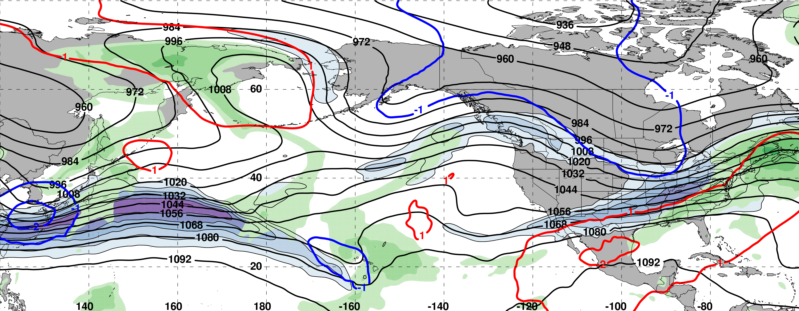
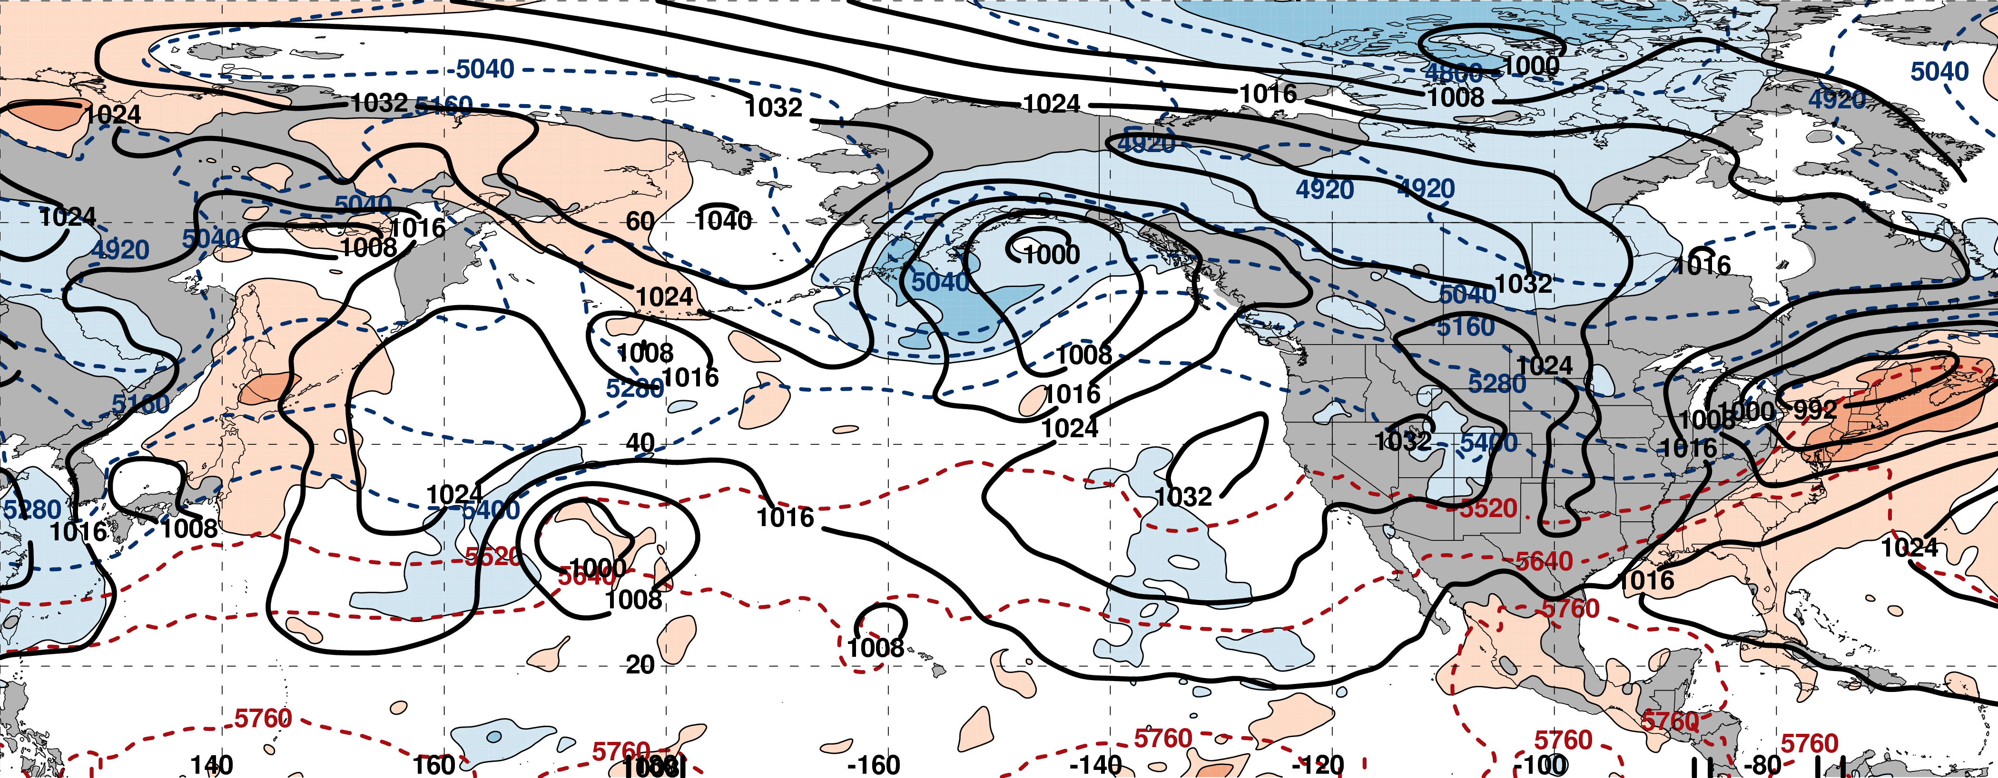
0000 UTC 02 March: 250-hPa Jet and Precipitable Water Anomalies
m s^{–1}
σ
0000 UTC 02 March: MSLP, Thickness, 850-hPa Temp. Anomalies
L
σ

Slide 62
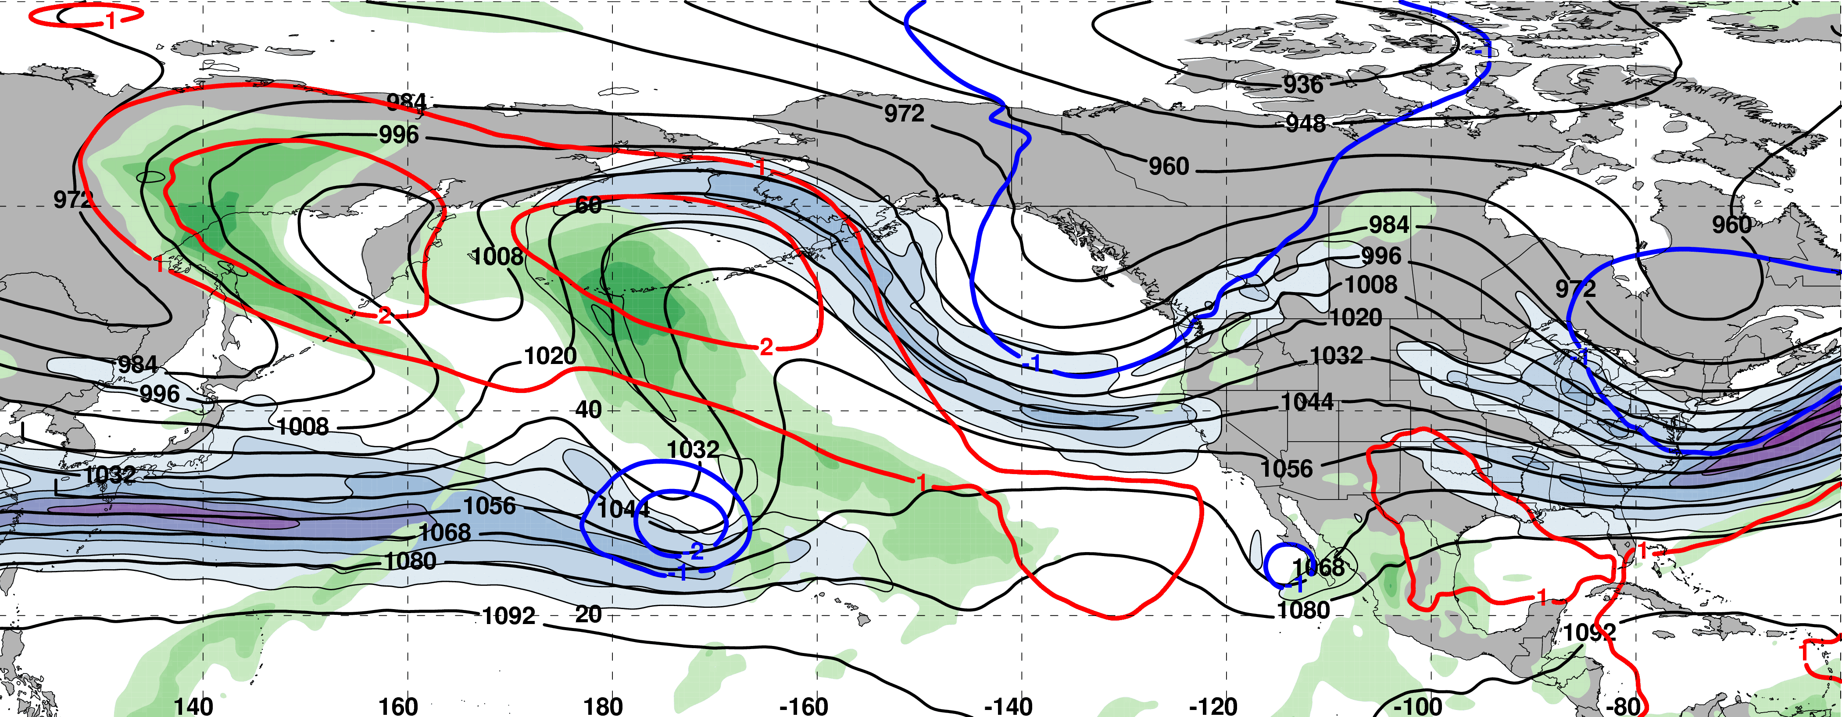
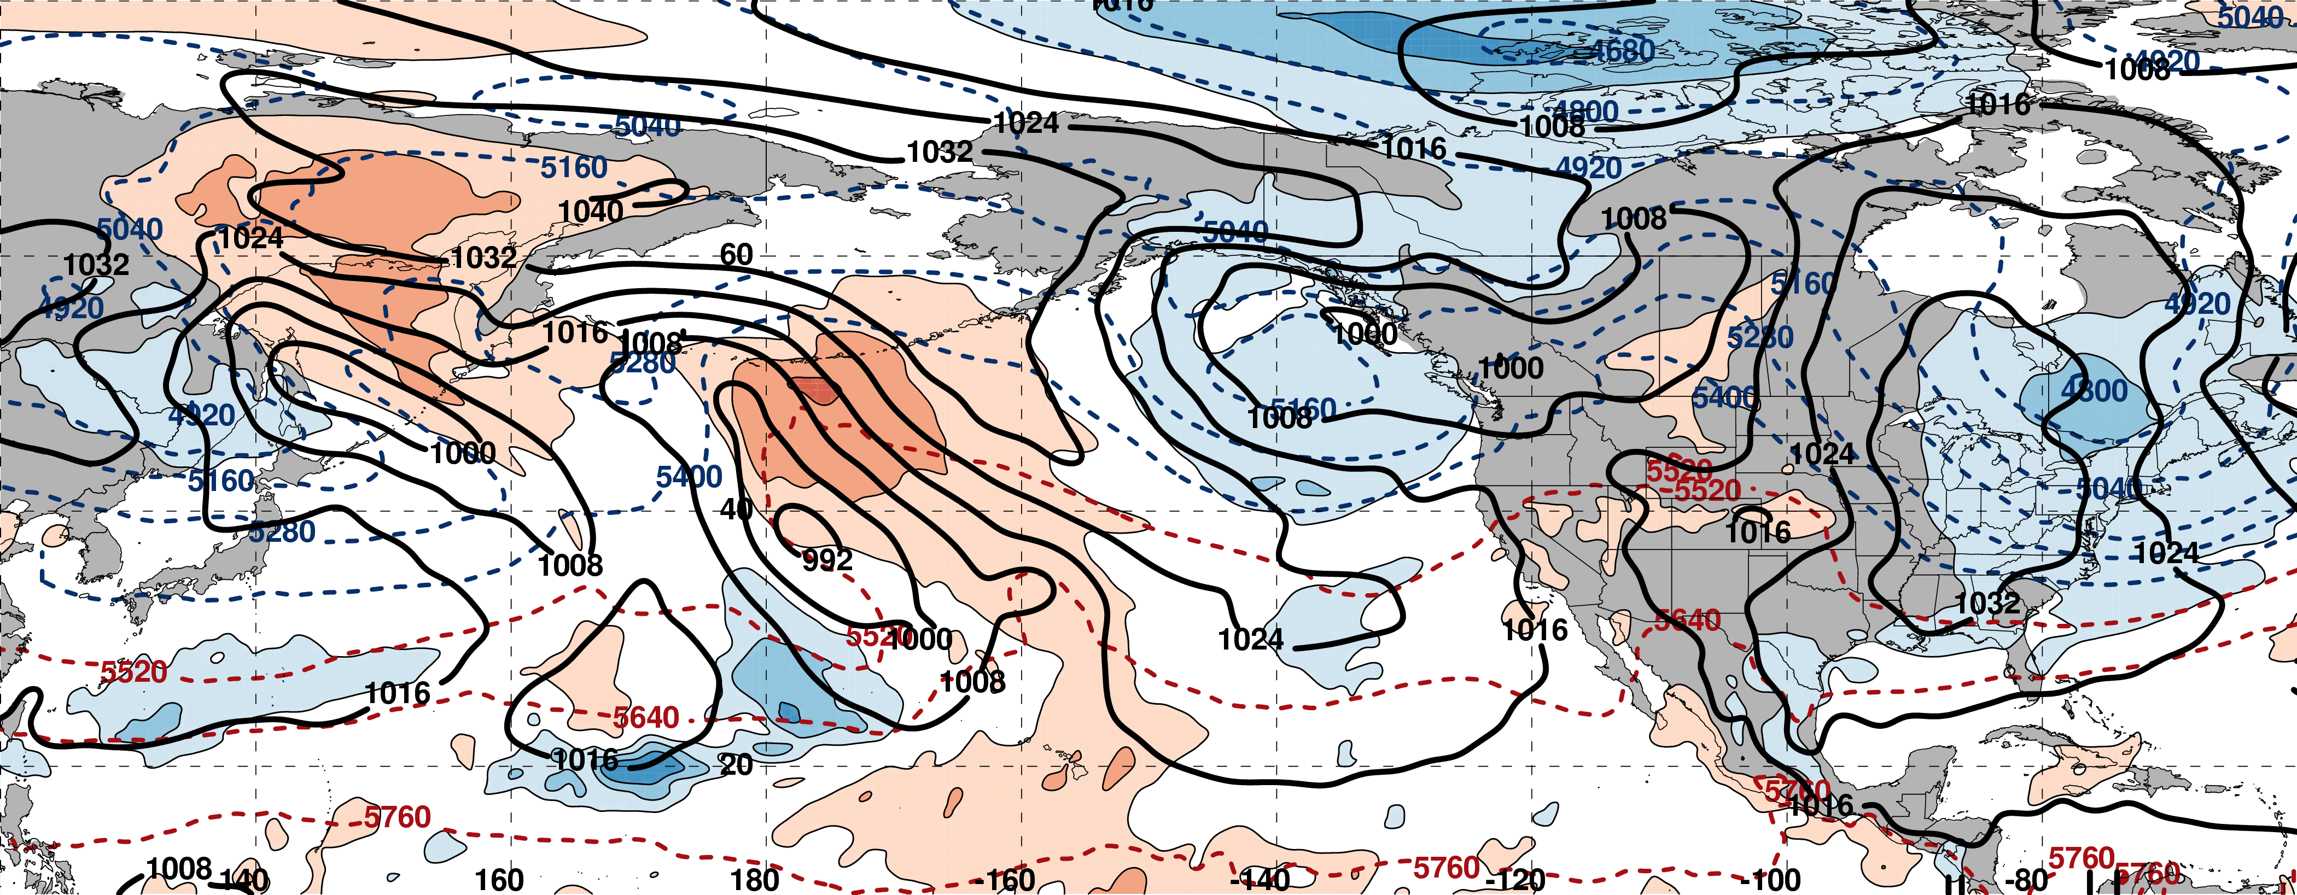
0000 UTC 04 March: 250-hPa Jet and Precipitable Water Anomalies
m s^{–1}
σ
0000 UTC 04 March: MSLP, Thickness, 850-hPa Temp. Anomalies
L
σ

Slide 63
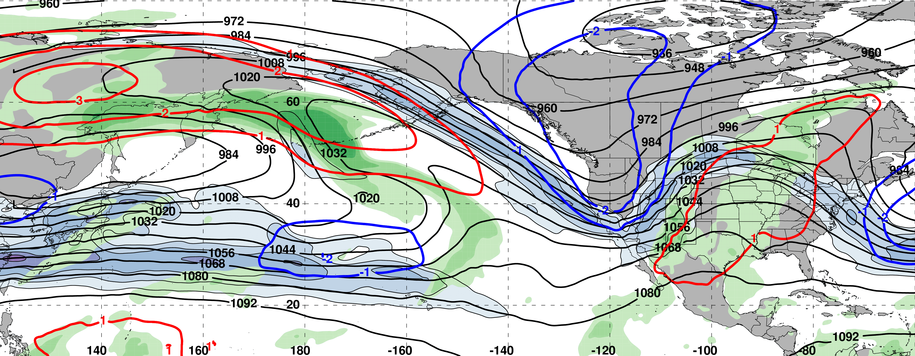
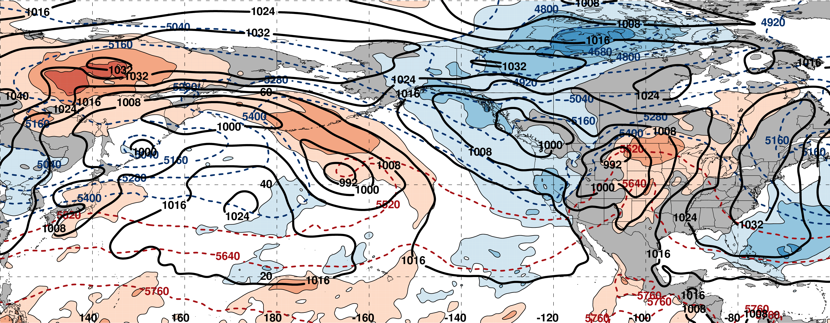
0000 UTC 06 March: 250-hPa Jet and Precipitable Water Anomalies
m s^{–1}
σ
0000 UTC 06 March: MSLP, Thickness, 850-hPa Temp. Anomalies
L
σ

Slide 64
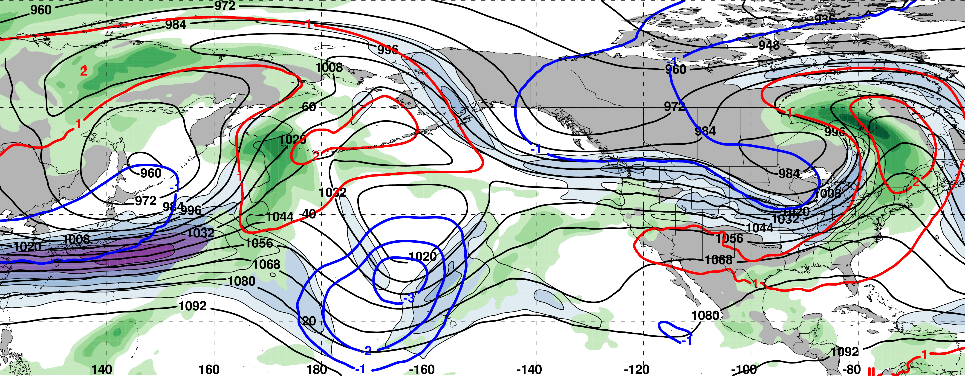
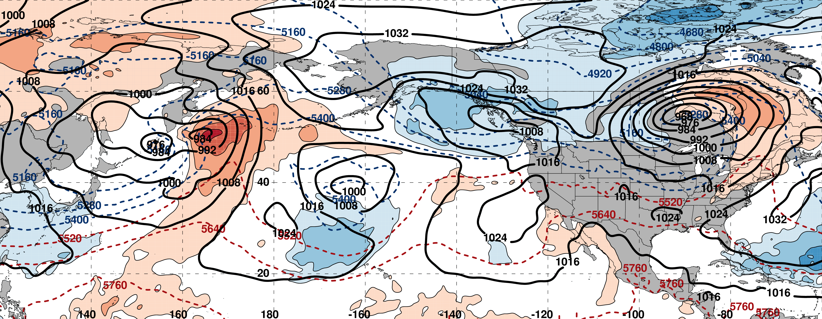
0000 UTC 08 March: 250-hPa Jet and Precipitable Water Anomalies
m s^{–1}
σ
0000 UTC 08 March: MSLP, Thickness, 850-hPa Temp. Anomalies
L
σ

Slide 65
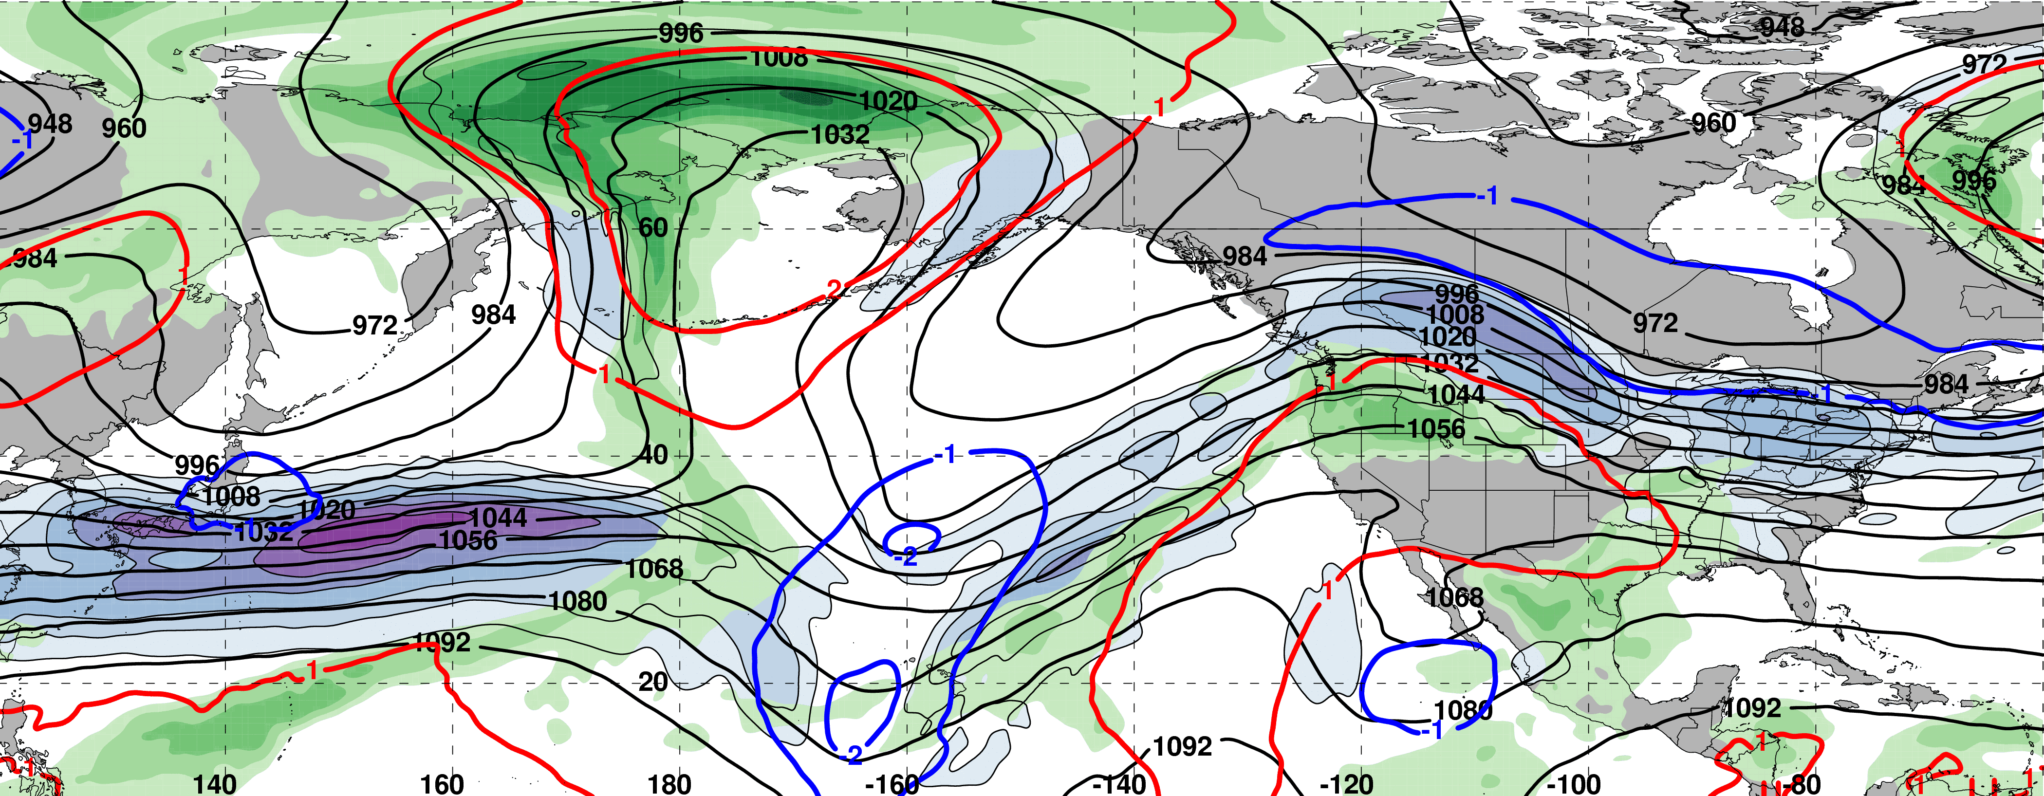
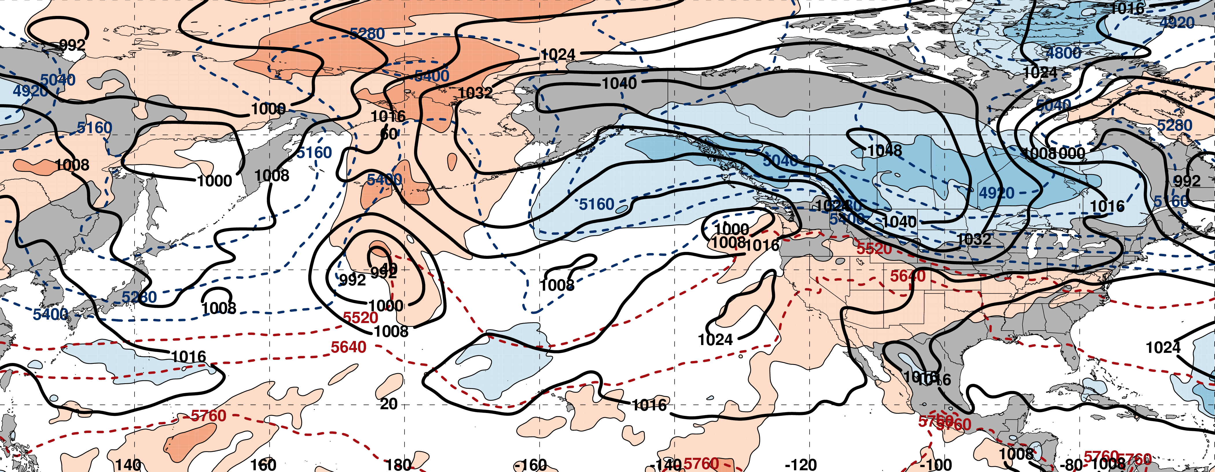
0000 UTC 10 March: 250-hPa Jet and Precipitable Water Anomalies
m s^{–1}
σ
0000 UTC 10 March: MSLP, Thickness, 850-hPa Temp. Anomalies
H
L
σ

Slide 66
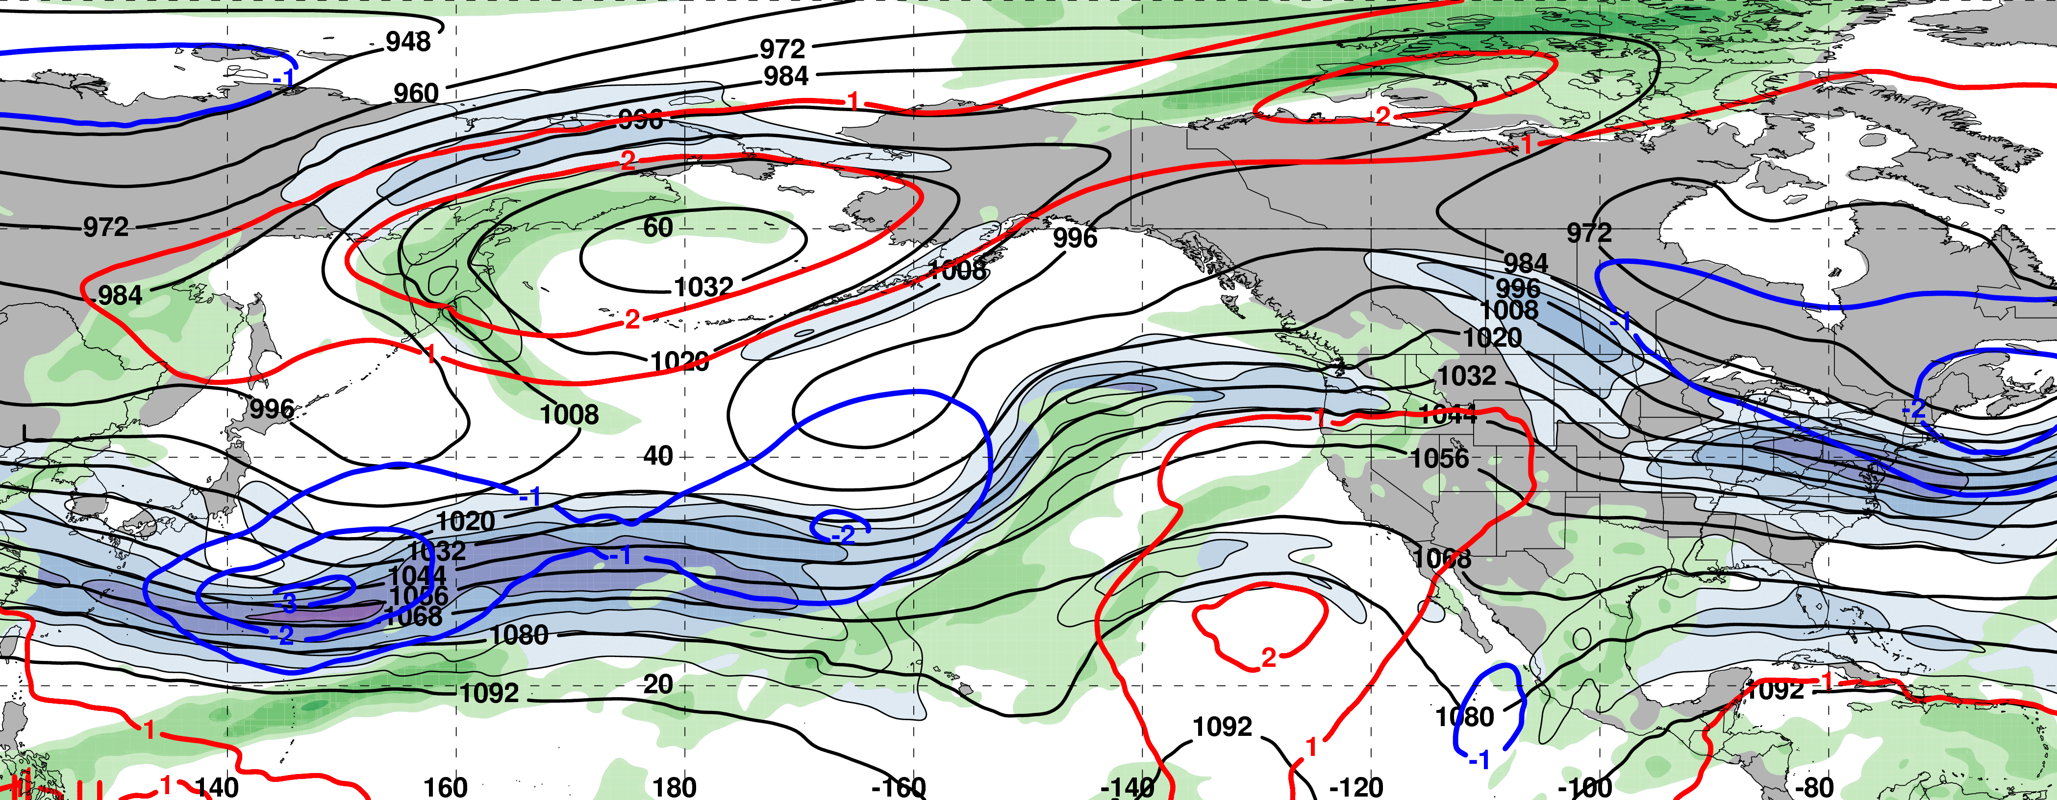
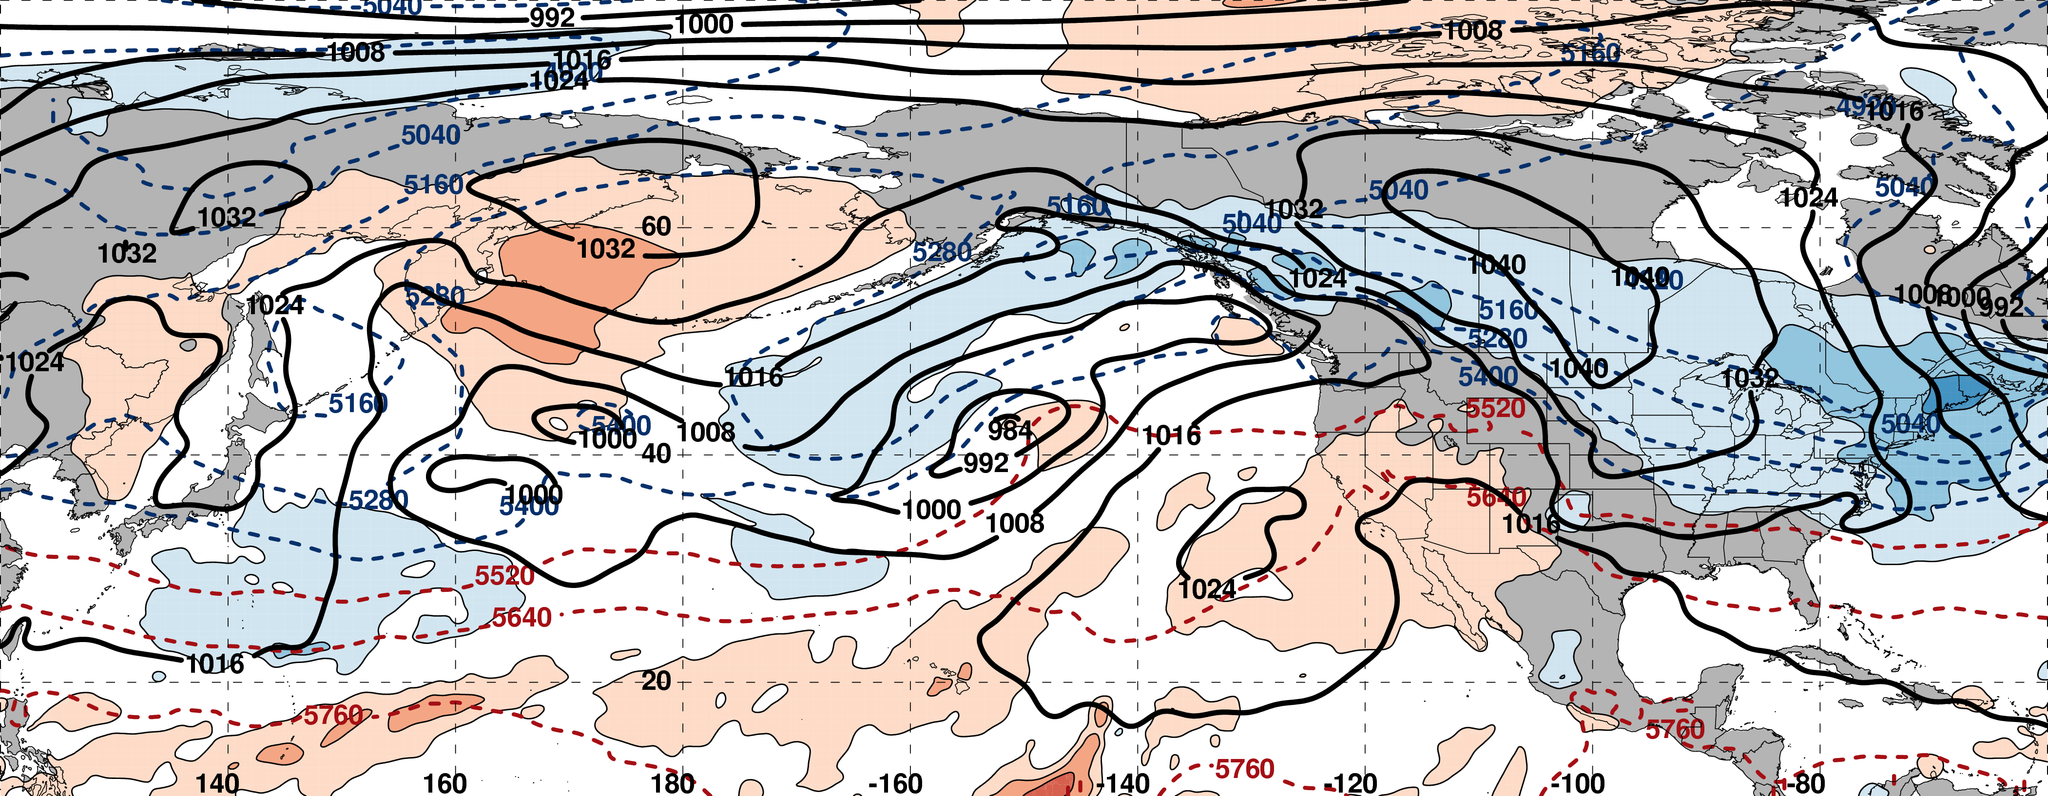
0000 UTC 12 March: 250-hPa Jet and Precipitable Water Anomalies
m s^{–1}
σ
0000 UTC 12 March: MSLP, Thickness, 850-hPa Temp. Anomalies
H
L
σ

Slide 67
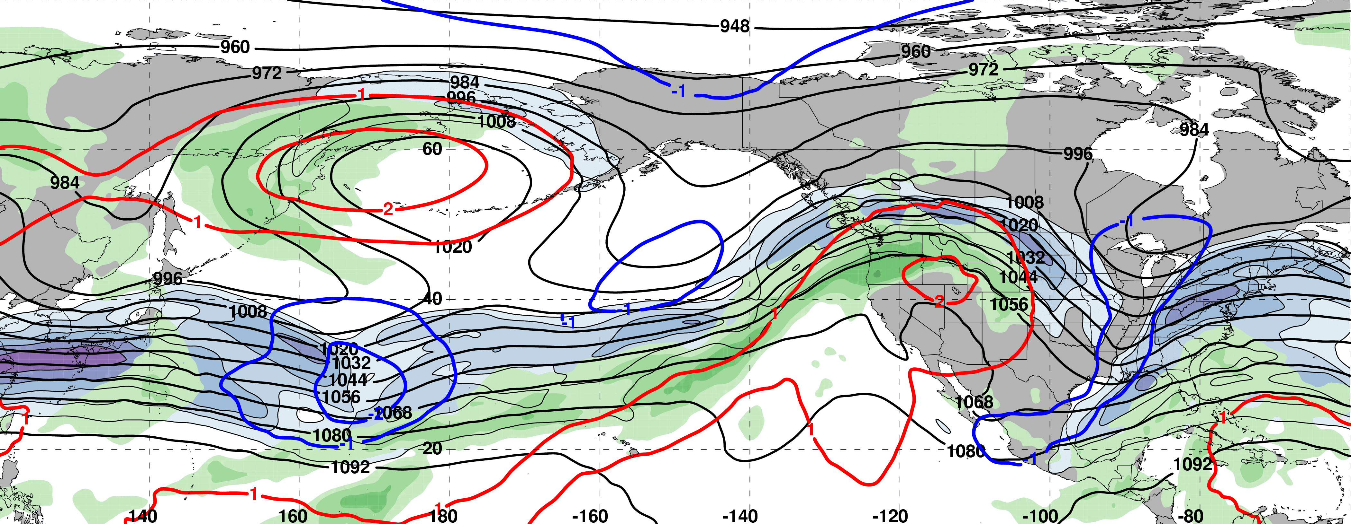
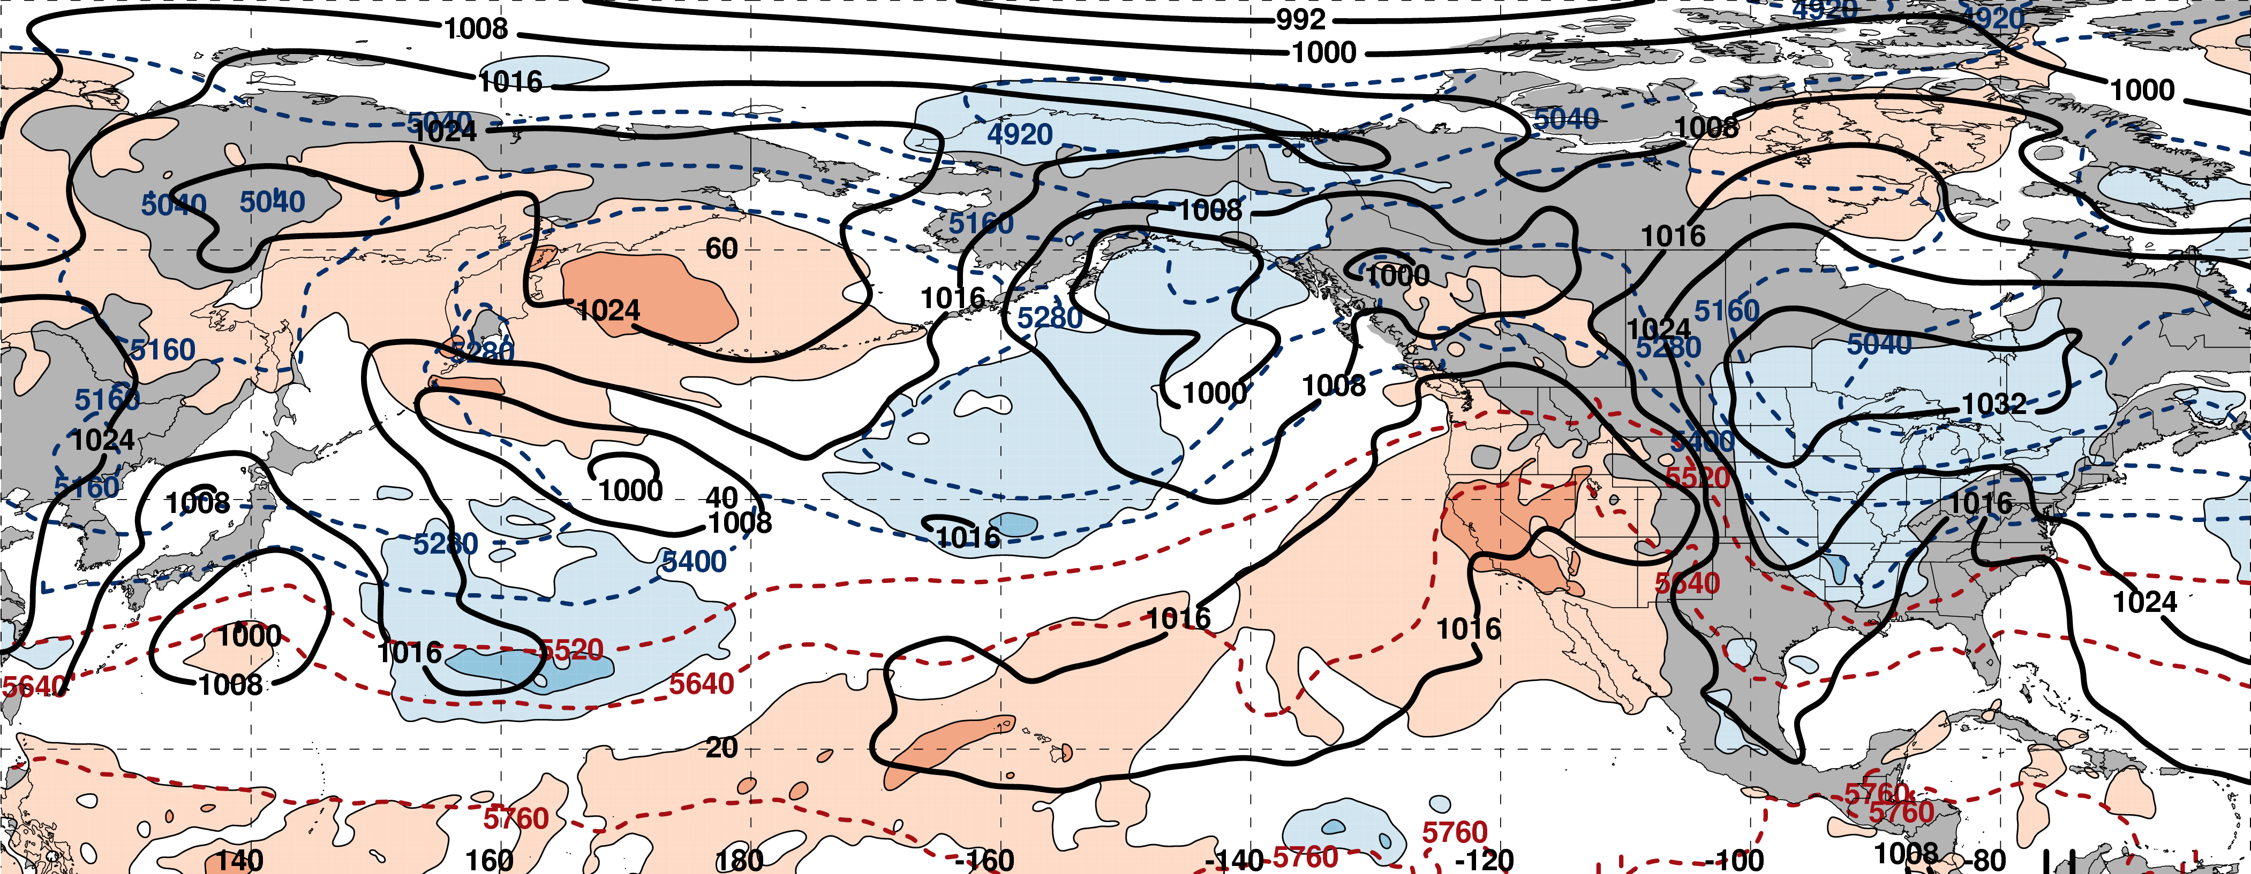
0000 UTC 14 March: 250-hPa Jet and Precipitable Water Anomalies
m s^{–1}
σ
0000 UTC 14 March: MSLP, Thickness, 850-hPa Temp. Anomalies
L
H
L
σ

Slide 68
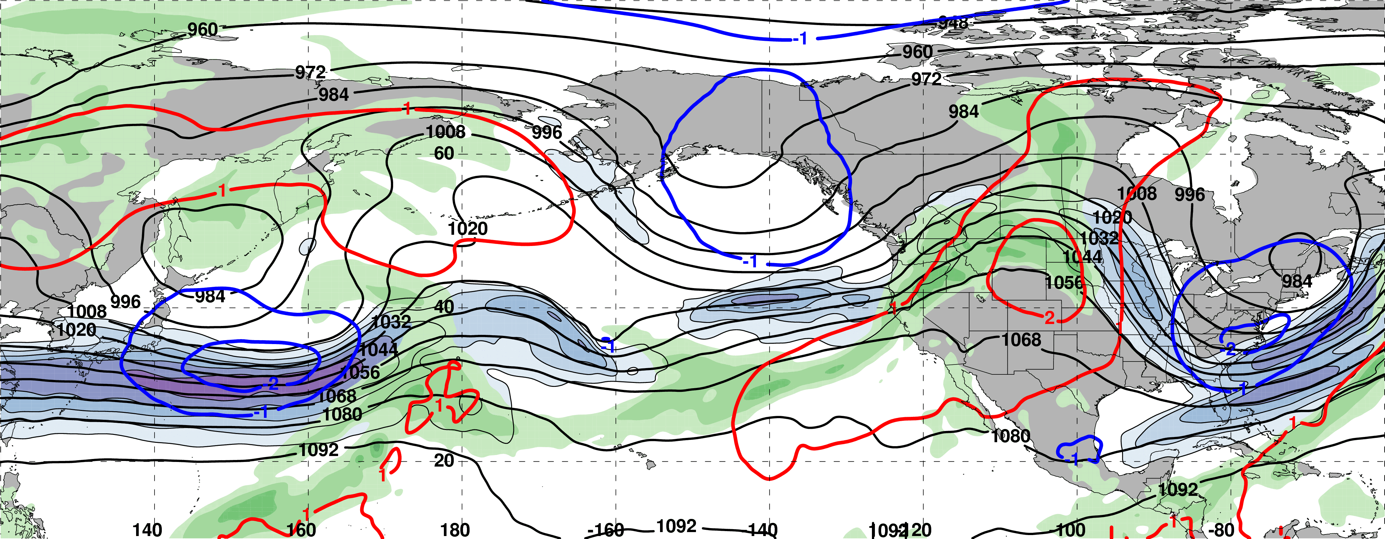
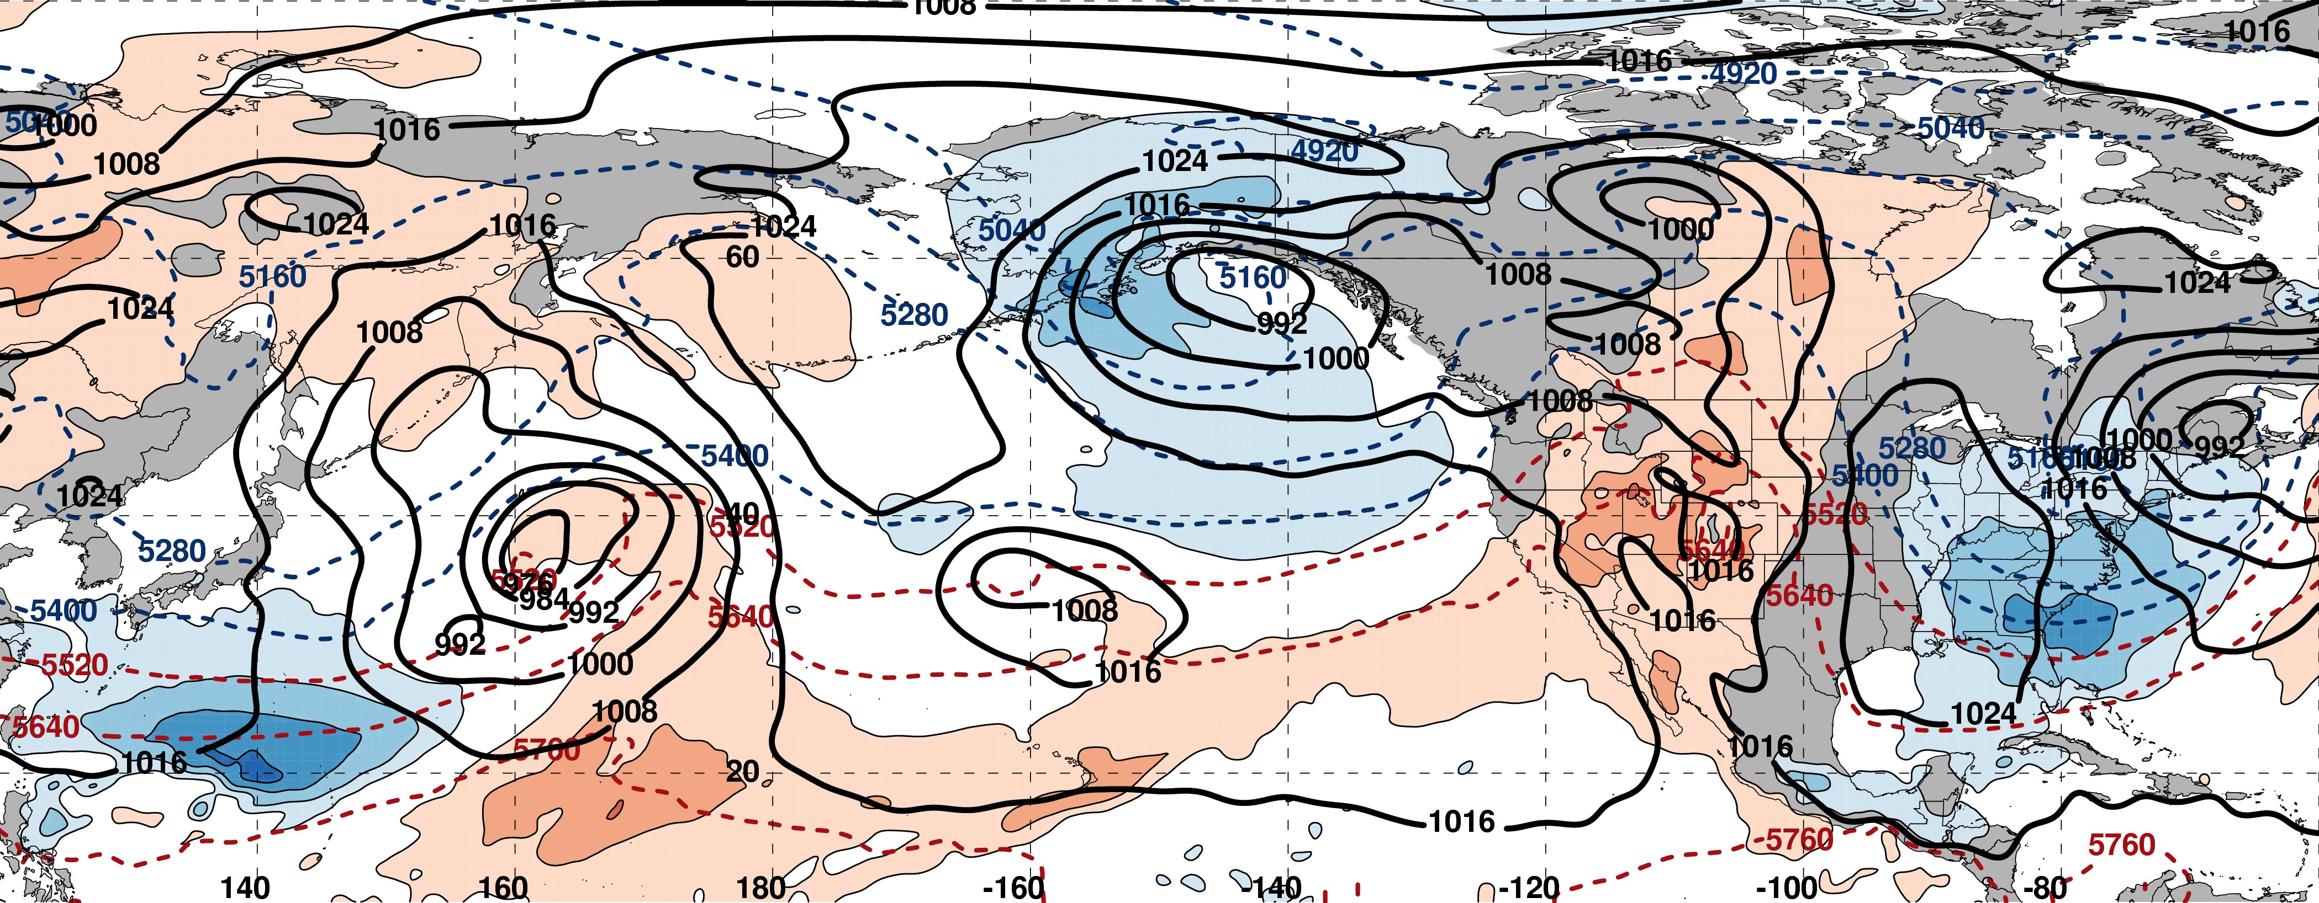
0000 UTC 16 March: 250-hPa Jet and Precipitable Water Anomalies
m s^{–1}
σ
0000 UTC 16 March: MSLP, Thickness, 850-hPa Temp. Anomalies
L
H
L
σ

Slide 69
Eastern U.S. Extreme Cold Events
Events during
Sept. – May 1979–2014 projected onto the NPJ phase diagram (N=173)
Poleward Shift
23
Each point is an average of the PCs
3–7 days prior to an event
30
47
Jet Retraction
Jet Extension
Equatorward shifts and jet extensions most often precede Eastern U.S. extreme cold events
73
Equatorward Shift
9–13 Mar. 2017

Slide 70
Summary
The NPJ phase diagram serves as an objective tool to characterize the instantaneous state and evolution of the upper-tropospheric flow pattern over the North Pacific.
Anomalous precipitation along the west coast in mid-February 2017 was preceded by an NPJ that was both extended and shifted poleward.
The NPJ regime transition from a jet extension to a jet retraction during late-February 2017 was characterized by large medium-range forecast errors in the context of the NPJ phase diagram.
The evolution of the upper-tropospheric flow pattern in early-March was conducive to the development of a broad trough over the Eastern U.S. and the transport of anomalously cold air into the region prior to and following the “Pi Day Snowstorm”.

