Slide 1
The Development of the North Pacific Jet Phase Diagram at the NCEP-WPC as a Tool to Characterize the Upper-Tropospheric Flow Pattern
Lance F. Bosart, Daniel Keyser, and Andrew C. Winters
Department of Atmospheric and Environmental Sciences
University at Albany, State University of New York, Albany, NY 12222
NGGPS / MAPP PI Meeting
College Park, MD
2–3 August 2017
This work is supported by NOAA Grant NA15NWS4680006

Slide 2
Motivation
Previous work highlighted the considerable North Pacific Jet (NPJ) variability during the medium-range period that characterizes the antecedent environments associated with continental U.S. extreme temperature events.

Slide 3
Motivation
Previous work highlighted the considerable North Pacific Jet (NPJ) variability during the medium-range period that characterizes the antecedent environments associated with continental U.S. extreme temperature events.
This NPJ variability motivated the development of the NPJ phase diagram as an objective tool to characterize the instantaneous state of the upper-tropospheric flow pattern over the North Pacific.

Slide 4
Motivation
Previous work highlighted the considerable North Pacific Jet (NPJ) variability during the medium-range period that characterizes the antecedent environments associated with continental U.S. extreme temperature events.
This NPJ variability motivated the development of the NPJ phase diagram as an objective tool to characterize the instantaneous state of the upper-tropospheric flow pattern over the North Pacific.
Consideration of the NPJ phase diagram offers the potential to increase confidence in operational probabilistic temperature forecasts during the medium-range period.

Slide 5
The Development of the
NPJ Phase Diagram

Slide 6
The NPJ Phase Diagram
Removed the mean and the annual and diurnal cycles from 6-hourly, 250-hPa zonal wind data from the CFSR (1979–2014) (Saha et al. 2014)
Restricted data to the cool season (Sept.–May)
Performed an EOF analysis on the zonal wind anomalies within the domain: 10–80°N ; 100°E–120°W
Analysis techniques and resultant EOF patterns are consistent with related work on the North Pacific Jet:
Athanasiadis et al. (2010)
Jaffe et al. (2011)
Griffin and Martin (2017)

Slide 7
The NPJ Phase Diagram
EOF 1 – Jet Extension/Retraction
Sept.–May mean 250-hPa zonal wind: black contours
Sept.–May 250-hPa zonal wind EOF 1 pattern: shading
+ EOF 1: Jet Extension
– EOF 1: Jet Retraction

Slide 8
The NPJ Phase Diagram
EOF 1 – Jet Extension/Retraction
Hypothetical Zonal Wind
Sept.–May mean 250-hPa zonal wind: black contours
Sept.–May 250-hPa zonal wind EOF 1 pattern: shading
+ EOF 1: Jet Extension
– EOF 1: Jet Retraction
Notes:
The outermost green contour is 20 m/s and contour interval for green contours is every 10 m/s. The green contours are calculated by adding the EOF patterns to the mean zonal wind. The resultant wind distribution would project onto the point (1,0) on the N. Pacific Jet phase diagram.

Slide 9
The NPJ Phase Diagram
EOF 1 – Jet Extension/Retraction
Hypothetical Zonal Wind
Sept.–May mean 250-hPa zonal wind: black contours
Sept.–May 250-hPa zonal wind EOF 1 pattern: shading
+ EOF 1: Jet Extension
– EOF 1: Jet Retraction
Notes:
The distribution of zonal wind in this slide would project onto the point (-1,0) on the N. Pacific Jet phase diagram.

Slide 10
The NPJ Phase Diagram
EOF 2 – Poleward/Equatorward Shift
Sept.–May mean 250-hPa zonal wind: black contours
Sept.–May 250-hPa zonal wind EOF 2 pattern: shading
+ EOF 2: Poleward Shift
– EOF 2: Equatorward Shift

Slide 11
The NPJ Phase Diagram
EOF 2 – Poleward/Equatorward Shift
Hypothetical Zonal Wind
Sept.–May mean 250-hPa zonal wind: black contours
Sept.–May 250-hPa zonal wind EOF 2 pattern: shading
+ EOF 2: Poleward Shift
– EOF 2: Equatorward Shift
Notes:
The zonal wind pattern in green would project onto the point (0,1) on the N. Pacific Jet phase diagram.

Slide 12
The NPJ Phase Diagram
EOF 2 – Poleward/Equatorward Shift
Hypothetical Zonal Wind
Sept.–May mean 250-hPa zonal wind: black contours
Sept.–May 250-hPa zonal wind EOF 2 pattern: shading
+ EOF 2: Poleward Shift
– EOF 2: Equatorward Shift
Notes:
The zonal wind pattern in green would project onto the point (0,-1) on the N. Pacific Jet phase diagram.

Slide 13
The NPJ Phase Diagram
0000 UTC 8 November 2014
250-hPa wind speed: shaded
Instantaneous 250-hPa zonal wind anomalies can be projected onto EOF 1 and EOF 2, resulting in a point on a North Pacific Jet phase diagram

Slide 14
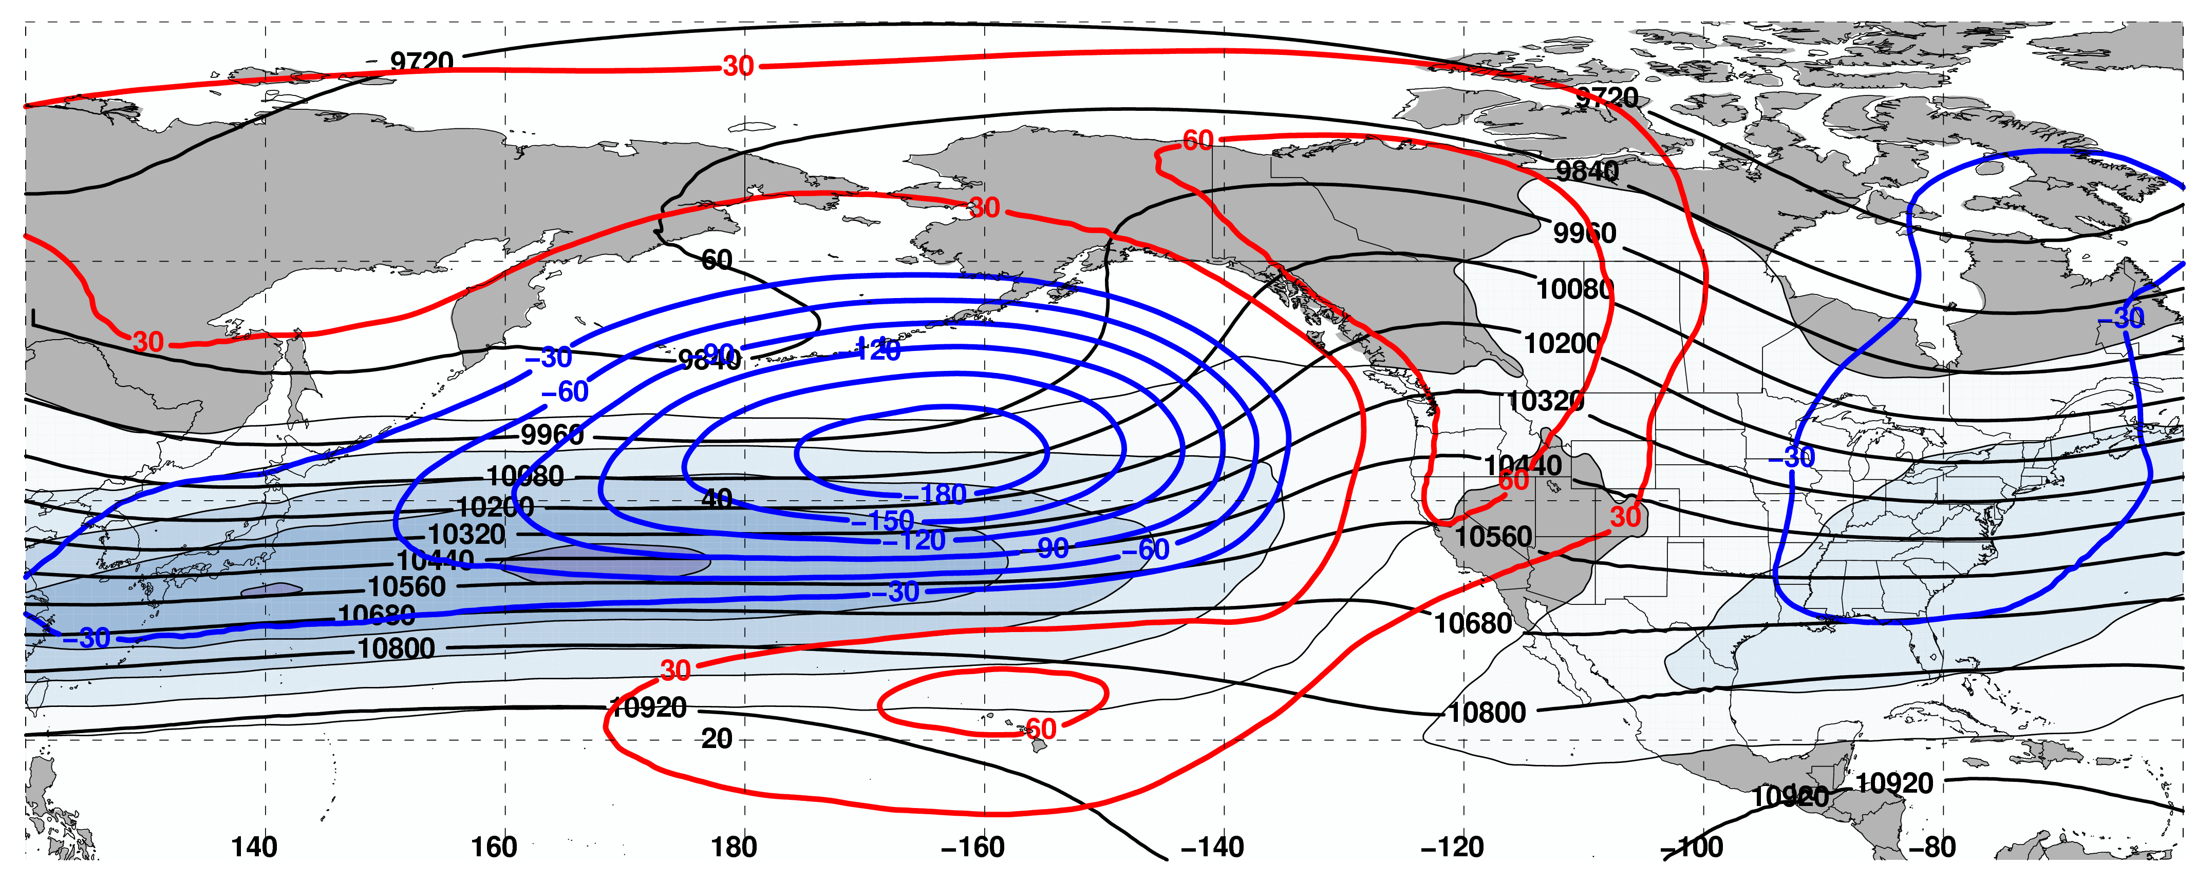
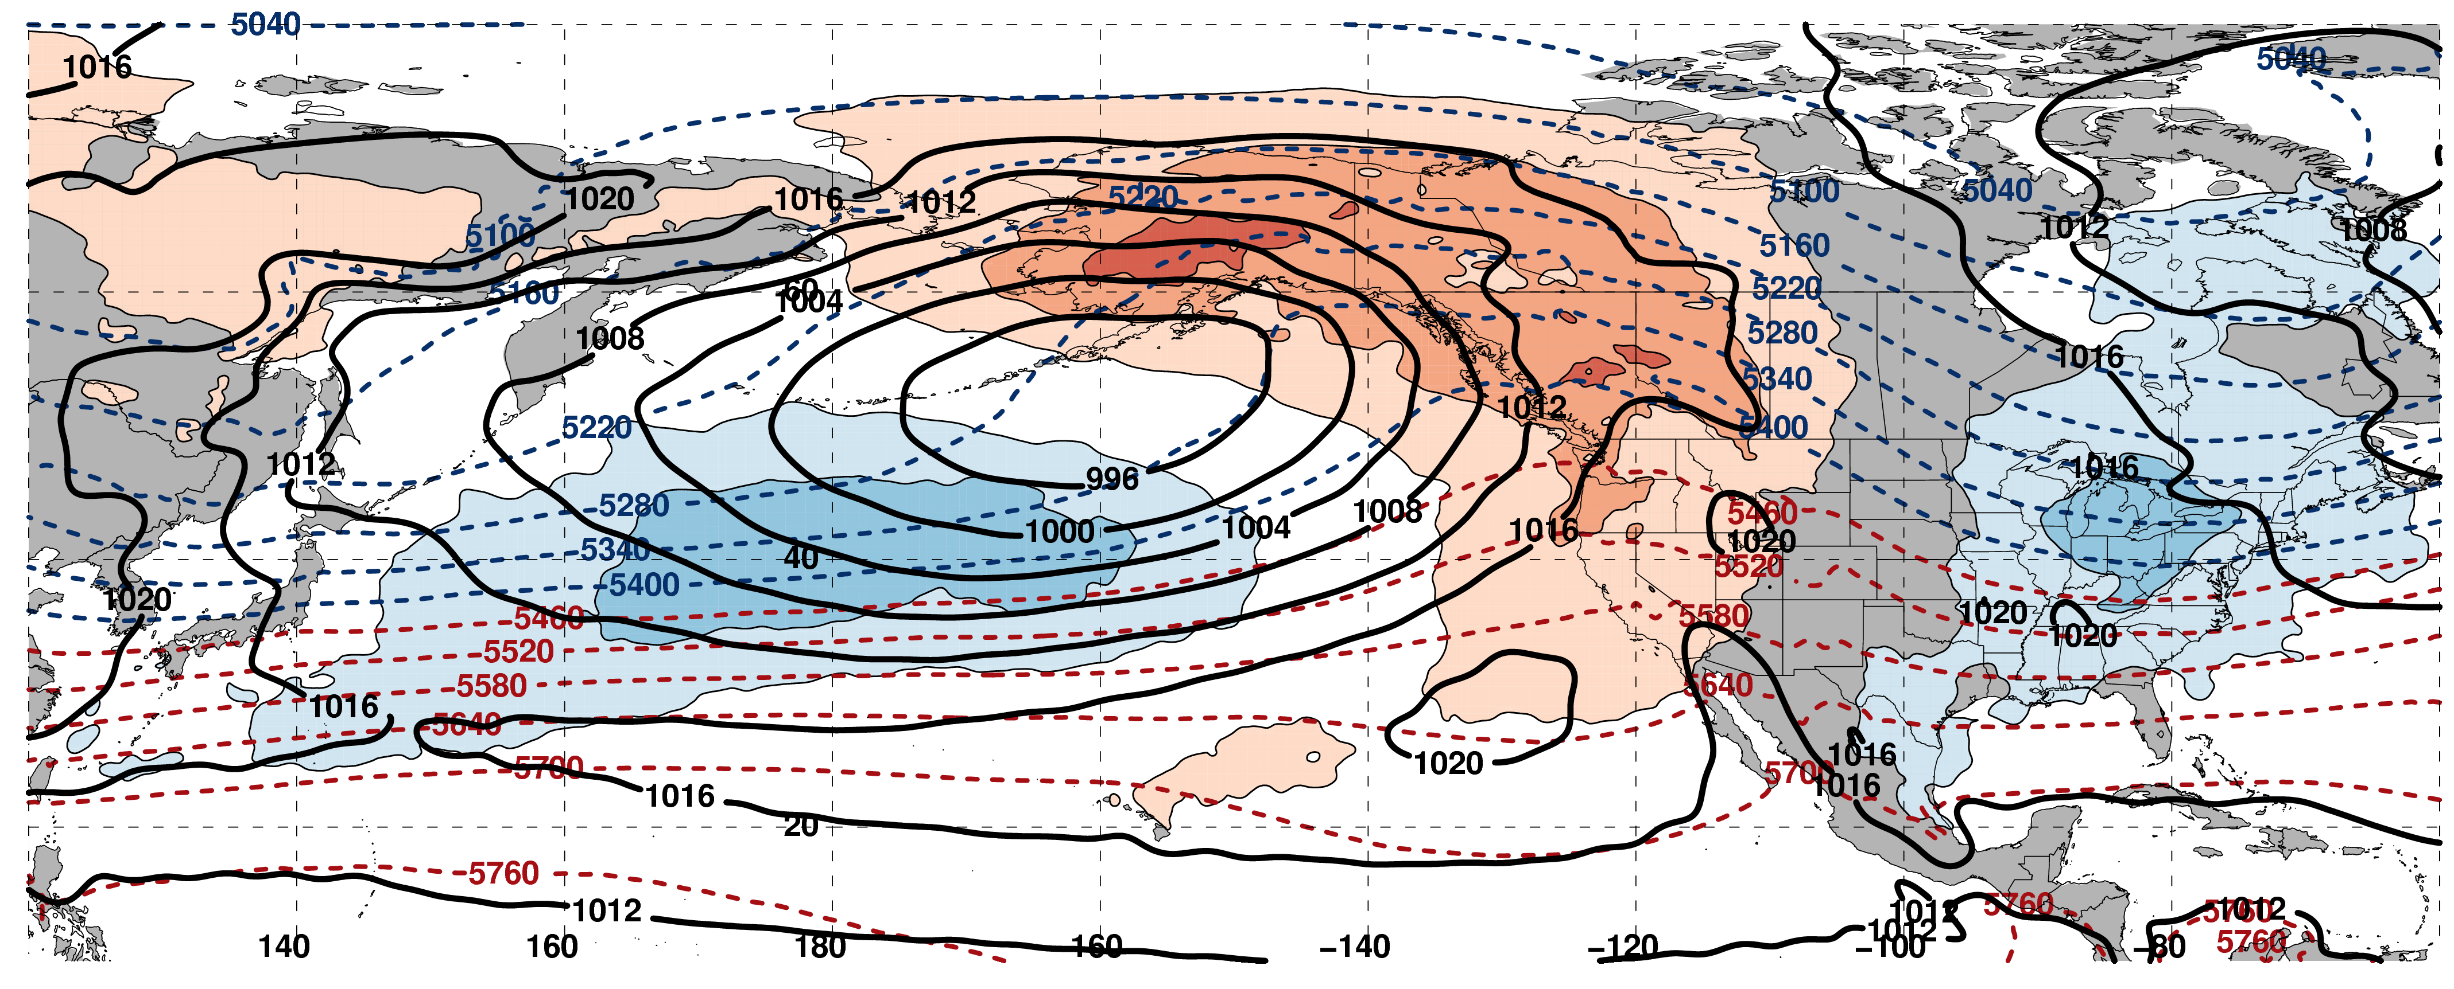
250-hPa Wind Speed, Geo. Heights, Geo. Height Anomalies: Jet Extension
m s^{–1}
Mean Sea-Level Pressure, 1000–500-hPa Thickness, 850-hPa Temp. Anomalies: Jet Extension
K

Slide 15
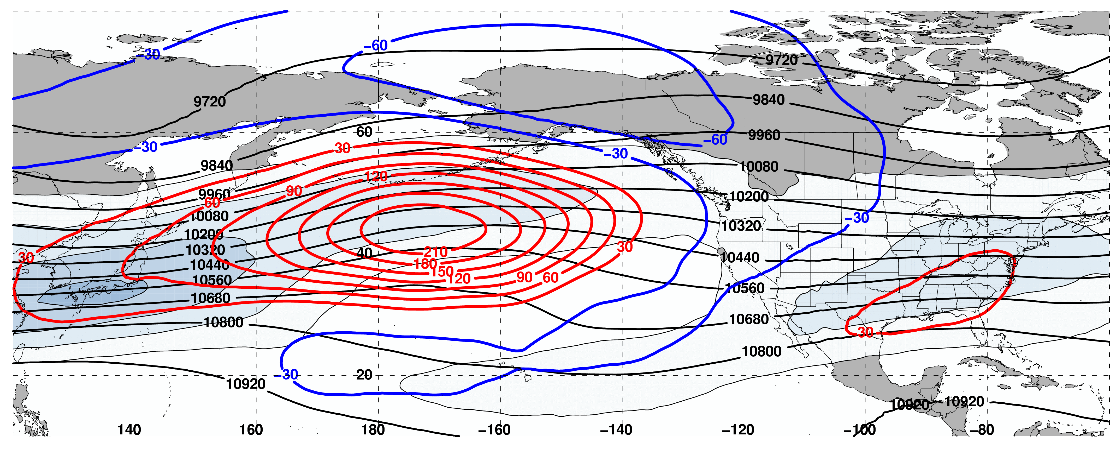
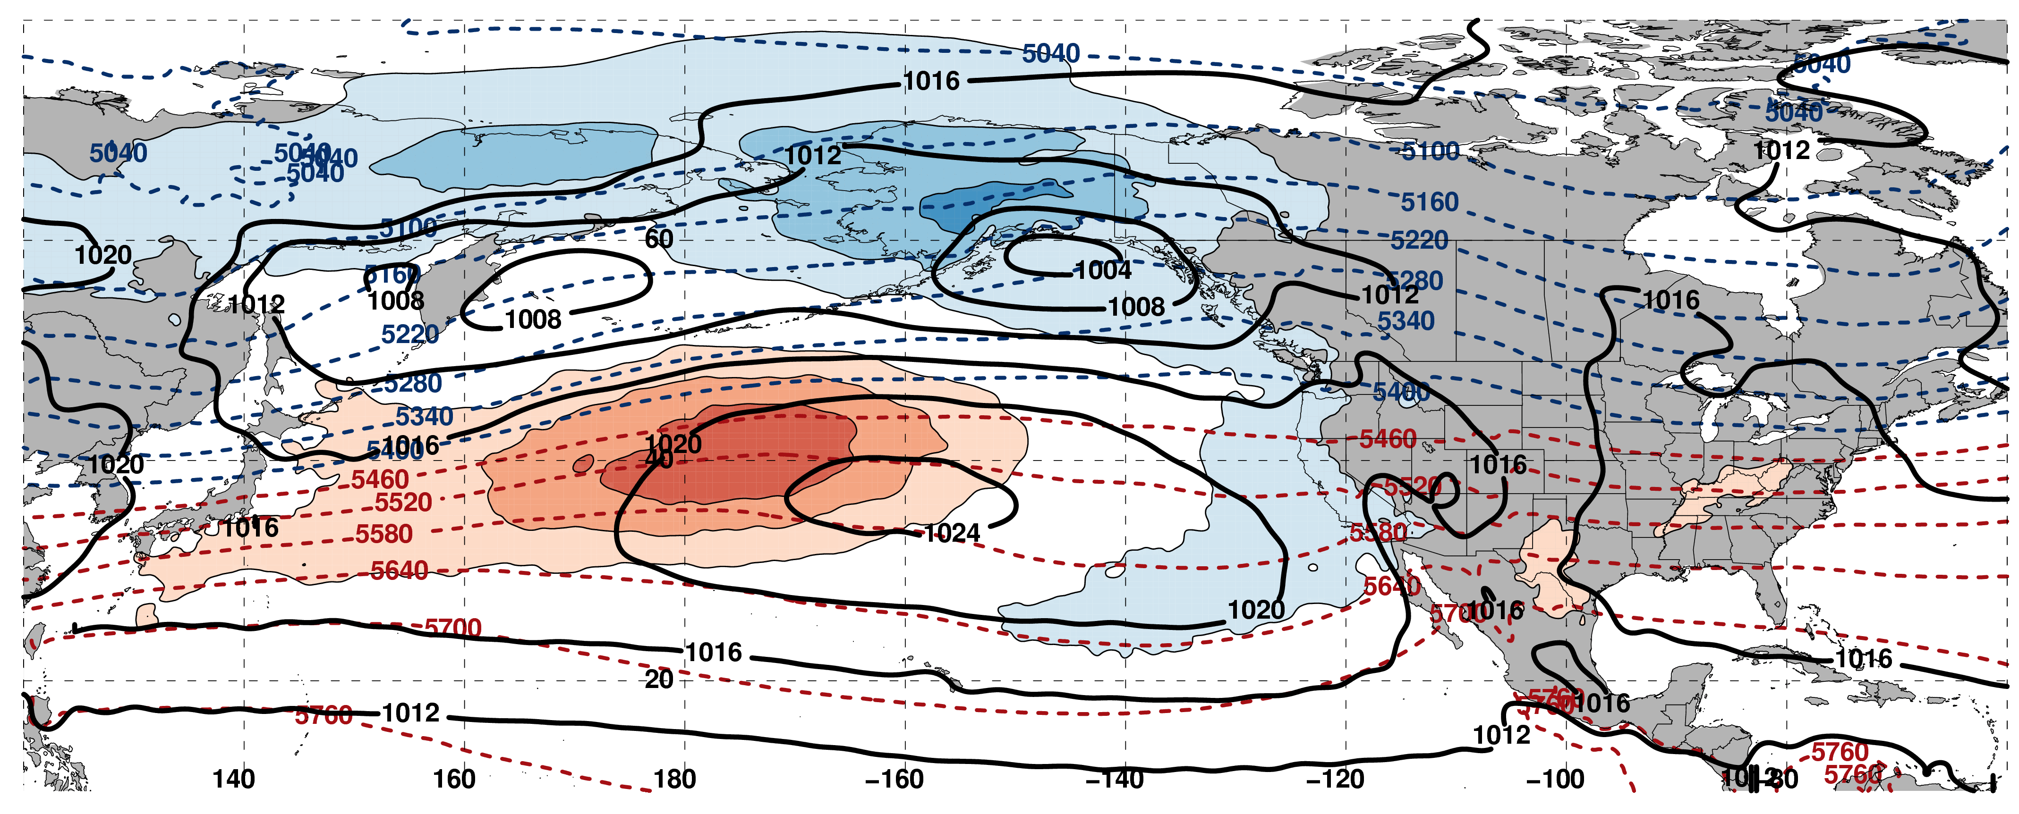
250-hPa Wind Speed, Geo. Heights, Geo. Height Anomalies: Jet Retraction
m s^{–1}
Mean Sea-Level Pressure, 1000–500-hPa Thickness, 850-hPa Temp. Anomalies: Jet Retraction
K

Slide 16
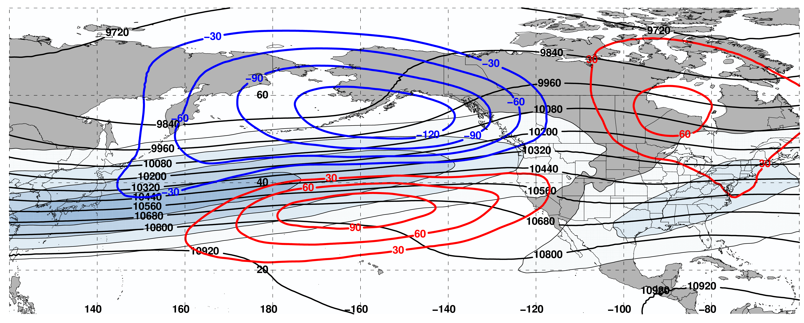
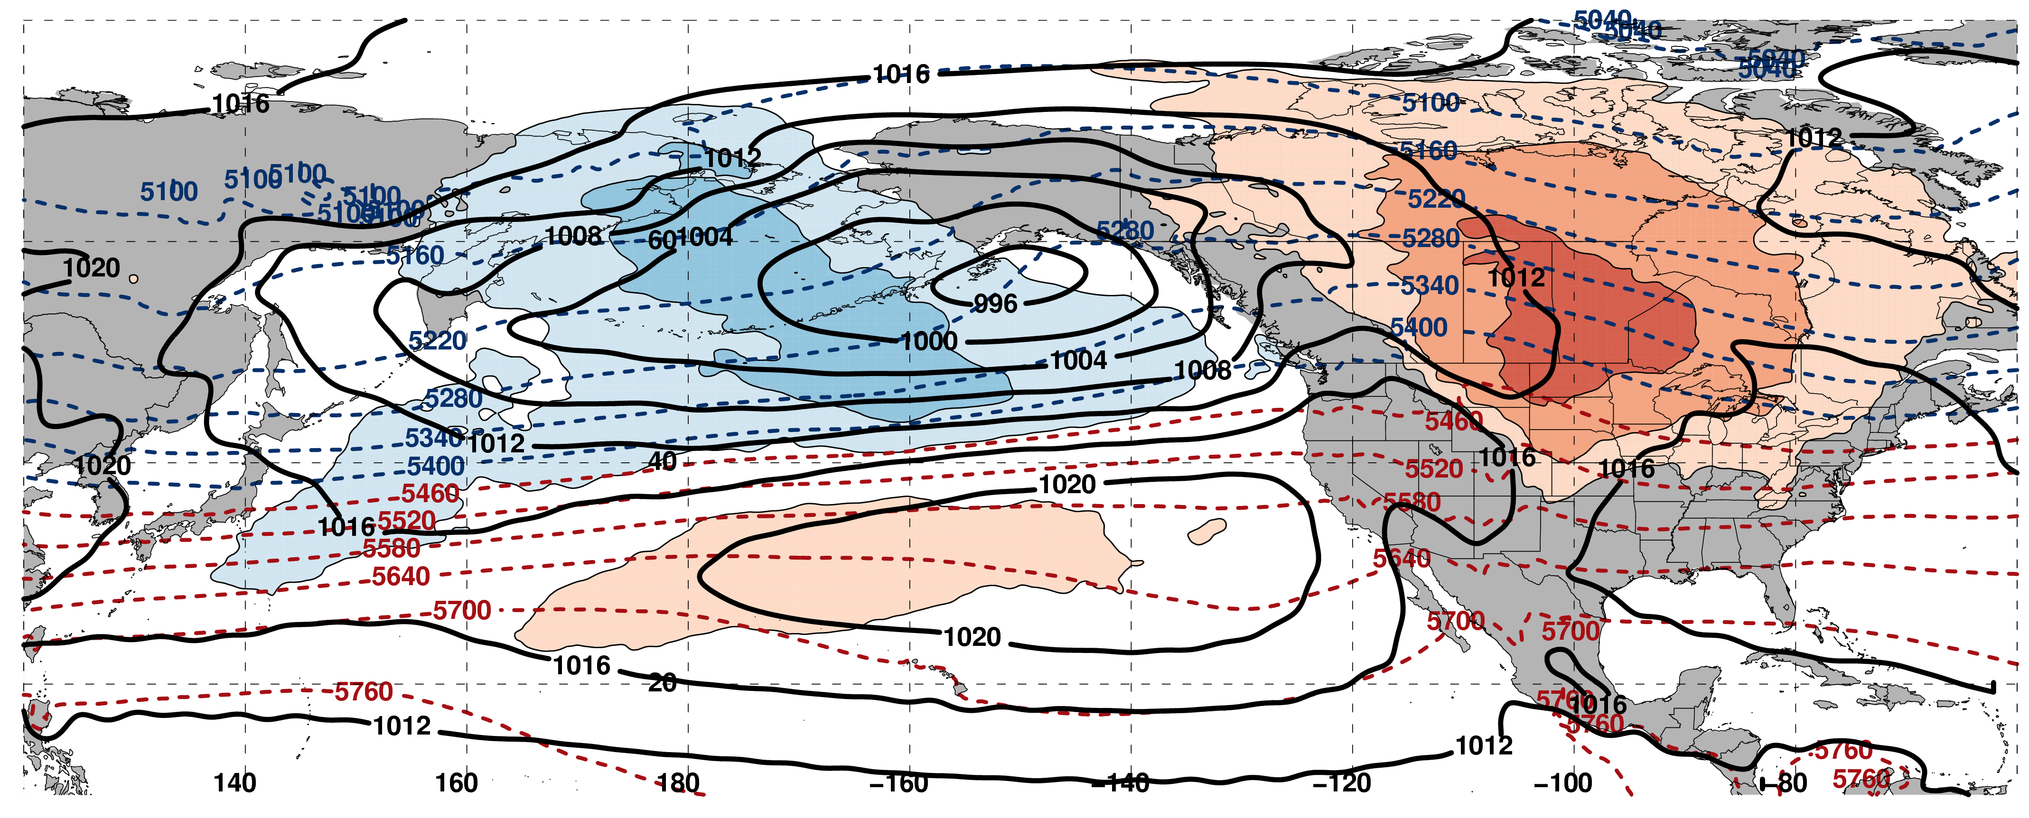
250-hPa Wind Speed, Geo. Heights, Geo. Height Anomalies: Poleward Shift
m s^{–1}
Mean Sea-Level Pressure, 1000–500-hPa Thickness, 850-hPa Temp. Anomalies: Poleward Shift
K

Slide 17
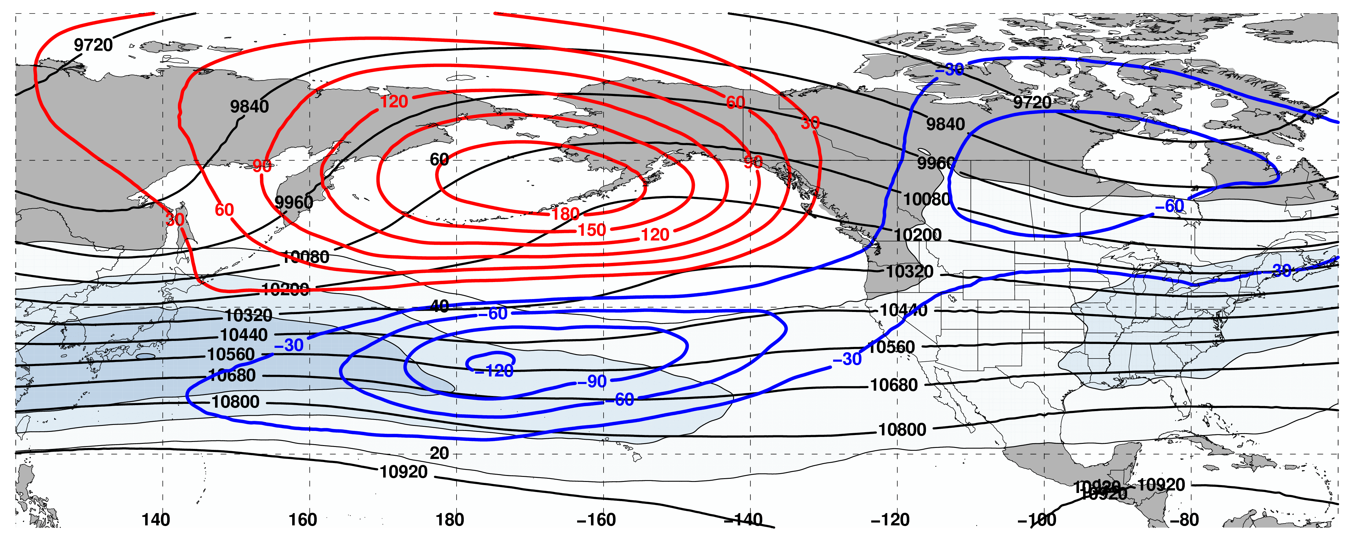
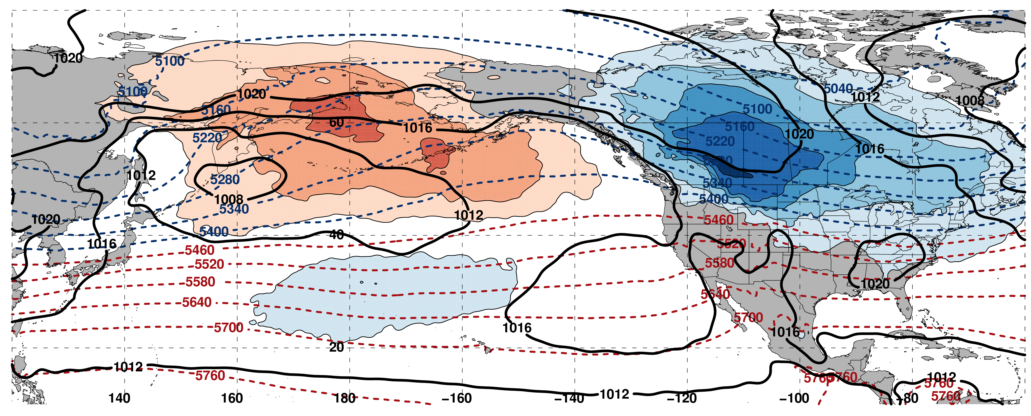
250-hPa Wind Speed, Geo. Heights, Geo. Height Anomalies: Equator. Shift
m s^{–1}
Mean Sea-Level Pressure, 1000–500-hPa Thickness, 850-hPa Temp. Anomalies: Equator. Shift
K

Slide 18
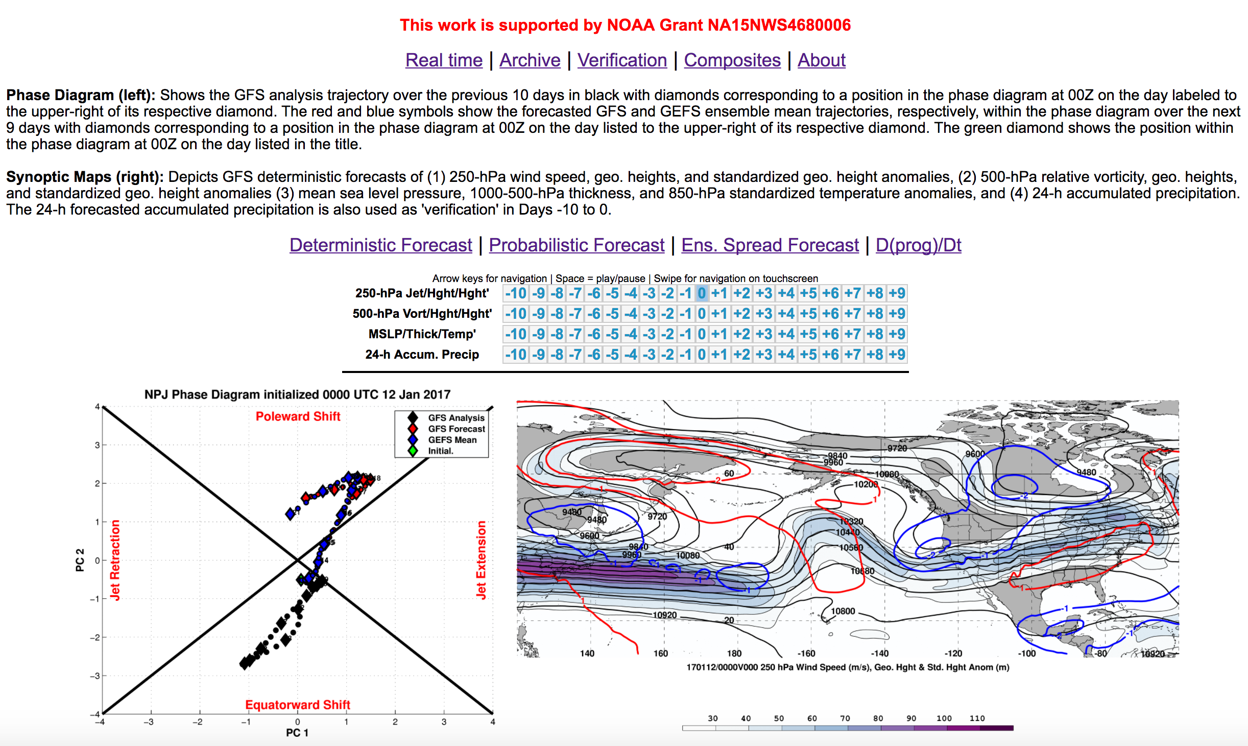
NPJ Phase Diagram Web Interface

Slide 19
NPJ Phase Diagram Web Interface

Slide 20
NPJ Phase Diagram Web Interface

Slide 21
NPJ Phase Diagram Web Interface

Slide 22
GEFS Forecast Skill in the Context of the NPJ Phase Diagram

Slide 23
NPJ Phase Diagram Forecast Skill
Determined the position within the NPJ phase diagram for all 0-h forecasts during Sept.–May 1984–2014 in the GEFS Reforecast V2 (Hamill et al. 2013)

Slide 24
GEFS Ensemble Mean Error by NPJ Regime
GEFS Reforecasts initialized within a particular NPJ regime
Circles on a particular line indicate statistically significant differences at the 95% confidence level with respect to another NPJ regime

Slide 25
GEFS Ensemble Mean Error by NPJ Regime
GEFS Reforecasts initialized within a particular NPJ regime
Circles on a particular line indicate statistically significant differences at the 95% confidence level with respect to another NPJ regime
Forecasts initialized during jet retractions exhibit significantly larger errors than
jet extensions and poleward shifts in the 168–216-h forecast period

Slide 26
GEFS Ensemble Mean Error by NPJ Regime
GEFS Reforecasts verifying within a particular NPJ regime
Circles on a particular line indicate statistically significant differences at the 99% confidence level with respect to another NPJ regime

Slide 27
GEFS Ensemble Mean Error by NPJ Regime
GEFS Reforecasts verifying within a particular NPJ regime
Circles on a particular line indicate statistically significant differences at the 99% confidence level with respect to another NPJ regime
Forecasts verifying during equatorward shifts and jet retractions exhibit significantly larger errors than jet extensions and poleward shifts in the 96–216-h forecast period

Slide 28
Best/Worst NPJ Phase Diagram Forecasts
Comparison between the periods characterized by the best/worst medium-range forecasts
Criteria: Forecasts must rank in the top/bottom 10% in terms of both:
The average GEFS ensemble mean error in the Day 8 and 9 forecasts
The average GEFS ensemble member error in the Day 8 and 9 forecasts

Slide 29
Best/Worst NPJ Phase Diagram Forecasts
Comparison between the periods characterized by the best/worst medium-range forecasts
Criteria: Forecasts must rank in the top/bottom 10% in terms of both:
The average GEFS ensemble mean error in the Day 8 and 9 forecasts
The average GEFS ensemble member error in the Day 8 and 9 forecasts
Hypothetical Best Forecast
Verification
Ensemble Mean Position
Individual Ens. Member

Slide 30
Best/Worst NPJ Phase Diagram Forecasts
Comparison between the periods characterized by the best/worst medium-range forecasts
Criteria: Forecasts must rank in the top/bottom 10% in terms of both:
The average GEFS ensemble mean error in the Day 8 and 9 forecasts
The average GEFS ensemble member error in the Day 8 and 9 forecasts
Represents a forecast with negligible ensemble mean error
Hypothetical Best Forecast
(1) Ens. Mean error ≈ 0
Verification
Ensemble Mean Position
Individual Ens. Member

Slide 31
Best/Worst NPJ Phase Diagram Forecasts
Comparison between the periods characterized by the best/worst medium-range forecasts
Criteria: Forecasts must rank in the top/bottom 10% in terms of both:
The average GEFS ensemble mean error in the Day 8 and 9 forecasts
The average GEFS ensemble member error in the Day 8 and 9 forecasts
Represents a forecast with negligible ensemble member error
Hypothetical Best Forecast
(1) Ens. Mean error ≈ 0
(2) Avg. Ens. Member error ≈ 0
Verification
Ensemble Mean Position
Individual Ens. Member

Slide 32
Best/Worst NPJ Phase Diagram Forecasts
Comparison between the periods characterized by the best/worst medium-range forecasts
Criteria: Forecasts must rank in the top/bottom 10% in terms of both:
The average GEFS ensemble mean error in the Day 8 and 9 forecasts
The average GEFS ensemble member error in the Day 8 and 9 forecasts
Hypothetical Intermediate Forecast
Verification
Ensemble Mean Position
Individual Ens. Member
Notes:
intermediate

Slide 33
Best/Worst NPJ Phase Diagram Forecasts
Comparison between the periods characterized by the best/worst medium-range forecasts
Criteria: Forecasts must rank in the top/bottom 10% in terms of both:
The average GEFS ensemble mean error in the Day 8 and 9 forecasts
The average GEFS ensemble member error in the Day 8 and 9 forecasts
Represents a forecast with negligible ensemble mean error
Hypothetical Intermediate Forecast
(1) Ens. Mean error ≈ 0
Verification
Ensemble Mean Position
Individual Ens. Member

Slide 34
Best/Worst NPJ Phase Diagram Forecasts
Comparison between the periods characterized by the best/worst medium-range forecasts
Criteria: Forecasts must rank in the top/bottom 10% in terms of both:
The average GEFS ensemble mean error in the Day 8 and 9 forecasts
The average GEFS ensemble member error in the Day 8 and 9 forecasts
Represents a forecast with considerable ensemble member error
Hypothetical Intermediate Forecast
(1) Ens. Mean error ≈ 0
(2) Avg. Ens. Member error >> 0
Verification
Ensemble Mean Position
Individual Ens. Member

Slide 35
Best/Worst NPJ Phase Diagram Forecasts
Comparison between the periods characterized by the best/worst medium-range forecasts
Criteria: Forecasts must rank in the top/bottom 10% in terms of both:
The average GEFS ensemble mean error in the Day 8 and 9 forecasts
The average GEFS ensemble member error in the Day 8 and 9 forecasts
Hypothetical Worst Forecast
Verification
Ensemble Mean Position
Individual Ens. Member

Slide 36
Best/Worst NPJ Phase Diagram Forecasts
Comparison between the periods characterized by the best/worst medium-range forecasts
Criteria: Forecasts must rank in the top/bottom 10% in terms of both:
The average GEFS ensemble mean error in the Day 8 and 9 forecasts
The average GEFS ensemble member error in the Day 8 and 9 forecasts
Represents a forecast with considerable ensemble mean error
Hypothetical Worst Forecast
(1) Ens. Mean error >> 0
Verification
Ensemble Mean Position
Individual Ens. Member

Slide 37
Best/Worst NPJ Phase Diagram Forecasts
Comparison between the periods characterized by the best/worst medium-range forecasts
Criteria: Forecasts must rank in the top/bottom 10% in terms of both:
The average GEFS ensemble mean error in the Day 8 and 9 forecasts
The average GEFS ensemble member error in the Day 8 and 9 forecasts
Represents a forecast with considerable ensemble member error
Hypothetical Worst Forecast
(1) Ens. Mean error >> 0
(2) Avg. Ens. Member error >> 0
Verification
Ensemble Mean Position
Individual Ens. Member

Slide 38
Best/Worst NPJ Phase Diagram Forecasts
Comparison between the periods characterized by the best/worst medium-range forecasts
 | PC1_{start} | PC2_{start} | Avg. ΔPC1 | Avg. ΔPC2 | Avg. 10-d Traj. Dist.
Best Forecasts (N=475) | 0.09 | 0.04 | 0.09 | 0.16 | 3.50 PC units
Worst Forecasts (N=763) | –0.18 | –0.08 | –0.01 | –0.21 | 4.33 PC units
The best forecasts typically initialize more frequently within jet extension and poleward shift NPJ regimes
The worst forecasts typically initialize more frequently within jet retraction and equatorward shift NPJ regimes
Worst
Best

Slide 39
Best/Worst NPJ Phase Diagram Forecasts
Comparison between the periods characterized by the best/worst medium-range forecasts
 | PC1_{start} | PC2_{start} | Avg. ΔPC1 | Avg. ΔPC2 | Avg. 10-d Traj. Dist.
Best Forecasts (N=475) | 0.09 | 0.04 | 0.09 | 0.16 | 3.50 PC units
Worst Forecasts (N=763) | –0.18 | –0.08 | –0.01 | –0.21 | 4.33 PC units
Poleward
Shift
Equatorward
Shift
The best forecast periods are typically characterized by poleward shifts over the next 10 days and anomalously short trajectories within the NPJ phase diagram
The worst forecast periods are typically characterized by equatorward shifts over the next 10 days and anomalously long trajectories within the NPJ phase diagram

Slide 40
Discussion
Forecasts initialized/verifying during jet extensions and poleward shifts are characterized by lower errors than those initialized/verifying during jet retractions and equatorward shifts.
The best NPJ phase diagram forecasts are most frequently initialized during jet extensions and poleward shifts and are typically characterized by periods with shorter trajectories through the NPJ phase diagram.
A topic of future research is to explain from a synoptic-dynamic perspective why jet extensions and poleward shifts exhibit greater forecast skill compared to jet retractions and equatorward shifts.

Slide 41
NPJ Phase Diagram Web Interface
A web interface has been developed and implemented at WPC that offers real time NPJ phase diagram forecasts and NPJ regime composites.
http://www.atmos.albany.edu/facstaff/awinters/realtime/About_EOFs.php
Contact: acwinters@albany.edu
Collaborators: Mike Bodner (WPC), Arlene Laing (NOAA), Dan Halperin (WPC), Josh Kastman (WPC), and
Sara Ganetis (WPC)

Slide 42
References
Athanasiadis, P. J., J. M. Wallace, and J. J. Wettstein, 2010: Patterns of wintertime jet stream variability and their relation to the storm tracks. J. Atmos. Sci., 67, 1361–1381.
Griffin, K. S., and J. E. Martin, 2017: Synoptic features associated with temporally coherent modes of variability of the North Pacific jet stream. J. Climate, 29, in press.
Hamill, T. M., G. T. Bates, J. S. Whitaker, D. R. Murray, M. Fiorino, T. J. Galarneau, Y. Zhu, and W. Lapenta, 2013: NOAA’s Second-Generation Global Medium-Range Ensemble Forecast Dataset. Bull. Amer. Meteor. Soc., 94, 1553–1565.
Jaffe, S. C., J. E. Martin, D. J. Vimont, and D. L. Lorenz, 2011: A synoptic climatology of episodic, subseasonal retractions of the Pacific jet. J. Climate, 24, 2846–2860.
Saha, S., and Coauthors, 2014: The NCEP Climate Forecast System Version 2. J. Climate, 27, 2185–2208.

Slide 43
Supplementary Slides

Slide 44
NPJ Regime Composites
Determined the position within the NPJ phase diagram at all analysis times in the CFSR at 6-h intervals between Sept.–May 1979–2014

Slide 45
NPJ Regime Composites
Isolated the analysis times during which there was a strong projection onto one of the four NPJ regimes (i.e., >1 PC unit from the origin)

Slide 46
NPJ Regime Composites
Isolated periods during which the NPJ resided within the same quadrant of the NPJ phase diagram for 3 consecutive days

Slide 47
Inter and Intraannual Characteristics of the
NPJ Phase Diagram

Slide 48
The NPJ Phase Diagram and ETEs
EAST U.S. COLD EVENTS (N = 173)
EAST U.S. WARM EVENTS (N = 239)
Poleward Shift
Poleward Shift
23
66
30
47
69
47
Jet Retraction
Jet Extension
Jet Retraction
Jet Extension
73
57
Equatorward Shift
Equatorward Shift
Mean Position
ETEs during Sept. – May are projected onto the NPJ phase diagram
Each ‘x’ is the average position within the NPJ phase diagram 3–7 days prior to an ETE

Slide 49
NPJ Regime Frequency by Month
Poleward and Equatorward Shifts are favored during September
NPJ regime frequencies are nearly equivalent during all other months

Slide 50
NPJ Regime Frequency and ENSO
Jet Extensions and Equatorward Shifts are favored during an El Niño
Jet Retractions and Poleward Shifts are favored during a La Niña

Slide 51
NPJ Regime Frequency and the MJO
Jet Retractions are favored during Phases 2, 3, and 4
Poleward Shifts are favored during Phases 5 and 6
Jet Extensions are favored during Phases 7, 8, and 1

Slide 52
NPJ Regime Frequency and the PNA
Jet Extensions and Poleward Shifts are favored during a positive PNA
Jet Retractions and Equatorward Shifts are favored during a negative PNA

Slide 53
NPJ Regime Forecast Frequency
The percent frequency that an NPJ regime is over/under forecast relative to verification at various forecast lead times in the GEFS ensemble mean reforecasts
NPJ Regime
 | Extension | Retraction | Poleward | Equator | Origin
24 h | 1.54% | 0% | 1.92% | –3.07% | –0.21%
48 h | 3.94% | –0.16% | 7.96% | –6.38% | –2.11%
72 h | 3.50% | –2.31% | 10.59% | –7.93% | –1.61%
96 h | 2.37% | –1.27% | 8.77% | –9.21% | –0.48%
120 h | 2.28% | –4.04% | 8.46% | –11.64% | 1.55%
144 h | 3.37% | –2.37% | 0.80% | –13.32% | 3.98%
168 h | 0% | –2.93% | –2.08% | –16.84% | 7.65%
192 h | –3.20% | –6.40% | –6.16% | –18.56% | 12.18%
216 h | –9.14% | –7.33% | –12.50% | –25.51% | 19.33%
Forecast Lead Time
Negative: under forecast // Positive: over forecast

Slide 54
NPJ Regime Forecast Frequency
The percent frequency that an NPJ regime is over/under forecast relative to verification at various forecast lead times in the GEFS ensemble mean reforecasts
NPJ Regime
 | Extension | Retraction | Poleward | Equator | Origin
24 h | 1.54% | 0% | 1.92% | –3.07% | –0.21%
48 h | 3.94% | –0.16% | 7.96% | –6.38% | –2.11%
72 h | 3.50% | –2.31% | 10.59% | –7.93% | –1.61%
96 h | 2.37% | –1.27% | 8.77% | –9.21% | –0.48%
120 h | 2.28% | –4.04% | 8.46% | –11.64% | 1.55%
144 h | 3.37% | –2.37% | 0.80% | –13.32% | 3.98%
168 h | 0% | –2.93% | –2.08% | –16.84% | 7.65%
192 h | –3.20% | –6.40% | –6.16% | –18.56% | 12.18%
216 h | –9.14% | –7.33% | –12.50% | –25.51% | 19.33%
Forecast Lead Time
Negative: under forecast // Positive: over forecast

Slide 55
Real time NPJ Phase Diagram Verification Statistics
2016–2017

Slide 56
Reliability Diagram (Sept 1 – May 31)
Perfect
Reliability
The GEFS appears to be underdispersive with respect to medium-range forecasts of the NPJ within the phase diagram

Slide 57
GFS Average Error – Regime

Slide 58
Average GEFS Mean Error – Regime

Slide 59
GEFS Probability of Detection – Regime

Slide 60
Time Series of GFS and GEFS Mean Error
GFS
9-Day Forecast
GEFS Mean
S
O
N
D
J
F
M
M
S
O
N
D
A
J
F
M
A
M
Colored dots identify the NPJ regime on a particular day

Slide 61
Jet Regime-Dependent Forecast Skill
Percent Difference Between the Frequency of Forecasts with Below-Normal and Above-Normal RMSE
Higher frequency of forecasts with
below-normal RMSE
(i.e., more good forecasts)
Higher frequency of forecasts with
above-normal RMSE
(i.e., more bad forecasts)

Slide 62
Jet Regime-Dependent Forecast Skill
Percent Difference Between the Frequency of Forecasts with Below-Normal and Above-Normal RMSE
Higher frequency of forecasts with
below-normal RMSE
(i.e., more good forecasts)
Higher frequency of forecasts with
above-normal RMSE
(i.e., more bad forecasts)

Slide 63
Best/Worst Forecast Statistics
10-d trajectory comparison between periods characterized by
the best/worst medium-range forecasts
All Events | PC1_{start} | PC2_{start} | ΔPC1 | ΔPC2 | Mean Traj. Dist
Good Forecasts (475) | 0.09 | 0.04 | 0.09 | 0.16 | 3.50
Bad Forecasts (763) | –0.18 | –0.08 | –0.01 | –0.21 | 4.33
Jet Extensions | PC1_{start} | PC2_{start} | ΔPC1 | ΔPC2 | Mean Traj. Dist
Good Forecasts (77) | 1.54 | –0.09 | –0.98 | 0.40 | 3.69
Bad Forecasts (90) | 1.35 | –0.01 | –1.41 | –0.14 | 4.57
Jet Retractions | PC1_{start} | PC2_{start} | ΔPC1 | ΔPC2 | Mean Traj. Dist
Good Forecasts (63) | –1.36 | 0.14 | 1.09 | 0.04 | 3.77
Bad Forecasts (145) | –1.58 | –0.11 | 1.18 | –0.25 | 4.56
Poleward Shifts | PC1_{start} | PC2_{start} | ΔPC1 | ΔPC2 | Mean Traj. Dist
Good Forecasts (63) | 0.12 | 1.45 | 0.00 | –0.81 | 3.59
Bad Forecasts (90) | –0.02 | 1.40 | –0.31 | –1.44 | 4.62
Equatorward Shifts | PC1_{start} | PC2_{start} | ΔPC1 | ΔPC2 | Mean Traj. Dist
Good Forecasts (61) | 0.20 | –1.42 | 0.36 | 1.08 | 3.52
Bad Forecasts (112) | –0.17 | –1.52 | 0.05 | 1.09 | 4.36
Origin | PC1_{start} | PC2_{start} | ΔPC1 | ΔPC2 | Mean Traj. Dist
Good Forecasts (211) | –0.03 | 0.07 | 0.13 | 0.12 | 3.31
Bad Forecasts (326) | –0.04 | 0.01 | –0.06 | –0.31 | 4.08

Slide 64
Reliability Diagram
Perfect
Reliability
GEFS Reforecasts appear to be underdispersive with respect to medium-range forecasts of the North Pacific Jet in the phase diagram

Slide 65
GEFS Ensemble Mean Error – Season
Circles on a particular line indicate statistically significant differences to the 95% confidence interval with respect to another jet regime.

Slide 66
GFS Average Error – Month

Slide 67
Average GEFS Mean Error – Month

Slide 68
GEFS Probability of Detection – Month

Slide 69
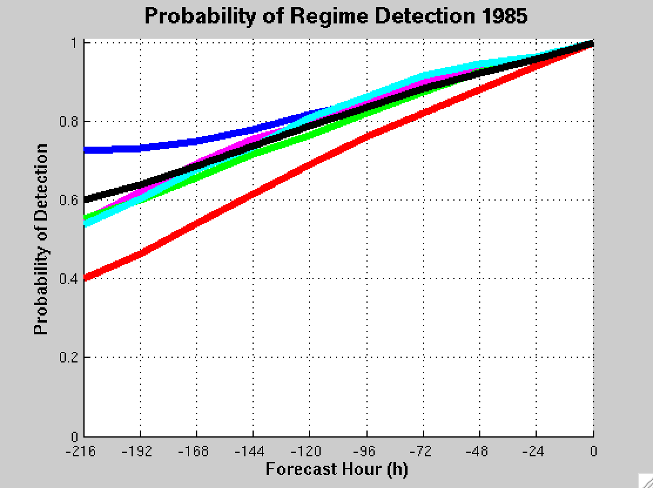
GEFS Ensemble Mean POD by NPJ Regime
For forecasts verifying within a particular NPJ regime
Extension
Retraction
Poleward
Equator
Origin
Mean

Slide 70
NPJ Phase Diagram Technical Slides

Slide 71
Real Time North Pacific Jet Phase Diagram
0000 UTC 8 November 2014
250-hPa wind speed: shaded
Instantaneous 250-hPa zonal wind anomalies can be projected onto EOF 1 and EOF 2, resulting in a point on a North Pacific Jet phase diagram

Slide 72
Real Time North Pacific Jet Phase Diagram
Each point on the phase diagram is a weighted average of the principal components within +/− 1 day of the time under consideration
Example: 0000 UTC 8 November 2014
Weight
5
4
3
2
1
Date
0000 UTC 7 Nov.
1200 UTC 7 Nov.
0000 UTC 8 Nov.
1200 UTC 8 Nov.
0000 UTC 9 Nov.

Slide 73
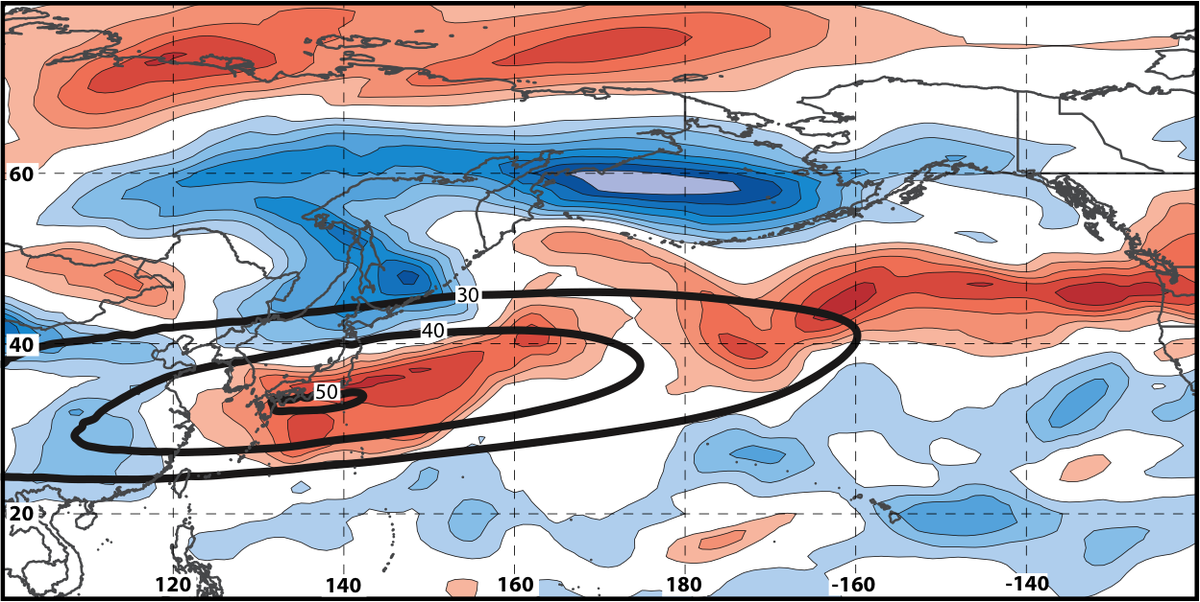
Real Time North Pacific Jet Phase Diagram
250-hPa zonal wind at 0000 UTC 2 Jun minus 250-hPa zonal wind at 0000 UTC 24 May (shading) in the GFS analyses shows the transition to a poleward-shifted jet regime
0000 UTC 24 May
(0-h forecast)
0000 UTC 2 Jun (verification)
Ensemble mean
Sept.–May mean 250-hPa zonal wind: black contours
Notes:
Note that the positive changes in zonal wind correspond exactly to where the positive anomalies are located in the EOF2 pattern – See slide 14.

Slide 74
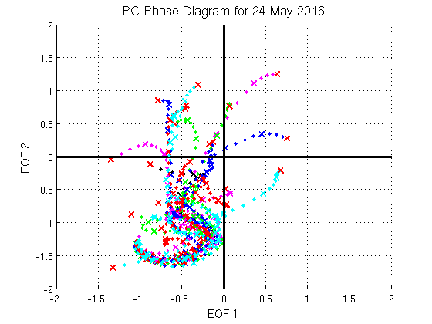
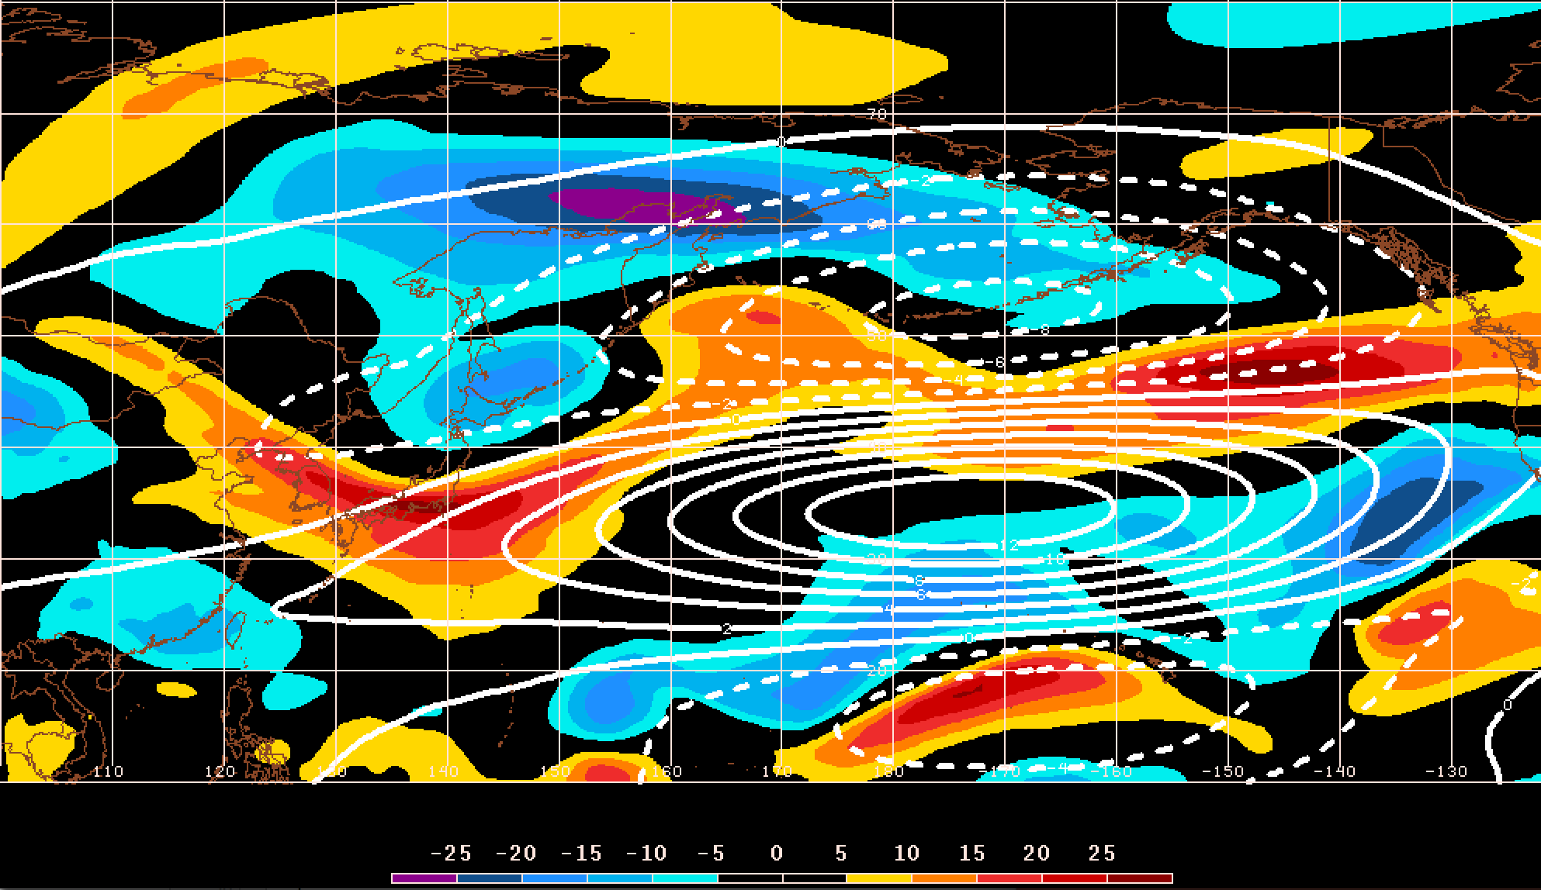
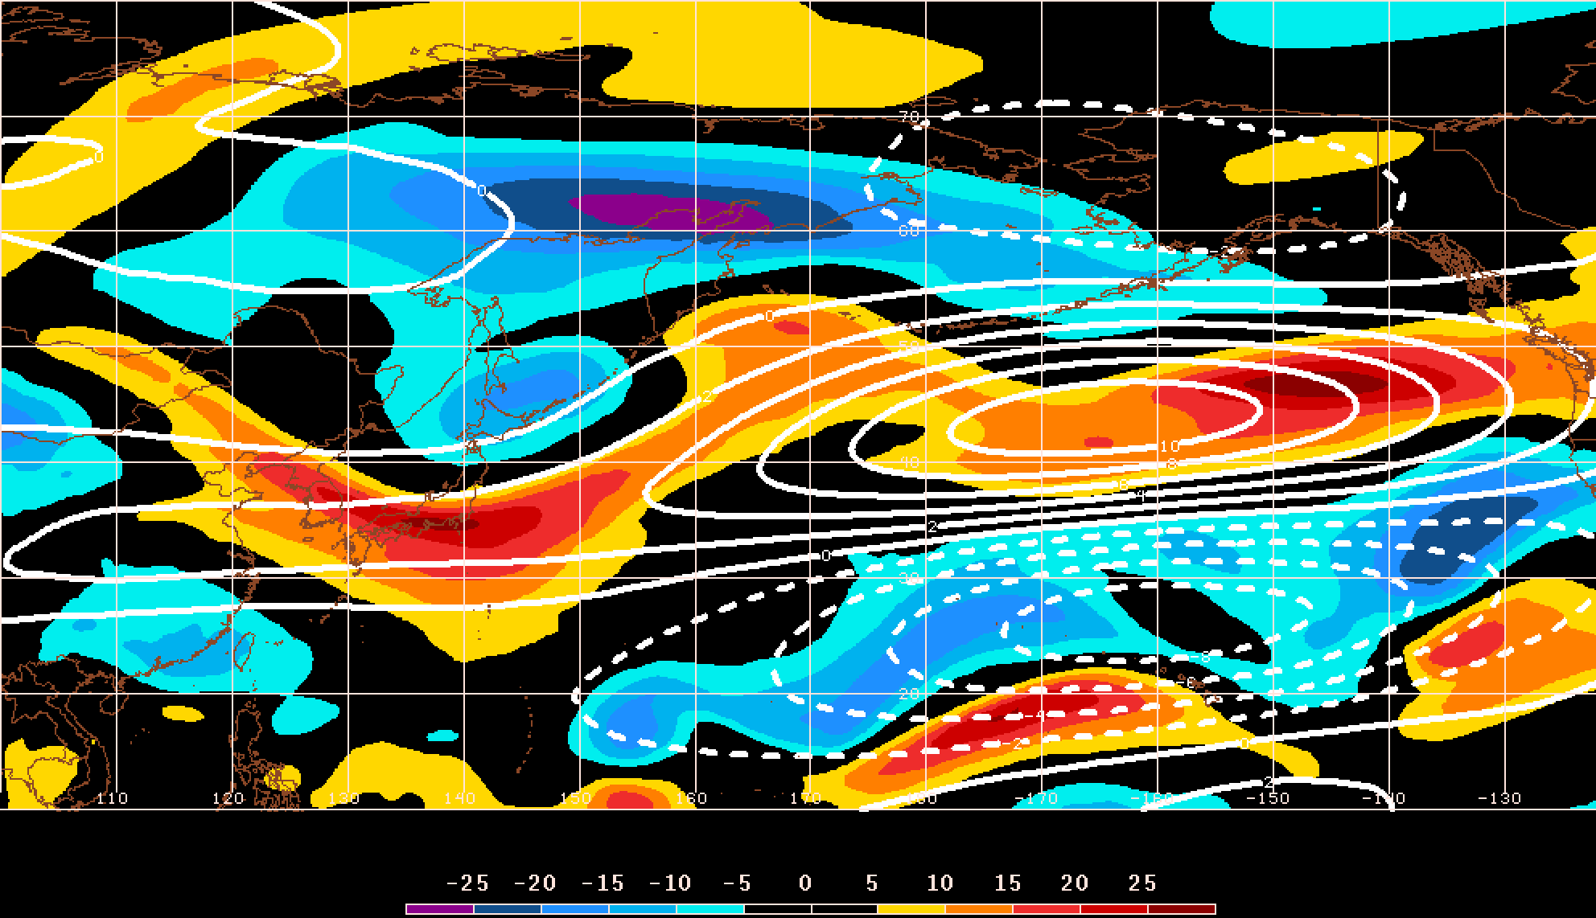
GEFS Ensemble Trajectories Initialized 0000 UTC 24 May 2016
250-hPa Zonal Wind Anomalies and EOF1: 0000 UTC 2 Jun
0000 UTC 2 Jun (verification)
m s^{–1}
250-hPa Zonal Wind Anomalies and EOF2: 0000 UTC 2 Jun
250-hPa zonal wind anomalies at 0000 UTC 2 Jun project strongly onto
EOF2 > 0
m s^{–1}

