Slide 1


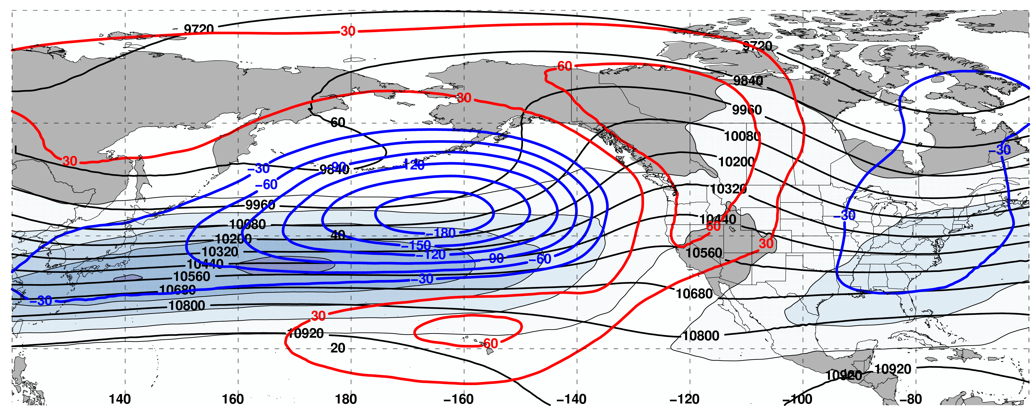
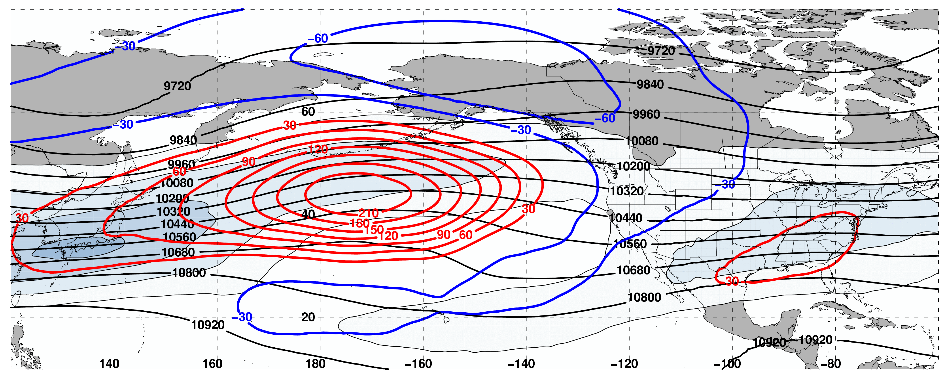
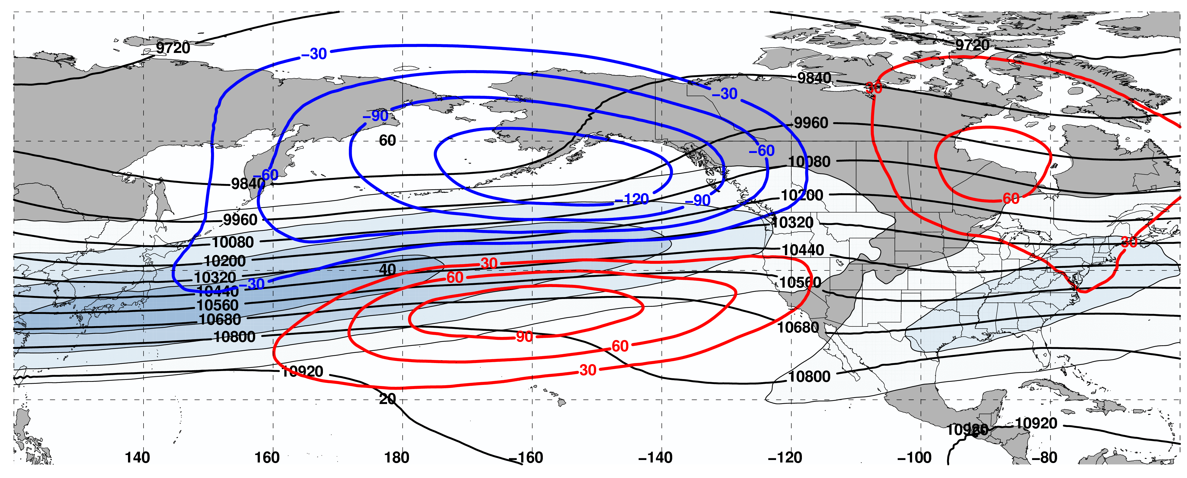
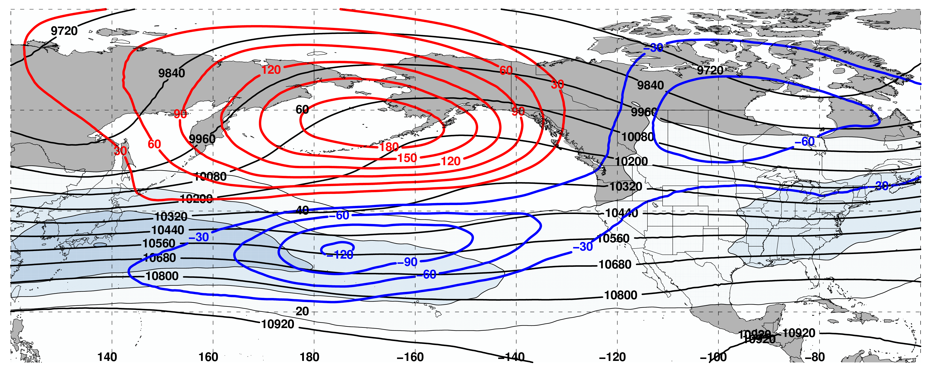
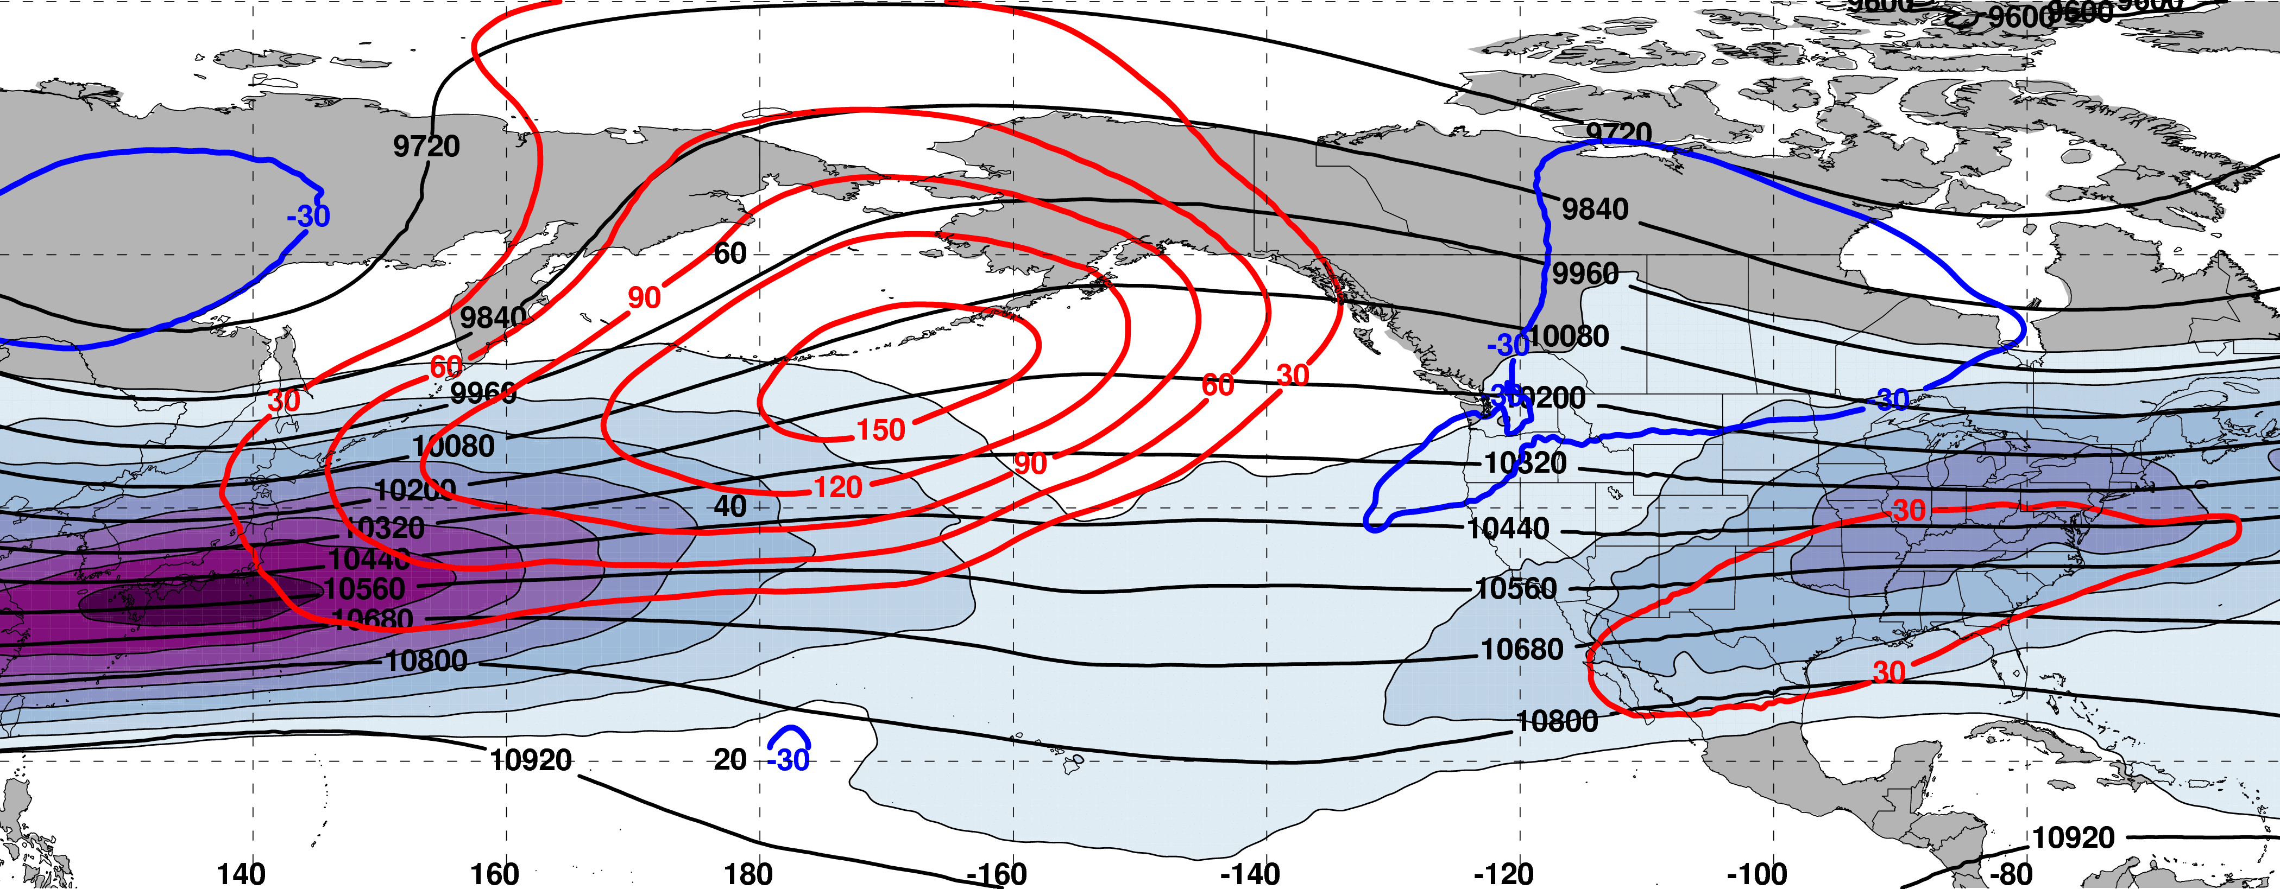
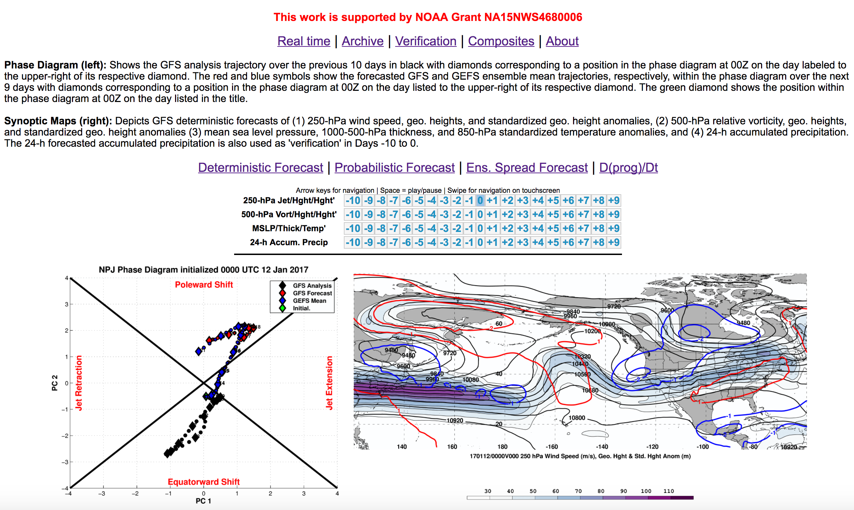
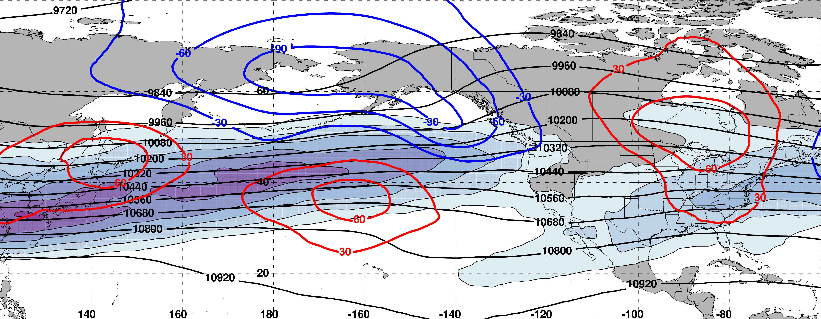
A North Pacific Jet Phase Diagram Perspective on Extreme Weather Events during 2016–2017: General Characteristics
Andrew C. Winters*, Lance F. Bosart*, and Daniel Keyser*
*Department of Atmospheric and Environmental Sciences, University at Albany, SUNY
contact: acwinters@albany.edu
This work is funded by NOAA under Grant NA15NWS4680006
Motivation
1. NPJ Phase Diagram and NPJ Regimes
3. NPJ Phase Diagram Forecast Skill
Considerable North Pacific Jet (NPJ) variability during the medium-range period characterizes the antecedent environments associated with continental U.S. extreme weather events.
This NPJ variability motivated the development of the NPJ phase diagram as an objective tool to characterize the instantaneous state and evolution of the upper-tropospheric flow pattern over the North Pacific.
This study explores the potential for the NPJ phase diagram to increase confidence in operational probabilistic temperature and precipitation forecasts during the medium-range period.
The NPJ phase diagram is constructed from the first two EOFs of Sept.–May 250-hPa zonal wind anomalies from the CFSR over the North Pacific (Fig. 1).
(a)
Forecasts verifying during equatorward shifts and jet retractions exhibit significantly larger errors than jet extensions and poleward shifts at forecast lead times between 96–216 h (Fig. 6a).
Table 1: The percent frequency that an NPJ regime is over/under forecast relative to verification at various forecast lead times for the GEFS ensemble mean reforecasts. Negative (blue) values indicate an NPJ regime is under forecast.
(a) EOF 1
+ EOF 1
Jet Extension
– EOF 1
Jet Retraction
(a) 0000 UTC 8 Nov 2014
 | Extension | Retraction | Poleward | Equator | Origin
24 h | 1.54% | 0% | 1.92% | –3.07% | –0.21%
48 h | 3.94% | –0.16% | 7.96% | –6.38% | –2.11%
72 h | 3.50% | –2.31% | 10.59% | –7.93% | –1.61%
96 h | 2.37% | –1.27% | 8.77% | –9.21% | –0.48%
120 h | 2.28% | –4.04% | 8.46% | –11.64% | 1.55%
144 h | 3.37% | –2.37% | 0.80% | –13.32% | 3.98%
168 h | 0% | –2.93% | –2.08% | –16.84% | 7.65%
192 h | –3.20% | –6.40% | –6.16% | –18.56% | 12.18%
216 h | –9.14% | –7.33% | –12.50% | –25.51% | 19.33%
+ EOF 2
Poleward Shift
– EOF 2
Equatorward Shift
(b)
Figure 2: (a) 250-hPa wind speed shaded in the fill pattern at 0000 UTC 8 Nov 2014. (b) 250-hPa zonal wind anomalies at 0000 UTC 8 Nov 2014 projected onto the NPJ phase diagram.
(b) EOF 2
(b)
Forecasts initialized during jet retractions exhibit significantly larger errors than jet extensions and poleward shifts at forecast lead times between 168– 216 h (Fig. 6b).
Data
Figure 1: (a) Sept.–May 250-hPa mean zonal wind contoured in black every 10 m s^{–1} above 30 m s^{–1} and the regression of the first EOF onto 250-hPa zonal wind anomaly data shaded in the fill pattern. (b) As in (a) but for the second EOF.
Instantaneous 250-hPa zonal wind anomalies can be projected onto EOF 1 and 2, resulting in a point on the NPJ phase diagram (Fig. 2).
Equatorward shifts are substantially under forecast at all forecast lead times compared to all other NPJ regimes (Table 1).
Poleward shifts are substantially over forecast at forecast lead times between 48–120 h (Table 1).
0.5º x 0.5º NCEP Climate Forecast System Reanalysis (CFSR; available every 6 h) during 1979–2014.
1.0º x 1.0º ESRL/PSD GEFS Reforecast v2 dataset (available every 24 h) during 1985–2014.
NPJ Regime Composites
Figure 6: GEFS ensemble mean error of NPJ phase diagram forecasts (a) verifying and (b) initialized within a particular NPJ regime. Circles on a particular line indicate statistically significant differences at the (a) 99% (b) 95% confidence level with respect to another NPJ regime.
Key Findings
(a)
N=159
(b)
N=162
4. Composite Best/Worst Forecast Periods
The prevailing NPJ regime has important implications for the downstream upper-tropospheric flow pattern over North America.
Forecasts verifying during equatorward shifts or jet retractions exhibit the largest NPJ phase diagram forecast errors during the medium-range period.
Substantial NPJ regime change and high-latitude blocking in the North Pacific are commonly associated with the worst NPJ phase diagram forecast periods.
Jet Extension
Jet Retraction
Table 2: Frequency of the best/worst forecasts initialized within each NPJ regime. Cases inside the red box are isolated for composite analysis in Fig. 7.
Of the four primary NPJ regimes, the worst forecast periods initialized most frequently during jet retractions and equatorward shifts (Table 2).
The worst forecast periods are characterized by equatorward shifts over the subsequent 10-day period (Table 3).
The worst forecast periods are characterized by anomalously long trajectories within the NPJ phase diagram, suggesting they are often associated with NPJ regime change (Table 3).
m s^{–1}
m s^{–1}
 | Extension | Retraction | Poleward | Equator. | Origin
Best (N=475) | 77 | 63 | 63 | 61 | 211
Worst (N=763) | 90 | 145 | 90 | 112 | 326
(c)
N=189
(d)
N=149
Table 3: Comparison between periods characterized by the best/worst medium-range forecasts. *’s indicate statistical significance at the 99.9% confidence interval.
Poleward Shift
Equatorward Shift
 | PC1_{start} | PC2_{start} | Avg. ΔPC1 | Avg. ΔPC2 | Avg. 10-d Traj. Length
Best (N=475) | 0.09* | 0.04 | 0.09 | 0.16* | 3.50 PC units*
Worst (N=763) | –0.18* | –0.08 | 0.01 | –0.21* | 4.33 PC units*
m s^{–1}
m s^{–1}
Operational Web Interface
Figure 3: Composite mean 250-hPa wind speed shaded in the fill pattern, 250-hPa geopotential height (black) contoured every 120 m, and 250-hPa geopotential height anomalies (red: positive, blue: negative) contoured every 30 m 4 days after the NPJ becomes characterized by a (a) jet extension, (b) jet retraction, (c) poleward shift, and (d) equatorward shift.
N=145
(d)
2. NPJ Phase Diagram Forecast Classification
The worst forecast periods initialized during a jet retraction exhibit an anomalous ridge over the North Pacific 192 h later (Fig. 7a) and an equatorward-shifted NPJ (Fig. 7d).
The best forecast periods initialized during a jet retraction exhibit an anomalous trough (ridge) over the North Pacific (North America) 192 h later (Fig. 7b) and a poleward-shifted NPJ (Fig. 7d).
The difference between the geopotential height anomalies shown in Figs. 7a and 7b suggests that the worst forecast periods initialized during a jet retraction are often characterized by high-latitude blocking in the North Pacific (Fig. 7c).
The best/worst NPJ phase diagram forecasts were classified as the forecasts that ranked in the bottom/top 10% in terms of both (Fig. 5):
The average GEFS ensemble mean error in the Day 8 and 9 forecasts.
The average GEFS ensemble member error in the Day 8 and 9 forecasts.
Figure 4: Schematic illustrating the classification scheme for NPJ phase diagram forecasts.
(a) 192 h After Worst Forecast
m s^{–1}
N=63
Figure 7: Composite mean 250-hPa wind speed in the fill pattern, 250-hPa geopotential height in black every 120 m, and positive (negative) 250-hPa geopotential height anomalies in red (blue) every 30 m 192 h following the initialization of the (a) worst and (b) best NPJ phase diagram forecasts during a jet retraction. (c) The difference between the 250-hPa geopotential height anomalies shown in (a) and (b). Statistically significant differences at the 99% confidence interval are stippled. (d) Composite trajectories within the NPJ phase diagram for the 10-d period following the initialization of the best and worst NPJ phase diagram forecasts during a jet retraction.
Hypothetical
Best Forecast
Hypothetical
Intermediate Forecast
Hypothetical
Worst Forecast
(b) 192 h After Best Forecast
m s^{–1}
Daily 9-day forecast trajectories within the NPJ phase diagram were constructed during Sept.–May 1985–2014 using the GEFS Reforecast v2.
Forecasts were classified based on position within the NPJ phase diagram at the 0-h forecast (Fig. 4).
Operational NPJ phase diagram forecasts and composites are available via: http://www.atmos.albany.edu/facstaff/ awinters/realtime/About_EOFs.php, and have been implemented at NCEP-WPC.
Verification
Ensemble Mean Position
Individual Ens. Member
Figure 5: Schematic illustrating the classification scheme for the best/worst NPJ phase diagram forecasts.
(c) (a) – (b)
m

