Slide 1


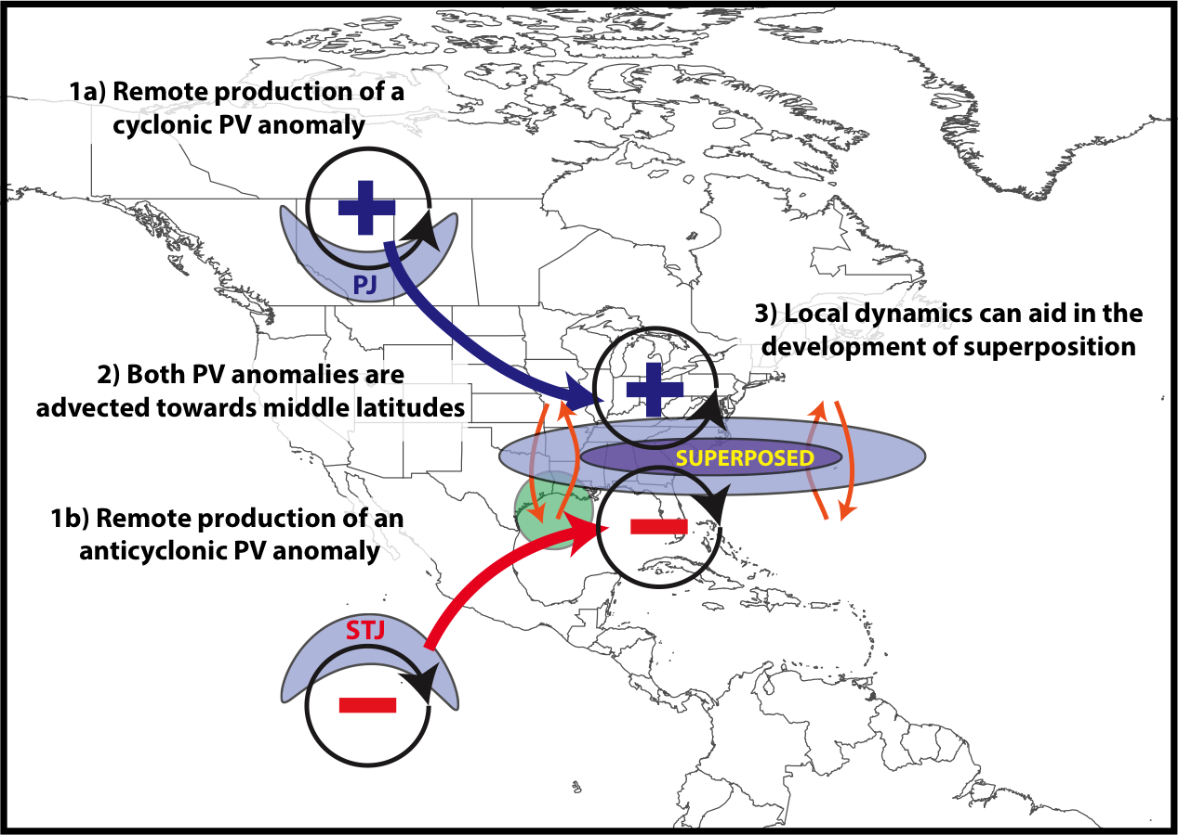
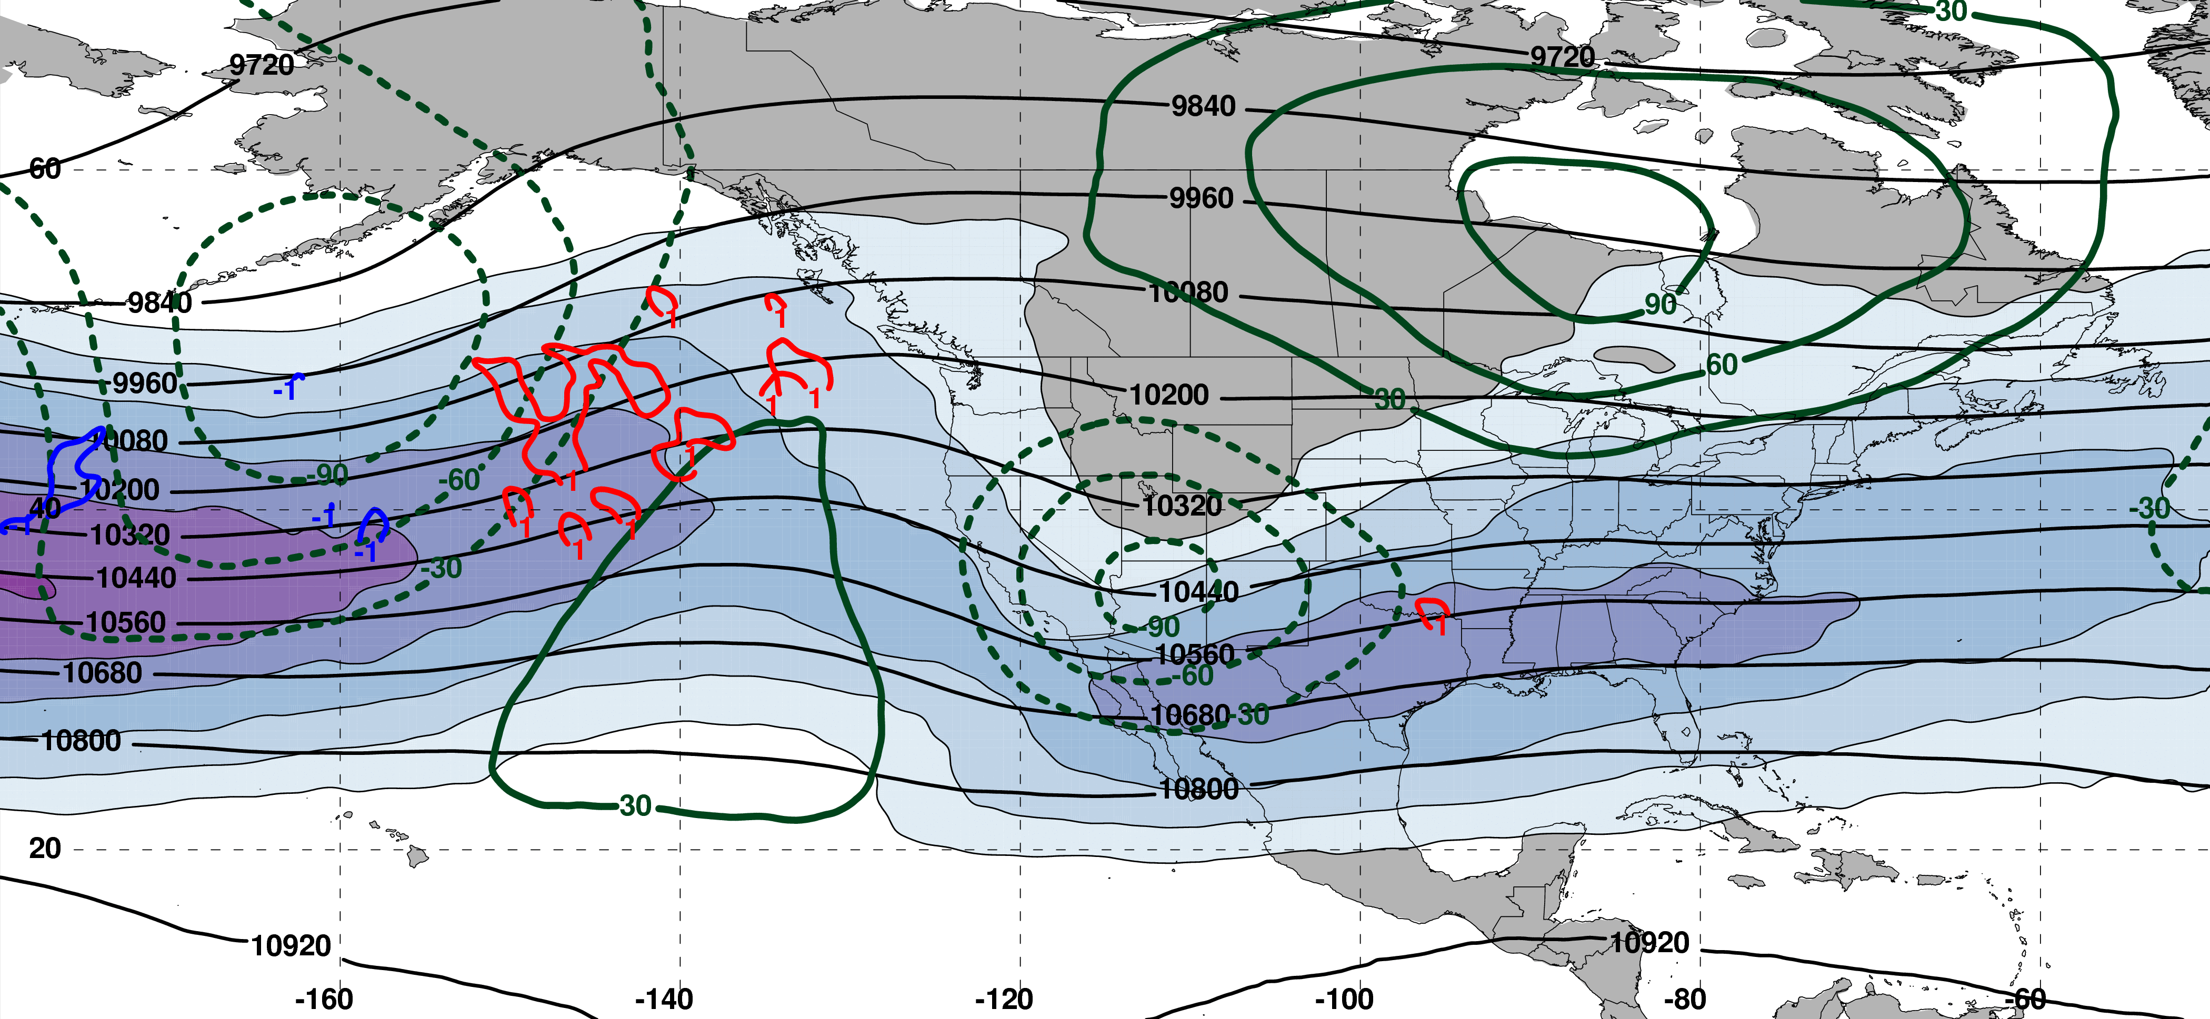
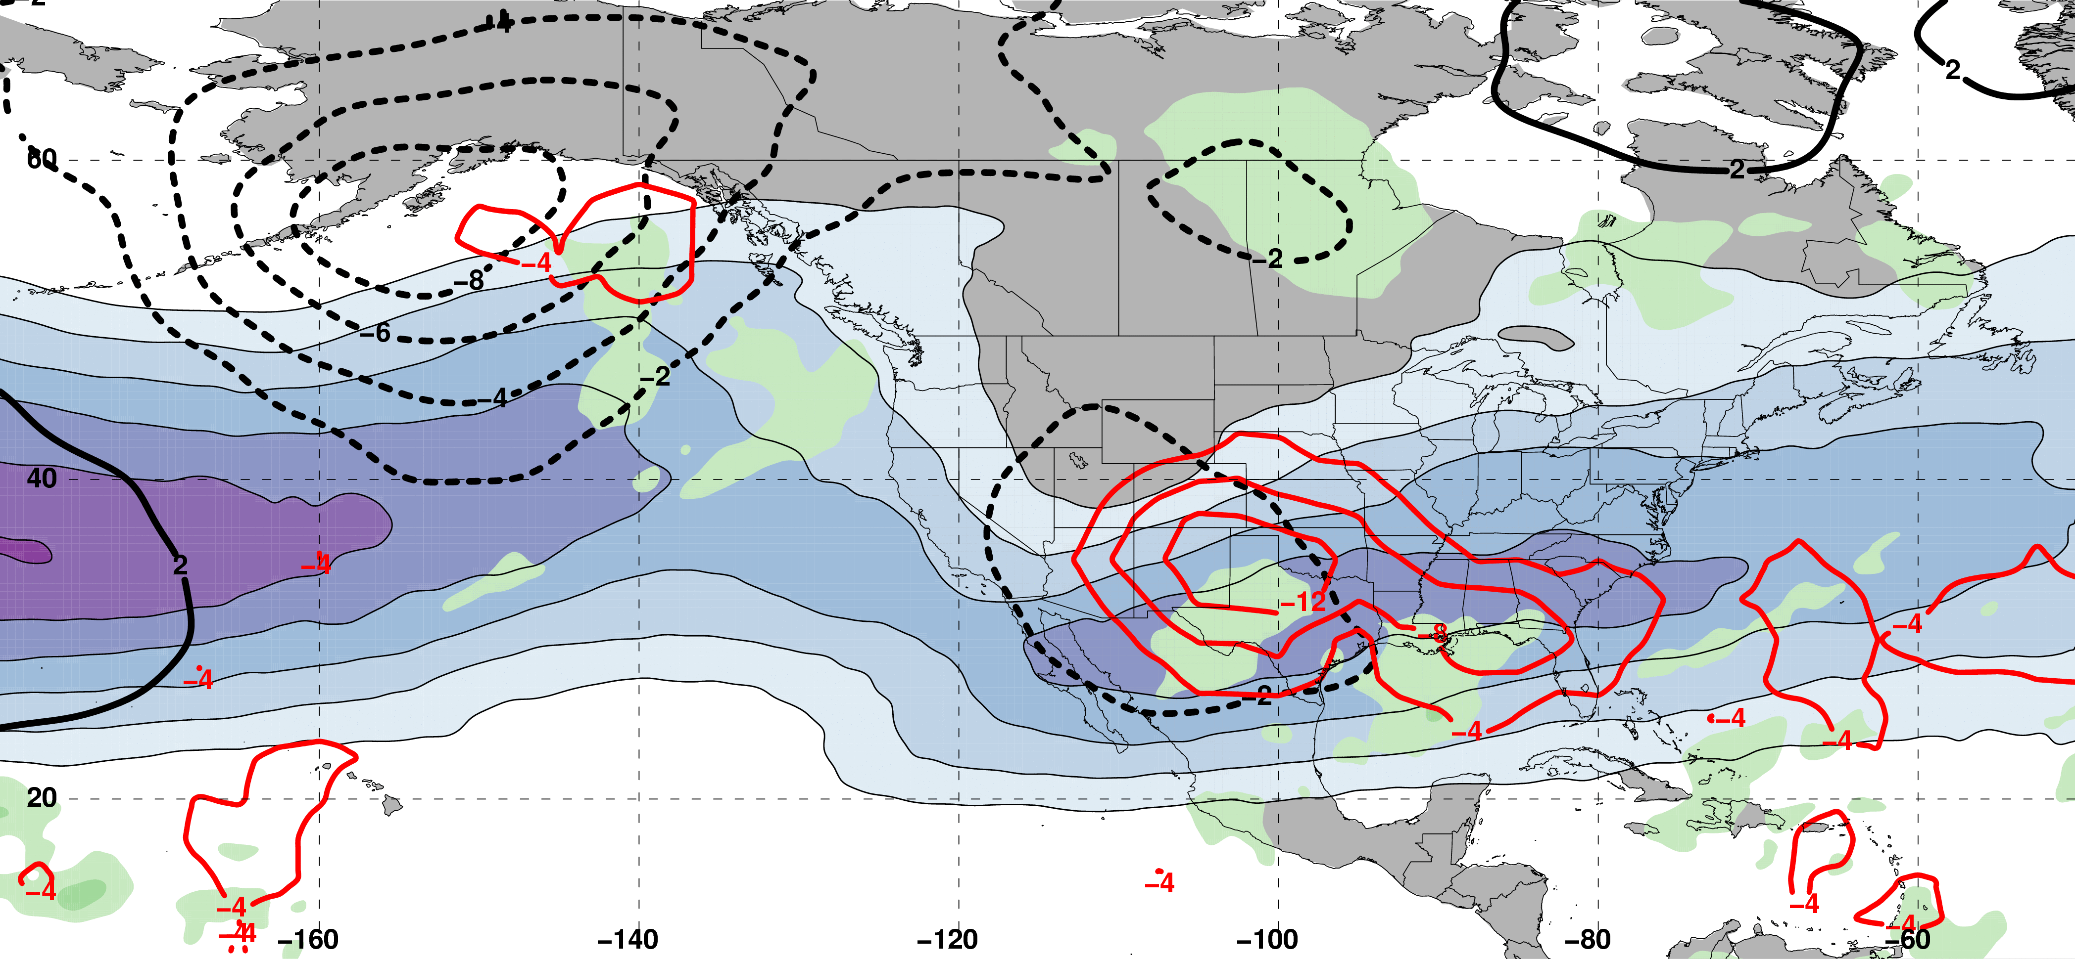
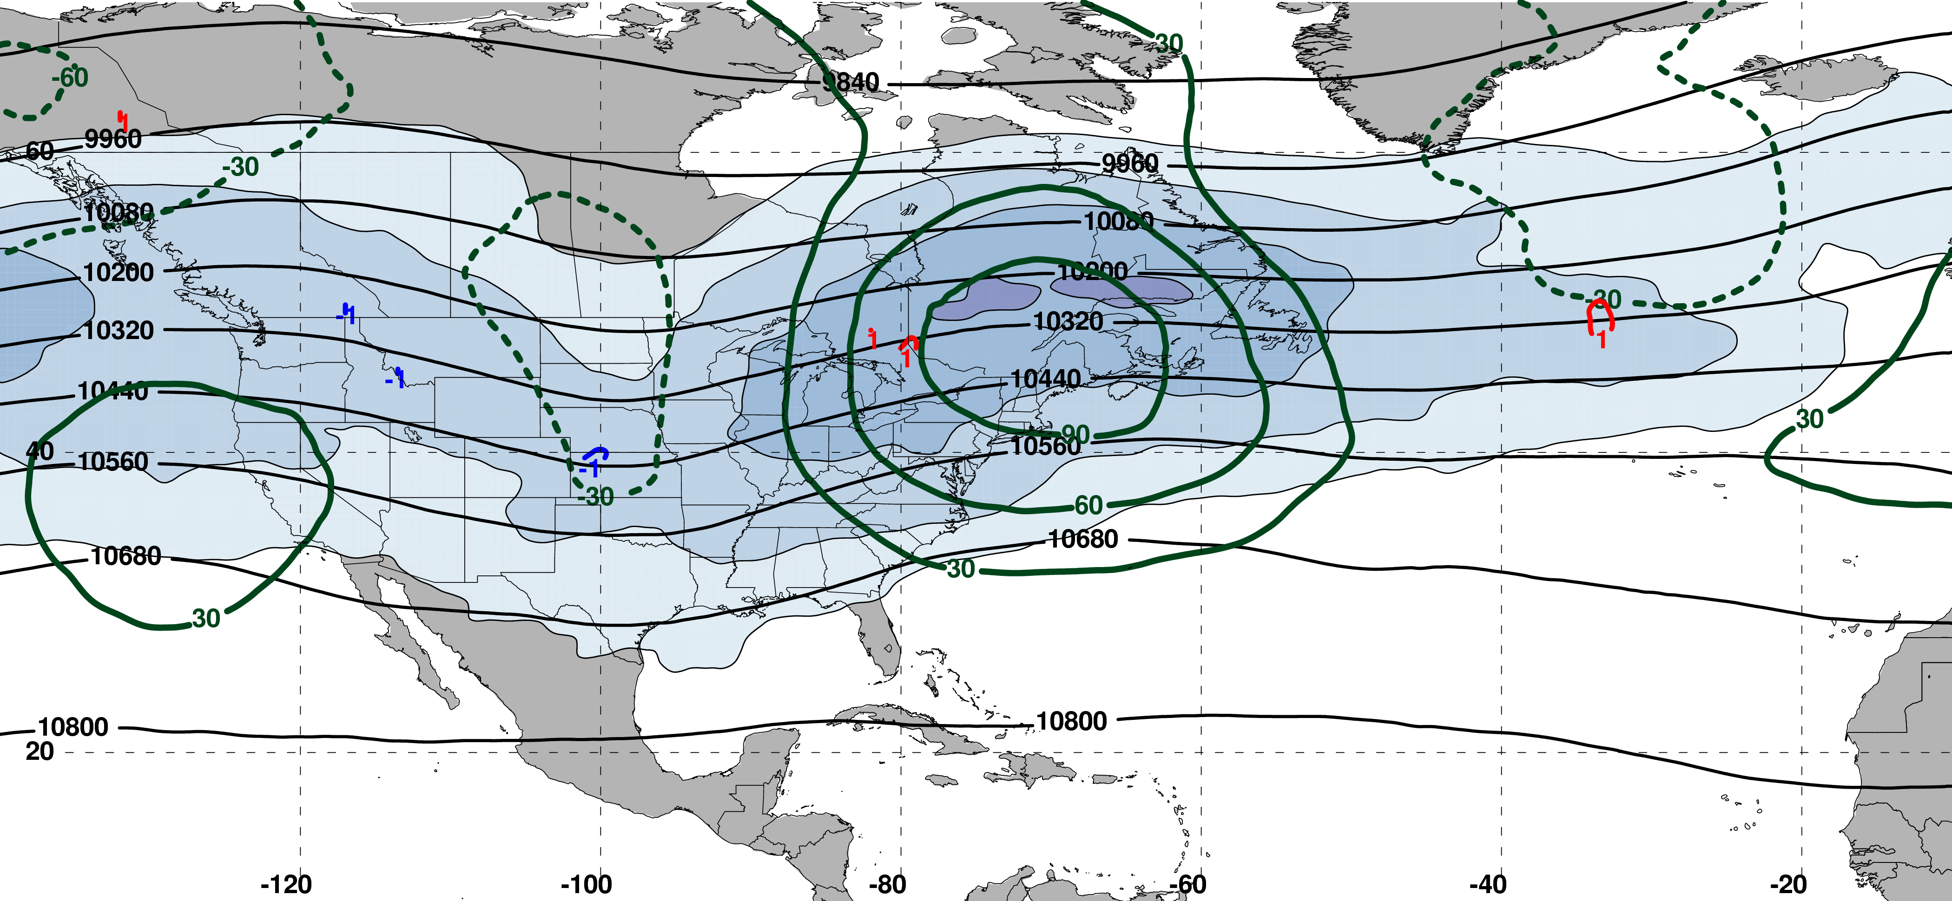
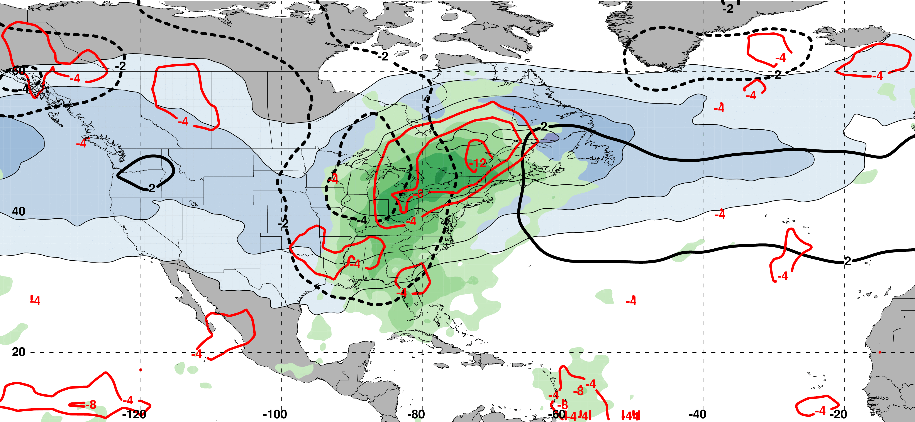
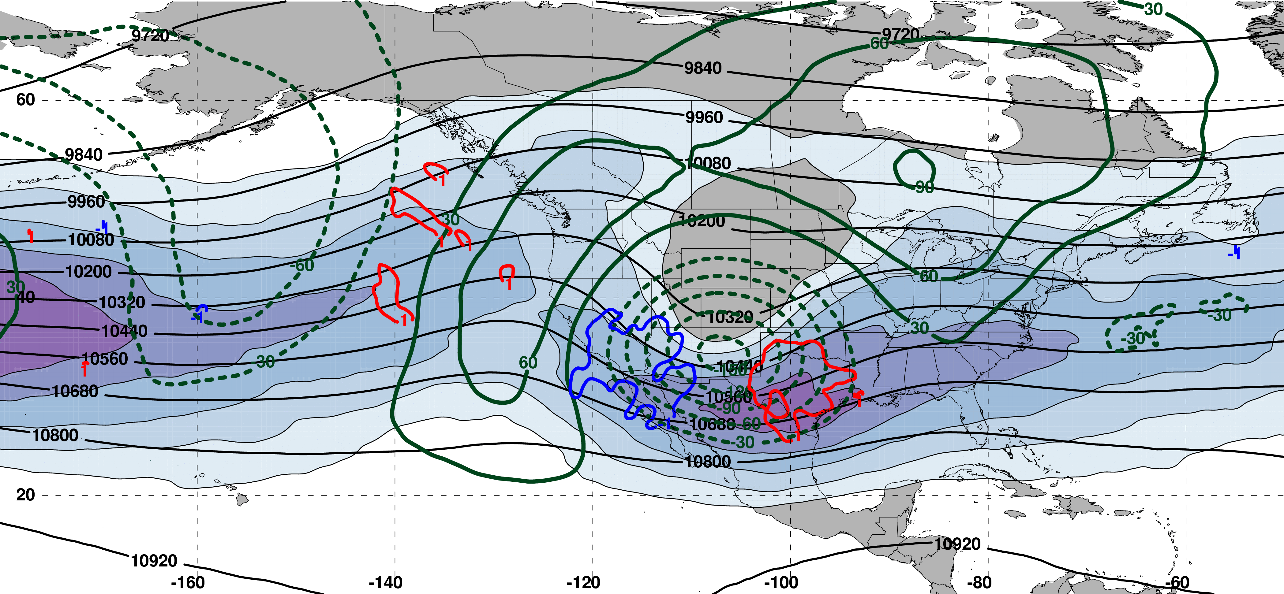
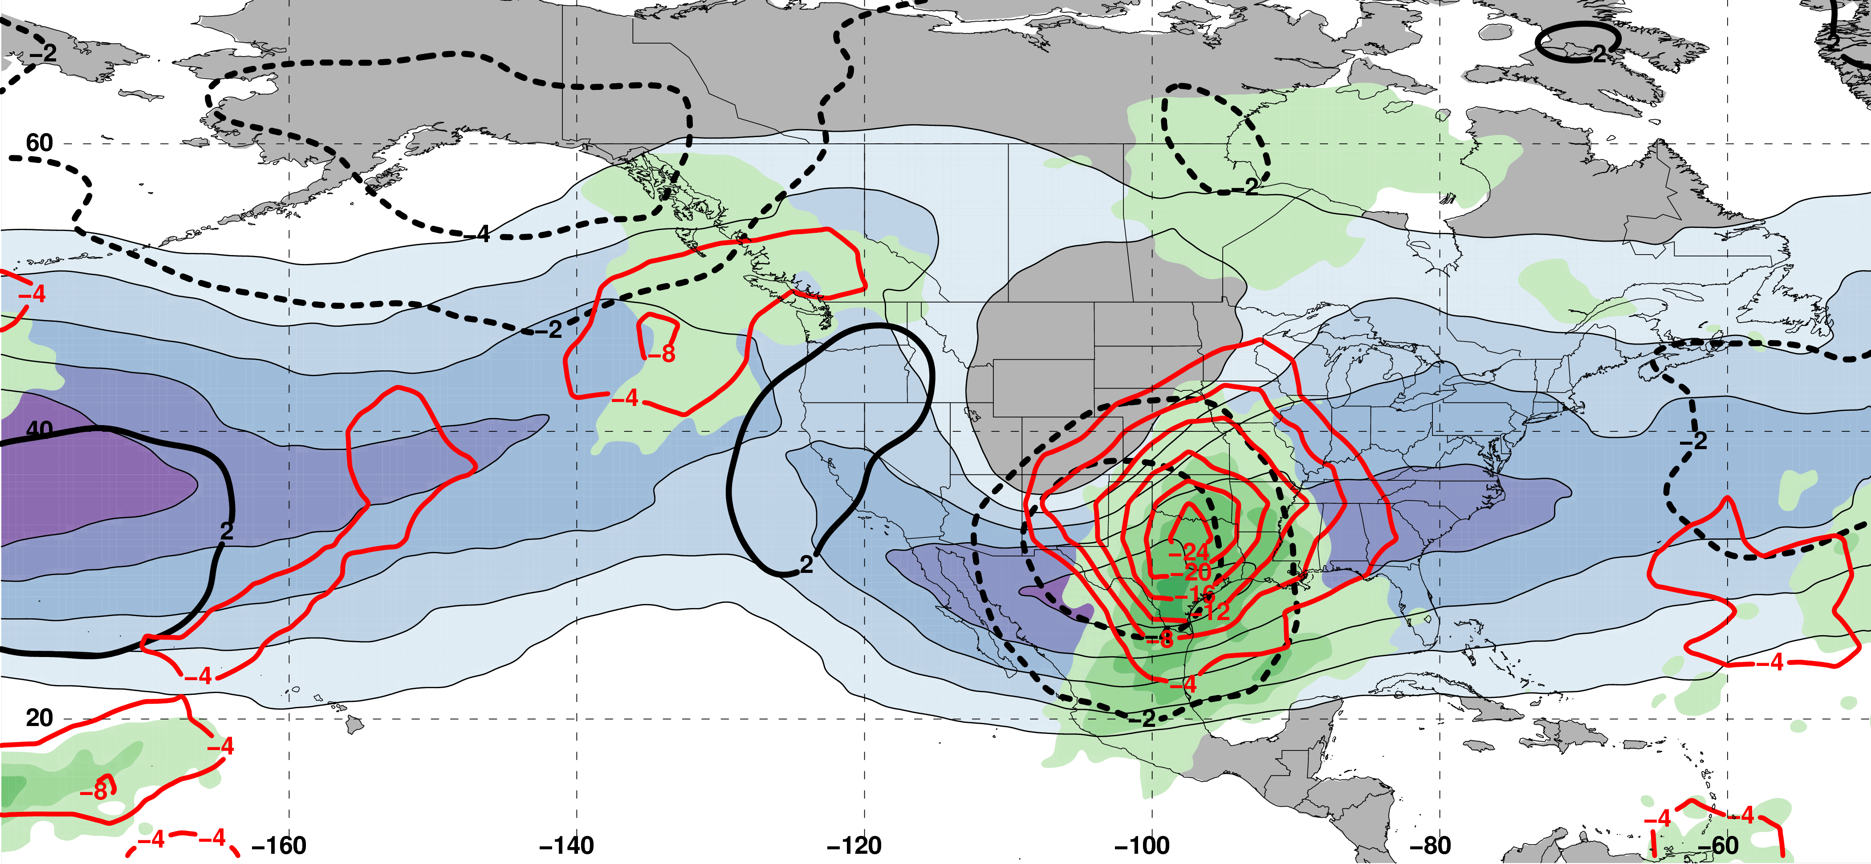
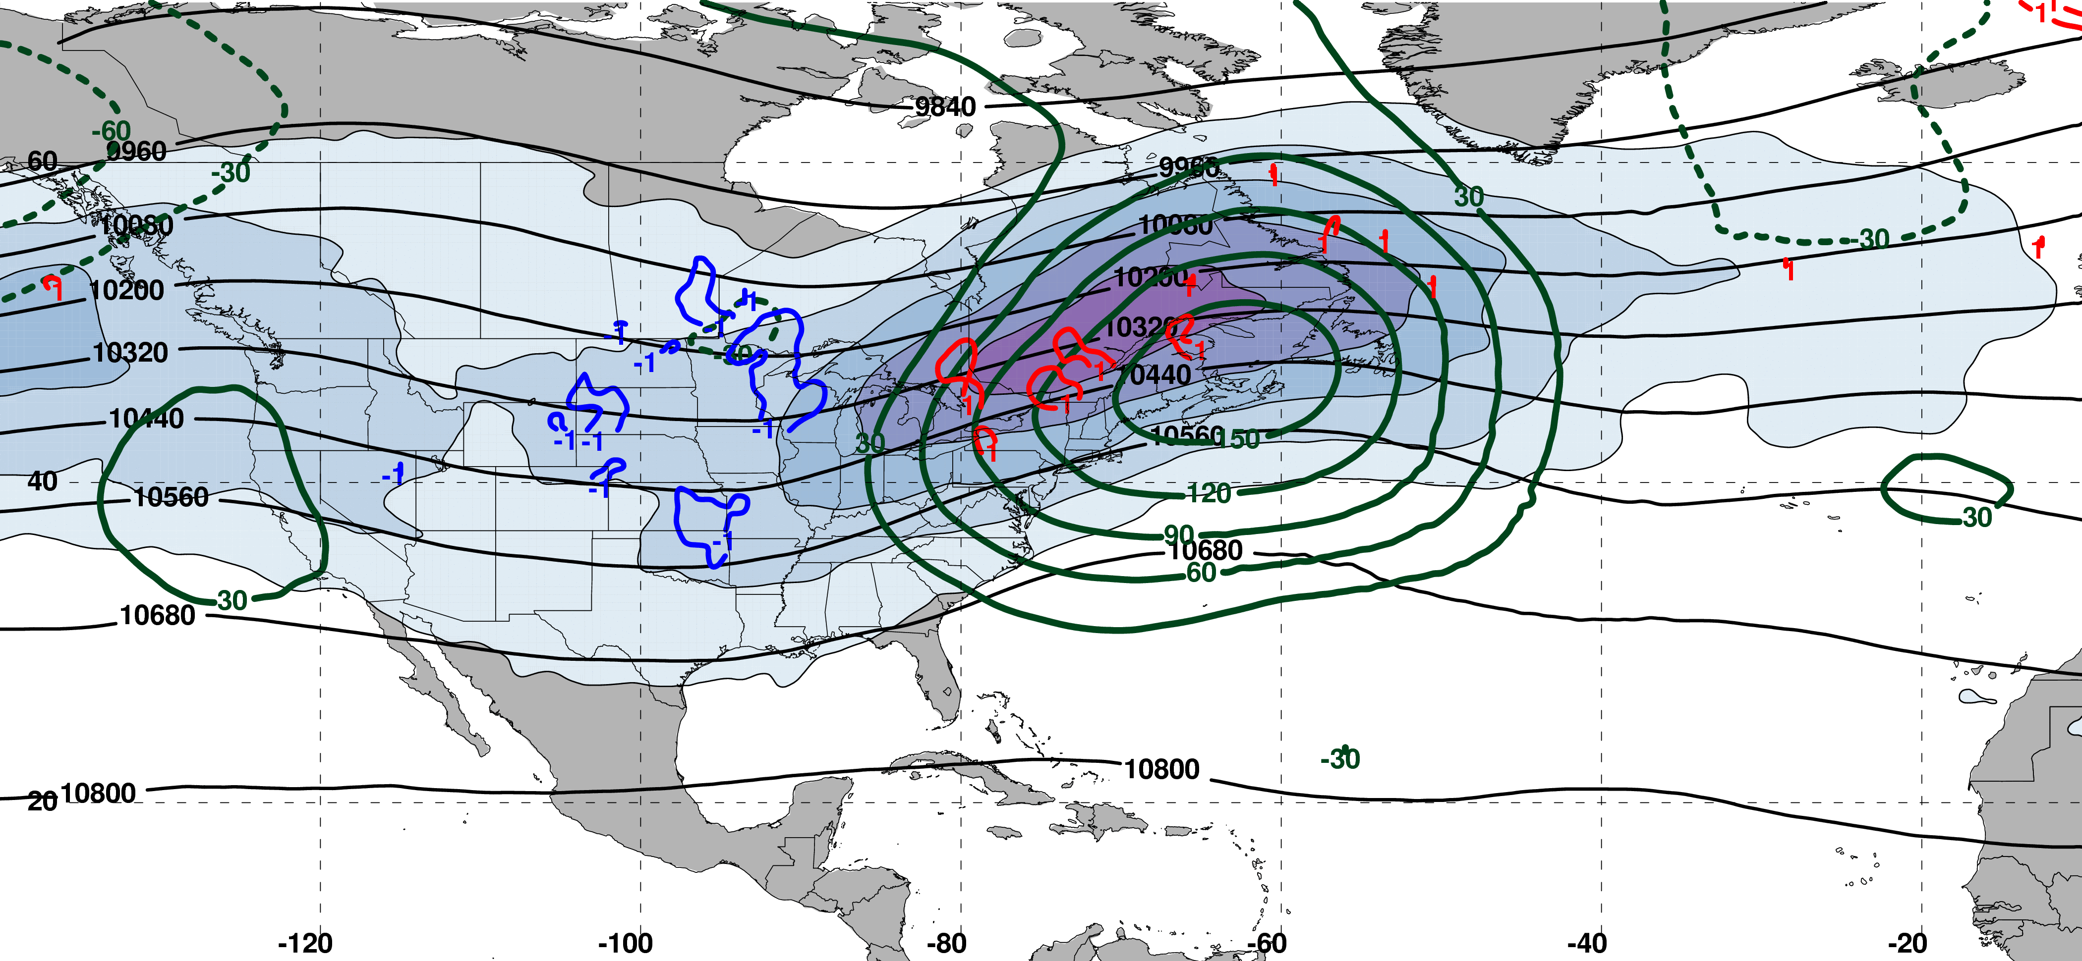
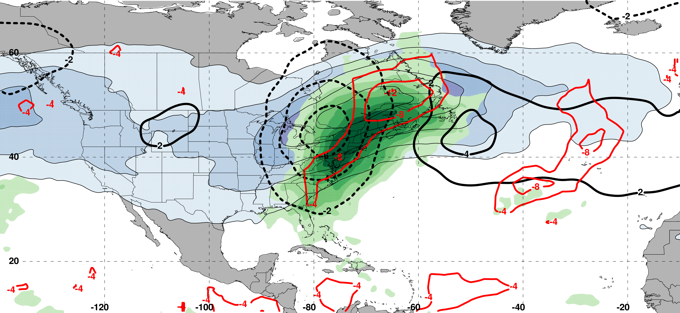
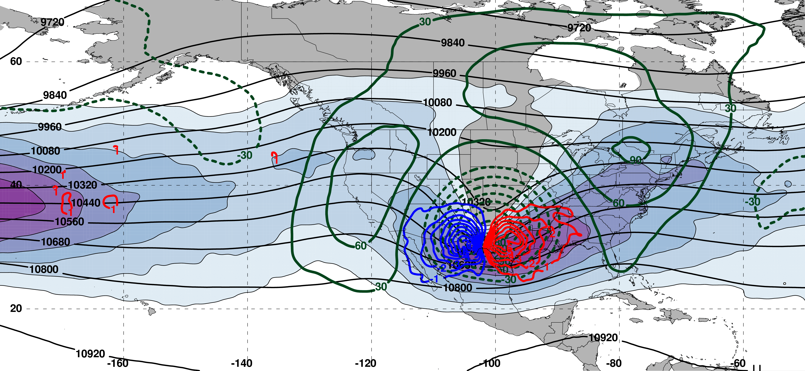
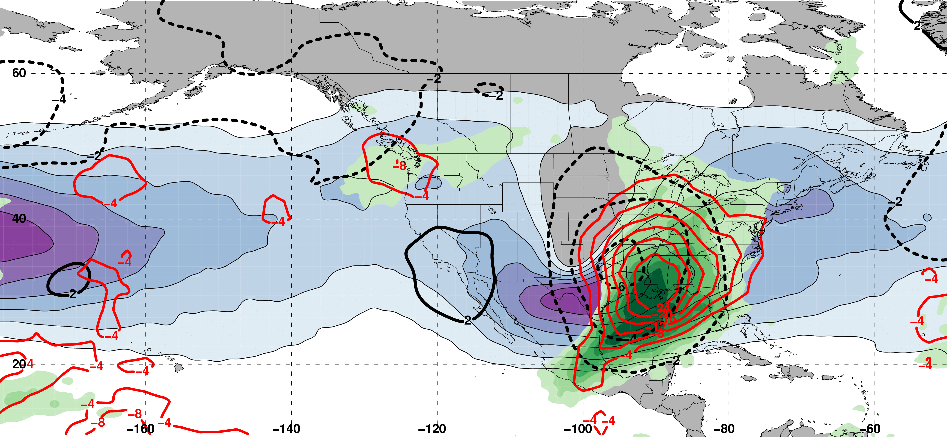
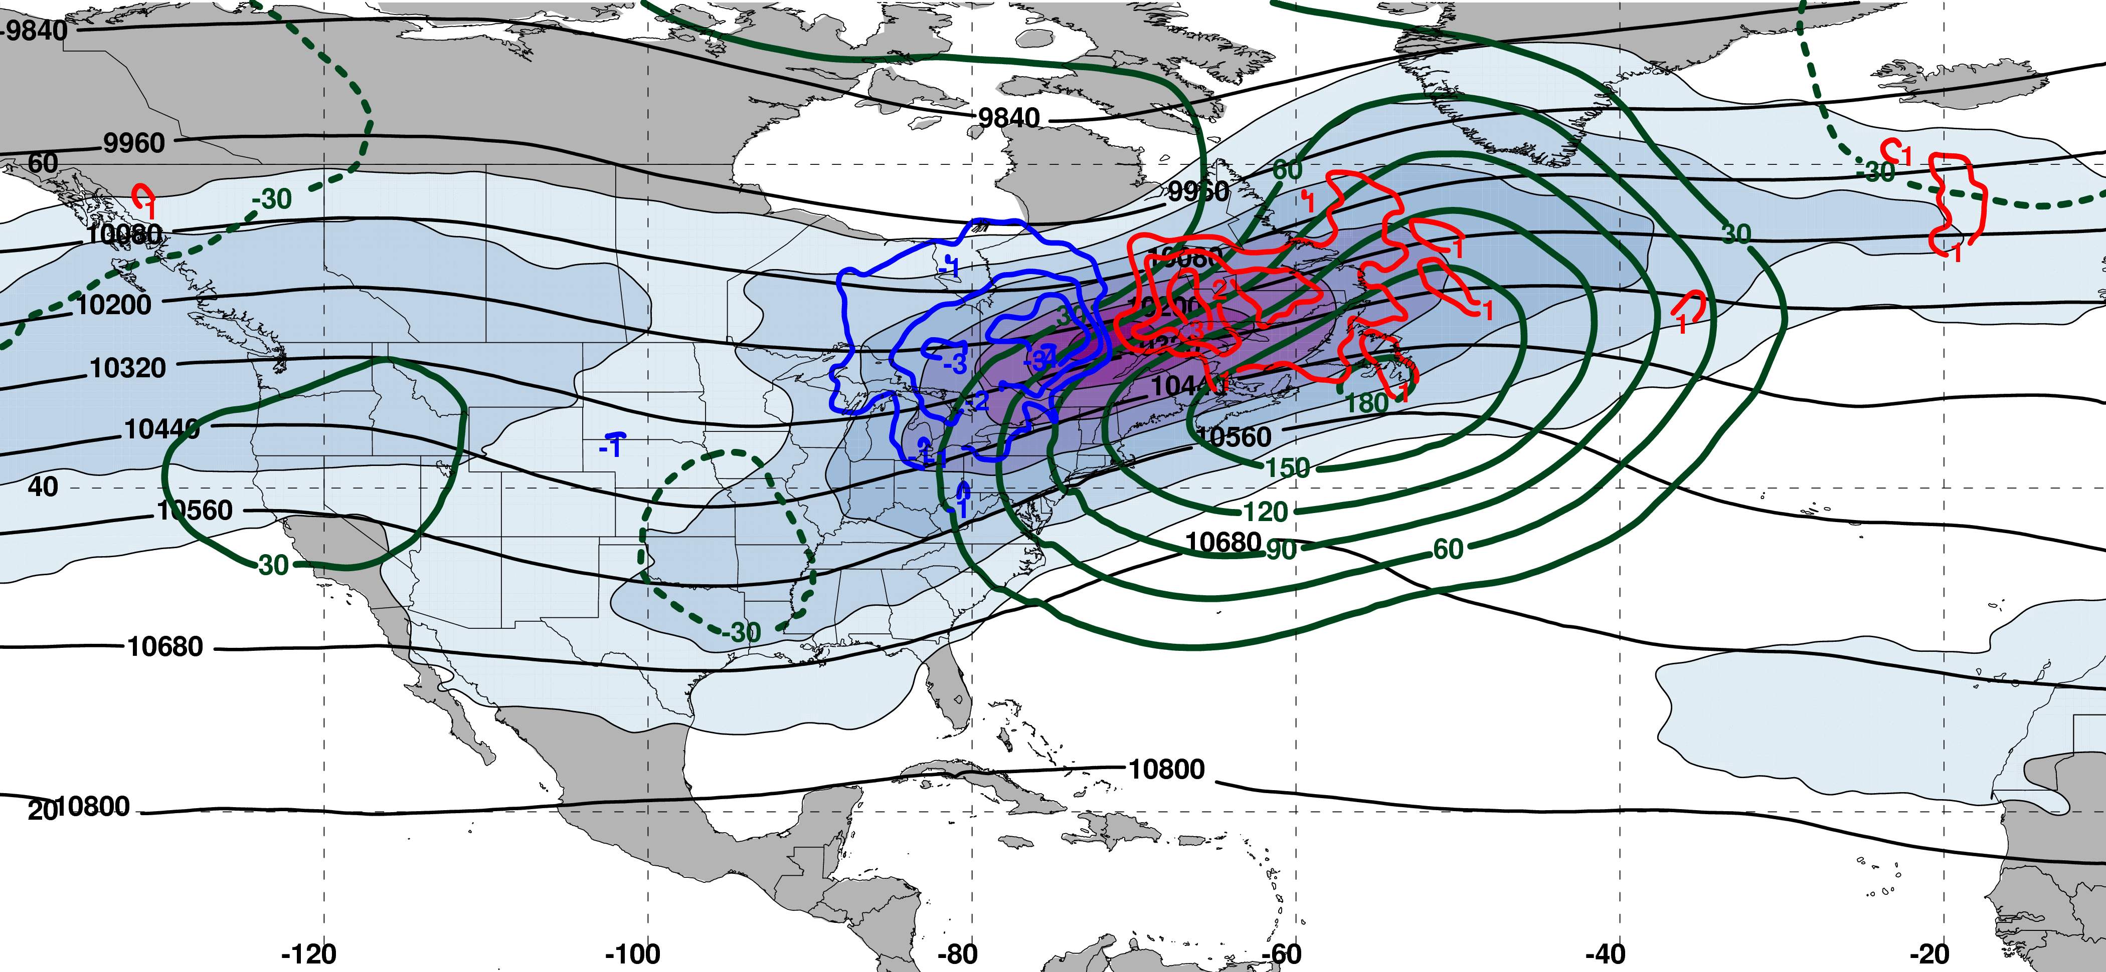
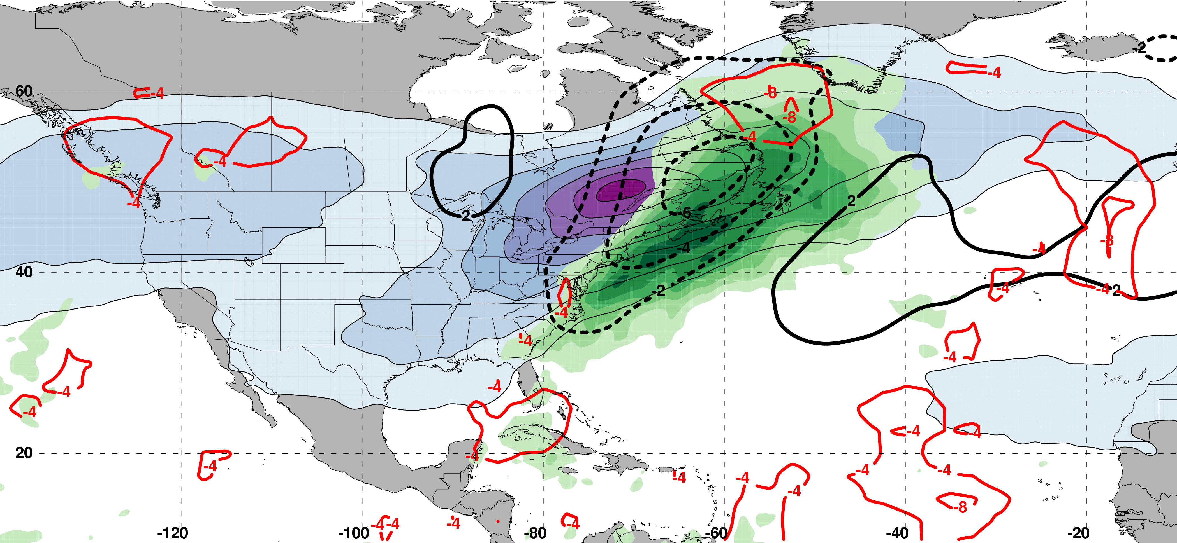
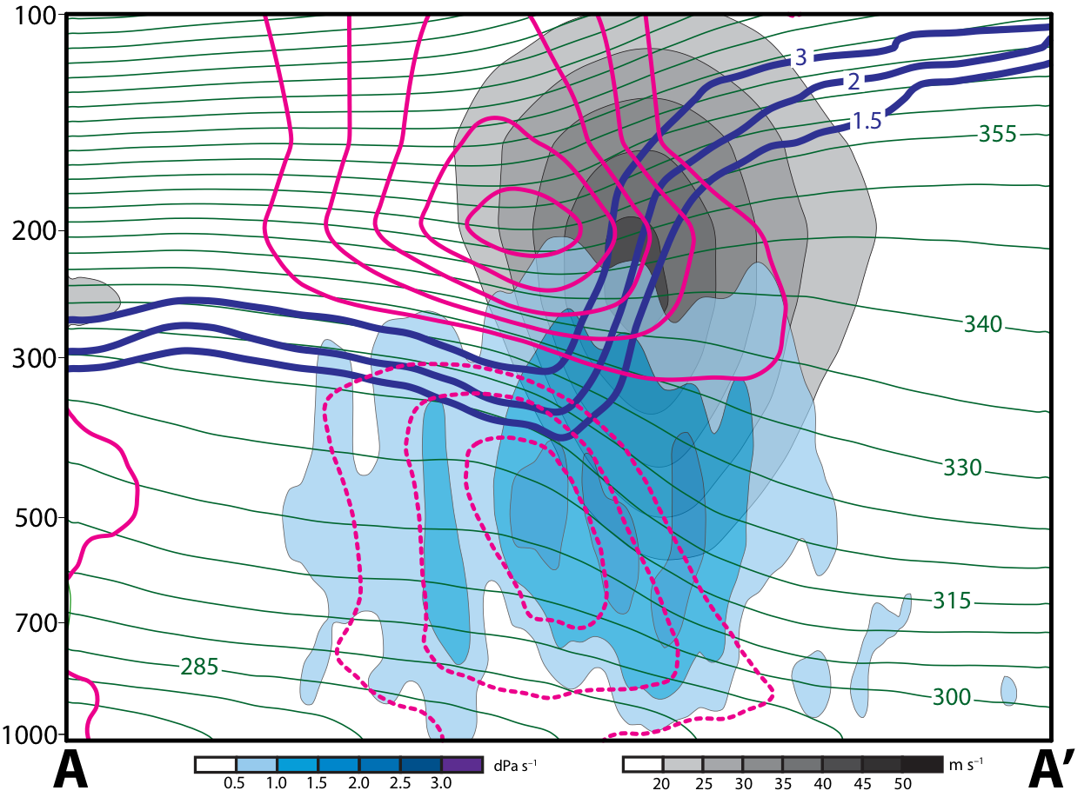
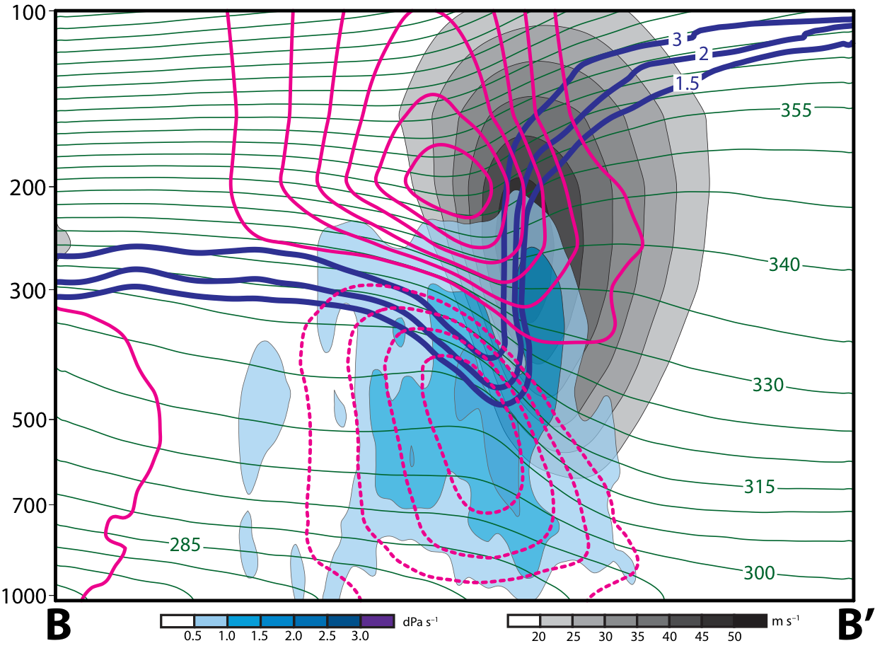
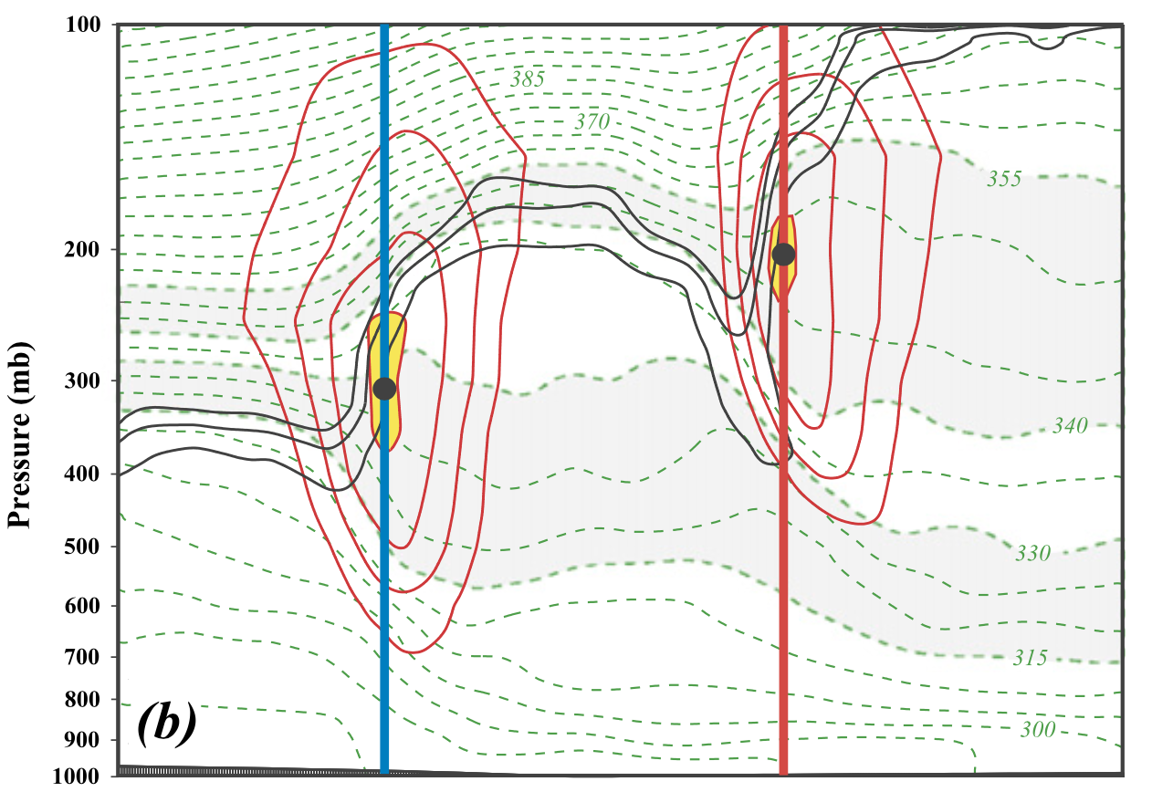
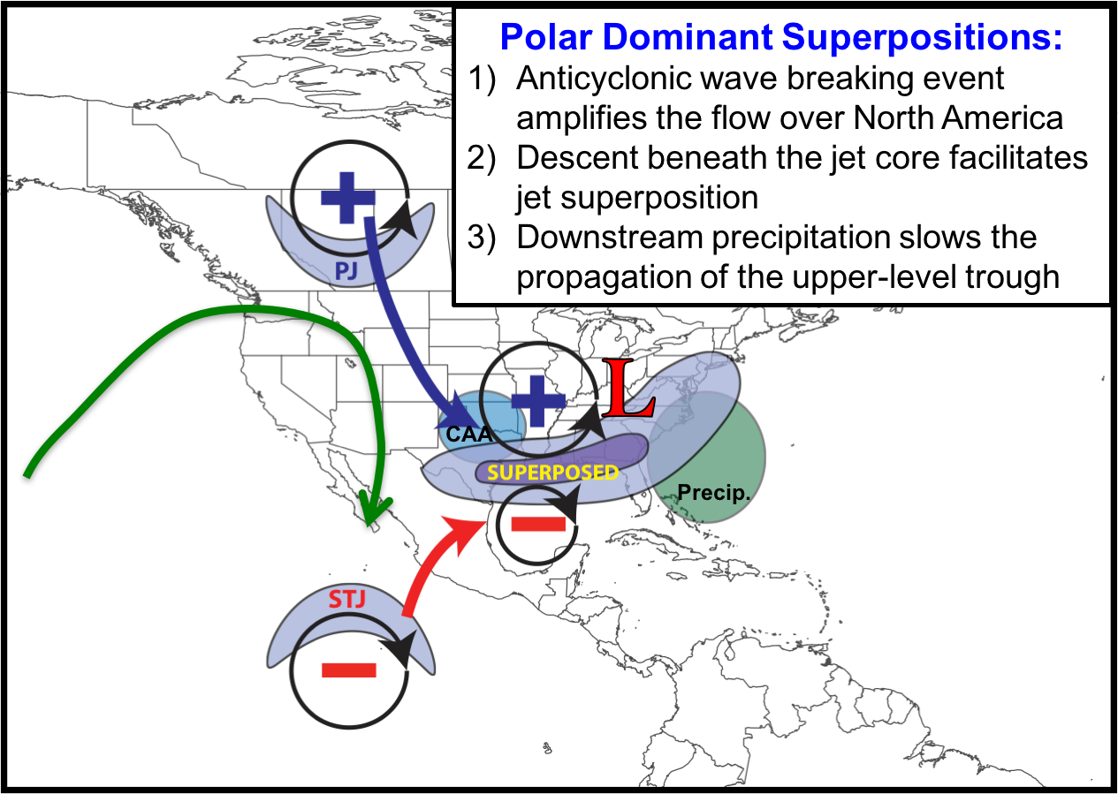
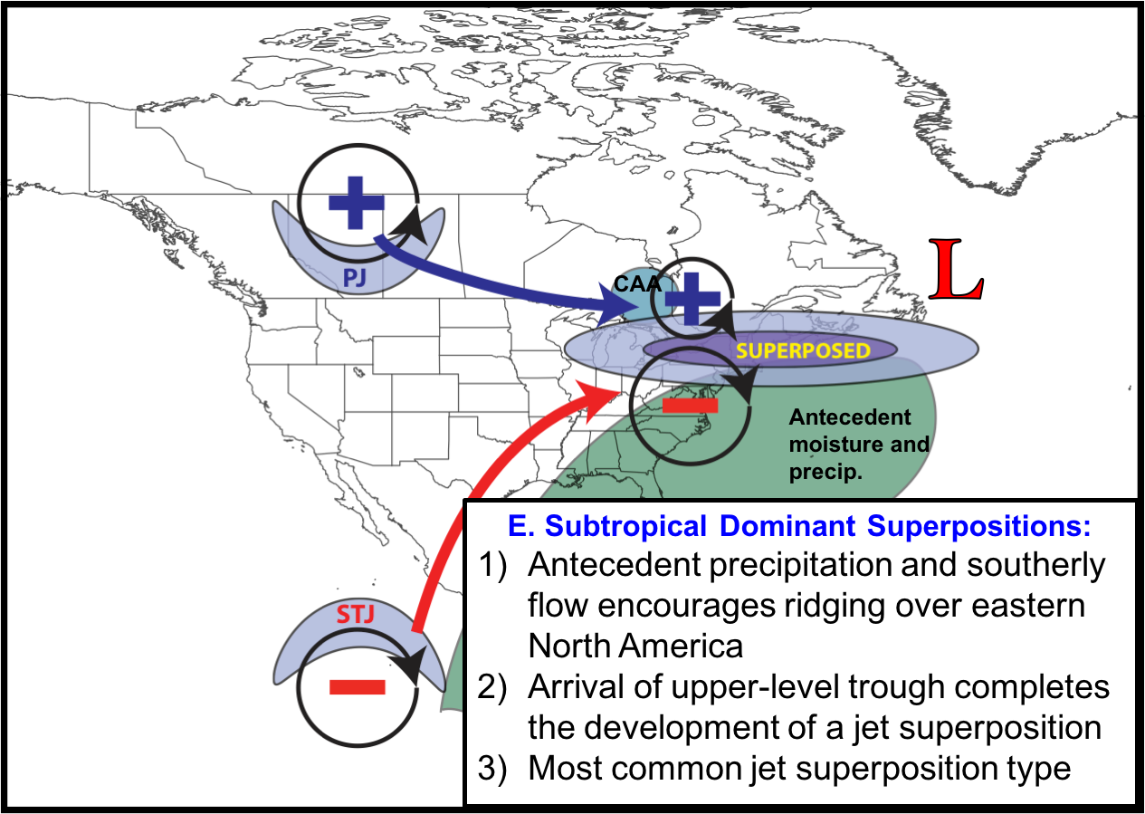
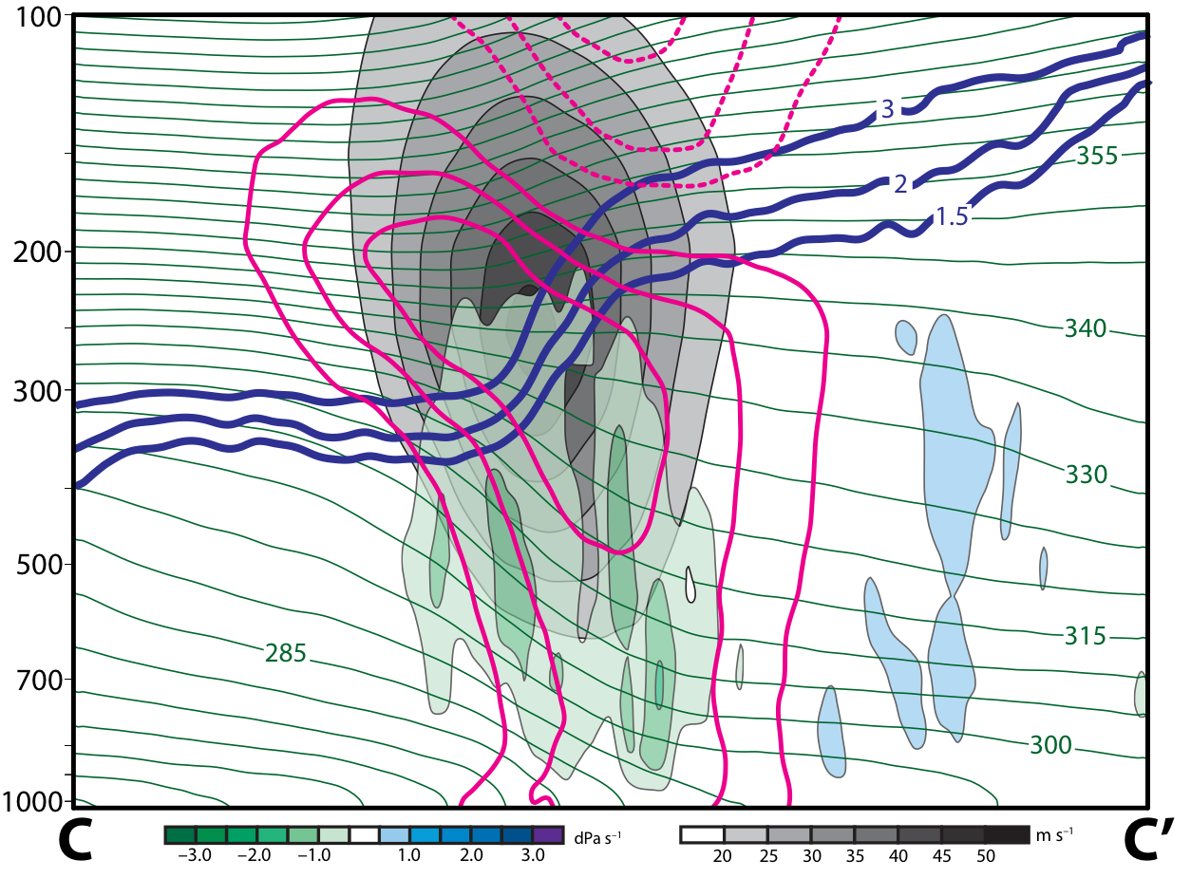
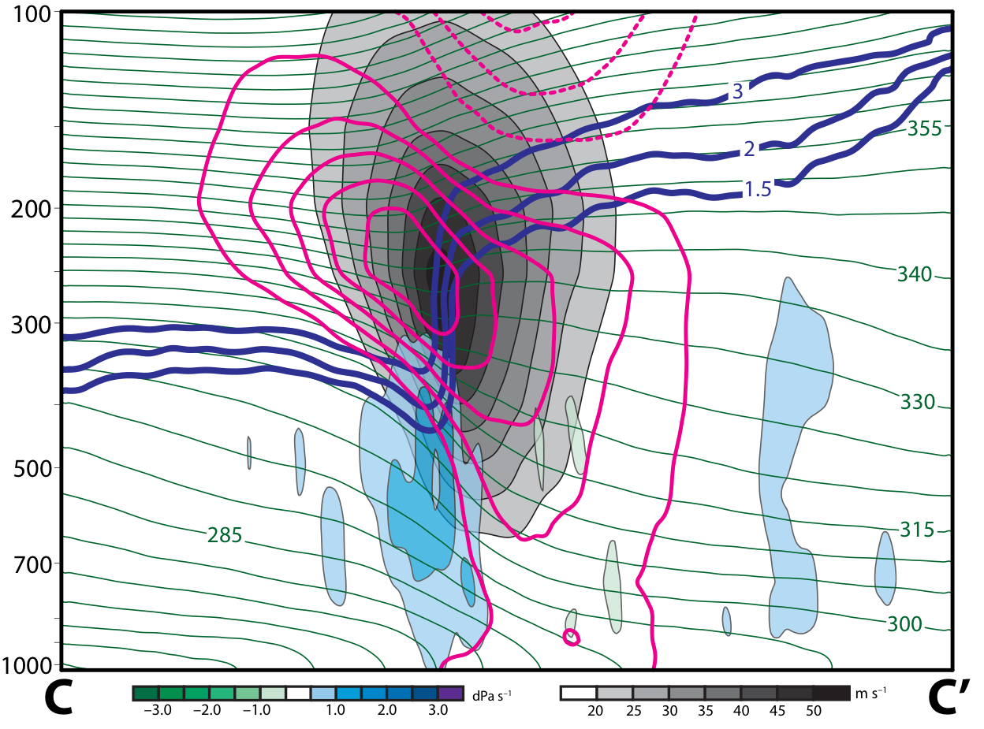
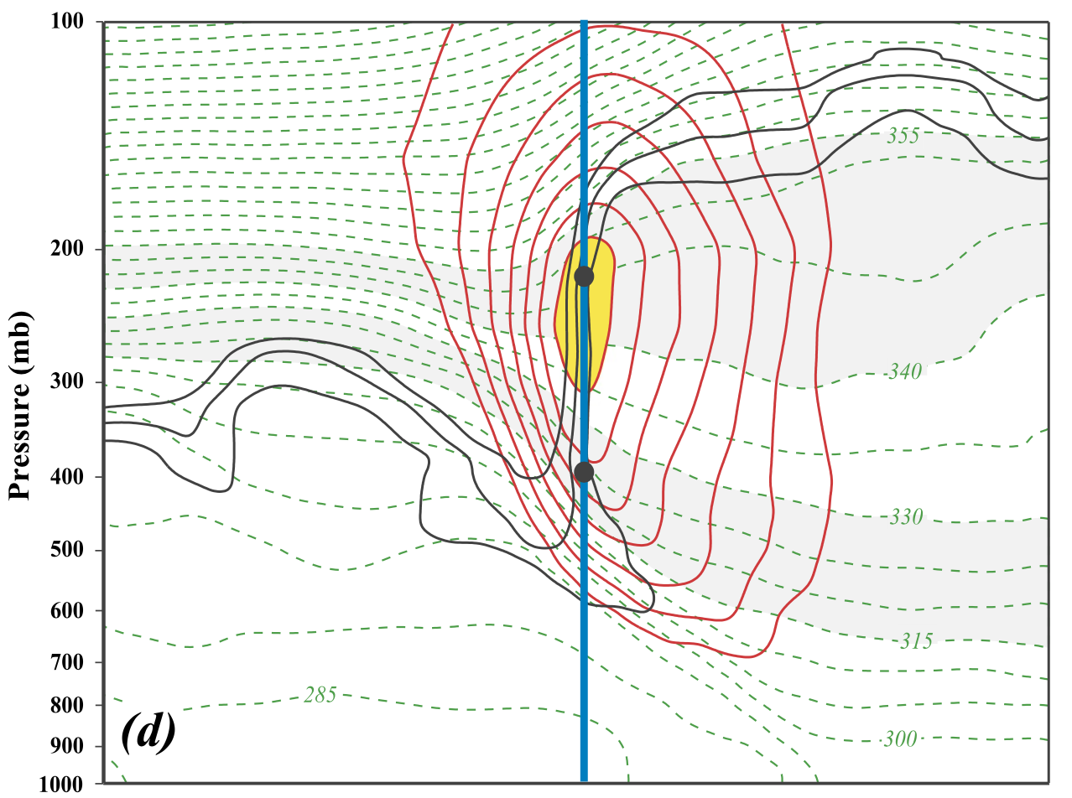
Antecedent Synoptic Environments Most Conducive to North American Polar/Subtropical Jet Superpositions
Andrew C. Winters*, Daniel Keyser*, and Lance F. Bosart*
A43I-2585
*Department of Atmospheric and Environmental Sciences, University at Albany, SUNY
contact: acwinters@albany.edu
This work is funded by an NSF-AGS Postdoctoral Research Fellowship (AGS-1624316)
1. Motivation
3. Jet Superposition Event Types
The position of a jet superposition at the start of an event is compared to the climatological position of the 2-PVU contour on the 320-K and 350-K isentropic surfaces in order to classify events (Figs. 3a,b,c).
Polar dominant events require a substantial deviation of the PJ from its climatological position and occur most frequently along the U.S. Gulf Coast (Fig. 3d).
Subtropical dominant events require a substantial deviation of the STJ from its climatological position and occur most frequently in the Pacific Northwest and Northeast U.S (Fig. 3e).
Hybrid events require a substantial deviation of both the PJ and STJ from their climatological positions and occur most frequently over the Southeast U.S. (Fig. 3f).
Subtropical dominant events are over 1.5 times more frequent than polar dominant events (Fig. 4).
Jet superposition events are most frequent during November and December across all event types (Fig. 4).
The atmosphere often exhibits a three-step pole-to-equator tropopause structure, with each break in the tropopause associated with a jet stream.
The polar jet stream (PJ) typically resides in the break between the polar and subtropical tropopause and is positioned atop the strongly baroclinic, tropospheric-deep polar front around 50°N.
The subtropical jet stream (STJ) resides in the break between the subtropical and the tropical tropopause and is situated on the poleward edge of the Hadley cell around 30°N.
On occasion, the large-scale flow pattern can evolve in such a way to eliminate the latitudinal separation between the PJ and the STJ, resulting in a vertical jet superposition and an environment conducive to high-impact weather (Fig. 1).
Considerable variability characterizes the antecedent environments conducive to jet superpositions, motivating a comprehensive study of the dynamical mechanisms that support jet superposition.
(a)
(b)
(c)
PJ
STJ
(d) N = 80
(e) N = 129
(f) N = 117
Figure 3: (a,b,c) The mean position of the 2-PVU contour on the 320-K and 350-K isentropic surfaces at 0000 UTC 1 January is indicated by the thin blue and red line, respectively, and represent the mean position of the polar and subtropical waveguides. Shaded areas bounding each mean contour indicate locations at which an observation of 2-PVU would be <|0.5σ| anomaly on a particular isentropic surface. Hypothetical deviations of the 2-PVU contour from its mean position on an isentropic surface are indicated by the thick blue or red contours to illustrate the event classification scheme. (d,e,f) Spatial frequency of jet superposition events classified into the event type listed atop a particular column.
West: N = 53
East: N = 76
Figure 4: Monthly count of jet superpositions by event type.
Figure 1: Conceptual model illustrating the development of a North American jet superposition. The blue ‘+’ (red ‘–’) signs indicate cyclonic (anticyclonic) potential vorticity (PV) anomalies, isotachs of the upper-tropospheric wind are shaded purple, an area of convection is shaded green, and the presence of ageostrophic jet tranverse circulations are indicated by the orange arrows (Adapted from Winters and Martin 2017).
(a) –2 d
(b) –2 d
L
4. Jet Superposition Event Composites
(a) –2 d
(b) –2 d
L
Polar Dominant Events
An upstream anticyclonic wave breaking event amplifies the downstream flow pattern over North America prior to jet superposition (Figs. 5a,c,e).
Geostrophic cold air advection upstream of a deep upper-level trough indicates strong forcing for quasi-geostrophic (QG) descent (Fig. 5e).
Collocated OLR and precipitable water anomalies downstream of the upper-level trough suggest that diabatic processes slow the propagation of the upper-level trough (Figs. 5b,d,f).
East Subtropical Dominant Events
Antecedent precipitation and anomalous southerly flow amplify a strong upper-level ridge prior to jet superposition (Figs. 6a–f).
Geostrophic cold air advection upstream of a weak upper-level trough indicates forcing for QG descent beneath the jet core at the time of jet superposition (Fig. 6e).
This descent aids the development of a jet superposition by further steepening the tropopause (Fig. 7d).
L
H
(c) –1 d
(d) –1 d
L
(c) –1 d
(d) –1 d
2. Jet Superposition Event Identification
H
L
L
H
Data:
  0.5º x 0.5º NCEP Climate Forecast System Reanalysis (CFSR; available every 6 h) during 1979–2010.
  2.5º x 2.5º NOAA Interpolated Outgoing Longwave Radiation (OLR) dataset (available every 24 h) during 1979–2010.
(e) 0 d
A
B
(f) 0 d
(e) 0 d
C
(f) 0 d
L
H
L
H
Methodology:
  Isolate CFSR grid points over North America characterized by a jet superposition during Nov–Mar 1979–2010 using the Christenson et al. (2017) scheme (Fig. 2).
  This scheme identifies jets based on the magnitude of both the vertically-integrated wind speed and horizontal PV gradient within predetermined isentropic layers.
  Retain times that rank in the top 10% in terms of the number of grid points characterized by a jet superposition.
  Filter retained analysis times to group together jet superpositions that are < 30 h and < 1500 km apart.
A’
B’
mm
C’
m s^{–1}
m s^{–1}
mm
Figure 5: Similar conventions as Fig. 6 but for polar dominant jet superposition events.
Figure 6: 250-hPa wind speed shaded as indicated in the legend, 250-hPa geopotential height contoured in black, 250-hPa geopotential height anomalies contoured in green with negative values dashed, and 300-hPa geostrophic cold- (warm-) air advection contoured in blue (red) (a) 2 days, (c) 1 day, and (e) 0 days prior to an east subtropical dominant jet superposition event. 250-hPa wind speed shaded as in (a), mean sea-level pressure anomalies contoured in black with negative values dashed, precipitable water anomalies shaded in green, and negative OLR anomalies contoured in red (b) 2 days, (d) 1 day, and (f) 0 days prior to jet superposition.
(a) –12 h
(b) 0 h
Figure 7 (left): Vertical cross sections, as identified in Fig. 5, of wind speed shaded in gray, vertical motion shaded following the legend, potential temperature contoured in green, potential temperature anomalies contoured in magenta with negative values dashed, and 1.5,2, and 3 PVU contoured in blue (a) 12 h (b) 0 h prior to a polar dominant jet superposition event. (c) and (d) As in (a) and (b) but for the vertical cross section indicated in Fig. 6 through a developing east subtropical dominant jet superposition event.
5. Summary
PJ
STJ
(a)
(b)
(c) –12 h
(d) 0 h
(a) 0000 UTC 27 Apr 2010
Figure 8: The frequency that jet superposition events are characterized by 300-hPa geostrophic cold-air advection and mean sea-level pressure, precipitable water, and OLR anomalies exceeding a specified magnitude.
Figure 2: (a) Vertical cross section through a separate PJ and STJ with 1–3 PVU contoured in black, isentropes contoured in green, isotachs contoured in red, jet cores shaded in yellow, and the 315–330- and 340–355-K isentropic layers shaded in gray. The blue (red) line corresponds to a grid column in which the black dot confirms a PJ (STJ) identification. (b) As in (a), but for a jet superposition (Adapted from Christenson et al. 2017).
Descent beneath the jet core acts to steepen the tropopause throughout a polar dominant event (Figs. 7a,b).
The diabatic erosion of upper-tropospheric PV that accompanies ascent directly beneath the jet core acts to steepen the tropopause prior to an east subtropical dominant event (Figs. 7c,d).
The largest precipitable water, OLR, and mean sea-level pressure anomalies coincide with the development of polar dominant events and lead the development of east subtropical dominant events (Fig. 8).
(b) 0000 UTC 24 Oct 2010
Figure 9: Conceptual schematics illustrating the development of (a) polar and (b) east subtropical dominant jet superposition events.

