Slide 1
The Development of the North Pacific Jet Phase Diagram at NCEP-WPC as an Objective Tool to Characterize the Upper-Tropospheric Flow Pattern
Andrew C. Winters, Lance F. Bosart, and Daniel Keyser
Department of Atmospheric and Environmental Sciences
University at Albany, State University of New York, Albany, NY 12222
8th Conference on Transition of Research to Operations
Austin, TX
11 January 2018
This work is supported by NOAA Grant NA15NWS4680006

Slide 2
Project Motivation
The antecedent environments associated with continental U.S. extreme temperature events are characterized by considerable North Pacific Jet (NPJ) variability during the medium-range forecast period
This NPJ variability motivated the development of the NPJ phase diagram as an objective tool to characterize the instantaneous state of the upper-tropospheric flow pattern over the North Pacific

Slide 3
Project Motivation
The antecedent environments associated with continental U.S. extreme temperature events are characterized by considerable North Pacific Jet (NPJ) variability during the medium-range forecast period
This NPJ variability motivated the development of the NPJ phase diagram as an objective tool to characterize the instantaneous state of the upper-tropospheric flow pattern over the North Pacific
This presentation explores the potential of the NPJ phase diagram to increase confidence in operational probabilistic temperature forecasts during the medium-range period

Slide 4
The Development of the
NPJ Phase Diagram

Slide 5
The NPJ Phase Diagram
Removed the mean and the annual and diurnal cycles from 6-hourly, 250-hPa zonal wind data from the CFSR (1979–2014) (Saha et al. 2014)
Restricted data to the cool season (Sept.–May)
Performed an EOF analysis on the zonal wind anomalies within the domain: 10–80°N , 100°E–120°W
Analysis techniques and resultant EOF patterns are consistent with related work on the NPJ:
Athanasiadis et al. (2010)
Jaffe et al. (2011)
Griffin and Martin (2017)

Slide 6
The NPJ Phase Diagram
EOF 1 – Jet Extension/Retraction
Sept.–May mean 250-hPa zonal wind: black contours
Sept.–May 250-hPa zonal wind EOF 1 pattern: shading
+ EOF 1: Jet Extension
– EOF 1: Jet Retraction

Slide 7
The NPJ Phase Diagram
EOF 1 – Jet Extension/Retraction
Hypothetical Zonal Wind
Sept.–May mean 250-hPa zonal wind: black contours
Sept.–May 250-hPa zonal wind EOF 1 pattern: shading
+ EOF 1: Jet Extension
– EOF 1: Jet Retraction
Notes:
The outermost green contour is 20 m/s and contour interval for green contours is every 10 m/s. The green contours are calculated by adding the EOF patterns to the mean zonal wind. The resultant wind distribution would project onto the point (1,0) on the N. Pacific Jet phase diagram.

Slide 8
The NPJ Phase Diagram
EOF 1 – Jet Extension/Retraction
Hypothetical Zonal Wind
Sept.–May mean 250-hPa zonal wind: black contours
Sept.–May 250-hPa zonal wind EOF 1 pattern: shading
+ EOF 1: Jet Extension
– EOF 1: Jet Retraction
Notes:
The distribution of zonal wind in this slide would project onto the point (-1,0) on the N. Pacific Jet phase diagram.

Slide 9
The NPJ Phase Diagram
EOF 2 – Poleward/Equatorward Shift
Sept.–May mean 250-hPa zonal wind: black contours
Sept.–May 250-hPa zonal wind EOF 2 pattern: shading
+ EOF 2: Poleward Shift
– EOF 2: Equatorward Shift

Slide 10
The NPJ Phase Diagram
EOF 2 – Poleward/Equatorward Shift
Hypothetical Zonal Wind
Sept.–May mean 250-hPa zonal wind: black contours
Sept.–May 250-hPa zonal wind EOF 2 pattern: shading
+ EOF 2: Poleward Shift
– EOF 2: Equatorward Shift
Notes:
The zonal wind pattern in green would project onto the point (0,1) on the N. Pacific Jet phase diagram.

Slide 11
The NPJ Phase Diagram
EOF 2 – Poleward/Equatorward Shift
Hypothetical Zonal Wind
Sept.–May mean 250-hPa zonal wind: black contours
Sept.–May 250-hPa zonal wind EOF 2 pattern: shading
+ EOF 2: Poleward Shift
– EOF 2: Equatorward Shift
Notes:
The zonal wind pattern in green would project onto the point (0,-1) on the N. Pacific Jet phase diagram.

Slide 12
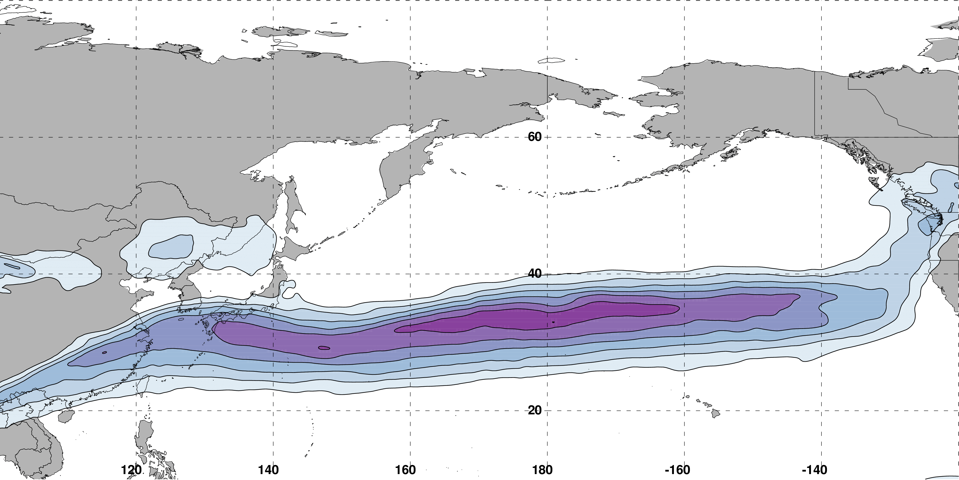
The NPJ Phase Diagram
0000 UTC 16 February 2017
250-hPa wind speed: shaded
m s^{–1}
Instantaneous 250-hPa zonal wind anomalies can be projected onto EOF 1 and EOF 2, resulting in a point on an NPJ phase diagram

Slide 13
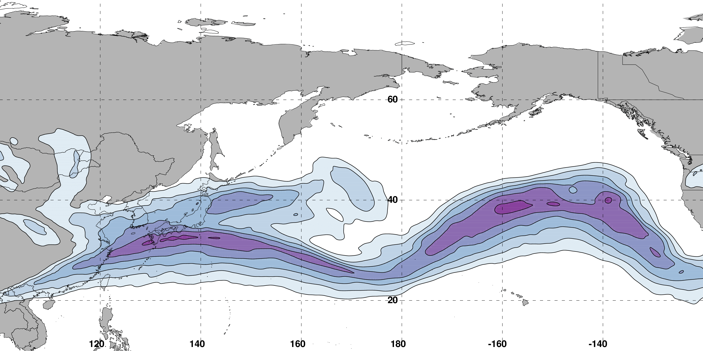
The NPJ Phase Diagram
0000 UTC 18 February 2017
250-hPa wind speed: shaded
m s^{–1}
Analyzed 250-hPa zonal wind anomalies can be projected onto EOF1 and EOF2 to describe the evolution of the NPJ
Notes:
Show forecast evolution for a period

Slide 14
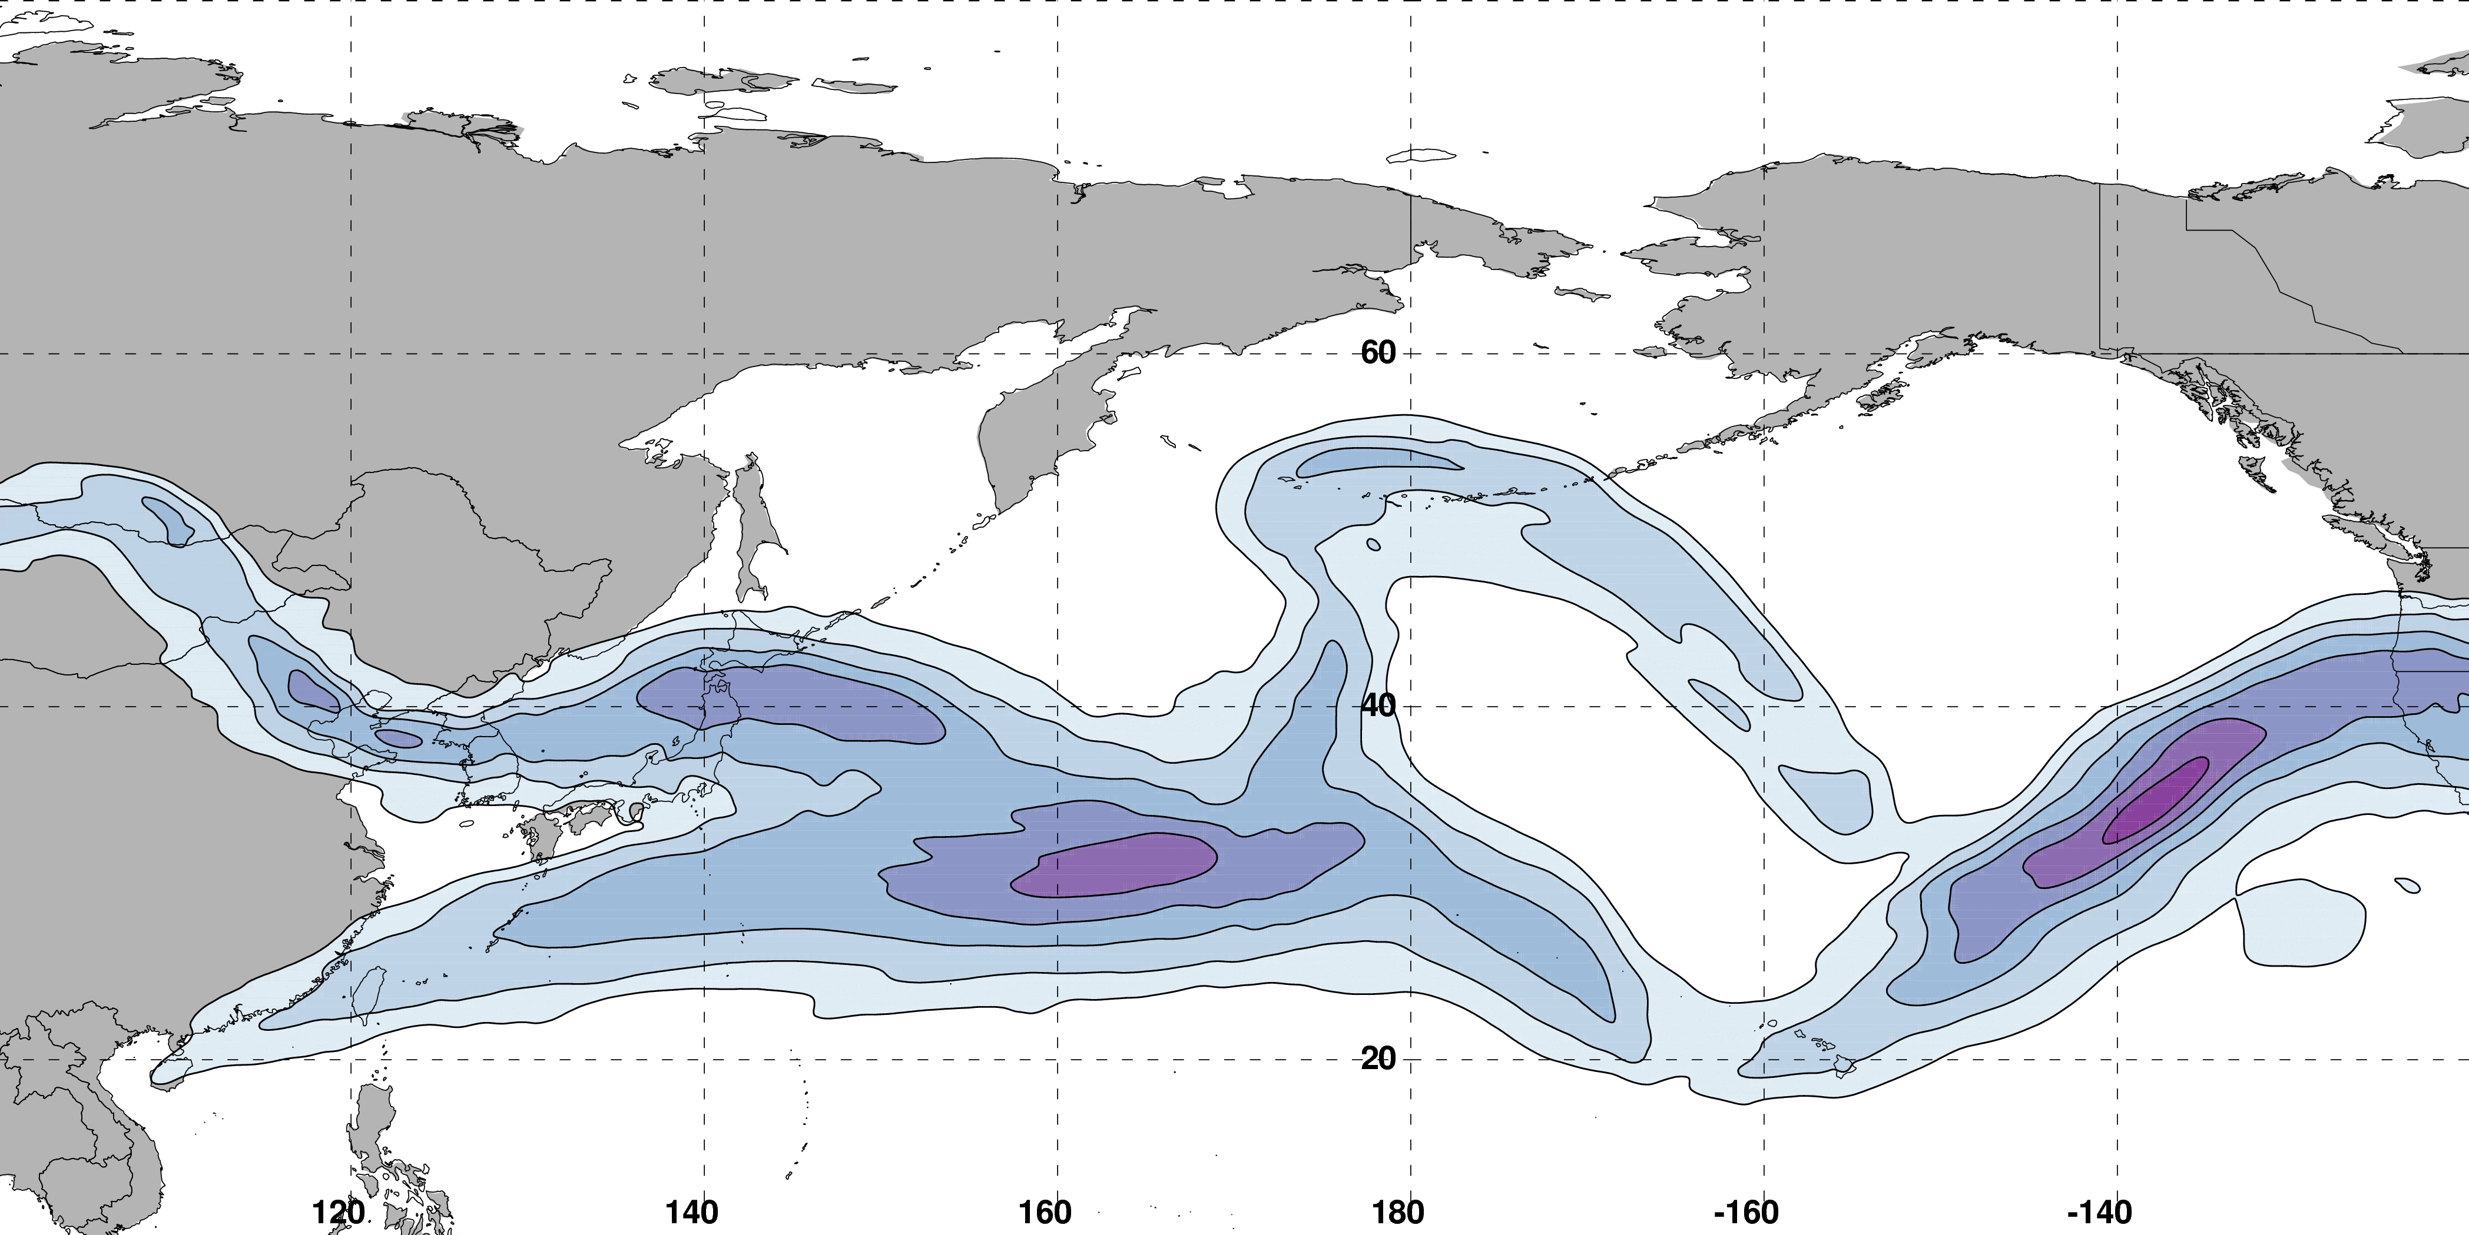
The NPJ Phase Diagram
0000 UTC 20 February 2017
250-hPa wind speed: shaded
m s^{–1}
Analyzed 250-hPa zonal wind anomalies can be projected onto EOF1 and EOF2 to describe the evolution of the NPJ
Notes:
Show forecast evolution for a period

Slide 15
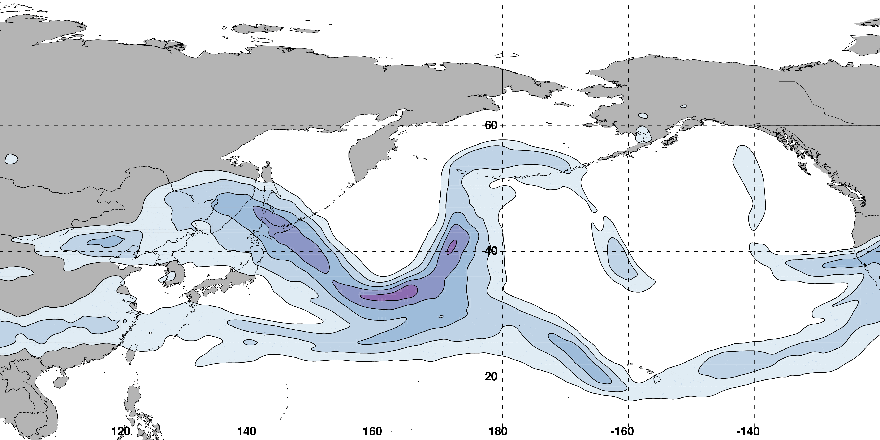
The NPJ Phase Diagram
0000 UTC 22 February 2017
250-hPa wind speed: shaded
m s^{–1}
Analyzed 250-hPa zonal wind anomalies can be projected onto EOF1 and EOF2 to describe the evolution of the NPJ
Notes:
Show forecast evolution for a period

Slide 16
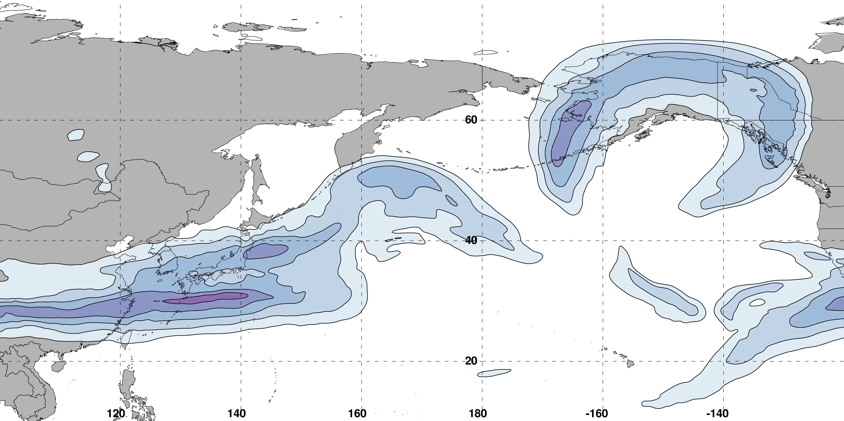
The NPJ Phase Diagram
0000 UTC 24 February 2017
250-hPa wind speed: shaded
m s^{–1}
Analyzed 250-hPa zonal wind anomalies can be projected onto EOF1 and EOF2 to describe the evolution of the NPJ
Notes:
Show forecast evolution for a period

Slide 17
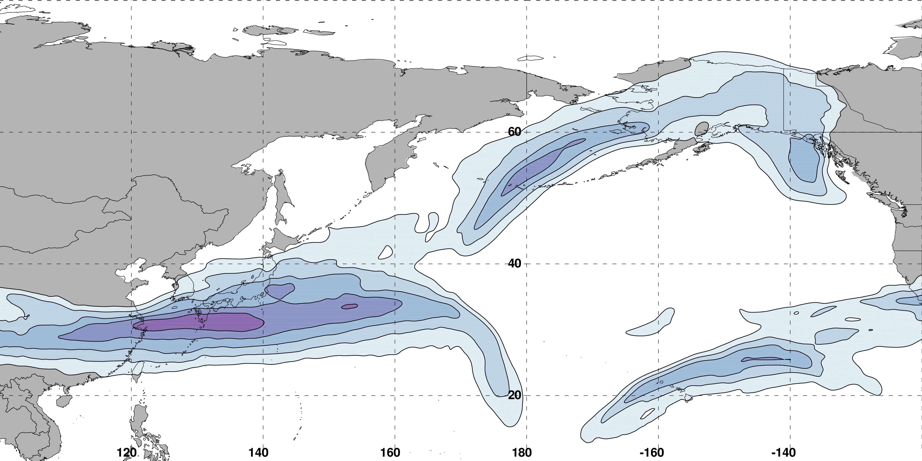
The NPJ Phase Diagram
0000 UTC 26 February 2017
250-hPa wind speed: shaded
m s^{–1}
Analyzed 250-hPa zonal wind anomalies can be projected onto EOF1 and EOF2 to describe the evolution of the NPJ

Slide 18
Influence of the Prevailing NPJ Regime on North America

Slide 19
250-hPa Wind Speed (shading), Geo. Heights (contours), Geo. Height Anom. (contours):
Jet Extension D+4
N = 159
m s^{–1}
99% Conf. Interval
MSLP Anom. (contours), 850-hPa Temp. Anom. (shading):
L
K

Slide 20
250-hPa Wind Speed (shading), Geo. Heights (contours), Geo. Height Anom. (contours):
Jet Retraction D+4
N = 162
m s^{–1}
99% Conf. Interval
MSLP Anom. (contours), 850-hPa Temp. Anom. (shading):
H
K

Slide 21
250-hPa Wind Speed (shading), Geo. Heights (contours), Geo. Height Anom. (contours):
Poleward Shift D+4
N = 189
m s^{–1}
99% Conf. Interval
MSLP Anom. (contours), 850-hPa Temp. Anom. (shading):
L
H
K

Slide 22
250-hPa Wind Speed (shading), Geo. Heights (contours), Geo. Height Anom. (contours):
Equator. Shift D+4
N = 149
m s^{–1}
99% Conf. Interval
MSLP Anom. (contours), 850-hPa Temp. Anom. (shading):
H
L
K

Slide 23
GEFS Forecast Skill in the Context of the NPJ Phase Diagram

Slide 24
NPJ Phase Diagram Forecast Skill
Determined the position within the NPJ phase diagram for all 0-h forecasts during Sept.–May 1985–2014 in the GEFS Reforecast v2 (Hamill et al. 2013)

Slide 25
GEFS Ensemble Mean Error by NPJ Regime
GEFS Reforecasts verifying during a particular NPJ regime
Circles on a particular line indicate statistically significant differences at the 99% confidence level with respect to another NPJ regime
Notes:
Additional slide with the takeaways from these two slides.

Slide 26
GEFS Ensemble Mean Error by NPJ Regime
GEFS Reforecasts verifying during a particular NPJ regime
Circles on a particular line indicate statistically significant differences at the 99% confidence level with respect to another NPJ regime
Forecasts verifying during equatorward shifts and jet retractions exhibit significantly larger errors than jet extensions and poleward shifts in the 96–216-h forecast period
Notes:
Additional slide with the takeaways from these two slides.

Slide 27
Best/Worst NPJ Phase Diagram Forecasts
Comparison between the periods characterized by the best/worst medium-range forecasts
Criteria: Forecasts must rank in the top/bottom 10% in terms of both:
The average GEFS ensemble mean error for the Day 8 and 9 forecasts
The average GEFS ensemble member error for the Day 8 and 9 forecasts
Notes:
Switch metric order to agree with subsequent slides

Slide 28
Best/Worst NPJ Phase Diagram Forecasts
Comparison between the periods characterized by the best/worst medium-range forecasts
The best forecasts occur disproportionately more during jet extensions and poleward shifts
The worst forecasts occur disproportionately more during jet retractions and equatorward shifts
Best (N=475)
Worst (N=763)
Frequency (%)
Notes:
Switch best/worst ratio magnitude

Slide 29
Best/Worst NPJ Phase Diagram Forecasts
Comparison between the periods characterized by the best/worst medium-range forecasts
 | Avg. ΔPC1 | Avg. ΔPC2 | Avg. 10-d Traj. Length.
Best Forecasts (N=475) | 0.09 | 0.16 | 3.50 PC units
Worst Forecasts (N=763) | 0.01 | –0.21 | 4.33 PC units
Statistically significant at the 99.9% confidence interval
Poleward
Shift
Equatorward
Shift
The best forecast periods are typically characterized by poleward shifts over the next 10 days and anomalously short trajectories within the NPJ phase diagram
The worst forecast periods are typically characterized by equatorward shifts over the next 10 days and anomalously long trajectories within the NPJ phase diagram
Notes:
Add the interpretation and links

Slide 30
Best/Worst NPJ Phase Diagram Forecasts
Comparison between the periods characterized by the best/worst medium-range forecasts
Best (N=475)
Worst (N=763)
What are the synoptic flow patterns associated with the best and worst forecasts initialized during a particular NPJ regime?
Frequency (%)
Notes:
Switch best/worst ratio magnitude

Slide 31
Best/Worst NPJ Phase Diagram Forecasts
Comparison between the periods characterized by the best/worst medium-range forecasts
Best (N=475)
Worst (N=763)
What are the synoptic flow patterns associated with the best and worst forecasts initialized during a particular NPJ regime?
Frequency (%)
Notes:
Switch best/worst ratio magnitude

Slide 32
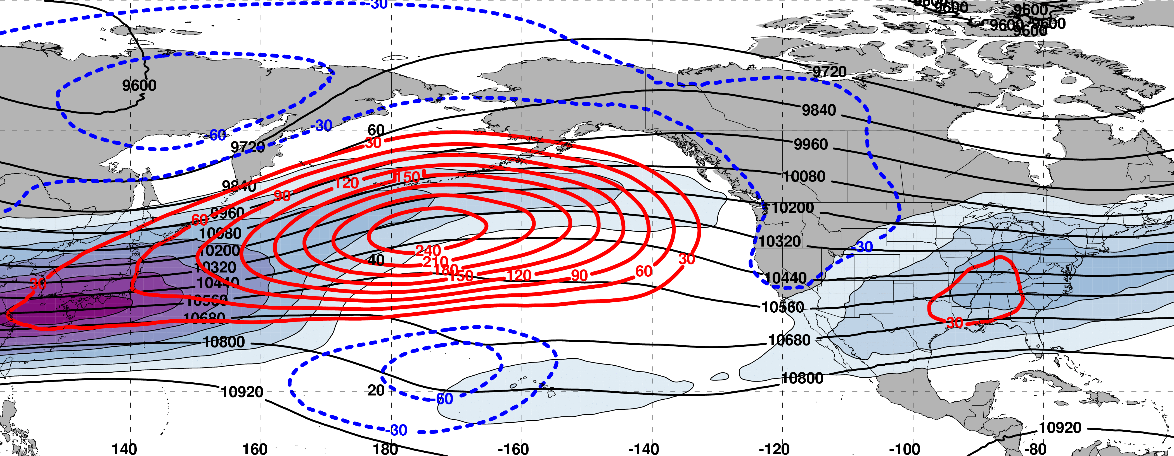
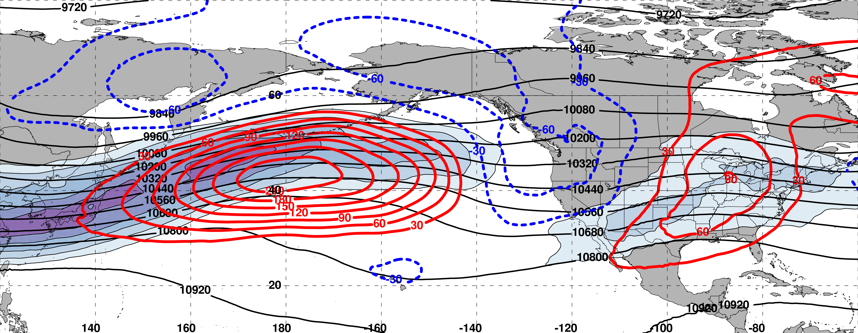
Initialization of a Worst Forecast during Jet Retraction (N=145)
250 hPa
m s^{–1}
Initialization of a Best Forecast during Jet Retraction (N=63)
250 hPa
m s^{–1}

Slide 33
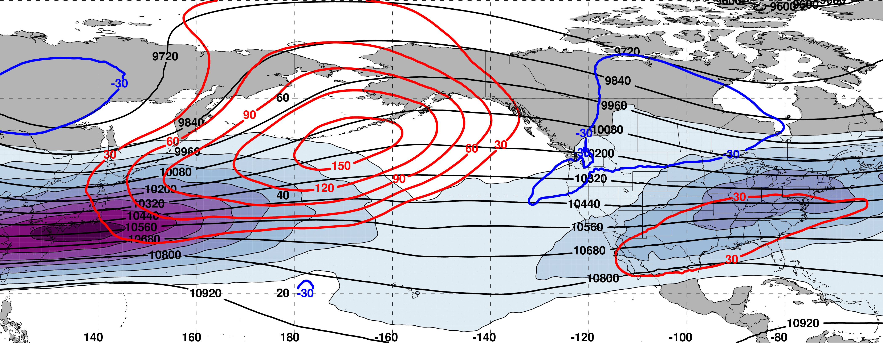
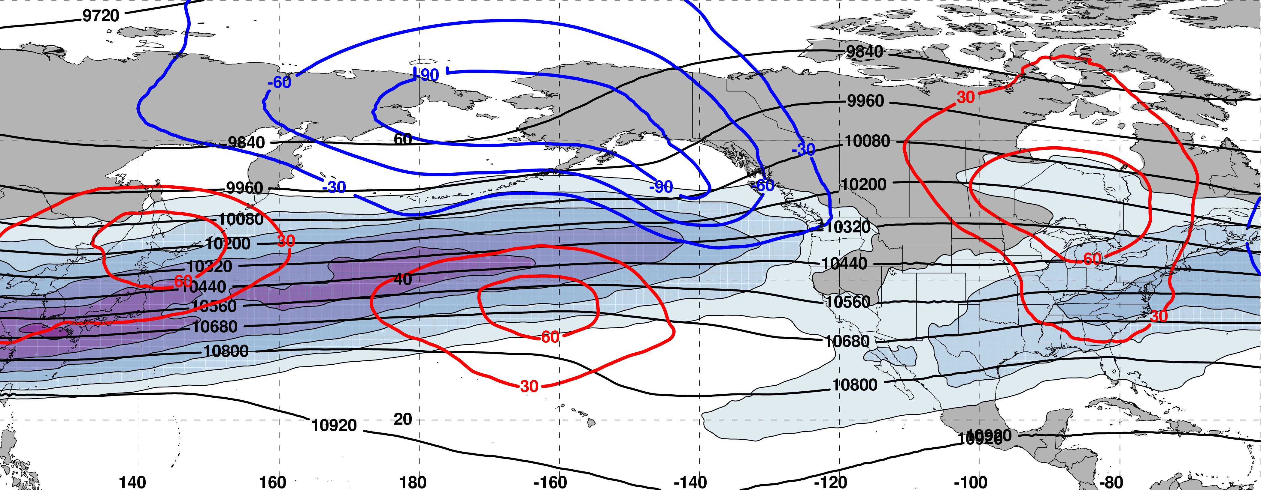
8 days following a Worst Forecast during Jet Retraction (N=145)
250 hPa
m s^{–1}
8 days following a Best Forecast during Jet Retraction (N=63)
250 hPa
m s^{–1}

Slide 34
Composite Difference: (Worst – Best) at 192 h
250 hPa
m
99% Conf. Interval
Relative to the best forecast periods, the worst forecast periods are frequently characterized by significantly higher heights at high latitudes and significantly lower heights at low latitudes over the North Pacific
The above composite difference pattern suggests that the worst forecast periods are often associated with upper-tropospheric blocking events over the North Pacific
Notes:
Start end labels in box. Change to 8 day trajectories.

Slide 35
Summary
Forecasts verifying during jet retractions and equatorward shifts are characterized by substantially larger errors than those verifying during jet extensions and poleward shifts
The worst forecasts are more frequently initialized during jet retractions and equatorward shifts
The worst forecast periods are associated with equatorward shifts and longer trajectories within the NPJ phase diagram during the 10-day period following forecast initialization
The worst forecast periods are often associated with upper-tropospheric blocking events over the North Pacific
Notes:
Forecasts refer to NPJ phase diagram forecasts
First bullet: Slide 21 and 23
Second bullet: Slide 22 and 23
Third bullet: Slide 23

Slide 36
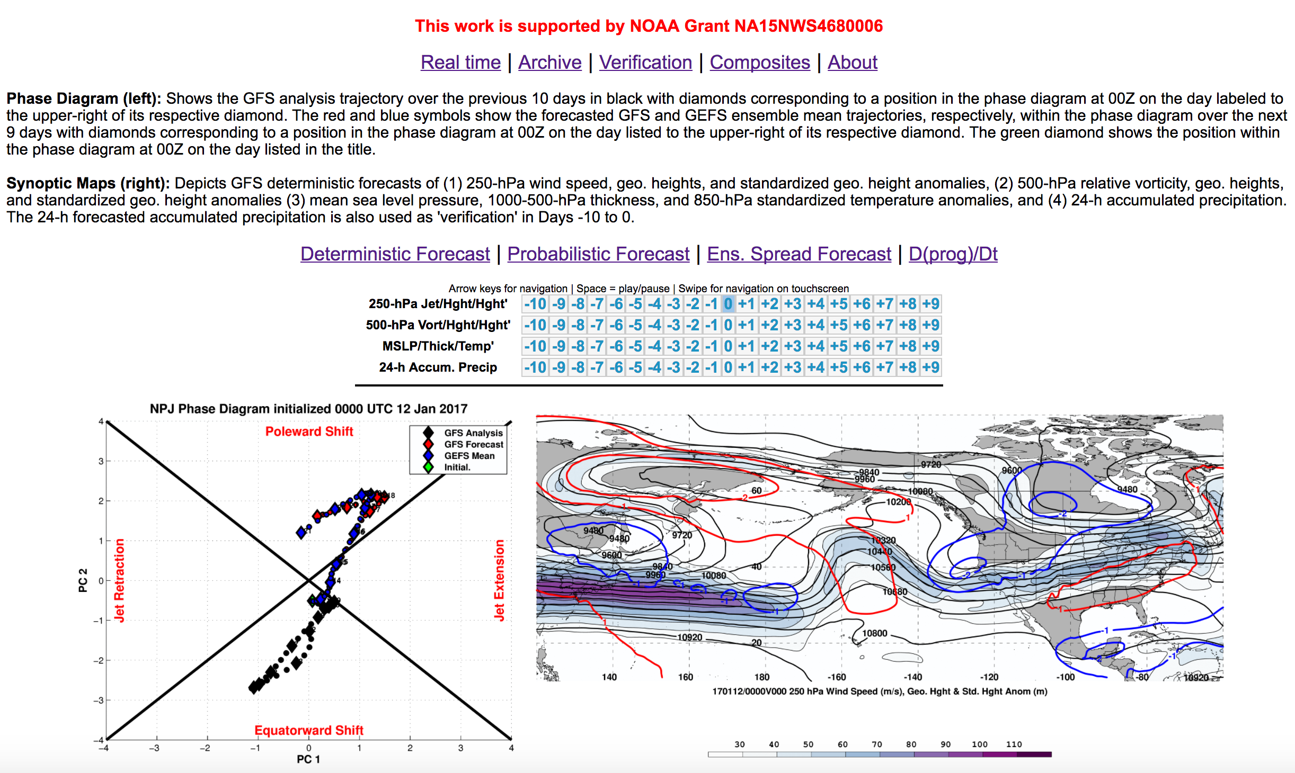
NPJ Phase Diagram Web Interface

Slide 37
NPJ Phase Diagram Web Interface
A web interface has been developed that offers real time NPJ phase diagram forecasts and extreme event composites:
http://www.atmos.albany.edu/facstaff/awinters/realtime/About_EOFs.php
Contact: acwinters@albany.edu
Collaborators: Mike Bodner (WPC), Arlene Laing (NOAA), Dan Halperin (ERAU), Bill Lamberson (WPC), Josh Kastman (WPC), and Sara Ganetis (WPC)

Slide 38
Supplementary Slides

Slide 39
References
Athanasiadis, P. J., J. M. Wallace, and J. J. Wettstein, 2010: Patterns of wintertime jet stream variability and their relation to the storm tracks. J. Atmos. Sci., 67, 1361–1381.
Griffin, K. S., and J. E. Martin, 2016: Synoptic features associated with temporally coherent modes of variability of the North Pacific jet stream. J. Climate, 29, in press.
Hamill, T. M., G. T. Bates, J. S. Whitaker, D. R. Murray, M. Fiorino, T. J. Galarneau, Y. Zhu, and W. Lapenta, 2013: NOAA’s Second-Generation Global Medium-Range Ensemble Forecast Dataset. Bull. Amer. Meteor. Soc., 94, 1553–1565.
Jaffe, S. C., J. E. Martin, D. J. Vimont, and D. L. Lorenz, 2011: A synoptic climatology of episodic, subseasonal retractions of the Pacific jet. J. Climate, 24, 2846–2860.
Saha, S., and Coauthors, 2014: The NCEP Climate Forecast System Version 2. J. Climate, 27, 2185–2208.

Slide 40
NPJ Regime Composite Patterns

Slide 41
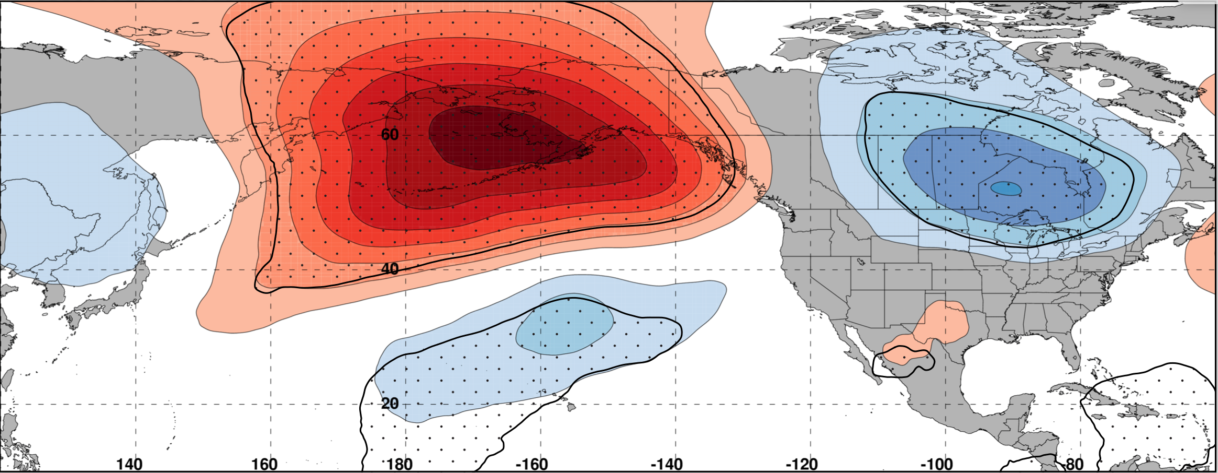
Composite Difference: (Worst – Best) at 192 h
250 hPa
m
99% Conf. Interval
The worst forecast periods are frequently characterized by significantly higher heights over the North Pacific and lower heights over North America
The composite difference pattern suggests that the worst forecast periods are often associated with upper-tropospheric blocking events
Start
End
Worst
Best
Notes:
Start end labels in box. Change to 8 day trajectories.

Slide 42
Composite Difference: (Worst – Best) at 192 h
250 hPa
m
99% Conf. Interval
The worst forecast periods are typically characterized by an equatorward shifted trajectory within the NPJ phase diagram
The best forecast periods are typically characterized by a poleward shifted trajectory within the NPJ phase diagram
Start
End
Worst
Best
Notes:
Start end labels in box. Change to 8 day trajectories.

Slide 43
Composite Difference: (Worst – Best) at 0 h
250 hPa
m
99% Conf. Interval
Relative to the best forecast periods, the worst forecast periods are frequently characterized by significantly higher heights over the eastern North Pacific at the time of forecast initialization
Notes:
Start end labels in box. Change to 8 day trajectories.

Slide 44
Composite Difference: (Worst – Best) at 0 h
99% Conf. Interval
Relative to the best forecasts, the worst forecast periods exhibit significantly higher heights over the eastern North Pacific irrespective of the NPJ regime at the time of forecast initialization
Notes:
Start end labels in box. Change to 8 day trajectories.

Slide 45
Composite Difference: (Worst – Best) at 192 h
99% Conf. Interval
The composite differences suggest that the worst forecast periods are often associated with upper-tropospheric blocking events over the North Pacific 8 days following forecast initialization irrespective of the NPJ regime at the time of forecast initialization
Notes:
Start end labels in box. Change to 8 day trajectories.

Slide 46
NPJ Regime Distributions

Slide 47
NPJ Regime Characteristics
Inter-annual Variability
Intra-annual Variability
The frequency of each NPJ regime exhibits considerable inter-annual and intra-annual variability

Slide 48
NPJ Regime Frequency and ENSO
Jet Extensions and Equatorward Shifts are favored during an El Niño
Jet Retractions and Poleward Shifts are favored during a La Niña

Slide 49
NPJ Regime Frequency and the MJO
Jet Retractions are favored during Phases 2, 3, and 4
Poleward Shifts are favored during Phases 5 and 6
Jet Extensions are favored during Phases 7, 8, and 1

Slide 50
NPJ Regime Frequency and the PNA
Jet Extensions and Poleward Shifts are favored during a positive PNA
Jet Retractions and Equatorward Shifts are favored during a negative PNA

Slide 51
Additional NPJ Phase Diagram Verification Statistics

Slide 52
GEFS Ensemble Mean Error by NPJ Regime
GEFS Reforecasts initialized during a particular NPJ regime
Circles on a particular line indicate statistically significant differences at the 99% confidence level with respect to another NPJ regime
Notes:
During instead of within

Slide 53
GEFS Ensemble Mean Error by NPJ Regime
GEFS Reforecasts initialized during a particular NPJ regime
Circles on a particular line indicate statistically significant differences at the 99% confidence level with respect to another NPJ regime
Forecasts initialized during jet retractions exhibit significantly larger errors than
jet extensions in the 192–216-h forecast period
Notes:
During instead of within

Slide 54
NPJ Phase Diagram Forecast Skill
Initialization NPJ Regime
Verification NPJ Regime
Poleward Shift
Poleward Shift
Jet Retraction
Jet Extension
Jet Retraction
Jet Extension
Equatorward Shift
Equatorward Shift
Greater Forecast Skill
Reduced Forecast Skill
Forecasts initialized during jet retractions are characterized by larger errors than those initialized during jet extensions and poleward shifts
Notes:
Additional slide with the takeaways from these two slides.

Slide 55
NPJ Phase Diagram Forecast Skill
Initialization NPJ Regime
Verification NPJ Regime
Poleward Shift
Poleward Shift
Jet Retraction
Jet Extension
Jet Retraction
Jet Extension
Equatorward Shift
Equatorward Shift
Greater Forecast Skill
Reduced Forecast Skill
Forecasts verifying during jet retractions and equatorward shifts are characterized by substantially larger errors than those verifying during jet extensions and poleward shifts
Notes:
Additional slide with the takeaways from these two slides.

Slide 56
NPJ Phase Diagram Forecast Skill
Initialization NPJ Regime
Verification NPJ Regime
Poleward Shift
Poleward Shift
Jet Retraction
Jet Extension
Jet Retraction
Jet Extension
Equatorward Shift
Equatorward Shift
Greater Forecast Skill
Reduced Forecast Skill
Jet retractions and equatorward shifts are often characterized by high-amplitude and/or short-wavelength flow patterns over the North Pacific, which may be a contributing factor to the reduced skill
Notes:
Additional slide with the takeaways from these two slides.

Slide 57
Best/Worst NPJ Phase Diagram Forecasts
Ratio of Best/Worst Forecasts
Average ΔPC2
Poleward Shift
Poleward Shift
Best
Jet Retraction
Jet Extension
Jet Retraction
Jet Extension
Worst
Equatorward Shift
Equatorward Shift
More Best Forecasts
More Worst Forecasts
The worst forecasts are most frequently initialized during jet retractions and equatorward shifts
The worst forecast periods frequently feature equatorward shifts during the 10-day period following forecast initialization
Notes:
Switch best/worst in words. One bullet for each result. New slide for each bullet

Slide 58
Best/Worst NPJ Phase Diagram Forecasts
Ratio of Best/Worst Forecasts
Average ΔPC2
Poleward Shift
Poleward Shift
Best
Jet Retraction
Jet Extension
Jet Retraction
Jet Extension
Worst
Equatorward Shift
Equatorward Shift
More Best Forecasts
More Worst Forecasts
The worst forecast periods are associated with longer trajectories through the NPJ phase diagram following forecast initialization, suggestive of rapid NPJ regime change
Notes:
Switch best/worst in words. One bullet for each result. New slide for each bullet

Slide 59
NPJ Regime Forecast Frequency
The percent frequency that an NPJ regime is over/under forecast relative to verification at various forecast lead times in the GEFS ensemble mean reforecasts
NPJ Regime Over Forecast
NPJ Regime Under Forecast
Notes:
Colorize and move to the back

Slide 60
NPJ Regime Forecast Frequency
The percent frequency that an NPJ regime is over/under forecast relative to verification at various forecast lead times in the GEFS ensemble mean reforecasts
Equatorward shifts are substantially under forecast at every forecast lead time compared to all other NPJ regimes
The degree to which equatorward shifts are under forecast corroborates the reduced skill of forecasts verifying during equatorward shifts
Notes:
Additional slide linking to previous stuff

Slide 61
Reliability Diagram
Perfect
Reliability
GEFS Reforecasts appear to be underdispersive with respect to medium-range forecasts of the North Pacific Jet in the phase diagram

Slide 62
GEFS Ensemble Mean Error – Season
Circles on a particular line indicate statistically significant differences to the 95% confidence interval with respect to another jet regime.

Slide 63
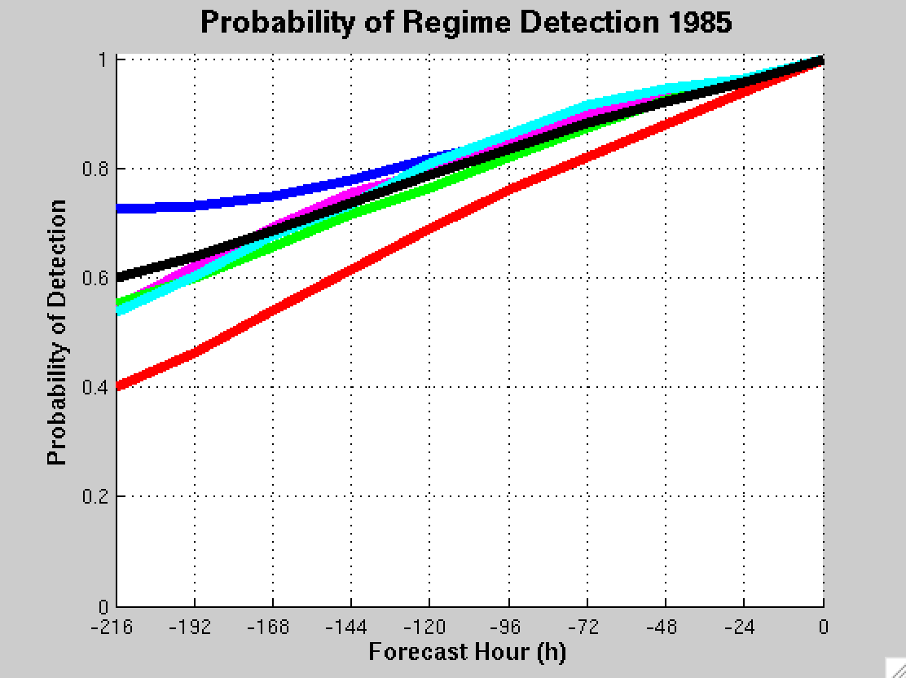
GEFS Ensemble Mean POD by NPJ Regime
For forecasts verifying within a particular NPJ regime
Extension
Retraction
Poleward
Equator
Origin
Mean

Slide 64
Frequency of Best/Worst NPJ Forecasts

Slide 65
Frequency of Worst NPJ Forecasts

Slide 66
Frequency of Best NPJ Forecasts

Slide 67
Jet Regime-Dependent Forecast Skill
Percent Difference Between the Frequency of Forecasts with Below-Normal and Above-Normal RMSE over North America
Higher frequency of forecasts with
below-normal RMSE
(i.e., more good forecasts)
Higher frequency of forecasts with
above-normal RMSE
(i.e., more bad forecasts)

Slide 68
Jet Regime-Dependent Forecast Skill
Percent Difference Between the Frequency of Forecasts with Below-Normal and Above-Normal RMSE over North America
Higher frequency of forecasts with
below-normal RMSE
(i.e., more good forecasts)
Higher frequency of forecasts with
above-normal RMSE
(i.e., more bad forecasts)

Slide 69
Best/Worst NPJ Phase Diagram Forecasts
Comparison between the periods characterized by the best/worst medium-range forecasts
Criteria: Forecasts must rank in the top/bottom 10% in terms of both:
The average GEFS ensemble mean error in the Day 8 and 9 forecasts
The average GEFS ensemble member error in the Day 8 and 9 forecasts
Hypothetical Best Forecast
Verification
Ensemble Mean Position
Individual Ens. Member

Slide 70
Best/Worst NPJ Phase Diagram Forecasts
Comparison between the periods characterized by the best/worst medium-range forecasts
Criteria: Forecasts must rank in the top/bottom 10% in terms of both:
The average GEFS ensemble mean error in the Day 8 and 9 forecasts
The average GEFS ensemble member error in the Day 8 and 9 forecasts
Represents a forecast with negligible ensemble mean error
Hypothetical Best Forecast
(1) Ens. Mean error ≈ 0
Verification
Ensemble Mean Position
Individual Ens. Member

Slide 71
Best/Worst NPJ Phase Diagram Forecasts
Comparison between the periods characterized by the best/worst medium-range forecasts
Criteria: Forecasts must rank in the top/bottom 10% in terms of both:
The average GEFS ensemble mean error in the Day 8 and 9 forecasts
The average GEFS ensemble member error in the Day 8 and 9 forecasts
Represents a forecast with negligible ensemble member error
Hypothetical Best Forecast
(1) Ens. Mean error ≈ 0
(2) Avg. Ens. Member error ≈ 0
Verification
Ensemble Mean Position
Individual Ens. Member

Slide 72
Best/Worst NPJ Phase Diagram Forecasts
Comparison between the periods characterized by the best/worst medium-range forecasts
Criteria: Forecasts must rank in the top/bottom 10% in terms of both:
The average GEFS ensemble mean error in the Day 8 and 9 forecasts
The average GEFS ensemble member error in the Day 8 and 9 forecasts
Hypothetical Intermediate Forecast
Verification
Ensemble Mean Position
Individual Ens. Member
Notes:
intermediate

Slide 73
Best/Worst NPJ Phase Diagram Forecasts
Comparison between the periods characterized by the best/worst medium-range forecasts
Criteria: Forecasts must rank in the top/bottom 10% in terms of both:
The average GEFS ensemble mean error in the Day 8 and 9 forecasts
The average GEFS ensemble member error in the Day 8 and 9 forecasts
Represents a forecast with negligible ensemble mean error
Hypothetical Intermediate Forecast
(1) Ens. Mean error ≈ 0
Verification
Ensemble Mean Position
Individual Ens. Member

Slide 74
Best/Worst NPJ Phase Diagram Forecasts
Comparison between the periods characterized by the best/worst medium-range forecasts
Criteria: Forecasts must rank in the top/bottom 10% in terms of both:
The average GEFS ensemble mean error in the Day 8 and 9 forecasts
The average GEFS ensemble member error in the Day 8 and 9 forecasts
Represents a forecast with considerable ensemble member error
Hypothetical Intermediate Forecast
(1) Ens. Mean error ≈ 0
(2) Avg. Ens. Member error >> 0
Verification
Ensemble Mean Position
Individual Ens. Member

Slide 75
Best/Worst NPJ Phase Diagram Forecasts
Comparison between the periods characterized by the best/worst medium-range forecasts
Criteria: Forecasts must rank in the top/bottom 10% in terms of both:
The average GEFS ensemble mean error in the Day 8 and 9 forecasts
The average GEFS ensemble member error in the Day 8 and 9 forecasts
Hypothetical Worst Forecast
Verification
Ensemble Mean Position
Individual Ens. Member

Slide 76
Best/Worst NPJ Phase Diagram Forecasts
Comparison between the periods characterized by the best/worst medium-range forecasts
Criteria: Forecasts must rank in the top/bottom 10% in terms of both:
The average GEFS ensemble mean error in the Day 8 and 9 forecasts
The average GEFS ensemble member error in the Day 8 and 9 forecasts
Represents a forecast with considerable ensemble mean error
Hypothetical Worst Forecast
(1) Ens. Mean error >> 0
Verification
Ensemble Mean Position
Individual Ens. Member

Slide 77
Best/Worst NPJ Phase Diagram Forecasts
Comparison between the periods characterized by the best/worst medium-range forecasts
Criteria: Forecasts must rank in the top/bottom 10% in terms of both:
The average GEFS ensemble mean error in the Day 8 and 9 forecasts
The average GEFS ensemble member error in the Day 8 and 9 forecasts
Represents a forecast with considerable ensemble member error
Hypothetical Worst Forecast
(1) Ens. Mean error >> 0
(2) Avg. Ens. Member error >> 0
Verification
Ensemble Mean Position
Individual Ens. Member
Notes:
Remove hypothetical illustrations and instead say what were gonna show

Slide 78
Real time NPJ Phase Diagram Verification Statistics
2016–2017

Slide 79
Reliability Diagram (Sept 1 – May 31)
Perfect
Reliability
The GEFS appears to be underdispersive with respect to medium-range forecasts of the NPJ within the phase diagram

Slide 80
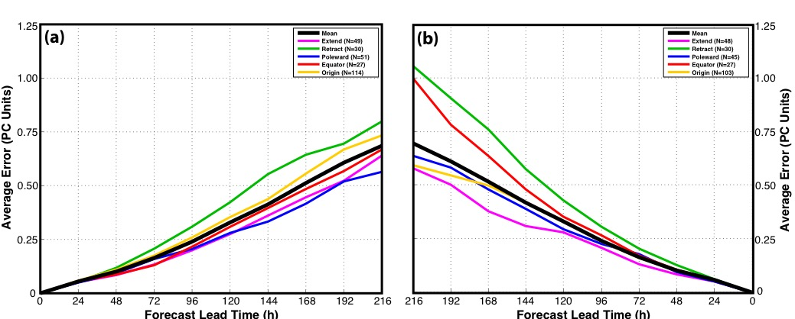
GEFS Ensemble Mean Error – Regime

Slide 81
GEFS Probability of Detection – Regime

Slide 82
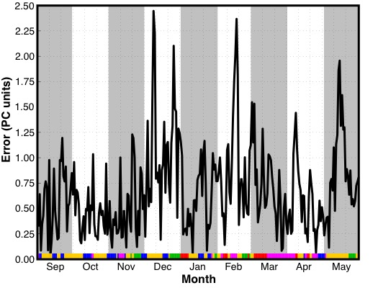
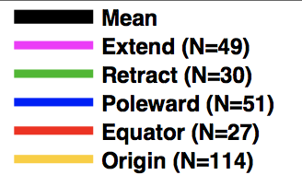
Real Time NPJ Phase Diagram Forecasts
Time series of 2016–2017 GEFS ensemble mean
9-day forecast error classified by initialization date

Slide 83
NPJ Phase Diagram and ETE’s

Slide 84
Western U.S. – All Events
Extreme Cold Event Centroids
EXTREME COLD EVENTS (N = 196)
Poleward Shift
23%
Events during
Sept. – May projected onto phase diagram
30%
20%
Jet Retraction
Jet Extension
Each ‘x’ is an average of the PCs
3–7 days prior to an event
27%
Equatorward Shift
Mean Projection

Slide 85
Western U.S. – All Events
Extreme Warm Event Centroids
EXTREME WARM EVENTS (N = 204)
Poleward Shift
27%
Events during
Sept. – May projected onto phase diagram
20%
26%
Jet Retraction
Jet Extension
Each ‘x’ is an average of the PCs
3–7 days prior to an event
27%
Equatorward Shift
Mean Projection

Slide 86
Eastern U.S. – All Events
Extreme Cold Event Centroids
EXTREME COLD EVENTS (N = 173)
Poleward Shift
13%
Events during
Sept. – May projected onto phase diagram
18%
27%
Jet Retraction
Jet Extension
Each ‘x’ is an average of the PCs
3–7 days prior to an event
42%
Equatorward Shift
Mean Projection

Slide 87
Eastern U.S. – All Events
Extreme Warm Event Centroids
EXTREME WARM EVENTS (N = 239)
Poleward Shift
27%
Events during
Sept. – May projected onto phase diagram
29%
20%
Jet Retraction
Jet Extension
Each ‘x’ is an average of the PCs
3–7 days prior to an event
24%
Equatorward Shift
Mean Projection

Slide 88
West Coast Extreme Precipitation Events
Events during
Sept. – May
1979–2014 projected onto the NPJ phase diagram (N=154)
Each “x” is an average of the PCs
3–7 days prior to a precip. event
West Coast Extreme Precipitation Events are most often preceded by Jet Extensions

Slide 89
NPJ Phase Diagram Technical Slides

Slide 90
Real Time North Pacific Jet Phase Diagram
0000 UTC 8 November 2014
250-hPa wind speed: shaded
Instantaneous 250-hPa zonal wind anomalies can be projected onto EOF 1 and EOF 2, resulting in a point on a North Pacific Jet phase diagram

Slide 91
Real Time North Pacific Jet Phase Diagram
Each point on the phase diagram is a weighted average of the principal components within +/− 1 day of the time under consideration
Example: 0000 UTC 8 November 2014
Weight
5
4
3
2
1
Date
0000 UTC 7 Nov.
1200 UTC 7 Nov.
0000 UTC 8 Nov.
1200 UTC 8 Nov.
0000 UTC 9 Nov.

Slide 92
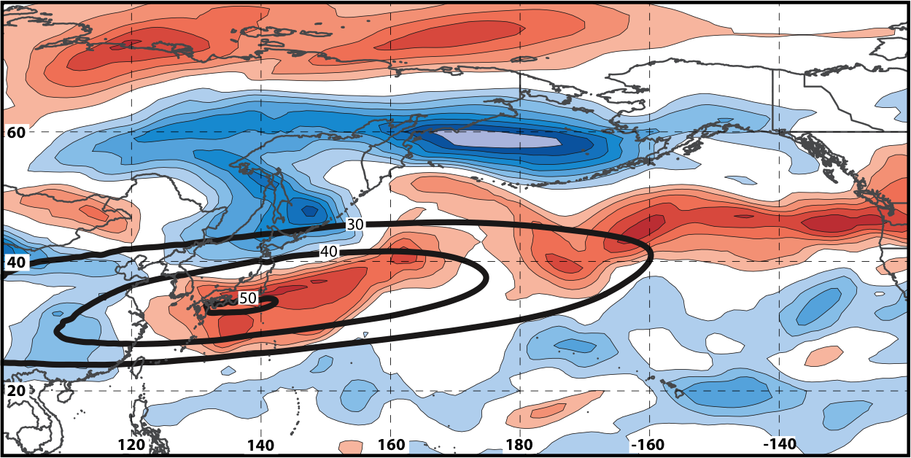
Real Time North Pacific Jet Phase Diagram
250-hPa zonal wind at 0000 UTC 2 Jun minus 250-hPa zonal wind at 0000 UTC 24 May (shading) in the GFS analyses shows the transition to a poleward-shifted jet regime
0000 UTC 24 May
(0-h forecast)
0000 UTC 2 Jun (verification)
Ensemble mean
Sept.–May mean 250-hPa zonal wind: black contours
Notes:
Note that the positive changes in zonal wind correspond exactly to where the positive anomalies are located in the EOF2 pattern – See slide 14.

Slide 93
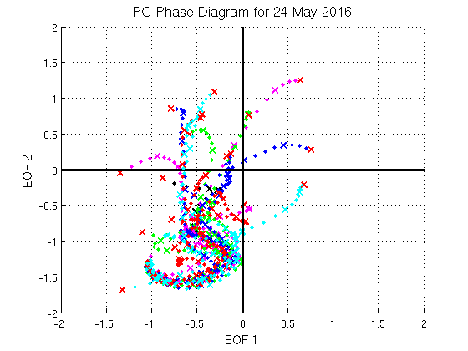
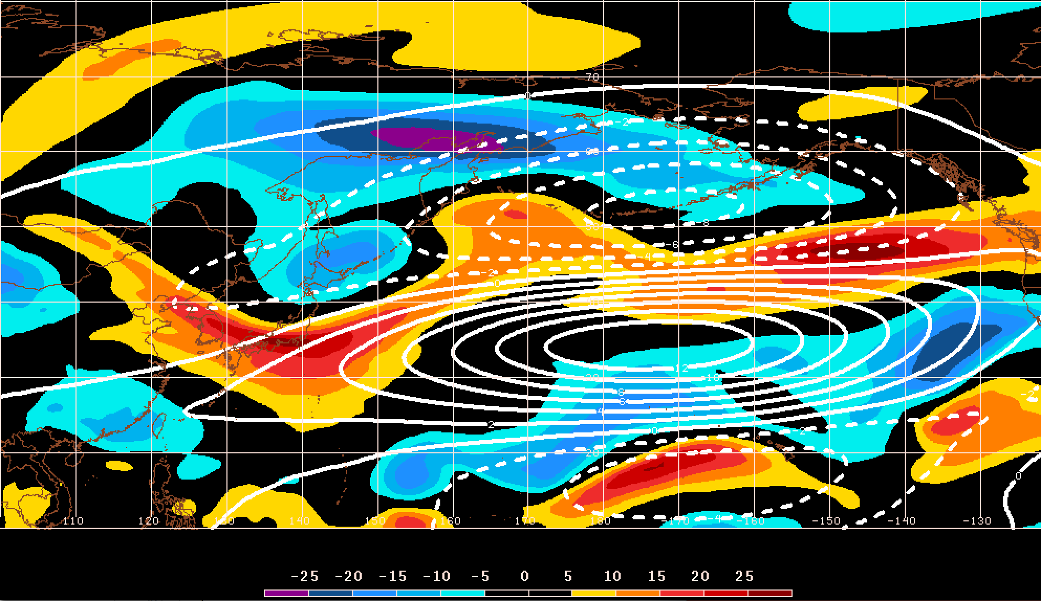
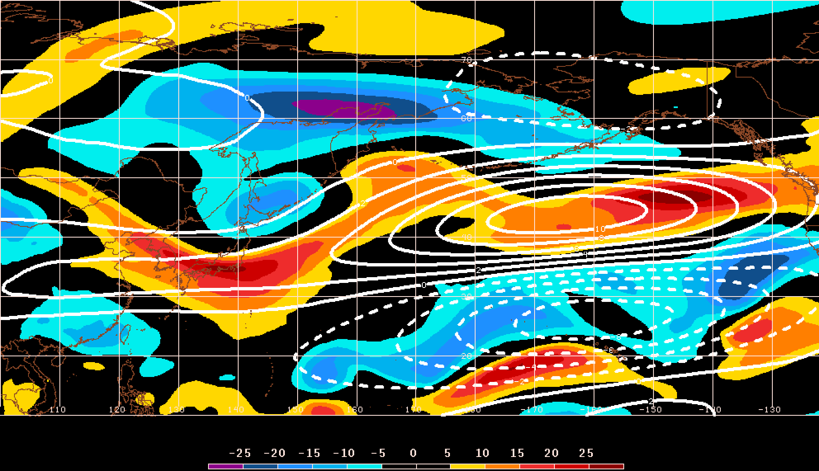
GEFS Ensemble Trajectories Initialized 0000 UTC 24 May 2016
250-hPa Zonal Wind Anomalies and EOF1: 0000 UTC 2 Jun
0000 UTC 2 Jun (verification)
m s^{–1}
250-hPa Zonal Wind Anomalies and EOF2: 0000 UTC 2 Jun
250-hPa zonal wind anomalies at 0000 UTC 2 Jun project strongly onto
EOF2 > 0
m s^{–1}

