Slide 1
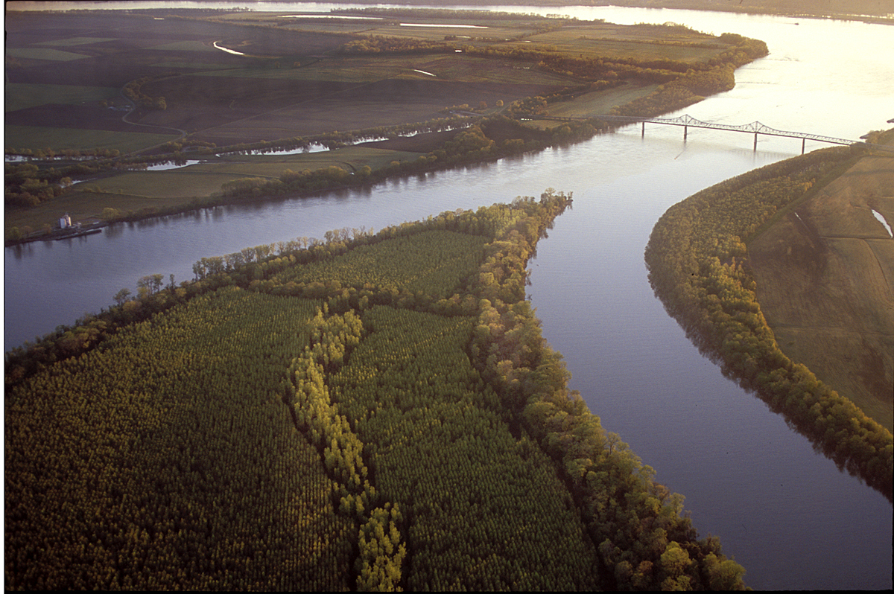

The Influence of Diabatic Heating on the Development of Two North American Jet Superposition Events
Andrew C. Winters
Department of Atmospheric and Oceanic Sciences (ATOC)
University of Colorado Boulder
100th AMS Annual Meeting
30th Conference on Weather Analysis and Forecasting
26th Conference on Numerical Weather Prediction
Boston, MA
14 January 2019
This work was funded by an NSF-PRF (AGS-1624316)

Slide 2
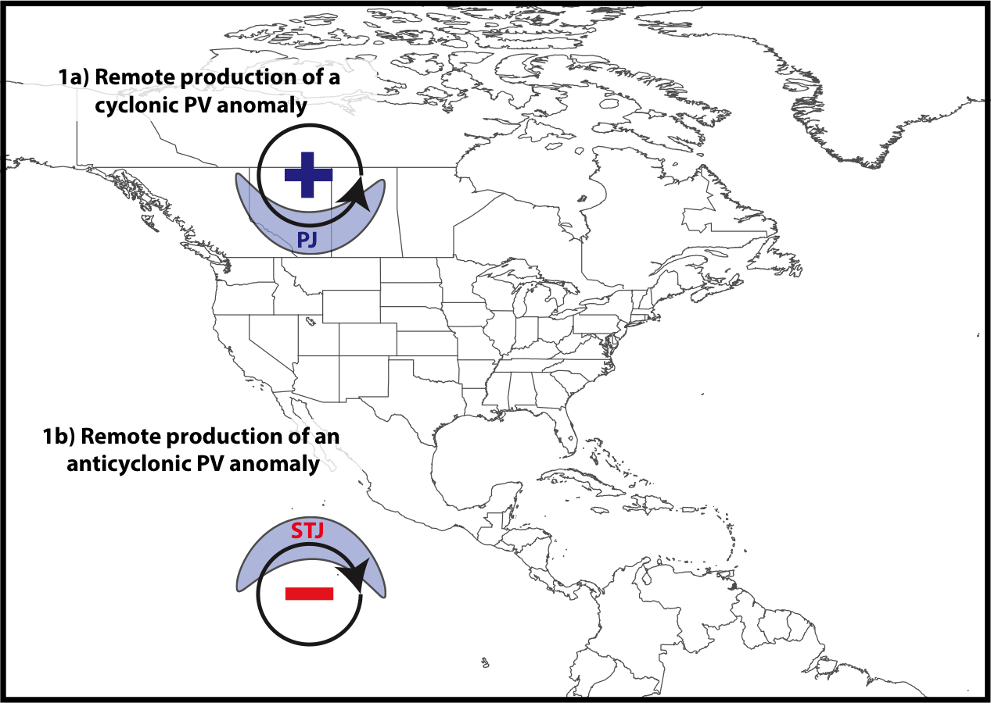
Jet Superposition Conceptual Model
Winters and Martin (2017)

Slide 3
Jet Superposition Conceptual Model
Polar cyclonic PV anomalies:
Characterize a dynamical environment conducive to midlatitude cyclogenesis.
Winters and Martin (2017)

Slide 4
Jet Superposition Conceptual Model
Winters and Martin (2017)

Slide 5
Jet Superposition Conceptual Model
Tropical anticyclonic PV anomalies:
Characterize a thermodynamic environment that features weak upper-tropospheric static stability.
Winters and Martin (2017)

Slide 6
Jet Superposition Conceptual Model
A
A’
Winters and Martin (2017)

Slide 7
Jet Superposition Conceptual Model
A
2-PVU Contour
Potential Temp.
Wind Speed
A’
Winters and Martin (2017)

Slide 8
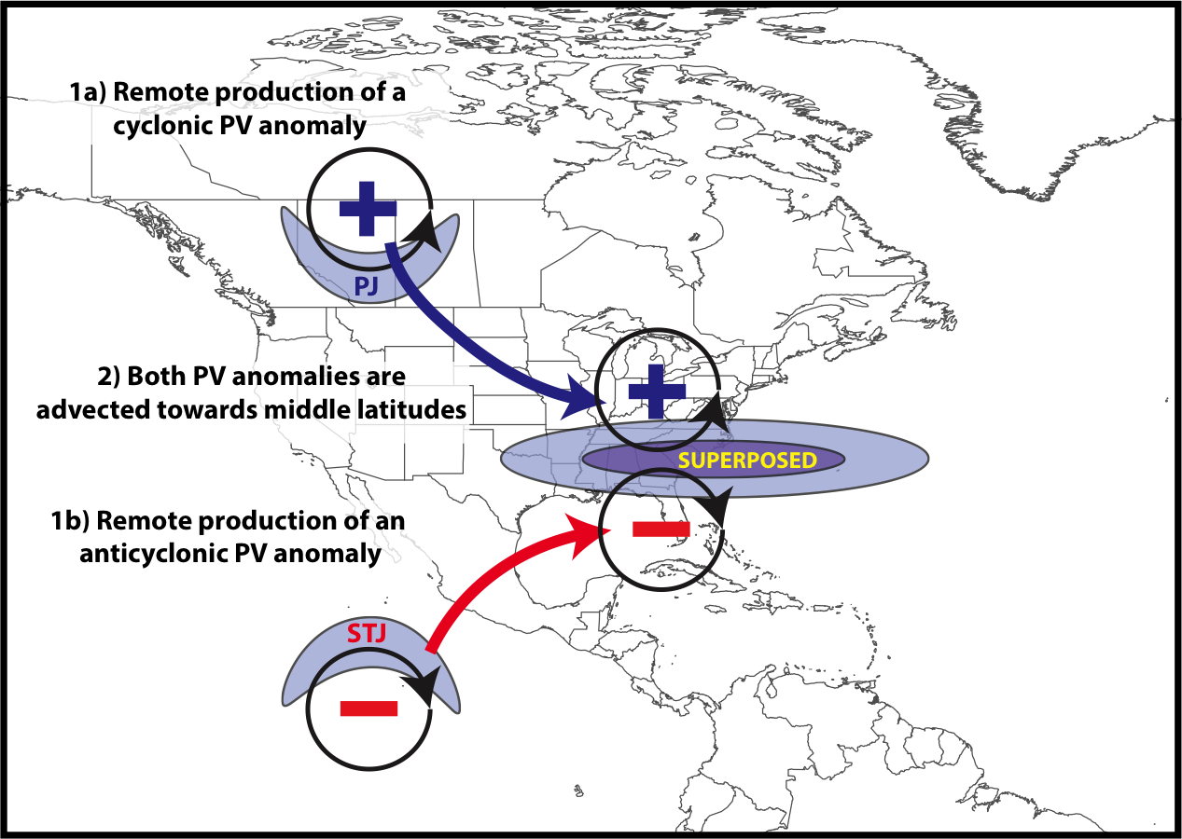
Jet Superposition Conceptual Model
Winters and Martin (2017)

Slide 9
Jet Superposition Conceptual Model
B
B’
Winters and Martin (2017)

Slide 10
Jet Superposition Conceptual Model
B
2-PVU Contour
Potential Temp.
Wind Speed
B’
Winters and Martin (2017)

Slide 11
Jet Superposition Conceptual Model
The processes that facilitate jet superposition vary based on the location at which the polar and subtropical jets superpose
Winters and Martin (2017)

Slide 12
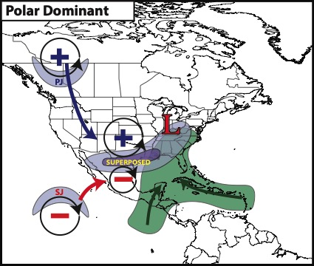
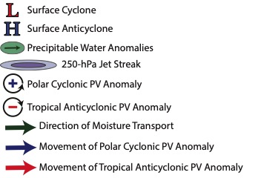
Jet Superposition Conceptual Model
During polar dominant events, diabatic processes do not directly contribute to the formation of a steep, tropopause wall
Winters et al., in revision

Slide 13
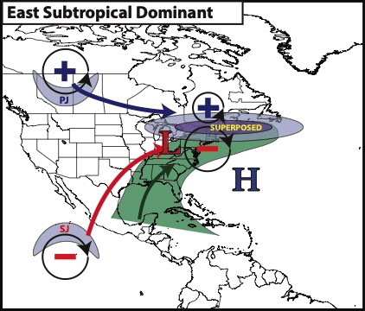
Jet Superposition Conceptual Model
During subtropical dominant events, diabatic processes directly contribute to the formation of a steep, tropopause wall
Winters et al., in revision

Slide 14
Jet Superposition Conceptual Model
If latent heating is omitted during subtropical dominant events, do the polar and subtropical jets still superpose?

Slide 15
Recent Subtropical Dominant
Jet Superposition Events

Slide 16
Recent Subtropical Dominant Superpositions
1200 UTC 22 December 2013
CFSR Analysis (Saha et al. 2014)
H
L
Mean Sea Level Pressure
H
500-hPa Ascent (Pa s^{–1})
The December 2013 case featured:
A tornado outbreak in the southeastern U.S.
Up to 1 in. of total ice accumulation near Toronto, ON
Maximum jet wind speeds in excess of 110 m s^{–1}

Slide 17
Recent Subtropical Dominant Superpositions
1200 UTC 22 December 2013
0600 UTC 20 February 2019
L
L
H
L
H
H
L
Mean Sea Level Pressure
500-hPa Ascent (Pa s^{–1})
The February 2019 case featured:
Up to 1 foot of snow accumulation in the northern Plains
An Atlantic cyclone with a central pressure below 944 hPa
Maximum jet wind speeds in excess of 110 m s^{–1}

Slide 18
Recent Subtropical Dominant Superpositions
1200 UTC 22 December 2013
0600 UTC 20 February 2019
L
L
H
L
H
H
L
Mean Sea Level Pressure
500-hPa Ascent (Pa s^{–1})

Slide 19
WRF Simulations:
December 2013 Case

Slide 20
WRF Simulations
2 single-domain simulations (“FULL”, “NOLH”)
WRF Version 3.9.1 (Skamarock et al. 2008)
6-day run time initialized at 0000 UTC 19 December 2013
90-second timestep
30-km horizontal resolution + 50 vertical levels (model top=50 hPa)
Initial and boundary conditions provided by the GFS Analysis
Thompson microphysics
Kain-Fritsch cumulus parameterization
MYJ PBL scheme
RRTMG radiation scheme
Noah land-surface model
No latent heating from microphysics
in “NOLH” simulation
y = 200
x = 250

Slide 21
WRF Simulations
1200 UTC 22 December 2013
“FULL”
“NOLH”
H
H
L
L
H
H
Mean Sea Level Pressure
500-hPa Ascent (Pa s^{–1})
Maximum 250-hPa wind speed is ~40 m s^{–1} weaker in “NOLH”
Surface cyclone over the southern Great Lakes is weaker and located farther west in ”NOLH”

Slide 22
WRF Simulations
1200 UTC 22 December 2013
“FULL” – “NOLH”: 850-hPa Pot. Temp.
850-hPa “FULL” Pot. Temp. (K)
The “FULL” simulation features a stronger lower-tropospheric temperature gradient than the “NOLH” simulation

Slide 23
WRF Simulations
1200 UTC 22 December 2013
“FULL” – “NOLH”: 850-hPa Pot. Temp.
“FULL” – “NOLH”: 250-hPa Height
850-hPa “FULL” Pot. Temp. (K)
250-hPa “FULL” Height
The “FULL” simulation features a stronger lower-tropospheric temperature gradient than the “NOLH” simulation
The “FULL” simulation features larger geopotential heights and stronger flow curvature within the eastern North American ridge

Slide 24
WRF Simulations
1200 UTC 22 December 2013
“FULL”
“NOLH”
H
H
L
L
H
H
Mean Sea Level Pressure
500-hPa Ascent (Pa s^{–1})
In the absence of latent heating, do the polar and subtropical jets become superposed?

Slide 25
WRF Simulations
1200 UTC 22 December 2013
“FULL”
“NOLH”
C
D
H
H
L
L
H
H
C’
D’
Mean Sea Level Pressure
500-hPa Ascent (Pa s^{–1})
In the absence of latent heating, do the polar and subtropical jets become superposed?

Slide 26
WRF Simulations
1200 UTC 22 December 2013
“FULL”
“NOLH”
Pressure (hPa)
D’
D
C’
C
2 PVU – “FULL”
2 PVU – “NOLH”
Potential Temp.

Slide 27
WRF Simulations
1200 UTC 22 December 2013
“FULL”
“NOLH”
SJ
Pressure (hPa)
PJ
D’
D
C’
C
2 PVU – “FULL”
The polar and subtropical jets do not superpose in the “NOLH” simulation
2 PVU – “NOLH”
Potential Temp.

Slide 28
WRF Simulations
1200 UTC 22 December 2013
“FULL”
“NOLH”
Pressure (hPa)
D’
D
C’
C
2 PVU – “FULL”
The slope of the dynamic tropopause is markedly shallower in the “NOLH” simulation
2 PVU – “NOLH”
Potential Temp.

Slide 29
WRF Simulations
0600 UTC 22 December 2013
“FULL”:
250-hPa PV Advection by Age. Wind
“NOLH”:
250-hPa PV Advection by Age. Wind
Strong negative PV advection by the ageostrophic wind is diagnosed at the level of the dynamic tropopause on the western flank of the upper-tropospheric ridge in the “FULL” simulation
2 PVU
250-hPa
Wind Speed

Slide 30
WRF Simulations
0600 UTC 22 December 2013
“FULL”:
250-hPa PV Advection by Nondiv. Age. Wind
“NOLH”:
250-hPa PV Advection by Nondiv. Age. Wind
Negative PV advection by the nondivergent component of the ageostrophic wind accounts for a large fraction of the PV advection by the full ageostrophic wind in the ”FULL” simulation
2 PVU
250-hPa
Wind Speed

Slide 31
WRF Simulations
0600 UTC 22 December 2013
“FULL”:
250-hPa PV Advection by Div. Age. Wind
“NOLH”:
250-hPa PV Advection by Div. Age. Wind
2 PVU
250-hPa
Wind Speed

Slide 32
WRF Simulations
0600 UTC 22 December 2013
“FULL”:
250-hPa PV Advection by Div. Age. Wind
“NOLH”:
250-hPa PV Advection by Div. Age. Wind
2 PVU
250-hPa
Wind Speed

Slide 33
WRF Simulations
0600 UTC 22 December 2013
“FULL”:
250-hPa PV Advection by Div. Age. Wind
“NOLH”:
250-hPa PV Advection by Div. Age. Wind
Negative PV advection by the divergent component of the ageostrophic wind is substantial on the western flank of the upper-tropospheric ridge in the “FULL” simulation
2 PVU
250-hPa
Wind Speed

Slide 34
Summary
Latent heating plays an important role during the development of “subtropical dominant” jet superposition events
The omission of latent heating during a WRF simulation (“NOLH”) of a subtropical dominant jet superposition event from December 2013 results in a double-jet structure
The presence of strong negative PV advection by the ageostrophic wind at the level of the dynamic tropopause facilitates the formation of a jet superposition in the “FULL” simulation
The results from this study have important implications for the subsequent evolution of the downstream large-scale flow pattern over the North Atlantic

Slide 35
Summary
Latent heating plays an important role during the development of “subtropical dominant” jet superposition events
The omission of latent heating during a WRF simulation (“NOLH”) of a subtropical dominant jet superposition event from December 2013 results in a double-jet structure
The presence of strong negative PV advection by the ageostrophic wind at the level of the dynamic tropopause facilitates the formation of a jet superposition in the “FULL” simulation
The results from this study have important implications for the subsequent evolution of the downstream large-scale flow pattern over the North Atlantic
Questions: andrew.c.winters@colorado.edu

Slide 36
Supplementary Slides

Slide 37
References
Cavallo, S. M., and G. J. Hakim, 2010: Composite structure of tropopause polar cyclones. Mon. Wea. Rev., 138, 3840−3857.
Pyle, M. E., D. Keyser, and L. F. Bosart, 2004: A diagnostic study of jet streaks: Kinematic signatures and relationship to coherent tropopause disturbances. Mon. Wea. Rev., 132, 297−319.
Saha, S. and co-authors, 2014: The NCEP Climate Forecast System Version 2. J. Climate, 27, 2185−2208
Skamarock, W. C., J. B. Klemp, J. Dudhia, D. O. Gill, D. M. Barker, M. G Duda, X.-Y. Huang, W. Wang, and J. G. Powers, 2008: A Description of the Advanced Research WRF Version 3. NCAR Tech. Note NCAR/TN-475+STR, 113 pp.
Winters, A. C., and J. E. Martin, 2017: Diagnosis of a North American polar/subtropical jet superposition employing piecewise potential vorticity inversion. Mon. Wea. Rev.,145, 1853-1873.
Winters, A. C., D. Keyser, L. F. Bosart, and J. E. Martin, 2019: Composite synoptic-scale environments conducive to North American polar–subtropical jet superposition events. Mon. Wea. Rev., 147, [in review]

Slide 38
February 2019 Case

Slide 39
February 2019 Case
0600 UTC 20 February 2019
“FULL”
“NOLH”
Mean Sea Level Pressure
500-hPa Ascent (Pa s^{–1})
Maximum 250-hPa wind speed is ~10–20 m s^{–1} weaker in “NOLH”
Surface cyclone over the North Atlantic is ~40 hPa weaker in ”NOLH”

Slide 40
WRF Simulations
1200 UTC 22 December 2013
“FULL” – 250-hPa Nondivergent Age. Wind
“NOLH”: 250-hPa Nondivergent Age. Wind
250-hPa Height: “FULL”
250-hPa Height: “NOLH”
A substantial fraction of the difference in jet wind speeds between the two simulations can be attributed to the nondivergent component of the ageostrophic wind

Slide 41
WRF Simulations
1200 UTC 22 December 2013
“FULL”
“NOLH”
Pressure (hPa)
D’
D
C’
C
The difference in the slope of the tropopause between the two simulations is due to marked differences in negative PV advection by the ageostrophic wind at the level of the dynamic tropopause
2 PVU – “FULL”
2 PVU – “NOLH”
Potential Temp.

Slide 42
Composite Characteristics

Slide 43
Jet Superposition Event Characteristics

Slide 44
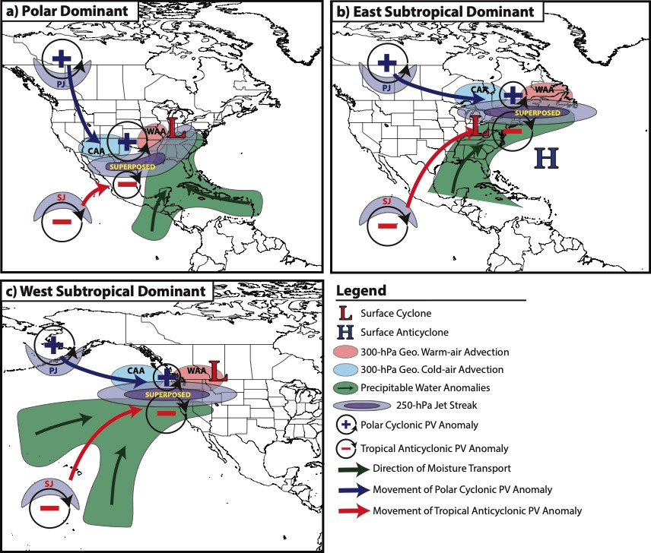
Jet Superposition Event Composites

Slide 45
Downstream Consequences
North Atlantic Oscillation: 5 Days After Jet Superposition
All Events
𝚫NAO
+0.11
Ave. Polar Dominant 𝚫NAO
+0.15
Ave. Subtropical Dominant 𝚫NAO
+0.13
Ave. Hybrid
𝚫NAO
+0.07

Slide 46
Background Material

Slide 47
Background
STJ
Modified from Defant and Taba (1957)
Subtropical Jet
PJ
Polar Jet
STJ
PJ

Slide 48
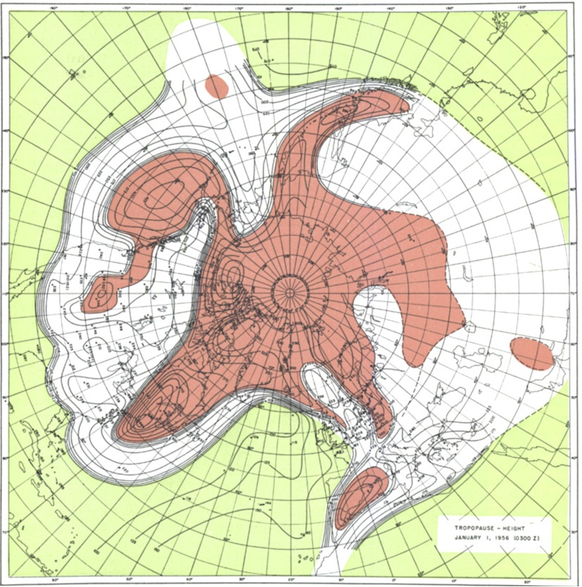
Background
Tropopause Pressure (hPa)
Phoenix
NP
North Pole
Maps of tropopause pressure help to identify the location of the jets.
While each jet occupies its own climatological latitude band, substantial meanders are common.
Occasionally, the latitudinal separation between the jets can vanish resulting in a vertical jet superposition.
STJ
PJ
NP
PJ
Tropical Tropopause
Subtropical Tropopause
Polar Tropopause
Polar Jet
STJ
Modified from Defant and Taba (1957)
Subtropical Jet

Slide 49
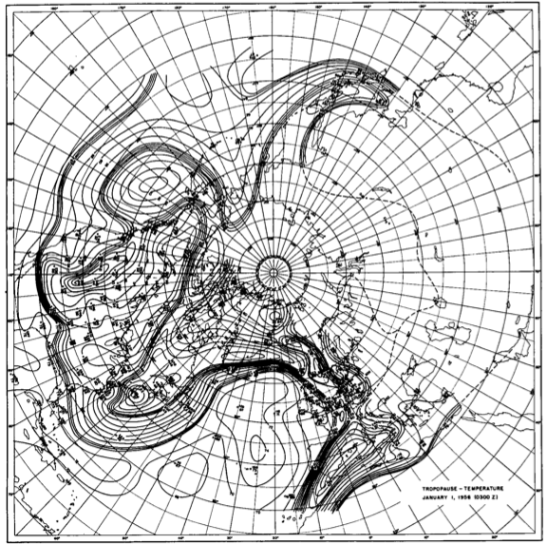
Background
Tropopause Temperature (ºC)
Phoenix
NP
North Pole
The pole-to-equator baroclinicity is combined into a much narrower zone of contrast in the vicinity of a jet superposition.
Intensified frontal structure is often attended by a strengthening of the superposed jet’s transverse circulation.
STJ
PJ
NP
Modified from Defant and Taba (1957)

Slide 50
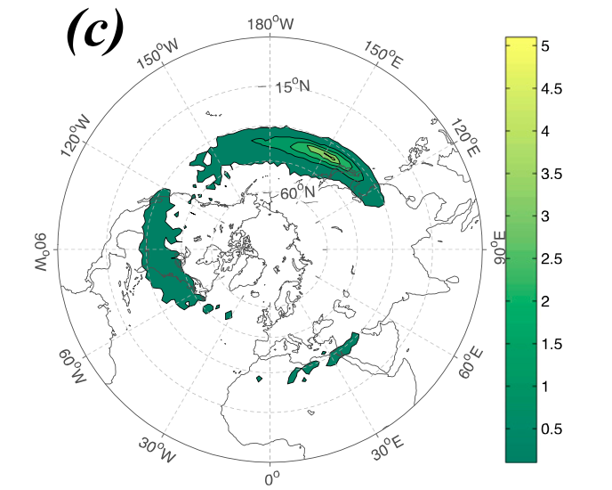
Background
Christenson et al. (2017) highlight three locations that experience the greatest frequency of
jet superpositions:
1) Western Pacific
2) North America
3) Northern Africa
Climatological frequency of Northern Hemisphere jet superposition events per cold season (Nov–Mar) 1960–2010
Number of Events
Christenson et al. (2017)

Slide 51
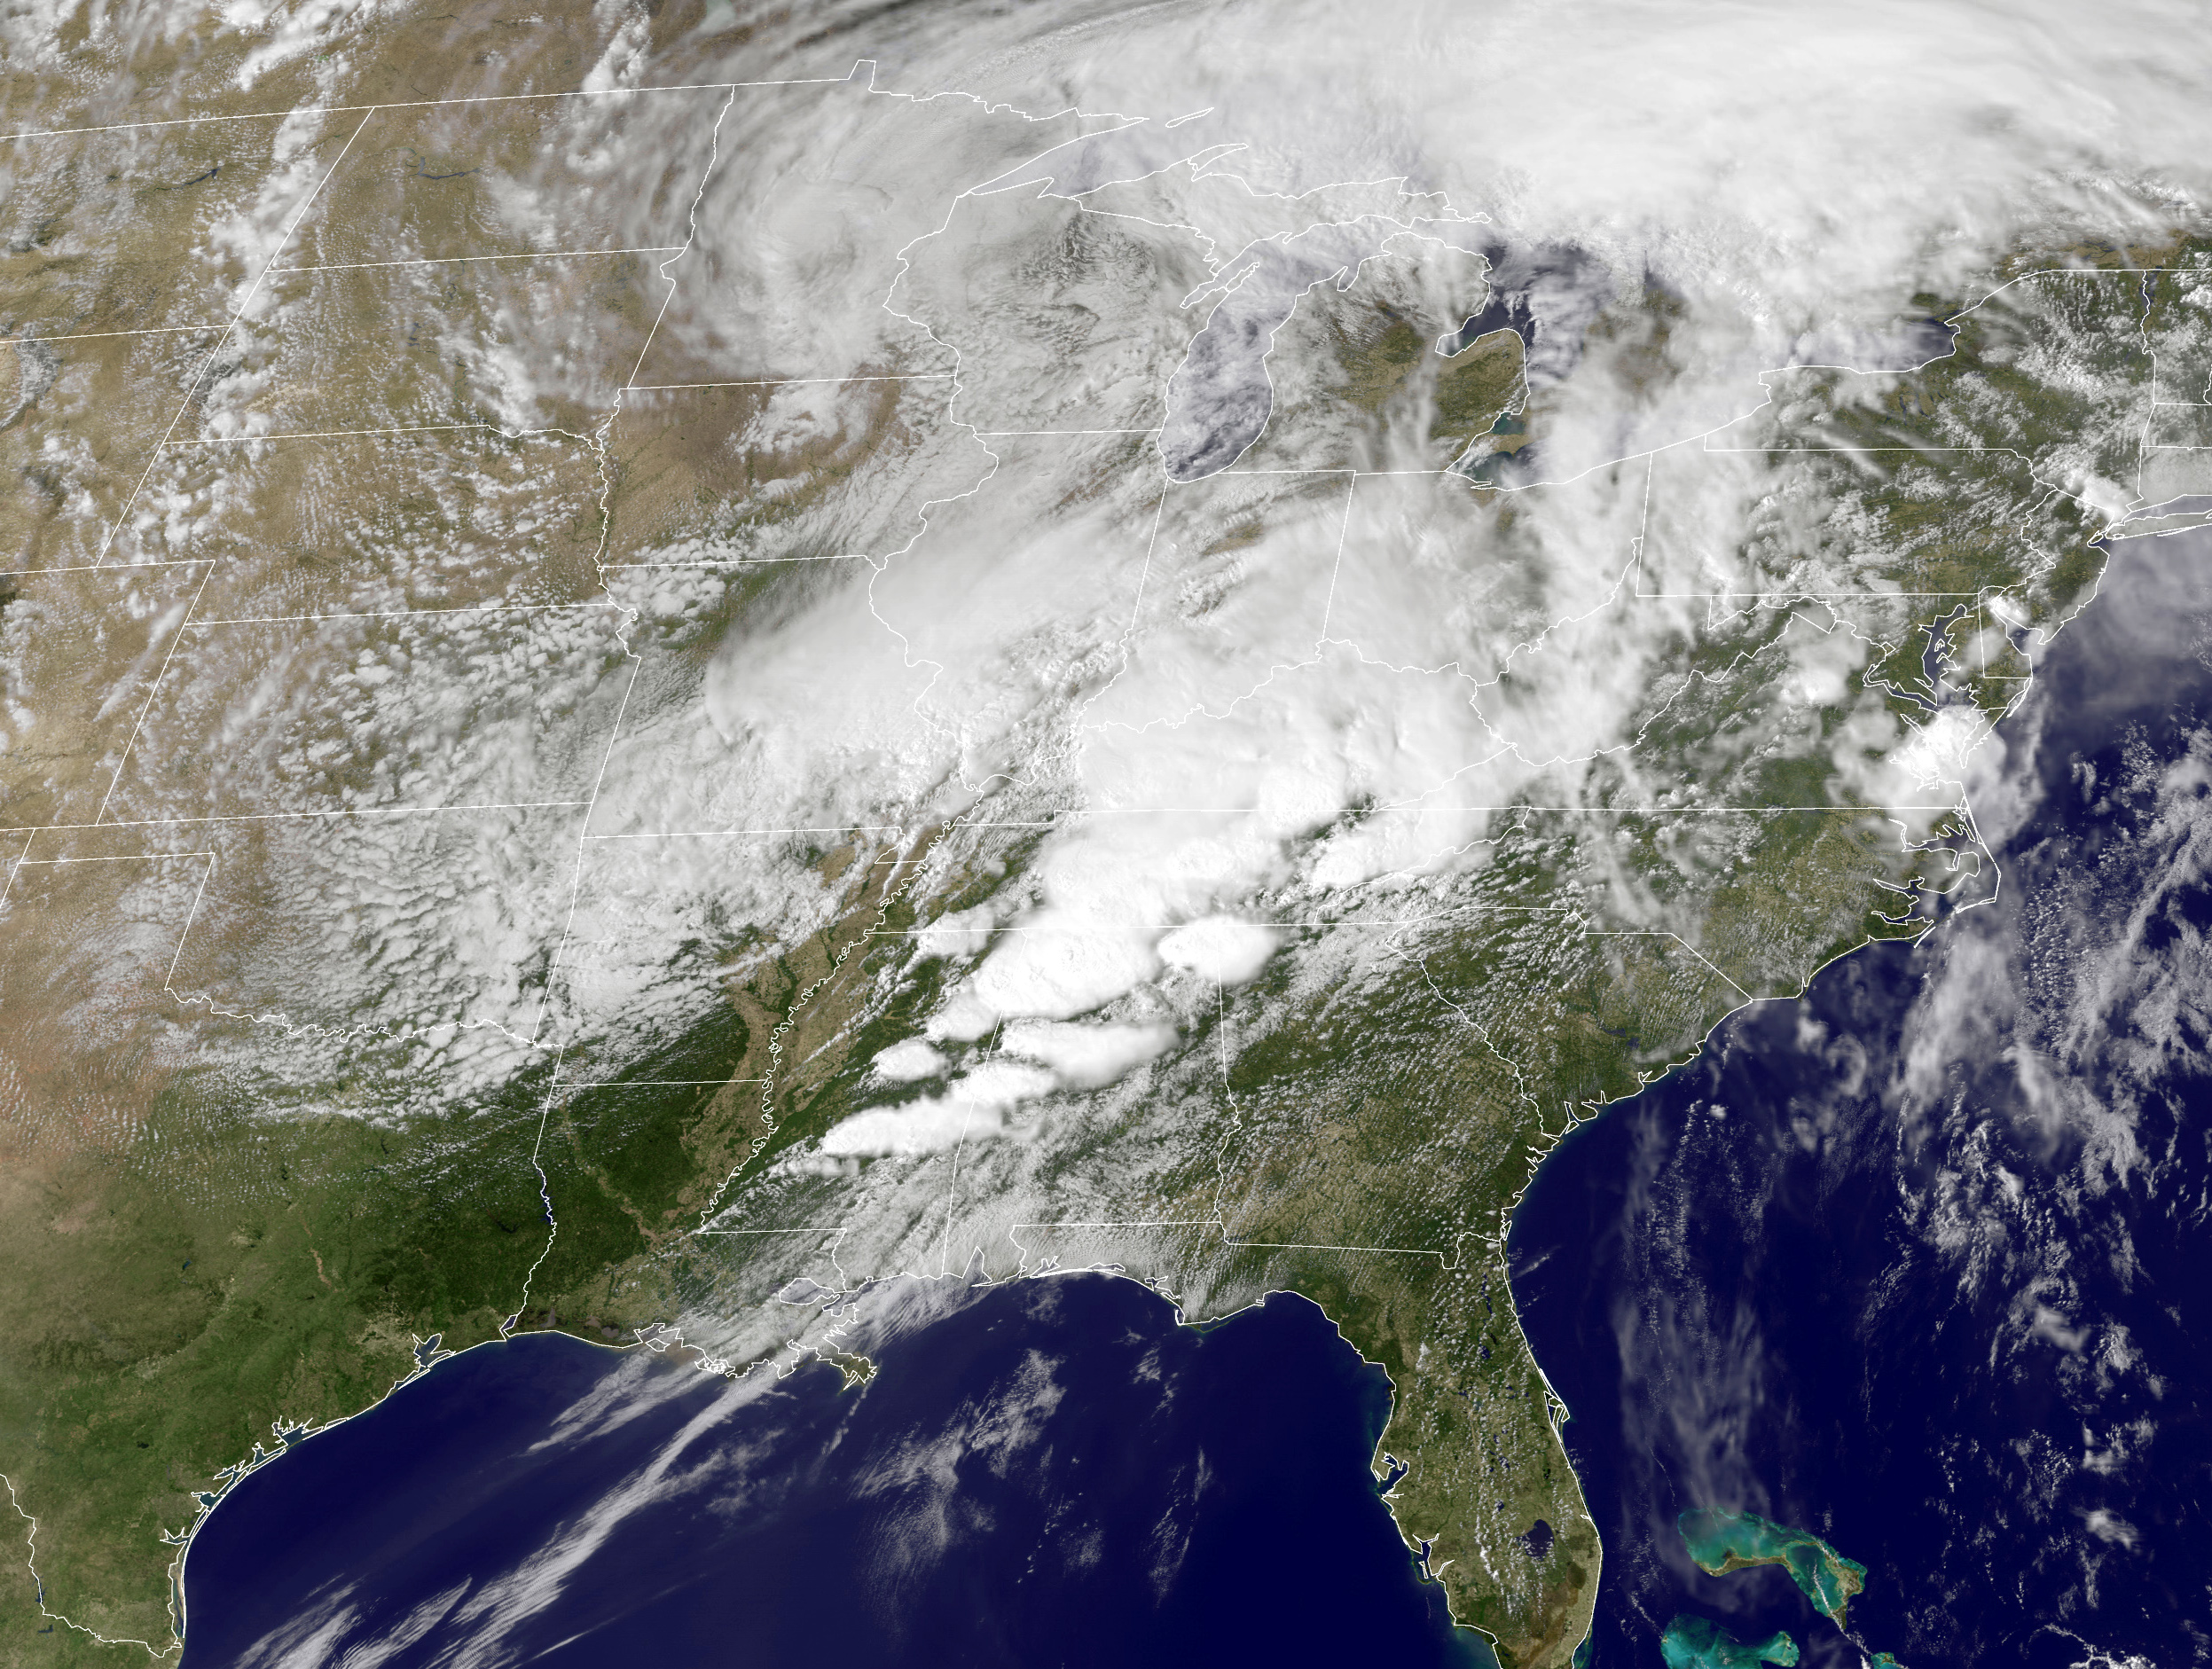
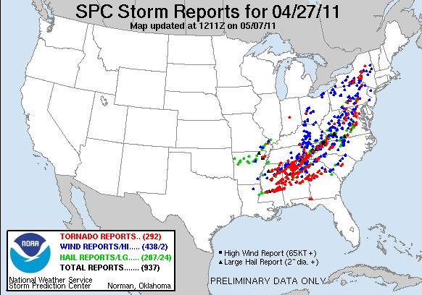
Jet Superpositions and High-Impact Weather
Jet superpositions can be an element of high-impact weather events
1–3 May 2010 Nashville Flood
Jet superposition enhanced the poleward moisture transport via its ageostrophic circulation (Winters and Martin 2014; 2016).
18–20 December 2009 Mid-Atlantic Blizzard
Jet superposition was associated with a rapidly deepening East Coast cyclone (Winters and Martin 2016; 2017).
26 October 2010: Explosive Cyclogenesis Event
Jet superposition over the West Pacific preceded the development of an intense Midwest U.S. cyclone.
25–28 April 2011 Tornado Outbreak
Jet superposition occurred over the West Pacific prior to the outbreak (Knupp et al. 2014; Christenson and Martin 2012).
NASA
SPC

Slide 52
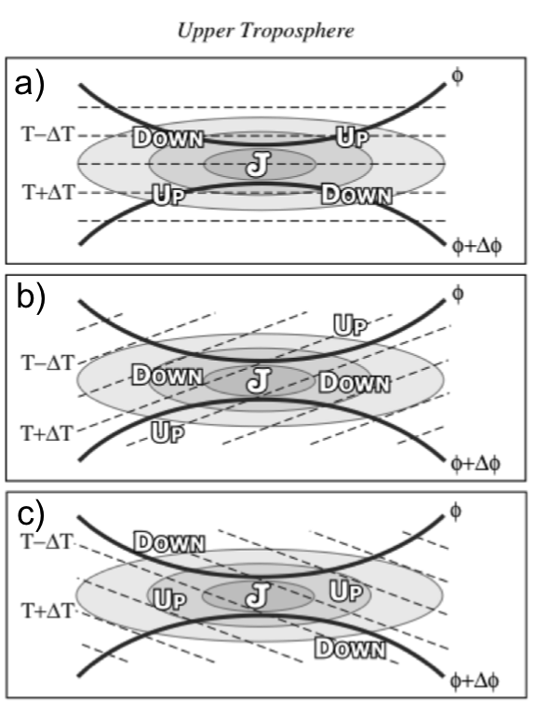
Ageostrophic Transverse Jet Circulations
Traditional four-quadrant model
Geo. cold-air advection (CAA) along the jet axis promotes subsidence through the jet core
Geo. warm-air advection (WAA) along the jet axis promotes
ascent through the jet core
Lang and Martin (2012)

Slide 53
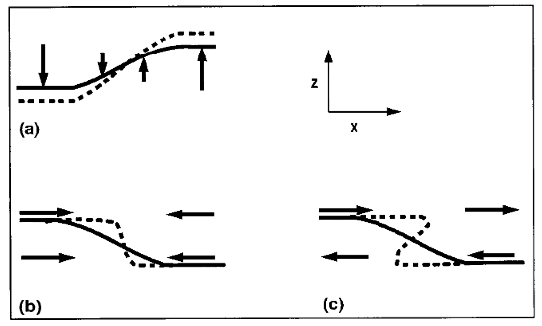
Background
Insight into how the tropopause can be restructured from a PV perspective can be found by consulting Wandishin et al. (2000)
Two processes can account for “foldogenesis”:
Differential vertical motions can vertically steepen the tropopause.
Convergence or a vertical shear can produce a differential horizontal advection of the tropopause surface.
Wandishin et al. 2000
These same mechanisms are also likely to play an important role in superpositions.

Slide 54
Jet Identification

Slide 55
Jet Superposition Event Classification
Determined the mean position of the 2-PVU contour on the 320-K and 350-K surfaces at each analysis time in the CFSR.
Compared the position of the jet superposition centroid at the start of each event against the climatological position of the 2-PVU contour.
Polar Dominant
0000 UTC 1 January
Jet Superposition Centroid

Slide 56
Jet Superposition Event Classification
Determined the mean position of the 2-PVU contour on the 320-K and 350-K surfaces at each analysis time in the CFSR.
Compared the position of the jet superposition centroid at the start of each event against the climatological position of the 2-PVU contour.
Polar Dominant
Subtropical Dominant
0000 UTC 1 January
Jet Superposition Centroid

Slide 57
Jet Superposition Event Classification
Determined the mean position of the 2-PVU contour on the 320-K and 350-K surfaces at each analysis time in the CFSR.
Compared the position of the jet superposition centroid at the start of each event against the climatological position of the 2-PVU contour.
Polar Dominant
Subtropical Dominant
Hybrid
0000 UTC 1 January
Jet Superposition Centroid

Slide 58
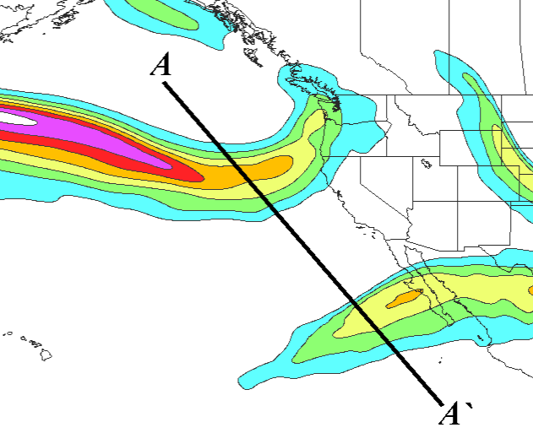
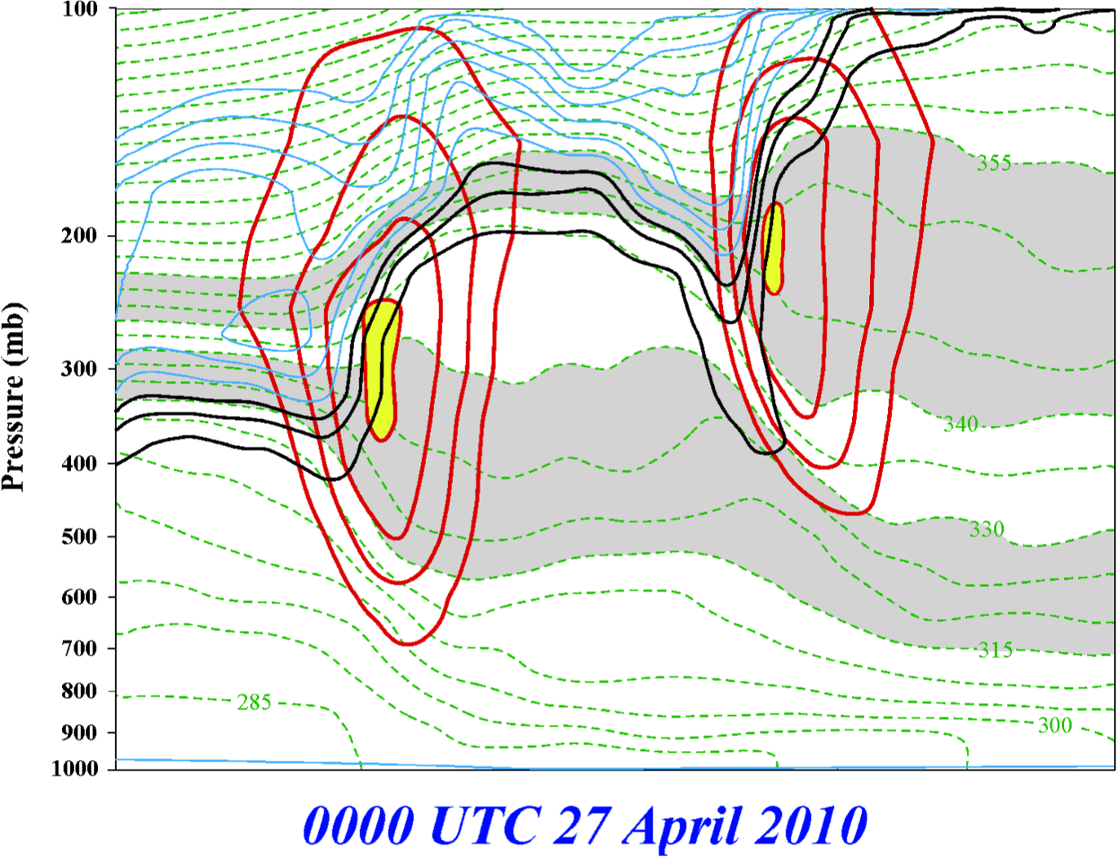
Jet Superposition Event Identification
0000 UTC 27 April 2010
A
PJ
STJ
STJ
A’
250-hPa wind speed
PJ
Isolated grid points over North America in the CFSR (Saha et al. 2014) characterized by polar and subtropical jets during Nov–Mar
1979–2010.
Isotachs
Potential Temp.
1,2,3-PVU contours
A
A’
Winters and Martin (2014, 2016, 2017); Christenson et al. (2017); Handlos and Martin (2016)

Slide 59
Jet Superposition Event Identification
0000 UTC 27 April 2010
A
PJ
STJ
A’
250-hPa wind speed
Isolated grid points over North America in the CFSR (Saha et al. 2014) characterized by polar and subtropical jets during Nov–Mar
1979–2010.
Isotachs
Potential Temp.
1,2,3-PVU contours
Strong horizontal PV gradient within the 1–3-PVU channel in the 315–330-K isentropic layer
A
A’
Winters and Martin (2014, 2016, 2017); Christenson et al. (2017); Handlos and Martin (2016)

Slide 60
Jet Superposition Event Identification
0000 UTC 27 April 2010
A
PJ
STJ
A’
250-hPa wind speed
Isolated grid points over North America in the CFSR (Saha et al. 2014) characterized by polar and subtropical jets during Nov–Mar
1979–2010.
Isotachs
Potential Temp.
1,2,3-PVU contours
Integrated 400–100-hPa wind speed must exceed 30 m s^{–1}
A
A’
Winters and Martin (2014, 2016, 2017); Christenson et al. (2017); Handlos and Martin (2016)

Slide 61
Jet Superposition Event Identification
0000 UTC 27 April 2010
A
PJ
PJ ID’s
STJ
A’
PJ
250-hPa wind speed
Isolated grid points over North America in the CFSR (Saha et al. 2014) characterized by polar and subtropical jets during Nov–Mar
1979–2010.
Isotachs
Potential Temp.
1,2,3-PVU contours
A
A’
Winters and Martin (2014, 2016, 2017); Christenson et al. (2017); Handlos and Martin (2016)

Slide 62
Jet Superposition Event Identification
0000 UTC 27 April 2010
A
PJ
PJ ID’s
STJ
A’
250-hPa wind speed
Isolated grid points over North America in the CFSR (Saha et al. 2014) characterized by polar and subtropical jets during Nov–Mar
1979–2010.
Isotachs
Potential Temp.
1,2,3-PVU contours
Strong horizontal PV gradient within the 1–3-PVU channel in the 340–355-K isentropic layer
A
A’
Winters and Martin (2014, 2016, 2017); Christenson et al. (2017); Handlos and Martin (2016)

Slide 63
Jet Superposition Event Identification
0000 UTC 27 April 2010
A
PJ
PJ ID’s
STJ
A’
250-hPa wind speed
Isolated grid points over North America in the CFSR (Saha et al. 2014) characterized by polar and subtropical jets during Nov–Mar
1979–2010.
Isotachs
Potential Temp.
1,2,3-PVU contours
Integrated 400–100-hPa wind speed must exceed 30 m s^{–1}
A
A’
Winters and Martin (2014, 2016, 2017); Christenson et al. (2017); Handlos and Martin (2016)

Slide 64
Jet Superposition Event Identification
0000 UTC 27 April 2010
A
PJ
STJ
PJ ID’s
STJ
STJ ID’s
A’
250-hPa wind speed
Isolated grid points over North America in the CFSR (Saha et al. 2014) characterized by polar and subtropical jets during Nov–Mar
1979–2010.
Isotachs
Potential Temp.
1,2,3-PVU contours
A
A’
Winters and Martin (2014, 2016, 2017); Christenson et al. (2017); Handlos and Martin (2016)

Slide 65
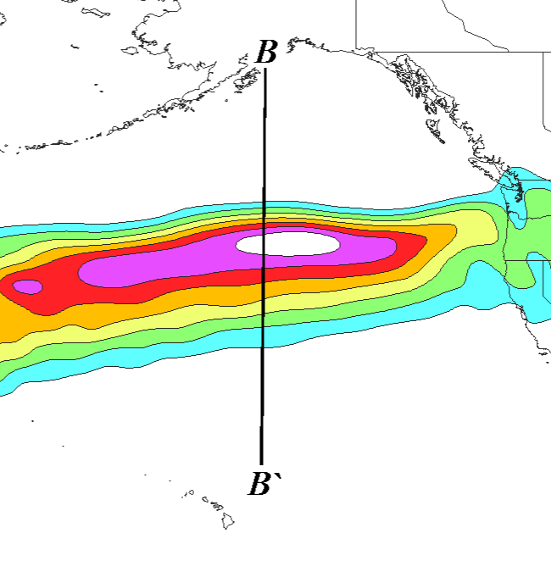
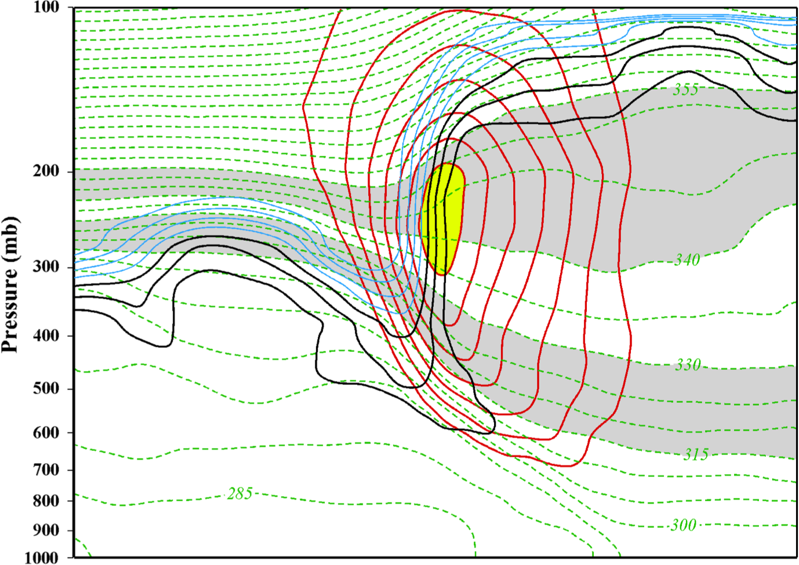
Jet Superposition Event Identification
0000 UTC 24 October 2010
B
SUPJ
B’
250-hPa wind speed
Isolated grid points over North America in the CFSR (Saha et al. 2014) characterized by a jet superposition during Nov–Mar
1979–2010.
Isotachs
Potential Temp.
1,2,3-PVU contours
B
B’
Winters and Martin (2014, 2016, 2017); Christenson et al. (2017); Handlos and Martin (2016)

Slide 66
Jet Superposition Event Identification
0000 UTC 24 October 2010
B
SUPJ
B’
250-hPa wind speed
Isolated grid points over North America in the CFSR (Saha et al. 2014) characterized by a jet superposition during Nov–Mar
1979–2010.
Isotachs
Potential Temp.
1,2,3-PVU contours
Criteria for both the polar and subtropical jets satisfied within the same grid column
B
B’
Winters and Martin (2014, 2016, 2017); Christenson et al. (2017); Handlos and Martin (2016)

Slide 67
Jet Superposition Event Identification
0000 UTC 24 October 2010
B
SUPJ
B’
SUPJ ID’s
250-hPa wind speed
Isolated grid points over North America in the CFSR (Saha et al. 2014) characterized by a jet superposition during Nov–Mar
1979–2010.
Isotachs
Potential Temp.
1,2,3-PVU contours
Criteria for both the polar and subtropical jets satisfied within the same grid column
B
B’
Winters and Martin (2014, 2016, 2017); Christenson et al. (2017); Handlos and Martin (2016)

Slide 68
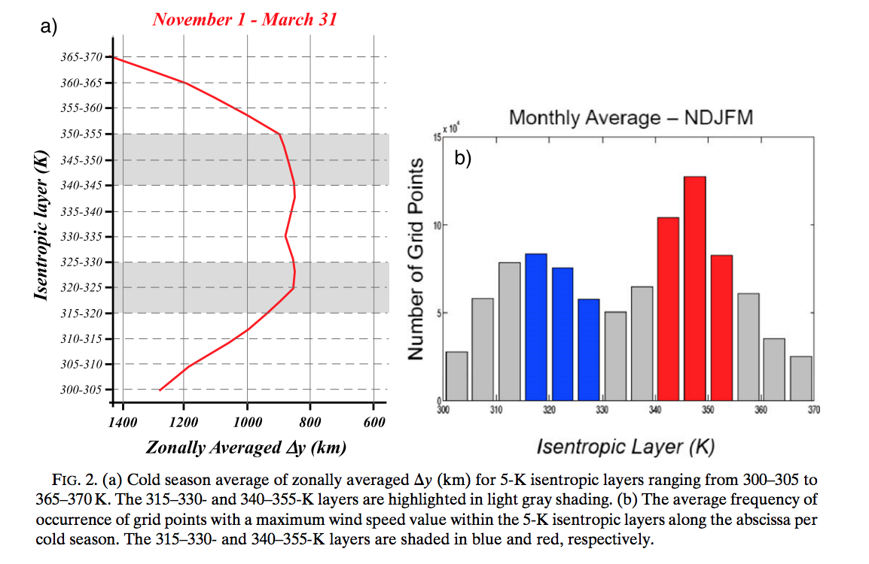
Background
Christenson et al. (2017)

Slide 69
Jet Superposition Event Identification

Slide 70
Jet Superposition Event Identification
Sample Jet Superposition Centroid Calculation
Calculated the centroid of each jet superposition based on all valid grid points at a particular analysis time.
To calculate the centroid, there must exist a group of 18 superposition grid points, of which no superposition grid point is >1000 km away from another superposition grid point.
d >1000 km
d >1000 km
d >1000 km
Used for calculation
Jet superposition centroid
Not used for calculation

