Slide 1
ATOC 4700: Weather Analysis and Forecasting
Professor: Andrew Winters
Tuesday / Thursday
1:00–2:15pm
SEEC S126
14 January 2019

Slide 2
Class Objectives
By the end of today’s class, you should have knowledge of:
The expectations and course policies for ATOC 4700
Have an understanding of basic meteorological conventions
Wind Speed and Direction
Geography
Universal Coordinated Time
Know the basic variables used to observe the state of the atmosphere, and their vertical/horizontal structure
Reading: Stull Ch. 1.1–1.5

Slide 3
About Me
Connor: Feel free to add some information/pictures to this slide to introduce yourself to the class.

Slide 4
About This Course

Slide 5
Course Content
Recipe for Forecasting the Weather:
Take a large, almost round, rotating sphere 8000 miles in diameter.
Surround it with a murky, viscous atmosphere of gases mixed with water vapor.
Tilt its axis so it wobbles back and forth with respect to a source of heat and light.
Freeze it at both ends and roast it in the middle
Cover its surface with liquid that constantly feeds water vapor into the atmosphere, and jagged topography that modulates motions within the atmosphere.
h/t Jon Martin

Slide 6
Course Content
Recipe for Forecasting the Weather:
Take a large, almost round, rotating sphere 8000 miles in diameter.
Surround it with a murky, viscous atmosphere of gases mixed with water vapor.
Tilt its axis so it wobbles back and forth with respect to a source of heat and light.
Freeze it at both ends and roast it in the middle
Cover its surface with liquid that constantly feeds water vapor into the atmosphere, and jagged topography that modulates motions within the atmosphere.
Then, try to predict the conditions of that atmosphere over a small area within a 5-mile radius for a period of 1–7 days in advance!
h/t Jon Martin

Slide 7
Course Content
General Course Topics:
The variety of measurements that are taken to observe the Earth’s atmosphere
The fundamental physical and dynamical processes that govern the:
Development of vertical motions within the troposphere
Development of midlatitude cyclones and their attendant frontal boundaries
Development of severe thunderstorms
Genesis of tropical cyclones
Evolution of weather systems along the Colorado Front Range
The principles for forecasting temperature, precipitation, and wind under a variety of atmospheric flow regimes
The principles of numerical weather prediction, and how to interpret operational forecast model output

Slide 8
Course Objectives
At the end of the semester, you will be able to:
Plot and interpret data on surface and upper-tropospheric weather maps
Connect observations and forecast model output to the physical and dynamical principles that govern the evolution of the Earth’s atmosphere
Diagnose locations susceptible to surface cyclogenesis and/or the development of a variety of high-impact weather events (e.g., tropical cyclones, severe thunderstorms, floods, etc.)
Deliver a discussion of current and forecast weather conditions that leverages the physical and dynamical principles that govern the Earth’s atmosphere
Assimilate observational and forecast model data to construct short-term forecasts of the weather conditions at a variety of locations throughout the United States

Slide 9
Course Assessment
Your final grade will be composed of the following elements:
2 Mid-Term Exams (10% each) – Feb. 13 and Mar. 19
1 Final Exam (20%) – Sat. May 2 (1:30–4:30p)
6 Quizzes (w/ 1 dropped) – 15%
6 Homework Assignments – 35%
Group Weather Discussions and your participation in the WxChallenge Forecast Competition (10%)
Weather discussions will be held during the last 15 minutes of each class period in the Collaboratory (across the hall).

Slide 10
Course Textbook and Website
Course Textbook:
Practical Meteorology: An Algebra-Based Survey of Atmospheric Science – Roland Stull
Available to download for free with a link on Canvas!
Course Website:
Accessible via canvas.colorado.edu

Slide 11
Course Accessibility
Contact Prof. Winters (andrew.c.winters@colorado.edu) if you have any concerns/accessibility requests with respect to the course
Please use “ATOC 4700” within the subject line of all e-mails related to this course

Slide 12
How to Succeed in this Course
Read the appropriate sections of the textbook prior to class and review your notes frequently
Attend all lectures and exams
Ask questions during and outside of class
Attend office hours if you are struggling with a concept
Check the class website frequently for important class-related announcements
Complete all coursework neatly, thoroughly, and on time
Contact Prof. Winters as soon as possible if you have any questions or concerns about the class

Slide 13
Basic Meteorological Conventions

Slide 14
Cartesian Coordinate System
Z (Vertical)
In this coordinate system:
The positive x-direction points to the east
The positive y-direction points to the north
The positive z-direction points upward
Y (North)
Position
X (East)

Slide 15
Cartesian Coordinate System
Z (Vertical)
In this coordinate system:
Velocity in the x-direction is denoted by “U” and referred to as the zonal wind
Velocity in the y-direction is denoted by “V” and referred to as the meridional wind
Velocity in the z-direction is denoted by “W” (or “$ω$” if using pressure as the vertical coordinate)
Y (North)
Position
X (East)
W (Vertical)
V (North)
Velocity
U (East)

Slide 16
Wind Direction
Winds are described based on the direction the wind is coming from
The wind direction is measured in degrees, with 0◦ representing a wind directed from the north to south
North
0◦
West
East
270◦
90◦
180◦
South

Slide 17
Wind Direction
Winds are described based on the direction the wind is coming from
The wind direction is measured in degrees, with 0◦ representing a wind directed from the north to south
The length of a wind vector describes its magnitude
The orientation of the wind vector describes the direction of the wind
North
0◦
West
East
270◦
90◦
180◦
South
Wind Vector

Slide 18
Wind Direction
Winds are described based on the direction the wind is coming from
The wind direction is measured in degrees, with 0◦ representing a wind directed from the north to south
Westerly = wind from the west
Easterly = wind from the east
Northerly = wind from the north
Southerly = wind from the south
North
0◦
West
East
270◦
90◦
180◦
South
Wind Vector

Slide 19
Sample Quiz Question!
The wind vector to the left describes a:
Easterly Wind
Westerly Wind
Northerly Wind
Southerly Wind
North
0◦
West
East
270◦
90◦
180◦
South
Wind Vector

Slide 20
Sample Quiz Question!
The wind vector to the left describes a:
Easterly Wind
Westerly Wind
Northerly Wind
Southerly Wind
North
0◦
West
East
270◦
90◦
180◦
South
Wind Vector

Slide 21
Another Sample Quiz Question!
Describe the wind direction in degrees:
North
0◦
West
East
270◦
90◦
180◦
South
Wind Vector

Slide 22
Another Sample Quiz Question!
Describe the wind direction in degrees:
45 degrees
Northeasterly Wind
North
0◦
West
East
270◦
90◦
180◦
South
Wind Vector

Slide 23
Geography
Lines of constant latitude are known as “parallels”
The Equator is defined to be at 0◦
Latitude is positive north of the equator, and negative south of the equator
Latitude is also defined in ◦N or ◦S based on the position of a parallel relative to the equator

Slide 24
Geography
Lines of constant longitude are known as “meridians”
The Greenwich Meridian (Great Britain) is defined to be at 0◦
Latitude is positive east of the Greenwich Meridian, and negative west of the Greenwich Meridian
Latitude is also defined in ◦E or ◦W based on the position of a meridian relative to the Greenwich Meridian

Slide 25
Geography
Knowledge of North American geography is essential in this course
Each quiz/exam will test your knowledge of North American geography
States
Major Cities
Countries
Provinces
Mountain Ranges
Bodies of Water
Each quiz/exam will feature a different region within North America
https://www.geographicguide.com/north-america-map.htm

Slide 26
Geography
In-class activity
With your pods, identify and label as many states and state capitals on the maps provided in 5 minutes
The pod with the most correct answers will receive a prize upon Prof. Winters’ return next week
1 point for each correct state; 2 points for each correct state capital

Slide 27
Coordinated Universal Time (UTC)
Corresponds to the time in Greenwich, Great Britain (at 0◦ longitude)
This time serves as the basis for coordinated meteorological observations worldwide
Forecast models are typically initialized at 0000, 0600, 1200, or 1800 UTC depending on the forecast model
Atmospheric soundings are typically conducted at 0000 UTC and 1200 UTC around the globe
0000 UTC corresponds to 5:00pm MST / 6:00pm MDT

Slide 28
Basic Atmospheric Variables and Structure

Slide 29
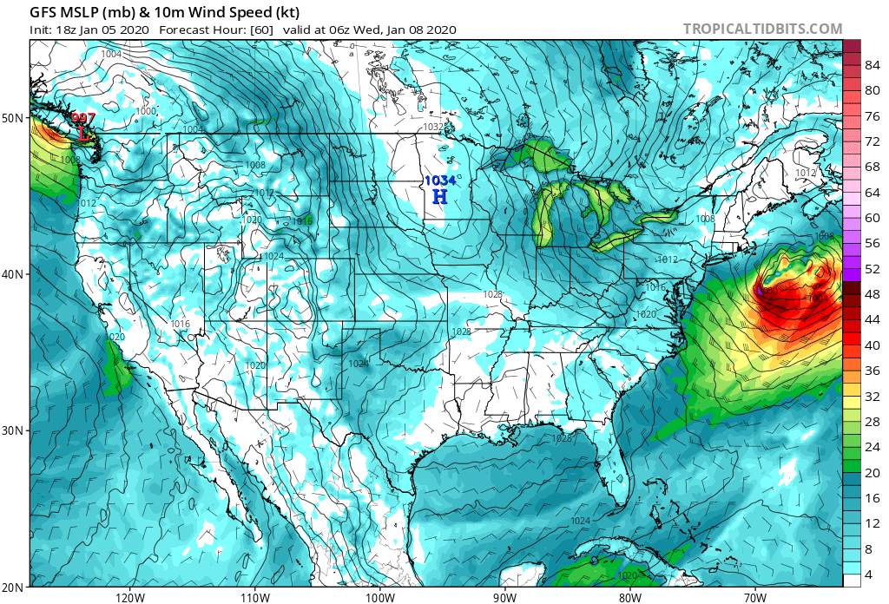
Wind Speed and Direction
Measured in m/s, knots, or mph
1 knot = 0.514 m/s
1 mph = 0.869 knots
Measured using an anemometer
The wind plays a substantial role in the transport of temperature and moisture within the atmosphere
The wind speed and direction varies based on topography, and the prevailing synoptic-scale conditions

Slide 30
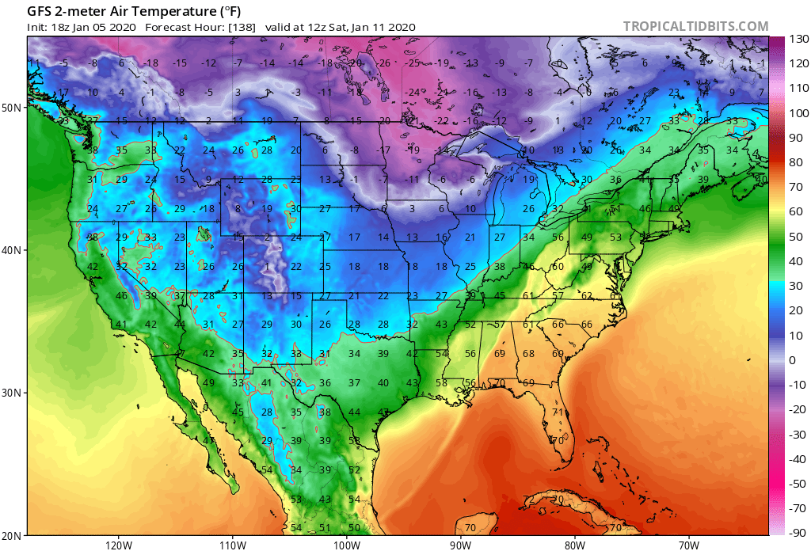
Temperature
Measured in Kelvin (K), degrees Celsius (◦C), or degrees Fahrenheit (◦F)
T_{Kelvin} = T_{Celsius} + 273
T_{Fahrenheit} = [(9/5) x T_{celsius}] + 32
Measured using a thermometer
Dependent on atmospheric pressure and density via the Ideal Gas Law ($p=ρRT$)
At midlatitudes, the temperature at a location is strongly modulated by the synoptic-scale circulation

Slide 31
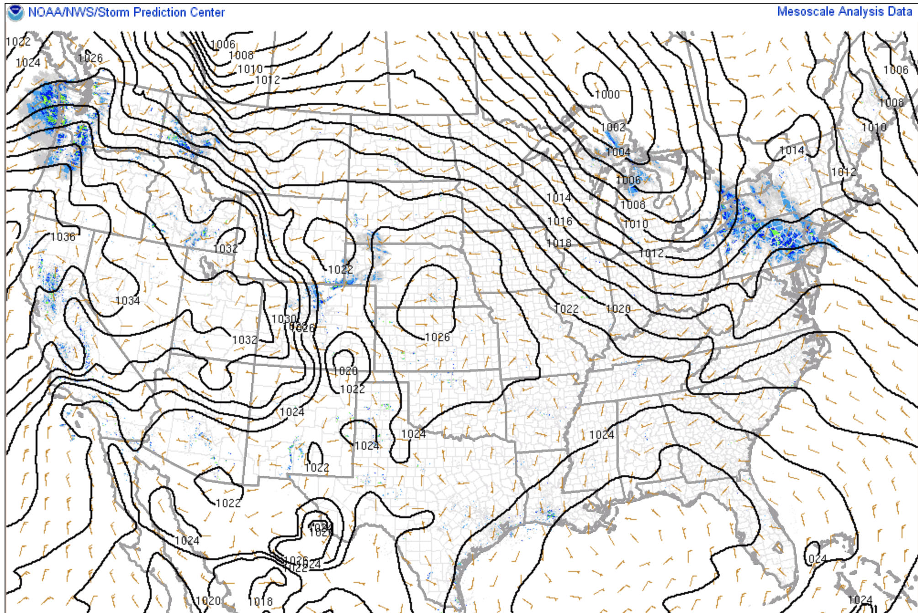
Pressure
Typically measured in hectopascals (hPa)
1 hPa = 100 Pa / 1 mb
Measured using a barometer
Corresponds to the weight of the atmosphere above a point (P=Force/Area)
L
H
The surface pressure distribution is used to identify the position of surface cyclones and anticyclones
The pressure distribution can be used to infer the surface wind speed/direction, and the transport of temperature/moisture

Slide 32
Moisture Variables
Dew Point Temperature (◦F or ◦C)
The temperature to which the air must cool (at constant pressure and without adding or removing water vapor) in order to reach saturation
Wet Bulb Temperature (◦F or ◦C)
The temperature measured by a thermometer wrapped in a wet cloth with air steadily blowing past it
Measures the lowest temperature that can be achieved solely by evaporating water into the air
Mixing Ratio (g/kg; denoted by r)
The amount of water vapor per kg of dry air
Saturation Mixing Ratio (g/kg)
The amount of water vapor per kg of dry air in a saturated air parcel. Varies exponentially with temperature.

Slide 33
Moisture Variables
Stull
Relative Humidity (%)
Approximately equal to the mixing ratio divided by the saturation mixing ratio.

Slide 34
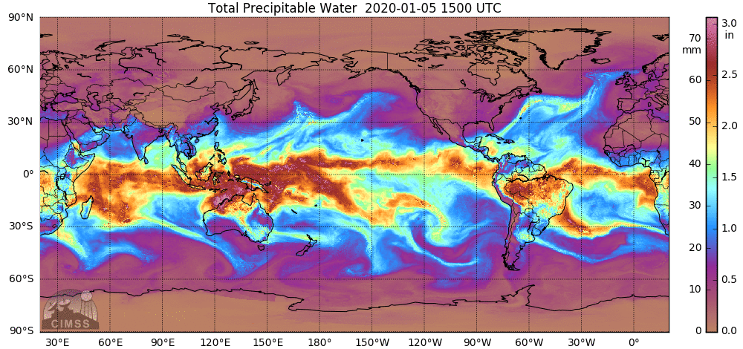
Moisture Variables
Precipitable Water (mm)
A measure of the total integrated water vapor within a column of air

Slide 35
Vertical Structure of the Atmosphere
The atmosphere features four layers:
Troposphere
Stratosphere
Mesosphere
Thermosphere

Slide 36
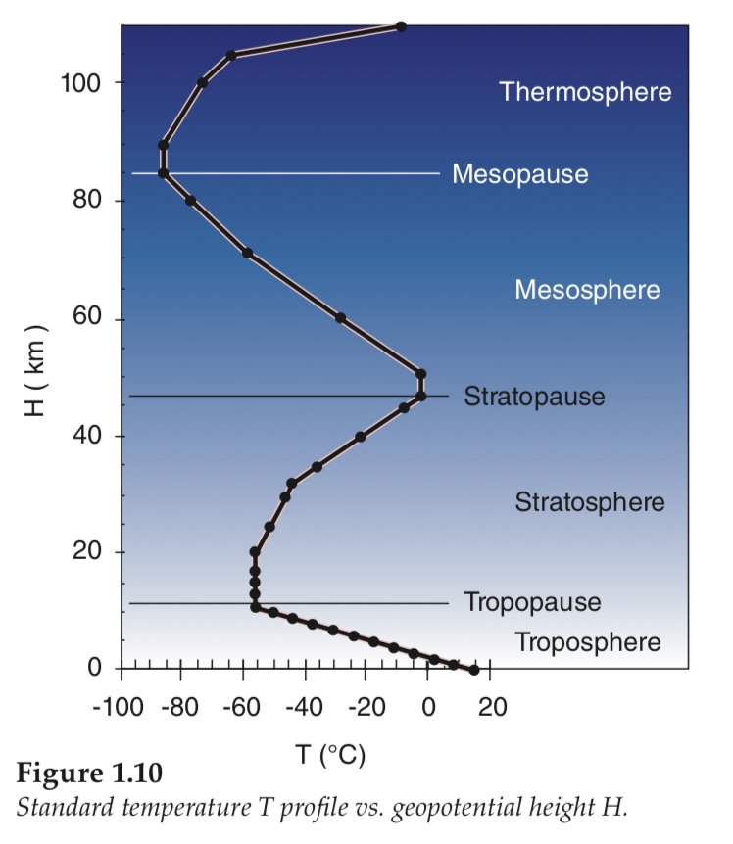
Vertical Structure of the Atmosphere
The atmosphere features four layers:
Troposphere
Stratosphere
Mesosphere
Thermosphere
We’ll primarily be concerned with what happens in the troposphere
Though, the circulation within the stratosphere can impact the troposphere and vice versa

Slide 37
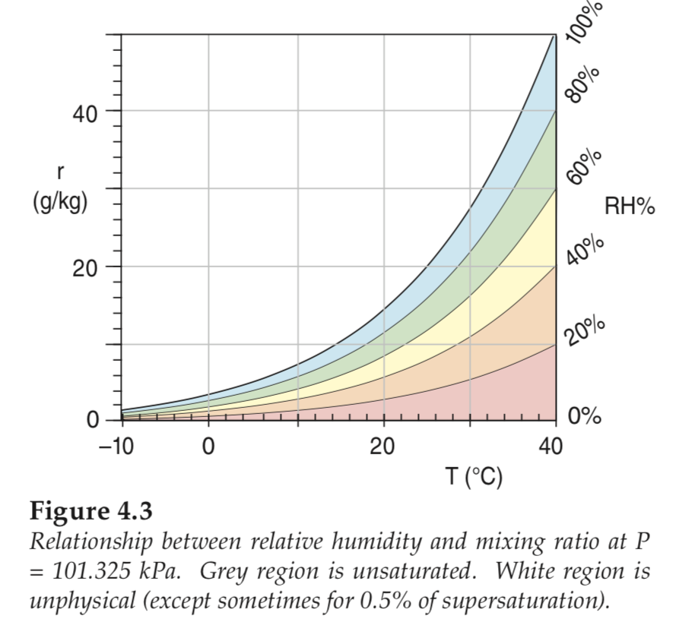
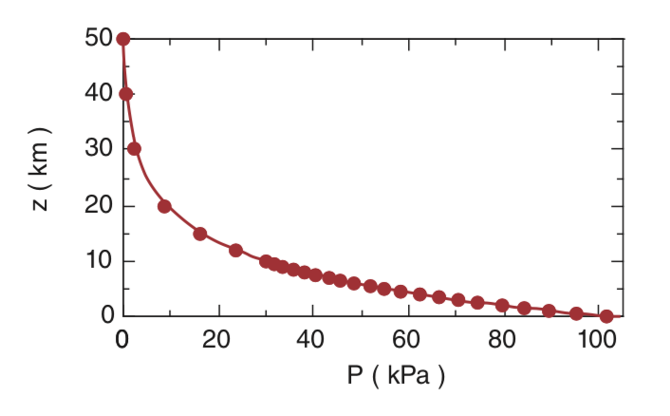
Vertical Structure of the Atmosphere
Pressure decreases exponentially with height in the atmosphere
Moisture is largely confined within the lowest few km of the troposphere where it is the warmest

Slide 38
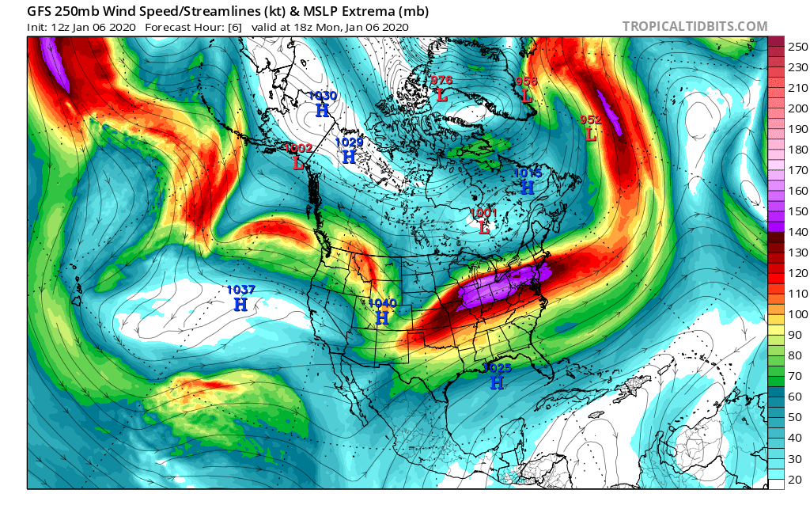
Vertical Structure of the Atmosphere
Within the troposphere, the wind speed is typically maximized at the level of the tropopause at midlatitudes

Slide 39
Surface Analysis

Slide 40
Class Objectives
By the end of this section, you should have knowledge of:
How to interpret and decode METARs
How to build a station model using observed atmospheric data at a location
How to perform a detailed hand analysis of surface observations, including the identification of surface cyclones/anticyclones and surface frontal boundaries
Reading: Stull 9.1–9.3

Slide 41
METARs
METeorological Aerodrome Reports (METARs)
The international reporting standard for surface observations
Observations taken hourly, or more often as necessary

Slide 42
METARs
KAUS 092135Z 26018G25KT 8SM -TSRA BR SCT045 BKN060 OVC080 30/21 A2992 RMK FQT LTGICCCCG OHD-W MOVG E RAB25 TSB32 CB ALQDS SLP132 P0035 T03020210 =
KAUS – Station Name (Austin, TX)
092135Z – Day of the Month and Time (9th at 2135 UTC)
26018G25KT – Wind direction, wind speed, and wind gusts (260º [westerly wind], at 18 kts, gusting to 25 kts)
8SM – Visibility (8 statute miles)
-TSRA – Thunderstorm and light rain
BR – Mist

Slide 43
METARs
KAUS 092135Z 26018G25KT 8SM -TSRA BR SCT045 BKN060 OVC080 30/21 A2992 RMK FQT LTGICCCCG OHD-W MOVG E RAB25 TSB32 CB ALQDS SLP132 P0035 T03020210 =
SCT045 – Scattered clouds at 4,500 feet (~50% coverage)
BKN060 – Broken clouds at 6,000 feet (~75% coverage)
OVC080 – Overcast clouds at 8,000 feet (~100% coverage)
30/21 – Temperature and Dewpoint in ºC or ºF (T = 30 ºC ; T_{dew}= 21 ºC in this case)
A2992 – Pressure in inches of Mercury (29.92 in.)

Slide 44
METARs
KAUS 092135Z 26018G25KT 8SM -TSRA BR SCT045 BKN060 OVC080 30/21 A2992 RMK FQT LTGICCCCG OHD-W MOVG E RAB25 TSB32 CB ALQDS SLP132 P0035 T03020210 =
RMK – Remarks section of METAR
FQT LTGICCCG OHD-W MOVG E – Frequent intercloud (IC), cloud-to-cloud (CC), and cloud-to-ground (CG) lightning (LTG) overhead (OHD). Arriving from the west, and moving east (W MOVG E)
RAB25 – Rain began at 25 minutes past the hour
TSB32 – Thunderstorm began at 32 minutes past the hour

Slide 45
METARs
KAUS 092135Z 26018G25KT 8SM -TSRA BR SCT045 BKN060 OVC080 30/21 A2992 RMK FQT LTGICCCCG OHD-W MOVG E RAB25 TSB32 CB ALQDS SLP132 P0035 T03020210 =
CB ALQDS – Cumulonimbus clouds (CB) in all quadrants of the sky (ALQDS)
SLP 132 – Sea level pressure in hPa (132 = 1013.2 hPa). If the first digit is 4 or less, append a 10 to the front of the number to get the pressure, if the first digit is 5 or more, append a 9 to the front of the number.
P0035 – Precipitation in .01 in. since the top of the hour (0.35 in.)

Slide 46
METARs
KAUS 092135Z 26018G25KT 8SM -TSRA BR SCT045 BKN060 OVC080 30/21 A2992 RMK FQT LTGICCCCG OHD-W MOVG E RAB25 TSB32 CB ALQDS SLP132 P0035 T03020210 =
T03020210 – Unrounded Temperature and dewpoint in ºC.
The four digits after “T” is the observed temperature (30.2ºC)
The remaining four digits describe the dew point temperature (21.0 ºC)

Slide 47
Station Plots
T
SLP
Vis
Wx
Cloud Cover
T_{d}
Wind direction
Wind speed

Slide 48
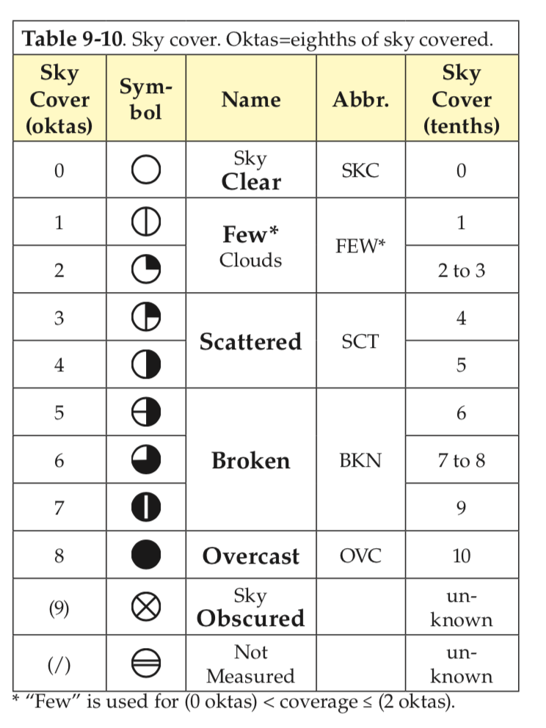
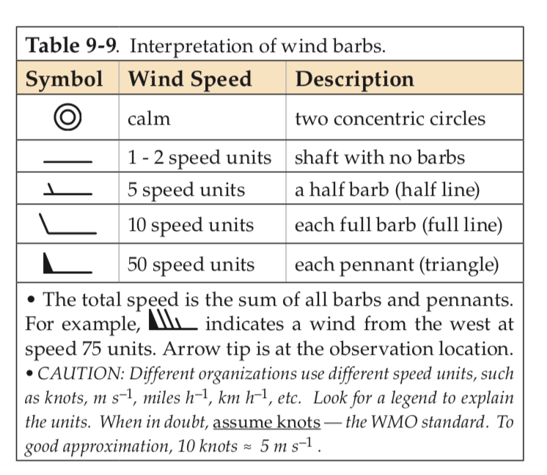
Station Plots
CLR
Sky cover and wind speed definitions for station plots

Slide 49
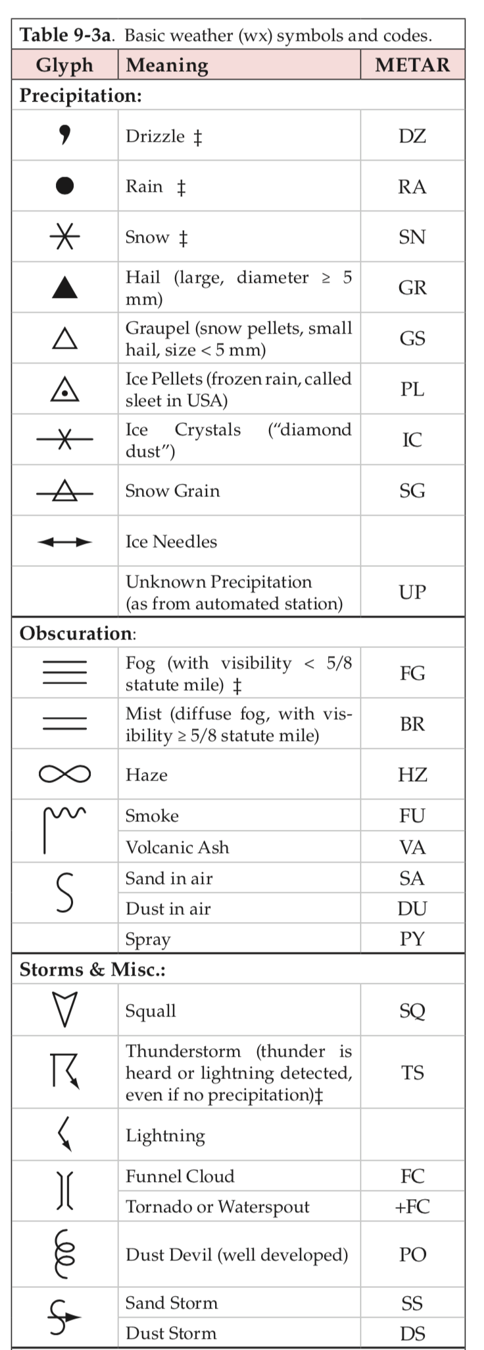
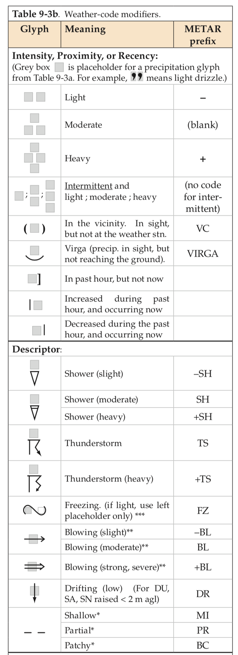
Station Plots
Different types of weather symbols and their modifiers

Slide 50
Station Plots
KAUS 092135Z 26018G25KT 8SM -TSRA BR SCT045 BKN060 OVC080 30/21 A2992 RMK FQT LTGICCCCG OHD-W MOVG E RAB25 TSB32 CB ALQDS SLP132 P0035 T03020210 =
T
SLP
Vis
Wx
Cloud Cover
T_{d}
Wind direction
Wind speed

Slide 51
Station Plots
KAUS 092135Z 26018G25KT 8SM -TSRA BR SCT045 BKN060 OVC080 30/21 A2992 RMK FQT LTGICCCCG OHD-W MOVG E RAB25 TSB32 CB ALQDS SLP132 P0035 T03020210 =
30
SLP
Vis
Wx
Cloud Cover
T_{d}
Wind direction
Wind speed

Slide 52
Station Plots
KAUS 092135Z 26018G25KT 8SM -TSRA BR SCT045 BKN060 OVC080 30/21 A2992 RMK FQT LTGICCCCG OHD-W MOVG E RAB25 TSB32 CB ALQDS SLP132 P0035 T03020210 =
30
SLP
Vis
Wx
Cloud Cover
21
Wind direction
Wind speed

Slide 53
Station Plots
KAUS 092135Z 26018G25KT 8SM -TSRA BR SCT045 BKN060 OVC080 30/21 A2992 RMK FQT LTGICCCCG OHD-W MOVG E RAB25 TSB32 CB ALQDS SLP132 P0035 T03020210 =
30
SLP
8
Wx
Cloud Cover
21
Wind direction
Wind speed

Slide 54
Station Plots
KAUS 092135Z 26018G25KT 8SM -TSRA BR SCT045 BKN060 OVC080 30/21 A2992 RMK FQT LTGICCCCG OHD-W MOVG E RAB25 TSB32 CB ALQDS SLP132 P0035 T03020210 =
30
132
8
Wx
Cloud Cover
21
Wind direction
Wind speed

Slide 55
Station Plots
KAUS 092135Z 26018G25KT 8SM -TSRA BR SCT045 BKN060 OVC080 30/21 A2992 RMK FQT LTGICCCCG OHD-W MOVG E RAB25 TSB32 CB ALQDS SLP132 P0035 T03020210 =
30
132
8
Cloud Cover
21
Wind direction
Wind speed

Slide 56
Station Plots
KAUS 092135Z 26018G25KT 8SM -TSRA BR SCT045 BKN060 OVC080 30/21 A2992 RMK FQT LTGICCCCG OHD-W MOVG E RAB25 TSB32 CB ALQDS SLP132 P0035 T03020210 =
30
132
8
Cloud Cover
21
Wind direction
If more than one cloud coverage is listed, defer to the cloud cover with the largest sky coverage
Wind speed

Slide 57
Station Plots
KAUS 092135Z 26018G25KT 8SM -TSRA BR SCT045 BKN060 OVC080 30/21 A2992 RMK FQT LTGICCCCG OHD-W MOVG E RAB25 TSB32 CB ALQDS SLP132 P0035 T03020210 =
30
132
8
Cloud Cover
21
For wind speed, round to the closest 5 kt interval

Slide 58
Station Plots – Your Turn!
KSEA 061653Z 18017KT 6SM -RA BR SCT012 OVC023 08/07 A3009 RMK AO2 PK WND 18029/1607 SLP196 P0005 T00830067

Slide 59
Station Plots
KSEA 061653Z 18017KT 6SM -RA BR SCT012 OVC023 08/07 A3009 RMK AO2 PK WND 18029/1607 SLP196 P0005 T00830067
8
196
6
Cloud Cover
7

Slide 60
Station Plots
KSEA 061653Z 18017KT 6SM -RA BR SCT012 OVC023 08/07 A3009 RMK AO2 PK WND 18029/1607 SLP196 P0005 T00830067
8
196
6
Cloud Cover
7
We can analyze a collection of station observations to learn more about the synoptic-scale conditions

Slide 61
Hand Analysis
Key Tips:
Survey station data to identify local maxima/minima
Start contouring a value that lies in the middle of your identified maxima/minima
Contour using standard intervals (4 hPa for surface pressure; 5º for surface temperature)
Isopleths should never branch or cross one another
Always label your isopleths
Contour lightly using a pencil
Contours should be smooth and not noisy (e.g., not jagged, no kinks) for a synoptic-scale analysis
Isopleths should never abruptly end in the middle of a map
Interpolate between stations where necessary (i.e., draw a 5ºC contour between two observations of 4ºC and 6ºC, for example)
To check the validity of your isopleths:
Imagine walking along one of them, smaller values should lie on one side of you and larger values on the other side.

Slide 62
Hand Analysis

Slide 63
Hand Analysis
Coldest
Warmest

Slide 64
Hand Analysis

Slide 65
Hand Analysis

Slide 66
Hand Analysis
For pressure:
When contouring lines of constant pressure (isobars), the spacing between isobars (gradient) should correspond to the wind speed at a station
Wider spacing between isobars = weak winds
Closer spacing between isobars = strong winds
Local minima in pressure = surface cyclones
Local maxima in pressure = surface anticyclones

Slide 67
Hand Analysis

Slide 68
Hand Analysis
L
H

Slide 69
Hand Analysis
To identify fronts:
Look for strong gradients in temperature (closely packed isotherms)
Look for a wind shift across the strong gradient in temperature
Look for a local minimum in pressure at the location of the front
To determine the frontal type and movement:
Evaluate the component of the wind perpendicular to the frontal zone
Evaluate whether that component of the wind is ushering in cold or warm air into that location.
Always draw the frontal boundary on the warm side of the temperature gradient

Slide 70
Hand Analysis
L

Slide 71
Hand Analysis
L

Slide 72
Hand Analysis
L

Slide 73
Hand Analysis
Your turn!
0000 UTC 27 January 1996 Great Lakes Cyclone
Developed in the Texas Panhandle and translated towards the Northeast
1–2 feet of snow and blizzard conditions in western Wisconsin/southeast Minnesota
Severe thunderstorms in Des Moines, Iowa

