Slide 1
A North Pacific Jet Phase Diagram Perspective on Extreme Weather Events during 2016–2017: Illustrative Examples
Lance F. Bosart, Andrew C. Winters, and Daniel Keyser
Department of Atmospheric and Environmental Sciences
University at Albany, State University of New York, Albany, NY 12222
18th Cyclone Workshop
Sainte Adele, QC
2 October 2017
This work is supported by NOAA Grant NA15NWS4680006

Slide 2
Motivation
The North Pacific Jet (NPJ) phase diagram serves as an objective tool to characterize the instantaneous state and evolution of the upper-tropospheric flow pattern over the North Pacific
The previous presentation indicated that jet retractions and equatorward shifts are generally characterized by reduced forecast skill in comparison to jet extensions and poleward shifts
The prevailing NPJ regime, as determined by the NPJ phase diagram, has important implications for the character of the downstream upper-tropospheric flow pattern over North America

Slide 3
NPJ Regime Composite Patterns
Griffin and Martin (2017) employed the NCEP-NCAR Reanalysis dataset to highlight the characteristic synoptic evolution associated with each NPJ regime
Their results are closely replicated by employing the CFSR and selecting out periods during which the NPJ resides within the same quadrant of the NPJ phase diagram for at least 3 consecutive days
The subsequent slides summarize the characteristic upper-tropospheric flow patterns associated with each NPJ regime 4 days following the development of that NPJ regime
Notes:
Day + 4 is chosen because it generally features the maximum response over North America.

Slide 4
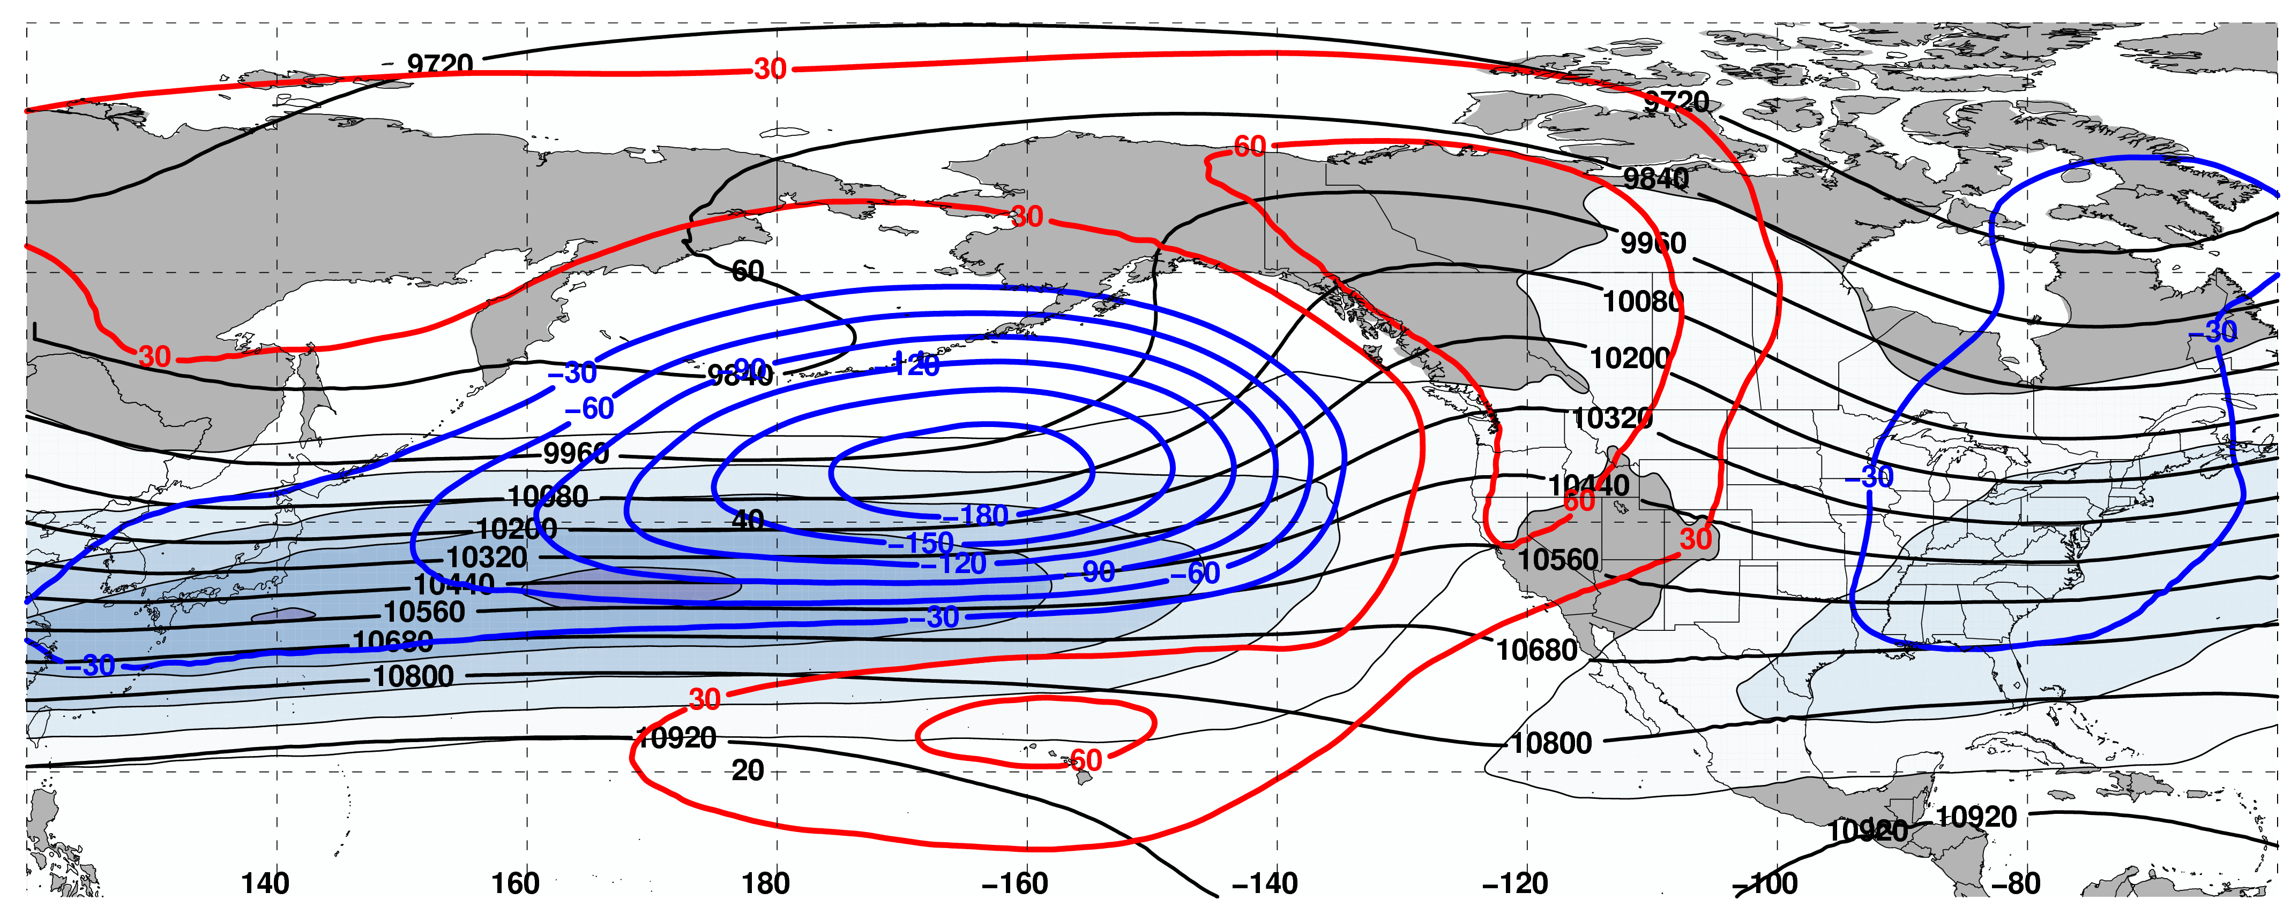
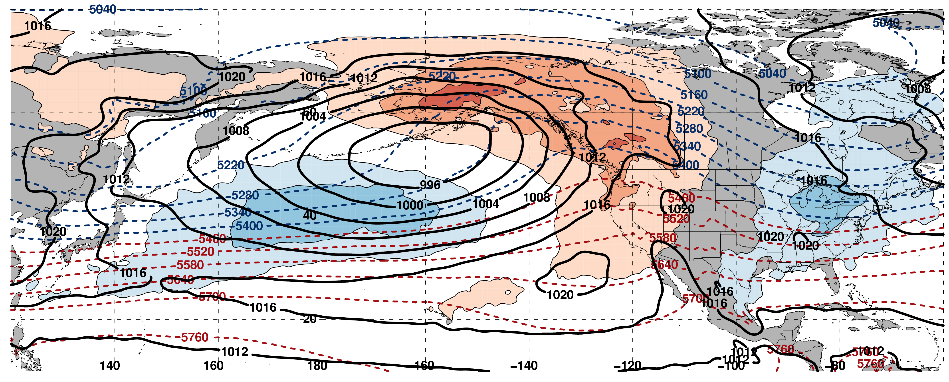
250-hPa Wind Speed (shading), Geo. Heights (contours), Geo. Height Anom. (contours):
Jet Extension D+4
N = 159
m s^{–1}
Mean SLP (contours), 1000–500-hPa Thick. (contours), 850-hPa Temp. Anom. (shading):
K

Slide 5
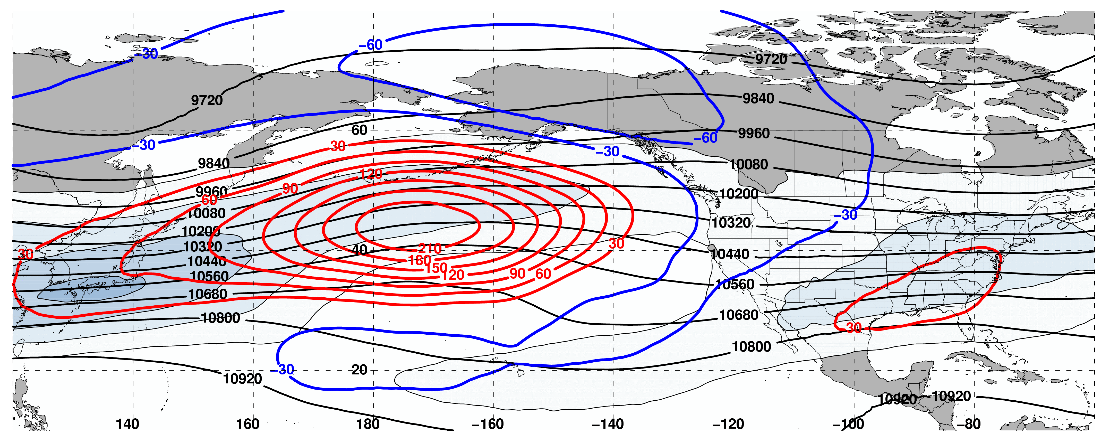
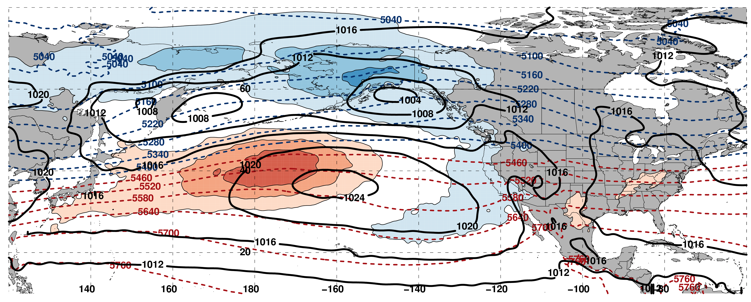
250-hPa Wind Speed (shading), Geo. Heights (contours), Geo. Height Anom. (contours):
Jet Retraction D+4
N = 162
m s^{–1}
Mean SLP (contours), 1000–500-hPa Thick. (contours), 850-hPa Temp. Anom. (shading):
K

Slide 6
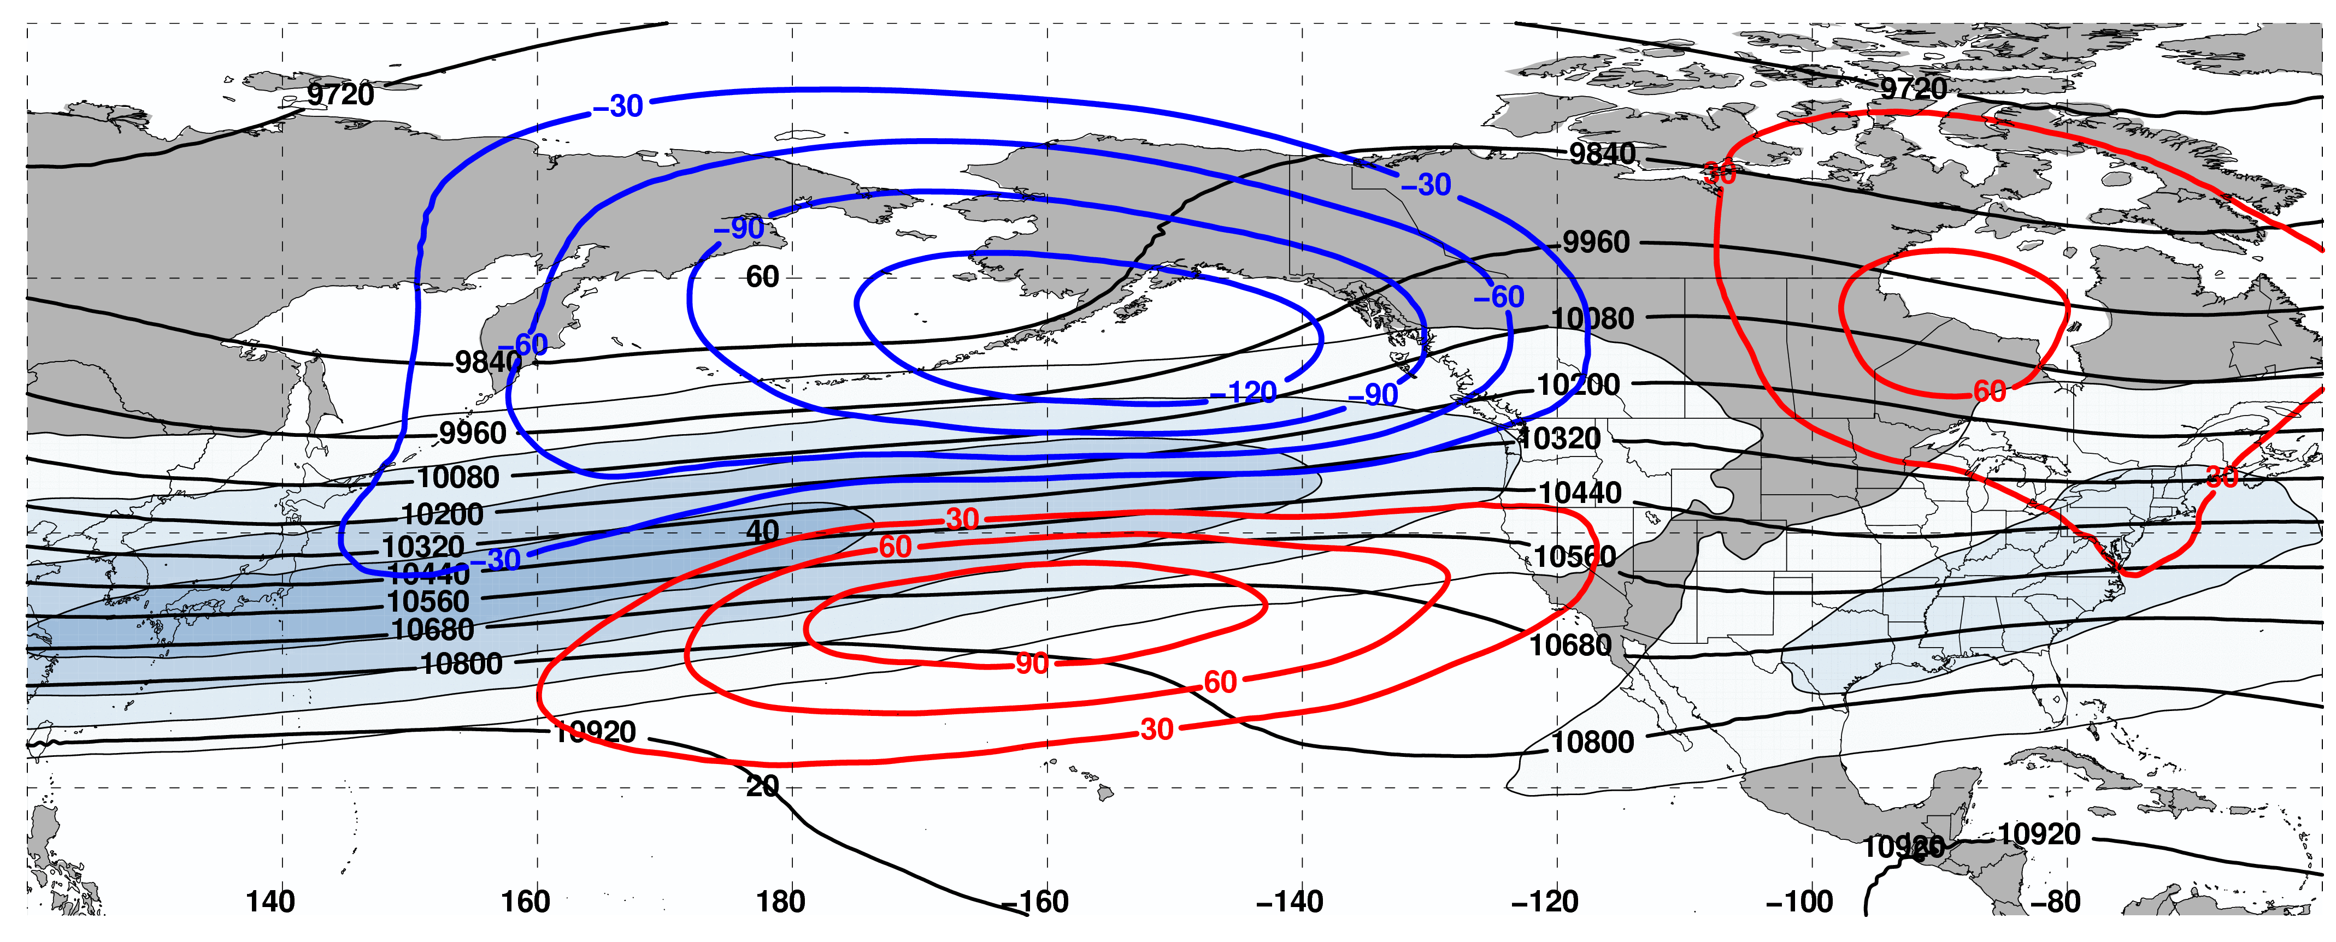
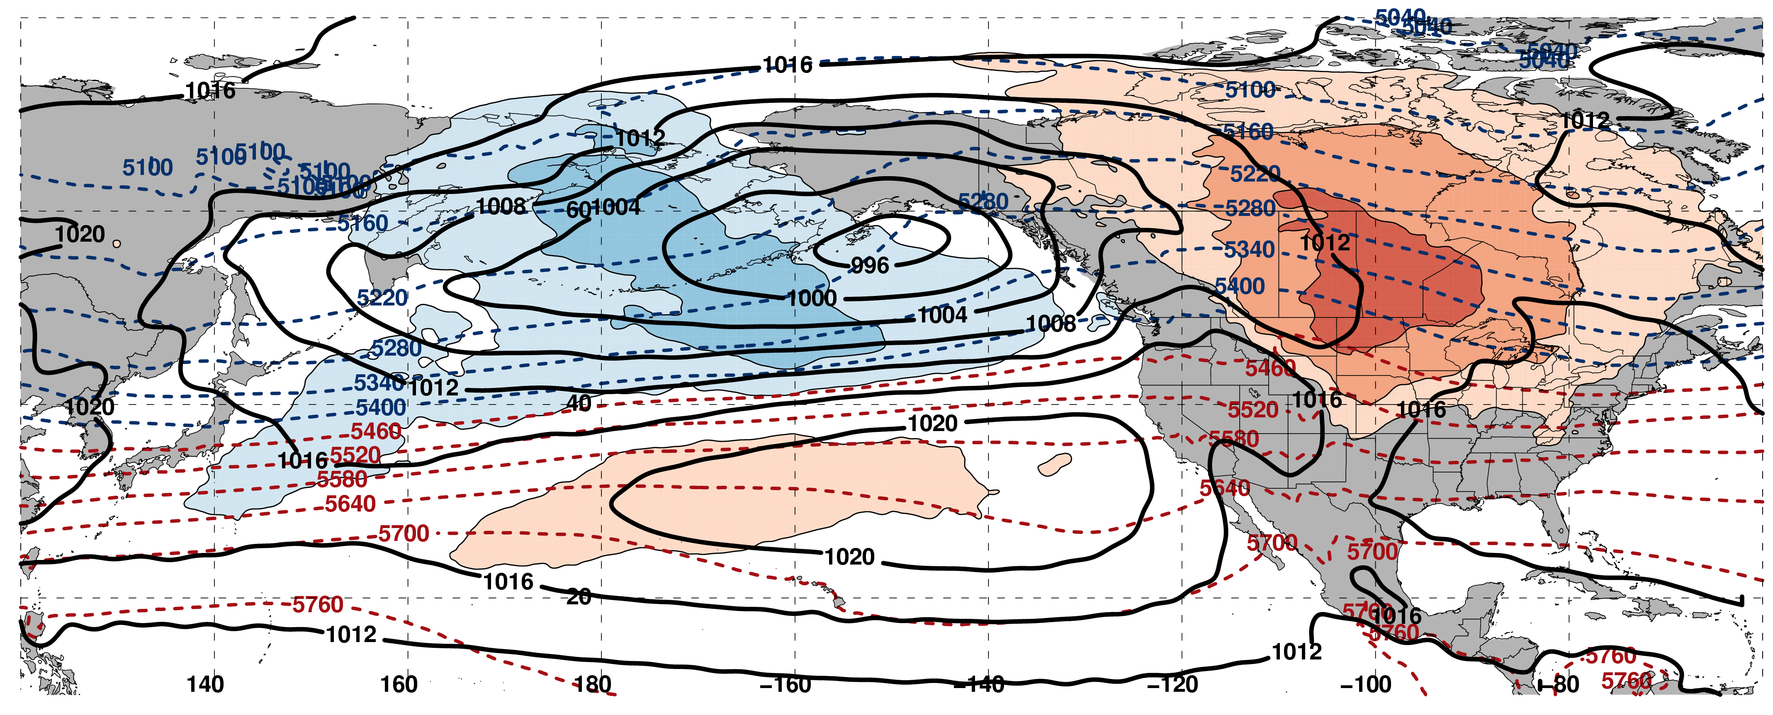
250-hPa Wind Speed (shading), Geo. Heights (contours), Geo. Height Anom. (contours):
Poleward Shift D+4
N = 189
m s^{–1}
Mean SLP (contours), 1000–500-hPa Thick. (contours), 850-hPa Temp. Anom. (shading):
K

Slide 7
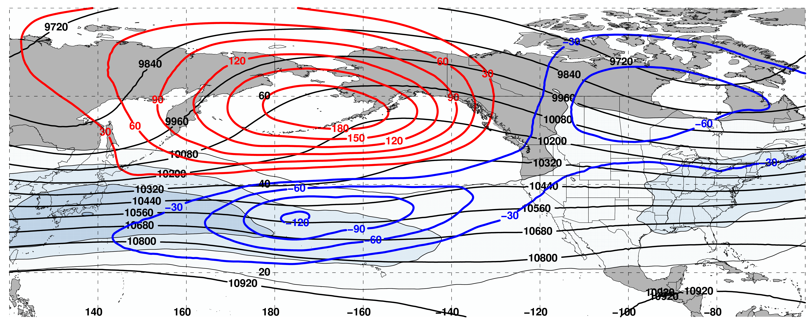
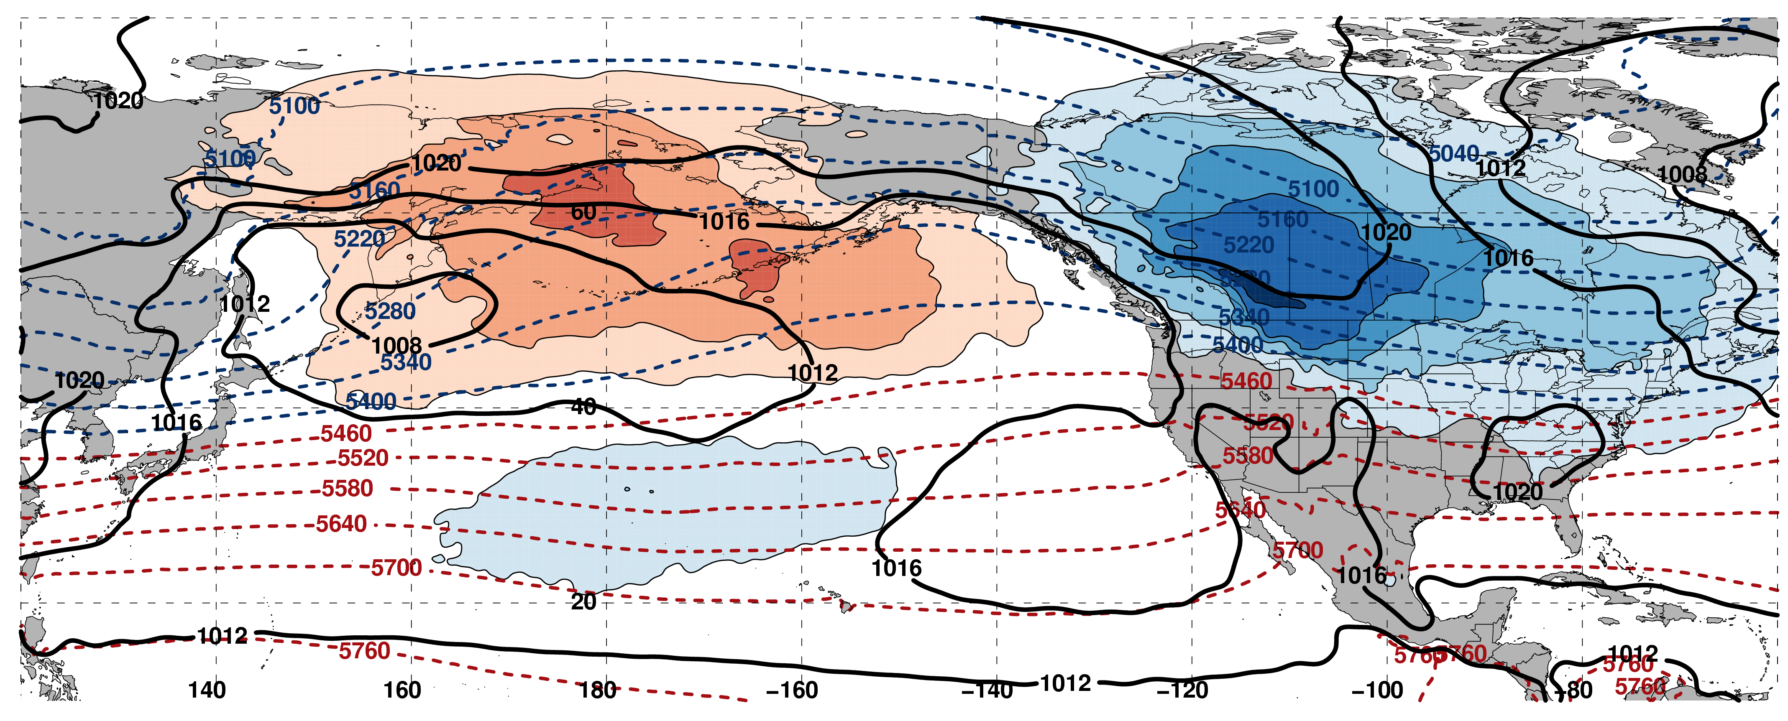
250-hPa Wind Speed (shading), Geo. Heights (contours), Geo. Height Anom. (contours):
Equator. Shift D+4
N = 149
m s^{–1}
Mean SLP (contours), 1000–500-hPa Thick. (contours), 850-hPa Temp. Anom. (shading):
K

Slide 8
Real Time NPJ Phase Diagram Forecasts
Knowledge of both the forecast skill and the downstream upper-tropospheric flow pattern associated with each NPJ regime offers the potential to better inform operational temperature and precipitation forecasts over the continental U.S.
This potential motivated the initialization of daily GEFS ensemble NPJ phase diagram forecasts during the 2016–2017 cool season (Sept.–May) at the University at Albany
The verification of these NPJ phase diagram forecasts presented an opportunity to identify medium-range periods that were characterized by reduced forecast skill during the 2016–2017 cool season

Slide 9
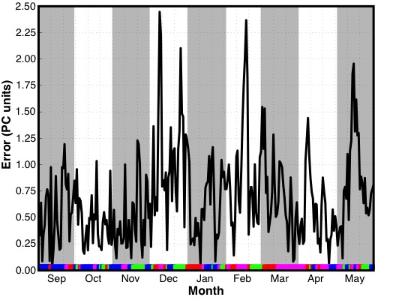
GEFS Ensemble Mean Error: 2016–2017
Time series of GEFS ensemble mean
9-day forecast error by initialization date
Jet Extension (N = 75)
Poleward Shift (N = 83)
Jet Retraction (N = 57)
Equatorward Shift (N = 56)

Slide 10
GEFS Ensemble Mean Error: 2016–2017
Time series of GEFS ensemble mean
9-day forecast error by initialization date
9-day NPJ phase diagram forecasts initialized during December, February, and early-March were characterized by substantial errors
Jet Extension (N = 75)
Poleward Shift (N = 83)
Jet Retraction (N = 57)
Equatorward Shift (N = 56)

Slide 11
GEFS Ensemble Mean Error: 2016–2017
Time series of GEFS ensemble mean
9-day forecast error by initialization date
This presentation will focus on applying the NPJ phase diagram to the period during Feb–Mar 2017 that was characterized by above normal forecast errors and high-impact weather
Jet Extension (N = 75)
Poleward Shift (N = 83)
Jet Retraction (N = 57)
Equatorward Shift (N = 56)

Slide 12
Case Study:
Feb/Mar 2017
High-Impact Weather

Slide 13
Case Study: Feb/Mar 2017 High-Impact Weather
Winter 2016/2017 was characterized by record setting precipitation in many parts of the Western U.S.
CDEC

Slide 14
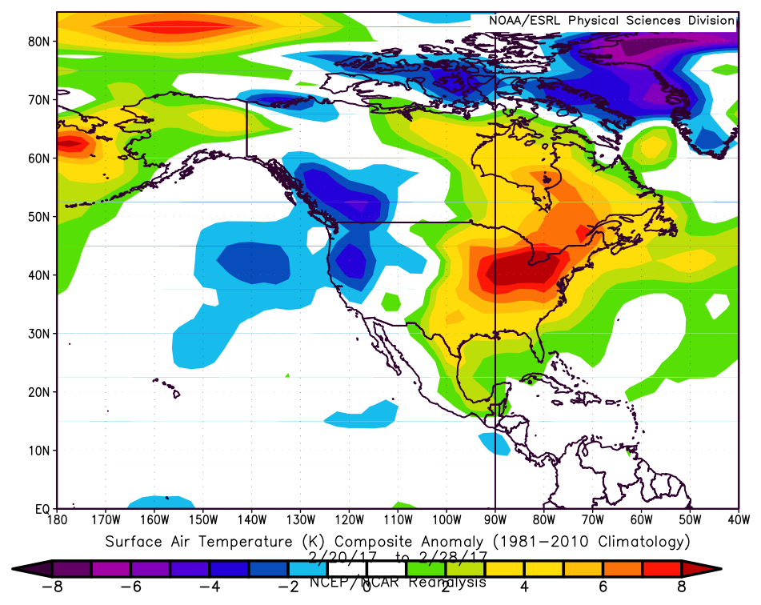
Case Study: Feb/Mar 2017 High-Impact Weather
Winter 2016/2017 was characterized by record setting precipitation in many parts of the Western U.S.
A NPJ regime change in late-February ushered anomalously warm/cold temperatures into the Eastern/Western U.S.
Composite Temperature Anomalies 20–28 Feb
ESRL

Slide 15
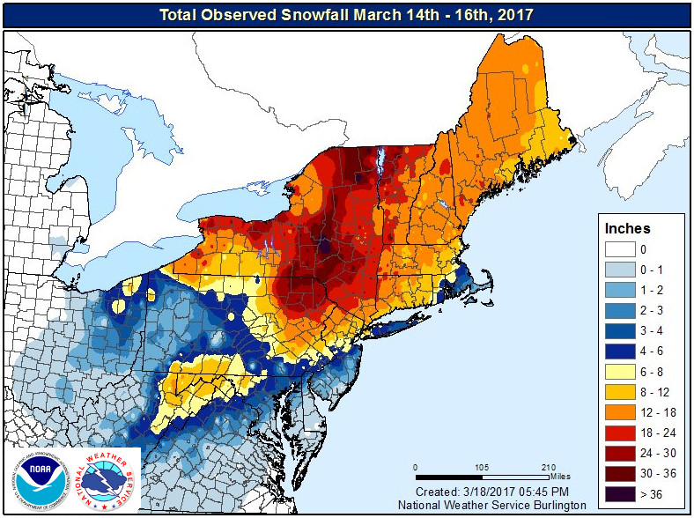
Case Study: Feb/Mar 2017 High-Impact Weather
Winter 2016/2017 was characterized by record setting precipitation in many parts of the Western U.S.
A NPJ regime change in late-February ushered anomalously warm/cold temperatures into the Eastern/Western U.S.
A second NPJ regime change in early-March facilitated the development of the “Pi Day Snowstorm” in the Northeast U.S.
NWS Burlington

Slide 16
Case Study:
Feb/Mar 2017
High-Impact Weather
I: Western U.S. Mid-February Rain and Jet Extension

Slide 17
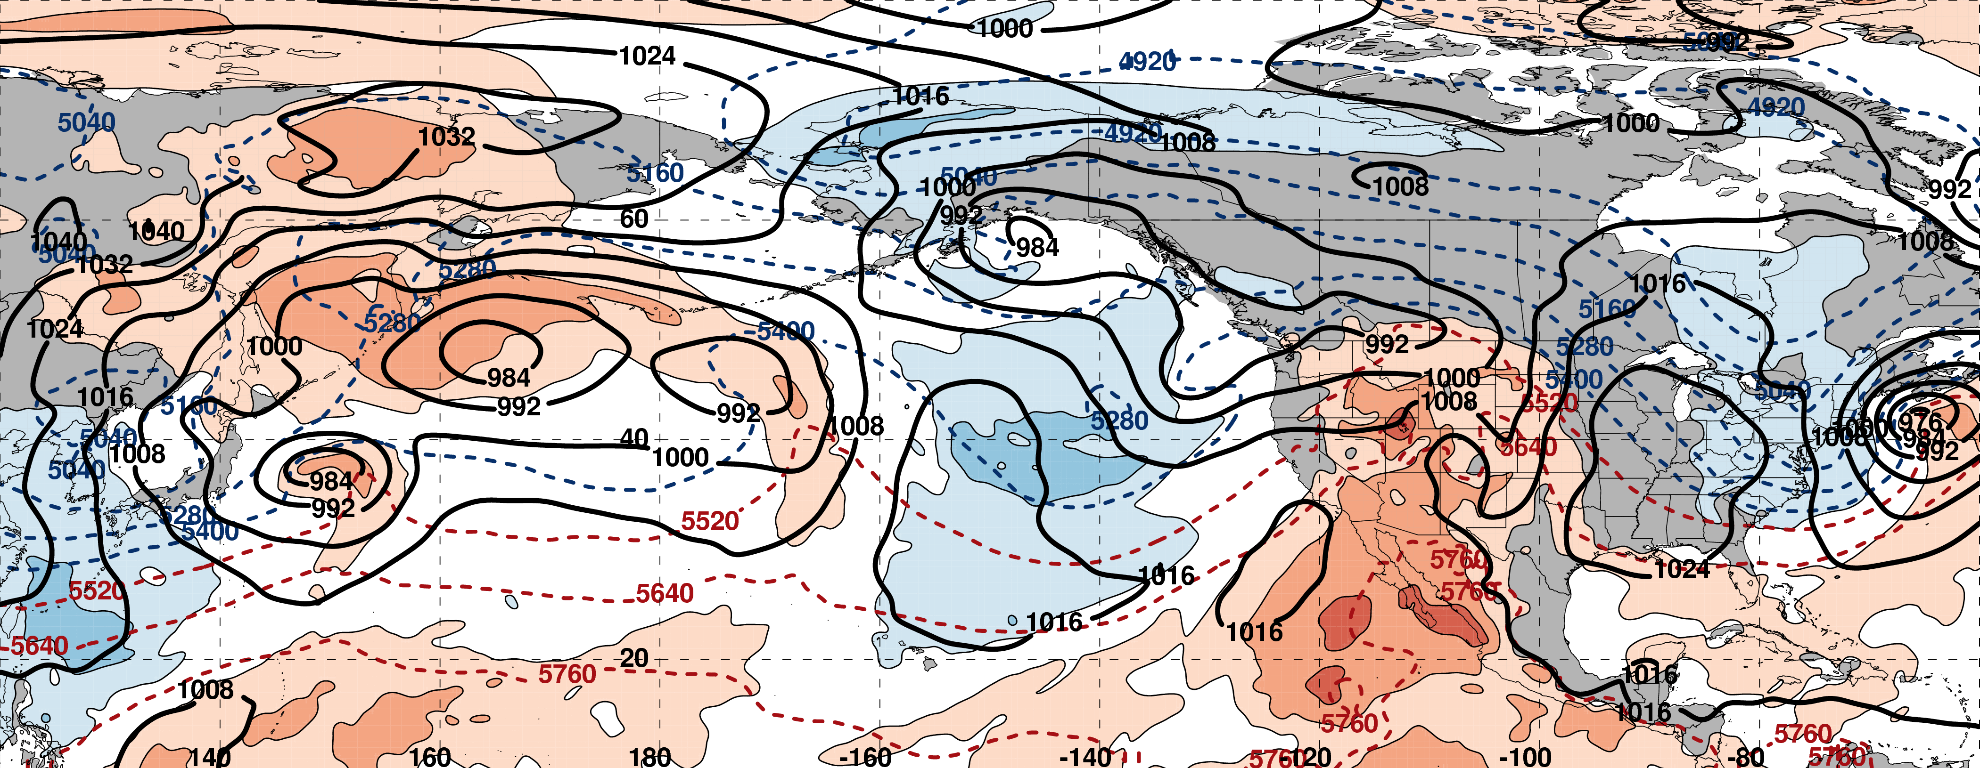
250-hPa Geo. Height (black contours)
250-hPa Standardized Geo. Height Anomalies (red contours: positive / blue contours: negative)
250-hPa Wind Speed (purple fill)
Standardized Precipitable Water Anomalies (green fill)
Mean Sea Level Pressure (black contours)
850-hPa Standardized Temperature Anomalies (red fill: positive / blue fill: negative)
1000–500-hPa Thickness (dashed red/blue contours)

Slide 18
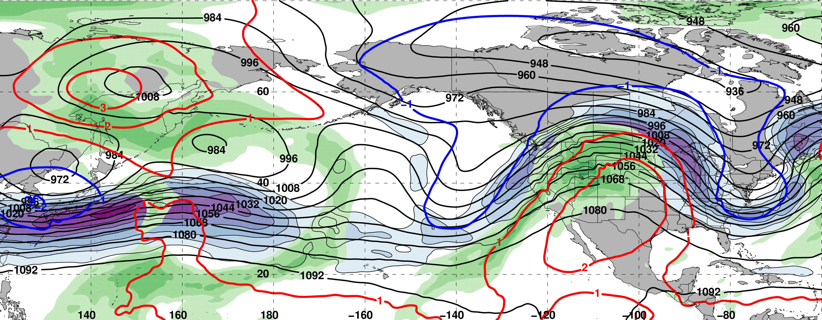
0000 UTC 10 February: 250-hPa Jet (shading) and Precipitable Water Anom. (shading)
m s^{–1}
σ
0000 UTC 10 February: MSLP (contours), Thick. (contours), 850-hPa Temp. Anom. (shading)
E. Asian
cold surge
σ

Slide 19
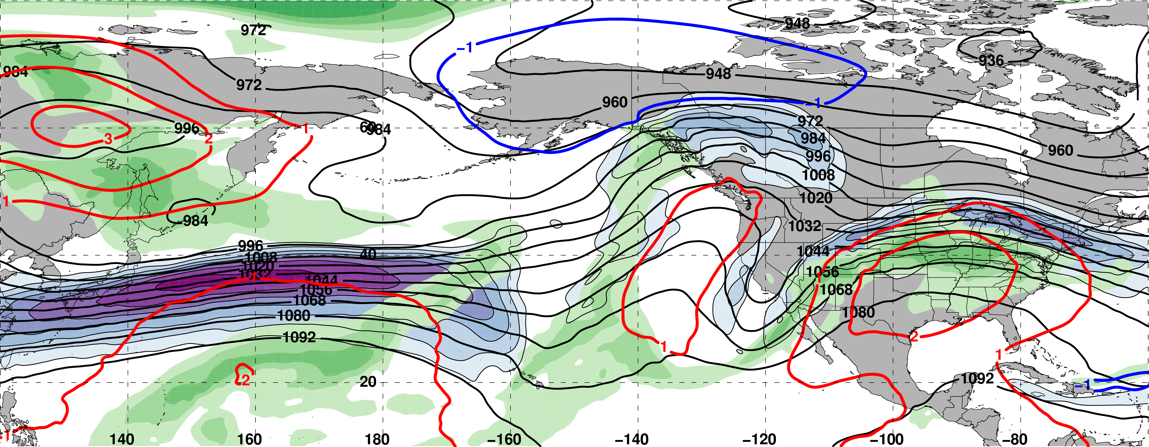
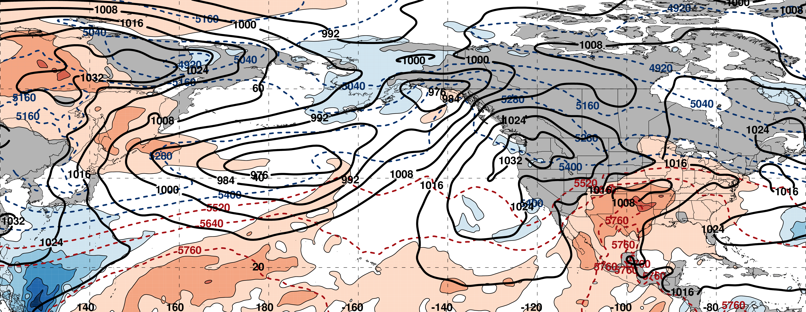
0000 UTC 12 February: 250-hPa Jet (shading) and Precipitable Water Anom. (shading)
m s^{–1}
σ
0000 UTC 12 February: MSLP (contours), Thick. (contours), 850-hPa Temp. Anom. (shading)
L
σ

Slide 20
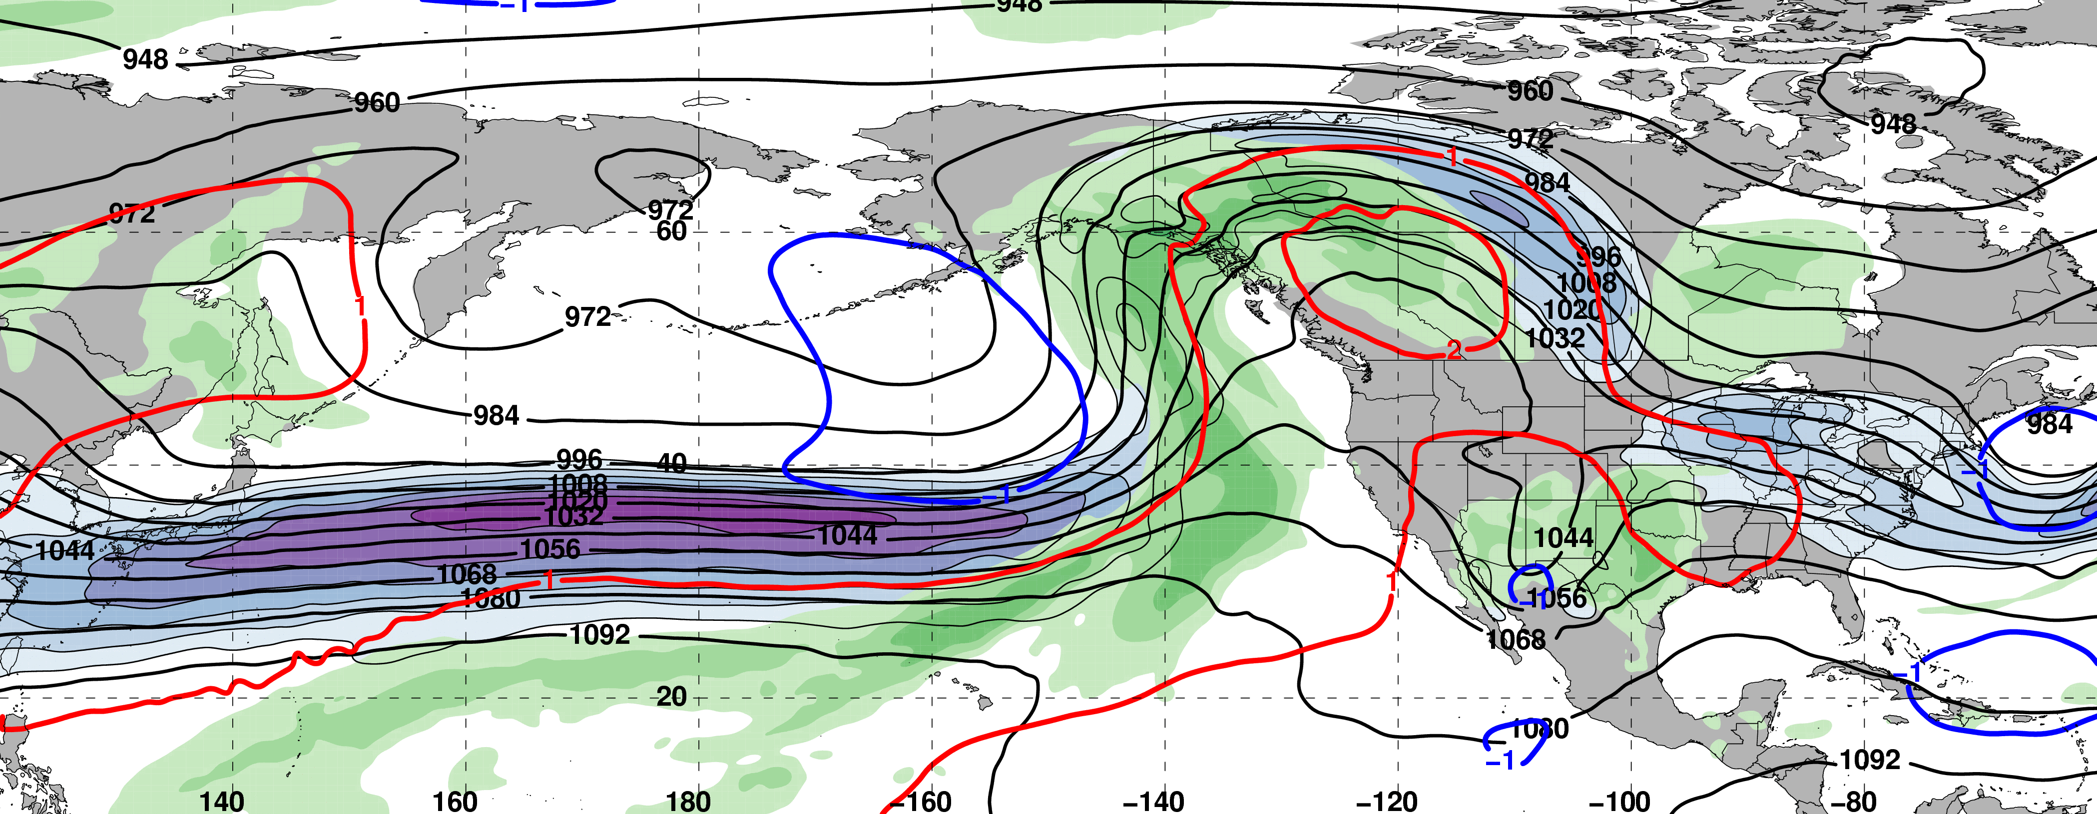
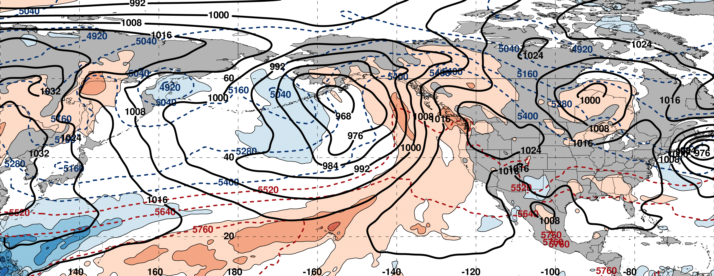
0000 UTC 14 February: 250-hPa Jet (shading) and Precipitable Water Anom. (shading)
m s^{–1}
σ
0000 UTC 14 February: MSLP (contours), Thick. (contours), 850-hPa Temp. Anom. (shading)
L
σ

Slide 21
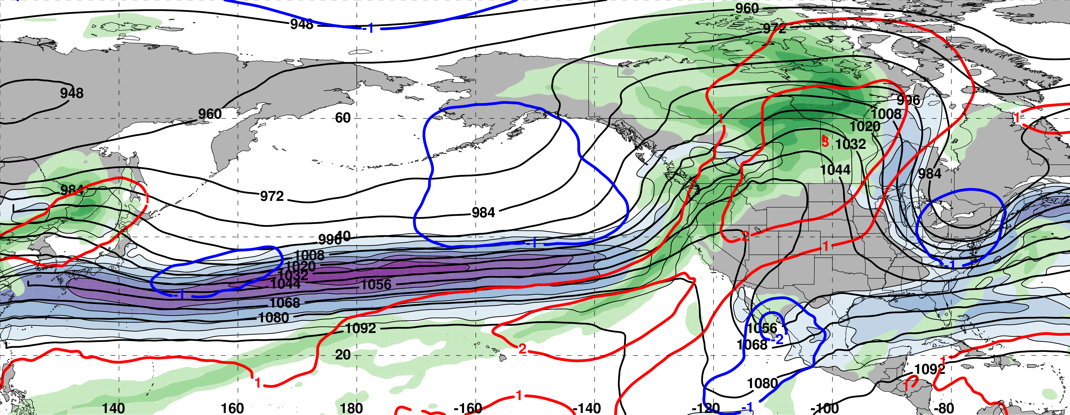
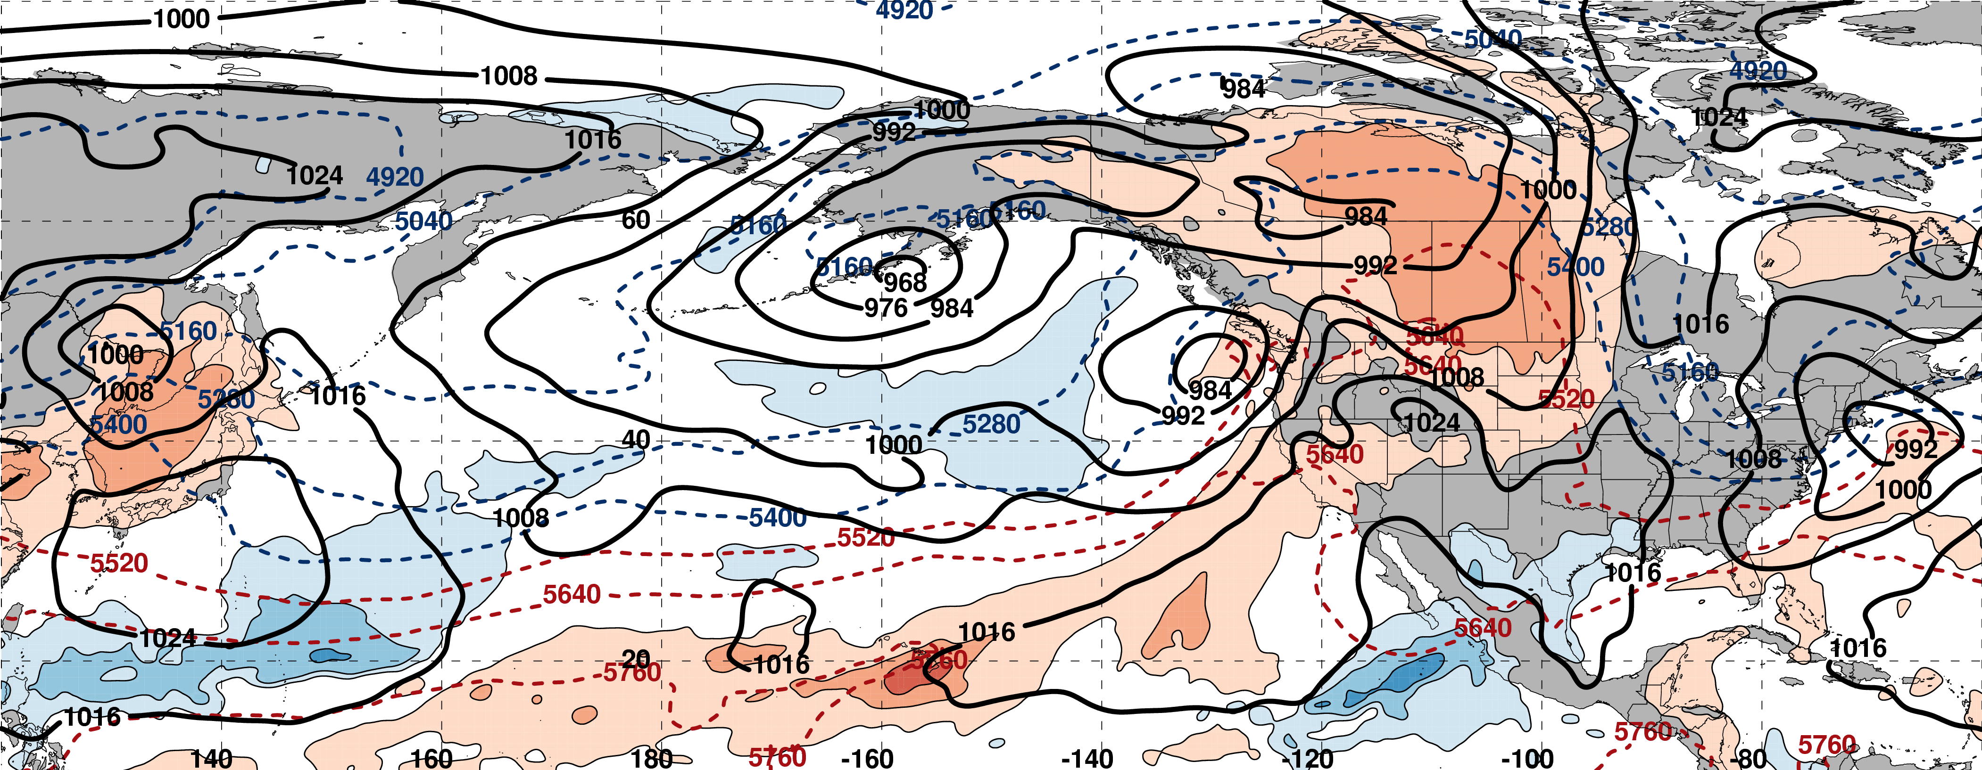
0000 UTC 16 February: 250-hPa Jet (shading) and Precipitable Water Anom. (shading)
m s^{–1}
σ
0000 UTC 16 February: MSLP (contours), Thick. (contours), 850-hPa Temp. Anom. (shading)
L
L
σ

Slide 22
0000 UTC 16 February: 250-hPa Jet (shading) and Precipitable Water Anom. (shading)
SeaTac 15 Feb Precip : 41 mm (1.63”)
SeaTac Tot. Feb Precip: 225 mm (8.85”)
m s^{–1}
σ
0000 UTC 16 February: MSLP (contours), Thick. (contours), 850-hPa Temp. Anom. (shading)
L
L
σ

Slide 23
West Coast Extreme Precipitation Events
Events during
Sept. – May
1979–2014 projected onto the NPJ phase diagram (N=154)
Each “x” is an average of the PCs
3–7 days prior to a precip. event
West Coast Extreme Precipitation Events are most often preceded by Jet Extensions

Slide 24
West Coast Extreme Precipitation Events
Events during
Sept. – May
1979–2014 projected onto the NPJ phase diagram (N=154)
Each “x” is an average of the PCs
3–7 days prior to a precip. event
West Coast Extreme Precipitation Events are most often preceded by Jet Extensions
9–13 Feb. 2017

Slide 25
Case Study:
Feb/Mar 2017
High-Impact Weather
II: Challenging Forecast of NPJ Regime Change

Slide 26
0000 UTC 16 February: 250-hPa Jet (shading) and Precipitable Water Anom. (shading)
m s^{–1}
σ
0000 UTC 16 February: MSLP (contours), Thick. (contours), 850-hPa Temp. Anom. (shading)
σ

Slide 27
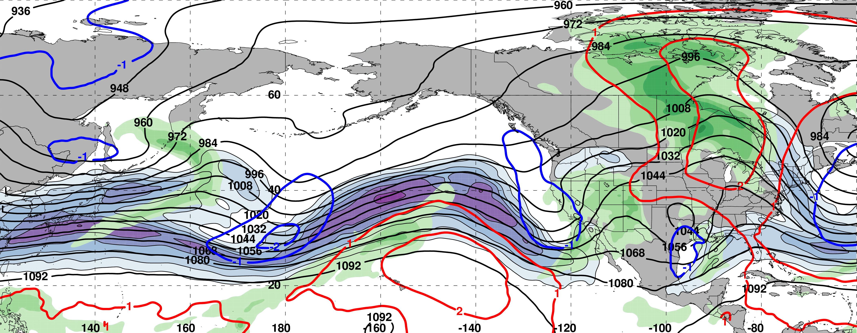
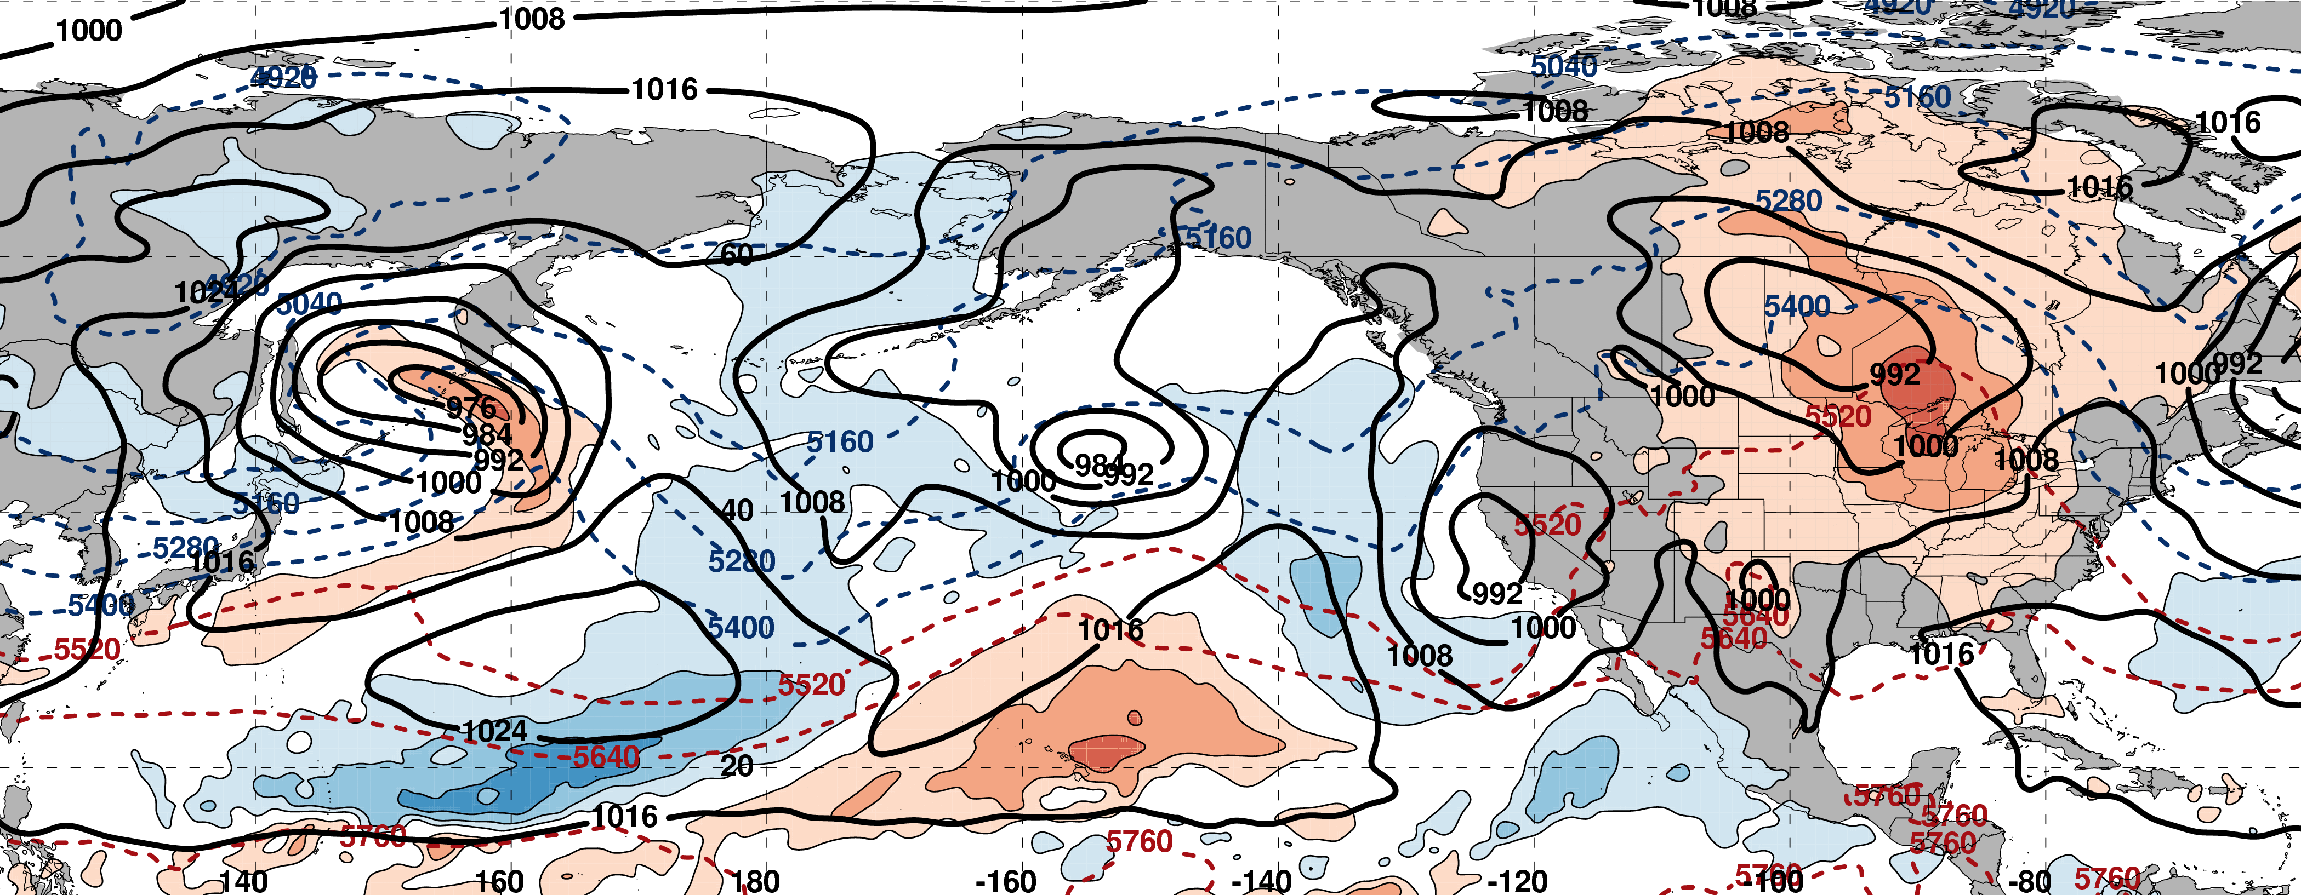
0000 UTC 18 February: 250-hPa Jet (shading) and Precipitable Water Anom. (shading)
m s^{–1}
σ
0000 UTC 18 February: MSLP (contours), Thick. (contours), 850-hPa Temp. Anom. (shading)
σ

Slide 28
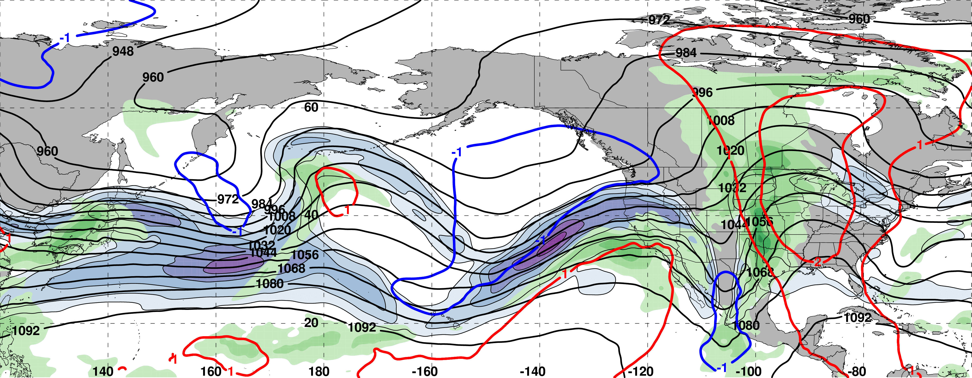
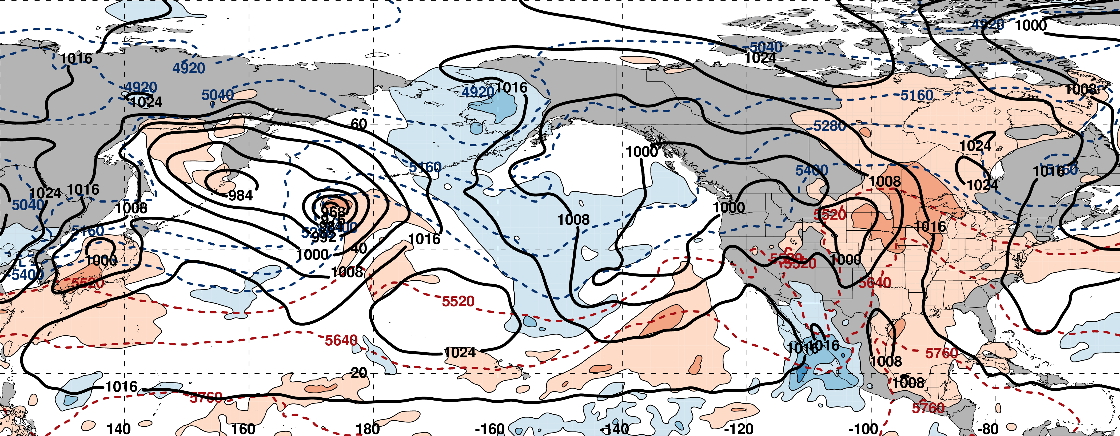
0000 UTC 20 February: 250-hPa Jet (shading) and Precipitable Water Anom. (shading)
m s^{–1}
σ
0000 UTC 20 February: MSLP (contours), Thick. (contours), 850-hPa Temp. Anom. (shading)
L
σ

Slide 29
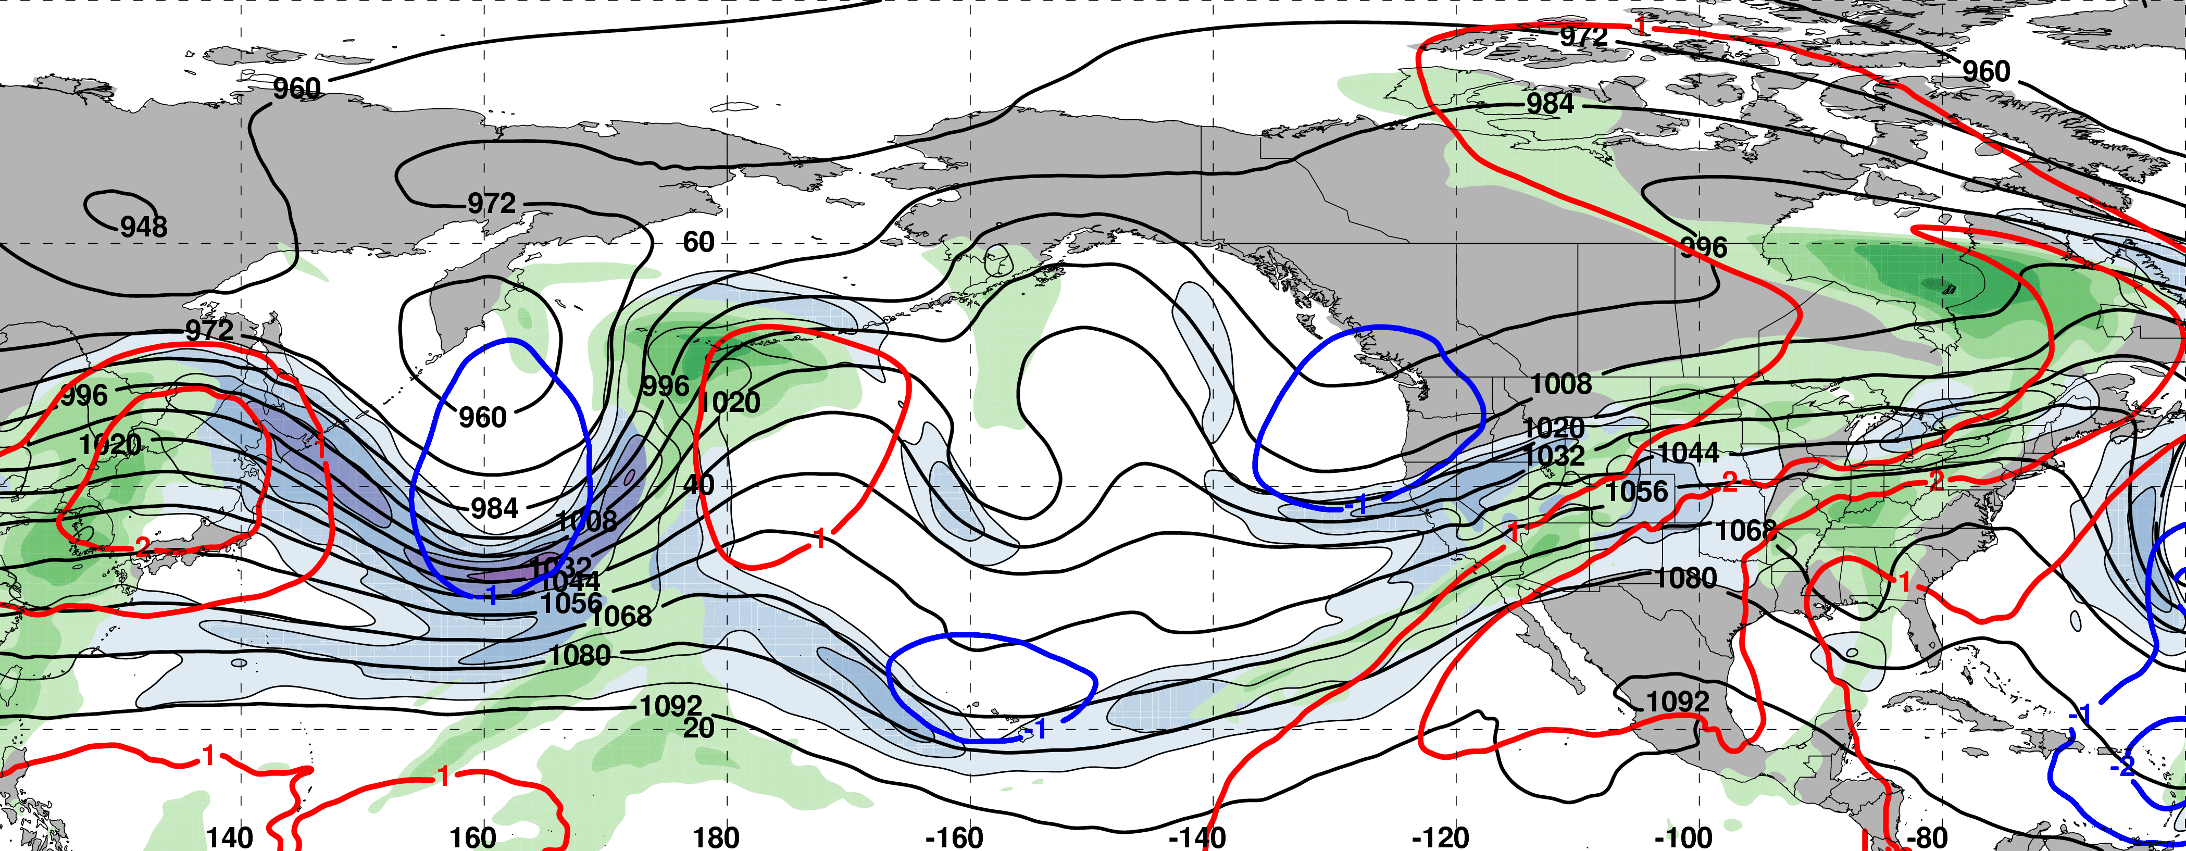
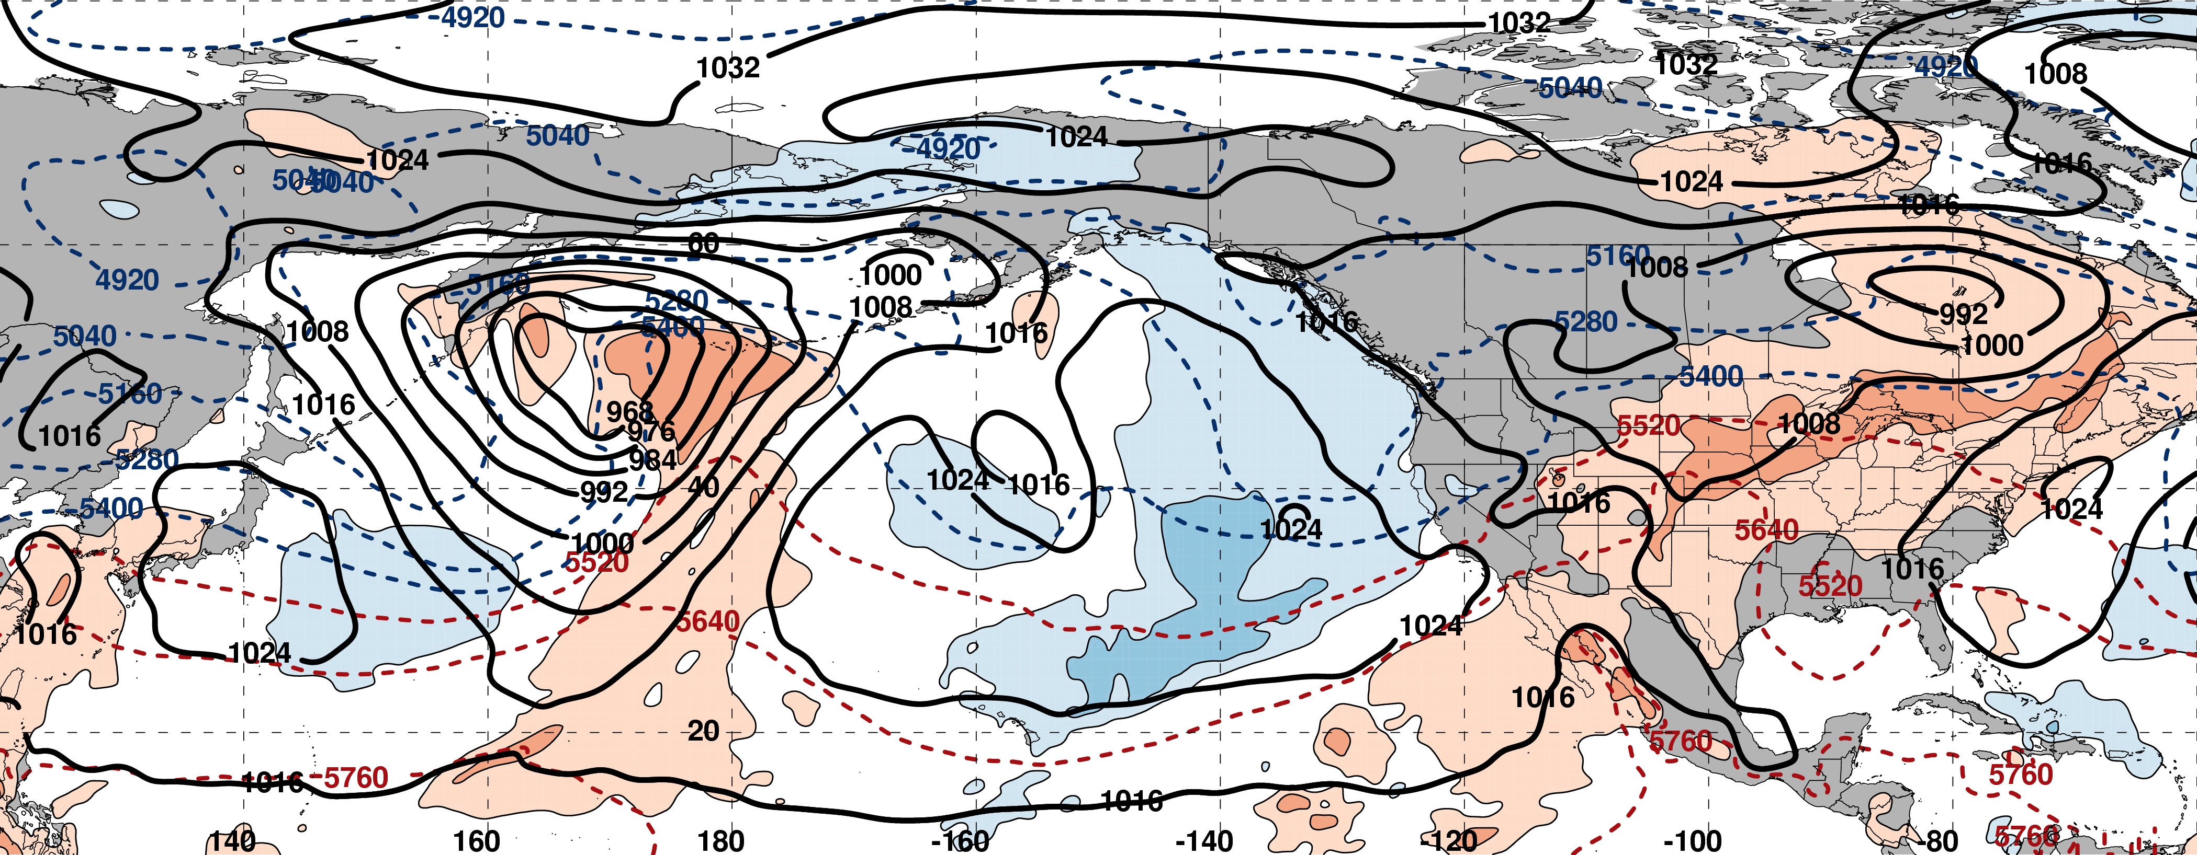
0000 UTC 22 February: 250-hPa Jet (shading) and Precipitable Water Anom. (shading)
m s^{–1}
σ
0000 UTC 22 February: MSLP (contours), Thick. (contours), 850-hPa Temp. Anom. (shading)
L
σ

Slide 30
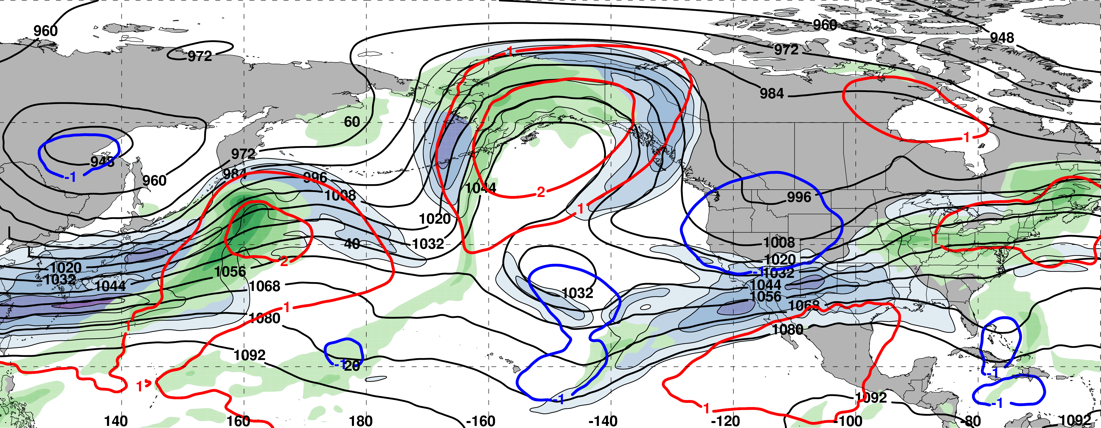
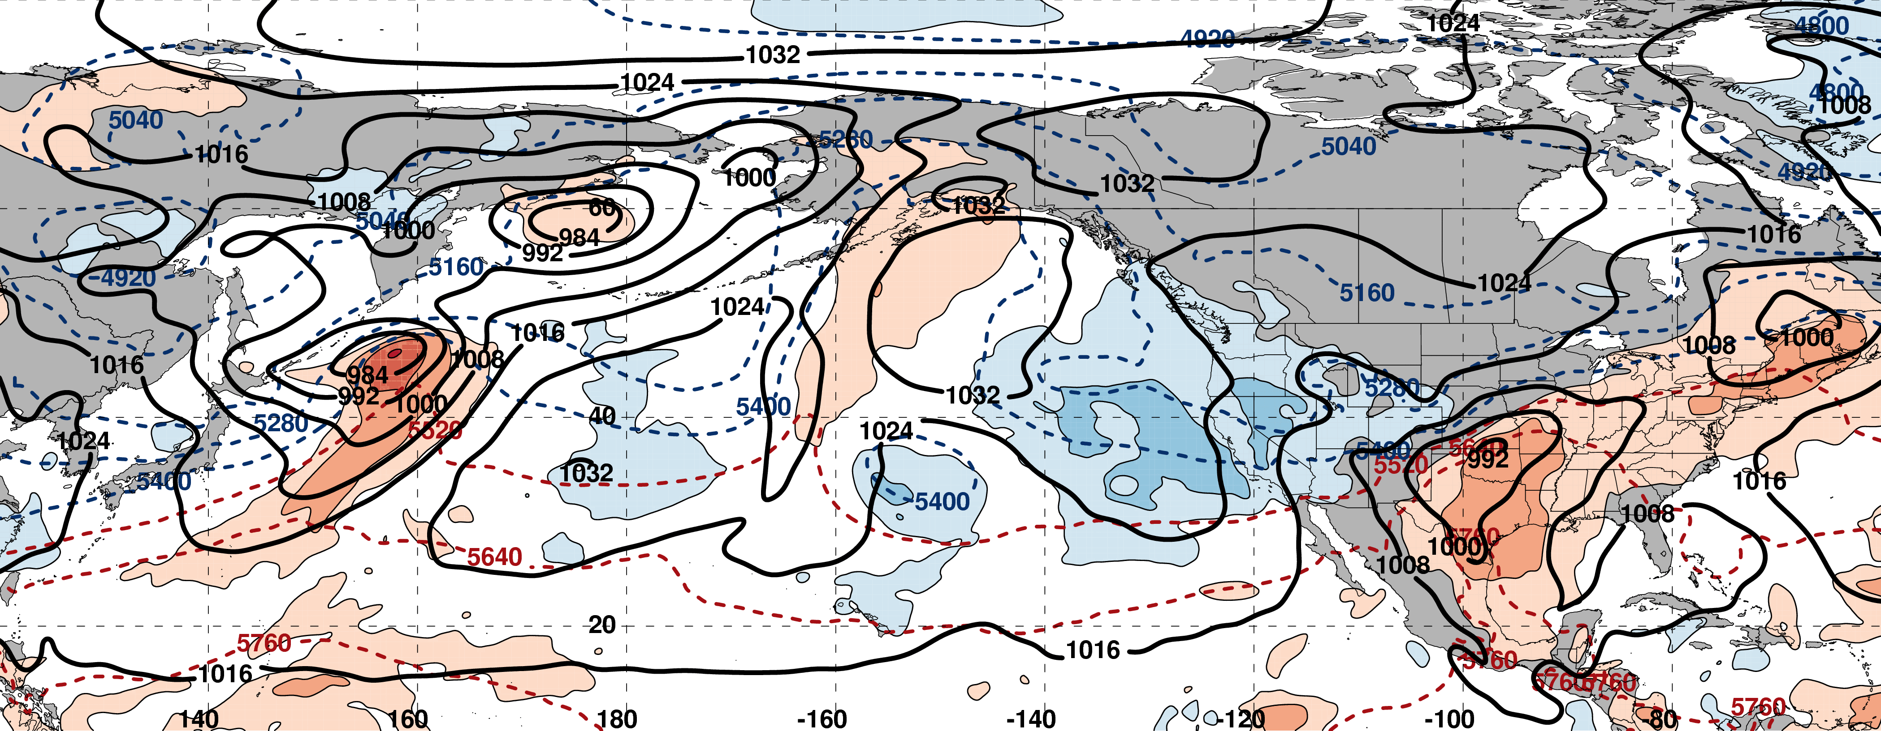
0000 UTC 24 February: 250-hPa Jet (shading) and Precipitable Water Anom. (shading)
m s^{–1}
σ
0000 UTC 24 February: MSLP (contours), Thick. (contours), 850-hPa Temp. Anom. (shading)
L
σ

Slide 31
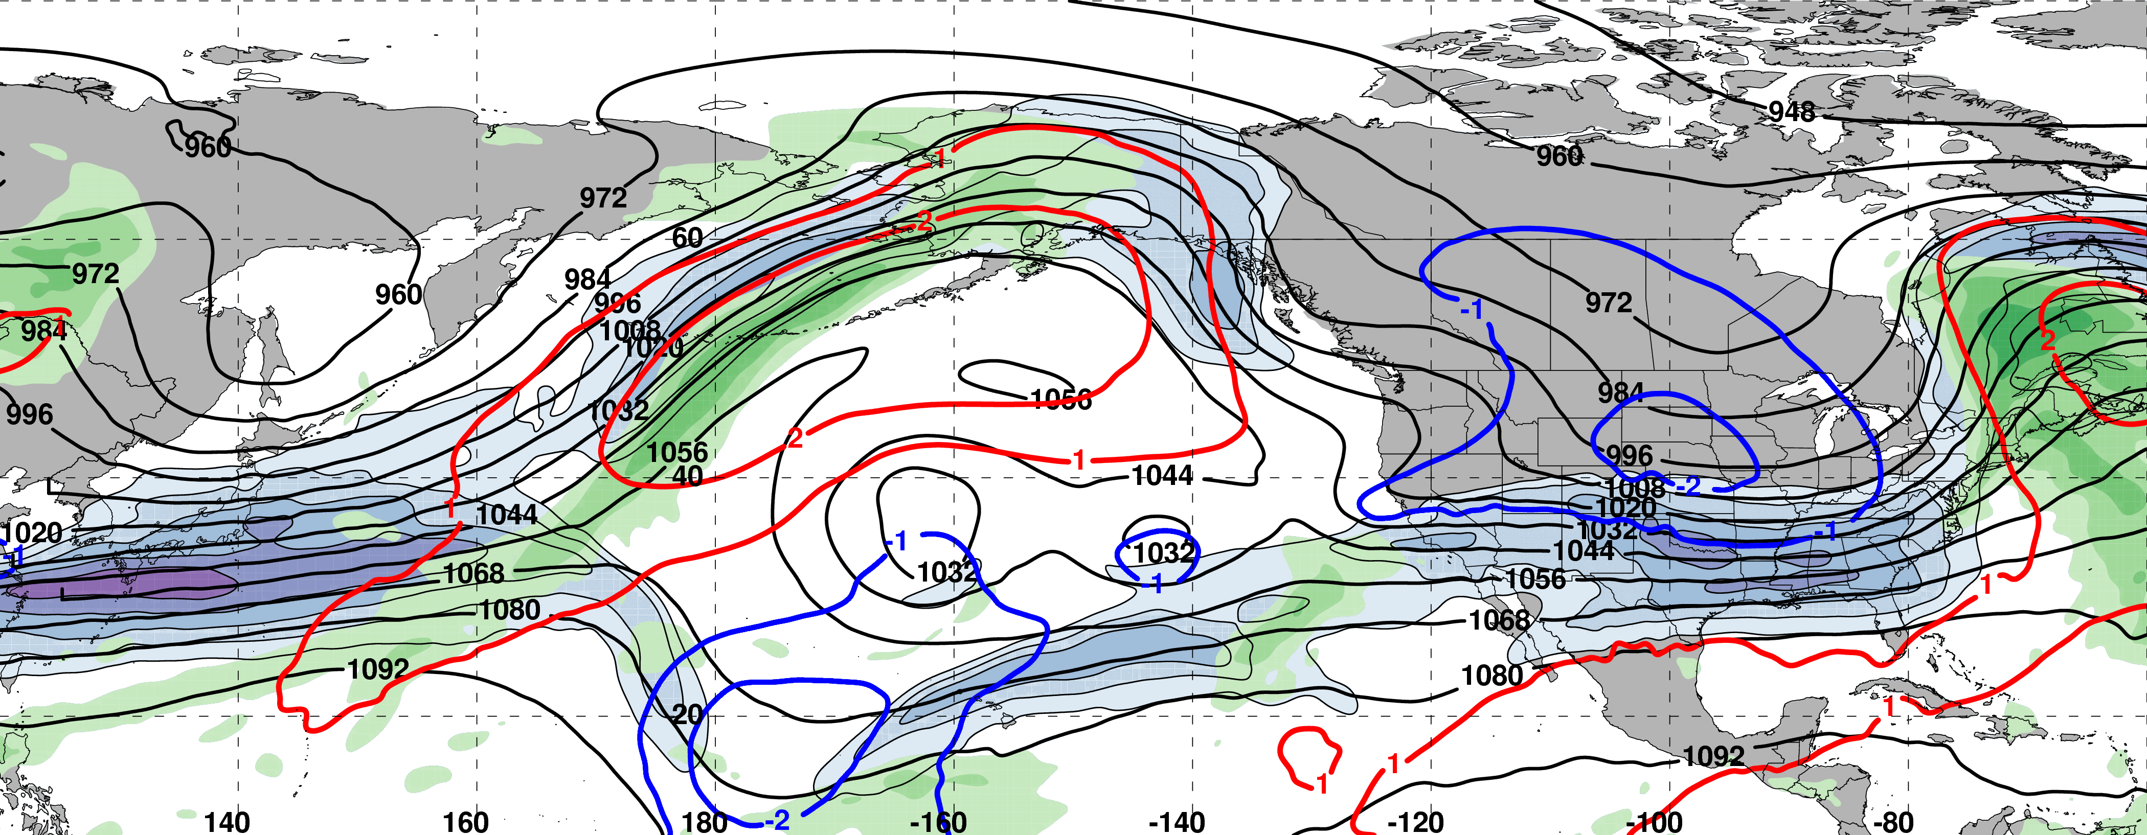
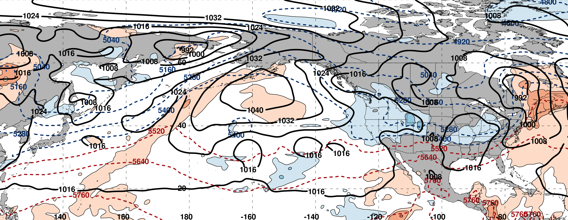
0000 UTC 26 February: 250-hPa Jet (shading) and Precipitable Water Anom. (shading)
m s^{–1}
σ
0000 UTC 26 February: MSLP (contours), Thick. (contours), 850-hPa Temp. Anom. (shading)
L
σ

Slide 32
0000 UTC 26 February: 250-hPa Jet (shading) and Precipitable Water Anom. (shading)
m s^{–1}
σ
0000 UTC 26 February: MSLP (contours), Thick. (contours), 850-hPa Temp. Anom. (shading)
Substantial Jet Retraction
σ

Slide 33
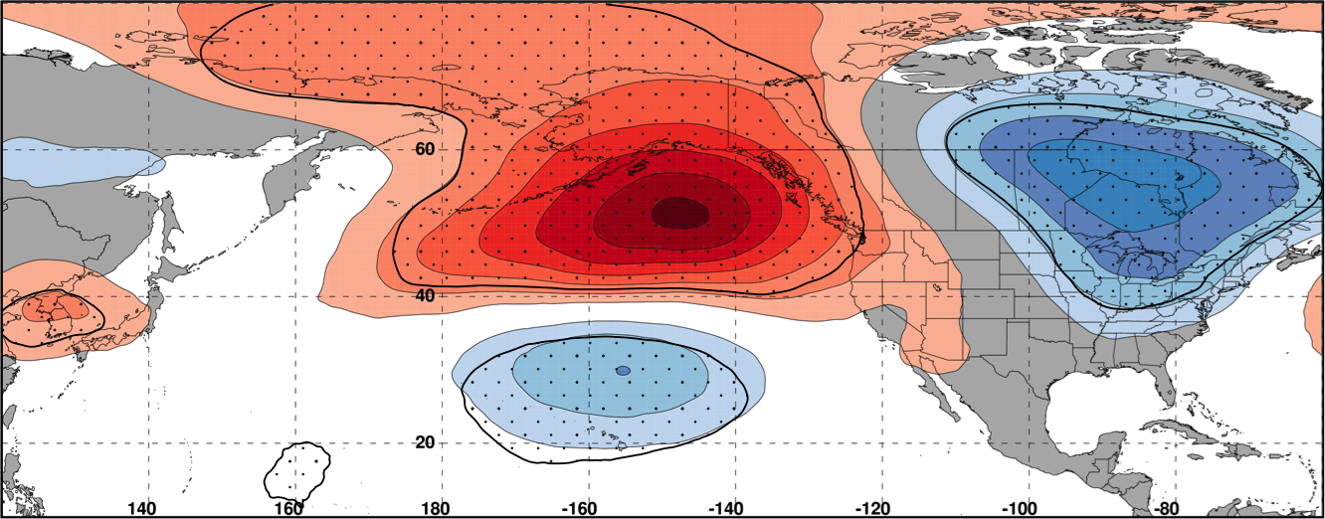
NPJ Regime Change
250-hPa Geo. Height Anom. Composite Difference: [Worst Forecast (N=90) – Best Forecast (N=77)] at 192 h
m
99% Conf. Interval
The worst NPJ phase diagram forecasts initialized during a jet extension are frequently associated with significantly higher heights over the North Pacific and significantly lower heights over North America 8 days after forecast initialization
Notes:
Start end labels in box. Change to 8 day trajectories.

Slide 34
250-hPa Geo. Height Anom. Composite Difference: [Worst Forecast (N=90) – Best Forecast (N=77)] at 192 h
m
99% Conf. Interval
0000 UTC 26 February: 250-hPa Jet (shading) and Precipitable Water Anom. (shading)
m s^{–1}
σ
Notes:
Start end labels in box. Change to 8 day trajectories.

Slide 35
NPJ Regime Change
9-day Probabilistic Forecast Trajectory Initialized at 0000 UTC 17 February 2017
The GEFS ensemble forecast indicated the NPJ regime transition was likely

Slide 36
NPJ Regime Change
9-day Probabilistic Forecast Trajectory Initialized at 0000 UTC 17 February 2017
The GEFS ensemble forecast indicated the NPJ regime transition was likely
The GEFS ensemble did not capture an equatorward shift of the NPJ axis
This 9-day forecast ranked 2nd worst during the 2016–2017 cool season

Slide 37
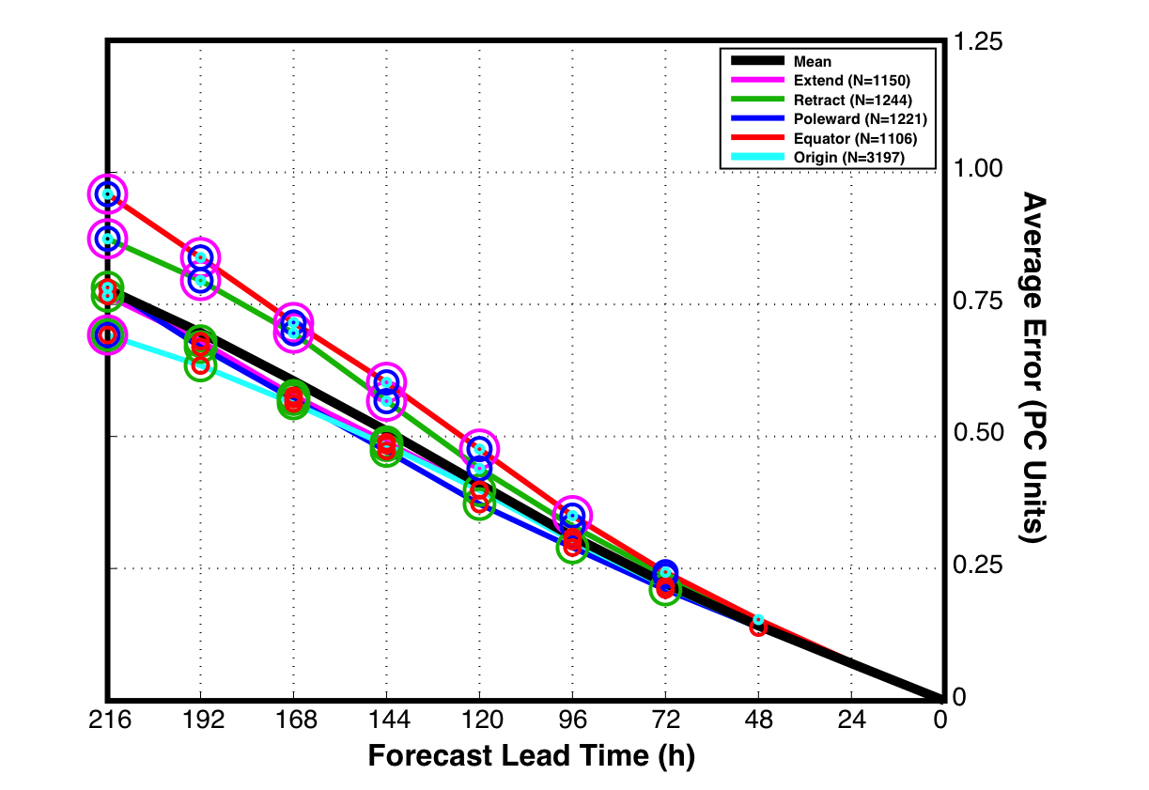
NPJ Regime Change
GEFS Reforecasts verifying during a particular NPJ regime
Circles on a particular line indicate statistically significant differences at the 99% confidence level with respect to another NPJ regime
Forecasts verifying during equatorward shifts and jet retractions exhibit significantly larger errors than jet extensions and poleward shifts in the 96–216-h forecast period

Slide 38
Case Study:
Feb/Mar 2017
High-Impact Weather
III: Persistent North Pacific Block and the “Pi Day Snowstorm”

Slide 39
0000 UTC 26 February: 250-hPa Jet (shading) and Precipitable Water Anom. (shading)
m s^{–1}
σ
0000 UTC 26 February: MSLP (contours), Thick. (contours), 850-hPa Temp. Anom. (shading)
L
σ

Slide 40
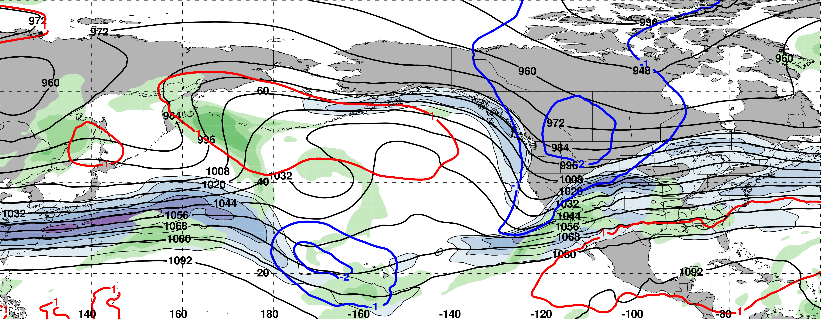
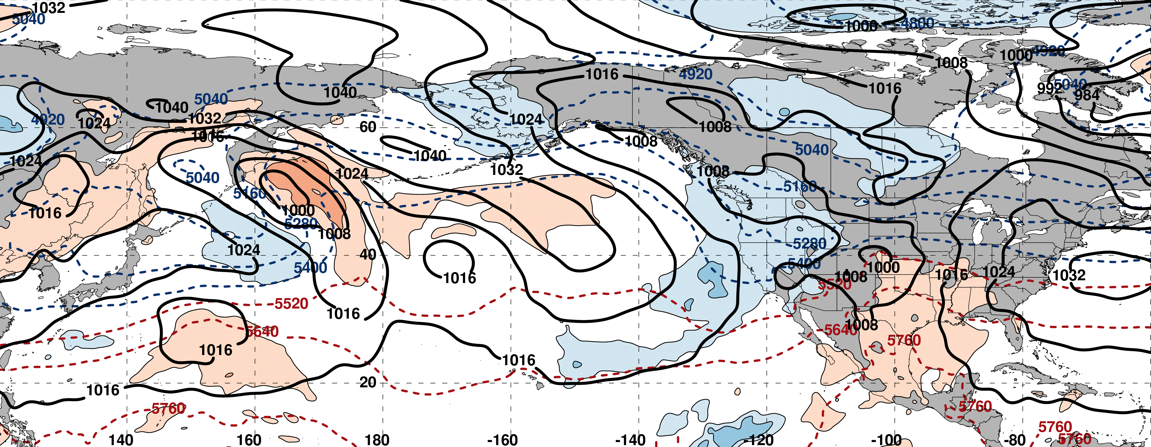
0000 UTC 28 February: 250-hPa Jet (shading) and Precipitable Water Anom. (shading)
North Pacific block persists the next two weeks
m s^{–1}
σ
0000 UTC 28 February: MSLP (contours), Thick. (contours), 850-hPa Temp. Anom. (shading)
Cold anomalies slowly intensify in NW Canada
L
σ

Slide 41
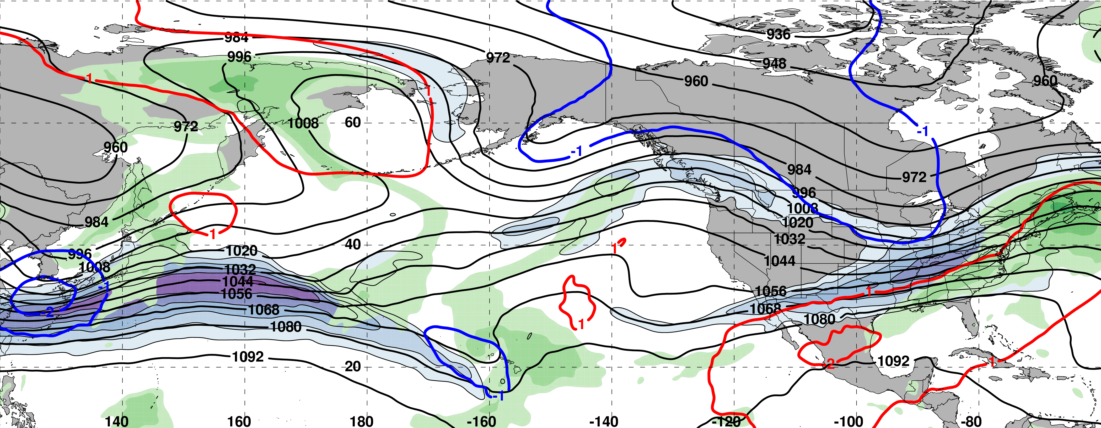
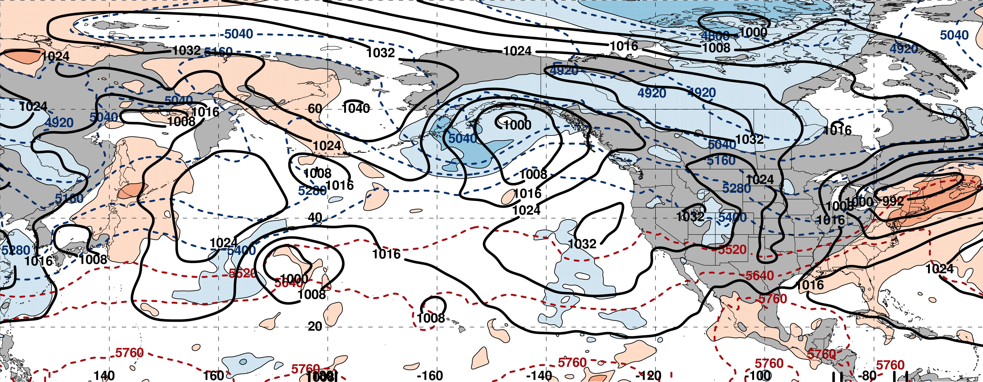
0000 UTC 02 March: 250-hPa Jet (shading) and Precipitable Water Anom. (shading)
m s^{–1}
σ
0000 UTC 02 March: MSLP (contours), Thick. (contours), 850-hPa Temp. Anom. (shading)
L
σ

Slide 42
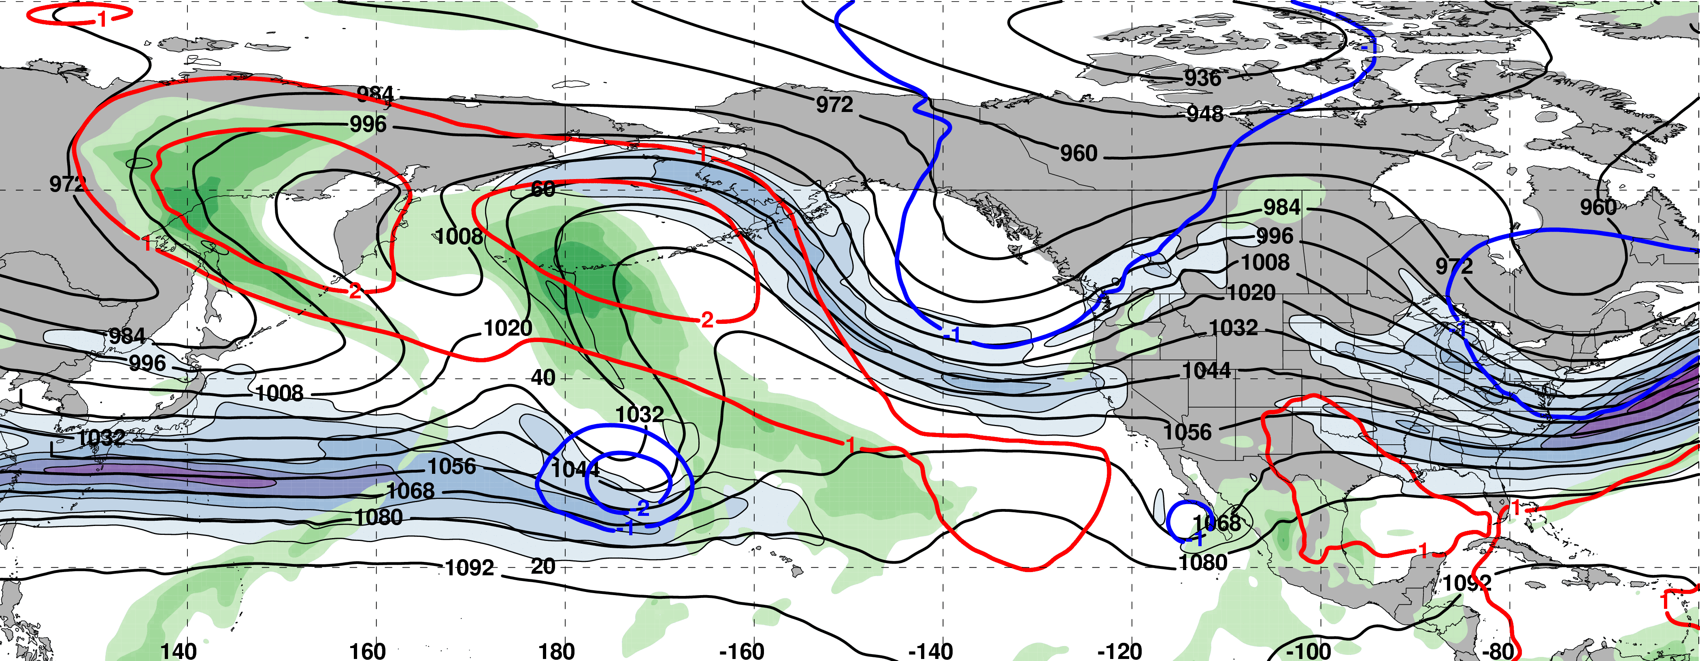
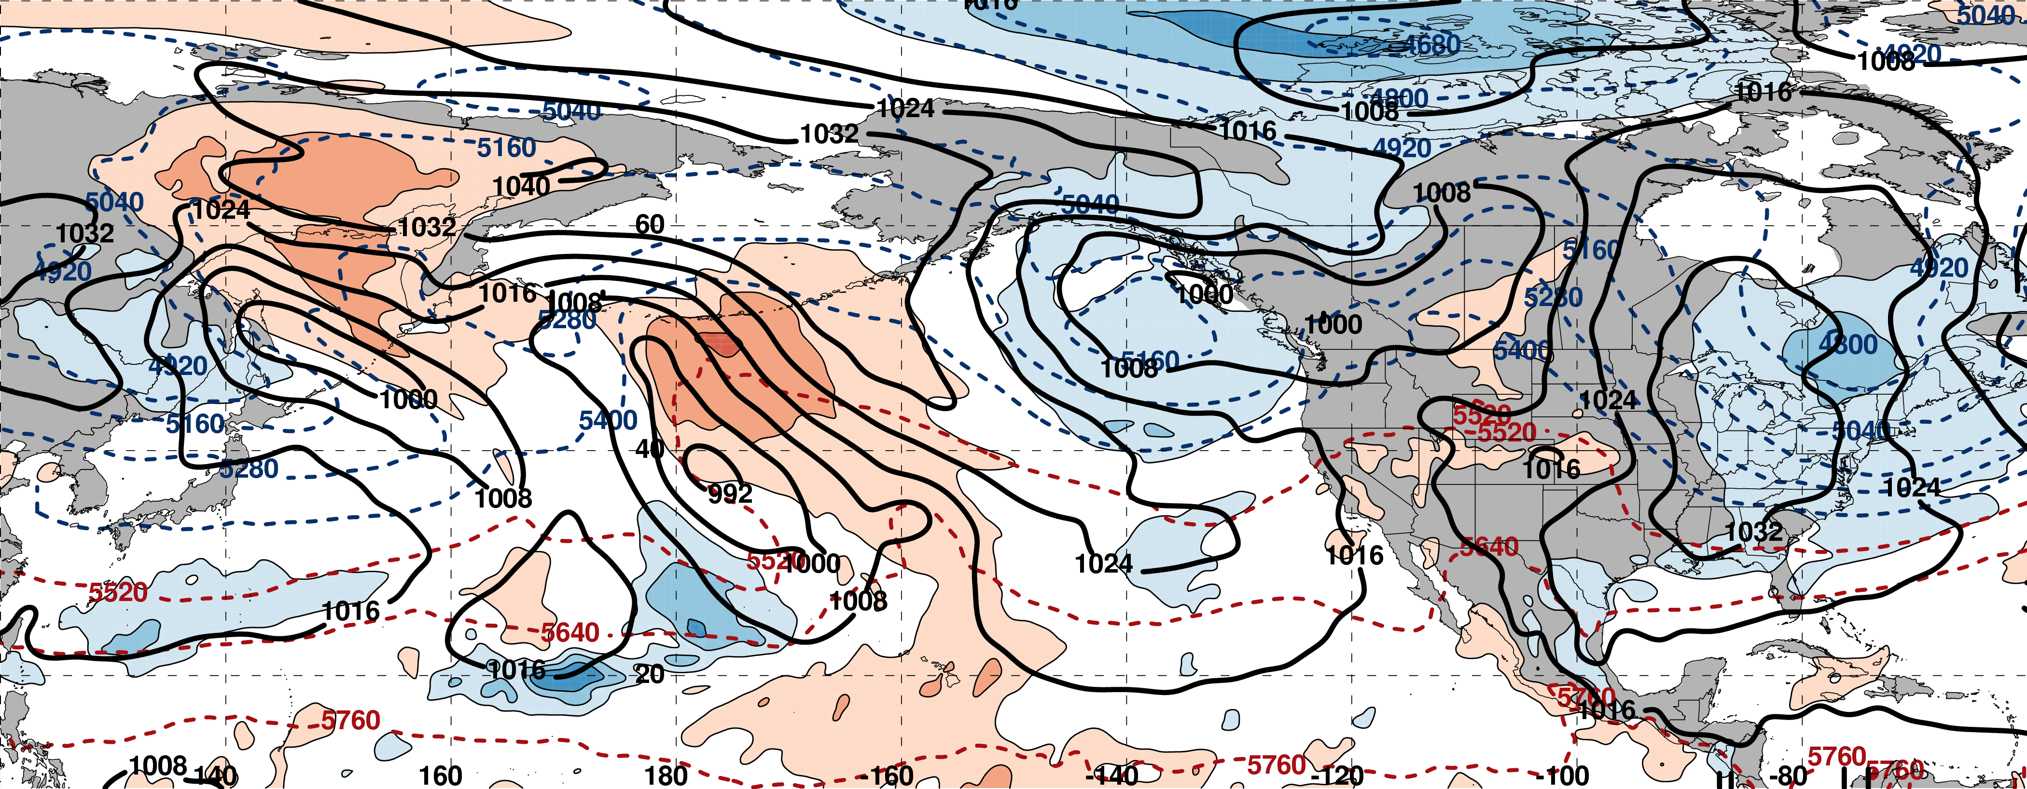
0000 UTC 04 March: 250-hPa Jet (shading) and Precipitable Water Anom. (shading)
m s^{–1}
σ
0000 UTC 04 March: MSLP (contours), Thick. (contours), 850-hPa Temp. Anom. (shading)
L
σ

Slide 43
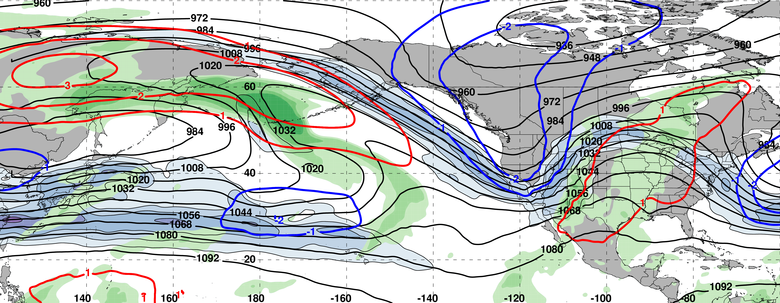
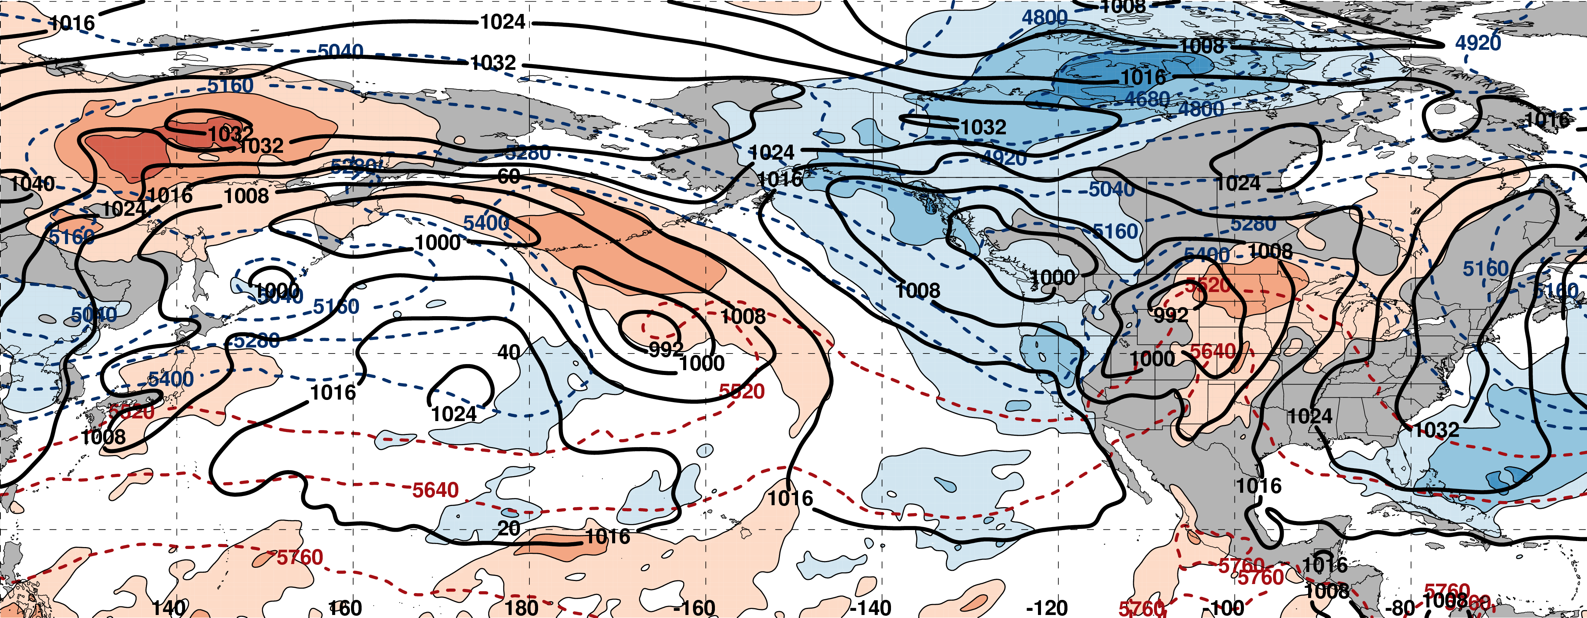
0000 UTC 06 March: 250-hPa Jet (shading) and Precipitable Water Anom. (shading)
m s^{–1}
σ
0000 UTC 06 March: MSLP (contours), Thick. (contours), 850-hPa Temp. Anom. (shading)
L
σ

Slide 44
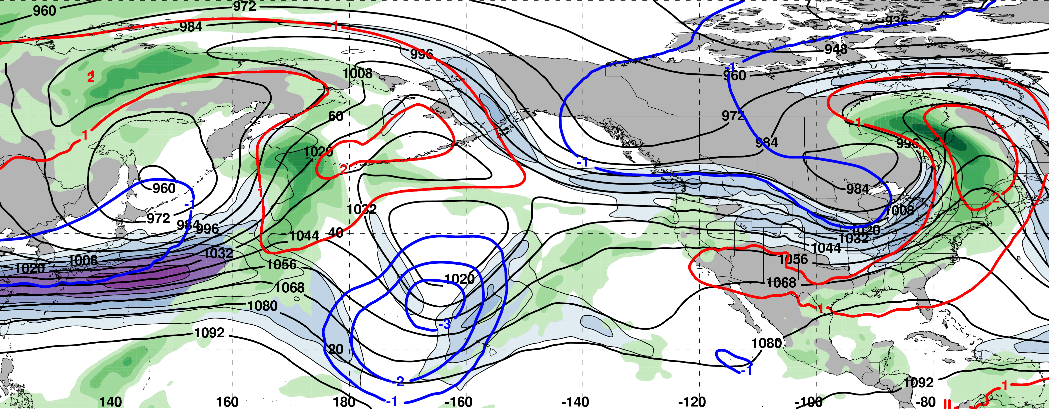
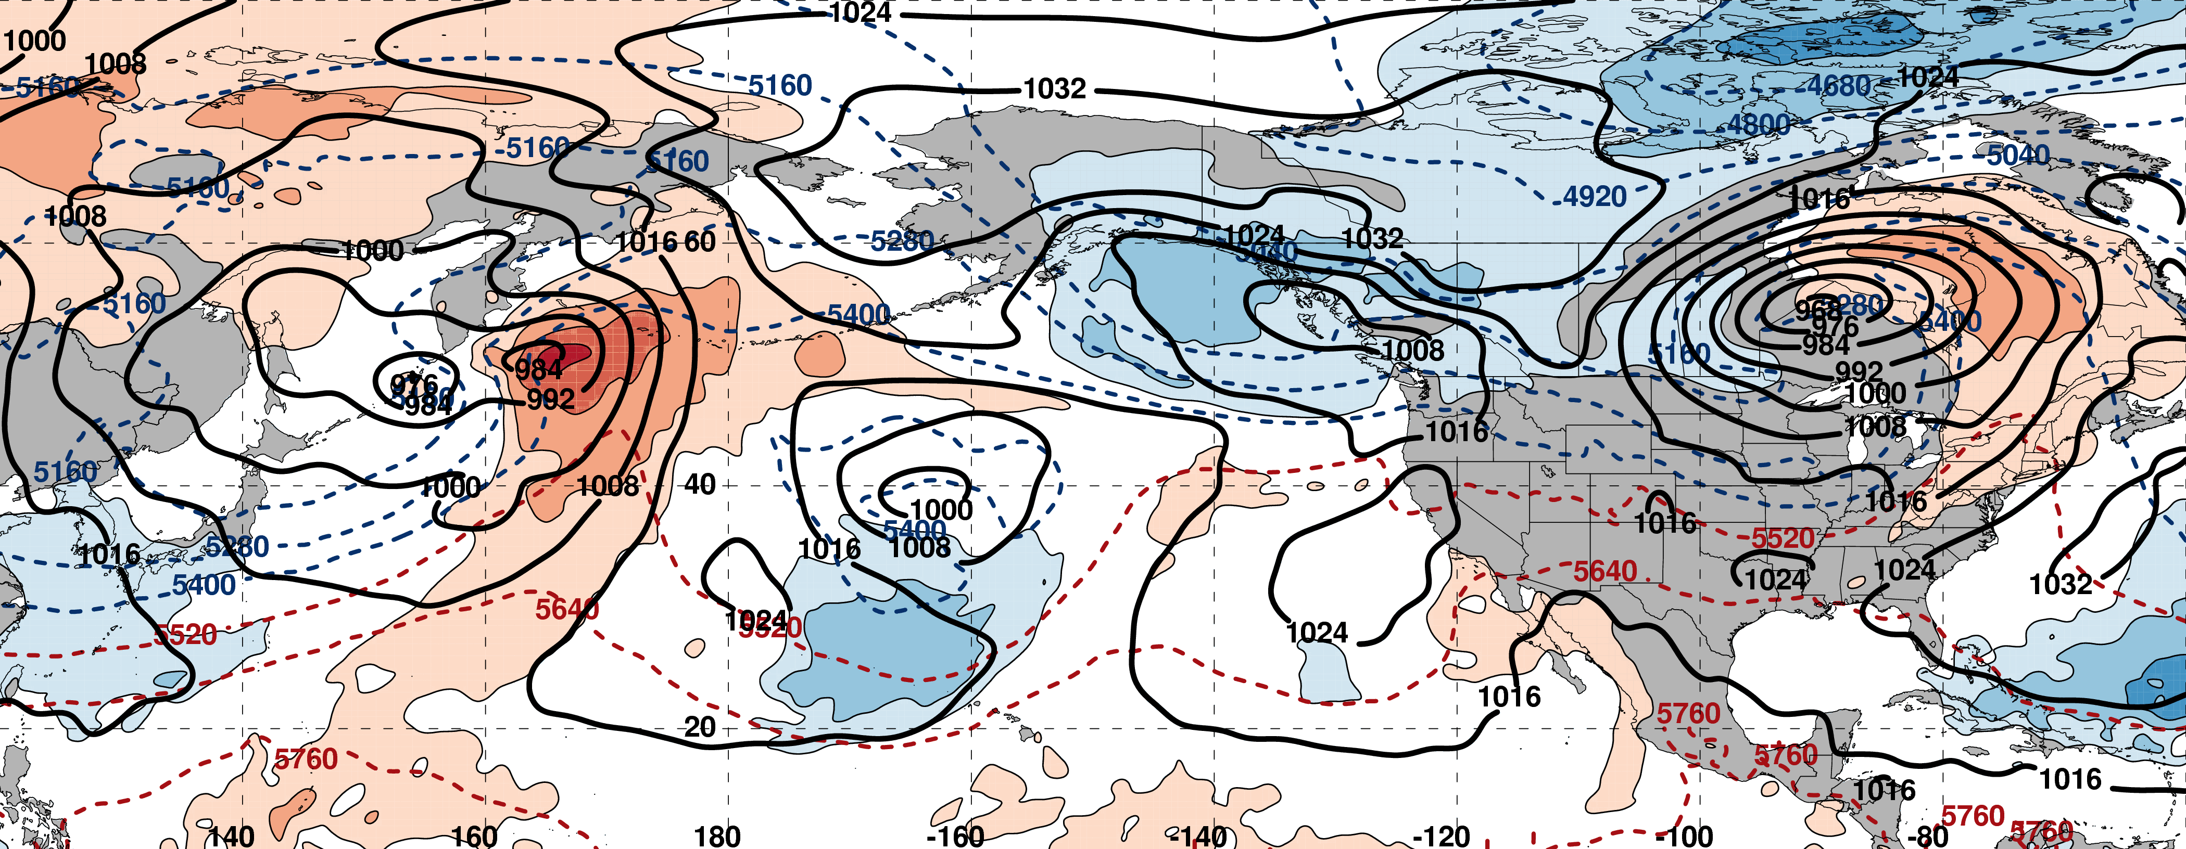
0000 UTC 08 March: 250-hPa Jet (shading) and Precipitable Water Anom. (shading)
m s^{–1}
σ
0000 UTC 08 March: MSLP (contours), Thick. (contours), 850-hPa Temp. Anom. (shading)
L
σ

Slide 45
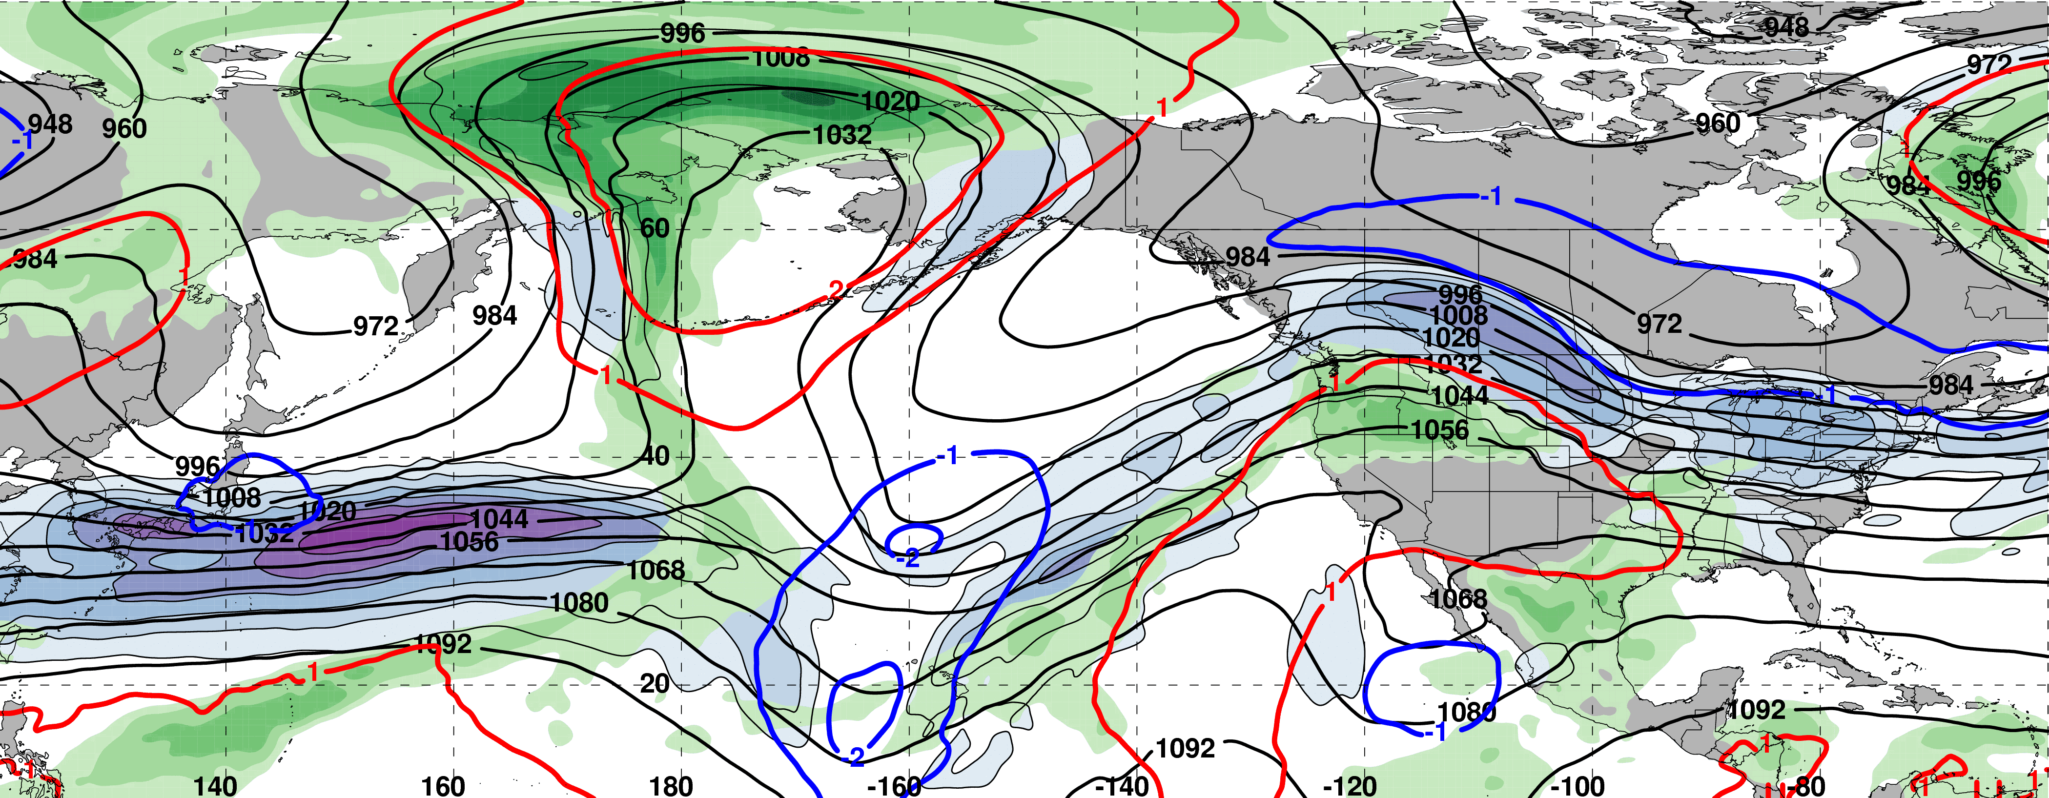
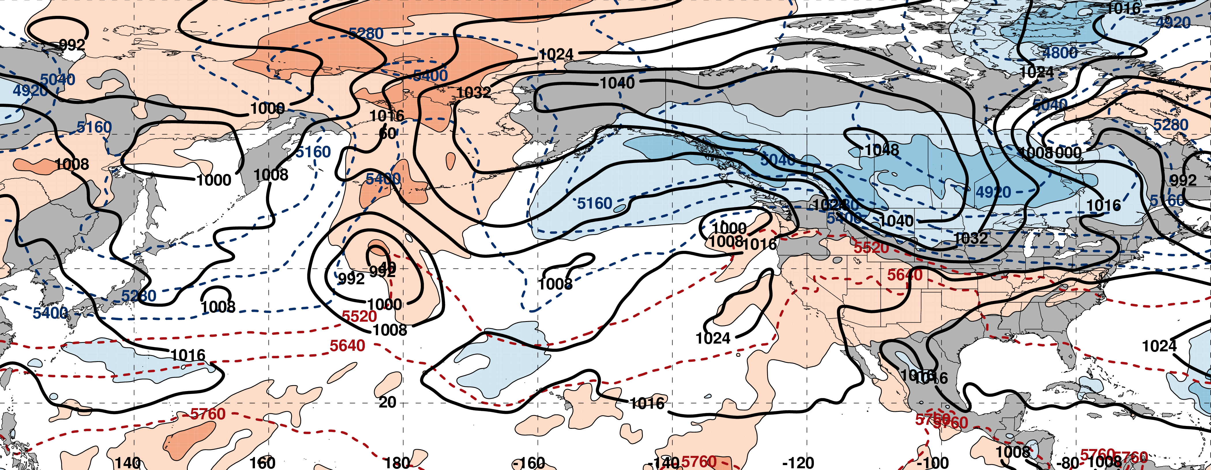
0000 UTC 10 March: 250-hPa Jet (shading) and Precipitable Water Anom. (shading)
m s^{–1}
σ
0000 UTC 10 March: MSLP (contours), Thick. (contours), 850-hPa Temp. Anom. (shading)
H
L
σ

Slide 46
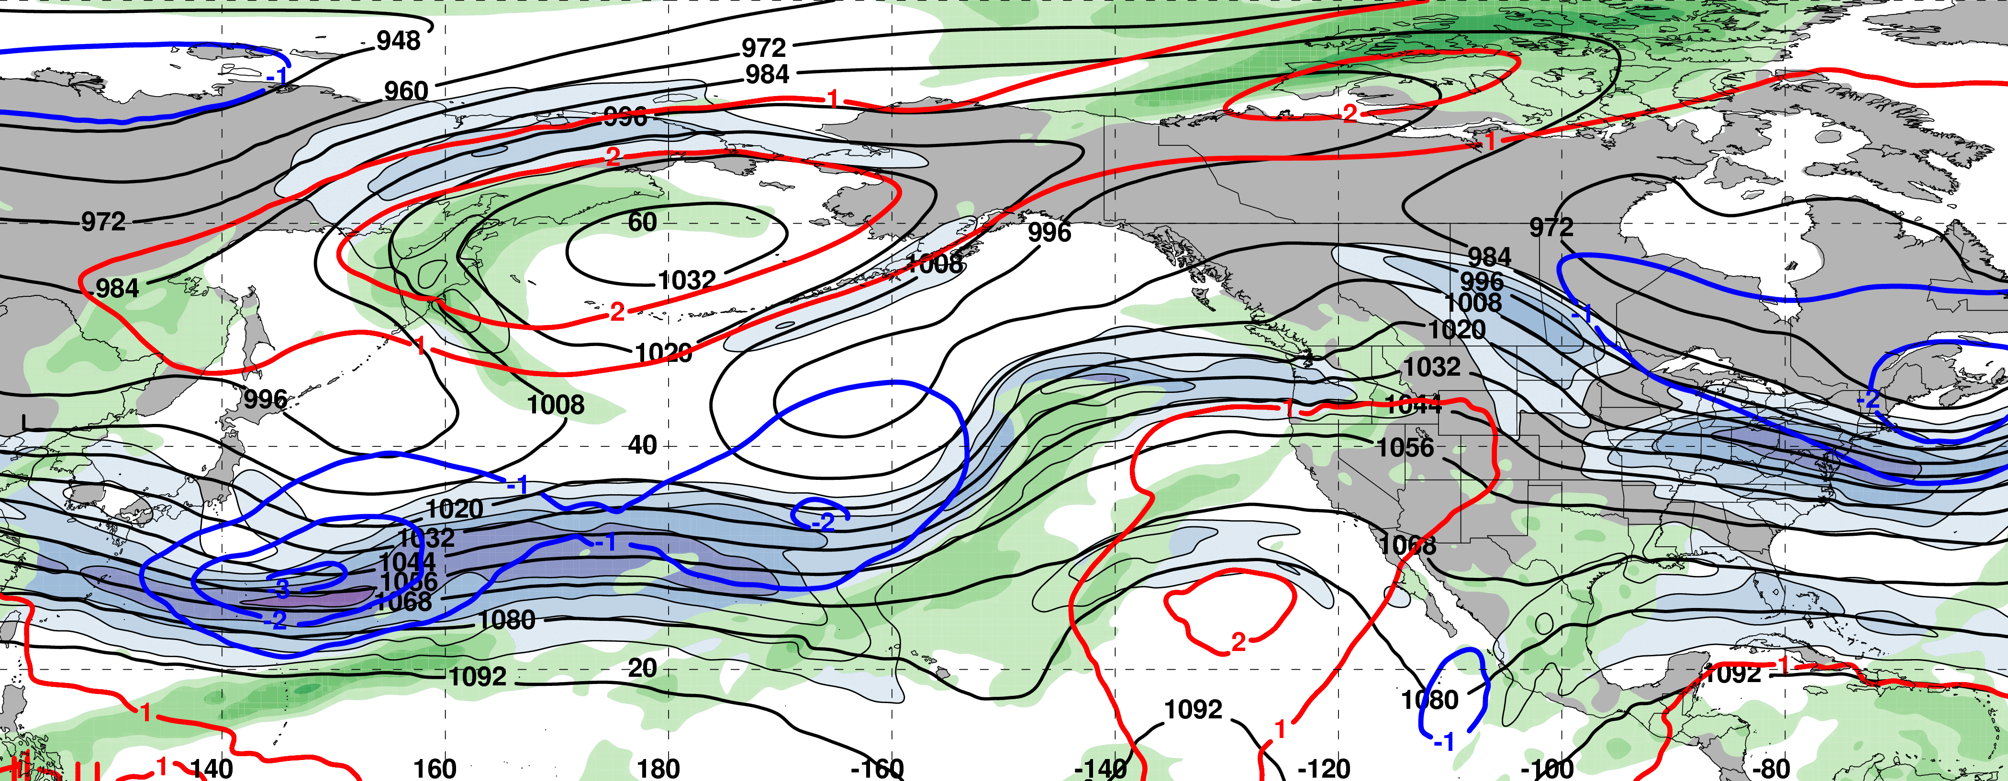
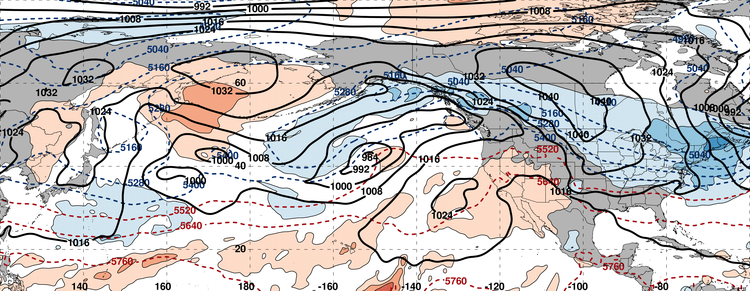
0000 UTC 12 March: 250-hPa Jet (shading) and Precipitable Water Anom. (shading)
m s^{–1}
σ
0000 UTC 12 March: MSLP (contours), Thick. (contours), 850-hPa Temp. Anom. (shading)
H
L
σ

Slide 47
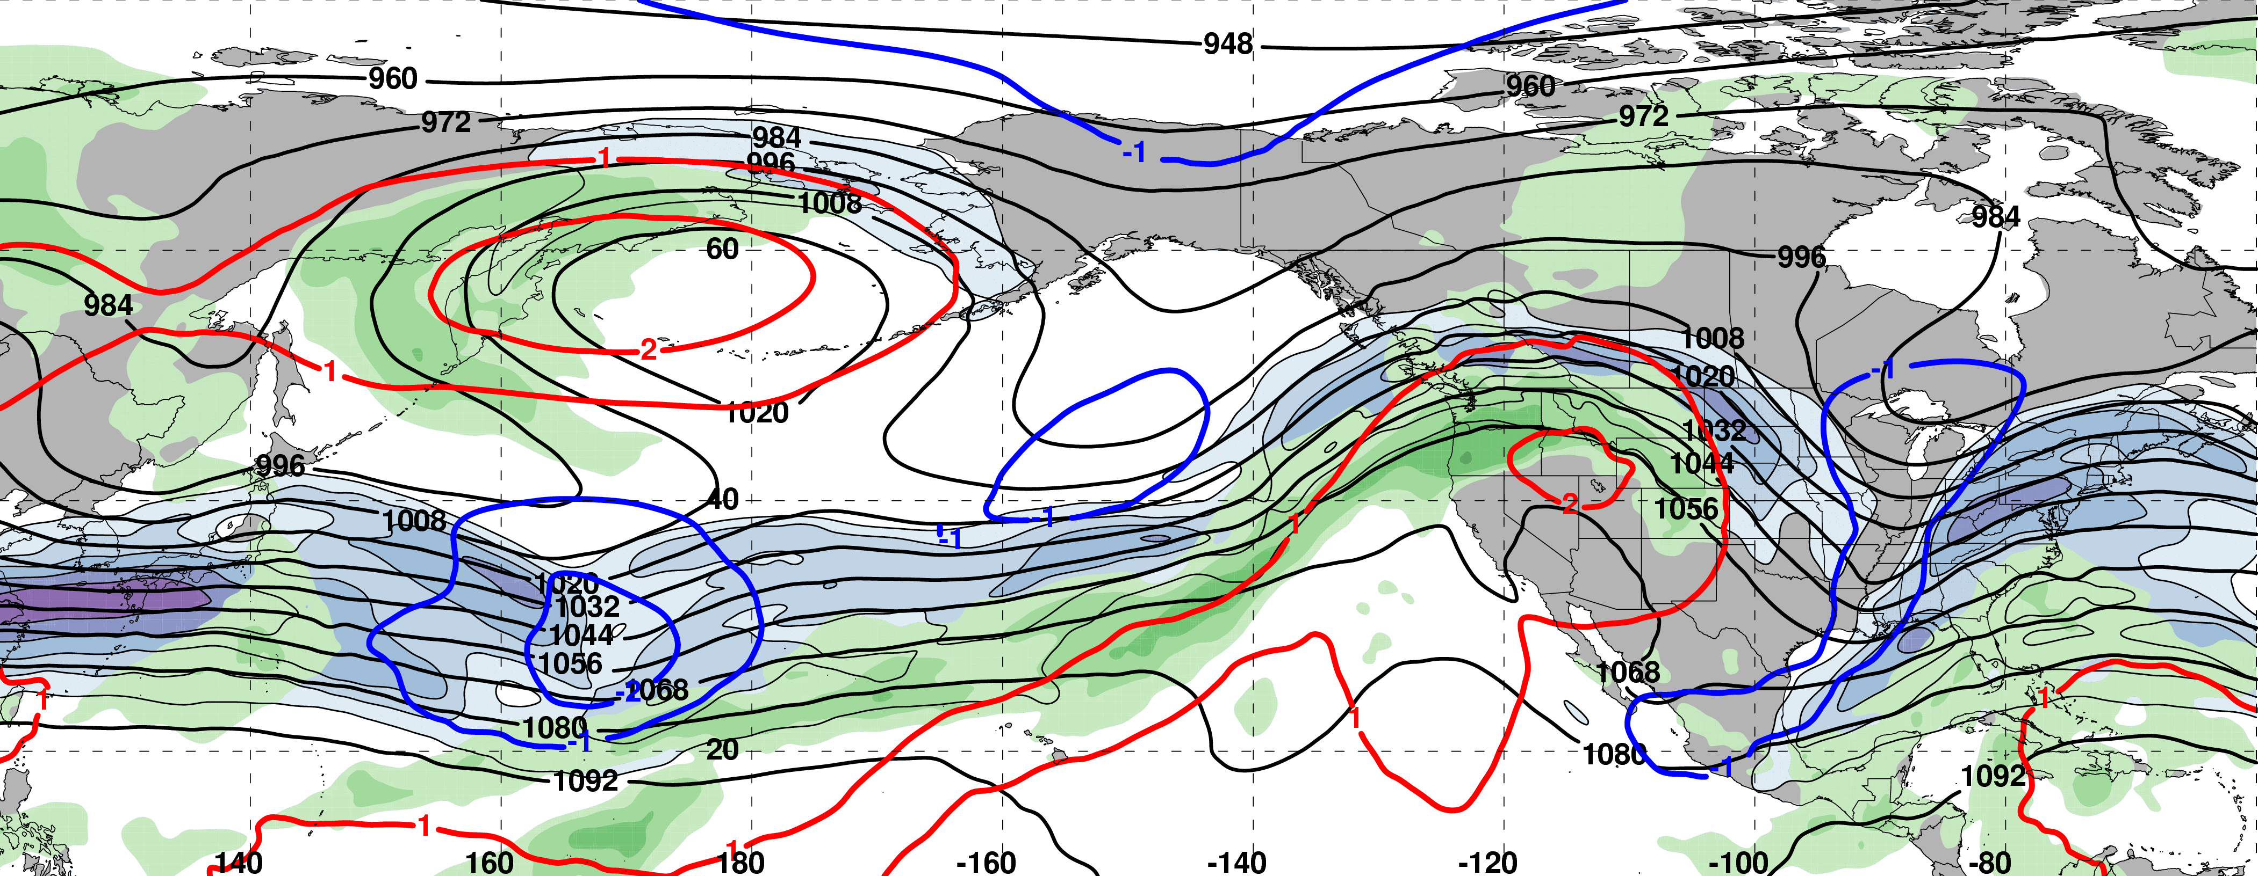
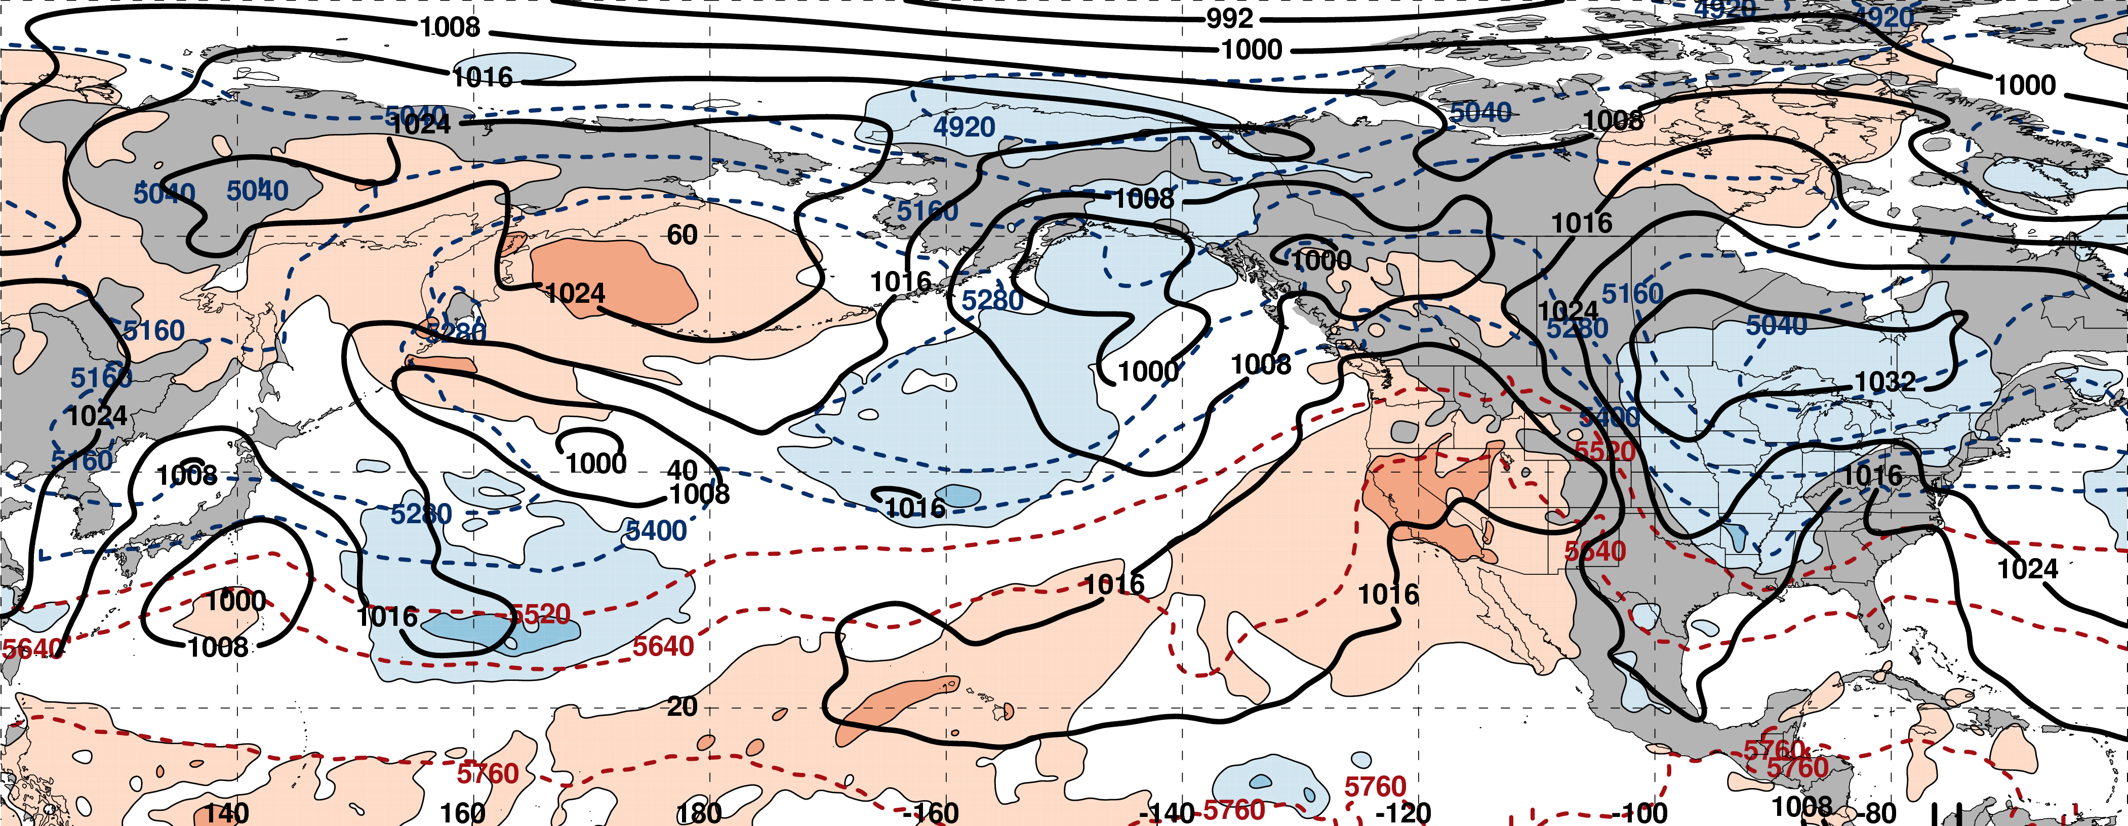
0000 UTC 14 March: 250-hPa Jet (shading) and Precipitable Water Anom. (shading)
m s^{–1}
σ
0000 UTC 14 March: MSLP (contours), Thick. (contours), 850-hPa Temp. Anom. (shading)
L
H
L
σ

Slide 48
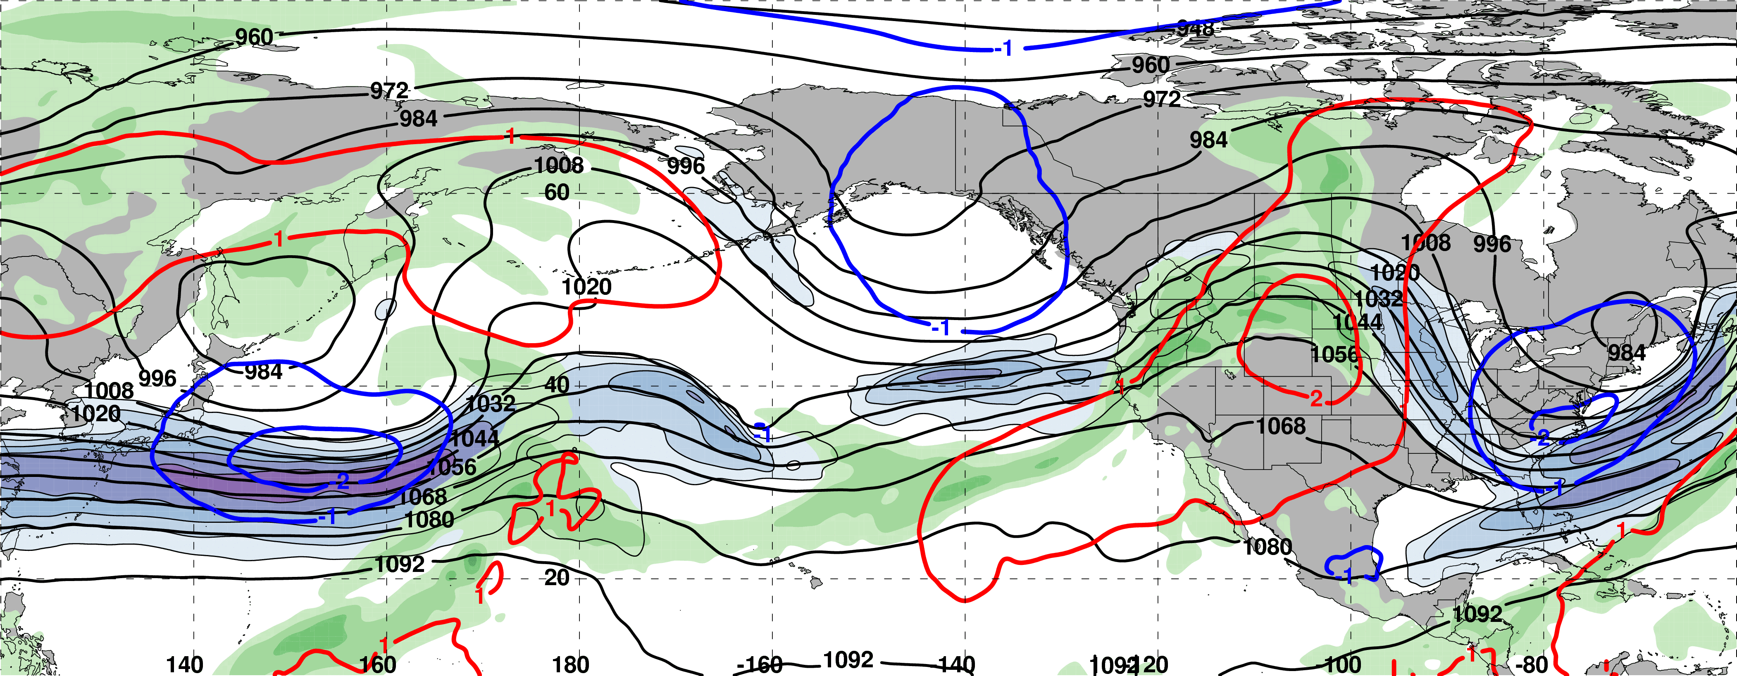
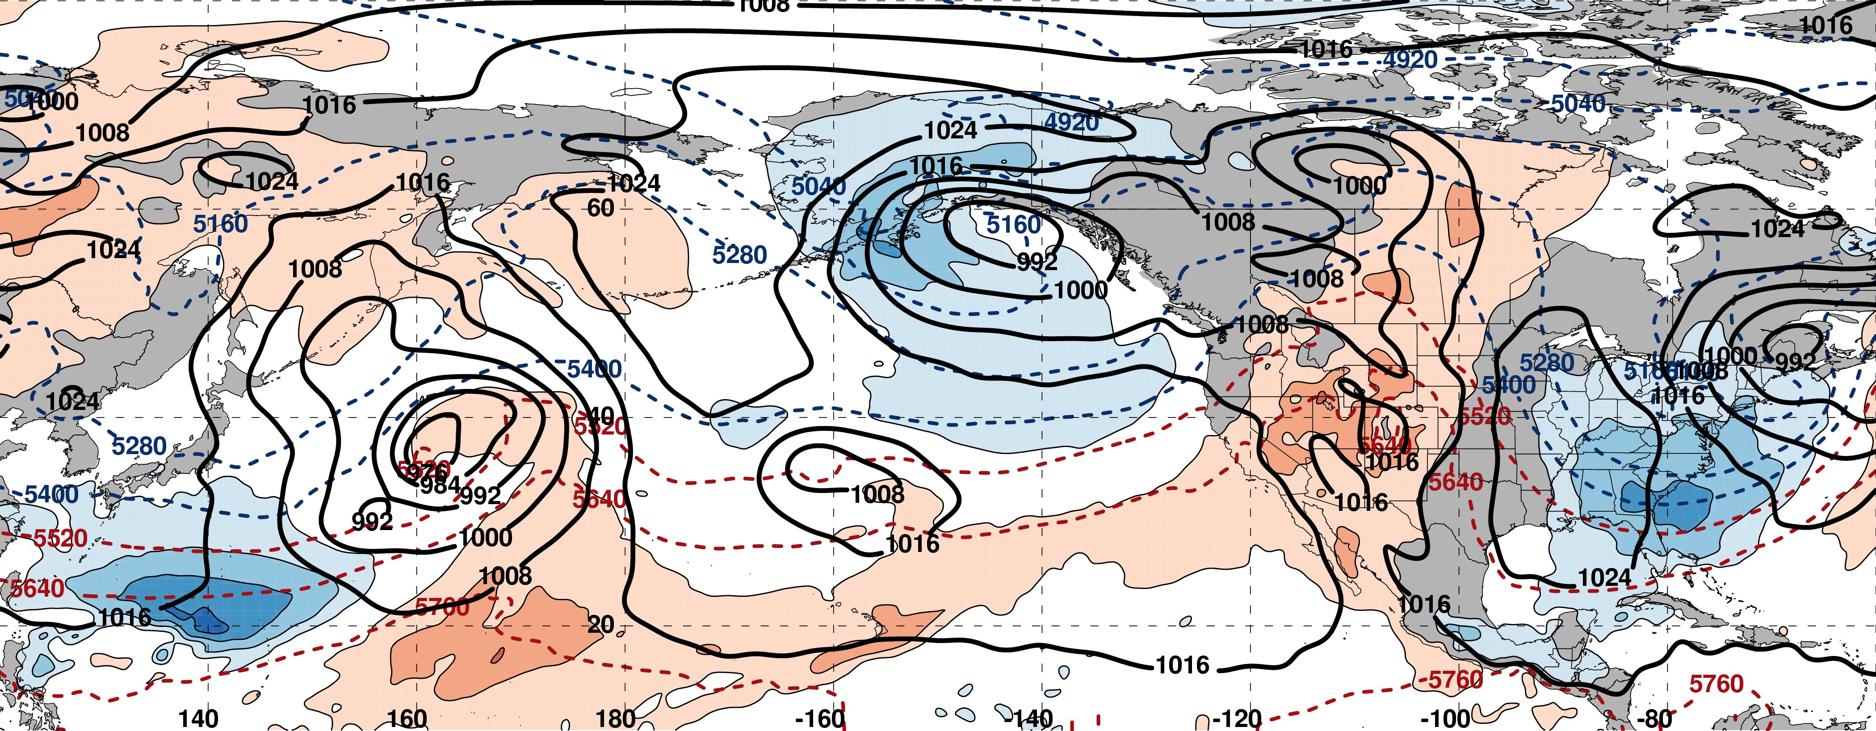
0000 UTC 16 March: 250-hPa Jet (shading) and Precipitable Water Anom. (shading)
m s^{–1}
σ
0000 UTC 16 March: MSLP (contours), Thick. (contours), 850-hPa Temp. Anom. (shading)
L
H
L
σ

Slide 49
Eastern U.S. Extreme Cold Events
Events during
Sept. – May 1979–2014 projected onto the NPJ phase diagram (N=173)
Poleward Shift
23
Each “x” is an average of the PCs
3–7 days prior to a cold event
30
47
Jet Retraction
Jet Extension
Equatorward shifts and jet extensions most often precede Eastern U.S. extreme cold events
73
Equatorward Shift

Slide 50
Eastern U.S. Extreme Cold Events
Events during
Sept. – May 1979–2014 projected onto the NPJ phase diagram (N=173)
Poleward Shift
23
Each “x” is an average of the PCs
3–7 days prior to a cold event
30
47
Jet Retraction
Jet Extension
Equatorward shifts and jet extensions most often precede Eastern U.S. extreme cold events
73
Equatorward Shift
9–13 Mar. 2017

Slide 51
Summary
Knowledge of both the forecast skill and the downstream flow pattern associated with each NPJ regime offers the potential to better inform operational temperature and precipitation forecasts over the continental U.S.
Anomalous precipitation along the Western U.S. coast in mid-February 2017 was preceded by an NPJ that was both extended and shifted poleward
The NPJ regime transition towards a jet retraction and equatorward shift during 14–26 February 2017 was characterized by large medium-range NPJ phase diagram forecast errors
The NPJ regime transition towards a jet extension during 26 February – 16 March was conducive to the development of a broad trough over the Eastern U.S. and the transport of anomalously cold air into the region prior to and following the “Pi Day Snowstorm”

Slide 52
NPJ Phase Diagram Web Interface
A web interface has been developed and implemented at WPC that offers real time NPJ phase diagram forecasts and NPJ regime composites

Slide 53
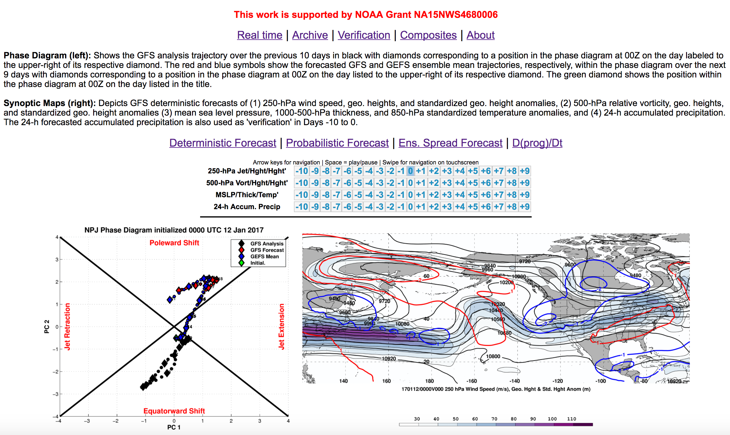
NPJ Phase Diagram Web Interface

Slide 54
NPJ Phase Diagram Web Interface
A web interface has been developed and implemented at WPC that offers real time NPJ phase diagram forecasts and NPJ regime composites
http://www.atmos.albany.edu/facstaff/awinters/realtime/About_EOFs.php
Contact: acwinters@albany.edu
Collaborators: Mike Bodner (WPC), Arlene Laing (NOAA), Dan Halperin (WPC), Bill Lamberson (WPC), Josh Kastman (WPC), and Sara Ganetis (WPC)

Slide 55
References
Athanasiadis, P. J., J. M. Wallace, and J. J. Wettstein, 2010: Patterns of wintertime jet stream variability and their relation to the storm tracks. J. Atmos. Sci., 67, 1361–1381.
Griffin, K. S., and J. E. Martin, 2017: Synoptic features associated with temporally coherent modes of variability of the North Pacific jet stream. J. Climate, 29, in press.
Jaffe, S. C., J. E. Martin, D. J. Vimont, and D. L. Lorenz, 2011: A synoptic climatology of episodic, subseasonal retractions of the Pacific jet. J. Climate, 24, 2846–2860.
Saha, S., and Coauthors, 2014: The NCEP Climate Forecast System Version 2. J. Climate, 27, 2185–2208.

Slide 56
Supplementary Slides

Slide 57
NPJ Phase Diagram Characteristics

Slide 58
Pacific Northwest Extreme Precipitation Events
Composite NPJ Trajectory during the 10 days prior to a Pac. NW Extreme Precip. Event (N=85)
Start
End
All event trajectories comprising the composite are repositioned to begin at the origin

Slide 59
NPJ Regime Frequency by Month
Poleward and Equatorward Shifts are favored during September
NPJ regime frequencies are nearly equivalent during all other months

Slide 60
NPJ Regime Frequency and ENSO
Jet Extensions and Equatorward Shifts are favored during an El Niño
Jet Retractions and Poleward Shifts are favored during a La Niña

Slide 61
NPJ Regime Frequency and the MJO
Jet Retractions are favored during Phases 2, 3, and 4
Poleward Shifts are favored during Phases 5 and 6
Jet Extensions are favored during Phases 7, 8, and 1

Slide 62
NPJ Regime Frequency and the PNA
Jet Extensions and Poleward Shifts are favored during a positive PNA
Jet Retractions and Equatorward Shifts are favored during a negative PNA

Slide 63
Real time NPJ Phase Diagram Verification Statistics
2016–2017

Slide 64
Reliability Diagram (Sept 1 – May 31)
Perfect
Reliability
The GEFS appears to be underdispersive with respect to medium-range forecasts of the NPJ within the phase diagram

Slide 65
GFS Average Error – Regime

Slide 66
Average GEFS Mean Error – Regime

Slide 67
GEFS Probability of Detection – Regime

Slide 68
NPJ Phase Diagram Forecast Skill
Determined the position within the NPJ phase diagram for all 0-h forecasts during Sept.–May 1985–2014 in the GEFS Reforecast v2 (Hamill et al. 2013)

Slide 69
Reliability Diagram
Perfect
Reliability
GEFS Reforecasts appear to be underdispersive with respect to medium-range forecasts of the North Pacific Jet in the phase diagram

Slide 70
GEFS Ensemble Mean Error – Season
Circles on a particular line indicate statistically significant differences to the 95% confidence interval with respect to another jet regime.

Slide 71
GFS Average Error – Month

Slide 72
Average GEFS Mean Error – Month

Slide 73
GEFS Probability of Detection – Month

Slide 74

GEFS Ensemble Mean POD by NPJ Regime
For forecasts verifying within a particular NPJ regime
Extension
Retraction
Poleward
Equator
Origin
Mean

Slide 75
Jet Regime-Dependent Forecast Skill
Percent Difference Between the Frequency of Forecasts with Below-Normal and Above-Normal RMSE
Higher frequency of forecasts with
below-normal RMSE
(i.e., more good forecasts)
Higher frequency of forecasts with
above-normal RMSE
(i.e., more bad forecasts)

Slide 76
Jet Regime-Dependent Forecast Skill
Percent Difference Between the Frequency of Forecasts with Below-Normal and Above-Normal RMSE
Higher frequency of forecasts with
below-normal RMSE
(i.e., more good forecasts)
Higher frequency of forecasts with
above-normal RMSE
(i.e., more bad forecasts)

Slide 77
NPJ Phase Diagram and ETE’s

Slide 78
Eastern U.S. – All Events
Extreme Warm Event Centroids
WARM EVENTS (N = 239)
Poleward Shift
66
Events during
Sept. – May projected onto phase diagram
69
Jet Retraction
47
Jet Extension
Each point is an average of the PCs
3–7 days prior to an event
57
Equatorward Shift
Mean Projection

Slide 79
Western U.S. – Pac. NW Cluster
Extreme Cold Event Centroids
COLD EVENTS (N = 78)
Poleward Shift
18
Events during
Sept. – May projected onto phase diagram
31
Jet Retraction
9
Jet Extension
Each point is an average of the PCs
3–7 days prior to an event
20
Equatorward Shift
–4
Mean Projection

Slide 80
Western U.S. – Pac. NW Cluster
Extreme Warm Event Centroids
WARM EVENTS (N = 89)
Poleward Shift
22
Events during
Sept. – May projected onto phase diagram
13
Jet Retraction
27
Jet Extension
Each point is an average of the PCs
3–7 days prior to an event
27
Equatorward Shift
–4
Mean Projection

Slide 81
NPJ Phase Diagram Technical Slides

Slide 82
Real Time North Pacific Jet Phase Diagram
0000 UTC 8 November 2014
250-hPa wind speed: shaded
Instantaneous 250-hPa zonal wind anomalies can be projected onto EOF 1 and EOF 2, resulting in a point on a North Pacific Jet phase diagram

Slide 83
Real Time North Pacific Jet Phase Diagram
Each point on the phase diagram is a weighted average of the principal components within +/− 1 day of the time under consideration
Example: 0000 UTC 8 November 2014
Weight
5
4
3
2
1
Date
0000 UTC 7 Nov.
1200 UTC 7 Nov.
0000 UTC 8 Nov.
1200 UTC 8 Nov.
0000 UTC 9 Nov.

Slide 84

Real Time North Pacific Jet Phase Diagram
250-hPa zonal wind at 0000 UTC 2 Jun minus 250-hPa zonal wind at 0000 UTC 24 May (shading) in the GFS analyses shows the transition to a poleward-shifted jet regime
0000 UTC 24 May
(0-h forecast)
0000 UTC 2 Jun (verification)
Ensemble mean
Sept.–May mean 250-hPa zonal wind: black contours
Notes:
Note that the positive changes in zonal wind correspond exactly to where the positive anomalies are located in the EOF2 pattern – See slide 14.

Slide 85



GEFS Ensemble Trajectories Initialized 0000 UTC 24 May 2016
250-hPa Zonal Wind Anomalies and EOF1: 0000 UTC 2 Jun
0000 UTC 2 Jun (verification)
m s^{–1}
250-hPa Zonal Wind Anomalies and EOF2: 0000 UTC 2 Jun
250-hPa zonal wind anomalies at 0000 UTC 2 Jun project strongly onto
EOF2 > 0
m s^{–1}

