Slide 1
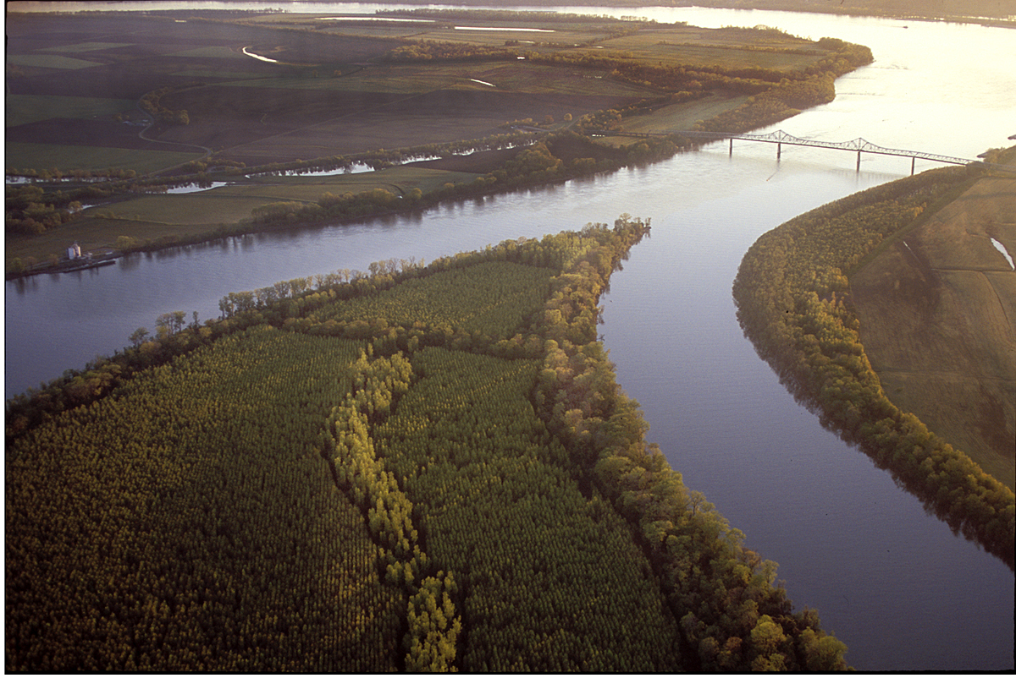


Discerning the Relative Importance of Polar and Tropical Upper-Tropospheric PV Anomalies during North American Polar/Subtropical Jet Superpositions
Andrew C. Winters
Daniel Keyser and Lance F. Bosart
18th Cyclone Workshop
Sainte-Adèle, QC
2 October 2017
This work is funded by an NSF-PRF (AGS-1624316)

Slide 2

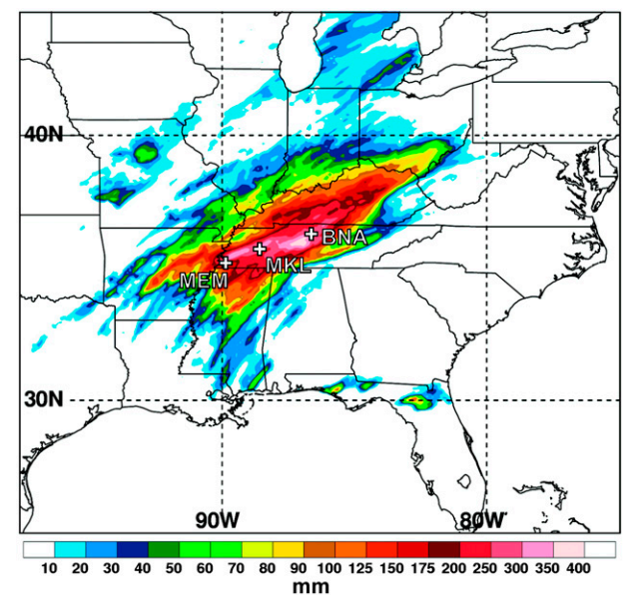
Jet Superpositions and High-Impact Weather
Jet superpositions can be an element of high-impact weather events
1–3 May 2010 Nashville Flood
Jet superposition enhanced the poleward moisture transport via its ageostrophic circulation (Winters and Martin 2014; 2016)
Moore et al. (2012)

Slide 3
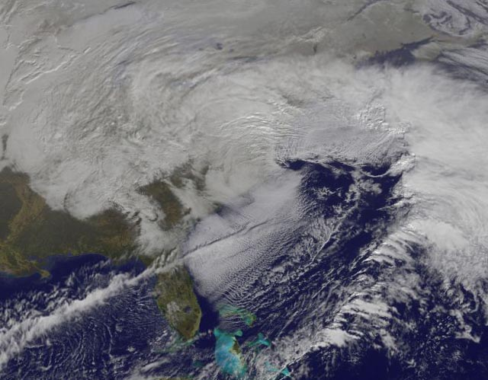
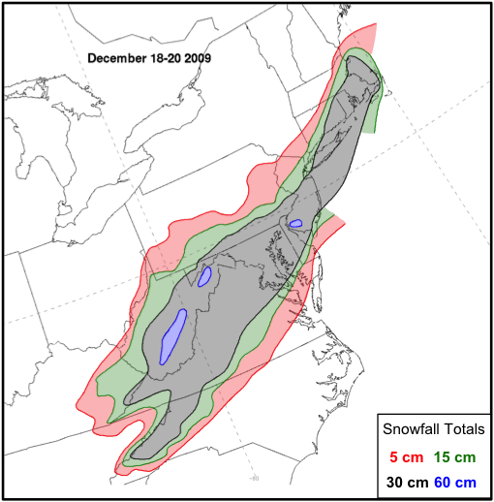
Jet Superpositions and High-Impact Weather
Jet superpositions can be an element of high-impact weather events
1–3 May 2010 Nashville Flood
Jet superposition enhanced the poleward moisture transport via its ageostrophic circulation (Winters and Martin 2014; 2016)
18–20 December 2009 Mid-Atlantic Blizzard
Jet superposition was associated with a rapidly deepening East Coast cyclone (Winters and Martin 2016; 2017)

Slide 4
Jet Superpositions and High-Impact Weather
Jet superpositions can be an element of high-impact weather events
1–3 May 2010 Nashville Flood
Jet superposition enhanced the poleward moisture transport via its ageostrophic circulation (Winters and Martin 2014; 2016)
18–20 December 2009 Mid-Atlantic Blizzard
Jet superposition was associated with a rapidly deepening East Coast cyclone (Winters and Martin 2016; 2017)
How do these structures develop?

Slide 5
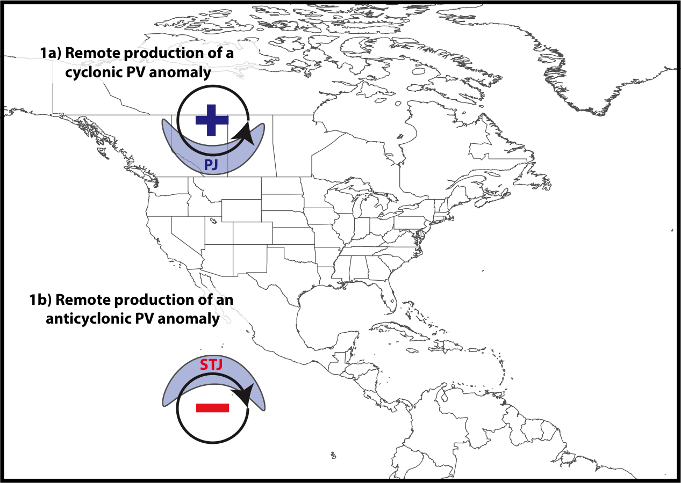
Jet Superposition Conceptual Model
Winters and Martin 2017

Slide 6
Jet Superposition Conceptual Model
Polar cyclonic PV anomalies:
Often referred to as coherent tropopause disturbances (Pyle et al. 2004) or tropopause polar vortices (Cavallo and Hakim 2010)
Typify a dynamical environment conducive to midlatitude cyclogenesis
Winters and Martin 2017

Slide 7
Jet Superposition Conceptual Model
Winters and Martin 2017

Slide 8
Jet Superposition Conceptual Model
Tropical anticyclonic PV anomalies:
Typify a thermodynamic environment characterized by weak upper-tropospheric static stability
Atmospheric rivers often form within the poleward-directed branch of their circulation
Winters and Martin 2017

Slide 9
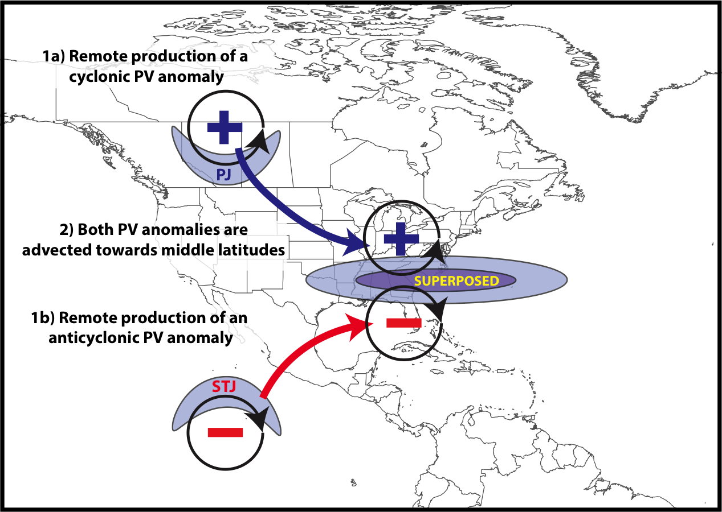
Jet Superposition Conceptual Model
Winters and Martin 2017

Slide 10
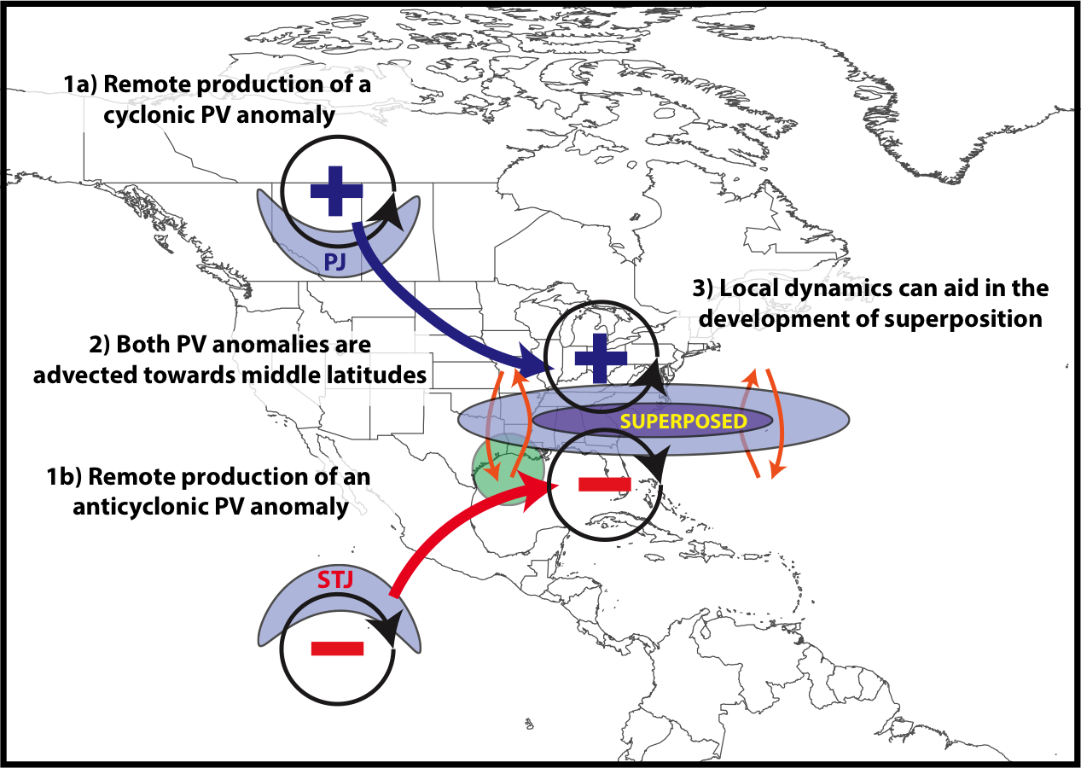
Jet Superposition Conceptual Model
Winters and Martin 2017

Slide 11
Jet Superposition Conceptual Model
The relative importance of these PV anomalies is highly variable between jet superposition events
Winters and Martin 2017

Slide 12
Jet Superposition Conceptual Model
GOAL: To determine the characteristic types of interaction that exist between upper-tropospheric PV anomalies during a jet superposition event
Winters and Martin 2017

Slide 13
Jet Superposition Event Identification and Classification

Slide 14
Jet Superposition Event Identification
Isolated NCEP CFSR (Saha et al. 2014) grid points over North America characterized by a jet superposition during Nov–Mar 1979–2010 using the Christenson et al. (2017) scheme
Retained analysis times that rank in the top 10% in terms the number of grid points characterized by a jet superposition
Filtered retained analysis times to group together jet superpositions that are < 30 h and < 1500 km of one another

Slide 15
Jet Superposition Event Identification
Isolated NCEP CFSR (Saha et al. 2014) grid points over North America characterized by a jet superposition during Nov–Mar 1979–2010 using the Christenson et al. (2017) scheme
Retained analysis times that rank in the top 10% in terms the number of grid points characterized by a jet superposition
Filtered retained analysis times to group together jet superpositions that are < 30 h and < 1500 km of one another
  326 unique jet superposition events

Slide 16
Jet Superposition Event Classification
Determined the mean position of the 2-PVU contour on the 320-K and 350-K surfaces at each analysis time in the CFSR.
0000 UTC 1 January

Slide 17
Jet Superposition Event Classification
Determined the mean position of the 2-PVU contour on the 320-K and 350-K surfaces at each analysis time in the CFSR.
0000 UTC 1 January
Polar Jet
Subtropical Jet

Slide 18
Jet Superposition Event Classification
Determined the mean position of the 2-PVU contour on the 320-K and 350-K surfaces at each analysis time in the CFSR.
Compared the position of the jet superposition centroid at the start of each event against the climatological position of the 2-PVU contour.
0000 UTC 1 January

Slide 19
Jet Superposition Event Classification
Determined the mean position of the 2-PVU contour on the 320-K and 350-K surfaces at each analysis time in the CFSR.
Compared the position of the jet superposition centroid at the start of each event against the climatological position of the 2-PVU contour.
Polar Dominant
0000 UTC 1 January
Jet Superposition Centroid

Slide 20
Jet Superposition Event Classification
Determined the mean position of the 2-PVU contour on the 320-K and 350-K surfaces at each analysis time in the CFSR.
Compared the position of the jet superposition centroid at the start of each event against the climatological position of the 2-PVU contour.
Polar Dominant
Subtropical Dominant
0000 UTC 1 January
Jet Superposition Centroid

Slide 21
Jet Superposition Event Classification
Determined the mean position of the 2-PVU contour on the 320-K and 350-K surfaces at each analysis time in the CFSR.
Compared the position of the jet superposition centroid at the start of each event against the climatological position of the 2-PVU contour.
Polar Dominant
Subtropical Dominant
Hybrid
0000 UTC 1 January
Jet Superposition Centroid

Slide 22
Jet Superposition Event Classification

Slide 23
Jet Superposition Event Classification

Slide 24
Jet Superposition Event Classification

Slide 25
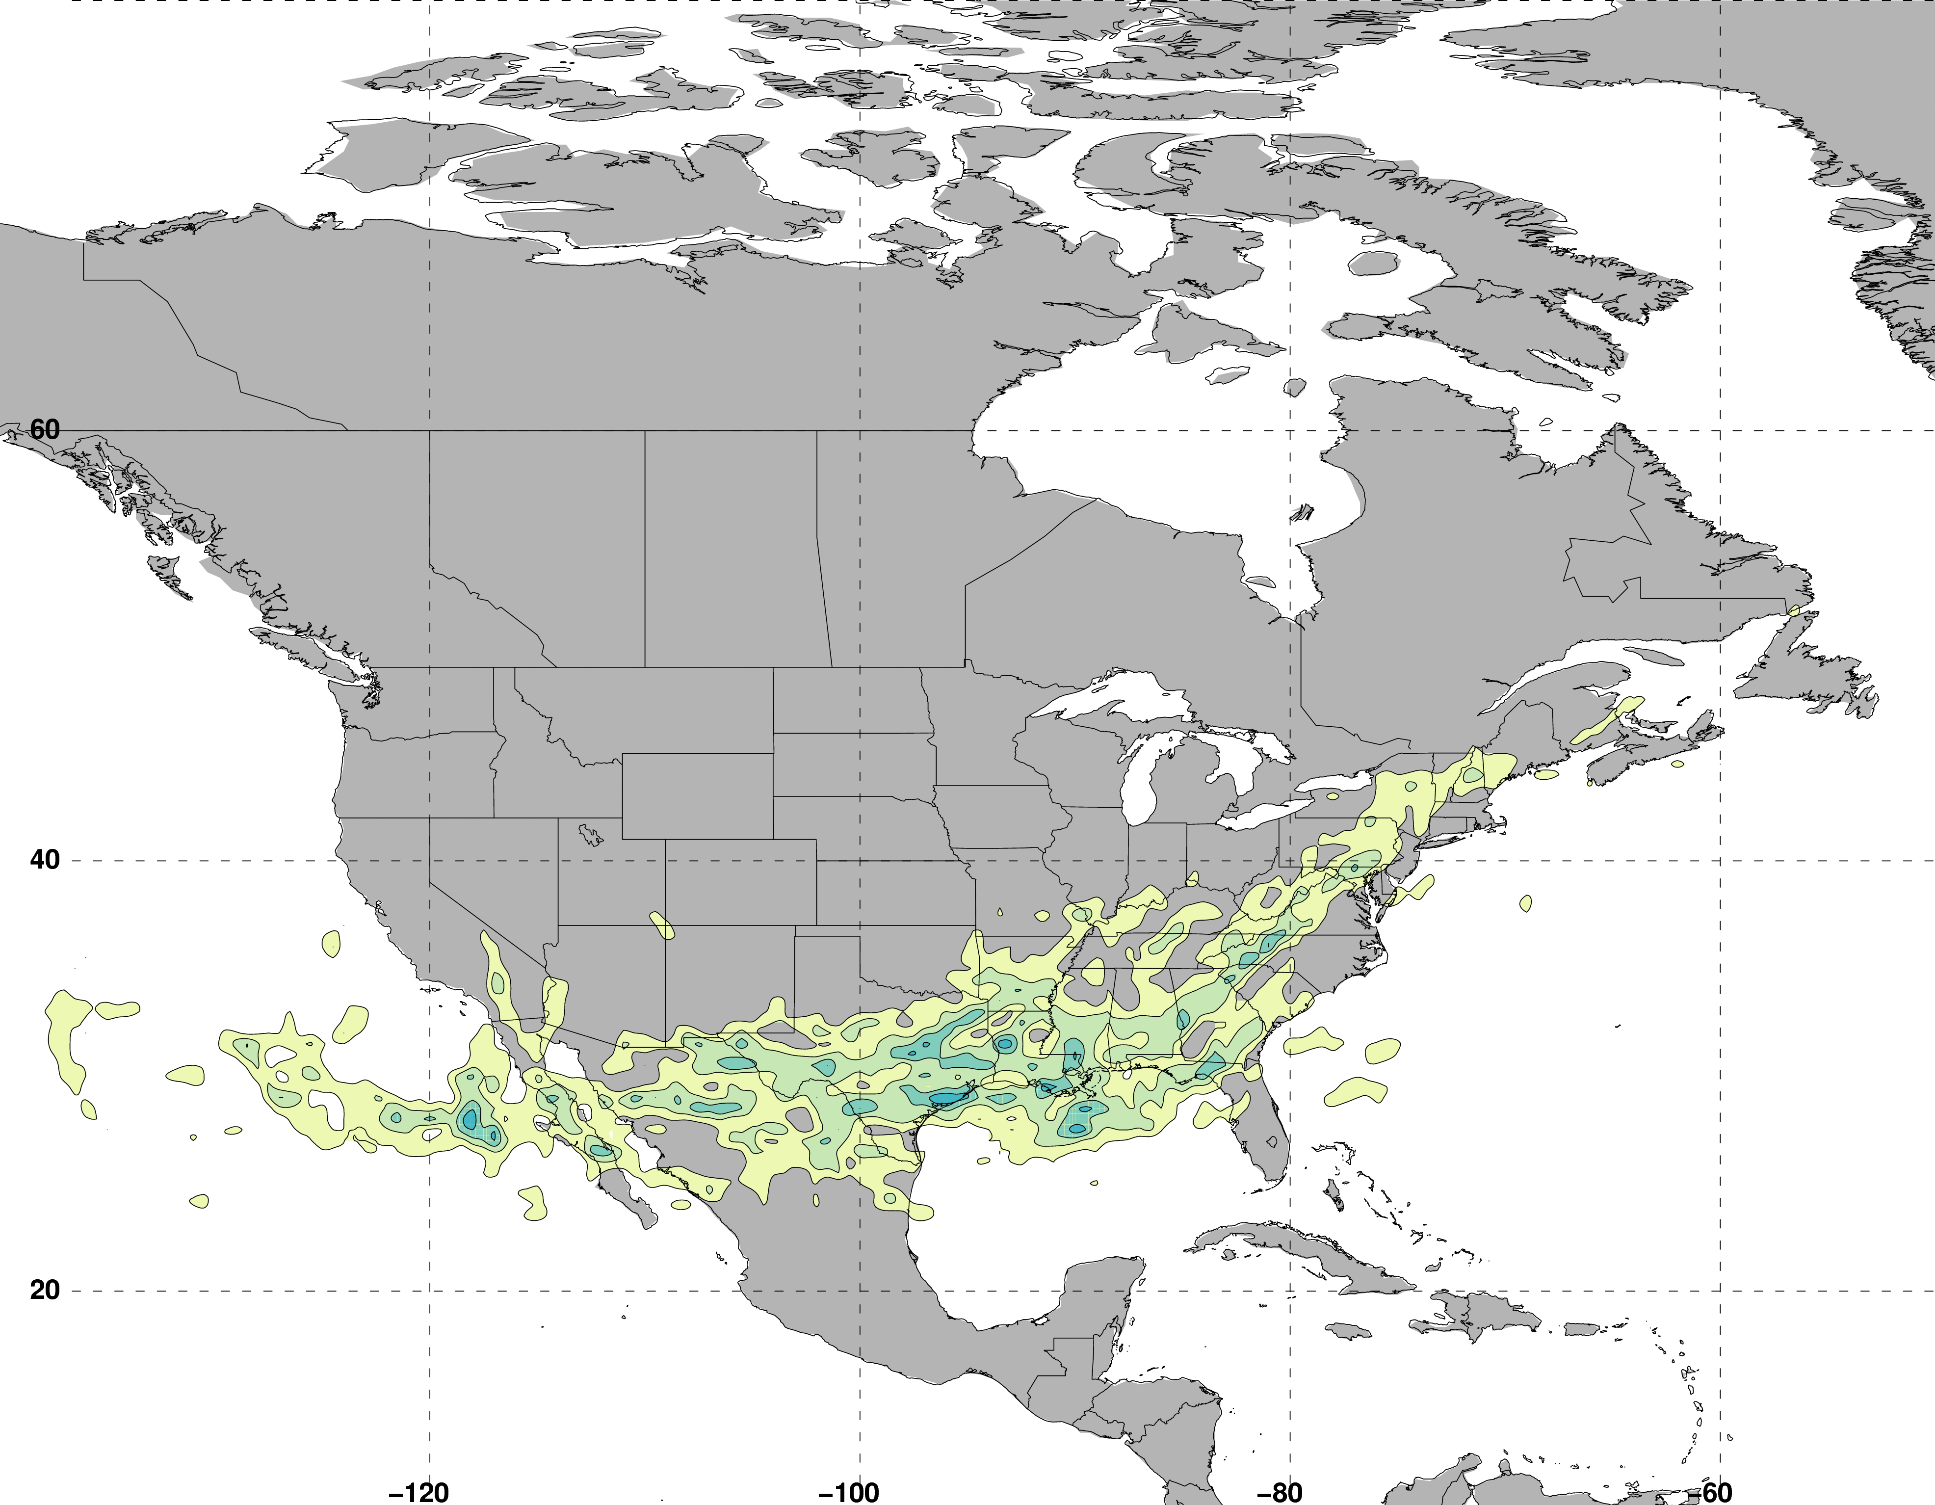
Jet Superposition Event Classification
Frequency of Polar Dominant Jet Superposition Events
N = 80
Legend
Centroid of all events

Slide 26
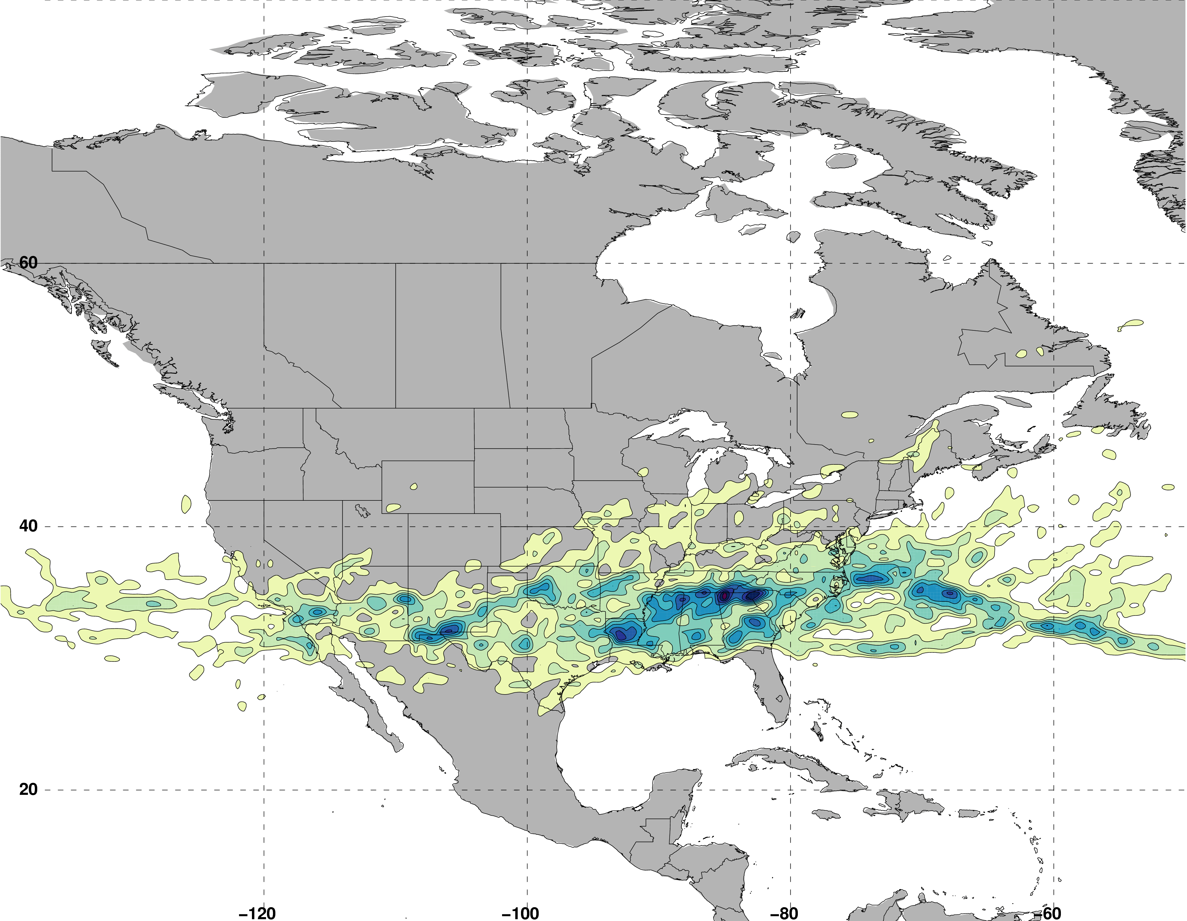
Jet Superposition Event Classification
Frequency of Hybrid Jet Superposition Events
N = 117
Legend
Centroid of all events

Slide 27
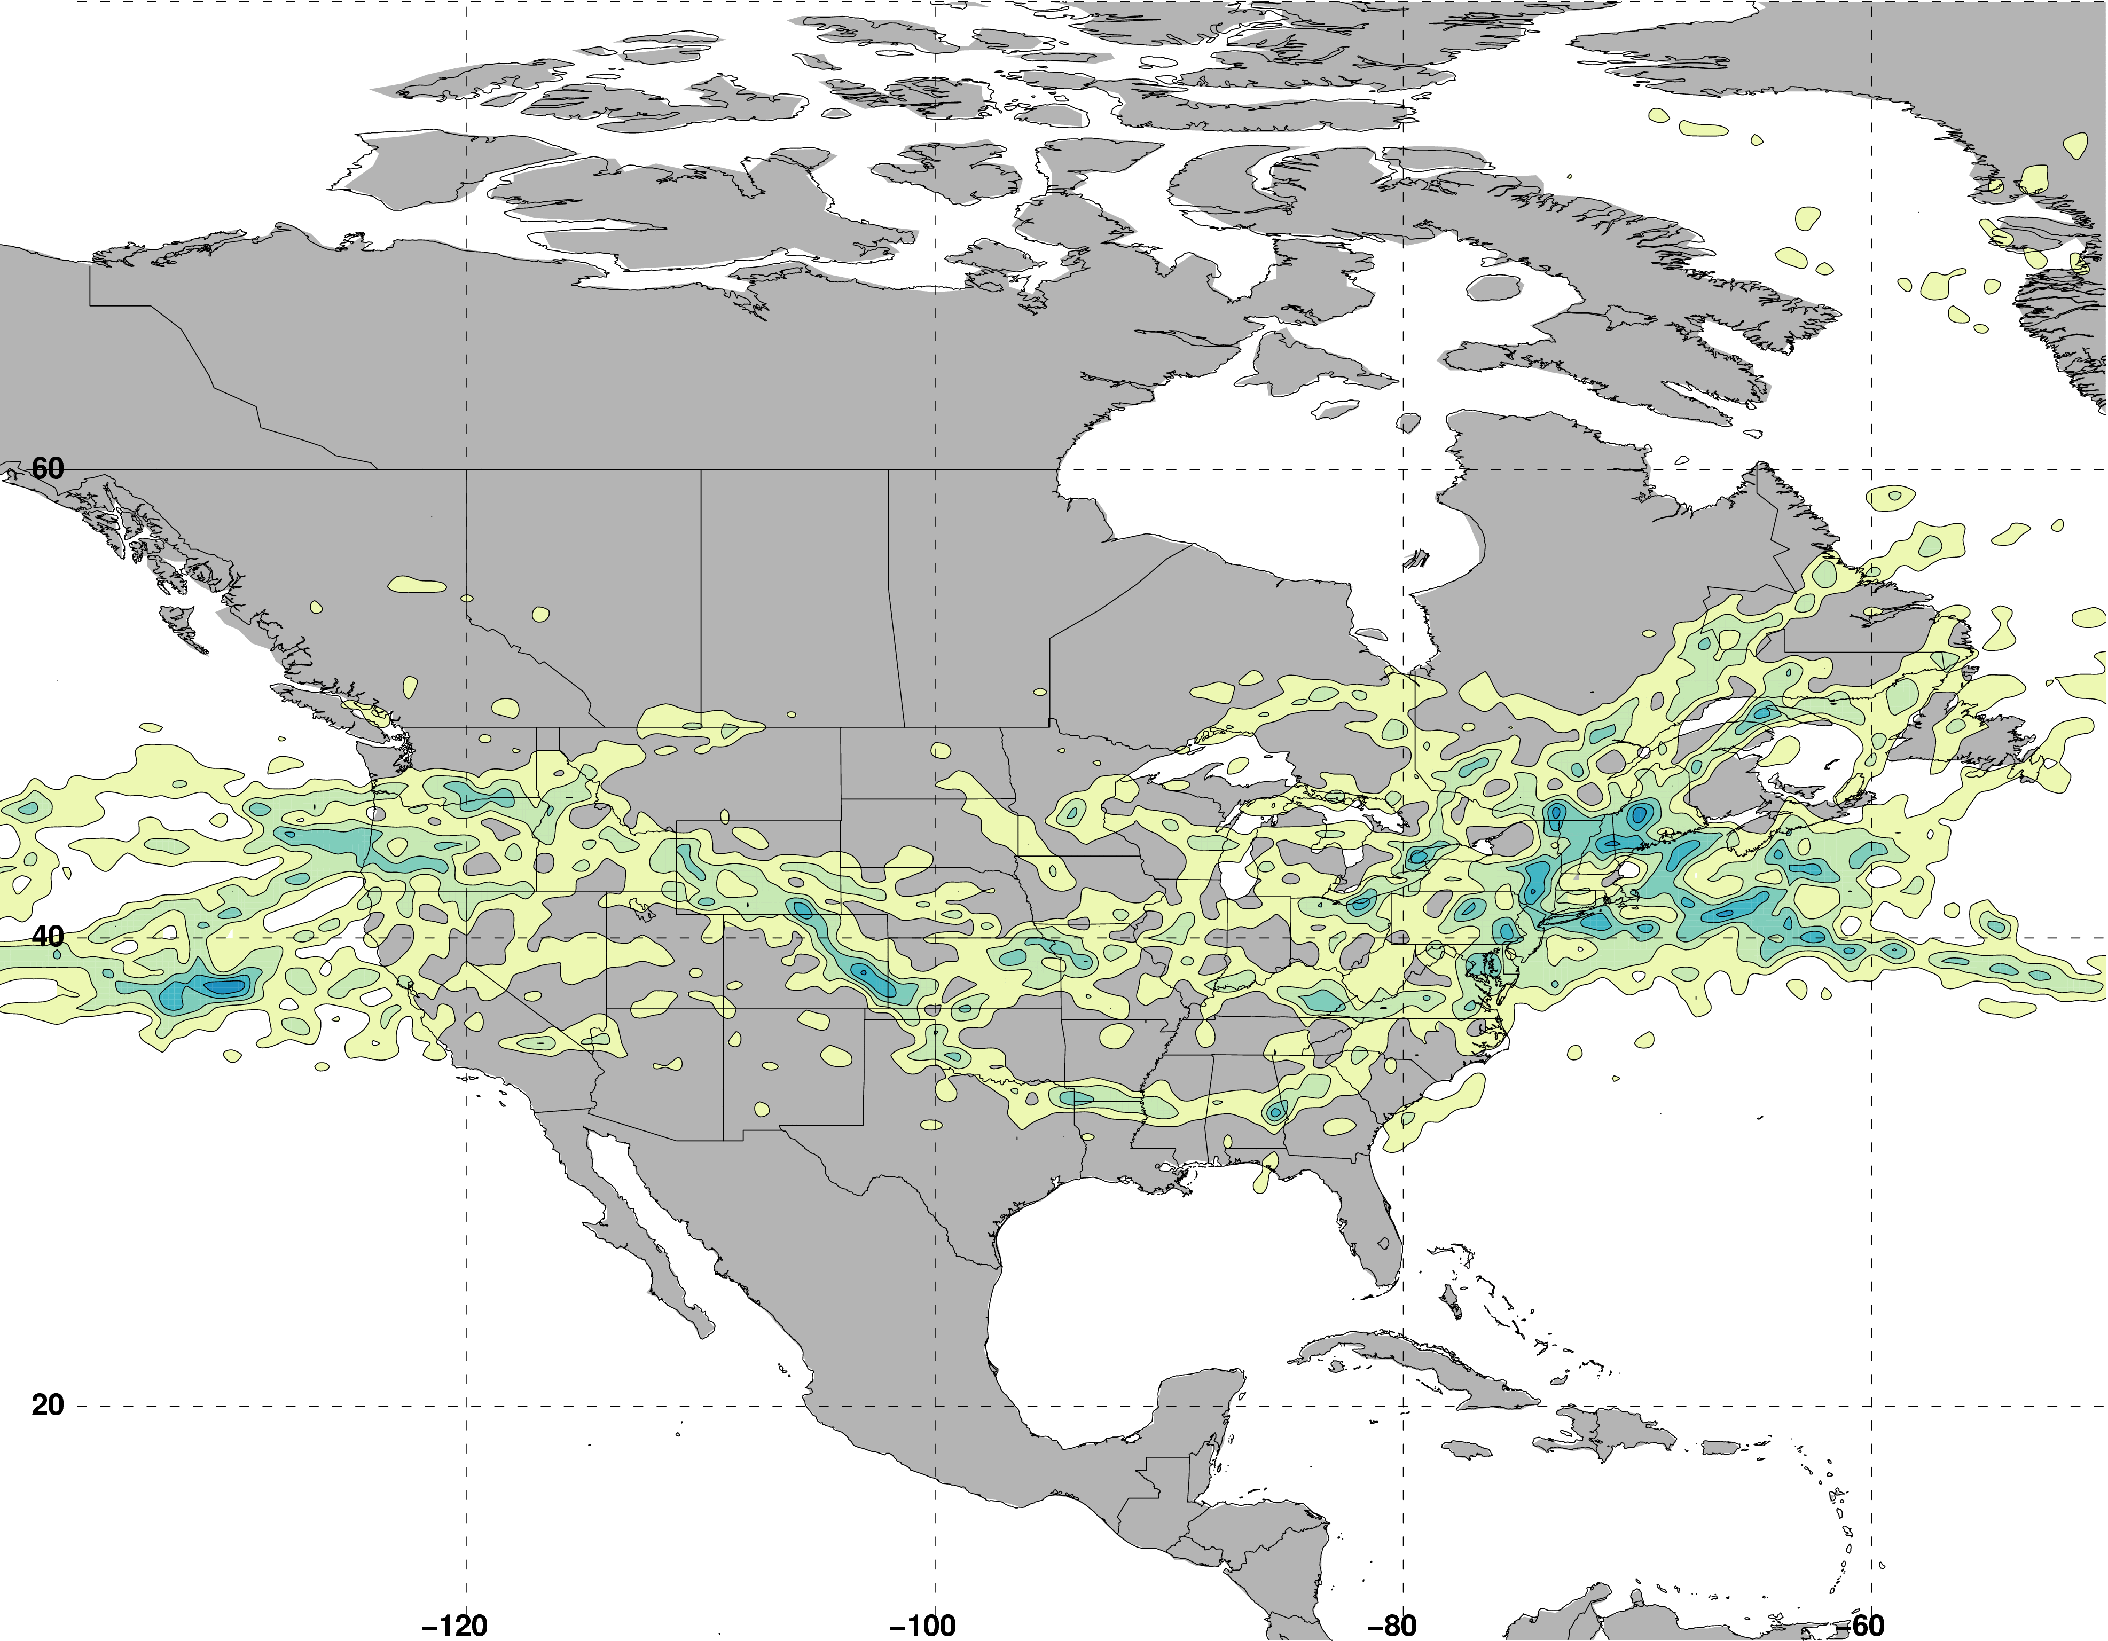
Jet Superposition Event Classification
Frequency of Subtropical Dominant Jet Superposition Events
N = 129
Legend
Centroid of all events

Slide 28
Jet Superposition Event Classification
Frequency of Subtropical Dominant Jet Superposition Events
N = 129
West: N = 53
East: N = 76
Legend
Centroid of all events

Slide 29
Jet Superposition Event Composites

Slide 30
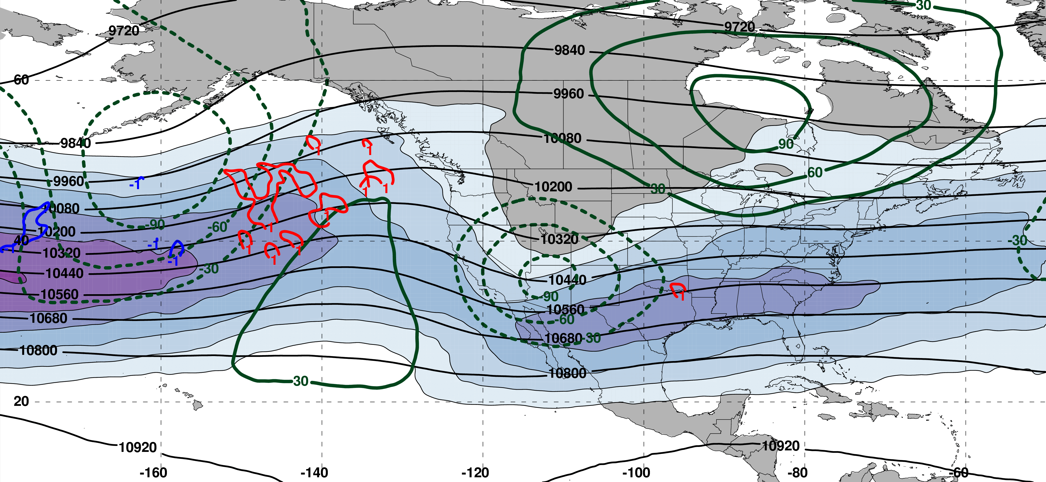
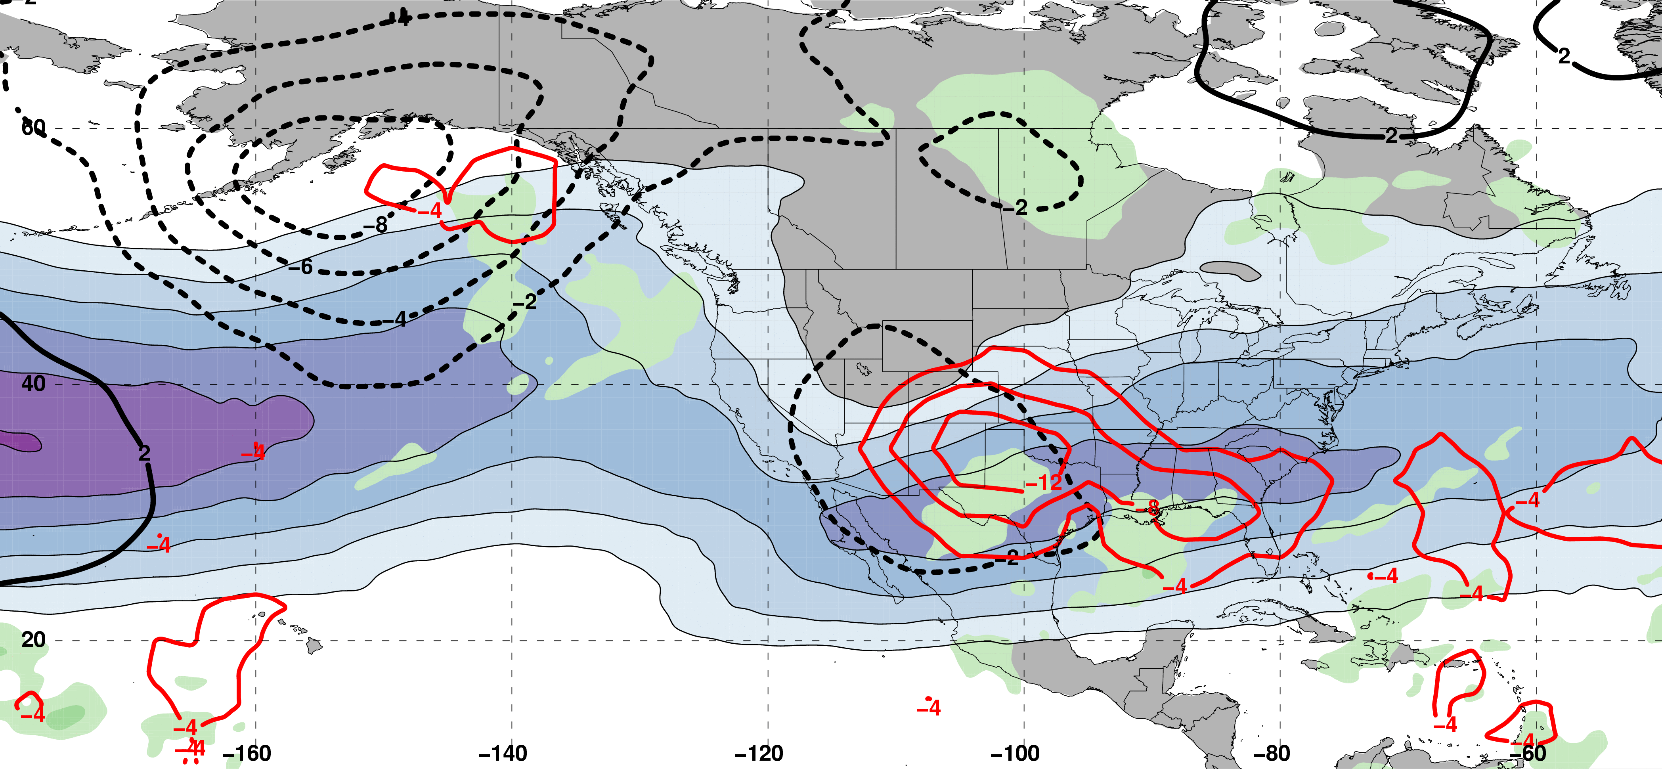
Polar Dominant Jet Superposition Events
250-hPa Jet, Geo. Height, & Geo. Height Anom., & 300-hPa Geo. Temp Adv.
250-hPa Geo. Height
300-hPa
Geo. WAA
2 Days
Prior to Jet Superposition
250-hPa Geo. Height Anom.
300-hPa
Geo. CAA
m s^{–1}
250-hPa Jet, MSLP Anom., PWAT Anom., & –OLR Anom.
L
L
N=80
MSLP Anom.
Neg. OLR
Anom.
mm

Slide 31
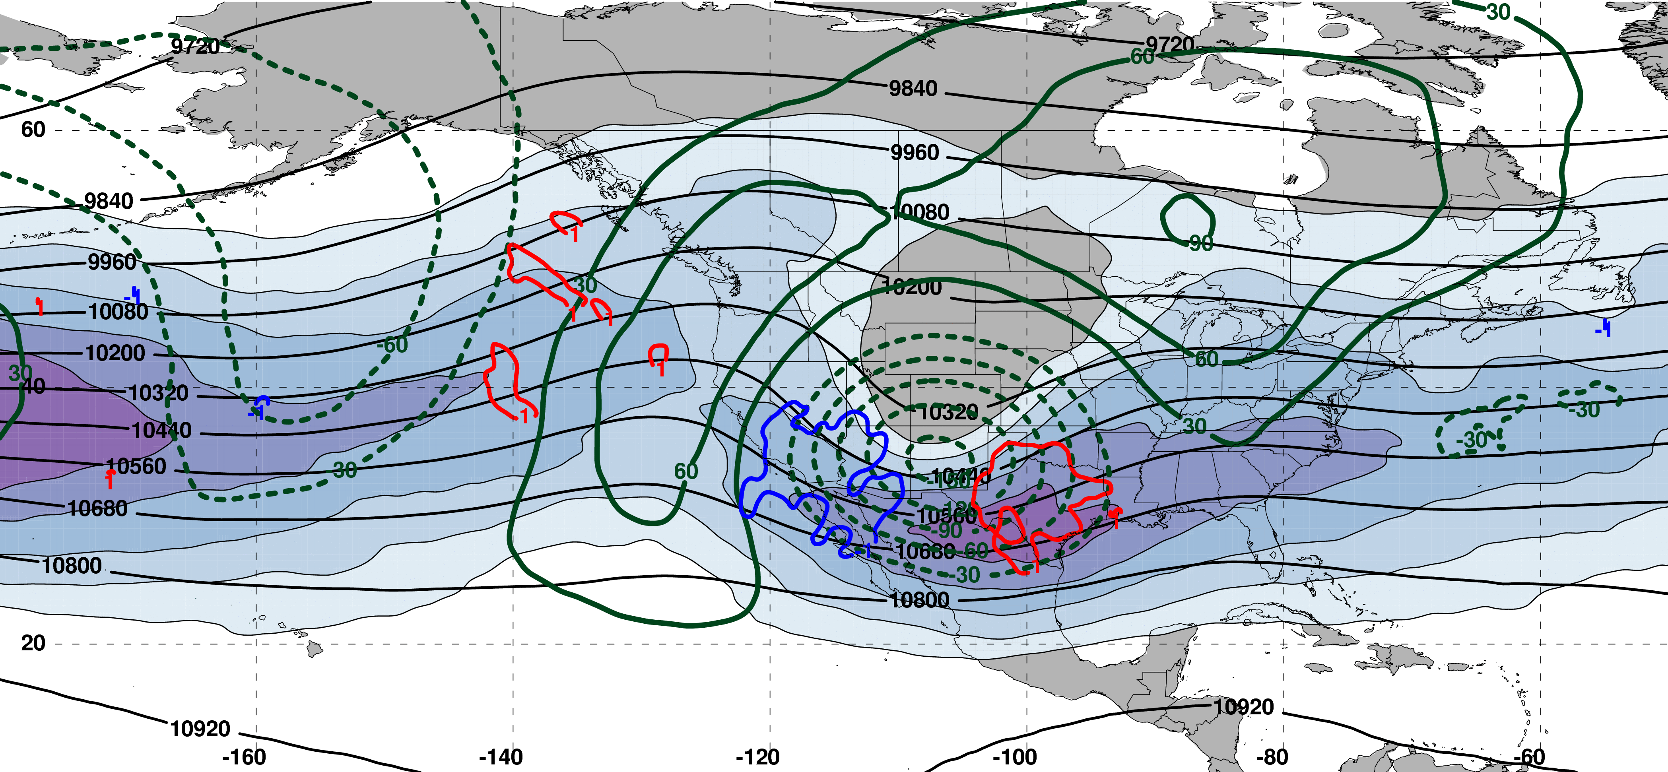
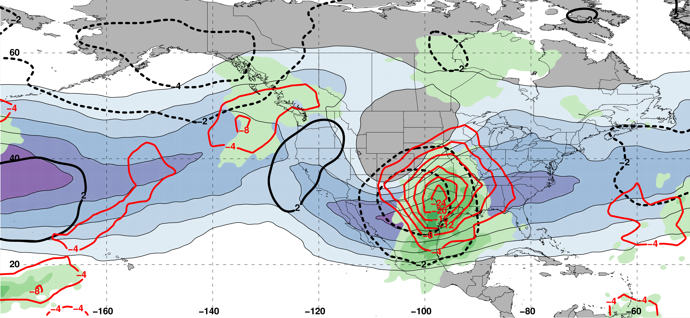
Polar Dominant Jet Superposition Events
250-hPa Jet, Geo. Height, & Geo. Height Anom., & 300-hPa Geo. Temp Adv.
250-hPa Geo. Height
300-hPa
Geo. WAA
1 Day
Prior to Jet Superposition
250-hPa Geo. Height Anom.
300-hPa
Geo. CAA
m s^{–1}
250-hPa Jet, MSLP Anom., PWAT Anom., & –OLR Anom.
L
H
L
N=80
MSLP Anom.
Neg. OLR
Anom.
mm

Slide 32
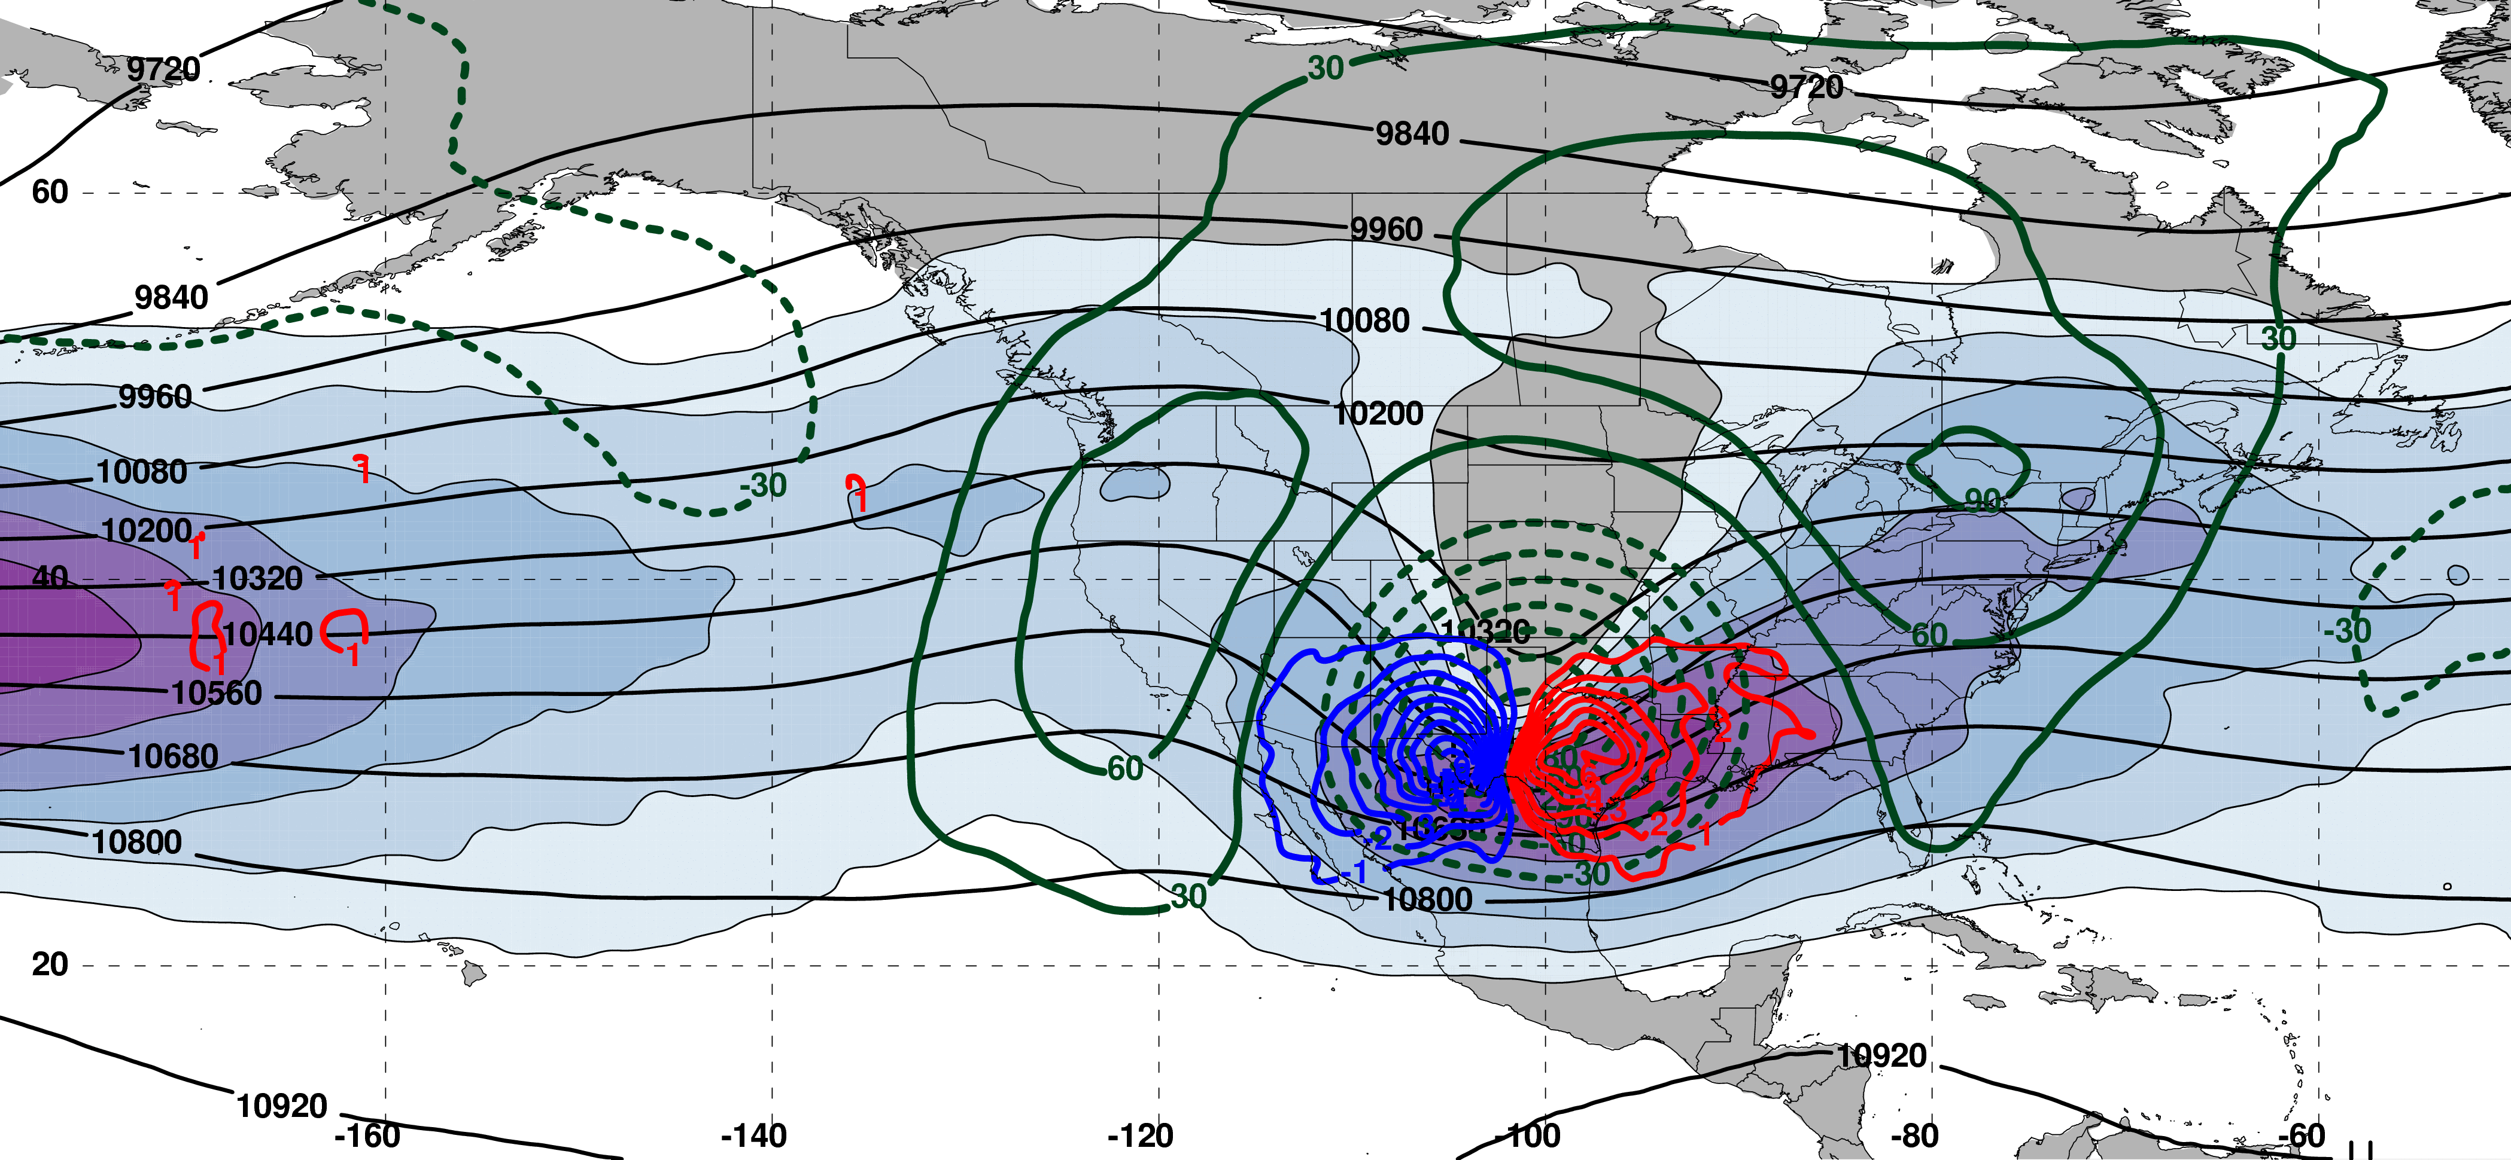
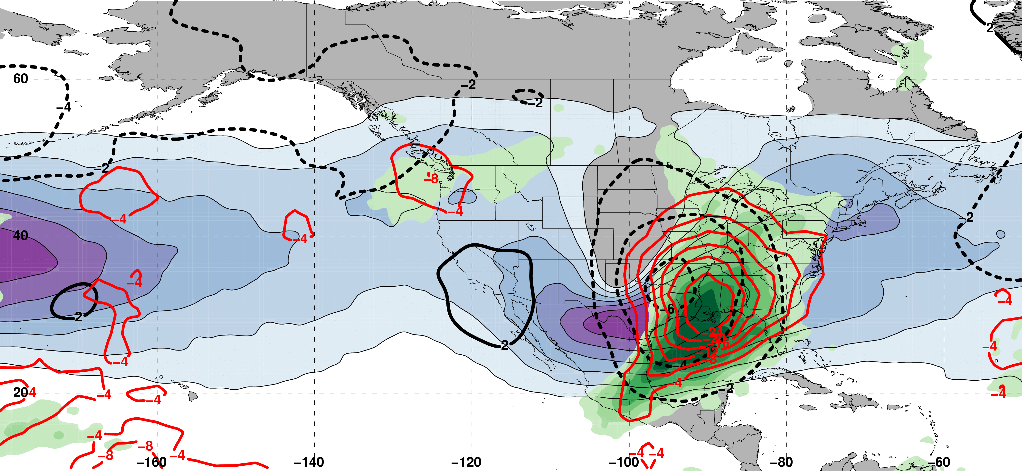
Polar Dominant Jet Superposition Events
250-hPa Jet, Geo. Height, & Geo. Height Anom., & 300-hPa Geo. Temp Adv.
250-hPa Geo. Height
300-hPa
Geo. WAA
0 Days
Prior to Jet Superposition
250-hPa Geo. Height Anom.
300-hPa
Geo. CAA
m s^{–1}
250-hPa Jet, MSLP Anom., PWAT Anom., & –OLR Anom.
Jet Superposition Centroid
H
L
N=80
MSLP Anom.
Neg. OLR
Anom.
mm

Slide 33
Polar Dominant Jet Superposition Events
250-hPa Jet, Geo. Height, & Geo. Height Anom., & 300-hPa Geo. Temp Adv.
A
250-hPa Geo. Height
300-hPa
Geo. WAA
A’
0 Days
Prior to Jet Superposition
250-hPa Geo. Height Anom.
300-hPa
Geo. CAA
m s^{–1}
250-hPa Jet, MSLP Anom., PWAT Anom., & –OLR Anom.
A
Jet Superposition Centroid
H
L
A’
N=80
MSLP Anom.
Neg. OLR
Anom.
mm

Slide 34
Polar Dominant Jet Superposition Events
250-hPa Jet, Geo. Height, & Geo. Height Anom., & 300-hPa Geo. Temp Adv.
A
B
250-hPa Geo. Height
300-hPa
Geo. WAA
A’
B’
0 Days
Prior to Jet Superposition
250-hPa Geo. Height Anom.
300-hPa
Geo. CAA
m s^{–1}
250-hPa Jet, MSLP Anom., PWAT Anom., & –OLR Anom.
A
B
Jet Superposition Centroid
H
L
A’
B’
N=80
MSLP Anom.
Neg. OLR
Anom.
mm

Slide 35
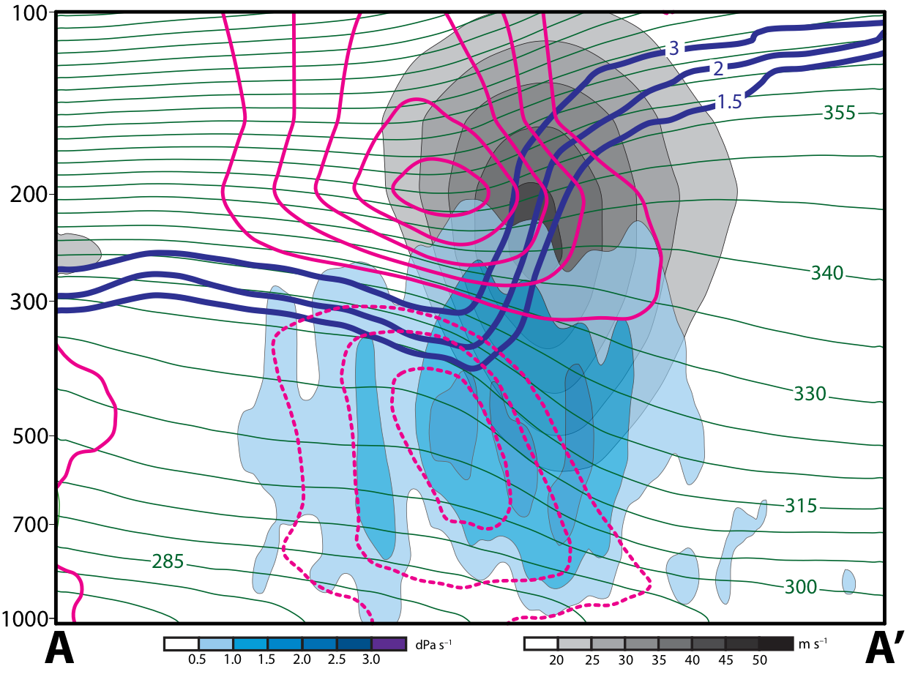
Polar Dominant Jet Superposition Events
12 Hours Prior to Jet Superposition
Legend
1.5-,2-,
3-PVU
θ
+ pert. θ
– pert. θ
ω
wind speed

Slide 36
Polar Dominant Jet Superposition Events
12 Hours Prior to Jet Superposition
Legend
1.5-,2-,
3-PVU
Warm and cold anomalies indicative of strong positive PV anomaly
θ
+ pert. θ
Subsidence directly beneath and poleward of the jet core
– pert. θ
ω
wind speed

Slide 37
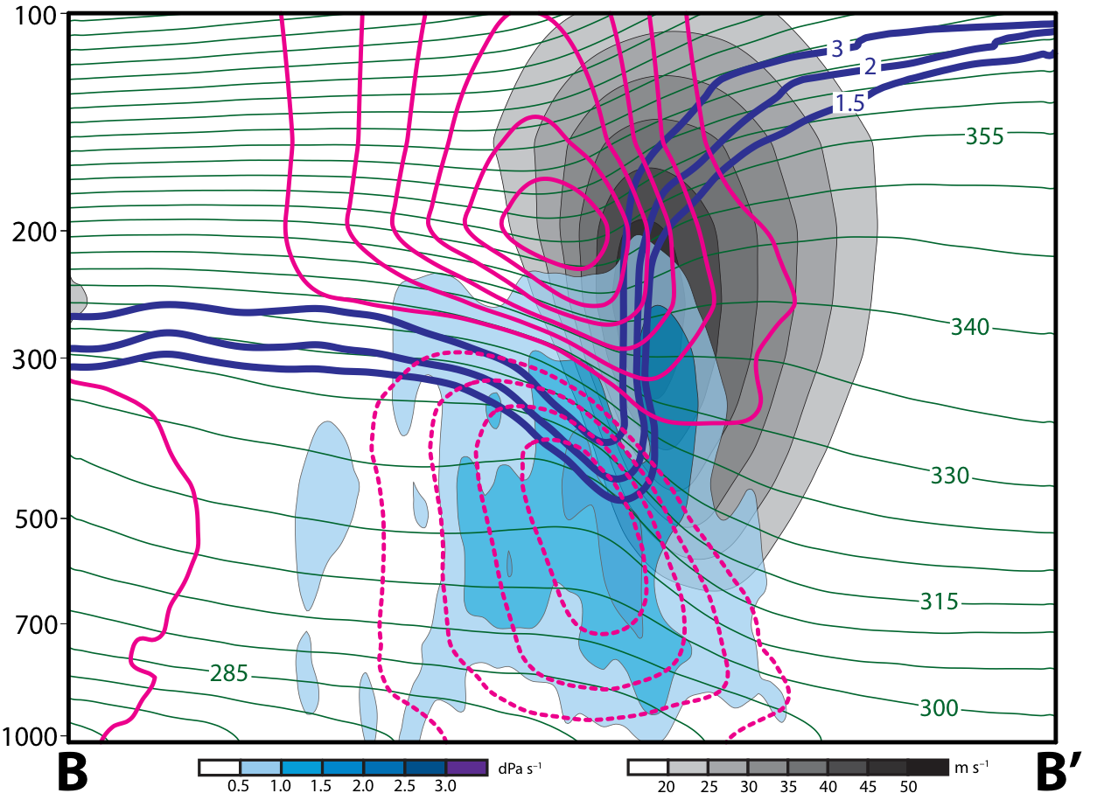
Polar Dominant Jet Superposition Events
0 Hours Prior to Jet Superposition
Legend
1.5-,2-,
3-PVU
θ
+ pert. θ
– pert. θ
ω
wind speed

Slide 38
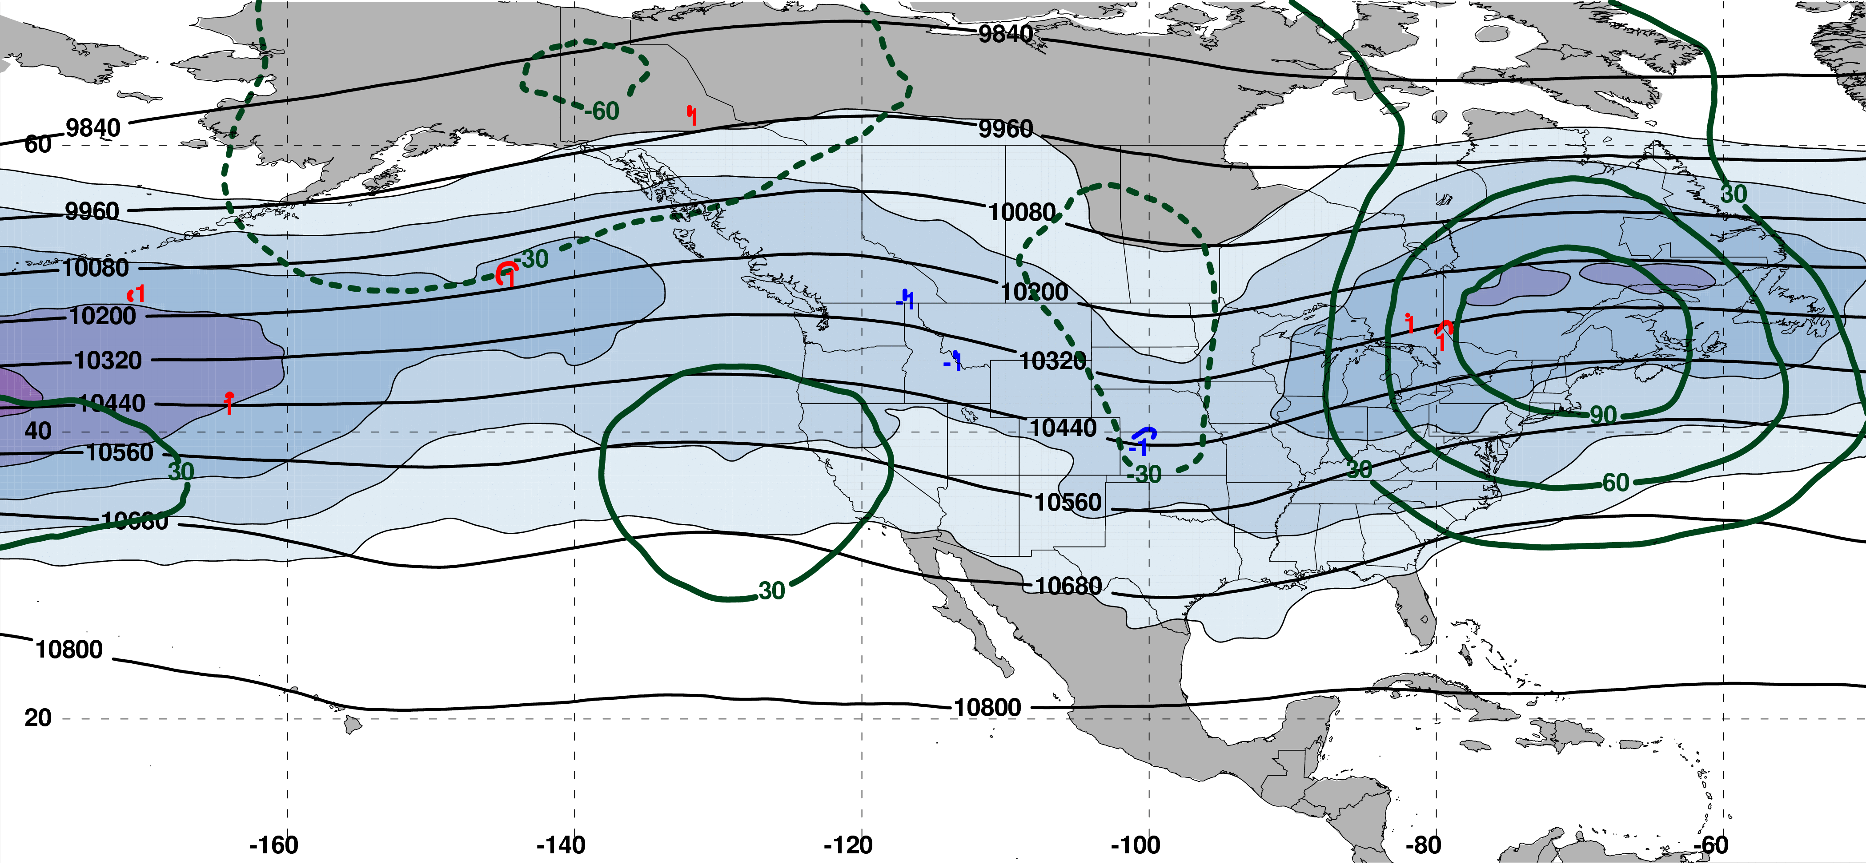
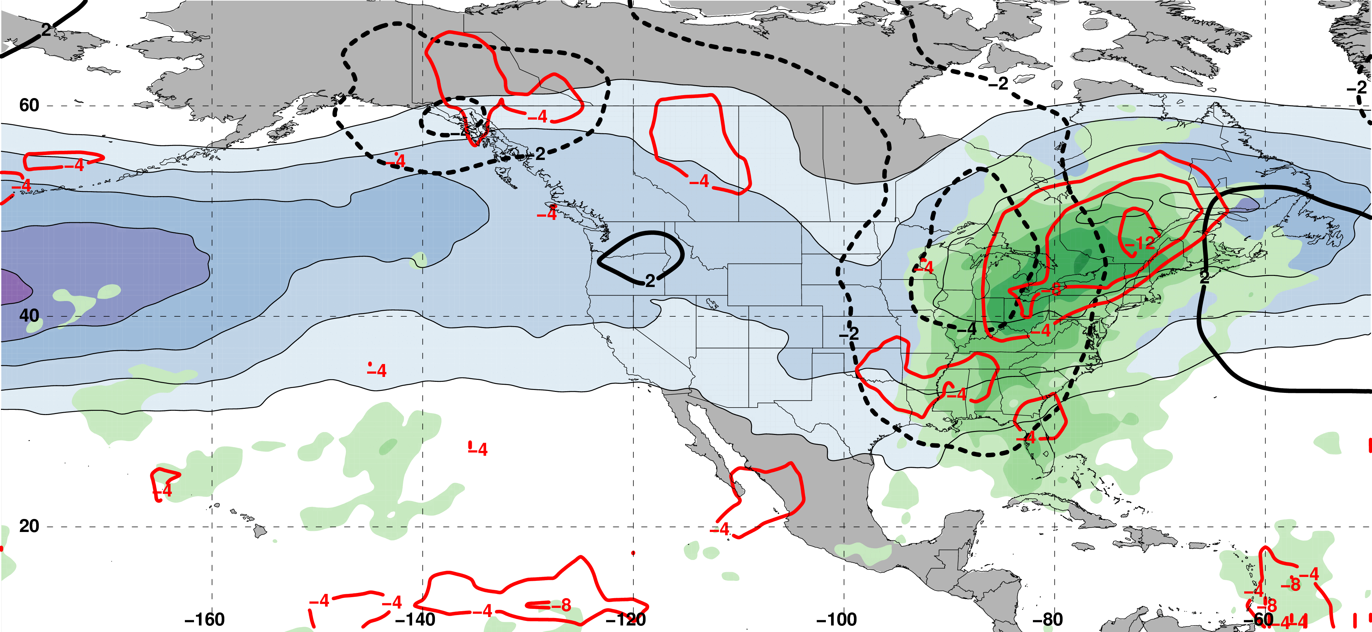
E. Subtropical Dominant Jet Superposition Events
250-hPa Jet, Geo. Height, & Geo. Height Anom., & 300-hPa Geo. Temp Adv.
250-hPa Geo. Height
300-hPa
Geo. WAA
2 Days
Prior to Jet Superposition
250-hPa Geo. Height Anom.
300-hPa
Geo. CAA
m s^{–1}
250-hPa Jet, MSLP Anom., PWAT Anom., & –OLR Anom.
L
H
N=76
MSLP Anom.
Neg. OLR
Anom.
mm

Slide 39
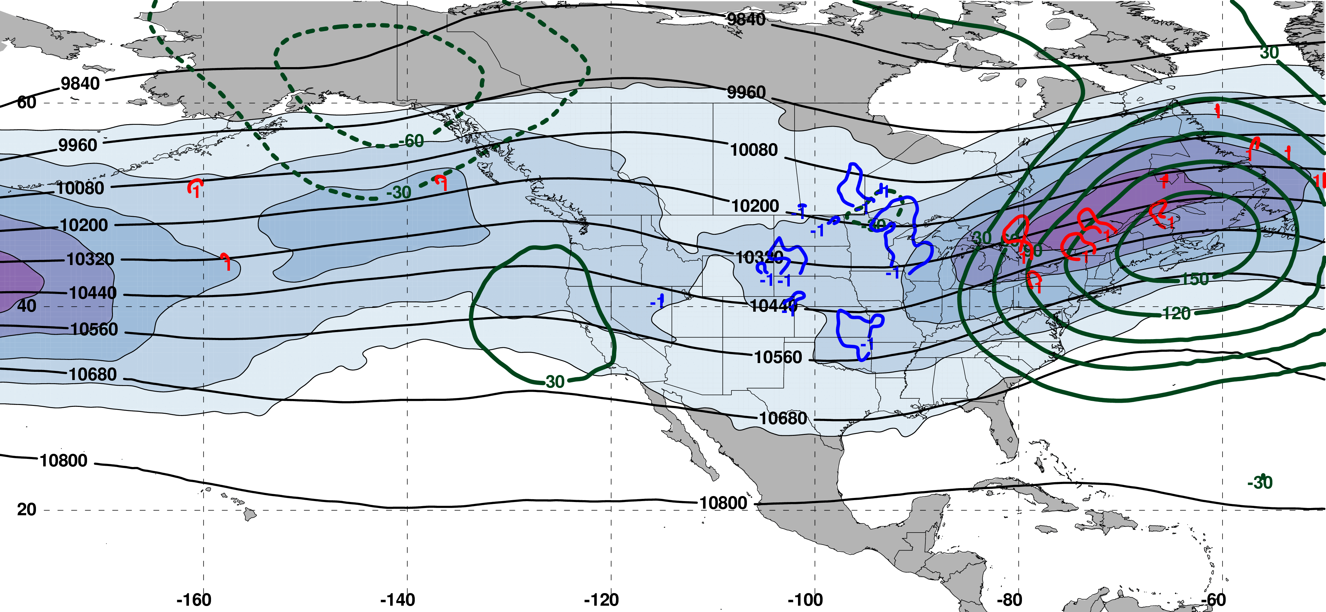
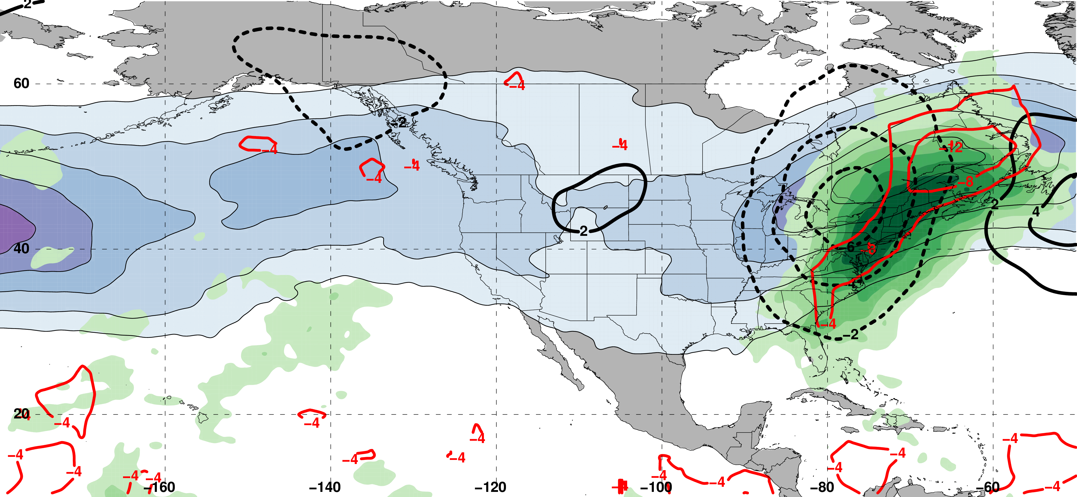
E. Subtropical Dominant Jet Superposition Events
250-hPa Jet, Geo. Height, & Geo. Height Anom., & 300-hPa Geo. Temp Adv.
250-hPa Geo. Height
300-hPa
Geo. WAA
1 Day
Prior to Jet Superposition
250-hPa Geo. Height Anom.
300-hPa
Geo. CAA
m s^{–1}
250-hPa Jet, MSLP Anom., PWAT Anom., & –OLR Anom.
L
H
N=76
MSLP Anom.
Neg. OLR
Anom.
mm

Slide 40
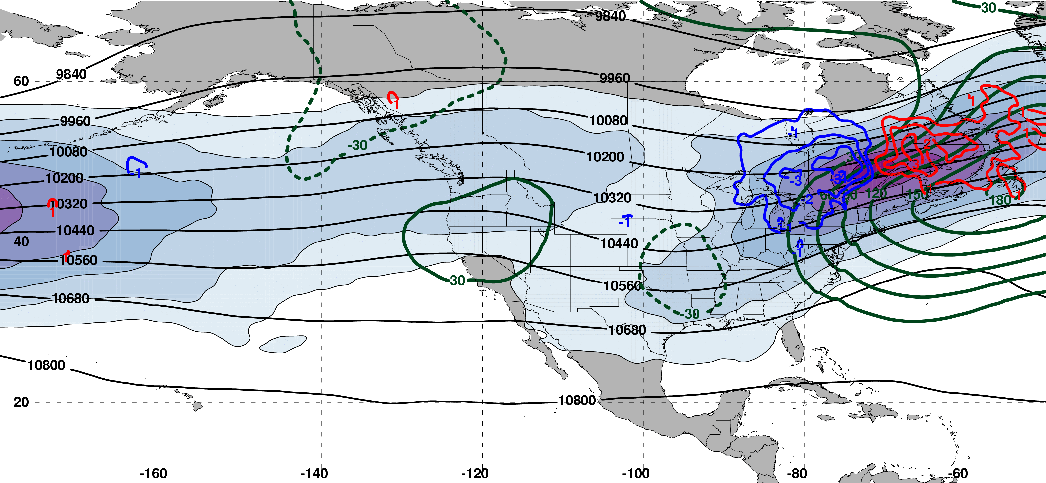
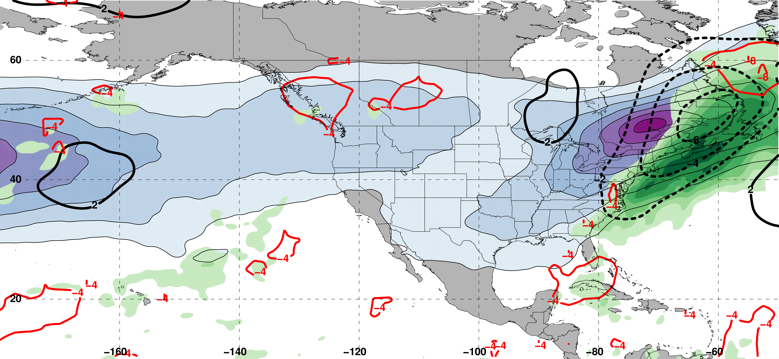
E. Subtropical Dominant Jet Superposition Events
250-hPa Jet, Geo. Height, & Geo. Height Anom., & 300-hPa Geo. Temp Adv.
250-hPa Geo. Height
300-hPa
Geo. WAA
0 Days
Prior to Jet Superposition
250-hPa Geo. Height Anom.
300-hPa
Geo. CAA
m s^{–1}
250-hPa Jet, MSLP Anom., PWAT Anom., & –OLR Anom.
L
Jet Superposition Centroid
N=76
MSLP Anom.
Neg. OLR
Anom.
mm

Slide 41
E. Subtropical Dominant Jet Superposition Events
250-hPa Jet, Geo. Height, & Geo. Height Anom., & 300-hPa Geo. Temp Adv.
C
250-hPa Geo. Height
300-hPa
Geo. WAA
C’
0 Days
Prior to Jet Superposition
250-hPa Geo. Height Anom.
300-hPa
Geo. CAA
m s^{–1}
250-hPa Jet, MSLP Anom., PWAT Anom., & –OLR Anom.
C
L
Jet Superposition Centroid
N=76
C’
MSLP Anom.
Neg. OLR
Anom.
mm

Slide 42
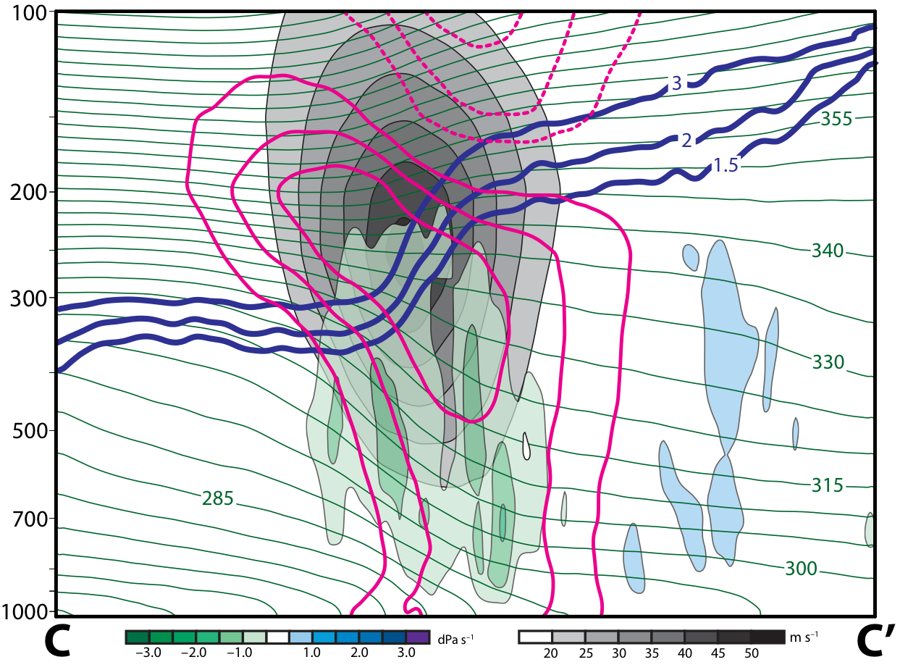
E. Subtropical Dominant Jet Superposition Events
12 Hours Prior to Jet Superposition
Legend
1.5-,2-,
3-PVU
θ
+ pert. θ
– pert. θ
ω
wind speed

Slide 43
E. Subtropical Dominant Jet Superposition Events
12 Hours Prior to Jet Superposition
Legend
Cold anomaly in the lower stratosphere and deep layer warm anomaly in the troposphere indicative of a negative PV anomaly
1.5-,2-,
3-PVU
θ
+ pert. θ
Ascent directly beneath the jet core
– pert. θ
ω
wind speed

Slide 44
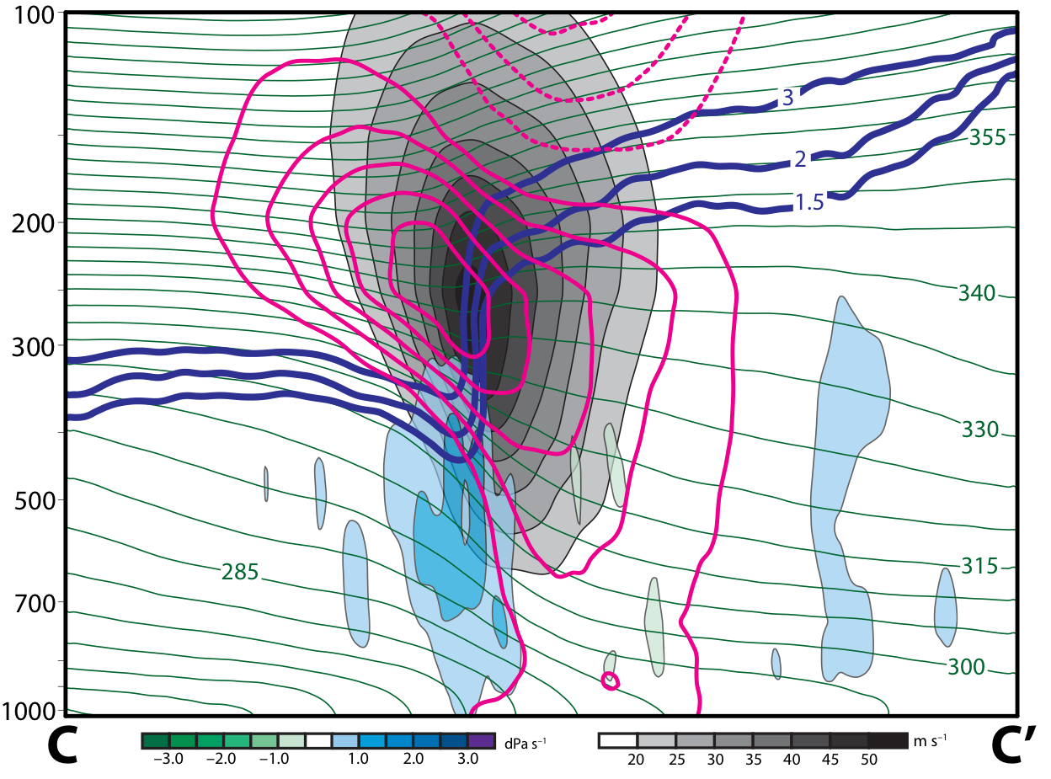
E. Subtropical Dominant Jet Superposition Events
0 Hours Prior to Jet Superposition
Legend
1.5-,2-,
3-PVU
θ
+ pert. θ
– pert. θ
ω
wind speed

Slide 45
E. Subtropical Dominant Jet Superposition Events
0 Hours Prior to Jet Superposition
Warm anomaly strengthens poleward of the jet, indicative of the arrival of a positive PV anomaly
Legend
1.5-,2-,
3-PVU
θ
+ pert. θ
Subsidence directly beneath and poleward of the jet core
– pert. θ
ω
wind speed

Slide 46
Summary
Polar Dominant Superpositions:

Slide 47
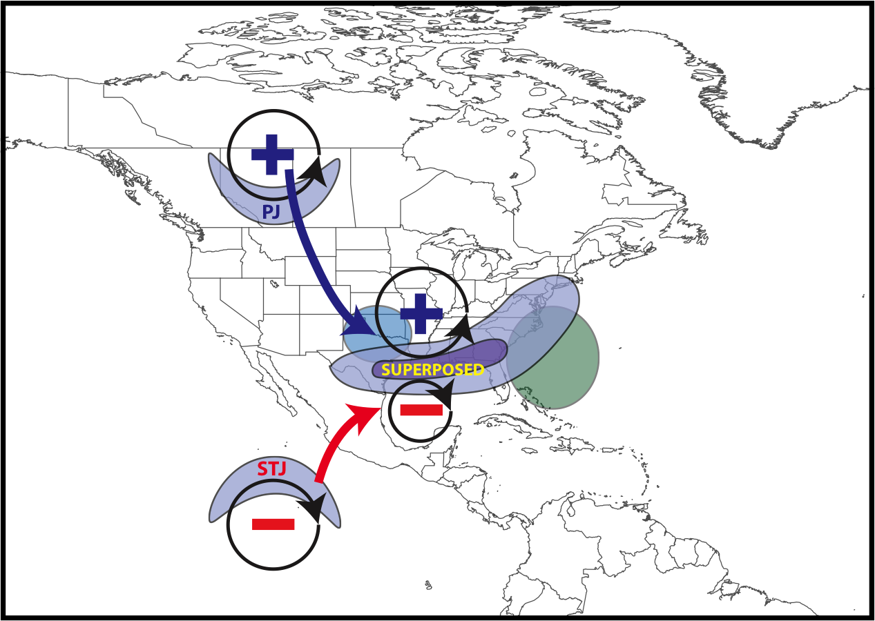
Summary
Polar Dominant Superpositions:
Anticyclonic wave breaking event amplifies the flow over North America
Descent beneath the jet core facilitates jet superposition
Downstream precipitation slows the propagation of the upper-level trough
L
CAA
Precip.

Slide 48
Summary
E. Subtropical Dominant Superpositions:

Slide 49
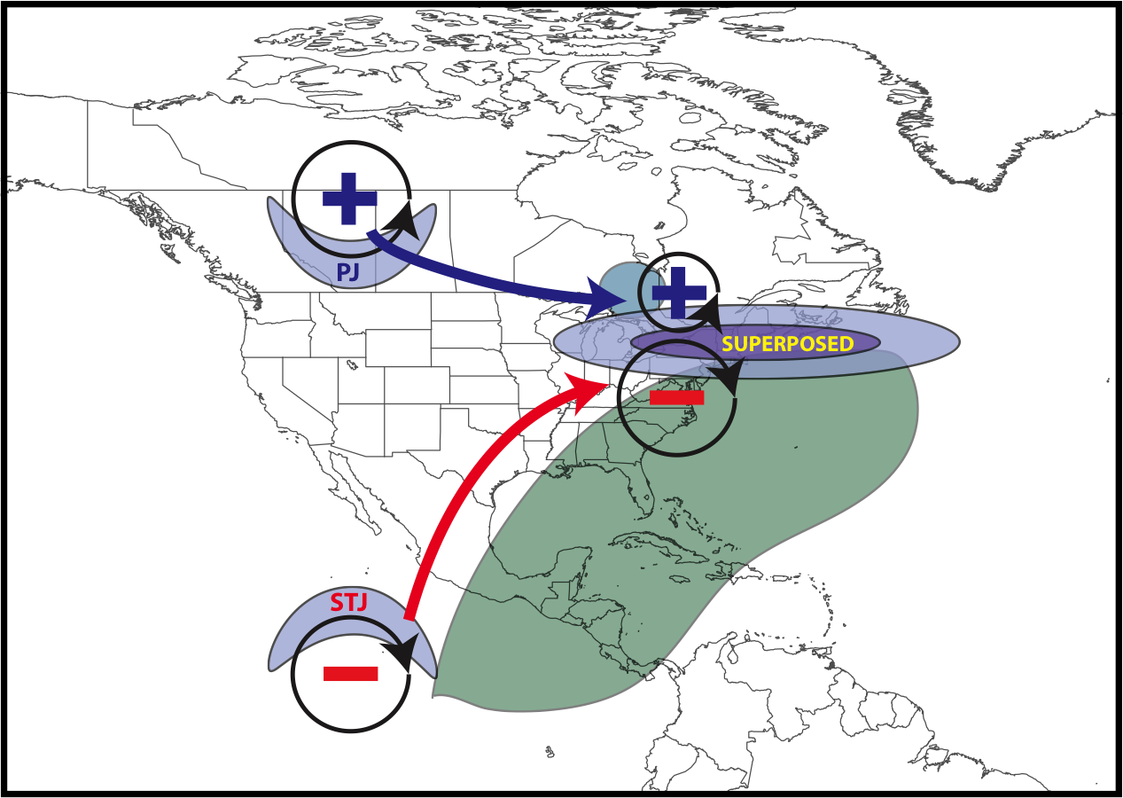
Summary
L
CAA
Antecedent moisture and precip.
E. Subtropical Dominant Superpositions:
Antecedent precipitation and southerly flow encourages ridging over eastern North America
Arrival of upper-level trough completes the development of a jet superposition
Most common jet superposition type

Slide 50
Supplementary Slides

Slide 51
References
Cavallo, S. M., and G. J. Hakim, 2010: Composite structure of tropopause polar cyclones. Mon. Wea. Rev., 138, 3840−3857.
Christenson, C. E., and J. E. Martin, 2012: The large-scale environment associated with the 25−28 April 2011 severe weather outbreak. 16th NWA Severe Storms and Doppler Radar Conference, Des Moines, IA, National Weather Association, 31 March 2012.
Christenson, C. E., J. E. Martin, and Z. J. Handlos, 2017: A synoptic-climatology of Northern Hemisphere, cold season polar and subtropical jet superposition events. J. Climate, 30, 7231-7246.
Knupp, K. R., T. A. Murphy, T. A. Coleman, R. A. Wade, S. A. Mullins, C. J. Schultz, E. V. Schultz, L. Carey, A. Sherrer, E. W. McCaul Jr., B. Carcione, S. Latimer, A. Kula, K. Laws, P. T. Marsh, and K. Klockow, 2014: Meteorological overview of the devastating 27 April 2011 Tornado Outbreak. Bull. Amer. Meteor. Soc., 95, 1041−1062.
Pyle, M. E., D. Keyser, and L. F. Bosart, 2004: A diagnostic study of jet streaks: Kinematic signatures and relationship to coherent tropopause disturbances. Mon. Wea. Rev., 132, 297−319.
Saha, S. and co-authors, 2014: The NCEP Climate Forecast System Version 2. J. Climate, 27, 2185−2208.
Winters, A. C., and J. E. Martin, 2014: The role of a polar/subtropical jet superposition in the May 2010 Nashville Flood. Wea. Forecasting, 29, 954–974.
Winters, A. C. and J. E. Martin, 2016: Synoptic and mesoscale processes supporting vertical superposition of the polar and subtropical jets in two contrasting cases. Quart. J. Roy. Meteor. Soc., 142, 1133–1149.
Winters, A. C., and J. E. Martin, 2017: Diagnosis of a North American polar/subtropical jet superposition employing potential vorticity inversion. Mon. Wea. Rev.,145, 1853-1873.

Slide 52
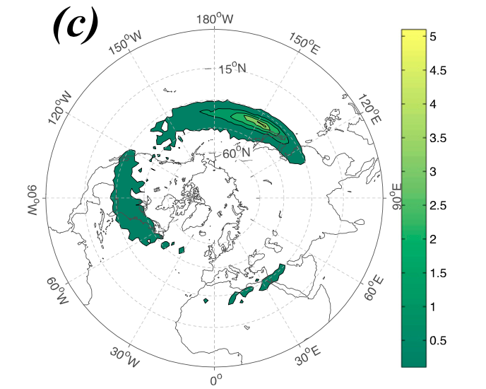
Climatological Jet Superposition Frequency
Christenson et. al (2017) demonstrated that three locations experience the greatest frequency of jet superpositions:
1) Western Pacific
2) North America
3) Northern Africa
Climatological frequency of Northern Hemisphere jet superposition events per cold season (Nov–Mar) 1960–2010
Frequency
Christenson et al. (2017)

Slide 53
Climatological Jet Superposition Frequency
Christenson et. al (2017) demonstrated that three locations experience the greatest frequency of jet superpositions:
1) Western Pacific
2) North America
3) Northern Africa
Climatological frequency of Northern Hemisphere jet superposition events per cold season (Nov–Mar) 1960–2010
Frequency
Christenson et al. (2017)

Slide 54
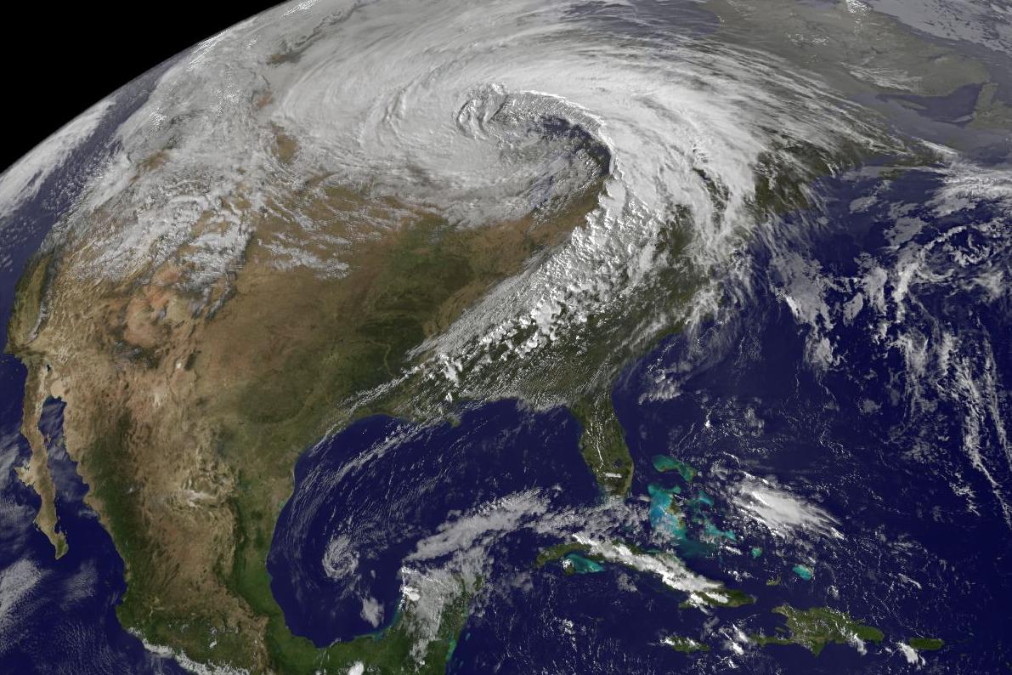
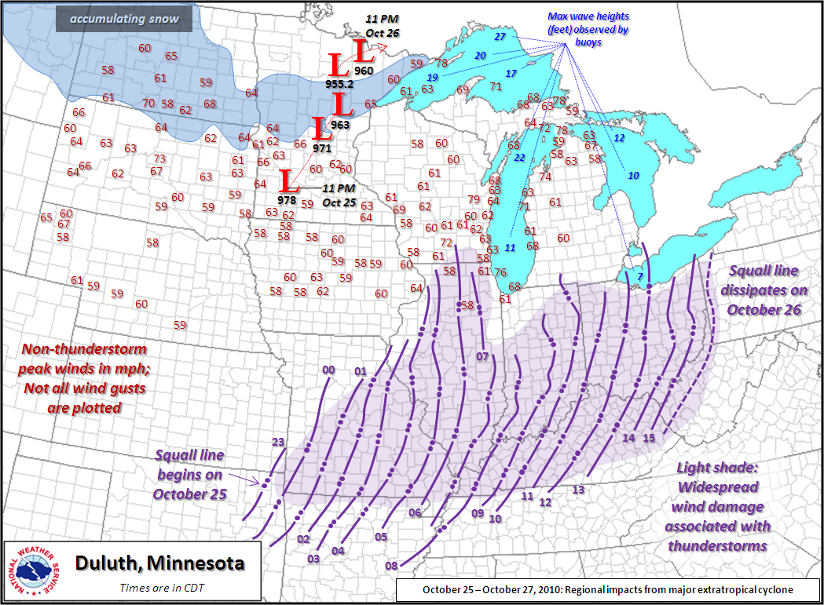
Jet Superpositions and High-Impact Weather
Jet superpositions can be an element of high-impact weather events
1–3 May 2010 Nashville Flood
Jet superposition enhanced the poleward moisture transport via its ageostrophic circulation (Winters and Martin 2014; 2016)
18–20 December 2009 Mid-Atlantic Blizzard
Jet superposition was associated with a rapidly deepening East Coast cyclone (Winters and Martin 2016; 2017)
26 October 2010: Explosive Cyclogenesis Event
Jet superposition over the West Pacific preceded the development of an intense Midwest U.S. cyclone

Slide 55
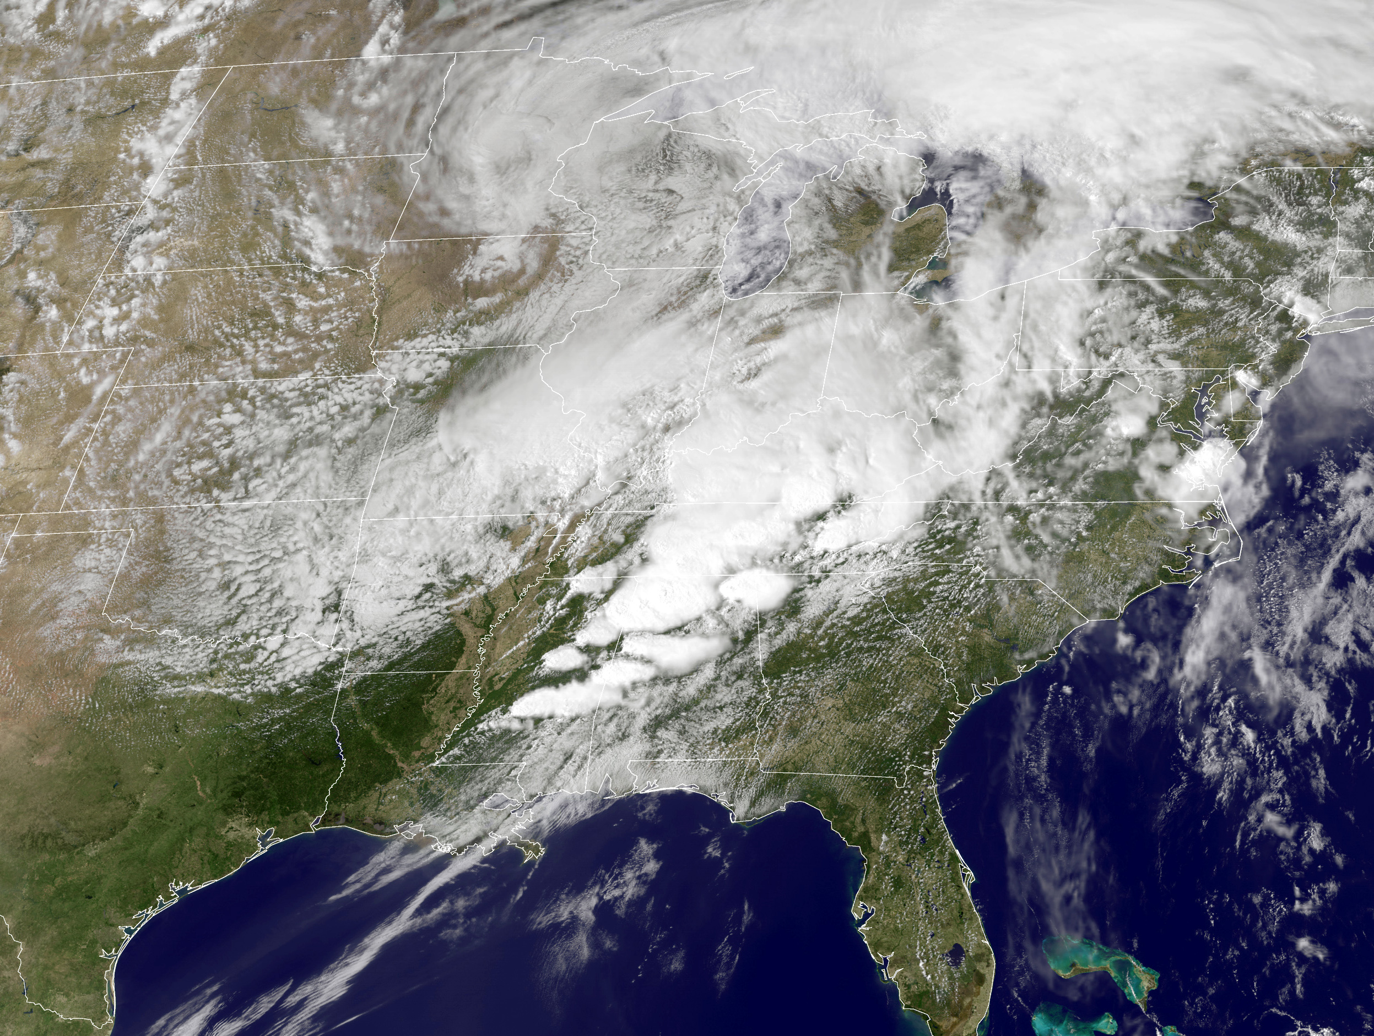
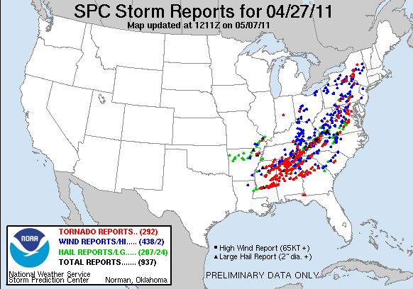
Jet Superpositions and High-Impact Weather
Jet superpositions can be an element of high-impact weather events
1–3 May 2010 Nashville Flood
Jet superposition enhanced the poleward moisture transport via its ageostrophic circulation (Winters and Martin 2014; 2016)
18–20 December 2009 Mid-Atlantic Blizzard
Jet superposition was associated with a rapidly deepening East Coast cyclone (Winters and Martin 2016; 2017)
26 October 2010: Explosive Cyclogenesis Event
Jet superposition over the West Pacific preceded the development of an intense Midwest U.S. cyclone
25–28 April 2011 Tornado Outbreak
Jet superposition occurred over the West Pacific prior to the outbreak (Knupp et al. 2014; Christenson and Martin 2012)

Slide 56
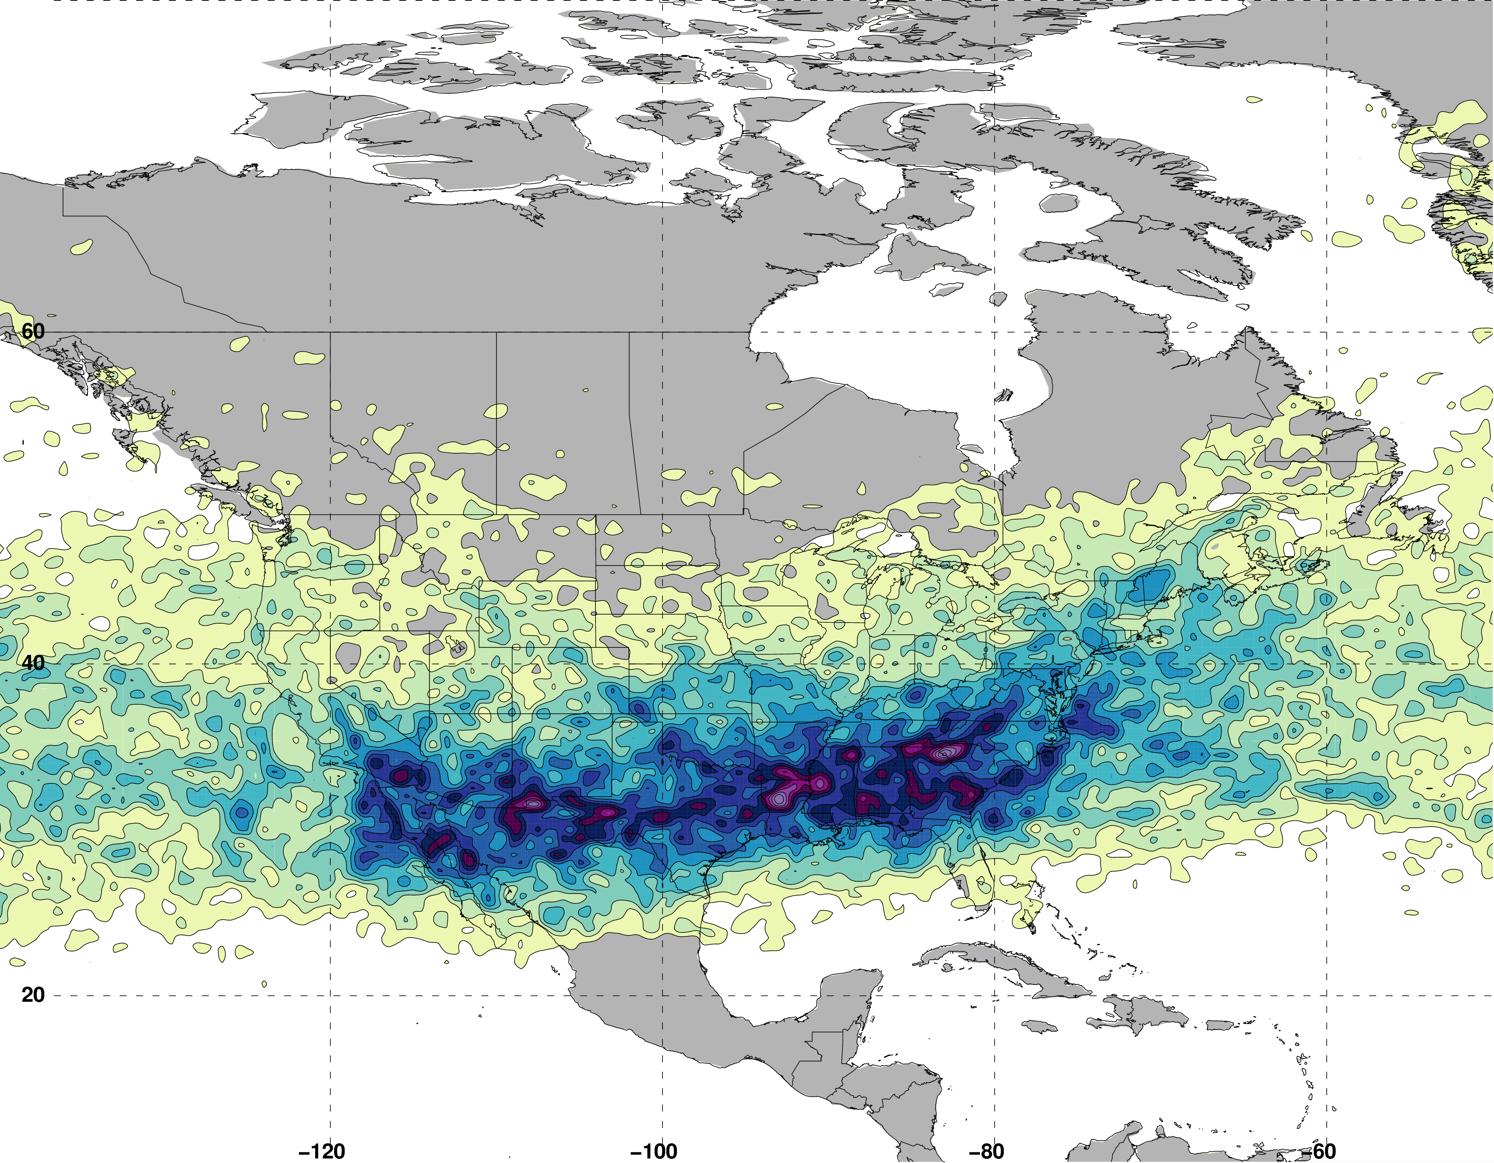
Jet Superposition Event Identification
Isolated CFSR grid points over North America characterized by a jet superposition during Nov–Mar 1979–2010 using the Christenson et al. (2017) scheme
Jet Superposition Frequency – All Times
N = 61660

Slide 57
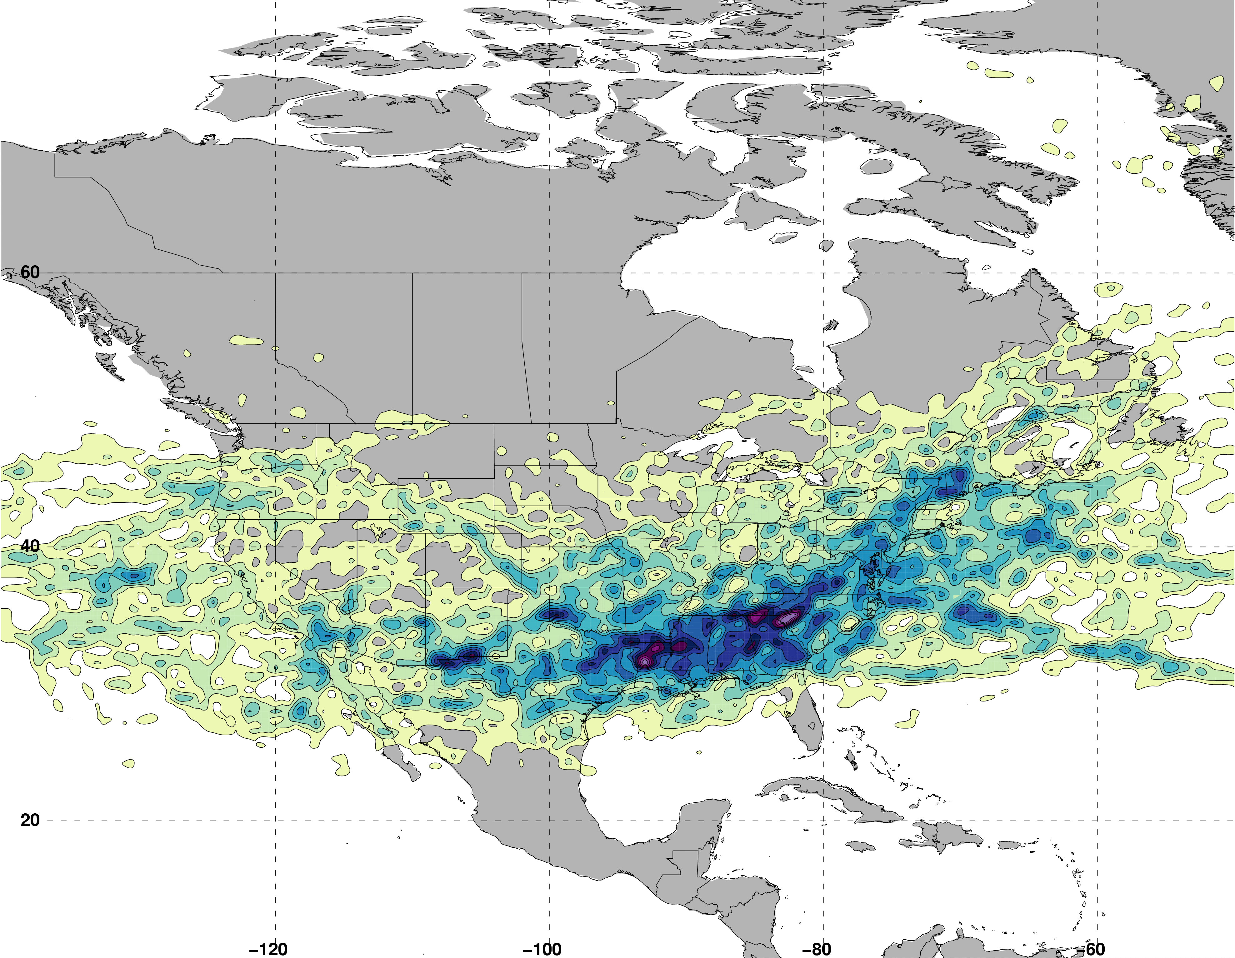
Jet Superposition Event Identification
Isolated CFSR grid points over North America characterized by a jet superposition during Nov–Mar 1979–2010 using the Christenson et al. (2017) scheme
Retained analysis times that rank in the top 10% in terms the number of grid points characterized by a jet superposition
Jet Superposition Frequency – Top 10% Times
N = 19485

Slide 58
Jet Superposition Event Identification
Isolated CFSR grid points over North America characterized by a jet superposition during Nov–Mar 1979–2010 using the Christenson et al. (2017) scheme
Retained analysis times that rank in the top 10% in terms the number of grid points characterized by a jet superposition
Filtered retained analysis times to group together jet superpositions that are <30 h and <1500 km of one another
Jet Superposition Frequency – Top 10% Times
N = 19485
326 unique jet superposition events

Slide 59
Jet Superposition Event Identification

Slide 60
Jet Superposition Event Identification
Sample Jet Superposition Centroid Calculation
Calculated the centroid of each jet superposition based on all valid grid points at a particular analysis time.
To calculate the centroid, there must exist a group of 18 superposition grid points, of which no superposition grid point is >1000 km away from another superposition grid point.
d >1000 km
d >1000 km
d >1000 km
Used for calculation
Jet superposition centroid
Not used for calculation

Slide 61
Jet Superposition Event Classification
Frequency of Polar Dominant Jet Superposition Events
N = 80
Legend
Centroid of all events
Composite movement of superposition

Slide 62
Jet Superposition Event Classification
Frequency of Hybrid Jet Superposition Events
N = 117
Legend
Centroid of all events
Composite movement of superposition

Slide 63
Jet Superposition Event Classification
Frequency of Subtropical Dominant Jet Superposition Events
N = 129
West: N = 53
East: N = 76
Legend
Centroid of all events
Composite movement of superposition

Slide 64
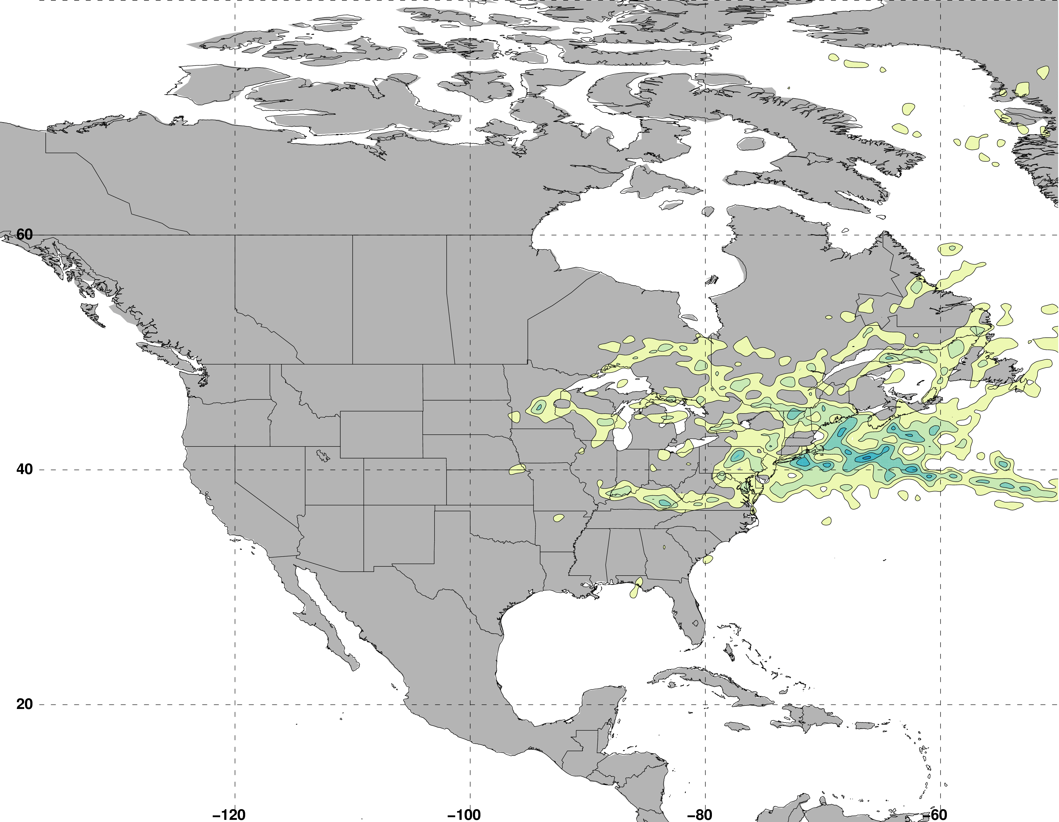
Jet Superposition Event Identification
Frequency of East Subtropical Dominant Jet Superposition Events
N = 76
Legend
Centroid of all events
Composite movement of superposition

Slide 65
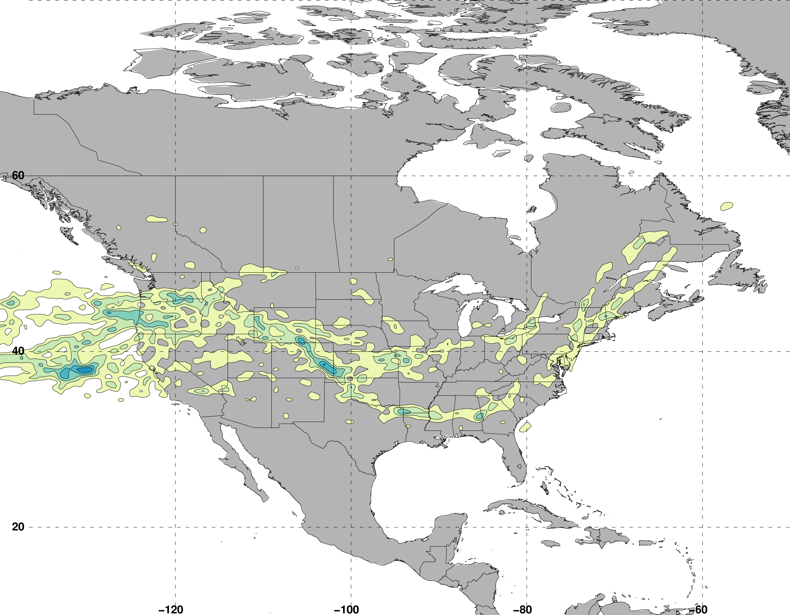
Jet Superposition Event Identification
Frequency of West Subtropical Dominant Jet Superposition Events
N = 53
Legend
Centroid of all events
Composite movement of superposition

Slide 66
Jet Superposition Event Classification

Slide 67
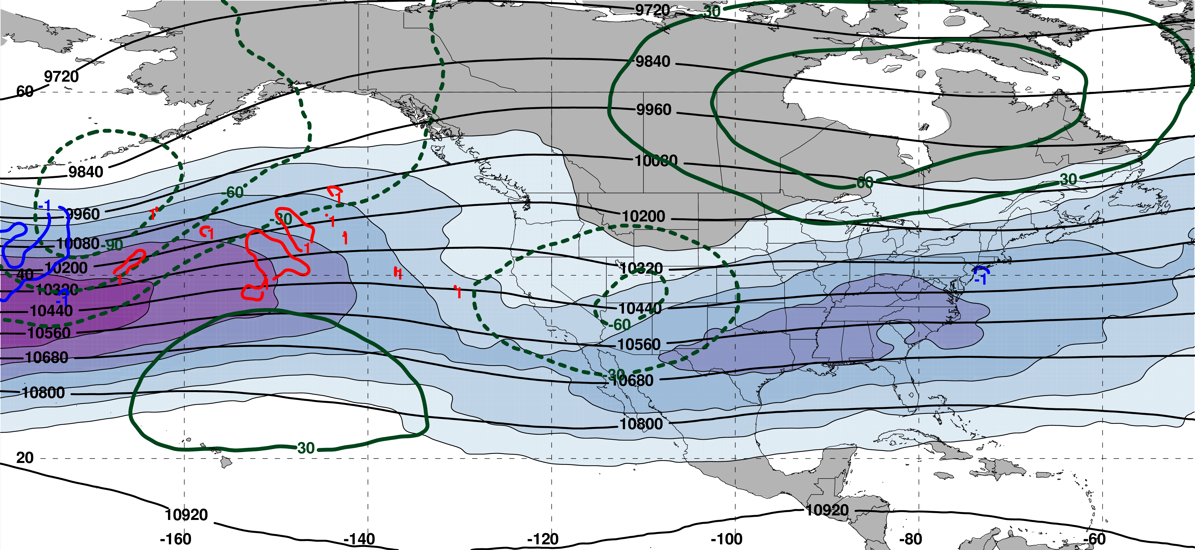
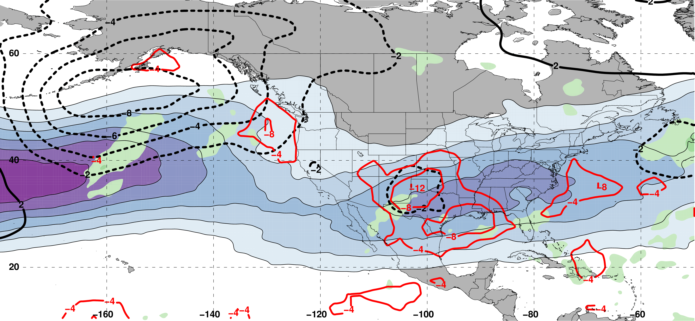
Polar Dominant Jet Superposition Events
250-hPa Jet, Geo. Height, & Geo. Height Anom., & 300-hPa Geo. Temp Adv.
3 Days
Prior to Jet Superposition
m s^{–1}
250-hPa Jet, MSLP Anom., PWAT Anom., & OLR Anom.
N=80
mm

Slide 68
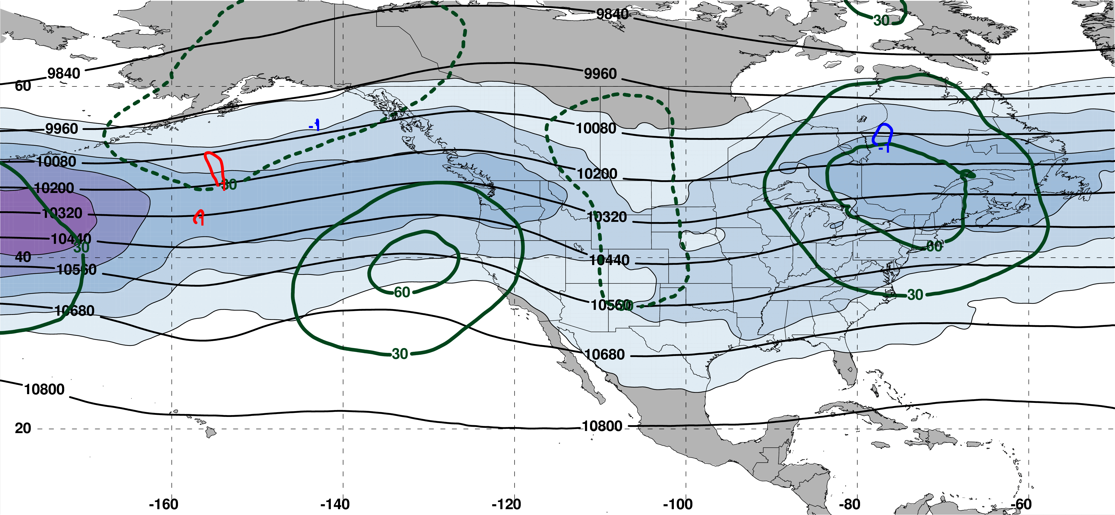
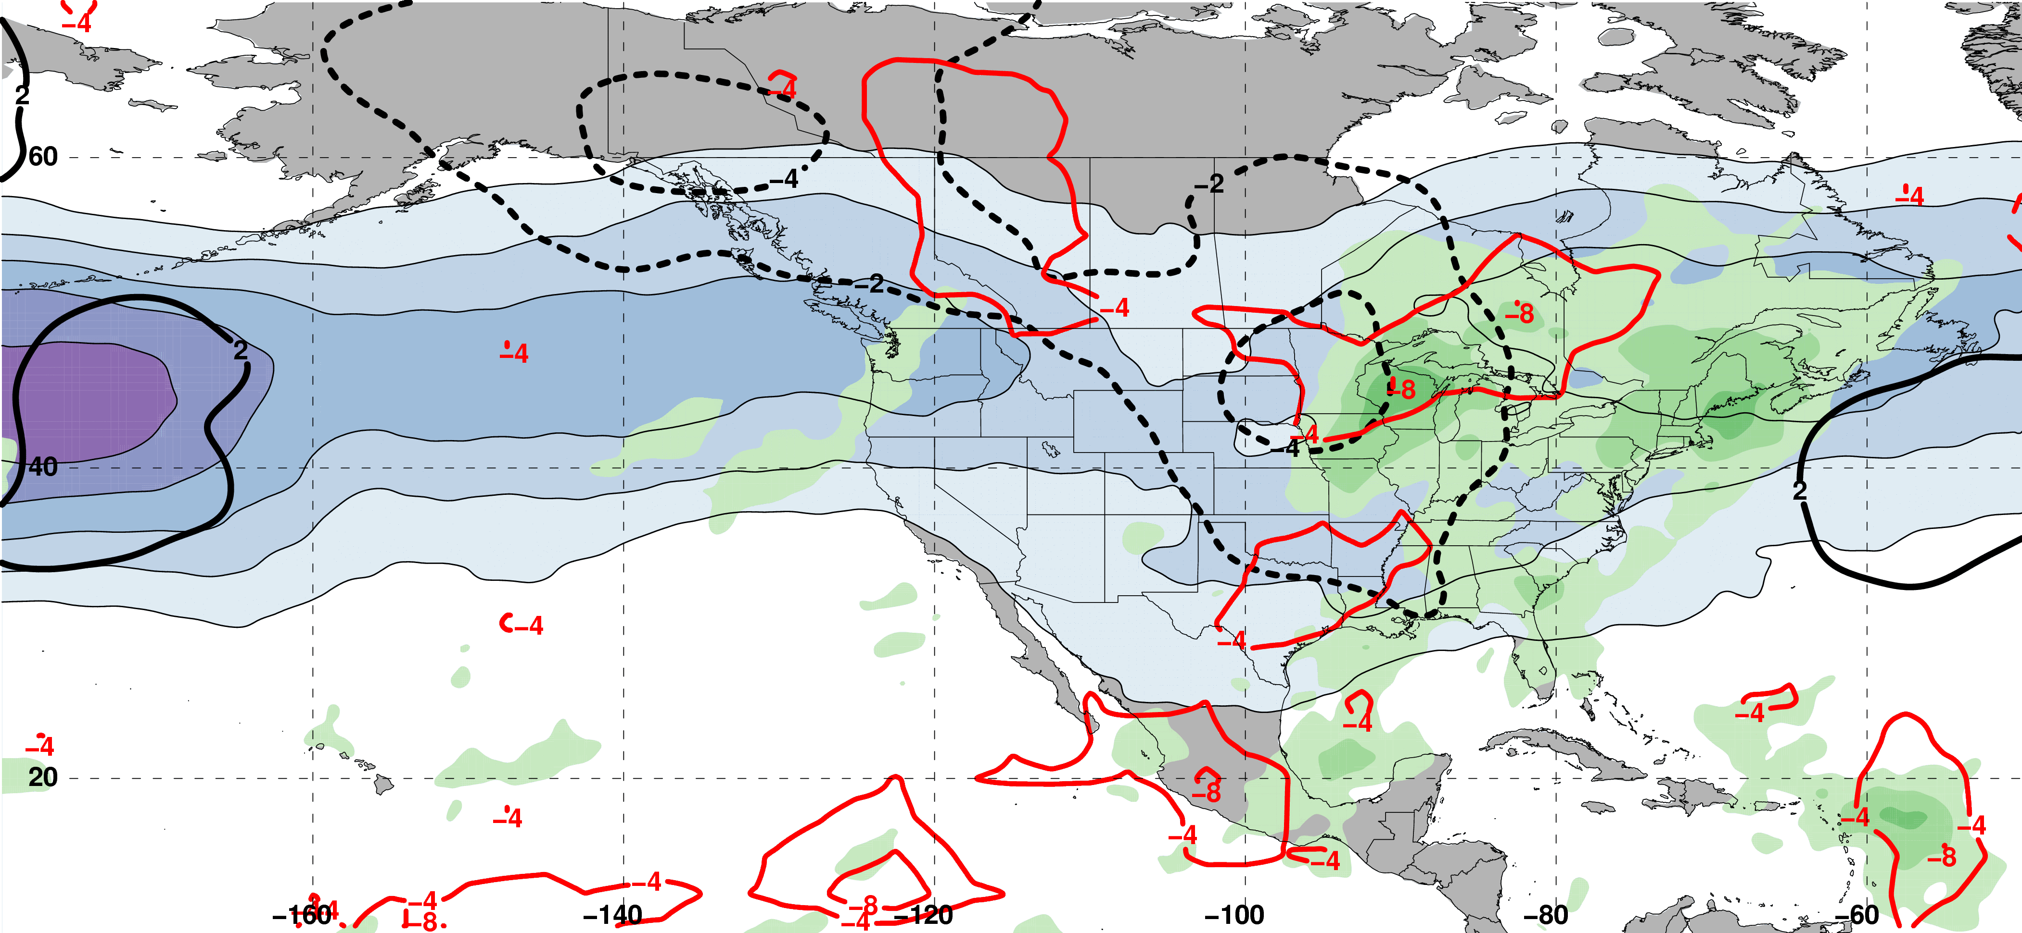
E. Subtropical Dominant Jet Superposition Events
250-hPa Jet, Geo. Height, & Geo. Height Anom., & 300-hPa Geo. Temp Adv.
3 Days
Prior to Jet Superposition
m s^{–1}
250-hPa Jet, MSLP Anom., PWAT Anom., & OLR Anom.
N=76
mm

Slide 69
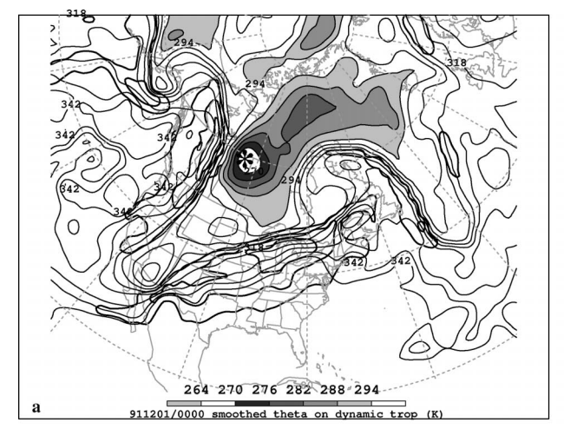
Polar Cyclonic PV Anomalies
DT Potential Temperature
Pyle et al. 2004

Slide 70
Polar Cyclonic PV Anomalies
DT Potential Temperature
Pyle et al. 2004
Polar cyclonic PV anomalies:
Often referred to as coherent tropopause disturbances or tropopause polar vortices (Cavallo and Hakim 2010)
Typify a dynamical environment conducive to midlatitude cyclogenesis

Slide 71
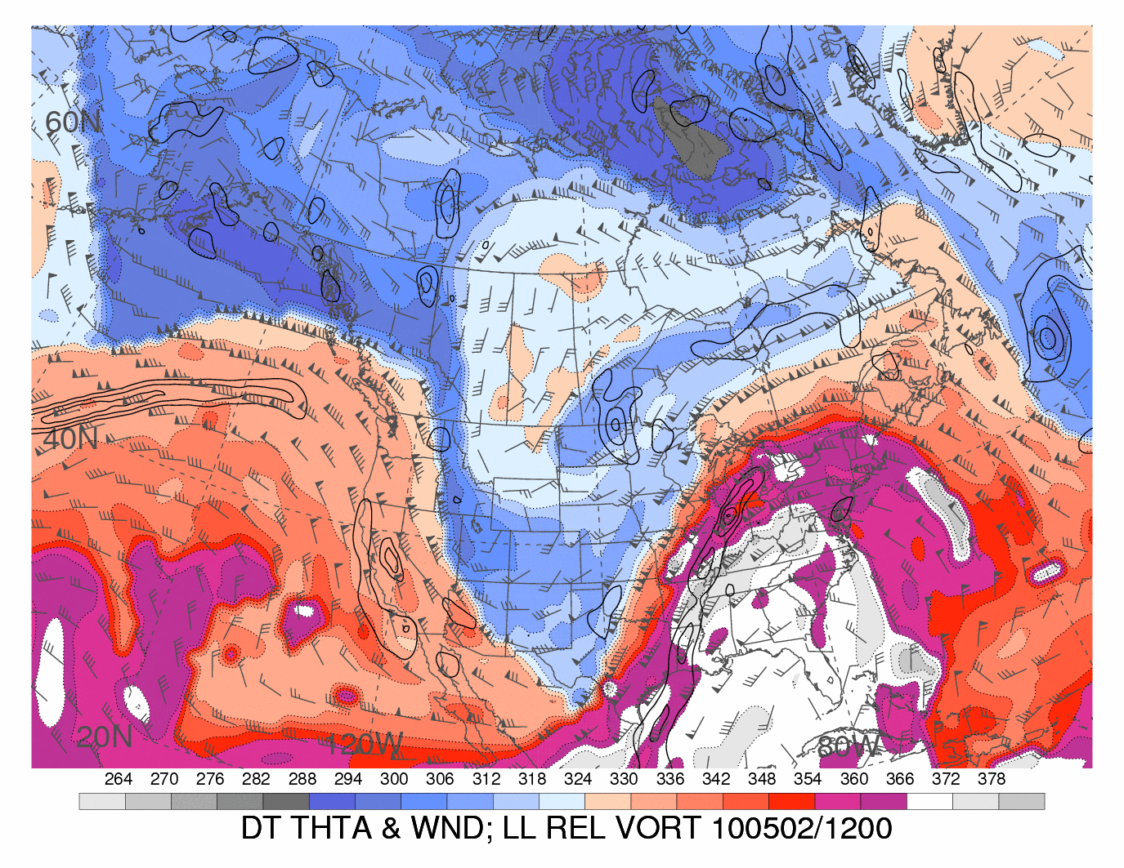
Tropical Anticyclonic PV Anomalies
DT Potential Temperature
Heather Archambault

Slide 72
Tropical Anticyclonic PV Anomalies
DT Potential Temperature
Tropical anticyclonic PV anomalies typify a thermodynamic environment characterized by:
Weak upper-tropospheric static stability
Atmospheric rivers within the poleward-directed branch of their circulation, on occasion
Heather Archambault

Slide 73
Background
Modified from Defant and Taba (1957)

Slide 74
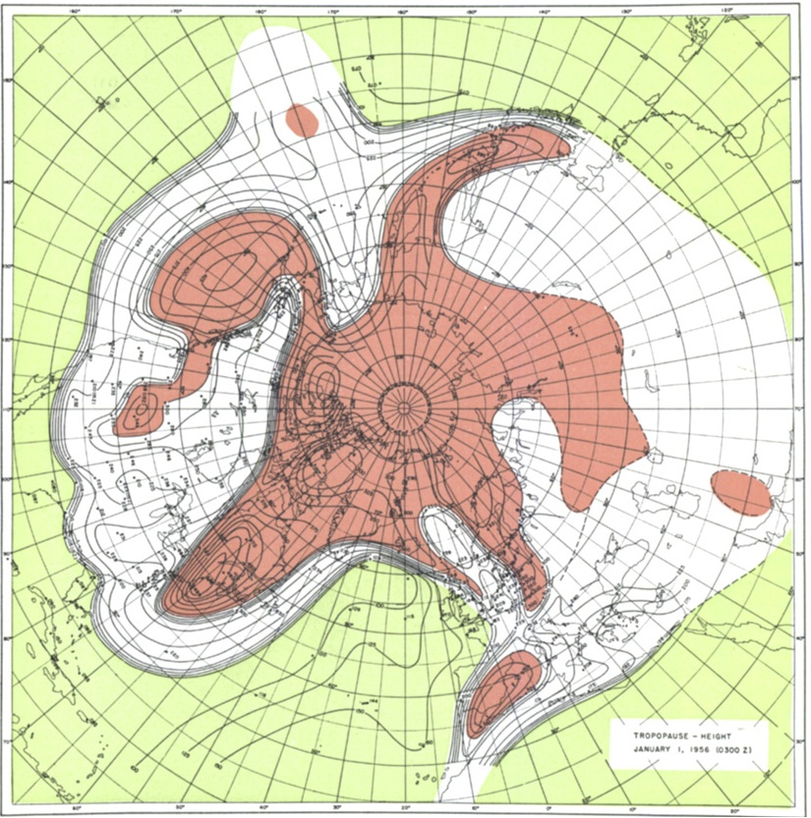
Background
Tropical Tropopause
Subtropical Tropopause
Polar Tropopause
Maps of tropopause pressure help to identify the location of jets.
While each jet occupies its own climatological latitude band – substantial meanders are common.
Occasionally, the latitudinal separation between the jets can vanish → vertical superposition.
STJ
POLJ
Modified from Defant and Taba (1957)
Notes:
Only flash to the tropopause temperature once to show the intensified frontal structure.

Slide 75
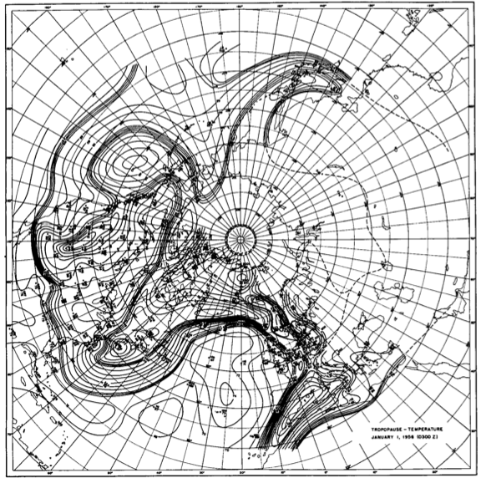
Background
POLJ
STJ
In the vicinity of superposition, the pole-to-equator baroclinicity is combined into a much narrower zone of contrast.
Intensified frontal structure is often attended by a strengthening of the jet’s transverse circulation.
Modified from Defant and Taba (1957)

Slide 76
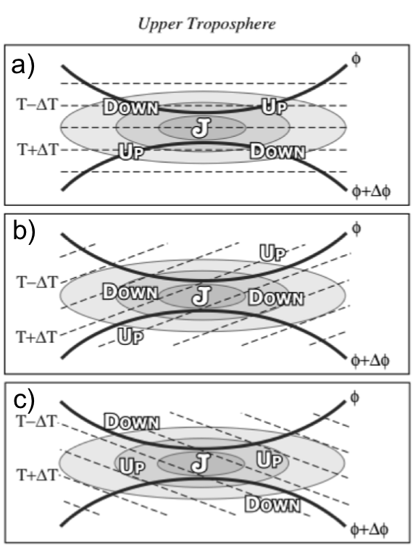
Background
Intensified baroclinicity often attended by a strengthening of the transverse circulation
Traditional four-quadrant model
Geo. CAA along the jet axis acts to promote subsidence through the jet core
Geo. WAA along the jet axis acts to promote ascent through the jet core
Lang and Martin (2012)

Slide 77
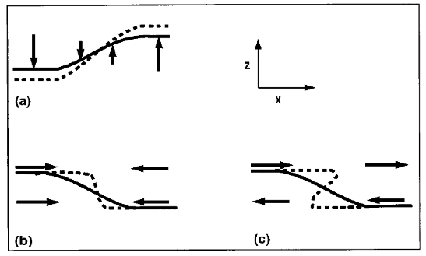
Background
Insight into how the tropopause can be restructured from a PV perspective can be found by consulting Wandishin et al. (2000)
Two processes can account for “foldogenesis”:
Differential vertical motions can vertically steepen the tropopause.
Convergence or a vertical shear can produce a differential horizontal advection of the tropopause surface.
Wandishin et al. 2000
These same mechanisms are also likely to play an important role in superpositions.

Slide 78
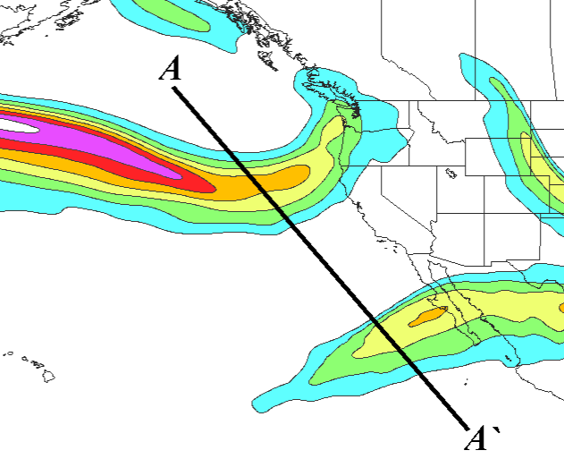
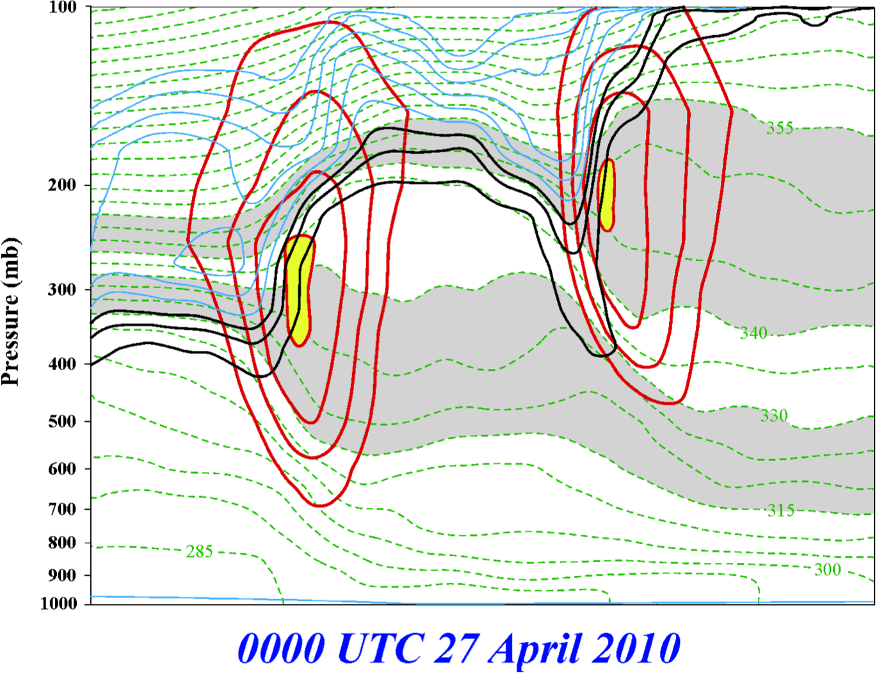
Jet Superposition Identification
These jet structures can be objectively identified!
Jets are identified within a grid column if integrated wind speed and horizontal PV gradient criteria are met
Isotachs
Potential Temp.
1,2,3-PVU contours
A
A’

Slide 79
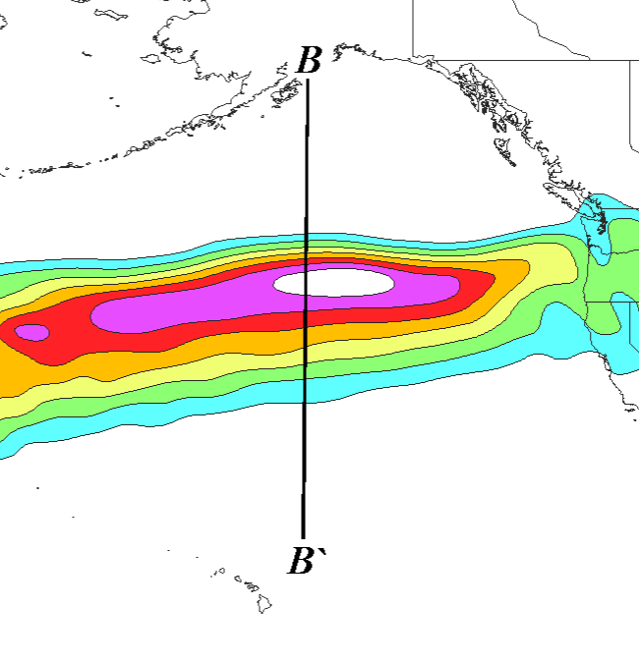

Jet Superposition Identification
Criteria for both the polar and subtropical jets met within the same grid column
Isotachs
Potential Temp.
1,2,3-PVU contours
B
B’

