Slide 1
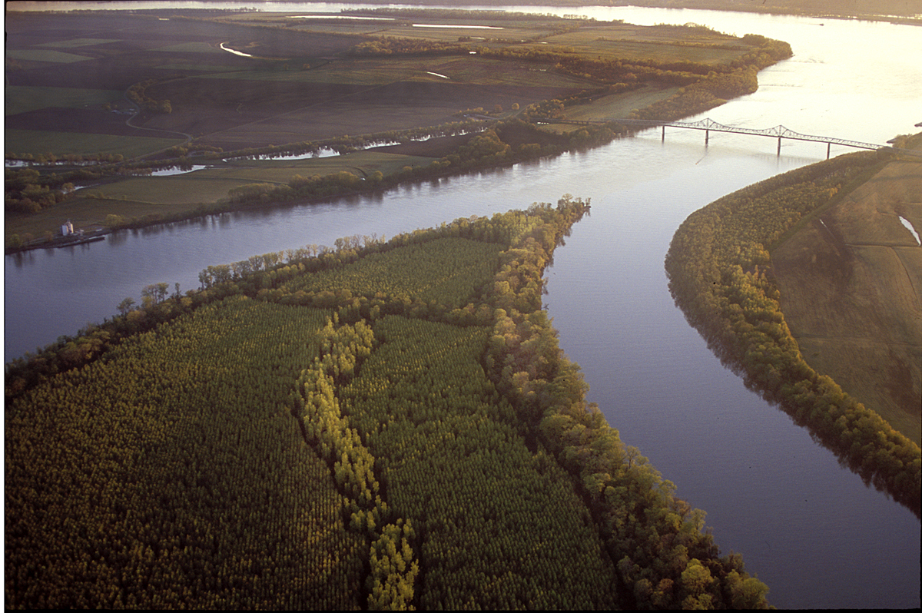


The Role of Subsidence during the Development of North American Polar/Subtropical Jet Superpositions
Andrew C. Winters
University of Colorado Boulder
Daniel Keyser and Lance F. Bosart
University at Albany, SUNY
19th Cyclone Workshop
Seeon, Bavaria, Germany
30 September 2019
This work was funded by an NSF-PRF (AGS-1624316)

Slide 2
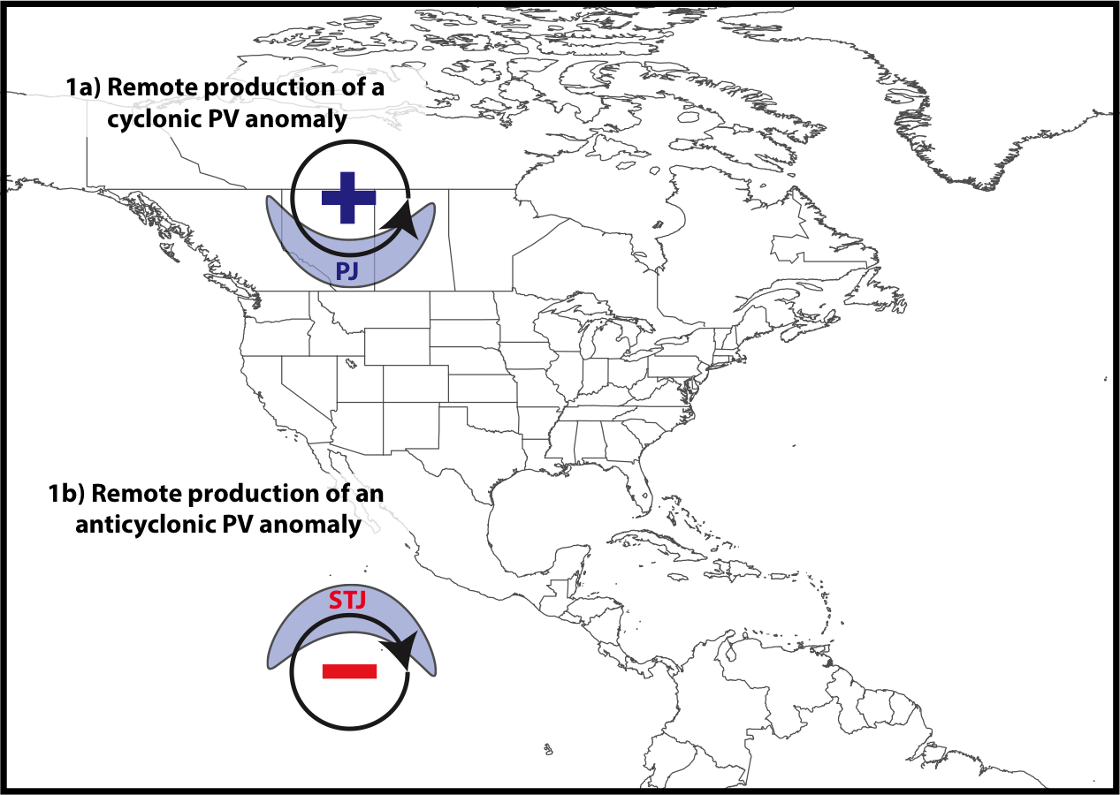
Jet Superposition Conceptual Model
Winters and Martin (2017)

Slide 3
Jet Superposition Conceptual Model
Polar cyclonic PV anomalies:
Often referred to as coherent tropopause disturbances (Pyle et al. 2004) or tropopause polar vortices (Cavallo and Hakim 2010).
Characterize a dynamical environment conducive to midlatitude cyclogenesis.
Winters and Martin (2017)

Slide 4
Jet Superposition Conceptual Model
Winters and Martin (2017)

Slide 5
Jet Superposition Conceptual Model
Tropical anticyclonic PV anomalies:
Characterize a thermodynamic environment characterized by weak upper-tropospheric static stability.
An atmospheric river often forms within the poleward-directed branch of the low-level circulation induced by an anticyclonic PV anomaly.
Winters and Martin (2017)

Slide 6
Jet Superposition Conceptual Model
A
A’
Winters and Martin (2017)

Slide 7
Jet Superposition Conceptual Model
A
2-PVU Contour
Potential Temp.
Wind Speed
A’
Winters and Martin (2017)

Slide 8
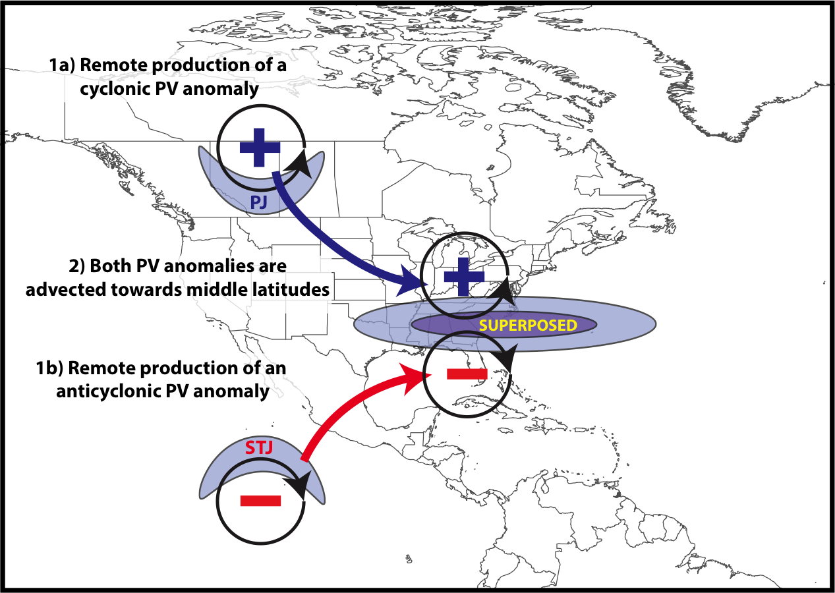
Jet Superposition Conceptual Model
Winters and Martin (2017)

Slide 9
Jet Superposition Conceptual Model
B
B’
Winters and Martin (2017)

Slide 10
Jet Superposition Conceptual Model
B
2-PVU Contour
Potential Temp.
Wind Speed
B’
Winters and Martin (2017)

Slide 11
Jet Superposition Conceptual Model
The relative importance of the antecedent PV anomalies is highly variable between jet superposition events
Winters and Martin (2017)

Slide 12
Jet Superposition Conceptual Model
What role do the antecedent PV anomalies play during the process of jet superposition?
Winters and Martin (2017)

Slide 13
Jet Superposition Event Identification and Classification

Slide 14
Jet Superposition Event Identification
Isolated NCEP CFSR (Saha et al. 2014) grid points over North America characterized by a jet superposition during Nov.–Mar. 1979–2010 using the Christenson et al. (2017) scheme.
Retained analysis times that rank in the top 10% in terms of the number of grid points characterized by a jet superposition.
Filtered retained analysis times to group together jet superpositions that are < 30 h and < 1500 km apart.
326 jet superposition events

Slide 15
Jet Superposition Event Identification
Isolated NCEP CFSR (Saha et al. 2014) grid points over North America characterized by a jet superposition during Nov.–Mar. 1979–2010 using the Christenson et al. (2017) scheme.
Retained analysis times that rank in the top 10% in terms of the number of grid points characterized by a jet superposition.
Filtered retained analysis times to group together jet superpositions that are < 30 h and < 1500 km apart.
Classified jet superposition events based on the deviations of the polar and subtropical jets from their respective climatological latitude bands at the time of jet superposition.

Slide 16
Jet Superposition Event Classification
Determined the mean position of the 2-PVU contour on the 320-K and 350-K surfaces at each analysis time in the CFSR.
0000 UTC 1 January

Slide 17
Jet Superposition Event Classification
Determined the mean position of the 2-PVU contour on the 320-K and 350-K surfaces at each analysis time in the CFSR.
0000 UTC 1 January
Polar Jet
Subtropical Jet

Slide 18
Jet Superposition Event Classification
Determined the mean position of the 2-PVU contour on the 320-K and 350-K surfaces at each analysis time in the CFSR.
Compared the position of the jet superposition centroid at the start of each event against the climatological position of the 2-PVU contour.
0000 UTC 1 January

Slide 19
Jet Superposition Event Classification
Determined the mean position of the 2-PVU contour on the 320-K and 350-K surfaces at each analysis time in the CFSR.
Compared the position of the jet superposition centroid at the start of each event against the climatological position of the 2-PVU contour.
Polar Dominant
0000 UTC 1 January
Jet Superposition Centroid

Slide 20
Jet Superposition Event Classification
Determined the mean position of the 2-PVU contour on the 320-K and 350-K surfaces at each analysis time in the CFSR.
Compared the position of the jet superposition centroid at the start of each event against the climatological position of the 2-PVU contour.
Polar Dominant
Subtropical Dominant
0000 UTC 1 January
Jet Superposition Centroid

Slide 21
Jet Superposition Event Classification
Determined the mean position of the 2-PVU contour on the 320-K and 350-K surfaces at each analysis time in the CFSR.
Compared the position of the jet superposition centroid at the start of each event against the climatological position of the 2-PVU contour.
Polar Dominant
Subtropical Dominant
Hybrid
0000 UTC 1 January
Jet Superposition Centroid

Slide 22
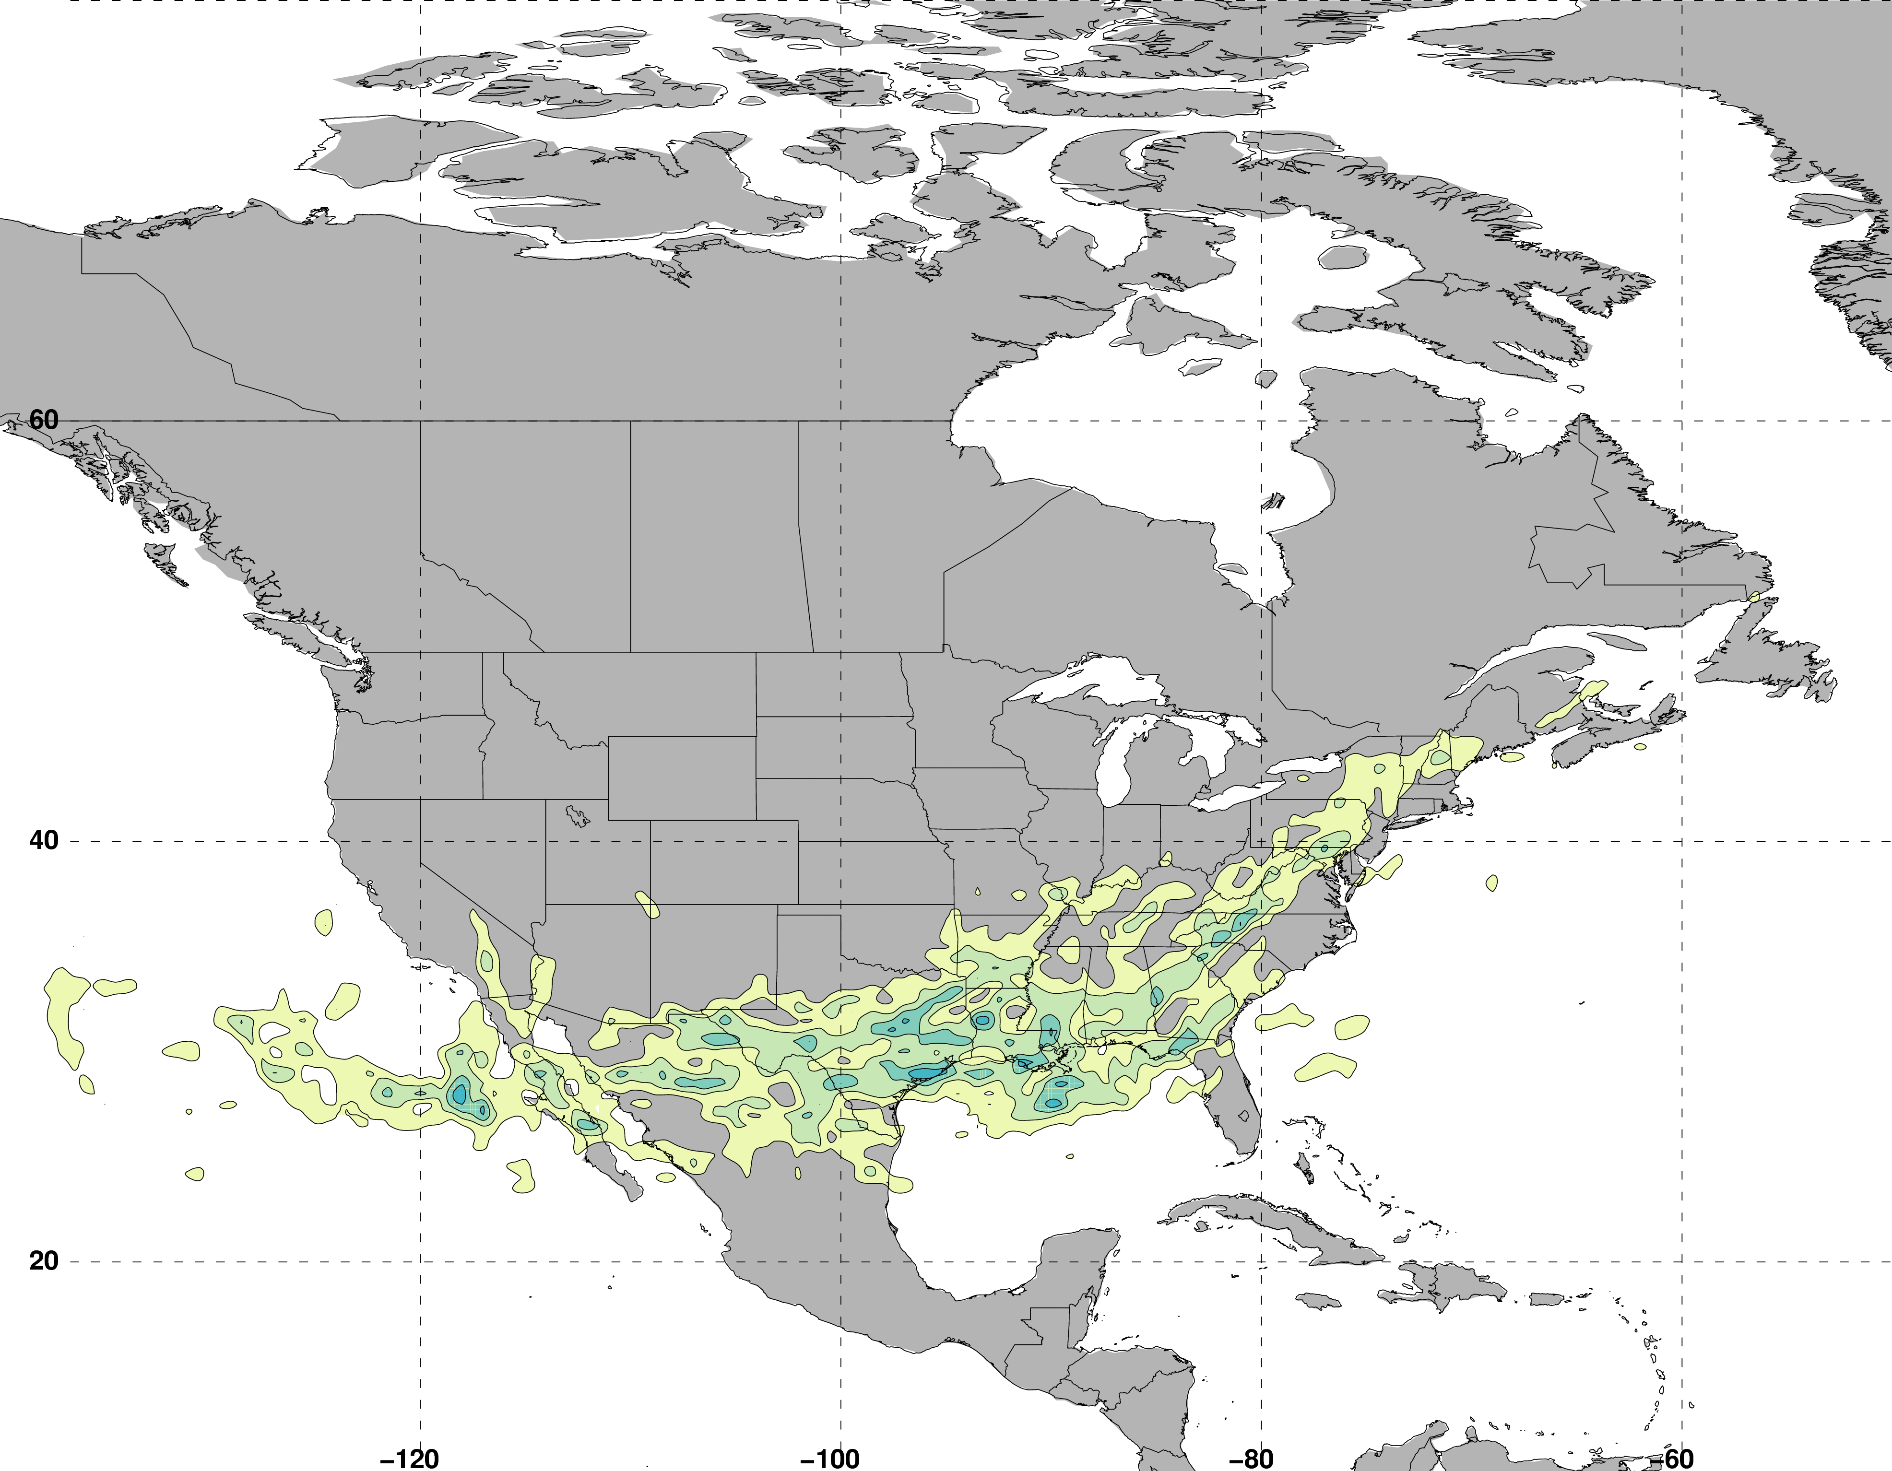
Jet Superposition Event Classification
Frequency of Polar Dominant Jet Superposition Events
N = 80
Legend
Avg. Location of Superposition
Number of events

Slide 23
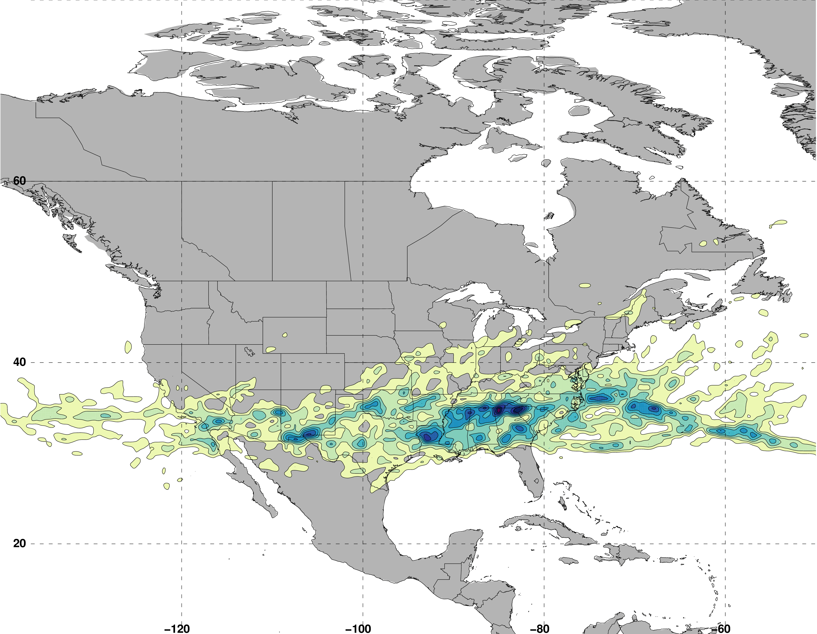
Jet Superposition Event Classification
Frequency of Hybrid Jet Superposition Events
N = 117
Legend
Avg. Location of Superposition
Number of events

Slide 24
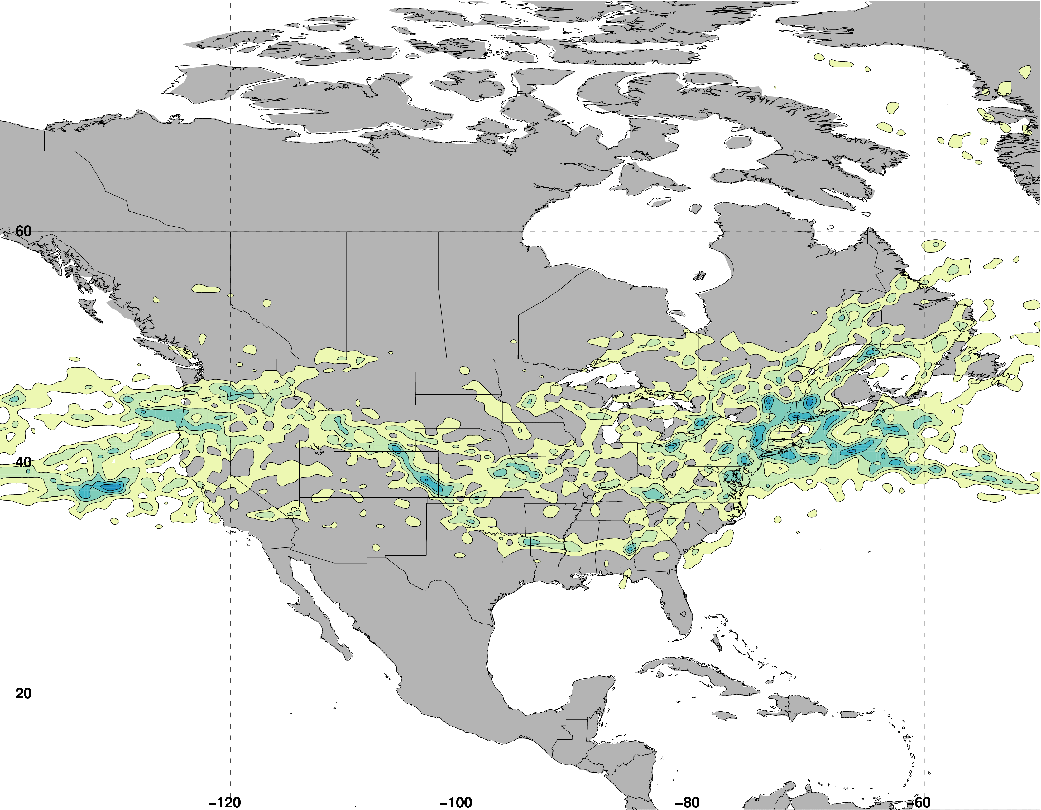
Jet Superposition Event Classification
Frequency of Subtropical Dominant Jet Superposition Events
N = 129
Legend
Avg. Location of Superposition
Number of events

Slide 25
Jet Superposition Event Classification
Frequency of Subtropical Dominant Jet Superposition Events
N = 129
West: N = 53
East: N = 76
Legend
Avg. Location of Superposition
Number of events

Slide 26
Jet Superposition Event
Composites

Slide 27
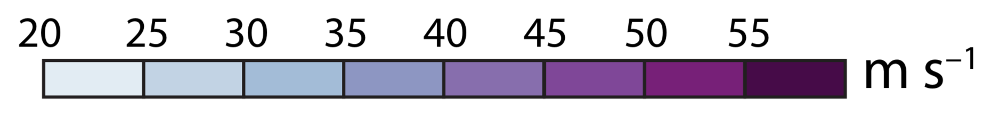
Polar Dominant
Jet Superposition Event Composites
East Subtropical Dominant
West Subtropical Dominant
250-hPa Geo. Height
250-hPa Geo. Height Anomalies
500-hPa Descent
Avg. Location of Superposition
Wind Speed

Slide 28
Polar Dominant
Jet Superposition Event Composites
Descent beneath the jet-entrance region is a common element among the jet superposition event composites.
East Subtropical Dominant
West Subtropical Dominant
250-hPa Geo. Height
250-hPa Geo. Height Anomalies
500-hPa Descent
Avg. Location of Superposition
Wind Speed

Slide 29
Polar Dominant
Jet Superposition Event Composites
Descent beneath the jet-entrance region is a common element among the jet superposition event composites.
East Subtropical Dominant
West Subtropical Dominant
250-hPa Geo. Height
250-hPa Geo. Height Anomalies
500-hPa Descent
Avg. Location of Superposition
Wind Speed

Slide 30
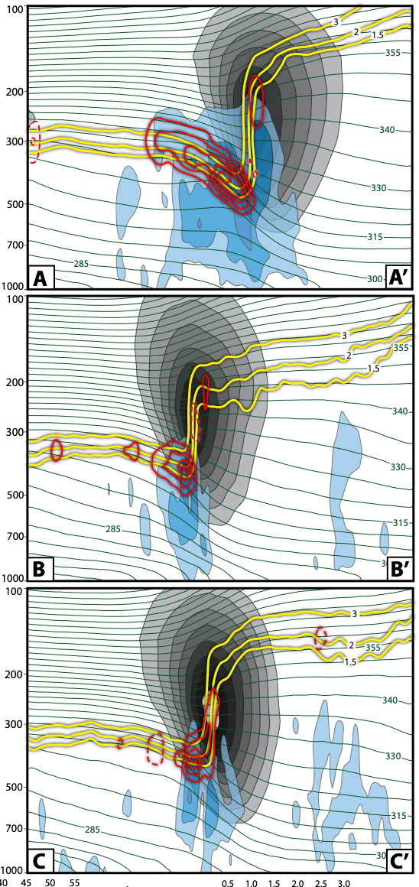
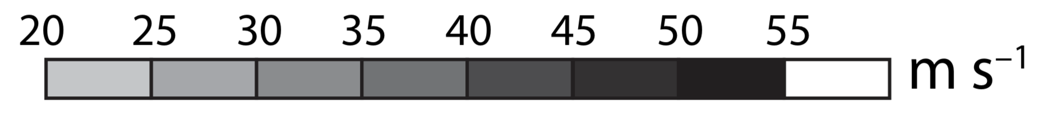
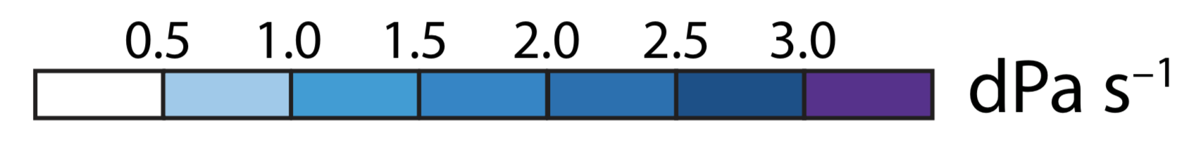
Polar Dominant
Jet Superposition Event Composites
Descent beneath the jet-entrance region is a common element among the jet superposition event composites.
Descent results in downward PV advection within the developing tropopause fold, which steepens the tropopause.
East Subtropical Dominant
West Subtropical Dominant
1.5-, 2-, 3-PVU
+ PV Advection
Potential Temperature
– PV Advection
Wind Speed
Descent

Slide 31
Polar Dominant
Jet Superposition Event Composites
Descent beneath the jet-entrance region is a common element among the jet superposition event composites.
Descent results in downward PV advection within the developing tropopause fold, which steepens the tropopause.
The consistent role of descent motivates further investigation of the dynamical mechanisms responsible for the descent.
East Subtropical Dominant
West Subtropical Dominant
1.5-, 2-, 3-PVU
+ PV Advection
Potential Temperature
– PV Advection
Wind Speed
Descent

Slide 32
Piecewise QGPV
Inversion

Slide 33
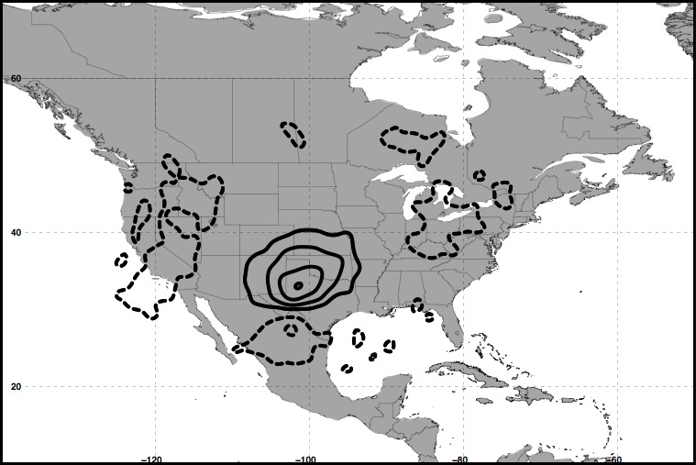
Piecewise QGPV Inversion
Polar Dominant Events
250 hPa
+ QGPV Anomalies
– QGPV Anomalies
Avg. Location
of Superposition
The descent characterizing each jet superposition event composite is examined further by isolating quasi-geostrophic (QG) PV anomalies in the vicinity of the jet superposition.

Slide 34
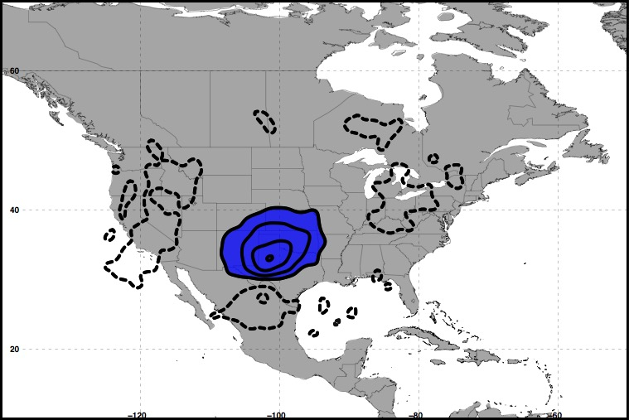
Piecewise QGPV Inversion
Polar Dominant Events
250 hPa
+ QGPV Anomalies
– QGPV Anomalies
Avg. Location
of Superposition
Polar Cyclonic QGPV Anomalies

Slide 35
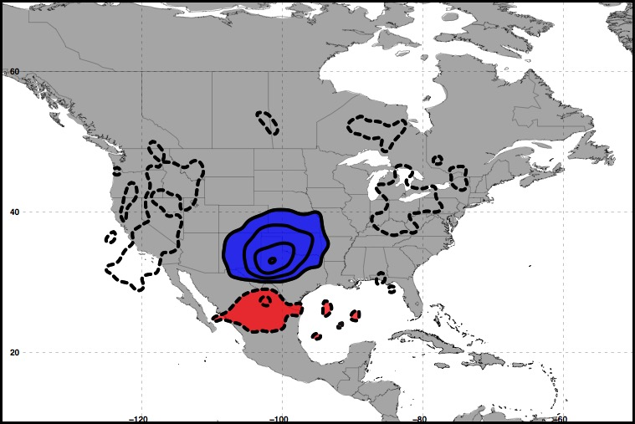
Piecewise QGPV Inversion
Polar Dominant Events
250 hPa
+ QGPV Anomalies
– QGPV Anomalies
Avg. Location
of Superposition
Polar Cyclonic QGPV Anomalies
Tropical Anticyclonic QGPV Anomalies

Slide 36
Piecewise QGPV Inversion
Polar Dominant Events
250 hPa
+ QGPV Anomalies
– QGPV Anomalies
Avg. Location
of Superposition
Polar Cyclonic QGPV Anomalies
Tropical Anticyclonic QGPV Anomalies

Slide 37
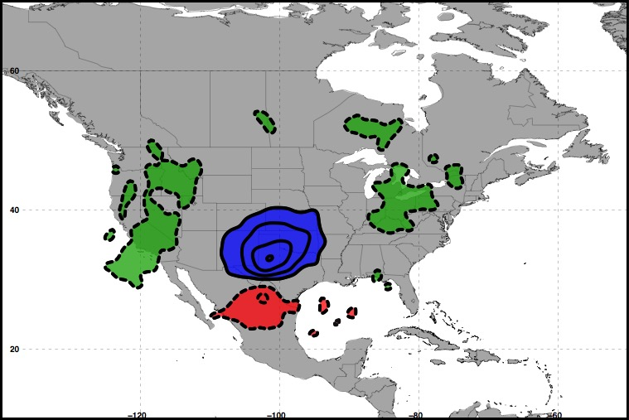
Piecewise QGPV Inversion
Polar Dominant Events
250 hPa
+ QGPV Anomalies
– QGPV Anomalies
Avg. Location
of Superposition
Polar Cyclonic QGPV Anomalies
Residual Upper-Tropospheric QGPV Anomalies
Tropical Anticyclonic QGPV Anomalies

Slide 38
Piecewise QGPV Inversion
Polar Dominant Events
250 hPa
+ QGPV Anomalies
– QGPV Anomalies
Avg. Location
of Superposition
Polar Cyclonic QGPV Anomalies
Residual Upper-Tropospheric QGPV Anomalies
Tropical Anticyclonic QGPV Anomalies
Lower-Tropospheric QGPV Anomalies

Slide 39
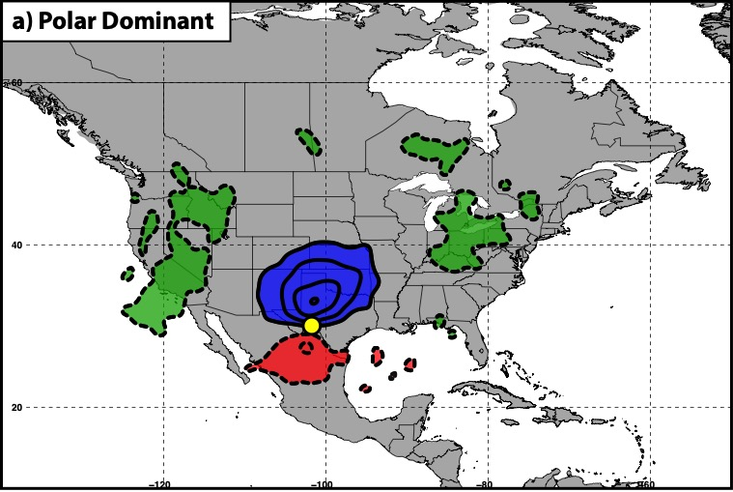
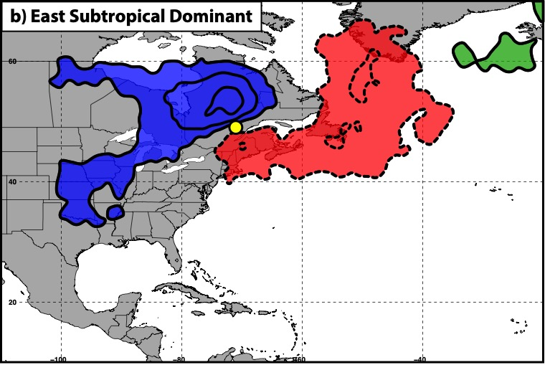
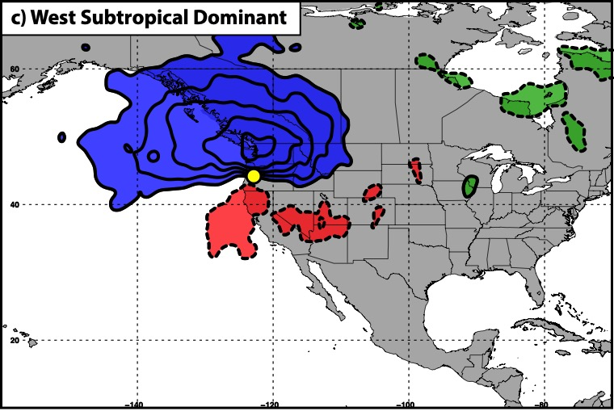
Piecewise QGPV Inversion
250 hPa
300 hPa
300 hPa
+ QGPV Anomalies
– QGPV Anomalies
Avg. Location of Superposition
Polar Cyclonic QGPV Anom.
Tropical Anticyclonic QGPV Anom.
Residual Upper-Tropospheric QGPV Anom.
Lower-Tropospheric QGPV Anom.

Slide 40

Piecewise QGPV Inversion
Each category of QGPV anomalies ($q_{i}^{′}$) is inverted to determine its associated perturbation geopotential ($φ_{i}^{′}$) field:
i
i
i

Slide 41

Piecewise QGPV Inversion
Each category of QGPV anomalies ($q_{i}^{′}$) is inverted to determine its associated perturbation geopotential ($φ_{i}^{′}$) field:
i
i
i
The perturbation geopotential fields and the composite
temperature ($T$) field are used to determine the QG vertical
motion ($ω_{i}$) associated with each category of QGPV:
i
i
i
i
i
i
i
i

Slide 42
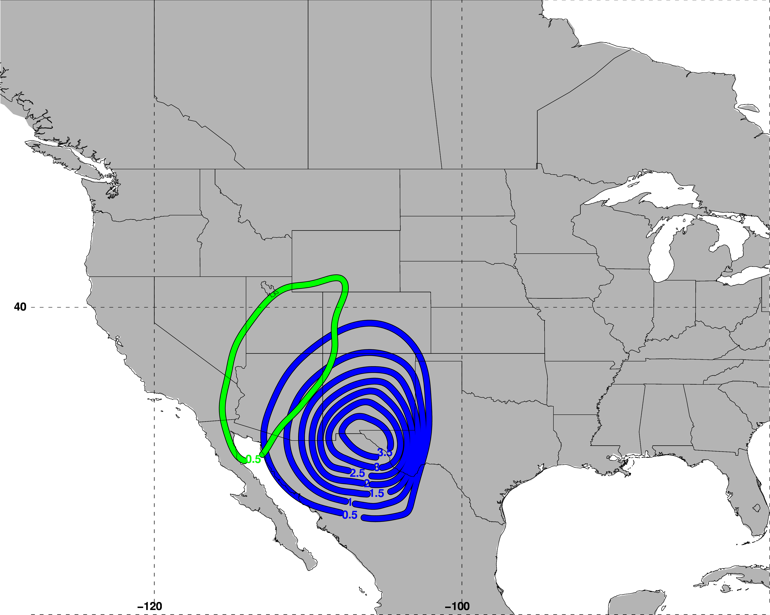
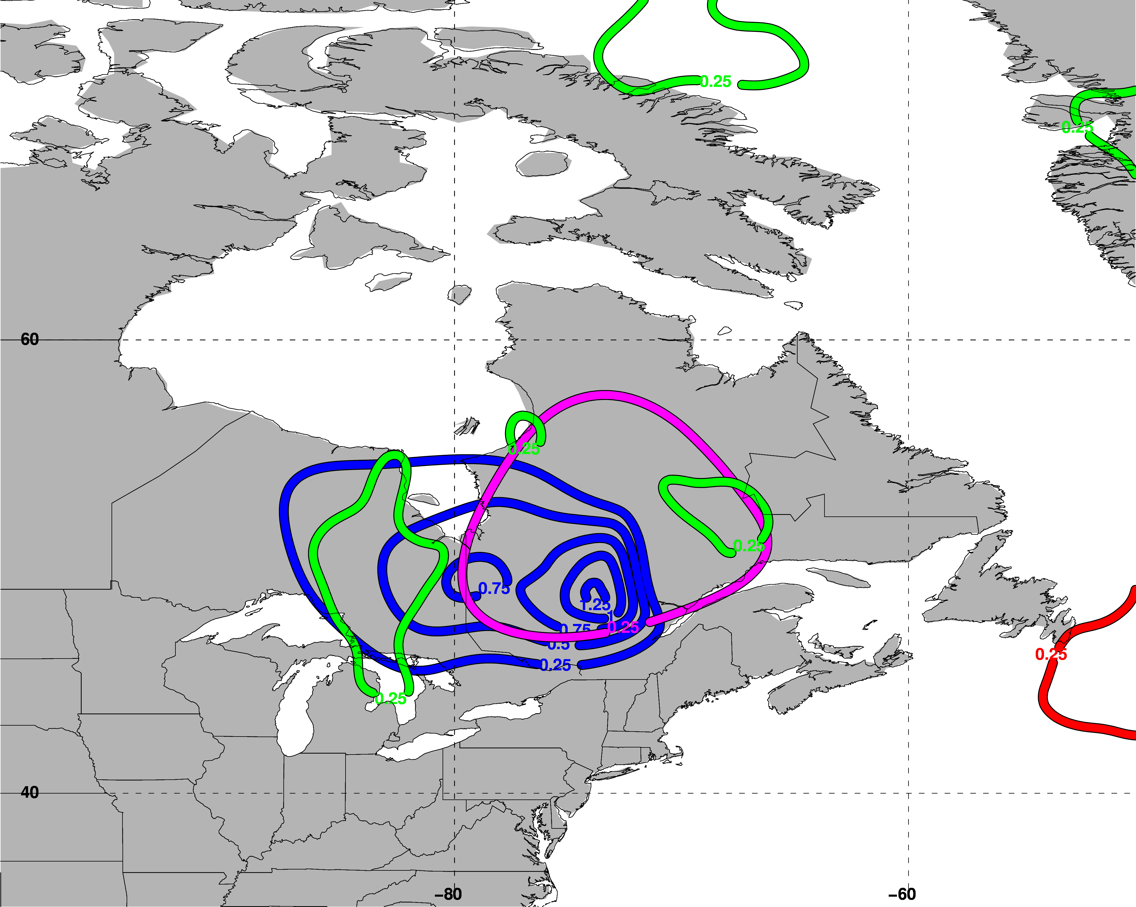
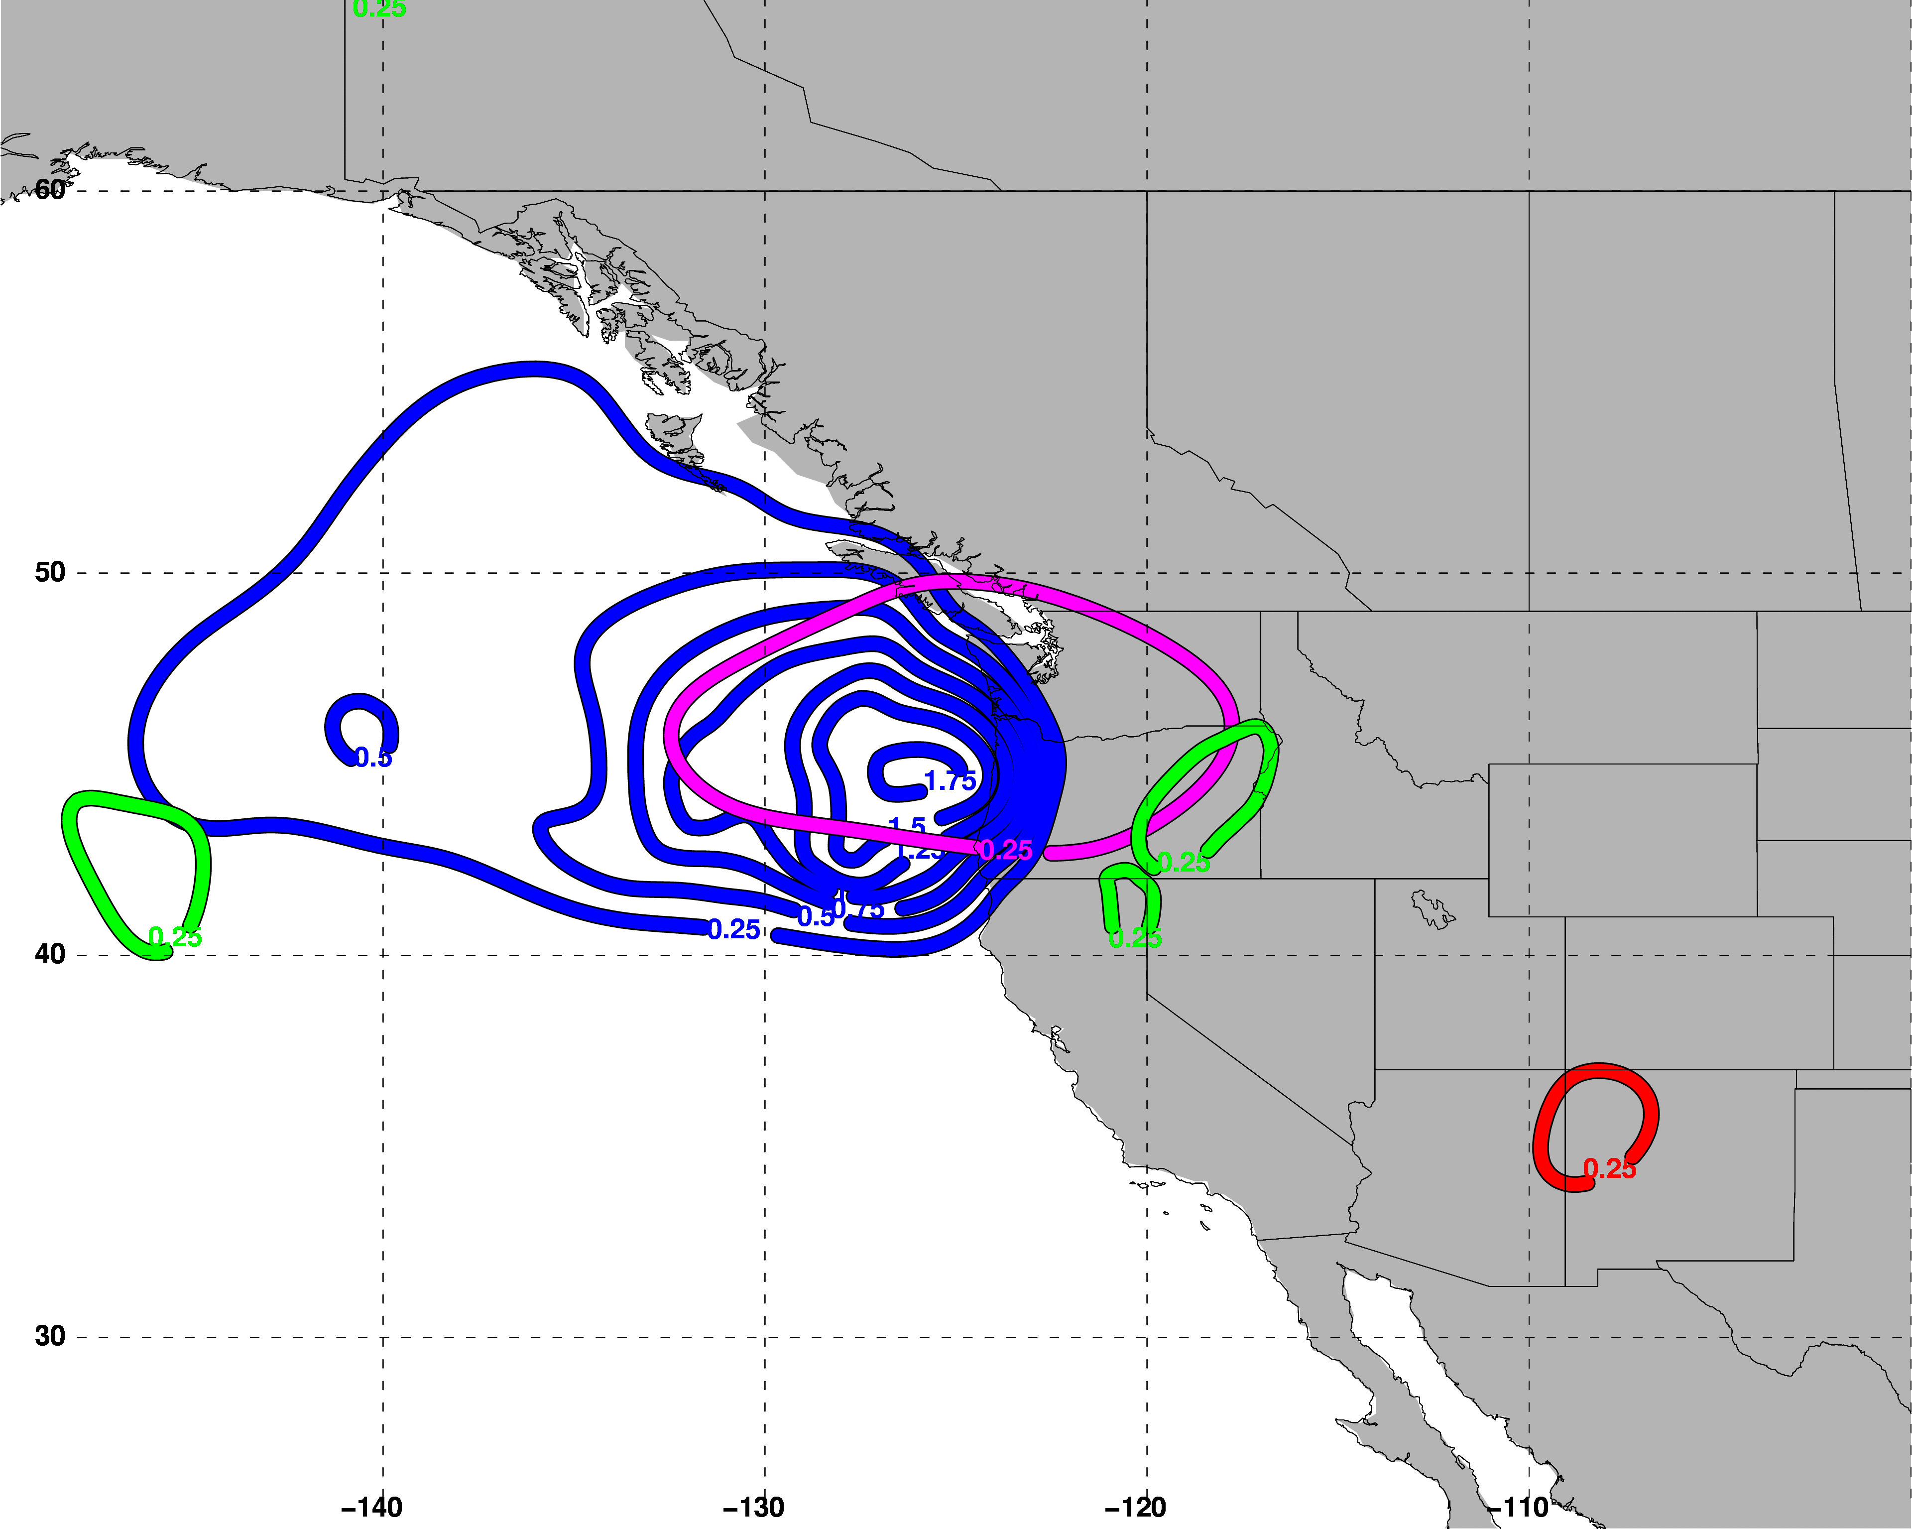
Polar Dominant
East Subtropical Dominant
500 hPa QG Descent
500 hPa QG Descent
West Subtropical Dominant
Polar Cyclonic QGPV Anomalies
Tropical Anticyclonic QGPV Anomalies
Residual Upper-Tropospheric QGPV Anomalies
Lower-Tropospheric QGPV Anomalies
500 hPa QG Descent
Avg. Location of Jet Superposition

Slide 43
Polar Dominant
East Subtropical Dominant
500 hPa QG Descent
500 hPa QG Descent
West Subtropical Dominant
Descent is primarily associated with polar cyclonic QGPV anomalies.
Polar Cyclonic QGPV Anomalies
Tropical Anticyclonic QGPV Anomalies
Residual Upper-Tropospheric QGPV Anomalies
Lower-Tropospheric QGPV Anomalies
500 hPa QG Descent
Avg. Location of Jet Superposition

Slide 44
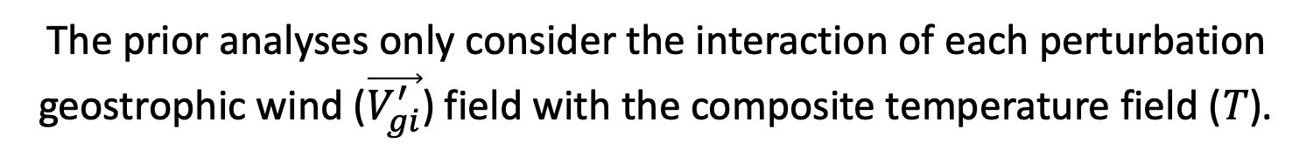
Piecewise QGPV Inversion
i
i
i
i
i
i
i
i
The prior analyses only consider the interaction of each perturbation geostrophic wind ($\vec{V_{gi}^{′}}$) field with the composite temperature field ($T$).

Slide 45

Piecewise QGPV Inversion
i
i
i
i
i
i
i
i
The prior analyses only consider the interaction of each perturbation geostrophic wind ($\vec{V_{gi}^{′}}$) field with the composite temperature field ($T$).
Each perturbation geopotential field ($φ_{i}^{′}$) is also accompanied by a perturbation temperature field ($T_{i}^{′}$) .

Slide 46
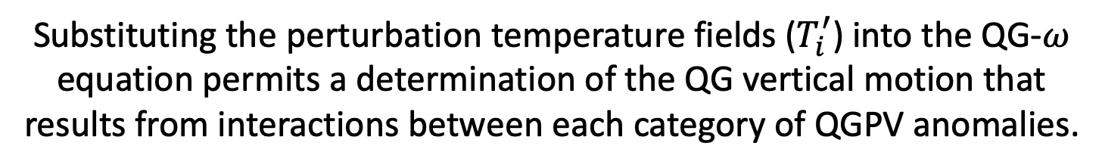
Piecewise QGPV Inversion
i
i
i
i
i
‘
‘
i
i
i
i
i
The prior analyses only consider the interaction of each perturbation geostrophic wind ($\vec{V_{gi}^{′}}$) field with the composite temperature field ($T$).
Each perturbation geopotential field ($φ_{i}^{′}$) is also accompanied by a perturbation temperature field ($T_{i}^{′}$) .
Substituting the perturbation temperature fields ($T_{i}^{′}$) into the QG-$ω$ equation permits a determination of the QG vertical motion that results from interactions between each category of QGPV anomalies.

Slide 47



Polar Dominant
East Subtropical Dominant
500-hPa $ω$
500-hPa $ω$
West Subtropical Dominant
Consider the QG $ω$ associated with each interaction term at the location of maximum descent.
500-hPa $ω$
Location of Maximum Descent
2 PVU on the 320-K surface
2 PVU on the 345-K surface
Avg. Location of Jet Superposition

Slide 48
Piecewise QGPV Inversion
P = Polar Dominant
E = East Subtropical Dominant
W = West Subtropical Dominant

Slide 49
Piecewise QGPV Inversion
P = Polar Dominant
E = East Subtropical Dominant
W = West Subtropical Dominant

Slide 50
Piecewise QGPV Inversion
P = Polar Dominant
E = East Subtropical Dominant
W = West Subtropical Dominant

Slide 51
Piecewise QGPV Inversion
P = Polar Dominant
E = East Subtropical Dominant
W = West Subtropical Dominant

Slide 52
Piecewise QGPV Inversion
P = Polar Dominant
E = East Subtropical Dominant
W = West Subtropical Dominant

Slide 53
Piecewise QGPV Inversion
P = Polar Dominant
E = East Subtropical Dominant
W = West Subtropical Dominant

Slide 54
Piecewise QGPV Inversion
P = Polar Dominant
E = East Subtropical Dominant
W = West Subtropical Dominant

Slide 55
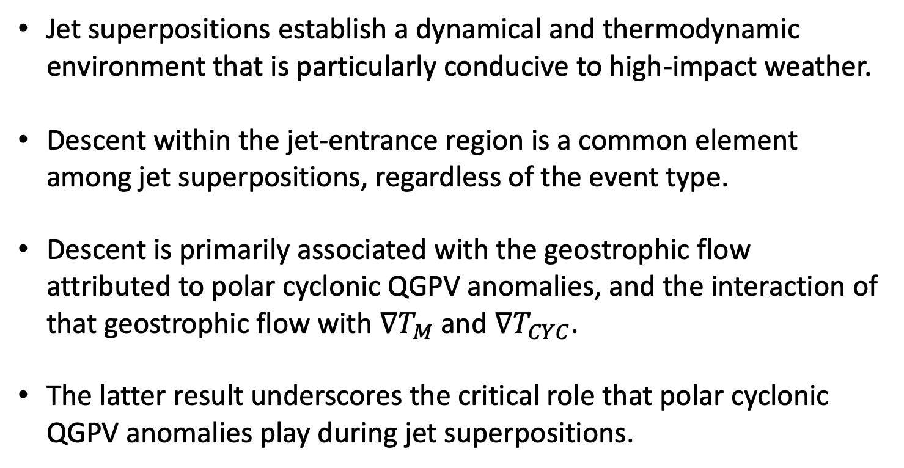
Summary
Jet superpositions establish a dynamical and thermodynamic environment that is particularly conducive to high-impact weather.
Descent within the jet-entrance region is a common element among jet superpositions, regardless of the event type.
Descent is primarily associated with the geostrophic flow attributed to polar cyclonic QGPV anomalies, and the interaction of that geostrophic flow with $∇T_{M}$ and $∇T_{CYC}$.
The latter result underscores the critical role that polar cyclonic QGPV anomalies play during jet superpositions.

Slide 56
Summary
Jet superpositions establish a dynamical and thermodynamic environment that is particularly conducive to high-impact weather.
Descent within the jet-entrance region is a common element among jet superpositions, regardless of the event type.
Descent is primarily associated with the geostrophic flow attributed to polar cyclonic QGPV anomalies, and the interaction of that geostrophic flow with $∇T_{M}$ and $∇T_{CYC}$.
The latter result underscores the critical role that polar cyclonic QGPV anomalies play during jet superpositions.
Contact: andrew.c.winters@colorado.edu

Slide 57
Supplementary Slides

Slide 58
References
Cavallo, S. M., and G. J. Hakim, 2010: Composite structure of tropopause polar cyclones. Mon. Wea. Rev., 138, 3840−3857.
Christenson, C. E., J. E. Martin, and Z. J. Handlos, 2017: A synoptic-climatology of Northern Hemisphere, cold season polar and subtropical jet superposition events. J. Climate, 30, 7231-7246.
Pyle, M. E., D. Keyser, and L. F. Bosart, 2004: A diagnostic study of jet streaks: Kinematic signatures and relationship to coherent tropopause disturbances. Mon. Wea. Rev., 132, 297−319.
Saha, S. and co-authors, 2014: The NCEP Climate Forecast System Version 2. J. Climate, 27, 2185−2208.
Winters, A. C., and J. E. Martin, 2017: Diagnosis of a North American polar/subtropical jet superposition employing piecewise potential vorticity inversion. Mon. Wea. Rev.,145, 1853-1873.

Slide 59
Shearwise and Transverse
QG Omega

Slide 60
Shearwise and Transverse QG Omega
Polar Dominant Events
Contours – Shearwise QG omega
Shading – Transverse QG omega

Slide 61
Shearwise and Transverse QG Omega
East Subtropical Dominant Events
Contours – Shearwise QG omega
Shading – Transverse QG omega

Slide 62
Shearwise and Transverse QG Omega
West Subtropical Dominant Events
Contours – Shearwise QG omega
Shading – Transverse QG omega

Slide 63
Psi Vector Partition
of the Full Vertical Motion

Slide 64
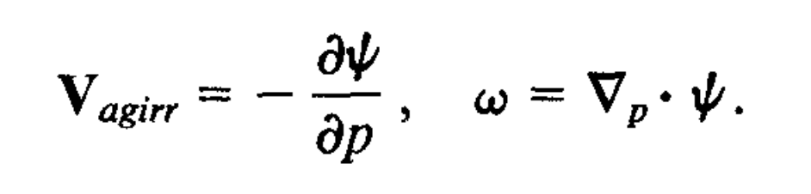
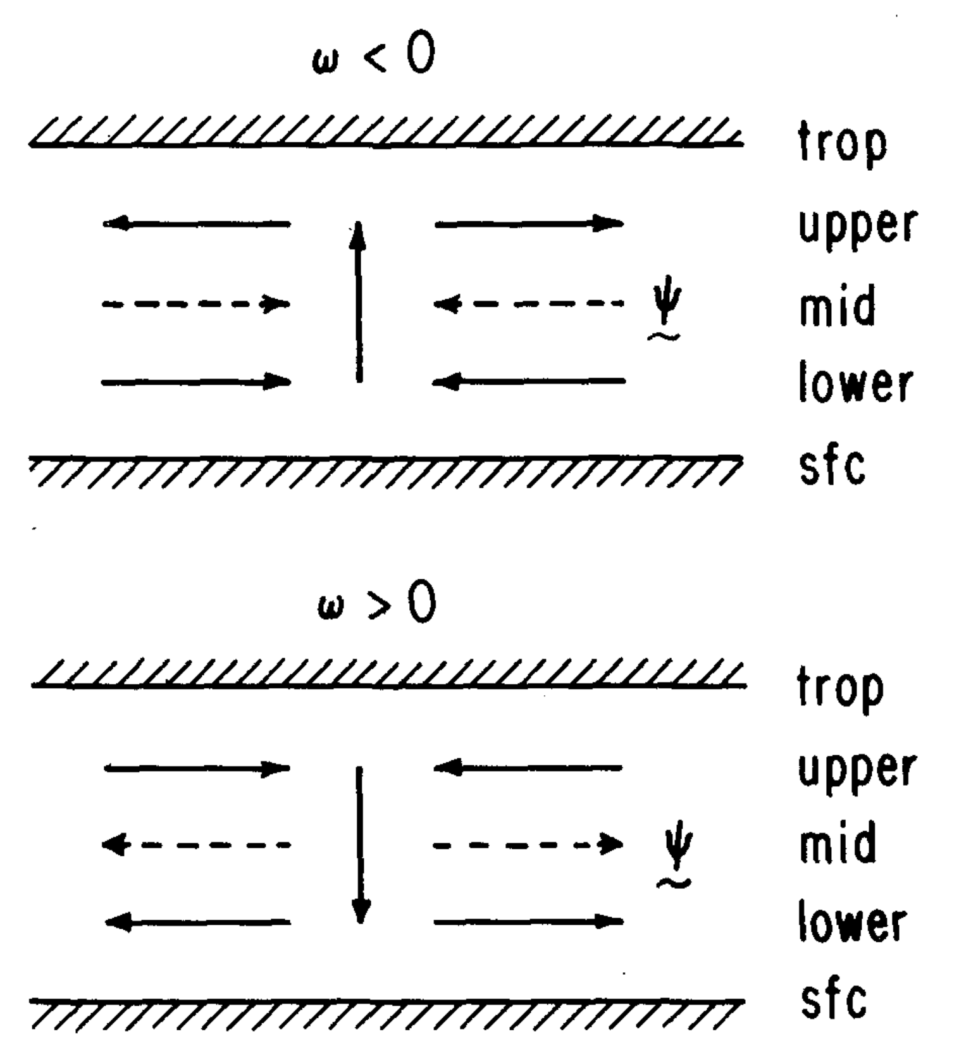
Psi Vectors
Keyser et al. 1989
A vector streamfunction field can be defined that describes the horizontal irrotational flow and vertical velocity.
The vector streamfunction can be determined uniquely from the vertical velocity field and by assuming suitable boundary conditions.
The projection of the “psi vector” onto planes in the along- and across-front directions can be used to examine the character of the three-dimensional vertical circulation
Keyser, D., B. D. Schmidt, and D. G. Duffy, 1989: A technique for representing three-dimensional vertical circulations in baroclinic disturbances. Mon. Wea. Rev., 117, 2463–2494.

Slide 65
Psi Vectors

Slide 66
Composite Characteristics

Slide 67
Jet Superposition Event Characteristics

Slide 68
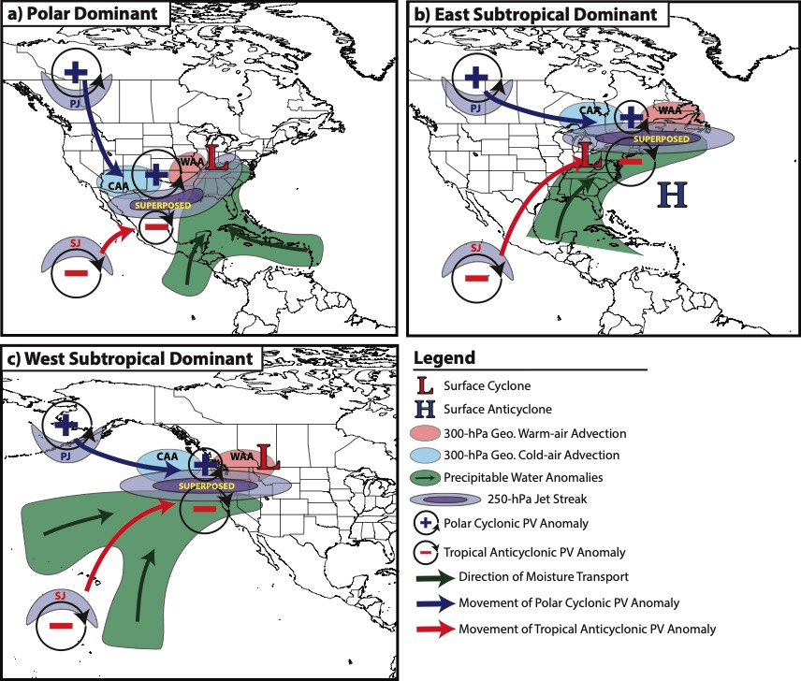
Jet Superposition Event Composites

Slide 69
Downstream Consequences
North Atlantic Oscillation: 5 Days After Jet Superposition
All Events
𝚫NAO
+0.11
Ave. Polar Dominant 𝚫NAO
+0.15
Ave. Subtropical Dominant 𝚫NAO
+0.13
Ave. Hybrid
𝚫NAO
+0.07

Slide 70
Background Material

Slide 71
Background
STJ
Modified from Defant and Taba (1957)
Subtropical Jet
PJ
Polar Jet
STJ
PJ

Slide 72
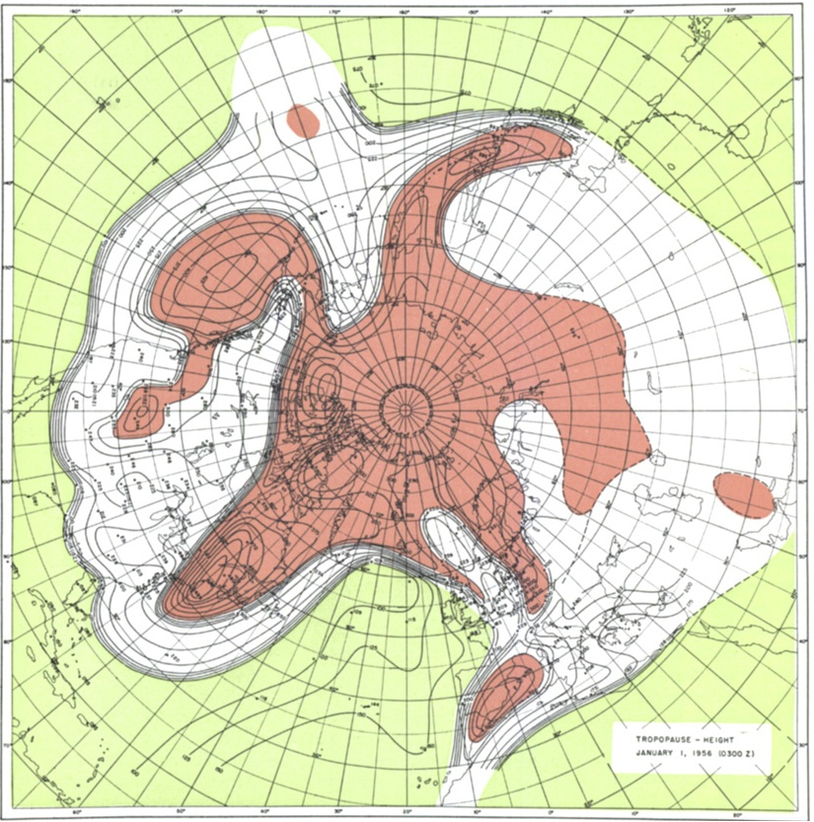
Background
Tropopause Pressure (hPa)
Phoenix
NP
North Pole
Maps of tropopause pressure help to identify the location of the jets.
While each jet occupies its own climatological latitude band, substantial meanders are common.
Occasionally, the latitudinal separation between the jets can vanish resulting in a vertical jet superposition.
STJ
PJ
NP
PJ
Tropical Tropopause
Subtropical Tropopause
Polar Tropopause
Polar Jet
STJ
Modified from Defant and Taba (1957)
Subtropical Jet

Slide 73
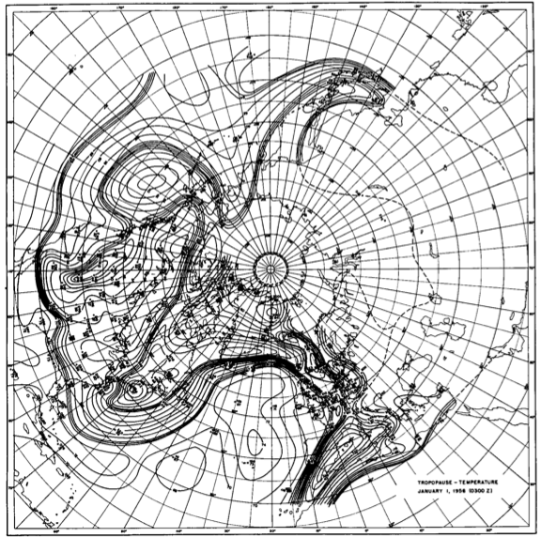
Background
Tropopause Temperature (ºC)
Phoenix
NP
North Pole
The pole-to-equator baroclinicity is combined into a much narrower zone of contrast in the vicinity of a jet superposition.
Intensified frontal structure is often attended by a strengthening of the superposed jet’s transverse circulation.
STJ
PJ
NP
Modified from Defant and Taba (1957)

Slide 74
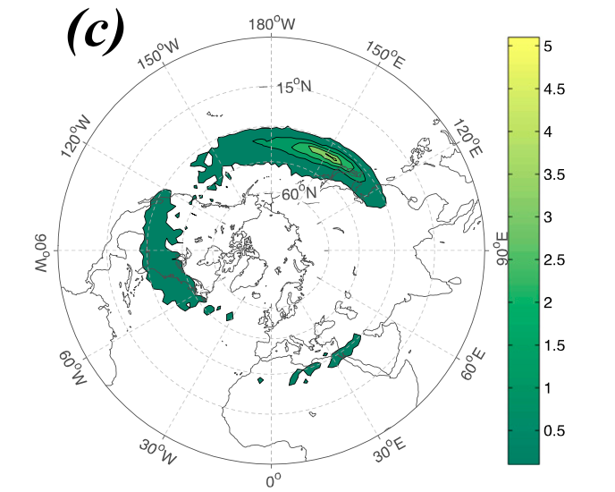
Background
Christenson et al. (2017) highlight three locations that experience the greatest frequency of
jet superpositions:
1) Western Pacific
2) North America
3) Northern Africa
Climatological frequency of Northern Hemisphere jet superposition events per cold season (Nov–Mar) 1960–2010
Number of Events
Christenson et al. (2017)

Slide 75
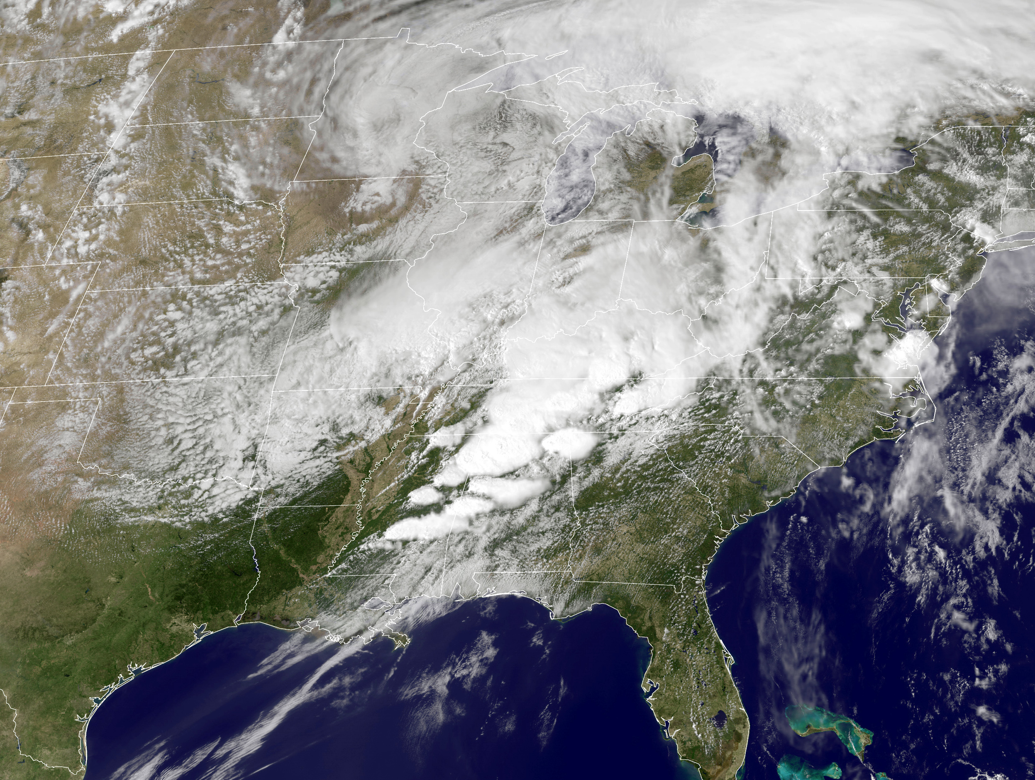
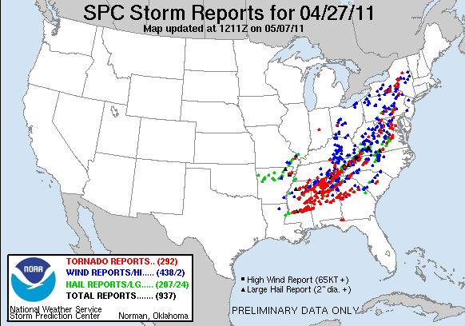
Jet Superpositions and High-Impact Weather
Jet superpositions can be an element of high-impact weather events
1–3 May 2010 Nashville Flood
Jet superposition enhanced the poleward moisture transport via its ageostrophic circulation (Winters and Martin 2014; 2016).
18–20 December 2009 Mid-Atlantic Blizzard
Jet superposition was associated with a rapidly deepening East Coast cyclone (Winters and Martin 2016; 2017).
26 October 2010: Explosive Cyclogenesis Event
Jet superposition over the West Pacific preceded the development of an intense Midwest U.S. cyclone.
25–28 April 2011 Tornado Outbreak
Jet superposition occurred over the West Pacific prior to the outbreak (Knupp et al. 2014; Christenson and Martin 2012).
NASA
SPC

Slide 76
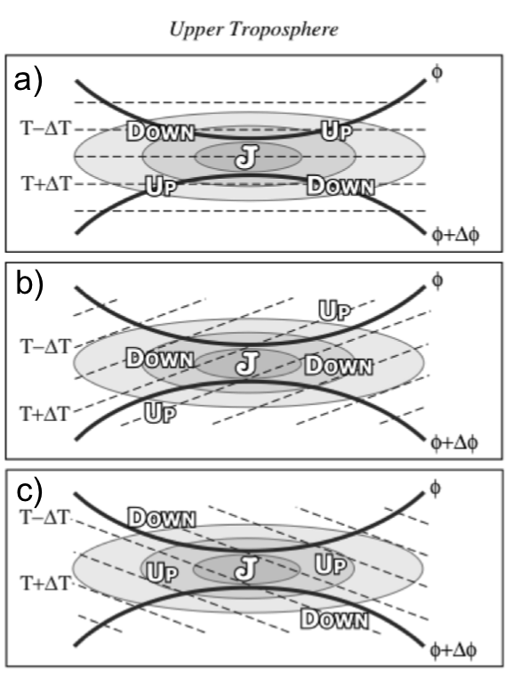
Ageostrophic Transverse Jet Circulations
Traditional four-quadrant model
Geo. cold-air advection (CAA) along the jet axis promotes subsidence through the jet core
Geo. warm-air advection (WAA) along the jet axis promotes
ascent through the jet core
Lang and Martin (2012)

Slide 77
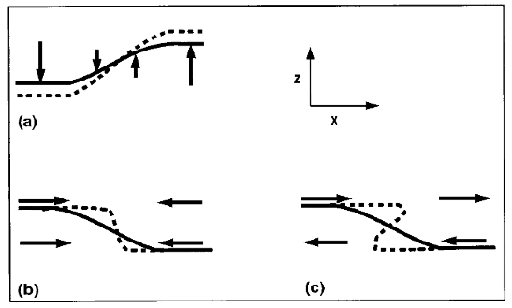
Background
Insight into how the tropopause can be restructured from a PV perspective can be found by consulting Wandishin et al. (2000)
Two processes can account for “foldogenesis”:
Differential vertical motions can vertically steepen the tropopause.
Convergence or a vertical shear can produce a differential horizontal advection of the tropopause surface.
Wandishin et al. 2000
These same mechanisms are also likely to play an important role in superpositions.

Slide 78
Jet Identification

Slide 79
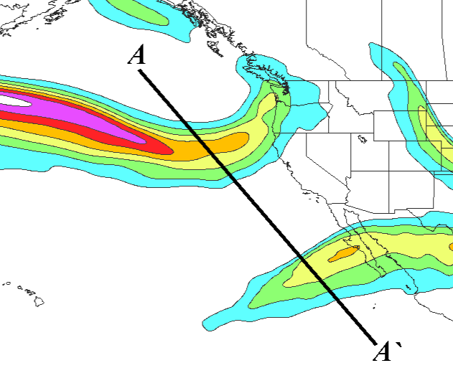
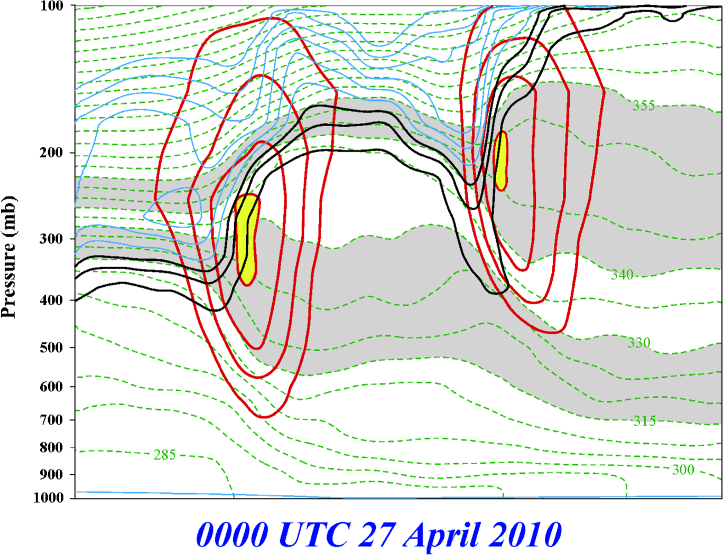
Jet Superposition Event Identification
0000 UTC 27 April 2010
A
PJ
STJ
STJ
A’
250-hPa wind speed
PJ
Isolated grid points over North America in the CFSR (Saha et al. 2014) characterized by polar and subtropical jets during Nov–Mar
1979–2010.
Isotachs
Potential Temp.
1,2,3-PVU contours
A
A’
Winters and Martin (2014, 2016, 2017); Christenson et al. (2017); Handlos and Martin (2016)

Slide 80
Jet Superposition Event Identification
0000 UTC 27 April 2010
A
PJ
STJ
A’
250-hPa wind speed
Isolated grid points over North America in the CFSR (Saha et al. 2014) characterized by polar and subtropical jets during Nov–Mar
1979–2010.
Isotachs
Potential Temp.
1,2,3-PVU contours
Strong horizontal PV gradient within the 1–3-PVU channel in the 315–330-K isentropic layer
A
A’
Winters and Martin (2014, 2016, 2017); Christenson et al. (2017); Handlos and Martin (2016)

Slide 81
Jet Superposition Event Identification
0000 UTC 27 April 2010
A
PJ
STJ
A’
250-hPa wind speed
Isolated grid points over North America in the CFSR (Saha et al. 2014) characterized by polar and subtropical jets during Nov–Mar
1979–2010.
Isotachs
Potential Temp.
1,2,3-PVU contours
Integrated 400–100-hPa wind speed must exceed 30 m s^{–1}
A
A’
Winters and Martin (2014, 2016, 2017); Christenson et al. (2017); Handlos and Martin (2016)

Slide 82
Jet Superposition Event Identification
0000 UTC 27 April 2010
A
PJ
PJ ID’s
STJ
A’
PJ
250-hPa wind speed
Isolated grid points over North America in the CFSR (Saha et al. 2014) characterized by polar and subtropical jets during Nov–Mar
1979–2010.
Isotachs
Potential Temp.
1,2,3-PVU contours
A
A’
Winters and Martin (2014, 2016, 2017); Christenson et al. (2017); Handlos and Martin (2016)

Slide 83
Jet Superposition Event Identification
0000 UTC 27 April 2010
A
PJ
PJ ID’s
STJ
A’
250-hPa wind speed
Isolated grid points over North America in the CFSR (Saha et al. 2014) characterized by polar and subtropical jets during Nov–Mar
1979–2010.
Isotachs
Potential Temp.
1,2,3-PVU contours
Strong horizontal PV gradient within the 1–3-PVU channel in the 340–355-K isentropic layer
A
A’
Winters and Martin (2014, 2016, 2017); Christenson et al. (2017); Handlos and Martin (2016)

Slide 84
Jet Superposition Event Identification
0000 UTC 27 April 2010
A
PJ
PJ ID’s
STJ
A’
250-hPa wind speed
Isolated grid points over North America in the CFSR (Saha et al. 2014) characterized by polar and subtropical jets during Nov–Mar
1979–2010.
Isotachs
Potential Temp.
1,2,3-PVU contours
Integrated 400–100-hPa wind speed must exceed 30 m s^{–1}
A
A’
Winters and Martin (2014, 2016, 2017); Christenson et al. (2017); Handlos and Martin (2016)

Slide 85
Jet Superposition Event Identification
0000 UTC 27 April 2010
A
PJ
STJ
PJ ID’s
STJ
STJ ID’s
A’
250-hPa wind speed
Isolated grid points over North America in the CFSR (Saha et al. 2014) characterized by polar and subtropical jets during Nov–Mar
1979–2010.
Isotachs
Potential Temp.
1,2,3-PVU contours
A
A’
Winters and Martin (2014, 2016, 2017); Christenson et al. (2017); Handlos and Martin (2016)

Slide 86
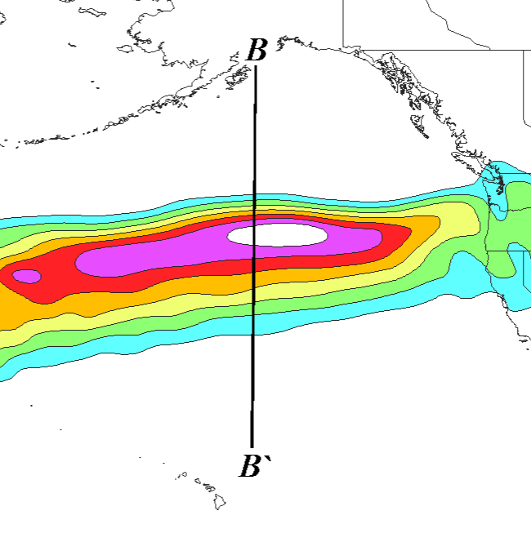
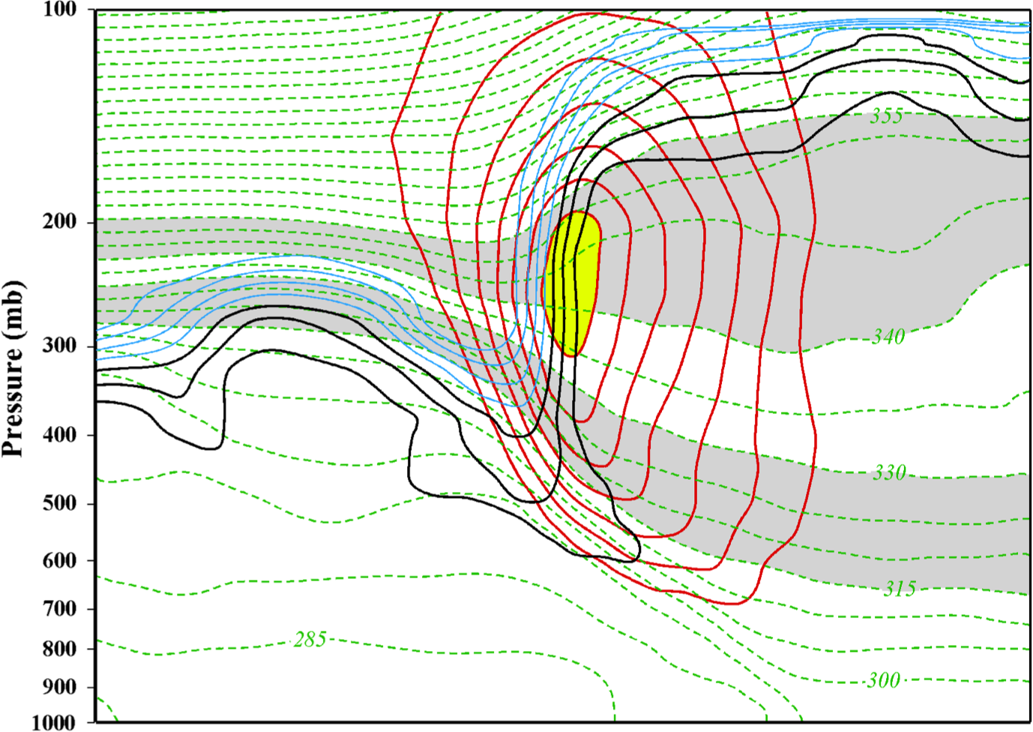
Jet Superposition Event Identification
0000 UTC 24 October 2010
B
SUPJ
B’
250-hPa wind speed
Isolated grid points over North America in the CFSR (Saha et al. 2014) characterized by a jet superposition during Nov–Mar
1979–2010.
Isotachs
Potential Temp.
1,2,3-PVU contours
B
B’
Winters and Martin (2014, 2016, 2017); Christenson et al. (2017); Handlos and Martin (2016)

Slide 87
Jet Superposition Event Identification
0000 UTC 24 October 2010
B
SUPJ
B’
250-hPa wind speed
Isolated grid points over North America in the CFSR (Saha et al. 2014) characterized by a jet superposition during Nov–Mar
1979–2010.
Isotachs
Potential Temp.
1,2,3-PVU contours
Criteria for both the polar and subtropical jets satisfied within the same grid column
B
B’
Winters and Martin (2014, 2016, 2017); Christenson et al. (2017); Handlos and Martin (2016)

Slide 88
Jet Superposition Event Identification
0000 UTC 24 October 2010
B
SUPJ
B’
SUPJ ID’s
250-hPa wind speed
Isolated grid points over North America in the CFSR (Saha et al. 2014) characterized by a jet superposition during Nov–Mar
1979–2010.
Isotachs
Potential Temp.
1,2,3-PVU contours
Criteria for both the polar and subtropical jets satisfied within the same grid column
B
B’
Winters and Martin (2014, 2016, 2017); Christenson et al. (2017); Handlos and Martin (2016)

Slide 89
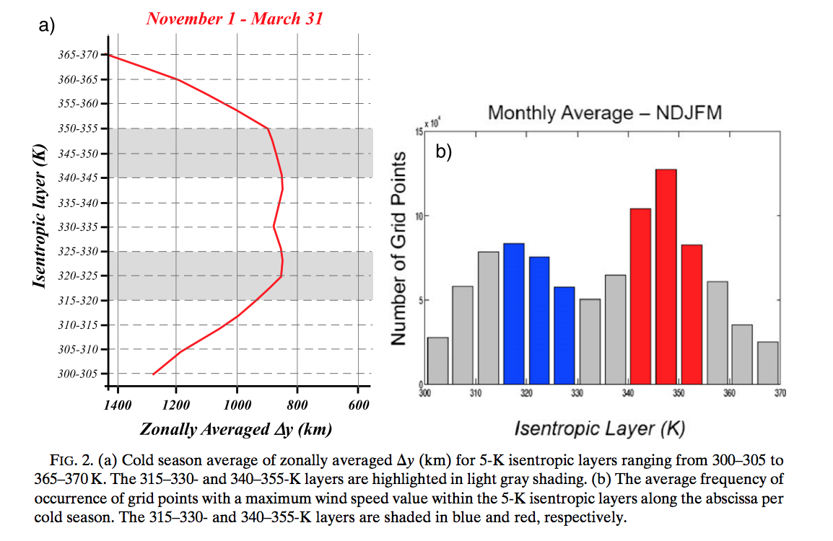
Background
Christenson et al. (2017)

Slide 90
Jet Superposition Event Identification

Slide 91
Jet Superposition Event Identification
Sample Jet Superposition Centroid Calculation
Calculated the centroid of each jet superposition based on all valid grid points at a particular analysis time.
To calculate the centroid, there must exist a group of 18 superposition grid points, of which no superposition grid point is >1000 km away from another superposition grid point.
d >1000 km
d >1000 km
d >1000 km
Used for calculation
Jet superposition centroid
Not used for calculation

