Slide 1
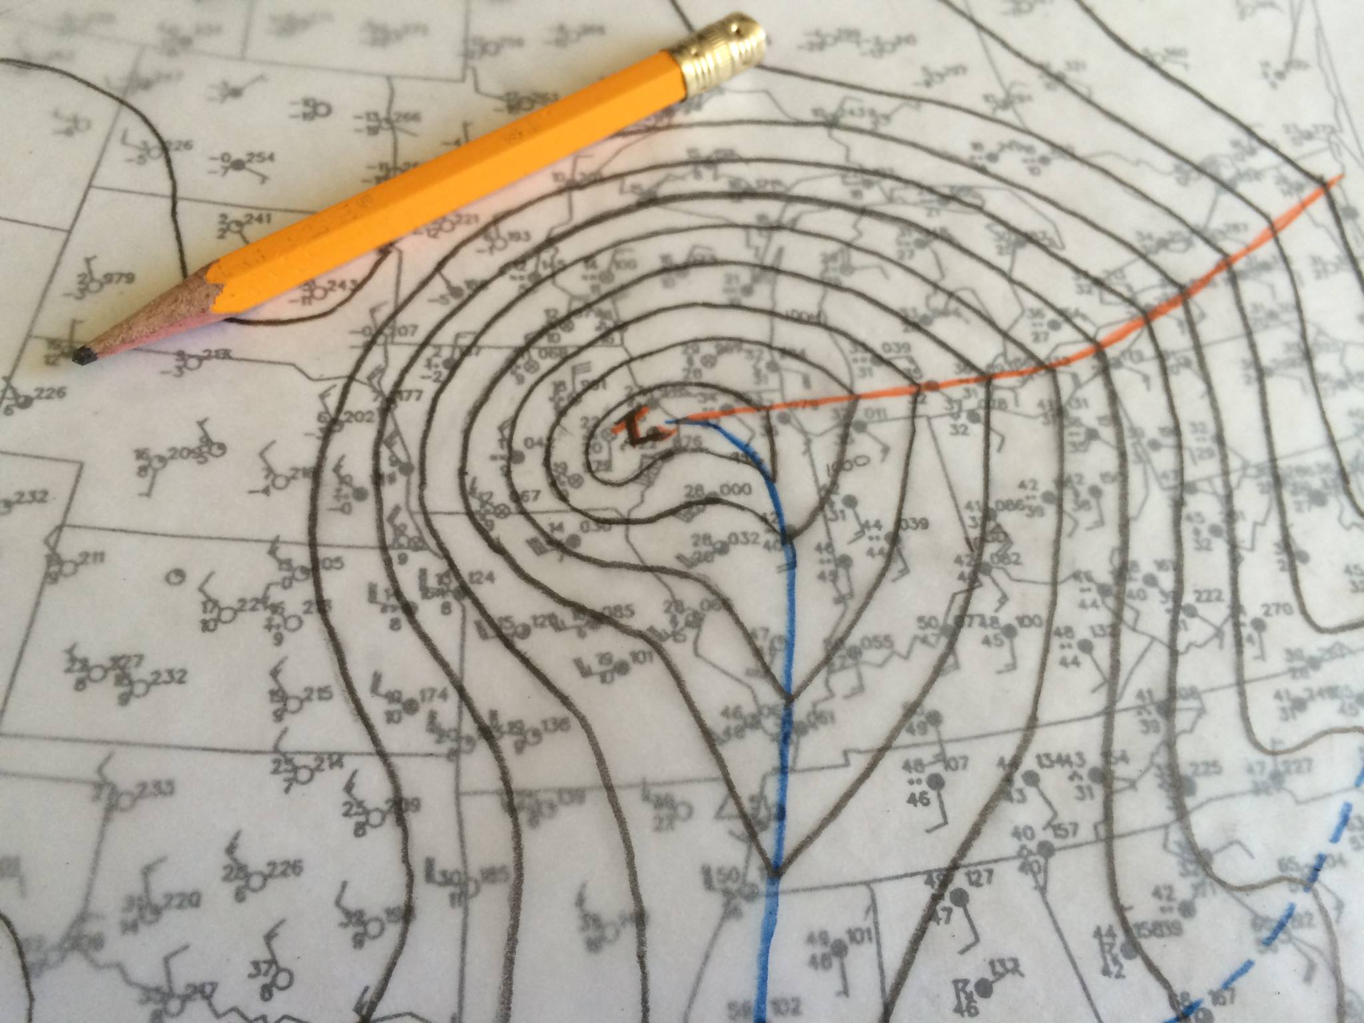
Fronts and Frontogenesis
Andrew C. Winters
ATM 631
6 February 2018

Slide 2
Definitions
Front: “Atmospheric fronts may be defined as sloping zones of pronounced transition in the thermal and wind fields.” (Keyser 1986)
Notes:
Meteorgraphs. Coordinated international effort to launch balloon soundings at 18 diff. locations across Europe. Wanted to capture the horizontal and vertical temperature structure throughout Europe.

Slide 3
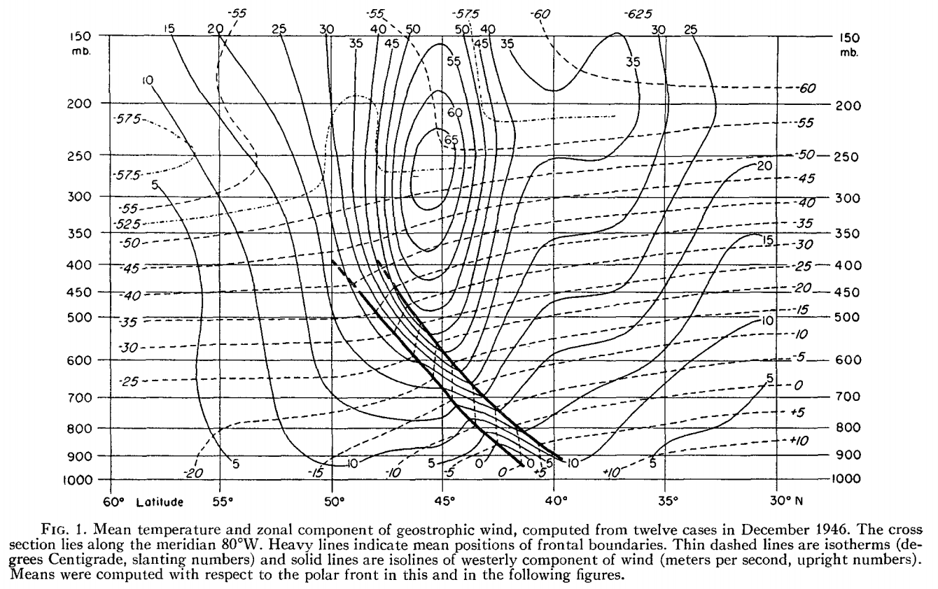
Definitions
Front: “Atmospheric fronts may be defined as sloping zones of pronounced transition in the thermal and wind fields.” (Keyser 1986)
Pressure
Palmén and Newton (1948)
Notes:
Meteorgraphs. Coordinated international effort to launch balloon soundings at 18 diff. locations across Europe. Wanted to capture the horizontal and vertical temperature structure throughout Europe.

Slide 4
Definitions
Front: “Atmospheric fronts may be defined as sloping zones of pronounced transition in the thermal and wind fields.” (Keyser 1986)
Strong horizontal temperature gradient
Pressure
Palmén and Newton (1948)
Notes:
Meteorgraphs. Coordinated international effort to launch balloon soundings at 18 diff. locations across Europe. Wanted to capture the horizontal and vertical temperature structure throughout Europe.

Slide 5
Definitions
Front: “Atmospheric fronts may be defined as sloping zones of pronounced transition in the thermal and wind fields.” (Keyser 1986)
Strong Static Stability
Pressure
Palmén and Newton (1948)
Notes:
Meteorgraphs. Coordinated international effort to launch balloon soundings at 18 diff. locations across Europe. Wanted to capture the horizontal and vertical temperature structure throughout Europe.

Slide 6
Definitions
Front: “Atmospheric fronts may be defined as sloping zones of pronounced transition in the thermal and wind fields.” (Keyser 1986)
Large Absolute Vorticity
Pressure
Palmén and Newton (1948)
Notes:
Meteorgraphs. Coordinated international effort to launch balloon soundings at 18 diff. locations across Europe. Wanted to capture the horizontal and vertical temperature structure throughout Europe.

Slide 7
Definitions
Front: “Atmospheric fronts may be defined as sloping zones of pronounced transition in the thermal and wind fields.” (Keyser 1986)
J
Large Vertical Shear
Pressure
Palmén and Newton (1948)
Notes:
Meteorgraphs. Coordinated international effort to launch balloon soundings at 18 diff. locations across Europe. Wanted to capture the horizontal and vertical temperature structure throughout Europe.

Slide 8
Definitions
Frontogenesis: The formation of a frontal boundary.
Frontolysis: The decay of a frontal boundary.
Notes:
Meteorgraphs. Coordinated international effort to launch balloon soundings at 18 diff. locations across Europe. Wanted to capture the horizontal and vertical temperature structure throughout Europe.

Slide 9

Definitions
Frontogenesis: The formation of a frontal boundary.
Frontolysis: The decay of a frontal boundary.
Mathematically, it describes the Lagrangian rate of change of the magnitude of the horizontal temperature gradient on a pressure surface (Bergeron 1928; Petterssen 1936):
$ℱ=\frac{d}{dt}\left|∇_{h}θ\right|$
Notes:
Meteorgraphs. Coordinated international effort to launch balloon soundings at 18 diff. locations across Europe. Wanted to capture the horizontal and vertical temperature structure throughout Europe.

Slide 10

Fronts and Frontogenesis
“The principal task of any meteorological institution of education and research must be to bridge the gap between the mathematician and practical man, that is to make the weather man realize the value of a modest theoretical education and to induce the theoretical man to take an occasional glance at the weather map. The polar front theory, beyond a doubt, represents the most successful effort yet to bridge the gulf that separates meteorological camps”
C.-G. Rossby (1934)
Shapiro et al. (1999)
Notes:
Meteorgraphs. Coordinated international effort to launch balloon soundings at 18 diff. locations across Europe. Wanted to capture the horizontal and vertical temperature structure throughout Europe.

Slide 11
Fronts and Frontogenesis
“The principal task of any meteorological institution of education and research must be to bridge the gap between the mathematician and practical man, that is to make the weather man realize the value of a modest theoretical education and to induce the theoretical man to take an occasional glance at the weather map. The polar front theory, beyond a doubt, represents the most successful effort yet to bridge the gulf that separates meteorological camps”
C.-G. Rossby (1934)
Shapiro et al. (1999)
Notes:
Meteorgraphs. Coordinated international effort to launch balloon soundings at 18 diff. locations across Europe. Wanted to capture the horizontal and vertical temperature structure throughout Europe.

Slide 12
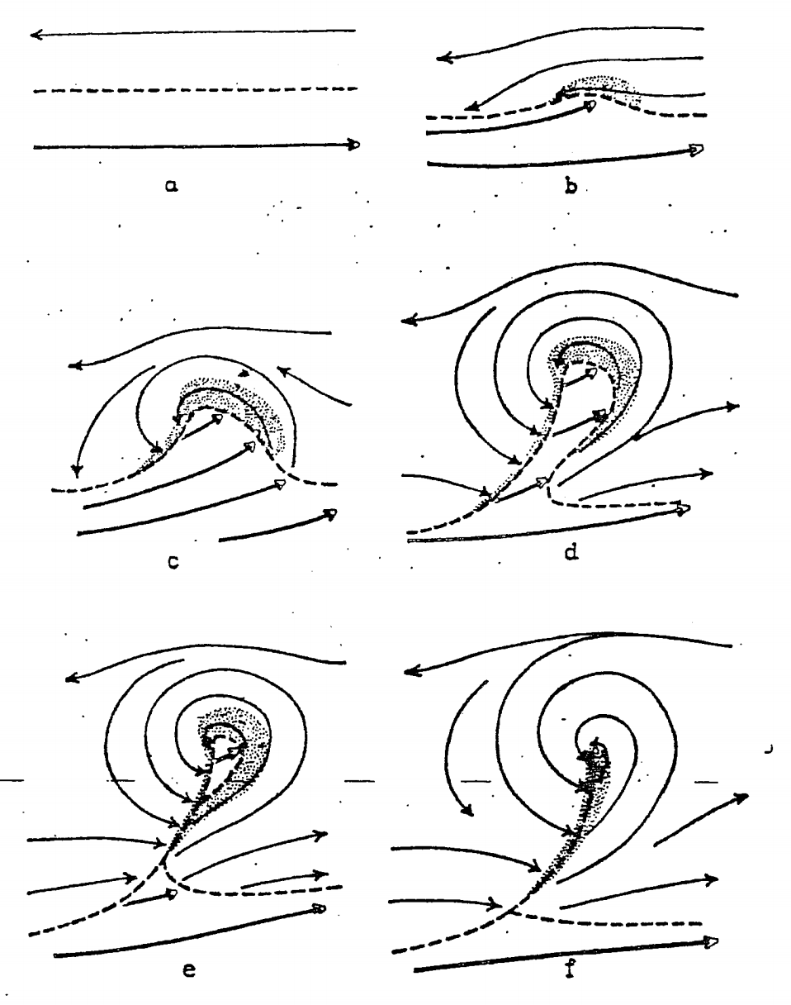
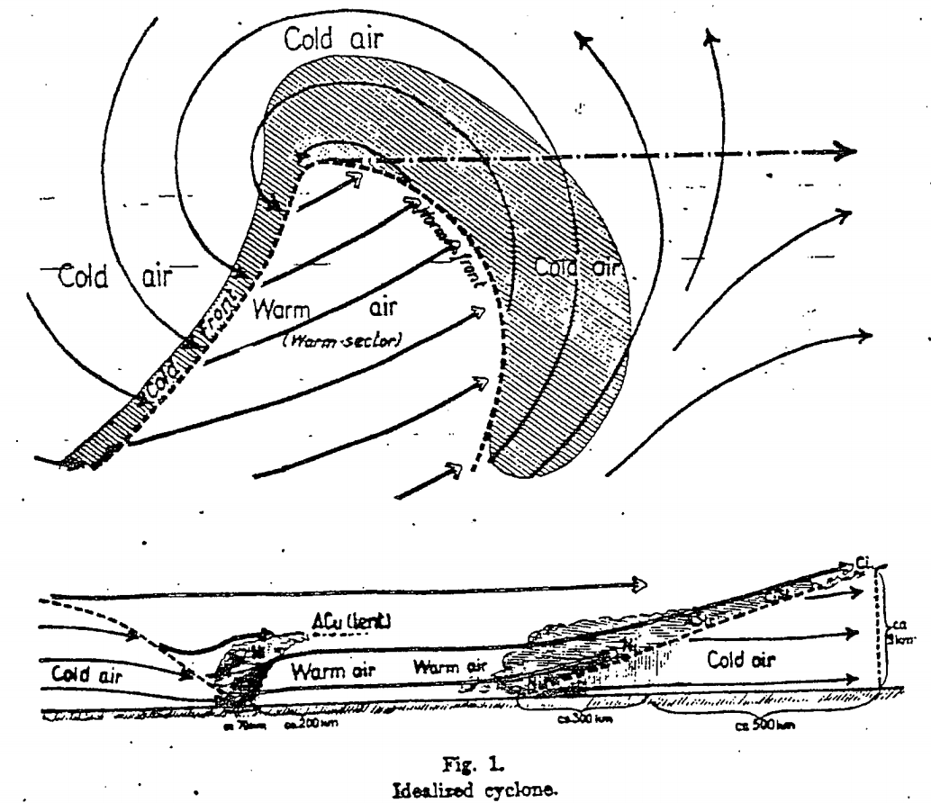
Observations of Fronts
Polar Front Theory
Bjerknes (1919); Bjerknes and Solberg (1921, 1922)
Notes:
The novelty of the polar-front cyclone model lies in the incorporation of fronts into a conceptual model that could used for routine synoptic analysis, provided a physical basis for diagnosing rising air and precipitation, and contributed an observational basis for theoretical studies of cyclogenesis. The model was also novel for its inclusion of warm and occluded fronts, as well as the generalization of the model to describe the life cycle of midlatitude cyclones.

Slide 13
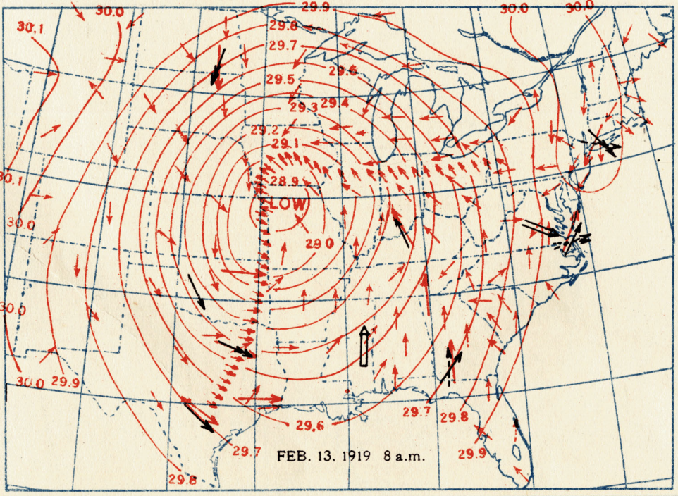
Observations of Fronts
Polar Front Theory in the U.S.
Meisinger (1920): Applied polar front theory concepts to a strong cyclogenesis event in the lee of the Rockies.
Notes:
The novelty of the polar-front cyclone model lies in the incorporation of fronts into a conceptual model that could used for routine synoptic analysis, provided a physical basis for diagnosing rising air and precipitation, and contributed an observational basis for theoretical studies of cyclogenesis. The model was also novel for its inclusion of warm and occluded fronts, as well as the generalization of the model to describe the life cycle of midlatitude cyclones.

Slide 14
Observations of Fronts
Polar Front Theory in the U.S.
Meisinger (1920): Applied polar front theory concepts to a strong cyclogenesis event in the lee of the Rockies.
Beck (1922): Appealed the U.S. Weather Bureau to adopt polar front theory concepts and increase observational capabilities.
Notes:
The novelty of the polar-front cyclone model lies in the incorporation of fronts into a conceptual model that could used for routine synoptic analysis, provided a physical basis for diagnosing rising air and precipitation, and contributed an observational basis for theoretical studies of cyclogenesis. The model was also novel for its inclusion of warm and occluded fronts, as well as the generalization of the model to describe the life cycle of midlatitude cyclones.

Slide 15
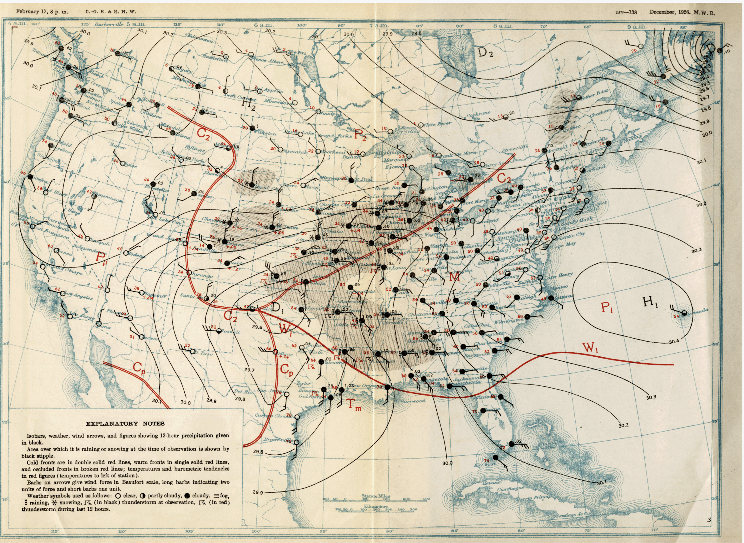
Observations of Fronts
Polar Front Theory in the U.S.
Rossby and Weightman (1926):
Investigated a case of lee cyclogenesis that featured interactions between four different air masses.
Notes:
The novelty of the polar-front cyclone model lies in the incorporation of fronts into a conceptual model that could used for routine synoptic analysis, provided a physical basis for diagnosing rising air and precipitation, and contributed an observational basis for theoretical studies of cyclogenesis. The model was also novel for its inclusion of warm and occluded fronts, as well as the generalization of the model to describe the life cycle of midlatitude cyclones.

Slide 16
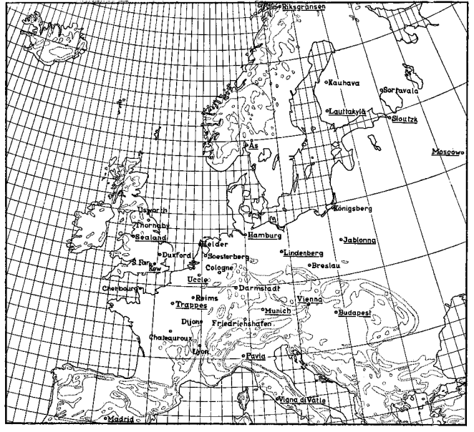
Observations of Fronts
Bjerknes and Palmén (1937)
Coordinated “swarm ascents” at 18 different locations across Europe.
Notes:
Meteorgraphs. Coordinated international effort to launch balloon soundings at 18 diff. locations across Europe. Wanted to capture the horizontal and vertical temperature structure throughout Europe.

Slide 17
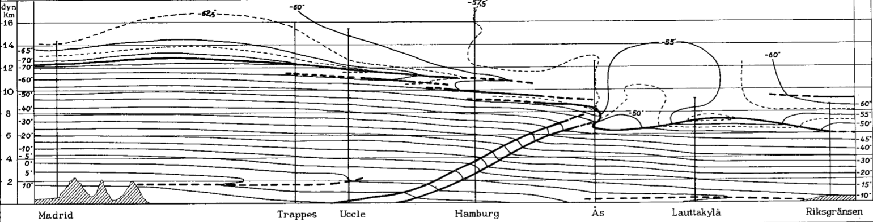
Observations of Fronts
Bjerknes and Palmén (1937)
The front is a transition zone across which the temperature gradient is discontinuous.
Notes:
Also noted that areas characterized by a strong horizontal temperature gradient exhibited stronger vertical wind shear.

Slide 18
Observations of Fronts
Bjerknes and Palmén (1937)
The front is a transition zone across which the temperature gradient is discontinuous.
The tropopause abruptly lowers at the location where the polar front intersects the tropopause.
Notes:
Also noted that areas characterized by a strong horizontal temperature gradient exhibited stronger vertical wind shear.

Slide 19
Observations of Fronts
Bjerknes and Palmén (1937)
COLD
WARM
WARM
COLD
The front is a transition zone across which the temperature gradient is discontinuous.
The tropopause abruptly lowers at the location where the polar front intersects the tropopause.
The meridional temperature gradient reverses directly above the tropopause break.
Notes:
Also noted that areas characterized by a strong horizontal temperature gradient exhibited stronger vertical wind shear.

Slide 20
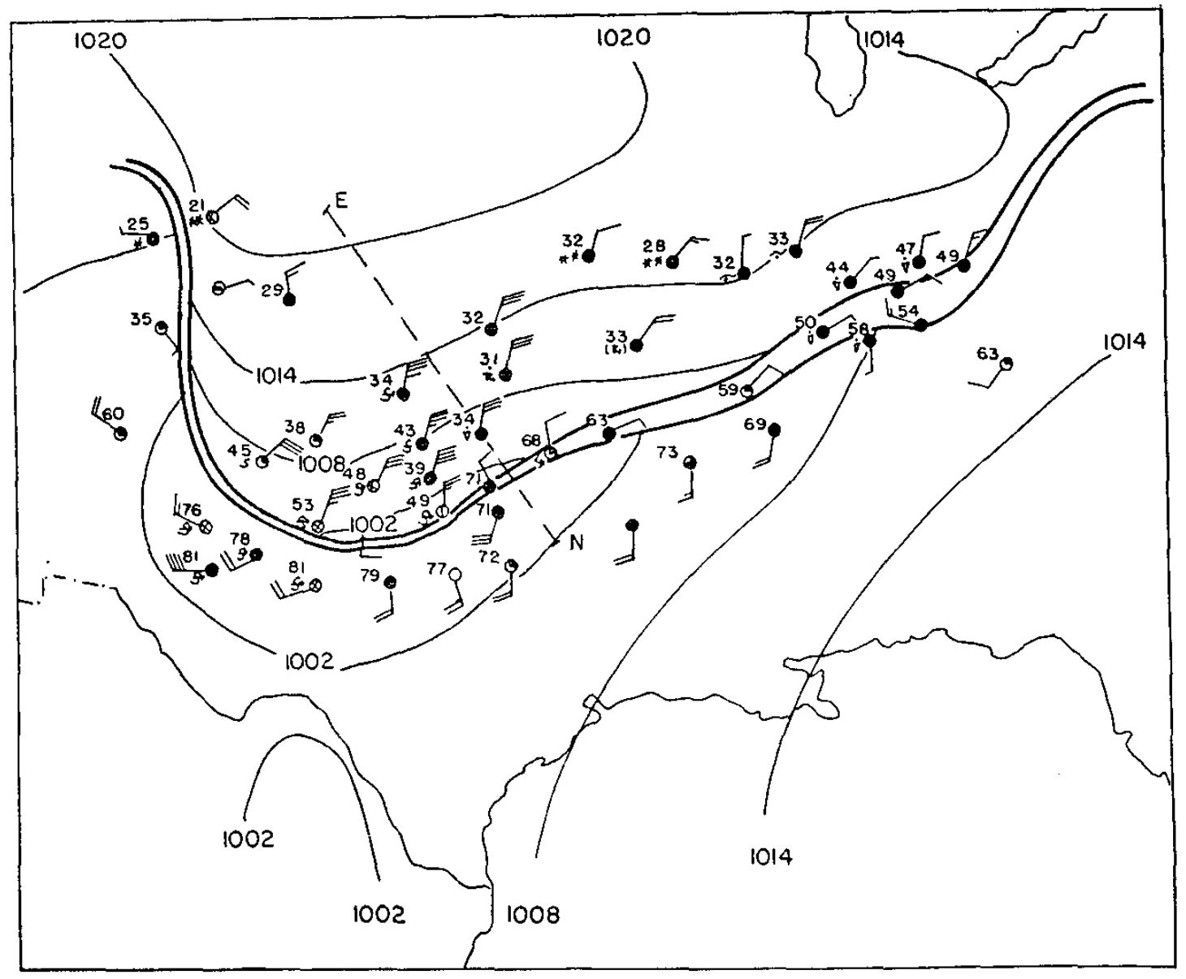
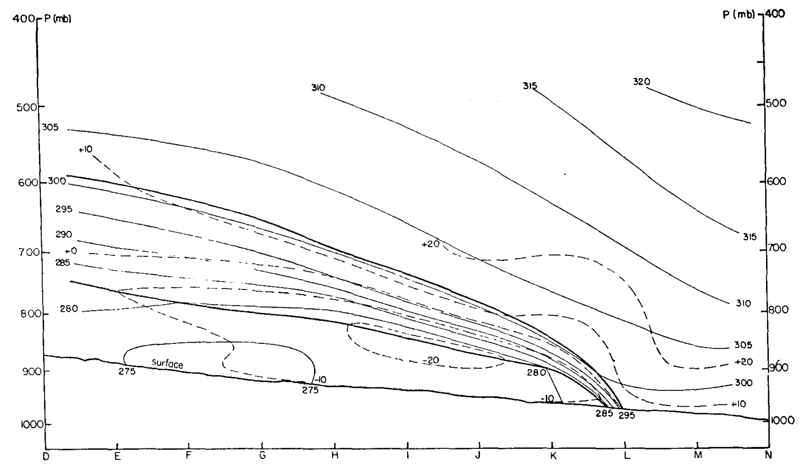
Observations of Fronts
Sanders (1955)
“Fred [Sanders] and I were kindred spirits who fed each other’s discontent with what we regarded as the nearly blind acceptance by many meteorologists of the [Norwegian Cyclone Model]” – Reed (2003)
E
N
E
N
Sanders (1955)
Notes:
Also noted that areas characterized by a strong horizontal temperature gradient exhibited stronger vertical wind shear.

Slide 21
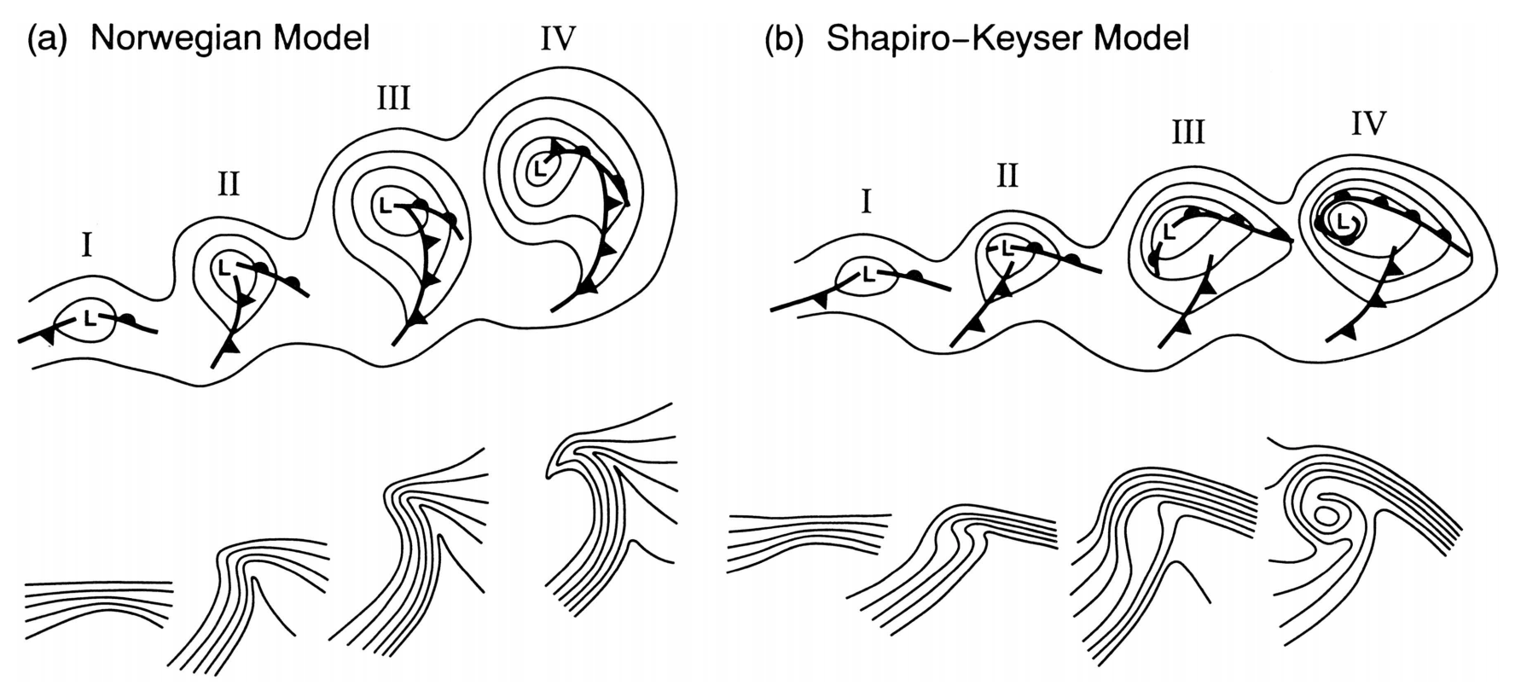
Observations of Fronts
Revisions to Polar Front Theory
The Shapiro–Keyser Cyclone Model (1990)
Schultz et al. (1998)
Notes:
Also noted that areas characterized by a strong horizontal temperature gradient exhibited stronger vertical wind shear.

Slide 22
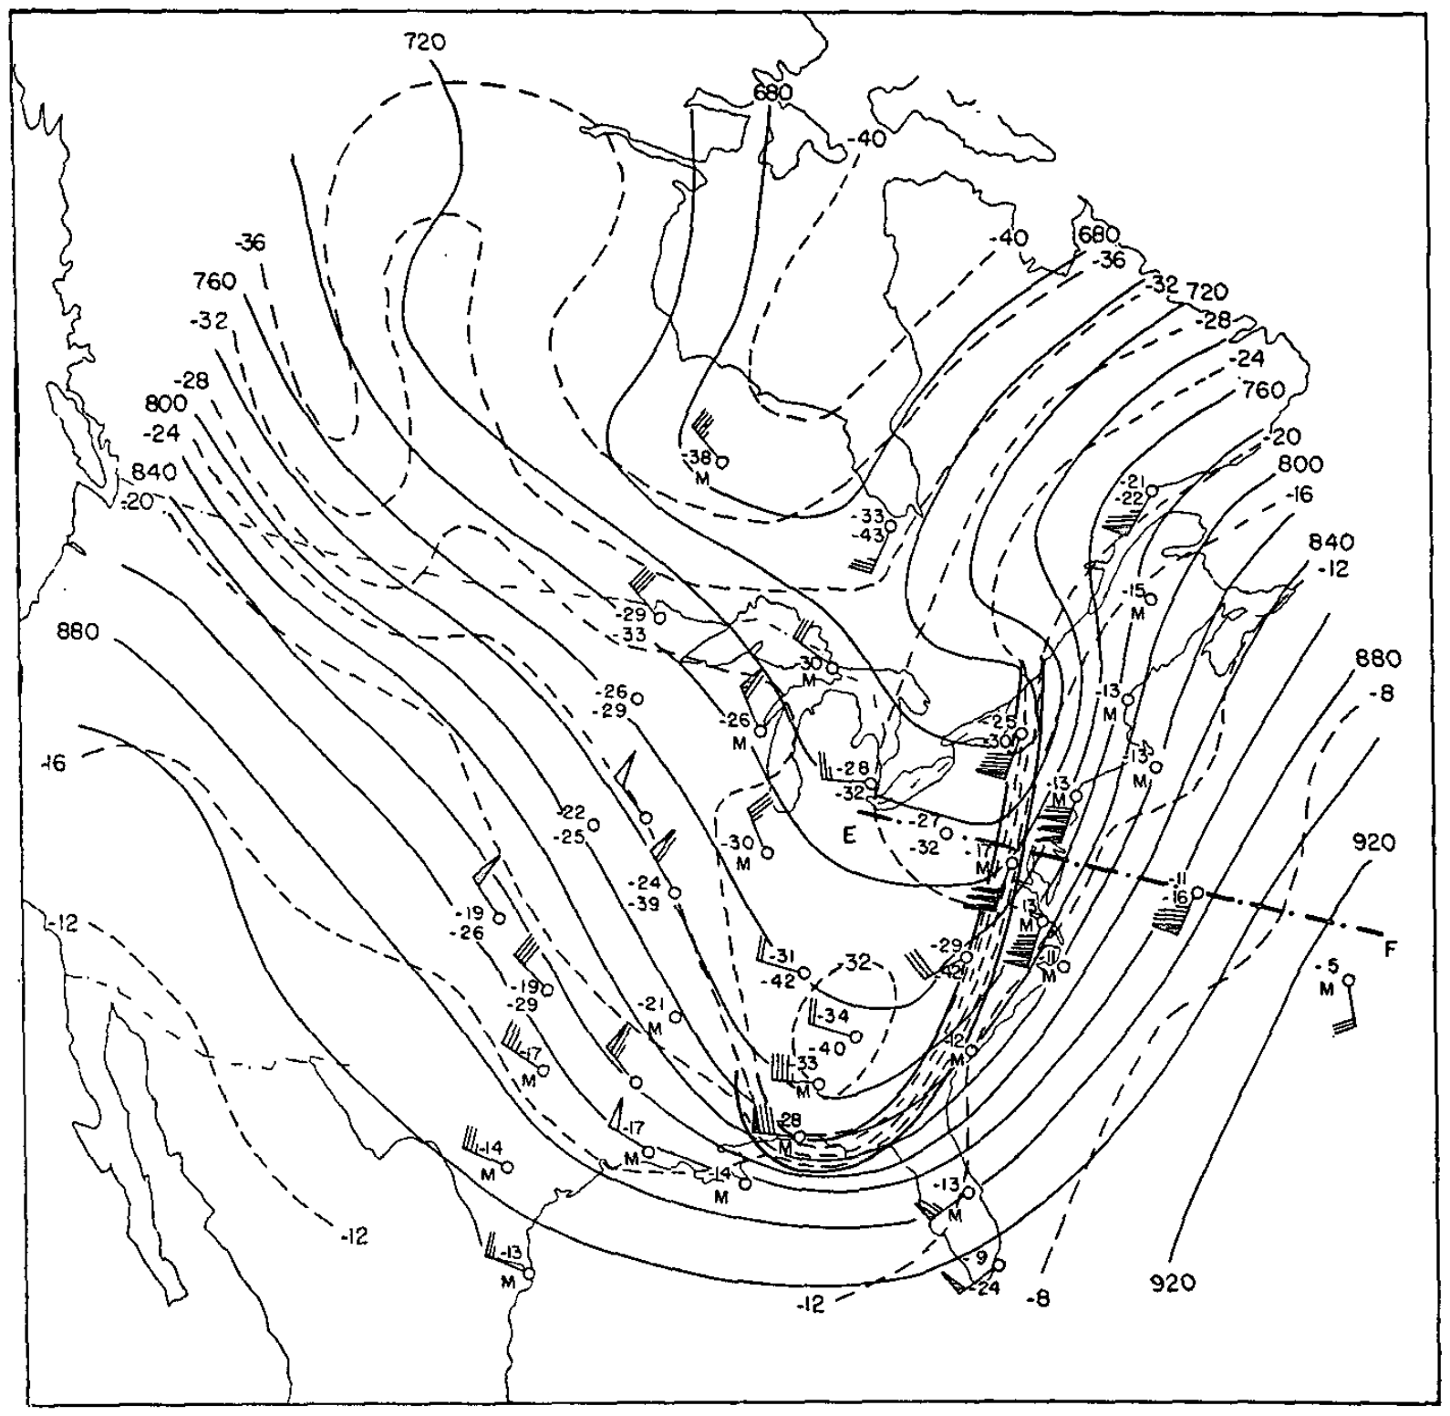
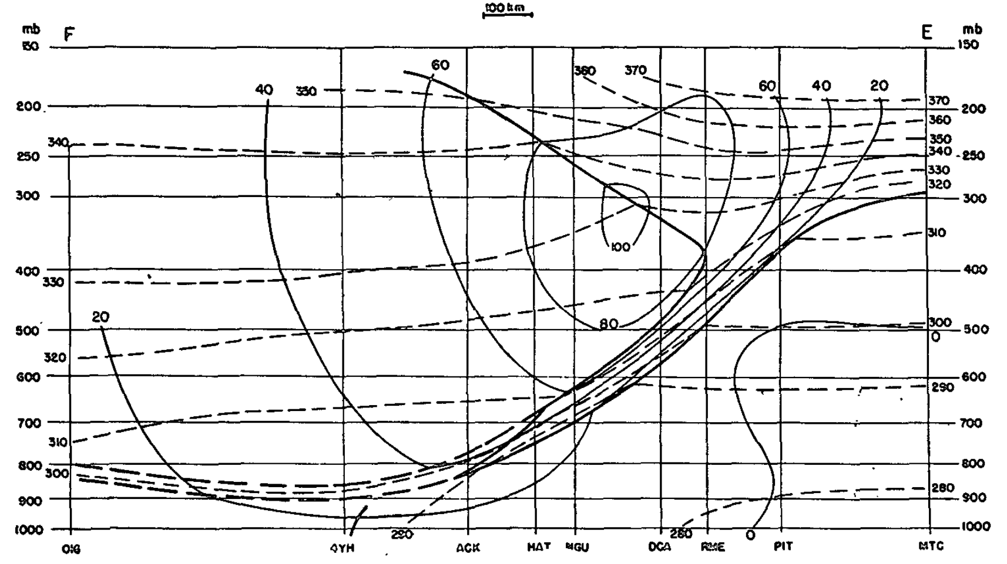
Observations of Fronts
Revisions to Polar Front Theory
Upper-level fronts are distinct from surface fronts
J
E
F
E
F
Reed (1955)
Notes:
Also noted that areas characterized by a strong horizontal temperature gradient exhibited stronger vertical wind shear.

Slide 23
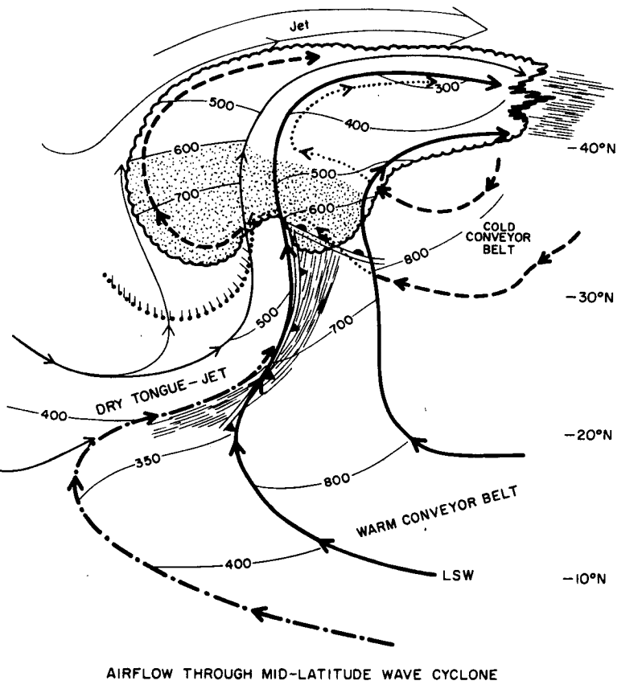
Observations of Fronts
Revisions to Polar Front Theory
Airstream models of midlatitude cyclones
Increased observations from multiple platforms, including satellites, resulted in further revisions to polar front theory.
The position of fronts are identified at the boundaries of the different airstreams.
Carlson (1980)
Notes:
Also noted that areas characterized by a strong horizontal temperature gradient exhibited stronger vertical wind shear.

Slide 24
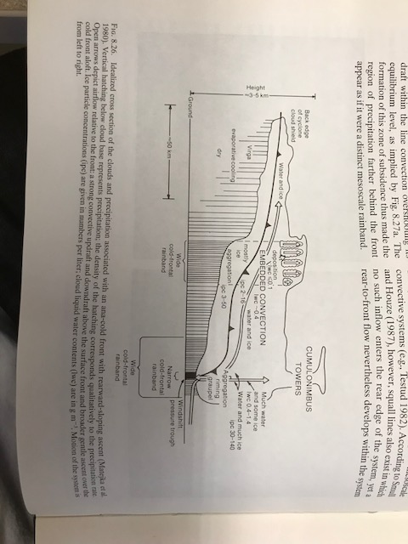
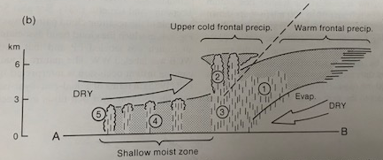
Observations of Fronts
Revisions to Polar Front Theory
Additional structures that did not conform to Polar Front Theory
Katafronts/Anafronts: Katafronts (Anafronts) feature a forward (backward) sloping frontal boundary and pre- (post-)frontal cloud bands (Bergeron 1937; Sansom 1951).
Split Fronts/Cold Fronts Aloft: Conforms well with the concept of a katafront, with a dry airstream overrunning the warm conveyor belt near a cold front (Browning and Monk 1982; Browning 1990; Hobbs et al. 1990; Mass and Schultz 1993).
Katafront
Anafront
Browning (1990)
Notes:
Also noted that areas characterized by a strong horizontal temperature gradient exhibited stronger vertical wind shear.

Slide 25
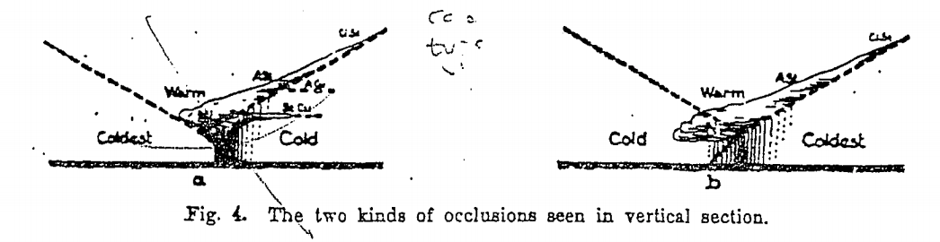
Observations of Fronts
Revisions to Polar Front Theory
Additional structures that did not conform to Polar Front Theory
Warm/Cold Occlusions: Occurs as a result of the “wrap-up” and lengthening of the warm-air tongue within a cyclone as it experiences deformation and rotation around the cyclone center (Bjerknes and Solberg 1922; Schultz and Vaughan 2011; Schultz et al. 2014).
Cold Occlusion
Warm Occlusion
Bjerknes and Solberg (1922)
Notes:
Also noted that areas characterized by a strong horizontal temperature gradient exhibited stronger vertical wind shear.

Slide 26
Observations of Fronts
Revisions to Polar Front Theory
Additional structures that did not conform to Polar Front Theory
Warm/Cold Occlusions: Occurs as a result of the “wrap-up” and lengthening of the warm-air tongue within a cyclone as it experiences deformation and rotation around the cyclone center (Bjerknes and Solberg 1922; Schultz and Vaughan 2011; Schultz et al. 2014).
Backdoor Fronts: Cold-air damming along the eastern slopes of topography can aid in the formation of backdoor cold fronts (Carr 1951).
Coastal Fronts: Most favorable in areas of topography that lock in cold air over the continent. Surface latent and sensible heat fluxes can also result in warming over the ocean and a strong land/sea temperature contrast (Bosart et al. 1972; Bosart 1975, 1981).
Notes:
Also noted that areas characterized by a strong horizontal temperature gradient exhibited stronger vertical wind shear.

Slide 27
Fronts and Frontogenesis
“The principal task of any meteorological institution of education and research must be to bridge the gap between the mathematician and practical man, that is to make the weather man realize the value of a modest theoretical education and to induce the theoretical man to take an occasional glance at the weather map. The polar front theory, beyond a doubt, represents the most successful effort yet to bridge the gulf that separates meteorological camps”
C.-G. Rossby (1934)
Shapiro et al. (1999)
Notes:
Meteorgraphs. Coordinated international effort to launch balloon soundings at 18 diff. locations across Europe. Wanted to capture the horizontal and vertical temperature structure throughout Europe.

Slide 28
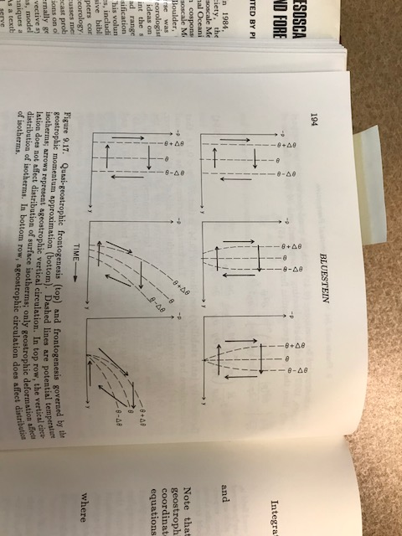
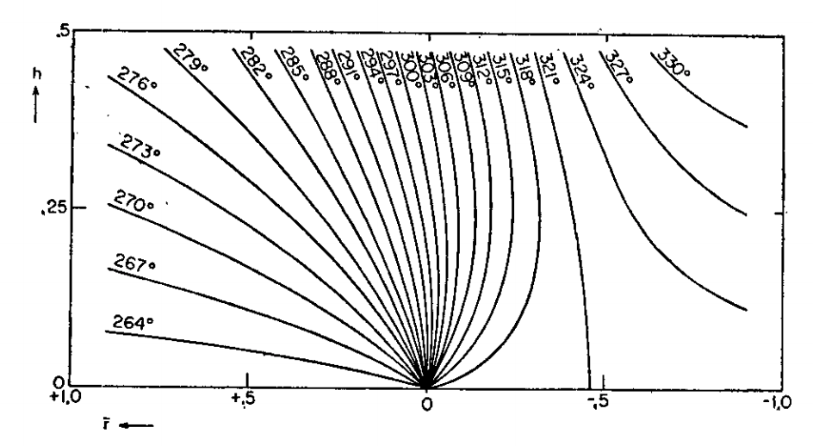
Theory of Fronts
Theory as a Bridge to Observations
Replicating Sanders (1955) and Reed (1955)
Quasi-geostrophic theory
(Stone 1966; Williams and Plotkin 1968; Williams 1968,1972; Mudrick 1974)
Frontogenesis is slow near the ground.
The frontal zone does not tilt with height.
The relative vorticity field contains large areas of anticyclonic vorticity too.
Regions of static instability are produced.
Bluestein (1986)
Stone (1966)
Notes:
Also noted that areas characterized by a strong horizontal temperature gradient exhibited stronger vertical wind shear.

Slide 29
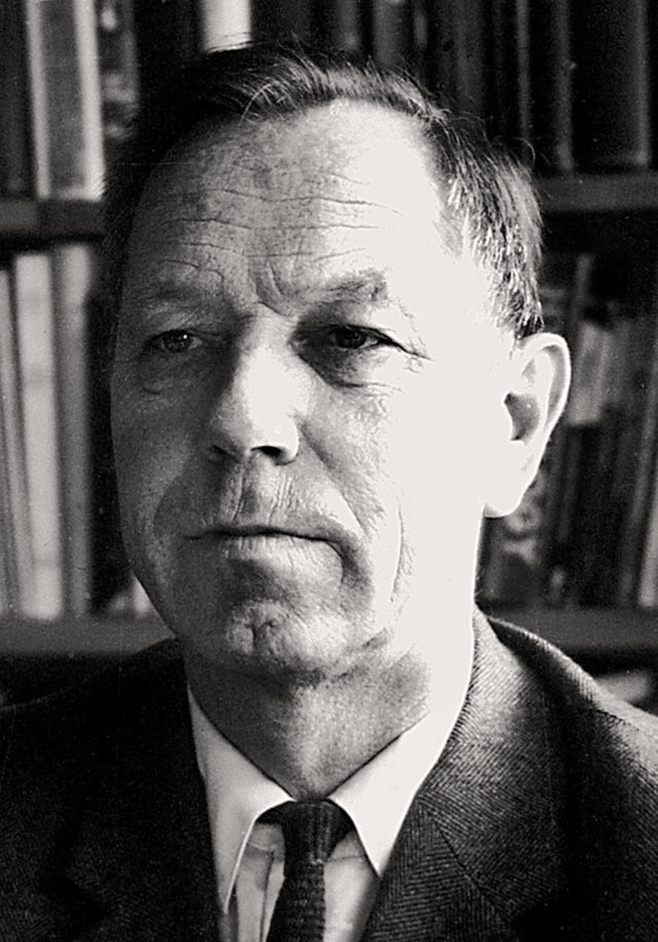
Theory of Fronts
Theory as a Bridge to Observations
Replicating Sanders (1955) and Reed (1955)
Arnt Eliassen
Semi-geostrophic theory
(Sawyer 1956; Eliassen 1962; Hoskins 1971; Hoskins and Bretherton 1972; Hoskins 1972)
Retains across-front advections of temperature and momentum by the ageostrophic wind.
The Sawyer (1956)–Eliassen (1962) Circulation Equation.
Norwegian Encyclopedia
Notes:
Also noted that areas characterized by a strong horizontal temperature gradient exhibited stronger vertical wind shear.

Slide 30
Theory of Fronts
Where:
X
Y

Slide 31
Theory of Fronts
Where:
X
Y

Slide 32
Theory of Fronts
Static Stability
Across-Front Baroclinicity
Horizontal Absolute Vorticity
Frontal Characteristics
Where:
X
Y

Slide 33
Theory of Fronts
Static Stability
Across-Front Baroclinicity
Horizontal Absolute Vorticity
Geostrophic and Diabatic Forcing
Frontal Characteristics
Where:
X
Y
Shearing
Confluence

Slide 34
Theory of Fronts
Shearing
Confluence

Slide 35
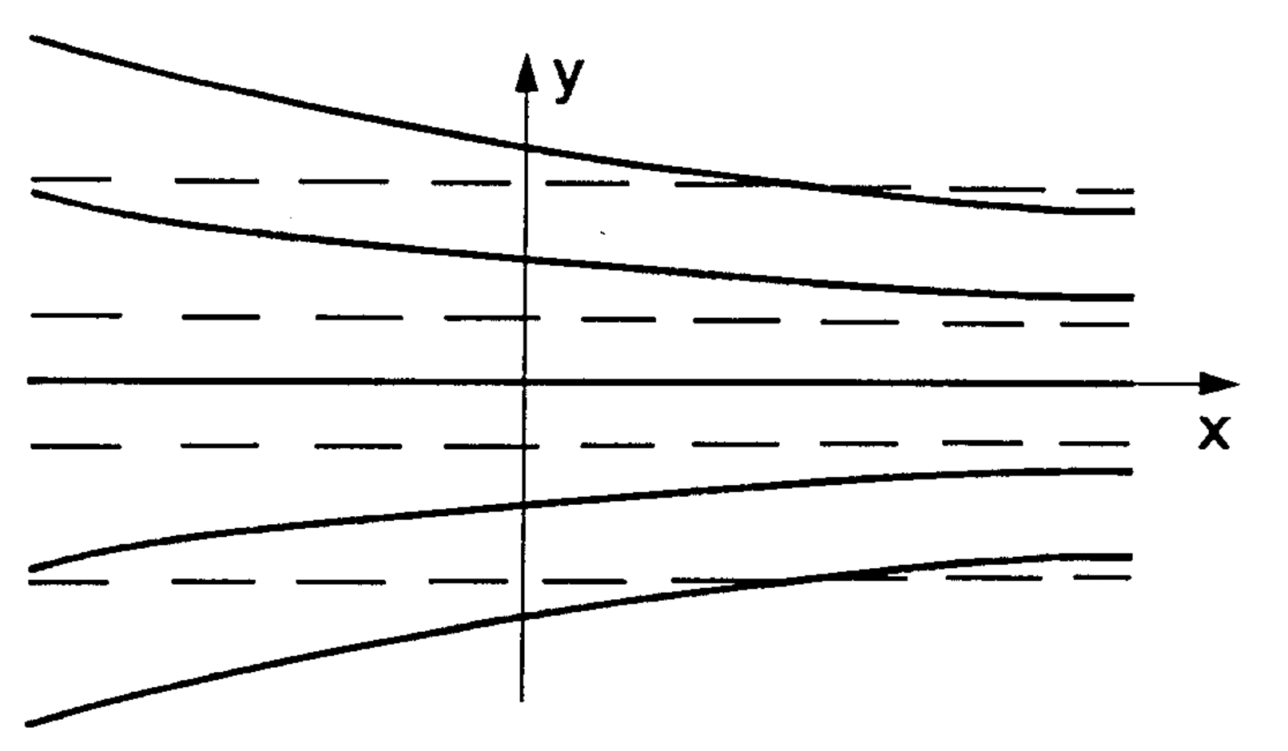
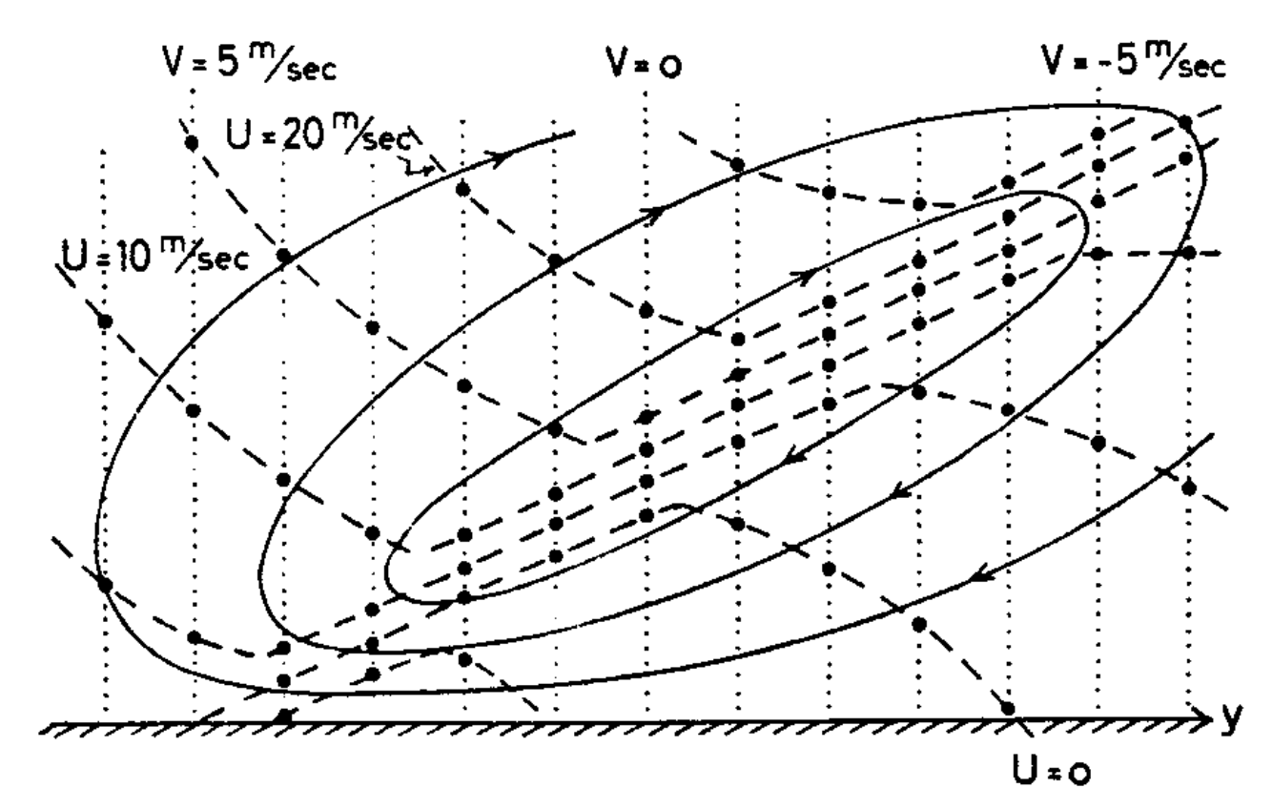
Theory of Fronts
Ageostrophic Circulation Generated by Geostrophic Confluence Deformation
Shearing
Confluence
Eliassen (1990)
Eliassen (1962)

Slide 36
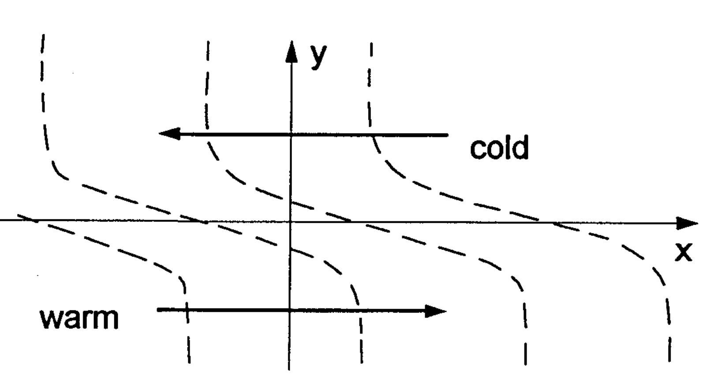
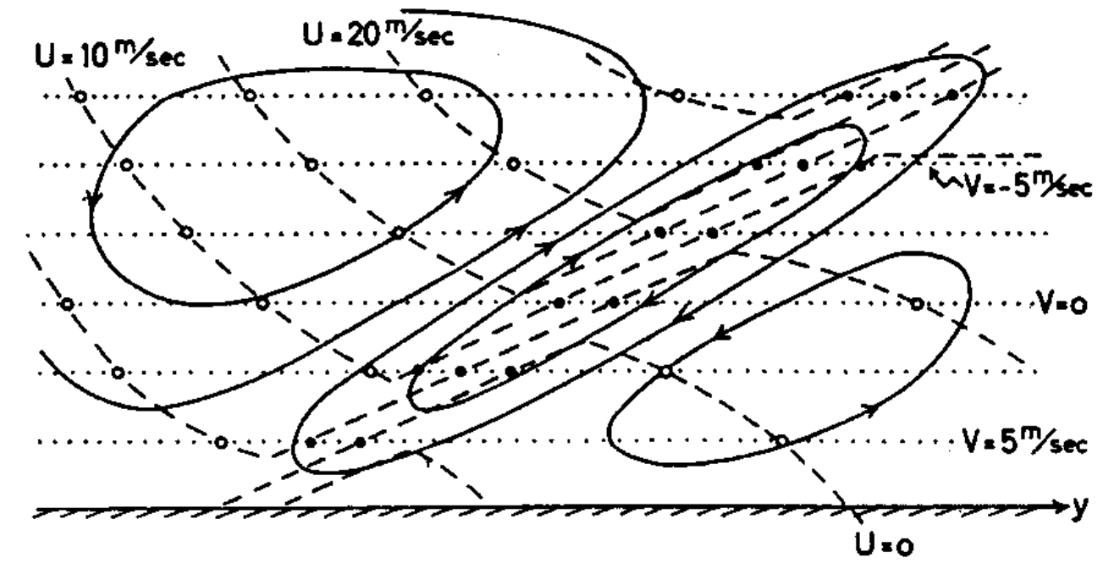
Theory of Fronts
Ageostrophic Circulation Generated by Geostrophic Shearing Deformation
Shearing
Confluence
Eliassen (1990)
Eliassen (1962)

Slide 37
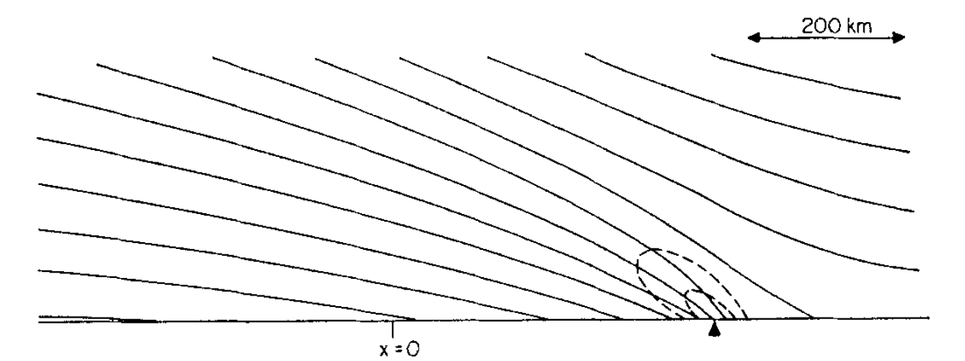
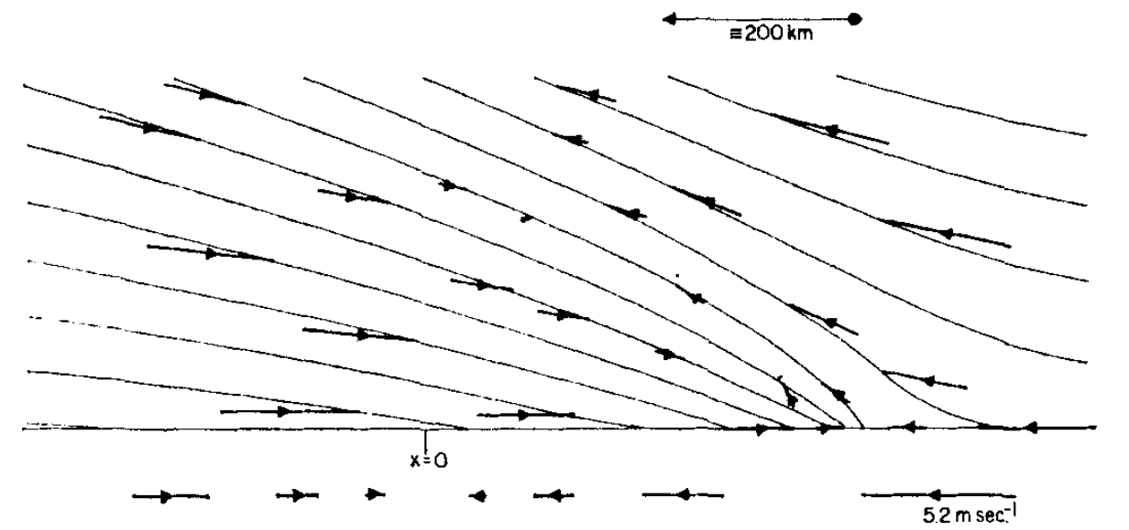
Theory of Fronts
Theory as a Bridge to Observations
Replicating Sanders (1955) and Reed (1955)
Hoskins (1971)
Semi-geostrophic theory
(Sawyer 1956; Eliassen 1962; Hoskins 1971; Hoskins and Bretherton 1972; Hoskins 1972)
Simulates surface and upper-level fronts that are similar to those observed by Sanders (1955) and Reed (1955).
Bluestein (1986) →
Notes:
Also noted that areas characterized by a strong horizontal temperature gradient exhibited stronger vertical wind shear.

Slide 38
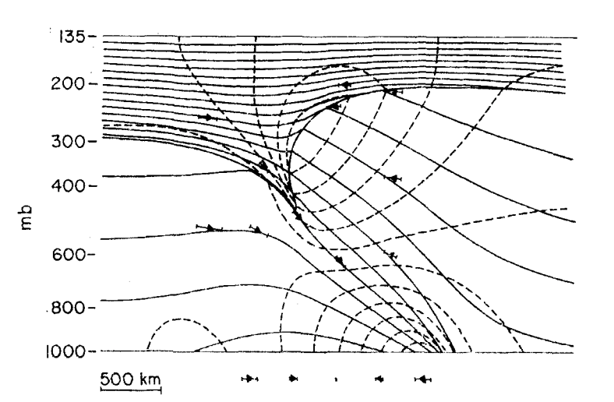
Theory of Fronts
Theory as a Bridge to Observations
Replicating Sanders (1955) and Reed (1955)
Hoskins (1972)
Semi-geostrophic theory
(Sawyer 1956; Eliassen 1962; Hoskins 1971; Hoskins and Bretherton 1972; Hoskins 1972)
Simulates surface and upper-level fronts that are similar to those observed by Sanders (1955) and Reed (1955).
Inclusion of frictional (e.g., Keyser and Anthes 1982) and diabatic effects (e.g., Thorpe and Emanuel 1985) further reconciled modelled versus observed frontal structures.
Notes:
Also noted that areas characterized by a strong horizontal temperature gradient exhibited stronger vertical wind shear.

Slide 39
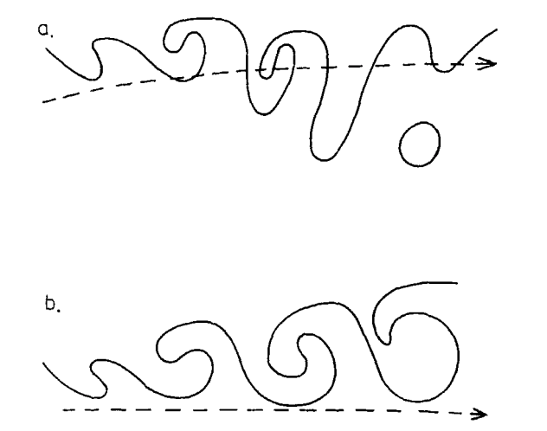
Theory of Fronts
Theory as a Bridge to Observations
Replicating Sanders (1955) and Reed (1955)
Thorncroft et al. (1993)
Primitive Equation Models
(Snyder et al. 1991; Thorncroft et al. 1993; Rotunno et al. 1994; Muraki et al. 1999; Rotunno et al. 2000)
Cyclone lifecycles differ considerably based on the background barotropic shear.
LC1
LC2
Notes:
Also noted that areas characterized by a strong horizontal temperature gradient exhibited stronger vertical wind shear.

Slide 40
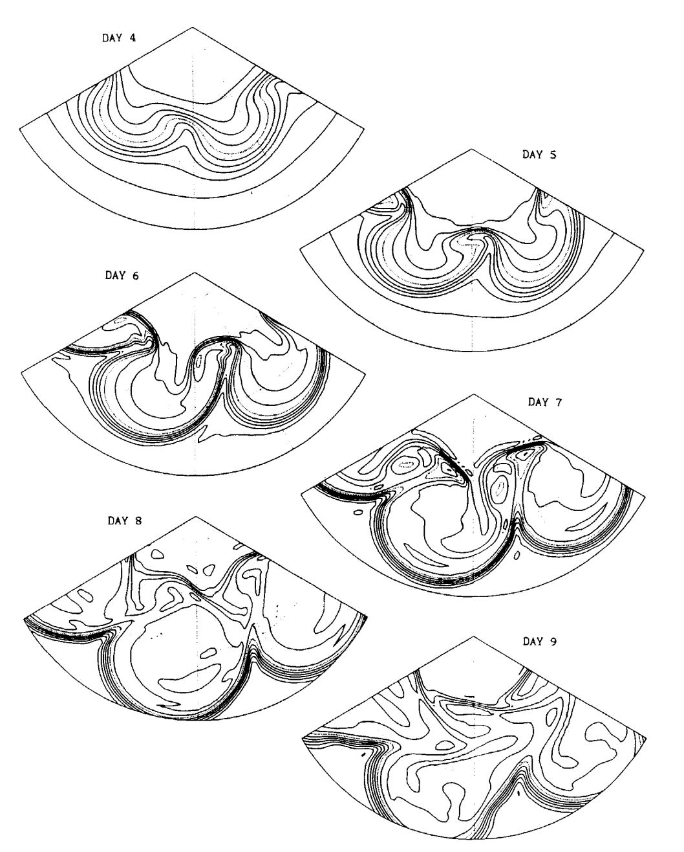
Theory of Fronts
Theory as a Bridge to Observations
Replicating Sanders (1955) and Reed (1955)
Thorncroft et al. (1993)
Primitive Equation Models
(Snyder et al. 1991; Thorncroft et al. 1993; Rotunno et al. 1994; Muraki et al. 1999; Rotunno et al. 2000)
Cyclone lifecycles differ considerably based on the background barotropic shear.
LC1
Notes:
Also noted that areas characterized by a strong horizontal temperature gradient exhibited stronger vertical wind shear.

Slide 41
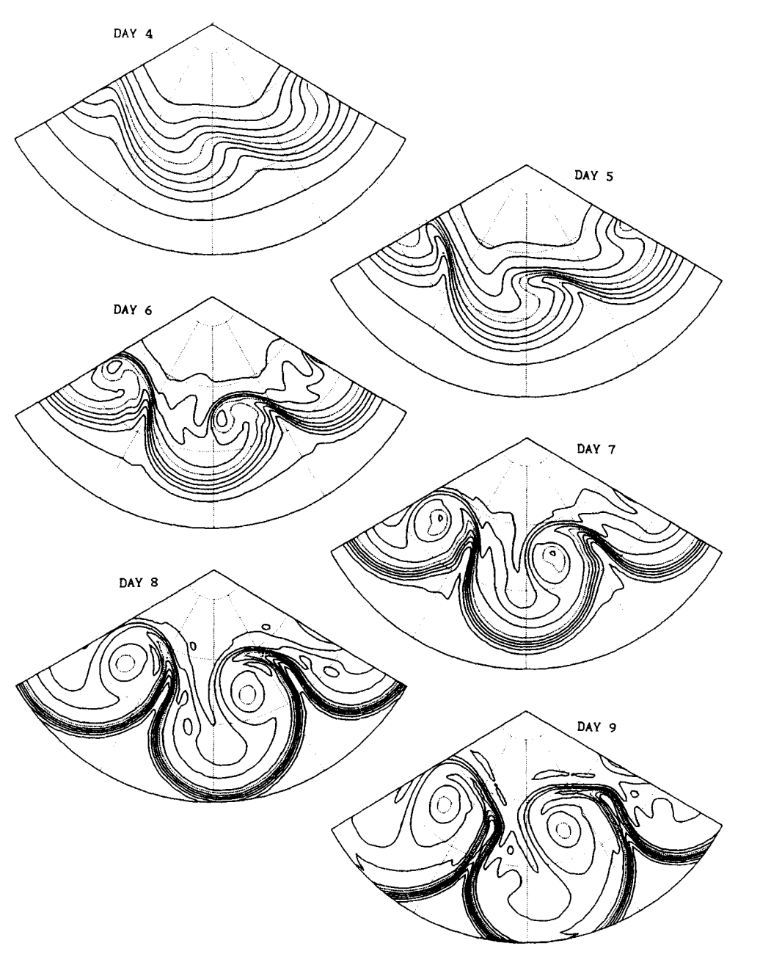
Theory of Fronts
Theory as a Bridge to Observations
Replicating Sanders (1955) and Reed (1955)
Thorncroft et al. (1993)
Primitive Equation Models
(Snyder et al. 1991; Thorncroft et al. 1993; Rotunno et al. 1994; Muraki et al. 1999; Rotunno et al. 2000)
Cyclone lifecycles differ considerably based on the background barotropic shear.
LC2
Notes:
Also noted that areas characterized by a strong horizontal temperature gradient exhibited stronger vertical wind shear.

Slide 42
Theory of Fronts
Theory as a Bridge to Observations
Replicating Sanders (1955) and Reed (1955)
Thorncroft et al. (1993)
Primitive Equation Models
(Snyder et al. 1991; Thorncroft et al. 1993; Rotunno et al. 1994; Muraki et al. 1999; Rotunno et al. 2000)
Cyclone lifecycles differ considerably based on the background barotropic shear.
Numerically-simulated cyclones can be affected significantly by the semi-geostrophic approximation.
LC2
Notes:
Also noted that areas characterized by a strong horizontal temperature gradient exhibited stronger vertical wind shear.

Slide 43
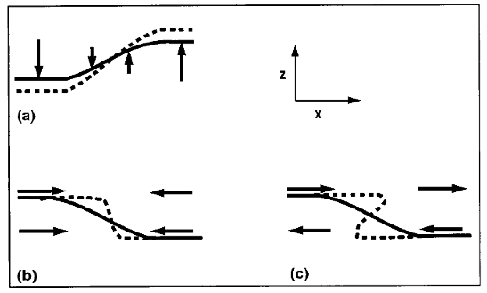
Theory of Fronts
Theory as a Bridge to Observations
Replicating Sanders (1955) and Reed (1955)
Wandishin et al. (2000)
PV Frontogenesis
(Davies and Rossa 1998; Wandishin et al. 2000; Pyle et al. 2004)
Processes that contribute to an increase in the magnitude of the temperature gradient on the tropopause can be used to diagnose tropopause folding.
Differential vertical motions can vertically steepen the tropopause.
Convergence or a vertical shear can produce a differential horizontal advection of the tropopause surface.
Notes:
Also noted that areas characterized by a strong horizontal temperature gradient exhibited stronger vertical wind shear.

Slide 44
Fronts and Frontogenesis
“The principal task of any meteorological institution of education and research must be to bridge the gap between the mathematician and practical man, that is to make the weather man realize the value of a modest theoretical education and to induce the theoretical man to take an occasional glance at the weather map. The polar front theory, beyond a doubt, represents the most successful effort yet to bridge the gulf that separates meteorological camps”
C.-G. Rossby (1934)
Shapiro et al. (1999)
Notes:
Meteorgraphs. Coordinated international effort to launch balloon soundings at 18 diff. locations across Europe. Wanted to capture the horizontal and vertical temperature structure throughout Europe.

Slide 45
Diagnosis of Fronts
Frontogenesis: The formation of a frontal boundary.
Frontolysis: The decay of a frontal boundary.
Notes:
Meteorgraphs. Coordinated international effort to launch balloon soundings at 18 diff. locations across Europe. Wanted to capture the horizontal and vertical temperature structure throughout Europe.

Slide 46
Diagnosis of Fronts
Frontogenesis: The formation of a frontal boundary.
Frontolysis: The decay of a frontal boundary.
Mathematically, it describes the Lagrangian rate of change of the magnitude of the horizontal temperature gradient on a pressure surface (Bergeron 1928; Petterssen 1936):
$ℱ=\frac{d}{dt}\left|∇_{h}θ\right|$
Notes:
Meteorgraphs. Coordinated international effort to launch balloon soundings at 18 diff. locations across Europe. Wanted to capture the horizontal and vertical temperature structure throughout Europe.

Slide 47
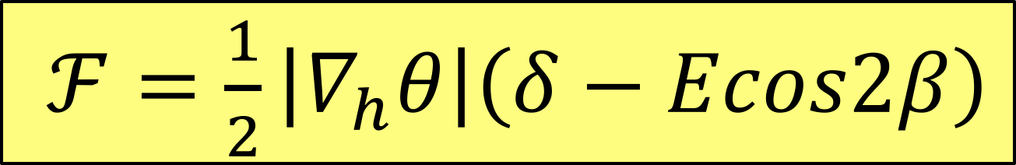
Diagnosis of Fronts
Frontogenesis: The formation of a frontal boundary.
Frontolysis: The decay of a frontal boundary.
Mathematically, it describes the Lagrangian rate of change of the magnitude of the horizontal temperature gradient on a pressure surface (Bergeron 1928; Petterssen 1936):
$ℱ=\frac{1}{2}\left|∇_{h}θ\right|\left(δ−Ecos2β\right)$
Notes:
Meteorgraphs. Coordinated international effort to launch balloon soundings at 18 diff. locations across Europe. Wanted to capture the horizontal and vertical temperature structure throughout Europe.

Slide 48
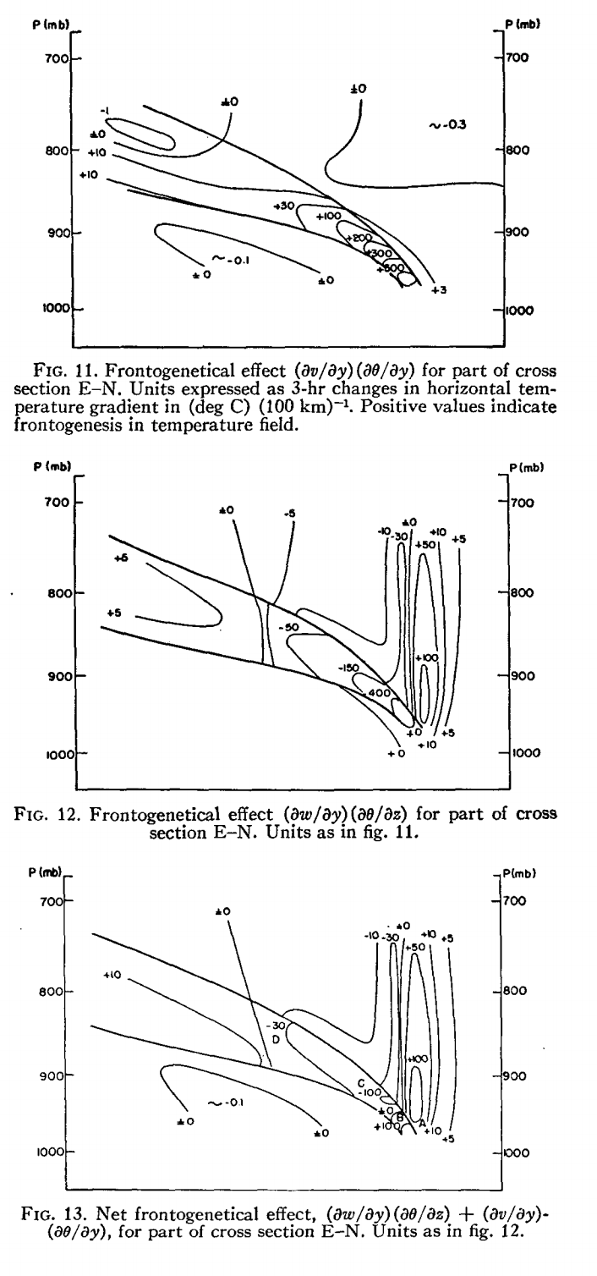
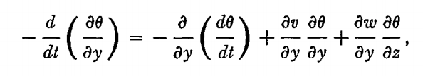
Diagnosis of Fronts
Kinematics of Frontogenesis
(Miller 1948; Sanders 1955)
E
N
Notes:
Also noted that areas characterized by a strong horizontal temperature gradient exhibited stronger vertical wind shear.

Slide 49
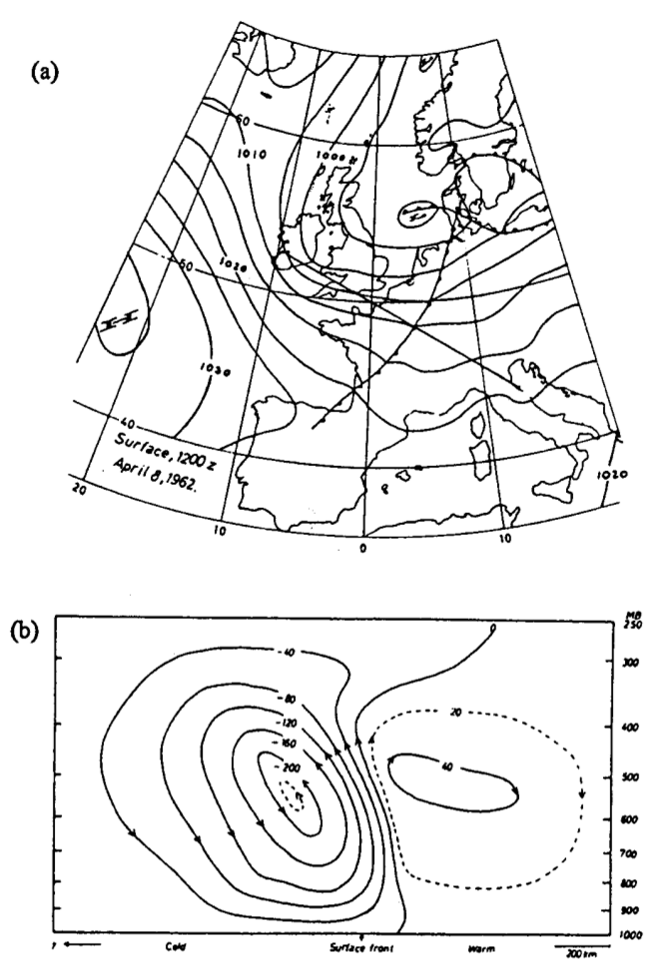
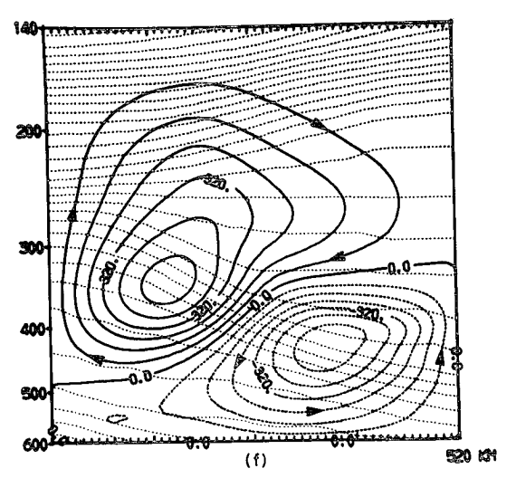
Diagnosis of Fronts
Application of the Sawyer–Eliassen Circulation Equation
Diagnosis of Ageostrophic Transverse Circulations
Todsen (1964)
Shapiro (1981)
Notes:
Also noted that areas characterized by a strong horizontal temperature gradient exhibited stronger vertical wind shear.

Slide 50
Diagnosis of Fronts
Application of the Sawyer–Eliassen Circulation Equation
Diagnosis of Ageostrophic Transverse Circulations
Shapiro (1981)
Lang and Martin (2012)
Notes:
Also noted that areas characterized by a strong horizontal temperature gradient exhibited stronger vertical wind shear.

Slide 51
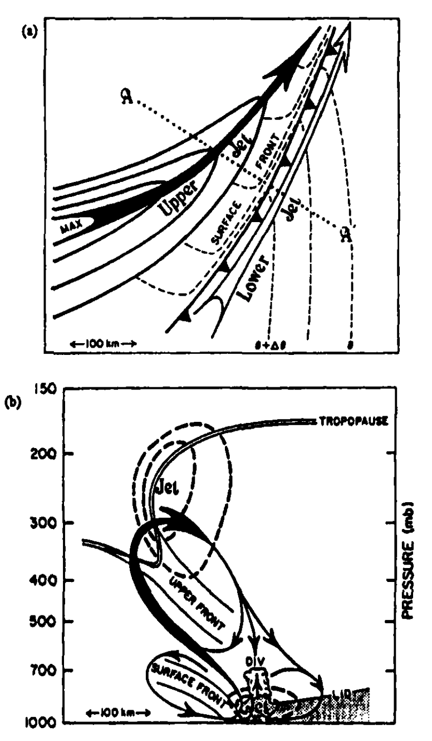
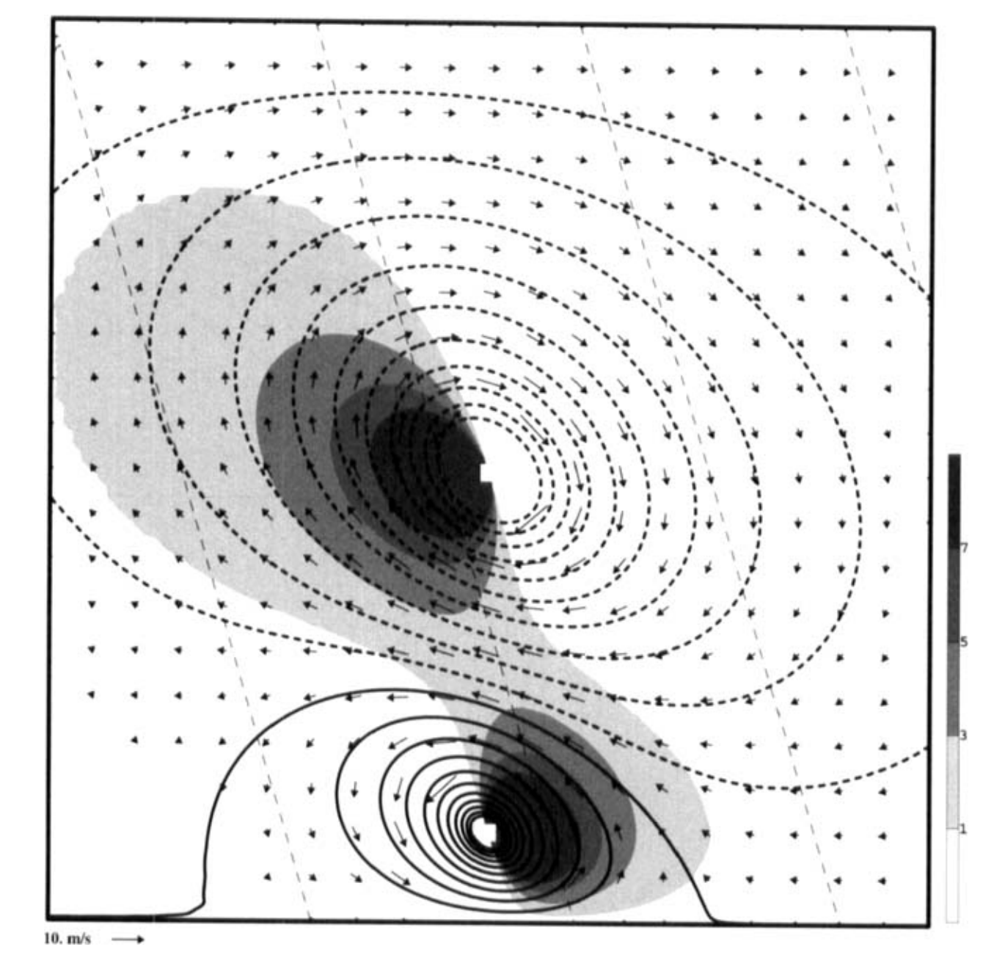
Diagnosis of Fronts
Application of the Sawyer–Eliassen Circulation Equation
Diagnosis of Ageostrophic Transverse Circulations
A
A’
Hakim and Keyser (2001)
Notes:
Also noted that areas characterized by a strong horizontal temperature gradient exhibited stronger vertical wind shear.

Slide 52
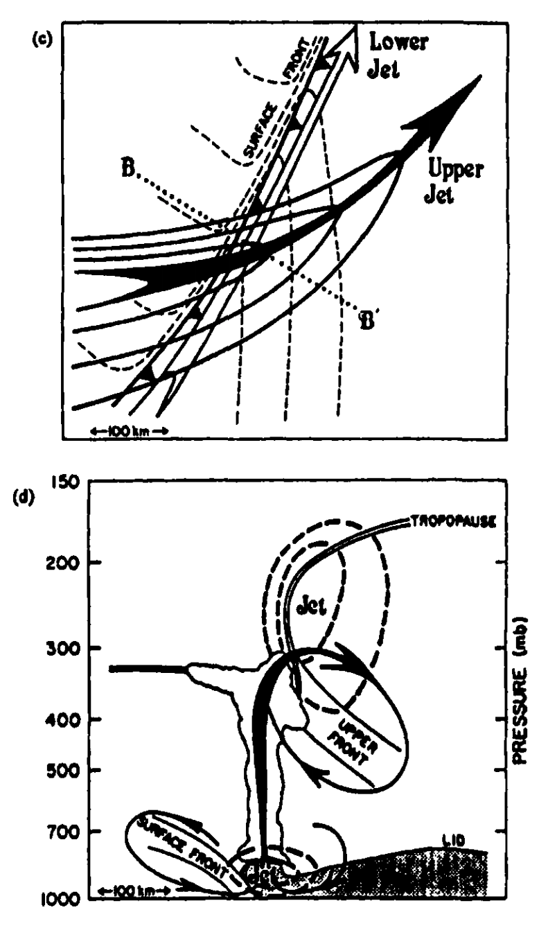
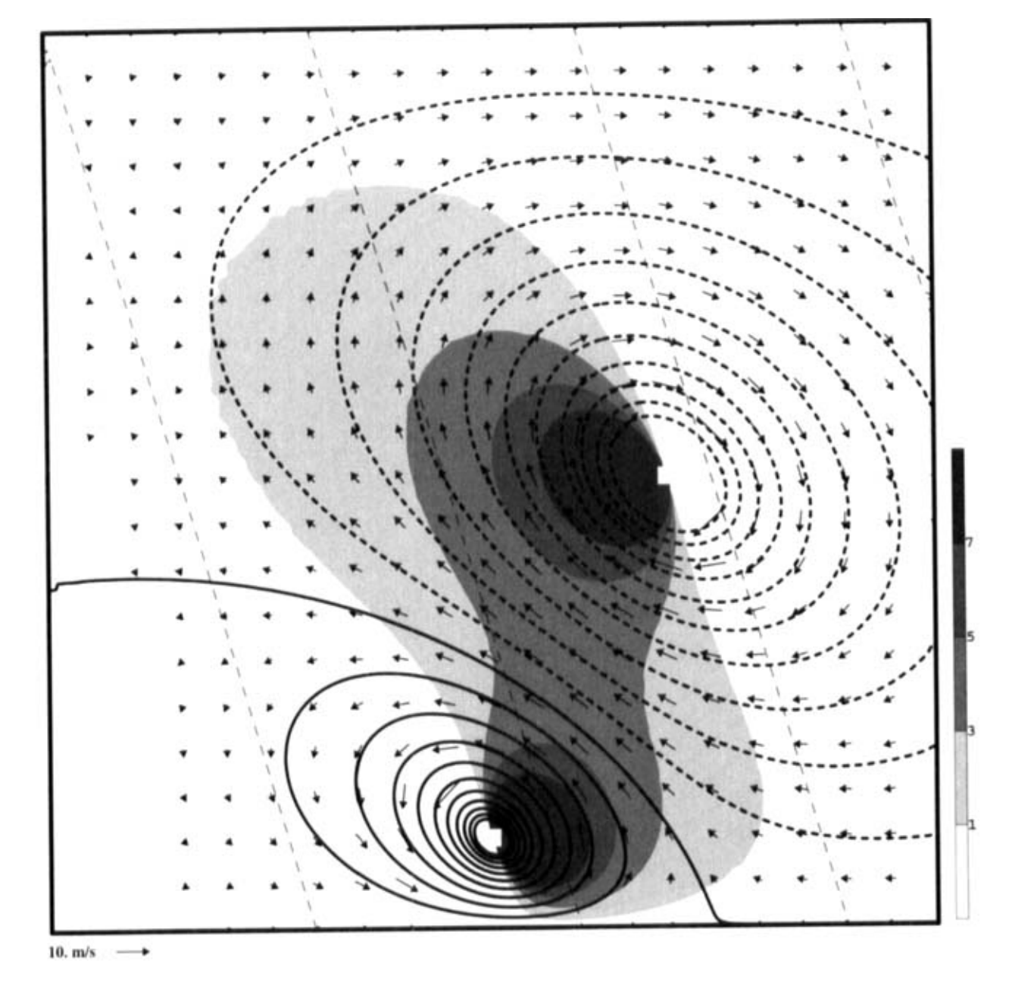
Diagnosis of Fronts
Application of the Sawyer–Eliassen Circulation Equation
Diagnosis of Ageostrophic Transverse Circulations
B
B’
Hakim and Keyser (2001)
Notes:
Also noted that areas characterized by a strong horizontal temperature gradient exhibited stronger vertical wind shear.

Slide 53
Diagnosis of Fronts
Frontal Circulations in Three-Dimensions
The Sawyer–Eliassen Circulation Equation has been generalized to three-dimensions, but its application has been limited (Hoskins and Draghici 1977; Bosart and Lin 1984; Xu 1990).
Notes:
Meteorgraphs. Coordinated international effort to launch balloon soundings at 18 diff. locations across Europe. Wanted to capture the horizontal and vertical temperature structure throughout Europe.

Slide 54
Diagnosis of Fronts
Frontal Circulations in Three-Dimensions
The Sawyer–Eliassen Circulation Equation has been generalized to three-dimensions, but its application has been limited (Hoskins and Draghici 1977; Bosart and Lin 1984; Xu 1990).
The Q-vector can be used to diagnose frontogenesis (Hoskins et al. 1978; Hoskins and Pedder 1980; Keyser et al. 1992; Morgan 1999; Martin 2006).
$ℱ=\frac{d}{dt}\left|∇_{h}θ\right|$
Notes:
Meteorgraphs. Coordinated international effort to launch balloon soundings at 18 diff. locations across Europe. Wanted to capture the horizontal and vertical temperature structure throughout Europe.

Slide 55
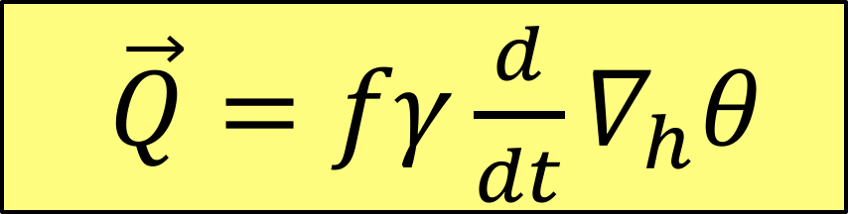
Diagnosis of Fronts
Frontal Circulations in Three-Dimensions
The Sawyer–Eliassen Circulation Equation has been generalized to three-dimensions, but its application has been limited (Hoskins and Draghici 1977; Bosart and Lin 1984; Xu 1990).
The Q-vector can be used to diagnose frontogenesis (Hoskins et al. 1978; Hoskins and Pedder 1980; Keyser et al. 1992; Morgan 1999; Martin 2006).
$\vec{Q}=fγ\frac{d}{dt}∇_{h}θ$
Notes:
Meteorgraphs. Coordinated international effort to launch balloon soundings at 18 diff. locations across Europe. Wanted to capture the horizontal and vertical temperature structure throughout Europe.

Slide 56
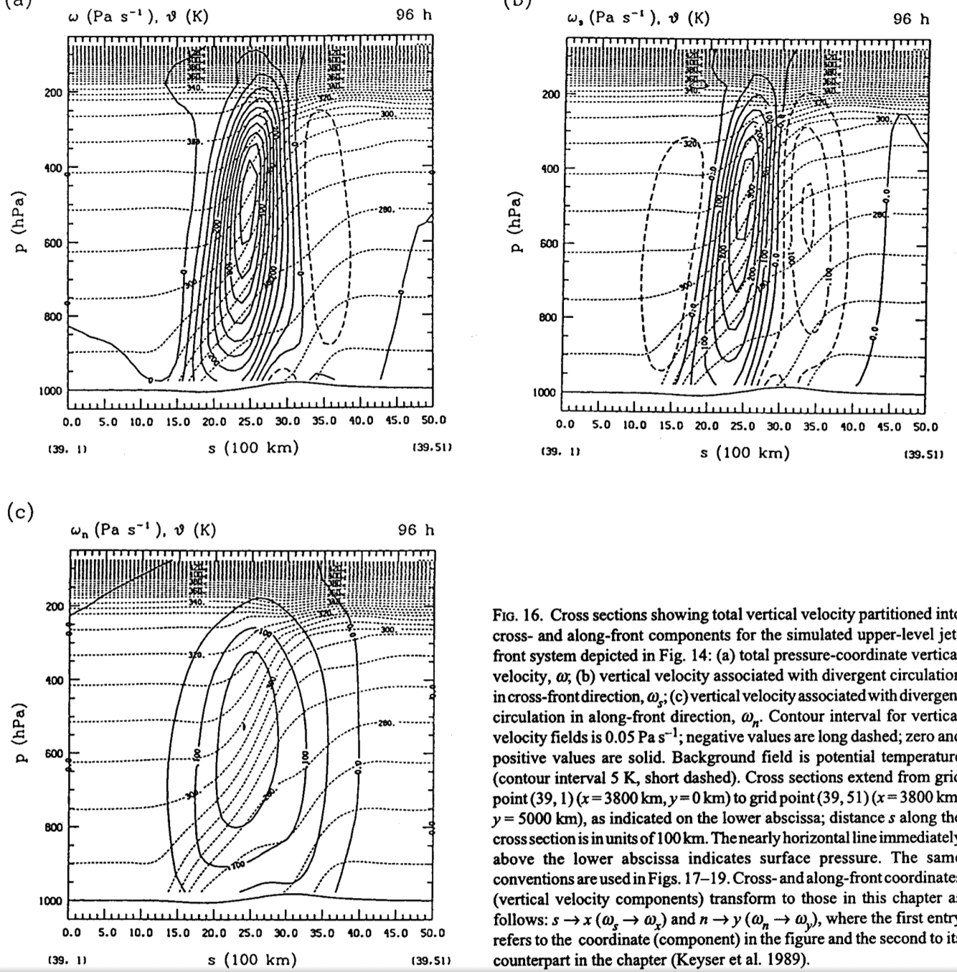
Diagnosis of Fronts
Frontal Circulations in Three-Dimensions – The Psi Vector
The Sawyer–Eliassen Circulation Equation neglects the along-flow component of the ageostrophic wind.
A majority of the vertical motion is of the transverse variety.
There are non-negligible contributions to the vertical motion field in the along-flow direction.
Full omega
Transverse omega
Shearwise omega
Keyser et al. (1989)
Notes:
Velocity potential and upper level divergence.

Slide 57
Future of Frontal Research
New observational and modelling capabilities permit reexaminations of frontal characteristics.
Research is required to better understand the interaction between diabatic, frictional, and frontal dynamics.
An influx of reanalysis and reforecast datasets permits novel evaluations of frontal-cyclone structure and the variability inherent in those structures.
Notes:
Velocity potential and upper level divergence.

Slide 58
References
Beck, A. L., 1922: The earth’s atmosphere as a circular vortex. Mon. Wea. Rev., 50, 393–401.
Bergeron, T., 1928: Über die dreidimensional verknüpfende Wetteranalyse. Geofys. Publ., 5, 1–111.
Bergeron, T., 1937: On the physics of fronts. Bull. Amer. Meteor. Soc., 18, 265–275.
Bjerknes, J., 1919: On the structure of moving cyclones. Geofys. Publ., 1(1), 1–8.
Bjerknes, J., and H. Solberg, 1921: Meteorological conditions for the formation of rain. Geofys. Publ., 2(3), 1–60.
Bjerknes, J., and H. Solberg, 1922: Life cycle of cyclones and the polar front theory of atmospheric circulation. Geofys. Publ., 3(1), 1–18.
Bjerknes, J., and E. Palmén, 1937: Investigations of selected European cyclones by means of serial ascents. Geofys. Publ., 12(2), 1-62.
Bluestein, H. B., 1986: Fronts and jet streaks: A theoretical perspective. Mesoscale Meteorology and Forecasting, P. S. Ray, Ed., Amer. Meteor. Soc., 173–215.
Bosart, L. F., 1975: New England coastal frontogenesis. Quart. J. Roy. Meteor. Soc., 101, 957–978.
Bosart, L. F., 1981: The Presidents’ Day Snowstorm of 18–19 February 1979: A subsynoptic scale event. Mon. Wea. Rev., 109, 1542–1566.
Bosart, L. F., J. Vaudo, and J. H. Helsdon, Jr., 1972: Coastal frontogenesis. J. Appl. Meteor., 11, 1236–1258.
Bosart, L. F., and S. C. Lin, 1984: A diagnostic analysis of the Presidents’ Day snowstorm of February 1979. Mon. Wea. Rev., 112, 2148–2177.
Browning, K. A., 1990: Organization of clouds and precipitation in extratropical cyclones. Extratropical Cyclones, The Erik Palmén Memorial Volume, C. W. Newton and E. O. Holopainen, Eds., Amer. Meteor. Soc., 129–153.
Browning, K. A., and G. A. Monk, 1982: A simple model for the synoptic analysis of cold fronts. Quart. J. Roy. Meteor. Soc., 108, 435–452.
Carlson, T. M., 1980: Airflow through midlatitude cyclones and the comma cloud pattern. Mon. Wea. Rev., 108, 1498–1509.
Carr, J. A., 1951: The east coast “back-door” front of May 16–20, 1951. Mon. Wea. Rev., 79, 100–105.
Davies, H. C., and A. M. Rossa, 1998: PV frontogenesis and upper-tropospheric fronts. Mon. Wea. Rev., 126, 1528–1539.
Eliassen, A., 1962: On the vertical circulation in frontal zones. Geofys. Publ., 24, 147–160.
Eliassen, A., 1990: Transverse circulations in frontal zones. Extratropical Cyclones, The Erik Palmén Memorial Volume, C. W. Newton and E. O. Holopainen, Eds., Amer. Meteor. Soc., 155–165.
Hakim, G. J., and D. Keyser, 2001: Canonical frontal circulation patterns in terms of Green’s functions for the Sawyer–Eliassen equation. Quart. J. Roy. Meteor. Soc., 127, 1795–1814.
Hobbs, P. V., J. D. Locatelli, and J. E. Martin, 1990: Cold fronts aloft and the forecasting of precipitation and severe weather east of the Rocky Mountains. Wea. Forecasting, 5, 613–626.
Hoskins, B. J., 1971: Atmospheric frontogenesis models: Some solutions. Quart. J. Roy. Meteor. Soc., 97, 139–153.
Notes:
Velocity potential and upper level divergence.

Slide 59
References
Hoskins, B. J., 1972: Non-Boussinesq effects and further development in a model of upper tropospheric frontogenesis. Quart. J. Roy. Meteor. Soc., 98, 532–541.
Hoskins, B. J., and F. P. Bretherton, 1972: Atmospheric frontogenesis models: Mathermatical formulation and solution. J. Atmos. Sci., 29, 11–37.
Hoskins, B. J., and I. Draghici, 1977: The forcing of ageostrophic motion according to the semi-geostrophic equations in an isentropic coordinate model. J. Atmos. Sci., 34, 1859–1867.
Hoskins, B. J., I. Draghici, and H. C. Davies, 1978: A new look at the 𝜔-equation. Quart. J. Roy. Meteor. Soc., 104, 31–38.
Hoskins, B. J., and M. A. Pedder, 1980: The diagnosis of middle latitude synoptic development. Quart. J. Roy. Meteor. Soc., 106, 707–719.
Keyser, D., 1986: Atmospheric fronts: An observational perspective. Mesoscale Meteorology and Forecasting, P. S. Ray, Ed., Amer. Meteor. Soc., 216–258.
Keyser, D., and R. A. Anthes, 1982: The influence of planetary boundary layer physics on frontal structure in the Hoskins-Bretherton horizontal shear model. J. Atmos. Sci., 39, 1783–1802.
Keyser, D., B. D. Schmidt, and D. G. Duffy, 1989: A technique for representing three-dimensional vertical circulations in baroclinic disturbances. Mon. Wea. Rev., 117, 2463-2494.
Keyser, D., B. D. Schmidt, and D. G. Duffy, 1992: Quasigeostrophic vertical motions diagnosed from the along- and across-isentrope components of the Q-vector. Mon. Wea. Rev., 120, 731–741.
Lang, A. A., and J. E. Martin, 2012: The structure and evolution of lower stratospheric frontal zones. Part I: Examples in northwesterly and southwesterly flow. Quart. J. Roy. Meteor. Soc., 138, 1350-1365.
Martin, J. E., 2006: The role of shearwise and transverse quasi-geostrophic vertical motions in the mid-latitude cyclone life cycle. Mon. Wea. Rev., 134, 1174–1193.
Meisinger, C. L., 1920: The great cyclone of mid-February, 1919. Mon. Wea. Rev., 48, 582–586.
Miller, J. E., 1948: On the concept of frontogenesis. J. Meteor., 5, 169–171.
Morgan, M. C., 1999: Using piecewise potential vorticity inversion to diagnose frontogenesis. Part I: A partitioning of the Q vector applied to diagnosing surface frontogenesis and vertical motion. Mon. Wea. Rev., 127, 2796–2821.
Mudrick, S. E., 1974: A numerical study of frontogenesis. J. Atmos. Sci., 31, 869–892.
Muraki, D. J., C. Snyder, and R. Rotunno, 1999: The next-order corrections to quasigeostrophic theory. J. Atmos. Sci., 56, 1547–1560.
Palmén, E., and C. W. Newton, 1948: A study of the mean wind and temperature distribution in the vicinity of the polar front in winter. J. Meteor., 5, 220–226.
Petterssen, S., 1936: A contribution to the theory of frontogenesis. Geofys. Publ., 11, 1–27.
Notes:
Velocity potential and upper level divergence.

Slide 60
References
Pyle, M. E., D. Keyser, and L. F. Bosart, 2004: A diagnostic study of jet streaks: Kinematic signatures and relationship to coherent tropopause disturbances. Mon. Wea. Rev., 297–319.
Reed, R. J., 1955: A study of a characteristic type of upper-level frontogenesis. J. Meteor., 12, 226-237.
Reed, R. J., 2003: A Short account of my education, career choice, and research motivation. A Half Century of Progress in Meteorology: A Tribute to Richard Reed, R. A. Johnson, and R. A. Houze, Jr., Eds., Amer. Meteor. Soc., 1–7.
Rossby, C.-G., 1934: Comments on meteorological research. J. Aeronaut. Sci., 1, 32–34.
Rossby, C.-G., and R. H. Weightman, 1926: Application of the polar-front theory to a series of American weather maps. Mon. Wea. Rev., 54, 485–496.
Rotunno, R., W. C. Skamarock, and C. Snyder, 1994: An analysis of frontogenesis in numerical simulations of baroclinic waves. J. Atmos. Sci., 51, 3373–3398.
Rotunno, R., D. J. Muraki, and C. Snyder, 2000: Unstable baroclinic waves beyond quasigeostrophic theory. J. Atmos. Sci., 57, 3285–3295.
Sanders, F., 1955: An investigation of the structure and dynamics of an intense surface frontal zone. J. Meteor., 12, 542–555.
Sansom, H. W., 1951: A study of cold fronts over the British Isles. Quart. J. Roy. Meteor. Soc., 77, 96–120.
Sawyer, J. S., 1956: The vertical circulation at meteorological fronts and its relation to frontogenesis. Proc. Roy. Soc. London, A234, 346–362.
Schultz, D. M., and C. F. Mass, 1993: The occlusion process in a midlatitude cyclone over land. Mon. Wea. Rev., 121, 918–940.
Schultz, D. M., D. Keyser, L. F. Bosart, 1998: The effect of large-scale flow on low-level frontal structure and evolution in midlatitude cyclones. Mon. Wea. Rev., 126, 1767–1791.
Schultz, D. M., and G. Vaughan, 2011: Occluded fronts and the occlusion process: A fresh look at conventional wisdom. Bull. Amer. Meteor. Soc., 92, 443–466.
Schultz, D. M., B. Antonescu, and A. Chiarello, 2014: Searching for the elusive cold-type occluded front. Mon. Wea. Rev., 142, 2565–2570.
Shapiro, M. A., 1981: Frontogenesis and geostrophically forced secondary circulations in the vicinity of the jet stream-frontal zone systems. J. Atmos. Sci., 38, 954-973.
Shapiro, M. A., and D. Keyser, 1990: Fronts, jet streams, and the tropopause. Extratropical Cyclones, The Erik Palmén Memorial Volume, C. W. Newton and E. O. Holopainen, Eds., Amer. Meteor. Soc., 167–191.
Shapiro, M. A., and Coauthors, 1999: A planetary-scale to mesoscale perspective of the life cycles of extratropical cyclones: The bridge between theory and observations. The Life Cycles of Extratropical Cyclones, M. A. Shapiro and S. Grønås, Eds., Amer. Meteor. Soc., 139–185.
Notes:
Velocity potential and upper level divergence.

Slide 61
References
Snyder, C., W. C. Skamarock, and R. Rotunno, 1991: A comparison of primitive equation and semigeostrophic simulations of baroclinic waves. J. Atmos. Sci., 48, 2179–2194.
Stone, P. H., 1966: Frontogenesis by horizontal wind deformation. J. Atmos. Sci., 23, 455–465.
Thorncroft, C. D., B. J. Hoskins, and M. E. McIntyre, 1993: Two paradigms of baroclinic-wave life-cycle behavior. Quart. J. Roy. Meteor. Soc., 119, 17–56.
Thorpe, A. J., and K. A. Emanuel, 1985: Frontogenesis in the presence of small stability to slantwise convection. J. Atmos. Sci., 42, 1809–1824.
Todsen, M., 1964: A computation of the vertical circulation in a frontal zone from the quasi-geostrophic equations. Air Force Cambridge Laboratories Tech. Note 4, OAR Contribution AF 61(052)-525, 23 pp.
Wandishin, M. S., J. W. Nielsen-Gammon, and D. Keyser, 2000: A potential vorticity diagnostic approach to upper-level frontogenesis within a developing baroclinic wave. J. Atmos. Sci., 57, 3918–3938.
Williams, R. T., 1968: A note on quasi-geostrophic frontogenesis. J. Atmos. Sci., 25, 1157–1159.
Williams, R. T., 1972: Quasi-geostrophic versus non-geostrophic frontogenesis. J. Atmos. Sci., 29, 3–10.
Williams, R. T., and J. Plotkin, 1968: Quasi-geostrophic frontogenesis. J. Atmos. Sci., 25, 201–206.
Xu, Q., 1990: Cold and warm frontal circulations in an idealized moist semigeostrophic baroclinic wave. J. Atmos. Sci., 47, 2337–2352.
Notes:
Velocity potential and upper level divergence.

