Slide 1
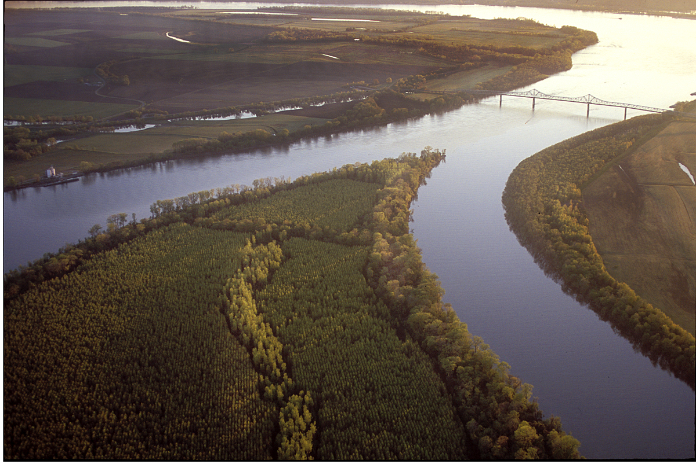


Antecedent Synoptic Environments
Most Conducive to North American
Polar/Subtropical Jet Superpositions
Andrew C. Winters
2 August 2018
This work is funded by an NSF-PRF (AGS-1624316)

Slide 2
Background
Modified from Defant and Taba (1957)

Slide 3
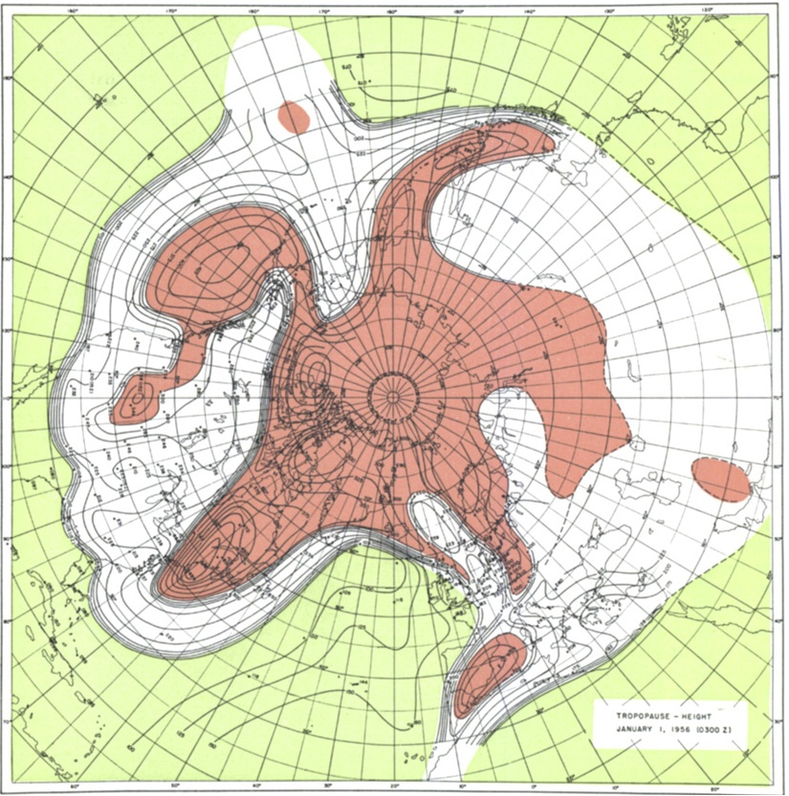
Background
Tropopause Pressure (hPa)
Albany
NP
North Pole
Maps of tropopause pressure help to identify the location of the jets
While each jet occupies its own climatological latitude band, substantial meanders are common
STJ
POLJ
NP
Tropical Tropopause
Subtropical Tropopause
Polar Tropopause
Modified from Defant and Taba (1957)

Slide 4
Background
Tropopause Pressure (hPa)
Albany
NP
North Pole
Maps of tropopause pressure help to identify the location of the jets
While each jet occupies its own climatological latitude band, substantial meanders are common
Occasionally, the latitudinal separation between the jets can vanish resulting in a vertical jet superposition
STJ
POLJ
NP
Tropical Tropopause
Subtropical Tropopause
Polar Tropopause
Modified from Defant and Taba (1957)

Slide 5
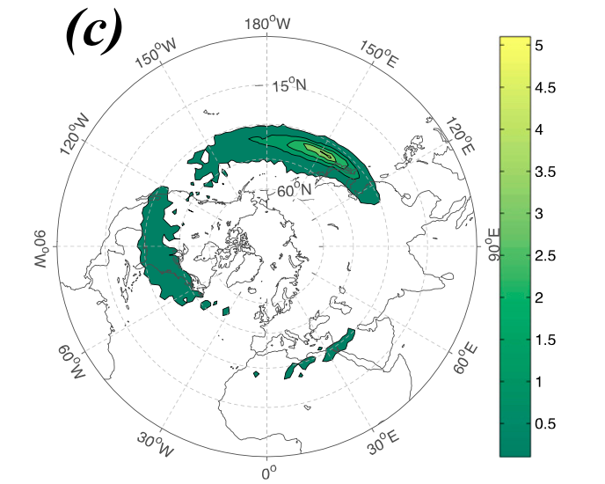
Background
Christenson et al. (2017) highlight three locations that experience the greatest frequency of
jet superpositions:
1) Western Pacific
2) North America
3) Northern Africa
Climatological frequency of Northern Hemisphere jet superposition events per cold season (Nov–Mar) 1960–2010
Number of Events
Christenson et al. (2017)

Slide 6
Background
Christenson et al. (2017) highlight three locations that experience the greatest frequency of
jet superpositions:
1) Western Pacific
2) North America
3) Northern Africa
Climatological frequency of Northern Hemisphere jet superposition events per cold season (Nov–Mar) 1960–2010
Number of Events
Christenson et al. (2017)

Slide 7
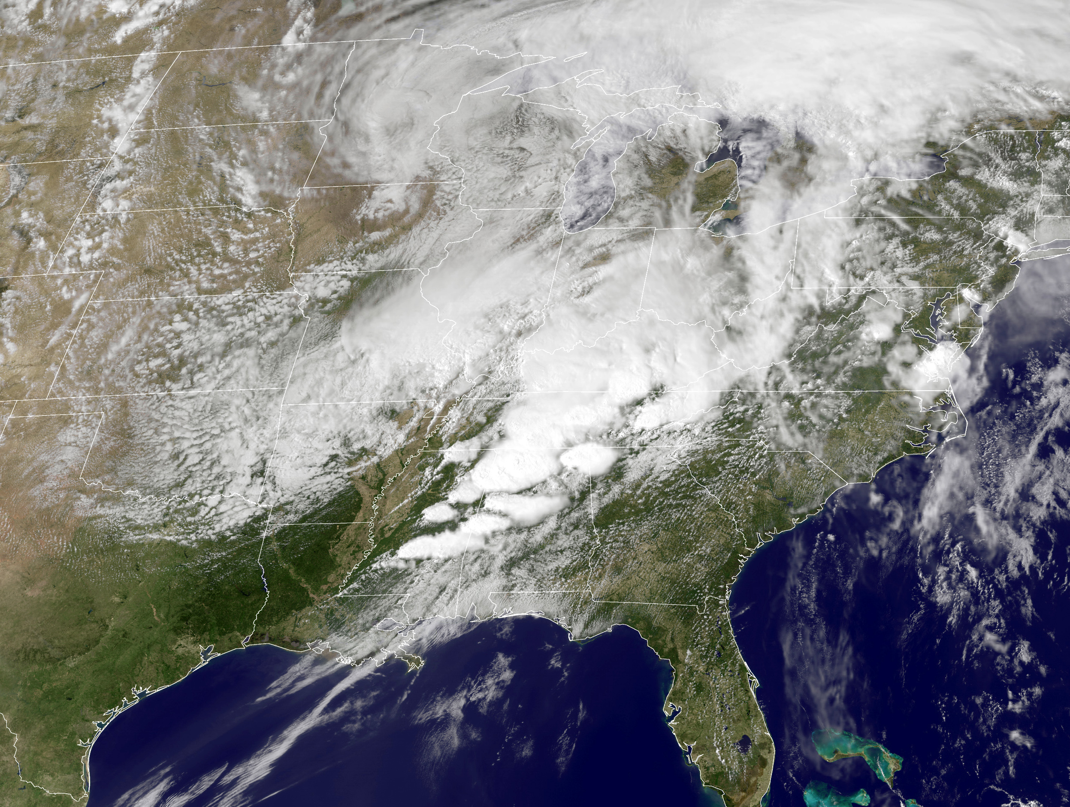
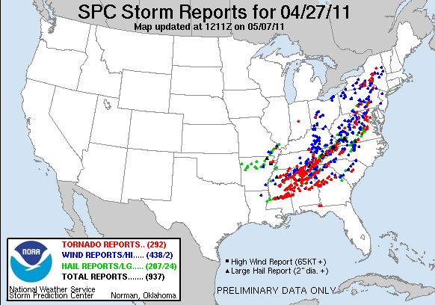
Background
Jet superpositions can be an element of high-impact weather events
1–3 May 2010 Nashville Flood
Jet superposition enhanced the poleward moisture transport via its ageostrophic circulation (Winters and Martin 2014; 2016)
18–20 December 2009 Mid-Atlantic Blizzard
Jet superposition was associated with a rapidly deepening East Coast cyclone (Winters and Martin 2016; 2017)
26 October 2010: Explosive Cyclogenesis Event
Jet superposition over the West Pacific preceded the development of an intense Midwest U.S. cyclone
25–28 April 2011 Tornado Outbreak
Jet superposition occurred over the West Pacific prior to the outbreak (Knupp et al. 2014; Christenson and Martin 2012)
NASA
SPC

Slide 8
Background
Jet superpositions can be an element of high-impact weather events
1–3 May 2010 Nashville Flood
Jet superposition enhanced the poleward moisture transport via its ageostrophic circulation (Winters and Martin 2014; 2016).
18–20 December 2009 Mid-Atlantic Blizzard
Jet superposition was associated with a rapidly deepening East Coast cyclone (Winters and Martin 2016; 2017).
26 October 2010: Explosive Cyclogenesis Event
Jet superposition over the West Pacific preceded the development of an intense Midwest U.S. cyclone.
25–28 April 2011 Tornado Outbreak
Jet superposition occurred over the West Pacific prior to the outbreak (Knupp et al. 2014; Christenson and Martin 2012).
NASA
How do these structures develop?
SPC

Slide 9
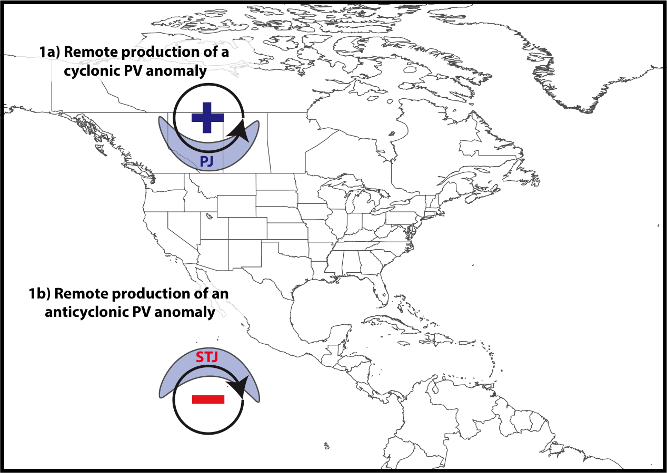
Jet Superposition Conceptual Model
Winters and Martin (2017)

Slide 10
Jet Superposition Conceptual Model
Polar cyclonic PV anomalies:
Often referred to as coherent tropopause disturbances (Pyle et al. 2004) or tropopause polar vortices (Cavallo and Hakim 2010)
Typify a dynamical environment conducive to midlatitude cyclogenesis
Winters and Martin (2017)

Slide 11
Jet Superposition Conceptual Model
Winters and Martin (2017)

Slide 12
Jet Superposition Conceptual Model
Tropical anticyclonic PV anomalies:
Typify a thermodynamic environment characterized by weak upper-tropospheric static stability
Atmospheric rivers often form within the poleward-directed branch of their circulation
Winters and Martin (2017)

Slide 13
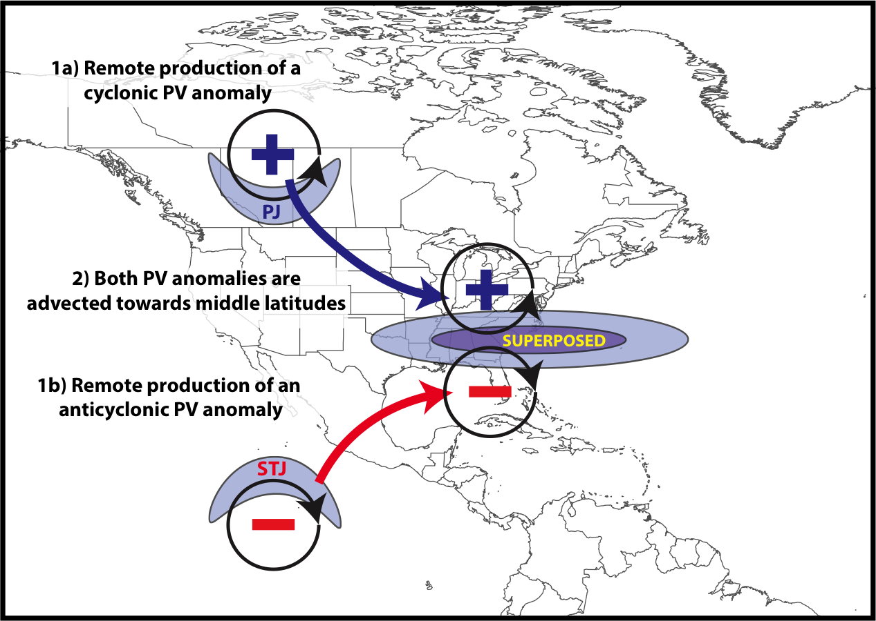
Jet Superposition Conceptual Model
Winters and Martin (2017)

Slide 14
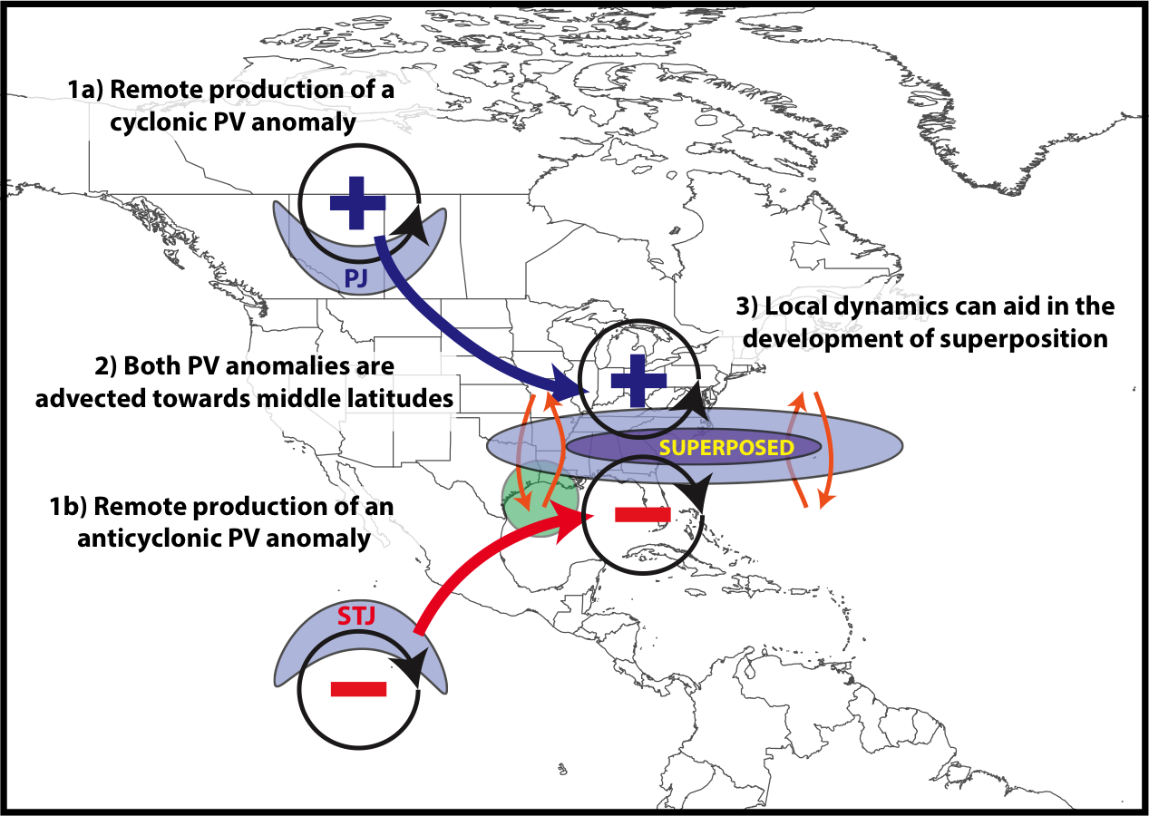
Jet Superposition Conceptual Model
Winters and Martin (2017)

Slide 15
Jet Superposition Conceptual Model
The relative importance of these PV anomalies is highly variable between jet superposition events
Winters and Martin (2017)

Slide 16
Jet Superposition Conceptual Model
GOAL: To determine the characteristic types of interaction that exist between upper-tropospheric PV anomalies during a jet superposition event
Winters and Martin (2017)

Slide 17
Supplementary Slides

Slide 18
Jet Superposition Event Climatology

Slide 19
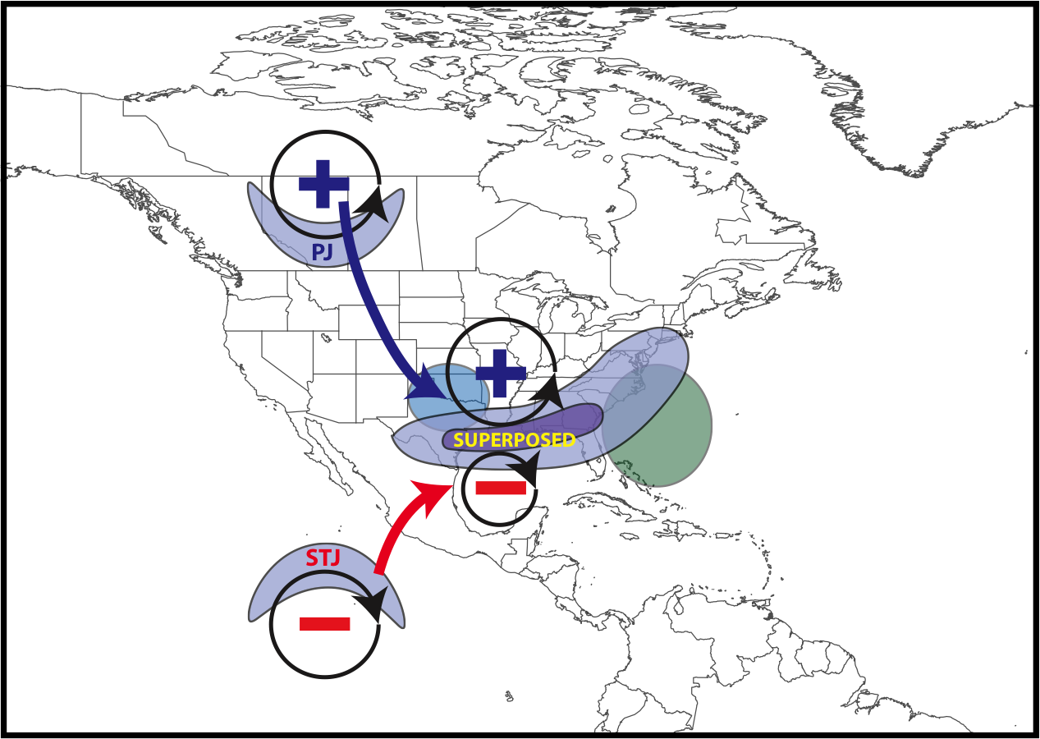
Synoptic Evolution of Events
Polar Dominant Events:
Anticyclonic wave breaking event amplifies the flow over North America
QG descent beneath the jet core forced by geostrophic CAA facilitates jet superposition
Downstream precipitation slows the propagation of the upper-level trough
L
CAA
Precip.

Slide 20
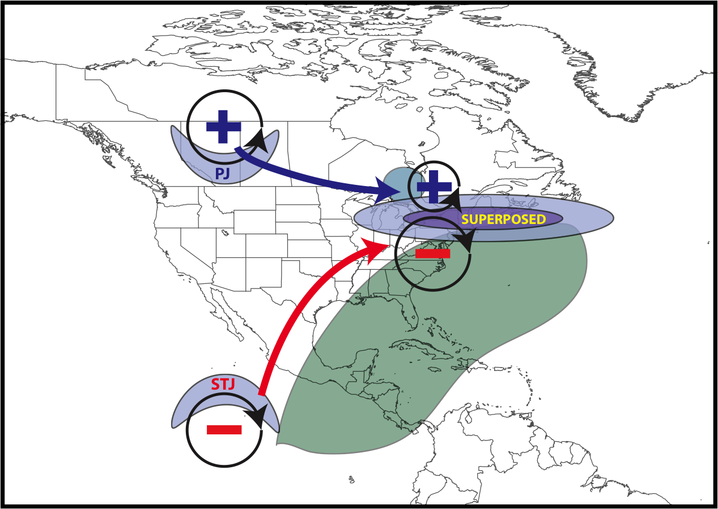
Synoptic Evolution of Events
L
CAA
Antecedent moisture and precip.
East Subtropical Dominant Events:
Antecedent precipitation and southerly flow amplify ridge over eastern North America
Arrival of upper-level trough is associated with geostrophic CAA at the time of jet superposition
Geostrophic CAA forces QG descent beneath the jet core and completes jet superposition

Slide 21
Future Work
Apply piecewise PV inversion (e.g., Davis and Emanuel 1991) to quantify the influence that polar cyclonic and tropical anticyclonic PV anomalies have on deforming the tropopause during each type of superposition event
Examine the impact that each type of jet superposition event has on the evolution of the downstream large-scale flow pattern
Utilize numerical simulations of jet superposition events to examine the sensitivity of jet superposition to diabatic processes
Further illuminate the connection between jet superposition events and high-impact weather events (e.g., severe weather, cyclogenesis, floods)

Slide 22
References
Cavallo, S. M., and G. J. Hakim, 2010: Composite structure of tropopause polar cyclones. Mon. Wea. Rev., 138, 3840−3857.
Christenson, C. E., and J. E. Martin, 2012: The large-scale environment associated with the 25−28 April 2011 severe weather outbreak. 16th NWA Severe Storms and Doppler Radar Conference, Des Moines, IA, National Weather Association, 31 March 2012.
Christenson, C. E., J. E. Martin, and Z. J. Handlos, 2017: A synoptic-climatology of Northern Hemisphere, cold season polar and subtropical jet superposition events. J. Climate, 30, 7231-7246.
Defant, F., and H. Taba, 1957: The threefold structure of the atmosphere and the characteristics of the tropopause. Tellus, 9, 259-275.
Lang, A. A., and J. E. Martin, 2012: The structure and evolution of lower stratospheric frontal zones. Part I: Examples in northwesterly and southwesterly flow. Quart. J. Roy. Meteor. Soc., 138, 1350-1365.
Knupp, K. R., T. A. Murphy, T. A. Coleman, R. A. Wade, S. A. Mullins, C. J. Schultz, E. V. Schultz, L. Carey, A. Sherrer, E. W. McCaul Jr., B. Carcione, S. Latimer, A. Kula, K. Laws, P. T. Marsh, and K. Klockow, 2014: Meteorological overview of the devastating 27 April 2011 Tornado Outbreak. Bull. Amer. Meteor. Soc., 95, 1041−1062.
Moore, B. J., P. J. Neiman, F. M. Ralph, and F. E. Barthold, 2012: Physical processes associated with heavy flooding rainfall in Nashville, Tennessee, and vicinity during 1-2 May 2010: The role of an atmospheric river and mesoscale convective systems. Mon. Wea. Rev., 140, 358-378.
Pyle, M. E., D. Keyser, and L. F. Bosart, 2004: A diagnostic study of jet streaks: Kinematic signatures and relationship to coherent tropopause disturbances. Mon. Wea. Rev., 132, 297−319.
Saha, S. and co-authors, 2014: The NCEP Climate Forecast System Version 2. J. Climate, 27, 2185−2208.
Winters, A. C., and J. E. Martin, 2014: The role of a polar/subtropical jet superposition in the May 2010 Nashville Flood. Wea. Forecasting, 29, 954–974.
Winters, A. C. and J. E. Martin, 2016: Synoptic and mesoscale processes supporting vertical superposition of the polar and subtropical jets in two contrasting cases. Quart. J. Roy. Meteor. Soc., 142, 1133–1149.
Winters, A. C., and J. E. Martin, 2017: Diagnosis of a North American polar/subtropical jet superposition employing potential vorticity inversion. Mon. Wea. Rev.,145, 1853-1873.

Slide 23
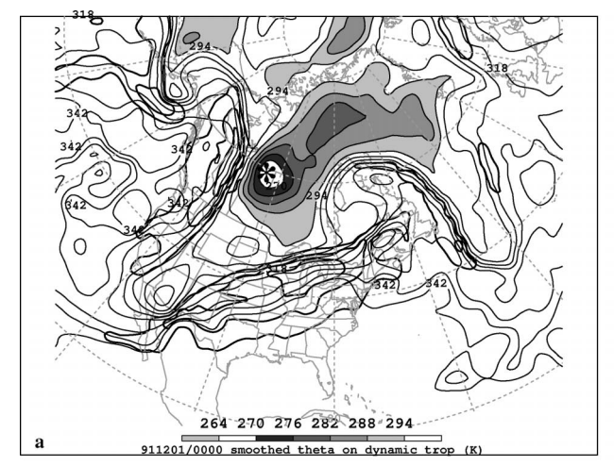
Jet Superposition Conceptual Model
Dynamic Tropopause Potential Temperature
Pyle et al. (2004)

Slide 24
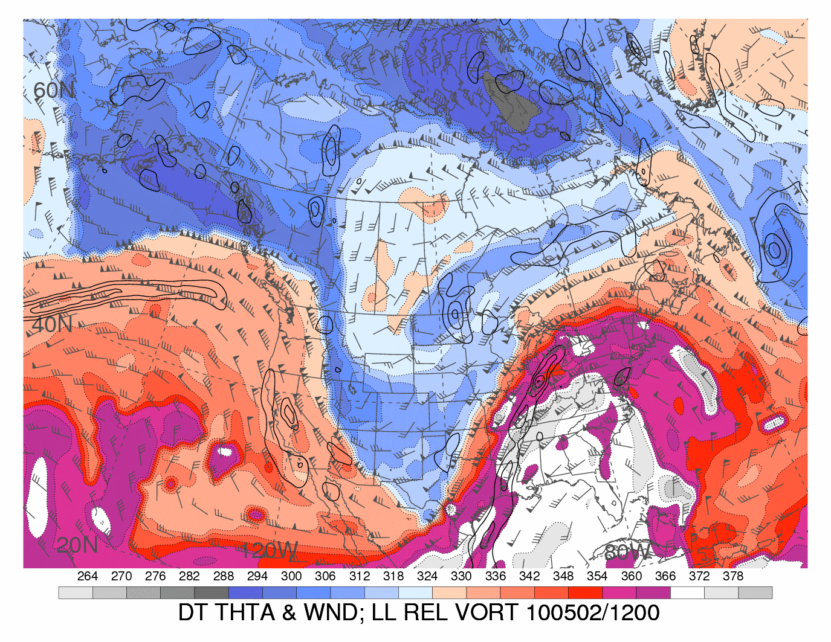
Jet Superposition Conceptual Model
Dynamic Tropopause Potential Temperature
Heather Archambault

