Slide 1
Weather Regime-Dependent Predictability: The Development of the North Pacific Jet Phase Diagram as a Tool to Characterize the Upper-Tropospheric Flow Pattern
Andrew C. Winters, Lance F. Bosart, and Daniel Keyser
Department of Atmospheric and Environmental Sciences
University at Albany, State University of New York, Albany, NY 12222
42nd Northeastern Storm Conference
Saratoga Springs, NY
11 March 2017
This work is supported by NOAA Grant NA15NWS4680006

Slide 2
Project Motivation
One or several extreme weather events (EWEs) during a single season can contribute disproportionately to temperature and precipitation anomaly statistics for a particular season.

Slide 3
Project Motivation
One or several extreme weather events (EWEs) during a single season can contribute disproportionately to temperature and precipitation anomaly statistics for a particular season.
The disproportionate contribution of EWEs to seasonal temperature and precipitation anomaly statistics suggests that EWEs need to be considered in understanding the dynamical and thermodynamic processes that operate at the weather–climate intersection.

Slide 4
Project Motivation
One or several extreme weather events (EWEs) during a single season can contribute disproportionately to temperature and precipitation anomaly statistics for a particular season.
The disproportionate contribution of EWEs to seasonal temperature and precipitation anomaly statistics suggests that EWEs need to be considered in understanding the dynamical and thermodynamic processes that operate at the weather–climate intersection.
Consideration of EWEs may improve operational probabilistic temperature and precipitation forecasts in the 8–10 day time range.

Slide 5
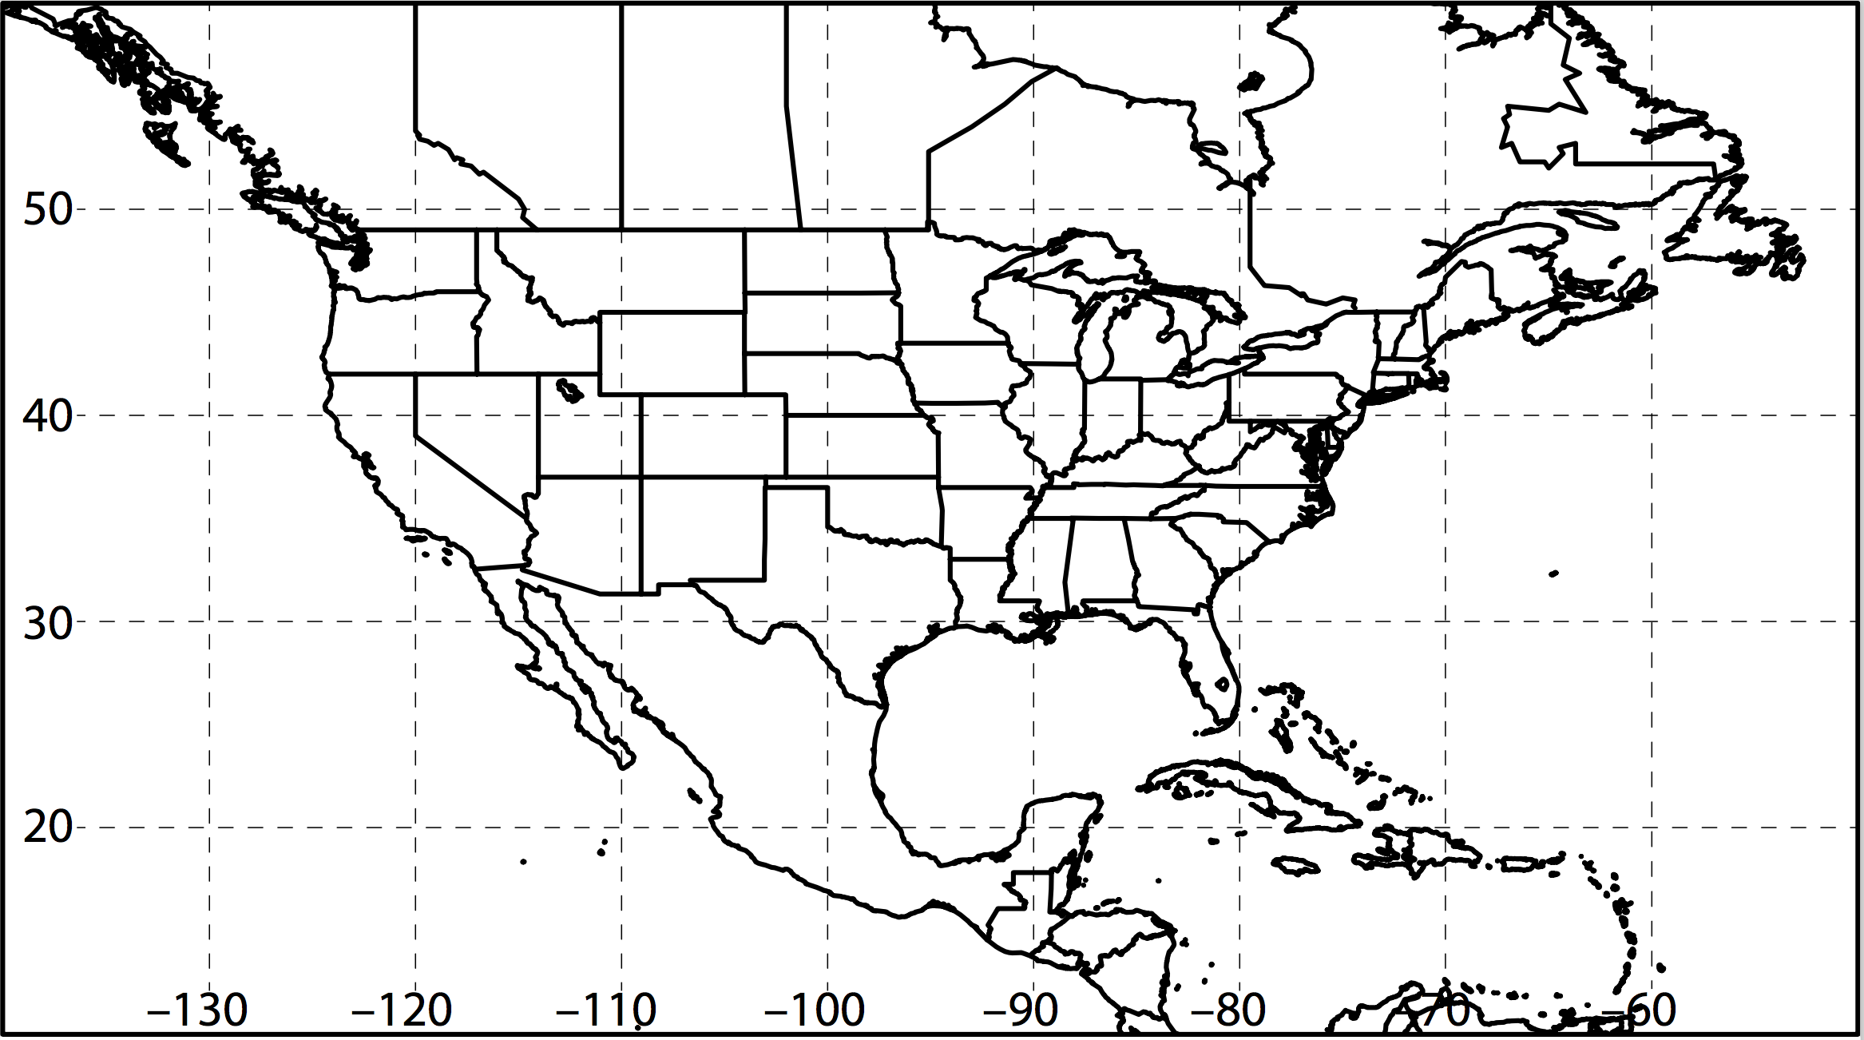
Extreme Event Identification
Extreme Cold Events:
Employed 1-h forecasts of 2-m temperature from the CFSR (0.5°× 0.5°) at 6-h intervals during 1979–2014 (Saha et al. 2014).
Compiled times during which at least one grid point was characterized by a temperature < 1st percentile within separate domains over the western and eastern U.S.
Western U.S.
Eastern U.S.

Slide 6
Extreme Event Identification
Extreme Cold Events:
Employed 1-h forecasts of 2-m temperature from the CFSR (0.5°× 0.5°) at 6-h intervals during 1979–2014 (Saha et al. 2014).
Compiled times during which at least one grid point was characterized by a temperature < 1st percentile within separate domains over the western and eastern U.S.
Identified times that ranked in the top 5% in terms of the number of grid points < 1st percentile as extreme cold events within each domain.
Western U.S.
Eastern U.S.

Slide 7
Extreme Event Identification
Extreme Cold Event Centroids: Eastern U.S. Domain (N = 225)
~Min. Size of an Extreme Cold Event

Slide 8
Extreme Event Identification
Extreme Cold Event Centroids: Eastern U.S. Domain (N = 225)
Northern Plains Cluster (N=65)
Southern Plains Cluster (N=58)
Southeast Cluster (N=50)
Northeast Cluster (N=52)
4 geographic clusters objectively identified using a k-means clustering algorithm

Slide 9
Extreme Event Identification
Extreme Cold Event Centroids: Eastern U.S. Domain (N = 225)
Northern Plains Cluster (N=65)
Southern Plains Cluster (N=58)
Southeast Cluster (N=50)
Northeast Cluster (N=52)
Considerable North Pacific Jet variability characterizes the antecedent environments associated with events in each geographic cluster

Slide 10
Antecedent Environments Associated with Cool-Season (Sept.–May) EWEs in the Context of North Pacific Jet Variability

Slide 11
250-hPa North Pacific Zonal Wind Variability
Removed the mean and the annual and diurnal cycles from 6-hourly, 250-hPa zonal wind data from the CFSR (1979–2014)
Restricted data to the cool season (Sept.–May)
Performed an EOF analysis on the zonal wind anomalies within the domain: 10–80°N ; 100°E–120°W
Analysis techniques and resultant EOF patterns are consistent with related work on the North Pacific Jet:
Athanasiadis et al. (2010)
Jaffe et al. (2011)
Griffin and Martin (2016)

Slide 12
250-hPa North Pacific Zonal Wind Variability
EOF 1 – Jet Extension/Retraction
Sept.–May mean 250-hPa zonal wind: black contours
Sept.–May 250-hPa zonal wind EOF 1 pattern: shading
+ EOF 1: Jet Extension
– EOF 1: Jet Retraction

Slide 13
250-hPa North Pacific Zonal Wind Variability
EOF 1 – Jet Extension/Retraction
Hypothetical Zonal Wind
Sept.–May mean 250-hPa zonal wind: black contours
Sept.–May 250-hPa zonal wind EOF 1 pattern: shading
+ EOF 1: Jet Extension
– EOF 1: Jet Retraction
Notes:
The outermost green contour is 20 m/s and contour interval for green contours is every 10 m/s. The green contours are calculated by adding the EOF patterns to the mean zonal wind. The resultant wind distribution would project onto the point (1,0) on the N. Pacific Jet phase diagram.

Slide 14
250-hPa North Pacific Zonal Wind Variability
EOF 1 – Jet Extension/Retraction
Hypothetical Zonal Wind
Sept.–May mean 250-hPa zonal wind: black contours
Sept.–May 250-hPa zonal wind EOF 1 pattern: shading
+ EOF 1: Jet Extension
– EOF 1: Jet Retraction
Notes:
The distribution of zonal wind in this slide would project onto the point (-1,0) on the N. Pacific Jet phase diagram.

Slide 15
250-hPa North Pacific Zonal Wind Variability
EOF 2 – Poleward/Equatorward Shift
Sept.–May mean 250-hPa zonal wind: black contours
Sept.–May 250-hPa zonal wind EOF 2 pattern: shading
+ EOF 2: Poleward Shift
– EOF 2: Equatorward Shift

Slide 16
250-hPa North Pacific Zonal Wind Variability
EOF 2 – Poleward/Equatorward Shift
Hypothetical Zonal Wind
Sept.–May mean 250-hPa zonal wind: black contours
Sept.–May 250-hPa zonal wind EOF 2 pattern: shading
+ EOF 2: Poleward Shift
– EOF 2: Equatorward Shift
Notes:
The zonal wind pattern in green would project onto the point (0,1) on the N. Pacific Jet phase diagram.

Slide 17
250-hPa North Pacific Zonal Wind Variability
EOF 2 – Poleward/Equatorward Shift
Hypothetical Zonal Wind
Sept.–May mean 250-hPa zonal wind: black contours
Sept.–May 250-hPa zonal wind EOF 2 pattern: shading
+ EOF 2: Poleward Shift
– EOF 2: Equatorward Shift
Notes:
The zonal wind pattern in green would project onto the point (0,-1) on the N. Pacific Jet phase diagram.

Slide 18
250-hPa North Pacific Zonal Wind Variability
0000 UTC 8 November 2014
250-hPa wind speed: shaded
Instantaneous 250-hPa zonal wind anomalies can be projected onto EOF 1 and EOF 2, resulting in a point on a North Pacific Jet phase diagram

Slide 19
250-hPa North Pacific Zonal Wind Variability
Extreme Cold Event Centroids: Eastern U.S. Domain (N = 225)
Northern Plains Cluster (N=65)
Southern Plains Cluster (N=58)
Southeast Cluster (N=50)
Northeast Cluster (N=52)
Projecting antecedent environments associated with extreme cold events onto the North Pacific Jet phase diagram can identify flow patterns conducive to the development of these events

Slide 20
Eastern U.S. – S. Plains Cluster
Extreme Cold Event Centroids
COLD EVENTS (N = 48)
Poleward Shift
4
Events during
Sept. – May projected onto phase diagram
4
Jet Retraction
14
Jet Extension
Each point is an average of the PCs
3–7 days prior to an event
26
Equatorward Shift
–4

Slide 21
Eastern U.S. – S. Plains Cluster
Extreme Cold Event Centroids
COLD EVENTS (N = 48)
Poleward Shift
4
Events during
Sept. – May projected onto phase diagram
4
Jet Retraction
14
Jet Extension
Each point is an average of the PCs
3–7 days prior to an event
26
Equatorward Shift
–4

Slide 22
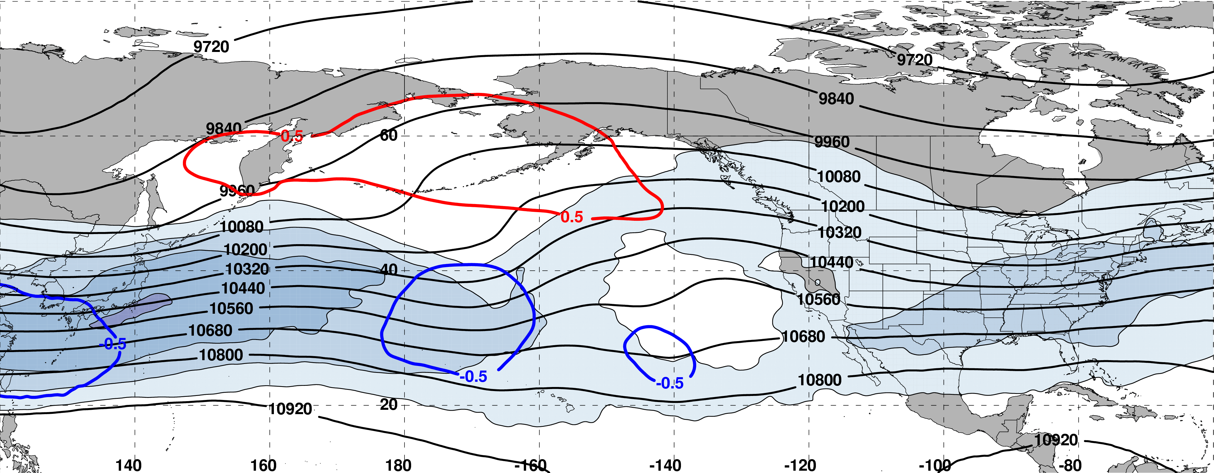
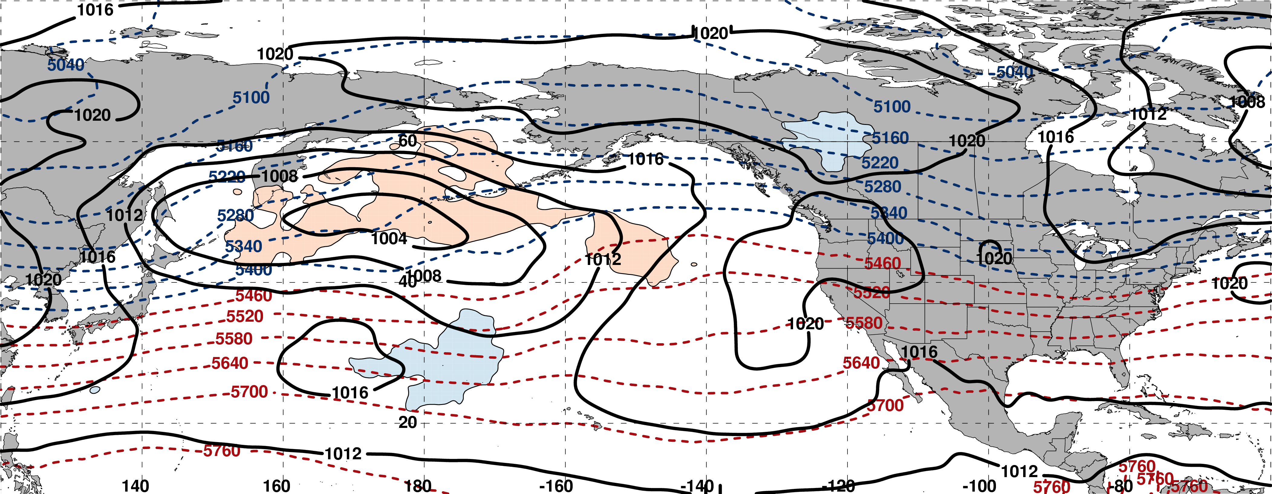
250-hPa Wind Speed, Geo. Heights, Std. Height Anomalies: Day −6
m s^{–1}
m s^{–1}
Mean Sea-Level Pressure, 1000–500-hPa Thickness, 850-hPa Std. Temp. Anomalies: Day −6
H
L
H
H
σ

Slide 23
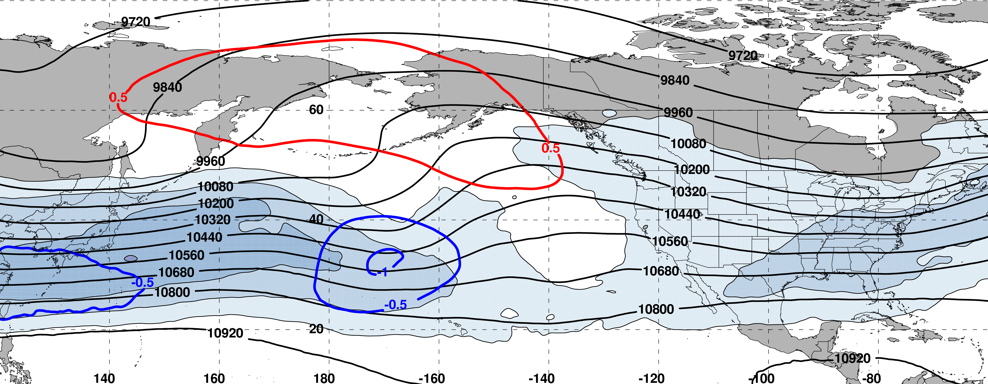
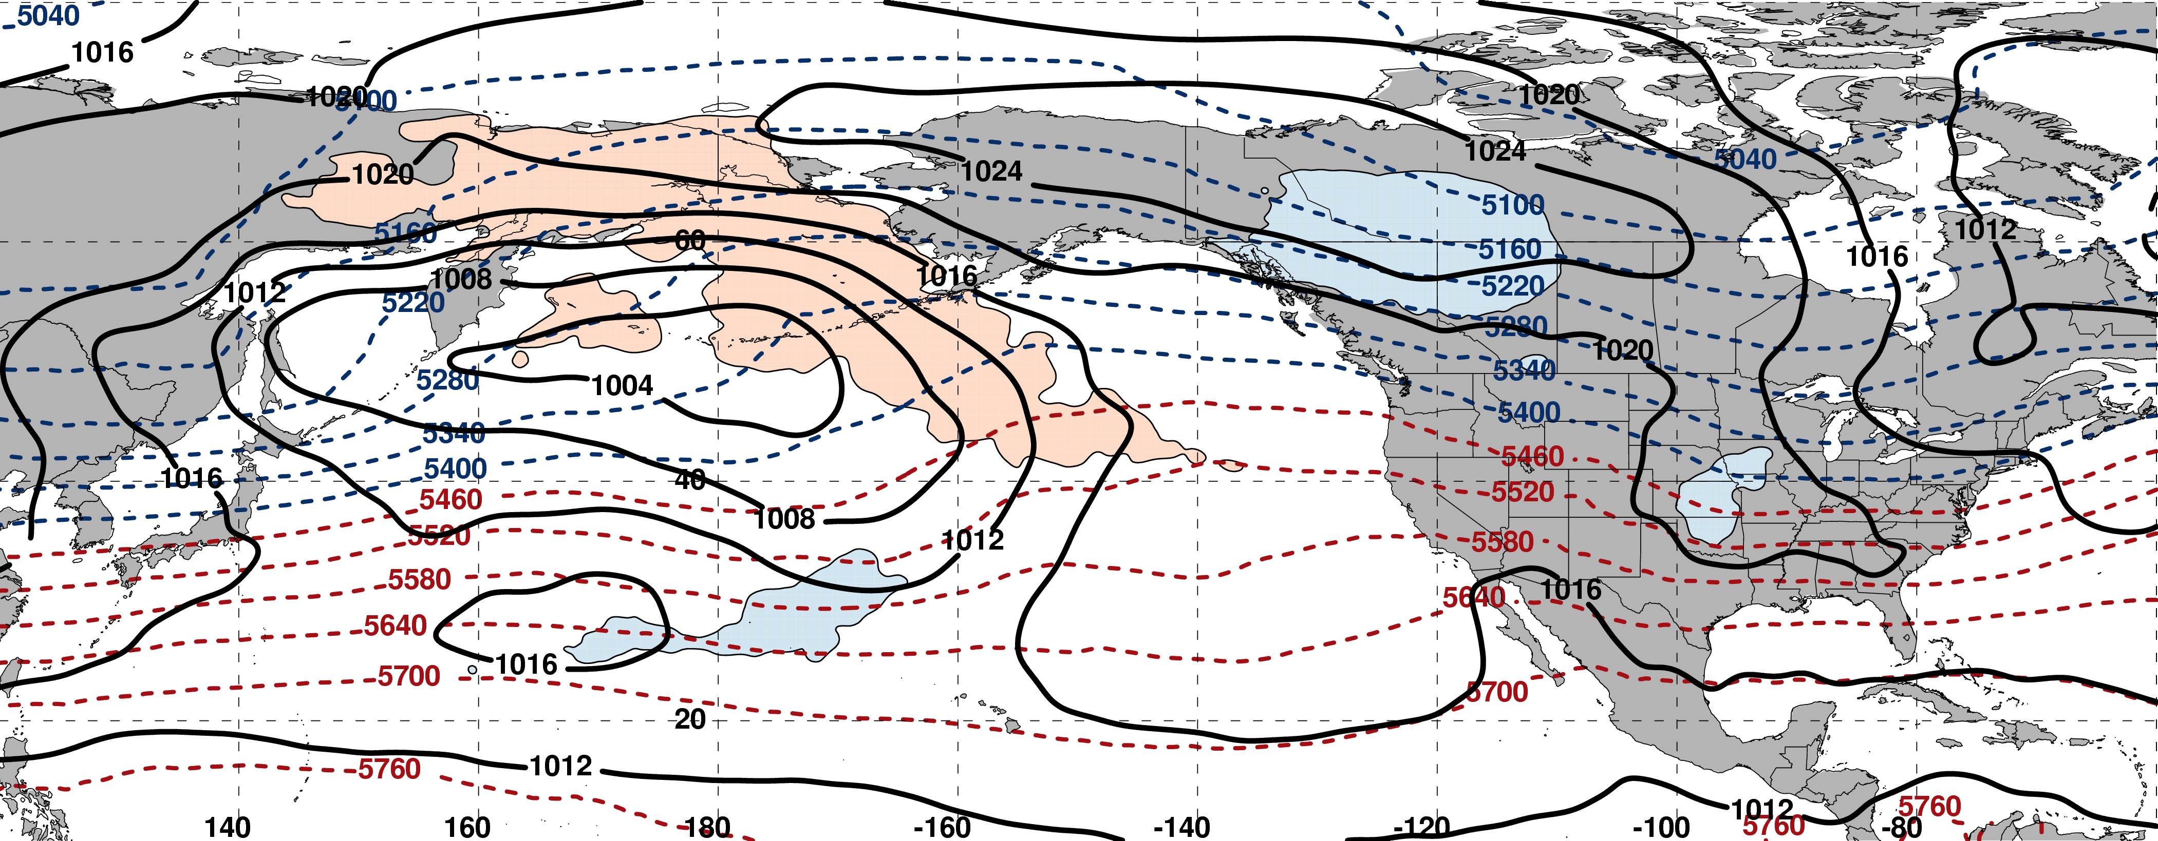
250-hPa Wind Speed, Geo. Heights, Std. Height Anomalies: Day −5
m s^{–1}
m s^{–1}
Mean Sea-Level Pressure, 1000–500-hPa Thickness, 850-hPa Std. Temp. Anomalies: Day −5
H
L
H
σ

Slide 24
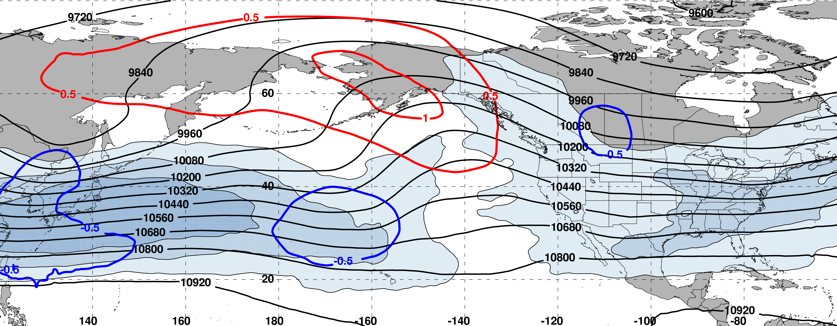
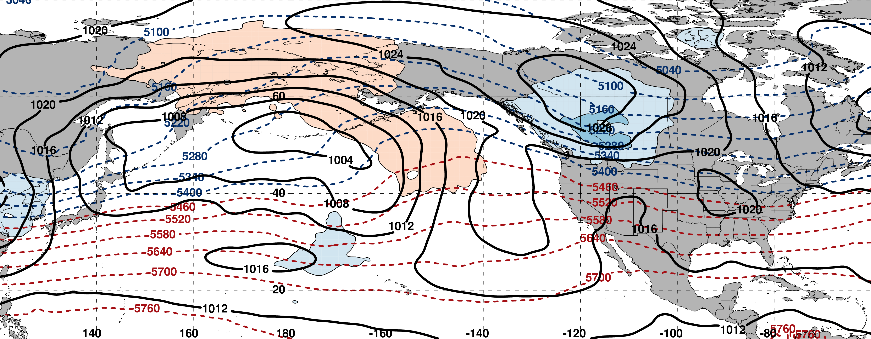
250-hPa Wind Speed, Geo. Heights, Std. Height Anomalies: Day −4
m s^{–1}
m s^{–1}
Mean Sea-Level Pressure, 1000–500-hPa Thickness, 850-hPa Std. Temp. Anomalies: Day −4
H
L
H
σ

Slide 25
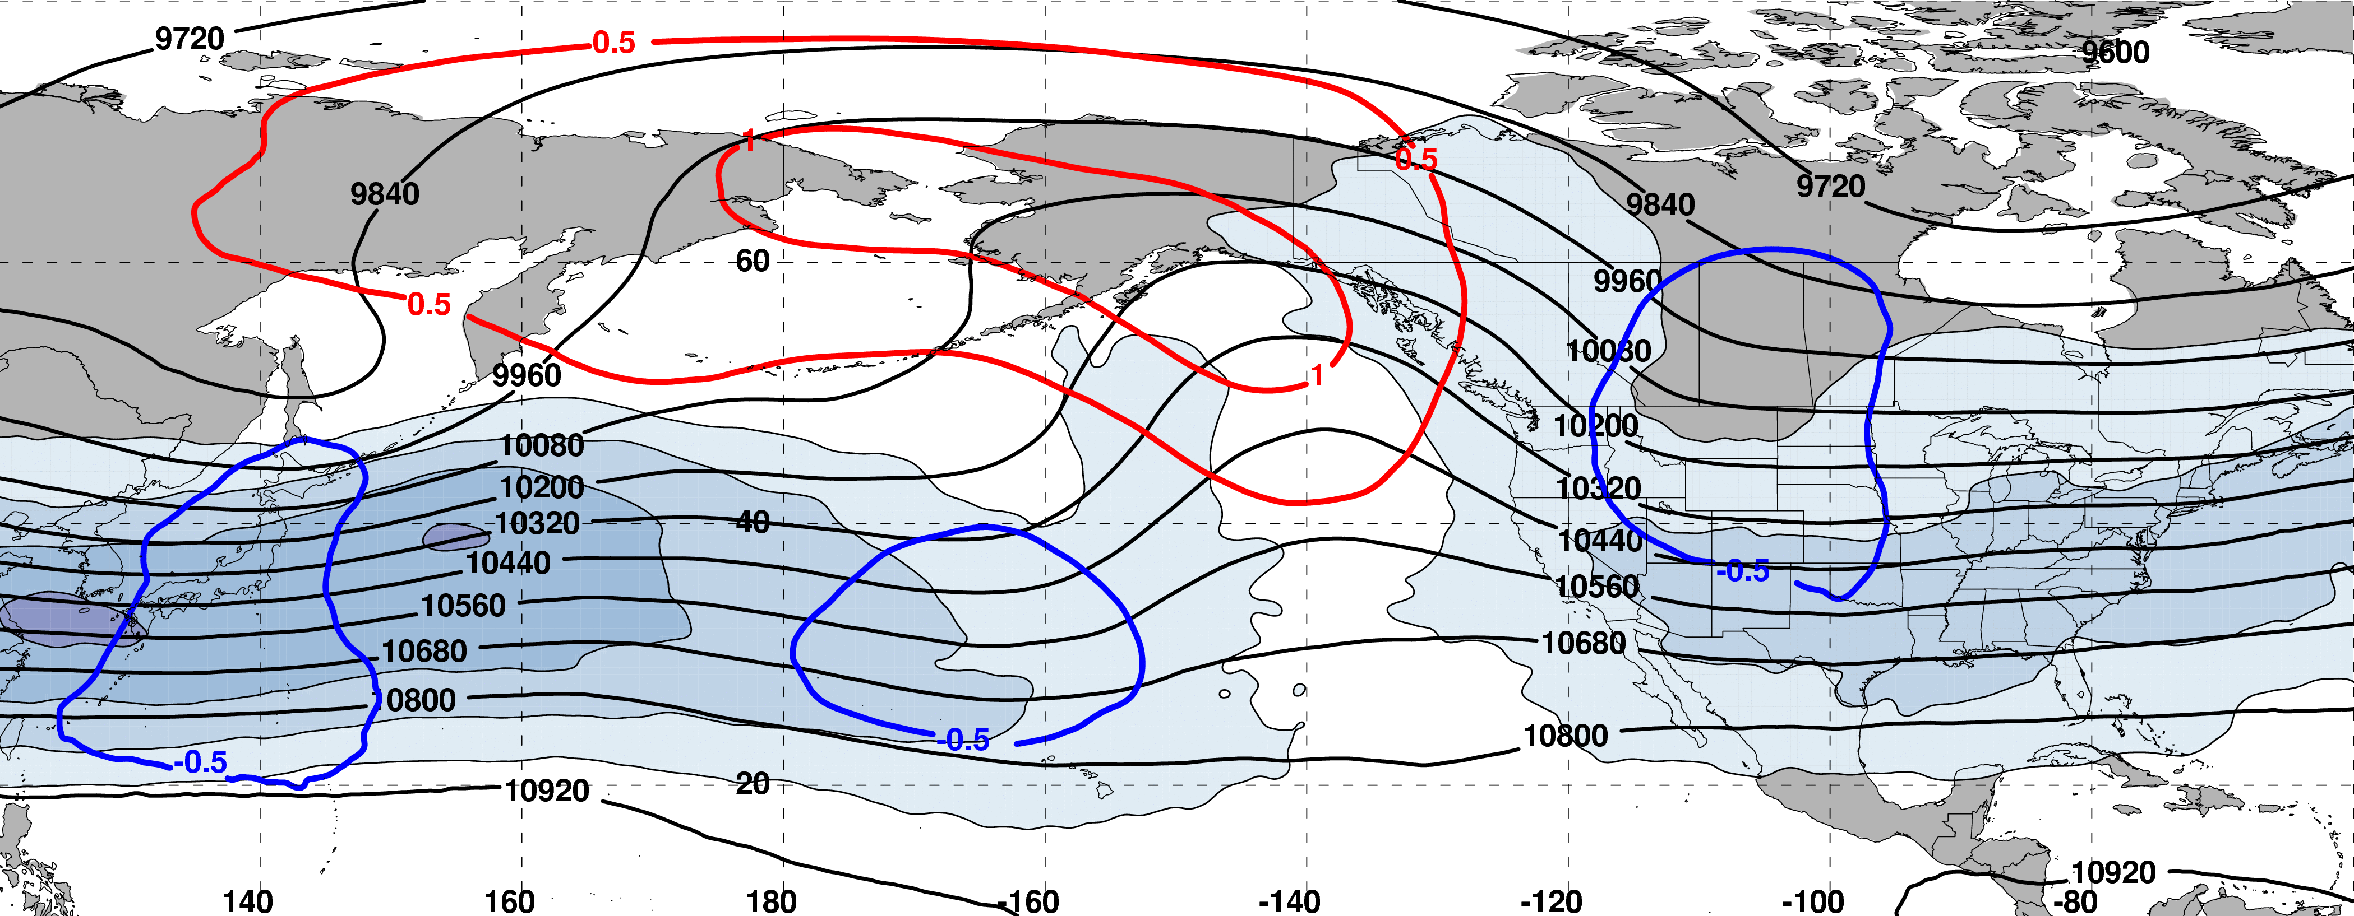
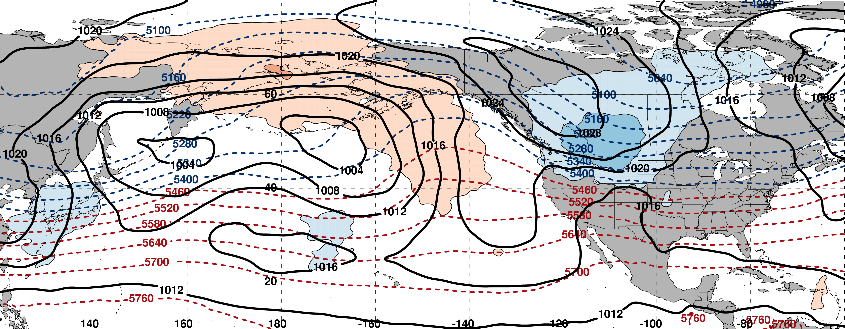
250-hPa Wind Speed, Geo. Heights, Std. Height Anomalies: Day −3
m s^{–1}
m s^{–1}
Mean Sea-Level Pressure, 1000–500-hPa Thickness, 850-hPa Std. Temp. Anomalies: Day −3
H
L
L
σ

Slide 26
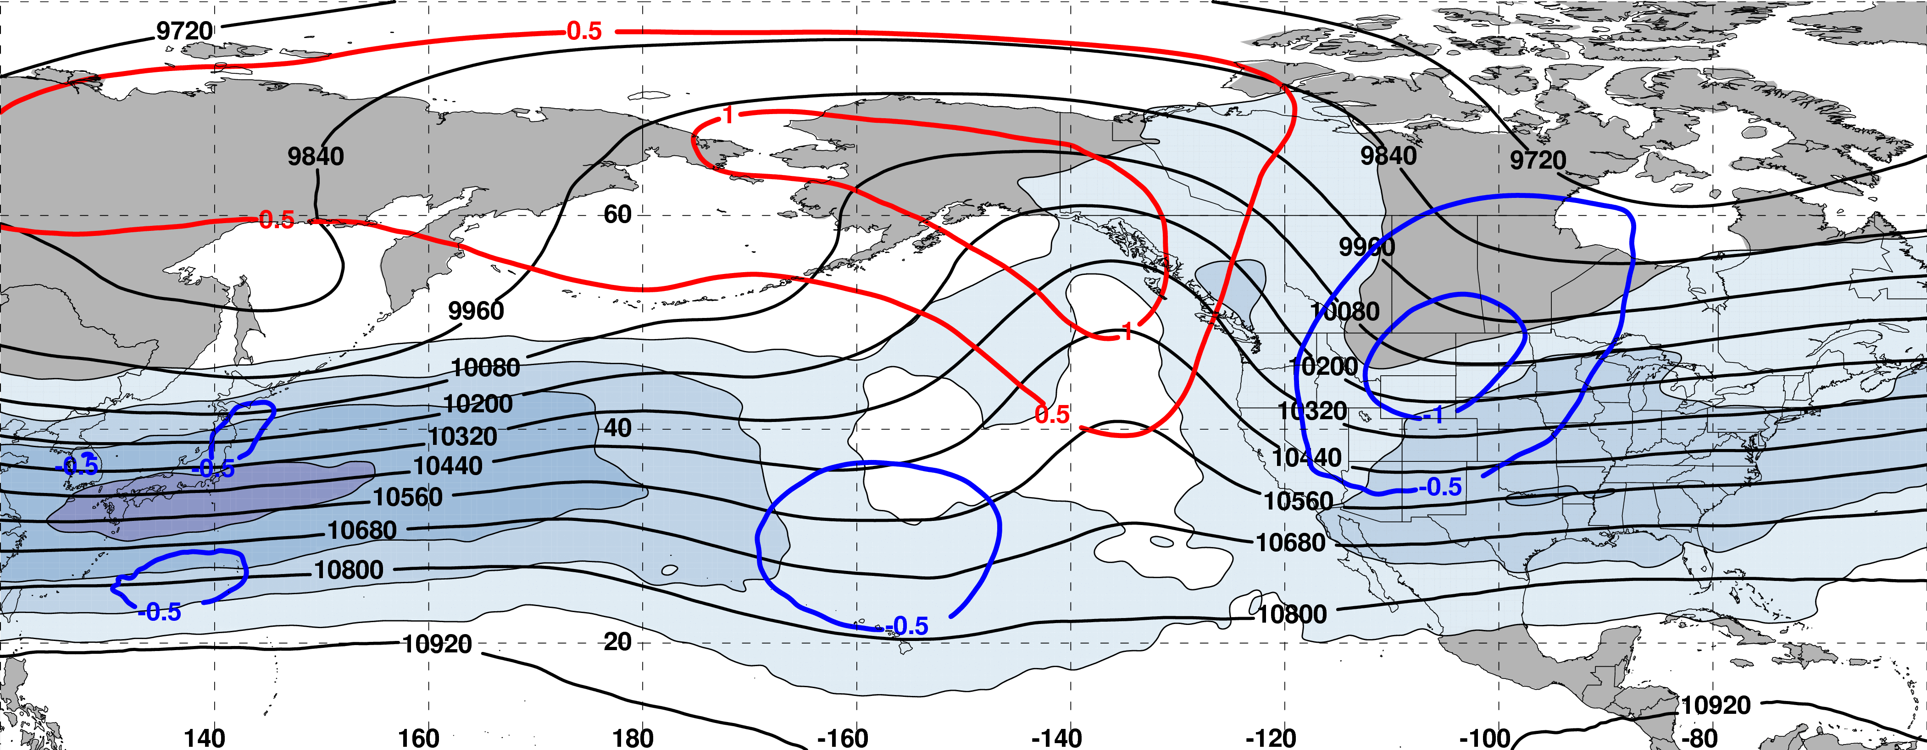
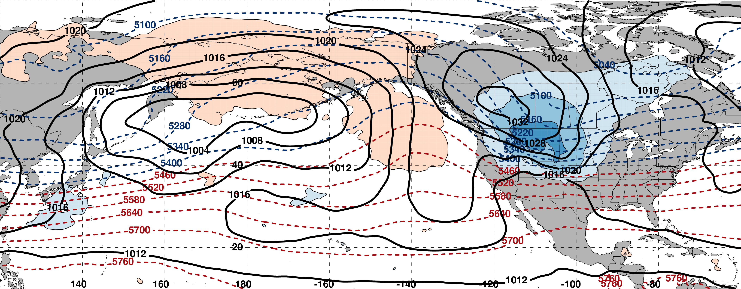
250-hPa Wind Speed, Geo. Heights, Std. Height Anomalies: Day −2
m s^{–1}
m s^{–1}
Mean Sea-Level Pressure, 1000–500-hPa Thickness, 850-hPa Std. Temp. Anomalies: Day −2
L
H
L
σ

Slide 27
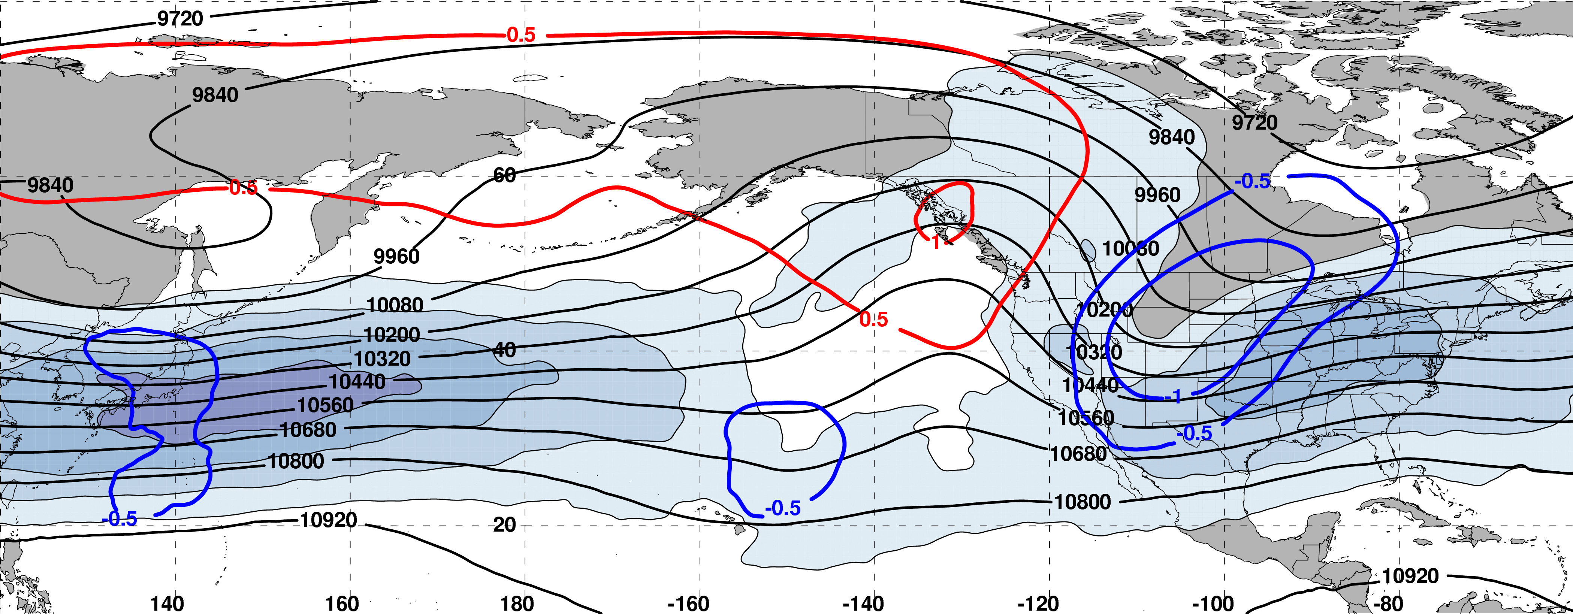
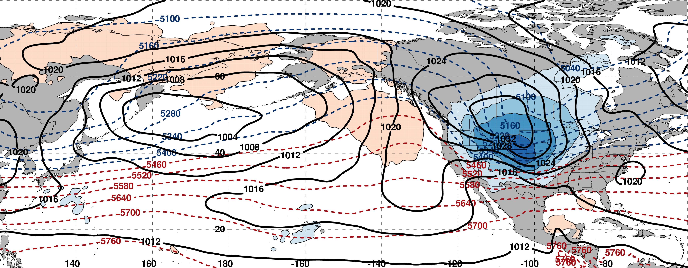
250-hPa Wind Speed, Geo. Heights, Std. Height Anomalies: Day −1
m s^{–1}
m s^{–1}
Mean Sea-Level Pressure, 1000–500-hPa Thickness, 850-hPa Std. Temp. Anomalies: Day −1
L
H
σ

Slide 28
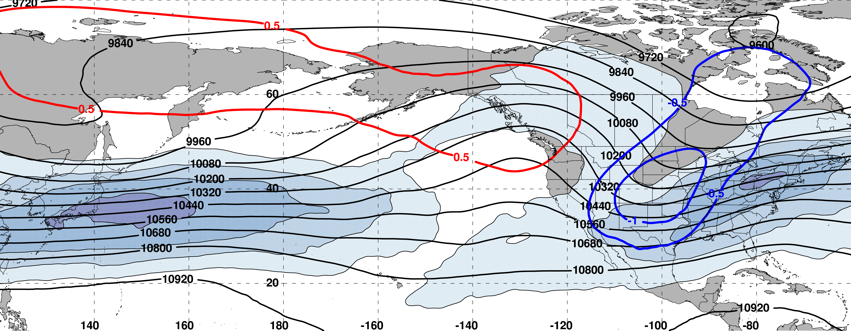
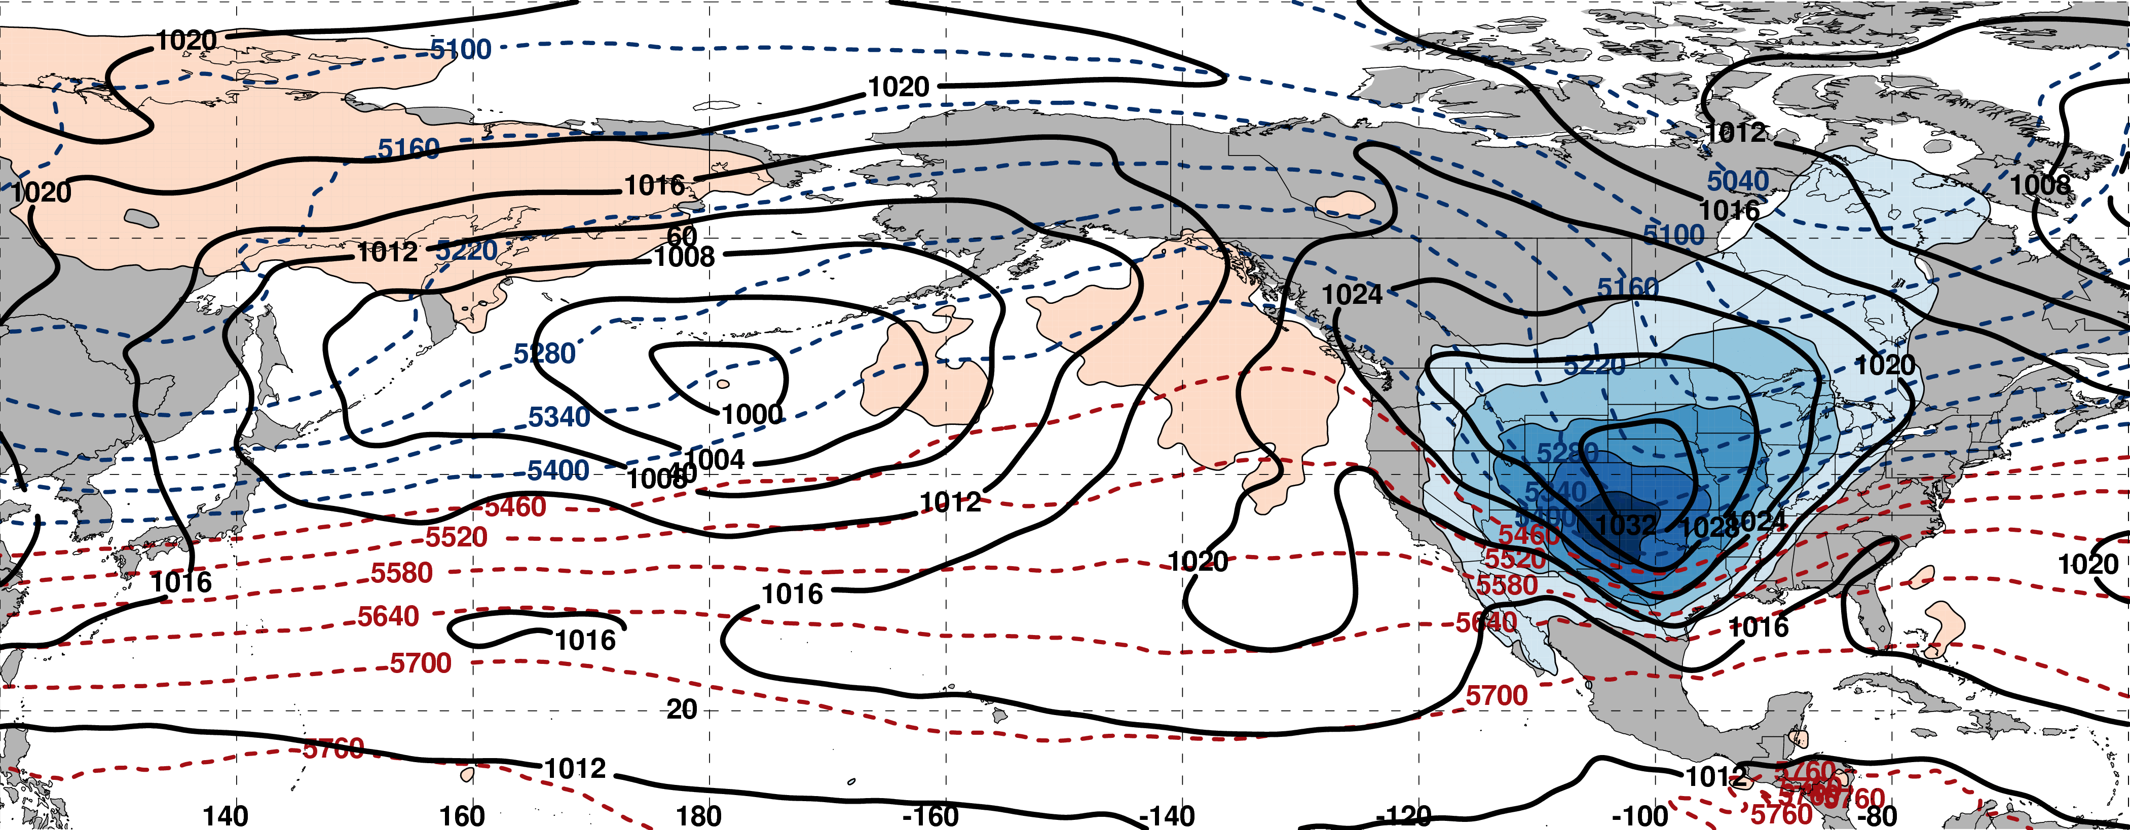
250-hPa Wind Speed, Geo. Heights, Std. Height Anomalies: Day 0
m s^{–1}
m s^{–1}
Mean Sea-Level Pressure, 1000–500-hPa Thickness, 850-hPa Std. Temp. Anomalies: Day 0
L
H
L
σ

Slide 29
Eastern U.S. – S. Plains Cluster
Extreme Cold Event Centroids
COLD EVENTS (N = 48)
Poleward Shift
4
Events during
Sept. – May projected onto phase diagram
4
Jet Retraction
14
Jet Extension
Each point is an average of the PCs
3–7 days prior to an event
26
Equatorward Shift
–4

Slide 30
Additional Applications of the North Pacific Jet Phase Diagram

Slide 31
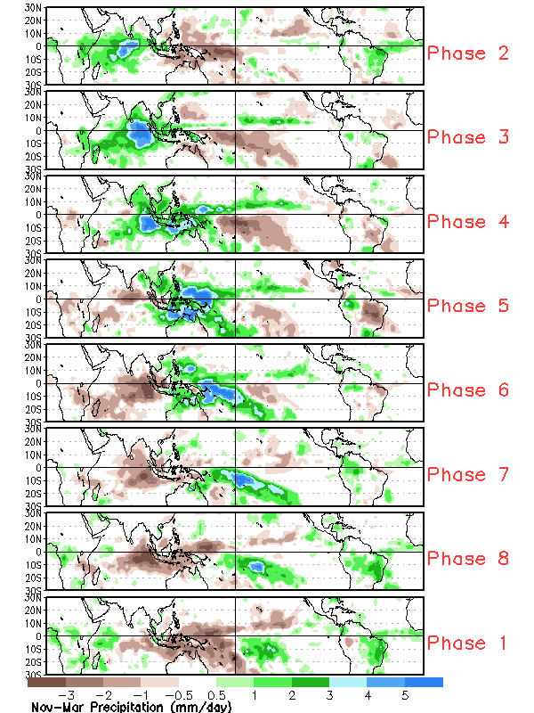
Jet Regime Frequency and the MJO
The Madden–Julian Oscillation (MJO) is a leading mode of intraannual variability in the tropics with a period of 30–60 days.
Climate Prediction Center
Nov–Mar Composite Daily Precipitation (mm)

Slide 32
Jet Regime Frequency and the MJO
The Madden–Julian Oscillation (MJO) is a leading mode of intraannual variability in the tropics with a period of 30–60 days.
The MJO is characterized by an eastward propagating region of enhanced convection in the equatorial Indian and Pacific Oceans.
Climate Prediction Center
Nov–Mar Composite Daily Precipitation (mm)

Slide 33
Jet Regime Frequency and the MJO
The Madden–Julian Oscillation (MJO) is a leading mode of intraannual variability in the tropics with a period of 30–60 days.
The MJO is characterized by an eastward propagating region of enhanced convection in the equatorial Indian and Pacific Oceans.
The location of convection can strongly modulate the midlatitude circulation.
Climate Prediction Center
Nov–Mar Composite Daily Precipitation (mm)

Slide 34
Jet Regime Frequency and the MJO
Jet Retractions are favored during Phases 2, 3, and 4
Poleward Shifts are favored during Phases 5 and 6
Jet Extensions are favored during Phases 7, 8, and 1

Slide 35
Summary
The North Pacific Jet phase diagram is a tool that objectively characterizes the upper-tropospheric flow pattern over the North Pacific.
Notes:
Remove ½ , etc. Revise third bullet so it is parallel to fourth.

Slide 36
Summary
The North Pacific Jet phase diagram is a tool that objectively characterizes the upper-tropospheric flow pattern over the North Pacific.
The North Pacific Jet phase diagram can be used to identify antecedent environments that are favorable for the production of extreme weather events over the U.S.
Notes:
Remove ½ , etc. Revise third bullet so it is parallel to fourth.

Slide 37
Summary
The North Pacific Jet phase diagram is a tool that objectively characterizes the upper-tropospheric flow pattern over the North Pacific.
The North Pacific Jet phase diagram can be used to identify antecedent environments that are favorable for the production of extreme weather events over the U.S.
The North Pacific Jet phase diagram can describe the relationship between the midlatitude upper-tropospheric flow pattern and modes of interannual and intraannual variability in the tropics.
Notes:
Remove ½ , etc. Revise third bullet so it is parallel to fourth.

Slide 38
Summary
The North Pacific Jet phase diagram is a tool that objectively characterizes the upper-tropospheric flow pattern over the North Pacific.
The North Pacific Jet phase diagram can be used to identify antecedent environments that are favorable for the production of extreme weather events over the U.S.
The North Pacific Jet phase diagram can describe the relationship between the midlatitude upper-tropospheric flow pattern and modes of interannual and intraannual variability in the tropics.
Notes:
Remove ½ , etc. Revise third bullet so it is parallel to fourth.

Slide 39
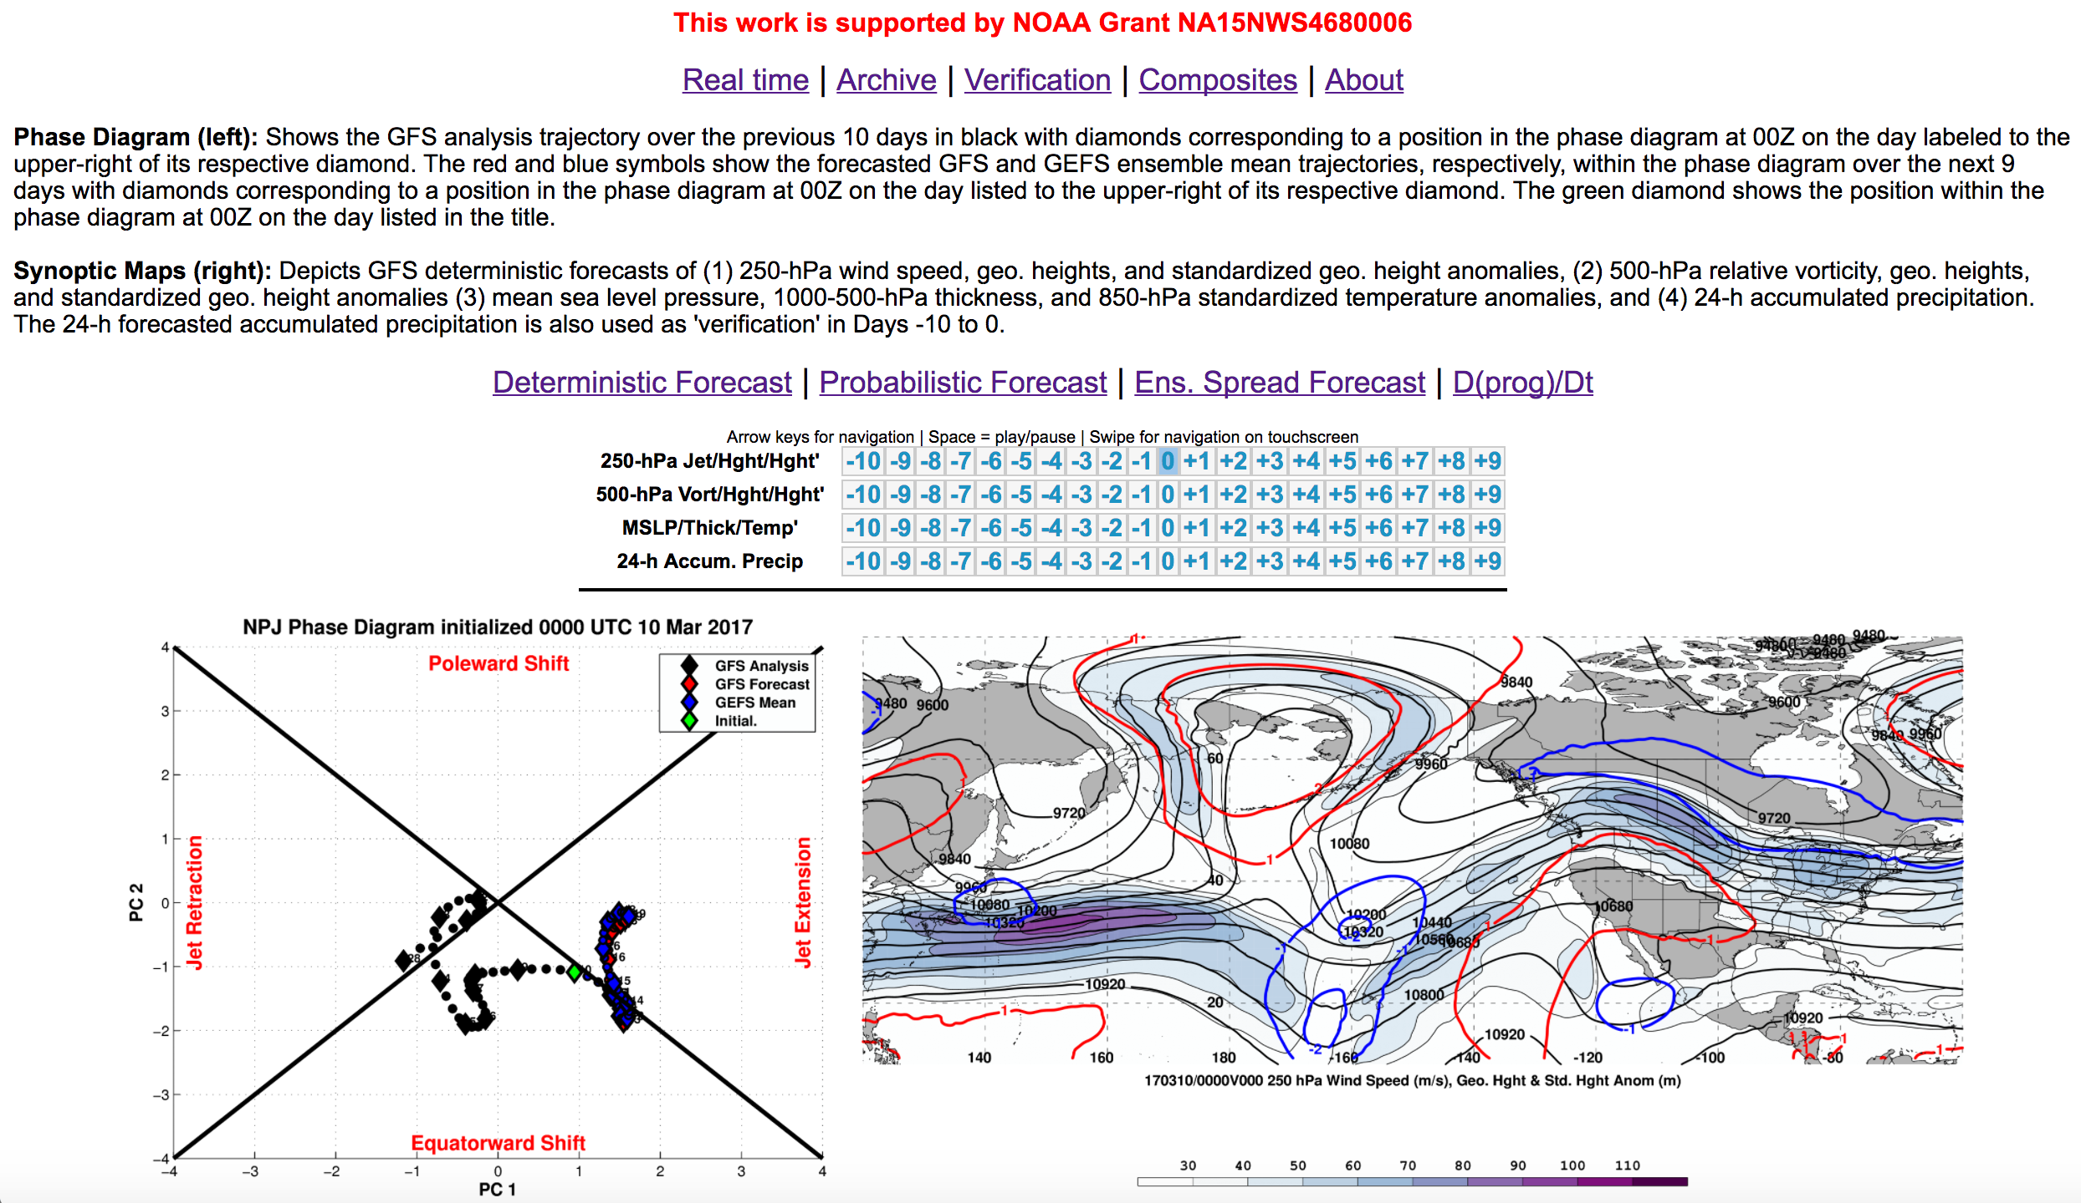
Phase Diagram Web Interface

Slide 40
Phase Diagram Web Interface

Slide 41
Phase Diagram Web Interface

Slide 42
Phase Diagram Web Interface

Slide 43
Summary
A web interface has been developed that offers real time North Pacific Jet phase diagram forecasts and extreme event composites.
http://www.atmos.albany.edu/facstaff/awinters/realtime/About_EOFs.php
Contact: acwinters@albany.edu
Special thanks to Mike Bodner (WPC), Arlene Laing (NOAA), and Dan Halperin (WPC) for their collaboration on this work

Slide 44
Supplementary Slides

Slide 45
References
Athanasiadis, P. J., J. M. Wallace, and J. J. Wettstein, 2010: Patterns of wintertime jet stream variability and their relation to the storm tracks. J. Atmos. Sci., 67, 1361–1381.
Griffin, K. S., and J. E. Martin, 2016: Synoptic features associated with temporally coherent modes of variability of the North Pacific jet stream. J. Climate, 29, in press.
Hamill, T. M., G. T. Bates, J. S. Whitaker, D. R. Murray, M. Fiorino, T. J. Galarneau, Y. Zhu, and W. Lapenta, 2013: NOAA’s Second-Generation Global Medium-Range Ensemble Forecast Dataset. Bull. Amer. Meteor. Soc., 94, 1553–1565.
Jaffe, S. C., J. E. Martin, D. J. Vimont, and D. L. Lorenz, 2011: A synoptic climatology of episodic, subseasonal retractions of the Pacific jet. J. Climate, 24, 2846–2860.
Saha, S., and Coauthors, 2014: The NCEP Climate Forecast System Version 2. J. Climate, 27, 2185–2208.

Slide 46
Project Outcomes
Provide forecasters with a “first alert” to the possibility of the occurrence of extreme temperature and precipitation events during week two on the basis of current conditions and model forecasts.
Provide forecasters with an indication of the character and flavor of possible extreme events as inferred from where the events lie in the frequency distributions of the anticipated event types.
Provide forecasters with knowledge that allows them to make science-based adjustments to model guidance and add value to week two forecasts of temperature and precipitation.

Slide 47
Extreme Event Identification

Slide 48
Extreme Event Identification
Extreme Warm Events:
Employed 1-h forecasts of 2-m temperature from the CFSR (0.5°× 0.5°) at 6-h intervals
Compiled data for each grid point within 21-day windows centered on each analysis time for 36 years, 1979–2014
  Each grid point has 756 (21×36) data points for each analysis time
Determined the temperature that corresponds to the 99th percentile for each grid point at a given analysis time
Frequency distribution of 2-m temperature at
1900 UTC 30 May for a grid point near Albany, NY

Slide 49
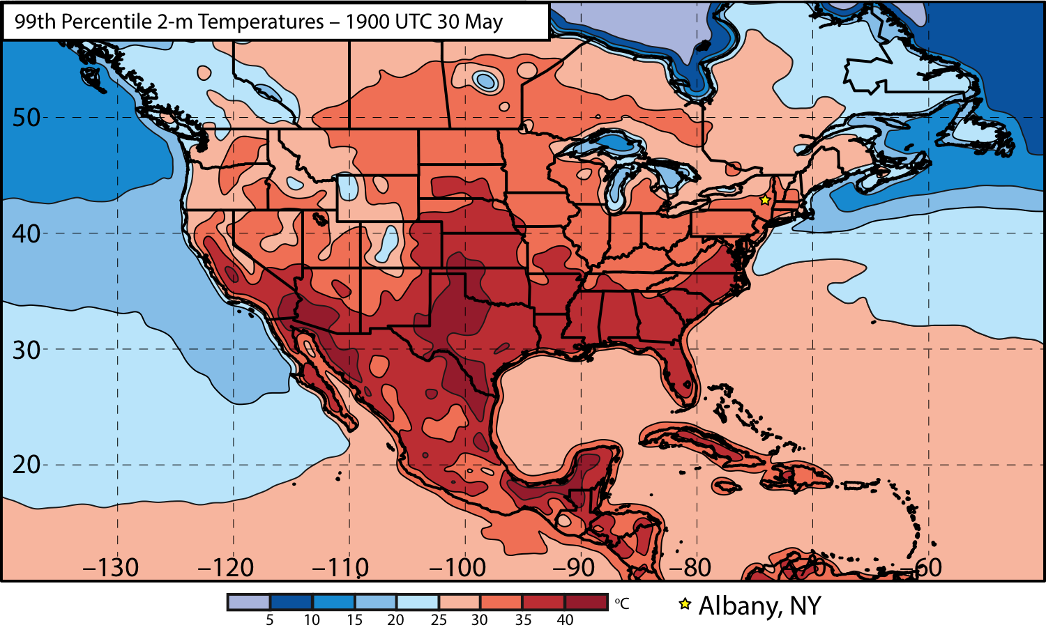
Extreme Event Identification

Slide 50
Extreme Event Identification
Western U.S.
Eastern U.S.

Slide 51
Extreme Event Identification
Extreme Warm Events:
Cataloged times during which at least one grid point was characterized by a temperature > 99th percentile
Ranked times within each domain by the number of grid points > 99th percentile
Identified times that rank in the top 5% in terms of the number of grid points > 99th percentile within each domain as extreme warm events
Frequency distribution of times exhibiting at least one grid point > 99th percentile

Slide 52
Extreme Event Identification
Extreme Precip. Events:
Employed CPC Unified Gauge-Based Analysis of Daily Precipitation over CONUS during 1979–2014 (0.25°× 0.25°)
Compiled data within 21-day windows centered on each time for all 36 years
  Each grid point has (21 × 36) 756 data points for a given time
Determined the precipitation values that correspond to the 99th percentile for each grid point at a given time (only for days precipitation was observed)
Identified times that rank in the top 5% in terms of the number of grid points > 99th percentile within each domain as extreme precipitation events

Slide 53
Extreme Event Identification
Temperature
Eastern U.S. (1st % Cold):
- Threshold: 221 grid points
~7.0°×7.0° box
- After QC: 225 events
Eastern U.S. (99th % Warm):
- Threshold: 224 grid points
~7.0°×7.0° box
- After QC: 304 events
Western U.S. (1st % Cold):
- Threshold: 125 grid points
~5.0°×5.0° box
- After QC: 271 events
Western U.S. (99th % Warm):
- Threshold: 144 grid points
~5.5°×5.5° box
- After QC: 264 events
Precipitation
Eastern U.S. (99th %):
- Threshold: 211 grid points
~3.5°×3.5° box
- After QC: 351 events
Western U.S. (99th %):
- Threshold: 141 grid points
~2.75°×2.75° box
- After QC: 333 events
Quality control: Events within 24-h of another event were considered to be the same event.

Slide 54
Extreme Event Identification
Extreme Warm Event Frequency: Eastern U.S. Domain (n = 304)

Slide 55
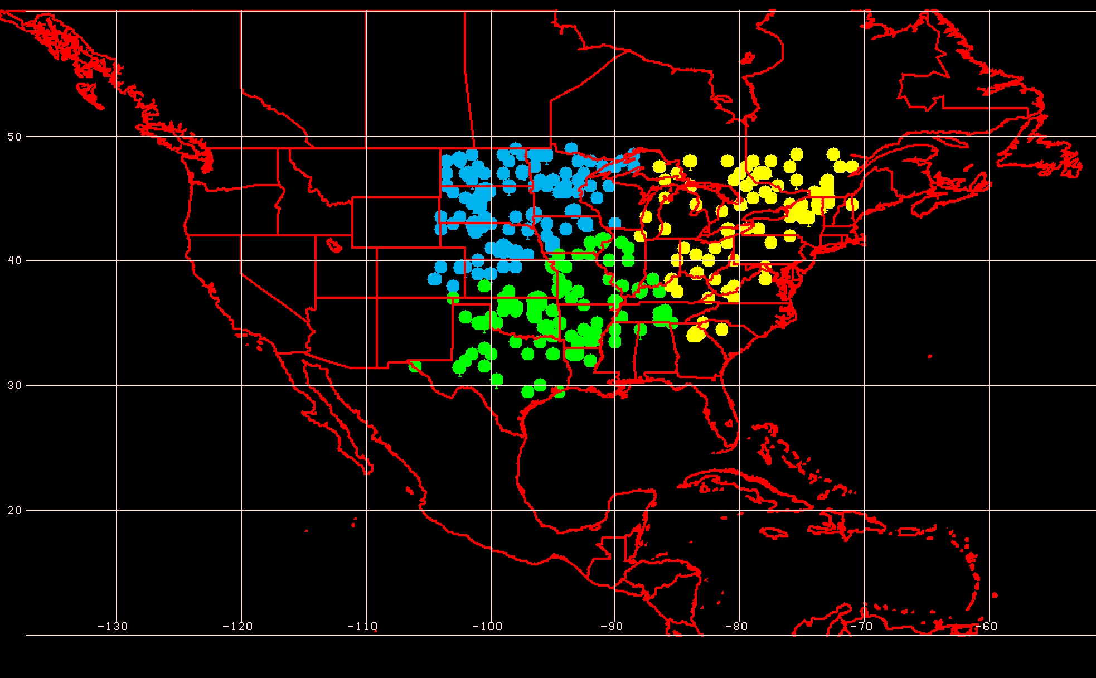
Geographic Event Clusters
Extreme Warm Event Centroids East of the Rockies

Slide 56
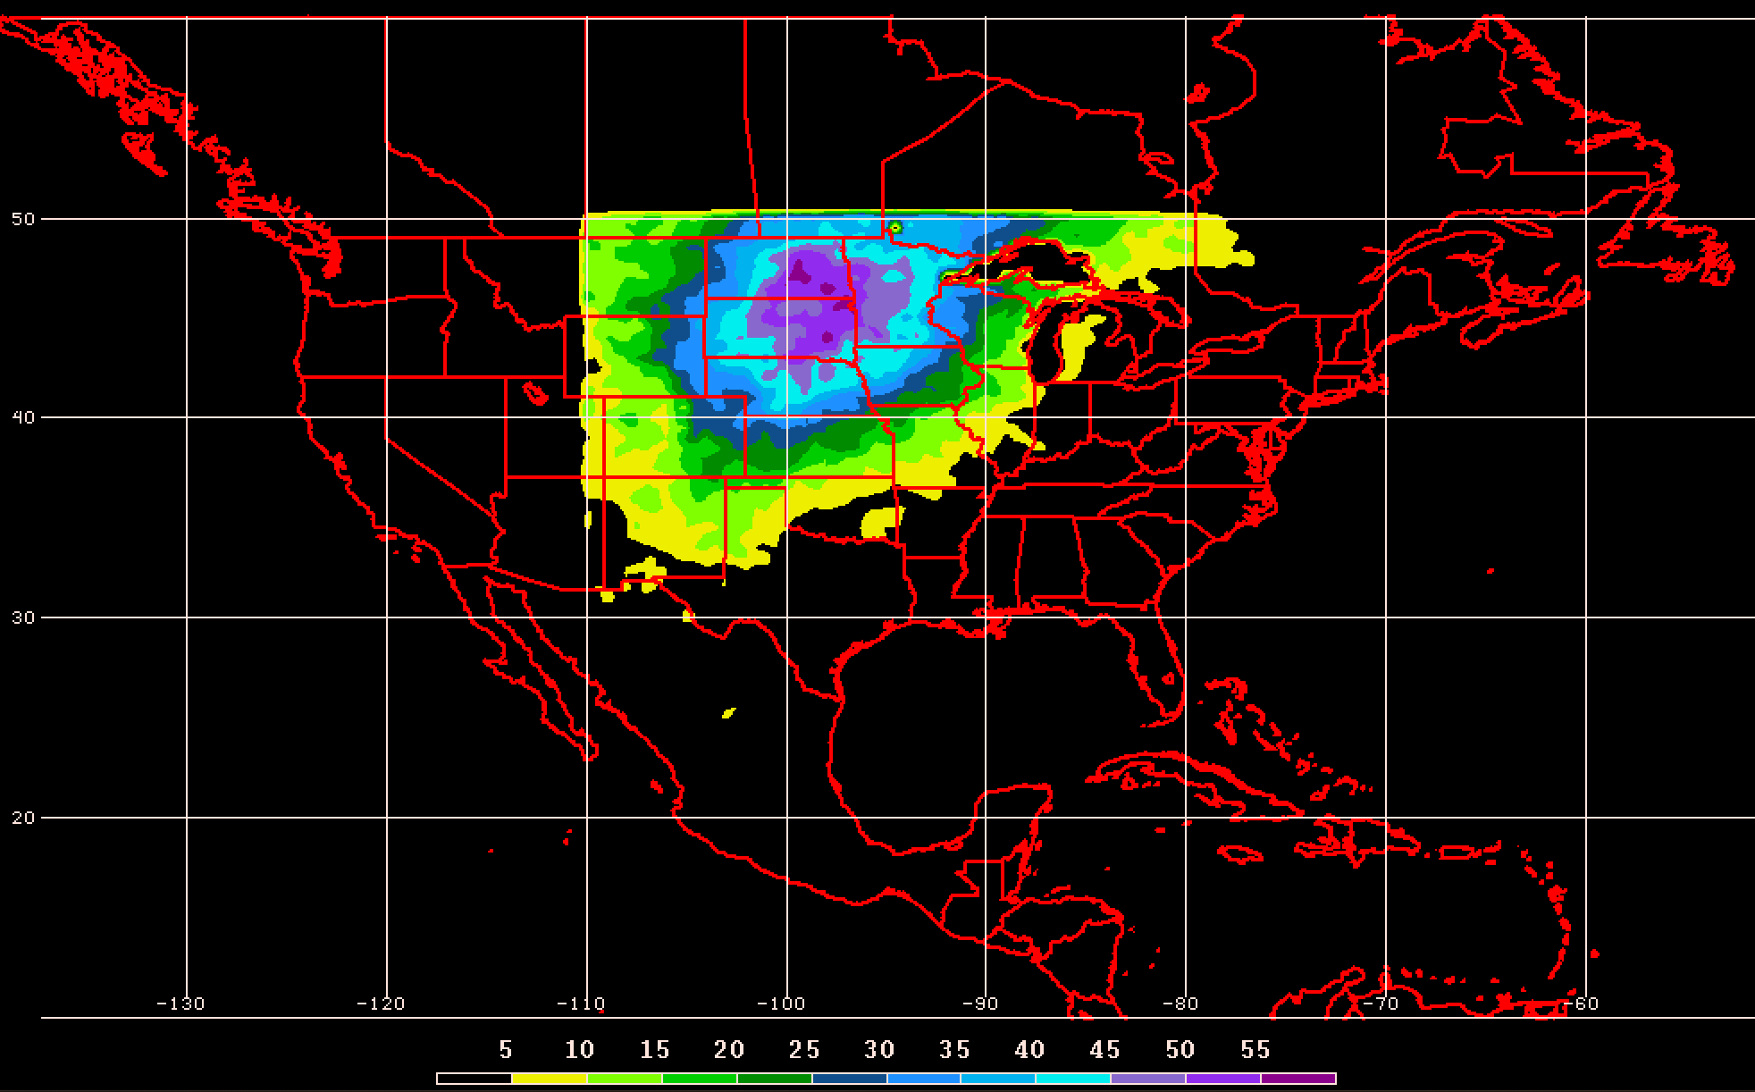
Geographic Event Clusters
Extreme Warm Event Frequency for Northern Plains

Slide 57
Eastern U.S. – S. Plains Cluster
Extreme Cold Event Centroids
COLD EVENTS (N = 48)
Poleward Shift
4
Events during
Sept. – May projected onto phase diagram
4
Jet Retraction
14
Jet Extension
Each point is an average of the PCs
3–7 days prior to an event
26
Equatorward Shift
–4
Mean Projection

Slide 58
Eastern U.S. – S. Plains Cluster
Extreme Warm Event Centroids
WARM EVENTS (N = 84)
Poleward Shift
18
Events during
Sept. – May projected onto phase diagram
35
Jet Retraction
15
Jet Extension
Each point is an average of the PCs
3–7 days prior to an event
16
Equatorward Shift
–4
Mean Projection

Slide 59
Eastern U.S. – All Events
Extreme Cold Event Centroids
COLD EVENTS (N = 173)
Poleward Shift
23
Events during
Sept. – May projected onto phase diagram
30
Jet Retraction
47
Jet Extension
Each point is an average of the PCs
3–7 days prior to an event
73
Equatorward Shift
Mean Projection

Slide 60
Eastern U.S. – All Events
Extreme Warm Event Centroids
WARM EVENTS (N = 239)
Poleward Shift
66
Events during
Sept. – May projected onto phase diagram
69
Jet Retraction
47
Jet Extension
Each point is an average of the PCs
3–7 days prior to an event
57
Equatorward Shift
Mean Projection

Slide 61
Western U.S. – Pac. NW Cluster
Extreme Cold Event Centroids
COLD EVENTS (N = 78)
Poleward Shift
18
Events during
Sept. – May projected onto phase diagram
31
Jet Retraction
9
Jet Extension
Each point is an average of the PCs
3–7 days prior to an event
20
Equatorward Shift

Slide 62
Western U.S. – Pac. NW Cluster
Extreme Warm Event Centroids
WARM EVENTS (N = 89)
Poleward Shift
22
Events during
Sept. – May projected onto phase diagram
13
Jet Retraction
27
Jet Extension
Each point is an average of the PCs
3–7 days prior to an event
27
Equatorward Shift
Mean Projection

Slide 63
Eastern U.S. – NE Cluster
Extreme Cold Event Centroids
COLD EVENTS (n = 39)
Poleward Shift
4
Events during
Sept. – May projected onto phase diagram
10
Jet Retraction
12
Jet Extension
Each point is an average of the PCs for
3–7 days prior to the event
13
Equatorward Shift

Slide 64
Eastern U.S. – NE Cluster
Extreme Warm Event Centroids
WARM EVENTS (n = 61)
Poleward Shift
20
Events during
Sept. – May projected onto phase diagram
10
Jet Retraction
14
Jet Extension
Each point is an average of the PCs for
3–7 days prior to the event
17
Equatorward Shift

Slide 65
Predictability by Jet Regime

Slide 66
Jet Regime Definitions

Slide 67
Jet Regime Frequency
Jet Regime Frequency and ENSO
Jet Extensions and Equatorward Shifts are favored during an El Niño
Jet Retractions and Poleward Shifts are favored during a La Niña

Slide 68
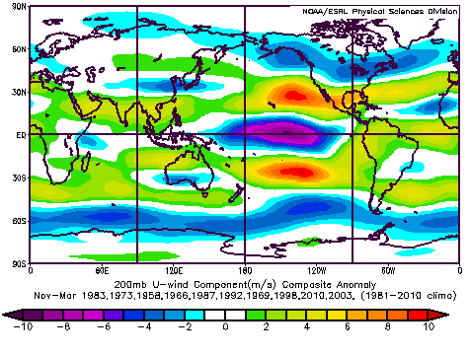
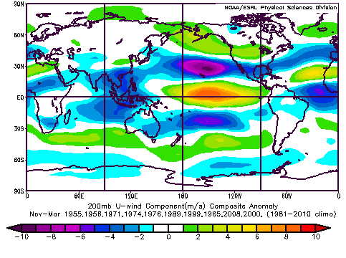
Jet Regime Frequency
Jet Regime Frequency and ENSO
El Niño
La Niña
Composite Zonal Wind Anomalies (m s^{–1})
Composite Zonal Wind Anomalies (m s^{–1})
Jet Extensions and Equatorward Shifts are favored during an El Niño
Jet Retractions and Poleward Shifts are favored during a La Niña

Slide 69
Predictability of Extreme Temperature Events
Percent Difference in the Frequency of Forecasts with Below- and Above-Normal RMSE Initialized during the same NPJ Regime
Higher frequency of forecasts with below-normal RMSE (i.e., good forecasts)
Higher frequency of forecasts with above-normal RMSE(i.e., bad forecasts)

Slide 70
Predictability of Extreme Temperature Events
Percent Difference in the Frequency of Forecasts with Below- and Above-Normal RMSE Initialized during the same NPJ Regime
Higher frequency of forecasts with below-normal RMSE (i.e., good forecasts)
Higher frequency of forecasts with above-normal RMSE(i.e., bad forecasts)

Slide 71
Forecast Skill of Extreme Temperature Events
GEFS Reforecasts (Hamill et al. 2013) of extreme cold and warm events at each forecast lead time were binned based on whether they exhibited a standardized root-mean-square error (RMSE) or standardized anomaly correlation coefficient (ACC) of 500-hPa geopotential height over the CONUS (25–55°N; 140–60°W) that was:
  Above-normal (>0.5σ)
  Below-normal (<–0.5σ)
  Near-normal (–0.5σ < x < 0.5σ)
Notes:
Additional bullet for transformation of rmse and acc into sigma units?

Slide 72
Forecast Skill of Extreme Temperature Events
GEFS Reforecasts (Hamill et al. 2013) of extreme cold and warm events at each forecast lead time were binned based on whether they exhibited a standardized root-mean-square error (RMSE) or standardized anomaly correlation coefficient (ACC) of 500-hPa geopotential height over the CONUS (25–55°N; 140–60°W) that was:
  Above-normal (>0.5σ)
  Below-normal (<–0.5σ)
  Near-normal (–0.5σ < x < 0.5σ)
The percent difference between the frequency of events with below-normal and above-normal RMSE or ACC offers information regarding the forecast skill of extreme events.

Slide 73
Forecast Skill of Extreme Temperature Events
Percent Difference Between the Frequency of Forecasts with Below-Normal and Above-Normal ACC
Higher frequency of forecasts with below-normal ACC
(i.e., more bad forecasts)
Higher frequency of forecasts with above-normal ACC
(i.e., more good forecasts)
Notes:
Good go with bad. Quote good and bad.

Slide 74
Forecast Skill of Extreme Temperature Events
Percent Difference Between the Frequency of Forecasts with Below-Normal and Above-Normal ACC
Higher frequency of forecasts with below-normal ACC
(i.e., more bad forecasts)
Higher frequency of forecasts with above-normal ACC
(i.e., more good forecasts)

Slide 75
Forecast Skill of Extreme Temperature Events
Percent Difference Between the Frequency of Forecasts with Below-Normal and Above-Normal RMSE
Higher frequency of forecasts with below-normal RMSE
(i.e., more good forecasts)
Higher frequency of forecasts with above-normal RMSE
(i.e., more bad forecasts)

Slide 76
Forecast Skill of Extreme Temperature Events
Percent Difference Between the Frequency of Forecasts with Below-Normal and Above-Normal RMSE
Higher frequency of forecasts with below-normal RMSE
(i.e., more good forecasts)
Higher frequency of forecasts with above-normal RMSE
(i.e., more bad forecasts)

Slide 77
Jet Regime Frequency
Jet Regime Frequency and the PNA
Jet Extensions and Poleward Shifts are favored during a positive PNA
Jet Retractions and Equatorward Shifts are favored during a negative PNA

Slide 78
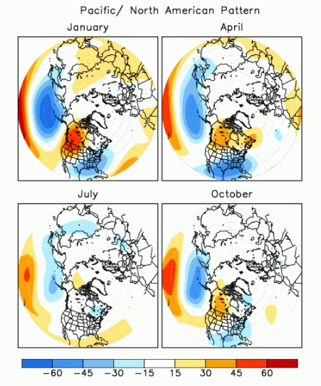
Jet Regime Frequency
Jet Regime Frequency and the PNA
Positive PNA pattern strongly resembles a jet extension
Negative PNA pattern strongly resembles a jet retraction
Climate Prediction Center

Slide 79
NPJ Phase Diagram

Slide 80
Candidate Verification Metrics
Forecast Error
  Distance between GFS deterministic forecast and the analysis at each forecast hour
  Distance between the GEFS ensemble mean forecast and the analysis at each forecast hour
  Average distance between ensemble members and the analysis at each forecast hour
Probability of Detection
  Did the analysis fall within the ensemble envelope at each forecast hour?

Slide 81
Candidate Verification Metrics
Reliability Diagram
  A reliability diagram is used to evaluate the performance of GEFS ensemble forecasts with respect to the NPJ Phase Diagram.
ROC
  Could a ROC be an alternative metric to evaluate the performance of GEFS ensemble forecasts with respect to the NPJ Phase Diagram?
100
Reliability Diagram
% occurrence
0
% forecasted
100
1
POD
ROC
0
FAR
1
Notes:
Reconsider “with respect to”.. Add schematics

Slide 82
Real Time North Pacific Jet Phase Diagram
0000 UTC 8 November 2014
250-hPa wind speed: shaded
Instantaneous 250-hPa zonal wind anomalies can be projected onto EOF 1 and EOF 2, resulting in a point on a North Pacific Jet phase diagram

Slide 83
Real Time North Pacific Jet Phase Diagram
Each point on the phase diagram is a weighted average of the principal components within +/− 1 day of the time under consideration
Example: 0000 UTC 8 November 2014
Weight
5
4
3
2
1
Date
0000 UTC 7 Nov.
1200 UTC 7 Nov.
0000 UTC 8 Nov.
1200 UTC 8 Nov.
0000 UTC 9 Nov.

Slide 84
Real Time North Pacific Jet Phase Diagram
Characterizes the past evolution and present state of the upper-tropospheric flow pattern over the North Pacific.
  Captures regime transitions
  Identifies flow patterns conducive to the development of EWEs
Characterizes the forecasted evolution of the upper-tropospheric flow pattern over the North Pacific.

Slide 85
Real Time North Pacific Jet Phase Diagram
0000 UTC 8 November 2014
250-hPa wind speed: shaded

Slide 86
Real Time North Pacific Jet Phase Diagram
0000 UTC 10 November 2014
250-hPa wind speed: shaded

Slide 87
Real Time North Pacific Jet Phase Diagram
0000 UTC 12 November 2014
250-hPa wind speed: shaded

Slide 88
Real Time North Pacific Jet Phase Diagram
0000 UTC 14 November 2014
250-hPa wind speed: shaded

Slide 89
Real Time North Pacific Jet Phase Diagram
0000 UTC 16 November 2014
250-hPa wind speed: shaded

Slide 90
Real Time North Pacific Jet Phase Diagram
0000 UTC 18 November 2014
250-hPa wind speed: shaded

Slide 91
Real Time North Pacific Jet Phase Diagram
16–19 November 2014 Composite Anomalies
500-hPa Geo. Height (m)
Surface Temperature (°C)

Slide 92
E. Rockies – S. Plains Cluster
Extreme Cold Event Centroids
COLD EVENTS (n = 48)
Poleward Shift
4
Events during
Sept. – May projected onto phase diagram
4
Jet Retraction
14
Jet Extension
Each point is an average of the PCs
3–7 days prior to the event
16–19 Nov. 2014
26
Equatorward Shift

Slide 93
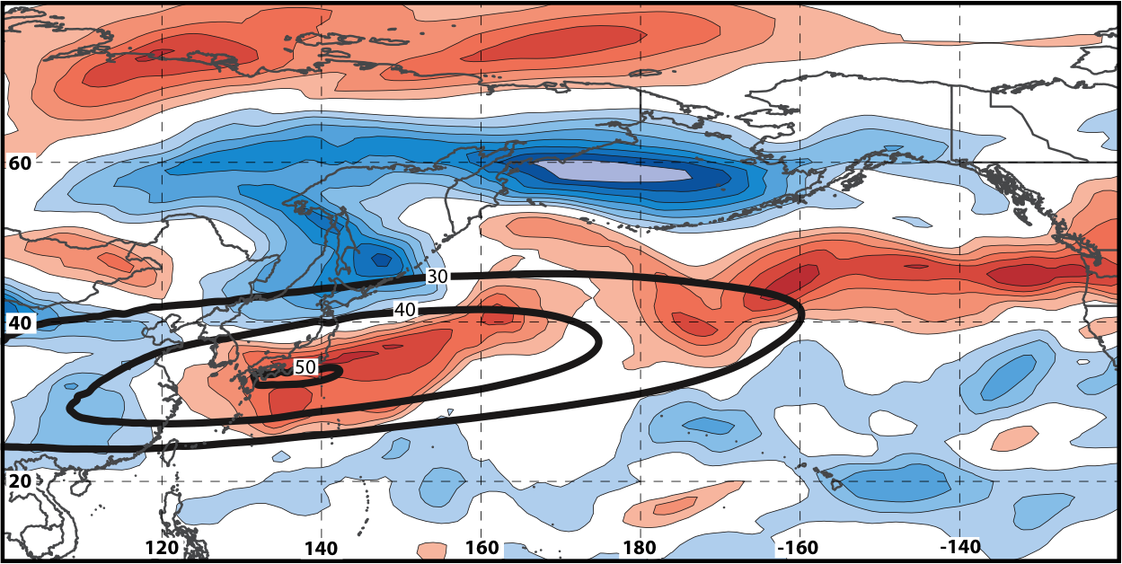
Real Time North Pacific Jet Phase Diagram
250-hPa zonal wind at 0000 UTC 2 Jun minus 250-hPa zonal wind at 0000 UTC 24 May (shading) in the GFS analyses shows the transition to a poleward-shifted jet regime
0000 UTC 24 May
(0-h forecast)
0000 UTC 2 Jun (verification)
Ensemble mean
Sept.–May mean 250-hPa zonal wind: black contours
Notes:
Note that the positive changes in zonal wind correspond exactly to where the positive anomalies are located in the EOF2 pattern – See slide 14.

Slide 94
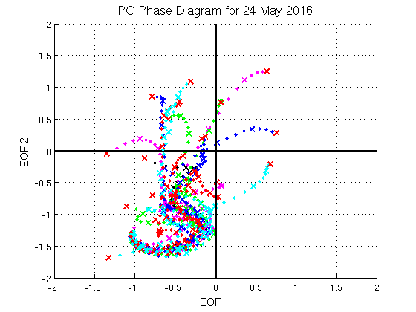
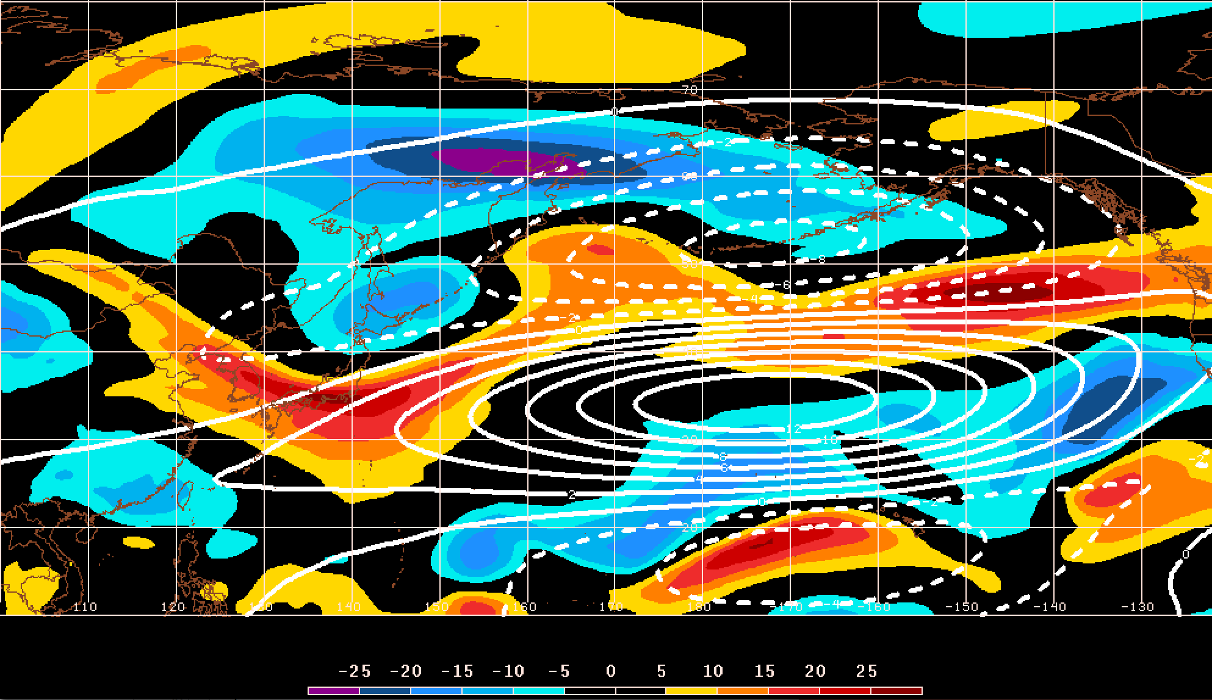
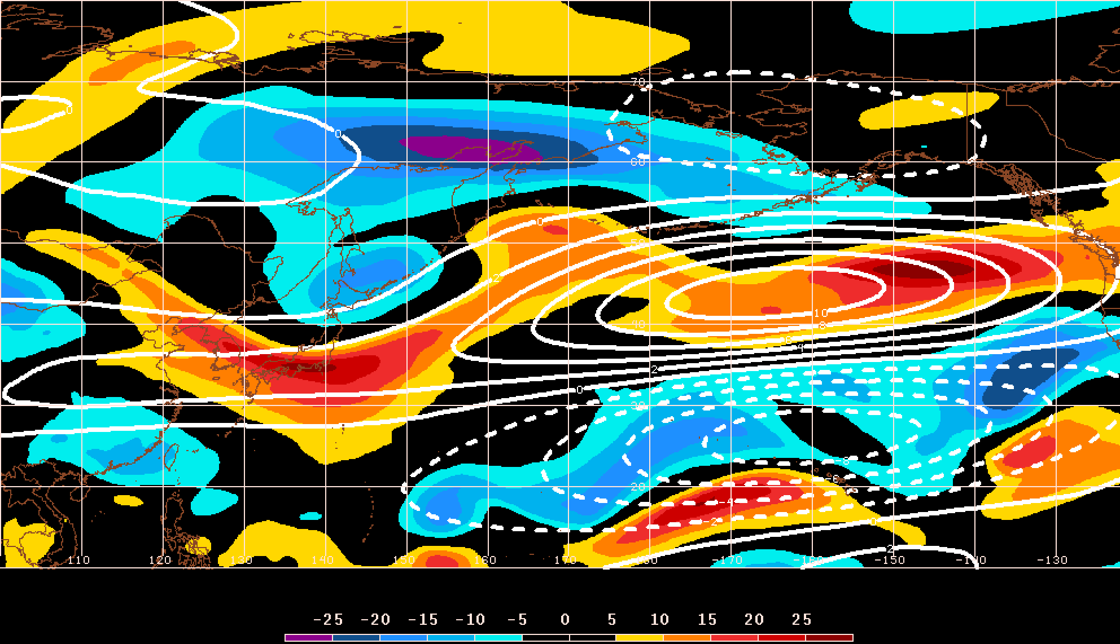
GEFS Ensemble Trajectories Initialized 0000 UTC 24 May 2016
250-hPa Zonal Wind Anomalies and EOF1: 0000 UTC 2 Jun
0000 UTC 2 Jun (verification)
m s^{–1}
250-hPa Zonal Wind Anomalies and EOF2: 0000 UTC 2 Jun
250-hPa zonal wind anomalies at 0000 UTC 2 Jun project strongly onto
EOF2 > 0
m s^{–1}

