Slide 1
An Investigation of the Skill of Week Two
Extreme Temperature and Precipitation
Forecasts at the NCEP-WPC
Lance F. Bosart¹, Daniel Keyser¹, and Andrew C. Winters¹
¹Department of Atmospheric and Environmental Sciences
University at Albany, State University of New York, Albany, NY 12222
NGGPS Annual Meeting and External FFO PI Meeting
College Park, MD
Friday 17 July 2015
**Updated: 25 October 2015**

Slide 2
Project Summary (1)
Improve temperature and precipitation forecasts on the 8–10 day time range at the WPC in collaboration with WPC personnel.
Develop a methodology for identifying extreme temperature and precipitation events over the CONUS for all seasons during 1979–present.
Perform an evaluation of operational NCEP GFS week two forecast skill for the extreme events with an emphasis on the 8–10 day time range.

Slide 3
Project Summary (2)
Construct climatologies of forecast temperature and precipitation distributions and stratify these distributions in a manner that will allow classification of various extreme events into characteristic event types.
Perform composite analyses of characteristic event types in order to determine the multiscale evolution of the governing atmospheric flow patterns that culminate in these event types.
Perform illustrative case studies of individual extreme temperature and precipitation events identified through the composite analyses.

Slide 4
Project Summary (3)
Conduct verification studies of GFS model and associated human forecasts for the illustrative case studies.
Test methodology and new forecast formats under development at WPC in the WPC Hydrometeorological Testbed and incorporate them into forecast operations.

Slide 5
Project Outcomes
Provide forecasters with a “first alert” to the possibility of the occurrence of extreme temperature and precipitation events during week two on the basis of current conditions and model forecasts.
Provide forecasters with an indication of the character and flavor of the possible extreme events as inferred from where the events lie in the PDFs of the anticipated event types.
Provide forecasters with knowledge that allows them to make science-based adjustments to model guidance and add value to week two forecasts of temperature and precipitation.

Slide 6
Supertyphoon Nuri (2014)

Slide 7
Supertyphoon Nuri (2014): Extratropical Transition, Explosive Reintensification as an Extratropical Cyclone, and Downstream Predictability Impacts
STY Nuri reaches 910 hPa on 2–3 Nov 2014
ET begins on 6–7 Nov as storm weakens to 984 hPa
Explosive reintensification as an EC on 7–8 Nov
Storm deepens 60 hPa in 30 h to 924 hPa by 0600 UTC 8 Nov
Storm at 924 hPa ties all-time record for deepest North Pacific EC
Omega block subsequently forms over western North America
Multiple arctic air masses invade the CONUS
CPC forecast for a greater chance of a warm November is toppled
Global models exhibit poor 5- and 10-day predictability of STY Nuri ET/EC
Global models exhibit good 5- and 10-day predictability of omega block

Slide 8
Motivation
Supertyphoon Nuri
31 Oct – 7 Nov 2014
(ET/EC Phase: 7–9 Nov 2014)

Slide 9
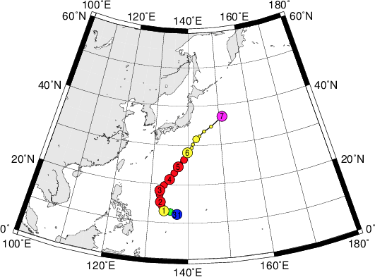
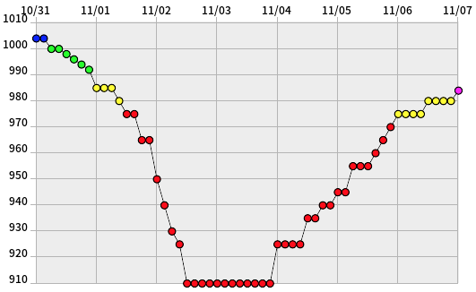
Supertyphoon Nuri: 31 Oct – 7 Nov 2014
JMA: Best Track
JMA: Minimum SLP (hPa)
Digital Typhoon (http://agora.ex.nii.ac.jp/digital-typhoon/index.html.en)

Slide 10
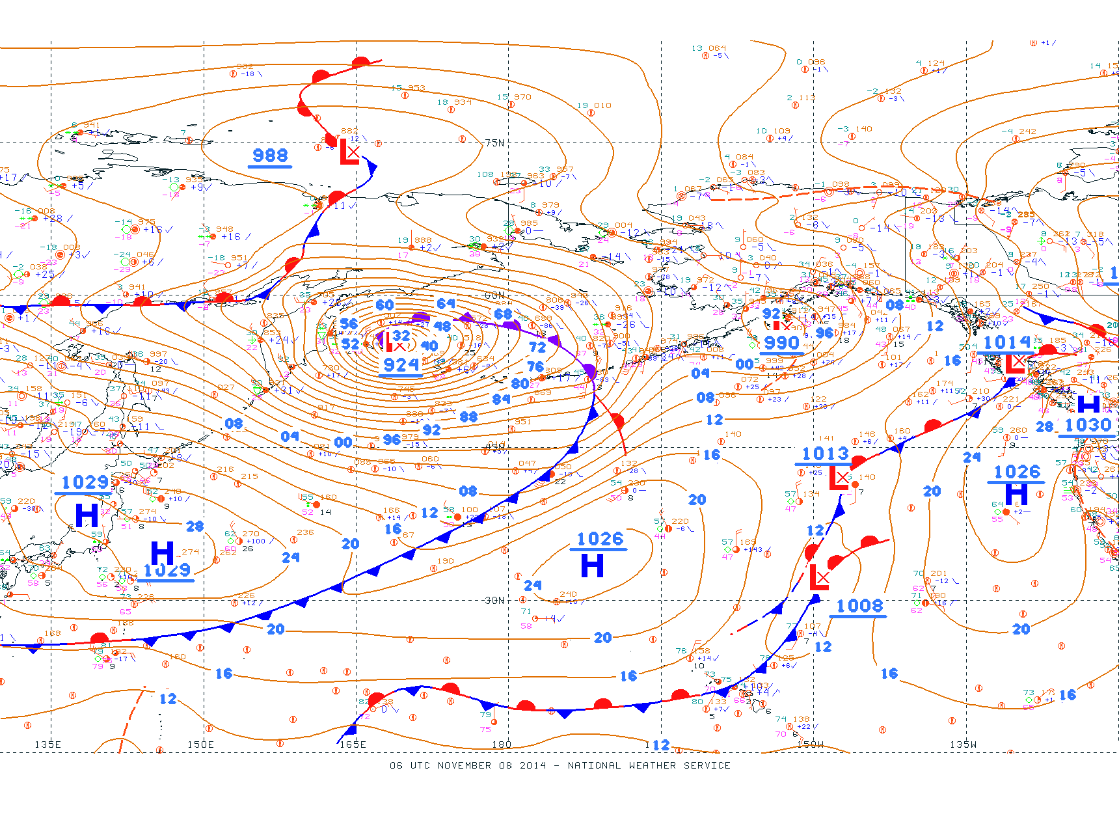
NCEP-OPC Surface Analysis:
0600 UTC 8 Nov 2014

Slide 11
Motivation
A Forecast Perspective

Slide 12
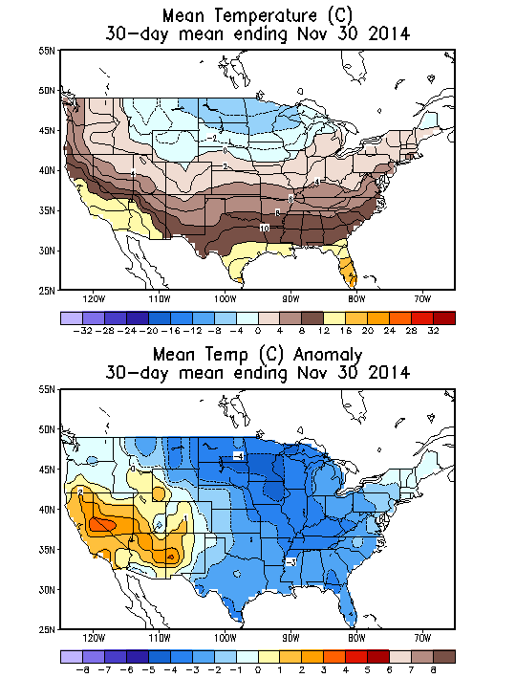
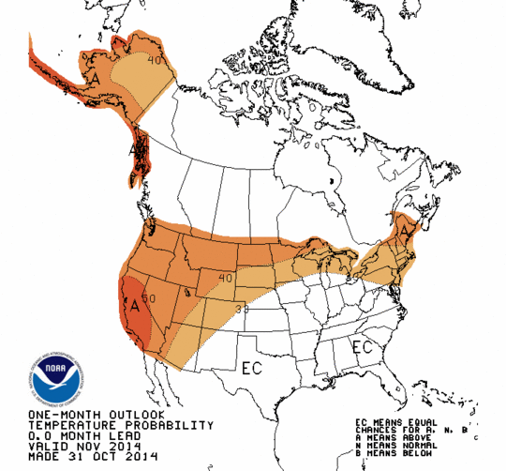
Nov 2014 CPC Forecast Temperature Anomaly Probability (Left); Mean and Observed Temperature Anomaly (°C , Right)
Notes:
CPC temperature forecasts for Nov 2014 indicated a greater likelihood of above average temperatures across much of the CONUS (particularly the western/northern U.S.). In reality, while temperatures ended up above average in the western U.S., below average temperatures prevailed over much of the eastern and central CONUS. This result was associated with an omega block that developed in early Nov over the eastern NPAC in response to the ET of Nuri. Subsequent cyclogenesis events that occurred in mid-Nov over the central/eastern Pacific helped to maintain the ridge and to encourage its longevity.

Slide 13
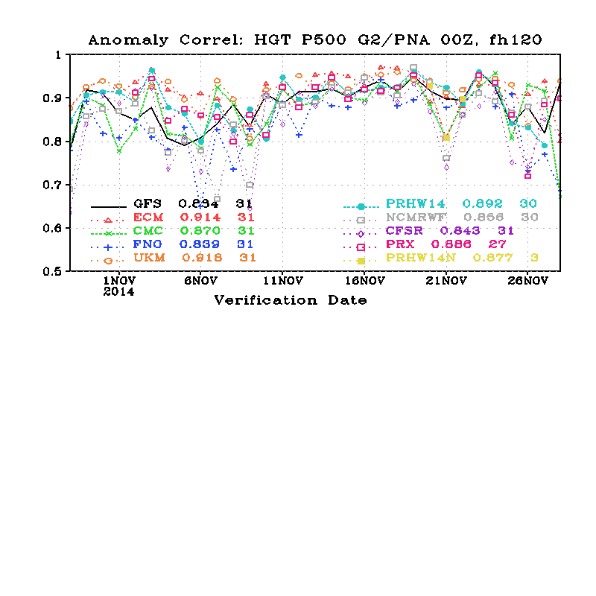
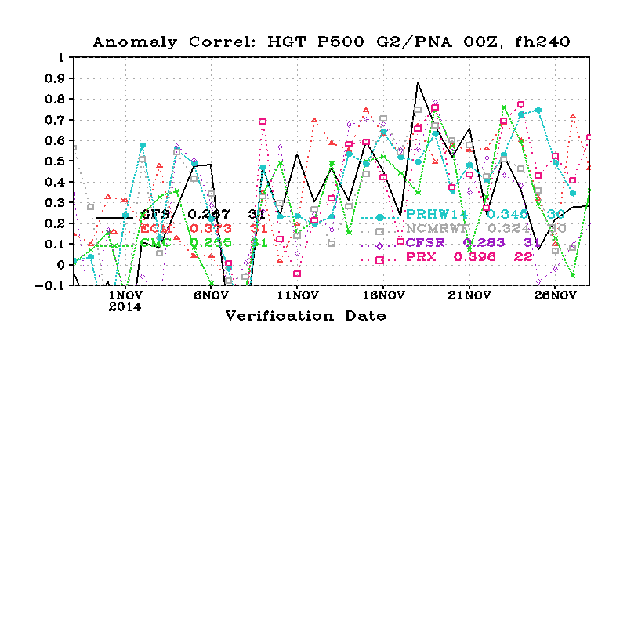
NCEP Comparison of Global Operational Model Forecasts of 120-h (Top) and 240-h (Bottom) Anomaly Correlation (AC) Skill for NPAC/NAMER: 28 Oct – 27 Nov 2014
0.8
AC
0.6
Time >
924 hPa
0.8
AC
0.6
Notes:
Note the drop off in 10-day model forecast skill of 500 hPa geopotential height over the NPAC and North America verifying 8 Nov 2014. This drop off in AC scores coincides with the ET of Nuri.

Slide 14
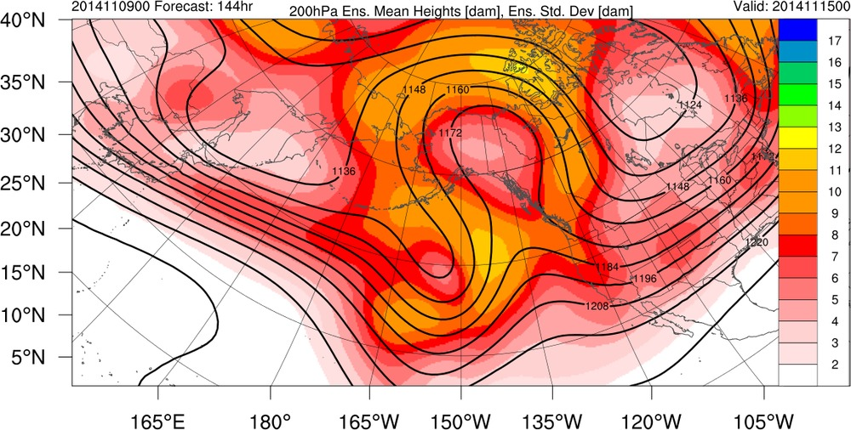
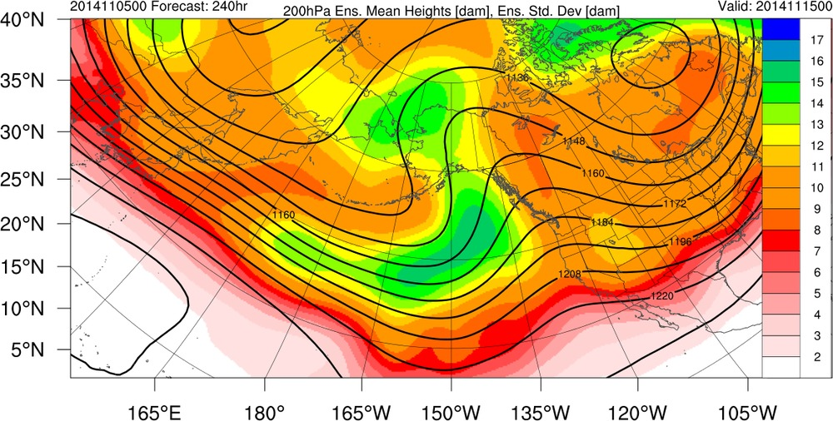
ECMWF Ensemble Mean 200-hPa Geopotential Height (dam) Forecasts and Ensemble Standard Deviation (dam)
144-h: 0000 UTC 15 Nov 2014
240-h: 0000 UTC 15 Nov 2014
Notes:
The ensemble mean 10-day forecast of 500 hPa geopotential height verifying 0000 UTC 15 Nov 2014 (bottom panel) suggested the development of a ridge over the western coast of N. America. Ensemble spread was mainly confined to the base of the trough equatorward of the Aleutians and in the apex of the ridge northwest of Alaska. Ensemble spread was smaller in magnitude for the 6-day forecast verifying 0000 UTC 15 Nov 2014 (top panel), with the position of the ridge well resolved. Questions remained regarding the amplitude of the ridge, however.

Slide 15
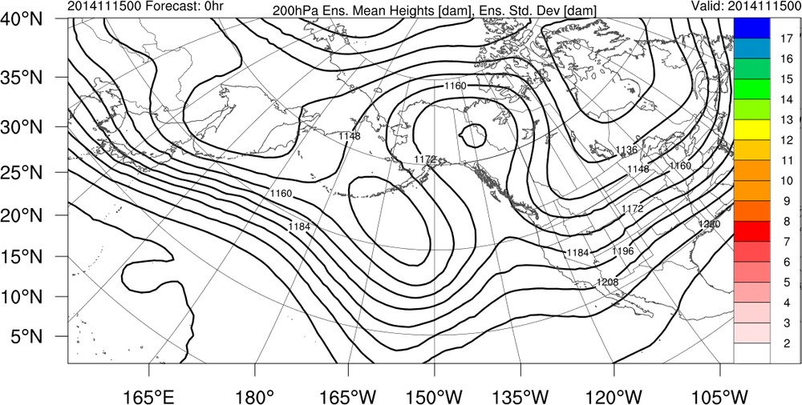
ECMWF Ensemble Mean 200-hPa Geopotential Height: 00 h Valid at 0000 UTC 15 Nov 2014
Notes:
Note how well the ensemble mean in the 6-day forecast (previous slide) matches up with the observations at 0000 UTC 15 Nov, representing a fairly successful forecast by the ECMWF.

Slide 16
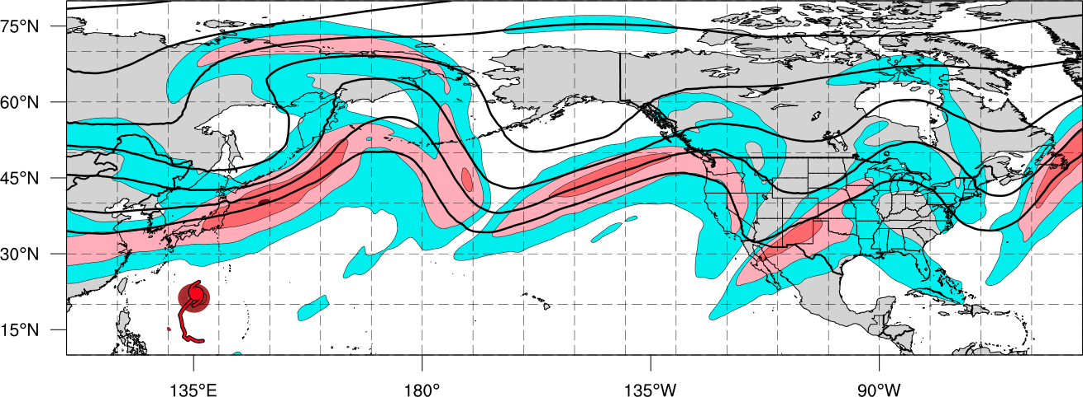
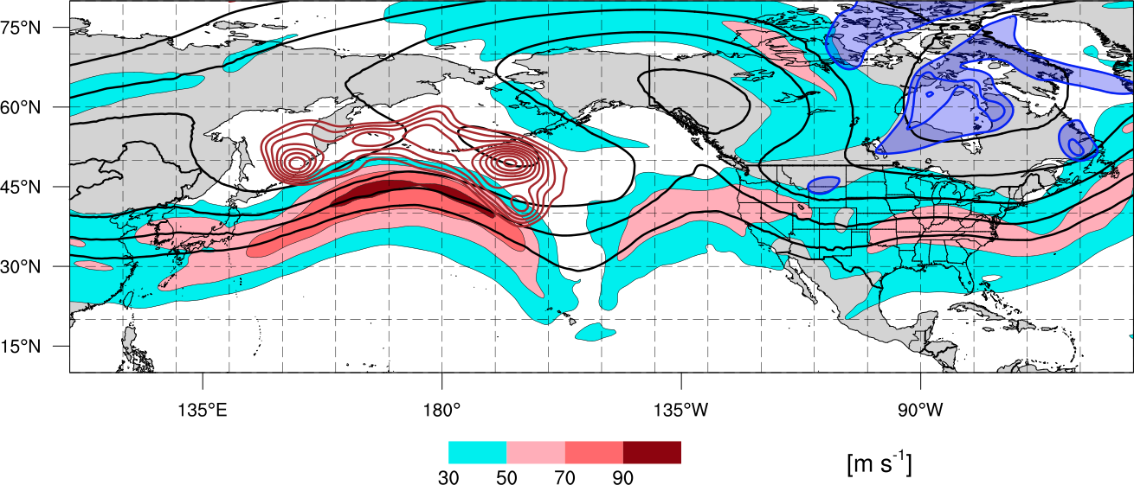
Schematic of Synoptic Evolution: 4–18 Nov 2014
0000 UTC 4 Nov 2014
Polar Cold Outbreak
L
Polar Jet
TC Outflow
STY Nuri
Legend
L
Extratropical low pressure center
H₁
High pressure center
Sea level pressure < 1000-hPa
Cold front
Arctic air
200-hPa geopotential height
Tropical Cyclone
200-hPa Isotachs

Slide 17
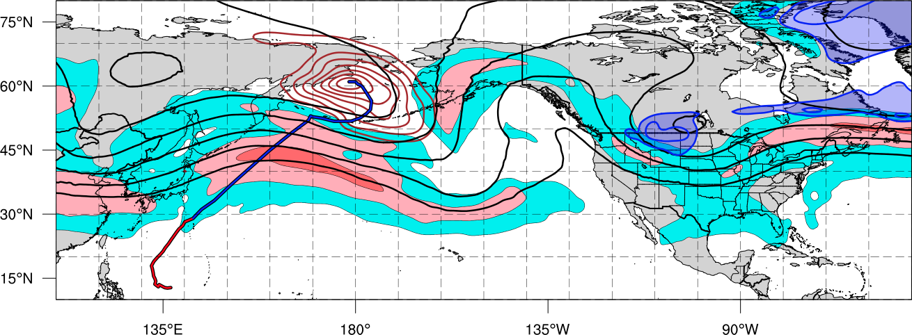
Schematic of Synoptic Evolution: 4–18 Nov 2014
1200 UTC 11 Nov 2014
Ex Nuri
L
H₁
Building Omega Block
1st Cold Surge
Polar Jet
Tropical Moisture
Legend
L
Extratropical low pressure center
H₁
High pressure center
Sea level pressure < 1000-hPa
Cold front
Arctic air
200-hPa geopotential height
Tropical Cyclone
200-hPa Isotachs
Notes:
Once the ridge became established over the eastern NPAC, it facilitated a series of equatorward cold surges across much of the eastern and central CONUS on its downstream edge.

Slide 18
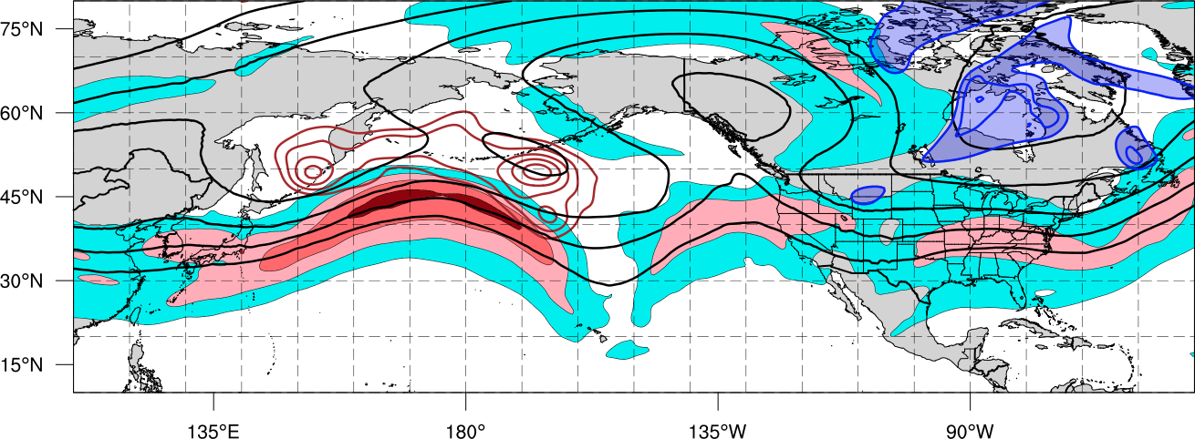
Schematic of Synoptic Evolution: 4–18 Nov 2014
1200 UTC 15 Nov 2014
H₃
Omega Block
Ex Nuri
2nd Cold Surge
L
H₂
Polar Jet
H₁
Legend
L
Extratropical low pressure center
H₁
High pressure center
Sea level pressure < 1000-hPa
Cold front
Arctic air
200-hPa geopotential height
Tropical Cyclone
200-hPa Isotachs

Slide 19
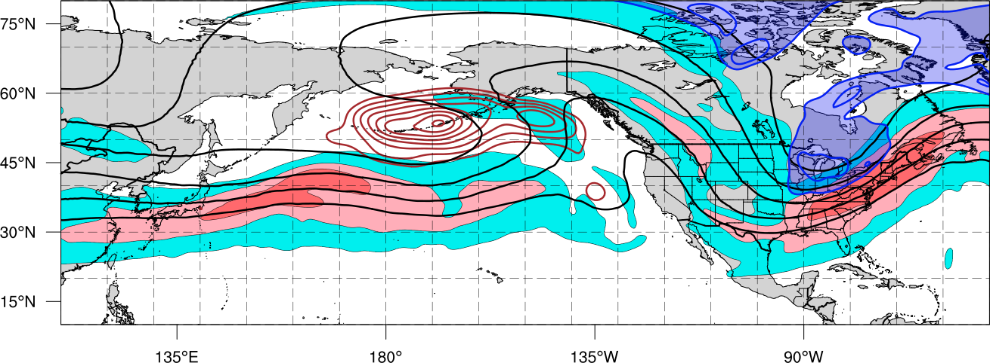
Schematic of Synoptic Evolution: 4–18 Nov 2014
1200 UTC 18 Nov 2014
Blocking Ridge
L
Ex Nuri
3rd Cold Surge
L
Polar Jet
H₂
H₂
H₃
H₁
Legend
L
Extratropical low pressure center
H₁
High pressure center
Sea level pressure < 1000-hPa
Cold front
Arctic air
200-hPa geopotential height
Tropical Cyclone
200-hPa Isotachs

Slide 20
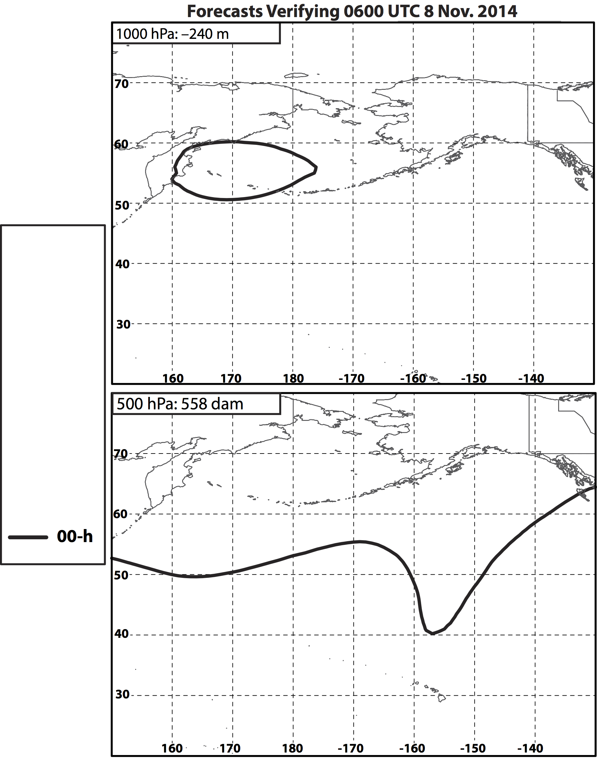
Nuri ET: 8 Nov
Notes:
The following slides show the position of a specific geopotential height contour (identified in the top left of each panel) in a series of GFS deterministic forecasts that all verified at the time shown at the top of the figure. The colors in the legend correspond to the lead-time of the individual forecasts (e.g., 240-h corresponds to the 240-h forecast of that geopotential height contour initialized at 0600 UTC 29 Oct 2014 and verifying at 0600 UTC 8 Nov 2014).

Slide 21
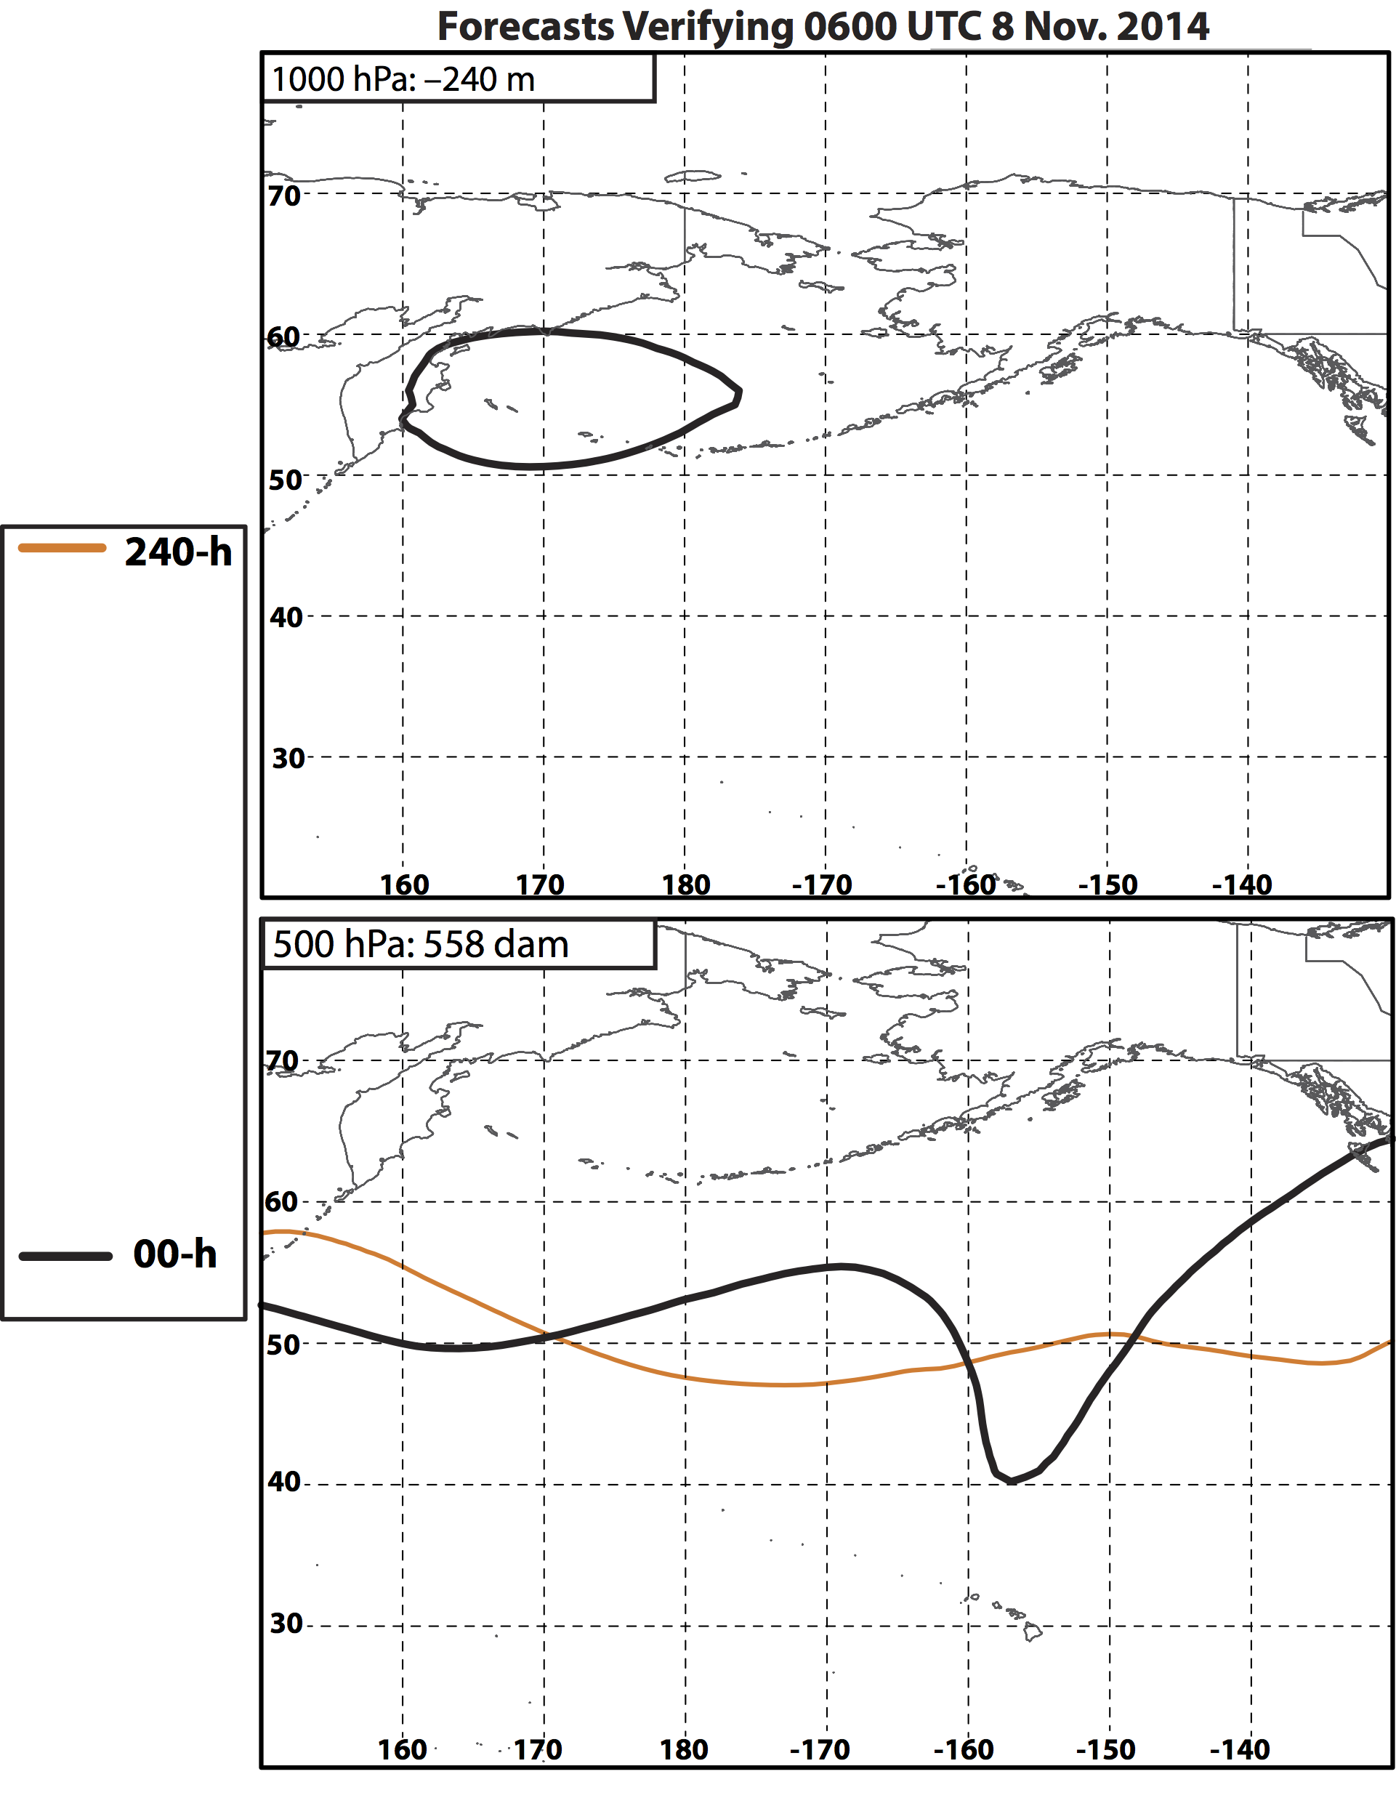
Nuri ET: 8 Nov

Slide 22
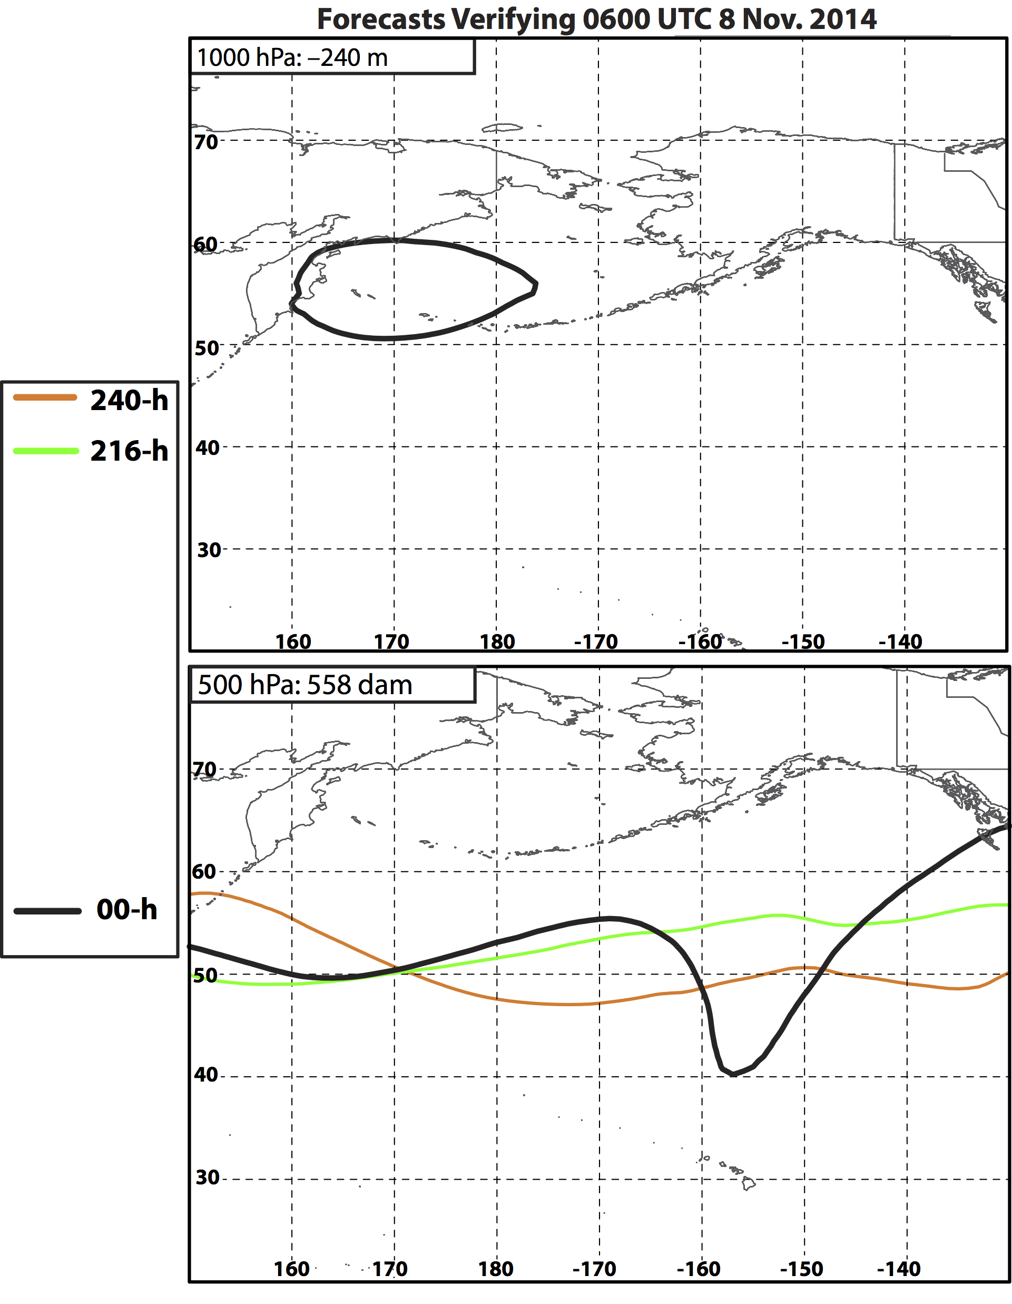
Nuri ET: 8 Nov

Slide 23
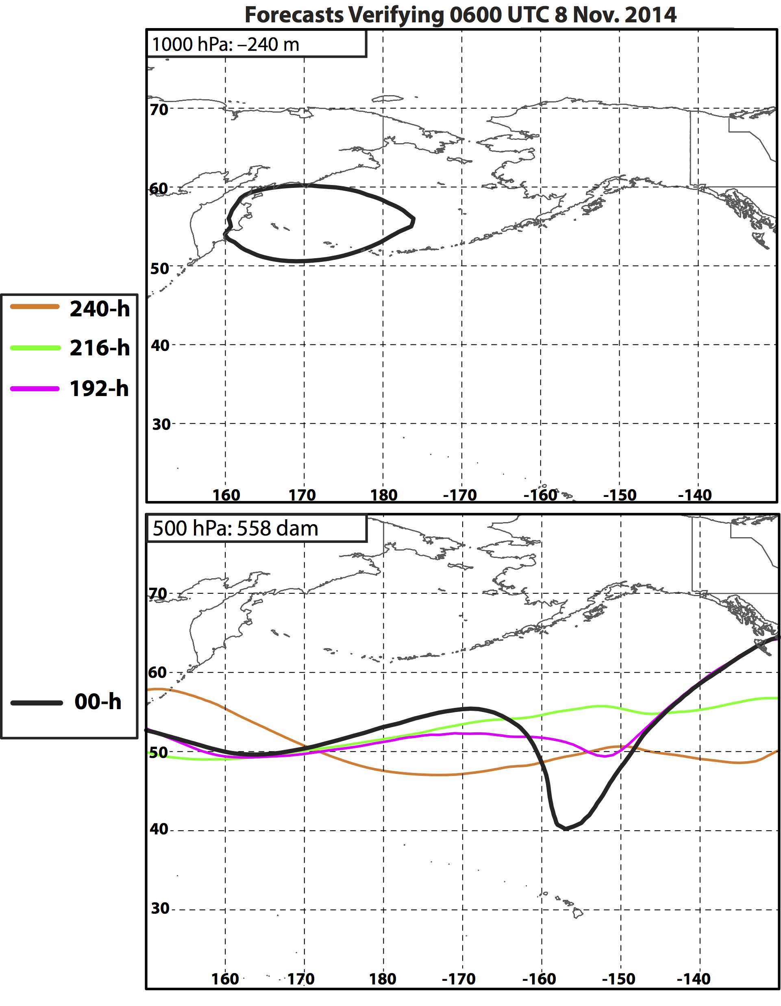
Nuri ET: 8 Nov

Slide 24
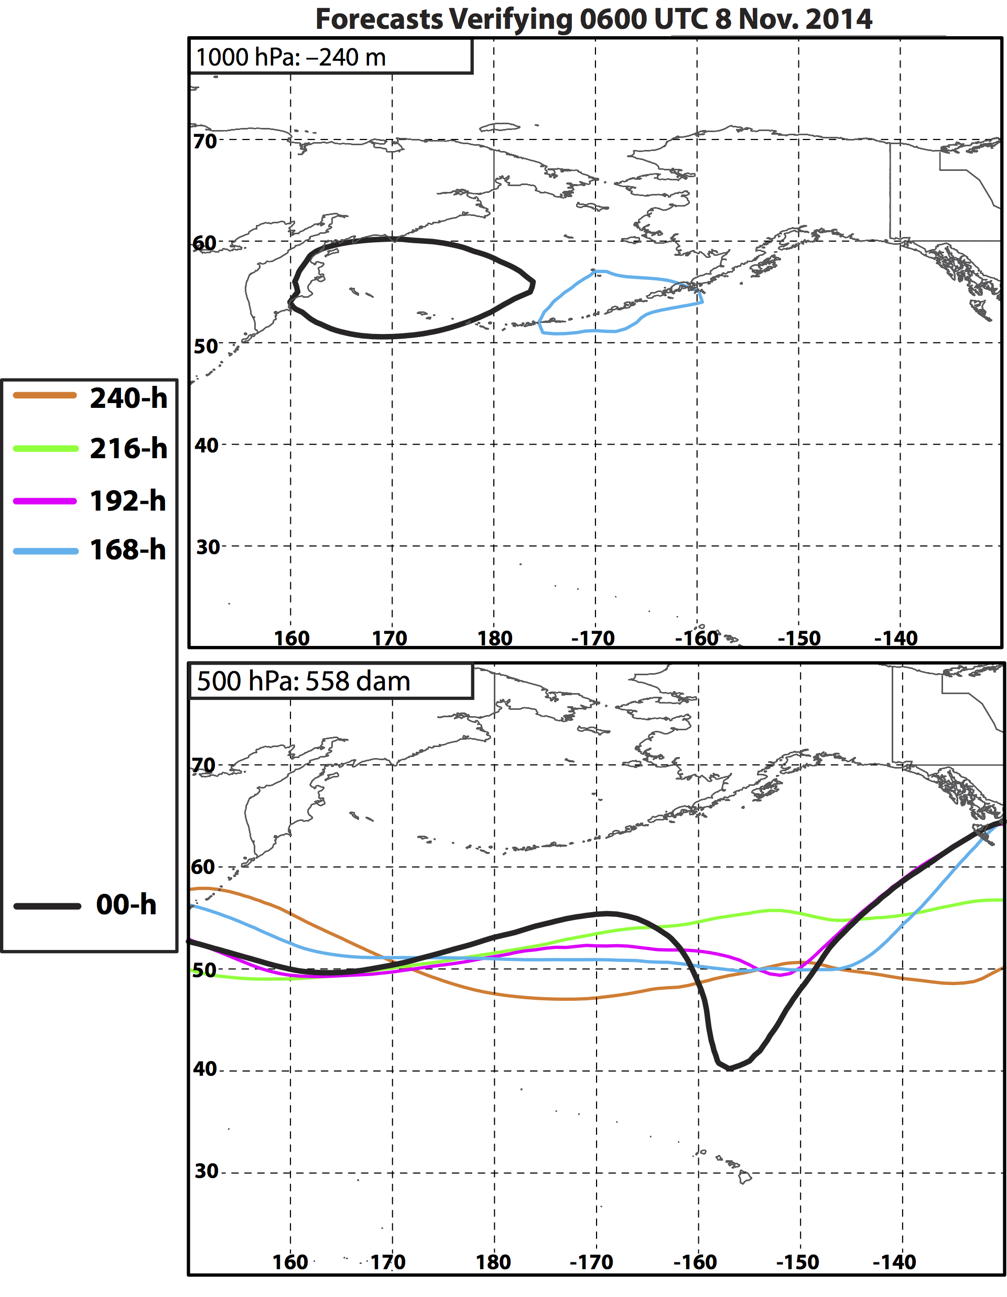
Nuri ET: 8 Nov

Slide 25
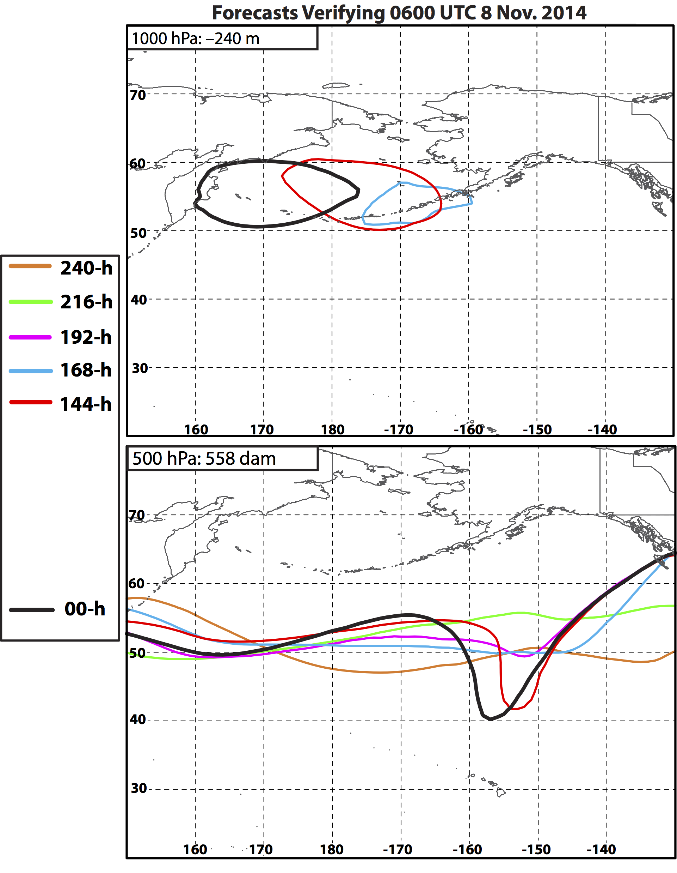
Nuri ET: 8 Nov
144-h forecast:
First forecast to show Nuri intensifying to levels that match observations.
Coincident with an indication of trough development poleward of Hawaii.
Notes:
Beginning with the 144-h forecast, forecasts began to suggest an explosive ET of Nuri and the development of a downstream trough poleward of Hawaii. This trough poleward of Hawaii would be instrumental in maintaining the omega block over the eastern NPAC a few days later.

Slide 26
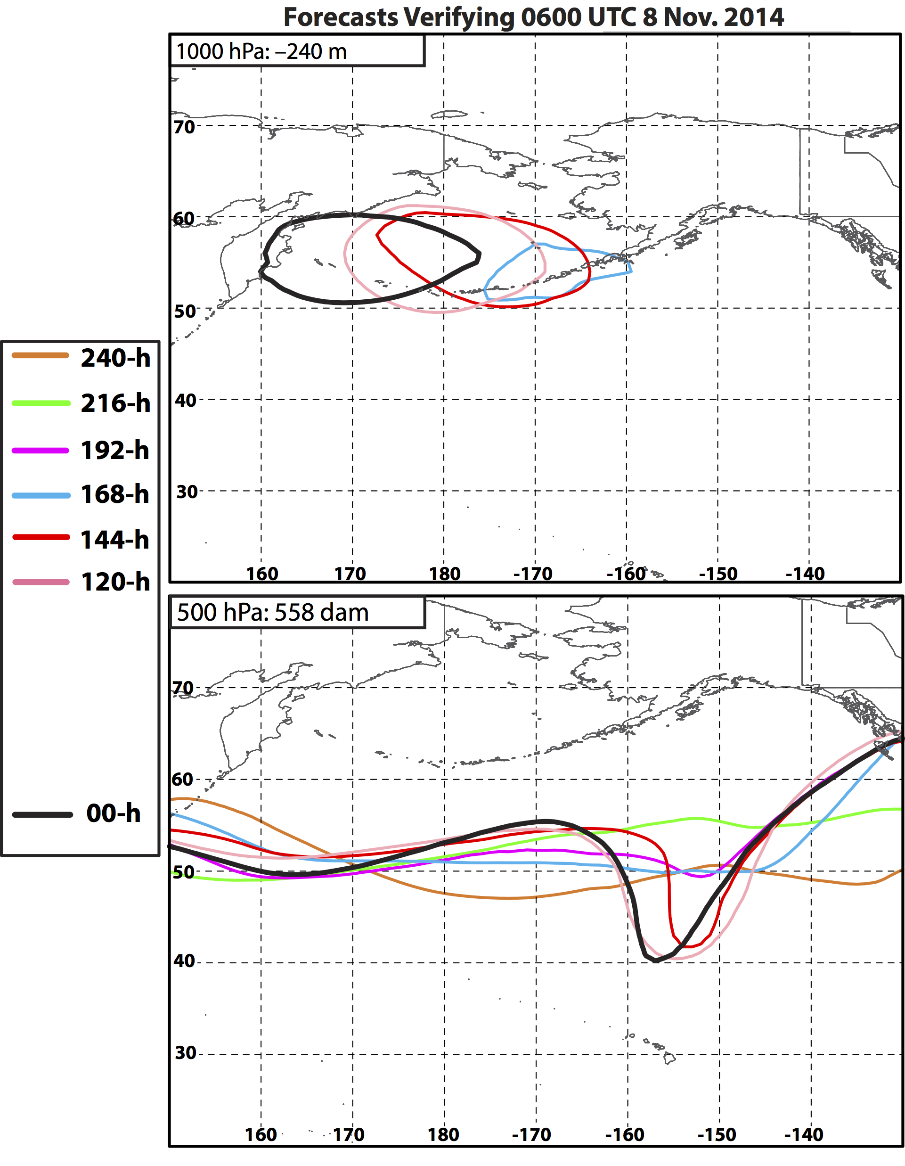
Nuri ET: 8 Nov
144-h forecast:
First forecast to show Nuri intensifying to levels that match observations.
Coincident with an indication of trough development poleward of Hawaii.

Slide 27
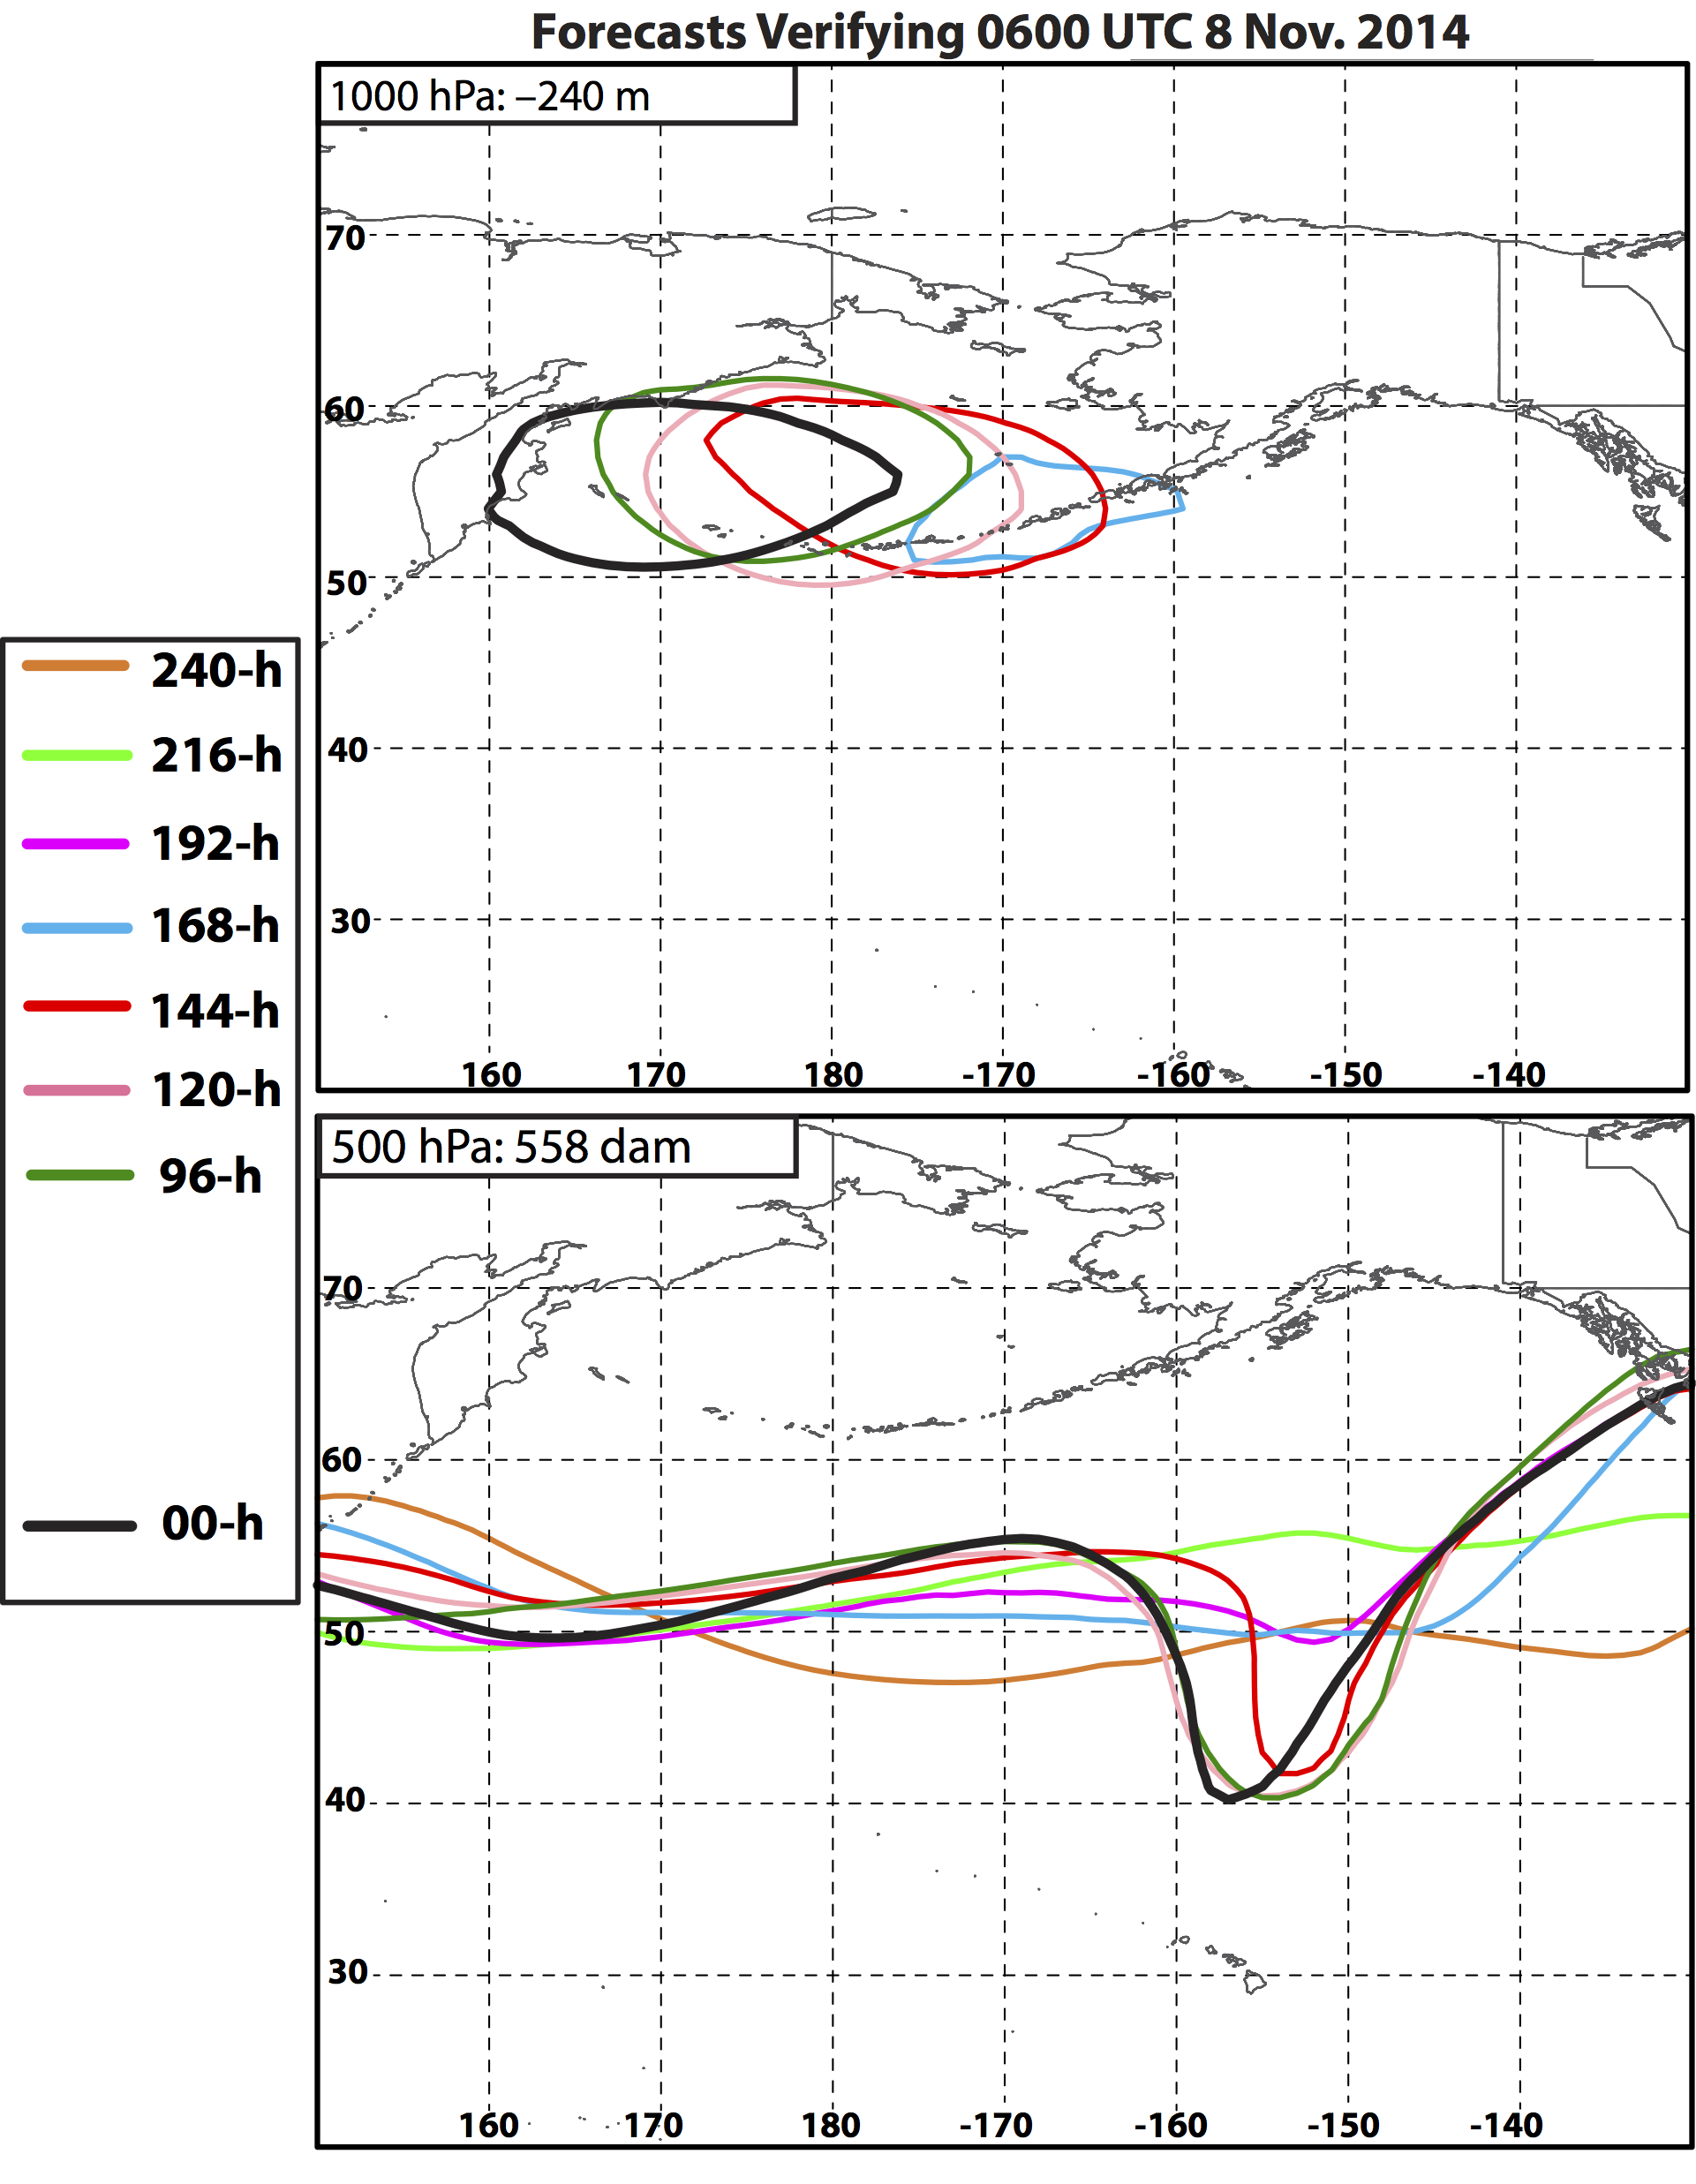
Nuri ET: 8 Nov
144-h forecast:
First forecast to show Nuri intensifying to levels that match observations.
Coincident with an indication of trough development poleward of Hawaii.

Slide 28
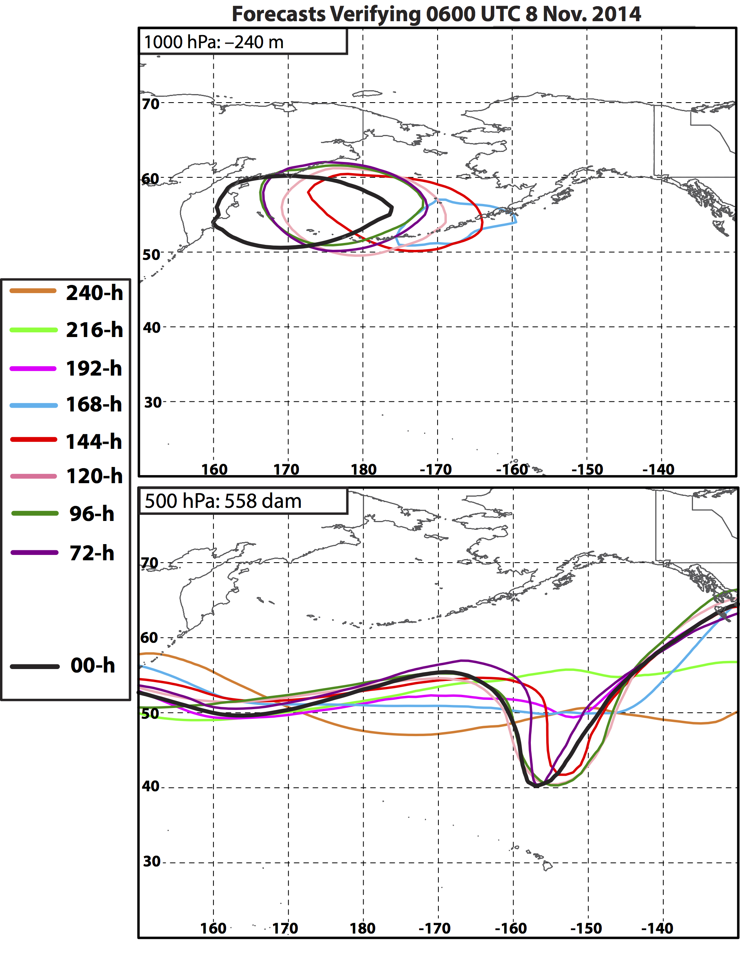
Nuri ET: 8 Nov
144-h forecast:
First forecast to show Nuri intensifying to levels that match observations.
Coincident with an indication of trough development poleward of Hawaii.

Slide 29
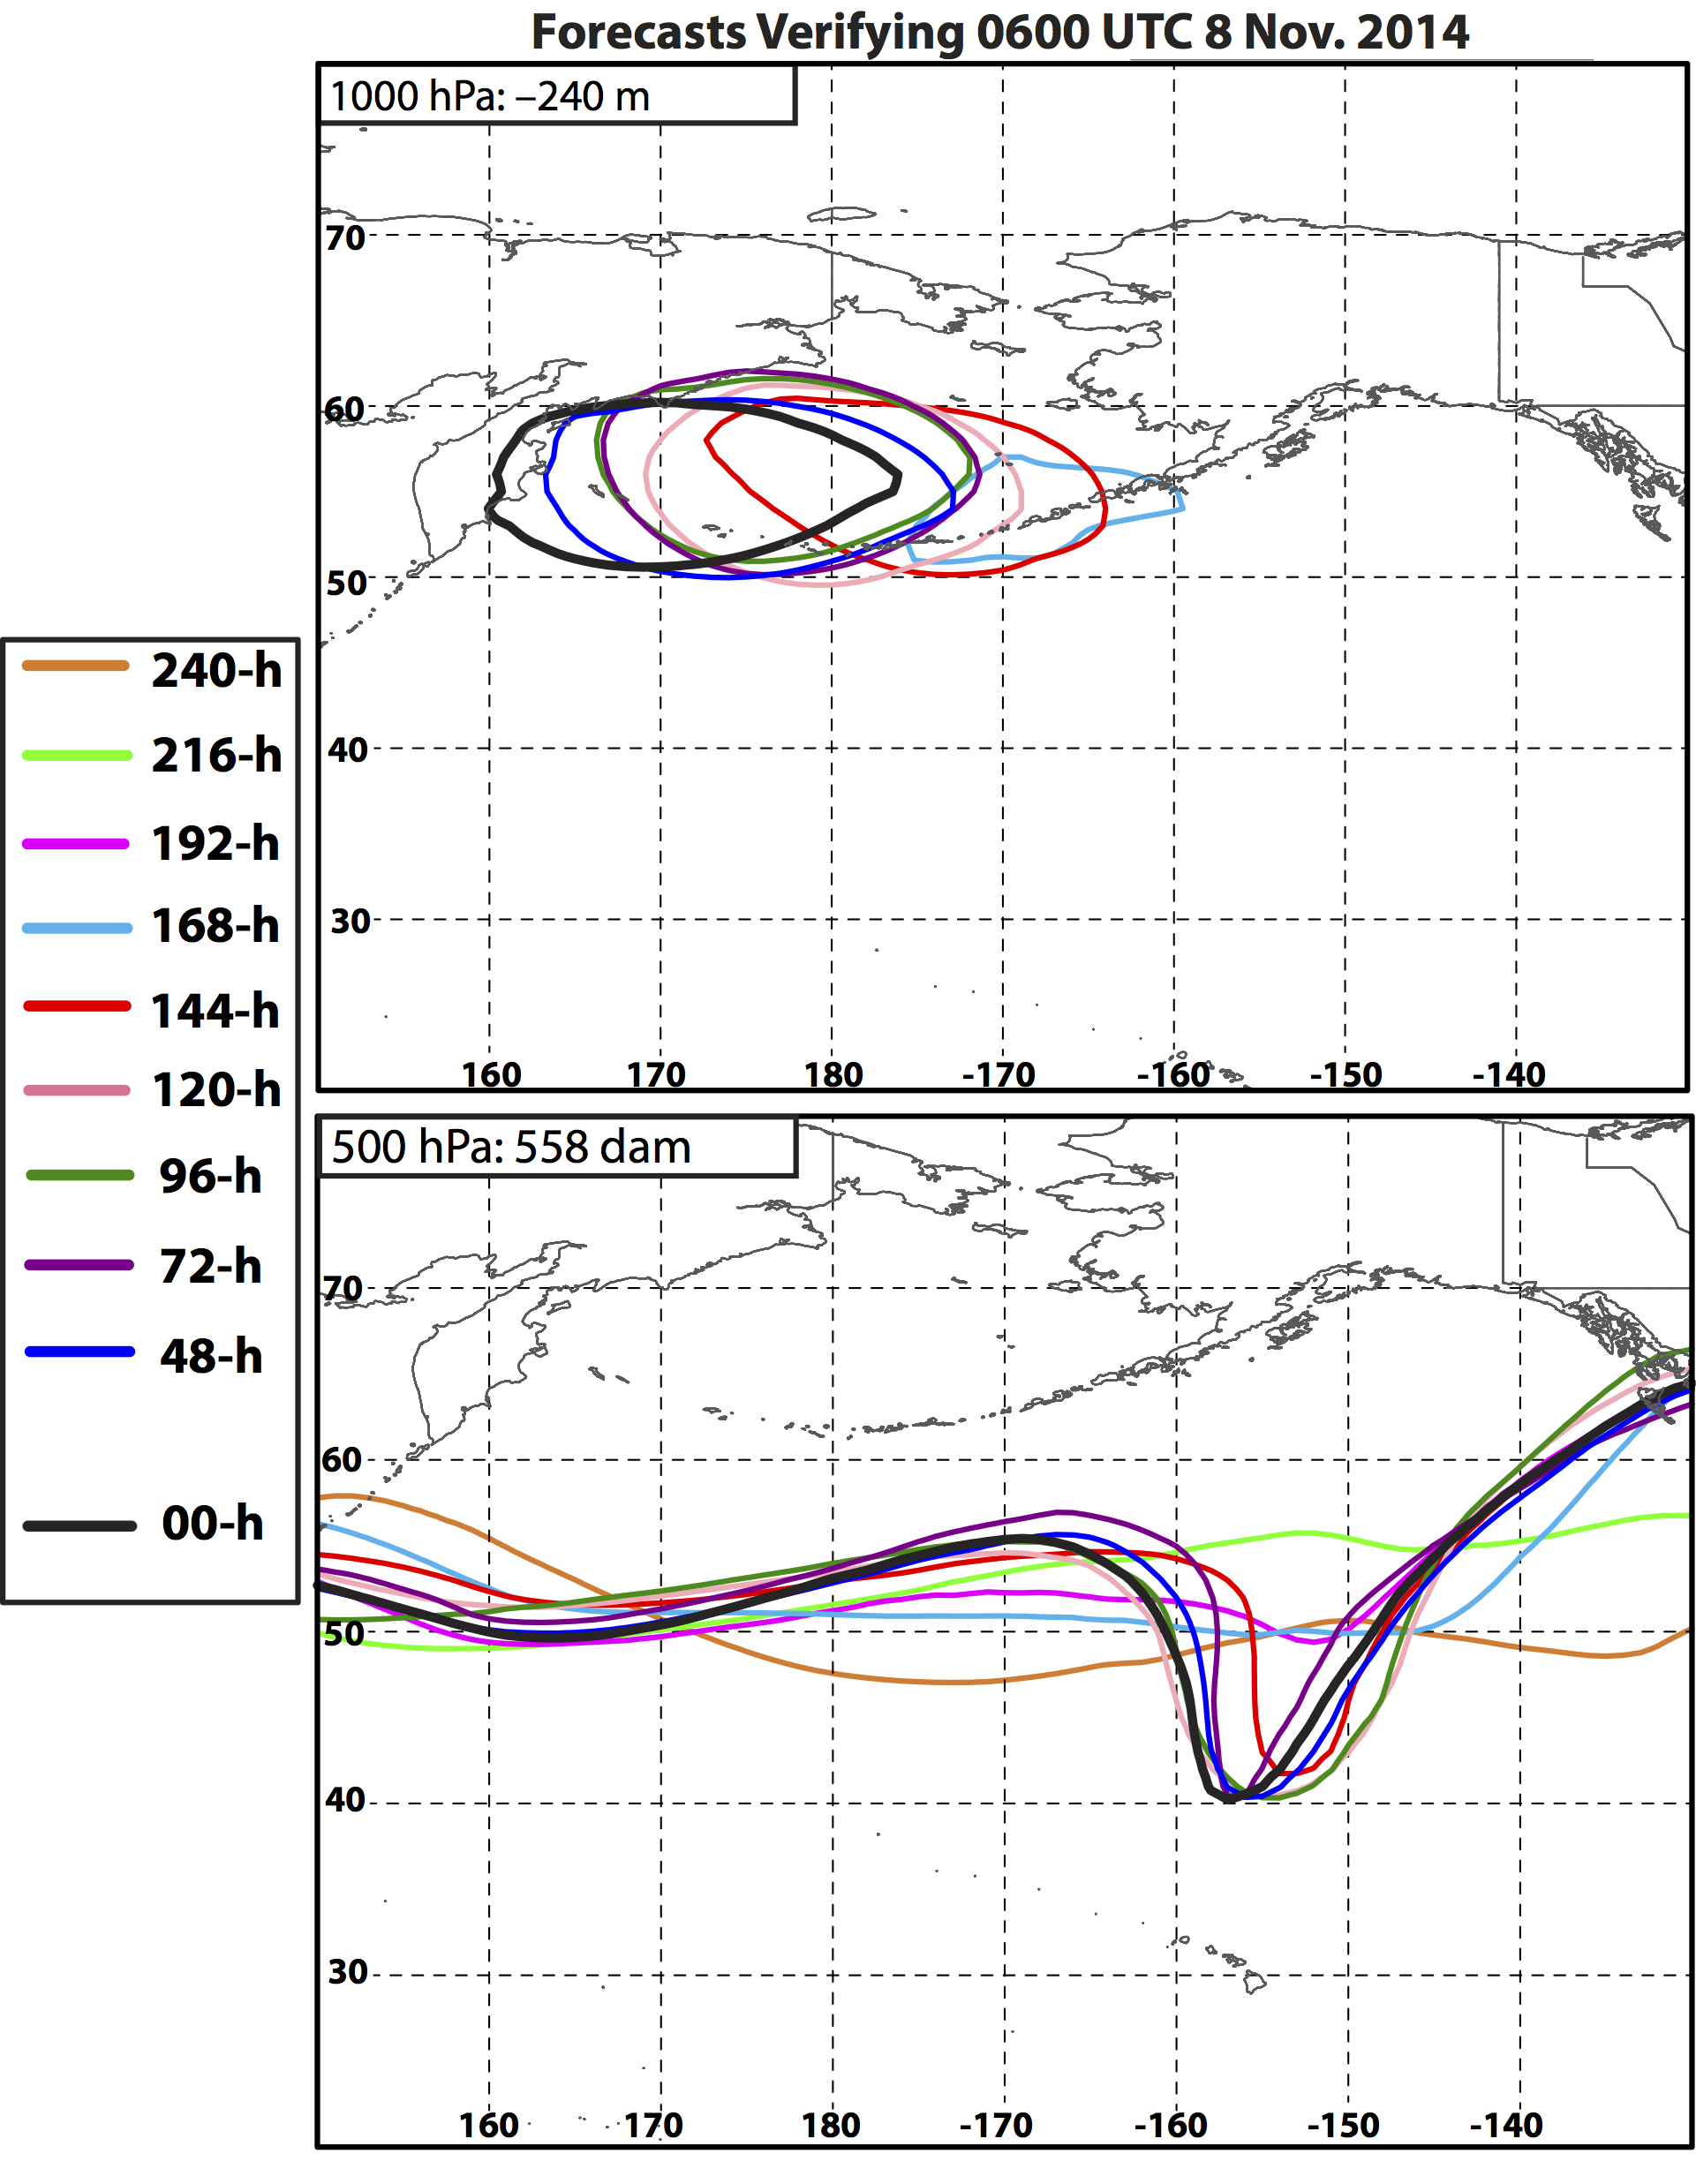
Nuri ET: 8 Nov
144-h forecast:
First forecast to show Nuri intensifying to levels that match observations.
Coincident with an indication of trough development poleward of Hawaii.

Slide 30
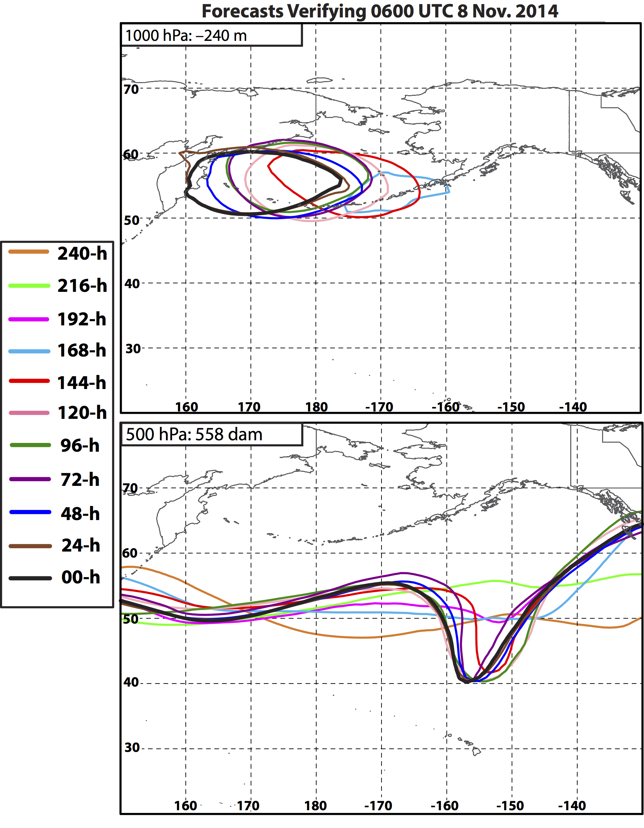
Nuri ET: 8 Nov
144-h forecast:
First forecast to show Nuri intensifying to levels that match observations.
Coincident with an indication of trough development poleward of Hawaii.
144-to-00-h forecast: Progressive westward shift in the location of ET Nuri in each subsequent forecast.
Notes:
Forecast uncertainty regarding the position of Nuri following ET remained up until the 24-h forecast.

Slide 31
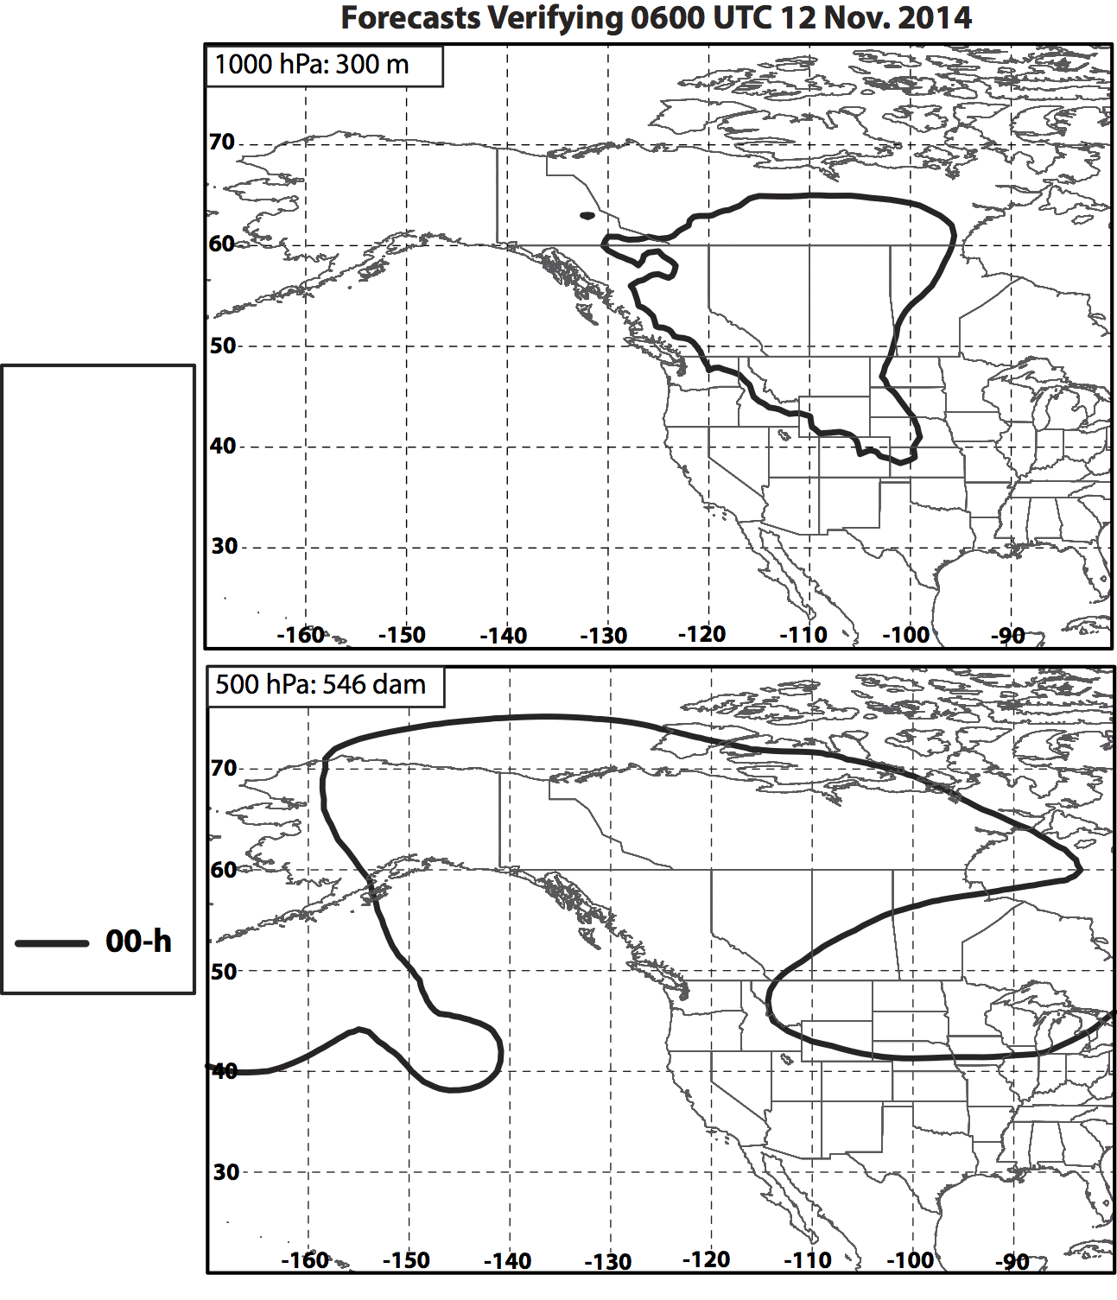
Eastern NPAC Ridge Amplification: 12 Nov
Notes:
Forecasts of 1000 hPa geopotential height at this time diagnose the areal extent of an anticyclone leeward of the Rocky Mountains (associated with the first cold surge in slide 17) and the 500 hPa ridge upstream over the eastern NPAC.

Slide 32
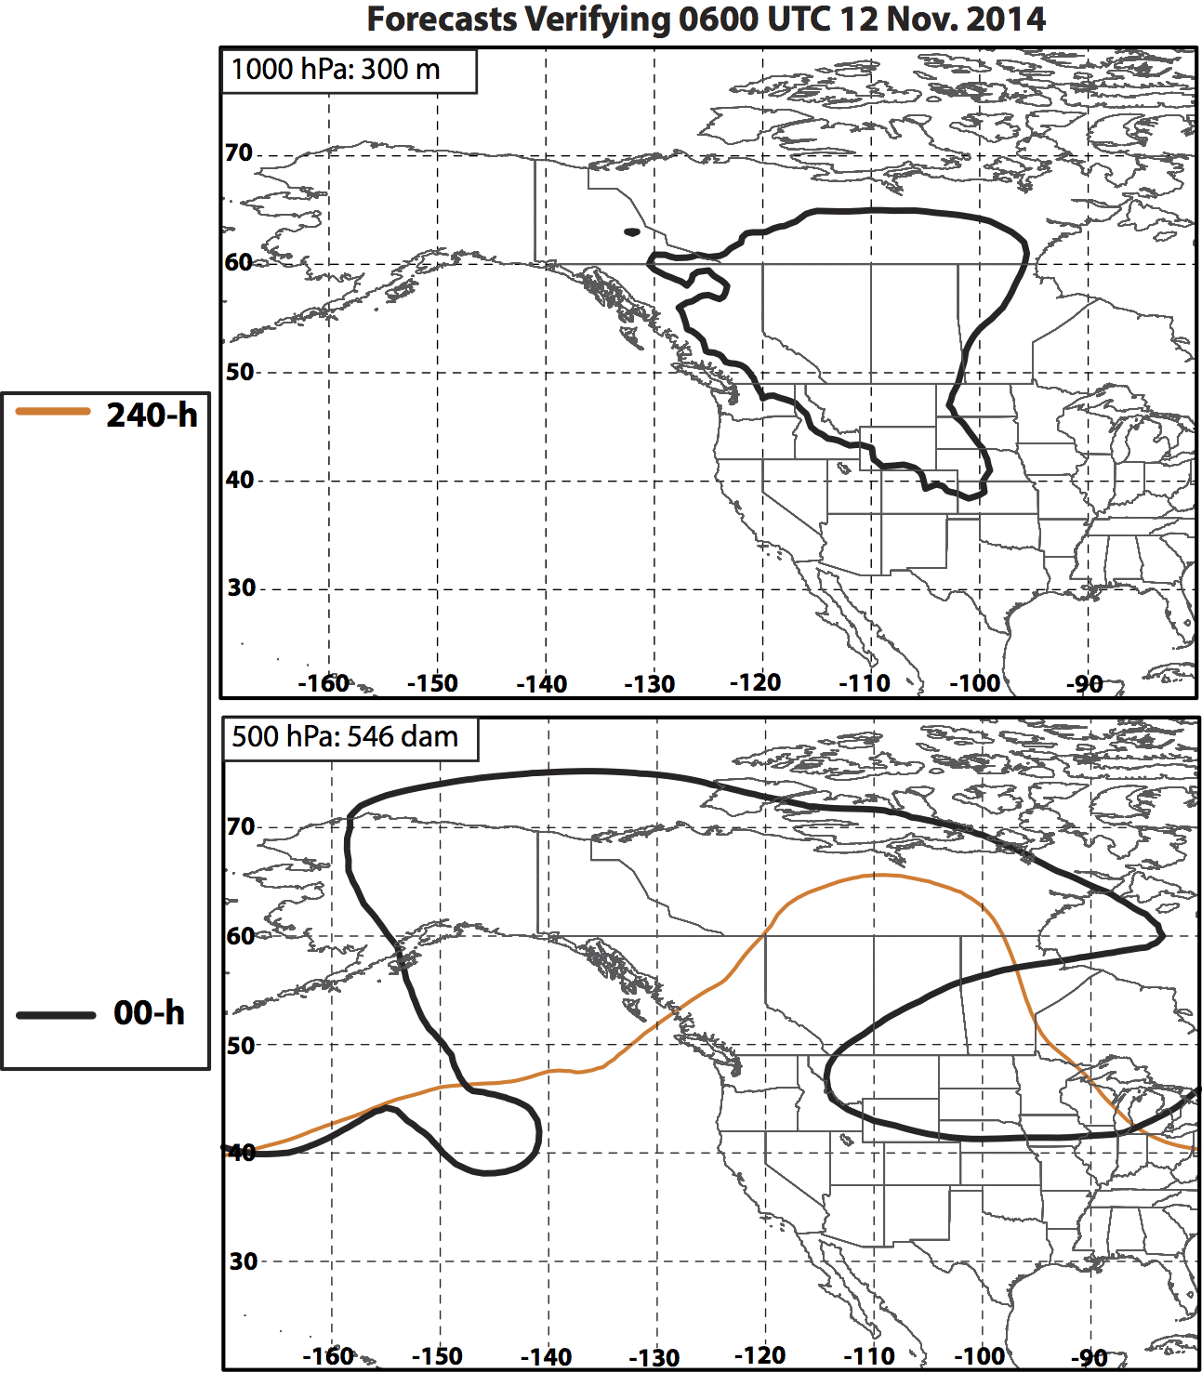
Eastern NPAC Ridge Amplification: 12 Nov

Slide 33
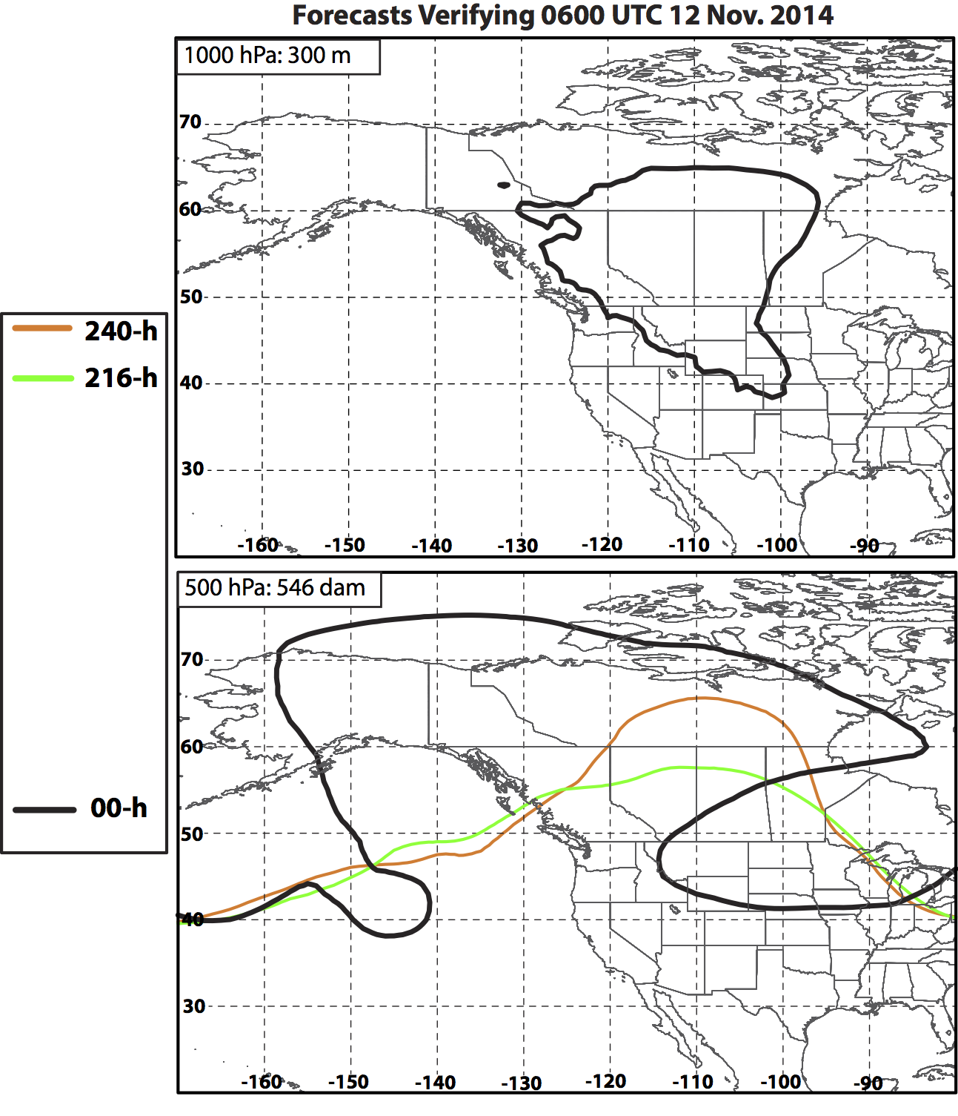
Eastern NPAC Ridge Amplification: 12 Nov

Slide 34
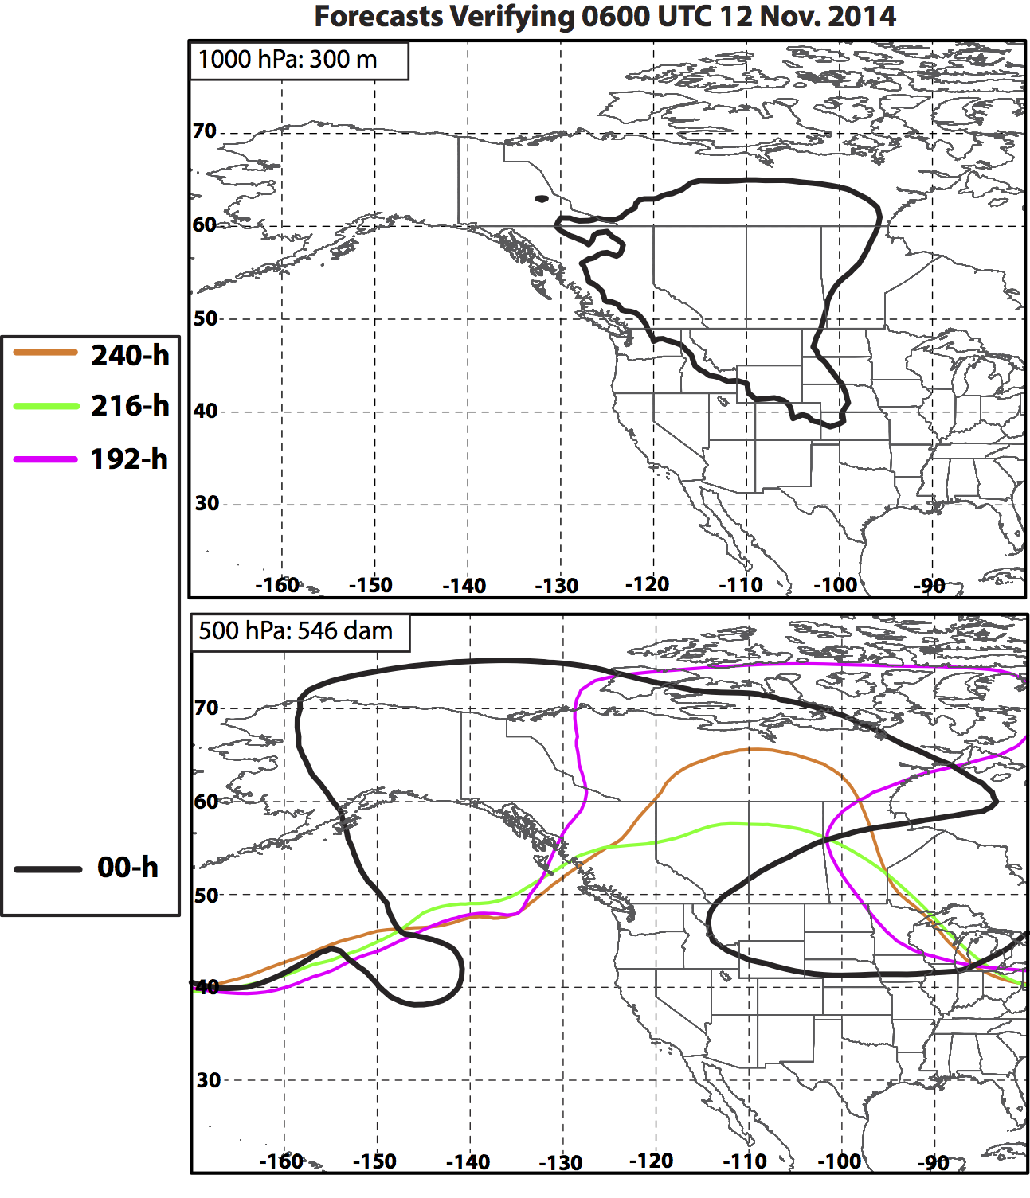
Eastern NPAC Ridge Amplification: 12 Nov

Slide 35
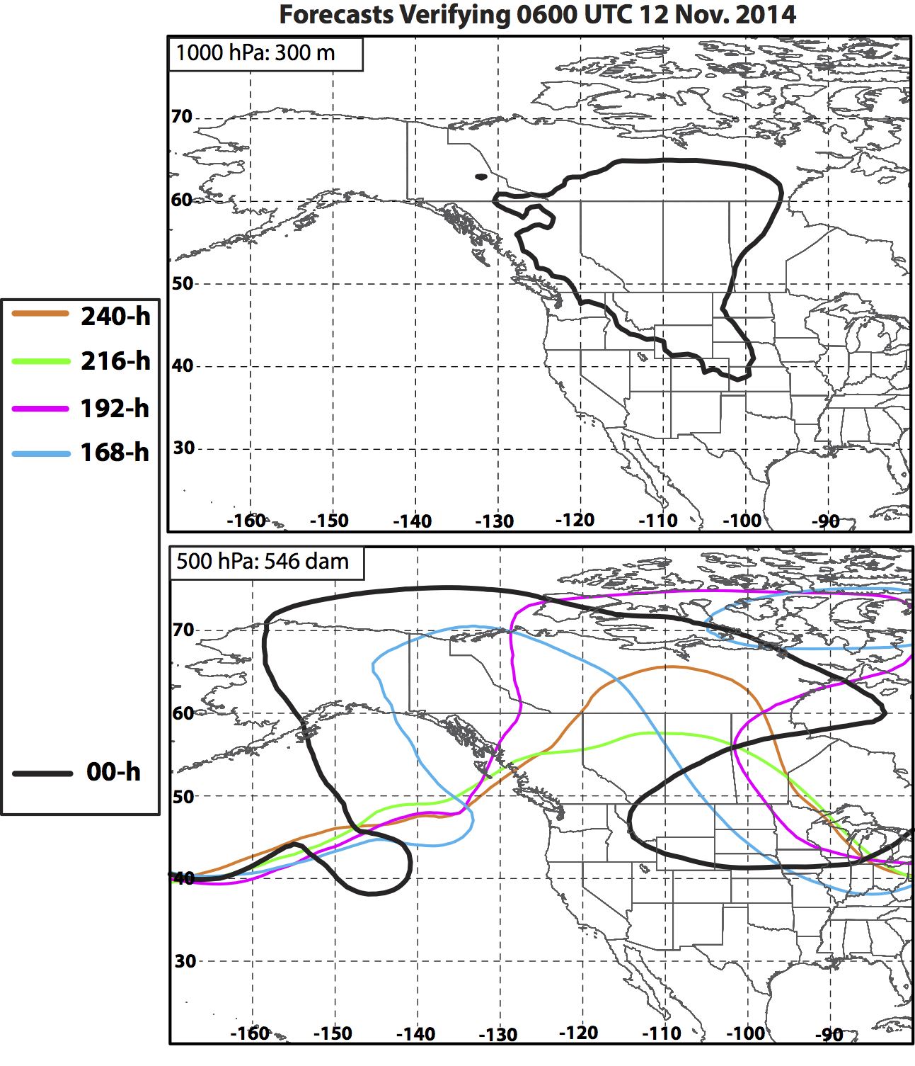
Eastern NPAC Ridge Amplification: 12 Nov
168-h forecast:
First indication of negatively tilted trough west of British Columbia.
Notes:
The 168-h forecast was initialized at 0600 UTC 5 Nov, for reference. Note that earlier forecasts predicted a positively tilted and more progressive trough over Canada.

Slide 36
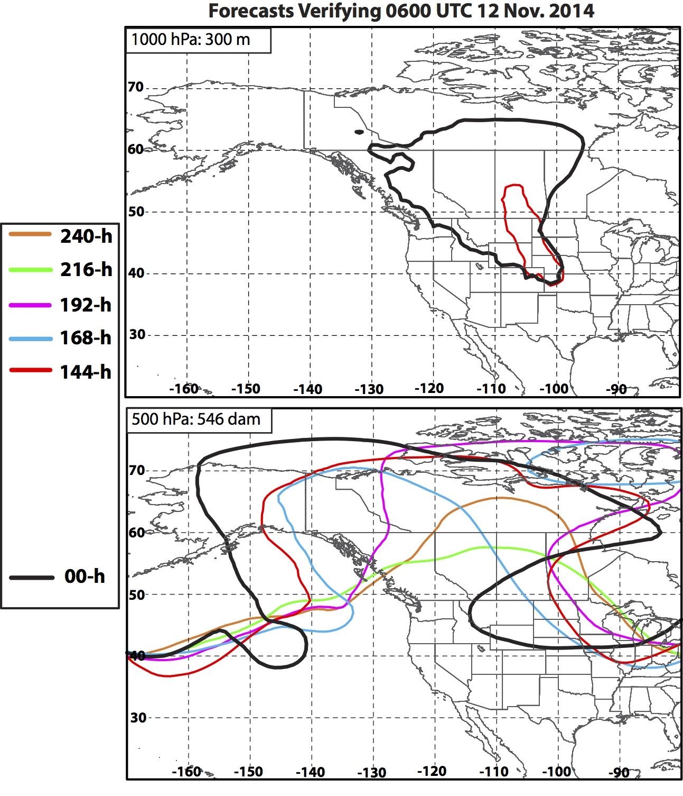
Eastern NPAC Ridge Amplification: 12 Nov
168-h forecast:
First indication of negatively tilted trough west of British Columbia.
144-h forecast:
First appearance of strong 1000 hPa anticyclone (>300 m) east of the Rockies, coinciding with improved resolution of the eastern side of the omega block.

Slide 37
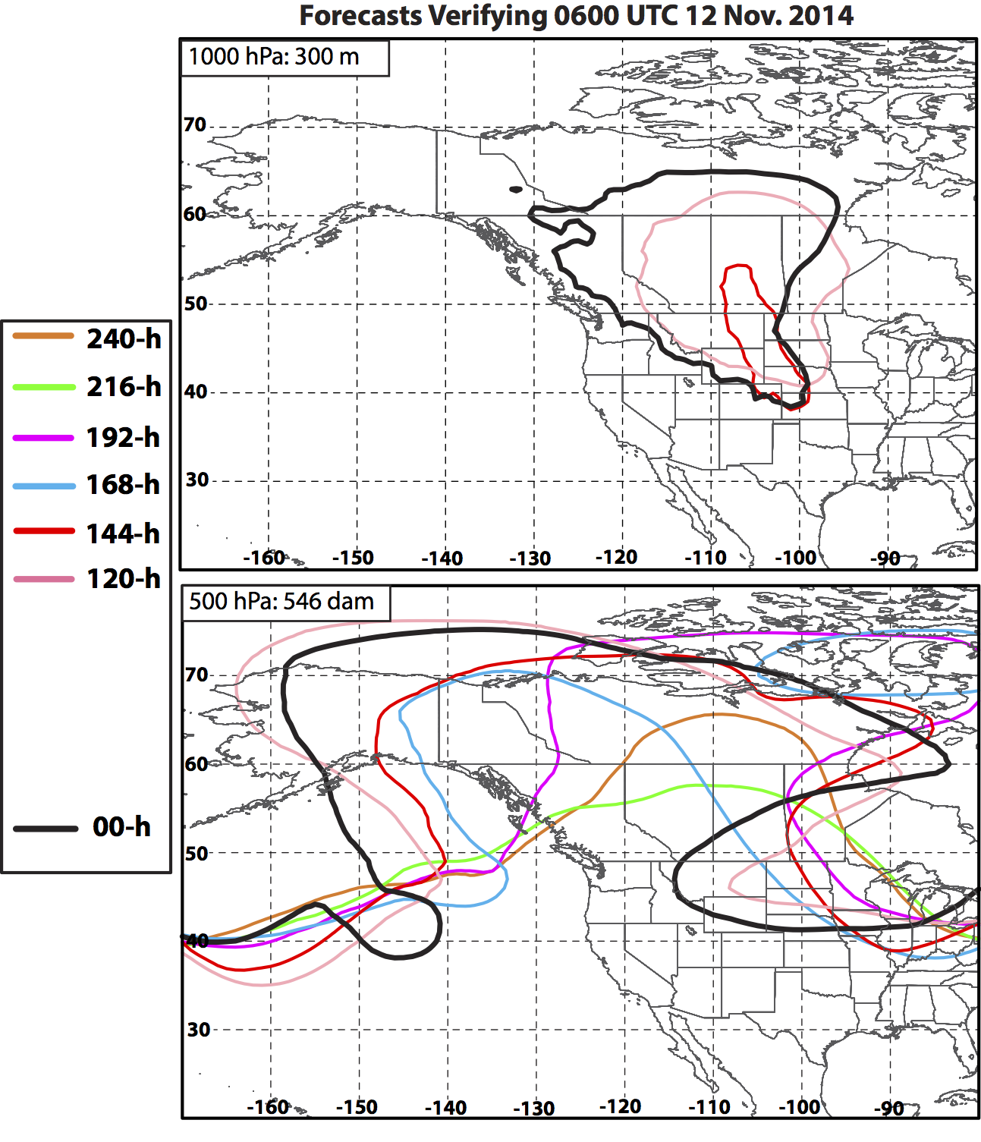
Eastern NPAC Ridge Amplification: 12 Nov
168-h forecast:
First indication of negatively tilted trough west of British Columbia.
144-h forecast:
First appearance of strong 1000 hPa anticyclone (>300 m) east of the Rockies, coinciding with improved resolution of the eastern side of the omega block.
Forecasts improve once Nuri ET occurs.
Notes:
Once the ET of Nuri occurs, the geometry of the zonally-elongated trough downstream of the ridge over the northern CONUS begins to become better resolved, as does the areal extent of the surface anticyclone in the lee of the northern Rocky Mountains.

Slide 38
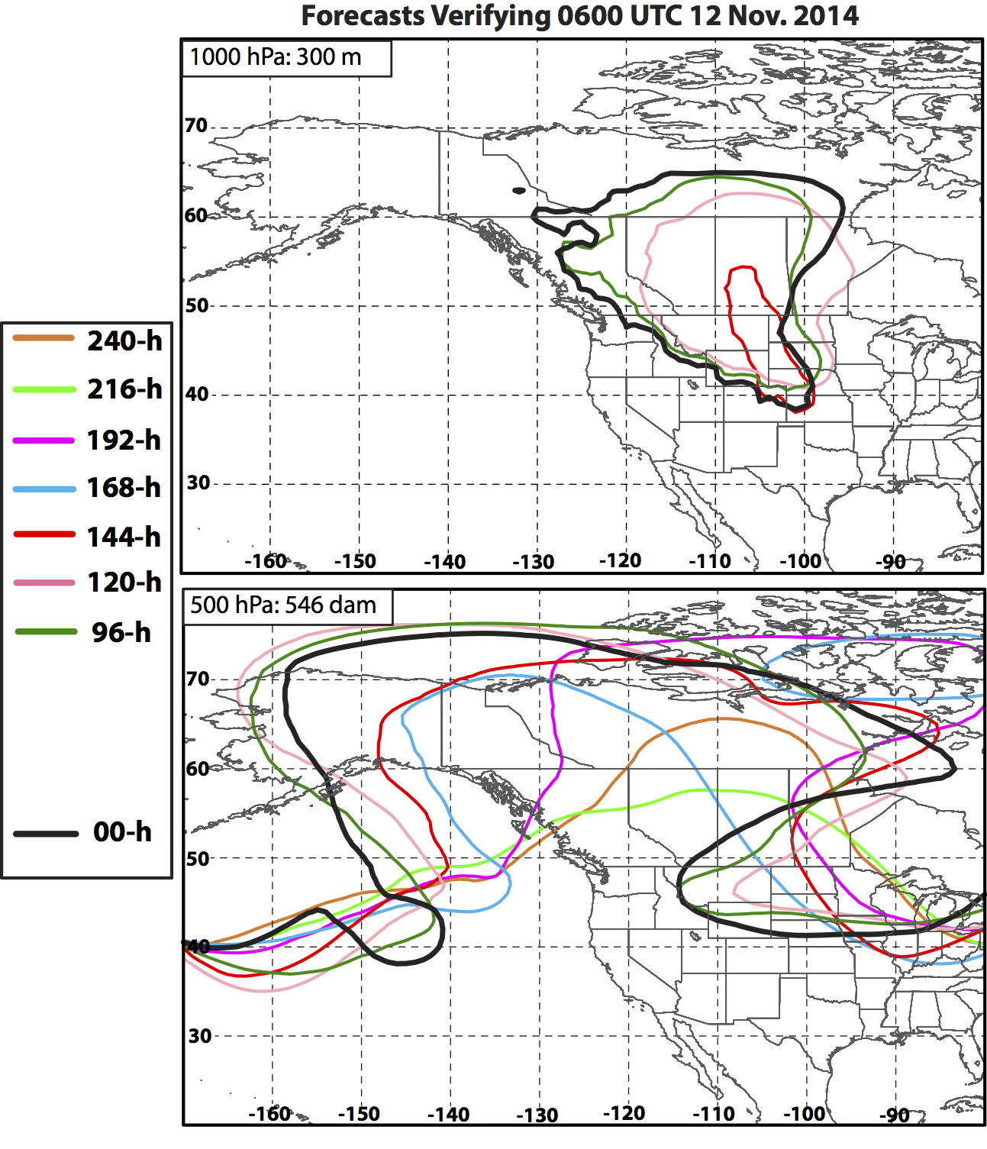
Eastern NPAC Ridge Amplification: 12 Nov
168-h forecast:
First indication of negatively tilted trough west of British Columbia.
144-h forecast:
First appearance of strong 1000 hPa anticyclone (>300 m) east of the Rockies, coinciding with improved resolution of the eastern side of the omega block.
Forecasts improve once Nuri ET occurs.

Slide 39
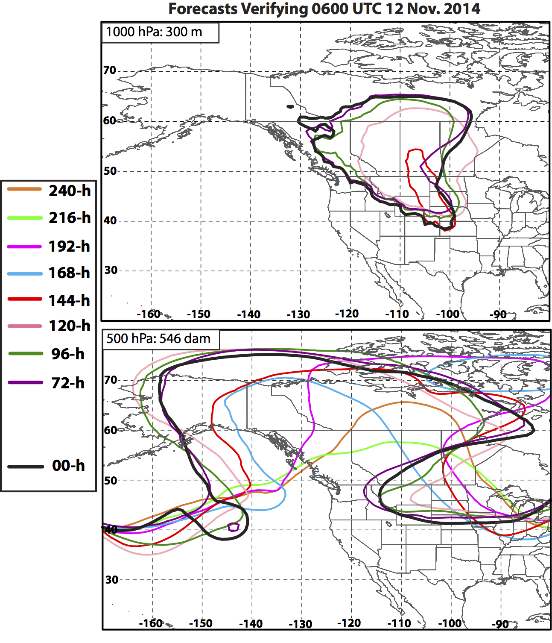
Eastern NPAC Ridge Amplification: 12 Nov
168-h forecast:
First indication of negatively tilted trough west of British Columbia.
144-h forecast:
First appearance of strong 1000 hPa anticyclone (>300 m) east of the Rockies, coinciding with improved resolution of the eastern side of the omega block.
Forecasts improve once Nuri ET occurs.

Slide 40
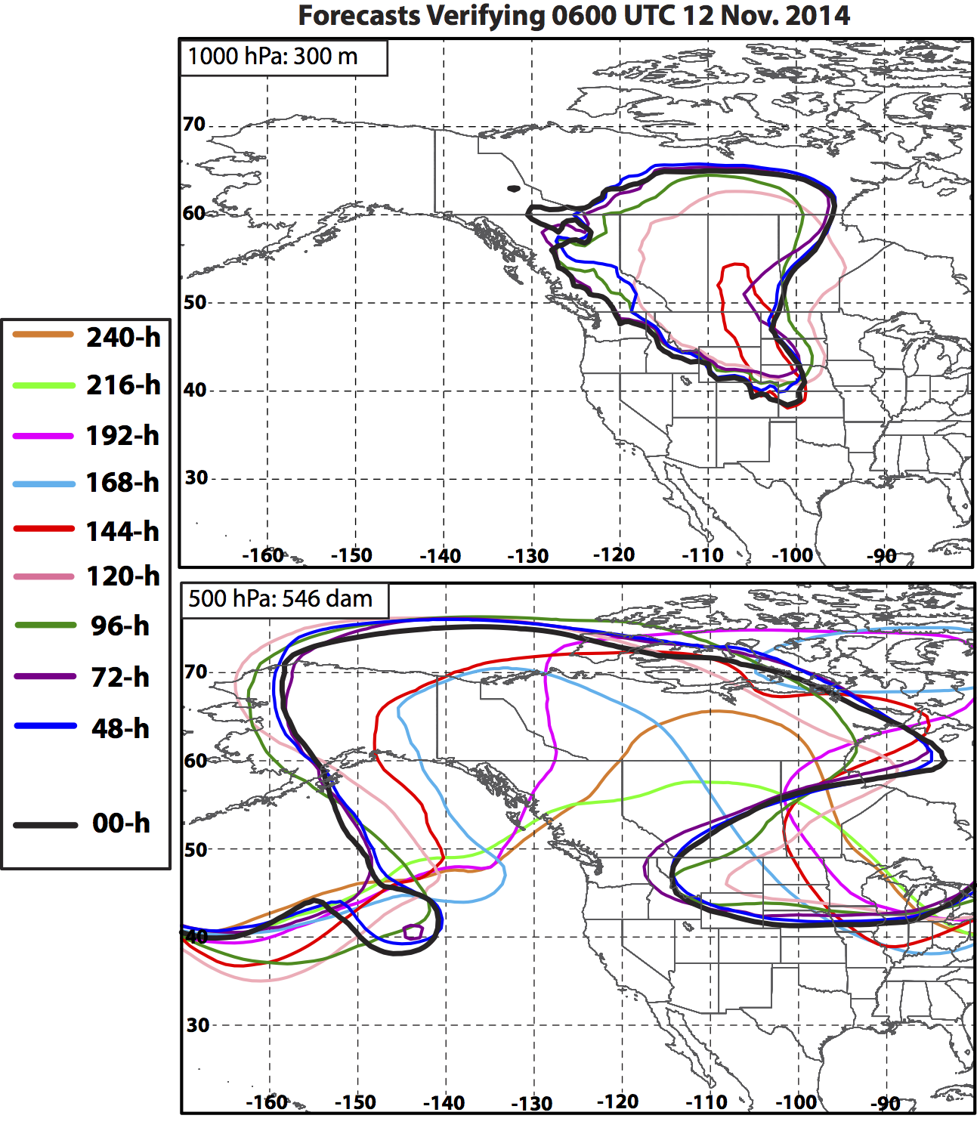
Eastern NPAC Ridge Amplification: 12 Nov
168-h forecast:
First indication of negatively tilted trough west of British Columbia.
144-h forecast:
First appearance of strong 1000 hPa anticyclone (>300 m) east of the Rockies, coinciding with improved resolution of the eastern side of the omega block.
Forecasts improve once Nuri ET occurs.

Slide 41
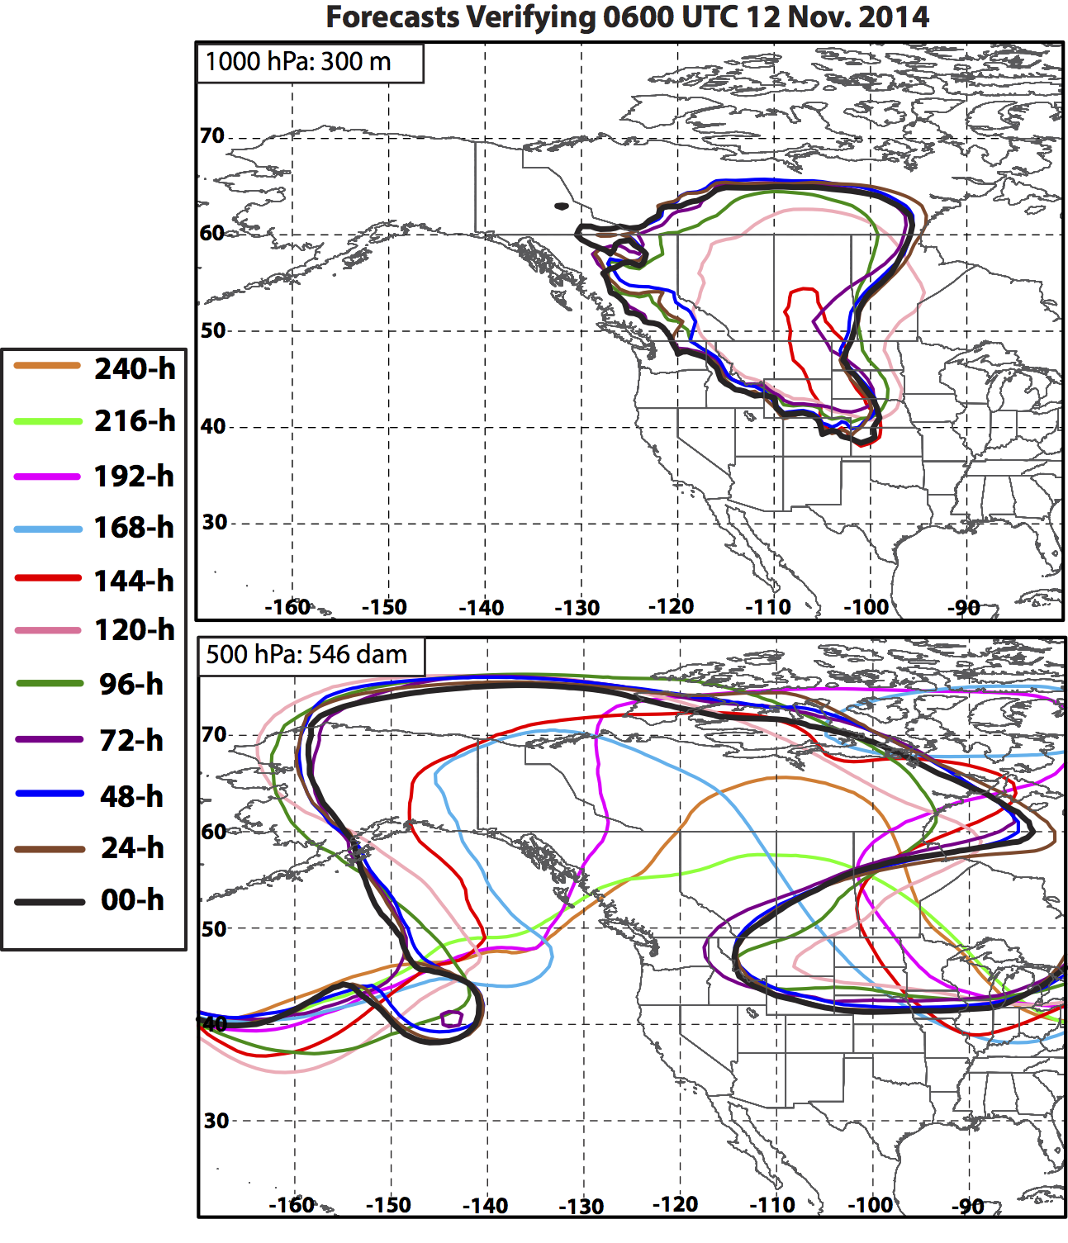
Eastern NPAC Ridge Amplification: 12 Nov
168-h forecast:
First indication of negatively tilted trough west of British Columbia.
144-h forecast:
First appearance of strong 1000 hPa anticyclone (>300 m) east of the Rockies, coinciding with improved resolution of the eastern side of the omega block.
Forecasts improve once Nuri ET occurs.

Slide 42
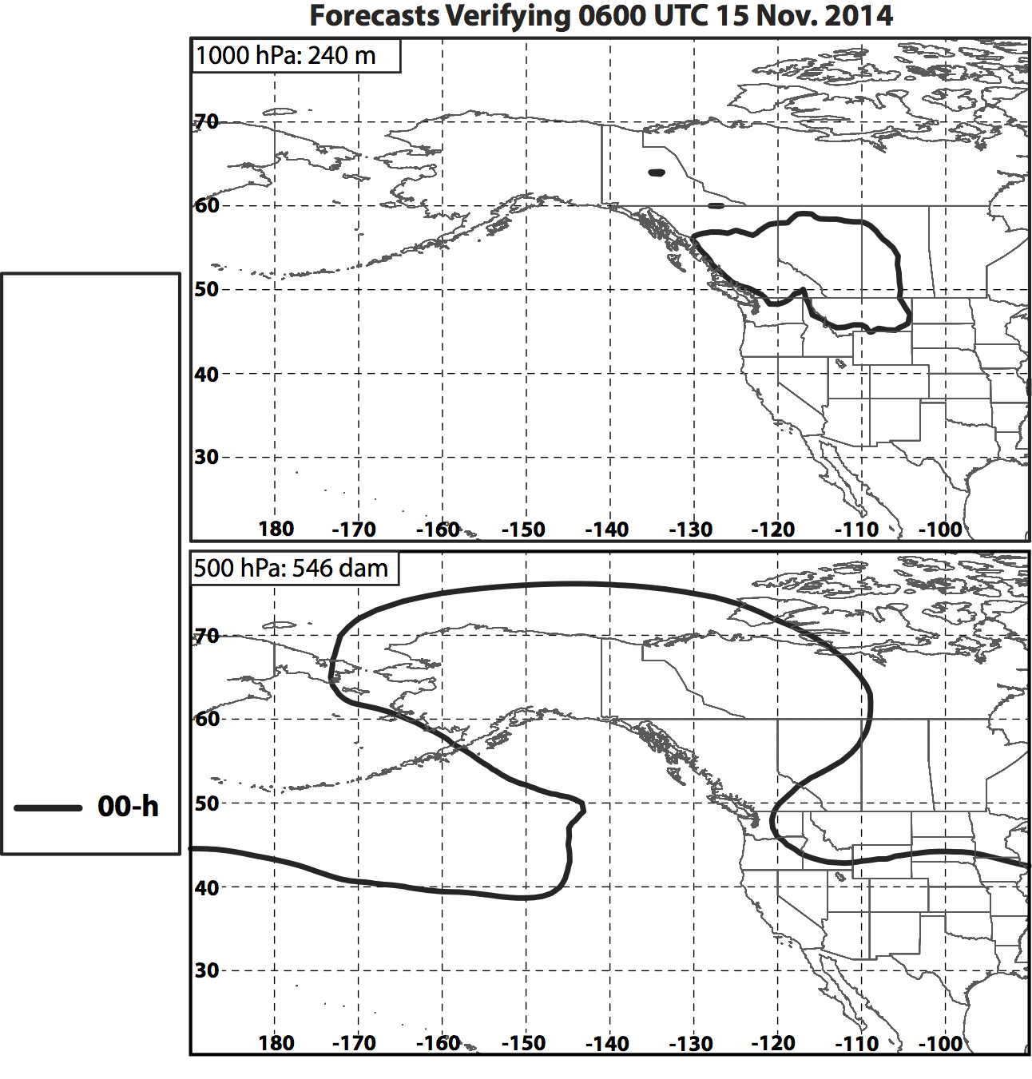
Eastern NPAC Ridge Maintenance: 15 Nov
Notes:
Forecasts of 1000 hPa geopotential height at this time diagnose the development of a second anticyclone in the lee of the northern Rocky Mountains that was associated with the second cold surge shown in Slide 18. This second anticyclone is also tied to the persistence of the eastern NPAC ridge.

Slide 43
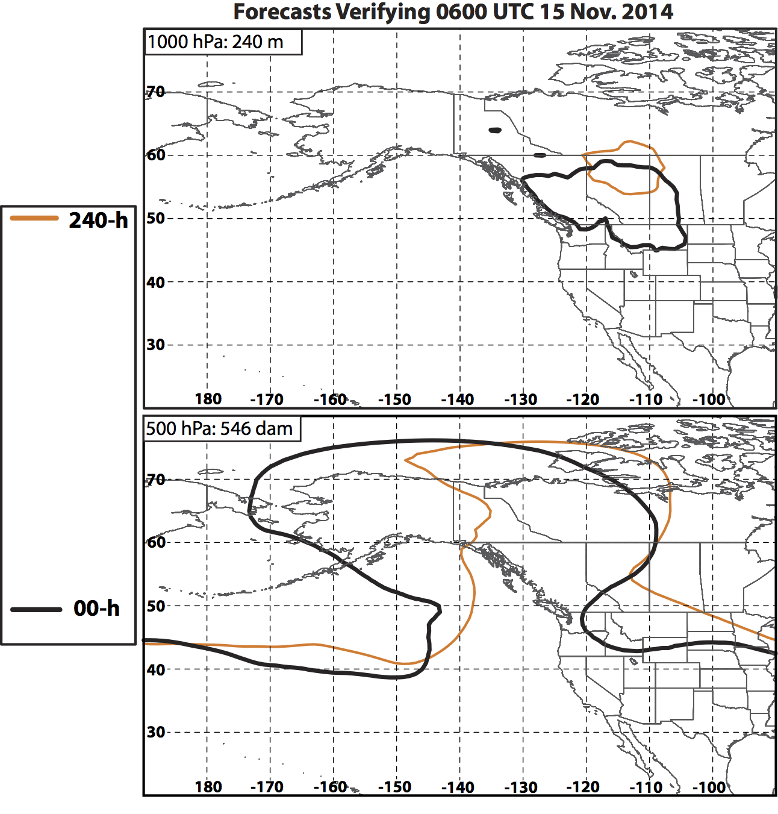
Eastern NPAC Ridge Maintenance: 15 Nov

Slide 44
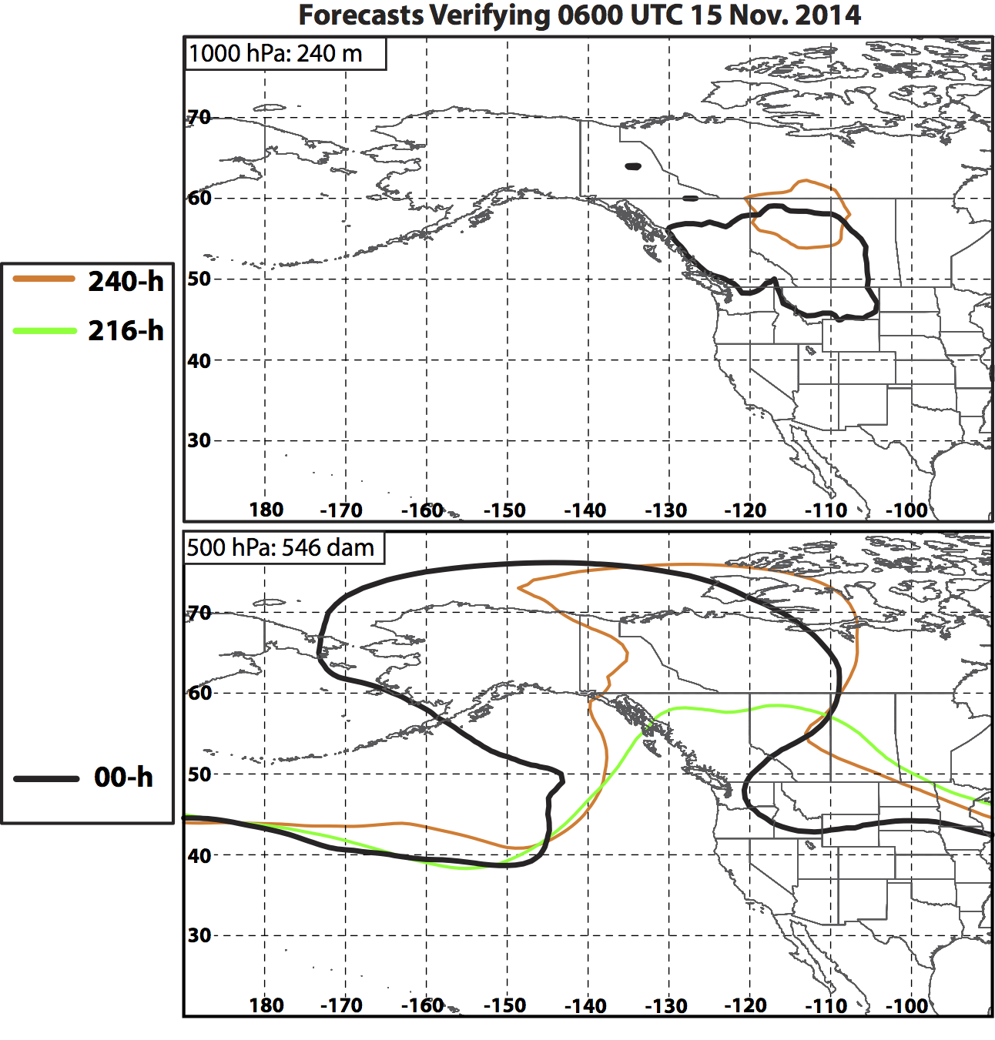
Eastern NPAC Ridge Maintenance: 15 Nov

Slide 45
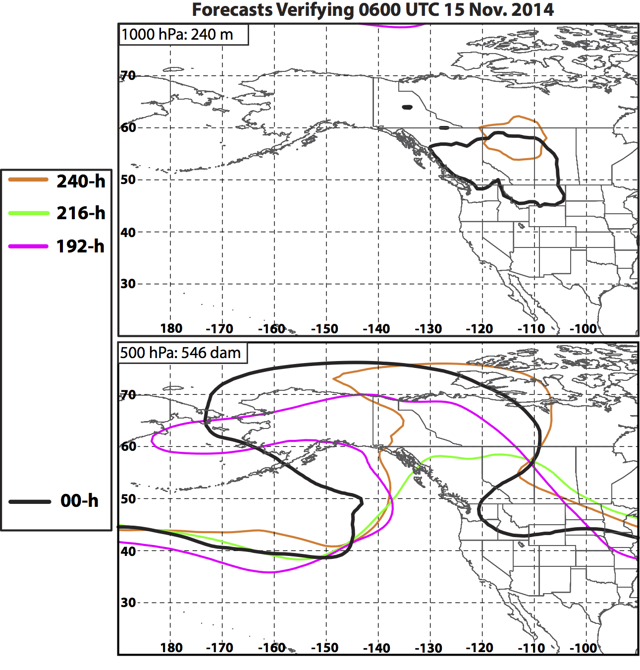
Eastern NPAC Ridge Maintenance: 15 Nov

Slide 46
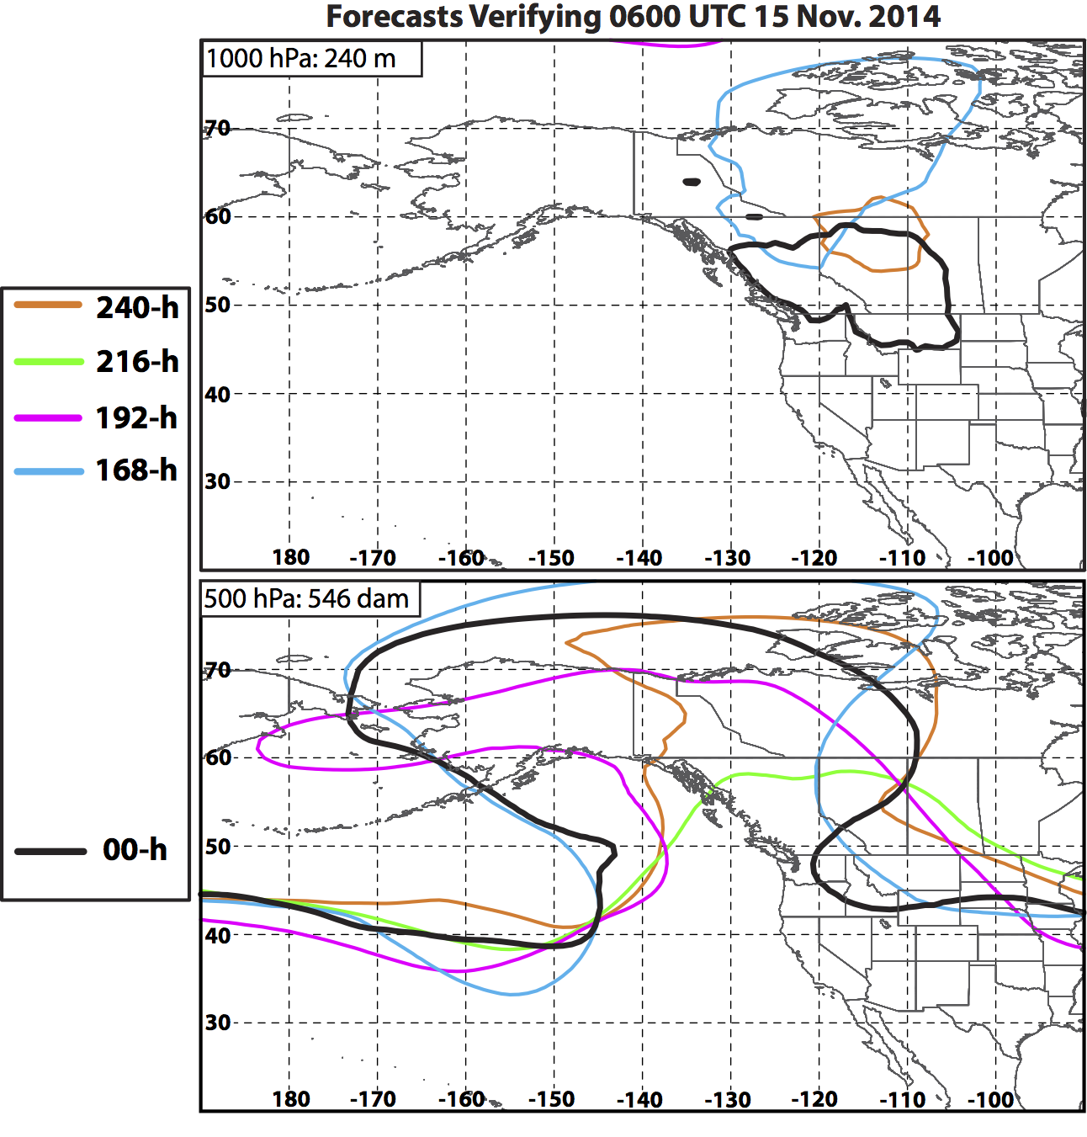
Eastern NPAC Ridge Maintenance: 15 Nov
168-h Forecast:
Once Nuri achieves its minimum SLP, forecasts begin to resolve 500 hPa trough over the Pacific Northwest.
Notes:
As with the previous set of forecasts for 12 Nov, the areal extent and geometry of the ridge becomes better resolved around the time of the ET of Nuri (7-8 Nov).

Slide 47
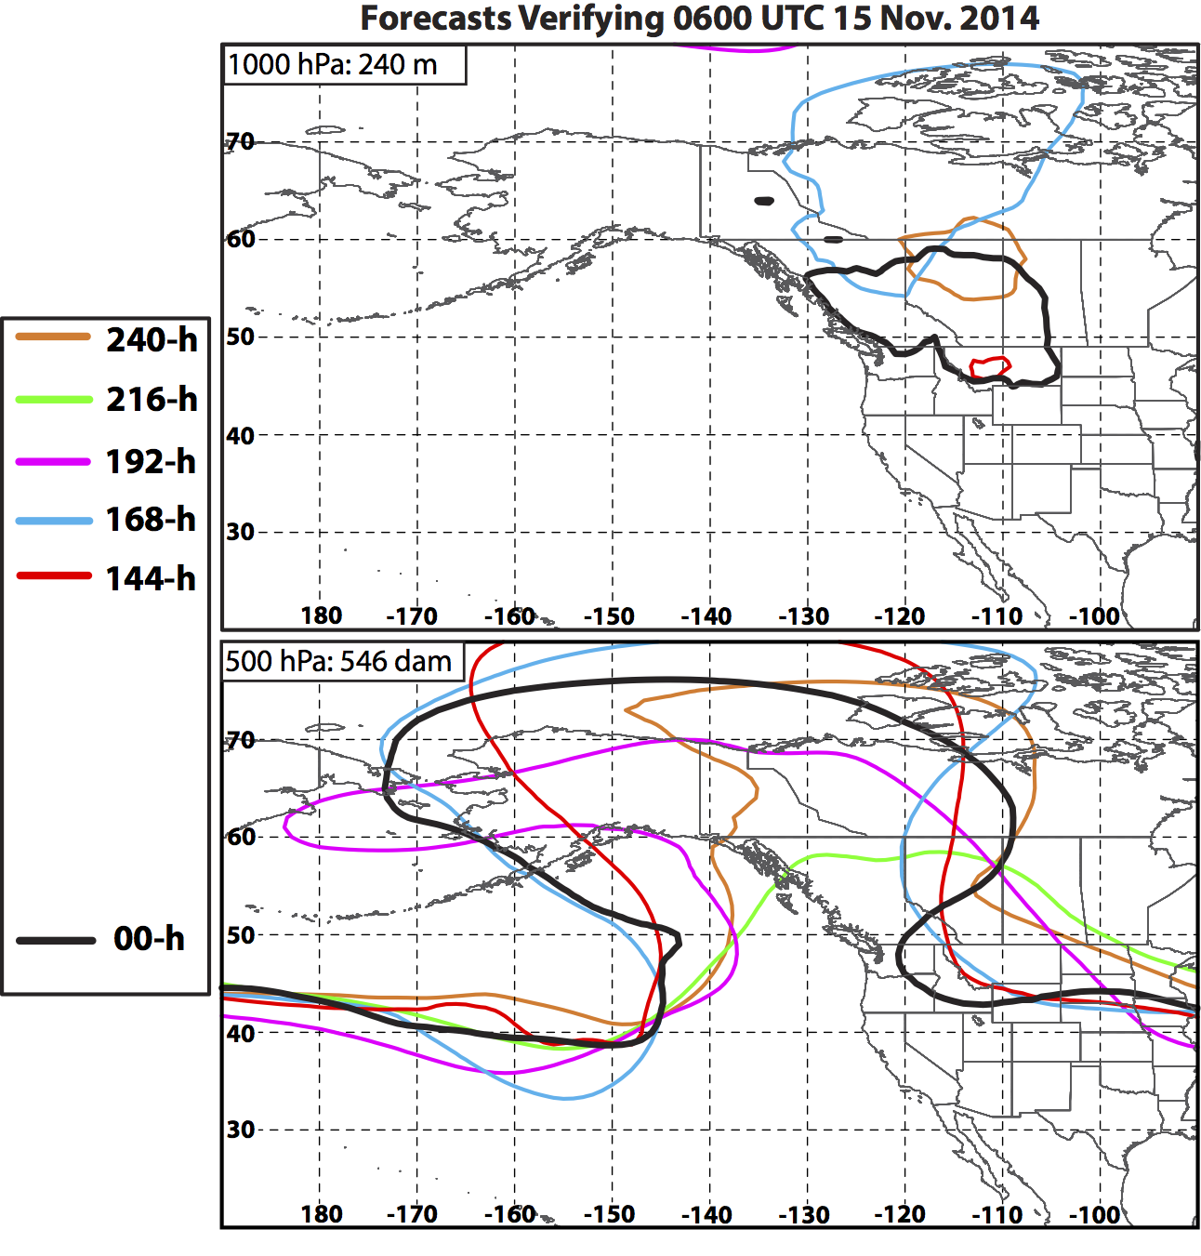
Eastern NPAC Ridge Maintenance: 15 Nov
168-h Forecast:
Once Nuri achieves its minimum SLP, forecasts begin to resolve 500 hPa trough over the Pacific Northwest.

Slide 48
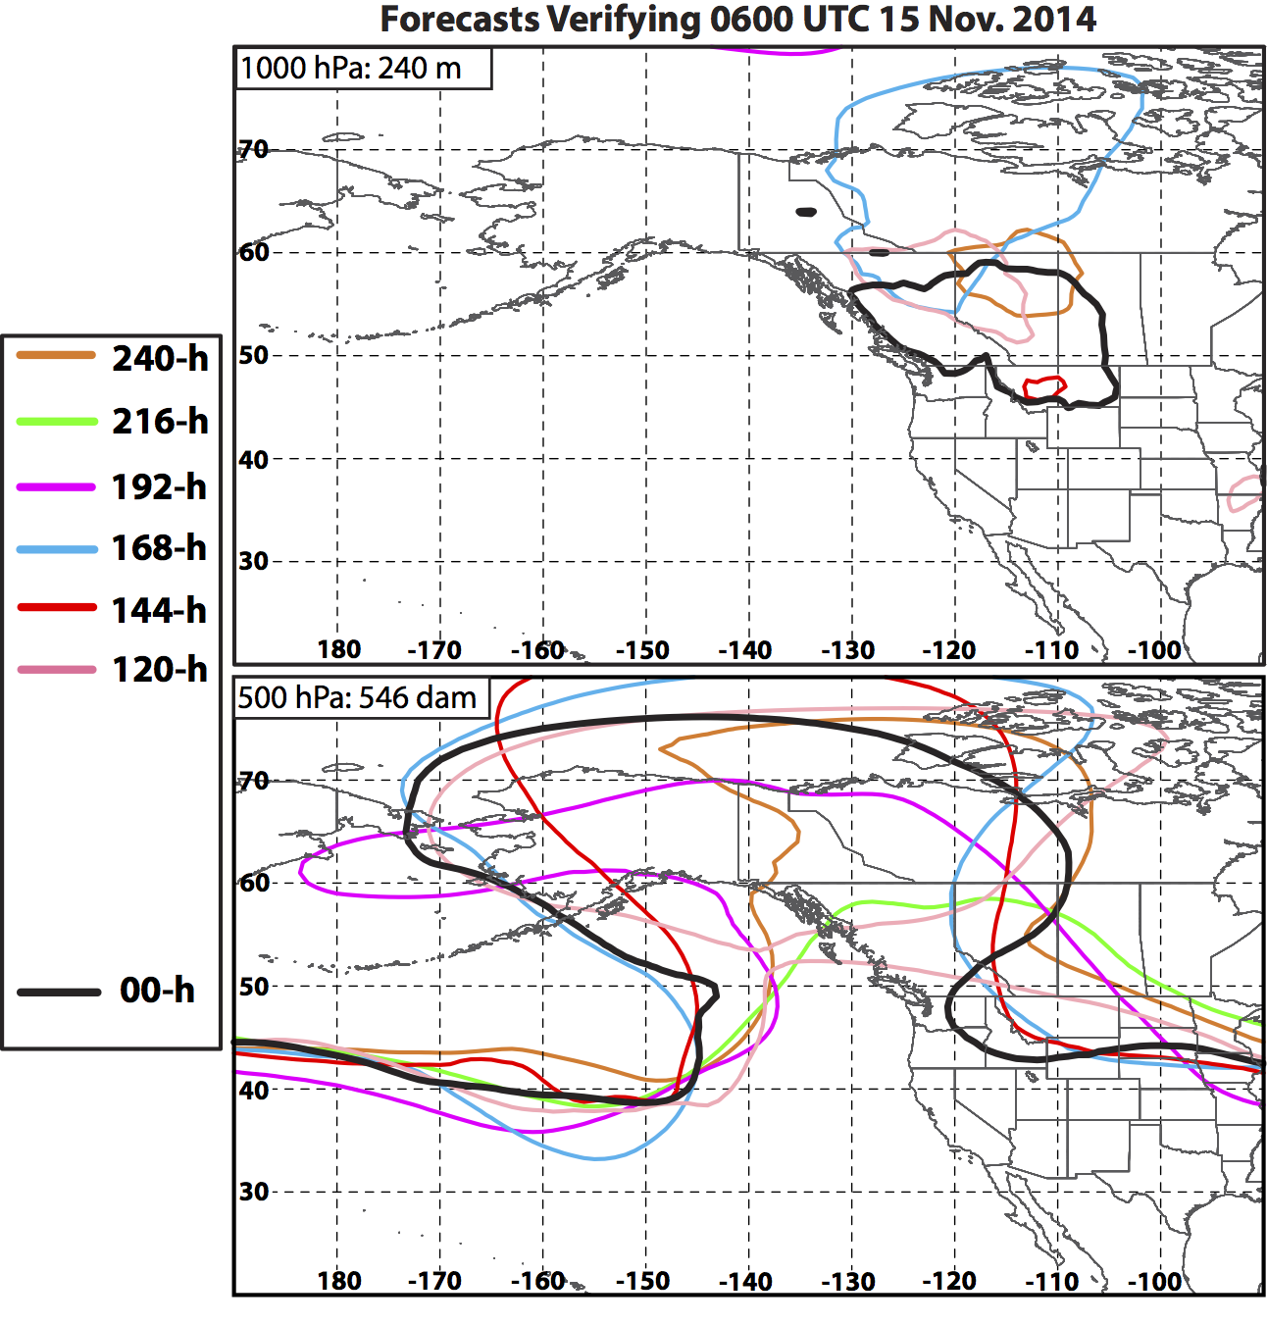
Eastern NPAC Ridge Maintenance: 15 Nov
168-h Forecast:
Once Nuri achieves its minimum SLP, forecasts begin to resolve 500 hPa trough over the Pacific Northwest.
120-h Forecast:
Once ridge amplification begins, forecasts better resolve 1000 hPa anticyclone and 500 hPa ridge.

Slide 49
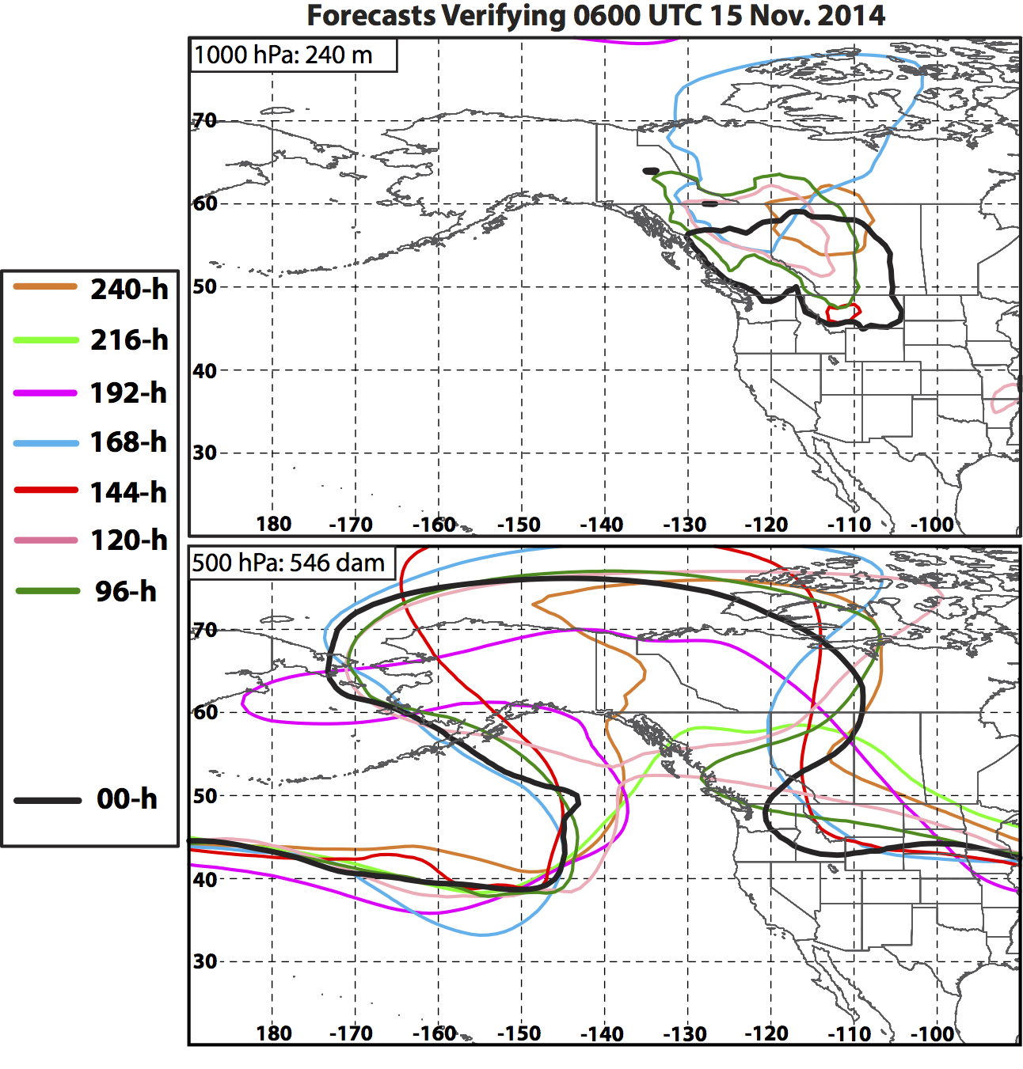
Eastern NPAC Ridge Maintenance: 15 Nov
168-h Forecast:
Once Nuri achieves its minimum SLP, forecasts begin to resolve 500 hPa trough over the Pacific Northwest.
120-h Forecast:
Once ridge amplification begins, forecasts better resolve 1000 hPa anticyclone and 500 hPa ridge.

Slide 50
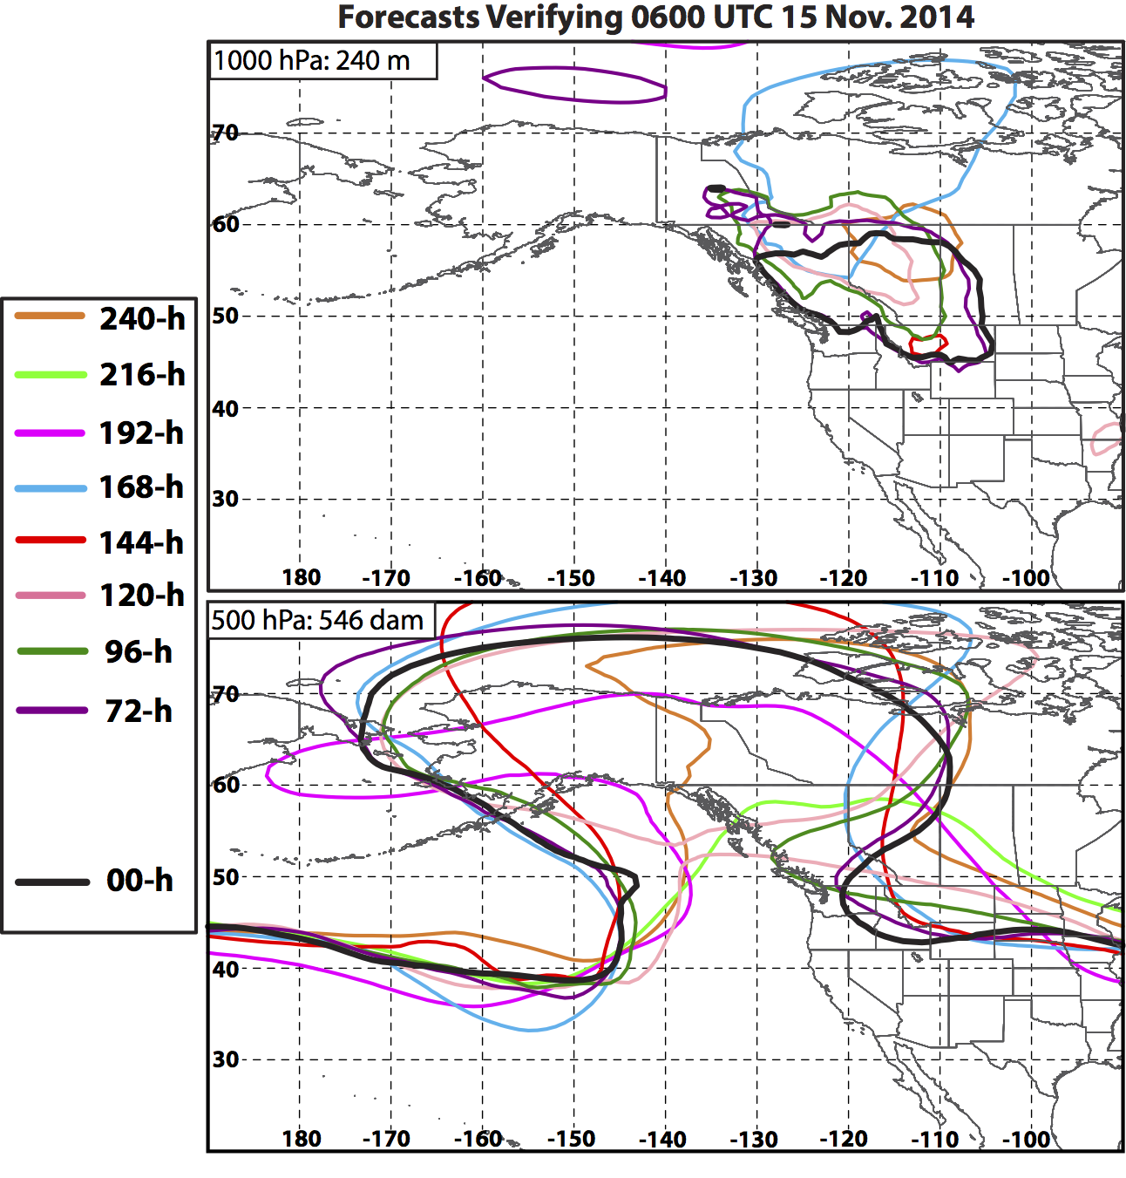
Eastern NPAC Ridge Maintenance: 15 Nov
168-h Forecast:
Once Nuri achieves its minimum SLP, forecasts begin to resolve 500 hPa trough over the Pacific Northwest.
120-h Forecast:
Once ridge amplification begins, forecasts better resolve 1000 hPa anticyclone and 500 hPa ridge.

Slide 51
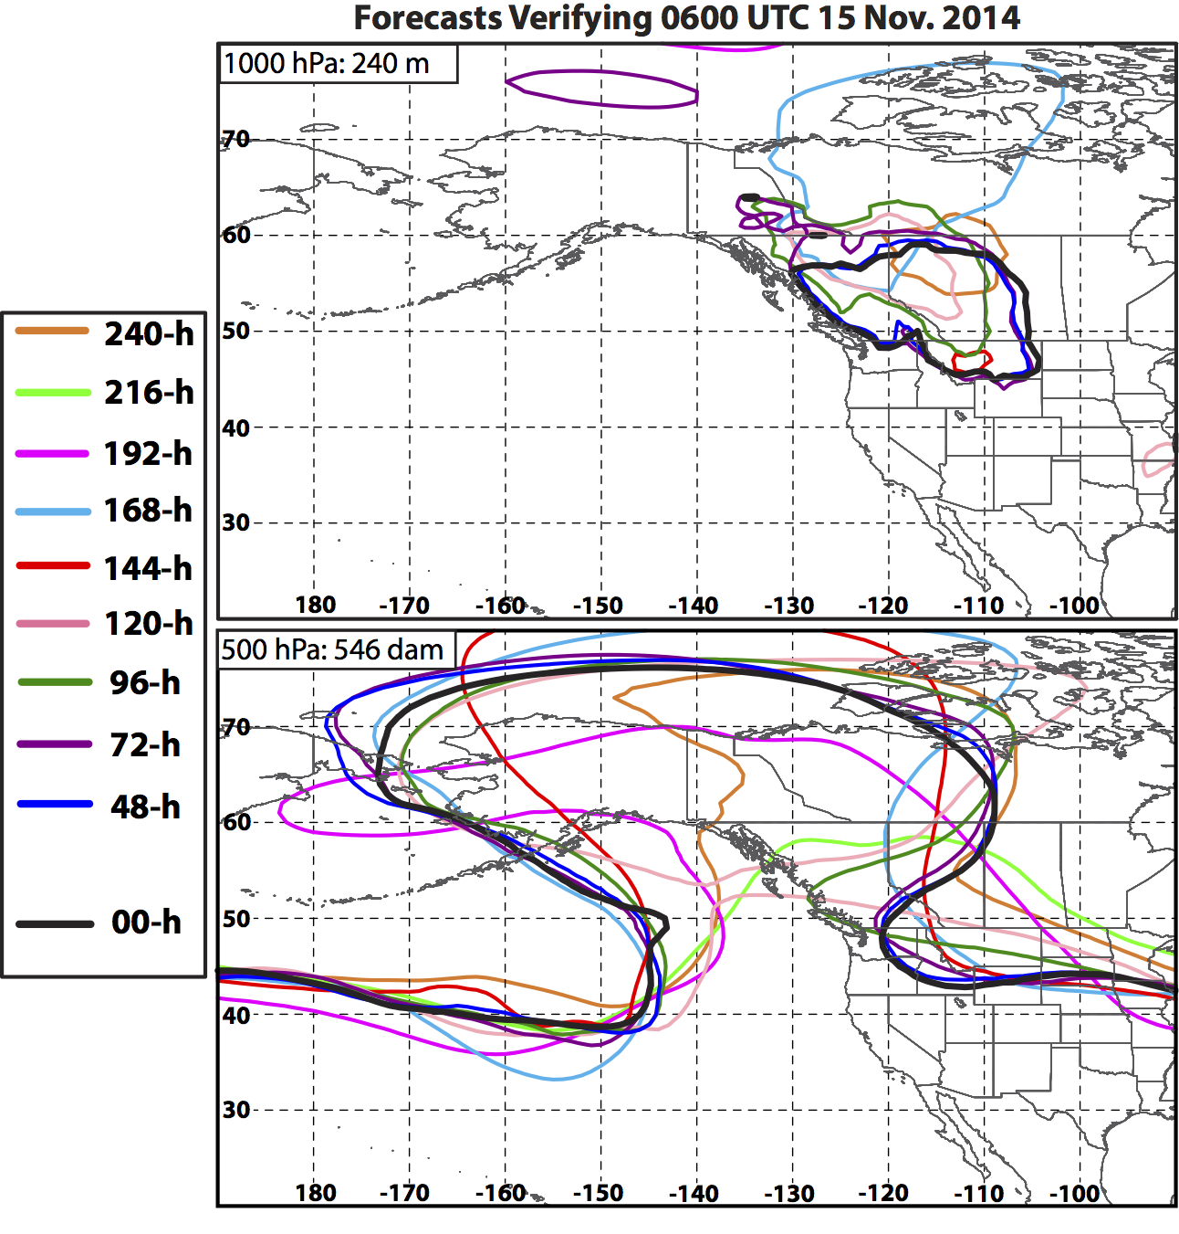
Eastern NPAC Ridge Maintenance: 15 Nov
168-h Forecast:
Once Nuri achieves its minimum SLP, forecasts begin to resolve 500 hPa trough over the Pacific Northwest.
120-h Forecast:
Once ridge amplification begins, forecasts better resolve 1000 hPa anticyclone and 500 hPa ridge.

Slide 52
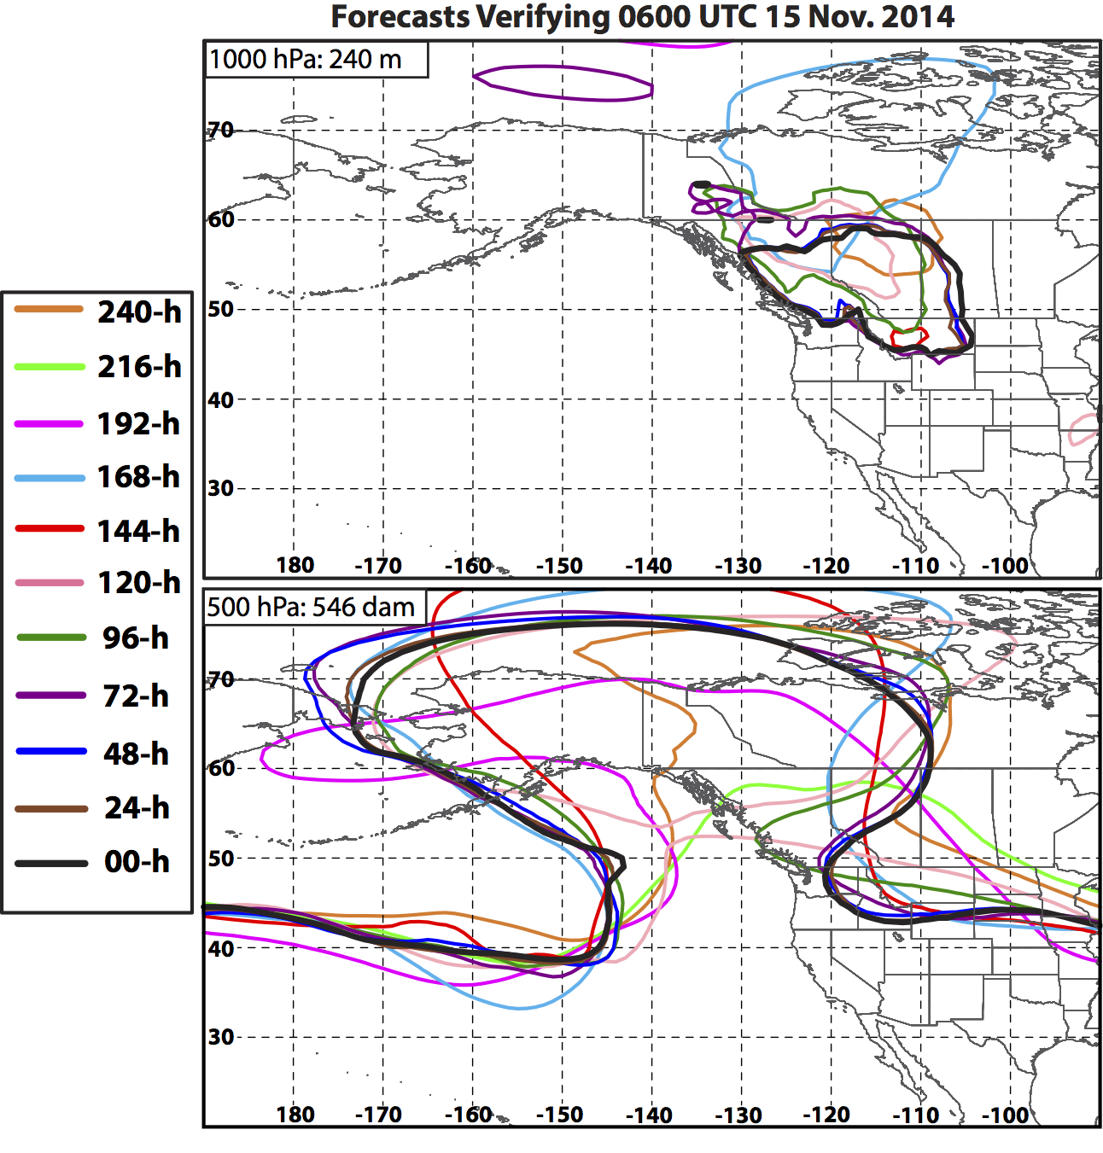
Eastern NPAC Ridge Maintenance: 15 Nov
168-h Forecast:
Once Nuri achieves its minimum SLP, forecasts begin to resolve 500 hPa trough over the Pacific Northwest.
120-h Forecast:
Once ridge amplification begins, forecasts better resolve 1000 hPa anticyclone and 500 hPa ridge.

Slide 53
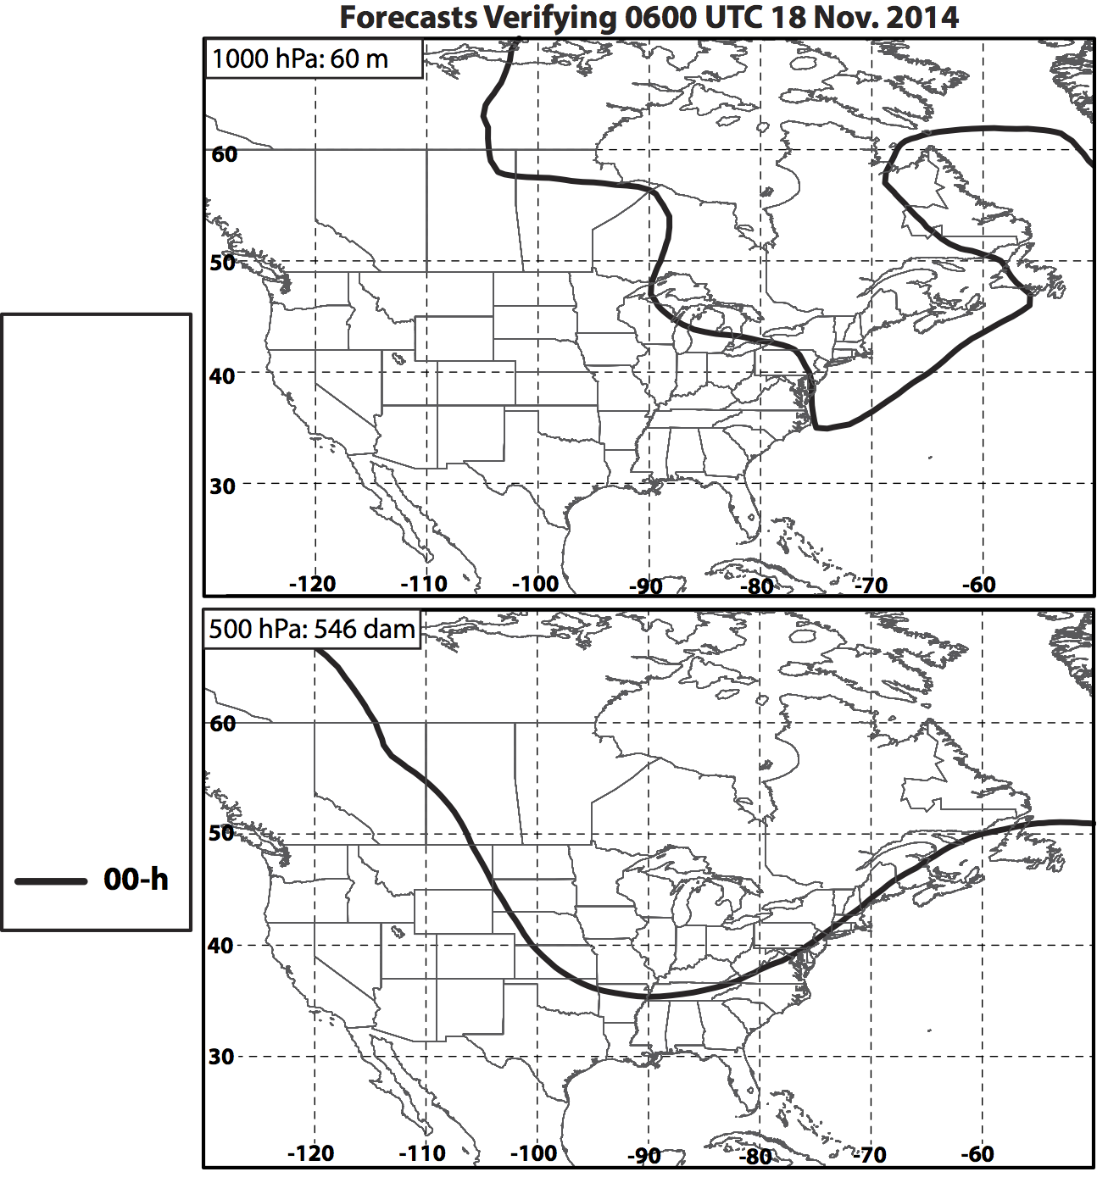
Buffalo Snow Event: 18 Nov
Notes:
Forecasts at this time diagnose the 1000 hPa geopotential height minimum associated with the Buffalo snow event (Slide 19) and the extent of the 500 hPa trough over much of the central and eastern CONUS.

Slide 54
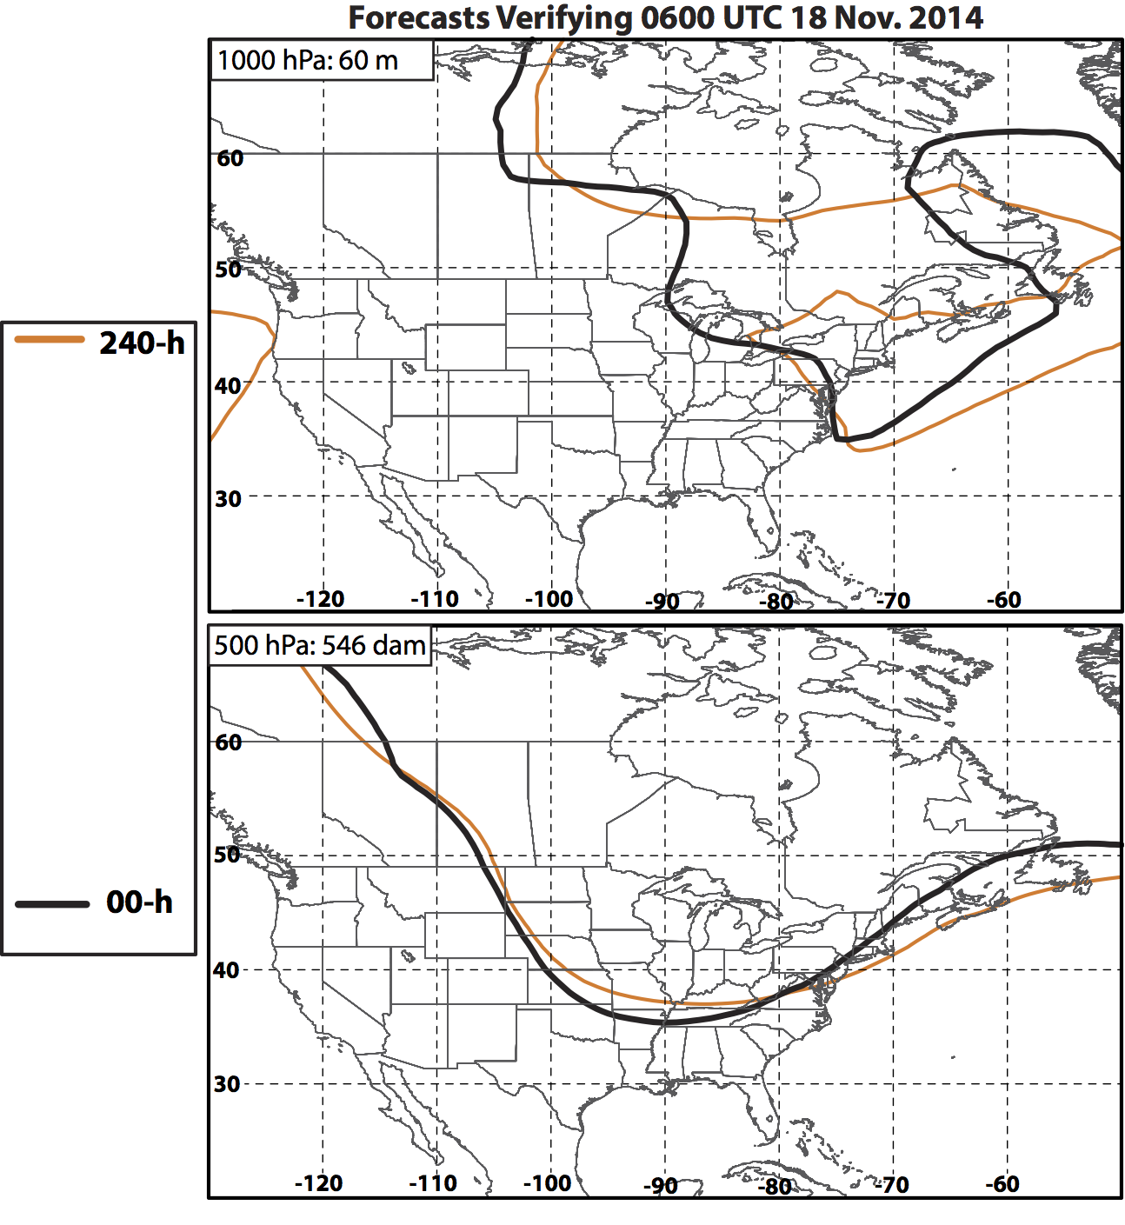
Buffalo Snow Event: 18 Nov

Slide 55

Buffalo Snow Event: 18 Nov

Slide 56

Buffalo Snow Event: 18 Nov

Slide 57

Buffalo Snow Event: 18 Nov

Slide 58

Buffalo Snow Event: 18 Nov
144-h Forecast:
Phase of upper-level trough is more accurately predicted.
This forecast initialized on 12 Nov, when eastern NPAC ridge becomes well established.

Slide 59

Buffalo Snow Event: 18 Nov
144-h Forecast:
Phase of upper-level trough is more accurately predicted.
This forecast initialized on 12 Nov, when eastern NPAC ridge becomes well established.

Slide 60

Buffalo Snow Event: 18 Nov
144-h Forecast:
Phase of upper-level trough is more accurately predicted.
This forecast initialized on 12 Nov, when eastern NPAC ridge becomes well established.

Slide 61

Buffalo Snow Event: 18 Nov
144-h Forecast:
Phase of upper-level trough is more accurately predicted.
This forecast initialized on 12 Nov, when eastern NPAC ridge becomes well established.

Slide 62

Buffalo Snow Event: 18 Nov
144-h Forecast:
Phase of upper-level trough is more accurately predicted.
This forecast initialized on 12 Nov, when eastern NPAC ridge becomes well established.

Slide 63

Buffalo Snow Event: 18 Nov
144-h Forecast:
Phase of upper-level trough is more accurately predicted.
This forecast initialized on 12 Nov, when eastern NPAC ridge becomes well established.
Model forecasts appear to show strongest agreement on this forecast compared to forecasts shown in previous diagrams.
Notes:
Forecasts of 1000 hPa and 500 hPa geopotential height verifying at 18 Nov 2014 were in general agreement with the placement of a trough over much of the eastern CONUS. Forecast uncertainties appear to be related not to the amplitude of the trough but rather its position. All of these forecasts, beginning with the 10-day forecast, were initialized following the ET of Nuri.

Slide 64
RMSE of Geopotential Height (m) Verifying at
0600 UTC 8 Nov 2014
300
500 hPa
1000 hPa
200
100
0
216
10/30
168
11/01
120
11/03
72
11/05
24
11/07
216
10/30
168
11/01
120
11/03
72
11/05
24
11/07
Forecast Hour (h)
144-h: Forecasts begin to show explosive ET in NPAC (2 Nov)
48-h: Interaction of Nuri with trough better predicted (6 Nov)
Notes:
The following four slides show the RMSE of 1000 hPa and 500 hPa geopotential height for GEFS ensemble members averaged over the domain shown in the top right of each panel. The ensemble mean RMSE, ensemble standard deviation of the RMSE, and ensemble spread of the RMSE at each forecast time are indicated following the legend in the top right of each panel. Note that the spread in ensemble error begins to decrease consistently beginning with the 144-h forecast. Spread collapses sharply 48-h prior to Nuri completing ET as details surrounding the ET are better resolved.

Slide 65
RMSE of Geopotential Height (m) Verifying at
0600 UTC 12 Nov 2014
300
500 hPa
1000 hPa
200
100
0
216
11/03
168
11/05
120
11/07
72
11/09
24
11/11
216
11/03
168
11/05
120
11/07
72
11/09
24
11/11
Forecast Hour (h)
96-h: Nuri intensifies to 924 hPa (8 Nov)
Notes:
The largest ensemble mean RMSE at 500 hPa and 1000 hPa in any 240-h forecast shown in this presentation is associated with the eastern NPAC ridge on 12 Nov. Errors decrease consistently as details concerning the ET of Nuri are better captured by the model. After the ET of Nuri (96-h), the ensemble spread sharply collapses.

Slide 66
RMSE of Geopotential Height (m) Verifying at
0600 UTC 15 Nov 2014
300
500 hPa
1000 hPa
200
100
0
216
11/06
168
11/08
120
11/10
72
11/12
24
11/14
216
11/06
168
11/08
120
11/10
72
11/12
24
11/14
Forecast Hour (h)
168-h: Nuri intensifies to 924 hPa (8 Nov)
120-h: Omega block in eastern NPAC begins to form (10 Nov)
Notes:
The largest forecast errors in geopotential height verifying on 15 Nov occur prior to the ET of Nuri. Errors remain level at 500 hPa until the 120-h forecast, when the omega block in the NPAC began to develop and became part of the model initial conditions.

Slide 67
RMSE of Geopotential Height (m) Verifying at
0600 UTC 18 Nov 2014
300
500 hPa
1000 hPa
200
100
0
216
11/09
168
11/11
120
11/13
72
11/15
24
11/17
216
11/09
168
11/11
120
11/13
72
11/15
24
11/17
Forecast Hour (h)
192-h: Omega block in eastern NPAC begins to form (10 Nov)
120-h: Omega block well established (13 Nov)
Notes:
Forecast errors for much of the CONUS begin to collapse after the 192-h forecast, when forecasts were initialized with knowledge of the omega block in the eastern NPAC. Overall, the ensemble mean errors in the 240-h forecast are less than those seen in the previous forecast times analyzed.

Slide 68
Impacts: Buffalo Snow Blitz and CONUS Record Cold

Slide 69


Slide 70


Slide 71


Buffalo (72528) Soundings:
0000 UTC 18 and 19 Nov 2014
1000–500 hPa thickness: 5034 m
T (500 hPa) –42.1 °C; T (850 hPa) –15.1°C
LWT – 850-hPa temperature difference: ~27°C

Slide 72

NCDC CONUS Temperature Rankings for Nov 2014 (Left) and Mean Temperature Anomalies (°F) for 16–22 Nov 2014 (Right)

Slide 73
Minimum Temperature Records Broken:
16–22 Nov 2014 (N = 2677)
Source: NCDC

Slide 74
Conclusions (1)
An upper-level disturbance creates a strong baroclinic zone and jet stream across the western North Pacific prior to ET of STY Nuri
The interaction of STY Nuri with a second baroclinic disturbance of arctic origin during ET leads to explosive reintensification of Nuri as an EC
Downstream high-latitude ridge amplification and omega block formation over Alaska and NW Canada follow explosive reintensification of Nuri as an EC

Slide 75
Conclusions (2)
Omega block maintenance (~10 days) enables multiples surges of early season arctic air to encompass much of the CONUS
Impacts of the arctic air surges include a near-epic lake-effect snowstorm south of Buffalo and a failed CPC Nov 2014 seasonal temperature forecast
North Pacific and North American model forecast skill is maximized one to two weeks after ET of STY Nuri and explosive reintensification of Nuri as an EC

Slide 76
Abrupt Regime Change
over Northeast U.S. in Late May and Early June 2015

Slide 77
Abrupt Regime Change from Much Above to Much Below Temperatures over the Northeast in Late May and Early June 2015
Largest CONUS positive temperature anomalies were found over the Northeast in May
Reversal from positive-to-negative temperature anomalies occurred at the end of May
Anomaly reversal was driven by surface anticyclogenesis over eastern Canada
Canadian anticyclogenesis occurred beneath a confluent poleward jet-entrance region
Surface anticyclone over eastern Canada drove chilly Atlantic air southwestward
Did a record-breaking snowpack over southeastern Canada exacerbate the chill?
Did below normal SSTs over the northwest Atlantic contribute to the chill?
Did relatively dry air over southeastern Canada allow for evaporative chilling?
GFS deterministic forecast did not catch onto the cool down until the 6–7 day forecast
Note: GFS forecast grids have aged off and would have to be retrieved

Slide 78


Mean and Anomaly 850-hPa Temperature (°C): Apr 2015

Slide 79


Mean and Anomaly 850-hPa Temperature (°C): May 2015

Slide 80


Mean (m) and Anomaly (m) 1000-hPa Geopotential Height: Apr 2015

Slide 81


Mean (dam) and Anomaly (m) 500-hPa Geopotential Height: May 2015

Slide 82


Mean (m) and Anomaly (m) 1000-hPa Geopotential Height: May 2015

Slide 83


Mean (mm) and Anomaly (mm) Precipitable Water: May 2015

Slide 84


Sea Level Pressure (hPa):
30 and 31 May 2015

Slide 85


Sea Level Pressure (hPa):
1 and 2 June 2015

Slide 86

NOAA NCEP-EMC Sea Surface Temperature (°C):
3 June 2015

Slide 87
A Final Thought:
One or several EWEs during a single season can contribute disproportionately to temperature and precipitation anomaly statistics for a particular season. This disproportionate contribution suggests that EWEs need to be considered in describing and understanding the dynamical and thermodynamic processes that operate at the weather–climate intersection in order to apply that knowledge to making operational probabilistic temperature and precipitation forecasts for the 8–10 day time period.

