Slide 1
An Investigation of the Skill of Week Two
Extreme Temperature and Precipitation
Forecasts at the NCEP-WPC
Lance F. Bosart, Daniel Keyser, and Andrew C. Winters
Department of Atmospheric and Environmental Sciences
University at Albany, State University of New York, Albany, NY 12222
NGGPS FFO PI Meeting
College Park, MD
2–3 August 2016

Slide 2
Project Motivation
One or several extreme weather events (EWEs) during a single season can contribute disproportionately to temperature and precipitation anomaly statistics for a particular season.
The disproportionate contribution of EWEs to seasonal temperature and precipitation anomaly statistics suggests that EWEs need to be considered in understanding the dynamical and thermodynamic processes that operate at the weather–climate intersection.
Consideration of EWEs may improve operational probabilistic temperature and precipitation forecasts in the 8–10 day time range.

Slide 3
Project Goal
Improve extreme temperature and precipitation forecasts on the 8–10 day time range at the WPC in collaboration with WPC personnel.

Slide 4
Project Summary
Performed illustrative case studies of individual extreme temperature and precipitation events and conducted verification studies of GFS operational and ensemble forecasts, and associated human forecasts for the illustrative case studies.

Slide 5
Project Summary
Considered four recent EWEs:
    22–23 Dec 2013 Northeast ice storm
    Nov 2014 record U.S. cold that followed the ET of STY Nuri in the western North Pacific
    25–27 January 2015 East Coast blizzard
    22–24 January 2016 mid-Atlantic blizzard
Forecasts for the four recent EWEs were strongly influenced by precursor events that perturbed the North Pacific Jet and amplified the upper-tropospheric flow pattern.
  Presentations accessible via: http://www.atmos.albany.edu/facstaff/awinters/mayreport

Slide 6
Project Summary
  Identified “events of opportunity” during the tenure of the project:
  Mid-February 2016 sequential mid-Atlantic cyclones
  20–21 March 2016 potential for a Nor’easter
  23–24 March 2016 Colorado Front Range snowstorm
  3–4 April 2016 extreme cold in the Northeast U.S.
  16 April 2016 High Plains extreme precipitation event
  26 April 2016 Central Plains severe weather outbreak
  June 2016 extreme heat in the Southwest U.S.

Slide 7
Project Summary
Developed a methodology for identifying extreme temperature and precipitation events over the CONUS for all seasons during 1979–2014.
Performed composite analyses of characteristic event types in order to determine the multiscale evolution of the governing atmospheric flow patterns that culminate in these event types.
Objectively identified extreme warm event centroids east of the Rockies (n = 304)
Northern Plains Cluster (n=116)
Southern Plains Cluster (n=102)
Eastern U.S. Cluster (n=86)

Slide 8
Project Summary
Developed a methodology for identifying extreme temperature and precipitation events over the CONUS for all seasons during 1979–2014.
Performed composite analyses of characteristic event types in order to determine the multiscale evolution of the governing atmospheric flow patterns that culminate in these event types.
Considerable North Pacific Jet variability characterizes the antecedent environments associated with events in each geographic cluster
Northern Plains Cluster (n=116)
Southern Plains Cluster (n=102)
Eastern U.S. Cluster (n=86)

Slide 9
Antecedent Environments Associated with Cool-Season (Sept.–May) EWEs in the Context of North Pacific Jet Variability

Slide 10
250-hPa North Pacific Zonal Wind Variability
Removed the mean and the annual and diurnal cycles from 6-hourly, 250-hPa zonal wind data from the CFSR (1979–2014)
Isolated only data during the cool season (September – May)
Performed an EOF analysis on the zonal wind anomalies within the domain: 10–80°N ; 100°E–120°W

Slide 11
250-hPa North Pacific Zonal Wind Variability
EOF 1 – Jet Extension/Retraction
Sept.–May mean 250-hPa zonal wind: black contours
Sept.–May 250-hPa zonal wind EOF 1 pattern: shading
+ EOF 1: Jet Extension
– EOF 1: Jet Retraction

Slide 12
250-hPa North Pacific Zonal Wind Variability
EOF 1 – Jet Extension/Retraction
Hypothetical Zonal Wind
Sept.–May mean 250-hPa zonal wind: black contours
Sept.–May 250-hPa zonal wind EOF 1 pattern: shading
+ EOF 1: Jet Extension
– EOF 1: Jet Retraction
Notes:
The outermost green contour is 20 m/s and contour interval for green contours is every 10 m/s. The green contours are calculated by adding the EOF patterns to the mean zonal wind. The resultant wind distribution would project onto the point (1,0) on the N. Pacific Jet phase diagram.

Slide 13
250-hPa North Pacific Zonal Wind Variability
EOF 1 – Jet Extension/Retraction
Hypothetical Zonal Wind
Sept.–May mean 250-hPa zonal wind: black contours
Sept.–May 250-hPa zonal wind EOF 1 pattern: shading
+ EOF 1: Jet Extension
– EOF 1: Jet Retraction
Notes:
The distribution of zonal wind in this slide would project onto the point (-1,0) on the N. Pacific Jet phase diagram.

Slide 14
250-hPa North Pacific Zonal Wind Variability
EOF 2 – Poleward/Equatorward Shift
Sept.–May mean 250-hPa zonal wind: black contours
Sept.–May 250-hPa zonal wind EOF 1 pattern: shading
+ EOF 2: Poleward Shift
– EOF 2: Equatorward Shift

Slide 15
250-hPa North Pacific Zonal Wind Variability
EOF 2 – Poleward/Equatorward Shift
Hypothetical Zonal Wind
Sept.–May mean 250-hPa zonal wind: black contours
Sept.–May 250-hPa zonal wind EOF 1 pattern: shading
+ EOF 2: Poleward Shift
– EOF 2: Equatorward Shift
Notes:
The zonal wind pattern in green would project onto the point (0,1) on the N. Pacific Jet phase diagram.

Slide 16
250-hPa North Pacific Zonal Wind Variability
EOF 2 – Poleward/Equatorward Shift
Hypothetical Zonal Wind
Sept.–May mean 250-hPa zonal wind: black contours
Sept.–May 250-hPa zonal wind EOF 1 pattern: shading
+ EOF 2: Poleward Shift
– EOF 2: Equatorward Shift
Notes:
The zonal wind pattern in green would project onto the point (0,-1) on the N. Pacific Jet phase diagram.

Slide 17
250-hPa North Pacific Zonal Wind Variability
0000 UTC 8 November 2014
250-hPa wind speed: shaded
Instantaneous 250-hPa zonal wind anomalies can be projected onto EOF 1 and EOF 2, resulting in a point on a North Pacific Jet phase diagram

Slide 18
250-hPa North Pacific Zonal Wind Variability
Extreme Warm Event Centroids: Eastern U.S. Domain (n = 304)
Northern Plains Cluster (n=116)
Southern Plains Cluster (n=102)
Eastern U.S. Cluster (n=86)
Projecting antecedent environments associated with extreme warm events onto the North Pacific Jet phase diagram can identify flow patterns conducive to the development of these events

Slide 19
E. Rockies – S. Plains Cluster
WARM EVENTS (n = 84)
Poleward Shift
18
Events during
Sept. – May projected onto phase diagram
35
Jet Retraction
15
Jet Extension
Each point is an average of the PCs for
3–7 days prior to the event
16
Equatorward Shift

Slide 20
E. Rockies – S. Plains Cluster
WARM EVENTS (n = 84)
Poleward Shift
18
Events during
Sept. – May projected onto phase diagram
35
Jet Retraction
15
Jet Extension
Each point is an average of the PCs for
3–7 days prior to the event
16
Equatorward Shift

Slide 21
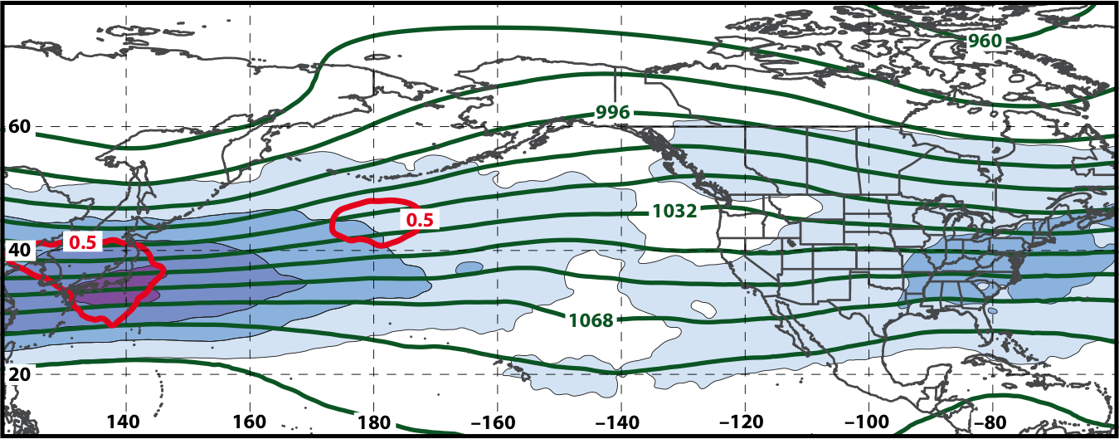
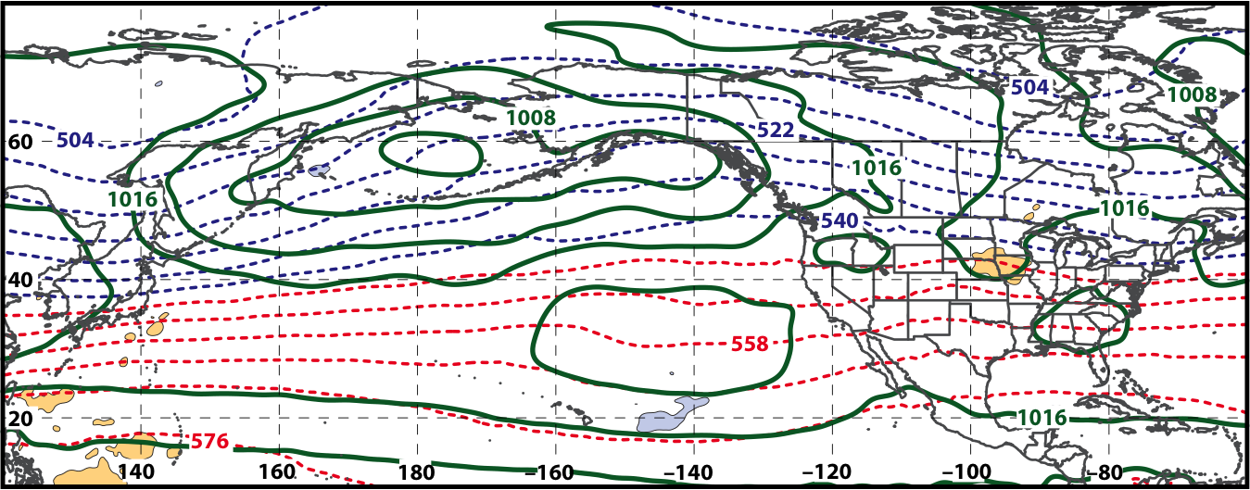
250-hPa Wind Speed, Geo. Heights, Std. Height Anomalies: Day −10
S. Plains Warm Event – Jet Retraction
m s^{–1}
Mean Sea-Level Pressure, 1000–500-hPa Thickness, 950-hPa Std. Temp. Anomalies: Day −10
L
L
H
H

Slide 22
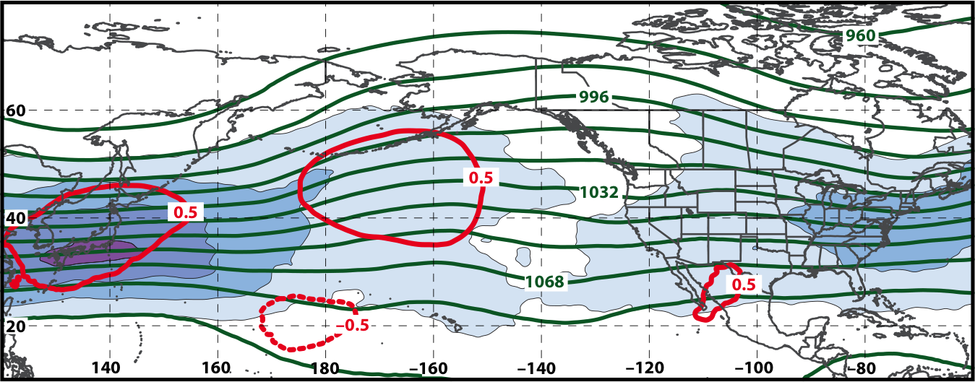
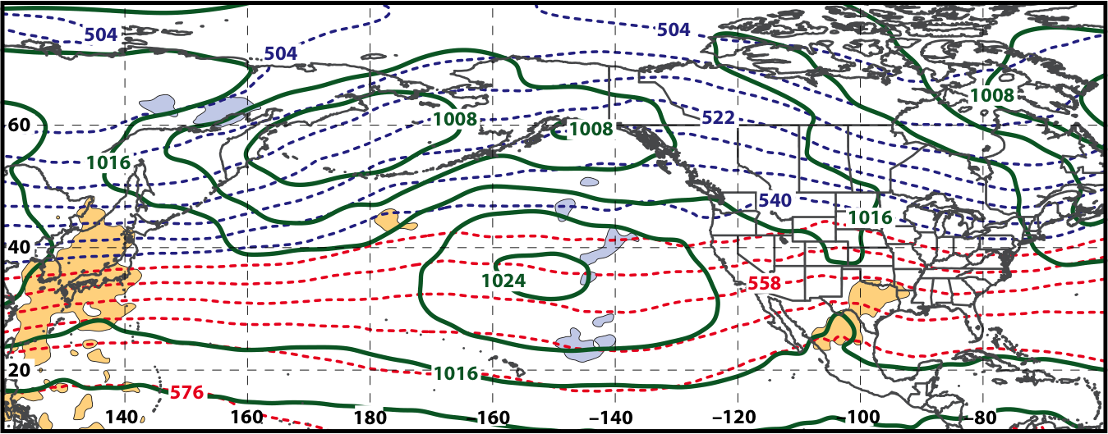
250-hPa Wind Speed, Geo. Heights, Std. Height Anomalies: Day −8
S. Plains Warm Event – Jet Retraction
m s^{–1}
Mean Sea-Level Pressure, 1000–500-hPa Thickness, 950-hPa Std. Temp. Anomalies: Day −8
L
H

Slide 23
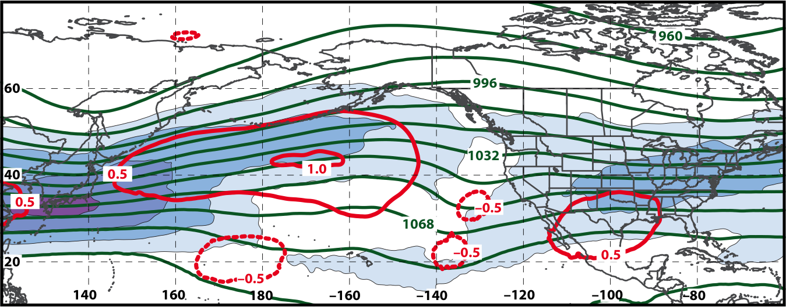
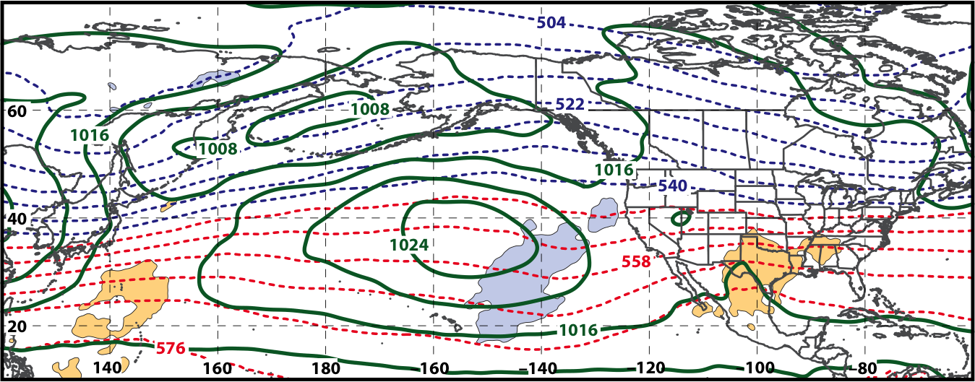
250-hPa Wind Speed, Geo. Heights, Std. Height Anomalies: Day −6
S. Plains Warm Event – Jet Retraction
m s^{–1}
Mean Sea-Level Pressure, 1000–500-hPa Thickness, 950-hPa Std. Temp. Anomalies: Day −6
L
H

Slide 24
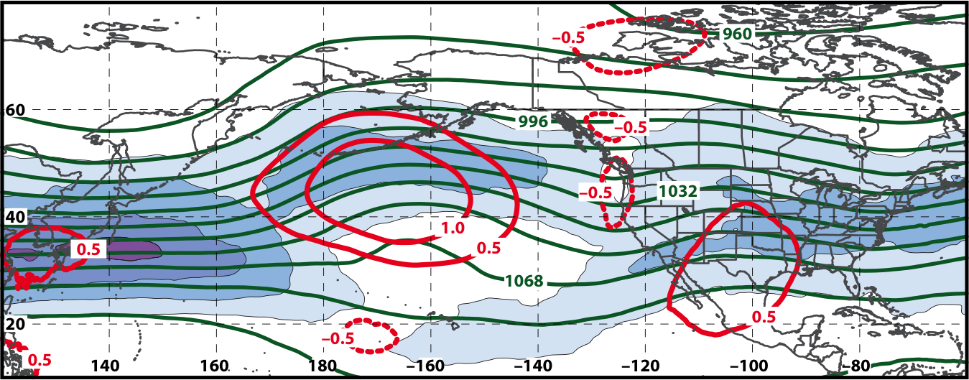
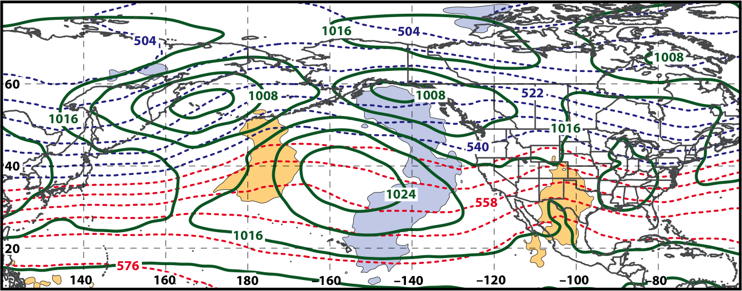
250-hPa Wind Speed, Geo. Heights, Std. Height Anomalies: Day −4
S. Plains Warm Event – Jet Retraction
m s^{–1}
Mean Sea-Level Pressure, 1000–500-hPa Thickness, 950-hPa Std. Temp. Anomalies: Day −4
L
L
H
H

Slide 25
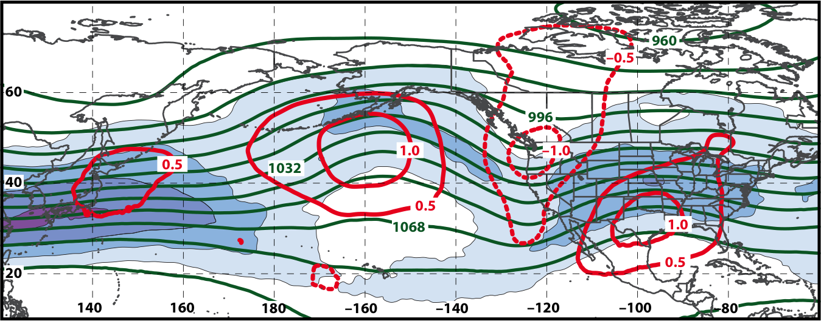
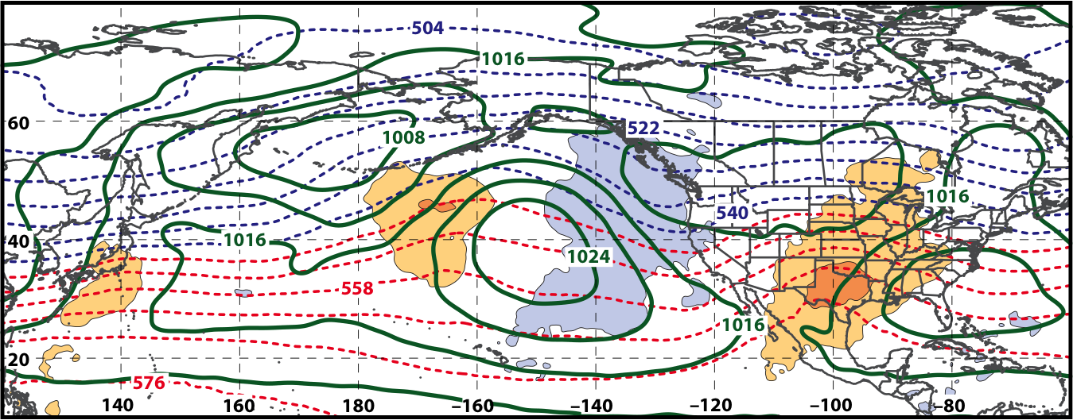
250-hPa Wind Speed, Geo. Heights, Std. Height Anomalies: Day −2
S. Plains Warm Event – Jet Retraction
m s^{–1}
Mean Sea-Level Pressure, 1000–500-hPa Thickness, 950-hPa Std. Temp. Anomalies: Day −2
L
L
H
H

Slide 26
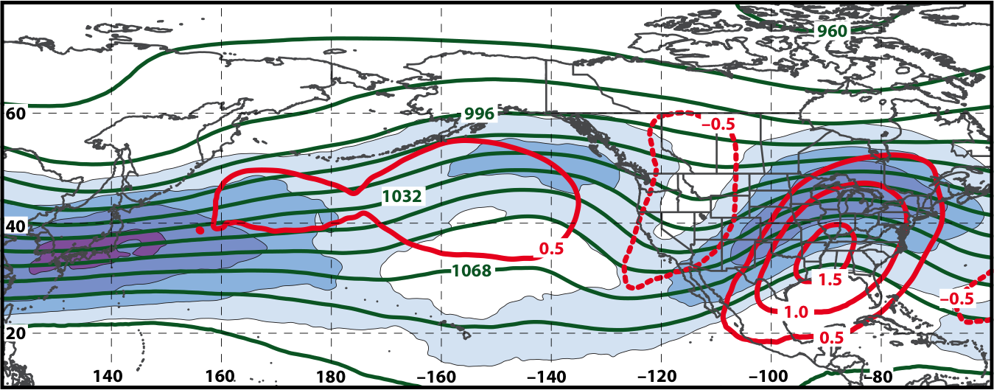
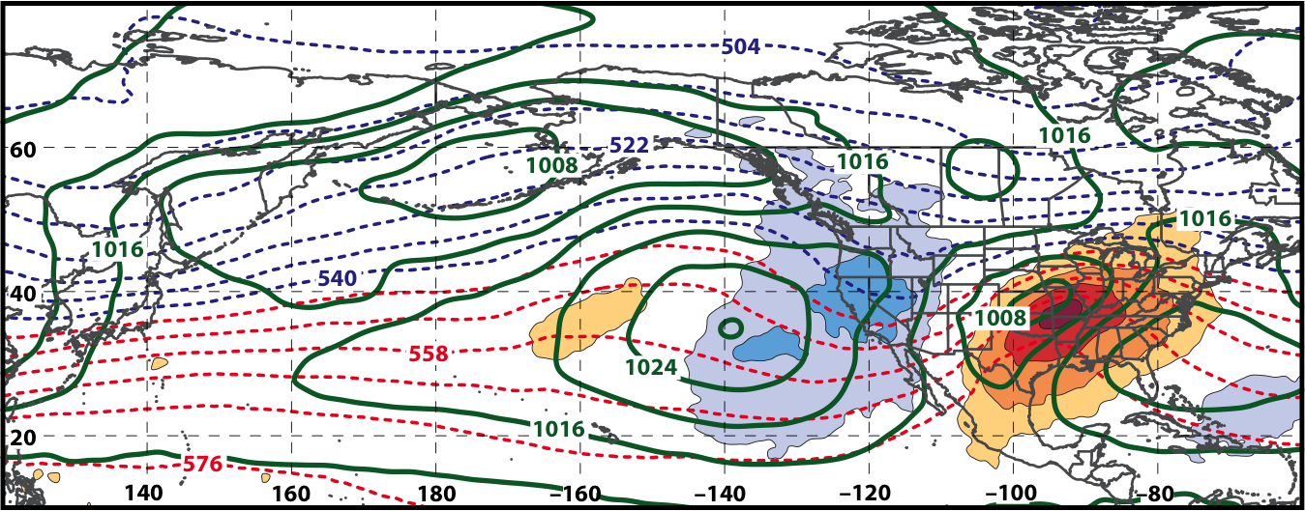
250-hPa Wind Speed, Geo. Heights, Std. Height Anomalies: Day 0
S. Plains Warm Event – Jet Retraction
m s^{–1}
Mean Sea-Level Pressure, 1000–500-hPa Thickness, 950-hPa Std. Temp. Anomalies: Day 0
L
H
H
L
H

Slide 27
E. Rockies – S. Plains Cluster
WARM EVENTS (n = 84)
Poleward Shift
18
Events during
Sept. – May projected onto phase diagram
35
Jet Retraction
15
Jet Extension
Each point is an average of the PCs for
3–7 days prior to the event
16
Equatorward Shift

Slide 28
E. Rockies – S. Plains Cluster
COLD EVENTS (n = 48)
Poleward Shift
4
Events during
Sept. – May projected onto phase diagram
4
Jet Retraction
14
Jet Extension
Each point is an average of the PCs for
3–7 days prior to the event
26
Equatorward Shift

Slide 29
W. Rockies – Pac. NW Cluster
WARM EVENTS (n = 89)
Poleward Shift
22
Events during
Sept. – May projected onto phase diagram
13
Jet Retraction
27
Jet Extension
Each point is an average of the PCs for
3–7 days prior to the event
27
Equatorward Shift

Slide 30
W. Rockies – Pac. NW Cluster
COLD EVENTS (n = 78)
Poleward Shift
18
Events during
Sept. – May projected onto phase diagram
31
Jet Retraction
9
Jet Extension
Each point is an average of the PCs for
3–7 days prior to the event
20
Equatorward Shift

Slide 31
Project Summary
Perform an evaluation of operational NCEP GFS and GEFS week two forecast skill for the identified extreme temperature and precipitation events over the CONUS during 1979–2014 for the 8–10 day time range.
  To be investigated during Fall 2016 in the context of the North Pacific Jet phase diagram
Test methodology and new forecast formats under development at WPC and incorporate them into forecast operations.
  Conduct regular teleconferences/visits with WPC personnel
  Develop real-time North Pacific Jet phase diagram (Sept. 2016)
  Evaluate and test North Pacific Jet phase diagram as part of the HMT Medium Range Experiments (Jan. 2017)

Slide 32
Real-Time North Pacific Jet Phase Diagram
Characterizes the past evolution and present state of the upper-tropospheric flow pattern over the North Pacific.
  Captures regime transitions
  Identifies flow patterns conducive to the development of EWEs

Slide 33
Real-Time North Pacific Jet Phase Diagram
0000 UTC 8 November 2014
250-hPa wind speed: shaded

Slide 34
Real-Time North Pacific Jet Phase Diagram
0000 UTC 10 November 2014
250-hPa wind speed: shaded

Slide 35
Real-Time North Pacific Jet Phase Diagram
0000 UTC 12 November 2014
250-hPa wind speed: shaded

Slide 36
Real-Time North Pacific Jet Phase Diagram
0000 UTC 14 November 2014
250-hPa wind speed: shaded

Slide 37
Real-Time North Pacific Jet Phase Diagram
0000 UTC 16 November 2014
250-hPa wind speed: shaded

Slide 38
Real-Time North Pacific Jet Phase Diagram
0000 UTC 18 November 2014
250-hPa wind speed: shaded

Slide 39
Real-Time North Pacific Jet Phase Diagram
16–19 November 2014 Composite Anomalies
500-hPa Geo. Height (m)
Surface Temperature (°C)

Slide 40
E. Rockies – S. Plains Cluster
COLD EVENTS (n = 48)
Poleward Shift
4
Events during
Sept. – May projected onto phase diagram
4
Jet Retraction
14
Jet Extension
Each point is an average of the PCs for
3–7 days prior to the event
16–19 Nov. 2014
26
Equatorward Shift

Slide 41
Real-Time North Pacific Jet Phase Diagram
Characterizes the past evolution and present state of the upper-tropospheric flow pattern over the North Pacific.
  Captures regime transitions
  Identifies flow patterns conducive to the development of EWEs
Characterizes the forecasted evolution of the upper-tropospheric flow pattern over the North Pacific.

Slide 42
Real-Time North Pacific Jet Phase Diagram
GEFS Ensemble Trajectories Initialized at 0000 UTC 24 May 2016
0000 UTC 24 May
(0-h forecast)
9-day forecast
0000 UTC 2 Jun (verification)
Ensemble mean
6-day forecast
4-day forecast
2-day forecast
Notes:
The choice of this case is purely arbitrary and not linked to any specific extreme event. It is only shown as a proof of concept to illustrate how such a forecast product may work.

Slide 43
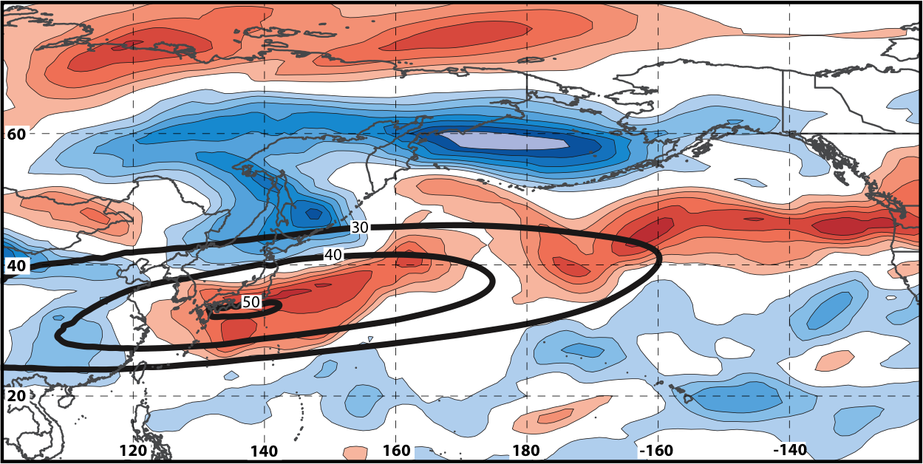
Real-Time North Pacific Jet Phase Diagram
250-hPa zonal wind at 0000 UTC 2 Jun minus 250-hPa zonal wind at 0000 UTC 24 May (shading) in the GFS analyses shows the transition to a poleward-shifted jet regime
0000 UTC 24 May
(0-h forecast)
0000 UTC 2 Jun (verification)
Ensemble mean
Sept.–May mean 250-hPa zonal wind: black contours
Notes:
Note that the positive changes in zonal wind correspond exactly to where the positive anomalies are located in the EOF2 pattern – See slide 14.

Slide 44
Project Outcomes
Provide forecasters with a “first alert” to the possibility of the occurrence of extreme temperature and precipitation events during week two on the basis of current conditions and model forecasts.
Provide forecasters with an indication of the character and flavor of possible extreme events as inferred from where the events lie in the frequency distributions of the anticipated event types.
Provide forecasters with knowledge that allows them to make science-based adjustments to model guidance and add value to week two forecasts of temperature and precipitation.

Slide 45
Supplementary Slides

Slide 46
Extreme Event Identification
Extreme Warm Events:
Employed 1-h forecasts of 2-m temperature from the CFSR (0.5°× 0.5°) at 6-h intervals
Compiled data for each grid point within 21-day windows centered on each analysis time for 36 years, 1979–2014
  Each grid point has 756 data points for each analysis time
Determined the temperature value that corresponds to the 99th percentile for each grid point at a given analysis time
2-m temperature frequency distribution at
1900 UTC 30 May for a grid point near Albany, NY

Slide 47
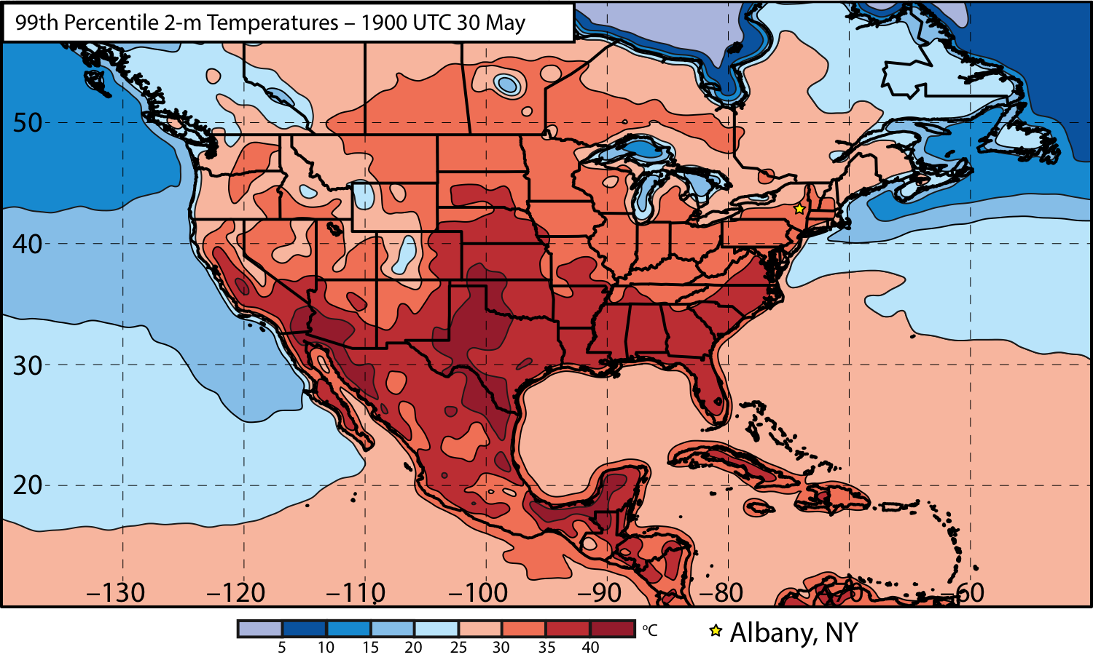
Extreme Event Identification

Slide 48
Extreme Event Identification
Western U.S.
Eastern U.S.

Slide 49
Extreme Event Identification
Extreme Warm Events:
Cataloged the times during which at least one grid point was characterized by a temperature > 99th percentile
Ranked times within each domain by the number of grid points > 99th percentile
Identified times that rank in the top 5% in terms of the number of grid points > 99th percentile within each domain as extreme warm events
Frequency distribution of times exhibiting at least one grid point > 99th percentile

Slide 50
Extreme Event Identification
Extreme Precip. Events:
Employed CPC Unified Gauge-Based Analysis of Daily Precipitation over CONUS (0.25°× 0.25°)
Compiled data within 21-day windows centered on each time for all 36 years
  Each grid point has 756 data points for a given time
Determined the precipitation values that correspond to the 99th percentile for each grid point at a given time (only for days precipitation was observed)
Identified times that rank in the top 5% in terms of the number of grid points > 99th percentile within each domain as extreme precipitation events

Slide 51
Extreme Event Identification
Temperature
Eastern U.S. (1st % Cold):
- Threshold: 221 grid points
~7.0°×7.0° box
- After QC: 226 events
Eastern U.S. (99th % Warm):
- Threshold: 224 grid points
~7.0°×7.0° box
- After QC: 304 events
Western U.S. (1st % Cold):
- Threshold: 125 grid points
~5.0°×5.0° box
- After QC: 271 events
Western U.S. (99th % Warm):
- Threshold: 144 grid points
~5.5°×5.5° box
- After QC: 264 events
Precipitation
Eastern U.S. (99th %):
- Threshold: 211 grid points
~3.5°×3.5° box
- After QC: 351 events
Western U.S. (99th %):
- Threshold: 141 grid points
~2.75°×2.75° box
- After QC: 333 events
Quality control: Events within 24-h of another event were considered to be the same event.

Slide 52
Extreme Event Identification
Extreme Warm Event Frequency: Eastern U.S. Domain (n = 304)

Slide 53
Extreme Event Identification
Extreme Warm Event Centroids: Eastern U.S. Domain (n = 304)
Northern Plains Cluster (n=116)
Southern Plains Cluster (n=102)
Eastern U.S. Cluster (n=86)
3 geographic clusters objectively identified using a k-means clustering algorithm

Slide 54
EOF Calculations
Removed the mean and the annual and diurnal cycles from 6-hourly, 250-hPa zonal wind data from the CFSR (1979–2014)
Isolated data for September – May only
Performed an EOF analysis within the domain: 10–80°N ; 100°E–120°W

Slide 55
Notes on North Pacific Jet Phase Diagram
Each point on the phase diagram is a weighted average of the principal components within +/− 1 day of the time under consideration
Example: 0000 UTC 15 November 2014
Weight
5
4
3
2
1
Date
0000 UTC 14 Nov.
1200 UTC 14 Nov.
0000 UTC 15 Nov.
1200 UTC 15 Nov.
0000 UTC 16 Nov.

