Slide 1
Regime-Dependent Predictability of Extreme Weather Events: Characteristic Event Types
Andrew C. Winters, Daniel Keyser, and Lance F. Bosart
Department of Atmospheric and Environmental Sciences
University at Albany, State University of New York, Albany, NY 12222
17th Northeast Regional Operational Workshop
Albany, New York 12222
2–3 November 2016
This work is supported by NOAA Grant NA15NWS4680006

Slide 2
Project Motivation
One or several extreme weather events (EWEs) during a single season can contribute disproportionately to temperature and precipitation anomaly statistics for a particular season.
The disproportionate contribution of EWEs to seasonal temperature and precipitation anomaly statistics suggests that EWEs need to be considered in understanding the dynamical and thermodynamic processes that operate at the weather–climate intersection.
Consideration of EWEs may improve operational probabilistic temperature and precipitation forecasts in the 8–10 day time range.

Slide 3
Extreme Event Identification
Extreme Warm Events:
Employed 1-h forecasts of 2-m temperature from the CFSR (0.5°× 0.5°) at 6-h intervals
Compiled data for each grid point within 21-day windows centered on each analysis time for 36 years, 1979–2014
  Each grid point has 756 (21×36) data points for each analysis time
Determined the temperature that corresponds to the 99th percentile for each grid point at a given analysis time
Frequency distribution of 2-m temperature at
1900 UTC 30 May for a grid point near Albany, NY

Slide 4
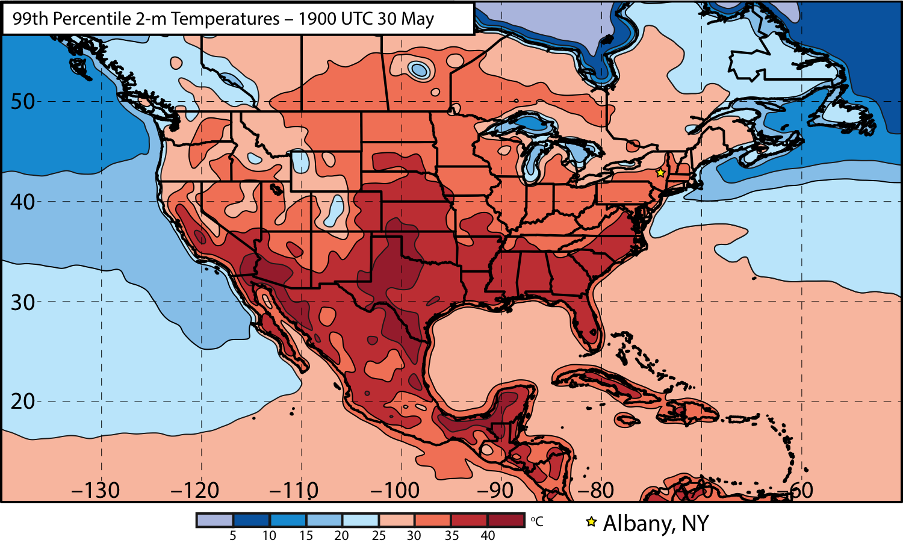
Extreme Event Identification

Slide 5
Extreme Event Identification
Western U.S.
Eastern U.S.

Slide 6
Extreme Event Identification
Extreme Warm Events:
Cataloged times during which at least one grid point was characterized by a temperature > 99th percentile
Ranked times within each domain by the number of grid points > 99th percentile
Identified times that rank in the top 5% in terms of the number of grid points > 99th percentile within each domain as extreme warm events
Frequency distribution of times exhibiting at least one grid point > 99th percentile

Slide 7
Extreme Event Identification
Extreme Warm Event Frequency: Eastern U.S. Domain (n = 304)

Slide 8
Extreme Event Identification
Extreme Warm Event Centroids: Eastern U.S. Domain (n = 304)
Northern Plains Cluster (n=116)
Southern Plains Cluster (n=102)
Eastern U.S. Cluster (n=86)
3 geographic clusters objectively identified using a k-means clustering algorithm

Slide 9
Extreme Event Identification
Extreme Warm Event Centroids: Eastern U.S. Domain (n = 304)
Northern Plains Cluster (n=116)
Southern Plains Cluster (n=102)
Eastern U.S. Cluster (n=86)
Considerable North Pacific Jet variability characterizes the antecedent environments associated with events in each geographic cluster

Slide 10
Antecedent Environments Associated with Cool-Season (Sept.–May) EWEs in the Context of North Pacific Jet Variability

Slide 11
250-hPa North Pacific Zonal Wind Variability
Removed the mean and the annual and diurnal cycles from 6-hourly, 250-hPa zonal wind data from the CFSR (1979–2014)
Restricted data to the cool season (Sept.–May)
Performed an EOF analysis on the zonal wind anomalies within the domain: 10–80°N ; 100°E–120°W
Analysis techniques and resultant EOF patterns are consistent with related work on the North Pacific Jet:
Athanasiadis et al. (2010)
Jaffe et al. (2011)
Griffin and Martin (2016)

Slide 12
250-hPa North Pacific Zonal Wind Variability
EOF 1 – Jet Extension/Retraction
Sept.–May mean 250-hPa zonal wind: black contours
Sept.–May 250-hPa zonal wind EOF 1 pattern: shading
+ EOF 1: Jet Extension
– EOF 1: Jet Retraction

Slide 13
250-hPa North Pacific Zonal Wind Variability
EOF 1 – Jet Extension/Retraction
Hypothetical Zonal Wind
Sept.–May mean 250-hPa zonal wind: black contours
Sept.–May 250-hPa zonal wind EOF 1 pattern: shading
+ EOF 1: Jet Extension
– EOF 1: Jet Retraction
Notes:
The outermost green contour is 20 m/s and contour interval for green contours is every 10 m/s. The green contours are calculated by adding the EOF patterns to the mean zonal wind. The resultant wind distribution would project onto the point (1,0) on the N. Pacific Jet phase diagram.

Slide 14
250-hPa North Pacific Zonal Wind Variability
EOF 1 – Jet Extension/Retraction
Hypothetical Zonal Wind
Sept.–May mean 250-hPa zonal wind: black contours
Sept.–May 250-hPa zonal wind EOF 1 pattern: shading
+ EOF 1: Jet Extension
– EOF 1: Jet Retraction
Notes:
The distribution of zonal wind in this slide would project onto the point (-1,0) on the N. Pacific Jet phase diagram.

Slide 15
250-hPa North Pacific Zonal Wind Variability
EOF 2 – Poleward/Equatorward Shift
Sept.–May mean 250-hPa zonal wind: black contours
Sept.–May 250-hPa zonal wind EOF 2 pattern: shading
+ EOF 2: Poleward Shift
– EOF 2: Equatorward Shift

Slide 16
250-hPa North Pacific Zonal Wind Variability
EOF 2 – Poleward/Equatorward Shift
Hypothetical Zonal Wind
Sept.–May mean 250-hPa zonal wind: black contours
Sept.–May 250-hPa zonal wind EOF 2 pattern: shading
+ EOF 2: Poleward Shift
– EOF 2: Equatorward Shift
Notes:
The zonal wind pattern in green would project onto the point (0,1) on the N. Pacific Jet phase diagram.

Slide 17
250-hPa North Pacific Zonal Wind Variability
EOF 2 – Poleward/Equatorward Shift
Hypothetical Zonal Wind
Sept.–May mean 250-hPa zonal wind: black contours
Sept.–May 250-hPa zonal wind EOF 2 pattern: shading
+ EOF 2: Poleward Shift
– EOF 2: Equatorward Shift
Notes:
The zonal wind pattern in green would project onto the point (0,-1) on the N. Pacific Jet phase diagram.

Slide 18
250-hPa North Pacific Zonal Wind Variability
0000 UTC 8 November 2014
250-hPa wind speed: shaded
Instantaneous 250-hPa zonal wind anomalies can be projected onto EOF 1 and EOF 2, resulting in a point on a North Pacific Jet phase diagram

Slide 19
250-hPa North Pacific Zonal Wind Variability
Extreme Warm Event Centroids: Eastern U.S. Domain (n = 304)
Northern Plains Cluster (n=116)
Southern Plains Cluster (n=102)
Eastern U.S. Cluster (n=86)
Projecting antecedent environments associated with extreme warm events onto the North Pacific Jet phase diagram can identify flow patterns conducive to the development of these events

Slide 20
Eastern U.S. – S. Plains Cluster
WARM EVENTS (n = 84)
Poleward Shift
18
Events during
Sept. – May projected onto phase diagram
35
Jet Retraction
15
Jet Extension
Each point is an average of the PCs for
3–7 days prior to the event
16
Equatorward Shift

Slide 21
Eastern U.S. – S. Plains Cluster
WARM EVENTS (n = 84)
Poleward Shift
18
Events during
Sept. – May projected onto phase diagram
35
Jet Retraction
15
Jet Extension
Each point is an average of the PCs for
3–7 days prior to the event
16
Equatorward Shift

Slide 22
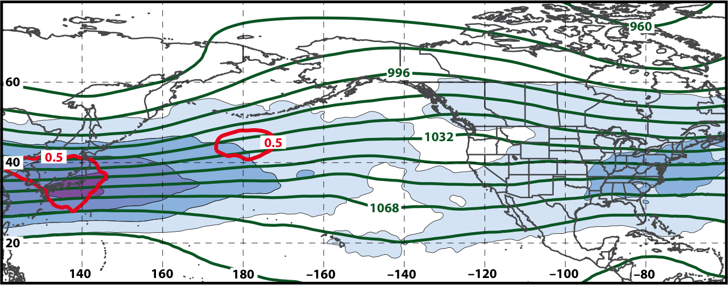
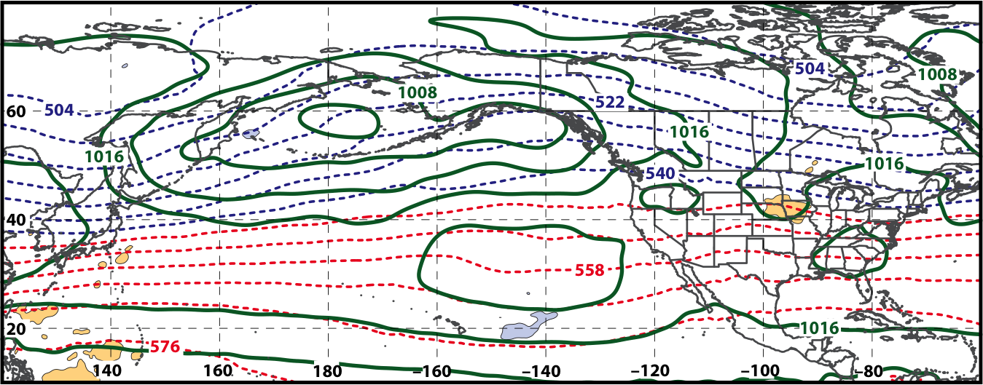
250-hPa Wind Speed, Geo. Heights, Std. Height Anomalies: Day −10
S. Plains Warm Event – Jet Retraction
m s^{–1}
Mean Sea-Level Pressure, 1000–500-hPa Thickness, 950-hPa Std. Temp. Anomalies: Day −10
L
L
H
H

Slide 23
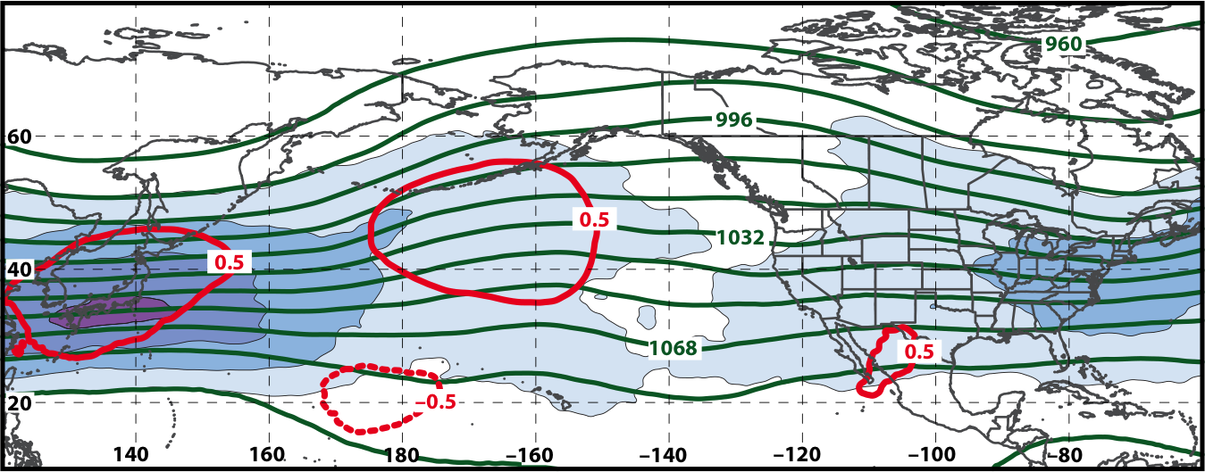
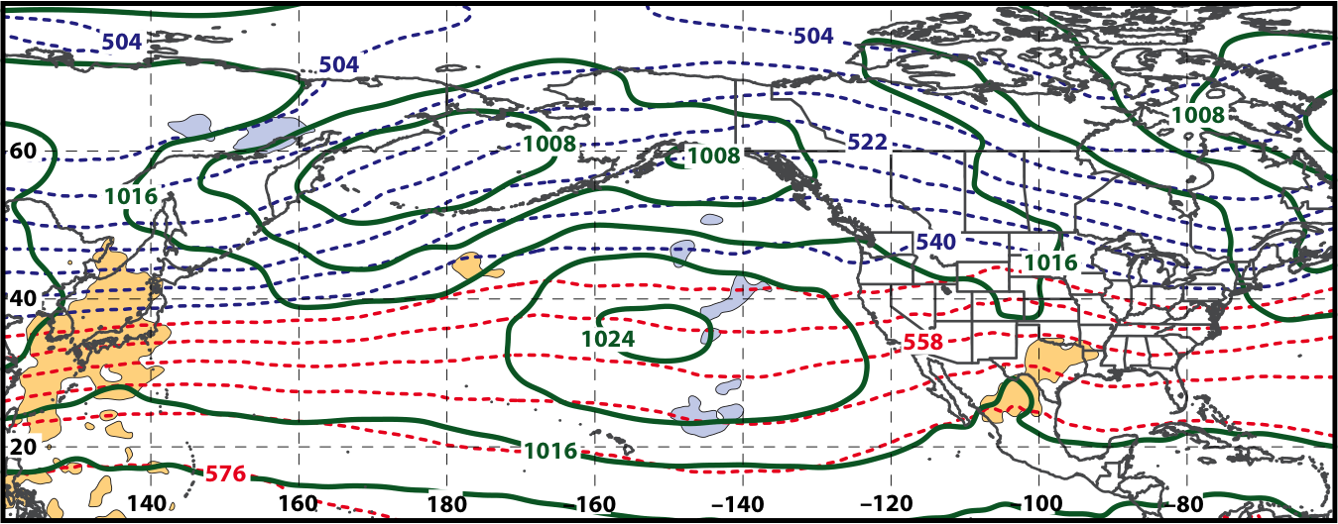
250-hPa Wind Speed, Geo. Heights, Std. Height Anomalies: Day −8
S. Plains Warm Event – Jet Retraction
m s^{–1}
Mean Sea-Level Pressure, 1000–500-hPa Thickness, 950-hPa Std. Temp. Anomalies: Day −8
L
H

Slide 24
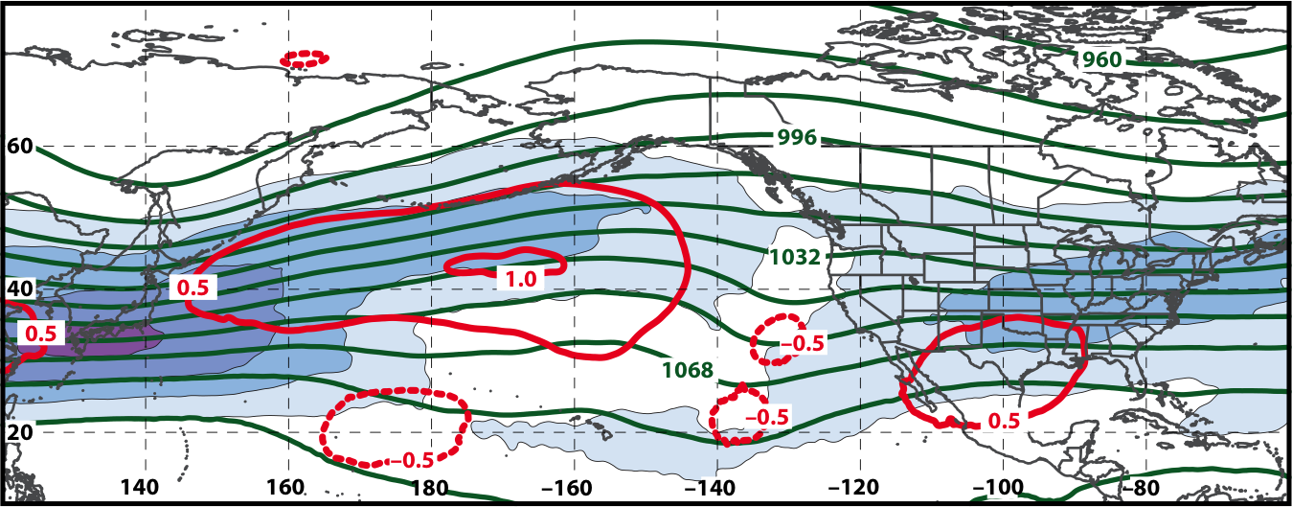
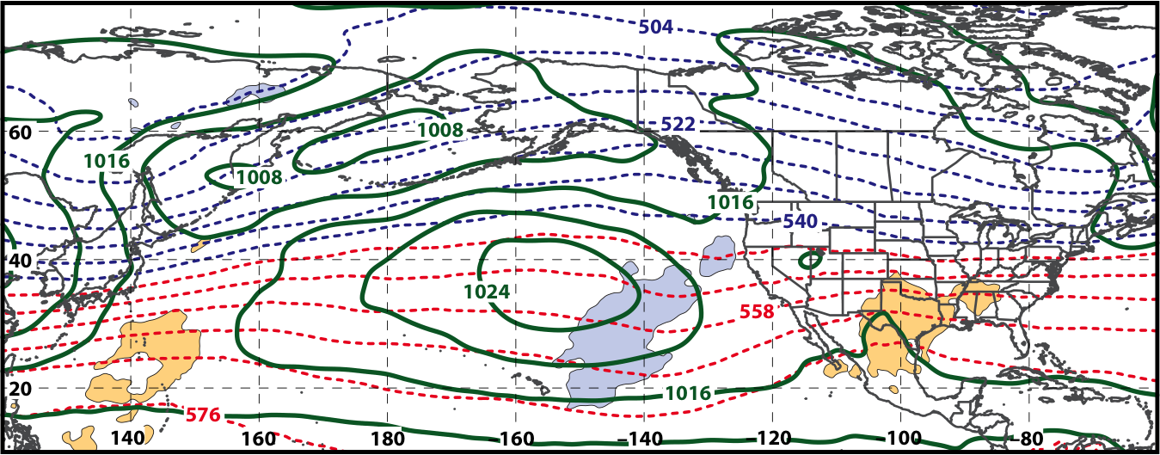
250-hPa Wind Speed, Geo. Heights, Std. Height Anomalies: Day −6
S. Plains Warm Event – Jet Retraction
m s^{–1}
Mean Sea-Level Pressure, 1000–500-hPa Thickness, 950-hPa Std. Temp. Anomalies: Day −6
L
H

Slide 25
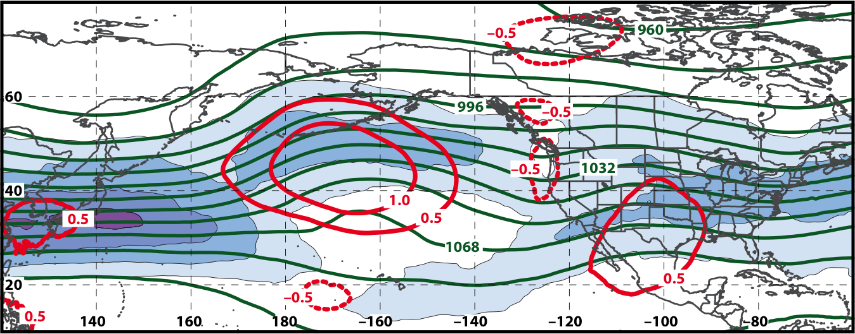
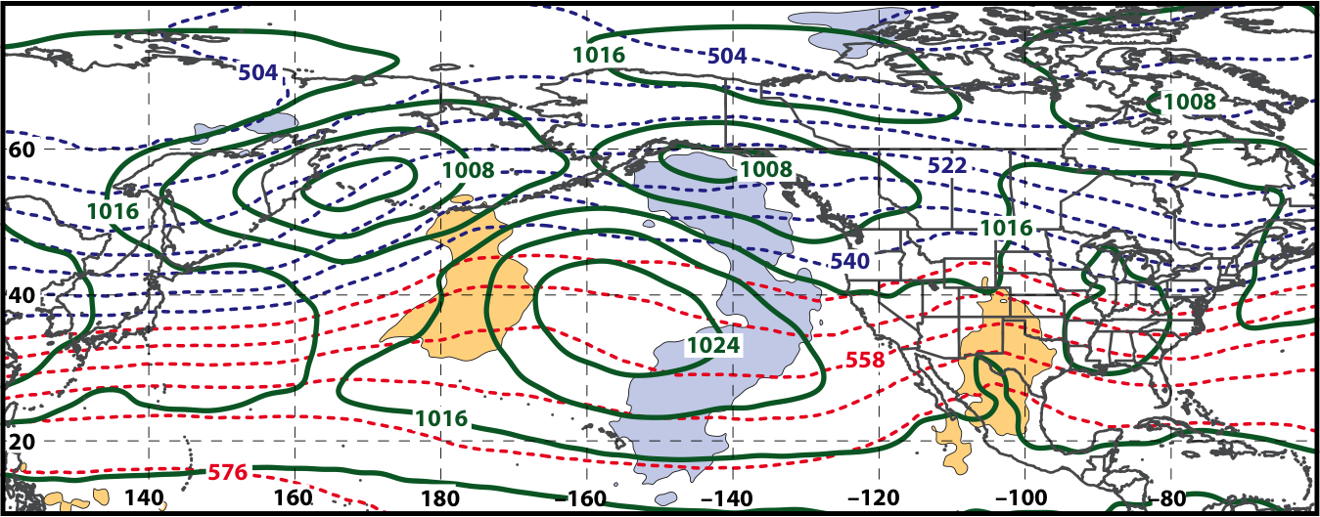
250-hPa Wind Speed, Geo. Heights, Std. Height Anomalies: Day −4
S. Plains Warm Event – Jet Retraction
m s^{–1}
Mean Sea-Level Pressure, 1000–500-hPa Thickness, 950-hPa Std. Temp. Anomalies: Day −4
L
L
H
H

Slide 26
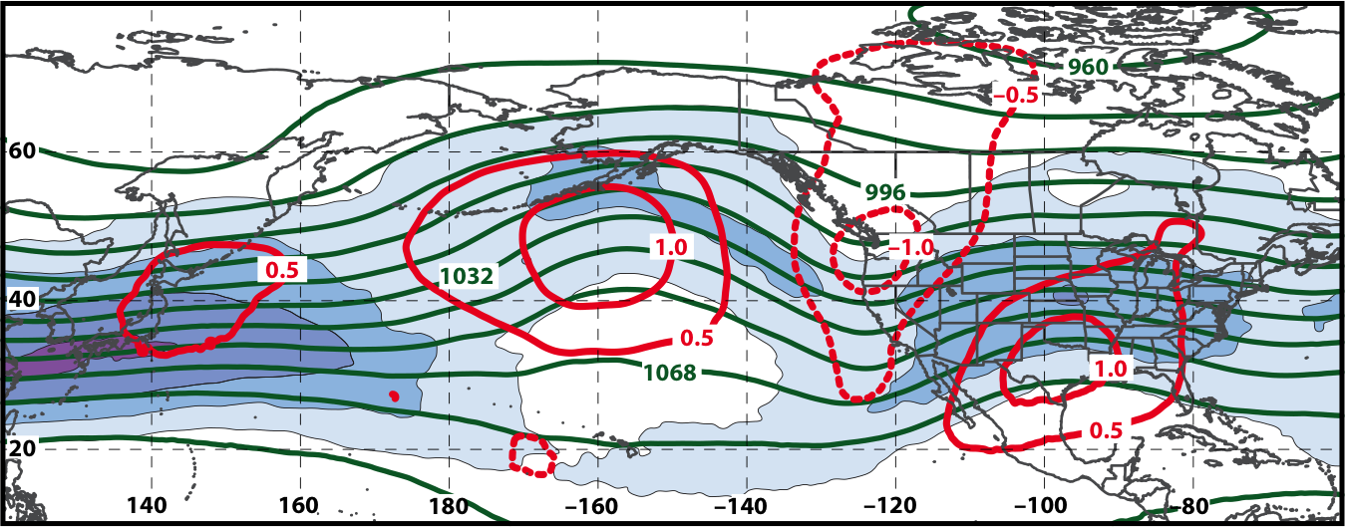
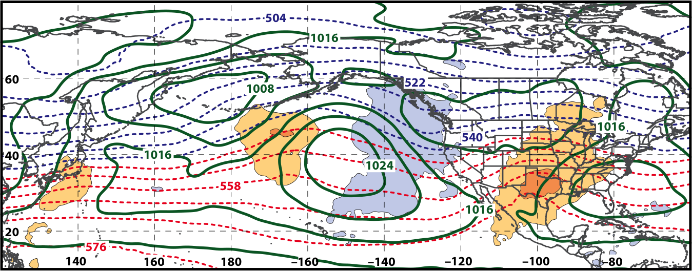
250-hPa Wind Speed, Geo. Heights, Std. Height Anomalies: Day −2
S. Plains Warm Event – Jet Retraction
m s^{–1}
Mean Sea-Level Pressure, 1000–500-hPa Thickness, 950-hPa Std. Temp. Anomalies: Day −2
L
L
H
H

Slide 27
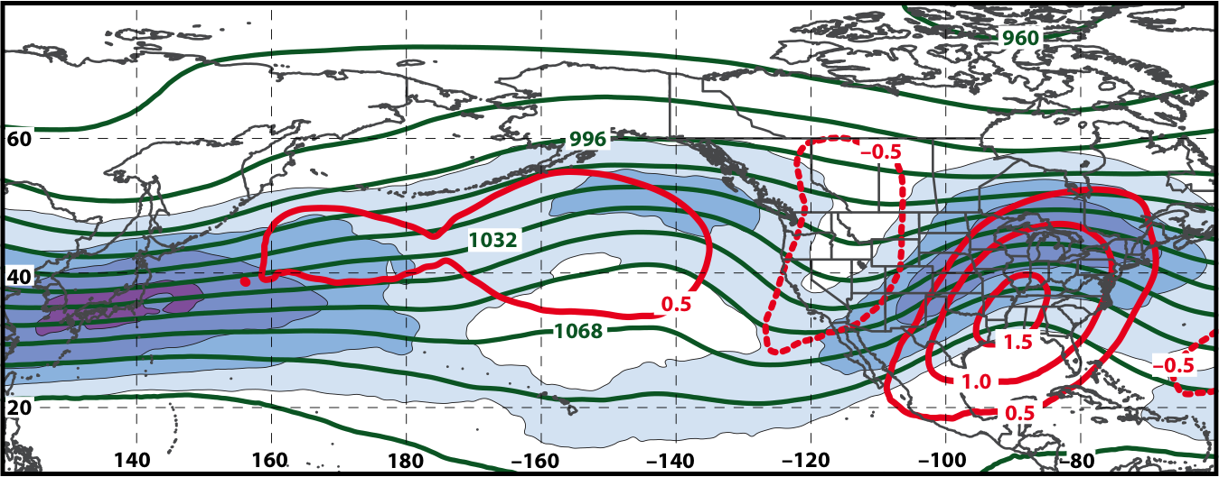
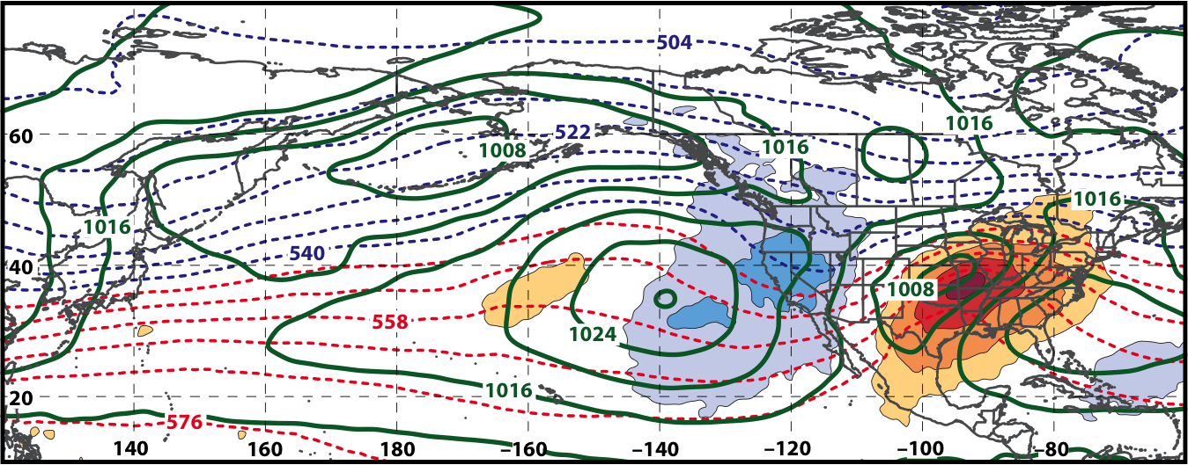
250-hPa Wind Speed, Geo. Heights, Std. Height Anomalies: Day 0
S. Plains Warm Event – Jet Retraction
m s^{–1}
Mean Sea-Level Pressure, 1000–500-hPa Thickness, 950-hPa Std. Temp. Anomalies: Day 0
L
H
H
L
H

Slide 28
Eastern U.S. – S. Plains Cluster
WARM EVENTS (n = 84)
Poleward Shift
18
Events during
Sept. – May projected onto phase diagram
35
Jet Retraction
15
Jet Extension
Each point is an average of the PCs for
3–7 days prior to the event
16
Equatorward Shift

Slide 29
Eastern U.S. – S. Plains Cluster
COLD EVENTS (n = 48)
Poleward Shift
4
Events during
Sept. – May projected onto phase diagram
4
Jet Retraction
14
Jet Extension
Each point is an average of the PCs for
3–7 days prior to the event
26
Equatorward Shift

Slide 30
Eastern U.S. – Eastern Cluster
WARM EVENTS (n = 61)
Poleward Shift
20
Events during
Sept. – May projected onto phase diagram
10
Jet Retraction
14
Jet Extension
Each point is an average of the PCs for
3–7 days prior to the event
17
Equatorward Shift

Slide 31
Eastern U.S. – Eastern Cluster
COLD EVENTS (n = 39)
Poleward Shift
4
Events during
Sept. – May projected onto phase diagram
10
Jet Retraction
12
Jet Extension
Each point is an average of the PCs for
3–7 days prior to the event
13
Equatorward Shift

Slide 32
Eastern U.S. – All Events
WARM EVENTS (n = 239)
Poleward Shift
66
Events during
Sept. – May projected onto phase diagram
69
Jet Retraction
47
Jet Extension
Each point is an average of the PCs for
3–7 days prior to an event
57
Equatorward Shift

Slide 33
Eastern U.S. – All Events
COLD EVENTS (n = 173)
Poleward Shift
23
Events during
Sept. – May projected onto phase diagram
30
Jet Retraction
47
Jet Extension
Each point is an average of the PCs for
3–7 days prior to an event
73
Equatorward Shift

Slide 34
Next Steps
Demonstrate further the potential of the North Pacific Jet phase diagram to indicate antecedent environments favorable for the development of EWEs over the continental U.S.
Differentiate between antecedent environments conducive to the development of extreme and non-extreme events.
Evaluate the skill of NCEP GFS and GEFS forecasts for the identified EWEs and for non-extreme events in the context of the North Pacific Jet phase diagram.
Develop a real-time North Pacific Jet phase diagram and test it during the HMT Medium Range Experiments at WPC this winter.

Slide 35
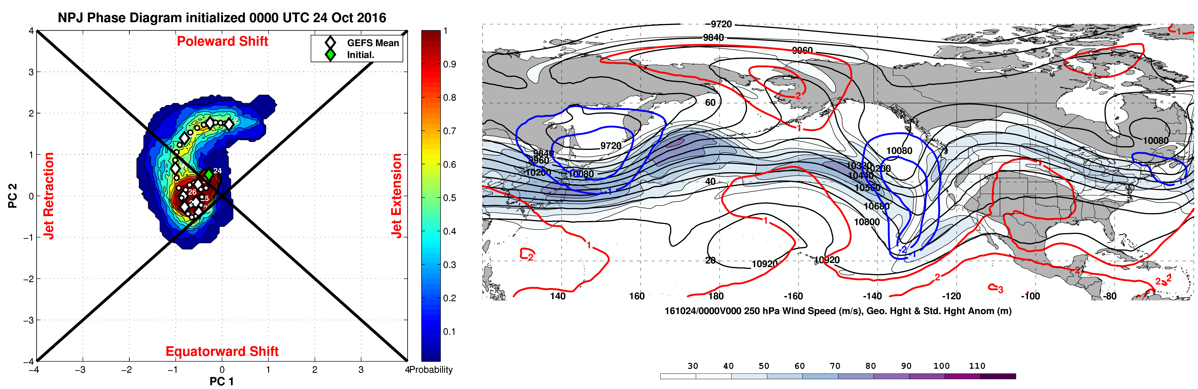
Real-Time North Pacific Jet Phase Diagram
9-day probabilistic forecast trajectory within the North Pacific Jet phase diagram
Probabilistic, GFS deterministic, and GEFS ensemble forecasts
Complementary analyses/forecasts of 250-hPa wind speed/geo. heights over the North Pacific and North America
Complementary analyses/forecasts of 850-hPa temperature anomalies and 24-h accumulated precipitation over the North Pacific and North America
URL: www.atmos.albany.edu/facstaff/awinters/realtime/Deterministic_NPJPD.php

Slide 36
Supplementary Slides

Slide 37
References
Athanasiadis, P. J., J. M. Wallace, and J. J. Wettstein, 2010: Patterns of wintertime jet stream variability and their relation to the storm tracks. J. Atmos. Sci., 67, 1361–1381.
Griffin, K. S., and J. E. Martin, 2016: Synoptic features associated with temporally coherent modes of variability of the North Pacific jet stream. J. Climate, 29, in press.
Jaffe, S. C., J. E. Martin, D. J. Vimont, and D. L. Lorenz, 2011: A synoptic climatology of episodic, subseasonal retractions of the Pacific jet. J. Climate, 24, 2846–2860.

Slide 38
Extreme Event Identification
Extreme Precip. Events:
Employed CPC Unified Gauge-Based Analysis of Daily Precipitation over CONUS during 1979–2014 (0.25°× 0.25°)
Compiled data within 21-day windows centered on each time for all 36 years
  Each grid point has (21 × 36) 756 data points for a given time
Determined the precipitation values that correspond to the 99th percentile for each grid point at a given time (only for days precipitation was observed)
Identified times that rank in the top 5% in terms of the number of grid points > 99th percentile within each domain as extreme precipitation events

Slide 39
Extreme Event Identification
Temperature
Eastern U.S. (1st % Cold):
- Threshold: 221 grid points
~7.0°×7.0° box
- After QC: 226 events
Eastern U.S. (99th % Warm):
- Threshold: 224 grid points
~7.0°×7.0° box
- After QC: 304 events
Western U.S. (1st % Cold):
- Threshold: 125 grid points
~5.0°×5.0° box
- After QC: 271 events
Western U.S. (99th % Warm):
- Threshold: 144 grid points
~5.5°×5.5° box
- After QC: 264 events
Precipitation
Eastern U.S. (99th %):
- Threshold: 211 grid points
~3.5°×3.5° box
- After QC: 351 events
Western U.S. (99th %):
- Threshold: 141 grid points
~2.75°×2.75° box
- After QC: 333 events
Quality control: Events within 24-h of another event were considered to be the same event.

Slide 40
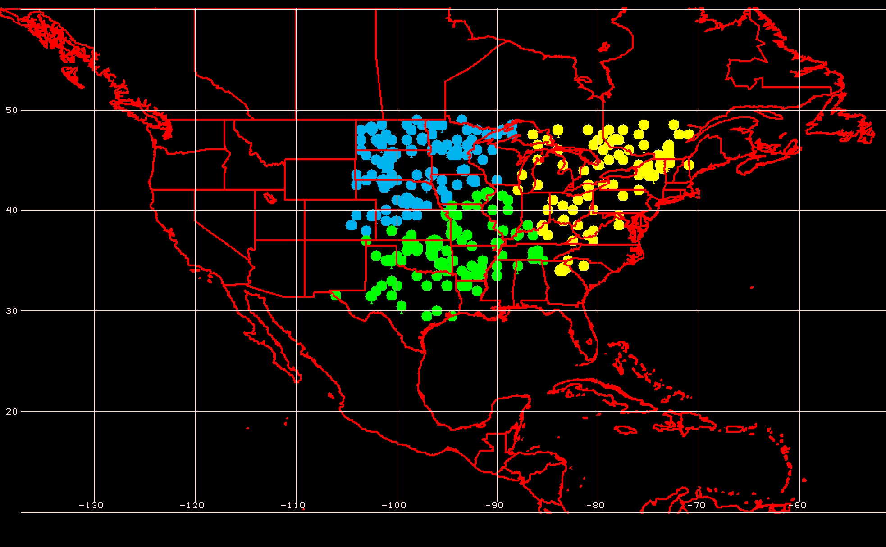
Geographic Event Clusters
Extreme Warm Event Centroids East of the Rockies

Slide 41
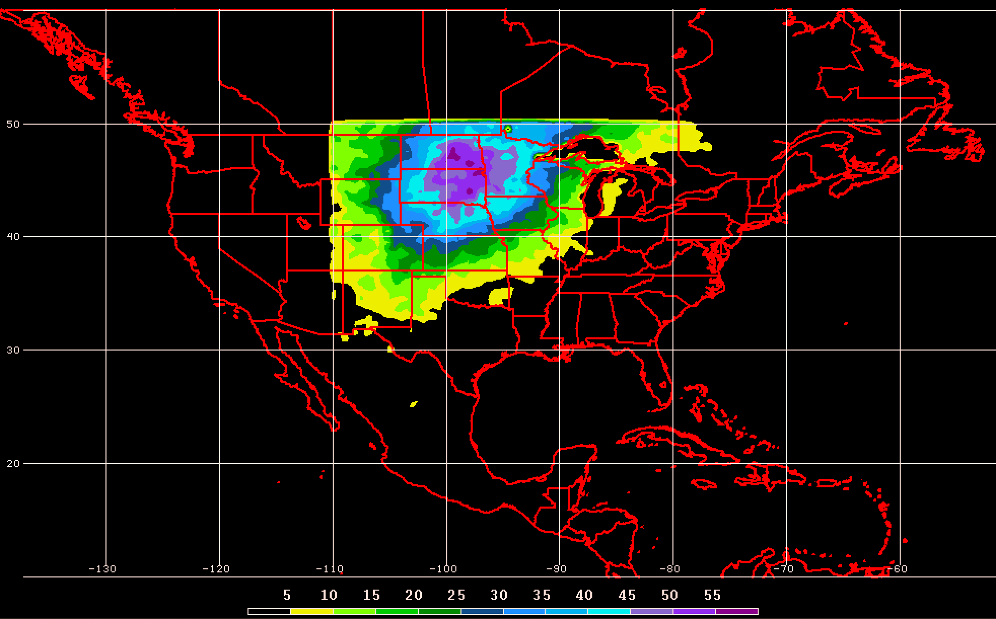
Geographic Event Clusters
Extreme Warm Event Frequency for Northern Plains

Slide 42
250-hPa North Pacific Zonal Wind Variability
0000 UTC 8 November 2014
250-hPa wind speed: shaded
Instantaneous 250-hPa zonal wind anomalies can be projected onto EOF 1 and EOF 2, resulting in a point on a North Pacific Jet phase diagram

Slide 43
Notes on North Pacific Jet Phase Diagram
Each point on the phase diagram is a weighted average of the principal components within +/− 1 day of the time under consideration
Example: 0000 UTC 8 November 2014
Weight
5
4
3
2
1
Date
0000 UTC 7 Nov.
1200 UTC 7 Nov.
0000 UTC 8 Nov.
1200 UTC 8 Nov.
0000 UTC 9 Nov.

Slide 44
Real-Time North Pacific Jet Phase Diagram
Characterizes the past evolution and present state of the upper-tropospheric flow pattern over the North Pacific.
  Captures regime transitions
  Identifies flow patterns conducive to the development of EWEs
Characterizes the forecasted evolution of the upper-tropospheric flow pattern over the North Pacific.

Slide 45
Real-Time North Pacific Jet Phase Diagram
0000 UTC 8 November 2014
250-hPa wind speed: shaded

Slide 46
Real-Time North Pacific Jet Phase Diagram
0000 UTC 10 November 2014
250-hPa wind speed: shaded

Slide 47
Real-Time North Pacific Jet Phase Diagram
0000 UTC 12 November 2014
250-hPa wind speed: shaded

Slide 48
Real-Time North Pacific Jet Phase Diagram
0000 UTC 14 November 2014
250-hPa wind speed: shaded

Slide 49
Real-Time North Pacific Jet Phase Diagram
0000 UTC 16 November 2014
250-hPa wind speed: shaded

Slide 50
Real-Time North Pacific Jet Phase Diagram
0000 UTC 18 November 2014
250-hPa wind speed: shaded

Slide 51
Real-Time North Pacific Jet Phase Diagram
16–19 November 2014 Composite Anomalies
500-hPa Geo. Height (m)
Surface Temperature (°C)

Slide 52
E. Rockies – S. Plains Cluster
COLD EVENTS (n = 48)
Poleward Shift
4
Events during
Sept. – May projected onto phase diagram
4
Jet Retraction
14
Jet Extension
Each point is an average of the PCs for
3–7 days prior to the event
16–19 Nov. 2014
26
Equatorward Shift

Slide 53
Western U.S. – Pac. NW Cluster
WARM EVENTS (n = 89)
Poleward Shift
22
Events during
Sept. – May projected onto phase diagram
13
Jet Retraction
27
Jet Extension
Each point is an average of the PCs for
3–7 days prior to the event
27
Equatorward Shift

Slide 54
Western U.S. – Pac. NW Cluster
COLD EVENTS (n = 78)
Poleward Shift
18
Events during
Sept. – May projected onto phase diagram
31
Jet Retraction
9
Jet Extension
Each point is an average of the PCs for
3–7 days prior to the event
20
Equatorward Shift

Slide 55
Real-Time North Pacific Jet Phase Diagram
GEFS Ensemble Trajectories Initialized at 0000 UTC 24 May 2016
0000 UTC 24 May
(0-h forecast)
9-day forecast
0000 UTC 2 Jun (verification)
Ensemble mean
6-day forecast
4-day forecast
2-day forecast
Notes:
The choice of this case is purely arbitrary and not linked to any specific extreme event. It is only shown as a proof of concept to illustrate how such a forecast product may work.

Slide 56
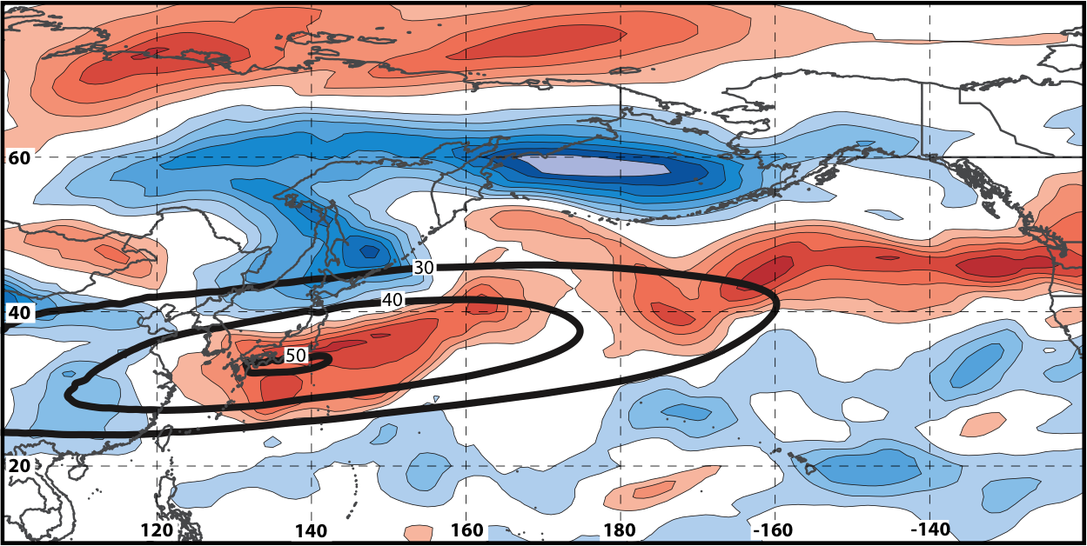
Real-Time North Pacific Jet Phase Diagram
250-hPa zonal wind at 0000 UTC 2 Jun minus 250-hPa zonal wind at 0000 UTC 24 May (shading) in the GFS analyses shows the transition to a poleward-shifted jet regime
0000 UTC 24 May
(0-h forecast)
0000 UTC 2 Jun (verification)
Ensemble mean
Sept.–May mean 250-hPa zonal wind: black contours
Notes:
Note that the positive changes in zonal wind correspond exactly to where the positive anomalies are located in the EOF2 pattern – See slide 14.

Slide 57
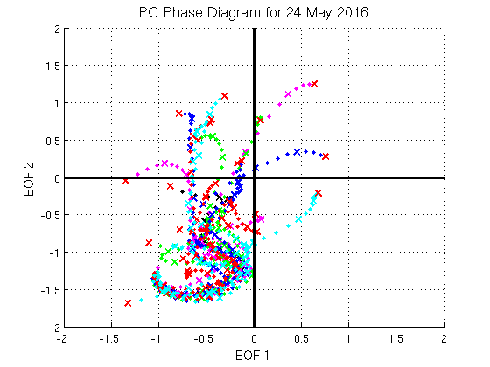
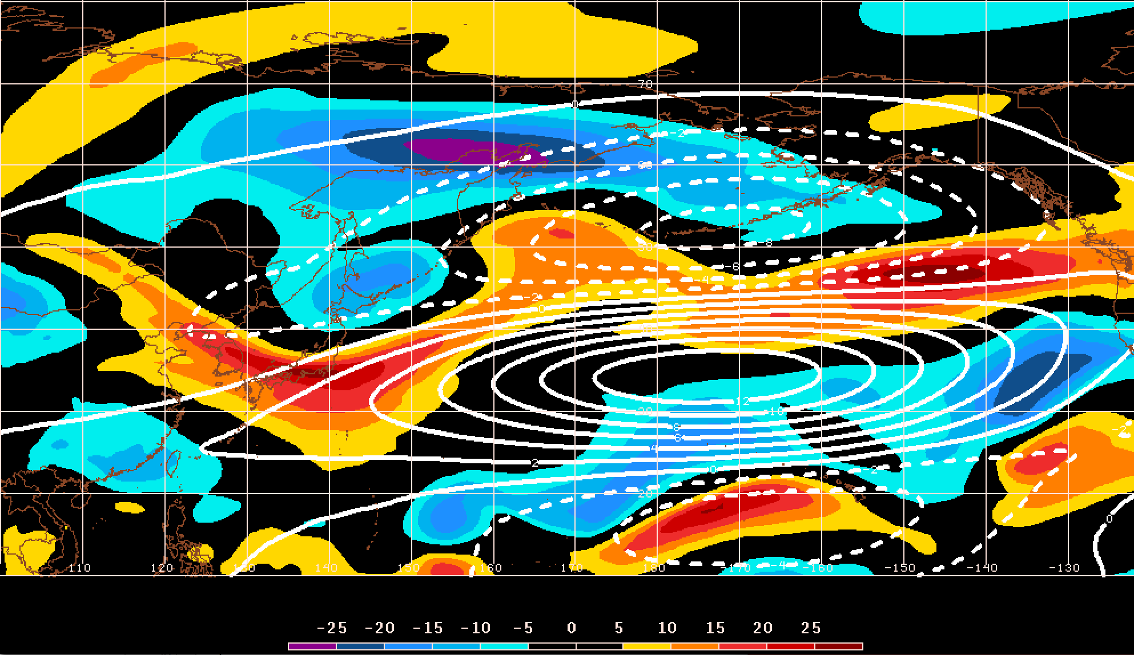
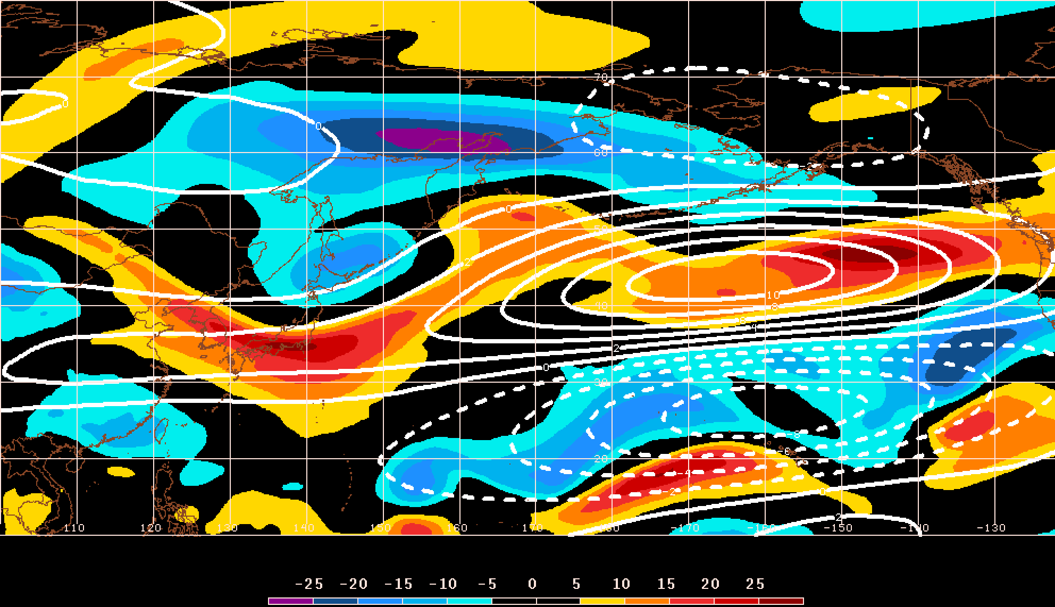
GEFS Ensemble Trajectories Initialized 0000 UTC 24 May 2016
250-hPa Zonal Wind Anomalies and EOF1: 0000 UTC 2 Jun
0000 UTC 2 Jun (verification)
m s^{–1}
250-hPa Zonal Wind Anomalies and EOF2: 0000 UTC 2 Jun
250-hPa zonal wind anomalies at 0000 UTC 2 Jun project strongly onto
EOF2 > 0
m s^{–1}

Slide 58
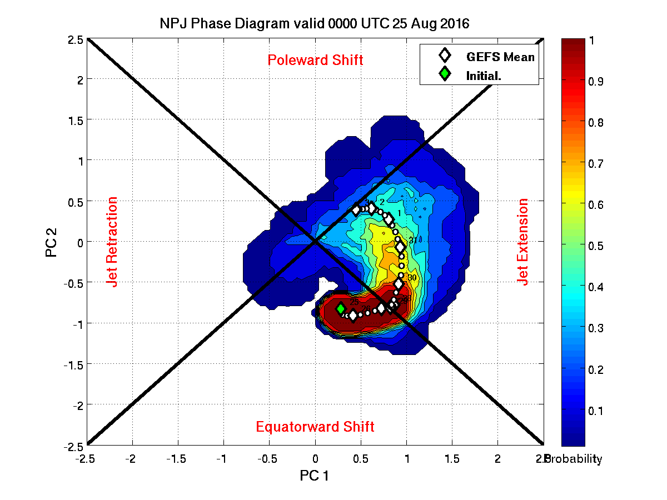
Real-time NPJ Phase Diagram Products
GEFS forecast probability of the verifying analysis occurring within a radius of 0.25 of a point during the upcoming 9-day period.

Slide 59
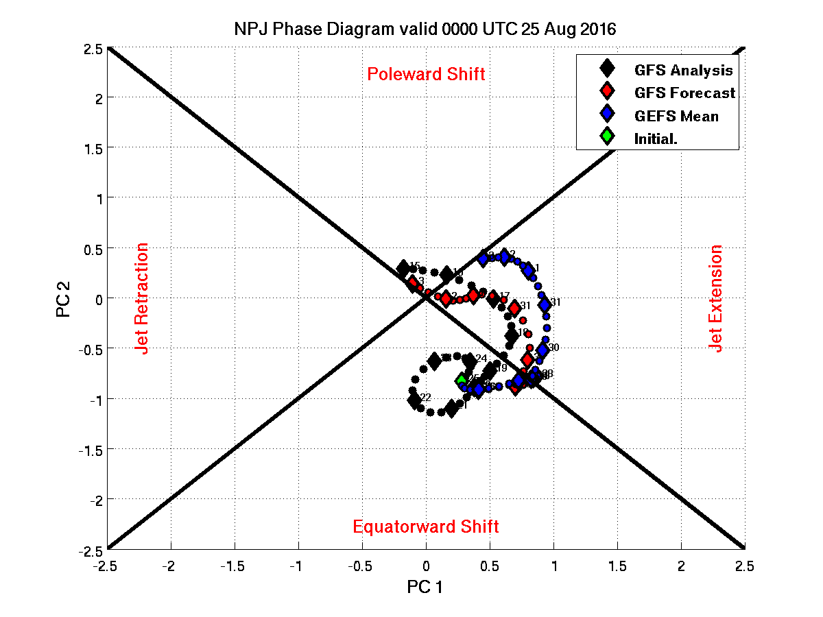
Real-time NPJ Phase Diagram Products
GFS deterministic and GEFS ensemble mean forecast trajectories with the GFS analysis over the previous 10-day period.

Slide 60
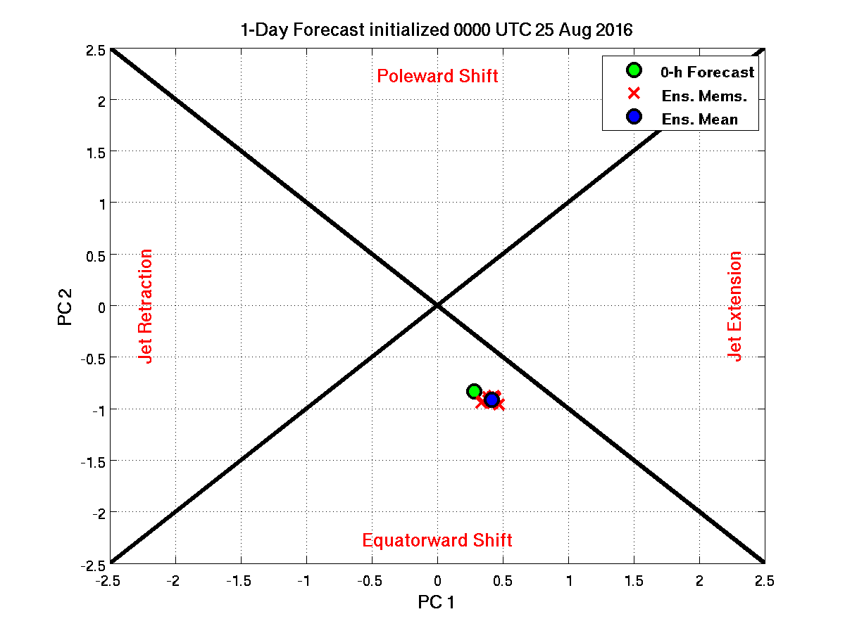
Real-time NPJ Phase Diagram Products
1-day forecast of GEFS ensemble members, GEFS ensemble mean, and 0-h forecast

Slide 61
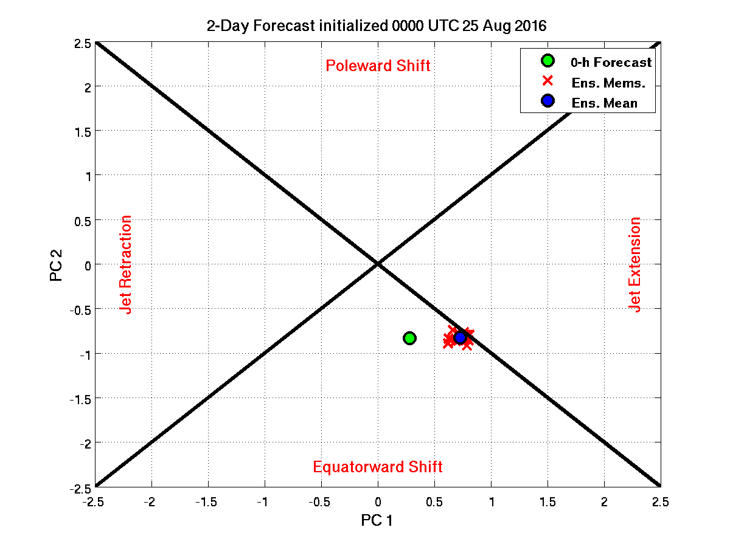
Real-time NPJ Phase Diagram Products
2-day forecast of GEFS ensemble members, GEFS ensemble mean, and 0-h forecast

Slide 62
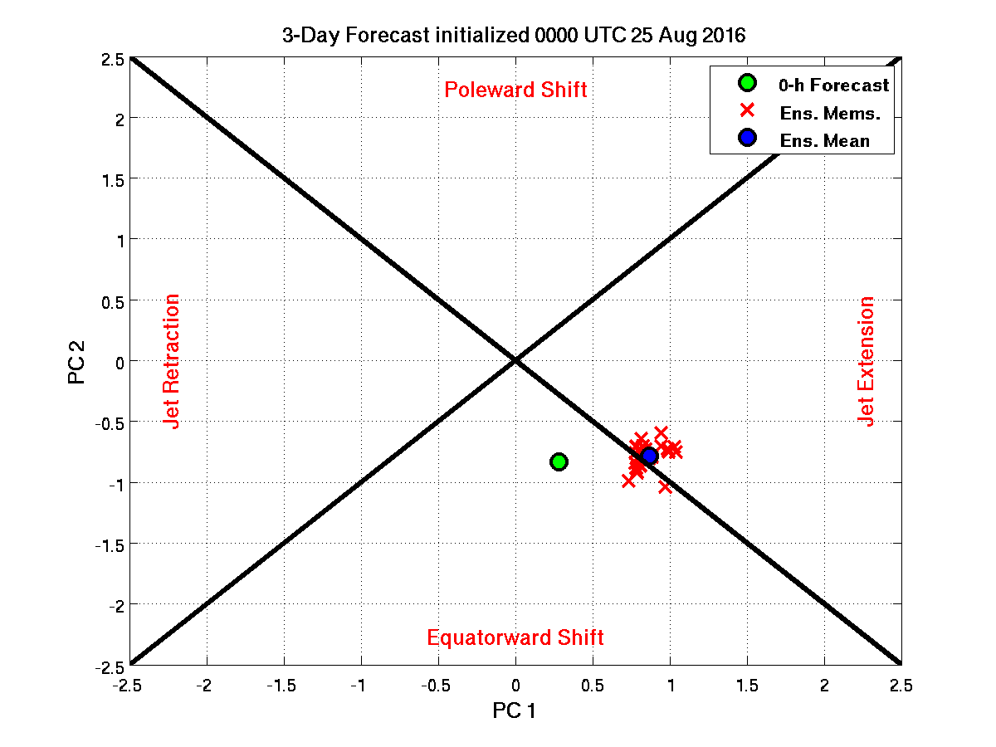
Real-time NPJ Phase Diagram Products
3-day forecast of GEFS ensemble members, GEFS ensemble mean, and 0-h forecast

Slide 63
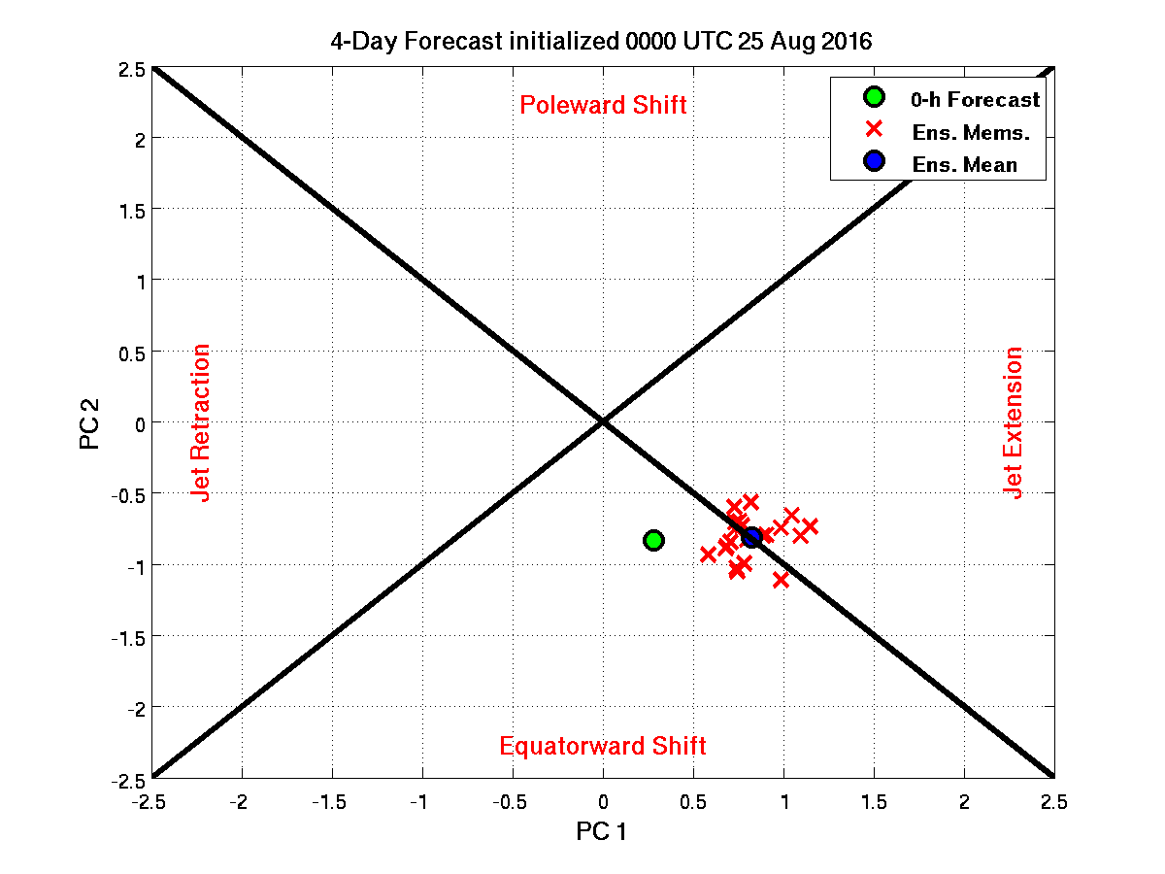
Real-time NPJ Phase Diagram Products
4-day forecast of GEFS ensemble members, GEFS ensemble mean, and 0-h forecast

Slide 64
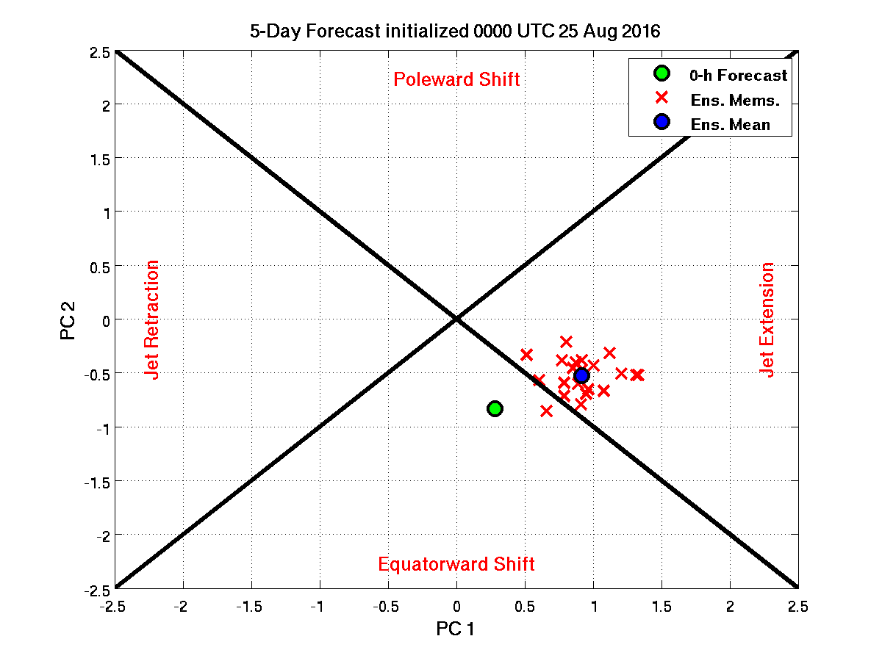
Real-time NPJ Phase Diagram Products
5-day forecast of GEFS ensemble members, GEFS ensemble mean, and 0-h forecast

Slide 65
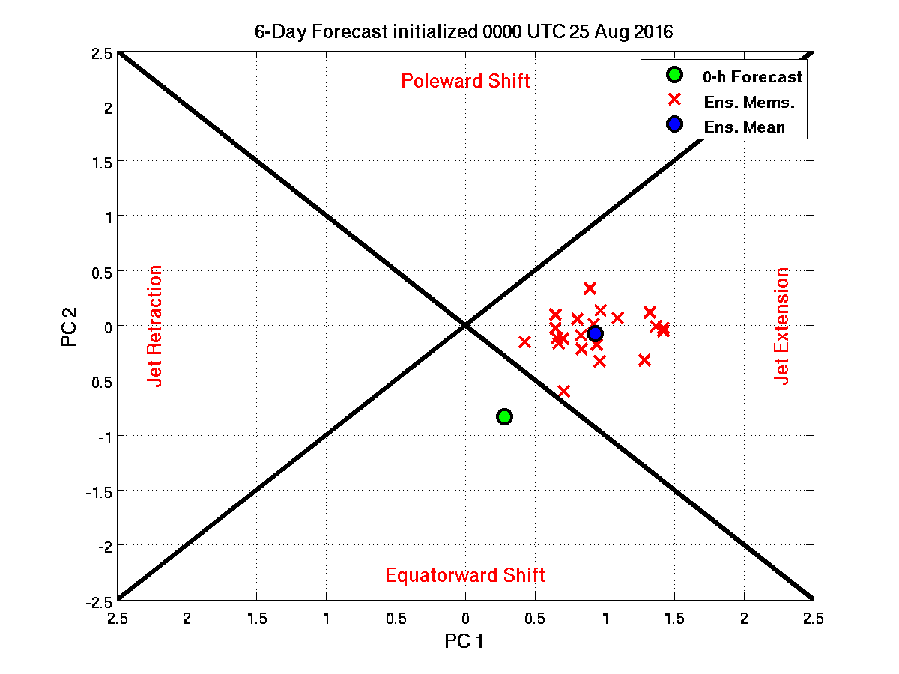
Real-time NPJ Phase Diagram Products
6-day forecast of GEFS ensemble members, GEFS ensemble mean, and 0-h forecast

Slide 66
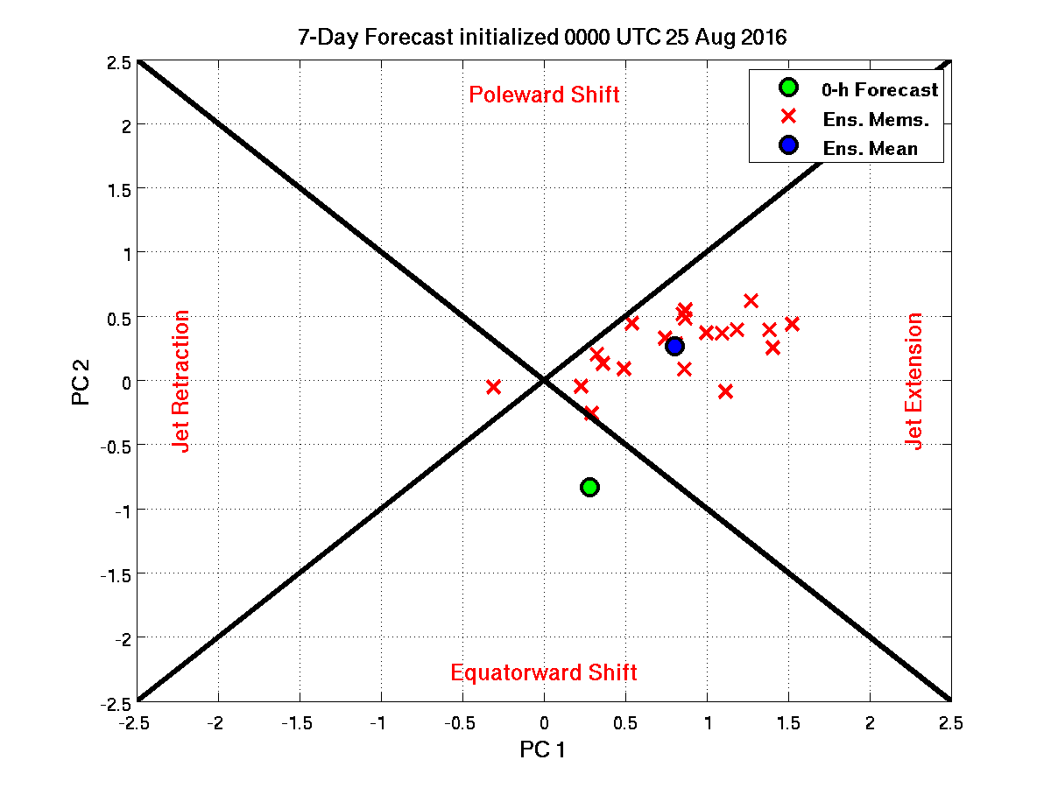
Real-time NPJ Phase Diagram Products
7-day forecast of GEFS ensemble members, GEFS ensemble mean, and 0-h forecast

Slide 67
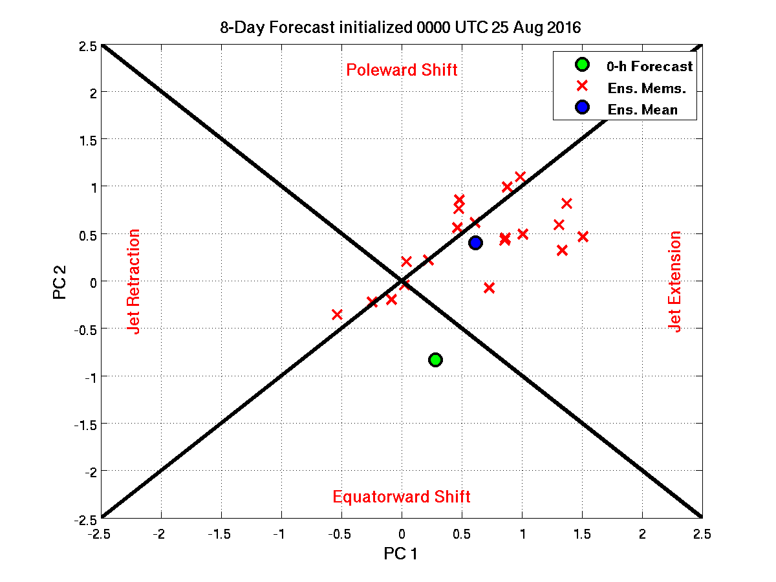
Real-time NPJ Phase Diagram Products
8-day forecast of GEFS ensemble members, GEFS ensemble mean, and 0-h forecast

Slide 68
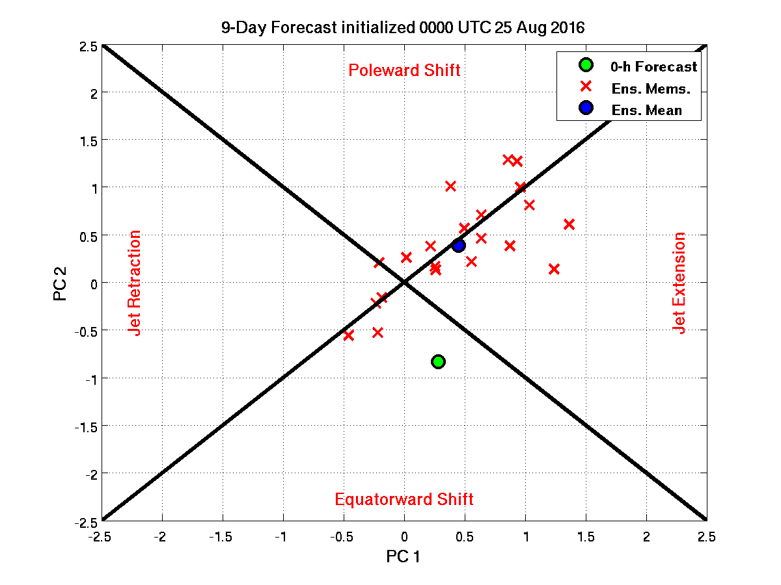
Real-time NPJ Phase Diagram Products
9-day forecast of GEFS ensemble members, GEFS ensemble mean, and 0-h forecast

Slide 69
Candidate Verification Metrics
Forecast Error
  Distance between GFS deterministic forecast and the analysis at each forecast hour
  Distance between the GEFS ensemble mean forecast and the analysis at each forecast hour
  Average distance between ensemble members and the analysis at each forecast hour
Probability of Detection
  Did the analysis fall within the ensemble envelope at each forecast hour?

Slide 70
Candidate Verification Metrics
Reliability Diagram
  Could a reliability diagram be used to evaluate the performance of GEFS ensemble forecasts with respect to the NPJ Phase Diagram?
ROC
  Could a ROC be an alternative metric to evaluate the performance of GEFS ensemble forecasts with respect to the NPJ Phase Diagram?
100
Reliability Diagram
% occurrence
0
% forecasted
100
1
POD
ROC
0
FAR
1
Notes:
Reconsider “with respect to”.. Add schematics

Slide 71
Next Steps
EWE Predictability
  What is the predictability of EWEs in the GEFS reforecast dataset with respect to the NPJ Phase Diagram?
General Predictability
  What is the predictability of all GEFS ensemble reforecasts with respect to the NPJ Phase Diagram?
Notes:
Reconsider “with respect to”.. Add schematics

Slide 72
Project Outcomes
Provide forecasters with a “first alert” to the possibility of the occurrence of extreme temperature and precipitation events during week two on the basis of current conditions and model forecasts.
Provide forecasters with an indication of the character and flavor of possible extreme events as inferred from where the events lie in the frequency distributions of the anticipated event types.
Provide forecasters with knowledge that allows them to make science-based adjustments to model guidance and add value to week two forecasts of temperature and precipitation.

