Slide 1
A North Pacific Jet Phase Diagram Perspective on Extreme Weather Events during 2016–2017: General Characteristics
Andrew C. Winters, Lance F. Bosart, and Daniel Keyser
Department of Atmospheric and Environmental Sciences
University at Albany, State University of New York, Albany, NY 12222
18th Northeast Regional Operational Workshop
Albany, NY
1–2 November 2017
This work is supported by NOAA Grant NA15NWS4680006

Slide 2
Motivation
The antecedent environments associated with continental U.S. extreme temperature and precipitation events are characterized by considerable North Pacific Jet (NPJ) variability during the medium-range period
This NPJ variability motivated the development of the NPJ phase diagram as an objective tool to characterize the instantaneous state of the upper-tropospheric flow pattern over the North Pacific

Slide 3
Motivation
This and the subsequent presentation will explore the potential of the NPJ phase diagram to increase confidence in operational probabilistic temperature and precipitation forecasts during the medium-range period
The subsequent presentation will address the implications of the prevailing NPJ regime, determined from the NPJ phase diagram, for the downstream upper-tropospheric flow pattern over North America

Slide 4
The Development of the
NPJ Phase Diagram

Slide 5
The NPJ Phase Diagram
Removed the mean and the annual and diurnal cycles from 6-hourly, 250-hPa zonal wind data from the CFSR (1979–2014) (Saha et al. 2014)
Restricted data to the cool season (Sept.–May)
Performed an EOF analysis on the zonal wind anomalies within the domain: 10–80°N , 100°E–120°W
Analysis techniques and resultant EOF patterns are consistent with related work on the NPJ:
Athanasiadis et al. (2010)
Jaffe et al. (2011)
Griffin and Martin (2017)

Slide 6
The NPJ Phase Diagram
EOF 1 – Jet Extension/Retraction
Sept.–May mean 250-hPa zonal wind: black contours
Sept.–May 250-hPa zonal wind EOF 1 pattern: shading
+ EOF 1: Jet Extension
– EOF 1: Jet Retraction

Slide 7
The NPJ Phase Diagram
EOF 1 – Jet Extension/Retraction
Hypothetical Zonal Wind
Sept.–May mean 250-hPa zonal wind: black contours
Sept.–May 250-hPa zonal wind EOF 1 pattern: shading
+ EOF 1: Jet Extension
– EOF 1: Jet Retraction
Notes:
The outermost green contour is 20 m/s and contour interval for green contours is every 10 m/s. The green contours are calculated by adding the EOF patterns to the mean zonal wind. The resultant wind distribution would project onto the point (1,0) on the N. Pacific Jet phase diagram.

Slide 8
The NPJ Phase Diagram
EOF 1 – Jet Extension/Retraction
Hypothetical Zonal Wind
Sept.–May mean 250-hPa zonal wind: black contours
Sept.–May 250-hPa zonal wind EOF 1 pattern: shading
+ EOF 1: Jet Extension
– EOF 1: Jet Retraction
Notes:
The distribution of zonal wind in this slide would project onto the point (-1,0) on the N. Pacific Jet phase diagram.

Slide 9
The NPJ Phase Diagram
EOF 2 – Poleward/Equatorward Shift
Sept.–May mean 250-hPa zonal wind: black contours
Sept.–May 250-hPa zonal wind EOF 2 pattern: shading
+ EOF 2: Poleward Shift
– EOF 2: Equatorward Shift

Slide 10
The NPJ Phase Diagram
EOF 2 – Poleward/Equatorward Shift
Hypothetical Zonal Wind
Sept.–May mean 250-hPa zonal wind: black contours
Sept.–May 250-hPa zonal wind EOF 2 pattern: shading
+ EOF 2: Poleward Shift
– EOF 2: Equatorward Shift
Notes:
The zonal wind pattern in green would project onto the point (0,1) on the N. Pacific Jet phase diagram.

Slide 11
The NPJ Phase Diagram
EOF 2 – Poleward/Equatorward Shift
Hypothetical Zonal Wind
Sept.–May mean 250-hPa zonal wind: black contours
Sept.–May 250-hPa zonal wind EOF 2 pattern: shading
+ EOF 2: Poleward Shift
– EOF 2: Equatorward Shift
Notes:
The zonal wind pattern in green would project onto the point (0,-1) on the N. Pacific Jet phase diagram.

Slide 12
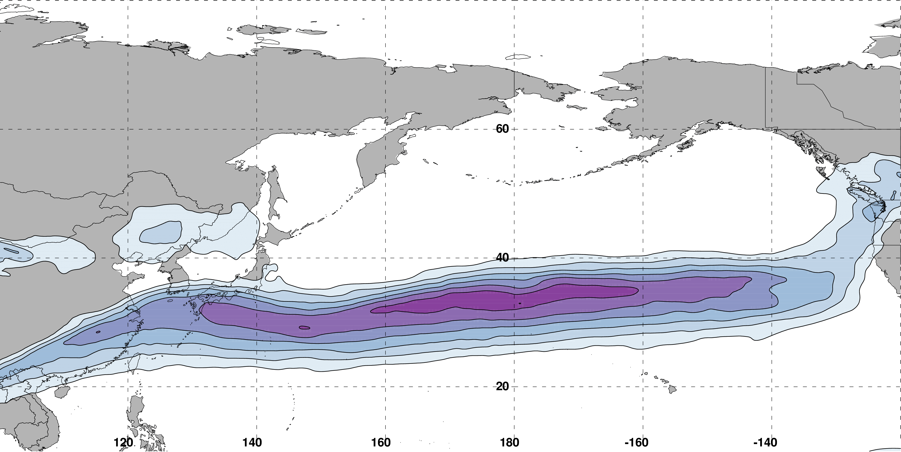
The NPJ Phase Diagram
0000 UTC 16 February 2017
250-hPa wind speed: shaded
m s^{–1}
Instantaneous 250-hPa zonal wind anomalies can be projected onto EOF 1 and EOF 2, resulting in a point on an NPJ phase diagram

Slide 13
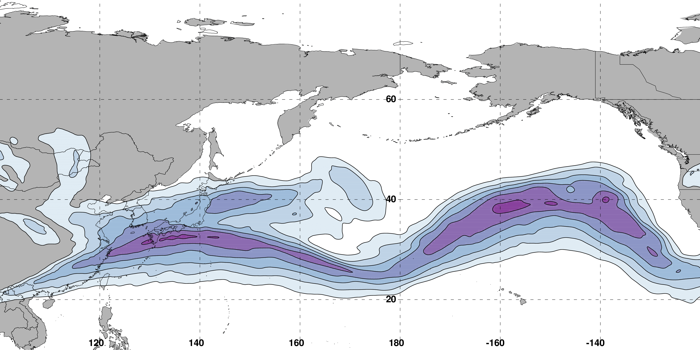
The NPJ Phase Diagram
0000 UTC 18 February 2017
250-hPa wind speed: shaded
m s^{–1}
Analyzed 250-hPa zonal wind anomalies can be projected onto EOF1 and EOF2 to describe the evolution of the NPJ
Notes:
Show forecast evolution for a period

Slide 14
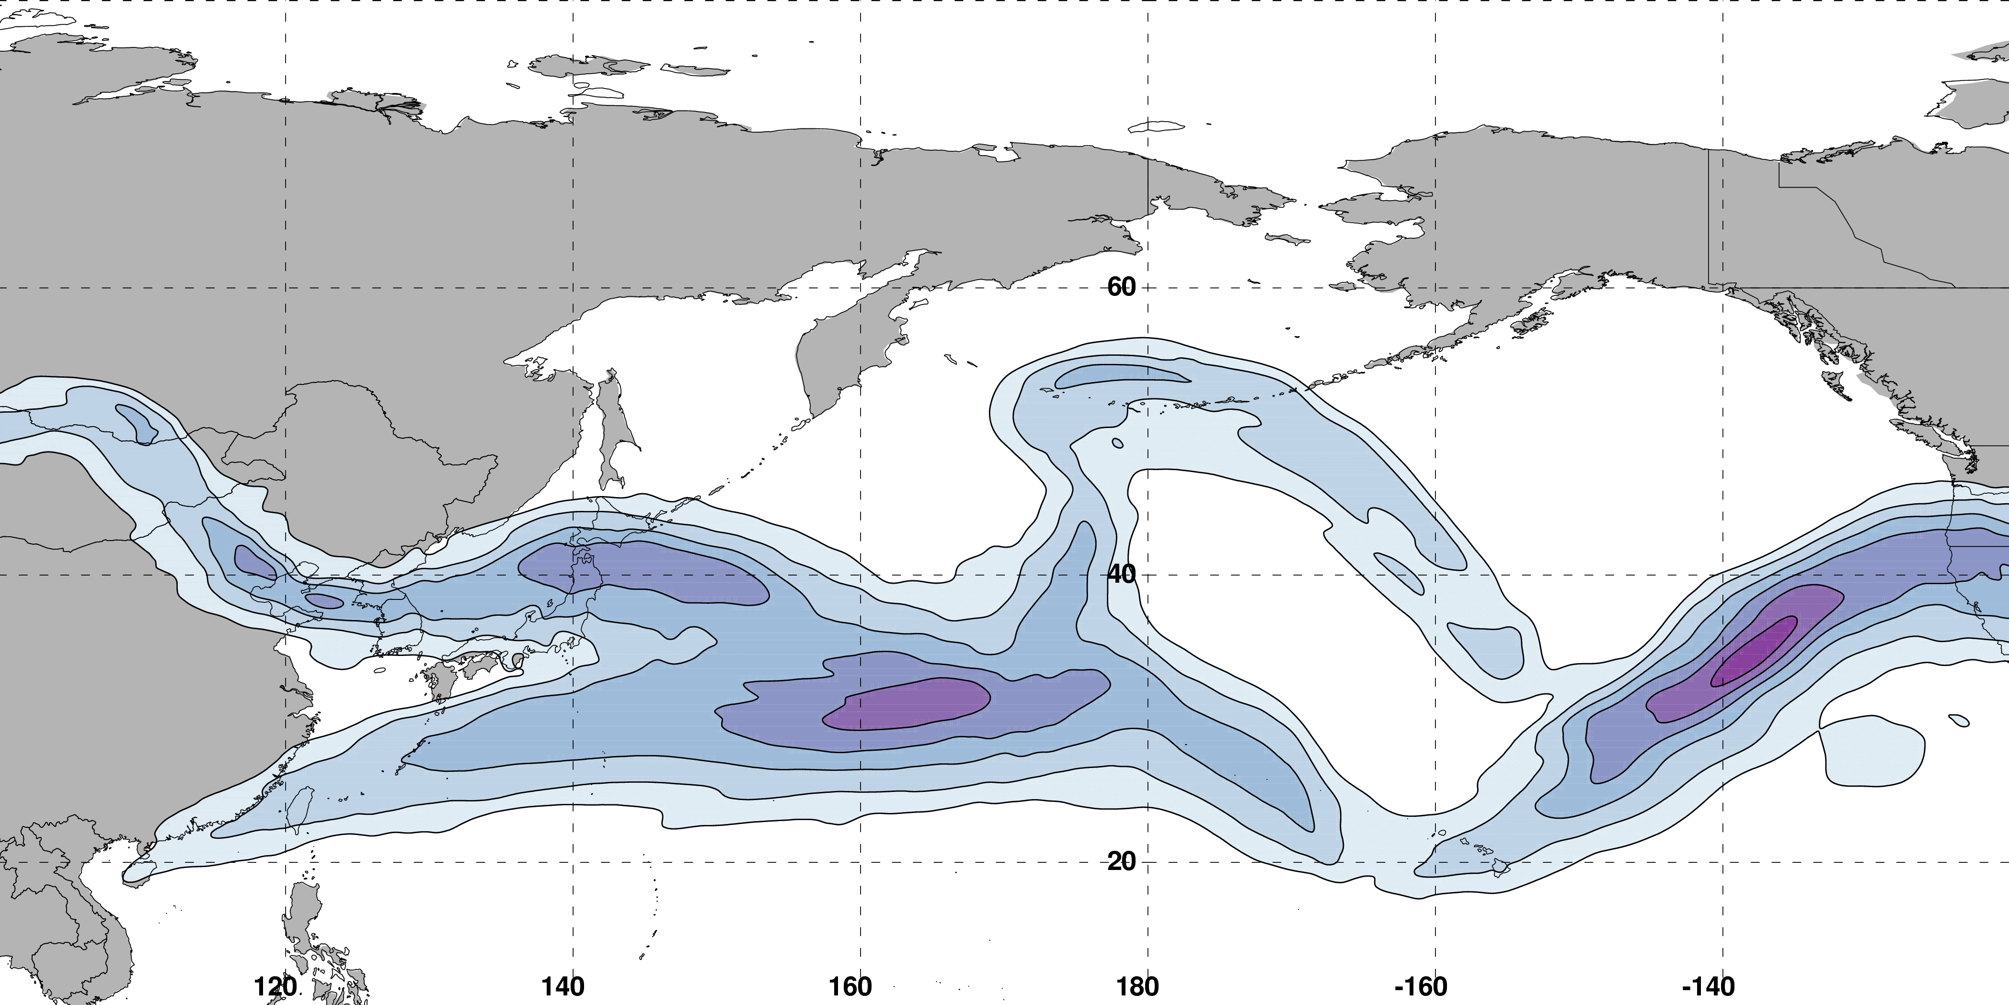
The NPJ Phase Diagram
0000 UTC 20 February 2017
250-hPa wind speed: shaded
m s^{–1}
Analyzed 250-hPa zonal wind anomalies can be projected onto EOF1 and EOF2 to describe the evolution of the NPJ
Notes:
Show forecast evolution for a period

Slide 15
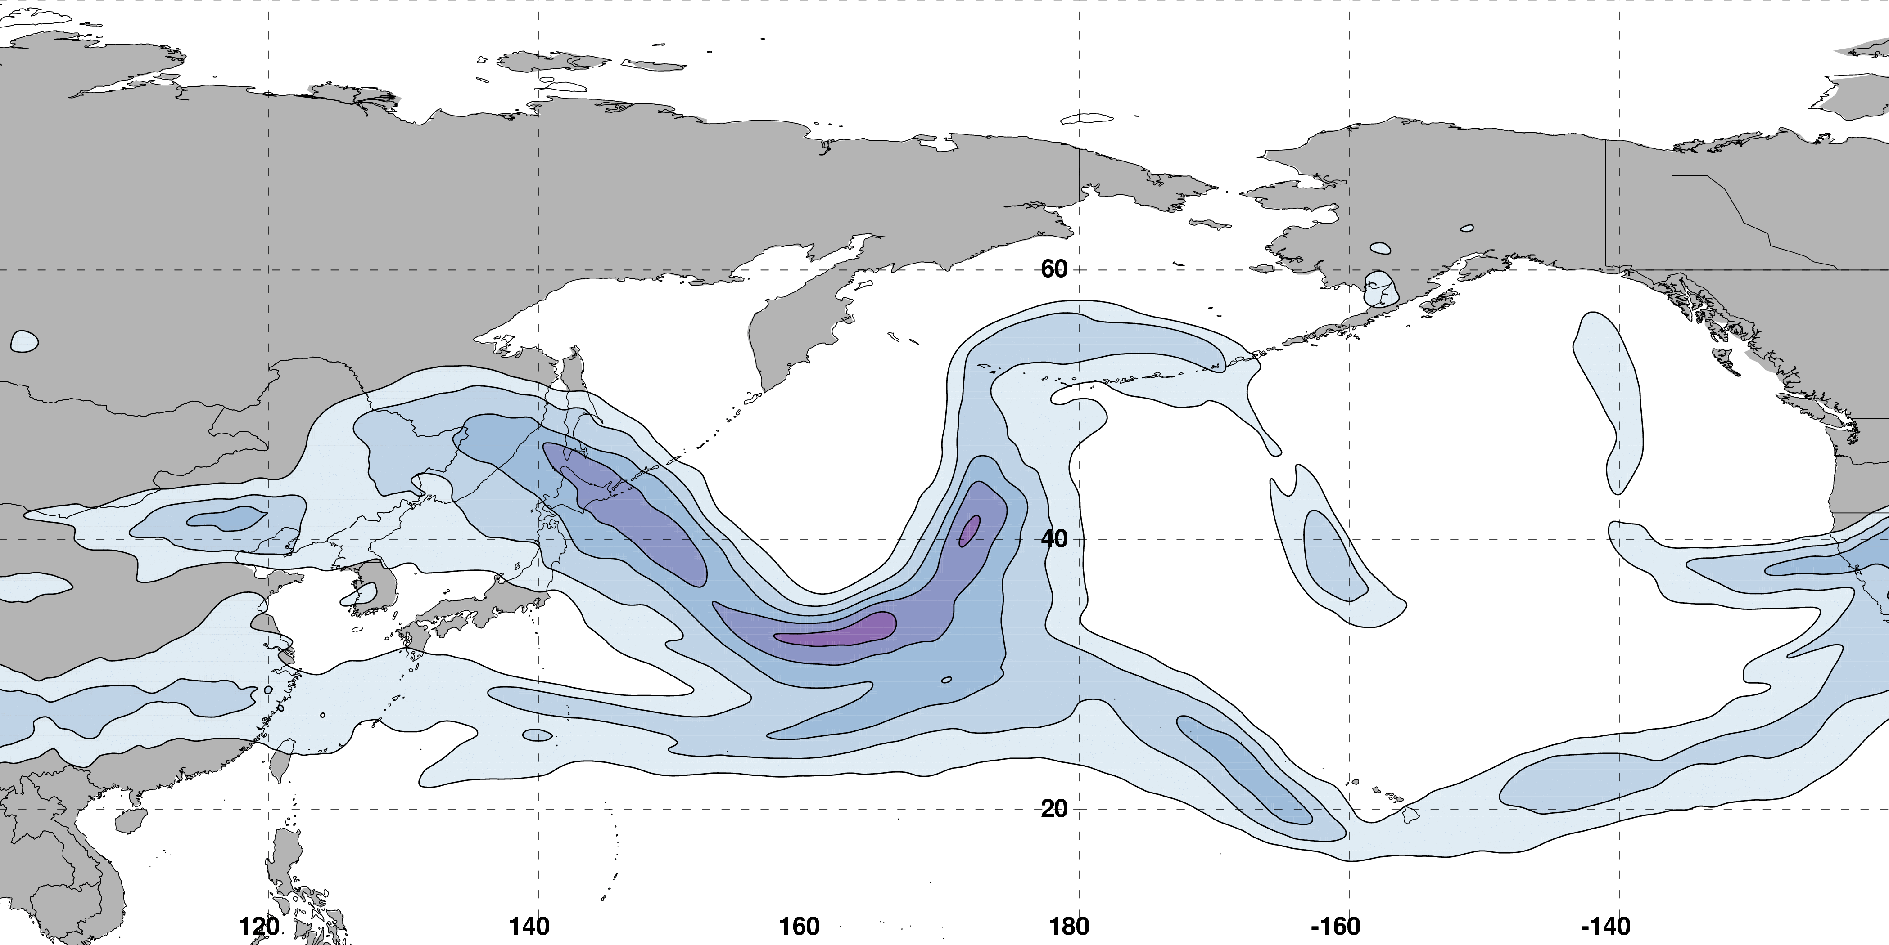
The NPJ Phase Diagram
0000 UTC 22 February 2017
250-hPa wind speed: shaded
m s^{–1}
Analyzed 250-hPa zonal wind anomalies can be projected onto EOF1 and EOF2 to describe the evolution of the NPJ
Notes:
Show forecast evolution for a period

Slide 16
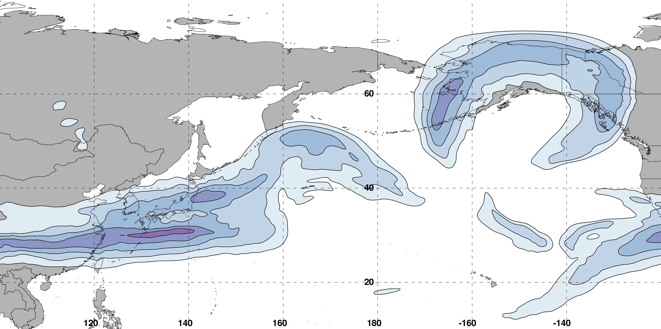
The NPJ Phase Diagram
0000 UTC 24 February 2017
250-hPa wind speed: shaded
m s^{–1}
Analyzed 250-hPa zonal wind anomalies can be projected onto EOF1 and EOF2 to describe the evolution of the NPJ
Notes:
Show forecast evolution for a period

Slide 17
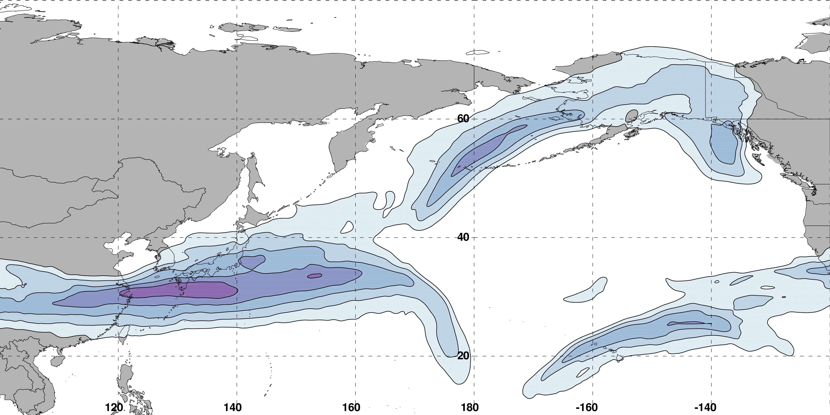
The NPJ Phase Diagram
0000 UTC 26 February 2017
250-hPa wind speed: shaded
m s^{–1}
Analyzed 250-hPa zonal wind anomalies can be projected onto EOF1 and EOF2 to describe the evolution of the NPJ

Slide 18
GEFS Forecast Skill in the Context of the NPJ Phase Diagram

Slide 19
NPJ Phase Diagram Forecast Skill
Determined the position within the NPJ phase diagram for all 0-h forecasts during Sept.–May 1985–2014 in the GEFS Reforecast v2 (Hamill et al. 2013)

Slide 20
GEFS Ensemble Mean Error by NPJ Regime
GEFS Reforecasts initialized during a particular NPJ regime
Circles on a particular line indicate statistically significant differences at the 95% confidence level with respect to another NPJ regime
Notes:
During instead of within

Slide 21
GEFS Ensemble Mean Error by NPJ Regime
GEFS Reforecasts initialized during a particular NPJ regime
Circles on a particular line indicate statistically significant differences at the 95% confidence level with respect to another NPJ regime
Forecasts initialized during jet retractions exhibit significantly larger errors than
jet extensions and poleward shifts in the 168–216-h forecast period
Notes:
Colorize the NPJ regimes in the text

Slide 22
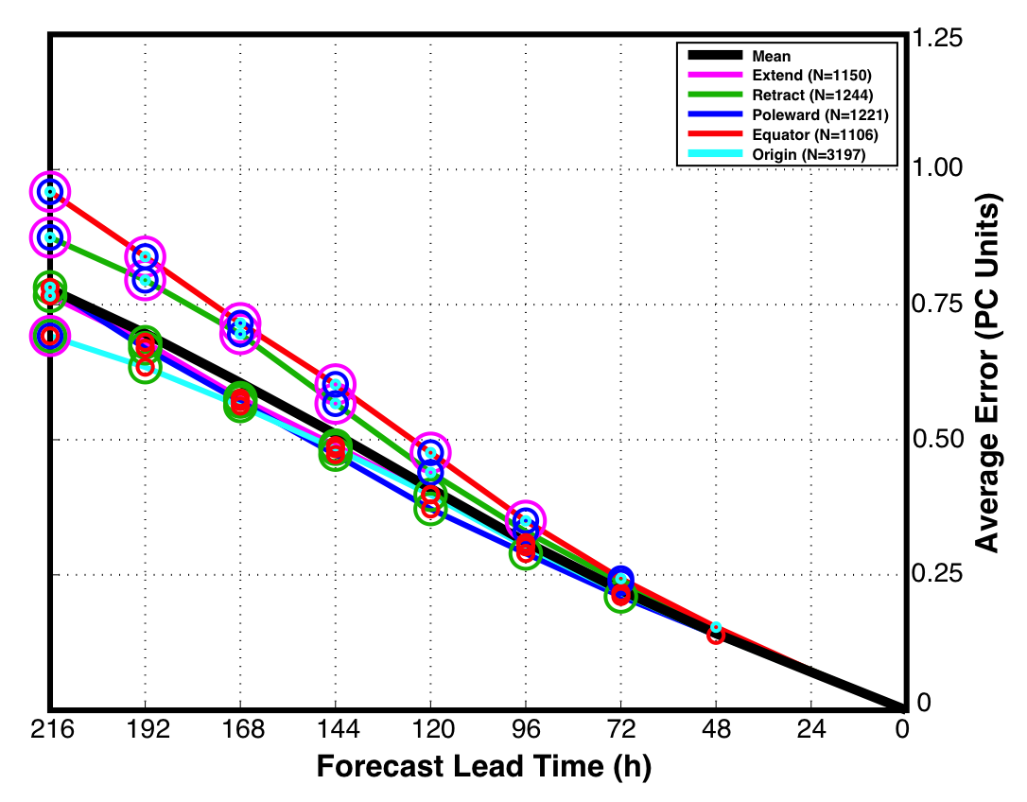
GEFS Ensemble Mean Error by NPJ Regime
GEFS Reforecasts verifying during a particular NPJ regime
Circles on a particular line indicate statistically significant differences at the 99% confidence level with respect to another NPJ regime
Forecasts verifying during equatorward shifts and jet retractions exhibit significantly larger errors than jet extensions and poleward shifts in the 96–216-h forecast period
Notes:
Additional slide with the takeaways from these two slides.

Slide 23
NPJ Phase Diagram Forecast Skill
Initialization NPJ Regime
Verification NPJ Regime
Poleward Shift
Poleward Shift
Jet Retraction
Jet Extension
Jet Retraction
Jet Extension
Equatorward Shift
Equatorward Shift
Greater Forecast Skill
Reduced Forecast Skill
Forecasts initialized during jet retractions are characterized by larger errors than those initialized during jet extensions and poleward shifts
Notes:
Additional slide with the takeaways from these two slides.

Slide 24
NPJ Phase Diagram Forecast Skill
Initialization NPJ Regime
Verification NPJ Regime
Poleward Shift
Poleward Shift
Jet Retraction
Jet Extension
Jet Retraction
Jet Extension
Equatorward Shift
Equatorward Shift
Greater Forecast Skill
Reduced Forecast Skill
Forecasts verifying during jet retractions and equatorward shifts are characterized by substantially larger errors than those verifying during jet extensions and poleward shifts
Notes:
Additional slide with the takeaways from these two slides.

Slide 25
NPJ Phase Diagram Forecast Skill
Initialization NPJ Regime
Verification NPJ Regime
Poleward Shift
Poleward Shift
Jet Retraction
Jet Extension
Jet Retraction
Jet Extension
Equatorward Shift
Equatorward Shift
Greater Forecast Skill
Reduced Forecast Skill
Jet retractions and equatorward shifts are often characterized by high-amplitude and/or short-wavelength flow patterns over the North Pacific, which may be a contributing factor to the reduced skill
Notes:
Additional slide with the takeaways from these two slides.

Slide 26
Best/Worst NPJ Phase Diagram Forecasts
Comparison between the periods characterized by the best/worst medium-range forecasts
Criteria: Forecasts must rank in the top/bottom 10% in terms of both:
The average GEFS ensemble mean error in the Day 8 and 9 forecasts
The average GEFS ensemble member error in the Day 8 and 9 forecasts

Slide 27
Best/Worst NPJ Phase Diagram Forecasts
Comparison between the periods characterized by the best/worst medium-range forecasts
Criteria: Forecasts must rank in the top/bottom 10% in terms of both:
The average GEFS ensemble mean error in the Day 8 and 9 forecasts
The average GEFS ensemble member error in the Day 8 and 9 forecasts
Hypothetical Best Forecast
Verification
Ensemble Mean Position
Individual Ens. Member

Slide 28
Best/Worst NPJ Phase Diagram Forecasts
Comparison between the periods characterized by the best/worst medium-range forecasts
Criteria: Forecasts must rank in the top/bottom 10% in terms of both:
The average GEFS ensemble mean error in the Day 8 and 9 forecasts
The average GEFS ensemble member error in the Day 8 and 9 forecasts
Represents a forecast with negligible ensemble mean error
Hypothetical Best Forecast
(1) Ens. Mean error ≈ 0
Verification
Ensemble Mean Position
Individual Ens. Member

Slide 29
Best/Worst NPJ Phase Diagram Forecasts
Comparison between the periods characterized by the best/worst medium-range forecasts
Criteria: Forecasts must rank in the top/bottom 10% in terms of both:
The average GEFS ensemble mean error in the Day 8 and 9 forecasts
The average GEFS ensemble member error in the Day 8 and 9 forecasts
Represents a forecast with negligible ensemble member error
Hypothetical Best Forecast
(1) Ens. Mean error ≈ 0
(2) Avg. Ens. Member error ≈ 0
Verification
Ensemble Mean Position
Individual Ens. Member

Slide 30
Best/Worst NPJ Phase Diagram Forecasts
Comparison between the periods characterized by the best/worst medium-range forecasts
Criteria: Forecasts must rank in the top/bottom 10% in terms of both:
The average GEFS ensemble mean error in the Day 8 and 9 forecasts
The average GEFS ensemble member error in the Day 8 and 9 forecasts
Hypothetical Intermediate Forecast
Verification
Ensemble Mean Position
Individual Ens. Member
Notes:
intermediate

Slide 31
Best/Worst NPJ Phase Diagram Forecasts
Comparison between the periods characterized by the best/worst medium-range forecasts
Criteria: Forecasts must rank in the top/bottom 10% in terms of both:
The average GEFS ensemble mean error in the Day 8 and 9 forecasts
The average GEFS ensemble member error in the Day 8 and 9 forecasts
Represents a forecast with negligible ensemble mean error
Hypothetical Intermediate Forecast
(1) Ens. Mean error ≈ 0
Verification
Ensemble Mean Position
Individual Ens. Member

Slide 32
Best/Worst NPJ Phase Diagram Forecasts
Comparison between the periods characterized by the best/worst medium-range forecasts
Criteria: Forecasts must rank in the top/bottom 10% in terms of both:
The average GEFS ensemble mean error in the Day 8 and 9 forecasts
The average GEFS ensemble member error in the Day 8 and 9 forecasts
Represents a forecast with considerable ensemble member error
Hypothetical Intermediate Forecast
(1) Ens. Mean error ≈ 0
(2) Avg. Ens. Member error >> 0
Verification
Ensemble Mean Position
Individual Ens. Member

Slide 33
Best/Worst NPJ Phase Diagram Forecasts
Comparison between the periods characterized by the best/worst medium-range forecasts
Criteria: Forecasts must rank in the top/bottom 10% in terms of both:
The average GEFS ensemble mean error in the Day 8 and 9 forecasts
The average GEFS ensemble member error in the Day 8 and 9 forecasts
Hypothetical Worst Forecast
Verification
Ensemble Mean Position
Individual Ens. Member

Slide 34
Best/Worst NPJ Phase Diagram Forecasts
Comparison between the periods characterized by the best/worst medium-range forecasts
Criteria: Forecasts must rank in the top/bottom 10% in terms of both:
The average GEFS ensemble mean error in the Day 8 and 9 forecasts
The average GEFS ensemble member error in the Day 8 and 9 forecasts
Represents a forecast with considerable ensemble mean error
Hypothetical Worst Forecast
(1) Ens. Mean error >> 0
Verification
Ensemble Mean Position
Individual Ens. Member

Slide 35
Best/Worst NPJ Phase Diagram Forecasts
Comparison between the periods characterized by the best/worst medium-range forecasts
Criteria: Forecasts must rank in the top/bottom 10% in terms of both:
The average GEFS ensemble mean error in the Day 8 and 9 forecasts
The average GEFS ensemble member error in the Day 8 and 9 forecasts
Represents a forecast with considerable ensemble member error
Hypothetical Worst Forecast
(1) Ens. Mean error >> 0
(2) Avg. Ens. Member error >> 0
Verification
Ensemble Mean Position
Individual Ens. Member
Notes:
Remove hypothetical illustrations and instead say what were gonna show

Slide 36
Best/Worst NPJ Phase Diagram Forecasts
Comparison between the periods characterized by the best/worst medium-range forecasts
Criteria: Forecasts must rank in the top/bottom 10% in terms of both:
The average GEFS ensemble mean error in the Day 8 and 9 forecasts
The average GEFS ensemble member error in the Day 8 and 9 forecasts
Metrics:
The frequency of the best and worst forecasts initialized during each NPJ regime
The average change in PC1 and PC2 during the 10-day period following the initialization of the best and worst forecasts
The average length of the trajectory through the NPJ phase diagram during the 10-day period following the initialization of the best and worst forecasts
Notes:
Switch metric order to agree with subsequent slides

Slide 37
Best/Worst NPJ Phase Diagram Forecasts
Comparison between the periods characterized by the best/worst medium-range forecasts
 | Extend | Retract | Poleward | Equator. | Origin
Best Forecasts (N=475) | 77 | 63 | 63 | 61 | 211
Worst Forecasts (N=763) | 90 | 145 | 90 | 112 | 326
Best/Worst Ratio (Ave = 0.62) | 0.86 | 0.43 | 0.70 | 0.54 | 0.65
The best forecasts occur disproportionately more during jet extensions and poleward shifts
The worst forecasts occur disproportionately more during jet retractions and equatorward shifts
Notes:
Switch best/worst ratio magnitude

Slide 38
Best/Worst NPJ Phase Diagram Forecasts
Comparison between the periods characterized by the best/worst medium-range forecasts
 | Avg. ΔPC1 | Avg. ΔPC2 | Avg. 10-d Traj. Length.
Best Forecasts (N=475) | 0.09 | 0.16 | 3.50 PC units
Worst Forecasts (N=763) | 0.01 | –0.21 | 4.33 PC units
Statistically significant at the 99.9% confidence interval
Poleward
Shift
Equatorward
Shift
The best forecast periods are typically characterized by poleward shifts over the next 10 days and anomalously short trajectories within the NPJ phase diagram
The worst forecast periods are typically characterized by equatorward shifts over the next 10 days and anomalously long trajectories within the NPJ phase diagram
Notes:
Add the interpretation and links

Slide 39
Best/Worst NPJ Phase Diagram Forecasts
Ratio of Best/Worst Forecasts
Average ΔPC2
Poleward Shift
Poleward Shift
Best
Jet Retraction
Jet Extension
Jet Retraction
Jet Extension
Worst
Equatorward Shift
Equatorward Shift
More Best Forecasts
More Worst Forecasts
The worst forecasts are most frequently initialized during jet retractions and equatorward shifts
The worst forecast periods frequently feature equatorward shifts during the 10-day period following forecast initialization
Notes:
Switch best/worst in words. One bullet for each result. New slide for each bullet

Slide 40
Best/Worst NPJ Phase Diagram Forecasts
Ratio of Best/Worst Forecasts
Average ΔPC2
Poleward Shift
Poleward Shift
Best
Jet Retraction
Jet Extension
Jet Retraction
Jet Extension
Worst
Equatorward Shift
Equatorward Shift
More Best Forecasts
More Worst Forecasts
The worst forecast periods are associated with longer trajectories through the NPJ phase diagram following forecast initialization, suggestive of rapid NPJ regime change
Notes:
Switch best/worst in words. One bullet for each result. New slide for each bullet

Slide 41
Best/Worst NPJ Phase Diagram Forecasts
Comparison between the periods characterized by the best/worst medium-range forecasts
 | Extend | Retract | Poleward | Equator. | Origin
Best Forecasts (N=475) | 77 | 63 | 63 | 61 | 211
Worst Forecasts (N=763) | 90 | 145 | 90 | 112 | 326
Best/Worst Ratio (Ave = 0.62) | 0.86 | 0.43 | 0.70 | 0.54 | 0.65
What are the synoptic flow patterns associated with the best and worst forecasts initialized during a particular NPJ regime?

Slide 42
Best/Worst NPJ Phase Diagram Forecasts
Comparison between the periods characterized by the best/worst medium-range forecasts
 | Extend | Retract | Poleward | Equator. | Origin
Best Forecasts (N=475) | 77 | 63 | 63 | 61 | 211
Worst Forecasts (N=763) | 90 | 145 | 90 | 112 | 326
Best/Worst Ratio (Ave = 0.62) | 0.86 | 0.43 | 0.70 | 0.54 | 0.65
What are the synoptic flow patterns associated with the best and worst forecasts initialized during a particular NPJ regime?

Slide 43
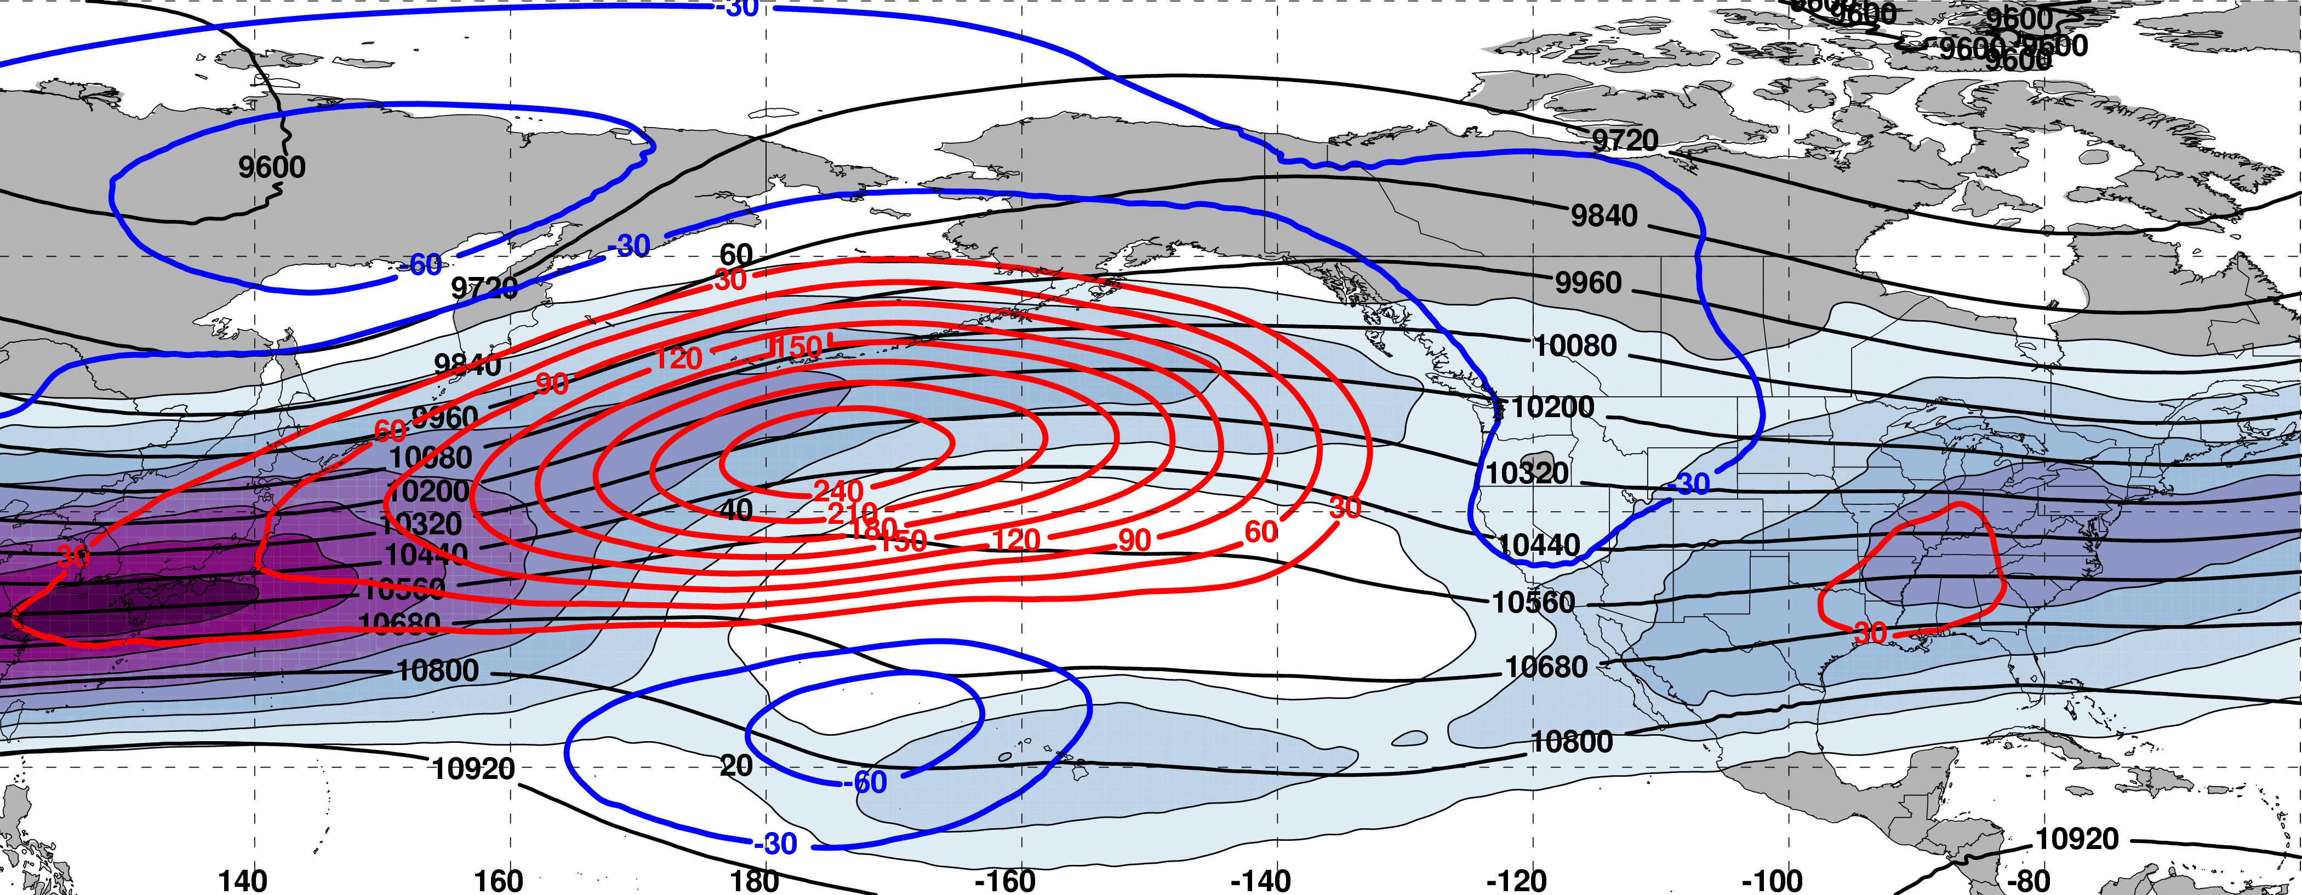
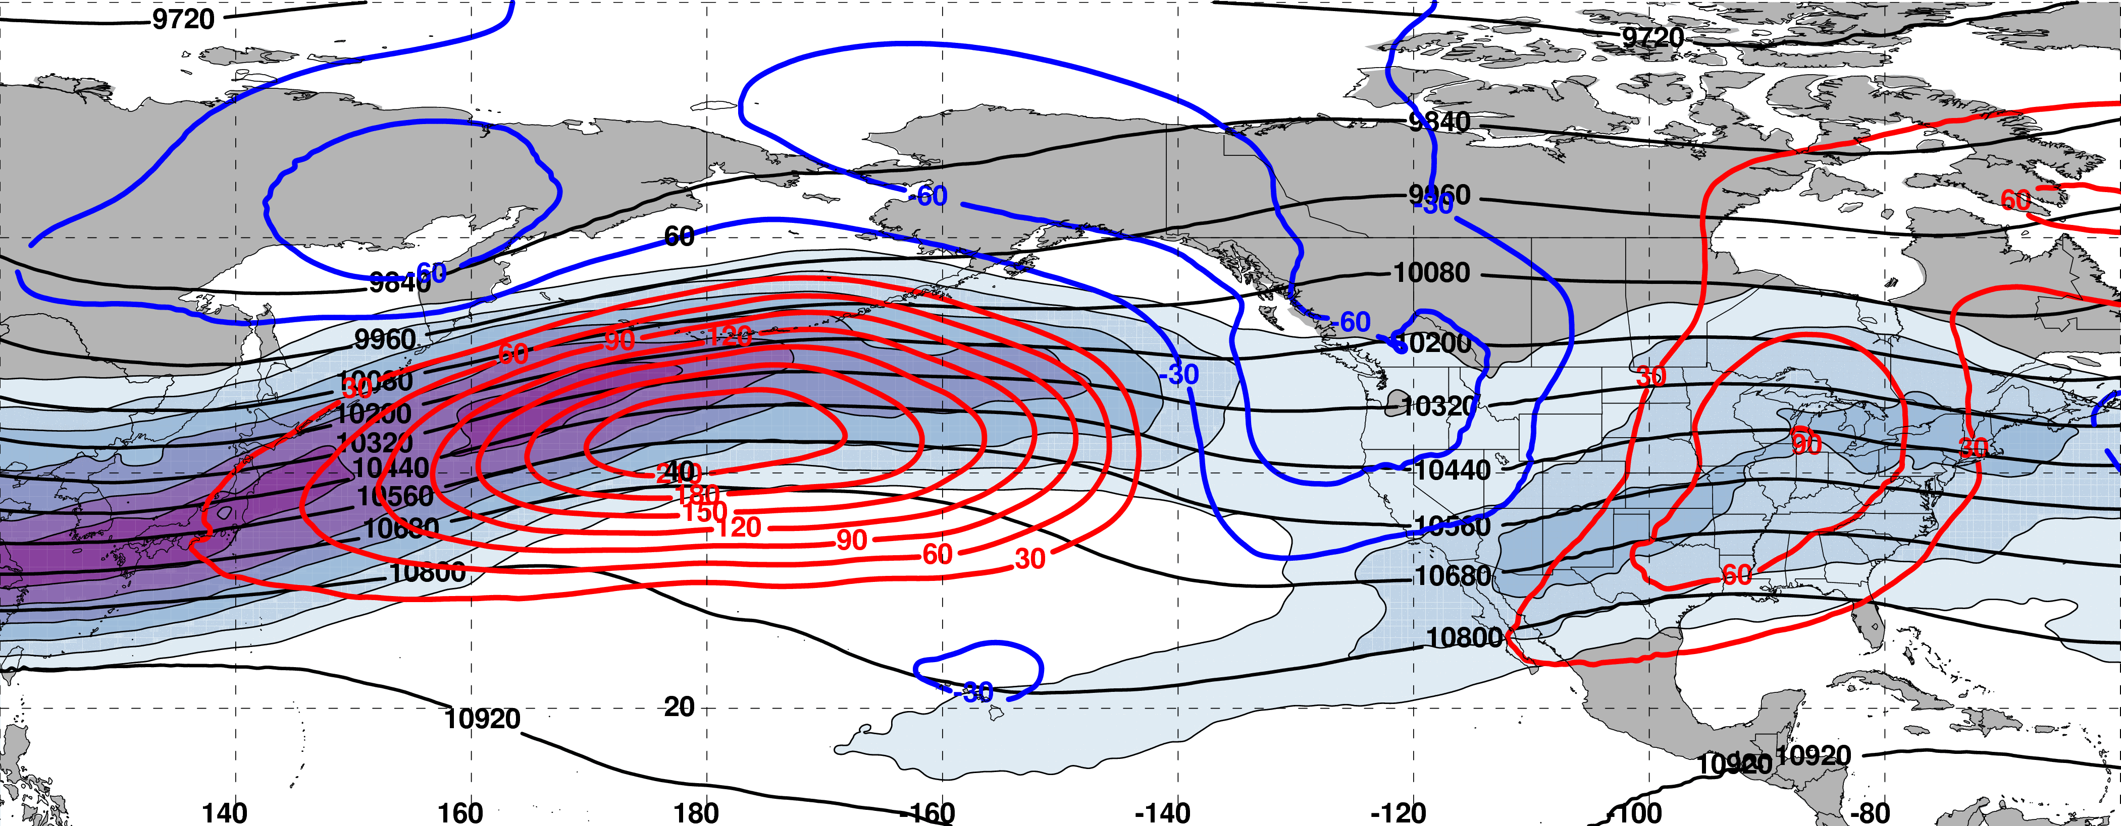
Initialization of a Worst Forecast during Jet Retraction (N=145)
250 hPa
m s^{–1}
Initialization of a Best Forecast during Jet Retraction (N=63)
250 hPa
m s^{–1}

Slide 44
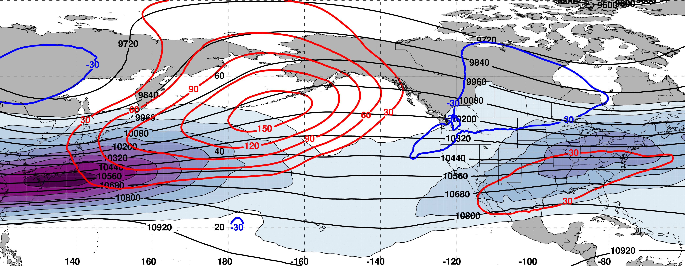
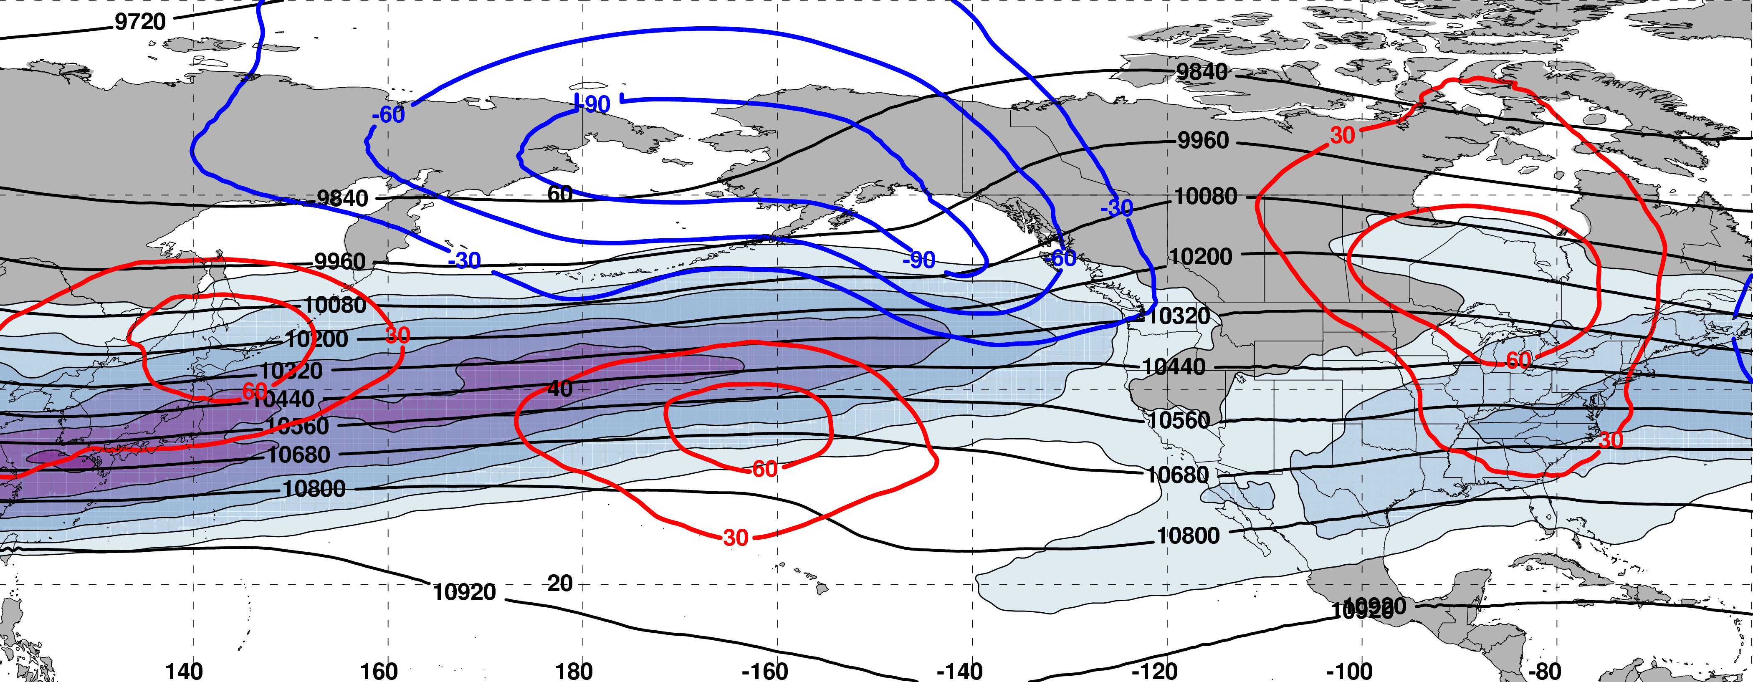
8 days following a Worst Forecast during Jet Retraction (N=145)
250 hPa
m s^{–1}
8 days following a Best Forecast during Jet Retraction (N=63)
250 hPa
m s^{–1}

Slide 45
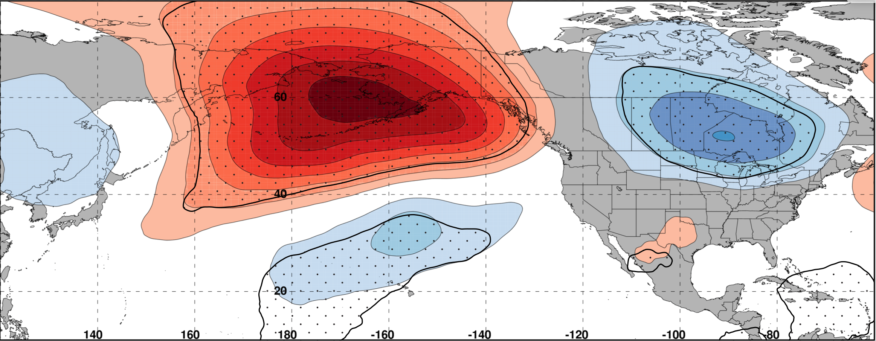
Composite Difference: (Worst – Best) at 192 h
250 hPa
m
99% Conf. Interval
Relative to the best forecast periods, the worst forecast periods are frequently characterized by significantly higher heights at high latitudes and significantly lower heights at low latitudes over the North Pacific
The above composite difference pattern suggests that the worst forecast periods are often associated with upper-tropospheric blocking events over the North Pacific
Notes:
Start end labels in box. Change to 8 day trajectories.

Slide 46
Summary
Forecasts initialized during jet retractions are characterized by larger errors than those initialized during jet extensions and poleward shifts
Forecasts verifying during jet retractions and equatorward shifts are characterized by substantially larger errors than those verifying during jet extensions and poleward shifts
Jet retractions and equatorward shifts are often characterized by high-amplitude and/or short-wavelength flow patterns over the North Pacific, which may be a contributing factor to reduced forecast skill
Notes:
Forecasts refer to NPJ phase diagram forecasts
First bullet: Slide 21 and 23
Second bullet: Slide 22 and 23
Third bullet: Slide 23

Slide 47
Summary
The worst forecasts are more frequently initialized during jet retractions and equatorward shifts, and are associated with equatorward shifts within the NPJ phase diagram during the 10-day period following forecast initialization
The worst forecasts are characterized by significantly longer trajectories within the NPJ phase diagram during the 10-day period following forecast initialization, suggestive of rapid NPJ regime change
Notes:
First Bullet: Slide 25, 26, and 28
Second Bullet: Slide 26 and 28
Third Bullet: Slide 33

Slide 48
Summary
The worst forecast periods initialized during a jet retraction are frequently characterized by significantly higher heights at high latitudes and significantly lower heights at low latitudes over the North Pacific 8 days following forecast initialization
The above pattern suggests that the worst forecasts are often associated with upper-tropospheric blocking events over the North Pacific
Notes:
First Bullet: Slide 25, 26, and 28
Second Bullet: Slide 26 and 28
Third Bullet: Slide 33

Slide 49
Supplementary Slides

Slide 50
References
Athanasiadis, P. J., J. M. Wallace, and J. J. Wettstein, 2010: Patterns of wintertime jet stream variability and their relation to the storm tracks. J. Atmos. Sci., 67, 1361–1381.
Griffin, K. S., and J. E. Martin, 2016: Synoptic features associated with temporally coherent modes of variability of the North Pacific jet stream. J. Climate, 29, in press.
Hamill, T. M., G. T. Bates, J. S. Whitaker, D. R. Murray, M. Fiorino, T. J. Galarneau, Y. Zhu, and W. Lapenta, 2013: NOAA’s Second-Generation Global Medium-Range Ensemble Forecast Dataset. Bull. Amer. Meteor. Soc., 94, 1553–1565.
Jaffe, S. C., J. E. Martin, D. J. Vimont, and D. L. Lorenz, 2011: A synoptic climatology of episodic, subseasonal retractions of the Pacific jet. J. Climate, 24, 2846–2860.
Saha, S., and Coauthors, 2014: The NCEP Climate Forecast System Version 2. J. Climate, 27, 2185–2208.

Slide 51
NPJ Regime Composite Patterns

Slide 52
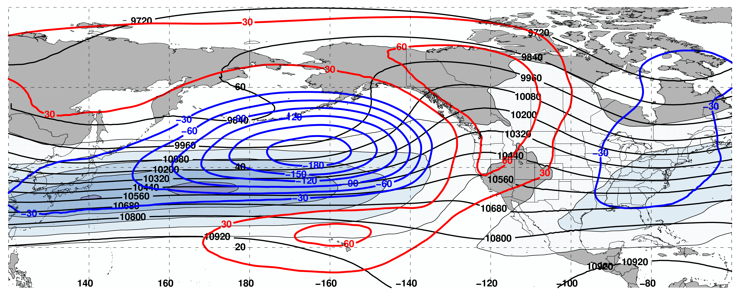
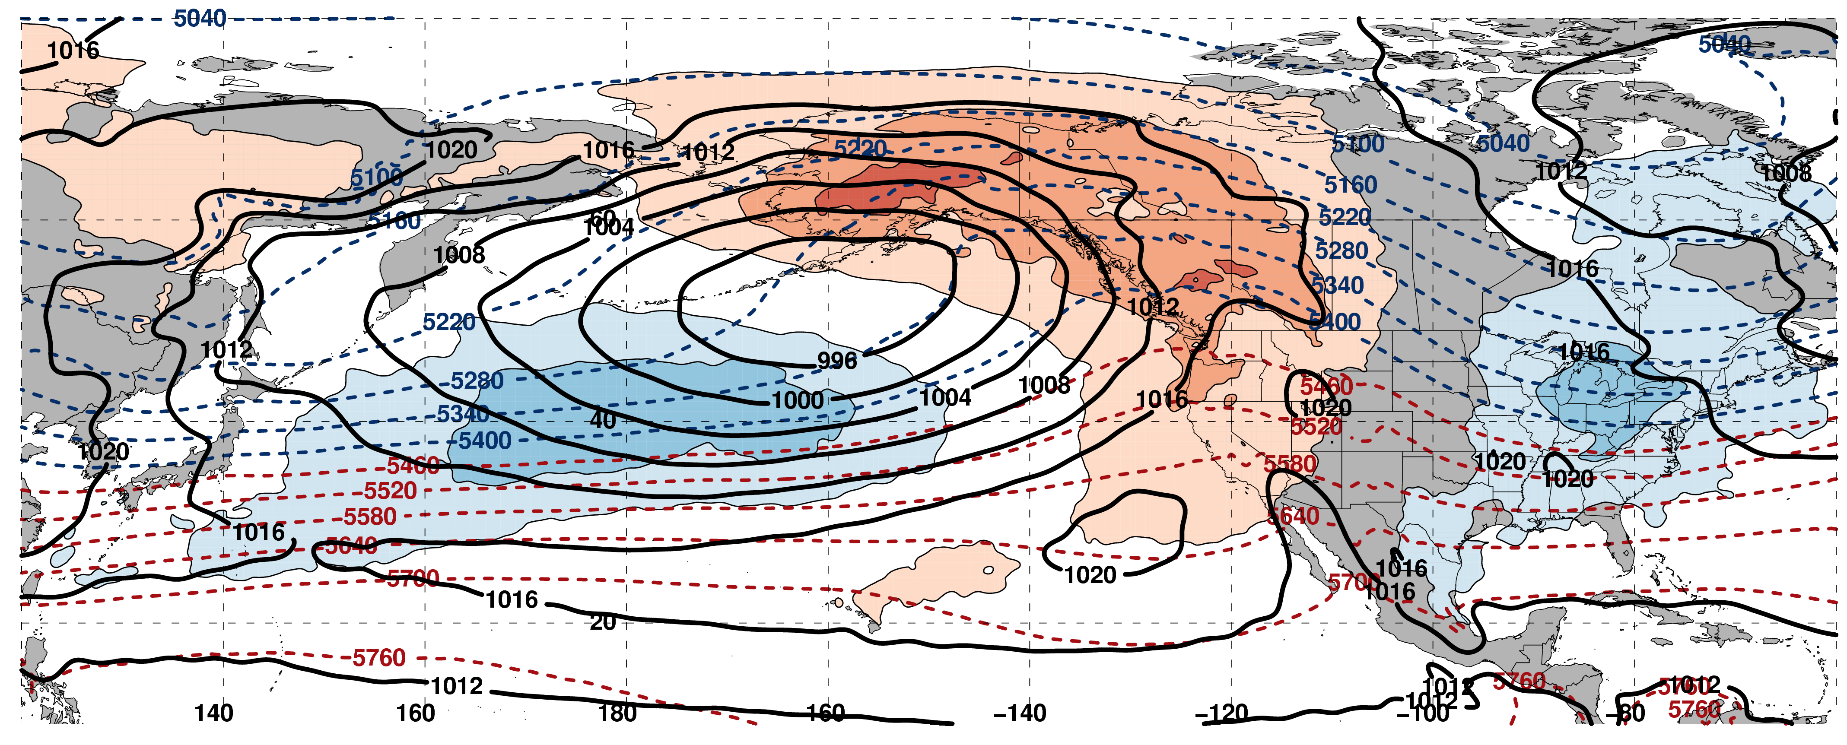
250-hPa Wind Speed, Geo. Heights, Geo. Height Anom.: Jet Extension D+4
m s^{–1}
Mean SLP, 1000–500-hPa Thick., 850-hPa Temp. Anom.: Jet Extension D+4
K

Slide 53
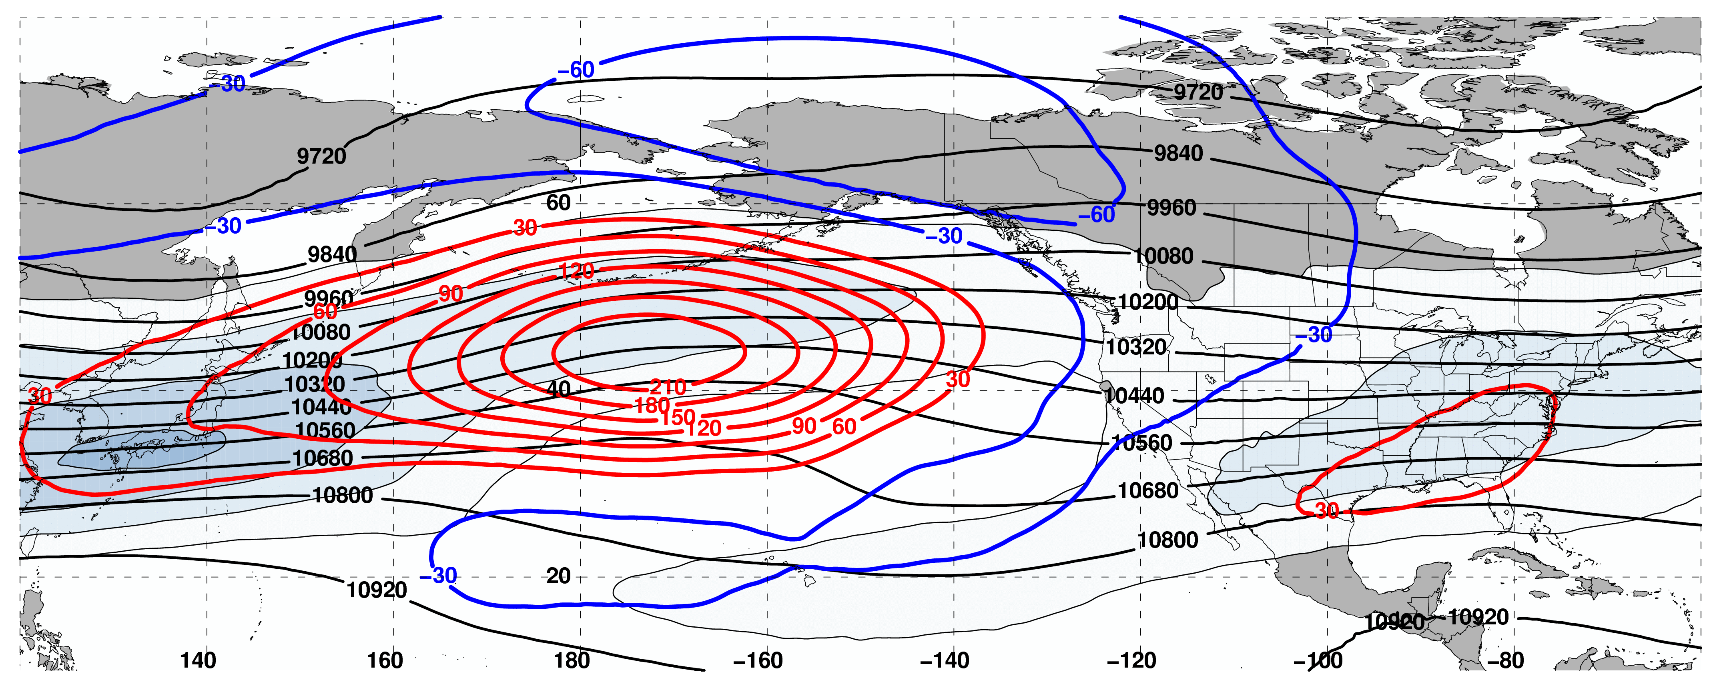
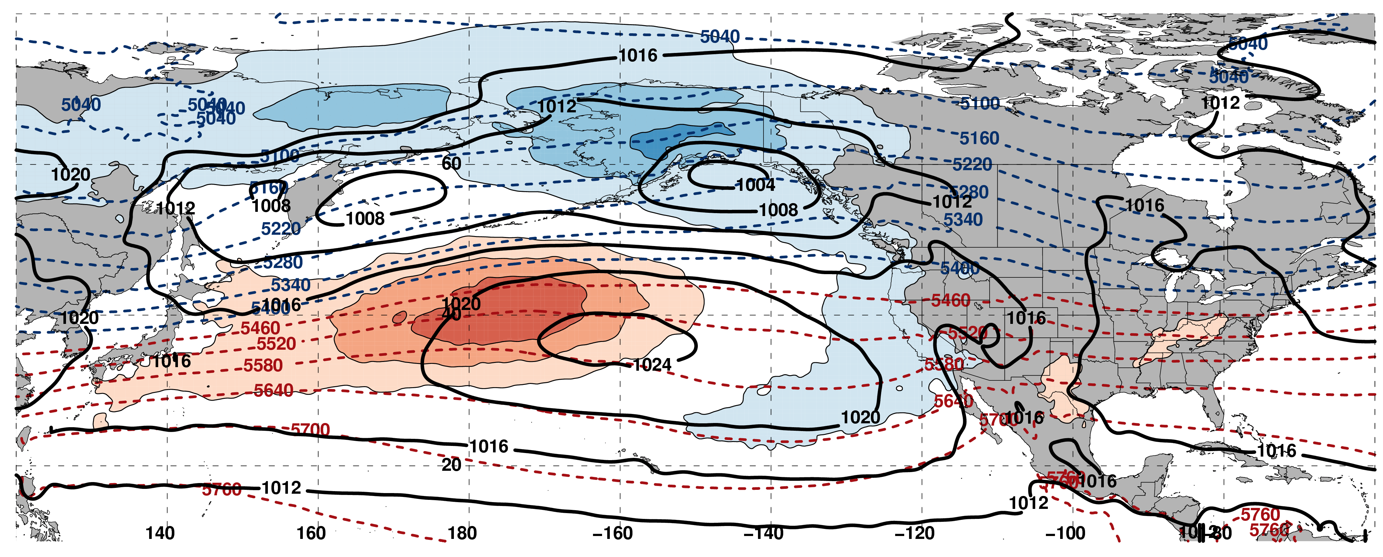
250-hPa Wind Speed, Geo. Heights, Geo. Height Anom.: Jet Retraction D+4
m s^{–1}
Mean SLP, 1000–500-hPa Thick., 850-hPa Temp. Anom.: Jet Retraction D+4
K

Slide 54
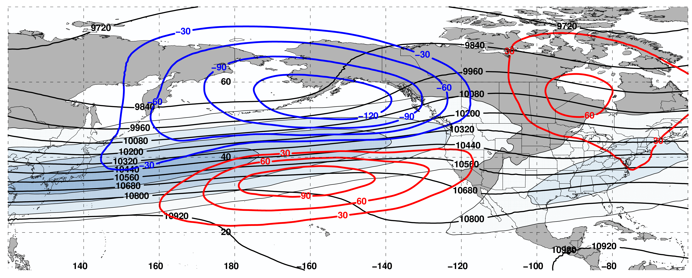
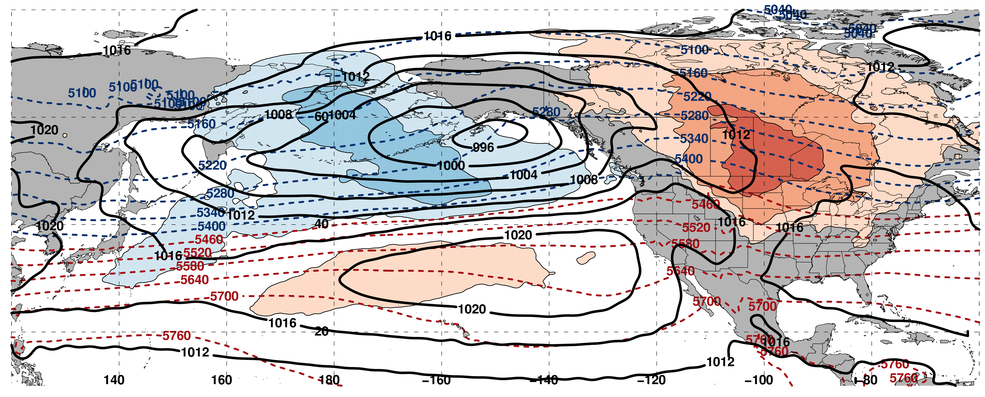
250-hPa Wind Speed, Geo. Heights, Geo. Height Anom.: Poleward Shift D+4
m s^{–1}
Mean SLP, 1000–500-hPa Thick., 850-hPa Temp. Anom.: Poleward Shift D+4
K

Slide 55
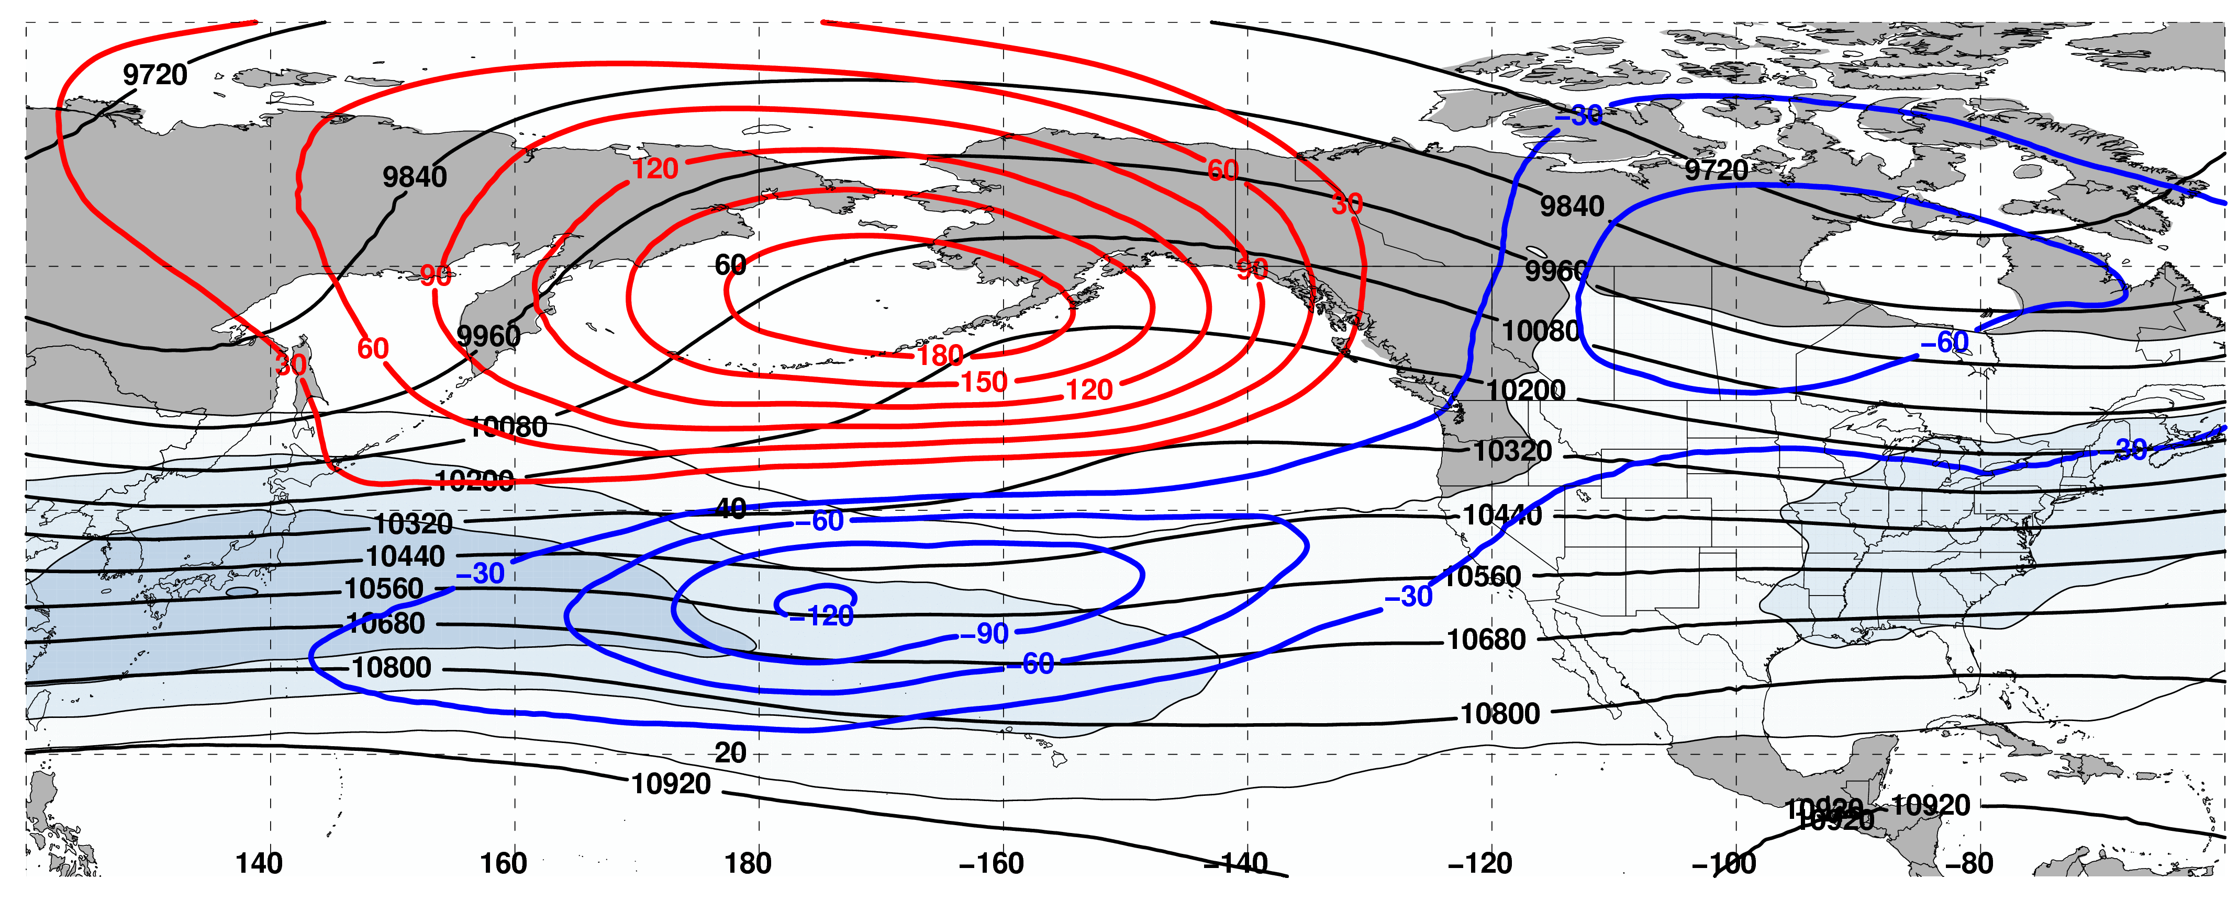
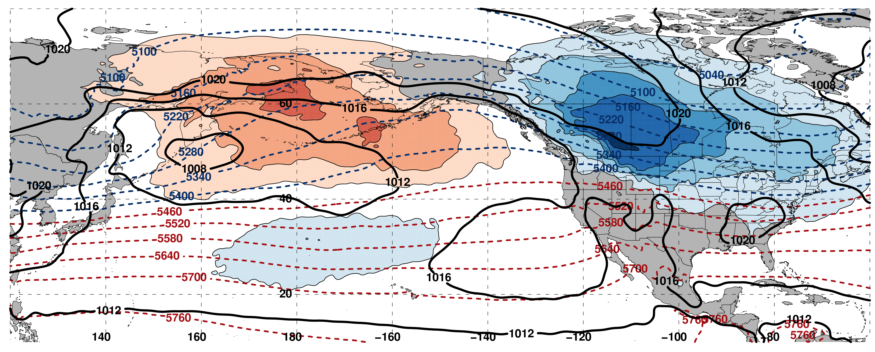
250-hPa Wind Speed, Geo. Heights, Geo. Height Anom.: Equator. Shift D+4
m s^{–1}
Mean SLP, 1000–500-hPa Thick., 850-hPa Temp. Anom.: Equator. Shift D+4
K

Slide 56
Composite Difference: (Worst – Best) at 192 h
250 hPa
m
99% Conf. Interval
The worst forecast periods are frequently characterized by significantly higher heights over the North Pacific and lower heights over North America
The composite difference pattern suggests that the worst forecast periods are often associated with upper-tropospheric blocking events
Start
End
Worst
Best
Notes:
Start end labels in box. Change to 8 day trajectories.

Slide 57
Composite Difference: (Worst – Best) at 192 h
250 hPa
m
99% Conf. Interval
The worst forecast periods are typically characterized by an equatorward shifted trajectory within the NPJ phase diagram
The best forecast periods are typically characterized by a poleward shifted trajectory within the NPJ phase diagram
Start
End
Worst
Best
Notes:
Start end labels in box. Change to 8 day trajectories.

Slide 58
NPJ Regime Distributions

Slide 59
NPJ Regime Frequency by Month
Poleward and Equatorward Shifts are favored during September
NPJ regime frequencies are nearly equivalent during all other months

Slide 60
NPJ Regime Frequency and ENSO
Jet Extensions and Equatorward Shifts are favored during an El Niño
Jet Retractions and Poleward Shifts are favored during a La Niña

Slide 61
NPJ Regime Frequency and the MJO
Jet Retractions are favored during Phases 2, 3, and 4
Poleward Shifts are favored during Phases 5 and 6
Jet Extensions are favored during Phases 7, 8, and 1

Slide 62
NPJ Regime Frequency and the PNA
Jet Extensions and Poleward Shifts are favored during a positive PNA
Jet Retractions and Equatorward Shifts are favored during a negative PNA

Slide 63
Additional NPJ Phase Diagram Verification Statistics

Slide 64
NPJ Regime Forecast Frequency
The percent frequency that an NPJ regime is over/under forecast relative to verification at various forecast lead times in the GEFS ensemble mean reforecasts
NPJ Regime Over Forecast
NPJ Regime Under Forecast
Notes:
Colorize and move to the back

Slide 65
NPJ Regime Forecast Frequency
The percent frequency that an NPJ regime is over/under forecast relative to verification at various forecast lead times in the GEFS ensemble mean reforecasts
Equatorward shifts are substantially under forecast at every forecast lead time compared to all other NPJ regimes
The degree to which equatorward shifts are under forecast corroborates the reduced skill of forecasts verifying during equatorward shifts
Notes:
Additional slide linking to previous stuff

Slide 66
Reliability Diagram
Perfect
Reliability
GEFS Reforecasts appear to be underdispersive with respect to medium-range forecasts of the North Pacific Jet in the phase diagram

Slide 67
GEFS Ensemble Mean Error – Season
Circles on a particular line indicate statistically significant differences to the 95% confidence interval with respect to another jet regime.

Slide 68
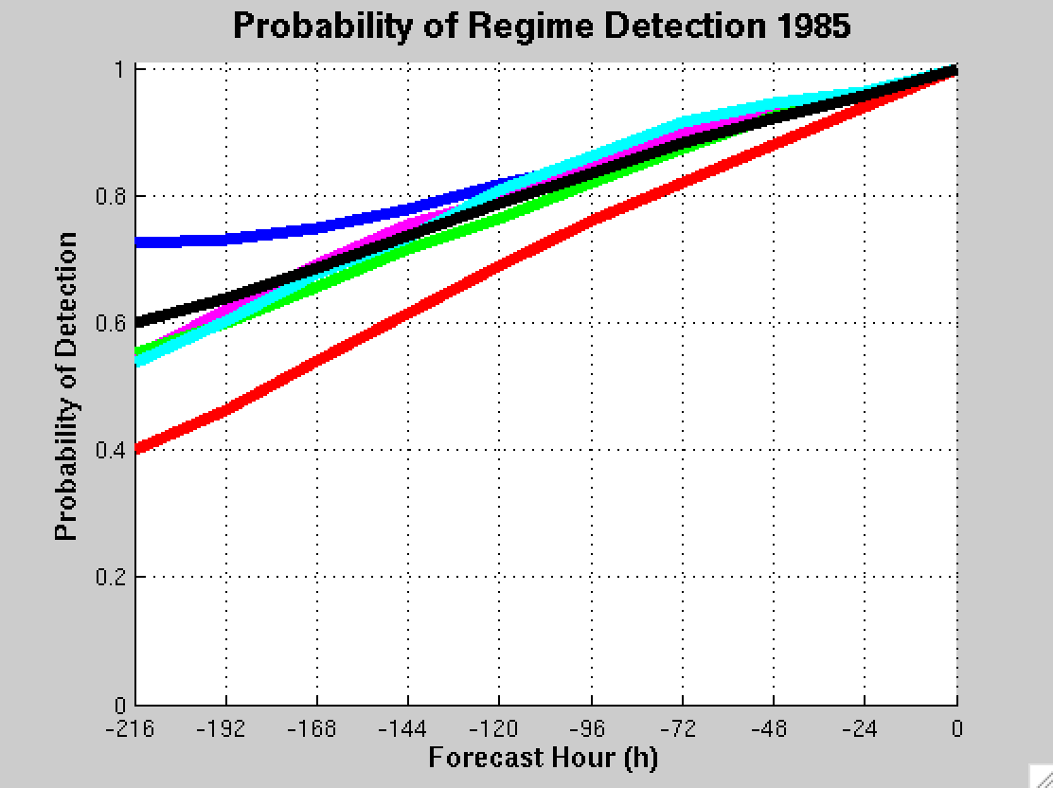
GEFS Ensemble Mean POD by NPJ Regime
For forecasts verifying within a particular NPJ regime
Extension
Retraction
Poleward
Equator
Origin
Mean

Slide 69
Frequency of Best/Worst NPJ Forecasts

Slide 70
Frequency of Worst NPJ Forecasts

Slide 71
Frequency of Best NPJ Forecasts

Slide 72
Jet Regime-Dependent Forecast Skill
Percent Difference Between the Frequency of Forecasts with Below-Normal and Above-Normal RMSE over North America
Higher frequency of forecasts with
below-normal RMSE
(i.e., more good forecasts)
Higher frequency of forecasts with
above-normal RMSE
(i.e., more bad forecasts)

Slide 73
Jet Regime-Dependent Forecast Skill
Percent Difference Between the Frequency of Forecasts with Below-Normal and Above-Normal RMSE over North America
Higher frequency of forecasts with
below-normal RMSE
(i.e., more good forecasts)
Higher frequency of forecasts with
above-normal RMSE
(i.e., more bad forecasts)

Slide 74
NPJ Phase Diagram and ETE’s

Slide 75
Eastern U.S. – All Events
Extreme Cold Event Centroids
COLD EVENTS (N = 173)
Poleward Shift
23
Events during
Sept. – May projected onto phase diagram
30
Jet Retraction
47
Jet Extension
Each point is an average of the PCs
3–7 days prior to an event
73
Equatorward Shift
Mean Projection

Slide 76
Eastern U.S. – All Events
Extreme Warm Event Centroids
WARM EVENTS (N = 239)
Poleward Shift
66
Events during
Sept. – May projected onto phase diagram
69
Jet Retraction
47
Jet Extension
Each point is an average of the PCs
3–7 days prior to an event
57
Equatorward Shift
Mean Projection

Slide 77
Western U.S. – Pac. NW Cluster
Extreme Cold Event Centroids
COLD EVENTS (N = 78)
Poleward Shift
18
Events during
Sept. – May projected onto phase diagram
31
Jet Retraction
9
Jet Extension
Each point is an average of the PCs
3–7 days prior to an event
20
Equatorward Shift
–4
Mean Projection

Slide 78
Western U.S. – Pac. NW Cluster
Extreme Warm Event Centroids
WARM EVENTS (N = 89)
Poleward Shift
22
Events during
Sept. – May projected onto phase diagram
13
Jet Retraction
27
Jet Extension
Each point is an average of the PCs
3–7 days prior to an event
27
Equatorward Shift
–4
Mean Projection

Slide 79
NPJ Phase Diagram Technical Slides

Slide 80
Real Time North Pacific Jet Phase Diagram
0000 UTC 8 November 2014
250-hPa wind speed: shaded
Instantaneous 250-hPa zonal wind anomalies can be projected onto EOF 1 and EOF 2, resulting in a point on a North Pacific Jet phase diagram

Slide 81
Real Time North Pacific Jet Phase Diagram
Each point on the phase diagram is a weighted average of the principal components within +/− 1 day of the time under consideration
Example: 0000 UTC 8 November 2014
Weight
5
4
3
2
1
Date
0000 UTC 7 Nov.
1200 UTC 7 Nov.
0000 UTC 8 Nov.
1200 UTC 8 Nov.
0000 UTC 9 Nov.

Slide 82
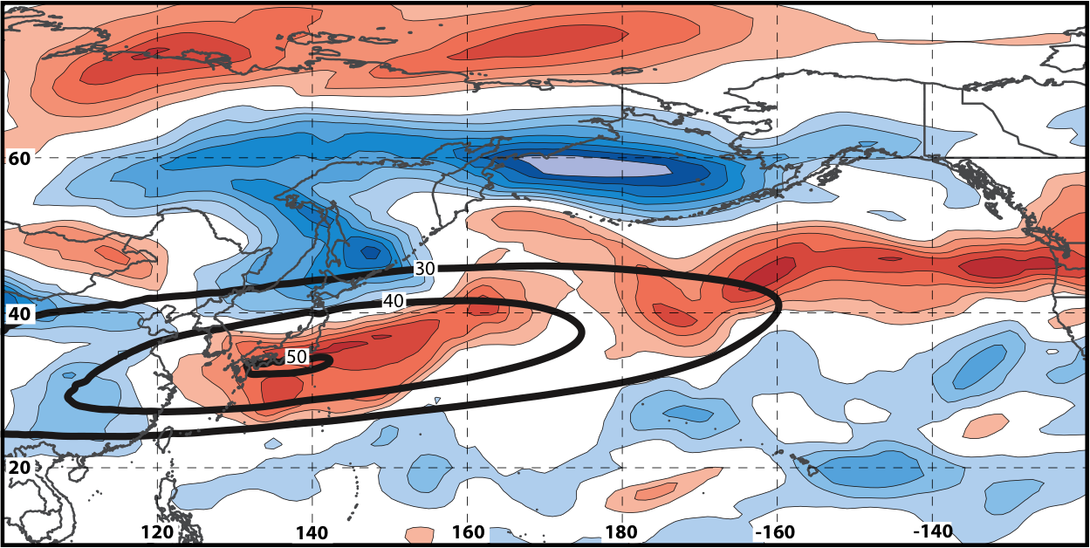
Real Time North Pacific Jet Phase Diagram
250-hPa zonal wind at 0000 UTC 2 Jun minus 250-hPa zonal wind at 0000 UTC 24 May (shading) in the GFS analyses shows the transition to a poleward-shifted jet regime
0000 UTC 24 May
(0-h forecast)
0000 UTC 2 Jun (verification)
Ensemble mean
Sept.–May mean 250-hPa zonal wind: black contours
Notes:
Note that the positive changes in zonal wind correspond exactly to where the positive anomalies are located in the EOF2 pattern – See slide 14.

Slide 83
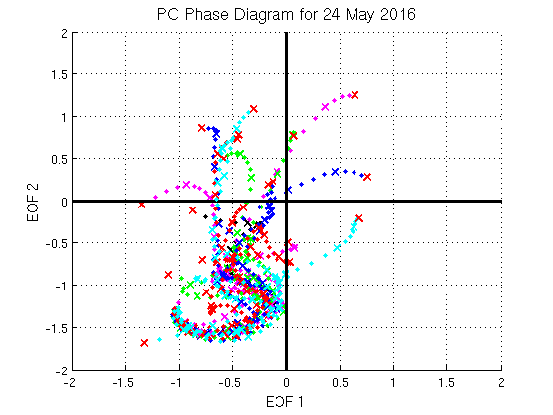
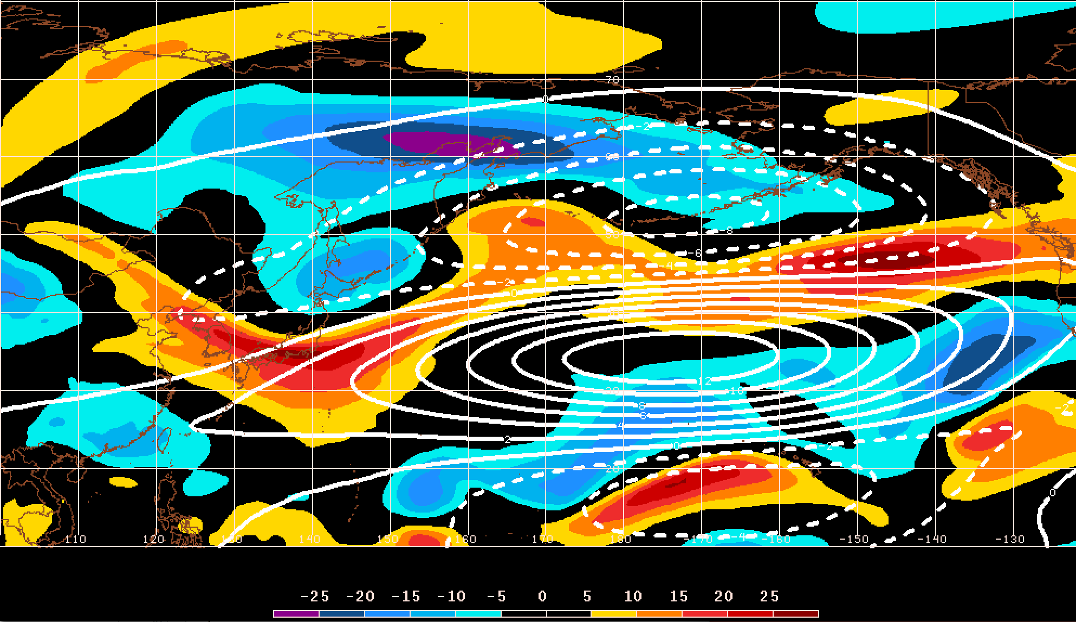
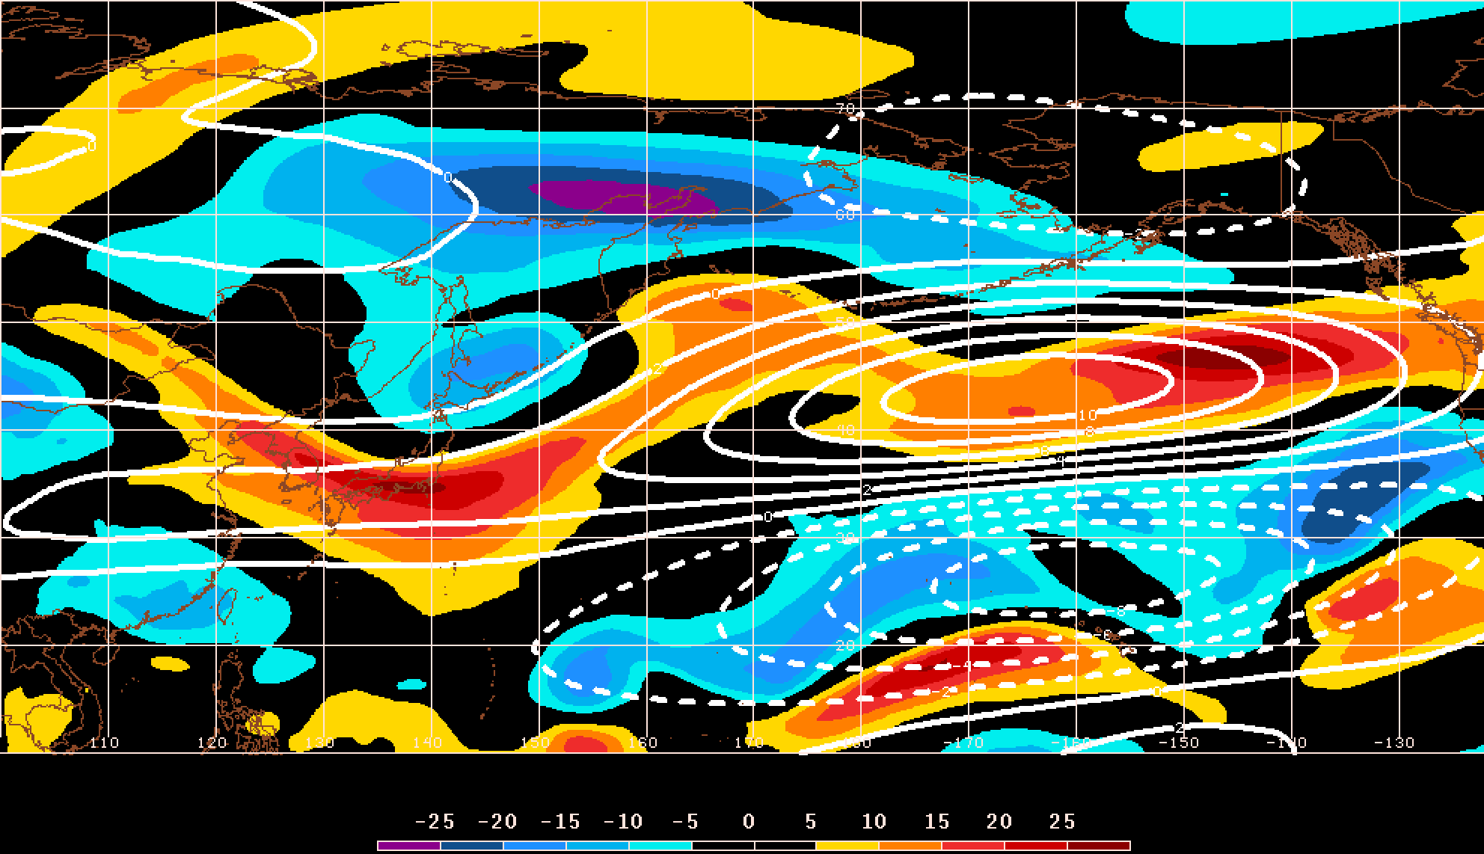
GEFS Ensemble Trajectories Initialized 0000 UTC 24 May 2016
250-hPa Zonal Wind Anomalies and EOF1: 0000 UTC 2 Jun
0000 UTC 2 Jun (verification)
m s^{–1}
250-hPa Zonal Wind Anomalies and EOF2: 0000 UTC 2 Jun
250-hPa zonal wind anomalies at 0000 UTC 2 Jun project strongly onto
EOF2 > 0
m s^{–1}

