Slide 1
A North Pacific Jet Phase Diagram Perspective on Extreme Weather Events during 2016–2017: Illustrative Examples
Lance F. Bosart, Andrew C. Winters, and Daniel Keyser
Department of Atmospheric and Environmental Sciences
University at Albany, State University of New York, Albany, NY 12222
NWA 42nd Annual Meeting
Garden Grove, CA
20 September 2017
This work is supported by NOAA Grant NA15NWS4680006

Slide 2
Motivation
Previous work highlighted the considerable North Pacific Jet (NPJ) variability during the medium-range period that characterizes the antecedent environments associated with continental U.S. extreme temperature events.

Slide 3
Motivation
Previous work highlighted the considerable North Pacific Jet (NPJ) variability during the medium-range period that characterizes the antecedent environments associated with continental U.S. extreme temperature events.
This NPJ variability motivated the development of the NPJ phase diagram as an objective tool to characterize the instantaneous state of the upper-tropospheric flow pattern over the North Pacific.

Slide 4
Motivation
Previous work highlighted the considerable North Pacific Jet (NPJ) variability during the medium-range period that characterizes the antecedent environments associated with continental U.S. extreme temperature events.
This NPJ variability motivated the development of the NPJ phase diagram as an objective tool to characterize the instantaneous state of the upper-tropospheric flow pattern over the North Pacific.
Consideration of the NPJ phase diagram offers the potential to increase confidence in operational probabilistic temperature and precipitation forecasts during the medium-range period.

Slide 5
The Development of the
NPJ Phase Diagram

Slide 6
The NPJ Phase Diagram
Removed the mean and the annual and diurnal cycles from 6-hourly, 250-hPa zonal wind data from the CFSR (1979–2014) (Saha et al. 2014)
Restricted data to the cool season (Sept.–May)
Performed an EOF analysis on the zonal wind anomalies within the domain: 10–80°N ; 100°E–120°W
Analysis techniques and resultant EOF patterns are consistent with related work on the North Pacific Jet:
Athanasiadis et al. (2010)
Jaffe et al. (2011)
Griffin and Martin (2017)

Slide 7
The NPJ Phase Diagram
EOF 1 – Jet Extension/Retraction
Sept.–May mean 250-hPa zonal wind: black contours
Sept.–May 250-hPa zonal wind EOF 1 pattern: shading
+ EOF 1: Jet Extension
– EOF 1: Jet Retraction

Slide 8
The NPJ Phase Diagram
EOF 1 – Jet Extension/Retraction
Hypothetical Zonal Wind
Sept.–May mean 250-hPa zonal wind: black contours
Sept.–May 250-hPa zonal wind EOF 1 pattern: shading
+ EOF 1: Jet Extension
– EOF 1: Jet Retraction
Notes:
The outermost green contour is 20 m/s and contour interval for green contours is every 10 m/s. The green contours are calculated by adding the EOF patterns to the mean zonal wind. The resultant wind distribution would project onto the point (1,0) on the N. Pacific Jet phase diagram.

Slide 9
The NPJ Phase Diagram
EOF 1 – Jet Extension/Retraction
Hypothetical Zonal Wind
Sept.–May mean 250-hPa zonal wind: black contours
Sept.–May 250-hPa zonal wind EOF 1 pattern: shading
+ EOF 1: Jet Extension
– EOF 1: Jet Retraction
Notes:
The distribution of zonal wind in this slide would project onto the point (-1,0) on the N. Pacific Jet phase diagram.

Slide 10
The NPJ Phase Diagram
EOF 2 – Poleward/Equatorward Shift
Sept.–May mean 250-hPa zonal wind: black contours
Sept.–May 250-hPa zonal wind EOF 2 pattern: shading
+ EOF 2: Poleward Shift
– EOF 2: Equatorward Shift

Slide 11
The NPJ Phase Diagram
EOF 2 – Poleward/Equatorward Shift
Hypothetical Zonal Wind
Sept.–May mean 250-hPa zonal wind: black contours
Sept.–May 250-hPa zonal wind EOF 2 pattern: shading
+ EOF 2: Poleward Shift
– EOF 2: Equatorward Shift
Notes:
The zonal wind pattern in green would project onto the point (0,1) on the N. Pacific Jet phase diagram.

Slide 12
The NPJ Phase Diagram
EOF 2 – Poleward/Equatorward Shift
Hypothetical Zonal Wind
Sept.–May mean 250-hPa zonal wind: black contours
Sept.–May 250-hPa zonal wind EOF 2 pattern: shading
+ EOF 2: Poleward Shift
– EOF 2: Equatorward Shift
Notes:
The zonal wind pattern in green would project onto the point (0,-1) on the N. Pacific Jet phase diagram.

Slide 13
The NPJ Phase Diagram
0000 UTC 8 November 2014
250-hPa wind speed: shaded
Instantaneous 250-hPa zonal wind anomalies can be projected onto EOF 1 and EOF 2, resulting in a point on a North Pacific Jet phase diagram

Slide 14
The NPJ Phase Diagram
0000 UTC 8 November 2014
250-hPa wind speed: shaded
Forecast 250-hPa zonal wind anomalies can be projected onto EOF1 and EOF2 to describe the subsequent evolution of the NPJ

Slide 15
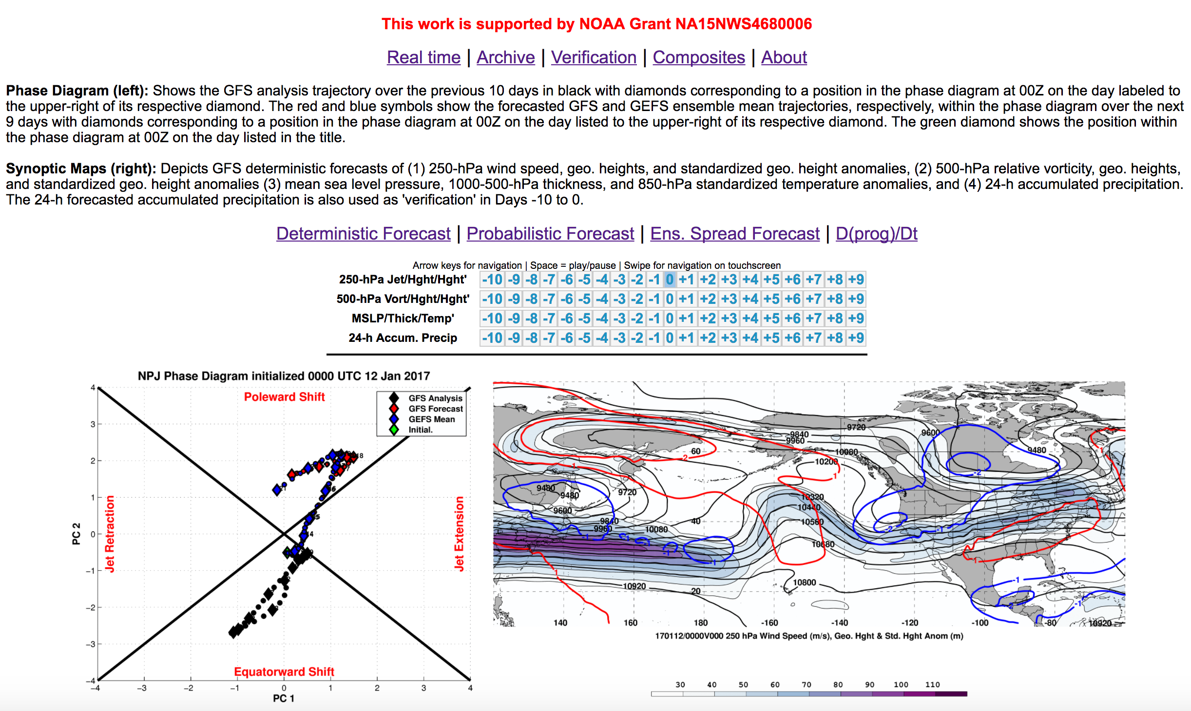
Real Time NPJ Phase Diagram Forecasts

Slide 16
Real Time NPJ Phase Diagram Forecasts

Slide 17
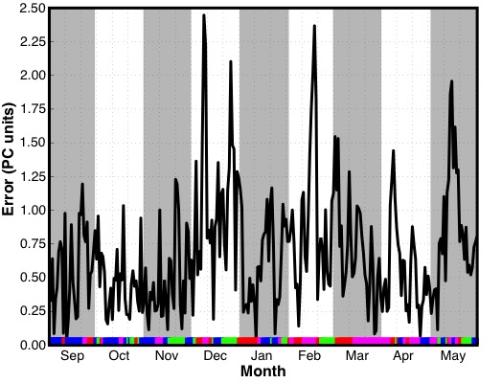
GEFS Ensemble Mean Error: 2016–2017
Time series of GEFS ensemble mean
9-day forecast error by initialization date
Jet Extension (N = 75)
Poleward Shift (N = 83)
Jet Retraction (N = 57)
Equatorward Shift (N = 56)

Slide 18
GEFS Ensemble Mean Error: 2016–2017
Time series of GEFS ensemble mean
9-day forecast error by initialization date
9-day forecasts initialized during December, February, and early-March were characterized by substantial GEFS ensemble mean errors
Jet Extension (N = 75)
Poleward Shift (N = 83)
Jet Retraction (N = 57)
Equatorward Shift (N = 56)

Slide 19
GEFS Ensemble Mean Error: 2016–2017
Time series of GEFS ensemble mean
9-day forecast error by initialization date
9-day forecasts initialized during December, February, and early-March were characterized by substantial GEFS ensemble mean errors
Jet Extension (N = 75)
Poleward Shift (N = 83)
Jet Retraction (N = 57)
Equatorward Shift (N = 56)

Slide 20
Case Study:
Feb/Mar 2017
NPJ Regime Changes

Slide 21
Case Study: Feb/Mar 2017 NPJ Regime Changes
Winter 2016/2017 was characterized by record setting precipitation in many parts of the Western U.S.
CDEC

Slide 22
Case Study: Feb/Mar 2017 NPJ Regime Changes
Winter 2016/2017 was characterized by record setting precipitation in many parts of the Western U.S.
A NPJ regime change in late-February ushered anomalously warm/cold temperatures into the Eastern/Western U.S.
Composite Temperature Anomalies 20–28 Feb
ESRL

Slide 23
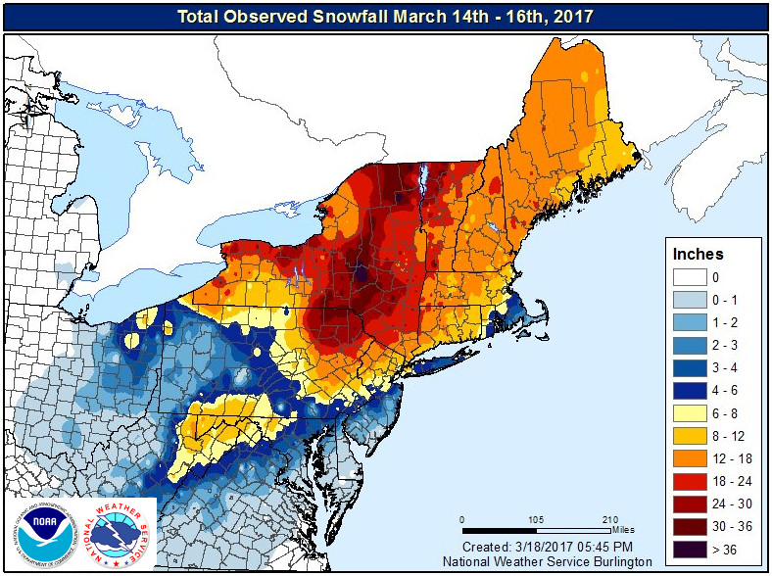
Case Study: Feb/Mar 2017 NPJ Regime Changes
Winter 2016/2017 was characterized by record setting precipitation in many parts of the Western U.S.
A NPJ regime change in late-February ushered anomalously warm/cold temperatures into the Eastern/Western U.S.
A second NPJ regime change in early-March facilitated the development of the “Pi Day Snowstorm” in the Northeast U.S.
NWS Burlington

Slide 24
Case Study:
Feb/Mar 2017
NPJ Regime Changes
I: Western U.S. Mid-February Rain

Slide 25
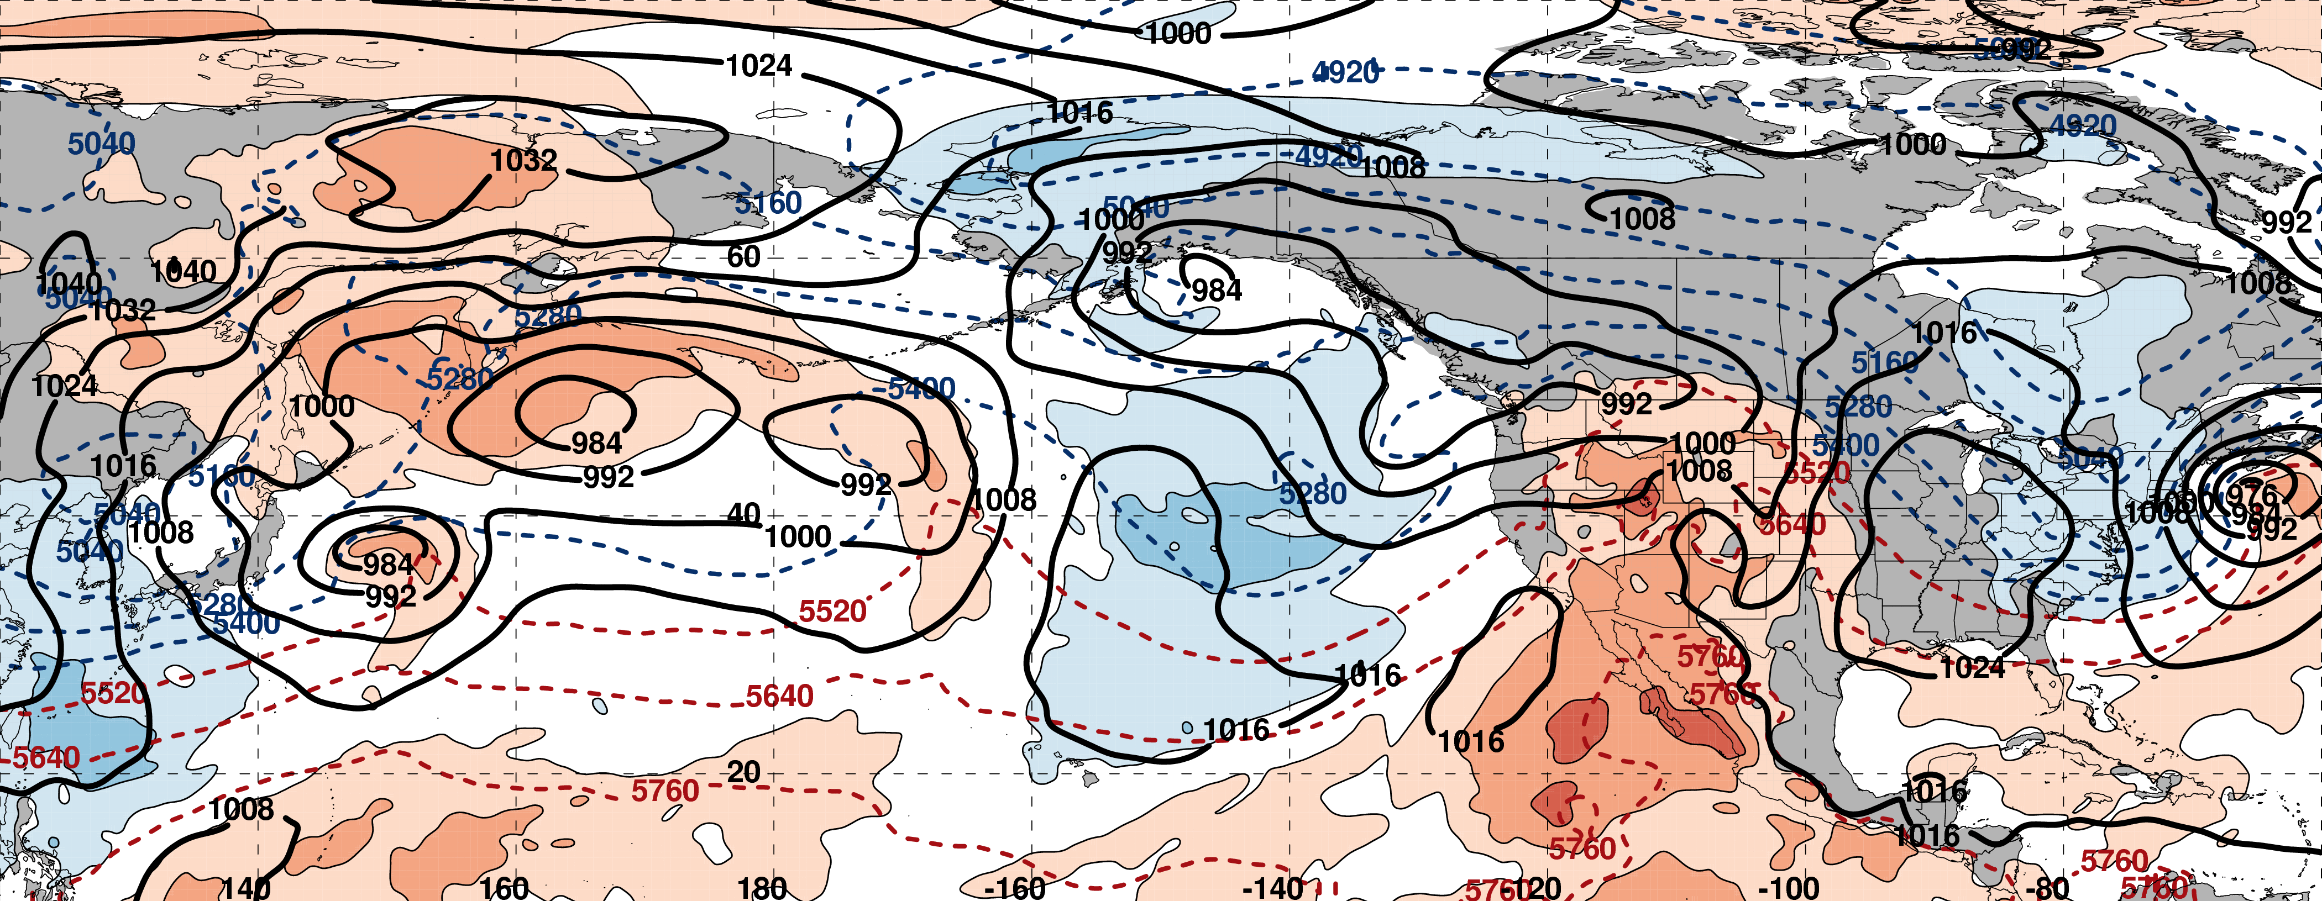
250-hPa Geo. Height (black contours)
250-hPa Standardized Geo. Height Anomalies (red contours: positive / blue contours: negative)
250-hPa Wind Speed (purple fill)
Standardized Precipitable Water Anomalies (green fill)
Mean Sea Level Pressure (black contours)
850-hPa Standardized Temperature Anomalies (red fill: positive / blue fill: negative)
1000–500-hPa Thickness (dashed red/blue contours)

Slide 26
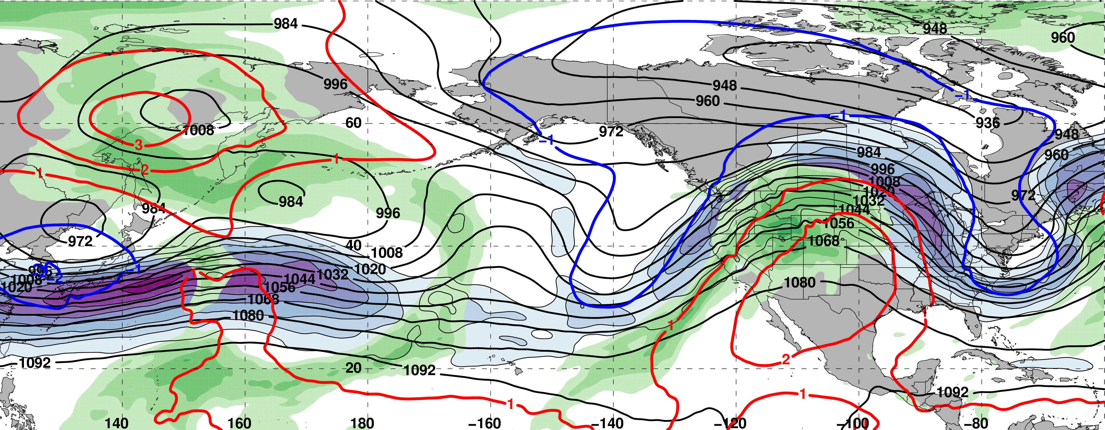
0000 UTC 10 February: 250-hPa Jet and Precipitable Water Anomalies
m s^{–1}
σ
0000 UTC 10 February: MSLP, Thickness, 850-hPa Temp. Anomalies
E. Asian
cold surge
σ

Slide 27
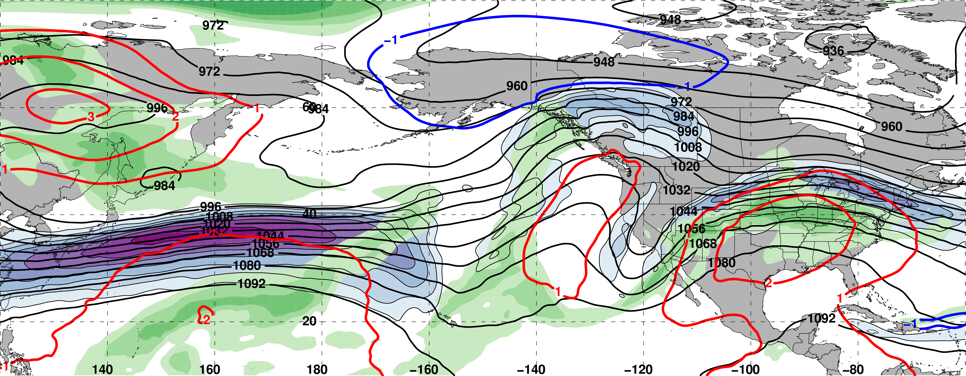
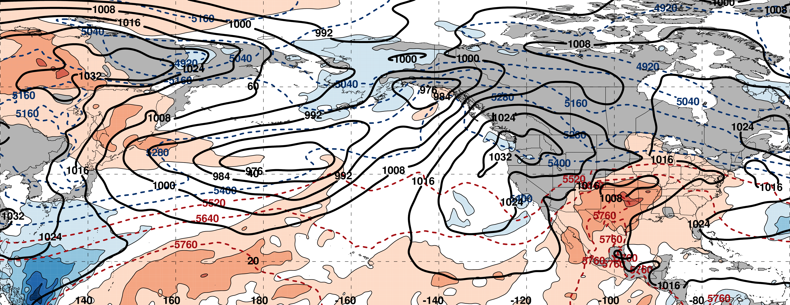
0000 UTC 12 February: 250-hPa Jet and Precipitable Water Anomalies
m s^{–1}
σ
0000 UTC 12 February: MSLP, Thickness, 850-hPa Temp. Anomalies
L
σ

Slide 28
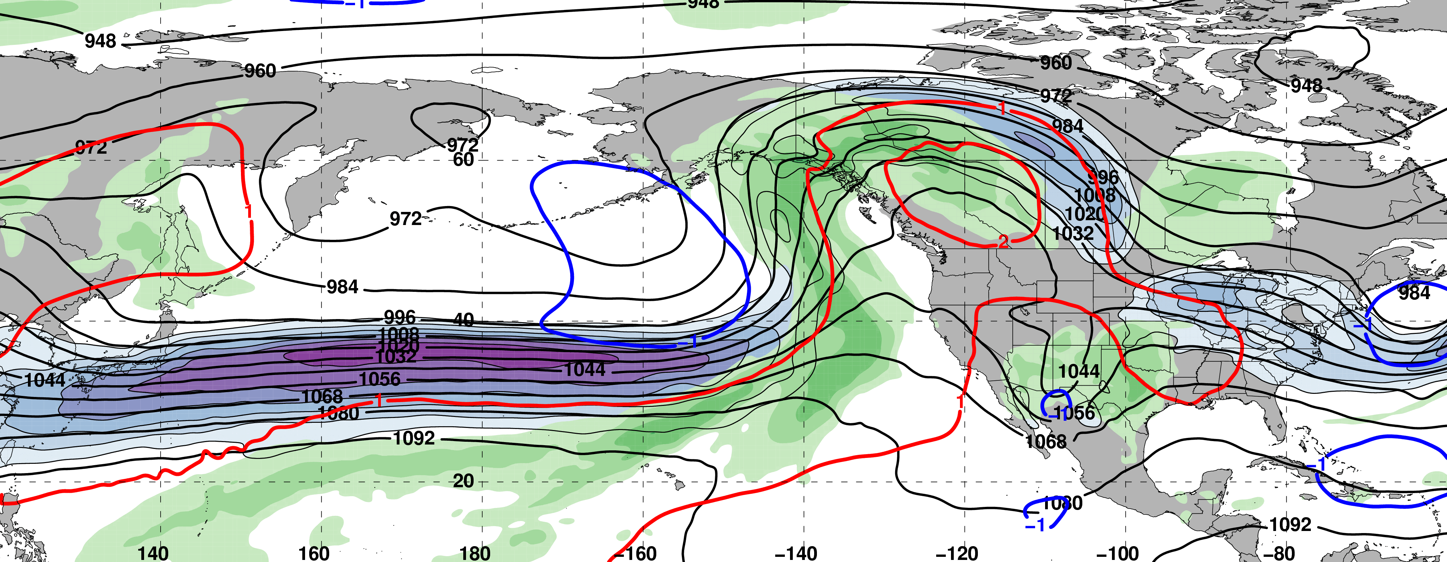
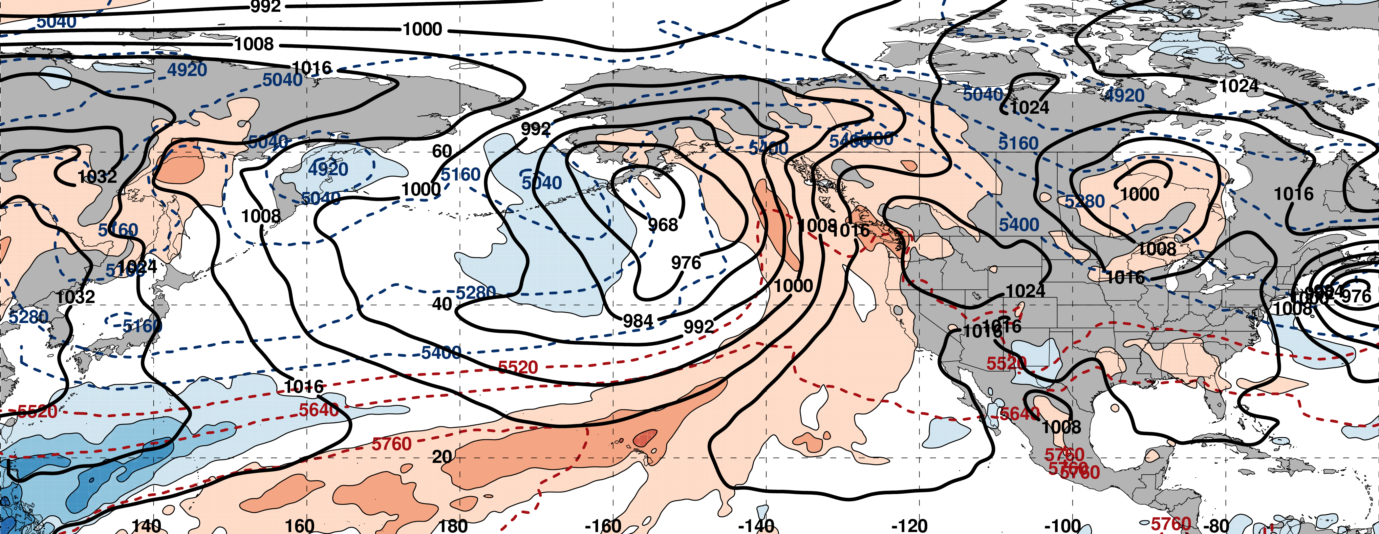
0000 UTC 14 February: 250-hPa Jet and Precipitable Water Anomalies
m s^{–1}
σ
0000 UTC 14 February: MSLP, Thickness, 850-hPa Temp. Anomalies
L
σ

Slide 29
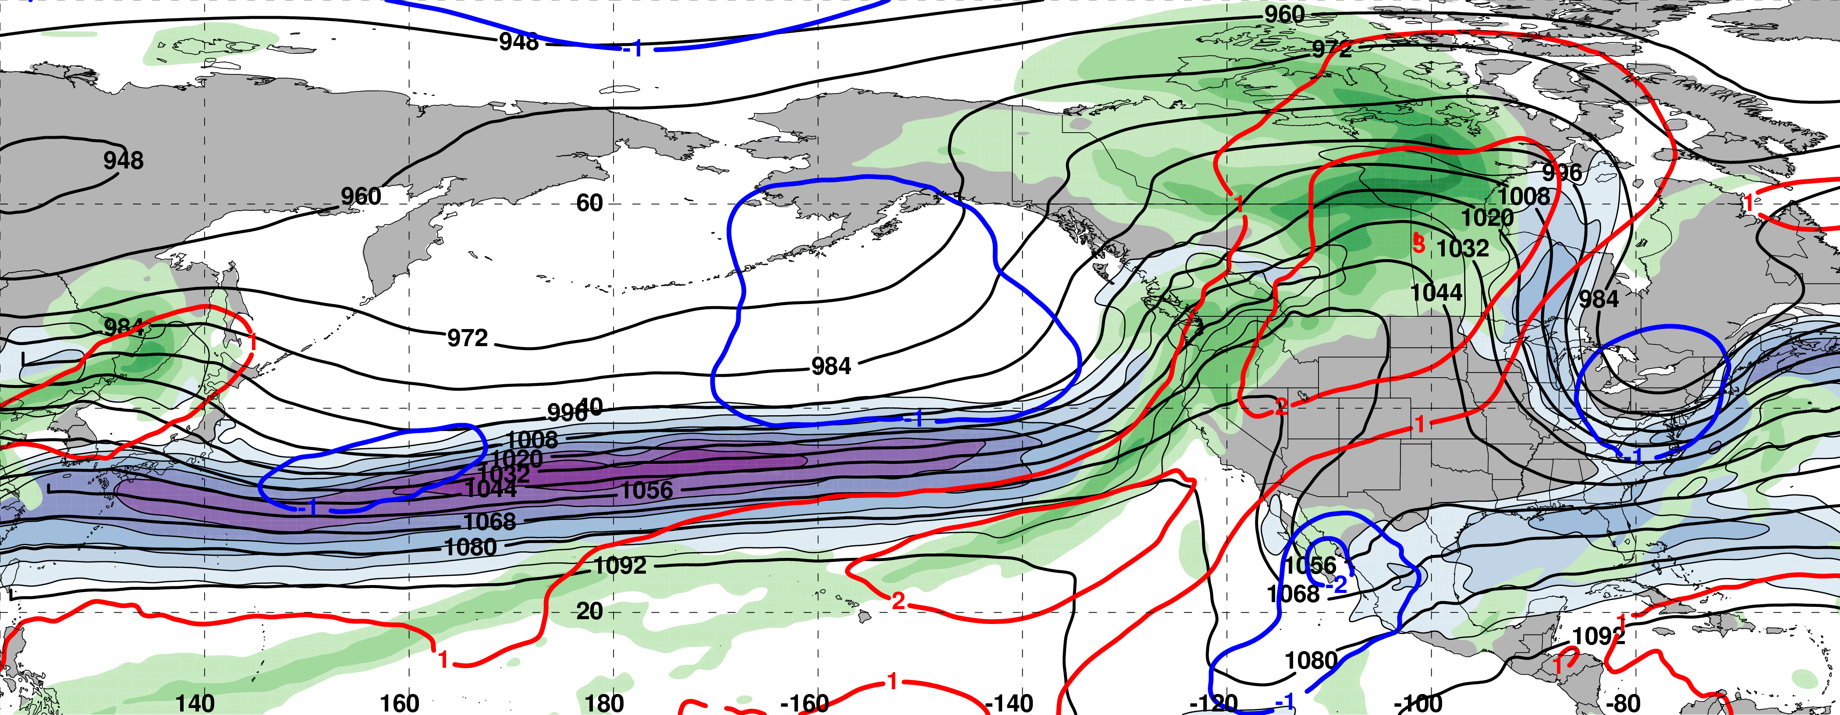
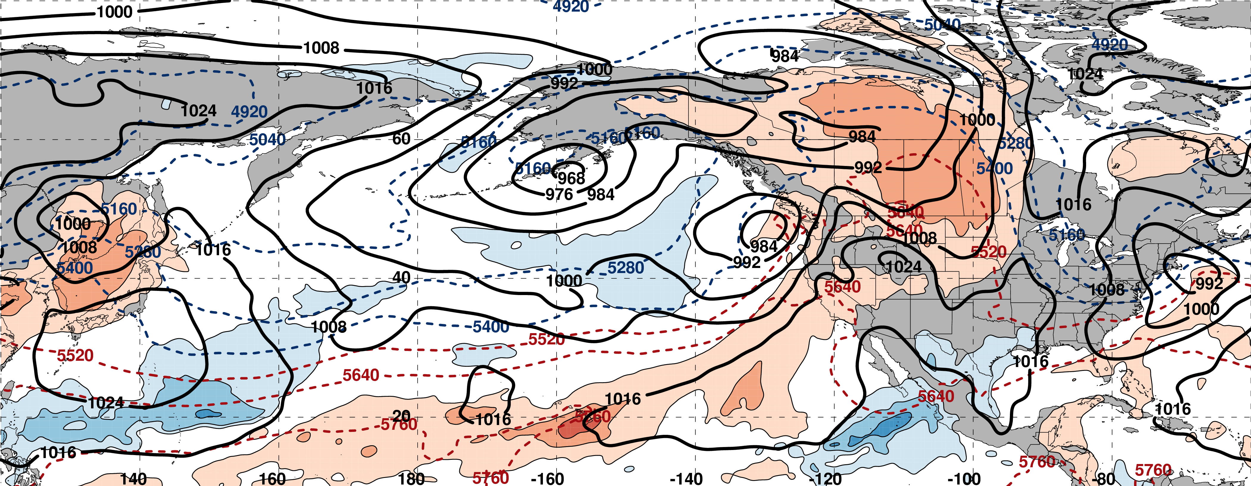
0000 UTC 16 February: 250-hPa Jet and Precipitable Water Anomalies
m s^{–1}
σ
0000 UTC 16 February: MSLP, Thickness, 850-hPa Temp. Anomalies
L
L
σ

Slide 30
0000 UTC 16 February: 250-hPa Jet and Precipitable Water Anomalies
SeaTac 15 Feb Precip : 1.63”
SeaTac Tot. Feb Precip: 8.85”
m s^{–1}
σ
0000 UTC 16 February: MSLP, Thickness, 850-hPa Temp. Anomalies
L
L
σ

Slide 31
West Coast Extreme Precipitation Events
Events during
Sept. – May
1979–2014 projected onto the NPJ phase diagram (N=154)
Each point is an average of the PCs
3–7 days prior to an event
West Coast Extreme Precipitation Events are most often preceded by Jet Extensions
9–13 Feb. 2017

Slide 32
Case Study:
Feb/Mar 2017
NPJ Regime Changes
II: First NPJ Regime Change

Slide 33
0000 UTC 16 February: 250-hPa Jet and Precipitable Water Anomalies
m s^{–1}
σ
0000 UTC 16 February: MSLP, Thickness, 850-hPa Temp. Anomalies
σ

Slide 34
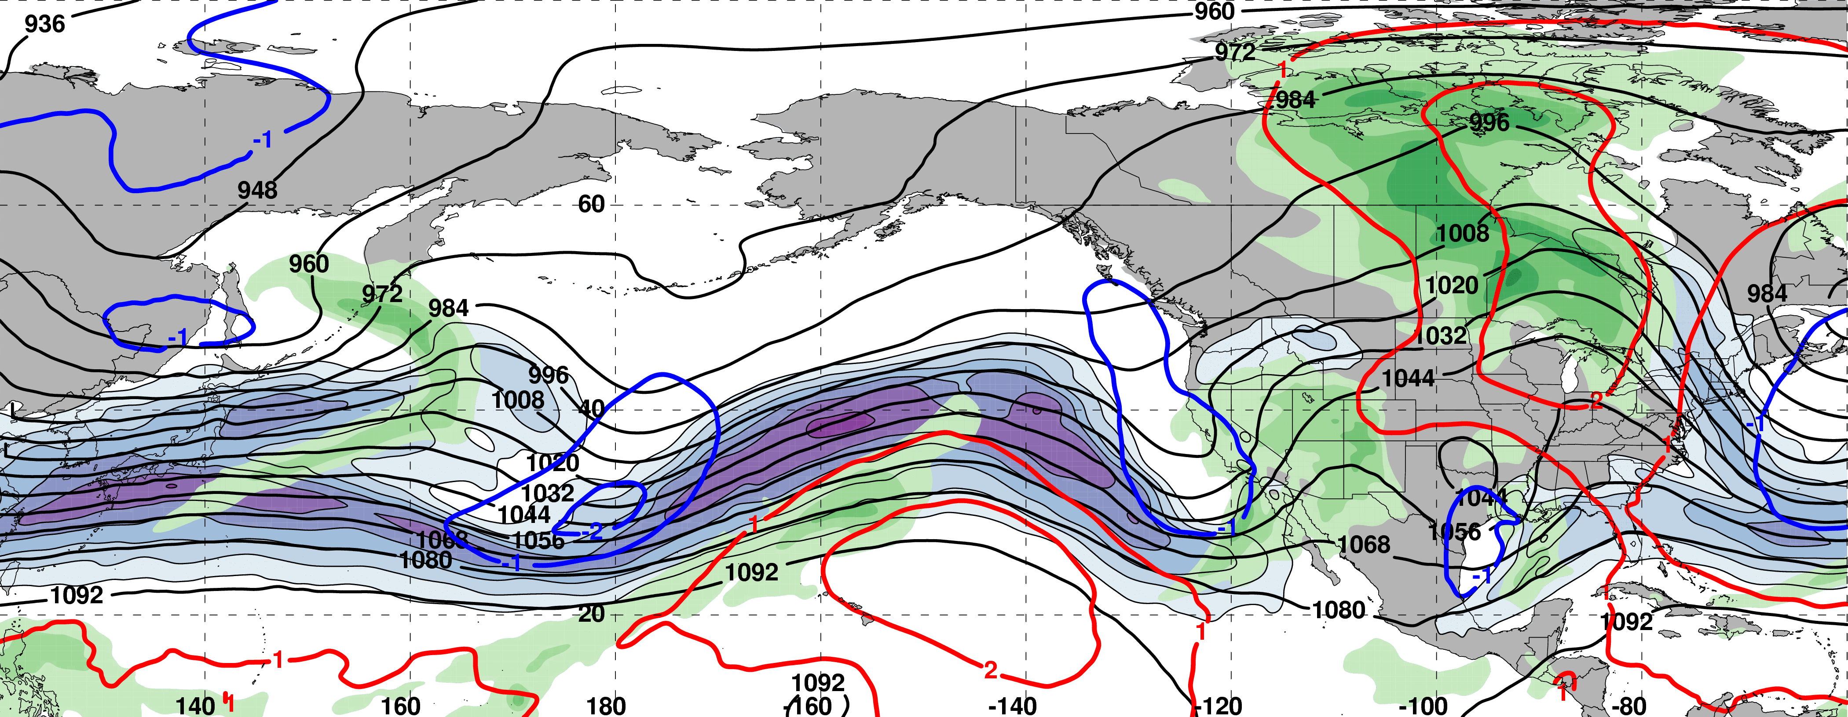
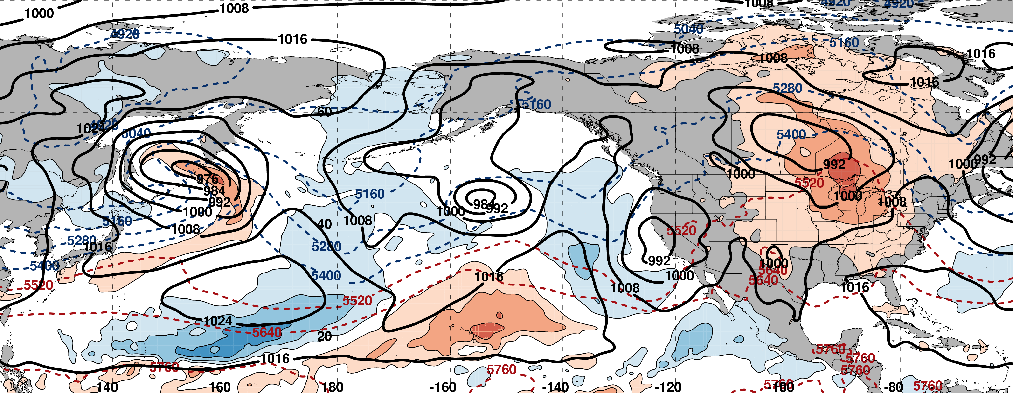
0000 UTC 18 February: 250-hPa Jet and Precipitable Water Anomalies
m s^{–1}
σ
0000 UTC 18 February: MSLP, Thickness, 850-hPa Temp. Anomalies
σ

Slide 35
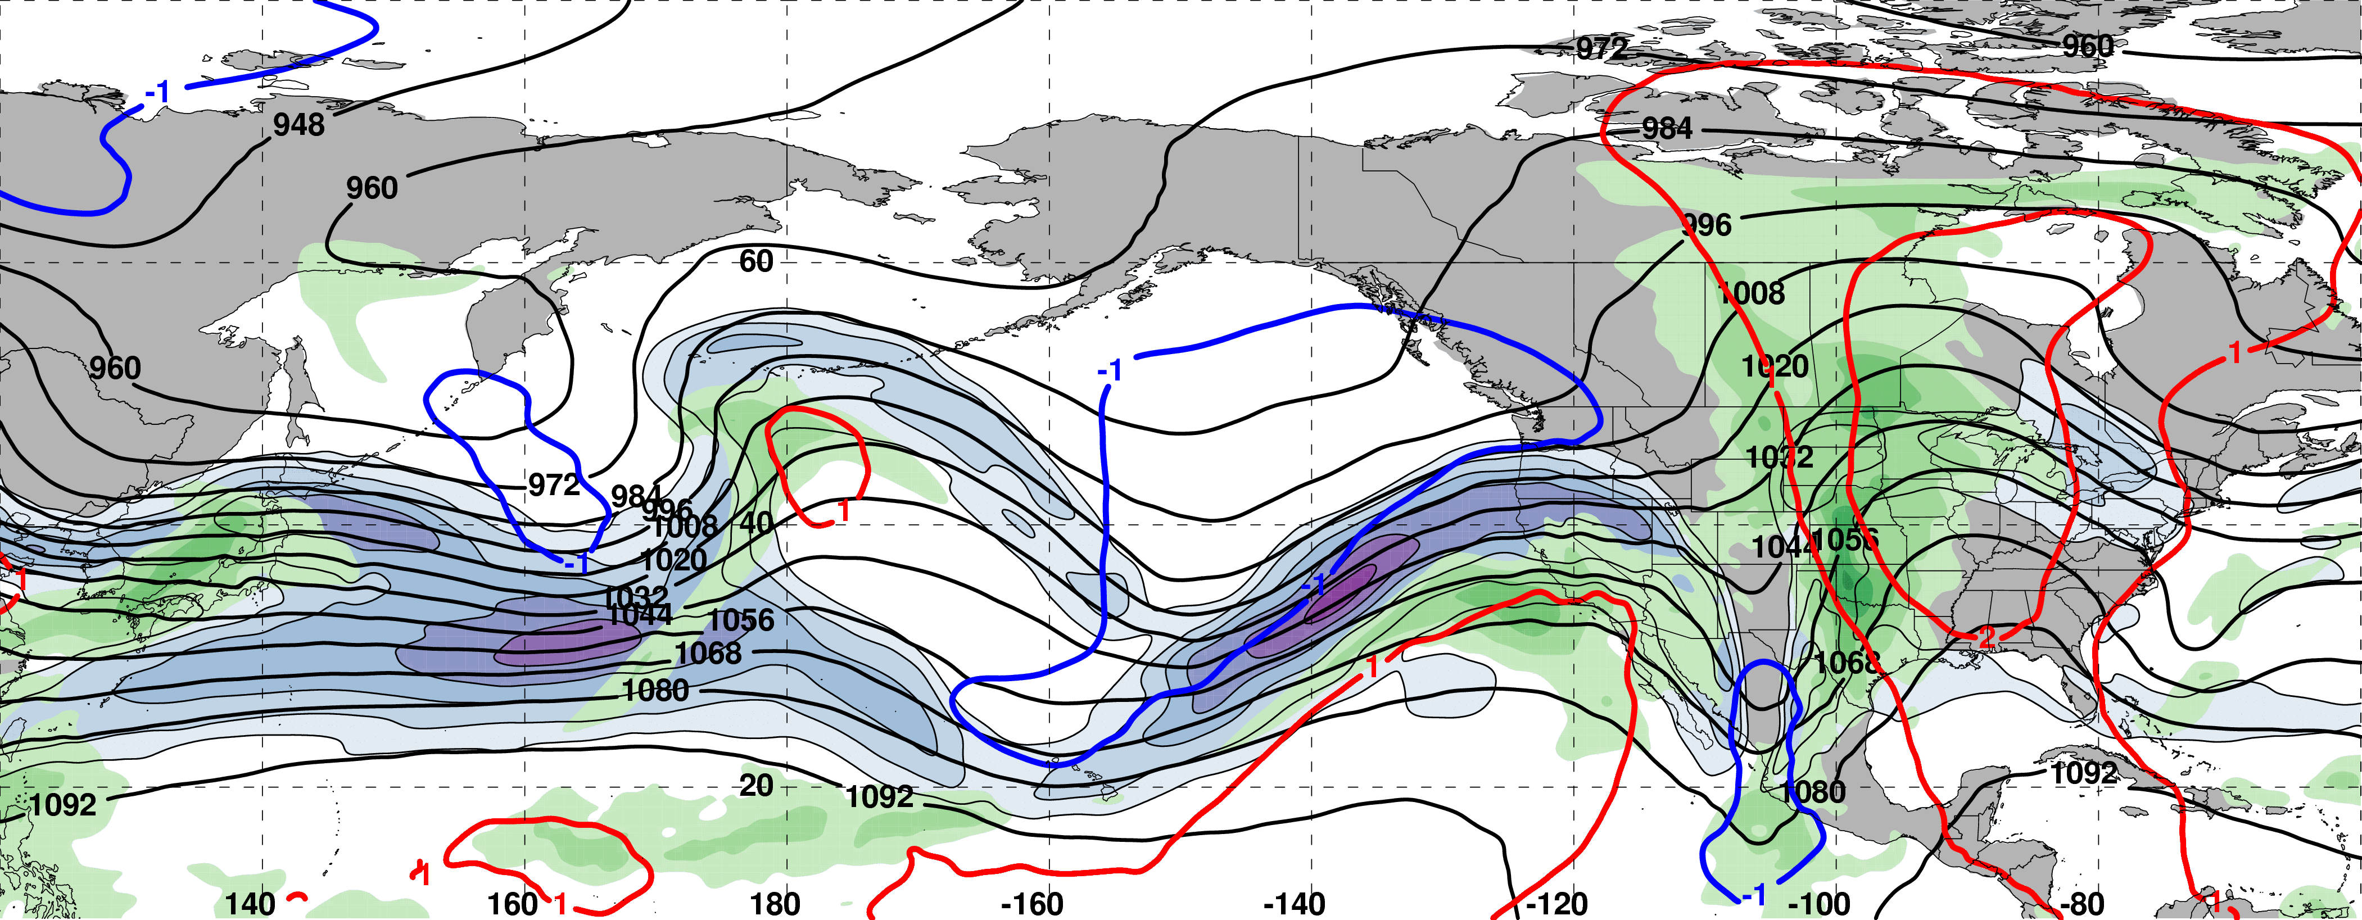
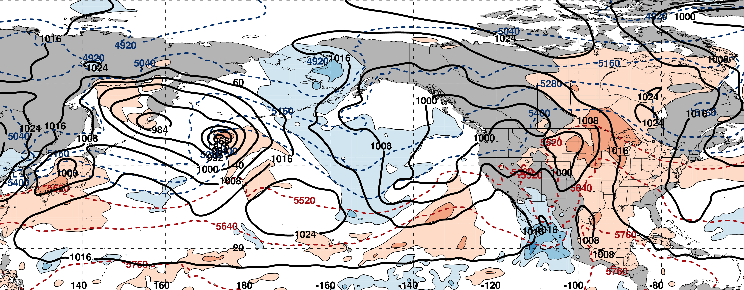
0000 UTC 20 February: 250-hPa Jet and Precipitable Water Anomalies
m s^{–1}
σ
0000 UTC 20 February: MSLP, Thickness, 850-hPa Temp. Anomalies
L
σ

Slide 36
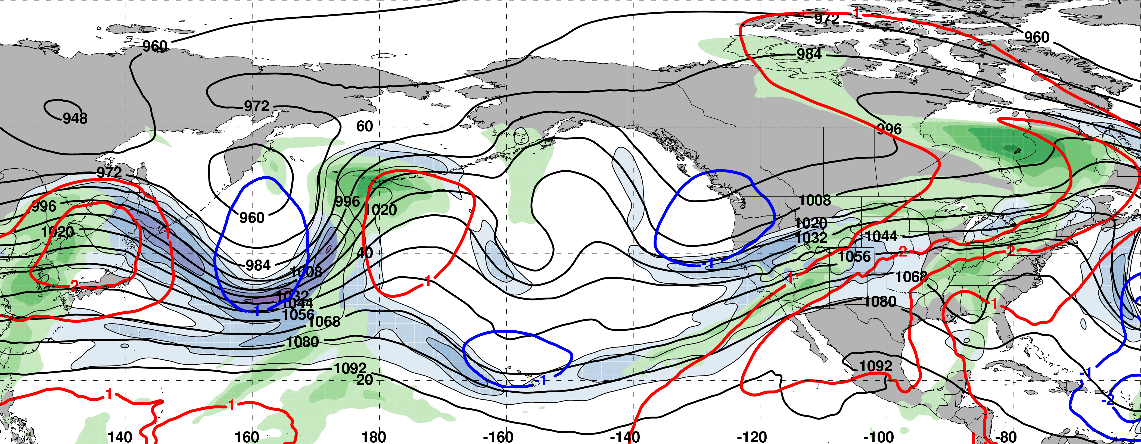
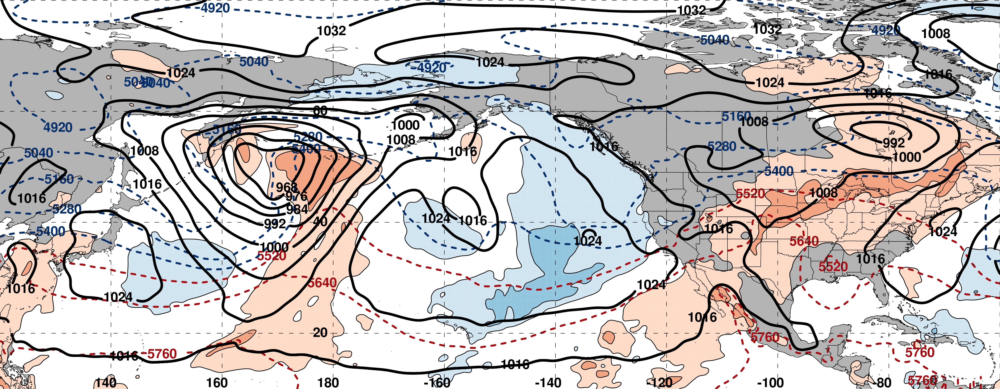
0000 UTC 22 February: 250-hPa Jet and Precipitable Water Anomalies
m s^{–1}
σ
0000 UTC 22 February: MSLP, Thickness, 850-hPa Temp. Anomalies
L
σ

Slide 37
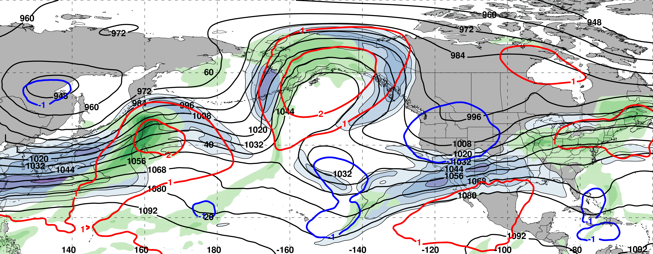
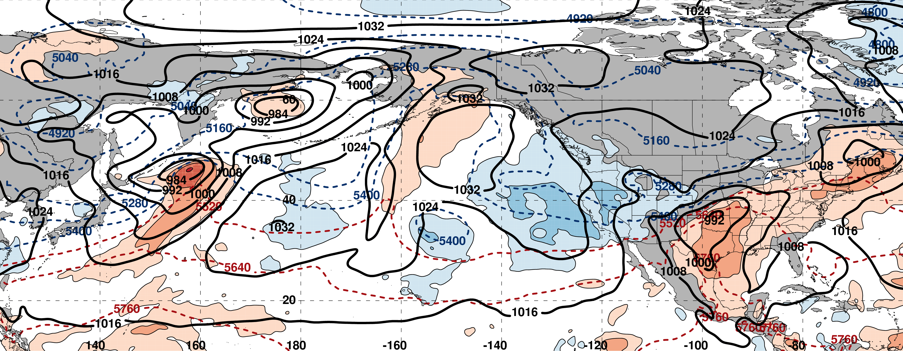
0000 UTC 24 February: 250-hPa Jet and Precipitable Water Anomalies
m s^{–1}
σ
0000 UTC 24 February: MSLP, Thickness, 850-hPa Temp. Anomalies
L
σ

Slide 38
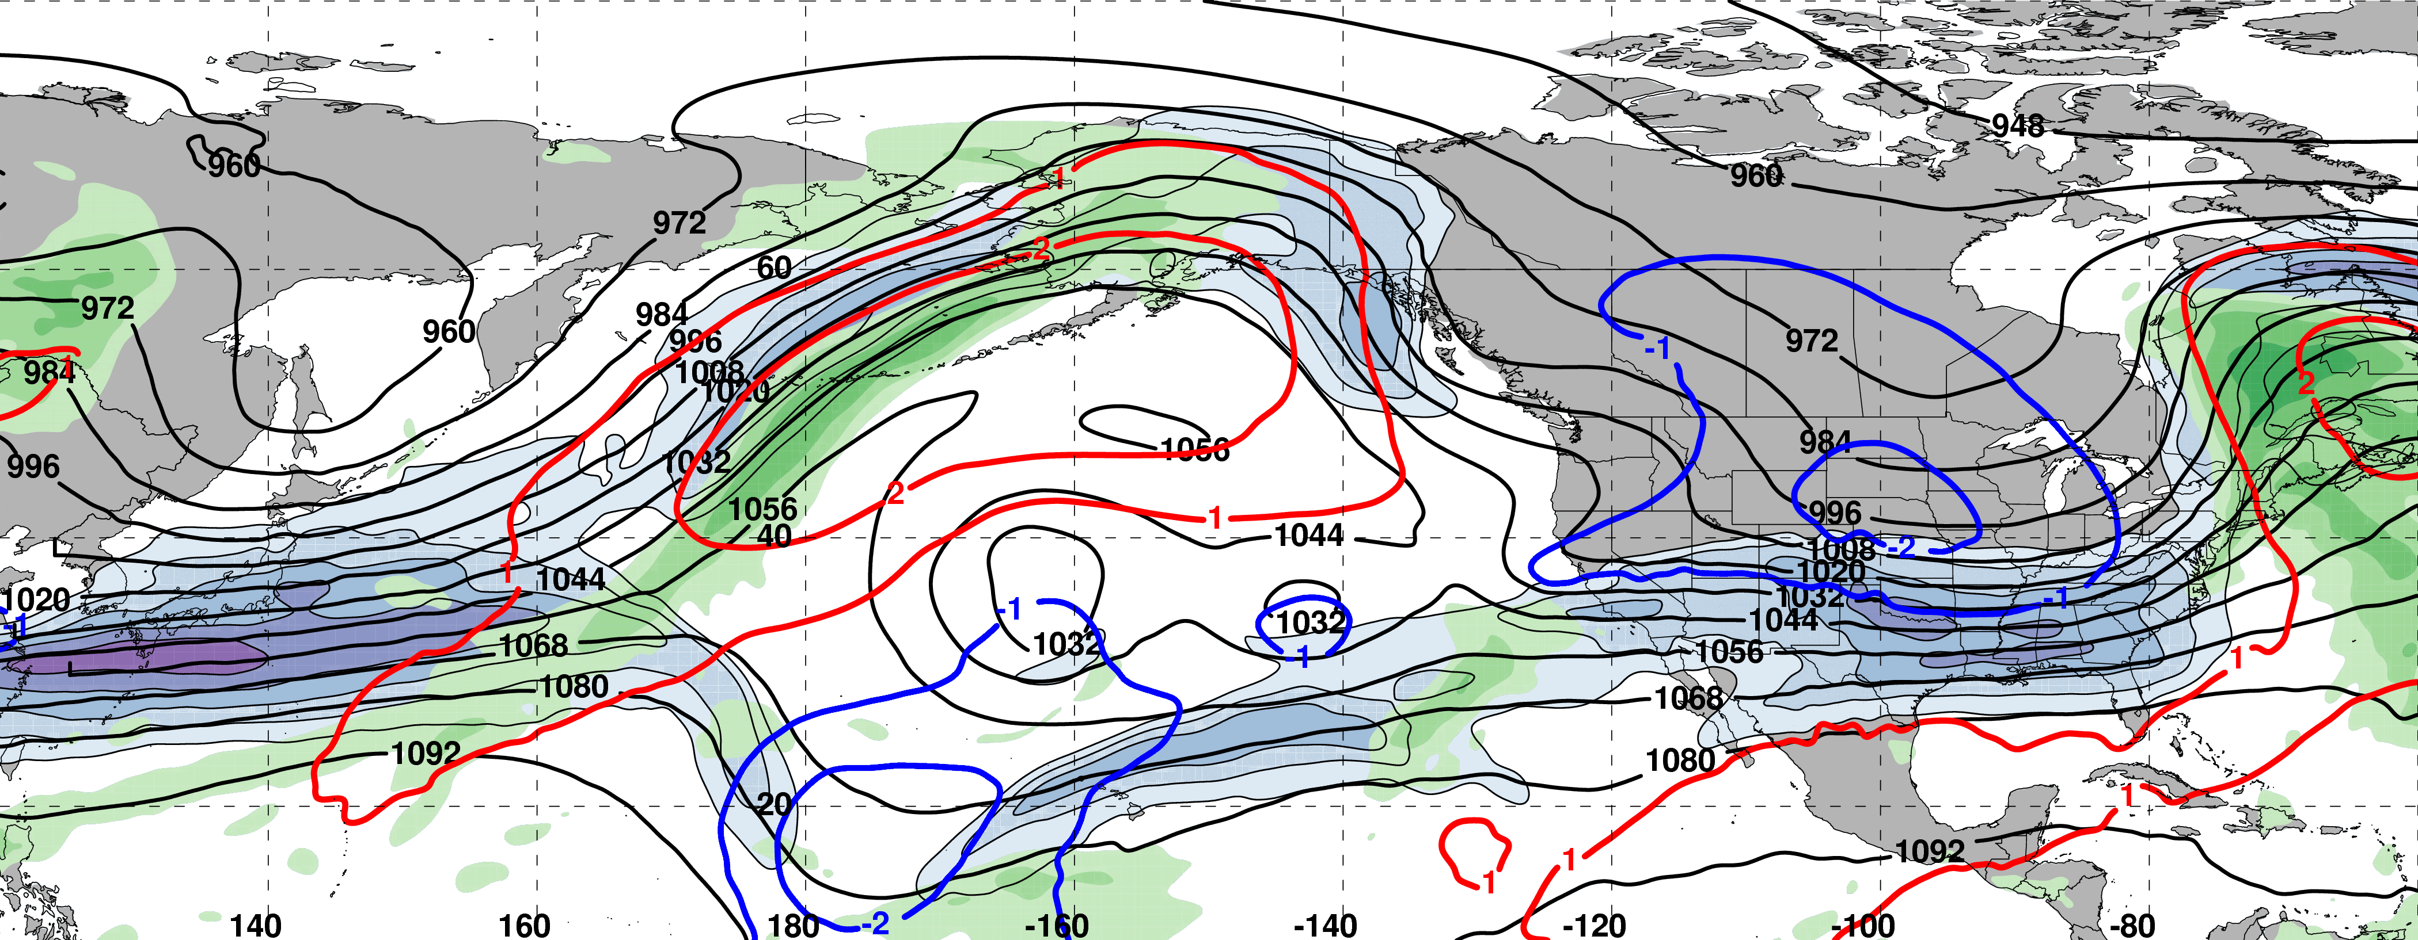
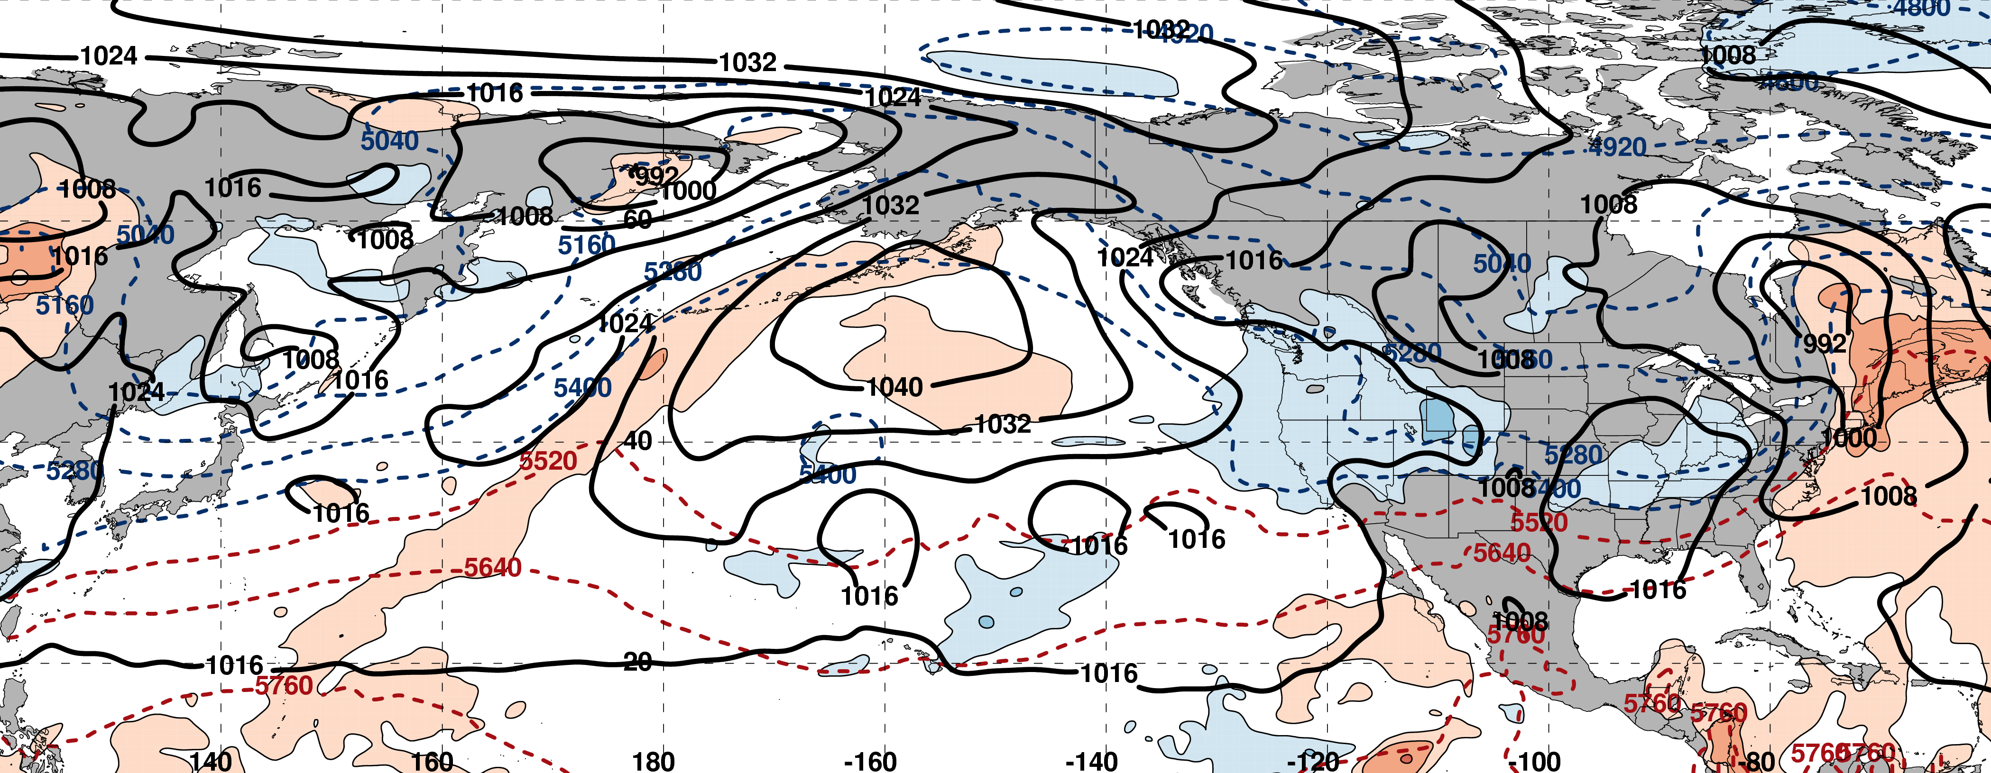
0000 UTC 26 February: 250-hPa Jet and Precipitable Water Anomalies
m s^{–1}
σ
0000 UTC 26 February: MSLP, Thickness, 850-hPa Temp. Anomalies
L
σ

Slide 39
0000 UTC 26 February: 250-hPa Jet and Precipitable Water Anomalies
m s^{–1}
σ
0000 UTC 26 February: MSLP, Thickness, 850-hPa Temp. Anomalies
Substantial Jet Retraction
σ

Slide 40
First NPJ Regime Change
9-day Probabilistic Forecast Trajectory Initialized at 0000 UTC 17 February 2017
The GEFS ensemble forecast indicated the NPJ regime transition was likely

Slide 41
First NPJ Regime Change
9-day Probabilistic Forecast Trajectory Initialized at 0000 UTC 17 February 2017
The GEFS ensemble forecast indicated the NPJ regime transition was likely
The GEFS ensemble did not capture an equatorward shift of the NPJ axis
This 9-day forecast ranked 2nd worst during the 2016–2017 cool season

Slide 42
GEFS Ensemble Mean Error by NPJ Regime
GEFS Reforecasts verifying within a particular NPJ regime
Circles on a particular line indicate statistically significant differences at the 99% confidence level with respect to another NPJ regime

Slide 43
GEFS Ensemble Mean Error by NPJ Regime
GEFS Reforecasts verifying within a particular NPJ regime
Circles on a particular line indicate statistically significant differences at the 99% confidence level with respect to another NPJ regime
Forecasts verifying during equatorward shifts and jet retractions exhibit significantly larger errors than jet extensions and poleward shifts in the 96–216-h forecast period

Slide 44
GEFS Ensemble Mean Error by NPJ Regime
GEFS Reforecasts verifying within a particular NPJ regime
Circles on a particular line indicate statistically significant differences at the 99% confidence level with respect to another NPJ regime
See Winters et al. poster at 10a Thursday
Forecasts verifying during equatorward shifts and jet retractions exhibit significantly larger errors than jet extensions and poleward shifts in the 96–216-h forecast period

Slide 45
Case Study:
Feb/Mar 2017
NPJ Regime Changes
III: Second NPJ Regime Change and the “Pi Day Snowstorm”

Slide 46
0000 UTC 26 February: 250-hPa Jet and Precipitable Water Anomalies
m s^{–1}
σ
0000 UTC 26 February: MSLP, Thickness, 850-hPa Temp. Anomalies
L
σ

Slide 47
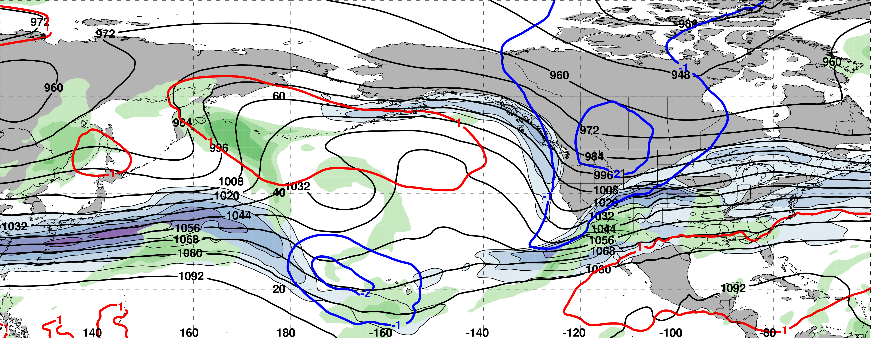
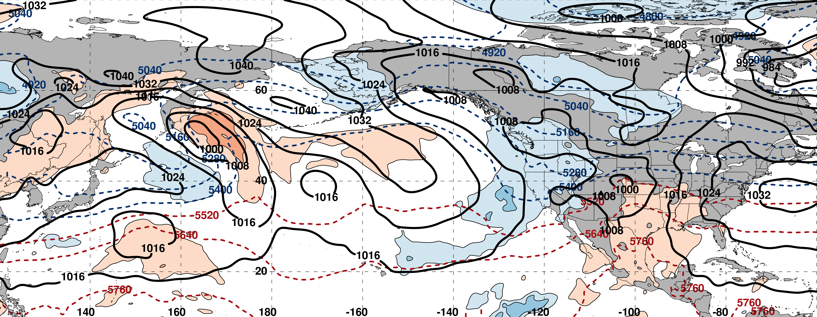
0000 UTC 28 February: 250-hPa Jet and Precipitable Water Anomalies
North Pacific block persists
m s^{–1}
σ
0000 UTC 28 February: MSLP, Thickness, 850-hPa Temp. Anomalies
L
σ

Slide 48
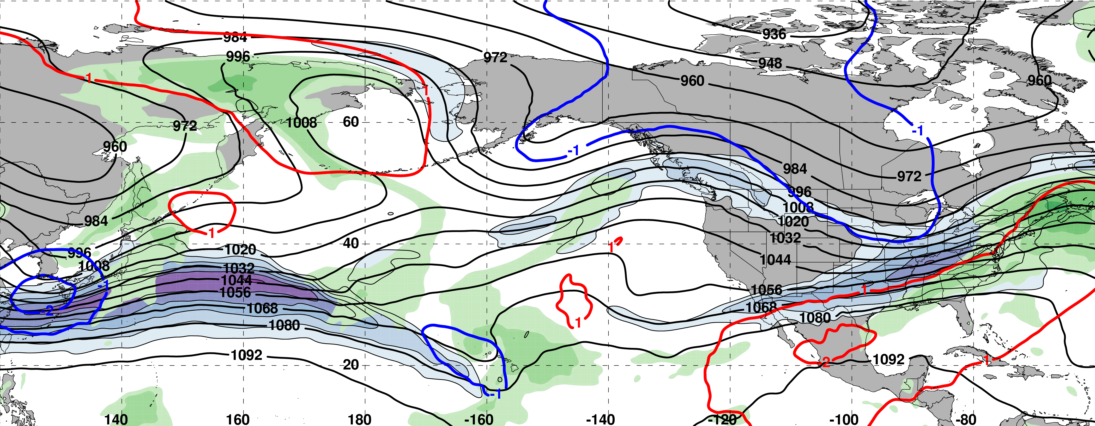
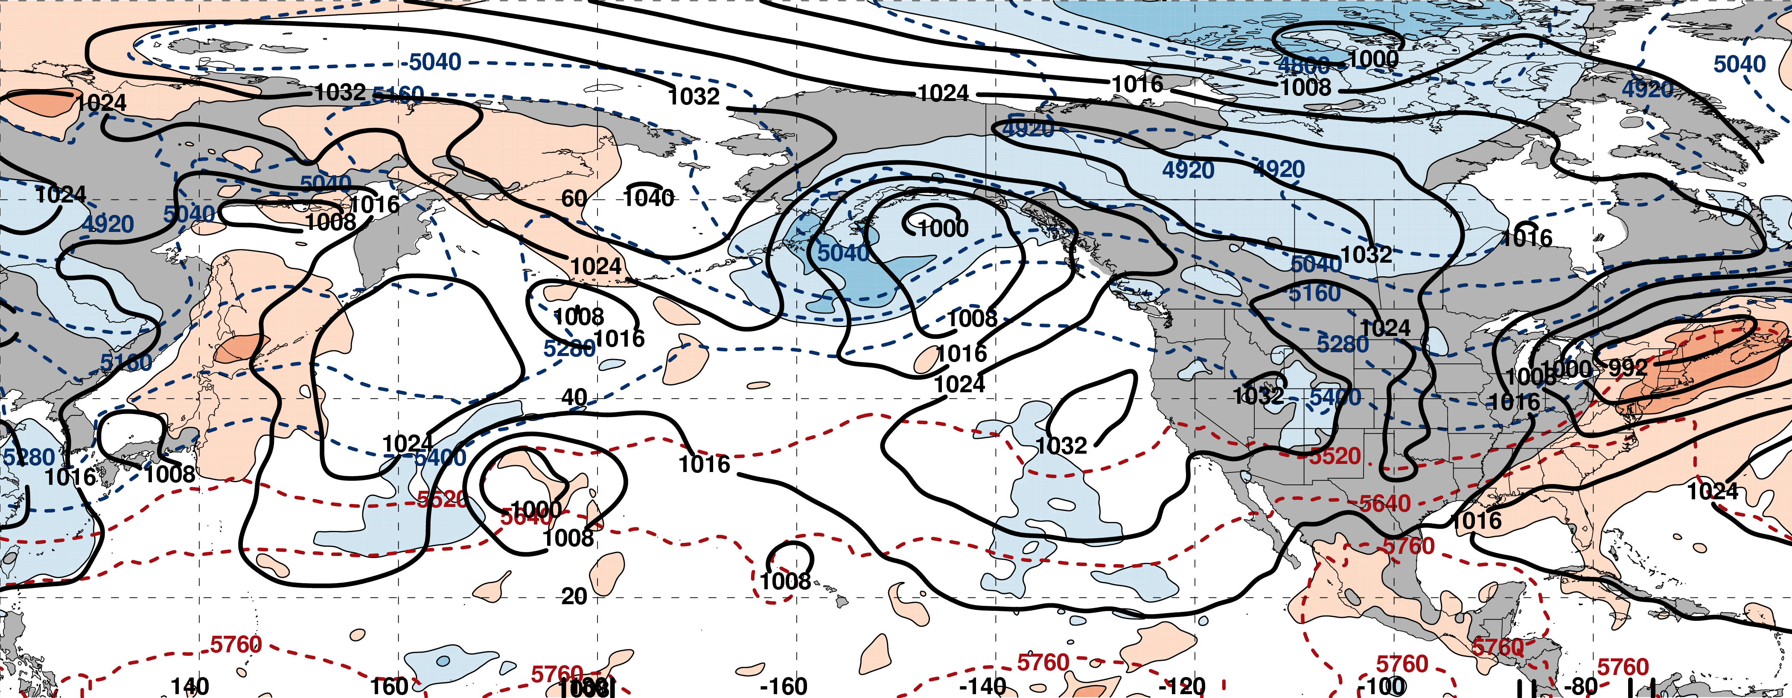
0000 UTC 02 March: 250-hPa Jet and Precipitable Water Anomalies
m s^{–1}
σ
0000 UTC 02 March: MSLP, Thickness, 850-hPa Temp. Anomalies
L
σ

Slide 49
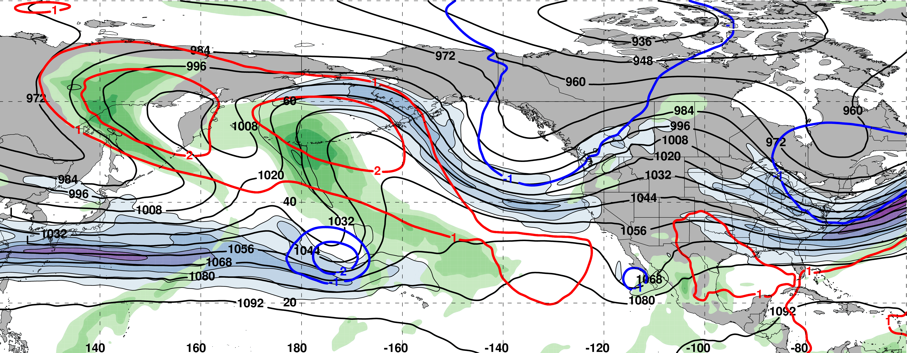
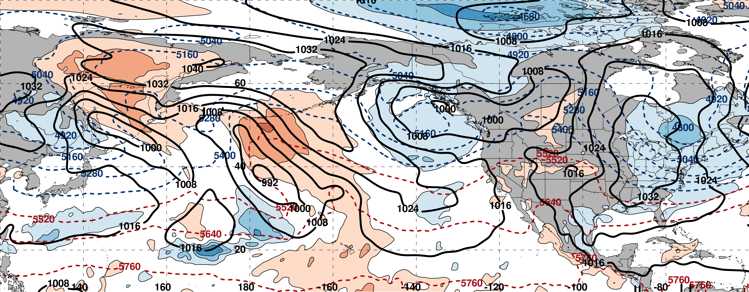
0000 UTC 04 March: 250-hPa Jet and Precipitable Water Anomalies
m s^{–1}
σ
0000 UTC 04 March: MSLP, Thickness, 850-hPa Temp. Anomalies
L
σ

Slide 50
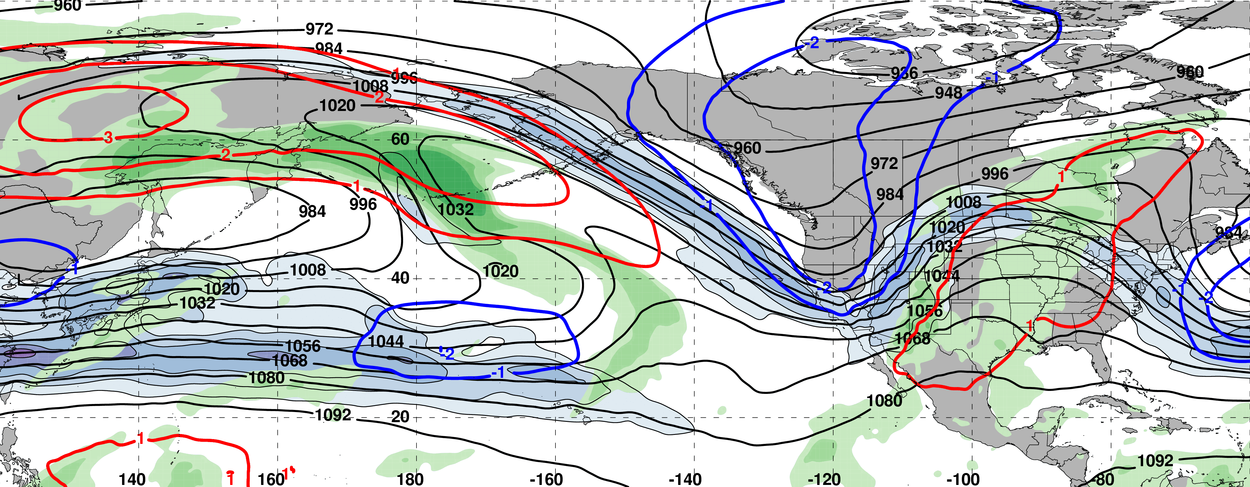
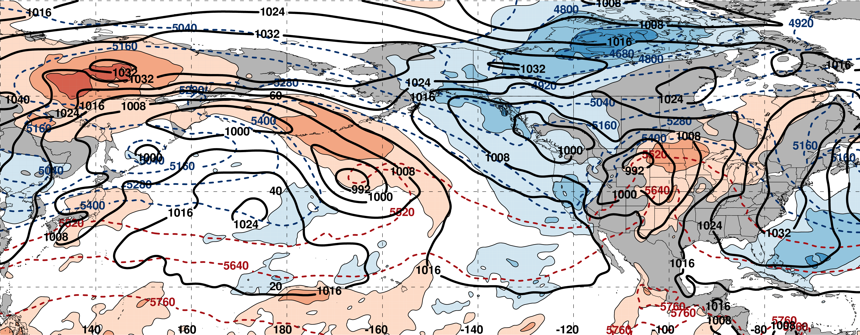
0000 UTC 06 March: 250-hPa Jet and Precipitable Water Anomalies
m s^{–1}
σ
0000 UTC 06 March: MSLP, Thickness, 850-hPa Temp. Anomalies
L
σ

Slide 51
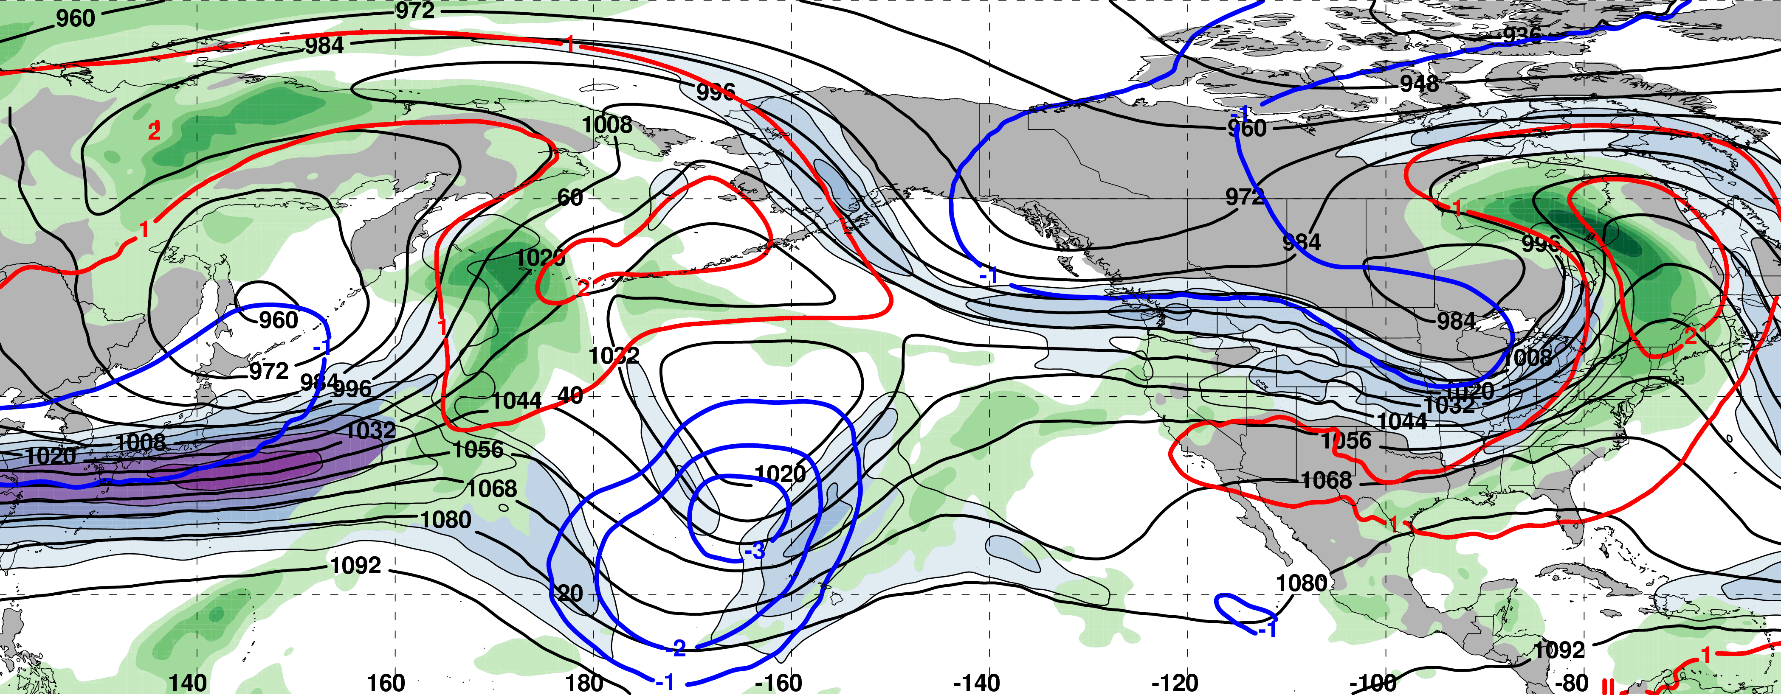
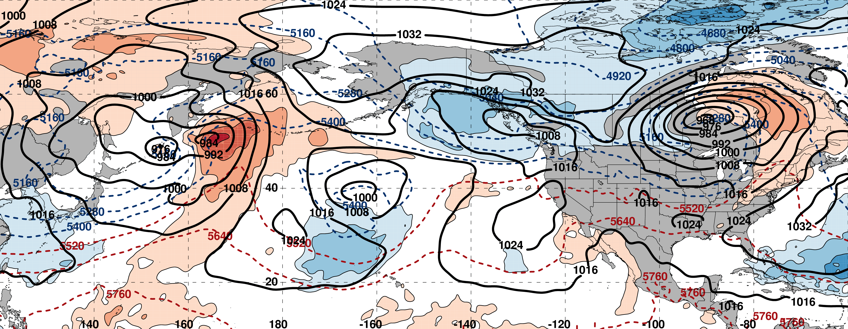
0000 UTC 08 March: 250-hPa Jet and Precipitable Water Anomalies
m s^{–1}
σ
0000 UTC 08 March: MSLP, Thickness, 850-hPa Temp. Anomalies
L
σ

Slide 52
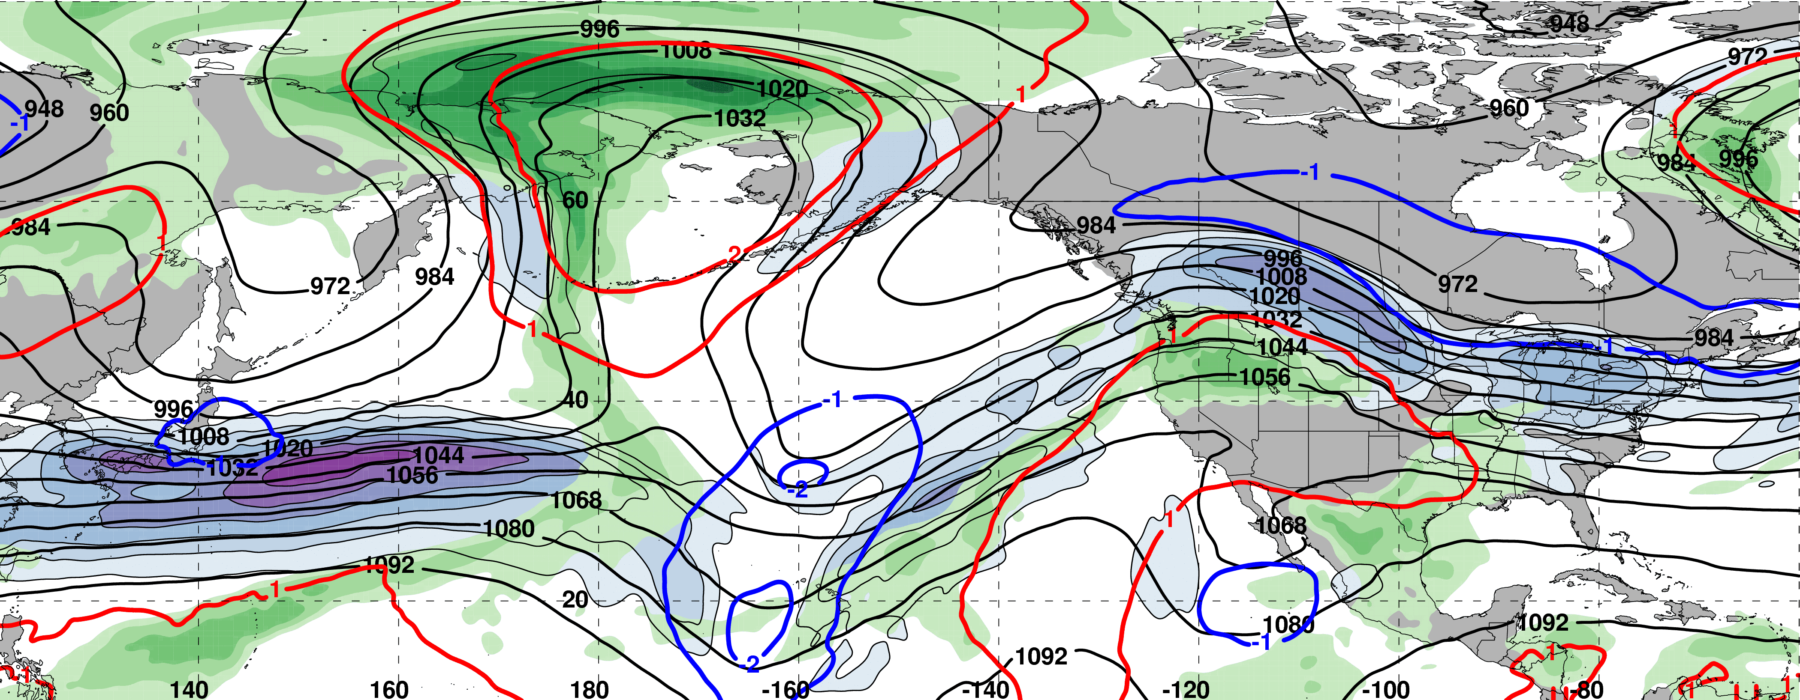
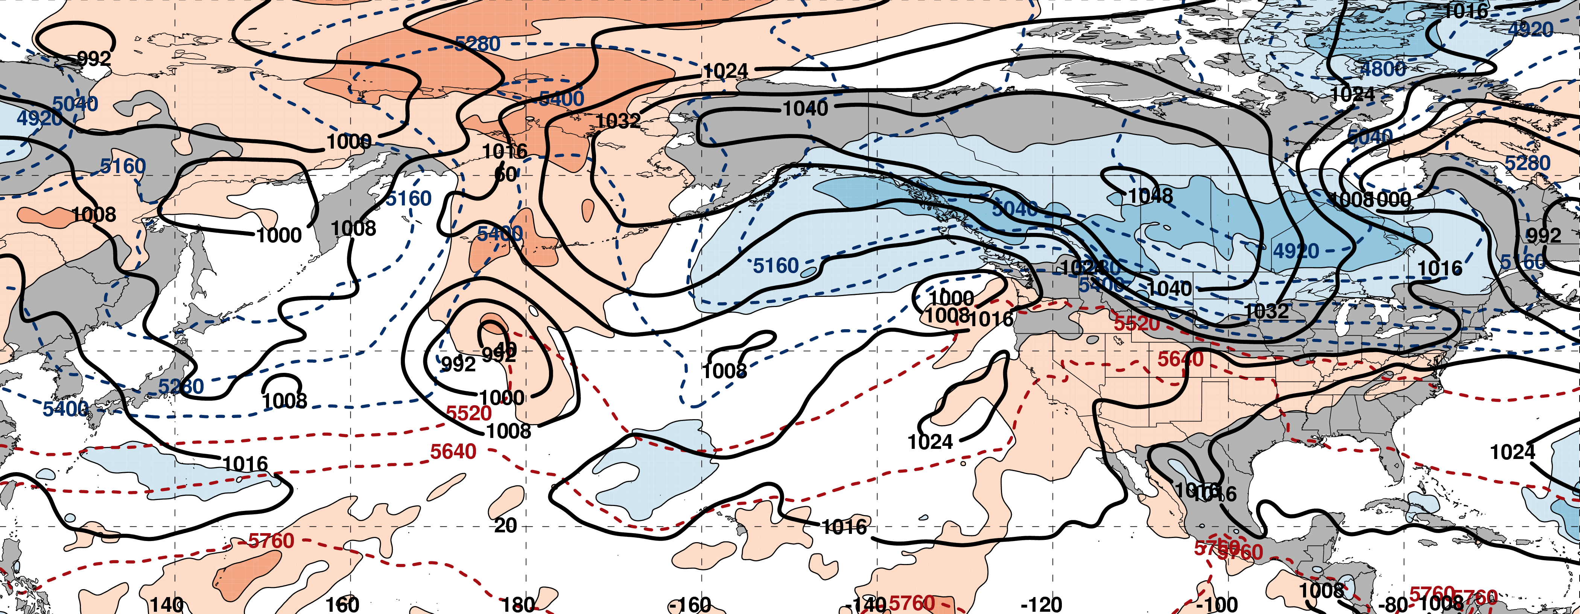
0000 UTC 10 March: 250-hPa Jet and Precipitable Water Anomalies
m s^{–1}
σ
0000 UTC 10 March: MSLP, Thickness, 850-hPa Temp. Anomalies
H
L
σ

Slide 53
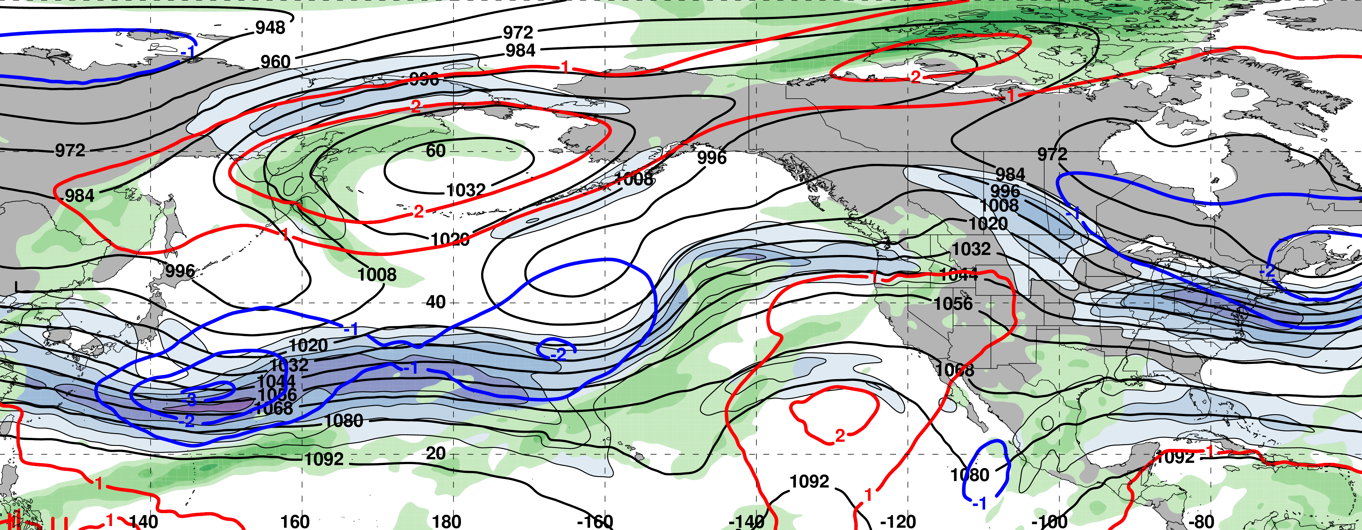
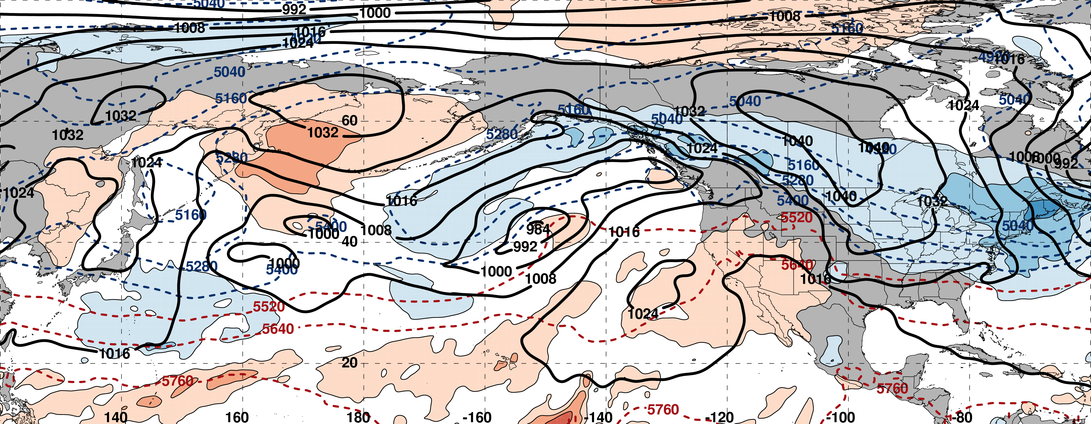
0000 UTC 12 March: 250-hPa Jet and Precipitable Water Anomalies
m s^{–1}
σ
0000 UTC 12 March: MSLP, Thickness, 850-hPa Temp. Anomalies
H
L
σ

Slide 54
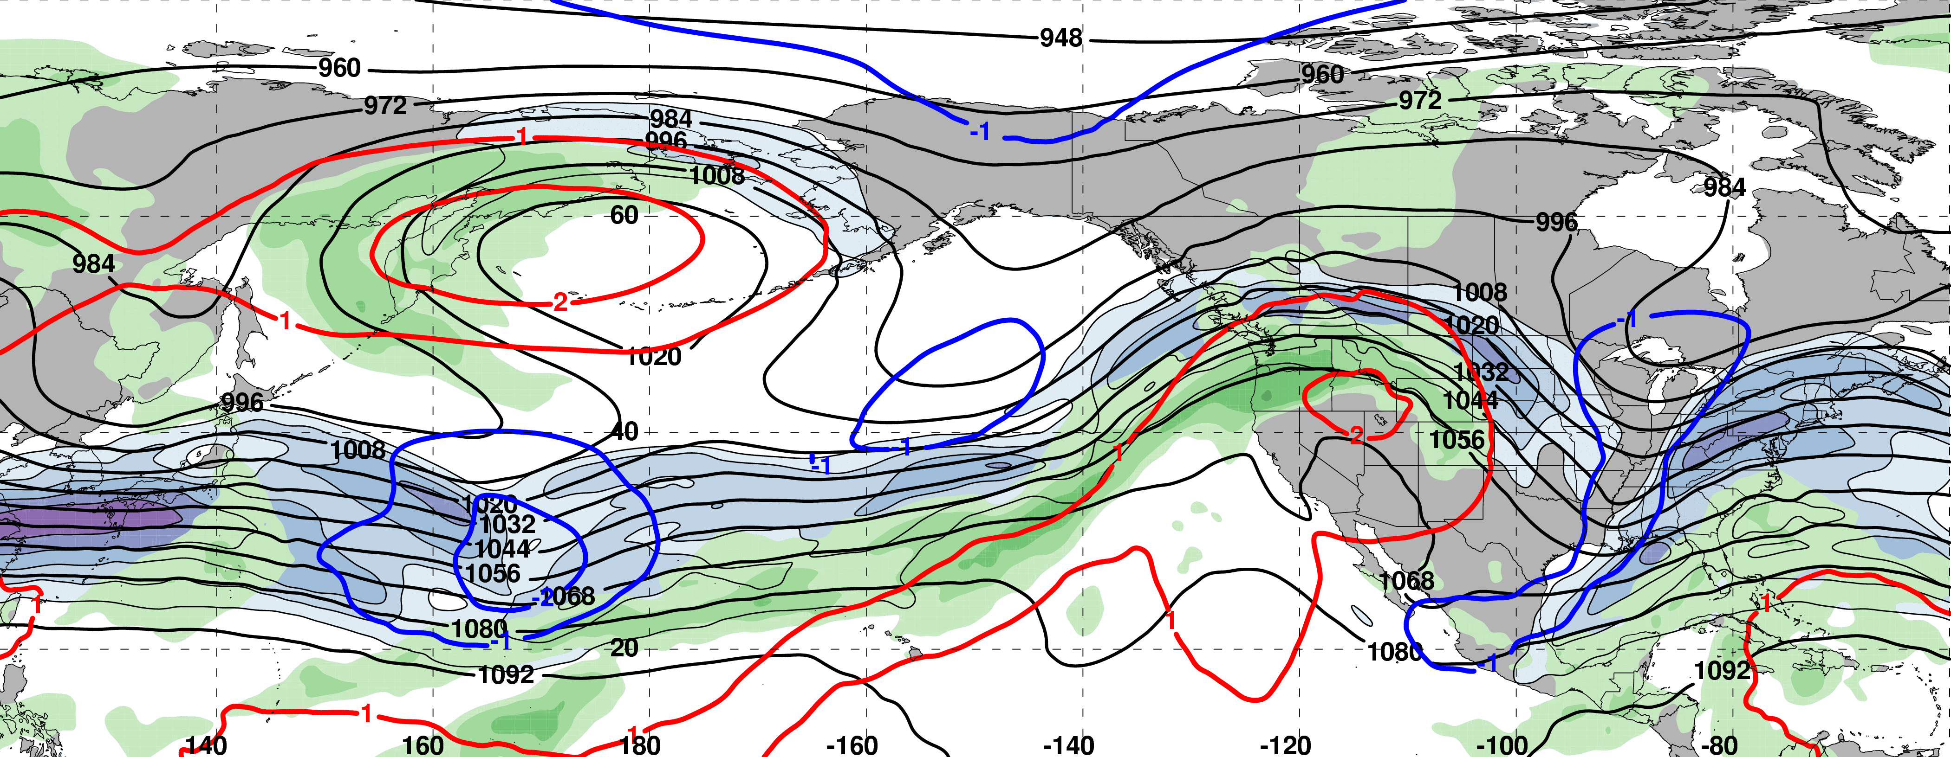
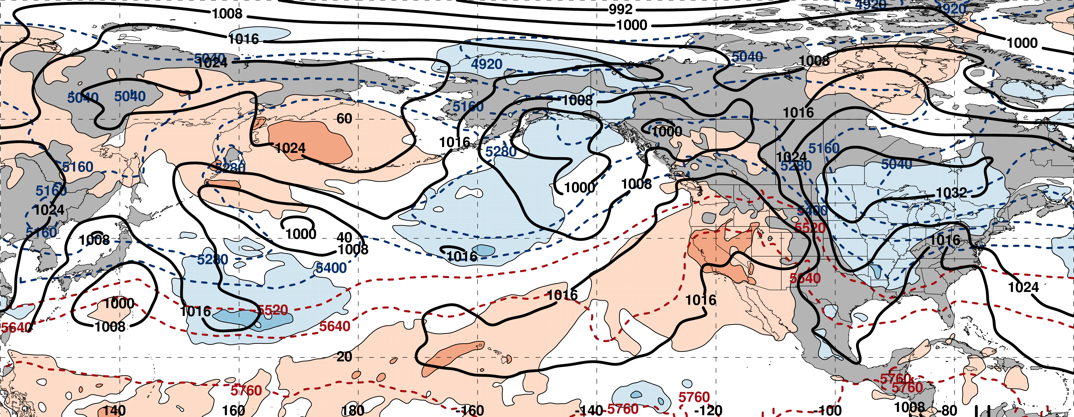
0000 UTC 14 March: 250-hPa Jet and Precipitable Water Anomalies
m s^{–1}
σ
0000 UTC 14 March: MSLP, Thickness, 850-hPa Temp. Anomalies
L
H
L
σ

Slide 55
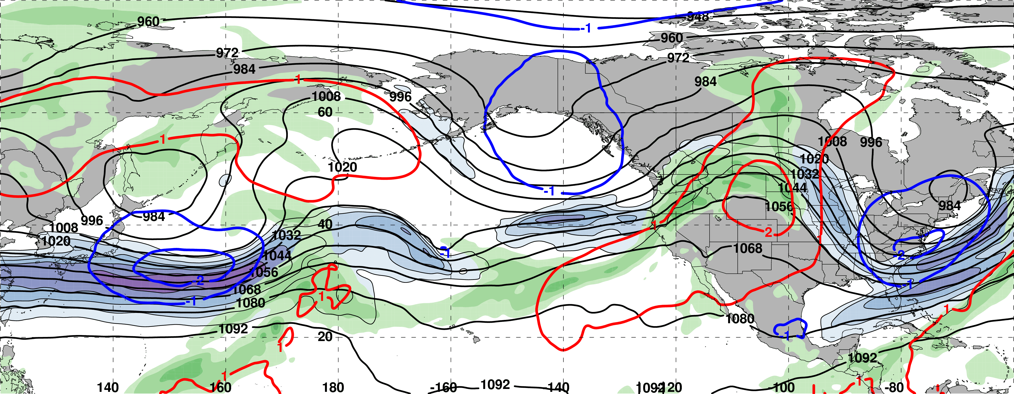
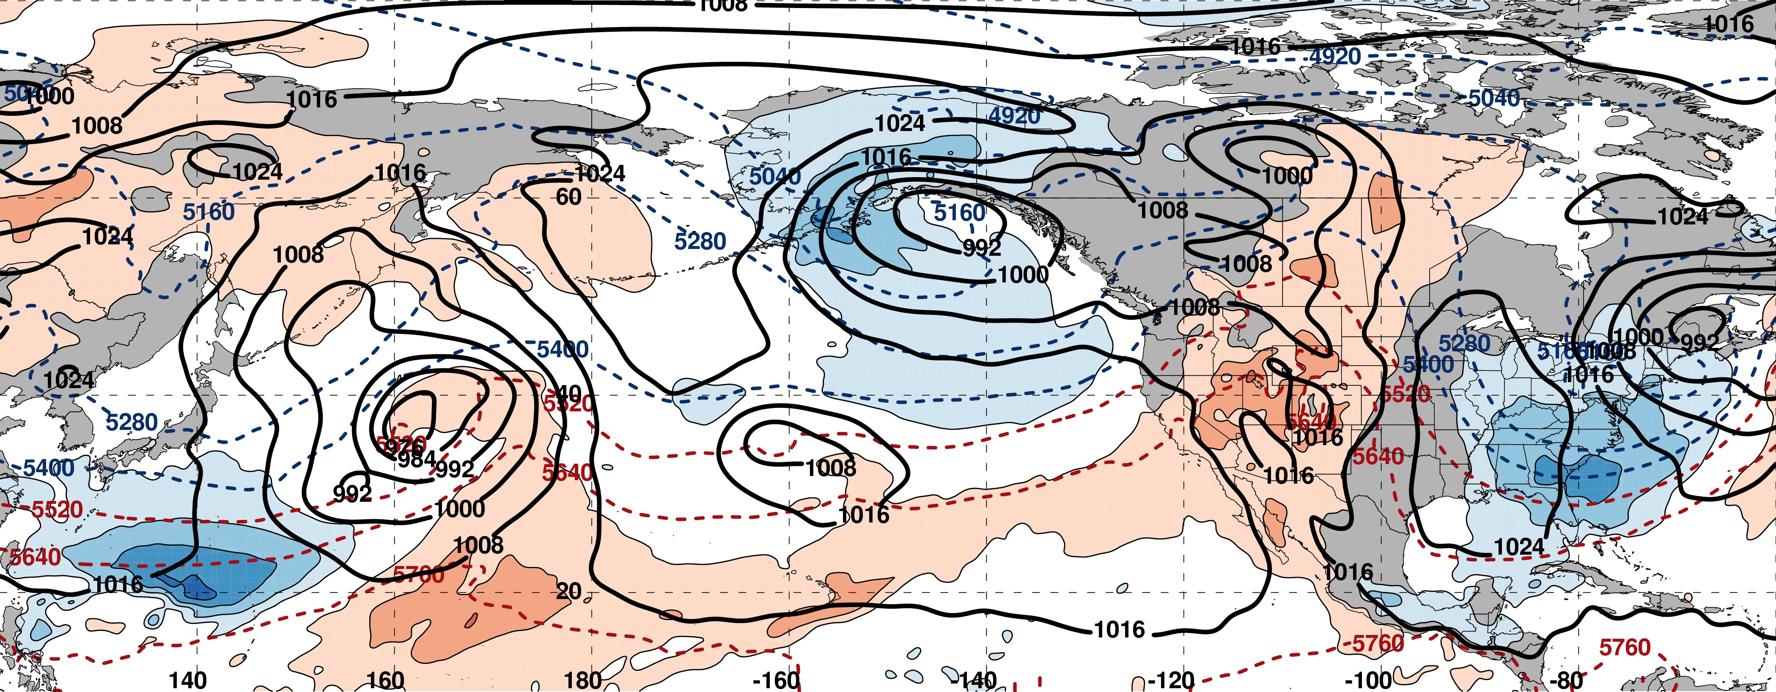
0000 UTC 16 March: 250-hPa Jet and Precipitable Water Anomalies
m s^{–1}
σ
0000 UTC 16 March: MSLP, Thickness, 850-hPa Temp. Anomalies
L
H
L
σ

Slide 56
Eastern U.S. Extreme Cold Events
Events during
Sept. – May 1979–2014 projected onto the NPJ phase diagram (N=173)
Poleward Shift
23
Each point is an average of the PCs
3–7 days prior to an event
30
47
Jet Retraction
Jet Extension
Equatorward shifts and jet extensions most often precede Eastern U.S. extreme cold events
73
Equatorward Shift
9–13 Mar. 2017

Slide 57
Summary
The NPJ phase diagram serves as an objective tool to characterize the instantaneous state and evolution of the upper-tropospheric flow pattern over the North Pacific.
Anomalous precipitation along the west coast in mid-February 2017 was preceded by an NPJ that was both extended and shifted poleward.
The NPJ regime transition from a jet extension to a jet retraction during late-February 2017 was characterized by large medium-range forecast errors in the context of the NPJ phase diagram.
The evolution of the upper-tropospheric flow pattern in early-March was conducive to the development of a broad trough over the Eastern U.S. and the transport of anomalously cold air into the region prior to and following the “Pi Day Snowstorm”.

Slide 58
NPJ Phase Diagram Web Interface
A web interface has been developed and implemented at WPC that offers real time NPJ phase diagram forecasts and NPJ regime composites.
http://www.atmos.albany.edu/facstaff/awinters/realtime/About_EOFs.php
Contact: acwinters@albany.edu
Collaborators: Mike Bodner (WPC), Arlene Laing (NOAA), Dan Halperin (WPC), Bill Lamberson (WPC), Josh Kastman (WPC), and Sara Ganetis (WPC)

Slide 59
References
Athanasiadis, P. J., J. M. Wallace, and J. J. Wettstein, 2010: Patterns of wintertime jet stream variability and their relation to the storm tracks. J. Atmos. Sci., 67, 1361–1381.
Griffin, K. S., and J. E. Martin, 2017: Synoptic features associated with temporally coherent modes of variability of the North Pacific jet stream. J. Climate, 29, in press.
Jaffe, S. C., J. E. Martin, D. J. Vimont, and D. L. Lorenz, 2011: A synoptic climatology of episodic, subseasonal retractions of the Pacific jet. J. Climate, 24, 2846–2860.
Saha, S., and Coauthors, 2014: The NCEP Climate Forecast System Version 2. J. Climate, 27, 2185–2208.

Slide 60
Supplementary Slides

Slide 61
NPJ Regime Composite Patterns

Slide 62
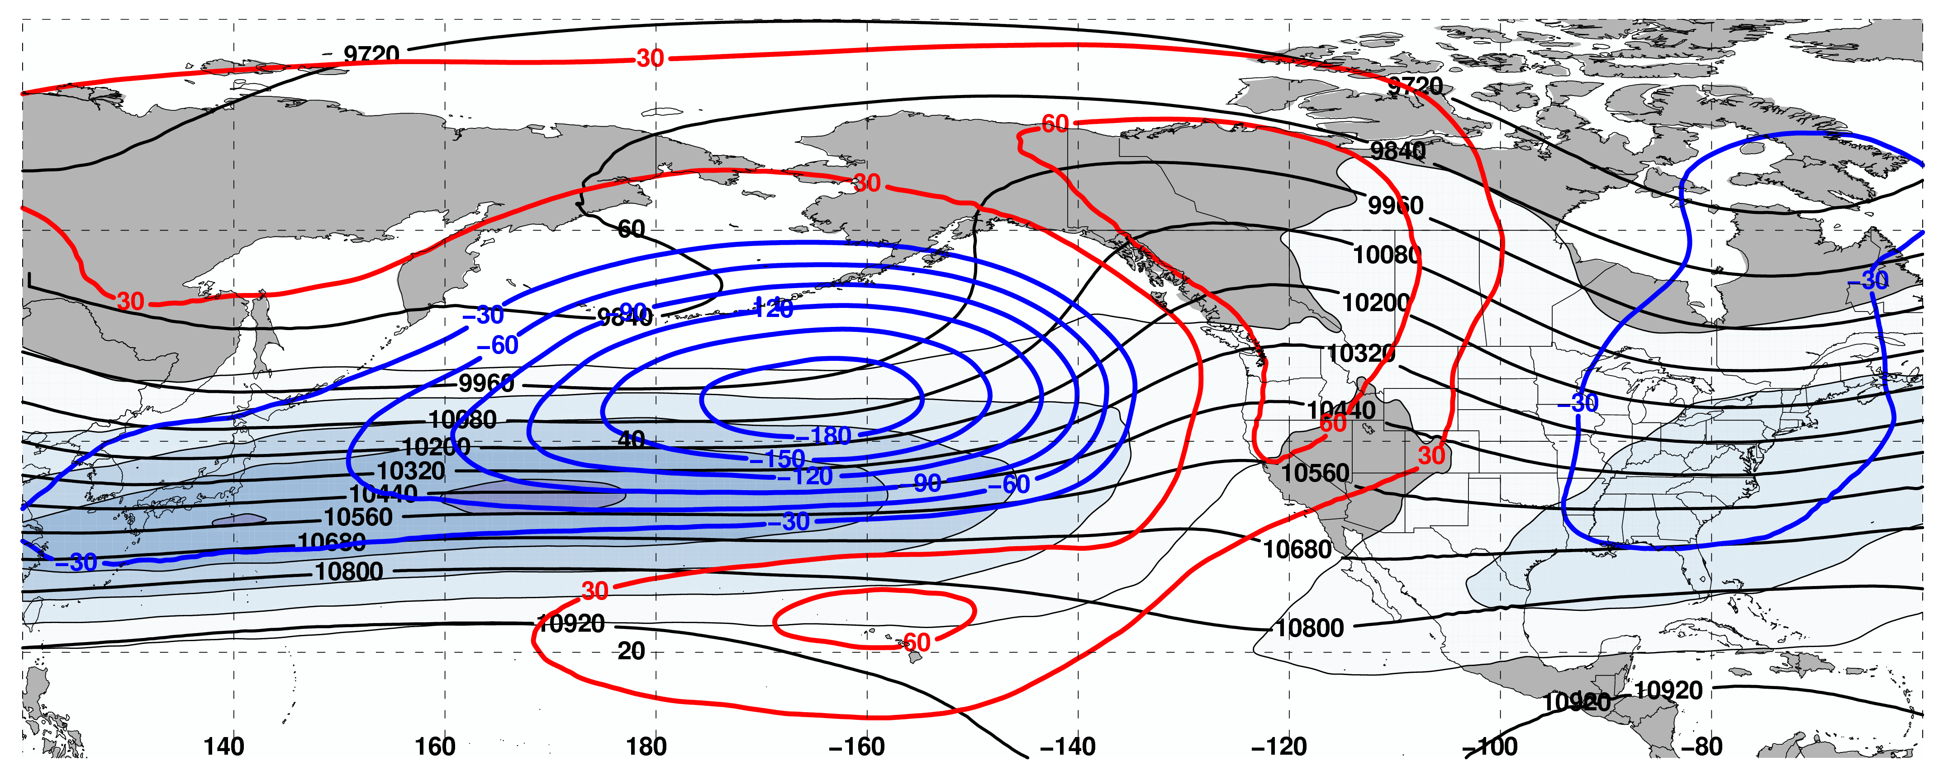
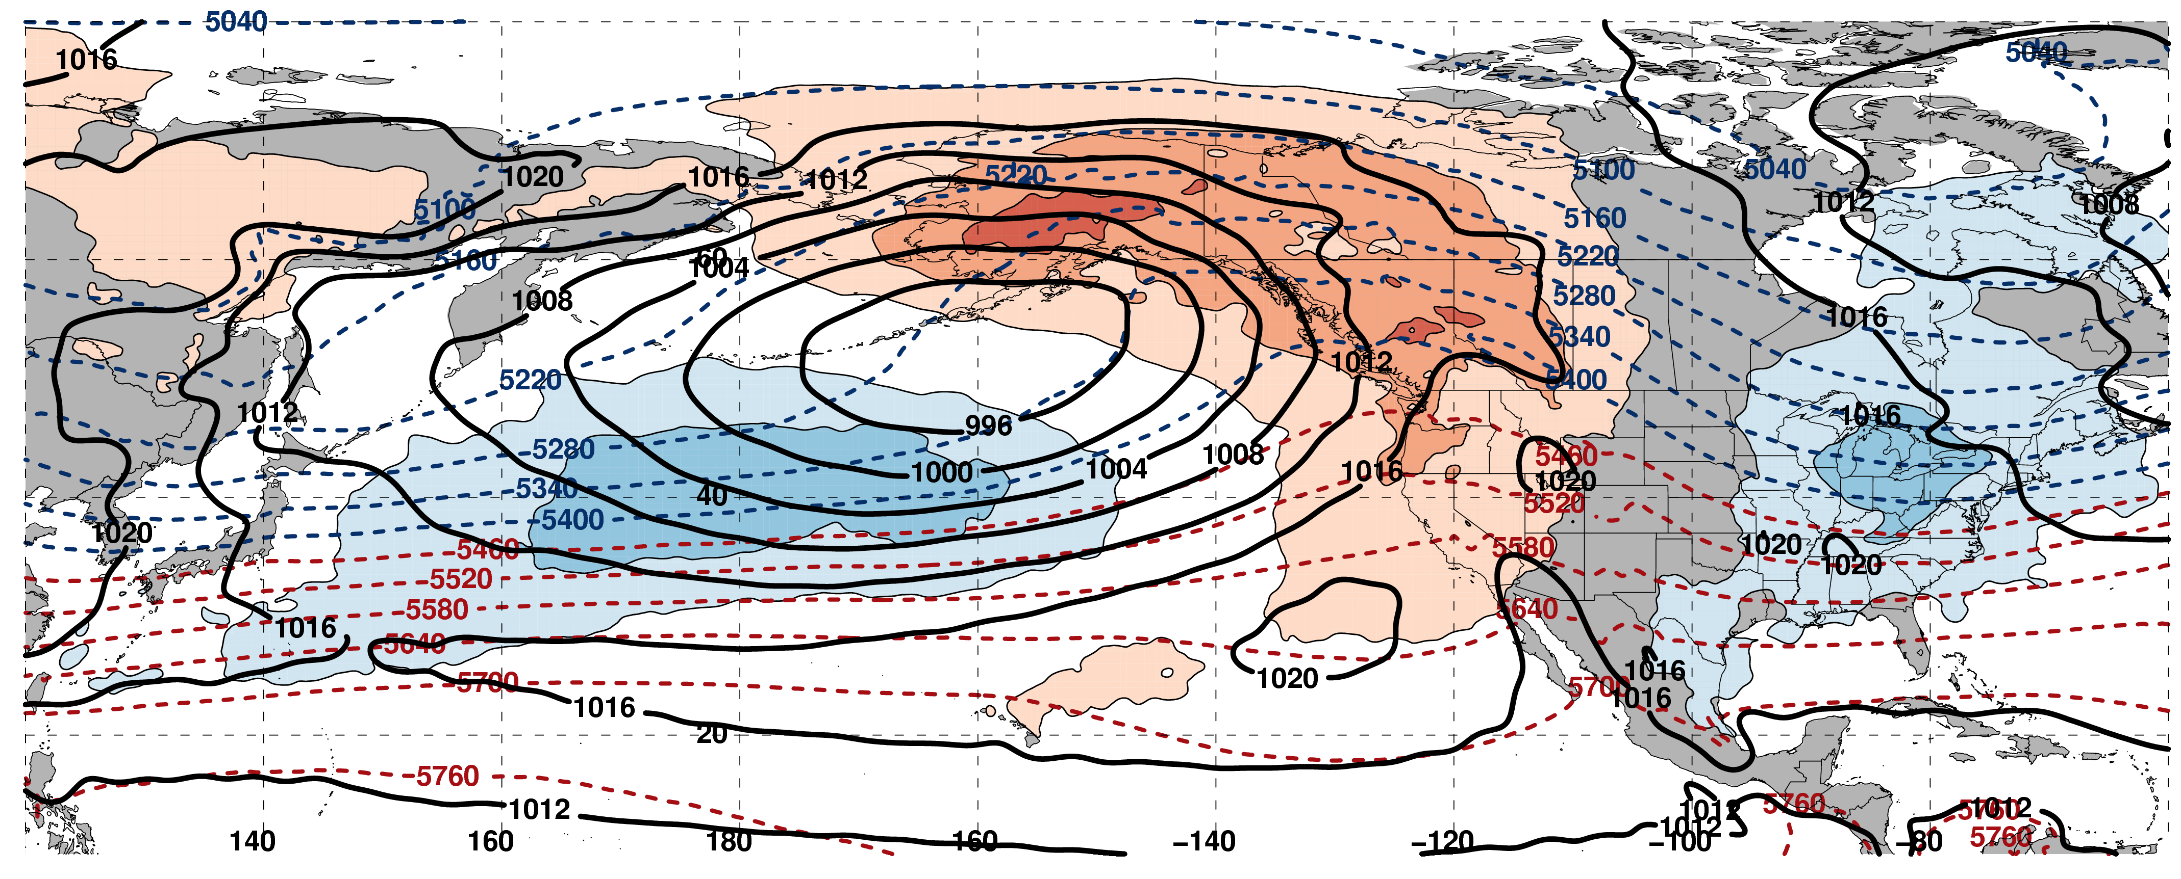
250-hPa Wind Speed, Geo. Heights, Geo. Height Anomalies: Jet Extension
m s^{–1}
Mean Sea-Level Pressure, 1000–500-hPa Thickness, 850-hPa Temp. Anomalies: Jet Extension
K

Slide 63
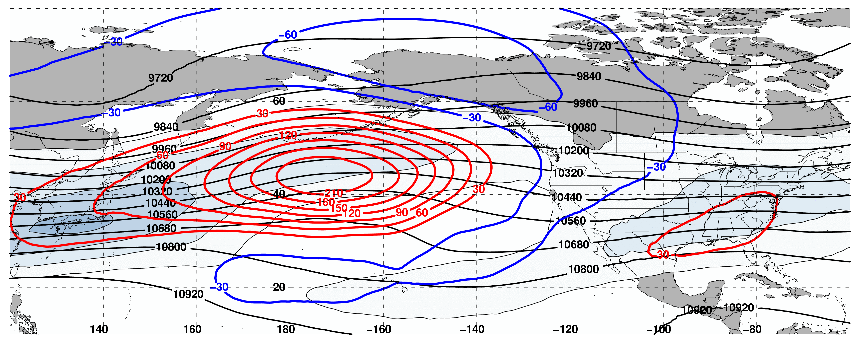
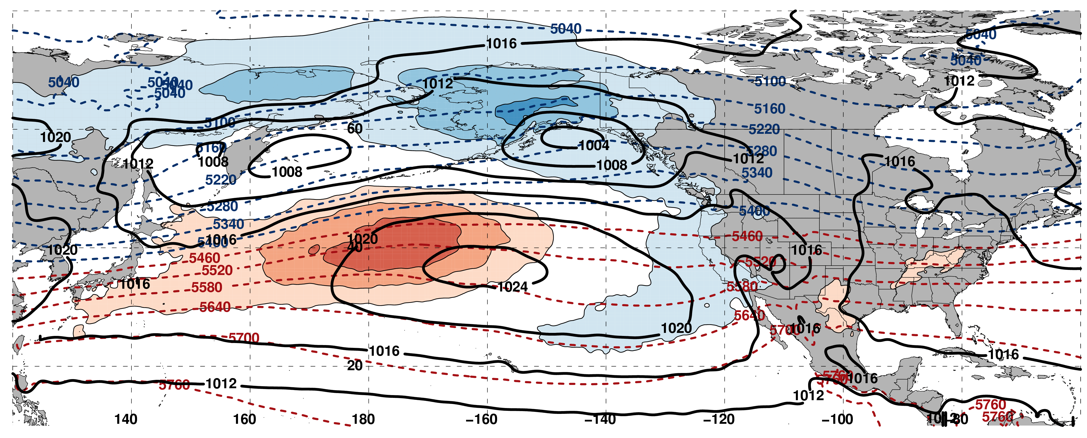
250-hPa Wind Speed, Geo. Heights, Geo. Height Anomalies: Jet Retraction
m s^{–1}
Mean Sea-Level Pressure, 1000–500-hPa Thickness, 850-hPa Temp. Anomalies: Jet Retraction
K

Slide 64
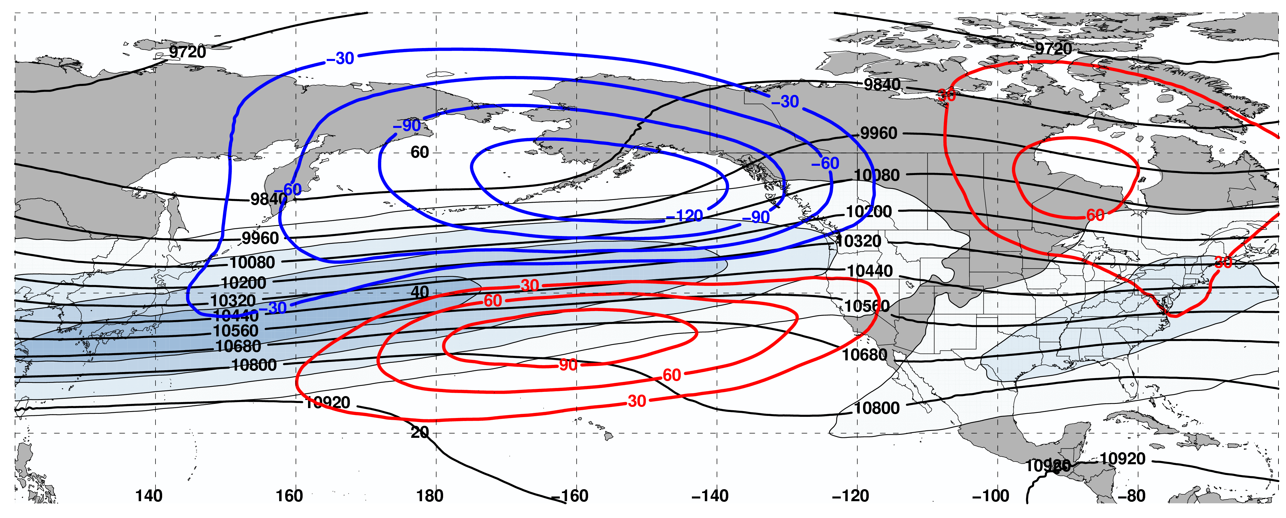
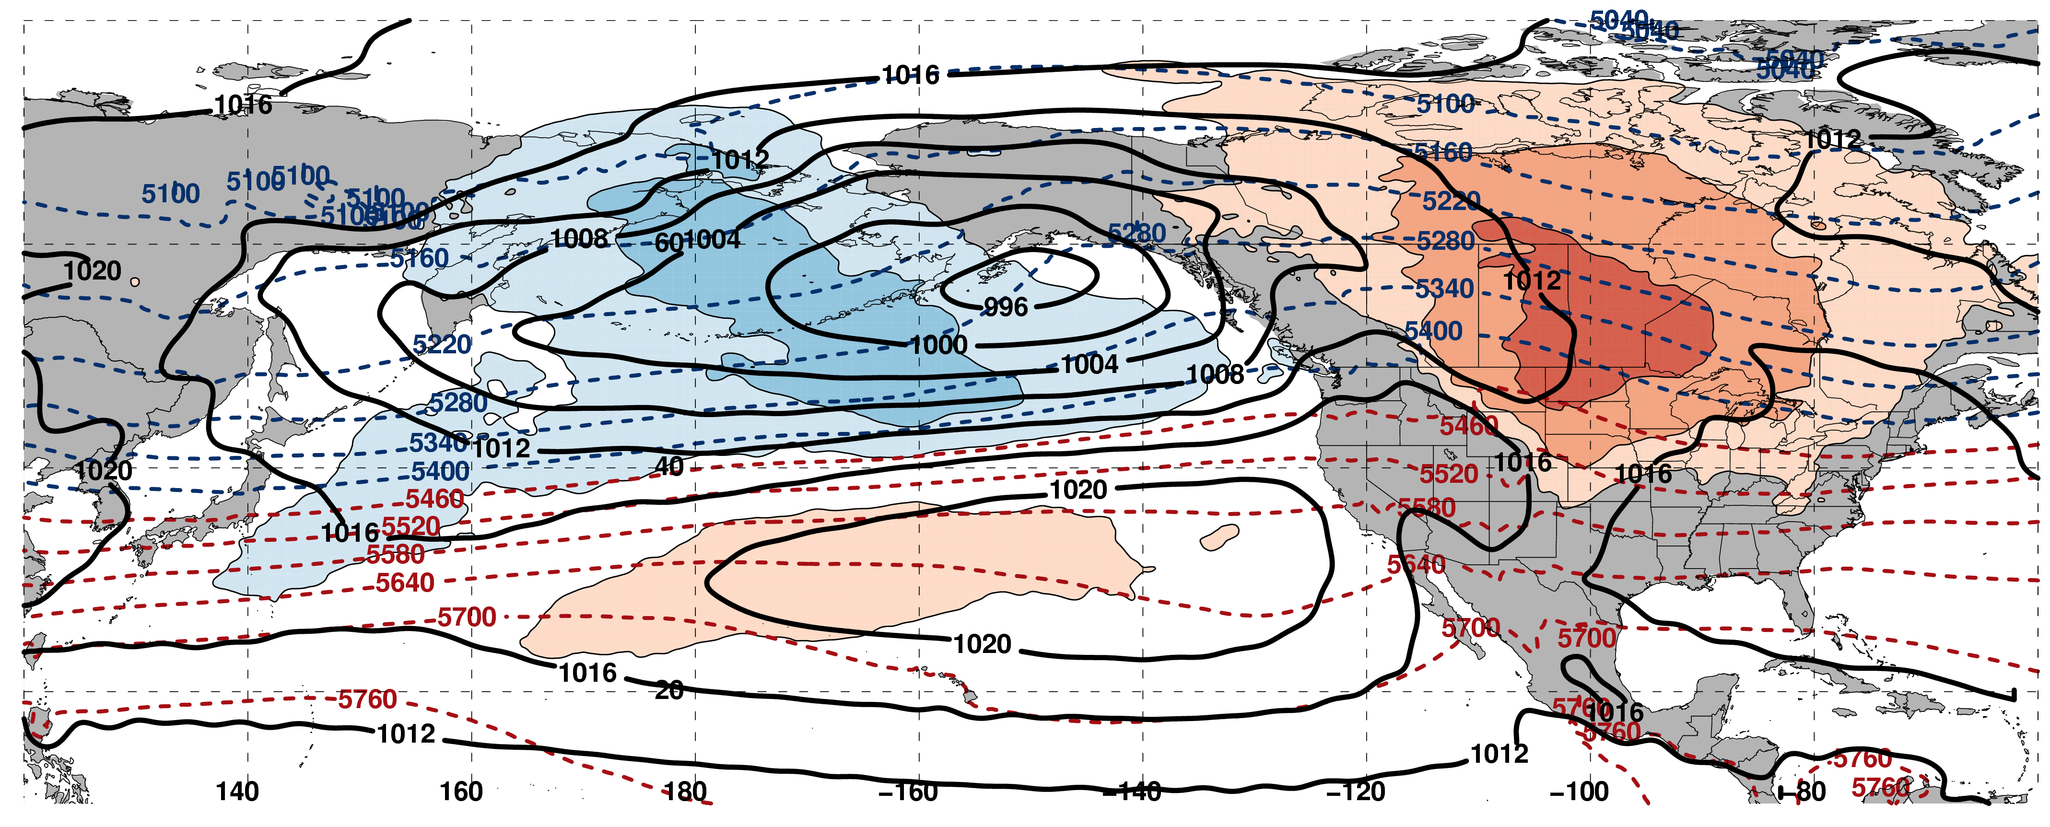
250-hPa Wind Speed, Geo. Heights, Geo. Height Anomalies: Poleward Shift
m s^{–1}
Mean Sea-Level Pressure, 1000–500-hPa Thickness, 850-hPa Temp. Anomalies: Poleward Shift
K

Slide 65
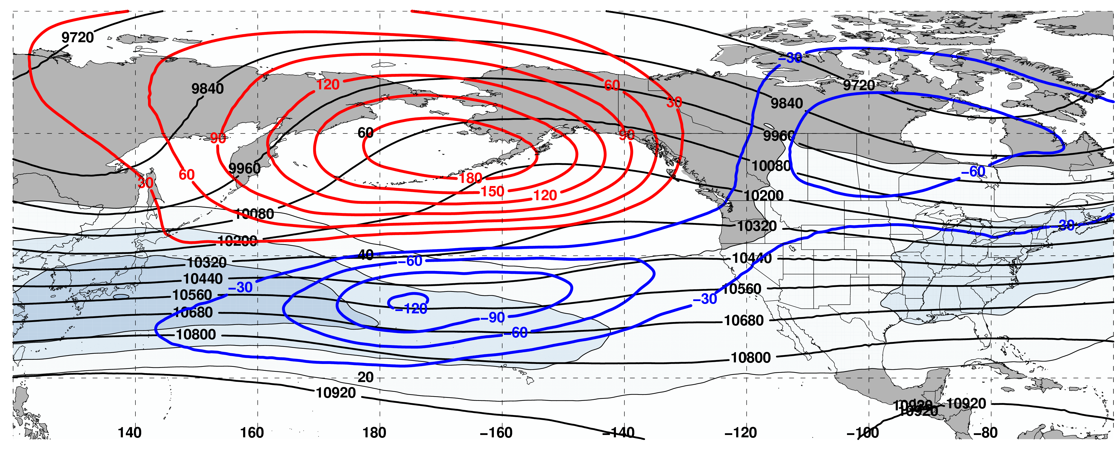
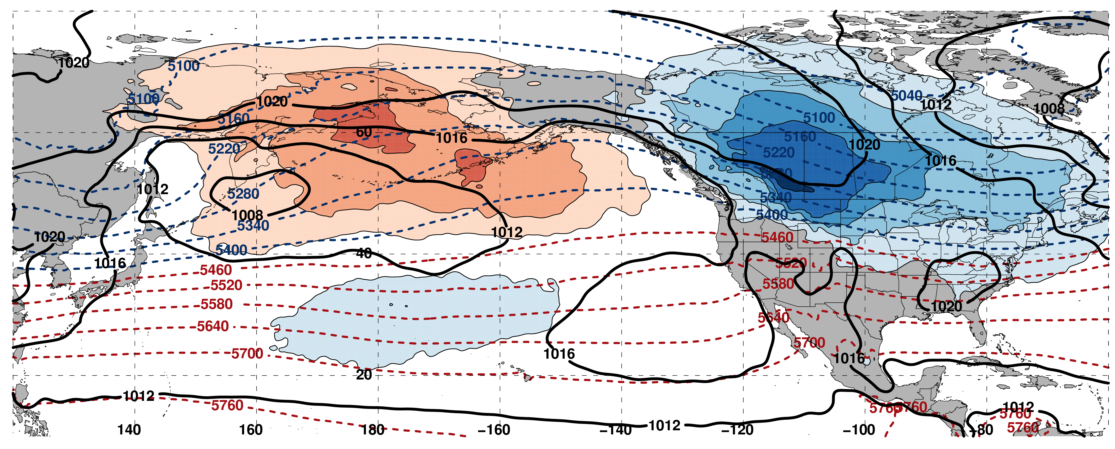
250-hPa Wind Speed, Geo. Heights, Geo. Height Anomalies: Equator. Shift
m s^{–1}
Mean Sea-Level Pressure, 1000–500-hPa Thickness, 850-hPa Temp. Anomalies: Equator. Shift
K

Slide 66
Pac. NW Extreme Precipitation Events
Composite NPJ Trajectory during the 10 days prior to a Pac. NW Extreme Precip. Event (N=85)
All event trajectories comprising the composite are repositioned to begin at the origin

Slide 67
NPJ Regime Frequency by Month
Poleward and Equatorward Shifts are favored during September
NPJ regime frequencies are nearly equivalent during all other months

Slide 68
NPJ Regime Frequency and ENSO
Jet Extensions and Equatorward Shifts are favored during an El Niño
Jet Retractions and Poleward Shifts are favored during a La Niña

Slide 69
NPJ Regime Frequency and the MJO
Jet Retractions are favored during Phases 2, 3, and 4
Poleward Shifts are favored during Phases 5 and 6
Jet Extensions are favored during Phases 7, 8, and 1

Slide 70
NPJ Regime Frequency and the PNA
Jet Extensions and Poleward Shifts are favored during a positive PNA
Jet Retractions and Equatorward Shifts are favored during a negative PNA

Slide 71
Real time NPJ Phase Diagram Verification Statistics
2016–2017

Slide 72
Reliability Diagram (Sept 1 – May 31)
Perfect
Reliability
The GEFS appears to be underdispersive with respect to medium-range forecasts of the NPJ within the phase diagram

Slide 73
GFS Average Error – Regime

Slide 74
Average GEFS Mean Error – Regime

Slide 75
GEFS Probability of Detection – Regime

Slide 76
NPJ Phase Diagram Forecast Skill
Determined the position within the NPJ phase diagram for all 0-h forecasts during Sept.–May 1984–2014 in the GEFS Reforecast V2 (Hamill et al. 2013)

Slide 77
Reliability Diagram
Perfect
Reliability
GEFS Reforecasts appear to be underdispersive with respect to medium-range forecasts of the North Pacific Jet in the phase diagram

Slide 78
GEFS Ensemble Mean Error – Season
Circles on a particular line indicate statistically significant differences to the 95% confidence interval with respect to another jet regime.

Slide 79
GFS Average Error – Month

Slide 80
Average GEFS Mean Error – Month

Slide 81
GEFS Probability of Detection – Month

Slide 82
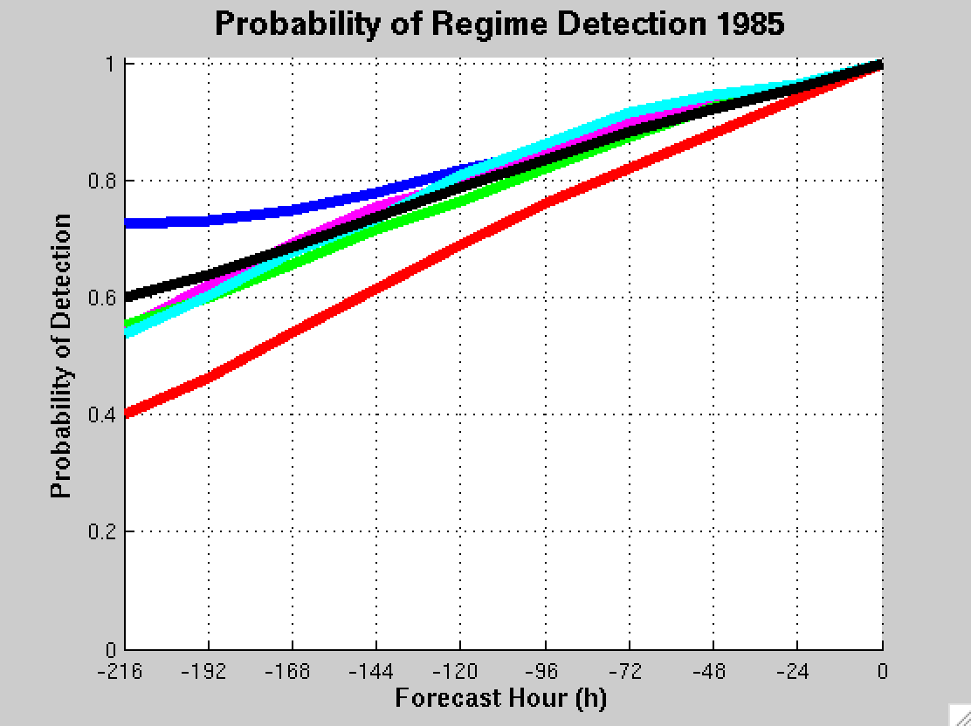
GEFS Ensemble Mean POD by NPJ Regime
For forecasts verifying within a particular NPJ regime
Extension
Retraction
Poleward
Equator
Origin
Mean

Slide 83
Jet Regime-Dependent Forecast Skill
Percent Difference Between the Frequency of Forecasts with Below-Normal and Above-Normal RMSE
Higher frequency of forecasts with
below-normal RMSE
(i.e., more good forecasts)
Higher frequency of forecasts with
above-normal RMSE
(i.e., more bad forecasts)

Slide 84
Jet Regime-Dependent Forecast Skill
Percent Difference Between the Frequency of Forecasts with Below-Normal and Above-Normal RMSE
Higher frequency of forecasts with
below-normal RMSE
(i.e., more good forecasts)
Higher frequency of forecasts with
above-normal RMSE
(i.e., more bad forecasts)

Slide 85
NPJ Phase Diagram and ETE’s

Slide 86
Eastern U.S. – All Events
Extreme Warm Event Centroids
WARM EVENTS (N = 239)
Poleward Shift
66
Events during
Sept. – May projected onto phase diagram
69
Jet Retraction
47
Jet Extension
Each point is an average of the PCs
3–7 days prior to an event
57
Equatorward Shift
Mean Projection

Slide 87
Western U.S. – Pac. NW Cluster
Extreme Cold Event Centroids
COLD EVENTS (N = 78)
Poleward Shift
18
Events during
Sept. – May projected onto phase diagram
31
Jet Retraction
9
Jet Extension
Each point is an average of the PCs
3–7 days prior to an event
20
Equatorward Shift
–4
Mean Projection

Slide 88
Western U.S. – Pac. NW Cluster
Extreme Warm Event Centroids
WARM EVENTS (N = 89)
Poleward Shift
22
Events during
Sept. – May projected onto phase diagram
13
Jet Retraction
27
Jet Extension
Each point is an average of the PCs
3–7 days prior to an event
27
Equatorward Shift
–4
Mean Projection

Slide 89
NPJ Phase Diagram Technical Slides

Slide 90
Real Time North Pacific Jet Phase Diagram
0000 UTC 8 November 2014
250-hPa wind speed: shaded
Instantaneous 250-hPa zonal wind anomalies can be projected onto EOF 1 and EOF 2, resulting in a point on a North Pacific Jet phase diagram

Slide 91
Real Time North Pacific Jet Phase Diagram
Each point on the phase diagram is a weighted average of the principal components within +/− 1 day of the time under consideration
Example: 0000 UTC 8 November 2014
Weight
5
4
3
2
1
Date
0000 UTC 7 Nov.
1200 UTC 7 Nov.
0000 UTC 8 Nov.
1200 UTC 8 Nov.
0000 UTC 9 Nov.

Slide 92
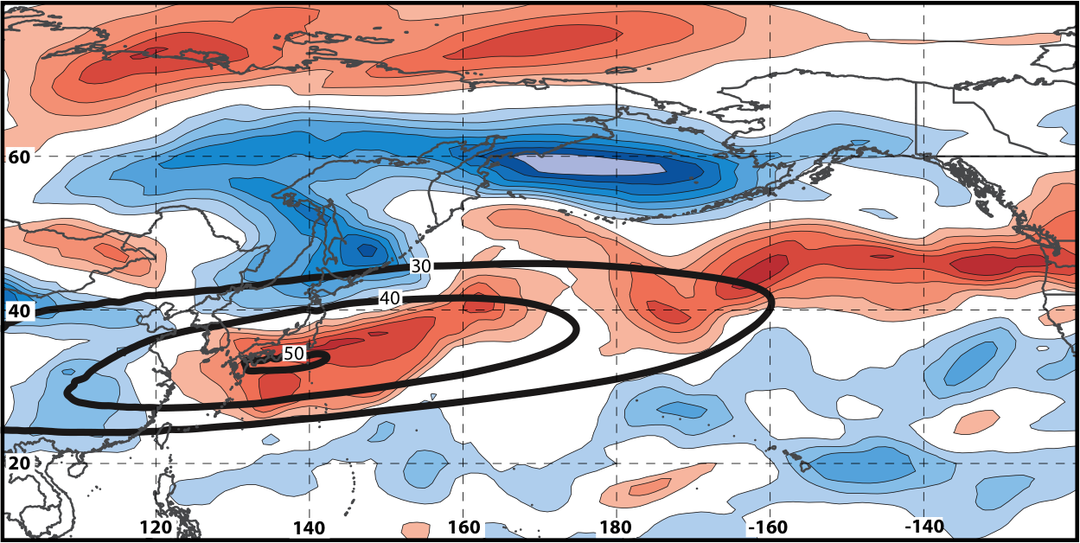
Real Time North Pacific Jet Phase Diagram
250-hPa zonal wind at 0000 UTC 2 Jun minus 250-hPa zonal wind at 0000 UTC 24 May (shading) in the GFS analyses shows the transition to a poleward-shifted jet regime
0000 UTC 24 May
(0-h forecast)
0000 UTC 2 Jun (verification)
Ensemble mean
Sept.–May mean 250-hPa zonal wind: black contours
Notes:
Note that the positive changes in zonal wind correspond exactly to where the positive anomalies are located in the EOF2 pattern – See slide 14.

Slide 93
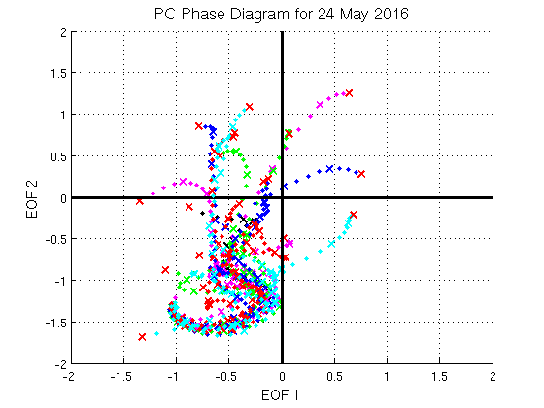


GEFS Ensemble Trajectories Initialized 0000 UTC 24 May 2016
250-hPa Zonal Wind Anomalies and EOF1: 0000 UTC 2 Jun
0000 UTC 2 Jun (verification)
m s^{–1}
250-hPa Zonal Wind Anomalies and EOF2: 0000 UTC 2 Jun
250-hPa zonal wind anomalies at 0000 UTC 2 Jun project strongly onto
EOF2 > 0
m s^{–1}

