Slide 1
Regime-Dependent Predictability of Extreme Weather Events: Representative Cases
Lance F. Bosart, Andrew C. Winters, and Daniel Keyser
Department of Atmospheric and Environmental Sciences
University at Albany, State University of New York, Albany, NY 12222
41st NWA Annual Meeting
Norfolk, VA
12–15 September 2016

Slide 2
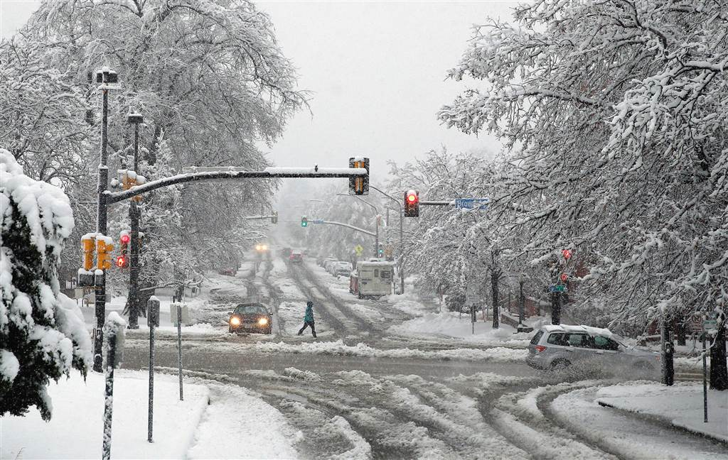
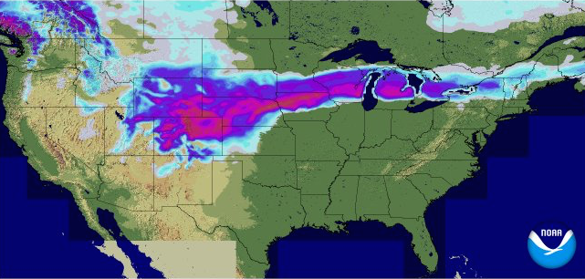

A particularly active weather pattern characterized the CONUS during 20 March – 4 April 2016
23–24 March 2016 Colorado Snowstorm
> 30 cm (1 ft) of snow in many locations along the front range
Hundreds of flights cancelled at DIA
Temperatures exceeded 20ºC the day prior to the snowstorm
Notable forecast uncertainty characterized the event
AP
24-h accumulated snow ending 0600 UTC 24 March 2016
0.1
1
3
5
15
25
50
cm

Slide 3
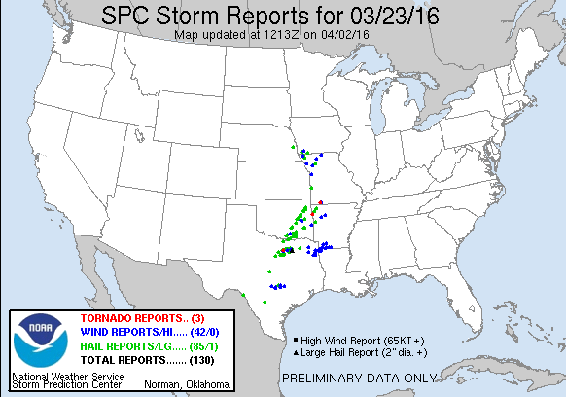
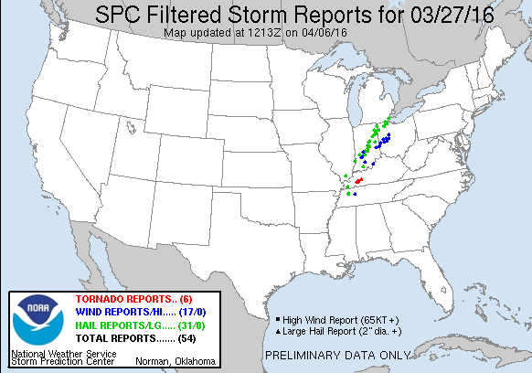
A particularly active weather pattern characterized the CONUS during 20 March – 4 April 2016
23 March and 27 March 2016 Severe Weather
184 combined severe weather reports to SPC on the two days
2 in. diameter hail reported near Dallas, TX, on 23 March
EF-2 tornado confirmed near Crofton, KY, on 27 March
A progressive synoptic flow pattern characterized both days

Slide 4
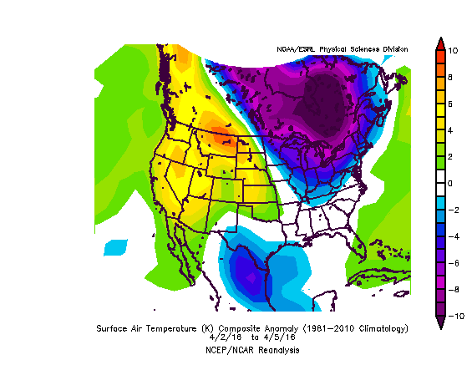
A particularly active weather pattern characterized the CONUS during 20 March – 4 April 2016
Late-March Omega Block and Early-April Northeast Cold
Omega block developed off the west coast during late March
Omega block facilitated the transport of well-below normal temperatures into the Northeast
6.4 in. of snow on 3–4 April accounted for 38% of the winter 2015–2016 snowfall (16.9 in.) in Albany, NY
500 hPa: 0000 UTC 30 March 2016
2–5 April 2016 Surface Temp. (ºC) Anomalies

Slide 5
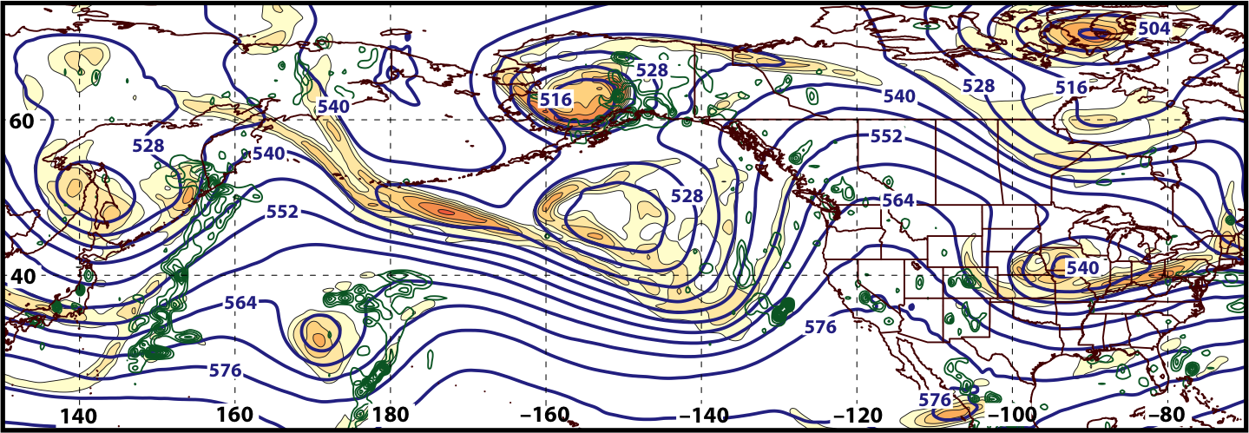
Synoptic Evolution: 20 March – 4 April 2016
0000 UTC 20 March 2016
500 hPa Heights (dam; blue)
500 hPa Rel. Vor. (10^{–5} s^{–1} fill pattern)
500 hPa Ascent (dPa s^{–1}; green)

Slide 6
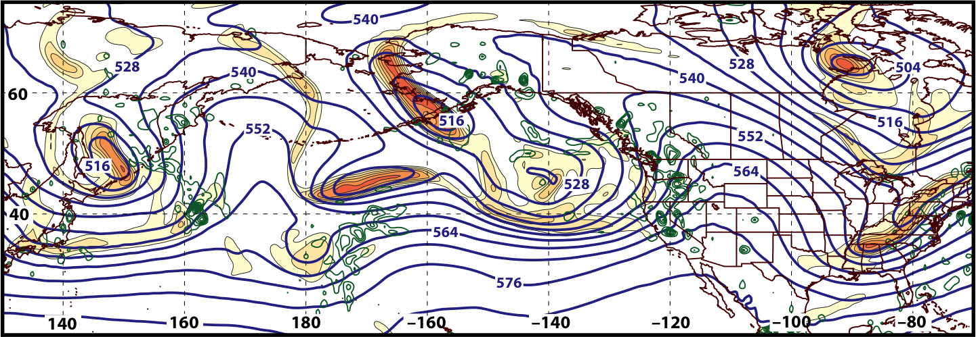
Synoptic Evolution: 20 March – 4 April 2016
0000 UTC 21 March 2016
500 hPa Heights (dam; blue)
500 hPa Rel. Vor. (10^{–5} s^{–1} fill pattern)
500 hPa Ascent (dPa s^{–1}; green)

Slide 7
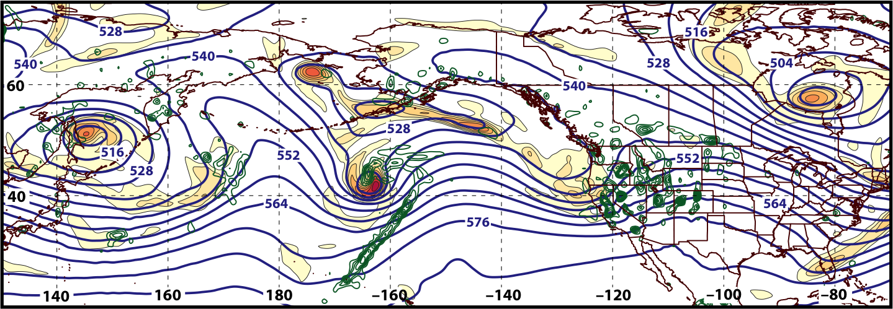
Synoptic Evolution: 20 March – 4 April 2016
0000 UTC 22 March 2016
500 hPa Heights (dam; blue)
500 hPa Rel. Vor. (10^{–5} s^{–1} fill pattern)
500 hPa Ascent (dPa s^{–1}; green)

Slide 8
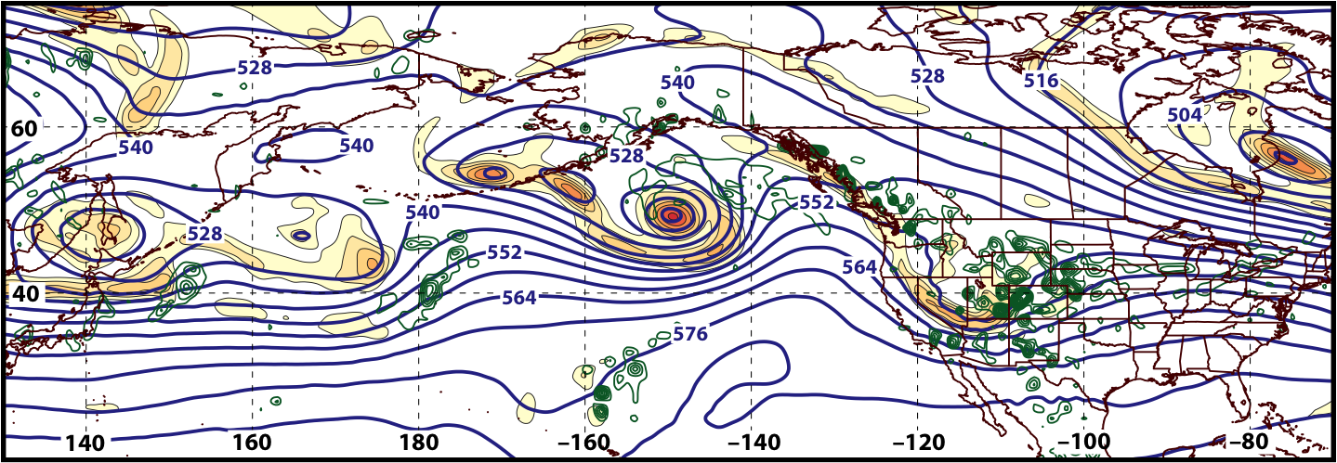
Synoptic Evolution: 20 March – 4 April 2016
0000 UTC 23 March 2016
500 hPa Heights (dam; blue)
500 hPa Rel. Vor. (10^{–5} s^{–1} fill pattern)
500 hPa Ascent (dPa s^{–1}; green)

Slide 9
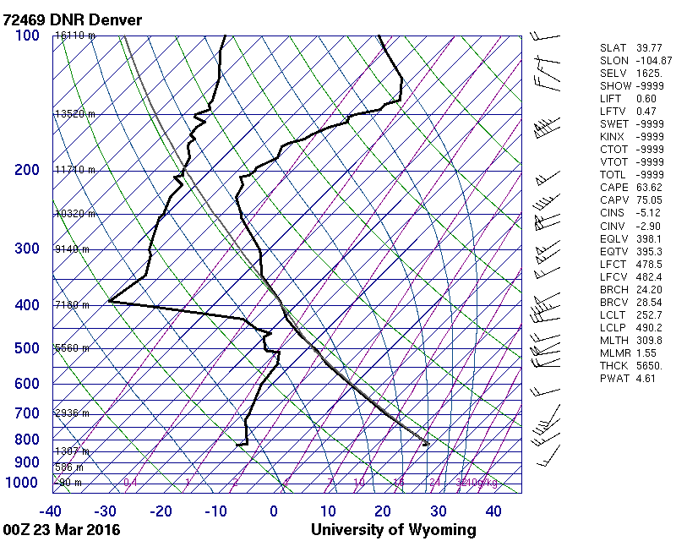
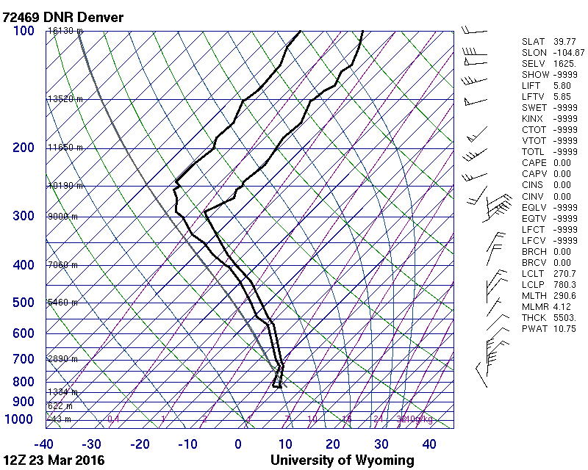
23–24 March 2016 Colorado Snowstorm
0000 UTC 23 March 2016
1200 UTC 23 March 2016

Slide 10
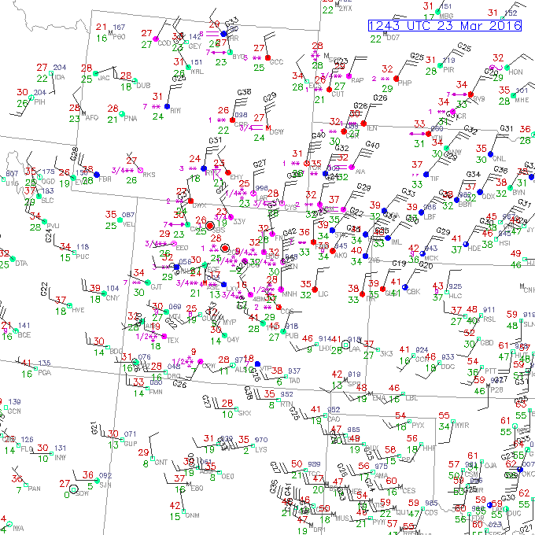
23–24 March 2016 Colorado Snowstorm
Surface
Observations:
1243 UTC
23 March 2016

Slide 11
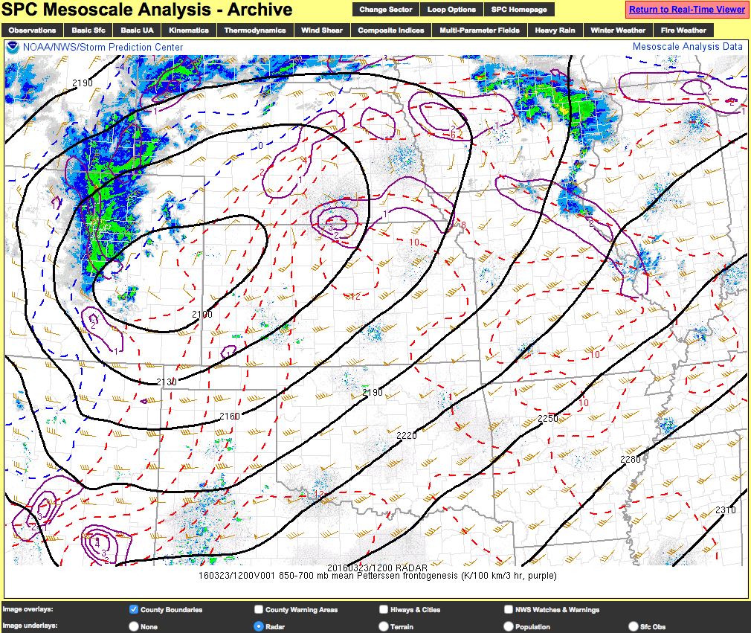
23–24 March 2016 Colorado Snowstorm
SPC Mesoanalysis:
1200 UTC
23 March 2016

Slide 12
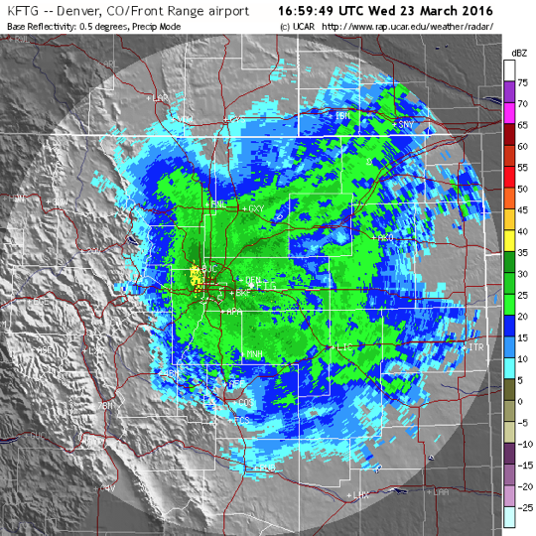
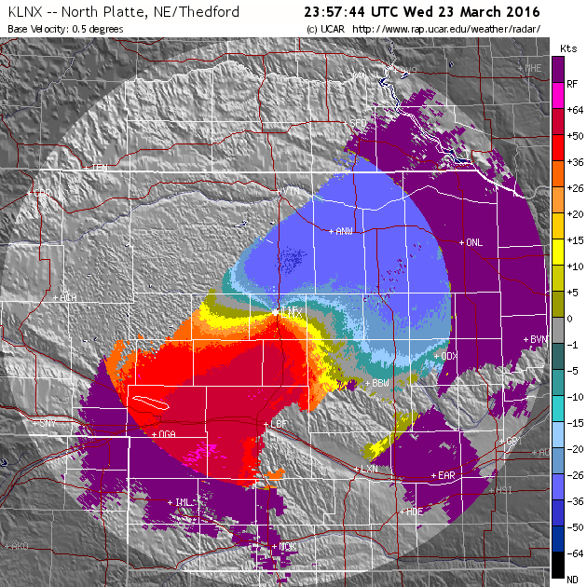
23–24 March 2016 Colorado Snowstorm
1700 UTC 23 March 2016
2357 UTC 23 March 2016
Base Reflectivity (KFTG)
Base Velocity (KLNX)

Slide 13
GFS DeterministicForecasts Verifying 1200 UTC 23 March 2016
500 hPa:
= 552 dam
850 hPa:
= 132 dam
800–700 hPa:
= 2×10^{–4} K s^{–1}
500 hPa:
= –1 Pa s^{–1}

Slide 14
GFS DeterministicForecasts Verifying 1200 UTC 23 March 2016
500 hPa: = 552 dam
850 hPa: = 132 dam
800–700 hPa: = 2×10^{–4} K s^{–1}
500 hPa: = –1 Pa s^{–1}

Slide 15
GFS DeterministicForecasts Verifying 1200 UTC 23 March 2016
500 hPa: = 552 dam
850 hPa: = 132 dam
800–700 hPa: = 2×10^{–4} K s^{–1}
500 hPa: = –1 Pa s^{–1}

Slide 16
GFS DeterministicForecasts Verifying 1200 UTC 23 March 2016
500 hPa: = 552 dam
850 hPa: = 132 dam
800–700 hPa: = 2×10^{–4} K s^{–1}
500 hPa: = –1 Pa s^{–1}

Slide 17
GFS DeterministicForecasts Verifying 1200 UTC 23 March 2016
500 hPa: = 552 dam
850 hPa: = 132 dam
800–700 hPa: = 2×10^{–4} K s^{–1}
500 hPa: = –1 Pa s^{–1}

Slide 18
GFS DeterministicForecasts Verifying 1200 UTC 23 March 2016
500 hPa: = 552 dam
850 hPa: = 132 dam
800–700 hPa: = 2×10^{–4} K s^{–1}
500 hPa: = –1 Pa s^{–1}

Slide 19
GFS DeterministicForecasts Verifying 1200 UTC 23 March 2016
500 hPa: = 552 dam
850 hPa: = 132 dam
800–700 hPa: = 2×10^{–4} K s^{–1}
500 hPa: = –1 Pa s^{–1}

Slide 20
GFS DeterministicForecasts Verifying 1200 UTC 23 March 2016
500 hPa: = 552 dam
850 hPa: = 132 dam
800–700 hPa: = 2×10^{–4} K s^{–1}
500 hPa: = –1 Pa s^{–1}

Slide 21
GFS DeterministicForecasts Verifying 1200 UTC 23 March 2016
500 hPa: = 552 dam
850 hPa: = 132 dam
800–700 hPa: = 2×10^{–4} K s^{–1}
500 hPa: = –1 Pa s^{–1}

Slide 22
GFS DeterministicForecasts Verifying 1200 UTC 23 March 2016
500 hPa: = 552 dam
850 hPa: = 132 dam
800–700 hPa: = 2×10^{–4} K s^{–1}
500 hPa: = –1 Pa s^{–1}

Slide 23
GFS DeterministicForecasts Verifying 1200 UTC 23 March 2016
500 hPa: = 552 dam
850 hPa: = 132 dam
800–700 hPa: = 2×10^{–4} K s^{–1}
500 hPa: = –1 Pa s^{–1}

Slide 24
GFS DeterministicForecasts Verifying 1200 UTC 23 March 2016
500 hPa: = 552 dam
850 hPa: = 132 dam
800–700 hPa: = 2×10^{–4} K s^{–1}
500 hPa: = –1 Pa s^{–1}

Slide 25
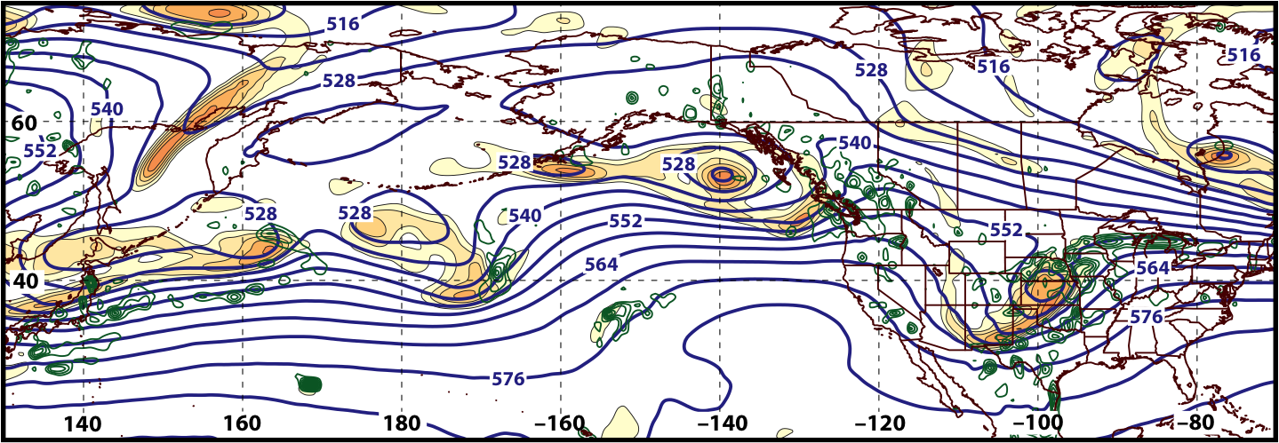
Synoptic Evolution: 20 March – 4 April 2016
0000 UTC 24 March 2016
500 hPa Heights (dam; blue)
500 hPa Rel. Vor. (10^{–5} s^{–1} fill pattern)
500 hPa Ascent (dPa s^{–1}; green)

Slide 26
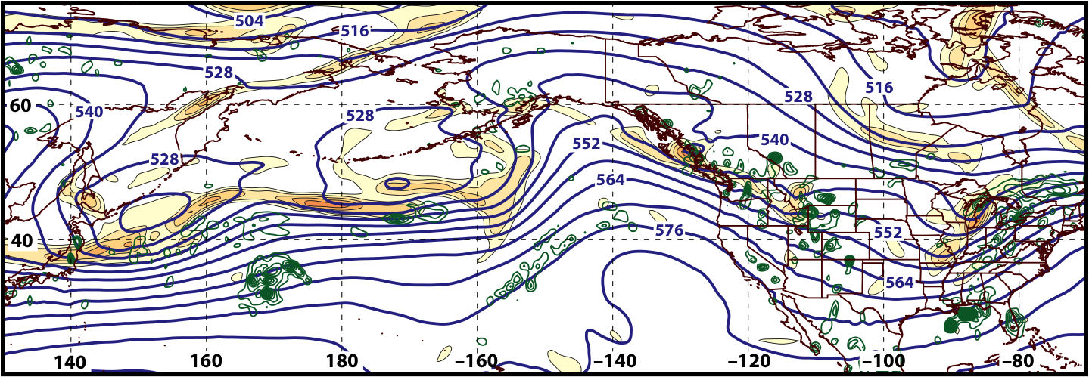
Synoptic Evolution: 20 March – 4 April 2016
0000 UTC 25 March 2016
500 hPa Heights (dam; blue)
500 hPa Rel. Vor. (10^{–5} s^{–1} fill pattern)
500 hPa Ascent (dPa s^{–1}; green)

Slide 27
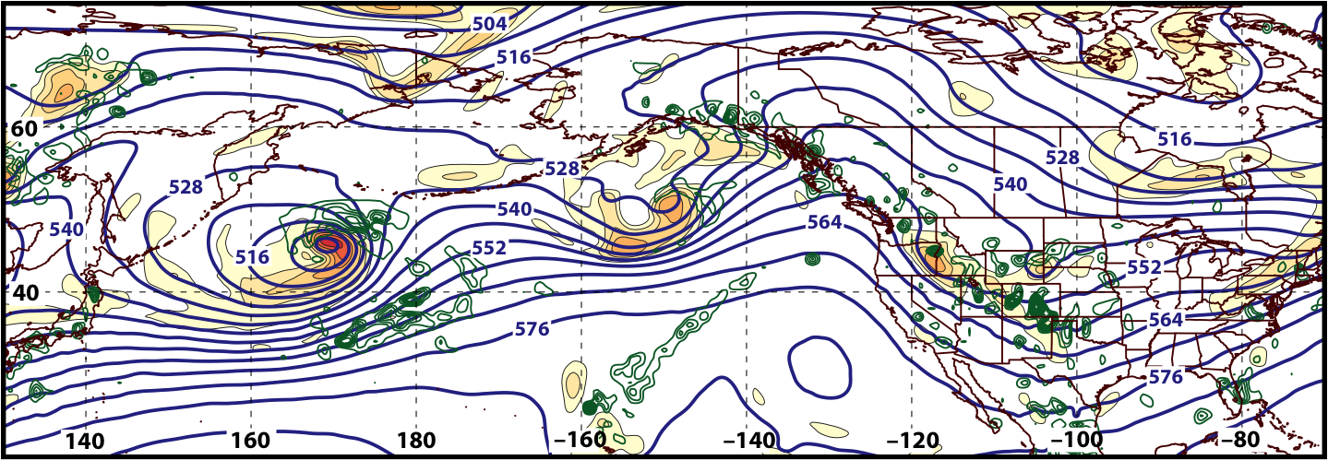
Synoptic Evolution: 20 March – 4 April 2016
0000 UTC 26 March 2016
500 hPa Heights (dam; blue)
500 hPa Rel. Vor. (10^{–5} s^{–1} fill pattern)
500 hPa Ascent (dPa s^{–1}; green)

Slide 28
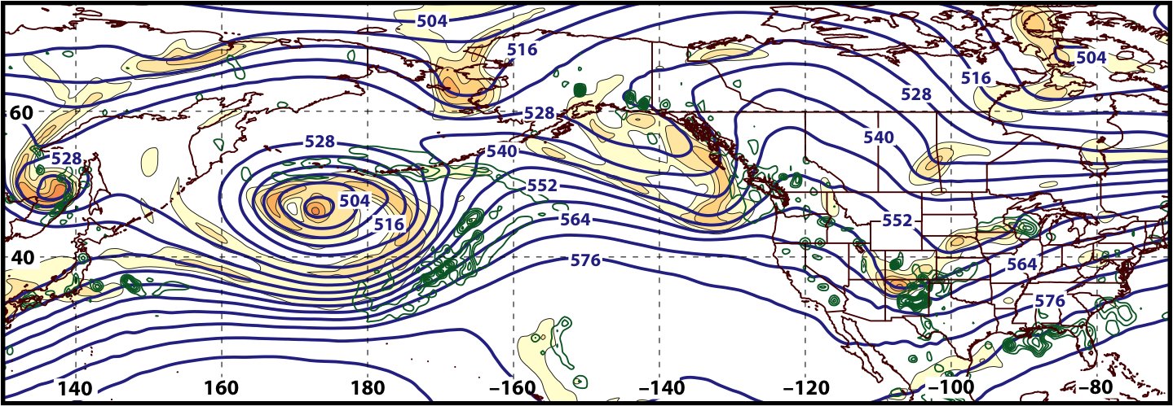
Synoptic Evolution: 20 March – 4 April 2016
0000 UTC 27 March 2016
500 hPa Heights (dam; blue)
500 hPa Rel. Vor. (10^{–5} s^{–1} fill pattern)
500 hPa Ascent (dPa s^{–1}; green)

Slide 29
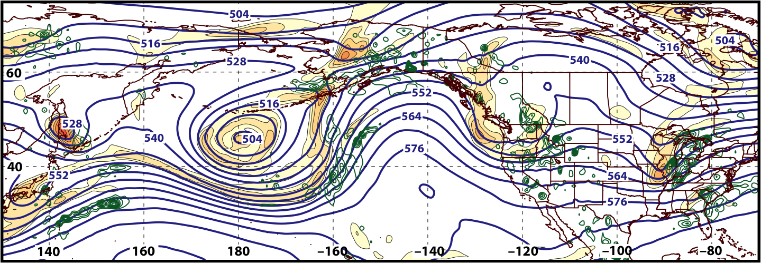
Synoptic Evolution: 20 March – 4 April 2016
0000 UTC 28 March 2016
500 hPa Heights (dam; blue)
500 hPa Rel. Vor. (10^{–5} s^{–1} fill pattern)
500 hPa Ascent (dPa s^{–1}; green)

Slide 30
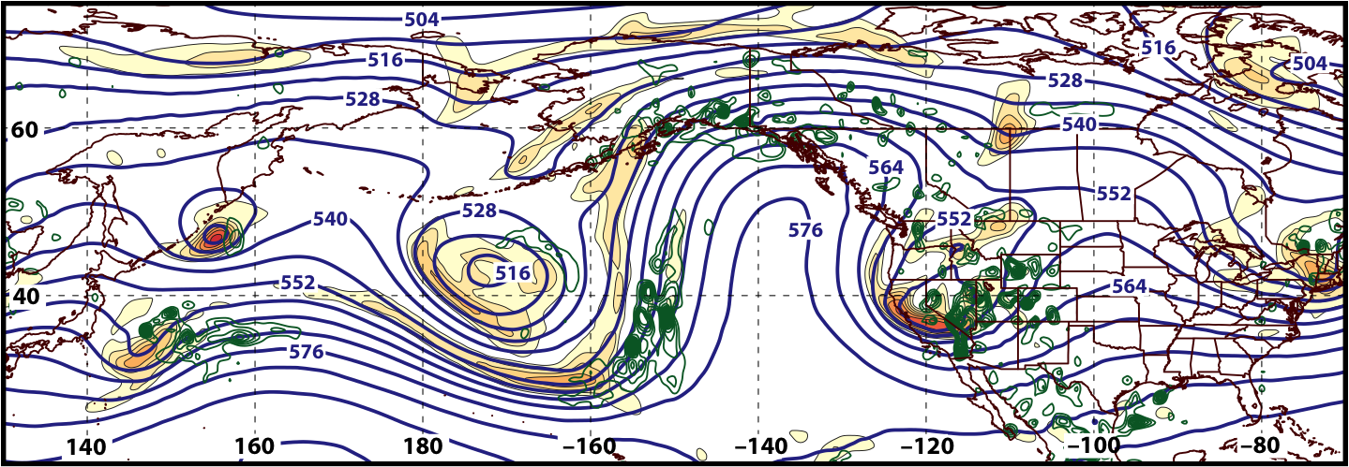
Synoptic Evolution: 20 March – 4 April 2016
0000 UTC 29 March 2016
500 hPa Heights (dam; blue)
500 hPa Rel. Vor. (10^{–5} s^{–1} fill pattern)
500 hPa Ascent (dPa s^{–1}; green)

Slide 31
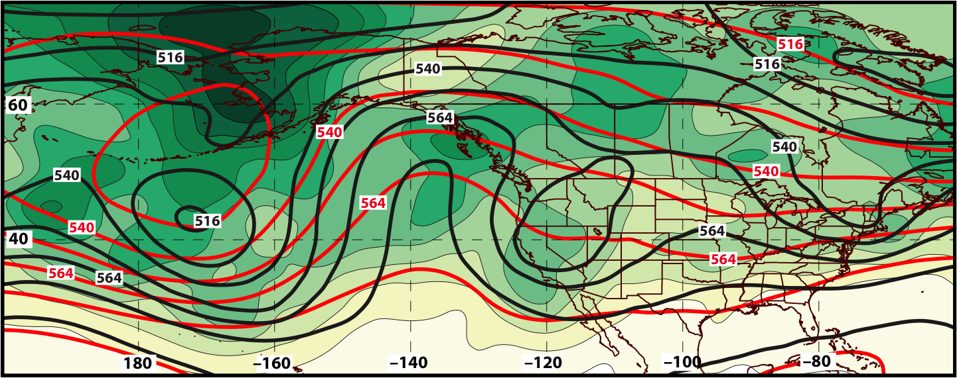
GEFS Ensemble Spread of Geo. Heights (m) Verifying 0000 UTC 29 March 2016
240-h Forecast
500 hPa
Ens. Spread:
Ens. Mean Geo. Heights
Observed Geo. Heights

Slide 32
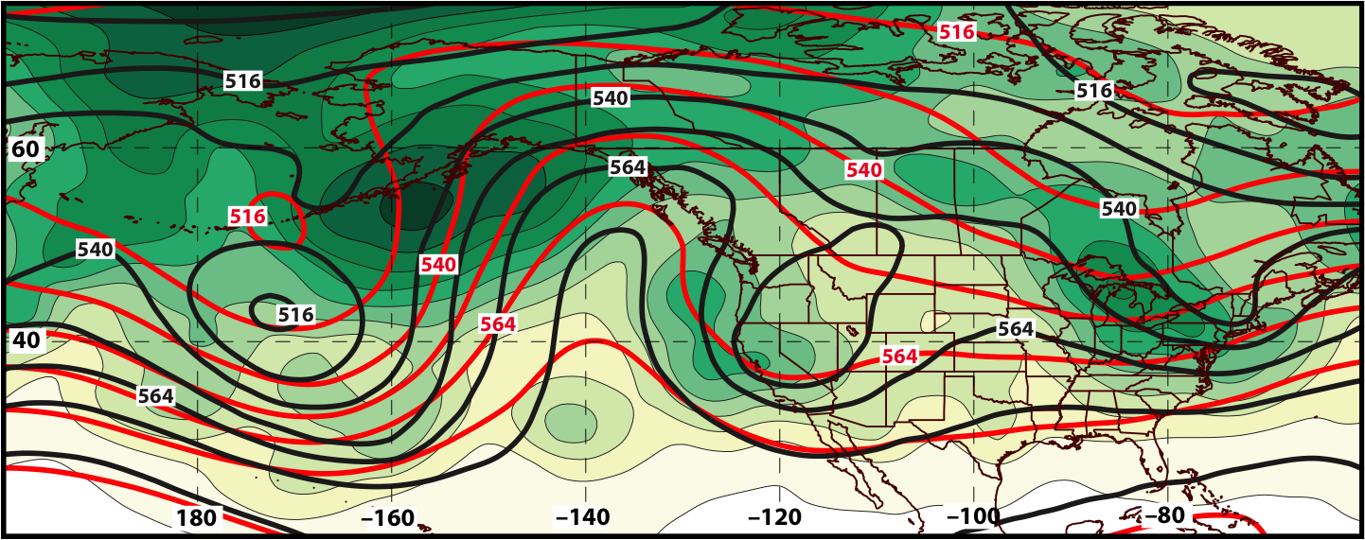
GEFS Ensemble Spread of Geo. Heights (m) Verifying 0000 UTC 29 March 2016
216-h Forecast
500 hPa
Ens. Spread:
Ens. Mean Geo. Heights
Observed Geo. Heights

Slide 33
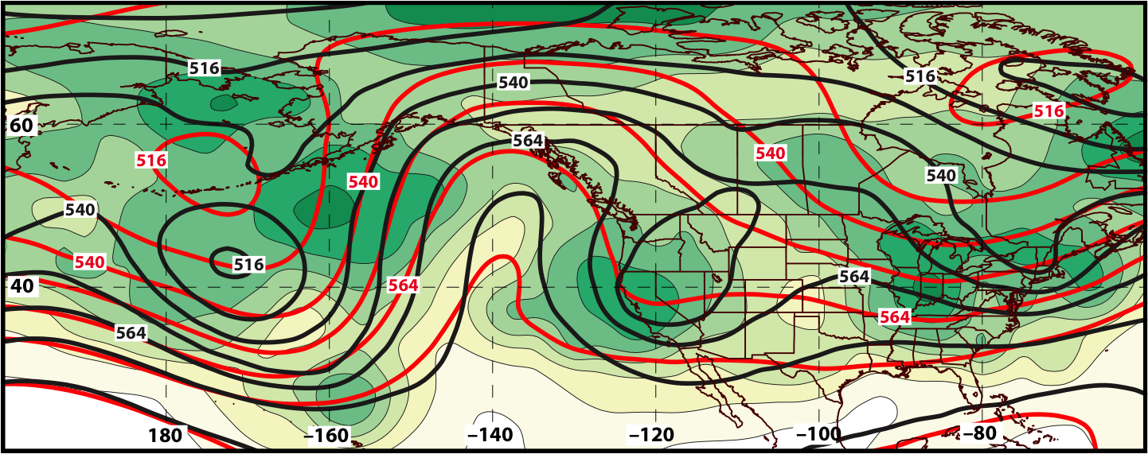
GEFS Ensemble Spread of Geo. Heights (m) Verifying 0000 UTC 29 March 2016
192-h Forecast
500 hPa
Ens. Spread:
Ens. Mean Geo. Heights
Observed Geo. Heights

Slide 34
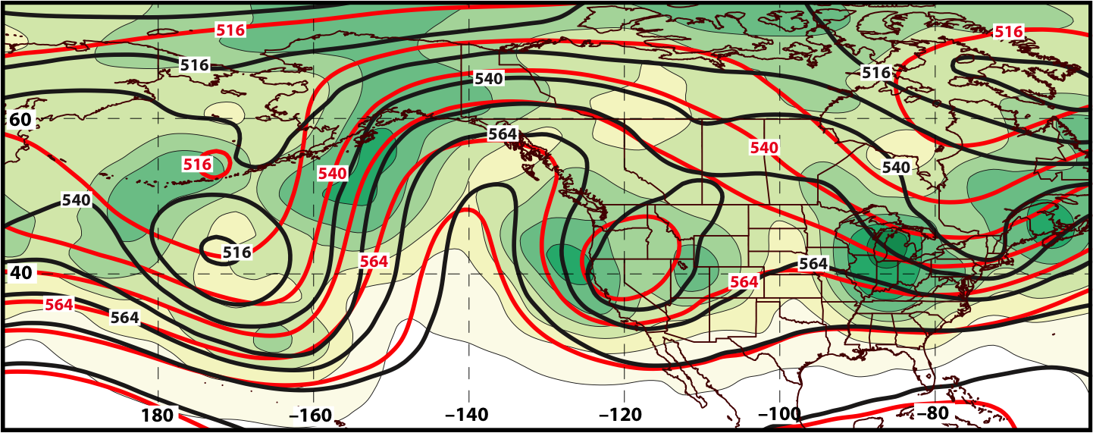
GEFS Ensemble Spread of Geo. Heights (m) Verifying 0000 UTC 29 March 2016
168-h Forecast
500 hPa
Ens. Spread:
Ens. Mean Geo. Heights
Observed Geo. Heights

Slide 35
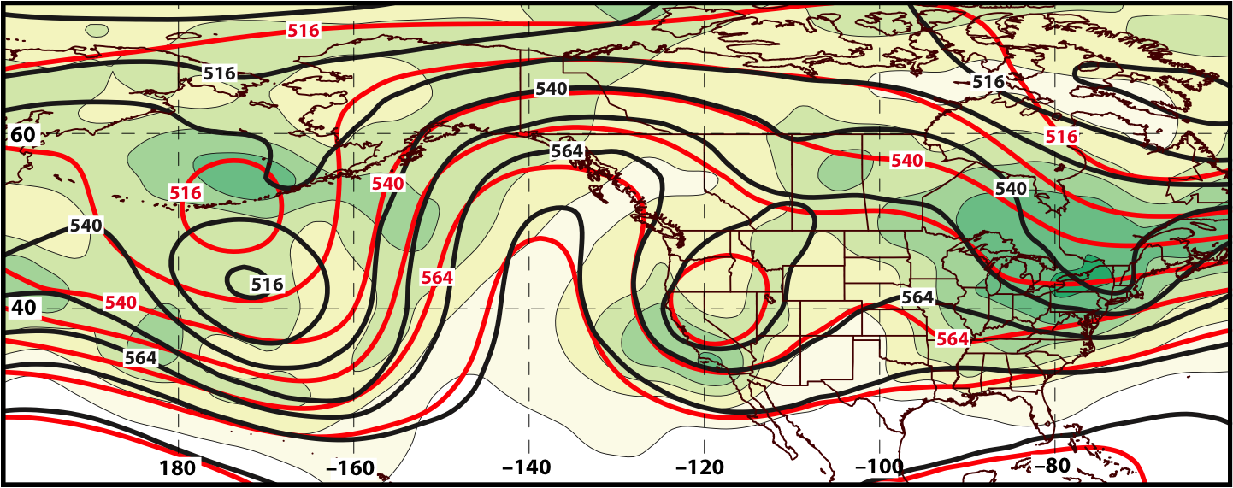
GEFS Ensemble Spread of Geo. Heights (m) Verifying 0000 UTC 29 March 2016
144-h Forecast
500 hPa
Ens. Spread:
Ens. Mean Geo. Heights
Observed Geo. Heights

Slide 36
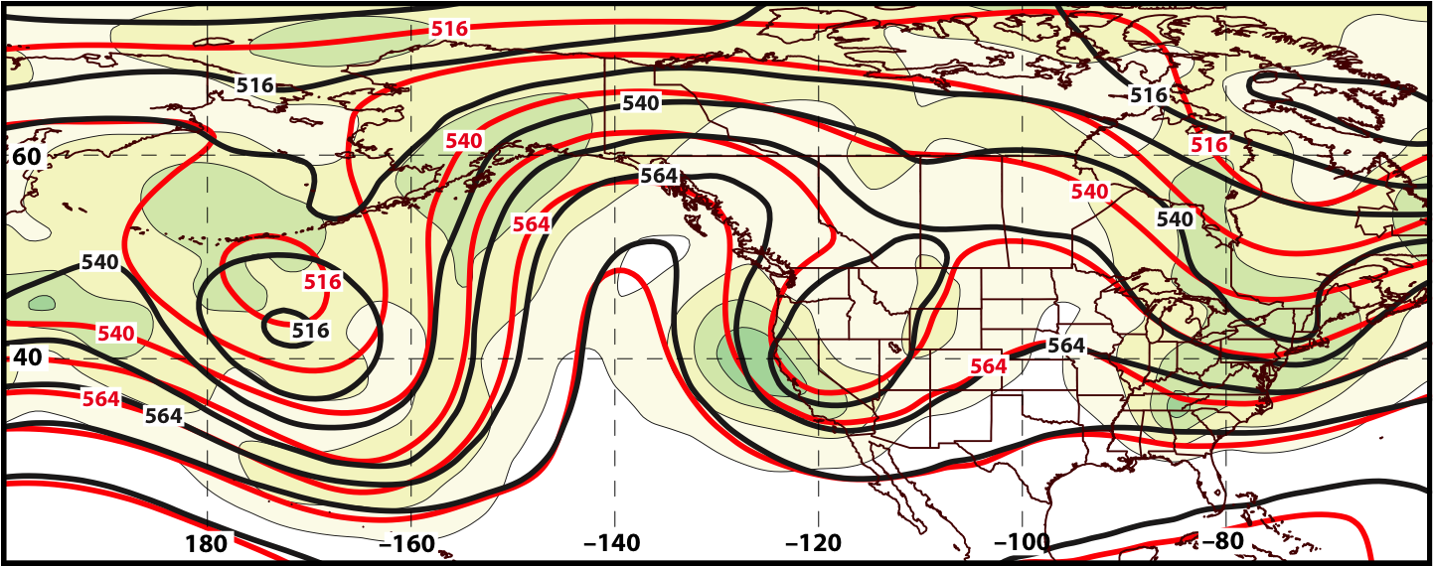
GEFS Ensemble Spread of Geo. Heights (m) Verifying 0000 UTC 29 March 2016
120-h Forecast
500 hPa
Ens. Spread:
Ens. Mean Geo. Heights
Observed Geo. Heights

Slide 37
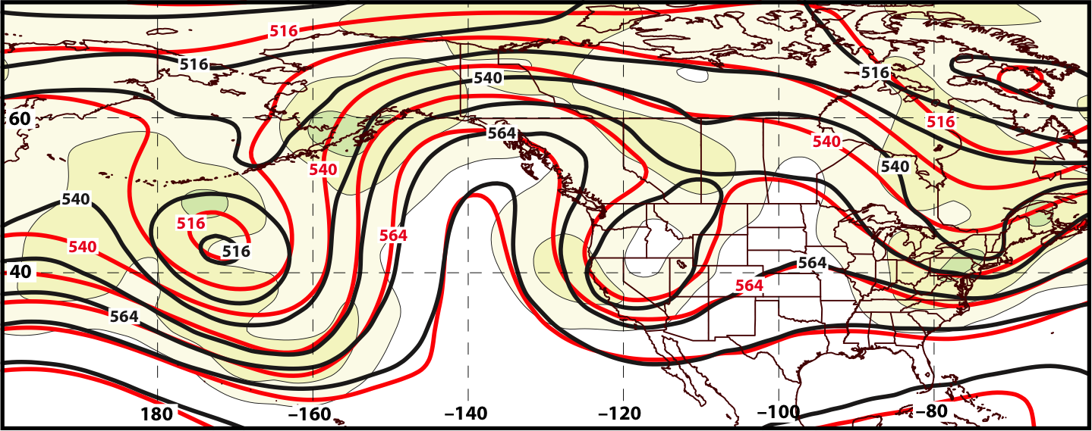
GEFS Ensemble Spread of Geo. Heights (m) Verifying 0000 UTC 29 March 2016
96-h Forecast
500 hPa
Ens. Spread:
Ens. Mean Geo. Heights
Observed Geo. Heights

Slide 38
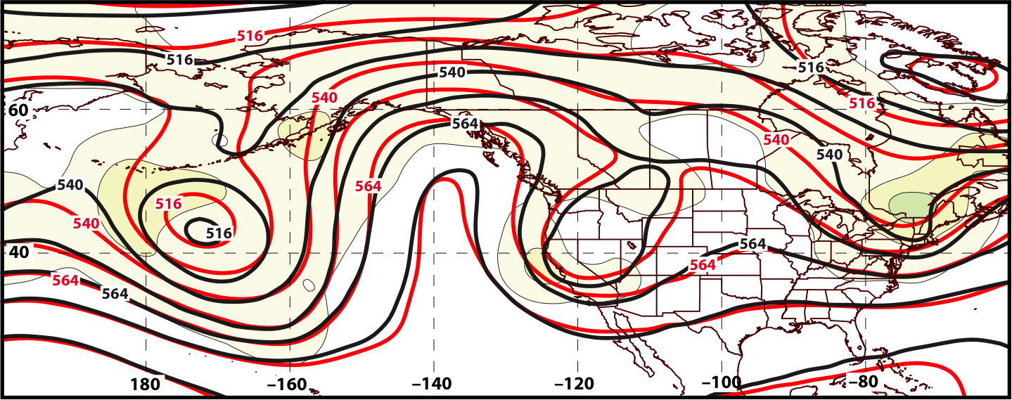
GEFS Ensemble Spread of Geo. Heights (m) Verifying 0000 UTC 29 March 2016
72-h Forecast
500 hPa
Ens. Spread:
Ens. Mean Geo. Heights
Observed Geo. Heights

Slide 39
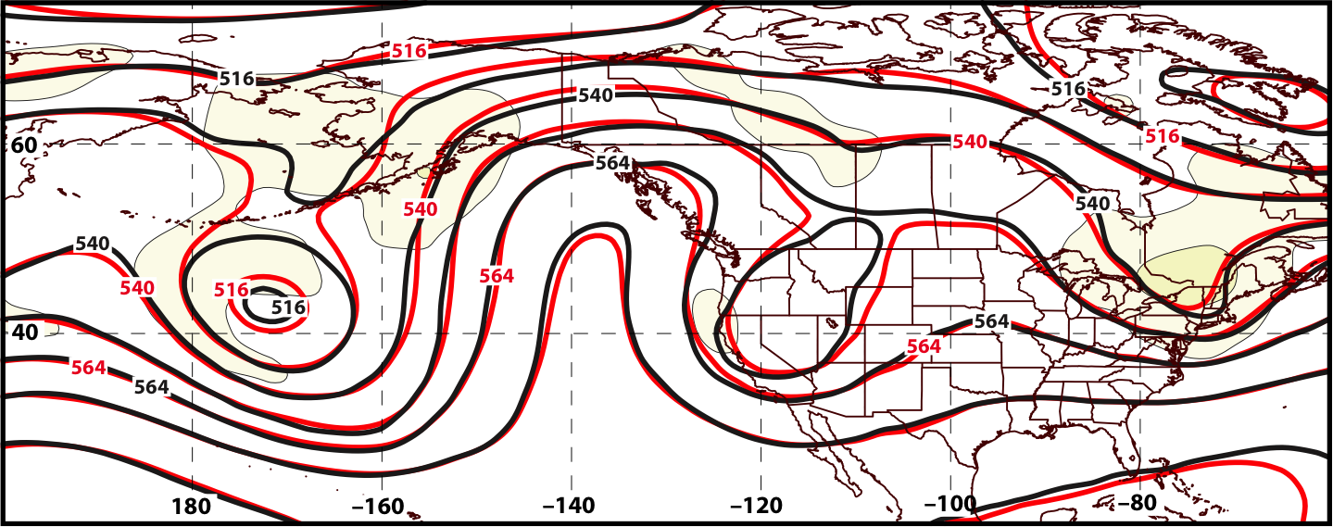
GEFS Ensemble Spread of Geo. Heights (m) Verifying 0000 UTC 29 March 2016
48-h Forecast
500 hPa
Ens. Spread:
Ens. Mean Geo. Heights
Observed Geo. Heights

Slide 40
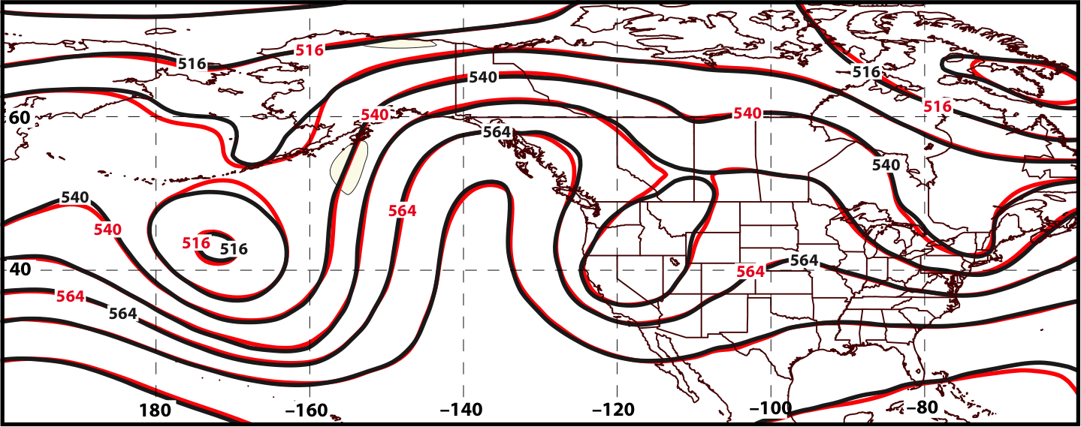
GEFS Ensemble Spread of Geo. Heights (m) Verifying 0000 UTC 29 March 2016
24-h Forecast
500 hPa
Ens. Spread:
Ens. Mean Geo. Heights
Observed Geo. Heights

Slide 41
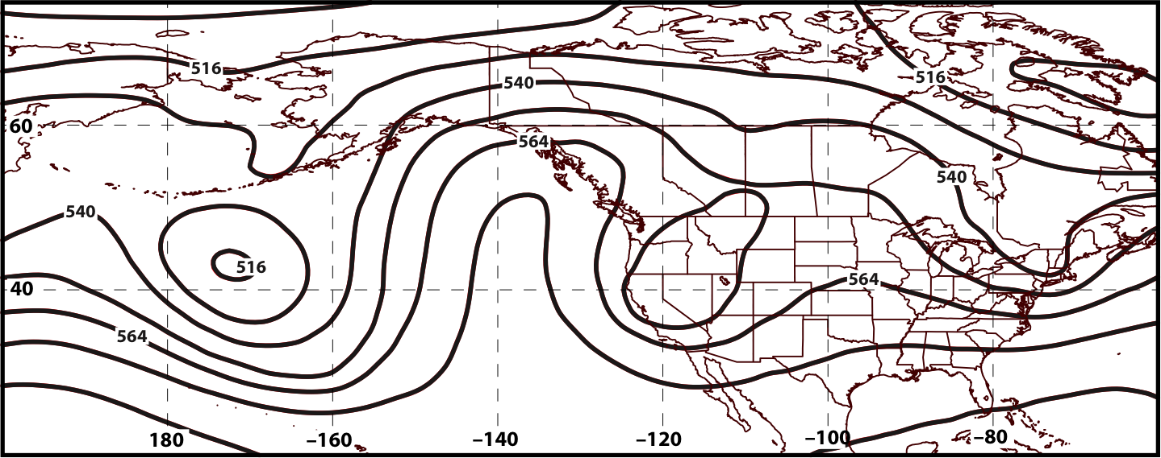
GEFS Ensemble Spread of Geo. Heights (m) Verifying 0000 UTC 29 March 2016
00-h Forecast
500 hPa
Ens. Spread:
Ens. Mean Geo. Heights
Observed Geo. Heights

Slide 42
Synoptic Evolution: 20 March – 4 April 2016
0000 UTC 29 March 2016
500 hPa Heights (dam; blue)
500 hPa Rel. Vor. (10^{–5} s^{–1} fill pattern)
500 hPa Ascent (dPa s^{–1}; green)

Slide 43
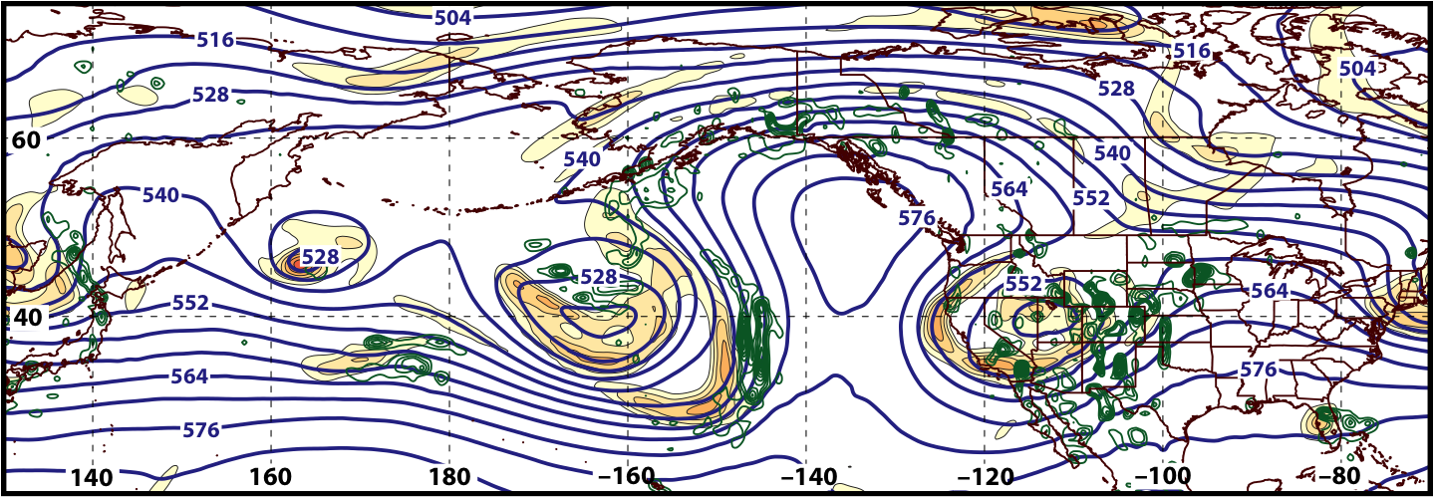
Synoptic Evolution: 20 March – 4 April 2016
0000 UTC 30 March 2016
500 hPa Heights (dam; blue)
500 hPa Rel. Vor. (10^{–5} s^{–1} fill pattern)
500 hPa Ascent (dPa s^{–1}; green)

Slide 44
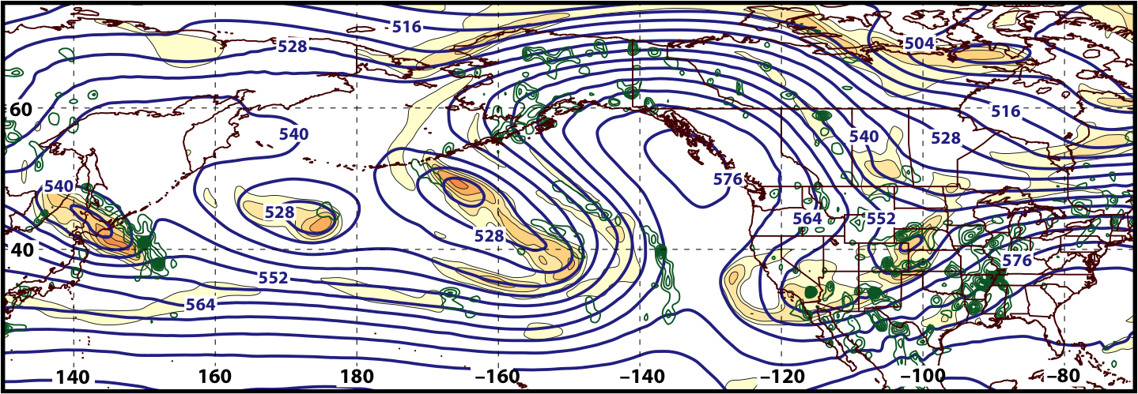
Synoptic Evolution: 20 March – 4 April 2016
0000 UTC 31 March 2016
500 hPa Heights (dam; blue)
500 hPa Rel. Vor. (10^{–5} s^{–1} fill pattern)
500 hPa Ascent (dPa s^{–1}; green)

Slide 45
E. Rockies – All Events
COLD EVENTS (n = 173)
Poleward Shift
23
Events during
Sept. – May projected onto phase diagram
30
Jet Retraction
47
Jet Extension
Each point is an average of the PCs for
3–7 days prior to an event
73
Equatorward Shift

Slide 46
Synoptic Evolution: 20 March – 4 April 2016
0000 UTC 31 March 2016
500 hPa Heights (dam; blue)
500 hPa Rel. Vor. (10^{–5} s^{–1} fill pattern)
500 hPa Ascent (dPa s^{–1}; green)

Slide 47
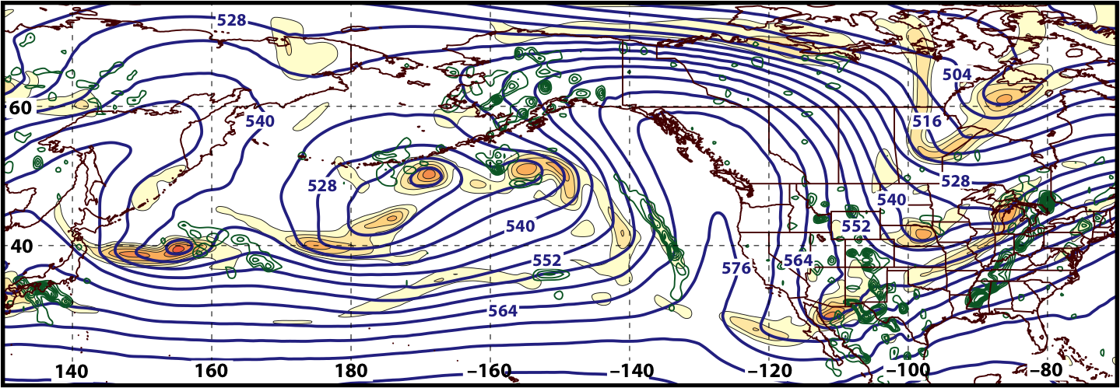
Synoptic Evolution: 20 March – 4 April 2016
0000 UTC 1 April 2016
500 hPa Heights (dam; blue)
500 hPa Rel. Vor. (10^{–5} s^{–1} fill pattern)
500 hPa Ascent (dPa s^{–1}; green)

Slide 48
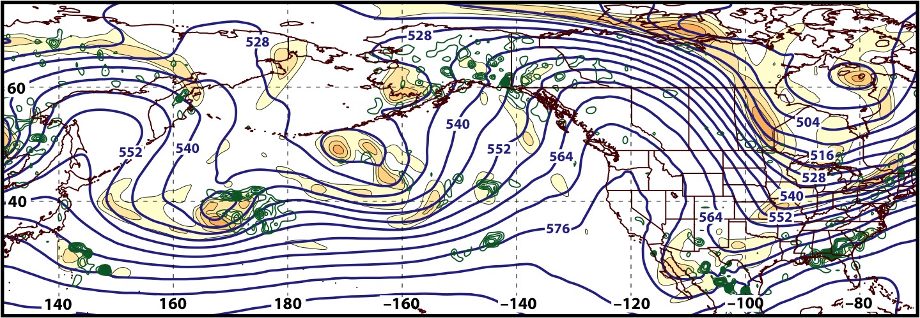
Synoptic Evolution: 20 March – 4 April 2016
0000 UTC 2 April 2016
500 hPa Heights (dam; blue)
500 hPa Rel. Vor. (10^{–5} s^{–1} fill pattern)
500 hPa Ascent (dPa s^{–1}; green)

Slide 49
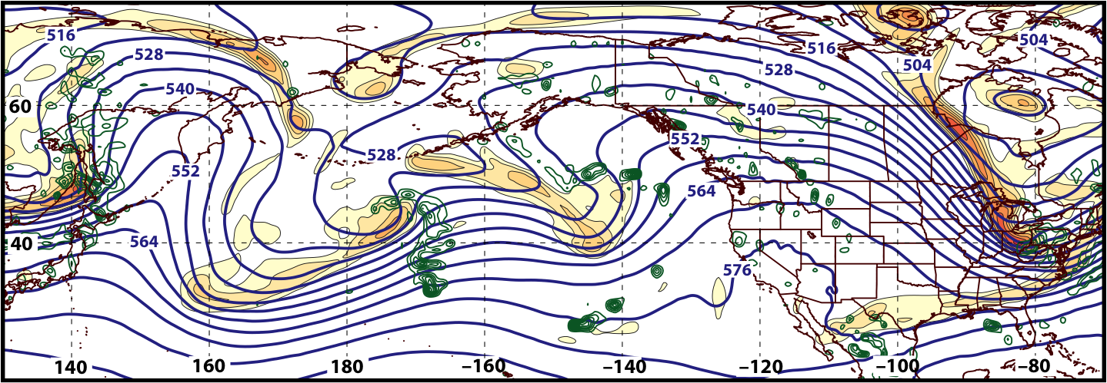
Synoptic Evolution: 20 March – 4 April 2016
0000 UTC 3 April 2016
500 hPa Heights (dam; blue)
500 hPa Rel. Vor. (10^{–5} s^{–1} fill pattern)
500 hPa Ascent (dPa s^{–1}; green)

Slide 50
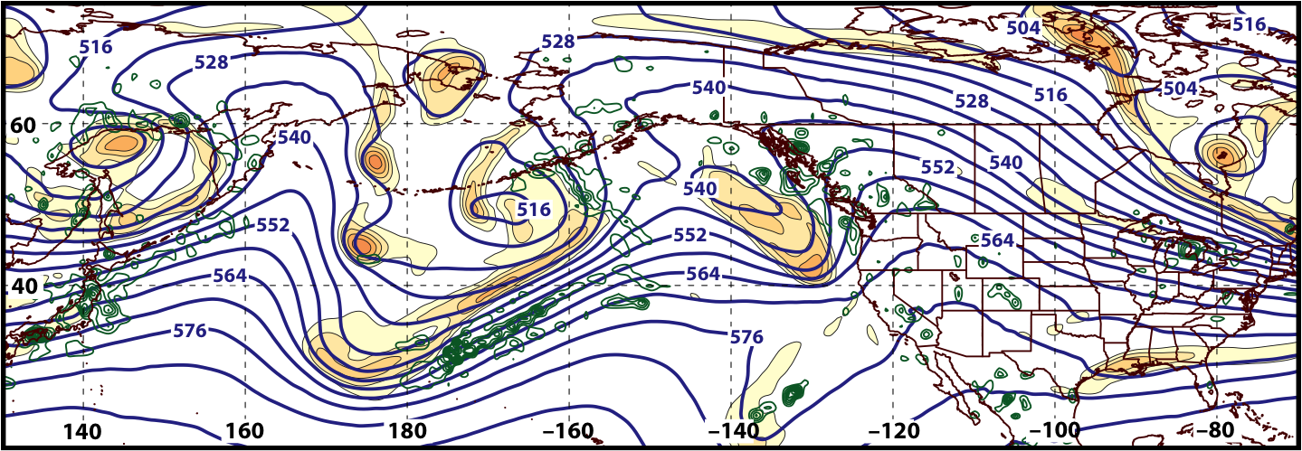
Synoptic Evolution: 20 March – 4 April 2016
0000 UTC 4 April 2016
500 hPa Heights (dam; blue)
500 hPa Rel. Vor. (10^{–5} s^{–1} fill pattern)
500 hPa Ascent (dPa s^{–1}; green)

Slide 51
Summary
Considerable predictability challenges characterized the development of the 23–24 March 2016 Colorado snowstorm during the hours immediately preceding the event.
The development of an omega block over the eastern North Pacific on 0000 UTC 29 March 2016 was relatively well predicted, although the geometry of the block was uncertain until 120 h prior to block development.
The evolution of the flow pattern prior to the onset of cold over the Northeast in early April is consistent with an antecedent environment conducive to extreme cold east of the Rocky Mountains.

Slide 52
Supplementary Slides

Slide 53
GFS DeterministicForecasts Verifying 1200 UTC 23 March 2016
500 hPa: = 552 dam
850 hPa: = 132 dam
850 hPa: = –10 m s^{–1}
500 hPa: = –1 Pa s^{–1}

Slide 54
GFS DeterministicForecasts Verifying 1200 UTC 23 March 2016
500 hPa: = 552 dam
850 hPa: = 132 dam
850 hPa: = –10 m s^{–1}
500 hPa: = –1 Pa s^{–1}

Slide 55
GFS DeterministicForecasts Verifying 1200 UTC 23 March 2016
500 hPa: = 552 dam
850 hPa: = 132 dam
850 hPa: = –10 m s^{–1}
500 hPa: = –1 Pa s^{–1}

Slide 56
GFS DeterministicForecasts Verifying 1200 UTC 23 March 2016
500 hPa: = 552 dam
850 hPa: = 132 dam
850 hPa: = –10 m s^{–1}
500 hPa: = –1 Pa s^{–1}

Slide 57
GFS DeterministicForecasts Verifying 1200 UTC 23 March 2016
500 hPa: = 552 dam
850 hPa: = 132 dam
850 hPa: = –10 m s^{–1}
500 hPa: = –1 Pa s^{–1}

Slide 58
GFS DeterministicForecasts Verifying 1200 UTC 23 March 2016
500 hPa: = 552 dam
850 hPa: = 132 dam
850 hPa: = –10 m s^{–1}
500 hPa: = –1 Pa s^{–1}

Slide 59
GFS DeterministicForecasts Verifying 1200 UTC 23 March 2016
500 hPa: = 552 dam
850 hPa: = 132 dam
850 hPa: = –10 m s^{–1}
500 hPa: = –1 Pa s^{–1}

Slide 60
GFS DeterministicForecasts Verifying 1200 UTC 23 March 2016
500 hPa: = 552 dam
850 hPa: = 132 dam
850 hPa: = –10 m s^{–1}
500 hPa: = –1 Pa s^{–1}

Slide 61
GFS DeterministicForecasts Verifying 1200 UTC 23 March 2016
500 hPa: = 552 dam
850 hPa: = 132 dam
850 hPa: = –10 m s^{–1}
500 hPa: = –1 Pa s^{–1}

Slide 62
GFS DeterministicForecasts Verifying 1200 UTC 23 March 2016
500 hPa: = 552 dam
850 hPa: = 132 dam
850 hPa: = –10 m s^{–1}
500 hPa: = –1 Pa s^{–1}

Slide 63
GFS DeterministicForecasts Verifying 1200 UTC 23 March 2016
500 hPa: = 552 dam
850 hPa: = 132 dam
850 hPa: = –10 m s^{–1}
500 hPa: = –1 Pa s^{–1}

Slide 64
GFS Deterministic Forecasts Verifying
0000 UTC 24 March 2016
500 hPa: = 552 dam

Slide 65
GFS Deterministic Forecasts Verifying
0000 UTC 24 March 2016
500 hPa: = 552 dam

Slide 66
GFS Deterministic Forecasts Verifying
0000 UTC 24 March 2016
500 hPa: = 552 dam

Slide 67
GFS Deterministic Forecasts Verifying
0000 UTC 24 March 2016
500 hPa: = 552 dam

Slide 68
GFS Deterministic Forecasts Verifying
0000 UTC 24 March 2016
500 hPa: = 552 dam

Slide 69
GFS Deterministic Forecasts Verifying
0000 UTC 24 March 2016
500 hPa: = 552 dam

Slide 70
GFS Deterministic Forecasts Verifying
0000 UTC 24 March 2016
500 hPa: = 552 dam

Slide 71
GFS Deterministic Forecasts Verifying
0000 UTC 24 March 2016
500 hPa: = 552 dam

Slide 72
GFS Deterministic Forecasts Verifying
0000 UTC 24 March 2016
500 hPa: = 552 dam

Slide 73
GFS Deterministic Forecasts Verifying
0000 UTC 24 March 2016
500 hPa: = 552 dam

Slide 74
GFS Deterministic Forecasts Verifying
0000 UTC 24 March 2016
500 hPa: = 552 dam

Slide 75
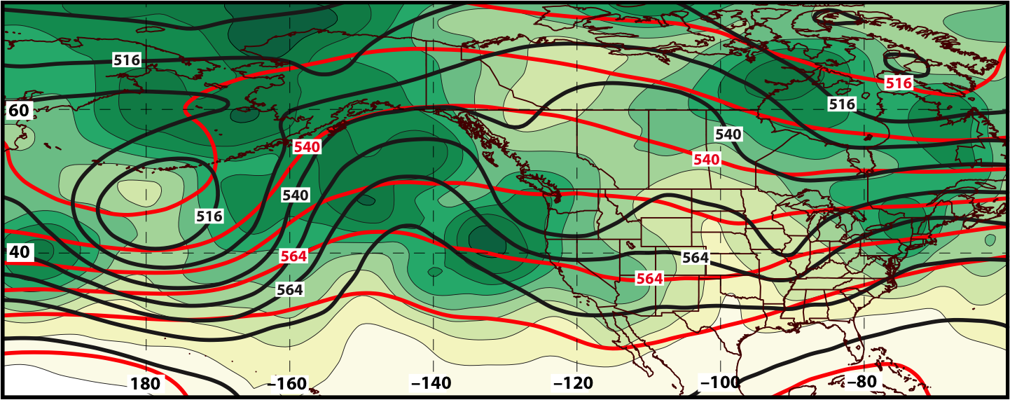
GEFS Ensemble Spread of Geo. Heights (m) Verifying 0000 UTC 28 March 2016
240-h Forecast
500 hPa
Ens. Spread:
Ens. Mean Geo. Heights
Observed Geo. Heights

Slide 76
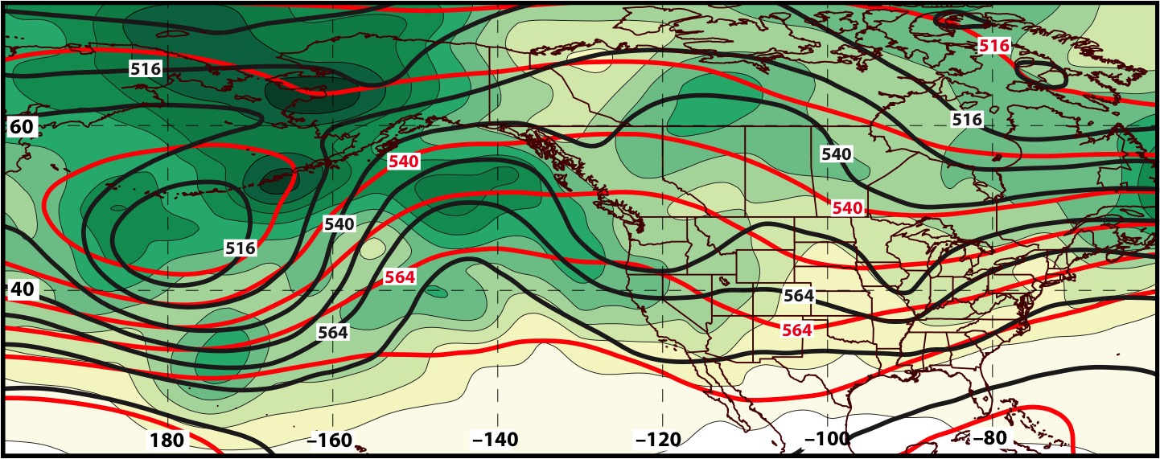
GEFS Ensemble Spread of Geo. Heights (m) Verifying 0000 UTC 28 March 2016
216-h Forecast
500 hPa
Ens. Spread:
Ens. Mean Geo. Heights
Observed Geo. Heights

Slide 77
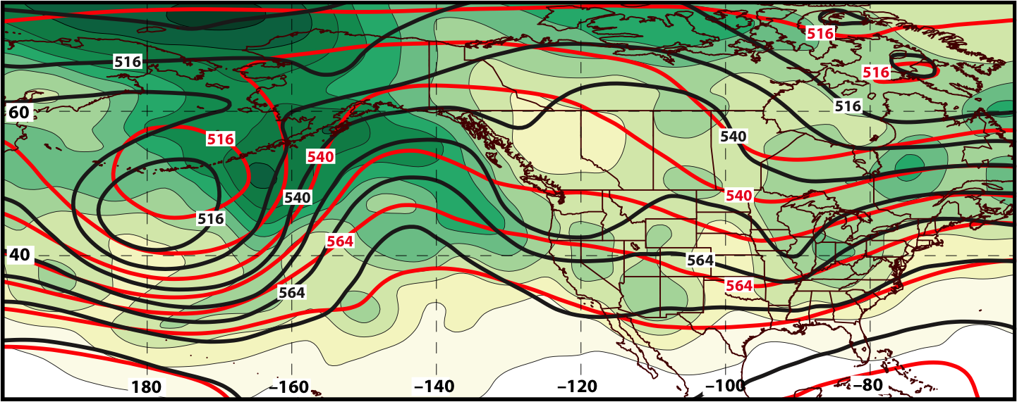
GEFS Ensemble Spread of Geo. Heights (m) Verifying 0000 UTC 28 March 2016
192-h Forecast
500 hPa
Ens. Spread:
Ens. Mean Geo. Heights
Observed Geo. Heights

Slide 78
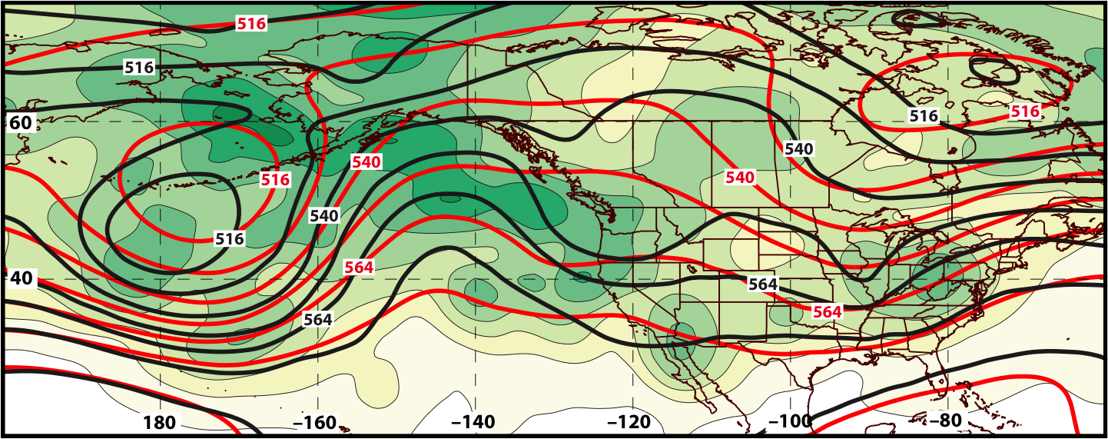
GEFS Ensemble Spread of Geo. Heights (m) Verifying 0000 UTC 28 March 2016
168-h Forecast
500 hPa
Ens. Spread:
Ens. Mean Geo. Heights
Observed Geo. Heights

Slide 79
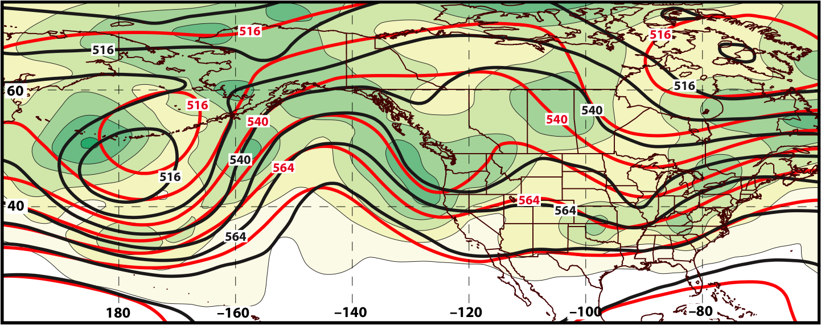
GEFS Ensemble Spread of Geo. Heights (m) Verifying 0000 UTC 28 March 2016
144-h Forecast
500 hPa
Ens. Spread:
Ens. Mean Geo. Heights
Observed Geo. Heights

Slide 80
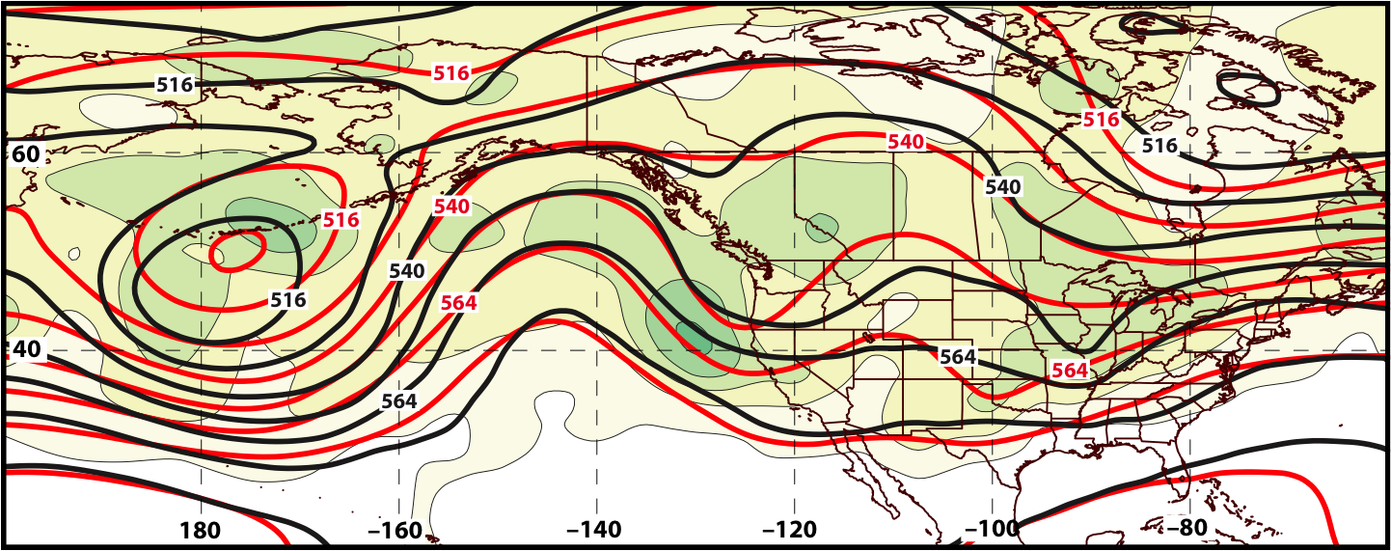
GEFS Ensemble Spread of Geo. Heights (m) Verifying 0000 UTC 28 March 2016
120-h Forecast
500 hPa
Ens. Spread:
Ens. Mean Geo. Heights
Observed Geo. Heights

Slide 81
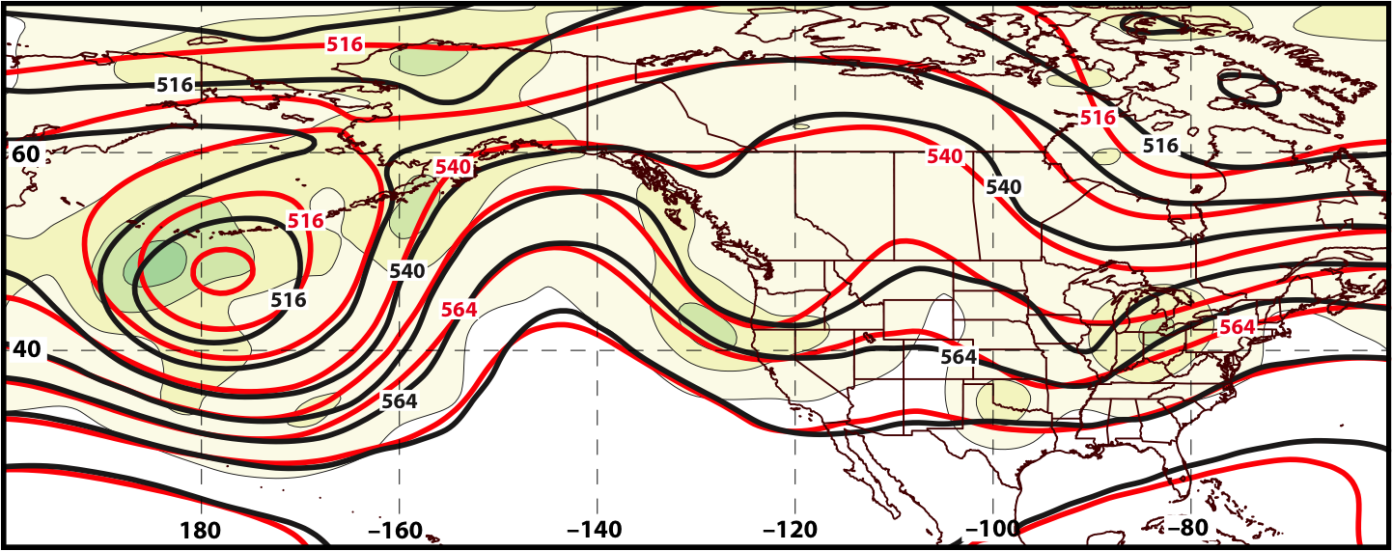
GEFS Ensemble Spread of Geo. Heights (m) Verifying 0000 UTC 28 March 2016
96-h Forecast
500 hPa
Ens. Spread:
Ens. Mean Geo. Heights
Observed Geo. Heights

Slide 82
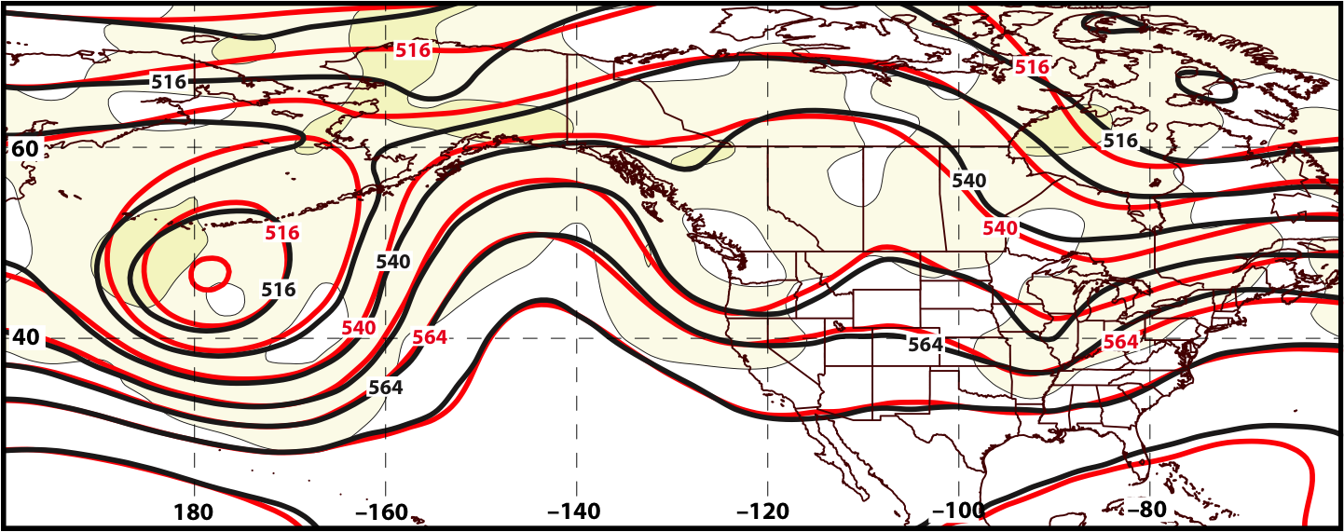
GEFS Ensemble Spread of Geo. Heights (m) Verifying 0000 UTC 28 March 2016
72-h Forecast
500 hPa
Ens. Spread:
Ens. Mean Geo. Heights
Observed Geo. Heights

Slide 83
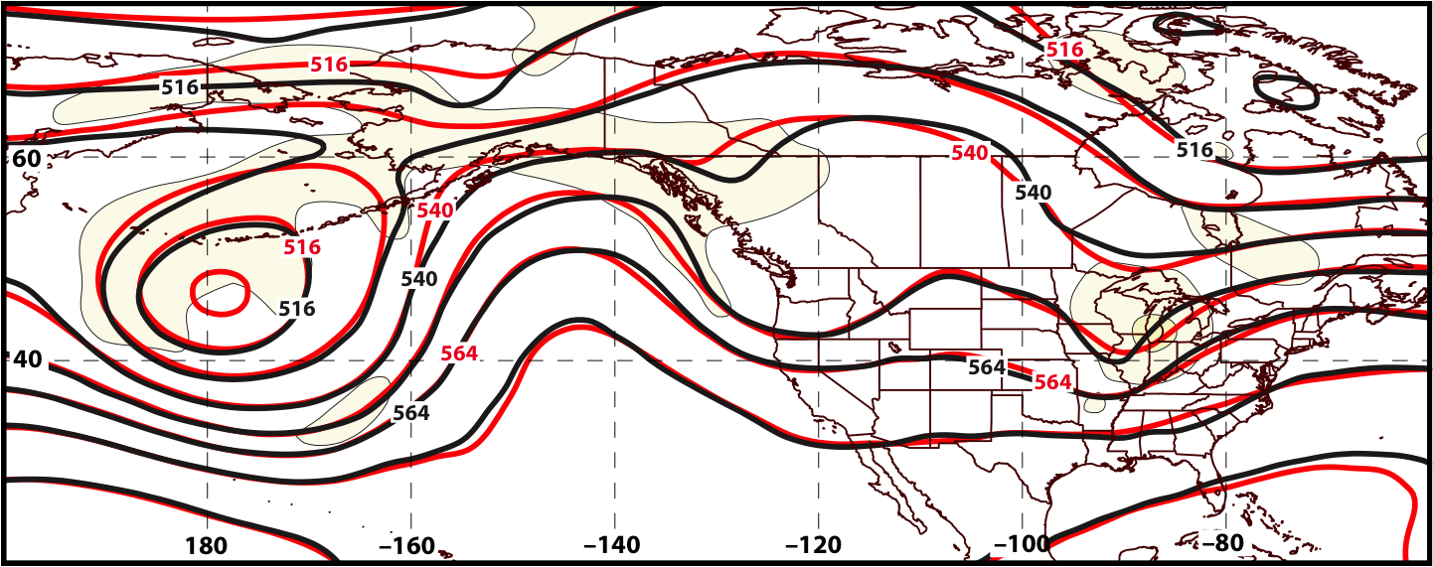
GEFS Ensemble Spread of Geo. Heights (m) Verifying 0000 UTC 28 March 2016
48-h Forecast
500 hPa
Ens. Spread:
Ens. Mean Geo. Heights
Observed Geo. Heights

Slide 84
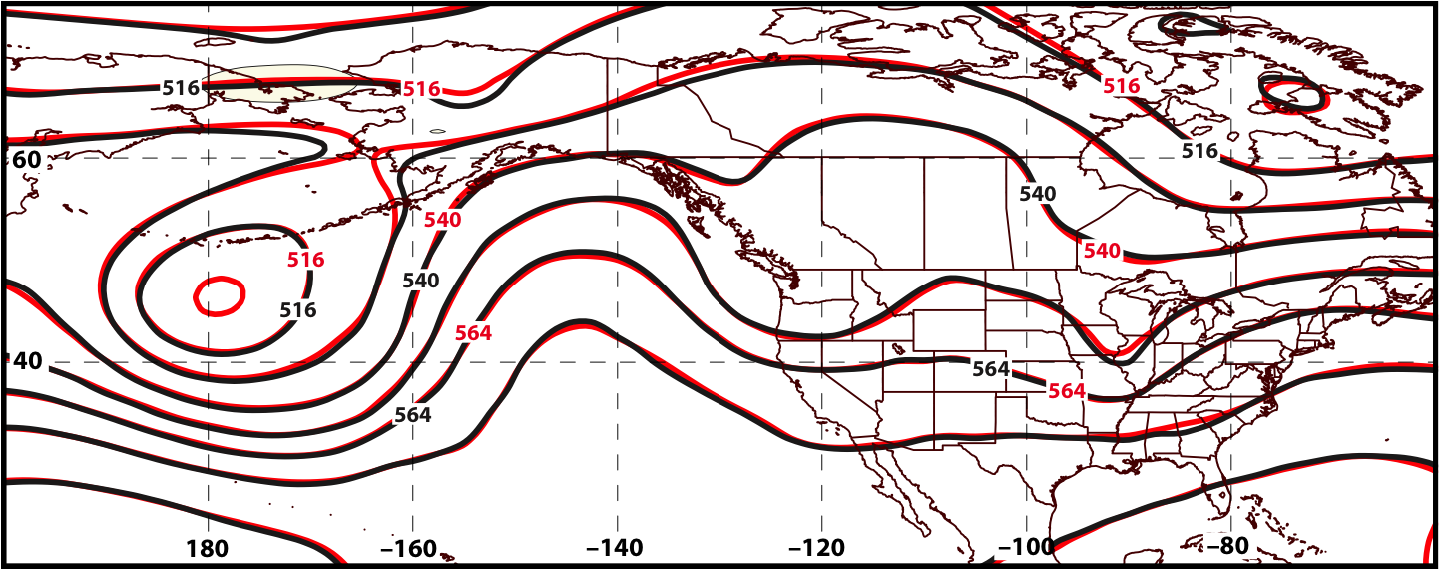
GEFS Ensemble Spread of Geo. Heights (m) Verifying 0000 UTC 28 March 2016
24-h Forecast
500 hPa
Ens. Spread:
Ens. Mean Geo. Heights
Observed Geo. Heights

Slide 85
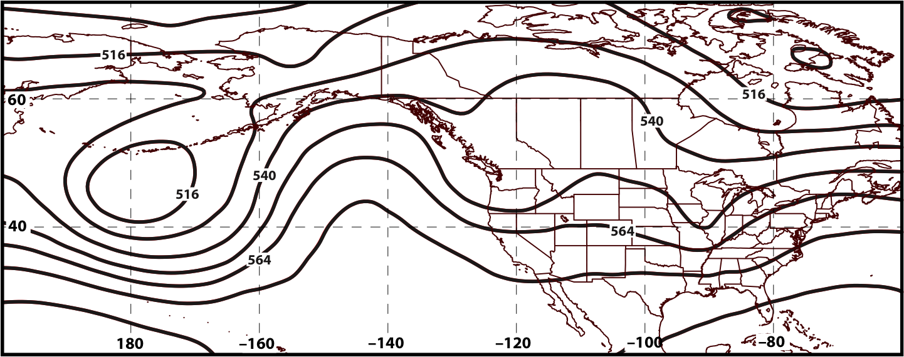
GEFS Ensemble Spread of Geo. Heights (m) Verifying 0000 UTC 28 March 2016
00-h Forecast
500 hPa
Ens. Spread:
Ens. Mean Geo. Heights
Observed Geo. Heights

